Slide 1


A Systematic Review of MOOC Research Methods and Topics:
Comparing 2014-2016 and 2016-2017
Meina Zhu
Annisa Sari
Curtis J. Bonk
Indiana University
School of Education, IST INDIANA UNIVERSITY BLOOMINGTON

Slide 2
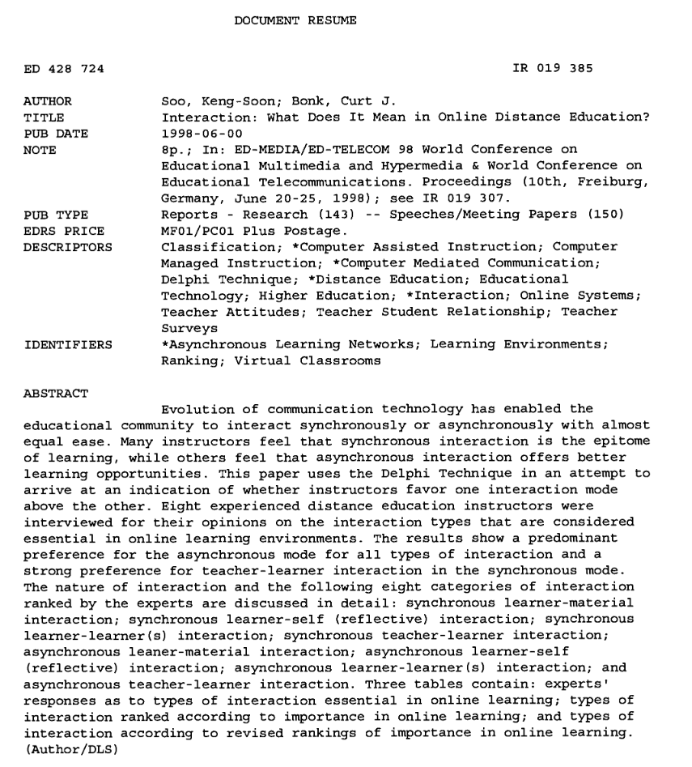
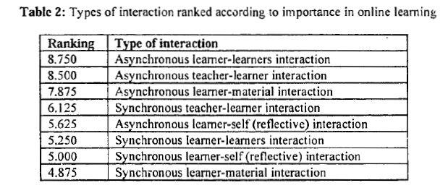


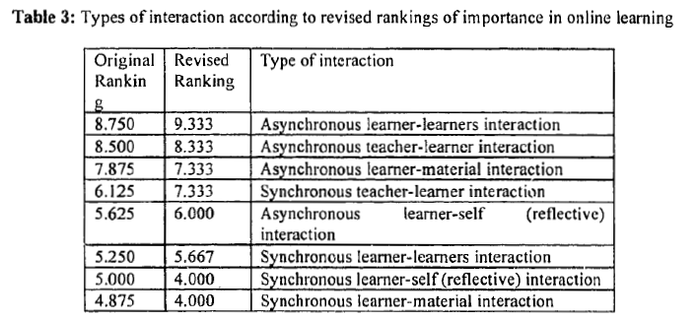
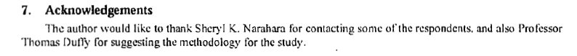
Soo, K. S., & Bonk, C. J. (1998, June 20-25). Interaction: What does it mean in online distance education. Paper (NOT/NEVER) presented at Ed-Media & Ed-Telecom 98, Freiberg, Germany.
(ERIC Document Reproduction Service No ED 428724).
Available: https://files.eric.ed.gov/fulltext/ED428724.pdf
Beatles Audio (6 secs): http://curtbonk.com/20-years-medium-audio.html
Beatles Video (6 secs): http://curtbonk.com/20-years-medium.html

Slide 3
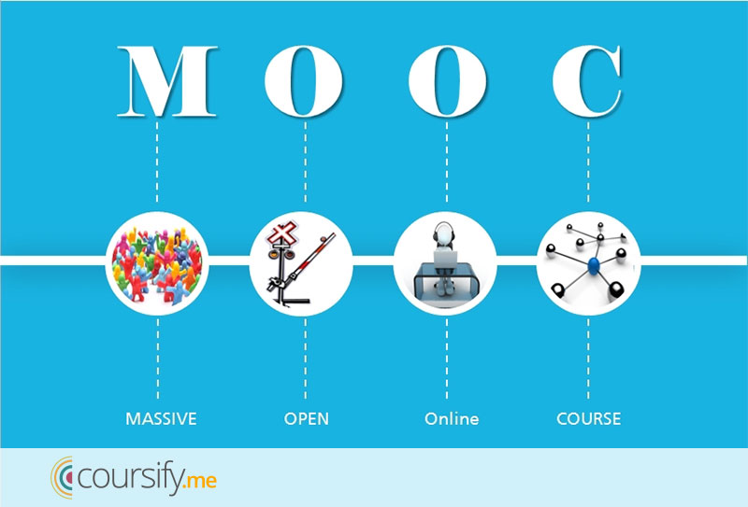

Slide 4

Email inbox: June 10, 2018 edX https://www.edx.org/course

Slide 5
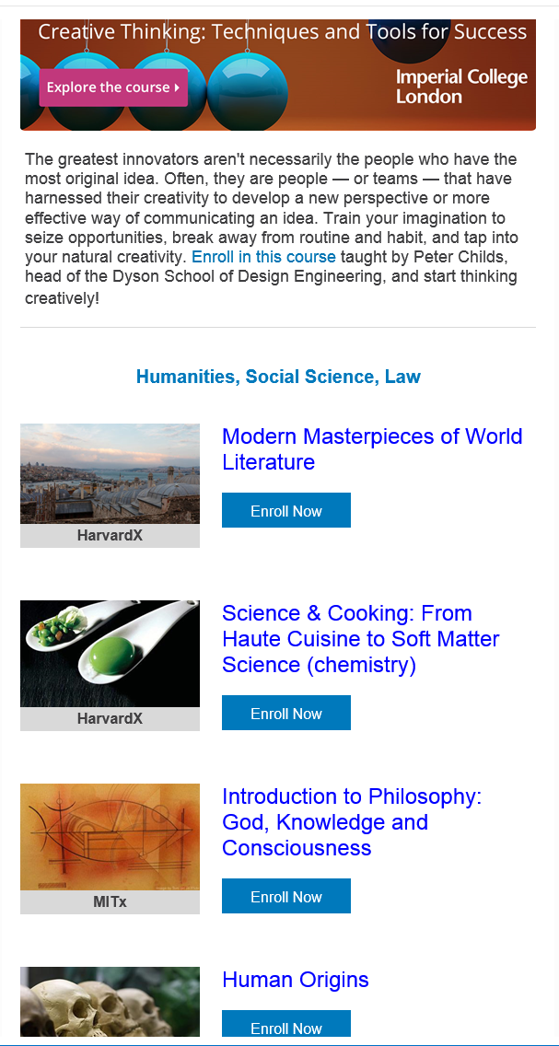

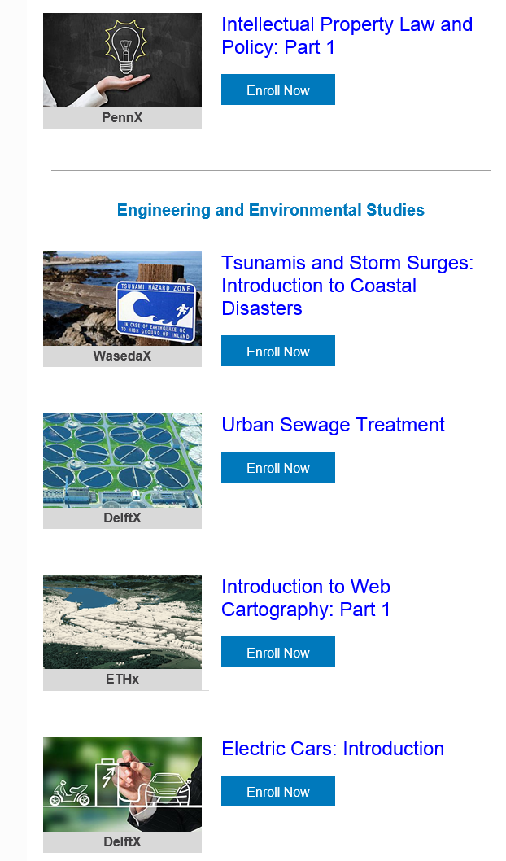
Email inbox: June 10, 2018 edX https://www.edx.org/course

Slide 6
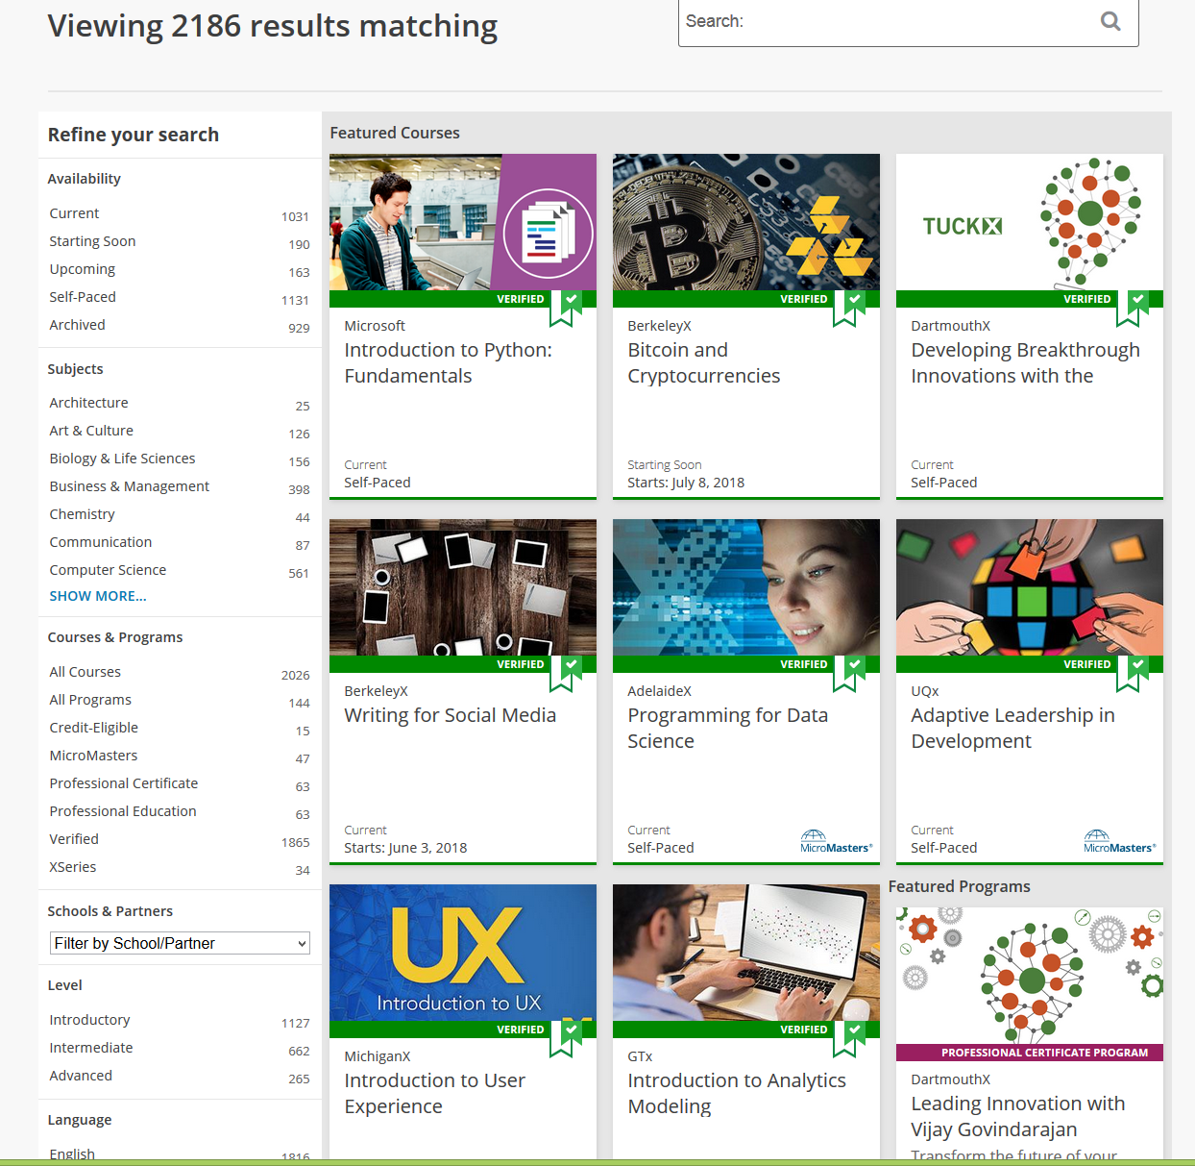

June 10, 2018 edX https://www.edx.org/course

Slide 7

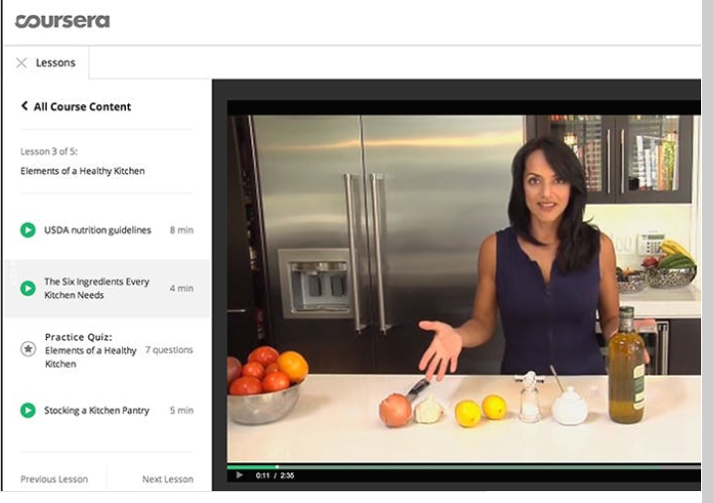
Email inbox: June 11, 2018
Coursera https://www.coursera.org/

Slide 8

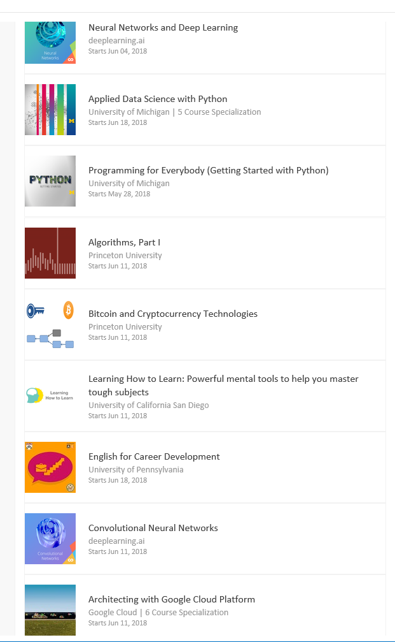
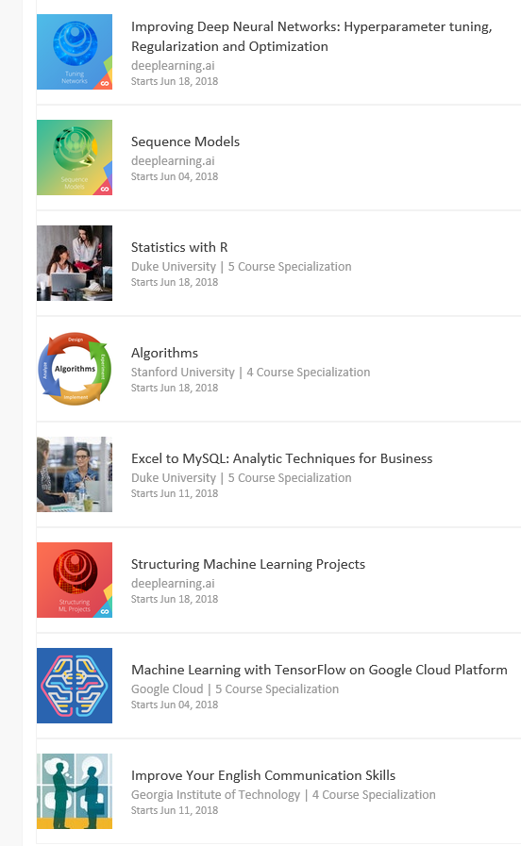
Email inbox: June 11, 2018
Coursera https://www.coursera.org/

Slide 9


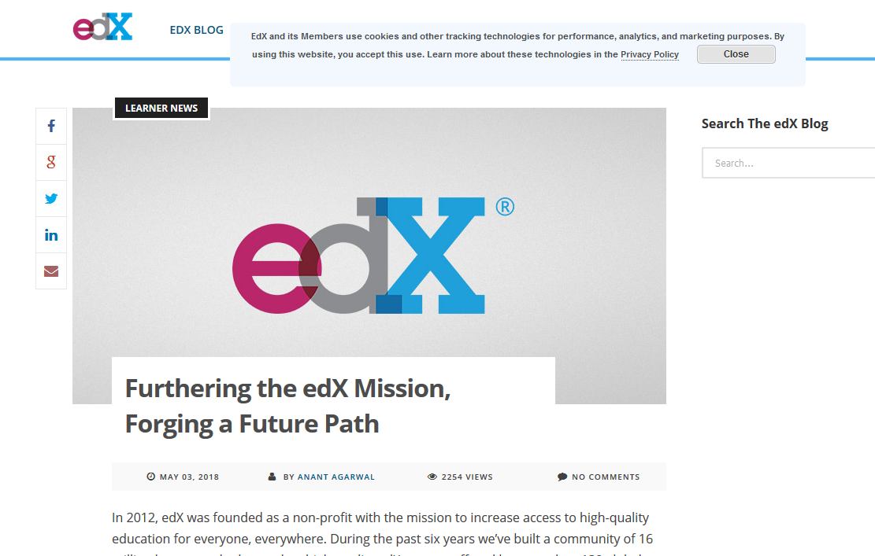
June 14, 2018
Free MOOCs Face the Music
Lindsay McKenzie, Inside Higher Ed https://www.insidehighered.com/news/2018/06/14/edx-introduces-support-fee-free-online-courses

Slide 10
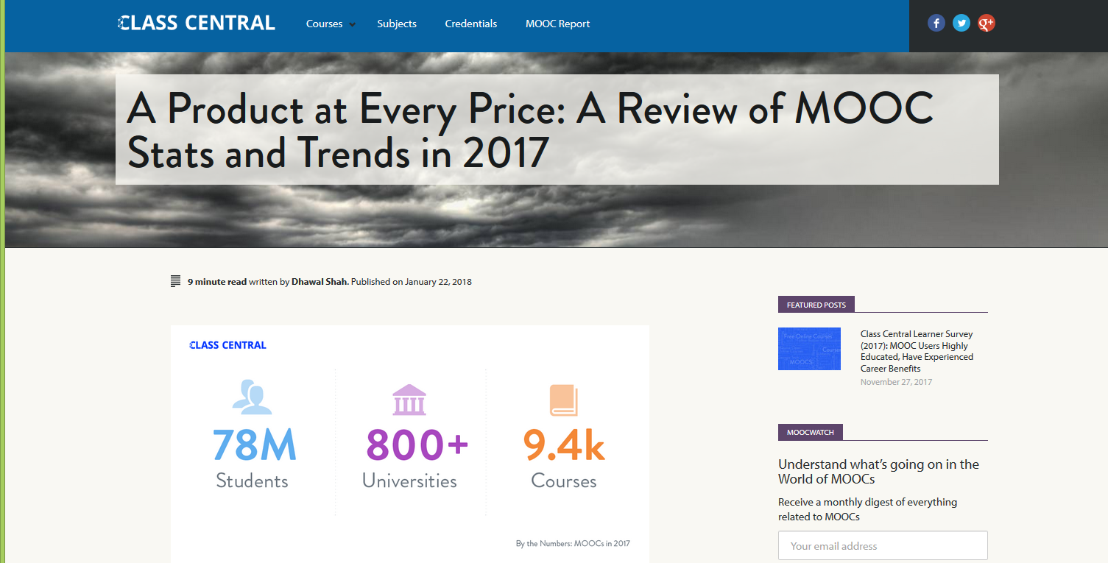
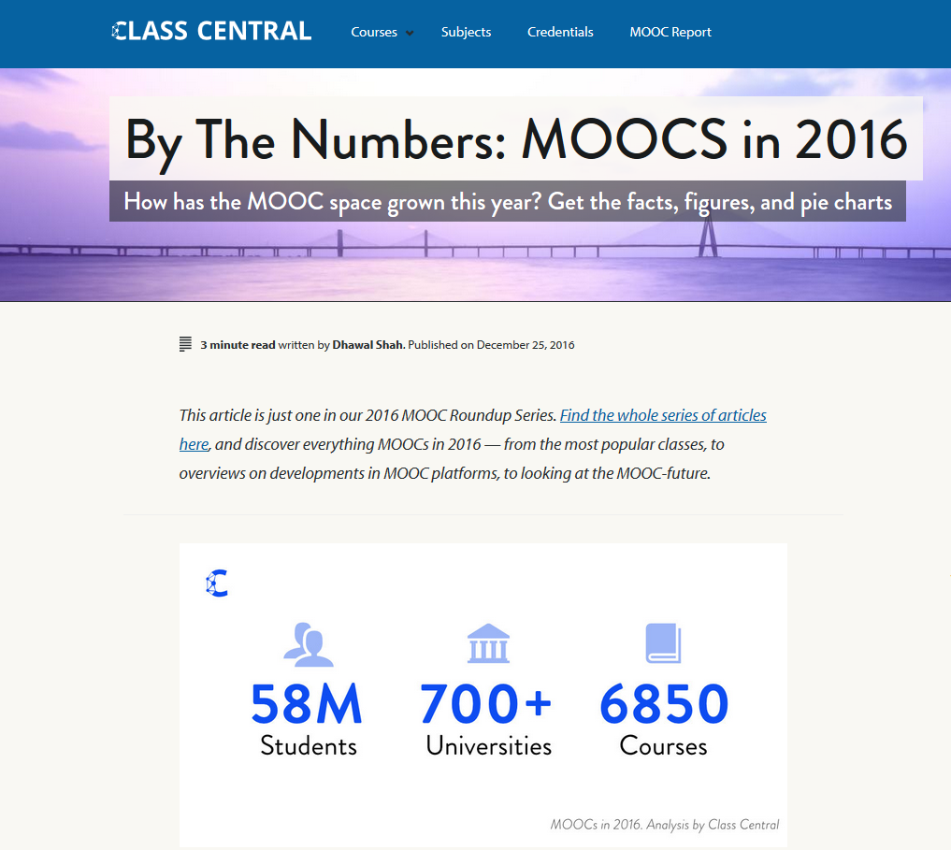
December 25, 2016 vs. January 22, 2018
A Review of MOOCs Stats and Trends in 2017, Dhawal Shah, Class Central https://www.class-central.com/report/moocs-stats-and-trends-2017/

Slide 11
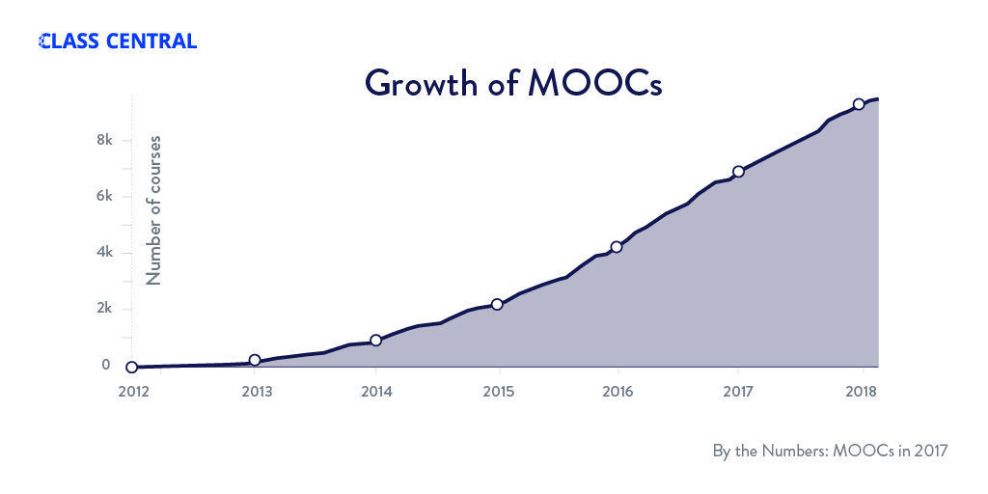
January 22, 2018
A Review of MOOCs Stats and Trends in 2017, Dhawal Shah, Class Central https://www.class-central.com/report/moocs-stats-and-trends-2017/

Slide 12
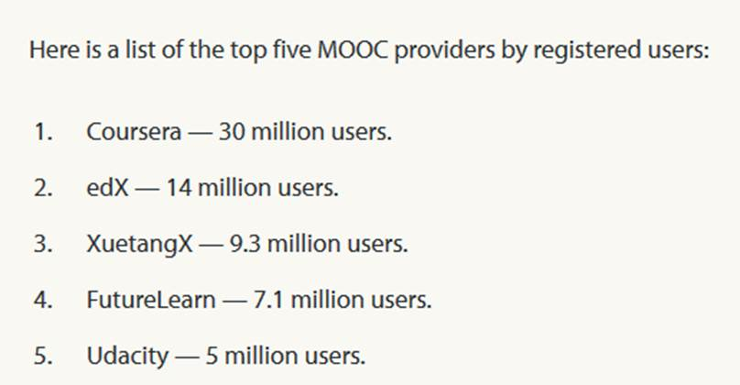
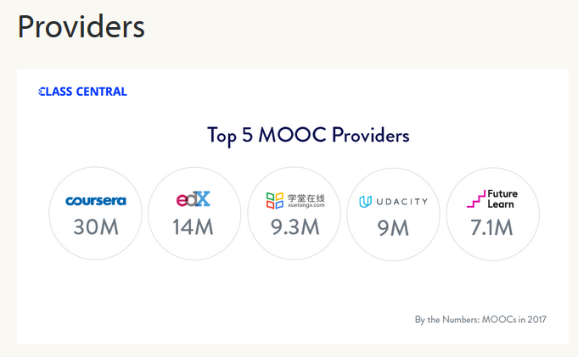


January 22, 2018
A Review of MOOCs Stats and Trends in 2017, Dhawal Shah, Class Central https://www.class-central.com/report/moocs-stats-and-trends-2017/

Slide 13
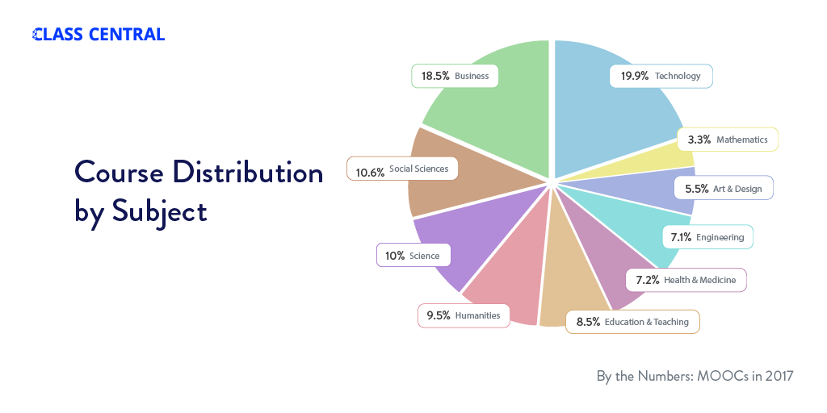
Subject areas (January 22, 2018)

Slide 14
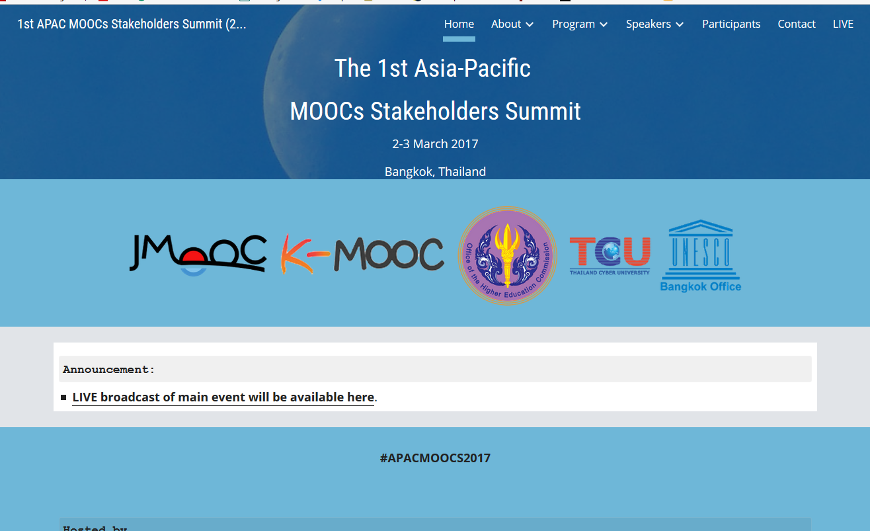

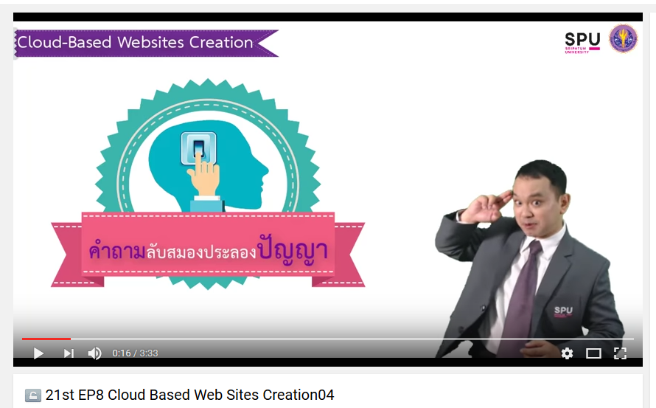
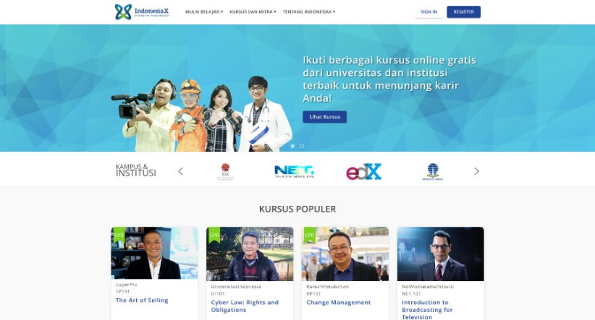
June 15, 2017
Massive List of MOOC Providers Around The World, Class Central
JMOOC, K-MOOC, and T-MOOC? https://www.class-central.com/report/mooc-providers-list/

Slide 15
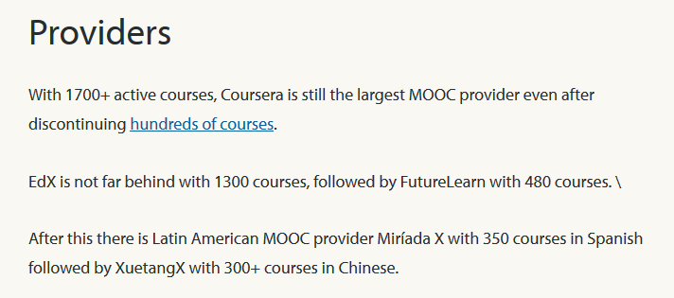
August 17, 2017
By the Numbers: MOOCs in 2016
Class Central, Dhawal Shah https://www.class-central.com/report/mooc-stats-2016/

Slide 16
September 2016
MOOCs, Graduate Skills Gaps, and Employability: A Qualitative Systematic Review of the Literature
David Santandreu Calonge and Mariam Aman Shah, IRRODL, 17(5), 67-90. http://www.irrodl.org/index.php/irrodl/article/view/2675/3881
“MOOCs have had a significant role in helping the traditional and the “new traditional” graduates to quickly up-skill before employment or to quickly “come on board” in their new job. MOOCs have provided flexible, on-demand, collaborative, and just-in-time learning opportunities through which to obtain relevant and applicable skills.” (p. 78)

Slide 17
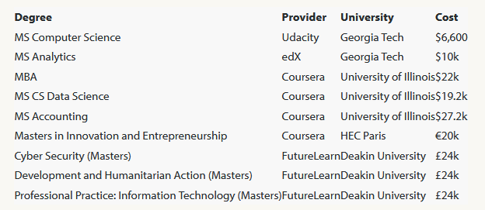
August 7, 2017
FutureLearn and Coventry University to Roll Out 50 Online Degrees (Last year Deakin University announced a similar partnership with FutureLearn)
Class Central, Dhawal Shah https://www.class-central.com/report/futurelearn-coventry-university-roll-50-online-degrees/

Slide 18
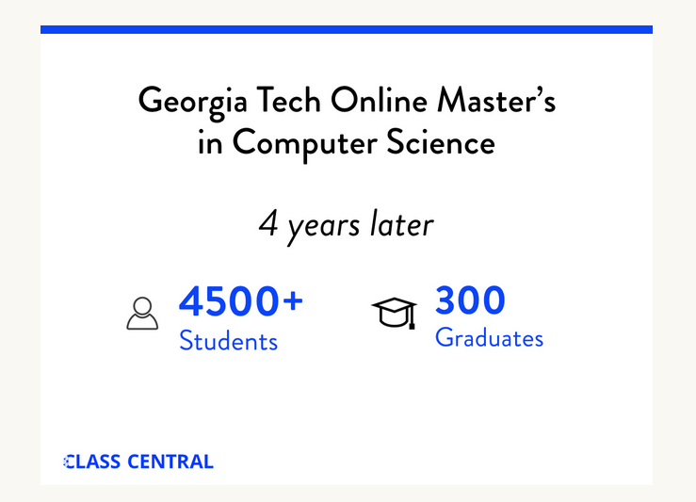
August 7, 2017
FutureLearn and Coventry University to Roll Out 50 Online Degrees
(Last year Deakin University announced a similar partnership with FutureLearn)
Class Central, Dhawal Shah https://www.class-central.com/report/futurelearn-coventry-university-roll-50-online-degrees/

Slide 19
September 2016
MOOCs, Graduate Skills Gaps, and Employability: A Qualitative Systematic Review of the Literature
David Santandreu Calonge and Mariam Aman Shah, IRRODL, 17(5), 67-90. http://www.irrodl.org/index.php/irrodl/article/view/2675/3881
“In 2013, research had already indicated that MOOCs offered unprecedented choice, customization and gave thousands of participants the possibility to have greater ownership and control over their learning experiences “rather than being constrained by centralized, instructor-controlled learning based on delivery of pre-fabricated curriculum” (McLoughlin, 2013). (p. 78.)

Slide 20
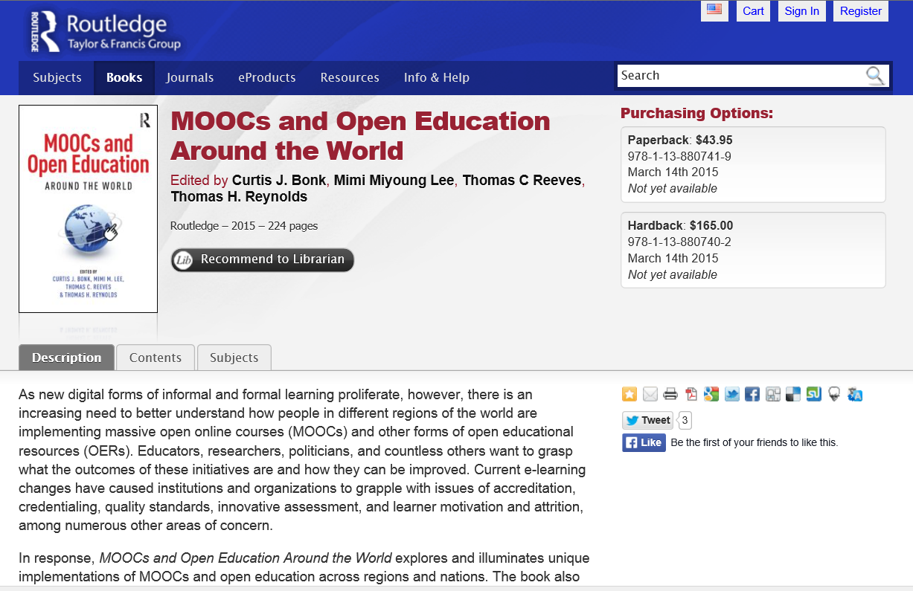






MOOCs and Open Education Around the World (2015) http://moocsbook.com/

Slide 21
2015
Instructional quality of Massive Open Online Courses (MOOCs).
Margaryan, Bianco, & Littlejohn, Computers & Education, 80, 77-83. http://www.sciencedirect.com/science/article/pii/S036013151400178X
“As MOOCs proliferate, drawing in increasing numbers of faculty and learners worldwide, the issue of their instructional quality becomes increasingly pressing.” (p. 82)

Slide 22
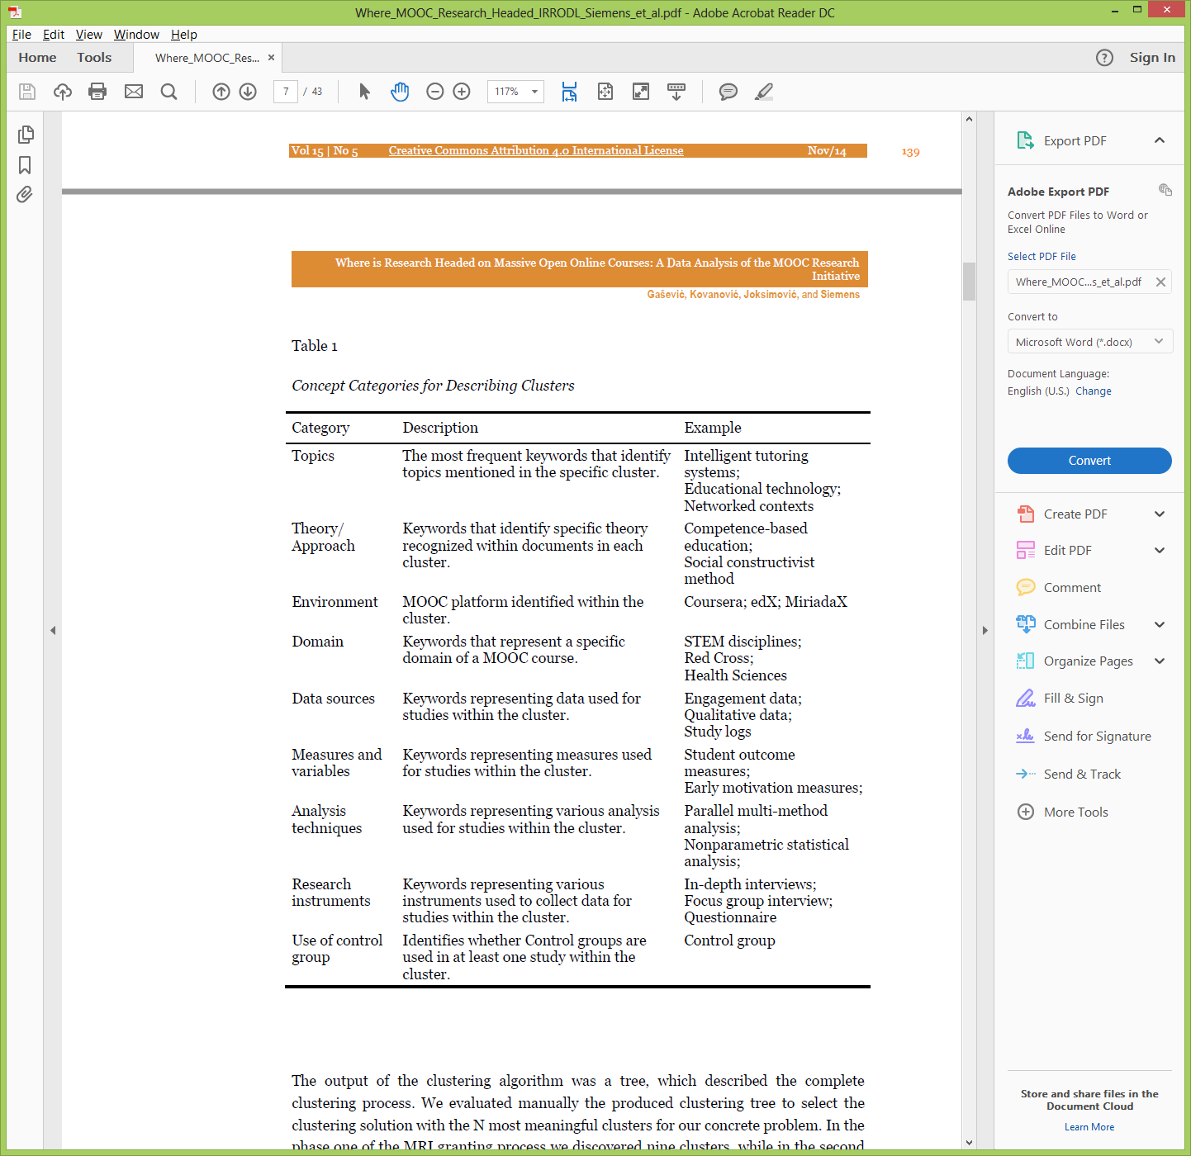
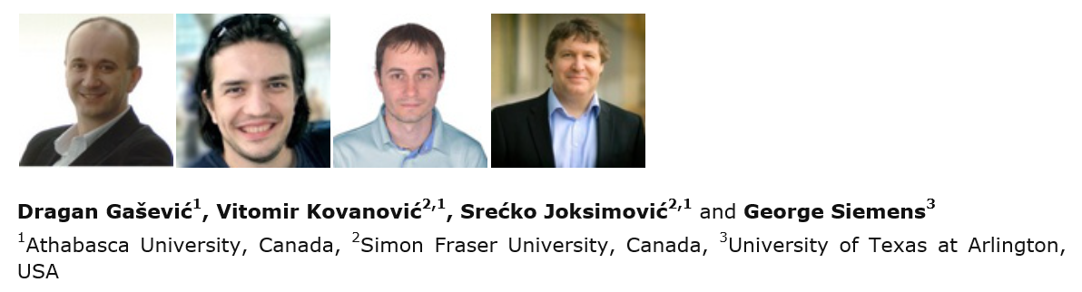
November 2014
Where is Research on Massive Open Online Courses Headed? A Data Analysis of the MOOC Research Initiative
Dragan Gasevic and colleagues (including George Siemens), IRRODL http://www.irrodl.org/index.php/irrodl/article/view/1954

Slide 23
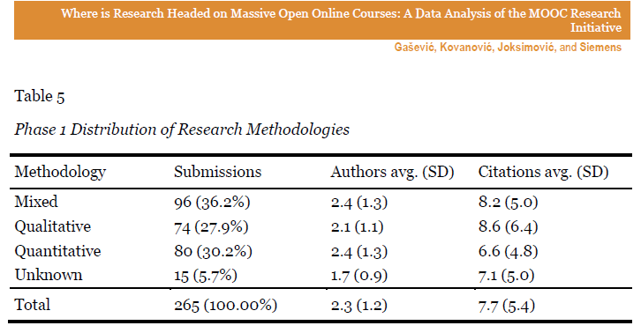
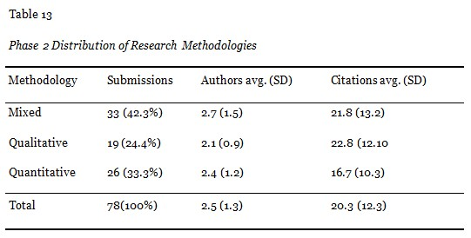
November 2014
Where is Research on Massive Open Online Courses Headed? A Data Analysis of the MOOC Research Initiative
Dragan Gasevic and colleagues (including George Siemens), IRRODL http://www.irrodl.org/index.php/irrodl/article/view/1954

Slide 24
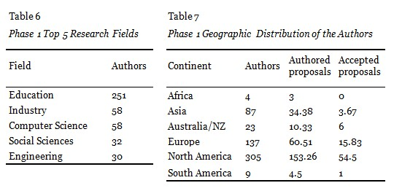
November 2014
Where is Research on Massive Open Online Courses Headed? A Data Analysis of the MOOC Research Initiative
Dragan Gasevic and colleagues (including George Siemens), IRRODL http://www.irrodl.org/index.php/irrodl/article/view/1954

Slide 25
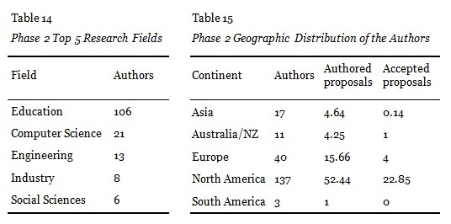
November 2014
Where is Research on Massive Open Online Courses Headed? A Data Analysis of the MOOC Research Initiative
Dragan Gasevic and colleagues (including George Siemens), IRRODL http://www.irrodl.org/index.php/irrodl/article/view/1954

Slide 26
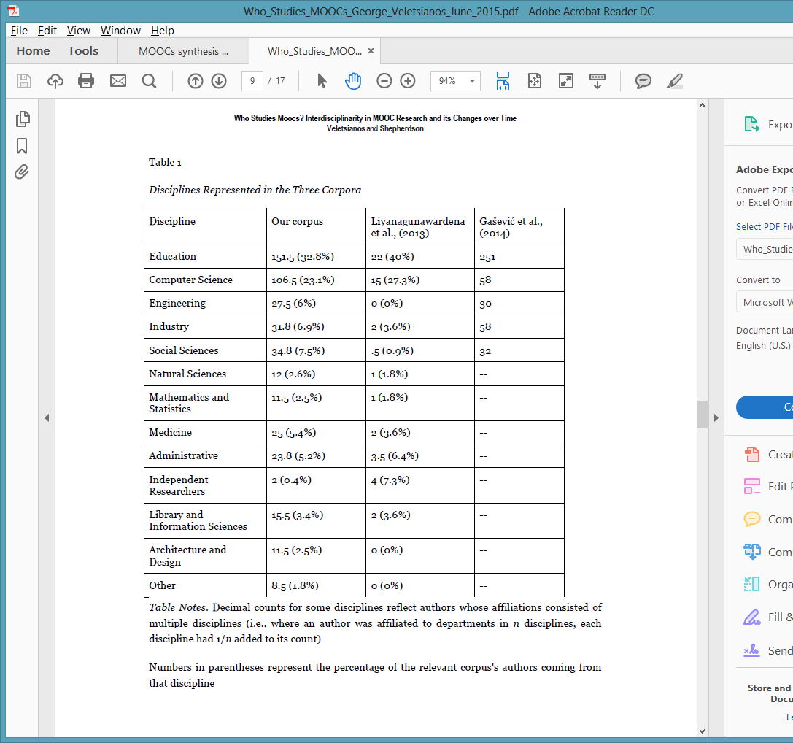

June 2015
Who Studies MOOCs? Interdisciplinarity in MOOC Research and its Changes over Time, IRRODL
George Veletsianos and Peter Sheperdson http://www.irrodl.org/index.php/irrodl/article/view/2448/3655

Slide 27
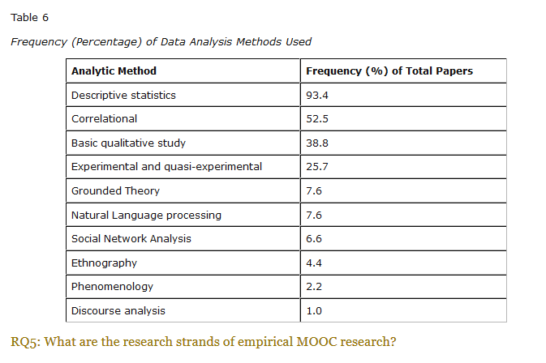
February 2016
A Systematic Analysis and Synthesis of the Empirical MOOC Literature Published in 2013-2015, IRRODL
George Veletsianos and Peter Sheperdson http://www.irrodl.org/index.php/irrodl/article/view/2448/3655

Slide 28
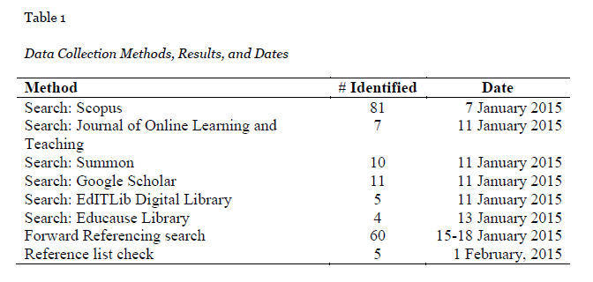

February 2016
A Systematic Analysis and Synthesis of the Empirical MOOC Literature Published in 2013-2015, IRRODL
George Veletsianos and Peter Sheperdson http://www.irrodl.org/index.php/irrodl/article/view/2448/3655

Slide 29
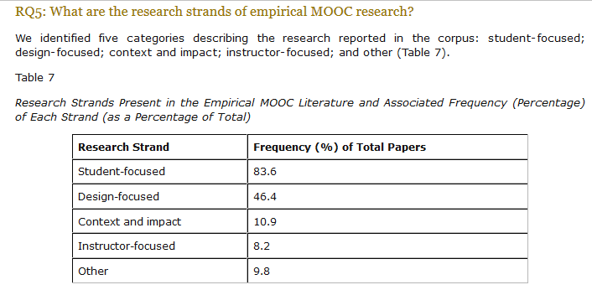

February 2016
A Systematic Analysis and Synthesis of the Empirical MOOC Literature Published in 2013-2015, IRRODL
George Veletsianos and Peter Sheperdson http://www.irrodl.org/index.php/irrodl/article/view/2448/3655

Slide 30

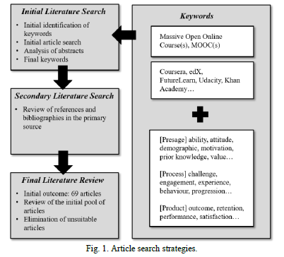

August 2017
A Contemporary Review of Research Methods Adopted to Understand Students’ and Instructors’ Use of Massive Open Online Courses (MOOCs)
Ruiqi Deng and Pierre Benckendorff

Slide 31
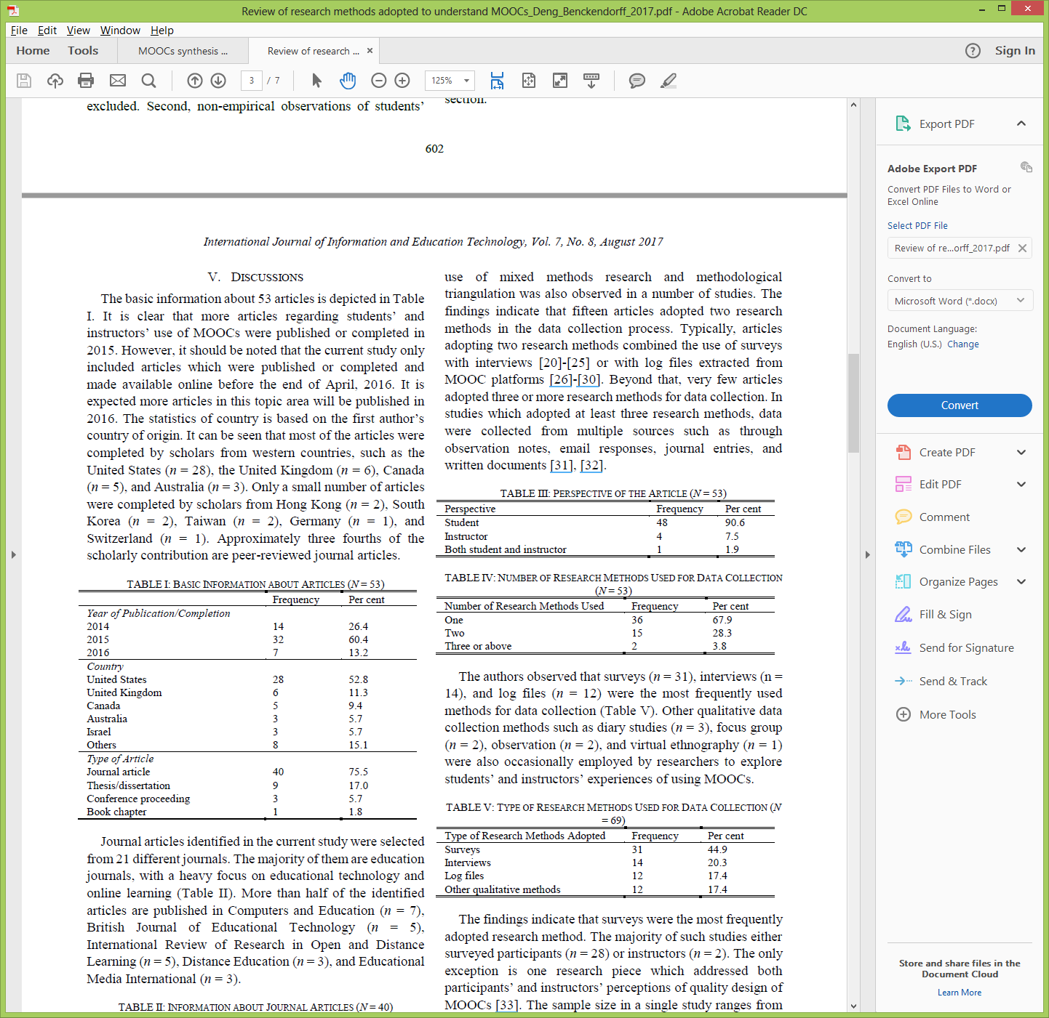
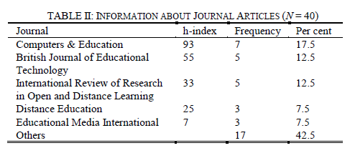


August 2017
A Contemporary Review of Research Methods Adopted to Understand Students’ and Instructors’ Use of Massive Open Online Courses (MOOCs)
Ruiqi Deng and Pierre Benckendorff

Slide 32
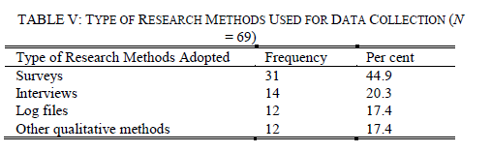
August 2017
A Contemporary Review of Research Methods Adopted to Understand Students’ and Instructors’ Use of Massive Open Online Courses (MOOCs)
Ruiqi Deng and Pierre Benckendorff

Slide 33
August 2017
A Contemporary Review of Research Methods Adopted to Understand Students’ and Instructors’ Use of Massive Open Online Courses (MOOCs)
Ruiqi Deng and Pierre Benckendorff, International Journal of Information and Education Technology, 7(8), 601-607.
“There are a number of research avenues which could be explored based upon the findings of this study. First, additional research strategies should be considered to understand students’ and instructors’ experience in using MOOCs.” (p. 605)

Slide 34
August 2017
A Contemporary Review of Research Methods Adopted to Understand Students’ and Instructors’ Use of Massive Open Online Courses (MOOCs)
Ruiqi Deng and Pierre Benckendorff, International Journal of Information and Education Technology, 7(8), 601-607.
“Second, triangulation of a wider range of research methods and data source should be undertaken. Beyond triangulation of surveys and interviews or log files, MOOC scholars are encouraged to combine other research methods to triangulate findings, such as diary studies and focus groups.” (p. 605)

Slide 35
August 2017
A Contemporary Review of Research Methods Adopted to Understand Students’ and Instructors’ Use of Massive Open Online Courses (MOOCs)
Ruiqi Deng and Pierre Benckendorff, International Journal of Information and Education Technology, 7(8), 601-607.
“Apart from diary studies, other qualitative research approaches have also been adopted by MOOC scholars. Focus groups were either adopted on their own, or with other qualitative research methods to probe participants’ motivation and experience.” (p. 605)

Slide 36
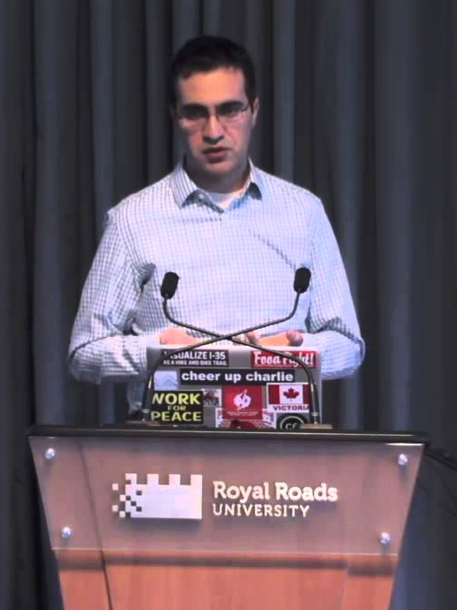
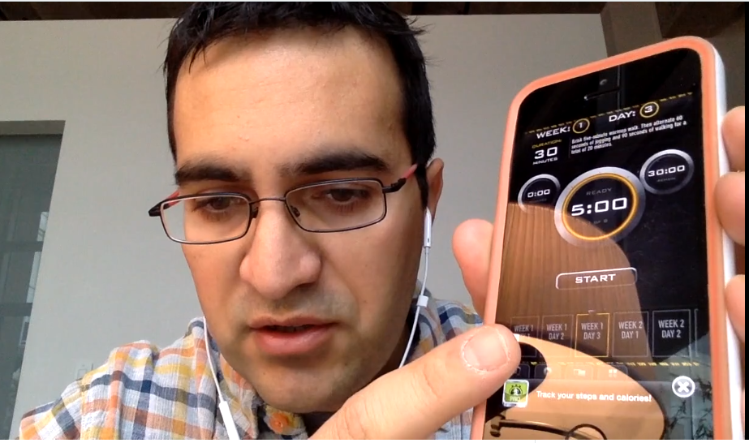

Quotes: Veletsianos et al. (2015-2016)
“To gain a deeper and more diverse understanding of the MOOC phenomenon, researchers need to use multiple research approaches (e.g., ethnography, phenomenology, discourse analysis) add content to them.” (p. 583.)
Veletsianos, Collier, & Schneider (2015, May), Digging deeper into learners’ experiences in MOOCs: Participation in social networks outside of MOOCs, notetaking and contexts surrounding content consumption. BJET, 46(3), 570-587.
“Dependence on Particular Research Methods May Restrict our Understanding of MOOCs.”
George Veletsianos & Peter Shepherdson’s Study (2016). Systematic Analysis and Synthesis of the Empirical MOOC Literature Published in 2013-2015. IRRODL. http://www.irrodl.org/index.php/irrodl/article/view/2448/3655

Slide 37

MOOC Research
(6 studies)

Slide 38

MOOC Study #1: MOOC Research
A Systematic Review of Research Methods and Topics of the Empirical MOOC Literature (2014-2016)
Zhu, M., Sari, A., & Lee, M. M. (2018). A Systematic Review of Research Methods and Topics of the Empirical MOOC Literature (2014-2016). The Internet and Higher Education. 37,31-39.

Slide 39

Research Design

Slide 40
Research Purpose & Questions
To gain a deeper and more diverse understanding of the current MOOC phenomenon by reviewing recent articles.
1. What are the research methods researchers employed in empirical MOOC studies?
2. What are the research topics or focuses in MOOC studies?
3. How are researchers of empirical MOOC studies geographically distributed?
4. In terms of the delivery of the MOOC, what are the countries which are attracting the most research?

Slide 41
Article Search Strategies
Key words
“MOOC” and “Massive Online Open Course(s)”
Databases
Scopus and peer-reviewed journal articles
Phase 1
October 2014 - November 2016
(146 in total)
Phase 2
December 2016 - July 2017
(51 in total)

Slide 42
Systematic Review of Research Methods in MOOCs (2014-2016)
(Zhu, M., Sari, A., & Lee, M. M., 2018)
 | Quantitative | Qualitative | Mixed methods
Student-focused | 39 | 9 | 26
Design-focused | 19 | 12 | 17
Context and impact | 9 | 6 | 5
Instructor-focused | 0 | 3 | 2

Slide 43
Systematic Review of Research Methods in MOOCs (2014-2016)
(Zhu, M., Sari, A., & Lee, M. M., 2018)
No. | Journal | Total
1 | International Review of Research in Open and Distance Learning (IRRODL) | 31
2 | Computers & Education | 12
3 | British Journal of Educational Technology | 9
4 | Online Learning | 7
5 | Distance Education | 5
6 | Educational Media International | 5
7 | Internet and Higher Education | 5
8 | Journal of Computer Assisted Learning | 5
9 | Computers in Human Behavior | 4
10 | Open Learning | 4
11 | Journal of Online Learning and Teaching | 3
12 | Journal of Asynchronous Learning Network | 3

Slide 44
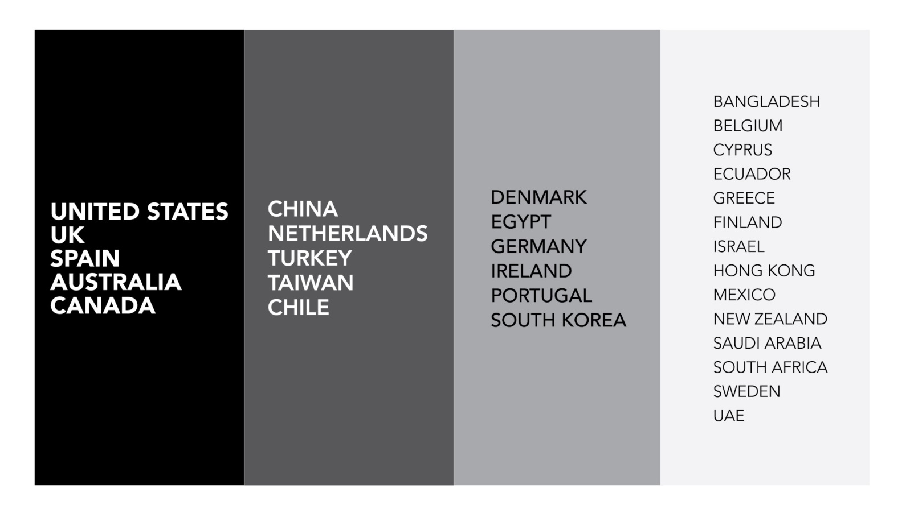
Systematic Review of Research Methods in MOOCs (2014-2016)
(Zhu, M., Sari, A., & Lee, M. M., 2018)
Location of MOOC Research Team Members (2014-2016)

Slide 45

Location of MOOC Research Team Members
(2014-2016)
(Zhu, M., Sari, A., & Lee, M. M., 2018)

Slide 46
Systematic Review of Research Methods in MOOCs (2014-2016)
(Zhu, M., Sari, A., & Lee, M. M., 2018)
RQ1: What are the research methods researchers employed in empirical MOOC studies? (N = 146)

Slide 47
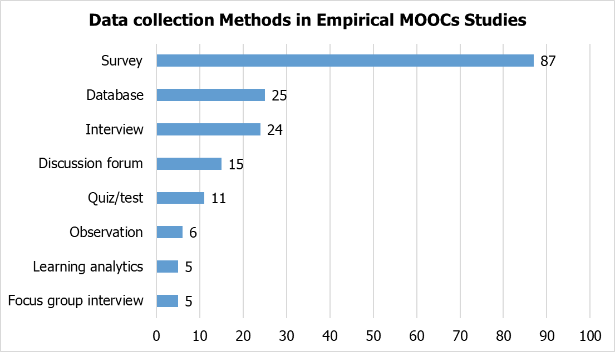
Systematic Review of Research Methods in MOOCs (2014-2016)
(Zhu, M., Sari, A., & Lee, M. M., 2018)
RQ1: What are the research methods researchers employed in empirical MOOC studies?

Slide 48
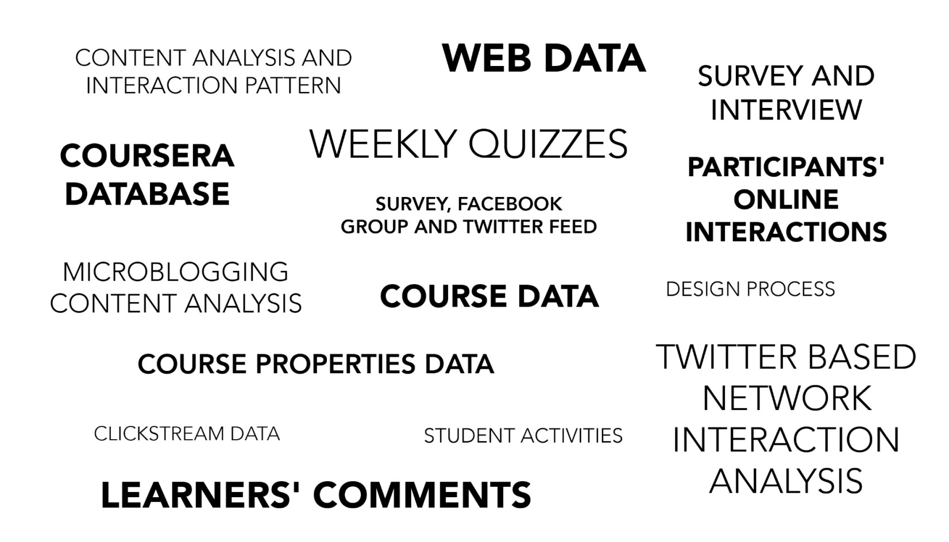
Specific Data Sources for MOOC Research
(2014-2016)
(Zhu, M., Sari, A., & Lee, M. M., 2018)

Slide 49
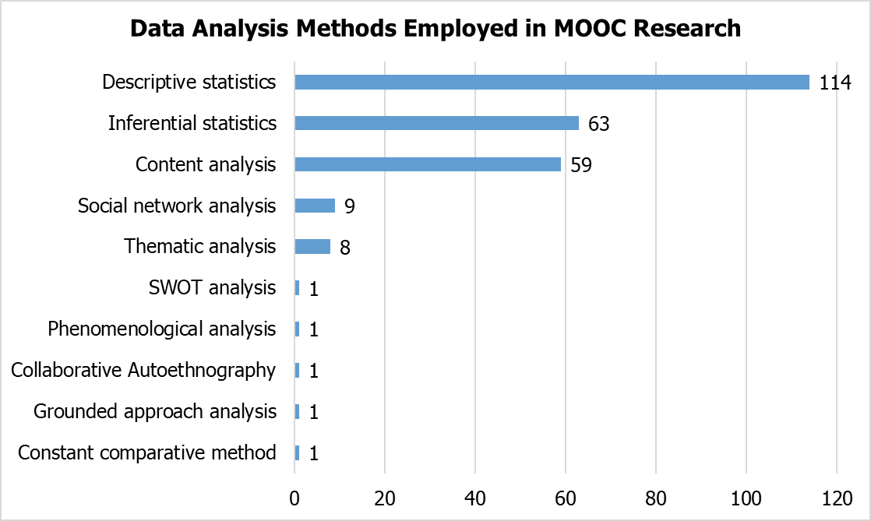
Systematic Review of Research Methods in MOOCs (2014-2016)
(Zhu, M., Sari, A., & Lee, M. M., 2018)
RQ1: What are the research methods researchers employed in empirical MOOC studies?

Slide 50
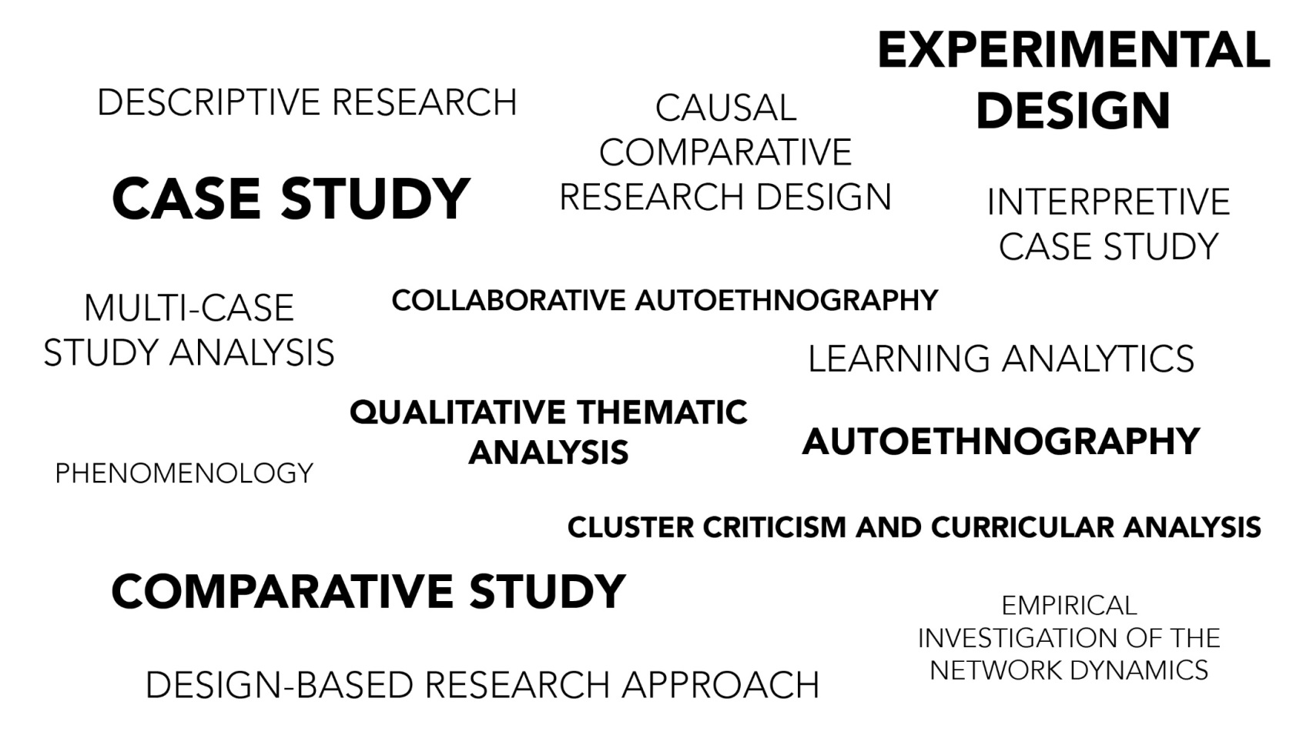
Specific Analytic Method for MOOC Research
(2014-2016)
(Zhu, M., Sari, A., & Lee, M. M., 2018)

Slide 51
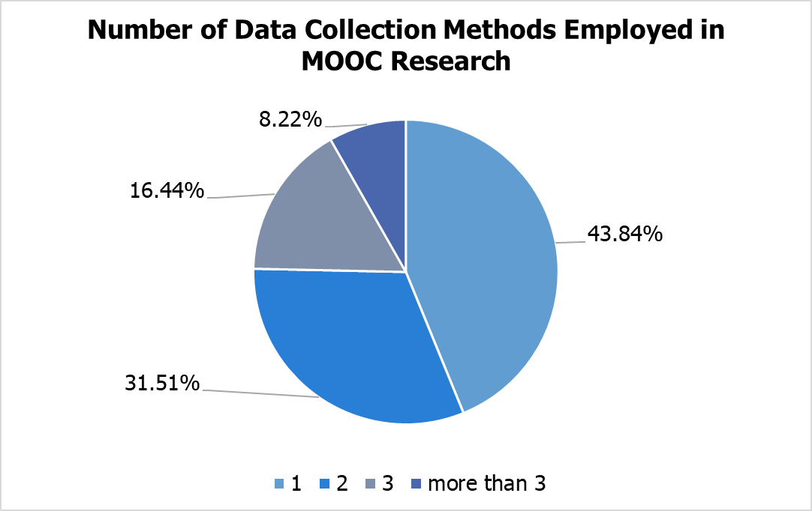
Systematic Review of Research Methods in MOOCs (2014-2016)
(Zhu, M., Sari, A., & Lee, M. M., 2018)
RQ1: What are the research methods researchers employed in empirical MOOC studies?

Slide 52
Number of Data Sources for MOOC Research
(2014-2017)
(Zhu, M., Sari, A., & Lee, M. M., 2018)
NUMBER OF DATA SOURCES | TOTAL | PERCENT
1 | 64 | 43.84%
2 | 46 | 31.51%
3 | 24 | 16.44%
>3 | 12 | 8.22%
TOTAL STUDIES | 146 | 100%

Slide 53

Data Sources of MOOC Research
(Note: when part of 2 or more data sources)
(2014-2016)
(Zhu, M., Sari, A., & Lee, M. M., 2018)

Slide 54
Findings
(Zhu, M., Sari, A., & Lee, M. M., 2018)
RQ2: What are the research focuses in MOOC studies?
Primary/general focus of MOOC delivery (out of 146 studies)
(note: some studies have more than one area of focus)

Slide 55
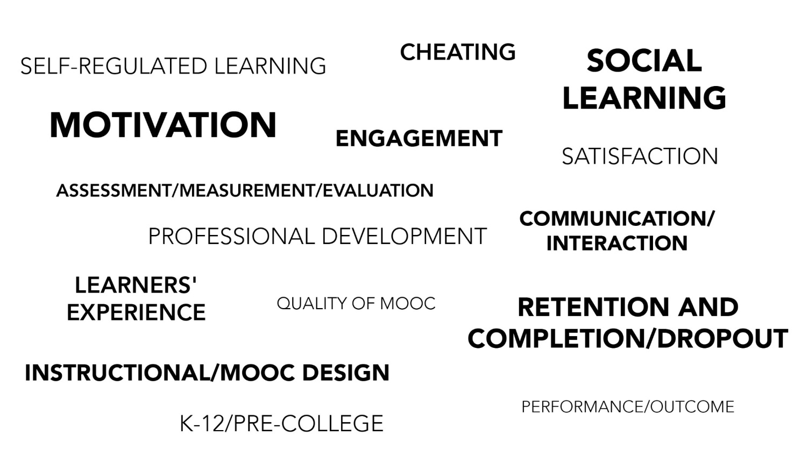
Systematic Review of Research Methods in MOOCs (2014-2016)
(Zhu, M., Sari, A., & Lee, M. M., 2018)
Specific Focus of MOOC Research (2014-2016)

Slide 56
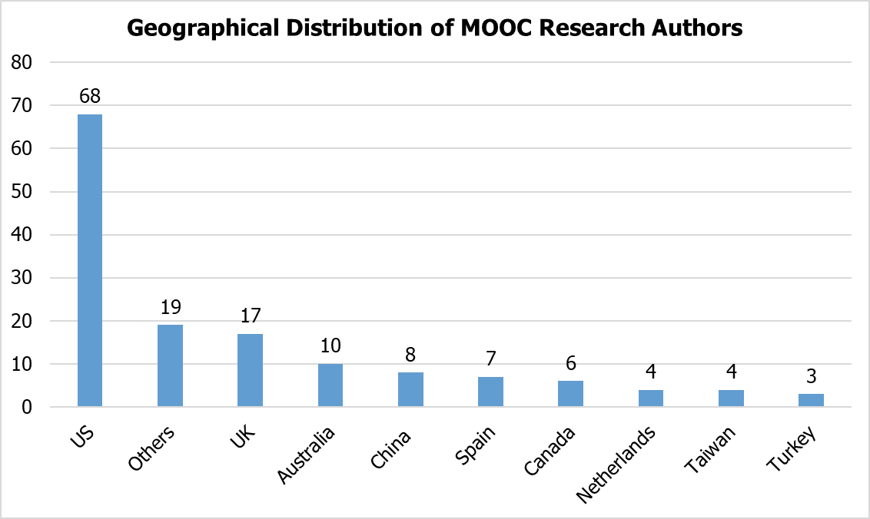
Findings (Zhu, M., Sari, A., & Lee, M. M., 2018)
RQ3: How are researchers of empirical MOOC studies geographically distributed?

Slide 57
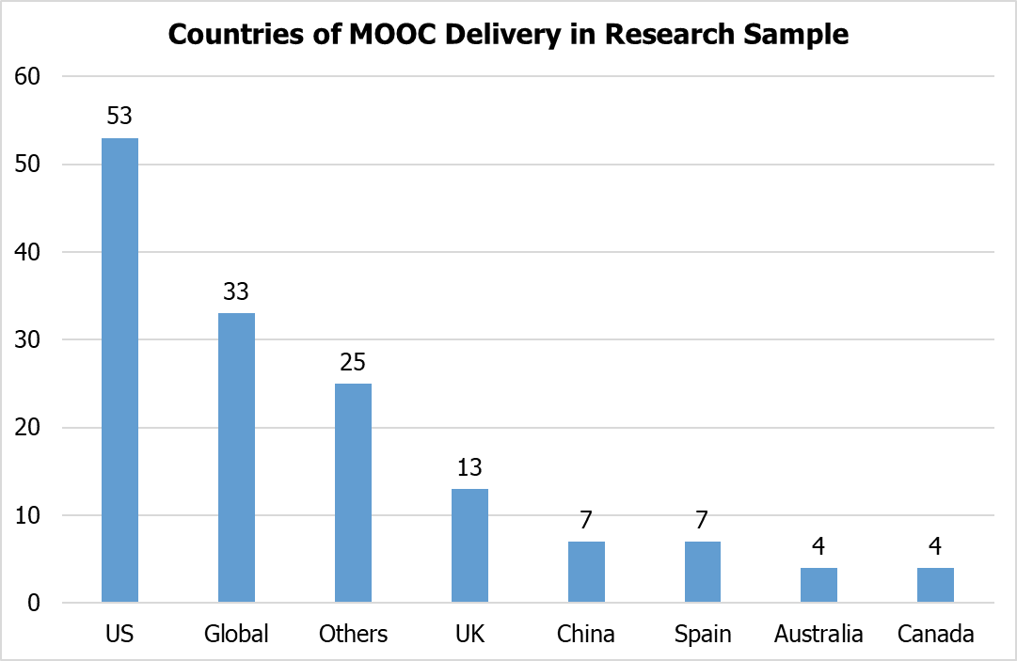
Findings (Zhu, M., Sari, A., & Lee, M. M., 2018)

Slide 58

Country of Origin of MOOC Delivery
(2014-2017)
(Zhu, M., Sari, A., & Lee, M. M., 2018)

Slide 59
February 2016
A Systematic Analysis and Synthesis of the Empirical MOOC Literature Published in 2013-2015
George Veletsianos and Peter Sheperdson, IRRODL, 17(2), 198-221 http://www.irrodl.org/index.php/irrodl/article/view/2448/3655
“Based on these results, we suggest that an expansion of the methodological approaches used in MOOC research is urgently needed. Given that research into MOOCs is expected to inform learning in all environments and not just MOOCs (Rose et al., 2015; Singer, 2014), a broader methodological toolkit is imperative.” (p. 214)

Slide 60
February 2016
A Systematic Analysis and Synthesis of the Empirical MOOC Literature Published in 2013-2015
George Veletsianos and Peter Sheperdson, IRRODL, 17(2), 198-221 http://www.irrodl.org/index.php/irrodl/article/view/2448/3655
“Fruitful future research endeavors in this area may focus on examining how particular methodologies have shaped the field, whether research methods are favored by researchers from particular disciplines, and some conferences and journals more than others distort the dominant narratives in the literature.” (p. 214)

Slide 61

MOOC Study #2: MOOC Research
A Systematic Review of MOOC Research Methods and Topics:
Comparing 2014-2016 and 2016-2017
Zhu, M., Sari, A., & Bonk, C. J. (2018). Presented at Ed Media Amsterdam.

Slide 62
Systematic Review of Research Methods and
Topics in MOOCs:
Comparing 2014-2016 and 2016-2017
(Zhu, M., Sari, A., & Bonk, C. J., 2018)
Figure 1a. Research methods used in empirical MOOCs studies (2016 – 2017) (n=51)

Slide 63
Systematic Review of Research Methods and Topics in MOOCs:
Comparing 2014-2016 and 2016-2017
(Zhu, M., Sari, A., & Bonk, C. J., 2018)
Figure 1b. Research methods used in empirical MOOCs studies (Note: Phase One (2014 – 2016) (n=146); Phase Two (2016 – 2017) (n=51))

Slide 64
Systematic Review of Research Methods and Topics in MOOCs:
Comparing 2014-2016 and 2016-2017
(Zhu, M., Sari, A., & Bonk, C. J., 2018)
Figure 2a. Data collection methods used in empirical MOOCs studies (2016 – 2017) (n=51) (Note: some studies contain more than one data collection method)

Slide 65
Systematic Review of Research Methods and Topics in MOOCs:
Comparing 2014-2016 and 2016-2017
(Zhu, M., Sari, A., & Bonk, C. J., 2018)
Figure 2b. Data collection methods used in empirical MOOCs studies (Note: some studies contain more than one data collection method and this figure only includes the main data collection methods)

Slide 66
Systematic Review of Research Methods and Topics in MOOCs:
Comparing 2014-2016 and 2016-2017
(Zhu, M., Sari, A., & Bonk, C. J., 2018)
Figure 3a. Specific data analysis methods for MOOC research (2014-2016 and 2016 – 2017)

Slide 67
Systematic Review of Research Methods and Topics in MOOCs:
Comparing 2014-2016 and 2016-2017
(Zhu, M., Sari, A., & Bonk, C. J., 2018)
Figure 3b. Specific data analysis methods for MOOC research (Note: some studies contain more than one data analysis method)

Slide 68

Systematic Review of Research Methods and Topics in MOOCs:
Comparing 2014-2016 and 2016-2017
(Zhu, M., Sari, A., & Bonk, C. J., 2018)

Slide 69
Systematic Review of Research Methods and Topics in MOOCs:
Comparing 2014-2016 and 2016-2017
(Zhu, M., Sari, A., & Bonk, C. J., 2018)
Figure 4a. Primary/general focus of MOOC delivery (2016 – 2017) (n=51) (Note: some studies contain more than one area of focus)

Slide 70
Systematic Review of Research Methods and Topics in MOOCs:
Comparing 2014-2016 and 2016-2017
(Zhu, M., Sari, A., & Bonk, C. J., 2018)
Figure 4b. Primary/general focus of MOOC delivery (Note: some studies contain more than one area of focus)

Slide 71

Systematic Review of Research Methods and Topics in MOOCs:
Comparing 2014-2016 and 2016-2017
(Zhu, M., Sari, A., & Bonk, C. J., 2018)

Slide 72
Systematic Review of Research Methods and Topics in MOOCs:
Comparing 2014-2016 and 2016-2017
(Zhu, M., Sari, A., & Bonk, C. J., 2018)
Figure 5. The location of the first author of MOOCs studies (2014 – 2017) (n=197) (Note: this figure only includes the main countries)

Slide 73
Systematic Review of Research Methods and Topics in MOOCs:
Comparing 2014-2016 and 2016-2017
(Zhu, M., Sari, A., & Bonk, C. J., 2018)
Figure 6. Collaboration among the authors of MOOCs studies (2016 – 2017) (n=51)

Slide 74
Systematic Review of Research Methods and Topics in MOOCs:
Comparing 2014-2016 and 2016-2017
(Zhu, M., Sari, A., & Bonk, C. J., 2018)
Figure 7. Countries of MOOC delivery in which the research was conducted (2014 – 2017) (n=197) (Note: this figure only includes the main countries)

Slide 75
October 2015
Predictors of Retention and Achievement in a Massive Open Online Course
Greene, Oswald, & Pomerantz
American Educational Research Journal, 52(5), 925-955. http://aer.sagepub.com/content/early/2015/05/08/0002831215584621
“If MOOCs are to fulfill their promise as a way of providing all learners with opportunities to obtain education at a low cost, much more research is needed regarding how to engage these students and help them to be successful in these environments.” (p. 952)

Slide 76


Additional Findings

Slide 77
Research Background
  MOOCs can be beneficial to both learners and instructors
    (Hew & Cheung, 2014)
  Instructors are one of the five main components of MOOCs; the other four are learners, topic, material, and context
    (Kop, 2011 )
  Few studies have examined instructional design from MOOC instructors’ perspectives
    (Margaryan et al., 2015; Ross, Sinclair, Knox, Bayne, & Macleod, 2014; Watson et al., 2016)

Slide 78

MOOC Study #3: MOOC Instructor Personalization and Addressing Learner Diversity
Bonk, C. J., Zhu, M., Kim, M., Xu, S., Sabir, N., & Sari, A. (in press). Pushing toward a more personalized MOOC: Exploring instructor selected activities, resources, and technologies for MOOC design and implementation. The International Review of Research on Open and Distributed Learning (IRRODL).

Slide 79
Research Purpose
  This study explores instructor motivations for offering MOOCs and the design innovations in MOOCs to better understand MOOC design practices and to provide suggestions for future MOOC instructors.

Slide 80

Study #3: Findings Recap
There is a lack of learner monitoring and feedback (i.e., mostly self and peer monitoring/feedback).
More emphasis on personalization in the design of the course than in the delivery of it.
Subtitles and transcripts are the most common ways to address cultural and linguistic differences.
Automated grading and feedback more prevalent than automated alerts, advice/counseling, and plagiarism detection.
Instructors have high interest in learning techniques for personalization in their next MOOC.

Slide 81
Future Research Might Explore…
  Specific instructional design practices for personalization and cultural sensitivity (e.g., focus groups, content analyses, active participation in MOOCs, reviews of historical records, additional surveys, or a combo).
  How emerging technologies (AR, VR, personal digital assistants, and AI) can be used to address learner needs.
  Need to develop guidelines, frameworks, and models for more engaging, culturally sensitive, and personalized learning environments.

Slide 82

MOOC Study #4: MOOC Instructor Design Challenges and Considerations
Bonk, C., J., Zhu, M., & Sari, A. (2018, April 14). MOOC Instructor Motivations, Innovations, and Designs: Surveys, Interviews, and Course Reviews. Paper presented at the 2018 American Educational Research Association (AERA) annual meeting, New York City, NY.

Slide 83

Research Questions
  What motivates instructors to offer MOOCs?
  What instructional innovations do MOOC instructors perceive?
  What do instructors perceive as the strengths of their MOOCs?
  How would they redesign the MOOC?

Slide 84

Research Methods-Data collection
Sequential mixed methods design (Creswell & Clark, 2007)
  Data Collection:
  (1) surveys, (2) interviews, and (3) course reviews.
  Participants:
  143 survey participants (10% response rate)
  12 interviewees

Slide 85
Research Methods-Data collection
  MOOC instructors interviewed
No. | Countries | Subject areas | Platforms
1. | The U.S. | Language and Literacy | Coursera
2. | The U.S. | Education | Coursera
3. | The U.S. | Education | Canvas
4. | The U.S. | Chemistry | Coursera
5. | UK | Public health | FutureLearn
6. | UK | Language and Literacy | FutureLearn
7. | Hong Kong | Math | Coursera
8. | Mainland China | Math | Coursera
9. | Canada | Psychology | Coursera
10. | Australia | Public Health | Open2Study
11. | Sweden | Computer Science | edX
12. | India | Management | edX

Slide 86
Significance & Conclusion
This study provides a window into the decision making of more than 100 MOOC instructors. Few studies have tapped into such a database.
This study provides key insights into instructors’ motivations for offering MOOCs as well as instructional innovations in MOOC design.
The results may inform MOOC stakeholders (i.e., institutions) of how to foster instructor motivation and instructional innovation in MOOCs.
This study can be used to train instructional designers on the design of MOOCs as well as the expectations of MOOC instructors that they may be working with.

Slide 87

Future Research Might Explore…
  The relationship between instructor motivation and the types of instructional innovations in MOOC design.
  Changes in MOOC instructor motivation across several MOOCs.
  MOOC instructor motivation by discipline, country, or region of the world.
  MOOC instructional professional development and instructor teaching skill changes from designing MOOCs.

Slide 88

October 2015
Predictors of Retention and Achievement in a Massive Open Online Course
Greene, Oswald, & Pomerantz, American Educational Research Journal, 52(5), 925-955. http://aer.sagepub.com/content/early/2015/05/08/0002831215584621
“If MOOCs are to fulfill their promise as a way of providing all learners with opportunities to obtain education at a low cost, much more research is needed regarding how to engage these students and help them to be successful in these environments.” (p. 952)

Slide 89

MOOC Study #5: Malaysian and Indonesian MOOC Instructors
Sari, A., Bonk, C., J., & Zhu, M. (2018). MOOCs Design and Challenges: What can be Learned from Existing MOOCs in Indonesia and Malaysia?

Slide 90
Research Questions
1. What are the instructors’ reasons to offer MOOCs?
2. How do instructors design their MOOCs?
3. What challenges do instructors experience in designing their MOOC?

Slide 91
Research Methods-Data collection
Research Design: mixed method design (Creswell, 1999)
Data Collection: Survey, interview, course review Web-based survey: 20 closed-ended questions + 2 open ended questions; 9 interview questions.
Participants: 46 survey participants (15.6%) and 9 interviewees (3 Malaysian + 6 Indonesian)

Slide 92
Study #5: Findings Recap and Future Directions
  Primary motives, include: (1) personal interest, (2) research purposes, (3) experience teaching a large online course, (4) institutional encouragement, and (5) altruism.
  Offering recognition such as certificate, badge, points, or transfer credit to increase student enrollment.
  Top challenges include encouraging collaboration, fostering engagement, video development, and time.
  Future research might add perspectives from students, affiliated institutions, and MOOC providers

Slide 93

Khe Foon (Timothy) Hew (2018)
Hew, K. F. (2018). Unpacking the Strategies of Ten Highly Rated MOOCs: Implications for Engaging Students in Large Online Courses. Teachers College Record, 120(1). https://www.coursetalk.com/
Hew (2018, p. 1) analyzed 4,565 coursetalk review comments of 10 highly rated MOOCs. He found “six key factors that can engage online [MOOC] participants and nine reasons for participant disaffection.”
Problem-centric learning supported by clear explanations.
Active learning supported by timely feedback (e.g., assignments, projects, discussion).
Course resources that cater to participants’
learning needs or preferences.
4. Instructor attributes (e.g., passion,
enthusiasm, humor, variety of examples).
5. Peer interaction.
6. Instructor availability.

Slide 94






Study #6: May 16, 2018
Instructional Explanations in MOOC Videos (studio and classroom)
Junghun Lee, Indiana University (study in process)

Slide 95
Future Directions
An expansion of methodological approaches in MOOCs research is needed.
Limited research still exists on instructor-related MOOC topics.
Additional research might explore the role(s) of instructional assistants (or former learners who are tutors or mentors).
Need to understand the learner better (drop-ins, latecomers, no-shows, engaged, non-engaged, drop-outs, etc.).
Cross-cultural comparison research might indicate how MOOC research paradigms differ in various regions of the world.

Slide 96

Curtis J. Bonk, IU, cjbonk@indiana.edu
Meina Zhu, IU, meinzhu@iu.edu
Annisa Sari, IU, annisa@uny.ac.id
Slides and Proceedings Paper at TrainingShare.com: http://www.trainingshare.com (go to “Archived Talks”)

