Slide 1
Writing Spaces and Tips

Slide 2
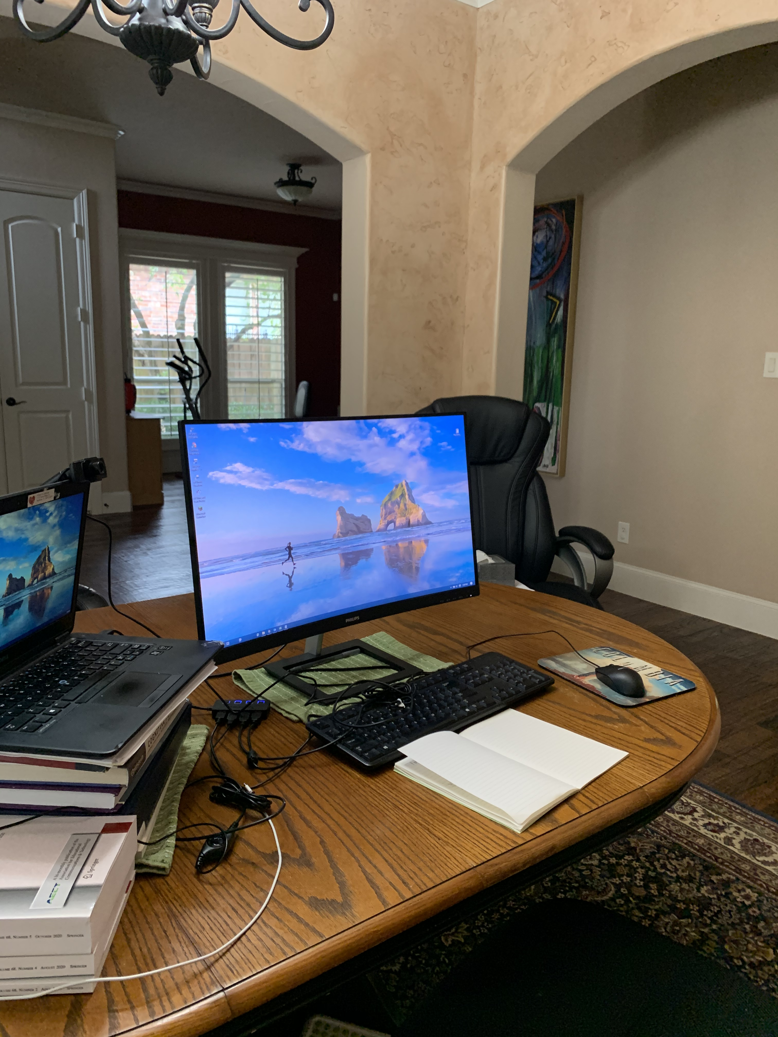
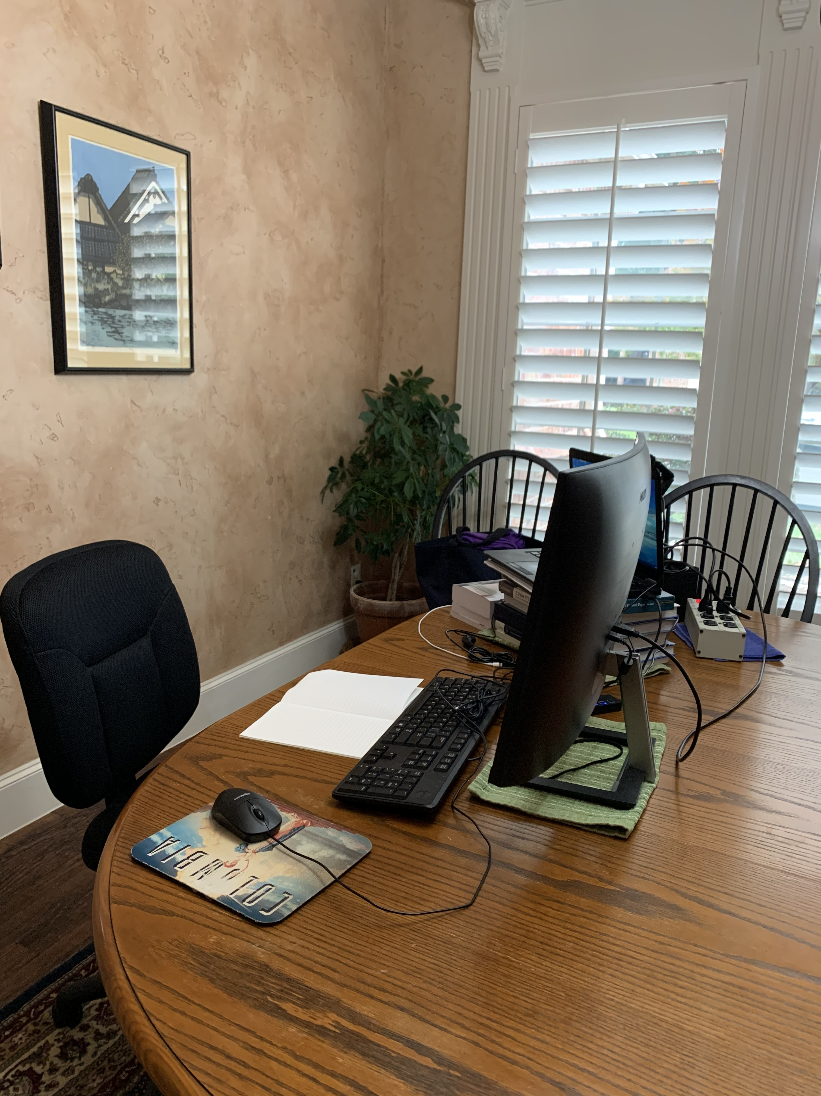
Dr. Lin Lin
Professor, Department of Learning Technologies, College of Information, University of North Texas
As far as writing, I usually need to set aside a block of time to write, and it usually takes longer than I have hoped. Yet, if I set aside time and get started, I usually can get it done and be happy about it. I know some people can do 15 minutes a day, but that doesn’t work for me.

Slide 3
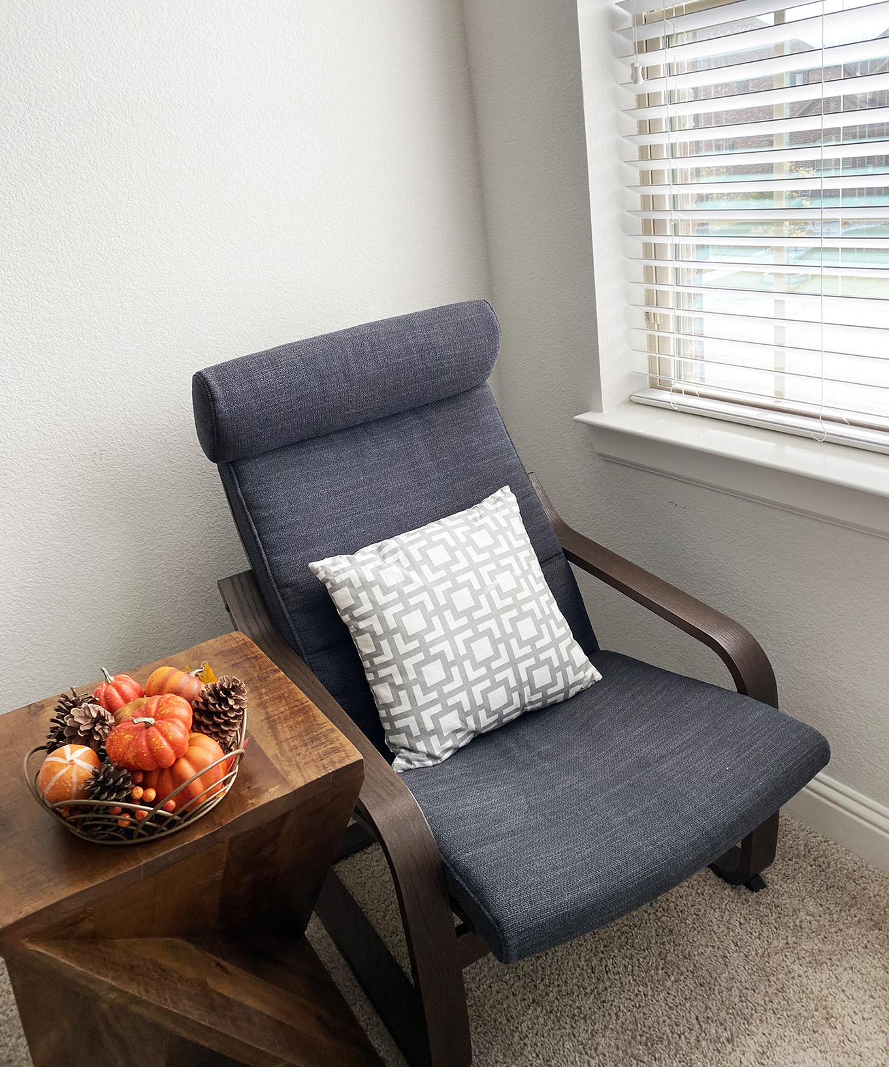

Dr. Yunjo An
Associate Professor and Chair of the Department of Learning Technologies, College of Information, University of North Texas
Write with your target audience in mind.
Be concise and to the point.
Revise, revise, revise!

Slide 4
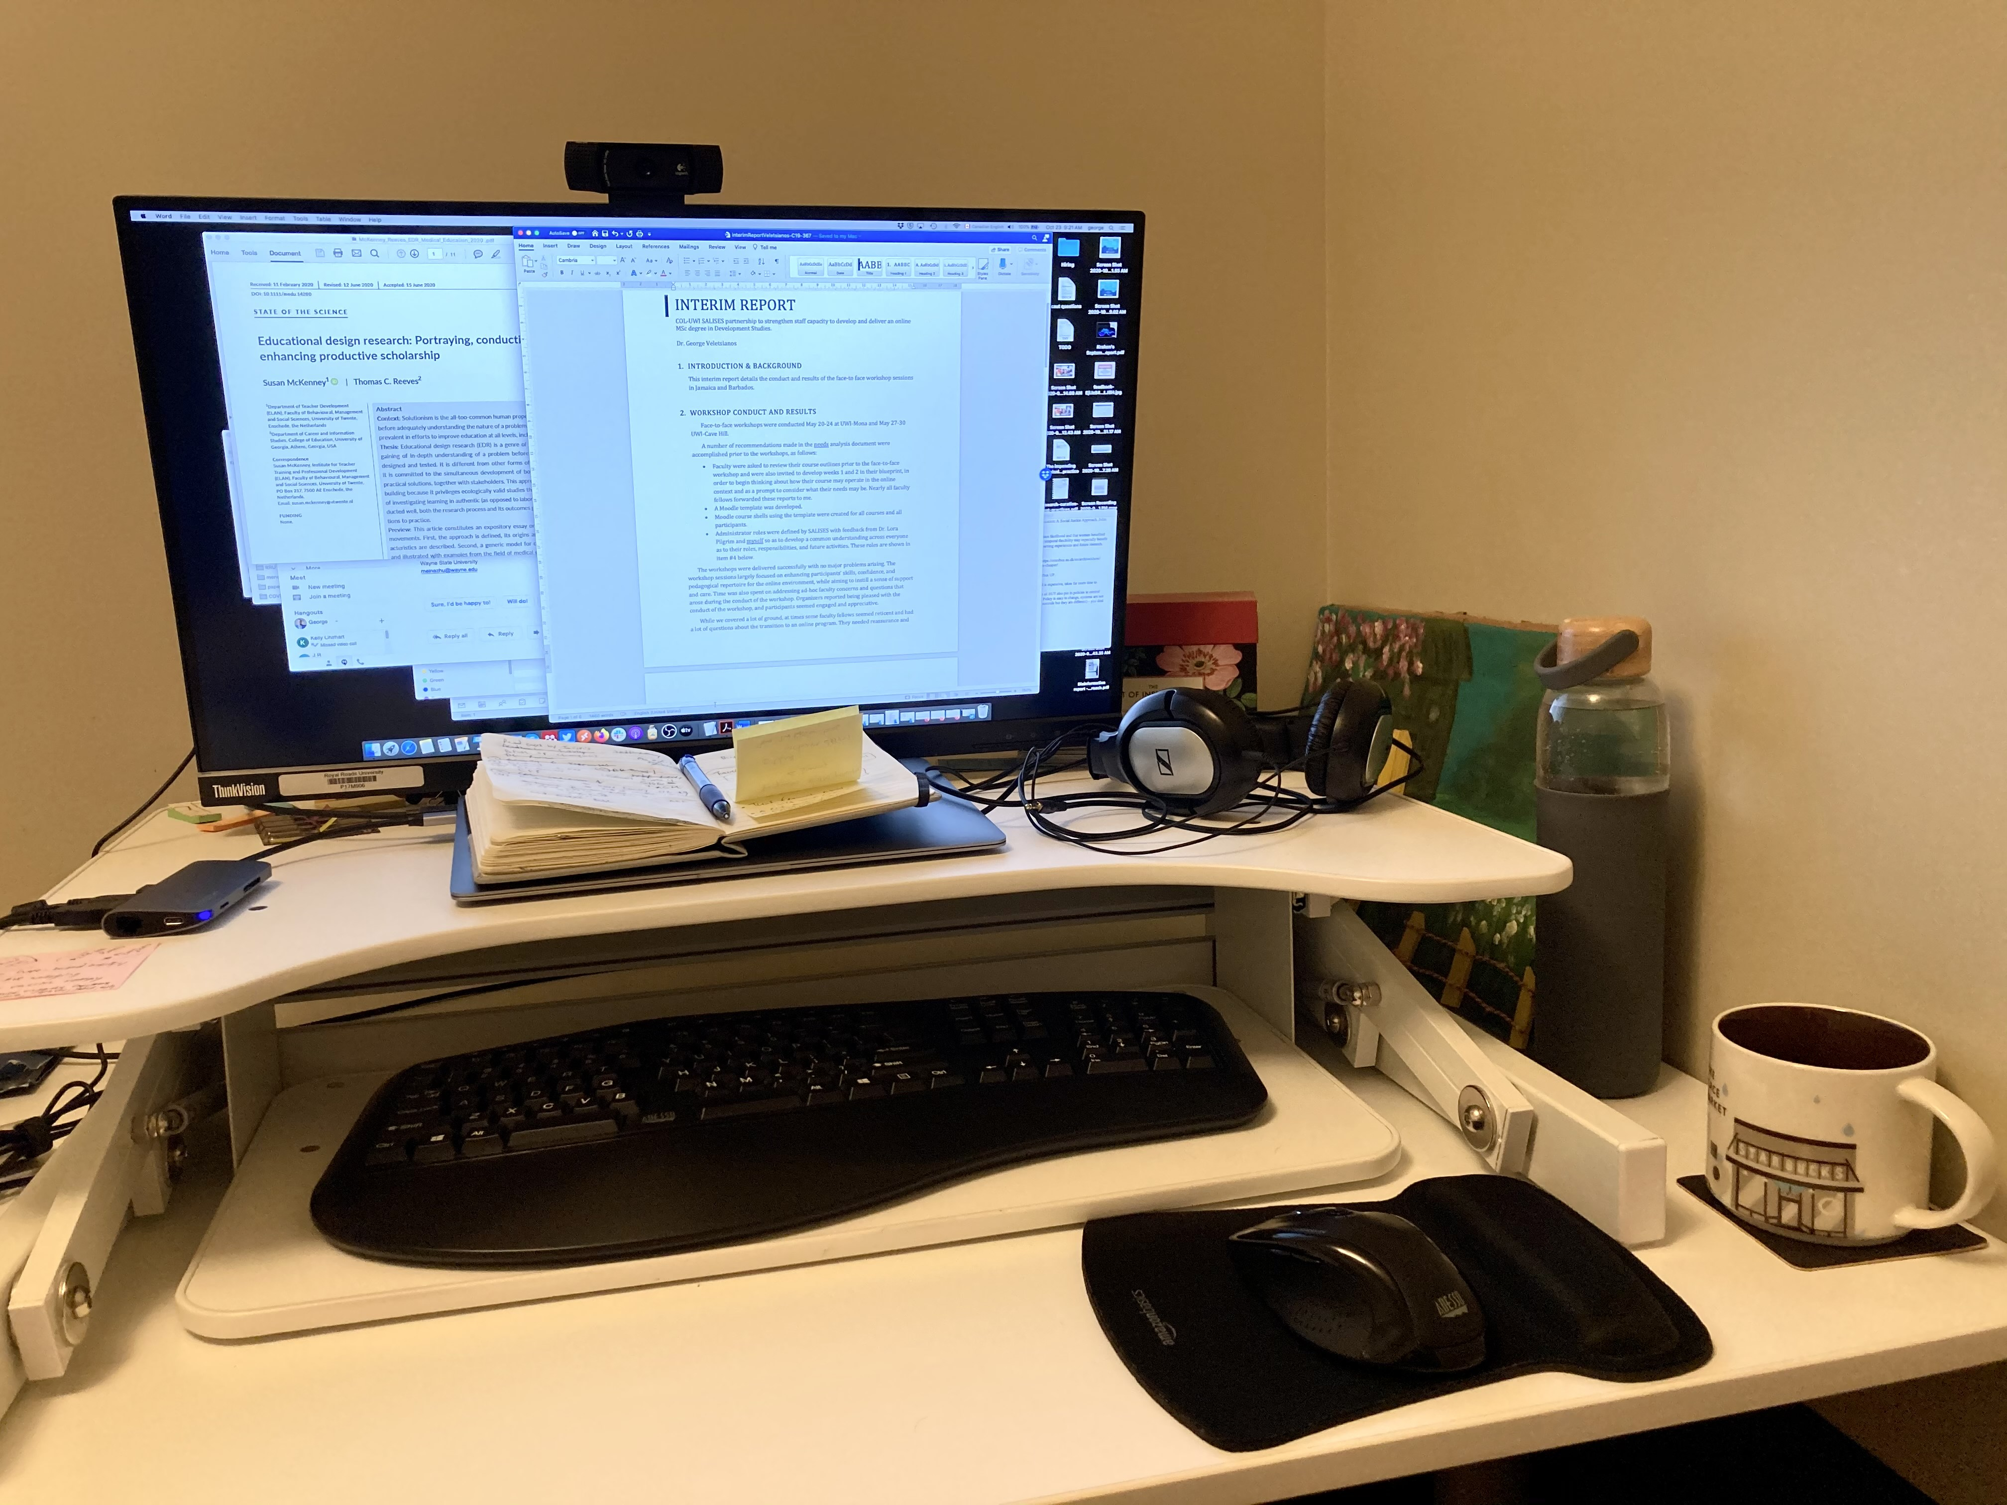
Dr. George Veletsianos
A full Professor in the School of Education and Technology at Royal Roads University. He holds the Canada Research Chair in Innovative Learning and Technology and the Commonwealth of Learning Chair in Flexible Learning.
When I write I block my access to the Internet to eliminate distractions.
I write in blocks of time and those range from 30 minutes to 2 hours, depending on availability.
I write very rough (and bad) first drafts that I edit later.

Slide 5
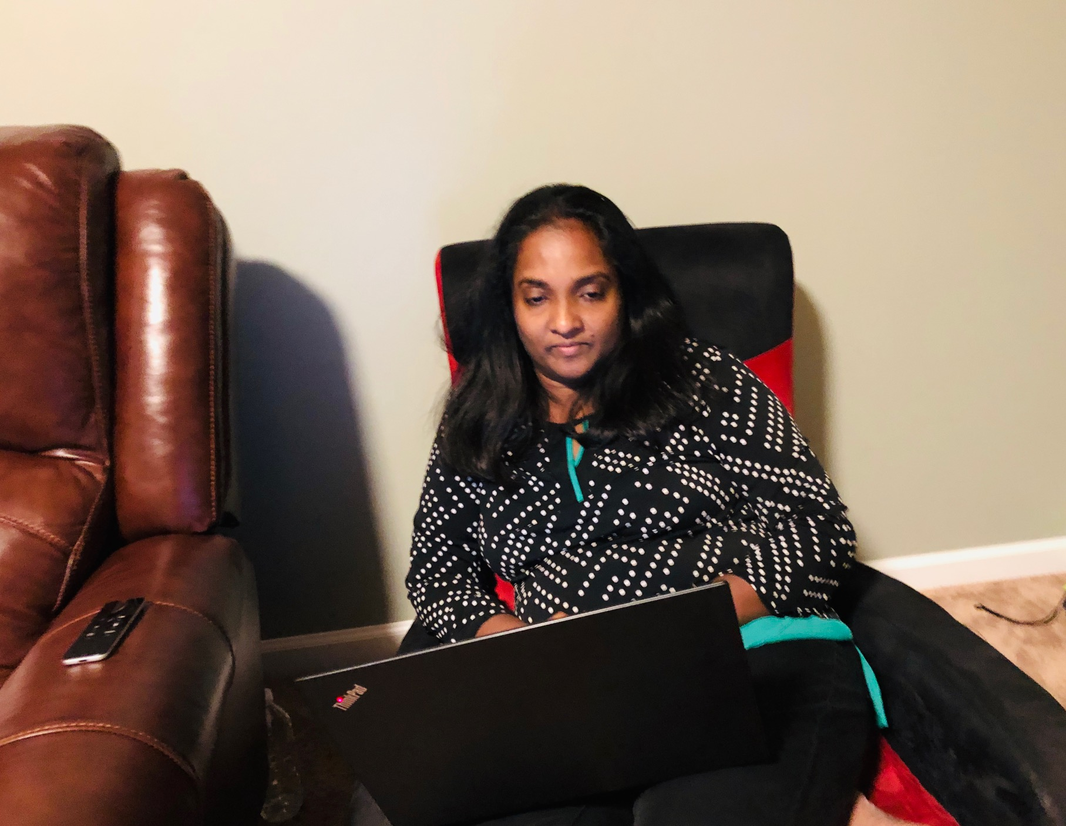
Dr. Florence Martin
Dr. Martin a Professor in Learning, Design and Technology, Program Director of the Post-Master’s Certificate of University and College Teaching and Program Coordinator of the Ed.D. in Educational Leadership, Learning, Design and Technology concentration at University of North Carolina Charlotte.
Set goals and deadlines
Write about topics that you are passionate about
Find a collaborative team to support you on projects

Slide 6
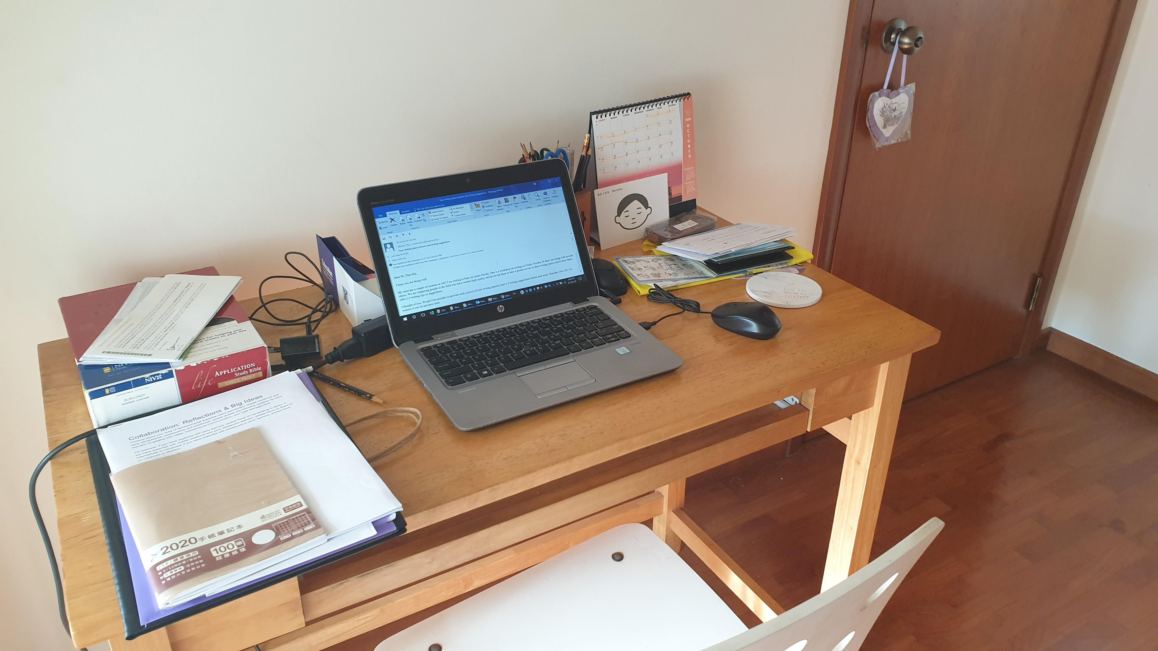
Dr. Looi Chee Kit
Dr. Chee Kit is Head of Learning Sciences Lab of the National Institute of Education, Nanyang Technological Society, the first research centre devoted to the study of the sciences of learning in the Asia-Pacific region.
We always think: I need to have my thought process sorted out or my ideas clarified before I started typing or writing. Oftentimes, once I start typing, the flow comes. Especially when I wrote academic reviews of papers submitted to journals or conferences. So don’t procrastinate, you can do the writing and thinking together …
If your first language is not English, don’t hold back because of your fear of writing in the language. Get your ideas out first, get the thoughts flowing, ... language editing can come latter. Focus on the ideas and the logical flow on the arguments. In some ways, academic writing is much easier than other forms of writing. Read more, imitate good writing, and keep thinking in English.
Get someone with writing experience to help to improve the writing. It can be a good fast way to improve.

Slide 7
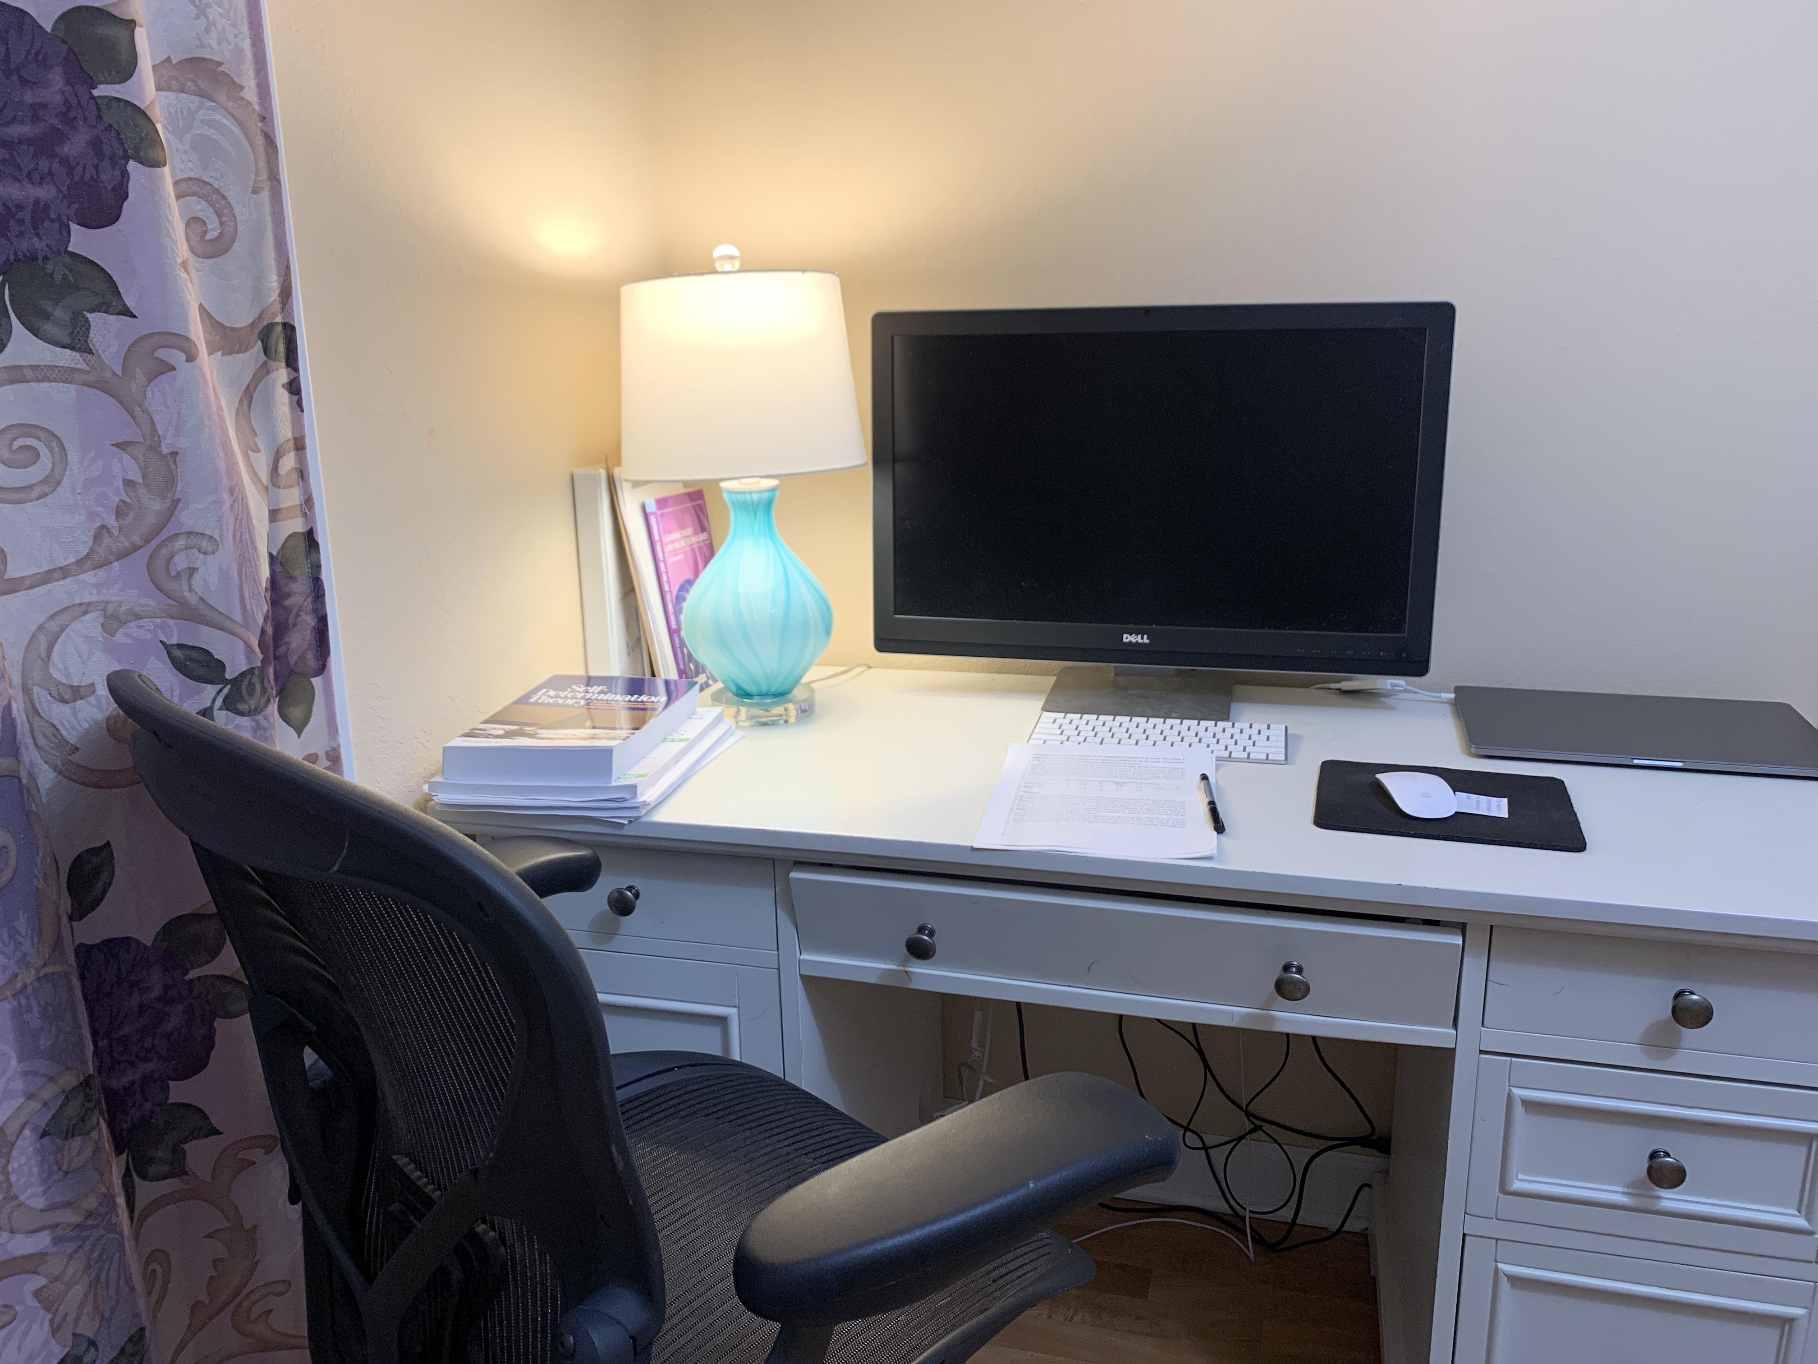
Dr. Fei Gao
Associate Professor in College of Technology Architecture and Applied Engineering at Bowling Green State University
Regularly read the cutting-edge research in your field.
Pay yourself first. Consider making writing your first task of the day.

Slide 8
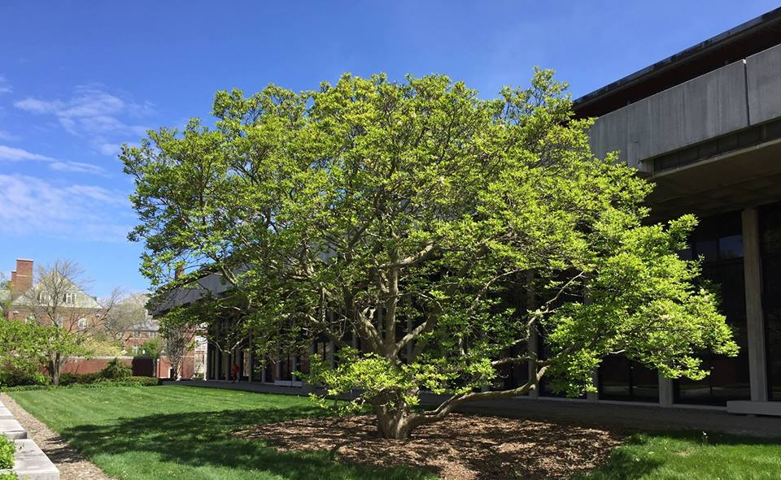
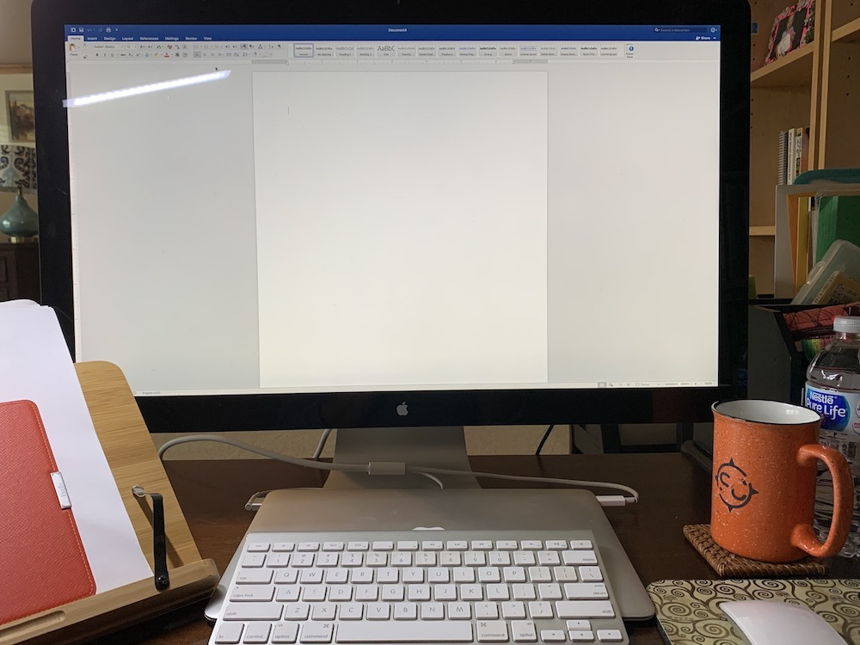
Dr. EunJung Grace Oh
Associate Professor, Education Policy, Organization and Leadership, University of Illinois at Urbana-Champaign
Block writing times for deep work each week on calendar. Treat those times same as meetings.
For days that I cannot have a block of time for writing, revisit the work-in-progress file for a short amount of time (20-30 mins would be fine) to keep up with my thinking thread and write as much as I could (e.g., revising/adding a paragraph, etc.).
Form a writing group with junior colleagues and meet once a month to share monthly writing goals and progress, and provide feedback on manuscripts, etc.

Slide 9
Dr. Dabae Lee’s Writing Tips
Assistant Professor and IDT Program Director at Emporia State University
Have sustainable and concrete goals.
  Don’t be too harsh on yourself.
  Little by little is okay.
  Maybe a paragraph per day.
Determine where to submit before starting to write.
  Write specifically for the journal’s scope and requirements.
Set the writing environment as enjoyable as possible.
  Favorite cup of tea or coffee.
  Cafe music.
  Enjoy the moment!

Slide 10
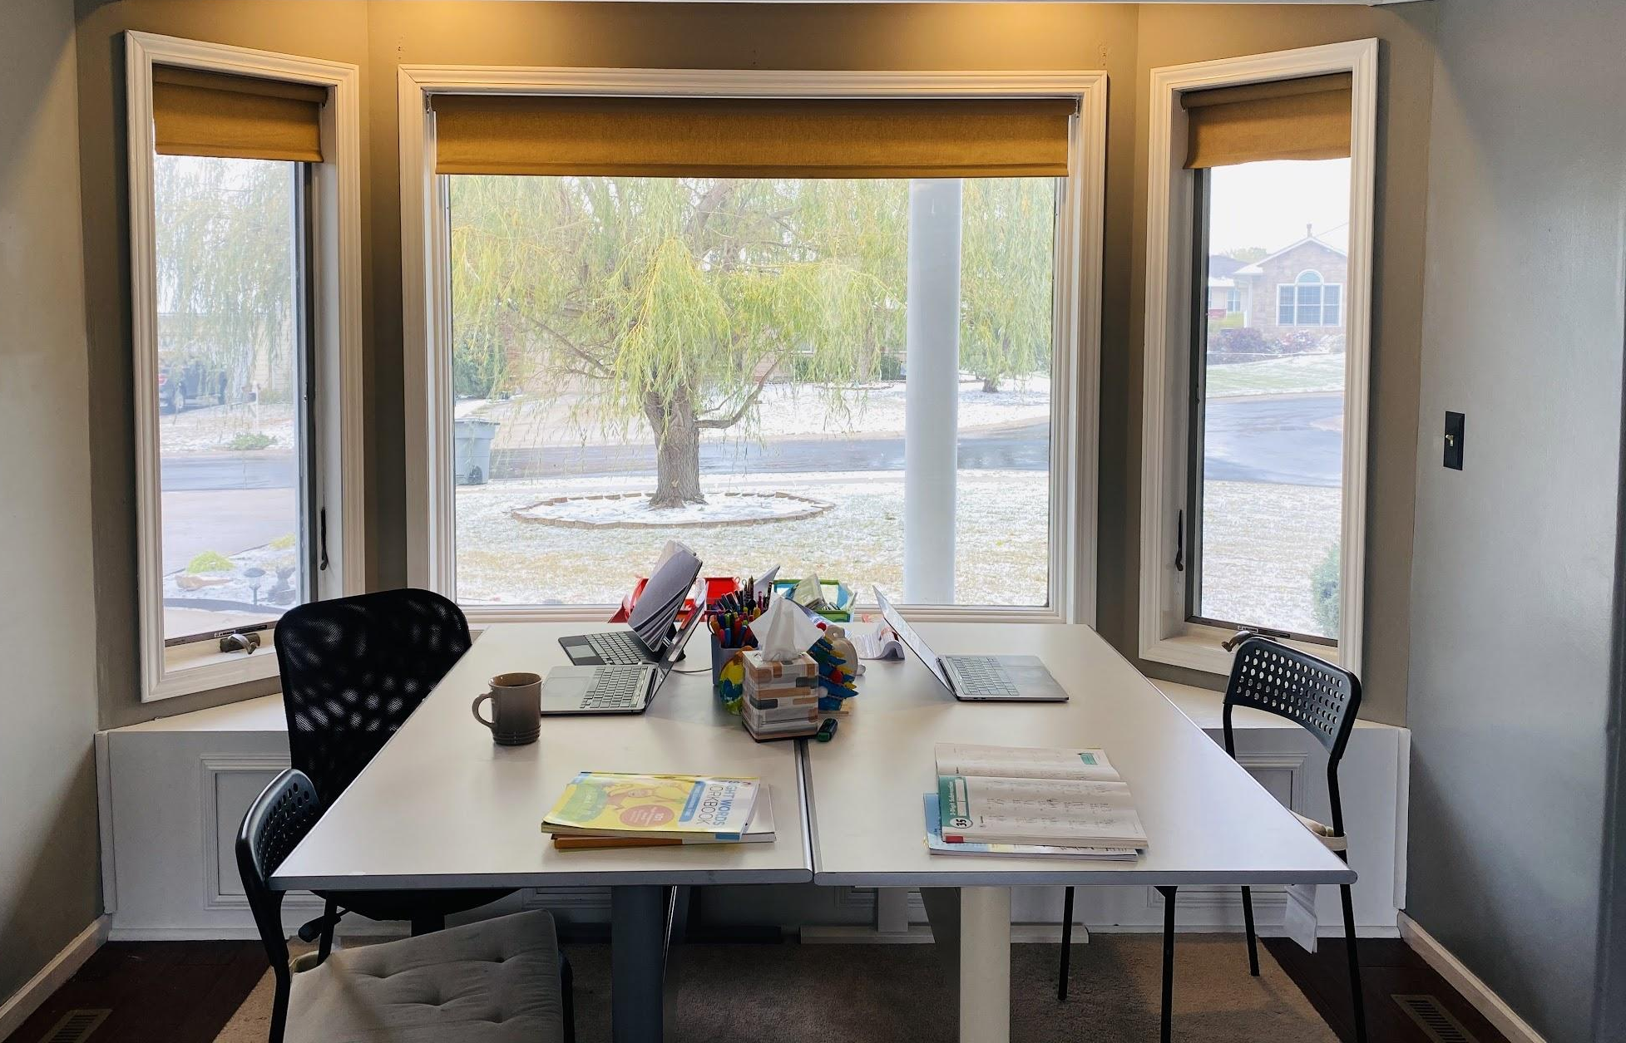
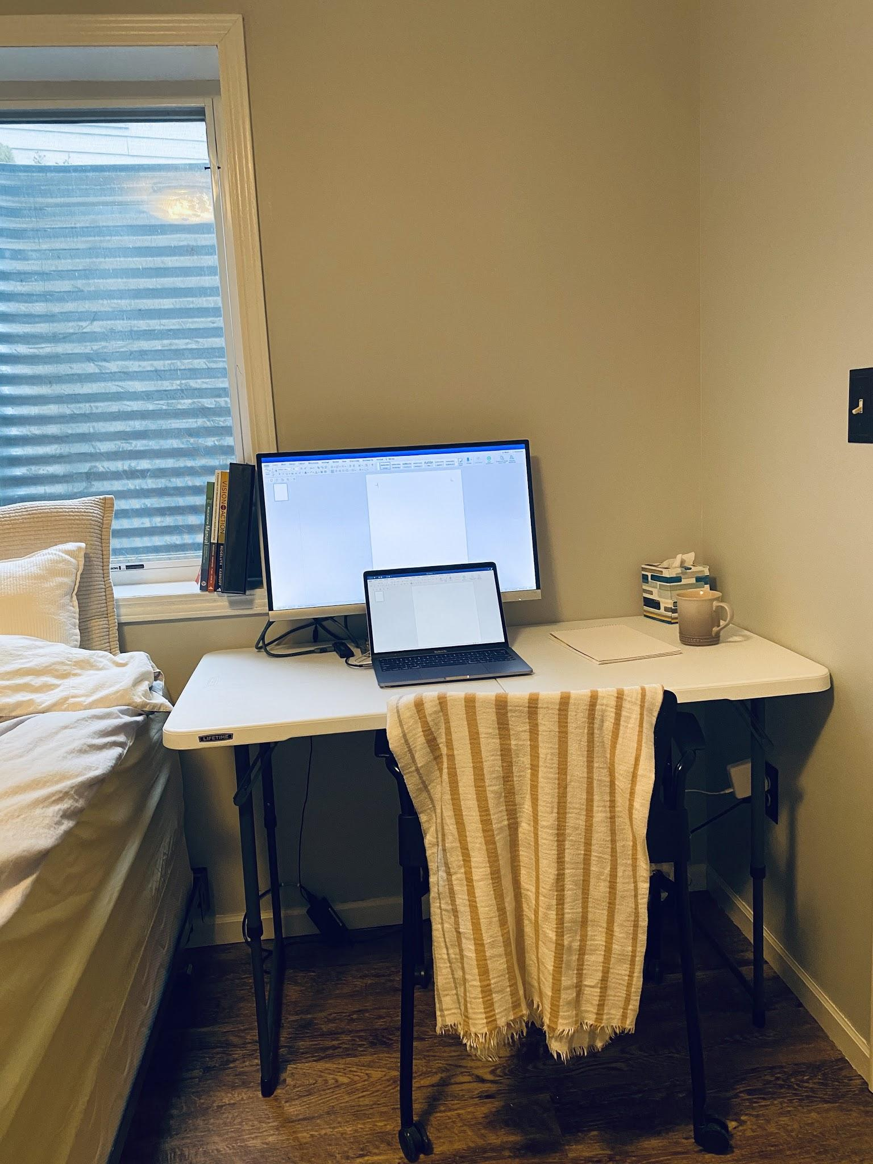
Dr. Dabae Lee’s Writing Spaces During the Pandemic
A writing space that I share with my family.
When I need to be alone -
A guest room in the basement.

Slide 11
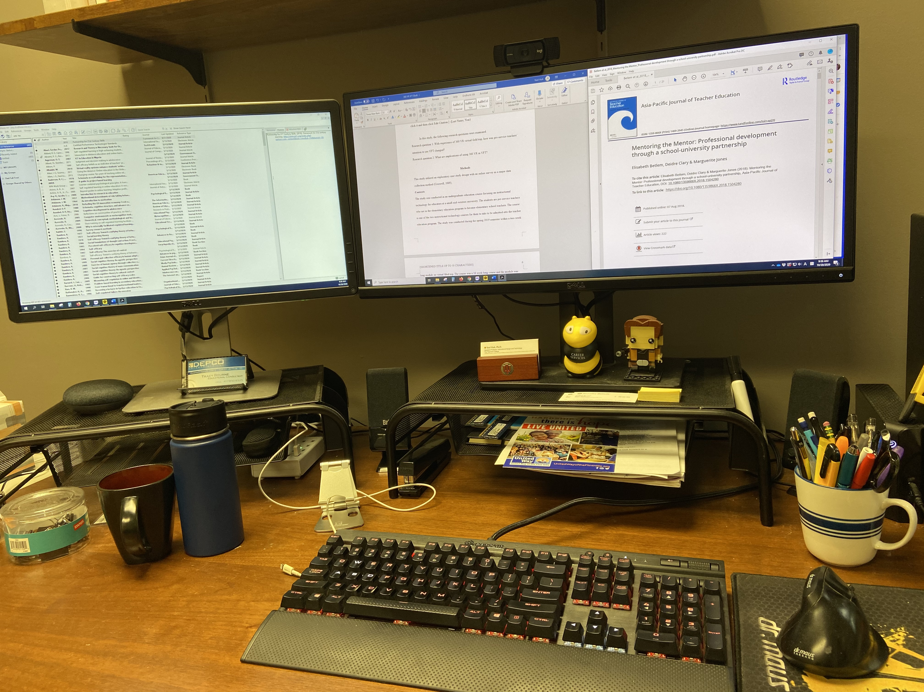
Dr. Yeol Huh
Assistant Professor and IDT Program Director at Emporia State University
For me, not a special tip for writing, but I purchased a mechanical keyboard that gives you a lively sound and feels when typing. I just wanted to make the act of typing a pleasant task.
Also, to help organize the reading materials for your literature review, using a blog type of tool with tagging is a good way. You can create a short summary of the article you read and give relevant tags (i.e., K-12, motivation, tech integration etc.) so that later you can sort the literature easily using the tag.

Slide 12
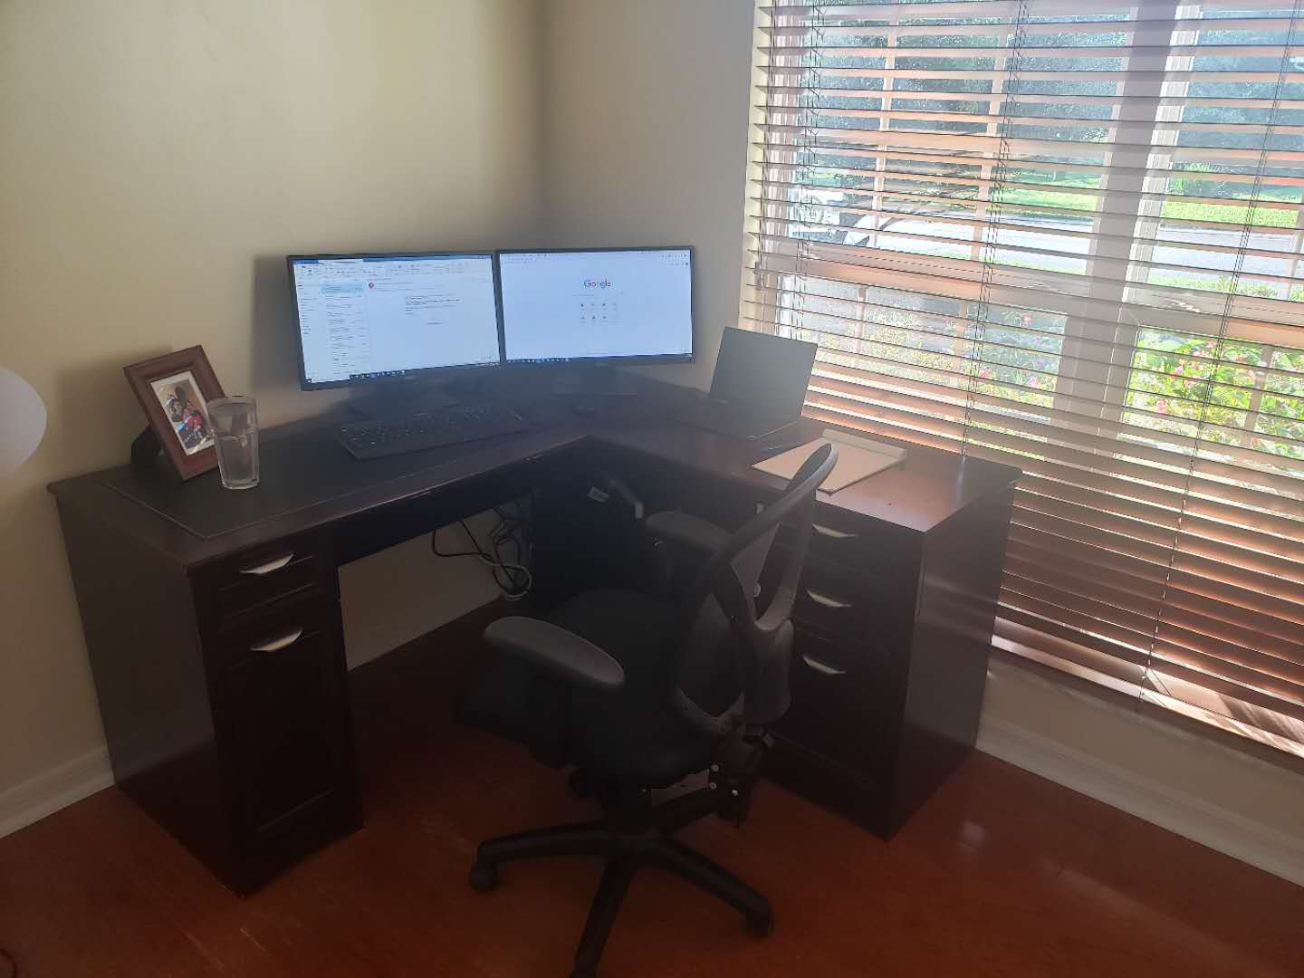
Dr. Wanli Xing
Assistant Professor, School of Teaching and Learning, University of Florida
Write every day. I try my best to write something for research everyday.
Establish strong collaborations.

Slide 13
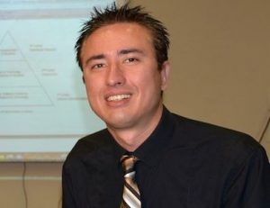
Dr. Albert D. Ritzhaupt
Associate Professor of Educational Technology
and Computer Science Education
Associate Director for Graduate Studies
School of Teaching and Learning, University of Florida
I don't think I am a good example of best practices for writing. I have been working at my dining room table for the past seven months, which is not ideally configured or ergonomic.
Additionally, when I write, I go on short binges where I keep writing for hours until I run out of steam. I don't think these situations are good examples of writing practices.

