Slide 1


Slide 2

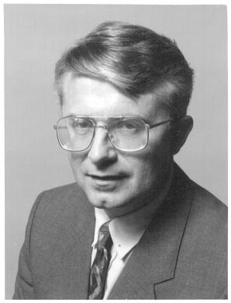
Why Use Video?
David Ausubel (1978) argued that knowledge was hierarchically organized.
New learning concepts and ideas to be subsumed under or anchored within prior learning experiences (i.e., meaningful info must be related to what already know).
Advance Organizers: Per Ausubel, we must provide a context, richer, deeper learning.

Slide 3
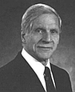

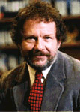
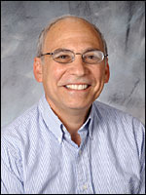
Why Use Shared Online Video?
4. Dual coding theory (learning information verbally and visually is more richly stored): Alan Paivio.
5. Anchored instruction and macrocontexts: John Bransford and colleagues.
6. Multimedia theory: Richard Mayer.

Slide 4
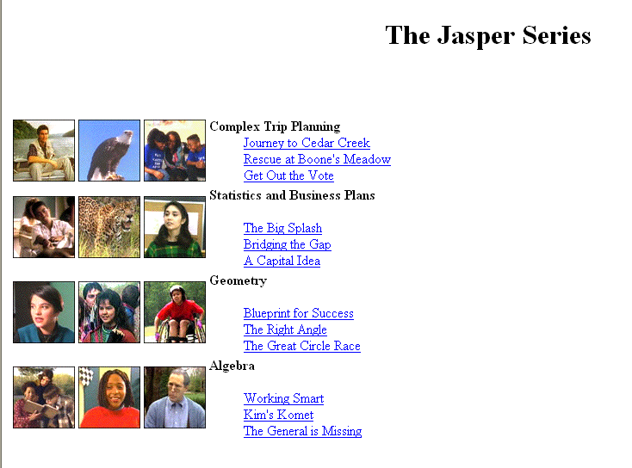
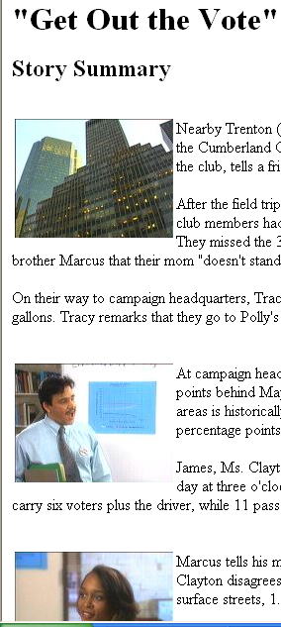
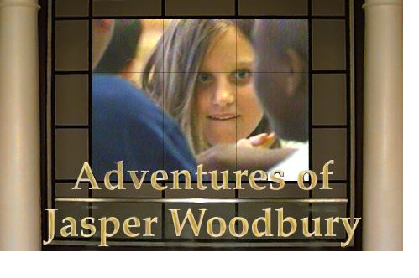
Anchored Instruction in short video clips—learn Math http://peabody.vanderbilt.edu/projects/funded/jasper/Jasperhome.html
Anchored Instruction

Slide 5
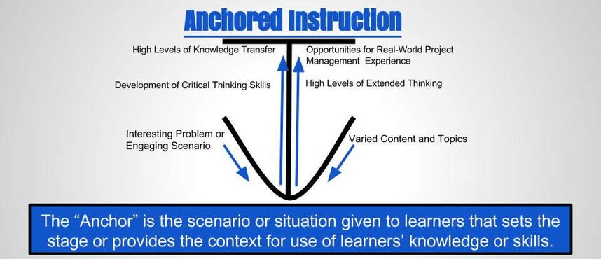
Anchored Instruction in short video clips—learn Math http://peabody.vanderbilt.edu/projects/funded/jasper/Jasperhome.html

Slide 6
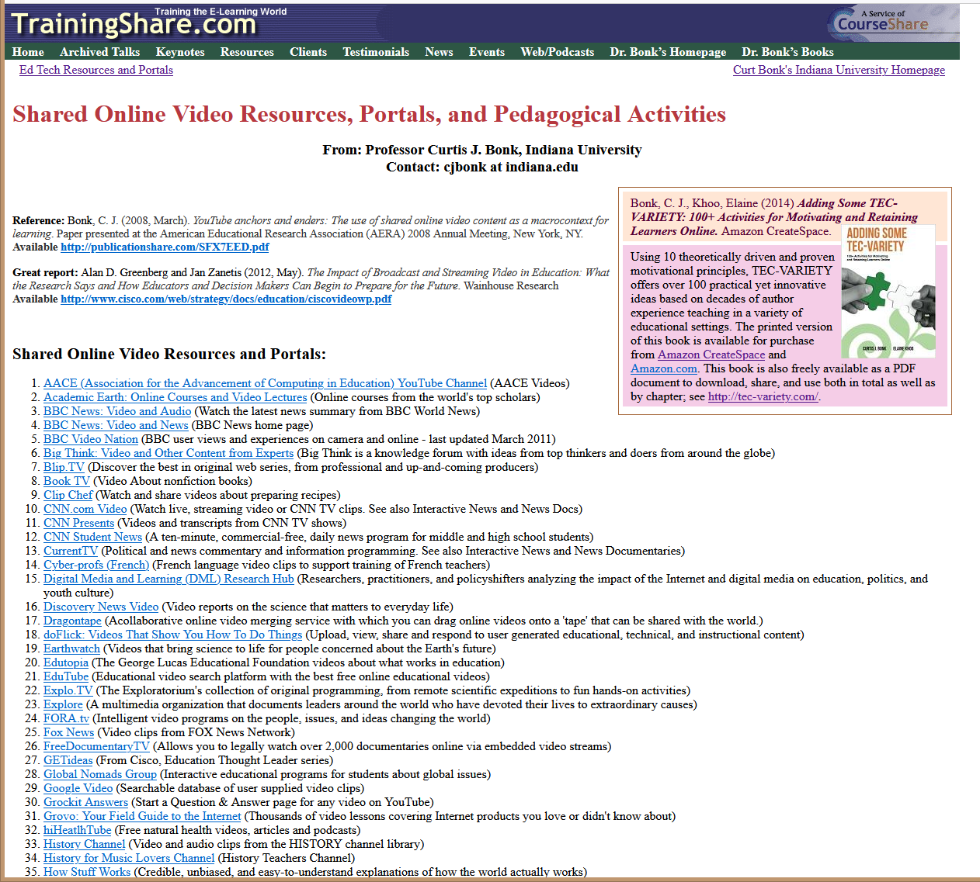
March 31, 2022
Shared Online Video Resources, Portals, and Pedagogical Activities
http://www.trainingshare.com/resources/Summary_of_Ways_to_Use_Shared_Online_Video.php

Slide 7
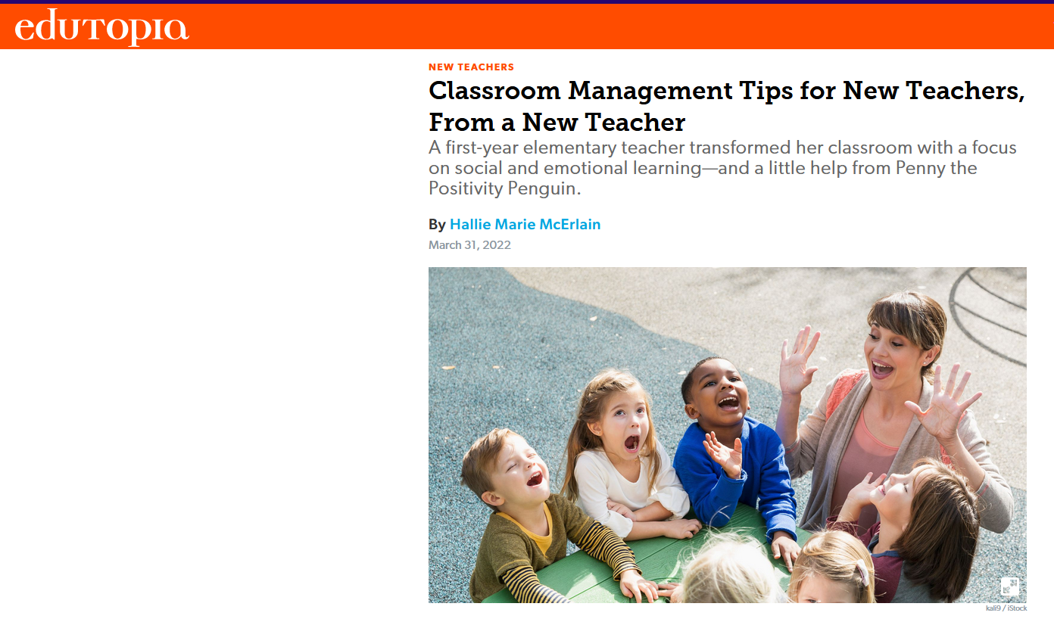
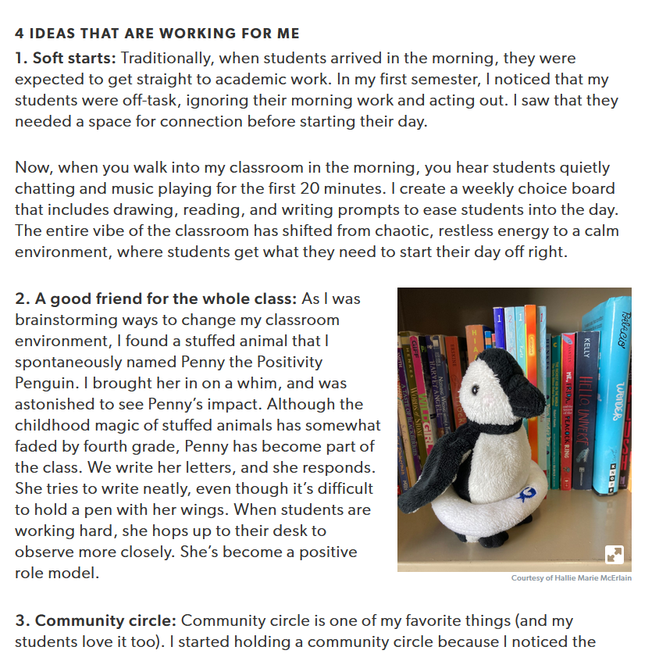
March 31, 2022
Edutopia
https://www.edutopia.org/article/classroom-management-tips-new-teachers-new-teacher

Slide 8
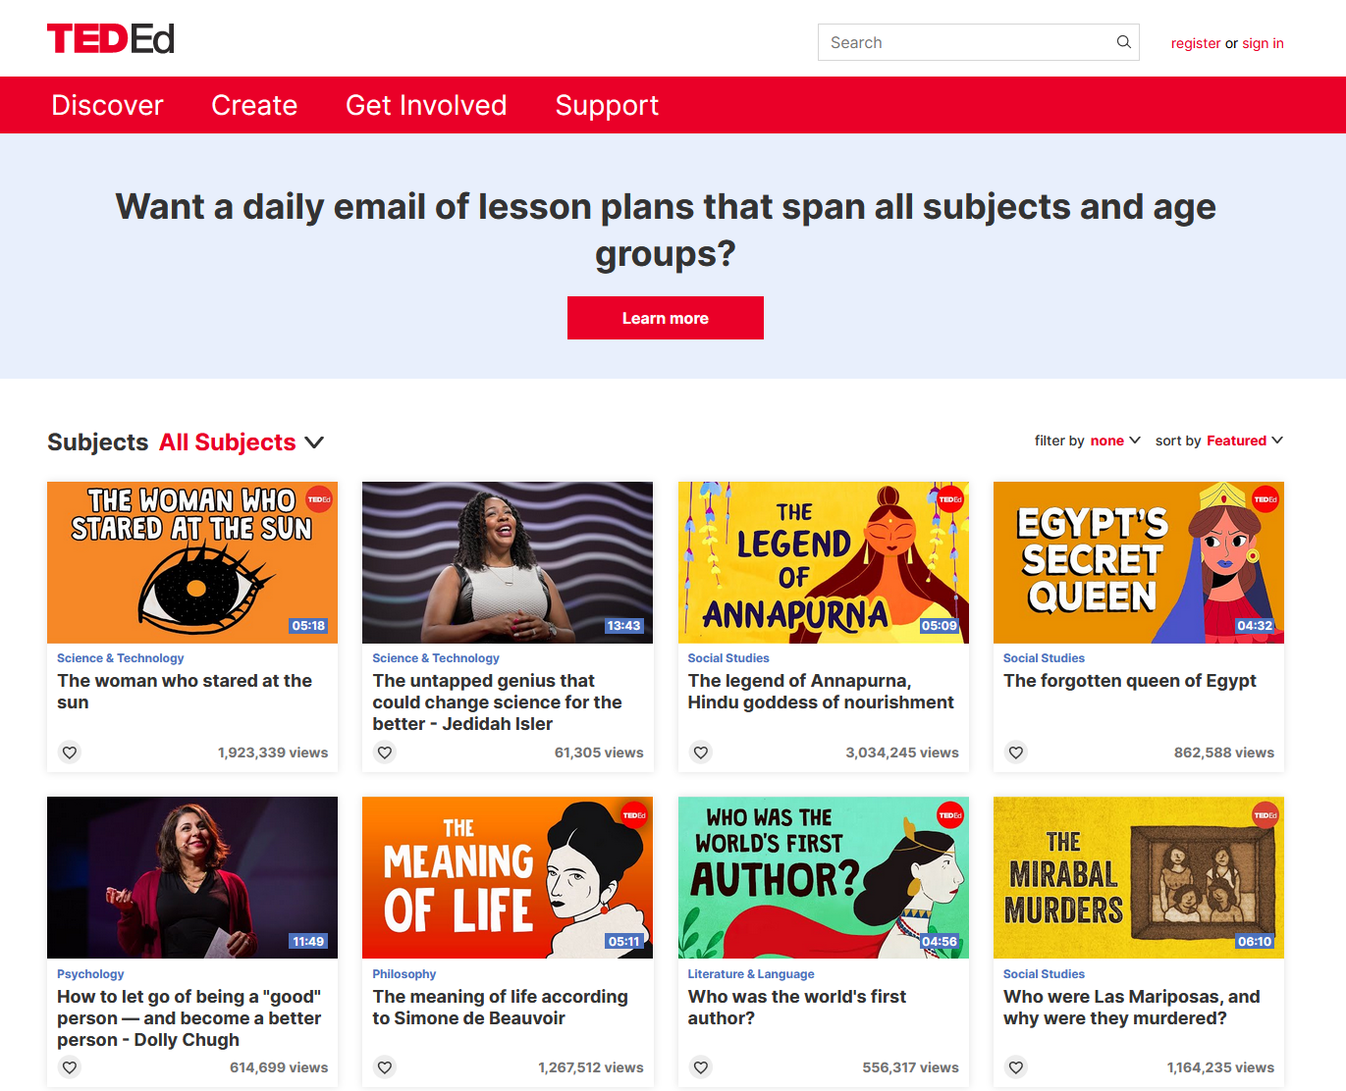
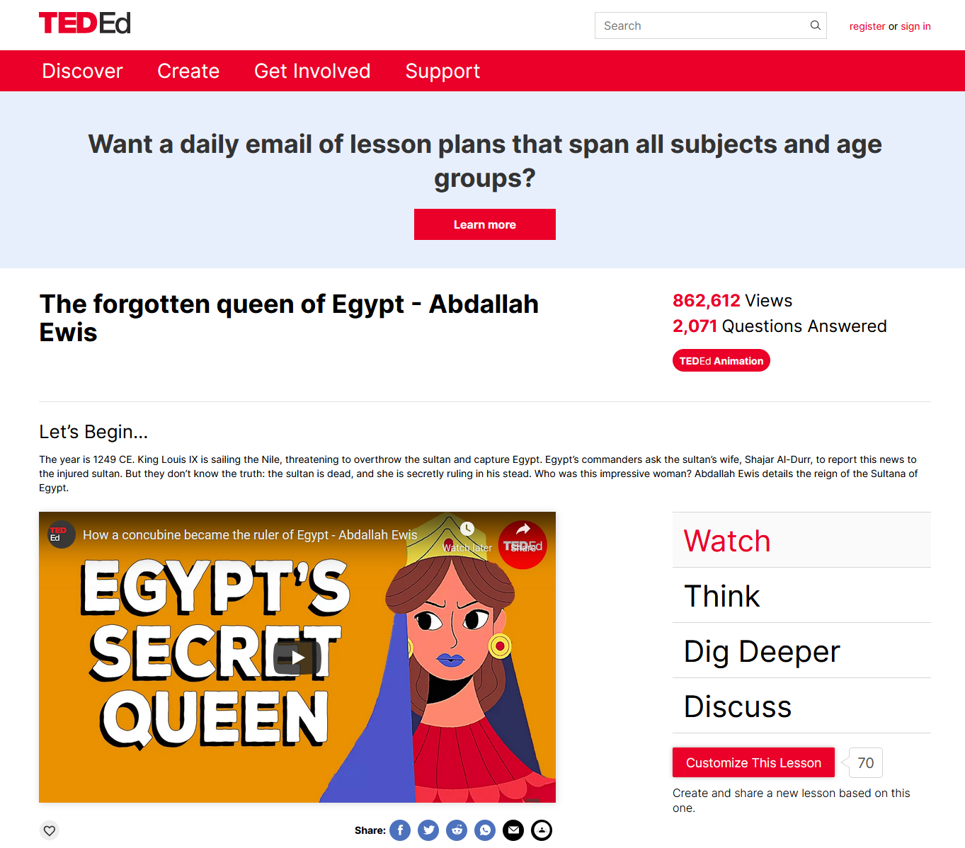
March 31, 2022
TEDEd
https://ed.ted.com/lessons?direction=desc&sort=featured-position

Slide 9
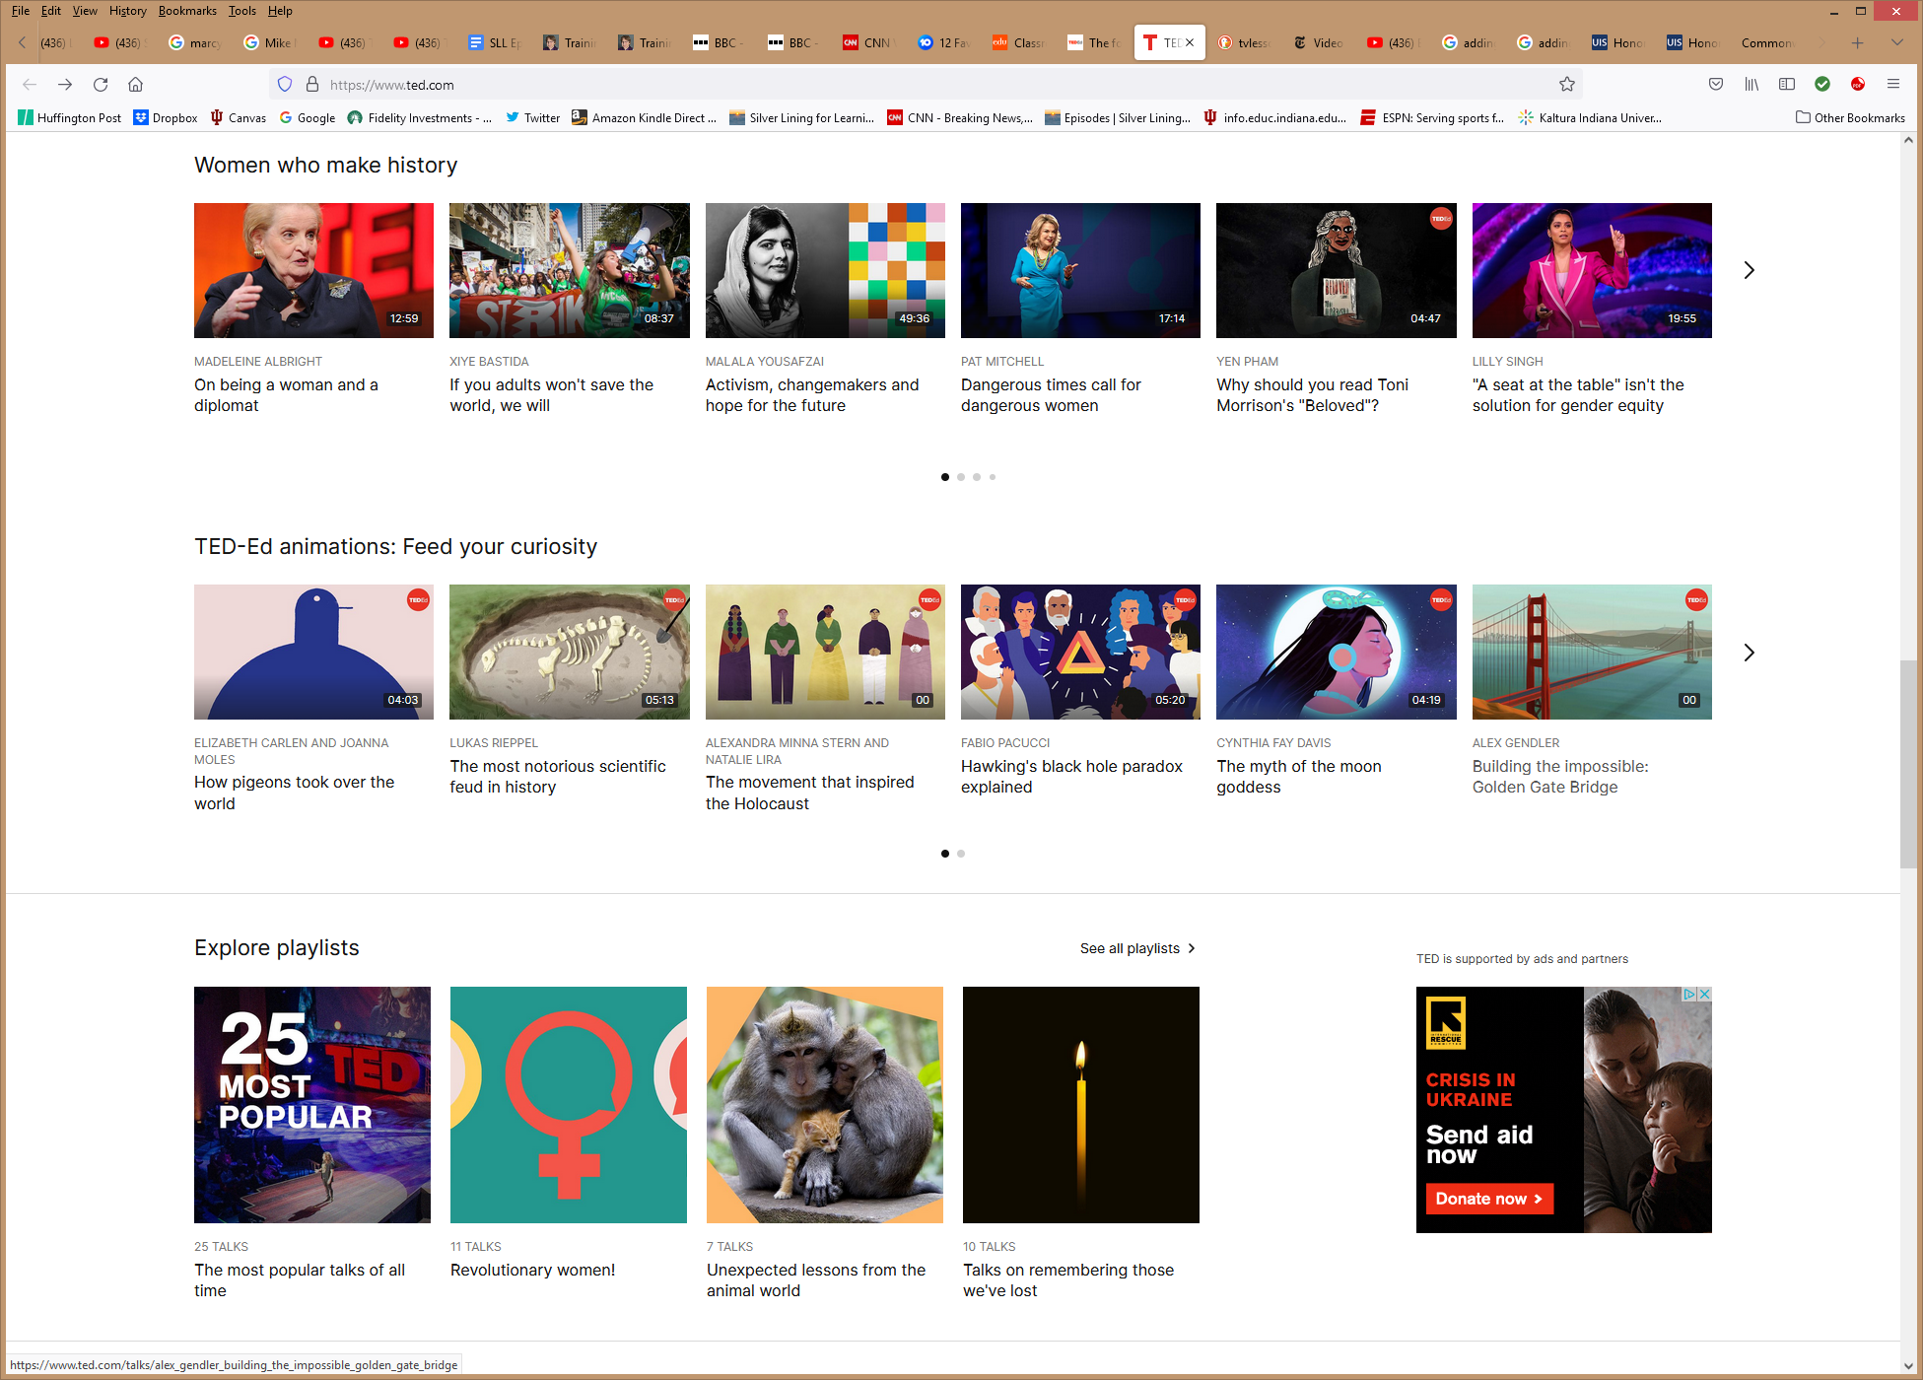
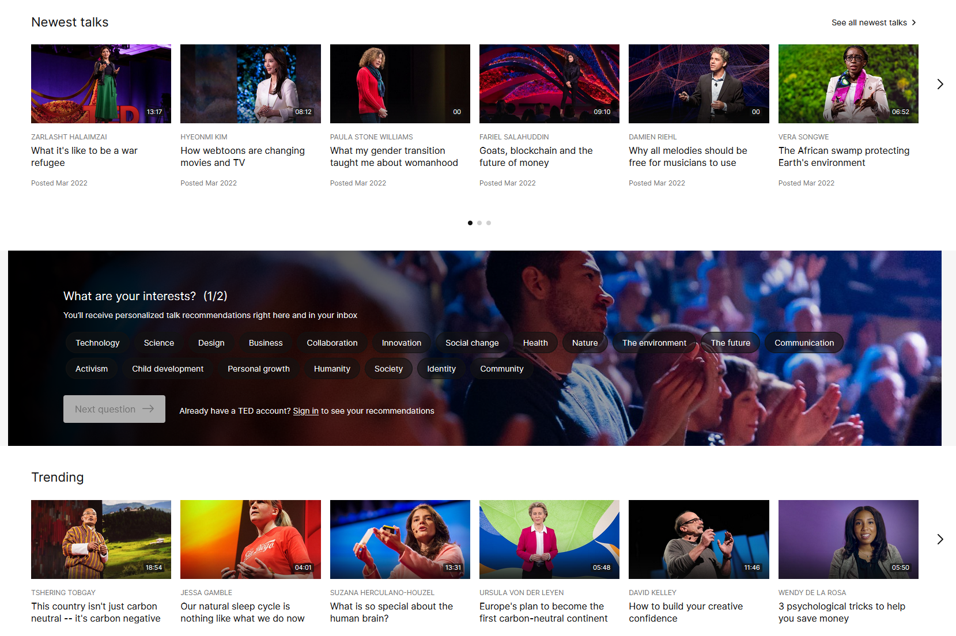
March 31, 2022
TEDEd
https://www.ted.com/

Slide 10
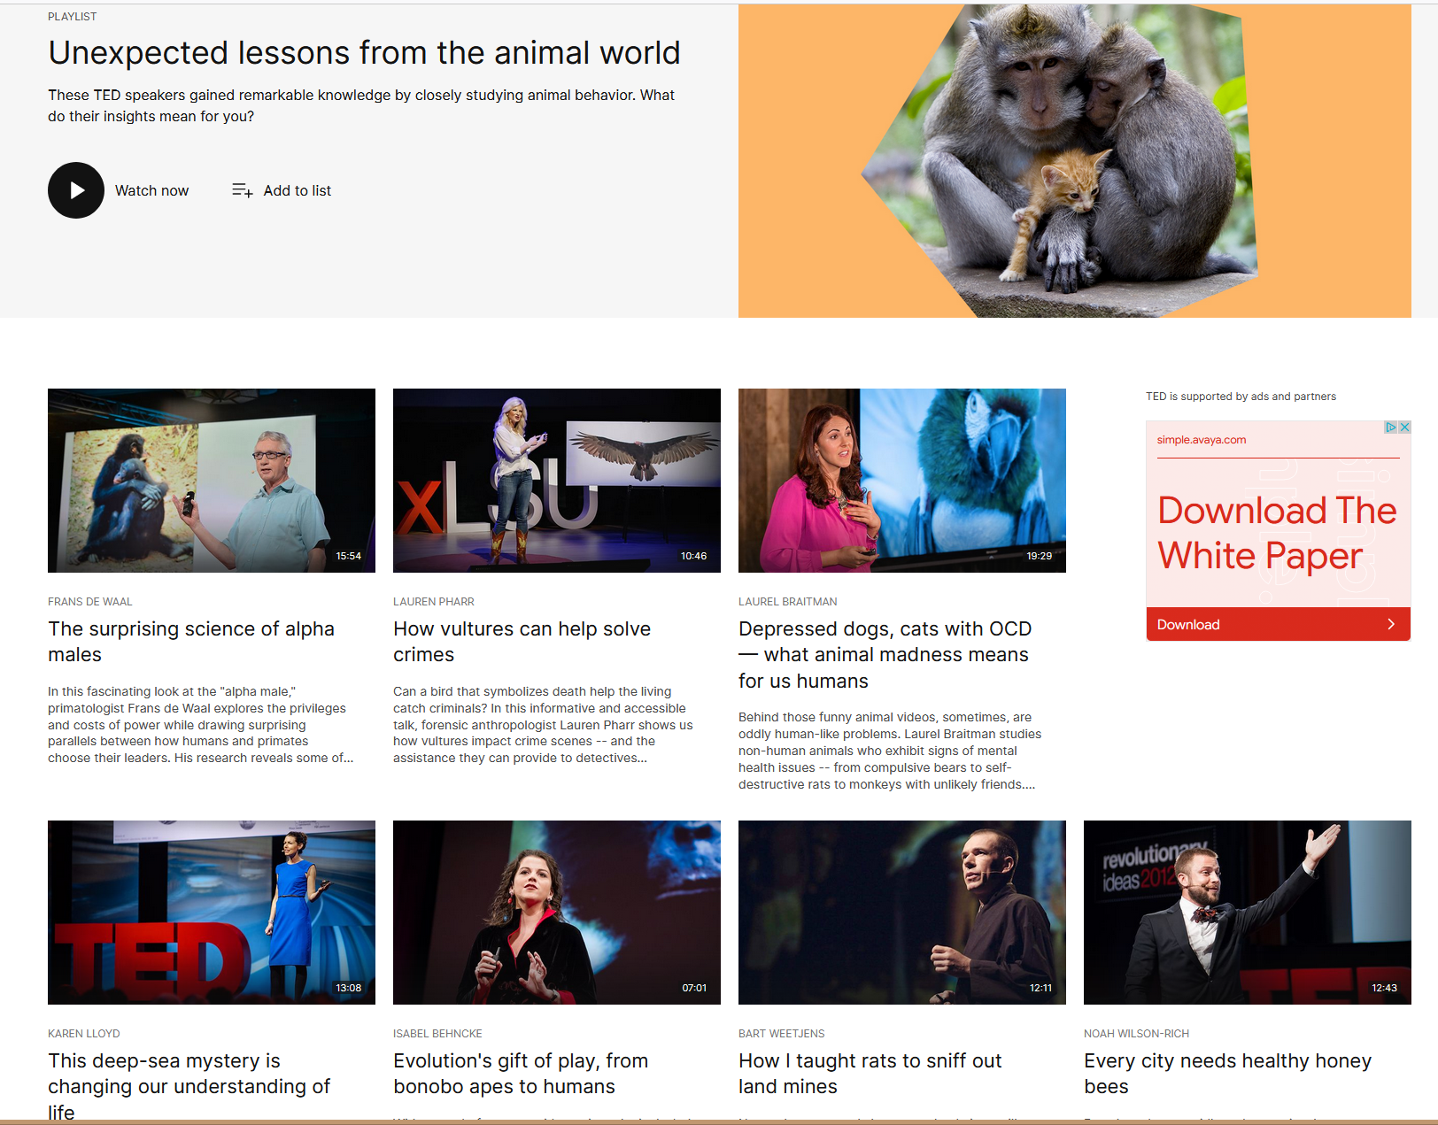
March 31, 2022
TEDEd
https://www.ted.com/

Slide 11
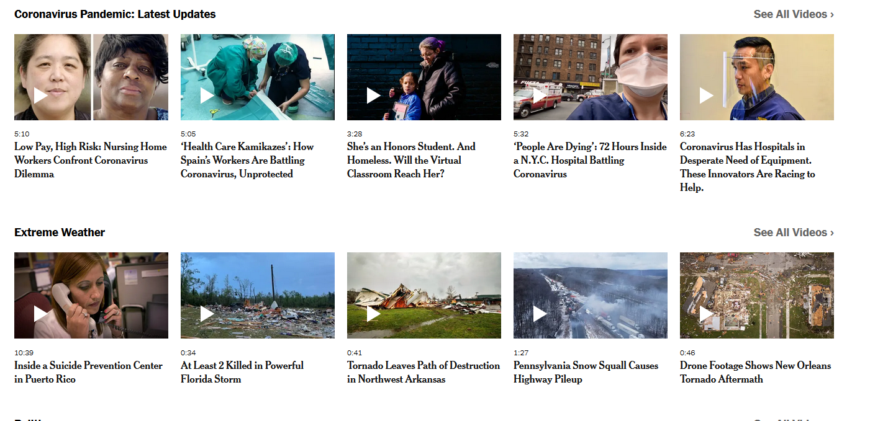
March 31, 2022
New York Times
https://www.nytimes.com/video

Slide 12
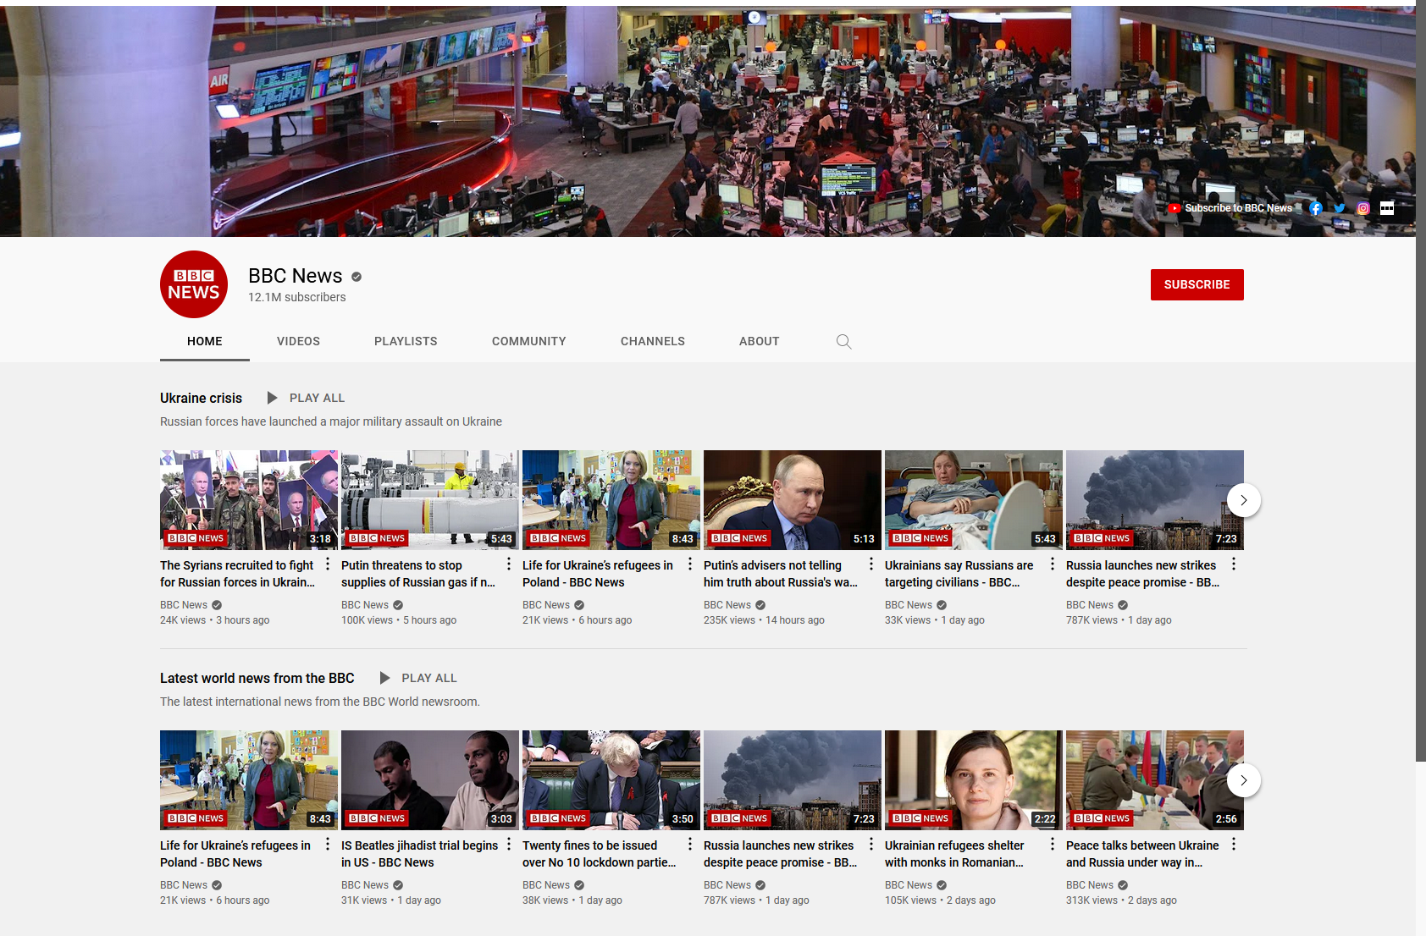
March 31, 2022
BBC News
https://www.youtube.com/c/BBCNews/featured

Slide 13


III. Ten More Pedagogical Uses of Shared Online Videos
1. Pause and Reflect
2. Key Concept Reflections
3. Video Anchor or Starter
4. Video Capstone or Ending
5. Online Weekly Content Previews and Discussions

Slide 14

More Uses of Shared Online Videos
6. Rank or Evaluate Anchor Archives
7. Student Anchor Creator Competitions
8. Concept or Technology Demonstrations
9. Anchor Video Debates
10. Anchor Creator Interviews

Slide 15
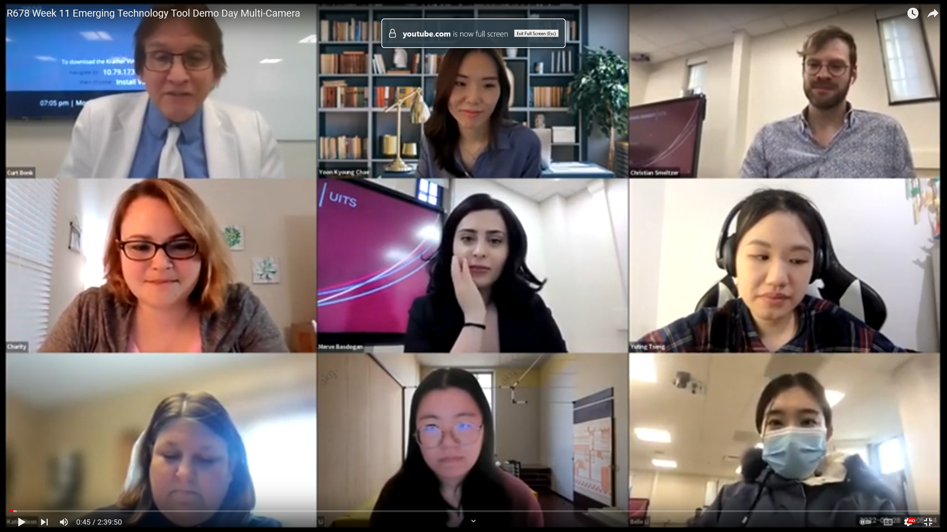
March 28, 2022
R678 Week 11 Emerging Technology Tool Demo Day
Single Camera View: https://youtu.be/FilNDFQz79c
Multiple Camera View: https://youtu.be/yKjQ0cXdJt0

Slide 16
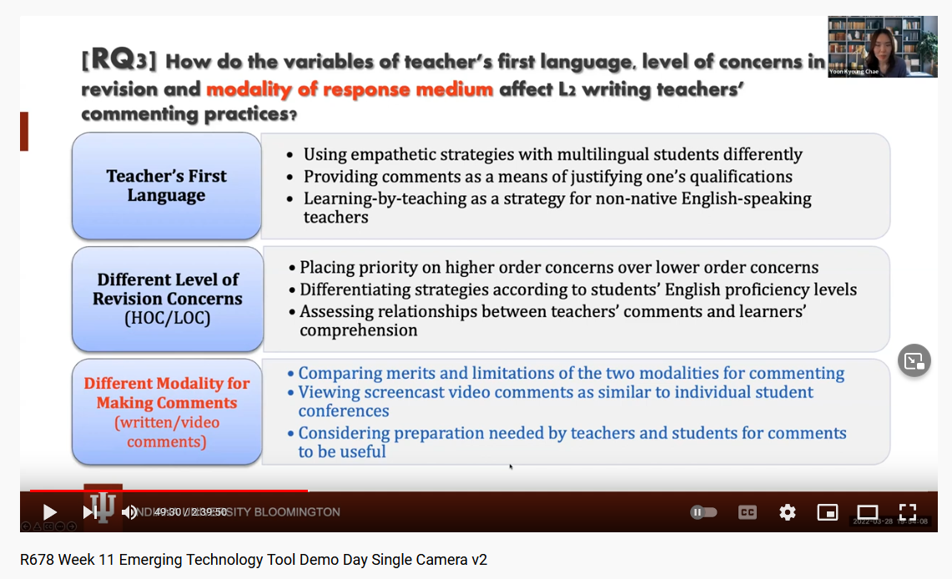
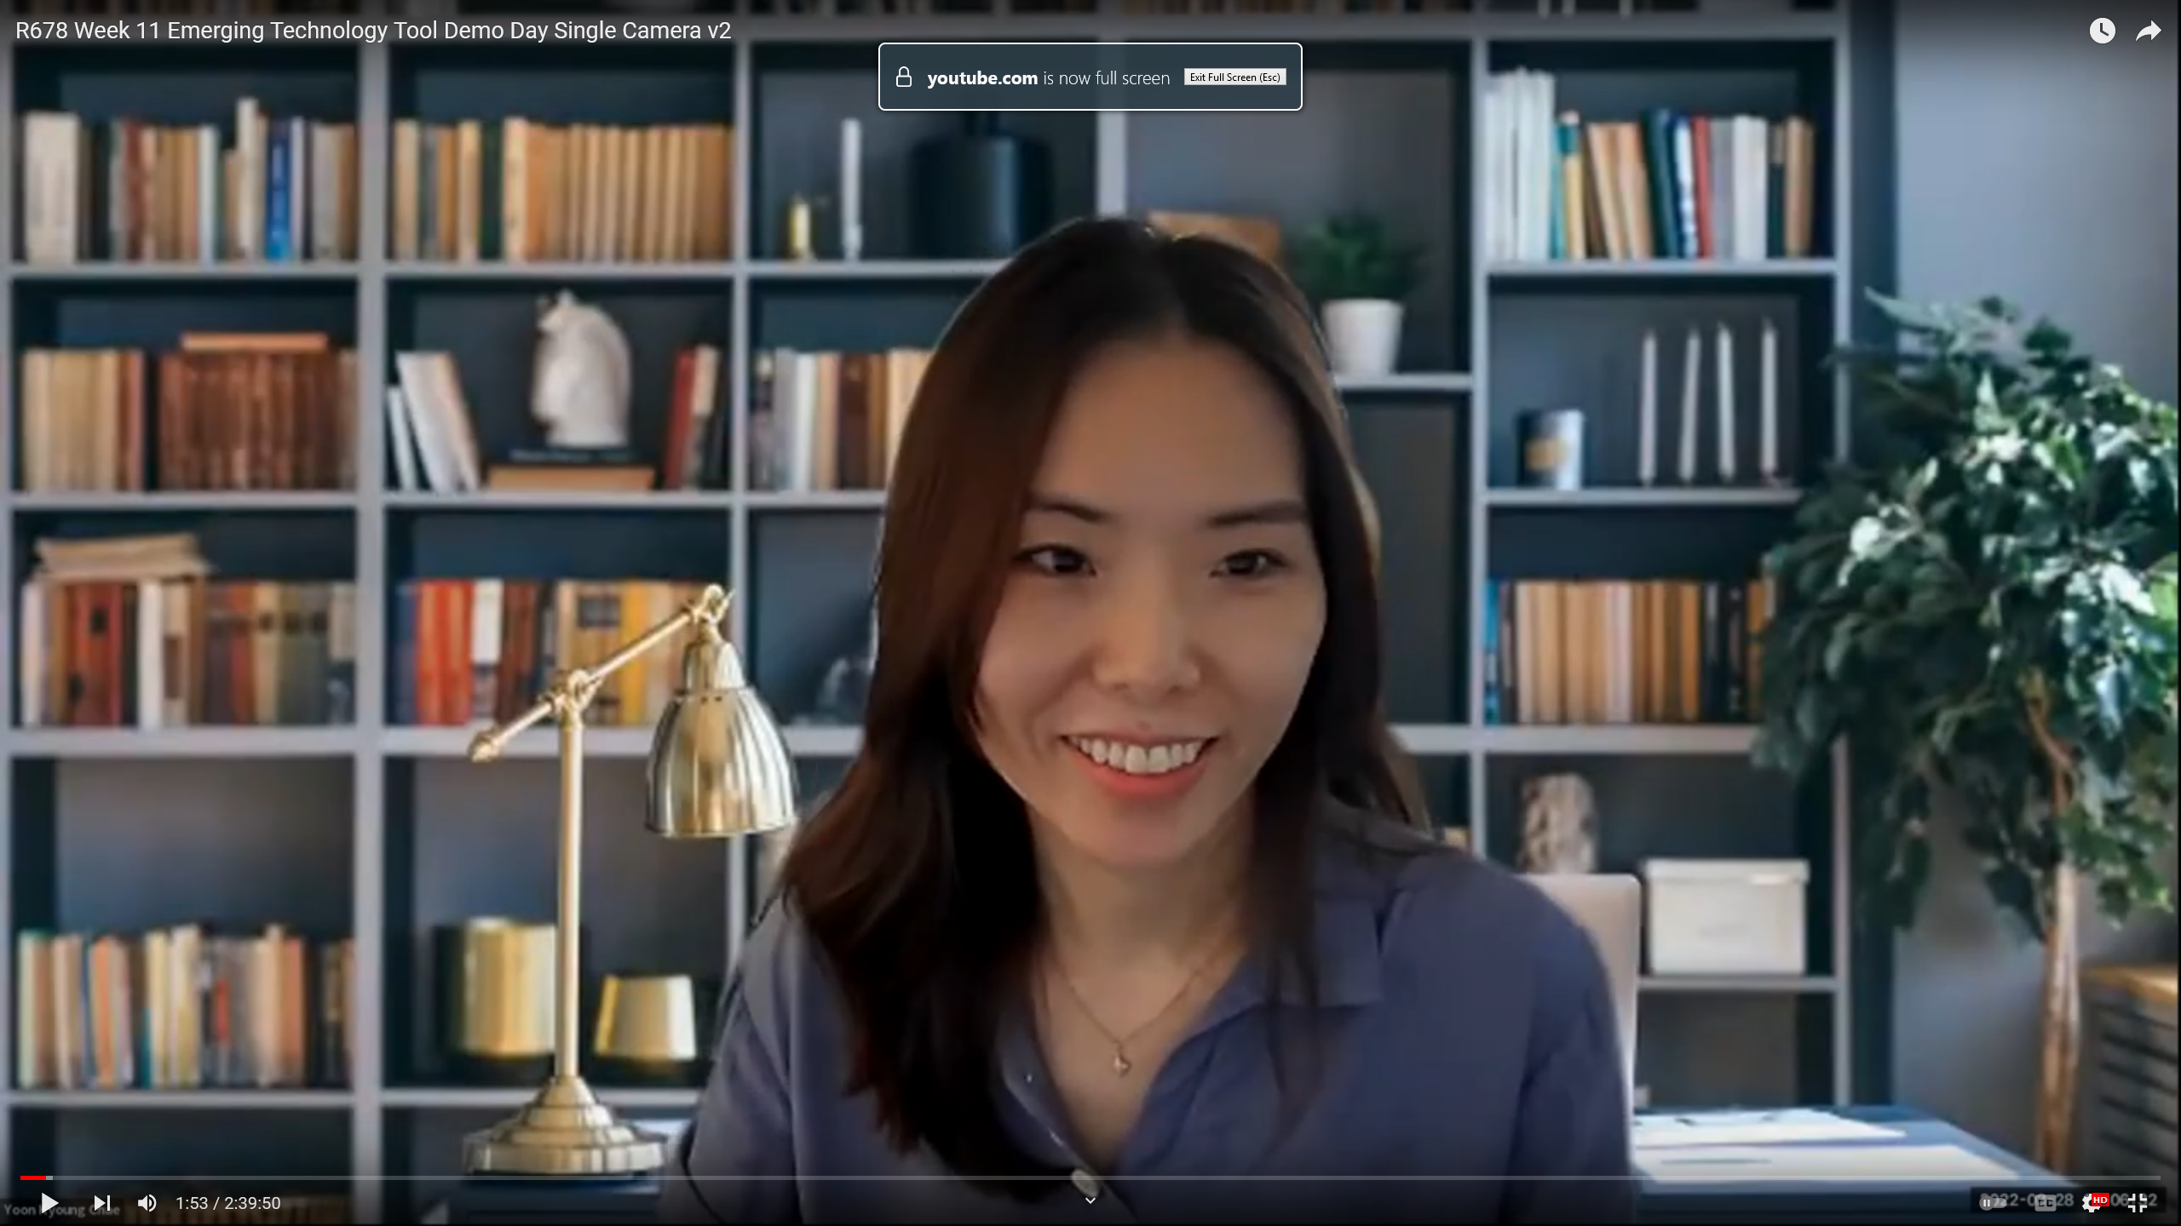
March 28, 2022
R678 Week 11 Emerging Technology Tool Demo Day
Single Camera View: https://youtu.be/FilNDFQz79c
Multiple Camera View: https://youtu.be/yKjQ0cXdJt0

Slide 17
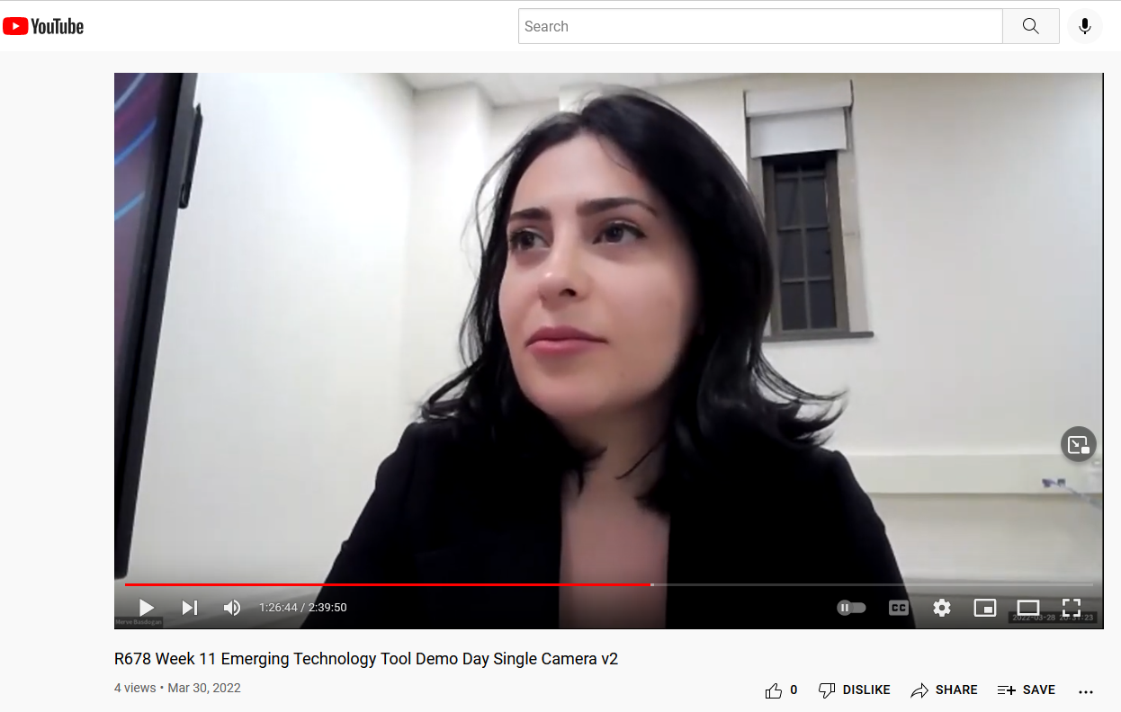
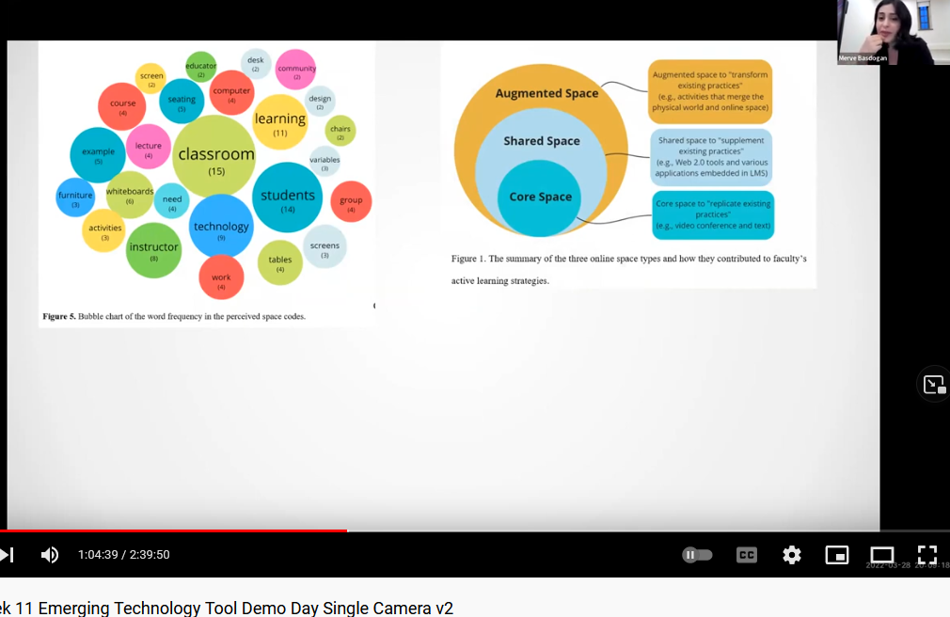
March 28, 2022
R678 Week 11 Emerging Technology Tool Demo Day
Single Camera View: https://youtu.be/FilNDFQz79c
Multiple Camera View: https://youtu.be/yKjQ0cXdJt0

Slide 18
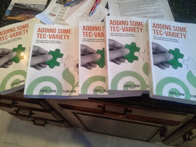



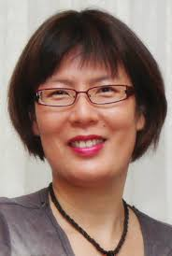
March 31, 2022
Free Book: Adding Some TEC-VARIETY
http://tec-variety.com/

Slide 19

June 2022
Commonwealth of Learning
Khoo, E., & Bonk, C. J. (in production). Motivation and Supporting Online Learners. Burnaby, BC, Canada: Commonwealth of Learning.
https://www.col.org/

