Slide 1
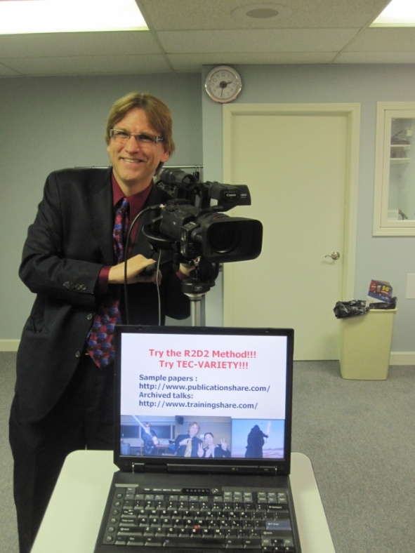
From Legends and Legacies to Silver Linings for Learning:
Using Shared Online Video for Engaging Online Learners
Dr. Curtis J. Bonk, cjbonk@indiana.edu
Professor, Indiana University

Slide 2


Slide 3
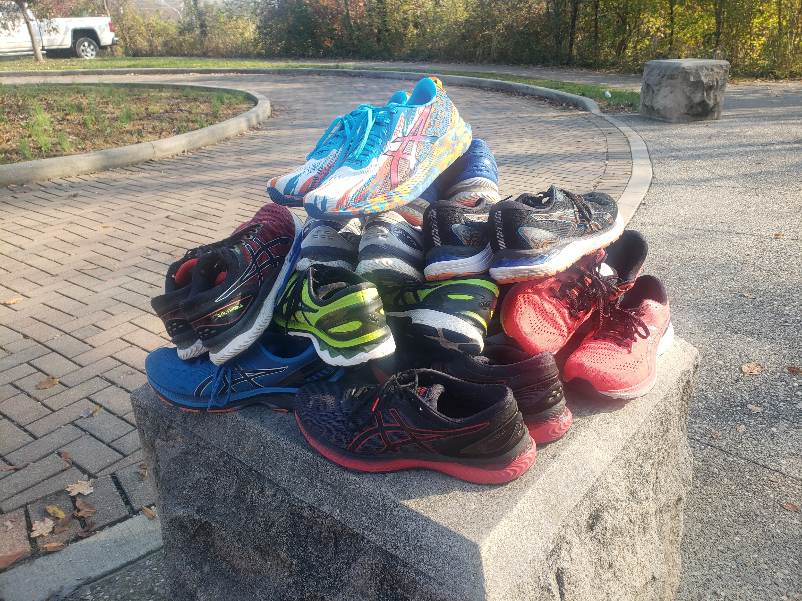

Slide 4
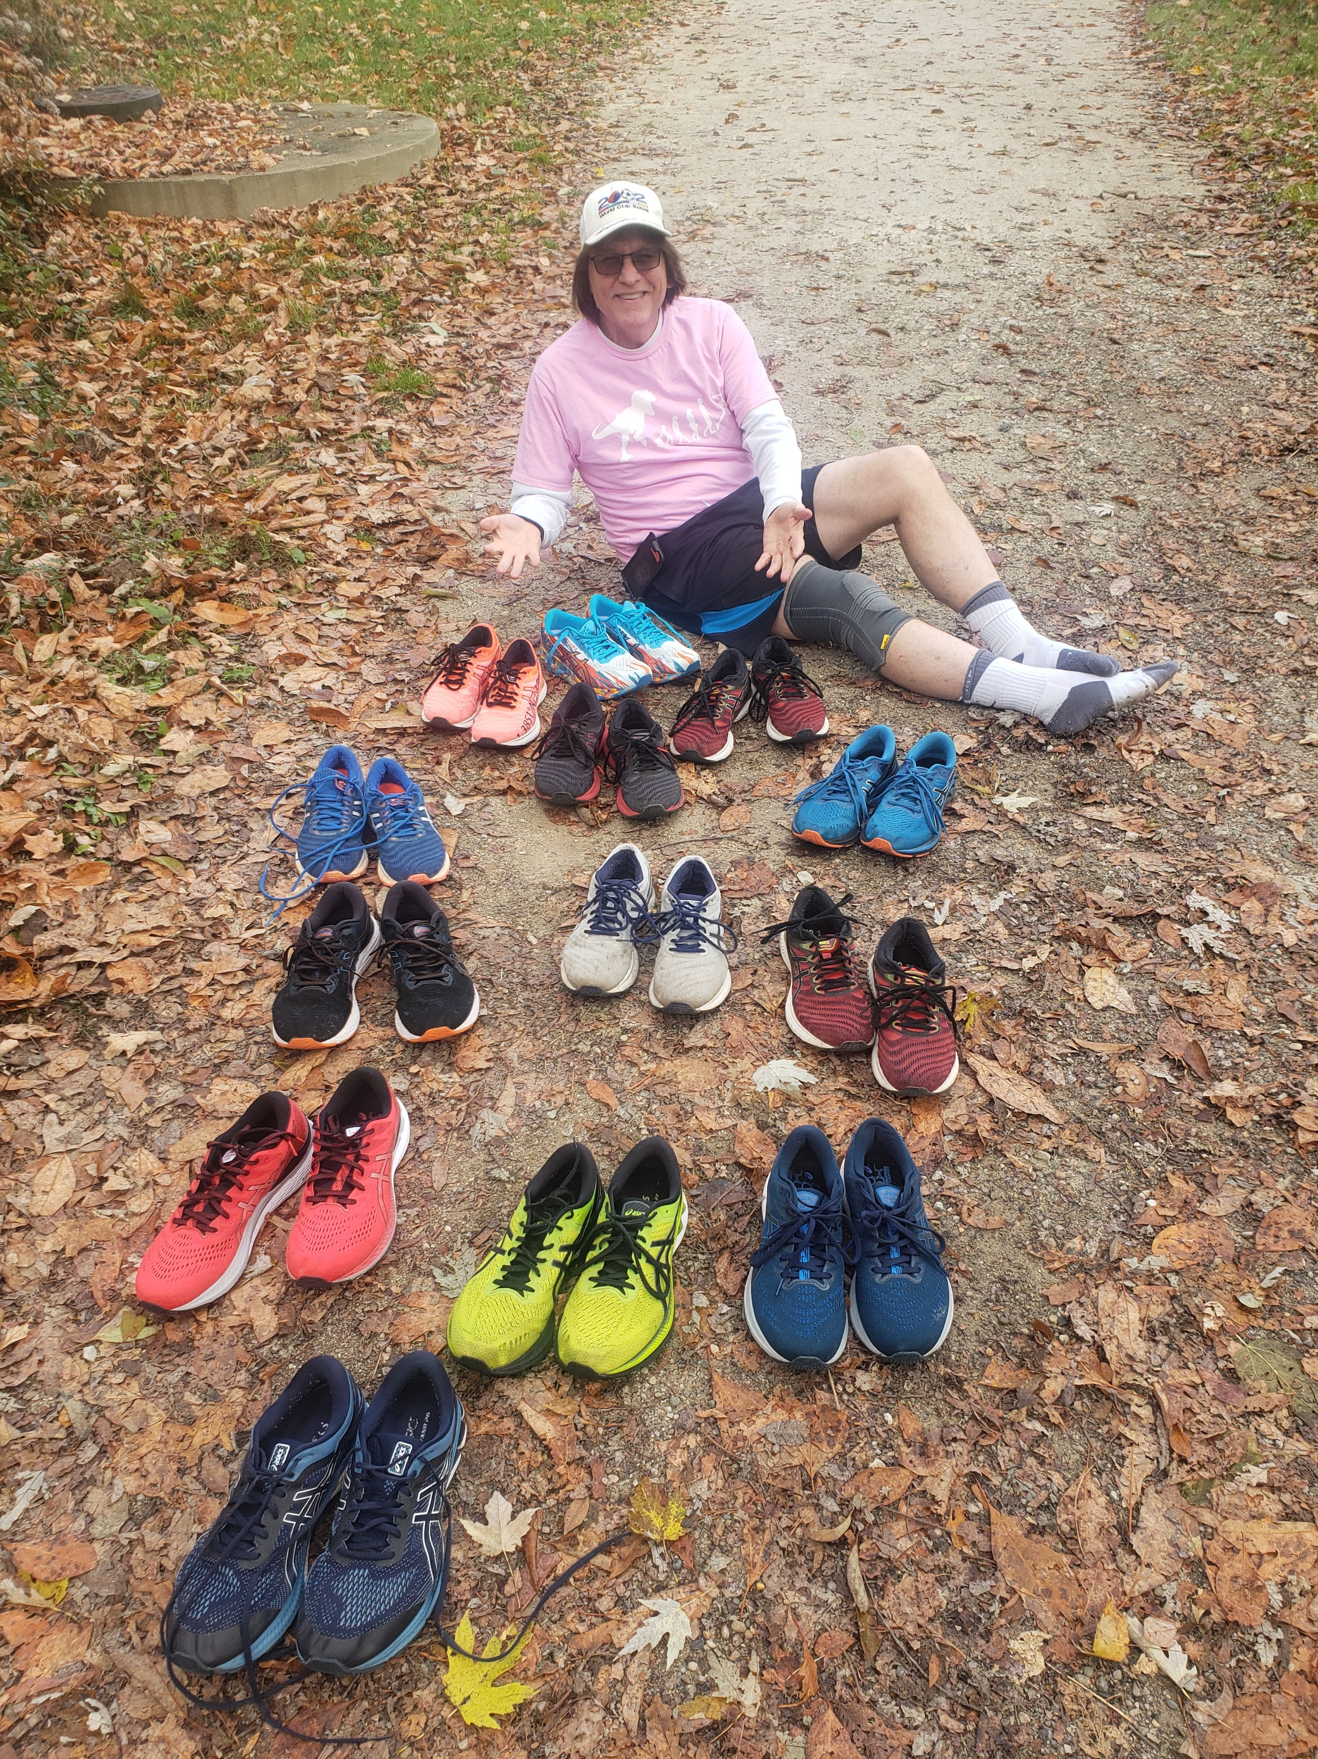
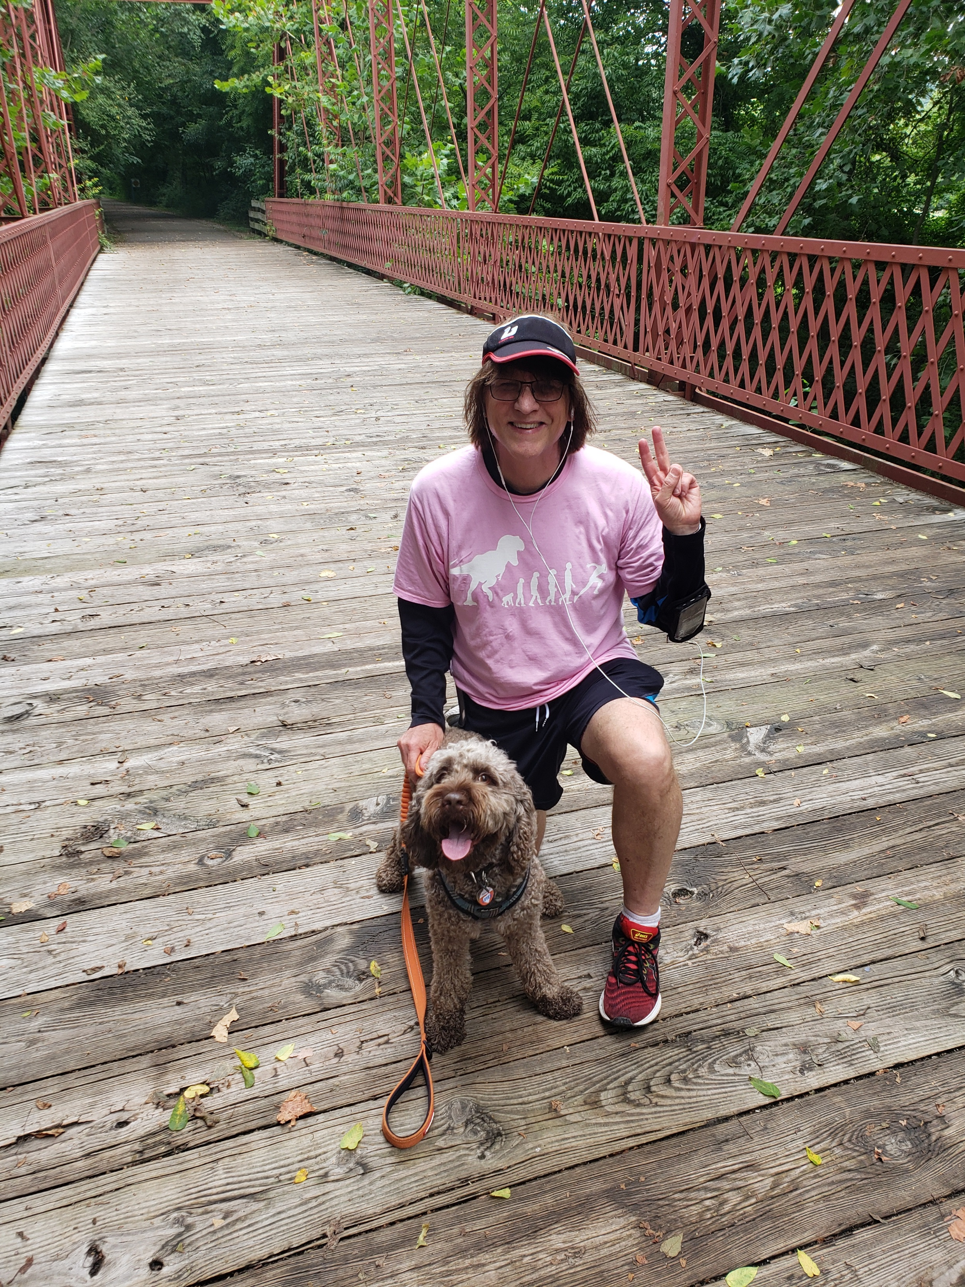

Slide 5
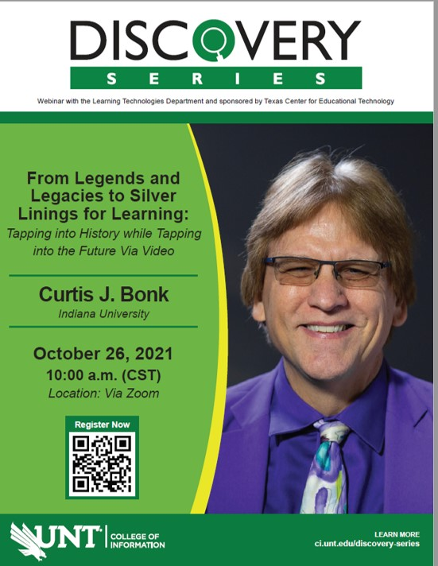
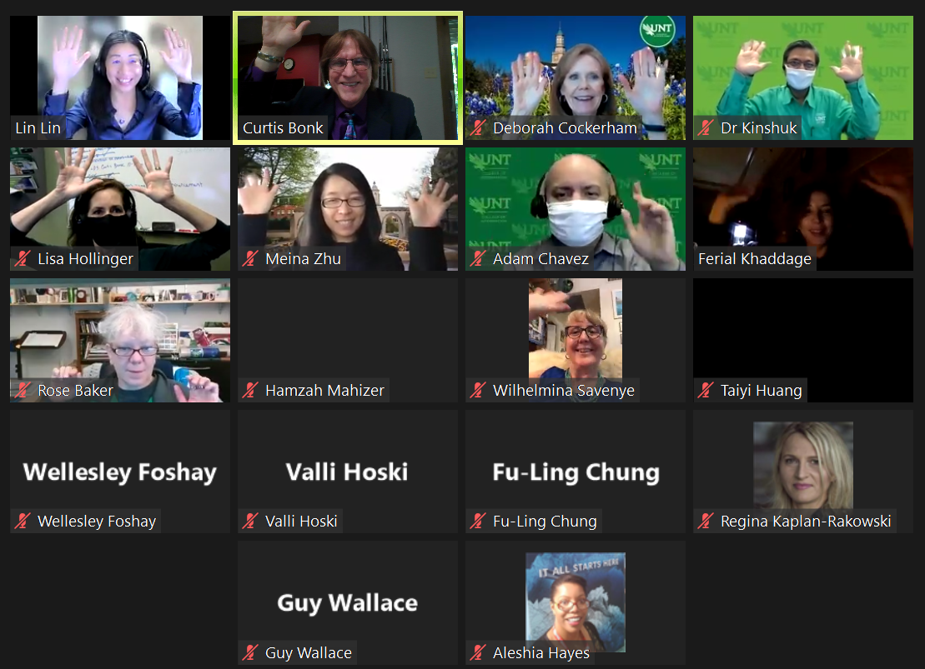
October 26, 2021
University of North Texas

Slide 6
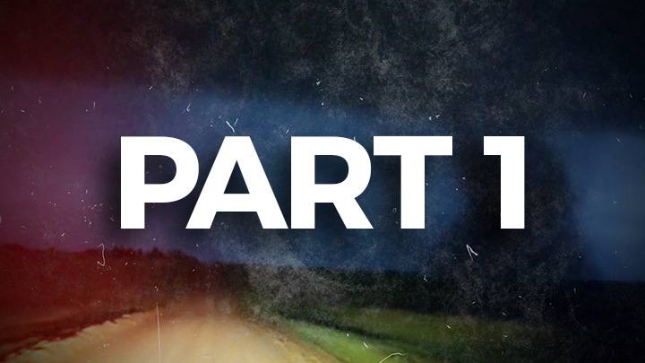

Slide 7

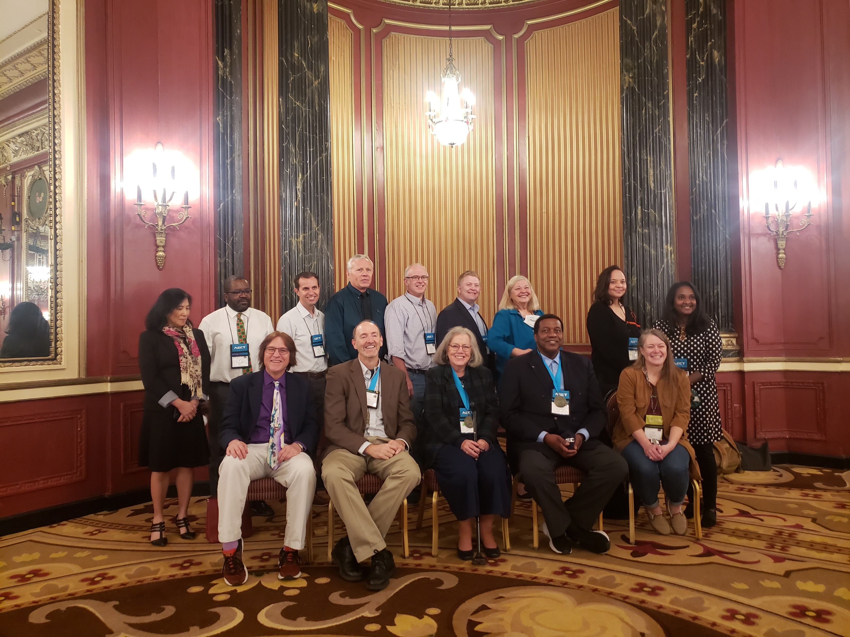
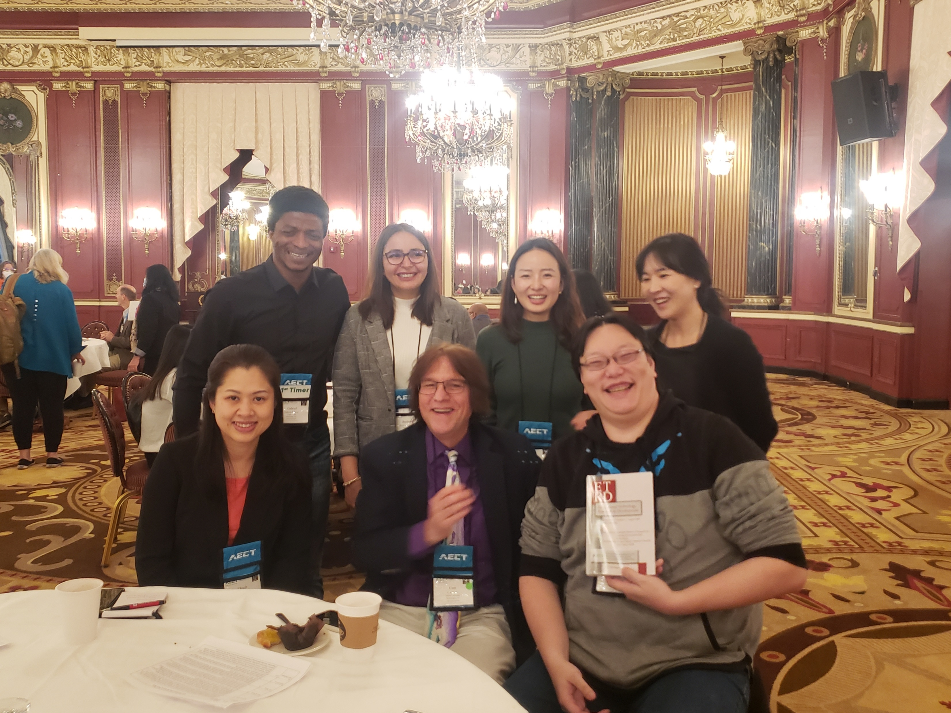

Slide 8
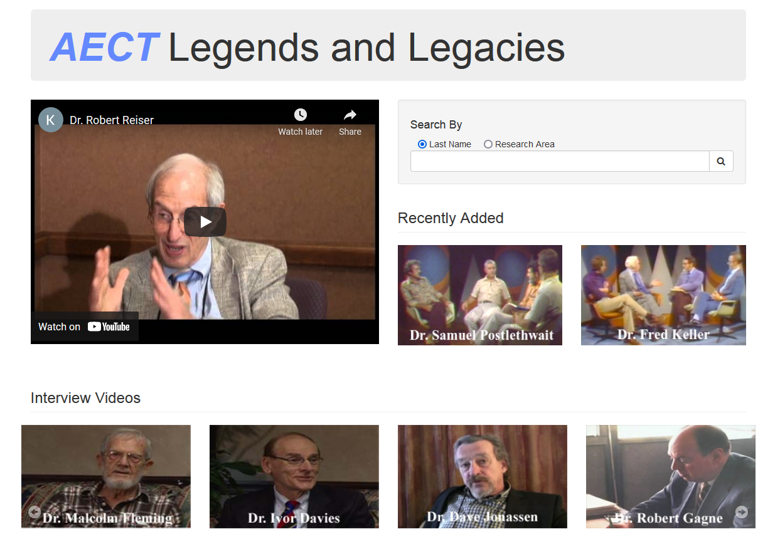
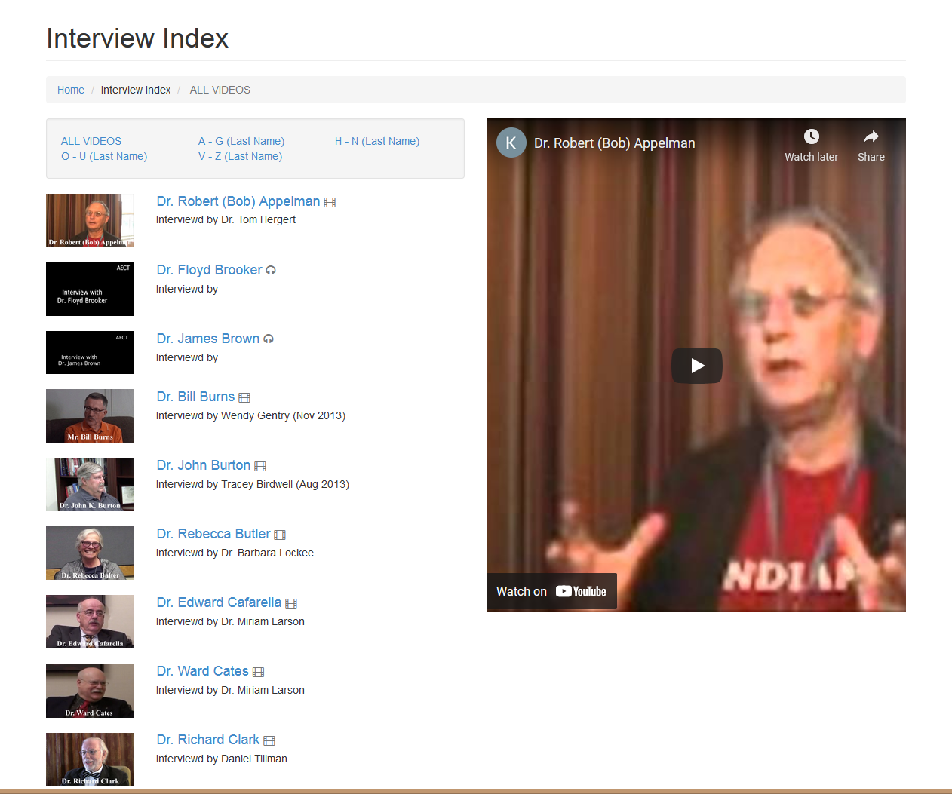
AECT Legends and Legacies Index http://aectlegends.org/all_index.php

Slide 9
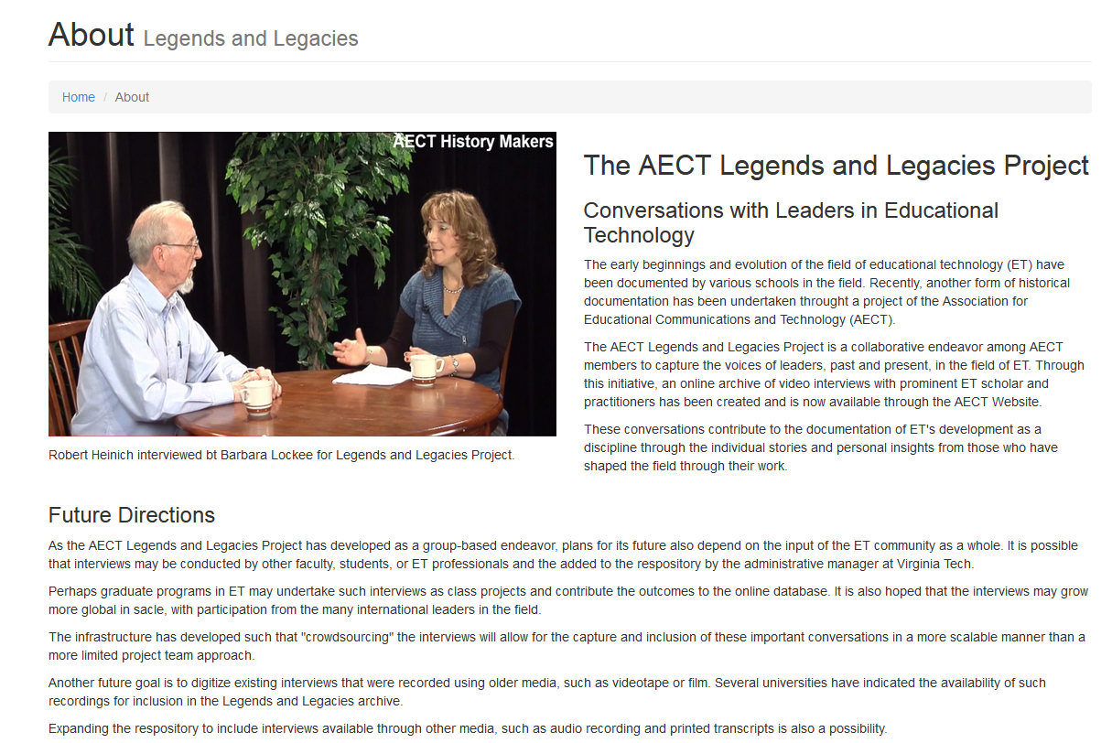
About the AECT Legends and Legacies http://aectlegends.org/about.php

Slide 10
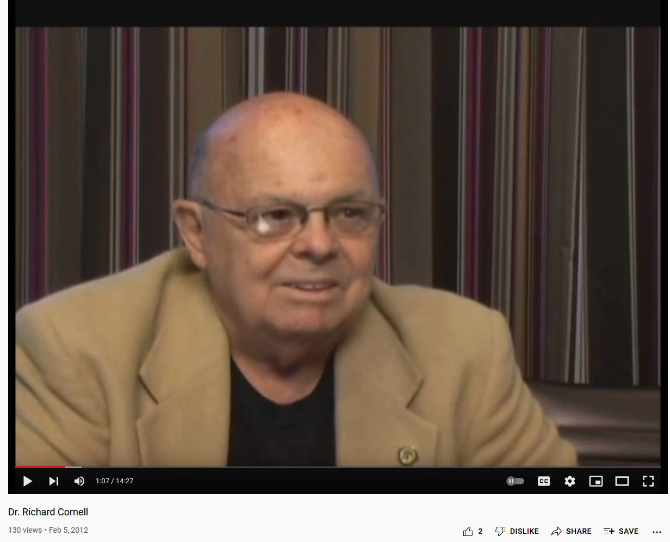
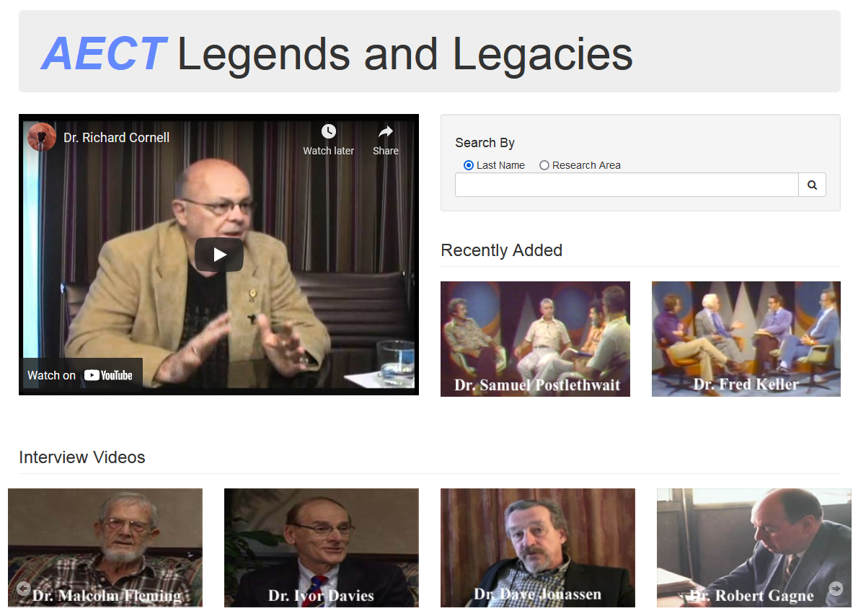
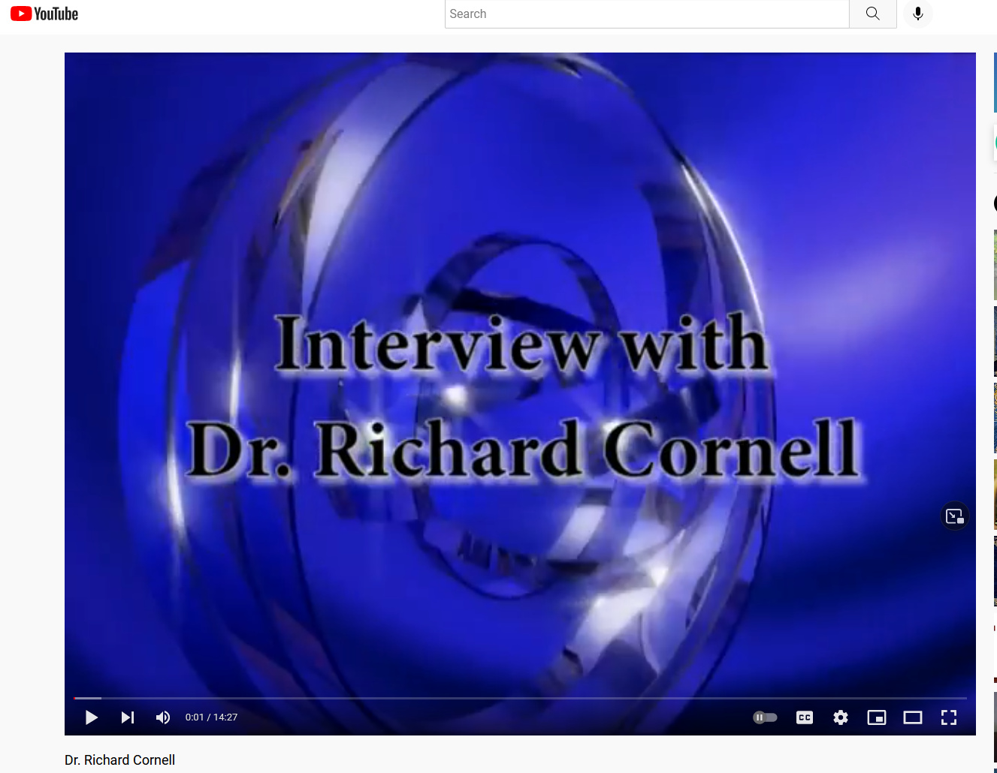
AECT Legends and Legacies http://aectlegends.org/
#1. Richard (Dick) Cornell, University of Central Florida (Video = 14:27)
https://www.youtube.com/watch?v=DGlARkp1iHo

Slide 11
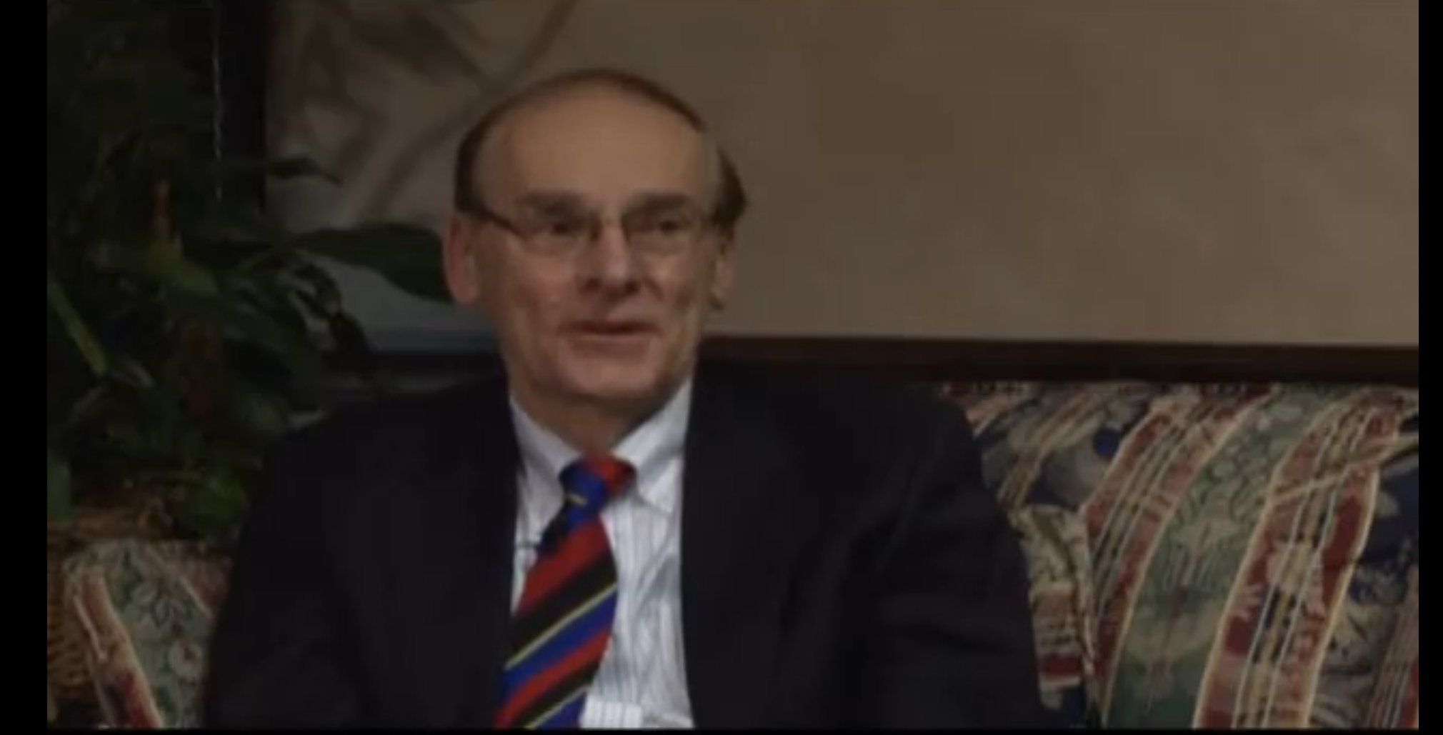
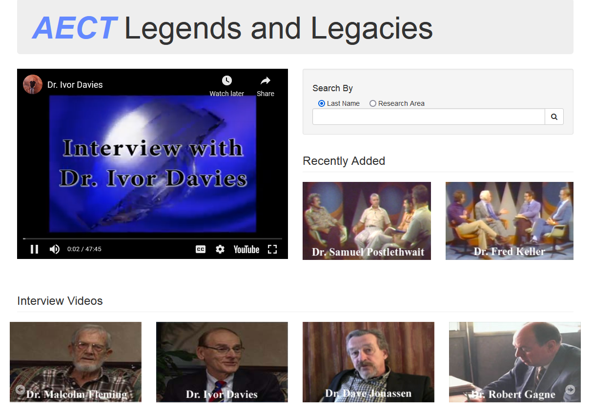
AECT Legends and Legacies http://aectlegends.org/
#2. Ivor Davis, Indiana University (Video = 47:44)
https://www.youtube.com/watch?v=_de5F-gf8t8&t=951s

Slide 12
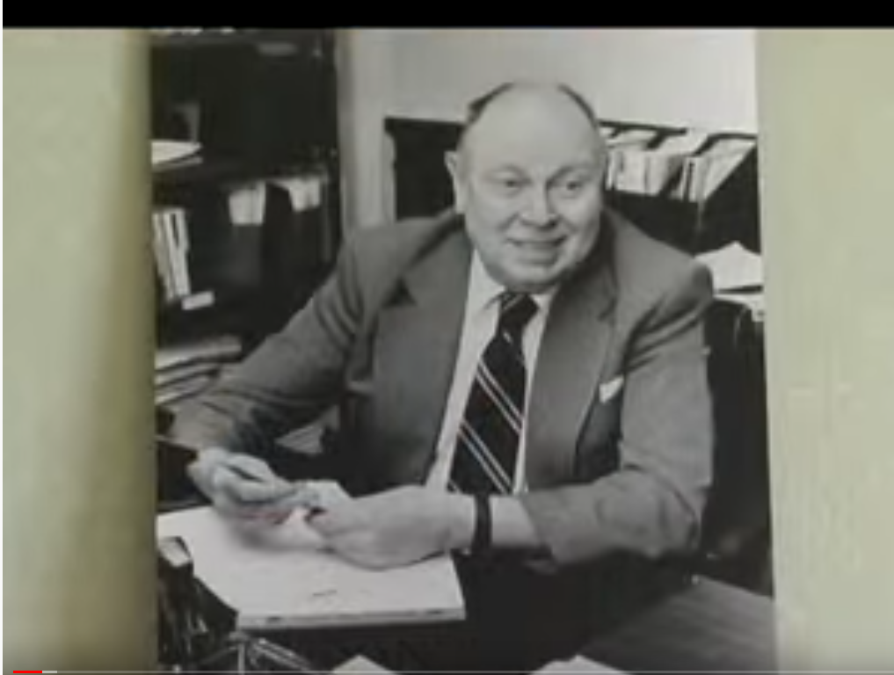
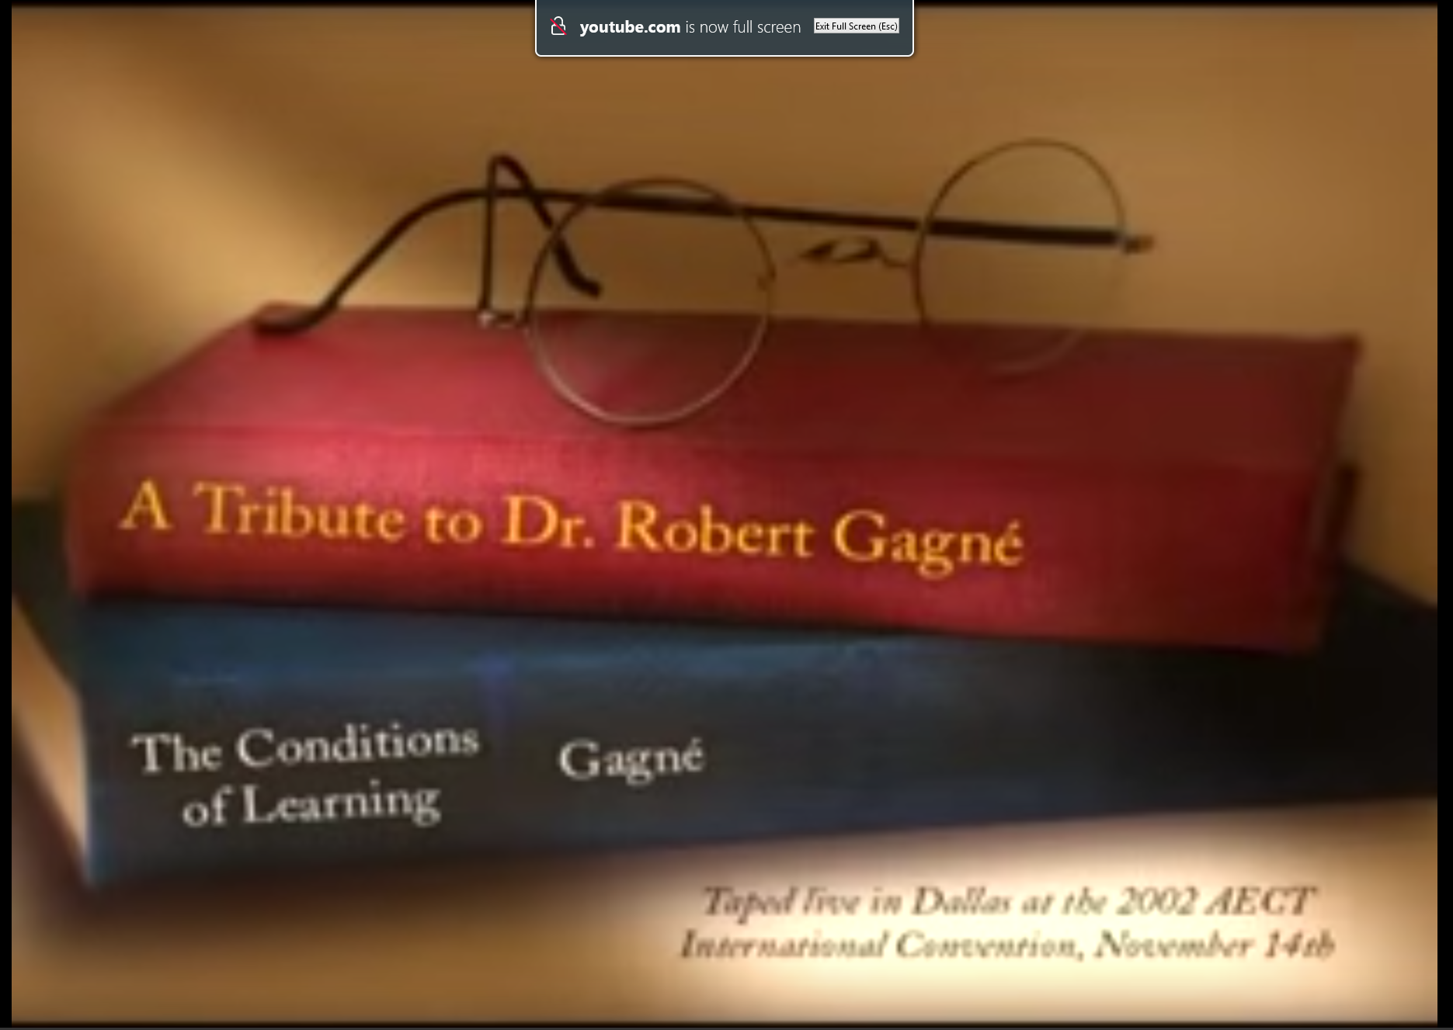
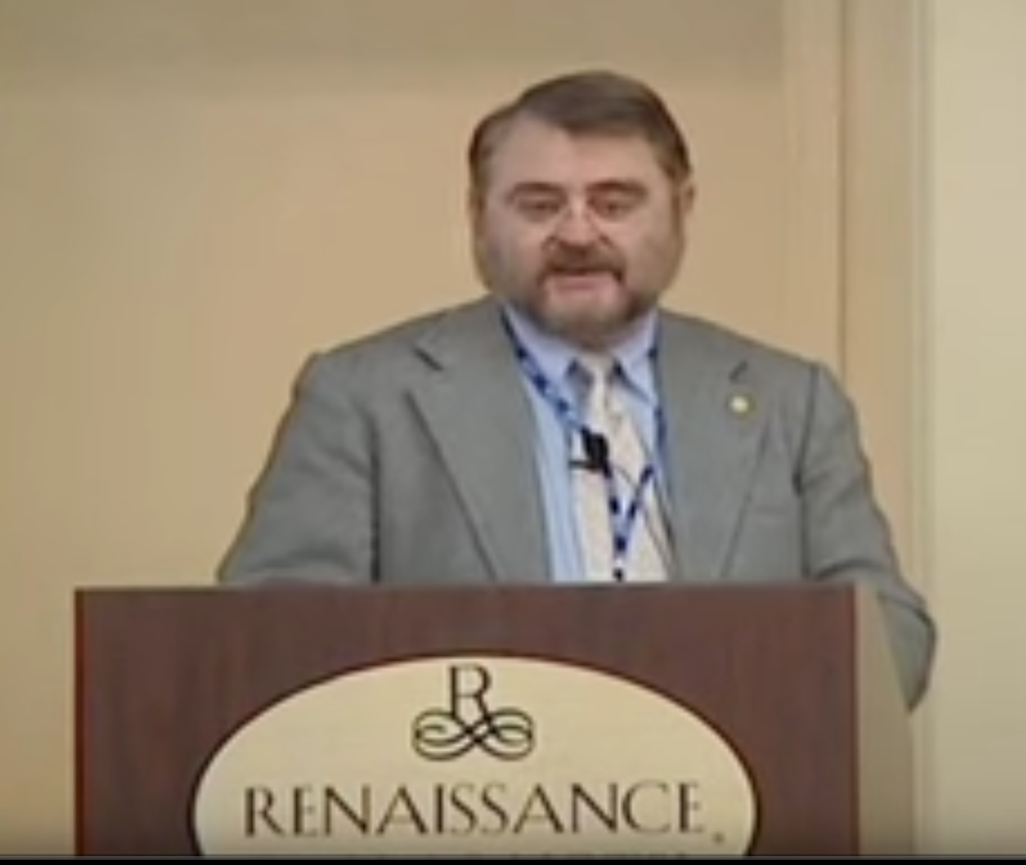
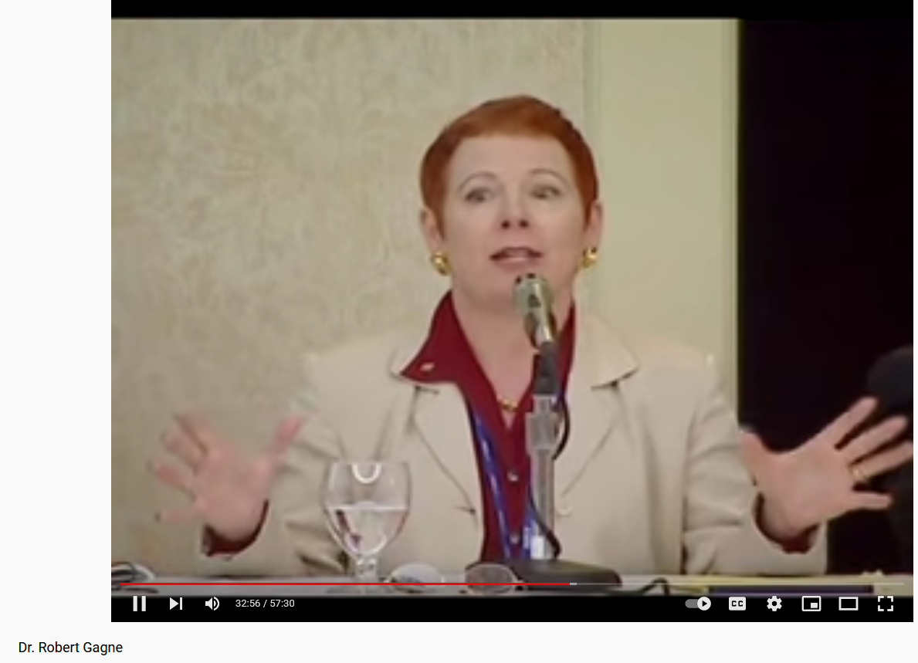
AECT Legends and Legacies http://aectlegends.org/
#3. Robert Gagne, Florida State Univ. (Video = 57:30)
https://www.youtube.com/watch?v=ggJ1-AjlGeE&t=2090s

Slide 13
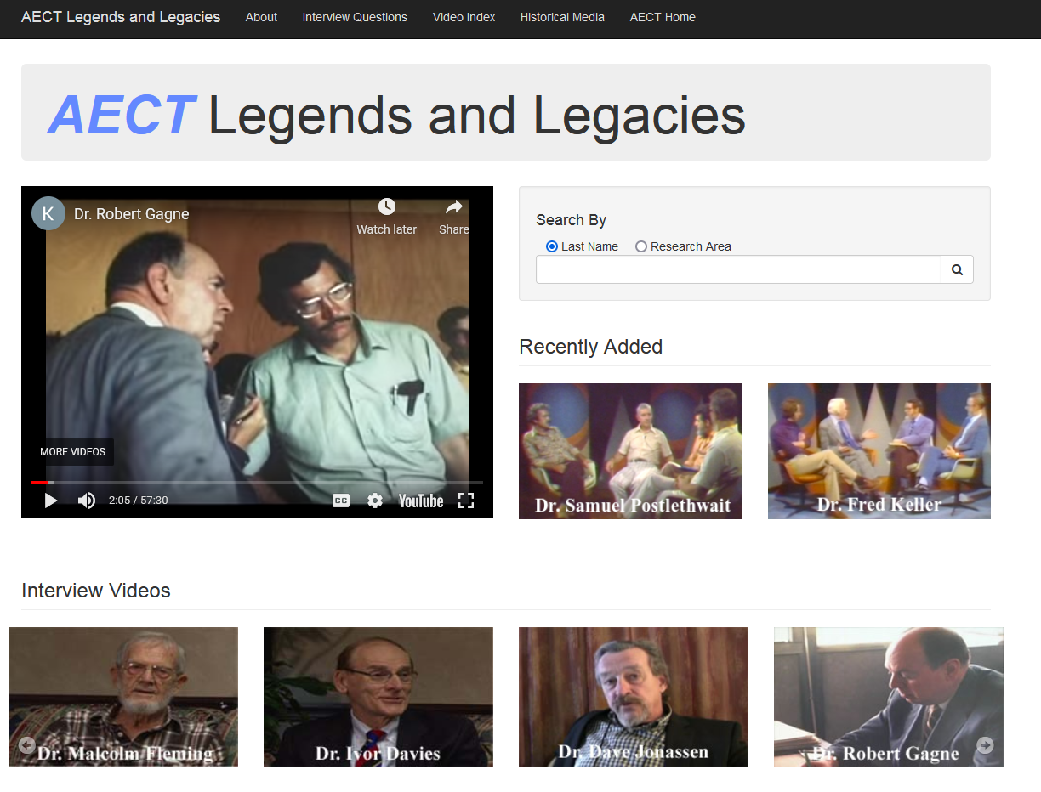
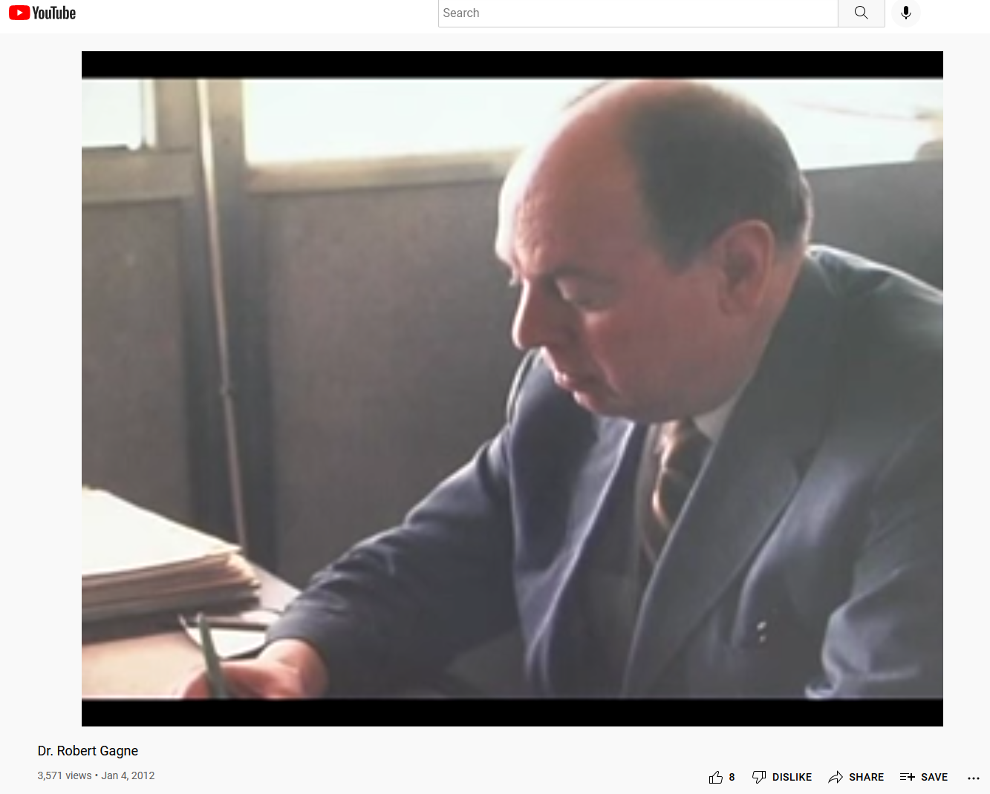
AECT Legends and Legacies http://aectlegends.org/

Slide 14
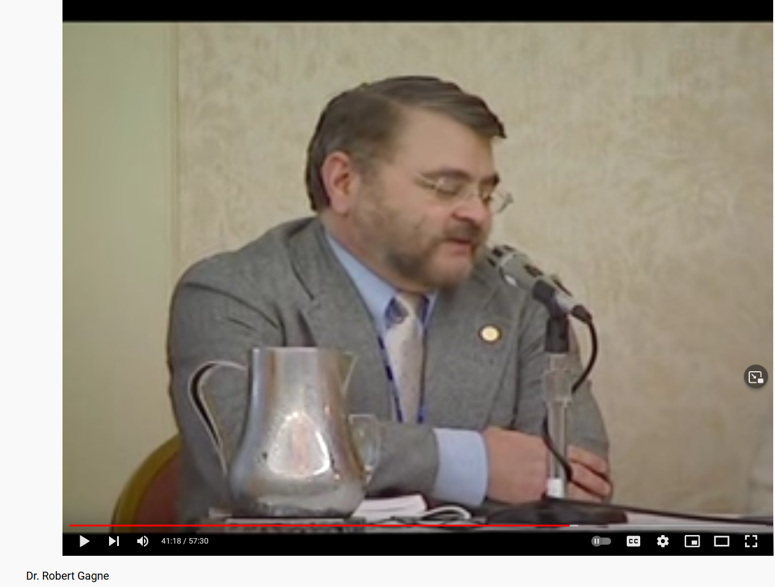
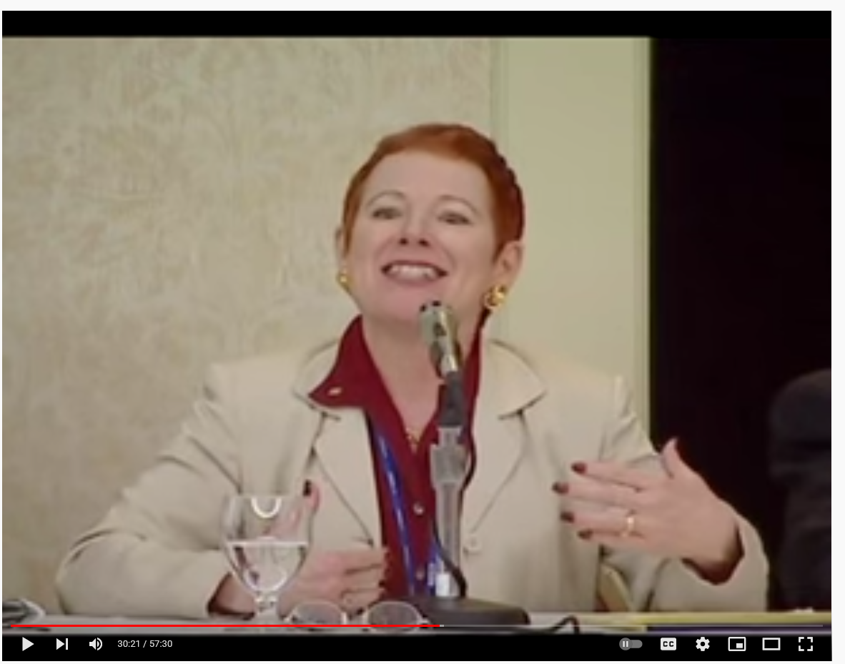
AECT Legends and Legacies http://aectlegends.org/
Michael Spector and Marcy Driscoll speak on Robert Gagne

Slide 15
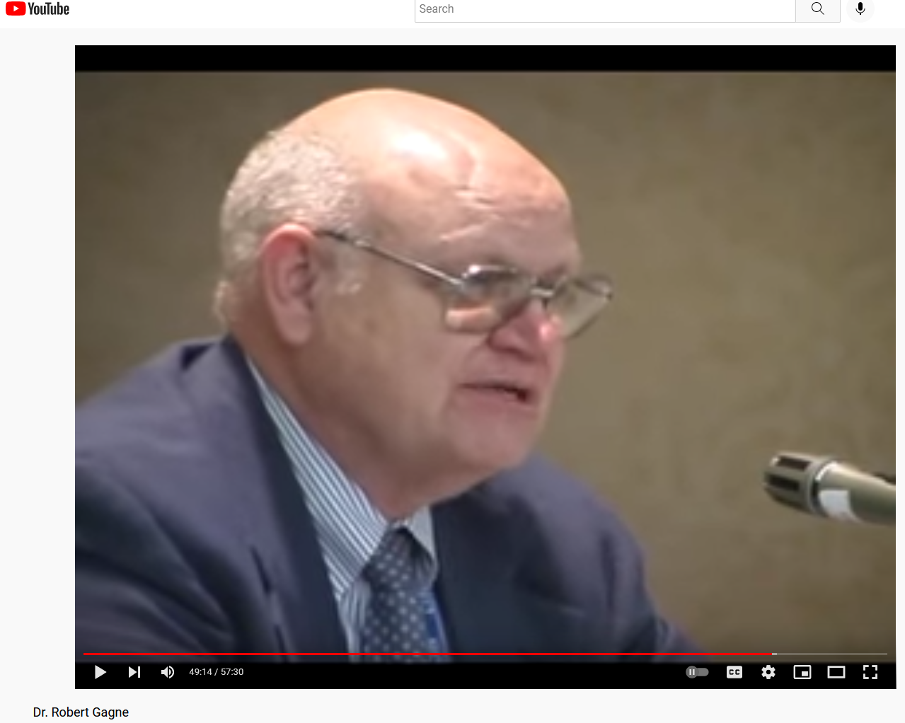
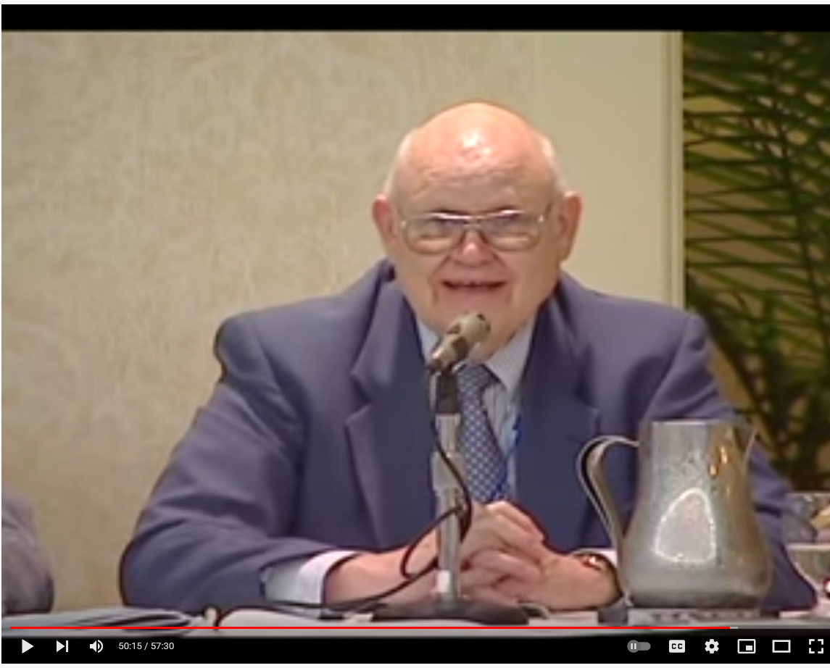
AECT Legends and Legacies http://aectlegends.org/
David Merrill speaks about Robert Gagne

Slide 16
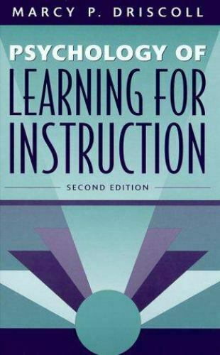
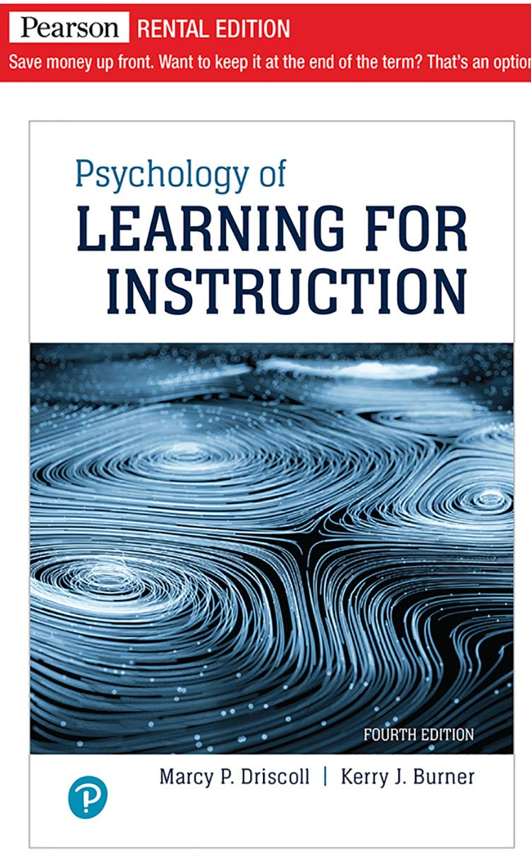
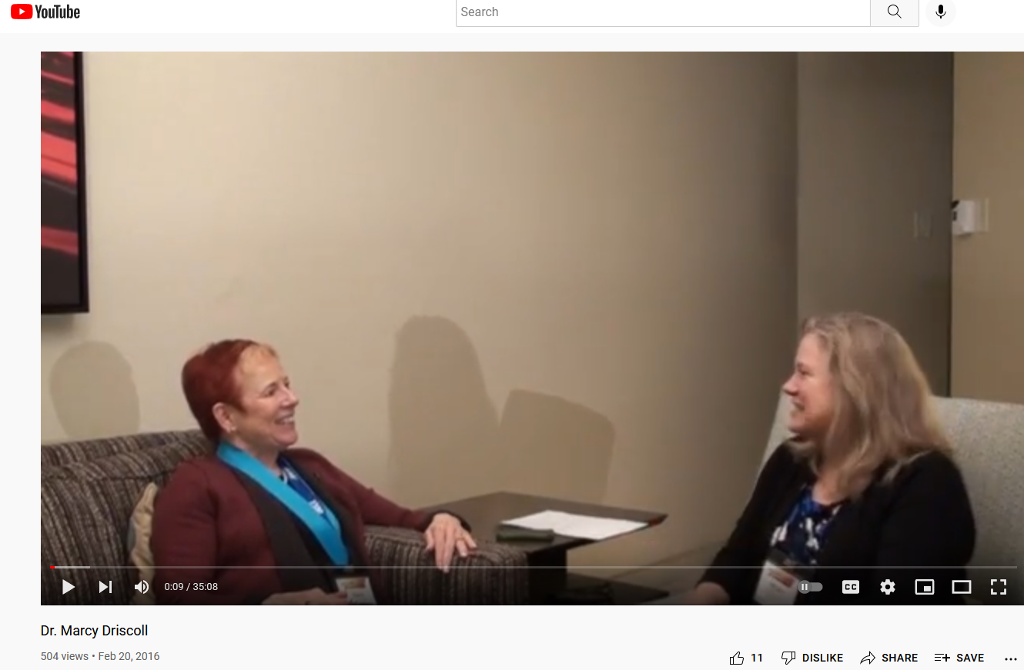
AECT Legends and Legacies http://aectlegends.org/
#4. Marcy Driscoll, Florida State University (Video = 35:08)
https://www.youtube.com/watch?v=OIdConJkQuA&t=2s

Slide 17
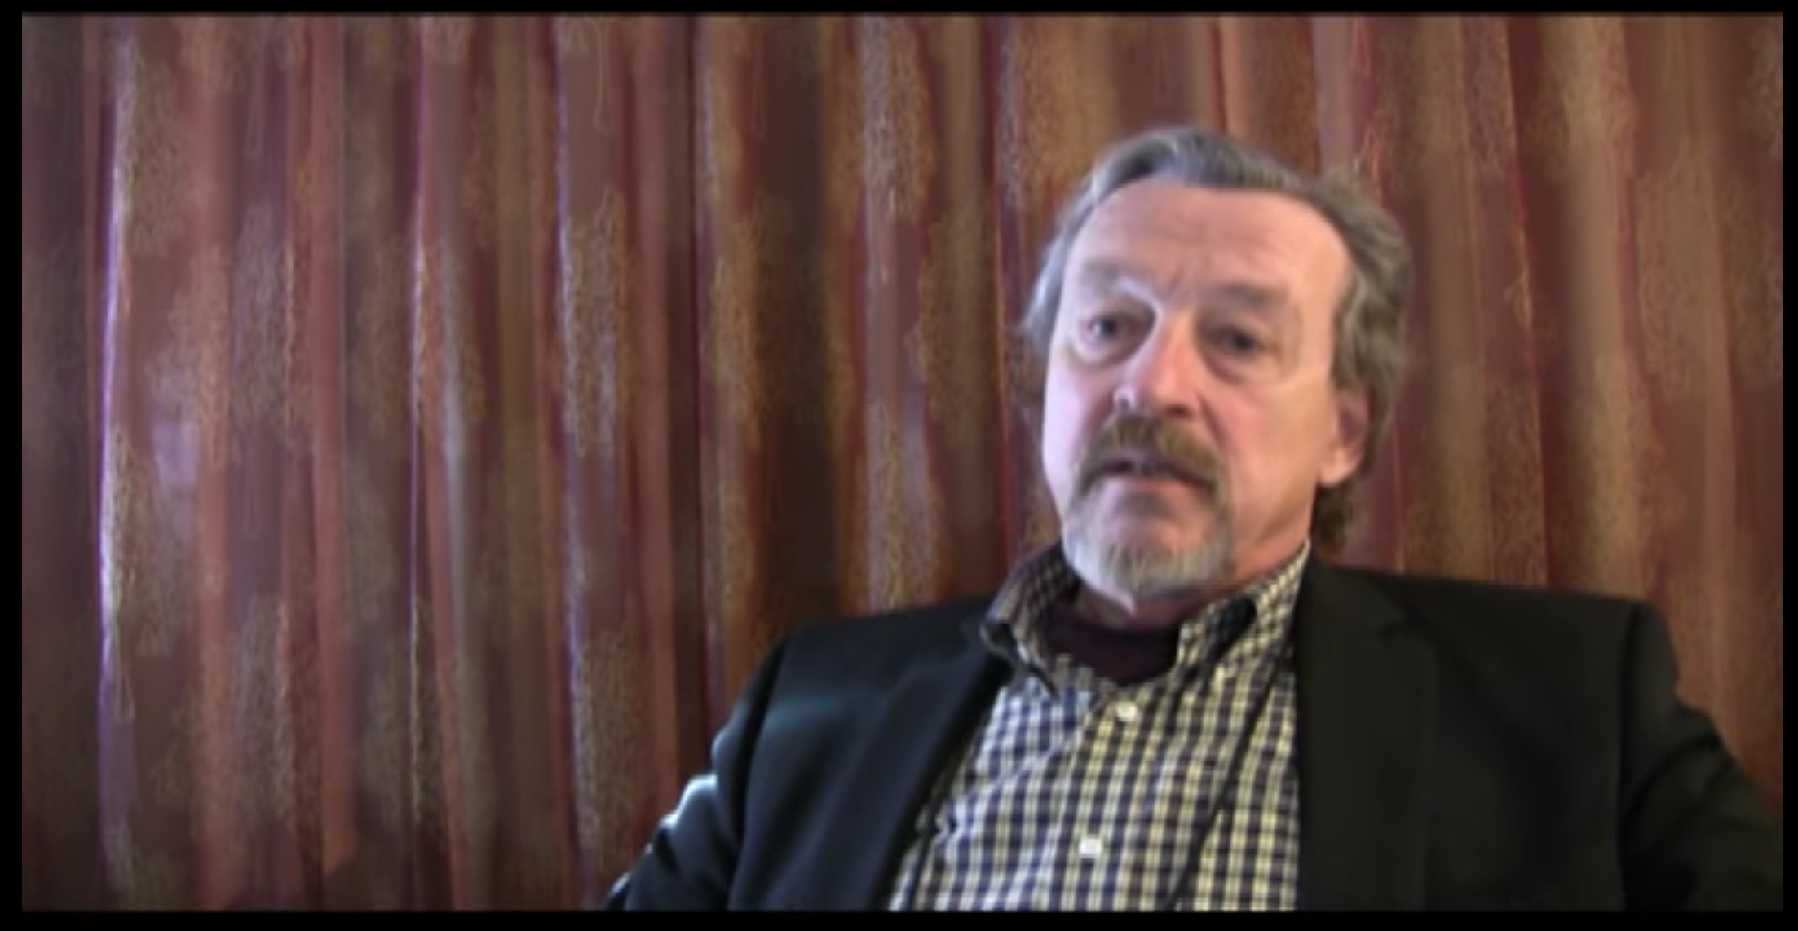
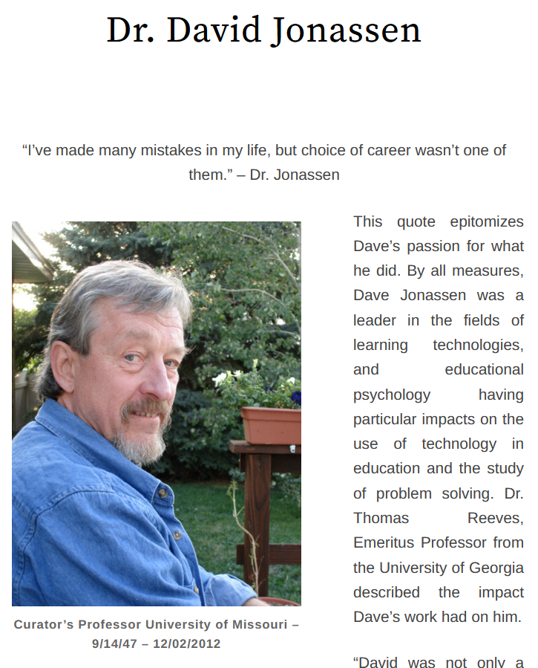
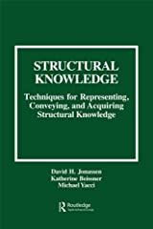
AECT Legends and Legacies http://aectlegends.org/
#5. David Jonassen, University of Missouri (Video = 35:19)
https://www.youtube.com/watch?v=Fhnotpgru-4

Slide 18
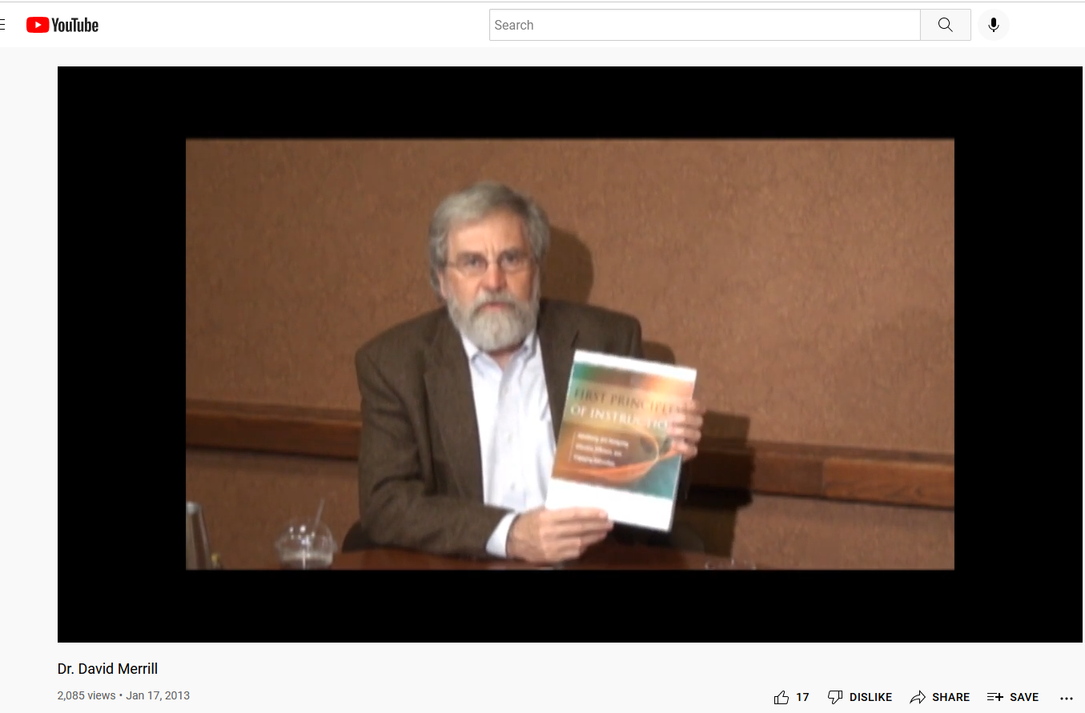
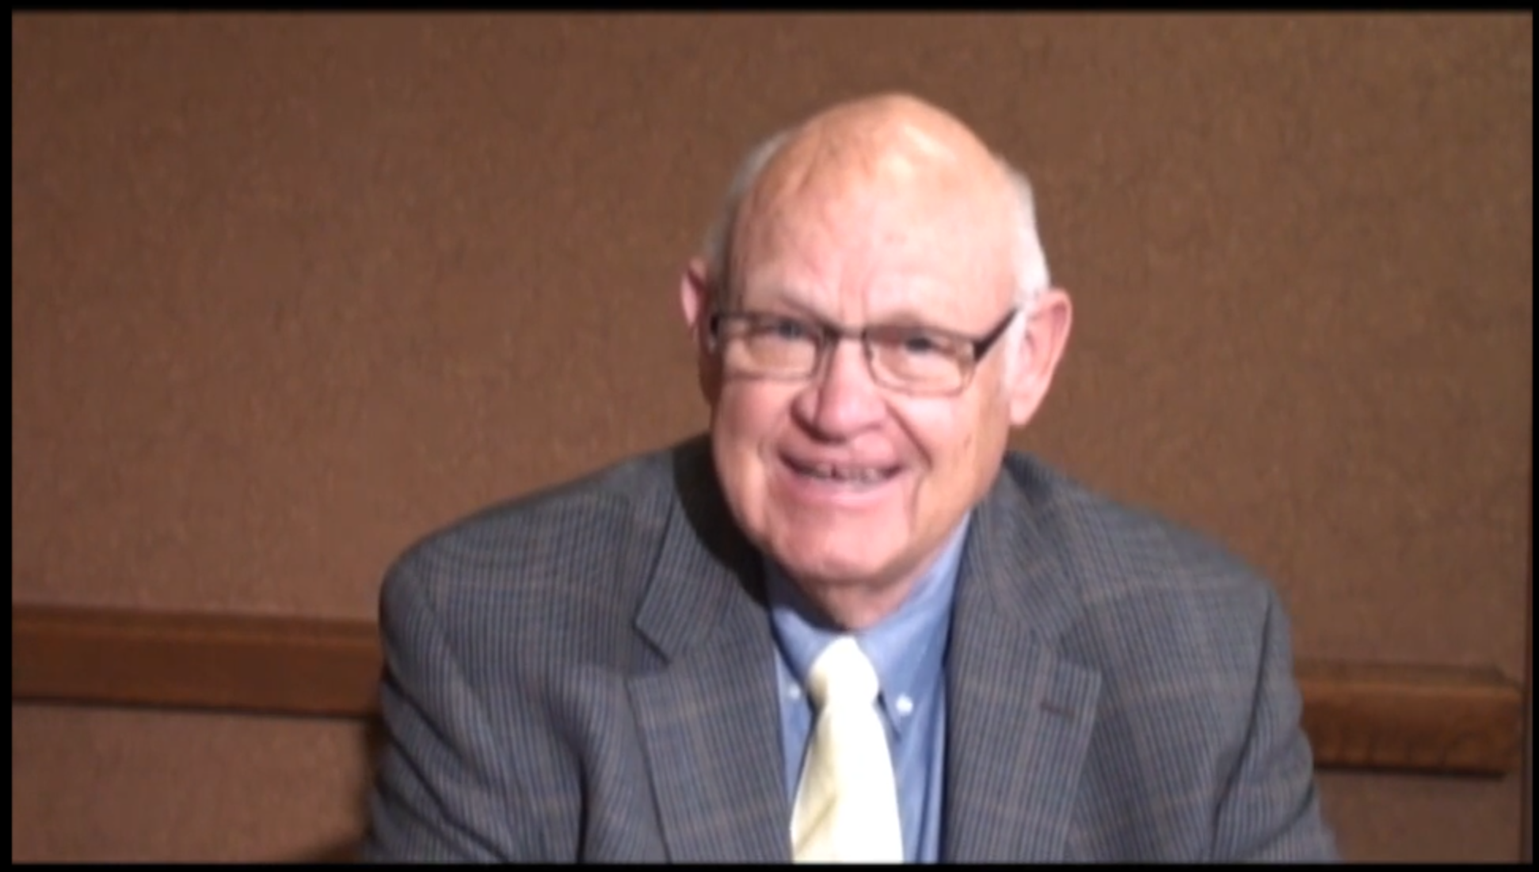
AECT Legends and Legacies http://aectlegends.org/
#6. David Merrill, BYU, Utah State University (Video = 53.56)
(interviewed by Gary Morrison, Old Dominion University)
https://www.youtube.com/watch?v=7COb2aZDrcs&t=2s

Slide 19
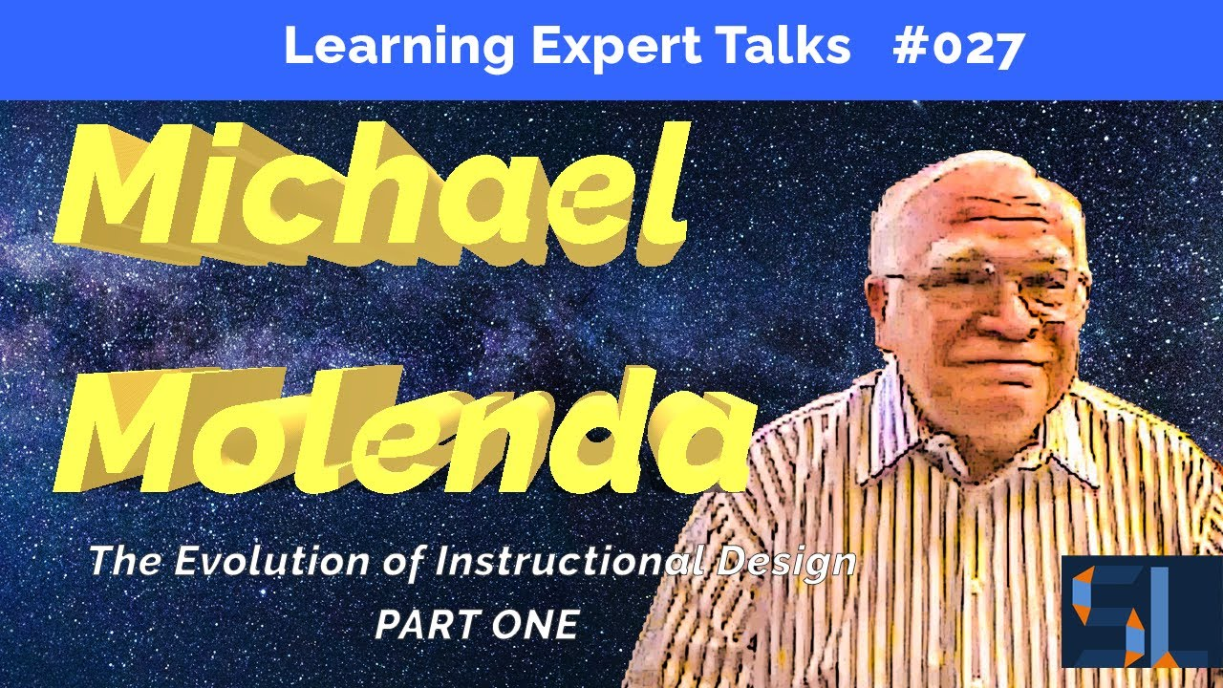
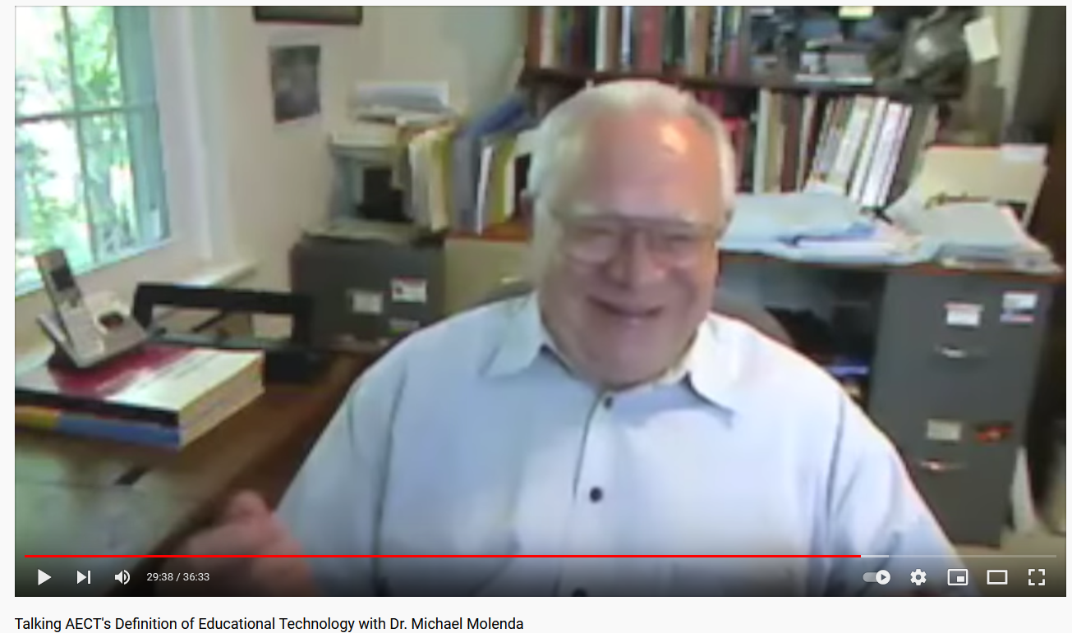
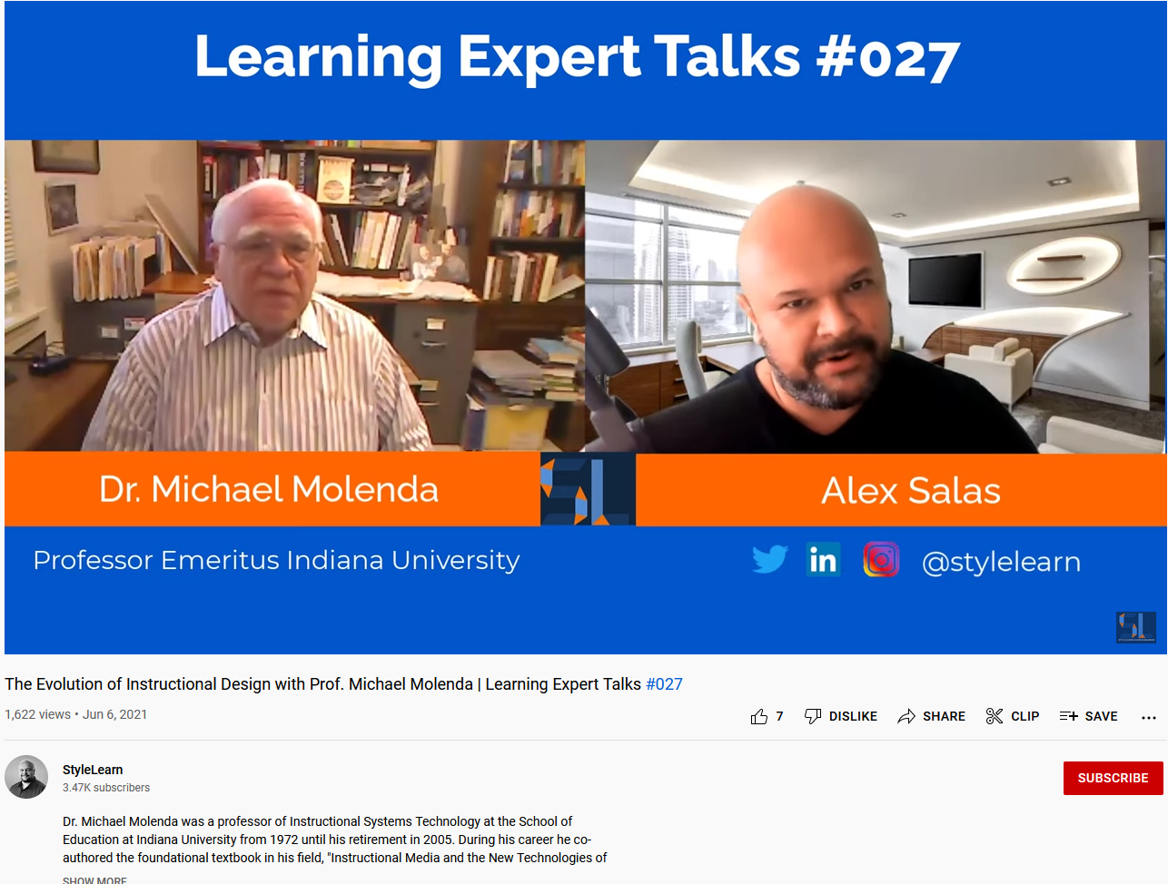
AECT Legends and Legacies http://aectlegends.org/
#7. Mike Molenda, Indiana University (Video = 29:16)
https://www.youtube.com/watch?v=sXSqkcwjCss

Slide 20
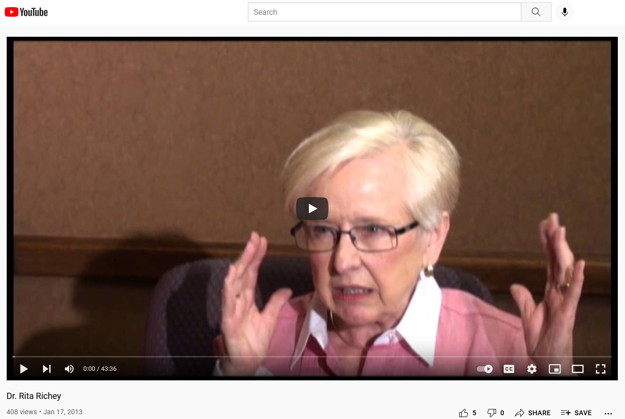
AECT Legends and Legacies http://aectlegends.org/
#8. Rita Richey, Wayne State University (Video = 43:36)
https://www.youtube.com/watch?v=F1kafjVHwQ8

Slide 21
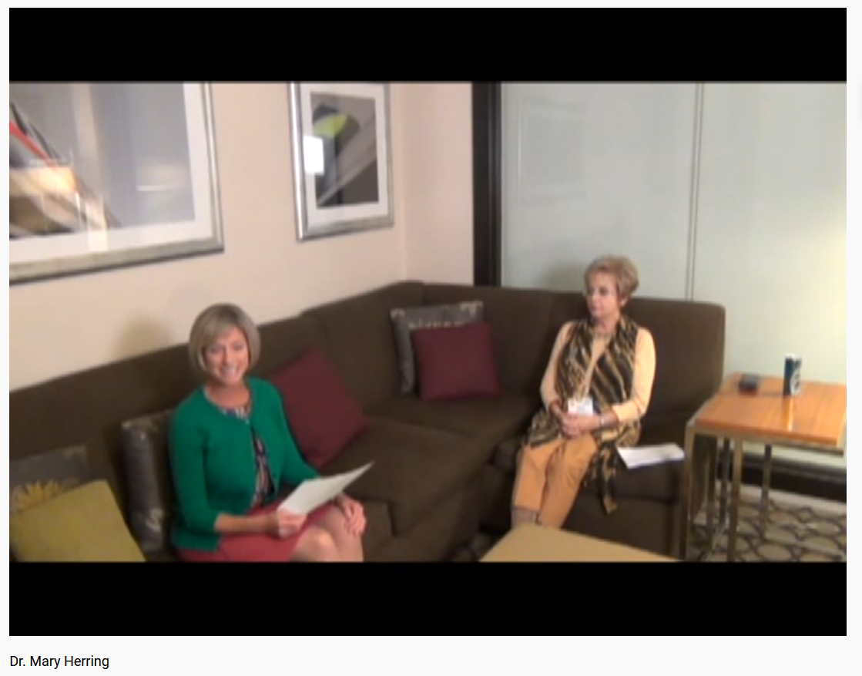
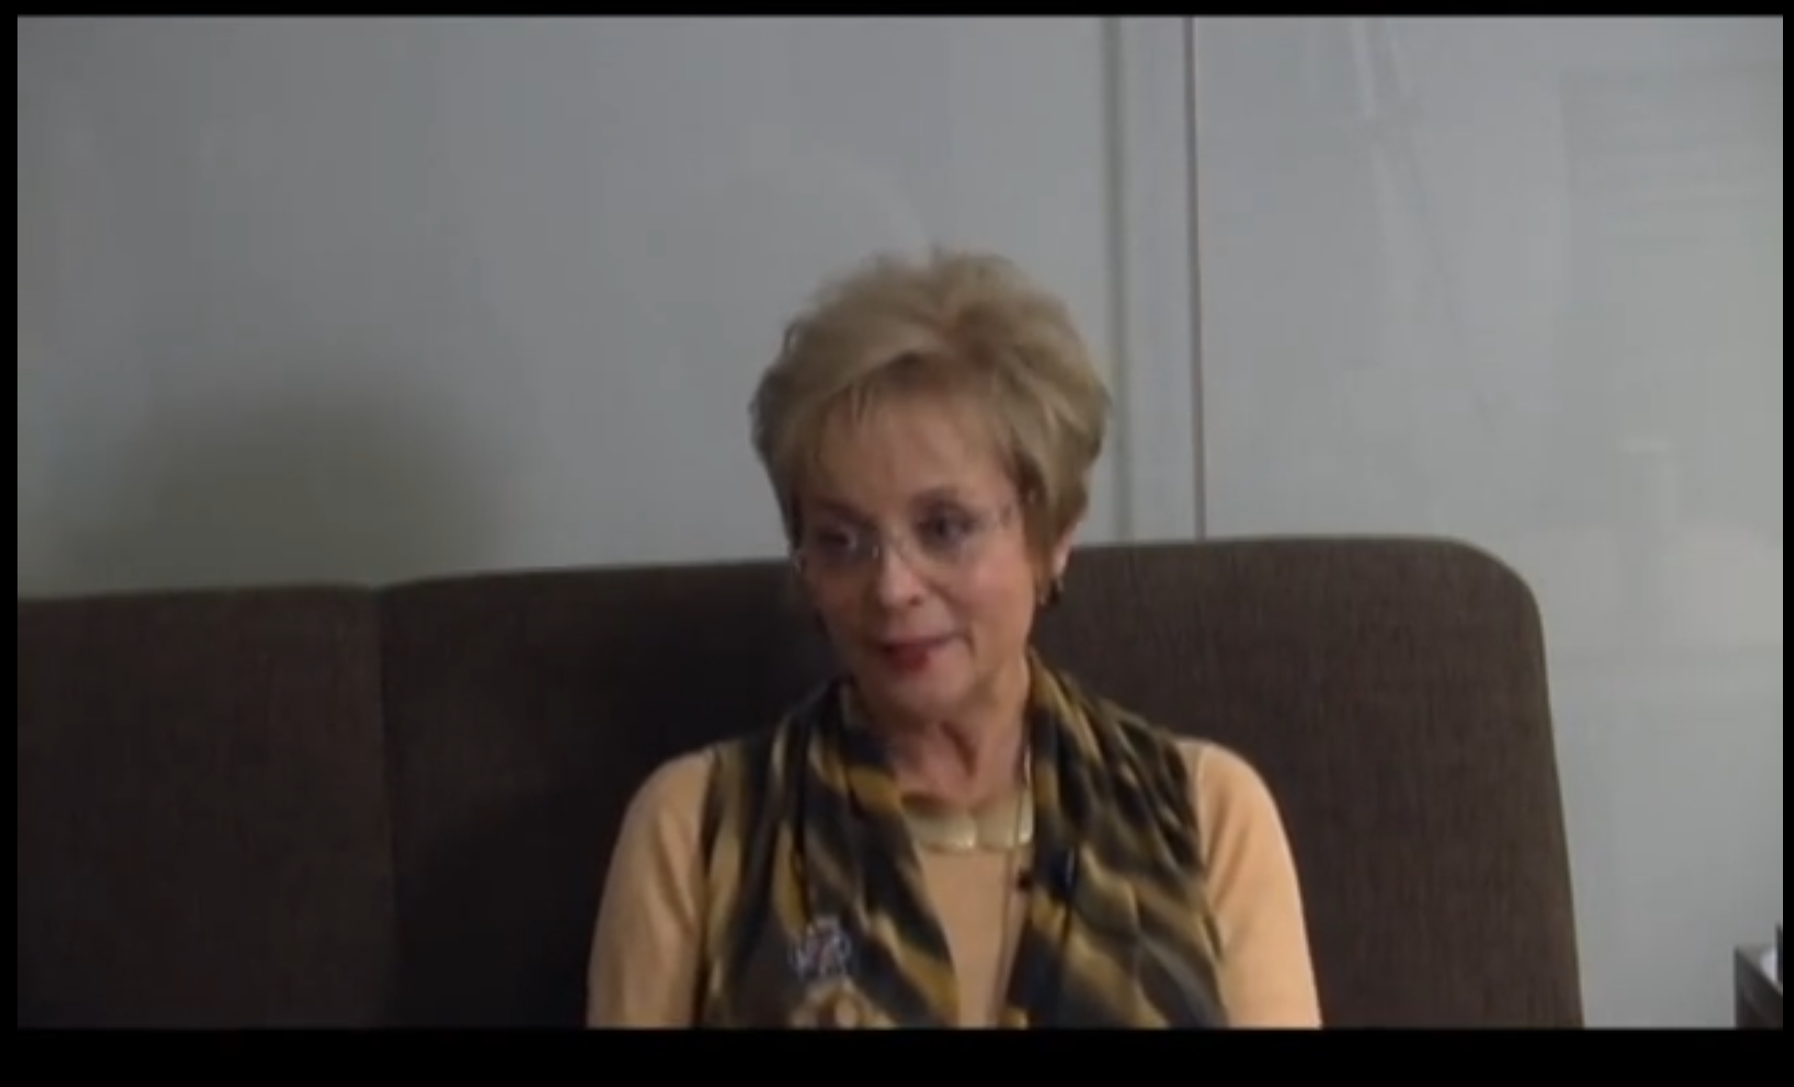
AECT Legends and Legacies http://aectlegends.org/
#9. Mary Herring, University of Northern Iowa (Video = 18:15)
https://www.youtube.com/watch?v=qK1Jcw7ZjZk

Slide 22
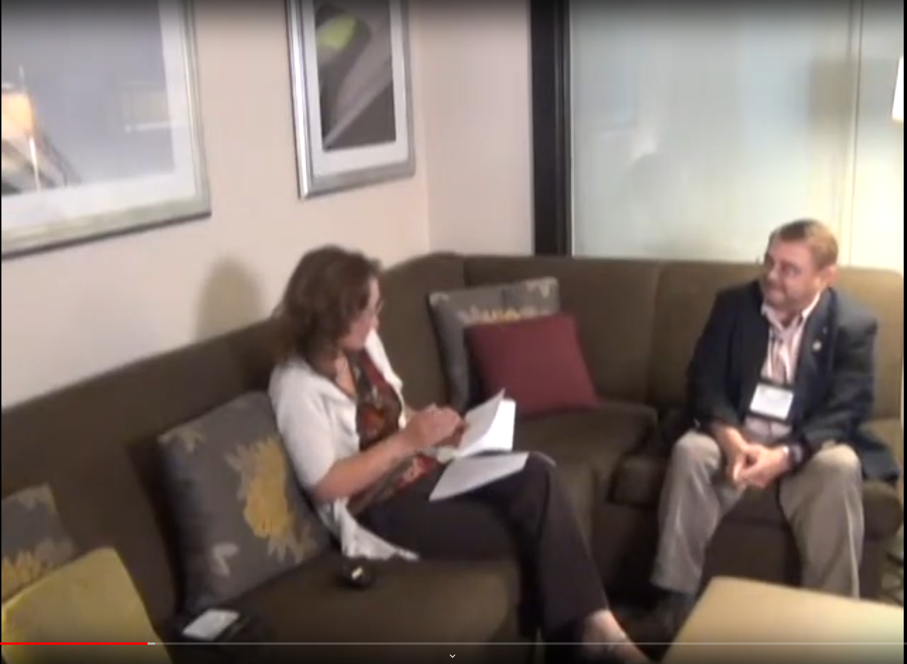
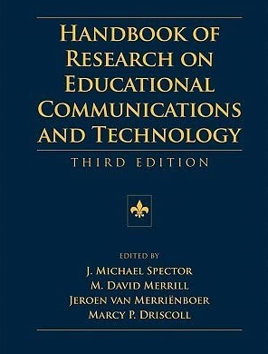
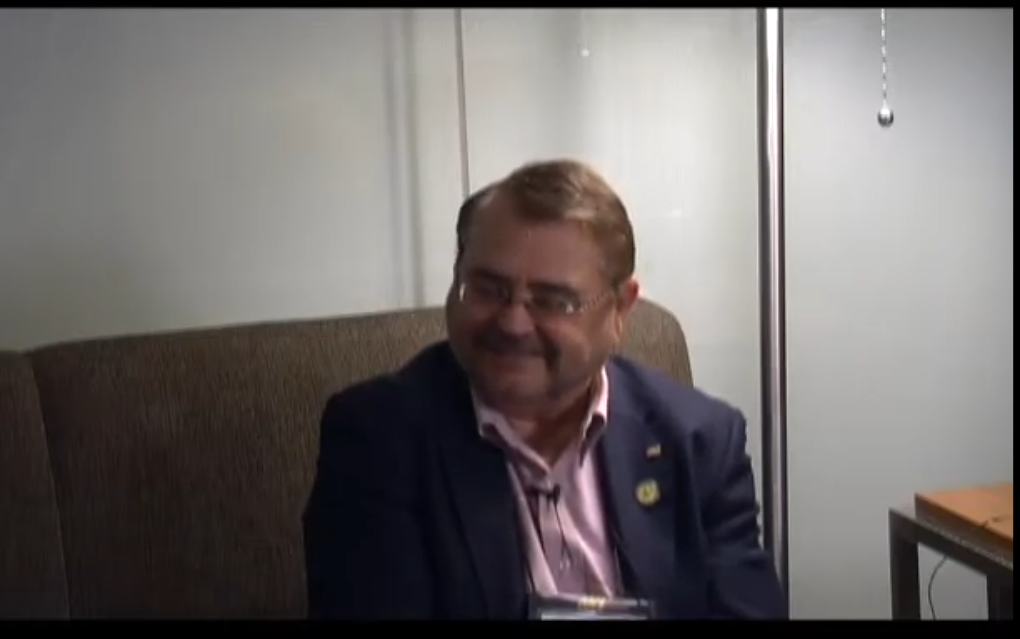
AECT Legends and Legacies http://aectlegends.org/
#10. Mike Spector, University of North Texas (Video = 40:16)
(interviewed by Barbara Lockee, Virginia Tech University)
https://www.youtube.com/watch?v=qjI9eZPJfPs

Slide 23
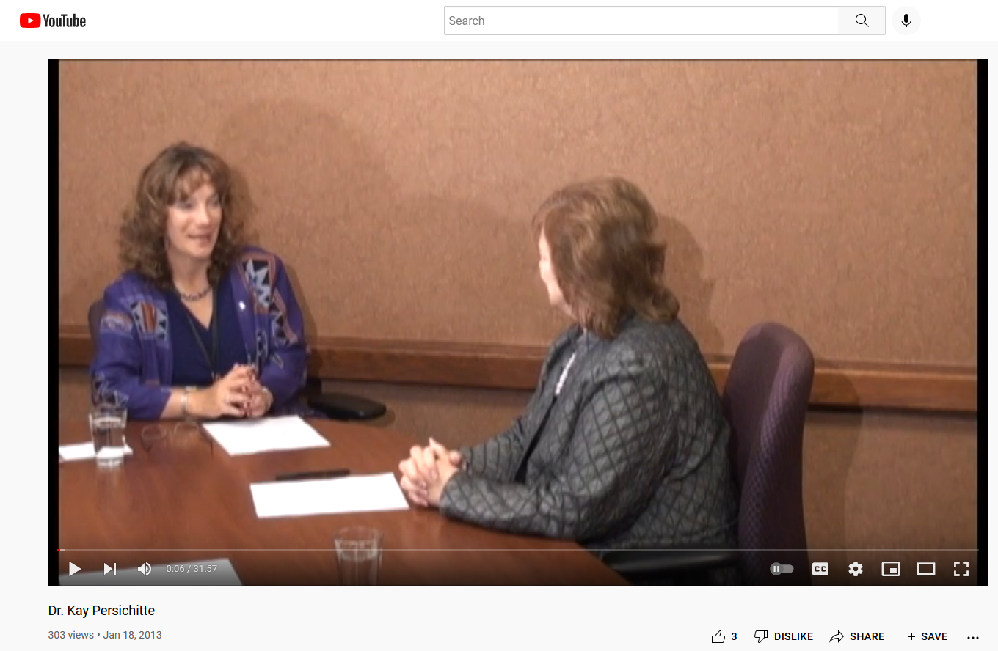
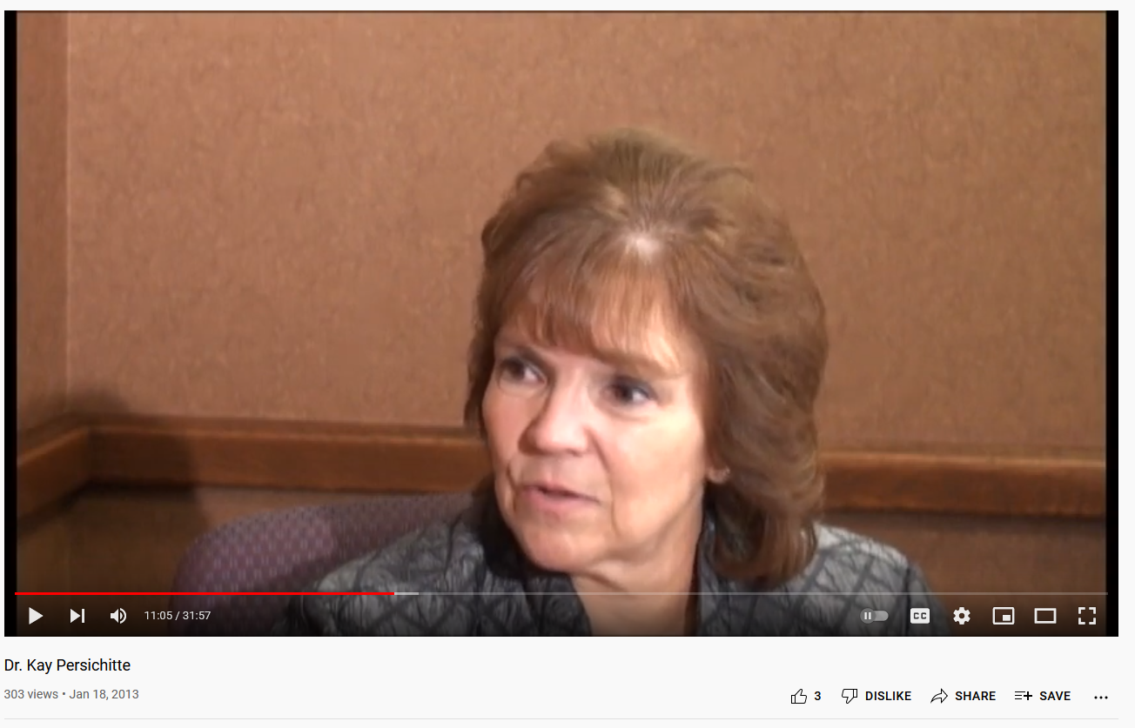
AECT Legends and Legacies http://aectlegends.org/
#11. Kay Persichitte, University of Wyoming (Video = 31:57)
(interviewed by Barbara Lockee, Virginia Tech University)
https://www.youtube.com/watch?v=dalz555GB_w&t=5s

Slide 24
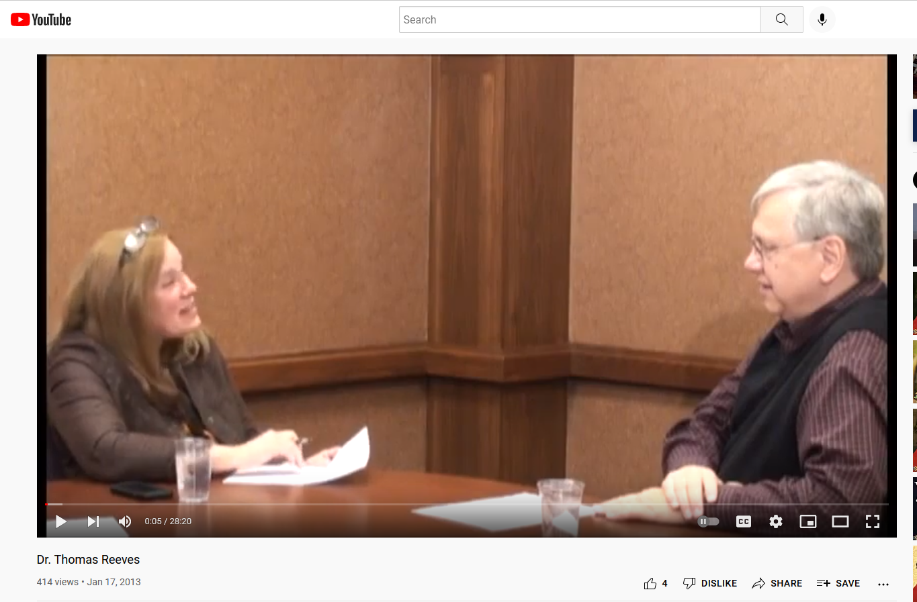

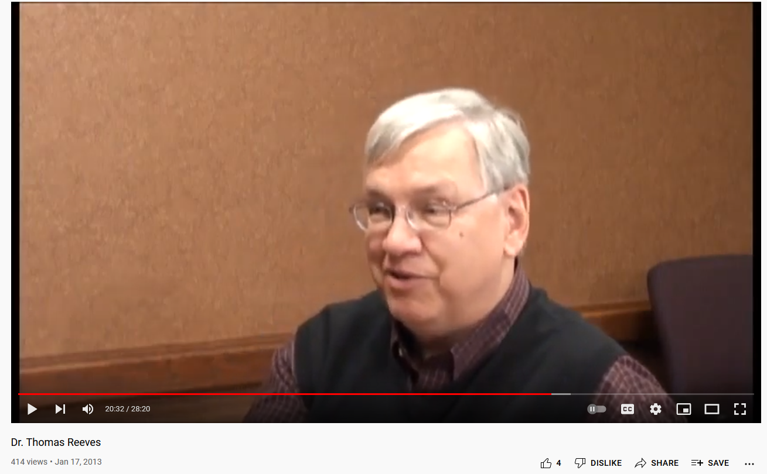
AECT Legends and Legacies http://aectlegends.org/
#12. Tom Reeves, University of Georgia (Video = 28:20)
https://www.youtube.com/watch?v=ZU32W1oclnw&t=1s

Slide 25
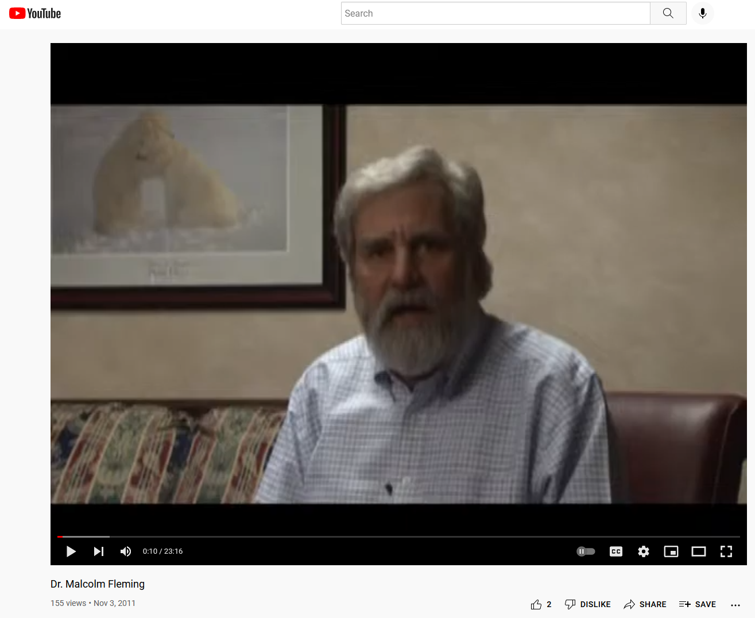
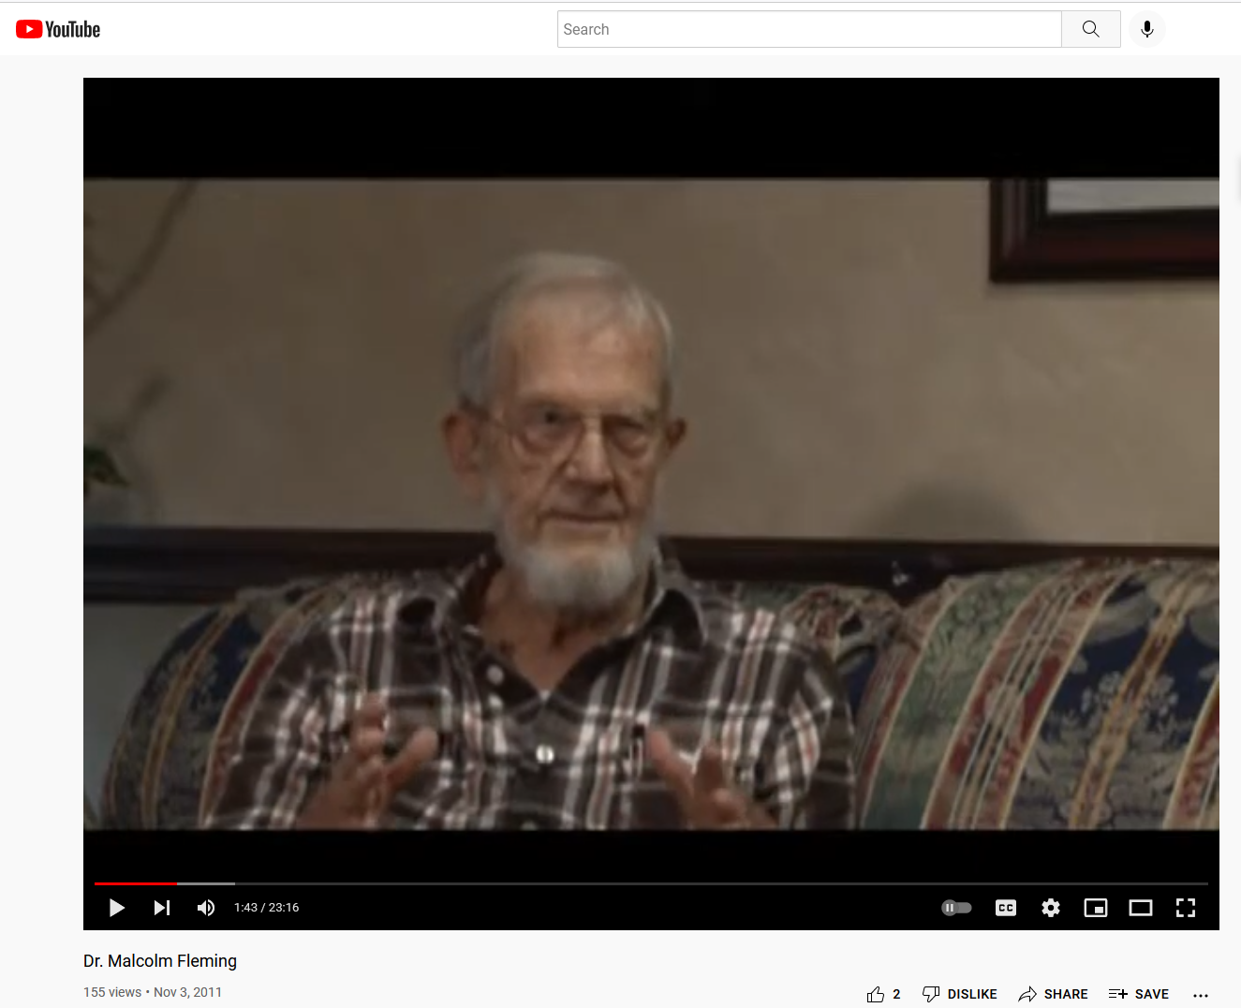
AECT Legends and Legacies http://aectlegends.org/
#13. Malcolm Fleming, Indiana University (Video = 23:16)
(interviewed by Gary Morrison, Old Dominion University)
https://www.youtube.com/watch?v=5ZtzeeR_9R4&t=1s

Slide 26


AECT Legends and Legacies http://aectlegends.org/
#14. Sharon Smaldino, Northern Illinois University (Video = 43:59)
https://www.youtube.com/watch?v=wOjhdH4dAE4

Slide 27




AECT Legends and Legacies http://aectlegends.org/
#15. Richard Mayor, UC Santa Barbara (Video = 15:32)
https://www.youtube.com/watch?v=7Y4SqwCc2Zc&t=1s

Slide 28

Pedagogical Uses of the Legends and Legacies Video Project

Slide 29
I. Pedagogical Uses of the AECT Legends and Legacy Videos
Watch 1 or more videos and write review or reflection papers.
Watch 5 or more videos and look for themes or common issues.
Draft educational change models, frameworks, or systems.
Interview prior Legend and Legacy participants.
Draft mini-chapters based on 10 or more of these interviews into a book.
Design historical analyses of the field as interactive timelines, concept maps, or technical reports.
Based on the past, have class draft a set of future trends papers.
Remix episodes with the most informative aspects of 3 or more videos.
Create concept snippets from various expert interviews.
Hold online discussion forums on episodes.
Create online role play or debate activities based on different episodes.
Have students reinterview (i.e., a follow-up) one of more of the people interviewed for the AECT Legend and Legacy video series.

Slide 30
Pedagogical Uses of the Legancies and Legends Project
Legacies and Legends project: Those selecting this option should watch video interview reflections or presentations from at least five leaders in the field of instructional and educational technology (e.g., Robert Reiser, Mike Molenda, Charlie Reigeluth, David Merrill, Michael Spector, Mendel Sherman, Marcy Driscoll, Robert Gagne, Rita Richey, Phil Harris, Robert Mayer, David Jonassen, Tom Reeves, Mike Hannafin, Kay Persichitte, Kyle Peck, etc.). If you select this option, you are to write a 4-5 page single spaced reflection (perhaps 2,000-3,000 words or more).

