Slide 1
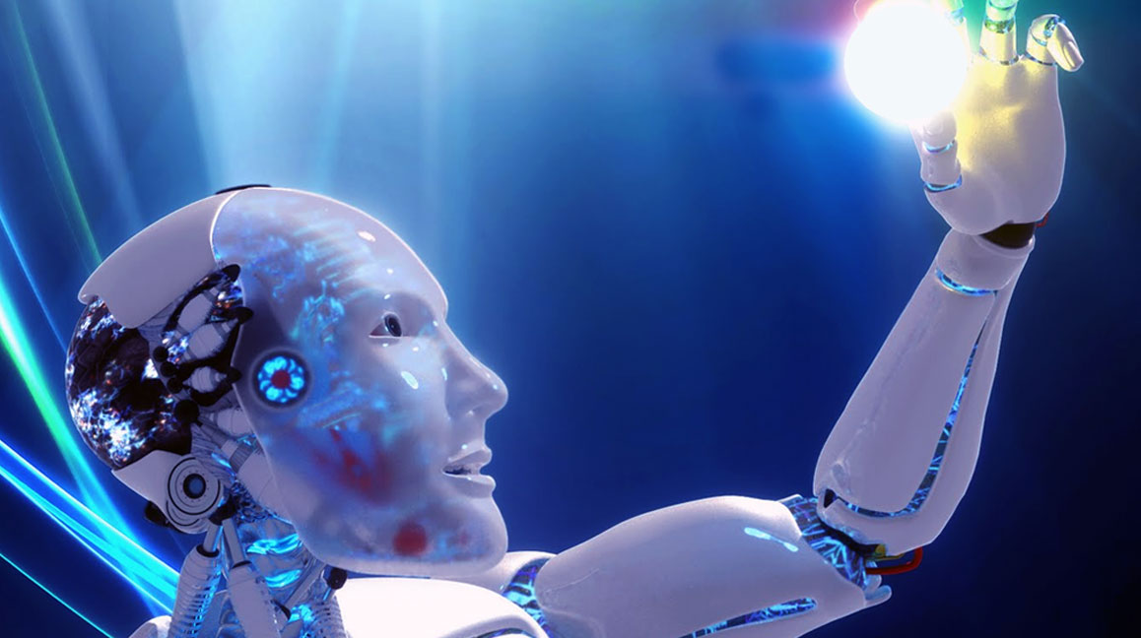

Learning IS Changing:
Thirty Ways, Many More Visions!
Curtis J. Bonk, Professor, Indiana University
cjbonk@indiana.edu
http://curtbonk.com/

Slide 2
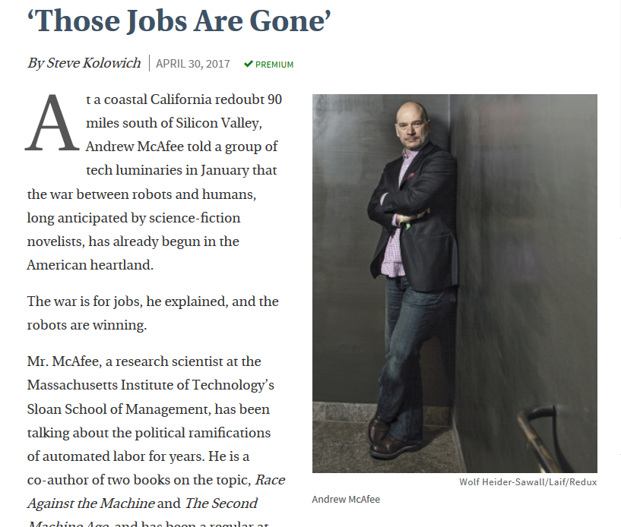

April 30, 2017
‘Those Jobs Are Gone’
Steve Kolowich, The Chronicle of Higher Education http://www.chronicle.com/article/Who-s-UpWho-s-Down-in/239964

Slide 3
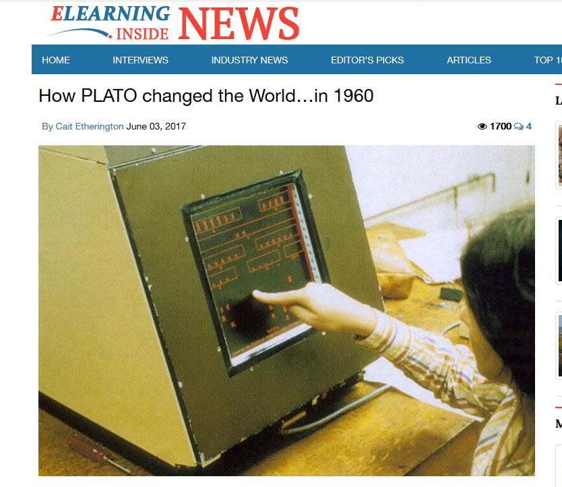
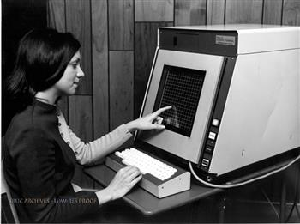
June 3, 2017
How PLATO changed the World…in 1960
Cait Etherington, ElearningInside News
(nearly 60 years ago) https://news.elearninginside.com/how-plato-changed-the-world-in-1960/

Slide 4
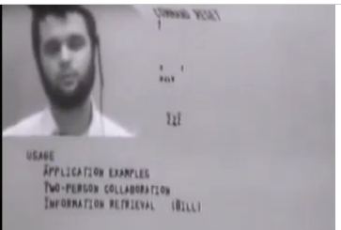
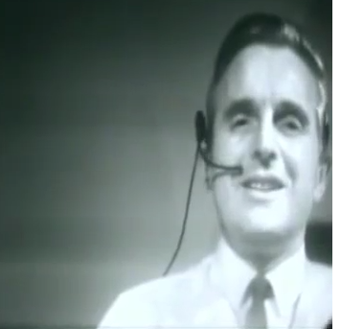
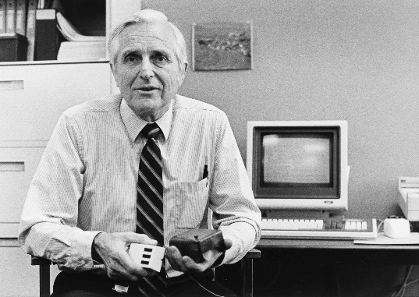
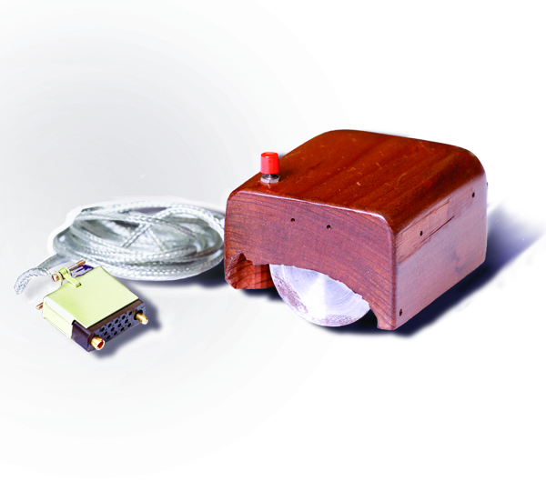
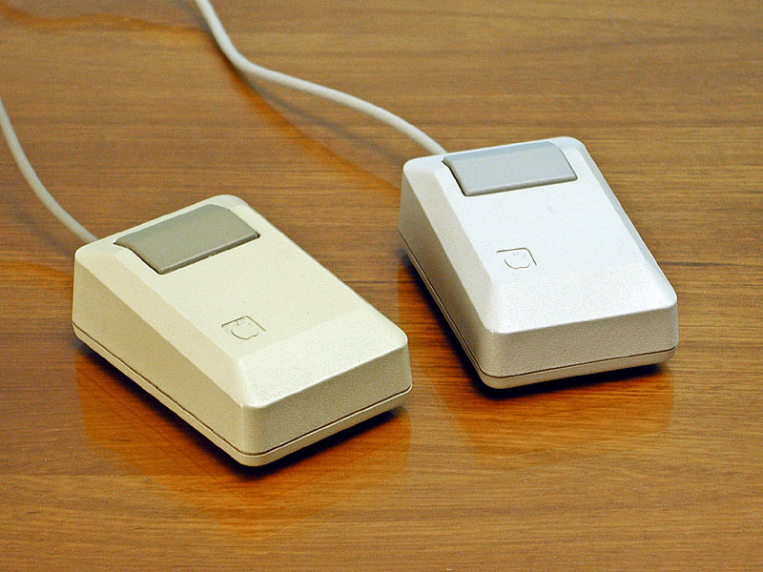
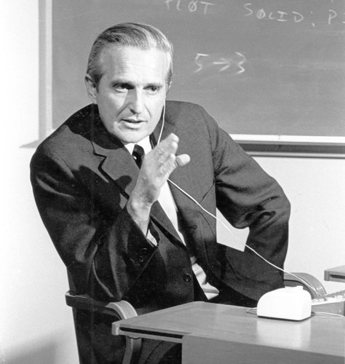
Intelligence Augmentation and Amplification
Douglas Engelbart’s “The Mother of All Inventions” (1968)
(50 years ago!)
(The live demonstration featured the introduction of the computer mouse, video conferencing, teleconferencing, hypertext, word processing, hypermedia, object addressing and dynamic file linking, bootstrapping, and a collaborative real-time editor.“) http://www.amazon.com/Machines-Loving-Grace-Common-Between/dp/0062266683
Engelbart's prototype of a computer mouse, as designed by Bill English from Engelbart's sketches.

Slide 5
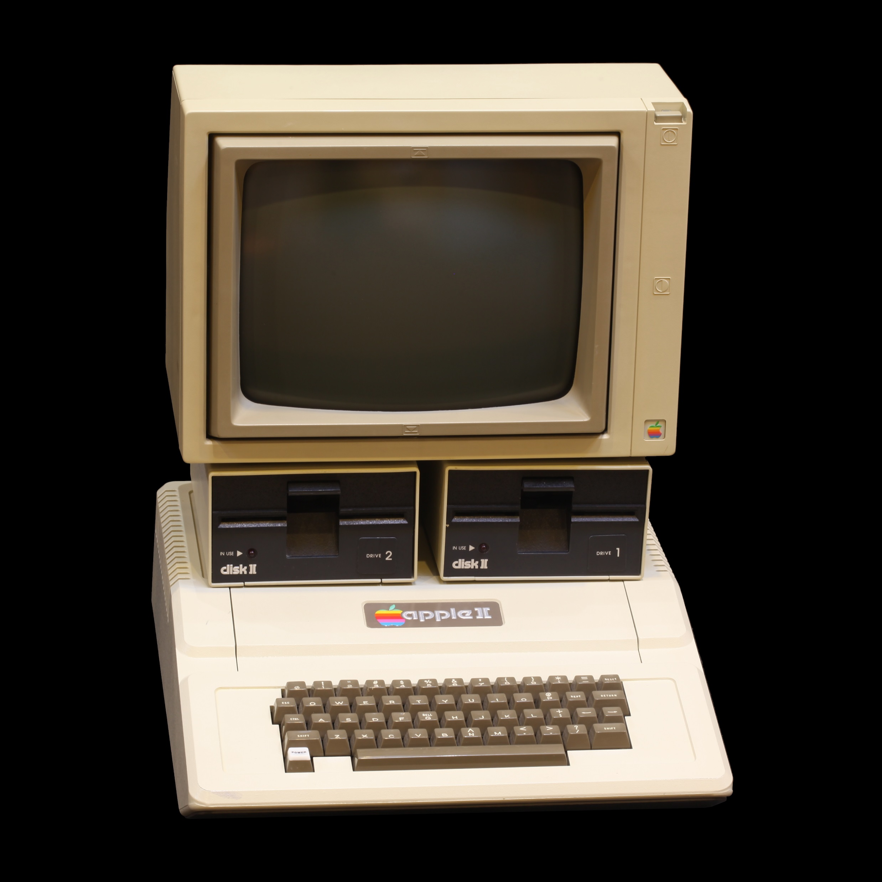
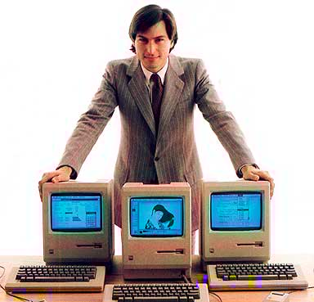
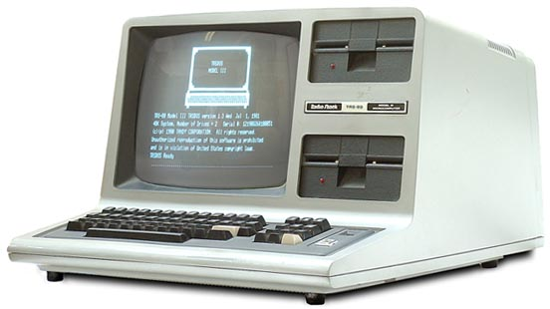
Poll #1: Do you remember the Apple II (40 years ago)

Slide 6
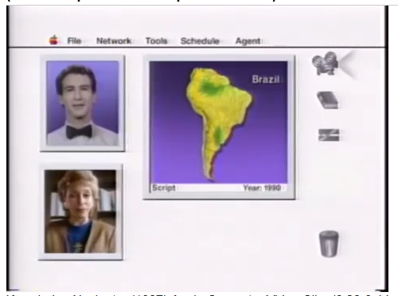
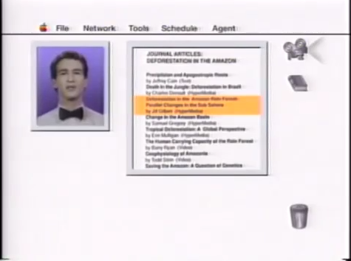
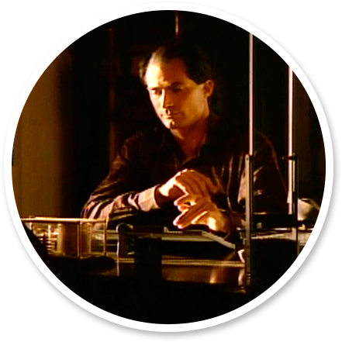
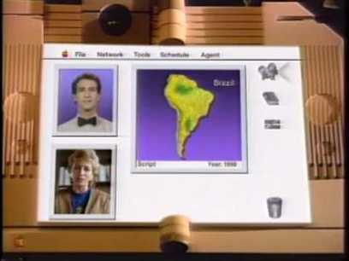
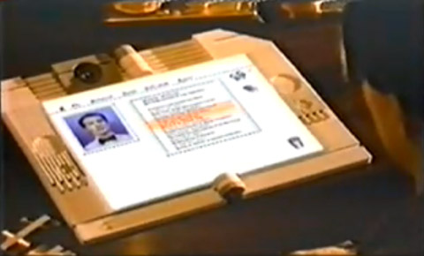
Knowledge Navigator (1987)
Apple Computer (30 years old!) http://www.youtube.com/watch?v=hb4AzF6wEoc

Slide 7

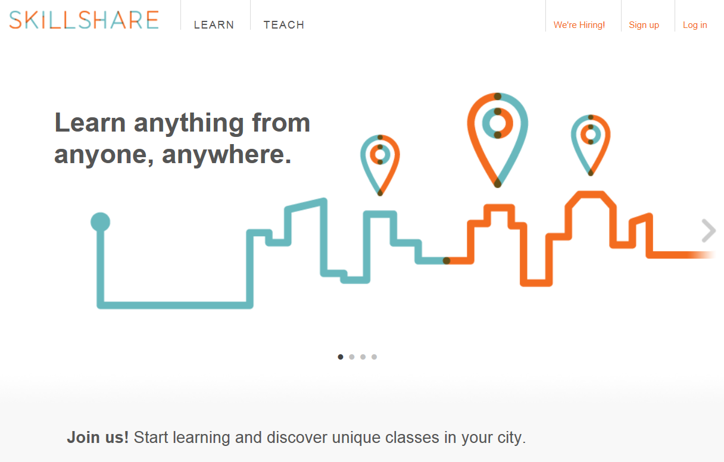
Fast Forward 30+ More Years…
“Anyone can now learn anything from anyone at any time.”

Slide 8
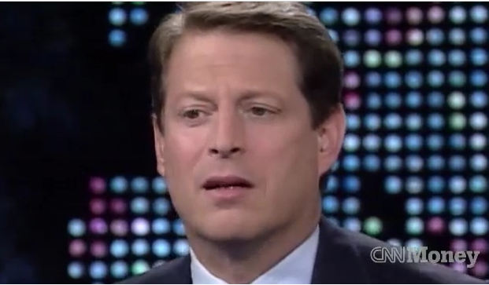
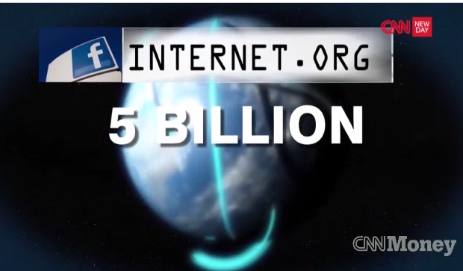
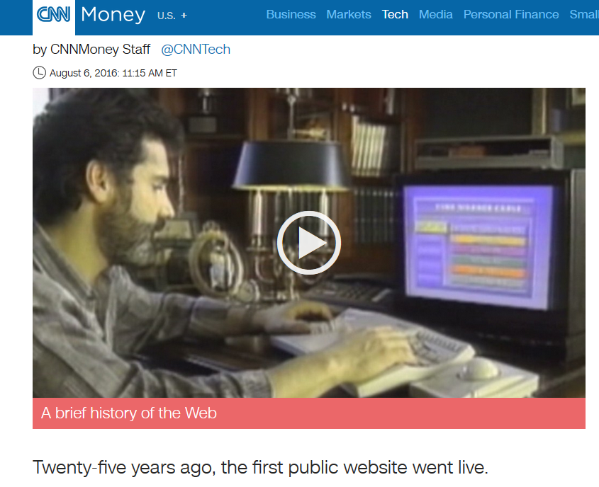
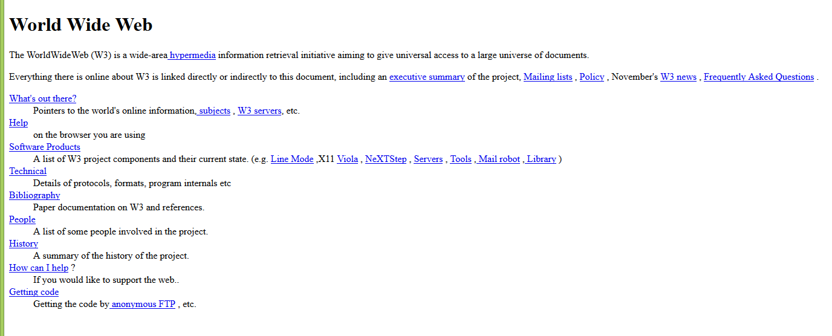
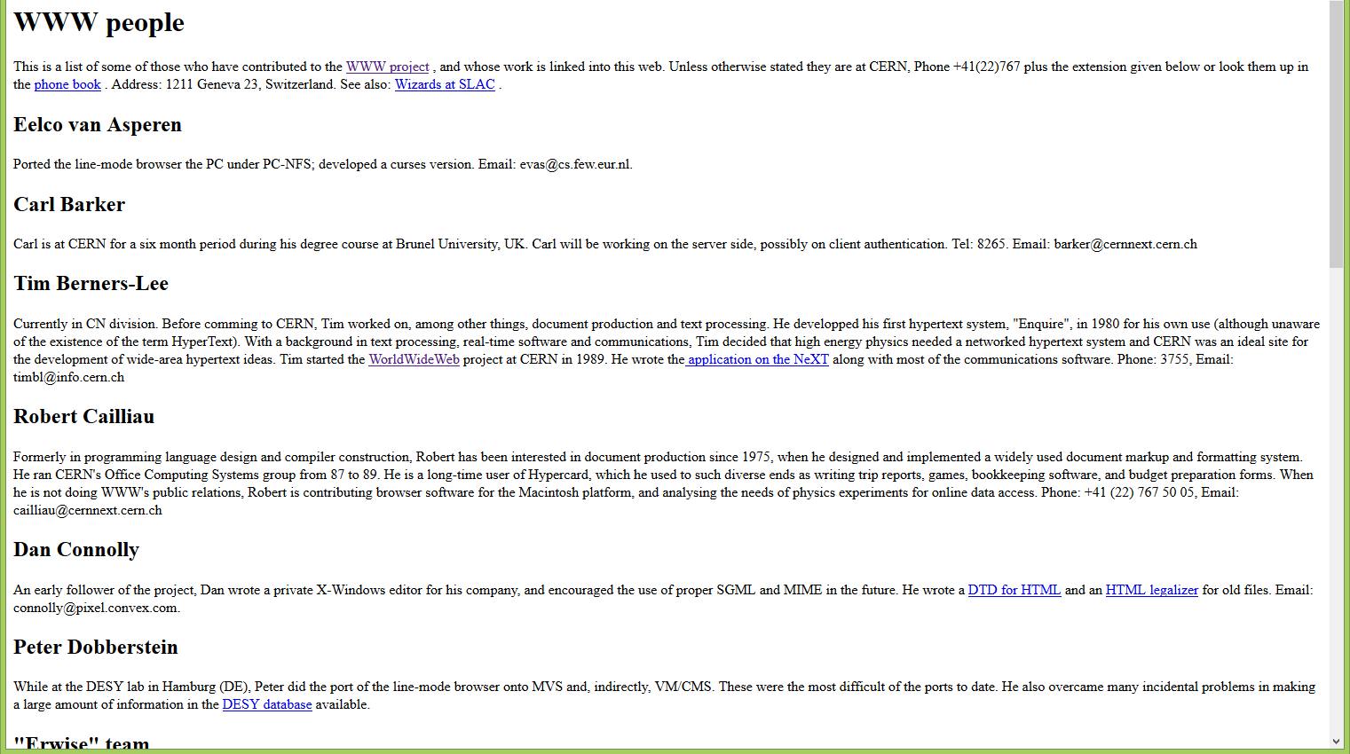
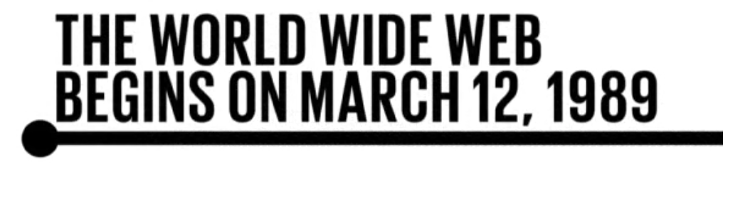
August 6, 2016
The Web at 25!
Happy (sort of) birthday, World Wide Web!, Erica Fink and Jonathan Tortora, CNN Money (Tech) http://info.cern.ch/ (First website) http://info.cern.ch/hypertext/WWW/TheProject.html http://money.cnn.com/2016/08/06/technology/world-wide-web-25-years-old/index.html?iid=hp-stack-dom

Slide 9
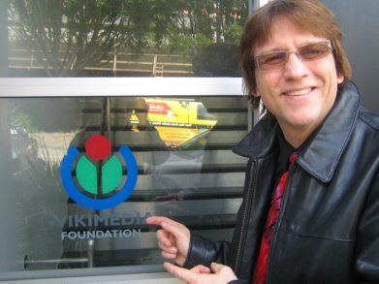


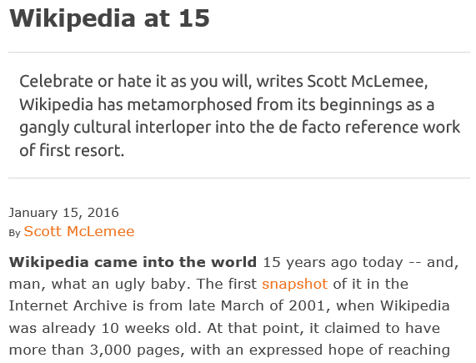
January 15, 2016
Wikipedia at 15!
Scott McLemee, Inside Higher Ed https://www.insidehighered.com/views/2016/01/15/essay-wikipedias-fifteenth-anniversary?utm_source=Inside+Higher+Ed&utm_campaign=4a9a248980-DNU20160115&utm_medium=email&utm_term=0_1fcbc04421-4a9a248980-197362401

Slide 10
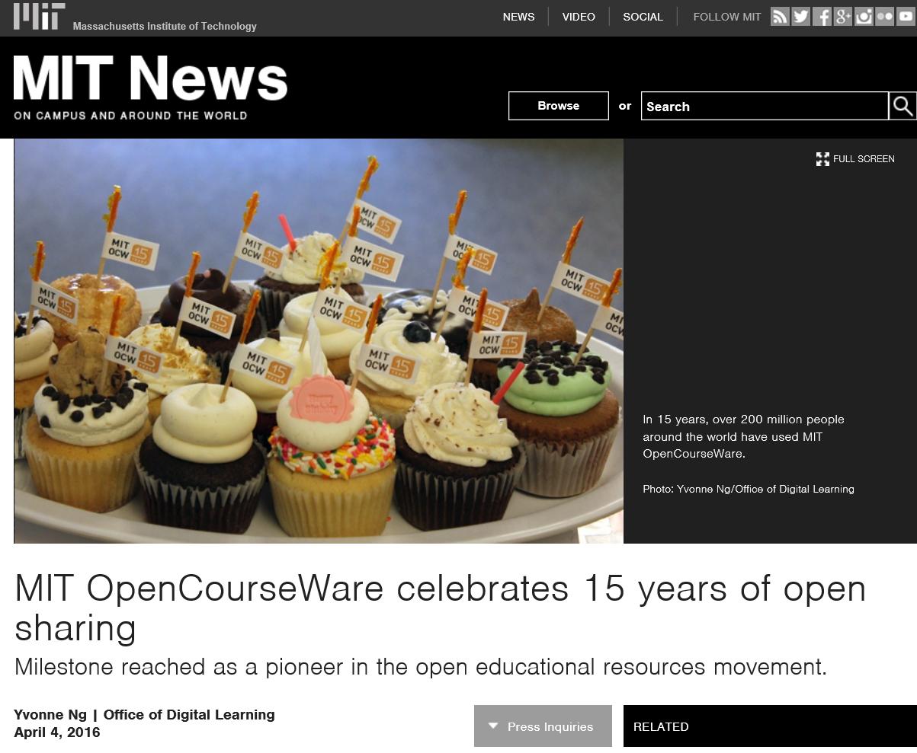
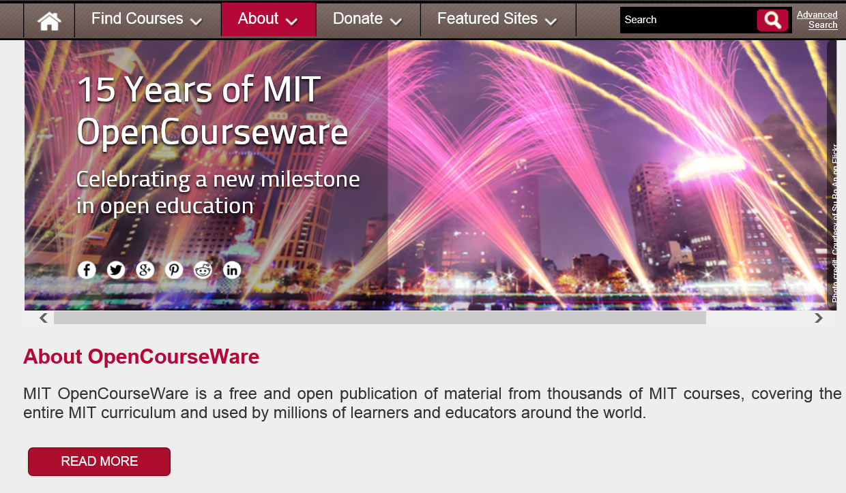
April 4, 2016
MIT OpenCourseWare at 15! http://ocw.mit.edu/about/15-years/

Slide 11
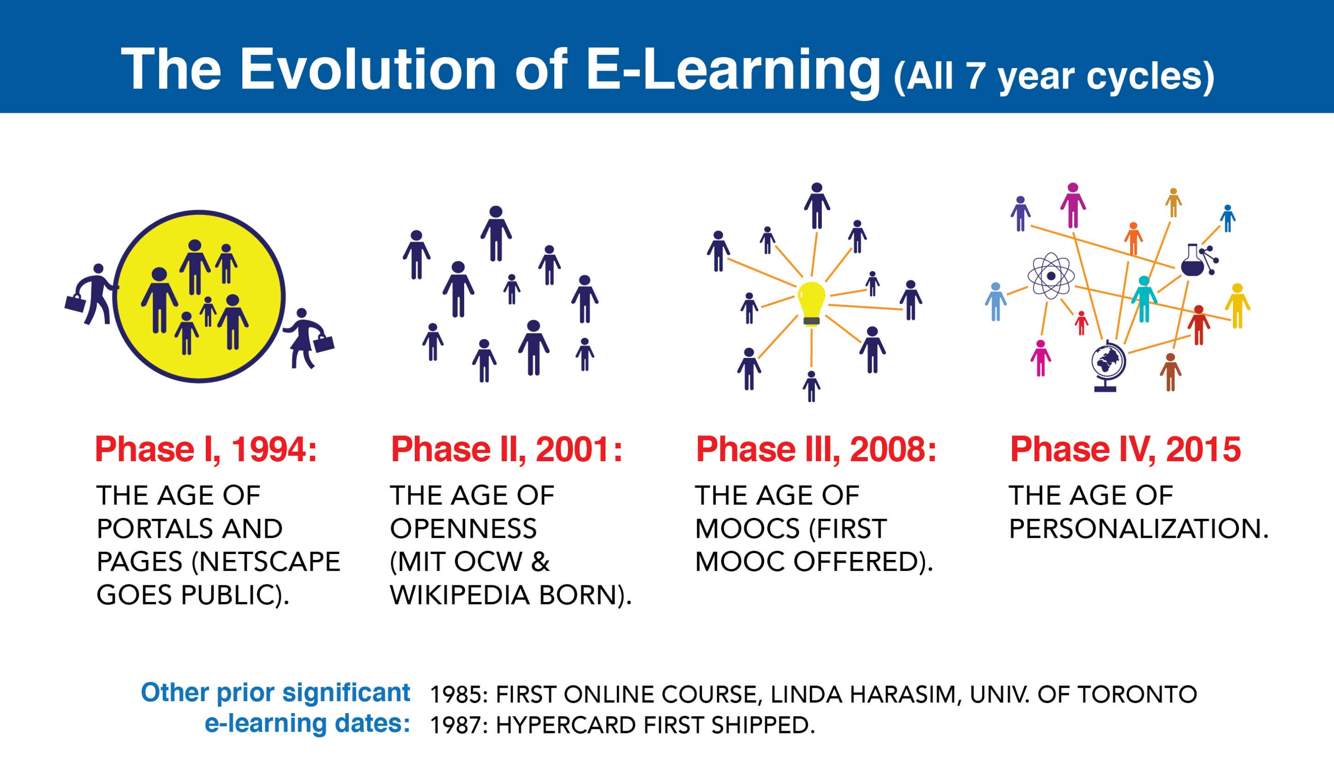

Slide 12
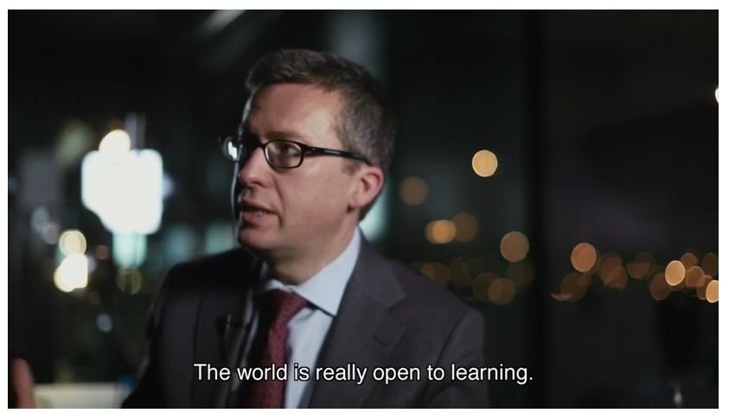
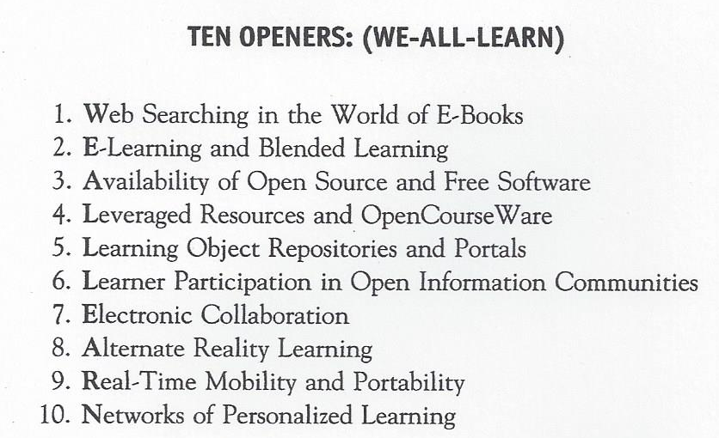
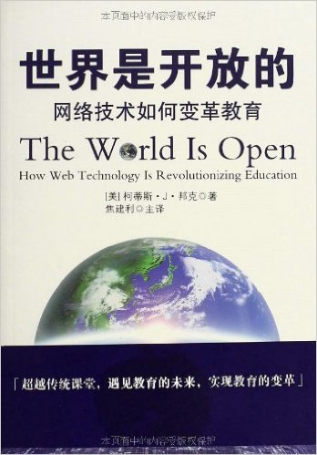

The World is Open:
How Web Technology Is Revolutioning Education

Slide 13
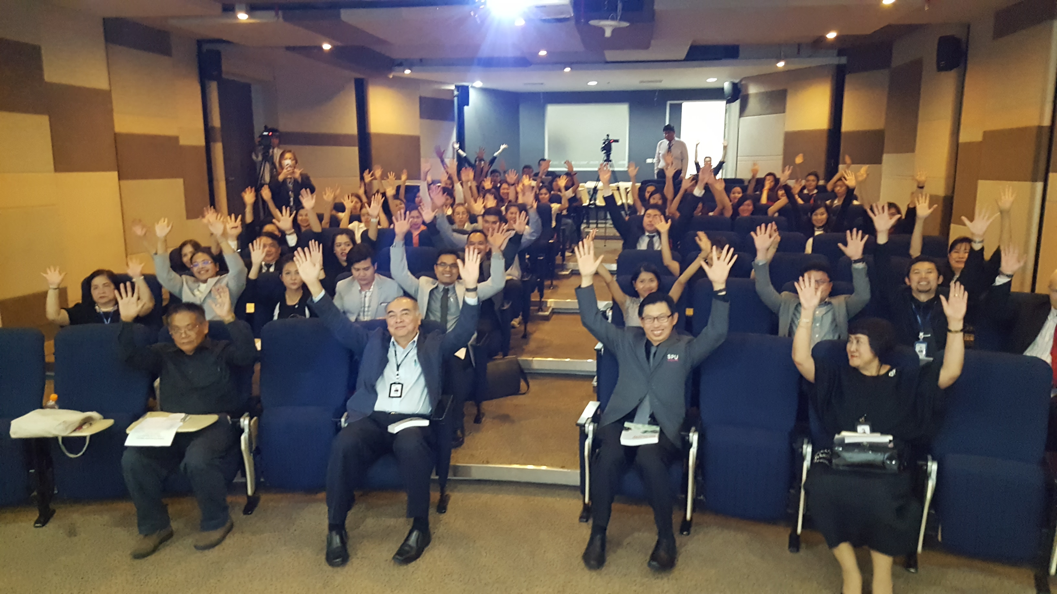
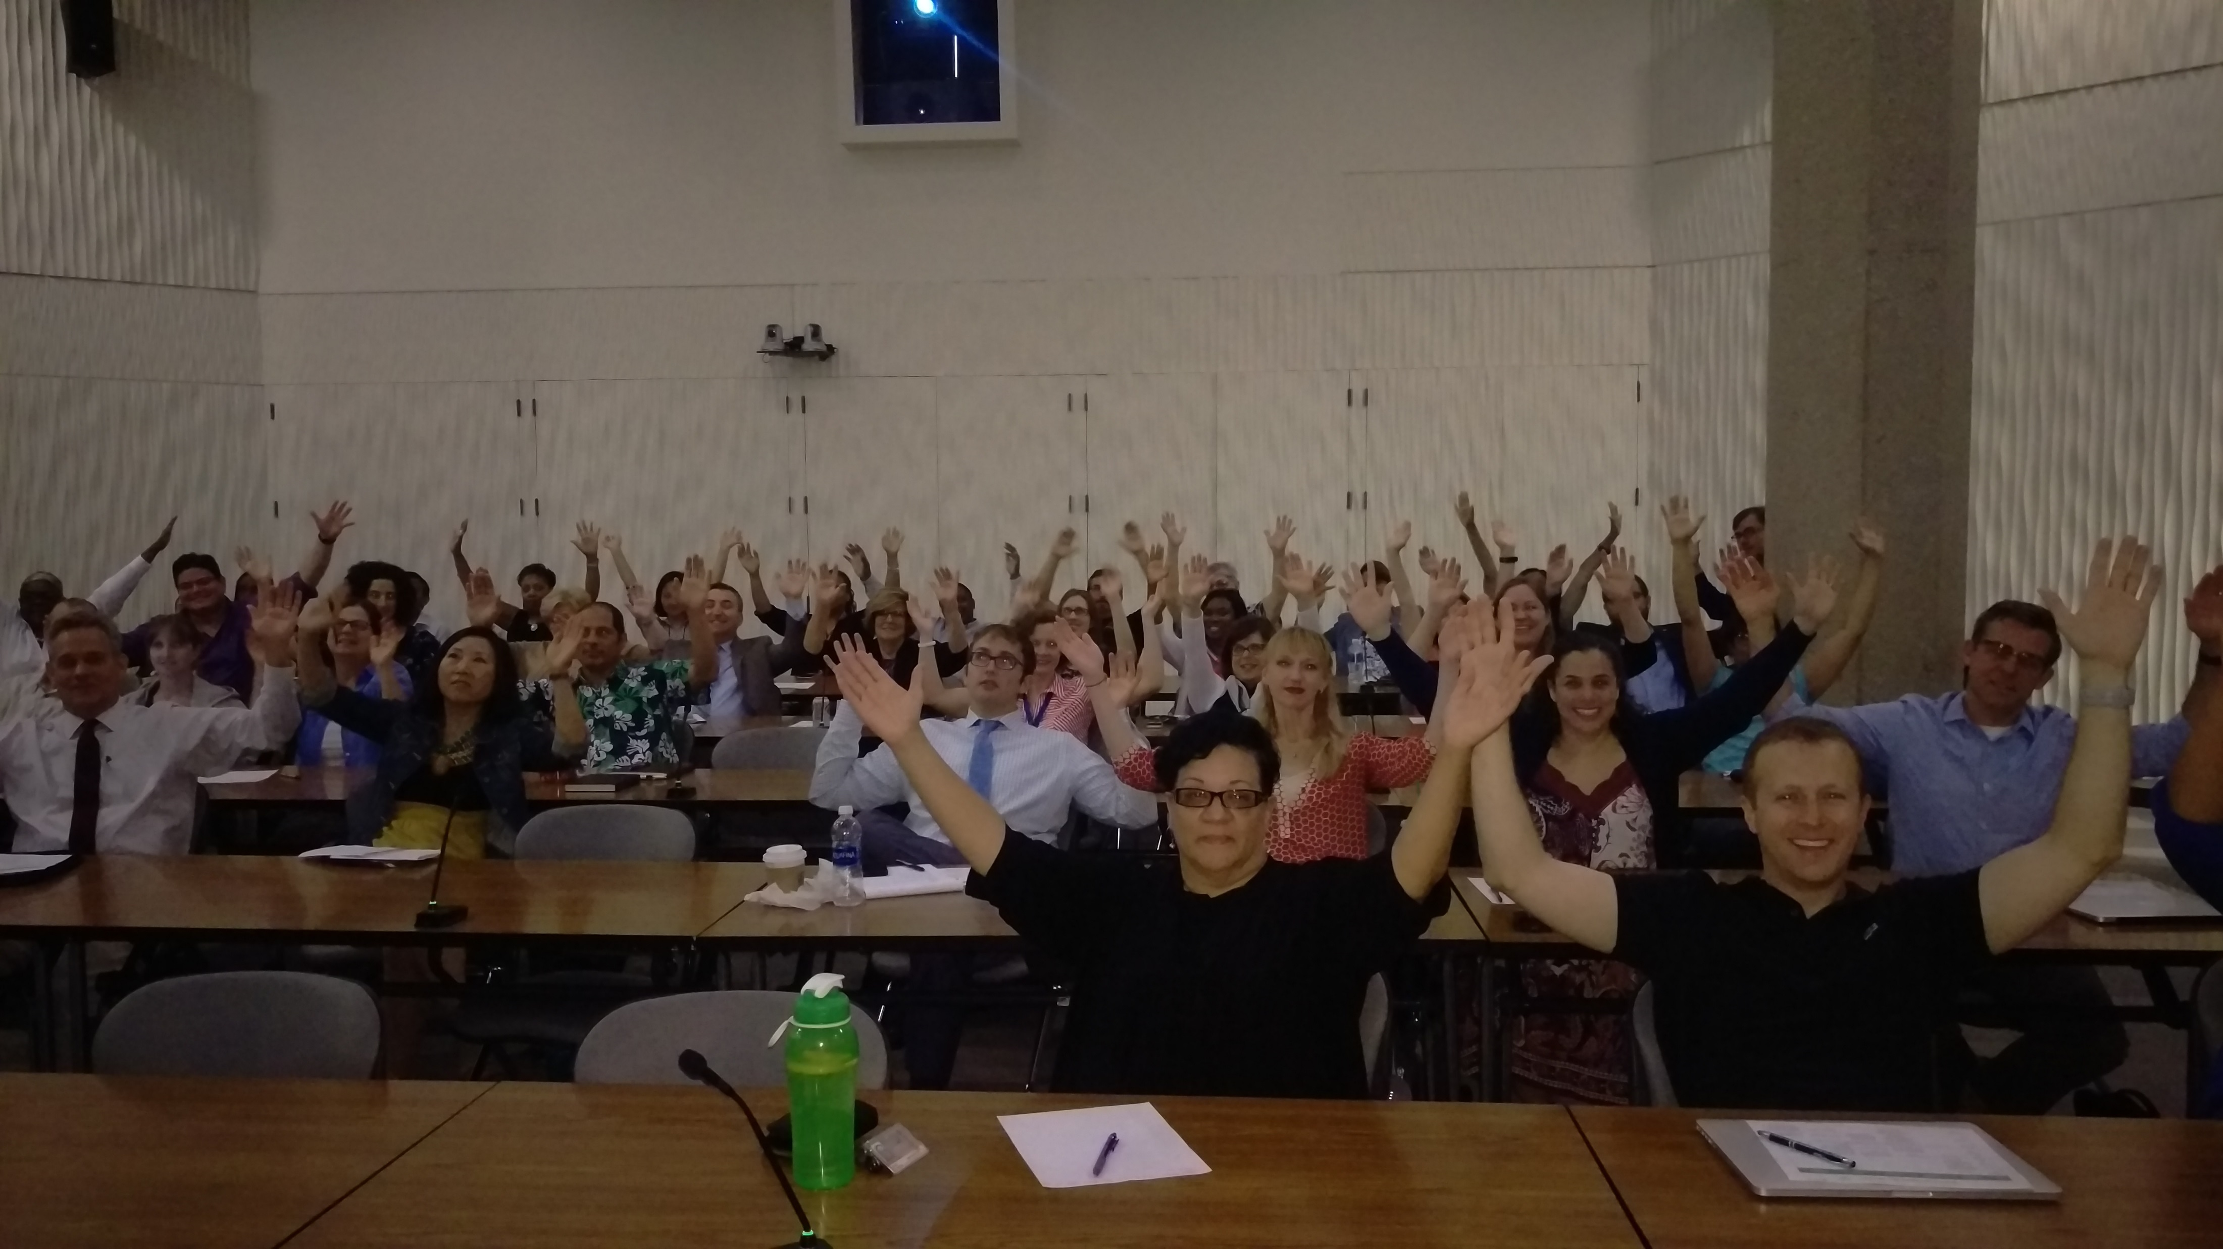
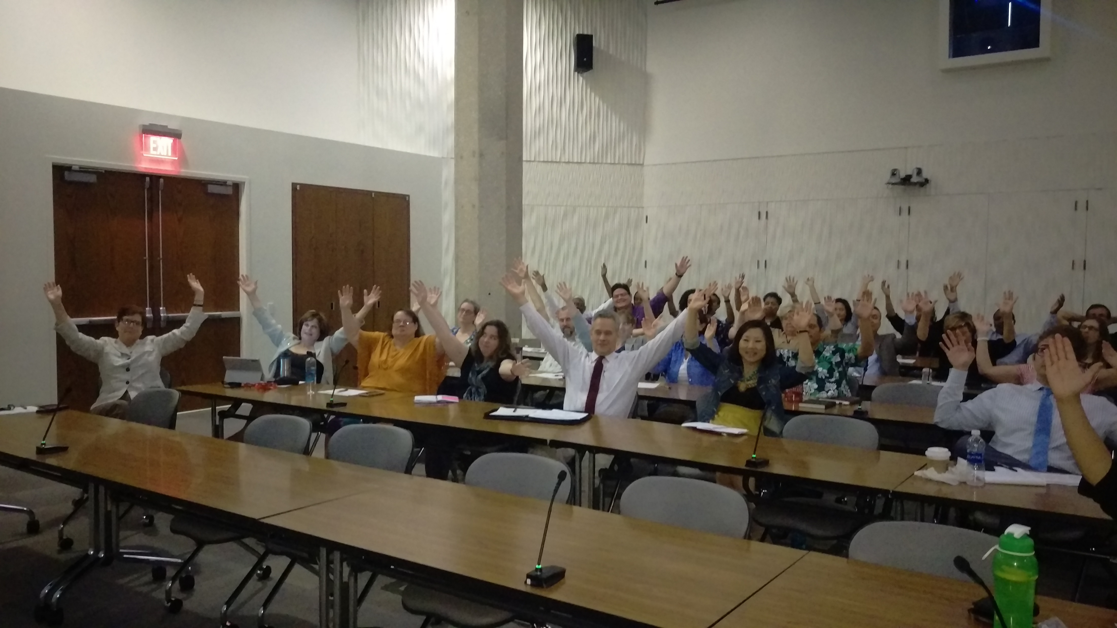
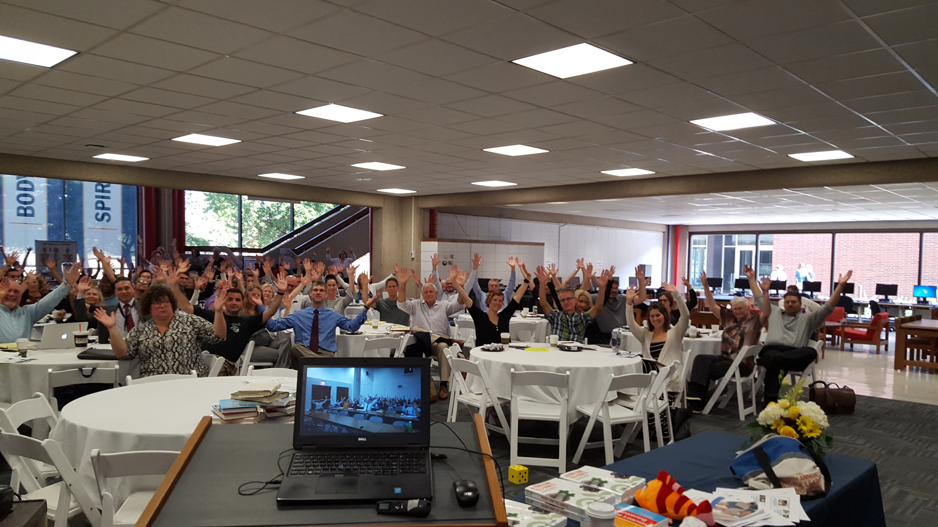
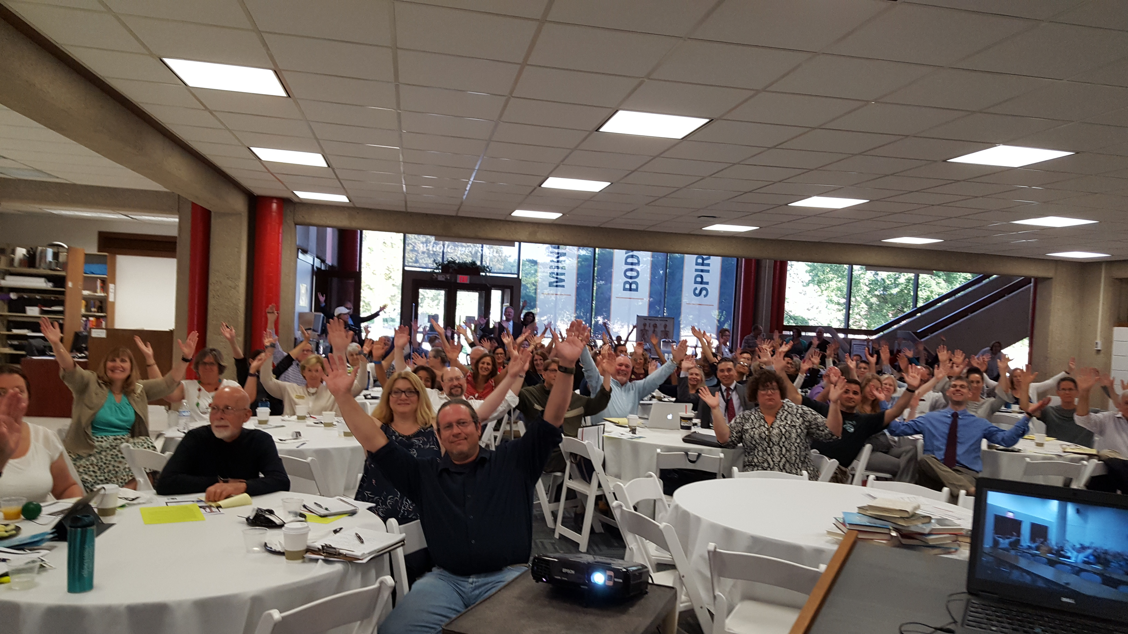
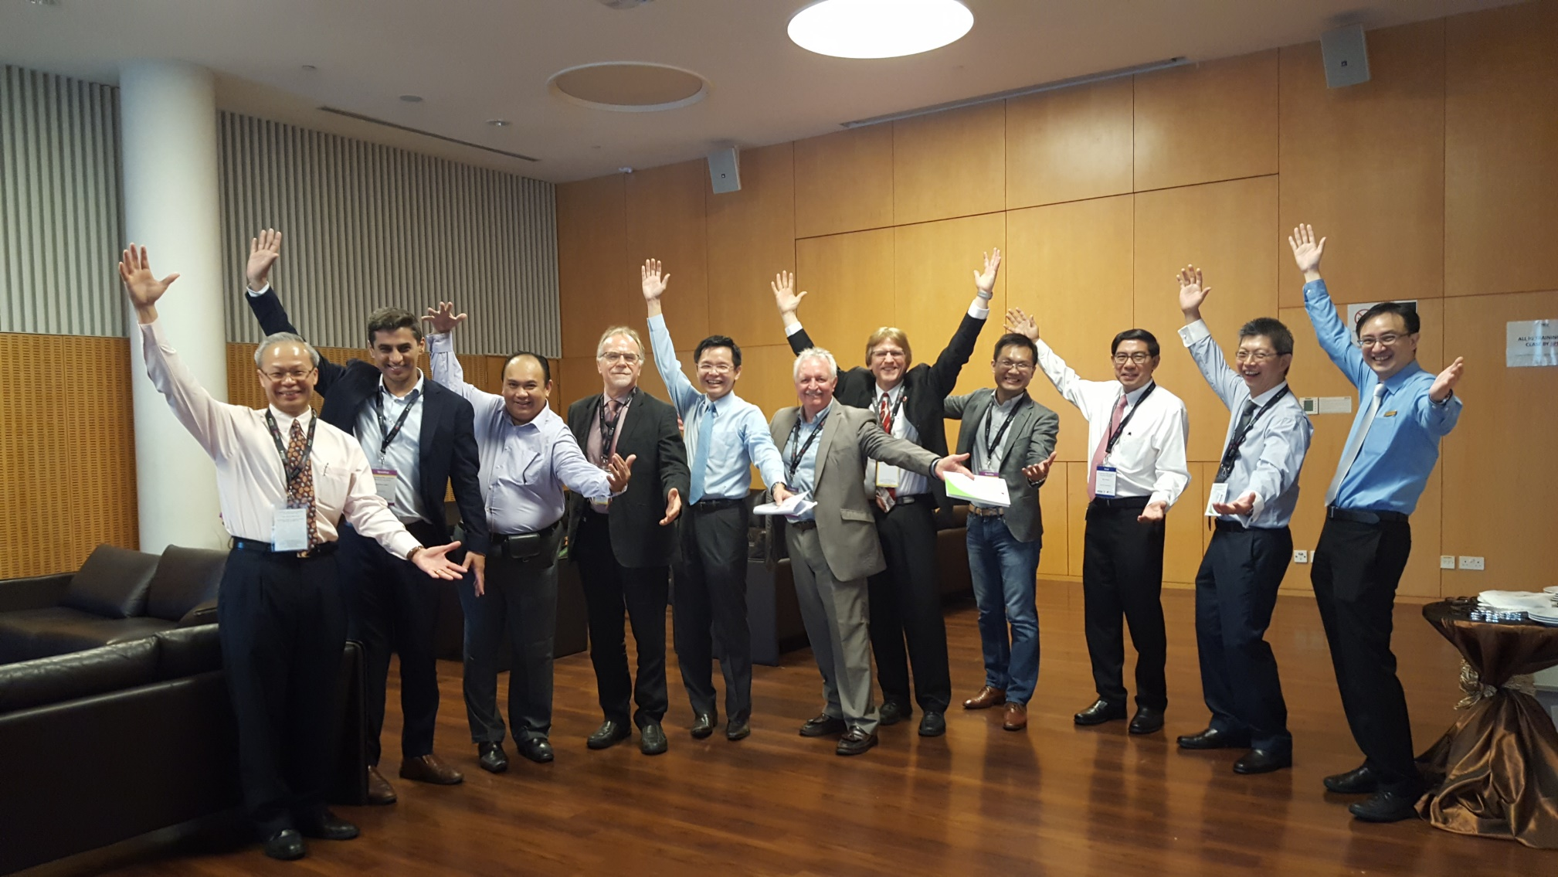
The World is Open

Slide 14
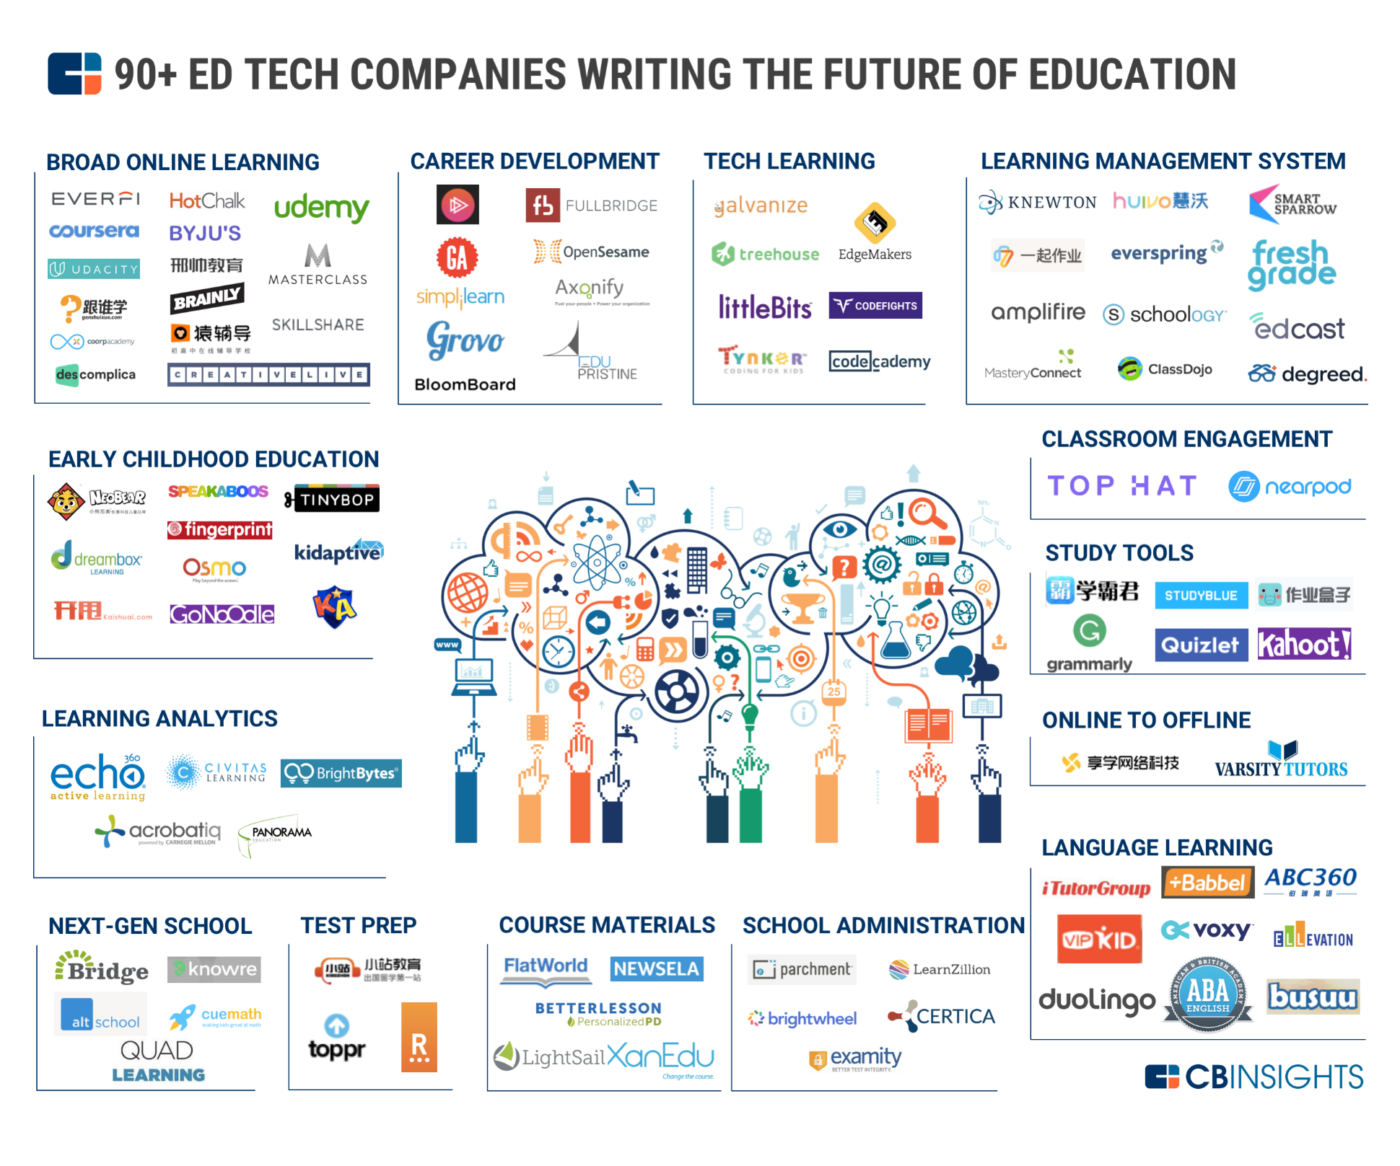
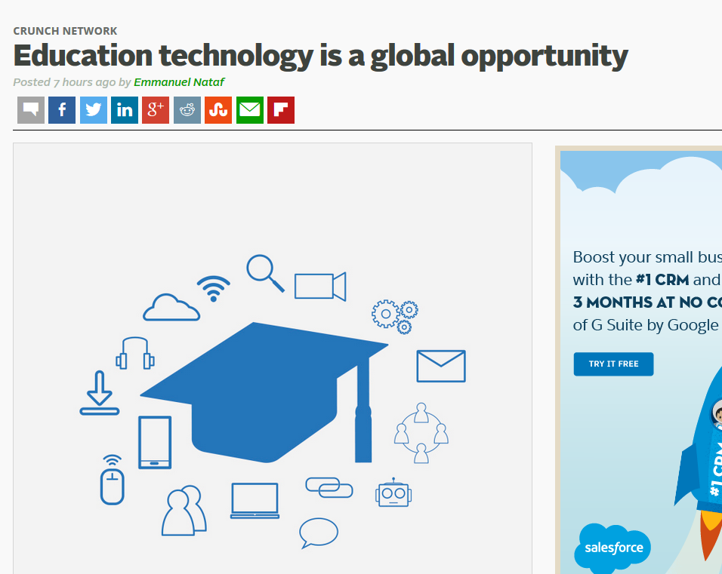
January 19, 2018
Education technology is a global opportunity
Emmanual Nataf, TechCrunch https://techcrunch.com/2018/01/19/education-technology-is-a-global-opportunity/ https://www.cbinsights.com/research/ed-tech-startup-market-map/?utm_content=buffer6565b&utm_medium=social&utm_source=linkedin.com&utm_campaign=buffer

Slide 15
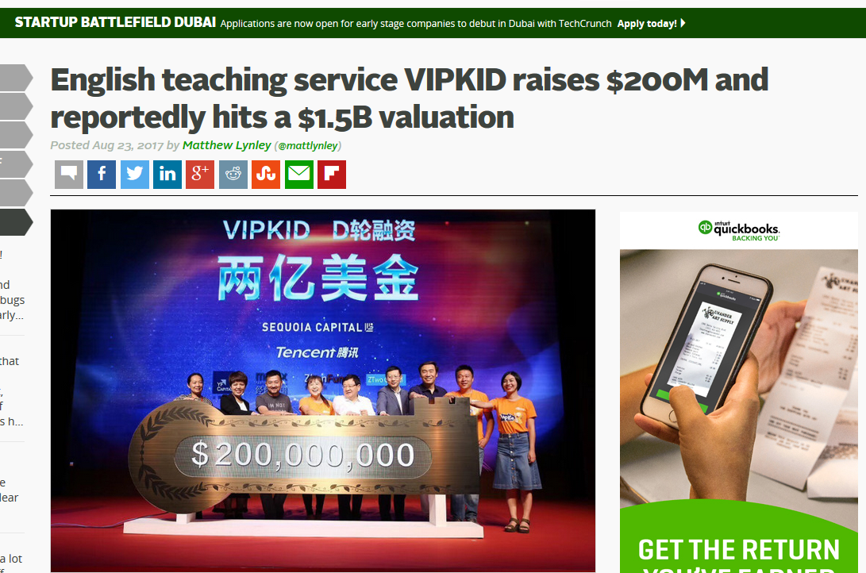
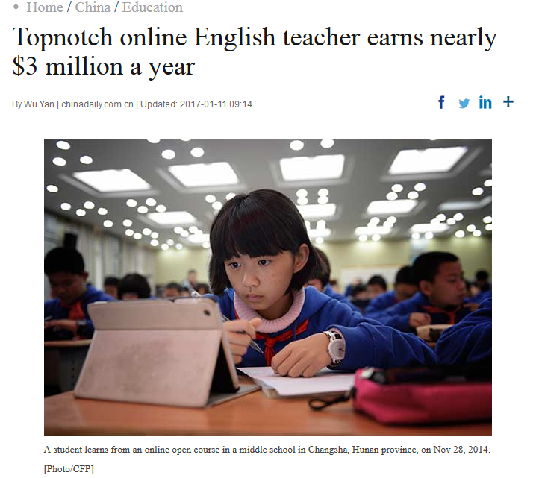
January 11, 2017
Topnotch online English teacher earns nearly $3 million a year,
Wu Yan, China Daily http://www.chinadaily.com.cn/china/2017-01/11/content_27920747.htm

Slide 16
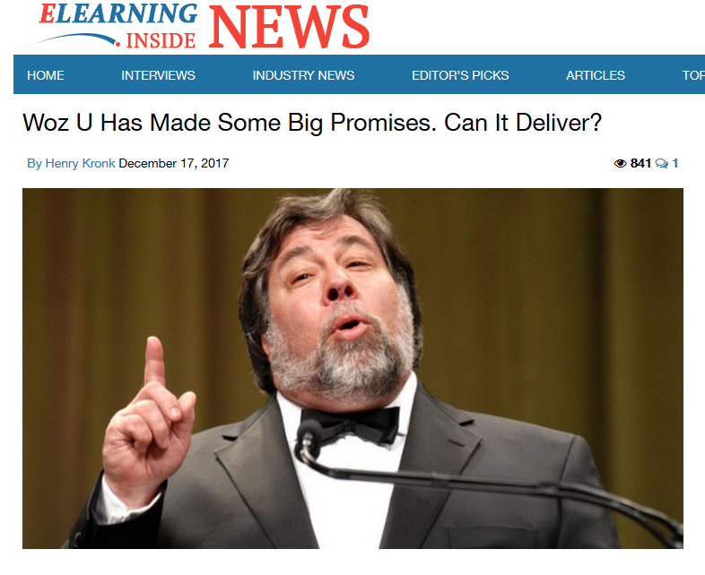
December 17, 2017
Woz U Has Made Some Big Promises. Can It Deliver?
Henry Kronk, ElearningInside News https://news.elearninginside.com/woz-u-made-big-promises-can-deliver/

Slide 17
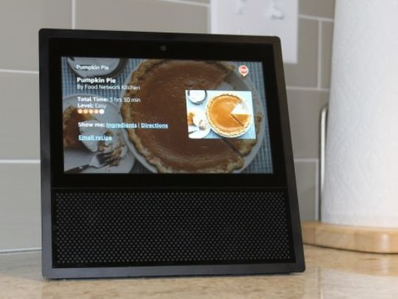
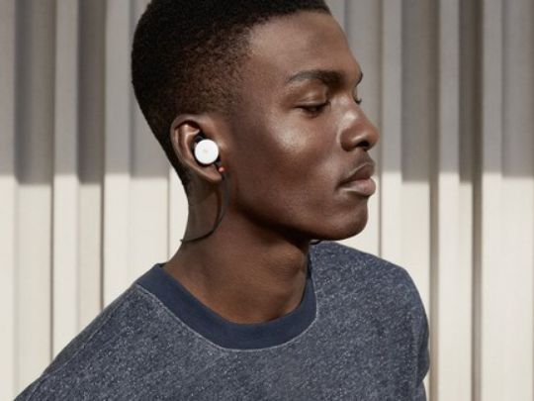
January 2, 2018
5G to AR: Here are 7 technologies to watch in 2018
Edward C. Baig, USA Today https://www.usatoday.com/story/tech/news/2018/01/02/artificial-intelligence-end-world-overblown-fears/985813001/
Augmented hearing

Slide 18
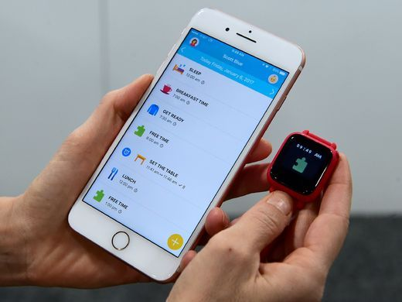
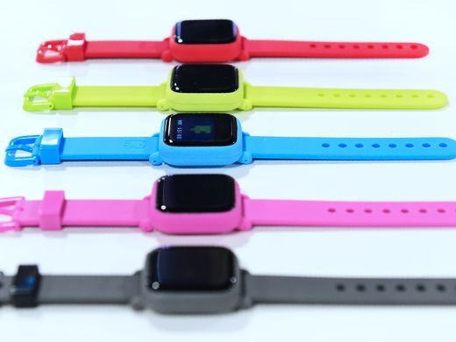
January 3, 2018
CES 2018: Your guide to the biggest consumer electronics show
USA Today https://www.usatoday.com/story/tech/news/2018/01/03/ces-2018-your-guide-biggest-consumer-electronics-show/1000778001/
The Octopus watch from Joy, an icon-based watch for kids to have good habits is on display during CES.

Slide 19
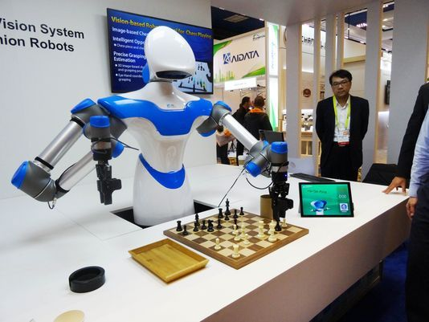
January 3, 2018
CES 2018: Your guide to the biggest consumer electronics show
USA Today https://www.usatoday.com/story/tech/news/2018/01/03/ces-2018-your-guide-biggest-consumer-electronics-show/1000778001/
A robot developed by Taiwan engineers moves chess pieces on a board against an opponent at the 2017 Consumer Electronic Show (CES) in Las Vegas, Nevada.(Photo: Rob Lever, AFP/Getty Images)

Slide 20
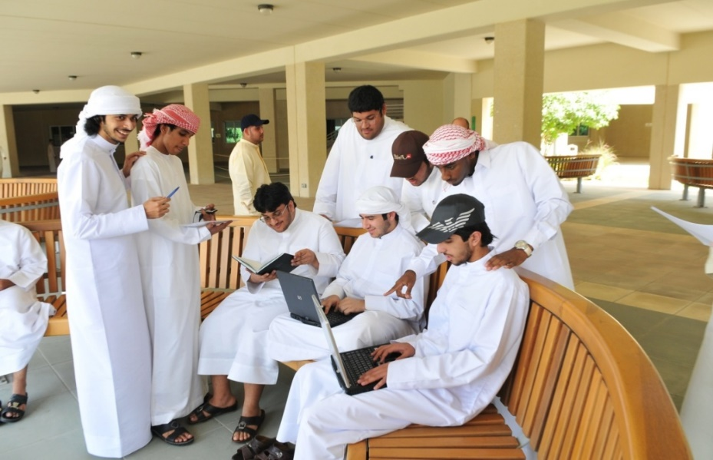

Clearly…
Learning is Changing!

Slide 21


Thirty Ways
Learning is Changing…
(i.e., it’s more informal, video-based, ubiquitous, collaborative, self-directed, global, mobile, open, massive, etc.)

Slide 22

30+ Ways Learning is Changing:
The Mega Trends

Slide 23

How Learning is Changing:
Mega Trend #1. Learner Engagement

Slide 24


July 17, 2017
Learning is More Collaborative
Buildings That Foster Collaboration,
Lawrence Biemiller, The Chronicle of Higher Education https://www.usatoday.com/story/money/2017/07/20/stocks-new-highs/496905001/
Social spaces, like this one in an interdisciplinary-science building at Arizona State U., don’t qualify for federal reimbursement of research-overhead costs. So now “we don’t build any single-purpose space,” says the university architect.

Slide 25





August 17, 2016
Learning is More Hands-on
Research: 3D Printing Market to Double by 2020, Joshua Bolkan, Campus Technology https://campustechnology.com/articles/2016/08/17/report-3d-printing-market-to-double-by-2020.aspx

Slide 26

January 12, 2017
Learning is More Hands-On
Pregnant Robots Give Birth to New Forms of Experiential Learning
Jenny Abamu, New Learning Times https://newlearningtimes.com/cms/article/4028/pregnant-robots-give-birth-to-new-forms-of

Slide 27


July 19, 2017
Learning is More Virtual
HoloLens Assists in Live Surgery
Tommy Palladino, Next Reality https://hololens.reality.news/news/hololens-assists-live-surgery-0178887/
Video #1: 1:09: http://curtbonk.com/hololens.html
Video #2: 1:37: http://curtbonk.com/hololens2.html
07/19/2017
HoloLens Assists in Live Surgery
Numerous examples exist of doctors and surgeons using HoloLens to plan surgeries. The device has even been used to view reference images during a procedure and stream it to a remote audience. Until recently, it has not been used to augment the surgeon's view of the patient during a live surgery.
Original Video: https://hololens.reality.news/news/hololens-assists-live-surgery-0178887/

Slide 28




July 19, 2017
Learning is More Virtual
Modern medicine breathes new life into virtual training https://www.usatoday.com/videos/tech/2017/07/28/modern-medicine-breathes-new-life-into-virtual-training/104073696/
Videos
2:34 (entire video): http://curtbonk.com/vr-medicine4b.html
.01-.21: http://curtbonk.com/vr-medicine.html
.37-.56: http://curtbonk.com/vr-medicine2.html
.57-1.29: http://curtbonk.com/vr-medicine3.html
1:30-2:27: http://curtbonk.com/vr-medicine4.html

Slide 29



February 7, 2017 (Engagement)
Learning is More Social
YouTube takes on Facebook with mobile live
Jefferson Graham, USA Today http://www.usatoday.com/story/tech/2017/02/07/youtube-takes-facebook-mobile-live/97566592/

Slide 30


October 16, 2017 (Engagement)
Learning is More Synchronous
Zoom Weekly Guests, Maria Solomou, Sept. 20, 2017
Personal Zoom link: https://IU.zoom.us/j/8123222878

Slide 31





May 7, 2015 (Engagement)
Learning is More Adventurous
Aaron Doering, Chasing Seals, TEDx http://chasingseals.com/ https://twitter.com/chasingseals

Slide 32






August 4, 2017
Learning is More Mobile
When our smartphones leave us out of touch
Brett Molina, USA Today https://www.usatoday.com/story/tech/news/2017/08/04/smartphones-distracted-walking-iphone-while-parenting-we-out-touch/519452001/

Slide 33



Learning is More Free
Want “FREE” engagement?
How about
“Adding Some TEC-VARIETY”? http://tec-variety.com/

Slide 34

How Learning is Changing:
Mega Trend #2. Pervasive Access

Slide 35




August 9, 2017
Learning is More Immediate…
The biggest dinosaur in history: Archaeologists reveal 122ft long PATAGOTITAN
Titanosaurs: the largest animals ever to walk the Earth https://www.theguardian.com/science/2016/jan/17/dinosaur-titanosaur-largest-animal-ever-walk-earth-argentina https://www.youtube.com/watch?v=4QohEL9_4_w

Slide 36




June 7, 2017
Learning is More Immediate…
Oldest Fossils of Homo Sapiens Found in Morocco, Altering History of Our Species, Carl Zimmer, The New York Times https://www.nytimes.com/2017/06/07/science/human-fossils-morocco.html?emc=edit_nn_20170608&nl=morning-briefing&nlid=53811944&te=1&_r=0

Slide 37


August 1, 2016 (Access)
Learning is More Ubiquitous
363 by Idea Group; Study Café
Meeting Place; Idea Space (Seoul, Korea) http://363.co.kr/wp/?page_id=244 http://363.co.kr/wp/?bw_gallery=study-cafe_11

Slide 38


November 1, 2017
Learning is More Online
Indiana University
Office of Online Education

Slide 39


June 7, 2016
Learning is More Free
Teaching refugees how to code
CNN Money http://money.cnn.com/video/technology/2016/06/07/recoded-flatiron-refugees-code.cnnmoney/index.html

Slide 40


August 5, 2015 (Access)
Learning is More Informal
Shubham Jaglan (10 years old) Overwhelmed by "Dream" Return Home After Double World Championship
Disha Chopra, NDTV Sports http://sports.ndtv.com/golf/news/246551-shubham-jaglan-overwhelmed-by-dream-return-home-after-double-world-championship http://www.ndtv.com/video/player/news/india-s-golf-prodigy-shubham-jaglan-returns-home-to-hero-s-welcome/377614

Slide 41



May 19, 2016 (Access)
Learning is More Free and Open
From MOOC to bootcamp to MIT
MIT News, Office of Digital Learning
(Jin Wu—from MITx to MIT Global Entrepreneurship Bootcamp to master’s student) http://news.mit.edu/2016/mooc-bootcamp-mit-0519

Slide 42




December 19, 2017
Learning is More Free and Open
OER Adoptions on the Rise
Lindsay McKenzie, Inside Higher Ed https://www.insidehighered.com/news/2017/12/19/more-faculty-members-are-using-oer-survey-finds

Slide 43


March 27, 2017 (Access)
Learning is More Free and Open
Beyond Free: Harnessing the resonant value in open and collaborative practices for the public good
David Porter, CEO, eCampus Ontario,
Open Education Ontario Summit https://www.slideshare.net/David_Porter https://www.ocls.ca/events/open-education-ontario-summit

Slide 44



March 27, 2017 (Access)
Learning is More Free and Open
Beyond Free: Harnessing the resonant value in open and collaborative practices for the public good
David Porter, CEO, eCampus Ontario,
Open Education Ontario Summit https://www.slideshare.net/David_Porter https://www.ocls.ca/events/open-education-ontario-summit

Slide 45



September 25, 2017
Learning is More Direct from Experts
Professors Have Taken Over the MOOCs:
How open online learning is changing
Joshua Kim, Inside Higher Ed https://www.insidehighered.com/blogs/technology-and-learning/professors-have-taken-over-moocs

Slide 46


January 9, 2017
Learning is More Direct from Experts
Jill Watson, Round Three
Georgia Tech course prepares for third semester with virtual teaching assistants
Jason Maderer, Georgia Tech News Center http://www.news.gatech.edu/2017/01/09/jill-watson-round-three

Slide 47

May 7, 2014 (Access)
Learning is More Global
CNA - Speaking Exchange (video chats) https://www.youtube.com/watch?v=-S-5EfwpFOk
FCB Brazil and the CNA language school network are launching the Speaking Exchange project, which connects CNA students in Brazil with Americans living in retirement homes.

Slide 48

How Learning is Changing:
Mega Trend #3. Customization

Slide 49



May 12, 2017 (Customization)
Learning is More Modifiable
The Future of Collaboration Spaces Encompasses Video
Interactive, Mobile, Julie Johnston, IU, Campus Technology https://campustechnology.com/articles/2016/09/07/the-future-of-collaboration-spaces-encompasses-video-interactive-mobile.aspx http://www.miamiherald.com/news/local/education/article143434384.html

Slide 50






May 9, 2017 (Customization)
Learning is On-Demand
Amazon Echo Show brings chatty Alexa to a two-way, video touchscreen
Edward C. Baig and Elizabeth Weise, USA Today https://www.usatoday.com/story/tech/reviews/2017/05/09/amazon-echo-show-touchscreen-video-alexa/101448844/
24 seconds: http://curtbonk.com/jetsons24.html
44 Seconds: http://curtbonk.com/jetsons44.html

Slide 51




April 17, 2017
Learning is More Blended
Facebook's future will blend physical and digital worlds
Jessica Guynn, USA Today https://www.usatoday.com/story/tech/news/2017/04/17/facebook-f8-2017-augmented-reality-mark-zuckerberg-camera/100435690/

Slide 52



January 20, 2016 (Customization)
Learning is More Blended
Universities tap growth of craft beer, offer classes, Chicago Tribune http://www.chicagotribune.com/business/ct-college-craft-beer-offer-classes-20160120-story.html

Slide 53



October 13, 2017
Learning is More Massive
Udacity Official Declares MOOCs ‘Dead’
(Though the Company Still Offers Them)
Clarissa Shen, Vice President & International Executive, Udacity, Jeffrey R. Young, Ed Surge https://tinyurl.com/yaw4kbvr

Slide 54



August 12, 2016 (Customization)
A Life of Happiness and Fulfillment
Indian School of Business, Rajagopal Raghanathan https://www.class-central.com/mooc/2860/coursera-a-life-of-happiness-and-fulfillment
2:31 Happiness video: http://curtbonk.com/happiness.html

Slide 55




May 20, 2016 (Customization)
Learning is More Massive agMOOCs (India) http://www.agmoocs.in/

Slide 56


July 1, 2015 (Customization)
Learning is More Communal
Chapter 14: Creating a Temporary Spontaneous Mini-Ecosystem through a MOOC
Paul Kim and Charlie Chung, Stanford University
Figure 2. Twitter thread announcing the MOOC

Slide 57




June 14, 2016 (Customization)
Chapter 15: Learning About MOOCs by Talking to Students
Charles Severance, Univ. of Michigan
Anuar Lequerica, Class Central https://www.class-central.com/report/dr-chuck-graduate-ceremony-python-specialization/

Slide 58







MOOCs and Open Education Around the World http://routledge-ny.com/books/details/9781138807419/

Slide 59



October 30, 2017
Learning is More Massive
Report: 59% of employed data scientists learned skills on their own or via a MOOC
Alison DeNisco Rayome https://www.techrepublic.com/article/report-59-of-employed-data-scientists-learned-skills-on-their-own-or-via-a-mooc/

Slide 60

August 17, 2017
By the Numbers: MOOCs in 2016
Class Central, Dhawal Shah https://www.class-central.com/report/mooc-stats-2016/

Slide 61

August 7, 2017
MOOCs for Credit
FutureLearn and Coventry University to Roll Out 50 Online Degrees
Class Central, Dhawal Shah https://www.class-central.com/report/futurelearn-coventry-university-roll-50-online-degrees/

Slide 62


December 25, 2016
Learning is More Massive
Class Central https://www.class-central.com/report/mooc-stats-2016/

Slide 63



April 20, 2015 (Customization)
Learning is Self-Directed
250 MOOCs and Counting: One Man’s Educational Journey, Chronicle of Higher Education http://chronicle.com/article/250-MOOCsCounting-One/229397/?cid=at
If the MOOC movement has faded, nobody told Jima Ngei. Mr. Ngei, who lives in Port Harcourt, Nigeria, has completed and passed 250.
Jima Ngei: “I had this unrelenting fear that this miracle of free access might evaporate soon.”

Slide 64




January 9, 2018 (Customization)
Learning is More Modular
MIT launches MITx MicroMasters in Principles of Manufacturing, MIT Open Learning http://news.mit.edu/2018/mit-launches-new-mitx-micromasters-program-principles-manufacturing-0109

Slide 65

30+ Ways Learning is Changing:
Recapping the Three Mega Trends:
Engagement, Access, and Customization

Slide 66


Any Questions or Comments?
Slides at: TrainingShare.com
Papers: PublicationShare.com
Free book: http://tec-variety.com/
Email: curt@worldisopen.com

