Slide 1

Hyper-Engaging Strategies to Enhance, Extend, and Even Transform Your Teaching
Curtis J. Bonk| cjbonk@Indiana.edu
Indiana University Bloomington
Meina Zhu| meinazhuiu@gmail.com
Wayne State University

Slide 2

Opening Activity #1:
Type Answer in the Chat Window: What is your favorite online learning activity…?

Slide 3
Opening Activity #2:
Type Answer in the Chat Window: What is your favorite type of learning technology today…?

Slide 4
Opening Activity #3:
Type Answer in the Chat Window: What is the technology that you think will most impact learning 10 years from now…

Slide 5

Polling Question #4:
Are we in the midst of a:
A. Learning Evolution or
B. Learning Revolution…
C. Neither

Slide 6


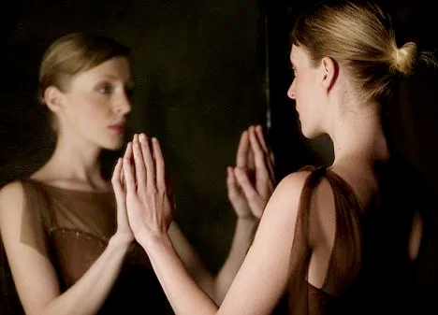
Poll #5: Have you reflected on your teaching philosophy or learning approach during the pandemic?
Yes many times and I am dramatically changing my philosophy statement.
Yes many times and I am taking action (meeting people, reading more, attending webinars like this, etc.).
Yes, I thought about it a couple of times and I am tweaking it.
Not sure. I’m kinda brain dead right now.
No, my teaching philosophy is basically the same.

Slide 7
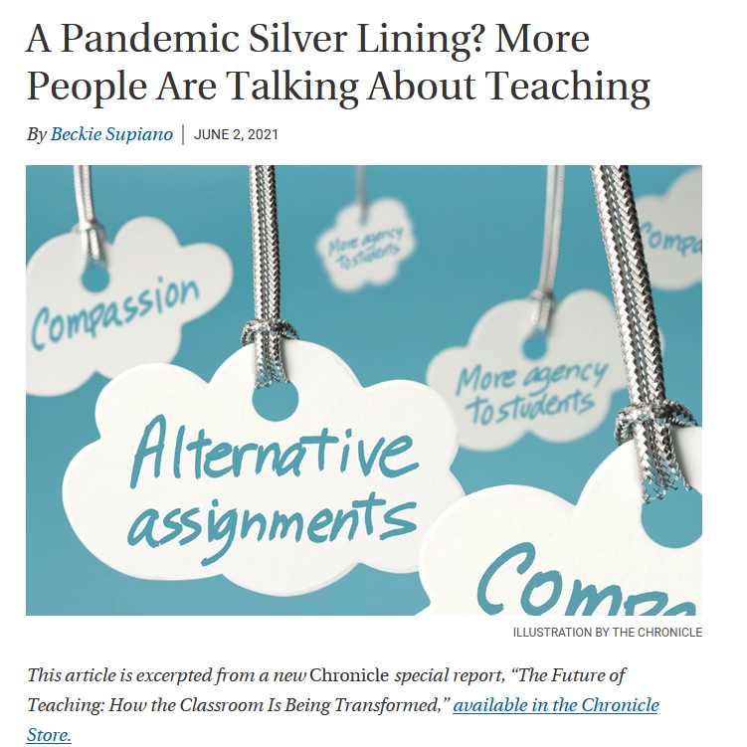

June 2, 2021
A Pandemic Silver Lining?
More People Are Talking About Teaching
Beckie Supiano, The Chronicle of Higher Education https://www.chronicle.com/article/a-pandemic-silver-lining-more-people-are-talking-about-teaching

Slide 8
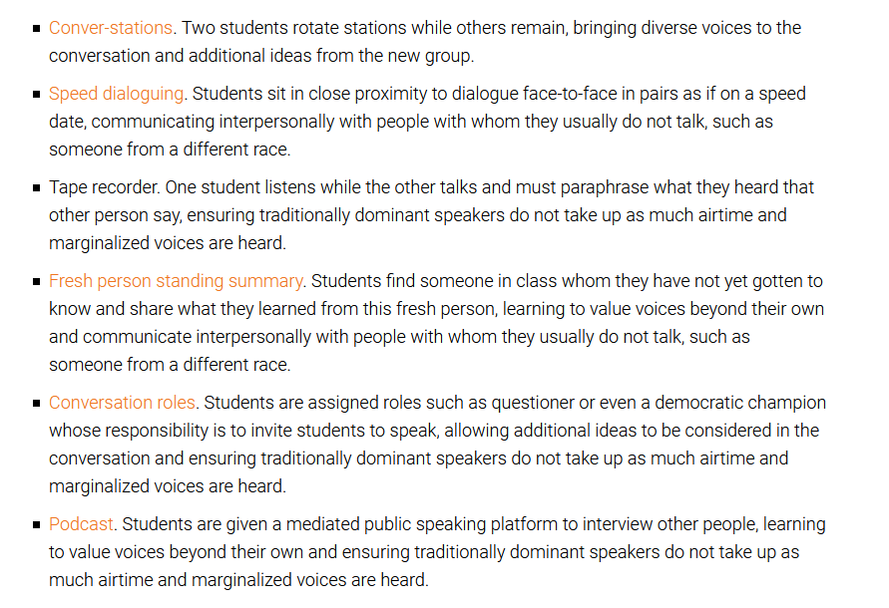
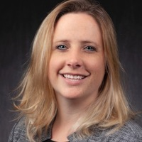
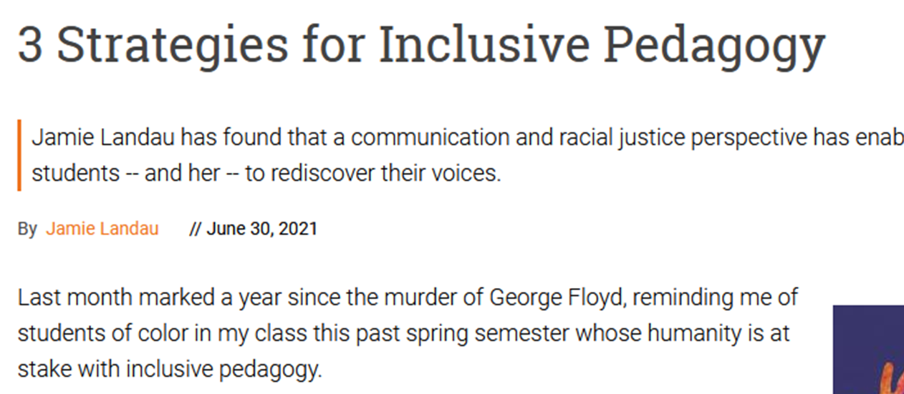
June 30, 2021
3 Strategies for Inclusive Pedagogy
Jamie Landau, Inside Higher Ed https://www.insidehighered.com/advice/2021/06/30/advice-instructors-making-classes-more-inclusive-opinion

Slide 9


Slide 10
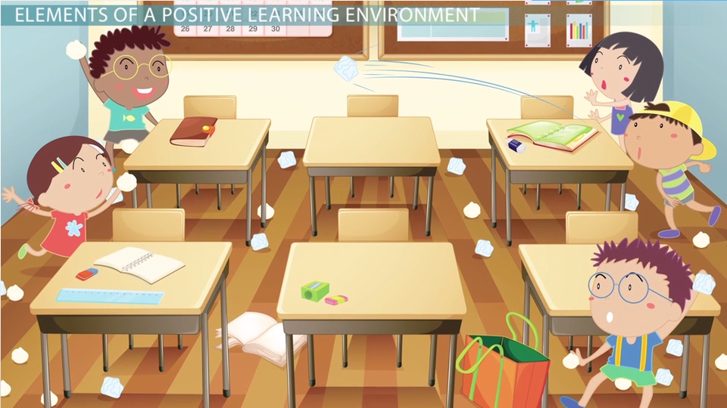
The Creation of Effective Learning Environments http://study.com/academy/lesson/learning-environment-in-the-classroom-definition-impact-importance.html

Slide 11
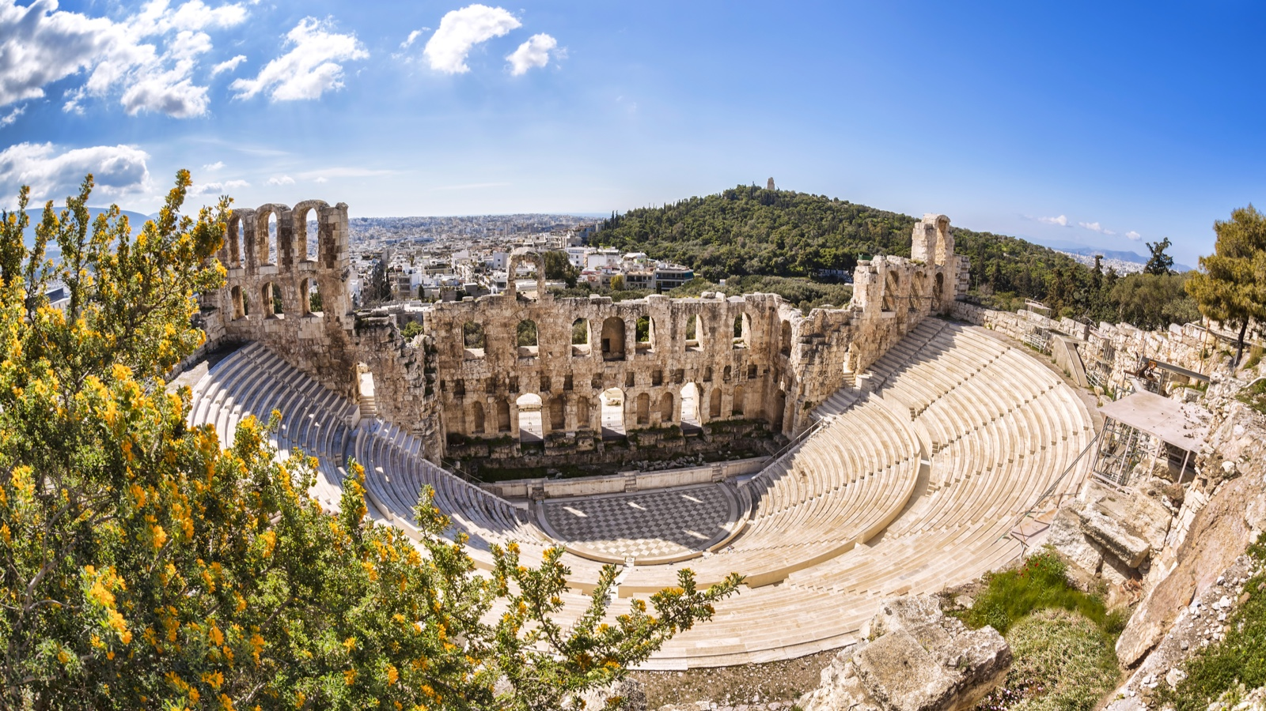
January 27, 2021
Indiana University's Collaborative Theatre: Perspectives on Innovation in Classroom Design
EDUCAUSE Review, Merve Basdogan, IU, UITS https://er.educause.edu/blogs/2021/1/indiana-universitys-collaborative-theatre-perspectives-on-innovation-in-classroom-design

Slide 12

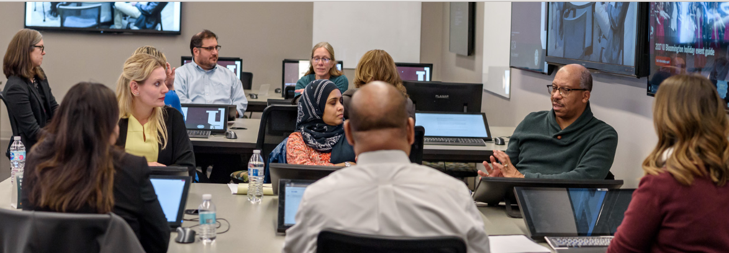
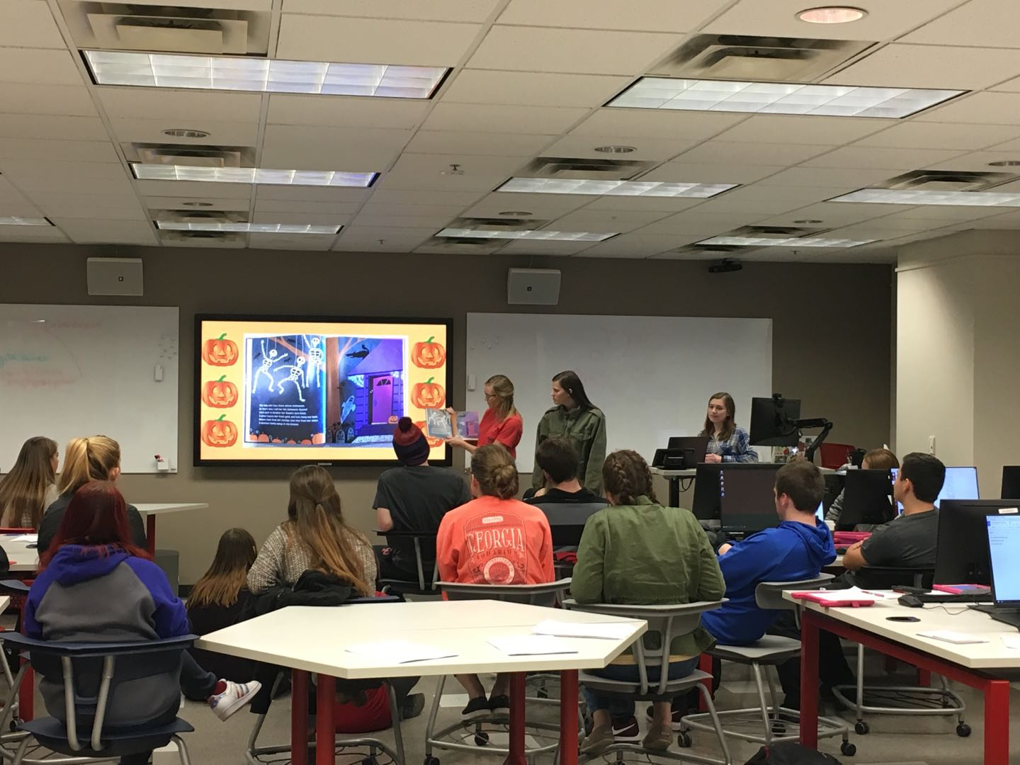
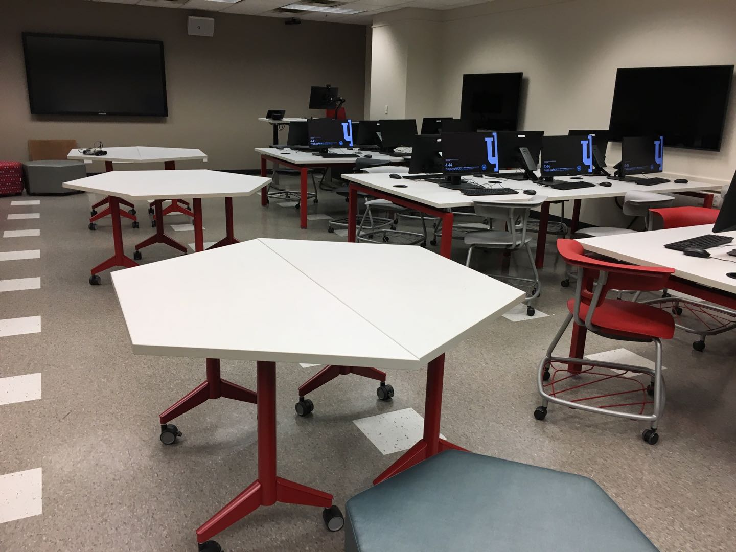
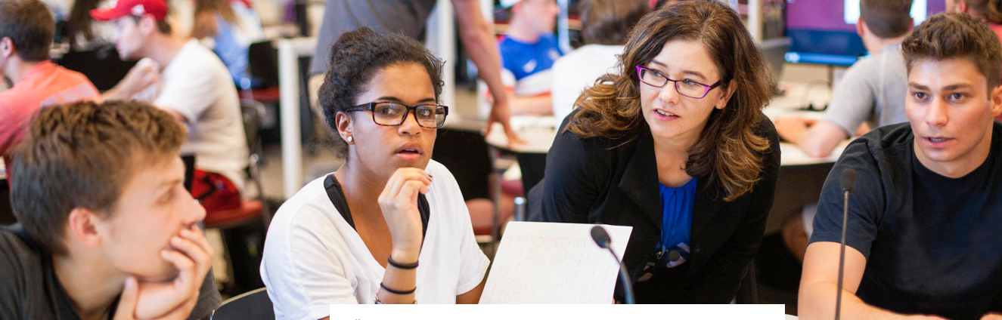
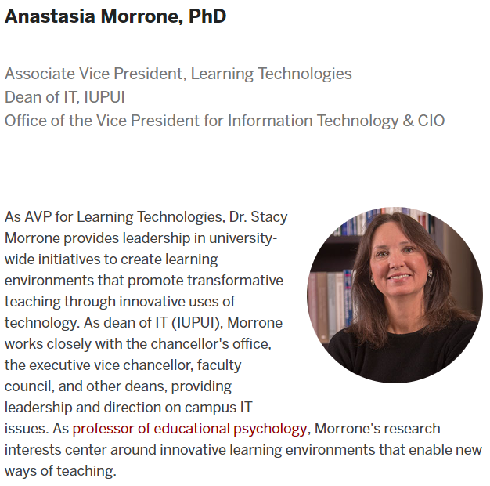
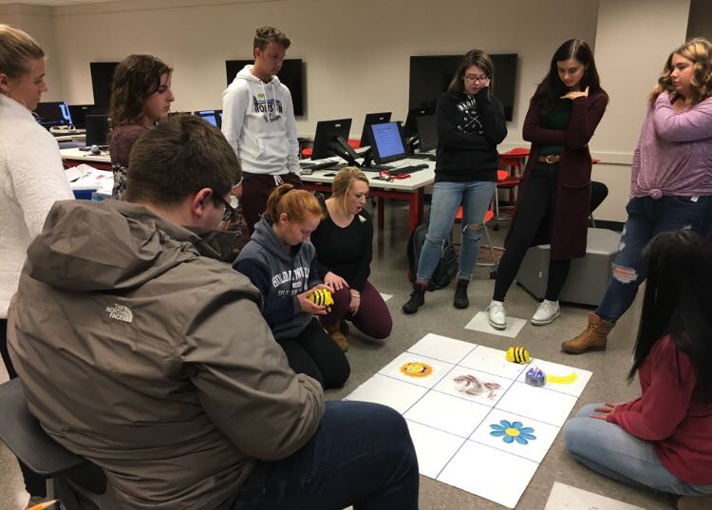
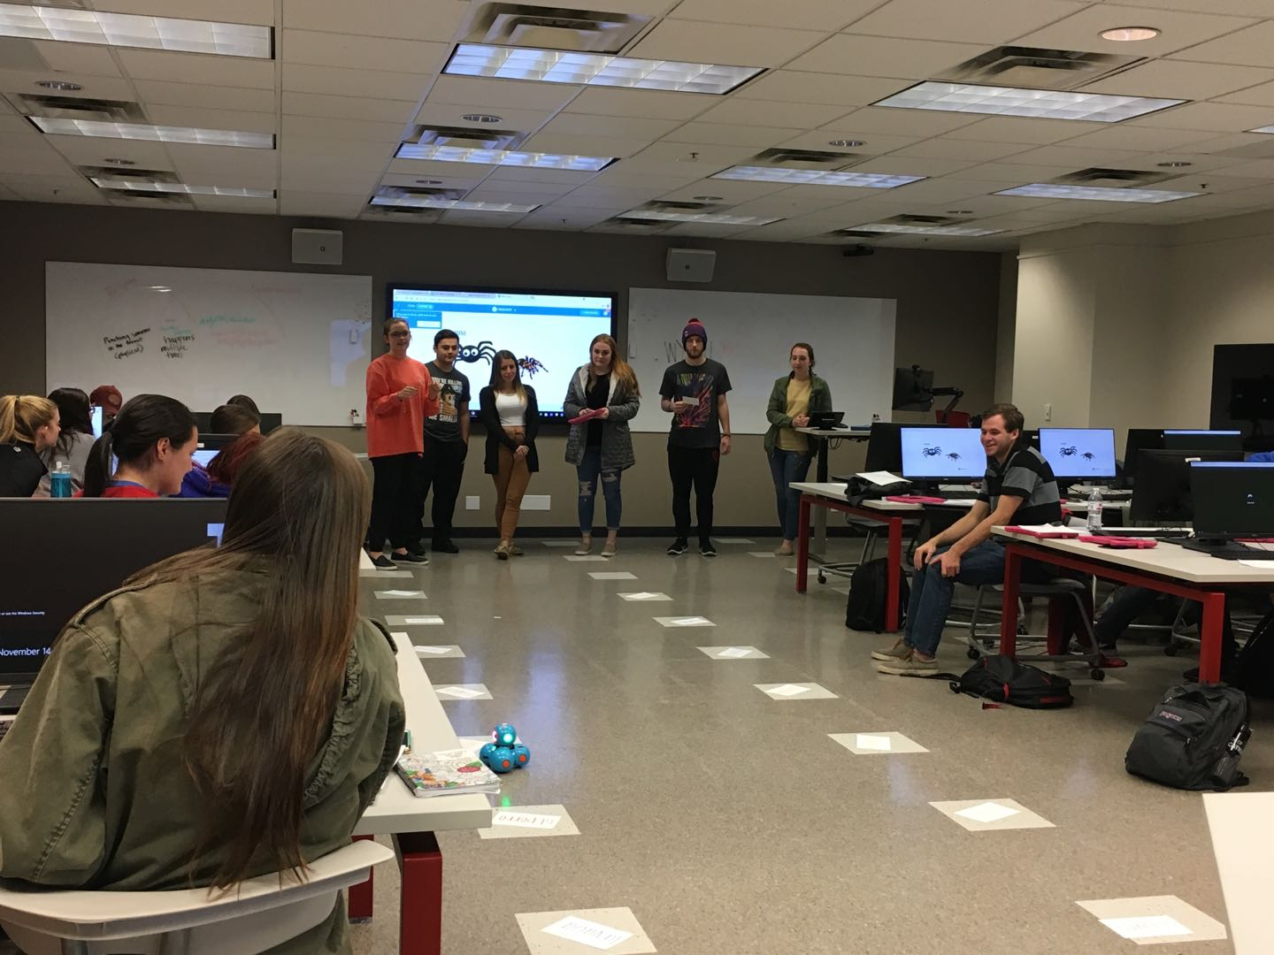
Mosaic Active Learning Classrooms
ALC for Pre-service Teachers’ CSCL
  Active learning classroom supported collaborative learning for pre-service teacher education
Notes:
https://mosaic.iu.edu/

Slide 13
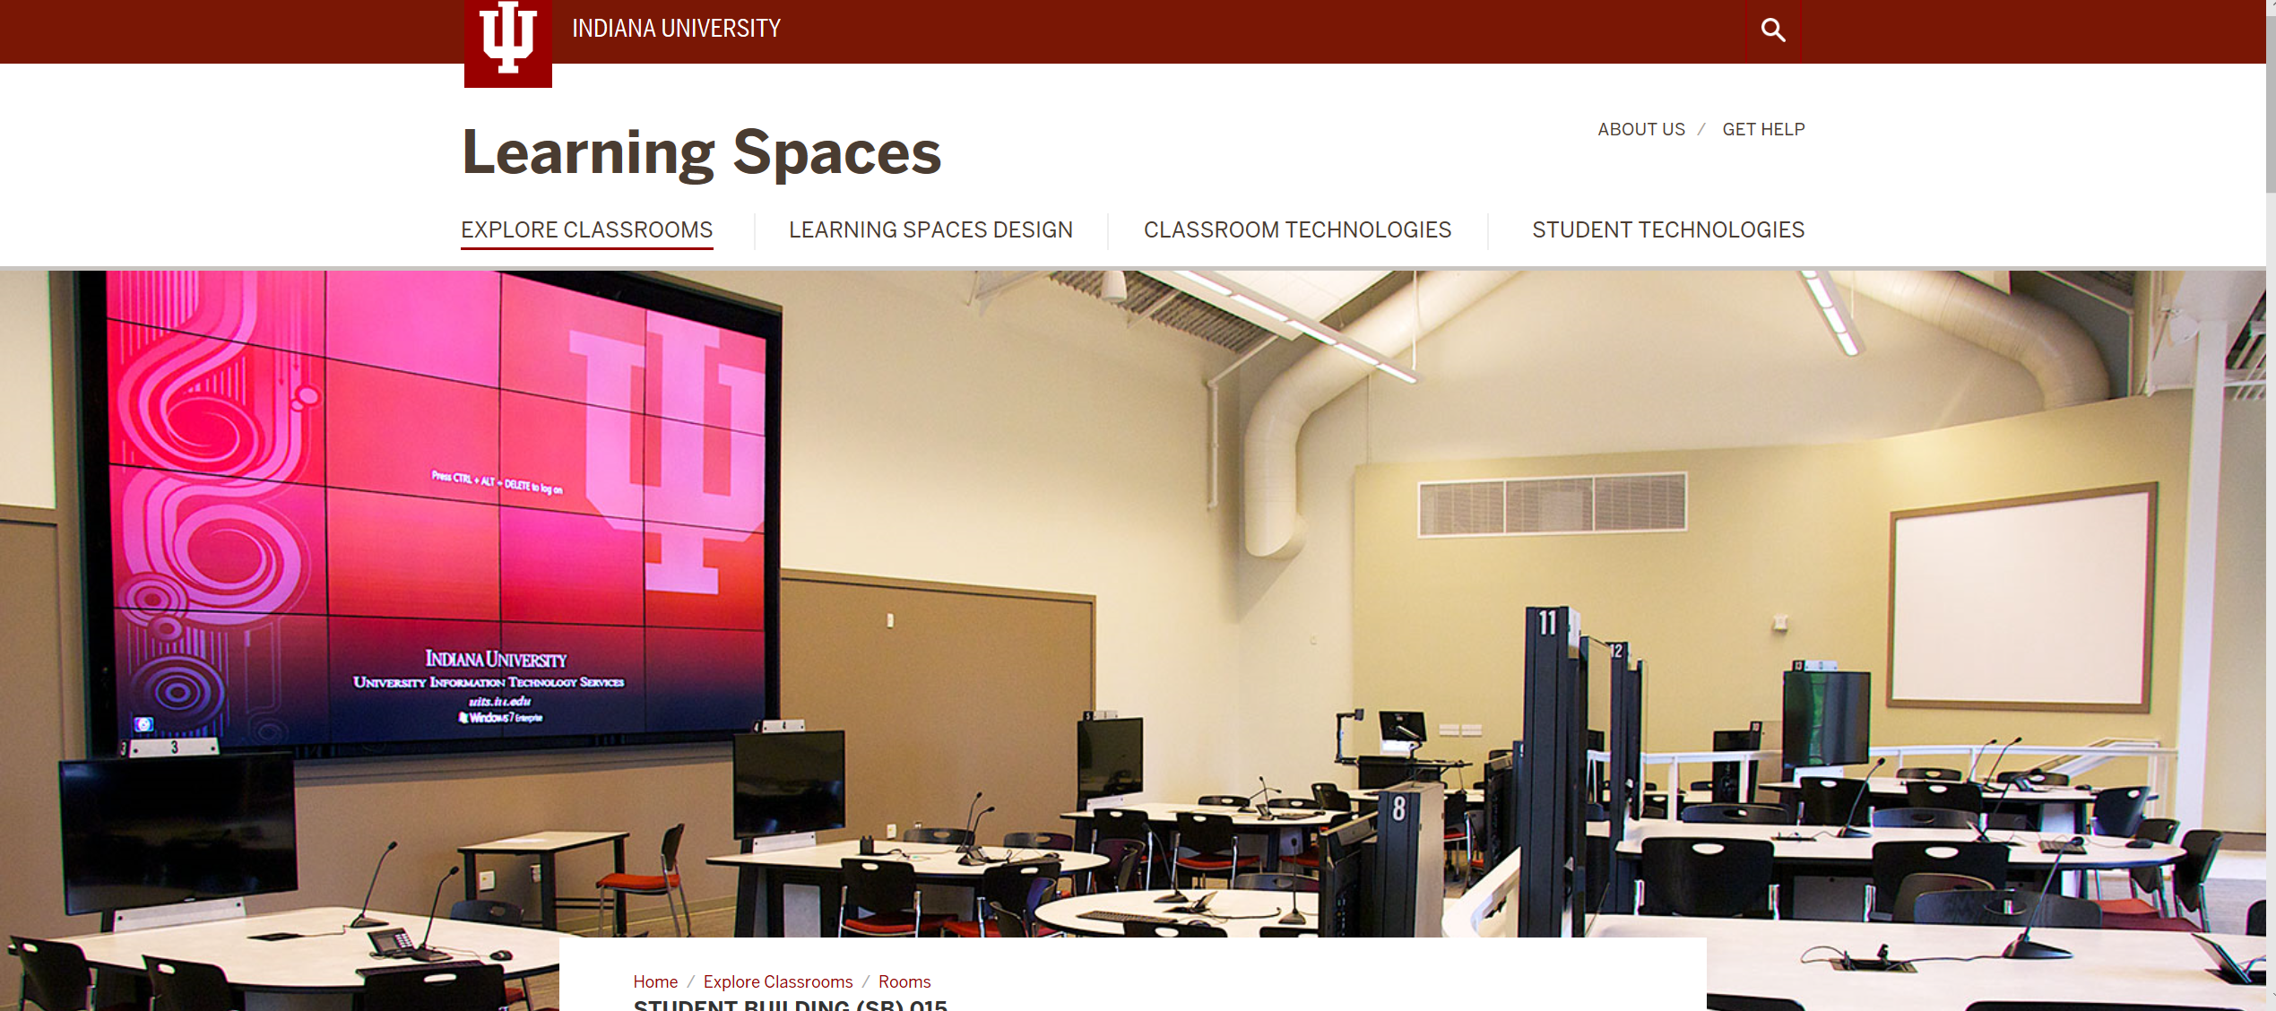
September 8, 2018
Mosaic Classrooms: Learning Spaces
Student Building 015 https://learningspaces.iu.edu/explore/rooms/SB015.html

Slide 14
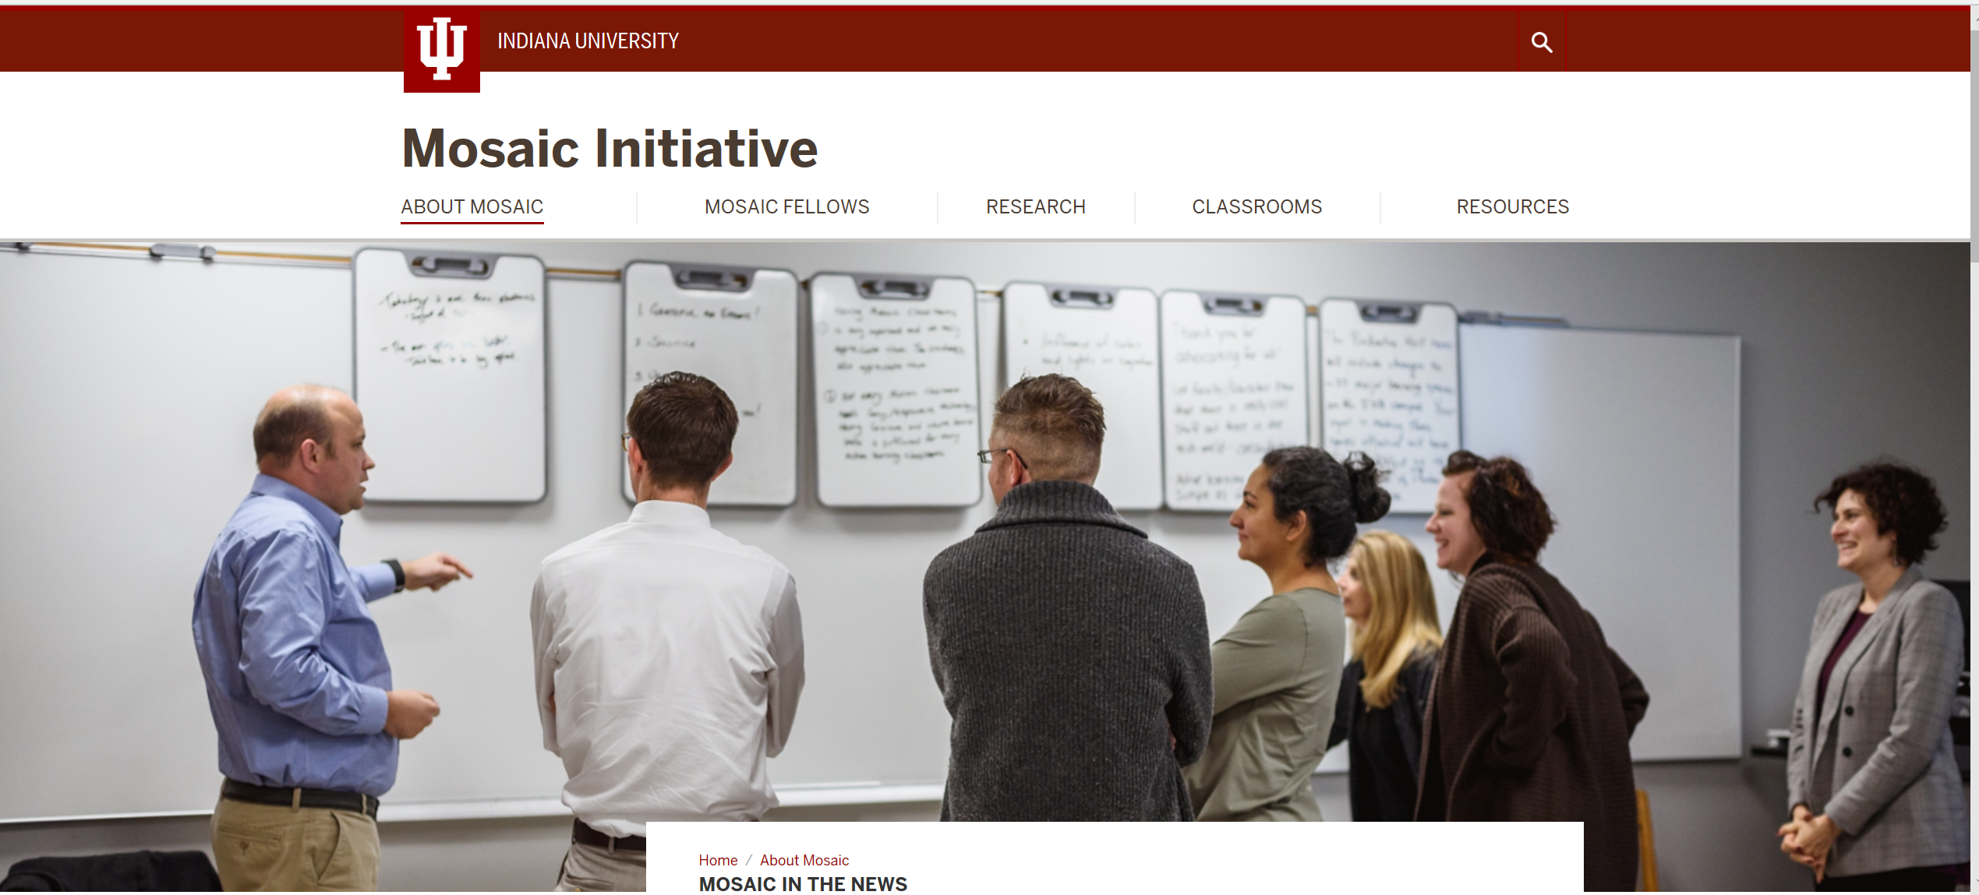
September 8, 2018
Mosaic in the News https://mosaic.iu.edu/about/news.html

Slide 15
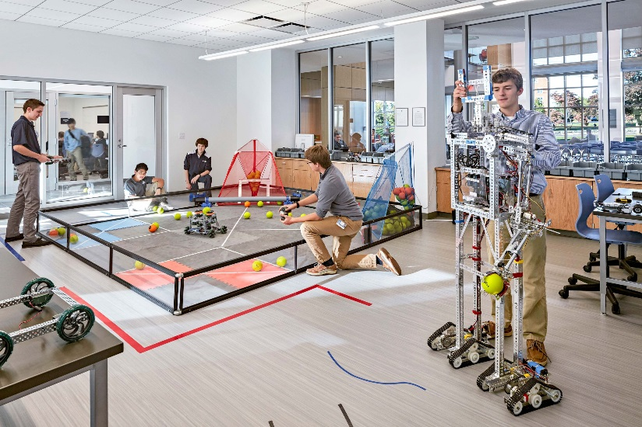
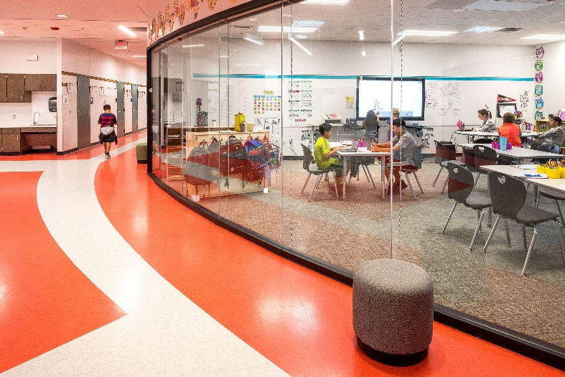
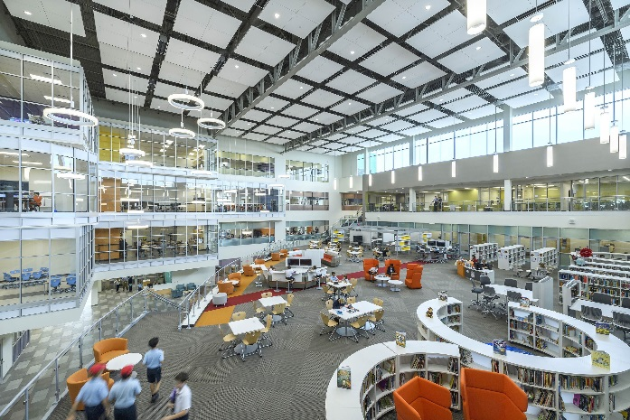
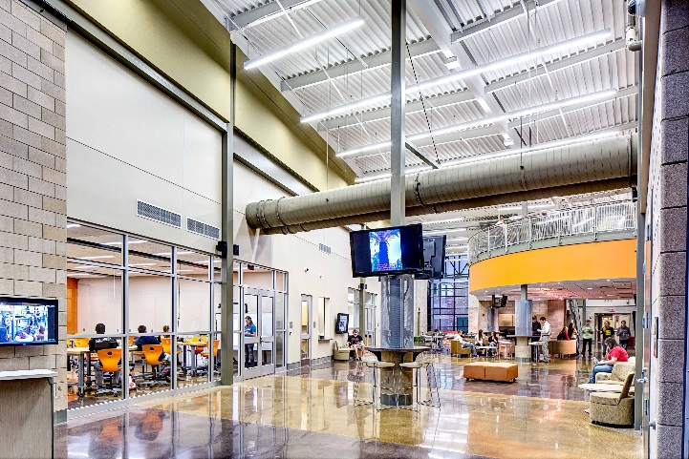
March 2, 2018
Learning is More Modifiable
The Architecture of Ideal Learning Environments
Emelina Minero, Edutopia https://www.edutopia.org/article/architecture-ideal-learning-environments

Slide 16
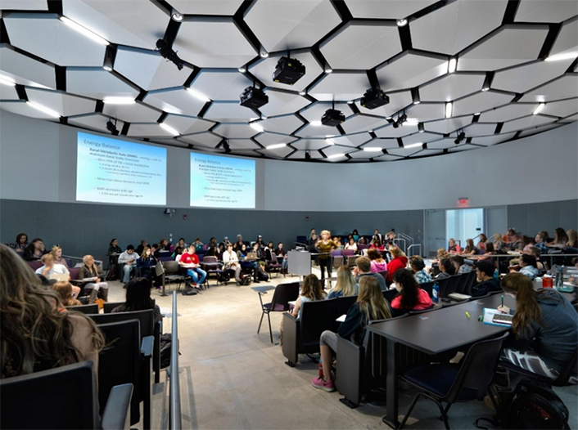
January 27, 2021
Indiana University's Collaborative Theatre: Perspectives on Innovation in Classroom Design
EDUCAUSE Review, Merve Basdogan, IU, UITS https://er.educause.edu/blogs/2021/1/indiana-universitys-collaborative-theatre-perspectives-on-innovation-in-classroom-design

Slide 17
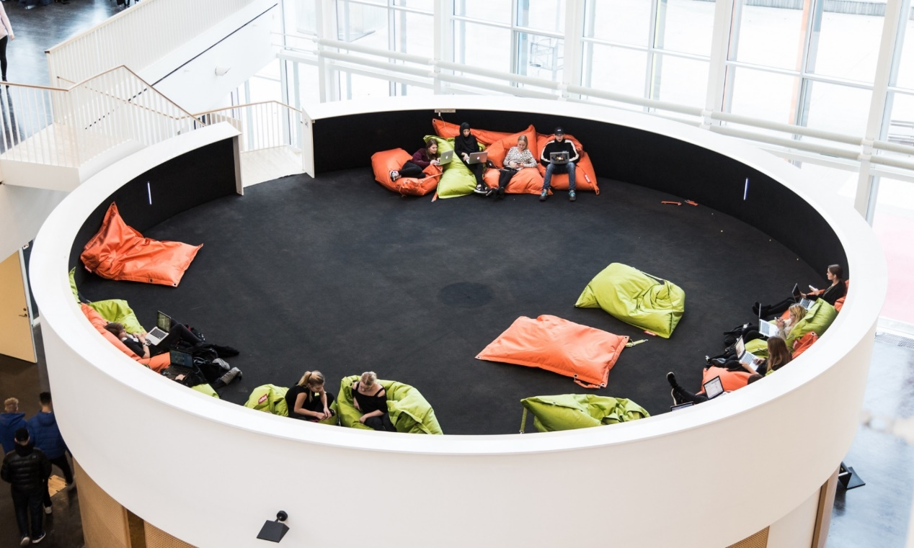
February 11, 2015
Inside the schools that dare to break with traditional teaching
The Guardian http://www.theguardian.com/teacher-network/2015/feb/11/schools-students-traditional-teaching
Ørestad Gymnasium (Copenhagen, Denmark), a school without classrooms, is designed to fit the ethos of 50% teacher-led learning and 50% independent student-centred learning. Photograph: Mathias Eis Schultz

Slide 18
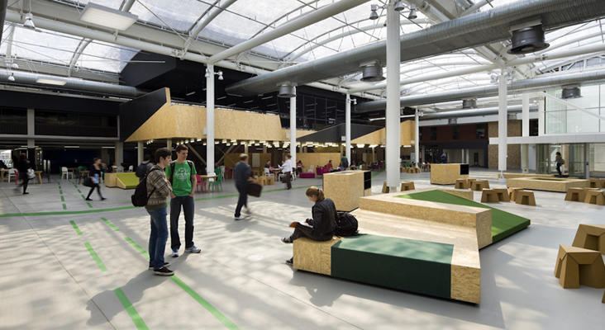
Learning Hub
(the University of Adelaide)

Slide 19
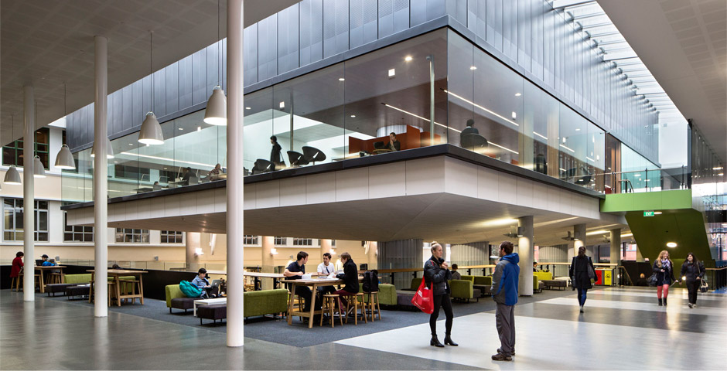
Learning Hub
(the University of Adelaide)

Slide 20
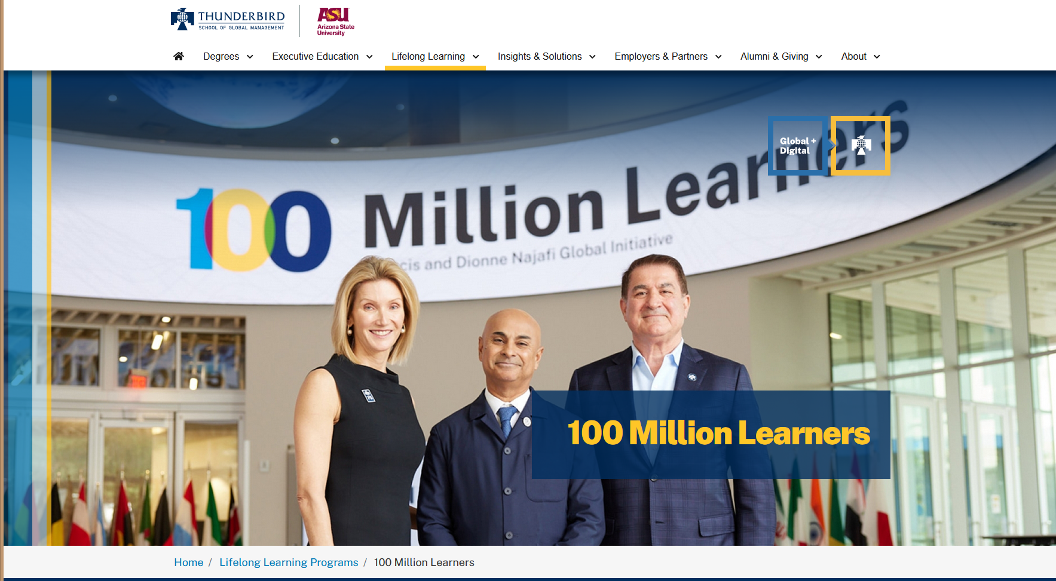
January 20, 2022
Francis and Dionne Najafi 100 Million Learners Global Initiative.
Video (2:07): https://vimeo.com/667987472?embedded=true&source=vimeo_logo&owner=13433234 https://thunderbird.asu.edu/lifelong-learning/100-million-learners

Slide 21
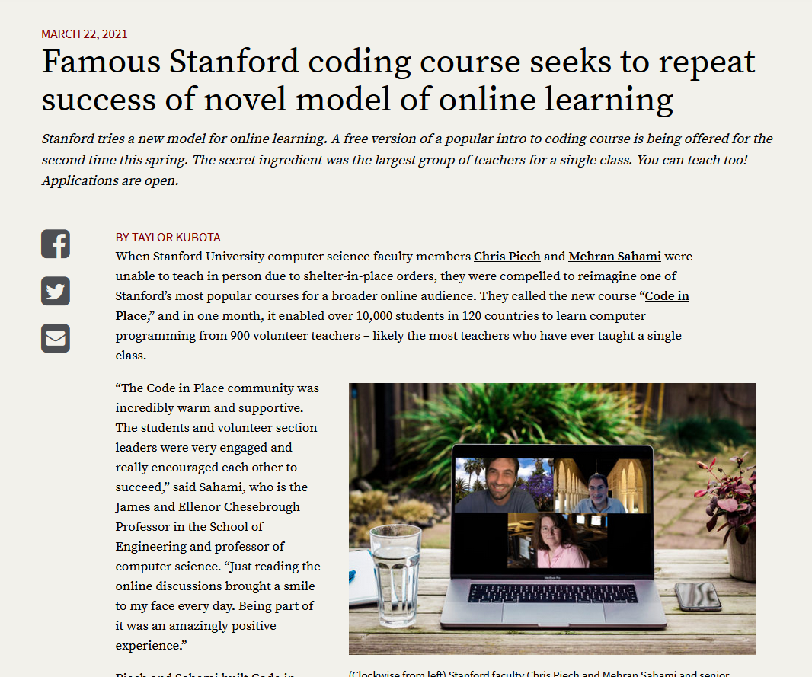
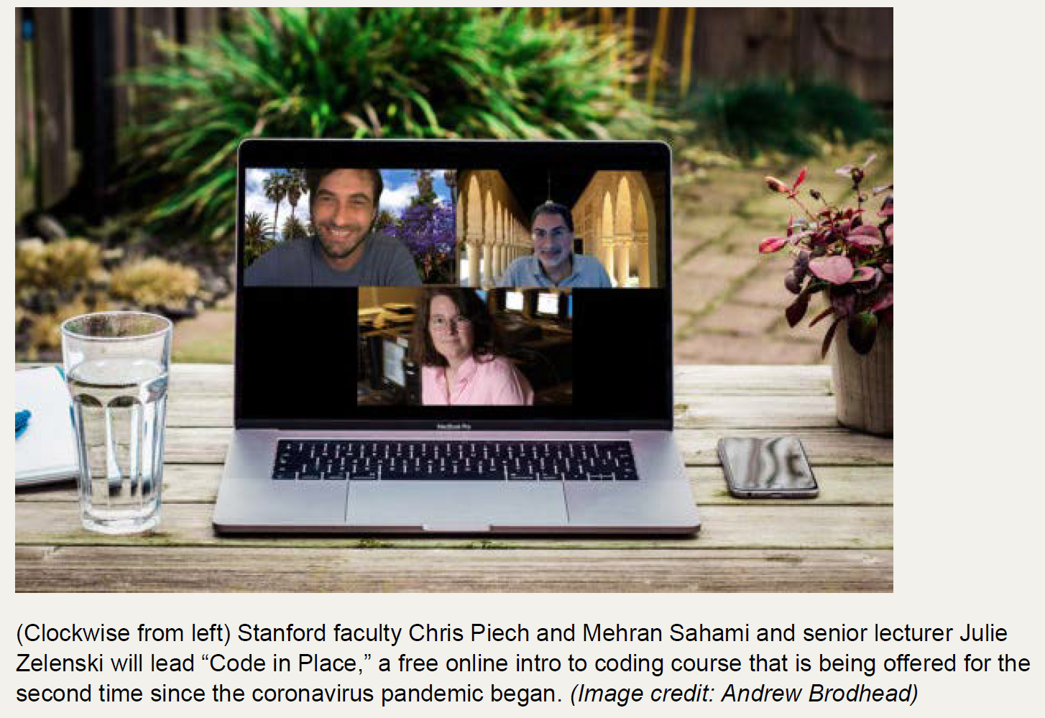
March 22, 2021
Famous Stanford coding course seeks to repeat success of novel model of online learning
(10,000 students, 120 countries, 900 volunteer teachers) https://news.stanford.edu/2021/03/22/famous-stanford-coding-course-free-online/

Slide 22
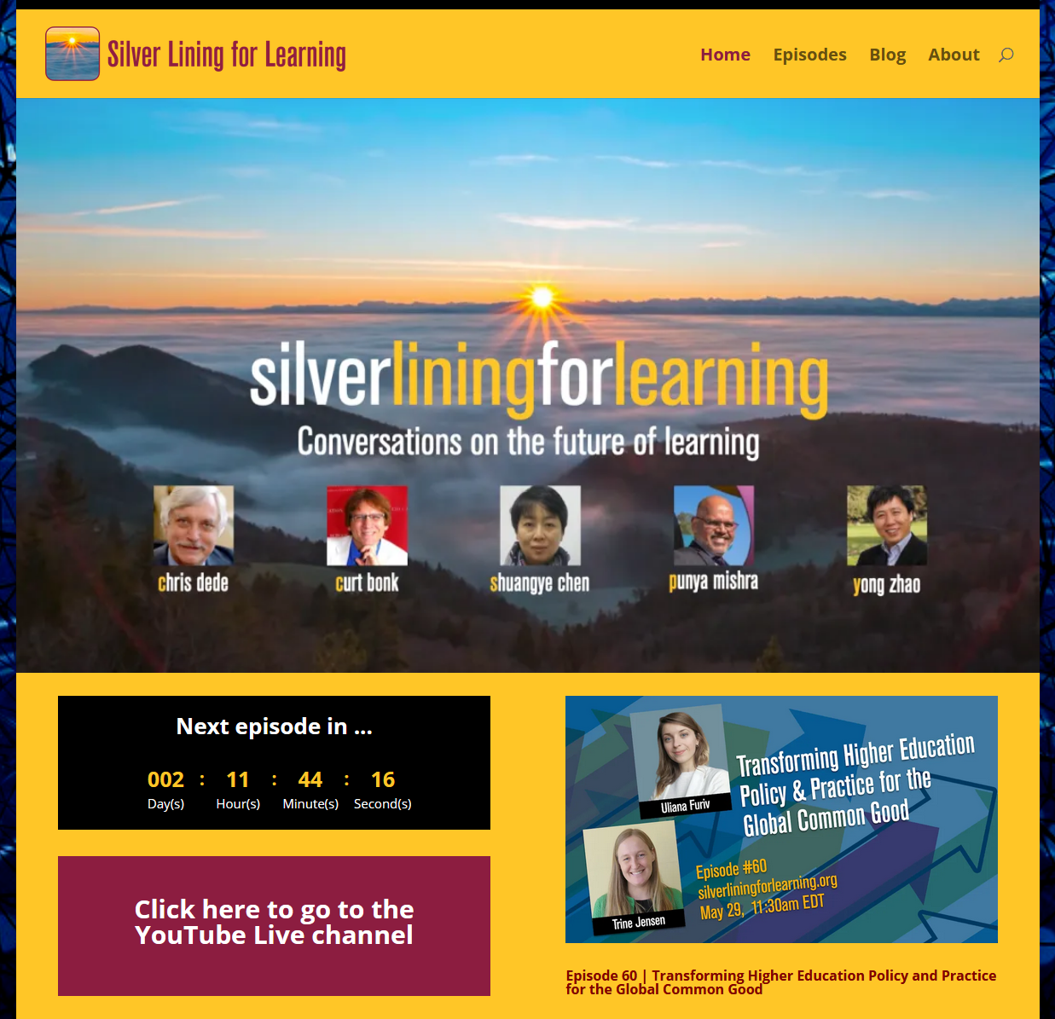
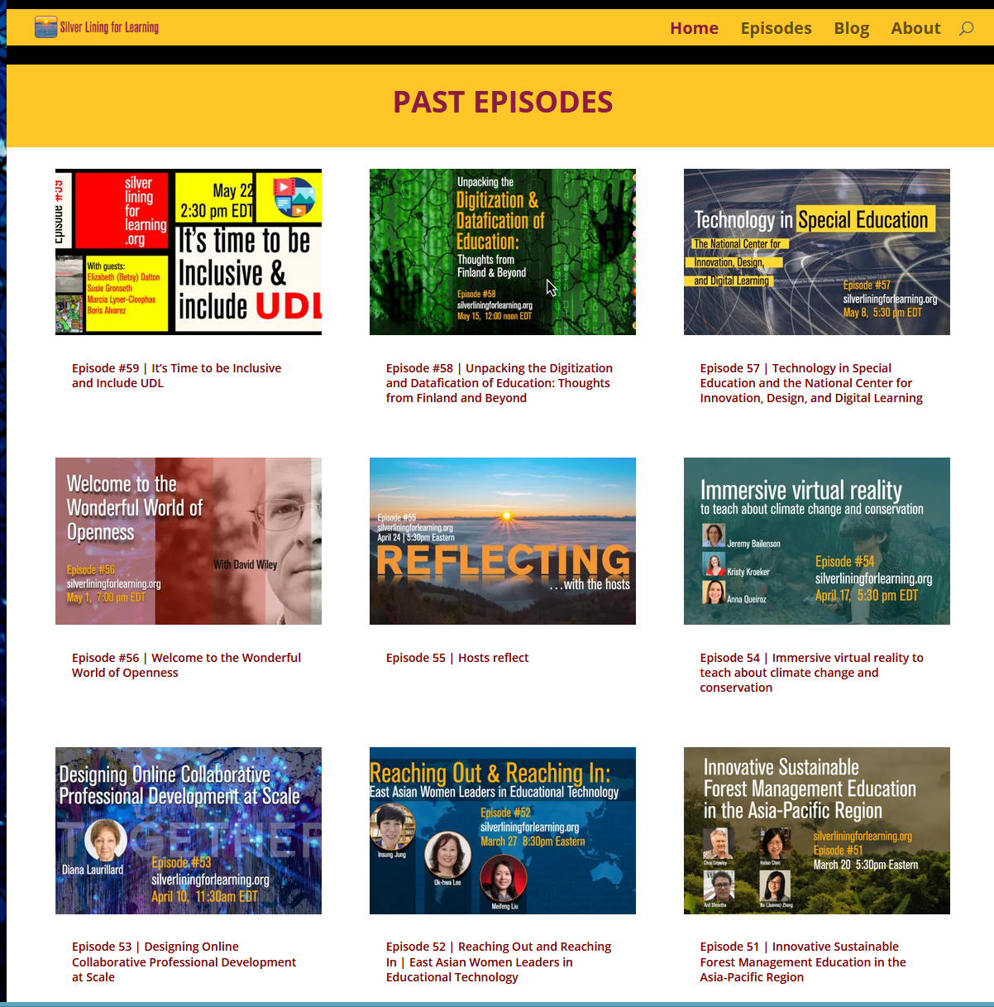
May 29, 2021
New Models of Education Emerging
Silver Lining for Learning https://silverliningforlearning.org/

Slide 23
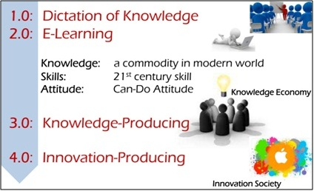
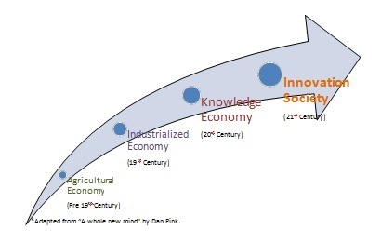

Now What is Education 4.0?
“Innovation-producing education. Learn more in: Development of Individual Agency within a Collaborative, Creative Learning Community” http://www.igi-global.com/dictionary/education-40/41755 https://thinc.in.th/engadmission/education4.html (Chula Engineering)

Slide 24
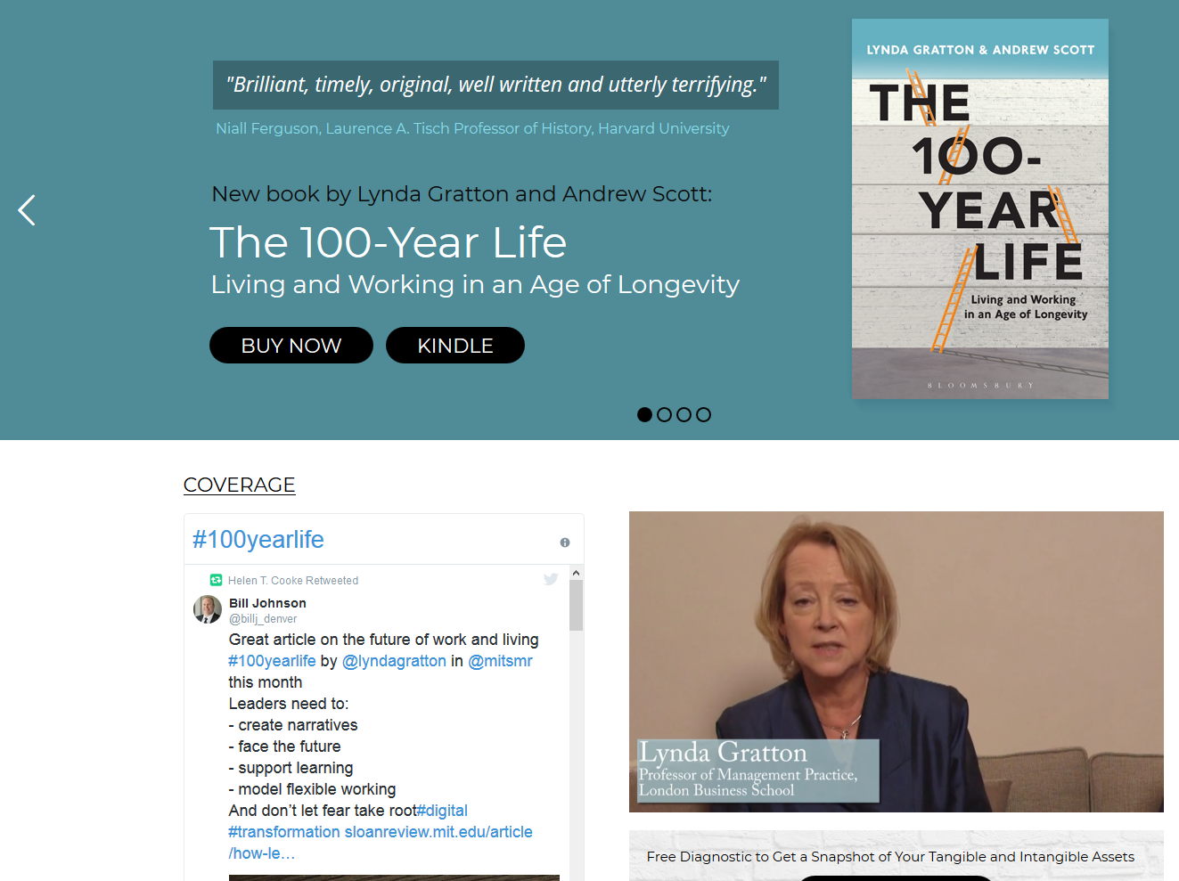

July 24, 2018
The 100-Year Life: Living and Working in an Age of Longevity
Lynda Gratton and Andrew Scott http://www.100yearlife.com/ https://www.amazon.com/100-Year-Life-Living-Working-Longevity/dp/1543624634

Slide 25
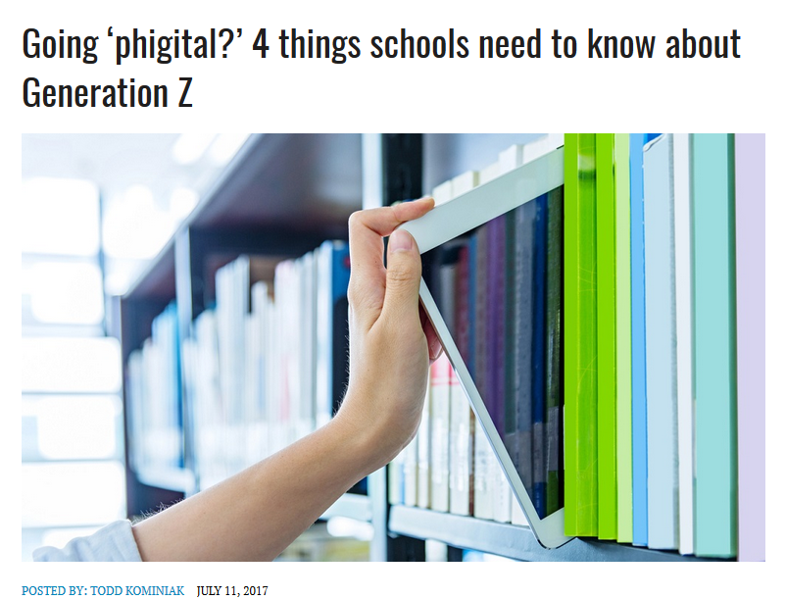
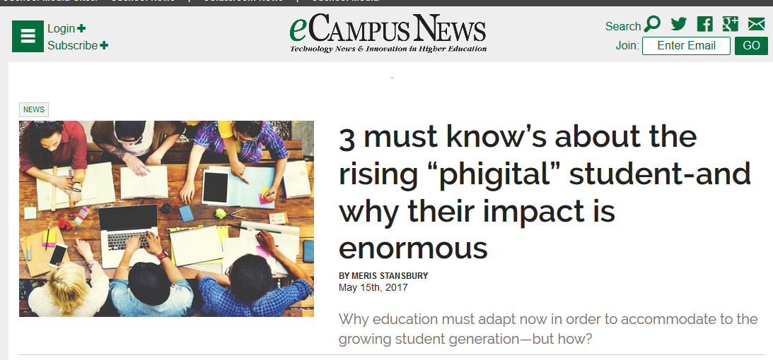
July 11, 2017
The Rise of the Phigital Learner
Going ‘phigital?’ 4 things schools need to know about Generation Z, Todd Kominiak, TrustEd http://trustedk12.com/phigital-digital-learning/
May 15, 2017
3 must know’s about the rising “phigital” student-and why their impact is enormous, Meris Stansbury, eCamous News https://www.ecampusnews.com/campus-administration/education-gen-z-phigital-student/

Slide 26
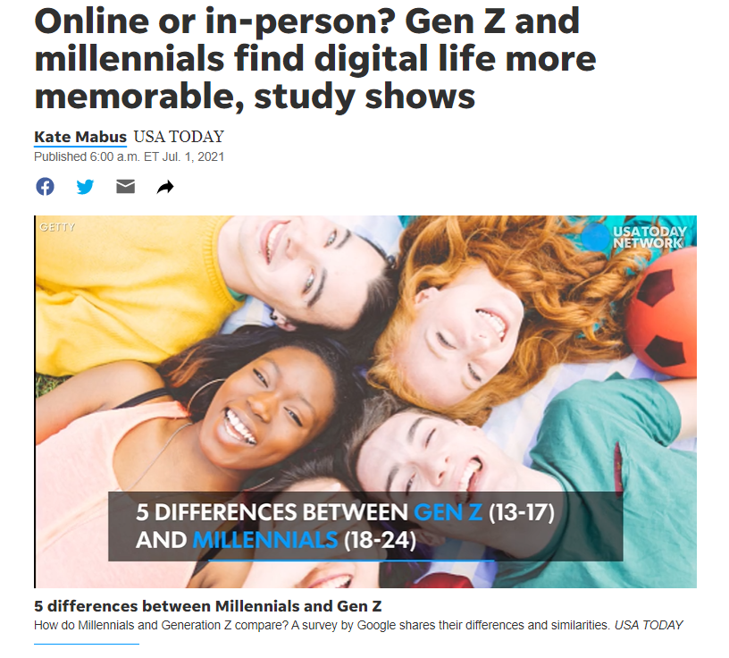
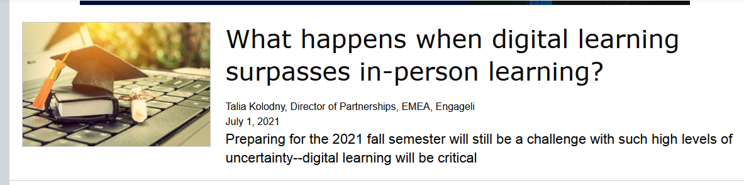
July 1, 2021
Online or in-person? Gen Z and millennials find digital life more memorable, study shows
Kate Mabus, USA Today https://www.usatoday.com/story/news/nation/2021/07/01/generation-z-millennial-survey-shows-digital-life-more-memorable/7783597002/
If there is one thing the pandemic is teaching us, it’s that deep human connections are essential for student and instructor wellbeing and for impactful education. As we move into a hybrid future, technology should not (and cannot!) replace human relationships and communications–it should enhance, enable, and enrich them.

Slide 27
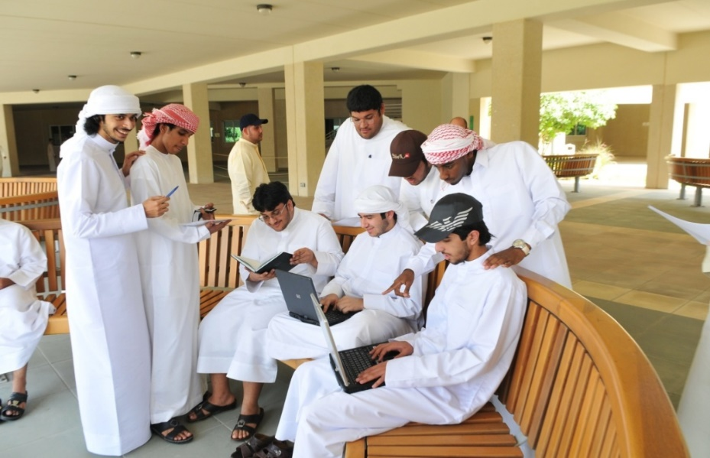
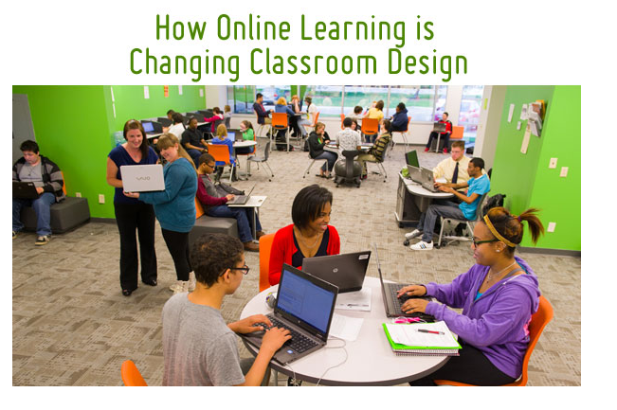
Clearly…
Learning is Changing!

Slide 28

Education 20/20

Slide 29

From Instructor as Credit Manager and Court Room Judge

Slide 30

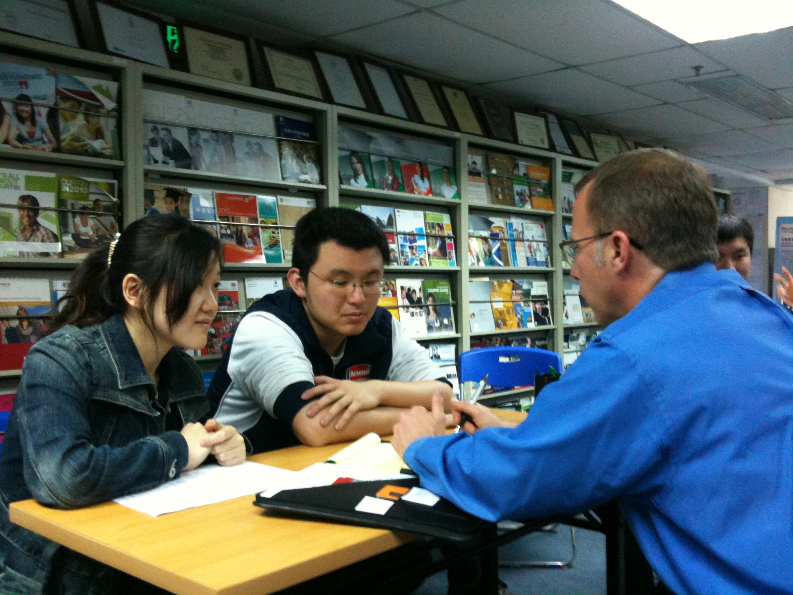
1. Instructor as Counselor

Slide 31

2. Instructor as Consultant

Slide 32

3. Instructor as Conductor

Slide 33
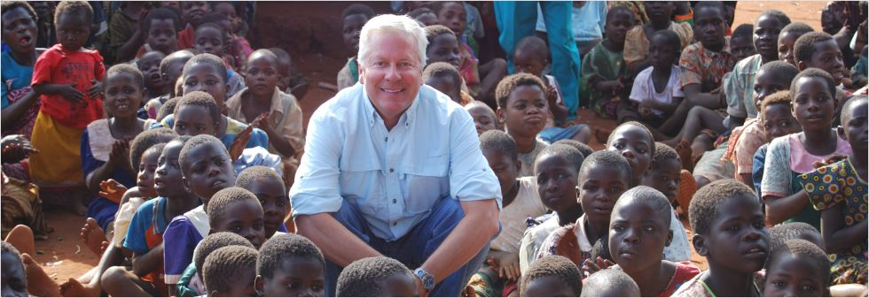
4. Instructor as Course Ambassador

Slide 34
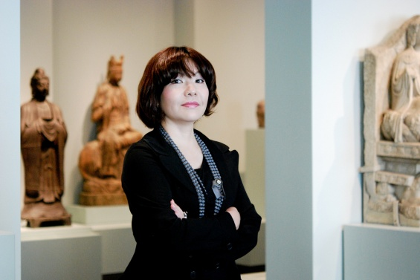
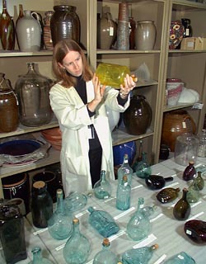
5. Instructor as Curator

Slide 35


6. Instructor as Concierge

Slide 36

7. Instructor as Camping Trip Guide

Slide 37
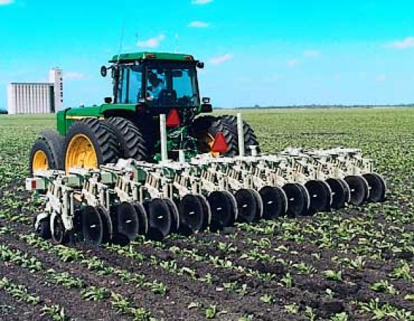
8. Instructor as Cultivator

Slide 38
20 New Roles of the Instructor
Course Ambassador
Captain
Consumer Advocate
Curator
Counselor
Cook
Change Catalyst
Concierge
Conductor
Comedian
Camping Trip Guide
Coach
Consultant
Course Expedition Leader
Collaborator
Community Organizer
Chemist
Care Giver
Cultivator
Colleague

Slide 40
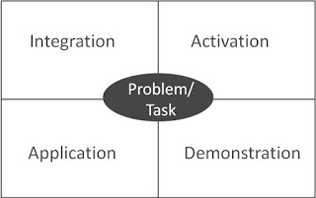
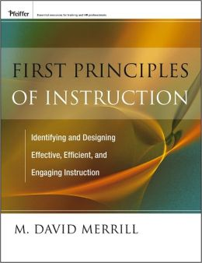
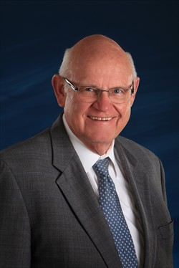
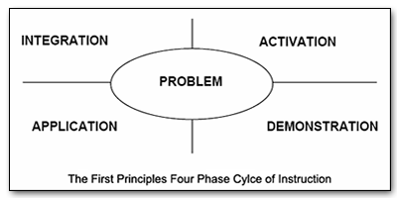
Merrill’s First Principles of Teaching/Instruction http://travelinedman.blogspot.com/2011/05/bonks-last-principles-of-instruction.html

Slide 41

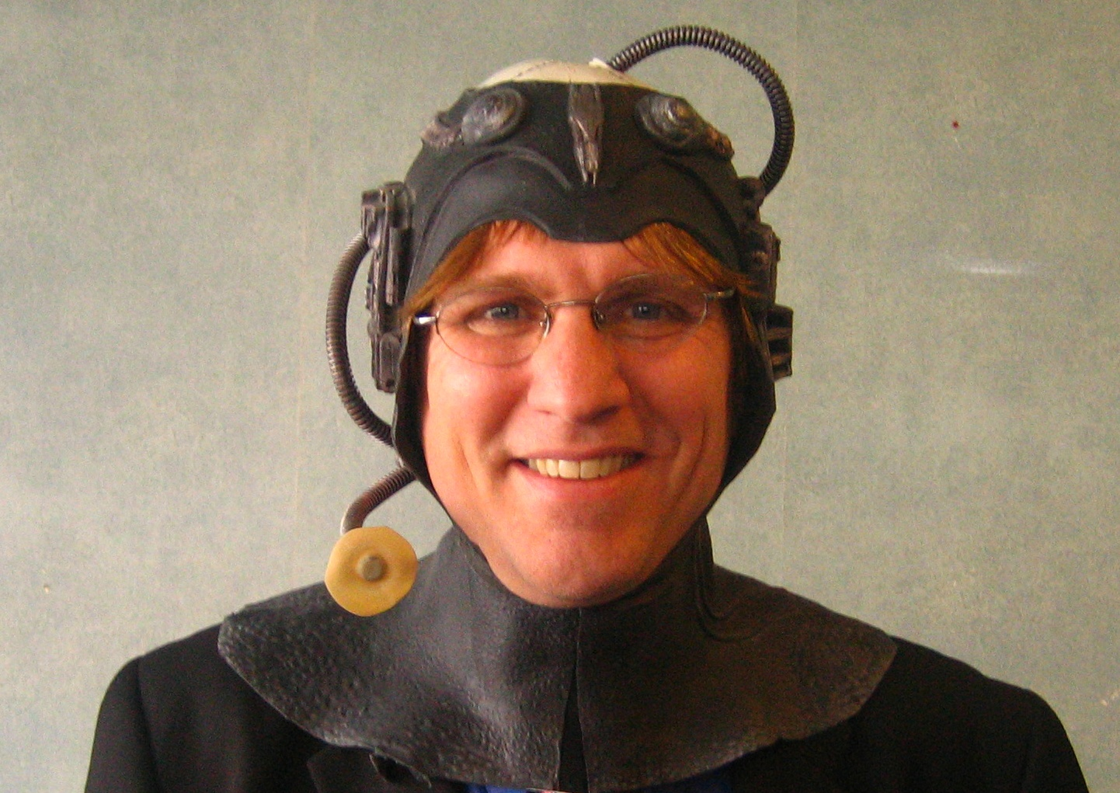
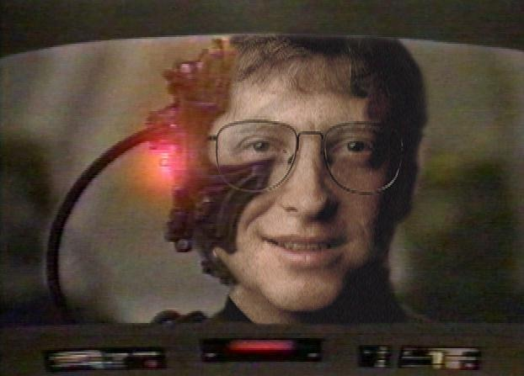
Overcoming the Resistance Movement

Slide 42

1. Incremental Change

Slide 43

2. Shared Success Stories and Best Practices

Slide 44
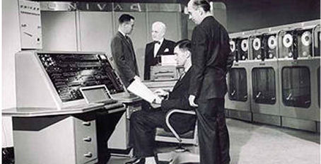
3. Modeling

Slide 45


4. Mentoring and Coaching

Slide 46



Bonk's Last Principles of Teaching/Instruction (Education 4.0?) http://travelinedman.blogspot.com/2011/05/bonks-last-principles-of-instruction.html http://www.applicadthai.com/articles/education-4-0/

Slide 47


1. The Principle of Flexibility http://travelinedman.blogspot.com/2011/05/bonks-last-principles-of-instruction.html

Slide 48

2. The Principle of Convenience http://travelinedman.blogspot.com/2011/05/bonks-last-principles-of-instruction.html

Slide 49

3. The Principle of Collegiality http://travelinedman.blogspot.com/2011/05/bonks-last-principles-of-instruction.html

Slide 50


4. The Principle of Cheerfulness and Optimism http://travelinedman.blogspot.com/2011/05/bonks-last-principles-of-instruction.html

Slide 51

5. The Principle of High Expectations http://travelinedman.blogspot.com/2011/05/bonks-last-principles-of-instruction.html

Slide 52

6. The Principle of Choice and Options http://travelinedman.blogspot.com/2011/05/bonks-last-principles-of-instruction.html

Slide 53


7. The Principle of Empowerment and Autonomy http://travelinedman.blogspot.com/2011/05/bonks-last-principles-of-instruction.html

Slide 54

8. The Principle of Support and Feedback http://travelinedman.blogspot.com/2011/05/bonks-last-principles-of-instruction.html

Slide 55

9. The Principle of Spontaneity http://travelinedman.blogspot.com/2011/05/bonks-last-principles-of-instruction.html

Slide 56

10. The Principle of Organization http://travelinedman.blogspot.com/2011/05/bonks-last-principles-of-instruction.html

Slide 57

11. The Principle of Sharing http://travelinedman.blogspot.com/2011/05/bonks-last-principles-of-instruction.html

Slide 58


12. The Principle of Nontraditional Learning http://travelinedman.blogspot.com/2011/05/bonks-last-principles-of-instruction.html

Slide 59


13. The Principle of Passion and Inspiration http://travelinedman.blogspot.com/2011/05/bonks-last-principles-of-instruction.html

Slide 60

14. The Principle of Relevance and Meaningfulness http://travelinedman.blogspot.com/2011/05/bonks-last-principles-of-instruction.html

Slide 61


15. The Principle of Trial and Error (i.e., it is ok to fail) http://travelinedman.blogspot.com/2011/05/bonks-last-principles-of-instruction.html

Slide 62

16. The Principle of Expanded Resources http://travelinedman.blogspot.com/2011/05/bonks-last-principles-of-instruction.html

Slide 63




The World is Open:
How Web Technology Is Revolutioning Education

Slide 64

The World is very open!
(South University of Science and Technology of China, Wednesday June 10, 2015)

Slide 65


The World is Wide Open!
(South University of Science and Technology of China, Wednesday June 10, 2015)

Slide 66






The World is Open

Slide 67

17. The Principle of Human Connectedness http://travelinedman.blogspot.com/2011/05/bonks-last-principles-of-instruction.html

Slide 68



18. The Principle of Cognitive Apprenticeship http://travelinedman.blogspot.com/2011/05/bonks-last-principles-of-instruction.html

Slide 69


19. The Principle of Purpose and Vision http://travelinedman.blogspot.com/2011/05/bonks-last-principles-of-instruction.html

Slide 70


20. ??? (what is missing) http://travelinedman.blogspot.com/2011/05/bonks-last-principles-of-instruction.html

Slide 71
Bonk's 20 "Last" Principles of Instruction
(LAST = Learning Activation System Template) http://travelinedman.blogspot.com/2011/05/bonks-last-principles-of-instruction.html
Choice and Options
Support and Feedback
Flexibility
Nontraditional Learning
Spontaneity
Passion and Inspiration
Convenience
Organization
Relevance and Meaningfulness
Collegiality
Sharing
Trial and Error (i.e., it is ok to fail)
Cheerfulness and Optimism
Expanded Resources
Purpose and Vision
High Expectations
#20 ???
Human Connectedness
Empowerment and Autonomy
Cognitive Apprenticeship

Slide 72



Thirty Ways
Learning is Changing…
(i.e., it’s more informal, video-based, ubiquitous, collaborative, self-directed, global, mobile, open, massive, etc.)
ARKit lets you create immersive augmented reality experiences on iOS devices. (Photo: Wareable)

Slide 73

Clearly…
Learning is Changing!

Slide 74



Poll #6:
Are you interested in Education 3.0?
A = Yes
B = No
C = Not sure

Slide 75




Poll #7: Is this an Evolution or Revolution?

Slide 76

Any Questions or Comments?
Curtis Bonk: cjbonk@Indiana.edu
Meina Zhu: meinazhuiu@gmail.com
http://www.trainingshare.com
(go to “Archived Talks)
Free book: http://tec-variety.com/

