Slide 1
Research on Self-Directed Learning and Motivation from MOOCs and Open Education
Curtis J. Bonk| cjbonk@Indiana.edu
Indiana University Bloomington
and
Meina Zhu| meinazhu@wayne.edu
Wayne State University

Slide 2
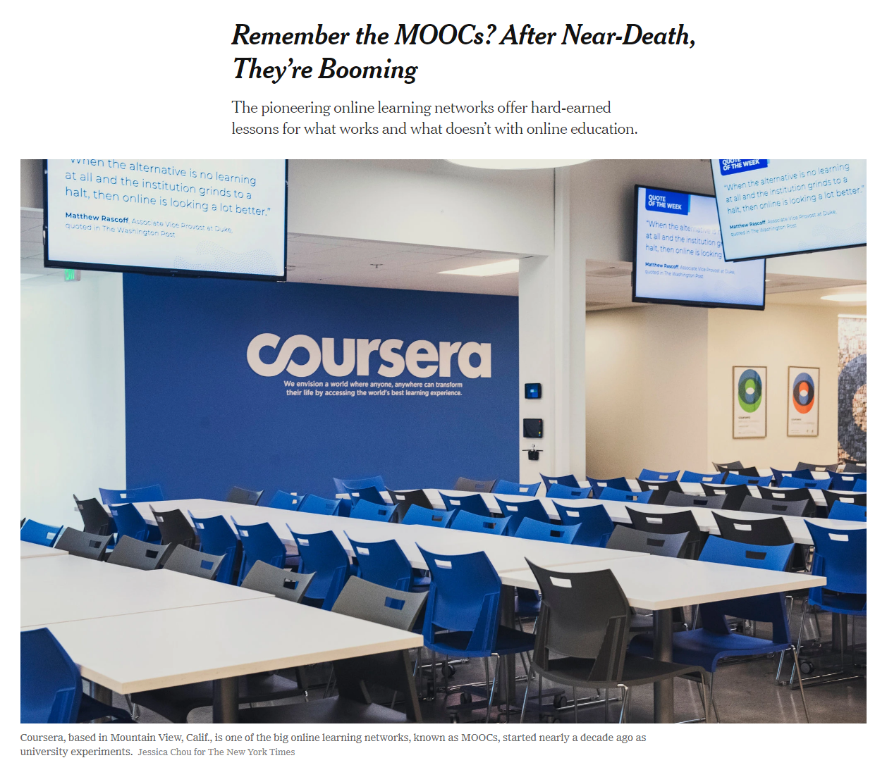

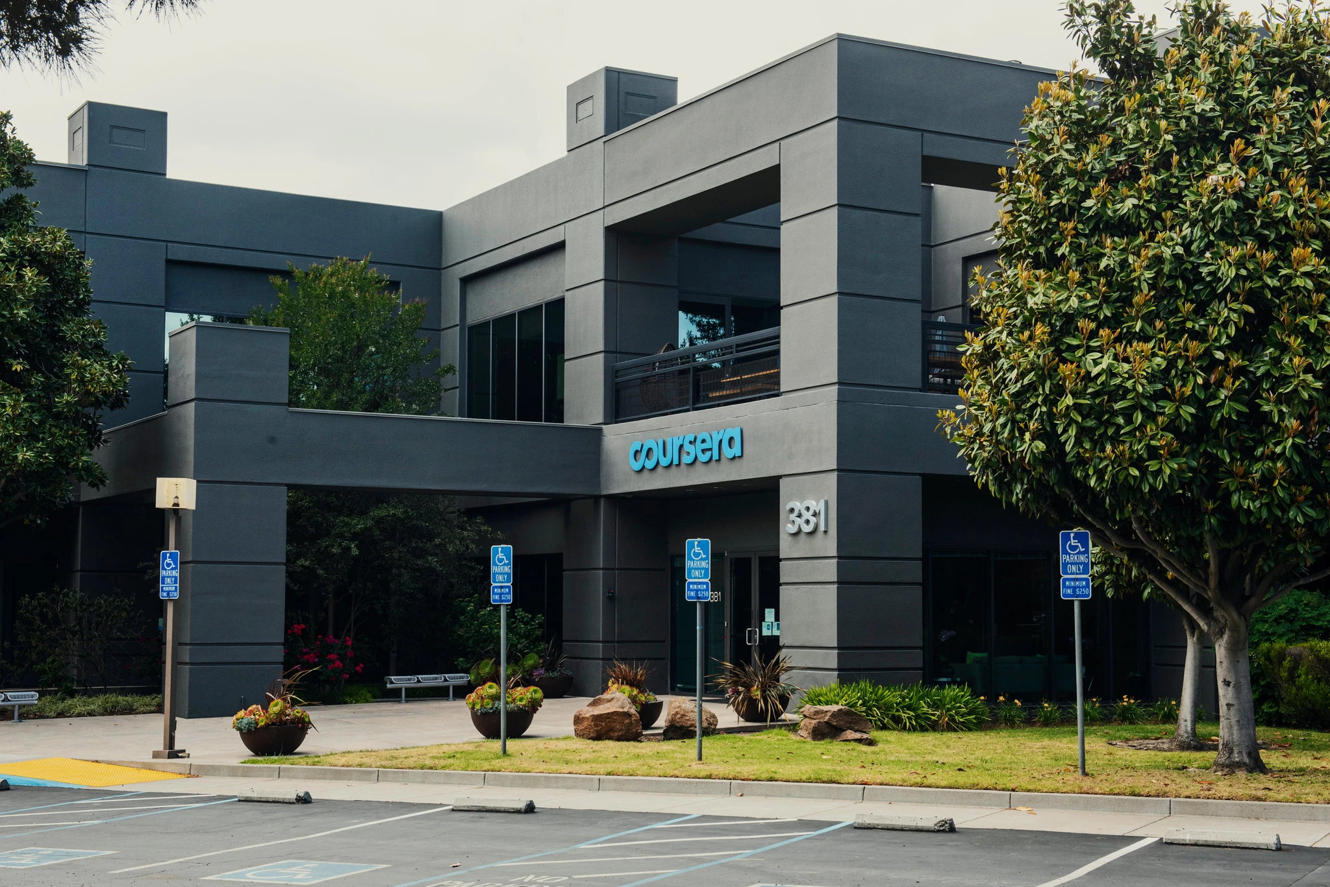
May 26, 2020
Remember the MOOCs?
After Near-Death, They’re Booming
Steven Lohr, The New York Times https://www.nytimes.com/2020/05/26/technology/moocs-online-learning.html
Coursera added 10 million new users from mid-March to mid-May. Credit...Jessica Chou for The New York Times

Slide 3
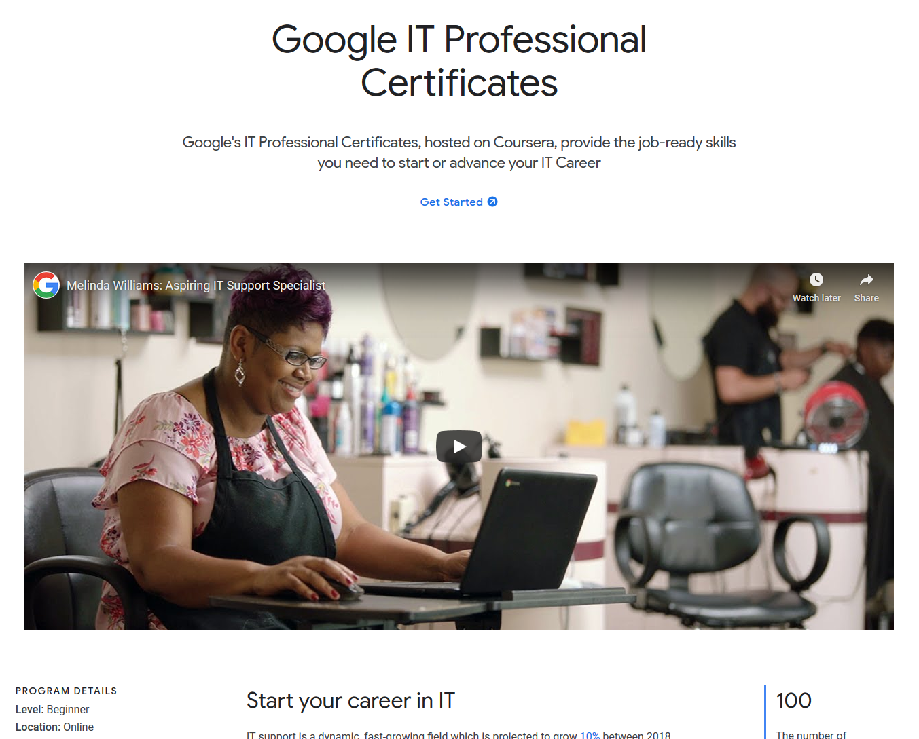
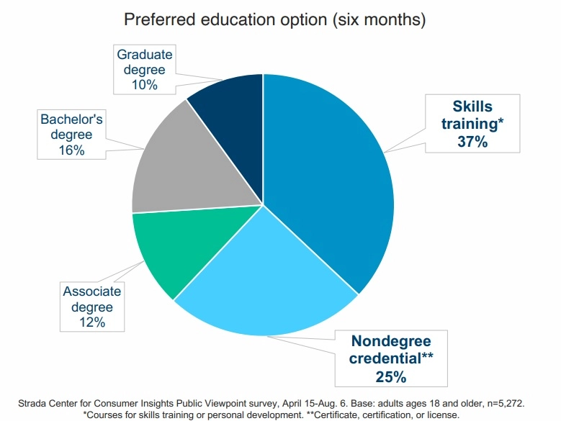
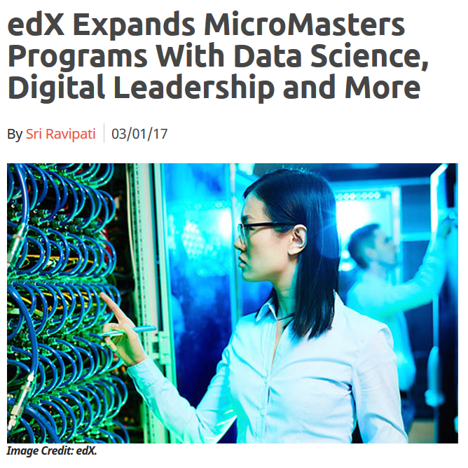
August 27, 2020
Alternative Credentials on the Rise
Paul Fain, Inside Higher Ed https://www.insidehighered.com/news/2020/08/27/interest-spikes-short-term-online-credentials-will-it-be-sustained

Slide 4
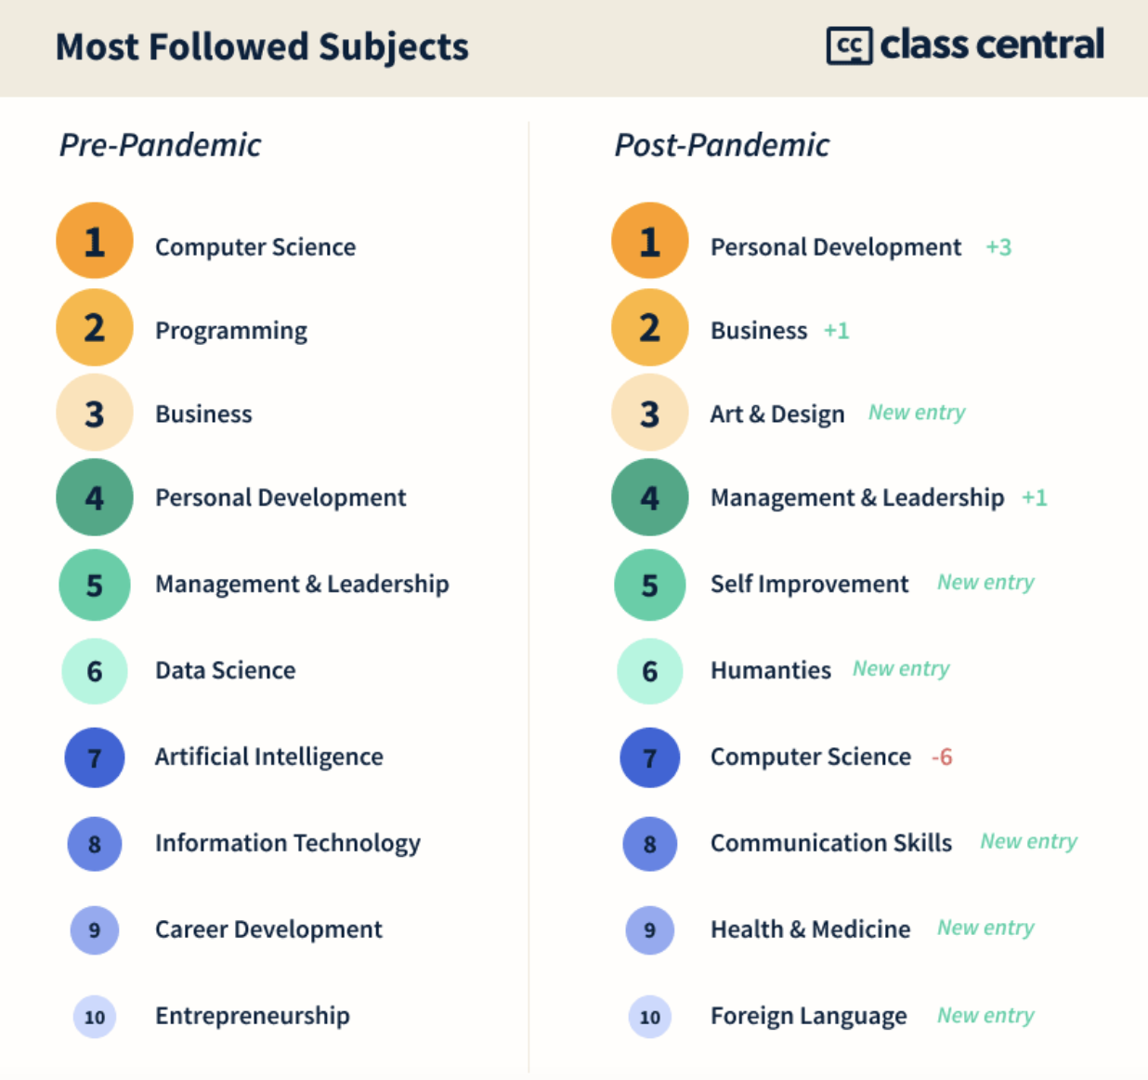
MOOCs Stats
December 14, 2020
The Second Year of the MOOC:
A Review of MOOC Stats and Trends in 2020, Dhawal Shah, Class Central
https://www.classcentral.com/report/the-second-year-of-the-mooc/

Slide 5
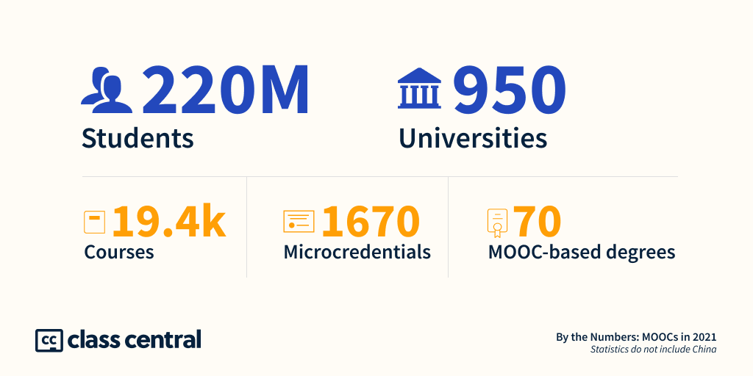
December 14, 2021
A Decade of MOOCs: A Review of MOOC Stats and Trends in 2021
Dhawal Shah, Class Central https://www.classcentral.com/report/moocs-stats-and-trends-2021/

Slide 6
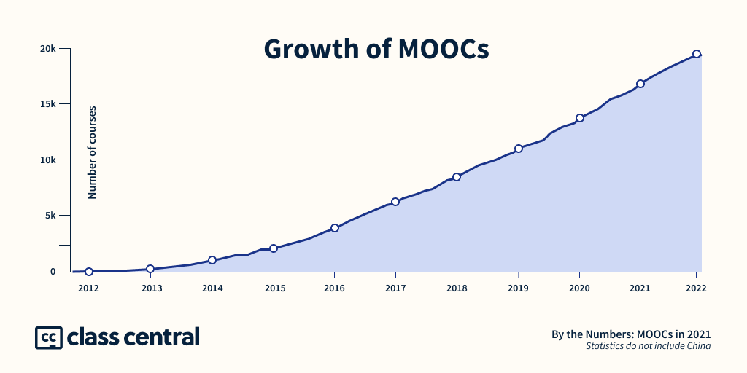
December 14, 2021
A Decade of MOOCs: A Review of MOOC Stats and Trends in 2021
Dhawal Shah, Class Central https://www.classcentral.com/report/moocs-stats-and-trends-2021/

Slide 7
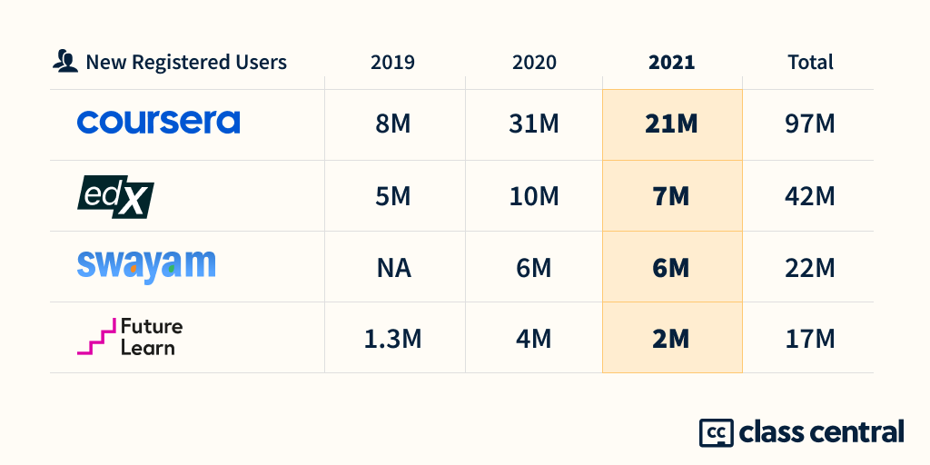
December 14, 2021
A Decade of MOOCs: A Review of MOOC Stats and Trends in 2021
Dhawal Shah, Class Central https://www.classcentral.com/report/moocs-stats-and-trends-2021/

Slide 8

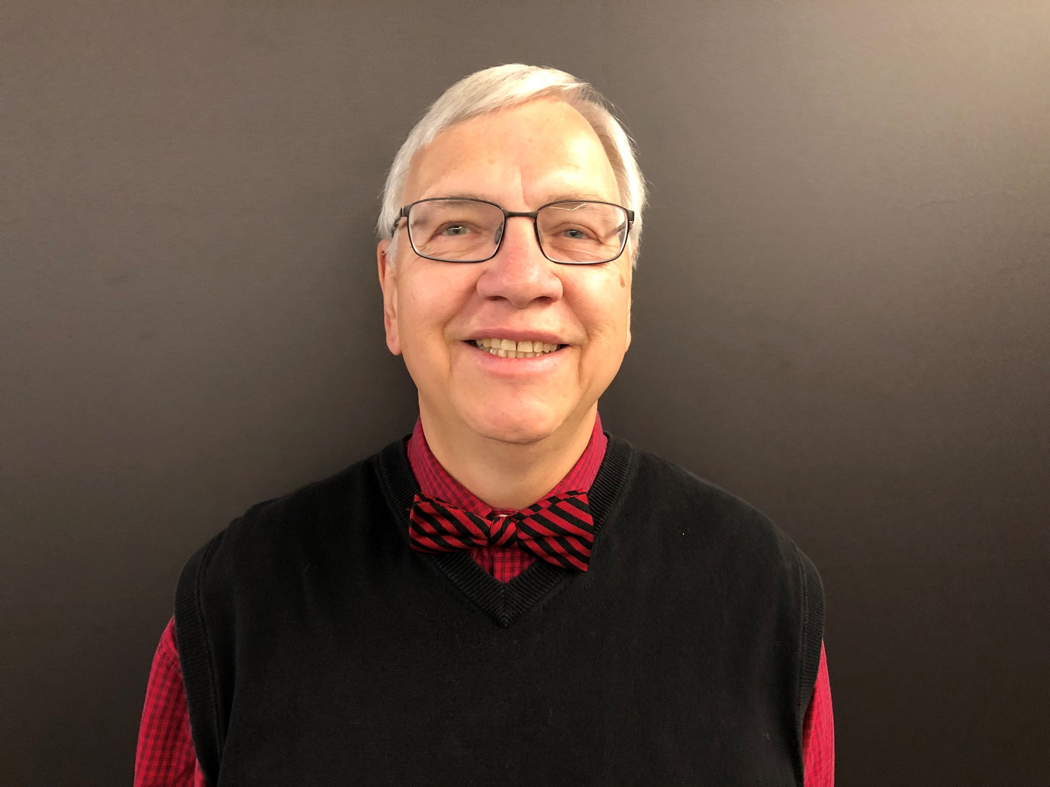




MOOC books
(2020) and (2015)
Notes:
Last year, I co-edited a book titled MOOCs and Open Education around the World. MOOCs stands for Massive Open Online Courses. An individual MOOC can enroll tens of thousands of students, and several MOOCs have now surpassed 1 million students in total enrollment. MOOCs are primarily offered by elite universities such as Stanford, MIT, and Harvard through enterprises such as Coursera, edX, and FutureLearn. More people enrolled in MOOCs developed at Harvard in a single year than attended Harvard in its entire 377-year history.

Slide 9

October 22, 2021
Wanted:
Billions of Self-Directed Learners https://www.peoplematters.in/article/training-development/the-era-of-self-directed-learning-hrs-new-role-and-strategy-24348

Slide 10
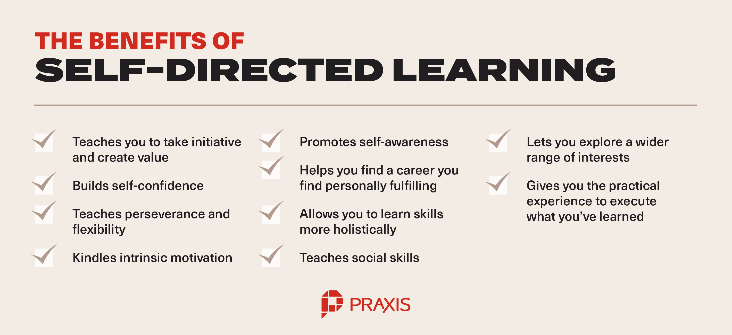
Benefits of Self-Directed Learners https://discoverpraxis.com/reasons-not-to-go-to-college/

Slide 11
Study #1
MOOCs Instructional Design to Facilitate Participants’ Self-directed Learning

Slide 12
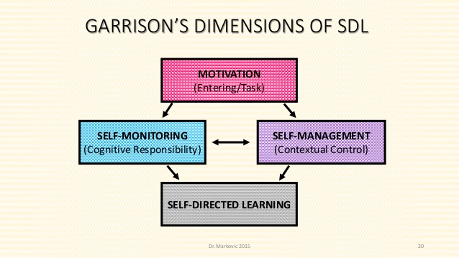
Key Terms
  Self-directed learning (SDL) (Garrison, 1997)
  (1) self-management
  (2) self-monitoring
  (3) motivation
Notes:
Garrison’s model: 3 inter-related part.

Slide 13
Research Background
  Learners need self-directed learning skills and strategies to be successful in MOOCs (Halawa, Greene, & Mitchell, 2014; Littlejohn & Milligan, 2016), as there is a lack of personalized interaction with teachers.
  Self-directness of a learner might vary in different learning environments which means that the learners could be more self-directed in one learning environment than another (Hiemstra, 1994).

Slide 14
Research Background
  Instructional design can greatly influence students’ interaction and engagement (Garrison & Cleveland-Innes, 2005) and success in online learning (Song, Singleton, Hill, & Koh, 2004; Swan, 2001).
  However, few studies have examined instructional design and the delivery of instruction using MOOCs from instructor perspectives (Margaryan et al., 2015; Watson et al., 2016); especially lacking is research on instructors’ perception of SDL and how they design MOOCs to facilitate students’ SDL.

Slide 15
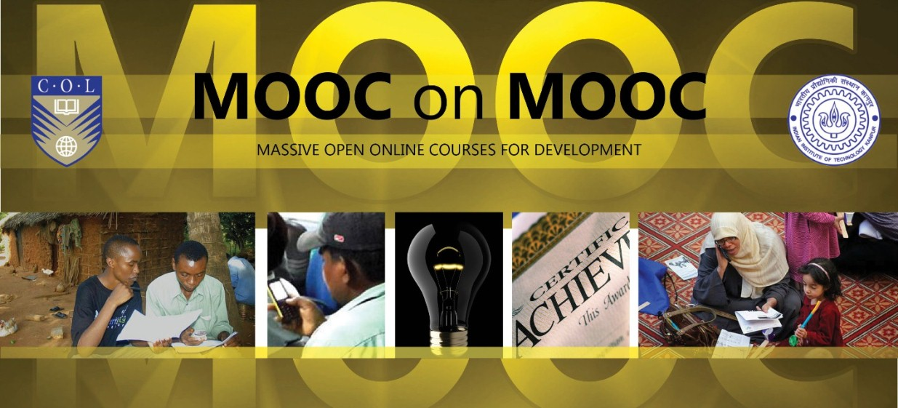
Research Purpose
  The purpose is to inform instructors or instructional designers and MOOC providers of the current practices of designing MOOCs to facilitate learners’ SDL.

Slide 16
Research Questions
  How do MOOC instructors perceive participant SDL skills?
  How do MOOC instructors perceive their facilitation of participant SDL skills?
  How do instructors design and deliver MOOCs to facilitate participant SDL skills?
    a. How is technology being used by MOOC instructors to support the development of participant SDL skills?
    b. What technology features or functions do MOOC instructors want to have to improve their facilitation of MOOC participant SDL skills?

Slide 17

Research Design
  Explanatory sequential mixed methods design (Creswell & Clark, 2017)
Pilot survey with 48 instructors
Survey
198 instructors
Review 22 MOOCs of interviewees
Interview 22 instructors
Review 22 MOOCs of interviewees
Pilot interview with 4 instructors

Slide 18

Data Collections
  Survey:
  Volunteer sampling (Creswell & Clark, 2017)
  198 instructors responded to the survey (10% response rate)
  Interview:
  Homogeneous purposeful sampling (Creswell & Clark, 2017; Patton, 2002)
  Maximal variation sampling (Creswell & Clark, 2017)
  22 interviewees
  MOOC review:
  Reviewed 22 interviewees’ MOOCs

Slide 19
Pseudonym | Country | Subject area | Platform | Gender | No. of O/B | No. of M | Mode of the M
Lucas | US | Social science | edX | M | 0 | 1 | I without T
Branden | US | Education | Udacity | M | 0 | 5 or more | Self-paced
Logan | US | Literacy and Language | Coursera | M | 5 or more | 5 or more | I with T
Emma | US | Literacy and Language | Coursera | F | 2 | 1 | Self-paced
Jason | US | Science | edX | M | 1 | 1 | I with T
Jackson | US | Medicine and health | Coursera | M | 5 or more | 1 | Self-paced
Samuel | US | Education | FutureLearn | M | 4 | 3 | Self-paced
Hannah | US | Education | Blackboard | F | 5 or more | 1 | I with T
Ashley | US | Education | EdX | F | 0 | 5 or more | I with T
Andrew | UK | Art | FutureLearn | M | 0 | 3 | I with T
Emily | UK | Medicine and health | FutureLearn | F | 2 | 2 | I with T
Aiden | UK | Social science | FutureLearn | M | 0 | 1 | Self-paced
Henry | UK | Social science | FutureLearn | M | 0 | 1 | Self-paced
Joseph | UK | Medicine and health | FutureLearn | M | 1 | 1 | Self-paced
Joshua | UK | Literacy and language | FutureLearn | M | 2 | 2 | I with T
Mason | Australia | Education | Coursera | M | 5 or more | 1 | I with T
Ethan | Australia | Business | Coursera | M | 3 | 1 | I without T
Ben | Australia | Social science | edX | M | 1 | 1 | I with T
Paul | France | Computer Science | Coursera | M | 1 | 1 | I with T
Fernando | Belgium | Research methods | Blackboard | M | 5 or more | 3 | I with T
Jacob | Netherland | Science | Coursera | M | 0 | 1 | I with T
Dylan | Israel | Science | Coursera | M | 5 or more | 3 | I without T
Data Collections
  Interview:

Slide 20
Data Analysis
RQs | Data Sources | Data analysis | Tools
RQ1 | Survey Interview | Descriptive statistics Content analysis (Elo & Kyngäs, 2008) | SPSS NVivo
RQ2 | Survey Interview | Descriptive statistics Content analysis | SPSS NVivo
RQ3 | Interview Course review | Content analysis Content analysis | NVivo NVivo

Slide 21
Research Context

Slide 22
RQ1 Perceptions of SDL
  A majority of the MOOC instructors thought that these skills or attributes are not static, and that SDL as a set of skills can be educated or students’ personal attributes that can be changed.

Slide 23

RQ1 Interview Results
  Emma’s understanding of SDL is more related to self-management and motivation. She said:
    “When I think about self-directed learning, I think about students managing their time and managing the coursework on their own, and how it fits into their schedules and their lives, how they interact with materials, what's going to keep them engaged.”

Slide 24
RQ2 Perceptions of Facilitation of SDL
  Most of MOOC instructors thought that they can intentionally or unintentionally facilitate students’ SDL.

Slide 25

RQ2 Interview Results
  Ashely emphasized the importance of both instructors’ facilitation and students’ SDL skills. She said:
    “The participant has a lot of flexibility on how they approach the content. I mean, obviously, we have things like assignments. We have things like online forums. And there're ways that we scaffold the learning experience. But there still is a lot of choice for the learner.”

Slide 26
RQ3 Strategies to Facilitate SDL
  Students’ intrinsic motivation plays an important role. However, extrinsic motivation provided by the MOOCs might help transfer extrinsic motivation to intrinsic motivation.
Motivations | Strategies
Entering motivation | MOOC instructors helped students identify the needs and goals of learning and sense of achievement.
Task motivation | MOOC instructors motivated students through instruction, learning materials, feedback, and learning community.

Slide 27
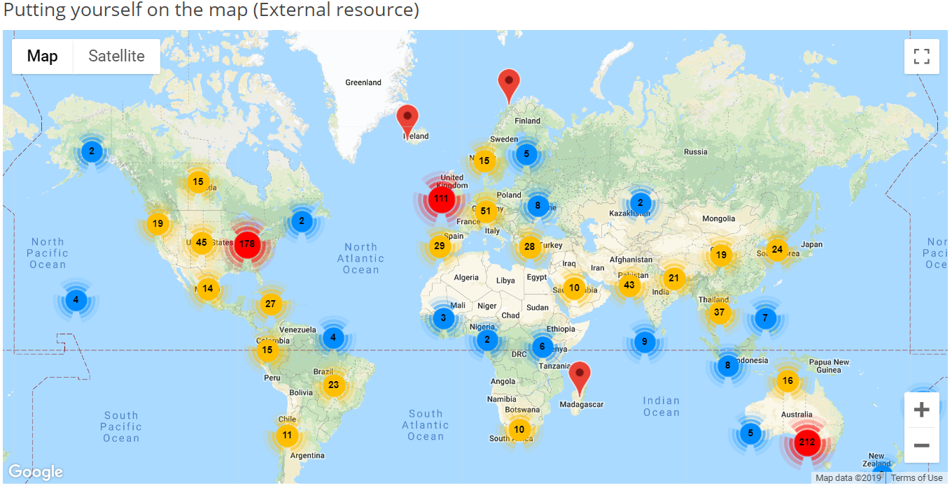
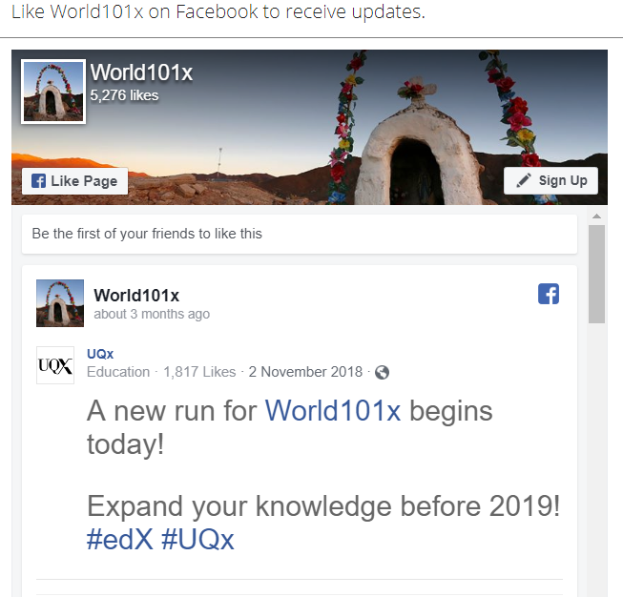
RQ3 Learning Community

Slide 28
RQ3 Strategies to Facilitate SDL
  Both internal feedback and external feedback were provided to help students’ self-monitoring.
Self-monitor |  | Strategies
Internal feedback | Cognition | MOOC instructors provided quizzes for self-assessment, tutorial on technology use, learning advice, navigation of the course, progress indicators, resources, and instructional modeling, etc.
 | Meta-cog | MOOC instructors encouraged students to reflect and think critically by providing reflection questions and building learning community.
External feedback |  | MOOC instructors, teaching assistants, and peers were involved in providing external feedback.

Slide 29
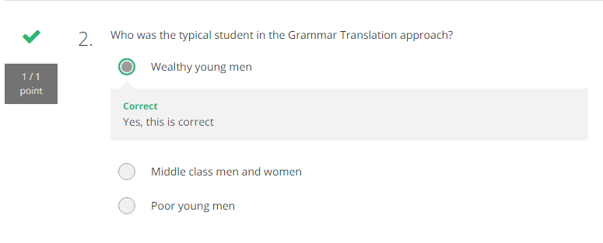
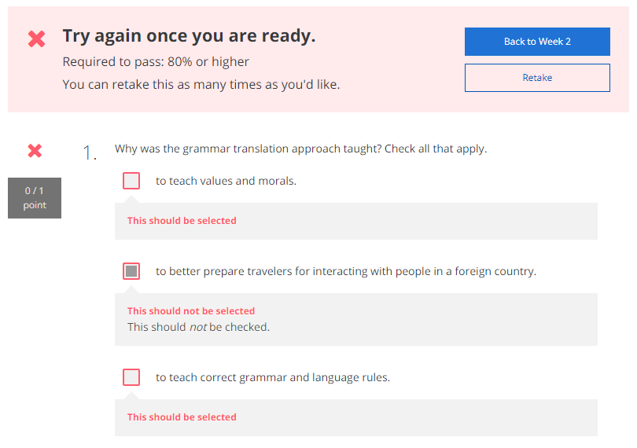
RQ3 Self-assessment (i.e., embedded quizzes)

Slide 30
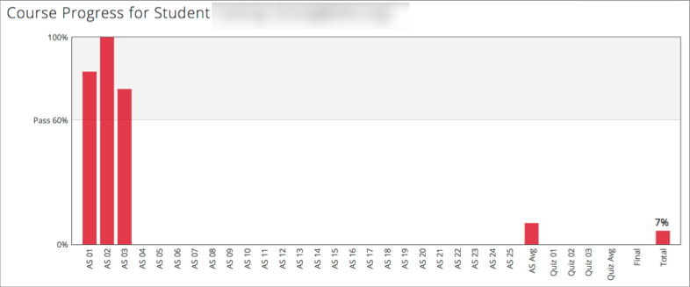
RQ3 Progress Indicators

Slide 31
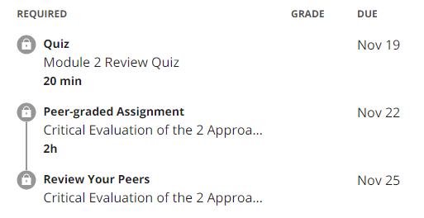
RQ3 External Feedback: Peer-assessment
(e.g., 3 peers assigned to review each assignment)

Slide 32
RQ3 Strategies to Facilitate SDL
  They helped students’ self-management concerning setting learning goals, time management, resources and support management although among the three elements of SDL, MOOC instructors had less control over students’ management.
Self-management | Strategies
Enactment of learning goals | Providing discussion questions, reflections, survey, and appreciation students’ learning goals.
Time management | Providing time frame, progress indicator, short learning units, and flexible timeline.
Management of resources and support | Providing flexible learning resources, peer-assessment, accessibilities, clear expectations, and short learning units.

Slide 33
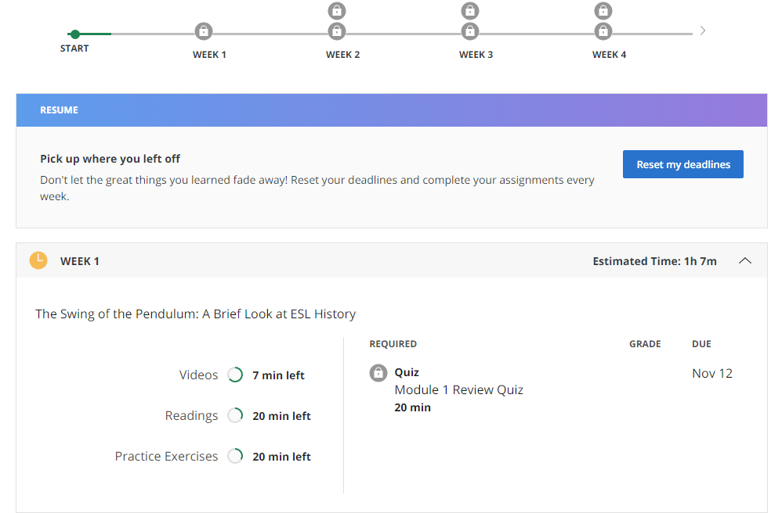
RQ3 Time Management
(e.g., time advisories and estimates)

Slide 34


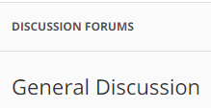



RQ3-a. Tech Used for SDL
  Synchronous communication technologies
    Google Hangouts YouTube Live
  Asynchronous communication technologies
    Discussion forum Blog Slackbot Flickr
  Multimedia (e.g., video and graphics)
  Feedback technologies

Slide 35
Discussion
  SDL can be Changed
  MOOC Instructors can Facilitate SDL
  Strategies to Facilitate SDL: A variety of strategies can be used to facilitate student SDL skills in terms of motivation, self-monitor, and self-management.
  Tech for SDL: Tech plays a vital role in facilitating SDL skills.
  Tech expectations: Adaptive learning systems, artificial intelligent systems, and learning analytics were expected to have to support SDL.

Slide 36
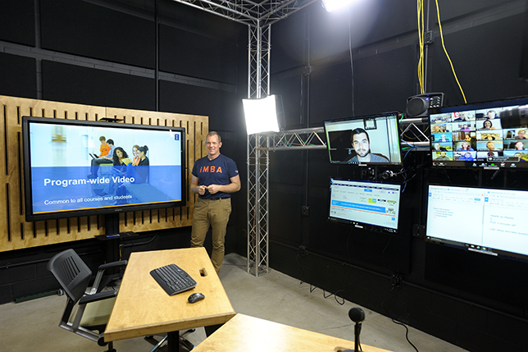
Implications
  For MOOC instructors and Instructional Designers
    Build learning community
    Inspire intrinsic motivation
    Personalize learning
  For MOOC providers
    Create a personalized learning environment
    Provide learning analytics to support learning and teaching

Slide 37

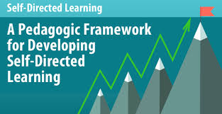

Top 10 Strategies to Facilitate SDL in MOOCs
  Helping students set their own learning goals.
  Building learning community.
  Offering immediate feedback.
  Embedding quizzes for self-assessment.
  Providing progress indicators.
  Providing reflection questions.
  Designing short learning units.
  Providing flexible timelines.
  Highlighting estimated time frames.
  Making available optional learning materials.

Slide 38

Top 10 Strategies to Facilitate SDL in MOOCs
  Helping students set their own learning goals.
  Example:
    “I have asked, at the first page of course, why they're taking the course. So that is the goal. A lot of people say, ‘I'm a teacher. And I want to do the stuff with my kids. Or I want to update my knowledge. Or I'm retired and I want to learn this.’”

Slide 39
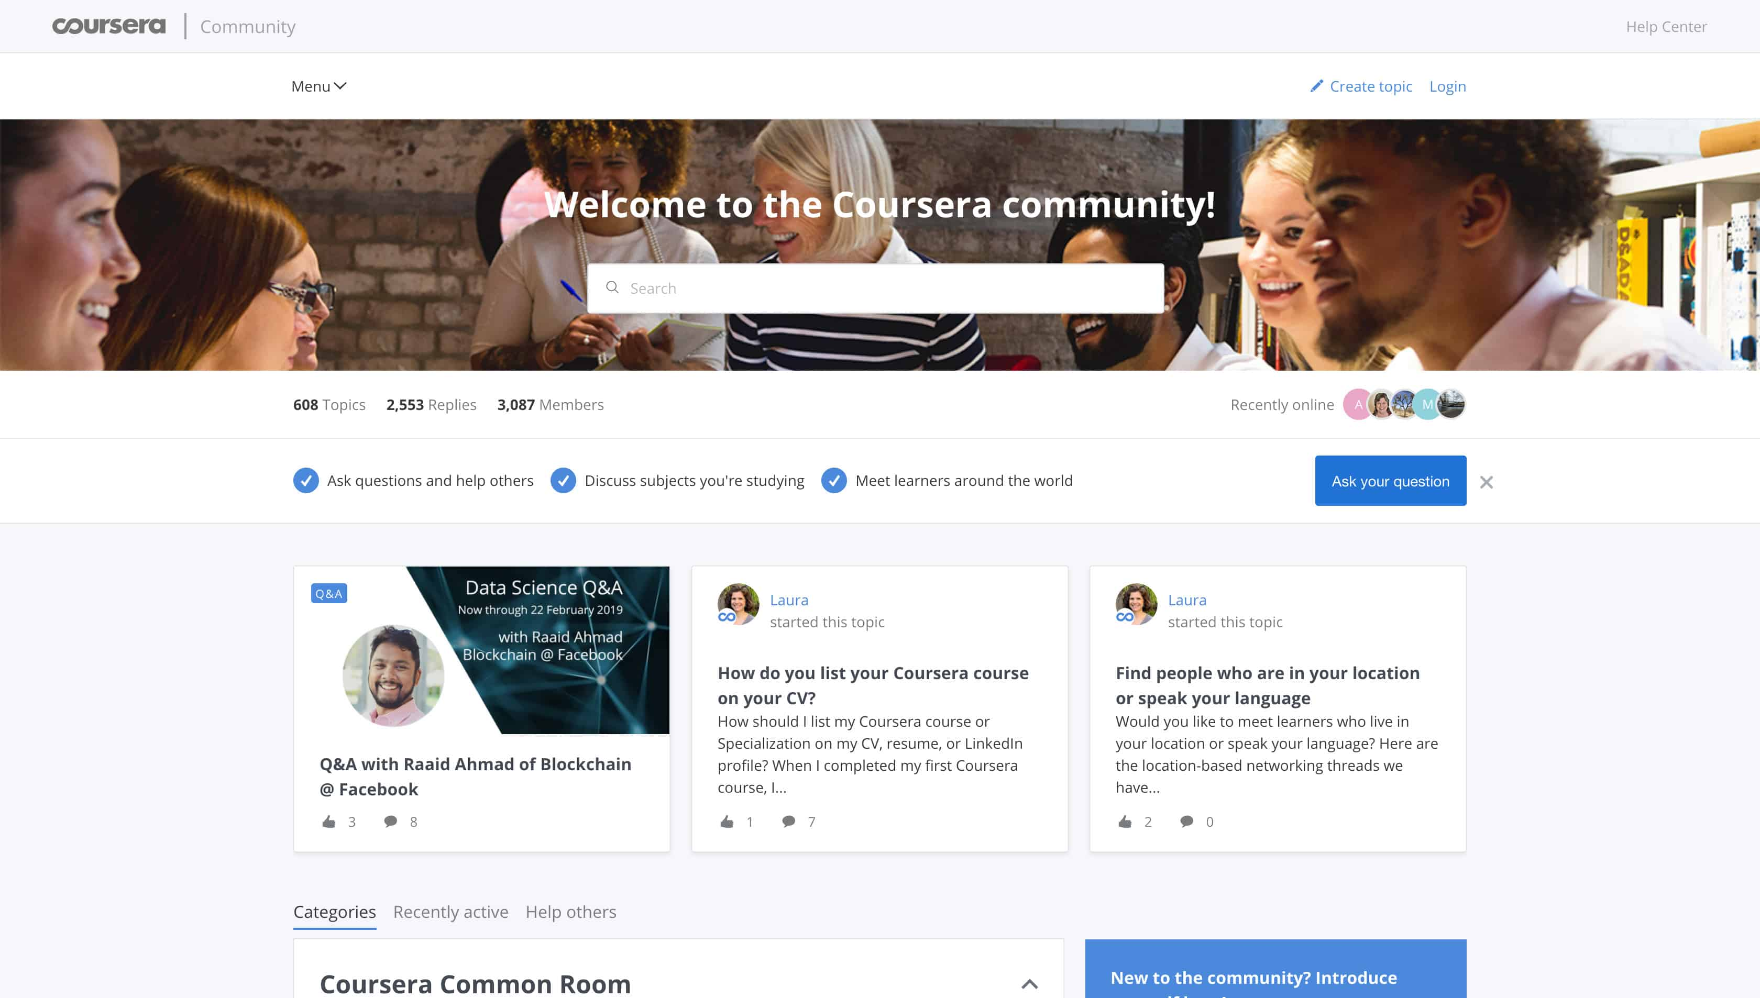
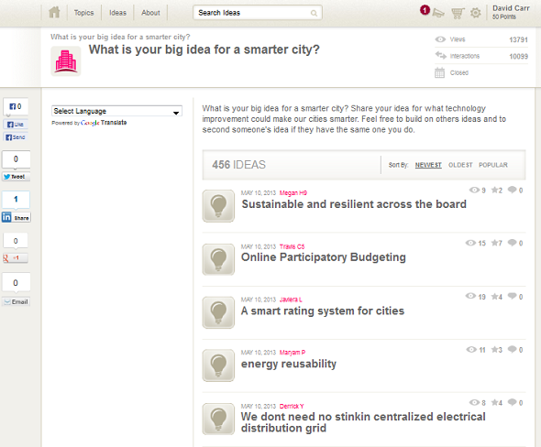
Top 10 Strategies to Facilitate SDL in MOOCs
  2. Building learning community.
    Joshua from the UK mentioned: We use a lot of resources that already exist. And then we use the MOOC discussion board as a place to where they, kind of, point out and say, “I've seen this. And this is useful. Well, I use this, and this is good. I created this.”

Slide 40
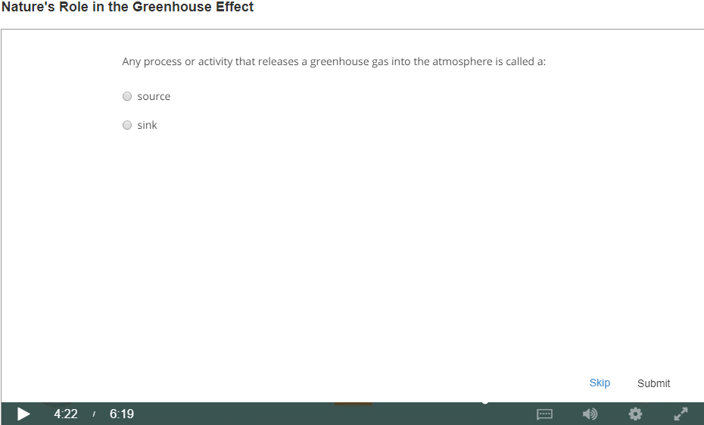
Top 10 Strategies to Facilitate SDL in MOOCs
  3. Offering immediate feedback.
  4. Embedding quizzes for self-assessment.

Slide 41
Top 10 Strategies to Facilitate SDL in MOOCs
  5. Providing progress indicators

Slide 42

Top 10 Strategies to Facilitate SDL in MOOCs
  6. Providing reflection questions.
    We introduced kind of moments that video was stopped and there was a question. The student had to think of it a bit. Sometimes it was kind of a rhetorical question. There wasn't even no answer required. But it was just a pause for a while to let the student reflect. (Jacob)

Slide 43
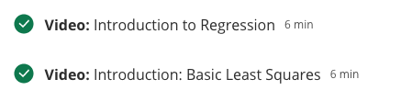
Top 10 Strategies to Facilitate SDL in MOOCs
  7. Designing short learning units.

Slide 44
Top 10 Strategies to Facilitate SDL in MOOCs
  8. Providing flexible timelines.

Slide 45
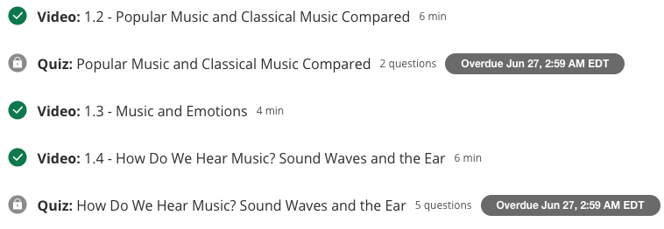
Top 10 Strategies to Facilitate SDL in MOOCs
  9. Highlighting estimated time frames.

Slide 46
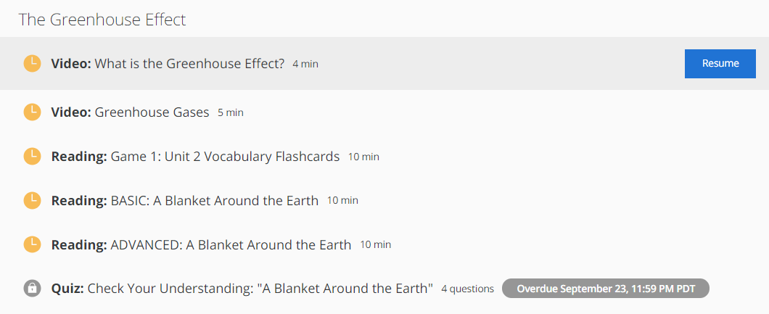
Top 10 Strategies to Facilitate SDL in MOOCs
  10. Making available optional learning materials.

Slide 47
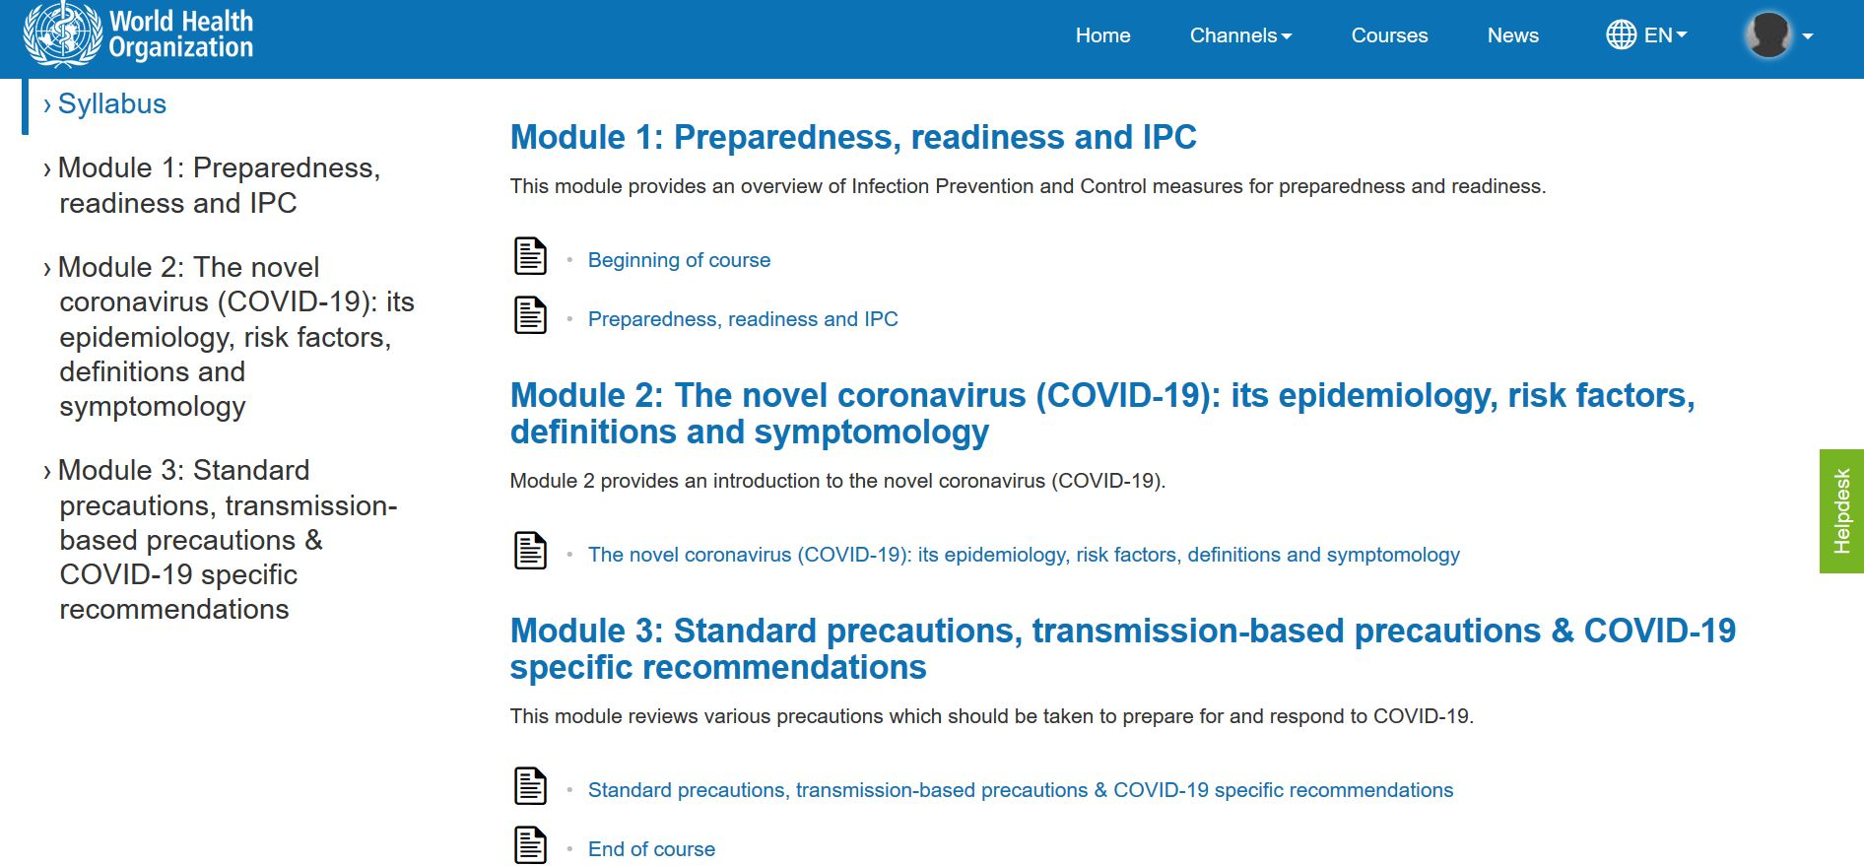
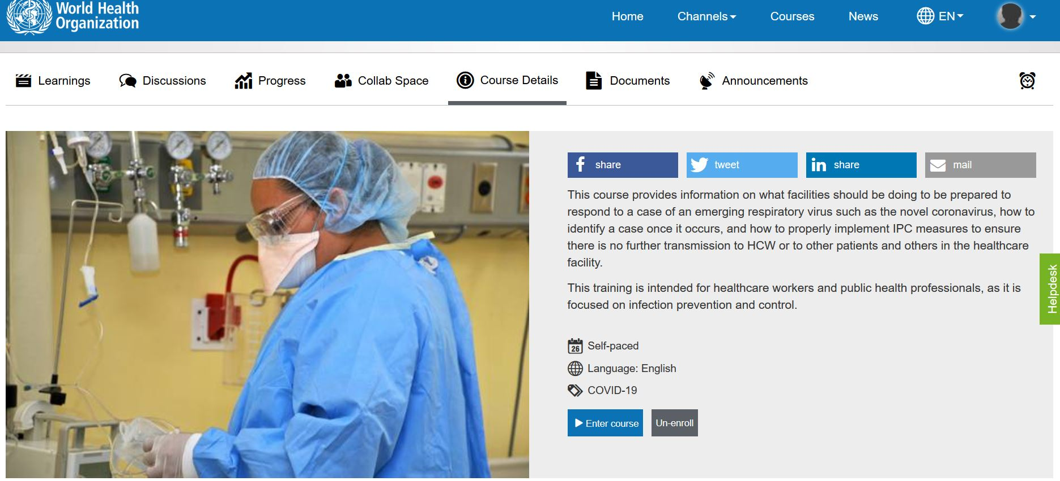
10 More Strategies to Facilitate SDL in MOOCs
  11. Structure continued…objectives, time to course completion, syllabus, number of modules, titles, etc.
  Graphic or visual organizations for essential material.
  The text on screen matched the narration enforcing the redundancy principle.

Slide 48
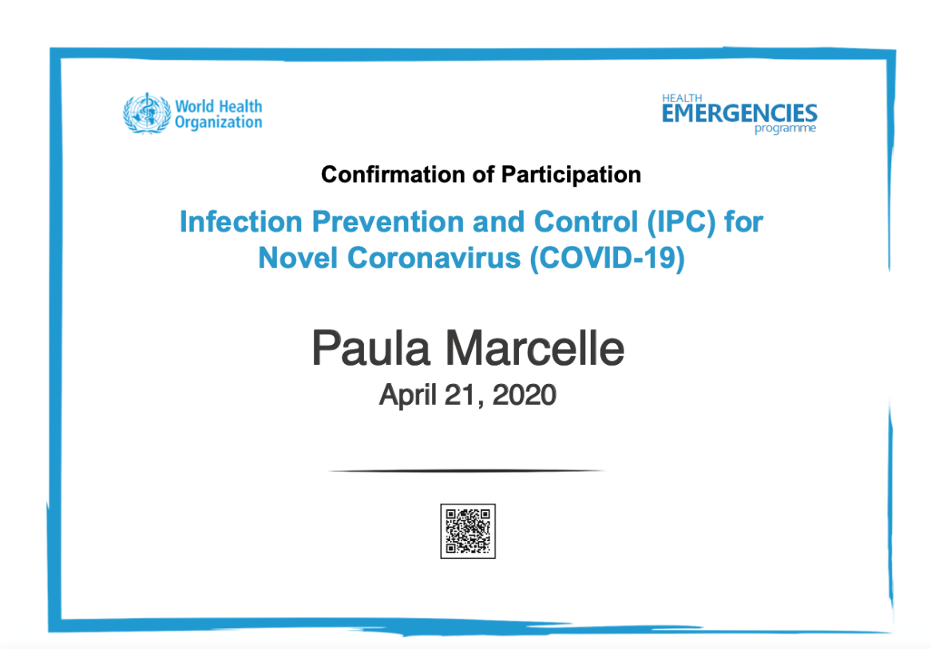
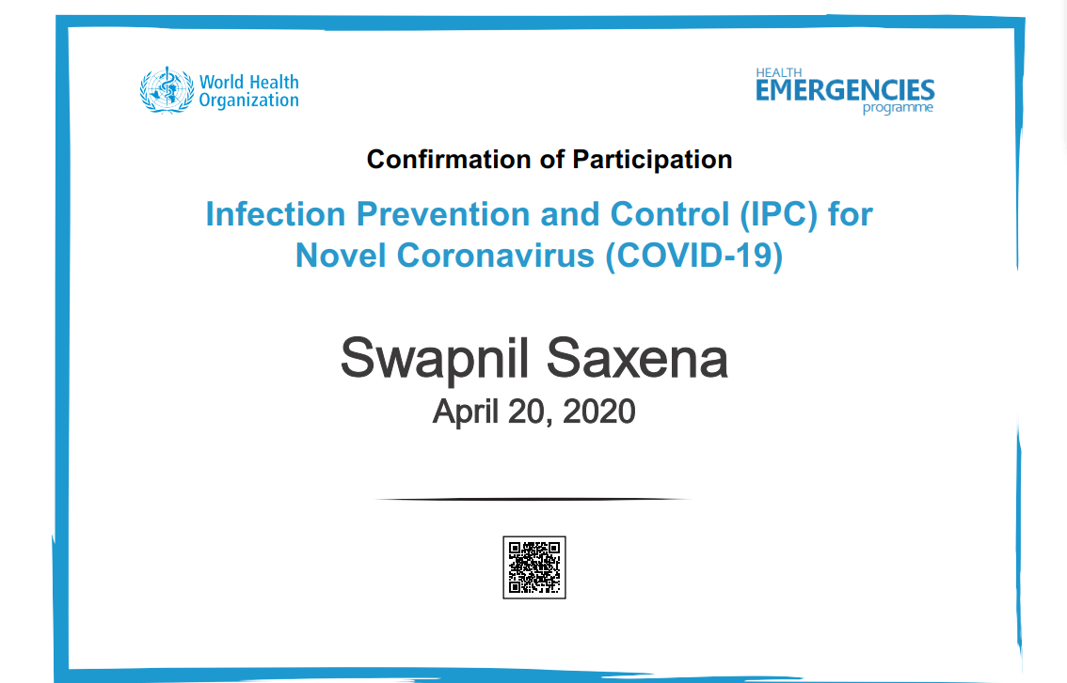
10 More Strategies to Facilitate SDL in MOOCs
  12. On completion of modules participants get a certificate.
  Providing External Rewards and Goals

Slide 49
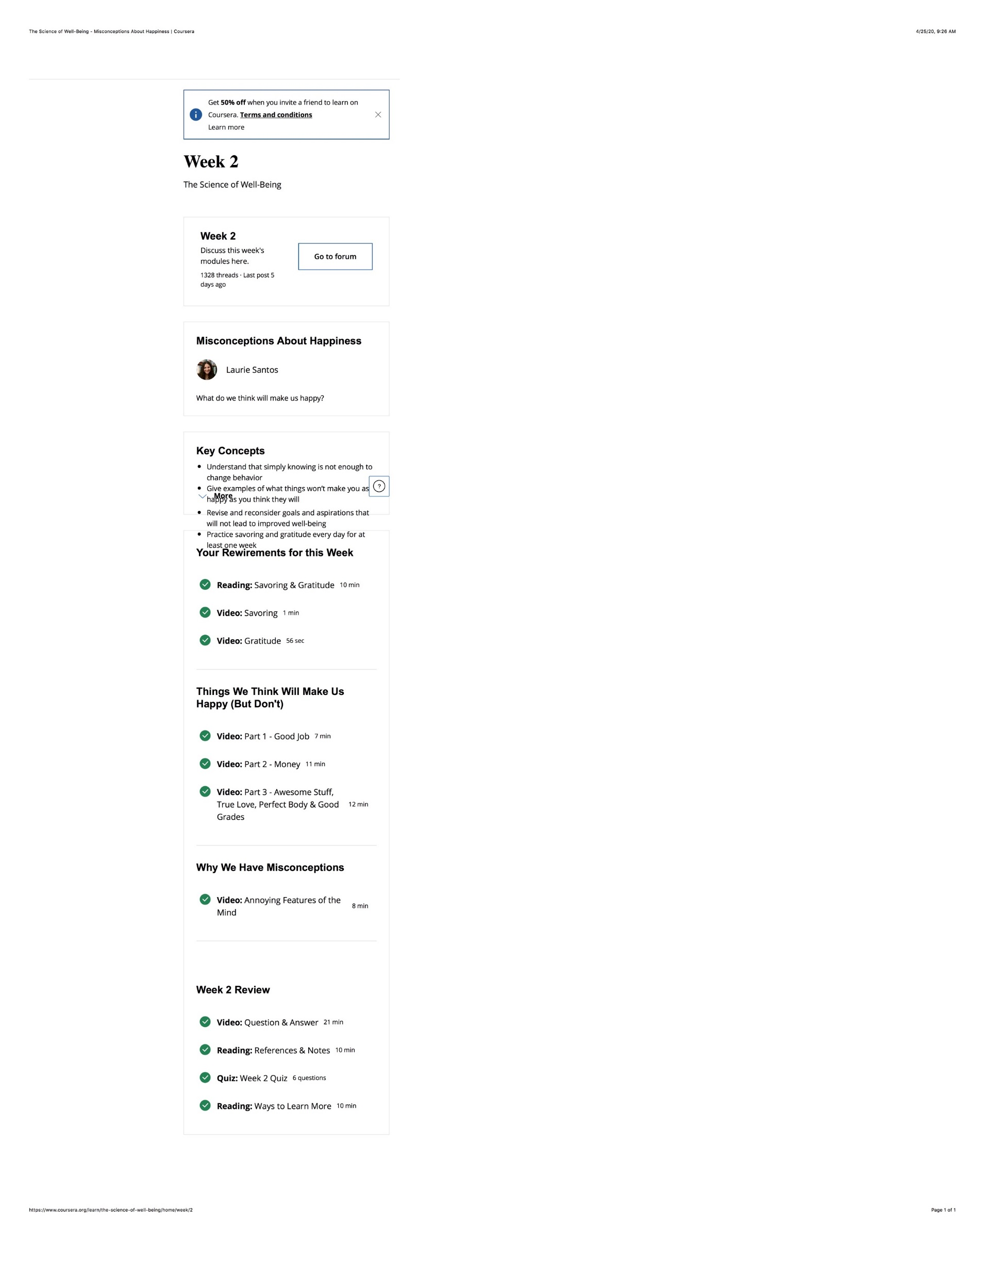
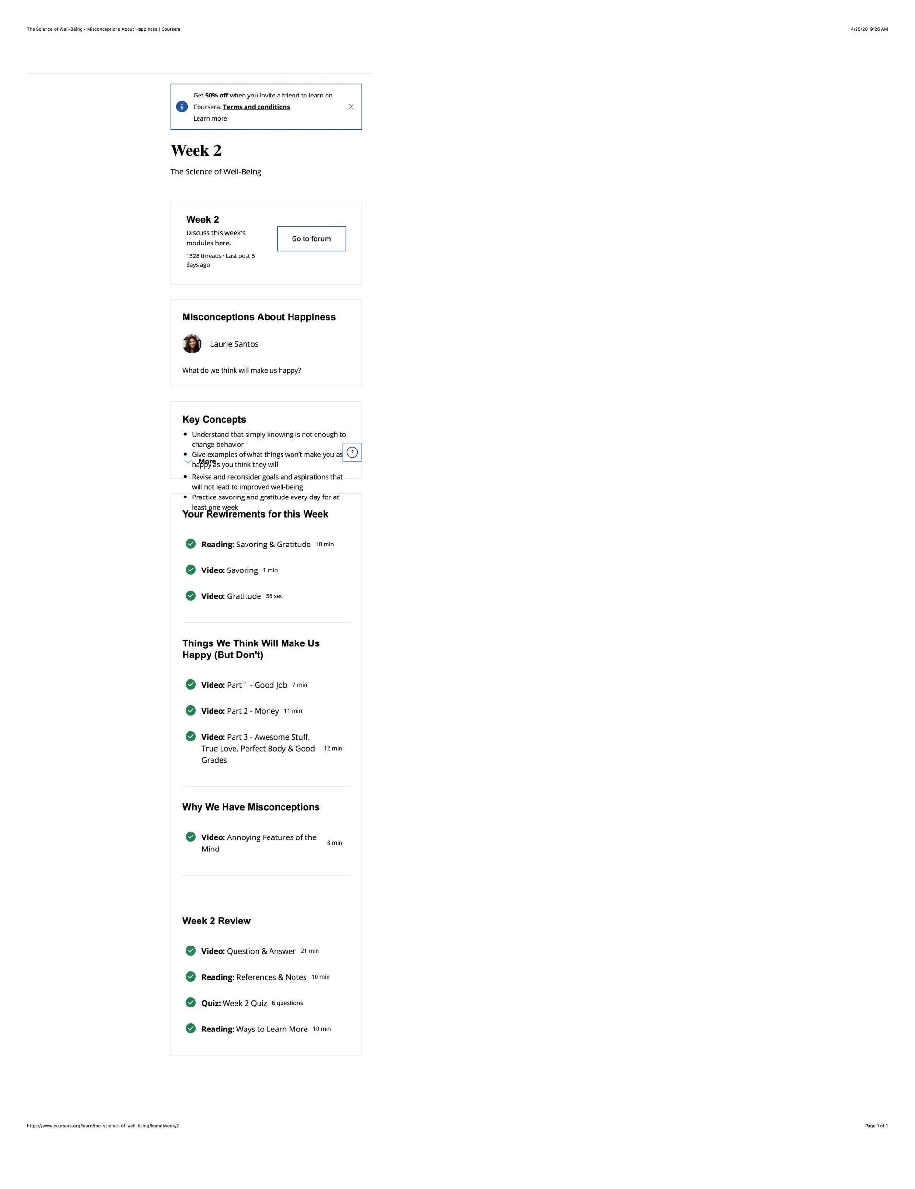
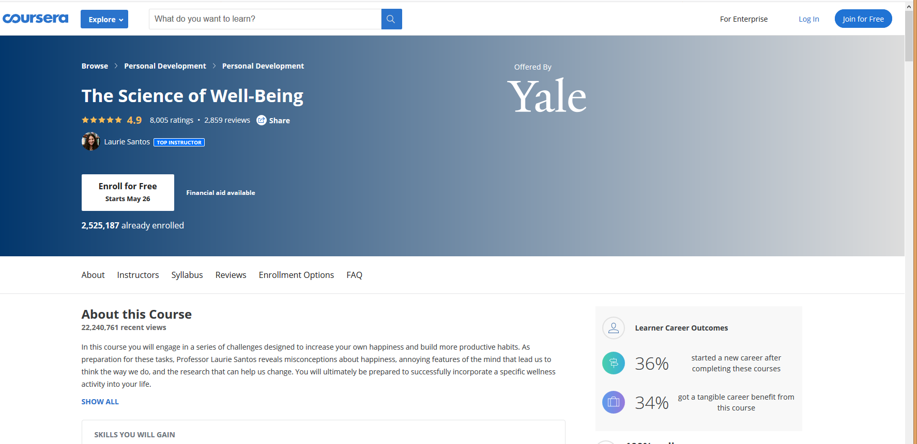
10 More Strategies to Facilitate SDL in MOOCs
  13. Week overview. The course is divided into week-long segments, and each week is chunked into manageable parts. Very importantly for the participant to be able to anticipate what can get done in one sitting, the length of each video is included.

Slide 50
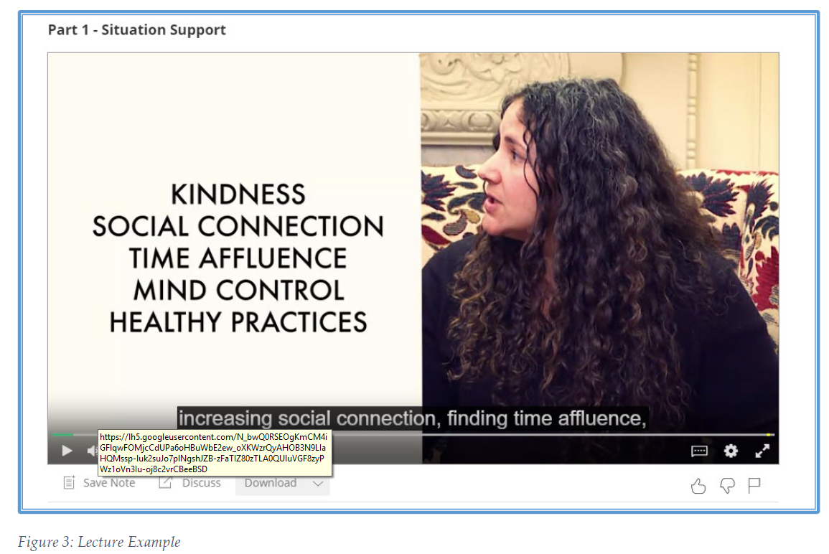
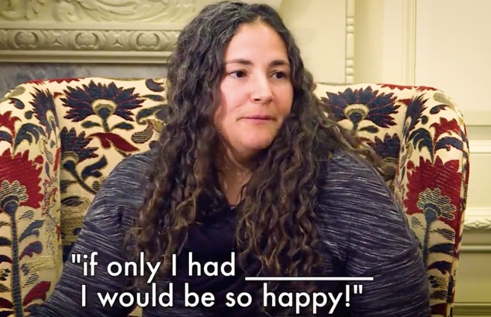

10 More Strategies to Facilitate SDL in MOOCs
  14. Lecture recorded and captions added.
Caption added to video
Video of student audience

Slide 51
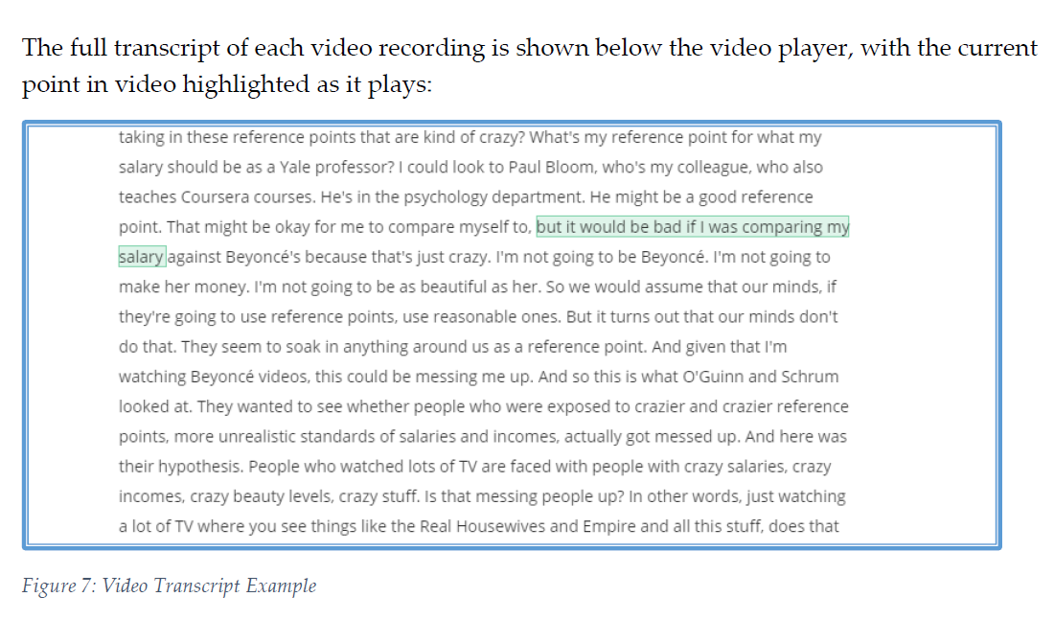
10 More Strategies to Facilitate SDL in MOOCs
  14. Continued…Lecture video transcripts.

Slide 52
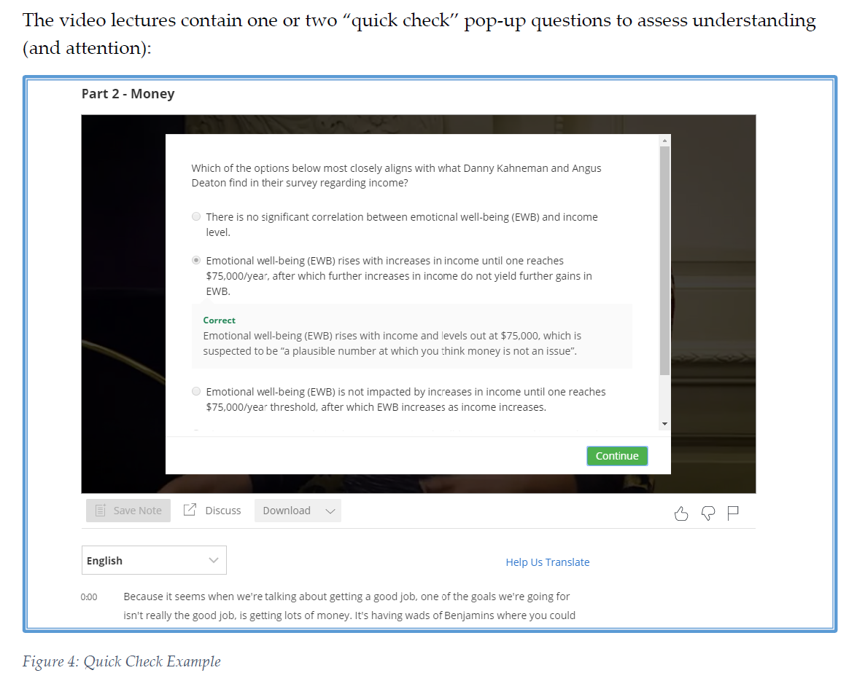
10 More Strategies to Facilitate SDL in MOOCs
  15. Quick check tasks.

Slide 53
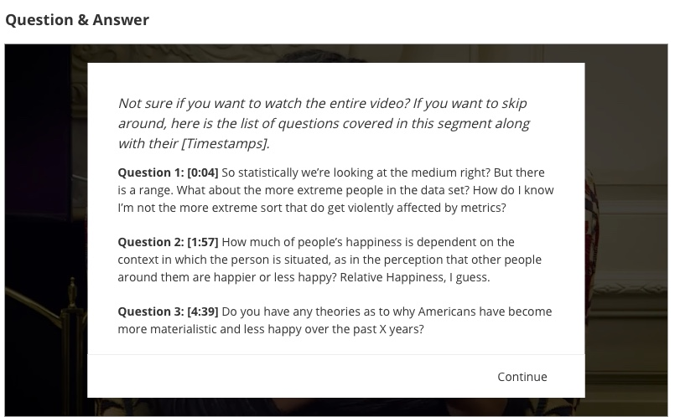
10 More Strategies to Facilitate SDL in MOOCs
  16. Providing students with self-selection options.
  There is the choice to watch all of the videos, read all of the materials, and submit all of the assignments, or there are choices all along the way to “cut corners” and take in only what the participant wants to.

Slide 54
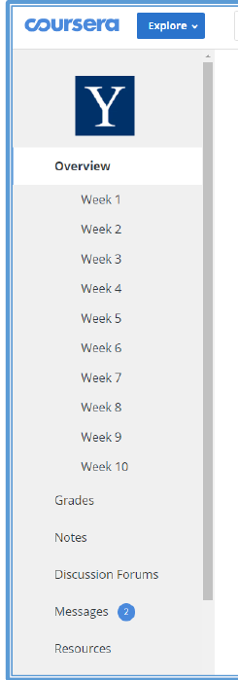
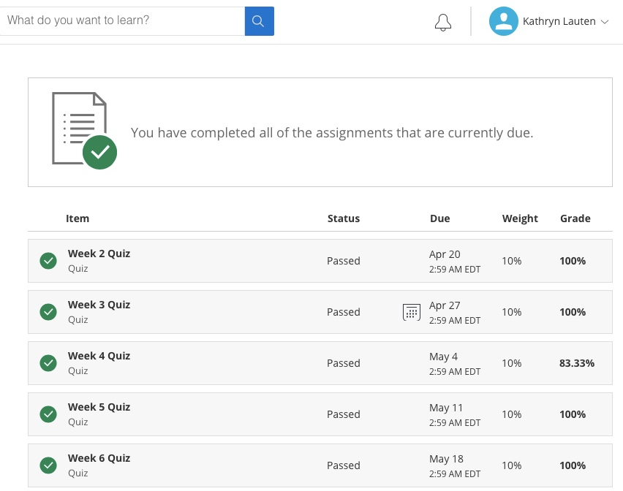
10 More Strategies to Facilitate SDL in MOOCs
  17. Visuals showing tasks completed.

Slide 55
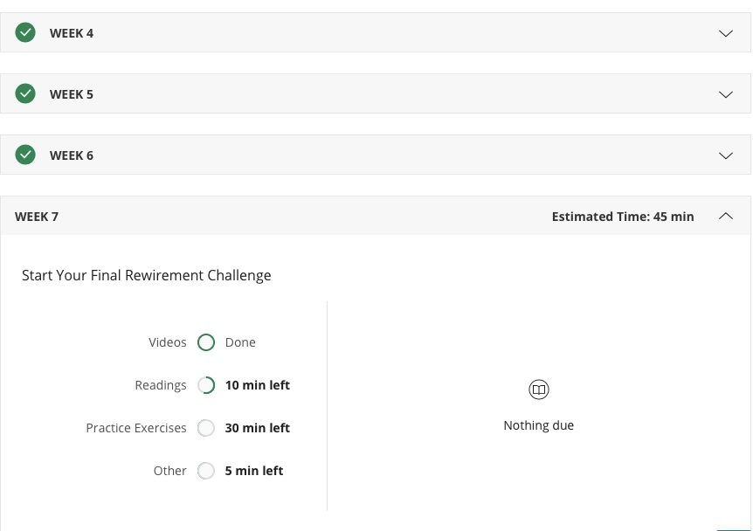
10 More Strategies to Facilitate SDL in MOOCs
  18. Visuals showing work progress.

Slide 56
10 More Strategies to Facilitate SDL in MOOCs
  19. Rewirements (assignments) for putting the material to practice (e.g, Random Acts of Kindness, Make A Social Connection, Let’s Get Physical, Meditate!, Sleep!, Gratitude Letter/Visit, Savoring, etc.)
Daily Gratitude Journal
Gratitude is a positive emotional state in which one recognizes and appreciates what one has received in life. Research shows that taking time to experience gratitude can make you happier and even healthier. For the next seven days, you will take 5-10 minutes each night to write down five things for which you are grateful. They can be little things or big things. But you really have to focus on them and actually write them down (Again, try to develop a tracking method works for you and utilize a note on your phone, a daily calendar, a special notebook, etc). You can just write a word or short phrase, but as you write these things down, take a moment to be mindful of the things you’re writing about (e.g., imagine the person or thing you’re writing about, etc.). This exercise should take at least five minutes. Do this each night for the whole week.

Slide 57
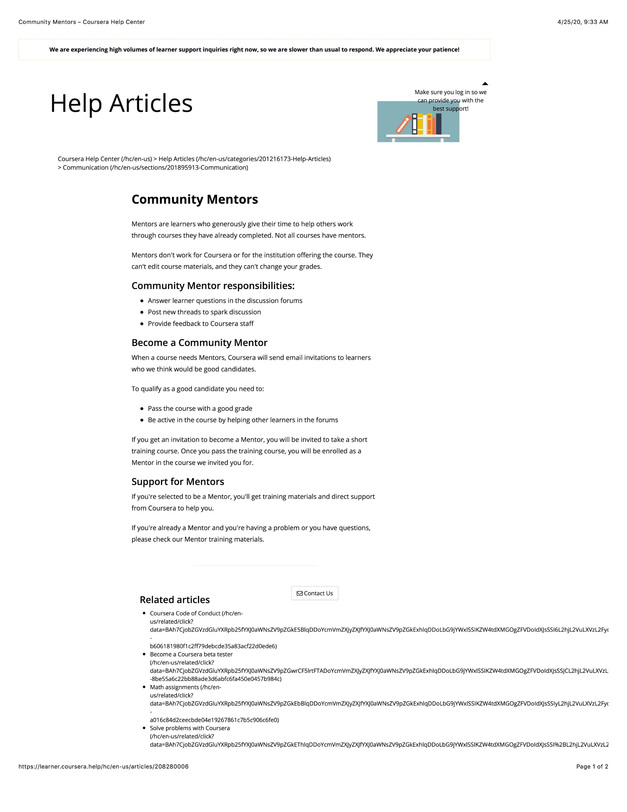
10 More Strategies to Facilitate SDL in MOOCs
20. Offer community support and help.

Slide 58
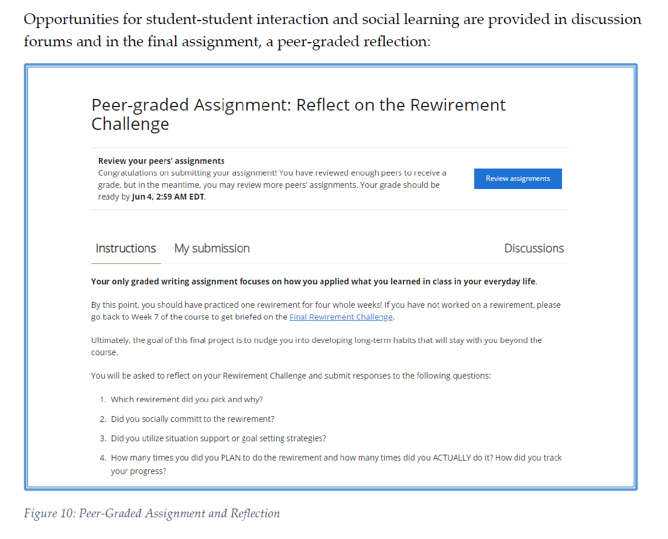
10 More Strategies to Facilitate SDL in MOOCs
Bonus Item: Peer-graded assignments.

Slide 59

MOOC Study #2
MOOC Learners and SDL
Zhu, M., Bonk, C. J., & Berri, S. (2022). Fostering self-directed learning in MOOCs: Motivation, learning strategies, and instruction. Online Learning

Slide 60
Research Questions
What motivated individuals to enroll in MOOCs?
What were the learning strategies that helped learners’ SDL in MOOCs?
What were the design and instructional elements of MOOCs that facilitated learners’ SDL?

Slide 61
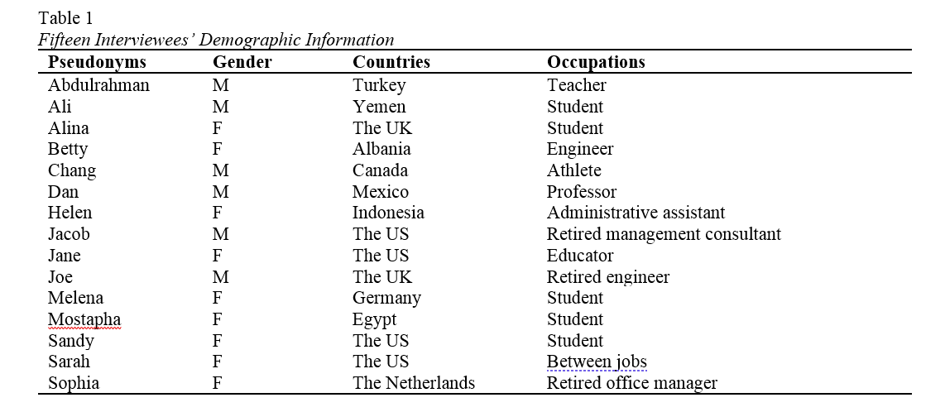
MOOC Study #2
MOOC Learners and SDL
Zhu, M., Bonk, C. J., & Berri, S. (2022). Fostering self-directed learning in MOOCs: Motivation, learning strategies, and instruction. Online Learning

Slide 62
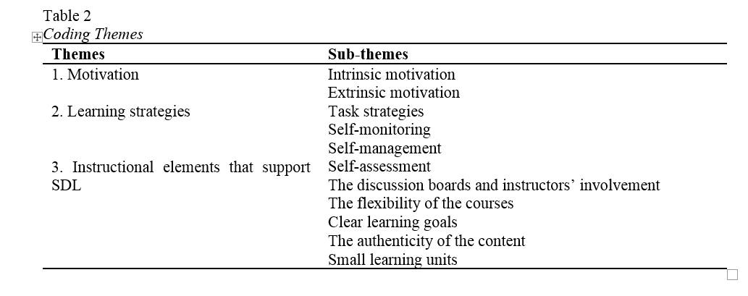
MOOC Study #2
MOOC Learners and SDL
Zhu, M., Bonk, C. J., & Berri, S. (2022). Fostering self-directed learning in MOOCs: Motivation, learning strategies, and instruction. Online Learning

Slide 63
RQ1. Intrinsic Motivation
Jacob, a retired management consultant from the US, expressed his motive behind enrolling in MOOCs as strictly intrinsic, “there's no reward. I'm retired. It's really just [that] I get very interested in topics. I realize holes in my knowledge and try to fill the holes.”

Slide 64
RQ1. Extrinsic Motivation
Besides educational purposes, some participants enrolled in MOOCs to help with their career development. For example, Sarah, who received her Ph.D. degree and was in between jobs at the time, selected topics such as anatomy, MatLab software, oncology, biology, and neuroscience. Sarah explained the purpose for taking these types of MOOCs was:
To acquire and improve my knowledge as a medical physicist…I consider my resume when selecting MOOC. I choose courses related to my professional field to add them to my curriculum; otherwise, there would be a period without being in contact with my profession.

Slide 65
RQ2. Learning Strategies
RQ2: What were the Learning Strategies that Helped Learners’ SDL in MOOCs?
Dan considered the progress bar to be a good indication of his progress, and it also created a healthy competition among the learners. Seeing where he was at in the course compared to the other learners gave him a push. He stated,
“All the progress bar with milestones, with a small quiz that doesn't count for the evaluation, but they're good for you to check if I'm really learning. And, for example, I like when you have these kinds of nice competition[s], right. Everyone starts a MOOC at the same time, but you see that these weeks you progress faster than other members in the MOOC.”

Slide 66
RQ2. Learning Strategies
RQ2: What were the Learning Strategies that Helped Learners’ SDL in MOOCs?
Note taking: Dan stated that his main learning strategy was notetaking: “I always have my little notebook for the MOOC that I'm working on or I'm studying. And whatever videos or whatever exercise that I was doing, I was always taking notes…”

Slide 67
RQ2. Self-monitoring
To help her self-monitoring, Melena noted how enriching her knowledge and knowing new things that she did not know before, along with doing well on the quizzes and tests, were vital indications of her progress. She explained, “Usually, there is a test after each week. Performing it, I can see in which topic I have the biggest gaps, or I got it well. Moreover, if I apply it in other areas of my life and it can also be seen then.”

Slide 68
RQ2. Self-management
Dan, the participant that enrolled in MOOCs as a learner and also taught MOOCs, described how he dedicated a certain time to work on MOOCs. For the most part, he allocated the mornings for reading and the afternoons for writing:
For me, I'm a researcher. I'm better at writing papers in that afternoon and reading in the morning… Also, I try to schedule my time for the MOOC as everyone scheduled. This is time to go to the gym or whatever.

Slide 69
RQ3. Design Elements
RQ3: What Design and Instructional Elements of MOOCs Facilitate Learners’ SDL from the Student’s Perspective?
Alina believed that having worksheets or a set of questions after each module was the most helpful strategy to evaluate her learning step by step. Being able to answer the questions after each module gave her a sense of how much knowledge she retained before starting the next module. Similarly, Sandy elaborated upon how quizzes and tests were helpful, but she wished they were more advanced and included questions and answers rather than only multiple-choice questions.

Slide 70
RQ3. Design Elements
Design Element: Clear Goals
As Dan explained: “Some tips at the opening of your MOOC saying: ‘hey guys, this is a MOOC that requires you a certain amount of hours per week. And there is a strong deadline for delivering homework and during your quizzes.’”

Slide 71
RQ3. Design Elements
Design Element: Authentic Examples
One participant, Helen, believed that authentic examples, resources, and visuals that some instructors demonstrated in their courses helped maintain her curiosity. In our interview, she explained:
When I studied the brain, the professor showed the real brain. Like, she took us to the laboratory and showed us how the brains, how they did it, they did things in the laboratory. So, I find it fascinating. I find it very interesting. Even though for the test I try to read, but for understanding and looking at the real thing, the visualization is very good.

Slide 72
RQ3. Design Elements
Design Element: Flexibility
Sandy, a former perfectionist, described her MOOC experience as life-changing. In this situation, the learner felt more comfortable directing her own learning rather than being pressured to follow a stricter schedule. When asked to describe her MOOCs experience, she explained,
“It helped me realize that I enjoy learning a lot more when I can just be a little more casual about it. I just find it a lot more enjoyable to learn. I think when I'm enjoying it more, I probably actually learn a lot more.”

Slide 73
RQ3. Design Elements
Design element- small learning units
As Joe explained:
I think what's really good is keeping it into small chunks. I'm going to say, roughly speaking, 3 to 7 minutes long because that makes it easy for you to put it down and pick it up again in small bits.

Slide 74
RQ3. Responsive Feedback
Design Element: Discussion board and feedback.
Jacob sadly acknowledged that: “I’ll ask [the professor] a question today. I'll type in a question on my computer in the forum. It may be 2 to 3 weeks before I get a reply.” Ali expressed that “it would be great to communicate with professors.” Similarly, Sarah explained that what affected her experience the most was the “lack of real-time interaction with the teacher.”

Slide 75


Study #3: Self-Directed learning in MOOCs:
Exploring the Relationships among motivation, self-monitoring, and self-management, Zhu, Bonk, & Doo, 2020, ETR&D
(SEM: Survey of 322 MOOC Learners)

Slide 76
Research Questions
H1: Motivation positively affects self-monitoring of MOOC students.
H2: Motivation positively affects self-management of MOOC students.
H3: Self-monitoring positively affects self-management of MOOC students.
H4: Self-monitoring mediates the relationship between learning motivation and self- management of MOOC instructors.

Slide 77
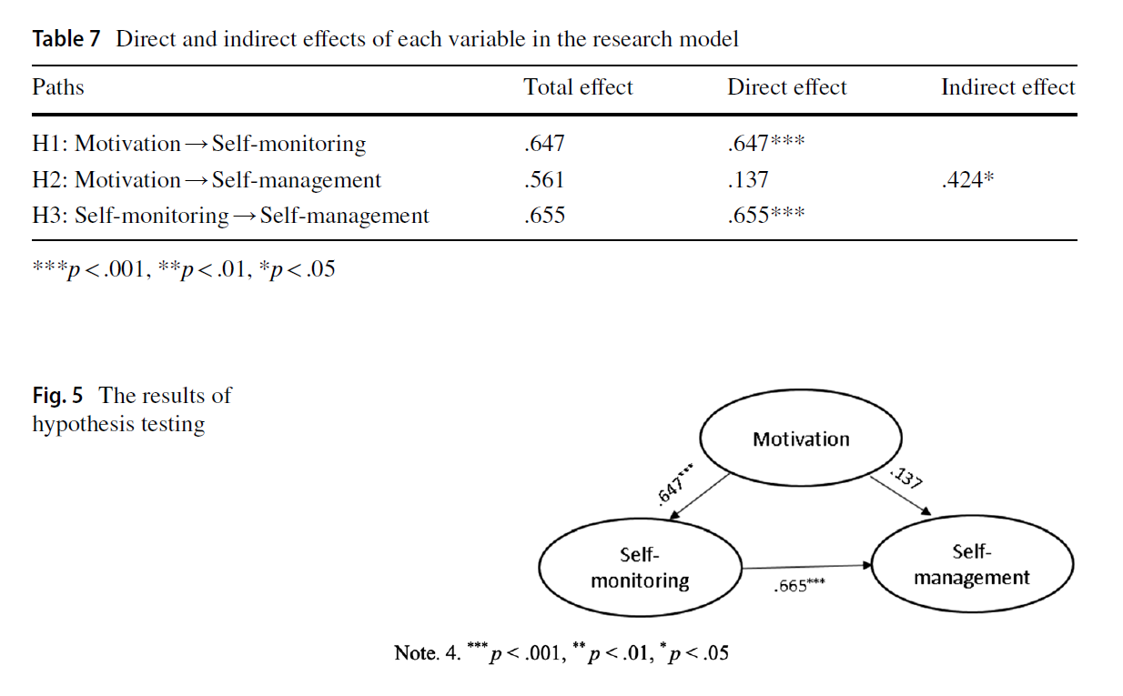
Study #3: Self-Directed learning in MOOCs:
Exploring the Relationships among motivation, self-monitoring, and self-management, Zhu, Bonk, & Doo, 2020, ETR&D
(SEM: Survey of 322 MOOC Learners)

Slide 78

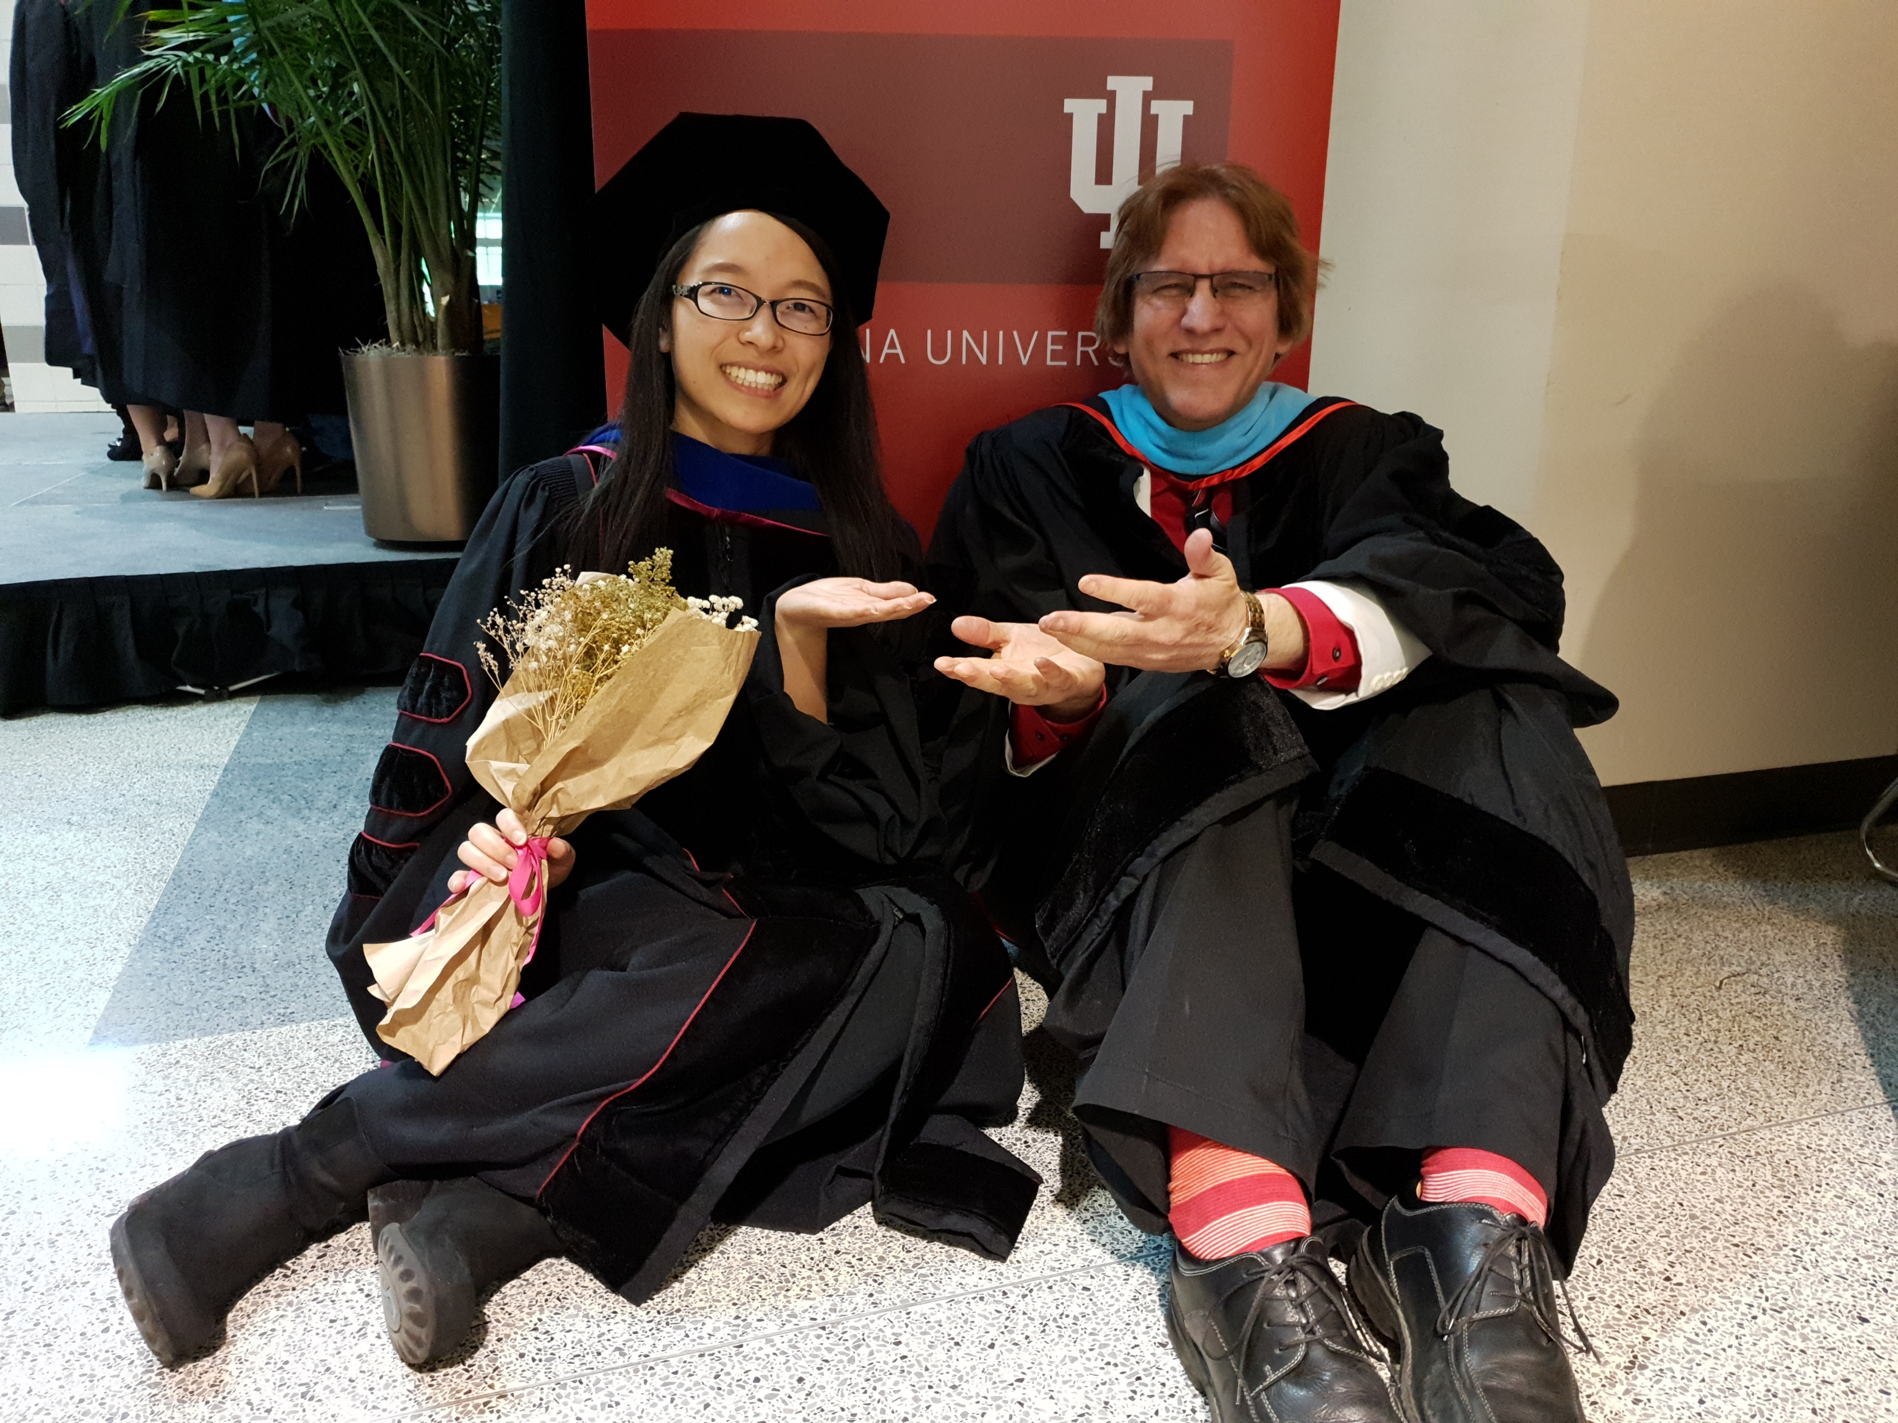

Any Questions?
Curtis Bonk: cjbonk@Indiana.edu
Meina Zhu: meinazhu@wayne.edu
Slides and Proceedings Paper at TrainingShare.com

