Slide 1
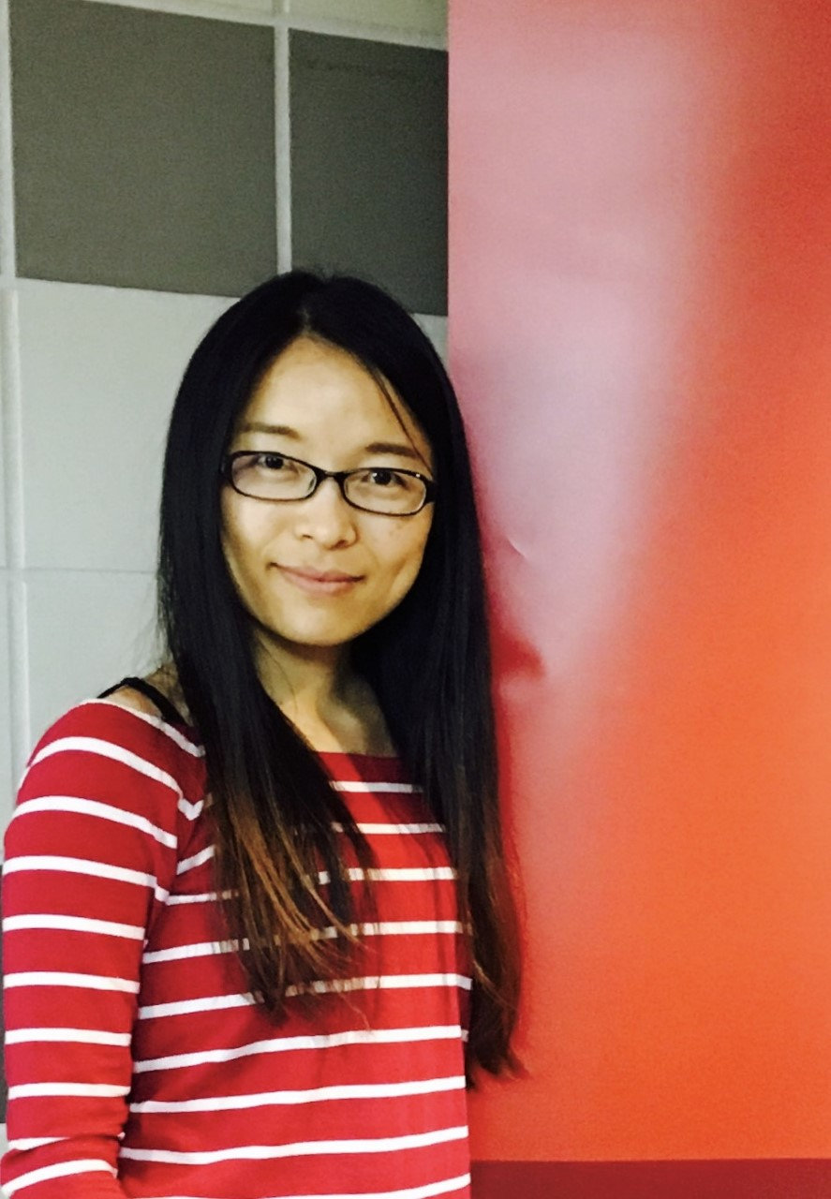



The G³ of Writing and Publishing Tips:
Gentle Guidelines, Great Stories, and Gigantic Scholarly Gains
Curtis J. Bonk, Ph.D., Indiana University
cjbonk@indiana.edu
Meina Zhu, Ph.D., Wayne State University
meinazhu@wayne.edu
Notes:
All
1

Slide 2

Writing Difficulties and Challenges of a Early Career Scholar
Time
Writing habits
Resources
Local/Global Support
Starter text
Reputation
Connections
Journal awareness
Energy/Stamina
Service/Teaching duties
Notes:
Ana
2

Slide 3

Writing Tips and Insights
Insights and Advice on Getting Published from a New Faculty’s Perspective
Notes:
3

Slide 4
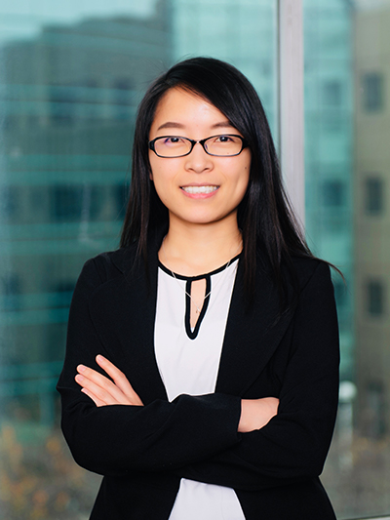
Meina Zhu:
An Early Career Perspective
1. Goals
2. Strategic Plans
3. Reflection
4. Collaborators
5. Professional Development
6. Research focus
Notes:
4

Slide 5
1. Writing Goals
Notes:
https://images.app.goo.gl/MKuUp4qKm1YVWaVy6
5

Slide 6


2. Strategic Plans
Notes:
6

Slide 7
3. Reflection on Writing
Notes:
https://images.app.goo.gl/GaBmk1XemmM54JxR7
7

Slide 8

4. Writing Collaborators
Notes:
Curt
8

Slide 9
October 3, 2019
Crucial Co-Writing Considerations
Jordan McNeill, Inside Higher Ed https://www.insidehighered.com/blogs/gradhacker/crucial-co-writing-considerations
Clarify authorship order ahead of time.
Have an honest conversation about the strengths of each team member--draft, revise, proofread, and format your manuscript.
Be clear on division of labor.
Nonwriting tasks are important too—taking notes, submission guidelines, and keep track of deadlines.
Set up digital collaboration norms and platforms—archiving, tracking, commenting, etc.
Respond to feedback professionally.
Build in time for feedback and revision.
Singular voice throughout paper—assign one member of team to read for writing style and flow.

Slide 10

Meina
Research Collaboration-Why?
Improve quality of research
Extend research relationships and networks
Foster interdisciplinary and transdisciplinary research
Share expertise and knowledge transfer
Enhance scientific and publishing productivity
Accelerate dissemination of findings for community benefit
Notes:
Retrieved from https://www.google.com/search?q=collaboration&tbm=isch&ved=2ahUKEwj8ivazkeDsAhUI0awKHcTRALsQ2-cCegQIABAA&oq=collaboration&gs_lcp=CgNpbWcQAzIFCAAQsQMyAggAMgIIADICCAAyAggAMgIIADICCAAyAggAMgIIADICCAA6BAgjECc6BAgAEEM6BwgAELEDEEM6CAgAELEDEIMBULmxDliCvQ5gzL4OaABwAHgAgAFPiAHKBpIBAjEzmAEAoAEBqgELZ3dzLXdpei1pbWfAAQE&sclient=img&ei=iQeeX7yiDYiiswXEo4PYCw&bih=881&biw=1965&tbs=il%3Acl&hl=en#imgrc=TBP9Sue5H-FIAM

Slide 11

Meina…
Research Collaboration-How?
Identify the skills that you can offer
Identify how the collaboration will meet your needs
Find collaborators
Introduce yourself
Set expectations at the beginning of the collaboration
Leverage tools for collaborations
Keep communicating
Do not be discouraged
Notes:
Retrieved from https://www.google.com/search?q=collaboration&tbm=isch&ved=2ahUKEwj8ivazkeDsAhUI0awKHcTRALsQ2-cCegQIABAA&oq=collaboration&gs_lcp=CgNpbWcQAzIFCAAQsQMyAggAMgIIADICCAAyAggAMgIIADICCAAyAggAMgIIADICCAA6BAgjECc6BAgAEEM6BwgAELEDEEM6CAgAELEDEIMBULmxDliCvQ5gzL4OaABwAHgAgAFPiAHKBpIBAjEzmAEAoAEBqgELZ3dzLXdpei1pbWfAAQE&sclient=img&ei=iQeeX7yiDYiiswXEo4PYCw&bih=881&biw=1965&tbs=il%3Acl&hl=en#imgrc=1C1gKEYxDs39-M&imgdii=FLQg6a_t9CpumM

Slide 12
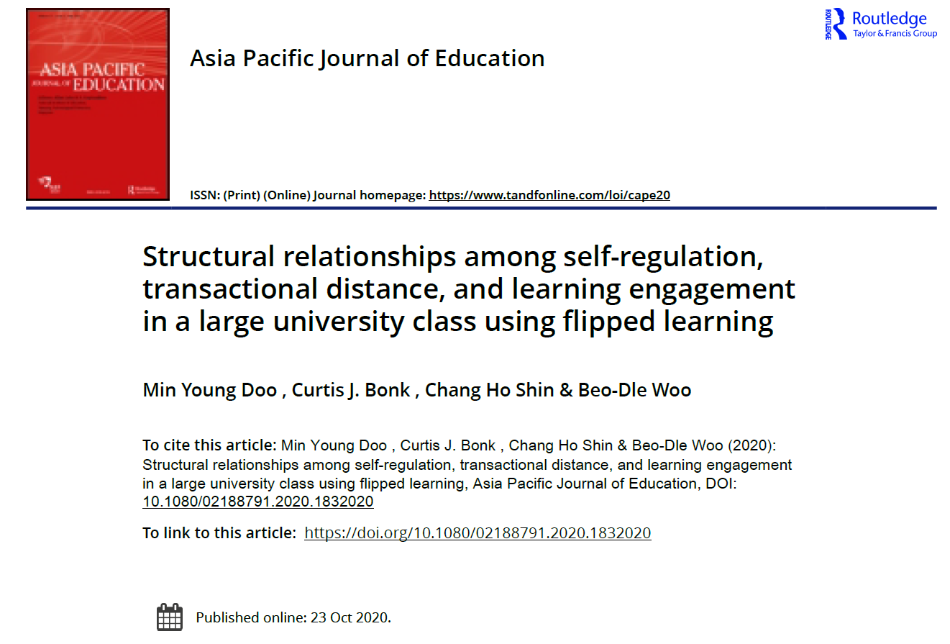
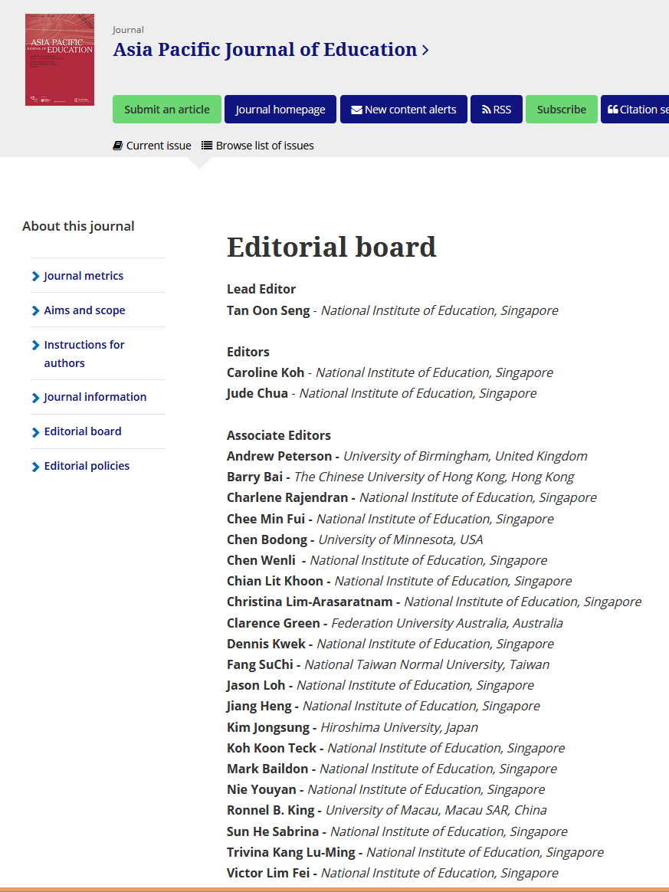
5. Sometimes you have to contact the editor…

Slide 13


6. Sometimes you have to send to an easier journal…

Slide 14
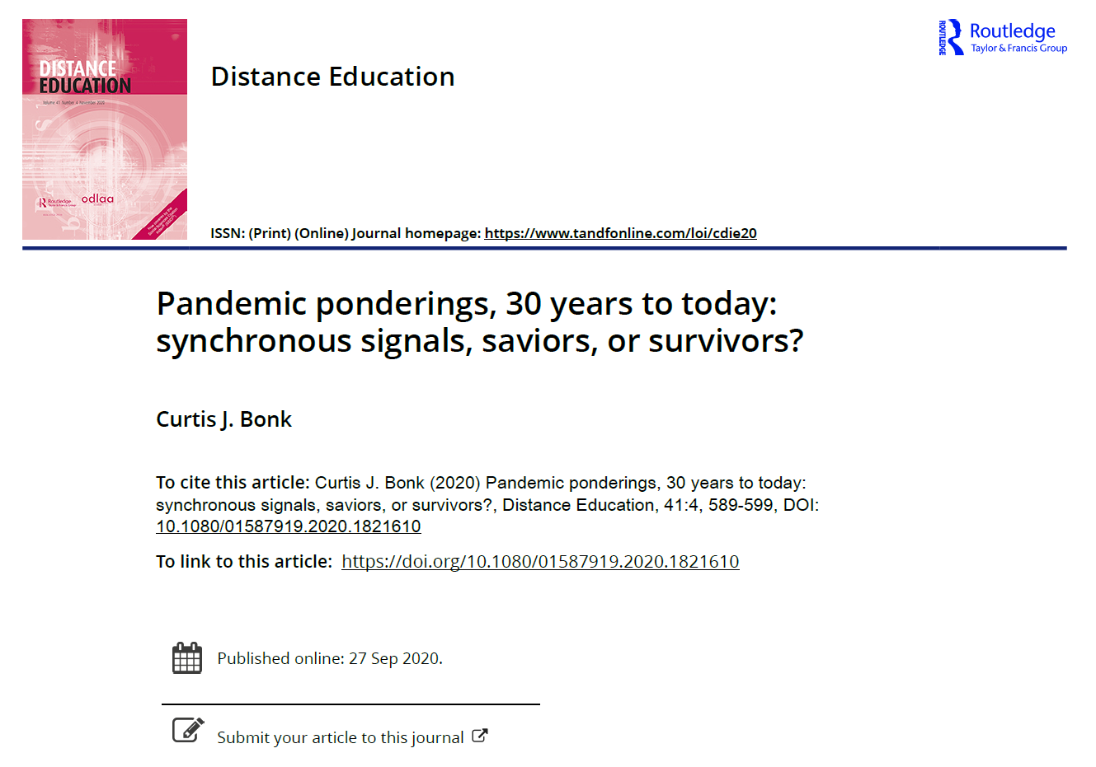

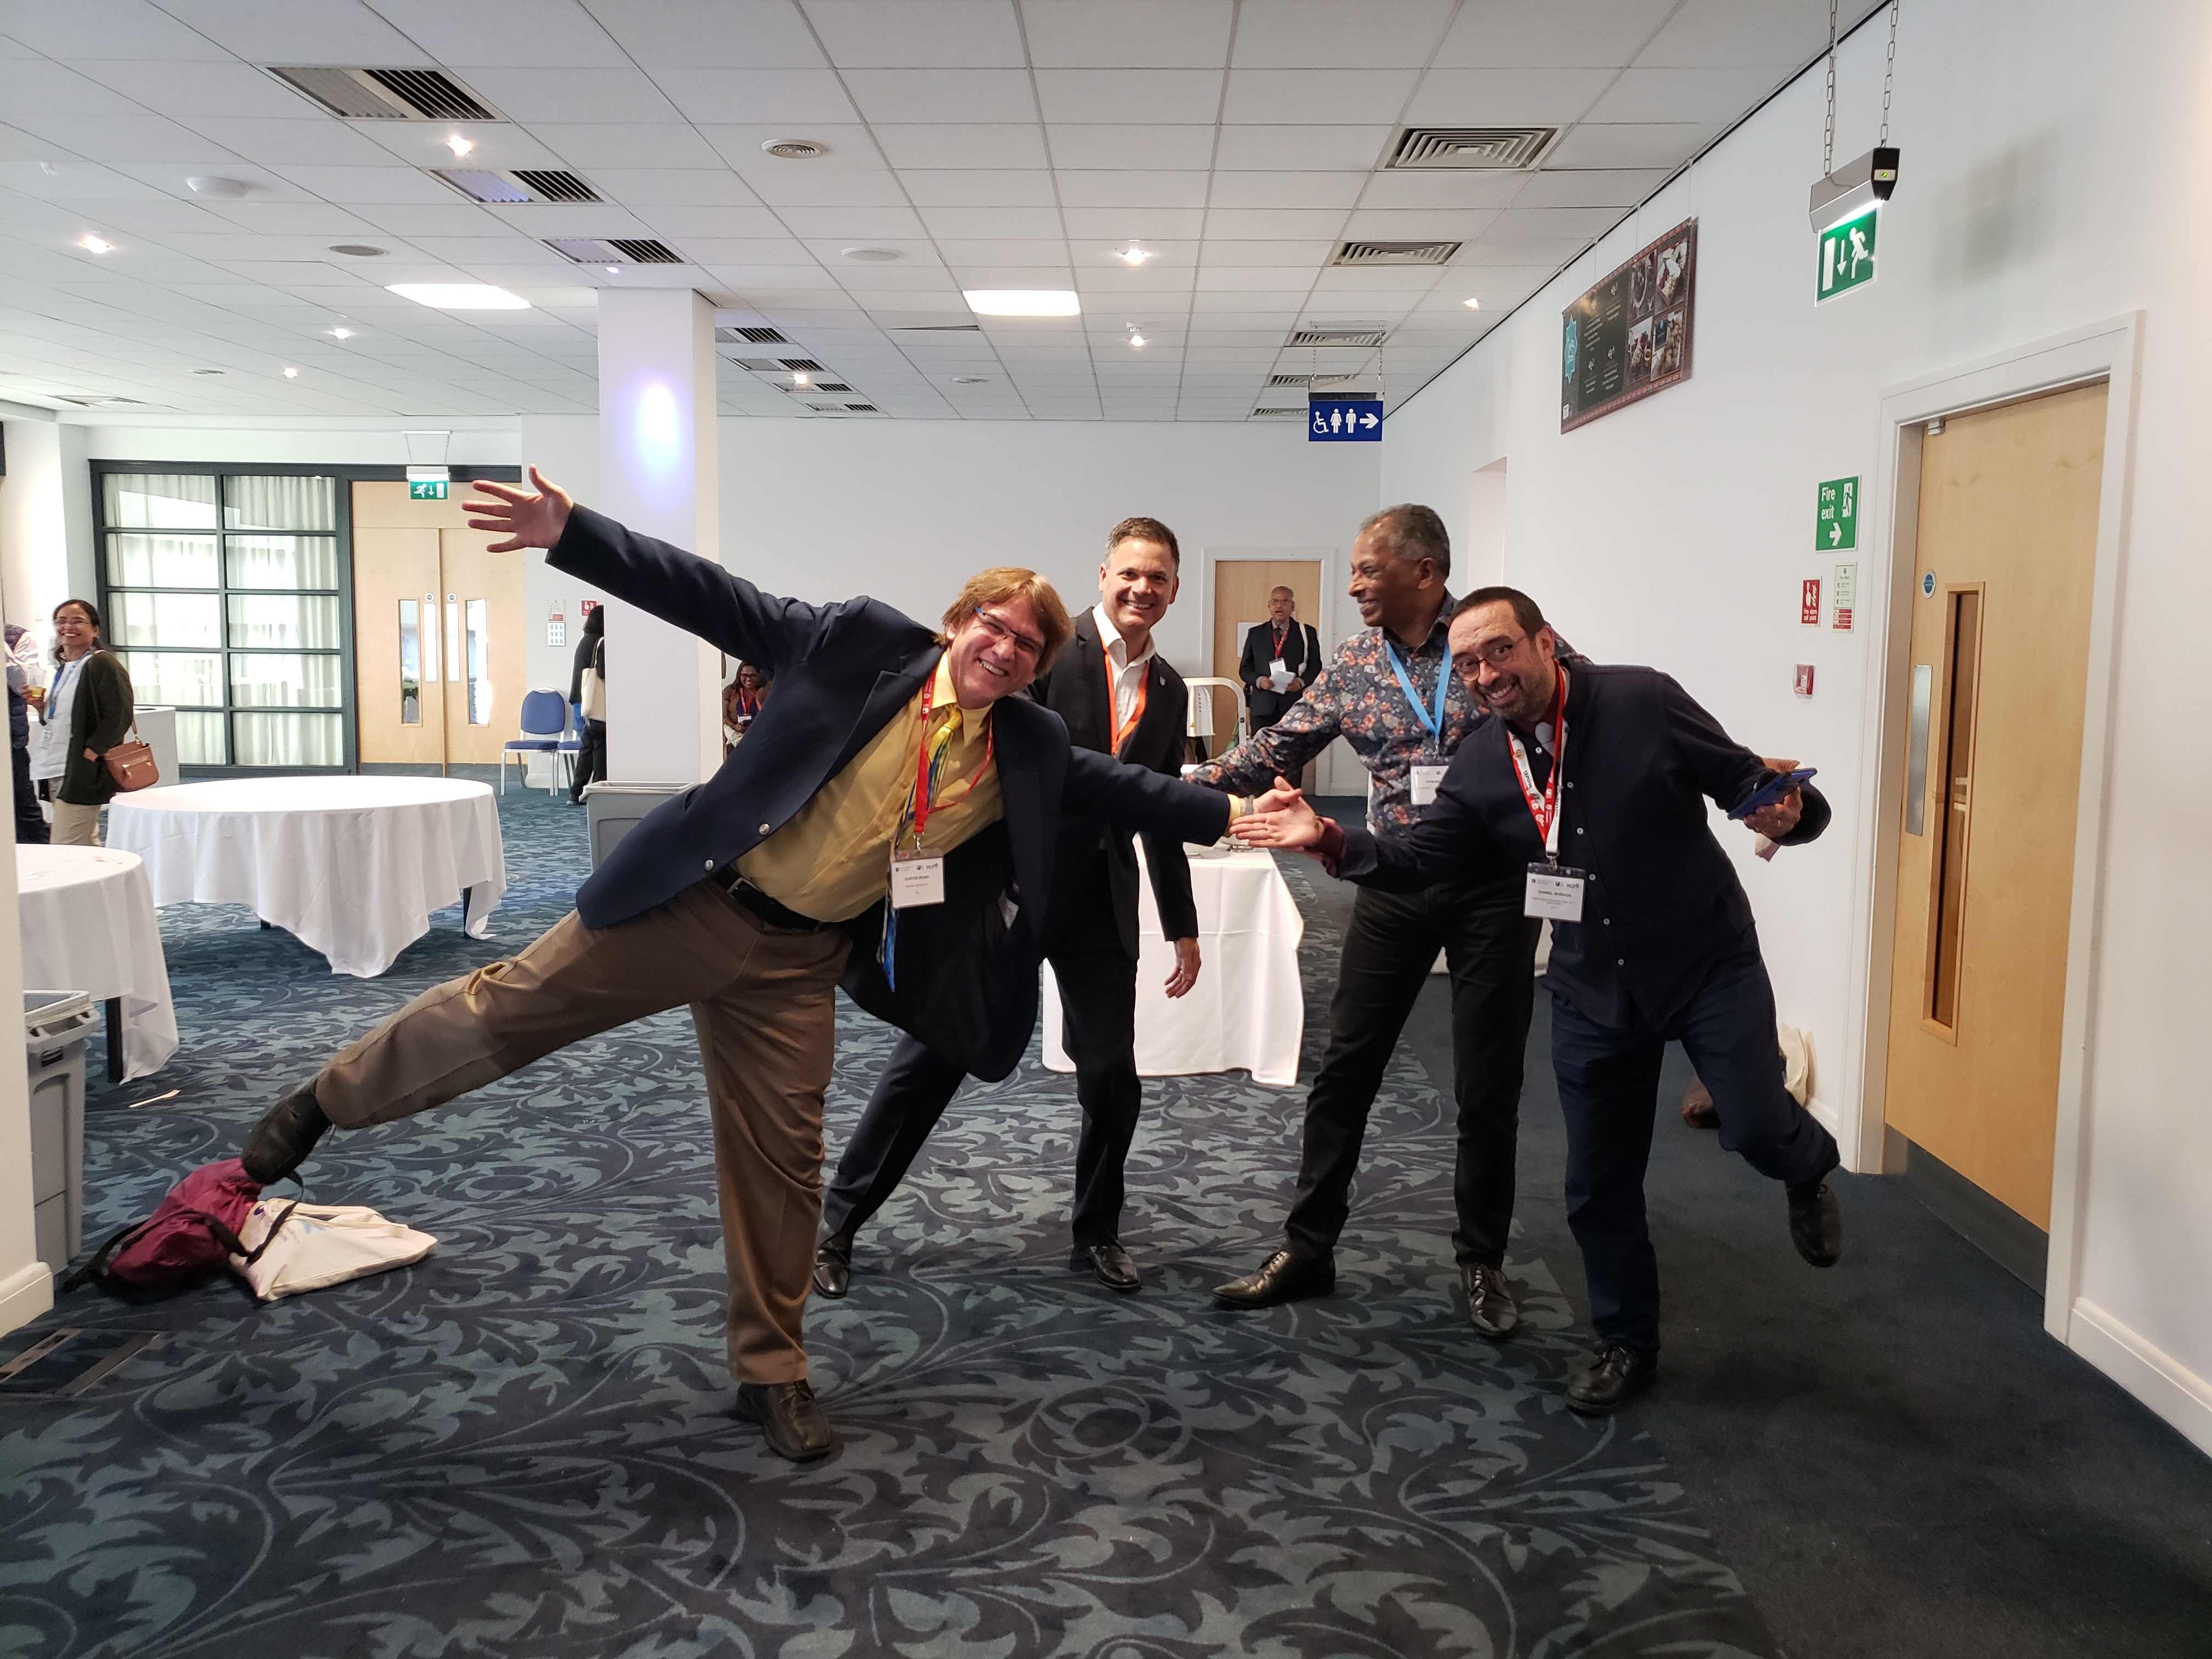

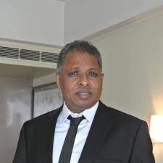
7. Sometimes you’re invited…

Slide 15
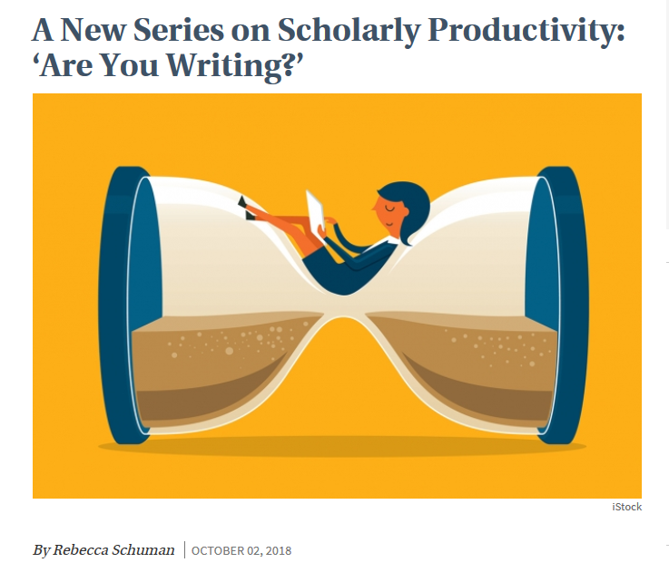
8. Mark the Level of Difficulty
A New Series on Scholarly Productivity:
‘Are You Writing?’
Rebecca Shuman, The Chronicle of Higher Education https://www.chronicle.com/article/A-New-Series-on-Scholarly/244689
Read as peer reviewer; mark up everything.
Catalog problems on a 1 to 3 difficulty scale (Level 1 takes less than 30 minutes, Level 2 takes 2 hours or less; Level 3 takes more time).
Fix the easy ones and gain momentum for the harder ones!
Take breaks as needed.
Notes:
Curt

Slide 16
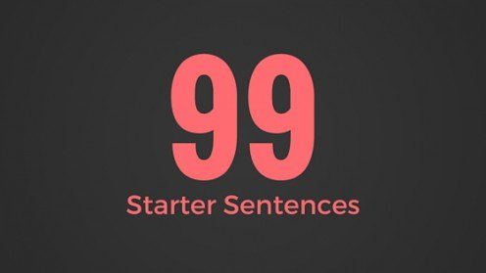

9. Generate Starter Text…
Author a blog
Use social media
Submit a conference proposal
Write editorials
Write book and software reviews
101
Notes:
Curt

Slide 17

March 31, 2019
10. Step Away From the Delete Button
Rebecca Schuman, The Chronicle of Higher Education https://www.chronicle.com/article/Step-Away-From-the-Delete/246013?cid=cp242

Slide 18


Sometimes There’s a Hot Streak:
Notes:
https://letslearnenglish.com/asking-for-and-giving-directions/
18

Slide 19

Curt Bonk:
Reflections on the Hot Streak
1. Persistence and grit.
2. Sense of now.
3. One at a time.
4. Assemble best team for you. Find comfort.
5. Intense and Relaxed Planning.
6. Explore Possible Journals and Commit.
7. Everyone has clear role.
8. Set bold and audacious goals.
9. Recheck list. Recheck goals.
10. Revel in good luck. Do not sulk if bad luck.
Notes:
19

Slide 20

Writing Space #1: Meina Zhu, Wayne State University
My room is my writing space when it is dark outside.

Slide 21
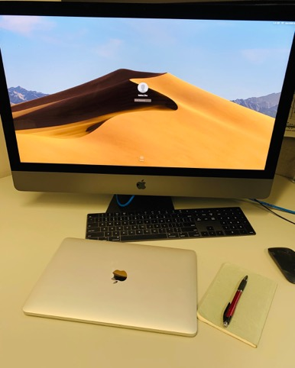
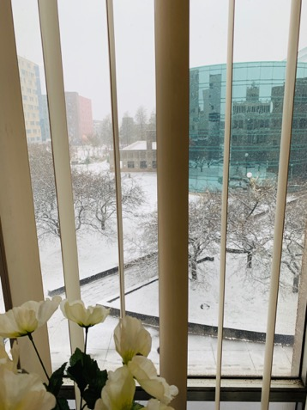
Writing Space #2: Meina Zhu
My office is my favorite place for writing during day time: perfect temperature, big screen, and great view.

Slide 22

Writing Tools: Meina Zhu
My collaborative tools are:
Google Drive
One Drive
Mendeley

Slide 23
Plans and Goals: Meina Zhu
Five year plans
One year plan
Two months plan
Weekly plan
Daily to do

Slide 24
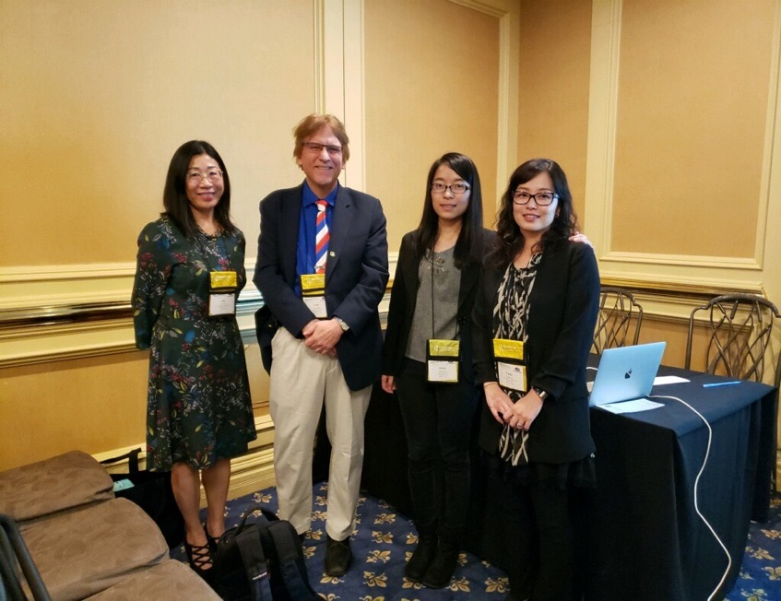
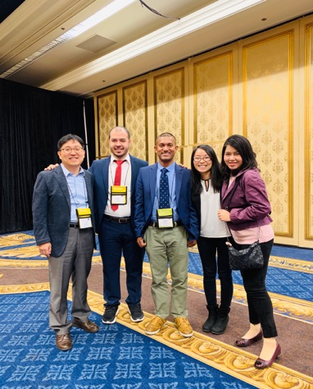
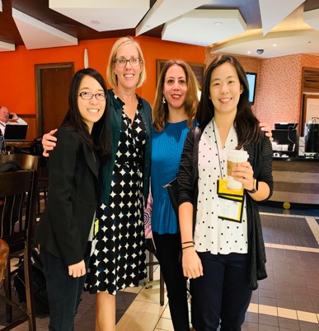
Writing Partners and Mentors: Meina Zhu

Slide 25

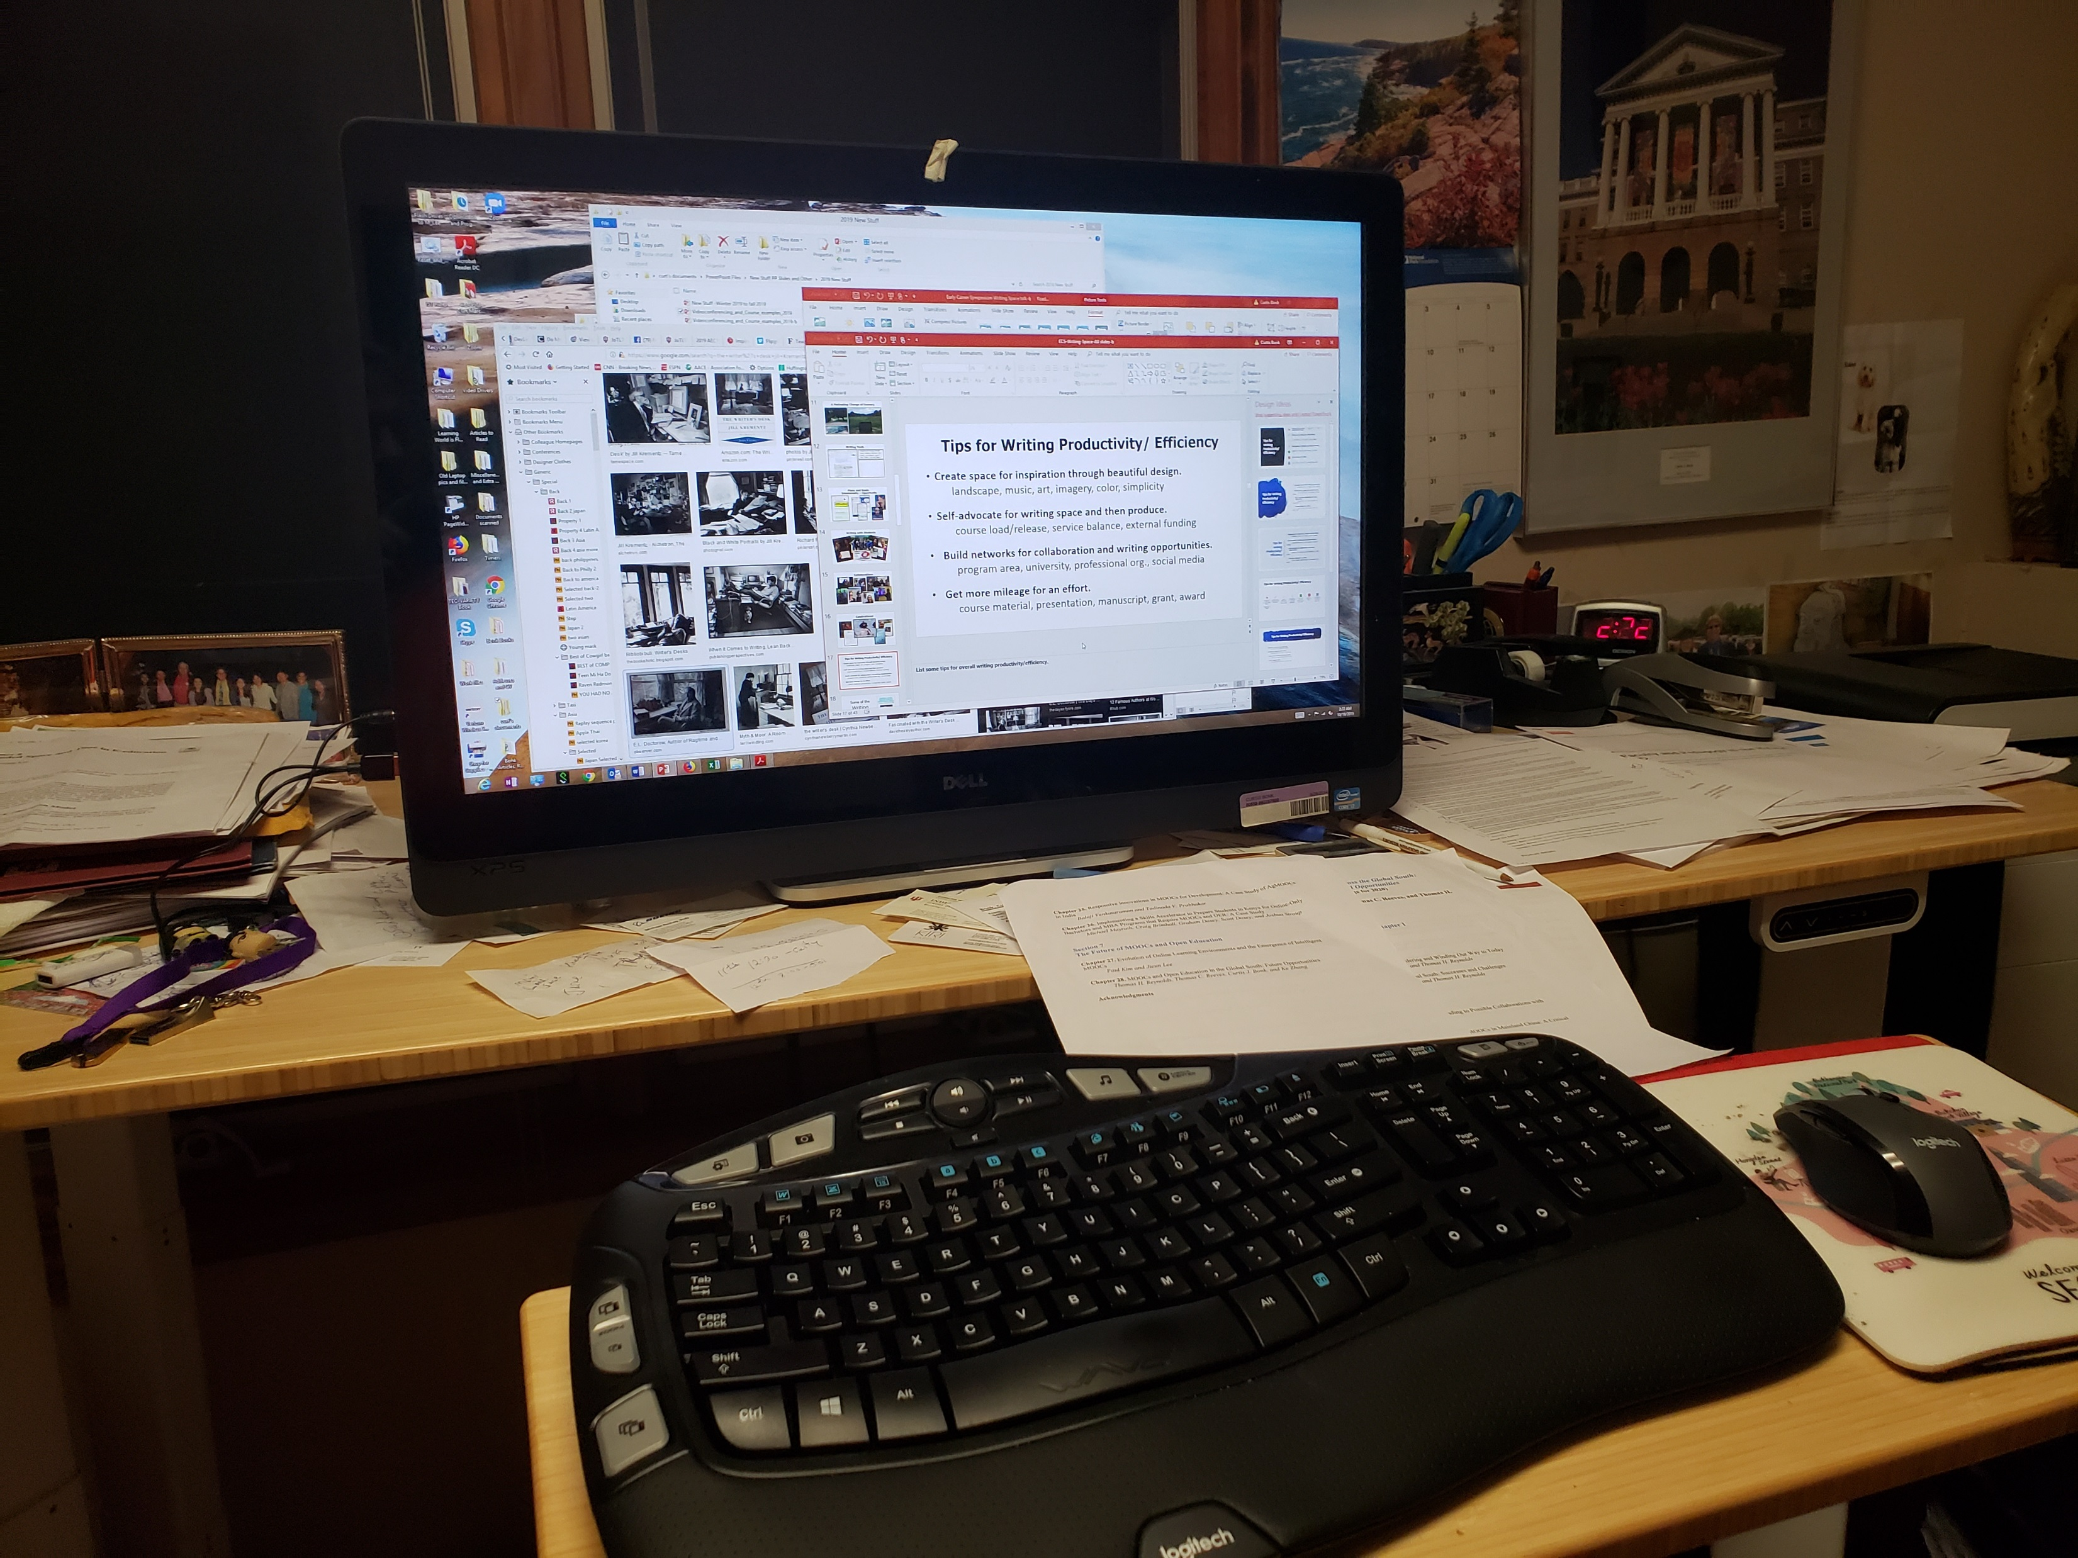
Writing Space
Curt Bonk, Indiana University
I having standing desk…power it up and down via hydraulics. And my office looks out into a forest.

Slide 26
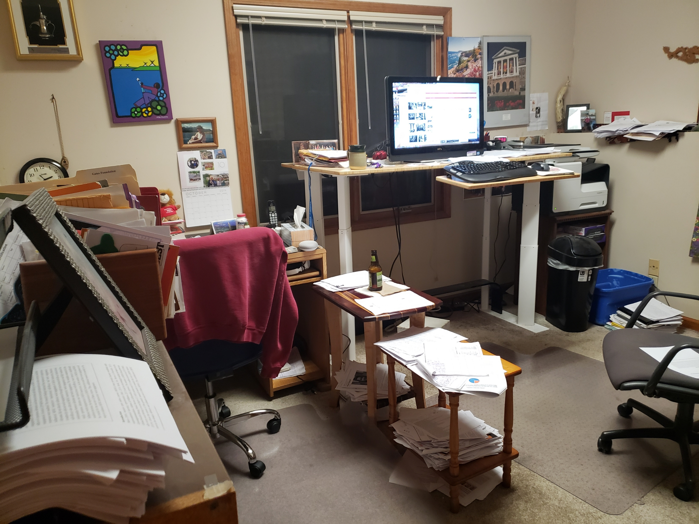
Writing Space: Curt Bonk
My office. I save interesting articles to later reference in papers and books.

Slide 27

Plans and Goals: Curt Bonk
How do you schedule your writing? How far in advance do you plan your writing? How do you prioritize your writing? How do you visualize your writing? Do you use a timeline or a planner? Do you have advice for developing a writing plan?
Plan: I save days for writing in my paper planner.
Focus: I say no to things that don’t fit my writing plans.
Track: I note projects in process and completed in my daily Dalia Lama quote of the day.
Monitor: I look at articles I have in review, in revision, and in press in my CV all the time.
Be Responsive: I respond to co-writer requests.
Goals: Put writing plans in annual report.

Slide 28


Writing Tips: Curt Bonk
Anything special that you do?
My top 10 key writing tips:
Create a “Work” file on your desktop.
Save screen shots, dates, and URLs of articles.
Create “Articles to read” folder on your desktop.
Listen to audiobooks for writing ideas.
Watch movies & look for educational issues and ideas.
Always save documents at least twice.
Send draft of document to yourself on email…restart anywhere.
Ask friends to read second or third draft.
Save articles published by year.
Keep drafts of articles in special files.

Slide 29
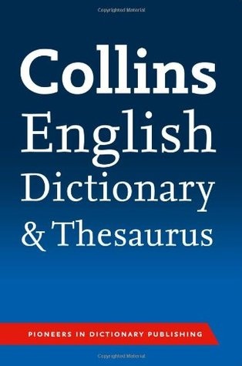
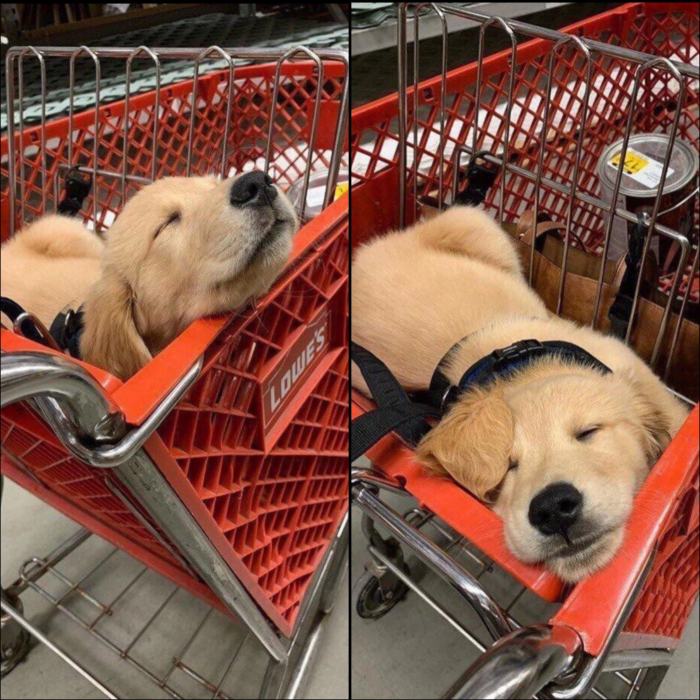
10 More Writing Tips: Curt Bonk
Anything special that you do?
My top 20 key writing tips:
11. The Collins thesaurus.
12. Look for historical info online (e.g., Wikipedia and other).
13. Relocate to another room to edit document (i.e., kitchen table).
14. Sometimes sit. Sometimes stand.
15. Print out articles that you read parts of online.
16. Review paper piles on my pool table before you write.
17. Find info and URLs in previous talk slides.
18. Almost be more optimistic than pessimistic.
19. Work when your friends and family are sleeping.
20. Wherever you are is your writing space.

Slide 30

Habits/Rituals/Inspiration: Writing
How do approach your writing tasks? Any rituals that you use and recommend for inspiration? Anything that really works for you?
Save writing ideas on slips of paper and look back at them.
Talk about your ideas.
Save starter text.
Clear email and to-do list.
Create checklist of plans.

Slide 31

Finding a Journal that Fits
What to look for?
Who will be your target readers?
Who are the authors and journals you cite the most related with your research program?
Is there a match between your work and the journal aims and scope?
What is the journal turnaround time?
What is the journal acceptance rate?
Do you know the editor(s)?
Notes:
Ana
https://www.editage.com/insights/how-to-choose-journals-for-submitting-your-paper
Who will be your target readers? Scholarly vs. non-scholarly periodicals
readership and target audience
Look for a match between your work and the journal aims and scope. – journal analysis
What is the journal’s turnaround time?
Acceptance rates? Get familiar with the journals’ acceptance rates
31

Slide 32
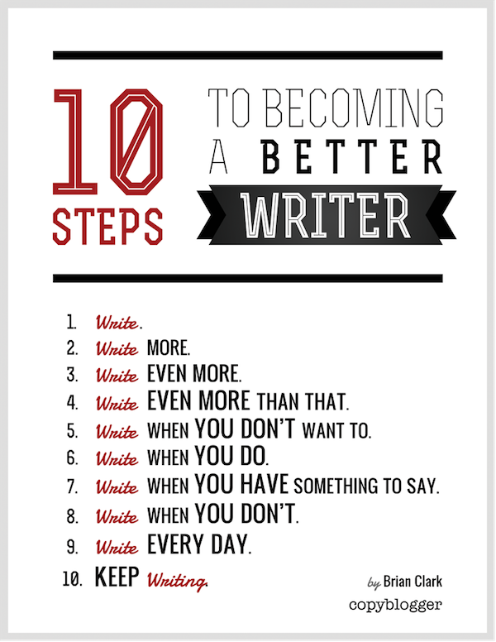
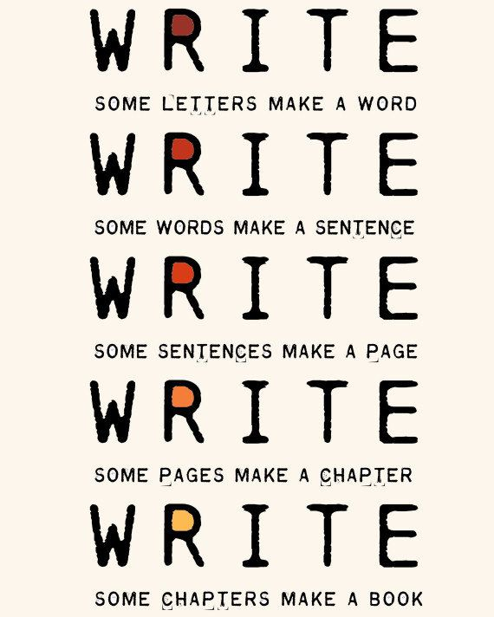
The Top 15 Writing Tips
Notes:
Curt
32

Slide 33
1. Mark Writing Days in Planner
Notes:
Curt
33

Slide 34
2. Maintain a List and Network of Potential Research and Writing Collaborators
Notes:
Curt
34

Slide 35
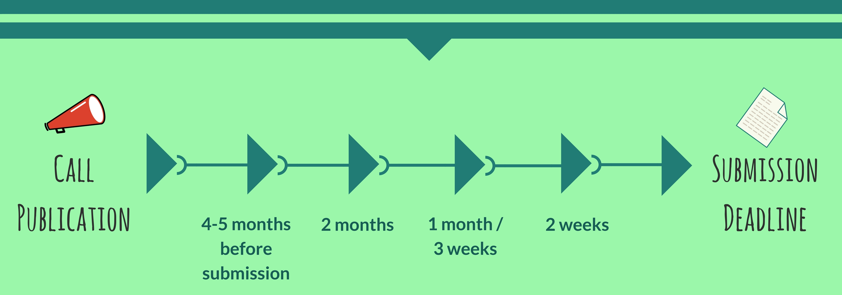
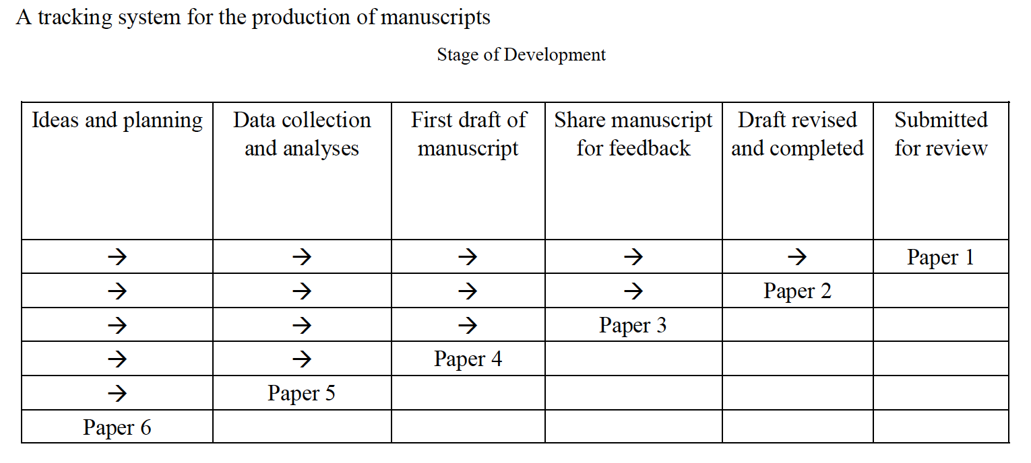
3. Draft a Timeline or Multiple Timelines with Flexible Goals
Notes:
Curt
Screenshot from Cecil’s article
35

Slide 36

4. Think Ahead About the Publishing Potential of Each Project
Notes:
Curt
36

Slide 37
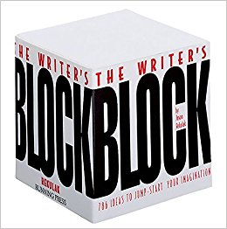

5. Find, Save, and Use Starter Text (overcomes writer’s block)
Notes:
Curt
37

Slide 38

6. Always Scan the Reference Sections of Other Articles to See What Journals are Popular
Notes:
Curt
38

Slide 39

7. Avoid High Quality (i.e., SSCI) Journal Fixations
Notes:
Curt
39

Slide 40


8. Be Second or Third Author Sometimes to Spread Limited Resources
Notes:
Curt
40

Slide 41
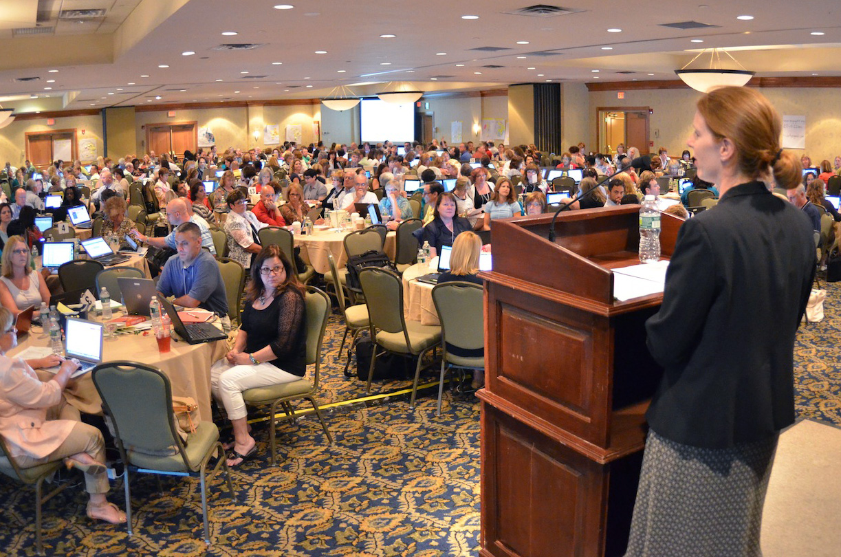

9. Try to Submit or Publish Your Paper Before the Conference
Notes:
Curt
41

Slide 42

10. Be Creative Somewhere
(e.g., unique model, figure, chart, etc.)
Notes:
Curt
42

Slide 43

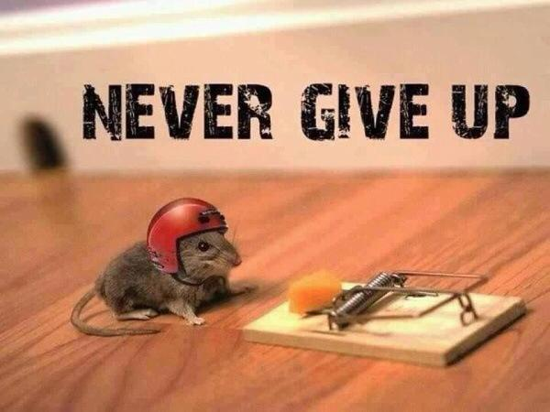
11. Try Not to Give Up: Persistence and Grit Wins the Day
Notes:
Curt
43

Slide 44
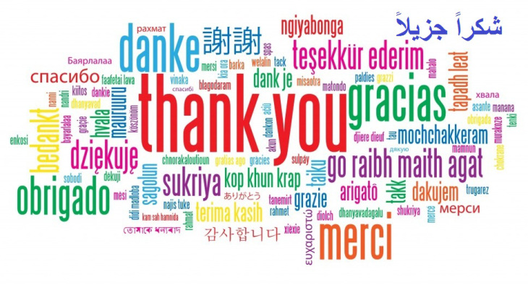
12. Be Polite and Thankful to the Journal or Book Chapter Editors
Notes:
Curt
44

Slide 45

13. Recap Reviewer Points and How You Attempted to Address Them
Notes:
Curt
45

Slide 46
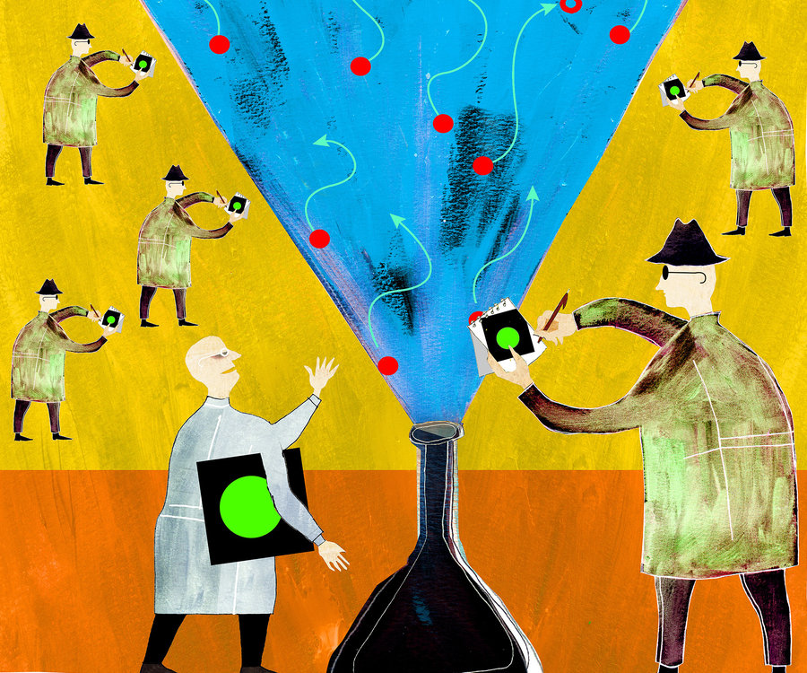


14. Share Your Publication Efforts (e.g., Twitter, Facebook, LinkedIn, email, ResearchGate, Academia.edu, etc.)
Notes:
Curt
46

Slide 47

15. Celebrate Your Writing Accomplishments with Friends
Notes:
Curt
47

Slide 48

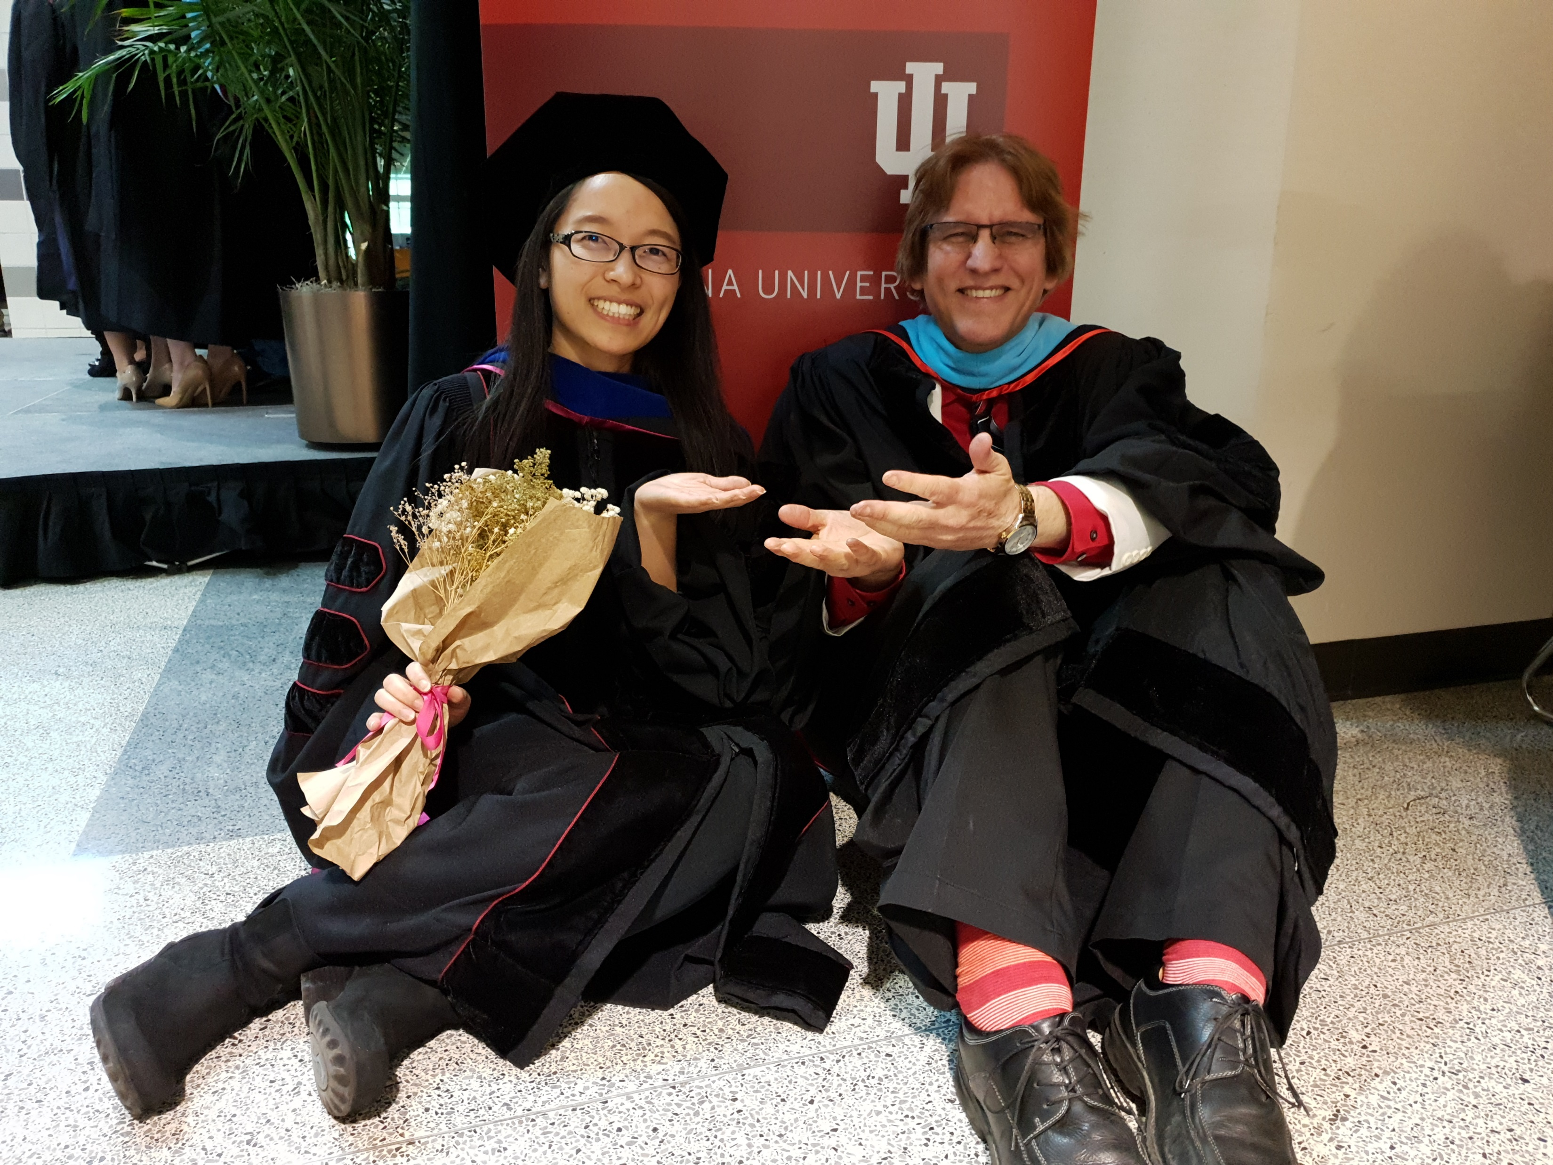
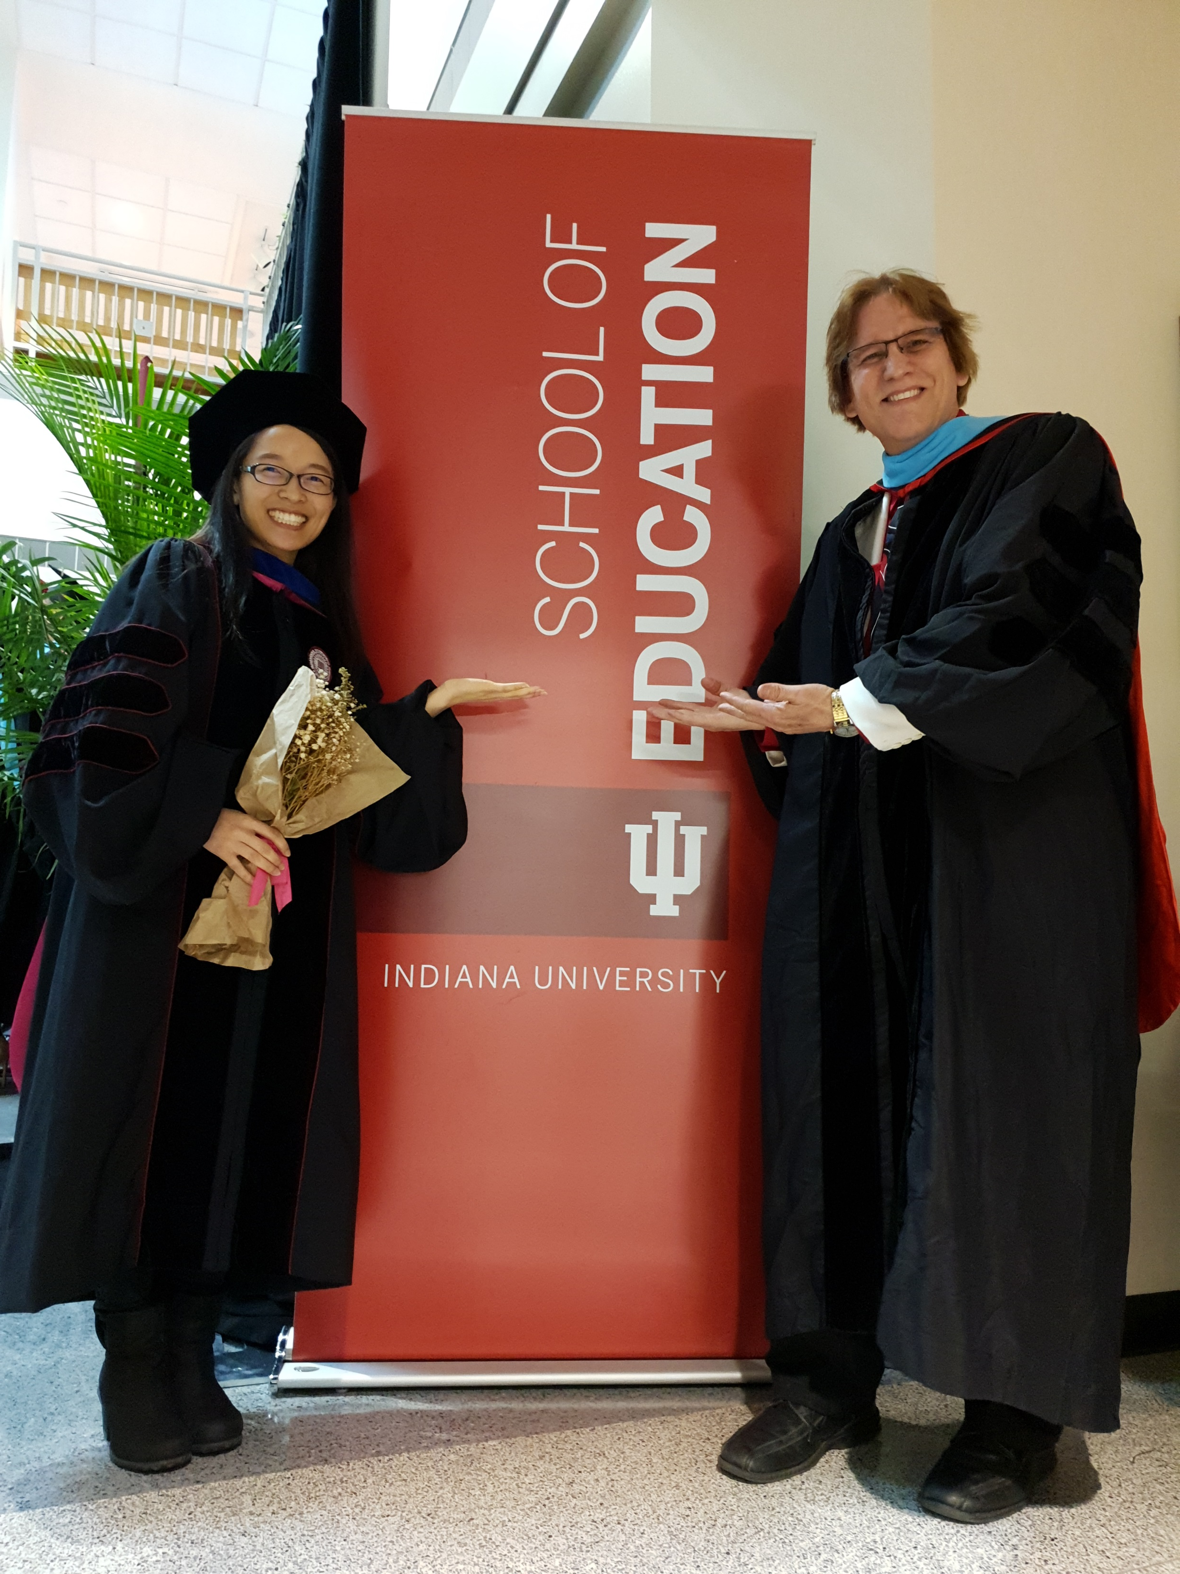
Concerns?
Comments?
Commitments?
Curt Bonk, IU, Email: cjbonk@Indiana.edu
Meina Zhu, WSU, Email: meinazhu@wayne.edu
Slides: http://www.trainingshare.com
Notes:
All
48

