Slide 1


Sharing Experiences of Simultaneous Open Access (Free) and Low Cost Book Publishing in Amazon CreateSpace
Curtis J. Bonk
Professor, Indiana University
cjbonk@indiana.edu
http://mypage.iu.edu/~cjbonk/

Slide 2

This talk is a “Two-For”

Slide 3


Part #1:
Self-Publishing and Open Access Books (and free e-book)

Slide 4
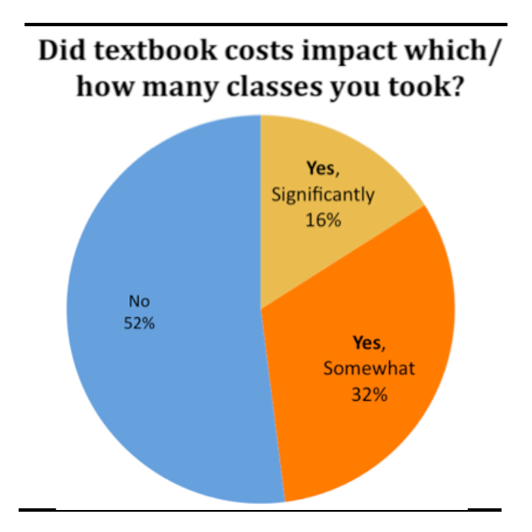
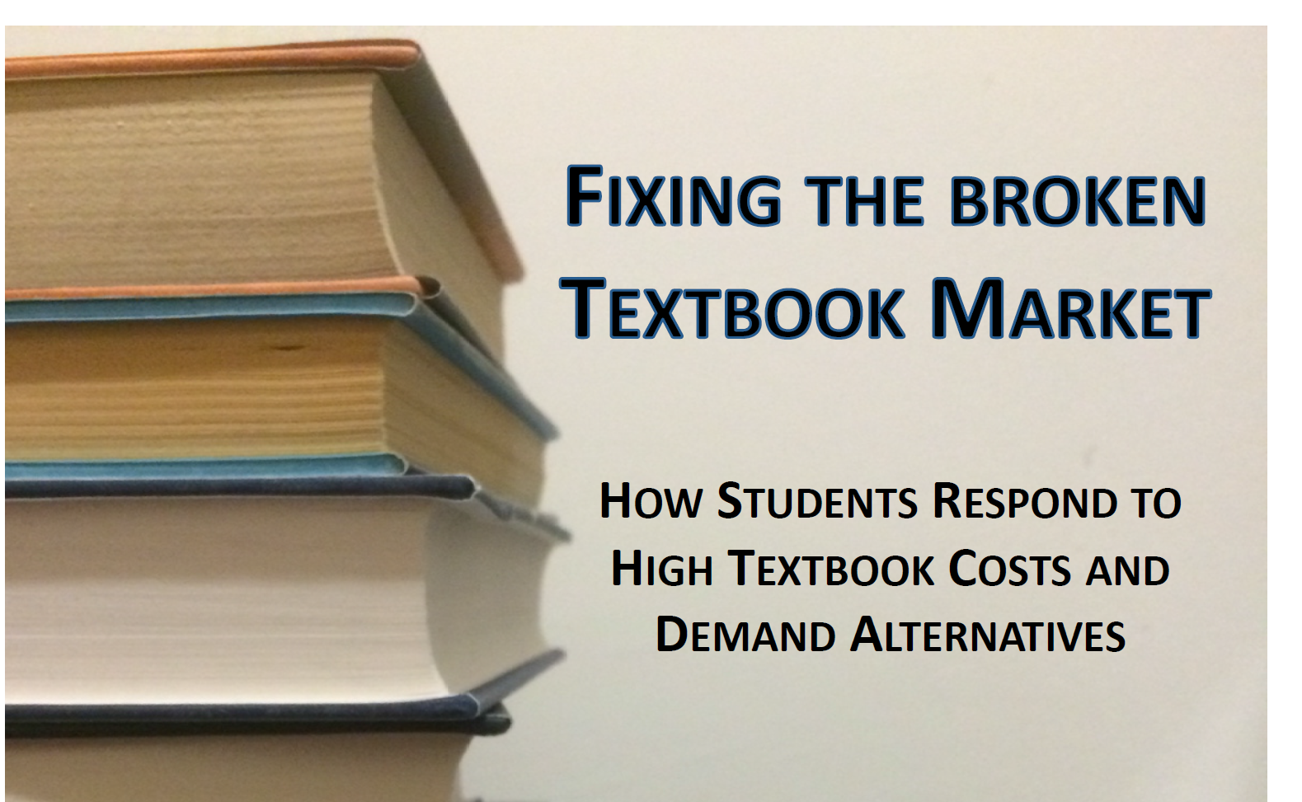
January 2014
Fixing the Broken Textbook Market:
How Students Respond to High Textbook Costs and Demand Alternatives
Ethan Senack, The Student PIRGs http://uspirg.org/sites/pirg/files/reports/NATIONAL%20Fixing%20Broken%20Textbooks%20Report_0.pdf

Slide 5
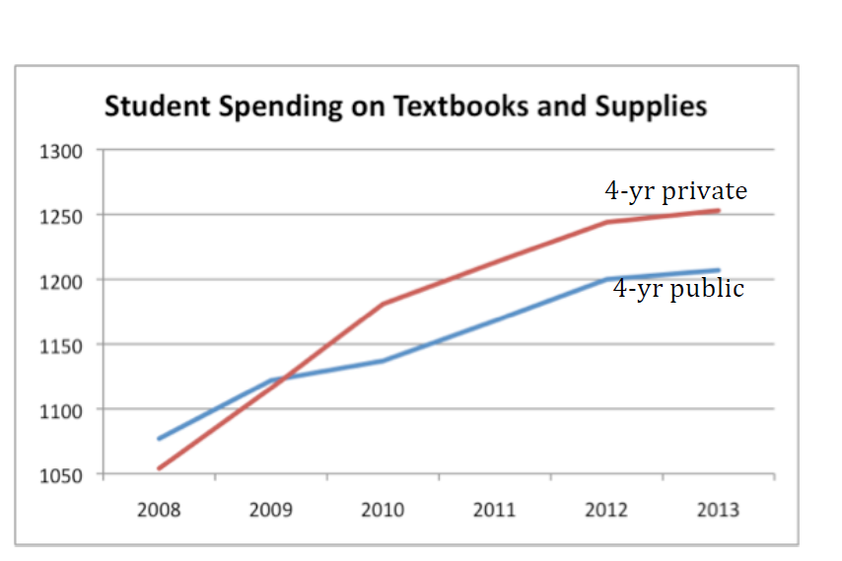
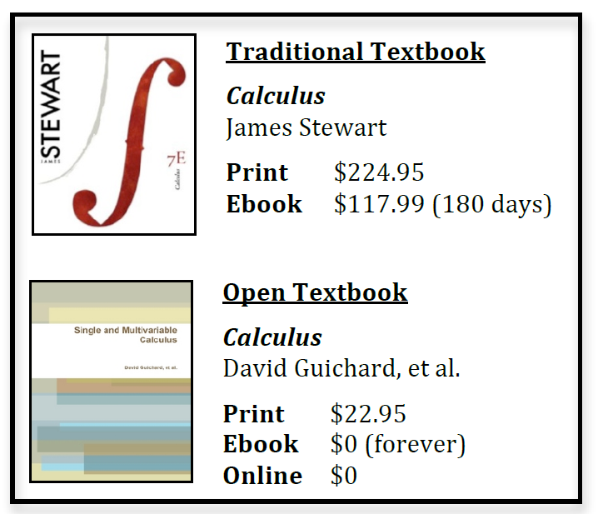
January 2014
Fixing the Broken Textbook Market:
How Students Respond to High Textbook Costs and Demand Alternatives,
Ethan Senack, The Student PIRGs http://uspirg.org/sites/pirg/files/reports/NATIONAL%20Fixing%20Broken%20Textbooks%20Report_0.pdf

Slide 6
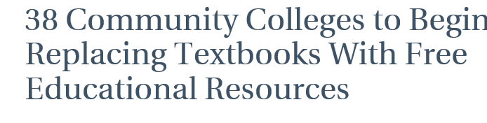
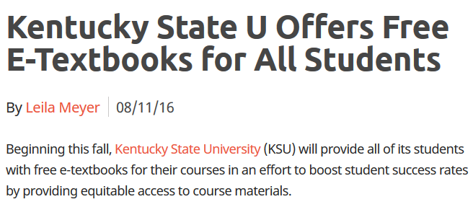
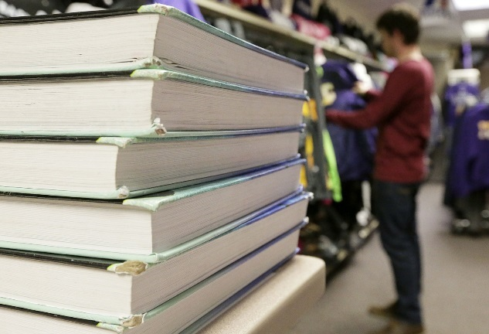

June 14, 2016 and August 11, 2016
Kentucky State U Offers Free E-Textbooks for All Students
Leila Meyer, eCampus News http://www.unescobkk.org/education/ict/online-resources/databases/ict-in-education-database/item/article/the-maker-movement-in-education-a-new-global-transformation/
The new effort is backed by grants totaling $9.8 million from several foundations, and is likely to give another boost to the growing movement for open educational resources, or OER.

Slide 7
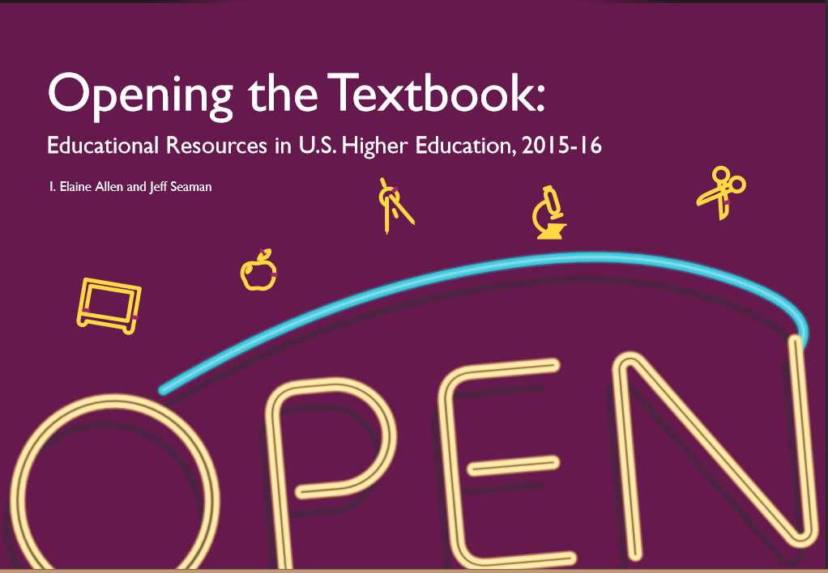
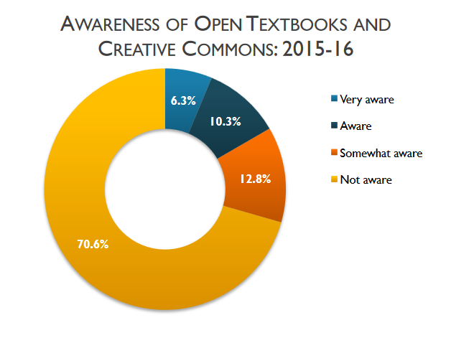
July 2016
Opening the Textbook: Educational Resources in U.S. Higher Education, 2015-2016
I. Elaine Allen and Jeff Seaman, Babson Survey Research Group http://www.onlinelearningsurvey.com/reports/openingthetextbook2016.pdf

Slide 8
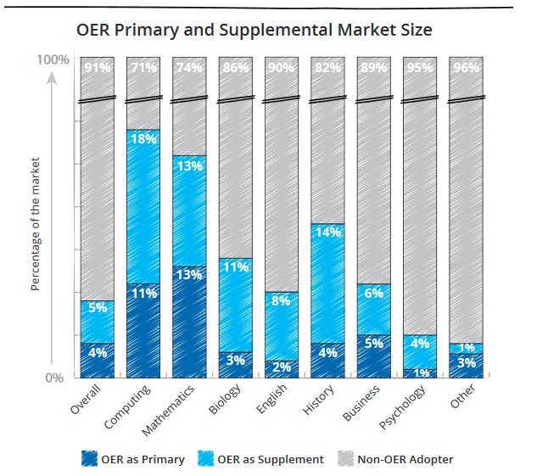
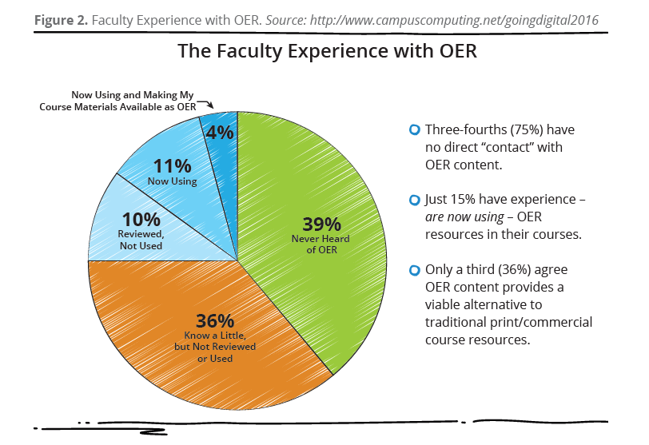
September 7, 2016
Open Educational Resources (OER) and the Evolving Higher Education Landscape
Cengage https://campustechnology.com/articles/2016/09/07/oer-use-to-triple-over-next-5-years.aspx http://assets.cengage.com/pdf/wp_oer-evolving-higher-ed-landscape.pdf

Slide 9



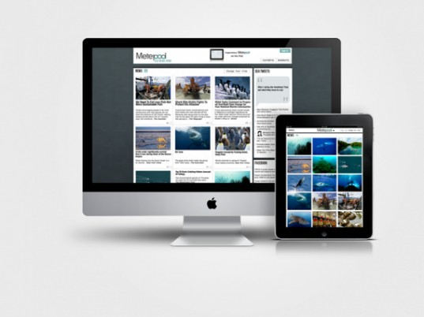
Audience Poll #1:
Who in here has thought about self-publishing a book?

Slide 10
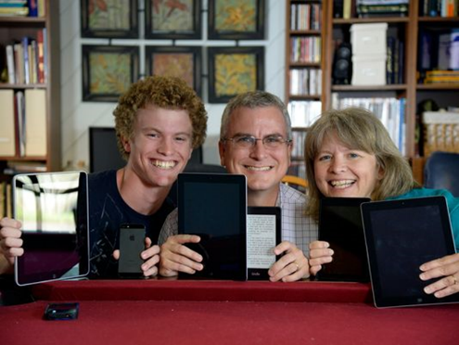

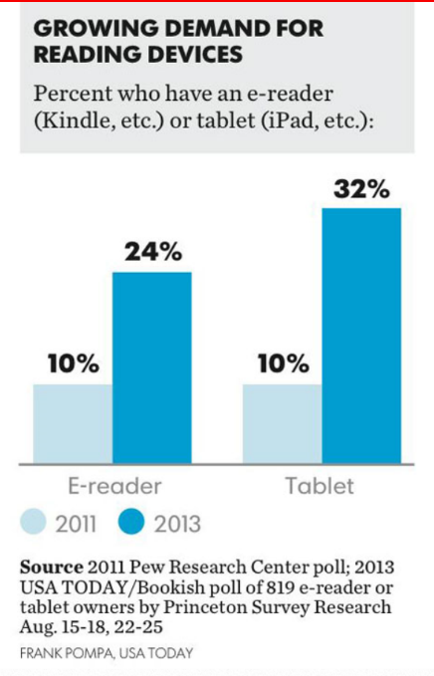
OpenStax College
(OpenStax College offers students free textbooks that meet scope and sequence requirements for most courses. These are peer-reviewed texts written by professional content developers.) http://openstaxcollege.org/

Slide 11
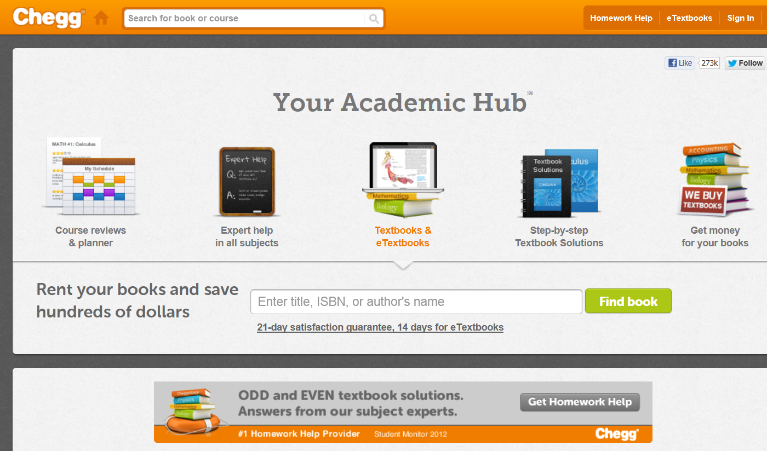
Chegg (free textbooks) http://www.chegg.com/

Slide 12


Lightning Source https://www1.lightningsource.com/default.aspx

Slide 13
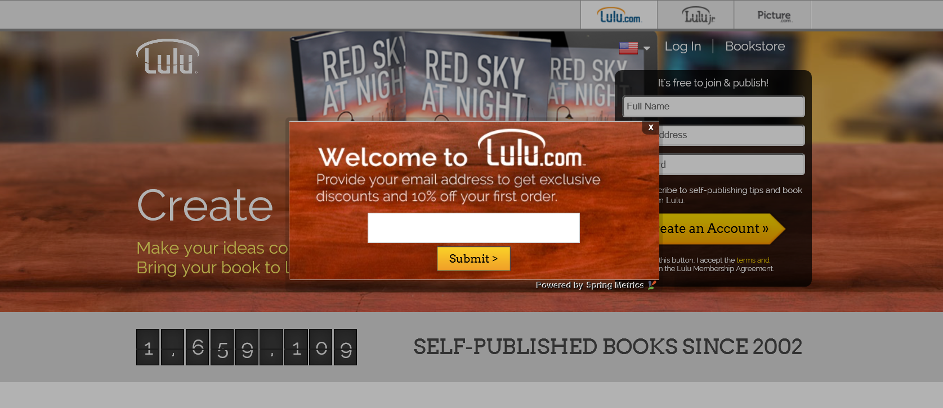
Lulu http://www.lulu.com/

Slide 14
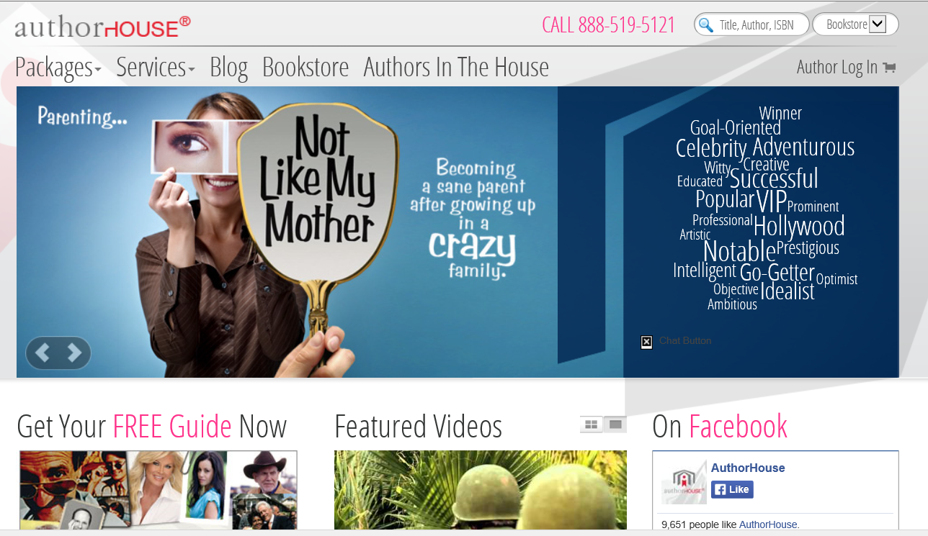
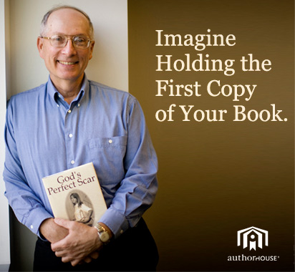
AuthorHouse http://www.authorhouse.com/

Slide 15
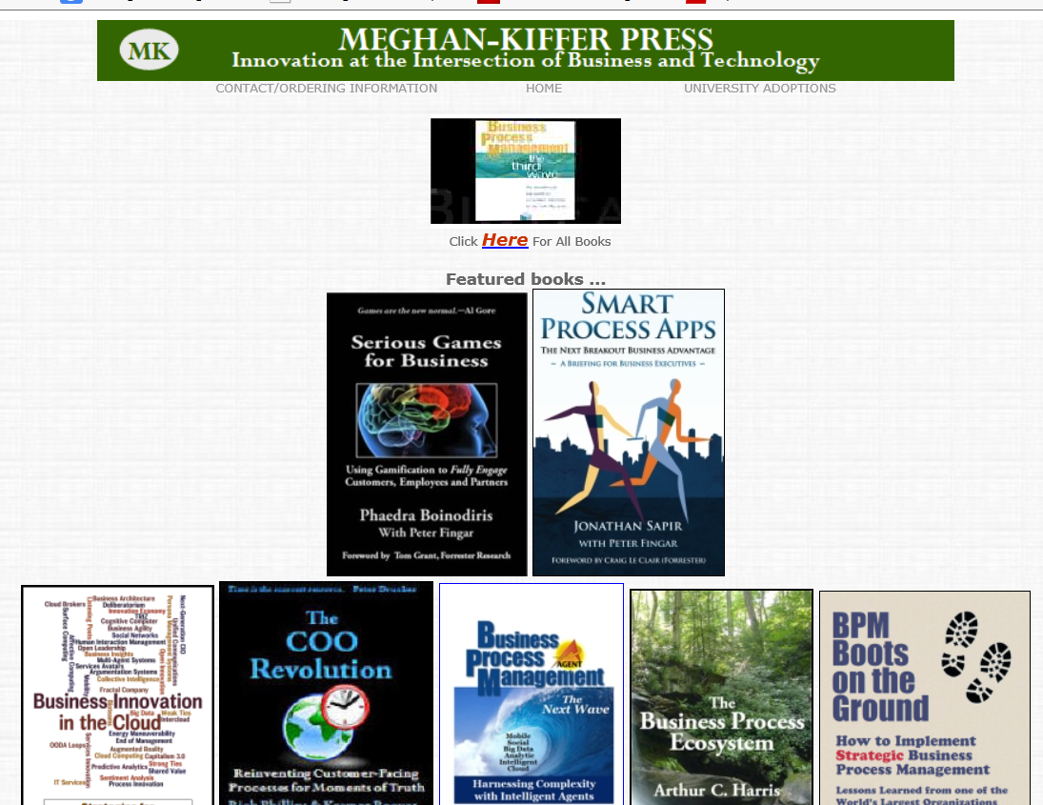

Mehgan-Kiffer Press
Peter Fingar peter@peterfingar.com http://www.mkpress.com/ http://www.peterfingar.com/

Slide 16

Self-Publishing Benefits
Personal Success
Enhanced Digital Identity
Freedom to Explore New Ideas
Sense of Personal Control (e.g., deadlines, formatting, appearance, length, title, etc.)
Fun
Expanded Network and Contacts
Future Possibilities

Slide 17

Free Book Advantages
Life impact.
Longevity of ideas.
Helps people in the developing world.
Less guilt when someone has a request or no gifts.
Trade royalties for new friends, speaking invites, users of ideas.
Can give to it my students, visitors, email contacts, etc.
Control; can inform or hand to whomever I want.
It is an experiment; see works (e.g., OpenWorldBooks.com).
The network expands.
It brings attention to the brand and everything else that I do.

Slide 18

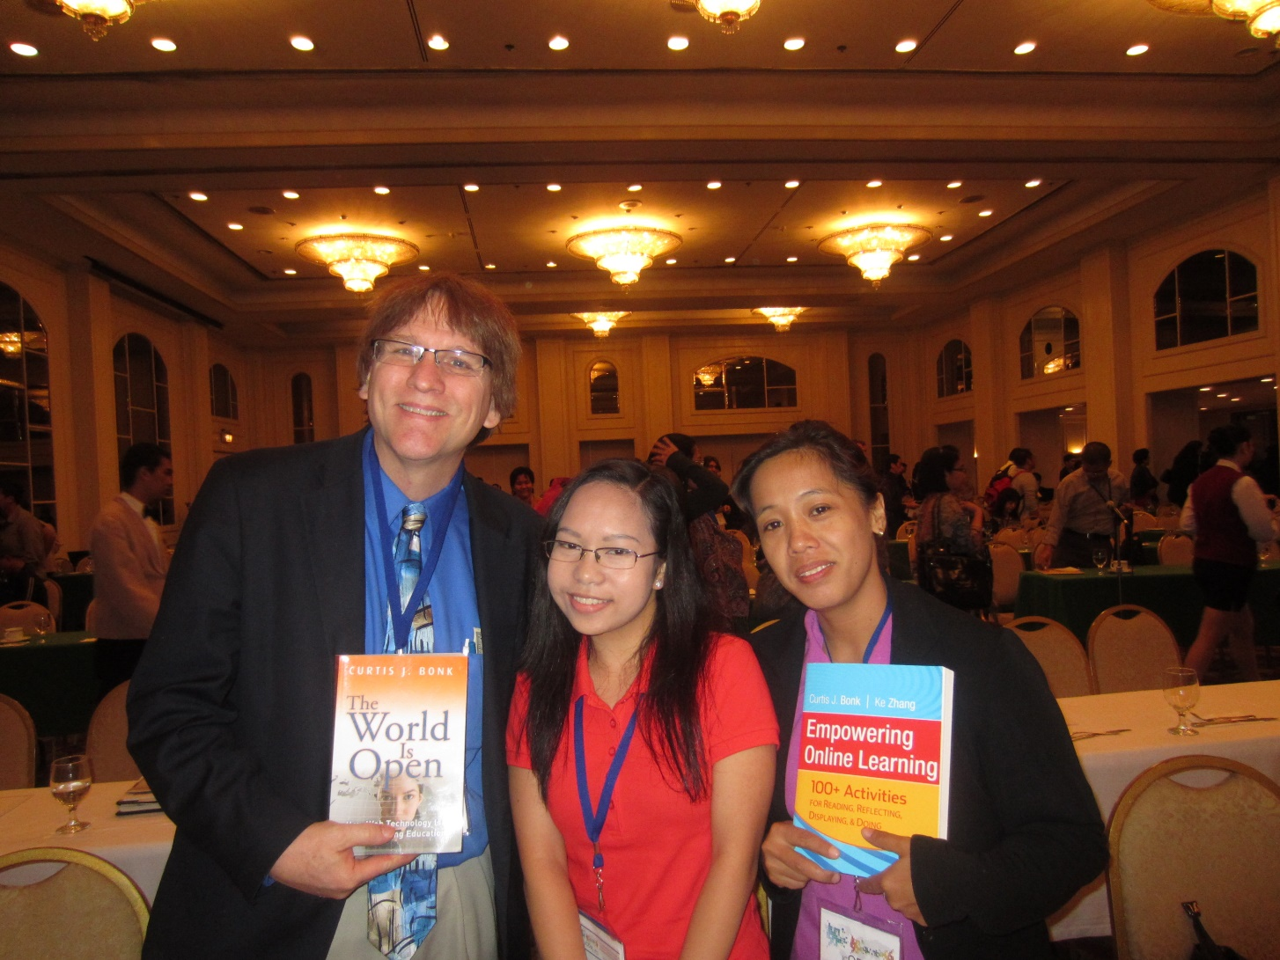
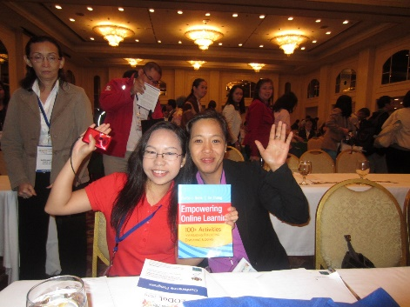
Who Needs Open Access?

Slide 19

Free Book Disadvantages
Say what? Making it free after 14 years of planning?
How to justify charging a fee in the future?
This project has been my baby for a long time.
Not cheap to produce; out of pocket costs = ?.
It could backfire and no one could find out about the book.
Assumption of lower quality. Reputation takes hit.
People could more easily plagiarize this book.
My body could tell me that I am an idiot.
My book writing colleague deserves some remuneration.
Will not get publisher connections, book exhibits, or newsletters.

Slide 20

Self-Publishing Challenges
Need collaborator(s)?
Who would serve as editor?
And copyeditor, proofreader, and indexer?
What about the book cover and other illustrations?
How to share or market when done?
Which book publishing services should he use?
Should he make individual chapters available for mobile devices? What about the Kindle?

Slide 21
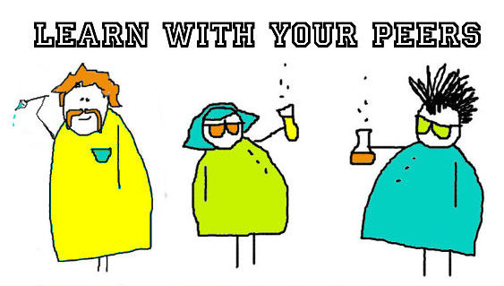
Quality Control?
Used the “PEERS” Approach!
Peer Review
Extensive Planning and Pilot Testing (14, 10, 7, 3, 1)
Expert Team Approach (e.g., editors, copyeditors, Web designers, graphic artists, illustrators, and designers, proofreaders, researchers, indexers, formatters, format converters, computer programmers, book publishers, consultants, etc.)
Relied on Proven Book Format
Sharing Samples

Slide 22

Let’s Play 20 Questions…!

Slide 23
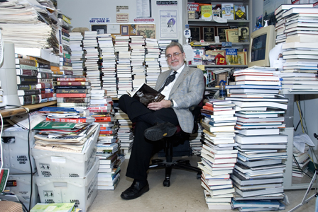
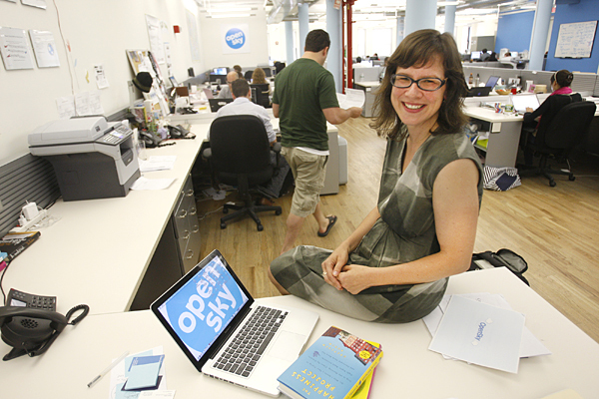
Q1. Need an Editor?
The rate per page, project, hour, varies, etc.

Slide 24
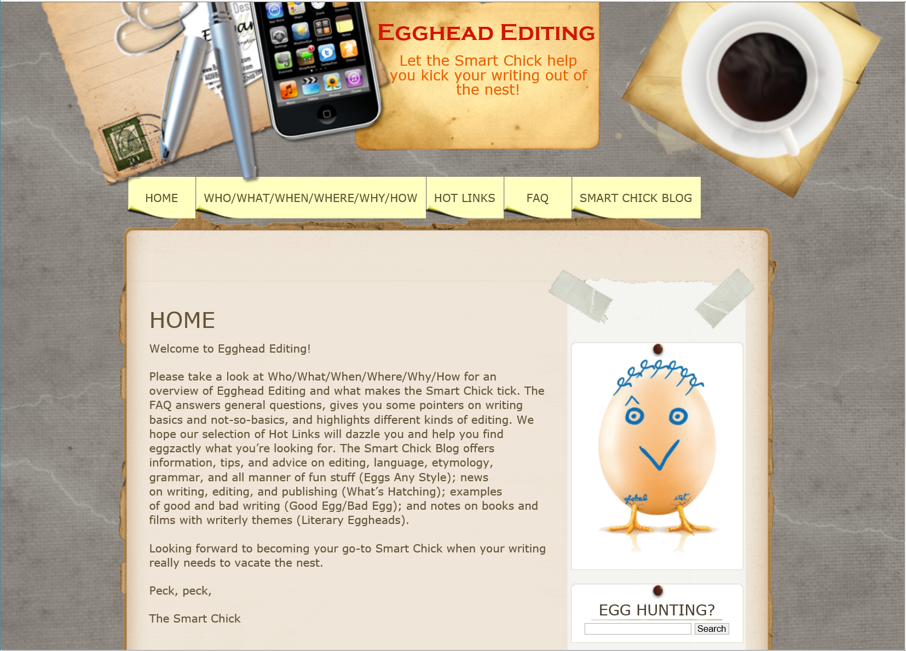
Q2. Need a Copyeditor? (e.g., Egghead Editing)
(change by page, project, hour, etc.) http://eggheadediting.com/
Donna J. Weinson: djweinson@gmail.com

Slide 25


Q3. Need a Human Proofreader?
(The rate per page, project, per hour, etc.)
(e.g., William Tyler Bryan-Askay)

Slide 26
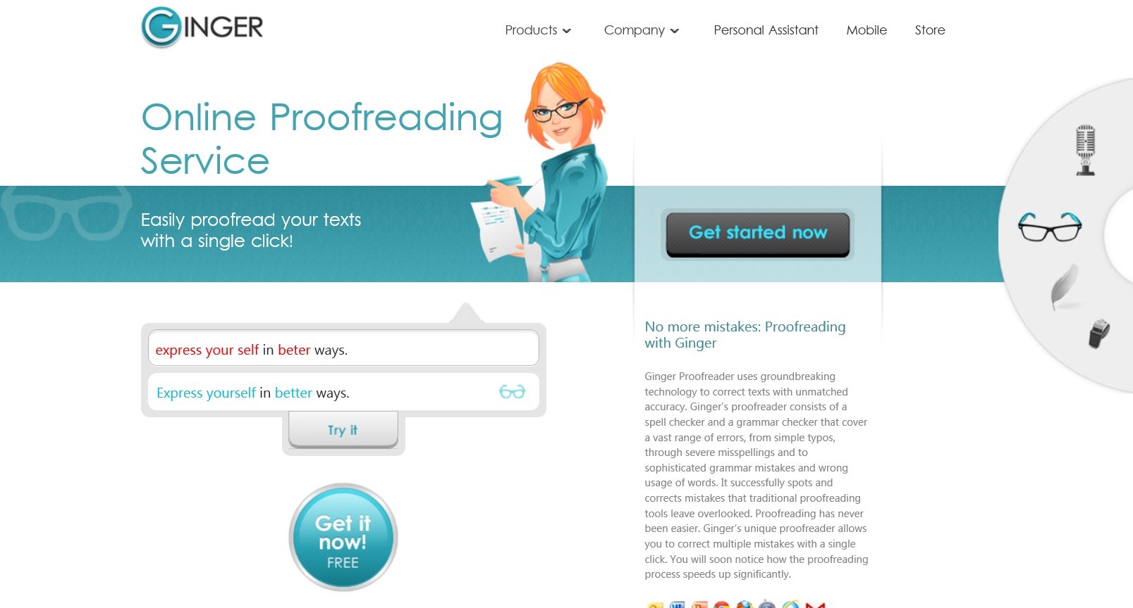
Q4. Need an Automated Proofreader?
Automated Services…
(e.g., Ginger: http://www.gingersoftware.com/proofreading)

Slide 27
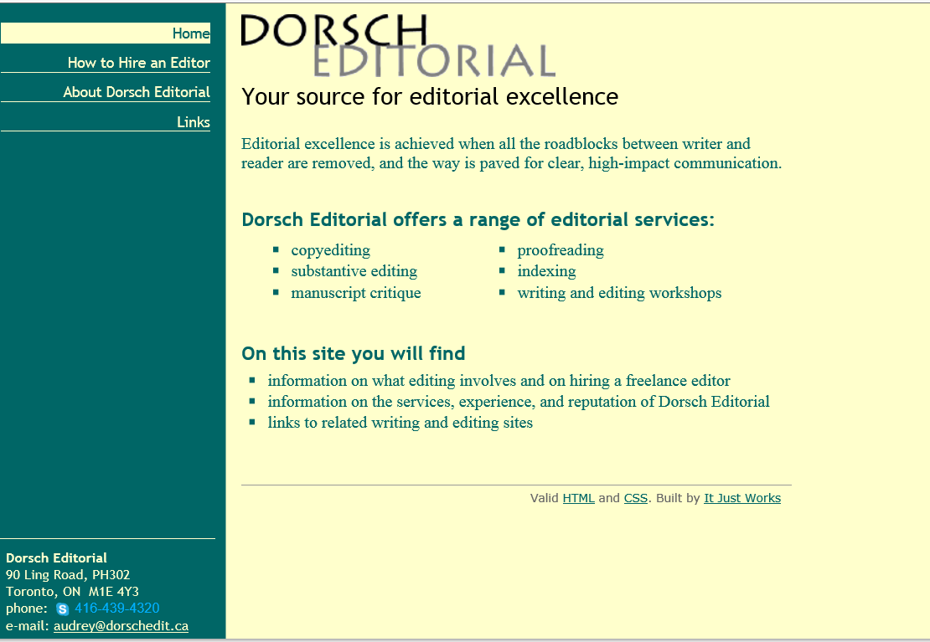
Q5. Need an Indexer? (e.g., Dorsch Editorial)
The rate per indexable page: Ranges depending on the density of the material, page size and type size, and whether the pages include a lot of tables/figures/images, etc. http://www.dorschedit.ca/
Contact: Audrey Dorsch: audrey@dorschedit.ca

Slide 28
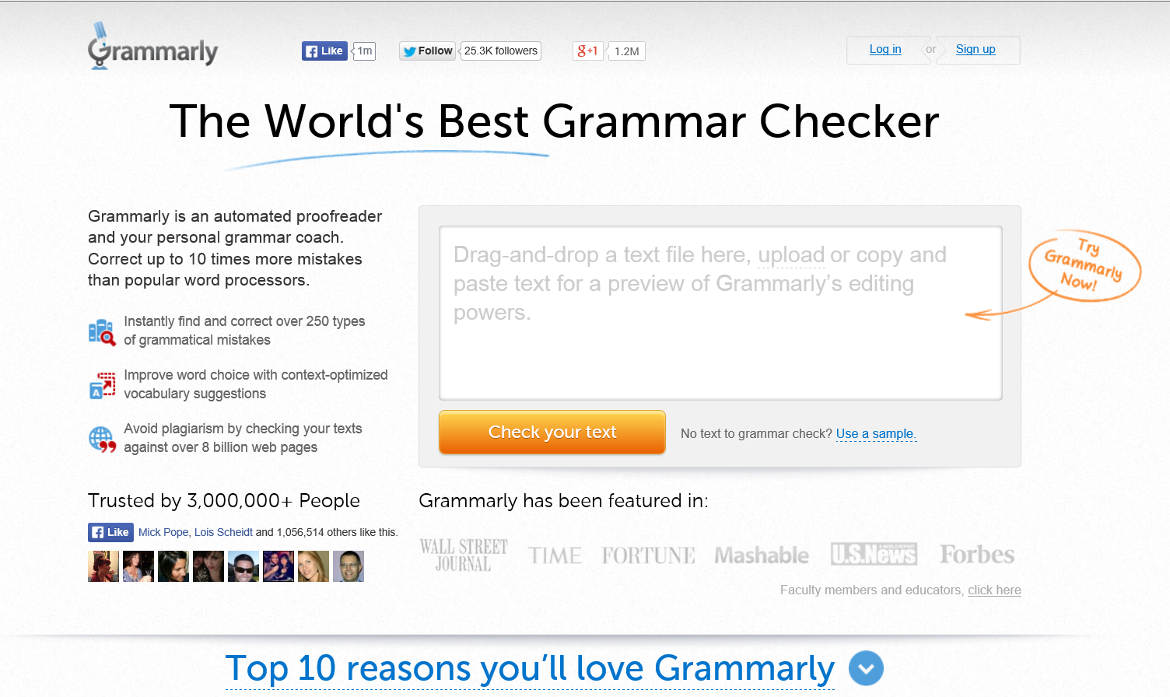
Q6. Need Additional Grammar Help?
Automated Services…
(e.g., Grammarly: http://www.grammarly.com/)

Slide 29


Q7. Need a Publisher?
Amazon CreateSpace (formerly BookSurge) https://www.createspace.com/

Slide 30
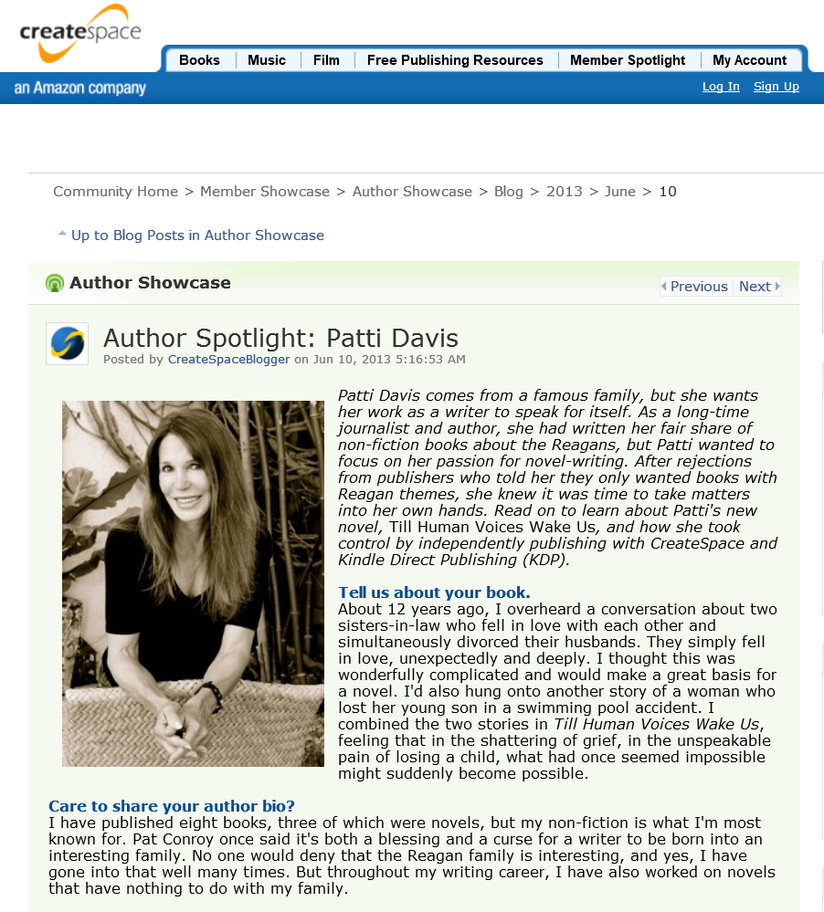


Q8: Where to go for marketing?
Answer: CreateSpace, Personal Contacts, Media Interviews, email campaigns, book homepage etc. https://www.createspace.com/en/community/community/member_showcase/author_showcase/blog/2013/06/10/author-spotlight-patti-davis

Slide 31
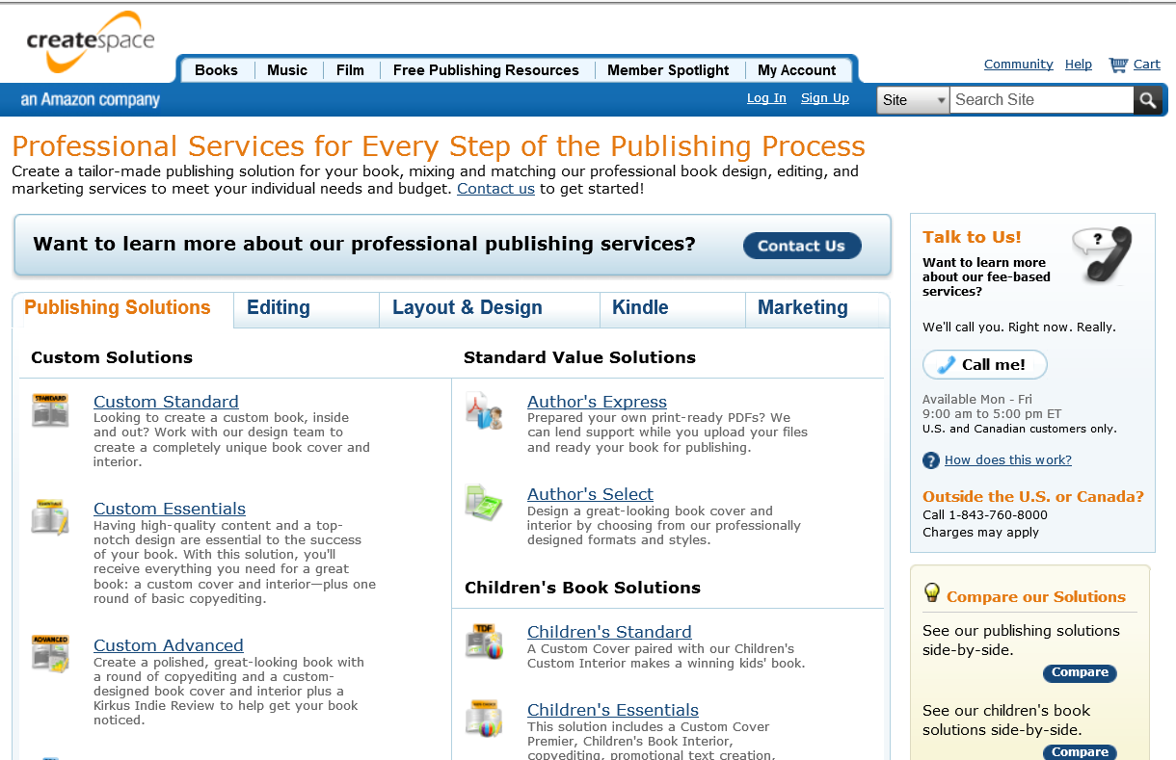
Q9: Need any Extra Services?
Amazon CreateSpace https://www.createspace.com/Services/AuthorsExpress.jsp

Slide 32
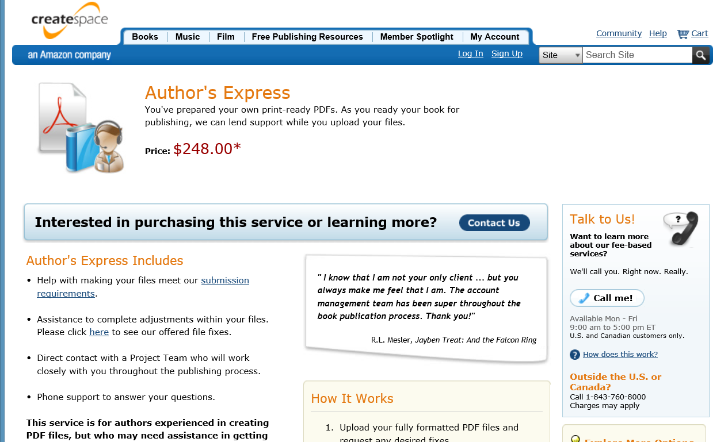
Q10: Basic Services?
Amazon CreateSpace
Author Express = $248 https://www.createspace.com/Services/AuthorsExpress.jsp

Slide 33
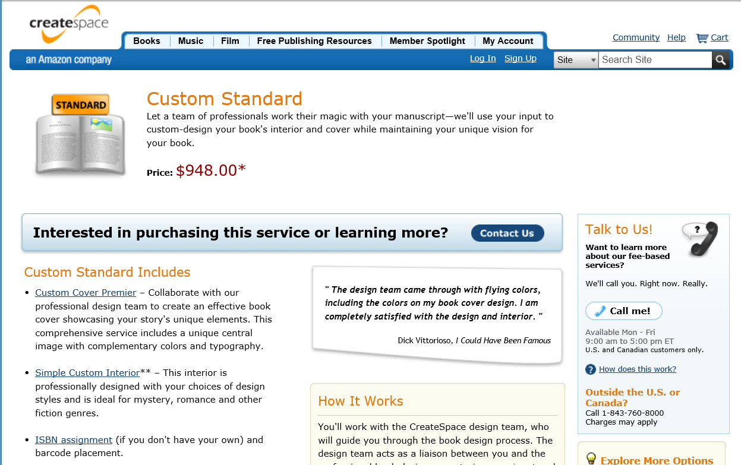
Q11: Custom Services?
Amazon CreateSpace
Custom Standard = $948 https://www.createspace.com/Services/CustomStandard.jsp

Slide 34
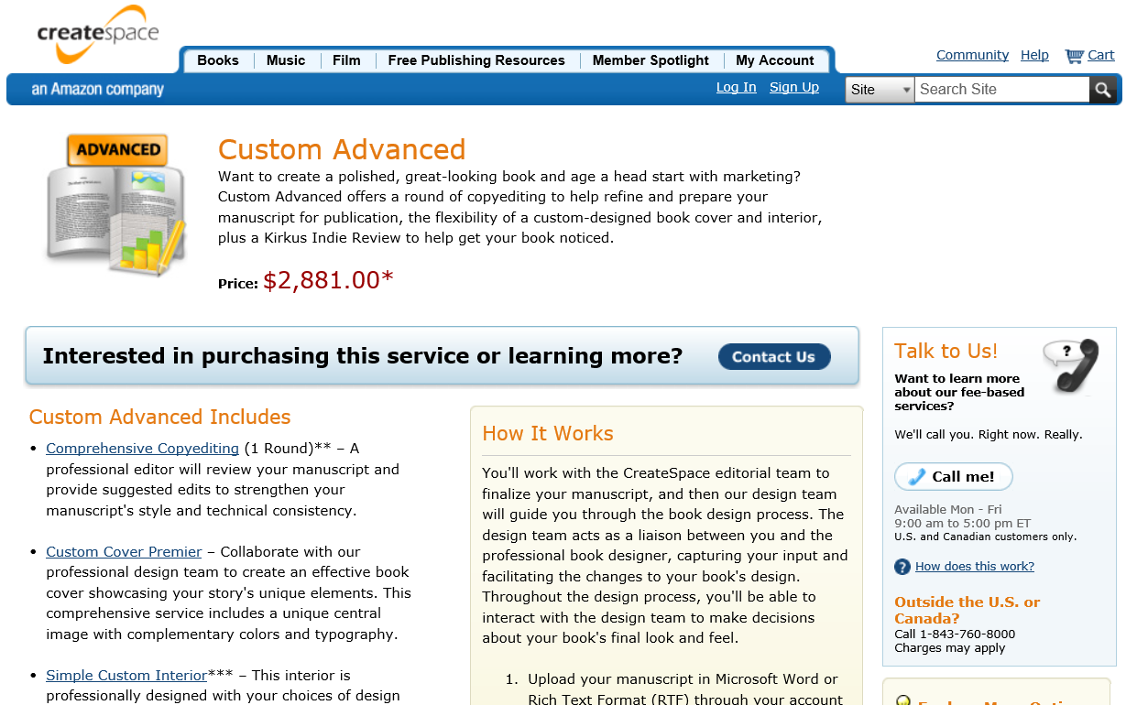
Q12: “Custom Advanced” Services Anyone?
Amazon CreateSpace
Custom Advanced = $2,881 https://www.createspace.com/Services/CustomAdvanced.jsp

Slide 35
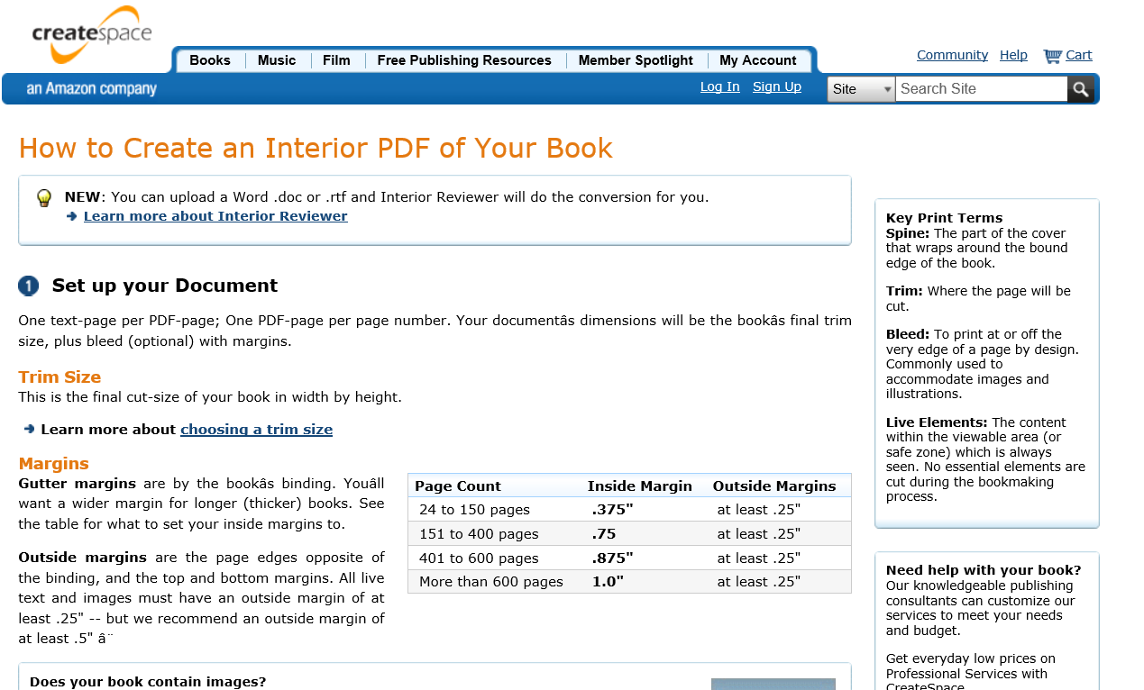
Q13: Need help with formatting?
Amazon CreateSpace https://www.createspace.com/Products/Book/InteriorPDF.jsp

Slide 36

Q14: Need legal services or support? e.g., Fisch & Richardson: http://www.fr.com/
New Media & Entertainment: http://www.fr.com/New-MediaEntertainment-Sectors/

Slide 37
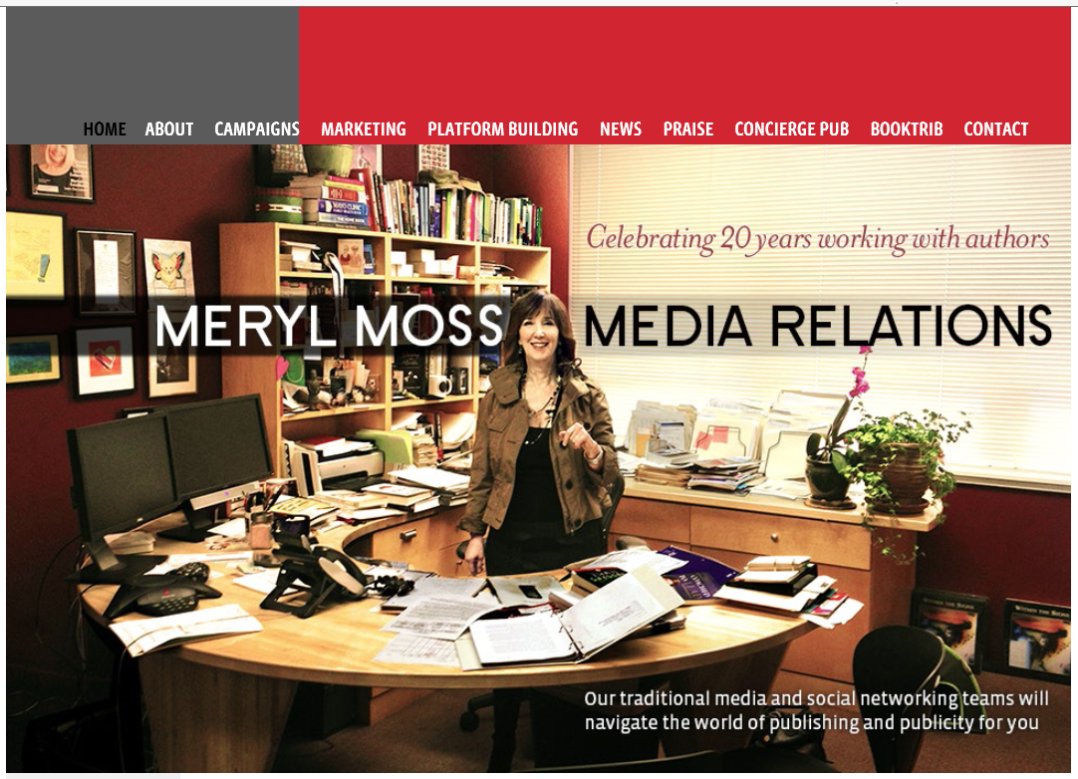

Q15: Need help with Book promotions?
(e.g., Meryl Moss; Media Muscle: http://www.mediamuscle.com/)
(e.g., Dottie DeHart; Dottie@dehartandcompany.com)

Slide 38

Q16: Need help with book website marketing? e.g., Digital Relevance: http://relevance.com/

Slide 39
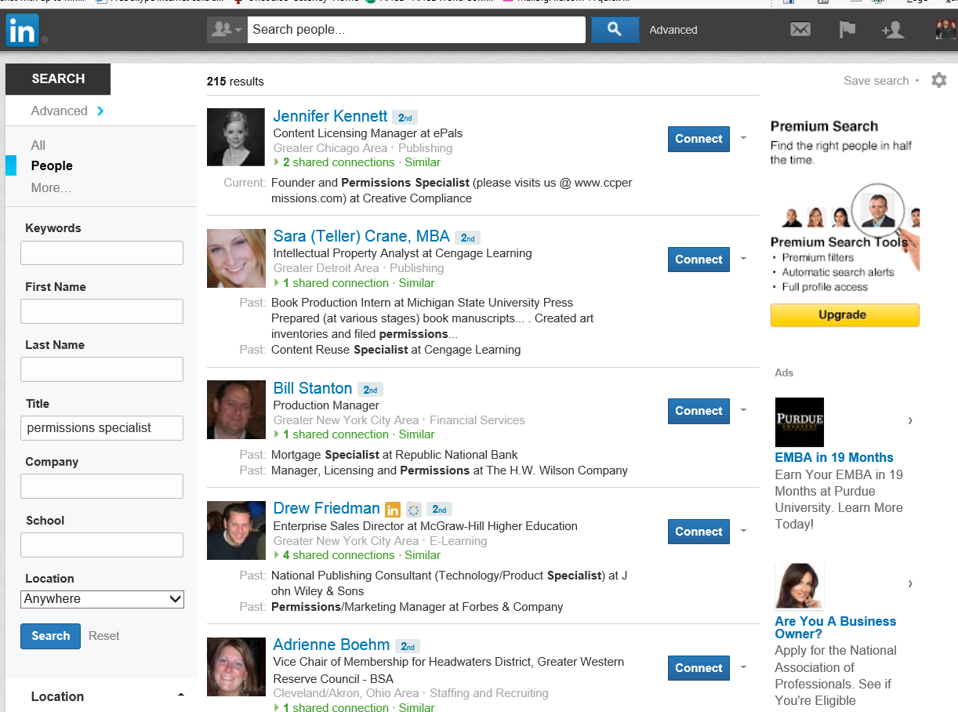
Q17: Need help with book permissions?
Try LinkedIn! http://www.linkedin.com/vsearch/p?orig=TSEO_SN&title=permissions+specialist&trk=TSEO_SN

Slide 40
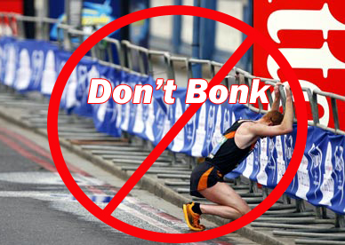
Q18: Need help with book endorsments?
The 6 B’s of Gathering Book Endorsements?
Brainstorm lists and then brainstorm again;
Be Bold and Brave and get some Big fish;
Be careful and be choosy;
Be honest about expectations;
Begging is not professional.
Don’t Bonk!

Slide 41
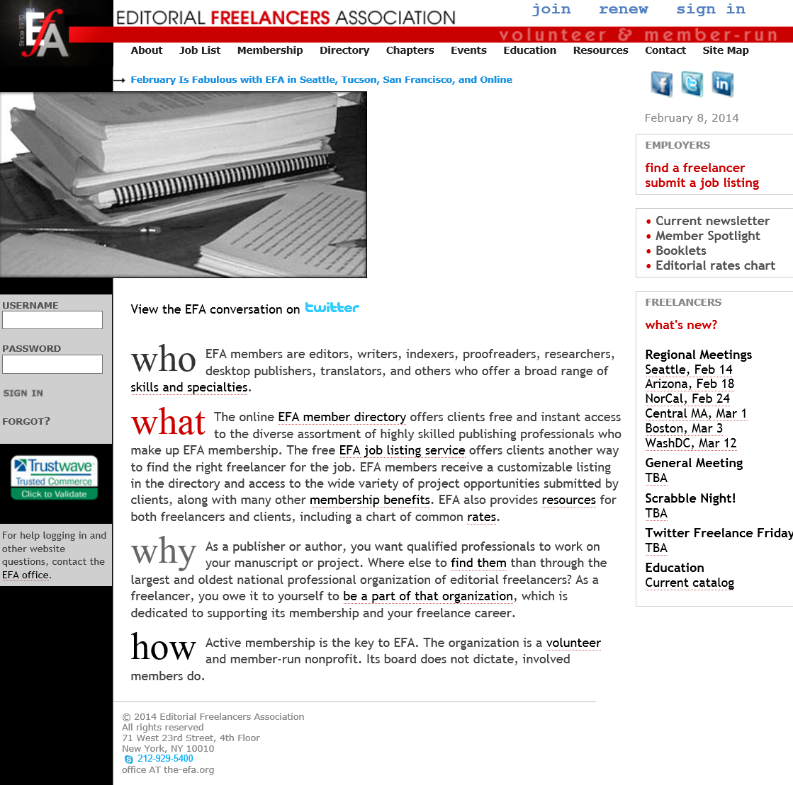
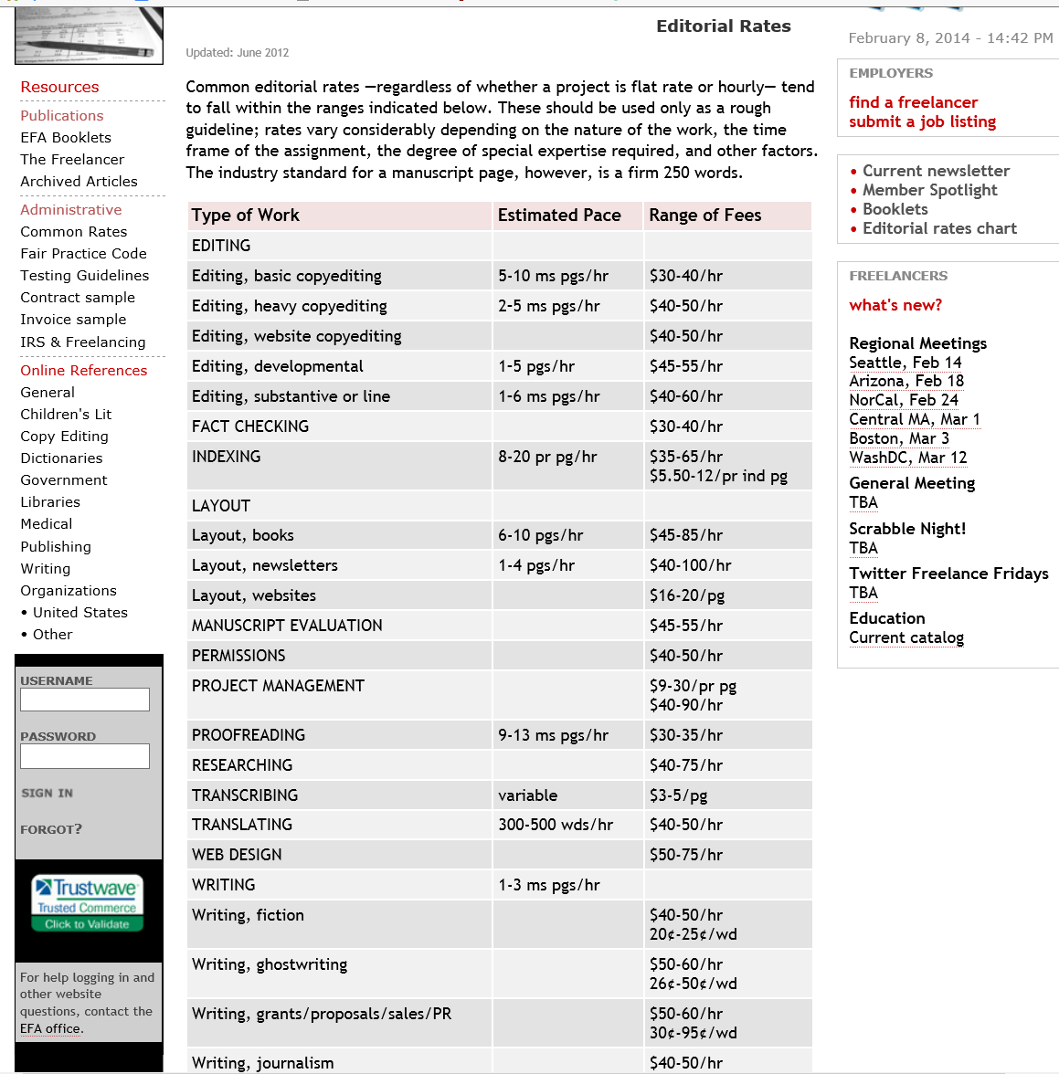
Q19: Need Help on Rates?
Editorial Freelancers Association http://www.the-efa.org/

Slide 42
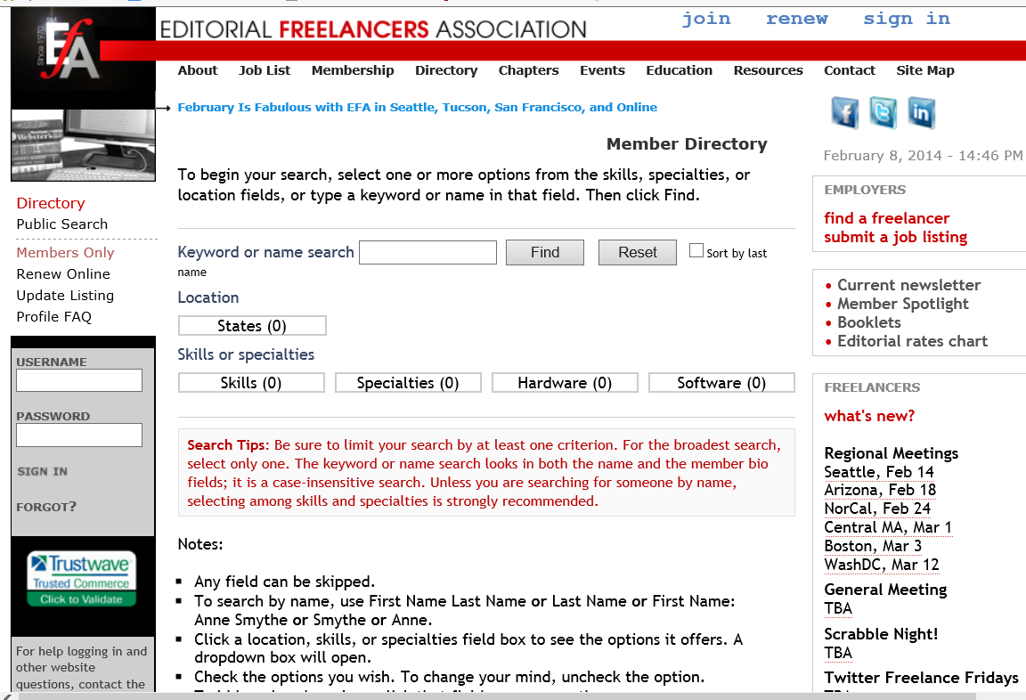
Q20: Need to Actually Find Someone?
Editorial Freelancers Association http://www.the-efa.org/dir/search.php

Slide 43

Options and Choices in
CreateSpace…

Slide 44

CreateSpace Dashboard https://tsw.createspace.com/title/

Slide 45
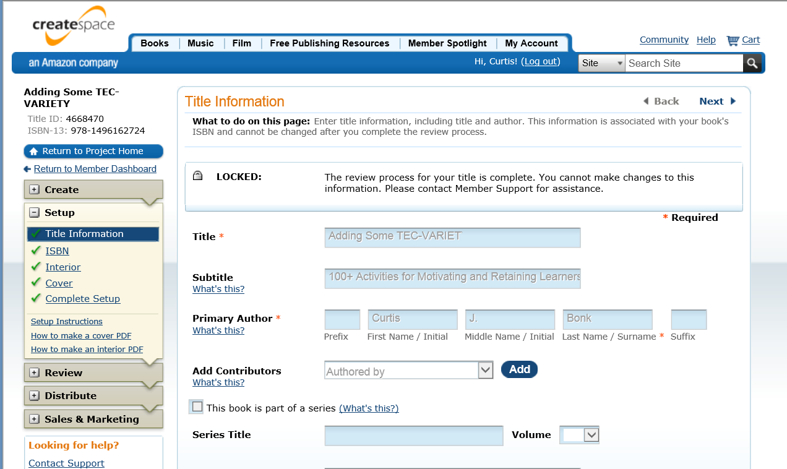
Input Title, Authors, Language, Pub Date, etc. https://tsw.createspace.com/title/setup/book_title_information

Slide 46
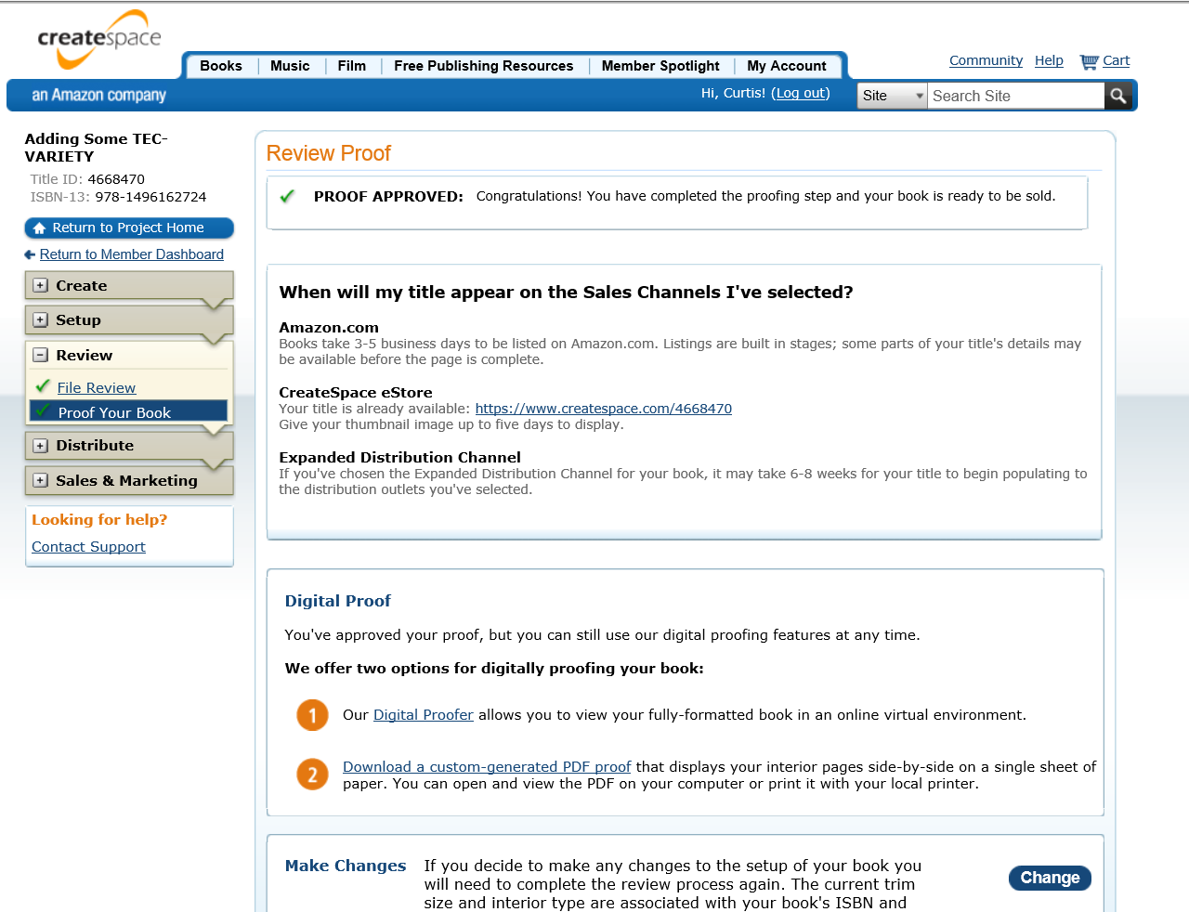
Approve Proof https://tsw.createspace.com/title/review/file_review

Slide 47
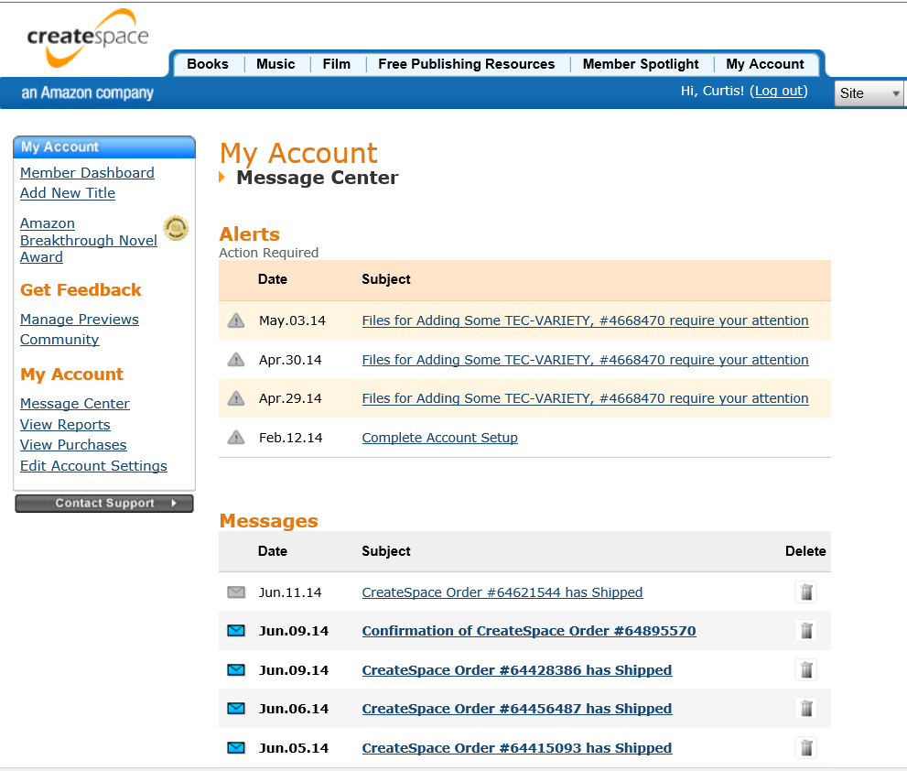
CreateSpace Member Message Center https://www.createspace.com/Member/MessageCenter.do

Slide 48
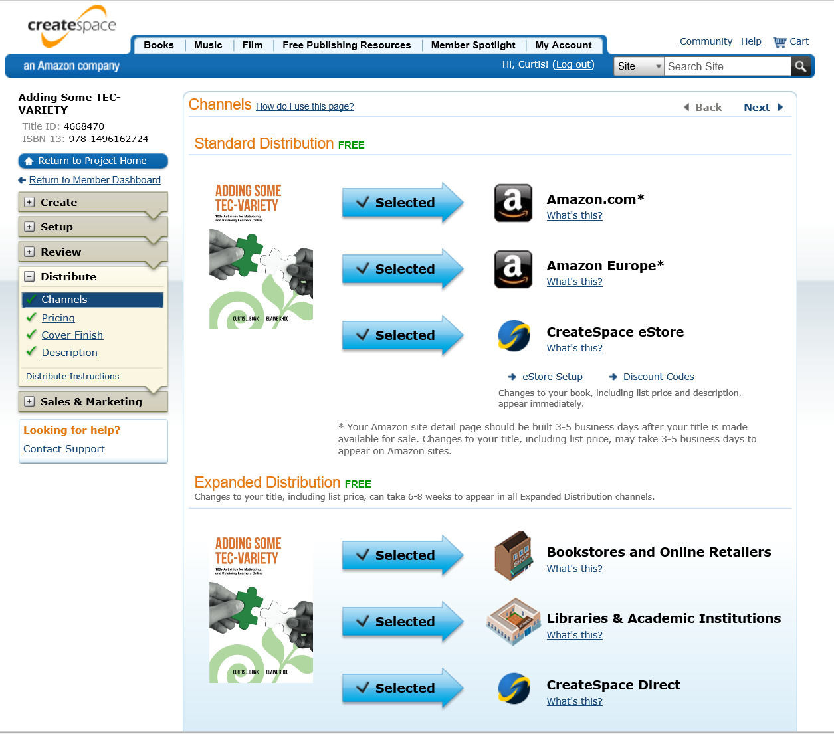
Decisions about Distribution Channels https://eu.createspace.com/title/distribute/channels

Slide 49
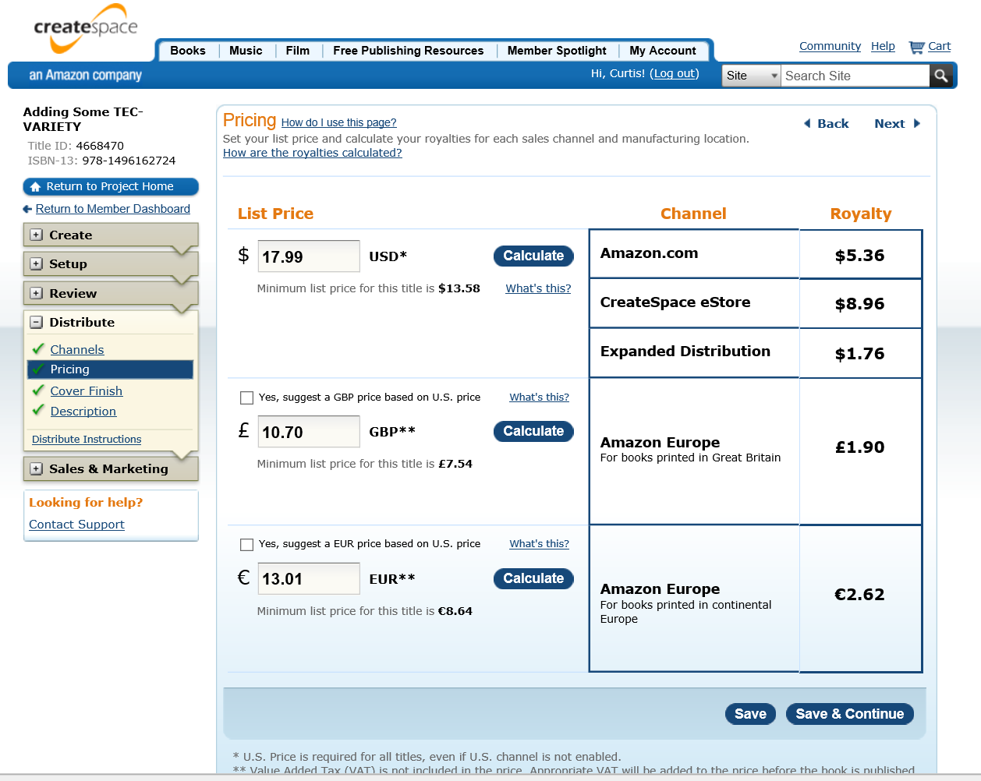
Decisions about Pricing https://eu.createspace.com/title/distribute/pricing

Slide 50
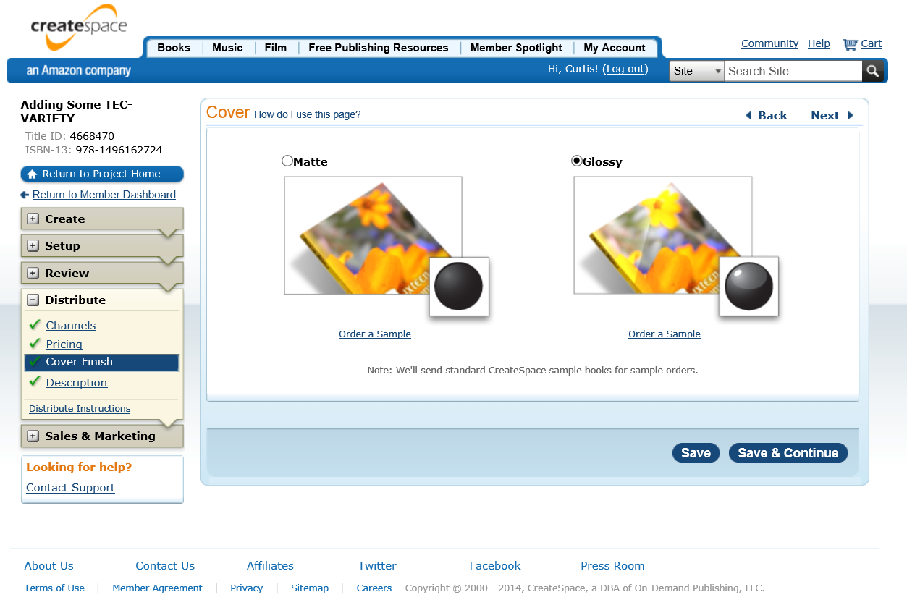
Decisions about Book Cover Finish https://tsw.createspace.com/title/distribute/covertype

Slide 51
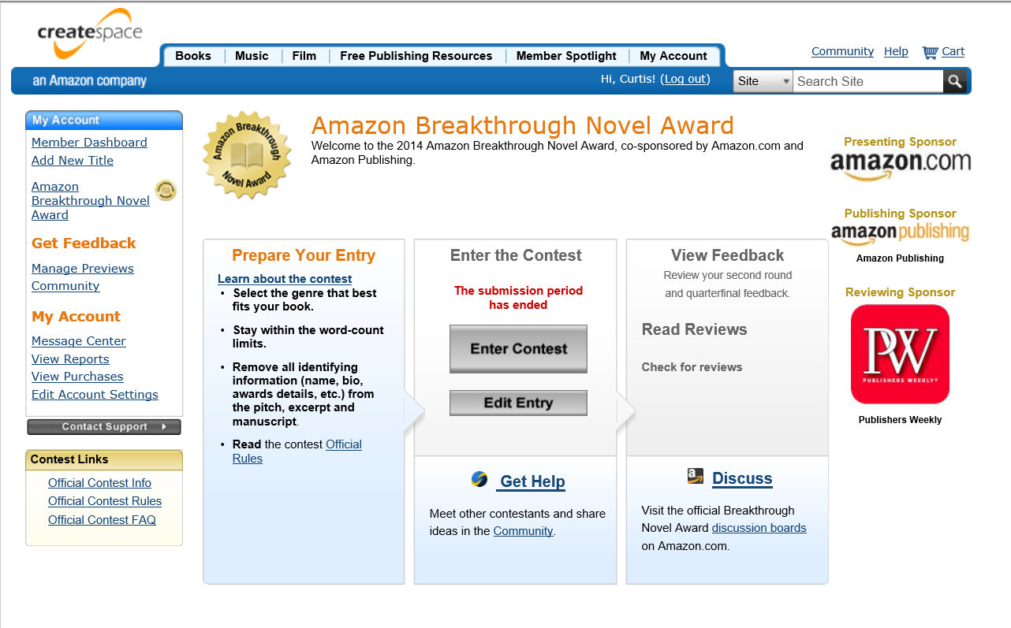
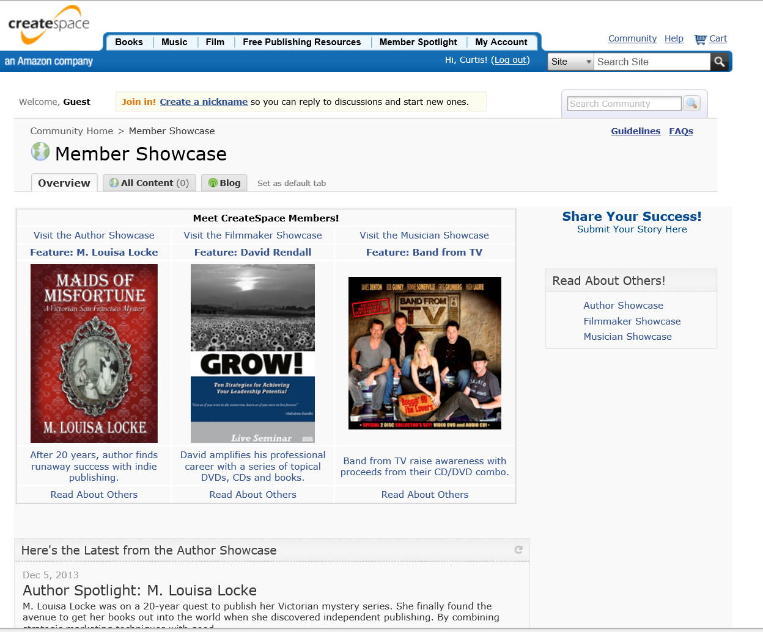
Enter Award Competitions https://www.createspace.com/pub/member/dashboard.abna.do

Slide 52



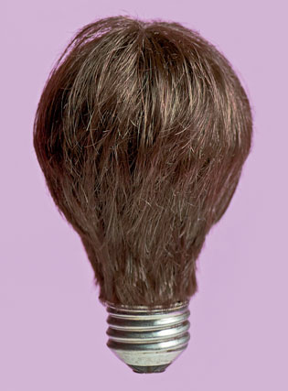
Audience Poll #2:
Are there any light bulbs going off?

Slide 53


A funny thing happened at the start of the millennium…
Discussions of this book began at AERA in New Orleans when talking to Vanessa Dennen and walking under a bridge at this conference in New Orleans in April 2000.

Slide 54
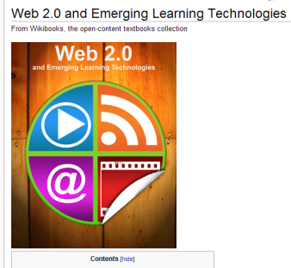

And it continued to 2006 and 2007 with Wikibooks…

Slide 55




Part #2: Introducing the free “TEC-VARIETY” Framework… http://tec-variety.com/ http://tec-variety.com/TEC-VARIETY-Chinese.pdf

Slide 56






1. Tone/Climate: A. Threaded Video Discussions, e.g., Flipgrid http://flipgrid.com/#429f88c5)

Slide 57

2. Encouragement, Feedback, etc.: A. Voice/Audio Feedback
Vocaroo: http://vocaroo.com/ http://vocaroo.com/delete/s0x8moQAYAiu/a37bbc9408bb8c95
(Recorded by Curt Bonk for the Open University of China)

Slide 58


April 1, 2016
3. Curiosity, Surprise:
A. Something in the News
(e.g., Potential Vikings site in North America spotted from space, Jareen Inman, CNN) http://www.cnn.com/2016/04/01/world/vikings-site-space-irpt/index.html

Slide 59



November 19, 2015
3. Curiosity, Surprise:
B. Something in the News
New daddy longlegs named after 'Lord of the Rings' character Smeagol, Mary Bowerman, USA Today http://www.usatoday.com/story/tech/nation-now/2015/11/19/new-daddy-longlegs-named-after-lord-rings-character-smeagol/76037286/

Slide 60

August 2, 2016
3. Curiosity, Surprise:
C. Mystery whale has scientists shocked,
New Whale Species Discovered, CNN http://www.cnn.com/videos/world/2016/08/02/new-whale-species-discovered-orig-vstan-ewoh.cnn

Slide 61

August 24, 2016
3. Curiosity, Surprise:
D. Scientists have discovered an Earth-like planet orbiting a nearby star, The Economist http://www.economist.com/news/science-and-technology/21705659-new-phase-search-life-elsewhere-about-begin-scientists-have?cid1=cust/ddnew/n/n/n/20160824n/owned/n/n/nwl/n/n/n/email&etear=dailydispatch

Slide 62



October 23, 2016
3. Curiosity, Surprise:
E. Meet Savannasaurus, a new huge dinosaur species, CNN http://www.cnn.com/videos/world/2016/10/21/dinosaur-discovery-australia-sfc-orig.cnn

Slide 63


October 5, 2016
4. Variety, Novelty, Fun, Fantasy:
A. Jeopardy Rocks https://www.jeopardy.rocks/r511merve/

Slide 64


5. Autonomy, Choice:
A. Enroll in a MOOC and Reflect (e.g., see Class Central)

Slide 65



6. Relevance, Meaningfulness:
A. Guest Chats (e.g., Emily Hixon, January 20, 2015) https://connect.iu.edu/p259wpiabg9/

Slide 66

7. Interactive, Collaborative:
A. Backchannel Chat (TodaysMeet) https://todaysmeet.com/
R678_Emerging_Learning_Technologies https://todaysmeet.com/R678_Emerging_Learning_Technologies

Slide 67



8. Engagement, Effort:
A. Interactive Timeline Maps,
October 22, 2014, Second immigration wave lifts diversity to record high, Edward Greg Toppo and Paul Overberg, USA Today http://www.usatoday.com/longform/news/nation/2014/10/21/diversity-race-ethnicity-change-100-years/16211133/

Slide 68


August 5, 2015
8. Engagement, Effort:
B. Interpreting Infographics
How much rainforest in that chocolate bar?
Global Forest Watch, Nancy Harris, Octavia Payne and Sarah Mann http://blog.globalforestwatch.org/2015/08/how-much-rainforest-is-in-that-chocolate-bar/

Slide 69

8. Engagement, Effort:
C. Map Animations
Yes, Mr. President, We Remade Our Atlas to Reflect Shrinking Ice
Christine Dell'Amore, National Geographic, August 3, 2015 http://news.nationalgeographic.com/2015/08/150803-arctic-ice-obama-climate-nation-science/?utm_content=buffer8a394&utm_medium=social&utm_source=twitter.com&utm_campaign=buffer

Slide 70


October 26, 2016
9. Tension, Challenge, etc.:
A. Controversial Issue Debates
R511, Rob Elliot, Erin Milanese, and Patrick Walsh Traditional Textbook (8:11) https://drive.google.com/file/d/0B25AtCR9Ddd5NE9DaS16RlpiMW8/view https://www.youtube.com/watch?v=Bcr3_aZT_xQ&feature=youtu.be

Slide 71



10. Yields Products, Goals:
A. Student Created Interview Videos
R678 Final Projects, April 2016
The Making of an Adventurer (video), Troy Cockrum https://www.youtube.com/watch?v=ew6e7Chd9I8

Slide 72


10. Yields Products, Goals:
B. Data Collection Tools
Design Article Database in Pinterest, Meina Zhu https://www.pinterest.com/zhumeina0000/r-678-emerging-learning-technology/

Slide 73

March 12, 2016
10. Yields Products, Goals:
C. Topic or Course Timeline
R678 John Falchi, Timeglider, An Abbreviated History of Distance Education http://timeglider.com/t/50843d8903a48008?min_zoom=1&max_zoom=100

Slide 74



October 26, 2016
10. Yields Products, Goals:
D. R511, Kai Westerfield, Jennifer Blankenship, and Colbi Lehman, Online Degree Programs
(11:54) Go Animate

Slide 75
Recap:
Which principle(s) of TEC-VARIETY will you use?
Tone/Climate
Encouragement, Feedback
Curiosity
Variety
Autonomy
Relevance
Interactive
Engagement
Tension
Yields Products

Slide 76


Audience Poll #3:
Who in here is now interested in self-publishing a book?

Slide 77

Audience Poll #4:
Is this the end for traditional publishers? Yes? No? Maybe?

Slide 78



Any Questions or Comments?
Slides at: TrainingShare.com
Papers: PublicationShare.com
Free book: http://tec-variety.com/
Dr. Curt Bonk – CJBonk@Indiana.edu

