Slide 1
Self-Direct to Learn, Self-Direct to Live:
Exploring Learner Choices, Experiences, and Possibilities in a Self-Directed Learning World
Curtis J. Bonk| cjbonk@Indiana.edu
Indiana University Bloomington
With…
Meina Zhu| meinazhu@wayne.edu
Wayne State University

Slide 2

Talk Outline
  MOOC News and Trends
  Study #1: MOOC Instructor ID Considerations and Challenges
  Study #2: MOOC ID for Self-directed Learning
  Study #3: MOOC Instructor Personalization

Slide 3
Talk Outline
  4. Study #4: Cultural Sensitivity in MOOCs
  5. Study $5: MOOC Learners and SDL
  5. Study #6: SEM and MOOC Learning
  6. Study #7: Duolingo
  7. Study #8: Nepali Youth SDL in MOOCs.

Slide 4


Polls
Poll #1: Who in here has taken a MOOC?
Poll #2: Are you happy or frustrated when you take a MOOC?

Slide 5

MOOC Trends and Recent Data

Slide 6
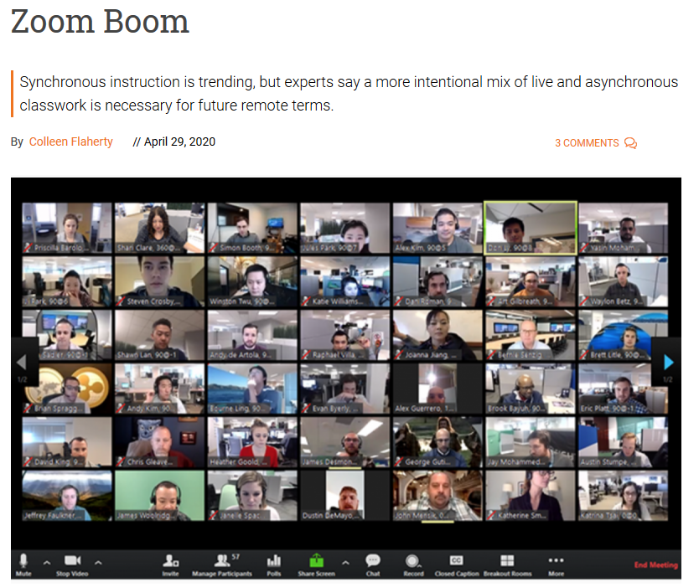
April 29, 2020
Zoom Boom
Synchronous instruction is trending, but experts say a more intentional mix of live and asynchronous classwork is necessary for future remote terms.
Colleen Flaherty, Inside Higher Ed https://www.insidehighered.com/news/2020/04/29/synchronous-instruction-hot-right-now-it-sustainable

Slide 7
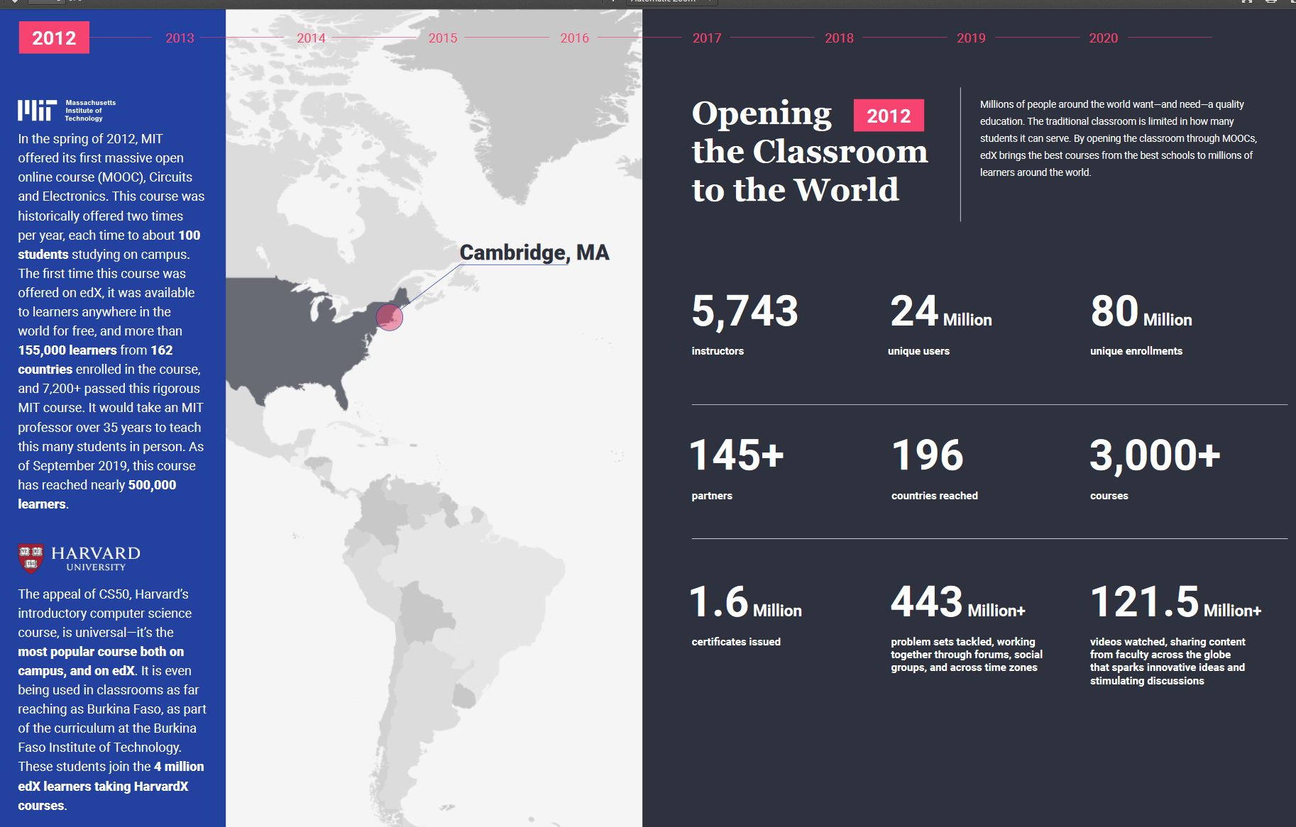
December 16, 2019
2020 Impact Report, edX https://www.edx.org/sites/default/files/2020-impact-report.pdf

Slide 8
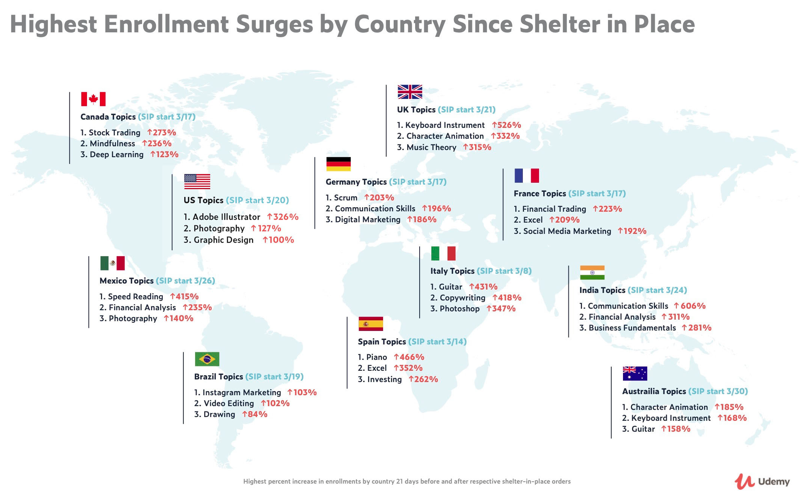

April 30, 2020
New Udemy Report Shows Surge in Global Online Ed in Response to COVID-19
People around the world are learning how to work from home and stay productive as the Future of Work arrives
Businesswire: https://www.businesswire.com/news/home/20200430005243/en/

Slide 9
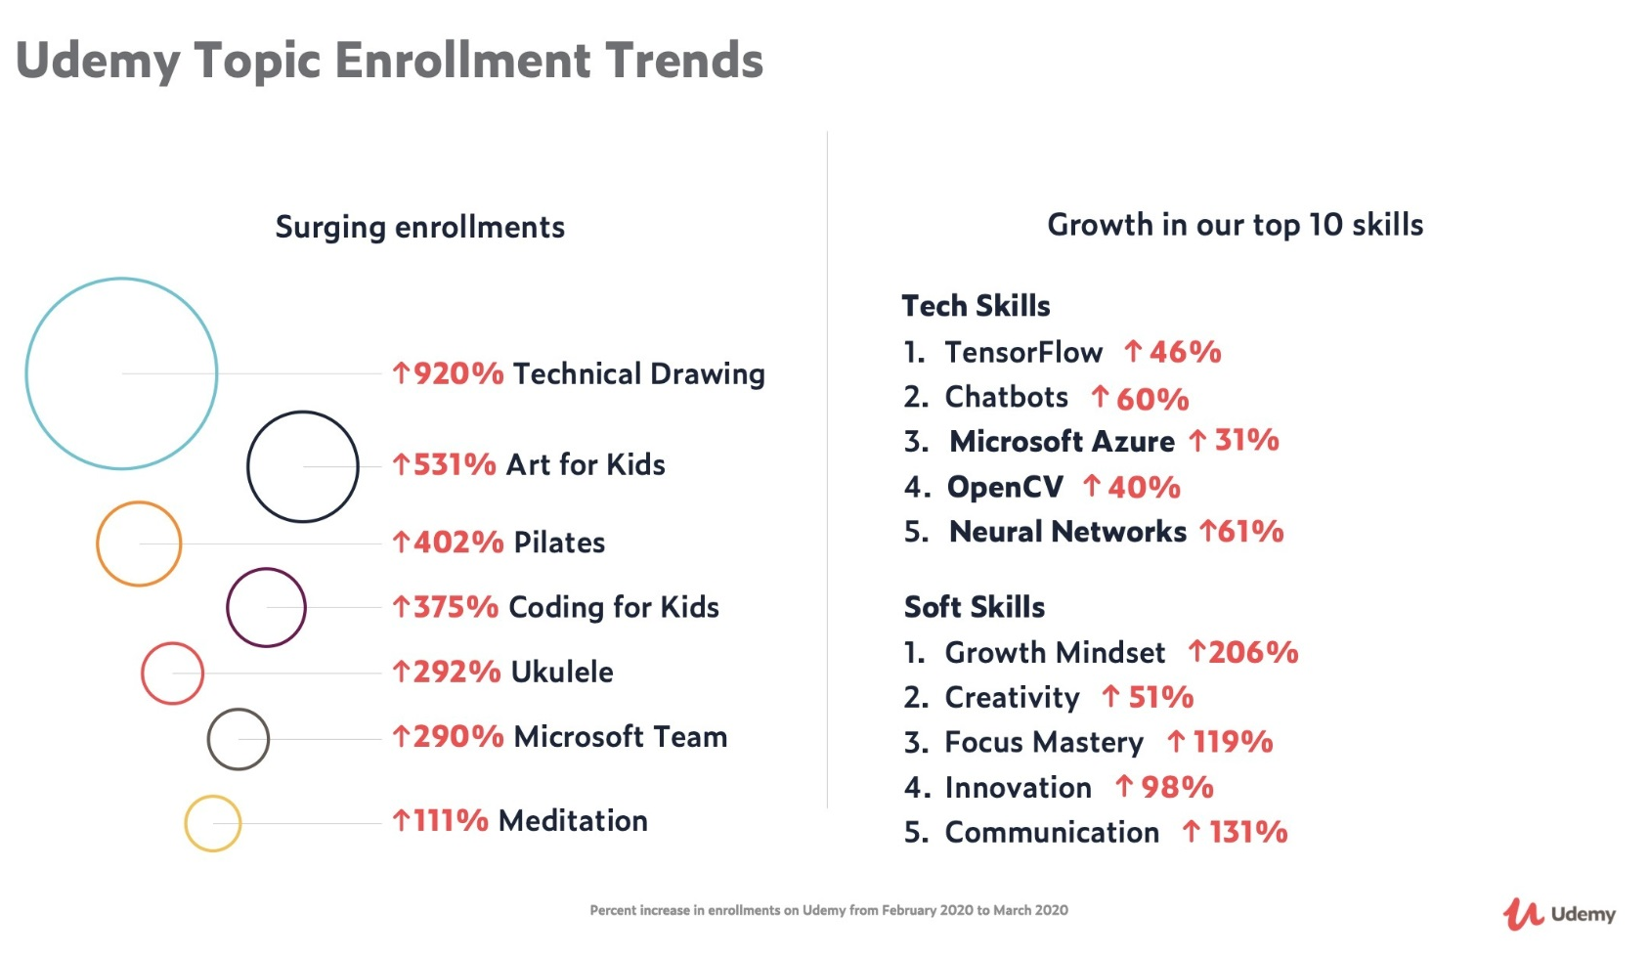
April 30, 2020
New Udemy Report Shows Surge in Global Online Education in Response to COVID-19
There has been an immense surge in enrollments in courses related to Telecommuting (21,598% increase) and Virtual Teams (1,523%), as well as Decision Making (277%), Self Discipline (237%), and Stress Management (235%).
https://www.businesswire.com/news/home/20200430005243/en/

Slide 10
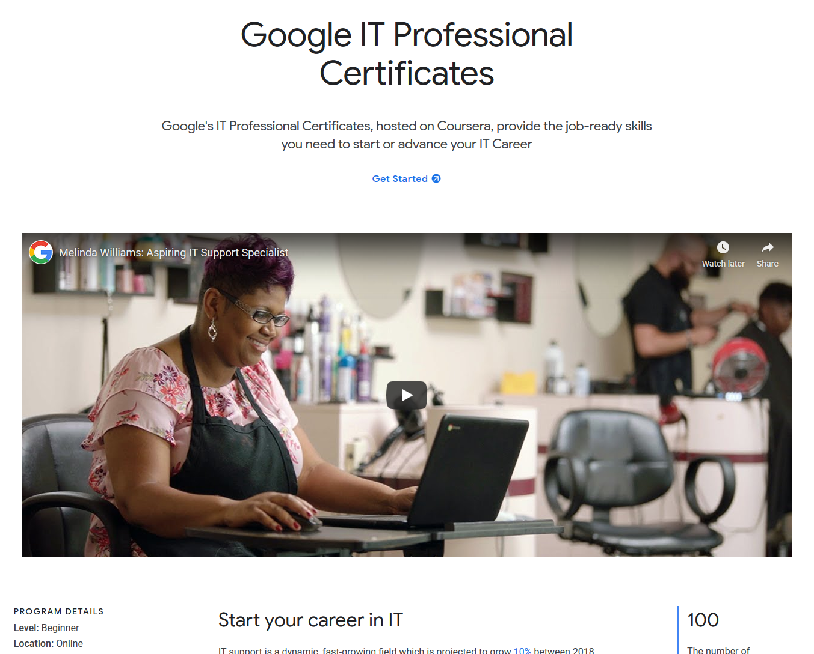
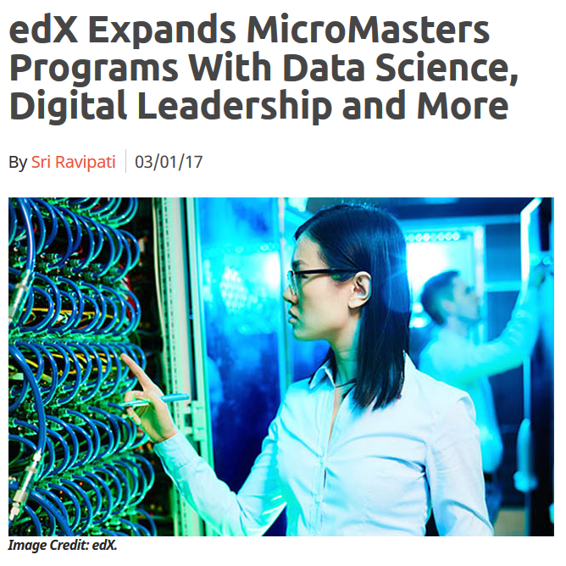
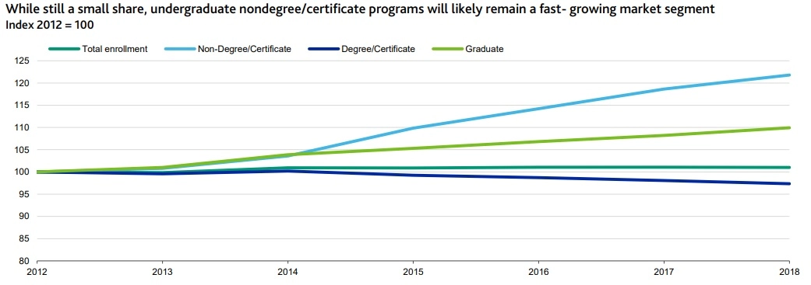
August 27, 2020
Alternative Credentials on the Rise
Paul Fain, Inside Higher Ed https://www.insidehighered.com/news/2020/08/27/interest-spikes-short-term-online-credentials-will-it-be-sustained
Sources: Moody's, U.S. Department of Education

Slide 11
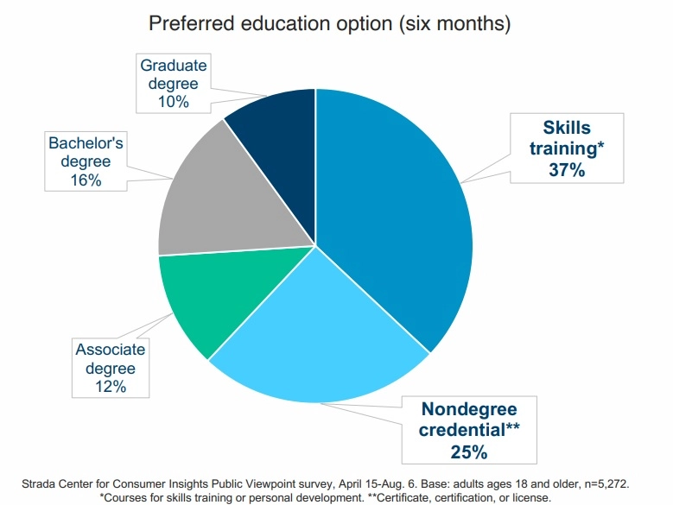
August 27, 2020
Alternative Credentials on the Rise
Paul Fain, Inside Higher Ed https://www.insidehighered.com/news/2020/08/27/interest-spikes-short-term-online-credentials-will-it-be-sustained

Slide 12
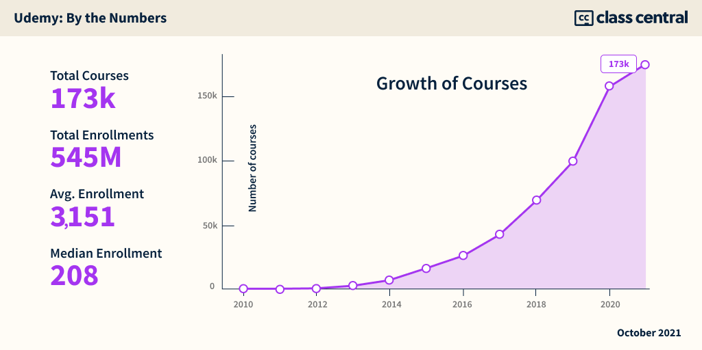
October 13, 2021
Analyzing Udemy’s IPO Filing:
$430M Revenue; $30M CorpU Acquisition; Consumer Segment Stalls, Enterprise Grows.
Dhawal Shah, Class Central https://www.classcentral.com/report/udemy-s1-analysis/

Slide 13
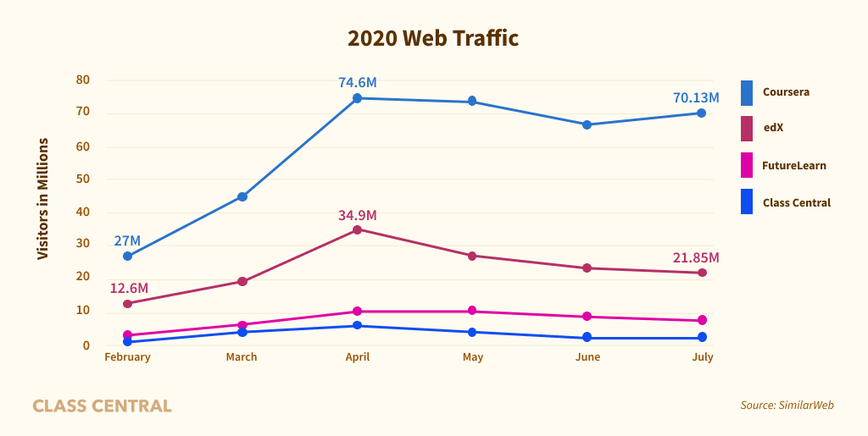
MOOCs Stats
August 16, 2020
By the Numbers: MOOCs During the Pandemic
Dhawal Shah, Class Central
https://www.classcentral.com/report/mooc-stats-pandemic/

Slide 14
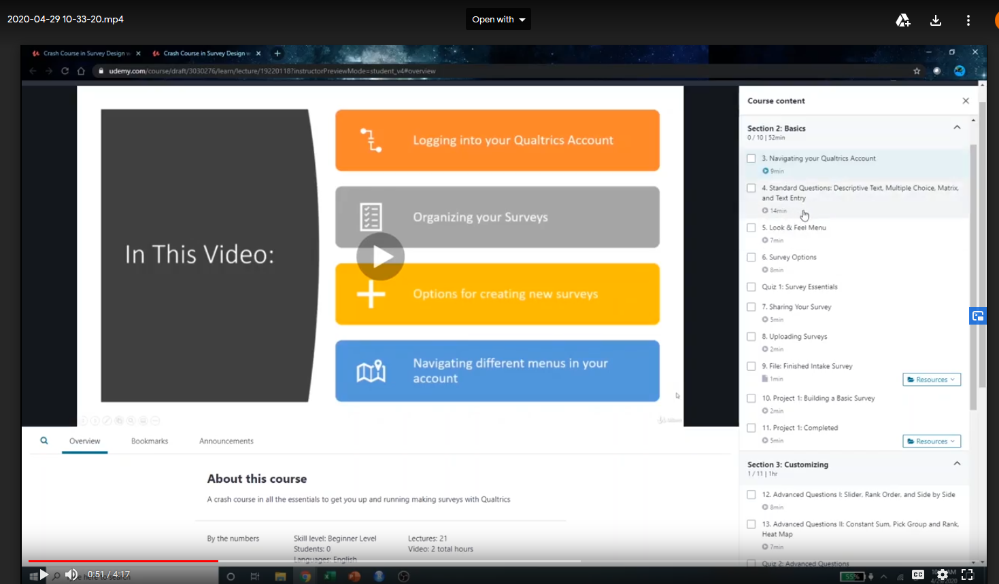
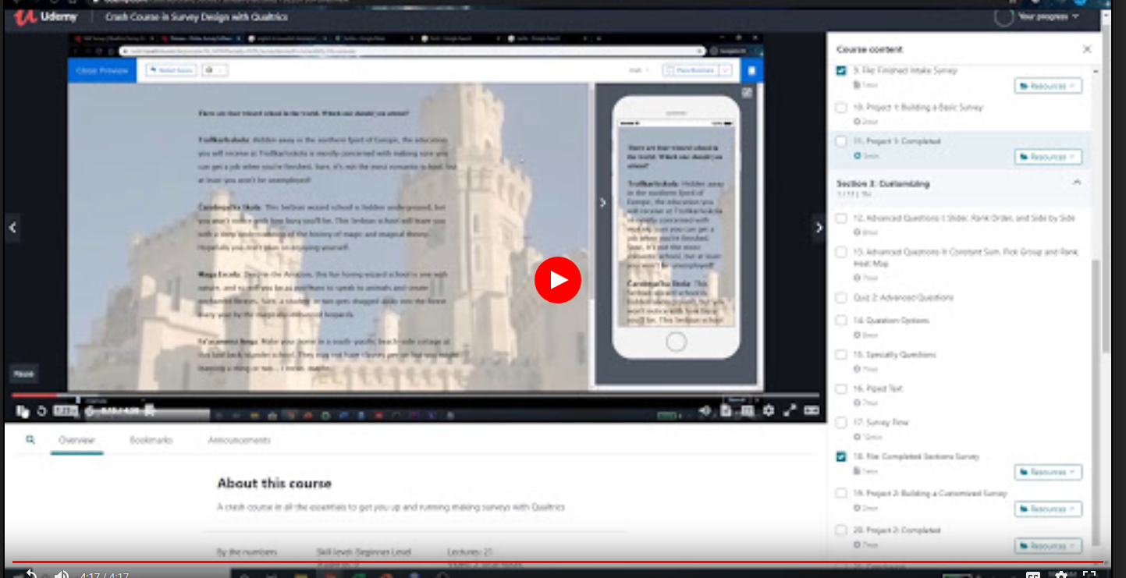
April 29, 2020
MOOC and Qualtrics
Tanner Phillips, Udemy https://drive.google.com/file/d/1fkiTPUbDYiK91V-8R3odkxFytHiqQnc0/view

Slide 15

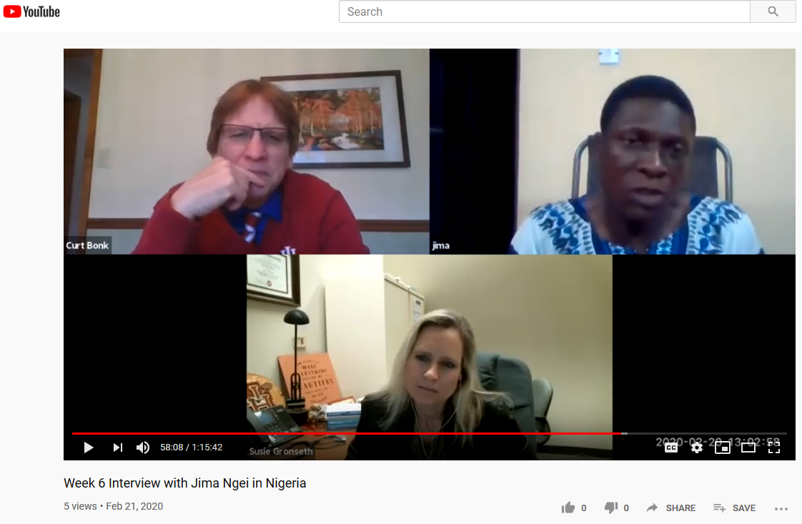
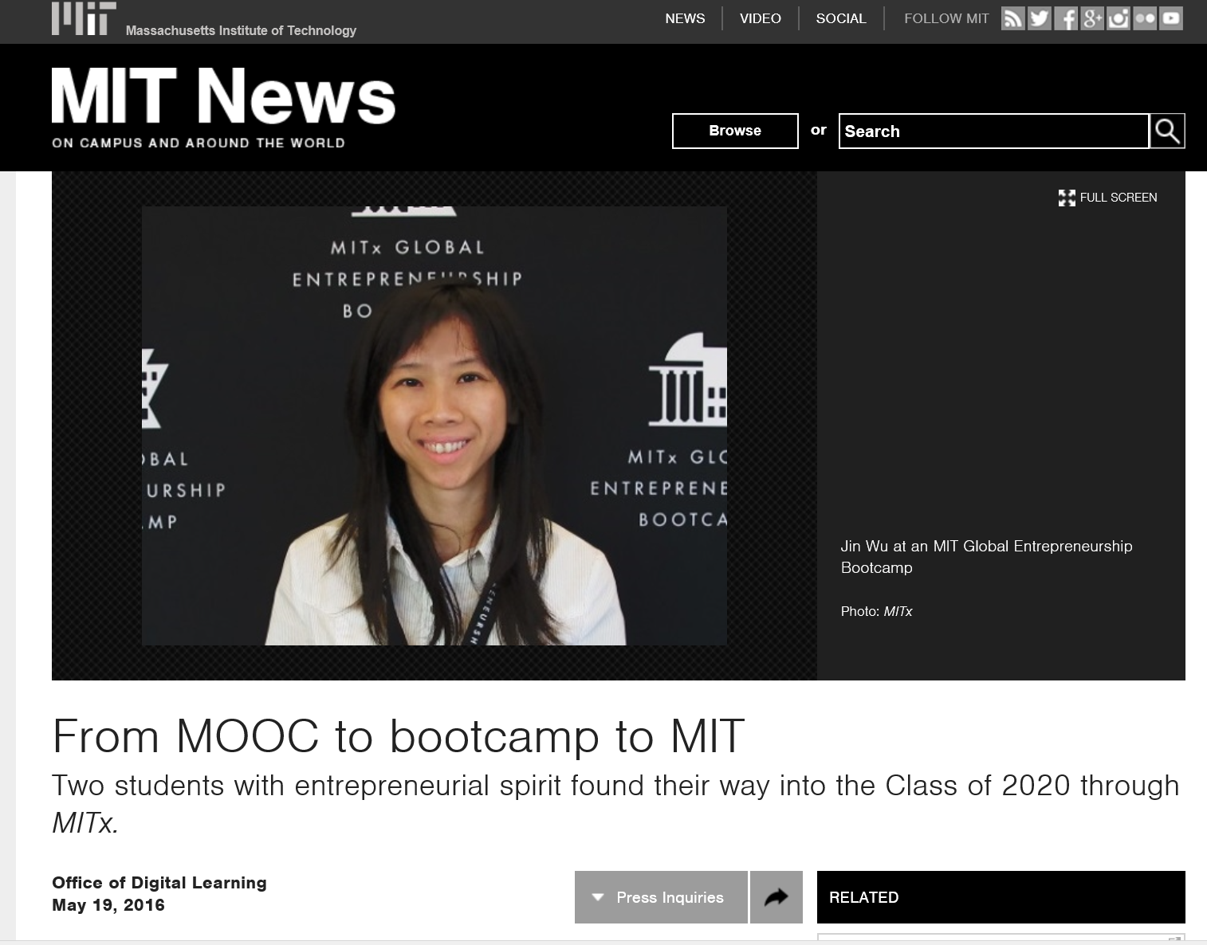

Hundred+ MOOC Clubs
February 21, 2020
250 MOOCs and Counting: One Man’s Educational Journey, Chronicle of Higher Education http://chronicle.com/article/250-MOOCsCounting-One/229397/?cid=at
If the MOOC movement has faded, nobody told Jima Ngei. Mr. Ngei, who lives in Port Harcourt, Nigeria, has completed and passed 250.
Jima Ngei: “I had this unrelenting fear that this miracle of free access might evaporate soon.”

Slide 16


MOOCs Stats
December 17, 2019
Online Degrees Slowdown: A Review of MOOC Stats and Trends in 2019, Dhawal Shah, Class Central
https://www.classcentral.com/report/moocs-stats-and-trends-2019/

Slide 17
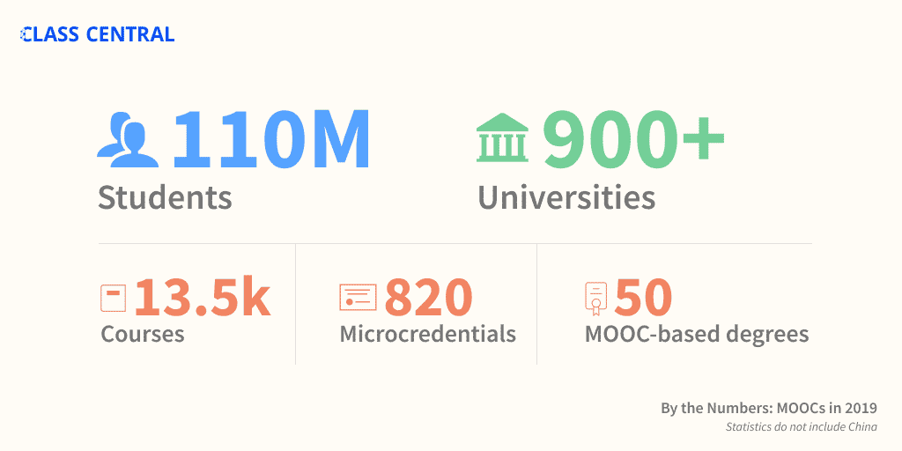
MOOCs Stats
December 17, 2019
A Review of MOOC Stats and Trends in 2019
Dhawal Shah, Class Central
https://www.classcentral.com/report/moocs-stats-and-trends-2019/

Slide 18
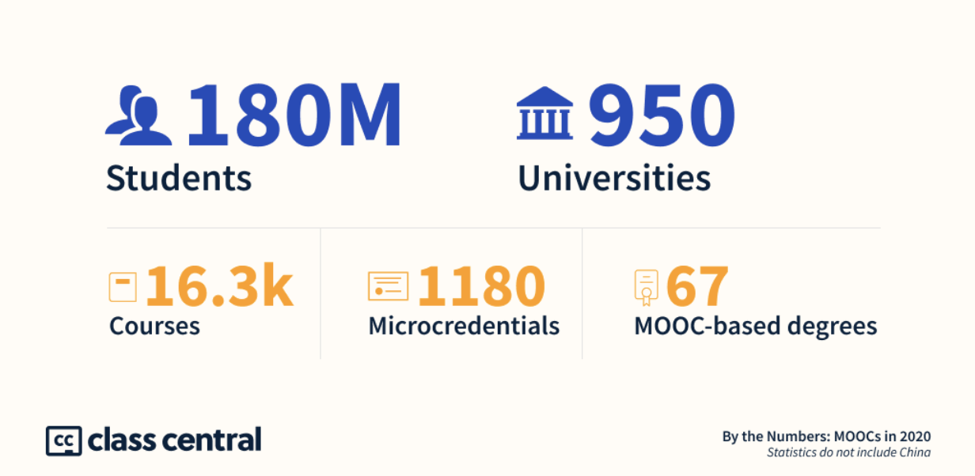
MOOCs Stats
December 14, 2020
The Second Year of the MOOC: A Review of MOOC Stats and Trends in 2020, Dhawal Shah, Class Central
https://www.classcentral.com/report/the-second-year-of-the-mooc/

Slide 19
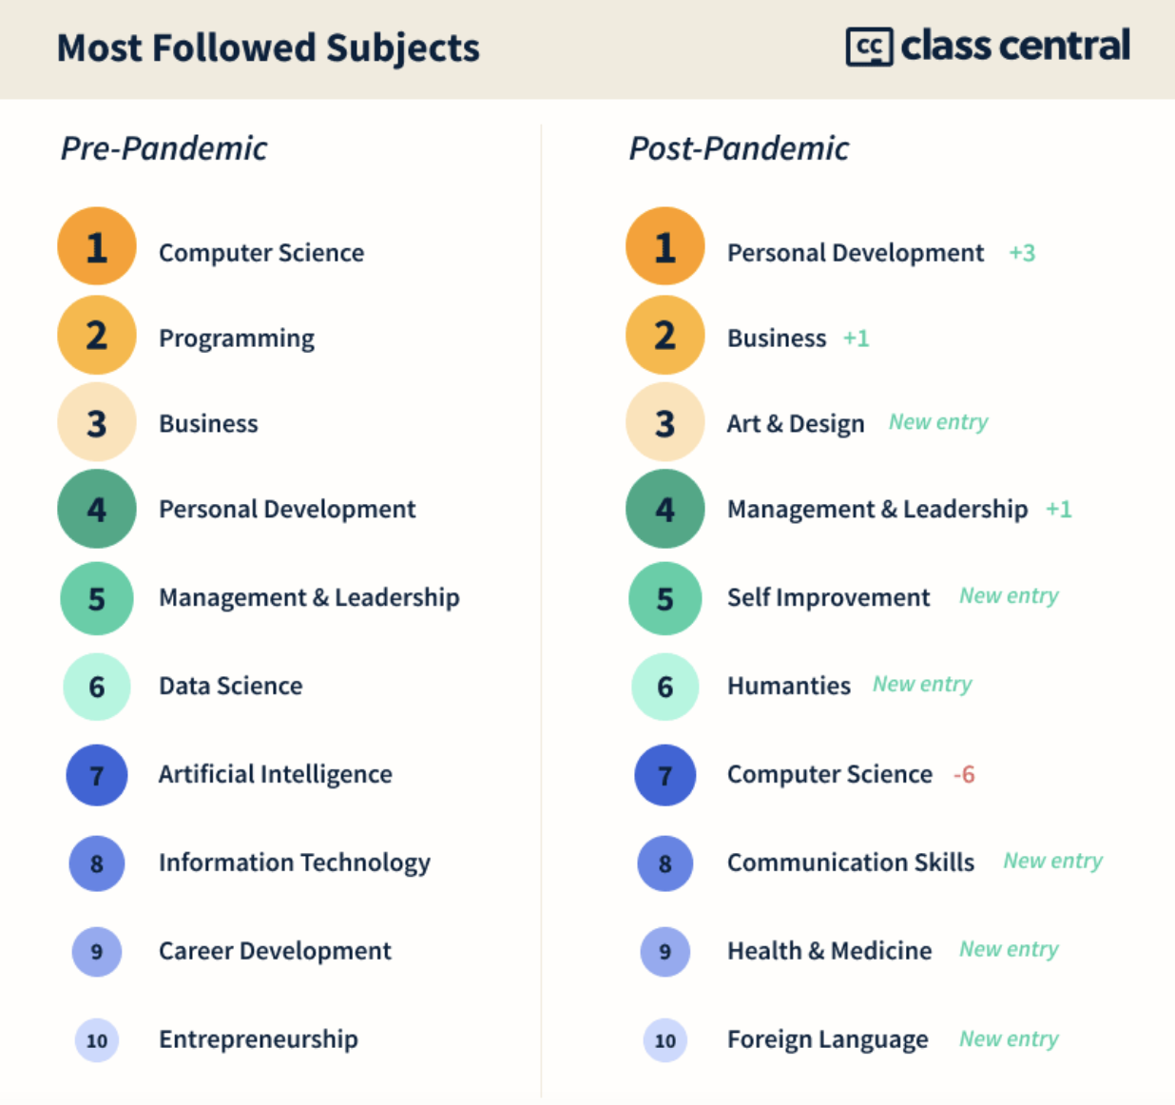
MOOCs Stats
December 14, 2020
The Second Year of the MOOC:
A Review of MOOC Stats and Trends in 2020, Dhawal Shah, Class Central
https://www.classcentral.com/report/the-second-year-of-the-mooc/

Slide 20
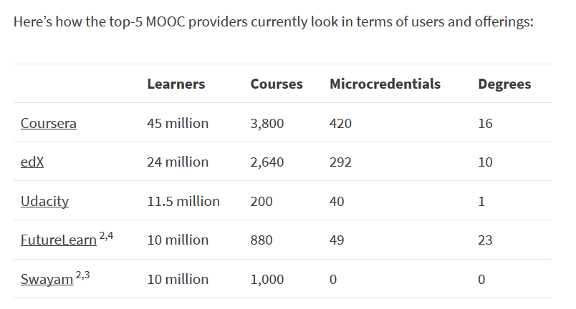
MOOCs Stats
December 17, 2019
A Review of MOOC Stats and Trends in 2019
Dhawal Shah, Class Central
https://www.classcentral.com/report/moocs-stats-and-trends-2019/

Slide 21
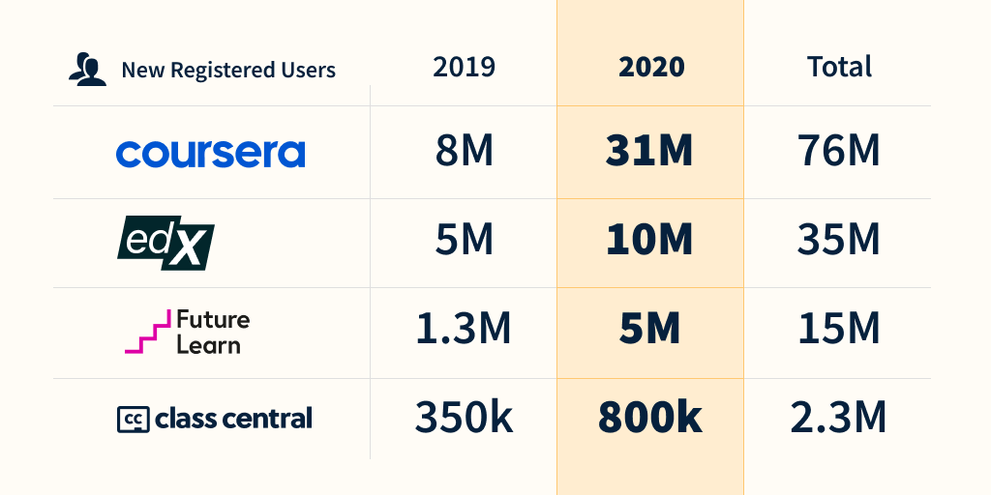
MOOCs Stats
December 14, 2020
The Second Year of the MOOC: A Review of MOOC Stats and Trends in 2020, Dhawal Shah, Class Central
https://www.classcentral.com/report/the-second-year-of-the-mooc/

Slide 22
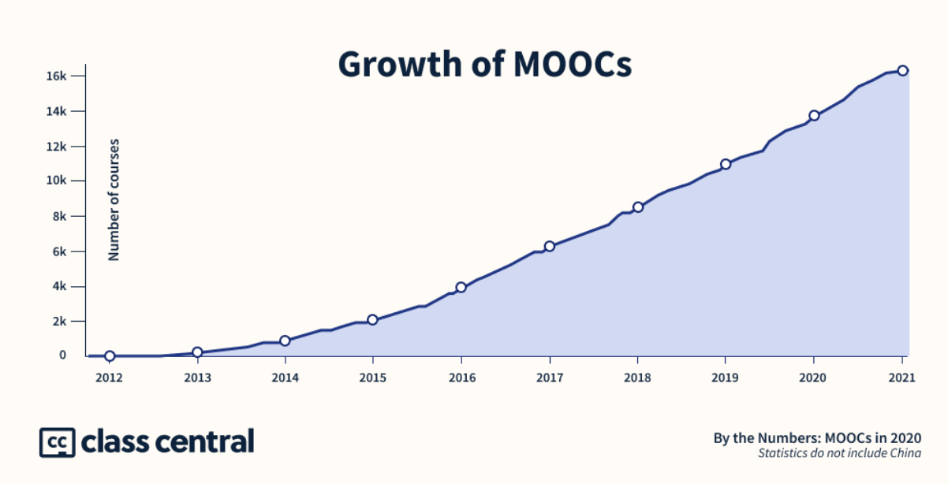
MOOCs Stats
December 14, 2020
The Second Year of the MOOC: A Review of MOOC Stats and Trends in 2020, Dhawal Shah, Class Central
https://www.classcentral.com/report/the-second-year-of-the-mooc/

Slide 23
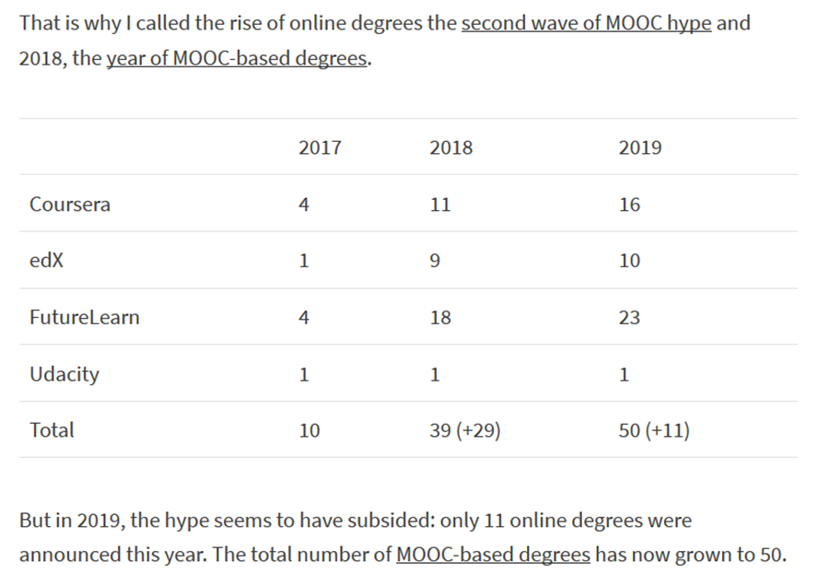
MOOCs Stats
December 17, 2019
A Review of MOOC Stats and Trends in 2019
Dhawal Shah, Class Central
https://www.classcentral.com/report/moocs-stats-and-trends-2019/

Slide 24
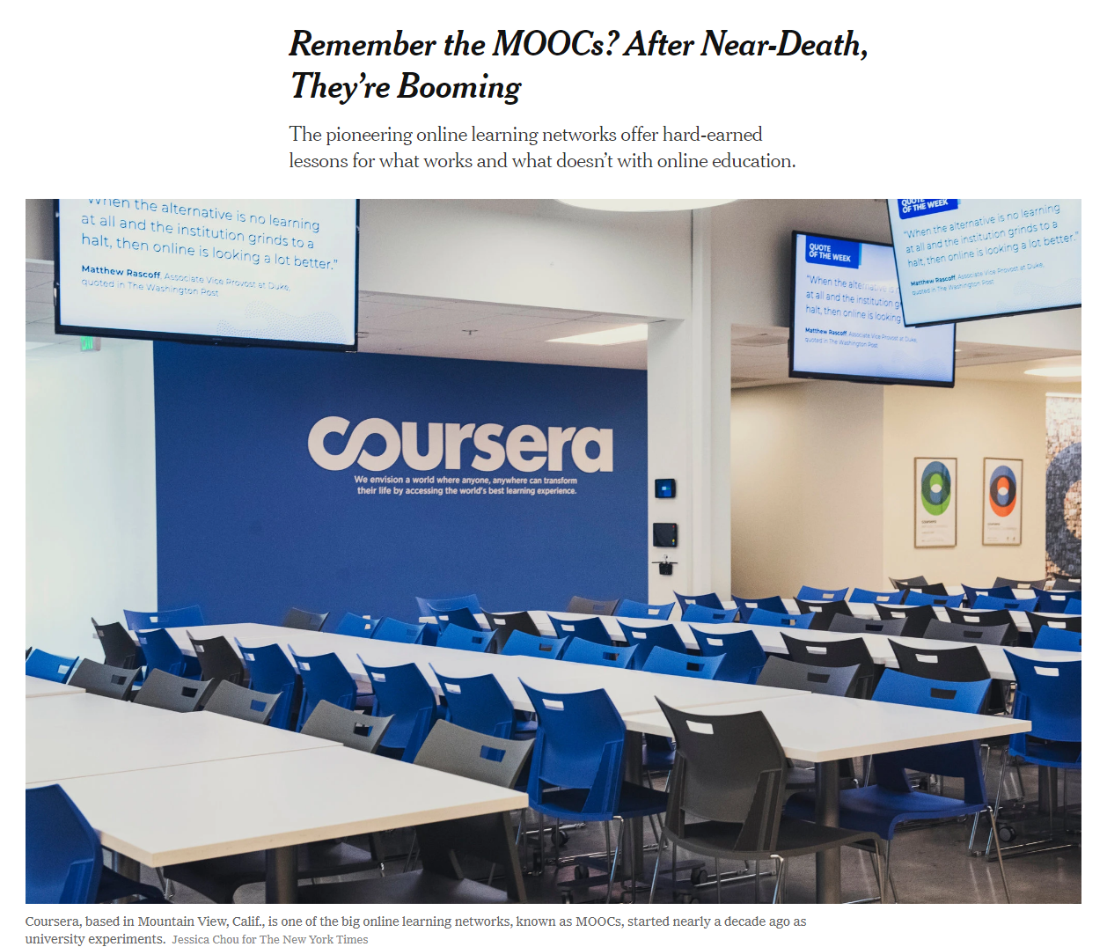

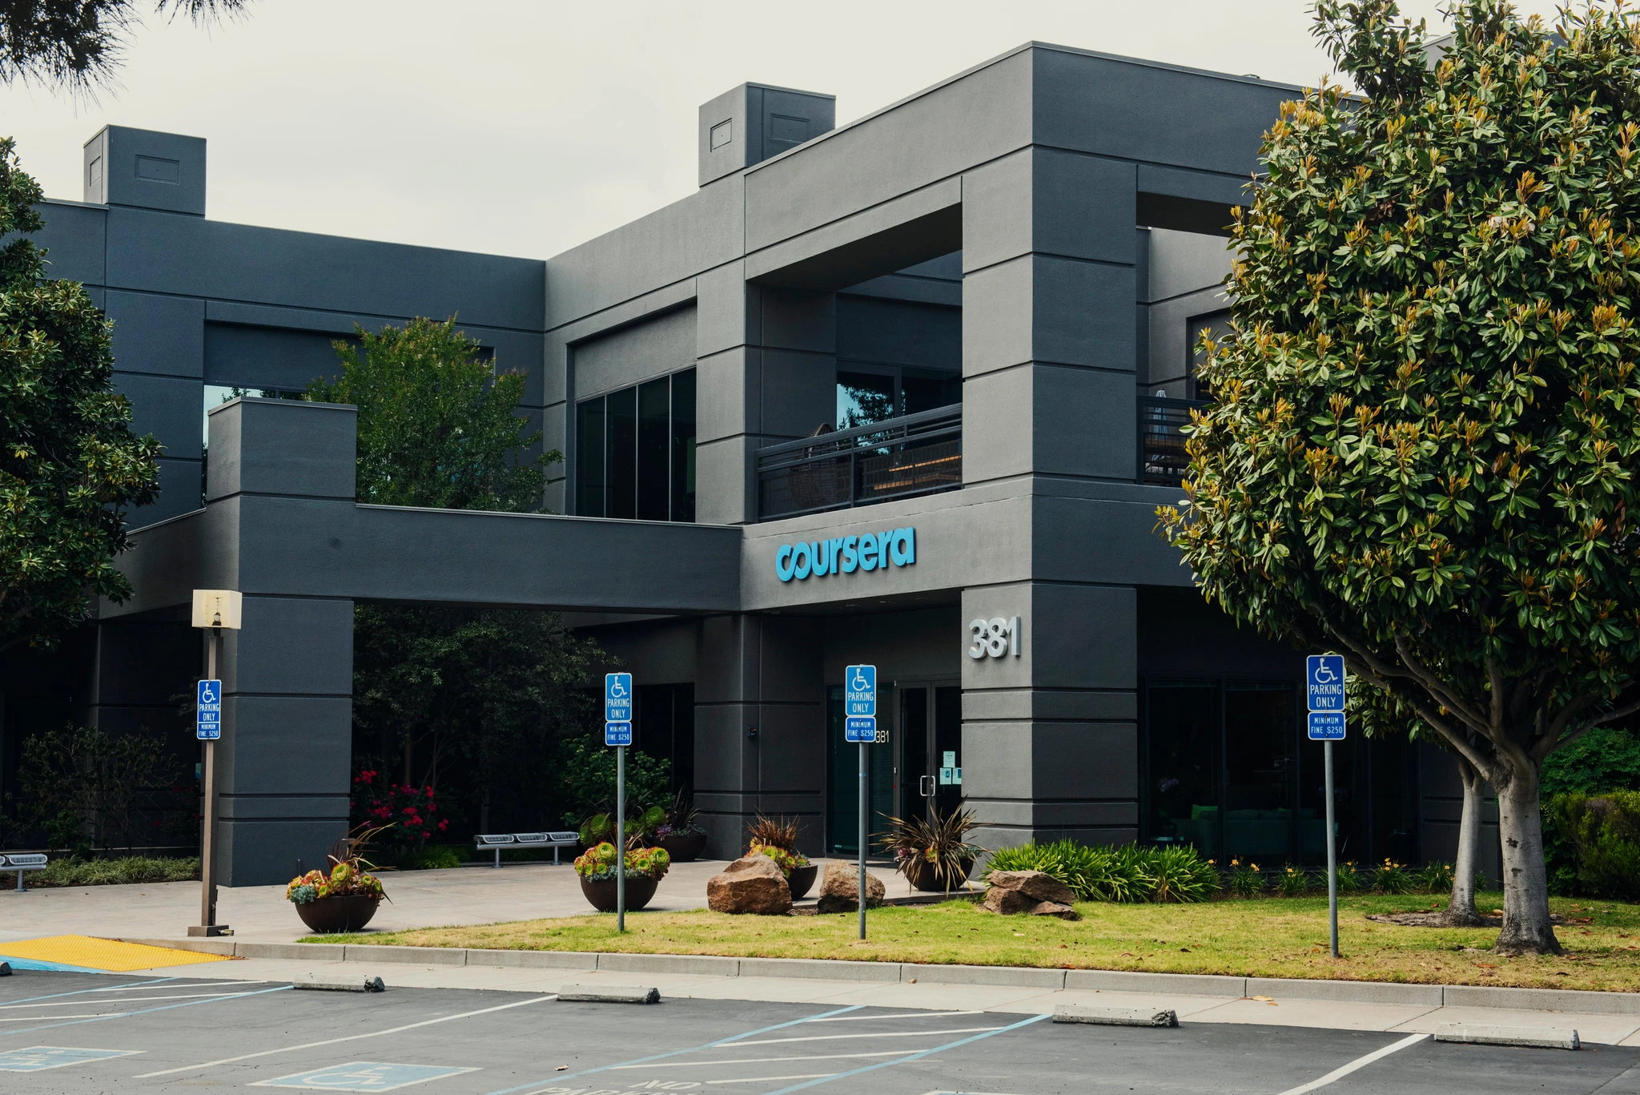
May 26, 2020
Remember the MOOCs?
After Near-Death, They’re Booming
Steven Lohr, The New York Times https://www.nytimes.com/2020/05/26/technology/moocs-online-learning.html
Coursera added 10 million new users from mid-March to mid-May. Credit...Jessica Chou for The New York Times

Slide 25
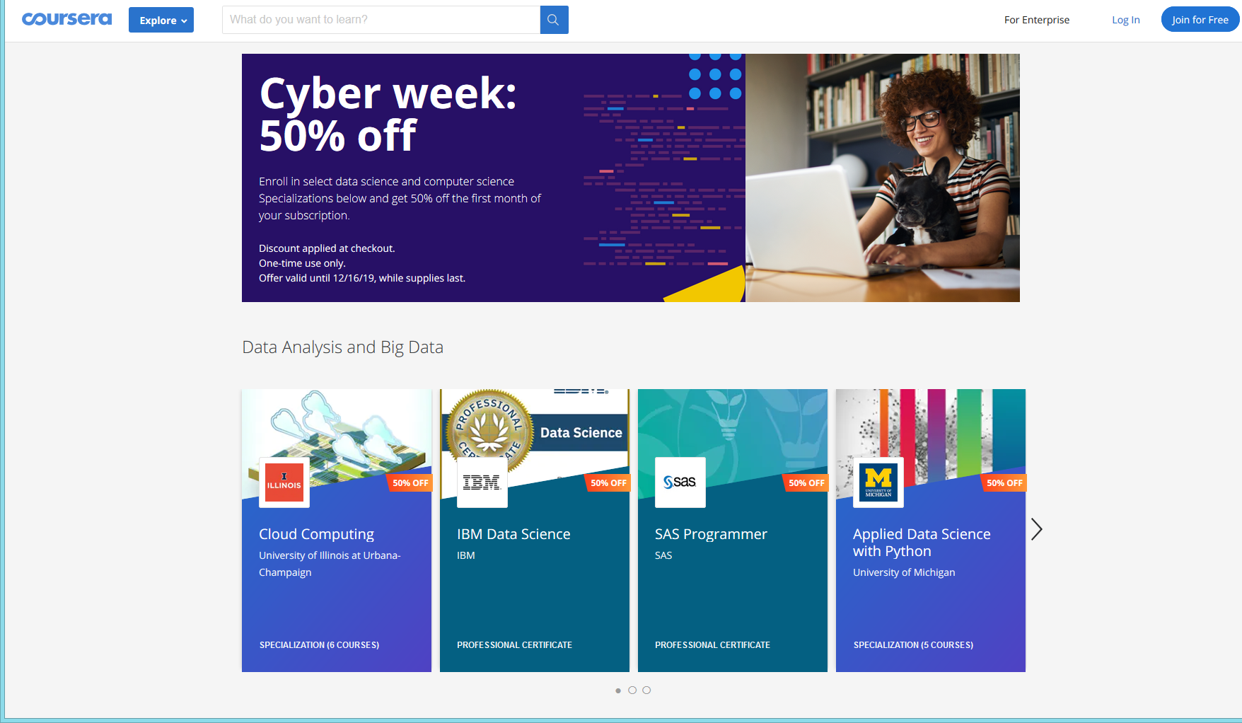
December 15, 2019
Coursera <no-reply@m.mail.coursera.org>
Ends TOMORROW: 50% off top tech Specializations

Slide 26
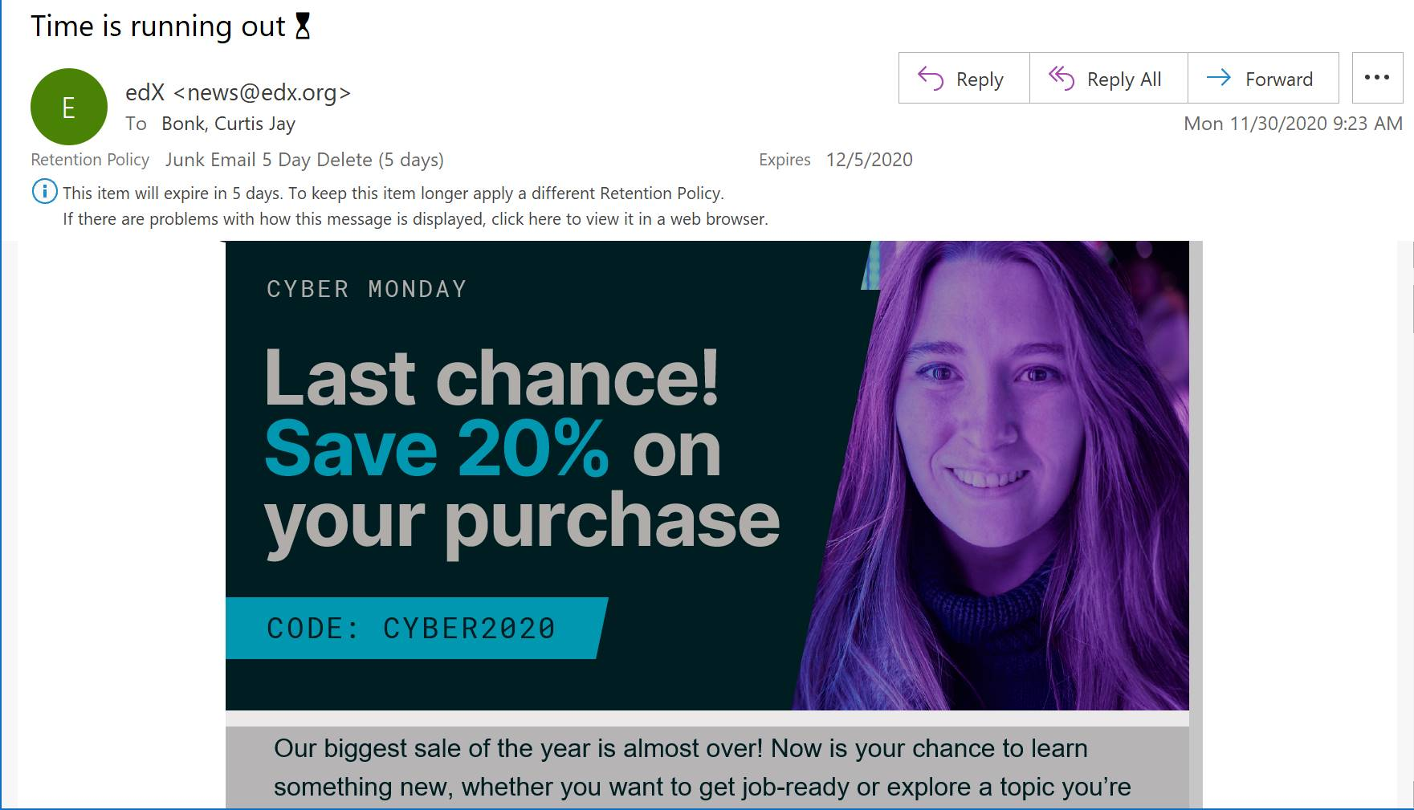
November 30, 2020
Cyber Monday

Slide 27






MOOC books
(2020) and (2015)
Notes:
Last year, I co-edited a book titled MOOCs and Open Education around the World. MOOCs stands for Massive Open Online Courses. An individual MOOC can enroll tens of thousands of students, and several MOOCs have now surpassed 1 million students in total enrollment. MOOCs are primarily offered by elite universities such as Stanford, MIT, and Harvard through enterprises such as Coursera, edX, and FutureLearn. More people enrolled in MOOCs developed at Harvard in a single year than attended Harvard in its entire 377-year history.

Slide 28


October 22, 2021
Wanted:
Billions of Self-Directed Learners

Slide 29

October 22, 2021
Wanted:
Billions of Self-Directed Learners https://www.peoplematters.in/article/training-development/the-era-of-self-directed-learning-hrs-new-role-and-strategy-24348

Slide 30
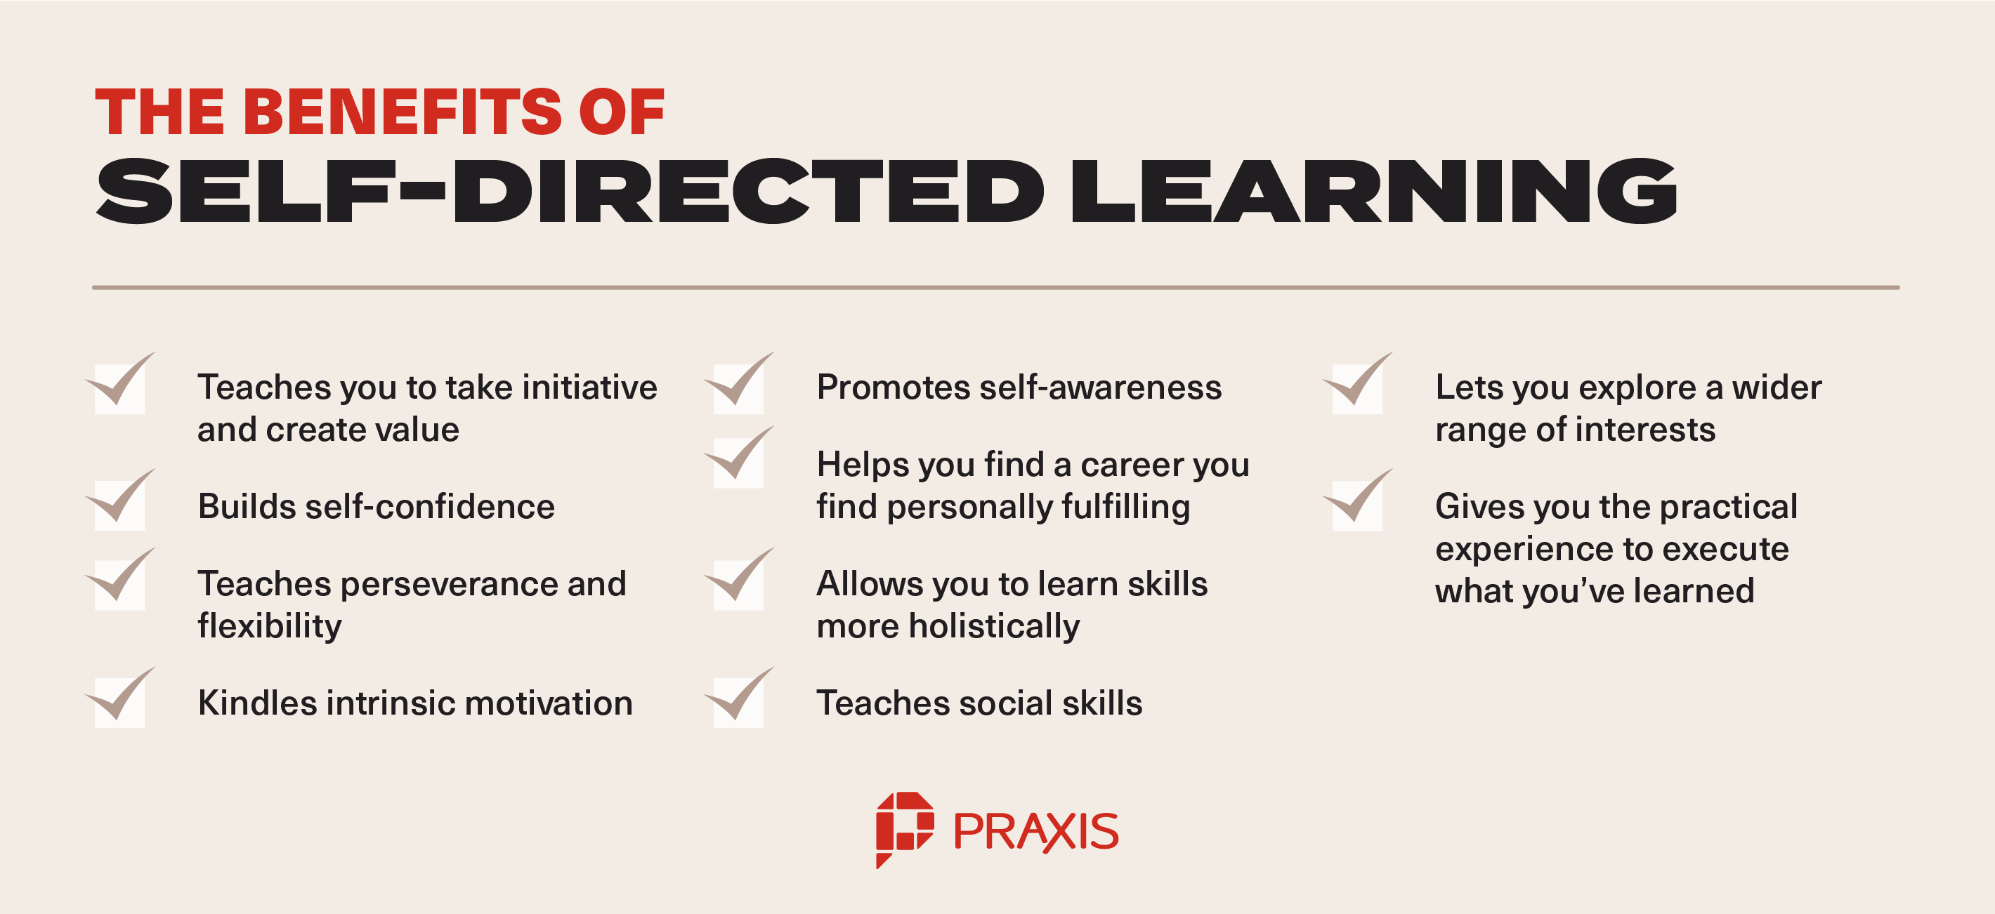
Benefits of Self-Directed Learners https://discoverpraxis.com/reasons-not-to-go-to-college/

Slide 31
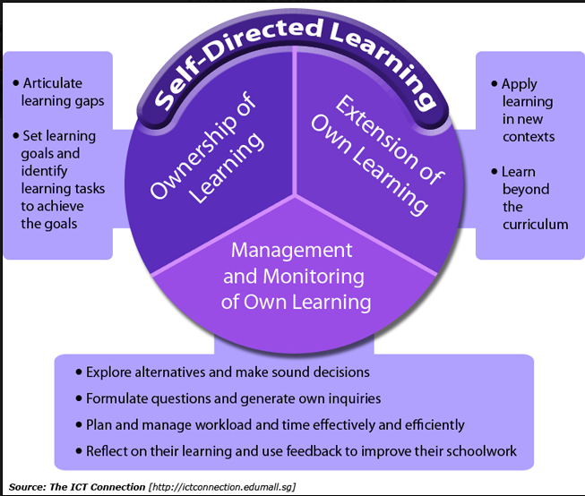
The Adult Learner
One Model of Self-Directed Learning http://the-adult-learner-2016.blogspot.com/2016/02/a-single-candle-self-directed-learning.html

Slide 32
Study #1
MOOCs Design
Considerations and Challenges
Zhu, M., Bonk, C. J., & Sari, A. (2018). Instructor experiences designing MOOCs in higher education: Pedagogical, resource, and logistical considerations and challenges. Online Learning, 22(4), 203-241.

Slide 33
Research Background
  MOOCs can be beneficial to both learners and instructors (Hew & Cheung, 2014).
  Instructional design is critical for online learning (Johnson & Aragon, 2003; Phipps & Merisotis, 1999).
  Instructors are one of the five main components of MOOCs (Kop, 2011).
  Few studies have examined instructional design from MOOC instructors’ perspectives (Margaryan et al., 2015; Watson et al., 2016).

Slide 34
Research Purpose
  The purpose of this study is to provide suggestions for future MOOC instructors and instructional designers in higher education through exploring MOOC design considerations and challenges from the instructor’s perspective.

Slide 35
Research Questions
  What are the design considerations of instructors when designing MOOCs?
  What challenges do instructors perceive when designing MOOCs?
  How do instructors address the challenges that they perceive related to MOOCs?

Slide 36

Research Design
  Sequential mixed methods design (Creswell & Clark, 2017)
Quan
Data Collection
Quan
Data Analysis
Qual
Data Collection
Interpretation of Entire Analysis
Qual
Data Analysis

Slide 37

Data Collection
  Data Collection:
    Survey, interview, and course review
  Participants:
    143 survey participants (10% response rate)
    12 interviewees

Slide 38
12 Interviewees
No. | Countries | Subject areas | Platforms
1. | The U.S. | Language and Literacy | Coursera
2. | The U.S. | Education | Coursera
3. | The U.S. | Education | Canvas
4. | The U.S. | Chemistry | Coursera
5. | UK | Medicine and Health | FutureLearn
6. | UK | Language and Literacy | FutureLearn
7. | Hong Kong (China) | Math | Coursera
8. | Mainland China | Math | Coursera
9. | Canada | Psychology | Coursera
10. | Australia | Medicine and Health | Open2Study
11. | Sweden | Computer Science | edX
12. | India | Management | edX

Slide 39
Data Analysis
RQs | Data Sources | Data analysis
RQ1 | Survey-multiple-choice questions Survey-open-ended questions Interview MOOC review | Descriptive statistics Content analysis (Elo & Kyngäs, 2008) Content analysis Content analysis
RQ2 | Survey-multiple-choice questions Survey-open-ended questions Interview | Descriptive statistics Content analysis Content analysis
RQ3 | Survey-multiple-choice questions Interview | Descriptive statistics Content analysis

Slide 40
Research Context

Slide 41
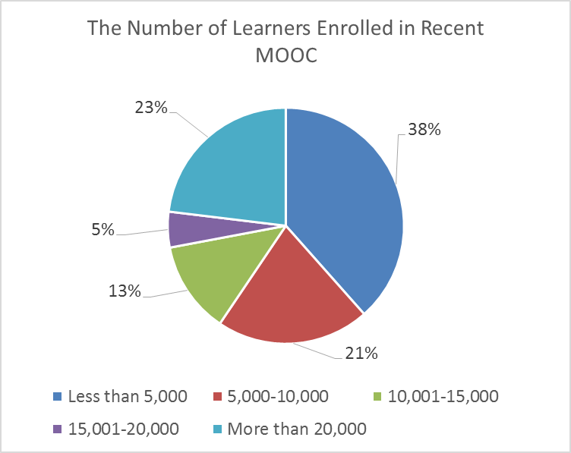
Research Context

Slide 42
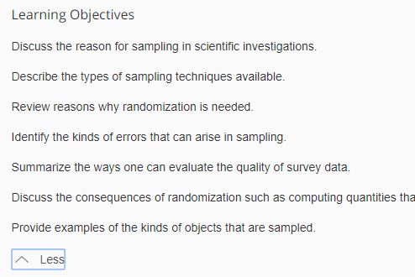
Findings RQ1
  RQ #1. What are the design considerations of instructors when designing MOOCs?
  Learning objectives
  Assessment
  Time for designing MOOC
  Engaging learners
An example of learning objectives:

Slide 43
RQ1 Survey Results

Slide 44
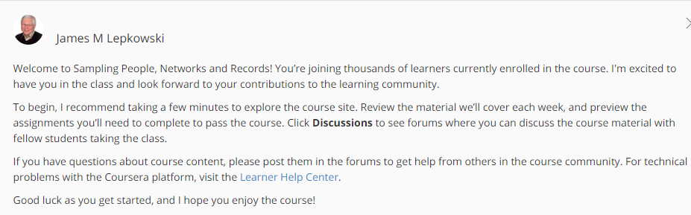
RQ1 Interview Results
  Engage learners
  One instructor from US mentioned:
    “I engaged people in the forum. So each week I would write a message that would be the new welcome page for the week that would say, ‘hey come to the forum and ask questions about this or come to the forum introduce yourself’... Of course, I tried to get students to feel like I was engaged with them during the videos by asking them questions and telling them to do things during the video.”

Slide 45
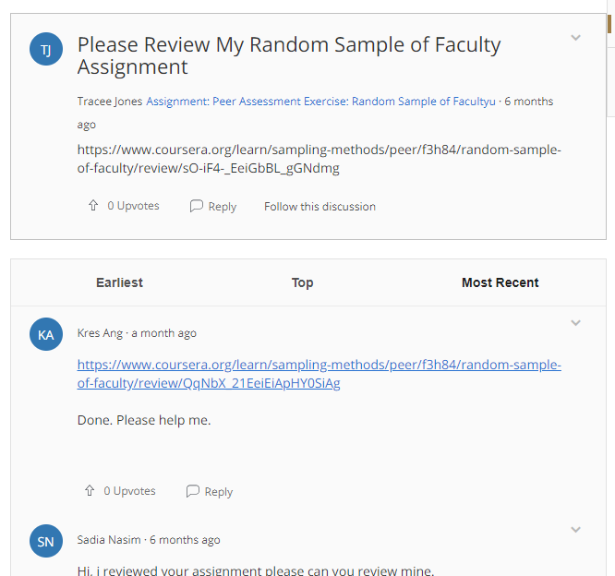
Findings RQ2
  RQ #2. What challenges do instructors perceive when designing MOOCs?
  Assessment methods
  Engaging students’ learning
  Time limitation
(Note: Above is an example of peer-assessment.)

Slide 46
RQ2 Survey Results

Slide 47

RQ2 Interview Results
  Time limitation
  One instructor from education subject mentioned:
    “I think one of the challenges is time. It does take a lot of time to get the videos done. I did not get a course release when I was doing, and it was a side project at the same time as my regular load.”

Slide 48
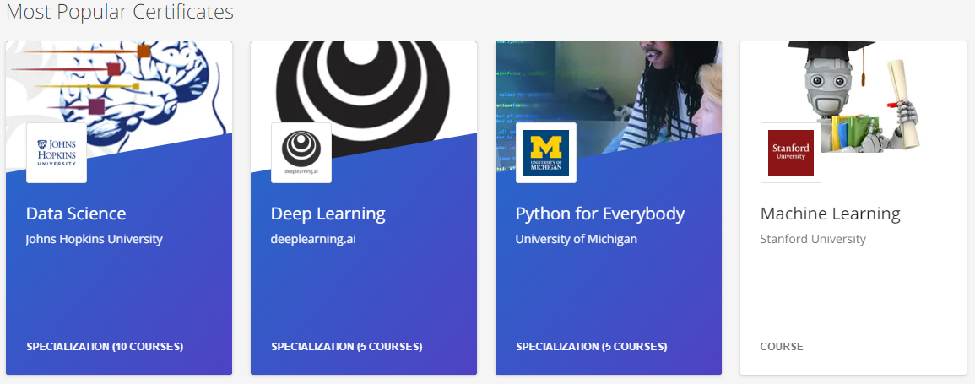
Findings RQ3
  RQ #3. How do instructors address the challenges that they perceive related to MOOCs?
  Explore other MOOC examples
  Seek help from the platform/colleagues/institutions

Slide 49
RQ3 Survey Results

Slide 50
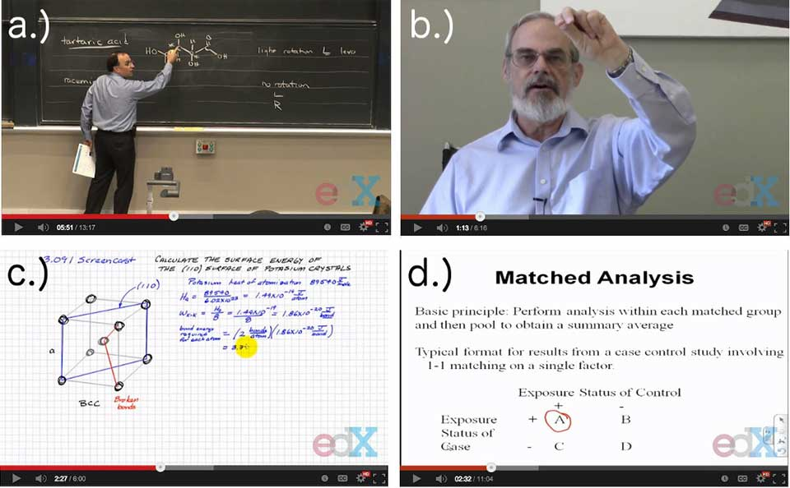
RQ3 Interview Results
  Explore other MOOC examples
  One MOOC instructor from the US mentioned:
    “When I started making the MOOC, I could see MOOCs that other people had made. So I could see what other people did in terms of having videos with questions embedded in the videos, which I really liked.”

Slide 51
Discussion
  The time limitation of creating MOOCs was the primary logistical consideration (Hew & Chung, 2014; Watson et al., 2016) and challenges.
  The pedagogical factors were the primary design considerations (Watson et al., 2016) and challenges in MOOC design.
  The assessment and engagement strategies are the main considerations as well as challenges.

Slide 52
Study #2
MOOCs Instructional Design to Facilitate Participants’ Self-directed Learning

Slide 53
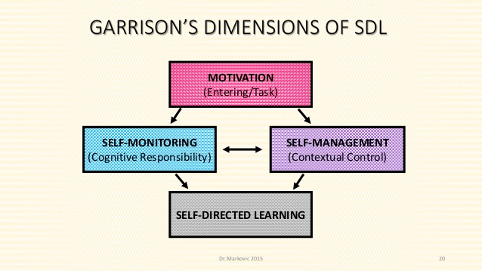
Key Terms
  Self-directed learning (SDL) (Garrison, 1997)
  (1) self-management
  (2) self-monitoring
  (3) motivation
Notes:
Garrison’s model: 3 inter-related part.

Slide 54
Research Background
  Learners need self-directed learning skills and strategies to be successful in MOOCs (Halawa, Greene, & Mitchell, 2014; Littlejohn & Milligan, 2016), as there is a lack of personalized interaction with teachers.
  Self-directness of a learner might vary in different learning environments which means that the learners could be more self-directed in one learning environment than another (Hiemstra, 1994).

Slide 55
Research Background
  Instructional design can greatly influence students’ interaction and engagement (Garrison & Cleveland-Innes, 2005) and success in online learning (Song, Singleton, Hill, & Koh, 2004; Swan, 2001).
  However, few studies have examined instructional design and the delivery of instruction using MOOCs from instructor perspectives (Margaryan et al., 2015; Watson et al., 2016); especially lacking is research on instructors’ perception of SDL and how they design MOOCs to facilitate students’ SDL.

Slide 56

Research Purpose
  The purpose is to inform instructors or instructional designers and MOOC providers of the current practices of designing MOOCs to facilitate learners’ SDL.

Slide 57
Research Questions
  How do MOOC instructors perceive participant SDL skills?
  How do MOOC instructors perceive their facilitation of participant SDL skills?
  How do instructors design and deliver MOOCs to facilitate participant SDL skills?
    a. How is technology being used by MOOC instructors to support the development of participant SDL skills?
    b. What technology features or functions do MOOC instructors want to have to improve their facilitation of MOOC participant SDL skills?

Slide 58

Research Design
  Explanatory sequential mixed methods design (Creswell & Clark, 2017)
Pilot survey with 48 instructors
Survey
198 instructors
Review 22 MOOCs of interviewees
Interview 22 instructors
Review 22 MOOCs of interviewees
Pilot interview with 4 instructors

Slide 59

Data Collections
  Survey:
  Volunteer sampling (Creswell & Clark, 2017)
  198 instructors responded to the survey (10% response rate)
  Interview:
  Homogeneous purposeful sampling (Creswell & Clark, 2017; Patton, 2002)
  Maximal variation sampling (Creswell & Clark, 2017)
  22 interviewees
  MOOC review:
  Reviewed 22 interviewees’ MOOCs

Slide 60
Pseudonym | Country | Subject area | Platform | Gender | No. of O/B | No. of M | Mode of the M
Lucas | US | Social science | edX | M | 0 | 1 | I without T
Branden | US | Education | Udacity | M | 0 | 5 or more | Self-paced
Logan | US | Literacy and Language | Coursera | M | 5 or more | 5 or more | I with T
Emma | US | Literacy and Language | Coursera | F | 2 | 1 | Self-paced
Jason | US | Science | edX | M | 1 | 1 | I with T
Jackson | US | Medicine and health | Coursera | M | 5 or more | 1 | Self-paced
Samuel | US | Education | FutureLearn | M | 4 | 3 | Self-paced
Hannah | US | Education | Blackboard | F | 5 or more | 1 | I with T
Ashley | US | Education | EdX | F | 0 | 5 or more | I with T
Andrew | UK | Art | FutureLearn | M | 0 | 3 | I with T
Emily | UK | Medicine and health | FutureLearn | F | 2 | 2 | I with T
Aiden | UK | Social science | FutureLearn | M | 0 | 1 | Self-paced
Henry | UK | Social science | FutureLearn | M | 0 | 1 | Self-paced
Joseph | UK | Medicine and health | FutureLearn | M | 1 | 1 | Self-paced
Joshua | UK | Literacy and language | FutureLearn | M | 2 | 2 | I with T
Mason | Australia | Education | Coursera | M | 5 or more | 1 | I with T
Ethan | Australia | Business | Coursera | M | 3 | 1 | I without T
Ben | Australia | Social science | edX | M | 1 | 1 | I with T
Paul | France | Computer Science | Coursera | M | 1 | 1 | I with T
Fernando | Belgium | Research methods | Blackboard | M | 5 or more | 3 | I with T
Jacob | Netherland | Science | Coursera | M | 0 | 1 | I with T
Dylan | Israel | Science | Coursera | M | 5 or more | 3 | I without T
Data Collections
  Interview:

Slide 61
Data Analysis
RQs | Data Sources | Data analysis | Tools
RQ1 | Survey Interview | Descriptive statistics Content analysis (Elo & Kyngäs, 2008) | SPSS NVivo
RQ2 | Survey Interview | Descriptive statistics Content analysis | SPSS NVivo
RQ3 | Interview Course review | Content analysis Content analysis | NVivo NVivo

Slide 62
Research Context

Slide 63
RQ1 Perceptions of SDL
  A majority of the MOOC instructors thought that these skills or attributes are not static, and that SDL as a set of skills can be educated or students’ personal attributes that can be changed.

Slide 64

RQ1 Interview Results
  Emma’s understanding of SDL is more related to self-management and motivation. She said:
    “When I think about self-directed learning, I think about students managing their time and managing the coursework on their own, and how it fits into their schedules and their lives, how they interact with materials, what's going to keep them engaged.”

Slide 65
RQ2 Perceptions of Facilitation of SDL
  Most of MOOC instructors thought that they can intentionally or unintentionally facilitate students’ SDL.

Slide 66

RQ2 Interview Results
  Ashely emphasized the importance of both instructors’ facilitation and students’ SDL skills. She said:
    “The participant has a lot of flexibility on how they approach the content. I mean, obviously, we have things like assignments. We have things like online forums. And there're ways that we scaffold the learning experience. But there still is a lot of choice for the learner.”

Slide 67
RQ3 Strategies to Facilitate SDL
  Students’ intrinsic motivation plays an important role. However, extrinsic motivation provided by the MOOCs might help transfer extrinsic motivation to intrinsic motivation.
Motivations | Strategies
Entering motivation | MOOC instructors helped students identify the needs and goals of learning and sense of achievement.
Task motivation | MOOC instructors motivated students through instruction, learning materials, feedback, and learning community.

Slide 68
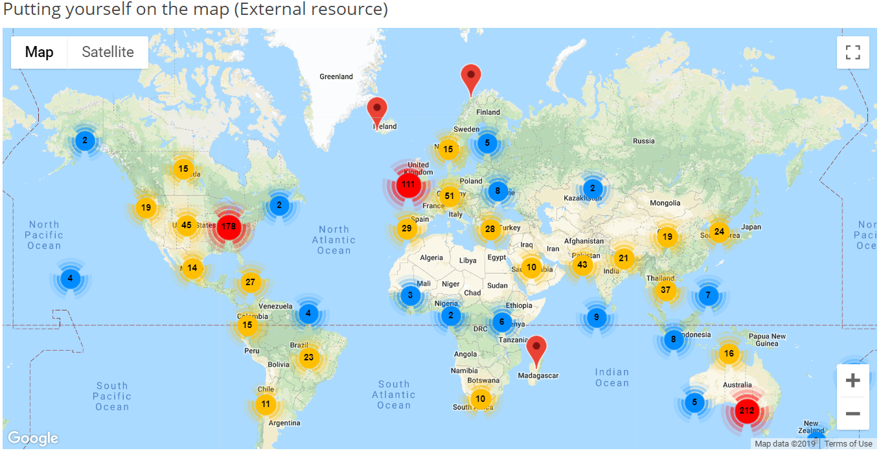
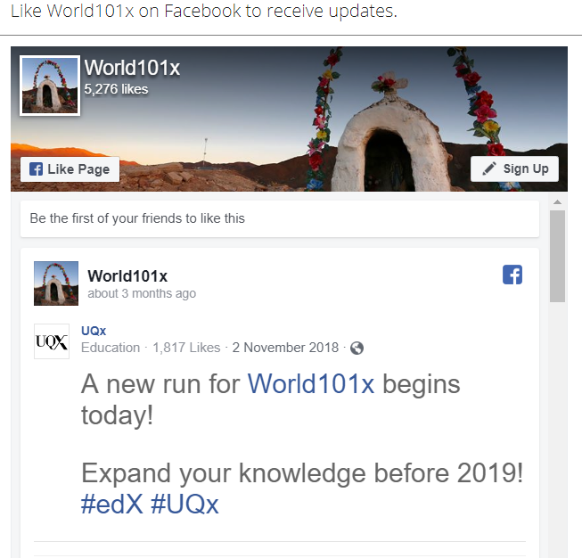
RQ3 Learning Community

Slide 69
RQ3 Strategies to Facilitate SDL
  Both internal feedback and external feedback were provided to help students’ self-monitoring.
Self-monitor |  | Strategies
Internal feedback | Cognition | MOOC instructors provided quizzes for self-assessment, tutorial on technology use, learning advice, navigation of the course, progress indicators, resources, and instructional modeling, etc.
 | Meta-cog | MOOC instructors encouraged students to reflect and think critically by providing reflection questions and building learning community.
External feedback |  | MOOC instructors, teaching assistants, and peers were involved in providing external feedback.

Slide 70
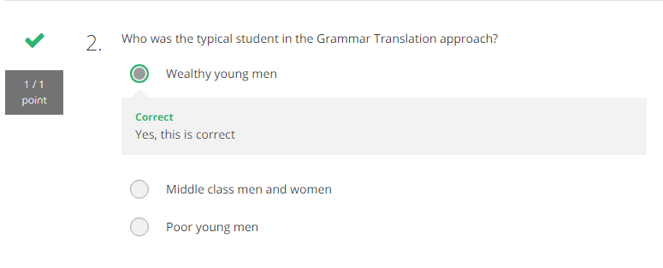
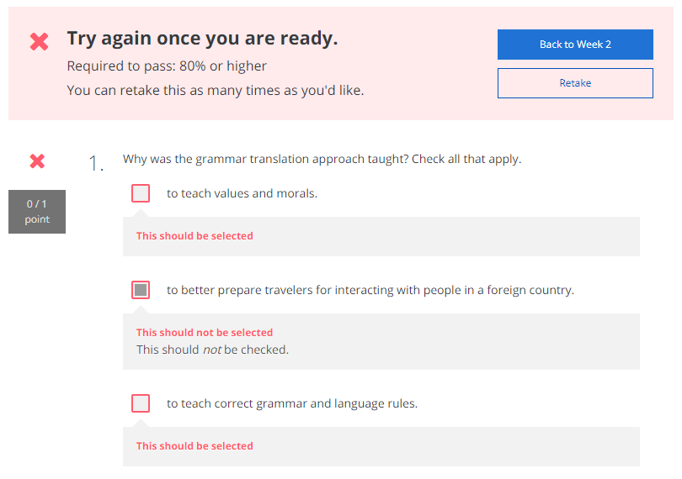
RQ3 Self-assessment (i.e., embedded quizzes)

Slide 71
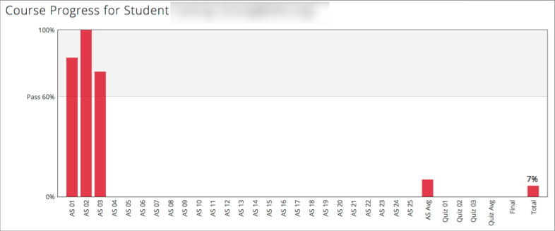
RQ3 Progress Indicators

Slide 72
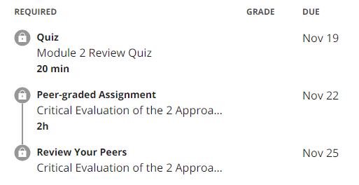
RQ3 External Feedback: Peer-assessment
(e.g., 3 peers assigned to review each assignment)

Slide 73
RQ3 Strategies to Facilitate SDL
  They helped students’ self-management concerning setting learning goals, time management, resources and support management although among the three elements of SDL, MOOC instructors had less control over students’ management.
Self-management | Strategies
Enactment of learning goals | Providing discussion questions, reflections, survey, and appreciation students’ learning goals.
Time management | Providing time frame, progress indicator, short learning units, and flexible timeline.
Management of resources and support | Providing flexible learning resources, peer-assessment, accessibilities, clear expectations, and short learning units.

Slide 74
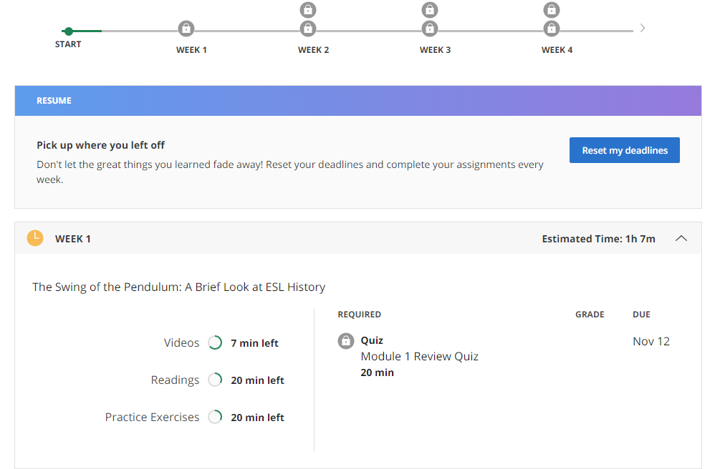
RQ3 Time Management
(e.g., time advisories and estimates)

Slide 75


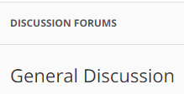



RQ3-a. Tech Used for SDL
  Synchronous communication technologies
    Google Hangouts YouTube Live
  Asynchronous communication technologies
    Discussion forum Blog Slackbot Flickr
  Multimedia (e.g., video and graphics)
  Feedback technologies

Slide 76
Discussion
  SDL can be Changed
  MOOC Instructors can Facilitate SDL
  Strategies to Facilitate SDL: A variety of strategies can be used to facilitate student SDL skills in terms of motivation, self-monitor, and self-management.
  Tech for SDL: Tech plays a vital role in facilitating SDL skills.
  Tech expectations: Adaptive learning systems, artificial intelligent systems, and learning analytics were expected to have to support SDL.

Slide 77
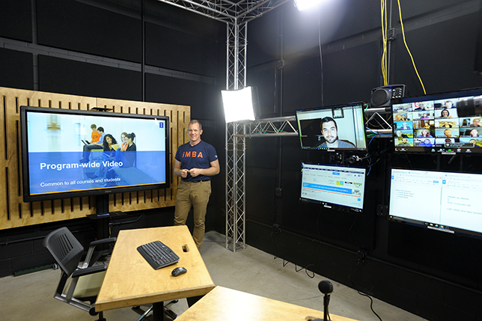
Implications
  For MOOC instructors and Instructional Designers
    Build learning community
    Inspire intrinsic motivation
    Personalize learning
  For MOOC providers
    Create a personalized learning environment
    Provide learning analytics to support learning and teaching

Slide 78



Top 10 Strategies to Facilitate SDL in MOOCs
  Helping students set their own learning goals.
  Building learning community.
  Offering immediate feedback.
  Embedding quizzes for self-assessment.
  Providing progress indicators.
  Providing reflection questions.
  Designing short learning units.
  Providing flexible timelines.
  Highlighting estimated time frames.
  Making available optional learning materials.

Slide 79

Top 10 Strategies to Facilitate SDL in MOOCs
  Helping students set their own learning goals.
  Example:
    “I have asked, at the first page of course, why they're taking the course. So that is the goal. A lot of people say, ‘I'm a teacher. And I want to do the stuff with my kids. Or I want to update my knowledge. Or I'm retired and I want to learn this.’”

Slide 80
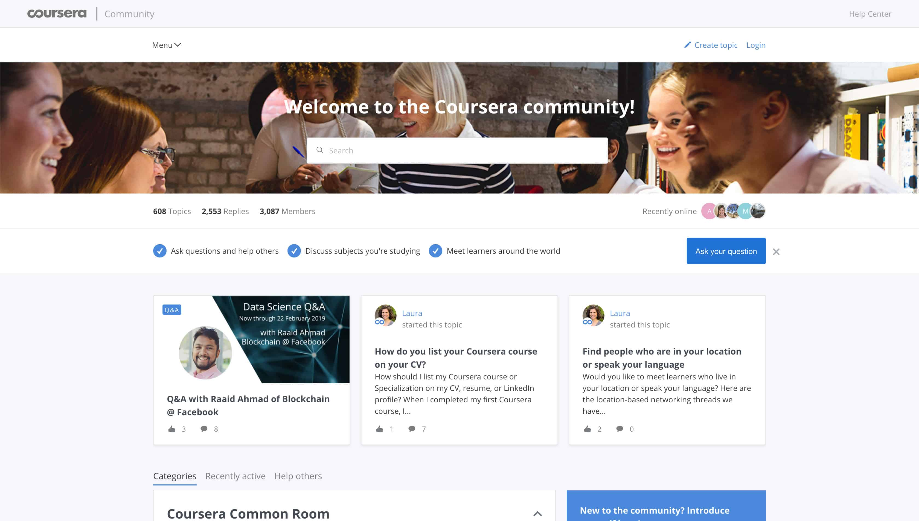
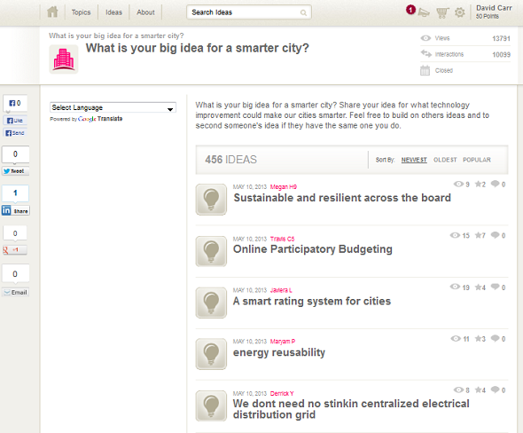
Top 10 Strategies to Facilitate SDL in MOOCs
  2. Building learning community.
    Joshua from the UK mentioned: We use a lot of resources that already exist. And then we use the MOOC discussion board as a place to where they, kind of, point out and say, “I've seen this. And this is useful. Well, I use this, and this is good. I created this.”

Slide 81
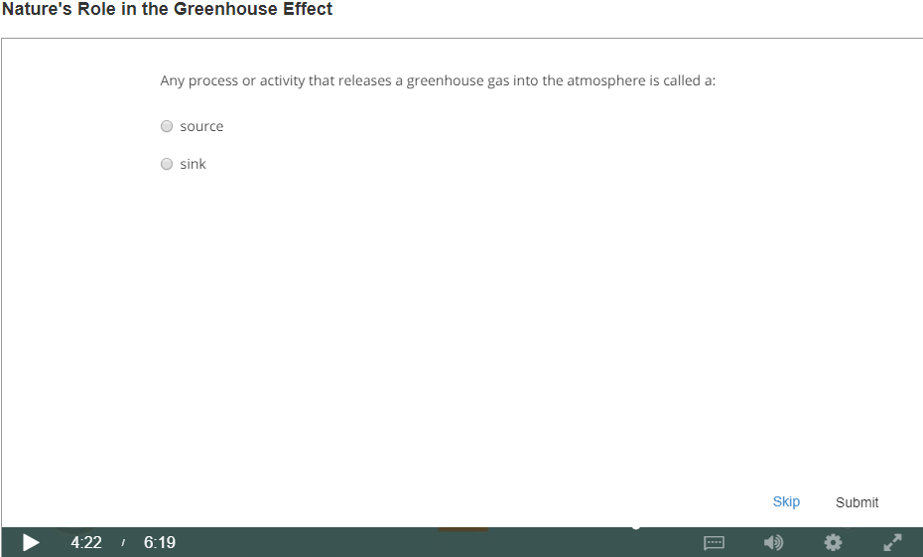
Top 10 Strategies to Facilitate SDL in MOOCs
  3. Offering immediate feedback.
  4. Embedding quizzes for self-assessment.

Slide 82
Top 10 Strategies to Facilitate SDL in MOOCs
  5. Providing progress indicators

Slide 83

Top 10 Strategies to Facilitate SDL in MOOCs
  6. Providing reflection questions.
    We introduced kind of moments that video was stopped and there was a question. The student had to think of it a bit. Sometimes it was kind of a rhetorical question. There wasn't even no answer required. But it was just a pause for a while to let the student reflect. (Jacob)

Slide 84
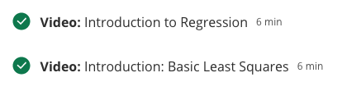
Top 10 Strategies to Facilitate SDL in MOOCs
  7. Designing short learning units.

Slide 85
Top 10 Strategies to Facilitate SDL in MOOCs
  8. Providing flexible timelines.

Slide 86
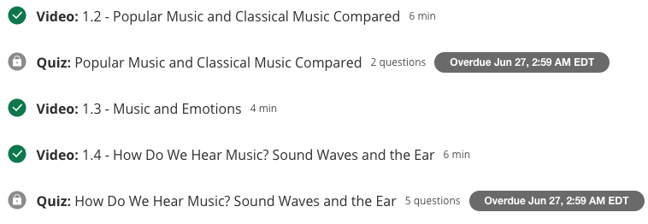
Top 10 Strategies to Facilitate SDL in MOOCs
  9. Highlighting estimated time frames.

Slide 87
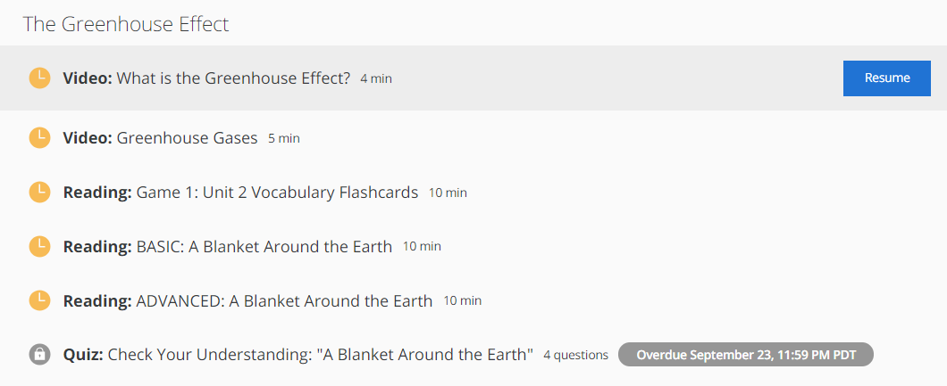
Top 10 Strategies to Facilitate SDL in MOOCs
  10. Making available optional learning materials.

Slide 88
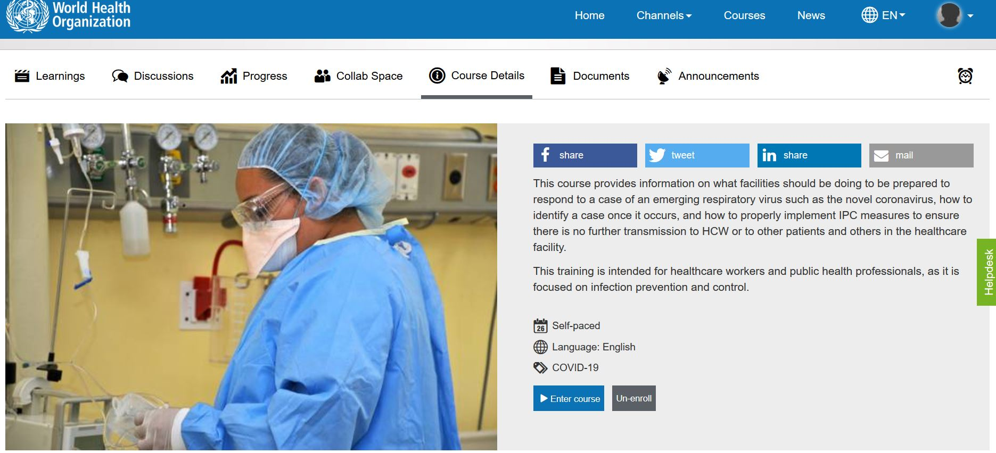
10 More Strategies to Facilitate SDL in MOOCs
  MOOC: Infection Prevention and Control (IPC) for Novel Corona virus (COVID-19) from OpenWHO (English Version)
  11. Structured learning environment:
  Clearly stated the learning objectives.
  Course details stated the expected time to complete the course.
  The syllabus, number of course modules, and title of each module.

Slide 89

10 More Strategies to Facilitate SDL in MOOCs
  11. Structure continued…
  Graphic or visual organizations for essential material.
  The text on screen matched the narration enforcing the redundancy principle.

Slide 90


10 More Strategies to Facilitate SDL in MOOCs
  12. On completion of modules participants get a certificate.
  Providing External Rewards and Goals

Slide 91

The Science of Well-Being, Yale

Slide 92


10 More Strategies to Facilitate SDL in MOOCs
  13. Week overview. The course is divided into week-long segments, and each week is chunked into manageable parts. Very importantly for the participant to be able to anticipate what can get done in one sitting, the length of each video is included.

Slide 93



10 More Strategies to Facilitate SDL in MOOCs
  14. Lecture recorded and captions added.
Caption added to video
Video of student audience

Slide 94

10 More Strategies to Facilitate SDL in MOOCs
  14. Continued…Lecture video transcripts.

Slide 95

10 More Strategies to Facilitate SDL in MOOCs
  15. Quick check tasks.

Slide 96

10 More Strategies to Facilitate SDL in MOOCs
  16. Providing students with self-selection options.
  There is the choice to watch all of the videos, read all of the materials, and submit all of the assignments, or there are choices all along the way to “cut corners” and take in only what the participant wants to.

Slide 97


10 More Strategies to Facilitate SDL in MOOCs
  17. Visuals showing tasks completed.

Slide 98

10 More Strategies to Facilitate SDL in MOOCs
  18. Visuals showing work progress.

Slide 99
10 More Strategies to Facilitate SDL in MOOCs
  19. Rewirements (assignments) for putting the material to practice (e.g, Random Acts of Kindness, Make A Social Connection, Let’s Get Physical, Meditate!, Sleep!, Gratitude Letter/Visit, Savoring, etc.)
Daily Gratitude Journal
Gratitude is a positive emotional state in which one recognizes and appreciates what one has received in life. Research shows that taking time to experience gratitude can make you happier and even healthier. For the next seven days, you will take 5-10 minutes each night to write down five things for which you are grateful. They can be little things or big things. But you really have to focus on them and actually write them down (Again, try to develop a tracking method works for you and utilize a note on your phone, a daily calendar, a special notebook, etc). You can just write a word or short phrase, but as you write these things down, take a moment to be mindful of the things you’re writing about (e.g., imagine the person or thing you’re writing about, etc.). This exercise should take at least five minutes. Do this each night for the whole week.

Slide 100

10 More Strategies to Facilitate SDL in MOOCs
20. Offer community support and help.

Slide 101

10 More Strategies to Facilitate SDL in MOOCs
Bonus Item: Peer-graded assignments.

Slide 102

MOOC Study #3

Slide 103


Slide 104


Slide 105


Slide 106


Slide 107


Slide 108


Slide 109


Slide 110
MOOC Study #4
Zhu, M., Sabir, N., Bonk, C. J., Sari, A., Xu., S., & Kim, M. (2021, April). Addressing learner cultural diversity in MOOC design and delivery: Strategies and practices of instructors and experts. Turkish Online Journal of Distance Education, 22(2), 1-25. https://doi.org/10.17718/tojde.906468;

Slide 111

Zhu, M., Sabir, N., Bonk, C. J., Sari, A., Xu., S., & Kim, M. (2021, April). Addressing learner cultural diversity in MOOC design and delivery: Strategies and practices of instructors and experts. Turkish Online Journal of Distance Education, 22(2), 1-25. https://doi.org/10.17718/tojde.906468;

Slide 112

Zhu, M., Sabir, N., Bonk, C. J., Sari, A., Xu., S., & Kim, M. (2021, April). Addressing learner cultural diversity in MOOC design and delivery: Strategies and practices of instructors and experts. Turkish Online Journal of Distance Education, 22(2), 1-25. https://doi.org/10.17718/tojde.906468;

Slide 113

Zhu, M., Sabir, N., Bonk, C. J., Sari, A., Xu., S., & Kim, M. (2021, April). Addressing learner cultural diversity in MOOC design and delivery: Strategies and practices of instructors and experts. Turkish Online Journal of Distance Education, 22(2), 1-25. https://doi.org/10.17718/tojde.906468;

Slide 114

Zhu, M., Sabir, N., Bonk, C. J., Sari, A., Xu., S., & Kim, M. (2021, April). Addressing learner cultural diversity in MOOC design and delivery: Strategies and practices of instructors and experts. Turkish Online Journal of Distance Education, 22(2), 1-25. https://doi.org/10.17718/tojde.906468;

Slide 115

Zhu, M., Sabir, N., Bonk, C. J., Sari, A., Xu., S., & Kim, M. (2021, April). Addressing learner cultural diversity in MOOC design and delivery: Strategies and practices of instructors and experts. Turkish Online Journal of Distance Education, 22(2), 1-25. https://doi.org/10.17718/tojde.906468;

Slide 116

Zhu, M., Sabir, N., Bonk, C. J., Sari, A., Xu., S., & Kim, M. (2021, April). Addressing learner cultural diversity in MOOC design and delivery: Strategies and practices of instructors and experts. Turkish Online Journal of Distance Education, 22(2), 1-25. https://doi.org/10.17718/tojde.906468;

Slide 117


Slide 118


Slide 119


Slide 120

MOOC Study #5
MOOC Learners and SDL
Zhu, M., Bonk, C. J., & Berri, S. (in press). Fostering self-directed learning in MOOCs: Motivation, learning strategies, and instruction. Online Learning

Slide 121
Research Questions
What motivated individuals to enroll in MOOCs?
What were the learning strategies that helped learners’ SDL in MOOCs?
What were the design and instructional elements of MOOCs that facilitated learners’ SDL?

Slide 122

MOOC Study #5
MOOC Learners and SDL
Zhu, M., Bonk, C. J., & Berri, S. (in press). Fostering self-directed learning in MOOCs: Motivation, learning strategies, and instruction. Online Learning

Slide 123

MOOC Study #5
MOOC Learners and SDL
Zhu, M., Bonk, C. J., & Berri, S. (in press). Fostering self-directed learning in MOOCs: Motivation, learning strategies, and instruction. Online Learning

Slide 124
RQ1. Intrinsic Motivation
Jacob, a retired management consultant from the US, expressed his motive behind enrolling in MOOCs as strictly intrinsic, “there's no reward. I'm retired. It's really just [that] I get very interested in topics. I realize holes in my knowledge and try to fill the holes.”

Slide 125
RQ1. Extrinsic Motivation
Besides educational purposes, some participants enrolled in MOOCs to help with their career development. For example, Sarah, who received her Ph.D. degree and was in between jobs at the time, selected topics such as anatomy, MatLab software, oncology, biology, and neuroscience. Sarah explained the purpose for taking these types of MOOCs was:
To acquire and improve my knowledge as a medical physicist…I consider my resume when selecting MOOC. I choose courses related to my professional field to add them to my curriculum; otherwise, there would be a period without being in contact with my profession.

Slide 126
RQ2. Learning Strategies
RQ2: What were the Learning Strategies that Helped Learners’ SDL in MOOCs?
Dan considered the progress bar to be a good indication of his progress, and it also created a healthy competition among the learners. Seeing where he was at in the course compared to the other learners gave him a push. He stated,
“All the progress bar with milestones, with a small quiz that doesn't count for the evaluation, but they're good for you to check if I'm really learning. And, for example, I like when you have these kinds of nice competition[s], right. Everyone starts a MOOC at the same time, but you see that these weeks you progress faster than other members in the MOOC.”

Slide 127
RQ2. Learning Strategies
RQ2: What were the Learning Strategies that Helped Learners’ SDL in MOOCs?
Note taking: Dan stated that his main learning strategy was notetaking: “I always have my little notebook for the MOOC that I'm working on or I'm studying. And whatever videos or whatever exercise that I was doing, I was always taking notes…”

Slide 128
RQ2. Self-monitoring
To help her self-monitoring, Melena noted how enriching her knowledge and knowing new things that she did not know before, along with doing well on the quizzes and tests, were vital indications of her progress. She explained, “Usually, there is a test after each week. Performing it, I can see in which topic I have the biggest gaps, or I got it well. Moreover, if I apply it in other areas of my life and it can also be seen then.”

Slide 129
RQ2. Self-management
Dan, the participant that enrolled in MOOCs as a learner and also taught MOOCs, described how he dedicated a certain time to work on MOOCs. For the most part, he allocated the mornings for reading and the afternoons for writing:
For me, I'm a researcher. I'm better at writing papers in that afternoon and reading in the morning… Also, I try to schedule my time for the MOOC as everyone scheduled. This is time to go to the gym or whatever.

Slide 130
RQ3. Design Elements
RQ3: What Design and Instructional Elements of MOOCs Facilitate Learners’ SDL from the Student’s Perspective?
Alina believed that having worksheets or a set of questions after each module was the most helpful strategy to evaluate her learning step by step. Being able to answer the questions after each module gave her a sense of how much knowledge she retained before starting the next module. Similarly, Sandy elaborated upon how quizzes and tests were helpful, but she wished they were more advanced and included questions and answers rather than only multiple-choice questions.

Slide 131
RQ3. Design Elements
Design Element: Clear Goals
As Dan explained: “Some tips at the opening of your MOOC saying: ‘hey guys, this is a MOOC that requires you a certain amount of hours per week. And there is a strong deadline for delivering homework and during your quizzes.’”

Slide 132
RQ3. Design Elements
Design Element: Authentic Examples
One participant, Helen, believed that authentic examples, resources, and visuals that some instructors demonstrated in their courses helped maintain her curiosity. In our interview, she explained:
When I studied the brain, the professor showed the real brain. Like, she took us to the laboratory and showed us how the brains, how they did it, they did things in the laboratory. So, I find it fascinating. I find it very interesting. Even though for the test I try to read, but for understanding and looking at the real thing, the visualization is very good.

Slide 133
RQ3. Design Elements
Design Element: Flexibility
Sandy, a former perfectionist, described her MOOC experience as life-changing. In this situation, the learner felt more comfortable directing her own learning rather than being pressured to follow a stricter schedule. When asked to describe her MOOCs experience, she explained,
“It helped me realize that I enjoy learning a lot more when I can just be a little more casual about it. I just find it a lot more enjoyable to learn. I think when I'm enjoying it more, I probably actually learn a lot more.”

Slide 134
RQ3. Design Elements
Design element- small learning units
As Joe explained:
I think what's really good is keeping it into small chunks. I'm going to say, roughly speaking, 3 to 7 minutes long because that makes it easy for you to put it down and pick it up again in small bits.

Slide 135
RQ3. Responsive Feedback
Design Element: Discussion board and feedback.
Jacob sadly acknowledged that: “I’ll ask [the professor] a question today. I'll type in a question on my computer in the forum. It may be 2 to 3 weeks before I get a reply.” Ali expressed that “it would be great to communicate with professors.” Similarly, Sarah explained that what affected her experience the most was the “lack of real-time interaction with the teacher.”

Slide 136


Study #6: Self-Directed learning in MOOCs:
Exploring the Relationships among motivation, self-monitoring, and self-management, Zhu, Bonk, & Doo, 2020, ETR&D
(SEM: Survey of 322 MOOC Learners)

Slide 137
Research Questions
H1: Motivation positively affects self-monitoring of MOOC students.
H2: Motivation positively affects self-management of MOOC students.
H3: Self-monitoring positively affects self-management of MOOC students.
H4: Self-monitoring mediates the relationship between learning motivation and self- management of MOOC instructors.

Slide 138

Study #6: Self-Directed learning in MOOCs:
Exploring the Relationships among motivation, self-monitoring, and self-management, Zhu, Bonk, & Doo, 2020, ETR&D
(SEM: Survey of 322 MOOC Learners)

Slide 139

Study #7: Self-directed language learning in Duolingo
Zixi Li lizixi@iu.edu
Curt Bonk: Cjbonk@Indiana.edu
Indiana University

Slide 140

Duolingo Features

Slide 141

Duolingo, CAPTCHA co-founder Luis von Ahn wins prestigious Lemelson-MIT prize; Video
https://www.nbcnews.com/news/latino/duolingo-captcha-co-founder-luis-von-ahn-wins-prestigious-lemelson-n908586

Slide 142



Slide 143


Slide 144


Slide 145


Slide 146

Study #7: Overview
This study investigated how the design and delivery of Duolingo support and facilitate student self-directed learning (SDL).
This study used a mixed-method.
84 survey respondents, and 10 semi-structured interviews.

Slide 147
Study #7: Scholarly Significance
The trend under globalization
  Learning foreign languages has become a trend under globalization.
Whether you are taking a foreign language class in school or
self-study, using language learning software is very common in the
learning process.
Impact of Covid-19
  Since the March 2020, with the impact of Covid-19, people stay home and quarantine, there is a rapid growth of Duolingo

Slide 148

Description of the Product
Duolingo is a free language-learning platform that has been one of the most popular tools for language learning. It includes a language-learning website and a mobile application, offering free lessons among 30 languages for more than 300 million learners.

Slide 149
Research Questions
How do Duolingo learners self-manage their learning goals, time, resources, and support?
What strategies are employed by Duolingo learners to overcome challenges and frustrations related to learning foreign languages with Duolingo?
What motivating factors underpin the decisions of learners to learn a foreign language with Duolingo?
How does the design and delivery of Duolingo foster learners to be self-directed learners?

Slide 150
Survey Participants
With the acknowledgment that Duolingo users have diverse backgrounds, participants should represent a wide range of age and ethnic groups. Participants include randomly selected Duolingo users who:
Are willing to participate in the evaluation
Have experience using Duolingo to learn a foreign language

Slide 151
Interview Participants
Participants are recruited based on their responses to the survey, which also should reflect the diverse backgrounds of Duolingo users. Participants have to be at least 18 years old.

Slide 152

Interview Participants

Slide 153

Preliminary Findings

Slide 154

Finding 1: Motivation
Language learners are mostly driven by intrinsic motivators that relates to culture, travel, and brain training.
Q3. What motivated you to learn a foreign language?
Brain Training
Travel
Culture
Job Opportunities
School
Family and Friends
Other

Slide 155


Finding 1: Motivation
The idea is that I would really like to go to Europe someday. (P5)
So in the last month, the idea came up of going from Hamburg with the train to Moscow and then transit to the trains. And then make some stops in Siberia and then end at Beijing and enjoy the visit in China. (P7)
But for people, who are more like my mother, when she talks about it, she is just like, “oh, well, I'm learning it. I don't expect to be conversational and I'm just learning it to keep my mind sharp”. (P8)

Slide 156

Finding 1: Motivation
3. Language learners are particularly motivated for their personal relevant needs, such as practical communications.
I just want to learn to speak and just be confident in this language, and be fluent in the language at some point, and just be able to converse with people who maybe don't speak English or something. (P7)
My goal is to learn Arabic relatively well because of my fiance. That's one of his native languages. And we would love to raise our kids bilingual. (P8)
I'm not an academic. I just enjoy communicating. (P9)
Basically I have a Japanese neighbor who I was trying to communicate with. (P10)
I think ultimately languages are about communication. (P10)

Slide 157
Finding 1: Motivation
4. Peer groups and social events are positive motivators.
I used to post my achievements with my friends on Facebook. And I have motivated people to keep the streaks. We congratulate each other. (P1)
I do interact a lot on the Duolingo Japanese forum. I like to help, help out other Learners. (P2)
I'm looking for Duolingo events as well because we can be more active, like talking with other people, learning with other people as well. (P6)
I think Duolingo, it's kind of good at capitalizing on personal and social motivation, and everybody's mentioned that. (P7)

Slide 158

Finding 2: Self-management
Purely relying on Duolingo to study a foreign language is not effective, a variety of electronic and non-electronic resources are needed to supplement Duolingo learning.
One of the reasons that I do recommend that people have a bunch and you use a bunch of stuff. (P2)
I think my biggest suggestion, as I mentioned a little earlier, is just don't use Duolingo as your only resources. (P3)
Possibly not to just use Duolingo alone, use it as a starter base
to just get sufficient vocabularies to take you to the next level
of crafting sentences. (P10)

Slide 159

Finding 3: Self-monitoring
Most of the learners highly relies on the technology to support monitoring, such as reinforcing micro learning habits without extra effort and maintaining learning process by receiving frequent practice reminders and notifications.
And after you have chosen the wrong one and at the end of this lesson, the system will provide you with a repeated choice to make you make a choice again. (P3)
And I don't actually see much about self-monitoring in the process. Because they have a clear structure, clear modules. Basically, you just tap in and go with it. (P5)
I think when they come to self-monitoring, it is really lacking, because there's no little test that I can take, and “okay, I have progressed to this level.” (P10)

Slide 160


Slide 161


Slide 162



Hey Duolingo…!!!

Slide 163

Do we have time for another study?

Slide 164

Study #8. Present Study…Nepali Youth Learn from MOOCs
With:
Dilnoza Kadirova: dilnozakadirova@gmail.com
Zixi Li lizixi@iu.edu
Curt Bonk: Cjbonk@Indiana.edu
Indiana University

Slide 165



The name of the Himalayan peak is Mt. Nilgiri with 7061 Meters height.
Bishwa Raj Gautam, Program Specialist, Regional English Language Office (RELO), U.S. Embassy, Nepal.
With Baman Kumar Ghimire, Motherland Secondary School, Pokhara, Nepal

Slide 166
November 9, 2019
Greetings from Nepal,
Baman Kumar Ghimire, Teacher
Motherland Secondary School, Pokhara
From: Baman Kumar Ghimire <baman.ghimire@gmail.com>
Sent: Saturday, November 9, 2019 1:49 PM
To: Thomas C Reeves <treeves@uga.edu>; Ke Zhang <prof.zhang@gmail.com>; Bonk, Curtis Jay <cjbonk@indiana.edu>; Tom Reynolds <mnoflwrs@hotmail.com>
Subject: Nepal_Update
Hello MOOC Mentors,
Greetings from Nepal
A piece of exciting outcome from Nepal. In February 2019, I held a workshop in a school about 70 students of age 13-15. I was excited to learn that in less than 8 months 78 students of age 10-15 from that school completed at least a MOOC. They have started mentoring MOOC to the neighboring schools, too. They are guided by no any incentives nor the craze for the popularity but they enjoy learning Online and taming fellows be digitally smart. Thus, through my request, last month, Regional English Language Officer(RELO) from US Embassy Nepal visited the school to honor their MOOC-Craze handing them the certificate they got.
Likewise, lately reported that, a school whose head teacher and a few students I mentored in 2017 has about 350 students completing at least a MOOC. Acknowledging the benefits of MOOCing and the growing interest of the students and guardians, the school administration has made at least a MOOC compulsory for the students age 11-14 in its school.
I am working on a next research on if MOOCs can benefit the students in Nepal. I have surveyed almost 800 high school students from Semi-urban regions of Nepal for the cause. Let's see what the finding will be !
Thanks for activating my MOOC spirit !
Good times,
Baman Kumar Ghimire
Teacher, Motherland Secondary School, Pokhara
Alumnus, International Exchange Programs(USA)
Alumnus, Australian Awards

Slide 167

November 9, 2019
Greetings from Nepal,
Baman Kumar Ghimire
Teacher, Motherland Secondary School, Pokhara

Slide 168


Participant #1
(boy, grade 10)

Slide 169


Participant #1
(boy, grade 10)

Slide 170


Participant #2
(girl, first MOOC age 10)

Slide 171


Participant #3
(teenage girl)

Slide 172


Participant #4
(13 year old girl; first MOOC at age 9)

Slide 173


Participant #5
(teenage girl)

Slide 174


November 9, 2019
Chapter 9. Nepali High School Students in Massive Open Online Courses (MOOCs): Impressive Results and a Promising Future
Baman Kumar Ghimire and Bishwa Raj Gautam
Greetings from Nepal
Baman Kumar Ghimire
Teacher, Motherland Secondary School, Pokhara

Slide 175

October 31, 2020
Silver Lining for Learning
Episode #33: Nepal https://silverliningforlearning.org/nepali-high-school-students-in-moocs-scalable-results-lending-to-an-optimistic-future/
Video (59:05): https://youtu.be/4k6pMe4XnP8

Slide 176

October 31, 2020
Silver Lining for Learning
Episode #33: Nepal
Video (59:05): https://youtu.be/4k6pMe4XnP8

Slide 177

October 31, 2020
Silver Lining for Learning
Episode #33: Nepal
Video (59:05): https://youtu.be/4k6pMe4XnP8

Slide 178

October 31, 2020
Silver Lining for Learning
Episode #33: Nepal

Slide 179

October 31, 2020
Silver Lining for Learning
Episode #33: Nepal

Slide 180

October 31, 2020
Silver Lining for Learning
Episode #33: Nepal

Slide 181

October 31, 2020
Silver Lining for Learning
Episode #33: Nepal

Slide 182

October 31, 2020
Silver Lining for Learning
Episode #33: Nepal

Slide 183

October 31, 2020
Silver Lining for Learning
Episode #33: Nepal

Slide 184

What’s Next?

Slide 185

What’s the Future?

Slide 186



Thank you!
Any Questions?
Curtis Bonk: cjbonk@Indiana.edu
Meina Zhu: meinazhu@wayne.edu
Slides and Proceedings Paper at TrainingShare.com: http://www.trainingshare.com (go to “Archived Talks”)

