Slide 1


Publishing as a graduate student:
Why? How? And What?
AECT Early Career Symposium
Marriott Downtown, Kansas City, MO
Ana-Paula Correia, Ph.D.
The Ohio State University
Curtis J. Bonk, Ph.D.
Indiana University
Notes:
All
1

Slide 2
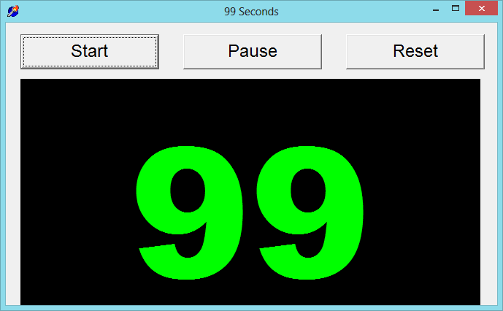

99 Seconds Activity #1
With your next chair neighbor discuss 1 to 2 writing dilemmas currently facing.
Notes:
Ana
2

Slide 3

Writing Difficulties and Challenges of a Early Career Scholar
Time
Teams
Notes:
Ana
3

Slide 4

Finding a Journal that Fits
What to look for?
Who will be your target readers?
Who are the authors and journals you cite the most related with your research program?
Is there a match between your work and the journal aims and scope?
What is the journal turnaround time?
What is the journal acceptance rate?
Notes:
Ana
https://www.editage.com/insights/how-to-choose-journals-for-submitting-your-paper
Who will be your target readers? Scholarly vs. non-scholarly periodicals
readership and target audience
Look for a match between your work and the journal aims and scope. – journal analysis
What is the journal’s turnaround time?
Acceptance rates? Get familiar with the journals’ acceptance rates
4

Slide 5
Selecting a Journal
Practitioner Journals
Target practitioners
Deal with problems and issues tied directly to practice
Receive wider circulations and visibility
Refereed or nonrefereed articles
Notes:
Ana
Unlike peer reviewed articles, nonrefereed articles, where publication decisions are made by one or more editors without using a blind review process, are important because they fill an important niche in practice oriented fields like ed tech.
Peer-reviewed or refereed articles undergo a blind review. This means that neither he authors nor reviewers know each other’s identity. This process is designed to endure that a manuscript has been reviewed and accepted in an ethical and unbiased manner by experts from a specific field.
Although refereed articles are often considered the gold standard in faculty promotion and tenure deliberations, nonrefereed articles nevertheless plan an important role within most academic disciplines.
Practitioner journals are targeted toward practitioners and deal with problems and issues tied directly to practice, Thus,, an article appearing in a practitioners journal could receive wider circulations and visibility than one published in a respected academic journal that is narrowly targeted toward a more limited audience.

Slide 6

Get Involved…
Review articles and conference proposals (learn about peer-review criteria and guidelines)
Review book proposals
Do a conference workshop
Organize a symposium
Notes:
Ana

Slide 7
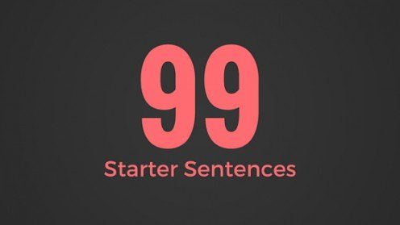

Generate Starter Text…
Author a blog
Use social media
Submit a conference proposal
Write editorials
Write book and software reviews
101
Notes:
Curt

Slide 8
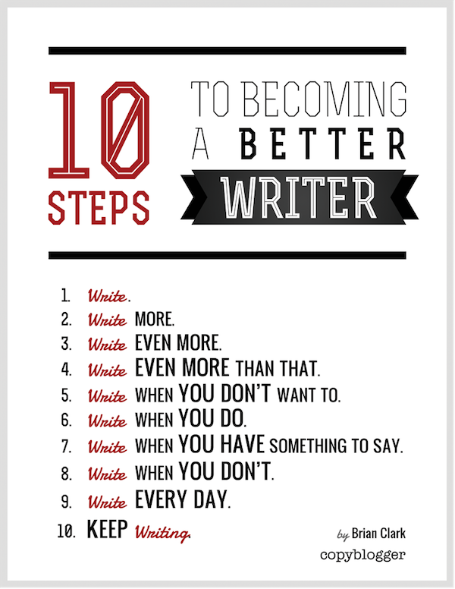
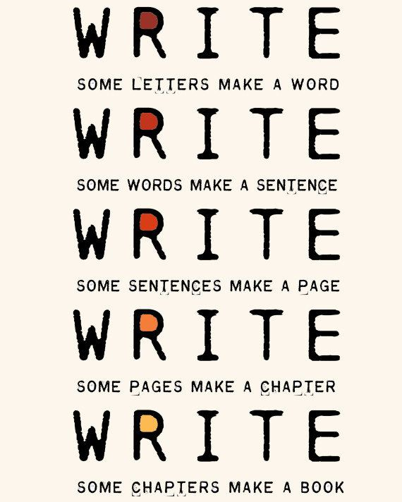
The Top 6 Writing Tips
Notes:
Curt
8

Slide 9


1. Mark Writing Days in Planner
Notes:
Curt
9

Slide 10

2. Maintain a List and Network of Potential Research and Writing Collaborators
Notes:
Curt
10

Slide 11
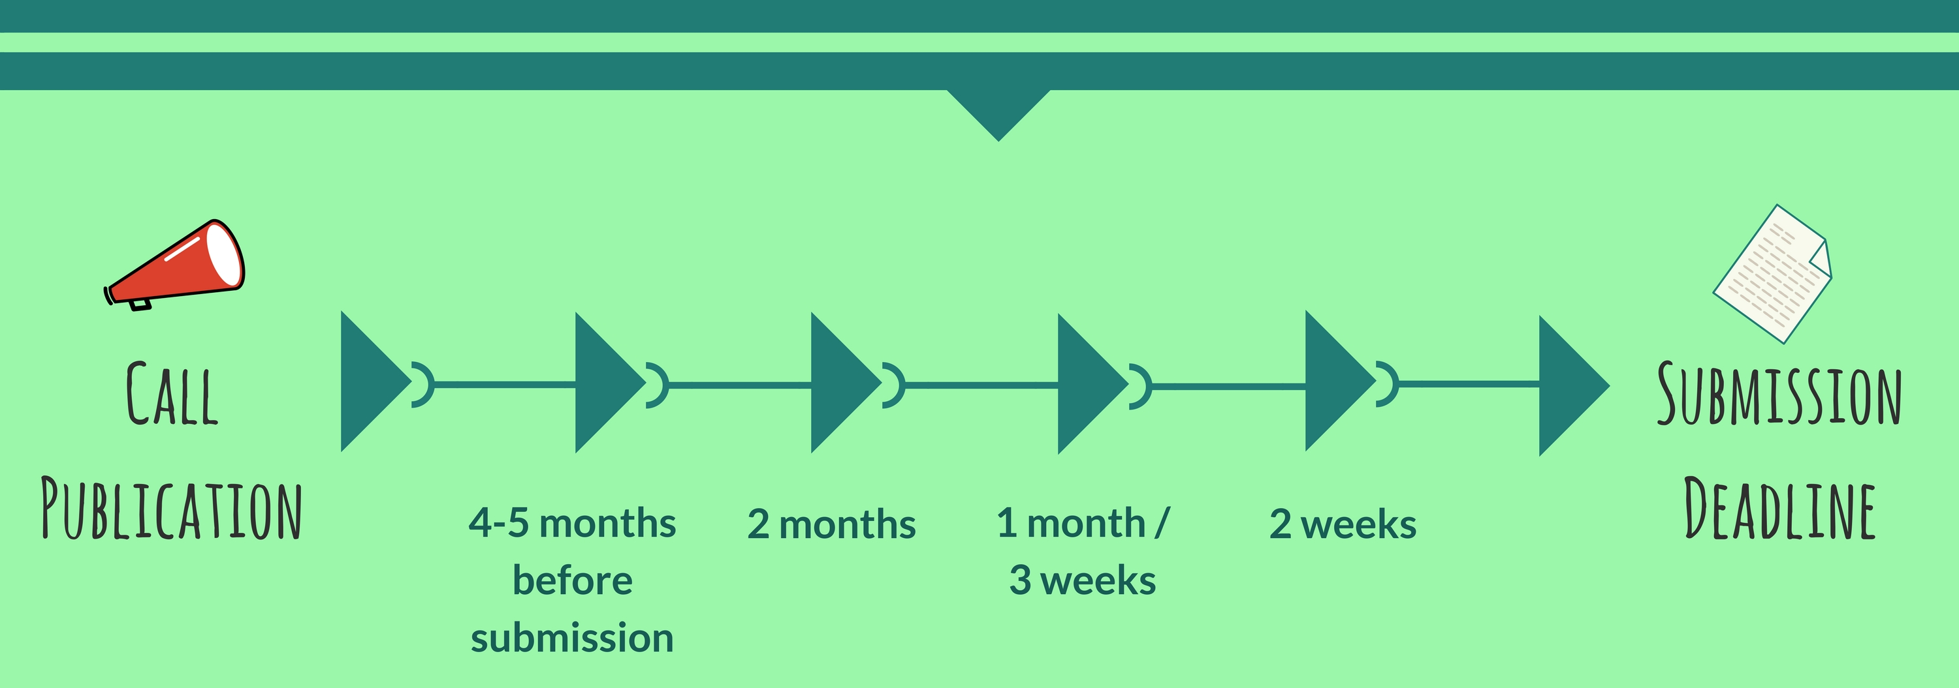
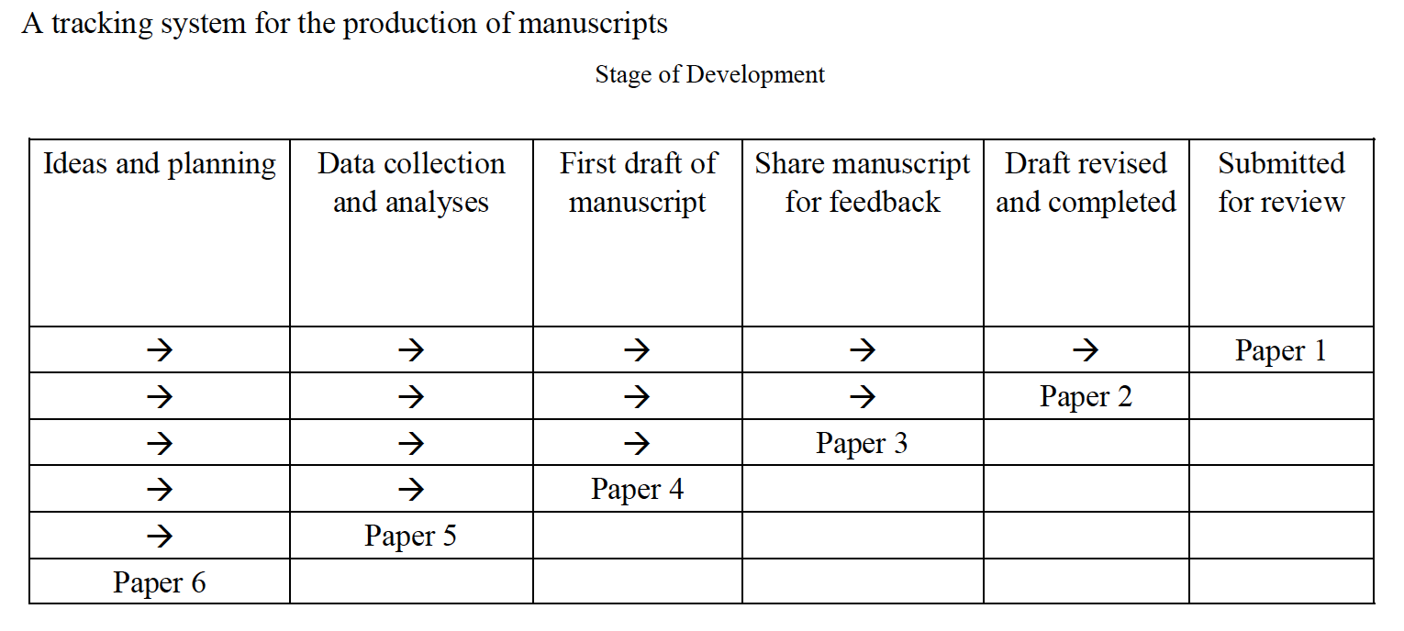
3. Draft a Timeline or Multiple Timelines with Flexible Goals
Notes:
Curt
Screenshot from Cecil’s article
11

Slide 12

4. Think Ahead About the Publishing Potential of Each Project
Notes:
Curt
12

Slide 13
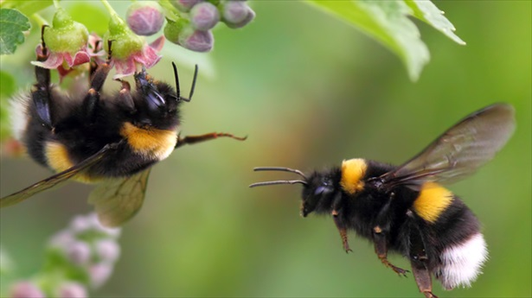

5. Be a Bumblebee and Butterfly
Notes:
Curt
13

Slide 14


6. Find, Save, and Use Starter Text (overcomes writer’s block)
Notes:
Curt
14

Slide 15

Join us for the GSA session
Publishing as a graduate student: Why? How? And What?
Thursday, October 25th
2:15-3:20 pm
Muehlebach, Roosevelt, Marriott Downtown
Kansas City, MO
https://tinyurl.com/y9jnonur
Notes:
Ana
Encourage audience to access the resources on GoogleDoc.
15

Slide 16




Thank You!
Ana-Paula Correia, OSU | Curt Bonk, IU
correia.12@osu.edu | cjbonk@indiana.edu
Follow me on Twitter: https://twitter.com/correia65 | TravelinEdMan in Twitter: https://twitter.com/travelinedman
http://anapaulacorreia.com/ | http://curtbonk.com/
Notes:
All
16

