Slide 1


Slide 2

MOOCs and Open Education in the Developing World

Slide 4
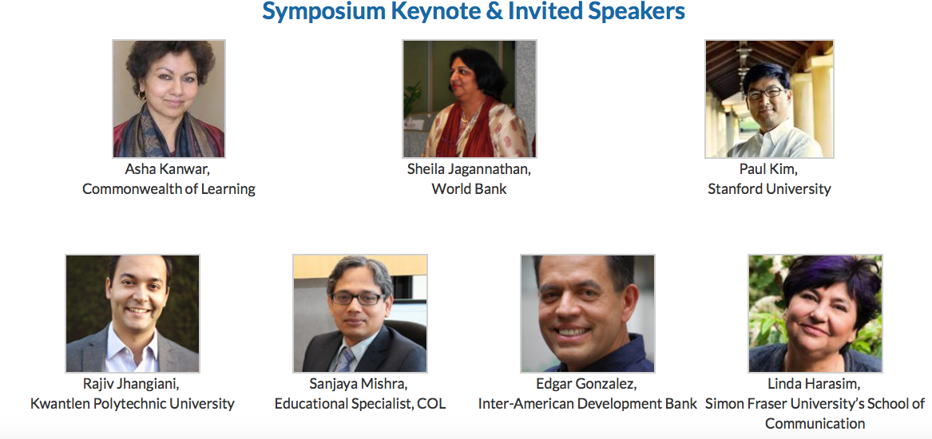

Slide 5


Slide 6


Slide 7
Collaboration

Slide 8
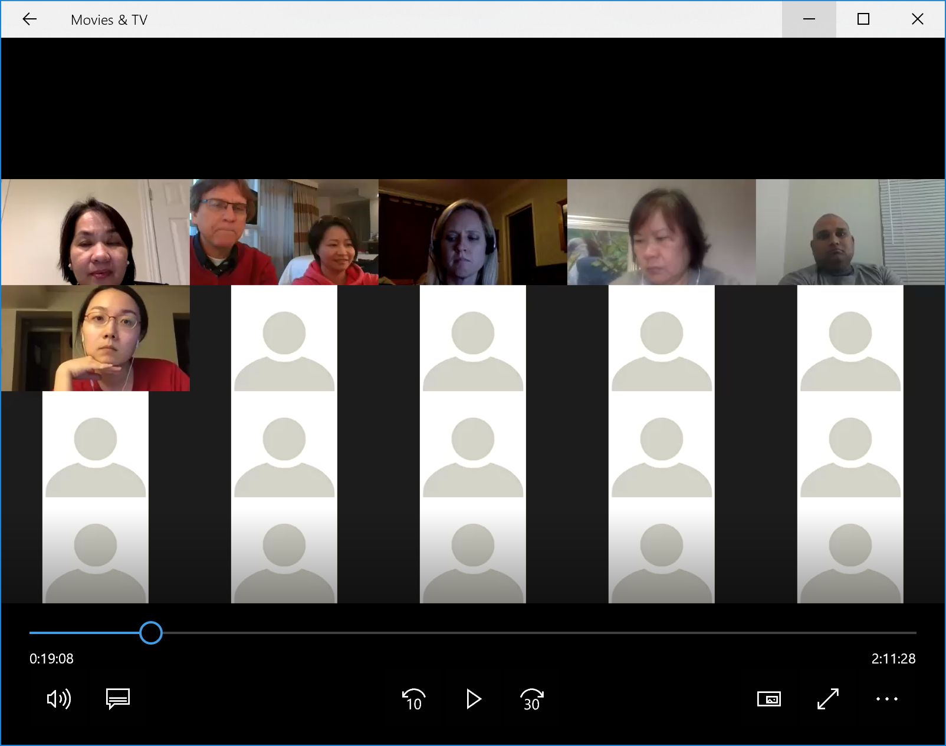
October 16-17, 2017 https://www.aace.org/conf/elearn/workshops/symposium/
Slides: http://www.trainingshare.com/workshop.php#aace2017b https://www.dropbox.com/sh/u32ifv8ick0f9f6/AACGUgxkaSIA62DHAJ8laEgca?dl=0

Slide 9
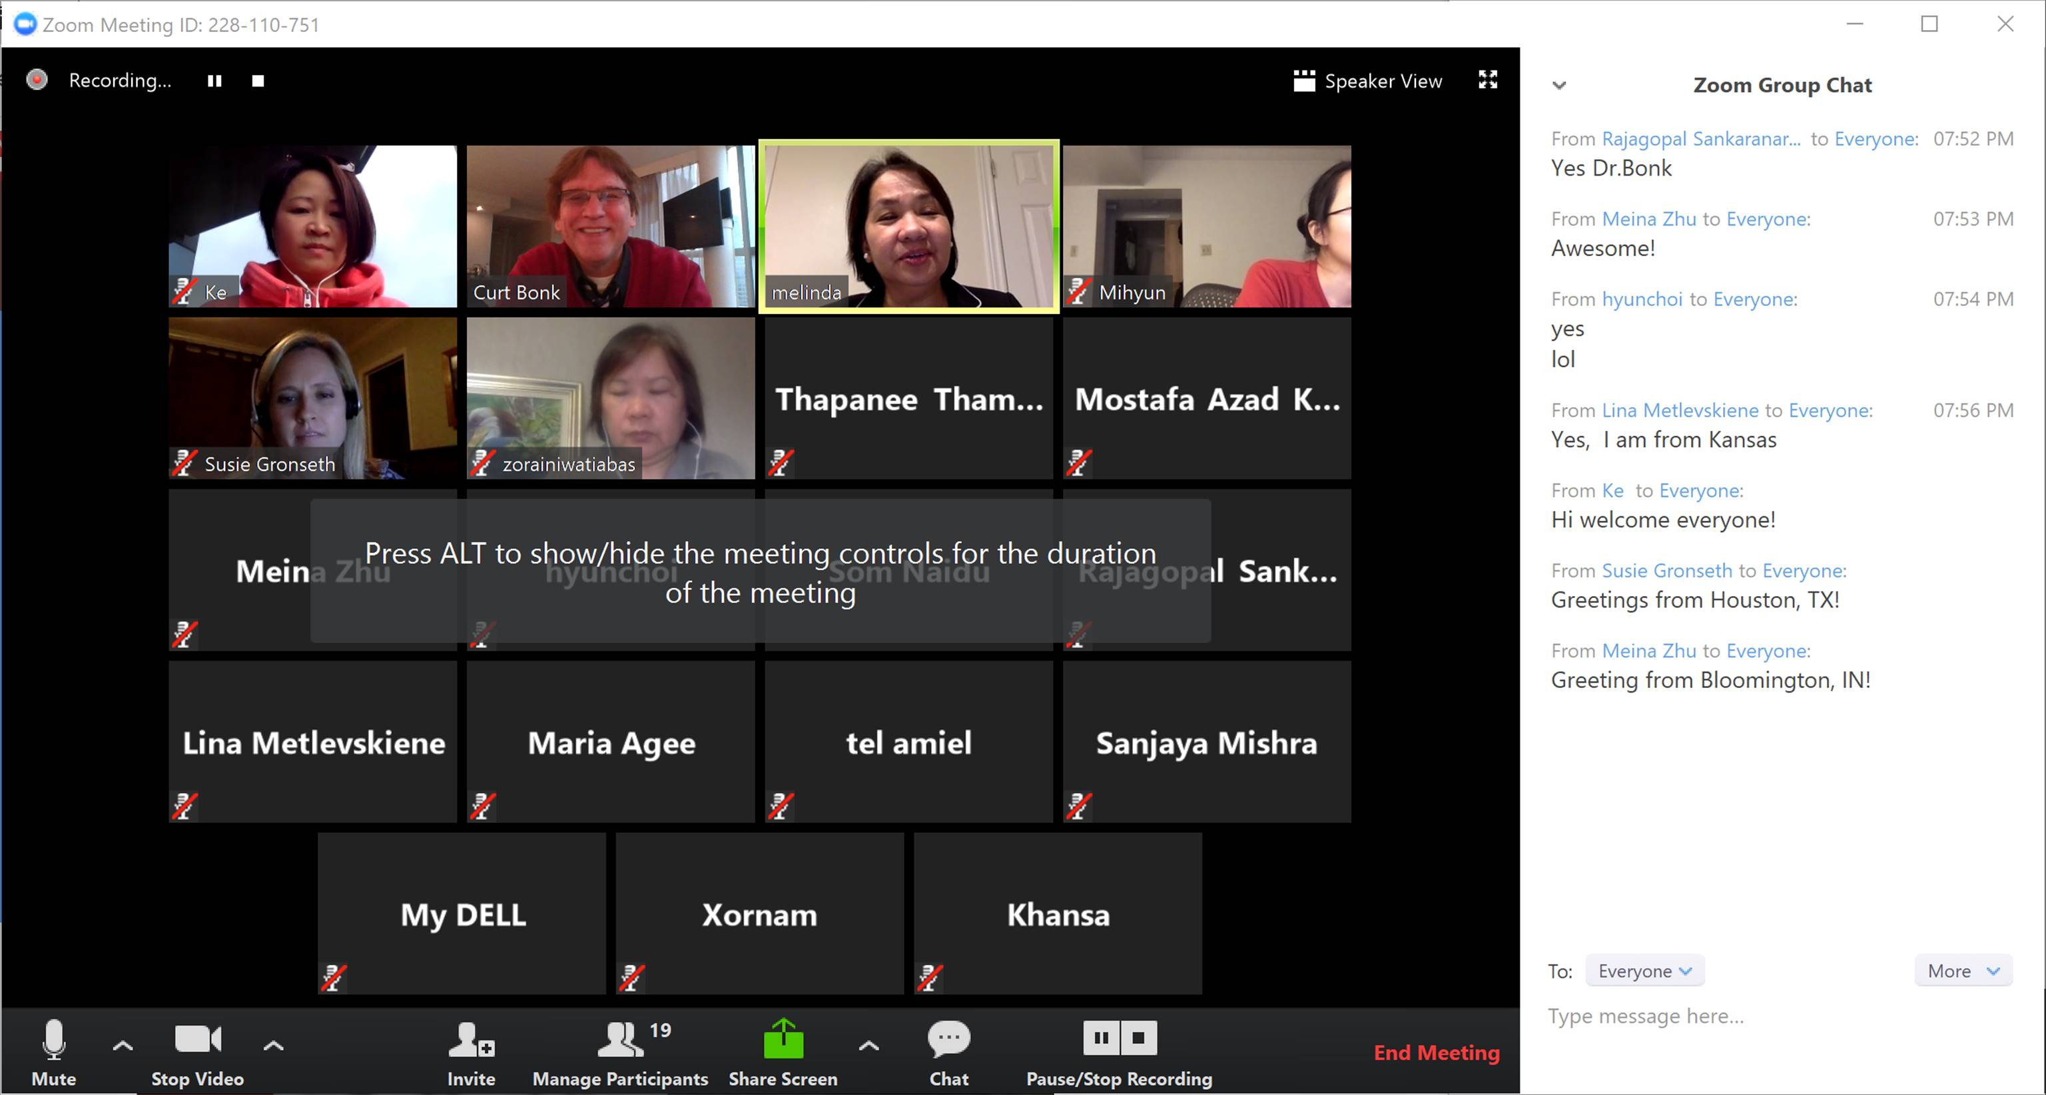
October 16-17, 2017 https://www.aace.org/conf/elearn/workshops/symposium/
Slides: http://www.trainingshare.com/workshop.php#aace2017b https://www.dropbox.com/sh/u32ifv8ick0f9f6/AACGUgxkaSIA62DHAJ8laEgca?dl=0

Slide 10
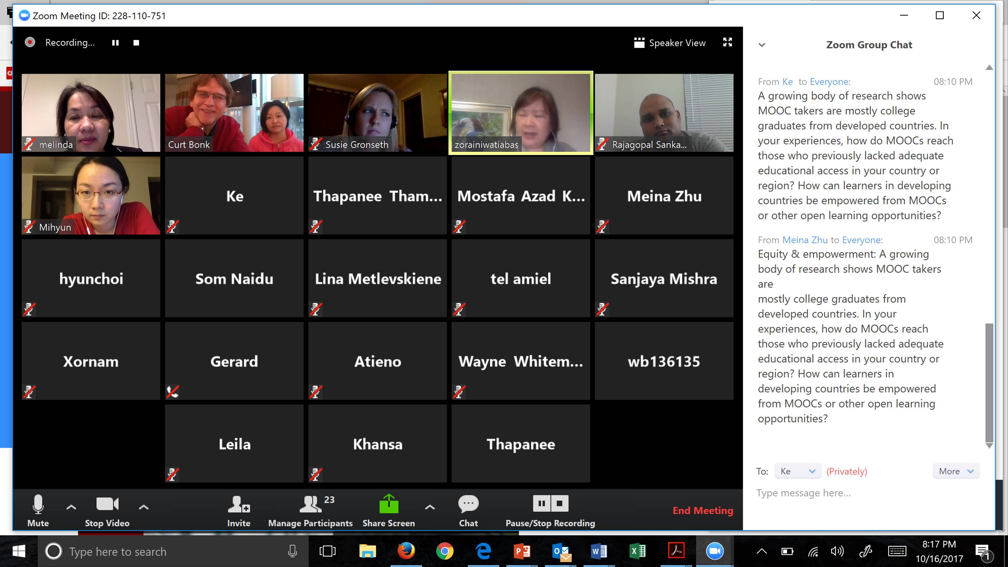
October 16-17, 2017 https://www.aace.org/conf/elearn/workshops/symposium/
Slides: http://www.trainingshare.com/workshop.php#aace2017b https://www.dropbox.com/sh/u32ifv8ick0f9f6/AACGUgxkaSIA62DHAJ8laEgca?dl=0

Slide 11
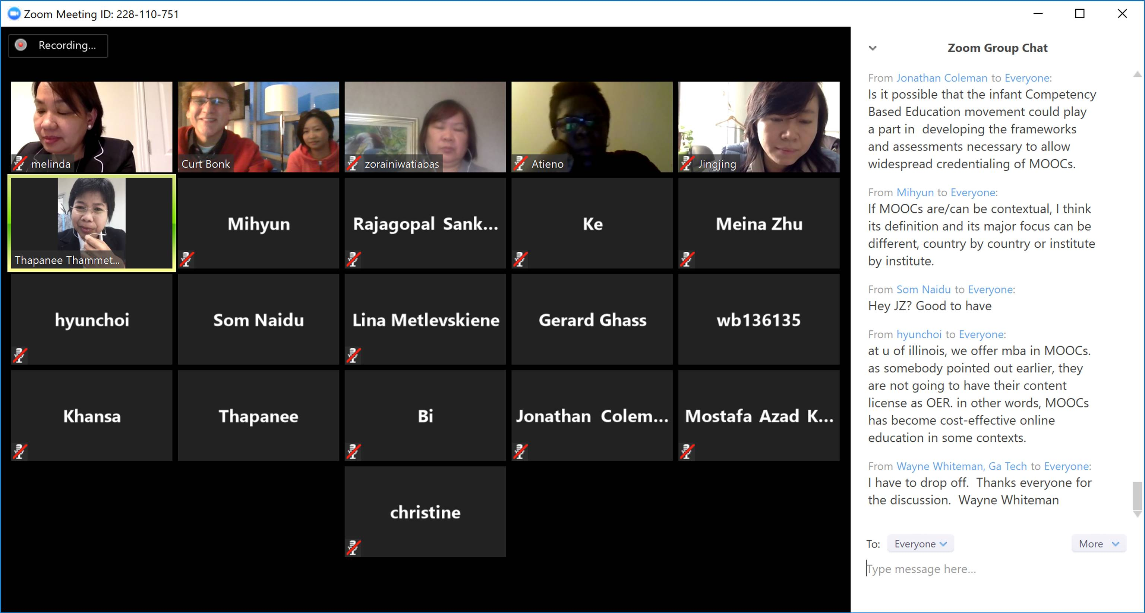
October 16-17, 2017 https://www.aace.org/conf/elearn/workshops/symposium/
Slides: http://www.trainingshare.com/workshop.php#aace2017b https://www.dropbox.com/sh/u32ifv8ick0f9f6/AACGUgxkaSIA62DHAJ8laEgca?dl=0

Slide 12
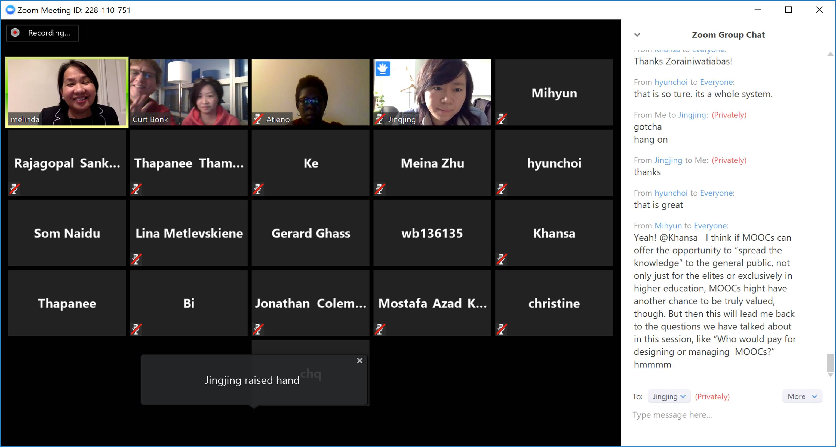
October 16-17, 2017 https://www.aace.org/conf/elearn/workshops/symposium/
Slides: http://www.trainingshare.com/workshop.php#aace2017b https://www.dropbox.com/sh/u32ifv8ick0f9f6/AACGUgxkaSIA62DHAJ8laEgca?dl=0

Slide 13
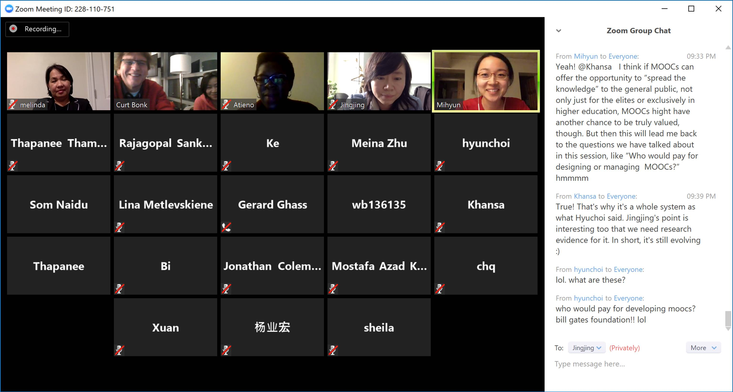
October 16-17, 2017 https://www.aace.org/conf/elearn/workshops/symposium/
Slides: http://www.trainingshare.com/workshop.php#aace2017b https://www.dropbox.com/sh/u32ifv8ick0f9f6/AACGUgxkaSIA62DHAJ8laEgca?dl=0

Slide 14
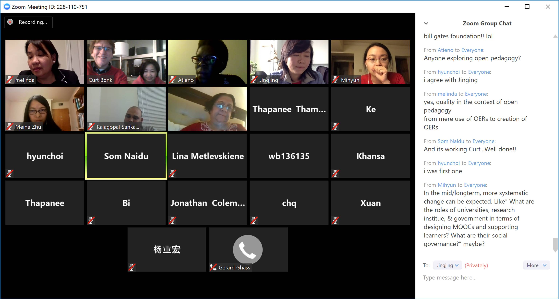
October 16-17, 2017 https://www.aace.org/conf/elearn/workshops/symposium/
Slides: http://www.trainingshare.com/workshop.php#aace2017b https://www.dropbox.com/sh/u32ifv8ick0f9f6/AACGUgxkaSIA62DHAJ8laEgca?dl=0

Slide 15
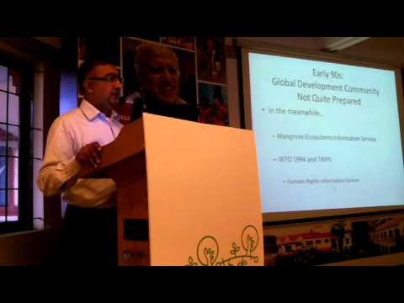
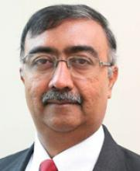
Balaji Venkataraman, Director for Tech and KM at Commonwealth of Learning ... https://1drv.ms/p/s!Am2Ebo7WtCOUogwdUPfaKtXKWZzg https://www.aace.org/conf/elearn/workshops/symposium/
Slides: http://www.trainingshare.com/workshop.php#aace2017b https://www.dropbox.com/sh/u32ifv8ick0f9f6/AACGUgxkaSIA62DHAJ8laEgca?dl=0

Slide 16
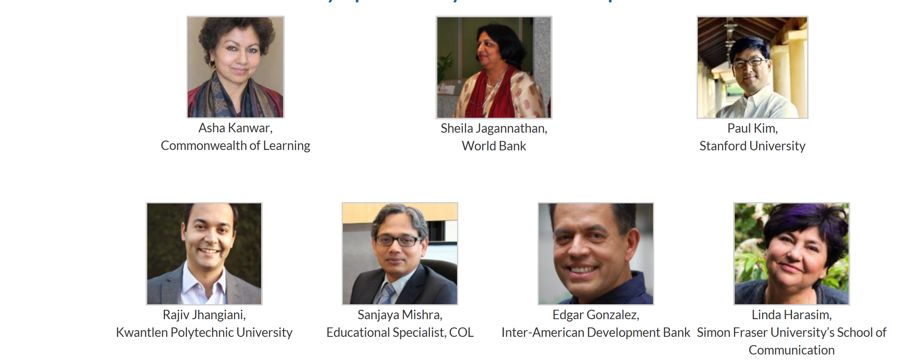
October 16-17, 2017 https://www.aace.org/conf/elearn/workshops/symposium/
Slides: http://www.trainingshare.com/workshop.php#aace2017b

Slide 17

October 16-17, 2017 https://www.aace.org/conf/elearn/workshops/symposium/
Slides: http://www.trainingshare.com/workshop.php#aace2017b

