Slide 1
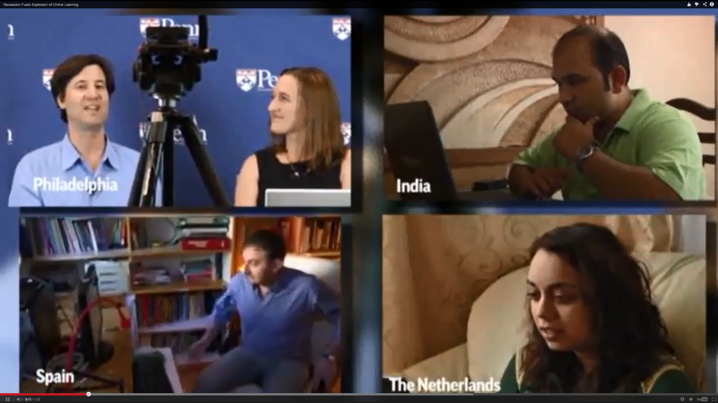
Personalizing the MOOC:
Insights from Experts Around Planet Earth
Curtis J. Bonk, Indiana University
cjbonk@Indiana.edu

Slide 2
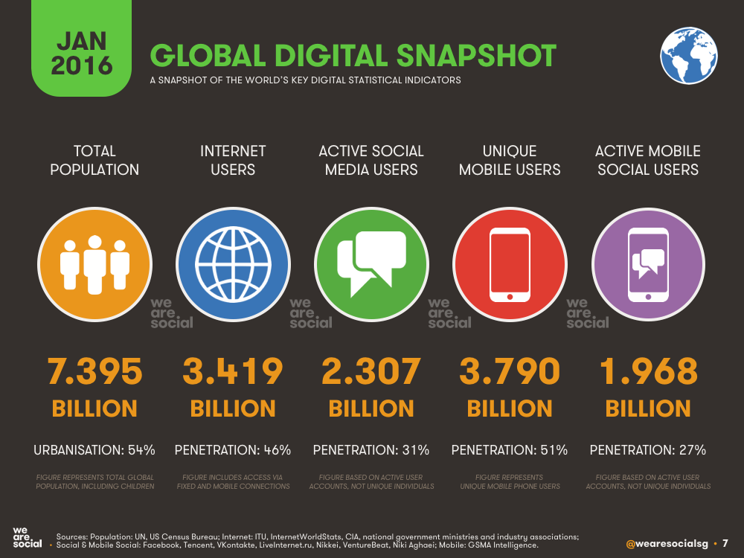

Digital Landscape in 2016: Right Time to Mainstream
Unique mobile users are those who use mobile for any purpose, active mobile social users are those who use mobile for accessing social media accounts such as facebook and twitter.
Internet penetration has been impressive in developing countries
Last 5 years, India and China have contributed to half of the 900 m new users
Sources: Population: UN, US Census Bureau
Notes:
We are at the right time when e-learning can be mainstreamed. Look at the statistics of what is going on around us.
Internet penetration has been impressive in developing countries.
For example in the past 4 years, china and india contributed almost half of the 900 million new internet users the expansion of mobile telephony has been even more impressive. And we expect to see similar number emerging from Africa over the next 5 years.

Slide 3

Part I.
Current Trends and Recent Cycles

Slide 4
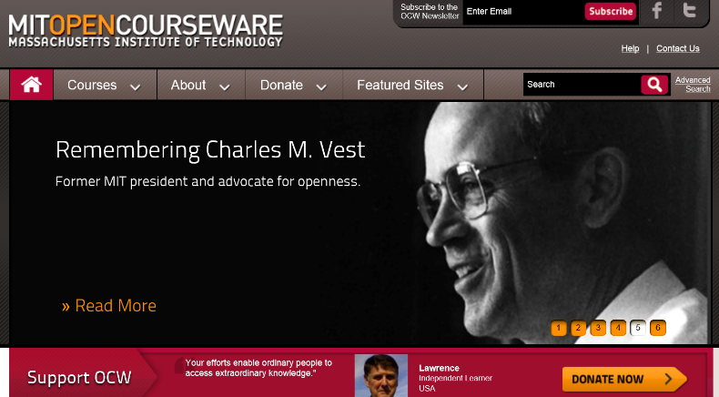
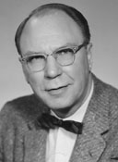
Audience Poll #1:
When did the world become open?

Slide 5
Milestones in Educational Technology
(All 7 year cycles)
1987: Hypercard first shipped.
1994: Netscape goes public.
2001: MIT OCW & Wikipedia Launched.
2008: First MOOC Offered.
2015: The Age of Personalization.

Slide 6
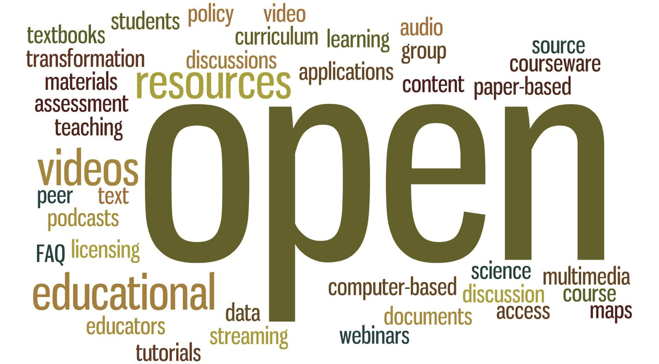
Audience Poll #2:
Who in here has used Opencourseware?

Slide 7

Audience Poll #3:
Who in here has taken a MOOC?

Slide 8
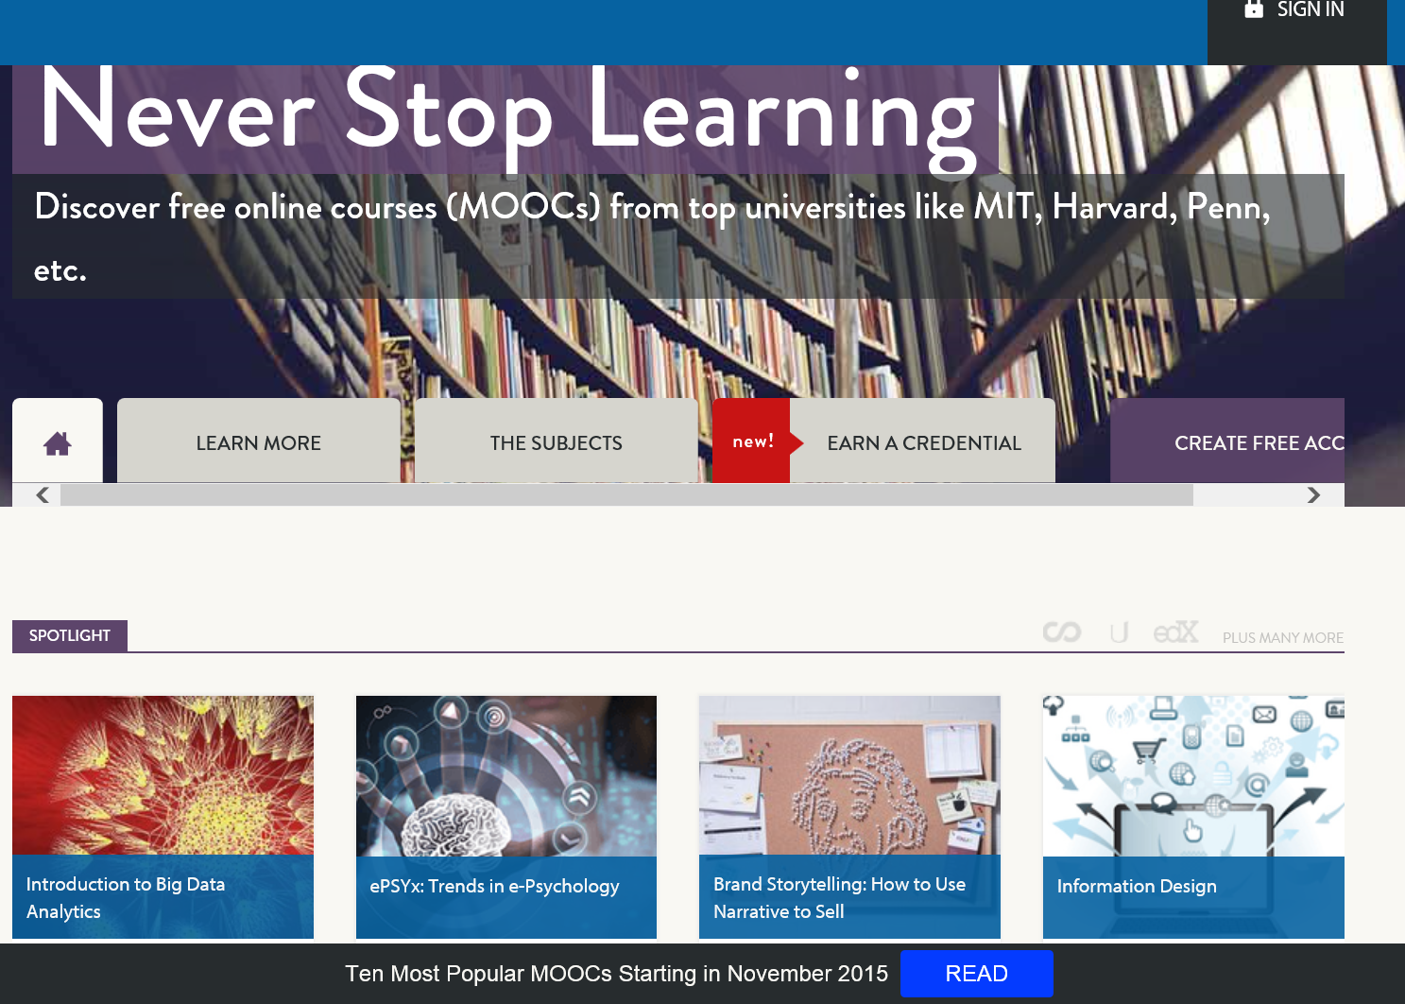
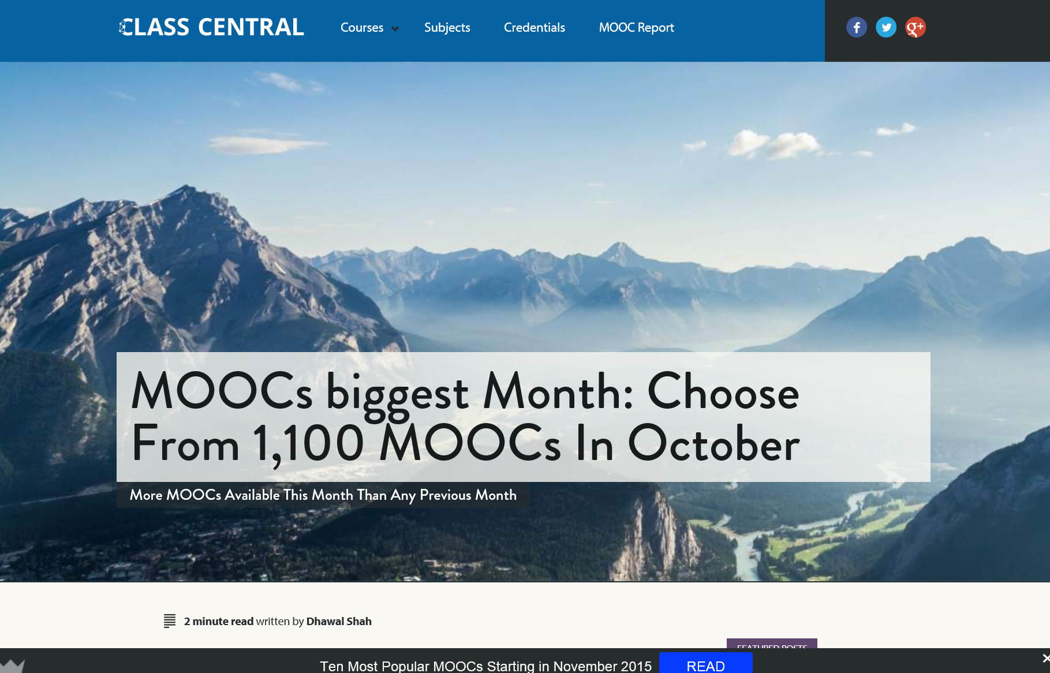
Audience Poll #4:
Who in here has taught a MOOC?

Slide 9
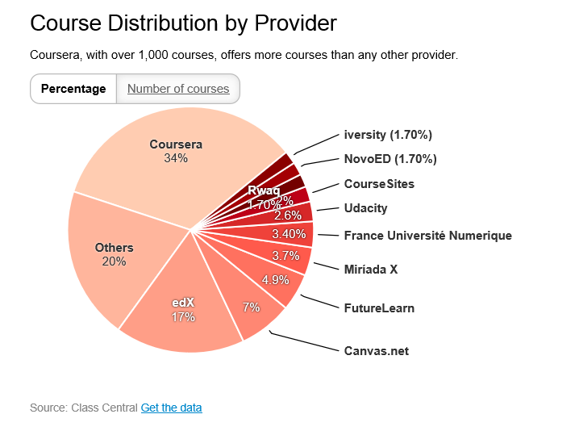
October 19, 2015
MOOCs Are Still Rising, at Least in Numbers,
Ellen Wexler, Chronicle of Higher Education http://chronicle.com/blogs/wiredcampus/moocs-are-still-rising-at-least-in-numbers/57527

Slide 10
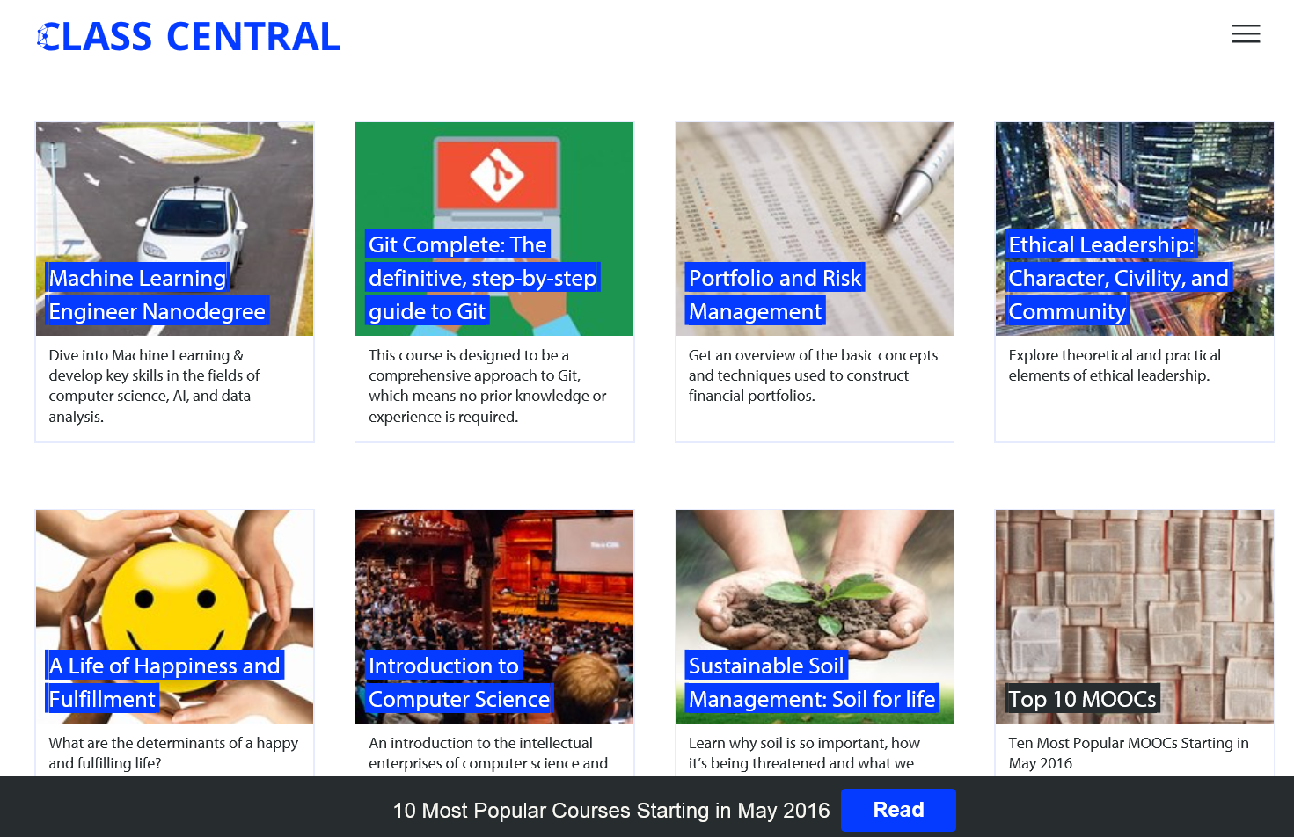
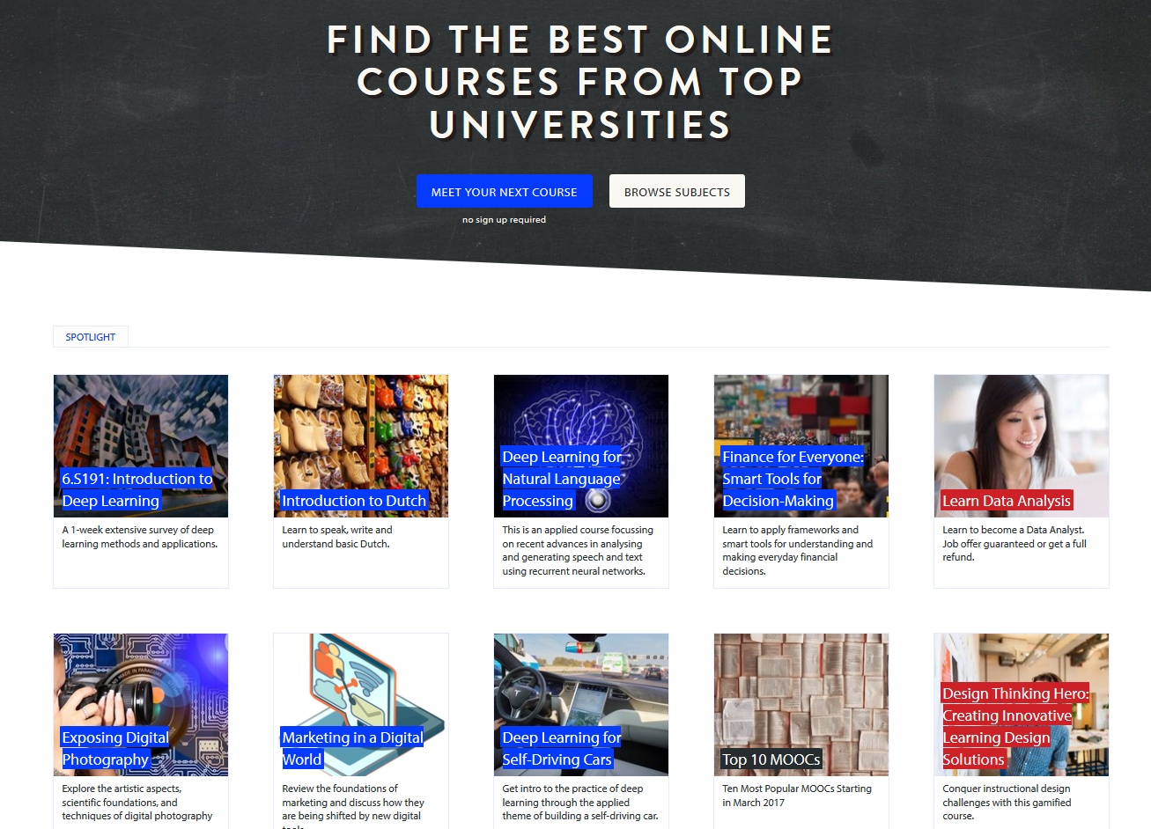
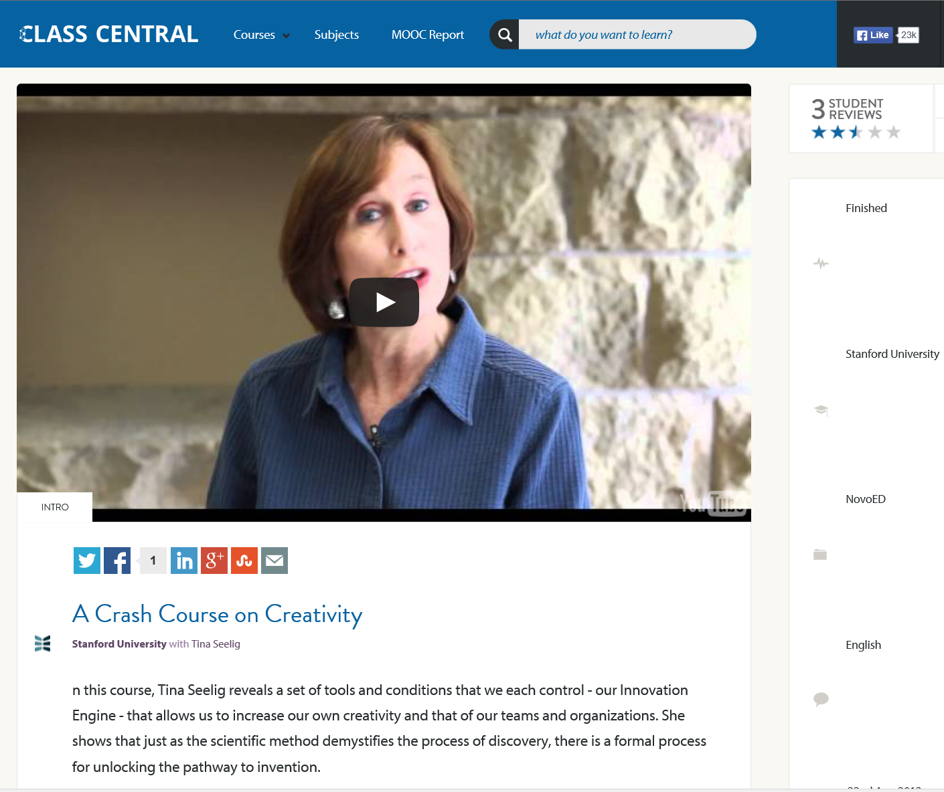
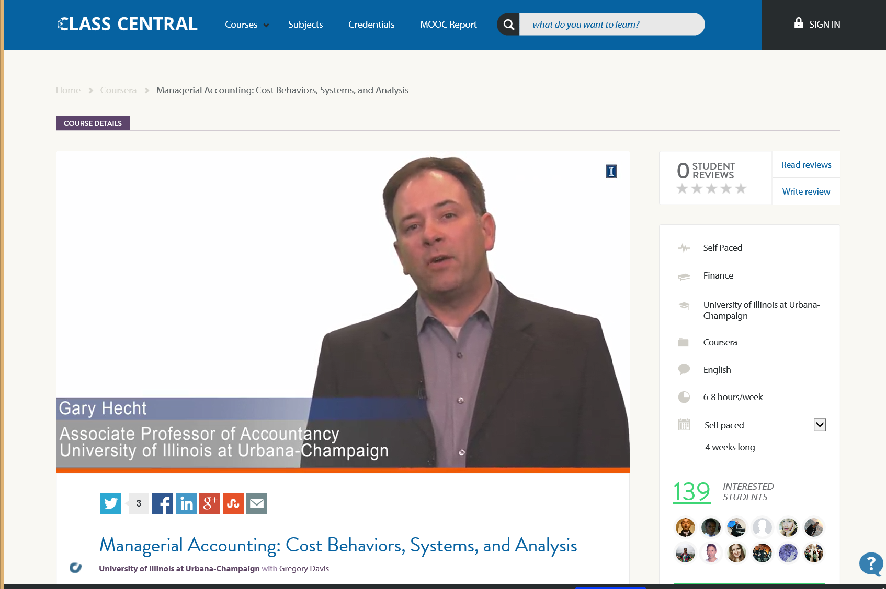
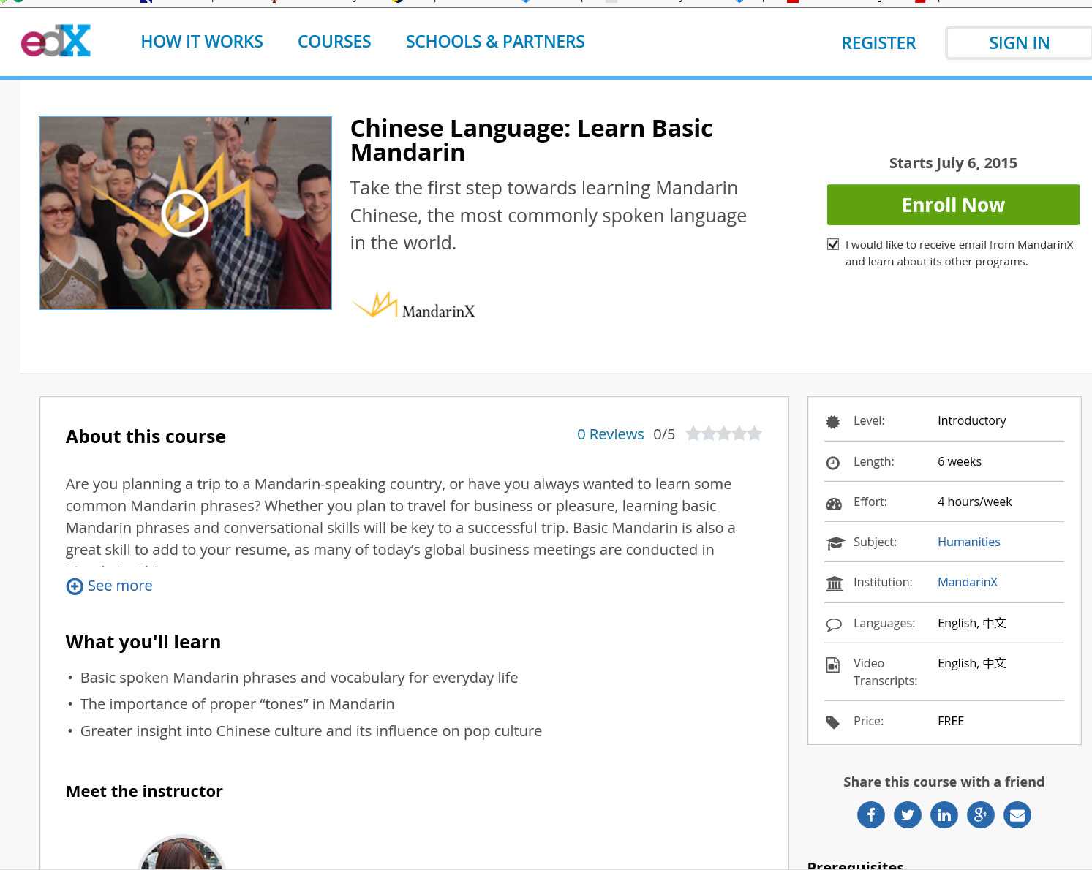
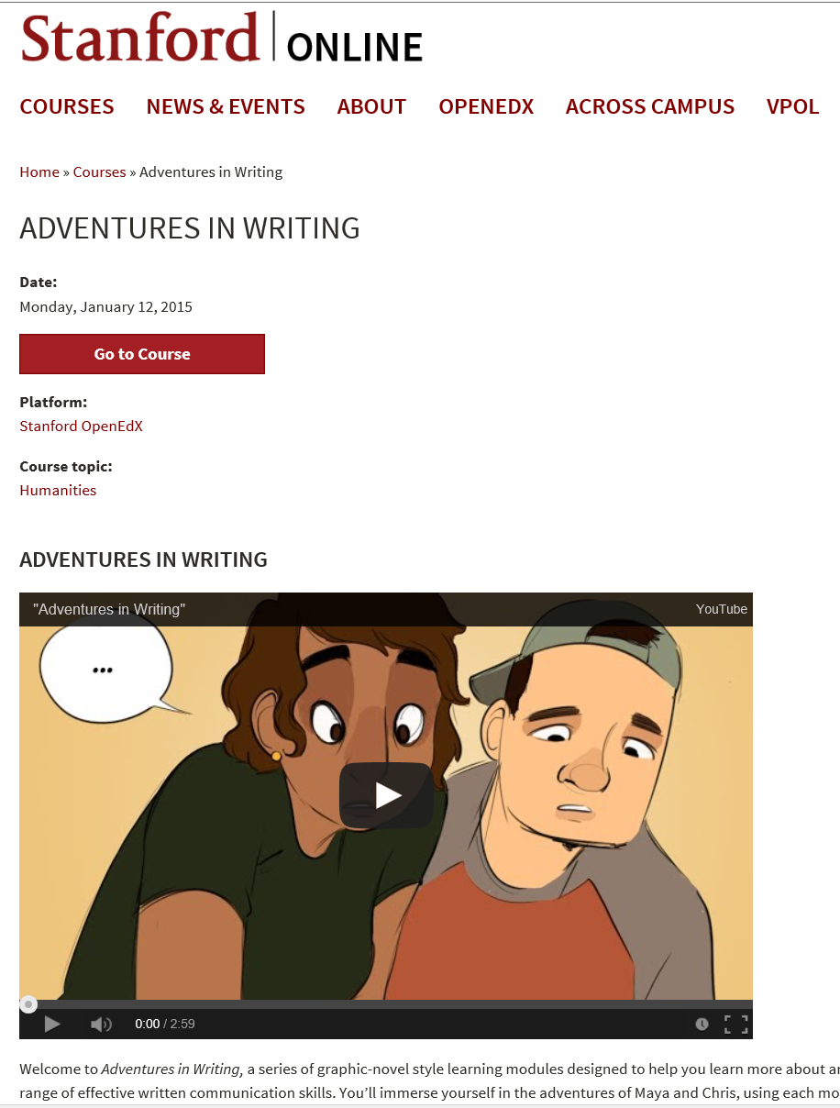
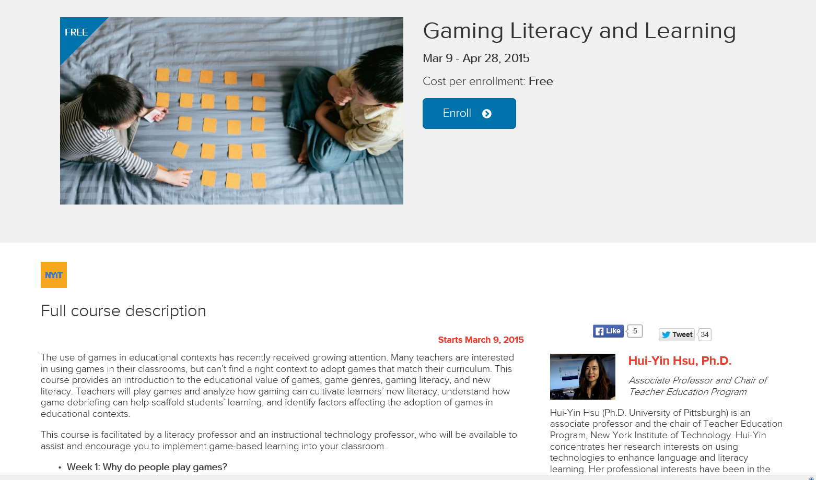
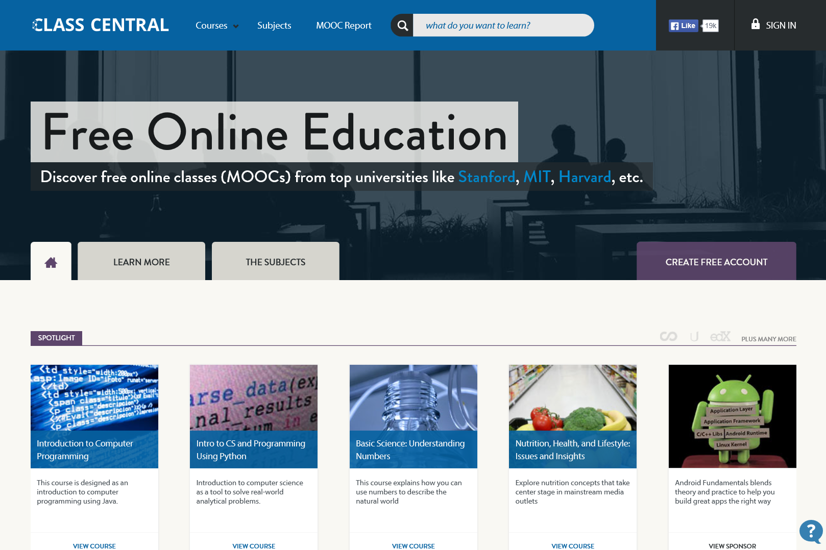
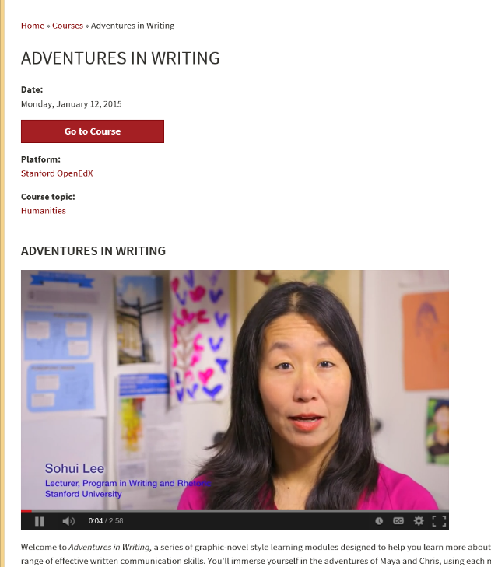
February 26, 2017
MOOC lists:
Class Central, the MOOC list, etc. https://www.mooc-list.com/ https://www.class-central.com/

Slide 11
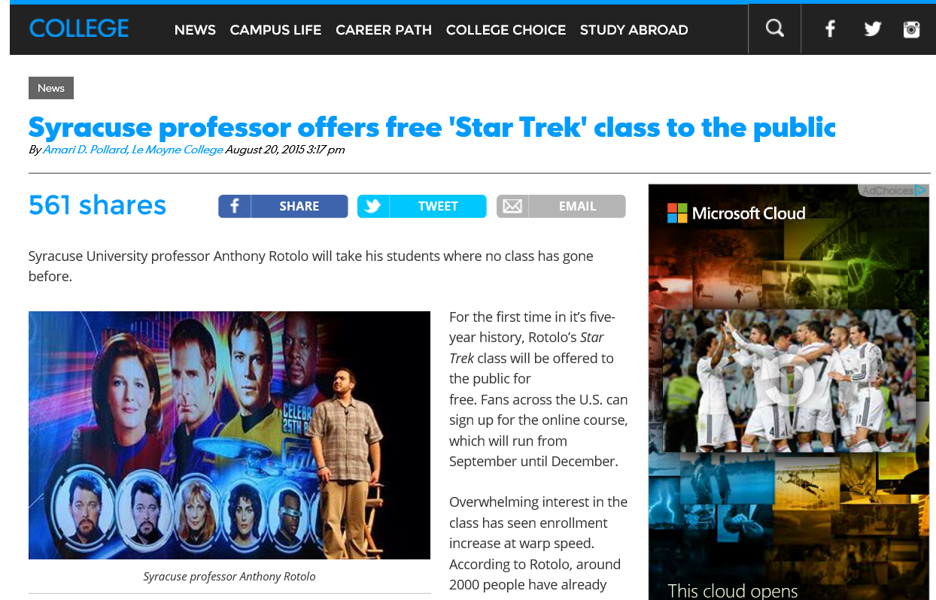

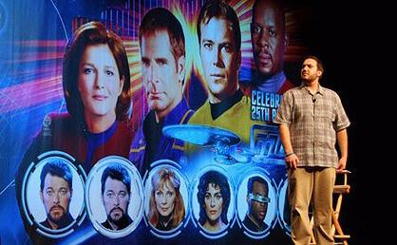
August 20, 2015
Unique Pedagogy
Syracuse professor offers free ‘Star Trek’ class to the public, USA Today, Amari D. Pollard, LeMayne College http://college.usatoday.com/2015/08/20/syracuse-professor-offers-free-star-trek-class-to-the-public/ r

Slide 12

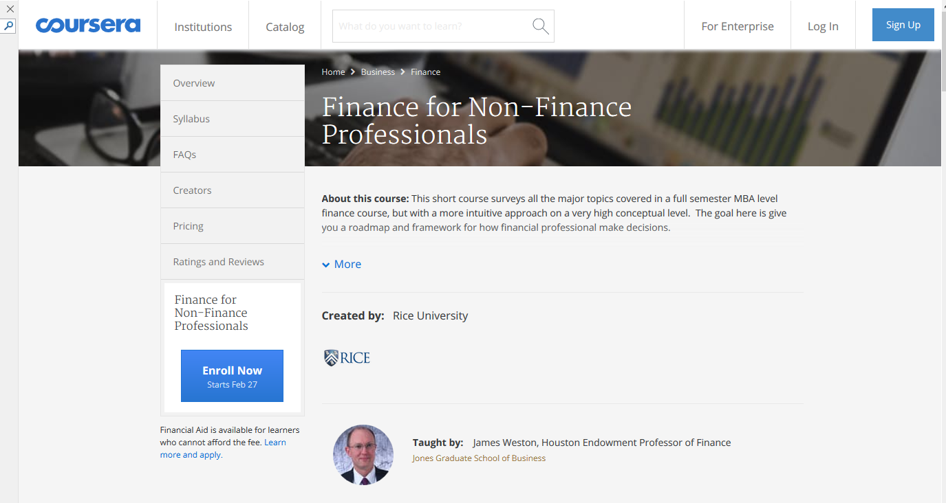
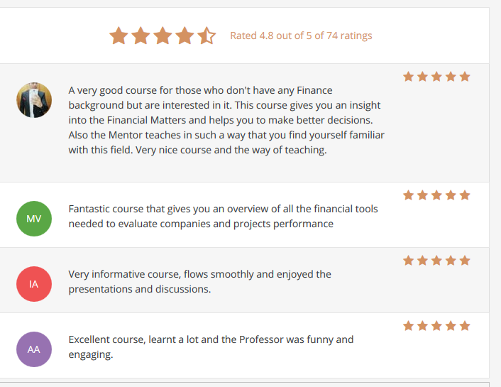
December 30, 2016
Finance for Non-Finance Professionals
James Weston, Rice University, Coursera https://www.coursera.org/learn/finance-for-non-finance?siteID=lpsebioGe3Q-BJ3wPlEmboN4G3tEZyFQ8A&utm_content=10&utm_medium=partners&utm_source=linkshare&utm_campaign=lpsebioGe3Q

Slide 13
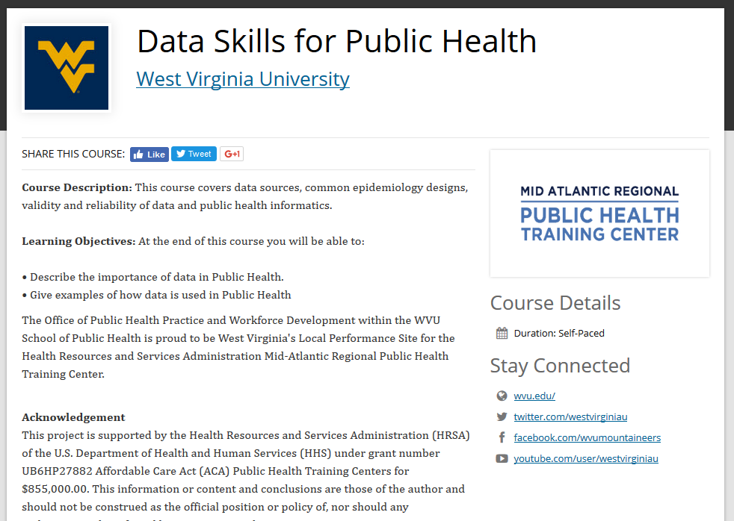
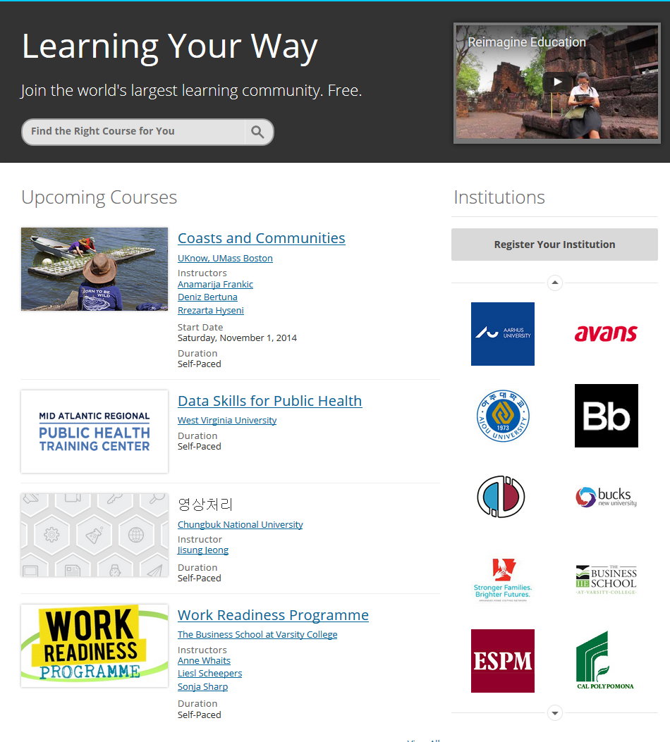
October 29, 2016
Open Education, Blackboard https://openeducation.blackboard.com/home?tab_tab_group_id=_12_1

Slide 14
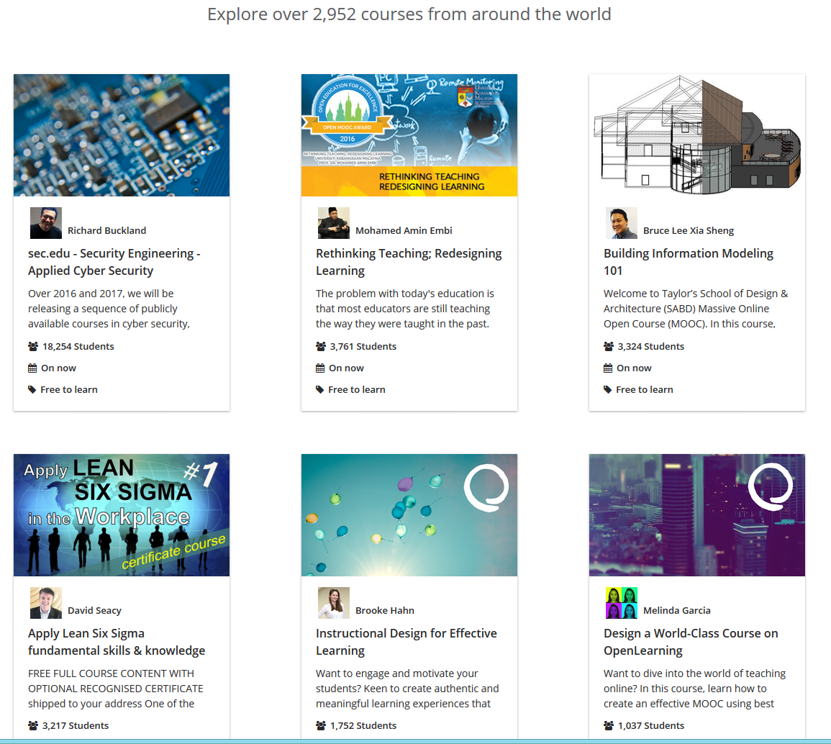
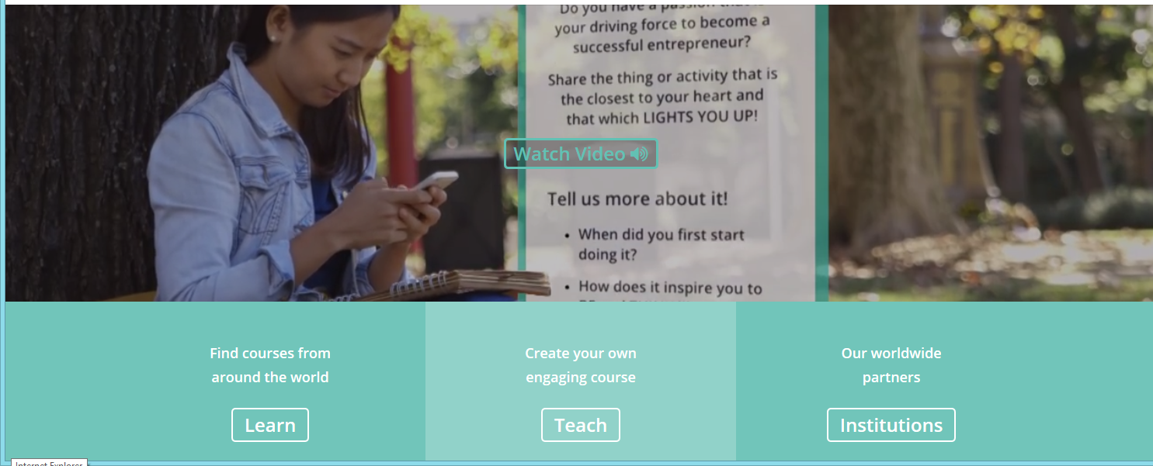
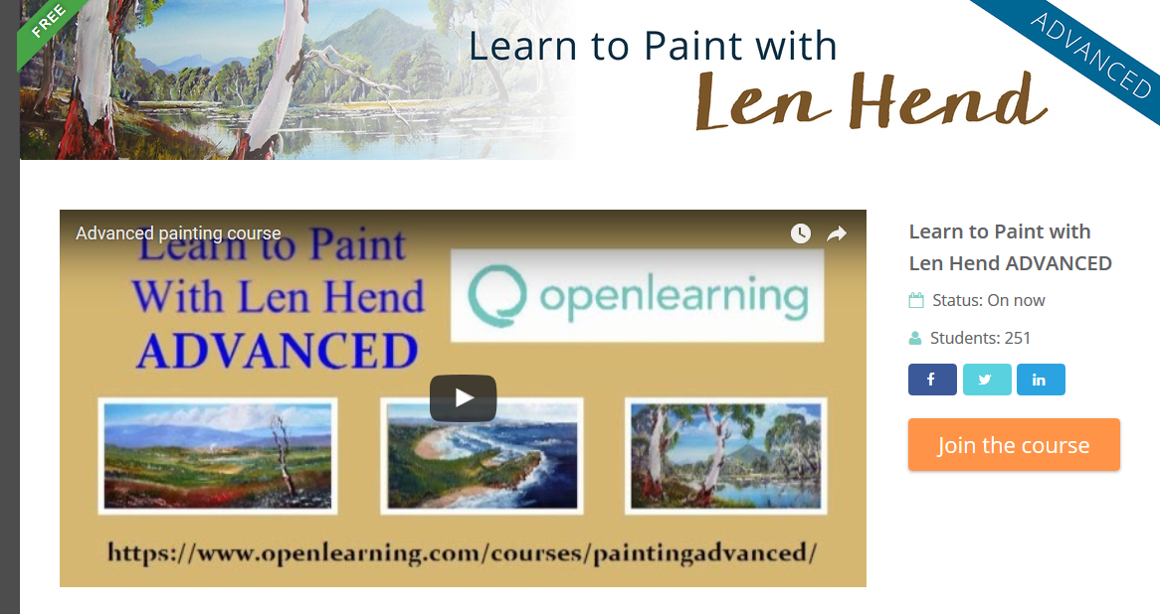
October 29, 2016
OpenLearning (Thailand) https://www.openlearning.com/

Slide 15
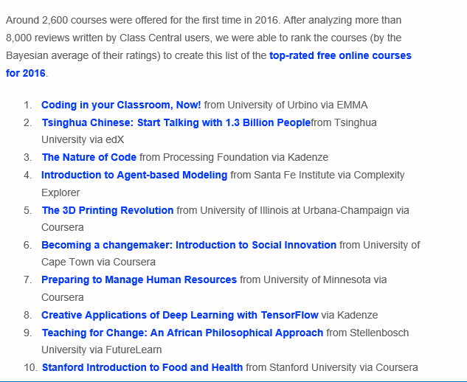

December 18, 2016
Best Online Courses of 2016, Class Central https://www.class-central.com/report/best-free-online-courses-2016/

Slide 16
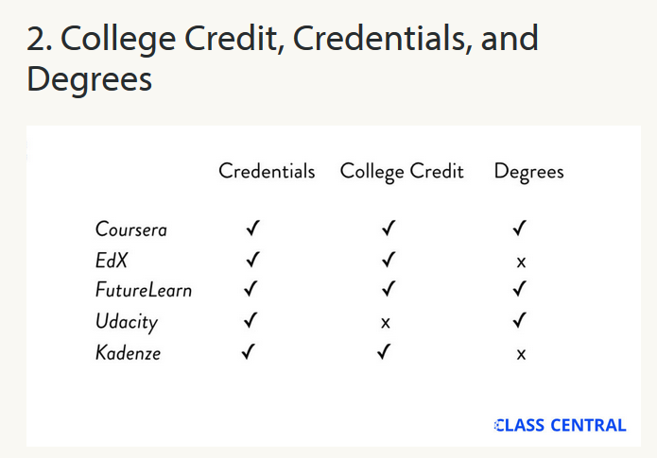
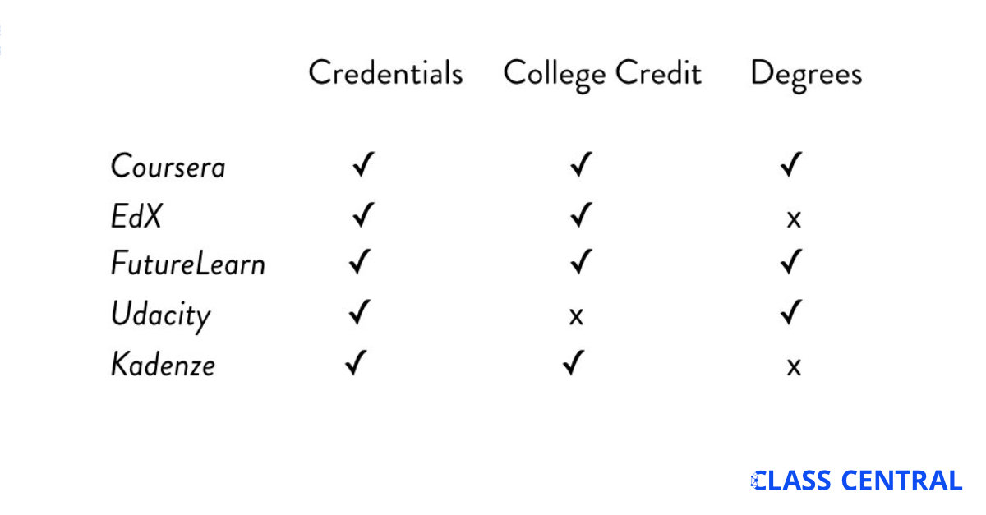
December 22, 2016
6 Biggest MOOC Trends of 2016, Dhawa Shah, Class Central https://www.class-central.com/report/biggest-mooc-trends-2016/

Slide 17
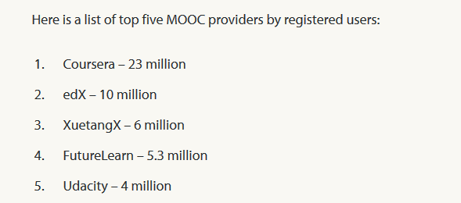
December 25, 2016
By The Numbers: MOOCS in 2016, Dhawa Shah, Class Central https://www.class-central.com/report/mooc-stats-2016/

Slide 18
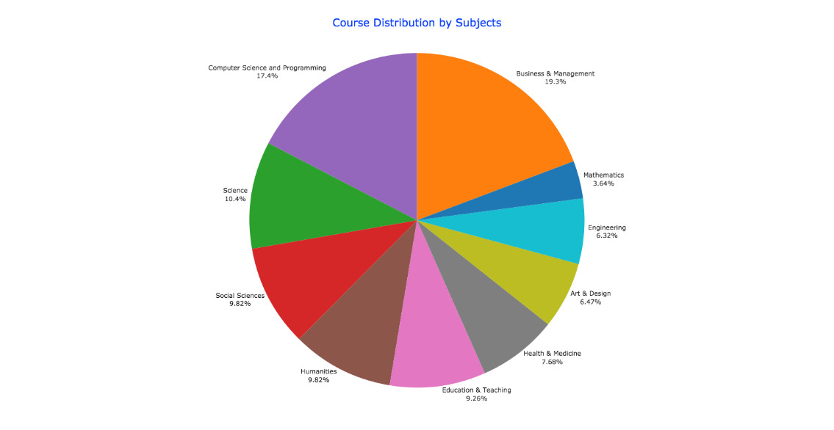
December 25, 2016
By The Numbers: MOOCS in 2016, Dhawa Shah, Class Central https://www.class-central.com/report/mooc-stats-2016/

Slide 19
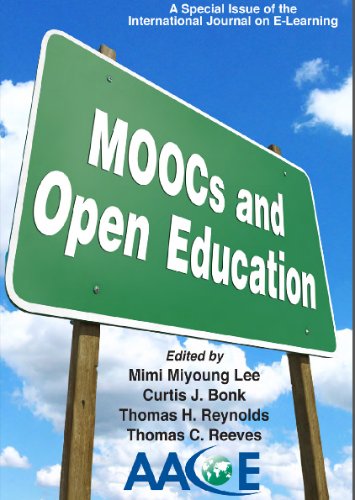

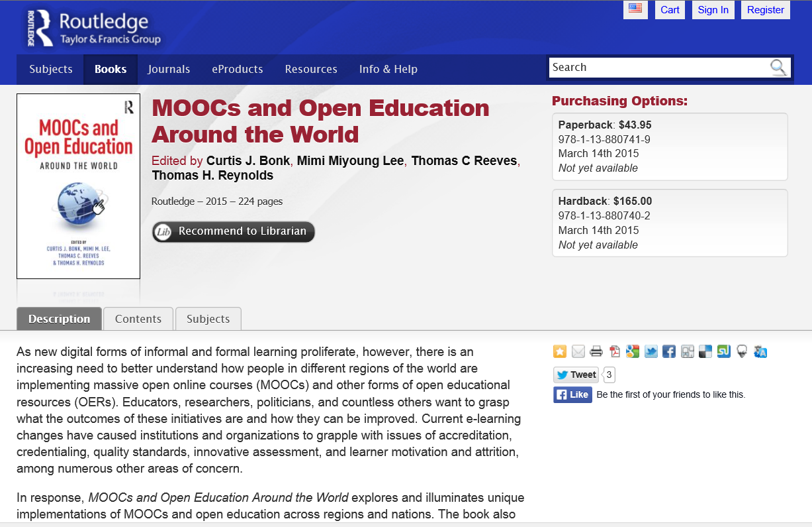



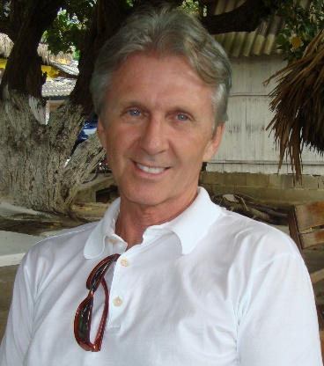
Part II.
MOOCs and Open Education Around the World http://routledge-ny.com/books/details/9781138807419/

Slide 20
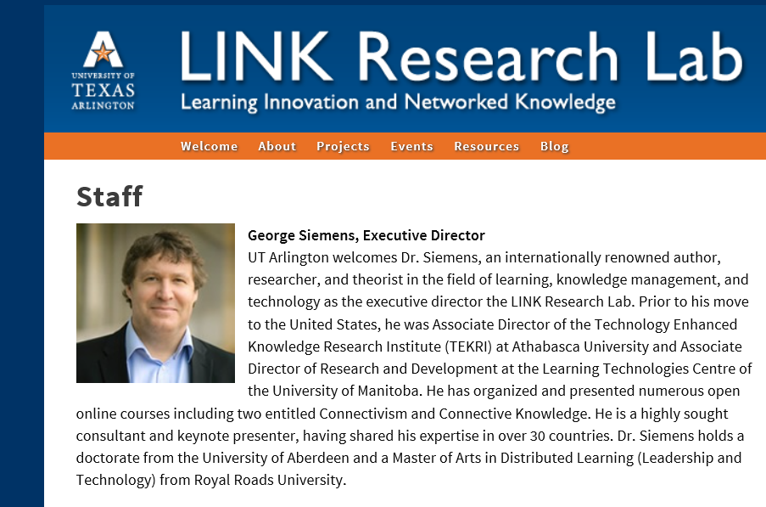
Foreword #1: The Role of MOOCs in the Future of Education?
George Siemens, Executive Director of the Learning Innovation and Networked Knowledge Research Lab, University of Texas Arlington

Slide 21
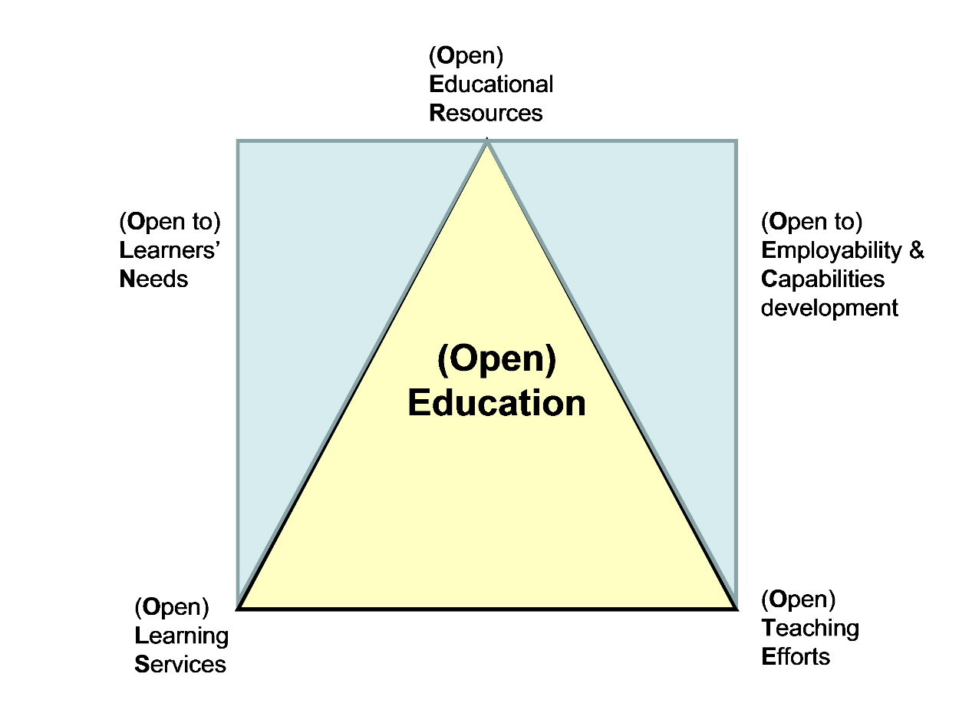
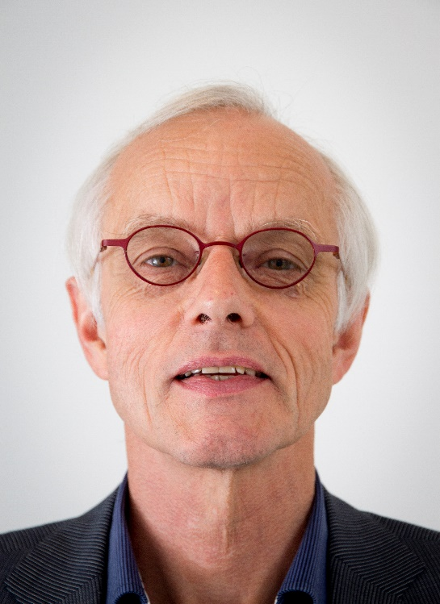
Foreword #2: Open(ing up) Education for All, Boosted by Moocs?
Fred Mulder, UNESCO Chair in Open Educational Resources at the Open University of the Netherlands

Slide 22
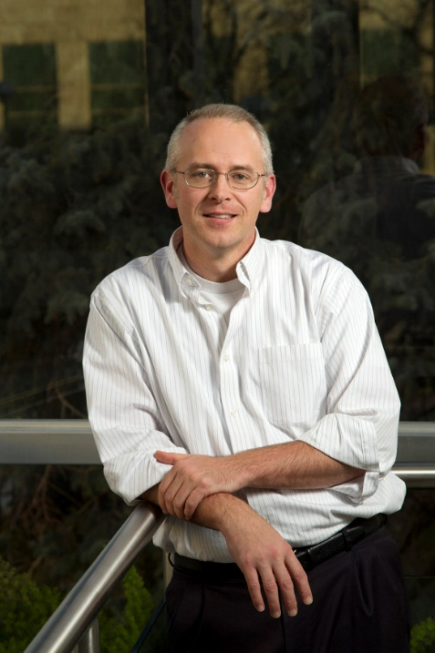
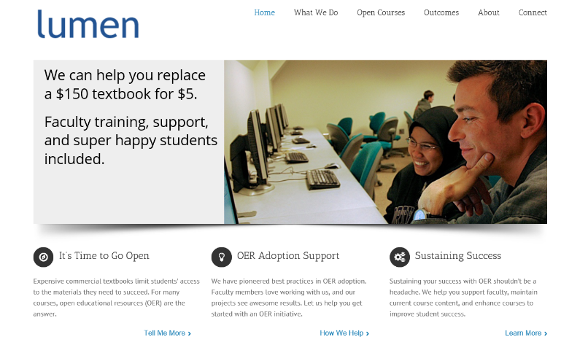
Chapter 1: The MOOC Misstep and the Open Education Infrastructure
David Wiley, Co-founder and Chief Academic Officer, Lumen Learning
The Open Education Infrastructure
Open Credentials
Open Assessments
Open Educational Resources
Open Competencies

Slide 23

Chapter 2: The Single Canon:
MOOCs and Academic Colonization
Karen Head, PhD
The Georgia Institute of Technology
“If MOOC proponents truly seek to offer the best educational opportunities to the world, they will have to open these platforms to a wide variety of institutions and instructors.”

Slide 24

Chapter 3: MOOCs and Open Education in Japan:
A Case of the Open University of Japan
Kumiko Aoki, Ph.D., The Open University of Japan
“It is hoped that MOOCs will play a significant role for stakeholders in Japanese higher education in the near future.”

Slide 25

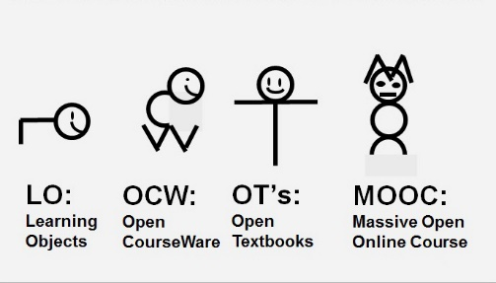
Chapter 4: MOOCs, MERLOT, and Open Educational Services
Gerard L. Hanley, Ph.D.
MERLOT Executive Director
Assistant Vice Chancellor, Academic Technology Services
California State University, Office of the Chancellor
Figure 1. MOOCs as a Recent Evolution of OER

Slide 26
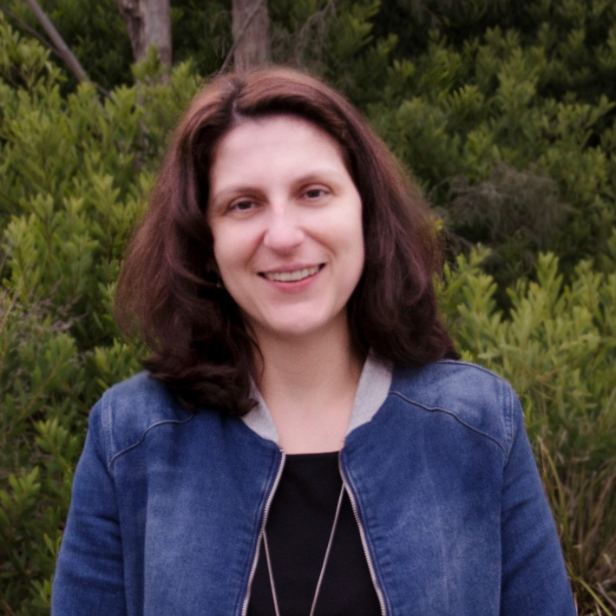
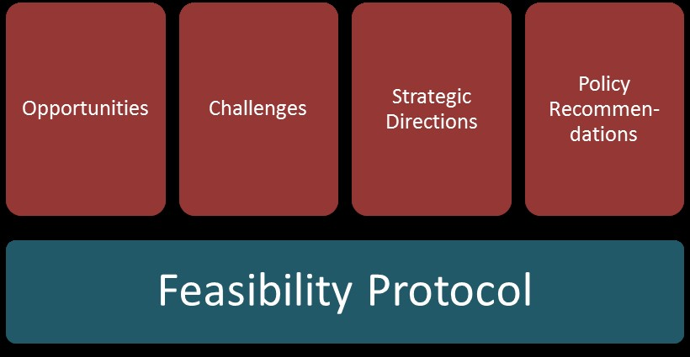
Chapter 5: Enabling Open Education: A Feasibility Protocol for Australian Higher Education
Dr Carina Bossu, University of Tasmania, Australia
Mr David Bull, University of Southern Queensland, Australia
Professor Mark Brown, Dublin City University, Ireland
Figure 5.1. Feasibility Protocol

Slide 27
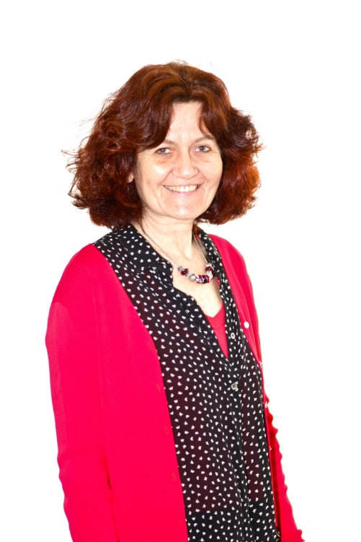
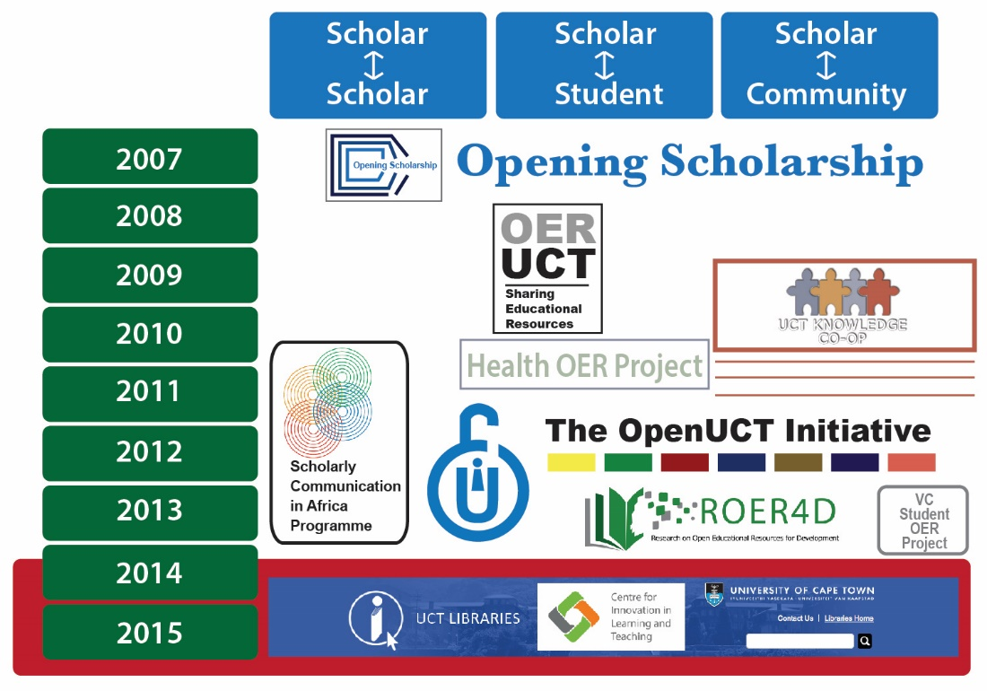
Chapter 6: Open Education at the University of Cape Town
Laura Czerniewicz, Glenda Cox, Cheryl Hodgkinson-Williams, and Michelle Willmers
Figure 3: The openness journey at the University of Cape Town (UCT)

Slide 28
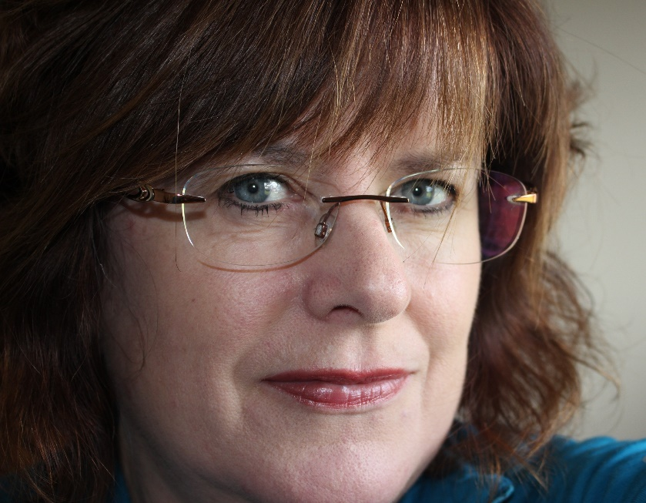
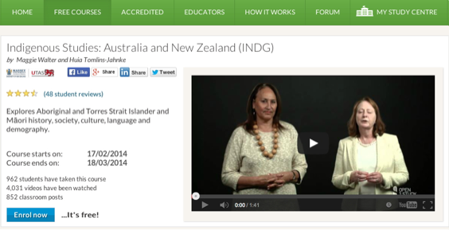
Chapter 8: MOOCs Downunder:
Insights from the Open2Study Experience
Maggie Hartnett, Mark Brown, and Amy Wilson
Massey University, Dublin City University, and Massey University
Figure 3: Example of the Indigenous Studies subject

Slide 29
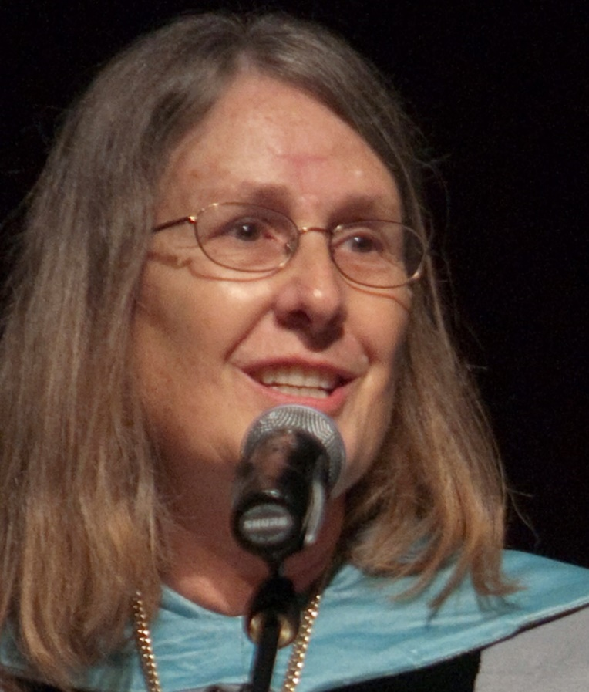
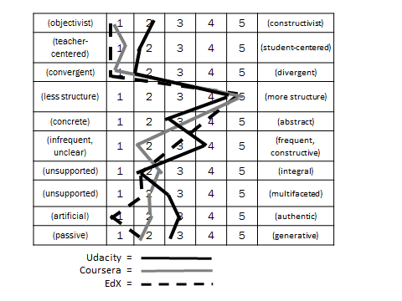
Chapter 10: MOOC Pedagogy
AMP: A Tool for Characterizing the Pedagogical Approaches of MOOCs
Karen Swan, Scott Day, Leonard Bogle, and Traci van Prooyen
University of Illinois Springfield
Figure 3. Ratings Metaphors

Slide 30
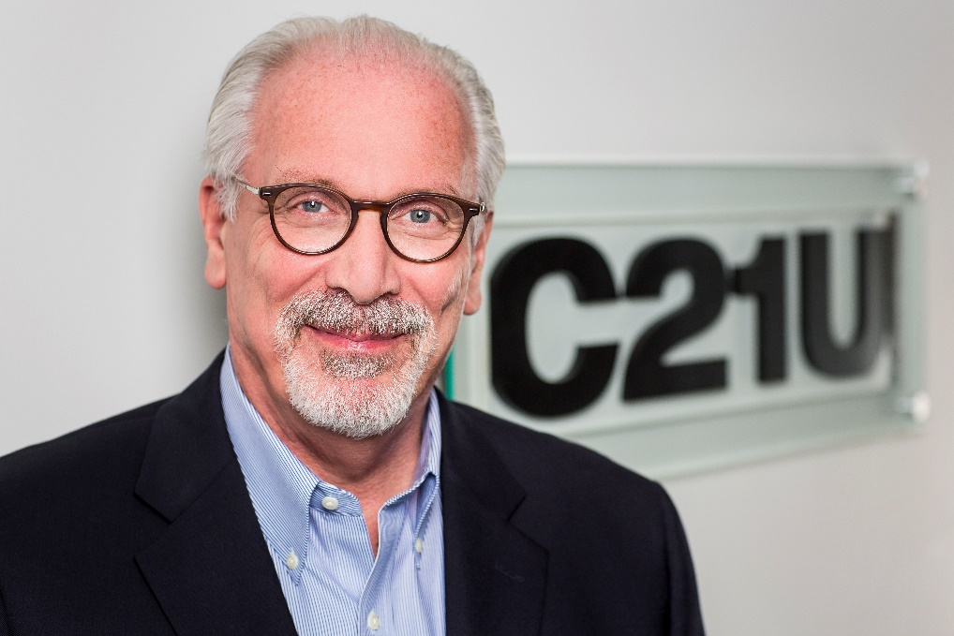
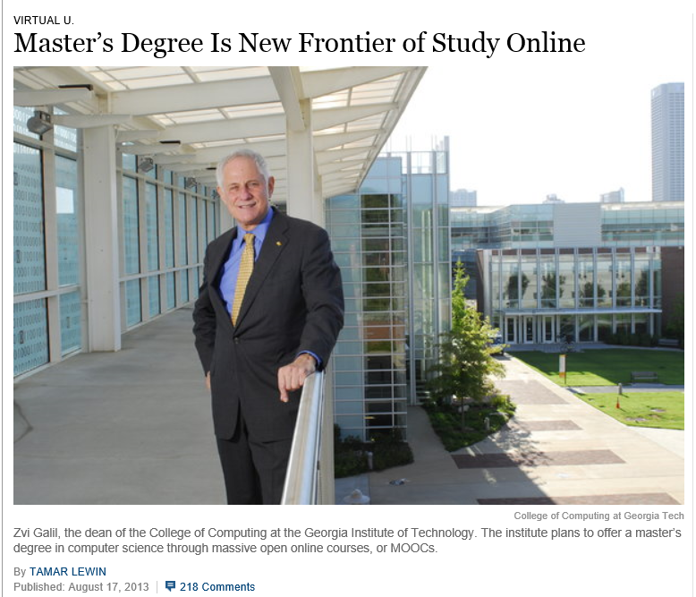
Chapter 13: Unbundling Higher Education and the Georgia Tech Online MS in Computer Science: A Chronicle
Richard DeMillo

Slide 31


April 23, 2015
Cost-Benefit Analysis
Offloading Semesters or Years to MOOCs
The Catch in Arizona State’s Low-Cost Freshman Year Online: No Aid, Chronicle of Higher Education, Thomas Fisher http://chronicle.com/article/The-Catch-in-Arizona-State-s/229617/
Anant Agarwal, the head of edX, which teamed up with Arizona State U. in the new project: “Our mission is to provide education to people who need it the most.”

Slide 32


Chapter 14: Creating a Temporary Spontaneous Mini-Ecosystem through a MOOC
Paul Kim and Charlie Chung, Stanford University
Figure 2. Twitter thread announcing the MOOC

Slide 33


Chapter 15: Learning about MOOCs by Talking to Students
Charles Severance, University of Michigan
Chuck Severance, U Michigan/Coursera) in Barcelona http://www.youtube.com/watch?v=JzNHvmSv8TI
Chuck Severance, University of Michigan https://www.coursera.org/course/pythonlearn

Slide 34


April 1, 2015
Flipped the Classroom with MOOCs
For a Better Flip, Try MOOCs, David Raths, Campus Technology http://campustechnology.com/articles/2015/04/01/for-a-better-flip-try-moocs.aspx

Slide 35


Chapter 16: Collaborative Design and Development of MOOCs for Teacher PD
Bernard Robin and Sara McNeil, Univ. of Houston

Slide 36





Chapter 18: Changing the Tune: MOOCs for Human Development? A Case Study
Balaji Venkatataraman and Asha Kanwar, COL

Slide 37


Chapter 19: Harnessing the Power of Open Learning to Share Global Prosperity and Eradicate Poverty
Sheila Jagannathan, World Bank, Washington DC
Figure 1: World Bank Group Twin Goals

Slide 38


Chapter 19: Harnessing the Power of Open Learning to Share Global Prosperity and Eradicate Poverty
Sheila Jagannathan, World Bank, Washington DC
MOOCs on Climate Change (e.g., impacts of climate change on farmland) and Risk and Opportunity (reducing the risk of childhood mortality)

Slide 39


Chapter 20: The Glocalization of MOOCs in Southeast Asia
Zoraini Wati Abas, Ed.D.
Figure 2. Eight of thirteen MOOCs offered by Taylor’s University

Slide 40



Chapter 22: OER and MOOCs in Africa: The AVU Experience
Griff Richards and Bakary Diallo,
African Virtual University, Nairobi, Kenya
It is estimated that only 6% of Africans can access post-secondary education. The development goal is set at 12% even though North America and Europe are somewhere around 45%.

Slide 41

Chapter 23: Open Learning in the Corporate Setting
Elliot Masie, The Learning CONSORTIUM @ The MASIE Center
“Open” is an interesting and disruptive word to use about a corporate setting. Yet, Open Learning is one of the most provocative and rapidly changing elements of how corporate learning is being harvested, delivered, and packaged.

Slide 42



Chapter 24: ALISON: A New World of Free Certified Learning
Mike Feerick, CEO & Founder, ALISON

Slide 43




Chapter 28: MOOCs 2030:
A Future for Massive Online Learning
Rebecca Ferguson, Mike Sharples (The Open University, UK), Russell Beale (University of Birmingham)
Figure 1. The Beyond Prototypes Models of the TEL Complex

Slide 44


Part III.
Ideas for Cultural Sensitivity

Slide 45

Chapter 2: USA/Georgia Tech: Karen Head
Be careful with: hand gestures (e.g., finger pointing—use at least two fingers), body movements, English dominance, political issues.
Jokes and humor can easily be misinterpreted.
Be aware of shifting political climates impacting resource access such as YouTube in China.
Many cultures do not have a linear approach (e.g., from A to B) to communication.
Using visual rhetoric (e.g., visual images) to communicate can be a minefield of problems.

Slide 46






January 27, 2014
Various Geo-Political Issues
Coursera Support Center, Why is my country blocked? http://help.coursera.org/customer/portal/articles/1425714-why-is-my-country-blocked-
Online education platform Coursera blocks students in Syria and Iran, Wamba, Nina Curley http://www.wamda.com/2014/01/coursera-blocks-syria-and-iran-moocs-online-courses

Slide 47

Chapter 3: Japan/The Open U Kumiko Aiko
  Make subtitles available in multiple languages based on intended audiences.
  Avoid references to current events that may only be shared by a small subgroup.

Slide 48

Chapter 5: Australia
Carina Bossu
To ensure inclusiveness (including cultural, ethical, and religious), one should openly license all educational materials developed for MOOCs, so as to guarantee the permissions and freedoms required for translation, adaptation, re-use, redistribution, and repackaging.

Slide 49

Duke MOOCs Around the World https://www.youtube.com/watch?v=nL5QQRR6IOU&feature=youtu.be

Slide 50

September 16, 2013
Courses from Open Content
Rwandan Degree Program Aims for a 'University in a Box', Chronicle of Higher Education, Megan O’Neil http://chronicle.com/article/Rwandan-Degree-Program-Aims/141631/
Students attend an orientation session at Kepler, a new hybrid program in Kigali, Rwanda, which will use MOOCs and classroom time to help students earn competency-based associate degrees.

Slide 51

Chap. 6: South Africa
Laura Czerniewicz
The single most important requirement is that MOOCs and MOOC resources be made available under Creative Commons licenses or other open licenses which allow for re-use and adaptation. it is essential a broadcast model be employed.
The agency for and ownership of local resources needs to be in the hands of those who best understand local conditions, and therefore they need to be able to create and adapt as they see fit.

Slide 52


Slide 53


Chapter 8:
New Zealand and Ireland
Mark Brown
  Create MOOCs on indigenous cultures and unique languages other than English (e.g., Irish).

Slide 54


Chapter 9: Scotland
U of Edinburgh
Amy Woodgate
  Intermittent Internet access on one’s mobile phone will not help to stream HD videos.
  Simple course designs (e.g., talking heads with minimal hand gestures) helps to make content more available for international audiences. More engaging content is more difficult to convert.

Slide 55





Mobile MOOCs
(e.g., mobile courses on smartphone)

Slide 56

Chapter 11:
India and Canada/COL
Sanjaya Mishra
  Be culturally sensitive to music and pictures while designing content for global audience.
  Consider technology used to develop the content (does it assist reuse and remixing?).
  Instead of focusing too much on the cultural sensitivity of MOOCs and raising costs, try to allow for reuse and remixing of content. Use open source technologies and content.

Slide 57


Chapter 12:
Netherlands/Open U
Fred Mulder and Darco Jansen
To be mindful of:
Different levels of digital literacy skills
Local resources by locals
Legal differences and barriers
Gender, age, and disability issues
Device-specific pedagogy and interface

Slide 58


May 27, 2015
MOOC Participant Study Strategies
The Invisible Learners Taking MOOCs,
George Veletsianos, Inside Higher Ed https://www.insidehighered.com/blogs/higher-ed-beta/invisible-learners-taking-moocs
Rajeev Bajpai, an airline pilot based in Mumbai, took an online computer-science course to gain programming skills.

Slide 59


Chapter 14:
USA/Stanford
Paul Kim and Charlie Chung
  Encourage students to download lecture videos and translate them to other languages and perhaps add captions and make available in their local cloud services.
  Encourage students to create low bandwidth versions of videos for those in low bandwidth areas.
  Encourage students to translate videos and add nuances and words understandable in local languages.
  Encourage students to meet locally in teams to share materials and take care of “sensitive matters.”

Slide 60

August 1, 2014
Can You Really Teach a MOOC in a Refugee Camp?
Steve Kolowich, Chronicle of Higher Education http://chronicle.com/blogs/wiredcampus/can-you-really-teach-a-mooc-in-a-refugee-camp/54191 /
Two men living in Dadaab, a refugee camp in Kenya, would watch lecture videos and take online quizzes at a nearby United Nations compound. (InZone)

Slide 61

Chapter 15:
USA/U Michigan
Chuck Severance
  Avoid troublesome metaphors and examples (e.g., the baseball World Series in the USA).
  Never show lecturer’s face (use audio only)—allows for complete overdubbing in the native language and avoid hand gesture problems.
  Make slides as word free as possible—where possible use symbols
  “Limit” to audio and “No” video OR keep the video “simple”

Slide 62

Chapter 19:
DC/World Bank Institute
Sheila Jagannathan
“Widen” and “increase” representations from more diverse groups and stakeholders (gender, non western, public and private, grass roots, etc.).
Make the contents more culturally sensitive/relevant.

Slide 63

Chapter 20
Indonesia and Malaysia
Zoraini Wati Abas
  Do not expect Asian audience to quickly voice their opinions
  Treat Asian audience as an equal
  Avoid issues related to religion and politics.
  Minimize distractions and negative feelings (e.g., do not show visuals or give examples of prohibited types of foods or animals)

Slide 64



March 4, 2016
MOOCs: vital tools in education of the future – or over-hyped online fad? (embedded video: 8:01)
Euro News, Sarah Chappell
MOOCs: vital tools in education of the future – or over-hyped online fad? http://www.euronews.com/2016/03/04/moocs-vital-tools-that-are-shaping-the-future-of-education-or-over-hyped-online/

Slide 65

Chapter 21:
U of Philippines Open U
Melinda Bandalaria
  Strictly avoid references to religion.
  Use acceptable dress code.
  Even when English is the primary or secondary language of the country, consider making MOOC content available in the major dialects of the country.

Slide 66

April 21, 2014
Benefits of MOOCs for Disadvantaged and Underprivileged
The Revolution Is Not Being MOOC-ized, Students are educated, employed, and male.
Gayle Christensen and Brandon Alcorn, UPenn, New Scientist http://www.slate.com/articles/health_and_science/new_scientist/2014/03/mooc_survey_students_of_free_online_courses_are_educated_employed_and_male.html
Filipino youths go online at an Internet café in Manila on Feb. 18, 2014. Two-thirds of Coursera participants come from the developed world, according to a new report.

Slide 67


Chapter 27:
Canada
Helene Fournier and Rita Hop
“Personalize” the learning experience to offset the massiveness.
Need to think hard about how cultural differences might be expressed and accepted in the MOOC platform.
  The road ahead hinges on personalizing learning experiences; the connectivist approach (i.e., cMOOCs) is which participants are in the driver’s seat.

Slide 68


March 1, 2016
Zoom
Tarleton State University, Texas
Dr. Credence Baker

Slide 69


Chapter 28:
UK/FutureLearn
Rebecca Ferguson and Mike Sharples
  Access. In many countries (e.g., in Africa, but also areas of Asia) mobile is the main means of access, so the courses need to be developed for a mobile-first experience, including pedagogy as well as interface.
  Provide transcripts of videos, preferably in multiple languages and multi-language subtitles.
  There are deep-seated cultural differences related to: the value of expert vs learner-originated knowledge; deference to experts; willingness to engage in discussion and critique.

Slide 70

January 20, 2016
Why the Future Is Bright for the World’s Poorest Farmers, Gates Notes, the blog of Bill Gates https://www.gatesnotes.com/Development/The-Future-of-Farming?WT.mc_id=01_20_2016_20_FutureofFarming_BG-LI_&WT.tsrc=BGLI

Slide 71

Part IV.
Personalization of MOOCs

Slide 72

Foreword:
Canada/USA
George Siemens
MOOCs are adopting CMUs OLI project (adaptive learning in stats) (e.g., Candace Thille at Stanford).
Smart Sparrow (adaptive learning company connected to ASU) has started running personalization in MOOCs. One personalized/adaptive MOOC with Australian univ.
Carolyn Rose at CMU recently ran a “Super Heroes” MOOC together with Smithsonian that used personalization approaches through "intelligent agents" to foster dialogue and collaboration.

Slide 73

October 1, 2014
Acrobatiq http://acrobatiq.com/

Slide 74



October 1, 2014
Smart Sparrow, Heat Maps on Misconceptions http https://www.smartsparrow.com/

Slide 75

Chapter 18:
Canada/COL
Balaji Venkataraman
In the Mooc on mobiles for development the course team received requests from two groups of learners in Sierra Leone and Zambia for the course materials on DVD.
AgMoocs initiative (http://www.agmoocs.in/) uses MooKIT platform designed for access in low bandwidth conditions. It includes a functionality for a learner to hear the voice track on a basic mobile phone.

Slide 76


May 20, 2016 agMOOCs (India) http://www.agmoocs.in/

Slide 77

Chapter 18:
Canada/COL
Balaji Venkataraman
In the Pacific COL supported the U of South Pacific with a specially constructed MOOKIT platform. Social media was integrated with it. Any interested learner can add his or her SM profile to the profile in the course. This will enable a learner to follow the discussions on the course forum in real time using just the smart phone. This bandwidth is cheaper in most Pacific island countries than bandwidth availed for laptops. This facility greatly contributed to increased course participation often overwhelming the team of instructors.

Slide 78

May 19, 2016
Facebook Schools MOOCs on Engagement
Jason Schmitt, EdSurge https://www.edsurge.com/news/2016-05-19-facebook-schools-moocs-on-engagement

Slide 79

Chapter 18:
DOCC/USA
Radhika Gajjala
Doing a "Collaborative" course requires that we engage the context - not just talk to it.... We start by dialogue and engagement with the students - the sensitivity would emerge through interaction and skype conversations and discussion and debate.

Slide 80

Chapter 18:
DOCC/USA
Liz Losh
The Selfie Course…
MOOCs often tend to misestimate the importance of situated experience in approaching learning as a meaning-making process.
Snapchat pedagogy, the ways that MOOCs overlook the importance of the mobile phone as a vehicle for connecting students -- who are individually situated in time, space, status, etc. -- in distributed learning networks.

Slide 81



September 2014
The Selfie Course http://www.selfieresearchers.com/the-selfie-course/

Slide 82

Chapter 19:
DC/World Bank Institute
Sheila Jagannathan
We try to do badging etc. to give motivation and personal incentives such as champion or expert.
We try to customize the discussion forums with regional and very level forums, topics and moderators.
Google hangouts are also used to customize and personalize at country or institutional levels.

Slide 83


Learning for Enjoyment vs. Credentials

Slide 84


December 23, 2016
HarvardX and MITx: Four Years of Open Online Courses -- Fall 2012 - Summer 2016
Isaac Chung, MIT, and Andrew Dean Ho, Harvard https://papers.ssrn.com/sol3/papers.cfm?abstract_id=2889436

Slide 85


March 3, 2016
‘Trump U.’ Draws Unflattering Spotlight to the Candidate as Fraud Cases Move Forward
Chronicle of Higher Education, Corrine Ruff http://chronicle.com/article/Trump-U-Draws/235573?cid=trend_right_a

Slide 86

Chapter 21:
Philippines Open U
Melinda Bandalaria
…one feature that we have integrated into our MOOCs which I think is one effort to personalize learning is the "Multiple Paths to Learning" or the "Learning on the Go." Through this feature, the learner can choose whether to learn through the video lessons, text lessons or podcast.
In terms of gadgets to use, of course, we made sure that the courses are accessible whatever device especially mobile devices, the learner has access to.

Slide 87

Chapter 22:
Canada/Africa
Griff Richards
“I think a concept like personalization is laudable, but I'd like to see where it sits in the list of things to do to improve MOOCs. For example if we look down Hattie's list of useful interventions, would personalization give us the biggest learning bang for the buck of development? Or would we get there through some simpler intervention like simply making the courses more self-paced.”

Slide 88

Chapter 25:
USA/Illinois
Vickie Cook
Personal notes within the MOOC from either other students or the instructor that the MOOC takes on a personalized emphasis…communications that do not use my name, or are generic to be reused– feel quite cold and impersonal.
Theory of “heutagogy” – basically learning that is self-determined and available in a mobile interface, I think it is important that personalization also create the desire to return to the MOOC for more.

Slide 89

Chapter 25:
USA/Illinois
Ray Schroeder
Most obvious way to personalize is to include group projects, allowing students to self-select into interest areas to conduct collaborative projects that are relevant to the MOOC topic
One of the easiest and most effective ways is to build self-reflection into each module of a MOOC.
Motivated self-determined learners (such as many MOOCers are) do naturally adapt, build upon and scaffold MOOCs to meet their personal learning needs and desires.

Slide 90
Part V. MOOC Instructor Survey Personalization Results
(July 2016)

Slide 91


1. How many MOOCs have you taught? (N = 152)

Slide 92


Q4: 3. How many MOOCs have you completed as a learner
(including any that you are currently enrolled in)?
Answered: 145 Skipped: 10

Slide 93


Q7. What is the delivery format of your most recent MOOC?
Answered: 143 Skipped: 12

Slide 95
13. How do you address students’ varying competencies and needs?[Check all that apply]

Slide 96
14. What types of learning resources can participants select from in your most recent MOOC?[Check all that apply]

Slide 98
17. How did you design your course to be suitable for students from different cultures and/or linguistic backgrounds?[Check all that apply]

Slide 99
18. Does the structure of your most recent or current MOOC provide any of the following?
[Check all that apply; N = 126]

Slide 101


February 1, 2017
Designing Adaptive Learning and Assessment in HarvardX: Collaborative Project by Harvard University and TutorGen
Yigal Rosen, Harvard University and Mary Jean Blink, TutorGen, Inc. http://vpal.harvard.edu/blog/designing-adaptive-learning-and-assessment-harvardx-collaborative-project-harvard

Slide 103

General Analytic Method MOOC Research (2014–2017)

Slide 104

Specific Analytic Method for MOOC Research (2014–2017)

Slide 105

Location of MOOC Research Team Members (2014–2017)

Slide 106

Country of Origin of MOOC Delivery
(2014–2017)

Slide 107

Focus of MOOC Research
(2014–2017)
*
*Seven studies had more than one area of focus.

Slide 108

Specific Topics of MOOC
Research (2014–2017)

Slide 109


MOOCs…
Ten Course/Instructional Design Guidelines

Slide 110

MOOC Instructor Guide #1.
Plan and Prepare for the Experience

Slide 111

MOOC Guide #2.
Build in Feedback for Each Experience (etc., Peer, Machine, Volunteer, and Self-Assessment)

Slide 112


MOOC Guide #3.
Create Interactivities
(e.g., use Polling Questions)

Slide 113

MOOC Guide #4.
Provide Variation and Choice

Slide 114


MOOC Guide #5.
Combine Sync and Async Instruction
(e.g., David Merrill and Charlie Reigeluth)

Slide 115


MOOC Guide #6.
Design Responsive and Interactive Learning Communities

Slide 116

MOOC Guide #7.
Offer Weekly Recaps and Updates

Slide 117



MOOC Guide #8.
Personalize the Activity or Experience Where Possible!

Slide 118

MOOC Guide #9.
Engage in Resource Sharing

Slide 119

MOOC Guide #10.
Be Willing to Change Midstream.

Slide 120




Any Comments or Questions?
Slides at: TrainingShare.com
Papers: PublicationShare.com
Free Book: http://tec-variety.com/
MOOCsBook: http://moocsbook.com/

