Slide 1
Instructor Efforts to Address Cultural Diversity in MOOC Design and Application
Curtis J. Bonk, Indiana University
Najia Sabir, Indiana University
Shuya Xu, Indiana University
Minkyoung Kim, Texas Tech University
Meina Zhu, Indiana University
Annisa Sari, Indiana University

Slide 2
Concerns Regarding the Emergence of MOOC
Learners are heterogenous (Watson, Ho, & Raman, 1994)
Misunderstanding might occur due to language barrier & communication style (Callaway, Matthew, & Felvegi, 2014)
Different cultures have different communication pattern (Hofstede, 1986; McLouglin, 2006)

Slide 3
Huge Need to Study Personalization
While several researchers have evaluated MOOC elements for personalization, such as course designs, assessments, and means of content delivery (e.g., de Oliveira Fassbinder, 2015; deWaard et al., 2011; Yousef, Chatti, Schroeder, & Wosnitza, 2014; Yuan & Powell, 2013), there is a scarcity of empirical studies which specifically investigate MOOC personalization from instructor perspectives.

Slide 4
Technologies for Personalization
Recently, Hayworth (2016) suggested that there are a wide range of technologies that can help personalize the learning environment including social bookmarking, wikis, blogs, image sharing, and collaborative tools. He also notes that such personalized learning environments (PLEs) have significant implications for distance educators, instructional designers, life-long learners, and administrators. Hayworth cautioned, however, against placing too much emphasis on technology solutions. Rather than technology-centered, adult learners exhibit a preference for learning which is social, participatory, and supported by rich media (McLoughlin & Lee, 2010).

Slide 5
Personalization Defined
Tapping into those two perspectives, the definition of personalization used in the present study was as follows: “personalization indicates the process by which MOOCs instructors adapt their course and teaching to meet students’ individual learning needs.”

Slide 6
Why Instructors?
Instructors are one of the five primary elements (instructors, learners, topic, materials, and context) in MOOCs (Kop, 2011)
Few studies leverage instructor perspectives to better understand such personalization and cultural sensitivity (Veletsianos & Shepherson, 2016)

Slide 7
Research Questions
In particular, this study focuses on the following three research questions:
What are the personalization practices of MOOC instructors in terms of content resources and associated technology tools employed?
What are the personalization practices of MOOC instructors in terms of the task structuring and pedagogical activities employed?
How would MOOC instructors structure their MOOC differently next time in terms of MOOC personalization?

Slide 8

MOOC Personalization Survey Results

Slide 9
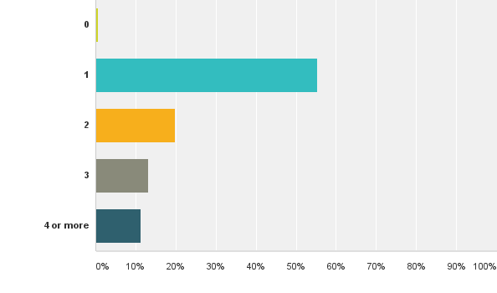
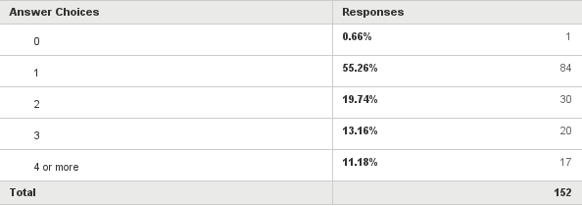
1. How many MOOCs have you taught? (N = 152)

Slide 10
How many MOOCs have you taught (including any that you are currently teaching)?

Slide 11
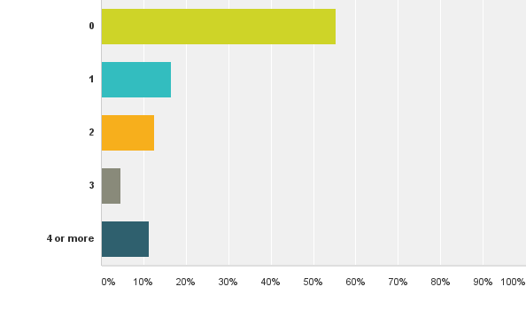
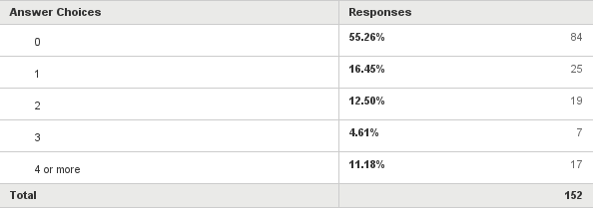
3. How many MOOCs have you completed as a learner (N = 152)

Slide 12
Q6. MOOC Instructor Dept./Discipline
Figure 1: MOOC instructor affiliations as reported on the online survey questionnaire. 140 (out of 145) MOOC instructors identified departmental and disciplinary affiliations for which they taught courses.

Slide 15
13. How do you address students’ varying competencies and needs?[Check all that apply]

Slide 16
14. What types of learning resources can participants select from in your most recent MOOC?[Check all that apply]

Slide 18
17. How did you design your course to be suitable for students from different cultures and/or linguistic backgrounds?[Check all that apply]

Slide 19
18. Does the structure of your most recent or current MOOC provide any of the following?
[Check all that apply; N = 126]

Slide 20
Does the structure of your most recent or current MOOC provide any of the following?

Slide 21
19. How is student progress/participation monitored or tracked? [Check all that apply; N = 137]

Slide 24
How did you design your course to be suitable for students from different cultures and/or linguistic backgrounds?

Slide 26
On a scale of 1 (low) to 10 (high), how much effort was placed on addressing the needs of individuals from different cultural backgrounds and languages in your most recent MOOC?

Slide 27
On a scale of 1 (low) to 10 (high), how much effort was placed on addressing the needs of individuals from different cultural backgrounds and languages in your most recent MOOC?
Figure 2: Efforts noted by MOOC instructors to personalize their course, as related though ranking questions (Note: the number indicates the number of instructors at each level).
Reported on a scale of one to ten, where ten indicated high levels of effort and one indicated low levels of effort.

Slide 28
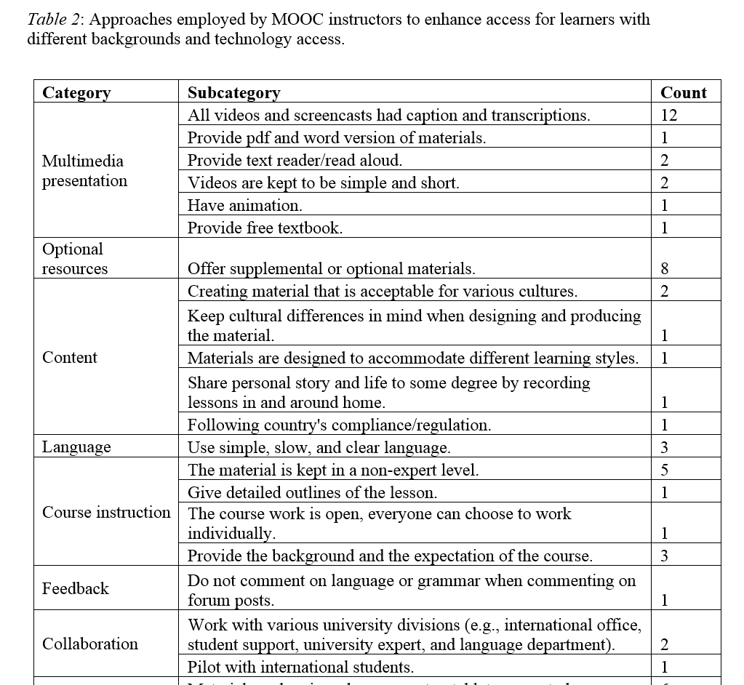
Table 2: Approaches employed by MOOC instructors to enhance access for learners with different backgrounds and technology access.

Slide 29
How MOOC instructors design their courses with the consideration of students’ background and technology access （Top 4 ways):
Providing captions and transcriptions to all videos and screencasted materials
Offering supplemental or optional materials
Making sure that all materials can be viewed on various devices, including computer, tablet, or smartphone
Keeping the materials at the level of a non-expert

Slide 30

Open-ended question 1: Can you provide one or more ways that you attempt to personalize the MOOC experience for those enrolled in the course?
Answered: 36 Skipped: 119
Replying personally to asynchronous discussion messages to explain or reference materials to students as well as to refer to peers. Retweeting and commenting on learners social media posts.
Mainly, we ran moderated peer discussion through Piazza. Students, teachers, and the moderator commented on student contributions.
To give more different case studies and examples, considering different backgrounds and interests. To have high order and low order assessments, considering the personal interest for deepening into content.
Its all about expectations and communication. From the first day of 'launching' we have moderators & academics assigned to welcome and encourage learners to ask questions and post comments for peer-to-peer feedback, etc. We also list specific times when different academics and experts will be online (various times/dates due to international reach) to have 1-2-1 and group discussions where applicable.
I adjust some of the content based on early discussion in the course to better meet the needs of the recruited cohort. Some of the material was co-created and labelled geographically.

Slide 31

Open-ended question 2: How do you use learning technology such as computer conferencing (e.g., Skype, Zoom, Google Hangouts, etc.) to personalize your MOOC?
Answered: 37 Skipped: 118
Online office hours were available through Appointlet. Had an online whiteboard to share with students' during scheduled office hours. Used Skype or Google Hangouts to video conference during online office hours.
Slack for group projects
I held virtual office hours during each of the three offerings of my course. In several had teaching associates join in. In the last offering, I used the first part of the meet-up to share current nutrition related news and studies to help keep the course more up to date (we also posted news and studies). One challenge of the course is keeping content current in subsequent offerings without reshooting videos or redoing all the PowerPoints. Used announcements, resources and the meetups to provide updates.
We didn't but I am working on another distance learning course now that is closed using Skype, Zoom and Webex. They are all good in different ways. The participants in the closed course have bonded much more as a cohort than any of the groups in the MOOC.
Google Hangouts are excellent - but they don't work in China. We also use WarpWire to allow student video presentations in private environment.

Slide 32

Open-ended question 3: How did you design your MOOC to make it easier to access for students with different backgrounds and technology access?
Answered: 34 Skipped: 121
Worked closely with university expert. Consulted with language dept. Talked with and piloted with our international students and friends from Jordan, China, Greece and Turkey.
Follow UK accessibility compliance guidelines. Main course material pitched at entry level but more complex further reading provided to allow students to 'go deeper' as well as range of case study content to facilitate more in-depth analysis.
There was scripts for everything ... videos mainly. There was also downloadable documents produced in different formats to make it easier depending on the technology they had available. The content was 'beginner' level so I think we naturally slowed down and covered the basics in a lot of detail - as well as providing links and documents with more information as different points.
Our content covered examples from different political and religious contexts, across Europe, the Americas, the Middle East and Asia, designed in turn to encourage students from diverse backgrounds to share their own political experience.

Slide 33

Open-ended question 4: In what ways, do you or your teaching assistants and moderators provide just in time support, feedback, and individualized learner attention?
Answered: 37 Skipped: 118
Tremendous amount of work here. We continuously monitor student performance and find where students are struggling. We then respond to struggle areas with forum posts and weekly updates.
We had all of our academics who developed the MOOC…assigned a different section to deliver and then moderate. So during the few days before/after the 'official launch' of our sections, we were online at various times to provide comments and feedback. We also gave learners specific dates/times that we would be online to discuss synchronously and answer questions, etc. We had resident entrepreneurs and business experts who were asked to be online over certain dates/times to provide the 'practical' view. Finally, we also have a central 'digital learning team' who support all University MOOCs.
Tremendous amount of work here. We continuously monitor student performance and find where students are struggling. We then respond to struggle areas with forum posts and weekly updates.
Constant, constant, constant attention to discussion forums.
Our computer technician checked every day for posts from students who were having technical problems and helped to correct them.

Slide 34

Open-ended question 5: If you were to redesign the course for enhanced personalization within your most recent MOOC offering, what would you do?
Answered: 37 Skipped: 118
I would encourage study groups with 'pupil teacher' techniques... champions in the 'crowd' leading smaller groups who are struggling or who would like more social and tutor presence.
Introduce Google Hangouts. Develop alternative pathways for content. Allow students more space to share own competencies and knowledge levels (perhaps wikis etc. ).
I would probably include one or two more items from non-western cultures and find an opportunity for students to share work in a different way.
I would review the latest cognitive science evidence on how best to achieve this important goal and redesign the course and its production accordingly.
I would hire some of our students and alumni to get involved - the students really loved the additional points-of-view and the interaction.
Change the videos - make them shorter and less formal. Give better instructions on use of discussion boards.

Slide 35
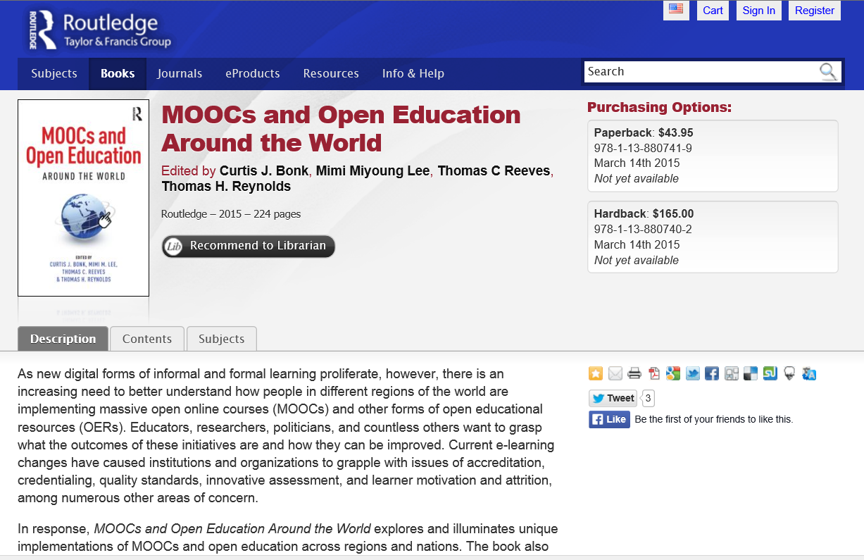



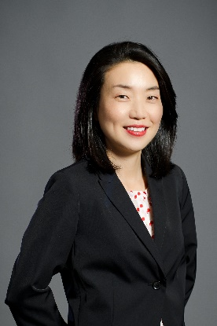


MOOCs and Open Education Around the World http://routledge-ny.com/books/details/9781138807419/

Slide 36
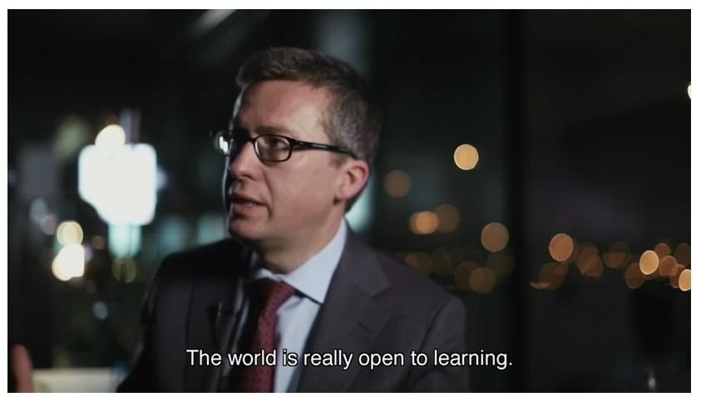



Any Questions or Comments?
Slides at: TrainingShare.com
Papers: PublicationShare.com
Free book: http://tec-variety.com/
Email: cjbonk@Indiana.edu

