Slide 1
Self-directed Learners’ Perceptions and Experiences of Learning STEM through MIT OCW
Meina Zhu | meinazhu@wayne.edu
Wayne State University
Curtis J. Bonk | cjbonk@Indiana.edu
Indiana University Bloomington
October 31, 2019

Slide 2

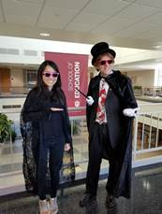
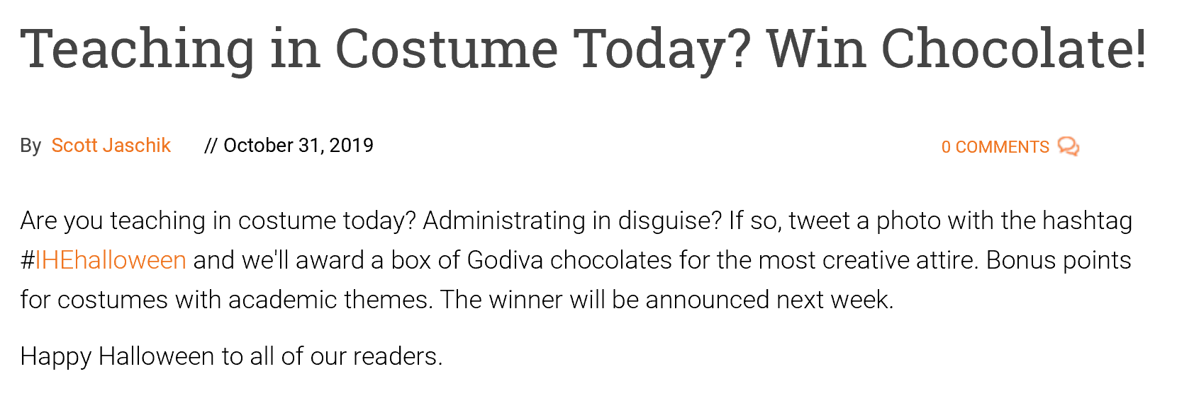
We hope this is a “Magical” talk.

Slide 3
Outline
  Quick trend data
  Research Background
  Research Purpose and Questions
  Research Design
  Results and Recap
  Discussion and Conclusion

Slide 4
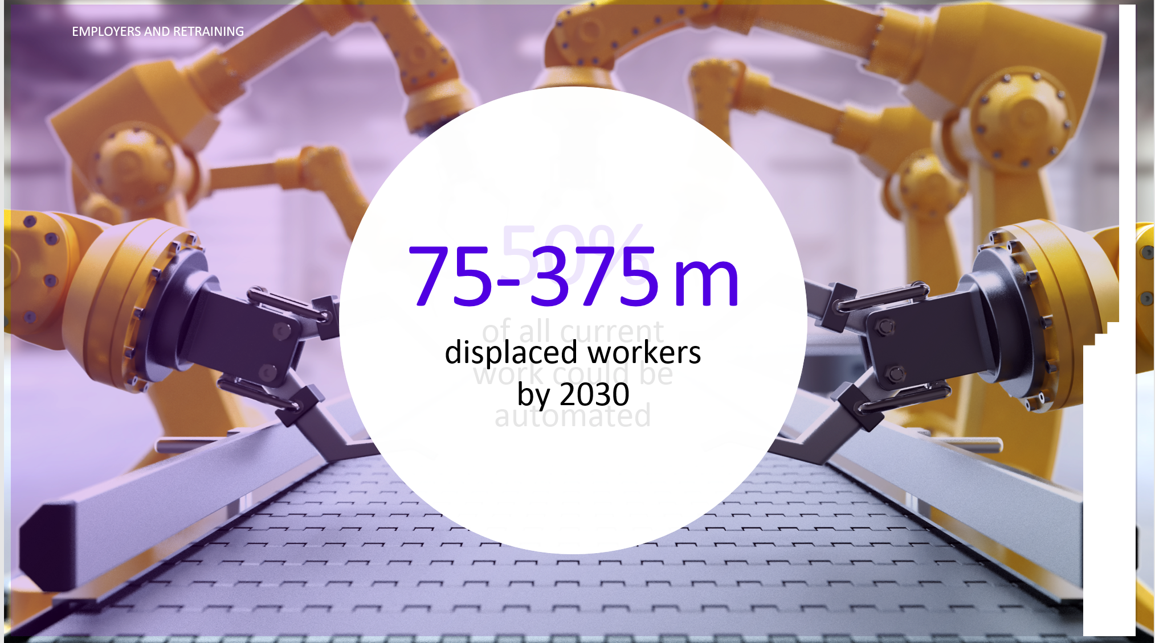
September 10, 2019
The Future of Learning,
Transforming Access
Simon Nelson, CEO, FutureLearn, PCF9 Conference, Edinburgh, Scotland
And the threat of AI and automation is very real. A 2017 report by McKinsey found that half of all current work activities could be automated, using technology that already exists. and that by 2030 anywhere from 75 million to 375 million workers worldwide will be displaced from their old jobs and require retraining.

Slide 5
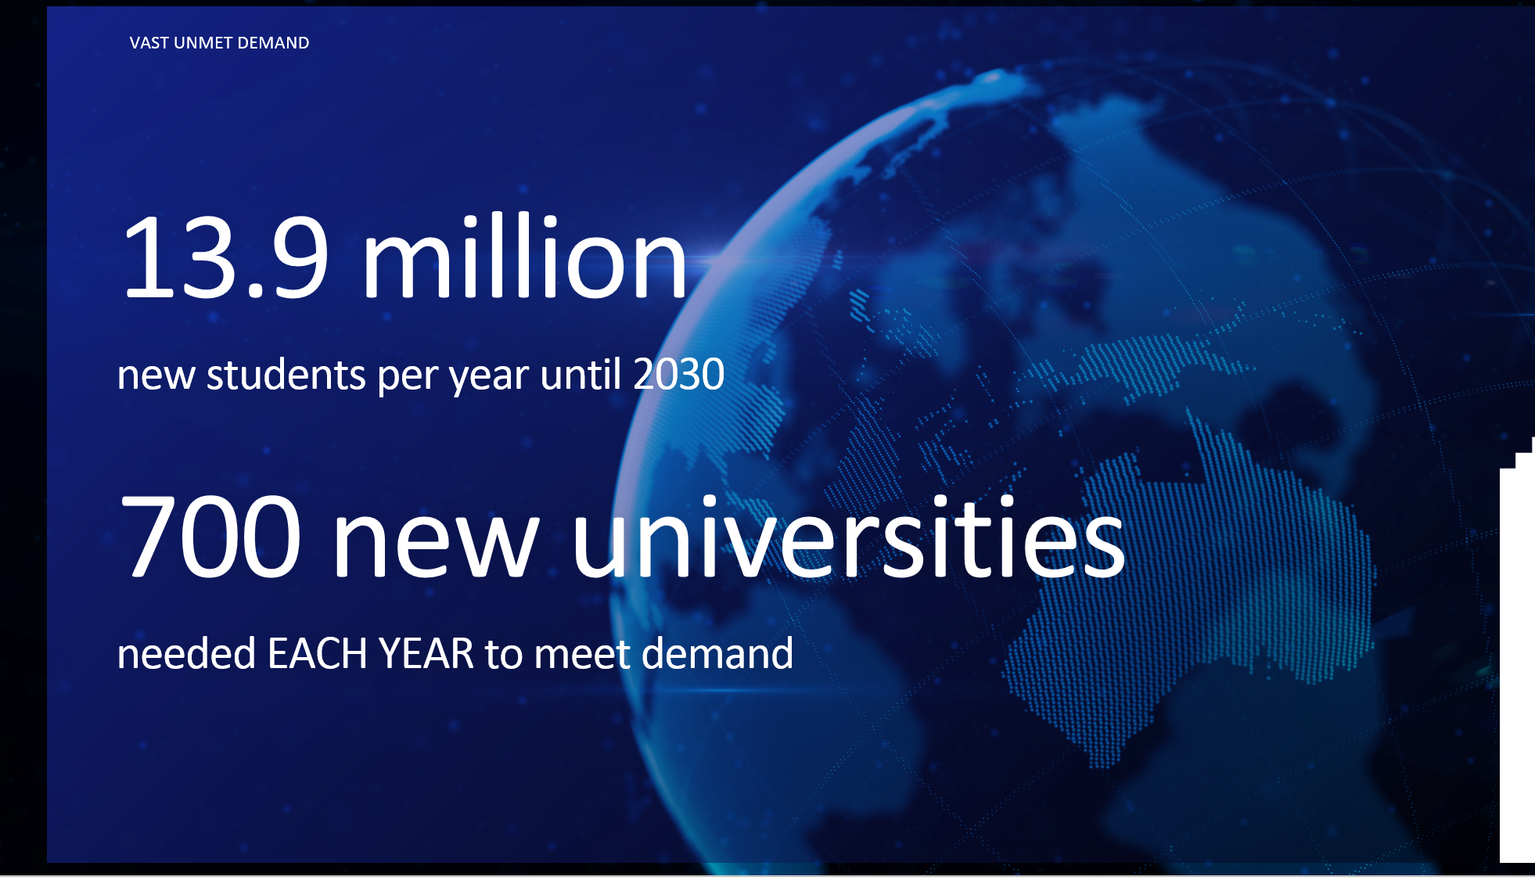
September 10, 2019
The Future of Learning,
Transforming Access
Simon Nelson, CEO, FutureLearn, PCF9 Conference, Edinburgh, Scotland

Slide 6
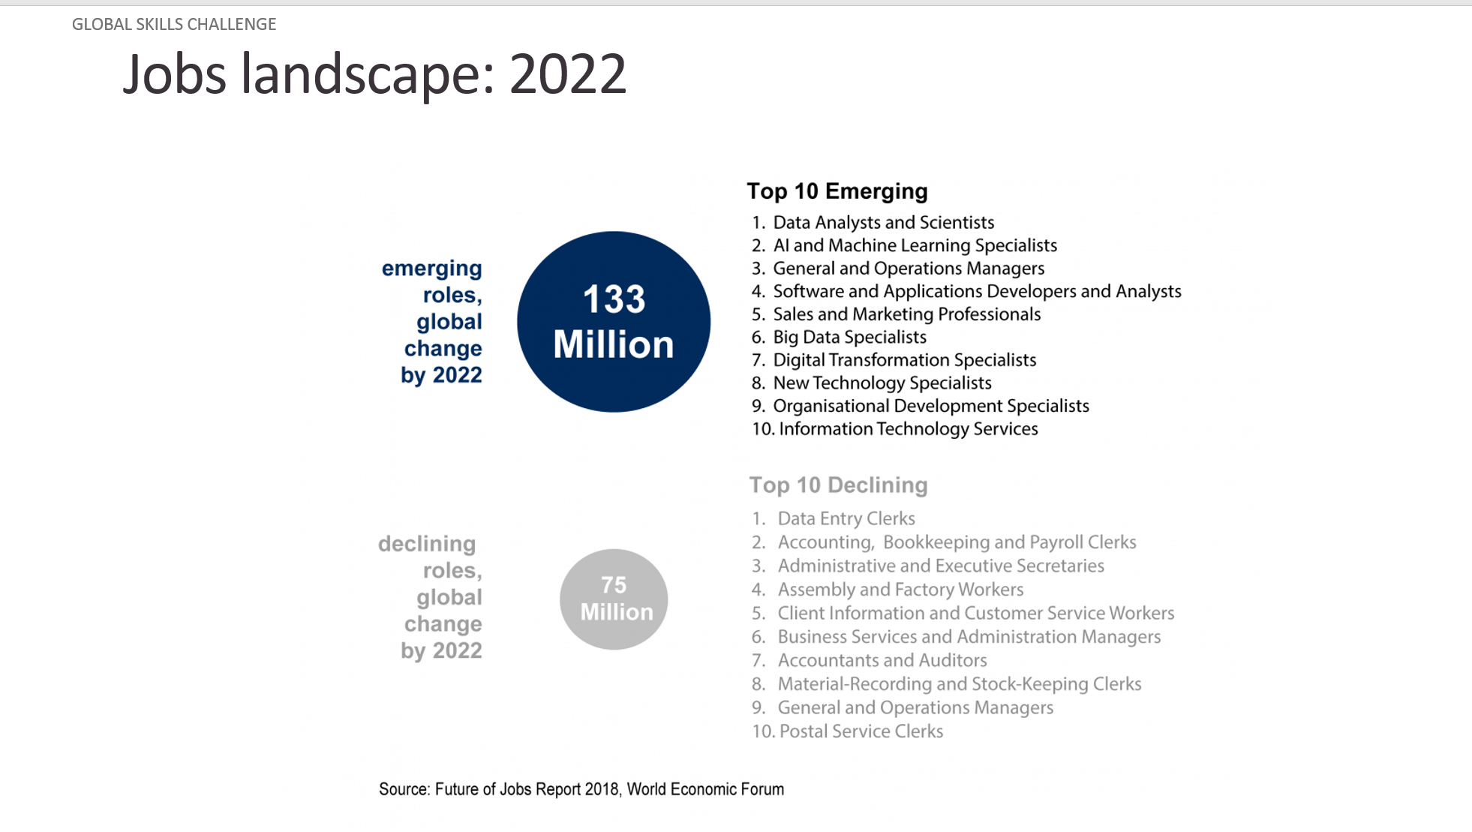
September 10, 2019
The Future of Learning,
Transforming Access
Simon Nelson, CEO, FutureLearn, PCF9 Conference, Edinburgh, Scotland

Slide 7
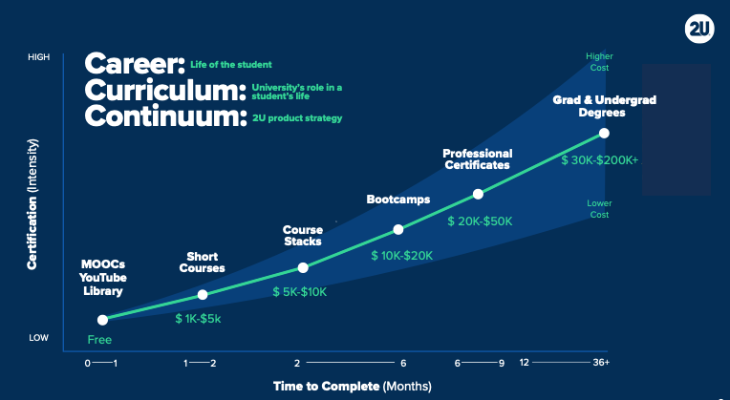
March 13, 2019
The Career Curriculum Continuum
Andrew Hermalyn, Inside Higher Ed
https://www.insidehighered.com/digital-learning/views/2019/03/13/how-universities-can-stay-center-learners-lives-opinion

Slide 8
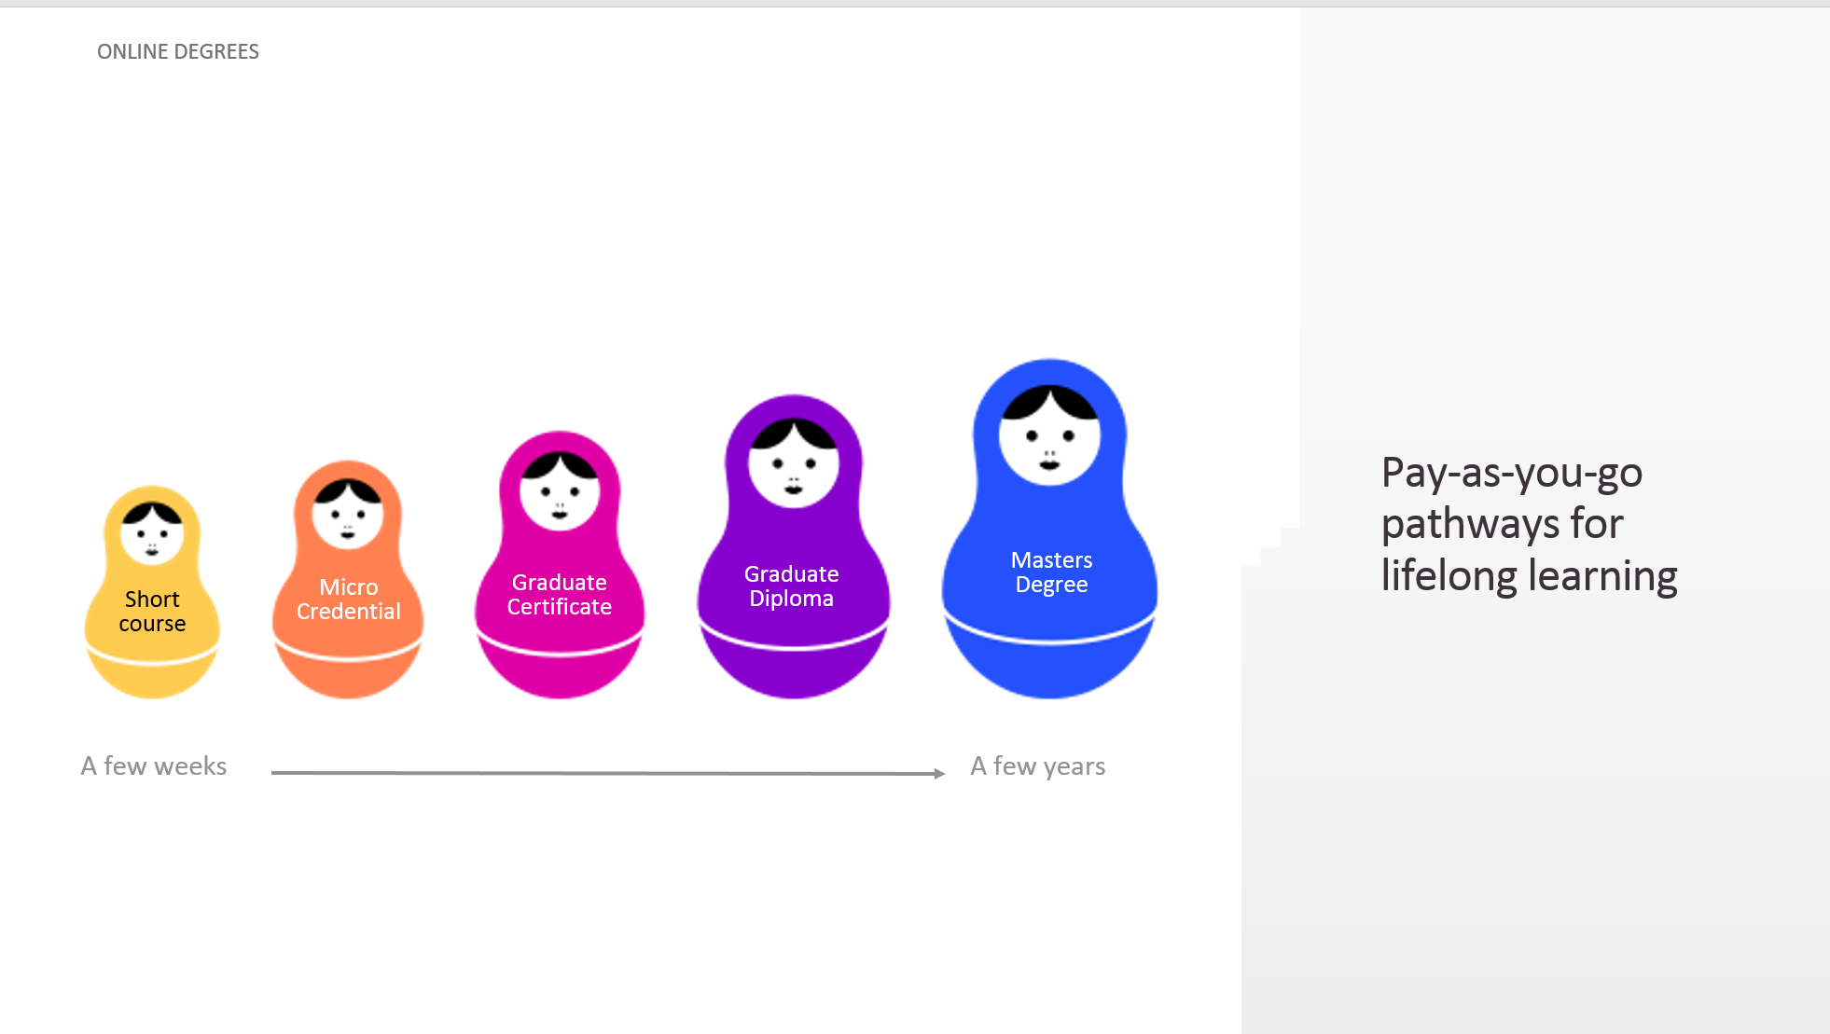
September 10, 2019
The Future of Learning,
Transforming Access
Simon Nelson, CEO, FutureLearn, PCF9 Conference, Edinburgh, Scotland

Slide 9
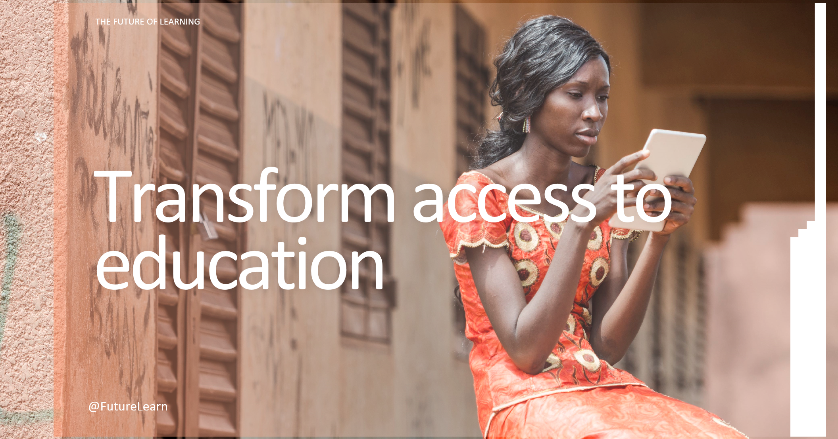
September 10, 2019
The Future of Learning,
Transforming Access
Simon Nelson, CEO, FutureLearn, PCF9 Conference, Edinburgh, Scotland

Slide 10
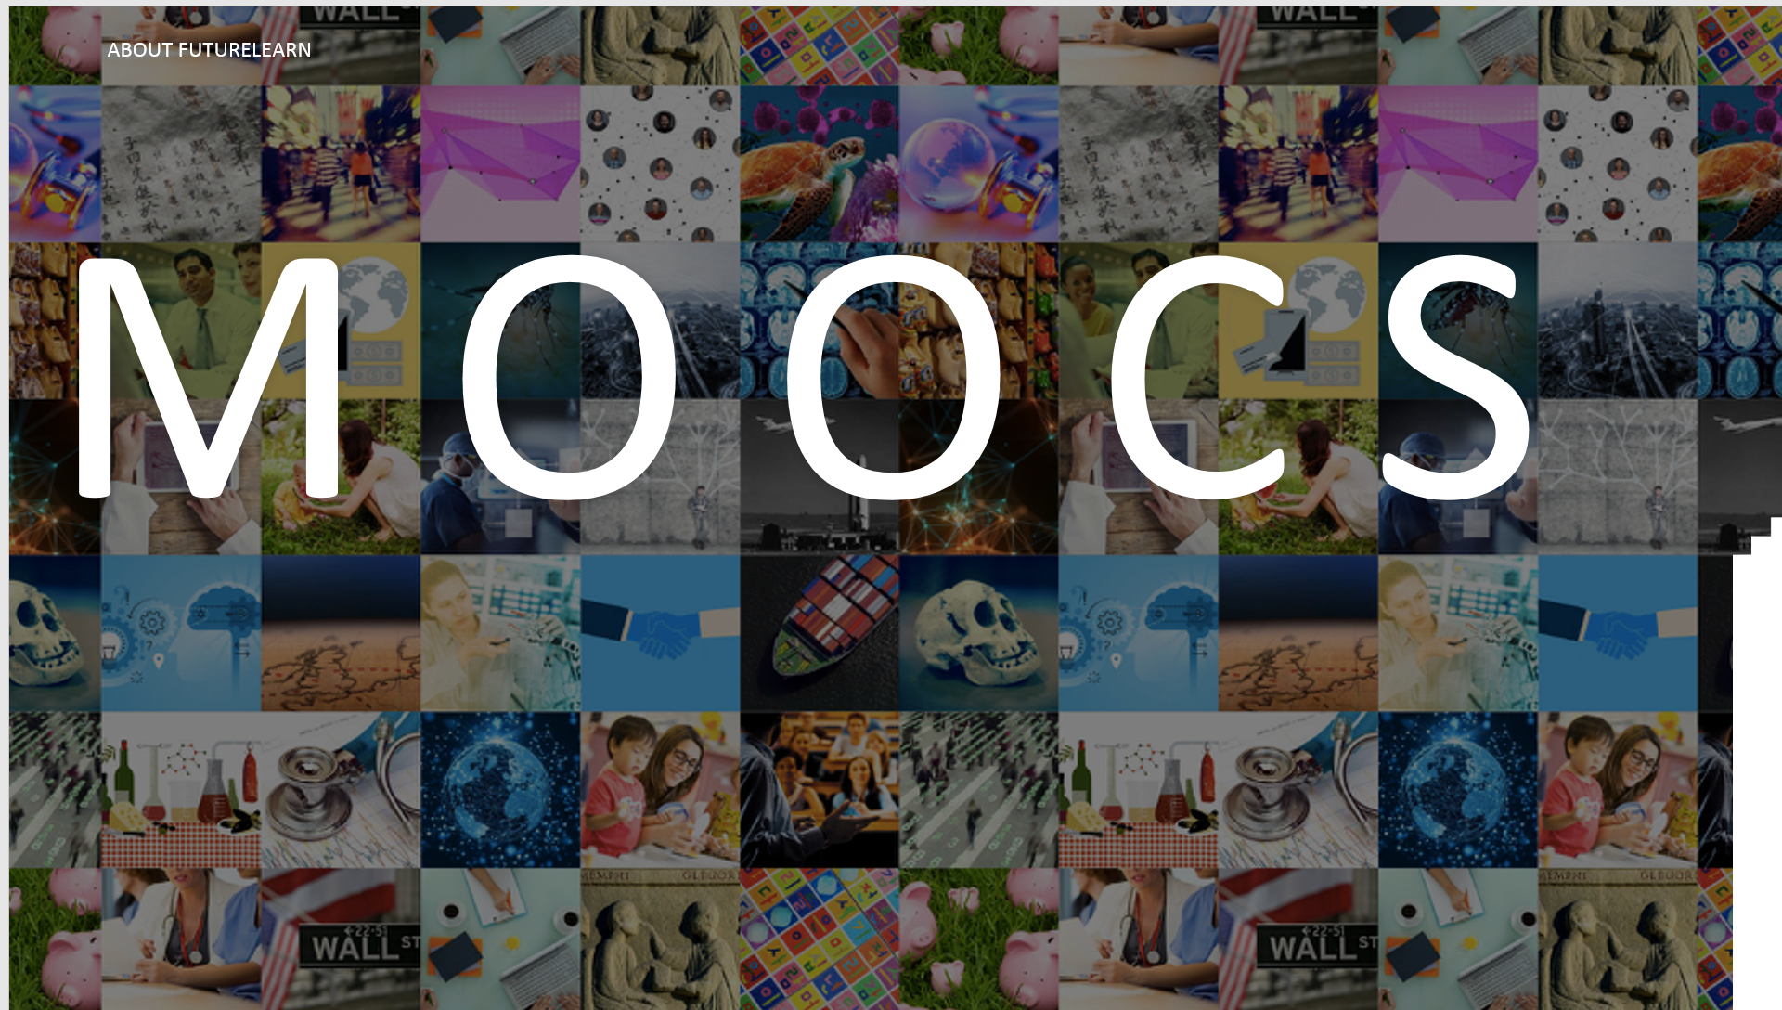
September 10, 2019
The Future of Learning,
Transforming Access
Simon Nelson, CEO, FutureLearn, PCF9 Conference, Edinburgh, Scotland

Slide 11

Open Education

Slide 12


Open Education Includes OpenCourseWare

Slide 13
Research Background

Slide 14
Research Background
MOOC Projects:
Bonk, C. J., Zhu, M., Kim, M., Xu, S., Sabir, N., & Sari, A. (2018, September). Pushing toward a more personalized MOOC: Exploring instructor selected activities, resources, and technologies for MOOC design and implementation. The International Review of Research on Open and Distributed Learning (IRRODL), 19(4), 92-115.
Zhu, M., Bonk, C. J., & Sari, A. (2018, December). Instructor experiences designing MOOCs in higher education: Pedagogical, resource, and logistical considerations and challenges. Online Learning, 22(4), 203-241.
Zhu, M., Bonk, C. J., & Sari, A. (2019). MOOC instructor motivations, innovations, and designs: Surveys, interviews, and course reviews. Canadian Journal of Learning and Technology, 45(1), 1-22. Available: https://www.cjlt.ca/index.php/cjlt/article/view/27795
Doo, M. Y., Tang, Y., Bonk, C. J., & Zhu, M. (2019). A Mixed Methods Look at MOOC Instructor Motivation and Career and Professional Development. Distance Education, 41(1).
Sari, A. R., Bonk, C. J., & Zhu, M. (2019). MOOC Instructor Designs and Challenges: What can be Learned from Existing MOOCs in Indonesia and Malaysia? Asia Pacific Education Review.
Zhu, M., & Bonk, C. J. (2019). Designing MOOCs to facilitate participant self-directed learning: An analysis of instructor perspectives and practices. International Journal of Self-Directed Learning.
Zhu, M., & Bonk, C. J. (in press for 2019). Designing MOOCs to Facilitate Participant Self-monitoring for Self-directed Learning. For Special Issue: Online Learning.
Zhu, M., Sabir, N., Bonk, C. J., Sari, A., Xu., S., & Kim, M. (in review). Addressing Learner Cultural Diversity in MOOC Design and Delivery: Strategies and Practices of Instructors and Experts. Educational Technology Research and Development (ETR&D).
An, Y.-J., Zhu, M., Bonk, C. J., & Lin, L. (in review). Exploring instructors’ perspectives, practices, and perceived support needs and barriers related to the gamification of MOOCs. Journal of Computing in Higher Education.
Notes:
2001

Slide 15
Research Background
OCW Projects:
Lee, M., Lin, M.-F., & Bonk, C. J. (2007, November). OOPS, turning MIT OpenCourseWare into Chinese: An analysis of a community of practice of global translators. International Review of Research in Open and Distance Learning, 8(3). https://doi.org/10.19173/irrodl.v8i3.463
Bonk, C. J., Lee, M. M., Kou, X., Xu, S. & Sheu, F.-R. (2015). Understanding the self-directed online learning preferences, goals, achievements, and challenges of MIT OpenCourseWare subscribers. Educational Technology and Society, 18(2), 349-368. Available: https://www.j-ets.net/ETS/journals/18_2/26.pdf
Zhu, M., & Bonk, C., J. (2019, October). Self-directed Learners’ Perceptions and Experiences of Learning STEM through MIT OCW. 2019 Open Education Conference, Phoenix, AZ.
= = = = = = = = = = = =
Zhu, M., Herring, S. C., & Bonk, C. J. (2019). Exploring ­presence in online learning through three forms of computer-mediated discourse analysis. Distance Education, 40(2), 205-225. DOI: 10.1080/01587919.2019.1600365
Notes:
2001

Slide 16
Research Background
  One of the earliest OER, the Massachusetts Institute of Technology (MIT) OpenCourseWare (OCW), shared MIT course materials and classroom recording videos with the public for free and open access.
  The latest MIT OCW report indicated that more than 2,400 courses were published. Among them, approximately 100 are full video courses (MIT OCW report, 2018).
Notes:
2001

Slide 17


Slide 18
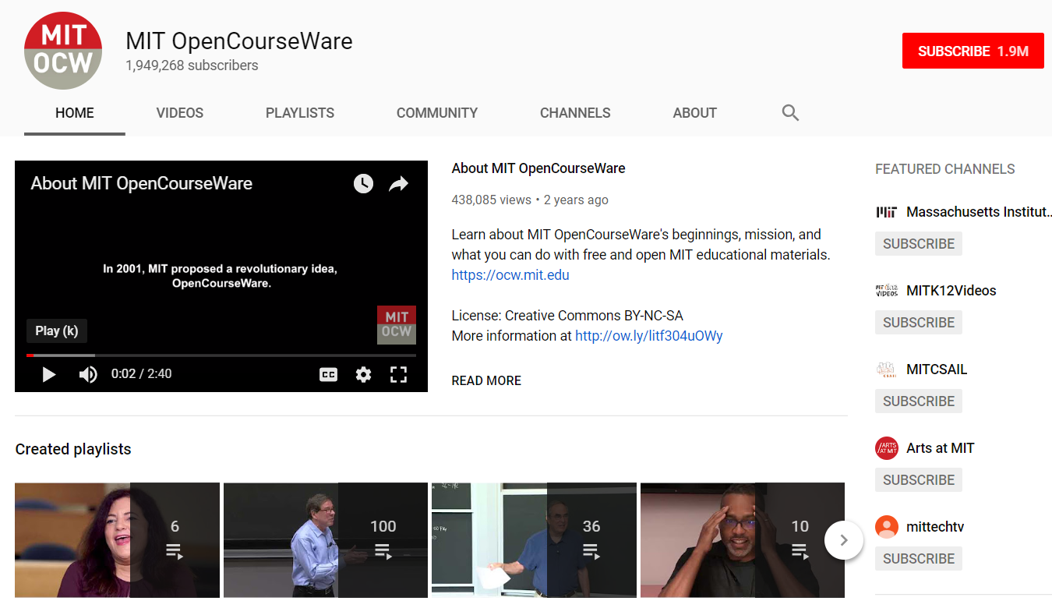
MIT OCW YouTube

Slide 19
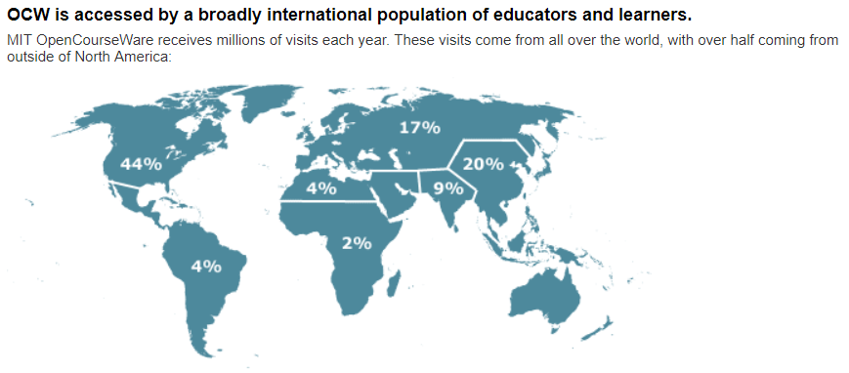
Research Background
  For the last two decades, MIT OCW are accessible for self-directed learners around the world to explore, learn, download, and share (Bonk, Lee, Kou, Xu, & Sheu, 2015)
  By December 2018, approximately 160 million users visited their website as well as YouTube videos (MIT OCW report, 2018)
Notes:
2001

Slide 20
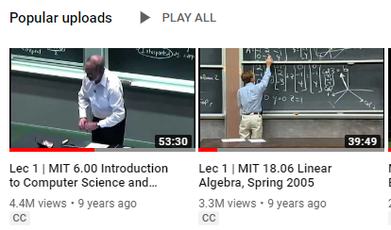
Research Background
  The most popular MIT OCW YouTube videos are related to STEM subjects such as computer science and algebra
  However, few studies have examined MIT OCW self-directed learners’ perceptions, learning experiences, and challenges.

Slide 21
Research Background
  Communities of Inquiry (CoI) (Garrison et al., 2000) research has shown that the framework provides an important conceptual perspective for examining communication and interaction (e.g., Akyol et al., 2009; Garrison et al., 2000) and learners’ perceived learning and satisfaction (Arbaugh, 2008) in online learning environments.
Notes:
Social presence describes relationships and the social climate in a learning community, which involves meaningful and trustful communication (Rourke, Anderson, Garrison, & Archer, 2007). It indicates the extent to which participants feel an affective connection to each other and is considered to be one of the important elements in a CoI (Garrison, Cleveland-Innes, & Fung, 2010). The extent of emotional expression, open communication, and group cohesion can indicate the level of social presence (Garrison et al., 2000).
Cognitive presence covers the learning phases from the initial practical inquiry to the eventual problem resolution. It indicates the extent to which online students construct knowledge and meaning through communication and thinking (Garrison, Anderson, & Archer, 2001).

Slide 22
Research Background
  CoI framework includes three interdependent dimensions, namely:
  social presence,
  cognitive presence, and
  teaching presence (Garrison et al., 2000).
Notes:
Social presence describes relationships and the social climate in a learning community, which involves meaningful and trustful communication (Rourke, Anderson, Garrison, & Archer, 2007). It indicates the extent to which participants feel an affective connection to each other and is considered to be one of the important elements in a CoI (Garrison, Cleveland-Innes, & Fung, 2010). The extent of emotional expression, open communication, and group cohesion can indicate the level of social presence (Garrison et al., 2000).
Cognitive presence covers the learning phases from the initial practical inquiry to the eventual problem resolution. It indicates the extent to which online students construct knowledge and meaning through communication and thinking (Garrison, Anderson, & Archer, 2001).

Slide 23
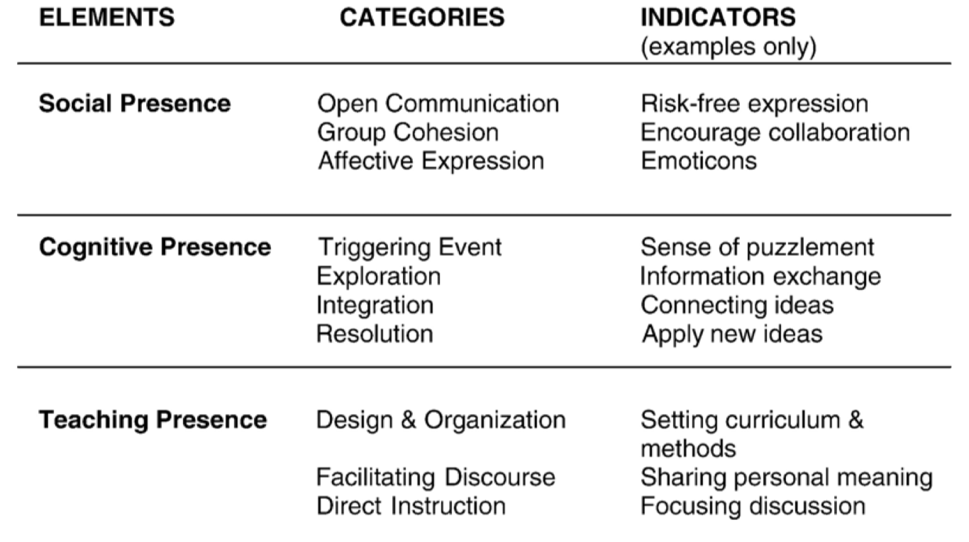
Research Background
Notes:
Social presence describes relationships and the social climate in a learning community, which involves meaningful and trustful communication (Rourke, Anderson, Garrison, & Archer, 2007). It indicates the extent to which participants feel an affective connection to each other and is considered to be one of the important elements in a CoI (Garrison, Cleveland-Innes, & Fung, 2010). The extent of emotional expression, open communication, and group cohesion can indicate the level of social presence (Garrison et al., 2000).
Cognitive presence covers the learning phases from the initial practical inquiry to the eventual problem resolution. It indicates the extent to which online students construct knowledge and meaning through communication and thinking (Garrison, Anderson, & Archer, 2001).

Slide 24
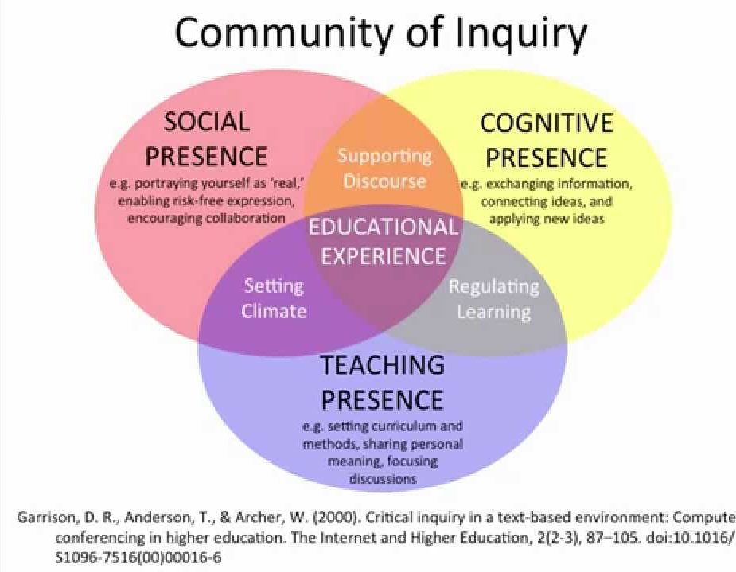
Research Background
Notes:
Social presence describes relationships and the social climate in a learning community, which involves meaningful and trustful communication (Rourke, Anderson, Garrison, & Archer, 2007). It indicates the extent to which participants feel an affective connection to each other and is considered to be one of the important elements in a CoI (Garrison, Cleveland-Innes, & Fung, 2010). The extent of emotional expression, open communication, and group cohesion can indicate the level of social presence (Garrison et al., 2000).
Cognitive presence covers the learning phases from the initial practical inquiry to the eventual problem resolution. It indicates the extent to which online students construct knowledge and meaning through communication and thinking (Garrison, Anderson, & Archer, 2001).

Slide 25
Research
Purpose and Questions

Slide 26
Research Purpose
  The purpose of this study was to inform OER designers and developers of the aspects to consider by uncovering learners’ perceptions, learning experiences, and challenges while learning STEM courses through MIT OCW YouTube videos using CoI framework.

Slide 27
Research Questions
  What were learners’ perceptions of the MIT OCW YouTube videos?
  How was social presence manifested in MIT OCW YouTube comments?
  How was cognitive presence manifested in MIT OCW YouTube comments?
  What are the challenges while learning in MIT OCW YouTube videos?

Slide 28
Research Design

Slide 29
Research Design
  This study used case study approach to empirically analyze persons, events, decisions, and projects in a real-life context (Thomas, 2011; Yin, 1994).
    MIT 6.00 Introduction to Computer Science and Programming with 23 videos
    MIT 18.06 Linear Algebra with 34 videos.
Notes:
Case study methodology can provide an in-depth and detailed examination of the situation and its contextual conditions.

Slide 30
Data Collections and Analysis
  Researchers collected all the comments of each video through NCapture for NVivo. The total number of comments for each course was around 3,000.
  Thematic analysis (Braun, Clarke, & Rance, 2014) and computer mediated discourse analysis (CMDA) (Herring, 2004) were used to analyze the data.
  For research questions (RQ) 1 and 4, researchers conducted thematic analysis. For RQs 2 and 3, both thematic analysis and CMDA were used.

Slide 31
Results

Slide 32
RQ1 Learners’ Perceptions of the MIT OCW YouTube videos
  MIT OCW learners from appreciated that MIT shared the free and high quality learning materials with the public
  MIT OCW saved a large amount of money for the learners reported in the comments. One participant stated that:
      I'm 16 and going to finish high school in a few months or so and God, I wish I could have gone to MIT. If only I had the money, ugh. But I am SO grateful that I get to see a glimpse of it at OpenCourseWare, at least. Thank so much for this, MIT.

Slide 33
RQ1 Learners’ Perceptions of the MIT OCW YouTube videos
  In addition, learners also appreciate the high quality courses below:
      I have been seeing many introduction to programming videos and this is by far the best one out there. Not only did it make me want to program more, it also wanted to make me want to stick to the skills. I'll hopefully learn. :) Good Job

Slide 34
RQ2 Social Presence
  Social presence in the YouTube comments was relatively low comparing to that in other social media. (Linguistic Inquiry and Word Count-LIWC)
Table 1. MIT 6.0 Introduction to Computer Science and Programming
Word frequency counts (values normalized per 100 words) ; Note: Lec refers to lecture video.
Items | Word count | 1st-pers. sg. pronouns | Social words | Positive emotions | Negative emotions | Cognitive process | Analytic | Clout | Authenticity | Emotional tone
Social |  | 5.51 | 9.71 | 4.57 | 2.1 | 10.77 | 55.92 | 55.45 | 55.66 | 63.35
Lec1 | 24977 | 4.44 | 7.59 | 4.38 | 1.07 | 12.05 | 58.57 | 54.76 | 33.51 | 84.23
Lec2 | 14542 | 3.51 | 7.24 | 3.95 | 1.06 | 13.11 | 57.15 | 50.61 | 28.34 | 78.65
Lec3 | 6694 | 3.94 | 7.19 | 4.11 | 1.48 | 13.12 | 60.75 | 49.34 | 28.45 | 74.70
Lec4 | 5125 | 2.61 | 5.99 | 3.14 | 1.58 | 13.03 | 58.04 | 46.41 | 22.41 | 55.18

Slide 35
RQ2 Social Presence
  Through thematic analysis, we found that OCW learners seldom expressed their personal emotions during learning. There were social interaction at the beginning of the course; however, the social interaction between learners decreased at the end of the course.

Slide 36
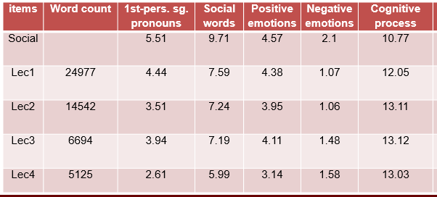
RQ3 Cognitive Presence
  Learners cognitive presence was highly manifested in the comments

Slide 37
RQ3 Cognitive Presence
  Learners mainly discussed learning content and knowledge in the comments. They tried to seek help for cognitive learning
    For example, one learner asked questions about the difficulties he/she encountered, “When trying to write the code at 32 mins. I get a syntax error on line 2. Why will this not work on my version of Python? x=15.”
    Similarly, another learner’s query was “When he is defining values, under numbers, under the number 3, is that a comma or a period? Is it float 3,14 or 3.14? Thanks.”

Slide 38
RQ4 Challenges
  Two general challenges were identified: (1) technology challenges and (2) social learning.
      For technology challenges, learners had trouble recognize the words on the screen due to the blurry video. One learner stated:
      I appreciated these videos but why they are so blurry. I am not able to figure out the things. Is there any alternative to these videos.

Slide 39
RQ4 Challenges
  Social learning
    Learners wanted to create a small team to learn specific topic. For instance, one learner said: “Looking for someone to study Computer Science with, anyone wanna team up? (Real responses please.)” Other learners replied to the post by saying, “Send me a PM” or “Everyone here wanting to Skype about CS, add me. I would like to hang out with people who want to learn coding too!”

Slide 40
Discussion and Conclusion

Slide 41
Recap of Findings
  Positive perceptions of free and high quality courses.
  Relatively low social presence comparing to that in general social media.
  Relatively high cognitive presence comparing to that in general social media.
  Technology challenges and social learning.

Slide 42
Discussion and Conclusions
  Can apply CoI framework to informal environment.
  OCW has a positive impact for self-directed learners (SDL) around the world.
  Even SDL learners seek community support.

Slide 43
Limitations
  Two courses from MIT OCW.
  STEM-related courses.
  One data source--YouTube comments.
  No direct observations or interviews.

Slide 44


Thank you!
Questions and Comments?
Meina Zhu | meinazhu@wayne.edu
Curtis J. Bonk | cjbonk@indiana.edu
Free Book: tec-variety.com/
Slides: http://www.trainingshare.com/
http://moocsbook.com/

