Slide 1


MOOCs and Open Education Around the World:
Recent News and Research Clues
Moodle MOOC #7, November 1, 2015 http://www.wiziq.com/online-class/3182476-mm7-moocs-and-open-education-around-the-world
Curt Bonk, Indiana University
cjbonk@indiana.edu

Slide 2

Fall 2014, On Wisconsin
MOOC, Meet MORC (Massive Open Radio Course)
WHA, UW Madison, College of the Air,1933,
Vocational Training dedicated to Agriculture, and later Home Economics and Typing

Slide 3

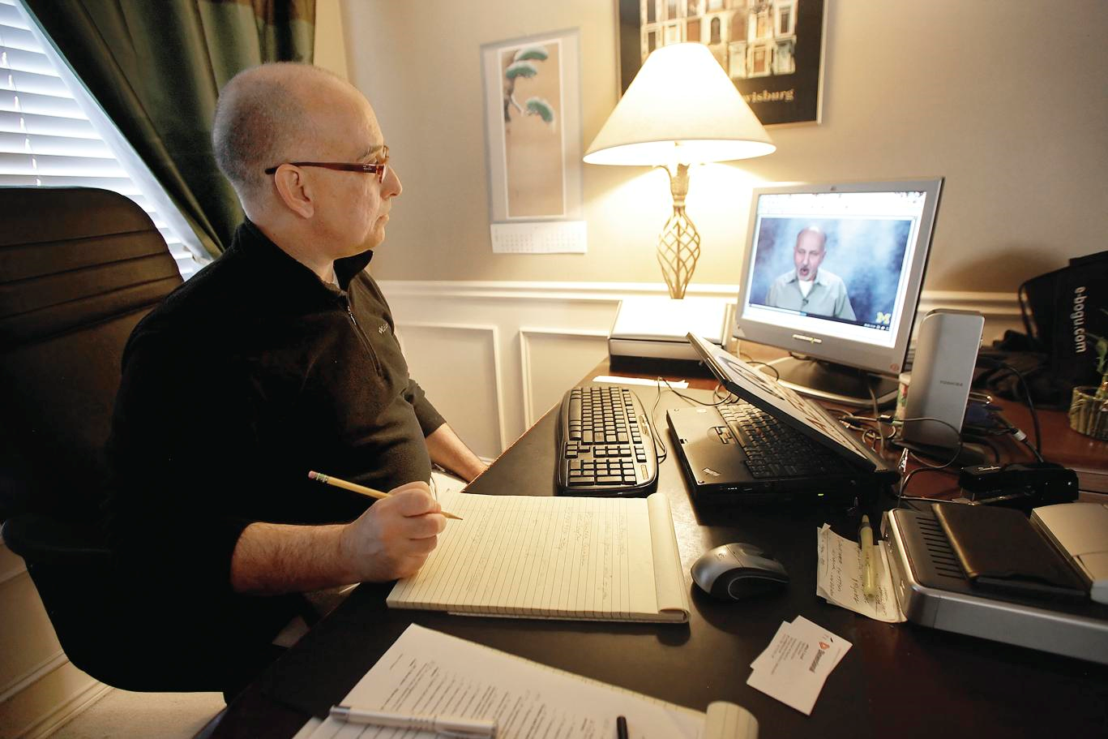
Enter the age of the MOOC…
Frank Basile, an aircraft technician, took an MITx course on circuits and electronics to increase his knowledge.
Joe Alfonso, a financial adviser from Oregon, is taking the online finance course as a "refresher."

Slide 4

Audience Poll #1:
Who in here has taken a MOOC?

Slide 5
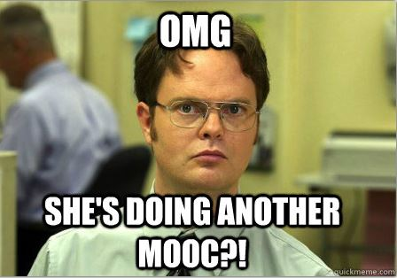
Jot down in the chat window the topic of MOOCs you have taken…

Slide 6
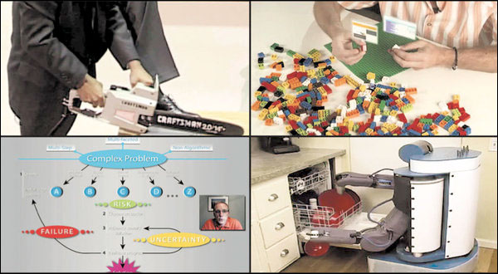

November 2, 2012
The Year of the MOOC,
New York Times, Laura Pappano, http://www.nytimes.com/2012/11/04/education/edlife/massive-open-online-courses-are-multiplying-at-a-rapid-pace.html?pagewanted=all
Clockwise, from top left: an online course in circuits and electronics with an M.I.T. professor (edX); statistics, Stanford (Udacity); machine learning, Stanford (Coursera); organic chemistry, University of Illinois, Urbana (Coursera).

Slide 7


June 19, 2013
2013 is “The Year of the Anti-MOOC”
George Siemens, UW-Madison Summit http://globalhighered.wordpress.com/european-moocs-in-global-context/

Slide 8
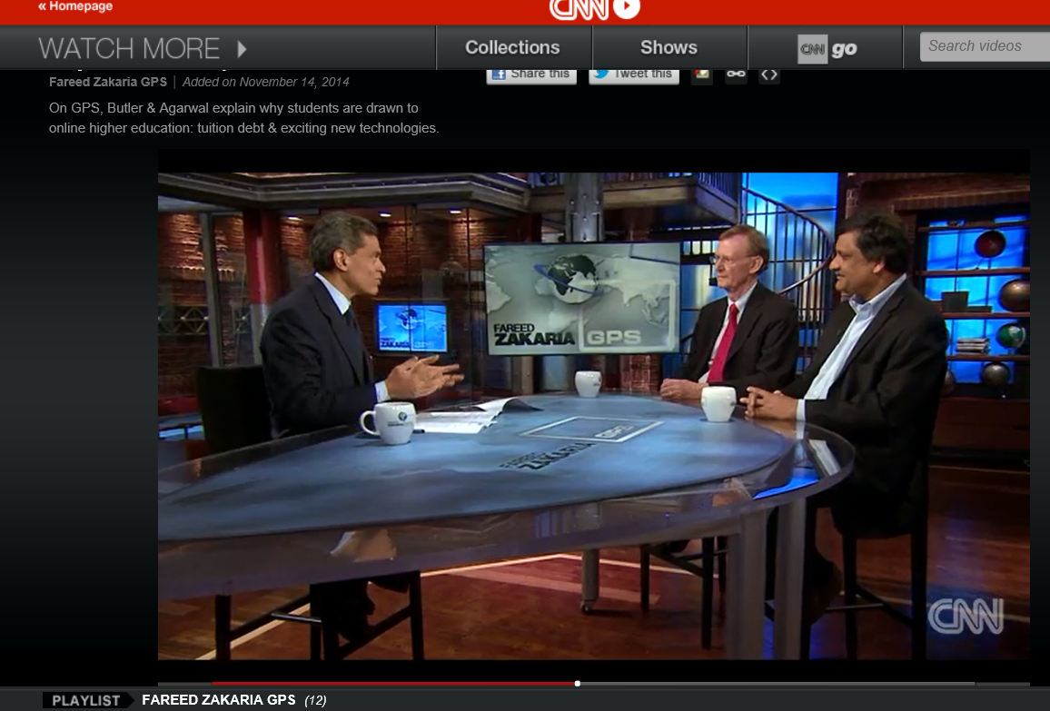
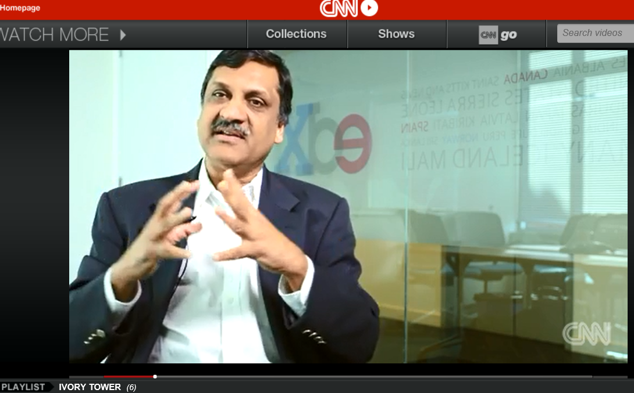
Poll #2: Are MOOCs Disruptive?
November 14, 2014 (2:25)
Why online ed disrupts the traditional model,
Fareed Zakaria GPS, CNN, On GPS, Stuart Butler & Anant Agarwal explain why students are drawn to online higher education: tuition debt & exciting new technologies http://www.cnn.com/video/data/2.0/video/bestoftv/2014/11/15/exp-gps-moocs-sot.cnn.html

Slide 9
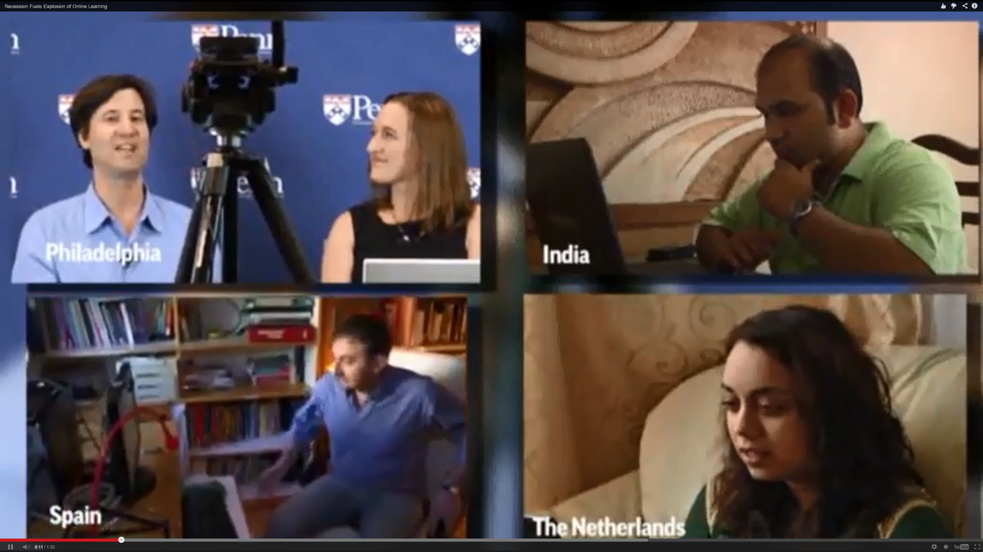
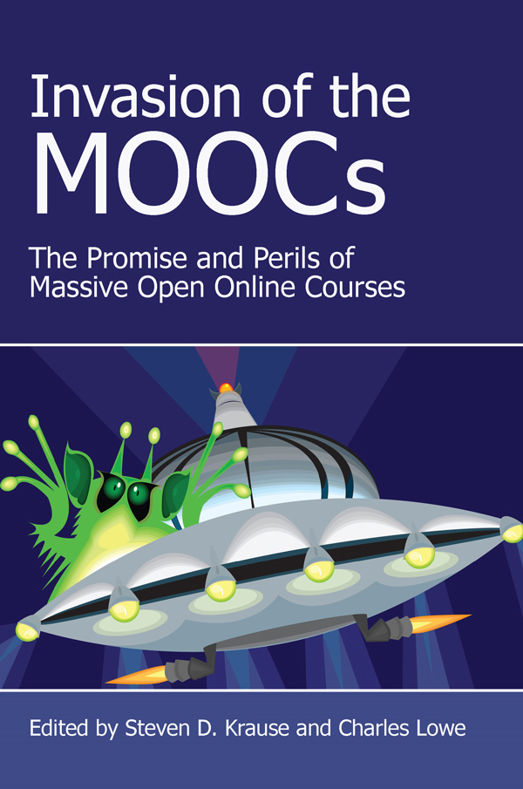
Poll #3: Do you have this free book?
The Invasion of the MOOCs: The Promise and Perils of Massive Open Online

Slide 10
August 30, 2015
Massive online courses grow; what's in it for the universities?, Kirk Pinho, Crain’s Detroit Business http://www.crainsdetroit.com/article/20150830/NEWS/308309998/massive-online-courses-grow-whats-in-it-for-the-universities
More than 3.25 million people took massive open online courses through the University of Michigan during the last three years — a figure equivalent to 76 percent of the metro Detroit population of 4.29 million.

Slide 11
August 30, 2015
Massive online courses grow; what's in it for the universities?, Kirk Pinho, Crain’s Detroit Business http://www.crainsdetroit.com/article/20150830/NEWS/308309998/massive-online-courses-grow-whats-in-it-for-the-universities
And all told, there have been between 16 million and 18 million people enrolled in MOOCs, about 2,500 of which had started or were scheduled to start as of July 2015, according to EdSurge Inc., an independent Burlingame, Calif.-based education technology information provider.
A typical MOOC enrollment level is around 25,000 students…

Slide 12
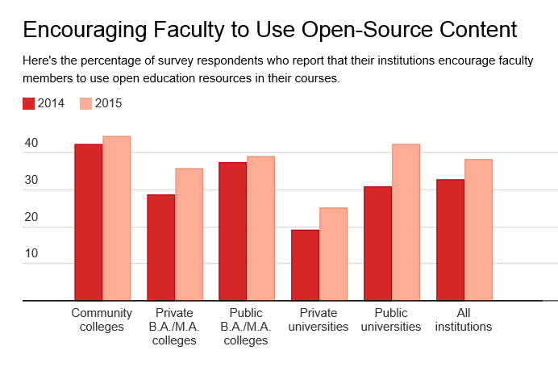
October 29, 2015
Campus Tech Leaders Report More Support for Free Educational Materials, Ellen Wexler, Chronicle of Higher Education http://chronicle.com/blogs/wiredcampus/campus-tech-leaders-report-more-support-for-free-educational-materials/57551?cid=at&utm_source=at&utm_medium=en&elq=e4e3f59aa76642fe887fb1ea8a5a4cee&elqCampaignId=1713&elqaid=6714&elqat=1&elqTrackId=e0e831d54b44442d93aff83de20111dd

Slide 13
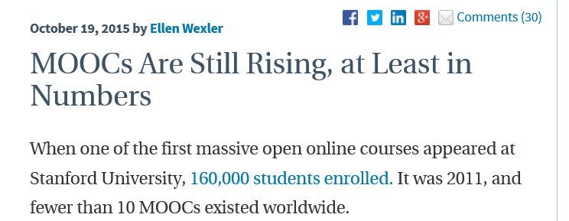
October 19, 2015
MOOCs Are Still Rising, at Least in Numbers,
Ellen Wexler, Chronicle of Higher Education http://chronicle.com/blogs/wiredcampus/moocs-are-still-rising-at-least-in-numbers/57527
The cumulative number of MOOCs didn’t break 100 until the end of 2012. But by the end of 2013 that number had grown to over 800. And today the number of registered MOOC students added in 2015 is nearly equal to the last three years combined.

Slide 14
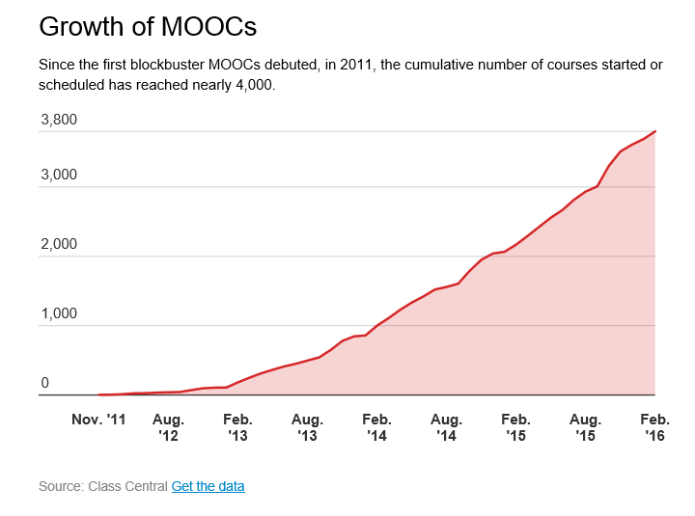
October 19, 2015
MOOCs Are Still Rising, at Least in Numbers,
Ellen Wexler, Chronicle of Higher Education http://chronicle.com/blogs/wiredcampus/moocs-are-still-rising-at-least-in-numbers/57527

Slide 15
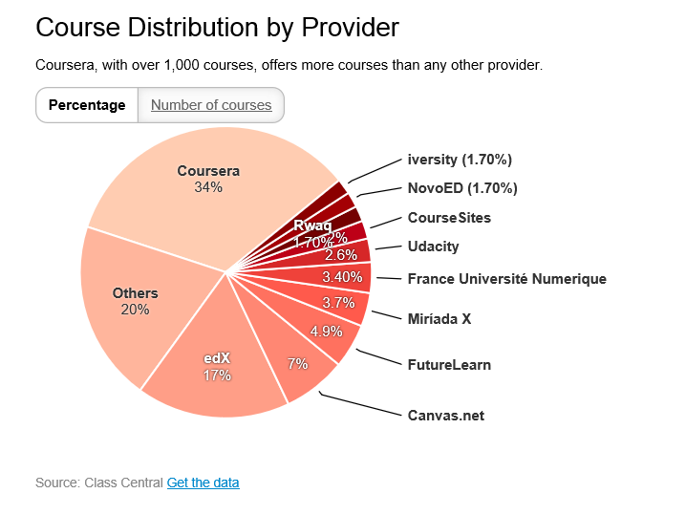
October 19, 2015
MOOCs Are Still Rising, at Least in Numbers,
Ellen Wexler, Chronicle of Higher Education http://chronicle.com/blogs/wiredcampus/moocs-are-still-rising-at-least-in-numbers/57527

Slide 16
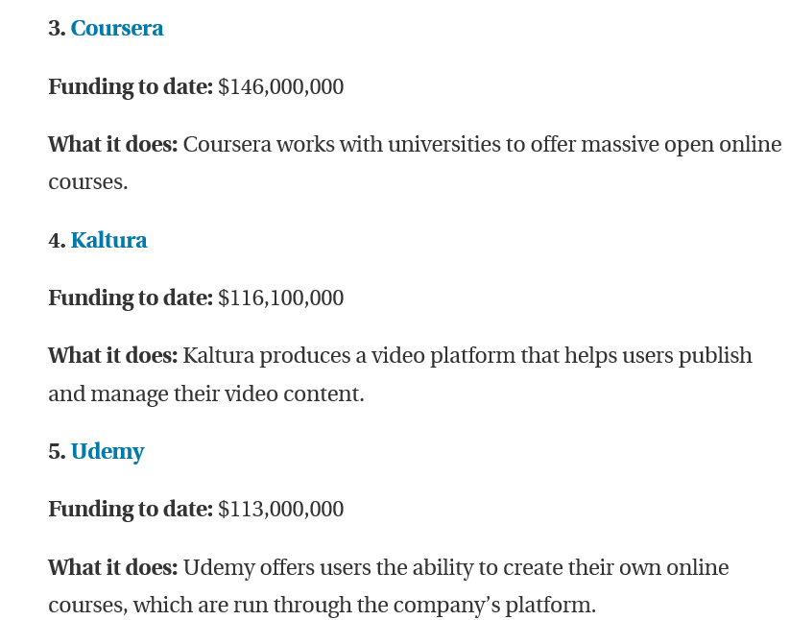
October 28, 2015
The 10 Ed-Tech Companies That Are Raising the Most Money (at a new high),
Ellen Wexler, Chronicle of Higher Education http://chronicle.com/article/The-10-Ed-Tech-Companies-That/233979?cid=at&utm_source=at&utm_medium=en&elq=e4e3f59aa76642fe887fb1ea8a5a4cee&elqCampaignId=1713&elqaid=6714&elqat=1&elqTrackId=89147eff5b0e4ea6acc74ddf74bcc70c

Slide 17
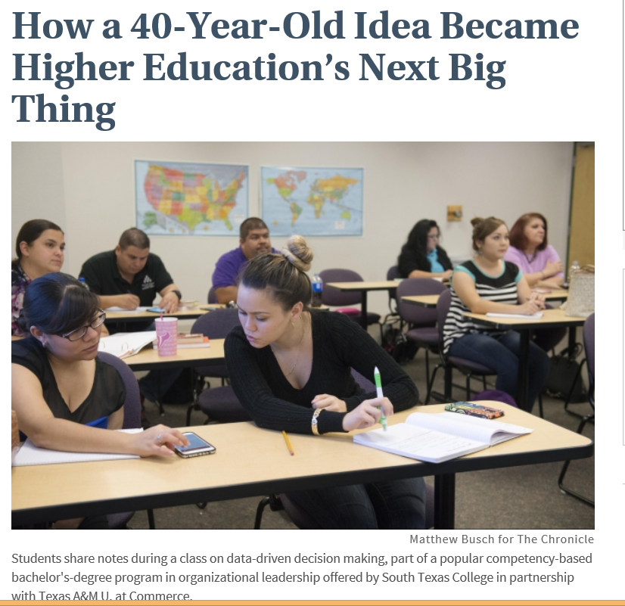
October 28, 2015
How a 40-Year-Old Idea Became Higher Education’s Next Big Thing,
Daniel Berrett, Chronicle of Higher Education http://chronicle.com/article/How-a-40-Year-Old-Idea-Became/233976?cid=trend_au&elq=62342a26bd944d5290bd6ce4a186a7fc&elqCampaignId=1718&elqaid=6721&elqat=1&elqTrackId=4c1c21b63d7b4da9b83bb5c5cb405dec

Slide 18
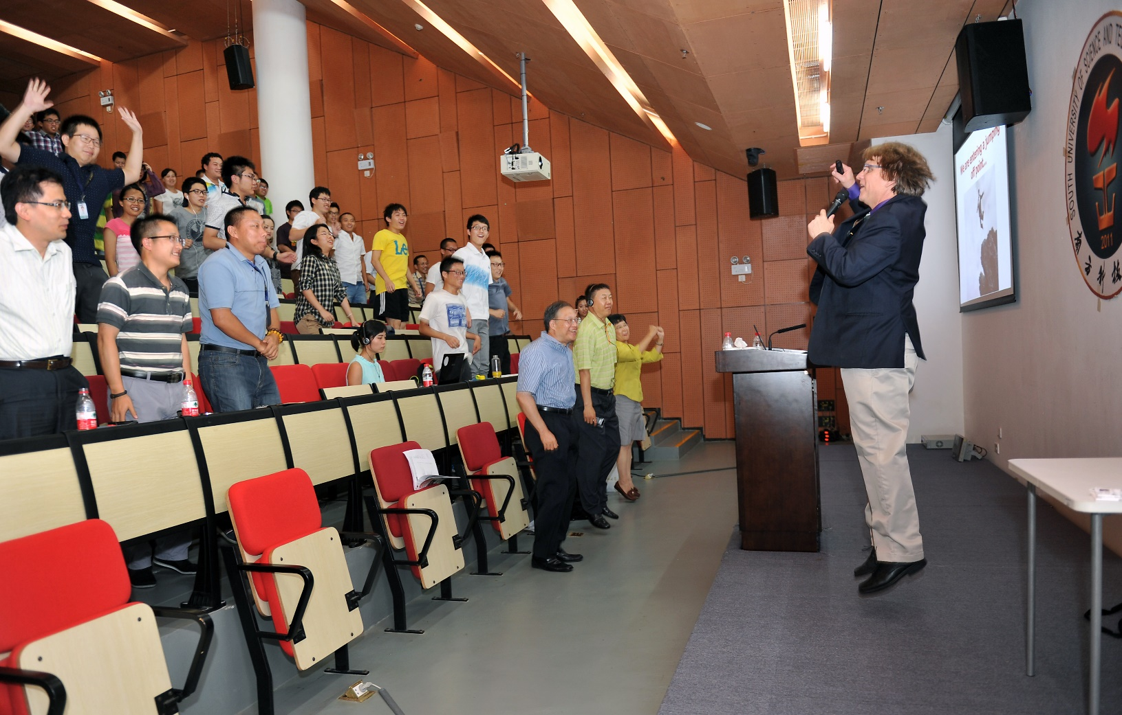
We are entering a jumping off point…
(South University of Science and Technology of China, Wednesday June 10, 2015)

Slide 19

Things are heating up! http://routledge-ny.com/books/details/9781138807419/

Slide 20

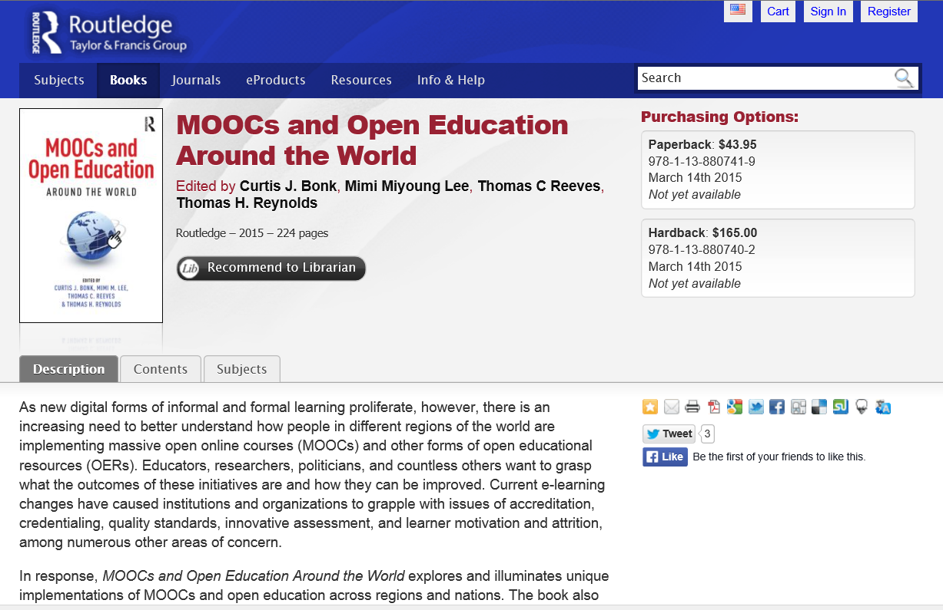



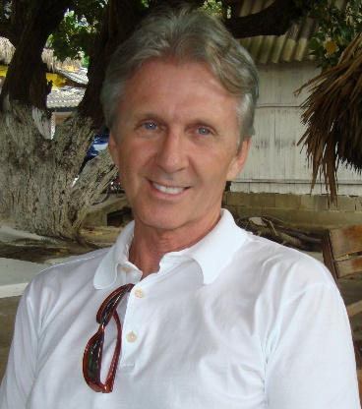
MOOCs and Open Education Around the World http://routledge-ny.com/books/details/9781138807419/

Slide 21
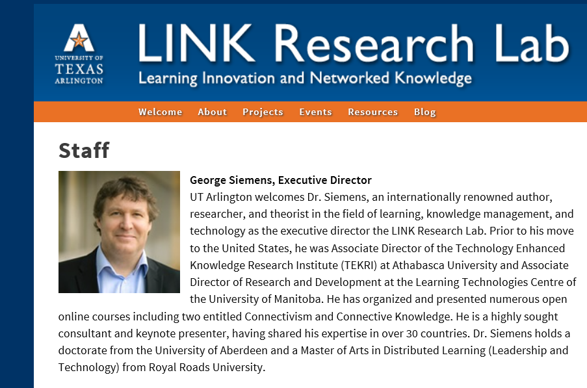
Foreword #1: Open(ing up) Education for All, Boosted by Moocs?
George Siemens, Executive Director of the Learning Innovation and Networked Knowledge Research Lab, University of Texas Arlington

Slide 22
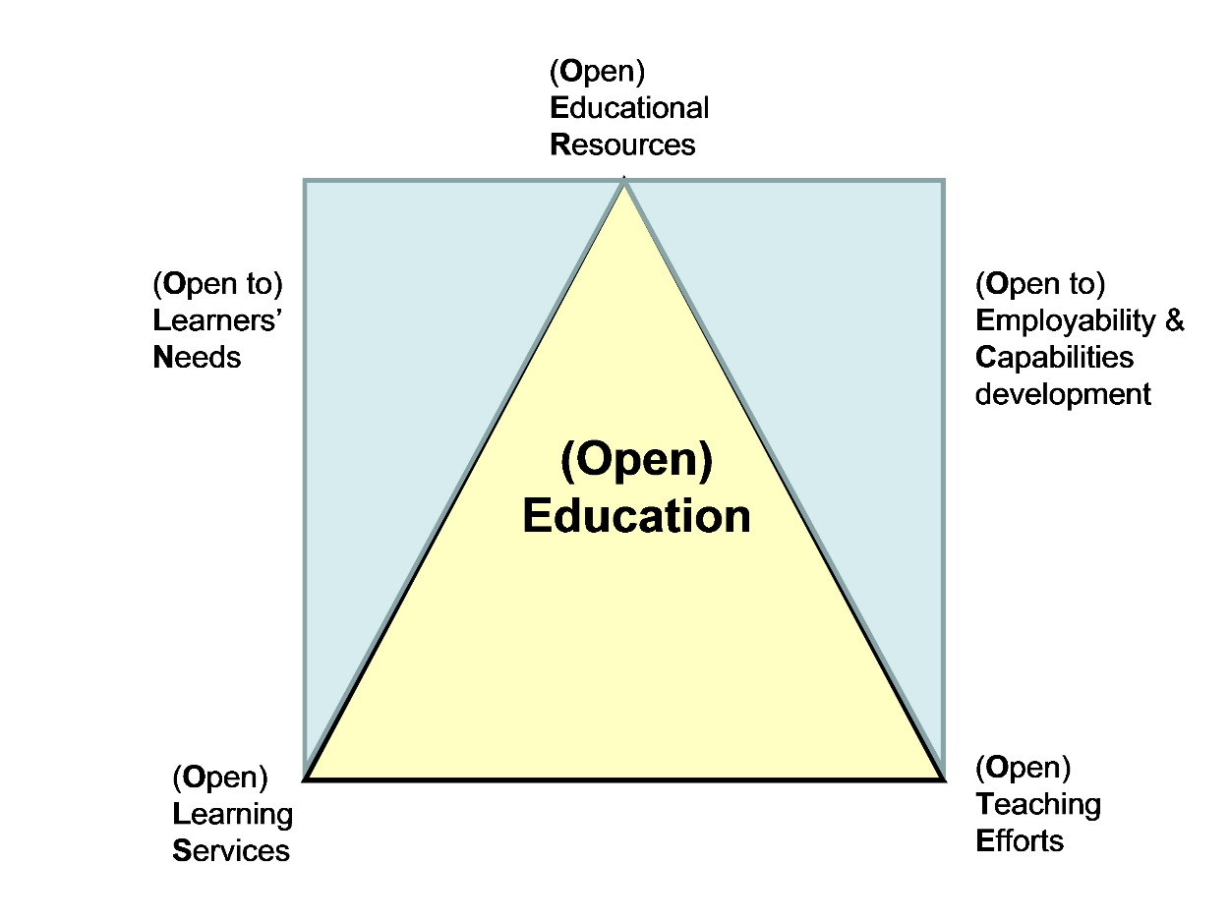
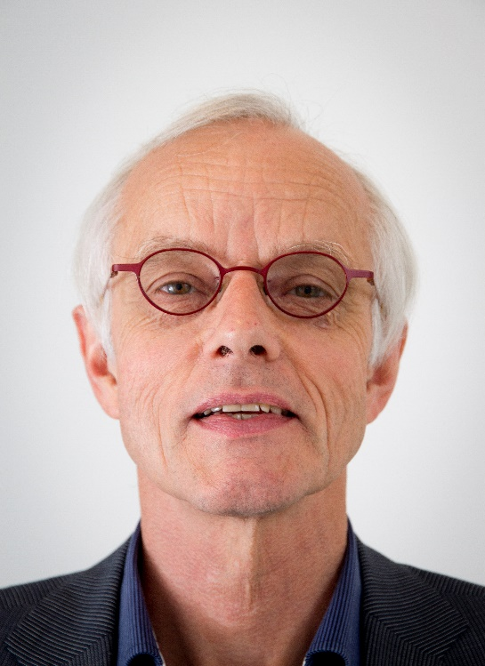
Foreword #2: Open(ing up) Education for All, Boosted by Moocs?
Fred Mulder, UNESCO Chair in Open Educational Resources at the Open University of the Netherlands

Slide 23
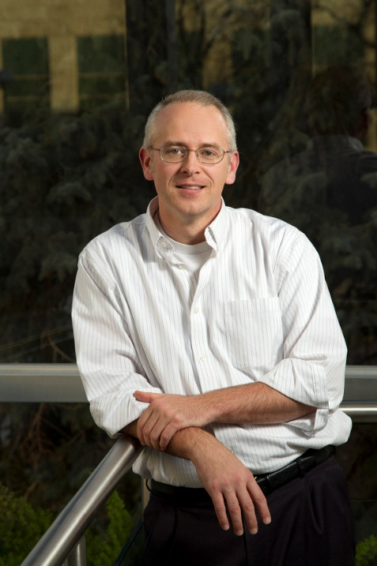
Chapter 1: The MOOC Misstep and the Open Education Infrastructure
David Wiley, Co-founder and Chief Academic Officer, Lumen Learning
The Open Education Infrastructure
A completely open education infrastructure, which can support extremely rapid, low cost experimentation and innovation, must be comprised of at least these four parts:
Open Credentials
Open Assessments
Open Educational Resources
Open Competencies

Slide 24

Chapter 2: The Single Canon:
MOOCs and Academic Colonization
Karen Head, PhD
The Georgia Institute of Technology
“If MOOC proponents truly seek to offer the best educational opportunities to the world, they will have to open these platforms to a wide variety of institutions and instructors. Expanded MOOCs that are entirely open could include a multitude of approaches and contexts, thereby exploding the notion of traditional canons in any discipline. Creating such expanded or open MOOCs could be one of the most important developments in pedagogical design.”

Slide 25

Chapter 3: MOOCs and Open Education in Japan:
A Case of the Open University of Japan
Kumiko Aoki, Ph.D., The Open University of Japan
“It is hoped that MOOCs will play a significant role for stakeholders in Japanese higher education in the near future. MOOCs and other forms of educational delivery that will emerge in the coming decades will help these individuals to realize that we now live in a vastly different era from when the dawn of distance learning in Japan back in 1950 as well as the start of the OUJ in 1983.”

Slide 26

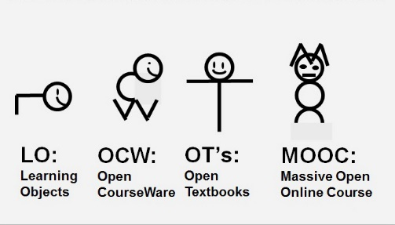
Chapter 4: MOOCs, MERLOT, and Open Educational Services
Gerard L. Hanley, Ph.D.
MERLOT Executive Director
Assistant Vice Chancellor, Academic Technology Services
California State University, Office of the Chancellor
Figure 1. MOOCs as a Recent Evolution of OER

Slide 27
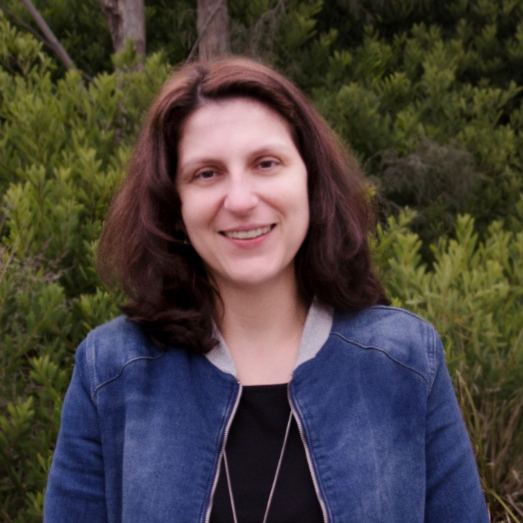
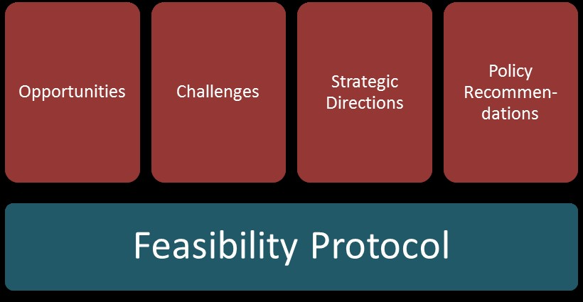
Chapter 5: Enabling Open Education: A Feasibility Protocol for Australian Higher Education
Dr Carina Bossu, University of Tasmania, Australia
Mr David Bull, University of Southern Queensland, Australia
Professor Mark Brown, Dublin City University, Ireland
Figure 5.1. Feasibility Protocol

Slide 28
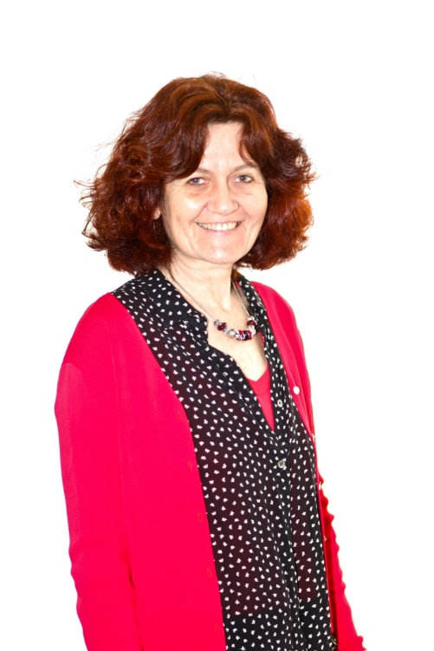
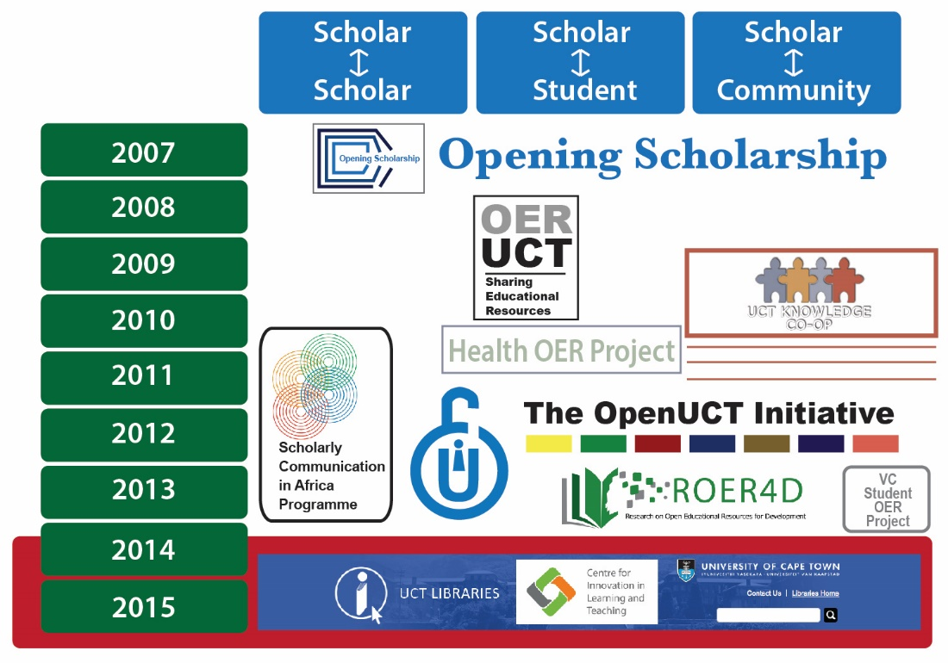
Chapter 6: Open Education at the University of Cape Town
Laura Czerniewicz, Glenda Cox, Cheryl Hodgkinson-Williams, and Michelle Willmers
Figure 3: The openness journey at the University of Cape Town (UCT)

Slide 29
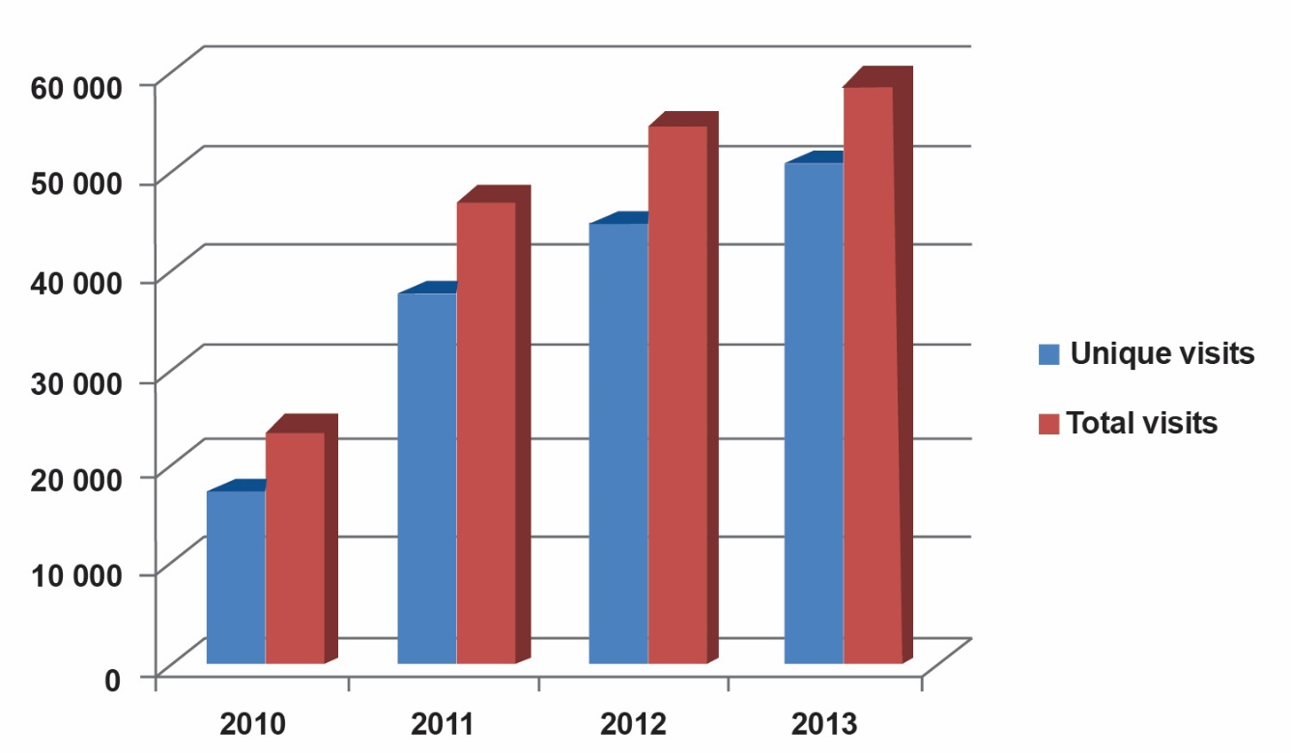
Chapter 6: Open Education at the University of Cape Town
Laura Czerniewicz, Glenda Cox, Cheryl Hodgkinson-Williams, and Michelle Willmers
Figure 3: Growth trajectory of visits to the OpenContent directory (2010-2013)

Slide 30

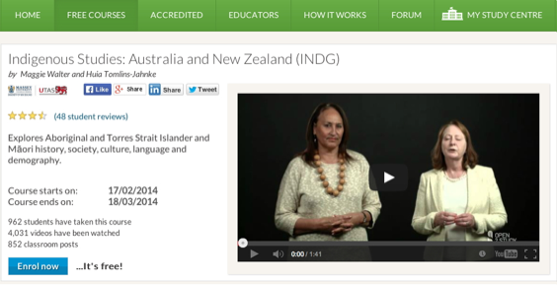
Chapter 8: MOOCs Downunder:
Insights from the Open2Study Experience
Maggie Hartnett, Mark Brown, and Amy Wilson
Massey University, Dublin City University, and Massey University
Figure 3: Example of the Indigenous Studies subject

Slide 31
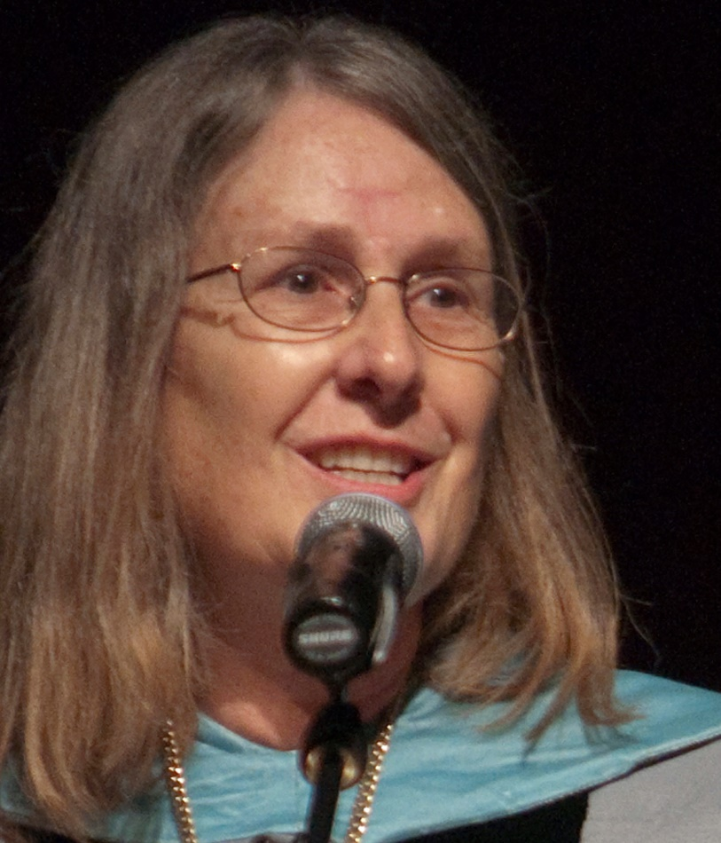
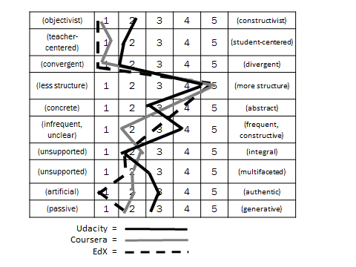
Chapter 10: MOOC Pedagogy
AMP: A Tool for Characterizing the Pedagogical Approaches of MOOCs
Karen Swan, Scott Day, Leonard Bogle, and Traci van Prooyen
University of Illinois Springfield
Figure 3. Ratings Metaphors

Slide 32

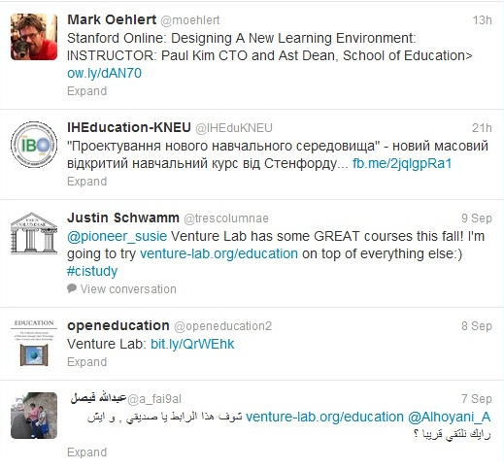
Chapter 14: Creating a Temporary Spontaneous Mini-Ecosystem through a MOOC
Paul Kim and Charlie Chung, Stanford University
Figure 2. Twitter thread announcing the MOOC

Slide 33
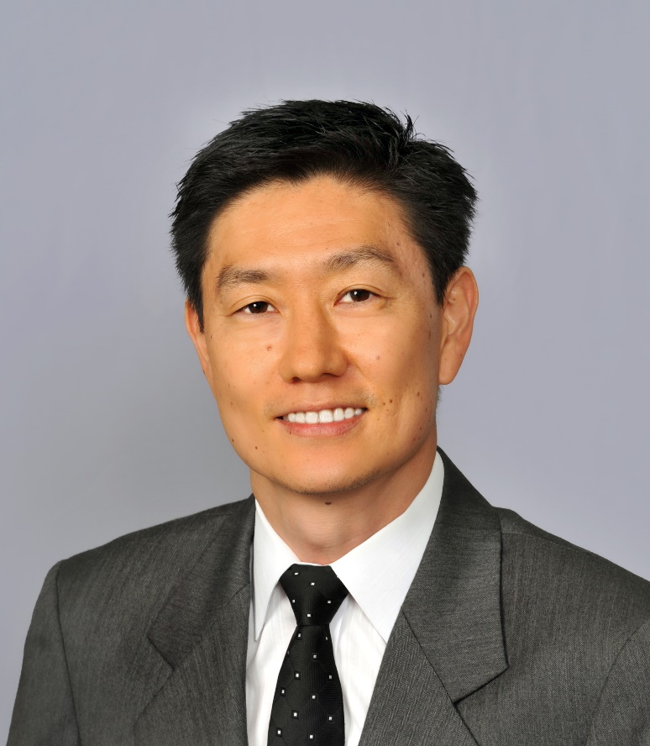
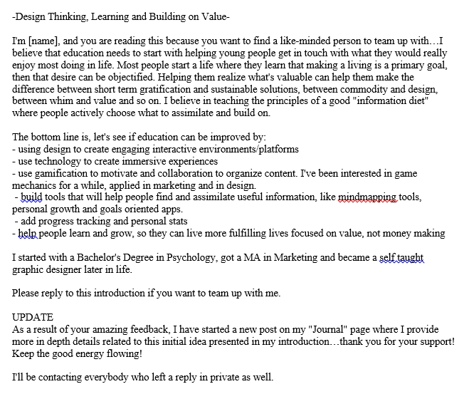
Chapter 14: Creating a Temporary Spontaneous Mini-Ecosystem through a MOOC
Paul Kim and Charlie Chung, Stanford University
Figure 2. Group solicitation message from a DNLE MOOC participant

Slide 34
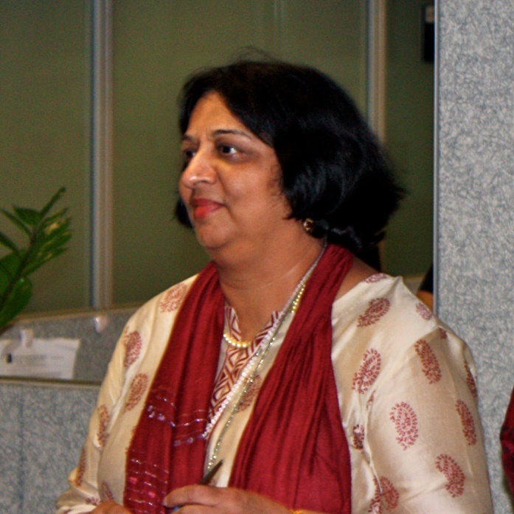

Chapter 19: Harnessing the Power of Open Learning to Share Global Prosperity and Eradicate Poverty
Sheila Jagannathan, World Bank, Washington DC
Figure 1: World Bank Group Twin Goals

Slide 35
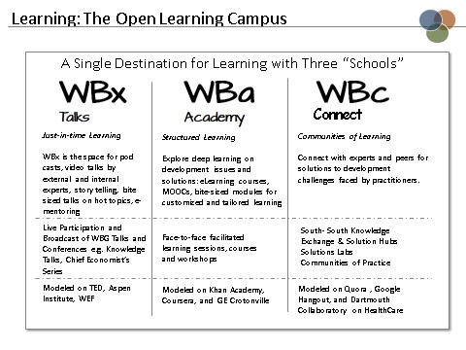

Chapter 19: Harnessing the Power of Open Learning to Share Global Prosperity and Eradicate Poverty
Sheila Jagannathan, World Bank, Washington DC
Figure 7: Open Learning Campus Structure

Slide 36
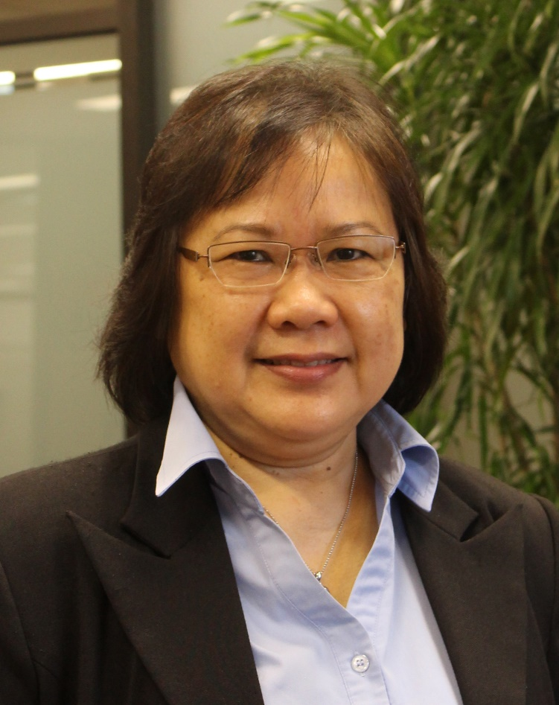
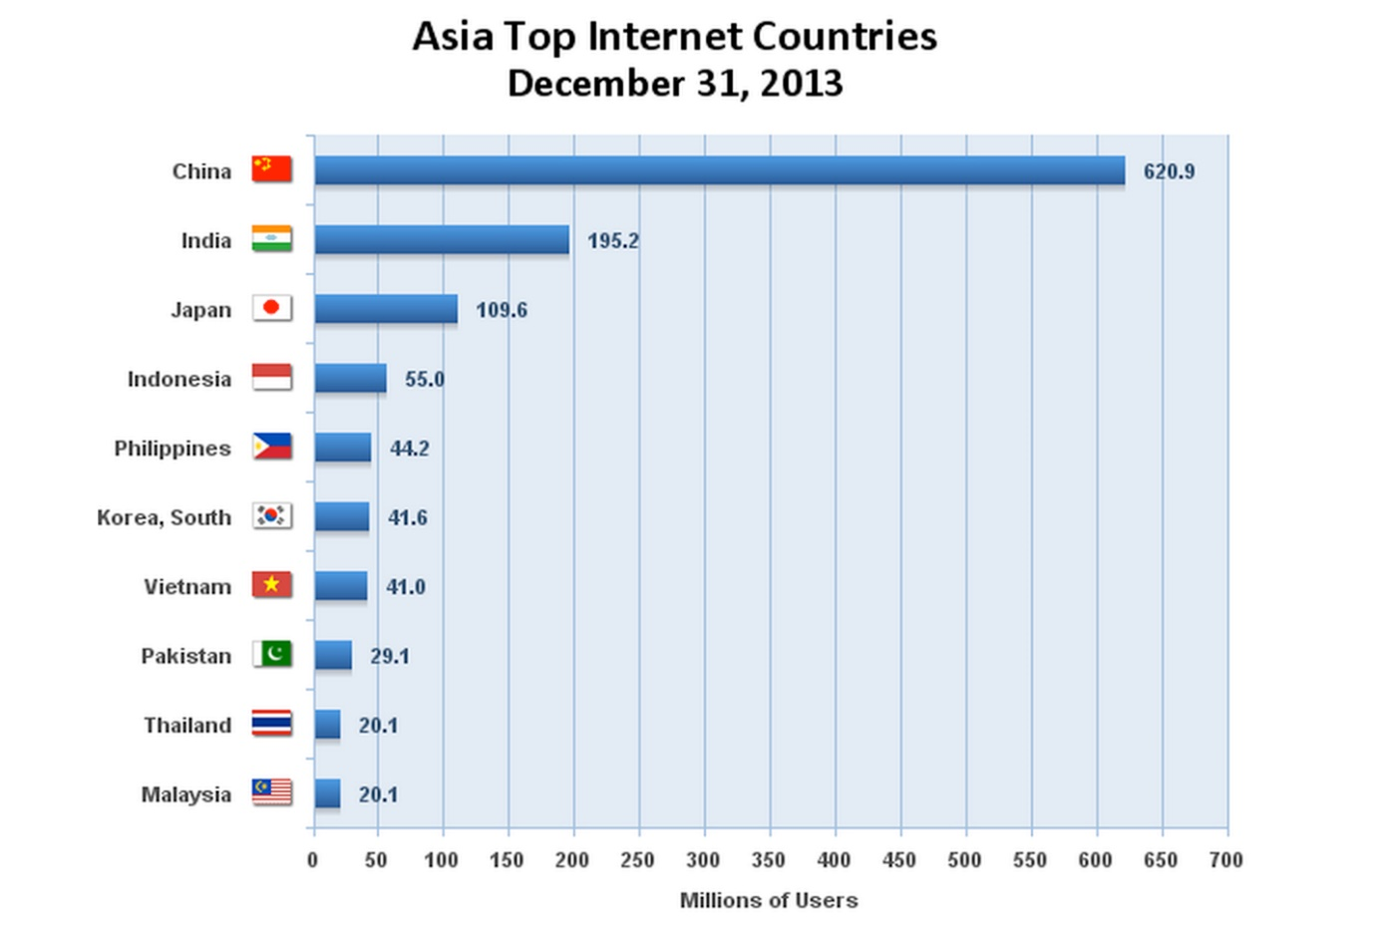
Chapter 20: The Glocalization of MOOCs in Southeast Asia
Zoraini Wati Abas, Ed.D.
Figure 1. Asia’s Top Ten Internet Countries

Slide 37

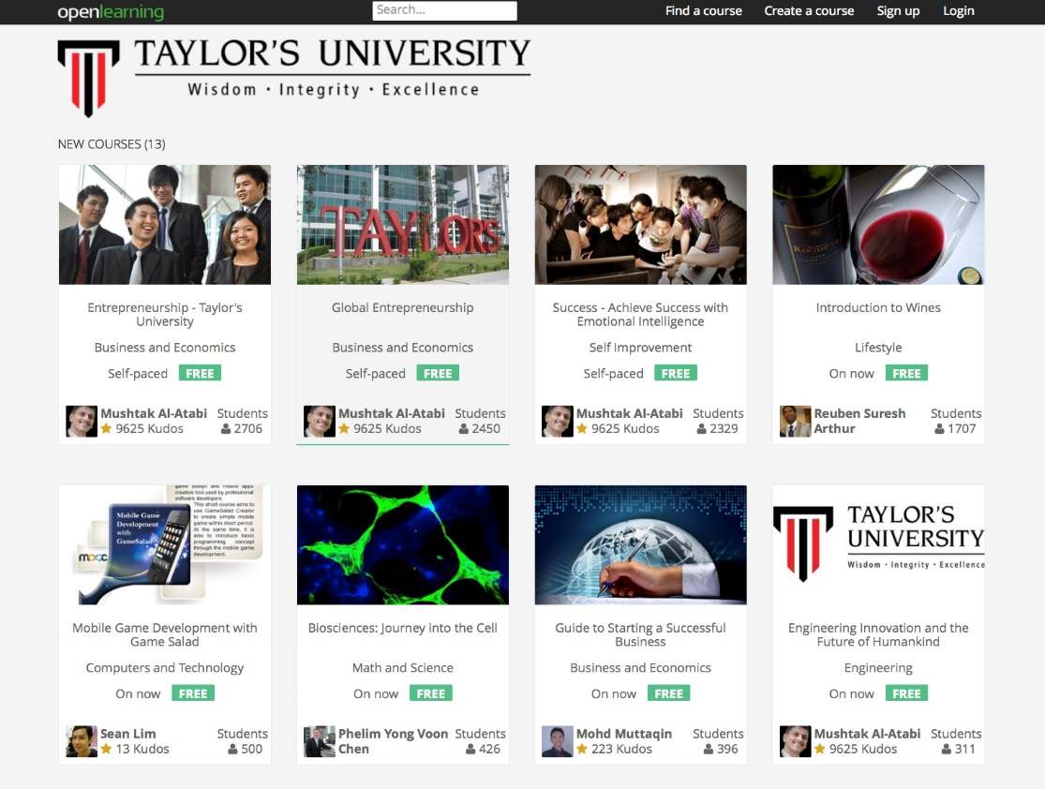
Chapter 20: The Glocalization of MOOCs in Southeast Asia
Zoraini Wati Abas, Ed.D.
Figure 2. Eight of thirteen MOOCs offered by Taylor’s University

Slide 38
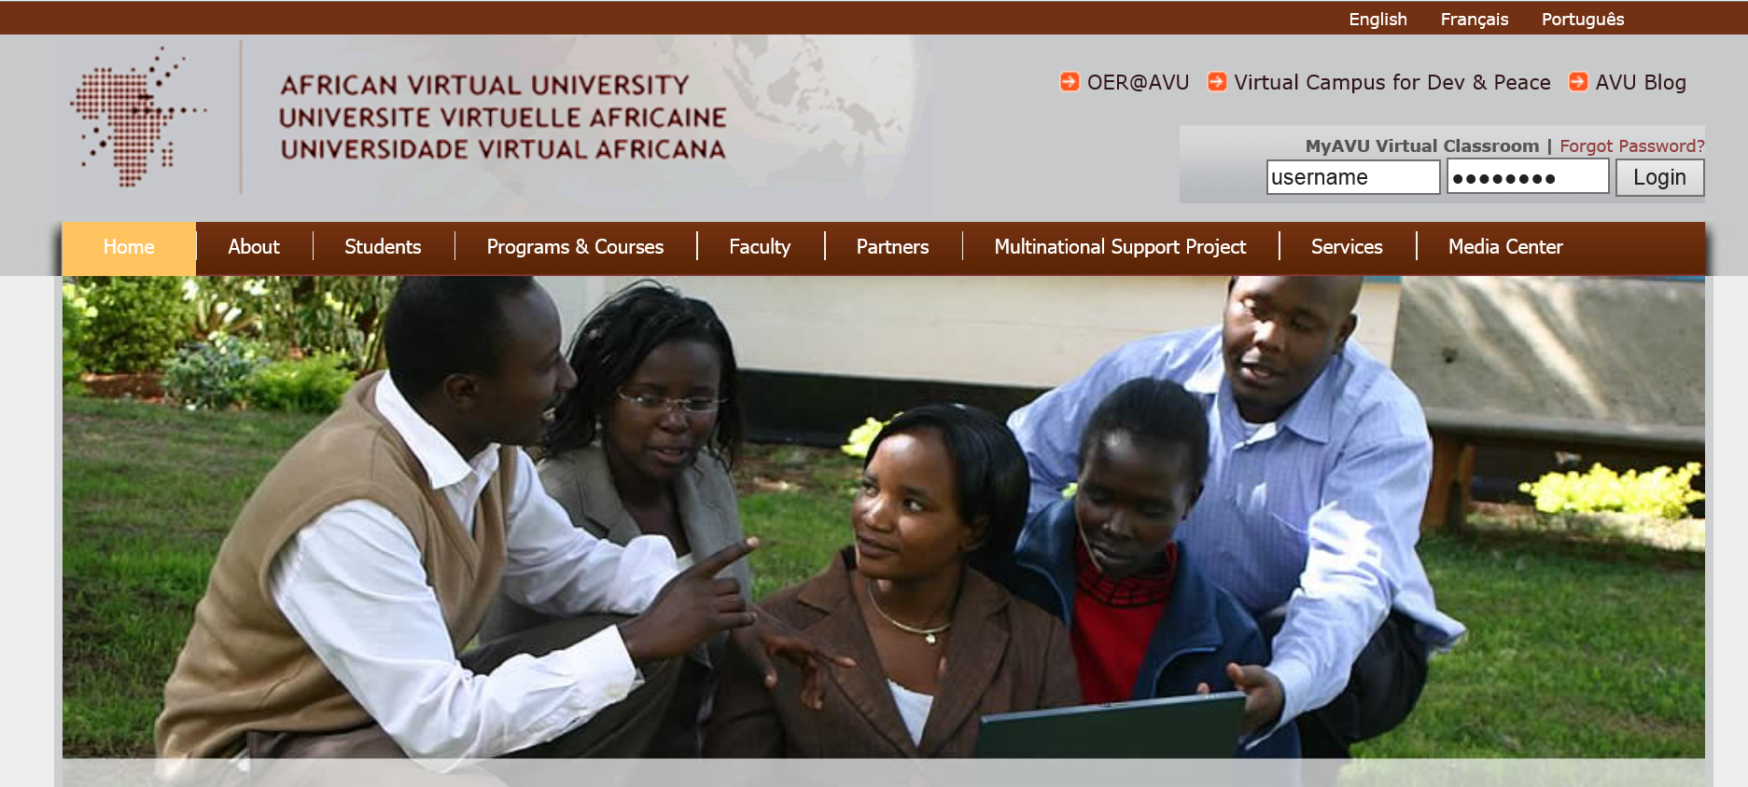
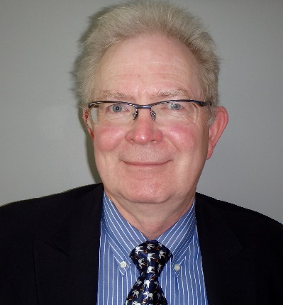
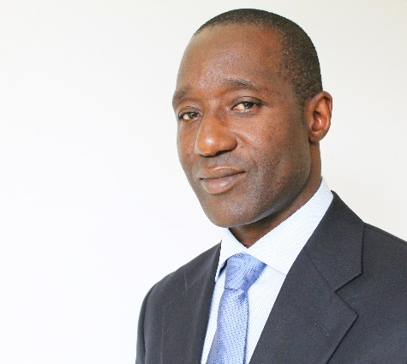
Chapter 22: OER and MOOCs in Africa: The AVU Experience
Griff Richards and Bakary Diallo,
African Virtual University, Nairobi, Kenya
It is estimated that only 6% of Africans can access post-secondary education. The development goal is set at 12% even though North America and Europe are somewhere around 45%. The gap is huge. This is not to say that African nations are not investing in post-secondary education. For example, Nigeria has been steadily building universities during the past couple of decades.

Slide 39
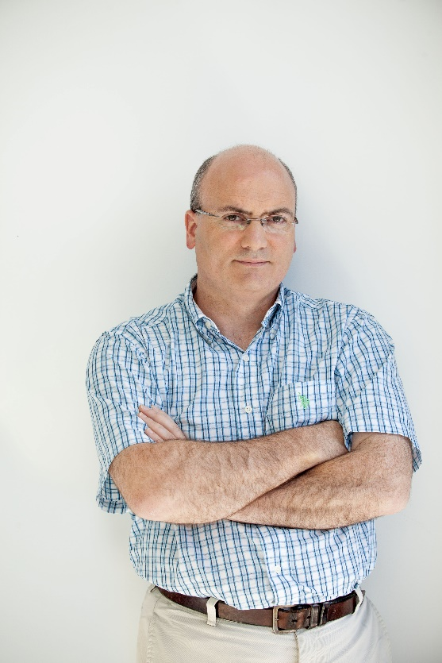

Chapter 24: ALISON: A New World of Free Certified Learning
Mike Feerick, CEO & Founder, ALISON

Slide 40

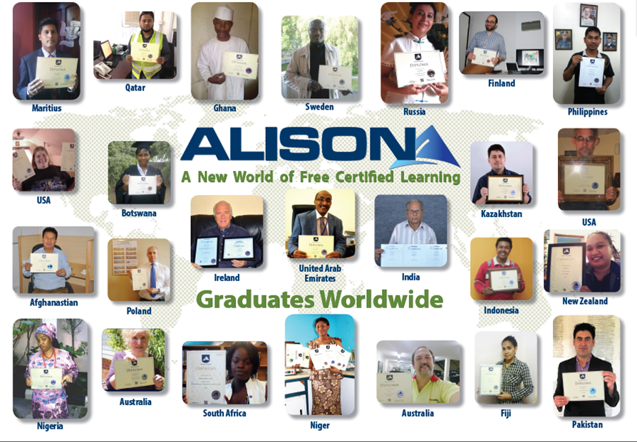
Chapter 24: ALISON: A New World of Free Certified Learning
Mike Feerick, CEO & Founder, ALISON

Slide 41
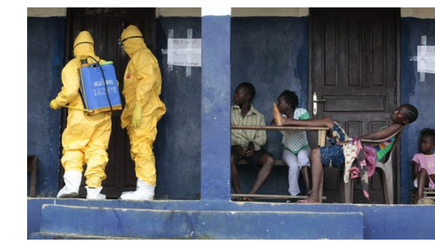
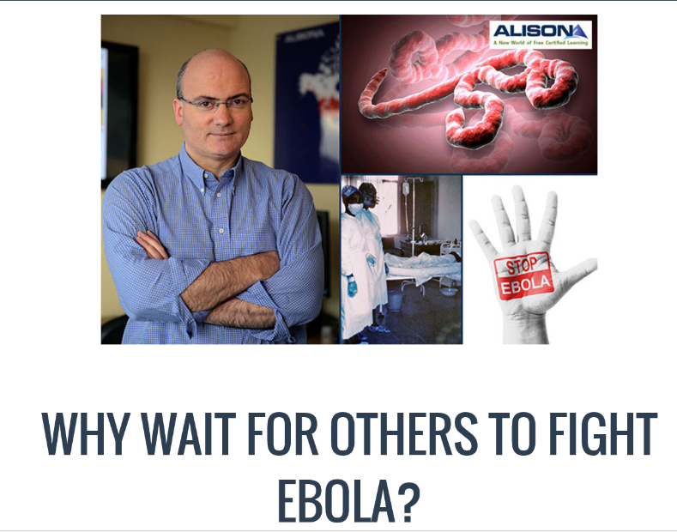
October 7, 2014
ALISON: Global Health Initiatives
Online Mooc courses deliver Ebola health advice, BBC News, Sean Coughlan http://www.bbc.com/news/education-29521360 http://www.advancelearning.com/why-wait-for-others-to-fight-ebola
Disinfecting a room in Monrovia, Liberia: Online courses are providing health advice to fight Ebola.

Slide 42
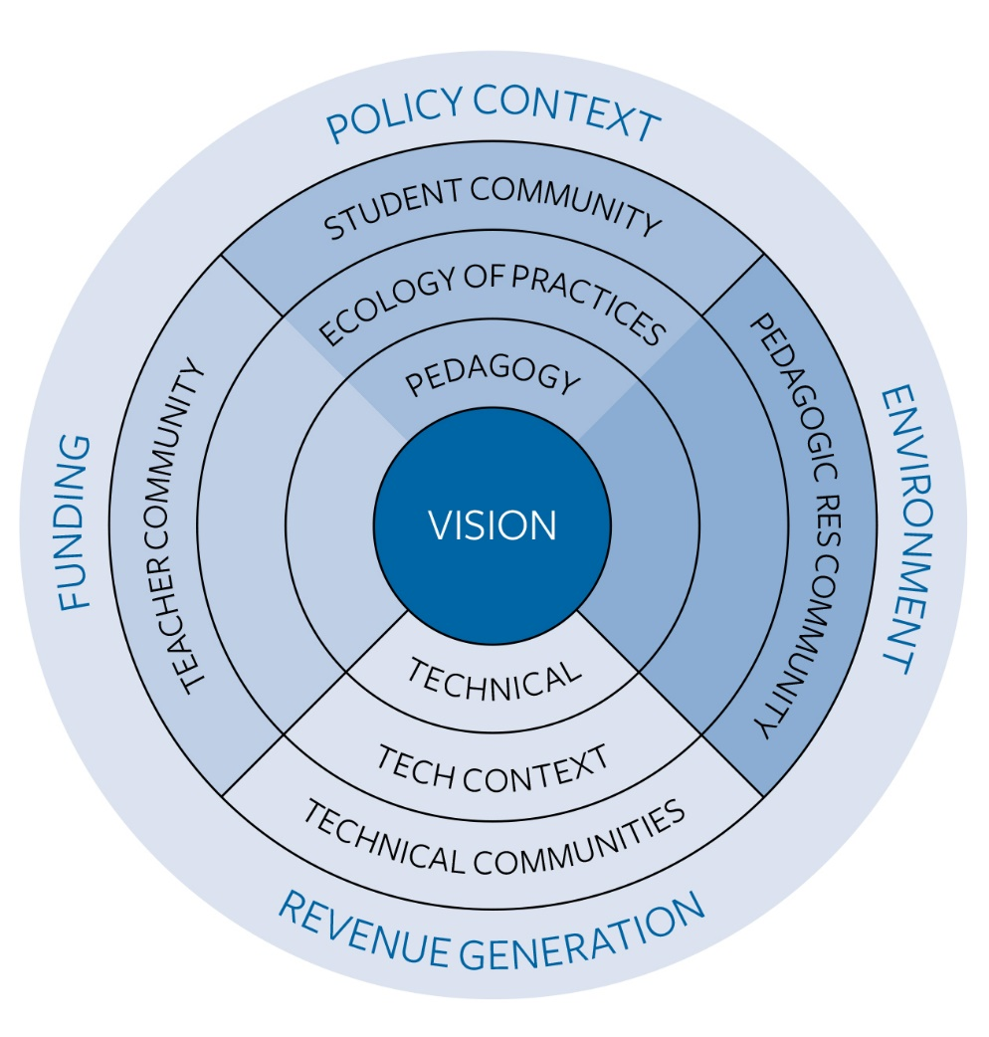
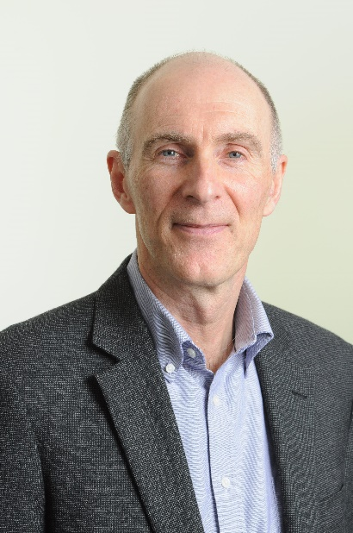
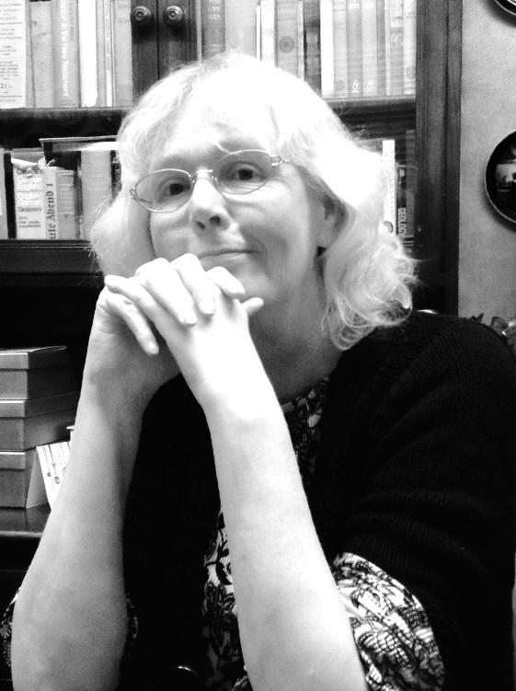
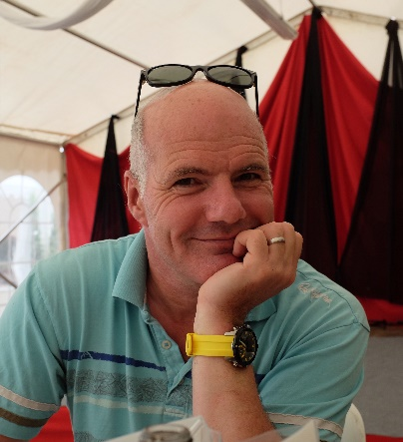
Chapter 28: MOOCs 2030:
A Future for Massive Online Learning
Rebecca Ferguson, Mike Sharples (The Open University, UK), Russell Beale (University of Birmingham)
Figure 1. The Beyond Prototypes Models of the TEL Complex

Slide 43
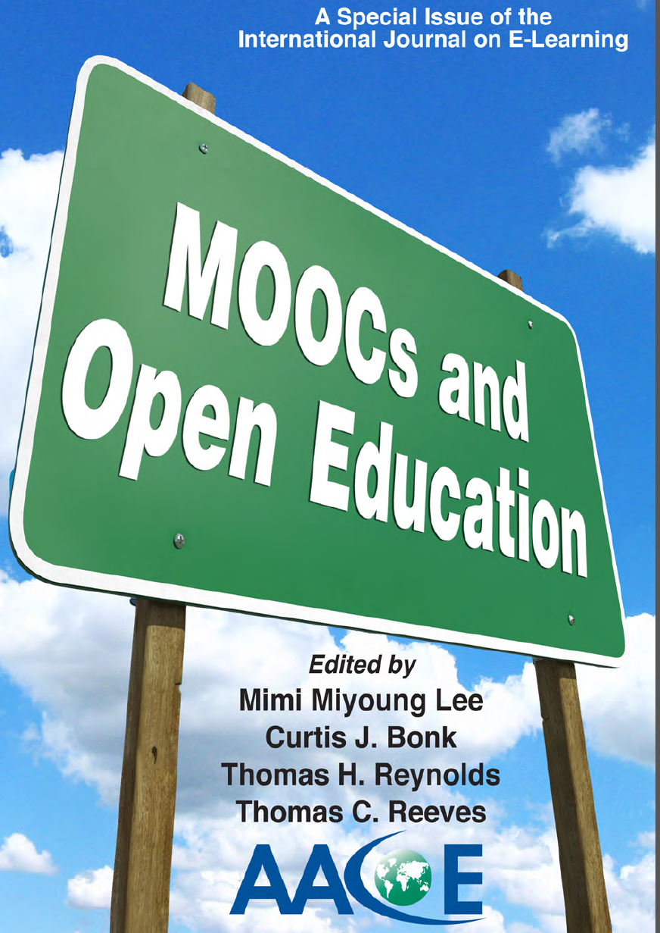

Slide 44
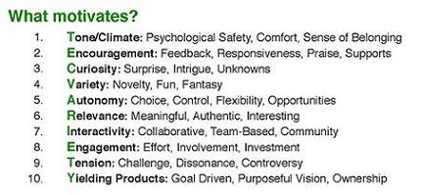


Want something FREE?
Introducing the “TEC-VARIETY” book…(Framework #1) http://tec-variety.com/

Slide 45

Question #1.
"What are the problems that MOOCs and OER are supposed to address?" or "Are MOOCs and OER "solutions" in search of problems?"
(Note: Put ideas in the chat window.)

Slide 46

30+ Sample MOOC Research Topics

Slide 47

May 2013
Research Topic #1.
Dropout (i.e., retention) Concerns
MOOCs @ Edinburgh 2013– Report #1

Slide 48

Audience Poll #4:
Have you ever dropped a MOOC?
Have you ever completed a MOOC?

Slide 49

May 2013
Research Topic #2.
MOOC Motivators
MOOCs @ Edinburgh 2013– Report #1

Slide 50

June 13, 2014
Research Topic #3.
Learner Engagement with Content
8 Things You Should Know About MOOCs
Chronicle of Higher Education, Jonah Newman and Soo Oh http://chronicle.com/article/MOOCs-EdX/146901/

Slide 51

April 17, 2014
Research Topic #4.
Impact of MOOCs Across Age, Gender, and Course Type

Slide 52

April 21, 2014
Research Topic #6. Benefits of MOOCs for Disadvantaged and Underprivileged
The Revolution Is Not Being MOOC-ized, Students are educated, employed, and male.
Gayle Christensen and Brandon Alcorn, UPenn, New Scientist http://www.slate.com/articles/health_and_science/new_scientist/2014/03/mooc_survey_students_of_free_online_courses_are_educated_employed_and_male.html
Filipino youths go online at an Internet café in Manila on Feb. 18, 2014. Two-thirds of Coursera participants come from the developed world, according to a new report.

Slide 53

June 12, 2014
Research Topic #7. Assessment and Credentialing Issues
Will a degree made up of Moocs ever be worth the paper it's written on?
The University of the People can now hand out degrees to its online students – but will employers take them seriously?, Louise Tickle The Guardian http://www.theguardian.com/higher-education-network/blog/2014/jun/12/moocs-viable-alternative-traditional-degree
Moocs can offer a lot, but they don't offer the feedback of a traditional degree.

Slide 54

May 31, 2014
Research Topic #8.
Localization of Content ocMOOCs and hMOOCs
Revolutionizing online education
Professor creates courses tailored to cultural differences,
Korea JoongAng Daily, KIM BONG-MOON [bongmoon@joongang.co.kr] http://koreajoongangdaily.joins.com/news/article/article.aspx?aid=2989930&cloc=joongangdaily%7Chome%7Cnewslist1
Professor Auh Yoon-il of Kyung Hee Cyber University explains the upcoming Kyung Hee MOOC 2.0 in an interview with the Korea JoongAng Daily at Kyung Hee University on Wednesday. (“one culture” or ocMOOCs and hMOOCs)

Slide 55




Research Topic #9.
Functioning of Translation Teams
Learning from Localized OER and OCW
(e.g., Opensource Opencourseware Prototype System (OOPS), Lucifer Chu, Janitor of OOPS)

Slide 56





January 27, 2014
Research Topic #10.
Various Geo-Political Issues
Coursera Support Center, Why is my country blocked? http://help.coursera.org/customer/portal/articles/1425714-why-is-my-country-blocked-
Online education platform Coursera blocks students in Syria and Iran, Wamba, Nina Curley http://www.wamda.com/2014/01/coursera-blocks-syria-and-iran-moocs-online-courses

Slide 57

May 27, 2015
Research Topic #11.
MOOC Participant Study Strategies
The Invisible Learners Taking MOOCs,
George Veletsianos, Inside Higher Ed https://www.insidehighered.com/blogs/higher-ed-beta/invisible-learners-taking-moocs

Slide 58


October 1, 2012: MOOC Students
MOOC Learner Study Strategies
4 Massive Open Online Courses and How They Work, Ben Gose, Chronicle of HE http://chronicle.com/blogs/techtherapy/2012/10/03/episode-99-what-wearable-computers-could-mean-for-campuses/
Krissa Swain, of Knoxville, Tenn., is taking "Operations Management" online to help develop her management skills.
Rajeev Bajpai, an airline pilot based in Mumbai, took an online computer-science course to gain programming skills.

Slide 59


April 30, 2014
Research Topic #12. Impact of Blending FTF Sessions with Online MOOCs
New Learning Hubs Locations Hosted by The New York Public Library and Seven Other Int’l Partners, Coursera Learning Hubs https://www.coursera.org/about/programs/learningHubs http://blog.coursera.org/post/84322385012/new-learning-hubs-locations-hosted-by-the-new-york

Slide 60


Research Topic #13.
Learning for Enjoyment vs. Credentials and Badges

Slide 61

Learning for Enjoyment Versus Credentials and Badges
“Just play around with ideas for alternatives to printed texts and don't be afraid to create your own, even if they're amateurish…I think we need to de-emphasise formal assessment and accreditation and encourage our playful side to see what is possible. Too much informal learning wants to get itself 'badged' or validated too quickly and this means its losing its genuine amateur status.”

Slide 62


October 1, 2015
Digital badges hit the big time in higher ed: Micro-credential programs target professionals needing a skills boost, Matt Zalaznick, University Business, October 2015 http://www.universitybusiness.com/article/digital-badges-hit-big-time-higher-ed

Slide 63

July 2015
Research Topic #14. MOOC Pedagogy
AMP: A Tool for Characterizing the Pedagogical Approaches of MOOCs
Karen Swan, Scott Day, Leonard Bogle, and Traci van Prooyen
University of Illinois Springfield
Figure 3. Ratings Metaphors

Slide 64

September 16, 2013
Research Topic #15. Issues of Quality
Rwandan Degree Program Aims for a 'University in a Box', Chronicle of Higher Education, Megan O’Neil http://chronicle.com/article/Rwandan-Degree-Program-Aims/141631/
Students attend an orientation session at Kepler, a new hybrid program in Kigali, Rwanda, which will use MOOCs and classroom time to help students earn competency-based associate degrees.

Slide 65

Half-Way Pt.
Which of the research ideas mentioned so far match what you have written down?
(Enter in Chat Window)

Slide 66





Research Topic #16.
Impact of Mobile MOOCs
(e.g., mobile courses on smartphone and perhaps soon on smart watches)

Slide 67


January 7, 2015
Research Topic #17.
Flipped the Classroom with MOOCs
When a Flipped-Classroom Pioneer Hands Off His Video Lectures, This Is What Happens, Jeffrey R. Young, The Chronicle of Higher Education http://chronicle.com/article/When-a-Flipped-Classroom/151031/
A student watches a video of Norman Nemrow's accounting class. Mr. Nemrow started the video lectures nearly 15 years ago at Brigham Young U. He is now retired, but students still watch him on the screen.

Slide 68



June 16, 2015
Learning is More Video-Based
Lynda.com Excel Training, IU
Acquired for $1.5 Billion, April 23, 2015 http://www.lynda.com/Excel-tutorials/Excel-2010-Essential-Training/61219-2.html

Slide 69


April 23, 2015
Research Topic #18.
Cost-Benefit Analysis
Offloading Semesters or Years to MOOCs
The Catch in Arizona State’s Low-Cost Freshman Year Online: No Aid, Chronicle of Higher Education, Thomas Fisher http://chronicle.com/article/The-Catch-in-Arizona-State-s/229617/
Anant Agarwal, the head of edX, which teamed up with Arizona State U. in the new project: “Our mission is to provide education to people who need it the most.”

Slide 70

January 8, 2015
Obama Plan Would Help Many Go to Community College Free
JULIE HIRSCHFELD DAVIS and TAMAR LEWIN, The New York Times http://www.nytimes.com/2015/01/09/us/politics/obama-proposes-free-community-college-education-for-some-students.html?_r=0
President Obama running onto the stage before delivering remarks at Central High School in Phoenix on Thursday. Credit Doug Mills/The New York Times

Slide 71



Building Talent Pipeline
Master’s Degree Is New Frontier of Study Online, August 17, 2013, The New York Times
By Tamar Lewin http://chronicle.com/article/MOOCs-May-Not-Be-So-Disruptive/140965/ http://extensionengine.com/putting-moocs-to-work-recap-infographic/#.VExR4o3wtjs

Slide 72



August 5, 2015
Research Topic #19.
Nanodegrees and Microcredentials
How Nanodegrees Are Disrupting Higher Education
John Waters, Campus Technology http://campustechnology.com/articles/2015/08/05/how-nanodegrees-are-disrupting-higher-education.aspx

Slide 73

October 7, 2015
MIT Master’s Program to Use MOOCs as ‘Admissions Test’, Jeffrey R. Young, Chronicle of Higher Education
MIT Unveils ‘MicroMaster’s,’ http://chronicle.com/article/MIT-Master-s-Program-to-Use/233685

Slide 74

February 2, 2015
Research Topic #20. Accessing Experts Via MOOCs for Informal Learning
Here Comes Professor Everybody: The ‘sharing economy’ meets higher education,
Chronicle of Higher Education, Jeffrey R. Young http://chronicle.com/article/Here-Comes-Professor-Everybody/151445/?cid=at
Kevin deLaplante, an associate professor at Iowa State U., makes an average of $2,500 per month teaching from his home studio (above) on sites like Udemy.

Slide 75


Employee to Employee Training
G2g (Googler to Googler) Training
Seven Ways to Corporate MOOC, Udemy blog, December 23, 2013, Shannon Hughes https://www.udemy.com/organizations/blog/2013/12/23/seven-ways-to-corporate-mooc/
Classes range from management and public speaking, to parenting and mountain climbing.

Slide 76



February 2, 2015
The Expert Cafe
Here Comes Professor Everybody: The ‘sharing economy’ meets higher education,
Chronicle of Higher Education, Jeffrey R. Young http://chronicle.com/article/Here-Comes-Professor-Everybody/151445/?cid=at

Slide 77


August 5, 2015
Shubham Jaglan Overwhelmed by "Dream" Return Home After Double World Championship
Disha Chopra, NDTV Sports http://sports.ndtv.com/golf/news/246551-shubham-jaglan-overwhelmed-by-dream-return-home-after-double-world-championship http://www.ndtv.com/video/player/news/india-s-golf-prodigy-shubham-jaglan-returns-home-to-hero-s-welcome/377614

Slide 78


January 15, 2015
Email from Udemy

Slide 79

September 15, 2015
Research Topic #21.
MOOCs for Social Impact
Social Learning for Social Impact, edX
Join the world’s first GROOC – a MOOC for groups – to collaborate with others globally and create social change. https://www.edx.org/course/social-learning-social-impact-mcgillx-groocx https://www.youtube.com/watch?t=36&v=WNg-5LFAMdI

Slide 80


September 15, 2015
Social Learning for Social Impact, edX
Join the world’s first GROOC – a MOOC for groups – to collaborate with others globally and create social change. https://www.edx.org/course/social-learning-social-impact-mcgillx-groocx https://www.youtube.com/watch?t=36&v=WNg-5LFAMdI

Slide 81

September 22, 2015
Research Topic #22.
MOOC Benefits and Impact
Who’s Benefiting from MOOCs, and Why
Chen Zhenghao, Brandon Alcorn, Gayle Christensen, Nicholas Eriksson, Daphne Koller, Ezekiel J. Emanuel, Harvard Business Review https://hbr.org/2015/09/whos-benefiting-from-moocs-and-why

Slide 82

September 22, 2015
Who’s Benefiting from MOOCs, and Why
Chen Zhenghao, Brandon Alcorn, Gayle Christensen, Nicholas Eriksson, Daphne Koller, Ezekiel J. Emanuel, Harvard Business Review https://hbr.org/2015/09/whos-benefiting-from-moocs-and-why

Slide 83


October 25, 2014
Research Topic #23.
Survey Research on OER Awareness and Use
Opening the Curriculum: Open Educational Resources in U.S. Higher Education, 2014
I. Elaine Allen and Jeff Seaman http://www.onlinelearningsurvey.com/reports/openingthecurriculum2014.pdf

Slide 84


Research Topic #24. Actual Use of Open Access Resources and Materials
Nature, Openwords, etc. http://www.openwords.com/ https://www.facebook.com/Openwords

Slide 85


October 6, 2015
Research Topic #25.
MOOCs as a Learning Supplement
Using MOOCs to Fill In Your Weak Spots, Hanna Peacock, Inside Higher Ed https://www.insidehighered.com/blogs/gradhacker/using-moocs-fill-your-weak-spots?utm_source=Inside+Higher+Ed&utm_campaign=bf05053fb7-DNU20151007&utm_medium=email&utm_term=0_1fcbc04421-bf05053fb7-197362401

Slide 86

April 20, 2015
Research Topic #26. Case Studies
250 MOOCs and Counting: One Man’s Educational Journey, Chronicle of Higher Education http://chronicle.com/article/250-MOOCsCounting-One/229397/?cid=at
If the MOOC movement has faded, nobody told Jima Ngei. Mr. Ngei, who lives in Port Harcourt, Nigeria, has completed and passed 250.
Jima Ngei: “I had this unrelenting fear that this miracle of free access might evaporate soon.”

Slide 87


Various Case Studies:
Life Impact from OER and MOOCs

Slide 88

MIT Data:
Prepares to Reenter University
(41-50 year old male, Middle East)
Most interesting experience of my own was my use of MIT OCW to refresh on Calculus. I purchased the textbook and followed one of several calculus options on the site. This was quite successful in re-introducing Calculus, as a prep to re-entering college 28 years after graduation - this time to study for a Master's.

Slide 89

MIT Data:
Retiree Develops New Hobby
(70+ year old female, North America)
I'm am avid photographer and have developed skills for developing my own website for display of my photography and books I have written that include my photographs…I've had multiple careers, from science, to public administration, and information technology. The development of my art is a new and exciting experience.

Slide 90

Life Changing Example
My life has changed in a big way. I used these new skills to create a small business that supplements my income. I couldn't use this income soley to support myself, but it does pay some bills.

Slide 91


October 6, 2014
Research Topic #27.
High School Student College Prep and Advanced Placement Courses edX turns attention to high school MOOCs, eSchool News http://www.eschoolnews.com/2014/10/06/high-school-moocs-839/print/

Slide 92


October 6, 2014
High School Initiative https://www.edx.org/high-school-initiative http://www.eschoolnews.com/2014/10/06/high-school-moocs-839/print/

Slide 93


Research Topic #28. MOOC List Access and Use (and ratings)
Enroll in a MOOC and Reflect
(e.g., see Class Central)

Slide 94



August 20, 2015
Research Topic #29. Unique Pedagogy
Syracuse professor offers free ‘Star Trek’ class to the public, USA Today, Amari D. Pollard, LeMayne College http://college.usatoday.com/2015/08/20/syracuse-professor-offers-free-star-trek-class-to-the-public/ r

Slide 95



May 26, 2015
Research Topic #30. Cultural Differences
MOOC Madness in China!
Edtech and MOOC Times in China
Michael Trucano On Tue, 05/12/2015, EduTech https://blogs.worldbank.org/edutech/edtech-and-mooc-times-china

Slide 96



June 26, 2015
In China, Where Everything is a MOOC, Education Week, Justin Reich, HarvardX Research Fellow http://blogs.edweek.org/edweek/edtechresearcher/2015/05/in_china_where_everything_is_a_mooc.html?r=284759497
The most memorable line from my recent visit to China was this: "We have 12 million K-12 teachers in China who need to receive this particular in-service training, so we started with a group of about 200,000."

Slide 97

Audience Poll #5:
Would you like to research MOOCs now?
A. Yes…
B. No…

Slide 98


Any Comments or Questions?
Slides at: TrainingShare.com
Papers: PublicationShare.com
Free Book: http://tec-variety.com/
MOOCsBook: http://moocsbook.com/

