Slide 1

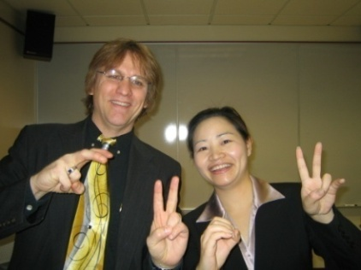
Masterclass 3:
Where Are You R2D2?:
Addressing Diverse Learner Needs with the Read, Reflect, Display, and Do Model
Curtis J. Bonk, Professor, Indiana University
cjbonk@indiana.edu
http://mypage.iu.edu/~cjbonk/

Slide 2

This Generation of Students

Slide 3

November 25, 2014
OER Research Hub, OER Evidence Report:
Building Understanding of Open Education
2013-2014 http://oerresearchhub.files.wordpress.com/2014/11/oerrh-evidence-report-2014.pdf

Slide 4
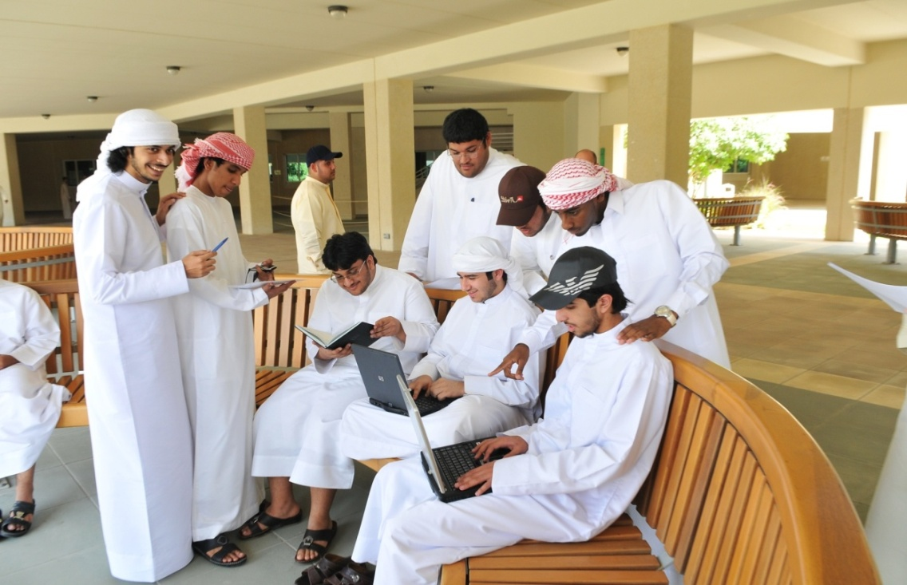
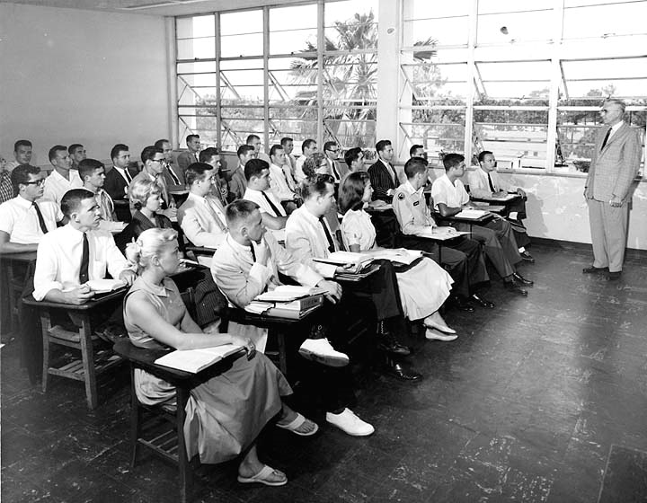
What about the Instructor in the Open World?

Slide 5
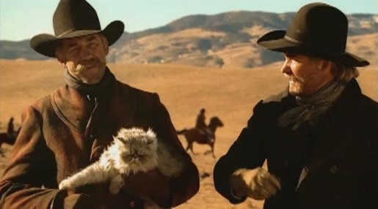
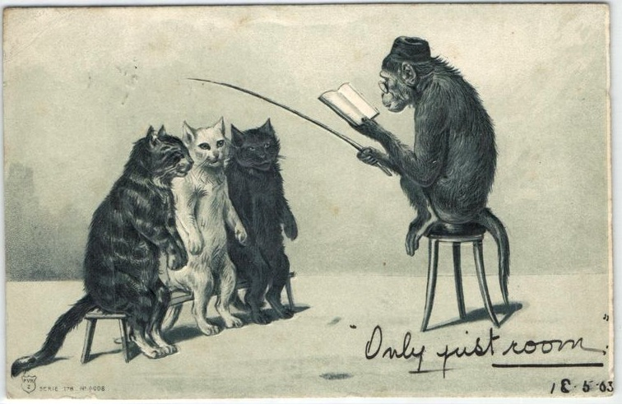
Nine “C”
Metaphors of Instructors
(e.g., “Cat Herders”)

Slide 6
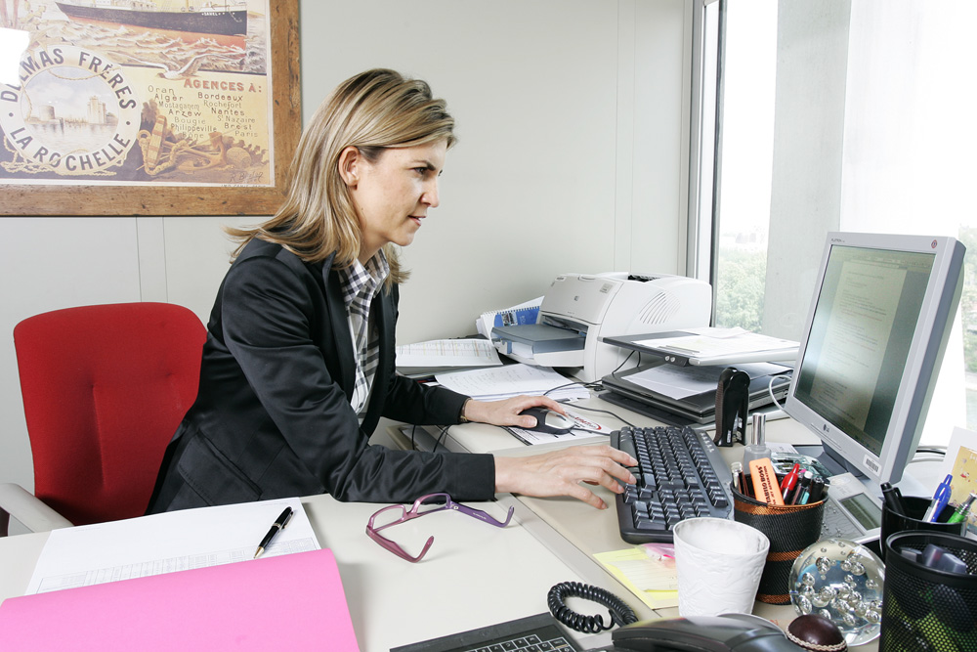
1. Instructor as Credit Manager

Slide 7
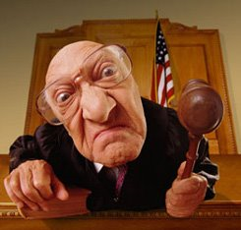
2. Instructor as Court Room Judge

Slide 8
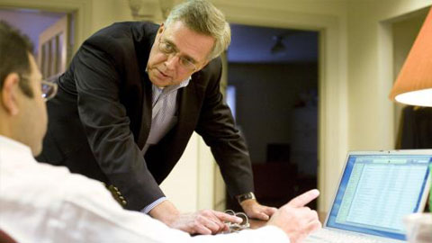
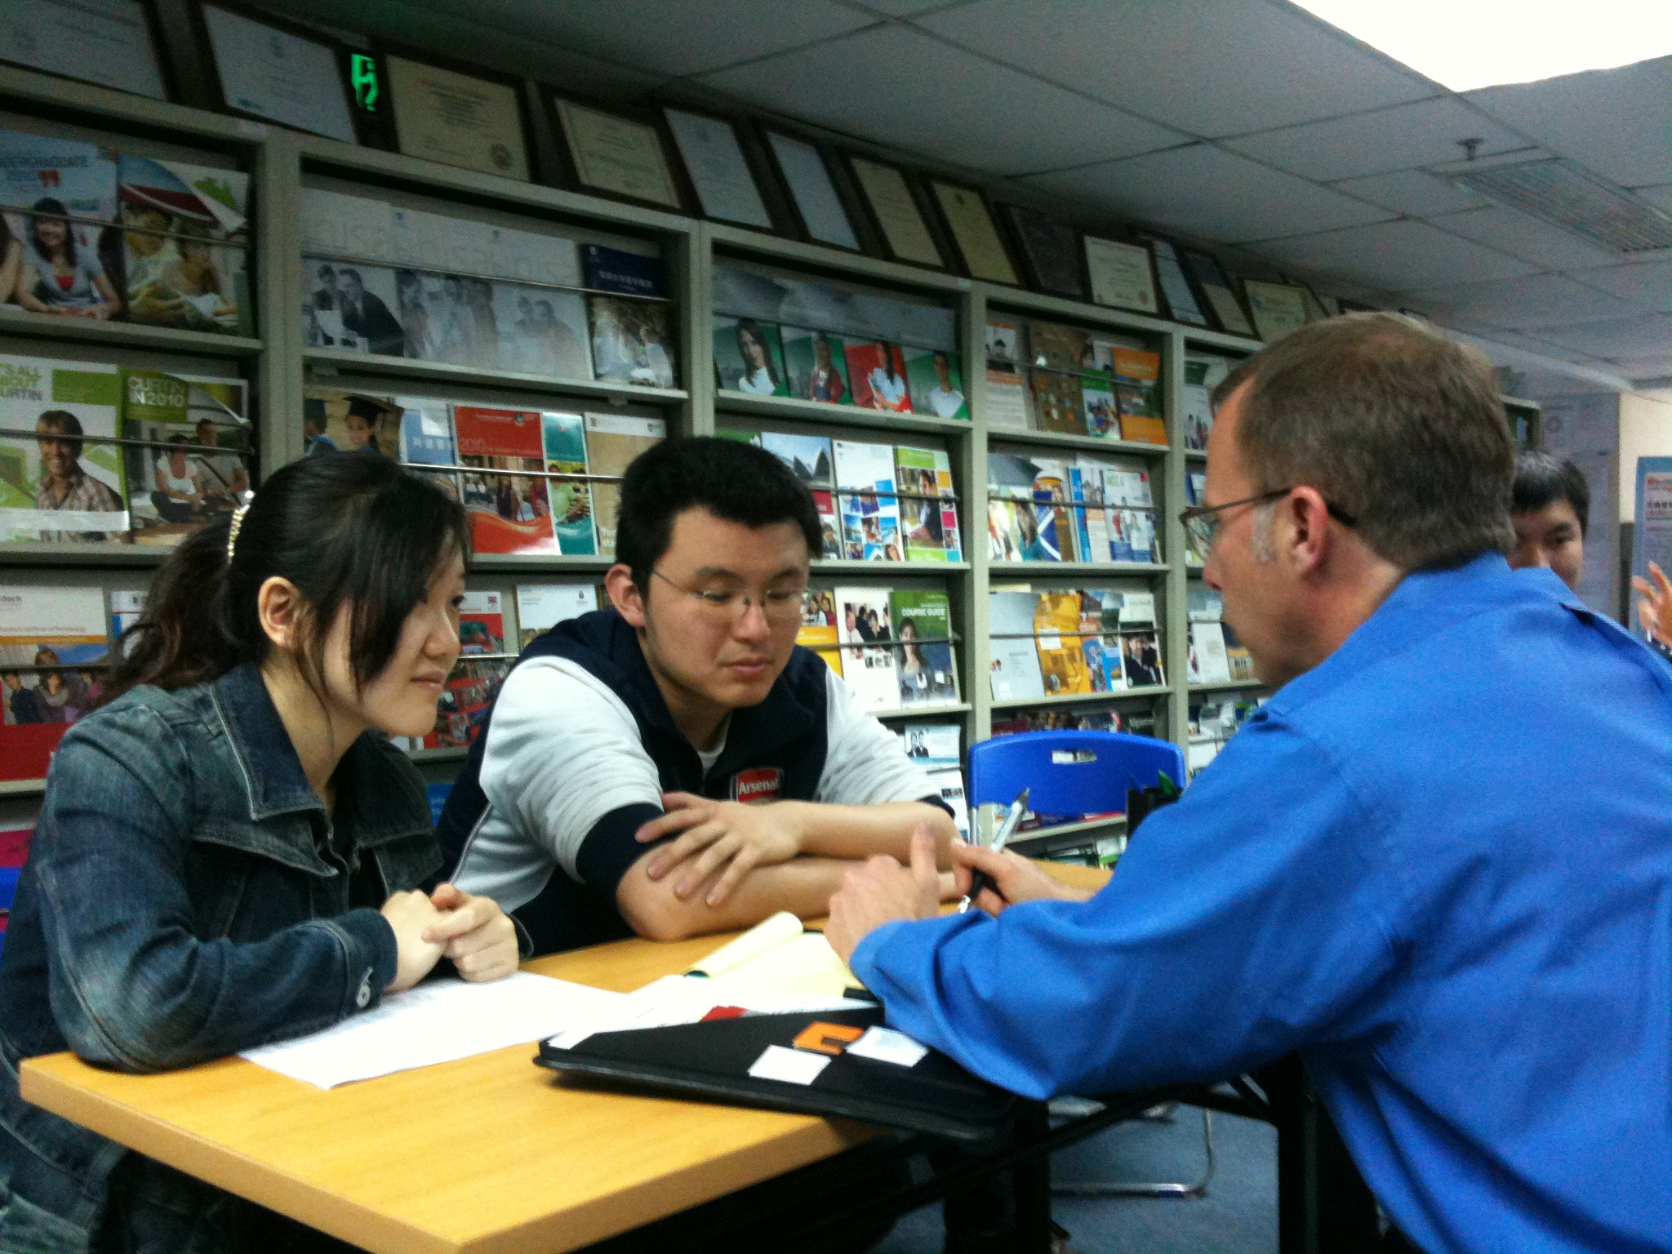
3. Instructor as Counselor

Slide 9

4. Instructor as Consultant

Slide 10
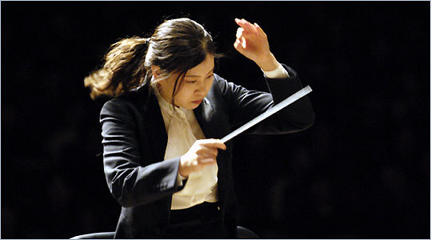
5. Instructor as Conductor

Slide 11
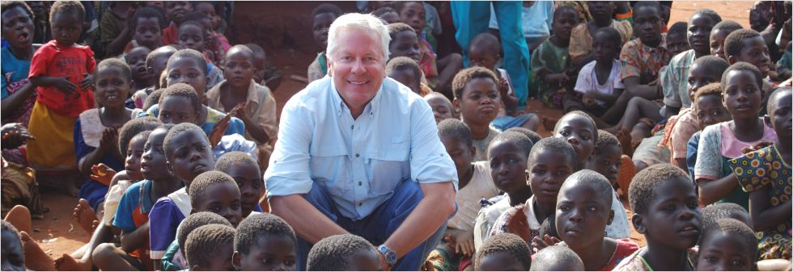
6. Instructor as Course Ambassador

Slide 12
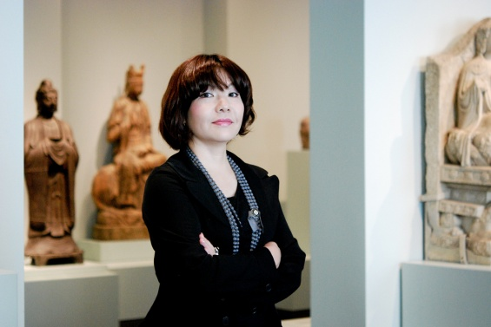
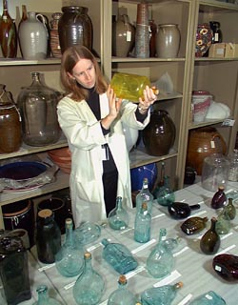
7. Instructor as Curator

Slide 13
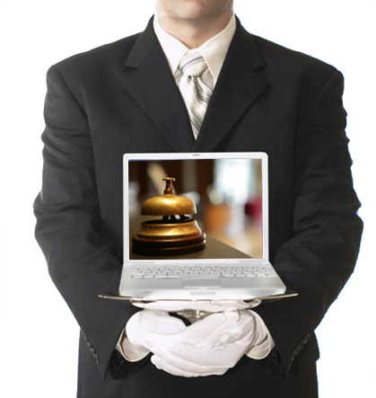
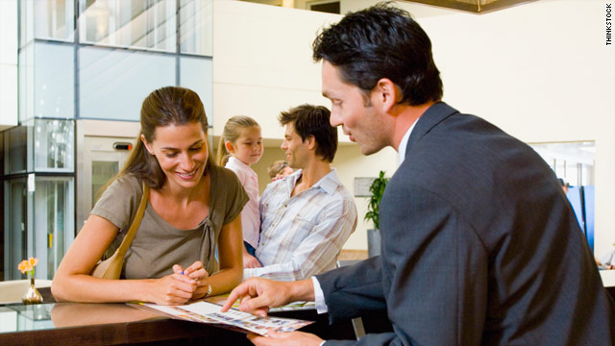
8. Instructor as Concierge

Slide 14
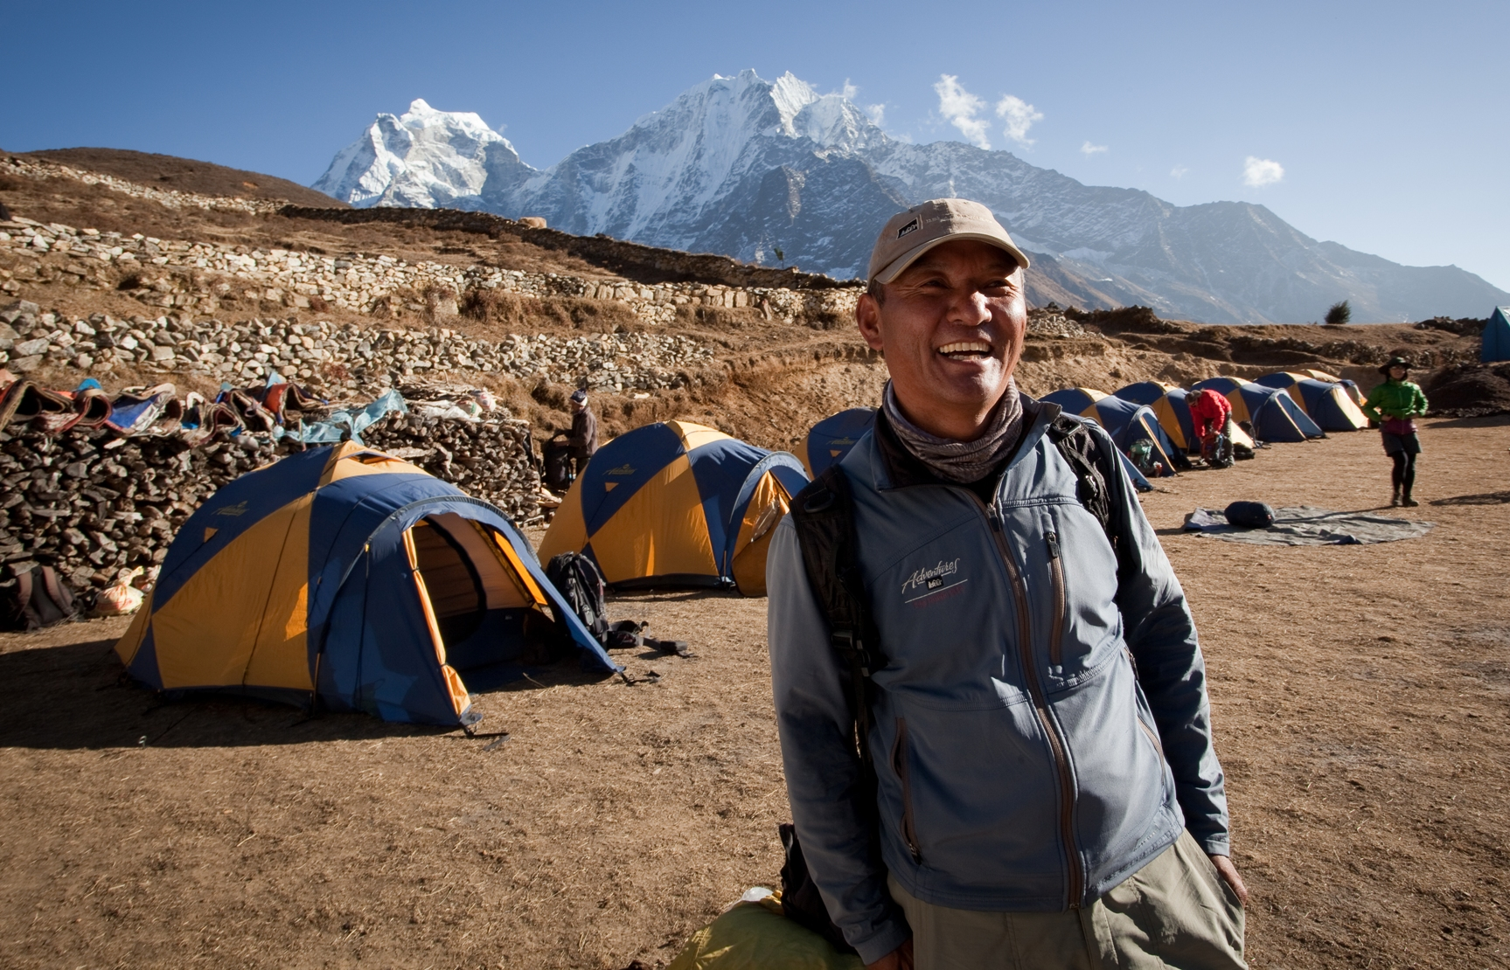
9. Instructor as Camping Trip Guide

Slide 15

#10? How About Instruction as a Cognitive Apprenticeship?

Slide 16

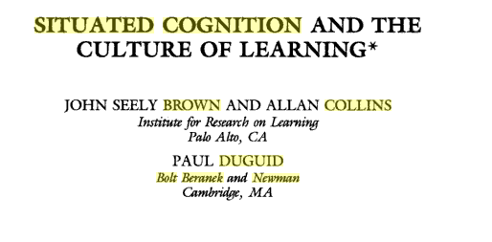
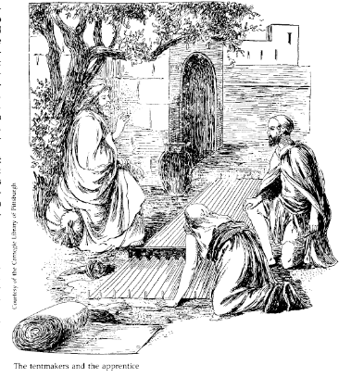
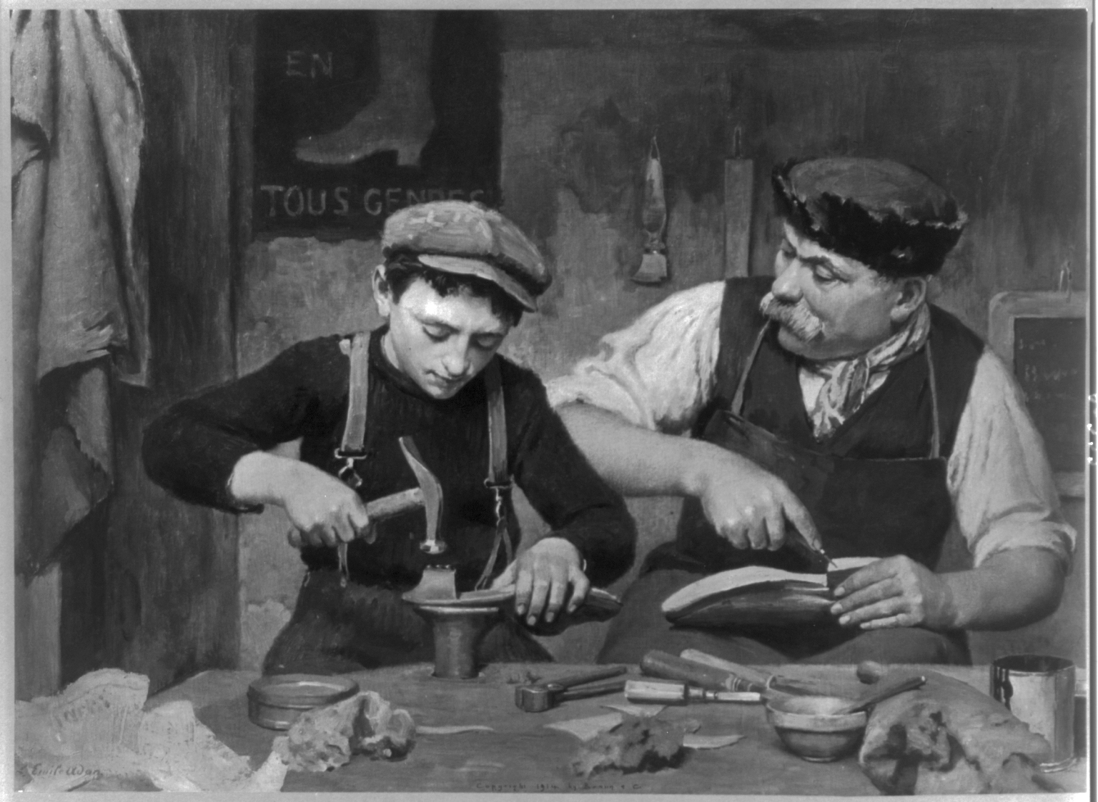

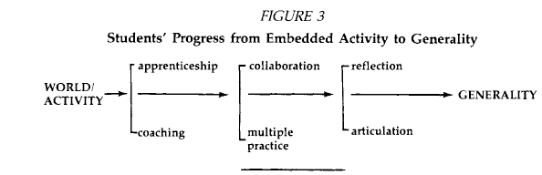
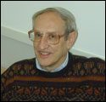
Brown, J. S., Collins, A., & Duguid, P. (1988). Cognitive apprenticeship, situated cognition, and social interaction.
Bolt, Beranek, and Newman, Inc., Technical Report No. 6886.

Slide 17
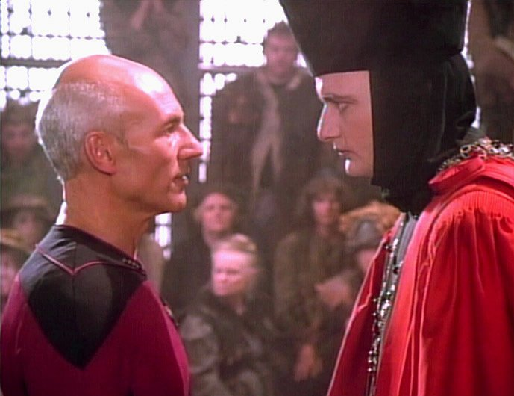
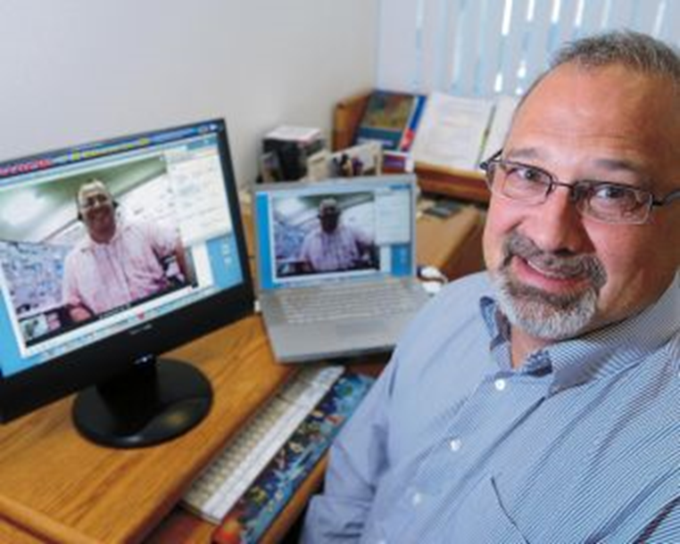
Expert Apprenticeship from Video

Slide 18
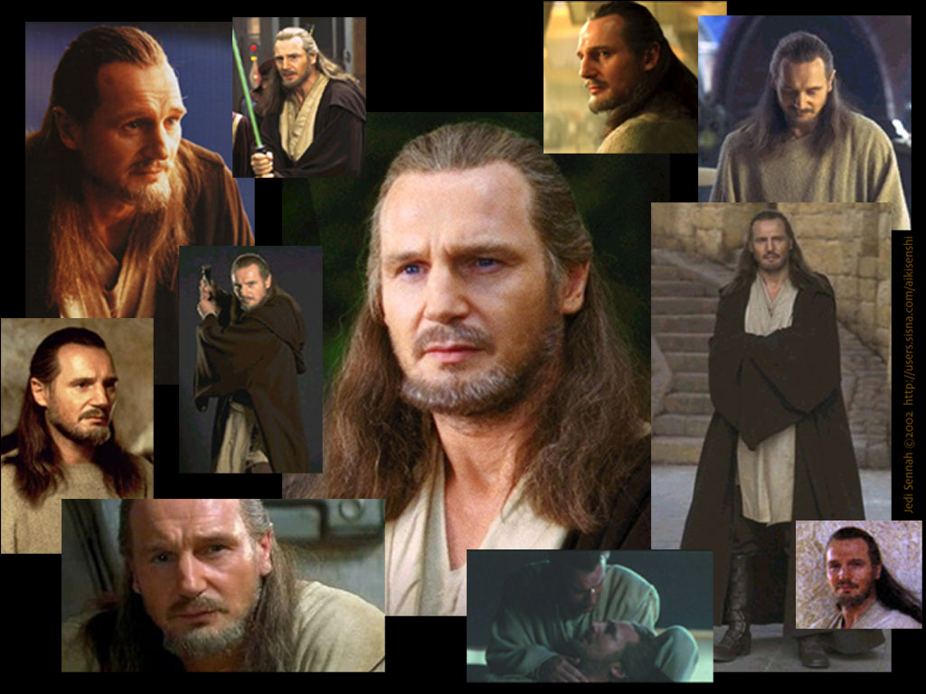
Addressing Learning Styles

Slide 19
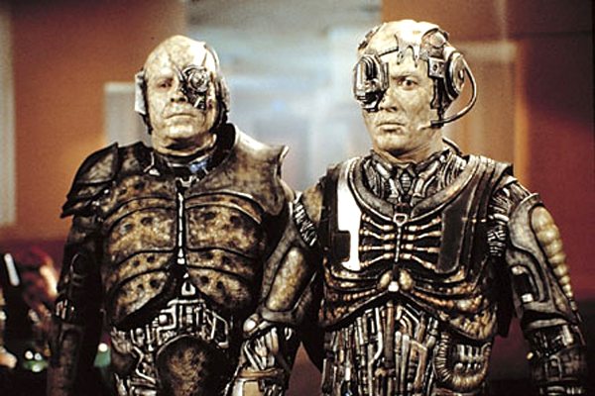
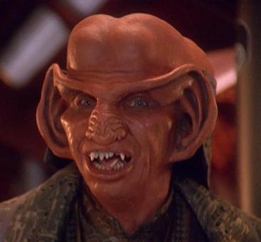
Question: How can technology address diverse learner needs?

Slide 20
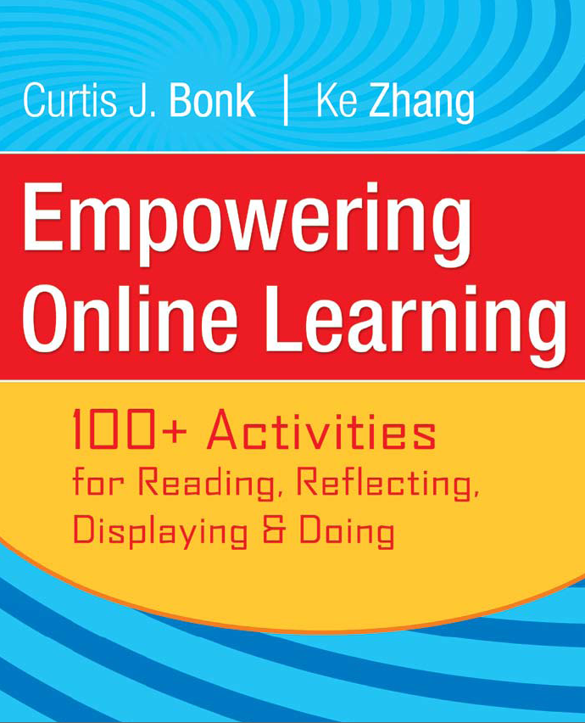
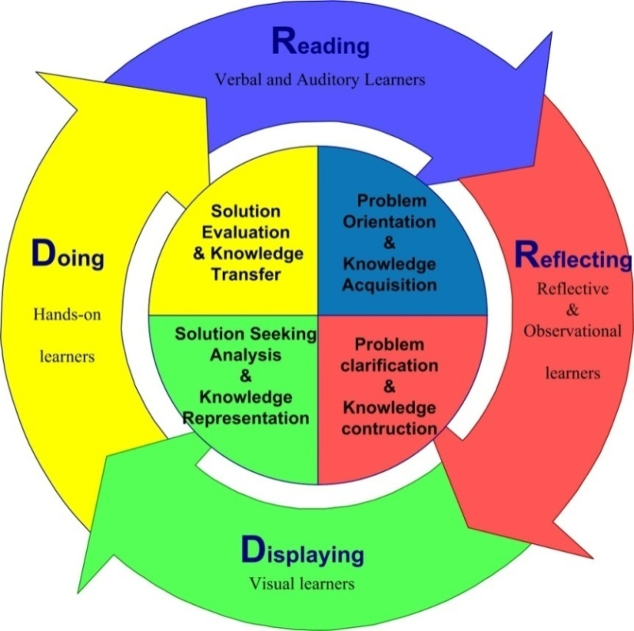
Framework #2: The R2D2 Model

Slide 21
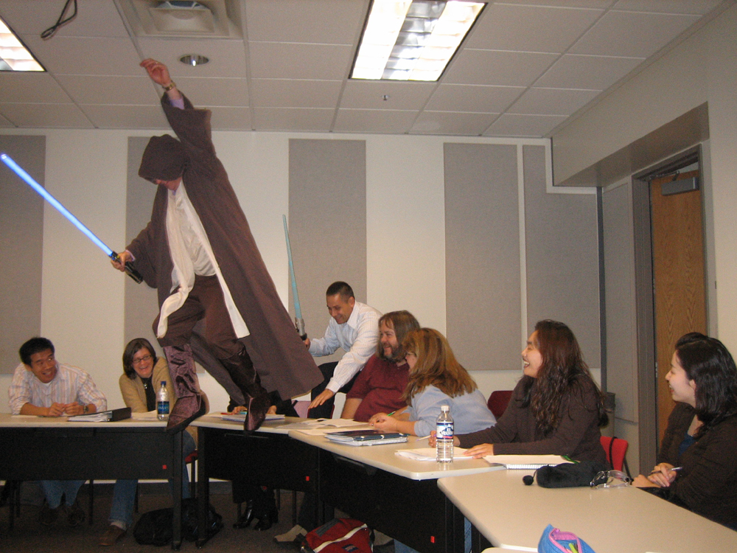

Slide 22
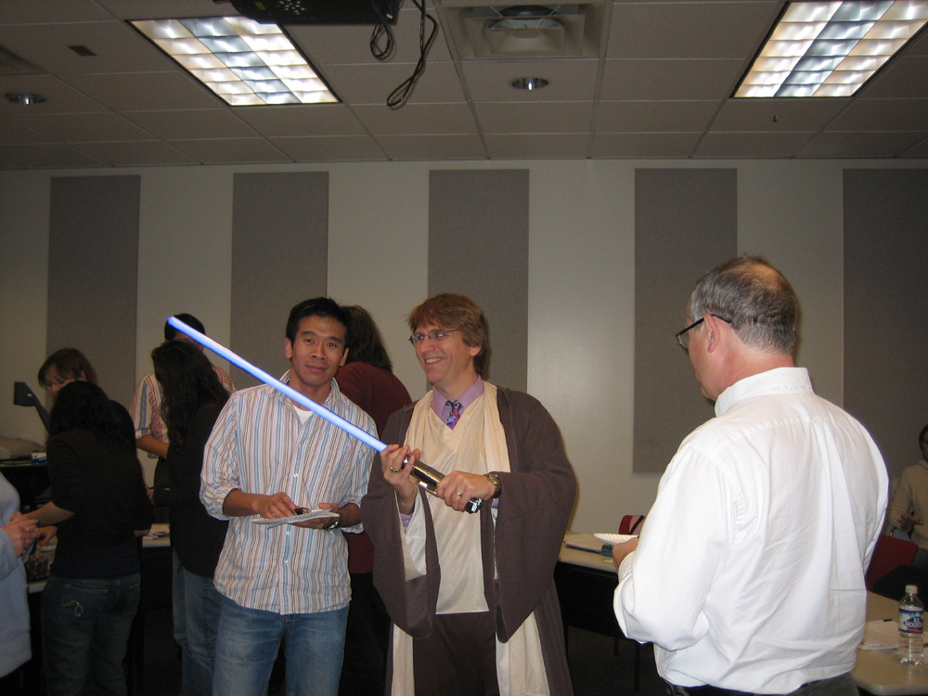

Slide 23
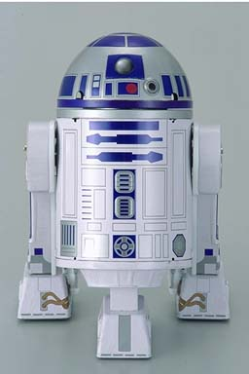
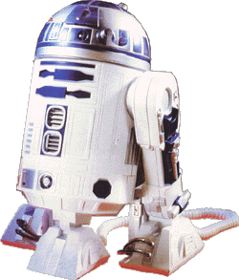
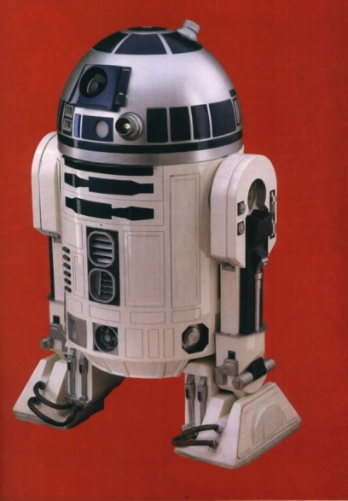
The R2D2 Method
Read (Auditory and Verbal Learners)
Reflect (Reflective Learners)
Display (Visual Learners)
Do (Tactile, Kinesthetic, Exploratory Learners)

Slide 24
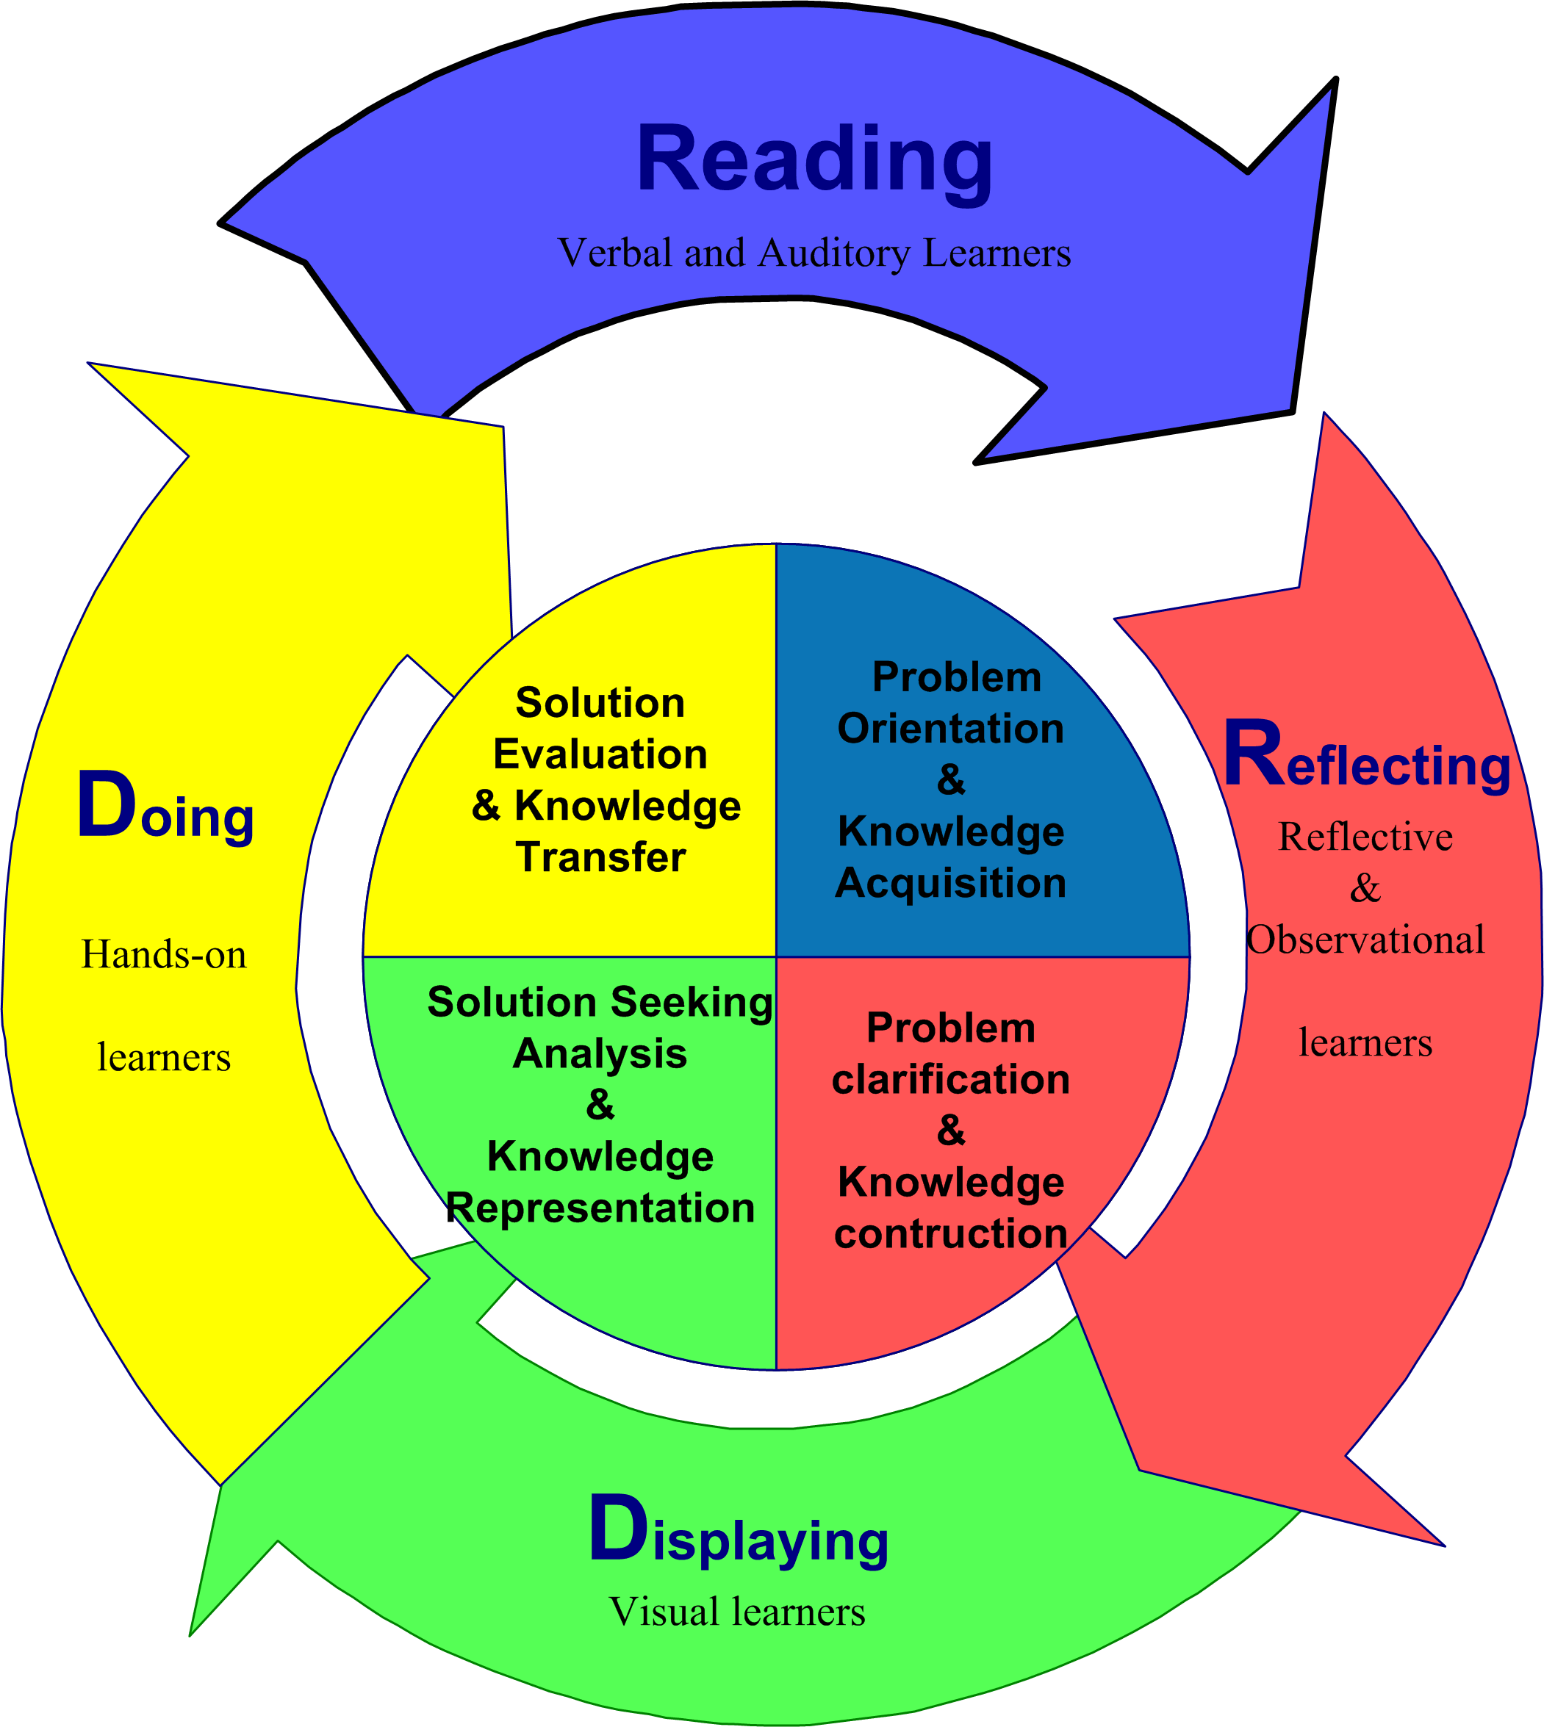
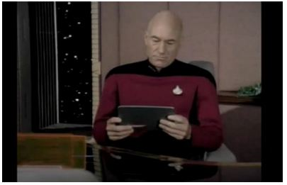

1. Auditory or Verbal Learners
Auditory and verbal learners prefer words, spoken or written explanations.

Slide 25
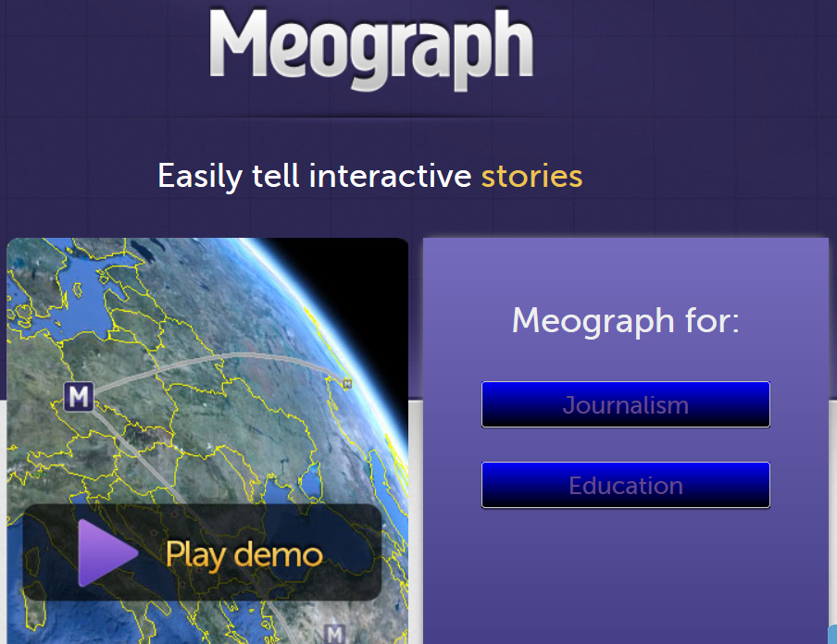

Read 1a. Collect and Listen to Interactive Stories
(e.g., Meograph: http://www.meograph.com/)

Slide 26
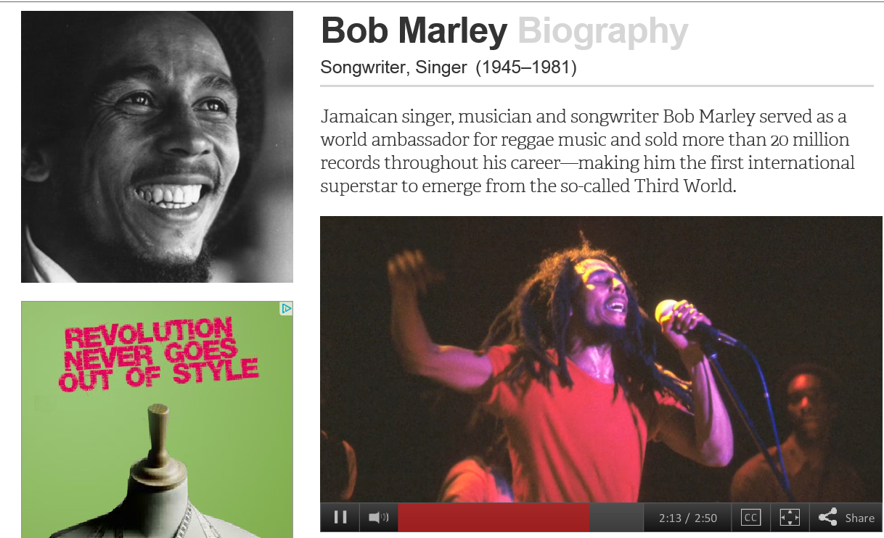
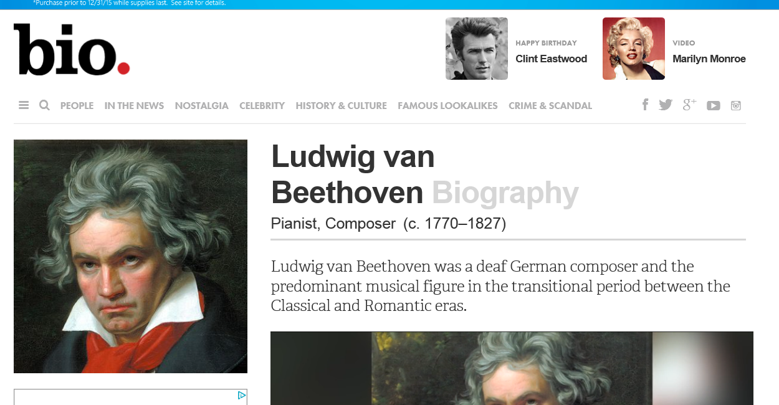
Read 1b.
Reading about the Life of a Musician (bio.com) http://www.biography.com/people/bob-marley-9399524

Slide 27
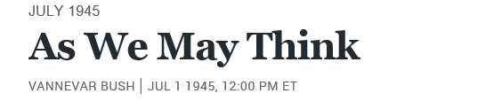
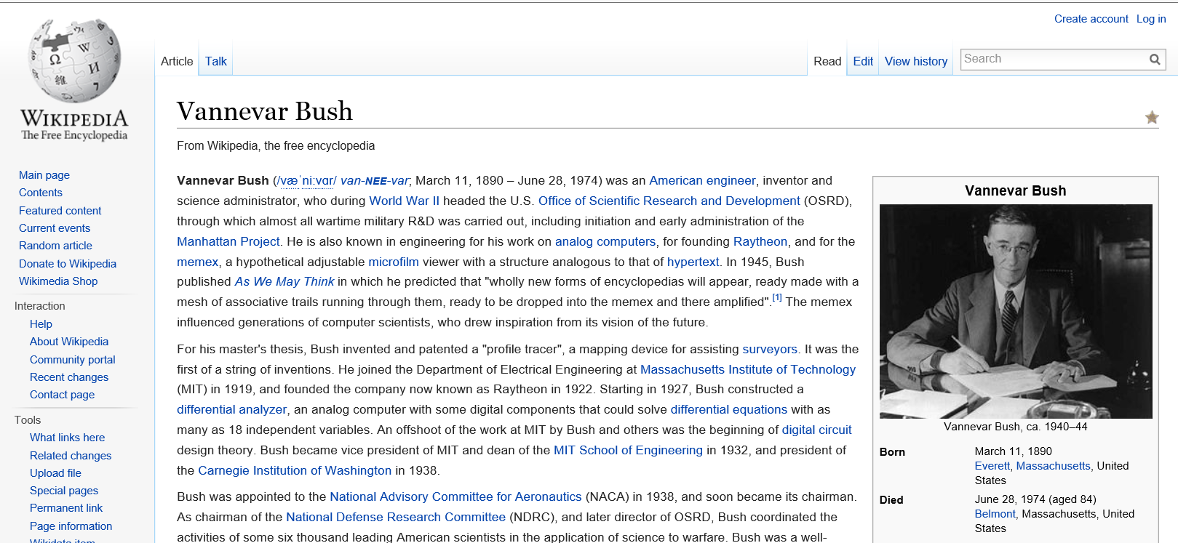
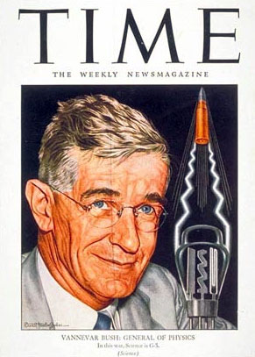
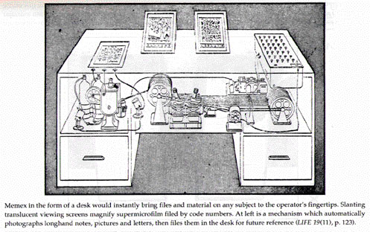
Read 1c.
Exploring the Life of a Prominent People (Wikipedia) http://en.wikipedia.org/wiki/Vannevar_Bush

Slide 28
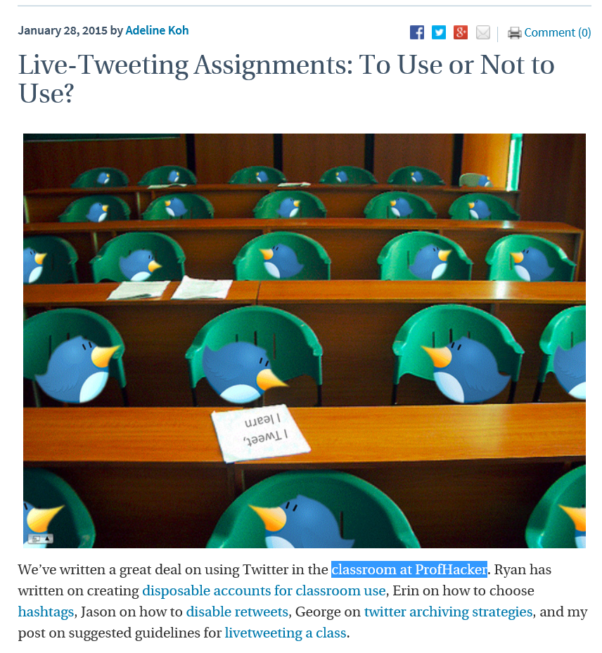
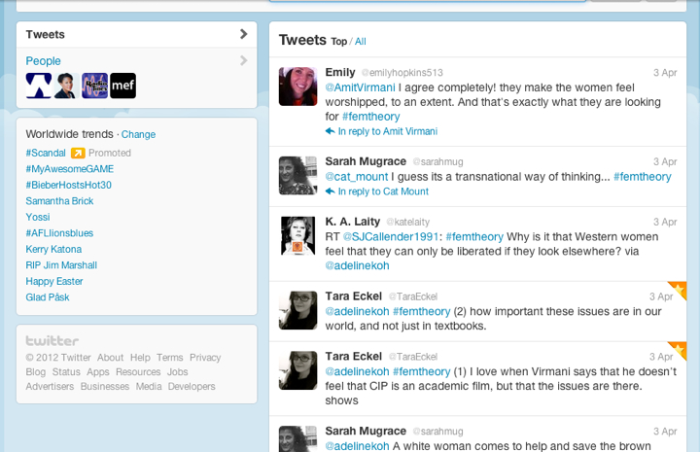
January 28, 2015
Read 1d. Twitter Fed Class Discussions
Live-Tweeting Assignments: To Use or Not to Use? he Chronicle of Higher Education, Adeline Koh http://chronicle.com/blogs/profhacker/live-tweeting-assignments-to-use-or-not-to-use/58949

Slide 29
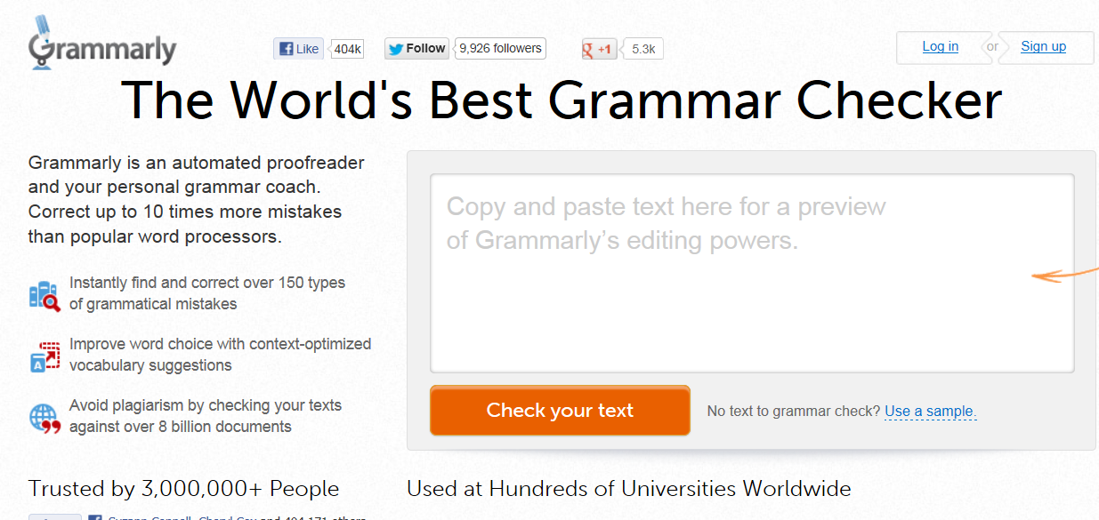


Read 1e. Grammer Checkers
(e.g., Grammarly, Ginger, GrammarCheck, PaperRater, and SpellCheckPlus) http://www.grammarly.com/

Slide 30
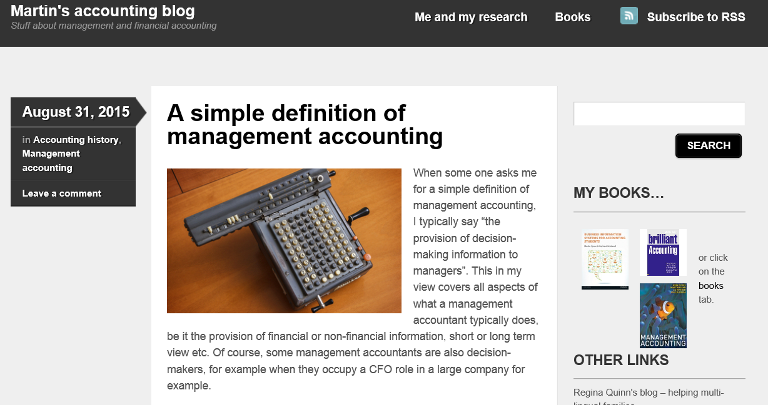
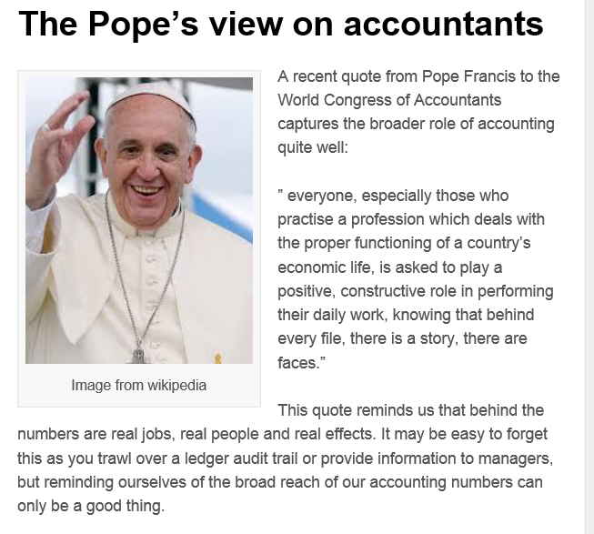
August 31, 2015
Read 1f. Review Blog Resources
(e.g., Martin’s Accounting Blog) http://martinjquinn.com/

Slide 31
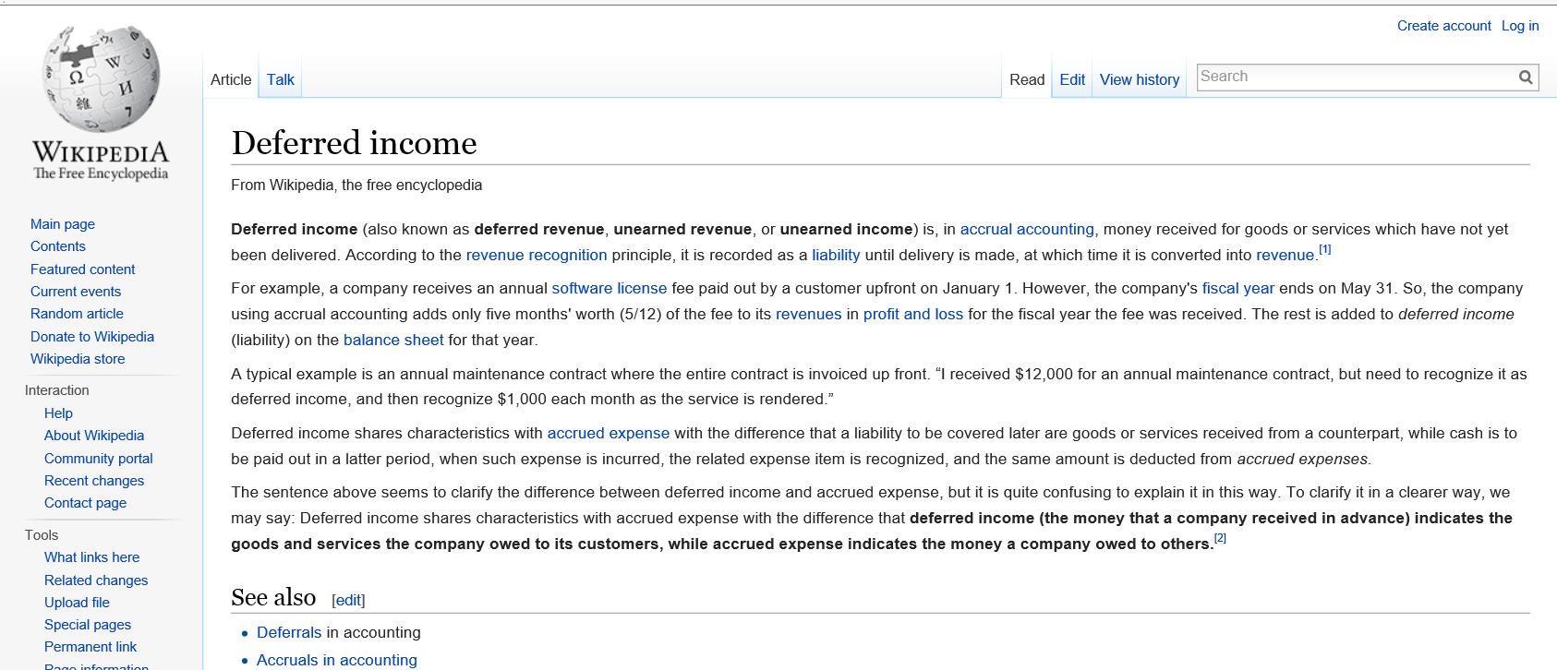
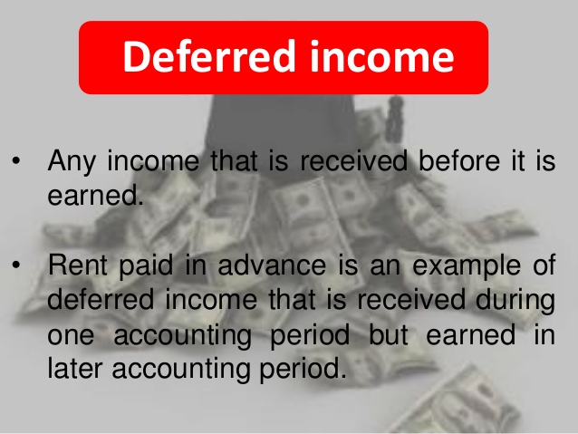
January 28, 2015
Read 1g. Wikipedia Activities (searches, reviews, critiques, edits, reflections, etc.) https://en.wikipedia.org/wiki/Deferred_income

Slide 32
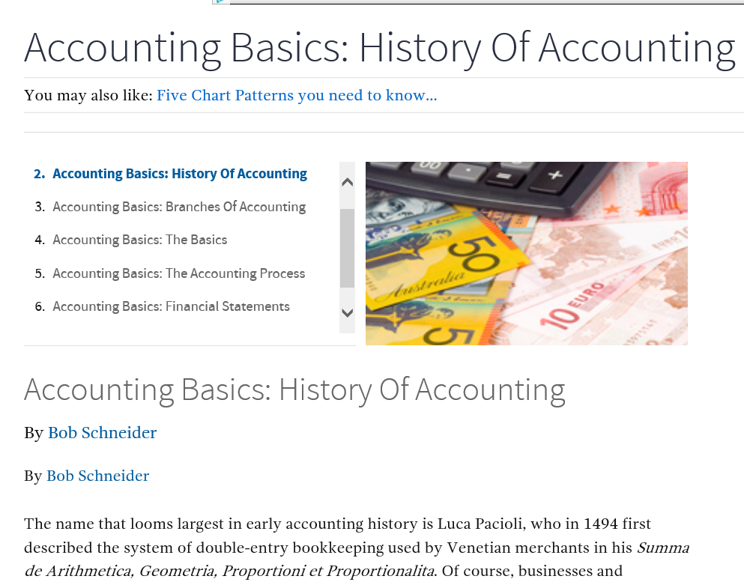
Read 1h.
Video Tutorials, Demonstrations, and How-To’s
Investopedia (videos, tutorials, etc.) http://www.investopedia.com/university/accounting/accounting1.asp

Slide 33


2. Reflective and Observational Learners
Reflective and observational learners prefer to reflect, observe, view, and watch learning; they make careful judgments and view things from different perspectives

Slide 34


Reflect 2a. Big Issue Reflections
(Big Questions Online (BQO)), Feb 3, 3015
(e.g., Is curiosity essential for human flourishing?) https://www.bigquestionsonline.com/content/do-we-have-souls

Slide 35


Reflect 2b.
Interpreting Infographics
July 24, 2014
Woman in Computer Science http://graduatedegrees.online.njit.edu/mscs-resources/mscs-infographics/women-in-computer-science/

Slide 36




Reflect 2c.
Podcast Show Reflections
OperaNow!: http://www.operanowpodcast.com/
LA Behind the Circle Podcast
http://www.laopera.org/news/Podcast-List/

Slide 37




Reflect 2d. Workplace Internship, Practicum, and Field Experiences

Slide 38









Reflect 2e.
Reflect on Virtual Timelines
(Dipity, xtimeline, Simile, etc.) http://www.usatoday.com/news/destinations/story/2011-08-25/Martin-Luther-King-Jr-Memorial-in-Washington-A-closer-look/50136470/1?csp=34news http://usatoday30.usatoday.com/tech/news/story/2011-09-22/steve-jobs-dies/50672498/1 http://www.cnet.com/news/steve-jobs-a-timeline/

Slide 39


Reflect 2f. Cultural Blogs (e.g., Dr. Kim Foreman, San Fran State Univ, Come and See Africa Blog; http://comeandseeafrica.blogspot.com/)

Slide 40



Poll #6:
Any light bulbs going off in your head so far…?
Yes definitely
Maybe
No

Slide 41



3. Visual Learners
Visual learners prefer diagrams, flowcharts, timelines, pictures, films, and demonstrations.

Slide 42




Display 3a. Virtualize Words Used
(e.g., Wordle, Tagzedo, Tagul, WordSift, Word It Out) http://shellyterrell.com/2010/02/14/12-word-cloud-resources-tips-tools/

Slide 43

Display 3b. Map Animations
Yes, Mr. President, We Remade Our Atlas to Reflect Shrinking Ice
Christine Dell'Amore, National Geographic, August 3, 3015 http://news.nationalgeographic.com/2015/08/150803-arctic-ice-obama-climate-nation-science/?utm_content=buffer8a394&utm_medium=social&utm_source=twitter.com&utm_campaign=buffer

Slide 44


Display 3c.
Interpreting Infographics
August 5, 2015
How much rainforest in that chocolate bar?
Global Forest Watch, Nancy Harris, Octavia Payne and Sarah Mann http://blog.globalforestwatch.org/2015/08/how-much-rainforest-is-in-that-chocolate-bar/

Slide 45


Reflect 2d.
More Interpreting Infographics
June 12, 2015
Google vs. Apple https://visual.ly/google-vs-apple-%E2%80%93-facts-figures-app-stores-race

Slide 46




Display 3e. (April 28, 2015)
Concept Mapping and Flowcharting
(Bubbl.us, Cmap, Gliffy, Spicynodes, or Mindomo) http://www.spicynodes.org/index.html

Slide 47



Display 3f. October 31, 2014
Penguin Science (Penguin Cam), Jean Pennycook http://www.penguinscience.com/ http://www.thistle.org/pcam2/images.shtml

Slide 48

Display 3g. Videos for clinical education (Verdi - La Traviata (1988) - Complete opera) https://www.youtube.com/watch?v=49UZa0TO2zQ

Slide 49







Display 3h.
Educational Videos:
CNN, BBC, TED, TED-Ed, ForaTV
Patsy Rodenburg: Why I Do Theater: https://www.ted.com/talks/patsy_rodenburg_why_i_do_theater
Ben Cameron: The true power of the performing arts : http://www.ted.com/talks/ben_cameron_tedxyyc?language=en
Kenichi Ebina: My magic moves: http://www.ted.com/talks/kenichi_ebina_s_magic_moves
Mallika Sarabhai: Dance to change the world: http://www.ted.com/talks/mallika_sarabhai
Wayne McGregor: A choreographer's creative process in real time: http://www.ted.com/talks/wayne_mcgregor_a_choreographer_s_creative_process_in_real_time
Bill T. Jones: The dancer, the singer, the cellist ... and a moment of creative magic http://www.ted.com/talks/bill_t_jones_the_dancer_the_singer_the_cellist_and_a_moment_of_creative_magic

Slide 50




Display 3i.
Educational Videos:
CNN, BBC, TED, TED-Ed, ForaTV
BBC One-Minute World News (May 27, 2015)
Turning Van Gogh's The Night Cafe into virtual reality http://www.bbc.com/news/technology-32751392

Slide 51


Display 3j.
Documentary Debates: e.g., Documentaries on Islamic Extremism http://www.bbc.com/news/entertainment-arts-32901215
Tribeca Film Festival https://tribecafilm.com/filmguide/among-the-believers-2015

Slide 52

Display 3k. Video Anchor: Drama (Urban School Performance Project in Lucknow, India)
Kathleen Gallagher from OISE. She does international/urban work using digital technologies to give voices to marginalized youth through drama. https://www.youtube.com/watch?v=JVCgf1cd4ZI

Slide 53

Display 3L.
Tracking the Life of a Scientist
(e.g., Brian J. Ford, independent scientist) http://www.youtube.com/user/tellymonitor#p/a/u/1/LhGeApsKjasr http://www.labnews.co.uk/news/prehistoric-revolution/

Slide 54


Display 3m.
Video Tutorials, Demonstrations, and How-To’s
WonderHowTo and Howcast http://www.howcast.com/ http://www.wonderhowto.com/ http://www.howcast.com/?s=tune+a+drum

Slide 55


Display 3n.
Video Tutorials, Demonstrations, and How-To’s
WonderHowTo, Howcast, MoneySee http://www.howcast.com/ http://www.wonderhowto.com/ http://www.monkeysee.com/play/24452-top-accounting-jobs

Slide 56





Display 3o.
Video Repositories and Portals
(e.g., Khan Academy, Music Masterpieces) https://www.khanacademy.org/humanities/music/music-masterpieces-old-new/ludwig-van-beethoven-music/v/ludwig-van-beethoven-part-1

Slide 57


Display 3p. Videos for clinical education (Sungkyunkwan University School of Medicine, www.mededu.or.kr)

Slide 58




Display 3q. Unique OER
(e.g., Dead Sea Scrolls) http://www.deadseascrolls.org.il/explore-the-archive http://www.deadseascrolls.org.il/explore-the-archive/search#q=site_en:'Qumran,_Cave_4' http://www.deadseascrolls.org.il/home

Slide 59



Display 3r.
Syrian Cultural Destroyed, CNN, July 3, 2014

Slide 60


Display 3s. Virtual Microscopes

Slide 61


Display 3t. Video Scenario Learning

Slide 62



4. Tactile/Kinesthetic Learners
Tactile/kinesthetic senses can be engaged in the learning process are role play, dramatization, cooperative games, simulations, creative movement and dance, multi-sensory activities, manipulatives and hands-on projects.

Slide 63


February 8, 2015
Do 4a. Recap Discussion (e.g., Prezi from Thuy Han for R678 class Week 4) https://prezi.com/r4vkwqolkrn9/httpswebarchiveorgweb20040303191129httpwwwnetco/?utm_campaign=share&utm_medium=copy

Slide 64



Do 4b. Student Music Recordings of Course Content
April 26, 2015
IST Groove Song, Jeffrey Jenkins, R511: https://soundcloud.com/jeffjenkins25/ist-groove
The World is Open , Jill Kaufman, R678: https://www.youtube.com/watch?v=ZRGV0Mg5Vmw&feature=youtu.be
Daniel Halluska, P540: http://www.youtube.com/watch?v=tOL7lrGsqnw

Slide 65


Do 4c. Interactive Archive/Gallery of Exemplary First-Year Writing Projects
(Fresh Writing, University of Notre Dame, September 24, 2014; https://freshwriting.nd.edu/)

Slide 66




10. Yields Products, Goals:
E. Student Created Mobile Apps
The App Builder: http://www.theappbuilder.com/
Mintian Guo: http://myapp.is/r685final
Videos: Watch selected videos from scholars and educators.
Benefits:
Can easily watch YouTube videos without having to open a separate application
Limitations:
Only accepts YouTube urls

Slide 67



1. Combining Phases (Media)
(Dual Coding Theory: Text + Video)
Text: http://en.wikipedia.org/wiki/Ray_Dolby
Video (September 20,2000): http://www.gigwise.com/news/84155/audio-pioneer-

Slide 68


2. Combining Phases (Media) Unique Open Educational Resources and Portals
(e.g., Mozart: http://www.mozartproject.org/)

Slide 69





3. Combining Phases (Media) Media Generated Content as Instructional Anchor
(e.g., Blues Music, Film, etc.)
(Blues legend B.B. King dies at age 89, May 15, 2015, VNN)
http://www.cnn.com/2015/05/15/entertainment/bb-king-dead/index.html
http://www.cnn.com/2014/11/07/showbiz/robin-williams-autopsy/

Slide 70


4. Combining Phases (Media)
Tracking Researchers and Explorers http://lt.umn.edu/earthducation/expedition6/

Slide 71


5. Combining Phases (Media)
Design Article Database in Facebook, Jenny Webeck https://www.facebook.com/JennyBELTT/timeline
Dr. Bonk's creative fun time group (R546) https://www.facebook.com/groups/830496290323899/

Slide 72



Poll #7: Which do you prefer…
(A) TEC-VARIETY or (B) R2D2?

Slide 73

Poll #8: How many ideas did you get from this talk?
0 if I am lucky.
Just 1.
2, yes, 2…just 2!
Do I hear 3? 3!!!!
4-5.
5-10.
More than 10.

Slide 74


Poll #9: Where are we headed?
Where is Education 3.0?

Slide 75


February 20, 2013
Star Trek-like holodeck may be closer to reality than you think
Matt Hartley, Financial Post, Canada http://business.financialpost.com/2013/02/20/star-trek-like-holodeck-may-be-closer-to-reality-than-you-think/?__lsa=054d-d58d

Slide 76



Poll #10: Any Questions?
Slides at: TrainingShare.com
Papers: PublicationShare.com
Free Book: http://tec-variety.com/ Dr. Curt Bonk – CJBonk@Indiana.edu

