Slide 1



MOOC and Open Education Around the World:
Recent News and Research Clues
Curt Bonk, Indiana University cjbonk@indiana.edu

Slide 2
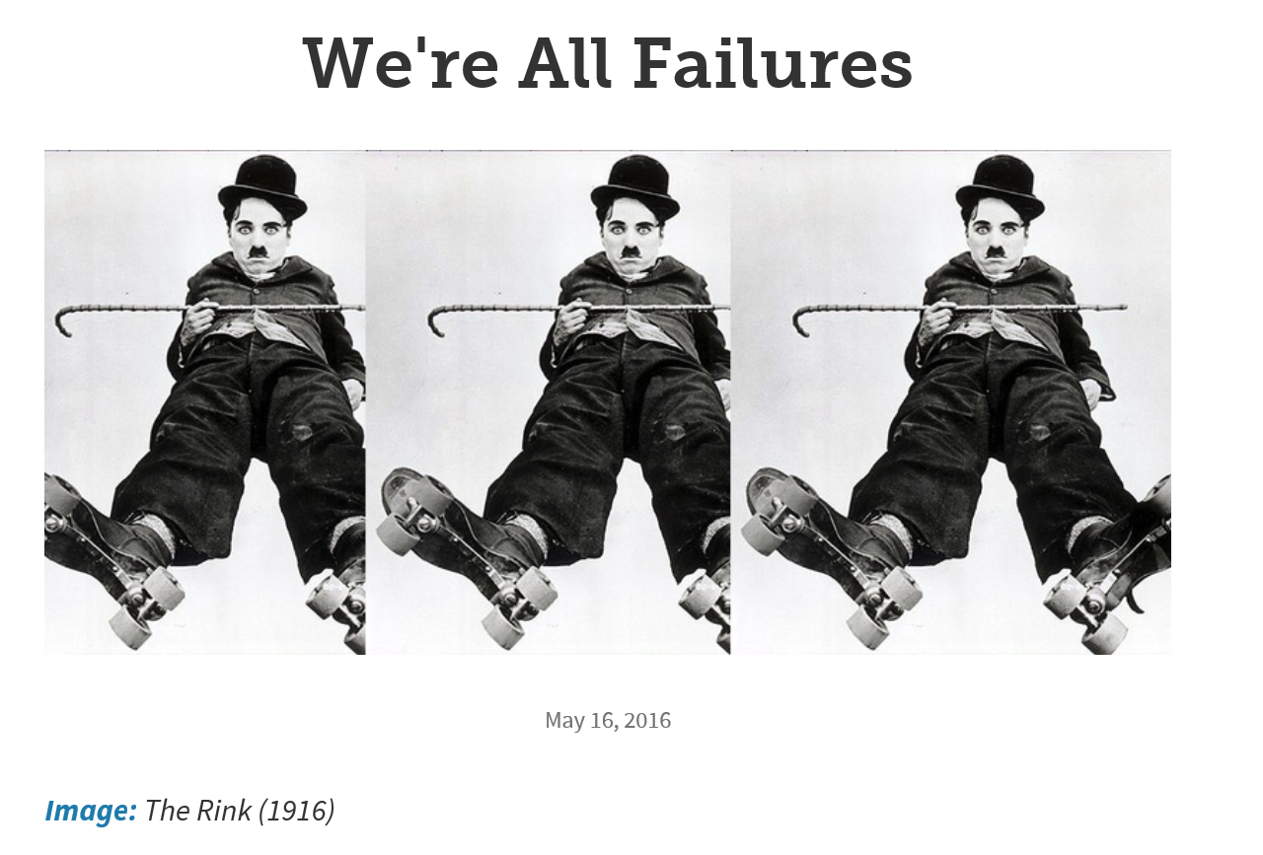
Audience Poll #1:
Does your research ever end in failure?
May 11, 2016
We're All Failures
The Chronicle of Higher Education https://chroniclevitae.com/news/1391-we-re-all-failures?cid=at&utm_source=at&utm_medium=en&elqTrackId=4fb9cc139bc44f8995a1fa5e537c1fd1&elq=c0dd0d45a2514289916fc3f4d5577e5f&elqaid=9077&elqat=1&elqCampaignId=3137

Slide 3
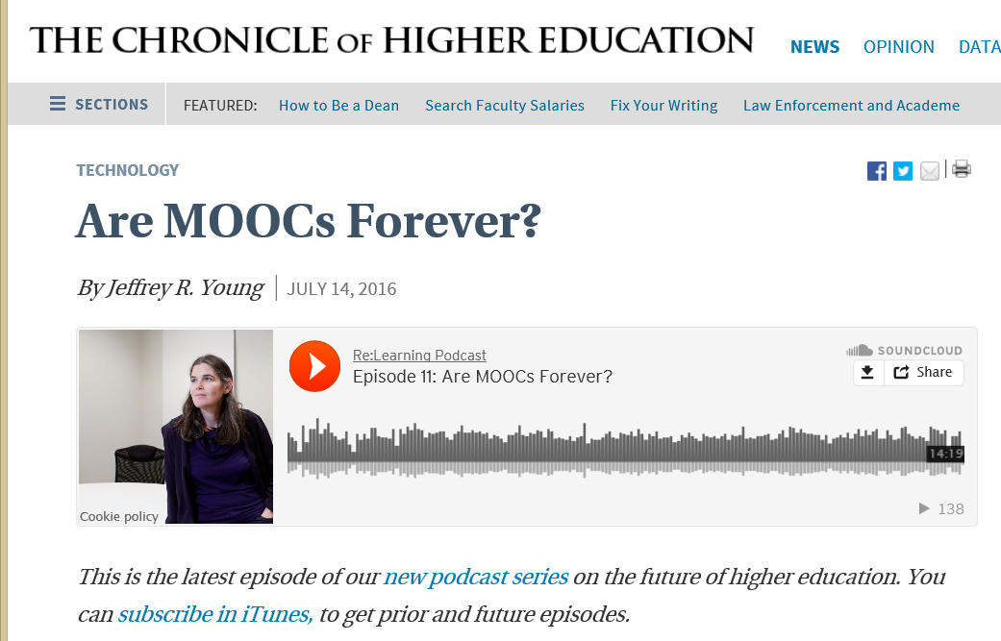
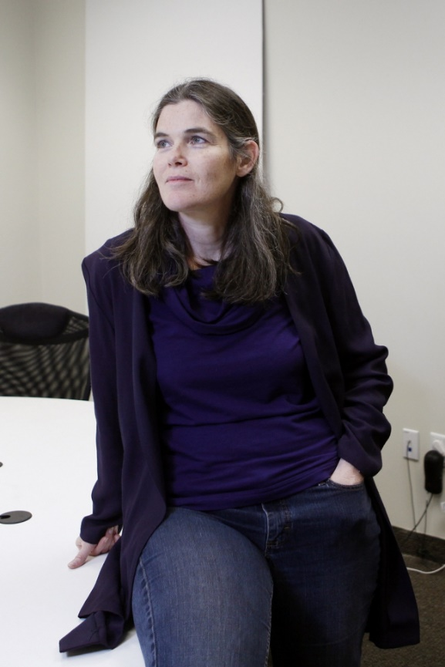
July 14, 2016
Are MOOCs Forever?
Jeffrey R. Young, The Chronicle of Higher Education http://chronicle.com/article/Are-MOOCs-Forever-/237130?cid=pm&utm_source=pm&utm_medium=en&elqTrackId=5f7b494bdda84023911d66f85b93e1e3&elq=5c0b2aa796e34526bf205d4b54603af9&elqaid=9837&elqat=1&elqCampaignId=3604

Slide 4
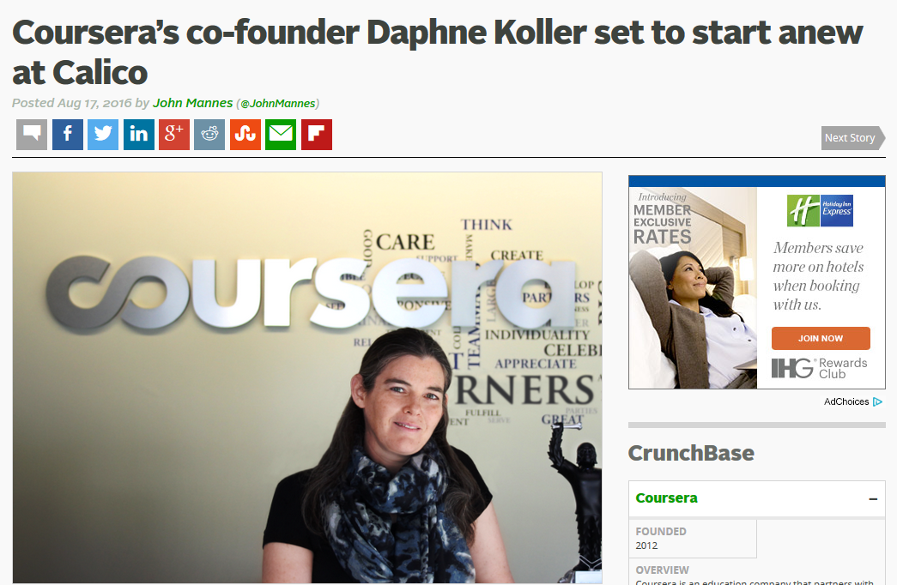
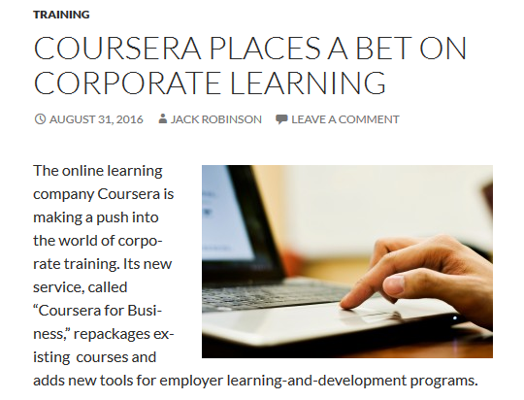
August 17, 2016
Coursera’s co-founder Daphne Koller set to start anew at Calico
John Mannes, TechCrunch https://techcrunch.com/2016/08/17/courseras-co-founder-daphne-koller-set-to-start-anew-at-calico/

Slide 5

Audience Poll #2:
Who in here has taken a MOOC?

Slide 6
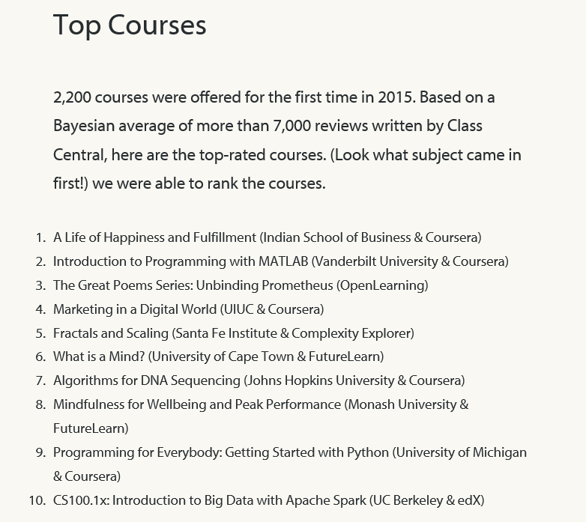
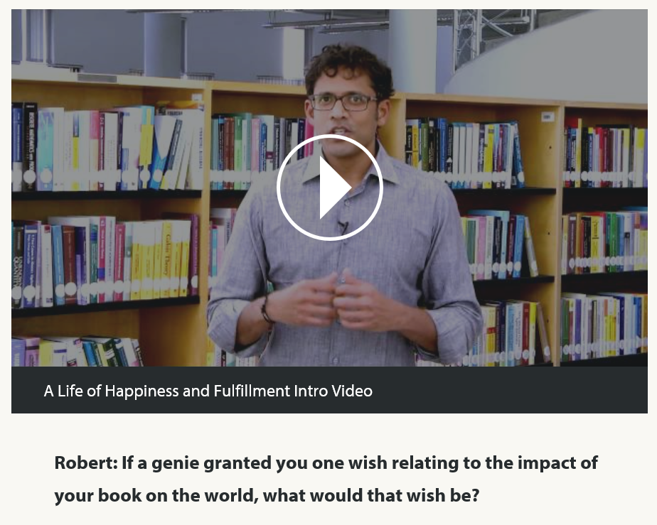
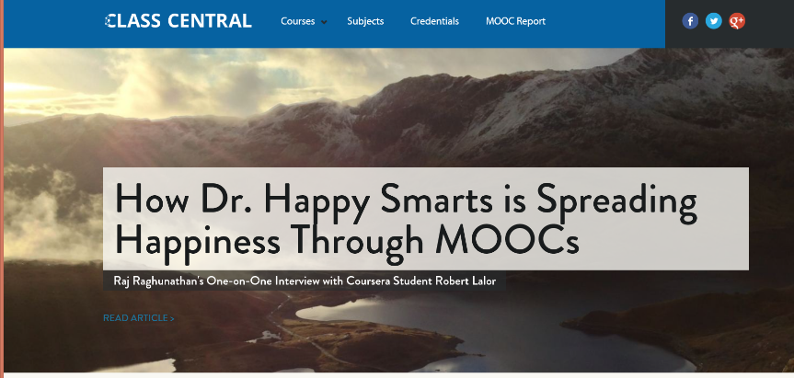
December 30, 2015
Less Experimentation, More Iteration:
A Review of MOOC Stats and Trends in 2015
Class Central Blog, Dhawal Shah https://www.class-central.com/report/moocs-stats-and-trends-2015/ https://www.class-central.com/report/ https://www.youtube.com/watch?v=LD0sNEVhNZ8

Slide 7
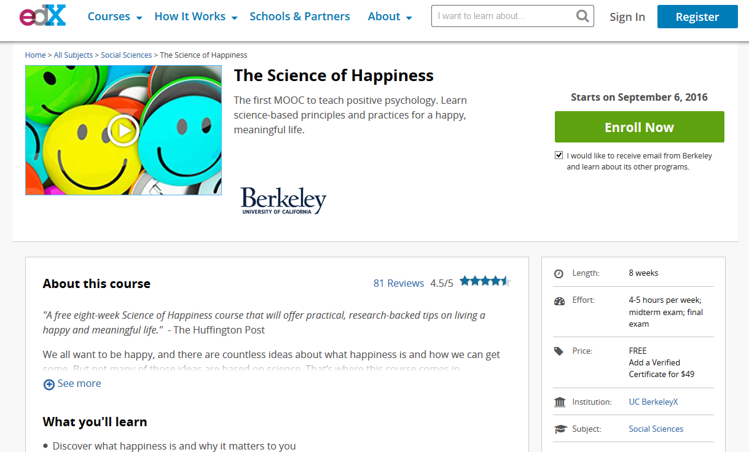
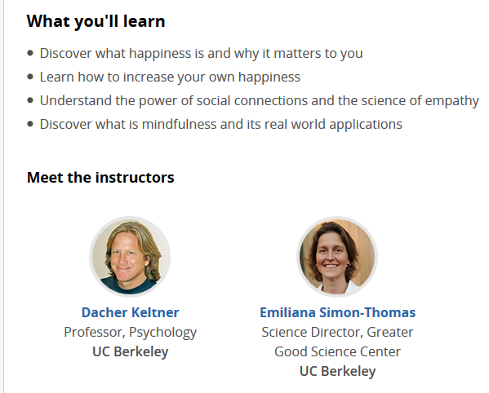
August 3, 2016
The Science of Happiness, edX, UC-Berkeley https://www.edx.org/course/science-happiness-uc-berkeleyx-gg101x-3#!

Slide 8
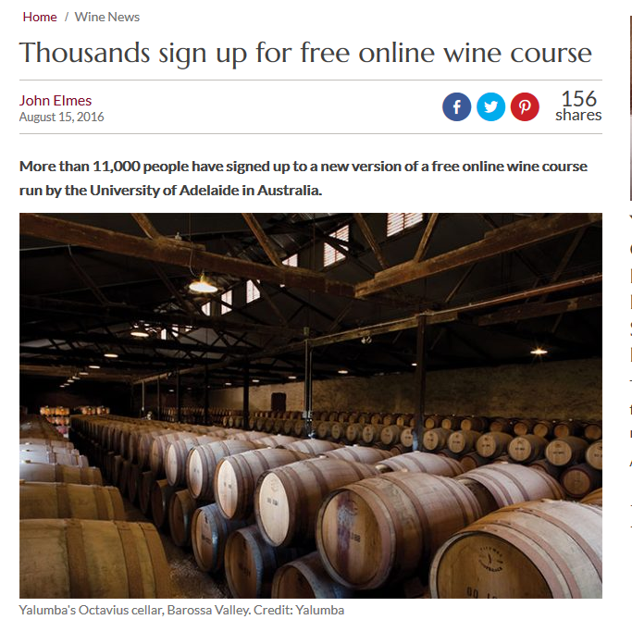
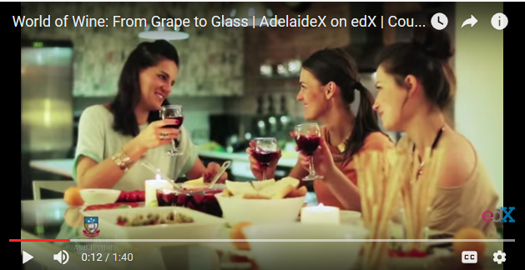
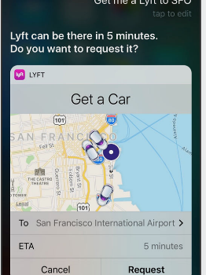
August 30, 2016
Thousands sign up for free online wine course, John Elmes, Wine News http://www.decanter.com/wine-news/online-wine-course-adelaide-325646/

Slide 9
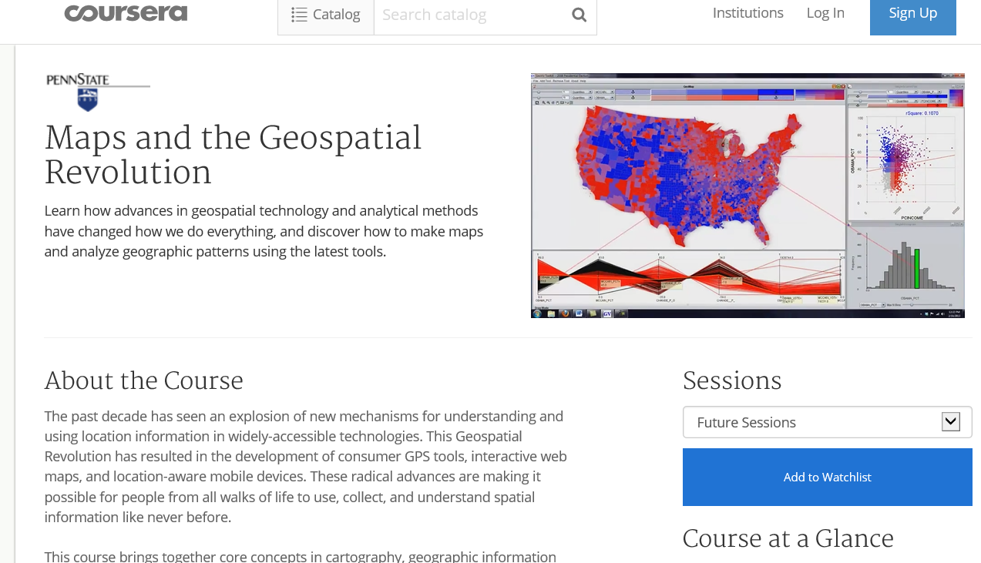
January 11, 2016
Maps and the Geospatial Revolution
Anthony C. Robinson, Penn State, Coursera http://chronicle.com/article/Mapping-a-MOOC-Reveals-Global/234795?cid=at&utm_source=at&utm_medium=en&elq=bf52c7566e1d42d6ac7d42b49e1980ea&elqCampaignId=2208&elqaid=7501&elqat=1&elqTrackId=ed3e40a9614c4a5fb84d8851653a8839

Slide 10
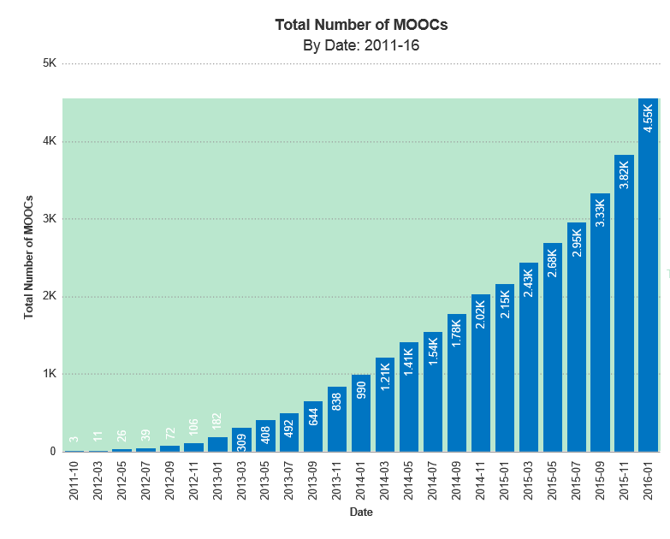
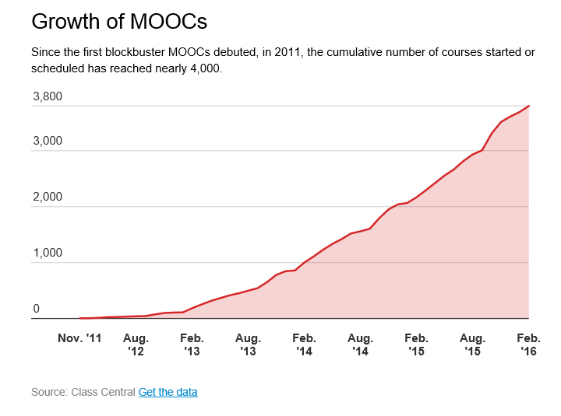
State of the MOOC 2016:
A Year of Massive Landscape Change For Massive Open Online Courses,
Online Course Report http://www.onlinecoursereport.com/state-of-the-mooc-2016-a-year-of-massive-landscape-change-for-massive-open-online-courses/ http://chronicle.com/blogs/wiredcampus/moocs-are-still-rising-at-least-in-numbers/57527

Slide 11
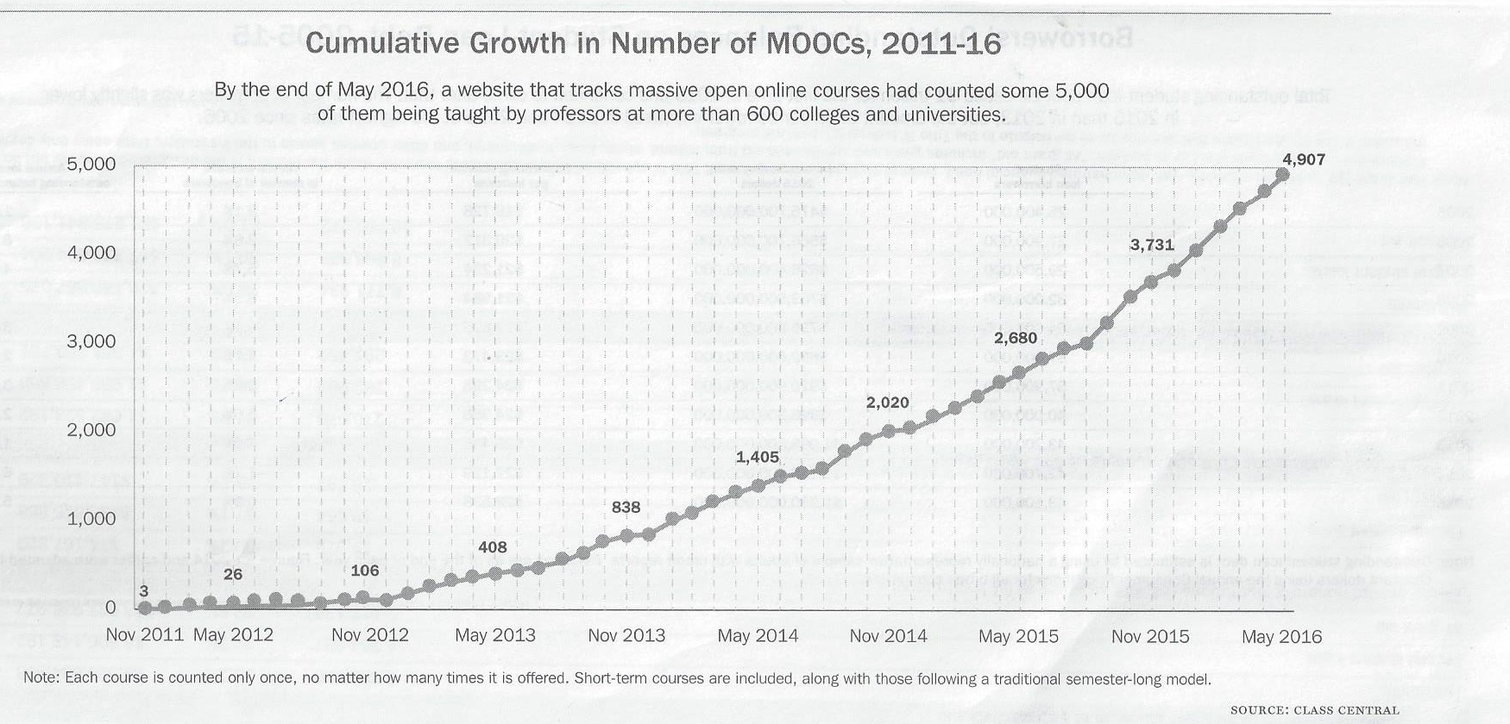
August 14, 2016
Data From the 2016 Almanac, Chronicle of Higher Education http://chronicle.com/interactives/almanac-2016?cid=cp51#id=37_502

Slide 12
January 14, 2016
Why You Should Care That MOOCs Had a Great 2015
Bravetta Hassell, Chief Learning Officer
data collected by Class Central:
35 million: total number of students who signed up for at least one course.
1,800: number of new courses announced.
75 percent: the amount of courses available in English (was 80 percent in 2014).
2,200: courses offered for the first time.
Reportlinker estimates the MOOC market to grow by nearly $7 billion by 2020.

Slide 13
January 14, 2016
Why You Should Care That MOOCs Had a Great 2015
Bravetta Hassell, Chief Learning Officer
Self-paced courses are getting a boost…More than 800 self-paced courses exist in the MOOC market, and that number is only getting larger.
MOOC providers are realizing their value. No longer are MOOC providers offering free certificates. At Coursera, the average course is $56; at edX, it’s $53. Further, Coursera is putting up a paywall for graded assignments for some courses.

Slide 14

February, 2016
MOOCWatch Feb 2016: More Students, More Price Points, More Models. Anuar Andres Lequerica is Class Central’s analyst https://www.class-central.com/report/moocwatch-feb-2016/
Arabic MOOC platform Nadrus has reached 100,000 students.
Brazilian MOOC platform Veduca has reached 800,000 students.
Coursera reaches 700,000 MOOCers in Brazil.
French MOOC platform France has reached 500,000 students.
FutureLearn has reached 3 million students. India: NIIT partners with edX to use MOOCs to train half a million people in tech skills.
Udemy has reached 10 million students.
University of London reached 1 million enrollments on Coursera.

Slide 15
July 21, 2016
The Scope of edX,
Joshua Kim, Inside Higher Ed https://www.insidehighered.com/blogs/technology-and-learning/scope-edx?utm_source=Inside+Higher+Ed&utm_campaign=56cdbb1f78-DNU20160722&utm_medium=email&utm_term=0_1fcbc04421-56cdbb1f78-197362401
Let me share some edX numbers that blew my mind:
There are 8.3 million (unique) lifelong learners on the edX platform.
Between 2012, when edX started, and today - there have been 27 million course enrollments.
Over 1,000 courses have been offered.
There have been over 2,300 faculty and staff that have taught on edX.
Over 840,000 certificates have been earned by edX learners.
EdX has over 100 schools, institutes and organizations in the Consortium creating open online courses.

Slide 16
July 21, 2016
The Scope of edX
Joshua Kim, Inside Higher Ed https://www.insidehighered.com/blogs/technology-and-learning/scope-edx?utm_source=Inside+Higher+Ed&utm_campaign=56cdbb1f78-DNU20160722&utm_medium=email&utm_term=0_1fcbc04421-56cdbb1f78-197362401
And where do edX lifelong learners come from?
There are lifelong learners in every country of the world (save North Korea).
A bit over a quarter (27%) of edX learners come from the U.S. The next biggest country is India (11%), the U.K. and Brazil (both 4%) and China, Canada, and Mexico (3% each).
Over four-in-ten edX learners live in emerging economy countries.
Does Coursera, NovoEd, FutureLearn, Canvas.net, and other open online learning platforms report similar levels and trends?

Slide 17
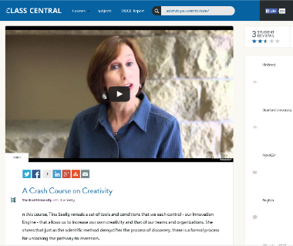
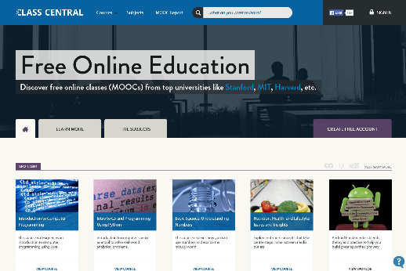
July 27, 2016
Class Central https://www.class-central.com/collection/top-free-online-courses
Now there are close to 6,000 MOOCs from 600+ universities around the world. This can be daunting to the millions of learners around the world who have never done an online course before.
That’s why we came up with a list of Top 50 MOOCs of All Time based on thousands of reviews written by Class Central users.

Slide 18
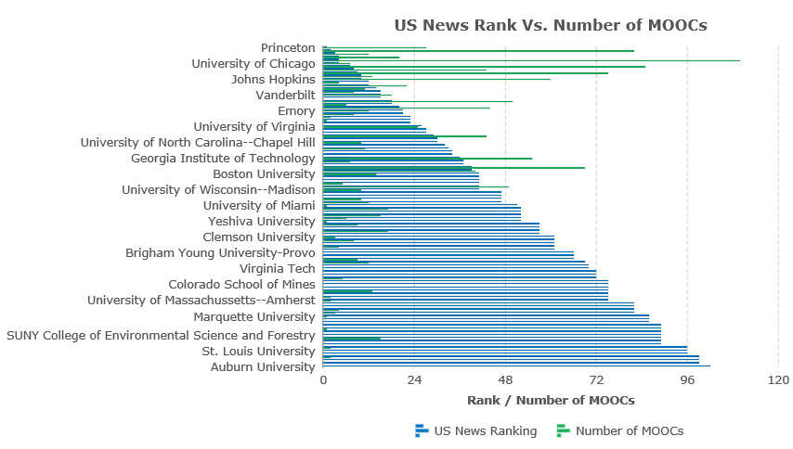
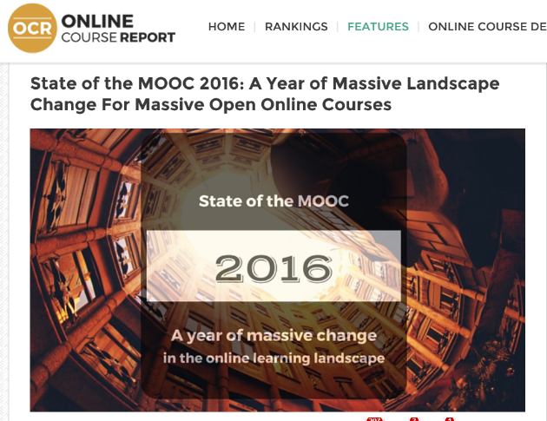
2016
State of the MOOC 2016:
A Year of Massive Landscape Change For Massive Open Online Courses, Online Course Report http://www.onlinecoursereport.com/state-of-the-mooc-2016-a-year-of-massive-landscape-change-for-massive-open-online-courses/

Slide 19
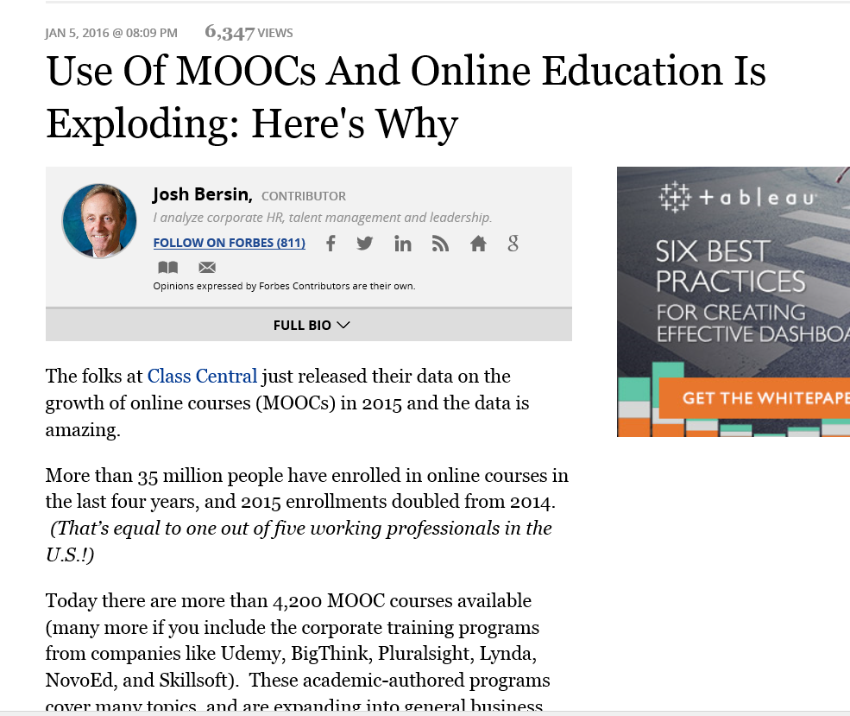
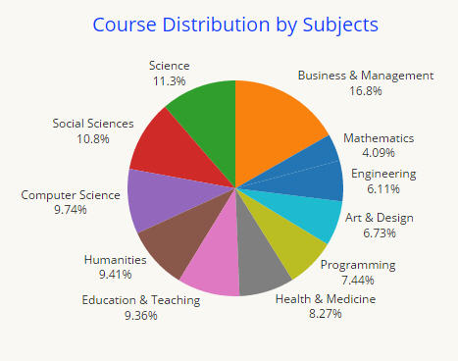
January 5, 2016
Use Of MOOCs And Online Education Is Exploding: Here's Why
Josh Bersin, Forbes http://www.forbes.com/sites/joshbersin/2016/01/05/use-of-moocs-and-online-education-is-exploding-heres-why/#290acdda7f09

Slide 20
May 19, 2016
Current Issues on MOOC Research
Trang Phan, University of Houston, tphanuh16@gmail.com
The influence of MOOCs on the future of higher education (Billington & Fronmuller, 2013)
The effects of MOOCs on learning and teaching (Martin, 2012)
The educational problems MOOCs might solve (Rivard, 2013)
The blending of face-to-face classes with online MOOC classes (Bruff, Fisher, McEwen, & Smith, 2013).

Slide 21
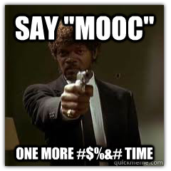
Question:
"What are the problems that MOOCs and OER are supposed to address?" or "Are MOOCs and OER "solutions" in search of problems?"
(Note: Best Answers get a MOOCs book.)

Slide 22
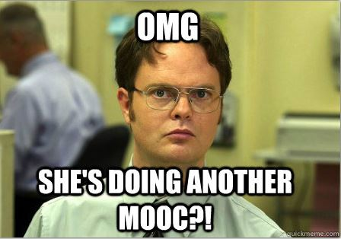
Activity #1:
During this talk, jot down a research idea on a card. We will share it at the end.
(Note: Best idea gets a MOOCs book.)

Slide 23

35 MOOC Research Topics
1. Learner-Focused
2. Instructor-Focused
3. Course/Instructional Design
4. Impact/Context
5. Other

Slide 24

MOOC Research Openings…
Part 1: Learner-Focused

Slide 25
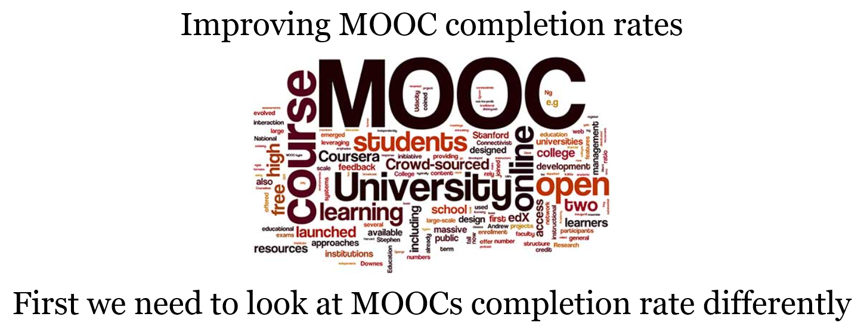
Audience Poll #3:
Have you ever dropped a MOOC?
Have you ever completed a MOOC? http://elearnhero.com/moocs-completion-rates/

Slide 26
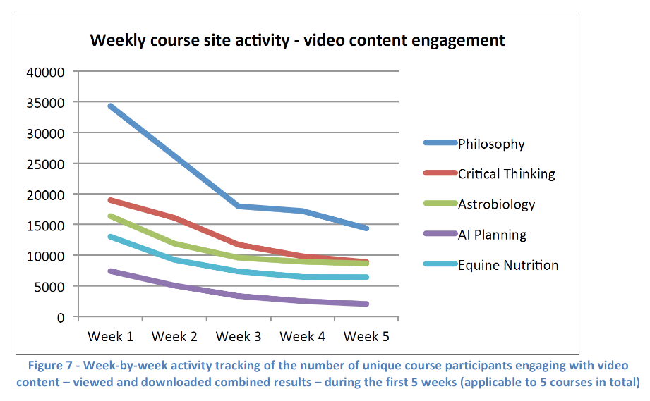
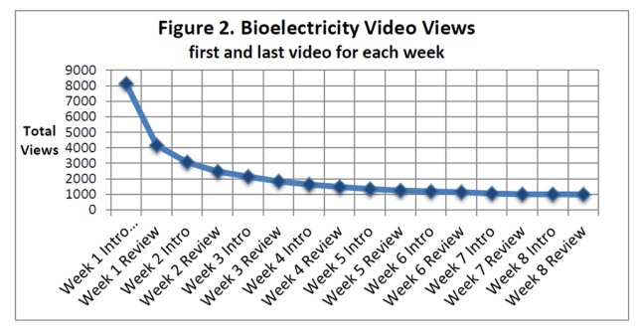
May 2013
Research Topic #1.
Dropout (i.e., retention) Concerns
MOOCs @ Edinburgh 2013– Report #1

Slide 27
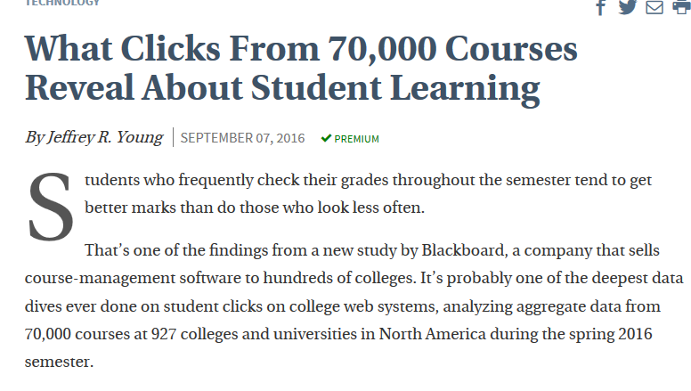
September 7, 2016
Research Topic #2.
Content Access and Use
What Clicks From 70,000 Courses Reveal
About Student Learning
Jeffrey R. Young, Chronicle of Higher Education http://www.chronicle.com/article/What-Clicks-From-70000/237704?cid=at&utm_source=at&utm_medium=en&elqTrackId=afbd8d54d8b6402fbf0356a3032c34c1&elq=52781cf944e142dd83f8f7bdf61b1eaf&elqaid=10562&elqat=1&elqCampaignId=3986

Slide 28
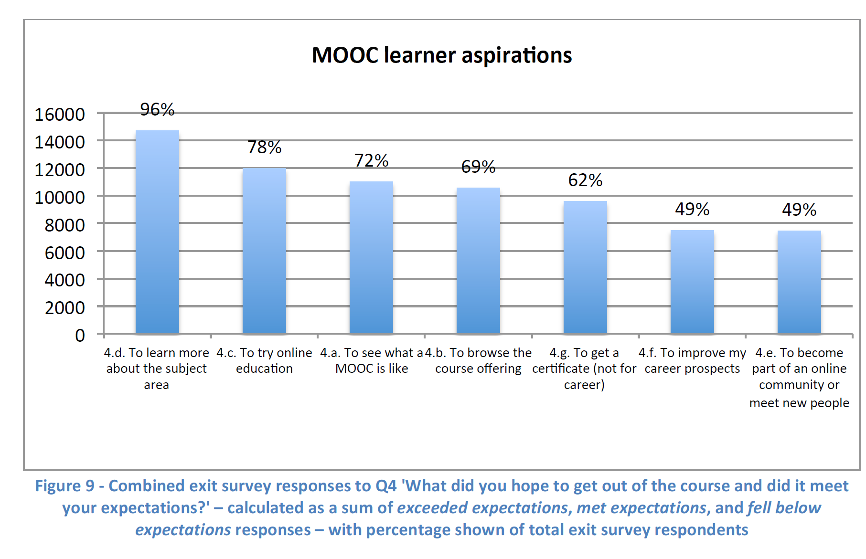
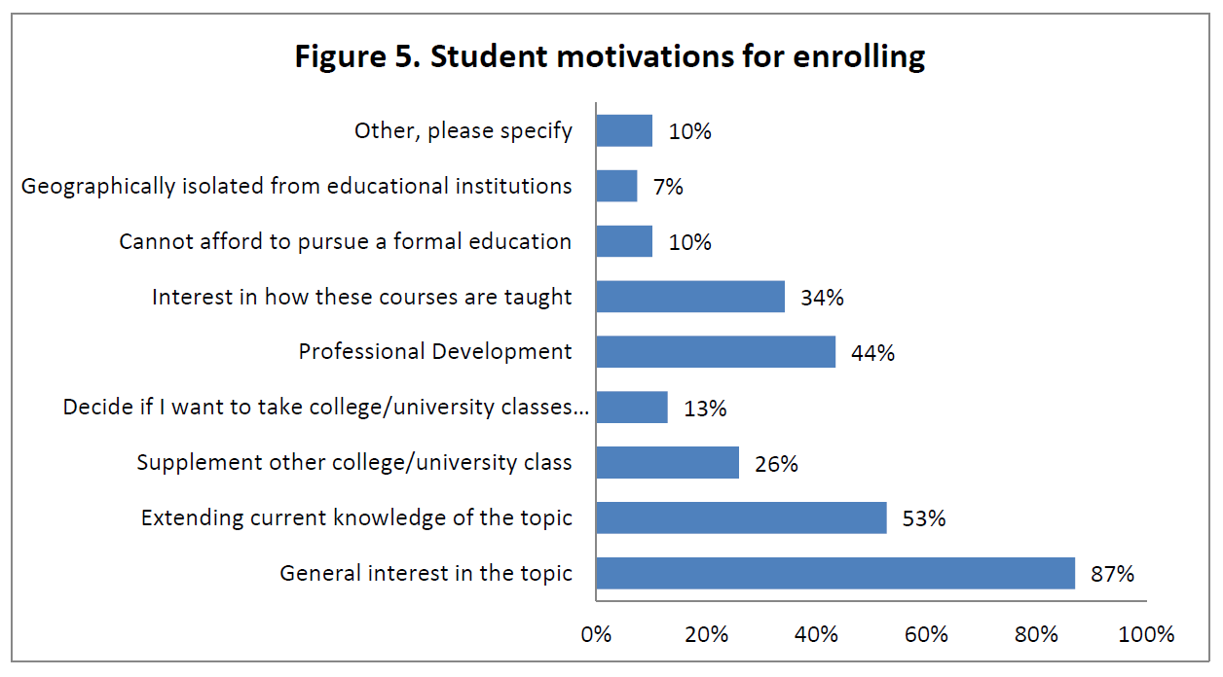
May 2013
Research Topic #3.
MOOC Motivators and Goals
MOOCs @ Edinburgh 2013– Report #1
Bioelectricity: A Quantitative Approach,
Duke University’s First MOOC

Slide 29
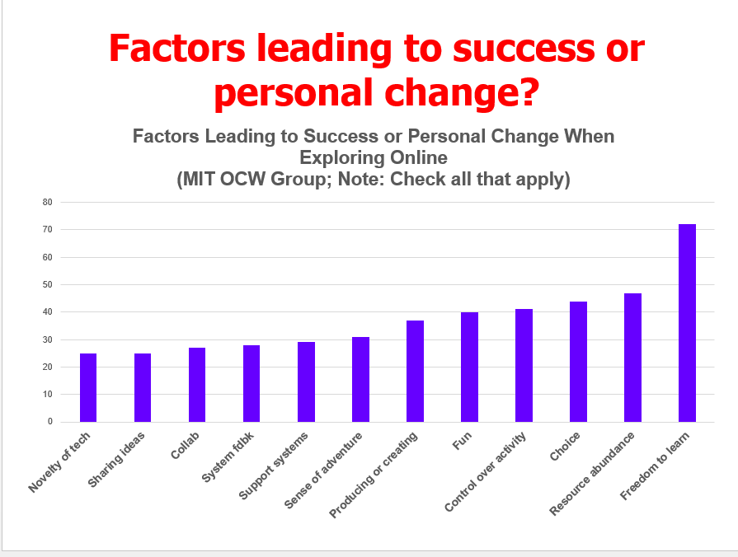
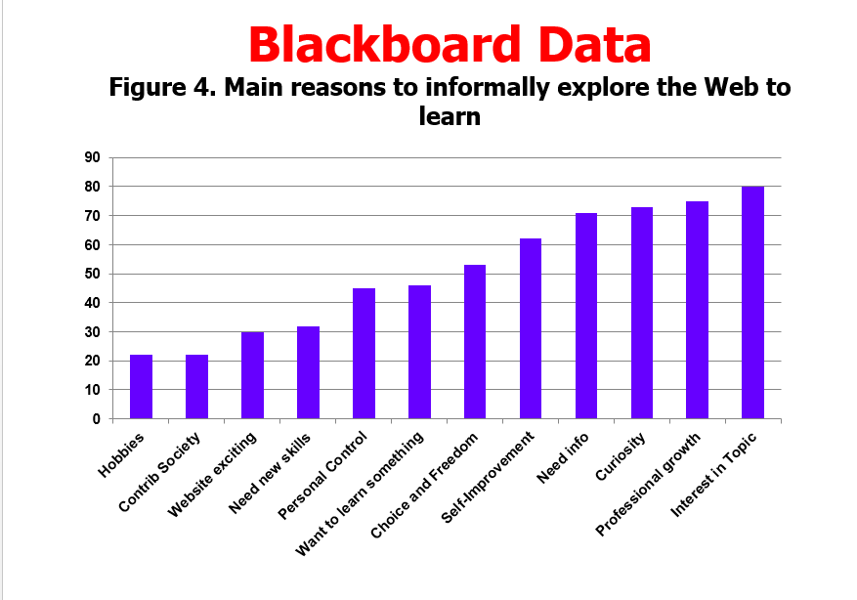
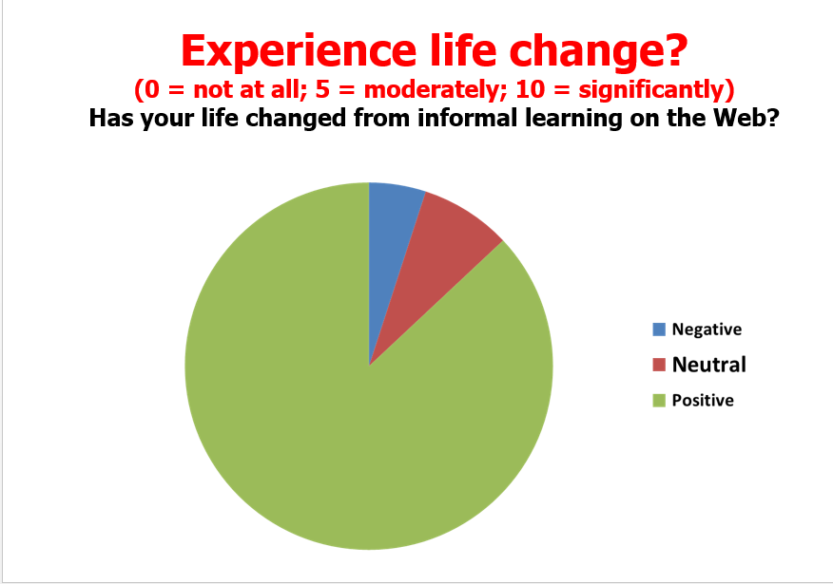
April, 2015
Learners Goals, Motivations, Achievements, Challenges, etc.
Bonk, C. J., Lee, M. M., Kou, X., Xu, S. & Sheu, F.-R. (2015). Understanding the Self-Directed Online Learning Preferences, Goals, Achievements, and Challenges of MIT OpenCourseWare Subscribers. Educational Technology and Society, 18(2), 349-368. Available: http://www.ifets.info/journals/18_2/26.pdf;
Issue TOC: http://www.ifets.info/issues.php?id=67

Slide 30
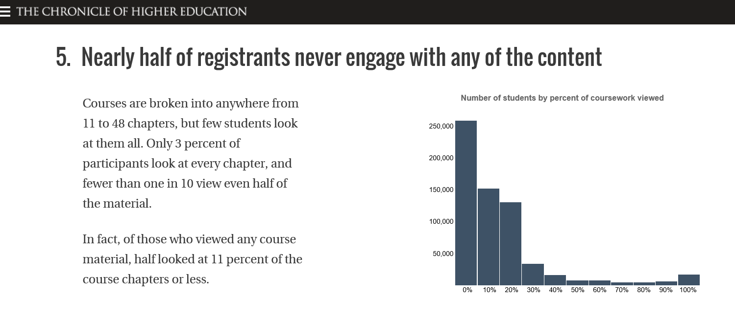
June 13, 2014
Research Topic #4.
Learner Engagement with Content
8 Things You Should Know About MOOCs
Chronicle of Higher Education, Jonah Newman and Soo Oh http://chronicle.com/article/MOOCs-EdX/146901/

Slide 31
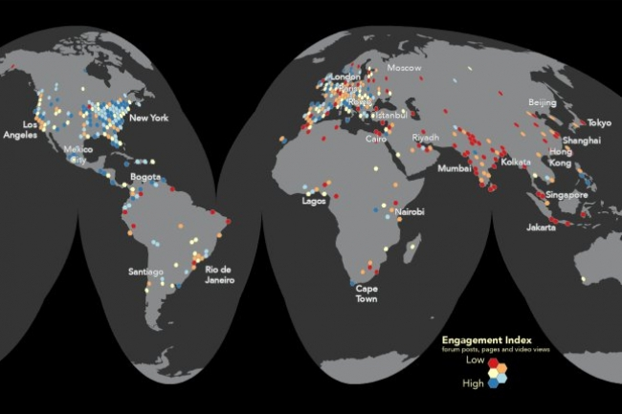
January 11, 2016
Mapping a MOOC Reveals Global Patterns in Student Engagement
Chronicle of Higher Education, Anthony C. Robinson http://chronicle.com/article/Mapping-a-MOOC-Reveals-Global/234795?cid=at&utm_source=at&utm_medium=en&elq=bf52c7566e1d42d6ac7d42b49e1980ea&elqCampaignId=2208&elqaid=7501&elqat=1&elqTrackId=ed3e40a9614c4a5fb84d8851653a8839

Slide 32
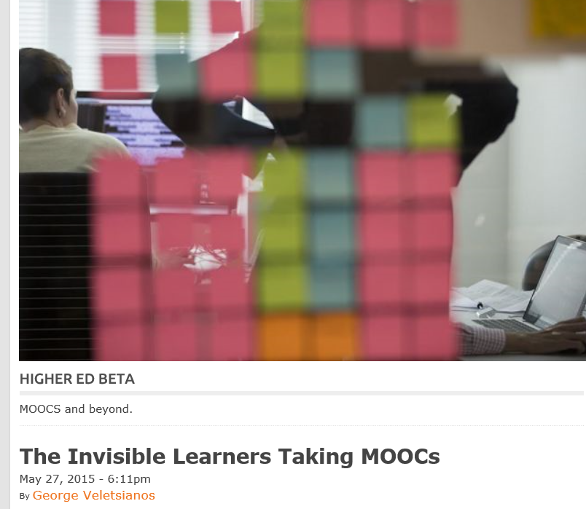

May 27, 2015
Research Topic #5.
MOOC Participant Study Strategies
The Invisible Learners Taking MOOCs,
George Veletsianos, Inside Higher Ed https://www.insidehighered.com/blogs/higher-ed-beta/invisible-learners-taking-moocs
Rajeev Bajpai, an airline pilot based in Mumbai, took an online computer-science course to gain programming skills.

Slide 33

October 6, 2015
Research Topic #6.
MOOCs as a Learning Supplement
Using MOOCs to Fill In Your Weak Spots, Hanna Peacock, Inside Higher Ed https://www.insidehighered.com/blogs/gradhacker/using-moocs-fill-your-weak-spots?utm_source=Inside+Higher+Ed&utm_campaign=bf05053fb7-DNU20151007&utm_medium=email&utm_term=0_1fcbc04421-bf05053fb7-197362401

Slide 34

April 21, 2014
Research Topic #7. Benefits of MOOCs for Disadvantaged and Underprivileged
The Revolution Is Not Being MOOC-ized, Students are educated, employed, and male.
Gayle Christensen and Brandon Alcorn, UPenn, New Scientist http://www.slate.com/articles/health_and_science/new_scientist/2014/03/mooc_survey_students_of_free_online_courses_are_educated_employed_and_male.html
Filipino youths go online at an Internet café in Manila on Feb. 18, 2014. Two-thirds of Coursera participants come from the developed world, according to a new report.

Slide 35
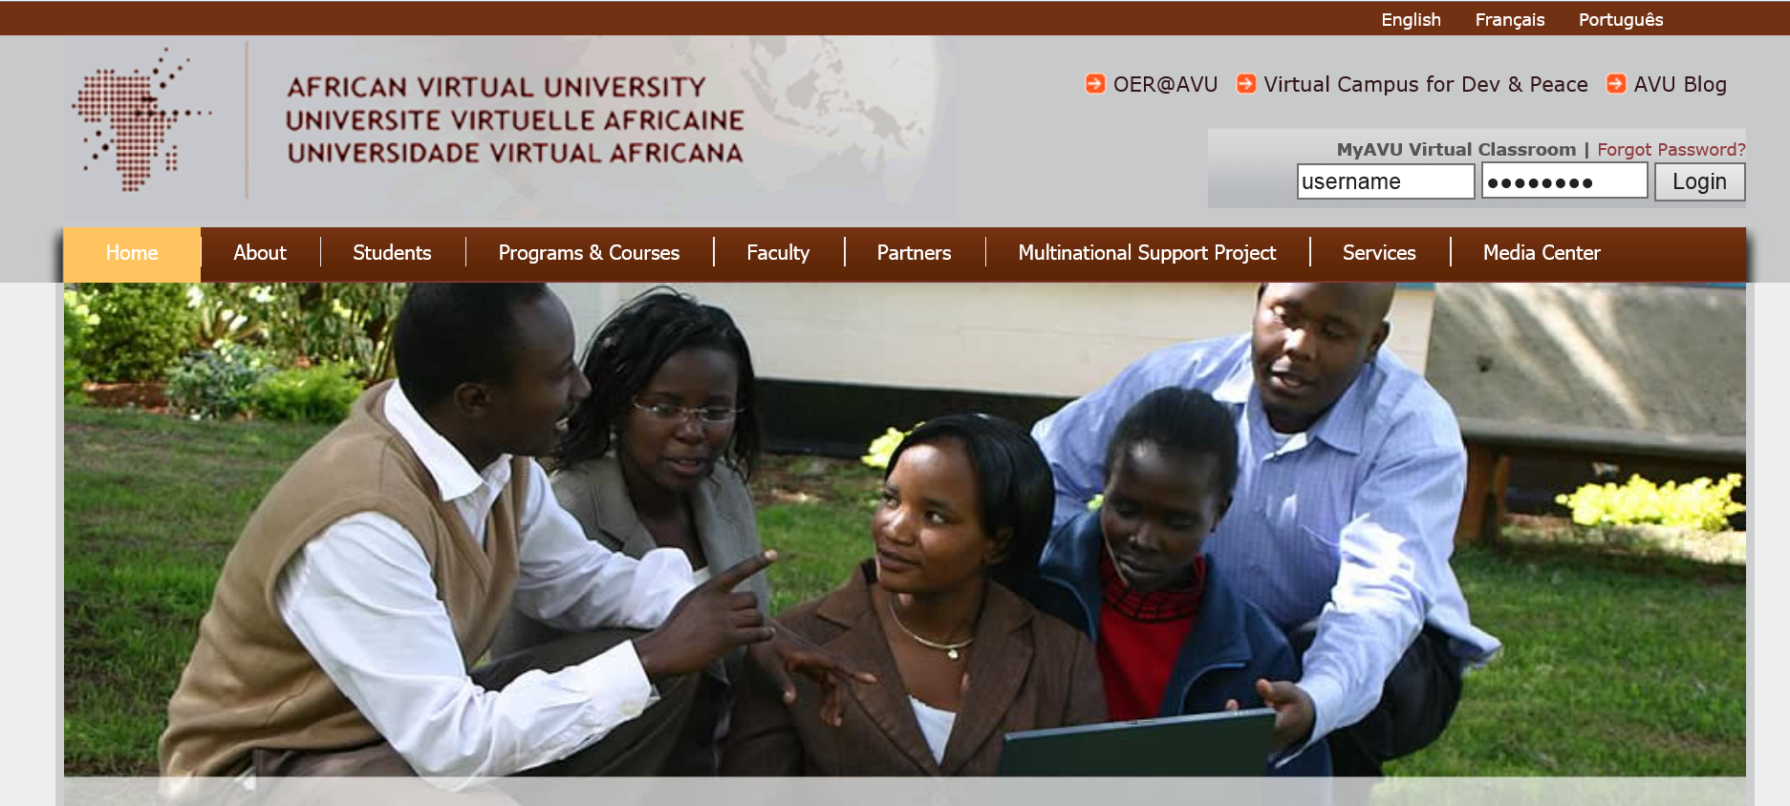
OER and MOOCs in Africa:
The AVU Experience
Griff Richards and Bakary Diallo, African Virtual University
Nairobi, Kenya
It is estimated that only 6% of Africans can access post-secondary education. The development goal is set at 12% even though North America and Europe are somewhere around 45%. The gap is huge. This is not to say that African nations are not investing in post-secondary education. For example, Nigeria has been steadily building universities during the past couple of decades.

Slide 36

April 20, 2015
Research Topic #8. Case Studies
250 MOOCs and Counting: One Man’s Educational Journey, Chronicle of Higher Education http://chronicle.com/article/250-MOOCsCounting-One/229397/?cid=at
If the MOOC movement has faded, nobody told Jima Ngei. Mr. Ngei, who lives in Port Harcourt, Nigeria, has completed and passed 250.
Jima Ngei: “I had this unrelenting fear that this miracle of free access might evaporate soon.”

Slide 37
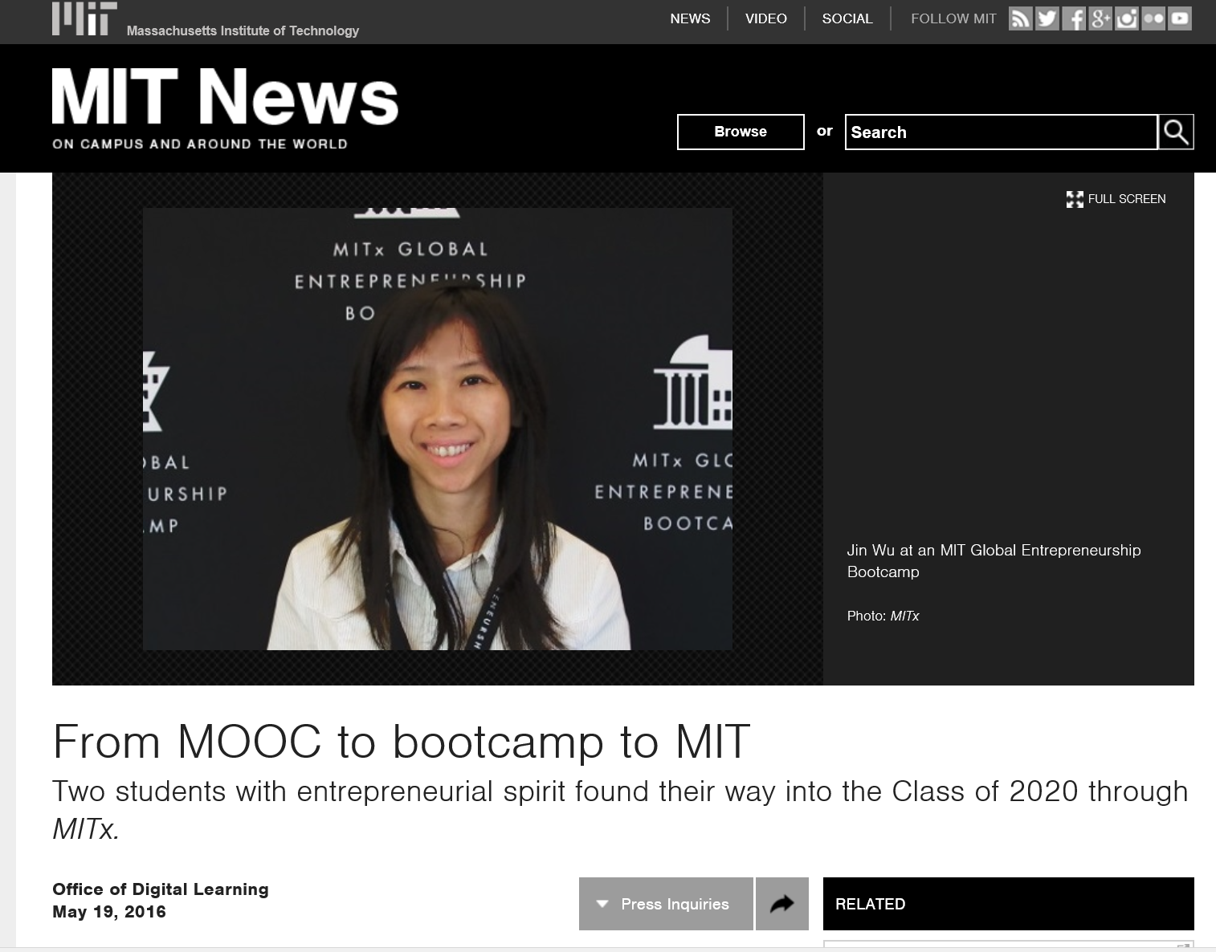
May 19, 2016
From MOOC to bootcamp to MIT
MIT News http://news.mit.edu/2016/mooc-bootcamp-mit-0519

Slide 38

MIT Data:
Prepares to Reenter University
(41-50 year old male, Middle East)
Most interesting experience of my own was my use of MIT OCW to refresh on Calculus. I purchased the textbook and followed one of several calculus options on the site. This was quite successful in re-introducing Calculus, as a prep to re-entering college 28 years after graduation - this time to study for a Master's.

Slide 39
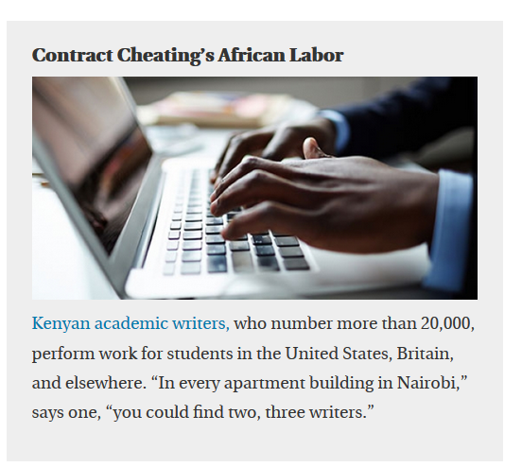
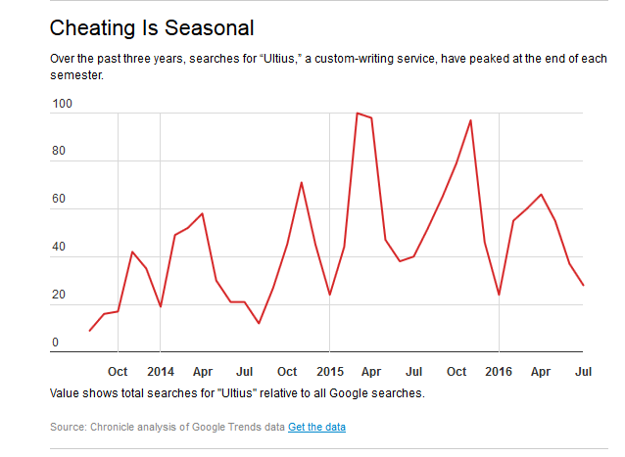
August 28, 2016
Research Topic #9. MOOC Plagiarism
The New Cheating Economy, Brad Wolverton, The Chronicle of Higher Education http://www.chronicle.com/article/The-New-Cheating-Economy/237587?cid=at&utm_source=at&utm_medium=en&elqTrackId=57c94038703546fda36eca130ad20e28&elq=ba28e5398d584c278a1266d3473adbd9&elqaid=10453&elqat=1&elqCampaignId=3922

Slide 40
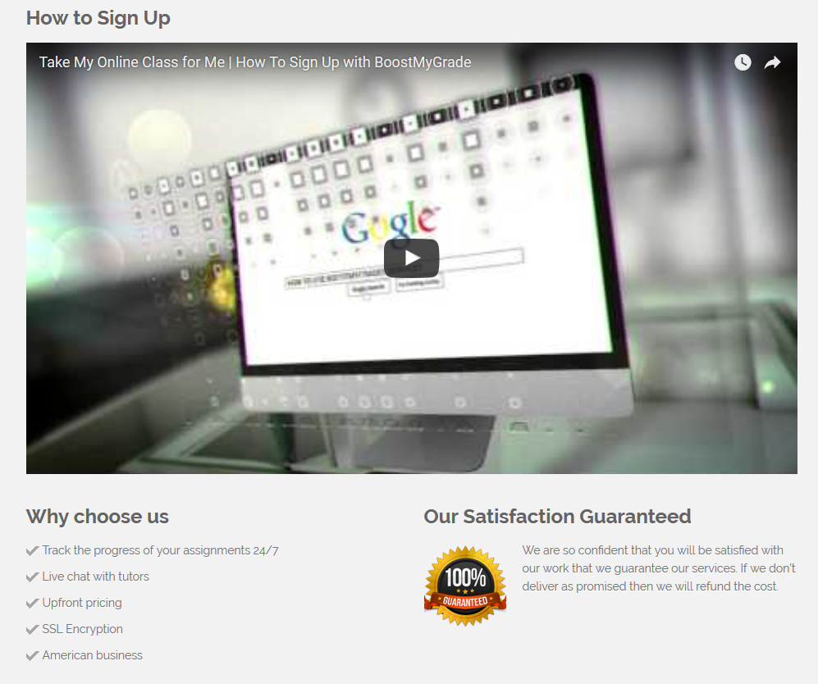
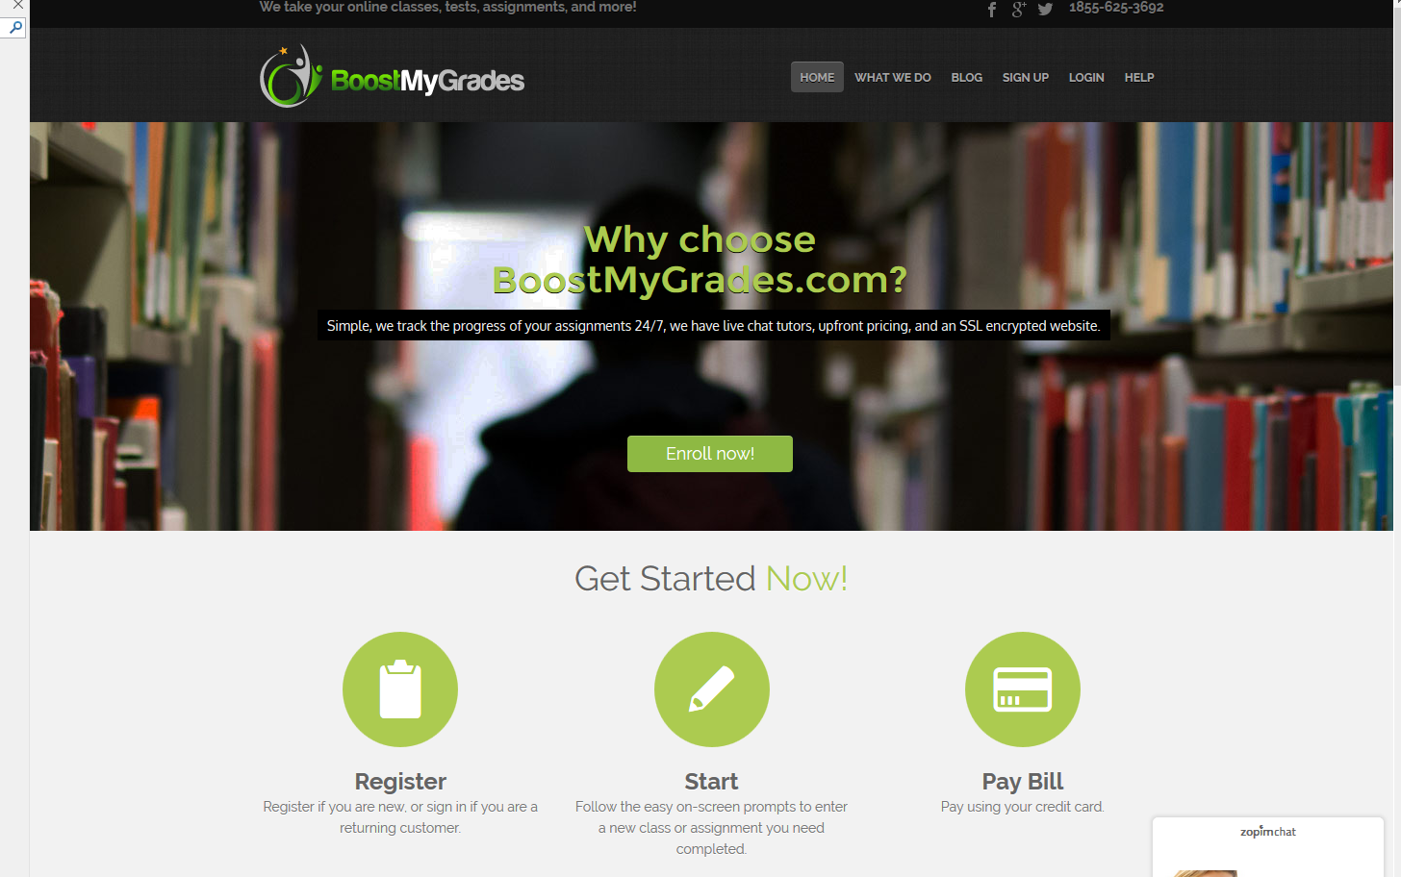
August 31, 2016
BoostMyGrade.com http://www.boostmygrade.com/

Slide 41
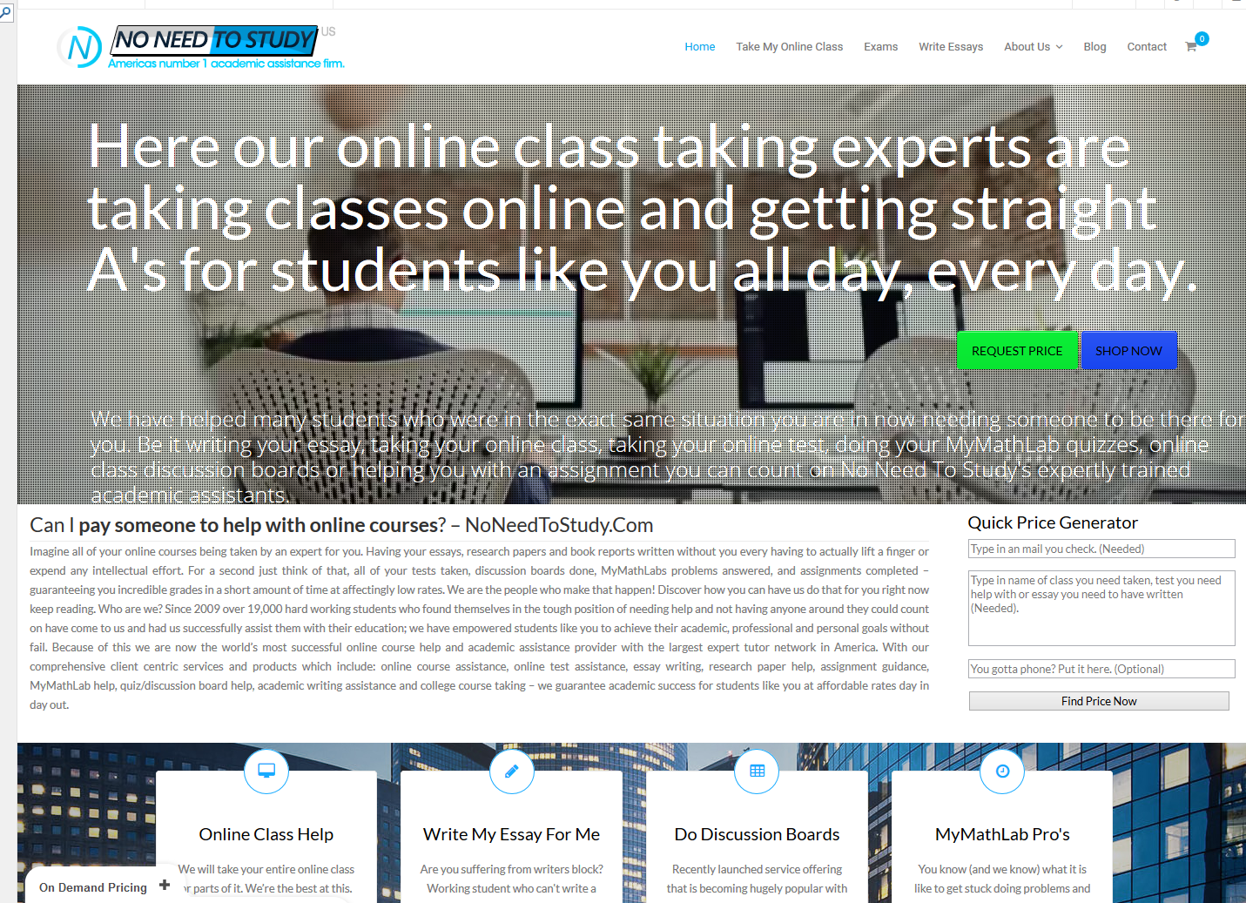
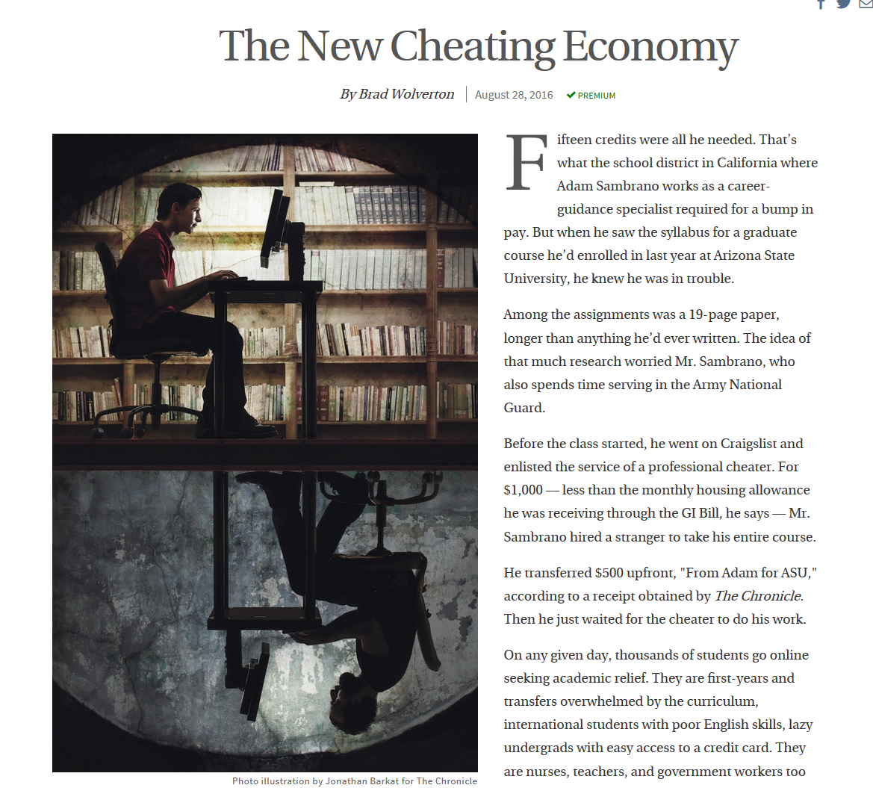
August 31, 2016
NoNeedtoStudy.com https://www.noneedtostudy.com/myclass/

Slide 42
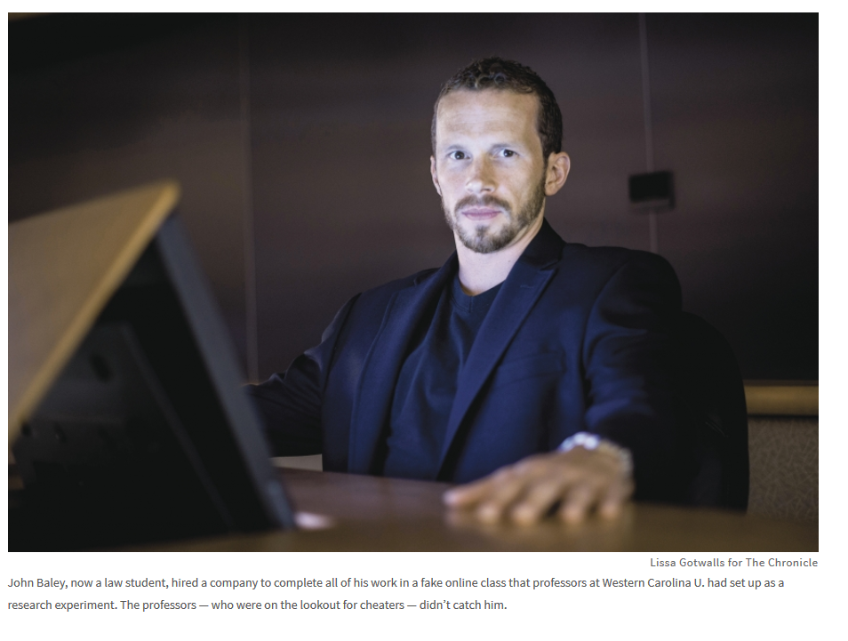
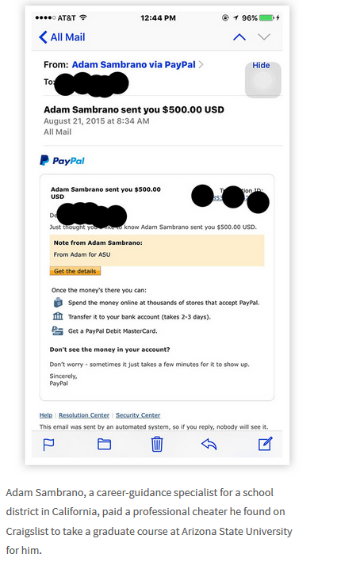

August 28, 2016
The New Cheating Economy, Brad Wolverton, The Chronicle of Higher Education http://www.chronicle.com/article/The-New-Cheating-Economy/237587?cid=at&utm_source=at&utm_medium=en&elqTrackId=57c94038703546fda36eca130ad20e28&elq=ba28e5398d584c278a1266d3473adbd9&elqaid=10453&elqat=1&elqCampaignId=3922

Slide 43

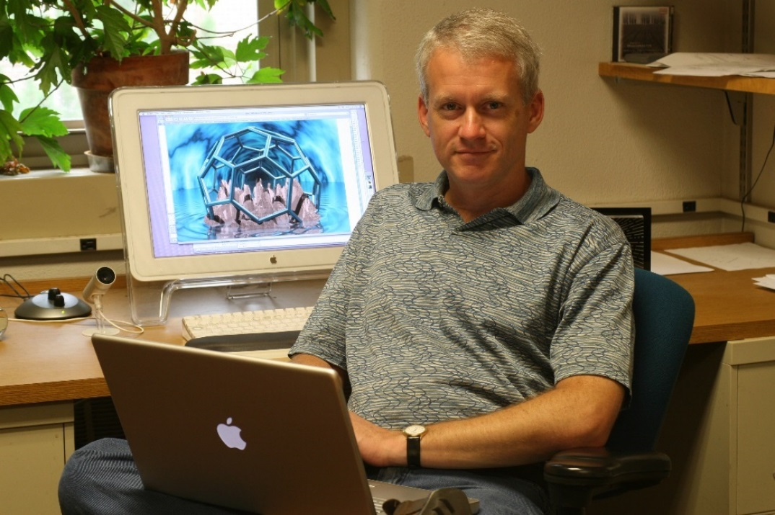
MOOC Research Openings…
Part 2: Instructor-Focused

Slide 44


October 25, 2014
Research Topic #10.
Faculty Awareness of the Open World
Opening the Curriculum: Open Educational Resources in U.S. Higher Education, 2014, I. Elaine Allen and Jeff Seaman http://www.onlinelearningsurvey.com/reports/openingthecurriculum2014.pdf

Slide 45
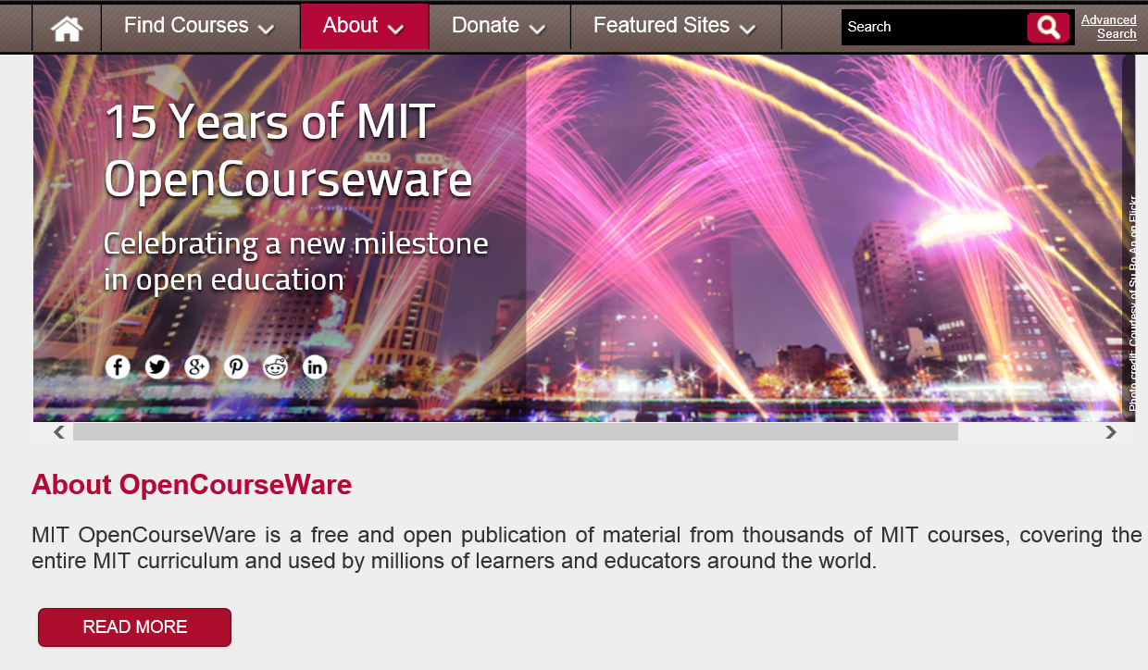
February 24, 2016
MIT OpenCourseWare http://ocw.mit.edu/about/15-years/

Slide 46
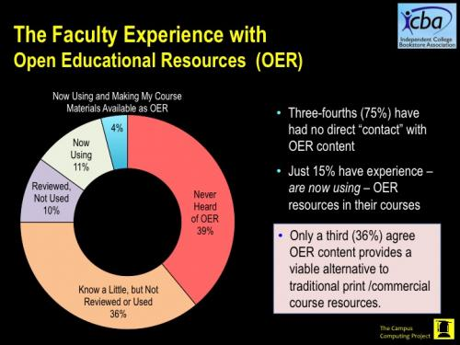
February 2016
Faculty Awareness of the Open World
Going Digital: Faculty Perspectives on Digital and OER Course Materials
Kenneth Green, The Campus Computing Project http://www.campuscomputing.net/goingdigital2016

Slide 47

February 2016
Going Digital: Faculty Perspectives on Digital and OER Course Materials
Kenneth Green, The Campus Computing Project http://www.campuscomputing.net/goingdigital2016

Slide 48


Research Topic #11. Actual Use of Open Access Resources and Materials
Nature, Openwords, etc. http://www.openwords.com/ https://www.facebook.com/Openwords

Slide 49

October 29, 2015
Research Topic #12.
Admin Support of the Open World
Campus Tech Leaders Report More Support for Free Educational Materials, Ellen Wexler, Chronicle of Higher Education

Slide 50


September 2, 2016
Research Topic #13.
Instructor MOOC Grading Impacting Motivation
Humans, the Latest MOOC Feature
Carl Straumsheim, Inside Higher Ed https://www.insidehighered.com/news/2016/09/02/massachusetts-institute-technology-experiments-instructor-grading-massive-open?utm_source=Inside+Higher+Ed&utm_campaign=4b5742079a-DNU20160902&utm_medium=email&utm_term=0_1fcbc04421-4b5742079a-197362401&mc_cid=4b5742079a&mc_eid=aa4227c9f6

Slide 51

Activity #2: Half-Way Pt.
Which of the research ideas mentioned so far match what you have written down?

Slide 52


MOOC Research Openings…
Part 3: Course/Instructional Design

Slide 53


Research Topic #14. MOOC Participant Help Giving Behaviors, Learning Communities, and Ecologies
Chapter 14: Creating a Temporary Spontaneous Mini-Ecosystem through a MOOC
Paul Kim and Charlie Chung, Stanford University
Figure 2. Twitter thread announcing the MOOC

Slide 54



July 2015
Research Topic #15. Rubric Analysis of MOOC Pedagogy
AMP: A Tool for Characterizing the Pedagogical Approaches of MOOCs
Karen Swan, Scott Day, Leonard Bogle, and Traci van Prooyen
University of Illinois Springfield
Figure 3. Ratings Metaphors

Slide 55


December 30, 2015
Research Topic #16. Research on Changes in Teaching Practices
Udemy Awards, 2015 Instructor Awards! https://teach.udemy.com/congratulations-to-udemys-outstanding-instructors-of-2015/

Slide 56



August 20, 2015
Research on Unique Pedagogy
Syracuse professor offers free ‘Star Trek’ class to the public, USA Today, Amari D. Pollard, LeMayne College http://college.usatoday.com/2015/08/20/syracuse-professor-offers-free-star-trek-class-to-the-public/ r

Slide 57

May 31, 2014
Research Topic #17.
Localization of Content and Multicultural Practices ocMOOCs and hMOOCs
Revolutionizing online education
Professor creates courses tailored to cultural differences,
Korea JoongAng Daily, KIM BONG-MOON [bongmoon@joongang.co.kr] http://koreajoongangdaily.joins.com/news/article/article.aspx?aid=2989930&cloc=joongangdaily%7Chome%7Cnewslist1
Professor Auh Yoon-il of Kyung Hee Cyber University explains the upcoming Kyung Hee MOOC 2.0 in an interview with the Korea JoongAng Daily at Kyung Hee University on Wednesday. (“one culture” or ocMOOCs and hMOOCs)

Slide 58


2016
Research Topic #18.
Language Availability
State of the MOOC 2016:
A Year of Massive Landscape Change For Massive Open Online Courses, Online Course Report http://www.onlinecoursereport.com/state-of-the-mooc-2016-a-year-of-massive-landscape-change-for-massive-open-online-courses/

Slide 59



June 26, 2015
Research Topic #19. Cultural Differences in MOOC Perceptions and Definitions
In China, Where Everything is a MOOC, Education Week, Justin Reich, HarvardX Research Fellow http://blogs.edweek.org/edweek/edtechresearcher/2015/05/in_china_where_everything_is_a_mooc.html?r=284759497
The most memorable line from my recent visit to China was this: "We have 12 million K-12 teachers in China who need to receive this particular in-service training, so we started with a group of about 200,000."

Slide 60


MOOC Research Openings…
Part 4: Impact/Context-Focused

Slide 61

Part 4: Impact/Context-Focused
Duke MOOCs Around the World https://www.youtube.com/watch?v=nL5QQRR6IOU&feature=youtu.be

Slide 62


April 23, 2015
Research Topic #20.
Cost-Benefit Analysis
Offloading Semesters or Years to MOOCs
The Catch in Arizona State’s Low-Cost Freshman Year Online: No Aid, Chronicle of Higher Education, Thomas Fisher http://chronicle.com/article/The-Catch-in-Arizona-State-s/229617/
Anant Agarwal, the head of edX, which teamed up with Arizona State U. in the new project: “Our mission is to provide education to people who need it the most.”

Slide 63



Building Talent Pipeline
Master’s Degree Is New Frontier of Study Online, August 17, 2013, The New York Times
By Tamar Lewin http://chronicle.com/article/MOOCs-May-Not-Be-So-Disruptive/140965/ http://extensionengine.com/putting-moocs-to-work-recap-infographic/#.VExR4o3wtjs

Slide 64


May 19, 2016
Research Topic #21. MOOC Access and Use (e.g., MOOC listings and ratings schemes)
MOOC lists: Class Central, the MOOC list https://www.mooc-list.com/ https://www.class-central.com/

Slide 65


October 7, 2015
Research Topic #22.
Alternative Delivery Systems
MIT Unveils ‘MicroMaster’s,’ Allowing Students to Get Half Their Degree From MOOCs, Andy Thomason, Chronicle of Higher Education

Slide 66

June 12, 2014
Research Topic #23. Economic Value of MOOCs (Assessment Issues)
Will a degree made up of Moocs ever be worth the paper it's written on?
The University of the People can now hand out degrees to its online students – but will employers take them seriously?, Louise Tickle The Guardian http://www.theguardian.com/higher-education-network/blog/2014/jun/12/moocs-viable-alternative-traditional-degree
Moocs can offer a lot, but they don't offer the feedback of a traditional degree.

Slide 67


April 17, 2014
Research Topic #24.
Impact of MOOCs Across Age, Gender, and Course Type
Infographic: Global MOOC statistics eCampus News, Meris Stansbury http://www.ecampusnews.com/research/infographic-moocs-global-436/
Inforgraphic: https://magic.piktochart.com/output/1747660-moocs
Krissa Swain, of Knoxville, Tenn., is taking "Operations Management" online to help develop her management skills.

Slide 68

What About Age?
Data Visualization Tools
(Harvard and MIT MOOCs)
Lawrence Biemiller, February 20, 2014, Chronicle of HE http://chronicle.com/blogs/wiredcampus/harvard-and-mit-release-visualization-tools-for-trove-of-mooc-data/50631?cid=pm&utm_source=pm&utm_medium=en

Slide 69


October 6, 2014
Research Topic #25.
High School Student College Prep and Advanced Placement Courses edX turns attention to high school MOOCs, eSchool News http://www.eschoolnews.com/2014/10/06/high-school-moocs-839/print/

Slide 70



January 11, 2016
7th grade scholarships for MOOC completion
U.S. News and World Report, eSchool News http://www.eschoolnews.com/2016/01/11/7th-grade-scholarships-for-mooc-completion/

Slide 71


Research Topic #26. Acceptability of MOOCs as Corporate Training
G2g (Googler to Googler) Training
Seven Ways to Corporate MOOC, Udemy blog, December 23, 2013, Shannon Hughes https://www.udemy.com/organizations/blog/2013/12/23/seven-ways-to-corporate-mooc/
Classes range from management and public speaking, to parenting and mountain climbing.

Slide 72



July 28, 2016
Udemy
Your opportunity for adventure ends tomorrow — 50% off any course https://www.udemy.com/courses/

Slide 73



September 15, 2015
Research Topic #27.
MOOCs for Social Impact
Social Learning for Social Impact, edX
Join the world’s first GROOC – a MOOC for groups – to collaborate with others globally and create social change. https://www.edx.org/course/social-learning-social-impact-mcgillx-groocx https://www.youtube.com/watch?t=36&v=WNg-5LFAMdI

Slide 74






January 27, 2014
Research Topic #28.
Various Geo-Political Issues
Coursera Support Center, Why is my country blocked? http://help.coursera.org/customer/portal/articles/1425714-why-is-my-country-blocked-
Online education platform Coursera blocks students in Syria and Iran, Wamba, Nina Curley http://www.wamda.com/2014/01/coursera-blocks-syria-and-iran-moocs-online-courses

Slide 75


October 7, 2014
ALISON: Global Health Initiatives
Online Mooc courses deliver Ebola health advice, BBC News, Sean Coughlan http://www.bbc.com/news/education-29521360 http://www.advancelearning.com/why-wait-for-others-to-fight-ebola
Disinfecting a room in Monrovia, Liberia: Online courses are providing health advice to fight Ebola.

Slide 76

September 16, 2013
Research Topic #29. Issues of Quality
Rwandan Degree Program Aims for a 'University in a Box', Chronicle of Higher Education, Megan O’Neil http://chronicle.com/article/Rwandan-Degree-Program-Aims/141631/
Students attend an orientation session at Kepler, a new hybrid program in Kigali, Rwanda, which will use MOOCs and classroom time to help students earn competency-based associate degrees.

Slide 77




Research Topic #30.
Impact of Mobile MOOCs
(e.g., mobile courses on smartphone)

Slide 78


May 20, 2016 agMOOCs (India) http://www.agmoocs.in/

Slide 79


August 31, 2015
MOOC Watch? samsung unveils Gear S2 smartwatch,
USA Today, Brett Molina http://www.usatoday.com/tech/

Slide 80


April 1, 2015
Research Topic #31.
Flipped the Classroom with MOOCs
For a Better Flip, Try MOOCs, David Raths, Campus Technology http://campustechnology.com/articles/2015/04/01/for-a-better-flip-try-moocs.aspx

Slide 81


April 30, 2014
Research Topic #32. Impact of Blending FTF Sessions with Online MOOCs
New Learning Hubs Locations Hosted by The New York Public Library and Seven Other Int’l Partners, Coursera Learning Hubs https://www.coursera.org/about/programs/learningHubs http://blog.coursera.org/post/84322385012/new-learning-hubs-locations-hosted-by-the-new-york

Slide 82


Research Topic #33.
Learning for Enjoyment vs. Credentials

Slide 83


Learning for Enjoyment Versus Credentials and Badges
“Just play around with ideas for alternatives to printed texts and don't be afraid to create your own, even if they're amateurish…I think we need to de-emphasise formal assessment and accreditation and encourage our playful side to see what is possible. Too much informal learning wants to get itself 'badged' or validated too quickly and this means its losing its genuine amateur status.”

Slide 84


March 3, 2016
‘Trump U.’ Draws Unflattering Spotlight to the Candidate as Fraud Cases Move Forward
Chronicle of Higher Education, Corrine Ruff http://chronicle.com/article/Trump-U-Draws/235573?cid=trend_right_a

Slide 85



August 5, 2015
Research Topic #34. Acceptability of
Nanodegrees and Microcredentials
How Nanodegrees Are Disrupting Higher Education
John Waters, Campus Technology http://campustechnology.com/articles/2015/08/05/how-nanodegrees-are-disrupting-higher-education.aspx

Slide 86




January 20, 2016
Coursera Specializations https://www.coursera.org/browse?utm_medium=email&utm_source=marketing&utm_campaign=aUAR4L-fEeW6i-NodUB9Qw&languages=en

Slide 87




July 28, 2016
Coursera Specializations email
Starting Monday: 9 Top Specializations https://www.coursera.org/courses?languages=en&utm_campaign=SkXukFONEea1Nr_6p0oZUA&utm_medium=email&utm_source=marketing

Slide 88

January 5, 2016
Use Of MOOCs And Online Education Is Exploding: Here's Why
Josh Bersin, Forbes http://www.forbes.com/sites/joshbersin/2016/01/05/use-of-moocs-and-online-education-is-exploding-heres-why/#290acdda7f09
Most of the MOOC providers now offer such credentials (there are over 100) and they include tools like Nanodegrees (Udacity), Credentials of Readiness (Harvard), XSeries (EdX), and many more. It’s not yet clear how well these credentials will be recognized by employers, but that’s where this market is going.
Most of these companies focus on technical education – software skills, IT systems, and other technical topics.

Slide 89

September 22, 2015
Research Topic #35.
MOOC Benefits and Impact
Who’s Benefiting from MOOCs, and Why
Chen Zhenghao, Brandon Alcorn, Gayle Christensen, Nicholas Eriksson, Daphne Koller, Ezekiel J. Emanuel, Harvard Business Review https://hbr.org/2015/09/whos-benefiting-from-moocs-and-why

Slide 90

September 22, 2015
Who’s Benefiting from MOOCs, and Why
Chen Zhenghao, Brandon Alcorn, Gayle Christensen, Nicholas Eriksson, Daphne Koller, Ezekiel J. Emanuel, Harvard Business Review https://hbr.org/2015/09/whos-benefiting-from-moocs-and-why

Slide 91


MOOC Research Openings…
Part 5: Other

Slide 92

MOOC Personalization Survey Results

Slide 93


1. How many MOOCs have you taught? (N = 152)

Slide 94


Q4: 3. How many MOOCs have you completed as a learner
(including any that you are currently enrolled in)?
Answered: 145 Skipped: 10

Slide 95


Q7. What is the delivery format of your most recent MOOC?
Answered: 143 Skipped: 12

Slide 97
13. How do you address students’ varying competencies and needs?[Check all that apply]

Slide 98
14. What types of learning resources can participants select from in your most recent MOOC?[Check all that apply]

Slide 100
17. How did you design your course to be suitable for students from different cultures and/or linguistic backgrounds?[Check all that apply]

Slide 101
18. Does the structure of your most recent or current MOOC provide any of the following?
[Check all that apply; N = 126]

Slide 104

Audience Poll #4:
Would you like to research MOOCs now? What was your idea?
A. Yes…
B. No…

Slide 105







MOOCs and Open Education Around the World http://routledge-ny.com/books/details/9781138807419/

Slide 106

Any Comments or Questions?
Slides at: TrainingShare.com
Papers: PublicationShare.com
Free Book: http://tec-variety.com/
MOOCsBook: http://moocsbook.com/

