Slide 1
On the Road Toward Fostering Greater Self-Directed Learning in MOOCs: Research Toward Better Design Practices
Curtis J. Bonk| cjbonk@Indiana.edu
Indiana University Bloomington
Meina Zhu| meinazhu@wayne.edu
Wayne State University
September 18, 2020

Slide 2
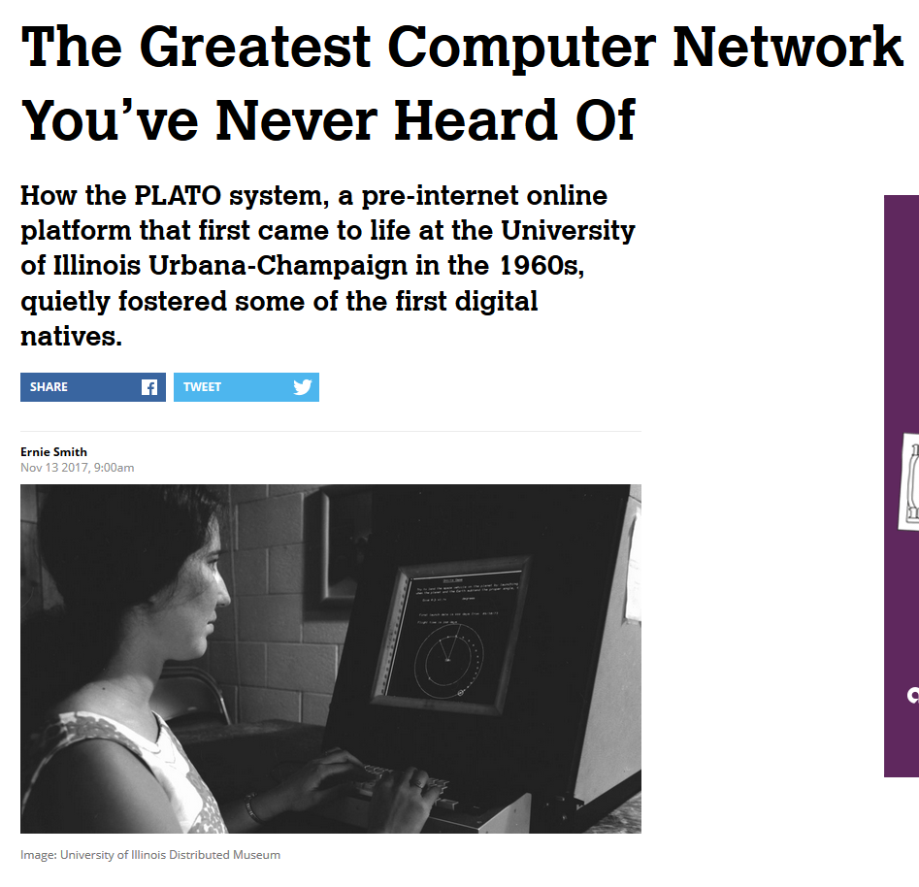

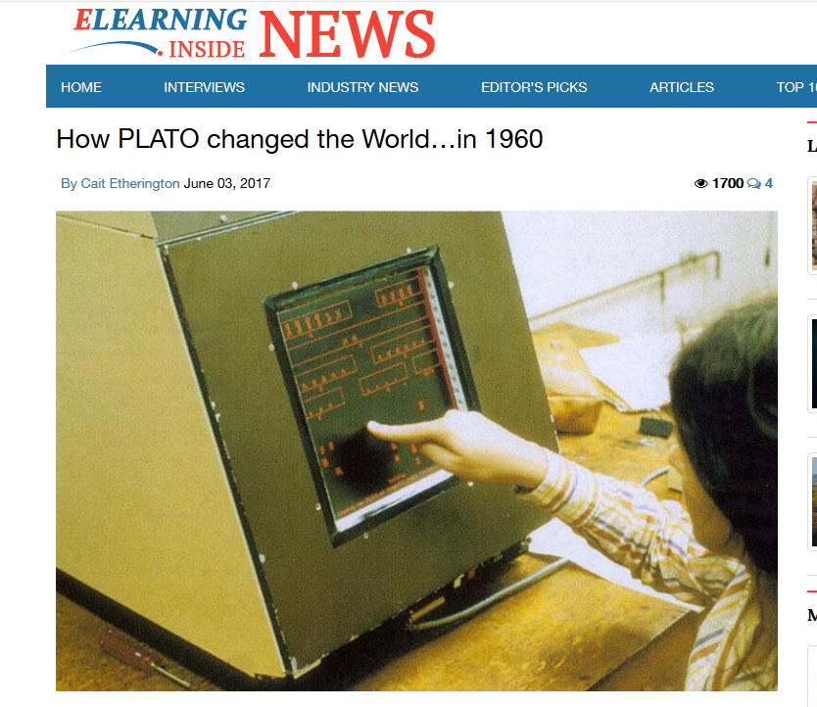
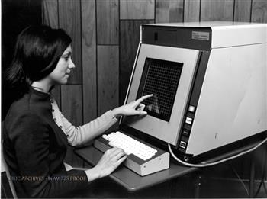
June 3, 2017
How PLATO changed the World…in 1960
Cait Etherington, ElearningInside News https://news.elearninginside.com/how-plato-changed-the-world-in-1960/
PLATO was the first generalized computer-assisted instruction system. Starting in 1960, it ran on the University of Illinois' ILLIAC I computer. By the late 1970s, it supported several thousand graphics terminals distributed worldwide, running on nearly a dozen different networked mainframe computers. Many modern concepts in multi-user computing were originally developed on PLATO, including forums, message boards, online testing, e-mail, chat rooms, picture languages, instant messaging, remote screen sharing, and multiplayer games.

Slide 3

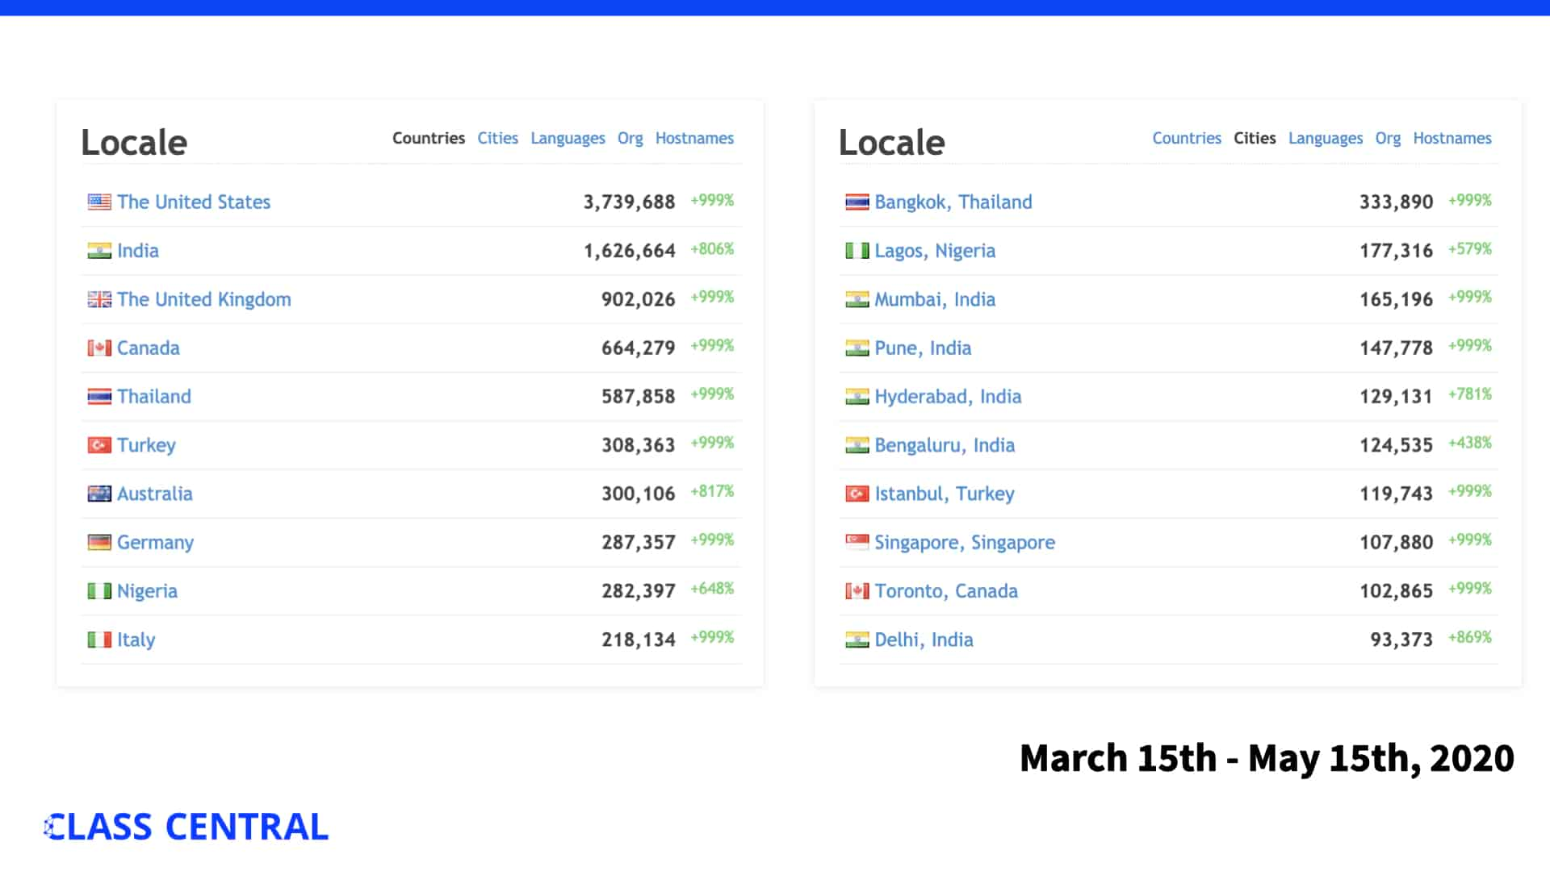
Talk Outline
  MOOC News and Trends.
  Study #1: MOOC ID Considerations and Challenges.
  Study #2: MOOC ID for Self-Directed Learning.
  20 SDL guidelines for MOOCs.

Slide 4


Polls
Poll #1: Who in here has taken a MOOC?
Poll #2: Are you happy when you take a MOOC?

Slide 5

MOOC Trends and Recent Data

Slide 6
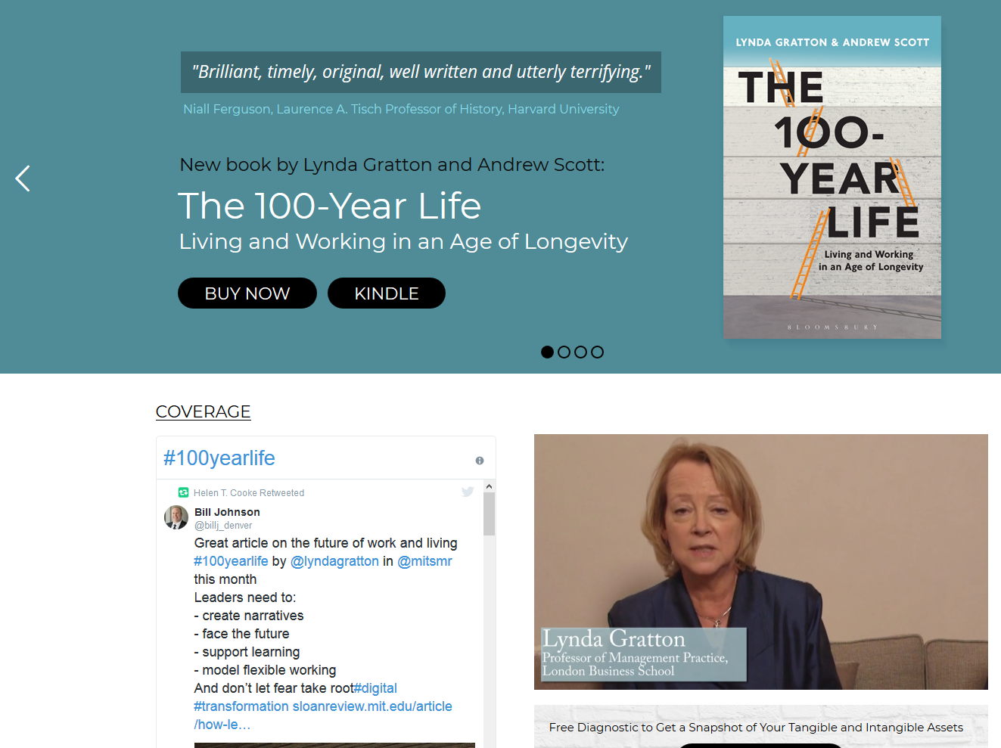

July 24, 2018
The 100-Year Life: Living and Working in an Age of Longevity
Lynda Gratton and Andrew Scott http://www.100yearlife.com/ https://www.amazon.com/100-Year-Life-Living-Working-Longevity/dp/1543624634

Slide 7
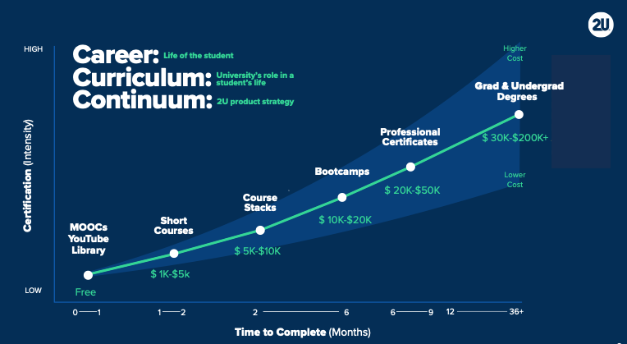
March 13, 2019
The Career Curriculum Continuum
Andrew Hermalyn, Inside Higher Ed https://www.insidehighered.com/digital-learning/views/2019/03/13/how-universities-can-stay-center-learners-lives-opinion

Slide 8
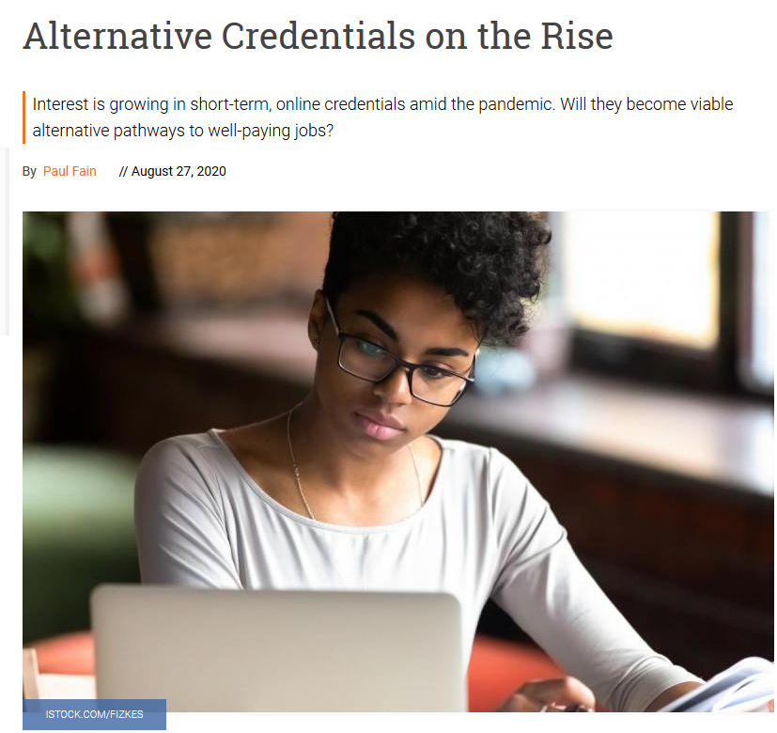
August 27, 2020
Alternative Credentials on the Rise
Paul Fain, Inside Higher Ed https://www.insidehighered.com/news/2020/08/27/interest-spikes-short-term-online-credentials-will-it-be-sustained

Slide 9
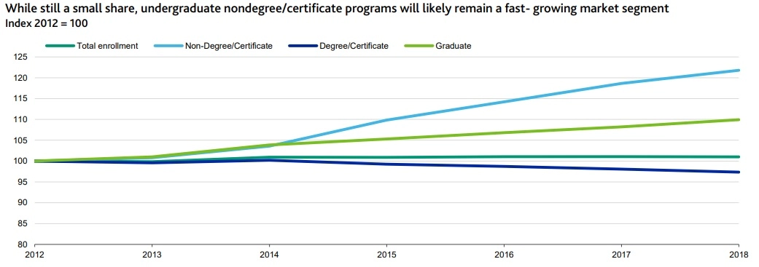
August 27, 2020
Alternative Credentials on the Rise
Paul Fain, Inside Higher Ed https://www.insidehighered.com/news/2020/08/27/interest-spikes-short-term-online-credentials-will-it-be-sustained
Sources: Moody's, U.S. Department of Education

Slide 10
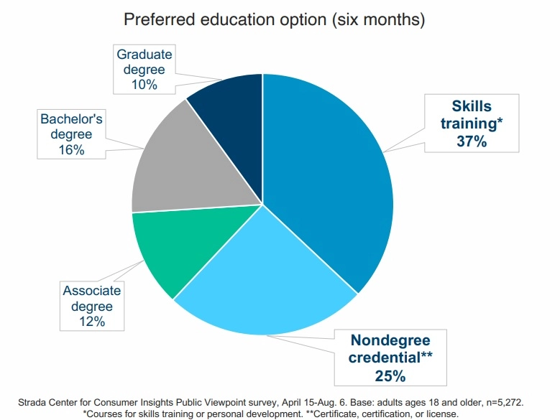
August 27, 2020
Alternative Credentials on the Rise
Paul Fain, Inside Higher Ed https://www.insidehighered.com/news/2020/08/27/interest-spikes-short-term-online-credentials-will-it-be-sustained

Slide 11
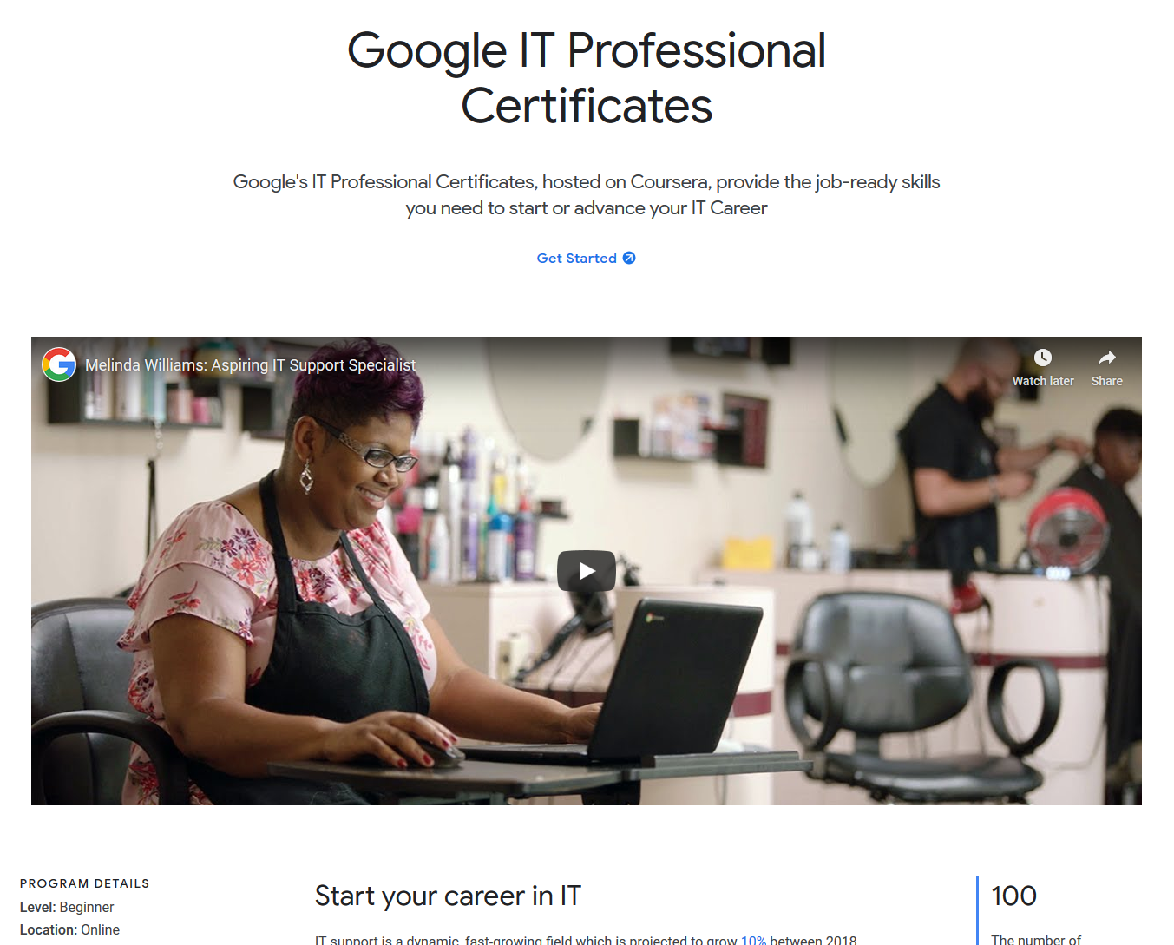
Professional Certificates
October 3, 2019
Google IT Professional Certificates
Coursera Blog https://grow.google/programs/it-support/?cid=wc&source=ams&sourceId=61203
Video: Melinda Williams: Aspiring IT Support Specialist (2:57) https://www.youtube.com/watch?time_continue=107&v=fvhPKZWbfms&feature=emb_logo

Slide 12
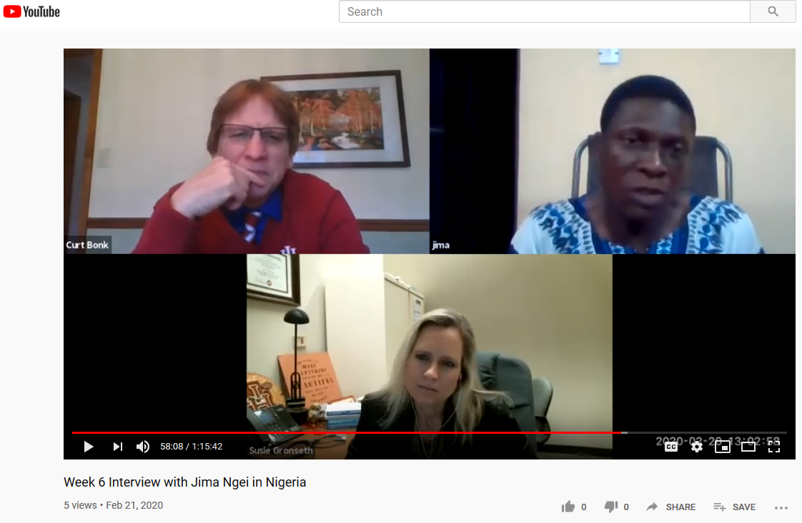
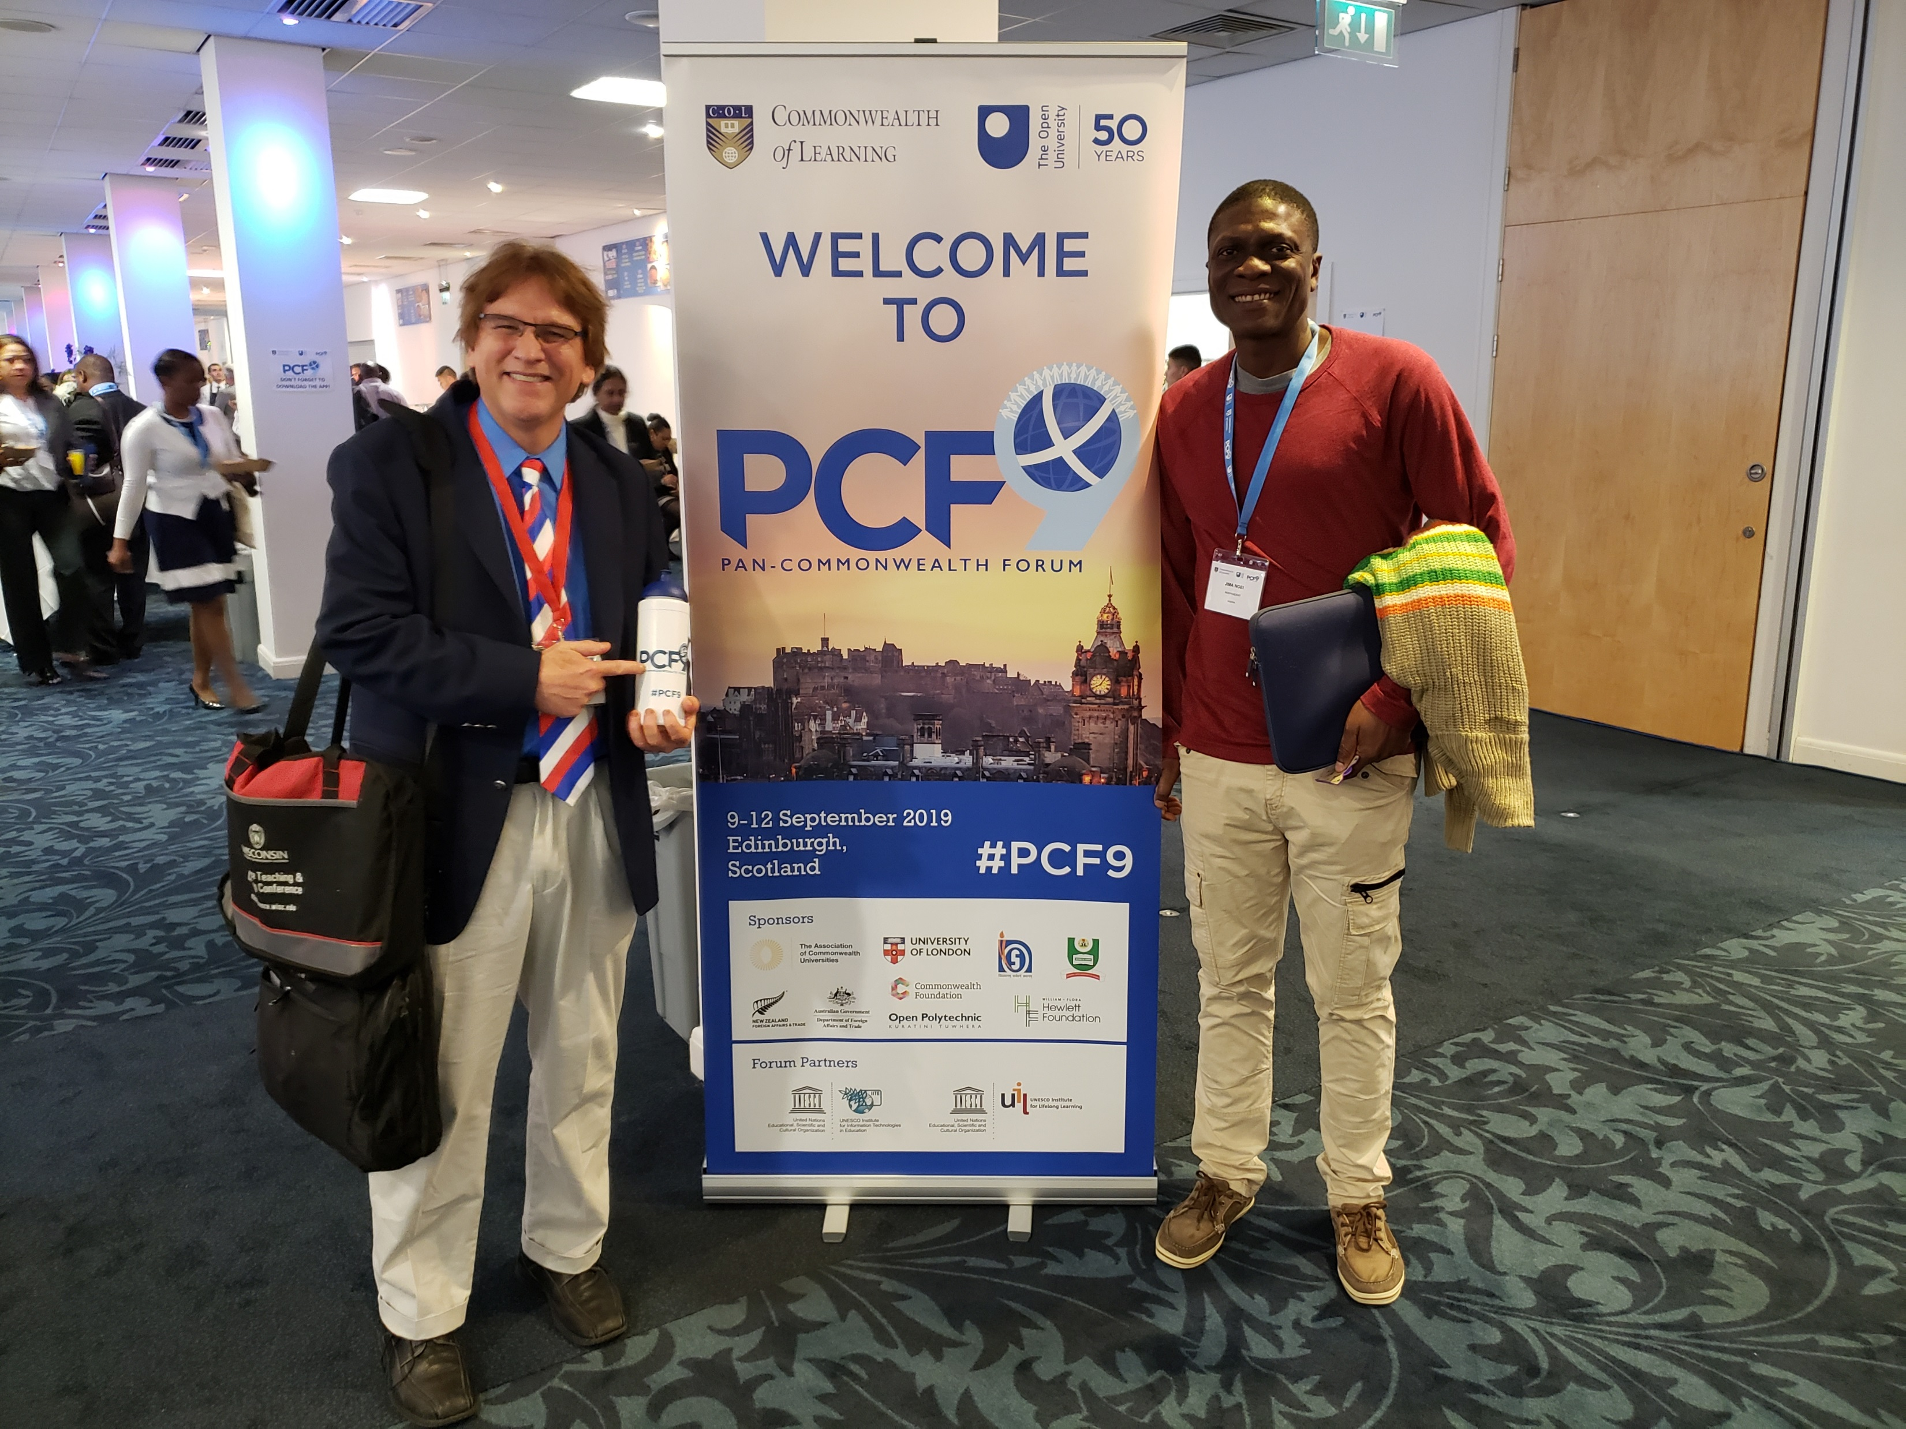

Hundred+ MOOC Clubs
September 11, 2019
250 MOOCs and Counting: One Man’s Educational Journey, Chronicle of Higher Education http://chronicle.com/article/250-MOOCsCounting-One/229397/?cid=at
If the MOOC movement has faded, nobody told Jima Ngei. Mr. Ngei, who lives in Port Harcourt, Nigeria, has completed and passed 250.

Slide 13
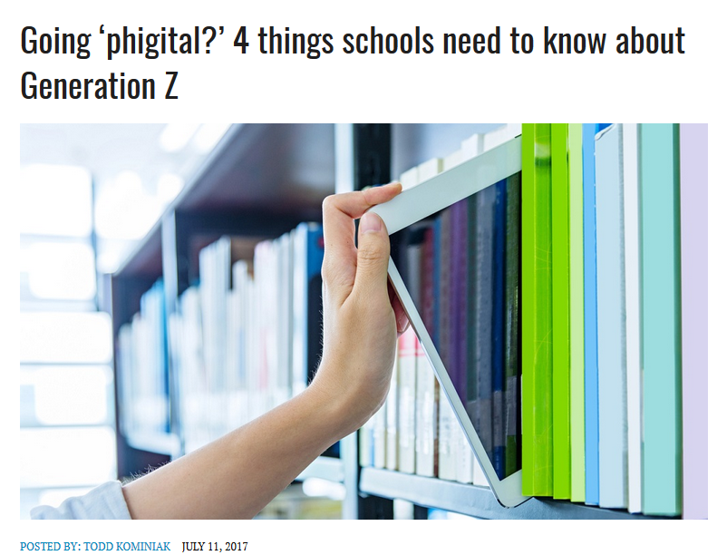
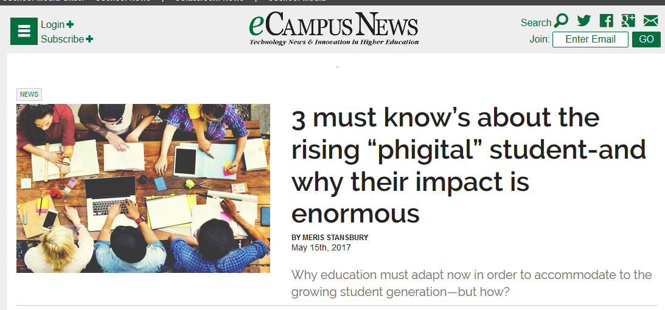
July 11, 2017
The Rise of the Phigital Learner
Going ‘phigital?’ 4 things schools need to know about Generation Z, Todd Kominiak, TrustEd http://trustedk12.com/phigital-digital-learning/
May 15, 2017
3 must know’s about the rising “phigital” student-and why their impact is enormous, Meris Stansbury, eCamous News https://www.ecampusnews.com/campus-administration/education-gen-z-phigital-student/

Slide 14
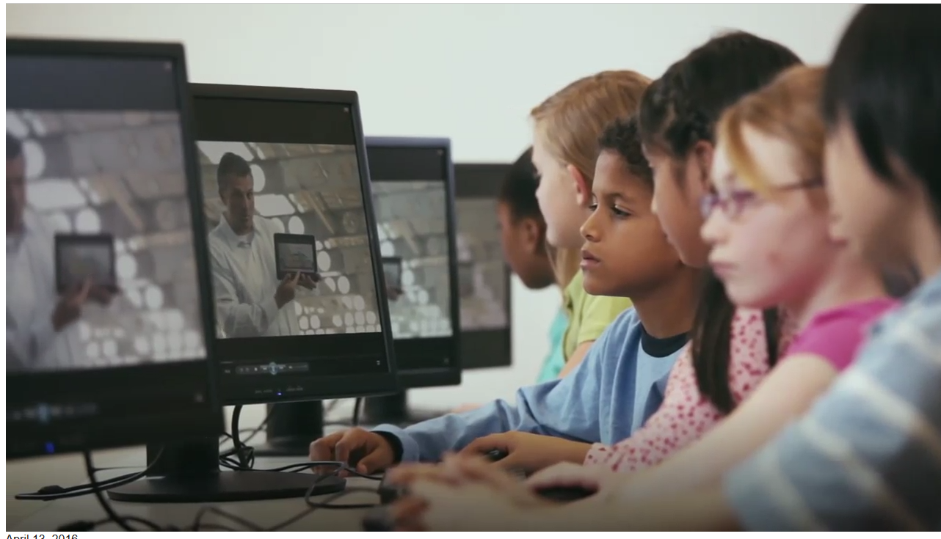
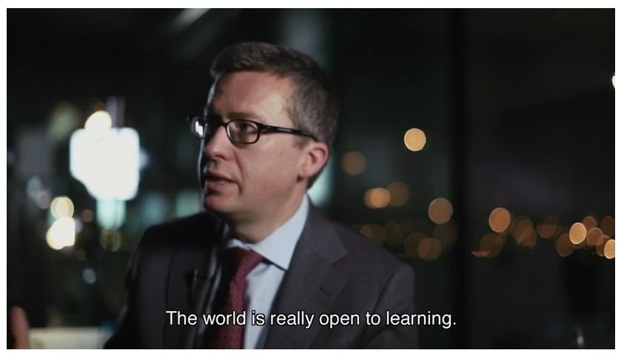
April 13, 2016
The Fourth Industrial Revolution:
What it means, how to respond
Klaus Schwab, Founder and Executive Chairman, World Economic Forum https://www.weforum.org/agenda/2016/01/the-fourth-industrial-revolution-what-it-means-and-how-to-respond/ http://trainingshare.com/fourth-industrial-evolution-video-clip.php http://www.tubechop.com/watch/8280981

Slide 15
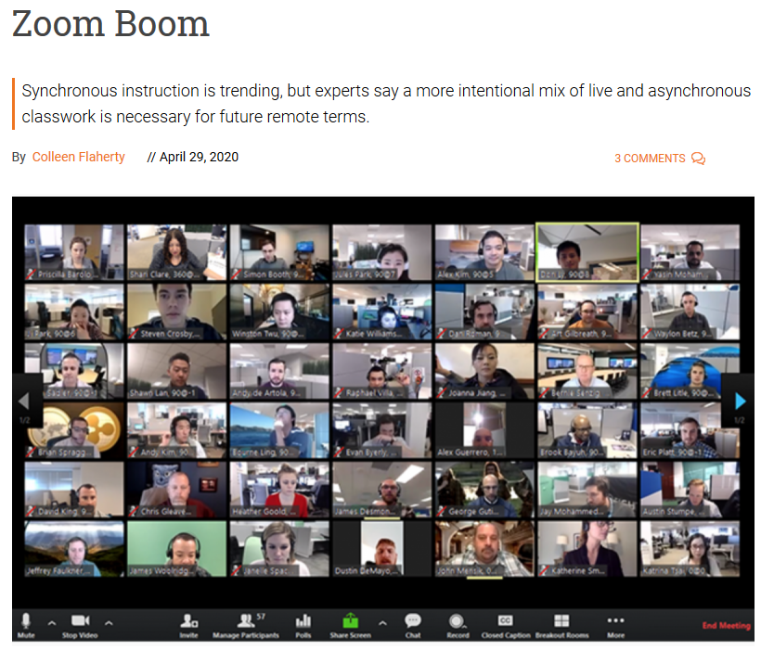
April 29, 2020
Zoom Boom
Synchronous instruction is trending, but experts say a more intentional mix of live and asynchronous classwork is necessary for future remote terms.
Colleen Flaherty, Inside Higher Ed https://www.insidehighered.com/news/2020/04/29/synchronous-instruction-hot-right-now-it-sustainable

Slide 16
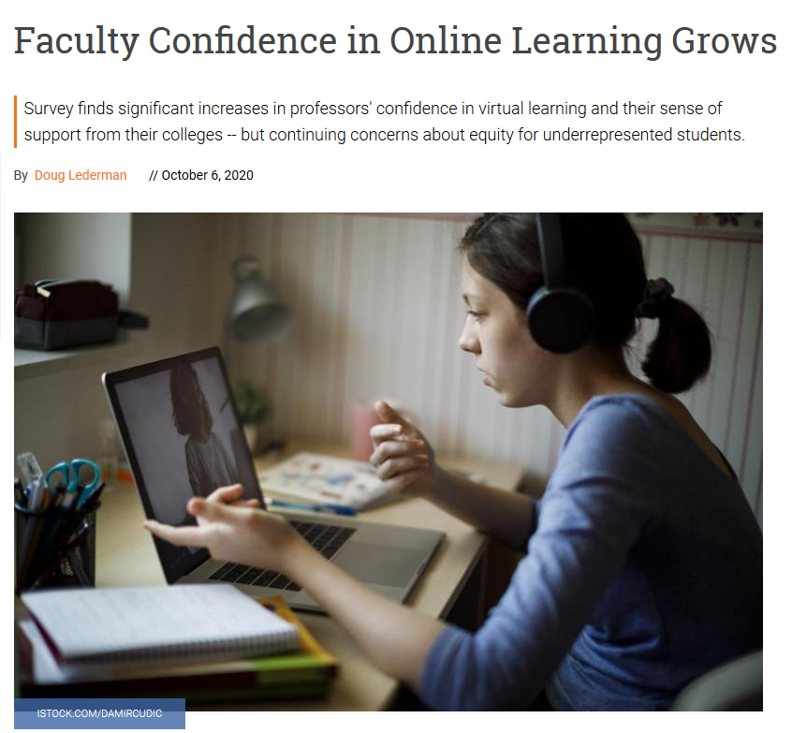
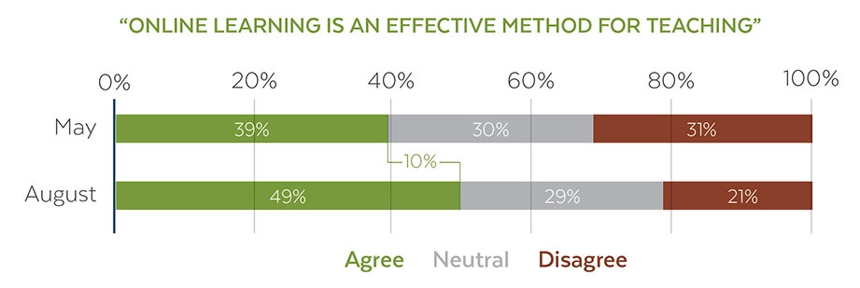
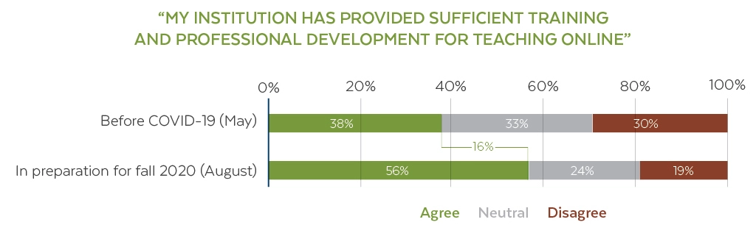
October 6, 2020
Faculty Confidence in Online Learning Grows
Doug Lederman, Inside Higher Ed https://www.insidehighered.com/digital-learning/article/2020/10/06/covid-era-experience-strengthens-faculty-belief-value-online

Slide 17

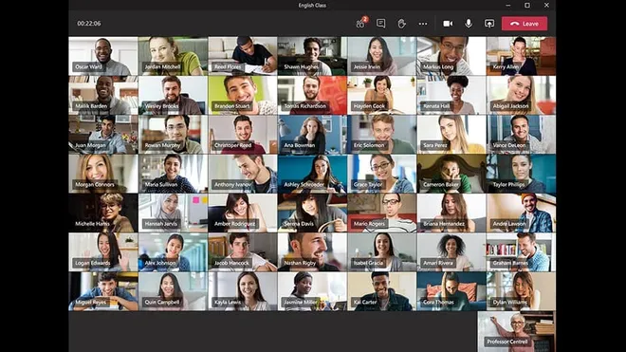
August 26, 2020
Zoom, Microsoft and Apple take on remote learning challenges as kids head back to school
Dalvin Brown, USA Today https://www.usatoday.com/story/tech/2020/08/26/zoom-google-apple-tech-firms-meet-remote-learning-needs-school-starts/5598975002/

Slide 18
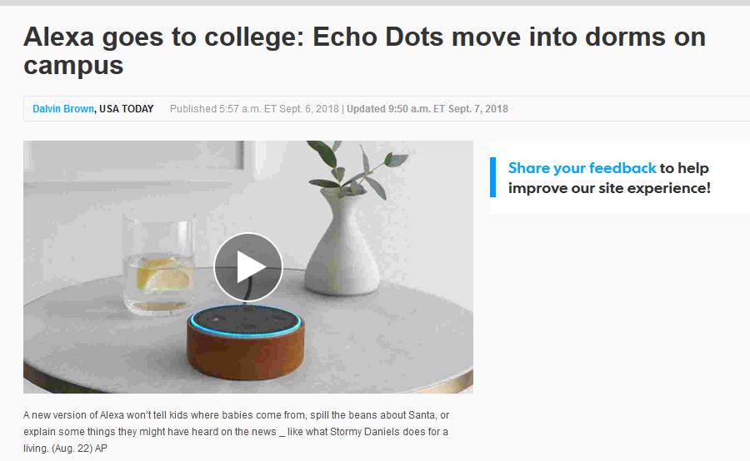
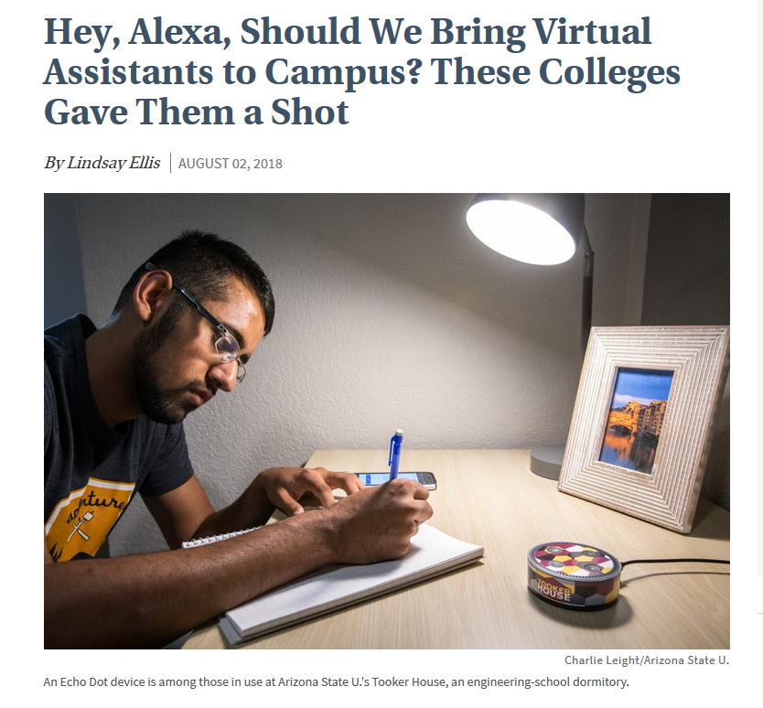
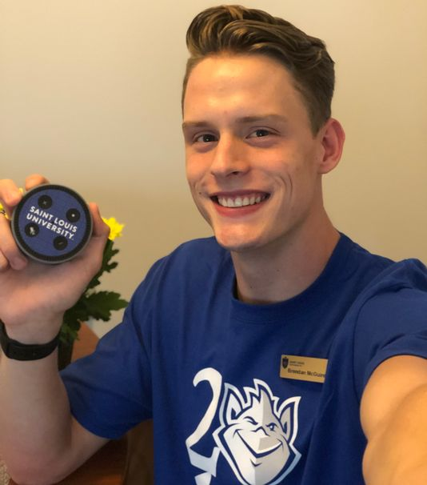

August 2, 2018
Learning is More On Demand
Hey, Alexa, Should We Bring Virtual Assistants to Campus? These Colleges Gave Them a Shot
Lindsey Ellis, The Chronicle of Higher Education https://www.chronicle.com/article/Hey-Alexa-Should-We-Bring/244129

Slide 19
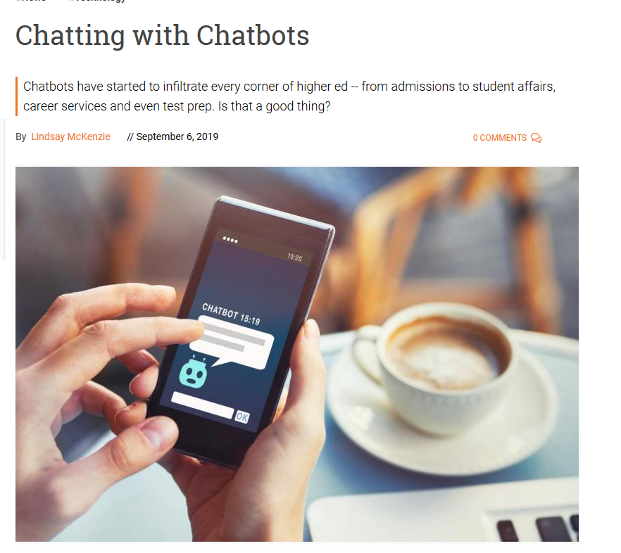

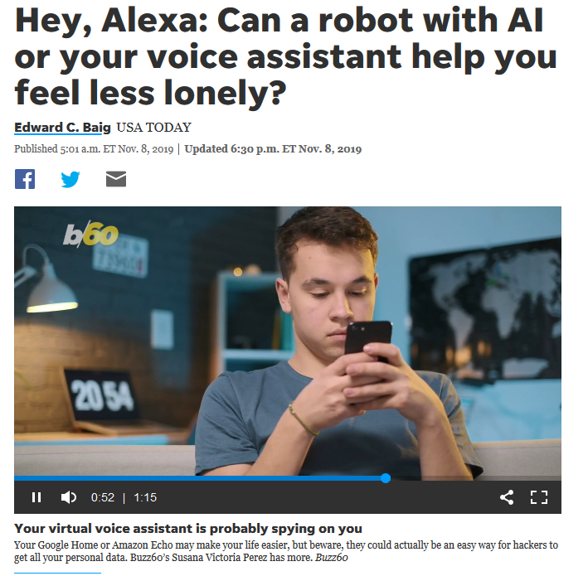

May/June 2020
Learning is More On Demand
Chatting with Chatbots and Text Buddies
Lindsey McKenzie, Inside Higher Ed https://www.insidehighered.com/news/2019/09/06/expansion-chatbots-higher-ed https://www.usatoday.com/story/tech/2019/11/08/alexa-google-assistant-ai-robots-become-substitute-friends/4057885002/

Slide 20
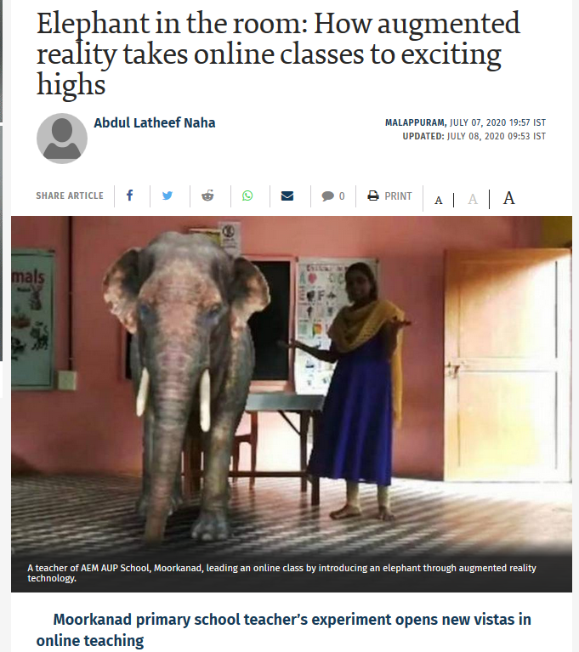

July 7, 2020
Elephant in the room: How augmented reality takes online classes to exciting highs,
Abdul Latheef Naha, The Hindu https://www.thehindu.com/news/national/kerala/augmented-reality-takes-online-classes-to-exciting-highs/article32014276.ece
When the whole world was in a lockdown in April, Mr. Shyam Vengalloor was racking his brains on finding a way to make virtual classrooms more exciting for children. Using green screen, Gif (graphics interchange format) images and several apps, Mr. Shyam succeeded in creating an augmented reality for the virtual class by superimposing graphics, audio and sensory enhancements.
A social science teacher of AEM AUP School, Moorkanad, introducing the globe through augmented reality technology during an online class.

Slide 21
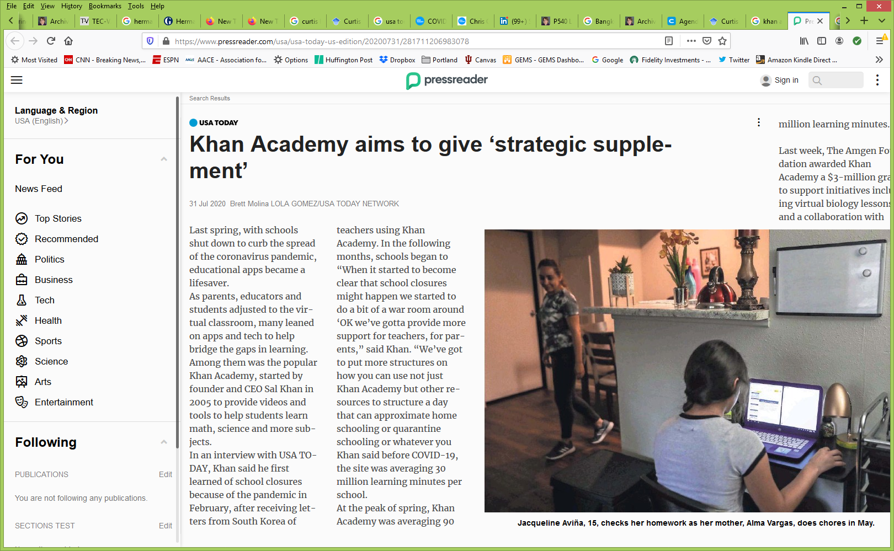
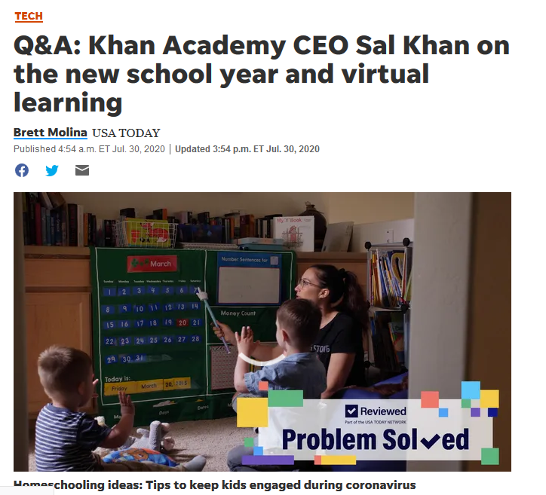
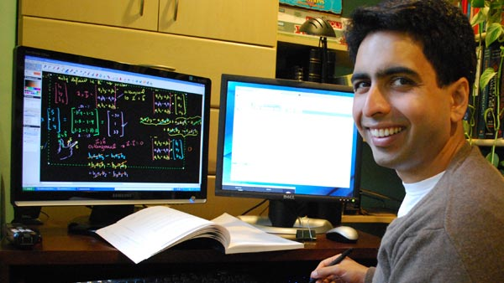
July 31, 2020
Learning is More Personal
Khan Academy aims to give ‘strategic supplement’
Brett Molina, USA Today https://www.usatoday.com/story/tech/2020/07/30/khan-academy-ceo-sal-khan-prepping-fall-virtual-learning/5525480002/

Slide 22
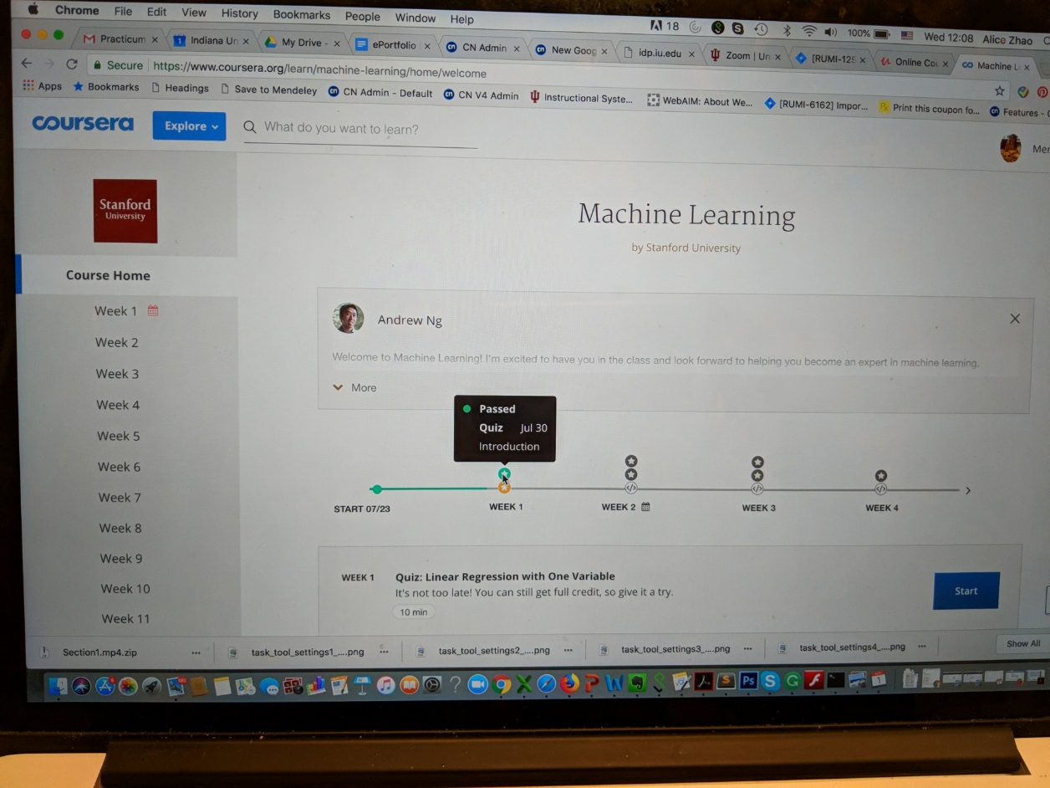
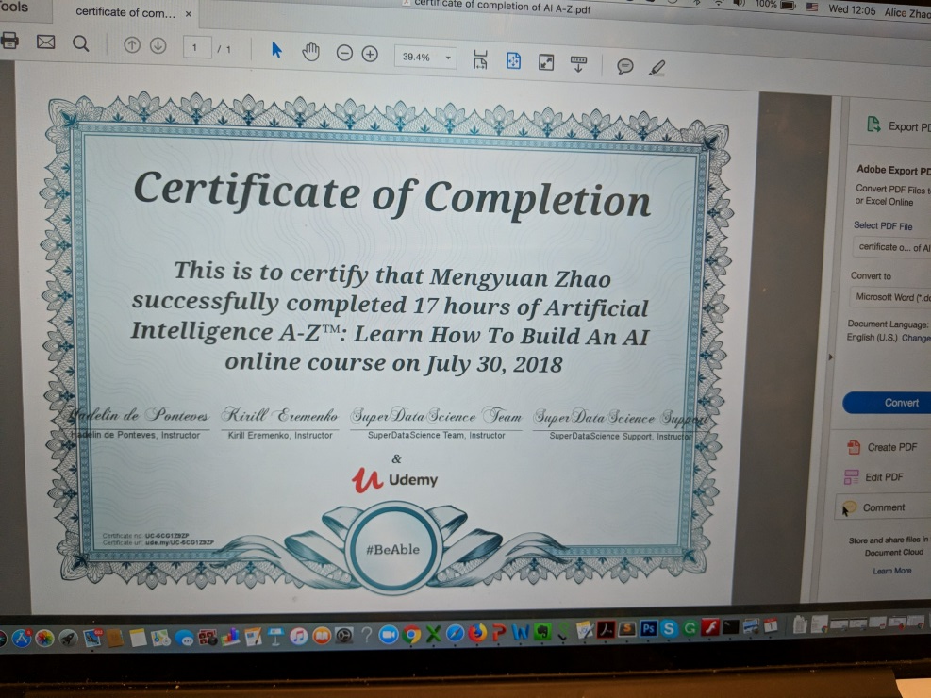
Student Independent Studies Via MOOCs
MOOC: AI A-Z: Learning How to Build an AI Online Course and Machine Learning
Mengyuan Zhao https://www.udemy.com/artificial-intelligence-az/ https://www.coursera.org/learn/machine-learning

Slide 23
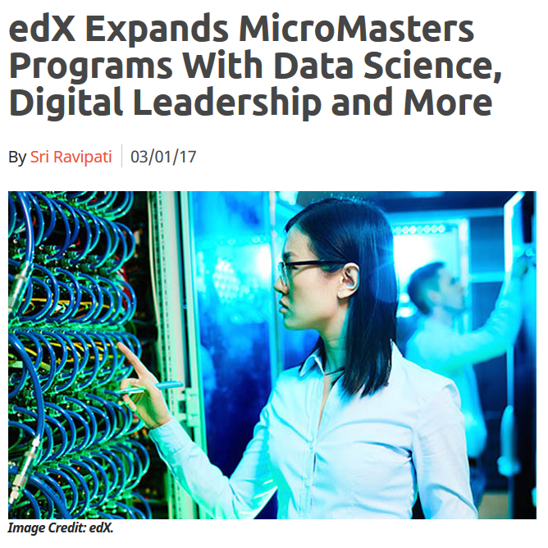
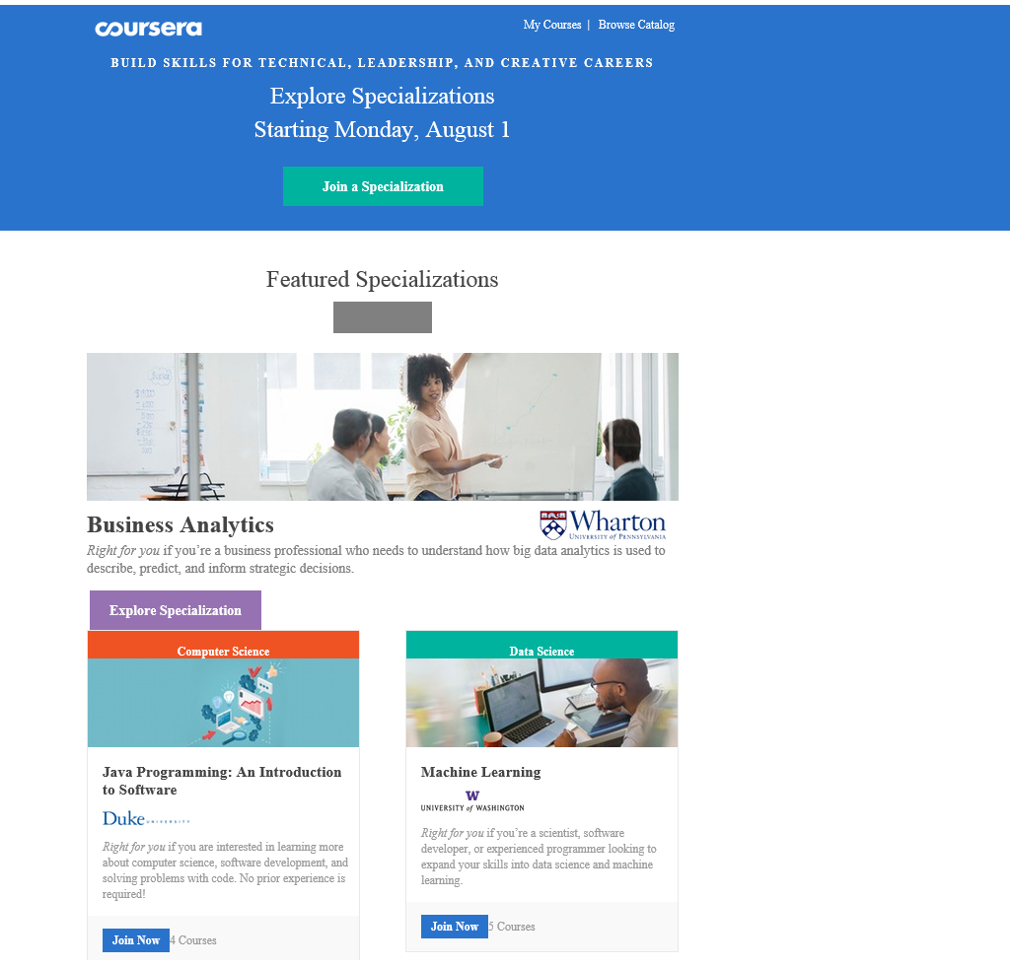
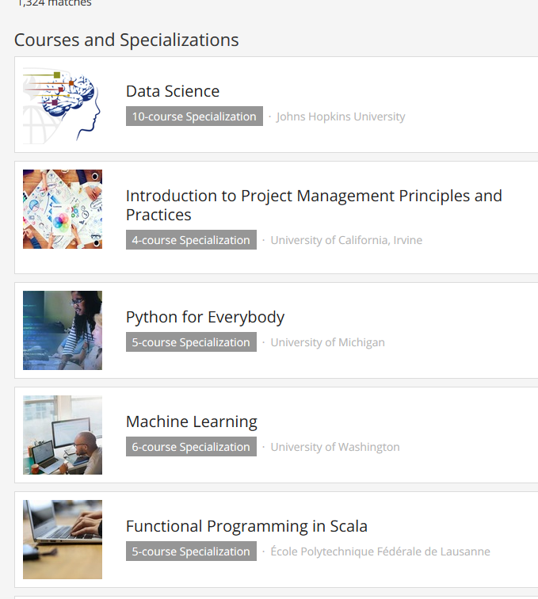
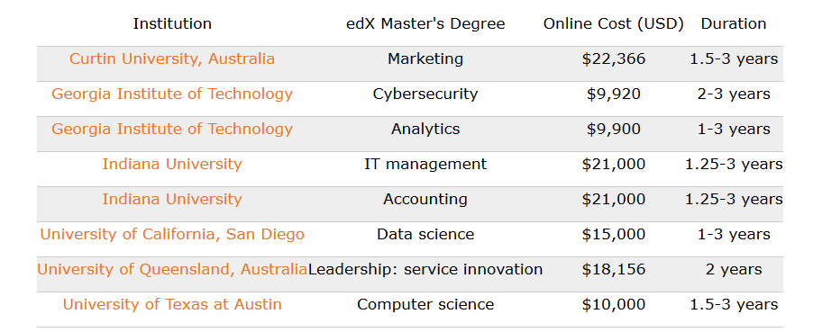
October 12, 2018 (Customization)
Learning is More on Modular edX Expands MicroMasters Programs With Data Science (“nanodegrees”)
Digital Leadership and More, Sri Ravipati, Campus Technology https://campustechnology.com/articles/2017/03/01/edx-expands-micromasters-programs-with-data-science-digital-leadership-and-more.aspx
Lindsey McKenzie, Inside Higher Ed https://www.insidehighered.com/news/2018/10/12/edx-launches-nine-low-cost-online-degrees

Slide 24
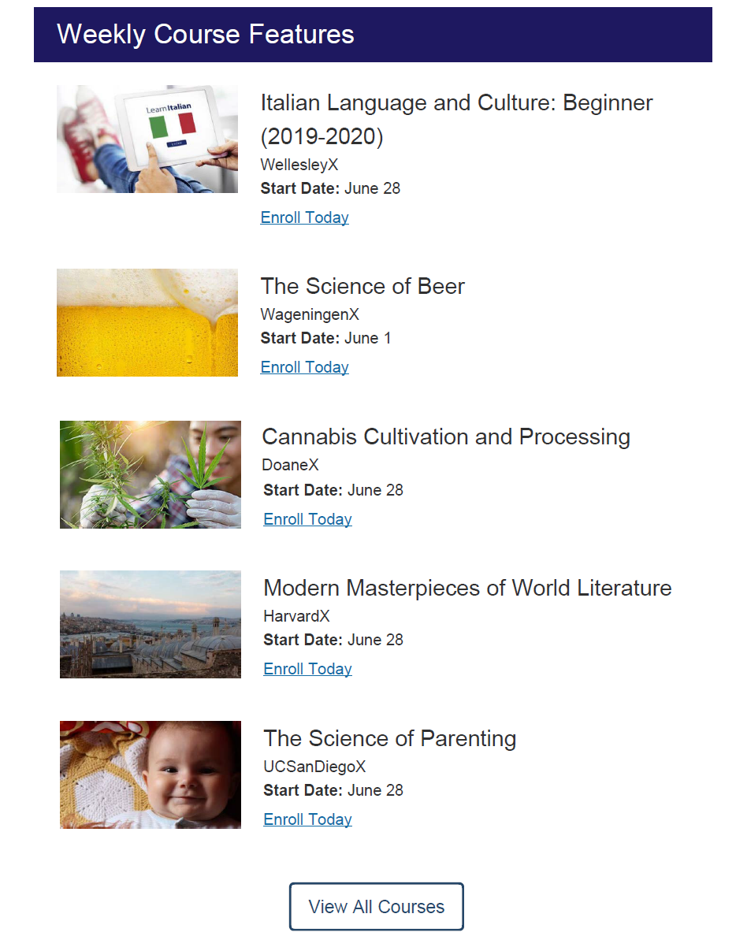
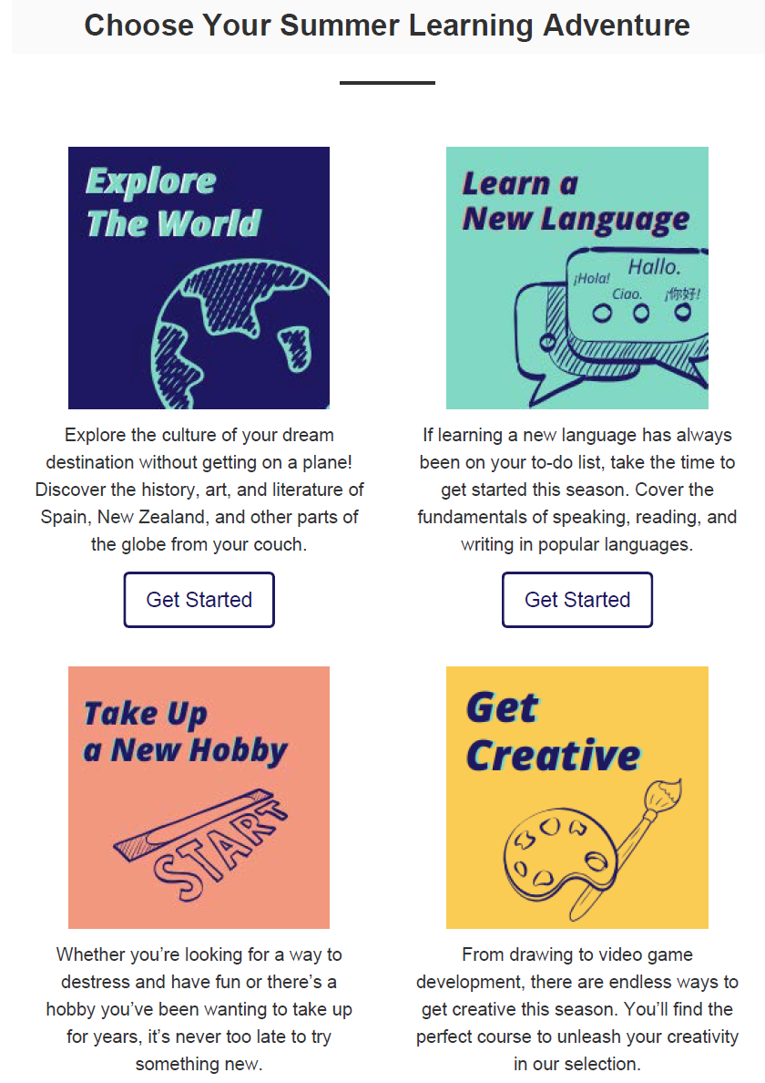
June 28, 2020
From: edX <news@edx.org>
Sent: Sunday, June 28, 2020 10:04 AM
To: Bonk, Curtis Jay <cjbonk@indiana.edu>
Subject: There’s a summer learning adventure for everyone

Slide 25
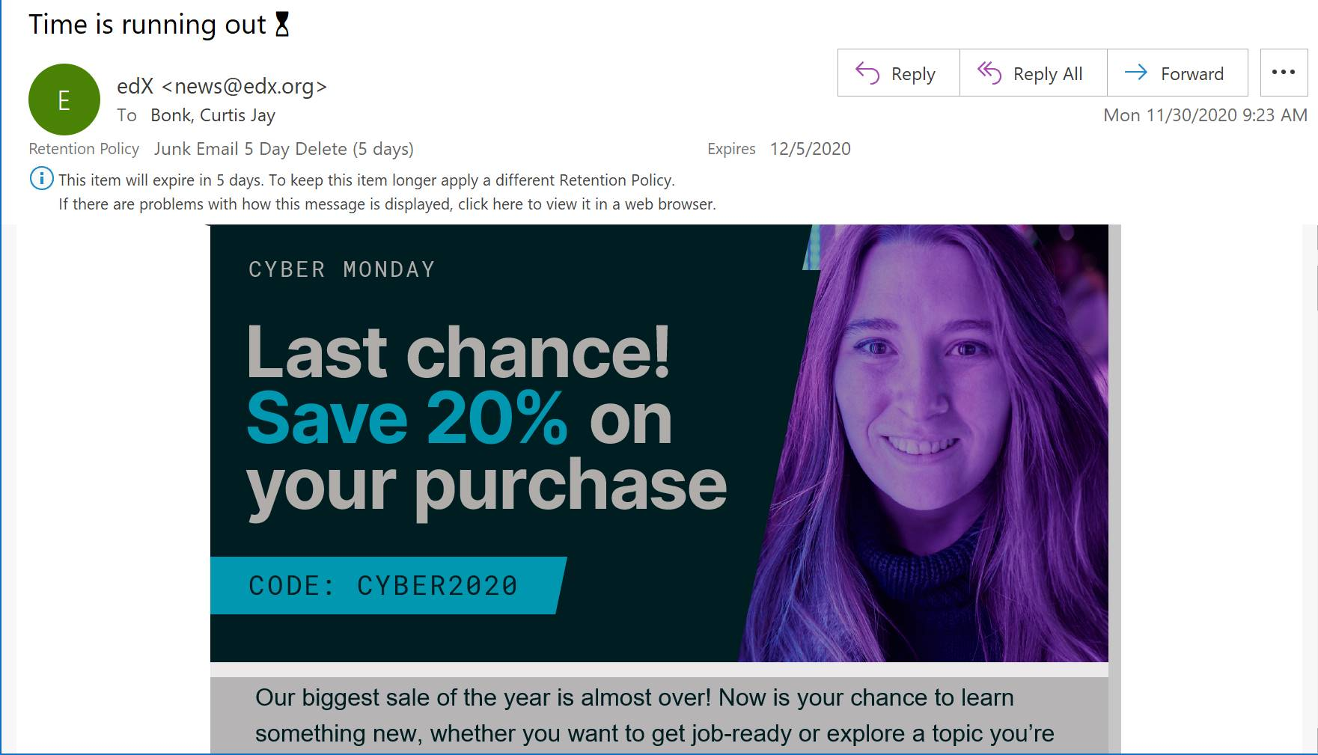
November 30, 2020
Cyber Monday

Slide 26


Slide 27
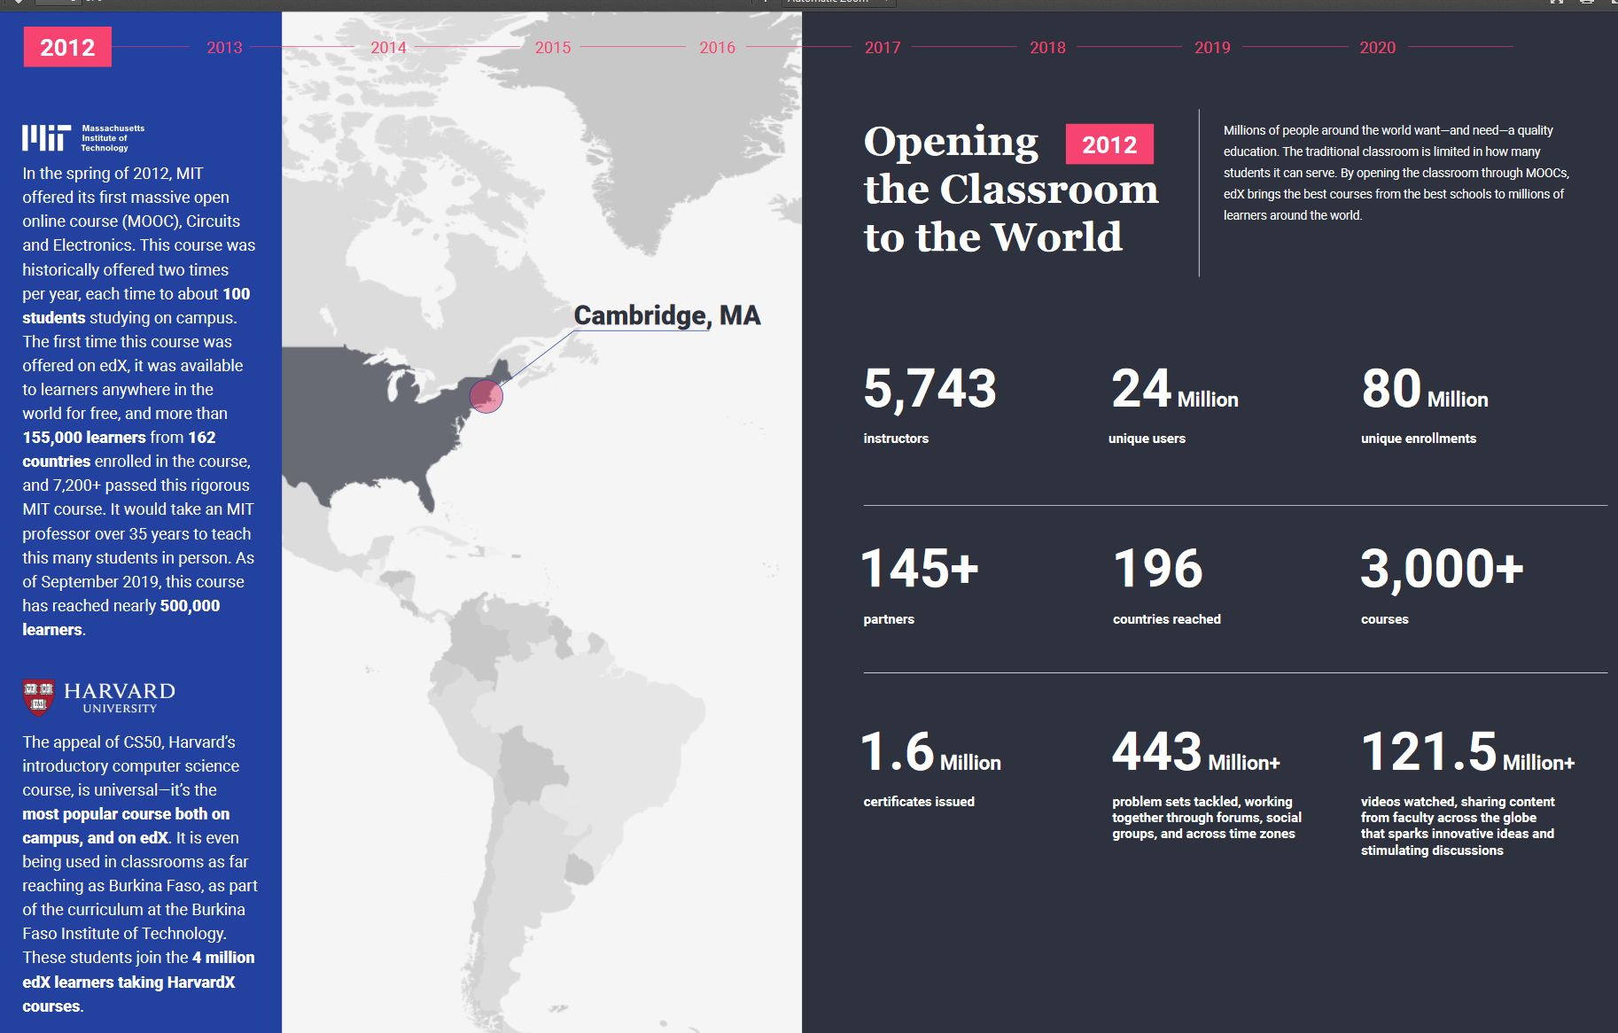
December 16, 2019
2020 Impact Report, edX https://www.edx.org/sites/default/files/2020-impact-report.pdf

Slide 28
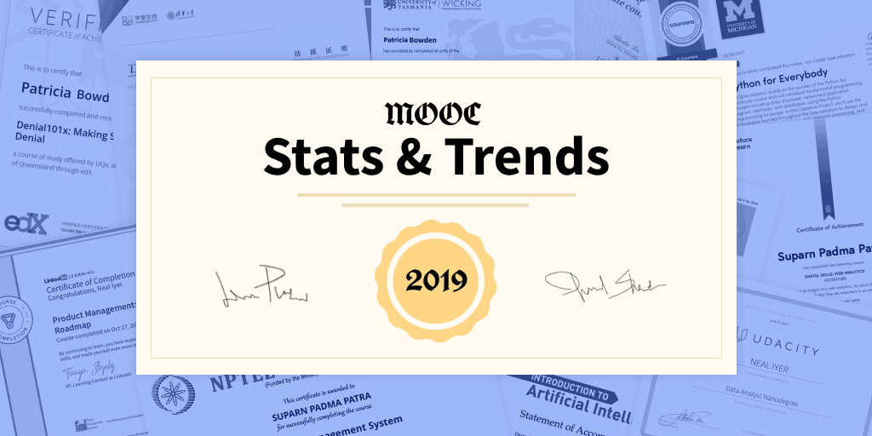

MOOCs Stats
December 17, 2019
Online Degrees Slowdown: A Review of MOOC Stats and Trends in 2019, Dhawal Shah, Class Central
https://www.classcentral.com/report/moocs-stats-and-trends-2019/

Slide 29
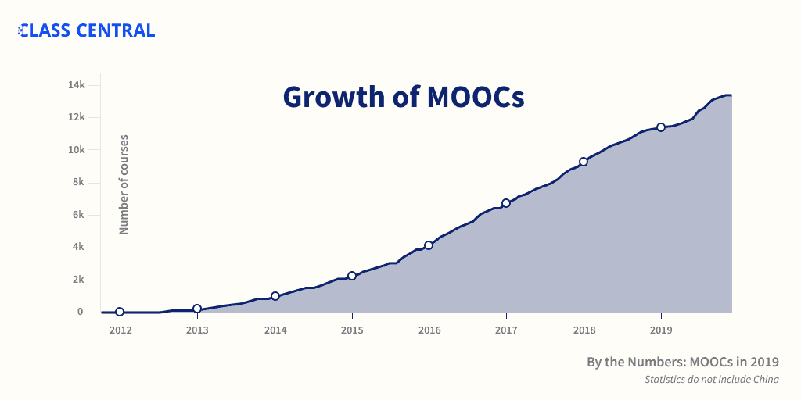
MOOCs Stats
December 17, 2019
A Review of MOOC Stats and Trends in 2019
Dhawal Shah, Class Central
https://www.classcentral.com/report/moocs-stats-and-trends-2019/

Slide 30
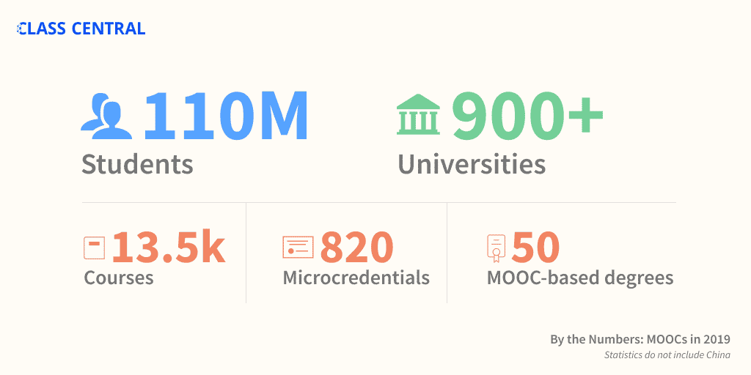
MOOCs Stats
December 17, 2019
A Review of MOOC Stats and Trends in 2019
Dhawal Shah, Class Central
https://www.classcentral.com/report/moocs-stats-and-trends-2019/

Slide 31
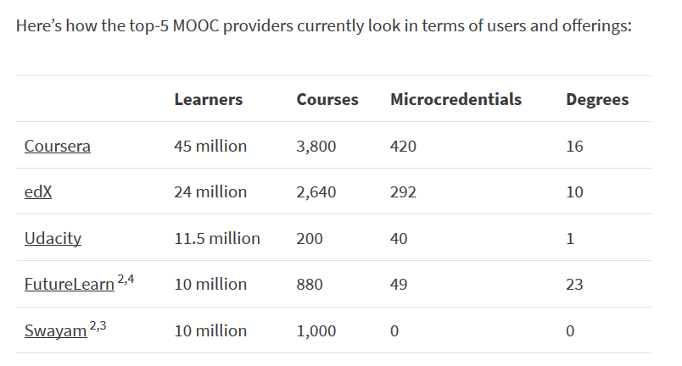
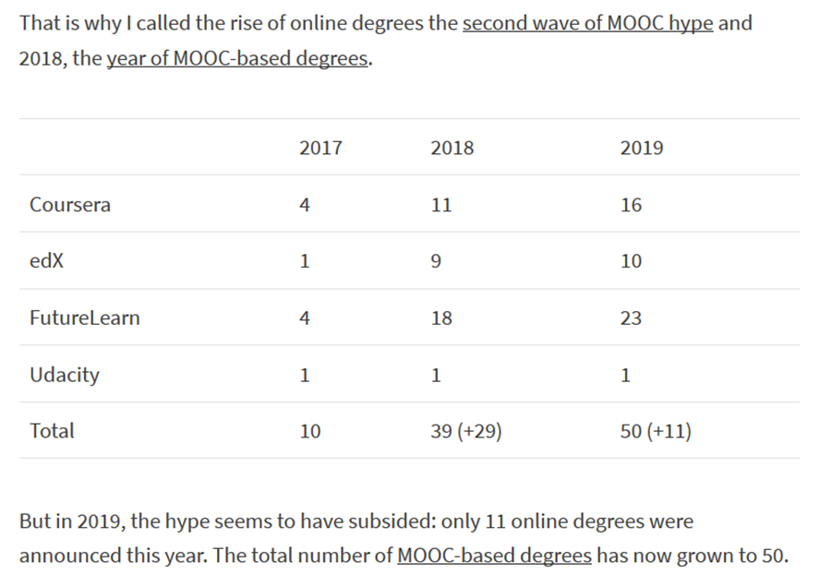
MOOCs Stats
December 17, 2019
A Review of MOOC Stats and Trends in 2019
Dhawal Shah, Class Central
https://www.classcentral.com/report/moocs-stats-and-trends-2019/

Slide 32


April 30, 2020
New Udemy Report Shows Surge in Global Online Education in Response to COVID-19
Businesswire
https://www.businesswire.com/news/home/20200430005243/en/
Categories with the highest surge in new courses include Office Productivity (159% increase), Health and Fitness (84%), IT & Software (77%), and Personal Development (61%).

Slide 33
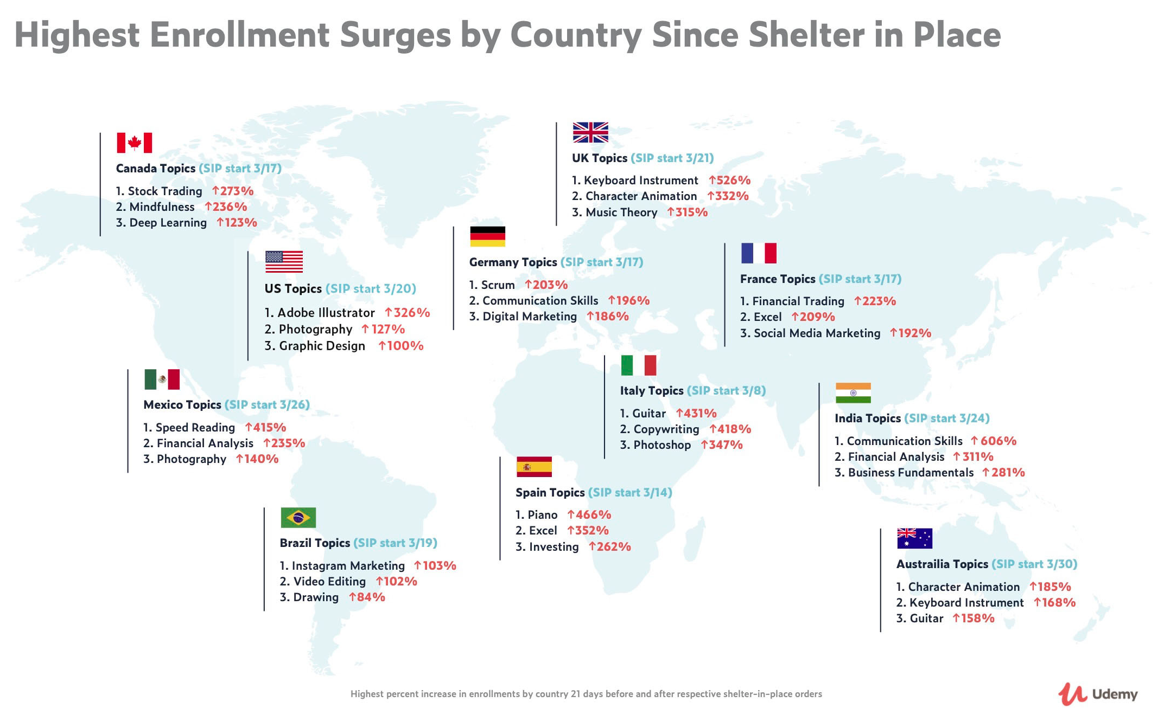
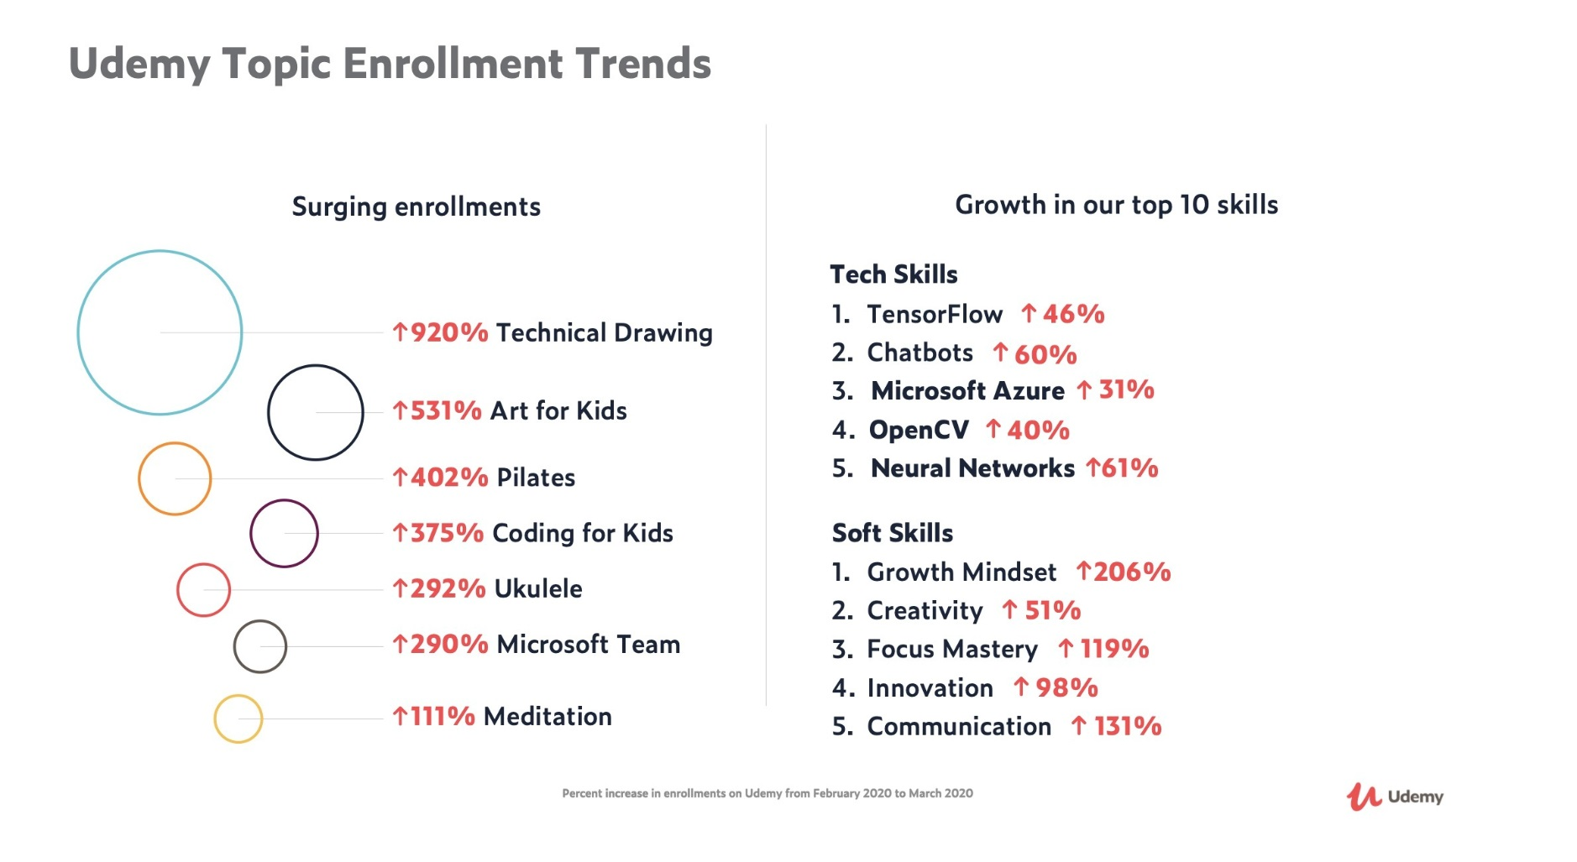
April 30, 2020
New Udemy Report Shows Surge in Global Online Education in Response to COVID-19
There has been an immense surge in enrollments in courses related to Telecommuting (21,598% increase) and Virtual Teams (1,523%), as well as Decision Making (277%), Self Discipline (237%), and Stress Management (235%).
https://www.businesswire.com/news/home/20200430005243/en/

Slide 34
April 30, 2020
New Udemy Report Shows Surge in Global Online Education in Response to COVID-19
People around the world are learning how to work from home and stay productive as the Future of Work arrives
Businesswire https://www.businesswire.com/news/home/20200430005243/en/

Slide 35
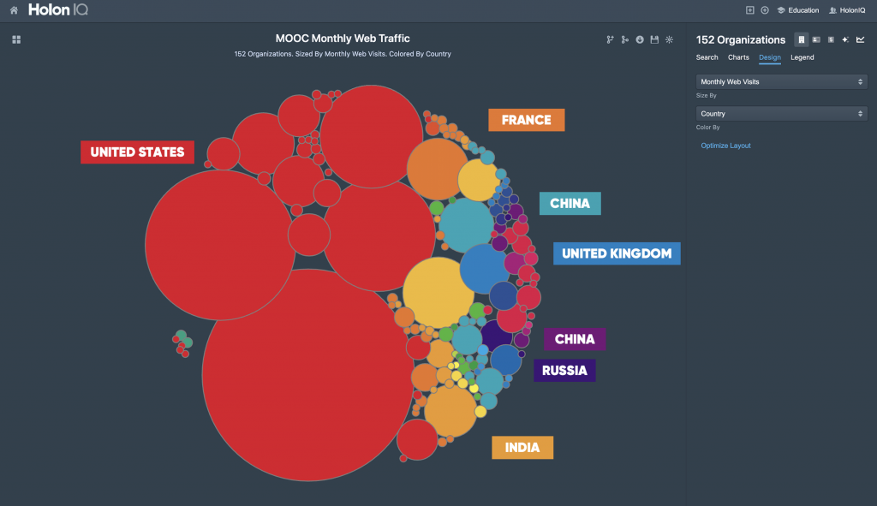
June 26, 2020
HolonIQ
2.5x Global MOOC Web Traffic
MOOC’s digital reach just grew 2.5x, up 300 million monthly visits globally, as isolated learners seek immediate solutions to their knowledge and skills needs amid a rapidly-evolving work landscape. https://www.holoniq.com/notes/global-mooc-web-traffic-benchmarks/
Is there another form of learning where so many people have deliberately chosen to come to learn in one month in the history of the world?

Slide 36
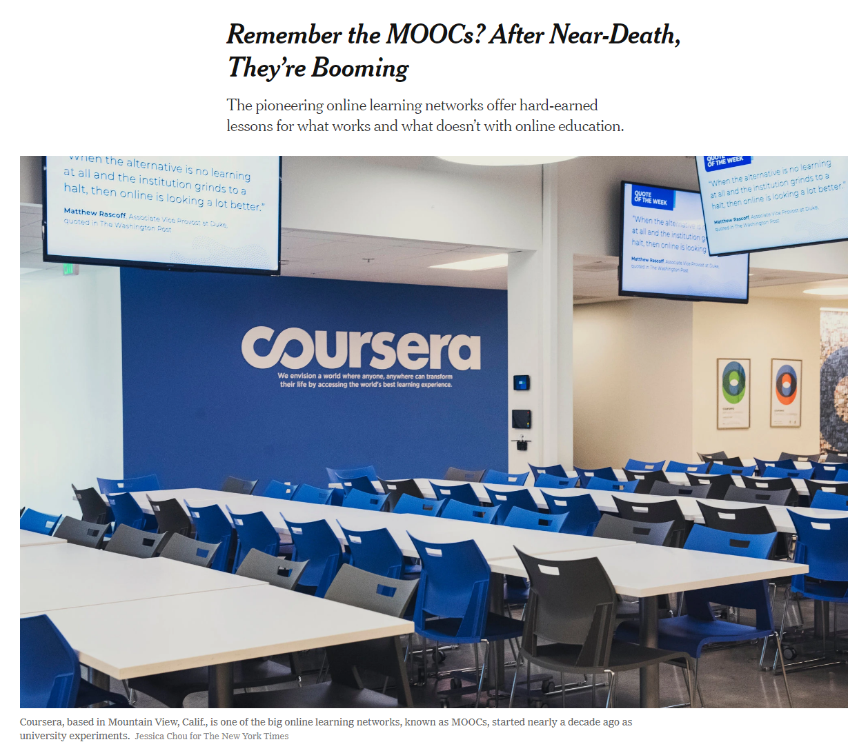

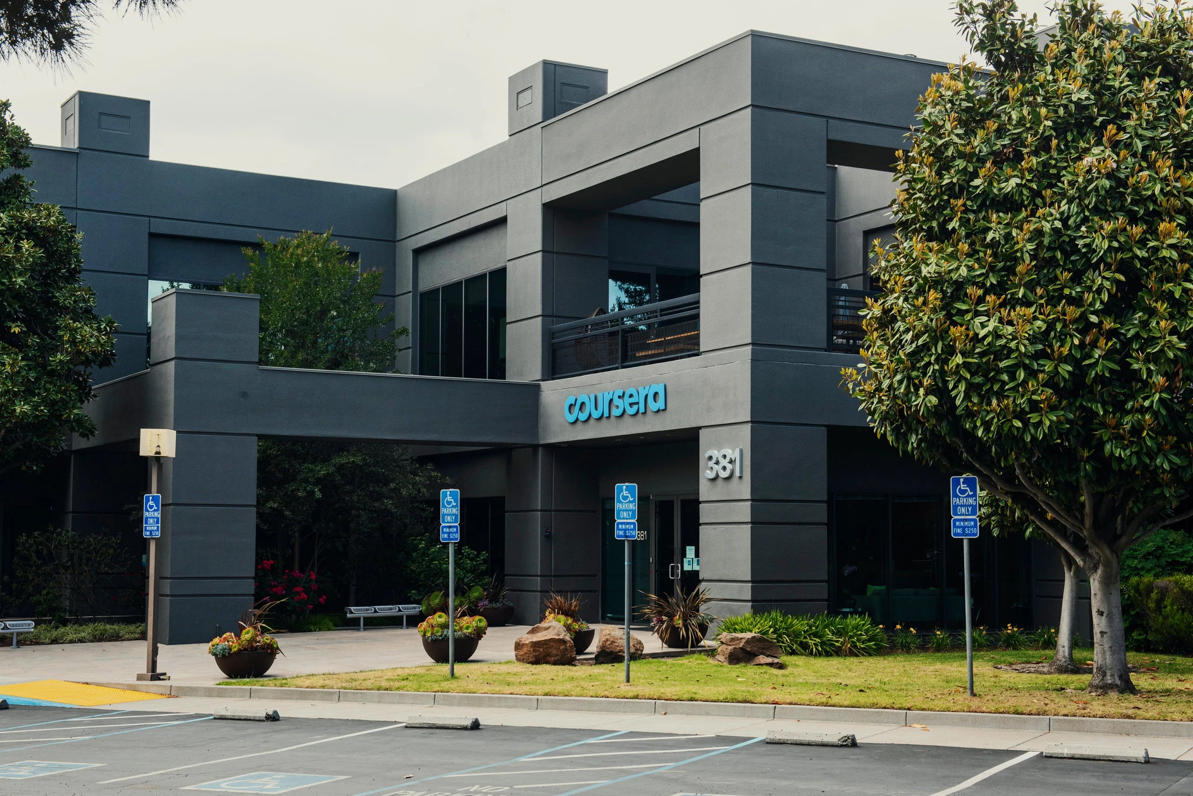
May 26, 2020
Remember the MOOCs?
After Near-Death, They’re Booming
Steven Lohr, The New York Times https://www.nytimes.com/2020/05/26/technology/moocs-online-learning.html
Coursera added 10 million new users from mid-March to mid-May. Credit...Jessica Chou for The New York Times

Slide 37

MOOCs Stats
August 16, 2020
By the Numbers: MOOCs During the Pandemic
Dhawal Shah, Class Central
https://www.classcentral.com/report/mooc-stats-pandemic/

Slide 38




August 9, 2020
250 Universities Just Launched 900 Free Online Courses. Here’s the Full List.
Dhawal Shah, Class Central https://www.classcentral.com/report/most-cited-mooc-research/
In the past nine years or so, over 900 universities have created around 15,000 MOOCs. I’ve been keeping track of these online courses the entire time here at Class Central, a search engine and reviews site for online education which has been used by 40 million learners around the world.

Slide 39

MOOCs Stats
August 16, 2020
New Registered Learners
Dhawal Shah, Class Central
https://www.classcentral.com/report/mooc-stats-pandemic/

Slide 40

MOOCs Stats
August 16, 2020
By the Numbers: MOOCs During the Pandemic
Dhawal Shah, Class Central
https://www.classcentral.com/report/mooc-stats-pandemic/

Slide 41


MOOCs Stats
August 16, 2020
By the Numbers: MOOCs During the Pandemic
Dhawal Shah, Class Central
https://www.classcentral.com/report/mooc-stats-pandemic/

Slide 42






MOOCs book #3
(2020)
Notes:
Last year, I co-edited a book titled MOOCs and Open Education around the World. MOOCs stands for Massive Open Online Courses. An individual MOOC can enroll tens of thousands of students, and several MOOCs have now surpassed 1 million students in total enrollment. MOOCs are primarily offered by elite universities such as Stanford, MIT, and Harvard through enterprises such as Coursera, edX, and FutureLearn. More people enrolled in MOOCs developed at Harvard in a single year than attended Harvard in its entire 377-year history.

Slide 43




November 9, 2019
Chapter 9: Nepali High School Students in MOOCs
Baman Kumar Ghimire
Teacher, Motherland Secondary School, Pokhara

Slide 44





November 26, 2019
Chapter 14. Capacity Building of Teachers: A Case Study of the Technology-Enabled Learning (TEL) Massive Open Online Courses
Sanjaya Mishra, Martha Cleveland-Innes, and Nathaniel Ostashewski

Slide 45



August 10 to September 13, 2020
Learning to Learn Online
Contact North/Nord and Athabasca University
Video Intro: 3:02 http://contactnorth.ltlo.ca/

Slide 46

June 3, 2020
Contact North|Contact Nord Webinars https://teachonline.ca/webinars

Slide 47






November 26, 2019
Chapter 16: Courses for a Cause:
MOOC Contributions to a “Better Place for All”
(Marianne Krasny et al., 2020)

Slide 48




July 25, 2020
Silver Lining for Learning https://silverliningforlearning.org/ https://www.youtube.com/channel/UC9XEsh89qrIlpmVVpQt-_aA/live

Slide 49








November 26, 2019
Chapter 25. Responsive Innovations in MOOCs for Development: A Case Study of AgMOOCs in India 300
Balaji Venkataraman and Tadinada V. Prabhakar
(agMOOCs in India) http://www.agmoocs.in/

Slide 50

June 8, 2019
The second half of humanity is joining the internet: They will change it, and it will change them
The Economist https://www.economist.com/leaders/2019/06/08/the-second-half-of-humanity-is-joining-the-internet

Slide 51


July 30, 2020
Disruptive Ecology:
The New Normal of Education in Post COVID-19

Slide 52


November 20, 2020
Many Texas families say remote learning isn’t working and they want it fixed https://www.texastribune.org/2020/11/20/texas-schools-remote-learning/

Slide 53
Study #1
MOOCs Design
Considerations and Challenges
Zhu, M., Bonk, C. J., & Sari, A. (2018). Instructor experiences designing MOOCs in higher education: Pedagogical, resource, and logistical considerations and challenges. Online Learning, 22(4), 203-241.

Slide 54
Research Background
  MOOCs can be beneficial to both learners and instructors (Hew & Cheung, 2014).
  Instructional design is critical for online learning (Johnson & Aragon, 2003; Phipps & Merisotis, 1999).
  Instructors are one of the five main components of MOOCs (Kop, 2011).
  Few studies have examined instructional design from MOOC instructors’ perspectives (Margaryan et al., 2015; Watson et al., 2016).

Slide 55
Research Purpose
  The purpose of this study is to provide suggestions for future MOOC instructors and instructional designers in higher education through exploring MOOC design considerations and challenges from the instructor’s perspective.

Slide 56
Research Questions
  What are the design considerations of instructors when designing MOOCs?
  What challenges do instructors perceive when designing MOOCs?
  How do instructors address the challenges that they perceive related to MOOCs?

Slide 57

Research Design
  Sequential mixed methods design (Creswell & Clark, 2017)
Quan
Data Collection
Quan
Data Analysis
Qual
Data Collection
Interpretation of Entire Analysis
Qual
Data Analysis

Slide 58

Data Collection
  Data Collection:
    Survey, interview, and course review
  Participants:
    143 survey participants (10% response rate)
    12 interviewees

Slide 59
12 Interviewees
No. | Countries | Subject areas | Platforms
1. | The U.S. | Language and Literacy | Coursera
2. | The U.S. | Education | Coursera
3. | The U.S. | Education | Canvas
4. | The U.S. | Chemistry | Coursera
5. | UK | Medicine and Health | FutureLearn
6. | UK | Language and Literacy | FutureLearn
7. | Hong Kong (China) | Math | Coursera
8. | Mainland China | Math | Coursera
9. | Canada | Psychology | Coursera
10. | Australia | Medicine and Health | Open2Study
11. | Sweden | Computer Science | edX
12. | India | Management | edX

Slide 60
Data Analysis
RQs | Data Sources | Data analysis
RQ1 | Survey-multiple-choice questions Survey-open-ended questions Interview MOOC review | Descriptive statistics Content analysis (Elo & Kyngäs, 2008) Content analysis Content analysis
RQ2 | Survey-multiple-choice questions Survey-open-ended questions Interview | Descriptive statistics Content analysis Content analysis
RQ3 | Survey-multiple-choice questions Interview | Descriptive statistics Content analysis

Slide 61
Research Context

Slide 62

Research Context

Slide 63

Findings RQ1
  RQ #1. What are the design considerations of instructors when designing MOOCs?
  Learning objectives
  Assessment
  Time for designing MOOC
  Engaging learners
An example of learning objectives:

Slide 64
RQ1 Survey Results

Slide 65

RQ1 Interview Results
  Engage learners
  One instructor from US mentioned:
    “I engaged people in the forum. So each week I would write a message that would be the new welcome page for the week that would say, ‘hey come to the forum and ask questions about this or come to the forum introduce yourself’... Of course, I tried to get students to feel like I was engaged with them during the videos by asking them questions and telling them to do things during the video.”

Slide 66

Findings RQ2
  RQ #2. What challenges do instructors perceive when designing MOOCs?
  Assessment methods
  Engaging students’ learning
  Time limitation
(Note: Above is an example of peer-assessment.)

Slide 67
RQ2 Survey Results

Slide 68

RQ2 Interview Results
  Time limitation
  One instructor from education subject mentioned:
    “I think one of the challenges is time. It does take a lot of time to get the videos done. I did not get a course release when I was doing, and it was a side project at the same time as my regular load.”

Slide 69

Findings RQ3
  RQ #3. How do instructors address the challenges that they perceive related to MOOCs?
  Explore other MOOC examples
  Seek help from the platform/colleagues/institutions

Slide 70
RQ3 Survey Results

Slide 71

RQ3 Interview Results
  Explore other MOOC examples
  One MOOC instructor from the US mentioned:
    “When I started making the MOOC, I could see MOOCs that other people had made. So I could see what other people did in terms of having videos with questions embedded in the videos, which I really liked.”

Slide 72
Discussion
  The time limitation of creating MOOCs was the primary logistical consideration (Hew & Chung, 2014; Watson et al., 2016) and challenges.
  The pedagogical factors were the primary design considerations (Watson et al., 2016) and challenges in MOOC design.
  The assessment and engagement strategies are the main considerations as well as challenges.

Slide 73
Study #2
MOOCs Instructional Design to Facilitate Participants’ Self-directed Learning
Zhu, M., & Bonk, C. J. (2019). Designing MOOCs to facilitate participant self-monitoring for self-directed learning. Online Learning, 23(4), 106-134
Zhu, M., & Bonk, C. J. (2019). Designing MOOCs to facilitate participant self-directed learning: An analysis of instructor perspectives and practices. International Journal of Self-Directed Learning, 16(2), 39-60.

Slide 74

Key Terms
  Self-directed learning (SDL) (Garrison, 1997)
  (1) self-management
  (2) self-monitoring
  (3) motivation
Notes:
Garrison’s model: 3 inter-related part.

Slide 75
Research Background
  Learners need self-directed learning skills and strategies to be successful in MOOCs (Halawa, Greene, & Mitchell, 2014; Littlejohn & Milligan, 2016), as there is a lack of personalized interaction with teachers.
  Self-directness of a learner might vary in different learning environments which means that the learners could be more self-directed in one learning environment than another (Hiemstra, 1994).

Slide 76
Research Background
  Instructional design can greatly influence students’ interaction and engagement (Garrison & Cleveland-Innes, 2005) and success in online learning (Song, Singleton, Hill, & Koh, 2004; Swan, 2001).
  However, few studies have examined instructional design and the delivery of instruction using MOOCs from instructor perspectives (Margaryan et al., 2015; Watson et al., 2016); especially lacking is research on instructors’ perception of SDL and how they design MOOCs to facilitate students’ SDL.

Slide 77

Research Purpose
  The purpose is to inform instructors or instructional designers and MOOC providers of the current practices of designing MOOCs to facilitate learners’ SDL.

Slide 78
Research Questions
  How do MOOC instructors perceive participant SDL skills?
  How do MOOC instructors perceive their facilitation of participant SDL skills?
  How do instructors design and deliver MOOCs to facilitate participant SDL skills?
    a. How is technology being used by MOOC instructors to support the development of participant SDL skills?
    b. What technology features or functions do MOOC instructors want to have to improve their facilitation of MOOC participant SDL skills?

Slide 79

Research Design
  Explanatory sequential mixed methods design (Creswell & Clark, 2017)
Pilot survey with 48 instructors
Survey
198 instructors
Review 22 MOOCs of interviewees
Interview 22 instructors
Review 22 MOOCs of interviewees
Pilot interview with 4 instructors

Slide 80

Data Collections
  Survey:
  Volunteer sampling (Creswell & Clark, 2017)
  198 instructors responded to the survey (10% response rate)
  Interview:
  Homogeneous purposeful sampling (Creswell & Clark, 2017; Patton, 2002)
  Maximal variation sampling (Creswell & Clark, 2017)
  22 interviewees
  MOOC review:
  Reviewed 22 interviewees’ MOOCs

Slide 81
Pseudonym | Country | Subject area | Platform | Gender | No. of O/B | No. of M | Mode of the M
Lucas | US | Social science | edX | M | 0 | 1 | I without T
Branden | US | Education | Udacity | M | 0 | 5 or more | Self-paced
Logan | US | Literacy and Language | Coursera | M | 5 or more | 5 or more | I with T
Emma | US | Literacy and Language | Coursera | F | 2 | 1 | Self-paced
Jason | US | Science | edX | M | 1 | 1 | I with T
Jackson | US | Medicine and health | Coursera | M | 5 or more | 1 | Self-paced
Samuel | US | Education | FutureLearn | M | 4 | 3 | Self-paced
Hannah | US | Education | Blackboard | F | 5 or more | 1 | I with T
Ashley | US | Education | EdX | F | 0 | 5 or more | I with T
Andrew | UK | Art | FutureLearn | M | 0 | 3 | I with T
Emily | UK | Medicine and health | FutureLearn | F | 2 | 2 | I with T
Aiden | UK | Social science | FutureLearn | M | 0 | 1 | Self-paced
Henry | UK | Social science | FutureLearn | M | 0 | 1 | Self-paced
Joseph | UK | Medicine and health | FutureLearn | M | 1 | 1 | Self-paced
Joshua | UK | Literacy and language | FutureLearn | M | 2 | 2 | I with T
Mason | Australia | Education | Coursera | M | 5 or more | 1 | I with T
Ethan | Australia | Business | Coursera | M | 3 | 1 | I without T
Ben | Australia | Social science | edX | M | 1 | 1 | I with T
Paul | France | Computer Science | Coursera | M | 1 | 1 | I with T
Fernando | Belgium | Research methods | Blackboard | M | 5 or more | 3 | I with T
Jacob | Netherland | Science | Coursera | M | 0 | 1 | I with T
Dylan | Israel | Science | Coursera | M | 5 or more | 3 | I without T
Data Collections
  Interview:

Slide 82
Data Analysis
RQs | Data Sources | Data analysis | Tools
RQ1 | Survey Interview | Descriptive statistics Content analysis (Elo & Kyngäs, 2008) | SPSS NVivo
RQ2 | Survey Interview | Descriptive statistics Content analysis | SPSS NVivo
RQ3 | Interview Course review | Content analysis Content analysis | NVivo NVivo

Slide 83
Research Context

Slide 84
RQ1 Perceptions of SDL
  A majority of the MOOC instructors thought that these skills or attributes are not static, and that SDL as a set of skills can be educated or students’ personal attributes that can be changed.

Slide 85

RQ1 Interview Results
  Emma’s understanding of SDL is more related to self-management and motivation. She said:
    “When I think about self-directed learning, I think about students managing their time and managing the coursework on their own, and how it fits into their schedules and their lives, how they interact with materials, what's going to keep them engaged.”

Slide 86
RQ2 Perceptions of Facilitation of SDL
  Most of MOOC instructors thought that they can intentionally or unintentionally facilitate students’ SDL.

Slide 87

RQ2 Interview Results
  Ashely emphasized the importance of both instructors’ facilitation and students’ SDL skills. She said:
    “The participant has a lot of flexibility on how they approach the content. I mean, obviously, we have things like assignments. We have things like online forums. And there're ways that we scaffold the learning experience. But there still is a lot of choice for the learner.”

Slide 88
RQ3 Strategies to Facilitate SDL
  Students’ intrinsic motivation plays an important role. However, extrinsic motivation provided by the MOOCs might help transfer extrinsic motivation to intrinsic motivation.
Motivations | Strategies
Entering motivation | MOOC instructors helped students identify the needs and goals of learning and sense of achievement.
Task motivation | MOOC instructors motivated students through instruction, learning materials, feedback, and learning community.

Slide 89


RQ3 Learning Community

Slide 90
RQ3 Strategies to Facilitate SDL
  Both internal feedback and external feedback were provided to help students’ self-monitoring.
Self-monitor |  | Strategies
Internal feedback | Cognition | MOOC instructors provided quizzes for self-assessment, tutorial on technology use, learning advice, navigation of the course, progress indicators, resources, and instructional modeling, etc.
 | Meta-cog | MOOC instructors encouraged students to reflect and think critically by providing reflection questions and building learning community.
External feedback |  | MOOC instructors, teaching assistants, and peers were involved in providing external feedback.

Slide 91


RQ3 Self-assessment (i.e., embedded quizzes)

Slide 92

RQ3 Progress Indicators

Slide 93

RQ3 External Feedback: Peer-assessment
(e.g., 3 peers assigned to review each assignment)

Slide 94
RQ3 Strategies to Facilitate SDL
  They helped students’ self-management concerning setting learning goals, time management, resources and support management although among the three elements of SDL, MOOC instructors had less control over students’ management.
Self-management | Strategies
Enactment of learning goals | Providing discussion questions, reflections, survey, and appreciation students’ learning goals.
Time management | Providing time frame, progress indicator, short learning units, and flexible timeline.
Management of resources and support | Providing flexible learning resources, peer-assessment, accessibilities, clear expectations, and short learning units.

Slide 95

RQ3 Time Management
(e.g., time advisories and estimates)

Slide 96






RQ3-a. Tech Used for SDL
  Synchronous communication technologies
    Google Hangouts YouTube Live
  Asynchronous communication technologies
    Discussion forum Blog Slackbot Flickr
  Multimedia (e.g., video and graphics)
  Feedback technologies

Slide 97
Discussion
  SDL can be Changed
  MOOC Instructors can Facilitate SDL
  Strategies to Facilitate SDL: A variety of strategies can be used to facilitate student SDL skills in terms of motivation, self-monitor, and self-management.
  Tech for SDL: Tech plays a vital role in facilitating SDL skills.
  Tech expectations: Adaptive learning systems, artificial intelligent systems, and learning analytics were expected to have to support SDL.

Slide 98

Implications
  For MOOC instructors and Instructional Designers
    Build learning community
    Inspire intrinsic motivation
    Personalize learning
  For MOOC providers
    Create a personalized learning environment
    Provide learning analytics to support learning and teaching

Slide 99



Top 10 Strategies to Facilitate SDL in MOOCs
  Helping students set their own learning goals.
  Building learning community.
  Offering immediate feedback.
  Embedding quizzes for self-assessment.
  Providing progress indicators.
  Providing reflection questions.
  Designing short learning units.
  Providing flexible timelines.
  Highlighting estimated time frames.
  Making available optional learning materials.

Slide 100

Top 10 Strategies to Facilitate SDL in MOOCs
  Helping students set their own learning goals.
  Example:
    “I have asked, at the first page of course, why they're taking the course. So that is the goal. A lot of people say, ‘I'm a teacher. And I want to do the stuff with my kids. Or I want to update my knowledge. Or I'm retired and I want to learn this.’”

Slide 101


Top 10 Strategies to Facilitate SDL in MOOCs
  2. Building learning community.
    Joshua from the UK mentioned: We use a lot of resources that already exist. And then we use the MOOC discussion board as a place to where they, kind of, point out and say, “I've seen this. And this is useful. Well, I use this, and this is good. I created this.”

Slide 102

Top 10 Strategies to Facilitate SDL in MOOCs
  3. Offering immediate feedback.
  4. Embedding quizzes for self-assessment.

Slide 103
Top 10 Strategies to Facilitate SDL in MOOCs
  5. Providing progress indicators

Slide 104

Top 10 Strategies to Facilitate SDL in MOOCs
  6. Providing reflection questions.
    We introduced kind of moments that video was stopped and there was a question. The student had to think of it a bit. Sometimes it was kind of a rhetorical question. There wasn't even no answer required. But it was just a pause for a while to let the student reflect. (Jacob)

Slide 105

Top 10 Strategies to Facilitate SDL in MOOCs
  7. Designing short learning units.

Slide 106
Top 10 Strategies to Facilitate SDL in MOOCs
  8. Providing flexible timelines.

Slide 107

Top 10 Strategies to Facilitate SDL in MOOCs
  9. Highlighting estimated time frames.

Slide 108

Top 10 Strategies to Facilitate SDL in MOOCs
  10. Making available optional learning materials.

Slide 109

10 More Strategies to Facilitate SDL in MOOCs
  MOOC: Infection Prevention and Control (IPC) for Novel Corona virus (COVID-19) from OpenWHO (English Version)
  11. Structured learning environment:
  Clearly stated the learning objectives.
  Course details stated the expected time to complete the course.
  The syllabus, number of course modules, and title of each module.

Slide 110

10 More Strategies to Facilitate SDL in MOOCs
  11. Structure continued…
  Graphic or visual organizations for essential material.
  The text on screen matched the narration enforcing the redundancy principle.

Slide 111


10 More Strategies to Facilitate SDL in MOOCs
  12. On completion of modules participants get a certificate.
  Providing External Rewards and Goals

Slide 112

One Example: Laurie Santos
The Science of Well-Being, Yale Univ.

Slide 113


10 More Strategies to Facilitate SDL in MOOCs
  13. Week overview. The course is divided into week-long segments, and each week is chunked into manageable parts. Very importantly for the participant to be able to anticipate what can get done in one sitting, the length of each video is included.

Slide 114



10 More Strategies to Facilitate SDL in MOOCs
  14. Lecture recorded and captions added.
Caption added to video
Video of student audience

Slide 115

10 More Strategies to Facilitate SDL in MOOCs
  14. Continued…Lecture video transcripts.

Slide 116

10 More Strategies to Facilitate SDL in MOOCs
  15. Quick check tasks.

Slide 117

10 More Strategies to Facilitate SDL in MOOCs
  16. Providing students with self-selection options.
  There is the choice to watch all of the videos, read all of the materials, and submit all of the assignments, or there are choices all along the way to “cut corners” and take in only what the participant wants to.

Slide 118


10 More Strategies to Facilitate SDL in MOOCs
  17. Visuals showing tasks completed.

Slide 119

10 More Strategies to Facilitate SDL in MOOCs
  18. Visuals showing work progress.

Slide 120
10 More Strategies to Facilitate SDL in MOOCs
  19. Rewirements (assignments) for putting the material to practice (e.g, Random Acts of Kindness, Make A Social Connection, Let’s Get Physical, Meditate!, Sleep!, Gratitude Letter/Visit, Savoring, etc.)
Daily Gratitude Journal
Gratitude is a positive emotional state in which one recognizes and appreciates what one has received in life. Research shows that taking time to experience gratitude can make you happier and even healthier. For the next seven days, you will take 5-10 minutes each night to write down five things for which you are grateful. They can be little things or big things. But you really have to focus on them and actually write them down (Again, try to develop a tracking method works for you and utilize a note on your phone, a daily calendar, a special notebook, etc). You can just write a word or short phrase, but as you write these things down, take a moment to be mindful of the things you’re writing about (e.g., imagine the person or thing you’re writing about, etc.). This exercise should take at least five minutes. Do this each night for the whole week.

Slide 121

10 More Strategies to Facilitate SDL in MOOCs
20. Offer community support and help.

Slide 122

10 More Strategies to Facilitate SDL in MOOCs
Bonus Item: Peer-graded assignments.

Slide 123

Do we have time for another study? No!

Slide 124

MOOC Study #3

Slide 125
Additional Research
An, Y.-J., Zhu, M., Bonk, C. J., & Lin, L. (2020, June 6-published online first). Exploring instructors’ perspectives, practices, and perceived support needs and barriers related to the gamification of MOOCs. Journal of Computing in Higher Education. Available (view only: https://rdcu.be/b4G6r); https://doi.org/10.1007/s12528-020-09256-w
Zhu, M., Bonk, C. J., & Doo, M.-Y. (2020). Self-directed learning in MOOCs: Exploring the relationships among motivation, self-monitoring, and self-management. Educational Technology Research and Development (ETR&D), 68(5), 1-21. DOI 10.1007/s11423-020-09747-8
Zhu, M., & Bonk, C. J. (2020). Technology tools and instructional strategies for designing and delivering MOOCs to facilitate self-monitoring of learners. Journal of Learning for Development, 7(1), 31-45. Available: https://jl4d.org/index.php/ejl4d/article/view/380/447
Sari, A. R., Bonk, C. J., & Zhu, M. (2020). MOOC instructor designs and challenges: What can be learned from existing MOOCs in Indonesia and Malaysia? Asia Pacific Education Review, 21(1), 143-166. DOI 10.1007/s12564-019-09618-9
Doo, M. Y., Tang, Y., Bonk, C. J., & Zhu, M. (2020). MOOC instructor motivation and career and professional development. Distance Education, 41(1), 26-47. https://doi.org/10.1080/01587919.2020.1724770
Zhu, M., Bonk, C. J., & Sari, A. (2019). MOOC instructor motivations, innovations, and designs: Surveys, interviews, and course reviews. Canadian Journal of Learning and Technology, 45(1), 1-22. Available: https://www.cjlt.ca/index.php/cjlt/article/view/27795

Slide 126



Thank you!
Any Questions?
Curtis Bonk: cjbonk@Indiana.edu
Meina Zhu: meinazhu@wayne.edu
Slides and Proceedings Paper at TrainingShare.com: http://www.trainingshare.com (go to “Archived Talks”)

