Slide 1
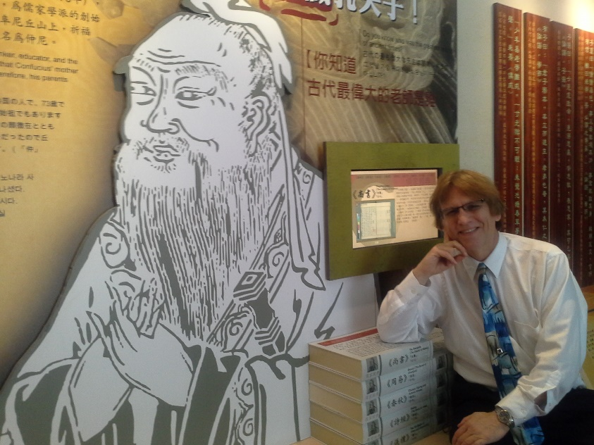
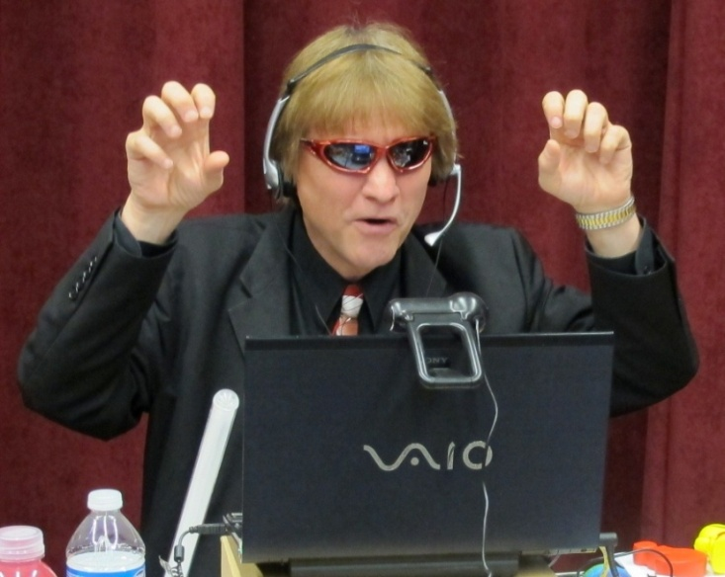
Education 3.0:
My, Our Learning World is Changing!
Curtis J. Bonk, Professor, Indiana University
cjbonk@indiana.edu
http://mypage.iu.edu/~cjbonk/

Slide 2
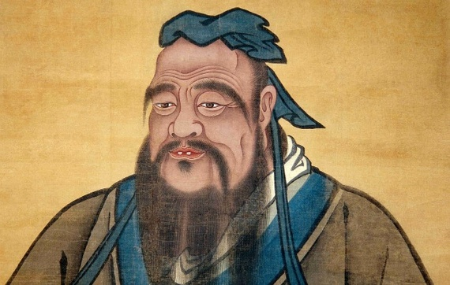
(Circa Confucius 551–479 BCE)

Slide 3
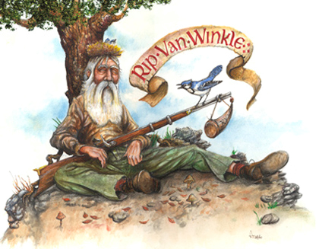

Slide 4
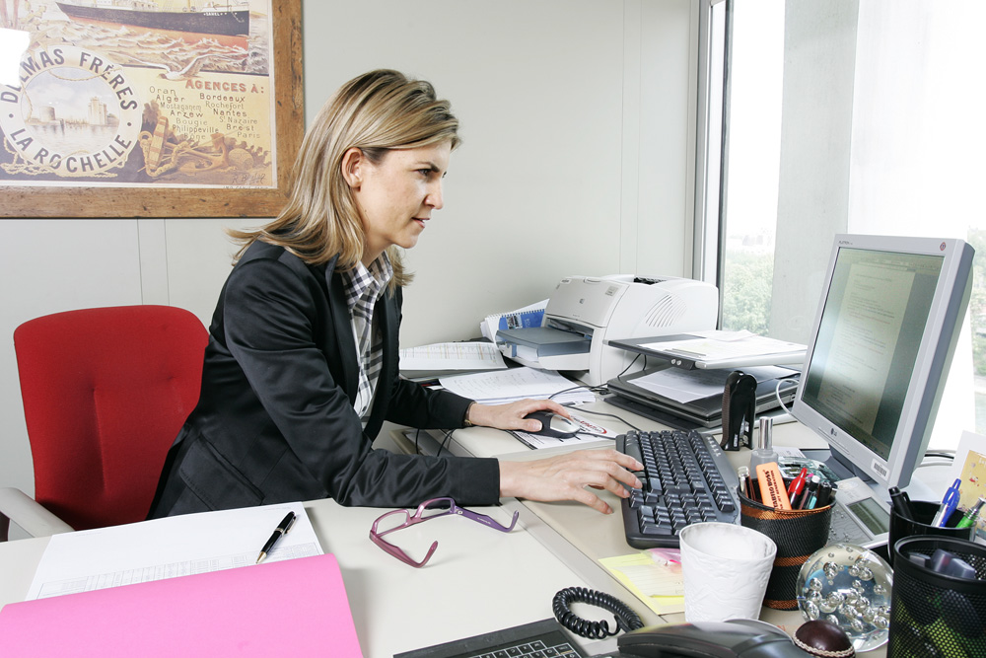
From Instructor as Credit Manager…to…

Slide 5
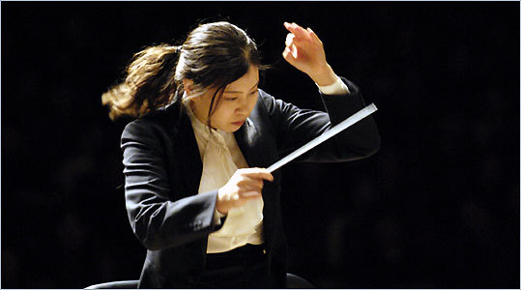
1. Instructor as Conductor

Slide 6
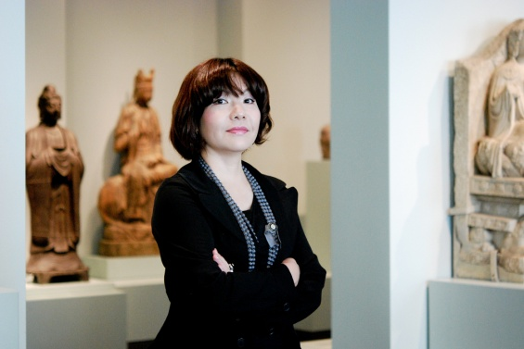
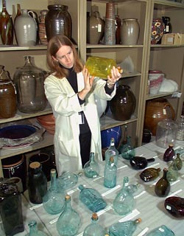
2. Instructor as Curator

Slide 7


3. Instructor as Concierge

Slide 8
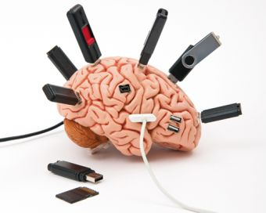

Poll:
Read any books on creativity or innovation lately?

Slide 9
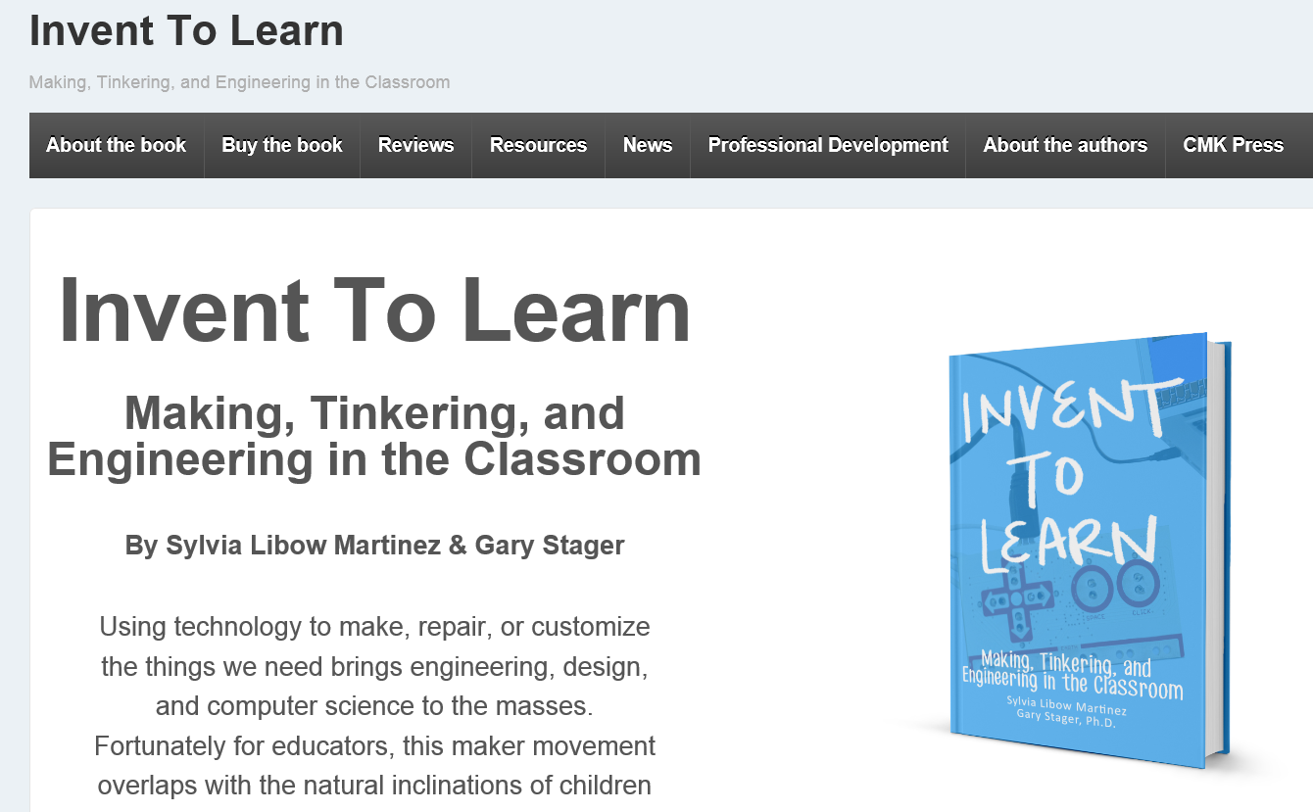
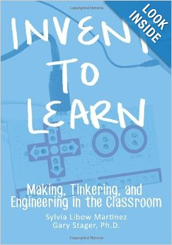
1. Invent to Learn:
Making, Tinkering, and Engineering in the Classroom
Sylvia Libow Martinez & Gary Stager (2013) http://www.inventtolearn.com/

Slide 10
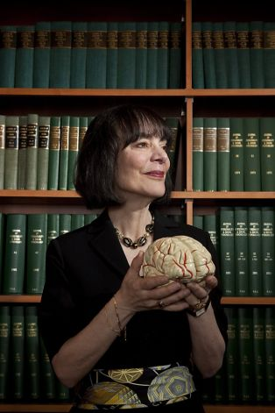
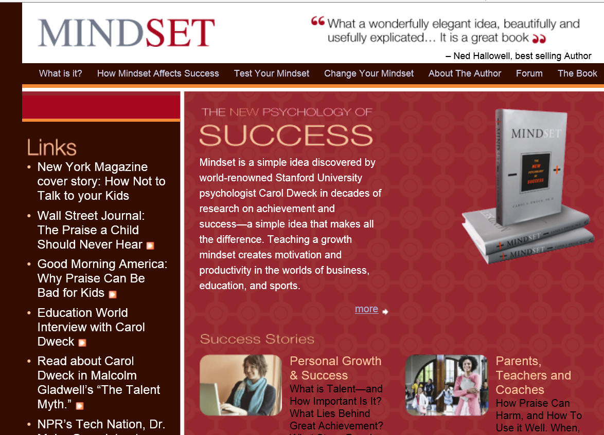
2. Mindset:
The New Psychology of Success
Carol Dweck (2006) http://mindsetonline.com/index.html http://mindsetonline.com/testyourmindset/step1.php

Slide 11
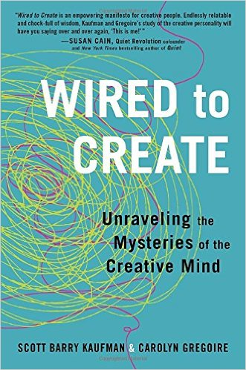

3. Wired to Create: Unraveling the Mysteries of the Creative Mind (2015)
Scott Barry Kaufman & Carolyn Gregory http://www.amazon.co.uk/Wired-Create-Unraveling-Mysteries-Creative/dp/0399174109 http://www.scientificamerican.com/article/how-to-cultivate-your-creativity-book-excerpt/

Slide 12
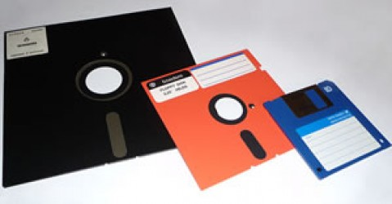
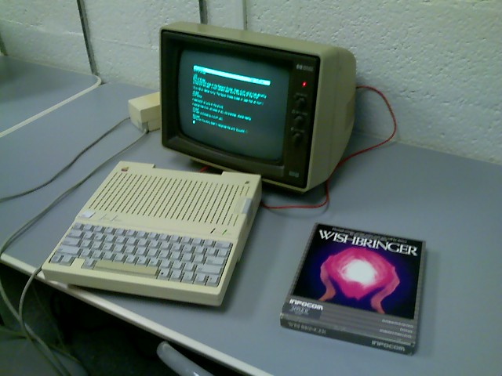
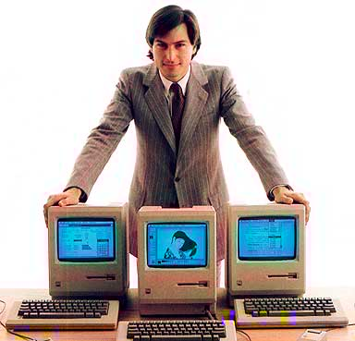
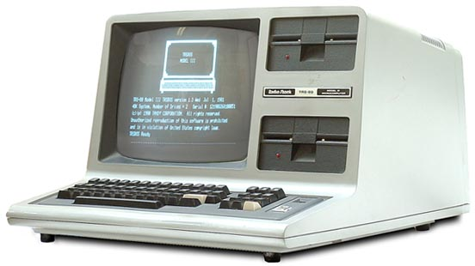
Poll:
Remember what technology you used to own?

Slide 13

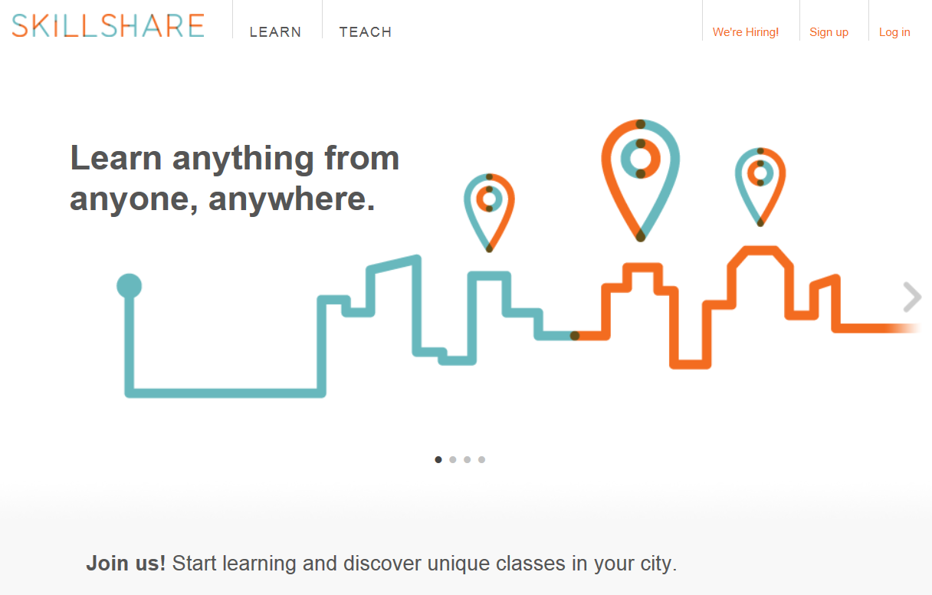
Fast Forward 30+ Years…
“Anyone can now learn anything from anyone at any time.”

Slide 14
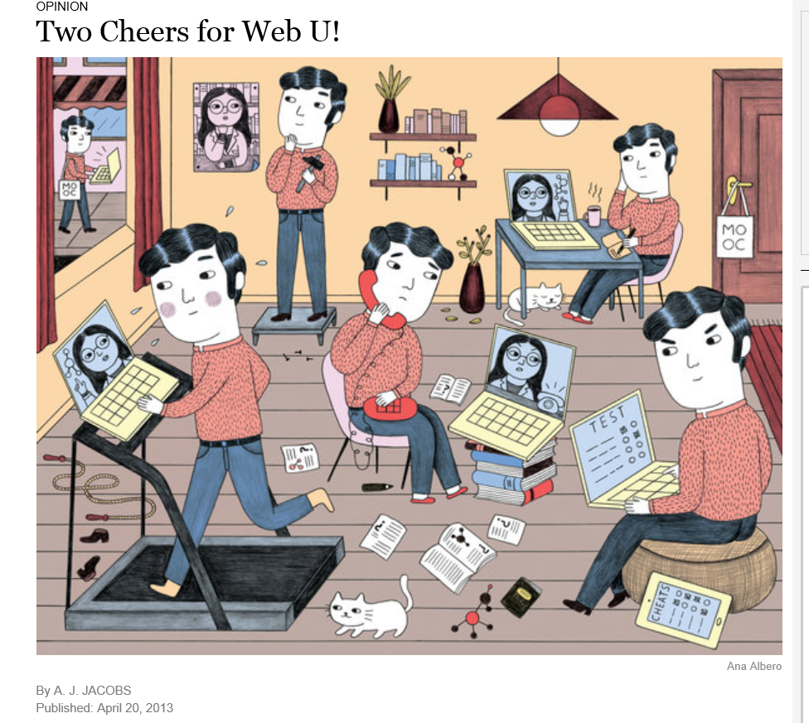

Thirty Ways
Learning is Changing…
(i.e., it’s more informal, video-based, ubiquitous, collaborative, self-directed, global, mobile, open, massive, etc.)

Slide 15
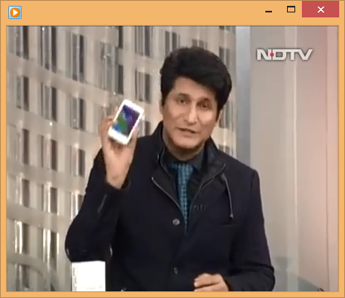
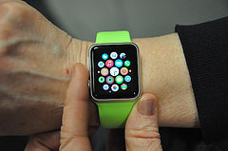
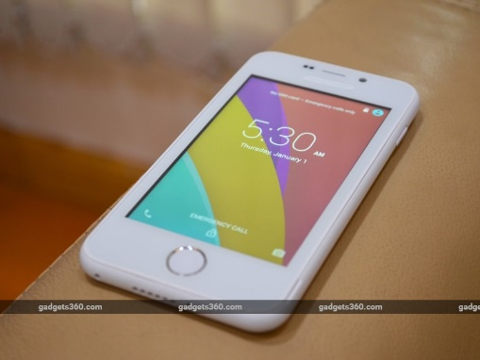
I. Learning is More Mobile
February 17, 2016
World’s Cheapest Smartphone at $3.67 https://m.facebook.com/hashtag/launched?refid=52&__tn__=%2As https://m.facebook.com/story.php?story_fbid=10153960012315798&id=102527030797 http://gadgets.ndtv.com/videos/freedom-251-launched-as-world-s-cheapest-smartphone-at-rs-251-404082

Slide 16
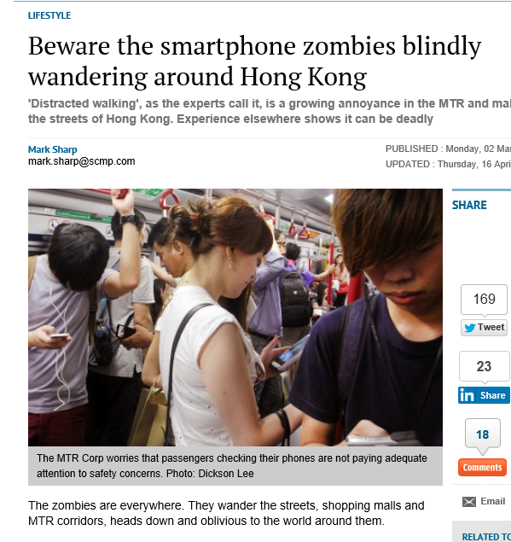
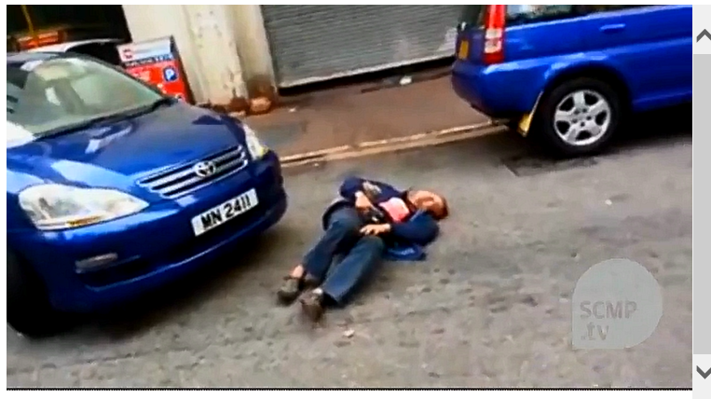
March 2, 2015
Beware the smartphone zombies blindly wandering around Hong Kong, Mark Sharp, South China Morning Post http://www.scmp.com/lifestyle/technology/article/1725001/smartphone-zombies-are-putting-your-life-and-theirs-danger

Slide 17
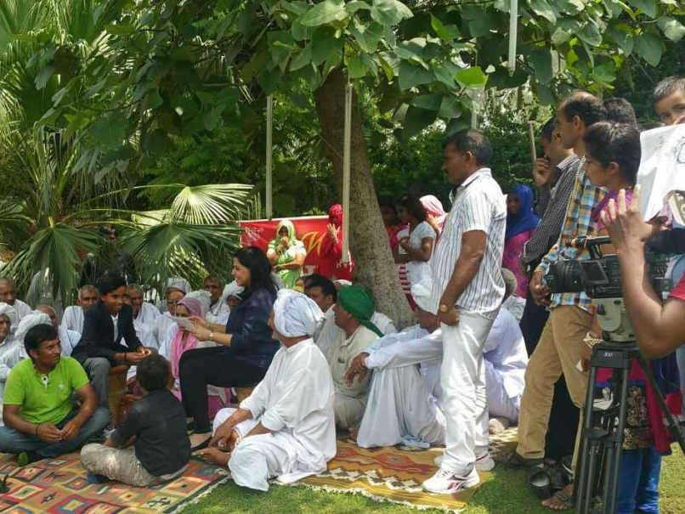
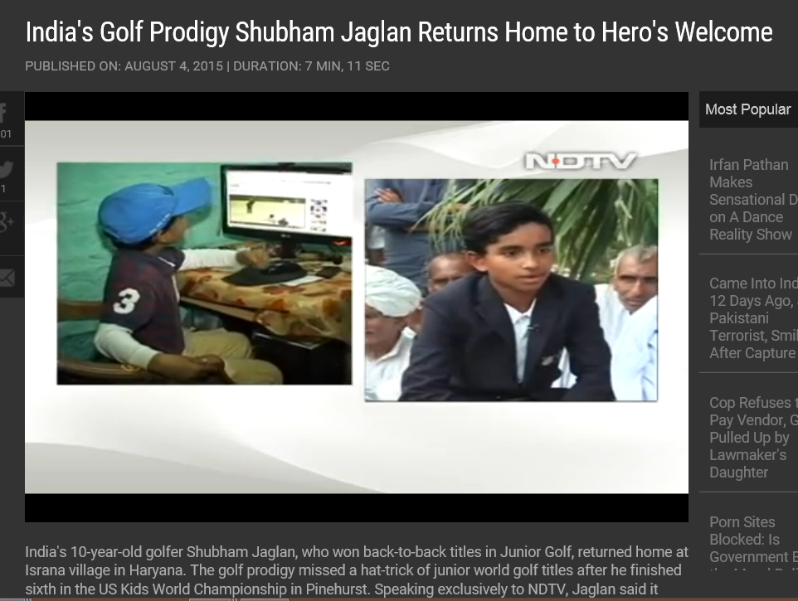
II. Learning is More Video-Based
August 5, 2015
Shubham Jaglan Overwhelmed by "Dream" Return Home After Double World Championship
Disha Chopra, NDTV Sports http://sports.ndtv.com/golf/news/246551-shubham-jaglan-overwhelmed-by-dream-return-home-after-double-world-championship http://www.ndtv.com/video/player/news/india-s-golf-prodigy-shubham-jaglan-returns-home-to-hero-s-welcome/377614

Slide 18
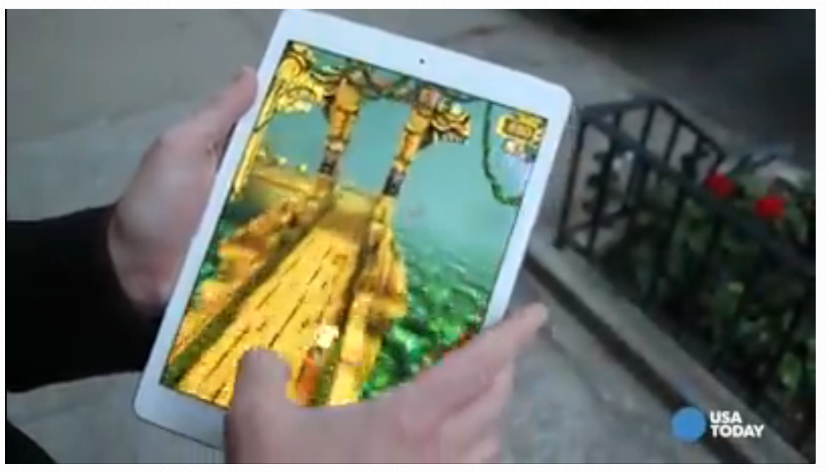
III. Learning is More Game-Based
October 21, 2014
Sexy iPad Air 2 is fabulous but not a must upgrade, Edward Baig, USA Today http://www.usatoday.com/story/tech/columnist/baig/2014/10/21/ipad-air2-fabulous-tablet-is-not-must-upgrade/17658295/

Slide 19
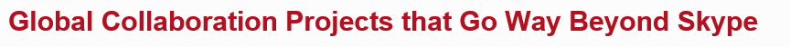
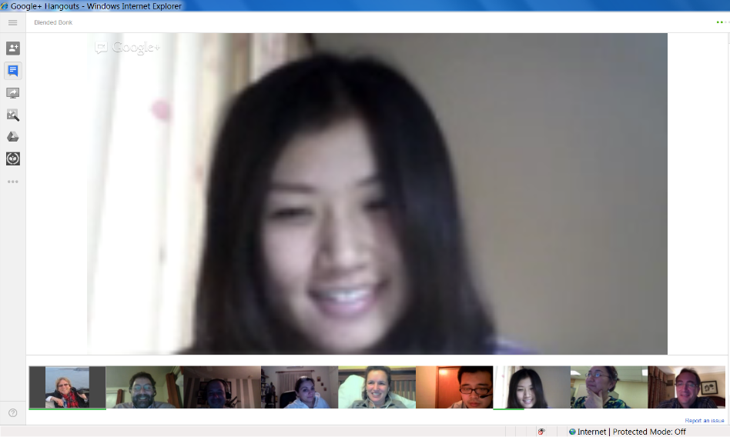
IV. Learning also is More Collaborative
March 26, 2014
Flat Connections: Welcome to Flat Connections - Learning about the world, with the world http://www.flatconnections.com/

Slide 20
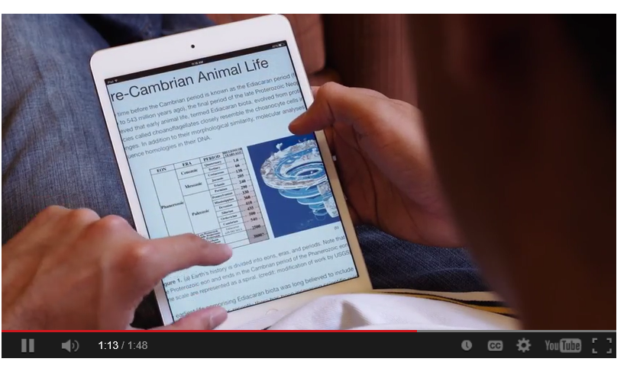
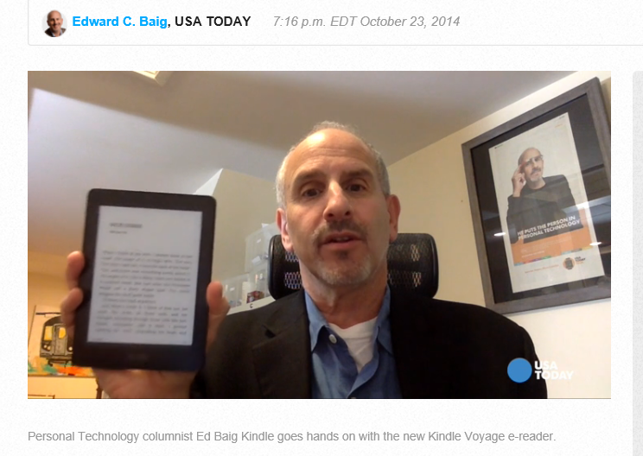
V. Learning is More Digital
October 23, 2014
New Amazon Kindle is a Voyage into eReader luxury, USA Today, Edward C. Baig http://www.usatoday.com/story/tech/columnist/baig/2014/10/23/amazon-kindle-voyage-is-voyage-into-ereader-luxury/17781255/

Slide 21
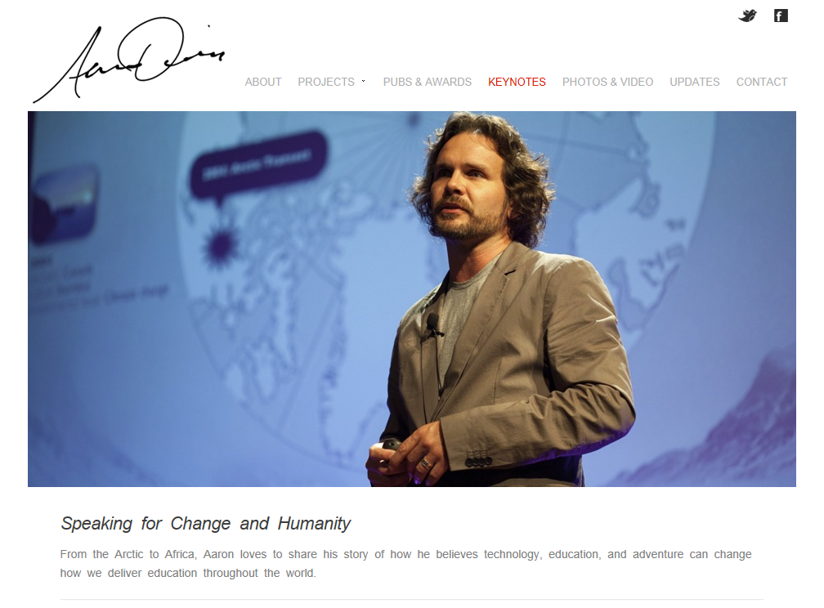
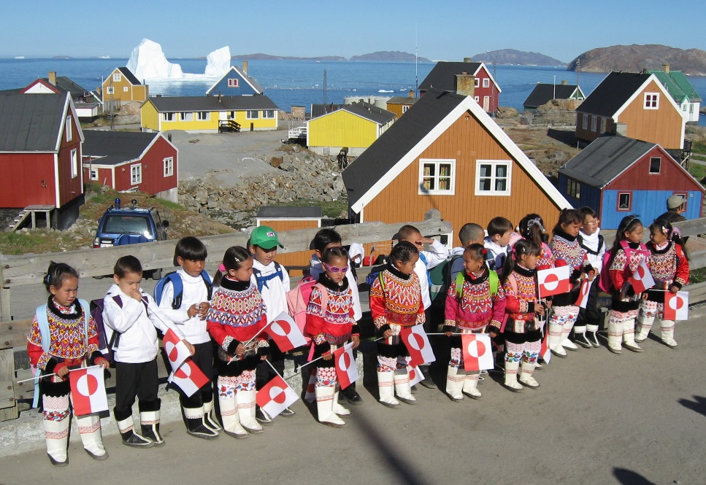
VI. Learning is More Adventurous
May 7, 2015
Aaron Doering, Chasing Seals, TEDx http://chasingseals.com/ https://twitter.com/chasingseals

Slide 22
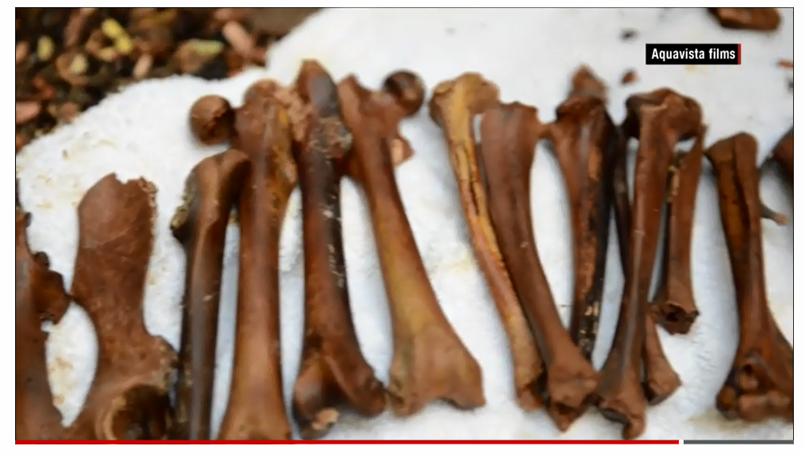
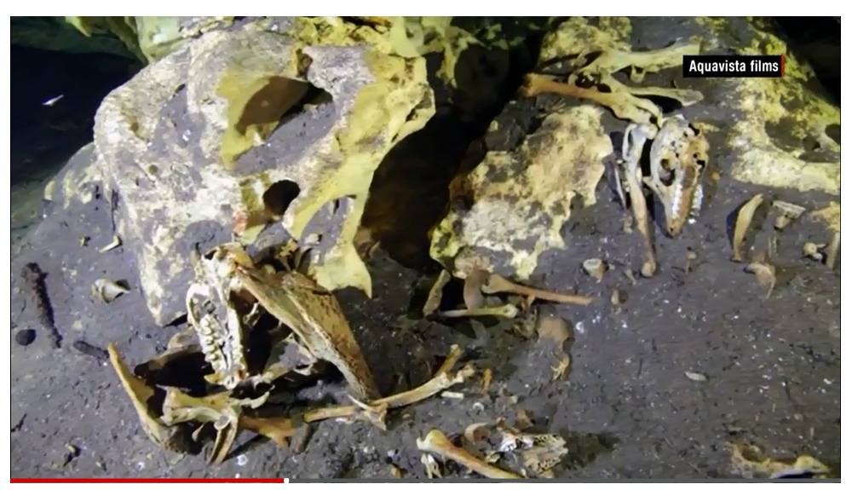
VII. Learning is More Immediate and Resource Rich
March 22, 2015
Madagascar marvel:
Divers find fossils of extinct giant lemurs
Daisy Carrington, for CNN, March 22, 2015 http://www.cnn.com/2015/03/19/africa/underwater-fossil-lemur-graveyard-madagascar/index.html

Slide 23
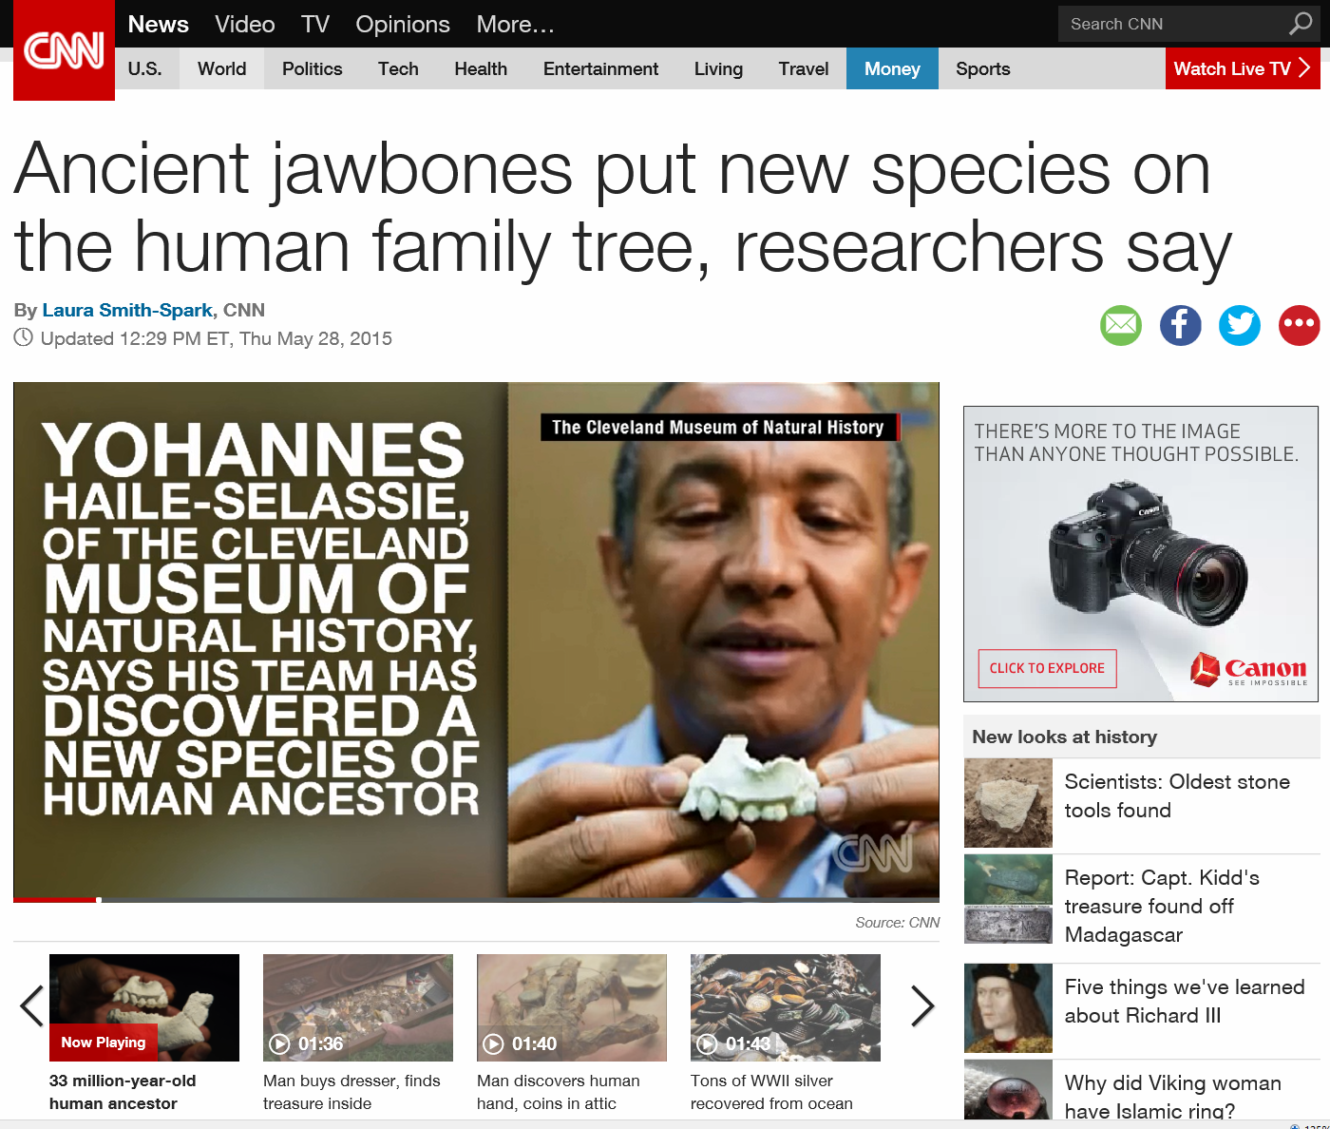
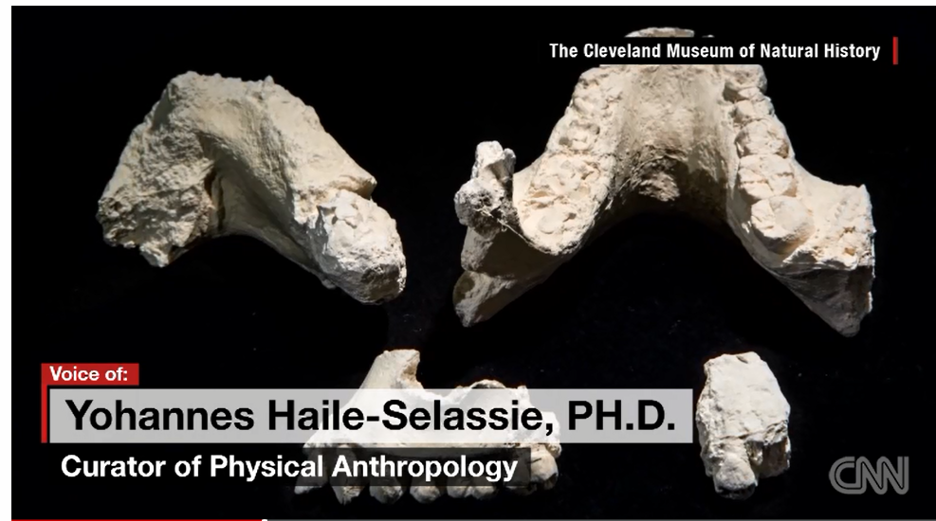
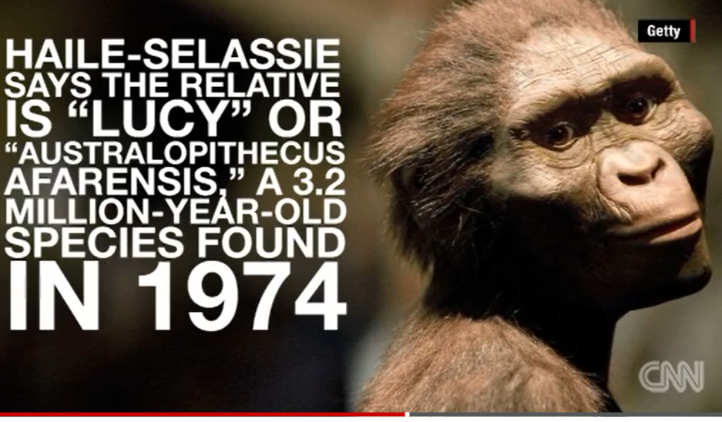
May 28, 2015
Immediate and Resource Rich
Ancient jawbones put new species on the human family tree, researchers say, Laura Smith-Spark, CNN http://www.cnn.com/2015/05/28/africa/ethiopia-fossil-hominin-ancestor/index.html

Slide 24
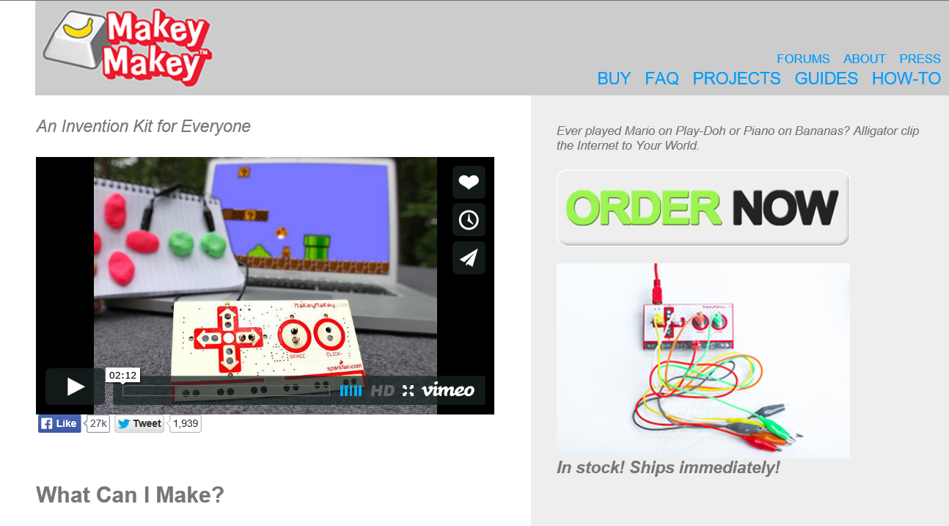
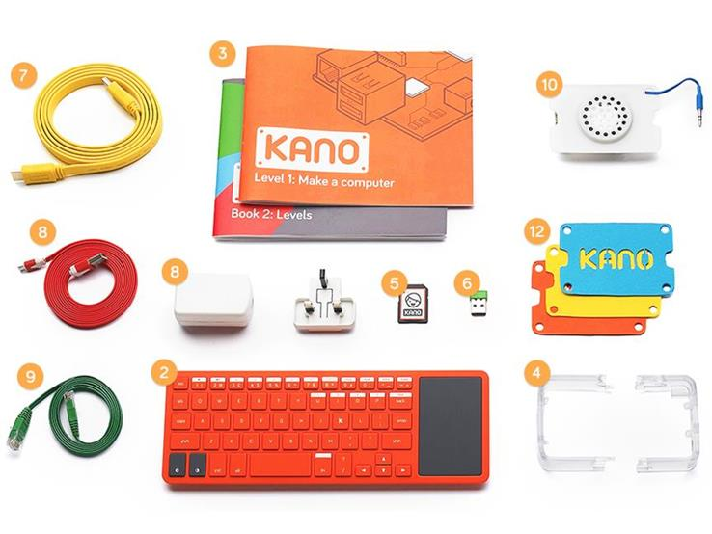
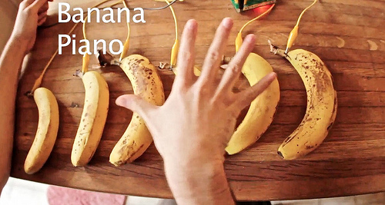
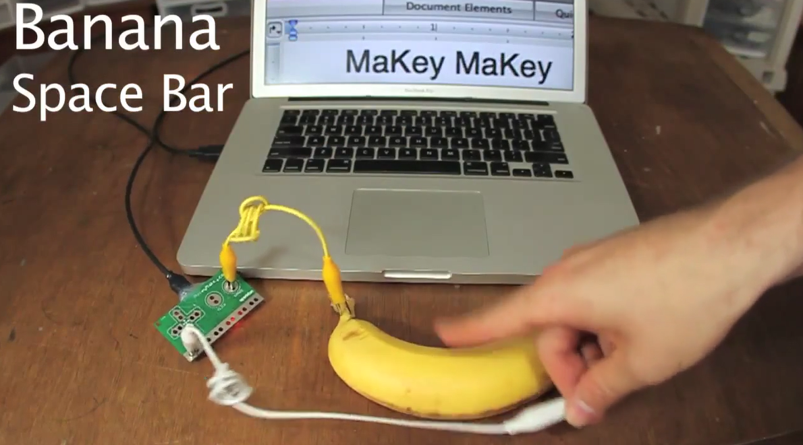
VIII. Learning is More Hands-On
February 2, 2015
Makey Makey and the Kano http://makeymakey.com/ https://vimeo.com/60307041

Slide 25
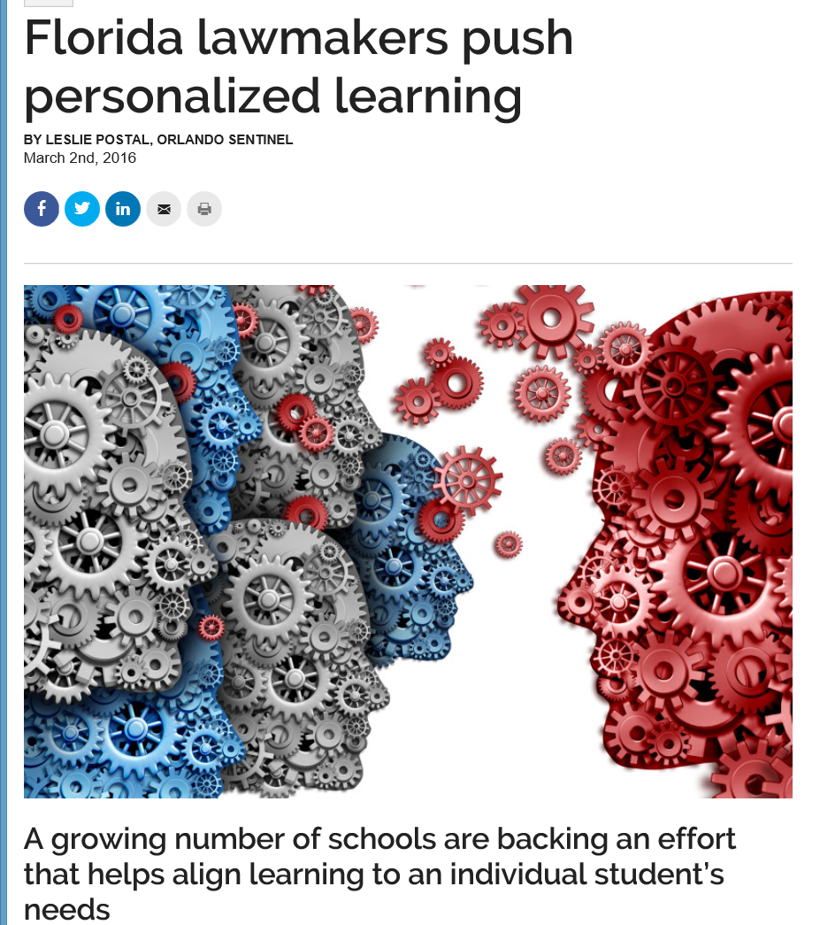
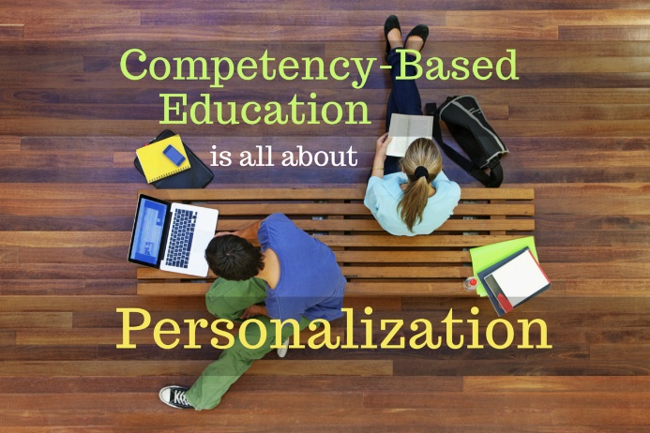
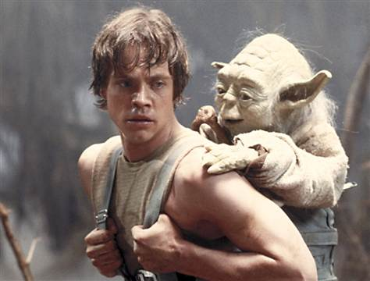
March 2, 2016
IX. Learning is More Personal
Florida lawmakers push personalized learning
Leslie Postal, Orlando Sentinel (eSchool News) http://www.orlandosentinel.com/features/education/os-competency-based-education-florida-lake-schools-20160212-story.html

Slide 26
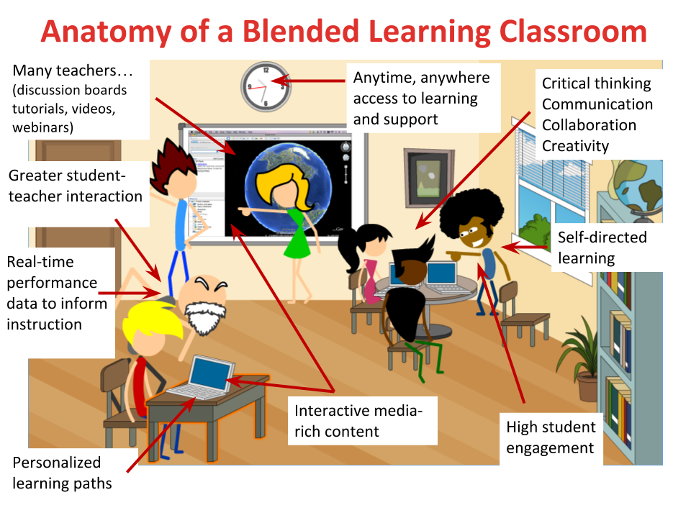
X. Learning is More Blended

Slide 27
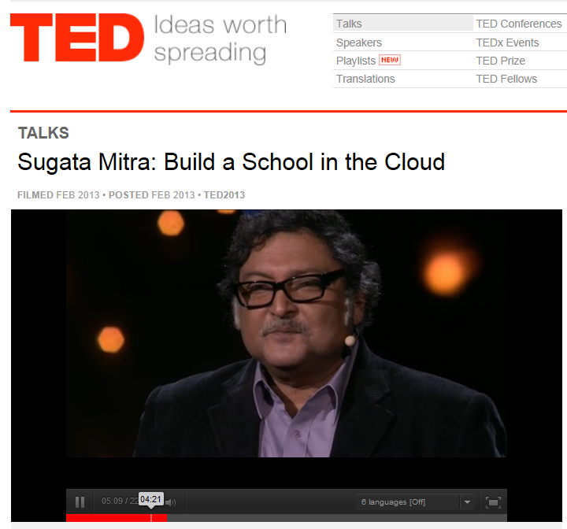
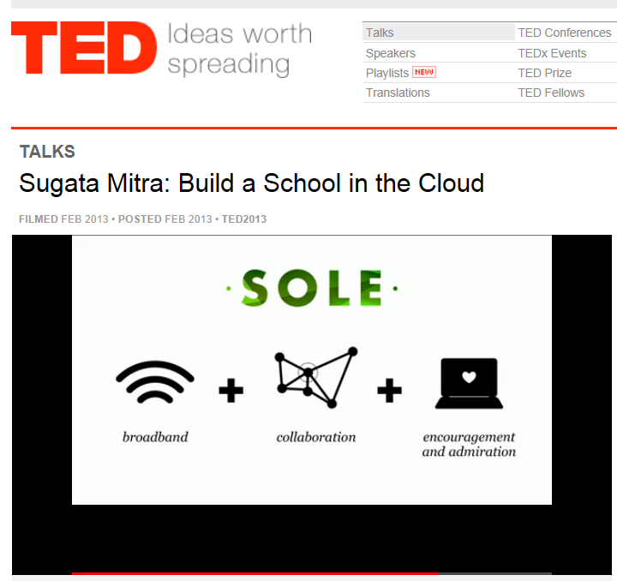
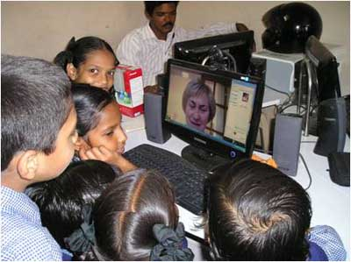
XI. Learning is More Self-Directed
February 2013
TED Talks
(Build a School in the Cloud; Self-Organized Learning Environments (SOLEs), TED Talk from Sugata Mitra http://www.ted.com/talks/sugata_mitra_build_a_school_in_the_cloud.html

Slide 28


XII. Learning is More Global
May 26, 2015
Exploring by the Seat of Our Pants
National Geographic, Jessica Shea http://blog.education.nationalgeographic.com/2015/05/26/exploring-by-the-seat-of-our-pants/
Two men living in Dadaab, a refugee camp in Kenya, would watch lecture videos and take online quizzes at a nearby United Nations compound. (InZone)

Slide 29

January 19, 2015
XIII. Learning is More Synchronous
(International Open Badges Extravaganza)
European Meeting in Zoom, November 2015)

Slide 30


October 30, 2015
XIV: Learning is More Online
Migrants get help through German online university
Mihret Yohannes and Jabeen Bhatti, Special for USA TODAY , USA Today “Kiron (University) relies on existing "mass open online courses," or MOOCs, and works with eight academics from Harvard and MIT to create a two-year course of study. This will provide many refugees with credits that can transfer to 35 traditional, brick-and-mortar universities across Europe that are partners with Kiron.”

Slide 31


Let’s Review:
Learning is Changing…
(i.e., it’s more informal, video-based, ubiquitous, collaborative, self-directed, global, mobile, open, massive, etc.)
Frank Basile, an aircraft technician, took an MITx course on circuits and electronics to increase his knowledge.
Joe Alfonso, a financial adviser from Oregon, is taking the online finance course as a "refresher."

Slide 32



The Web of Learning

Slide 33

We are entering a jumping off point…
(South University of Science and Technology of China, Wednesday June 10, 2015)

Slide 34



Frameworks and Models

Slide 35



3. Curiosity, Fun:
A. Virtual Expeditions
July 23, 2015
What Google’s virtual field trips look like in the classroom, eSchool News, Stephen Noonoo

Slide 36

October 16, 2015
5. Autonomy, Choice:
C. Newseum Ed https://newseumed.org/

Slide 37

6. Relevance, Meaningfulness:
A. Map Animations
Yes, Mr. President, We Remade Our Atlas to Reflect Shrinking Ice
Christine Dell'Amore, National Geographic, August 3, 3015 http://news.nationalgeographic.com/2015/08/150803-arctic-ice-obama-climate-nation-science/?utm_content=buffer8a394&utm_medium=social&utm_source=twitter.com&utm_campaign=buffer

Slide 38

8. Engagement, Effort:
A. Interpreting Infographics
August 5, 2015
How much rainforest in that chocolate bar?
Global Forest Watch, Nancy Harris, Octavia Payne and Sarah Mann http://blog.globalforestwatch.org/2015/08/how-much-rainforest-is-in-that-chocolate-bar/

Slide 39




10. Yields Products, Goals:
A. Shared Online Video Tests and Quizzes (e.g., TED-Ed) http://education.ted.com/

Slide 40



Any Comments or Questions?
Slides at: TrainingShare.com
Papers: PublicationShare.com
Book: http://tec-variety.com/
Email: curt@worldisopen.com

