Slide 1
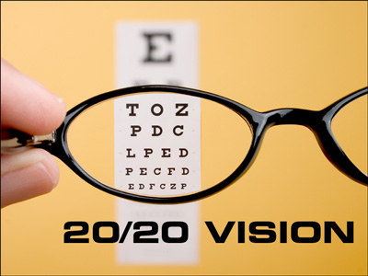
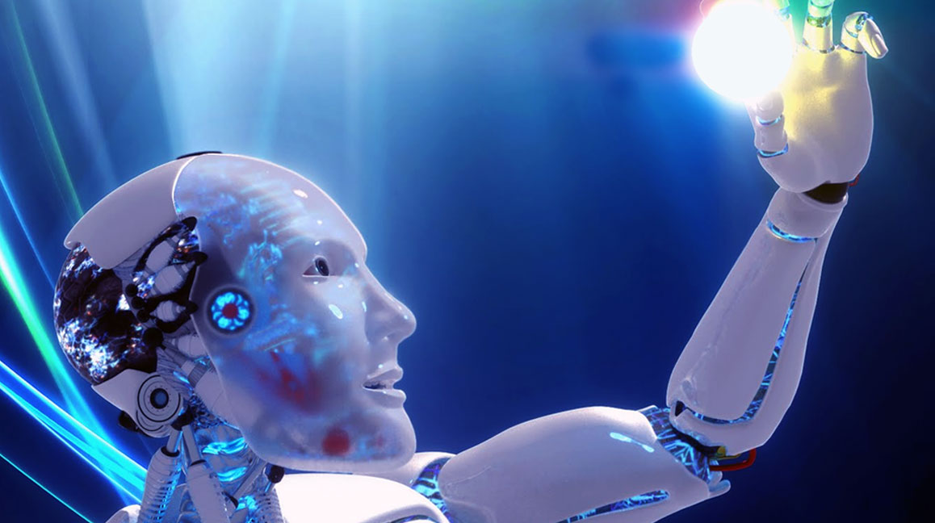

Technology Today, Technology Tomorrow:
Might Learning Evolutions lead to Learning Revolutions?
Curtis J. Bonk, Professor, Indiana University
cjbonk@indiana.edu
http://curtbonk.com/

Slide 2
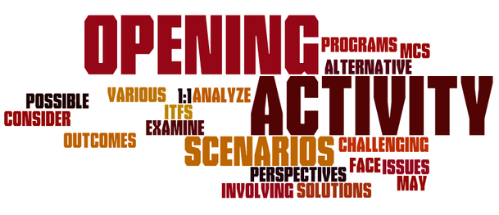
Opening Activity #1:
Type Answer in the Chat Window: What is your favorite type of learning technology today…?

Slide 3
Opening Activity #2:
Type Answer in the Chat Window: What is the technology that you think will most impact learning 10 years from now…

Slide 4

Polling Question #1:
Are we in the midst of a:
A. Learning Evolution or
B. Learning Revolution…
C. Neither

Slide 5

Talk Overview
Pandemic Pondering
Technology Yesterday
Education 20/20
Technology Today
  30 ways learning is changing…
5. Technology Trends of Tomorrow

Slide 6
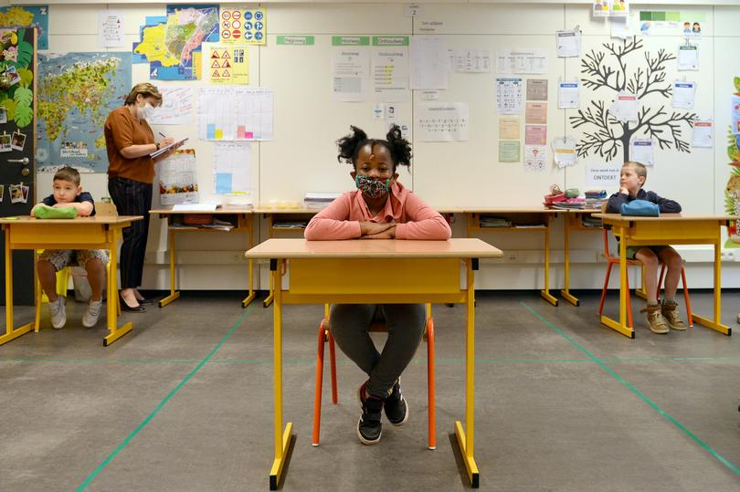

July 30, 2020
Part 1: Pandemic Pondering
Disruptive Ecology:
The New Normal of Education in Post COVID-19

Slide 7
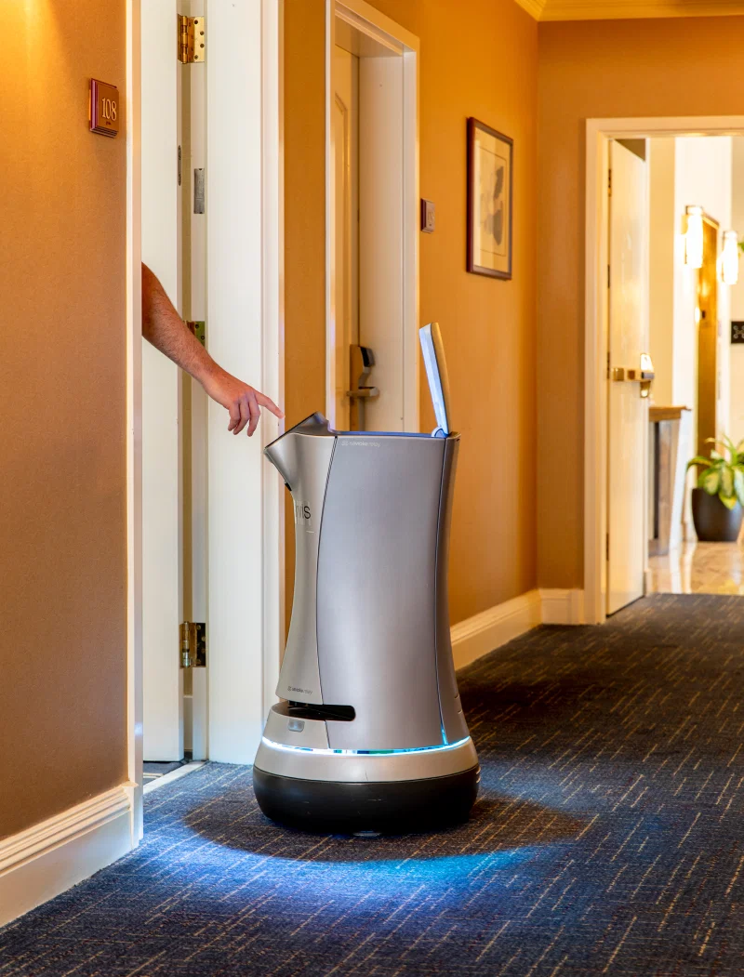
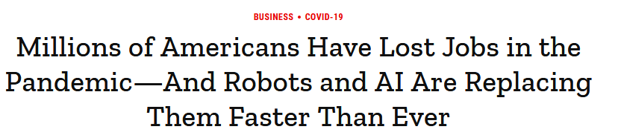
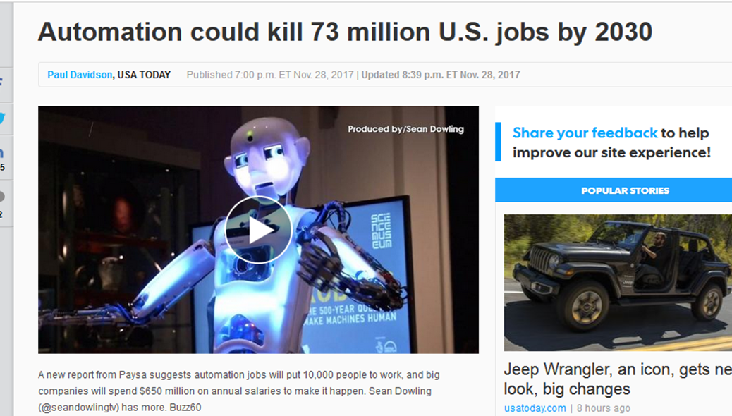
August 6, 2020
Millions of Americans Have Lost Jobs in the Pandemic—And Robots and AI Are Replacing Them Faster Than Ever
Alana Semuels, Time https://time.com/5876604/machines-jobs-coronavirus/
Jarvis the robotic butler on duty at the Grand Hotel in Sunnyvale, Calif., on July 30

Slide 8
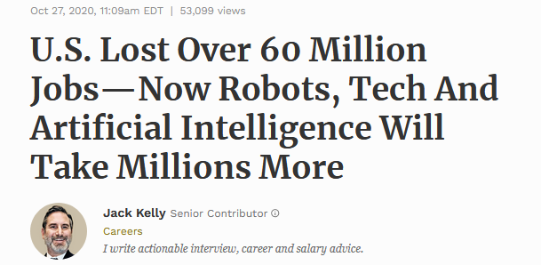
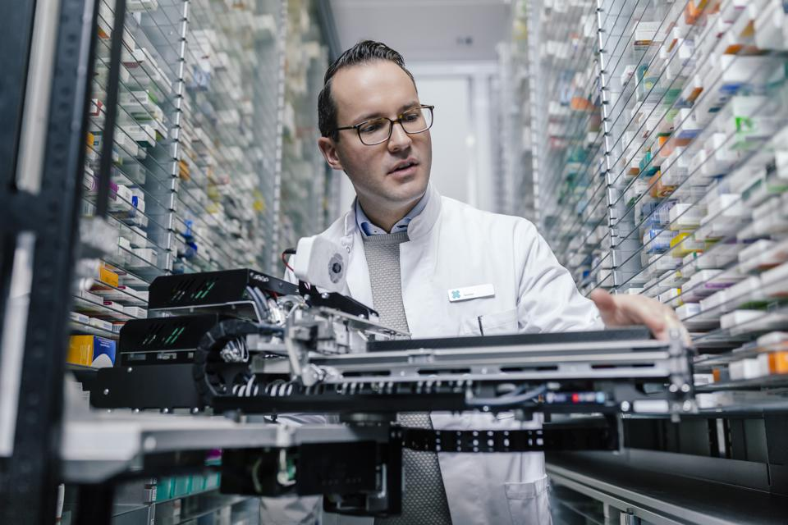
October 27, 2020
U.S. Lost Over 60 Million Jobs—Now Robots, Tech And Artificial Intelligence Will Take Millions More
Jack Kelly, Forbes https://www.forbes.com/sites/jackkelly/2020/10/27/us-lost-over-60-million-jobs-now-robots-tech-and-artificial-intelligence-will-take-millions-more/?sh=2ddf5f951a52
Video (1:20): http://curtbonk.com/automation.html
Video (1:20): http://curtbonk.com/automation2.html

Slide 9
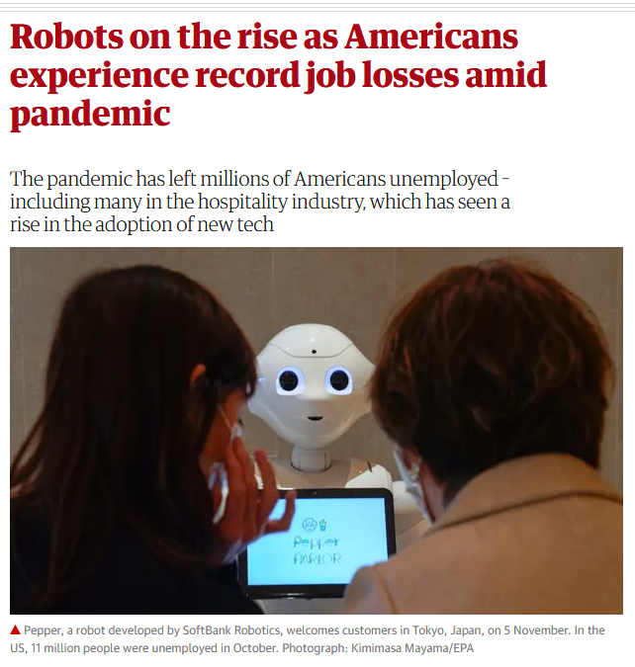
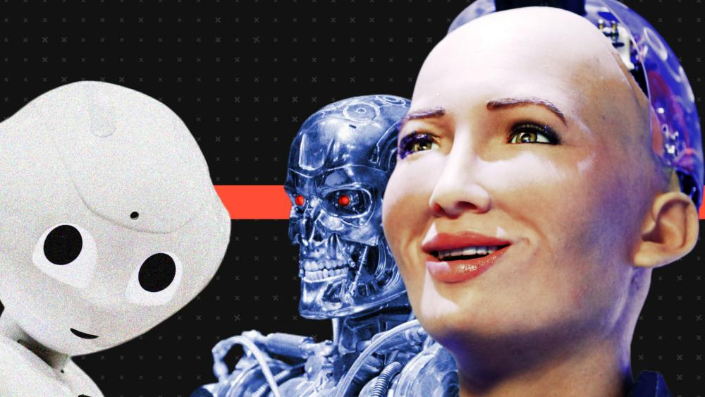
November 27, 2020
Robots on the rise as Americans experience record job losses amid pandemic
Lauran Arantani, The Guardian https://www.theguardian.com/technology/2020/nov/27/robots-replacing-jobs-automation-unemployment-us

Slide 10
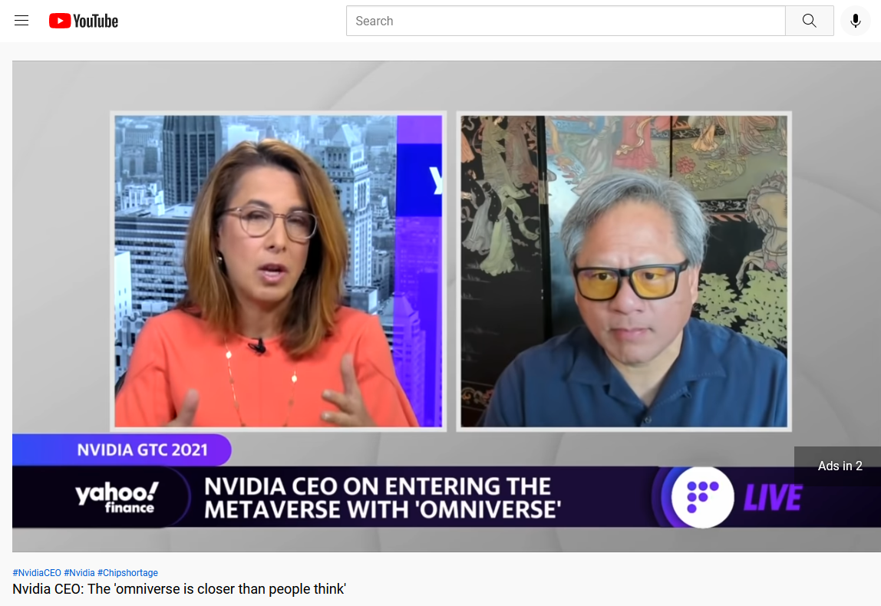
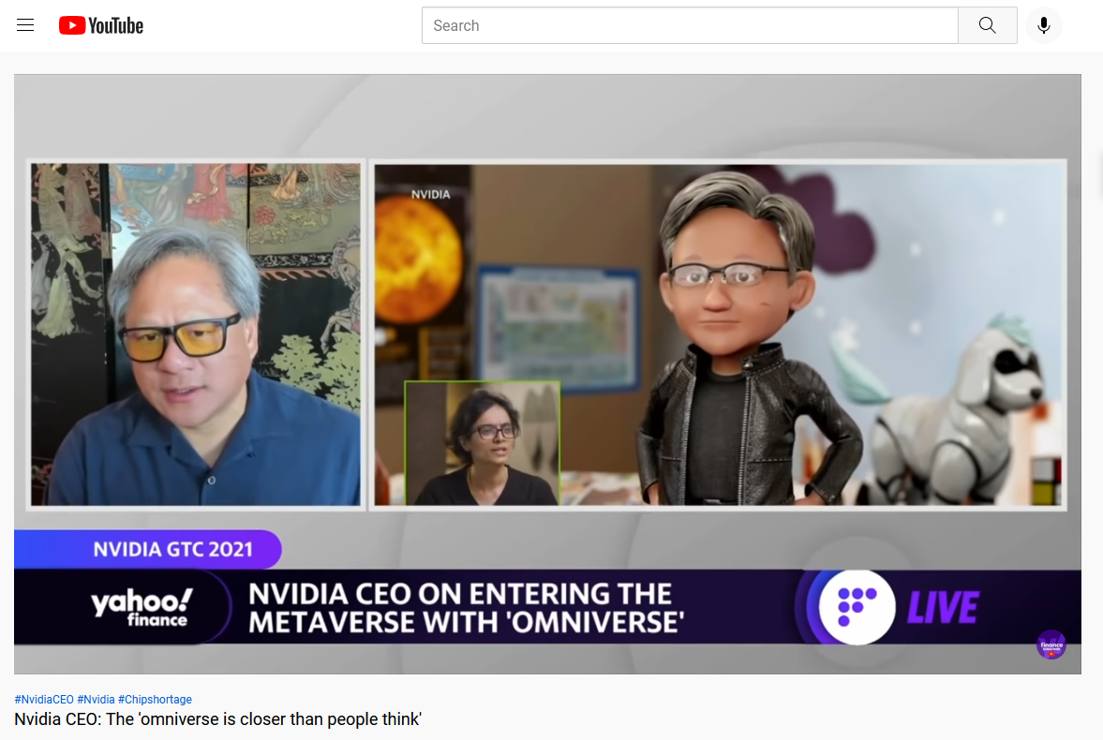
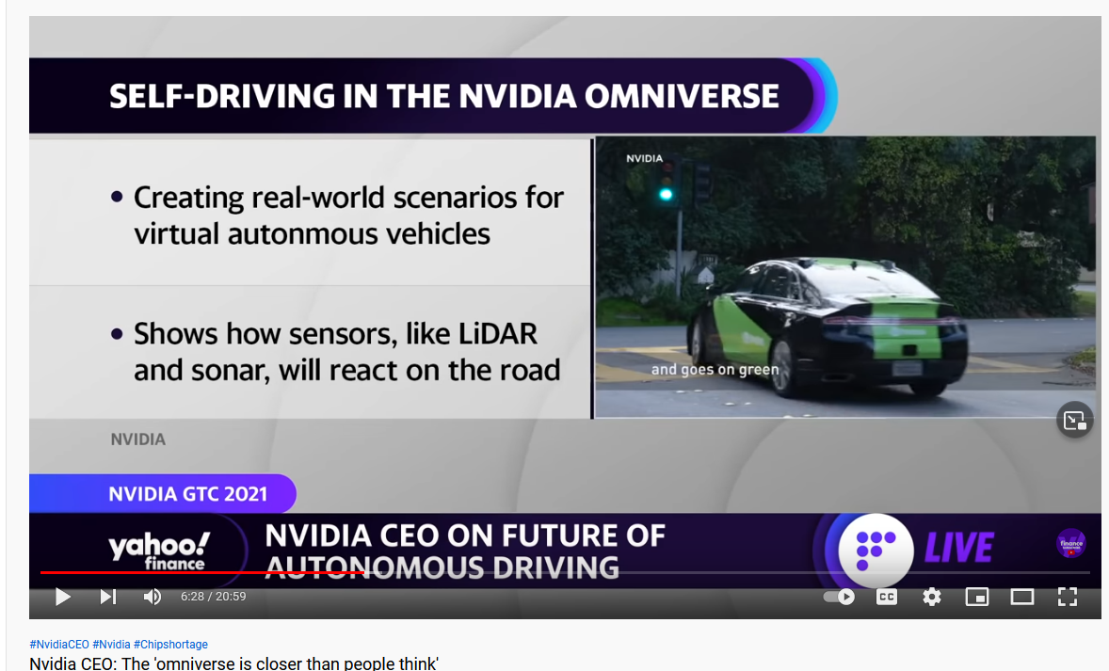
November 10, 2021
Nvidia CEO: The 'omniverse is closer than people think', November 10, 2021 https://www.youtube.com/watch?v=fcL3EV9dUys

Slide 11
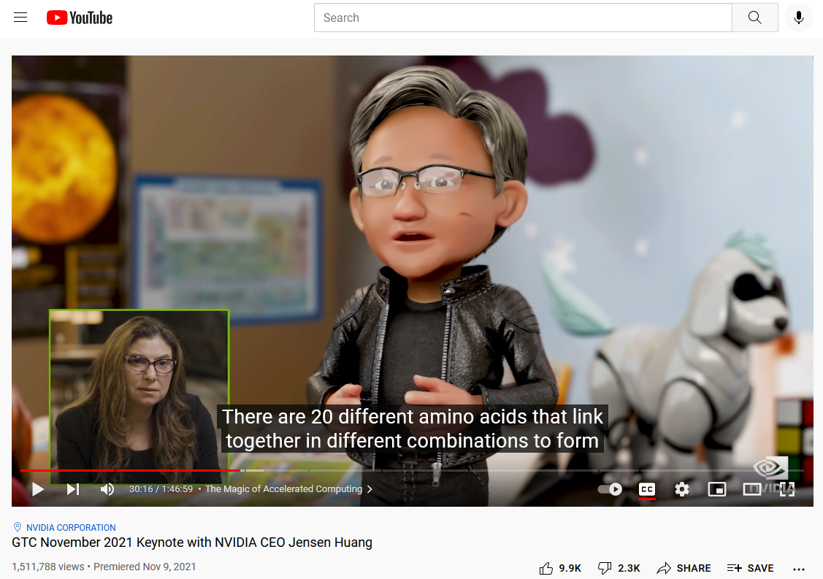
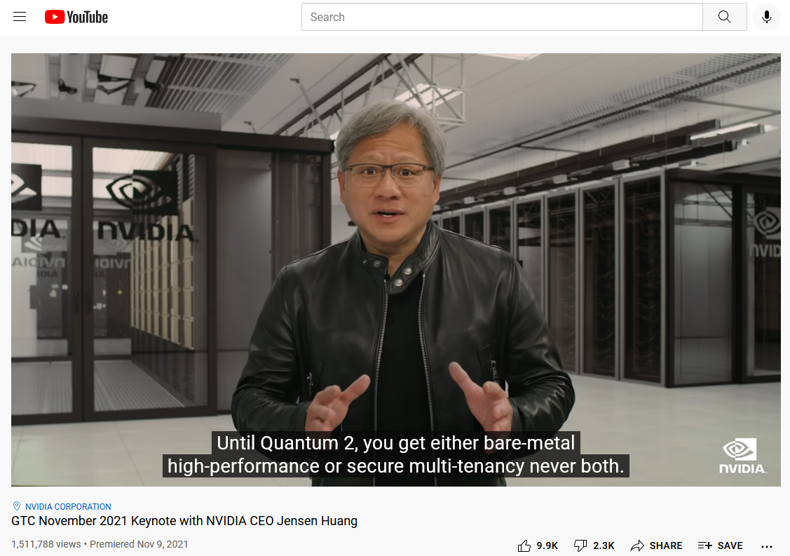
November 9, 2021
GTC November 2021 Keynote with NVIDIA CEO Jensen Huang https://www.youtube.com/watch?v=jhDiaUL_RaM

Slide 12
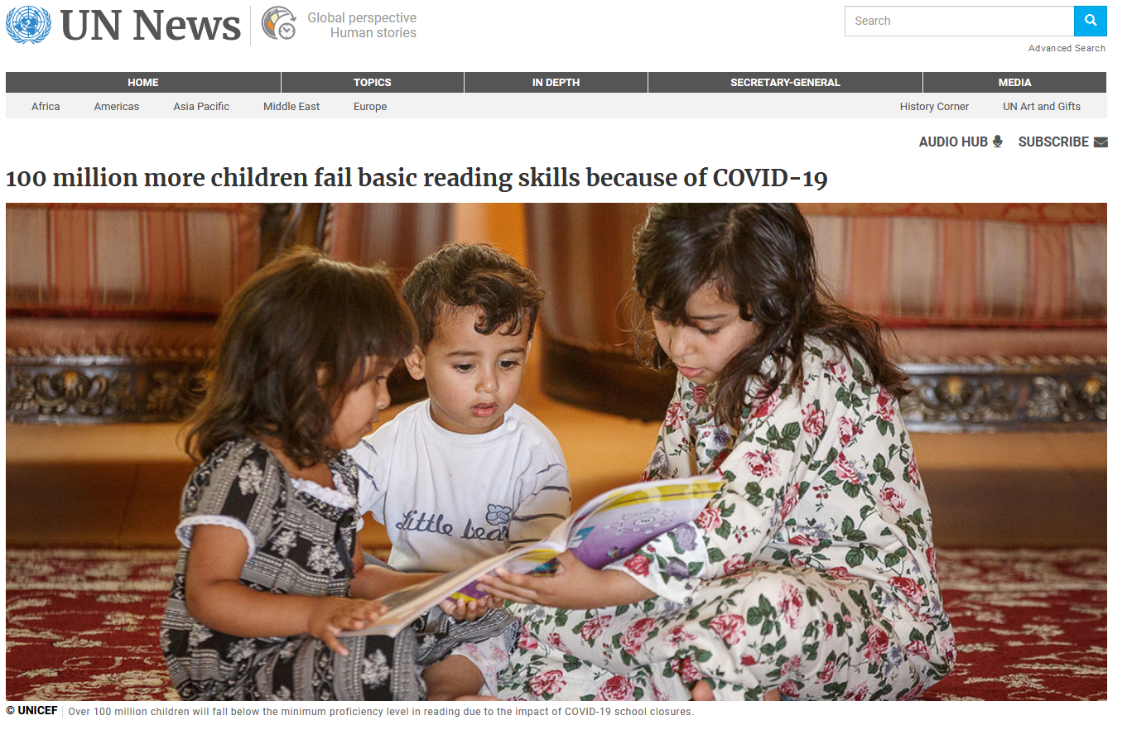
March 26, 2021
100 million more children fail basic reading skills because of COVID-19
UN News https://news.un.org/en/story/2021/03/1088392

Slide 13
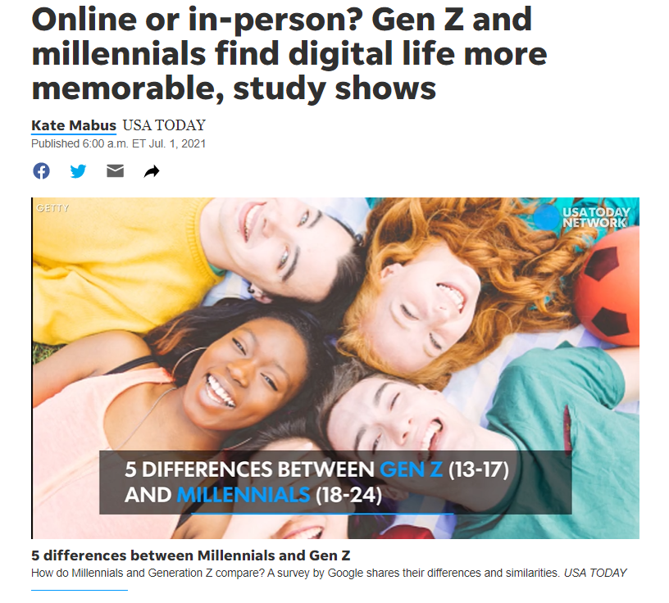
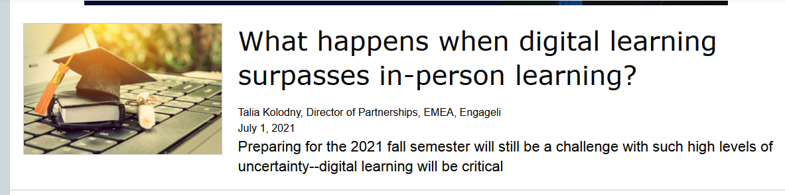
July 1, 2021
Online or in-person? Gen Z and millennials find digital life more memorable, study shows
Kate Mabus, USA Today https://www.usatoday.com/story/news/nation/2021/07/01/generation-z-millennial-survey-shows-digital-life-more-memorable/7783597002/
If there is one thing the pandemic is teaching us, it’s that deep human connections are essential for student and instructor wellbeing and for impactful education. As we move into a hybrid future, technology should not (and cannot!) replace human relationships and communications–it should enhance, enable, and enrich them.

Slide 14
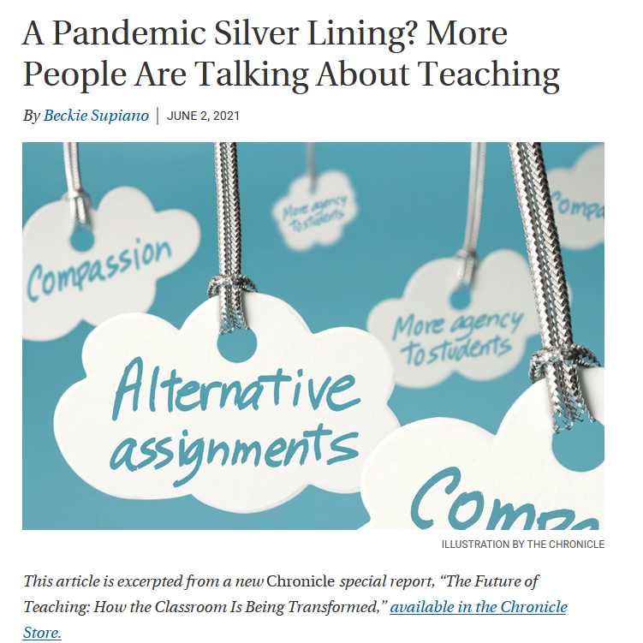
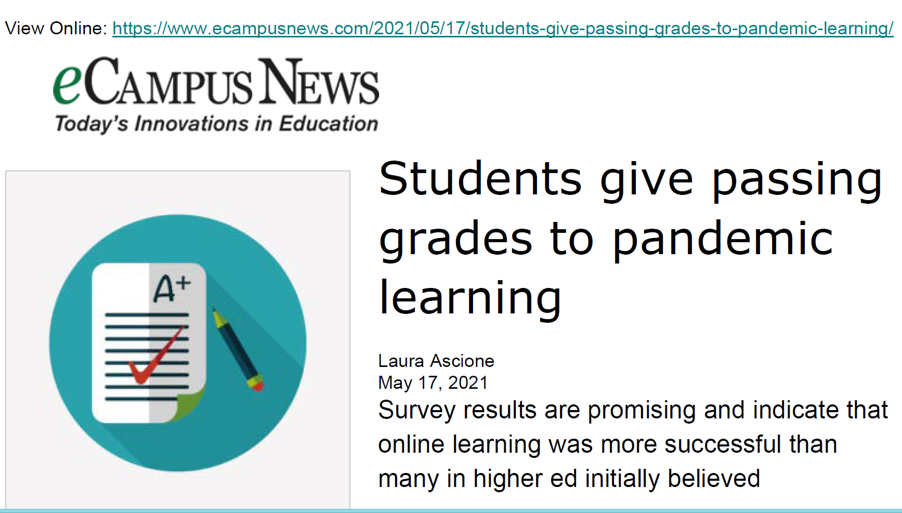
June 2, 2021
A Pandemic Silver Lining? More People Are Talking About Teaching
Beckie Supiano, The Chronicle of Higher Education https://www.chronicle.com/article/a-pandemic-silver-lining-more-people-are-talking-about-teaching

Slide 15

February 26, 2021
Ever have 'Zoom fatigue?' These are the causes and how to fix them, researchers say
Brett Molina, USA Today https://www.usatoday.com/story/tech/2021/02/26/zoom-fatigue-causes-and-how-to-fix/6831569002/

Slide 16
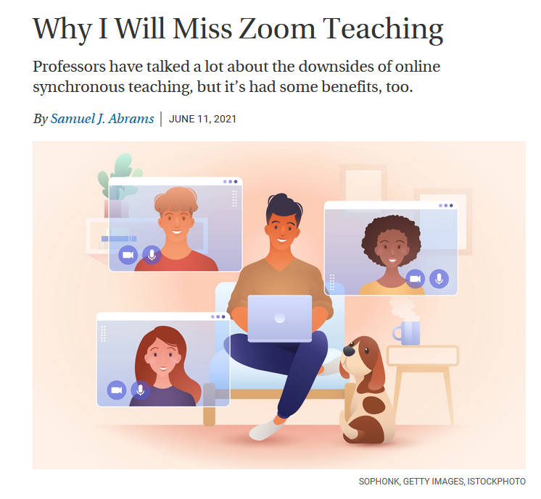
June 11, 2021
Why I Will Miss Zoom Teaching
Samuel Abrams, The Chronicle of Higher Education https://www.chronicle.com/article/why-i-will-miss-zoom-teaching

Slide 17
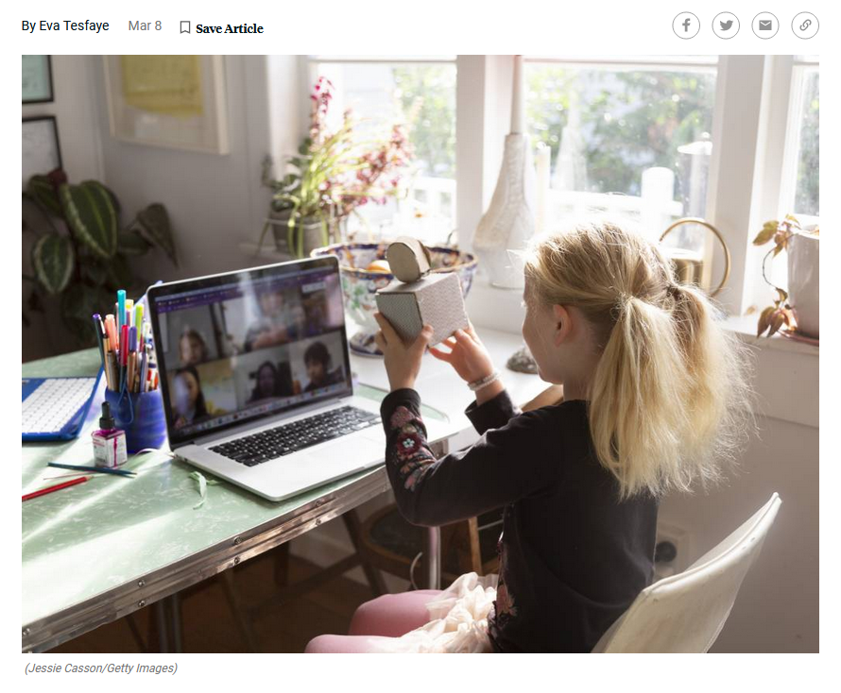
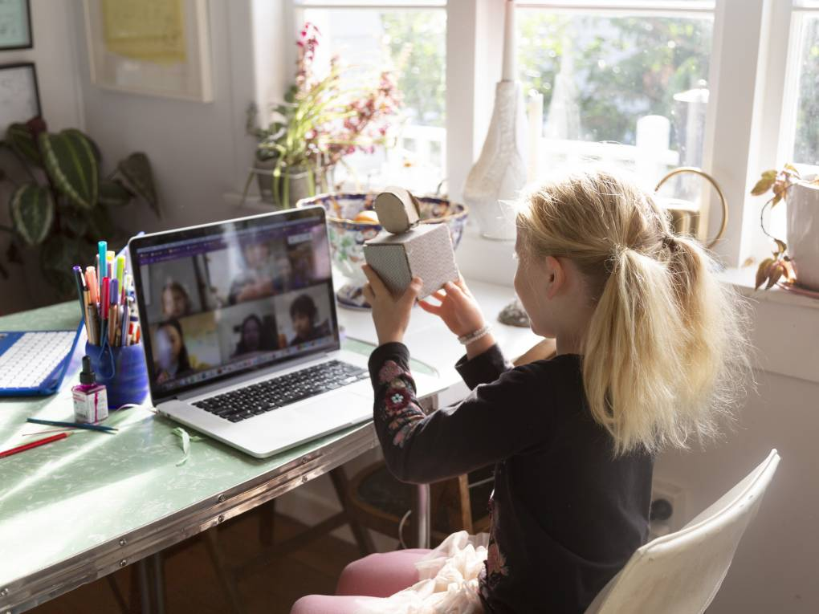
March 8, 2021
As Many Parents Fret Over Remote Learning, Some Find Their Kids Are Thriving
Eva Tedfaye, MindShift https://www.kqed.org/mindshift/57480/as-many-parents-fret-over-remote-learning-some-find-their-kids-are-thriving

Slide 18
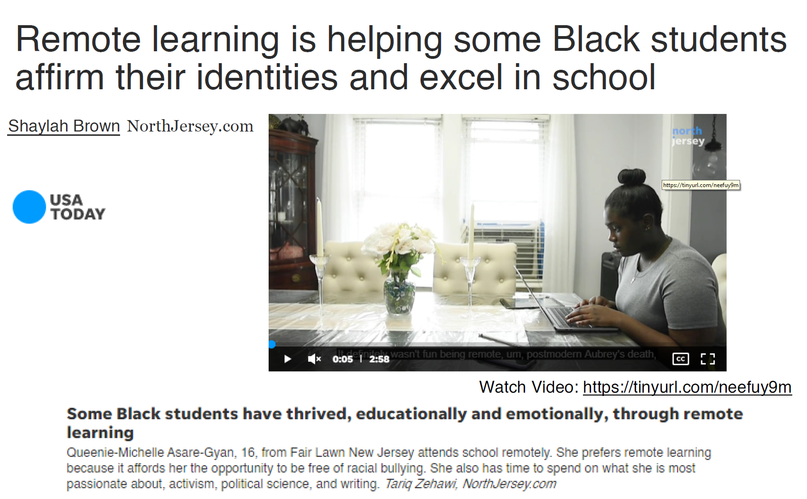
May 7, 2021
Why some black teens thrived with remote school
Shaylah Brown, USA Today https://www.usatoday.com/story/news/education/2021/05/07/how-black-students-new-jersey-excel-school-remote-learning/4973789001/

Slide 19
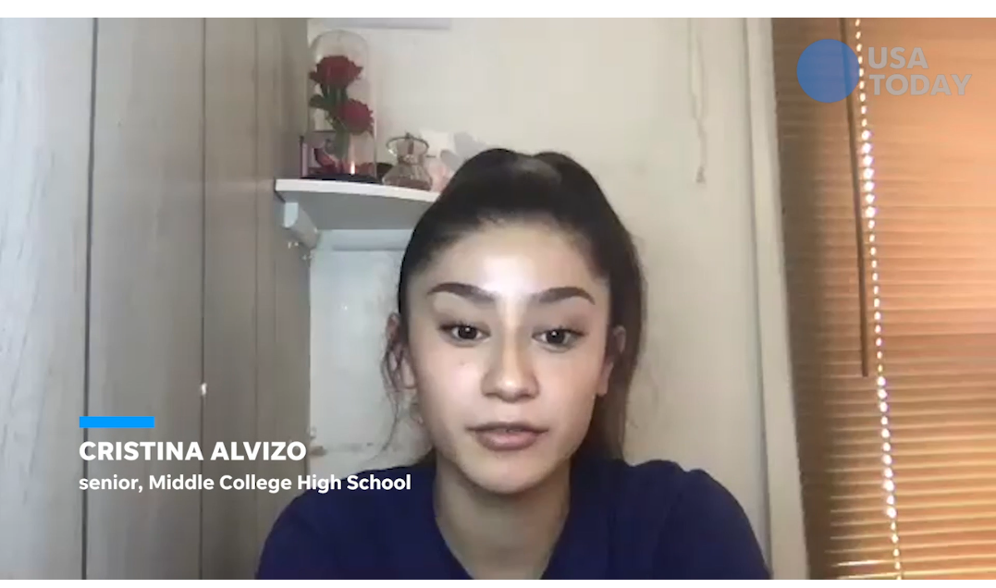
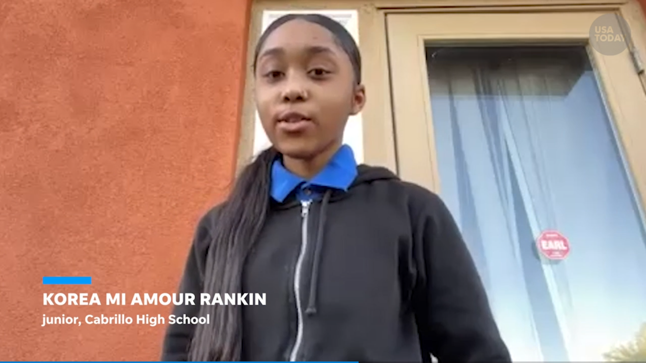
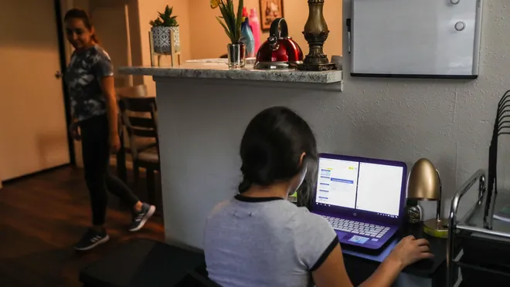
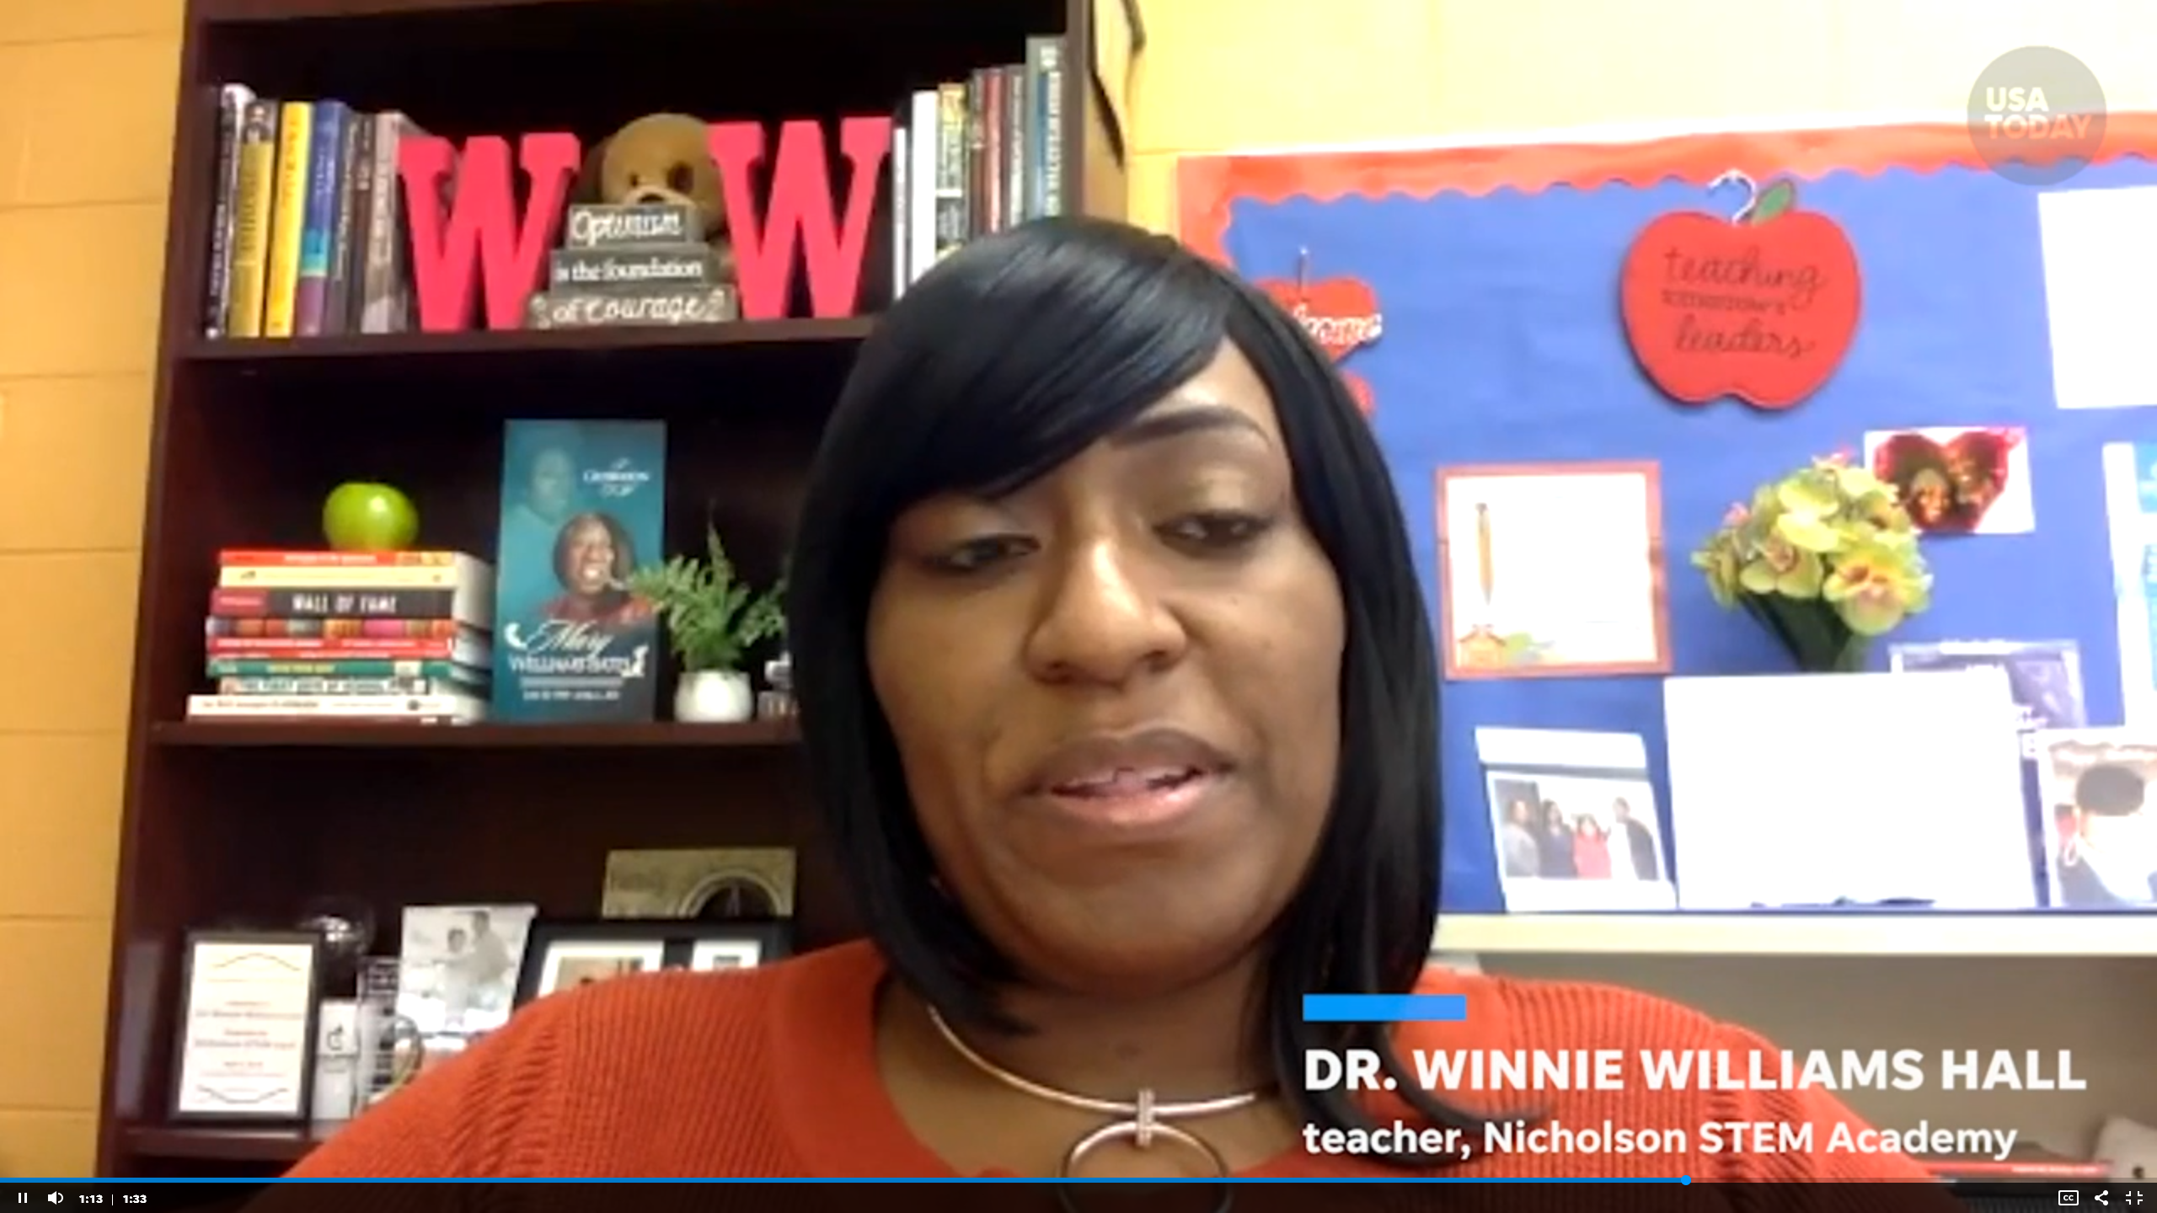
June 5, 2021
After a tough year, schools are axing virtual learning.
Some families want to stay online.
Erin Richards, USA Today
Video (1:27): NYC Mayor promised a return to normal for school system http://curtbonk.com/usa4.html
Video (1:33) Students discuss what surprised them most hybrid learnings http://curtbonk.com/usa3.html https://www.usatoday.com/story/news/education/2021/06/05/covid-online-school-in-person/7523002002/

Slide 20
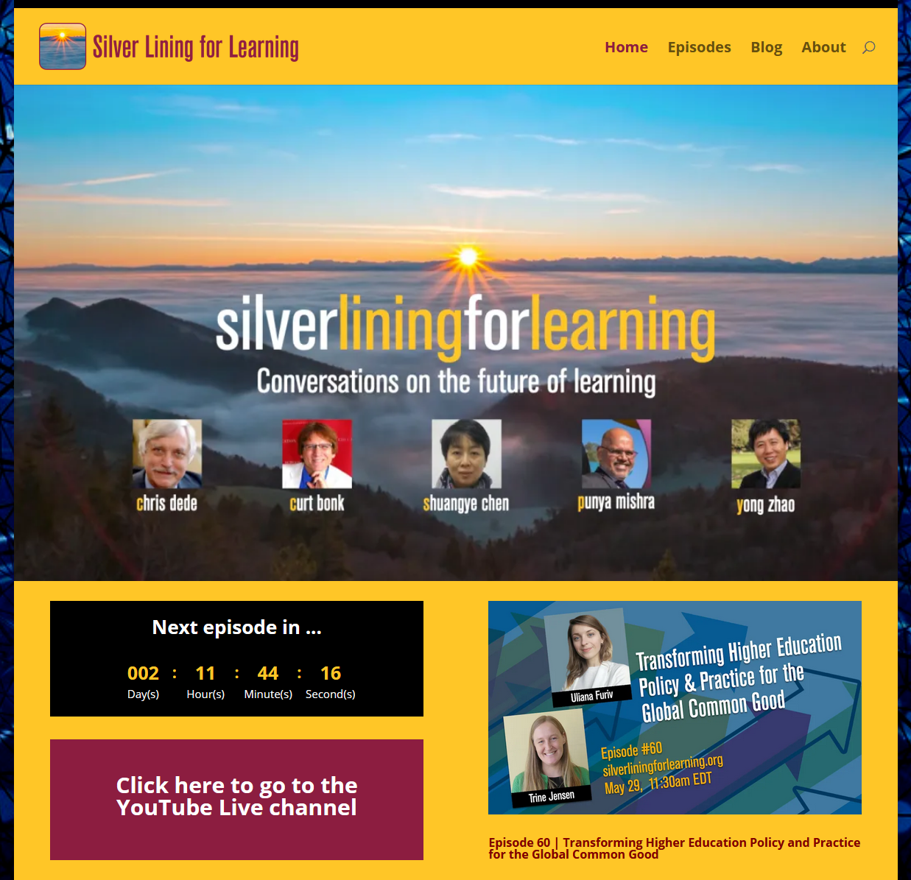
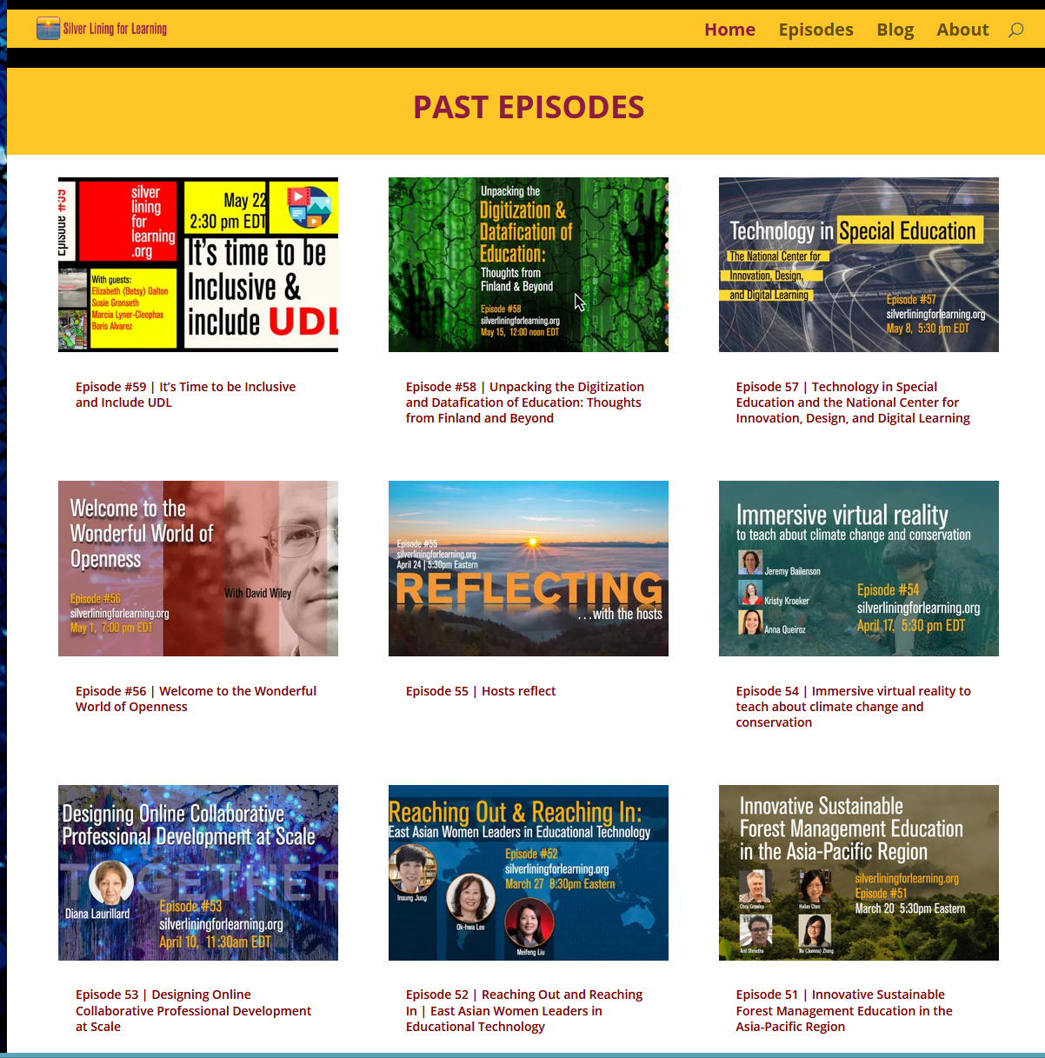
May 29, 2021
New Models of Education Emerging
Silver Lining for Learning https://silverliningforlearning.org/

Slide 21
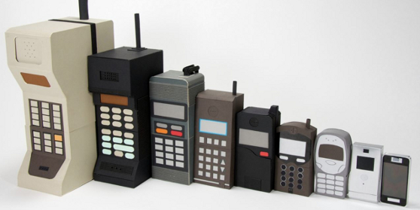
Part 2: Technology Yesterday

Slide 22
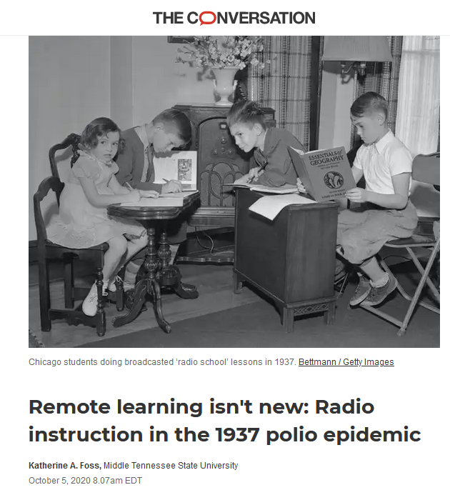
October 5, 2020
Remote learning isn't new:
Radio instruction in the 1937 polio epidemic
Katherine A. Foss, The Conversation https://theconversation.com/amp/remote-learning-isnt-new-radio-instruction-in-the-1937-polio-epidemic-143797

Slide 23
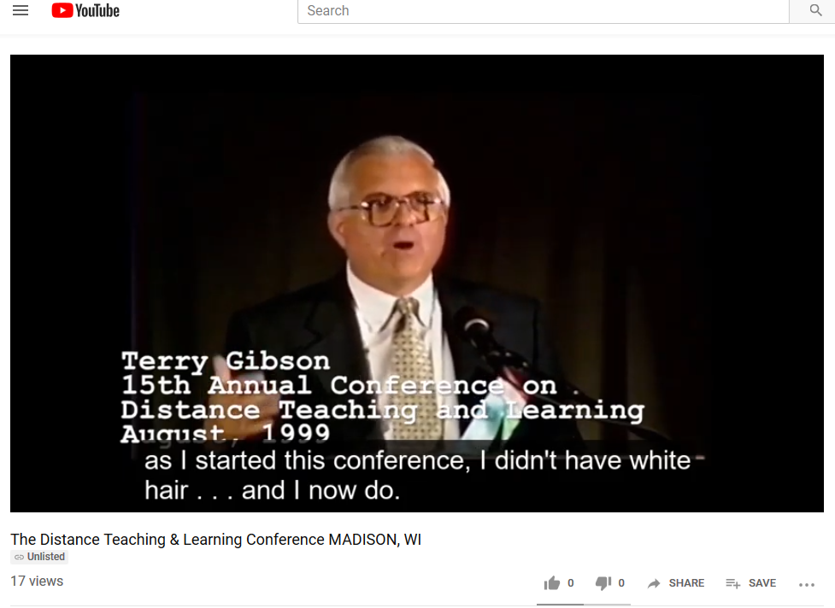
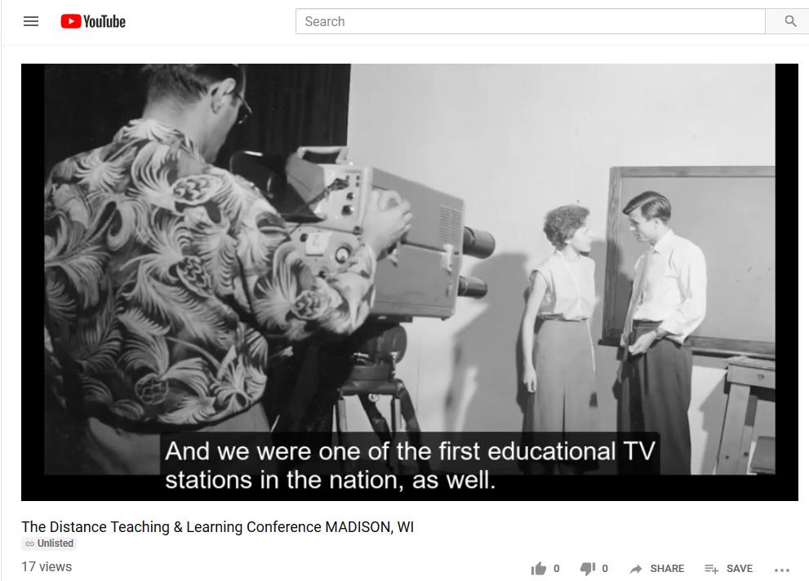
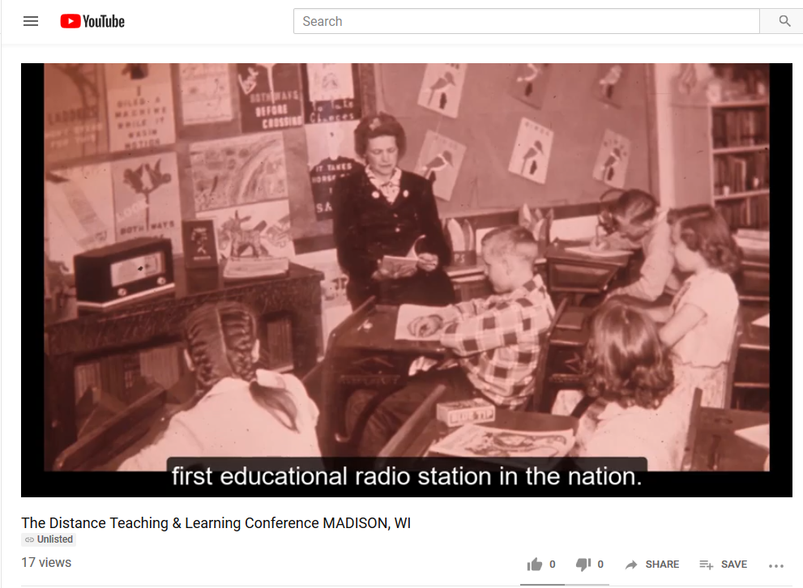
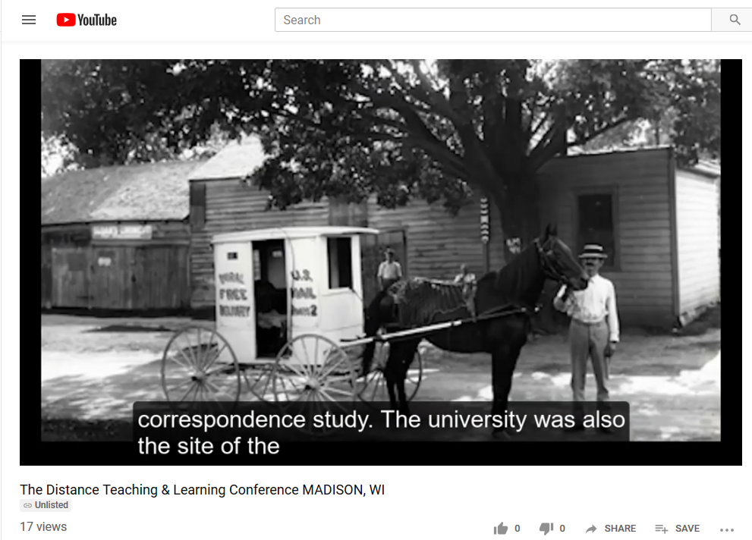

Slide 24

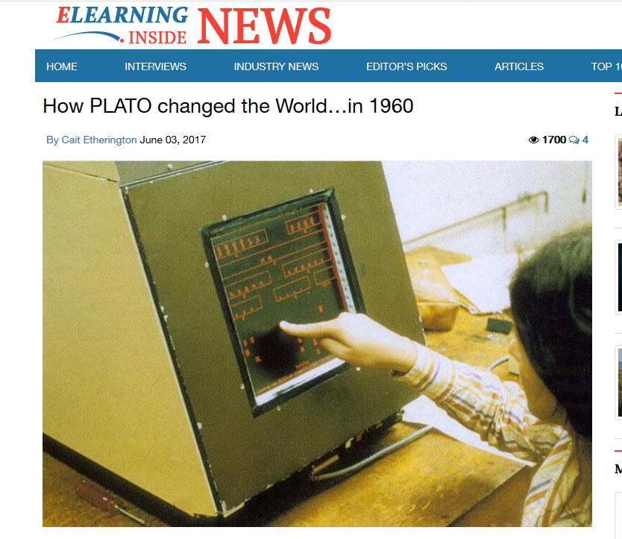
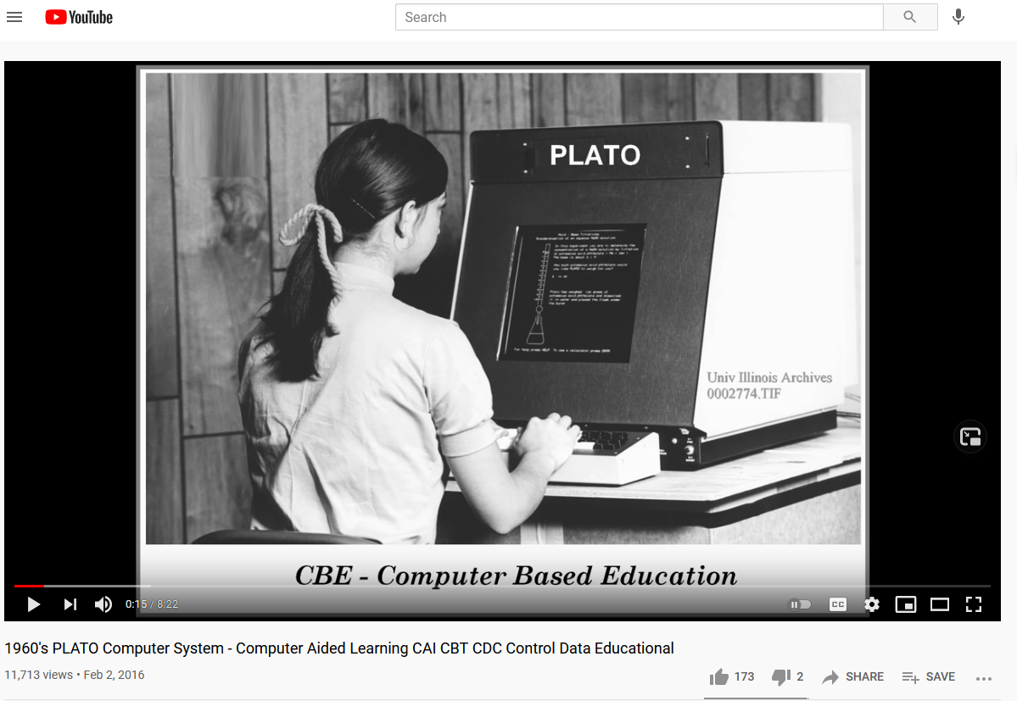
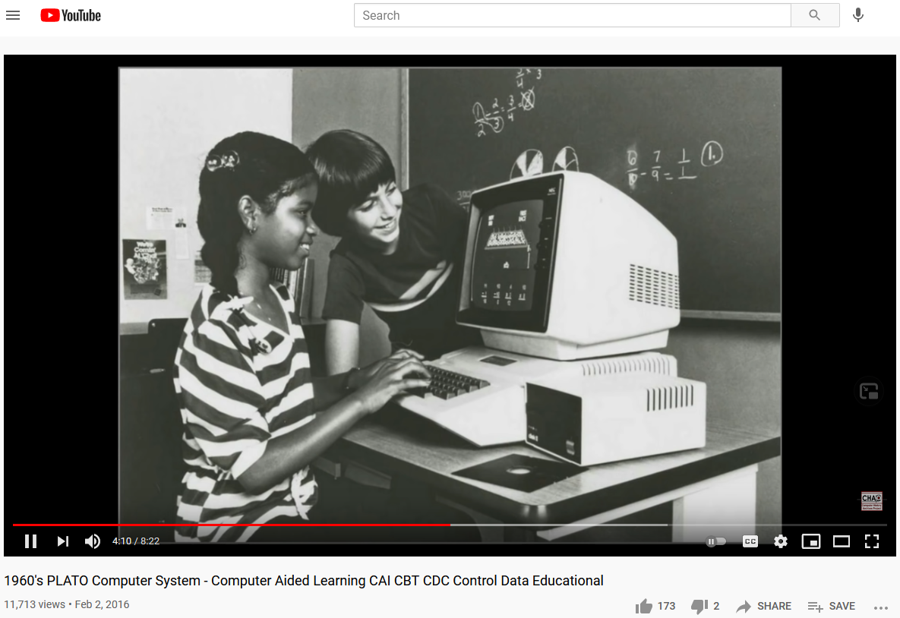
June 3, 2017
How PLATO changed the World…in 1960
Cait Etherington, ElearningInside News https://www.youtube.com/watch?v=tTmWcGhlXqA https://news.elearninginside.com/how-plato-changed-the-world-in-1960/
PLATO was the first generalized computer-assisted instruction system. Starting in 1960, it ran on the University of Illinois' ILLIAC I computer. By the late 1970s, it supported several thousand graphics terminals distributed worldwide, running on nearly a dozen different networked mainframe computers. Many modern concepts in multi-user computing were originally developed on PLATO, including forums, message boards, online testing, e-mail, chat rooms, picture languages, instant messaging, remote screen sharing, and multiplayer games.

Slide 25
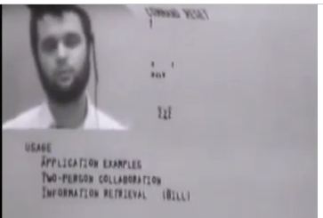
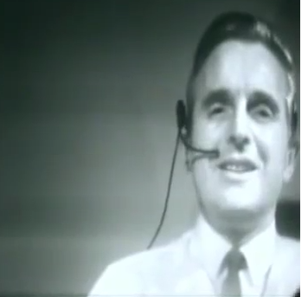
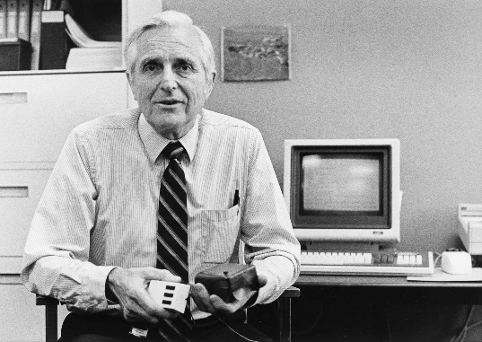
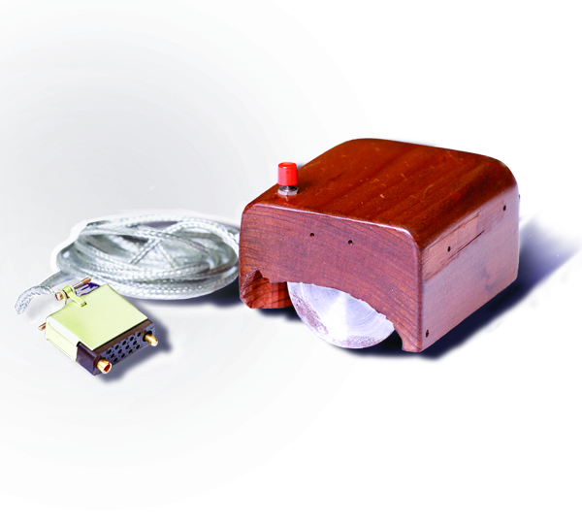
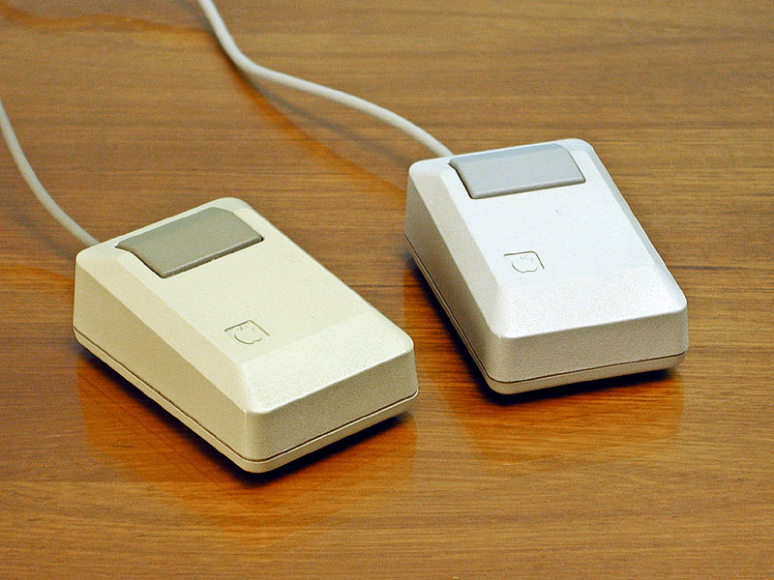
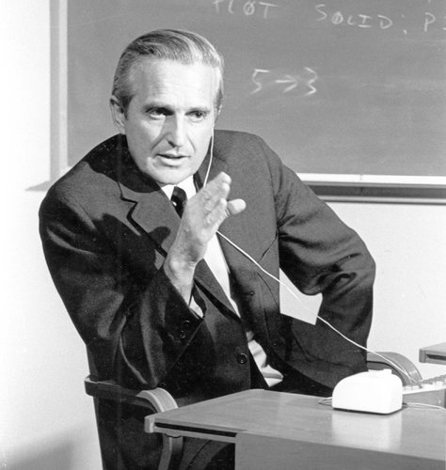
Intelligence Augmentation and Amplification
Douglas Engelbart’s “The Mother of All Inventions” (1968)
Augmentation Research Center (ARC)
(The live demonstration featured the introduction of the computer mouse, video conferencing, teleconferencing, hypertext, word processing, hypermedia, object addressing and dynamic file linking, bootstrapping, and a collaborative real-time editor.“) http://www.amazon.com/Machines-Loving-Grace-Common-Between/dp/0062266683
Engelbart's prototype of a computer mouse, as designed by Bill English from Engelbart's sketches.

Slide 26
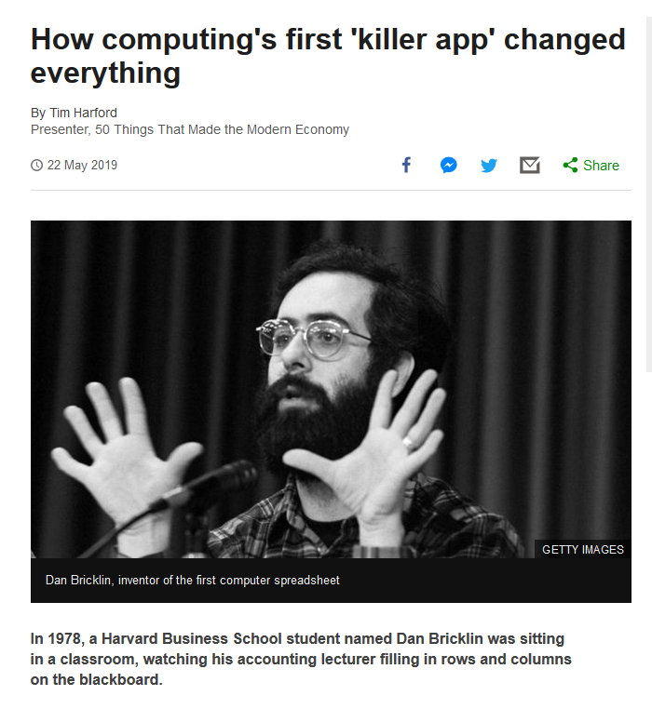
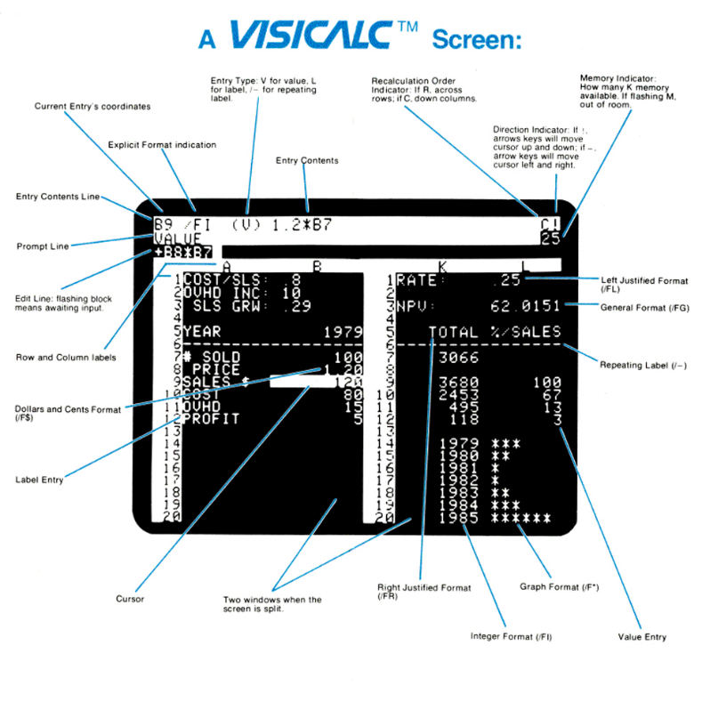
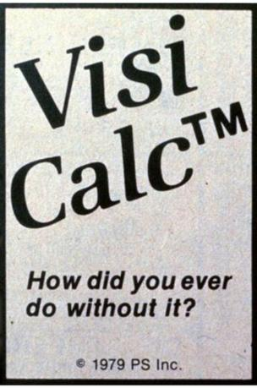

May 22, 2019
Who Remembers VisiCalc???
How computing's first 'killer app' changed everything
Tom Harford, BBC News https://www.bbc.com/news/business-47802280
Dan Bricklin, inventor of the first computer spreadsheet

Slide 27
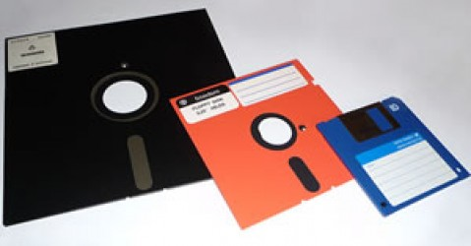


May 10, 2013
10 ed-tech tools of the 70s, 80s, and 90s eSchool News, Meris Stansbury http://www.eschoolnews.com/2013/05/10/10-ed-tech-tools-of-the-70s-80s-and-90s/print/

Slide 28



Bob Clasen, University of Wisconsin https://www.youtube.com/watch?v=kCm1_MGaqec&feature=youtu.be
February 27, 1934-March 17, 2018 https://www.cressfuneralservice.com/obituary/249139/Robert-Clasen/

Slide 29





September 26, 2018
Remember Education 2.0?
The rise and fall of the company behind ‘Reader Rabbit’ and all your favorite educational games
Abigail Cain, The Outline https://theoutline.com/post/6293/reader-rabbit-history-the-learning-company-zoombinis-carmen-sandiego?zd=1&zi=qmbuobk7
Rocky’s Boots: https://www.youtube.com/watch?v=a-NLh58bIIk
Project YES (Curt Bonk): https://youtu.be/bZD5mQH4Ups

Slide 30





34 years ago…
Knowledge Navigator (1987)
Apple Computer http://www.youtube.com/watch?v=hb4AzF6wEoc

Slide 31





August 6, 2021
The Web is now 30+! http://info.cern.ch/ (First website) http://money.cnn.com/2016/08/06/technology/world-wide-web-25-years-old/index.html?iid=hp-stack-dom https://webfoundation.org/about/vision/history-of-the-web/ https://home.cern/science/computing/birth-web/short-history-web

Slide 32


Slide 33






January 15, 2021
Wikipedia is now 20+!
Simon Garfield, Esquire: What We Know And Can Agree On: Wikipedia At 20 https://en.wikipedia.org/wiki/Wikipedia:20th_anniversary https://www.esquire.com/uk/culture/a34412278/wikipedia-at-20/ https://wikipedia20.pubpub.org/

Slide 34


April 4, 2021
MIT OpenCourseWare is now 20+! https://www.youtube.com/watch?v=0aAEamhJHUI https://ocw.mit.edu/about/milestones/ https://news.mit.edu/2021/mit-courseware-educational-resource-to-millions-0406

Slide 35


Fast Forward to 2021…
“Anyone can now learn anything from anyone at any time.”

Slide 36


July 24, 2018
The 100-Year Life: Living and Working in an Age of Longevity
Lynda Gratton and Andrew Scott http://www.100yearlife.com/ https://www.amazon.com/100-Year-Life-Living-Working-Longevity/dp/1543624634

Slide 37

March 13, 2019
The Career Curriculum Continuum
Andrew Hermalyn, Inside Higher Ed https://www.insidehighered.com/digital-learning/views/2019/03/13/how-universities-can-stay-center-learners-lives-opinion

Slide 38



February 25, 2020
The 60 Year Curriculum:
Developing New Educational Models to Serve the Agile Labor Market
Chris Dede, Harvard University, The Evolllution https://evolllution.com/revenue-streams/professional_development/the-60-year-curriculum-developing-new-educational-models-to-serve-the-agile-labor-market/
219: The 60-Year Curriculum with Rovy Branon https://teibelinc.com/podcast/219

Slide 39


July 11, 2017
The Rise of the Phigital Learner
Going ‘phigital?’ 4 things schools need to know about Generation Z, Todd Kominiak, TrustEd http://trustedk12.com/phigital-digital-learning/
May 15, 2017
3 must know’s about the rising “phigital” student-and why their impact is enormous, Meris Stansbury, eCamous News https://www.ecampusnews.com/campus-administration/education-gen-z-phigital-student/

Slide 40








The World is Open

Slide 41

The World is very open!
(South University of Science and Technology of China, Wednesday June 10, 2015)

Slide 42


Clearly…
Learning is Changing!

Slide 43



Part 4. Thirty Ways
Learning is Changing…
(i.e., it’s more informal, video-based, ubiquitous, collaborative, self-directed, global, mobile, open, massive, etc.)

Slide 44




November 11, 2020
Educational technology is coming of age during the pandemic: Nowhere more so than in India https://www.economist.com/international/2020/11/11/educational-technology-is-coming-of-age-during-the-pandemic

Slide 45

30+ Ways Learning is Changing:
The Mega Trends

Slide 46
Polling Question #2:
Are we in the midst of a:
A. Learning Evolution or
B. Learning Revolution…
C. Neither

Slide 47
Polling Question #3:
Which is the most important trend? a. Mega Trend #1. Learner Engagement b. Mega Trend #2. Pervasive Access c. Mega Trend #3. Customization

