Slide 1

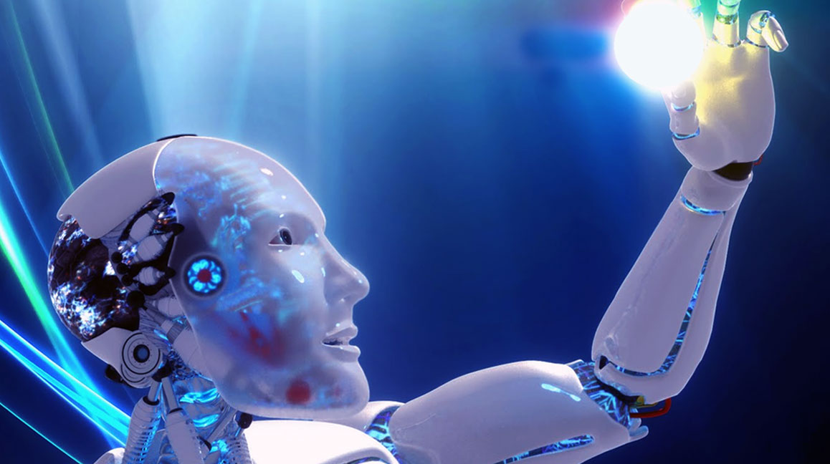

Technology Today, Technology Tomorrow:
Might Learning Evolutions lead to Learning Revolutions?
Curtis J. Bonk, Professor, Indiana University
cjbonk@indiana.edu
http://curtbonk.com/

Slide 2
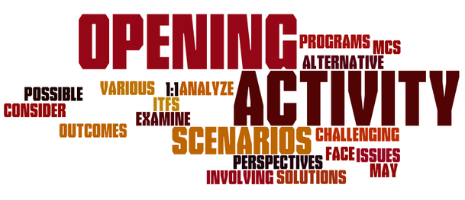
Opening Activity #1:
Type Answer in the Chat Window: What is your favorite type of learning technology today…?

Slide 3
Opening Activity #2:
Type Answer in the Chat Window: What is the technology that you think will most impact learning 10 years from now…

Slide 4

Polling Question #1:
Are we in the midst of a:
A. Learning Evolution or
B. Learning Revolution…
C. Neither

Slide 5

Talk Overview
Pandemic Pondering
Technology Yesterday
Education 20/20
Technology Today
  30 ways learning is changing…
5. Technology Trends of Tomorrow

Slide 6
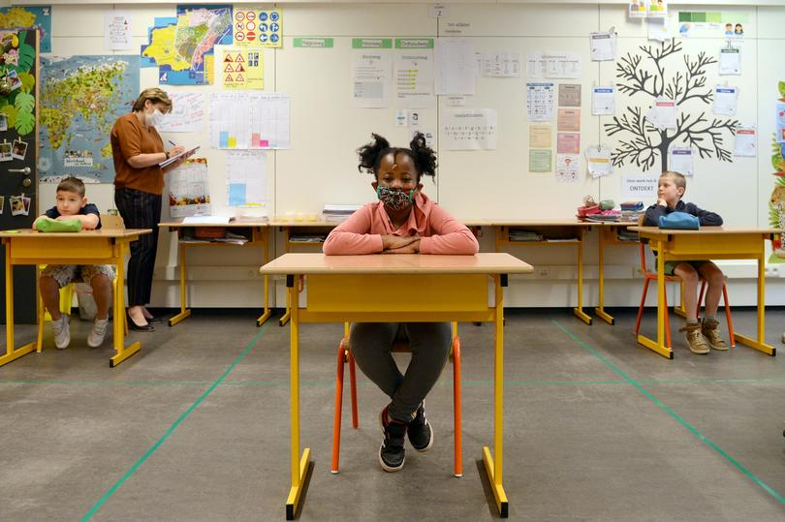

July 30, 2020
Part 1: Pandemic Pondering
Disruptive Ecology:
The New Normal of Education in Post COVID-19

Slide 7
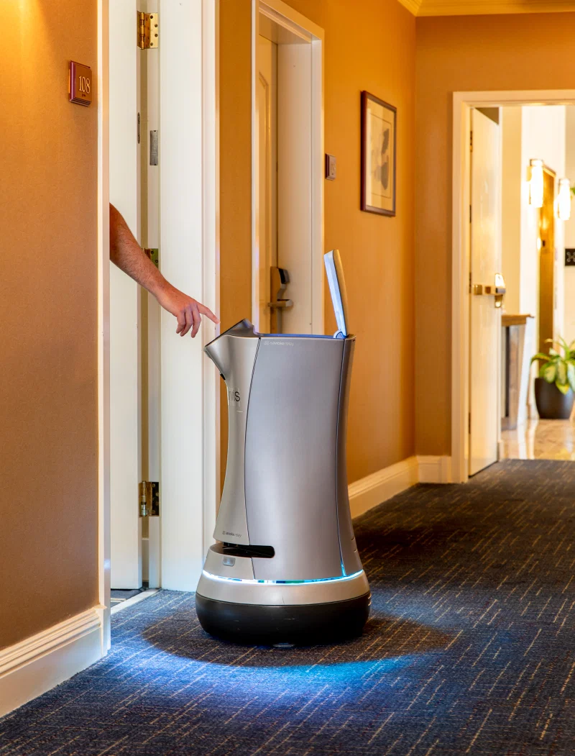
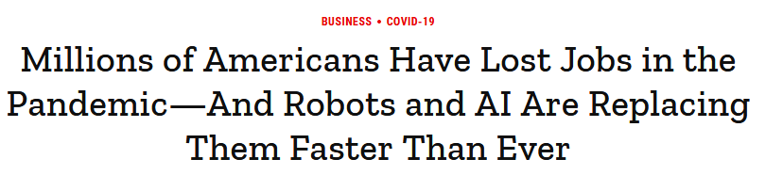
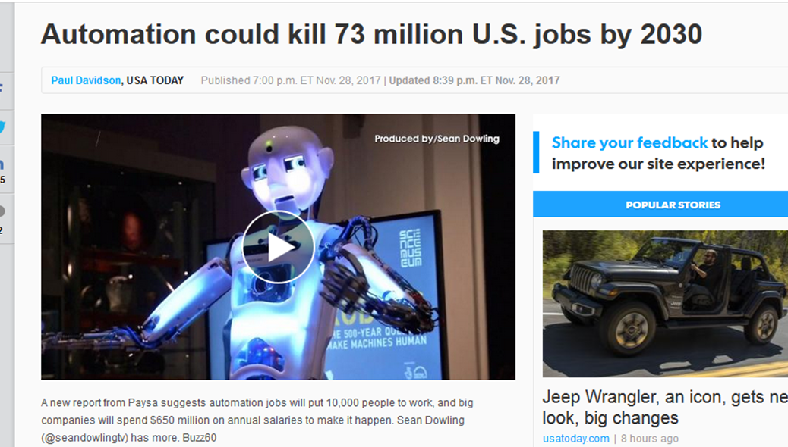
August 6, 2020
Millions of Americans Have Lost Jobs in the Pandemic—And Robots and AI Are Replacing Them Faster Than Ever
Alana Semuels, Time https://time.com/5876604/machines-jobs-coronavirus/
Jarvis the robotic butler on duty at the Grand Hotel in Sunnyvale, Calif., on July 30

Slide 8
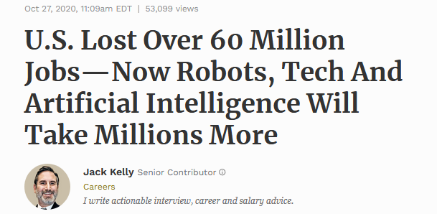
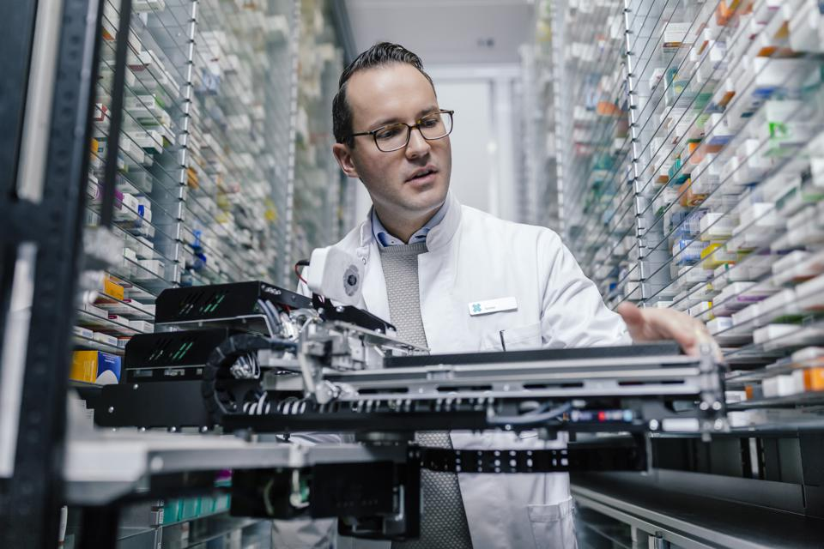
October 27, 2020
U.S. Lost Over 60 Million Jobs—Now Robots, Tech And Artificial Intelligence Will Take Millions More
Jack Kelly, Forbes https://www.forbes.com/sites/jackkelly/2020/10/27/us-lost-over-60-million-jobs-now-robots-tech-and-artificial-intelligence-will-take-millions-more/?sh=2ddf5f951a52
Video (1:20): http://curtbonk.com/automation.html
Video (1:20): http://curtbonk.com/automation2.html

Slide 9
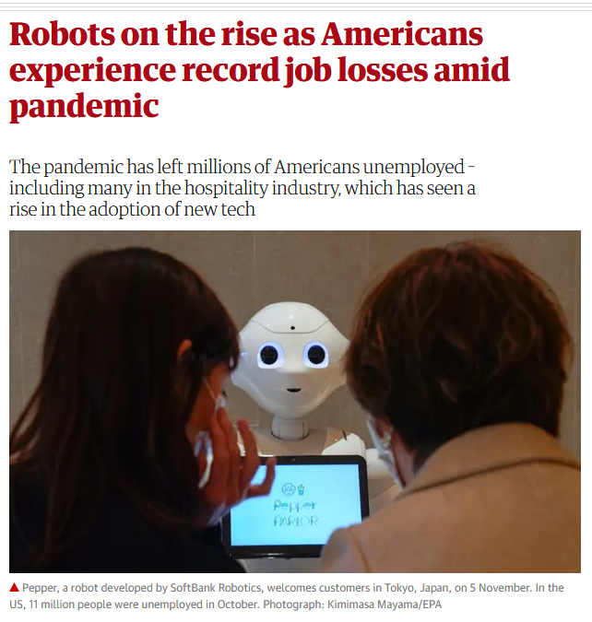
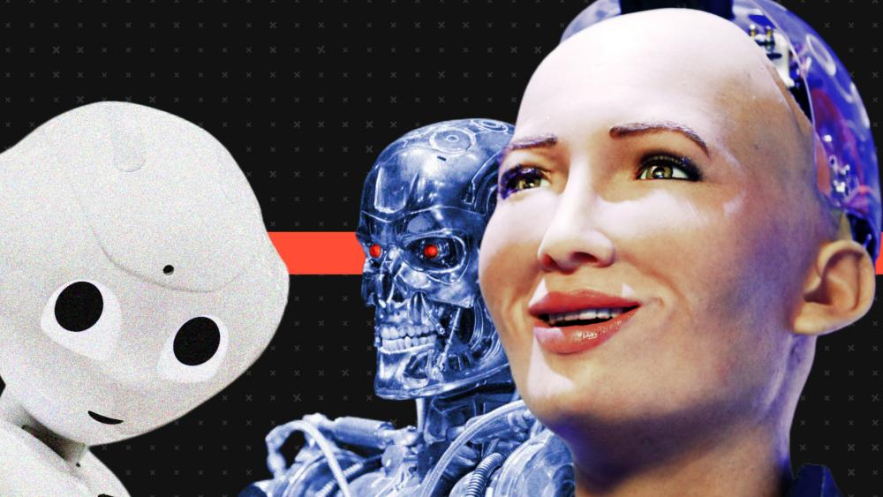
November 27, 2020
Robots on the rise as Americans experience record job losses amid pandemic
Lauran Arantani, The Guardian https://www.theguardian.com/technology/2020/nov/27/robots-replacing-jobs-automation-unemployment-us

Slide 10
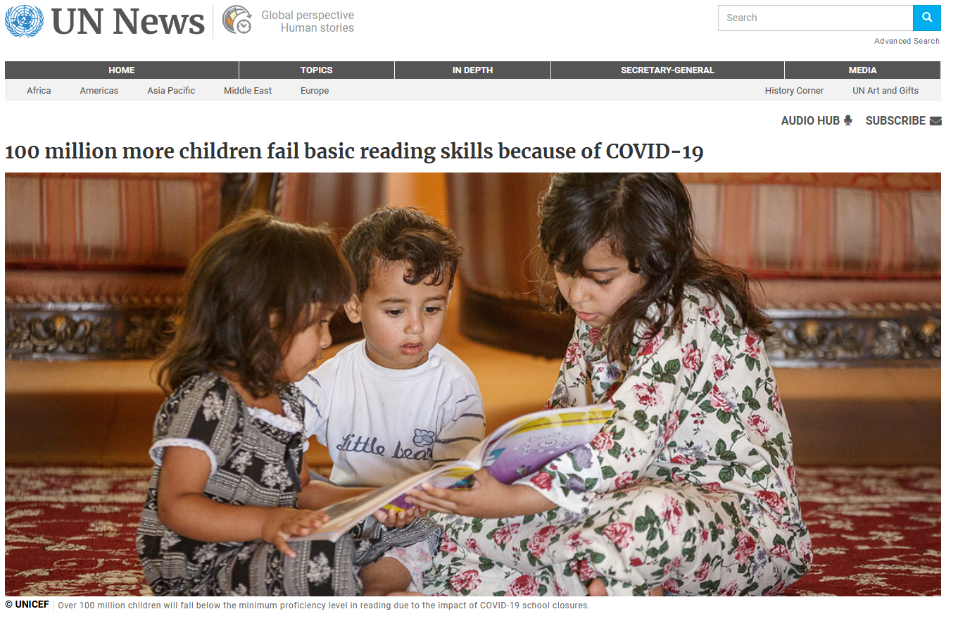
March 26, 2021
100 million more children fail basic reading skills because of COVID-19
UN News https://news.un.org/en/story/2021/03/1088392

Slide 11
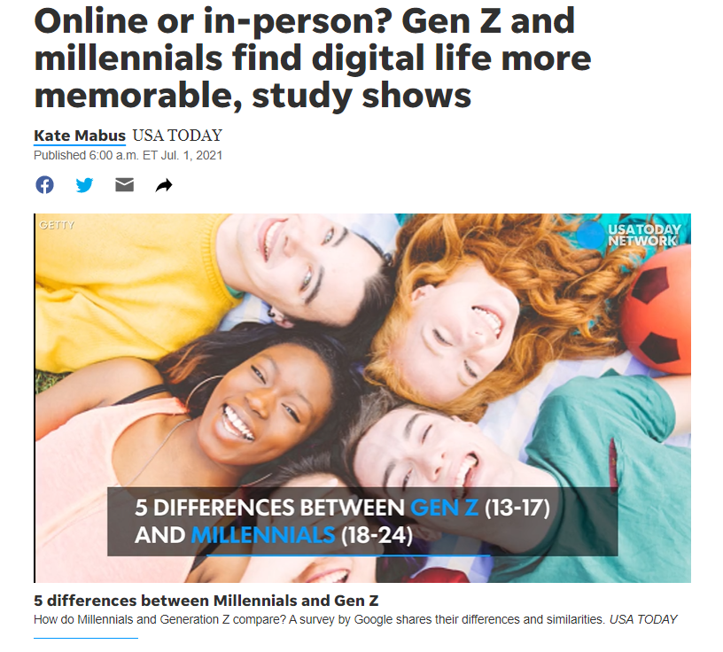
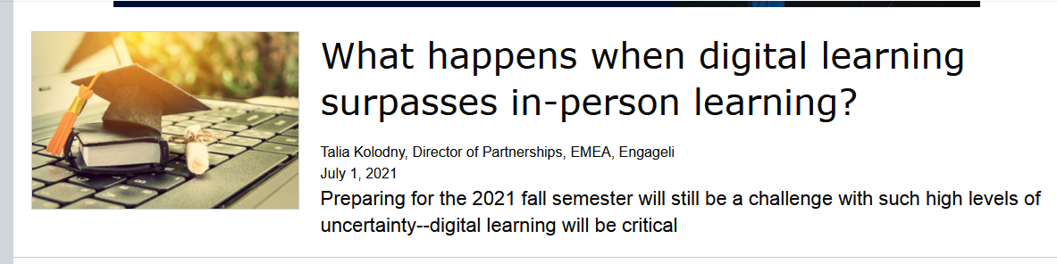
July 1, 2021
Online or in-person? Gen Z and millennials find digital life more memorable, study shows
Kate Mabus, USA Today https://www.usatoday.com/story/news/nation/2021/07/01/generation-z-millennial-survey-shows-digital-life-more-memorable/7783597002/
If there is one thing the pandemic is teaching us, it’s that deep human connections are essential for student and instructor wellbeing and for impactful education. As we move into a hybrid future, technology should not (and cannot!) replace human relationships and communications–it should enhance, enable, and enrich them.

Slide 12
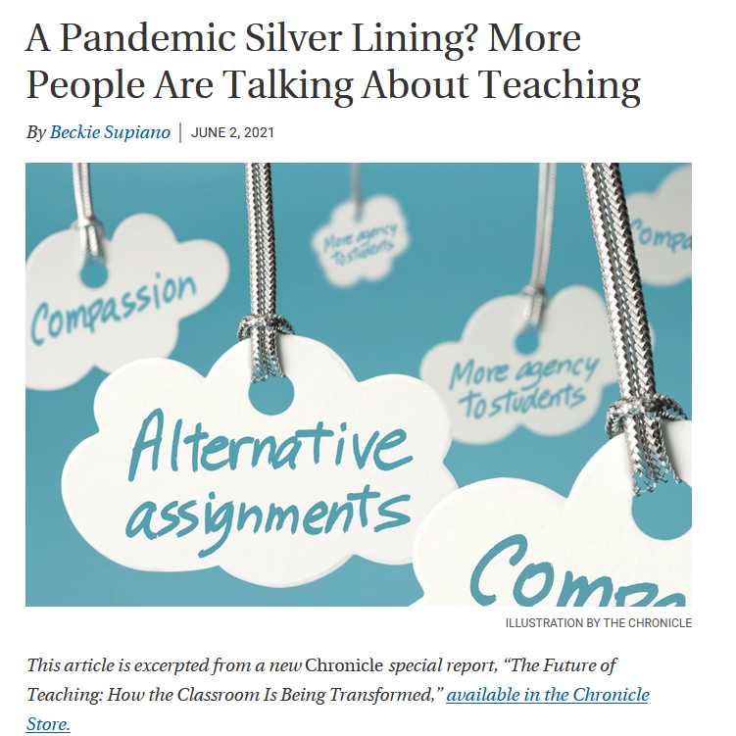
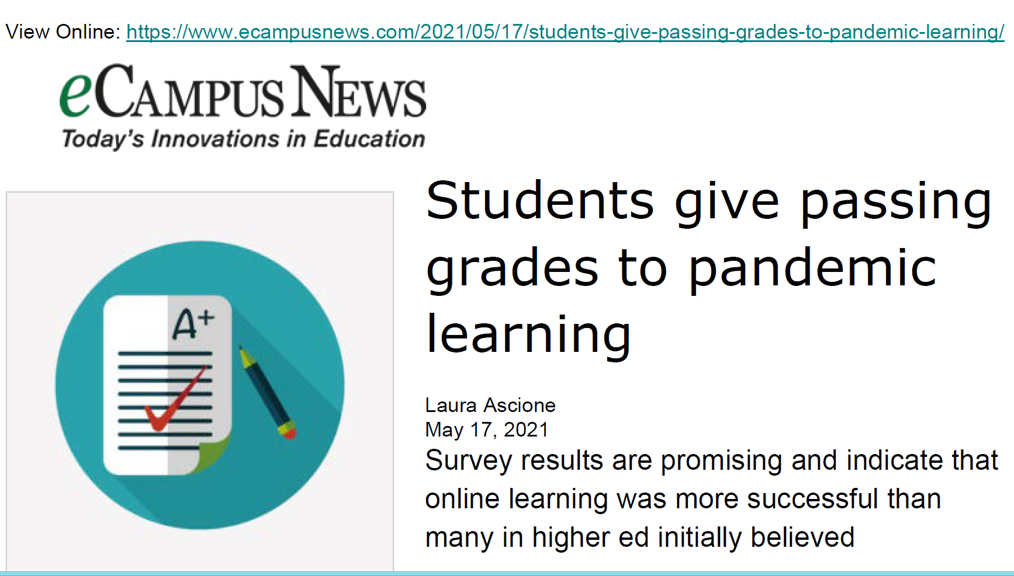
June 2, 2021
A Pandemic Silver Lining? More People Are Talking About Teaching
Beckie Supiano, The Chronicle of Higher Education https://www.chronicle.com/article/a-pandemic-silver-lining-more-people-are-talking-about-teaching

Slide 13
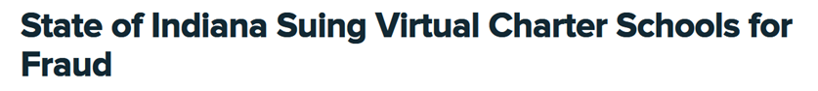
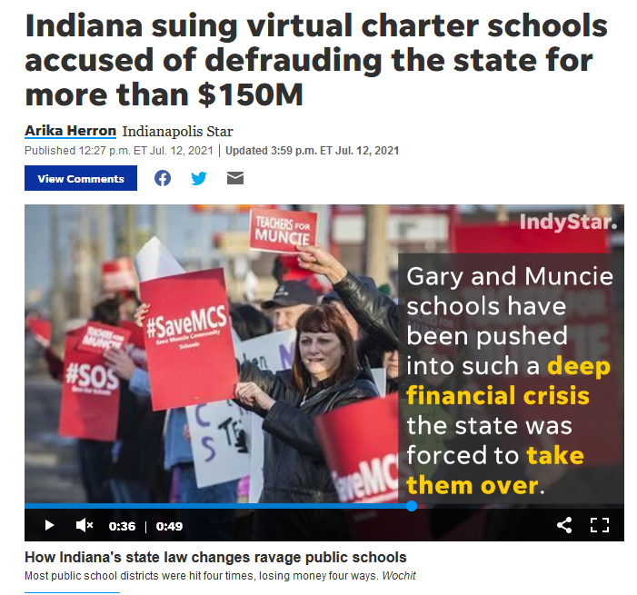
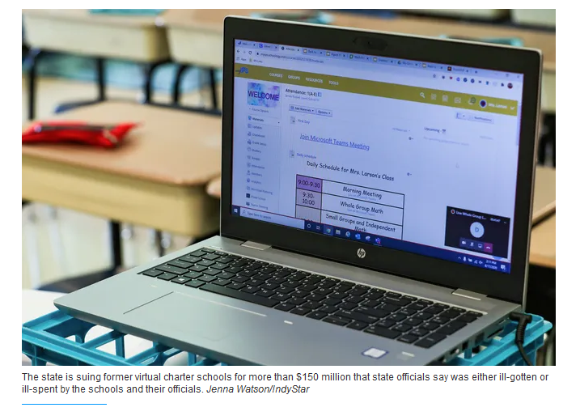
July 12, 2021
Indiana suing virtual charter schools accused of defrauding the state for more than $150M
Arika Herron, Indianapolis Star https://www.indystar.com/story/news/education/2021/07/12/indiana-virtual-charter-schools-state-suing-more-than-150-million/7938215002/

Slide 14

February 26, 2021
Ever have 'Zoom fatigue?' These are the causes and how to fix them, researchers say
Brett Molina, USA Today https://www.usatoday.com/story/tech/2021/02/26/zoom-fatigue-causes-and-how-to-fix/6831569002/

Slide 15
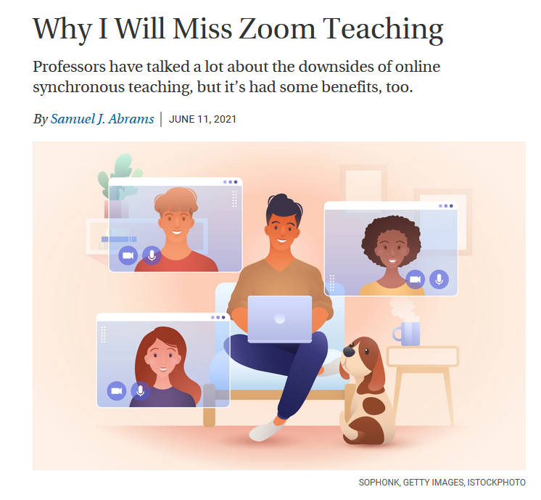
June 11, 2021
Why I Will Miss Zoom Teaching
Samuel Abrams, The Chronicle of Higher Education https://www.chronicle.com/article/why-i-will-miss-zoom-teaching

Slide 16
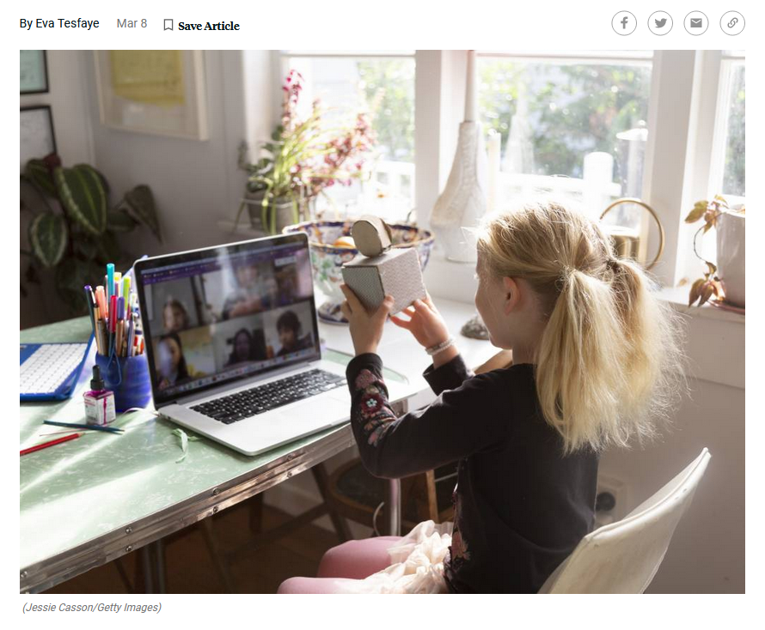
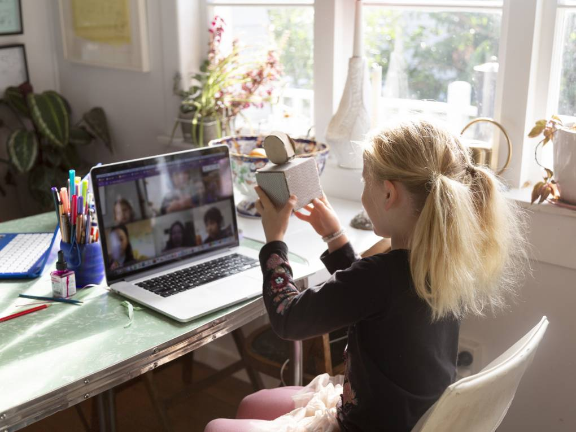
March 8, 2021
As Many Parents Fret Over Remote Learning, Some Find Their Kids Are Thriving
Eva Tedfaye, MindShift https://www.kqed.org/mindshift/57480/as-many-parents-fret-over-remote-learning-some-find-their-kids-are-thriving

Slide 17
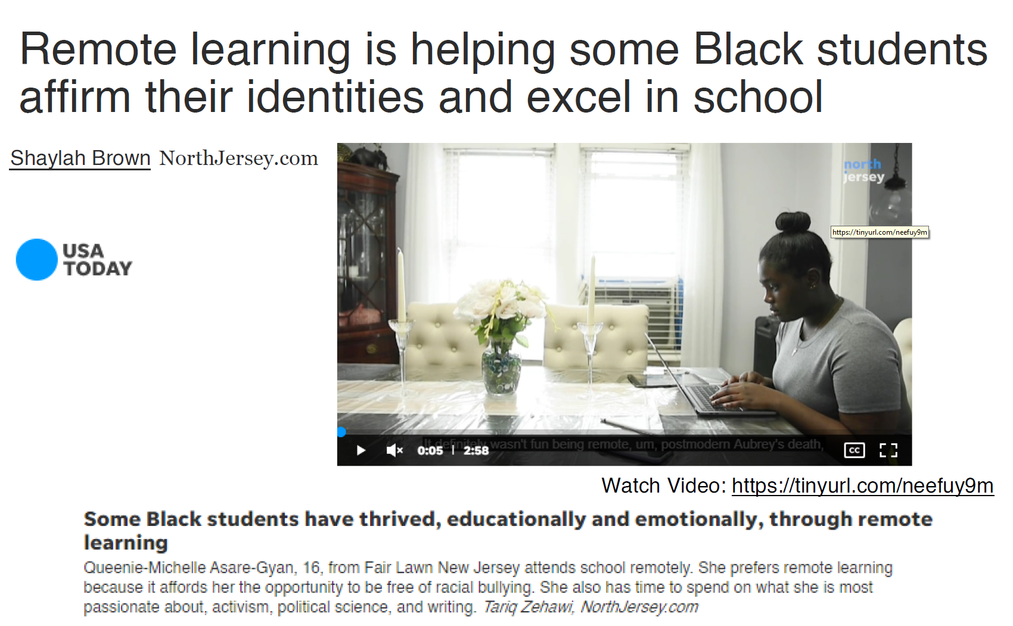
May 7, 2021
Why some black teens thrived with remote school
Shaylah Brown, USA Today https://www.usatoday.com/story/news/education/2021/05/07/how-black-students-new-jersey-excel-school-remote-learning/4973789001/

Slide 18
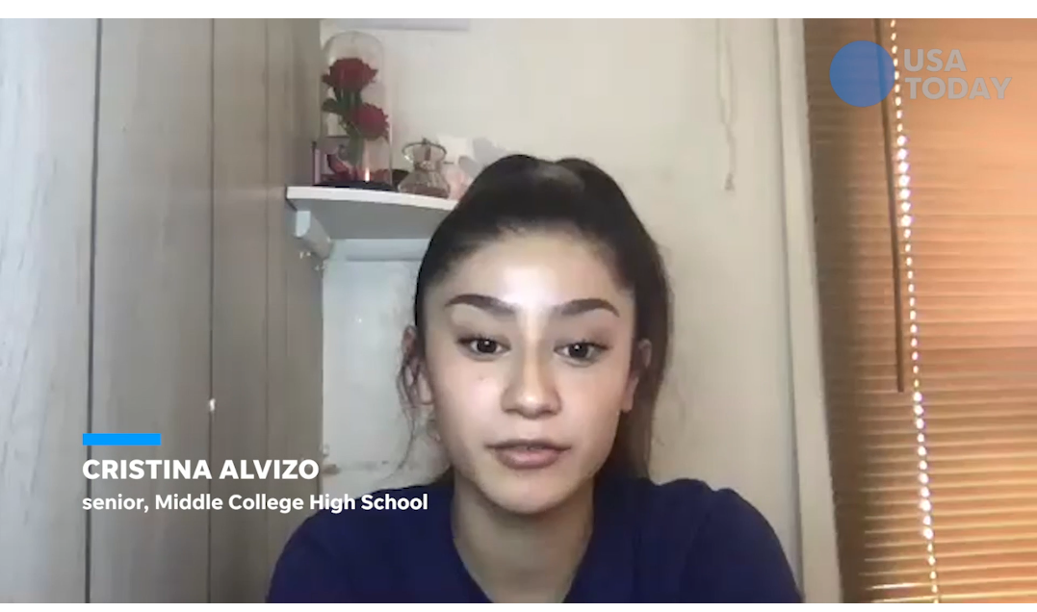
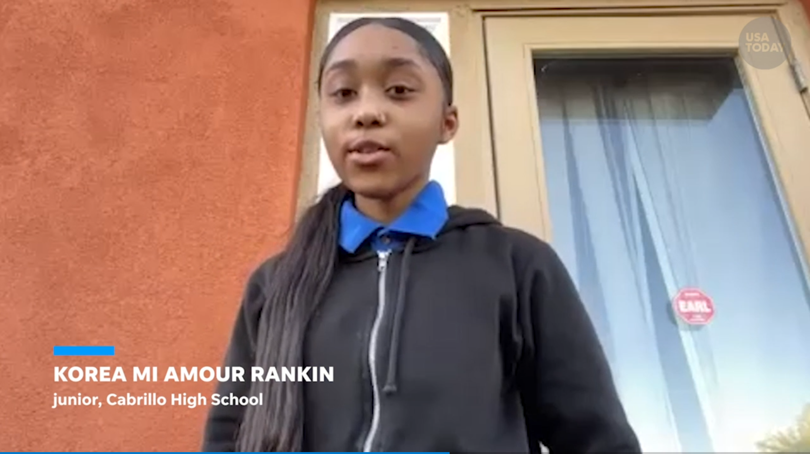
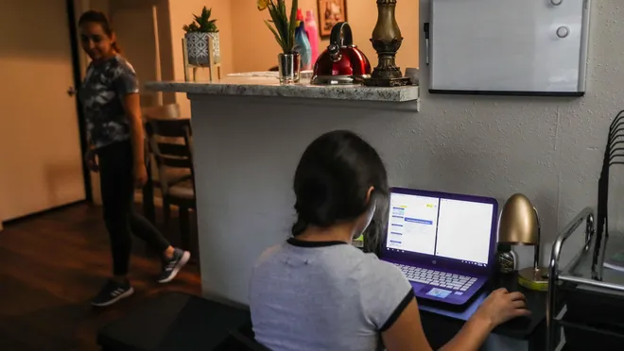
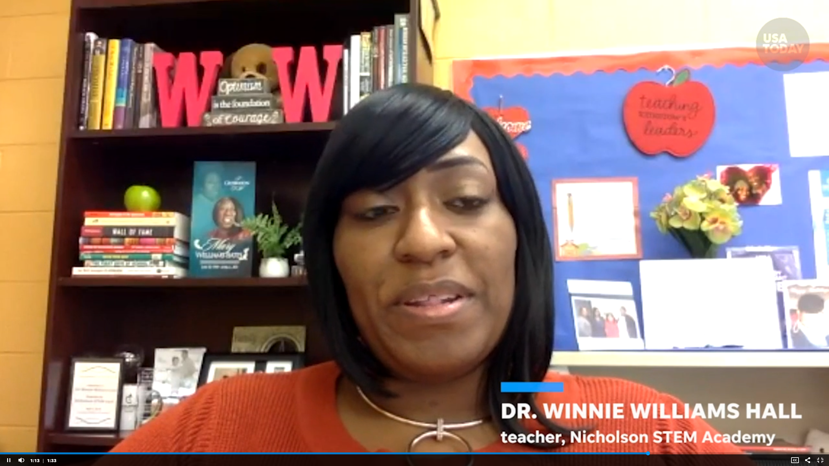
June 5, 2021
After a tough year, schools are axing virtual learning.
Some families want to stay online.
Erin Richards, USA Today
Video (1:27): NYC Mayor promised a return to normal for school system http://curtbonk.com/usa4.html
Video (1:33) Students discuss what surprised them most hybrid learnings http://curtbonk.com/usa3.html https://www.usatoday.com/story/news/education/2021/06/05/covid-online-school-in-person/7523002002/

Slide 19
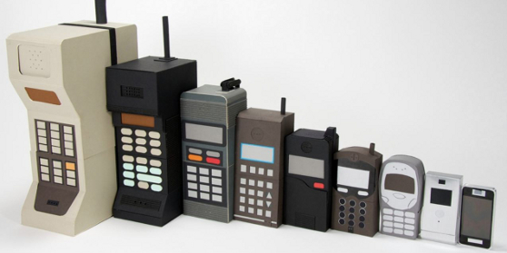
Part 2: Technology Yesterday

Slide 20
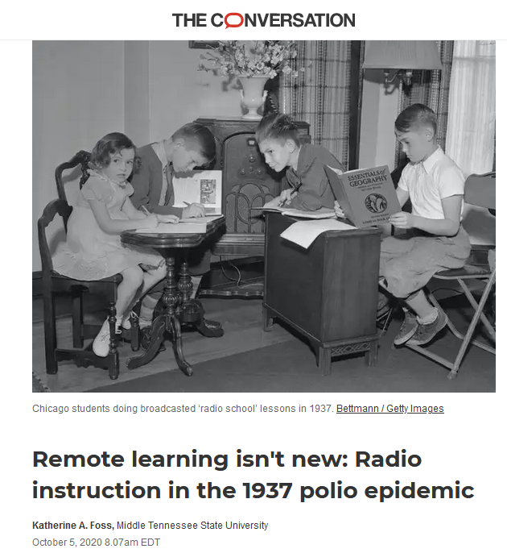
October 5, 2020
Remote learning isn't new:
Radio instruction in the 1937 polio epidemic
Katherine A. Foss, The Conversation https://theconversation.com/amp/remote-learning-isnt-new-radio-instruction-in-the-1937-polio-epidemic-143797

Slide 21
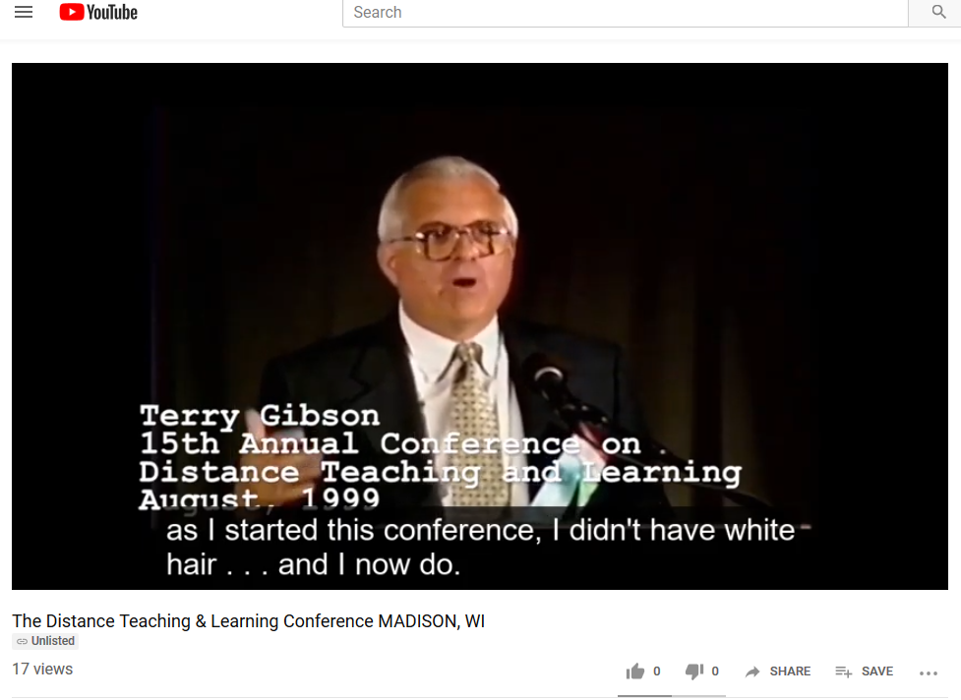
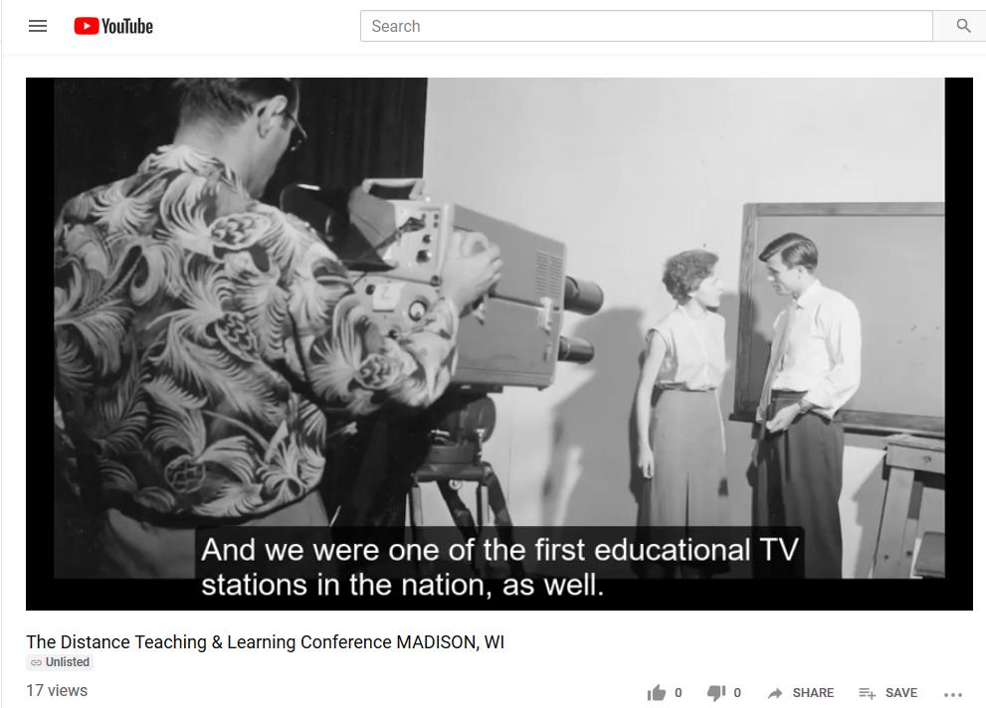
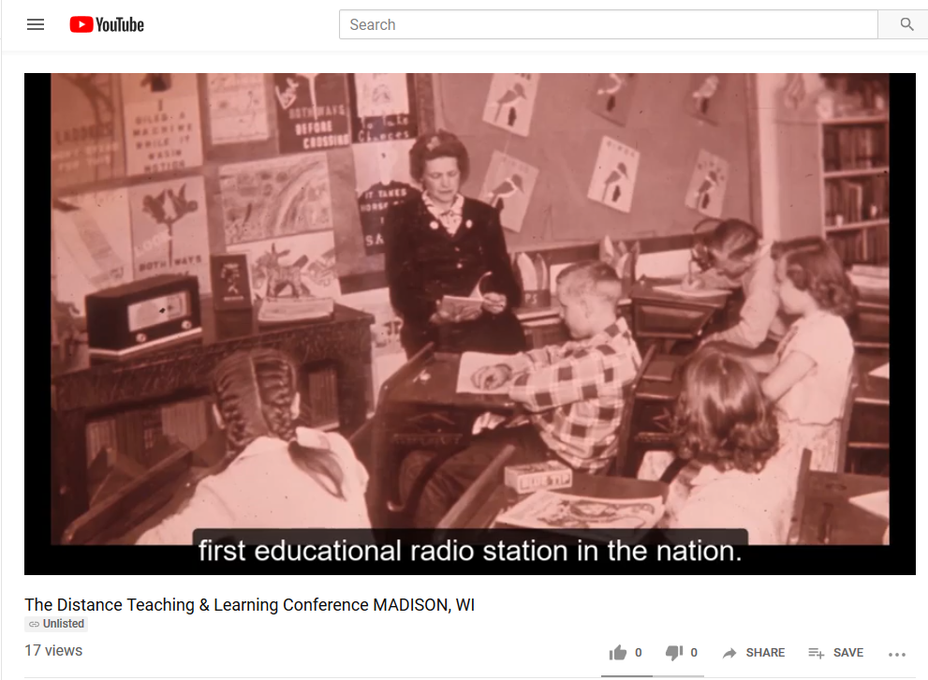
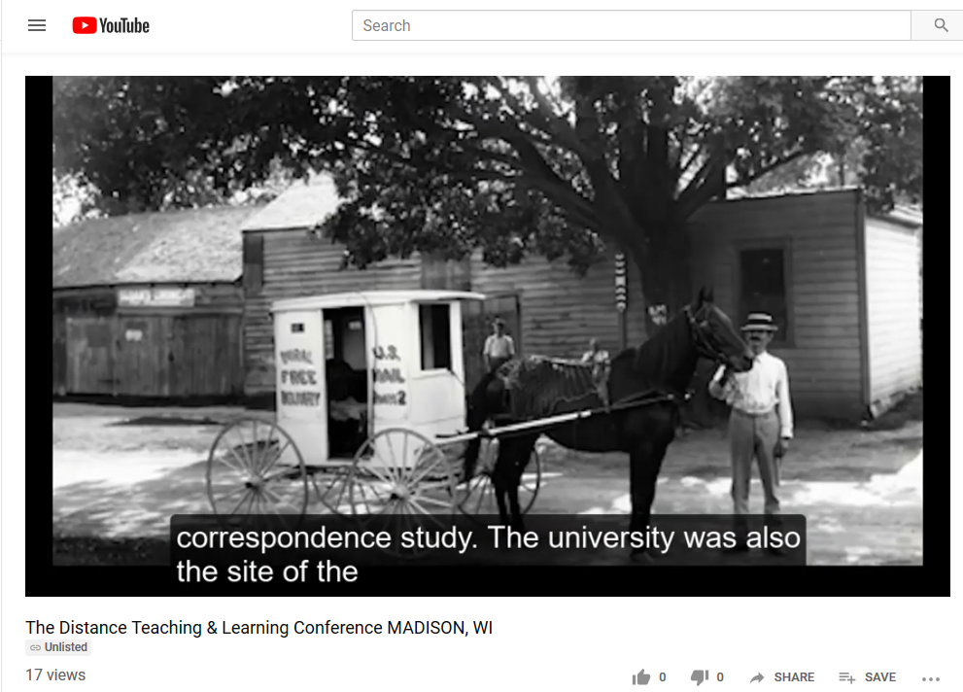

Slide 22

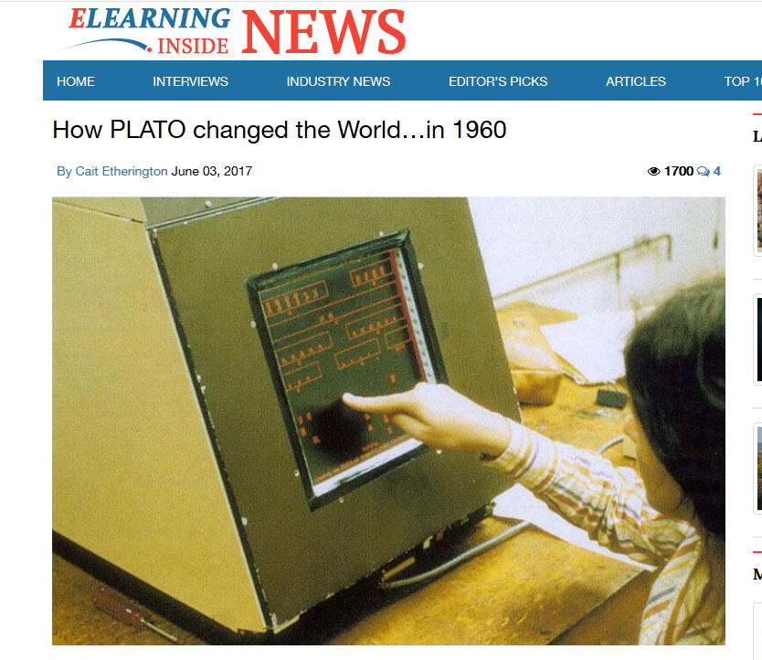
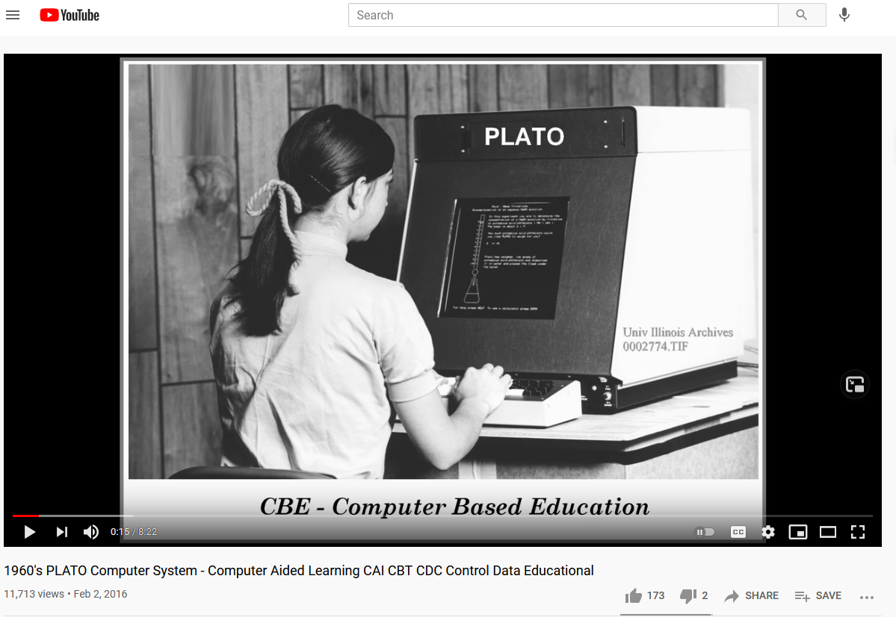
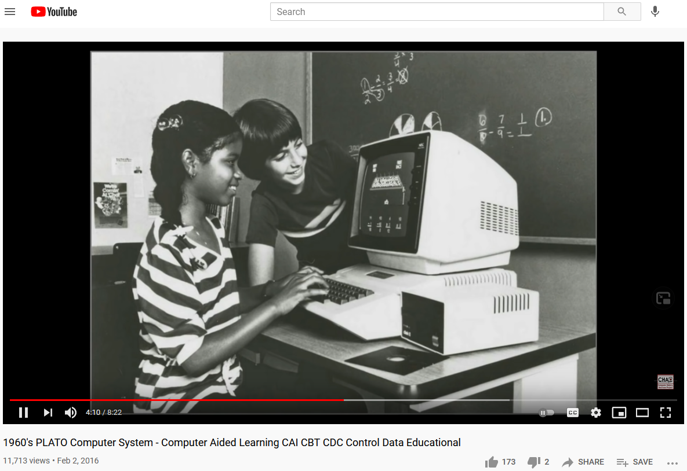
June 3, 2017
How PLATO changed the World…in 1960
Cait Etherington, ElearningInside News https://www.youtube.com/watch?v=tTmWcGhlXqA https://news.elearninginside.com/how-plato-changed-the-world-in-1960/
PLATO was the first generalized computer-assisted instruction system. Starting in 1960, it ran on the University of Illinois' ILLIAC I computer. By the late 1970s, it supported several thousand graphics terminals distributed worldwide, running on nearly a dozen different networked mainframe computers. Many modern concepts in multi-user computing were originally developed on PLATO, including forums, message boards, online testing, e-mail, chat rooms, picture languages, instant messaging, remote screen sharing, and multiplayer games.

Slide 23
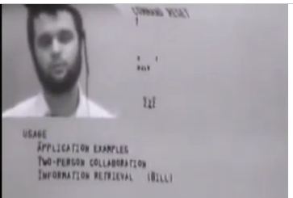
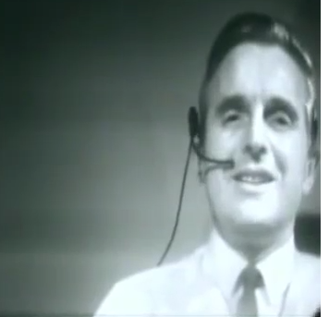
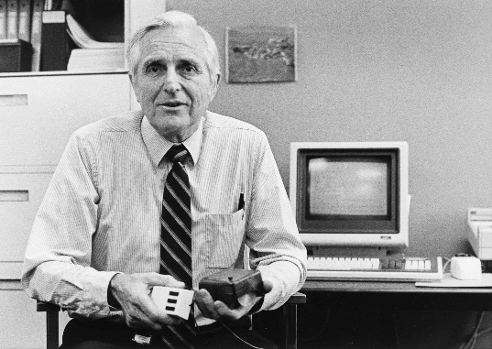
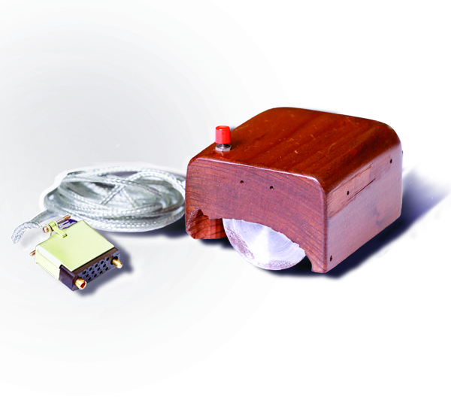
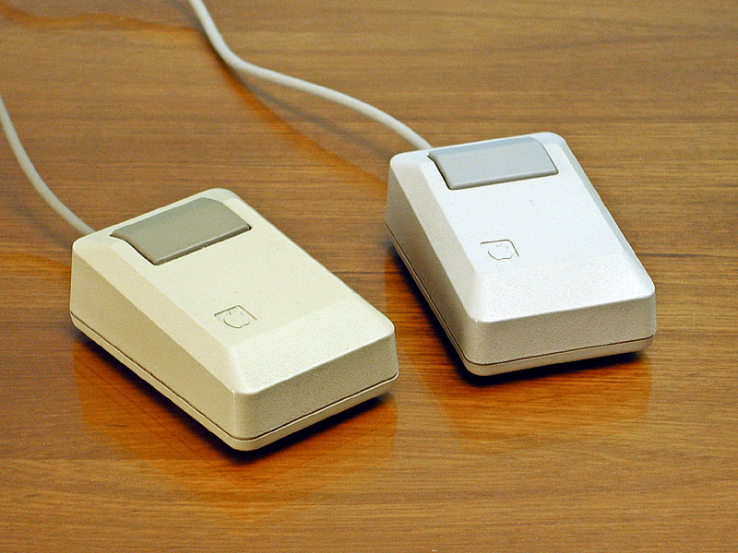
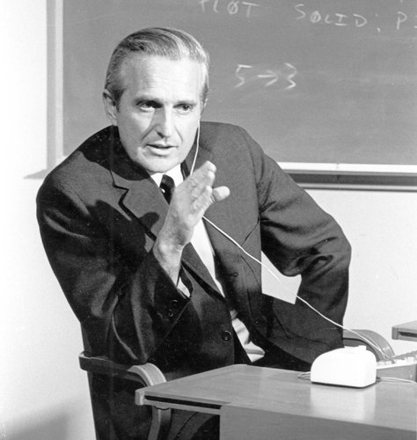
Intelligence Augmentation and Amplification
Douglas Engelbart’s “The Mother of All Inventions” (1968)
Augmentation Research Center (ARC)
(The live demonstration featured the introduction of the computer mouse, video conferencing, teleconferencing, hypertext, word processing, hypermedia, object addressing and dynamic file linking, bootstrapping, and a collaborative real-time editor.“) http://www.amazon.com/Machines-Loving-Grace-Common-Between/dp/0062266683
Engelbart's prototype of a computer mouse, as designed by Bill English from Engelbart's sketches.

Slide 24
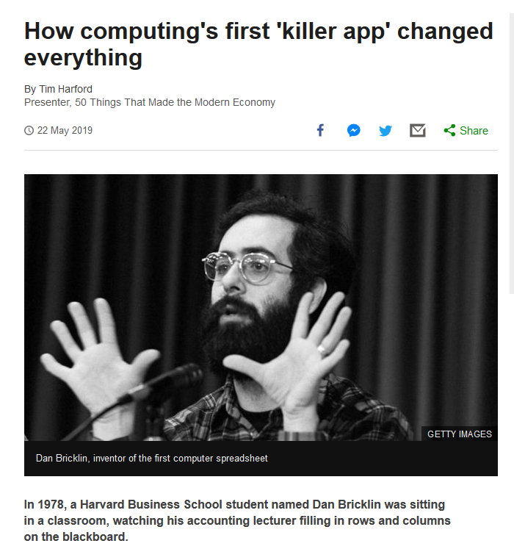
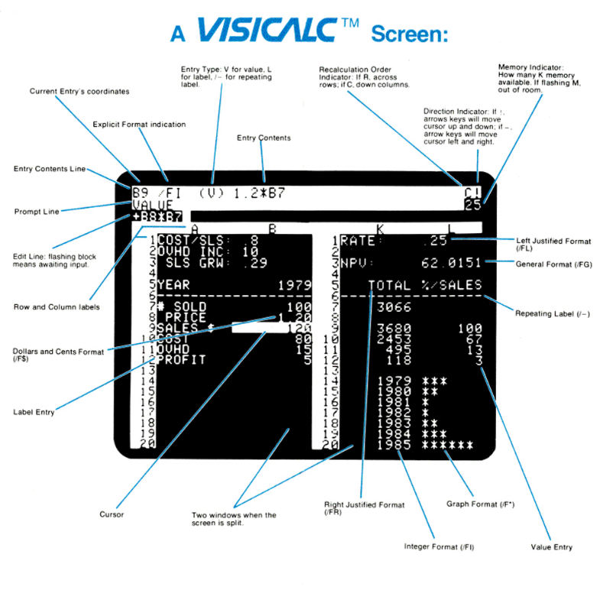
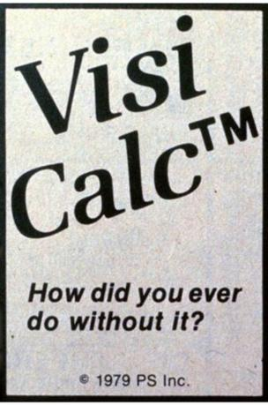

May 22, 2019
Who Remembers VisiCalc???
How computing's first 'killer app' changed everything
Tom Harford, BBC News https://www.bbc.com/news/business-47802280
Dan Bricklin, inventor of the first computer spreadsheet

Slide 25
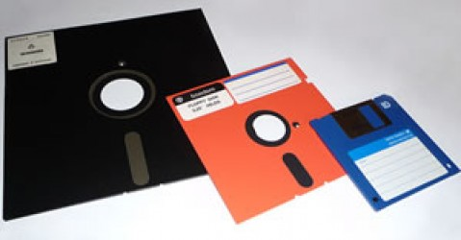
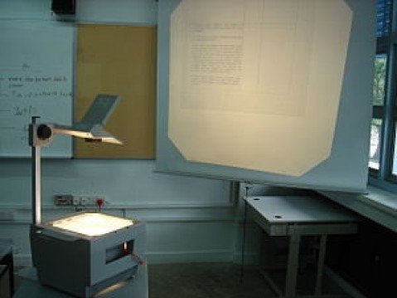
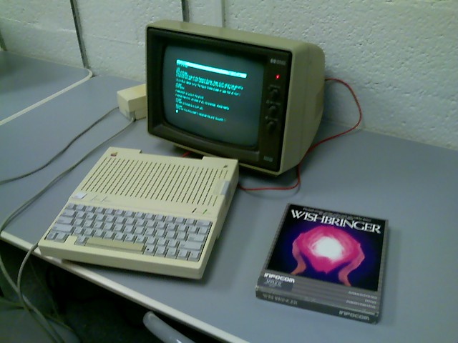
May 10, 2013
10 ed-tech tools of the 70s, 80s, and 90s eSchool News, Meris Stansbury http://www.eschoolnews.com/2013/05/10/10-ed-tech-tools-of-the-70s-80s-and-90s/print/

Slide 26
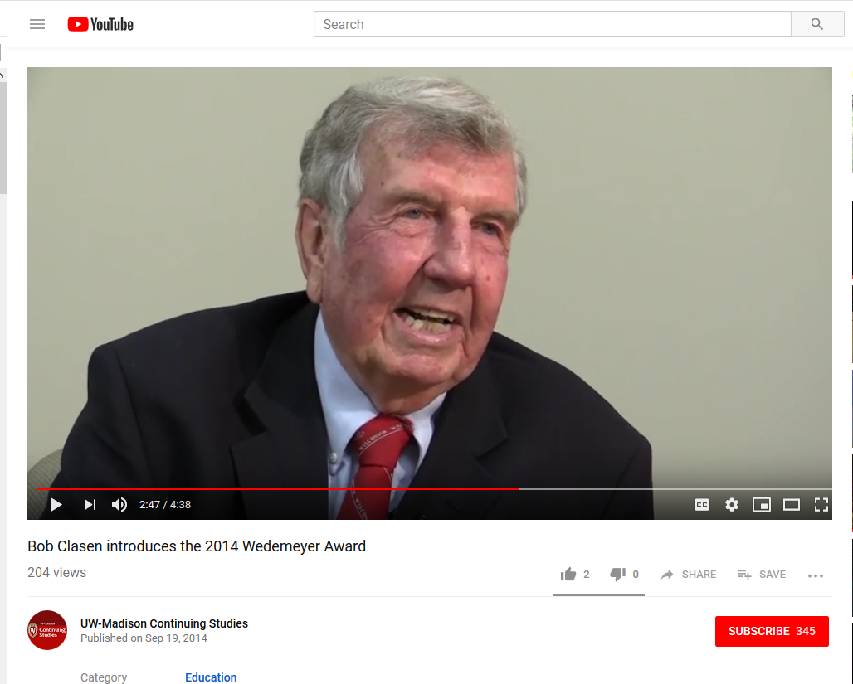
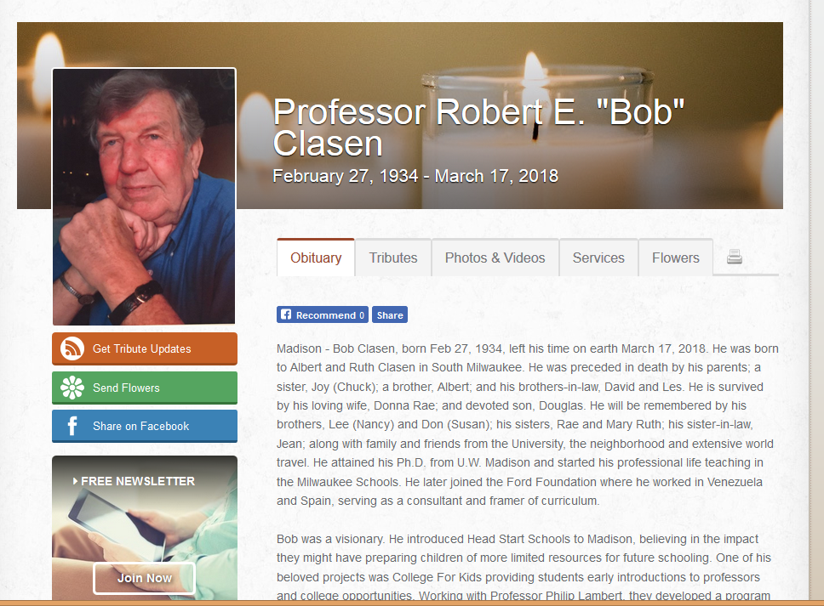
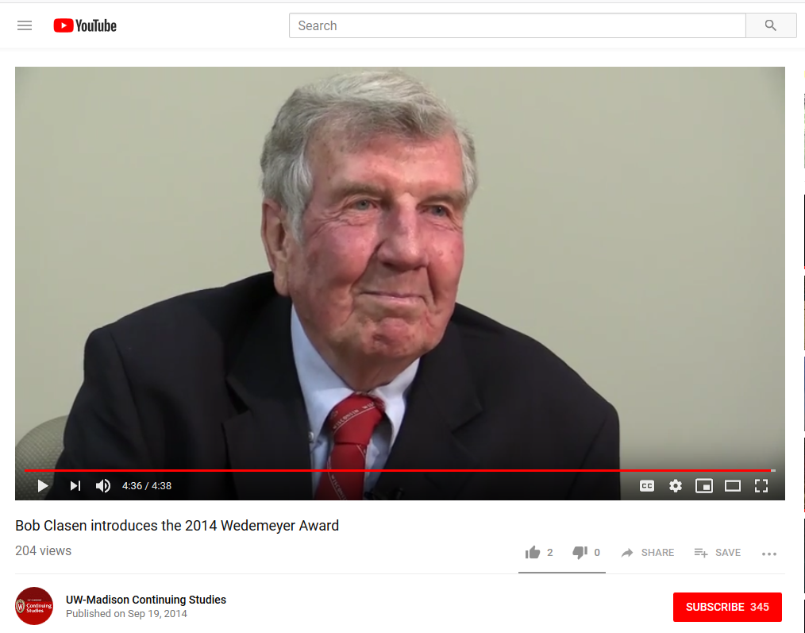
Bob Clasen, University of Wisconsin https://www.youtube.com/watch?v=kCm1_MGaqec&feature=youtu.be
February 27, 1934-March 17, 2018 https://www.cressfuneralservice.com/obituary/249139/Robert-Clasen/

Slide 27





34 years ago…
Knowledge Navigator (1987)
Apple Computer http://www.youtube.com/watch?v=hb4AzF6wEoc

Slide 28





August 6, 2021
The Web will be 30! http://info.cern.ch/ (First website) http://money.cnn.com/2016/08/06/technology/world-wide-web-25-years-old/index.html?iid=hp-stack-dom https://webfoundation.org/about/vision/history-of-the-web/ https://home.cern/science/computing/birth-web/short-history-web

Slide 29


Slide 30






January 15, 2021
Wikipedia is 20!
Simon Garfield, Esquire: What We Know And Can Agree On: Wikipedia At 20 https://en.wikipedia.org/wiki/Wikipedia:20th_anniversary https://www.esquire.com/uk/culture/a34412278/wikipedia-at-20/ https://wikipedia20.pubpub.org/

Slide 31


April 4, 2021
MIT OpenCourseWare is 20! https://www.youtube.com/watch?v=0aAEamhJHUI https://ocw.mit.edu/about/milestones/ https://news.mit.edu/2021/mit-courseware-educational-resource-to-millions-0406

Slide 32


Fast Forward to 2021…
“Anyone can now learn anything from anyone at any time.”

Slide 33


Education 3.0
“In Education 3.0, classrooms would move away from lectures, such as this one, to having class time be spent on discussions and projects, using digital technology.”
(Per Wikipedia: https://en.wikipedia.org/wiki/Education_3.0

Slide 34



Now What is Education 4.0?
“Innovation-producing education. Learn more in: Development of Individual Agency within a Collaborative, Creative Learning Community” http://www.igi-global.com/dictionary/education-40/41755 https://thinc.in.th/engadmission/education4.html (Chula Engineering)

Slide 35


July 24, 2018
The 100-Year Life: Living and Working in an Age of Longevity
Lynda Gratton and Andrew Scott http://www.100yearlife.com/ https://www.amazon.com/100-Year-Life-Living-Working-Longevity/dp/1543624634

Slide 36

March 13, 2019
The Career Curriculum Continuum
Andrew Hermalyn, Inside Higher Ed https://www.insidehighered.com/digital-learning/views/2019/03/13/how-universities-can-stay-center-learners-lives-opinion

Slide 37



February 25, 2020
The 60 Year Curriculum:
Developing New Educational Models to Serve the Agile Labor Market
Chris Dede, Harvard University, The Evolllution https://evolllution.com/revenue-streams/professional_development/the-60-year-curriculum-developing-new-educational-models-to-serve-the-agile-labor-market/
219: The 60-Year Curriculum with Rovy Branon https://teibelinc.com/podcast/219

Slide 38


July 11, 2017
The Rise of the Phigital Learner
Going ‘phigital?’ 4 things schools need to know about Generation Z, Todd Kominiak, TrustEd http://trustedk12.com/phigital-digital-learning/
May 15, 2017
3 must know’s about the rising “phigital” student-and why their impact is enormous, Meris Stansbury, eCamous News https://www.ecampusnews.com/campus-administration/education-gen-z-phigital-student/

Slide 39

Part 3. Education 20/20

Slide 40



Slide 41


20 New Roles of the Instructor
Course Ambassador
Captain
Consumer Advocate
Curator
Counselor
Cook
Change Catalyst
Concierge
Conductor
Comedian
Camping Trip Guide
Coach
Consultant
Course Expedition Leader
Collaborator
Community Organizer
Chemist
Care Giver
Cultivator
Colleague

Slide 42






Slide 43




Merrill’s First Principles of Teaching/Instruction http://travelinedman.blogspot.com/2011/05/bonks-last-principles-of-instruction.html

Slide 44



Bonk's Last Principles of Teaching/Instruction (Education 4.0?) http://travelinedman.blogspot.com/2011/05/bonks-last-principles-of-instruction.html http://www.applicadthai.com/articles/education-4-0/

Slide 45

1. The Principle of Flexibility http://travelinedman.blogspot.com/2011/05/bonks-last-principles-of-instruction.html
(e.g., multiple due dates, grace period, flexible agenda, etc.)

Slide 46


2. The Principle of Convenience http://travelinedman.blogspot.com/2011/05/bonks-last-principles-of-instruction.html
(e.g., multiple ways to turn in, record the class, get student input on time to teach the class, etc.)

Slide 47

6. The Principle of Choice and Options http://travelinedman.blogspot.com/2011/05/bonks-last-principles-of-instruction.html
(e.g., sign up for weeks to present, have 10 midterm or final options and pick any 4, choose if want to work as a group/team or individually submit, etc.)

Slide 48


7. The Principle of Empowerment and Autonomy http://travelinedman.blogspot.com/2011/05/bonks-last-principles-of-instruction.html
(e.g., build something for a wider audience, design, negotiate the syllabus in a wiki, students vote on agenda items, student presentations of final projects, etc.)

Slide 49

8. The Principle of Support and Feedback http://travelinedman.blogspot.com/2011/05/bonks-last-principles-of-instruction.html
(e.g., offer extensive feedback, assign critical friends for feedback, offer summary feedback for common questions, use job aids and scaffolds, etc.)

Slide 50

10. The Principle of Organization http://travelinedman.blogspot.com/2011/05/bonks-last-principles-of-instruction.html
(e.g., create and share agenda in advance, contact guest speakers in advance and share their bios and pics, arrange order of student presentations, etc.)

Slide 51

11. The Principle of Sharing http://travelinedman.blogspot.com/2011/05/bonks-last-principles-of-instruction.html

Slide 52

14. The Principle of Relevance and Meaningfulness http://travelinedman.blogspot.com/2011/05/bonks-last-principles-of-instruction.html

Slide 53

16. The Principle of Expanded Resources http://travelinedman.blogspot.com/2011/05/bonks-last-principles-of-instruction.html

Slide 54





The World of Open Education

Slide 55




The World is Open:
How Web Technology Is Revolutioning Education

Slide 56








The World is Open

Slide 57

The World is very open!
(South University of Science and Technology of China, Wednesday June 10, 2015)

Slide 58

17. The Principle of Human Connectedness http://travelinedman.blogspot.com/2011/05/bonks-last-principles-of-instruction.html

Slide 59


20. ??? (what is missing) http://travelinedman.blogspot.com/2011/05/bonks-last-principles-of-instruction.html

Slide 60
Bonk's 20 "Last" Principles of Instruction
(LAST = Learning Activation System Template) http://travelinedman.blogspot.com/2011/05/bonks-last-principles-of-instruction.html
Choice and Options
Support and Feedback
Flexibility
Nontraditional Learning
Spontaneity
Passion and Inspiration
Convenience
Organization
Relevance and Meaningfulness
Collegiality
Sharing
Trial and Error (i.e., it is ok to fail)
Cheerfulness and Optimism
Expanded Resources
Purpose and Vision
High Expectations
#20 ???
Human Connectedness
Empowerment and Autonomy
Cognitive Apprenticeship

Slide 61


Clearly…
Learning is Changing!

Slide 62



Part 4. Thirty Ways
Learning is Changing…
(i.e., it’s more informal, video-based, ubiquitous, collaborative, self-directed, global, mobile, open, massive, etc.)

Slide 63




November 11, 2020
Educational technology is coming of age during the pandemic: Nowhere more so than in India https://www.economist.com/international/2020/11/11/educational-technology-is-coming-of-age-during-the-pandemic

Slide 64

30+ Ways Learning is Changing:
The Mega Trends

Slide 65
Polling Question #1:
Are we in the midst of a:
A. Learning Evolution or
B. Learning Revolution…
C. Neither

Slide 66
Polling Question #2:
Which is the most important trend? a. Mega Trend #1. Learner Engagement b. Mega Trend #2. Pervasive Access c. Mega Trend #3. Customization

Slide 67

How Learning is Changing:
Mega Trend #1. Learner Engagement

Slide 68



March 2021
Learning is More Mobile
Best small phone 2021: The top tiny, compact smartphone choices
James Rogerson, TechRadar https://www.techradar.com/best/best-small-phone
The Octopus watch from Joy, an icon-based watch for kids to have good habits is on display during CES.

Slide 69


March 1, 2021
Learning is Hands-on
Student Designed Videos
M-Learning for K-12 Education
Terri and Terri https://www.youtube.com/watch?app=desktop&v=4gv_mc7D6vo
Amy Papst: https://www.youtube.com/watch?v=jJcaqGoSspE&feature=youtu.be
Qi Li, Gangnam: http://www.youtube.com/watch?v=7Q429lqxZaU&feature=youtu.be
Miguel Lara (Web 2.0 FREEDOM): http://www.youtube.com/watch?v=8cmCFWi9lW8
Kimberly Vincent-Layton: https://www.youtube.com/watch?v=4Ic39_rYLII&feature=youtu.be

Slide 70

July 2, 2021
Learning is Hands-on
Teaching coding and design can lead to tech literacy
Jean Sharp, eCampus News https://www.eschoolnews.com/2021/07/02/teaching-coding-and-design-can-lead-to-tech-literacy/?ps=999999999-0013000000j08pF-0033000000q5TNf&esmc=202252
Encouraging technology creators means engaging students in project-based technology courses that introduce them to coding, design, gaming, and animation. And as students complete projects such as developing an app, creating a 3D video game, or designing a collection, they gain relevant, hands-on experience using industry-standard tools professionals use. Students apply creativity, problem-solving, and critical thinking skills–competencies that are important in preparing students for the future and are applicable to any career, whether it’s in technology or not.

Slide 71





June 27, 2020
Learning is Hands-on
Design Products (students created infographics, brochures, timelines)
Canva is an online design program that does not require much design skills. You can design professional looking brochures, infographics, PPTs, flyers, and syllabus for free.

Slide 72



Learning is Hands-on
Video, Podcast Show, Documentary, Website, Animation, Song, etc. https://app.animaker.com/animo/2h5b0Hz2gxURJ5x4/?shareid=view%7C2h5b0Hz2gxURJ5x4

Slide 73


May 11, 2020
Learning is More Game-based
What is smileUP & How to use it?
SMILE, Paul Kim at Stanford https://www.youtube.com/watch?v=pblU8sSALWo

Slide 74

March 21, 2021
Learning is More Digitally Rich
ELCL 6270: Teaching Physical Science with the STEAM Approach
Heejung An: ANH2@wpunj.edu, William Paterson University https://padlet.com/anh21/4haa7swcscf1r77s

Slide 75

April 11, 2021
Learning is More Collaborative
Brainstorming in Jamboard or Miro https://jamboard.google.com/

Slide 76





Fall 2019, R511
Learning is More Collaborative
Team Article Debates
Nuclino (like a wiki…may delete by mistake, trial version, limited) https://www.nuclino.com/

Slide 77



July 23, 2021
Learning is More Collaborative
Kritik is a peer-grading platform
Authentic peer-to-peer interaction for a New Era of Education.
Carine Marette https://www.linkedin.com/in/carinemarette/ https://www.kritik.io/, Carine@kritik.io

Slide 78

October 20, 2020
Learning is More Visual
The British Museum https://britishmuseum.withgoogle.com/

Slide 79


April 22, 2018
Learning is More Visual
Microsoft AI Commercial ft. Common
Video 1:00: Microsoft AI Commercial ft: https://www.youtube.com/watch?v=9tucY7Jhhs4 / (Feb 11, 2018)
Video 1:48: Microsoft AI: Amplifying Human Ingenuity: https://www.youtube.com/watch?v=NDmu7Z5NPXo
Video 1:00: Microsoft AI: Empowering Innovators ft. Common: https://www.youtube.com/watch?v=Z5OWdqfAYfw (April 22, 2018)
Video: 1:00 Microsoft AI + Iconem: Preserving History ft. Common: https://www.youtube.com/watch?v=ZDZjaIhzMSM (April 22, 2018)
Video: 0:44: Microsoft AI + The Yield: Taking the guesswork out of farming ft. Common: https://www.youtube.com/watch?v=7rzufxlGH4o (April 22, 2018)

Slide 80



November 23, 2020
Learning is More Immersive
Can AR be the antidote to virtual classroom shortcomings?
Parker McDonnough, eSchool News https://www.eschoolnews.com/2020/11/23/can-ar-be-the-antidote-to-virtual-classroom-shortcomings/2/ https://www.zdnet.com/article/view-pyramids-of-ancient-egypt-via-this-360-degree-vr-capture/
AR brings learning to life and allows students to experience education during distance learning. With AR, students can walk through Stonehenge, tour the Egyptian pyramids, go on a virtual field trip of the Louvre Museum, or explore the cavities of the human heart – all from the comfort of their homes. Students can even take a journey to outer space or visit UNESCO world heritage sites….explore Mount Rushmore or the muscular system in AR.

Slide 81




July 17, 2017
Learning is More Immersive
Learning Chemistry in Virtual Reality,
Sarah Hardman, New Learning Times https://newlearningtimes.com/cms/article/4519/learning-chemistry-in-virtual-reality
1:38 video: https://vialogues.com/vialogues/play/38337/
All: http://curtbonk.com/chemistry-vr.html
01.-.41: http://curtbonk.com/chemistry-vr-1.html
.41-1:16: http://curtbonk.com/chemistry-vr-2.html
1:16-1:36: http://curtbonk.com/chemistry-vr-3.html

Slide 82


May 1, 2018
Learning is More Immersive
3 ways districts can use AR and AI
Justin Anglio, eSchool News https://www.eschoolnews.com/2018/05/01/3-amazing-ways-our-district-is-using-ar-and-vr/
When a teacher glances around her classroom, Lumilo allows her to see real-time analytics (in the form of icons) floating directly above each student’s head. The teacher can glance directly at a student or “click” on a student’s icon to see more detailed information about where and how that student might be struggling.

Slide 83


June 24, 2021
Learning is More Immersive
This Week In XR: VR Ad Excitement, Tencent Invests $50M In Ultraleap, The Linkedin Of VR
Charlie Fink, Forbes https://apple.news/A0dVCTuPtQsu0VdrQccHb6A
A New World Awaits – Varjo's Special Event on June 24, 2021
Metaverse explained (22:50): https://www.youtube.com/watch?v=MHDFNr0MNek
http://curtbonk.com/vr3.html
Mixed Reality Hand Tracking with Varjo XR-1 and Ultraleap (solar system/Earth):
Video (1:20): http://curtbonk.com/vr1.html

Slide 84



April 15, 2021
Learning is More Visual
Google Earth's New 3D Time-Lapse Feature Shows How Humans Are Affecting the Planet
Sam Rutherford, Gizmodo https://gizmodo.com/google-earths-new-3d-time-lapse-feature-shows-how-human-1846685339

Slide 85

Poll #3: Any light bulbs going off in you head so far?
Yes definitely…many of them…pop…pop…pop!
Yes, several times.
Yes maybe!
Not yet (but hopefully soon…)
Nope. Darn it my brain is not working today.
There’s no hope with this idiot presenting.

