Slide 1


MOOC Instructor Research: Motivations, Considerations, and Personalizations in the Design of Instruction for the Masses
Curtis J. Bonk
Meina Zhu
Annisa Sari
Indiana University
School of Education, IST INDIANA UNIVERSITY BLOOMINGTON

Slide 2
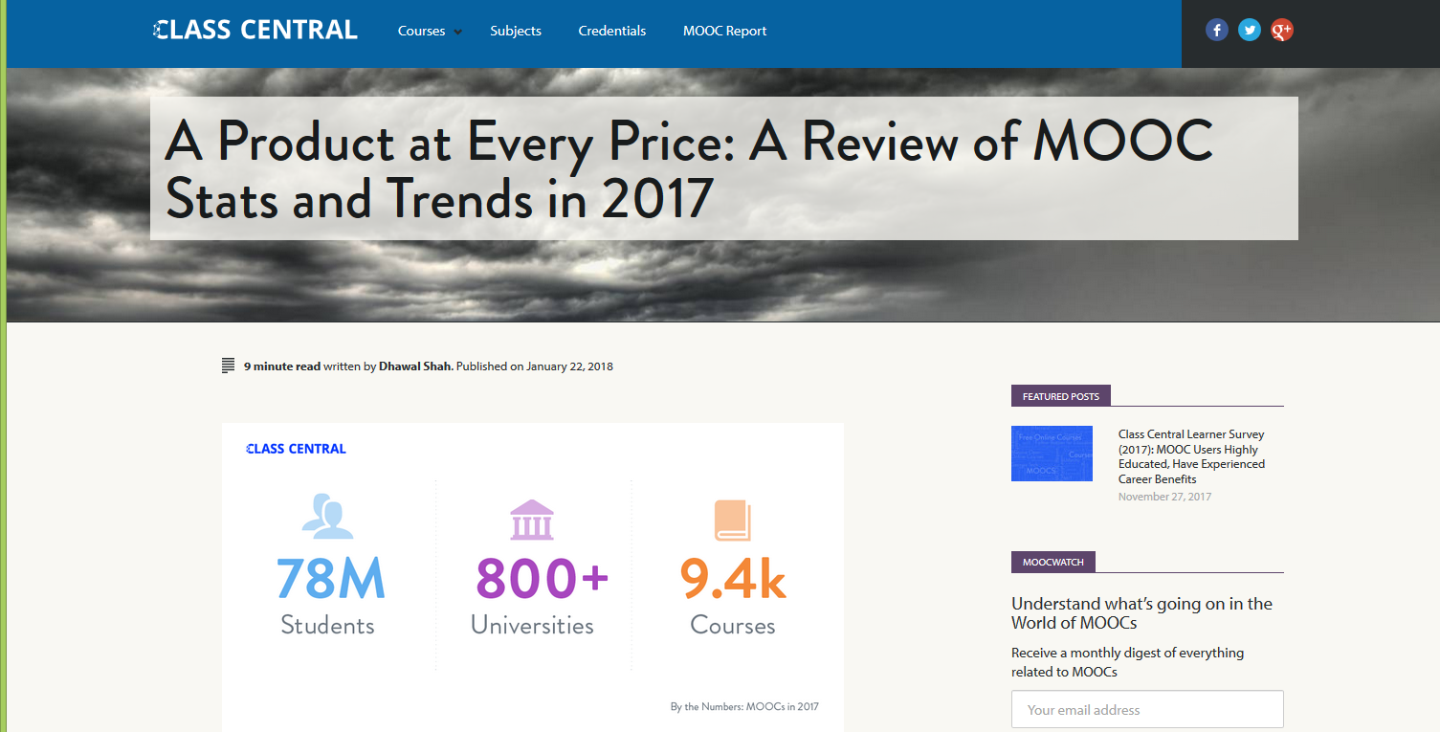
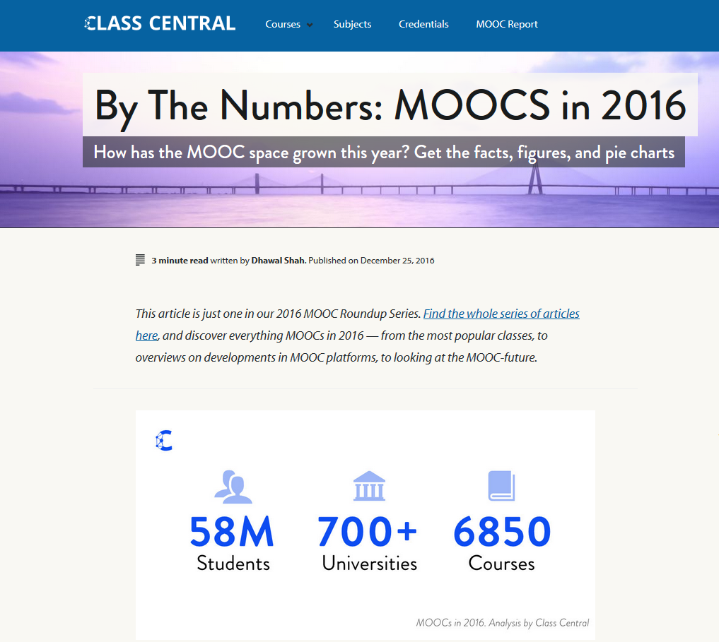
December 25, 2016 vs. January 22, 2018
A Review of MOOCs Stats and Trends in 2017, Dhawal Shah, Class Central https://www.class-central.com/report/moocs-stats-and-trends-2017/

Slide 3
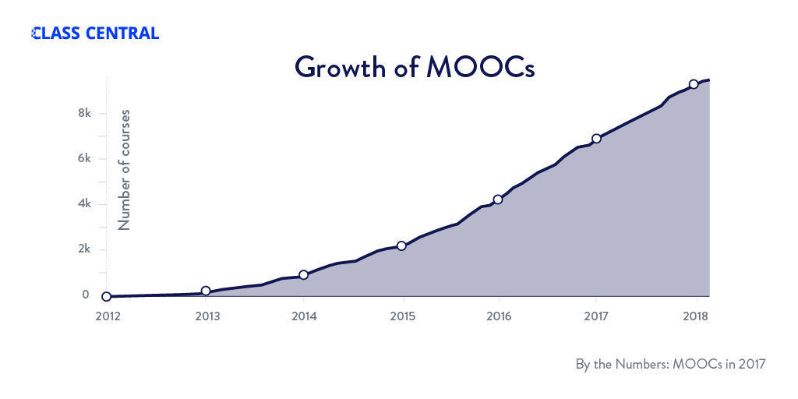
January 22, 2018
A Review of MOOCs Stats and Trends in 2017, Dhawal Shah, Class Central https://www.class-central.com/report/moocs-stats-and-trends-2017/

Slide 4
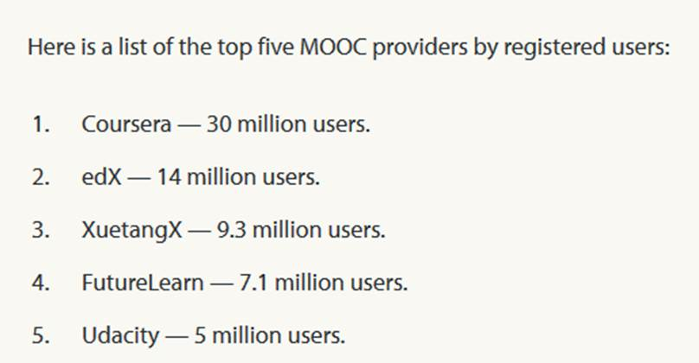
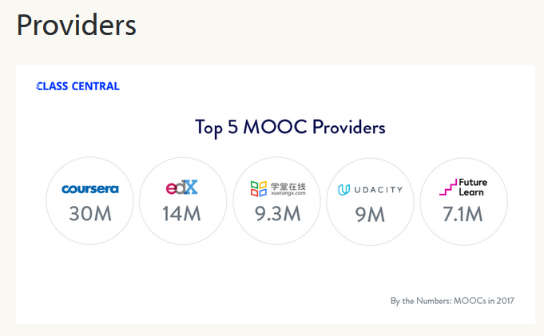


January 22, 2018
A Review of MOOCs Stats and Trends in 2017, Dhawal Shah, Class Central https://www.class-central.com/report/moocs-stats-and-trends-2017/

Slide 5
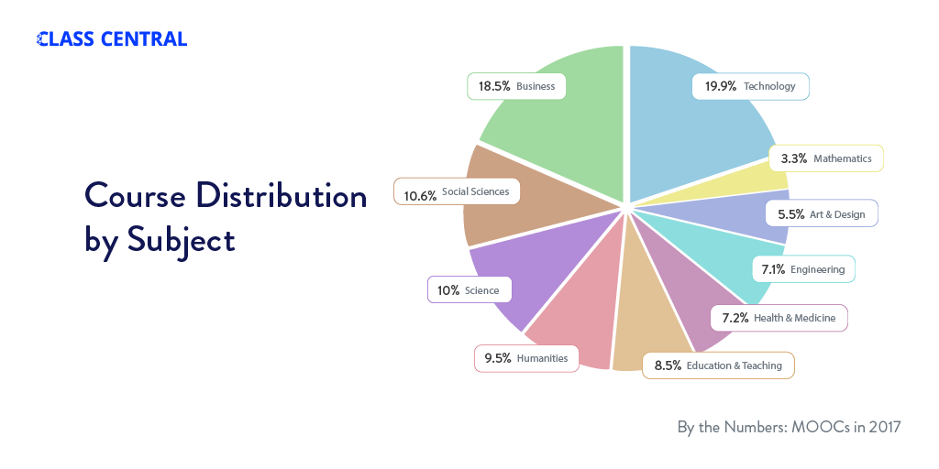
Subject areas (January 22, 2018)

Slide 6
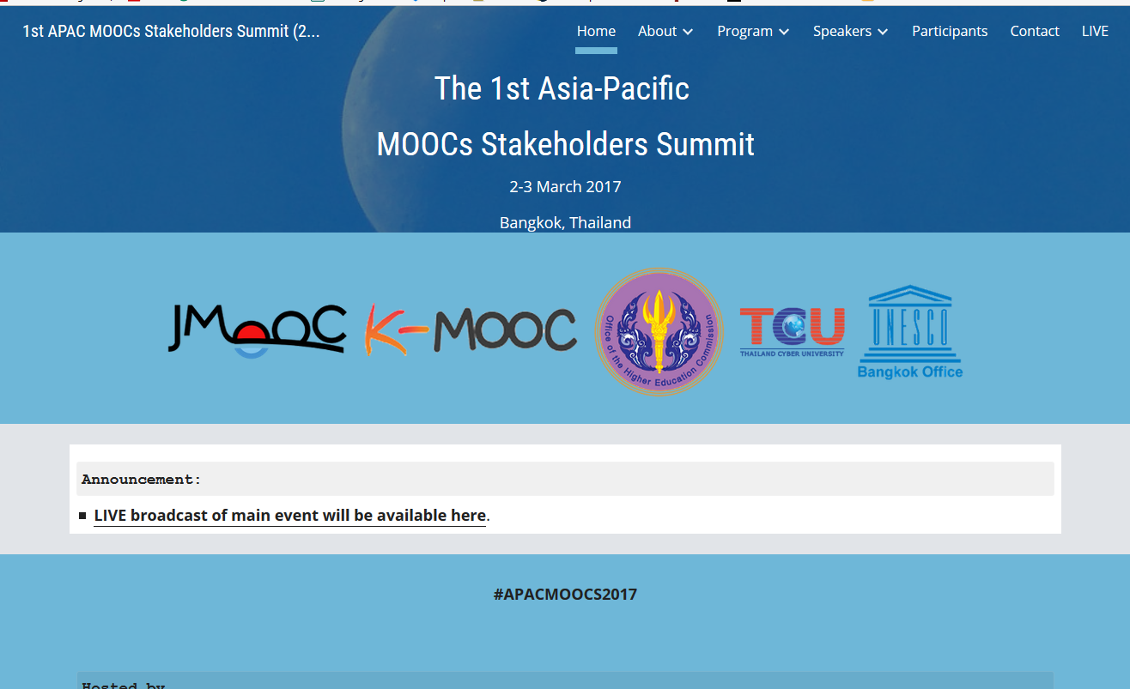

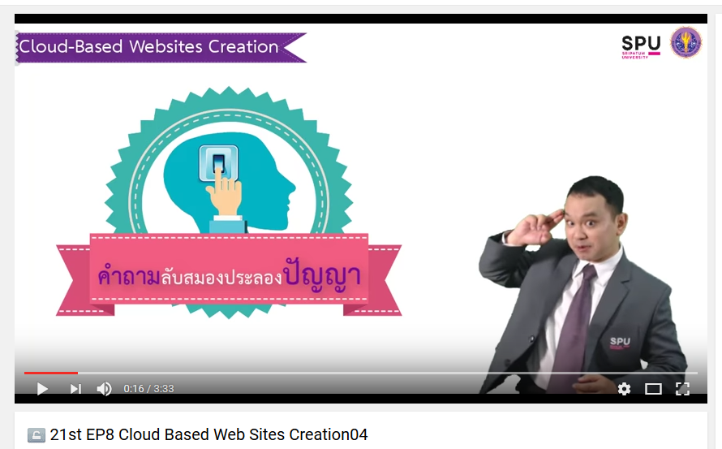
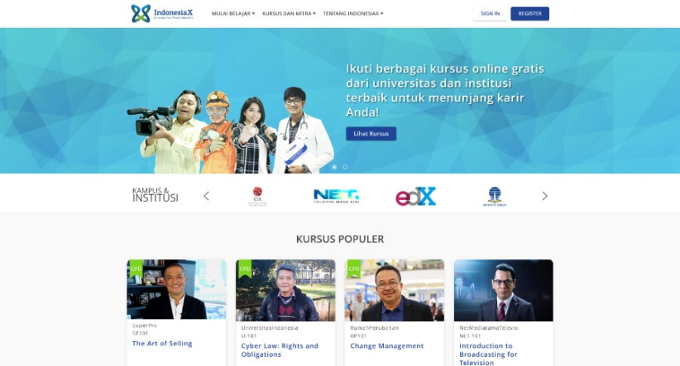
June 15, 2017
Massive List of MOOC Providers Around The World, Class Central
JMOOC, K-MOOC, and T-MOOC? https://www.class-central.com/report/mooc-providers-list/

Slide 7
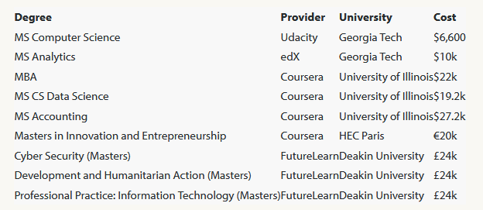
August 7, 2017
FutureLearn and Coventry University to Roll Out 50 Online Degrees (Last year Deakin University announced a similar partnership with FutureLearn)
Class Central, Dhawal Shah https://www.class-central.com/report/futurelearn-coventry-university-roll-50-online-degrees/

Slide 8
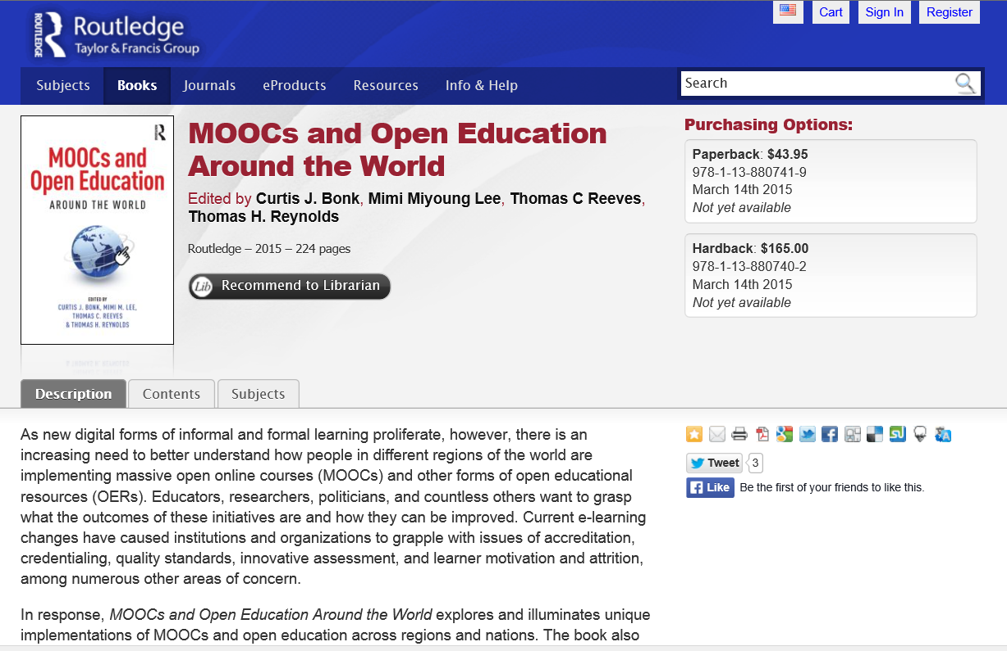






MOOCs and Open Education Around the World (2015) http://moocsbook.com/

Slide 9
2015
Instructional quality of Massive Open Online Courses (MOOCs).
Margaryan, Bianco, & Littlejohn, Computers & Education, 80, 77-83. http://www.sciencedirect.com/science/article/pii/S036013151400178X
“As MOOCs proliferate, drawing in increasing numbers of faculty and learners worldwide, the issue of their instructional quality becomes increasingly pressing.” (p. 82)

Slide 10

MOOC Research
(5 studies)

Slide 11

MOOC Study #1: MOOC Research
A Systematic Review of Research Methods and Topics of the Empirical MOOC Literature (2014-2016)
Zhu, M., Sari, A., & Lee, M. M. (2018). A Systematic Review of Research Methods and Topics of the Empirical MOOC Literature (2014-2016). The Internet and Higher Education. 37,31-39.

Slide 12
Systematic Review of Research Methods in MOOCs (2014-2016)
(Zhu, M., Sari, A., & Lee, M. M., 2018)
 | Quantitative | Qualitative | Mixed methods
Student-focused | 39 | 9 | 26
Design-focused | 19 | 12 | 17
Context and impact | 9 | 6 | 5
Instructor-focused | 0 | 3 | 2

Slide 13
Systematic Review of Research Methods in MOOCs (2014-2016)
(Zhu, M., Sari, A., & Lee, M. M., 2018)
No. | Journal | Total
1 | International Review of Research in Open and Distance Learning (IRRODL) | 31
2 | Computers & Education | 12
3 | British Journal of Educational Technology | 9
4 | Online Learning | 7
5 | Distance Education | 5
6 | Educational Media International | 5
7 | Internet and Higher Education | 5
8 | Journal of Computer Assisted Learning | 5
9 | Computers in Human Behavior | 4
10 | Open Learning | 4
11 | Journal of Online Learning and Teaching | 3
12 | Journal of Asynchronous Learning Network | 3

Slide 14
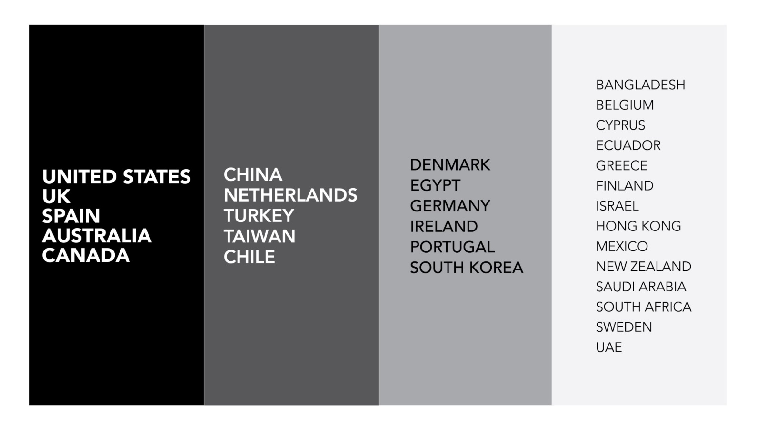
Systematic Review of Research Methods in MOOCs (2014-2016)
(Zhu, M., Sari, A., & Lee, M. M., 2018)
Location of MOOC Research Team Members (2014-2016)

Slide 15
Systematic Review of Research Methods in MOOCs (2014-2016)
(Zhu, M., Sari, A., & Lee, M. M., 2018)
RQ1: What are the research methods researchers employed in empirical MOOC studies?

Slide 16
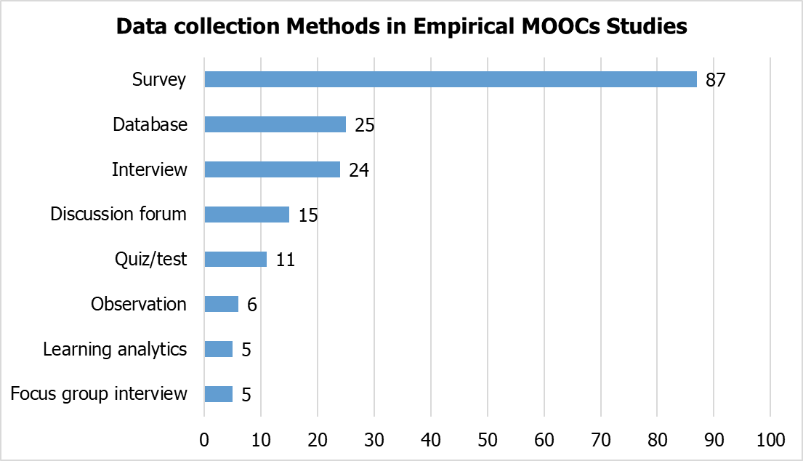
Systematic Review of Research Methods in MOOCs (2014-2016)
(Zhu, M., Sari, A., & Lee, M. M., 2018)
RQ1: What are the research methods researchers employed in empirical MOOC studies?

Slide 17
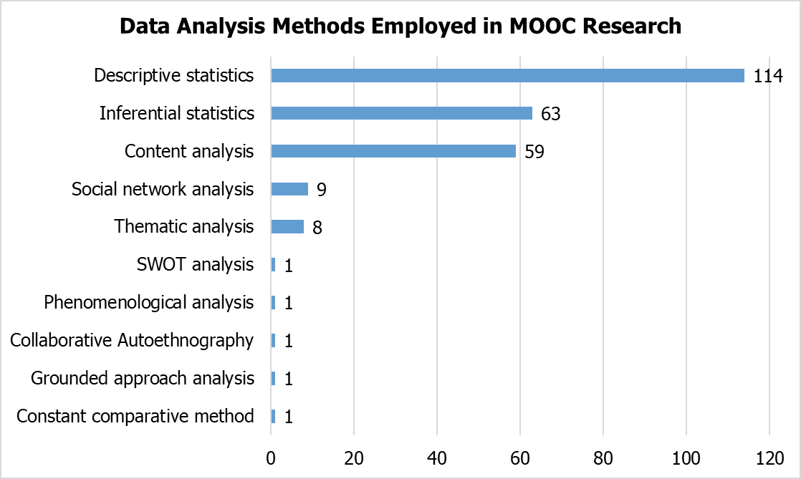
Systematic Review of Research Methods in MOOCs (2014-2016)
(Zhu, M., Sari, A., & Lee, M. M., 2018)
RQ1: What are the research methods researchers employed in empirical MOOC studies?

Slide 18
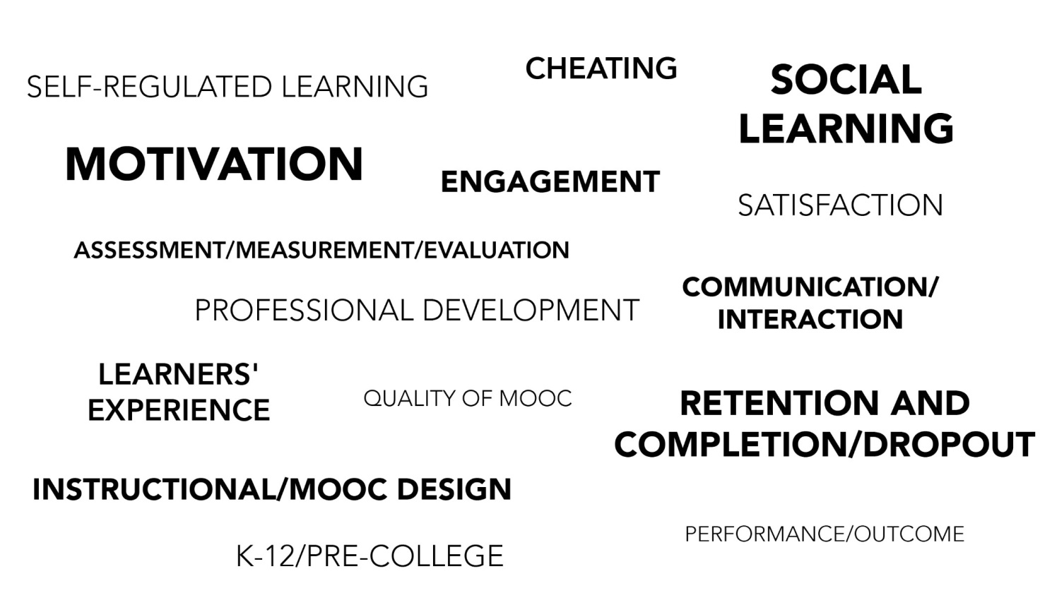
Systematic Review of Research Methods in MOOCs (2014-2016)
(Zhu, M., Sari, A., & Lee, M. M., 2018)
Specific Focus of MOOC Research (2014-2016)

Slide 19
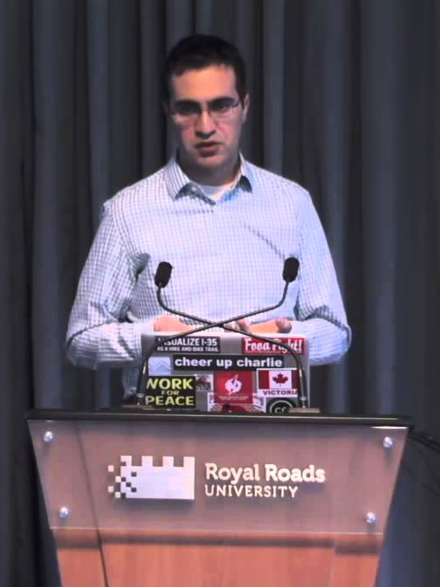
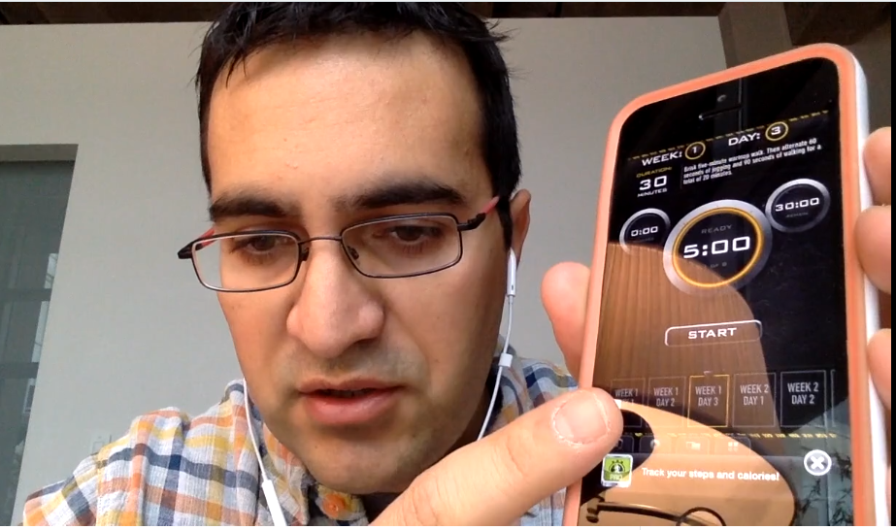

Quotes: Veletsianos et al. (2015-2016)
“To gain a deeper and more diverse understanding of the MOOC phenomenon, researchers need to use multiple research approaches (e.g., ethnography, phenomenology, discourse analysis) add content to them.” (p. 583.)
Veletsianos, Collier, & Schneider (2015, May), Digging deeper into learners’ experiences in MOOCs: Participation in social networks outside of MOOCs, notetaking and contexts surrounding content consumption. BJET, 46(3), 570-587.
“Dependence on Particular Research Methods May Restrict our Understanding of MOOCs.”
George Veletsianos & Peter Shepherdson’s Study (2016). Systematic Analysis and Synthesis of the Empirical MOOC Literature Published in 2013-2015. IRRODL. http://www.irrodl.org/index.php/irrodl/article/view/2448/3655

Slide 20

MOOC Study #2: MOOC Research
A Systematic Review of MOOC Research Methods and Topics:
Comparing 2014-2016 and 2016-2017
Zhu, M., Sari, A., & Bonk, C. J. (2018). To be presented at Ed Media Amsterdam.

Slide 21
Systematic Review of Research Methods and Topics in MOOCs: Comparing 2014-2016 and 2016-2017
(Zhu, M., Sari, A., & Bonk, C. J., 2018)
Figure 2. Research methods used in empirical MOOCs studies (2016 – 2017) (n=51)

Slide 22
Systematic Review of Research Methods and Topics in MOOCs: Comparing 2014-2016 and 2016-2017
(Zhu, M., Sari, A., & Bonk, C. J., 2018)
Figure 4. Data collection methods used in empirical MOOCs studies (2016 – 2017) (n=51) (Note: some studies contain more than one data collection method)

Slide 23
Systematic Review of Research Methods and Topics in MOOCs: Comparing 2014-2016 and 2016-2017
(Zhu, M., Sari, A., & Bonk, C. J., 2018)
Figure 6. Specific data analysis methods for MOOC research (2014-2016 and 2016 – 2017)

Slide 24
Systematic Review of Research Methods and Topics in MOOCs: Comparing 2014-2016 and 2016-2017
(Zhu, M., Sari, A., & Bonk, C. J., 2018)
Figure 8. Primary/general focus of MOOC delivery (2016 – 2017) (n=51) (Note: some studies contain more than one area of focus)

Slide 25
Systematic Review of Research Methods and Topics in MOOCs: Comparing 2014-2016 and 2016-2017
(Zhu, M., Sari, A., & Bonk, C. J., 2018)
Figure 12. Countries of MOOC delivery in which the research was conducted (2014 – 2017) (n=197) (Note: this figure only includes the main countries)

Slide 26
Next Steps Rationale…
Research Background
  MOOCs can be beneficial to both learners and instructors
    (Hew & Cheung, 2014)
  Instructors are one of the five main components of MOOCs; the other four are learners, topic, material, and context
    (Kop, 2011 )
  Few studies have examined instructional design from MOOC instructors’ perspectives
    (Margaryan et al., 2015; Ross, Sinclair, Knox, Bayne, & Macleod, 2014; Watson et al., 2016)

Slide 27

Research Design

Slide 28
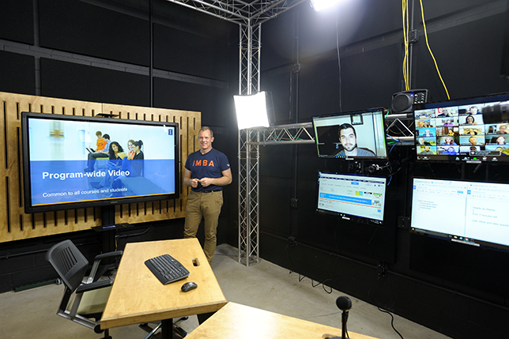
MOOC Study #3: MOOC Instructor Personalization and Addressing Learner Diversity
Bonk, C. J., Zhu, M., Kim, M., Xu, S., Sabir, N., & Sari, A. (in press). Pushing toward a more personalized MOOC: Exploring instructor selected activities, resources, and technologies for MOOC design and implementation. The International Review of Research on Open and Distributed Learning (IRRODL).

Slide 29
Figure 1. MOOC instructor departmental or primary discipline affiliations (n=150)

Slide 30
Figure 2. Size of most recent MOOC enrollments for survey respondents (n= 150)

Slide 31
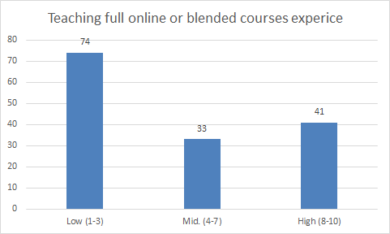
Figure 1. MOOC instructor prior experience teaching fully online and blended courses prior to teaching their most recent MOOC (Note: on a scale of 1 (low) to 10 (high) (n= 148))

Slide 32
Figure 2. MOOC instructor involvement in designing course content for the MOOC (Note: on a scale of 1 (low) to 10 (high) (n=152)

Slide 33
Figure 3. Effort placed on meeting unique learner needs when designing most recent MOOC
(Note: on a scale of 1 (low) to 10 (high) (n=144)

Slide 34
Figure 4. Effort placed on meeting unique learner needs when delivering most recent MOOC
(Note: on a scale of 1 (low) to 10 (high) (n=144)

Slide 35
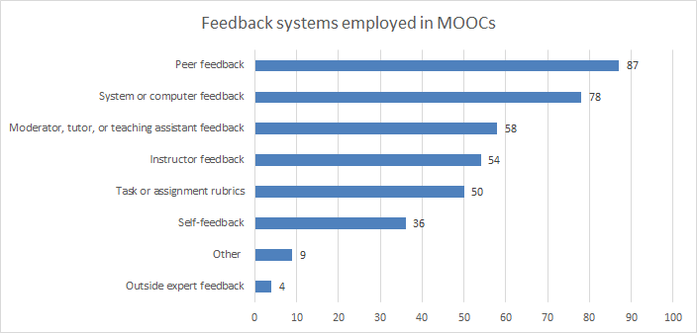
Figure 5. Number of MOOCs that offer different types of learner feedback (n=135)

Slide 36
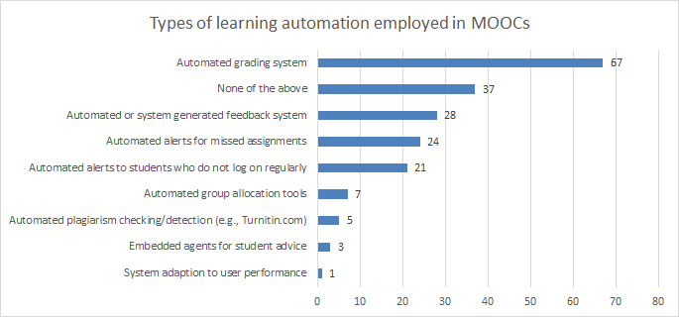
Figure 6. Number of MOOCs that offer different types of learning system automation and adaptation (n=127)

Slide 37
Figure 7. MOOC instructor interest in learning new ways to personalize their next MOOC offering (Note: on a scale of 1 (low) to 10 (high) (n=134)

Slide 38
Figure 8. The perceived effort of MOOC instructors in addressing the needs of individuals from different cultural backgrounds and languages in their most recent MOOC (Note: on a scale of 1 (low) to 10 (high) (n= 141)

Slide 39
Figure 9: MOOC instructors (n=133) instructional practices to address cultural diversity

Slide 40
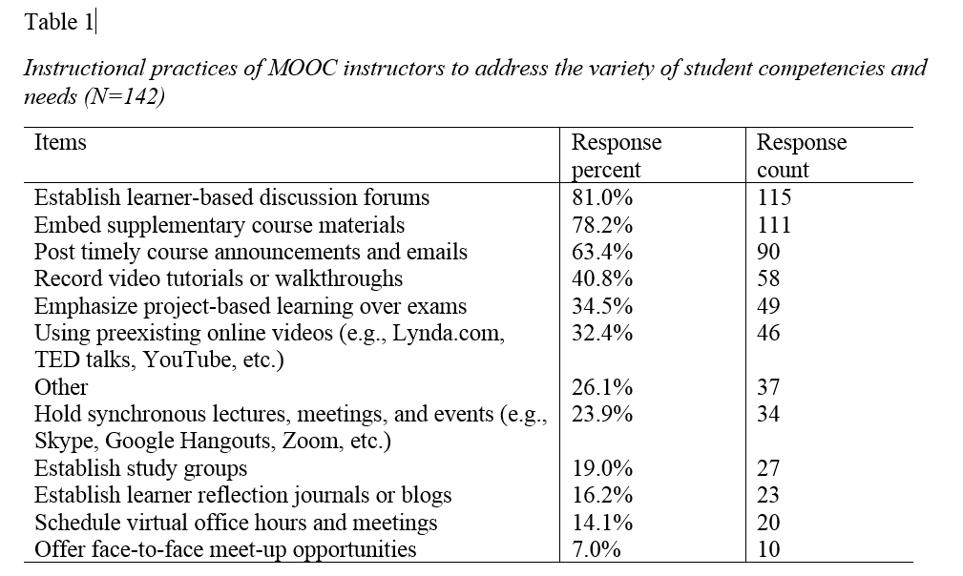
Table 1. Instructional Practices of MOOC Instructors to Address the Variety of Student Competencies and Needs (n=142)

Slide 41
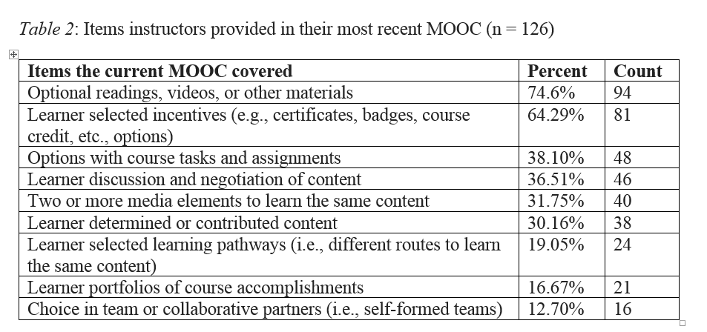
Table 2. Instructional Practices of MOOC Instructors to Address the Variety of Student Competencies and Needs (n=142)

Slide 42
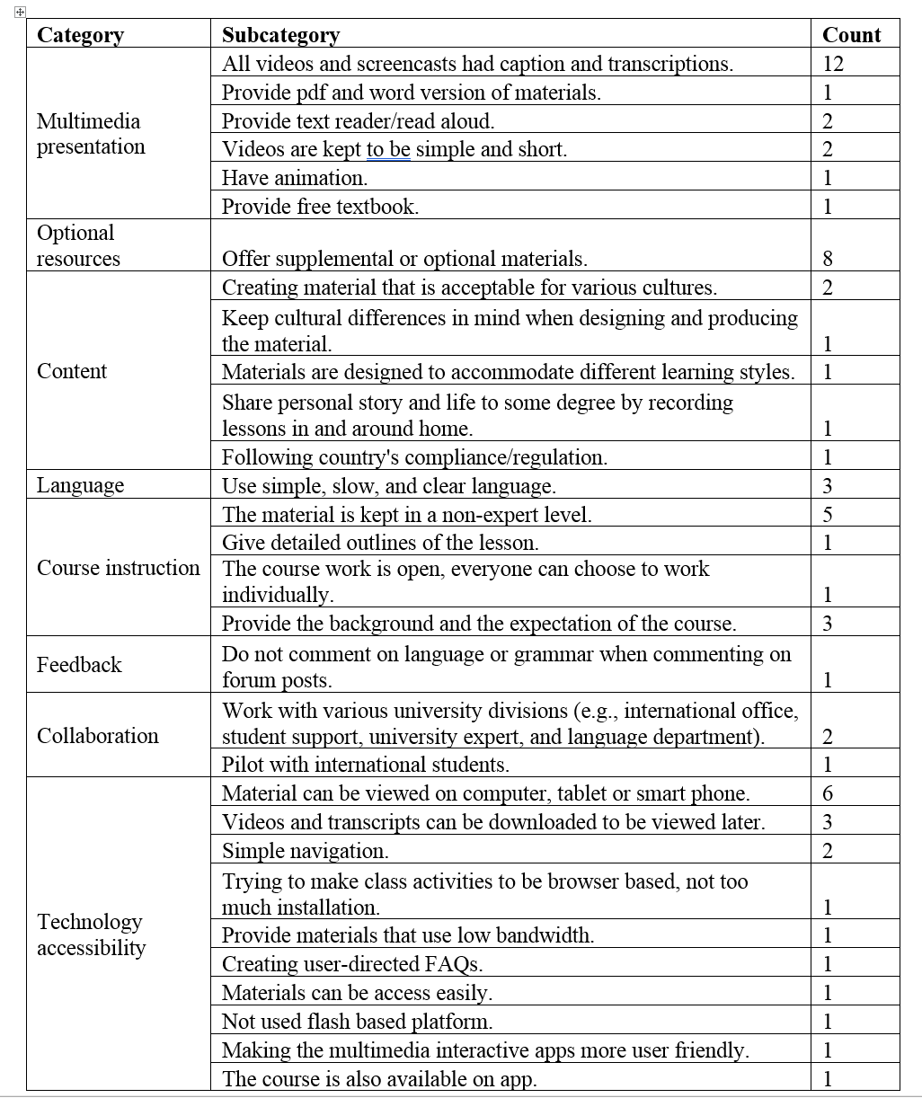

Slide 43

Study #3: Findings Recap
There is a lack of learner monitoring and feedback (i.e., mostly self and peer monitoring/feedback).
More emphasis on personalization in the design of the course than in the delivery of it.
Subtitles and transcripts are the most common ways to address cultural and linguistic differences.
Automated grading and feedback more prevalent than automated alerts, advice/counseling, and plagiarism detection.
Instructors have high interest in learning techniques for personalization in their next MOOC.

Slide 44
Future Research Might Explore…
  Specific instructional design practices for personalization and cultural sensitivity (e.g., focus groups, content analyses, active participation in MOOCs, reviews of historical records, additional surveys, or a combo).
  How emerging technologies (AR, VR, personal digital assistants, and AI) can be used to address learner needs.
  Need to develop guidelines, frameworks, and models for more engaging, culturally sensitive, and personalized learning environments.

Slide 45
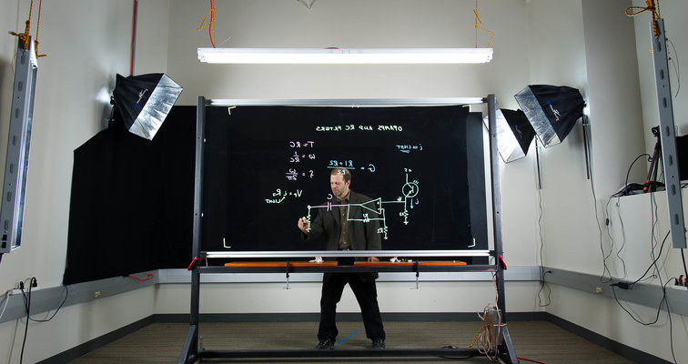
MOOC Study #4: MOOC Instructor Design Challenges and Considerations
Bonk, C., J., Zhu, M., & Sari, A. (2018, April 14). MOOC Instructor Motivations, Innovations, and Designs: Surveys, Interviews, and Course Reviews. Paper presented at the 2018 American Educational Research Association (AERA) annual meeting, New York City, NY.

Slide 46
Research Questions
  What motivates instructors to offer MOOCs?
  What instructional innovations do MOOC instructors perceive?
  What do instructors perceive as the strengths of their MOOCs?
  How would they redesign the MOOC?

Slide 47
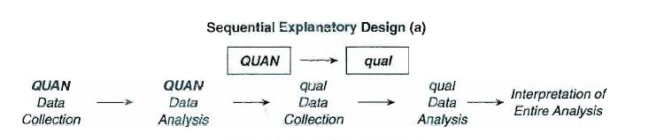
Research Methods-Data collection
Sequential mixed methods design (Creswell & Clark, 2007)
  Data Collection:
  (1) surveys, (2) interviews, and (3) course reviews.
  Participants:
  143 survey participants (10% response rate)
  12 interviewees

Slide 48
Research Methods-Data collection
  MOOC instructors interviewed
No. | Countries | Subject areas | Platforms
1. | The U.S. | Language and Literacy | Coursera
2. | The U.S. | Education | Coursera
3. | The U.S. | Education | Canvas
4. | The U.S. | Chemistry | Coursera
5. | UK | Public health | FutureLearn
6. | UK | Language and Literacy | FutureLearn
7. | Hong Kong | Math | Coursera
8. | Mainland China | Math | Coursera
9. | Canada | Psychology | Coursera
10. | Australia | Public Health | Open2Study
11. | Sweden | Computer Science | edX
12. | India | Management | edX

Slide 49
Prior Online or Blended Experience

Slide 50
Prior MOOC Experience

Slide 51
Subject Area of MOOC Taught

Slide 52
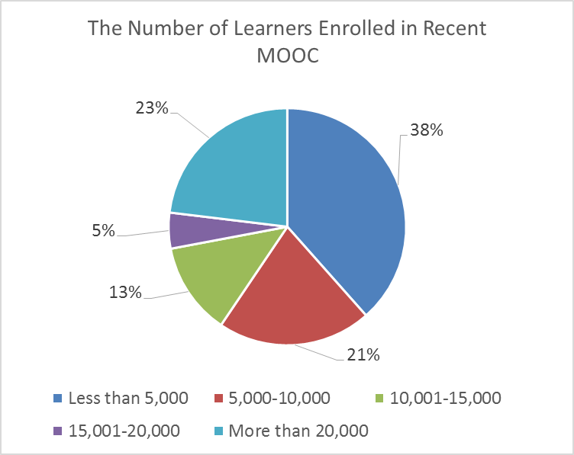
MOOC Enrollments

Slide 53
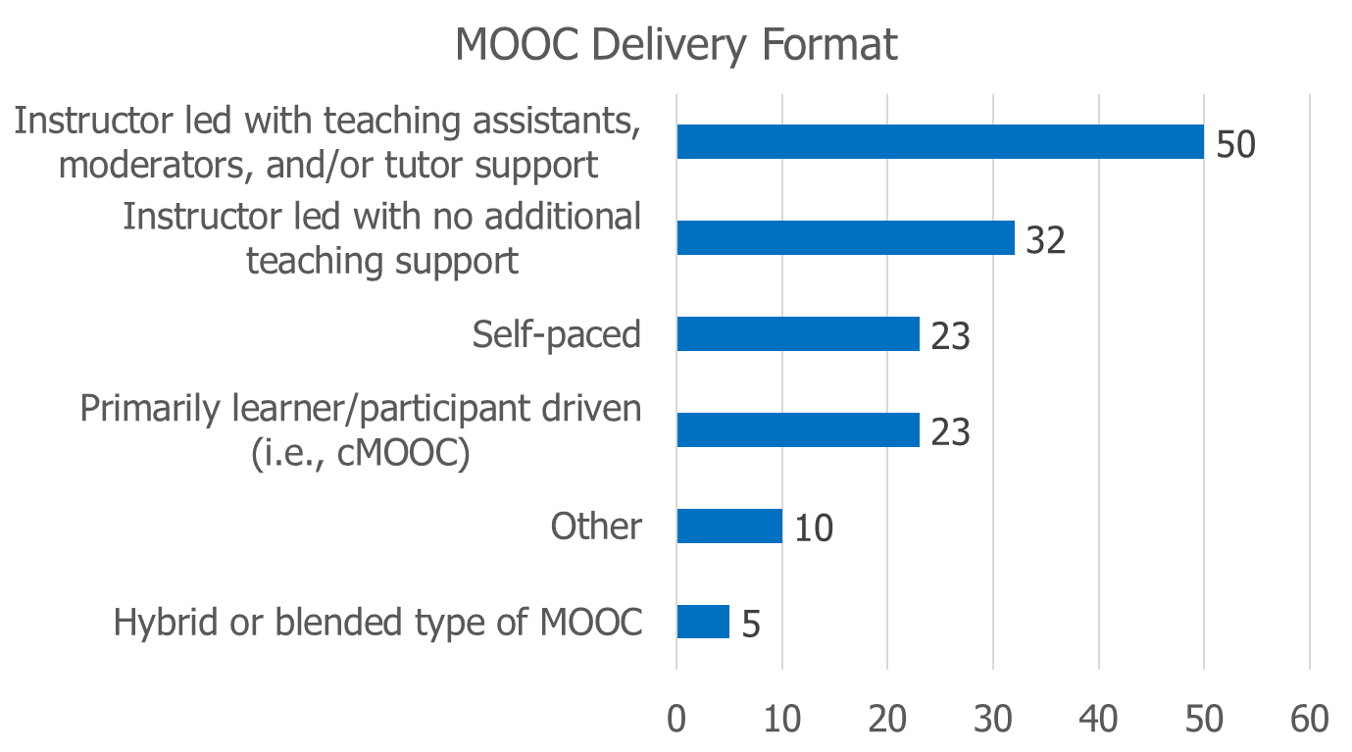
MOOC Delivery Format

Slide 54
Involvement in Course Design

Slide 55
Enjoyment in Designing MOOCs

Slide 56
1. Motivational Findings
  RQ1: What motivated instructors to offer MOOCs?

Slide 57
1. Motivational Findings
  RQ1: What motivated instructors to offer MOOCs?
    Many of them wanted to experience instructional innovation with MOOCs.
    U.S.: decided to design MOOCs “just to experiment.”
    U.S.: “expose your university to broader world.”
    Sweden: “summarizes our way to teaching Computer Architecture and then I was very motivated to give a MOOC.”
    U.S. “The initial motivation was to make some video resources for my own students.”

Slide 58
2. Innovation Findings
  RQ2: What instructional innovations do MOOC instructors perceive?
  Cutting videos into small chunks.
  Integrating interactive media.
  Peer review.
  Problem-based learning.
  Service learning.

Slide 59
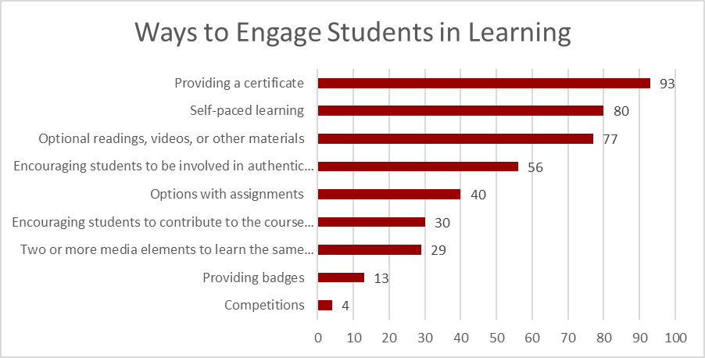
Engagement
Figure 5. Ways to engage students in learning

Slide 60
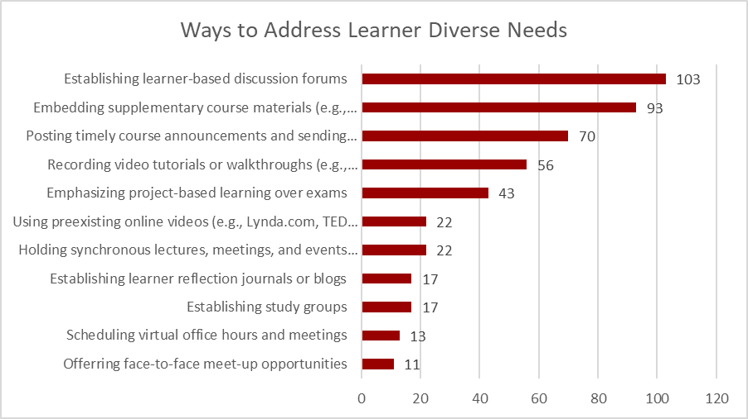
Address Diverse Learner Needs
Figure 7. Ways used by MOOC instructors to address learner diverse needs

Slide 61
3. MOOC Strengths Findings
  RQ3: What do instructors perceive as the strengths of their MOOCs?
  The topic of the MOOC itself.
  The pedagogical methods employed.
  The impact on participants.

Slide 62
Findings
RQ. How do instructors address the challenges that they perceive related to MOOCs?
Explore other MOOC examples
Seek help from the platform/Colleagues/institutions

Slide 63
Findings
RQ. What are the design considerations of instructors when designing MOOCs?
Learning objectives
Assessment
Time for designing MOOC
Engaging learners

Slide 64
4. MOOC Design Findings
  RQ4: How would they redesign the MOOC?
    Overall, they were satisfied with the current course, especially with the structure.
    One literacy instructor from the UK emphatically stated:
      “Actually no. I'm quite happy with it and we've had good feedback from learners.”

Slide 65
4. MOOC Design Findings
  RQ4: How would they redesign the MOOC?
  Adjusting the difficulty of quizzes.
  Adding lab experiences.
  Adding international perspectives.
  Cancelling peer-grading.
  Increasing instructor-student and peer-to-peer interaction.
  Inviting guest speakers.
  Making the length of the MOOC shorter.
  Using learning analytics before redesigning MOOC.

Slide 66
4. MOOC Design Findings
  RQ4: How would they redesign the MOOC?
    Data from the platform
    He further added:
    “I probably am a much better teacher than I was before…To think about that [i.e., less interaction with students when using prerecorded video] made me a different teacher. I’m sure I’m a different teacher after that. If you want to become a better teacher, you develop a MOOC.”

Slide 67
Study #4: Findings Recap
Growth and relatedness needs were the primary instructor motivations for offering MOOCs.
  Growth needs included curiosity about MOOCs and the exploration of new ways of teaching; such findings align well with the research from Hew and Cheung (2014).
Various pedagogical innovations were mentioned by the interviewees (e.g., guests, PBL, service learning, peer review, interactive media, etc.).
MOOC instructors interviewed were satisfied with the designs of their MOOCs, but did want to make major changes to their course. (Lacking time? And overly rely on positive student feedback.)

Slide 68
Significance & Conclusion
This study provides a window into the decision making of more than 100 MOOC instructors. Few studies have tapped into such a database.
This study provides key insights into instructors’ motivations for offering MOOCs as well as instructional innovations in MOOC design.
The results may inform MOOC stakeholders (i.e., institutions) of how to foster instructor motivation and instructional innovation in MOOCs.
This study can be used to train instructional designers on the design of MOOCs as well as the expectations of MOOC instructors that they may be working with.

Slide 69
Future Research Might Explore…
  The relationship between instructor motivation and the types of instructional innovations in MOOC design.
  Changes in MOOC instructor motivation across several MOOCs.
  MOOC instructor motivation by discipline, country, or region of the world.
  MOOC instructional professional development and instructor teaching skill changes from designing MOOCs.

Slide 70
October 2015
Predictors of Retention and Achievement in a Massive Open Online Course
Greene, Oswald, & Pomerantz, American Educational Research Journal, 52(5), 925-955. http://aer.sagepub.com/content/early/2015/05/08/0002831215584621
“If MOOCs are to fulfill their promise as a way of providing all learners with opportunities to obtain education at a low cost, much more research is needed regarding how to engage these students and help them to be successful in these environments.” (p. 952)

Slide 71

MOOC Study #5: Malaysian and Indonesian MOOC Instructors
Sari, A., Bonk, C., J., & Zhu, M. (2018). MOOCs Design and Challenges: What can be Learned from Existing MOOCs in Indonesia and Malaysia?

Slide 72
Research Questions
1. What are the instructors’ reasons to offer MOOCs?
2. How do instructors design their MOOCs?
3. What challenges do instructors experience in designing their MOOC?

Slide 73
Research Methods-Data collection
Research Design: mixed method design (Creswell, 1999)
Data Collection: Survey, interview, course review Web-based survey: 20 closed-ended questions + 2 open ended questions; 9 interview questions.
Participants: 46 survey participants (15.6%) and 9 interviewees (3 Malaysian + 6 Indonesian)

Slide 74
Demographics

Slide 75
Demographics

Slide 76
Demographics
(24 used Open Learn (Malaysia); 9 used IndonesiaX, 5 used iMOOC, 5 used MOOCs Universitas Terbuka, etc.)

Slide 77
Delivery Format

Slide 78
Reasons Offer MOOCs

Slide 79
Preparation for MOOC

Slide 80
Increase Attraction

Slide 81
Increase Participation

Slide 82
Participation Monitoring

Slide 83
Assess Learning

Slide 84
Obtain Feedback

Slide 85
MOOC Instructor Challenges

Slide 86
Help of Advice from…?

Slide 87
Study #5: Findings Recap and Future Directions
  Primary motives, include: (1) personal interest, (2) research purposes, (3) experience teaching a large online course, (4) institutional encouragement, and (5) altruism.
  Offering recognition such as certificate, badge, points, or transfer credit to increase student enrollment.
  Top challenges include encouraging collaboration, fostering engagement, video development, and time.
  Future research might add perspectives from students, affiliated institutions, and MOOC providers

Slide 88
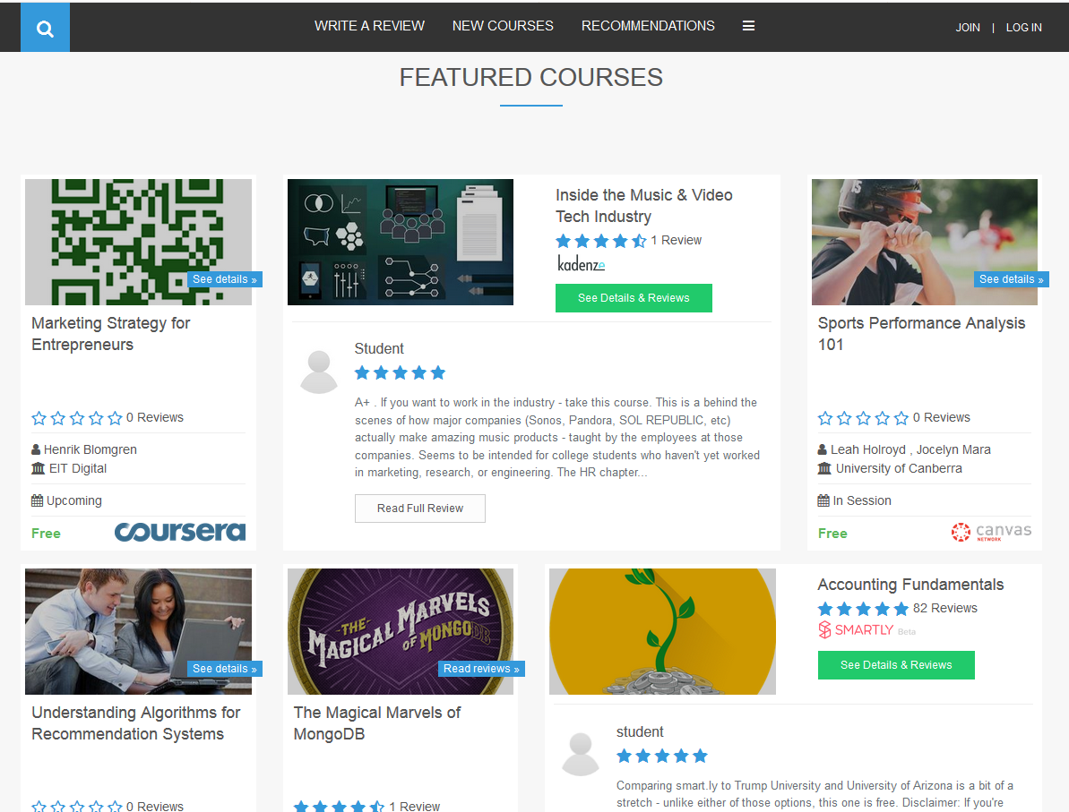
Khe Foon (Timothy) Hew (2018)
Hew, K. F. (2018). Unpacking the Strategies of Ten Highly Rated MOOCs: Implications for Engaging Students in Large Online Courses. Teachers College Record, 120(1). https://www.coursetalk.com/
Hew’s (2018, p. 1) analyzed 4,565 coursetalk review comments of 10 highly rated MOOCs. He found “six key factors that can engage online [MOOC] participants and nine reasons for participant disaffection.”
Problem-centric learning supported by clear explanations.
Active learning supported by timely feedback (e.g., assignments, projects, discussion).
Course resources that cater to participants’ learning needs or preferences.
Instructor attributes (e.g., passion, enthusiasm, humor, variety of examples).
Peer interaction.
Instructor availability.

Slide 89
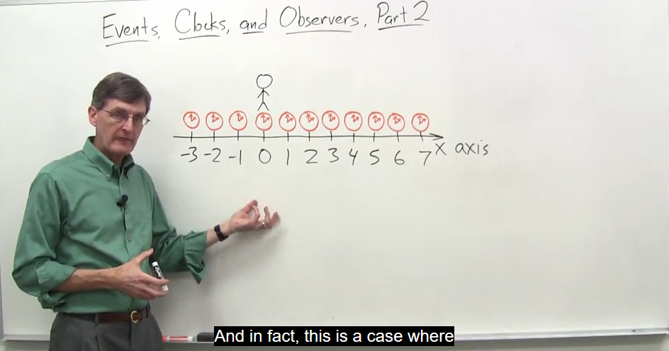

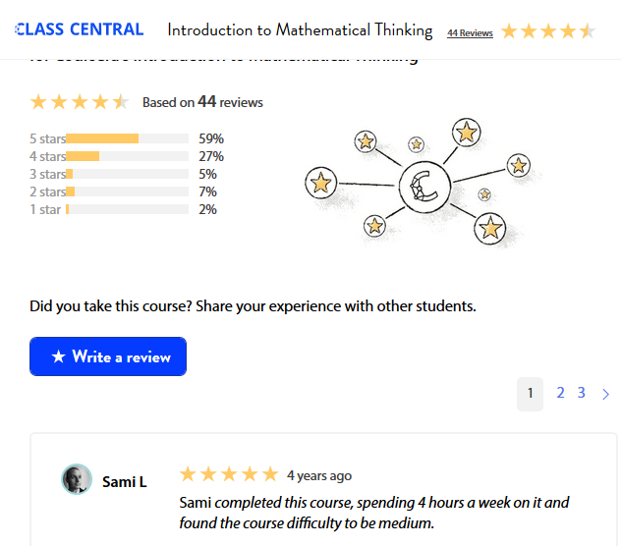
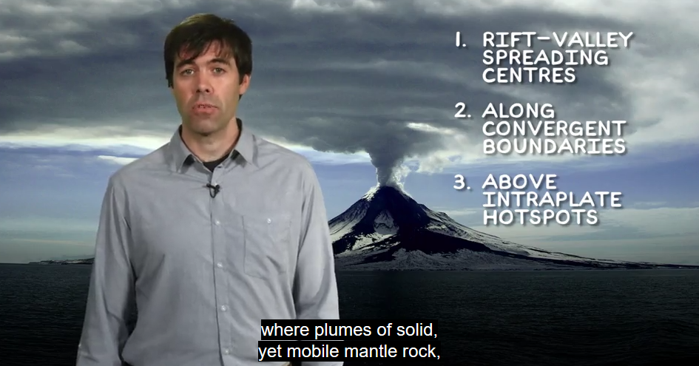
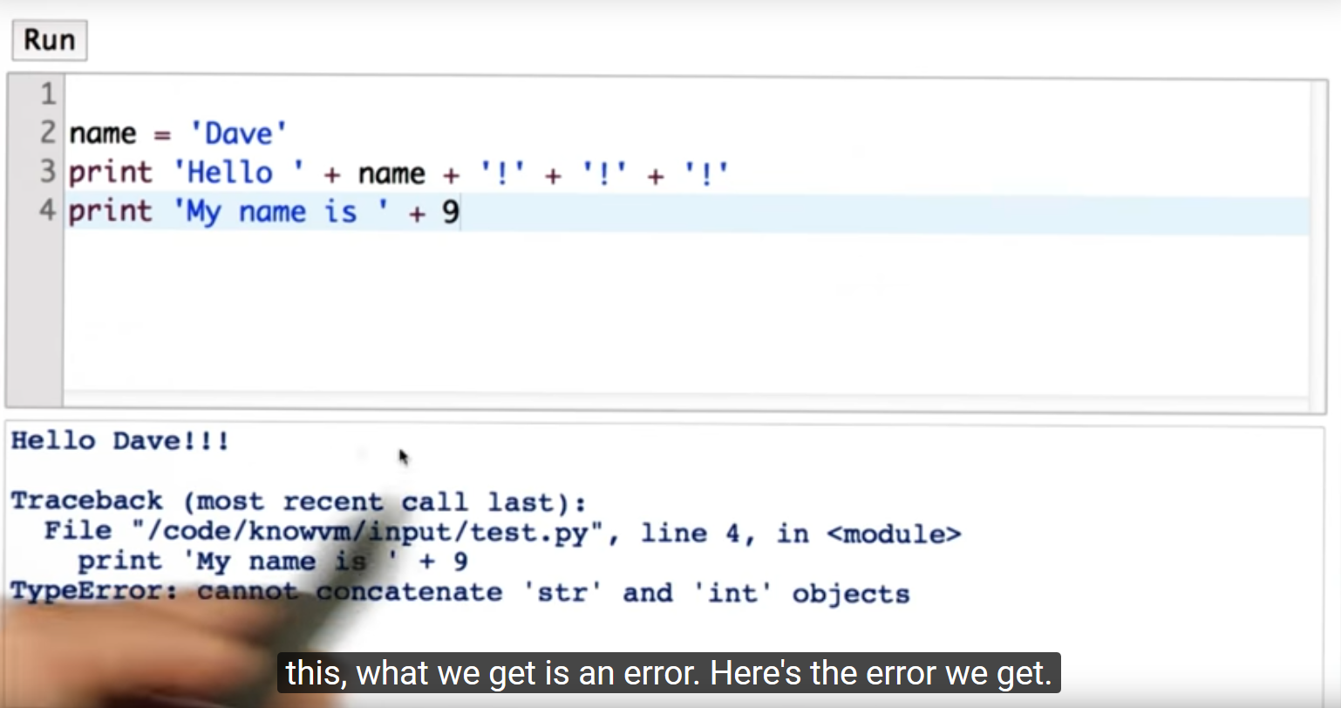

Study #6: May 16, 2018
Instructional Explanations in MOOC Videos (studio and classroom)
Junghun Lee, Indiana University

Slide 90

Curtis J. Bonk, IU, cjbonk@indiana.edu
Meina Zhu, IU, meinzhu@iu.edu
Annisa Sari, IU, annisa@uny.ac.id
Slides and Proceedings Paper at TrainingShare.com: http://www.trainingshare.com (go to “Archived Talks”)

