Slide 1


Innovations in Education:
How to Use Social Media, Mobile Learning, MOOCs and Open Educational Resources to Transform Learning
Curt Bonk, Indiana University, cjbonk@indiana.edu
November 9, 2017

Slide 2
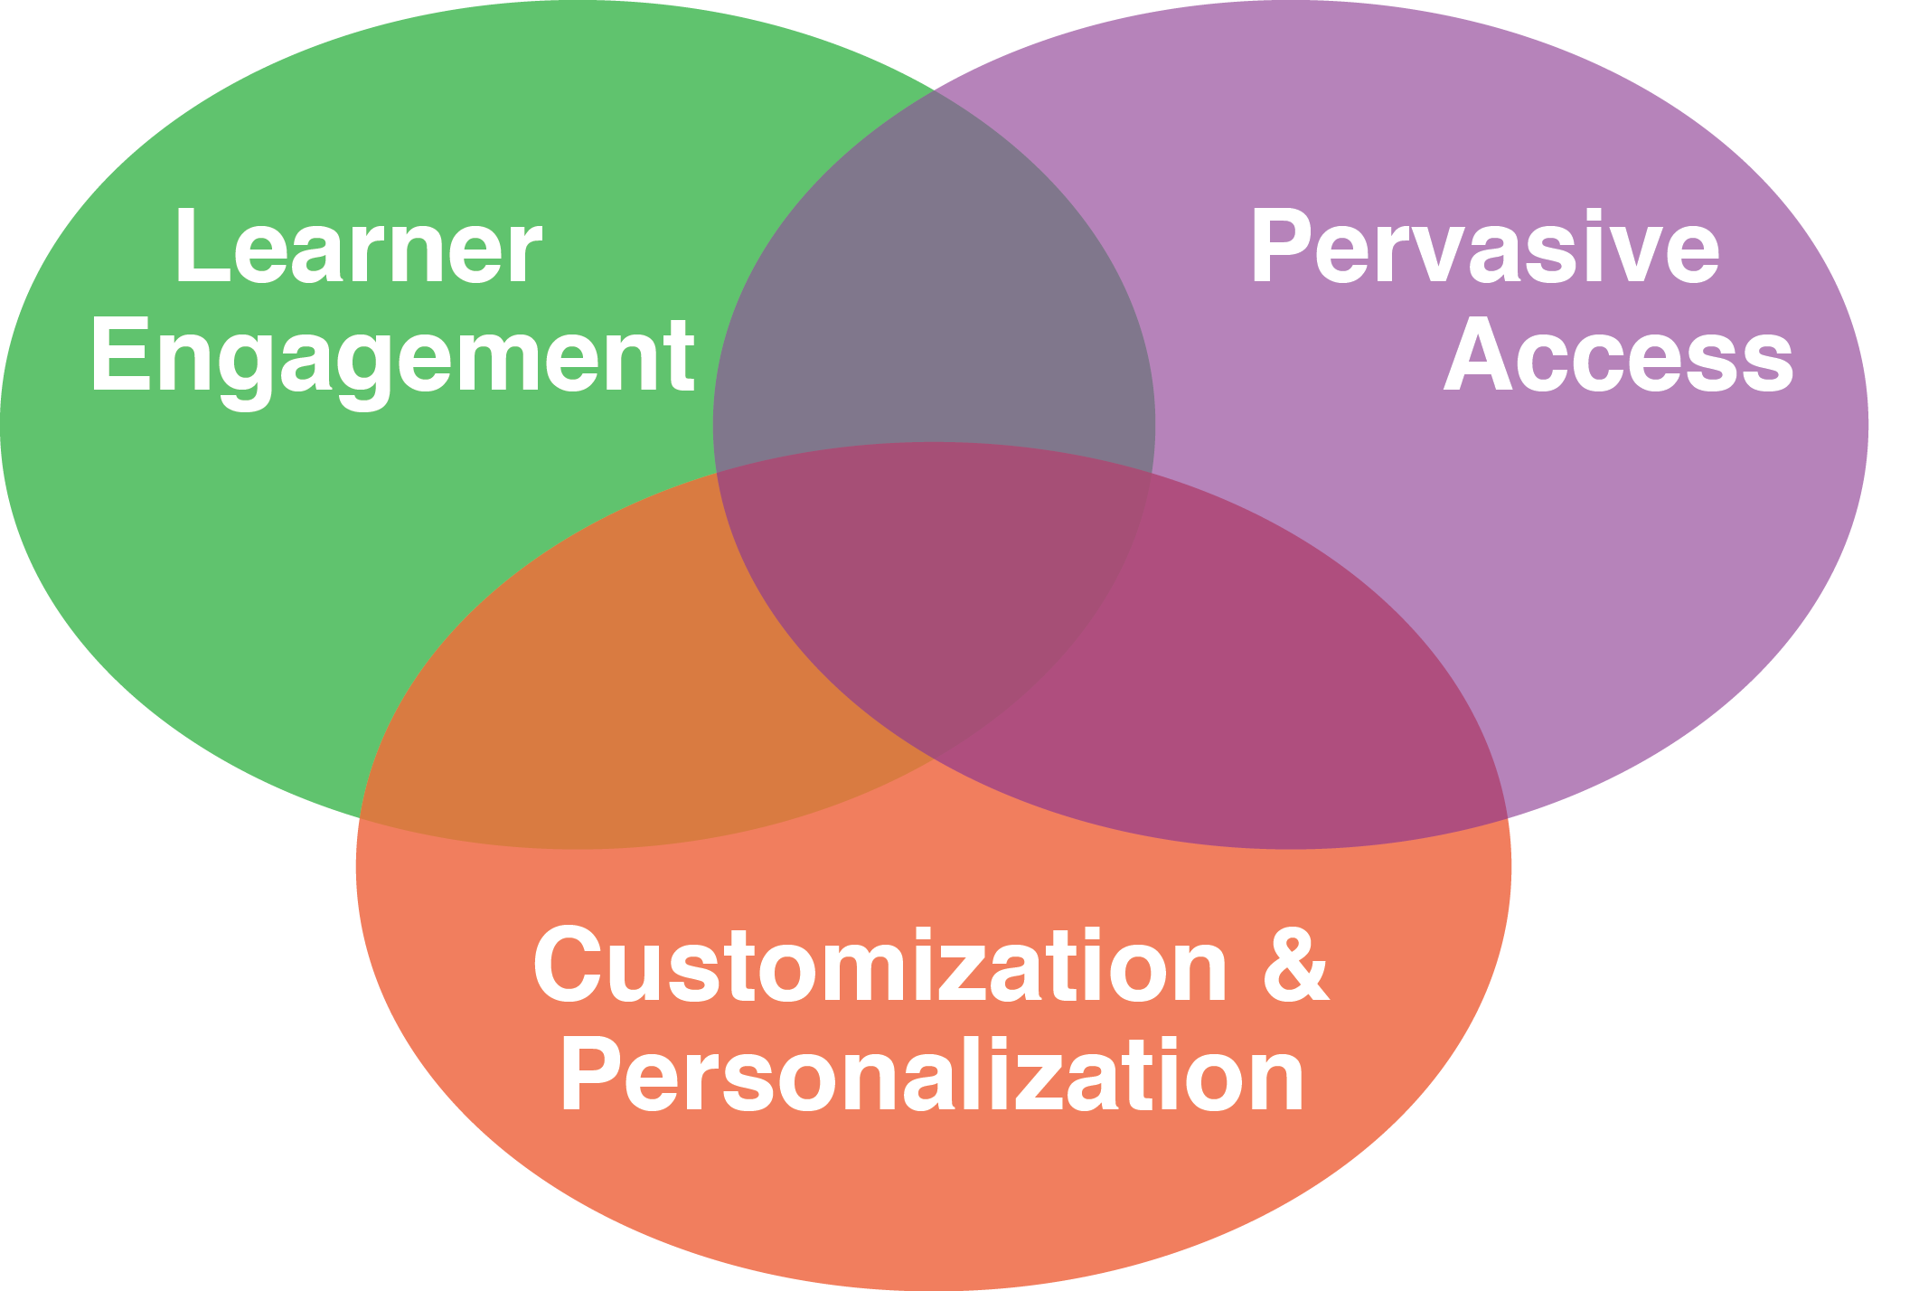
30+ Ways Learning is Changing:
The Mega Trends

Slide 3
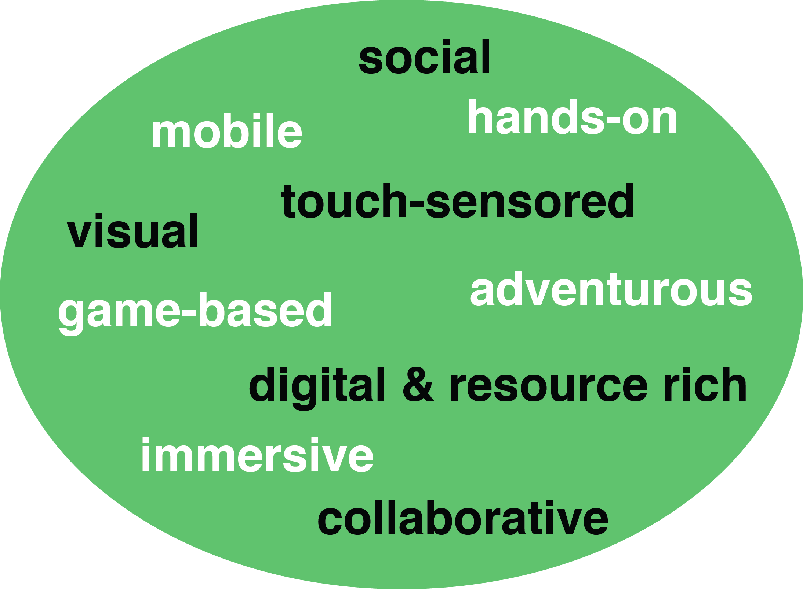
How Learning is Changing:
Mega Trend #1. Learner Engagement

Slide 4
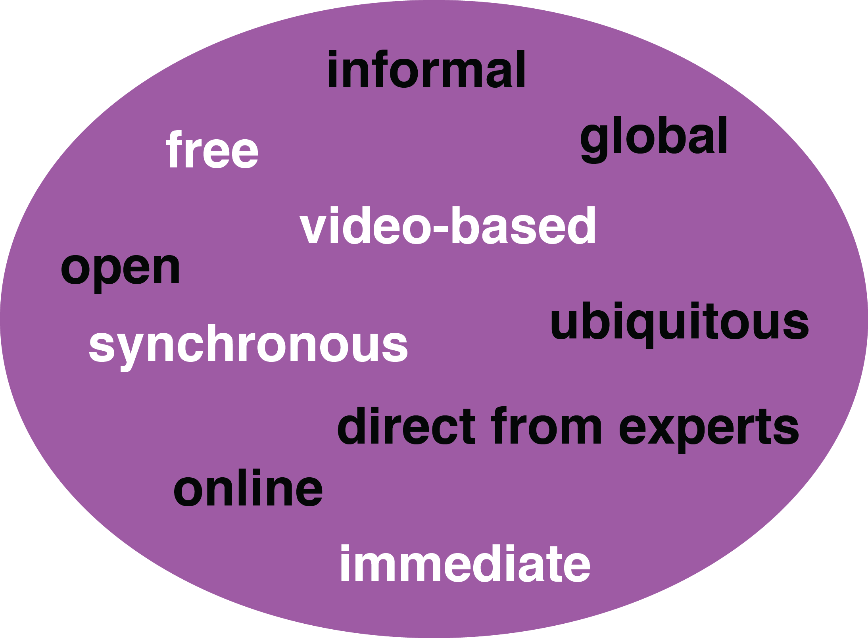
How Learning is Changing:
Mega Trend #2. Pervasive Access

Slide 5
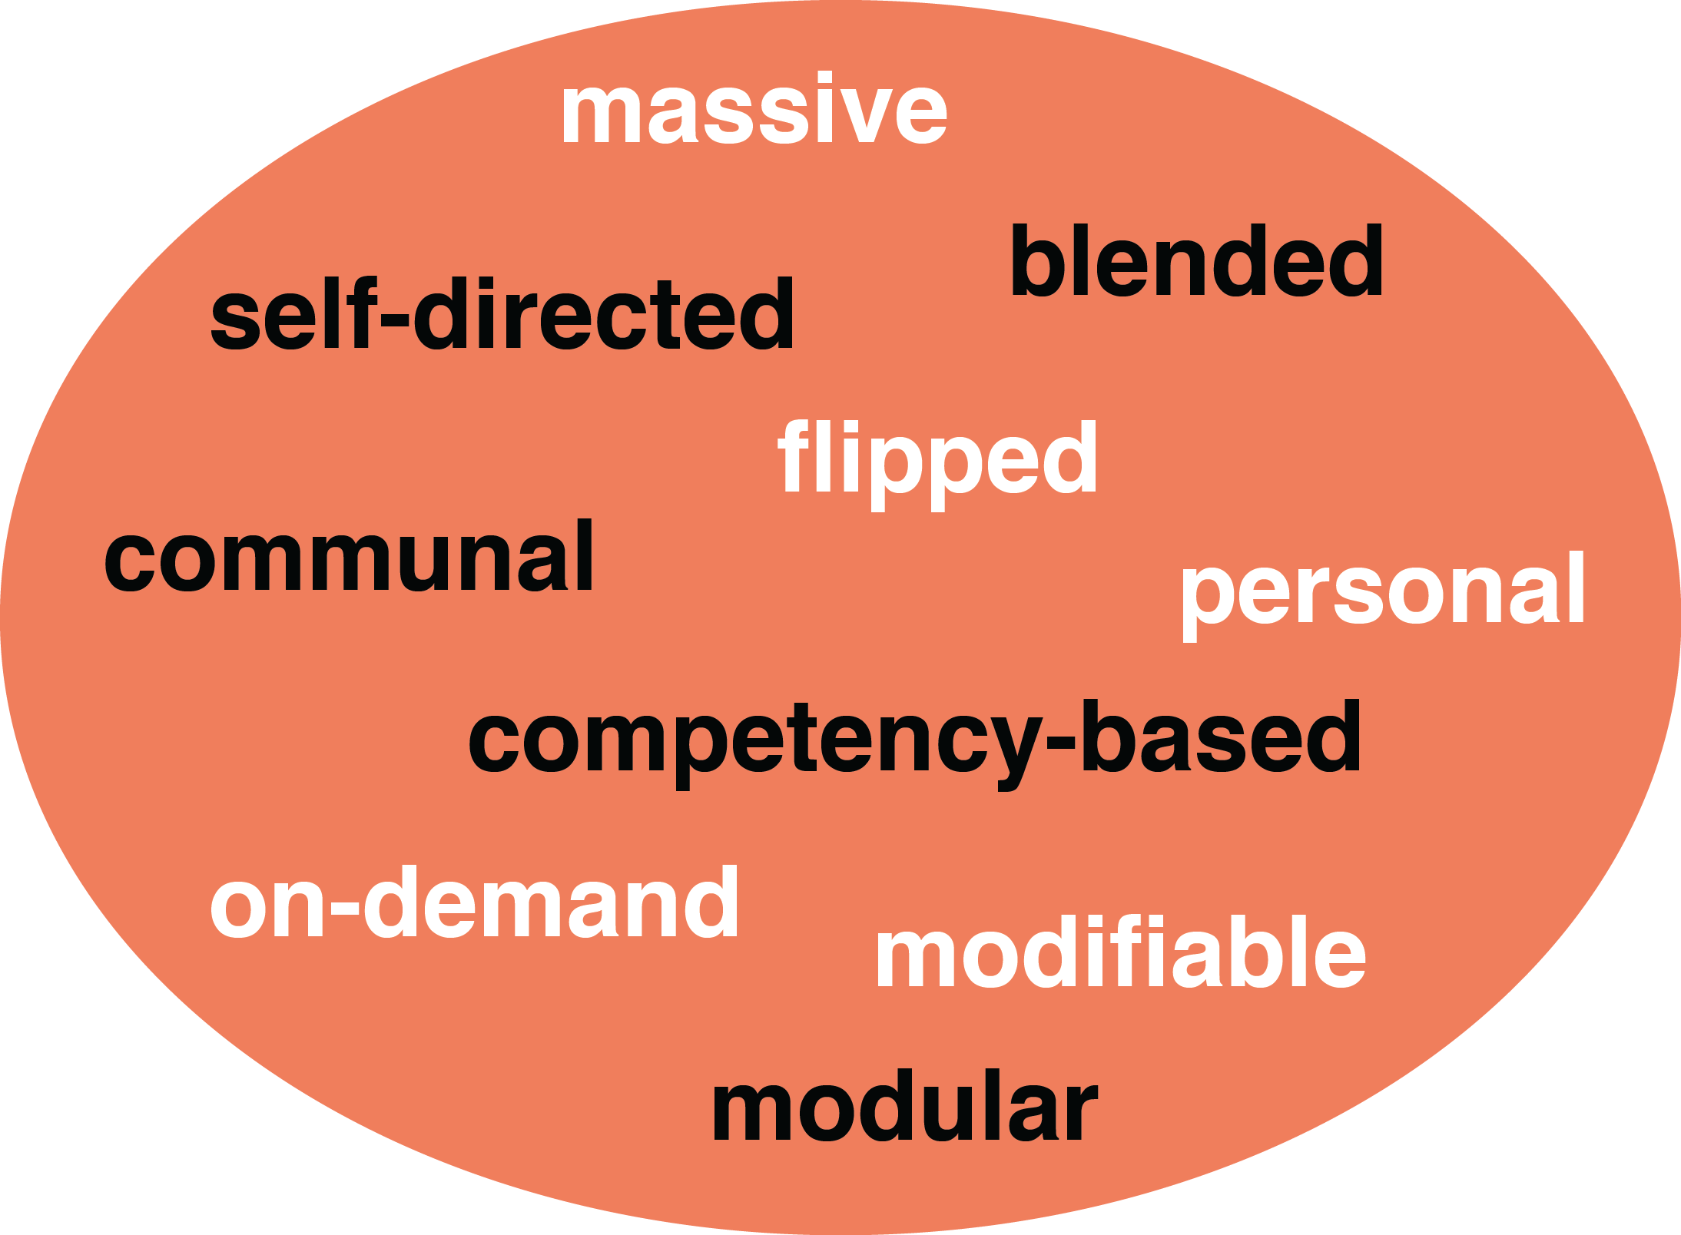
How Learning is Changing:
Mega Trend #3. Customization

Slide 6
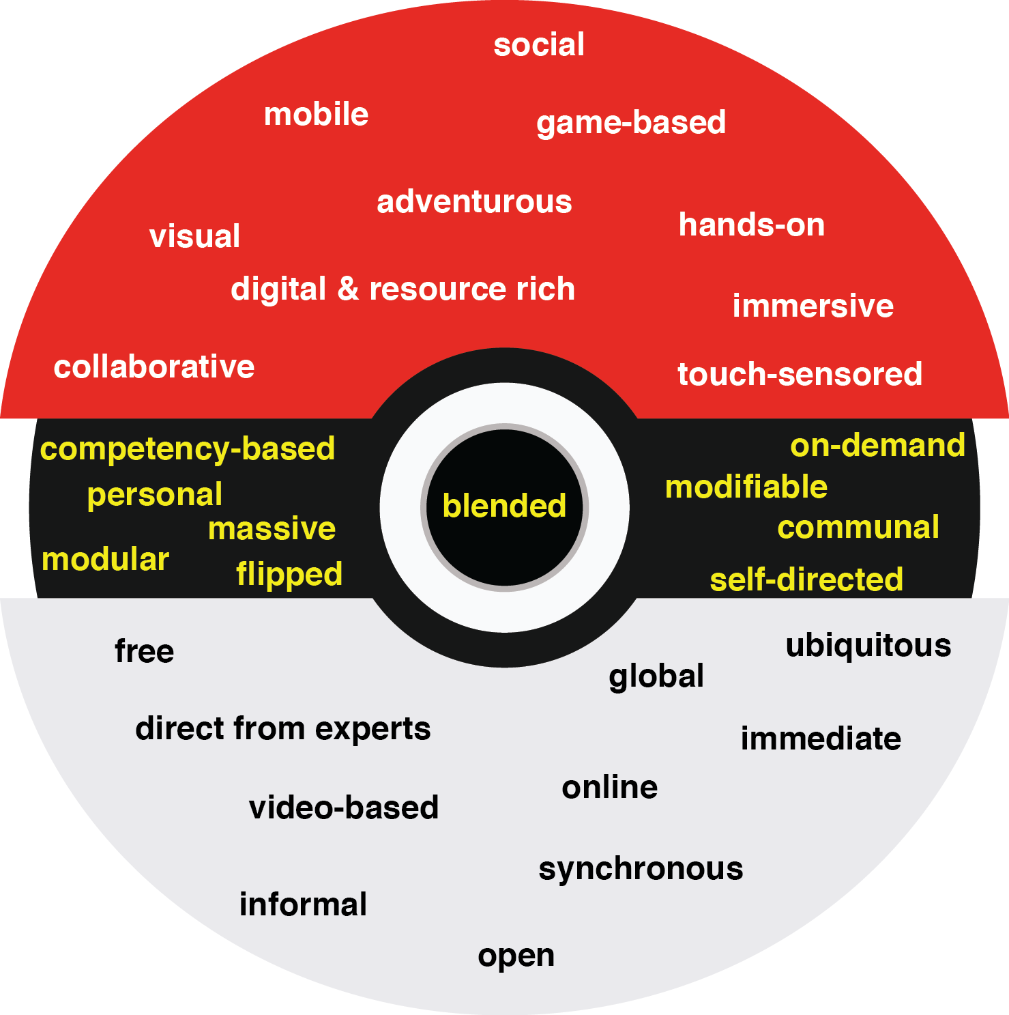
30+ Ways Learning is Changing:
Recapping the Three Mega Trends:
Engagement, Access, and Customization

Slide 7
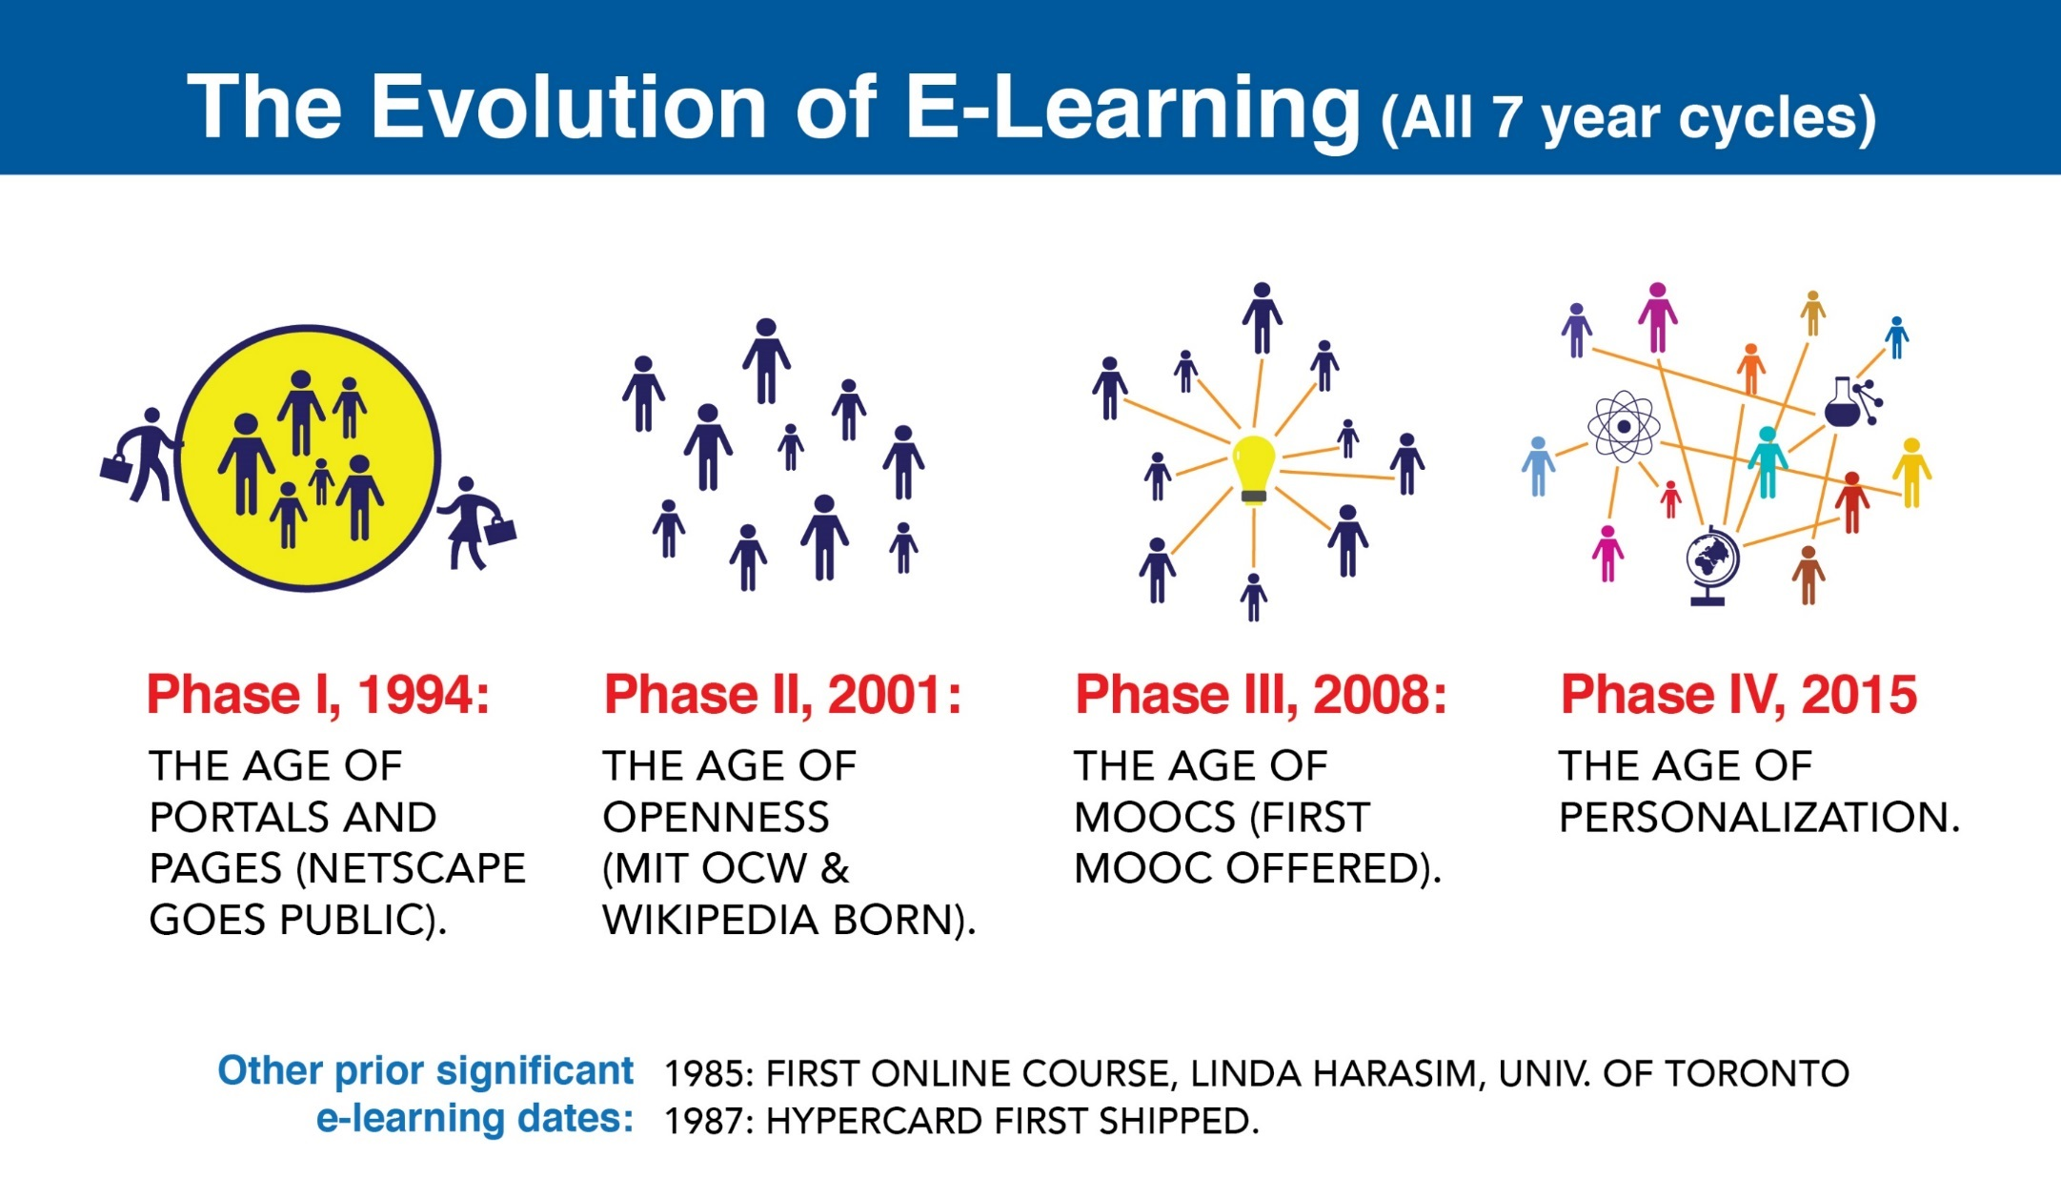

Slide 8
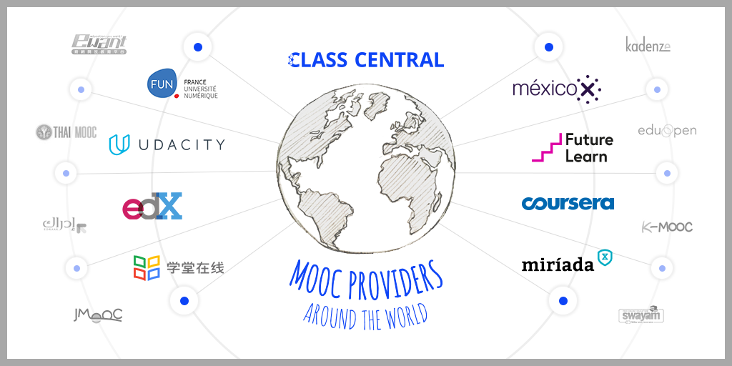

June 15, 2017
Massive List of MOOC Providers Around The World
(Where to Find MOOCs: The Definitive Guide to MOOC Providers )
Class Central, Dhawal Shah https://www.class-central.com/report/mooc-providers-list/

Slide 9
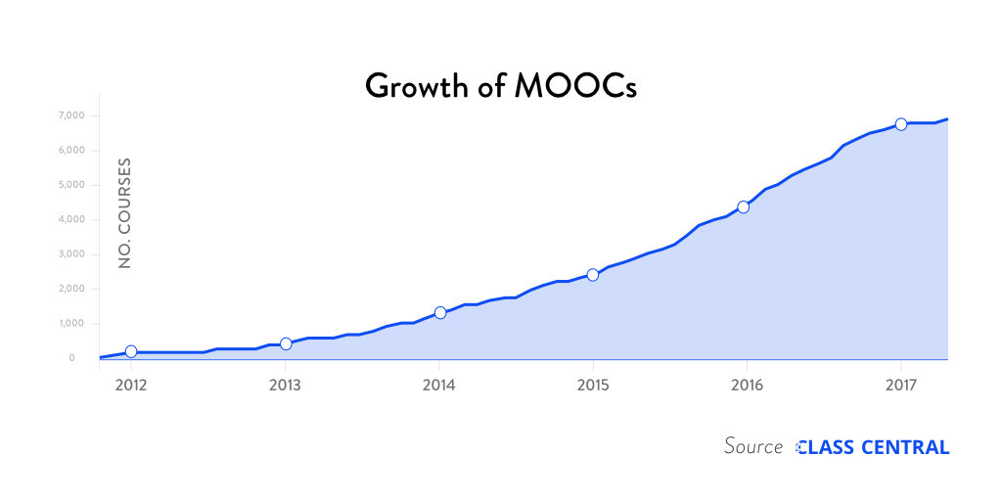
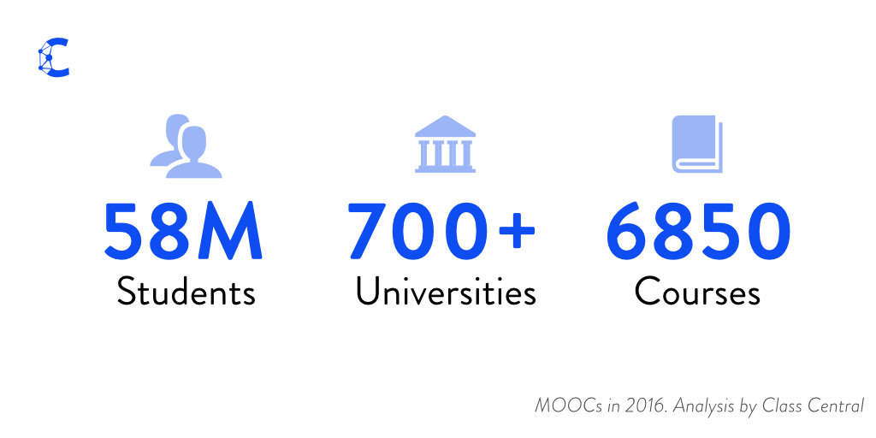
Research Background
The Numbers: MOOCS in 2016 (Dec 25th, Class Central)
Notes:
Dhawa Shah, Class Central
https://www.class-central.com/report/mooc-stats-2016/

Slide 10
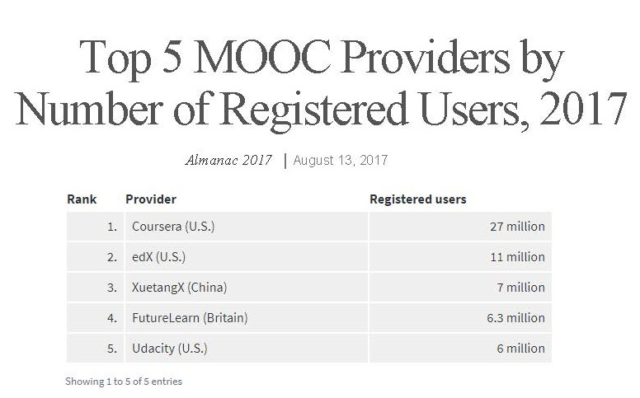
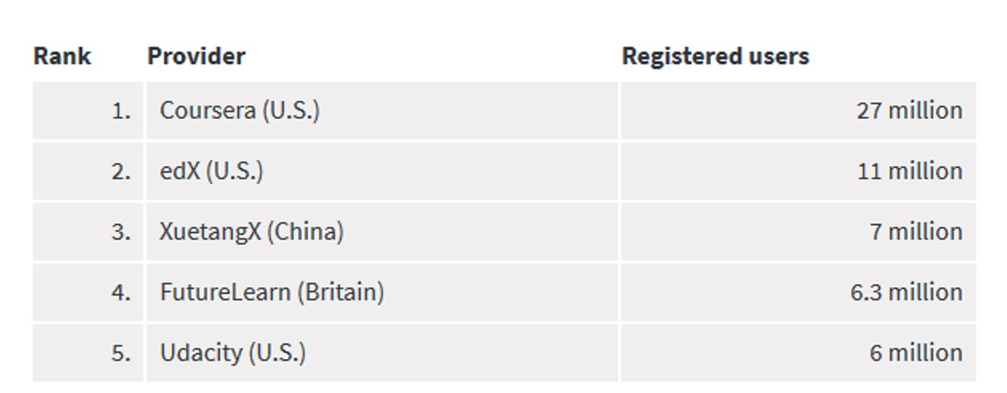

Slide 11
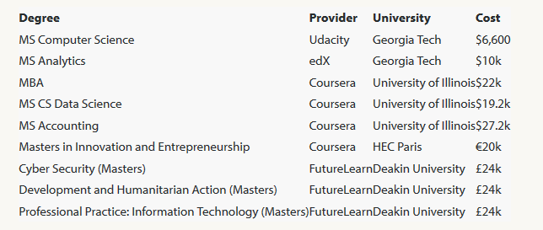
August 7, 2017
1. MOOCs for Credit
FutureLearn and Coventry University to Roll Out 50 Online Degrees
Class Central, Dhawal Shah https://www.class-central.com/report/futurelearn-coventry-university-roll-50-online-degrees/

Slide 12
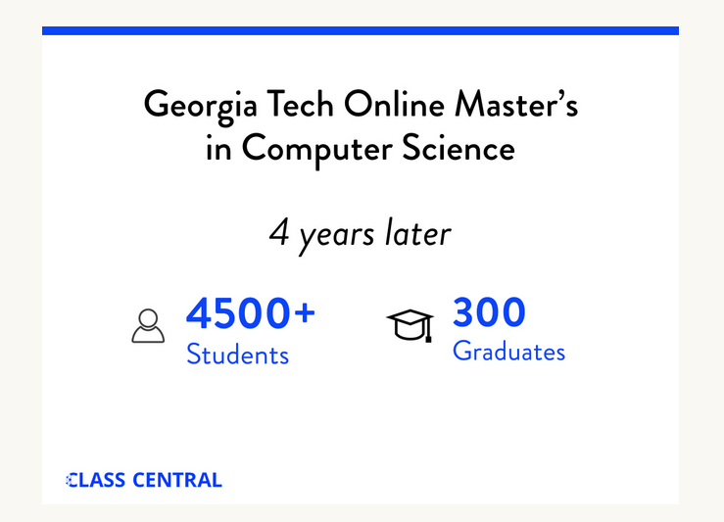
August 7, 2017
FutureLearn and Coventry University to Roll Out 50 Online Degrees
Class Central, Dhawal Shah https://www.class-central.com/report/futurelearn-coventry-university-roll-50-online-degrees/

Slide 13
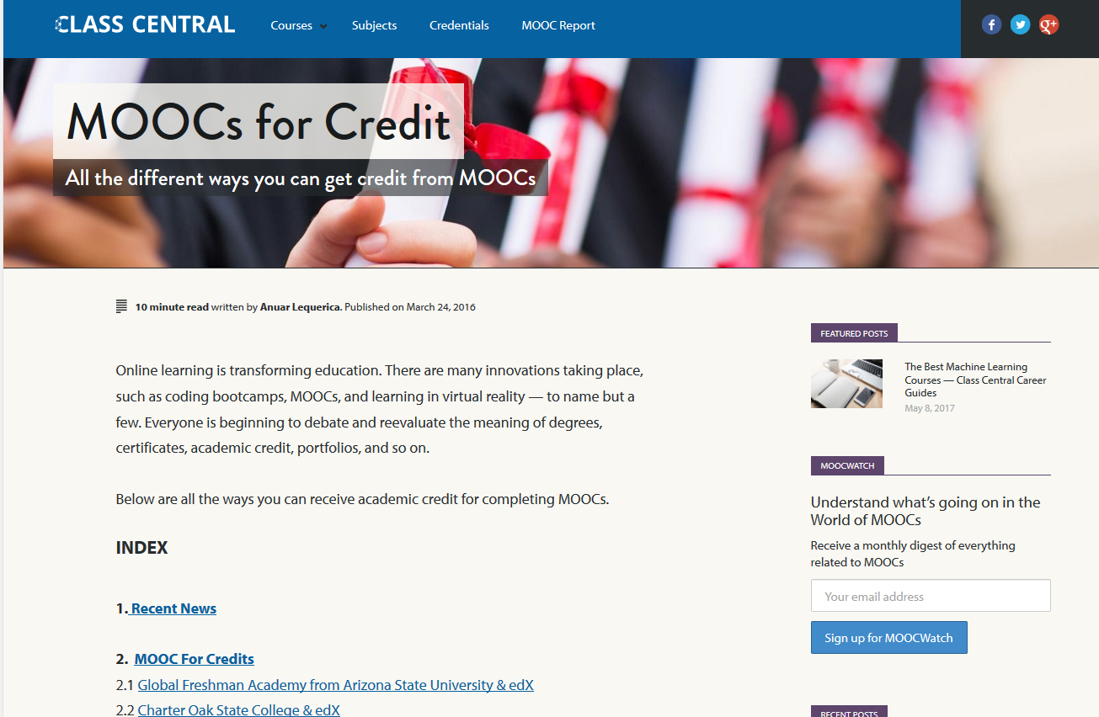
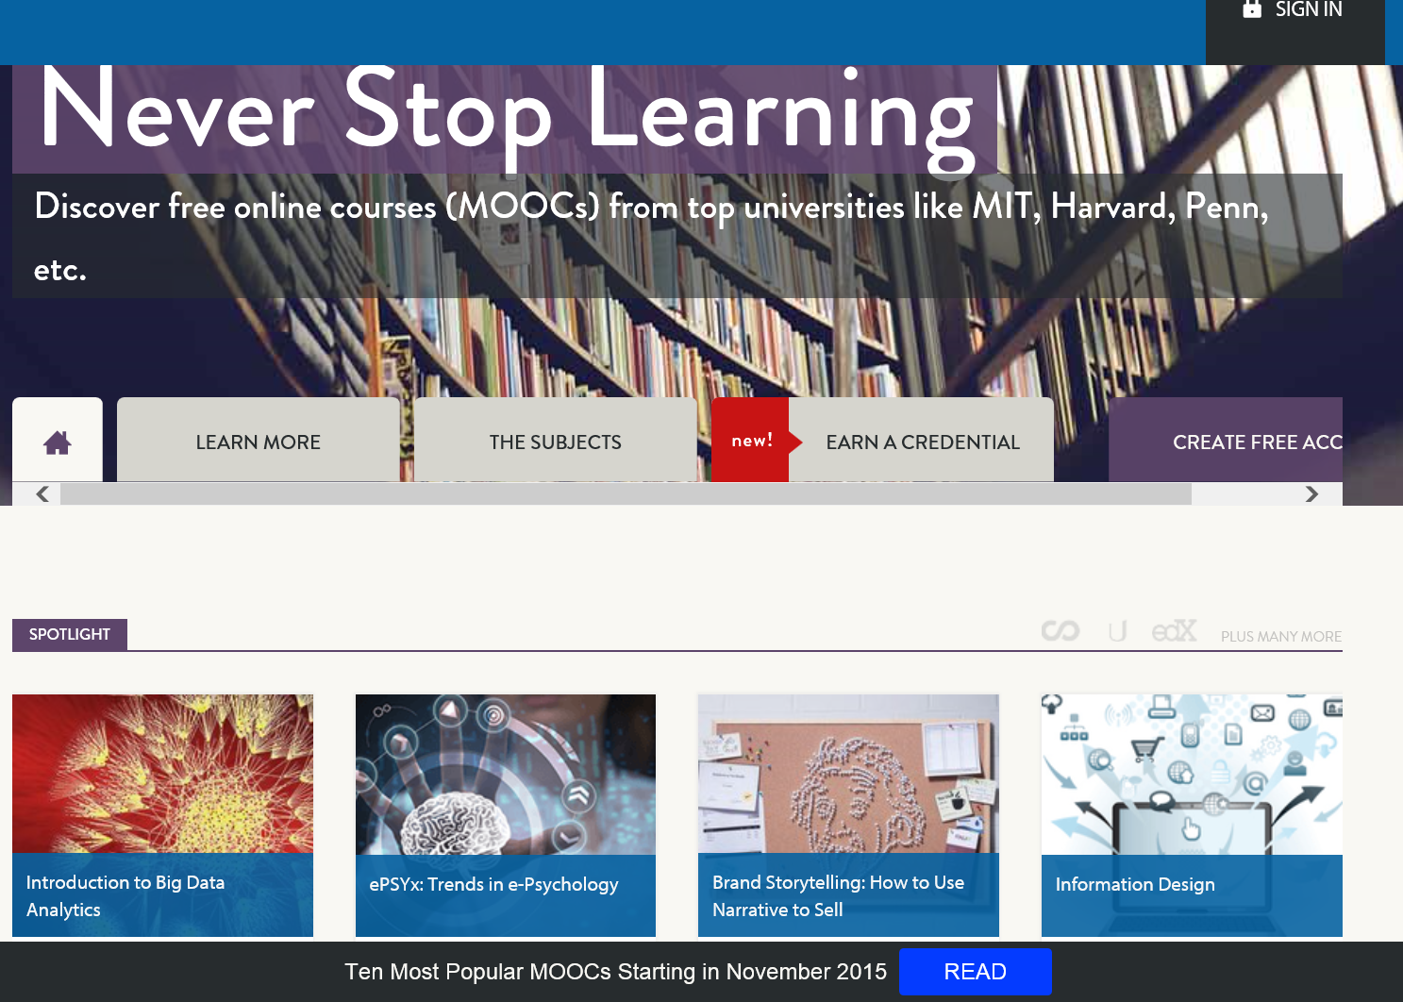
June 15, 2017
MOOCs for Credit
Class Central https://www.class-central.com/report/moocs-for-credit/

Slide 14
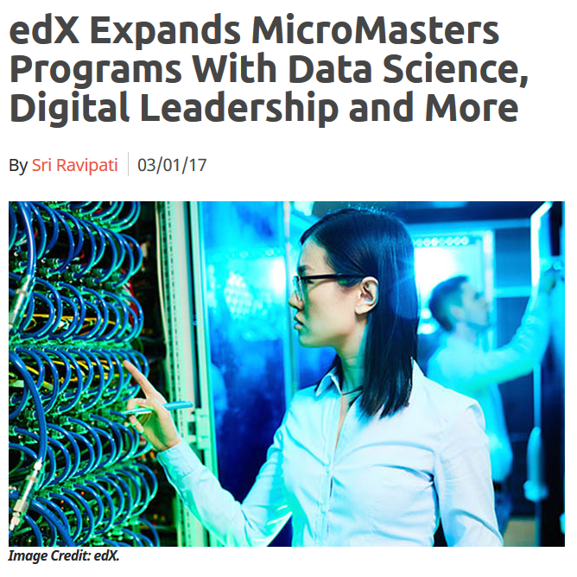
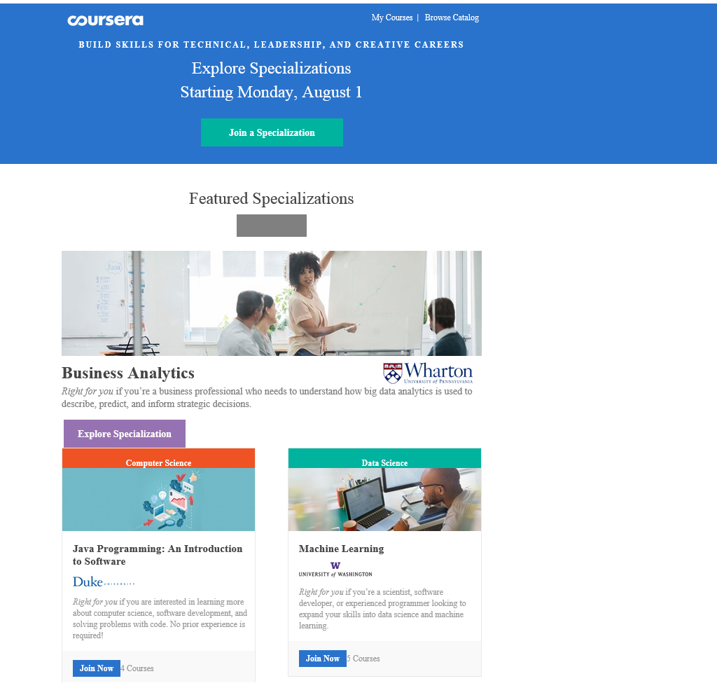
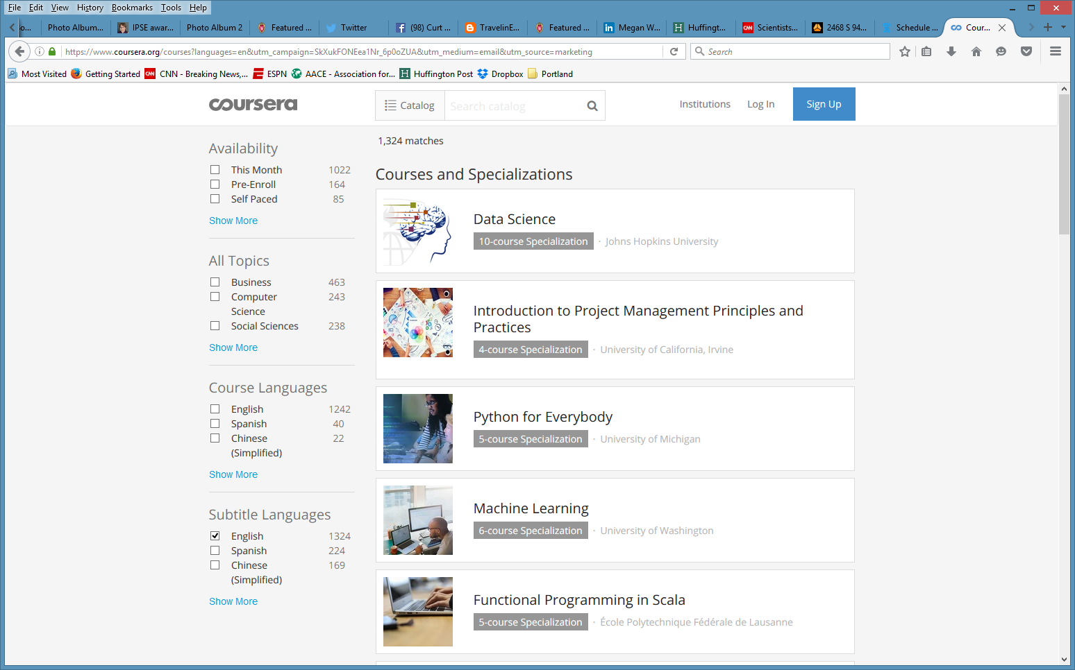
March 3, 2017
2. MOOCs for Credentialing edX Expands MicroMasters Programs With Data Science (“nanodegrees”)
Digital Leadership and More, Sri Ravipati, Campus Technology https://campustechnology.com/articles/2017/03/01/edx-expands-micromasters-programs-with-data-science-digital-leadership-and-more.aspx

Slide 15
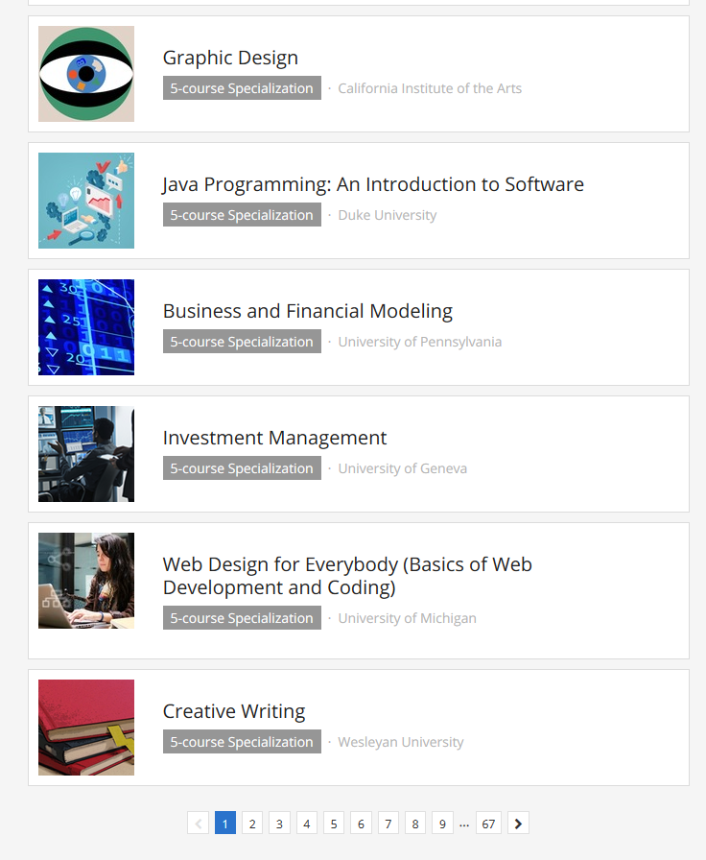
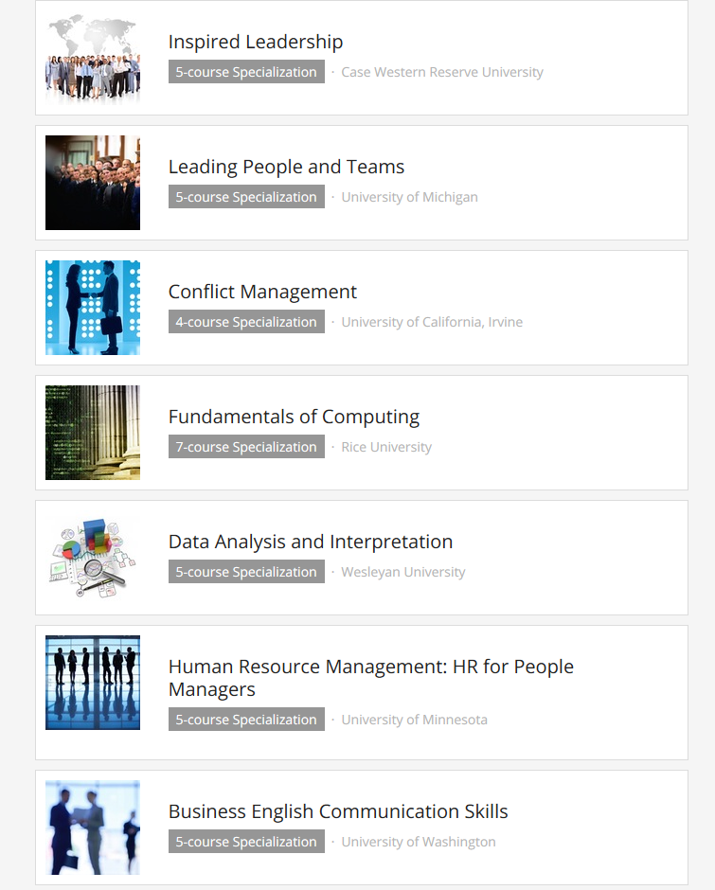
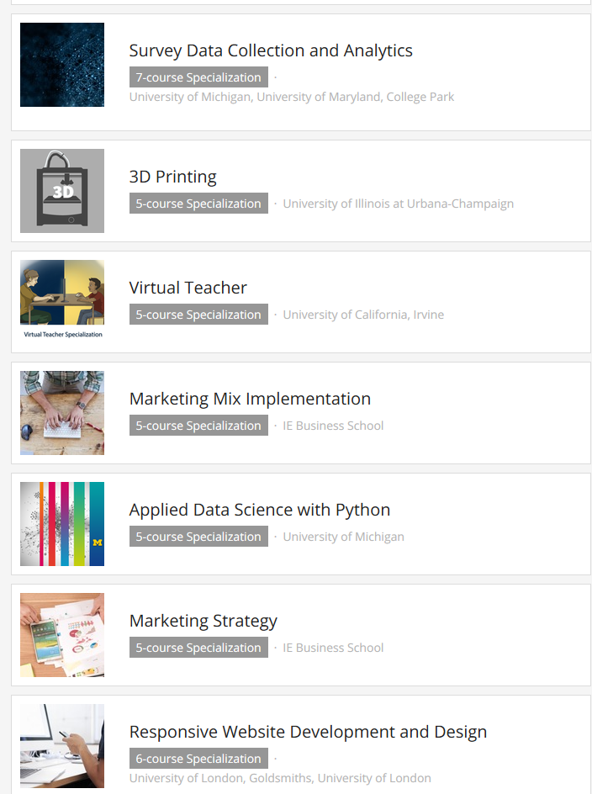
July 28, 2016
Coursera Specializations email
Starting Monday: 9 Top Specializations https://www.coursera.org/courses?languages=en&utm_campaign=SkXukFONEea1Nr_6p0oZUA&utm_medium=email&utm_source=marketing

Slide 16
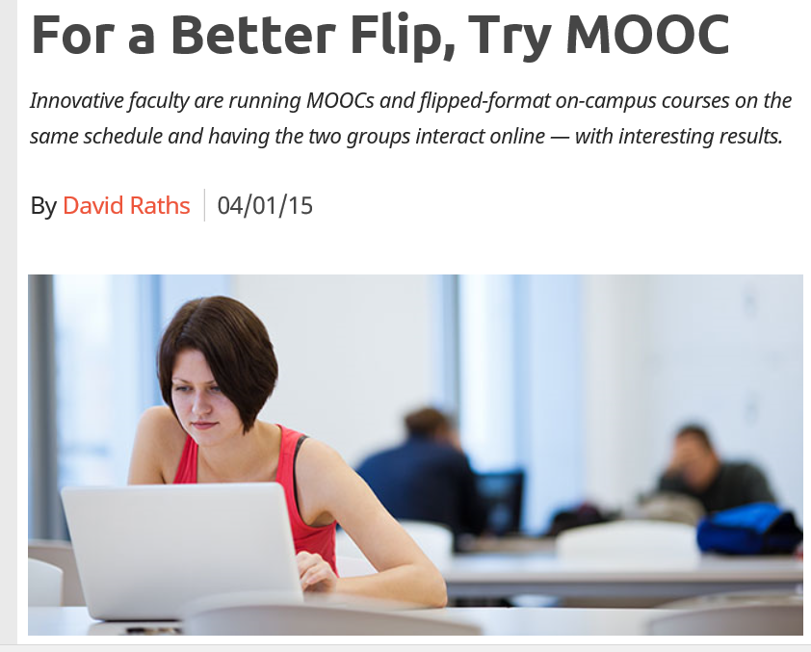
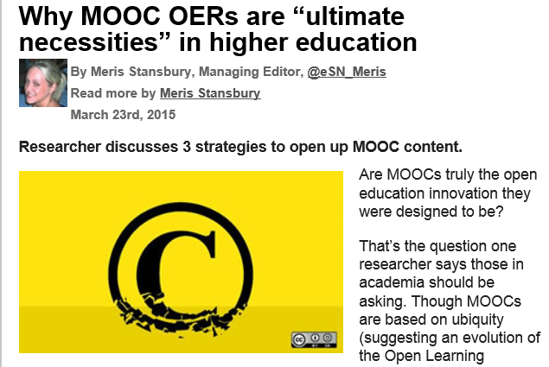
April 1, 2015
3. MOOCs for Extending Course Resources (e.g., flipping the class)
For a Better Flip, Try MOOCs, David Raths, Campus Technology http://campustechnology.com/articles/2015/04/01/for-a-better-flip-try-moocs.aspx

Slide 17
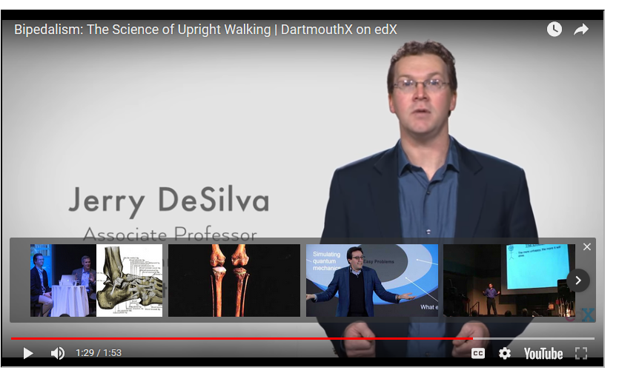
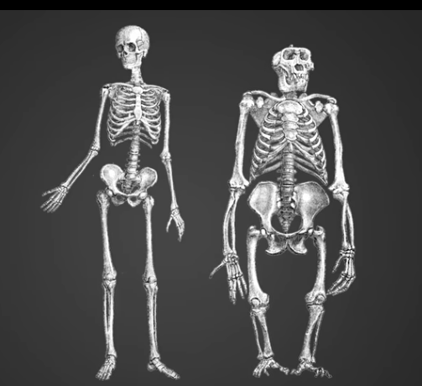
September 25, 2017
4. MOOCs for Expanding Instructor Influence
Professors Have Taken Over the MOOCs:
How open online learning is changing
Joshua Kim, Inside Higher Ed https://www.insidehighered.com/blogs/technology-and-learning/professors-have-taken-over-moocs

Slide 18

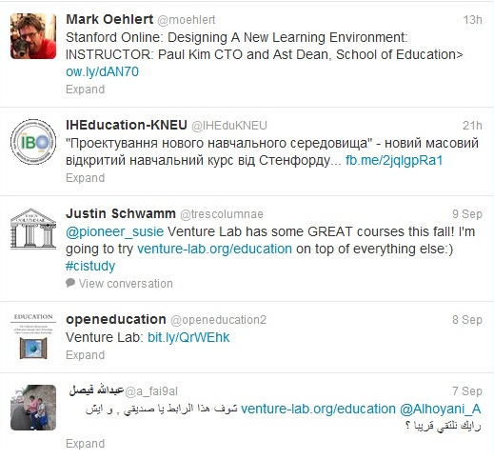
July 1, 2015
5. MOOCs for Global Collaboration
Chapter 14: Creating a Temporary Spontaneous Mini-Ecosystem through a MOOC
Paul Kim and Charlie Chung, Stanford University
Figure 2. Twitter thread announcing the MOOC

Slide 19
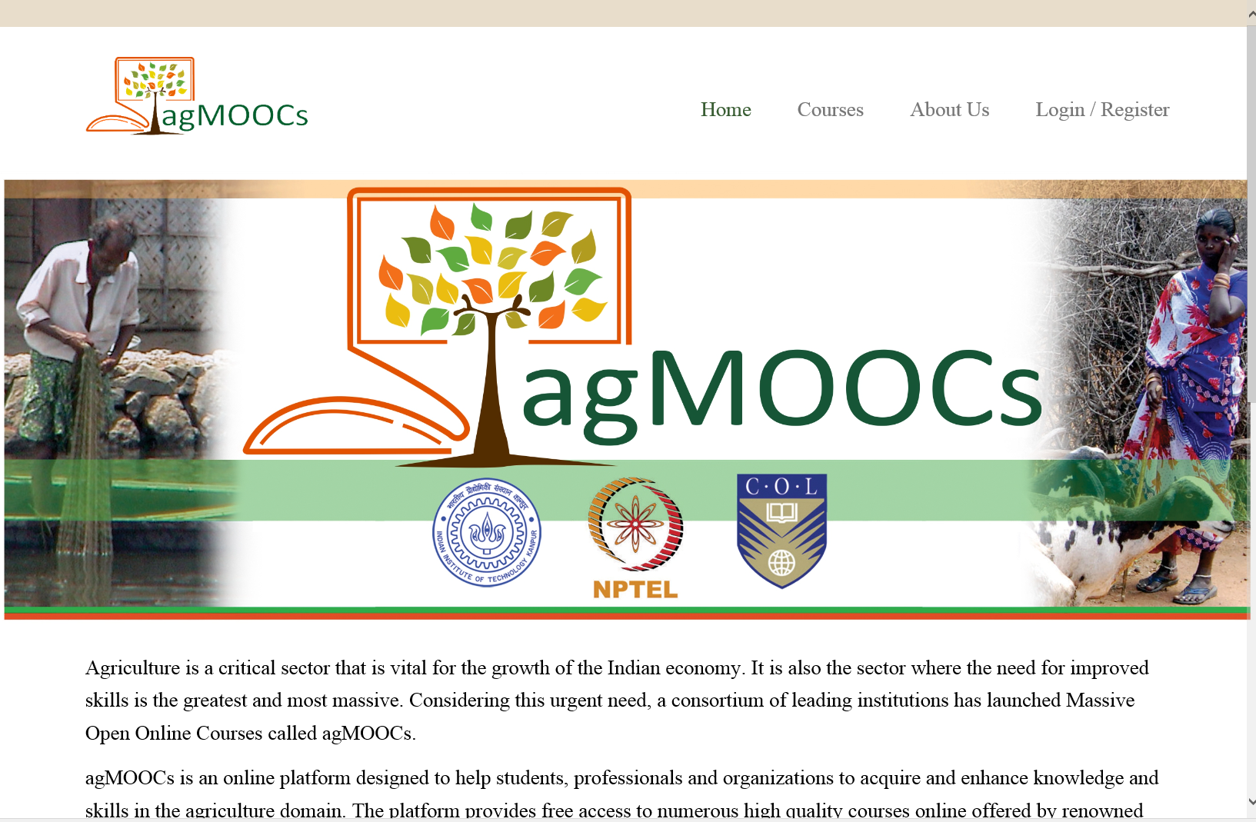


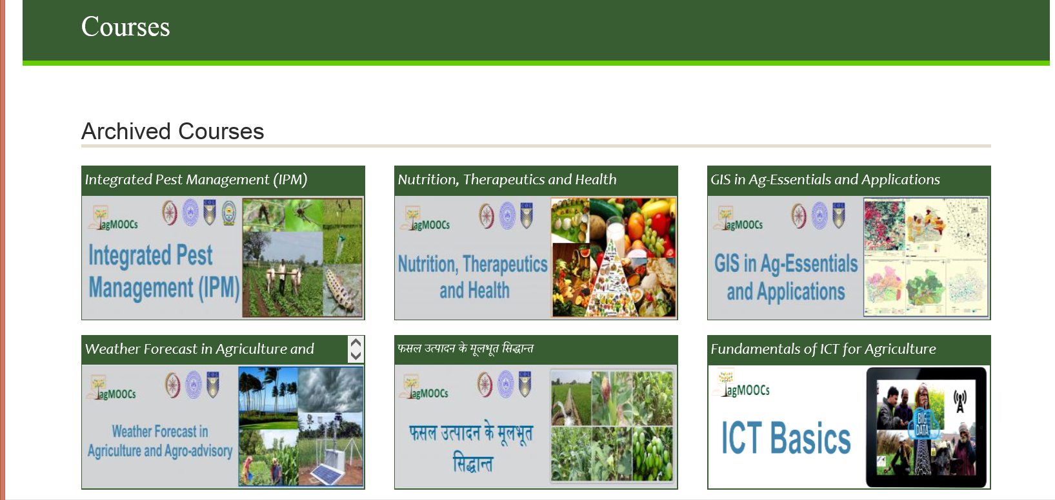
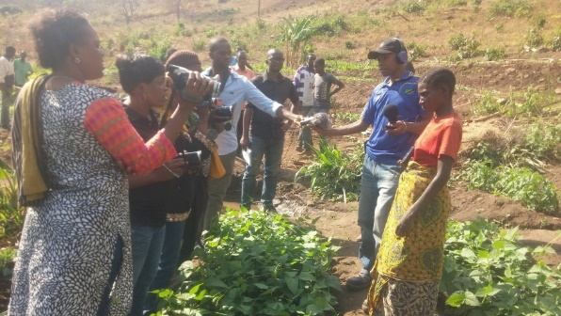
May 20, 2016
6. MOOCs for Development agMOOCs (India) http://www.agmoocs.in/

Slide 20
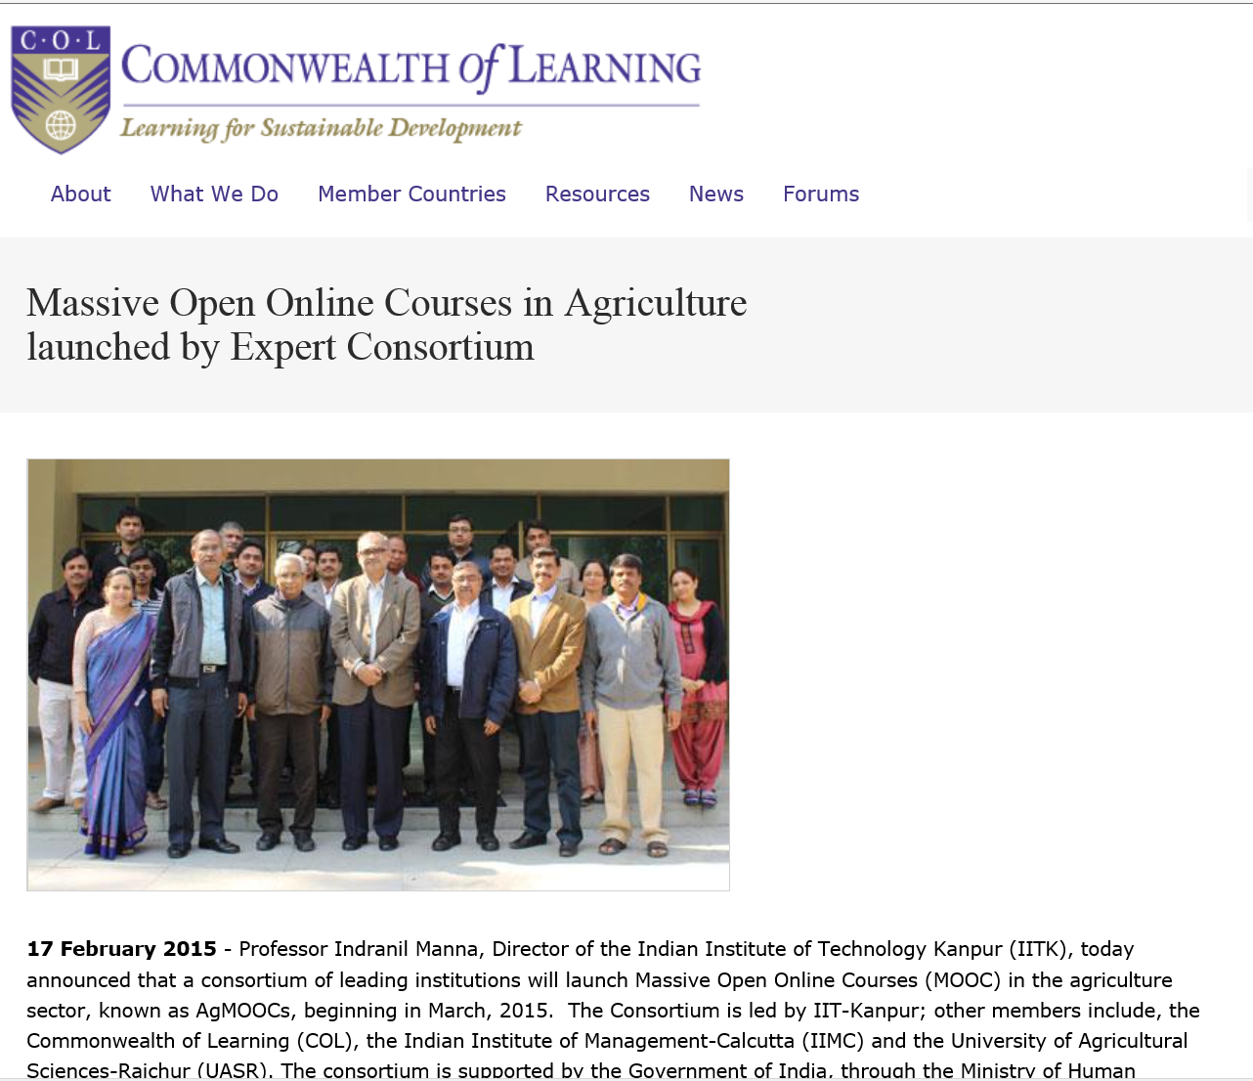
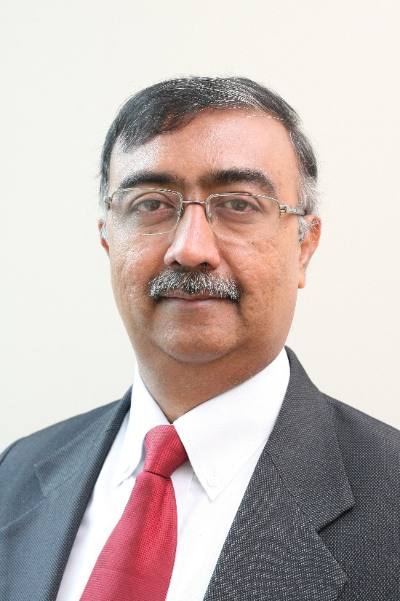
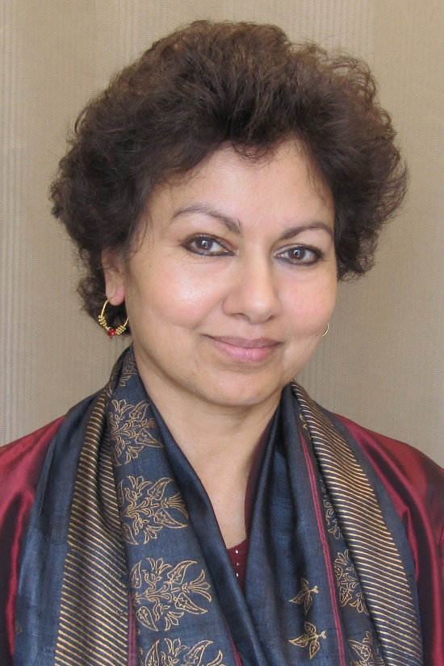
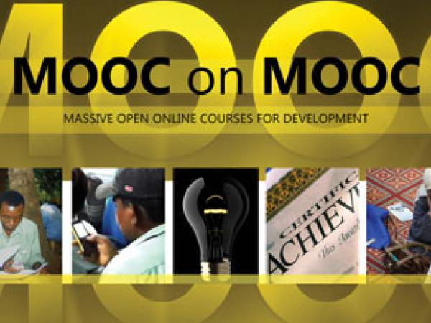
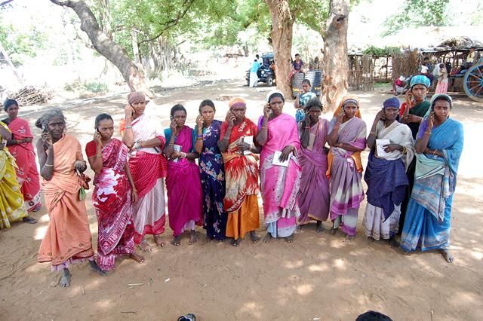
Chapter 18: Changing the Tune: MOOCs for Human Development? A Case Study
MOOCs for Development
Balaji Venkatataraman and Asha Kanwar, COL

Slide 21
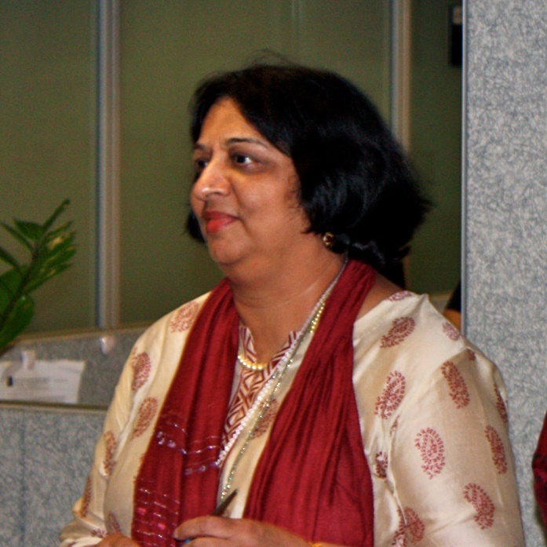
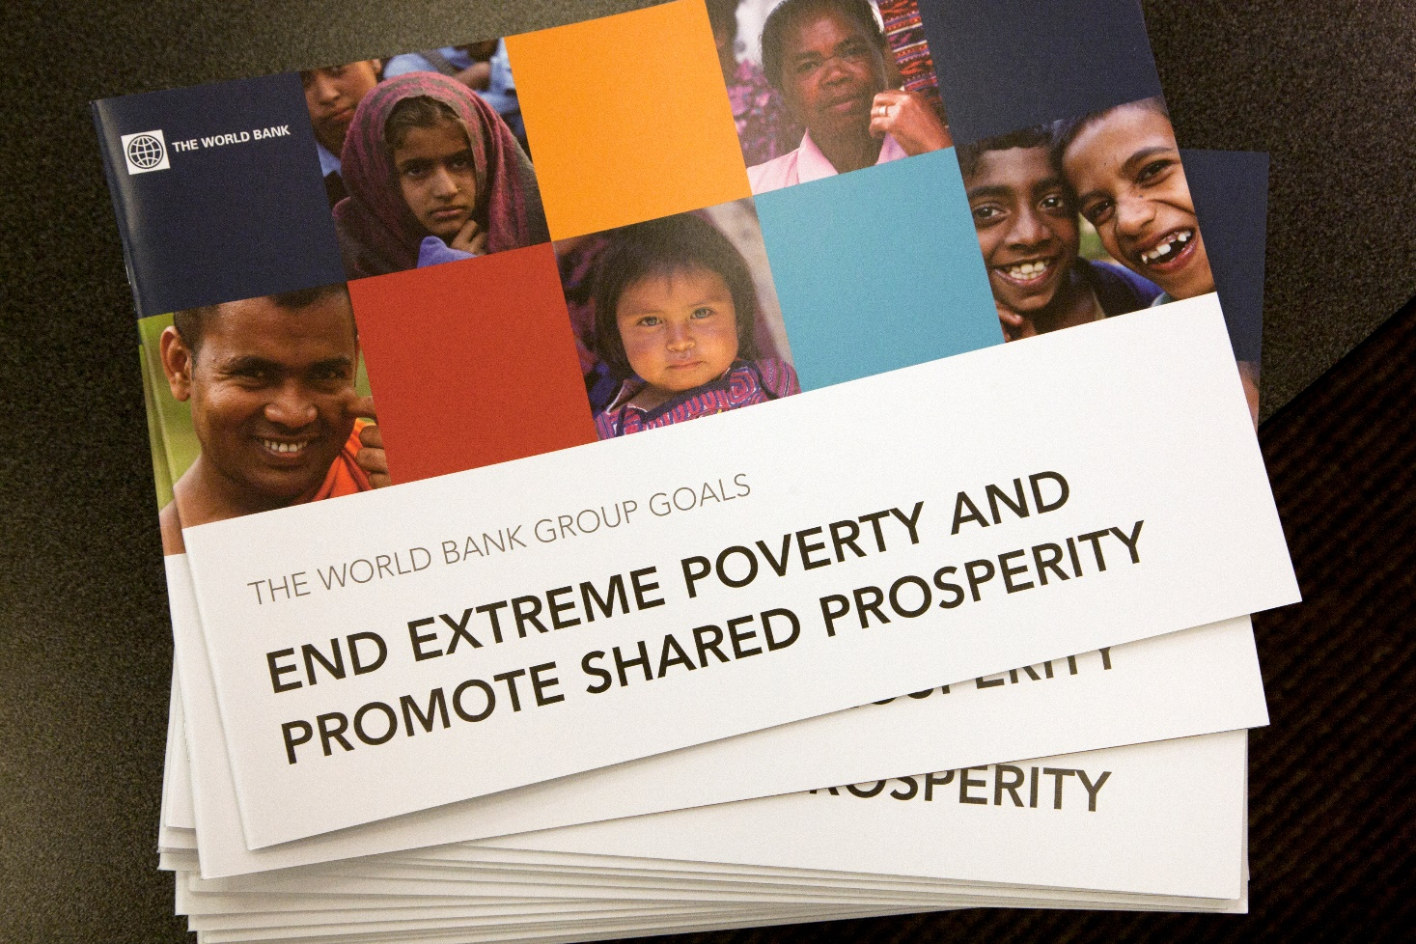
Chapter 19: Harnessing the Power of Open Learning to Share Global Prosperity and Eradicate Poverty
7. MOOCs for Societal Issues
Sheila Jagannathan, World Bank, Washington DC
Figure 1: World Bank Group Twin Goals

Slide 22
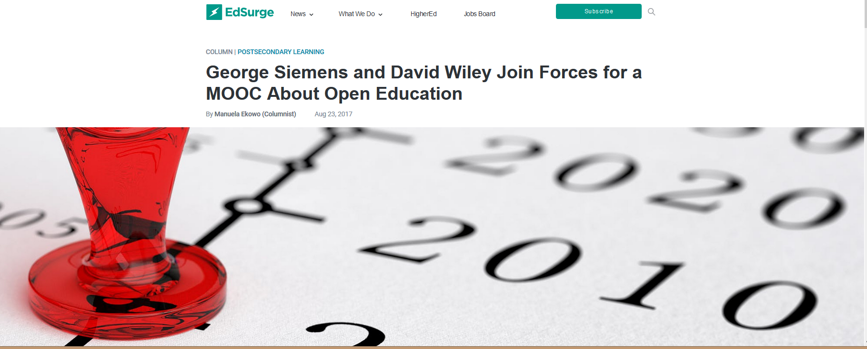
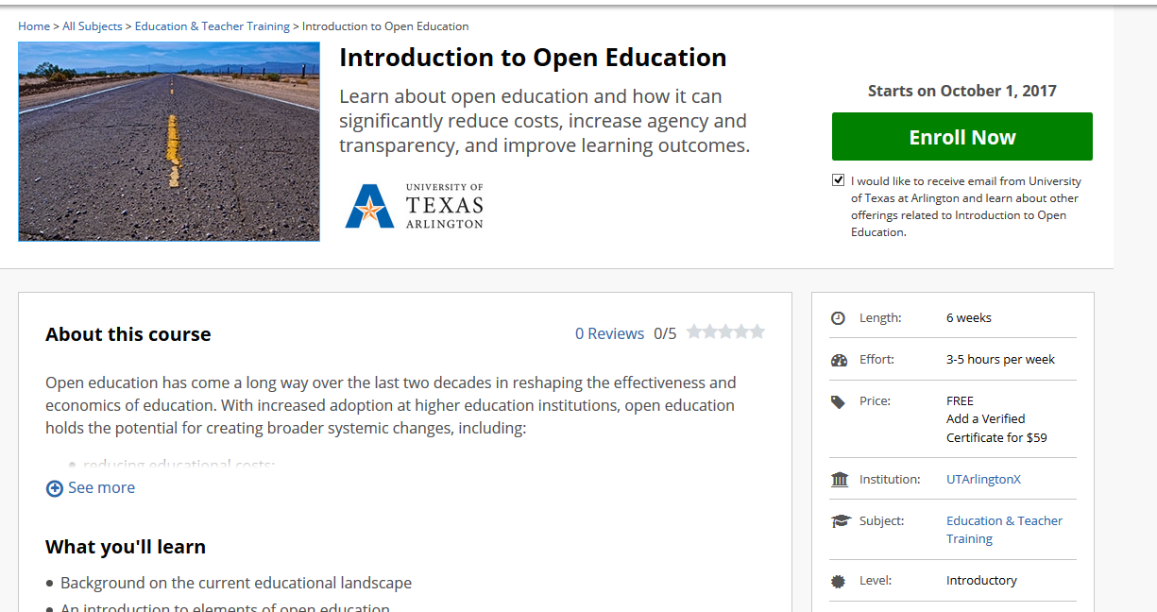
August 23, 2017
8. MOOCs for Explaining Trends and Innovations
George Siemens and David Wiley Join Forces for a MOOC About Open Education
Manuela Ekowo, EdSurge https://www.edsurge.com/news/2017-08-23-george-siemens-and-david-wiley-join-forces-for-a-mooc-about-open-education https://www.edx.org/course/introduction-open-education-utarlingtonx-link-oex

Slide 23
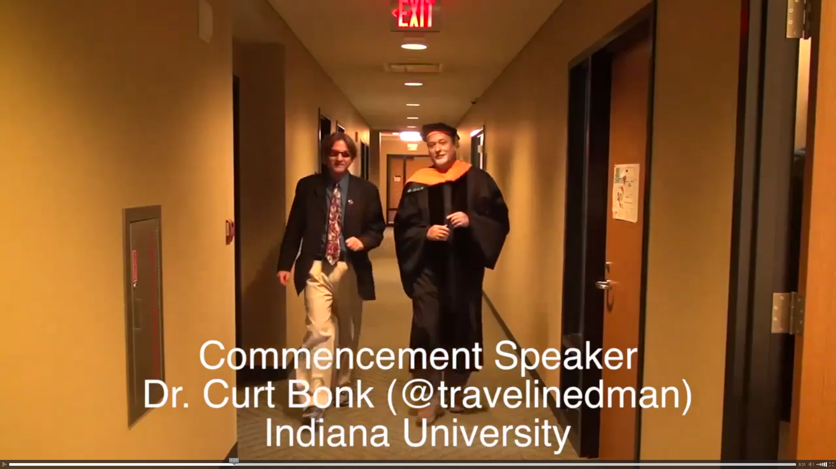
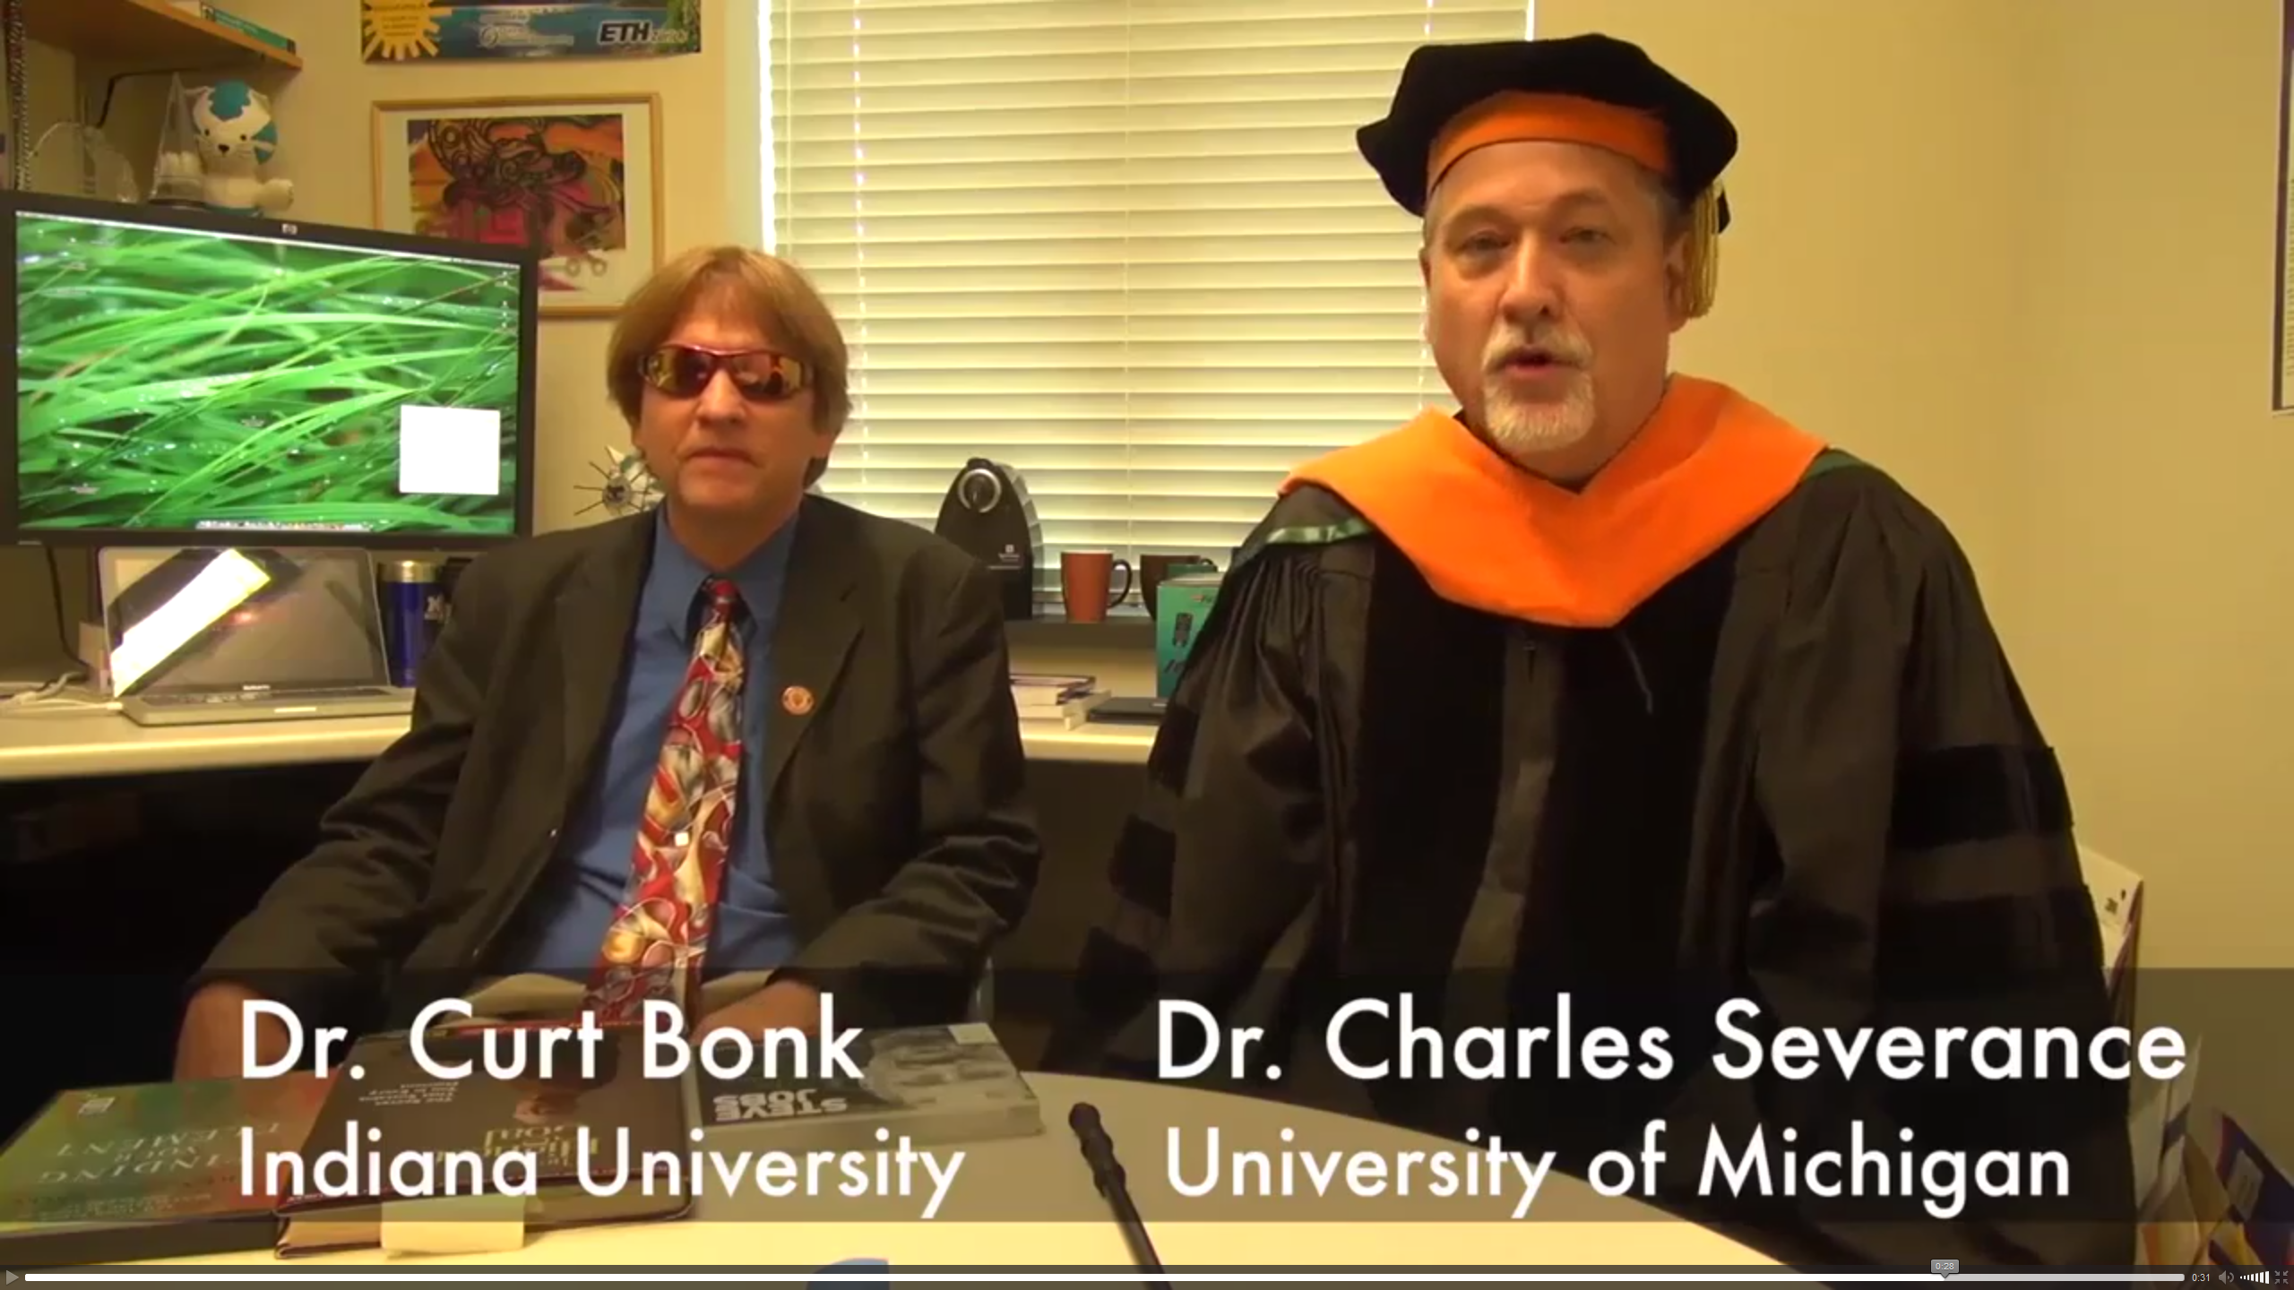
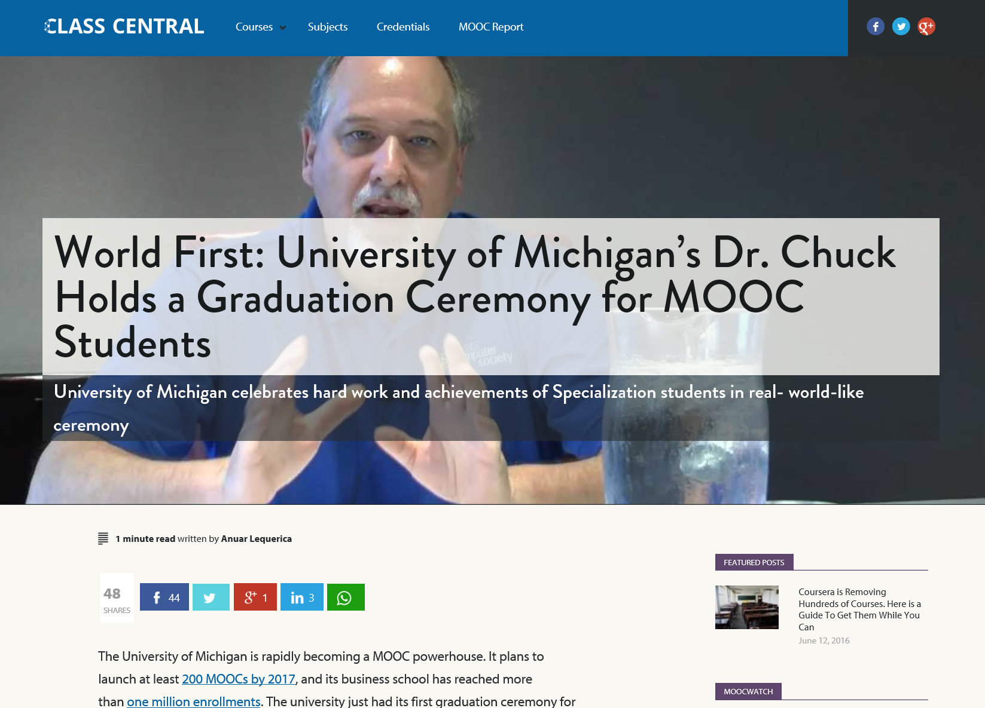
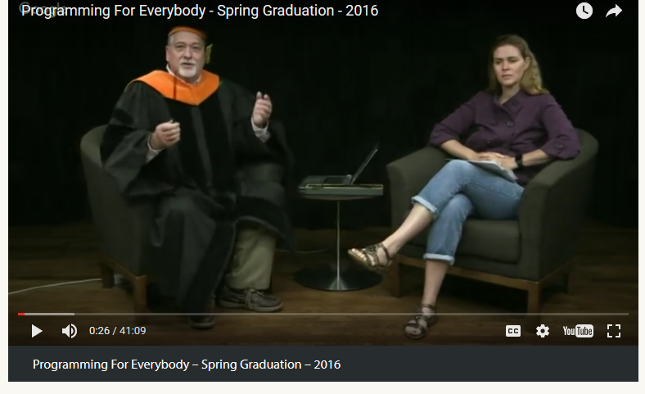
June 14, 2016
9. MOOC for Equipping Teachers with Needed Skills (e.g., programming)
Chapter 15: Learning About MOOCs by Talking to Students
Charles Severance, Univ. of Michigan
Anuar Lequerica, Class Central https://www.class-central.com/report/dr-chuck-graduate-ceremony-python-specialization/

Slide 24
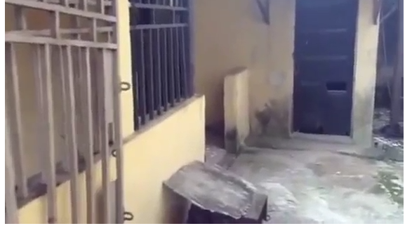
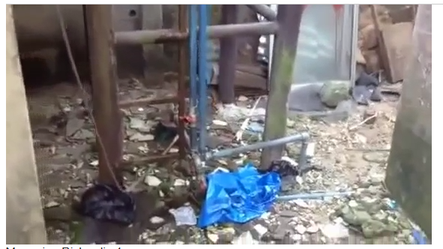

April 20, 2015
10. MOOCs for the Disadvantaged and Underprivileged
250 MOOCs and Counting: One Man’s Educational Journey, Chronicle of Higher Education http://chronicle.com/article/250-MOOCsCounting-One/229397/?cid=at
If the MOOC movement has faded, nobody told Jima Ngei. Mr. Ngei, who lives in Port Harcourt, Nigeria, has completed and passed 250.
Jima Ngei: “I had this unrelenting fear that this miracle of free access might evaporate soon.”

Slide 25



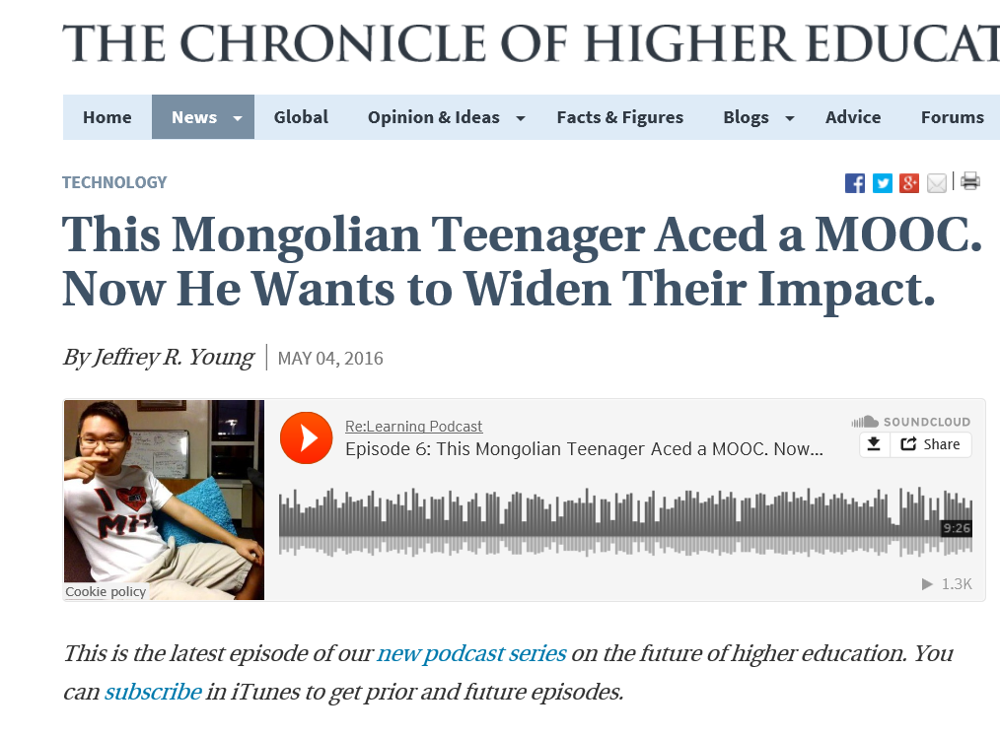
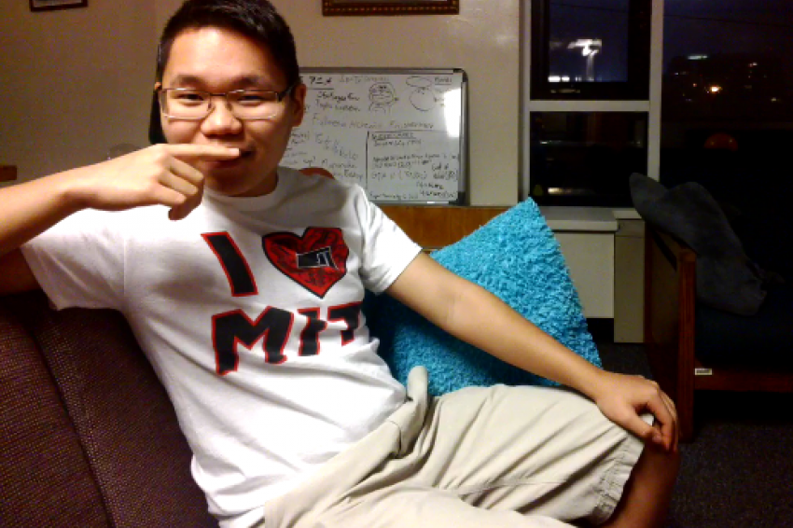
May 4, 2016
11. MOOCs for Screening Talent
This Mongolian Teenager Aced a MOOC
(140,000 people take the MIT MOOC on Circuits and Electronics, 1 of 300 to get a perfect score)
The Chronicle of Higher Education, Jeffrey R. Young http://chronicle.com/article/This-Mongolian-Teenager-Aced-a/236362

Slide 26
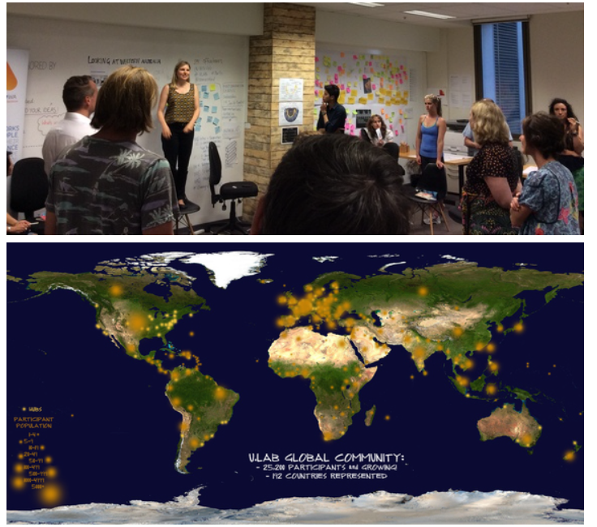

May 4, 2016
12. MOOCs for Spirituality
MOOC 4.0: The Next Revolution in Learning & Leadership, Otto Scharmer, Huffington Post http://www.huffingtonpost.com/otto-scharmer/mooc-40-the-next-revoluti_b_7209606.html

Slide 27
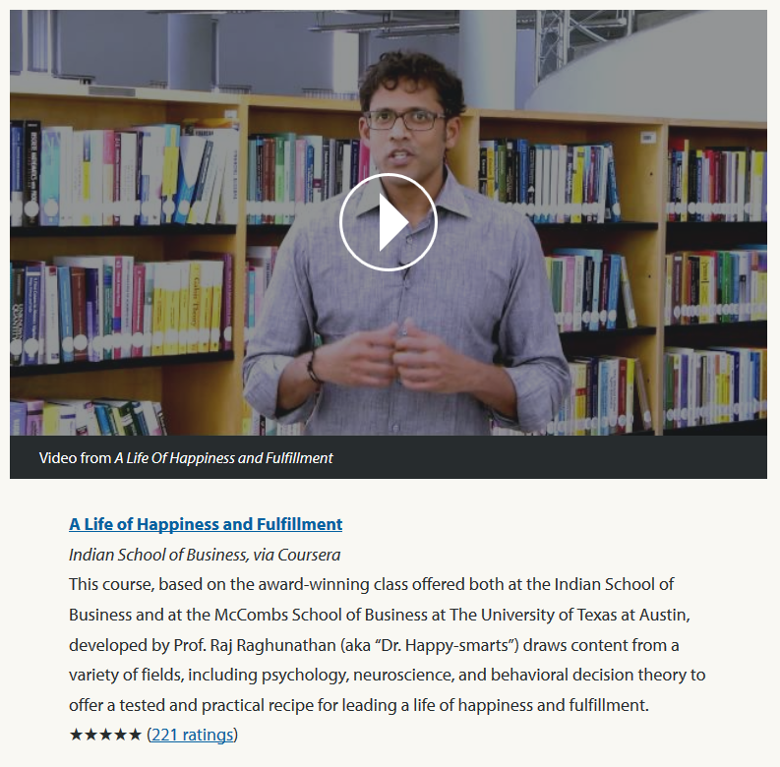
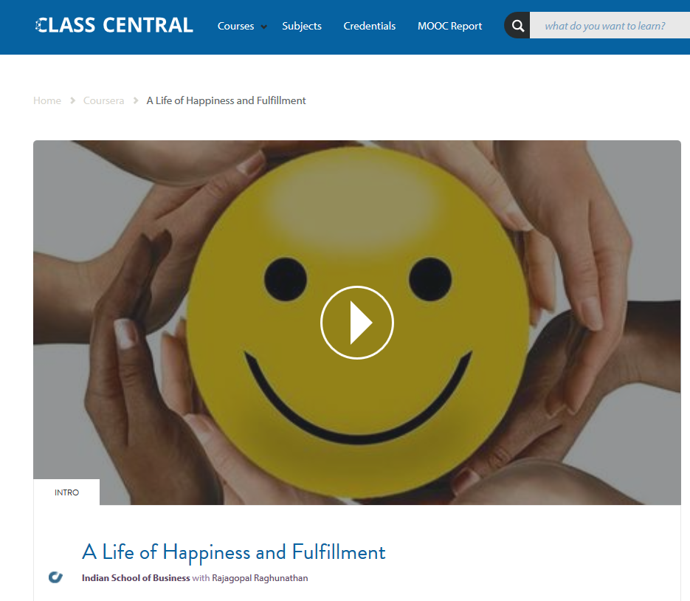
August 12, 2016
13. MOOCs for Personal Change
A Life of Happiness and Fulfillment
Indian School of Business, Rajagopal Raghanathan https://www.class-central.com/mooc/2860/coursera-a-life-of-happiness-and-fulfillment
2:31 Happiness video: http://curtbonk.com/happiness.html

Slide 28
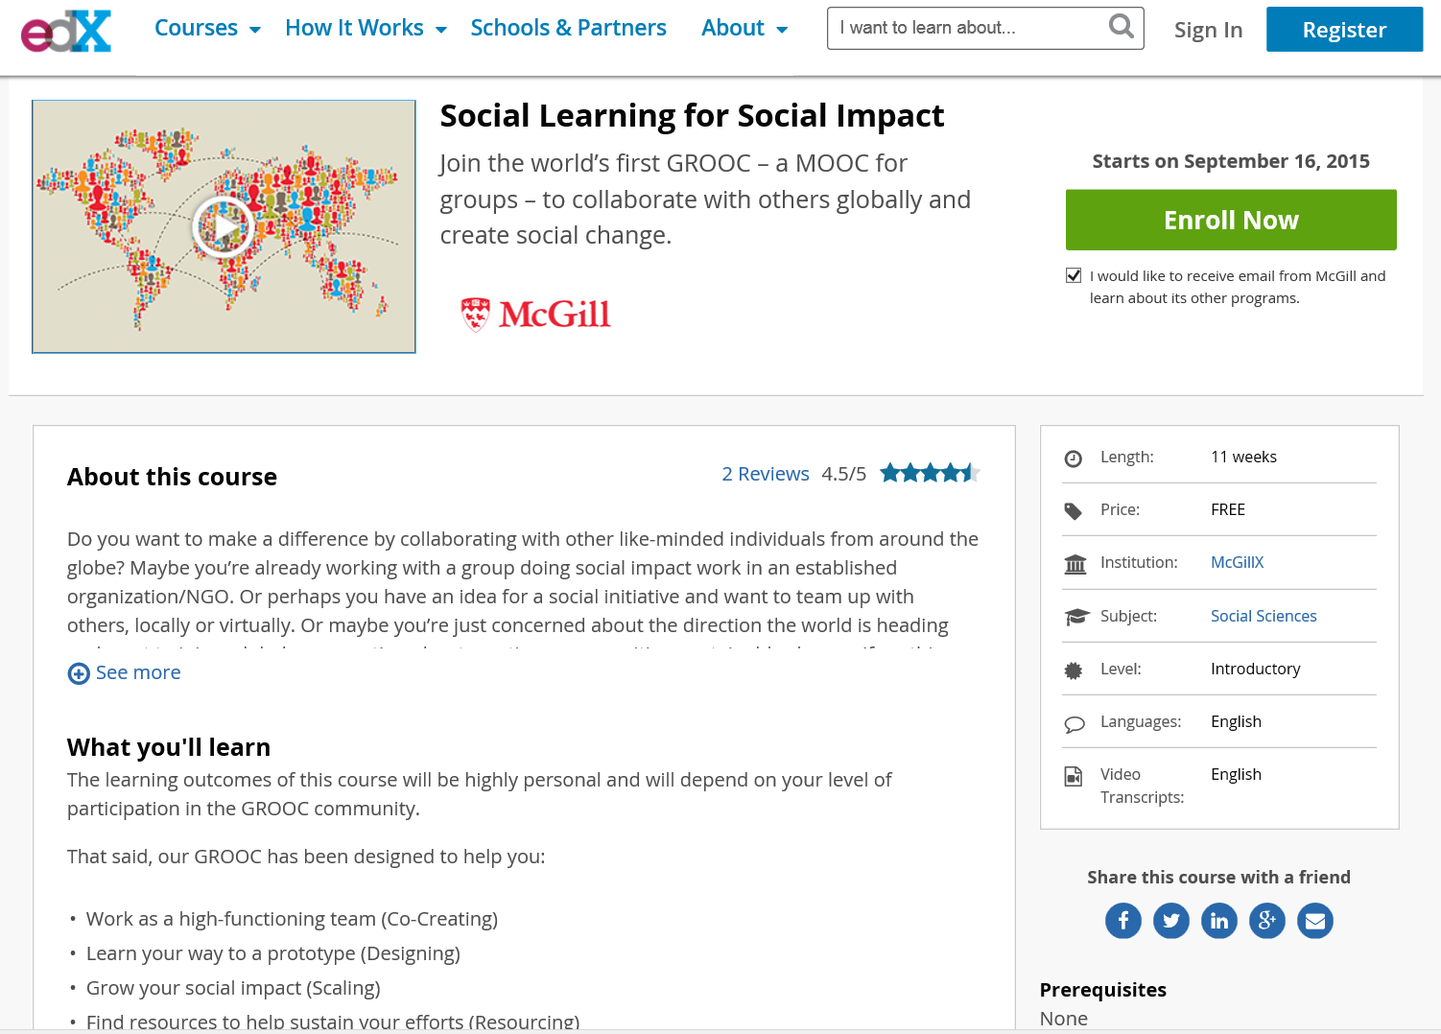


September 15, 2015
14. MOOCs for Social Impact
Social Learning for Social Impact, edX
Join the world’s first GROOC – a MOOC for groups – to collaborate with others globally and create social change. https://www.edx.org/course/social-learning-social-impact-mcgillx-groocx https://www.youtube.com/watch?t=36&v=WNg-5LFAMdI

Slide 29


October 7, 2014
15. MOOCs for Public Health
ALISON: Global Health Initiatives
Online Mooc courses deliver Ebola health advice, BBC News, Sean Coughlan http://www.bbc.com/news/education-29521360 http://www.advancelearning.com/why-wait-for-others-to-fight-ebola
Disinfecting a room in Monrovia, Liberia: Online courses are providing health advice to fight Ebola.

Slide 30





August 24, 2016
16. MOOCs for Cultural Expansion
K-MOOCs (and ocMOOCs and hMOOCs)
Revolutionizing online education
Professor creates courses tailored to cultural differences
Korea JoongAng Daily, Bong-Moon Kim http://koreajoongangdaily.joins.com/news/article/article.aspx?aid=2989930&cloc=joongangdaily%7Chome%7Cnewslist1 http://www.kmooc.kr/

Slide 31



August 20, 2015
17. MOOCs for Fantasy Worlds
Syracuse professor offers free ‘Star Trek’ class to the public, USA Today, Amari D. Pollard, LeMayne College http://college.usatoday.com/2015/08/20/syracuse-professor-offers-free-star-trek-class-to-the-public/ r

Slide 32



August 23, 2017
18. MOOCs for Experimentation and Potential Disruption
‘Disrupt This!’
Doug Lederman, Inside Higher Ed https://www.insidehighered.com/digital-learning/article/2017/08/23/author-disrupt-discusses-role-technology-higher-education

Slide 33




August 9, 2017
19. MOOCs for Free College
New Venture Will Offer Free Courses That Students Can Take for College Credit
Goldie Blumenstyk, The Chronicle of Higher Education http://www.chronicle.com/article/New-Venture-Will-Offer-Free/240883

Slide 34

September 16, 2013
Rwandan Degree Program Aims for a 'University in a Box', Chronicle of Higher Education, Megan O’Neil http://chronicle.com/article/Rwandan-Degree-Program-Aims/141631/
Students attend an orientation session at Kepler, a new hybrid program in Kigali, Rwanda, which will use MOOCs and classroom time to help students earn competency-based associate degrees.

Slide 35


20. MOOCs for Life Change
Frank Basile, an aircraft technician, took an MITx course on circuits and electronics to increase his knowledge.
Joe Alfonso, a financial adviser from Oregon, is taking the online finance course as a "refresher."

Slide 36

Documenting Success Stories
MOOC Benefits and Impact
Who’s Benefiting from MOOCs, and Why
Chen Zhenghao, Brandon Alcorn, Gayle Christensen, Nicholas Eriksson, Daphne Koller, Ezekiel J. Emanuel, Harvard Business Review https://hbr.org/2015/09/whos-benefiting-from-moocs-and-why

Slide 37

September 22, 2015
Who’s Benefiting from MOOCs, and Why
Chen Zhenghao, Brandon Alcorn, Gayle Christensen, Nicholas Eriksson, Daphne Koller, Ezekiel J. Emanuel, Harvard Business Review https://hbr.org/2015/09/whos-benefiting-from-moocs-and-why

Slide 38






Any Questions or Comments?
MOOCsBook: http://moocsbook.com/
Slides at: TrainingShare.com
Papers: PublicationShare.com
Free book: http://tec-variety.com/
Email: curt@worldisopen.com

