Slide 1

The G³ of Writing and Publishing Tips:
Gentle Guidelines, Great Stories, and Gigantic Scholarly Gains
Curtis J. Bonk, Ph.D.
Indiana University
cjbonk@indiana.edu
Notes:
All
1

Slide 2
Purposes of this Session
Part I: The Process
a. Exploring the process for getting published
b. Selecting a journal for publication
c. Academic information resources
d. Predatory journal issues
e. Taking the plunge
Part II: Writing Tips and Insights
a. Examining 20+ writing tips
b. Making commitments to future writing
III. Slaying I-Monsters
a. Detailing the pros & cons of SSCI publications
Notes:
Ana

Slide 3
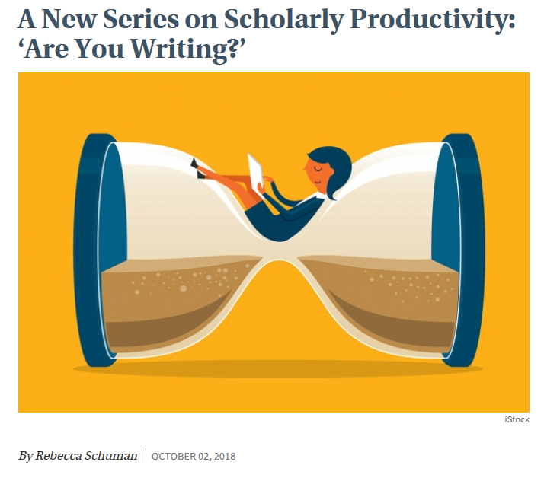
October 2, 2018
A New Series on Scholarly Productivity: ‘Are You Writing?’
Rebecca Schulman, The Chronicle of Higher Education https://www.chronicle.com/article/A-New-Series-on-Scholarly/244689

Slide 4
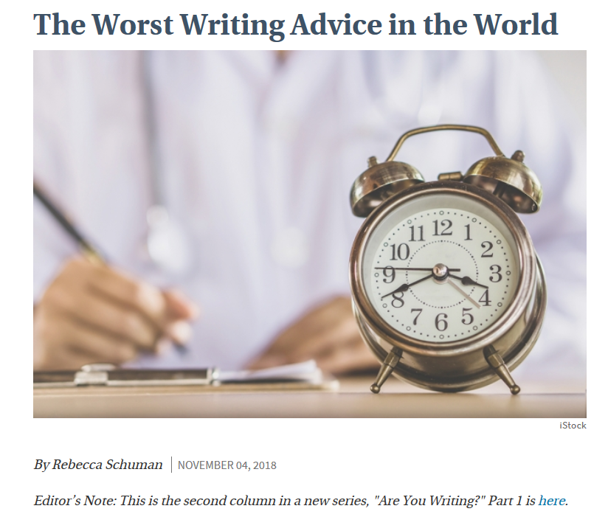
November 4, 2018
The Worst Writing Advice in the World
Rebecca Schulman, The Chronicle of Higher Education https://www.chronicle.com/article/The-Worst-Writing-Advice-in/244972?cid=cp242

Slide 5

December 12, 2018
Don’t Spend Your Holiday Break Writing
Rebecca Schuman, The Chronicle of Higher Education https://www.chronicle.com/article/Don-t-Spend-Your-Holiday/245292

Slide 6
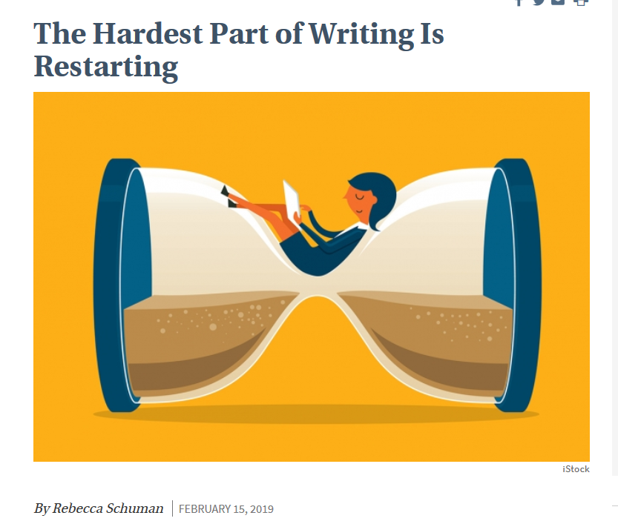
February 15, 2019
The Hardest Part of Writing Is Restarting
Rebecca Schuman, The Chronicle of Higher Education https://www.chronicle.com/article/The-Hardest-Part-of-Writing-Is/245720?cid=cp242

Slide 7

March 31, 2019
Step Away From the Delete Button
Rebecca Schuman, The Chronicle of Higher Education https://www.chronicle.com/article/Step-Away-From-the-Delete/246013?cid=cp242

Slide 8
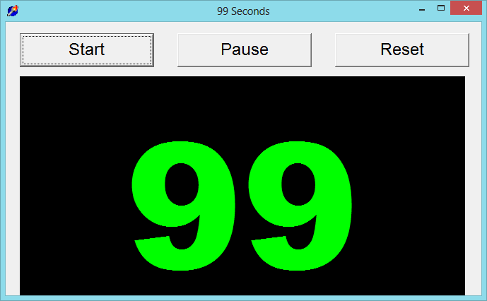

99 Seconds Activity #1
With your next chair neighbor discuss 1 to 2 writing dilemmas currently facing.
Notes:
Ana
Not sure if we want to keep all these activities as we only have 1 hour and 5 minutes and need to leave time for questions. It’s up to you….
8

Slide 9

Part I: The Process
Insights and Advice on Getting Published in Higher Education
Notes:
Ana

Slide 10

Writing Difficulties and Challenges of a Early Career Scholar
Time
Writing habits
Resources
Local/Global Support
Starter text
Reputation
Connections
Journal awareness
Energy/Stamina
Service/Teaching duties
Notes:
Ana
10

Slide 11
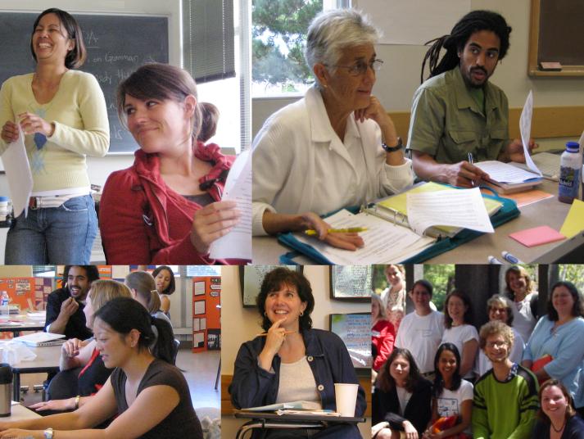
Put Forward your Best Work
Collaborative research projects
Literature reviews
Reflections/
conceptual pieces
Grant projects
Class projects
Notes:
Ana
11

Slide 12

Finding a Journal that Fits
What to look for?
Who will be your target readers?
Who are the authors and journals you cite the most related with your research program?
Is there a match between your work and the journal aims and scope?
What is the journal turnaround time?
What is the journal acceptance rate?
Do you know the editor(s)?
Notes:
Ana
https://www.editage.com/insights/how-to-choose-journals-for-submitting-your-paper
Who will be your target readers? Scholarly vs. non-scholarly periodicals
readership and target audience
Look for a match between your work and the journal aims and scope. – journal analysis
What is the journal’s turnaround time?
Acceptance rates? Get familiar with the journals’ acceptance rates
12

Slide 13

Finding a Journal that Fits
Where to look for?
Social Sciences Citation Index (SSCI) is a commercial citation index product of Clarivate Analytics. It was originally developed by the Institute for Scientific Information from the Science Citation Index.
European Reference Index for the Humanities and the Social Sciences (ERIH PLUS) was created and developed by European researchers under the coordination of the Standing Committee for the Humanities of the European Science Foundation.
Notes:
Ana
13

Slide 14
Where to start?
Practitioner Journals
Target practitioners
Deal with problems and issues tied directly to practice
Receive wider circulations and visibility
Refereed or nonrefereed articles
Notes:
Ana
Unlike peer reviewed articles, nonrefereed articles, where publication decisions are made by one or more editors without using a blind review process, are important because they fill an important niche in practice oriented fields like ed tech.
Peer-reviewed or refereed articles undergo a blind review. This means that neither he authors nor reviewers know each other’s identity. This process is designed to endure that a manuscript has been reviewed and accepted in an ethical and unbiased manner by experts from a specific field.
Although refereed articles are often considered the gold standard in faculty promotion and tenure deliberations, nonrefereed articles nevertheless plan an important role within most academic disciplines.
Practitioner journals are targeted toward practitioners and deal with problems and issues tied directly to practice, Thus,, an article appearing in a practitioners journal could receive wider circulations and visibility than one published in a respected academic journal that is narrowly targeted toward a more limited audience.

Slide 15

Where to start?
Peer-Reviewed Journals
Top-tier journals: are SSCI-indexed
Second-tier journals: have an established history in the field
Third-tier journals: often are newer to the field
Notes:
Ana
you should publish everything you do, even if it is only acceptable for a lower tier journal. It demonstrates your commitment to finish a project and makes your work available to everyone else. Lower tier journals are also great outlets for quality undergraduate research that you have directed.

Slide 16

TOP-TIER JOURNALS
British Journal of Educational Technology
Educational Technology Research and Development
The Internet and Higher Education
Instructional Science
Notes:
Ana
Mention:
http://www.trainingshare.com/resources/distance_ed_journals_and_online_learning_books.php
More examples:
Distance EducationDistance Education; The Internet and Higher Education; Asian Journal of Technology InnovationAsian Journal of Technology Innovation ; Australasian Journal of Educational Technology
Educational Technology Research and Development
16

Slide 17
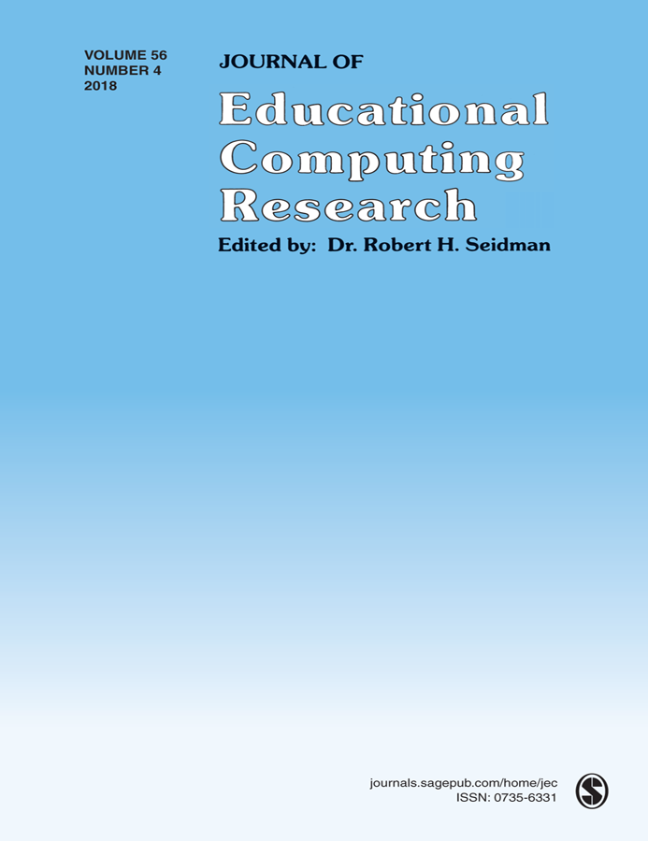
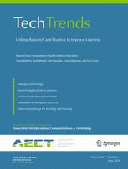
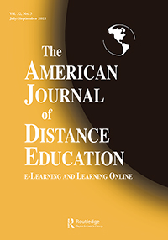
SECOND-TIER JOURNALS
Journal of Educational Computing Research
TechTrends
The American Journal of Distance Education
Notes:
Ana
Journal of Technology and Teacher EducationJournal of Technology and Teacher Education; The Quarterly Review of Distance EducationJournal of Technology and Teacher Education; The Quarterly Review of Distance Education; Science & Education
Journal of Digita Learning in Teacher Education
International Review of Research in Open and Distributed Learning
The American Journal of Distance Education
17

Slide 18
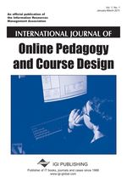


THIRD-TIER JOURNALS
(often new journals)
International Journal of Online Pedagogy and Course Design
Contemporary Issues in Technology and Teacher Education
Interactive Technology and Smart Education
Notes:
Ana
International Journal of Gaming and Computer Mediated SimulationsInternational Journal of Gaming and Computer Mediated Simulations; Advances in MultimediaInternational Journal of Gaming and Computer Mediated Simulations; Advances in Multimedia; Learning: Research and Practice
International Journal of Designs for Learning

Slide 19
Resource and Idea Suggestions
Subscribe to news feeds (not too many)
Save links and images to interesting articles
Review saved documents for themes monthly
Share those links in Facebook, Twitter, etc., for peer reactions
Write to people interviewed in articles

Slide 20
Academic information/ Resources
(Feng-Ru Sheu, Kent State University, 2018)
Tools for research
  Citation/reference management
    Ex. Endnote, Zotero, Refwork, Paper, etc.
  Incorporate other software
    Ex. Nvivo (qualitative analysis tool, Network analysis i.e.)
Writing Tutorial Services
Tutoring Services
Writing Tools (e.g., Grammarly)

Slide 21
Academic information/ resources (Cont’d)
(Feng-Ru Sheu, Kent State University, 2018)
Journal selection/evaluation
  Impact/accreditation (*Predatory Journals)
  Citation index (Web of Science, Google Scholar, etc.)
  Impact factor
  Ranking
  Open Access vs. non-Open Access
    Directory of Open Access Journals
    Open Access Scholarly Publishers Association

Slide 22
Academic information/ resources (Cont’d)
(Feng-Ru Sheu, Kent State University, 2018)
Journal evaluation & legitimacy
  Consult with a librarian
  Visit & Examine the journal's web site.
  Reach out to journal's editorial board members.
  Aim and goals of journal. Read the scope of the journal.
  Read their peer review policy.
  Check to see what "author fees" are being requested
  Research industry associations.
    DOAJ= Directory of Open Access Journals
    OASPA = Open Access Scholarly Publishers Association

Slide 23
Journal Impact Factor
(Feng-Ru Sheu, Kent State University, 2018)
Impact = The frequency in which the average article in a journal has been cited in a specific period of time.
Rank or importance of a journal = the higher impact factor, the better rank.
The calculation is to dividing the number of times articles were cited by the number of articles that were citable. It is usually based on a two-year period.
Tools to measure journal impact factor
Journal Citation Report, https://goo.gl/yVw8si
Scimago Journal Rank (SRJ), https://www.scimagojr.com/
Notes:
Feng-Ru

Slide 24
Predatory Journals/ Publishers
(Feng-Ru Sheu, Kent State University, 2018)
Be Aware of Predatory Journals/Publishers!
The publishing venue prey on academicians for making money without following scholarly publishing standards, commonly seen in the Open Access world.
Also called “Pseudo-journals,” “fake journals,” and “sham journals.”
(Beager, 2017; Clark & Smith, 2017)
Notes:
Feng-Ru
the “Think. Check. Submit.” checklist developed by a coalition of scholarly publishing organizations
Think
Are you submitting your research to a trusted journal?
Is it the right journal for your work?

Slide 25
Predatory Journals/ Publishers
(Feng-Ru Sheu, Kent State University, 2018)
Be Aware of Predatory Journals/Publishers!
Characteristics
  The journal asks for a submission fee
  Promises of fast peer review and fast publication
  Spam emails to attract potential authors
  Small size of editorial board or not indicated clearly
  Newness and the quantity: a very new journal that consists of a high quantity of articles in one issue
  Inconsistencies in the scope and the content or journal title and contact address
(Beager, 2017; Prater, 2018)
Notes:
Feng-Ru
the “Think. Check. Submit.” checklist developed by a coalition of scholarly publishing organizations
Think
Are you submitting your research to a trusted journal?
Is it the right journal for your work?

Slide 26
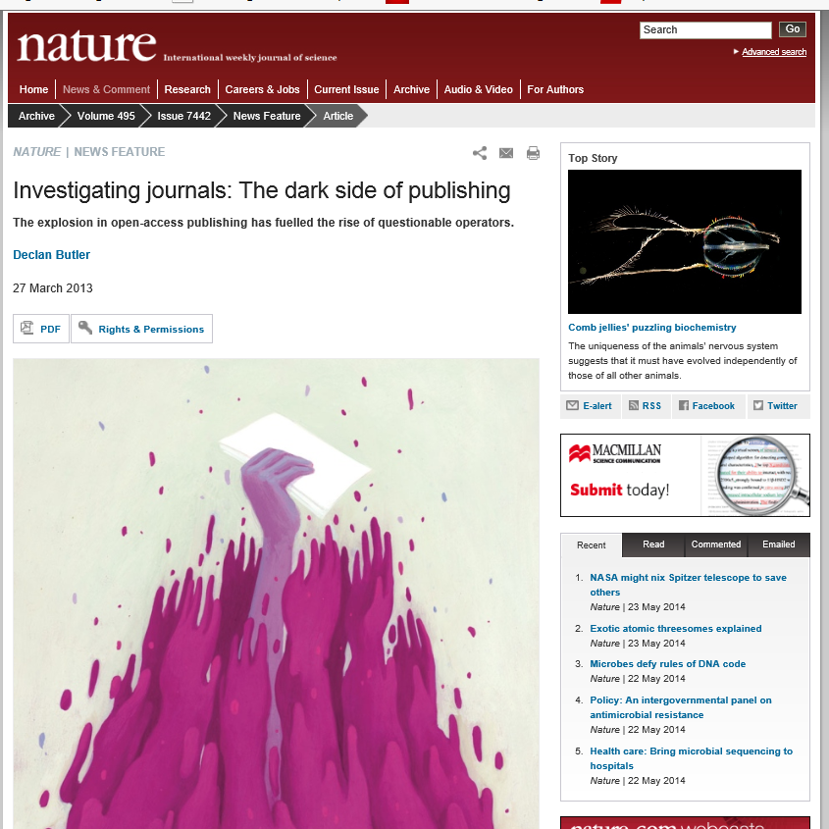
March 27, 2013
Investigating journals:
The dark side of publishing (The explosion in open-access publishing has fuelled the rise of questionable operators), Declan Butler, Nature http://www.nature.com/news/disciplinary-action-1.12668

Slide 27
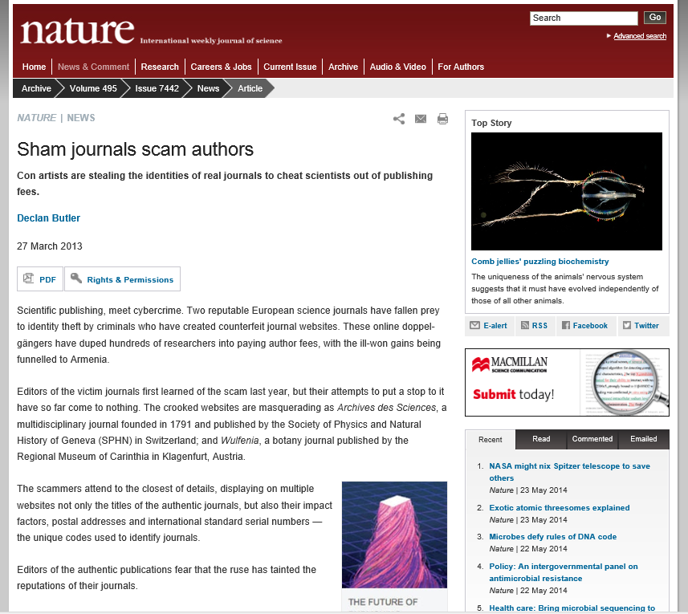
March 27, 2013
Sham journals scam authors:
Con artists are stealing the identities of real journals to cheat scientists out of publishing fees.
Declan Butler, Nature http://www.nature.com/news/sham-journals-scam-authors-1.12681

Slide 28
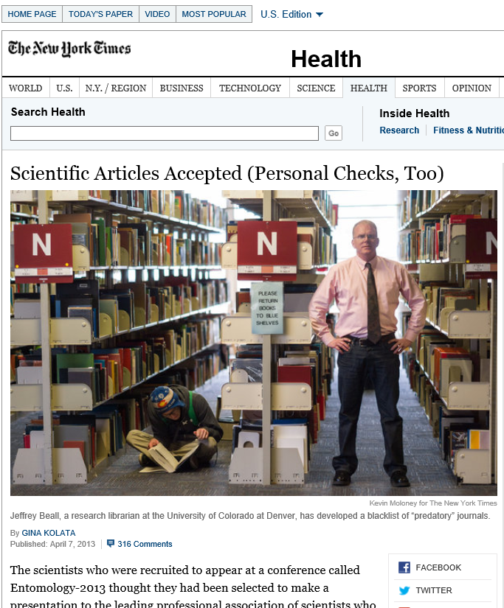
April 7, 2014
Scientific Articles Accepted
(Personal Checks, Too)
Gina Kolata, The New York Times http://www.nytimes.com/2013/04/08/health/for-scientists-an-exploding-world-of-pseudo-academia.html?_r=1&

Slide 29
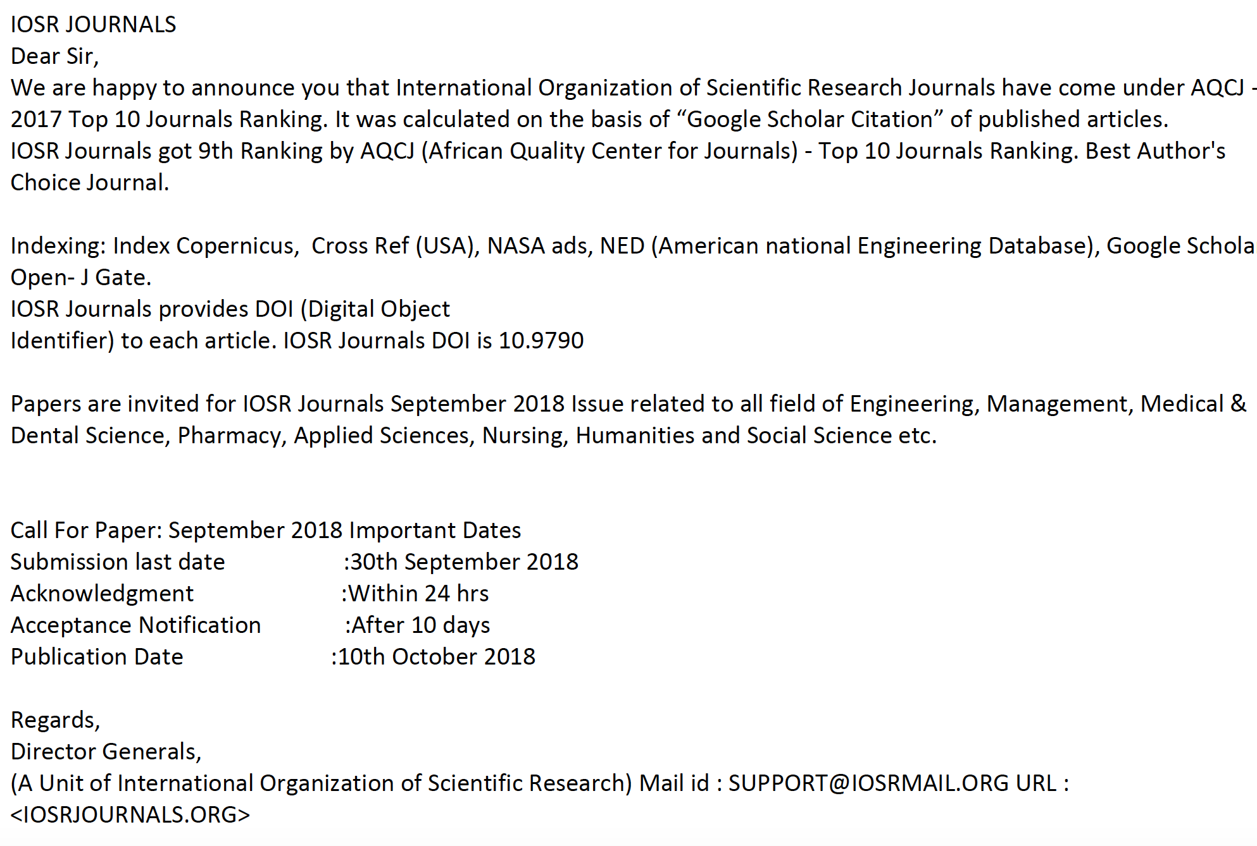
Predatory Journals/ Publishers
(Feng-Ru Sheu, Kent State University, 2018)
Examples of spam emails to attract potential authors
Notes:
Feng-Ru
the “Think. Check. Submit.” checklist developed by a coalition of scholarly publishing organizations
Think
Are you submitting your research to a trusted journal?
Is it the right journal for your work?

Slide 30
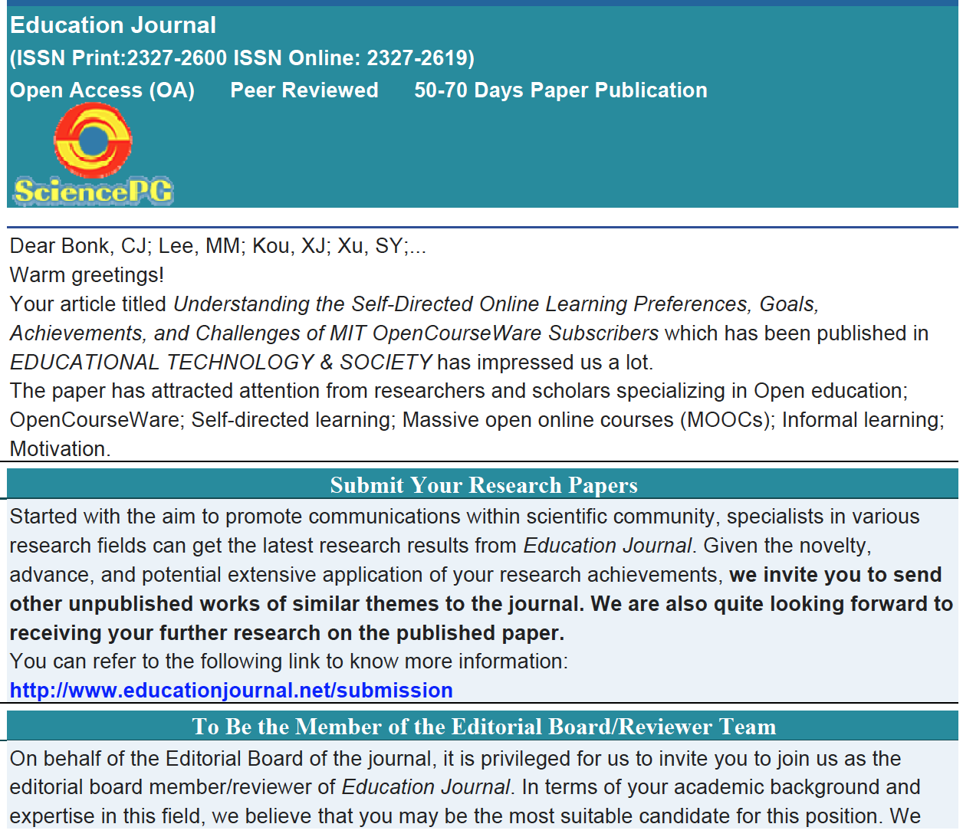
Predatory Journals/ Publishers
(Feng-Ru Sheu, Kent State University, 2018)
Examples of spam emails to attract potential authors
Notes:
Feng-Ru
the “Think. Check. Submit.” checklist developed by a coalition of scholarly publishing organizations
Think
Are you submitting your research to a trusted journal?
Is it the right journal for your work?

Slide 31
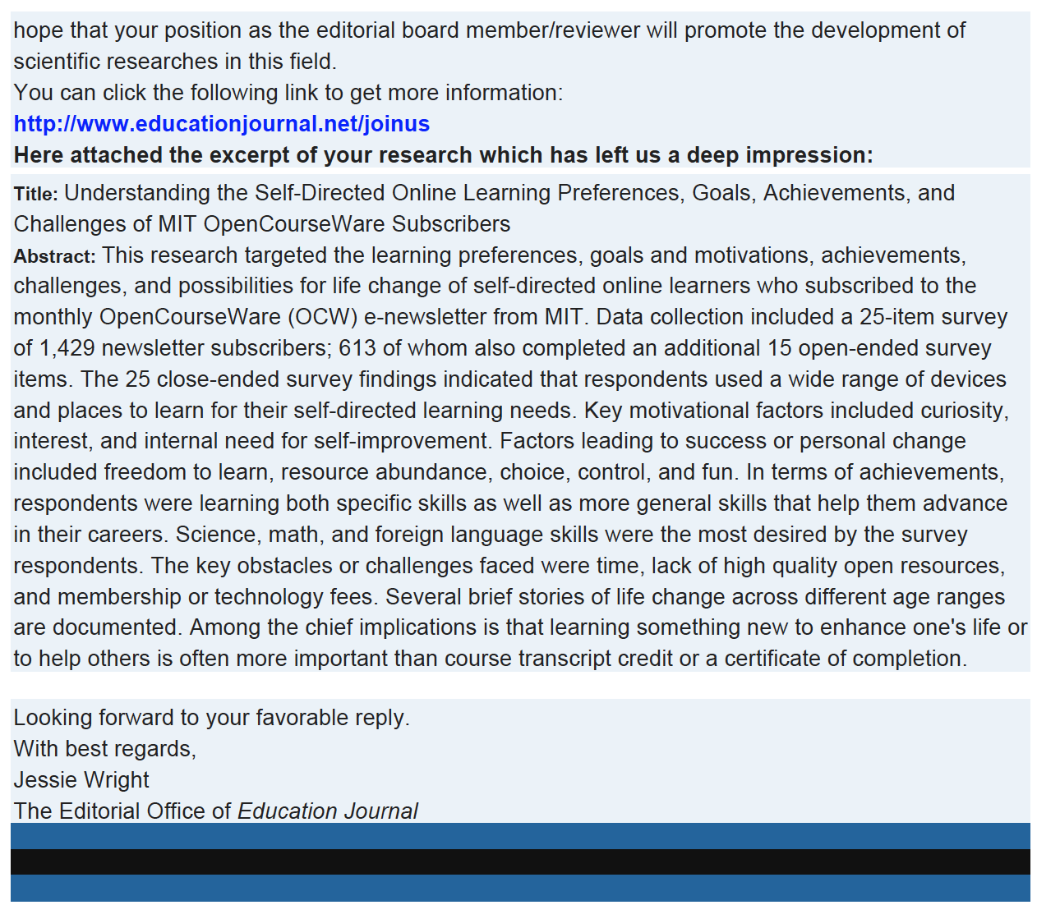

Slide 32
Selecting a Journal
(Feng-Ru Sheu, Kent State University, 2018)
Be Aware Predatory Journals!
Using the “Think. Check. Submit.” checklist
  Developed by a initiative of scholarly publishing organizations
(think.check.submit.org, 2018)
Notes:
Feng-Ru

Slide 33

Selecting a Journal
(Feng-Ru Sheu, Kent State University, 2018)
Be Aware Predatory Journals!
Criteria to check the journal
  Do you or your colleagues know the journal?
  Can you easily identify and contact the publisher?
  Is the journal clear about the type of peer review it uses?
  Are articles indexed in services that you use?
  Is it clear what fees will be charged?
  Do you recognize the editorial board?
  Is the Publisher a member of a recognized industry initiative?
Access the checklist in detail at http://thinkchecksubmit.org/check/
Notes:
Feng-Ru

Slide 34
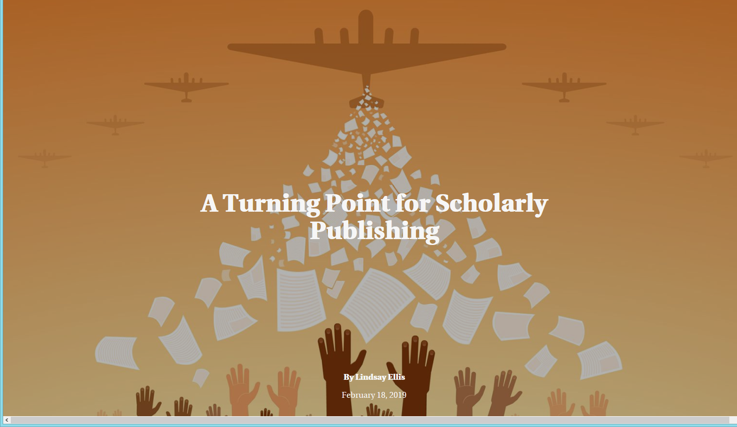
February 18, 2019
A Turning Point for Scholarly Publishing
Lindsey Ellis, The Chronicle of Higher Education https://www.chronicle.com/interactives/Trend19-OpenAccess-Main

Slide 35
Selecting a Journal
(Feng-Ru Sheu, Kent State University, 2018)
Two resources to identify the journals and publishers
The Directory of Open Access Journals (DOAJ): https://doaj.org/
  Identify legitimate and high quality open access, peer-reviewed journals
Beall’s List of Predatory Journals and Publishers: https://beallslist.weebly.com/
  Identify predatory journals/publishers
Notes:
Feng-Ru

Slide 36
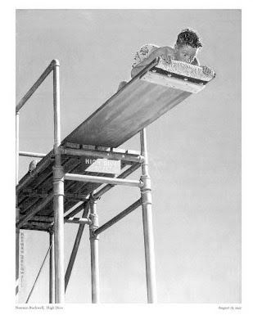
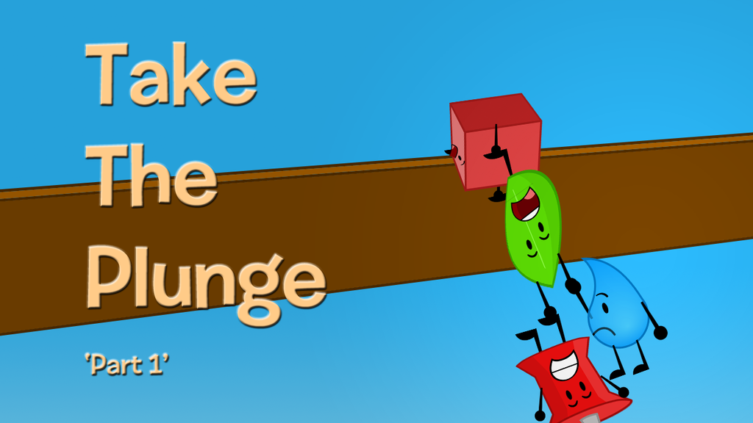
Take the Plunge…Part 1
Look for opportunities to create publishable manuscripts from your dissertation
Contribute with a chapter
Conduct an interview
Write a practical article, newsletter, or book review
Notes:
Ana
Review articles and conference proposals (learn about peer-review criteria and guidelines)
Review book proposals
Do a conference workshop
Organize a symposium
36

Slide 37

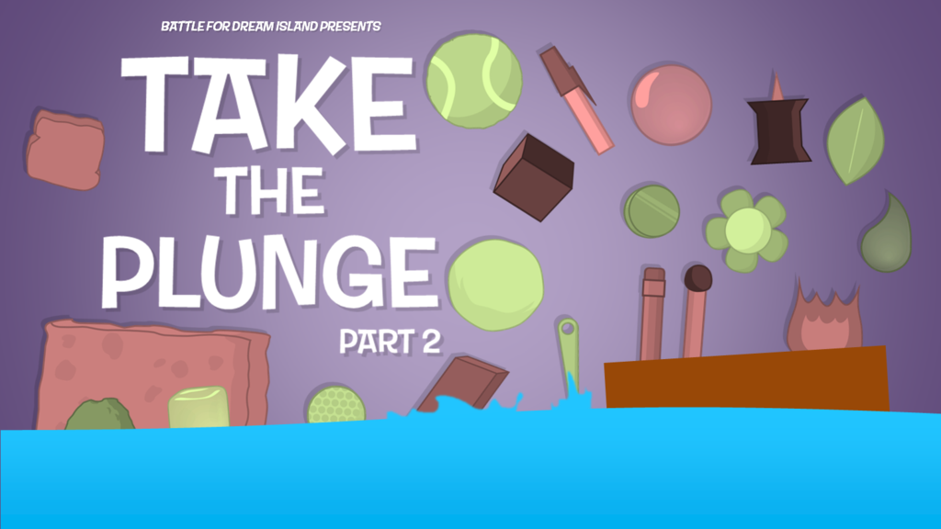
Take the Plunge…Part 2
Write a major grant proposal
Lead a special journal issue
Edit a book
Sole author a book
Get your name out there!
Notes:
Curt
37

Slide 38
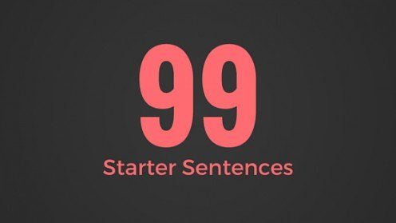

Generate Starter Text…
Author a blog
Use social media
Submit a conference proposal
Write editorials
Write book and software reviews
101
Notes:
Curt

Slide 39
99 Seconds Activity #2
Commit to 1 to 2 things that take the plunge and share them with your next chair neighbor.
Notes:
Curt
Not sure if we want to keep all these activities as we only have 1 hour and 5 minutes and need to leave time for questions. It’s up to you….
39

Slide 40
Part II: Writing Tips and Insights
Insights and Advice on Getting Published Higher Education
Notes:
Curt
40

Slide 41

October 2, 2018
How to Learn to Write Like a Machine
Rose Jacobs, Inside Higher Ed https://www.chronicle.com/blogs/linguafranca/2018/10/02/how-to-learn-to-write-like-a-machine/
Notes:
Curt

Slide 42
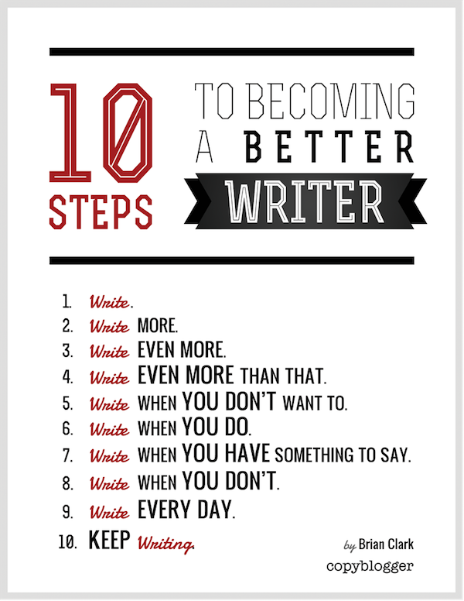
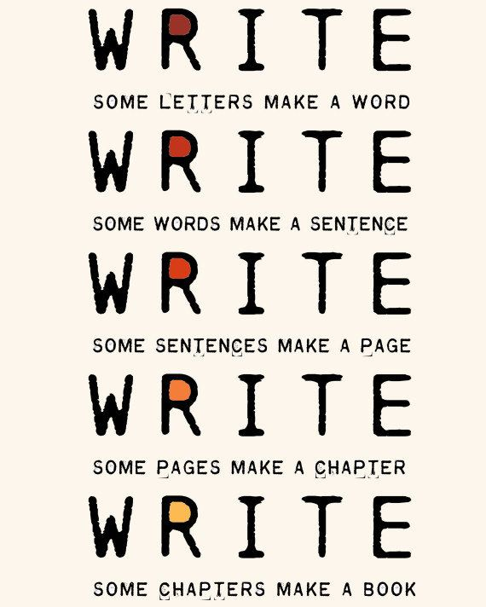
The Top 20 Writing Tips
Notes:
Curt
42

Slide 43


1. Mark Writing Days in Planner
Notes:
Curt
43

Slide 44
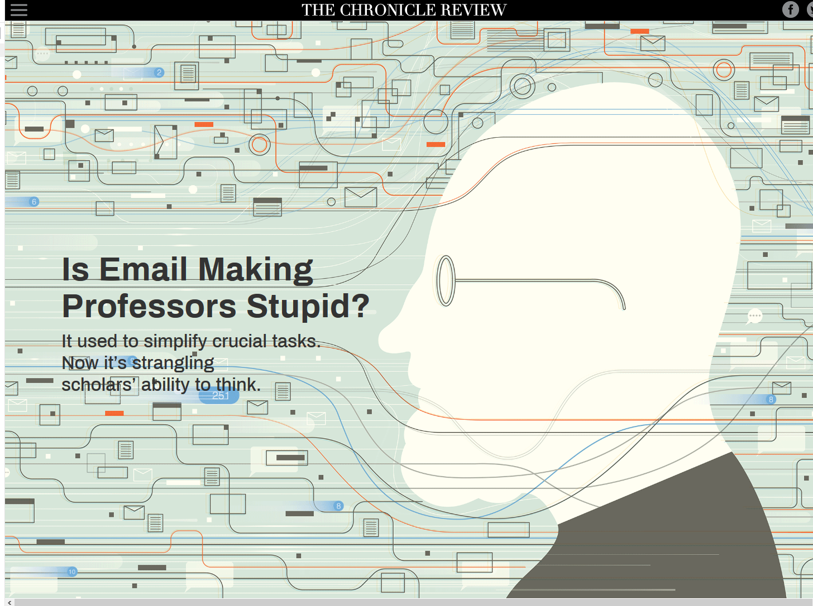
February 13, 2019
Is Email Making Professors Stupid?
Cal Newport, The Chronicle of Higher Education https://www.chronicle.com/interactives/is-email-making-professors-stupid

Slide 45

2. Maintain a List and Network of Potential Research and Writing Collaborators
Notes:
Curt
45

Slide 46


Sidenote: Find Good People to Work With…Life is Short—Avoid Egomaniacs and People Who Lie
Notes:
Curt
46

Slide 47
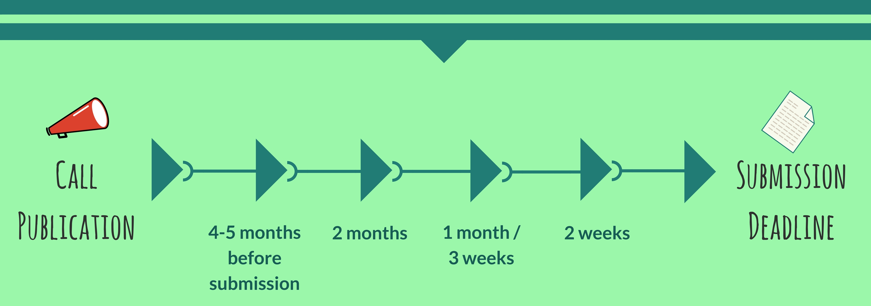
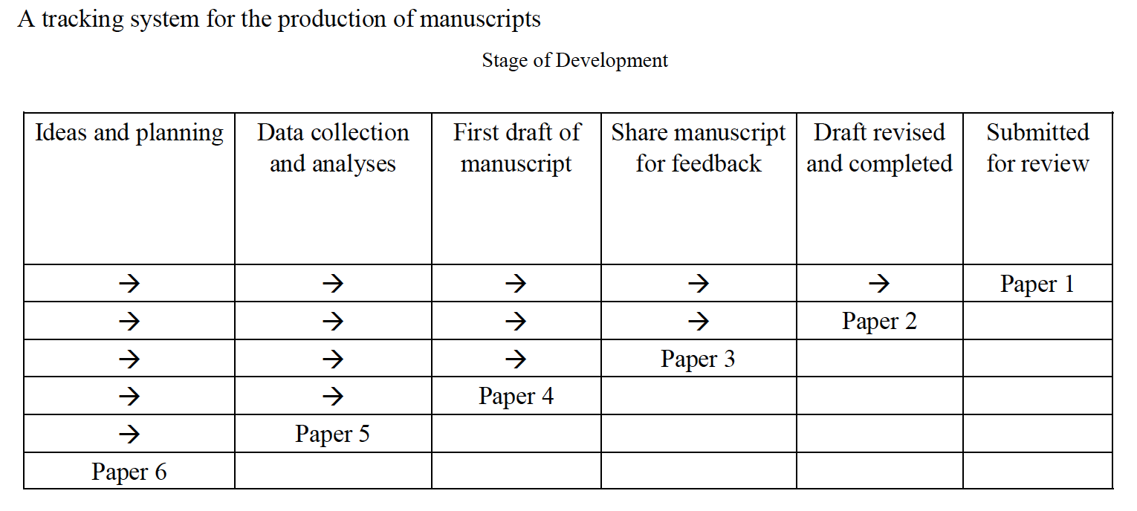
3. Draft a Timeline or Multiple Timelines with Flexible Goals
Notes:
Curt
Screenshot from Cecil’s article
47

Slide 48
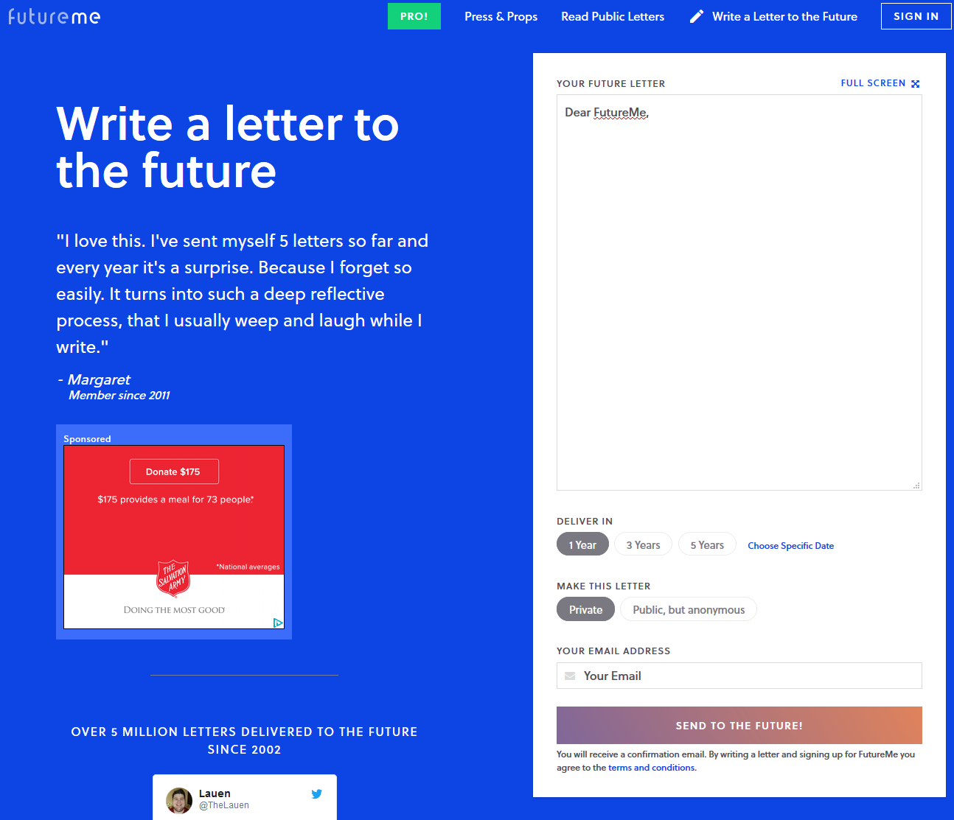
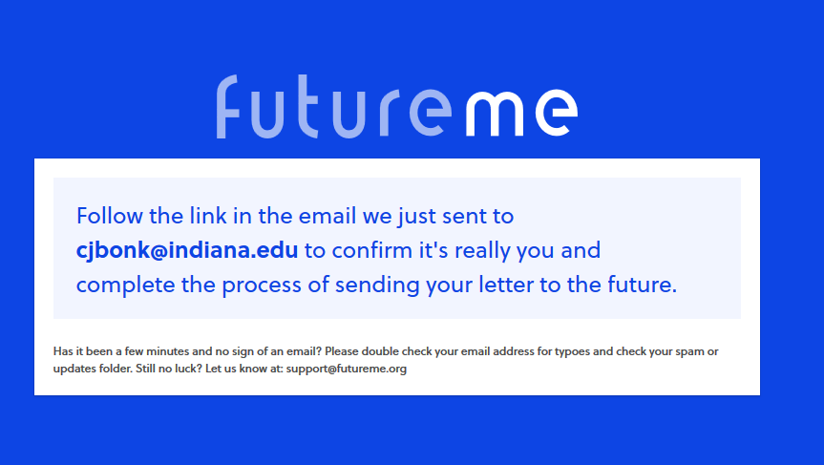
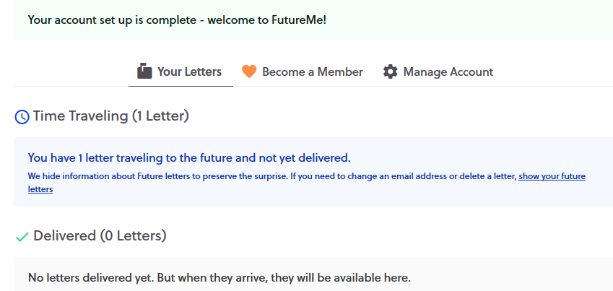
October 10, 2018
Perhaps write to your future self about your goals…
FutureMe.org
Write a letter to the future https://www.futureme.org/
Notes:
Curt
Screenshot from Cecil’s article
48

Slide 49

4. Think Ahead About the Publishing Potential of Each Project
Notes:
Curt
49

Slide 50
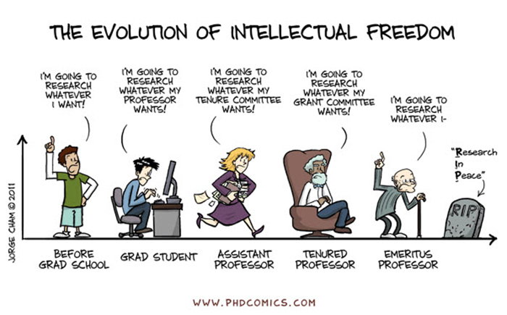
Sidenote: Don’t Just Publish for the Sake of Publishing…
Notes:
Curt
50

Slide 51
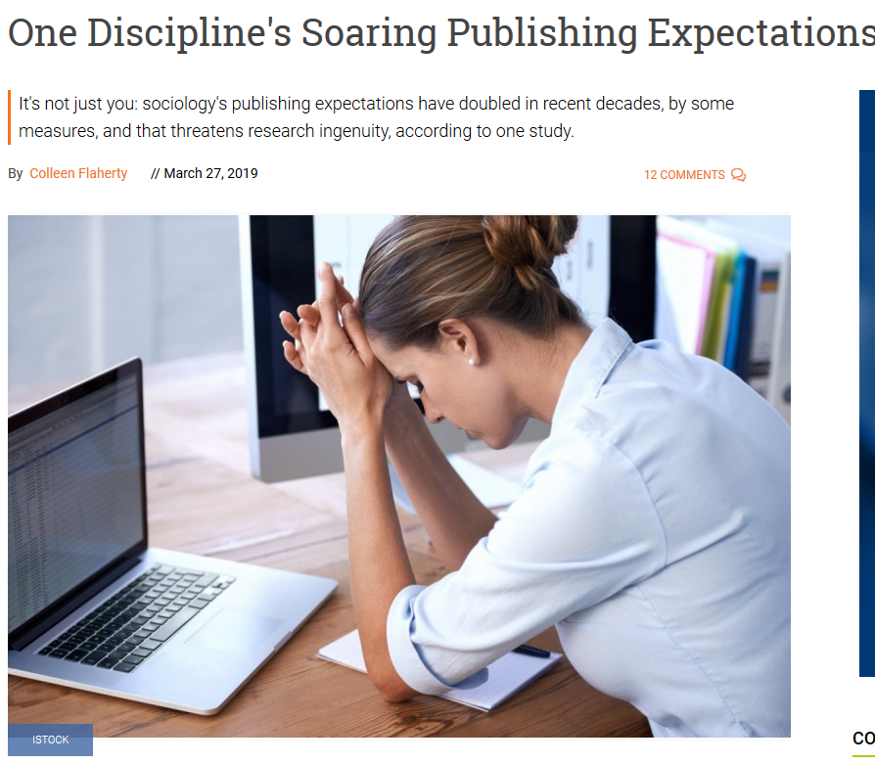
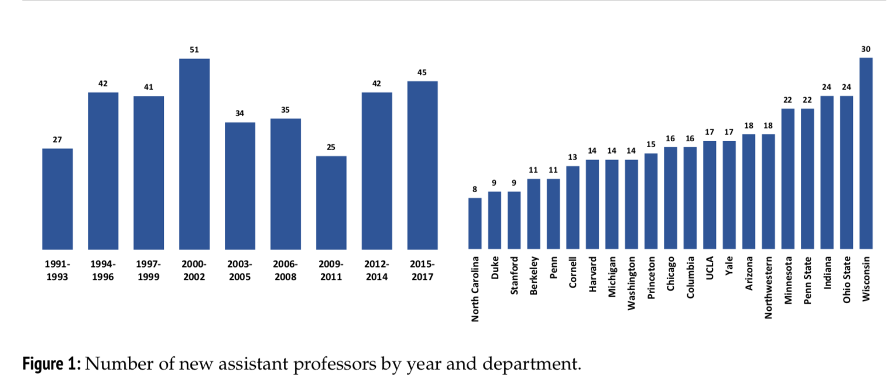
March 27, 2019
One Discipline's Soaring Publishing Expectations
Colleen Flaherty, Inside Higher Ed https://www.insidehighered.com/news/2019/03/27/sociologys-publishing-expectations-have-doubled-recent-decades

Slide 52
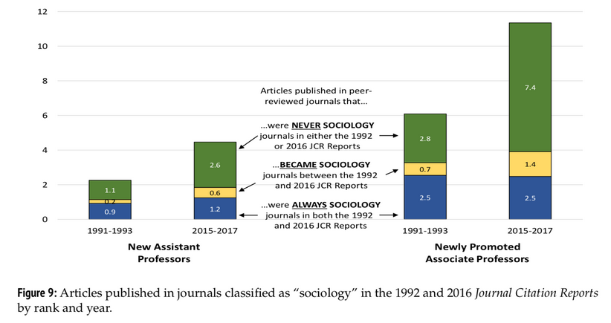
March 27, 2019
One Discipline's Soaring Publishing Expectations
Colleen Flaherty, Inside Higher Ed https://www.insidehighered.com/news/2019/03/27/sociologys-publishing-expectations-have-doubled-recent-decades

Slide 53
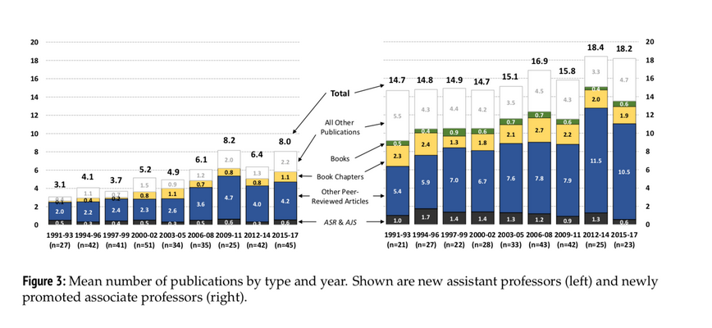
March 27, 2019
One Discipline's Soaring Publishing Expectations
Colleen Flaherty, Inside Higher Ed https://www.insidehighered.com/news/2019/03/27/sociologys-publishing-expectations-have-doubled-recent-decades

Slide 54
March 27, 2019
One Discipline's Soaring Publishing Expectations
Colleen Flaherty, Inside Higher Ed https://www.insidehighered.com/news/2019/03/27/sociologys-publishing-expectations-have-doubled-recent-decades
“What does that look like, exactly? In 2017, new assistant professors at the 21 departments included in the study had published 4.8 peer-reviewed articles, on average, on their start date. About 25 years ago, the number was 2.5.”

Slide 55
March 27, 2019
One Discipline's Soaring Publishing Expectations
Colleen Flaherty, Inside Higher Ed https://www.insidehighered.com/news/2019/03/27/sociologys-publishing-expectations-have-doubled-recent-decades
“Newly promoted associated professors in article-centric subfields in the 2010s also published almost twice as many peer-reviewed articles as their counterparts two decades earlier. And even in book-centric subfields, the number of peer-reviewed articles has risen.”

Slide 56
March 27, 2019
One Discipline's Soaring Publishing Expectations
Colleen Flaherty, Inside Higher Ed https://www.insidehighered.com/news/2019/03/27/sociologys-publishing-expectations-have-doubled-recent-decades
Asked whether he thought his findings would apply to other social science fields, Warren said recently that he suspected "the larger macro forces at work -- which really have to do with the organization and financing of higher education -- apply at least to the other social sciences and economics."
In any case, he said, sociologists now face “much greater pressure to publish” and “to publish often.”

Slide 57
March 27, 2019
One Discipline's Soaring Publishing Expectations
Colleen Flaherty, Inside Higher Ed https://www.insidehighered.com/news/2019/03/27/sociologys-publishing-expectations-have-doubled-recent-decades
Echoing the “why” piece of his study, Warren said that his findings have potential “human consequences,” in that “it's stressful and may push otherwise qualified people out of the field.”
Expectation creep also has “implications both for the quality of scholarship -- which may go down as demands for quantity increase -- and for the topics that sociologists may choose to study,” he said.

Slide 58
March 27, 2019
One Discipline's Soaring Publishing Expectations
Colleen Flaherty, Inside Higher Ed https://www.insidehighered.com/news/2019/03/27/sociologys-publishing-expectations-have-doubled-recent-decades
In other words, the trend toward more publications might also mean a trend toward “topics or approaches that ensure quicker and more certain publication.”

Slide 59
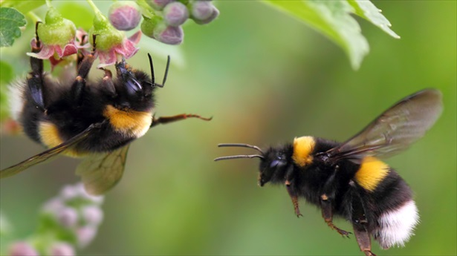

5. Be a Bumblebee and Butterfly
Notes:
Curt
59

Slide 60


6. Find, Save, and Use Starter Text (overcomes writer’s block)
Notes:
Curt
60

Slide 61

7. Always Scan the Reference Sections of Other Articles to See What Journals are Popular
Notes:
Curt
61

Slide 62

8. Avoid High Quality (i.e., SSCI) Journal Fixations
Notes:
Curt
62

Slide 63


9. Be Second or Third Author Sometimes to Spread Limited Resources
Notes:
Curt
63

Slide 64

10. If Need Summer Money, Teach Short Term or Intensive Courses
Notes:
Curt
64

Slide 65
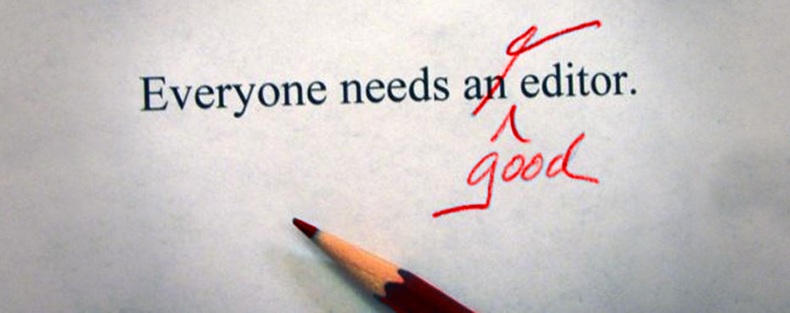
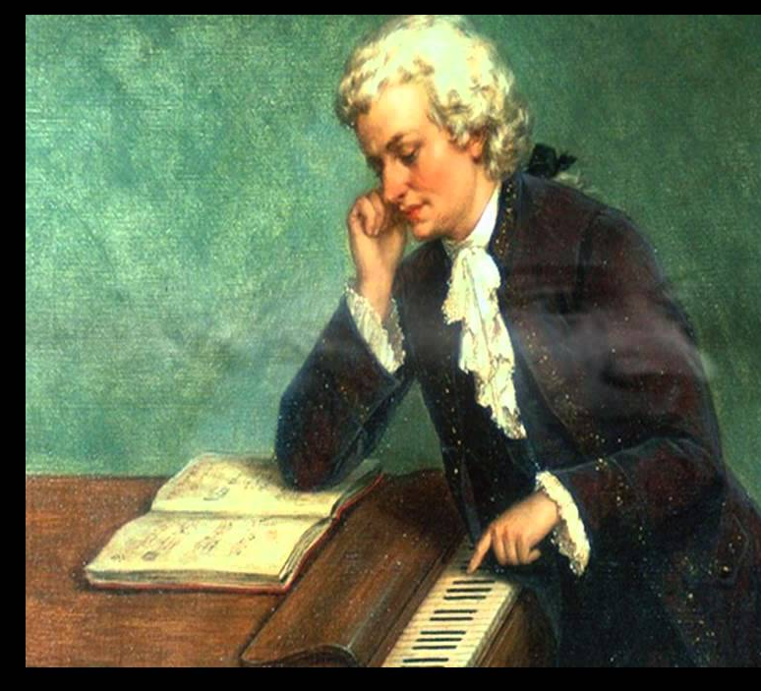
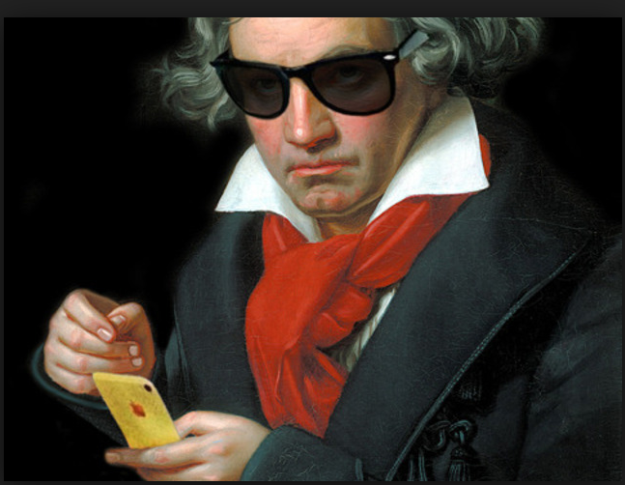
11. Edit Your Papers a Lot! (Mozartian vs. Beethovenian)
Notes:
Curt
65

Slide 66


October 1, 2018
6 Tips to Shape Up Your Writing
Two-Minute Tips: Short videos to help you excel in the academic workplace
Fernanda Zamudio-Suaréz, The Chronicle of Higher Education https://www.chronicle.com/article/6-Tips-to-Shape-Up-Your/244281?cid=cp221 https://www.chronicle.com/specialreport/Two-Minute-Tips/221
Writing is an exercise (write!).
Set goals based on output not input (e.g., 3 pages double-spaced).
Find a voice (don’t just focus on getting published).
Give yourself time (not deadlines).
Pick a puzzle (your writing is an answer to that puzzle).
Edit your work (over and over and over again…just like Beethoven).
Notes:
Curt

Slide 67
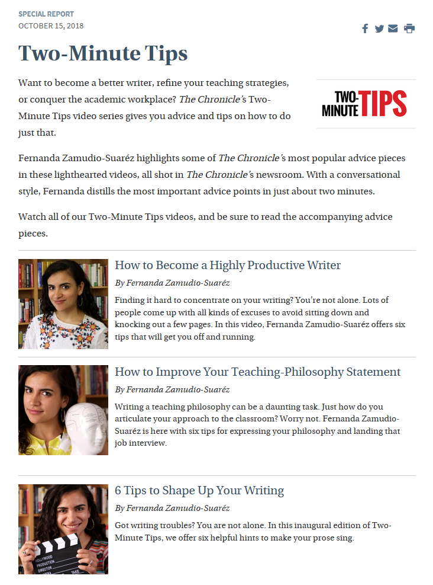
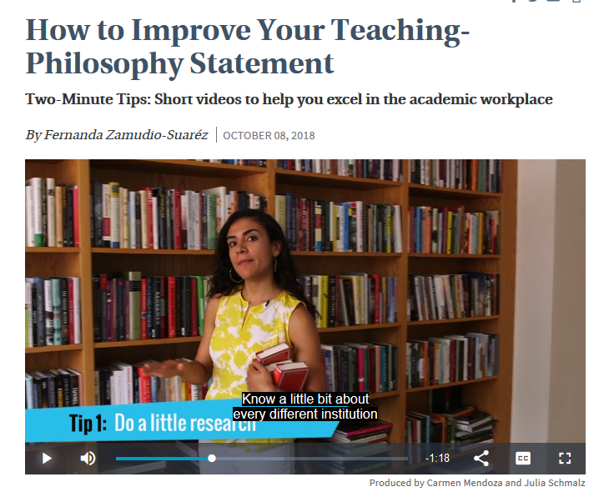
October 8, 2018
How to Improve Your Teaching-Philosophy Statement
Two-Minute Tips: Short videos to help you excel in the academic workplace
Fernanda Zamudio-Suaréz, The Chronicle of Higher Education https://www.chronicle.com/article/How-to-Improve-Your/244283 https://www.chronicle.com/specialreport/Two-Minute-Tips/221
Notes:
curt

Slide 68
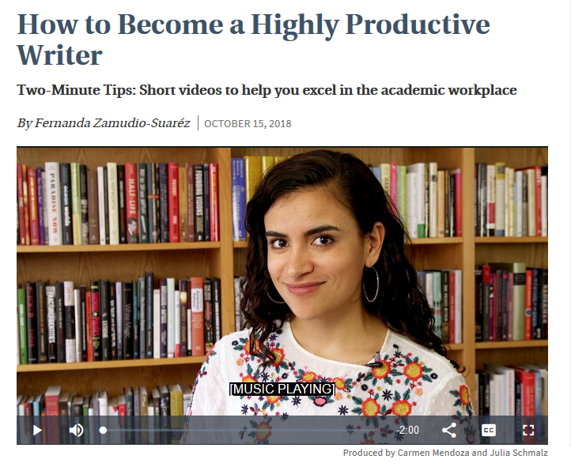
October 15, 2018
How to Become a Highly Productive Writer
Two-Minute Tips: Short videos to help you excel in the academic workplace
Fernanda Zamudio-Suaréz, The Chronicle of Higher Education https://www.chronicle.com/article/How-to-Become-a-Highly/244351?cid=cp221 https://www.chronicle.com/specialreport/Two-Minute-Tips/221
Notes:
curt

Slide 69
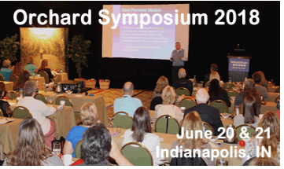
12. Organize Conference Symposia Which Can Lead to Special Journal Issues and Books
Notes:
Curt
69

Slide 70
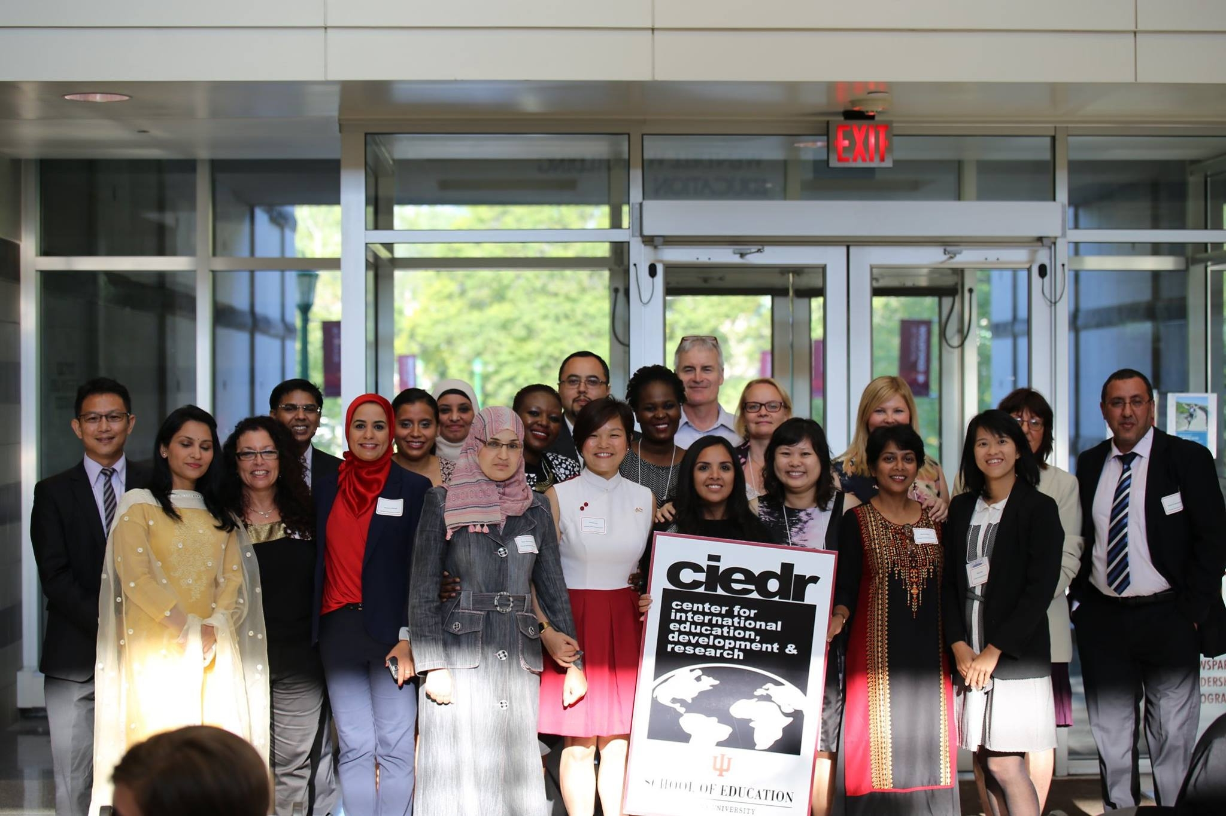
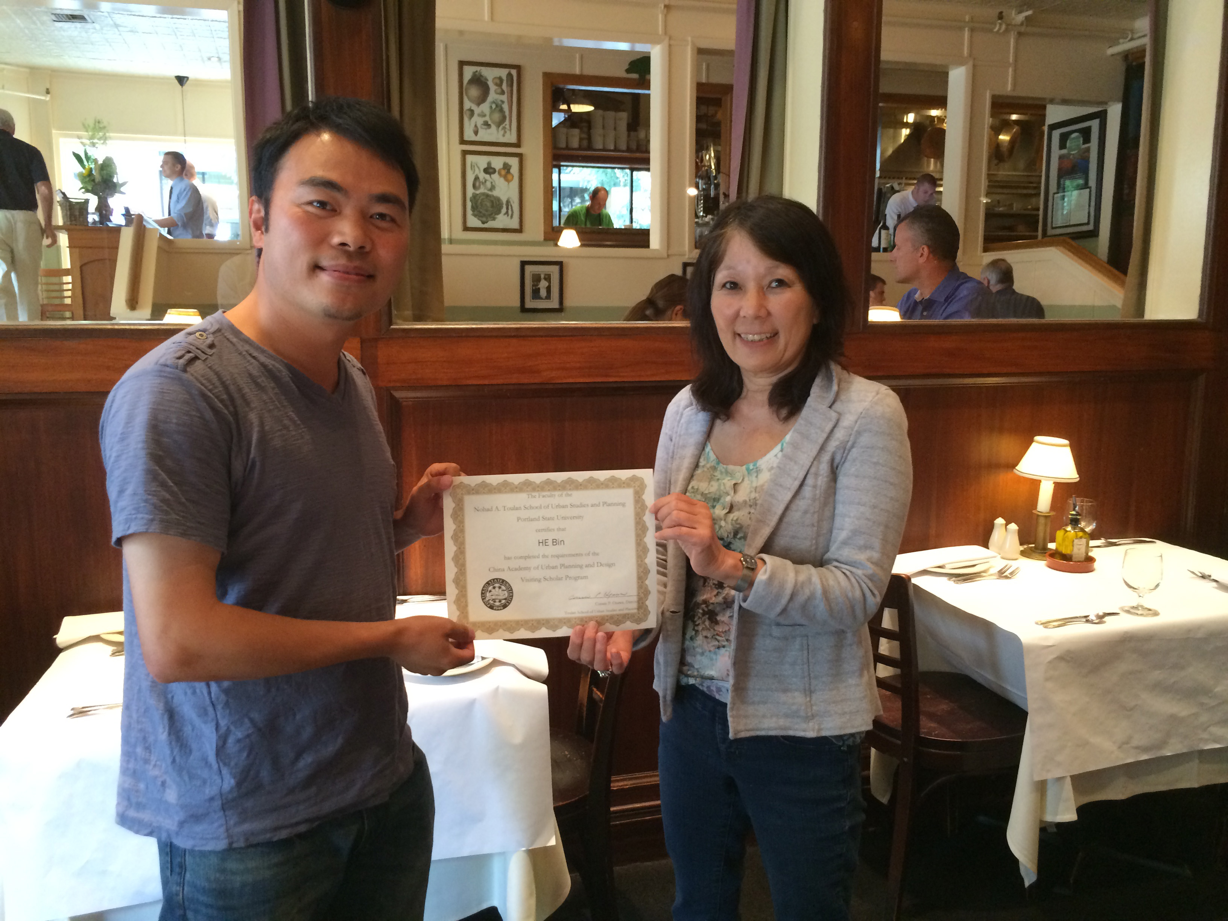
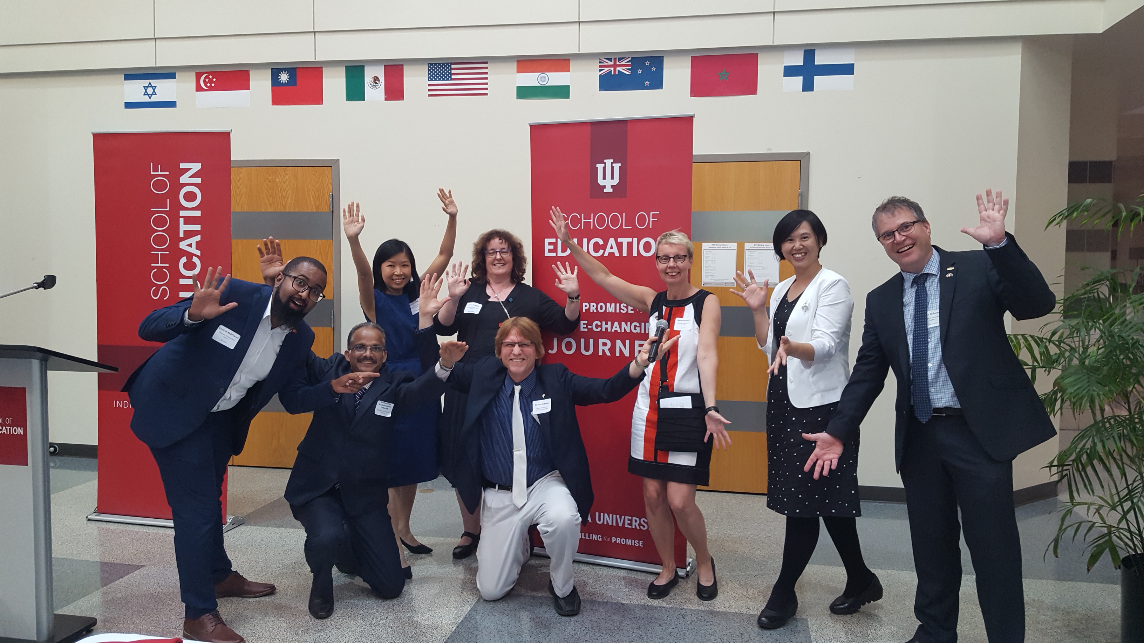
13. Sponsor Visiting Scholars to Work with You; They Often Have Writing Plans
Notes:
Curt
70

Slide 71
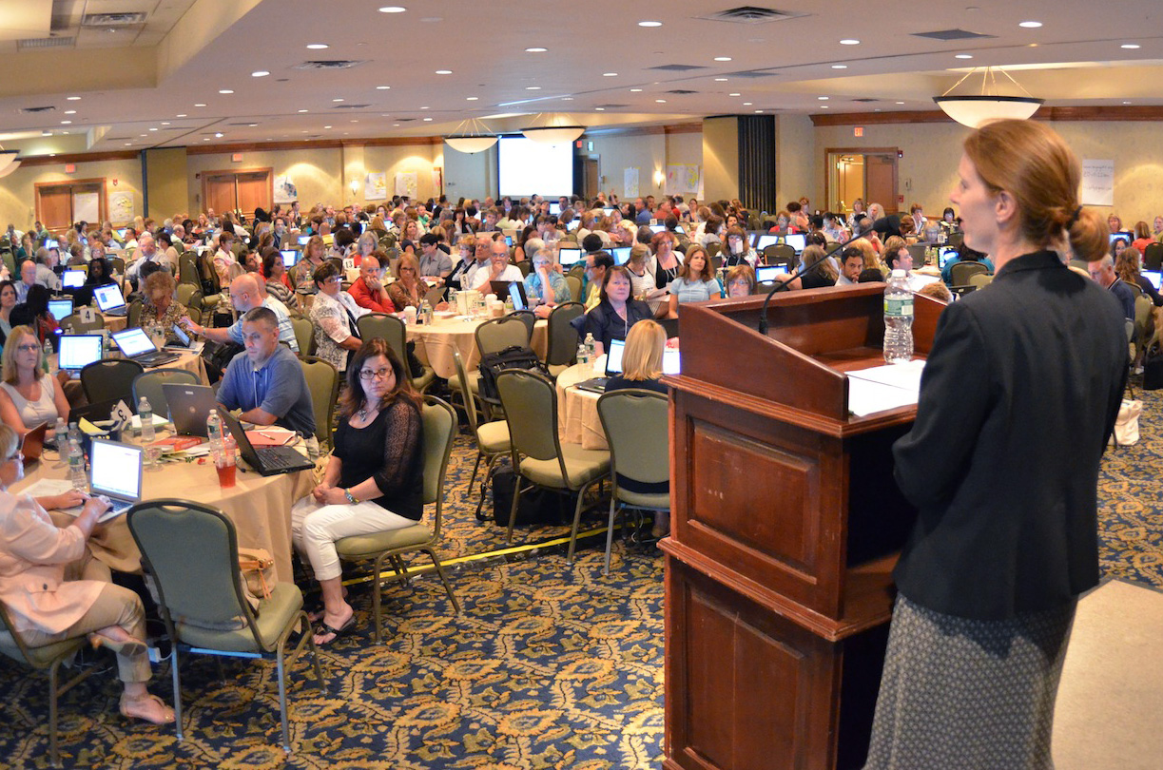

14. Try to Submit or Publish Your Paper Before the Conference
Notes:
Curt
71

Slide 72

15. Be Creative Somewhere
(e.g., unique model, figure, chart, etc.)
Notes:
Curt
72

Slide 73
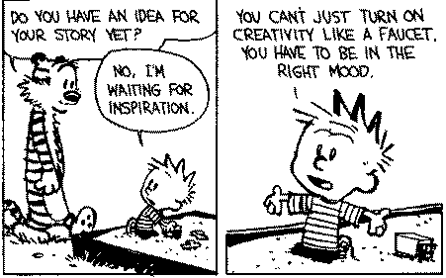

Sidenote: Modify Your Environment (Find or Create Your Personal Sandbox)
Notes:
Curt
73

Slide 74

But not too much!
Notes:
Curt
74

Slide 75

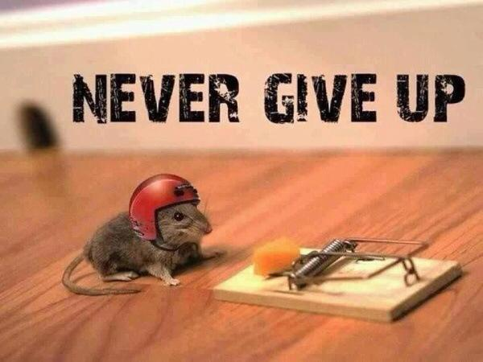
16. Try Not to Give Up: Persistence and Grit Wins the Day
Notes:
Curt
75

Slide 76
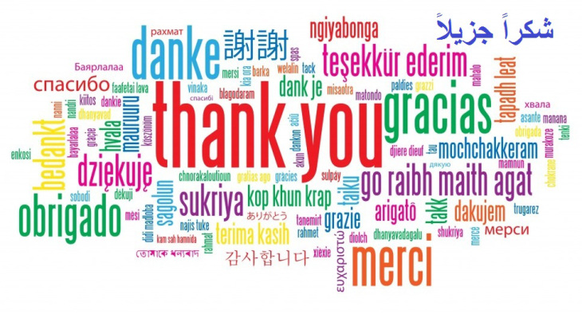
17. Be Polite and Thankful to the Journal or Book Chapter Editors
Notes:
Curt
76

Slide 77

18. Recap Reviewer Points and How You Attempted to Address Them
Notes:
Curt
77

Slide 78
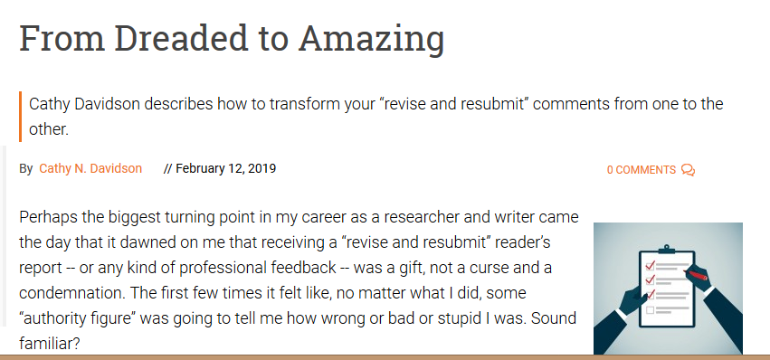

February 12, 2019
From Dreaded to Amazing
Cathy N. Davidson, Inside Higher Ed https://www.insidehighered.com/advice/2019/02/12/how-use-reviewers-revise-and-resubmit-comments-most-effectively-opinion

Slide 79
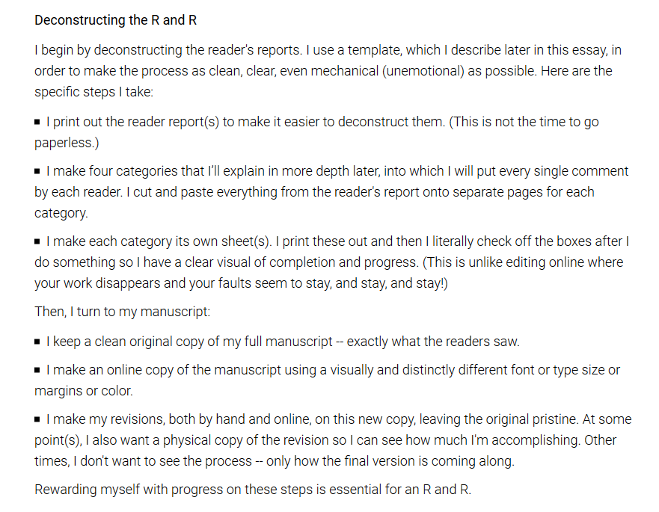
February 12, 2019
From Dreaded to Amazing
Cathy N. Davidson, Inside Higher Ed https://www.insidehighered.com/advice/2019/02/12/how-use-reviewers-revise-and-resubmit-comments-most-effectively-opinion

Slide 80

February 12, 2019
From Dreaded to Amazing
Cathy N. Davidson, Inside Higher Ed https://www.insidehighered.com/advice/2019/02/12/how-use-reviewers-revise-and-resubmit-comments-most-effectively-opinion

Slide 81

March 24, 2019
Tackling Revisions
Alexandra Gold, Inside Higher Ed https://www.insidehighered.com/blogs/gradhacker/tackling-revisions

Slide 82

October 4, 2018
A New Series on Scholarly Productivity:
‘Are You Writing?’
Rebecca Shuman, The Chronicle of Higher Education https://www.chronicle.com/article/A-New-Series-on-Scholarly/244689
Read as peer reviewer; mark up everything.
Catalog problems on a 1 to 3 difficulty scale (Level 1 takes less than 30 minutes, Level 2 takes 2 hours or less; Level 3 takes more time).
Fix the easy ones and gain momentum for the harder ones!
Take breaks as needed.
Notes:
Curt

Slide 83



19. Share Your Publication Efforts (e.g., Twitter, Facebook, LinkedIn, email, ResearchGate, Academia.edu, etc.)
Notes:
Curt
83

Slide 84

20. Celebrate Your Writing Accomplishments with Friends
Notes:
Curt
84

Slide 85



You never know where you’ll be celebrating your writing accomplishments…
Even at a wedding of your nephew!
Notes:
Curt
85

Slide 86

January 6, 2019
You’re a Full Professor. Now What?
Kathryn N. McDaniel, The Chronicle of Higher Education https://www.chronicle.com/article/You-re-a-Full-Professor-Now/245403

Slide 87

Just don’t celebrate too much!
Notes:
Curt
87

Slide 88

Bonus #1. Be Careful Committing to Other People’s Projects (OPP)
Notes:
Curt
88

Slide 89


Bonus #2. Look for Special Issues that You Might Contribute To
Notes:
Curt
89

Slide 90

Bonus #3. Save Research Articles for a Rainy Day
(file folders on different topics)
Notes:
Curt
90

Slide 91

Bonus #4. Treat Graduate Students as Colleagues
(hec, treat everyone as a colleague)
Notes:
Curt
91

Slide 92

February 24, 2019
The Importance of Friendships
Sophia Sanchez, Inside Higher Ed https://www.insidehighered.com/blogs/university-venus/importance-friendships

Slide 93


Bonus #5. Find a Mentor and Ask Senior People for Advice
Notes:
Curt
93

Slide 94


February 25, 2019
Dear Faculty: You Matter More Than You Know
Brandon Busteed, Inside Higher Ed https://www.insidehighered.com/views/2019/02/25/faculty-mentors-provide-students-exceptional-educational-benefits-opinion

Slide 95

Bonus #6. Form a Writing Group
Notes:
Curt
95

Slide 96

December 2, 2018
On the Value of Dissertation-Writing Groups
Leonard Cassuto, The Chronicle of Higher Education https://www.chronicle.com/article/on-the-value-of/245184

Slide 97


Bonus #7. Write for the General Public
Notes:
Curt
97

Slide 98


March 25, 2019
Writing for Peers vs. the Public:
When Academic Writing Falls Short
Diana Brazzell, Inside Higher Ed https://www.insidehighered.com/blogs/rethinking-research/writing-peers-vs-public-when-academic-writing-falls-short

Slide 99

January 29, 2019
The Professor Who Quit His Tenured Job to Make Podcasts and Lecture Videos
Jeffrey R. Young, EdSurge https://www.edsurge.com/news/2019-01-29-the-professor-who-quit-his-tenured-job-to-make-podcasts-and-lecture-videos

Slide 100

Bonus #8. Keep a Notebook of What Thinking
Notes:
Curt
100

Slide 101


February 24, 2019
‘Slouching Toward’ Productivity,
Deidra Faye Jackson, Inside Higher Ed https://www.insidehighered.com/blogs/gradhacker/%E2%80%98slouching-toward%E2%80%99-productivity

Slide 102

Bonus #9. Engage in Free Writing
Notes:
Curt
102

Slide 103

Bonus #10. Read Everyday!

Slide 104
Time to Recap…
The process for getting published
The process for selecting a journal for publication
Writing tips and insights
Curated resources
You commitments to future writing
Notes:
Ana
Encourage audience to access the resources on GoogleDoc.
104

Slide 105




Concerns?
Comments?
Commitments?
Curt Bonk, Indiana University
Email: cjbonk@Indiana.edu
Homepage: http://curtbonk.com/
TravelinEdMan in Twitter:
https://twitter.com/travelinedman
Notes:
All
105

