Slide 1

Self-Direct to Learn, Self-Direct to Live: Exploring Learner Choices, Experiences, and Possibilities in a Self-Directed Learning World
Curtis J. Bonk
Indiana University
cjbonk@indiana.edu
http://curtbonk.com/
Notes:
Background picture from
https://unsplash.com/photos/O5mmDoBqTF8

Slide 2
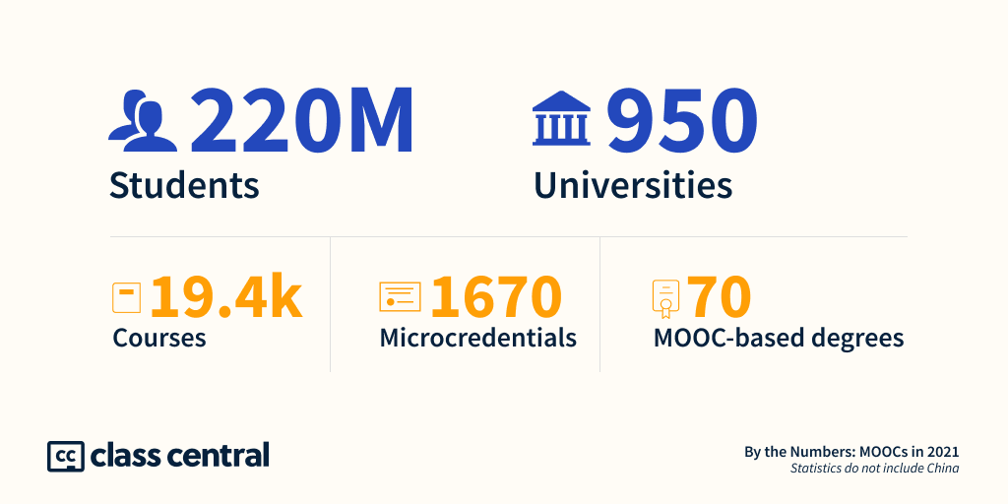
December 14, 2021
A Decade of MOOCs: A Review of MOOC Stats and Trends in 2021
Dhawal Shah, Class Central https://www.classcentral.com/report/moocs-stats-and-trends-2021/

Slide 3
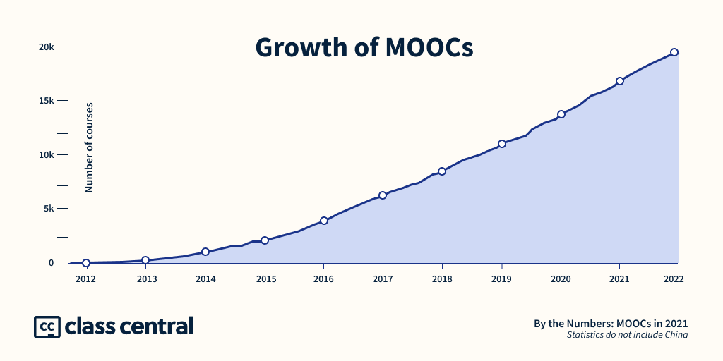
December 14, 2021
A Decade of MOOCs: A Review of MOOC Stats and Trends in 2021
Dhawal Shah, Class Central https://www.classcentral.com/report/moocs-stats-and-trends-2021/

Slide 4
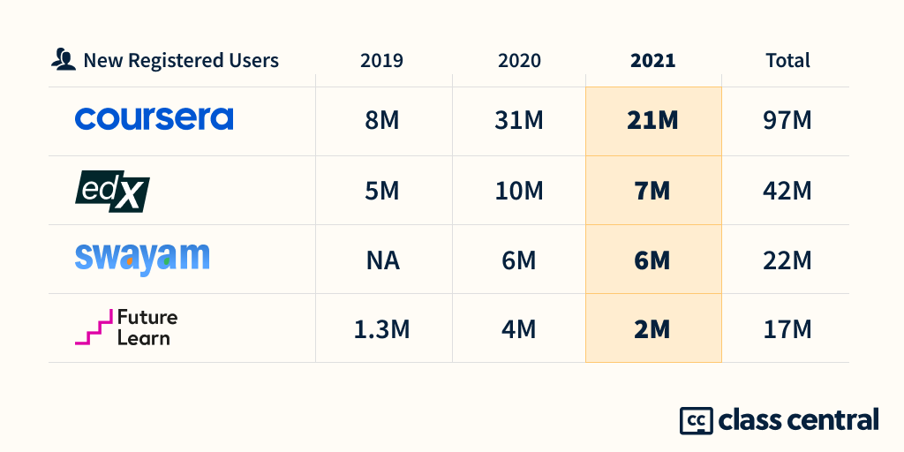
December 14, 2021
A Decade of MOOCs: A Review of MOOC Stats and Trends in 2021
Dhawal Shah, Class Central https://www.classcentral.com/report/moocs-stats-and-trends-2021/

Slide 5






MOOC books
(2020) and (2015)
Notes:
Last year, I co-edited a book titled MOOCs and Open Education around the World. MOOCs stands for Massive Open Online Courses. An individual MOOC can enroll tens of thousands of students, and several MOOCs have now surpassed 1 million students in total enrollment. MOOCs are primarily offered by elite universities such as Stanford, MIT, and Harvard through enterprises such as Coursera, edX, and FutureLearn. More people enrolled in MOOCs developed at Harvard in a single year than attended Harvard in its entire 377-year history.

Slide 6
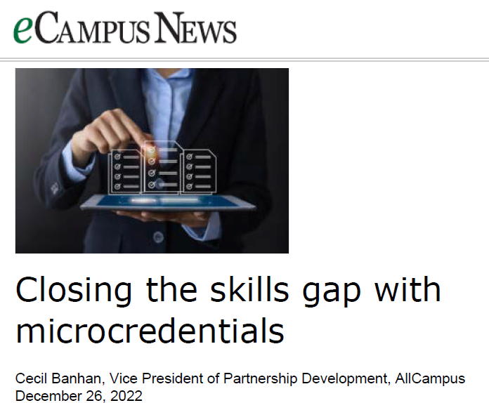

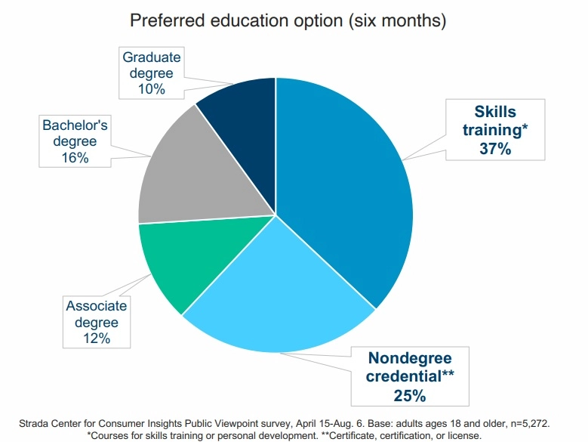
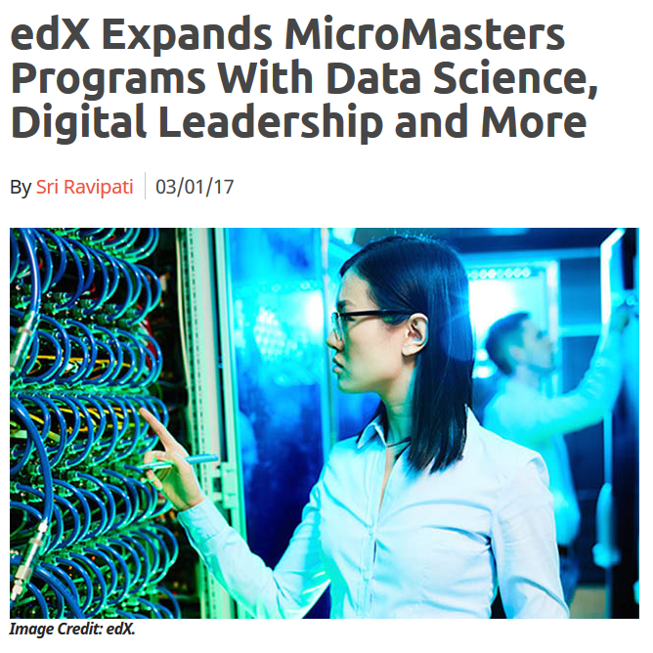
December 26, 2022
Closing the skills gap with microcredentials
Cecil Banhan, eCampus News
Alternative Credentials on the Rise https://www.ecampusnews.com/2022/12/26/closing-the-skills-gap-with-microcredentials

Slide 7


Slide 8
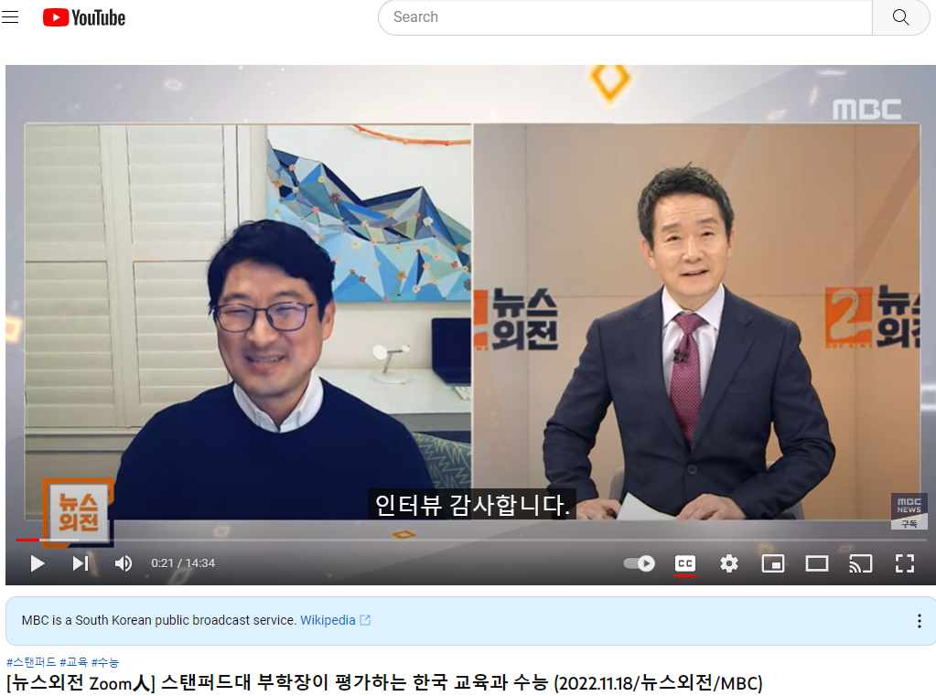
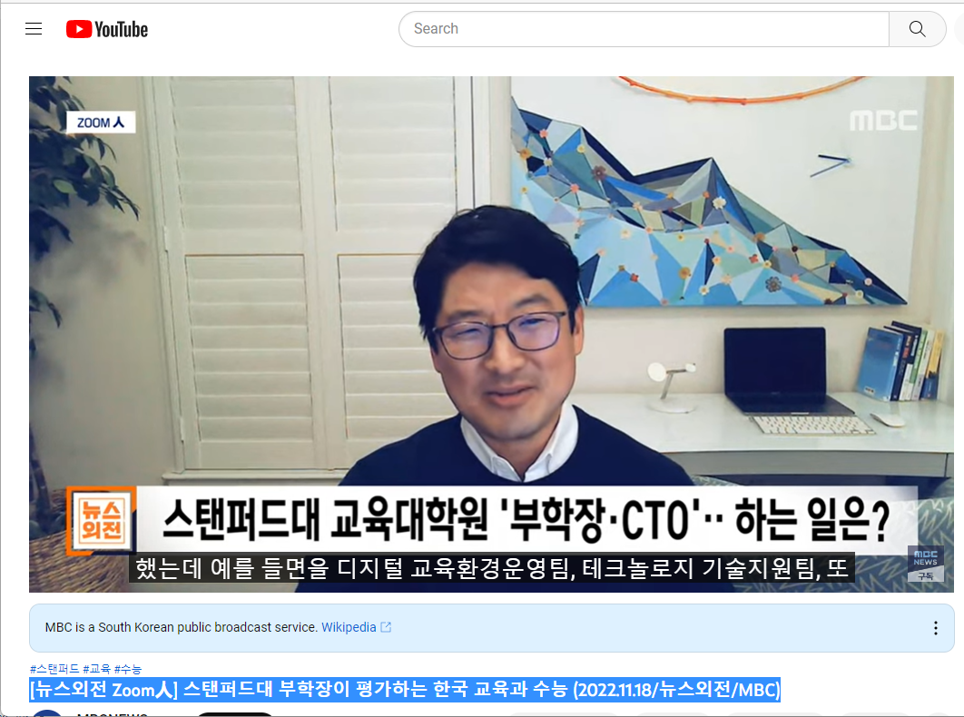
November 18, 2022
[뉴스외전 Zoom人] 스탠퍼드대 부학장이 평가하는 한국 교육과 수능 (2022.11.18/뉴스외전/MBC) https://www.youtube.com/watch?v=p9mygFNixqU

Slide 9

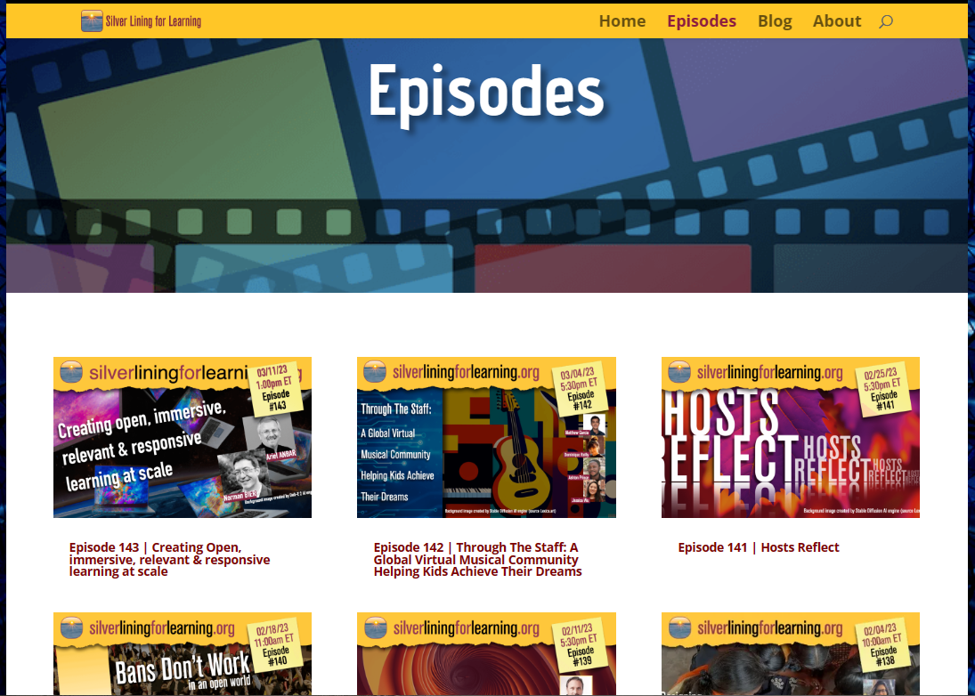
March 14, 2023
Silver Lining for Learning Webcast/Podcast https://silverliningforlearning.org/ https://silverliningforlearning.org/episodes/

Slide 10
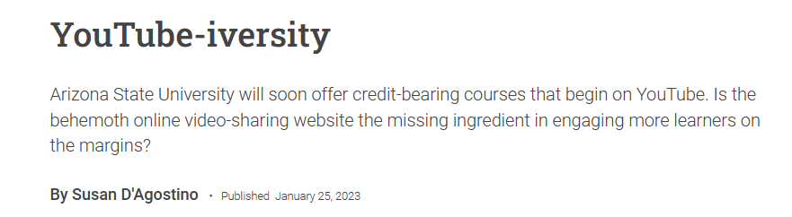
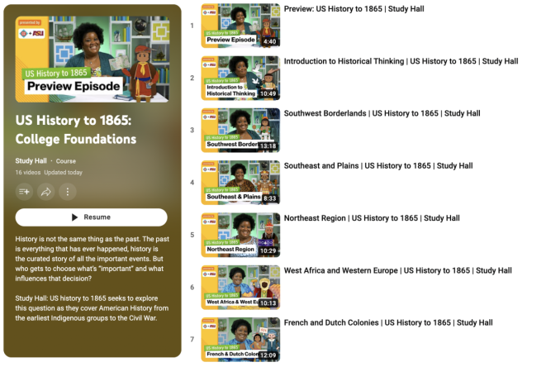
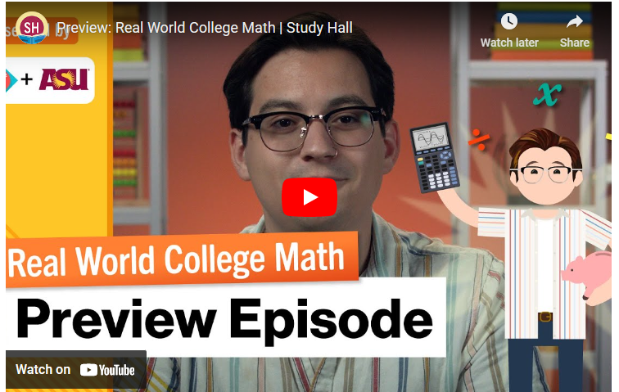
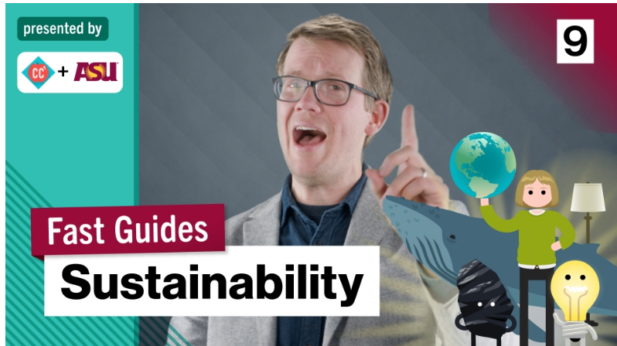
January 25, 2023
YouTube-iversity, ASU
Susan D’Agostino, Inside Higher Ed https://www.insidehighered.com/news/2023/01/25/arizona-state-turns-youtube-reach-learners-margins

Slide 11
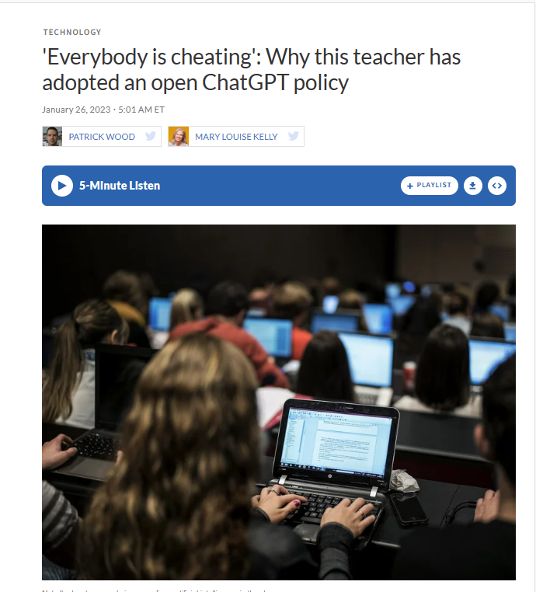
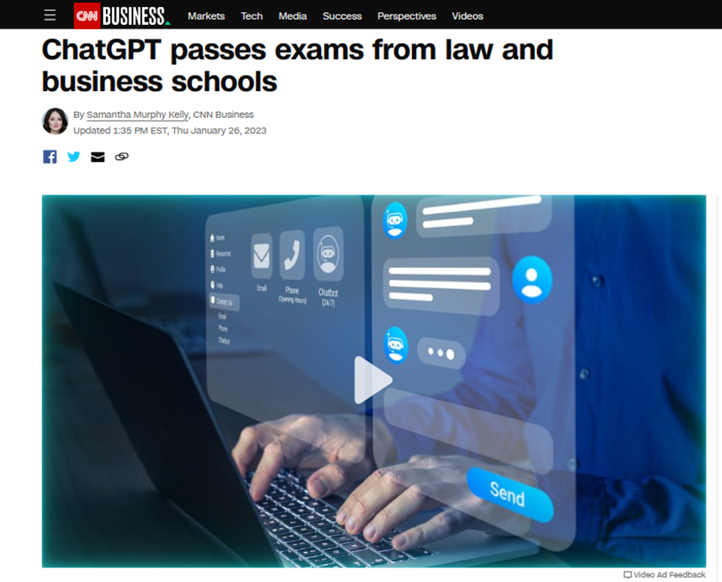
January 26, 2023
‘Everyone is cheating:’
Why this teacher has adopted an open ChatGPT policy
Patrick Wood and Mary Louis Kelly, NPR https://health.wusf.usf.edu/2023-01-26/everybody-is-cheating-why-this-teacher-has-adopted-an-open-chatgpt-policy

Slide 12

January 18, 2023
Why I’m Not Scared of ChatGPT
Christopher Grobe, The Chronicle of Higher Education https://www.chronicle.com/article/why-im-not-scared-of-chatgpt

Slide 13
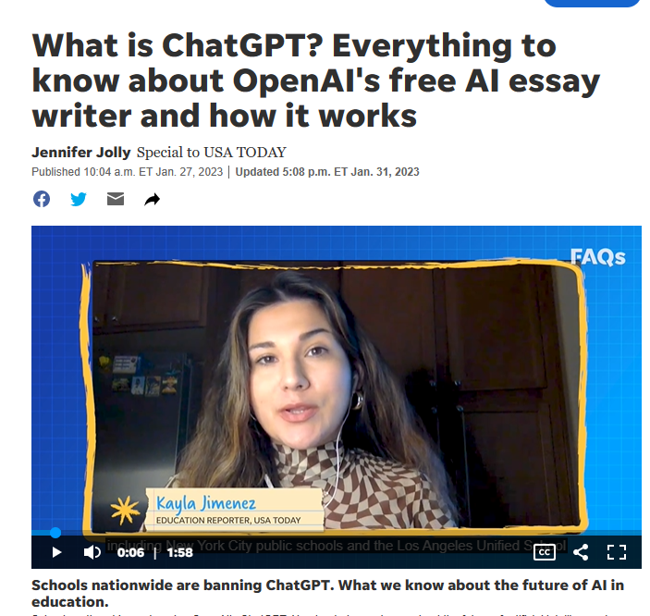
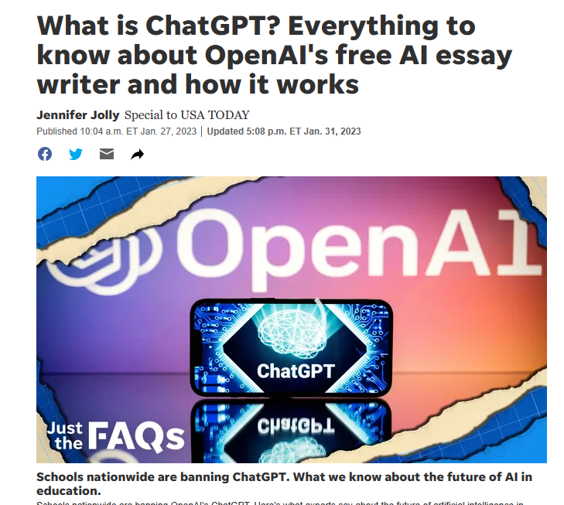
January 31, 2023
What is ChatGPT? Everything to know about OpenAI's free AI essay writer and how it works
Jennifer Jolly, USA Today https://www.usatoday.com/story/tech/2023/01/27/chatgpt-buzzfeed-ai/11129947002/

Slide 14
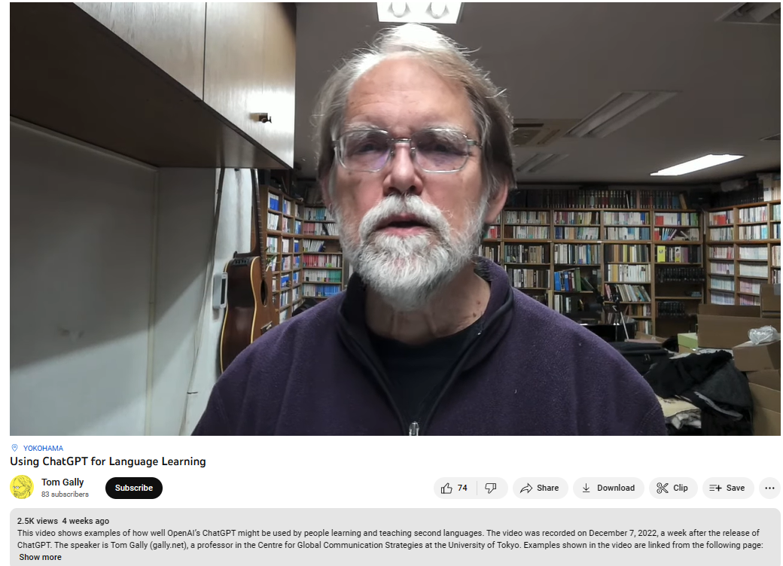
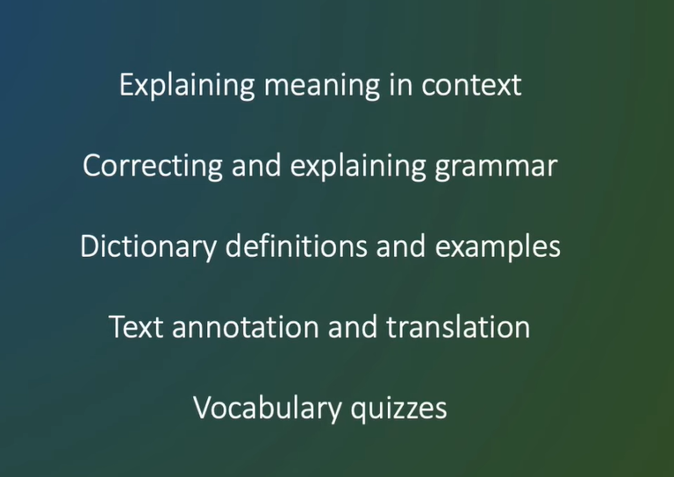

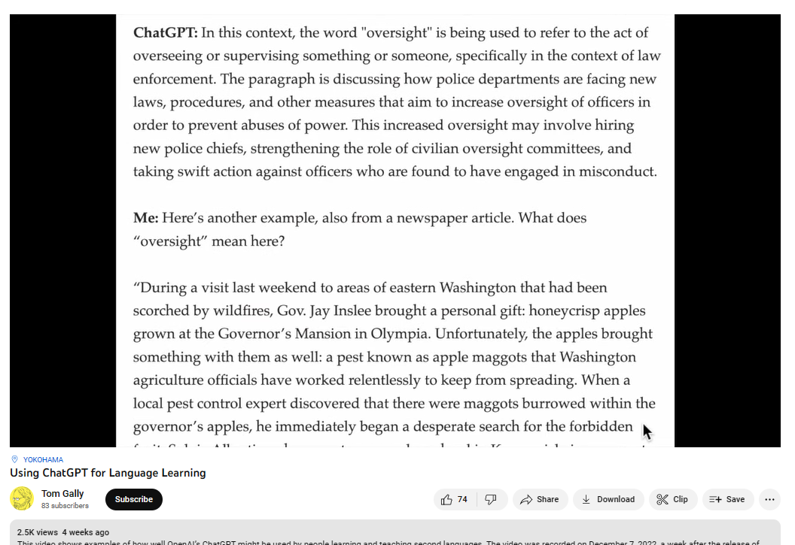
December 24, 2022
Using ChatGPT for Language Learning, Tom Gally
Will AI change the future of language learning?｜ChatGPT
Grace Guo, Mandarin Chinese https://www.youtube.com/watch?v=H3_CDYroEvU

Slide 15


October 22, 2021
Wanted:
Billions of Self-Directed Learners https://www.peoplematters.in/article/training-development/the-era-of-self-directed-learning-hrs-new-role-and-strategy-24348

Slide 16
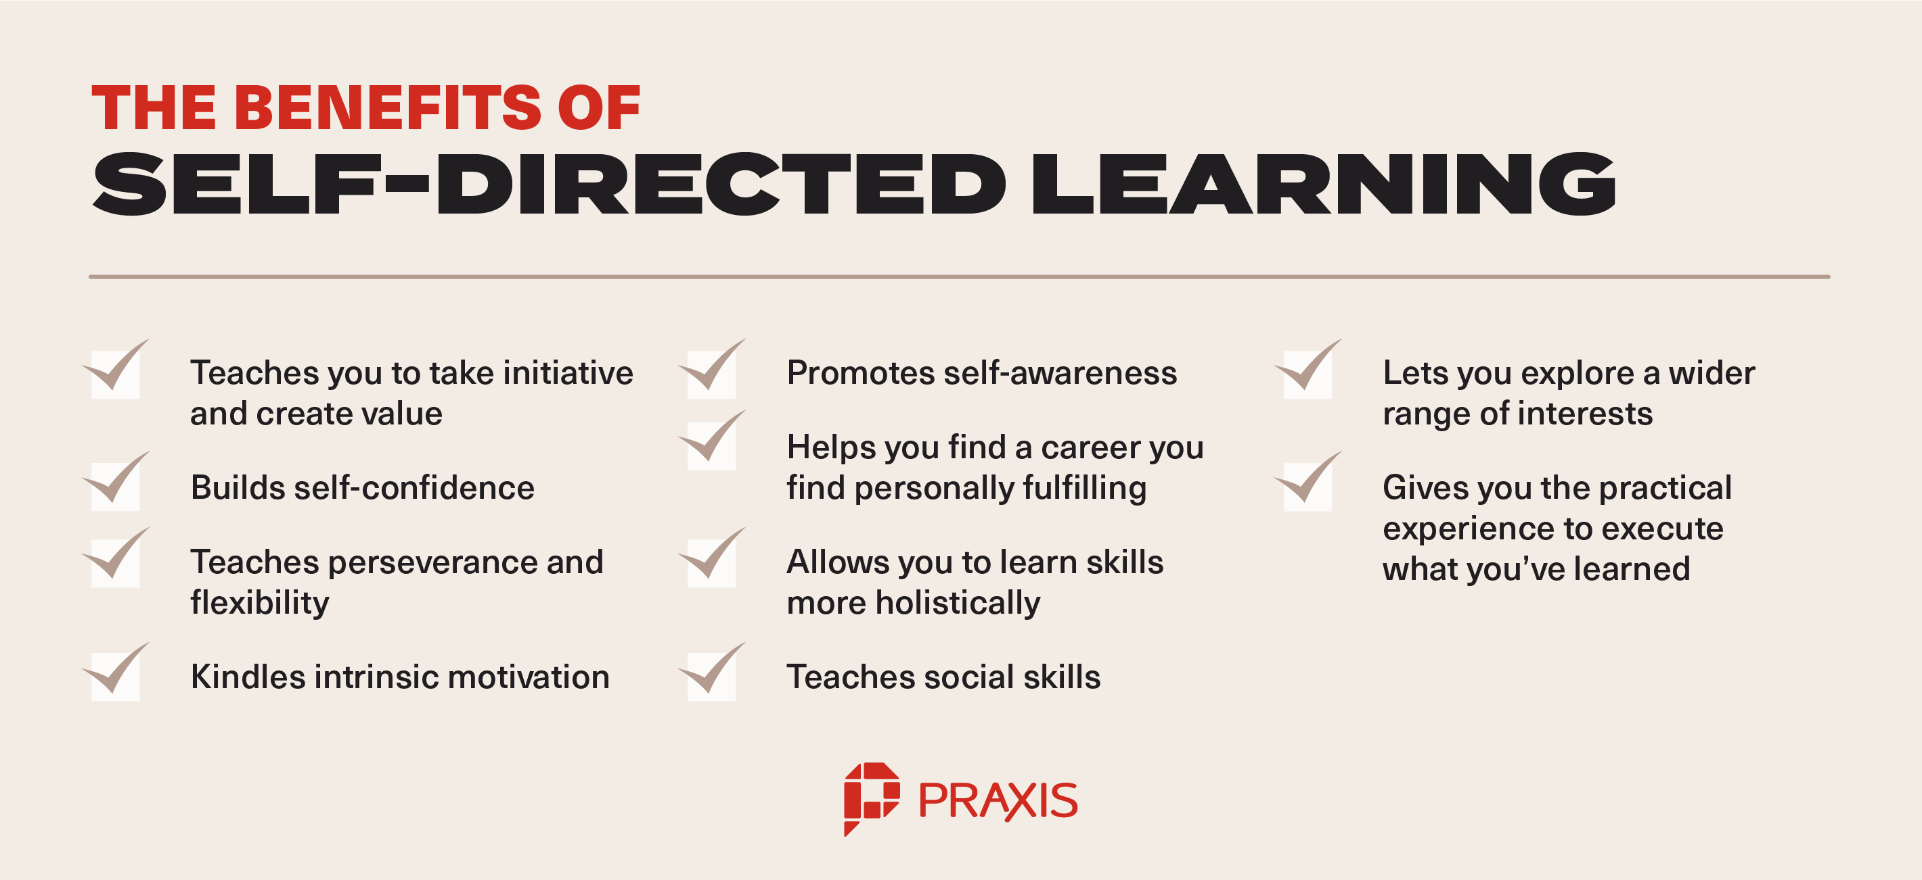
Benefits of Self-Directed Learners https://discoverpraxis.com/reasons-not-to-go-to-college/

Slide 17

Study #1. Nepali Youth Learn from MOOCs

Slide 18

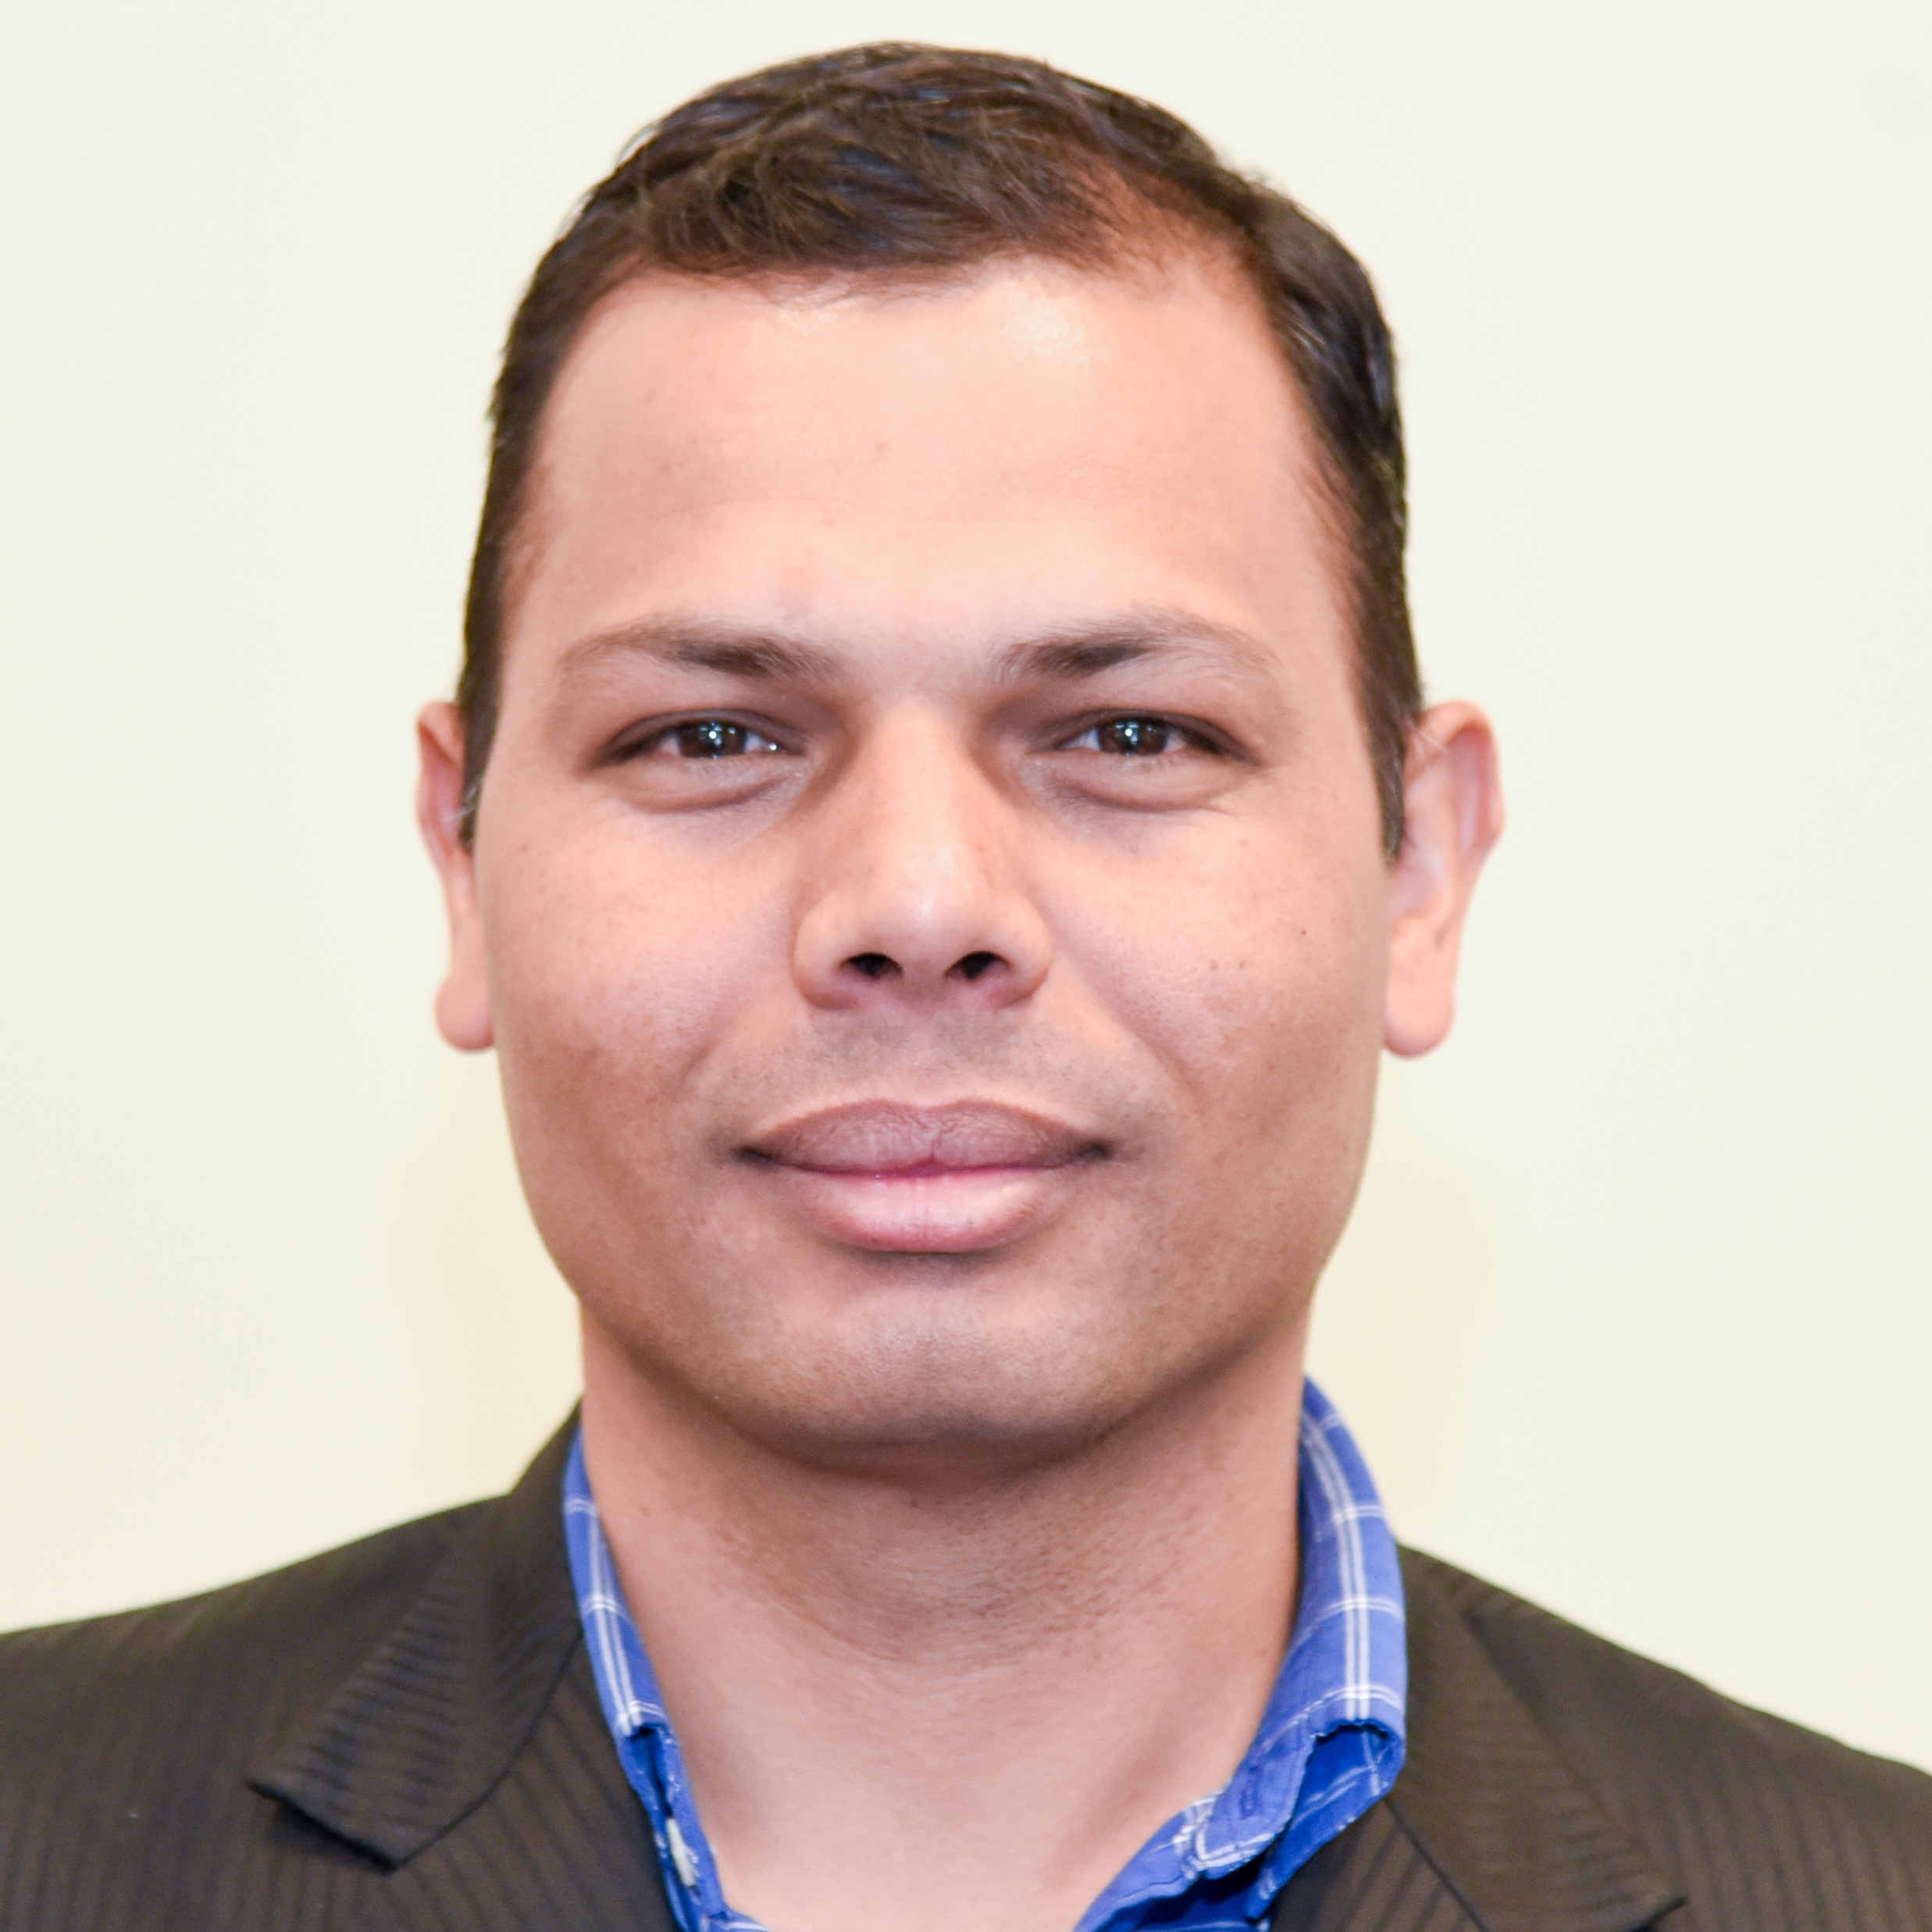
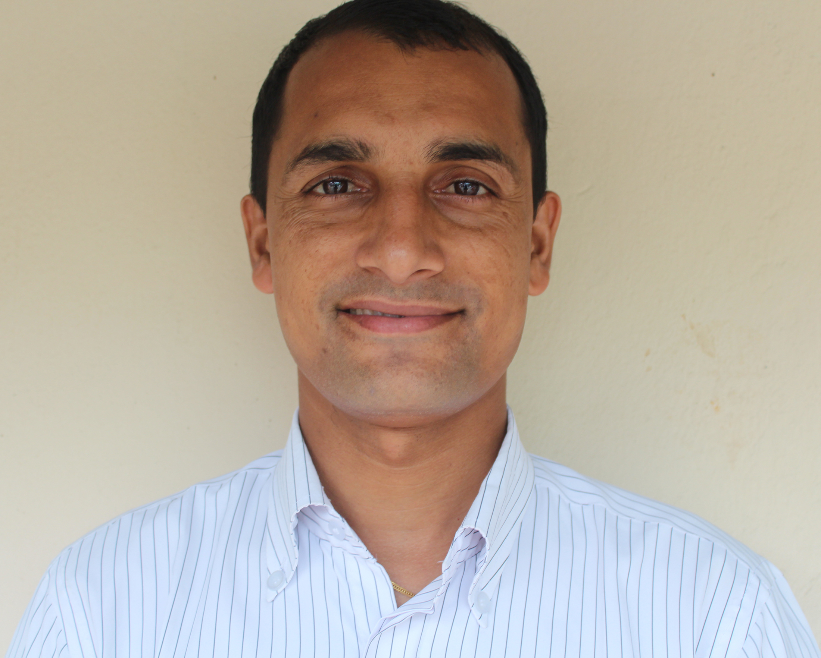
The name of the Himalayan peak is Mt. Nilgiri with 7061 Meters height.
Bishwa Raj Gautam, Program Specialist, Regional English Language Office (RELO), U.S. Embassy, Nepal.
With Baman Kumar Ghimire, Motherland Secondary School, Pokhara, Nepal

Slide 19
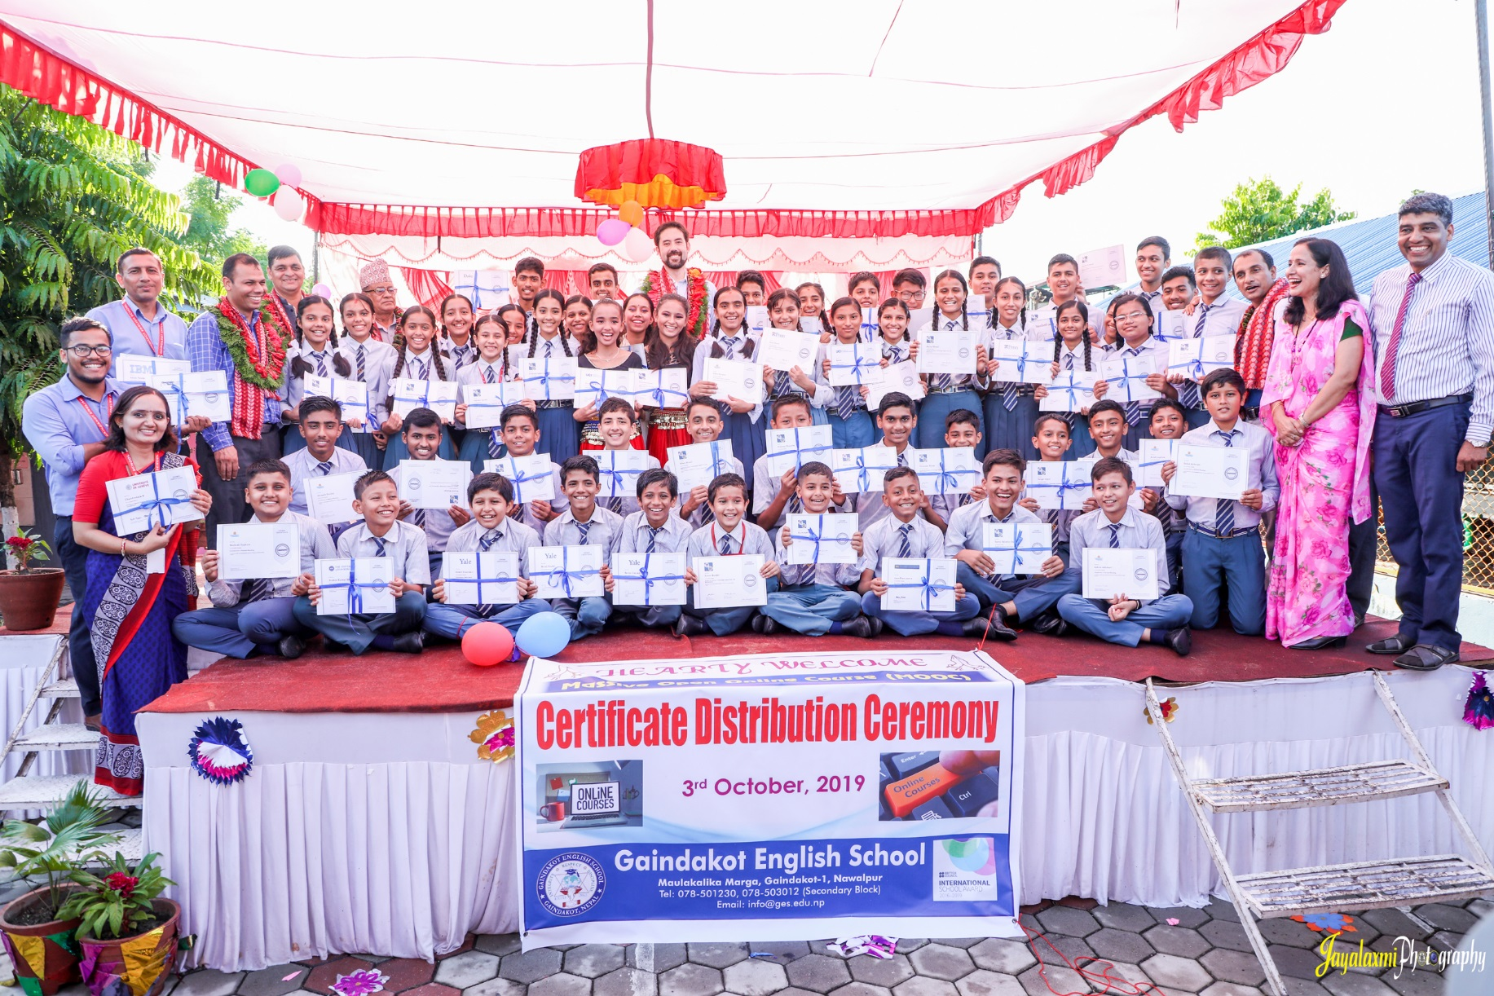
November 9, 2019
Greetings from Nepal,
Baman Kumar Ghimire
Teacher, Motherland Secondary School, Pokhara

Slide 20
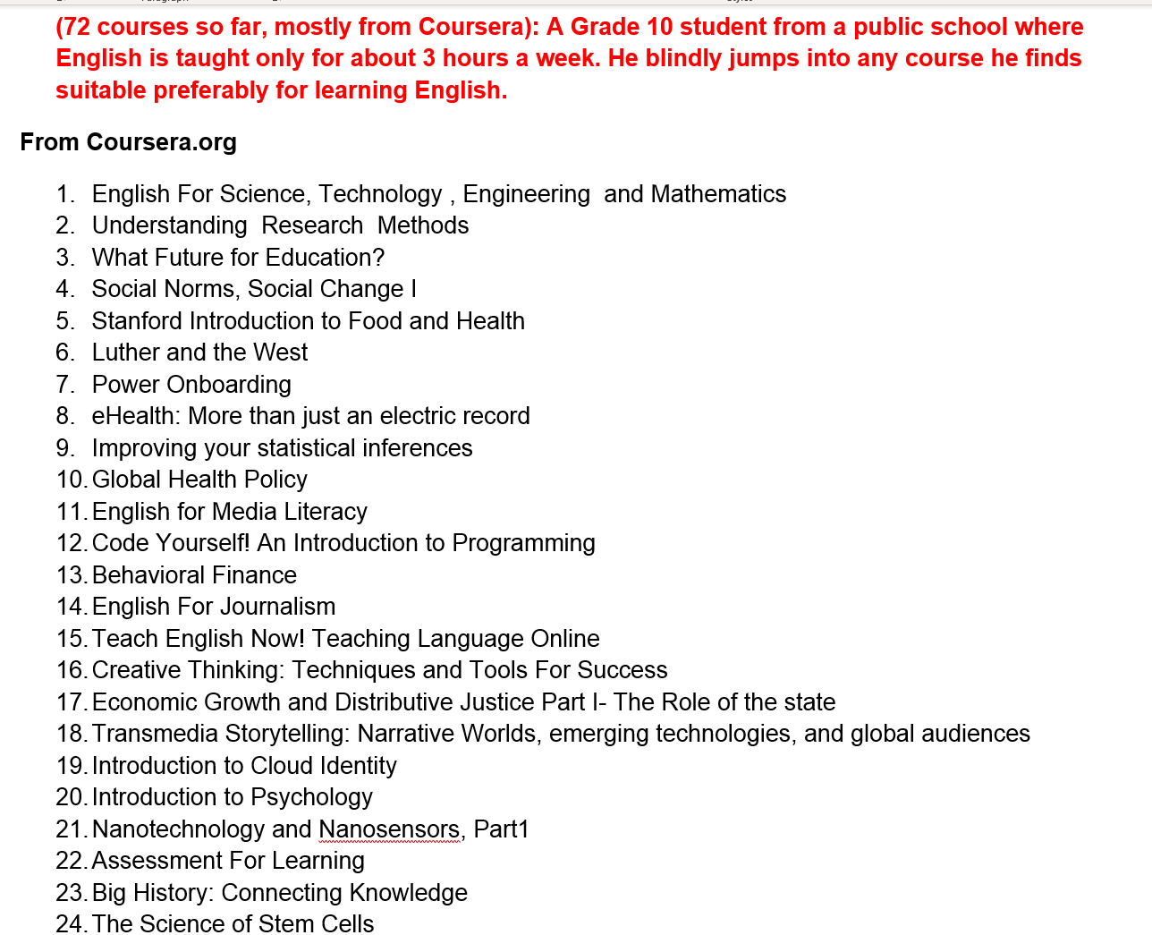
Participant #1
(boy, grade 10)

Slide 21
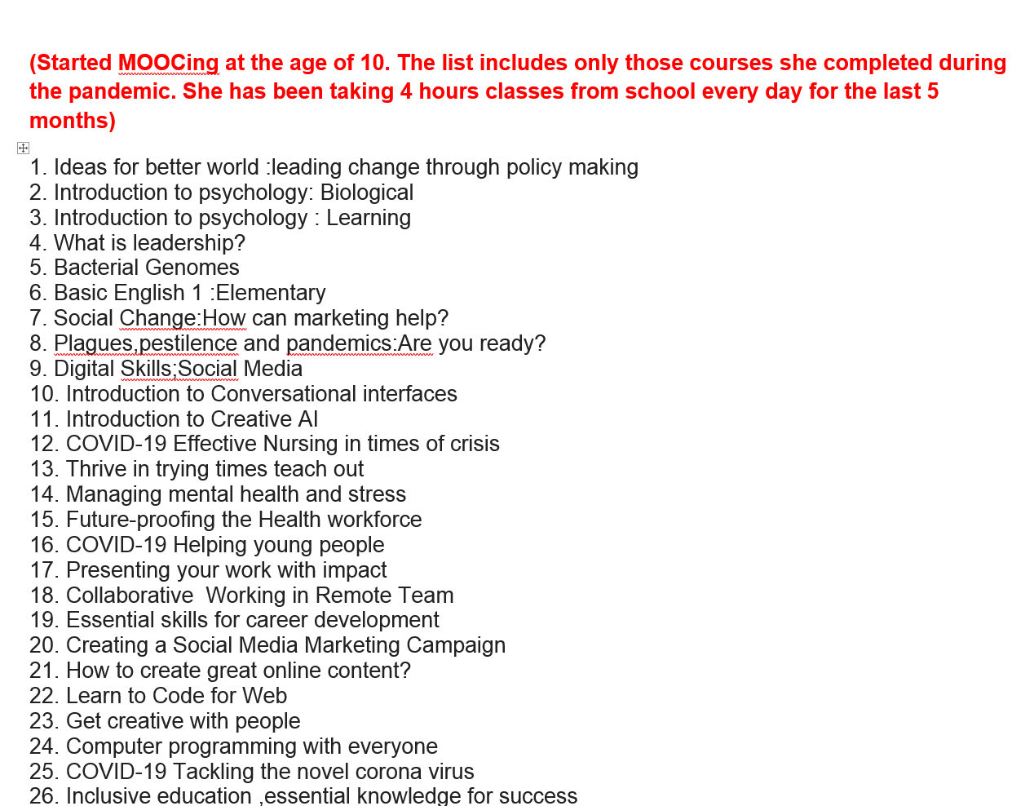
Participant #2
(girl, first MOOC age 10)

Slide 22
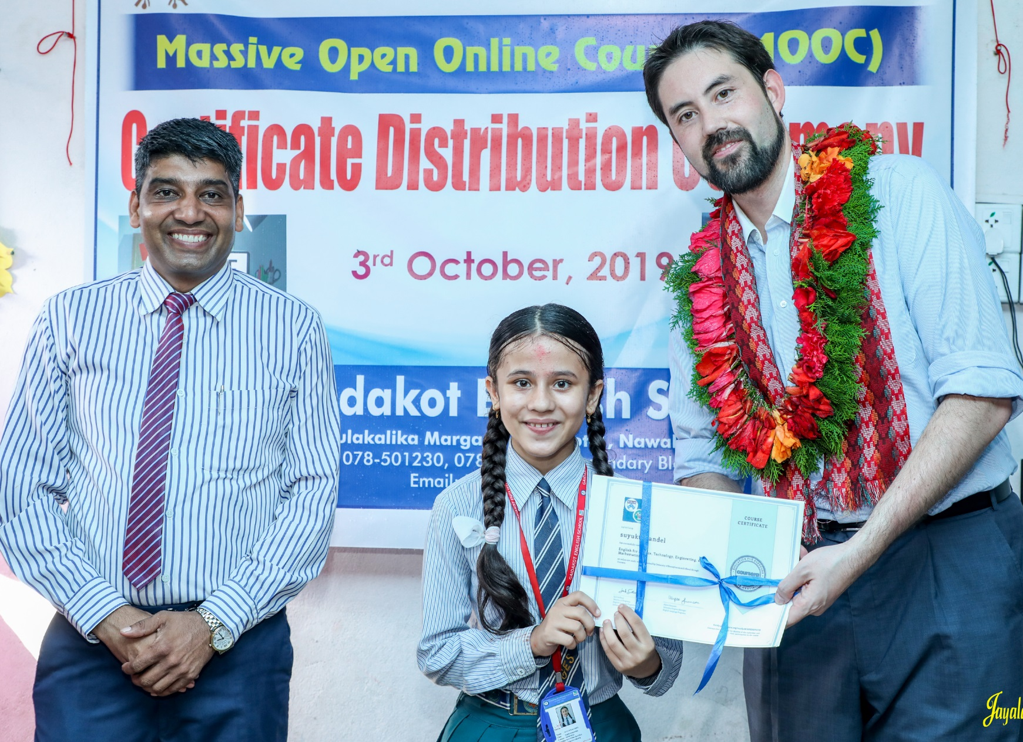
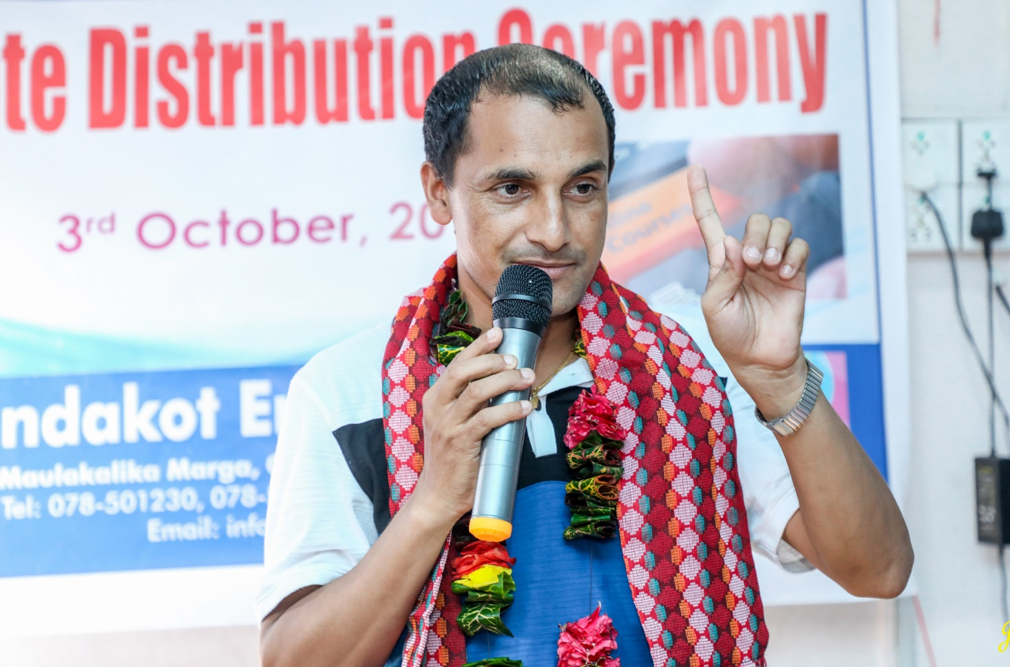
November 9, 2019
Chapter 9. Nepali High School Students in Massive Open Online Courses (MOOCs): Impressive Results and a Promising Future
Baman Kumar Ghimire and Bishwa Raj Gautam
Greetings from Nepal
Baman Kumar Ghimire
Teacher, Motherland Secondary School, Pokhara

Slide 23
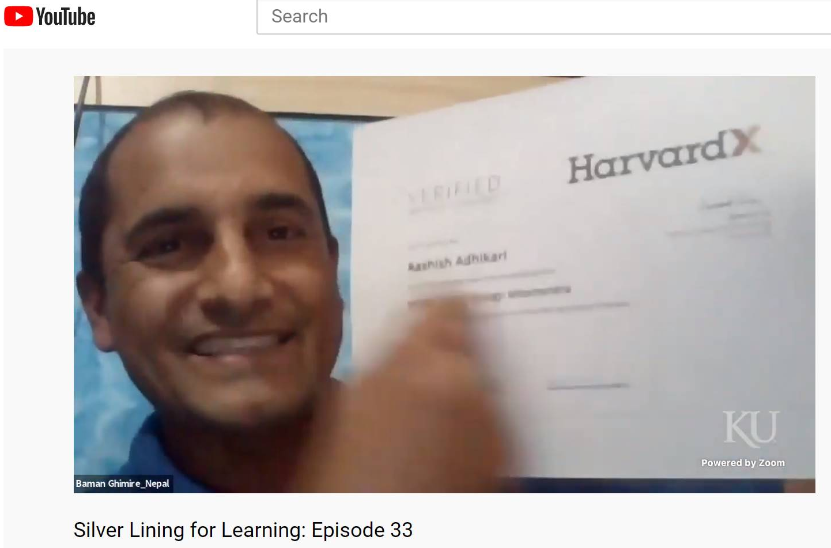
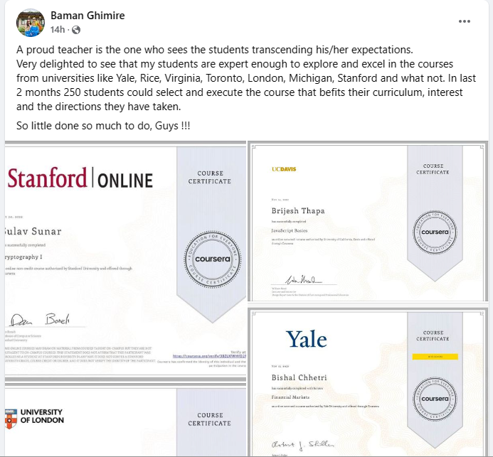
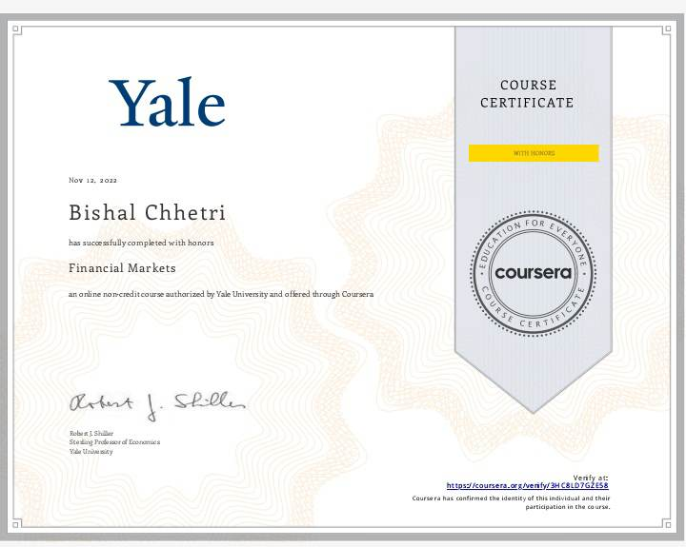
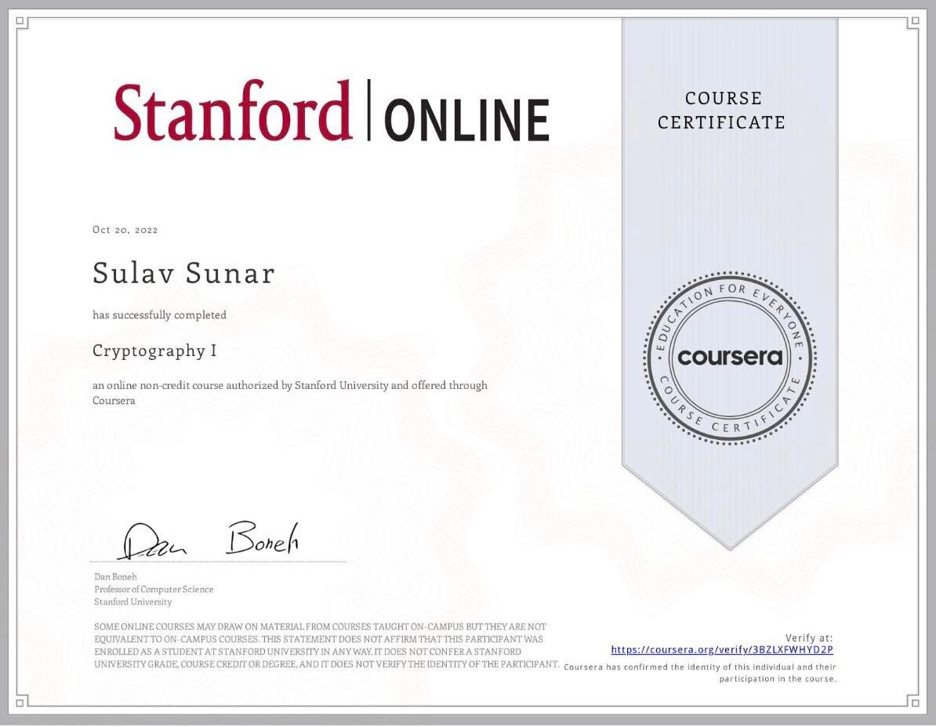
December 20, 2022
Baman Ghimire https://www.facebook.com/baman.ghimire.3

Slide 24
Data Collection Background
Student Interviews
Total #13
Semi-structured
7 female
6 male
Teacher Interviews
total #7
Semi-structured
4 female
3 female
Student Focus Groups
total #2
Semi-structured
total 8 students

Slide 25
Research Questions
Methods: Teacher’s Perspective
What scaffoldings and environmental cues were provided by teachers to support Nepali adolescent in enrolling and succeeding in MOOCs?
What are Nepali teachers' perspectives on using MOOCs as supplementary resources?

Slide 26
Participants
Participant | Job title | Years of using MOOCs | School Type | Number of Students Completed MOOCs
Teacher #1 | Science Teacher | 4 years | Private | 15-20
Teacher #2 | EFL Teacher | 7 years | Private | more than 20
Teacher #3 | EFL Teacher, Principal | 3 years | Private | more than 20
Teacher #4 | EFL Teacher | 1 year | Private | more than 20
Teacher #5 | EFL Teacher | 1 month | Public school; ACCESS | 2 completed
Teacher #6 | EFL Teacher | 1 month | Public school; ACCESS | 2 completes
Teacher #7 | EFL Teacher, Principal | 8-9 years | Private | more than 20

Slide 27
Identified Themes
Sources of support | parental; teacher's fading support; external support
Teacher roles | facilitators, guides, cheerleaders
Substantial gains | teachers learning from MOOCs, benefits, positive outcomes
Strategies & student initiatives | student mentors, intrinsic sources, incentives
Challenges & suggestions | engaging with courses, resources, design

Slide 28
RQ 1
Sources of support | parental; teacher's fading support; external support
“They did on their own pace but initially we guided them, initially we guided them and every week what we follow up them initially but later on they did by themselves.” (T#1, line-134-136)
“…the school has been promoting these kinds of activities, please, to let your children be with the computer. If they ask for, and it was really very difficult to convince the parents as well.” (T#3, line 390-396)

Slide 29
RQ 1
Strategies & student initiatives | student mentors, intrinsic sources, incentives
“Those students who just completed MOOC, they are really happy got excited here they are leading the group and they are sharing their experience.”(T#4, line 588-591)
“They have shown interest in coding, and they have started now they're running coding Club in school. And they mentor the junior those who did coding courses and now mentoring the juniors they're supporting the juniors.”(T#1, line 259-263)
“…they were quite interested, they showed their motivation in doing the courses, so we didn't have to push them. You know, they were like motivated internally…”(T#4, line 283-286)

Slide 30
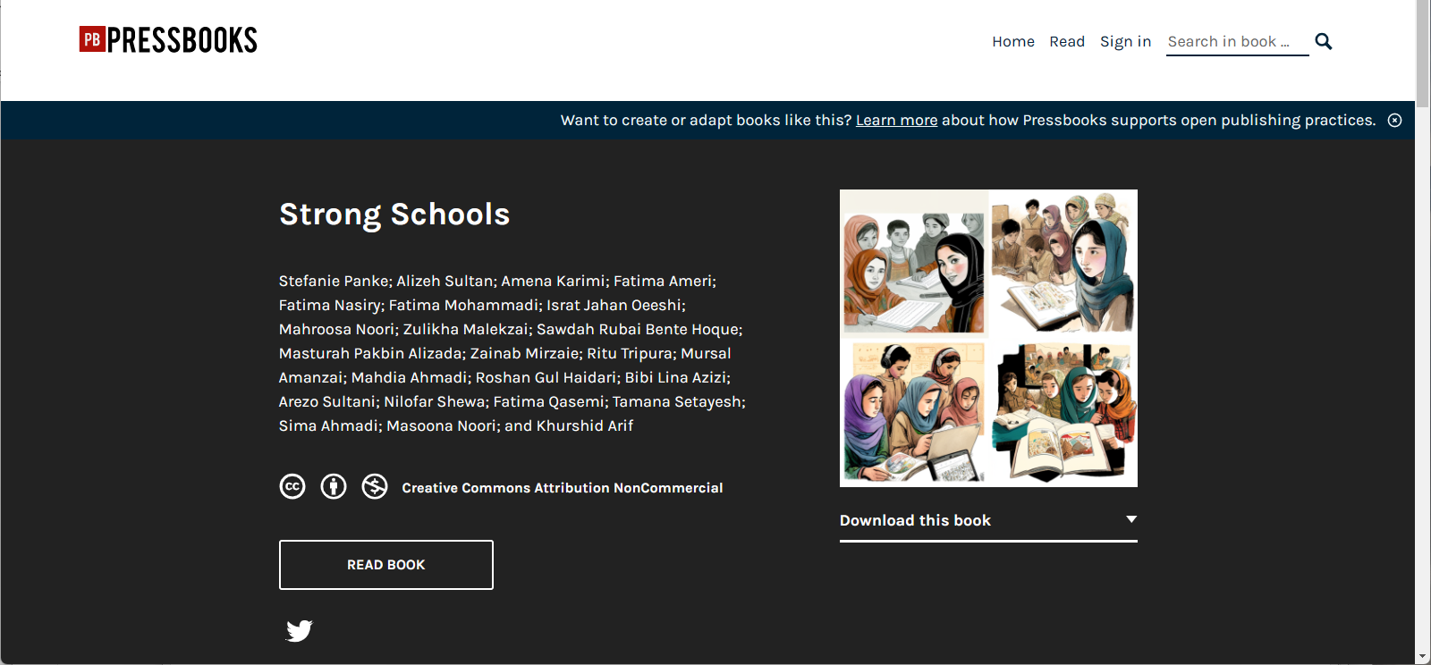
February 15, 2023
Strong Schools, Afghani Women
Asian University of Women https://pressbooks.pub/schools/ file:///C:/Users/18123/Downloads/Strong-Schools-1674597042.pdf

Slide 31

Study #2: Li & Bonk (in press CALL)
Self-directed language learning in Duolingo

Slide 32
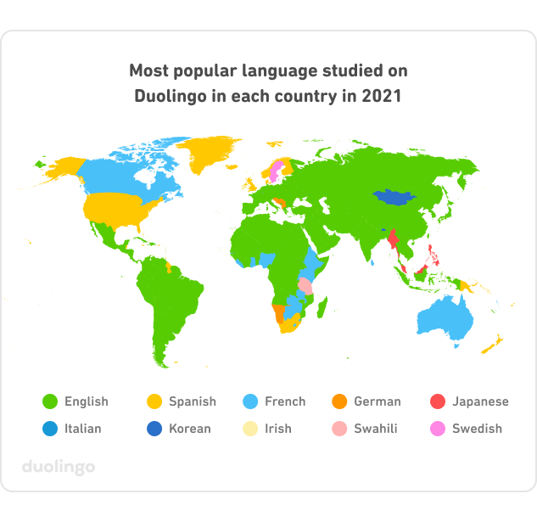
(Blanco, 2021)

Slide 33
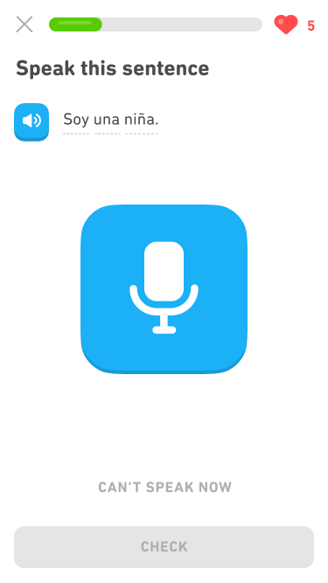
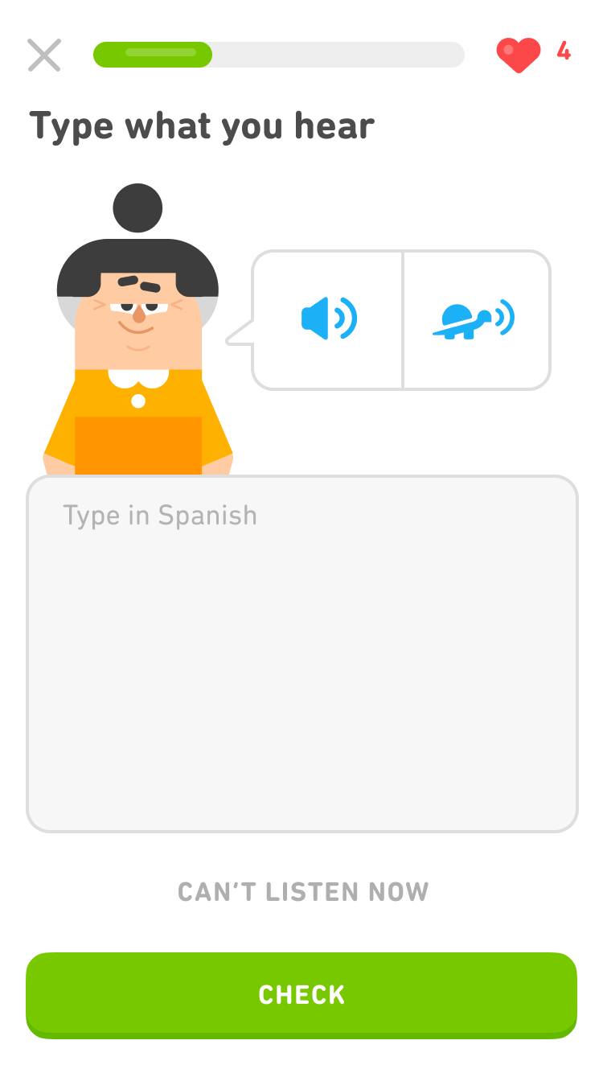
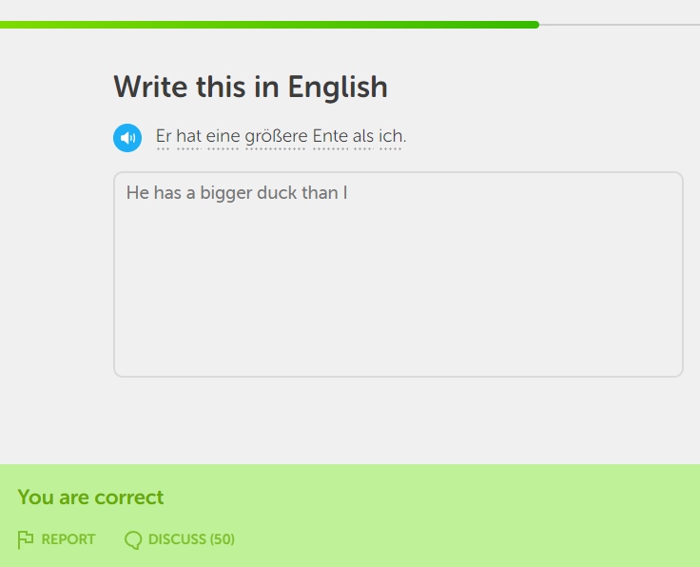
Platform Overview

Slide 34
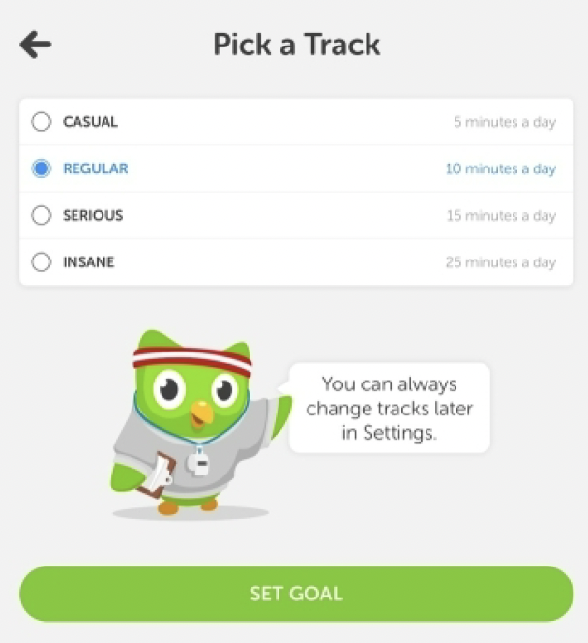
Goal Setting
Based on microlearning.
Is goal-oriented.
Range from 5 min/day to 20 min/day.
Flexibility to personalized.
Teachers may track students’ performance if use “Schools”
Notes:
Duolingo is based on the concept of microlearning, constructed with small learning units and short-term-focused learning activities that reach users through the day (Brebera, 2017). The daily study goal ranges from 5 min/day to 20 min/day, which can be easily completed on the mobile app whether when the learner is waiting in the checkout line at a grocery store or sitting on a bus to school. It provides the learner great flexibility to personalize their learning process that matches their learning goal, learning capability, time limitations, etc. More recently, the context for Duolingo use has extended to a formal classroom setting. Teachers can incorporate Duolingo into their individual lesson plan and track students’ performance through Duolingo (Gigaom: Language-learning app, 2015).

Slide 35
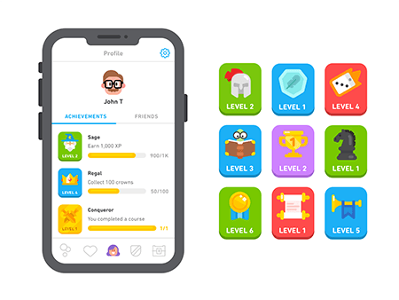
Gamification
Duolingo applies gameful learning to keep the learner motivated and consistently engaged in a positive and casual learning environment.
Its learning process is structured as a learning game that has game features, such as reward, badges, and leader-board, to allow users to learn as playing.
Notes:
Duolingo applies gameful learning to keep the learner motivated and consistently engaged in a positive and casual learning environment. Its learning process is structured as a learning game that has game features, such as reward, badges, and leader-board, to allow users to learn as playing.
. Gems and lingots are used as rewards, functioning as virtual currency that learners gain by completing lessons or skills. Leaderboards provide opportunities for learners to compete with other learners, forming social connections and interactions between online users. The level-system provides a way to track a learner’s learning process. When users learn on Duolingo, they earn experience points (XP), which determine a user’s language level. Badges are important components of Duolingo design, which display user’s achievements in the learning process (Huynh, Zuo, & Ilda, 2016).

Slide 36
Research Questions
How do Duolingo learners self-manage their learning goals, time, resources, and support?
What strategies are employed by Duolingo learners to overcome challenges and frustrations related to learning foreign languages with Duolingo?
What motivating factors underpin the decisions of learners to learn a foreign language with Duolingo?
How does the design and delivery of Duolingo foster learners to be self-directed learners?

Slide 37
Context of the Study
Learning with technology (e.g., Duolingo) in an out-of-classroom context is often challenged by the absence of instructors and lack of guidance.
Therefore, it demands a much higher level of self-directed learning (SDL) ability for the learners to be successful.
White (1995) suggests that learners need to have strong independence, autonomy, and control to self-manage learning and make their own decisions in distance language learning.

Slide 38
Garrison’s (1997) Framework of SDL
Self-management is the task control ability that is associated with external activities, such as time, resources, and goal management.
Self-monitoring is the cognitive and metacognitive process of establishing learning strategies and learning paces.
Motivation can initiate and sustain learning efforts towards cognitive goals (Garrison, 1997).

Slide 39
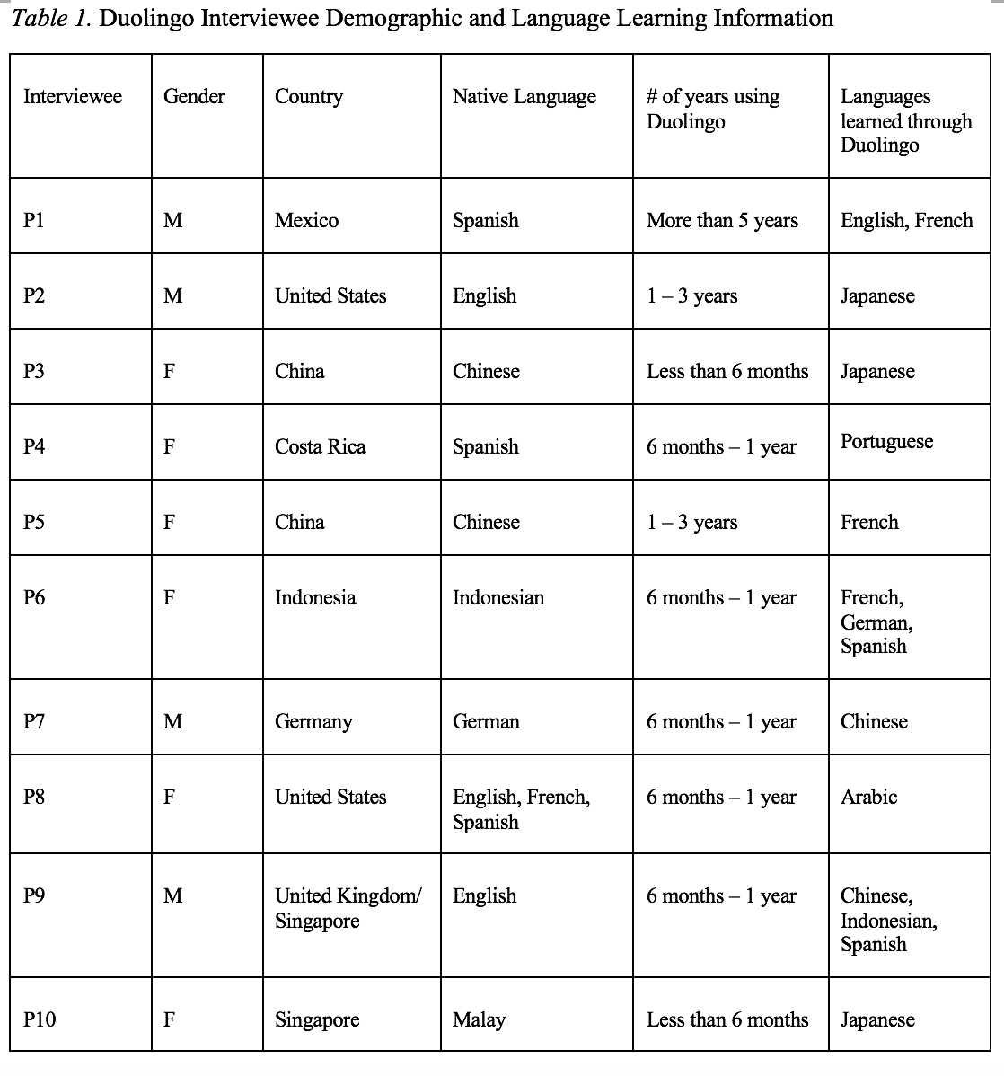
Study Design
The 10 research participants represented a wide range of age and ethnic groups.
Participants of this study were screened and identified through the previous survey that was distributed through the Duolingo forum, an online language community using Discord, as well as through postings on Facebook pages, emails, and WeChat groups. The interviewees’ demographics are listed in Table 1.

Slide 40
Goal Management
Goals specify the amount of effort required to succeed and the self-satisfaction anticipated (Schunk, 1990).
Goal setting leads to task assessment and considerations of the appropriate learning strategies from a metacognitive perspective (Ridley et al., 1992).
In MALL, timescales influence the dynamic nature of the learning ecology and so influence the learning goals.
Setting realistic and achievable goals is more likely to lead to a successful SDL.
Notes:
A goal is something that an individual is intentionally attempting to achieve, whereas goal-setting refers to establishing a goal and adjusting it as needed. (Bandura 1986, 1988; Lunenburg, 2011). Goals with specific standards can enhance learning because they specify the amount of effort required to succeed and the self-satisfaction anticipated (Schunk, 1990). Further, goal setting leads to task assessment and considerations of the appropriate learning strategies from a metacognitive perspective (Ridley et al., 1992). In MALL, timescales influence the dynamic nature of the learning ecology and so influence the learning goals. In effect, learners lose motivation when there are not enough accomplishments in a reasonable time towards the learning goals (Isbell et al., 2017). Accordingly, setting realistic and achievable goals is more likely to lead to a successful SDL.

Slide 41
Self-management
Specific goals can lead to improved performance, and learners' learning goals can be self-initiated or technology-defined.
Distractions from daily living may make time management difficult, both physically and psychologically.
A single MALL tool like Duolingo is not enough to master a language in all dimensions; as a result, they seek and manage other resources to complement their learning.
Both human and material resources can be used to complement Duolingo learning.

Slide 42
Self-management
“I think my biggest suggestion, as I mentioned a little earlier, is just don't use Duolingo as your only resource. Because particularly nowadays or for any language, there are so many other resources out there and there are certain things that each of them does better or worse than the others.”
Interviewee #2
“My opinion on that is since Duolingo is a non-human system, I think to have a human tutor at the end of a section would actually be a nice relief, a nice change of pace.”
Interviewee #9

Slide 43
Time Management
The majority of interviewees (n=8) stated that daily life activities are a constraint to their time management.
The significant obstacle is due to work demands, which have an impact on learners’ physical and emotional ability to complete their learning goals on a consistent basis.
“Because my schedule can be busy. Sometimes, especially during the exam
period in schools, I really have no time. I'm just busy completing my markings.”
Interviewee #10
Notes:
The majority of interviewees (n=8) stated that daily life activities are a constraint to their time management. The significant obstacles that interviewees face relate to time constraints for studying a language and the limited free time due to work demands, both of which have an impact on their physical and emotional ability to complete their learning goals on a consistent basis. P10, for example, stated, “Because my schedule can be busy. Sometimes, especially during the exam period in schools, I really have no time. I'm just busy completing my markings.”
Despite the fact that learners face a variety of physical and physiological challenges when it comes to time management, eight interviewees (n=8) either use technology-assisted time management or a self-developed time management system to overcome time constraints. To cope with the problem, four of them (n=4) even use a combination of technology and individual planning systems to facilitate time management. Six interviewees (n=6) reported that Duolingo notifications via phone push and emails are effective at reminding them to devote time to language learning. As P7 from Germany noted, “Because I wa

Slide 44
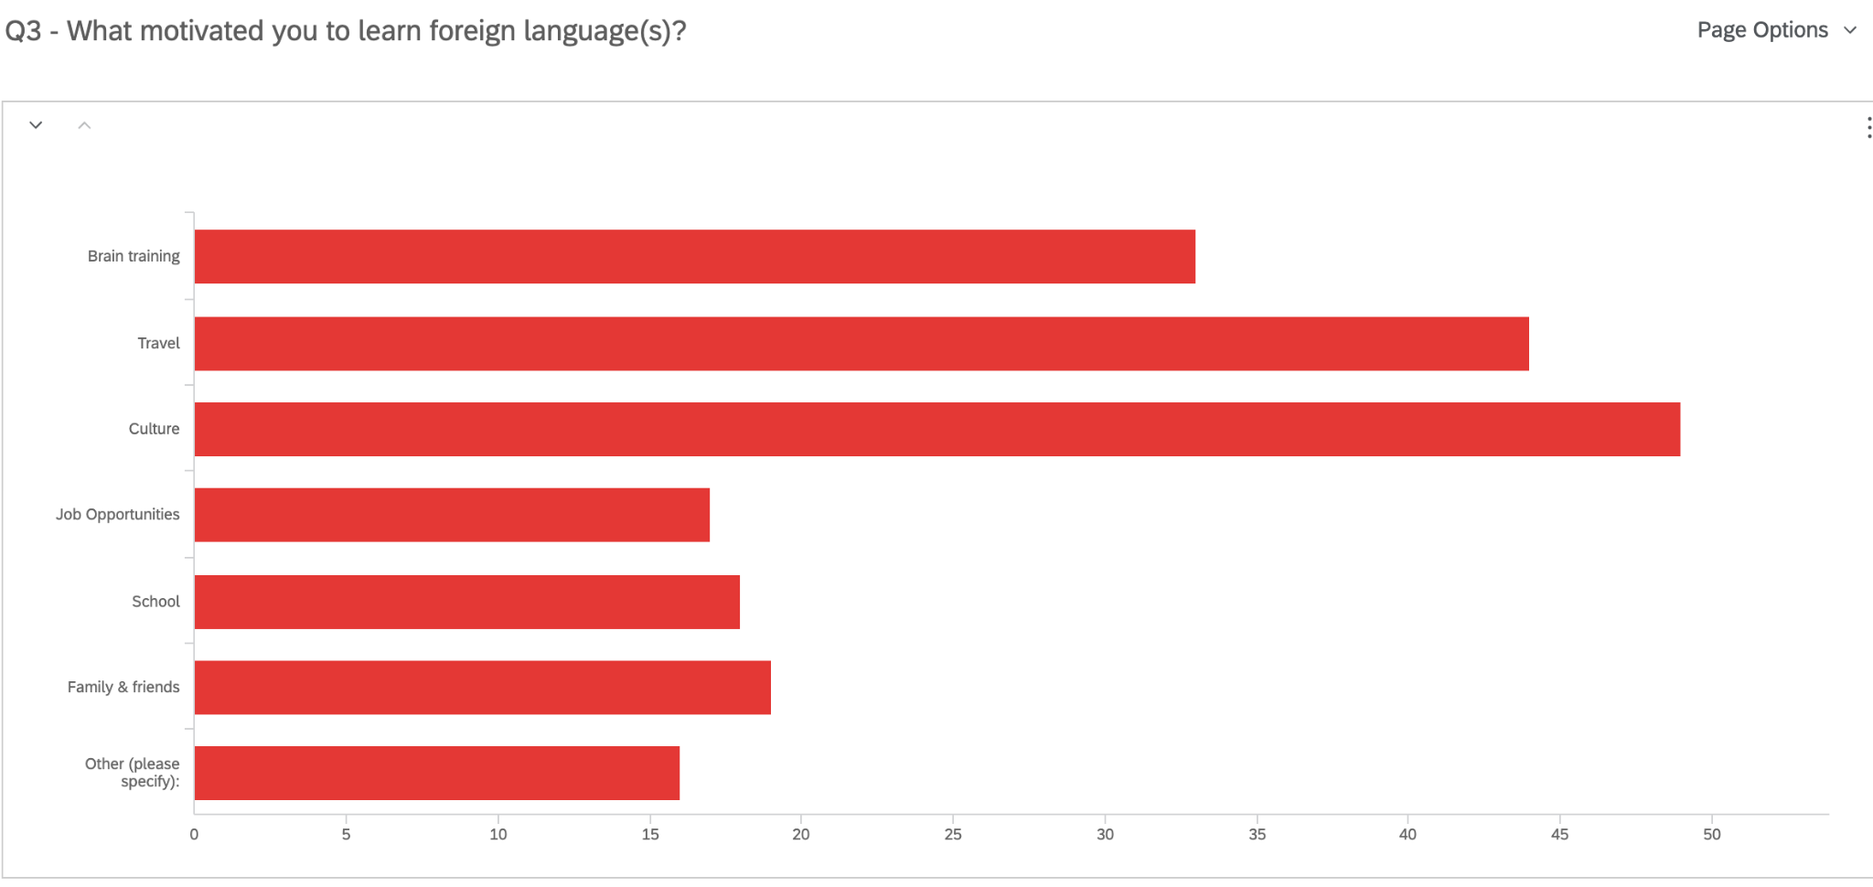
Finding: Motivation
Language learners are mostly driven by intrinsic motivators that relates to culture, travel, and brain training.
Q3. What motivated you to learn a foreign language?
Brain Training
Travel
Culture
Job Opportunities
School
Family and Friends
Other

Slide 45


Finding: Motivation
The idea is that I would really like to go to Europe someday. (P5)
So in the last month, the idea came up of going from Hamburg with the train to Moscow and then transit to the trains. And then make some stops in Siberia and then end at Beijing and enjoy the visit in China. (P7)
But for people, who are more like my mother, when she talks about it, she is just like, “oh, well, I'm learning it. I don't expect to be conversational and I'm just learning it to keep my mind sharp.” (P8)

Slide 46
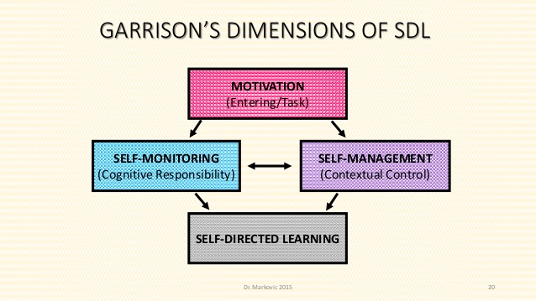
Study #3
MOOCs Instructional Design to Facilitate Participants’ Self-Directed Learning

Slide 47

Data Collections
  Survey:
  Volunteer sampling (Creswell & Clark, 2017)
  198 instructors responded to the survey (10% response rate)
  Interview:
  Homogeneous purposeful sampling (Creswell & Clark, 2017; Patton, 2002)
  Maximal variation sampling (Creswell & Clark, 2017)
  22 interviewees
  MOOC review:
  Reviewed 22 interviewees’ MOOCs

Slide 48
Pseudonym | Country | Subject area | Platform | Gender | No. of O/B | No. of M | Mode of the M
Lucas | US | Social science | edX | M | 0 | 1 | I without T
Branden | US | Education | Udacity | M | 0 | 5 or more | Self-paced
Logan | US | Literacy and Language | Coursera | M | 5 or more | 5 or more | I with T
Emma | US | Literacy and Language | Coursera | F | 2 | 1 | Self-paced
Jason | US | Science | edX | M | 1 | 1 | I with T
Jackson | US | Medicine and health | Coursera | M | 5 or more | 1 | Self-paced
Samuel | US | Education | FutureLearn | M | 4 | 3 | Self-paced
Hannah | US | Education | Blackboard | F | 5 or more | 1 | I with T
Ashley | US | Education | EdX | F | 0 | 5 or more | I with T
Andrew | UK | Art | FutureLearn | M | 0 | 3 | I with T
Emily | UK | Medicine and health | FutureLearn | F | 2 | 2 | I with T
Aiden | UK | Social science | FutureLearn | M | 0 | 1 | Self-paced
Henry | UK | Social science | FutureLearn | M | 0 | 1 | Self-paced
Joseph | UK | Medicine and health | FutureLearn | M | 1 | 1 | Self-paced
Joshua | UK | Literacy and language | FutureLearn | M | 2 | 2 | I with T
Mason | Australia | Education | Coursera | M | 5 or more | 1 | I with T
Ethan | Australia | Business | Coursera | M | 3 | 1 | I without T
Ben | Australia | Social science | edX | M | 1 | 1 | I with T
Paul | France | Computer Science | Coursera | M | 1 | 1 | I with T
Fernando | Belgium | Research methods | Blackboard | M | 5 or more | 3 | I with T
Jacob | Netherland | Science | Coursera | M | 0 | 1 | I with T
Dylan | Israel | Science | Coursera | M | 5 or more | 3 | I without T
Data Collections
  Interview:

Slide 49

Study #4
MOOC Learners and SDL
Zhu, M., Bonk, C. J., & Berri, S. (2022). Fostering self-directed learning in MOOCs: Motivation, learning strategies, and instruction. Online Learning

Slide 50
Research Questions
What motivated individuals to enroll in MOOCs?
What were the learning strategies that helped learners’ SDL in MOOCs?
What were the design and instructional elements of MOOCs that facilitated learners’ SDL?

Slide 51
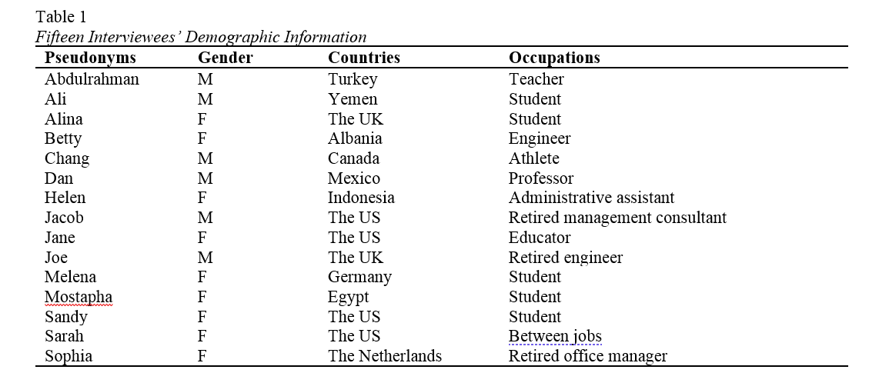
Study #4
MOOC Learners and SDL
Zhu, M., Bonk, C. J., & Berri, S. (2022). Fostering self-directed learning in MOOCs: Motivation, learning strategies, and instruction. Online Learning

Slide 52
RQ1. Intrinsic Motivation
Jacob, a retired management consultant from the US, expressed his motive behind enrolling in MOOCs as strictly intrinsic, “there's no reward. I'm retired. It's really just [that] I get very interested in topics. I realize holes in my knowledge and try to fill the holes.”

Slide 53
RQ1. Extrinsic Motivation
Besides educational purposes, some participants enrolled in MOOCs to help with their career development. For example, Sarah, who received her Ph.D. degree and was in between jobs at the time, selected topics such as anatomy, MatLab software, oncology, biology, and neuroscience. Sarah explained the purpose for taking these types of MOOCs was:
To acquire and improve my knowledge as a medical physicist…I consider my resume when selecting MOOC. I choose courses related to my professional field to add them to my curriculum; otherwise, there would be a period without being in contact with my profession.

Slide 54
RQ2. Learning Strategies
RQ2: What were the Learning Strategies that Helped Learners’ SDL in MOOCs?
Dan considered the progress bar to be a good indication of his progress, and it also created a healthy competition among the learners. Seeing where he was at in the course compared to the other learners gave him a push. He stated,
“All the progress bar with milestones, with a small quiz that doesn't count for the evaluation, but they're good for you to check if I'm really learning. And, for example, I like when you have these kinds of nice competition[s], right. Everyone starts a MOOC at the same time, but you see that these weeks you progress faster than other members in the MOOC.”

Slide 55



Top 10 Strategies to Facilitate SDL in MOOCs
  Helping students set their own learning goals.
  Building learning community.
  Offering immediate feedback.
  Embedding quizzes for self-assessment.
  Providing progress indicators.
  Providing reflection questions.
  Designing short learning units.
  Providing flexible timelines.
  Highlighting estimated time frames.
  Making available optional learning materials.

Slide 56
15 Guidelines and Strategies for Fostering and Enhancing Self-Directed Online Learning
Zhu, M., & Bonk, C. J. (2022). Guidelines and strategies for fostering and enhancing self-directed online learning. Open Learning: The Journal of Open, Distance and e-Learning. DOI: https://doi.org/10.1080/02680513.2022.2141105
15 guidelines for promoting SDL in MOOCs and similar large scale open education environments:
(1) helping students set their own learning goals,
(2) encouraging learners to make plans,
(3) offering flexible timelines,
(4) highlighting estimated time frames,
(5) embedding tasks and activities to form a learning community,
(6) supplying timely and constructive feedback,
(7) embedding quizzes for self-assessment,
(8) crafting visuals showing work progress and tasks completed,
(9) providing reflection questions,
(10) designing time-sensitive learning units,
(11) making available optional learning materials and self-selection options,
(12) creating a structured learning environment, including weekly overviews,
(13) making sure that lectures are recorded with captions added,
(14) inserting application exercises for putting the course material into practice, and
(15) using gamification to support SDL.

Slide 57
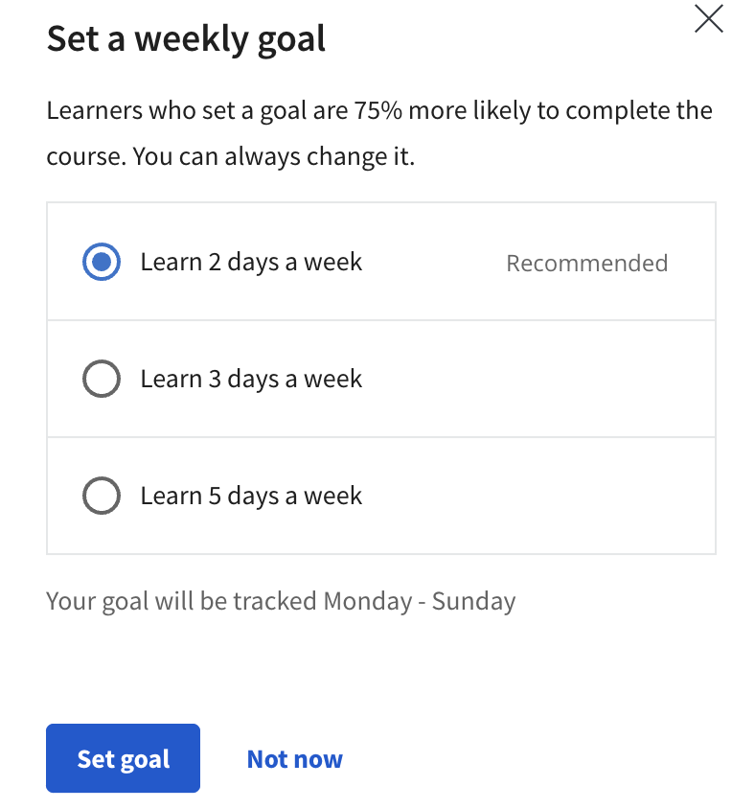

#1. Helping students set their own learning goals

Slide 58
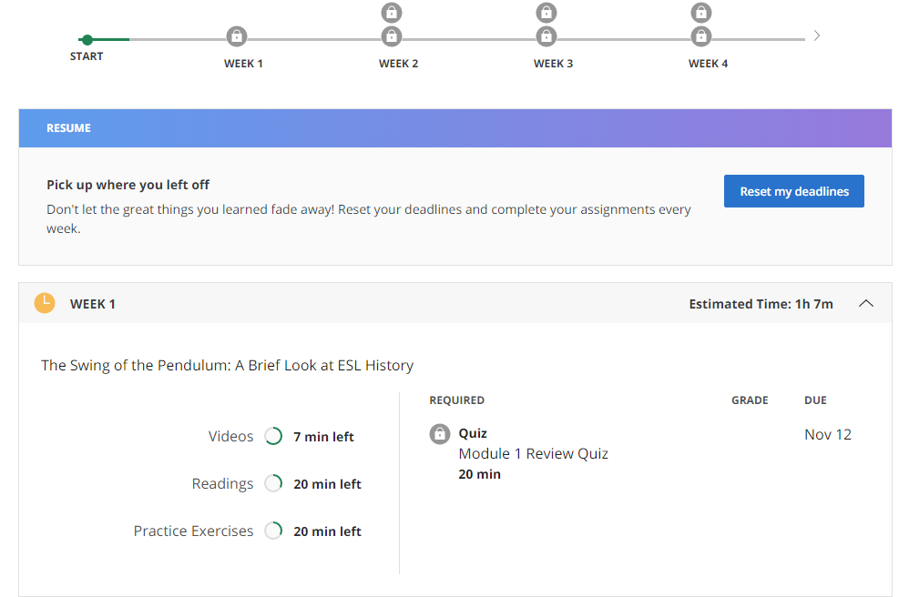
#4. Highlighting estimated time frames

Slide 59
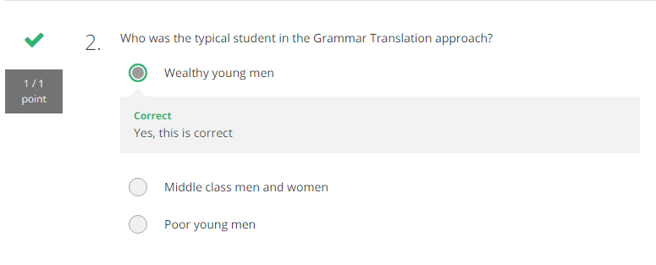
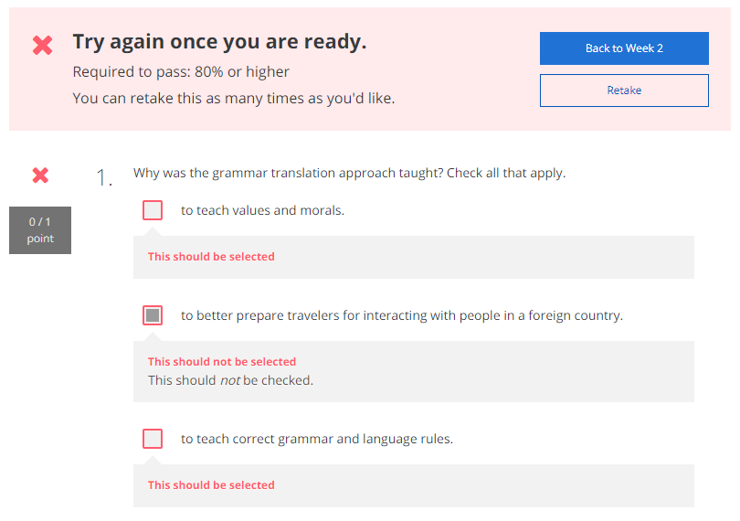
#7. Embedding quizzes for self-assessment

Slide 60
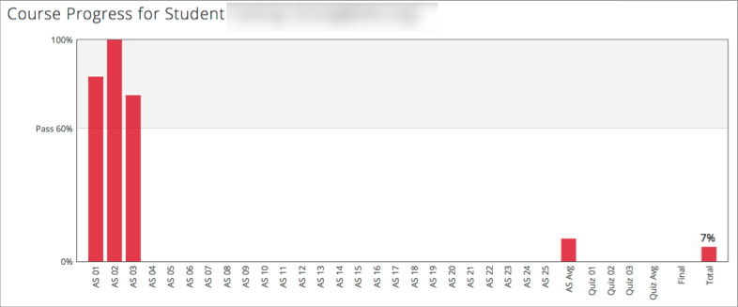
#8. Crafting visuals showing work progress and tasks completed

Slide 61


#9. Providing reflection questions

Slide 62
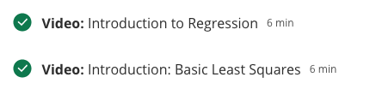
#10. Designing time-sensitive learning units

Slide 63
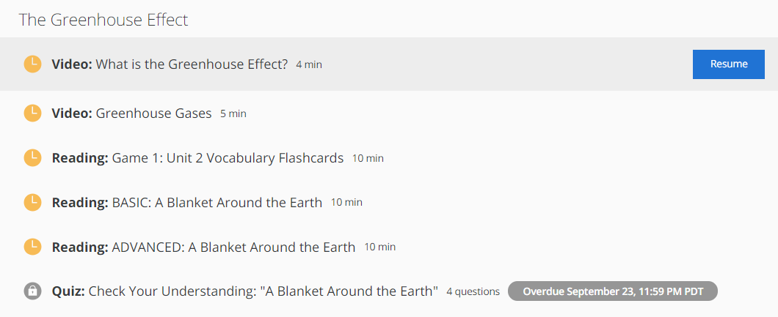
#11. Making available optional learning materials and self-selection options

Slide 64

#13. Making sure that lectures are recorded with captions added

Slide 65

#14. Inserting application exercises for putting the course material into practice

Slide 66

#15. Using gamification to support SDL

Slide 67
Study #5. Investigating South American Massive Open Online Course (MOOCs) Instructors’ Designs Supporting Self-Directed Learning (SDL)
IST CONFERENCE, 2023
Xiaoying Zheng, Zixi Li, Dr. Curtis J. Bonk, Dr. Meina Zhu, Dr. Thomas Reynolds
INDIANA UNIVERSITY BLOOMINGTON
Notes:
Good morning, everyone. I am Xiaoying Zheng. I am here to present a research study on Massive Open Online Course (MOOCs). This study investigates how South American instructors design MOOCs to support self-directed learning.
As you can see, we have five people on the team, with 3 faculty members and 2 doctoral students.

Slide 68

Research Questions
LITERATURE REVIEW
What strategies do MOOCs instructors in South America use to facilitate learners’ self-management skills, such as goal setting, time, and resource management?
What strategies do instructors use to support learners’ self-monitor skills, such as self-evaluating learning and monitoring process?
What strategies do instructors use to maintain learners’ motivation?
What are some frustrations and challenges for instructors when they design MOOCs?
Notes:
Therefore, we developed the research questions as the following. …

Slide 69
Participants Recruitment
METHOD
366 MOOCs instructors from institutions in South America were identified from major MOOCs websites (i.e., Coursera, EdX, FutureLearn)
A bilingual survey in English and Spanish was distributed through emails to these instructors to collect demographic information, understanding towards SDL, and screen participants.
The criteria for selecting these participants were that they should have designed at least one MOOC.
44 survey responses were collected, and 11 instructors accepted the interview invitation.
Notes:
Based on the result of participants recruitment, …

Slide 70
Participants Demographics
METHOD
Name | Gender | Country | No. of MOOCs taught
Alejandro | Male | Colombia | 1
Bruno | Male | Argentina | more than 5
Christopher | Male | Colombia | 2
Daniela | Female | Colombia | 1
Echa | Female | Colombia | 2
Felipe | Male | Brazil | 1
Gavino | Male | Colombia | 2
Hernán | Male | Brazil | 4
Ignacio | Male | Colombia | 1
Jorge | Male | Chile | 3
Keiman | Male | Chile | 1
Notes:
The demographic information of the 11 instructors can be seen from this table. All of them had at least one year of MOOC teaching experience.

Slide 71
1. Self-Management
TENTATIVE FINDINGS
Key finding 1: The most common way to support self-management is breaking down a long video (e.g., 30 mins) into short videos (e.g., 5 mins).
Quote 1: “Shorter videos instead of longer videos is better because you can ask questions about the specific topic, not the 30 minutes talking to the camera.” (Bruno)
Quote 2: “If you do videos that are 20-min long, that's sad, but they are not going to last. If you do 5 videos of 3 minutes each, in comparison to one of 20 minutes, or something like that, it's gonna be different.” (Echa)
Notes:
According to our preliminary data analysis, we had two findings in terms of self-management. We found that…
For example, the instructor Bruno stated that:…
#feedback：
As I mention about the research questions
Quote: 是否要都讲，二选一？“”Based on one participant…”
有详有略

Slide 72
Thank You!
Q&A
Curtis J. Bonk
Professor, IST Dept.
Indiana University
cjbonk@indiana.edu
http://curtbonk.com/

