Slide 1
Investigating South American Massive Open Online Course (MOOCs) Instructors’ Designs Supporting Self-Directed Learning (SDL)
IST CONFERENCE, 2023
Xiaoying Zheng, Zixi Li, Dr. Curtis J. Bonk, Dr. Meina Zhu, Dr. Thomas Reynolds
INDIANA UNIVERSITY BLOOMINGTON
Notes:
Good morning, everyone. I am Xiaoying Zheng. I am here to present a research study on Massive Open Online Course (MOOCs). This study investigates how South American instructors design MOOCs to support self-directed learning.
As you can see, we have five people on the team, with 3 faculty members and 2 doctoral students.

Slide 2
Context
SECTION 1
Notes:
Firstly, let me introduce the context of our study.

Slide 3

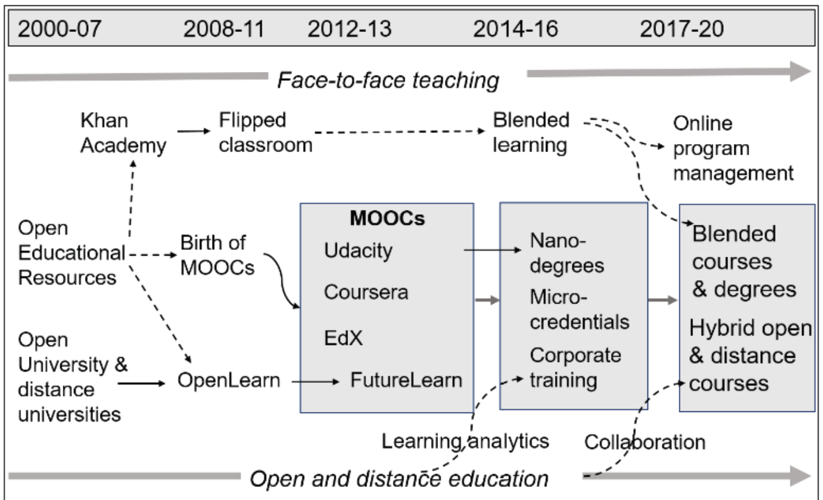
Massive Open Online Course (MOOCs)
CONTEXT
(Sharples,M., 2019)
Notes:
As our study focuses on identify ways of facilitate self-directed learning skills of MOOC students, our main context is the MOOCs. MOOCs, known as “Massive Open Online Courses” , together with open education, has been rising steadily since 2008. Later, the blended learning comes out. As we can see from this picture. ‘
With the rising of open education since 2008, MOOCs, which stands for “Massive Open Online Courses,” has been increasingly popular as a new trend of learning with technology.

Slide 4
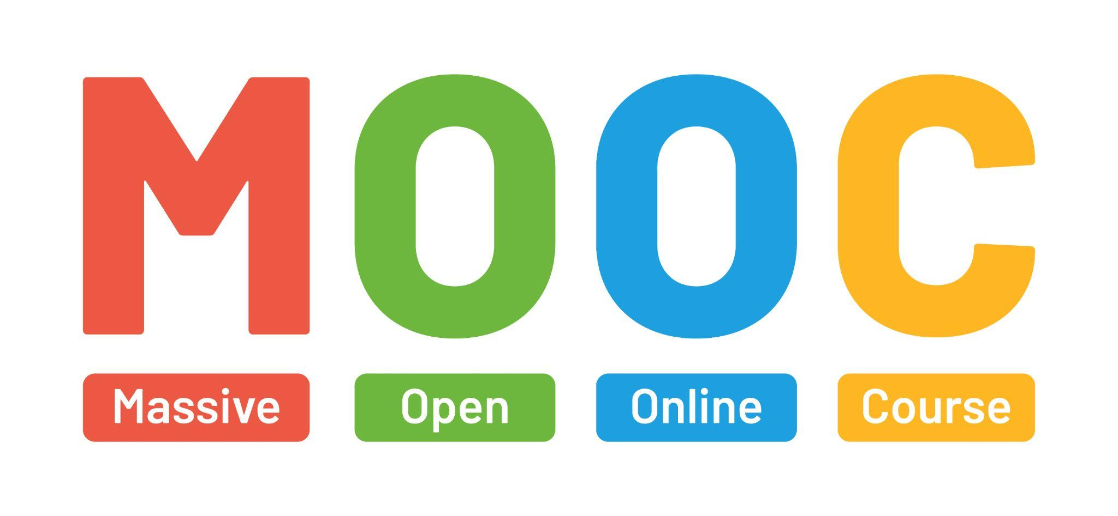
MOOCs Development
CONTEXT
MOOCs have an impact on large population. (Stewart, 2013, p. 236)
Online and blended learning expanded since the 20th century. (Bonk et. al, 2020)
Notes:
In general, MOOCs became one of the most popular forms of online learning that exposed a large number of individuals to “open, decentered practices and distributed expertise” since it was born. And by the end of the 20th century, online and blended learning expanded to provide freely accessible learning support to everyone.

Slide 5

MOOCs’ Learning
CONTEXT
MOOC learning significantly differs from traditional classroom learning regarding the roles and duties of both instructors and learners.
Successful MOOCs learning requires self-directed learning (SDL) skills
( Zhu et al., 2020; Kim et al., 2021).
Notes:
MOOCs and other forms of open and online education brought students access to knowledge and available free resources at home. As MOOC learning significantly differs from traditional classroom learning, in terms of roles and duties of instructors and learners, the successful learners are self-directly ones.

Slide 6
Literature Review
SECTION 2

Slide 7
Self-Directed Learning (SDL)
LITERATURE REVIEW
Self-directed learning (SDL) refers to a type of learning where individuals are in charge of the planning, implementation, and assessment of one’s own learning process, which is a critical ability in the learning environments of this new learning age, which are often informal, online, and open (Bonk, 2009, 2020; Hiemstra, 1994; Loyens et al., 2008).
Various models and views on SDL have emerged over the years. Candy (1991), Brockett and Hiemstra (1991), and Garrison (1997) were among the most frequently cited and comprehensive SDL models (Song and Hill, 2007).
Notes:
When we went through the literature review of self-directed learning, it refers to a learning type in which individual learners are in charge of their own learning on planning, implementation, and assessment of the learning process. It is a critical ability in learning environments in this new informal, online and open age.
In additional, there were various models and views about the SDL. The scholars as you can see here were the most frequently cited, and their models were comparatively comprehensive.

Slide 8
Self-Directed Learning (SDL)
LITERATURE REVIEW
Garrison (1997) included a new SDL perspective, namely, motivation, which is especially relevant when attempting to learn from MOOCs because many studies have reported that motivation played an important role in MOOC learning through conceptualization, engagement, commitment, and strategies (Hew & Cheung, 2014; Littlejohn et al., 2016; Romero-Fras et al., 2020; Zheng et al., 2015).
Notes:
In our study, we picked the Garrison’s framework of SDL, because it included a new SDL perspective: motivation. The motivation is highly relevant in the context of MOOC learning because many study have proved that the motivation played an important role in MOOC learning through conceptualization, engagement, commitment, and strategies.

Slide 9
Garrison’s (1997) SDL Framework
LITERATURE REVIEW
Self-management refers to the ability of task control, including goal setting and the management of time, resources, and support.
Self-monitoring refers to the cognitive and metacognitive process to construct learning approaches and strategies while setting the learning pace.
Motivation refers to both entering motivation and task motivation, which can initiate and sustain learning efforts towards cognitive goals.
Notes:
According to Garrison’s SDL framework, there are three components of self-directed learning: self-management, self-monitoring, and motivation. Respectively, self-management means …

Slide 10
MOOCs & SDL
LITERATURE REVIEW
MOOC learning significantly differs from traditional classroom learning regarding the roles and duties of both instructors and learners. (Zhu et al., 2020)
Successful MOOC learning requires self-directed learning (SDL) skills (Kim et al., 2021; Zhu et al., 2020).
As the opportunities to learn from free and open online resources have become increasingly common, there has been increased research interest in self-regulated learning (SRL) and SDL when accessing MOOCs (Alonso-Mencía et al., 2020).
Notes:
Regarding the connections of MOOCs and SDL, the literatures showed that…

Slide 11
Research Gap
LITERATURE REVIEW
Less than 1% of the scientific literature on MOOCs has been centered in the South American region (Veletsianos & Shepherdson, 2016).
Existing research on MOOCs in South America has primarily employed quantitative research methods (Sánchez & Reyes-Rojas, 2019; Veletsianos & Shepherdson, 2016; Zhu, Sari, & Bonk, 2018).
While the majority of MOOCs research focused on students’ learning, recent research indicated that designing MOOCs is challenging for instructors because of MOOCs’ massiveness and openness (Sari et al., 2020).
Notes:
After literature review, we found some research gaps under this topic. …..
(add on the last one) This study will collect instructors’ perspectives of designing MOOCs that support SDL. Findings may suggest ways to enhance instructor professional development to support students’ SDL.

Slide 12
Research Questions
LITERATURE REVIEW
What strategies do MOOCs instructors in South America use to facilitate learners’ self-management skills, such as goal setting, time, and resource management?
What strategies do instructors use to support learners’ self-monitor skills, such as self-evaluating learning and monitoring process?
What strategies do instructors use to maintain learners’ motivation?
What are some frustrations and challenges when they design MOOCs?
Notes:
Therefore, we developed the research questions as the following. …

Slide 13
Method
SECTION 3
Notes:
As for the method we used in this study,

Slide 14
Overview
METHOD
A qualitative method was used to fill in the research gap.
Convenient sampling was applied.
Individual interviews were conducted with 11 MOOCs instructors.
Thematic analysis was used to analyze the data.
The data analysis process is still ongoing.
Notes:
In general, we used a qualitative…

Slide 15
Participants Recruitment
METHOD
366 MOOCs instructors from institutions located in South America were identified from major MOOCs websites (i.e., Coursera, EdX, FutureLearn).
A bilingual survey in English and Spanish was distributed through emails to these instructors to collect demographic information, understanding towards SDL, and screen participants.
The criteria for selecting these participants were that they should have designed at least one MOOC.
44 survey responses were collected, and 11 instructors accepted for the interview invitation.
Notes:
Based on the result of participants recruitment, …

Slide 16
Participants Demographics
METHOD
Name | Gender | Country | # of MOOCs taught
Alejandro | Male | Colombia | 1
Bruno | Male | Argentina | more than 5
Christopher | Male | Colombia | 2
Daniela | Female | Colombia | 1
Echa | Female | Colombia | 2
Felipe | Male | Brazil | 1
Gavino | Male | Colombia | 2
Hernán | Male | Brazil | 4
Ignacio | Male | Colombia | 1
Jorge | Male | Chile | 3
Keiman | Male | Chile | 1
Notes:
The demographic information of the 11 instructors can be seen from this table. All of them had at least one year of MOOC teaching experience.

Slide 17
Instrument
METHOD
The interview instrument was adapted from the Zhu et al. (2019, 2020) study, which investigated MOOC instructors' practices to facilitate student SDL, which was based on Garrison's (1997) conceptual framework.
The semi-structured interview protocol included:
  The consent information
  Interviewees’ demographic questions
  Questions about instructors’ perception of SDL and open education
  Questions about specific perspectives of SDL based on Garrison (1997)
  Questions about instructors’ professional development needs
Notes:
We applied the semi-structured interview in order to collect as much information as we can. The protocol covered the questions such as…

Slide 18
Interview Protocol Sample
METHOD
Question 2 | What types of support do you receive from your home institutions? Is there a team facilitating your MOOCs design?
Question 4 | What do you think of the responsibility of instructors to facilitate students’ SDL skills in MOOCs?
Question 5 | How do you think the design and delivery of your MOOC can help develop students’ self-management skills such as time, resources, and support? Could you please give me a specific example in designing or developing your MOOC that might have had a direct or indirect impact on these skills?
Notes:
Here are the samples of the interview questions.

Slide 19
Data Analysis
METHOD
All interviews were conducted and video recorded through Zoom.
Thematic analysis (Braun & Clarke, 2006) are used for data analysis.
After the researchers reviewed the transcriptions to improve the accuracy, member check is applied to further increase the accuracy.
Data are coded through NVivo 12.
Data analysis is still ongoing at this moment.
Notes:
After we recorded and transcribed the interviews, we conducted a thematic analysis with Nvivo. For now, the data analysis is still ongoing.

Slide 20
Tentative Findings
SECTION 4
Notes:
In the following, I will present some tentative findings

Slide 21
Self-Management
TENTATIVE FINDINGS
Key finding #1: The most common way to support self-management is breaking down a long video (e.g., 30 mins) into short videos (e.g., 5 mins).
Quote 1: “Shorter videos instead of longer videos is better because you can ask questions about the specific topic, not the 30 minutes talking to the camera. ” (Bruno)
Quote 2: “If you do videos that are 20 min long, that's sad, but they are not going to last. If you do 5 videos of 3 minutes each, in comparison to one of 20 minutes, or something like that, it's gonna be different.” (Echa)
Notes:
According to our preliminary data analysis, we had two findings in terms of self-management. We found that…
For example, the instructor Bruno stated that:…

Slide 22
Self-Management
TENTATIVE FINDINGS
Key finding #2: Many of them did not help with goal setting for students, but said students to do so. About half of them mentioned writing clear learning objectives is important so that students know what to expect and give students directions.
Quote: “No, I definitely did not design the MOOC with that in mind. And I guess within class, it’s very seldom that you find the student that wants to go beyond the core class requirements….I should incorporate complimentary MOOCs that they like to take to direct them to online material that might be of their interests.” (Keiman)
Notes:
The second finding upon the self-management was that…

Slide 23
Self-Monitoring
TENTATIVE FINDINGS
Key finding: Reflection questions, progress bar that shows completion, quizzes, and peer-to-peer evaluations, and forums are designed for students to self-monitor their learning.
Quote 1: “...progress bars, like a roadmap, of course, completion. So you know where you are in each way you can saw. Yes, I think most of those tools we have.” (Felipe)
Quote 2: “Oh, in terms of monitoring their learning, what we have is a single material. I have a quiz associated with it, and they only progress in the course if they felt 80% of the quiz correct.” (Hernán)
Notes:
As for he self-monitoring, we found that…
This was a MOOC, but for a moment we had someone monitoring the forum. And there were a few debates in the forum. And someone like a teaching assistant or a student helping us with the monitoring (#5) ??

Slide 24
Motivation
TENTATIVE FINDINGS
Key finding: About half of the interviewees mentioned that they make efforts to motivate students by designing interactive elements (e.g., peer-to-peer interaction, pop-out quizzes in the video), but the gamification features are limited.
Quote 1: “They started like, okay, ‘did you know that?’ And you needed to click (the answers) in order to let it (the feedback) pop out, and then get more information….They made it definitely more interactive than just a reading a book or an article.” (Alejandro)
Quote 2: “We manage motivation with a lot of visual aids, just like dynamics, not like try to make like short videos, show something to make a question, something have to interact and come back and give answer to the question, see if you felt it right or not.” (Daniela)
Notes:
In terms of motivation, …

Slide 25
Professional Development
TENTATIVE FINDINGS
Key finding: Almost all the teachers received a certain level of training or facilitation from their home institutions on editing videos. They indicated that working in a team with instructional designers or technicians is crucial.
Quote 1: “The university has a recording studio, with two employees working there. They recorded the video and did small editing, so that’s a very good support. ” (Hernán)
Quote 2: “I had a lot of supports on the recordings, and tutoring my materials of my actual physical course, and then like how to translate the specific activities to make it adapt to MOOCs.” (Jorge)
Notes:
We also noticed the patterns of professional development. We found that…
In term of professional development, we also found that

Slide 26
Interesting Perspectives
TENTATIVE FINDINGS
Students need to feel the content is relevant to their life can be motivated, which aligns with previous studies on major motivations to take MOOCs.
Some instructors collaborate with European instructors to teach MOOCs, teaching styles differ from South American styles and so need students to adapt.
Some South-American-based MOOCs platforms are more adapted to their culture (e.g., aesthetic, gamification features).
One instructor mentioned he felt lonely because not many people in South America worked on designing MOOCs and he could not find more accessible support when designing MOOCs.
Notes:
In addition, we found some interesting perspectives in the sharing of the instructors.
In addition, there are also some interesting perspectives discovered through our interviews. For example…

Slide 27
Significance of Study
SECTION 5
Notes:
As the project is still ongoing, we will restate the significance of study, instead of the conclusion and discussion

Slide 28
Fill in Research Gaps
SIGNIFICANCE
Few scientific literature on MOOCs has been centered in the South American region.
Existing research on MOOCs in South America has primarily employed quantitative research methods
In addition to the students’ learning, designing MOOCs is challenging for instructors because of MOOCs’ massiveness and openness.
Notes:
-MOOCs are becoming a global phenomenon that enhances and extends learning for everyone, but only 0.5% of scientific literature was centered in the South American region (Veletsianos & Shepherdson, 2016).
-Most of the research was based on quantitative research methods, there is an urgent need for in-depth qualitative research on MOOCs in South America (Sánchez & Reyes-Rojas, 2019; Veletsianos & Shepherdson, 2016; Zhu et al., 2018). The study seeks to fill the research gap of the MOOC phenomenon in South America.
-Most MOOC research has focused on learners (Doo et al., 2020). However, while few studies were conducted from the standpoint of an instructor, MOOC designs are challenging for instructors because of their large scale and openness (Sari et al., 2020). In effect, the findings of this study are intended to help close the research gap on MOOC instructors in academia, especially in South America.

Slide 29
Possible Implementations
SIGNIFICANCE
In addition, the findings should impact on the design and delivery of courses that affect millions of students in practice. A critical impact of this study is to provide institution leaders with the insights of carrying out MOOCs projects, especially focusing on providing professional development support for MOOCs instructors.
Notes:
Because MOOCs have such a large number of students, even little changes are likely to have a large global impact on teaching and learning.

Slide 30
Limitations
SECTION 6
Notes:
There were also limitations in this study

Slide 31
Samples
LIMITATIONS
Convenient sampling was used. Given that the response rate is low, there is a limited number of participants that we were able to access and reach to.
We had almost a half of the participants came from Colombia and the other half from Argentina, Brazil, anc Chile.
We also had only two female participants and nine male participants. Demographic information may influence their perception towards our research questions.
Therefore, any generalization of the findings from this study to other settings might be cautious, at best.
Notes:
For sample, we used the convenient samplings which led to a limited number of participants
So any generalization of findings from the study to other settings …

Slide 32
Participants
LIMITATIONS
Participants were voluntary. The instructors who volunteered to participate in this study could have had higher awareness and motivation to design and deliver MOOCs to facilitate SDL skills than the others who did not participate in the study. As such, the findings of the study may have volunteer bias.
Notes:
And the instructors were volunteered to participant in this study. So these is some volunteer bias emerged inevitably.

Slide 33
Data Source
LIMITATIONS
Only a single data source. The study relied on self-reported interview data. Future research could expand to additional data sources and methodologies.
Notes:
As for the data, there was only a single source of it.

Slide 34
Q & A
SECTION 7

Slide 35
References
SECTION 8

Slide 36
REFERENCES
Alonso-Mencía, M. E., Alario-Hoyos, C., Maldonado-Mahauad, J., Estévez-Ayres, I., Pérez-Sanagustín, M., & Delgado Kloos, C. (2020). Self-regulated learning in MOOCs: lessons learned from a literature review. Educational Review, 72(3), 319-345.
Bonk, C. J. (2009). The World is Open: How Web Technology is Revolutionizing Education. San Francisco, CA: Jossey-Bass.
Bonk, C. J. (2020). Pandemic ponderings, 30 years to today: Synchronous signals, saviors, or survivors? Distance Education, 41(4), 589-599. https://doi.org/10.1080/01587919.2020.1821610
Bonk, C. J., & Zhu, M. (Eds.). (2022). Transformative Teaching Around the World: Stories of Cultural Impact, Technology Integration, and Innovative Pedagogy. Routledge.
Braun, V., & Clarke, V. (2006). Using thematic analysis in psychology. Qualitative research in psychology, 3(2), 77-101.
Garrison, D. R. (1997). Self-directed learning: Toward a comprehensive model. Adult education quarterly, 48(1), 18-33.
Hiemstra, R. (1994). Self-directed learning. IACE Hall of Fame Repository.
Kim, D., Jung, E., Yoon, M., Chang, Y., Park, S., Kim, D., & Demir, F. (2021). Exploring the structural relationships between course design factors, learner commitment, self-directed learning, and intentions for further learning in a self-paced MOOC. Computers & Education, 166, 104171.
Littlejohn, A., Hood, N., Milligan, C., & Mustain, P. (2016). Learning in MOOCs: Motivations and self-regulated learning in MOOCs. The Internet and Higher Education, 29, 40-48.
Loyens, S. M., Magda, J., & Rikers, R. M. (2008). Self-directed learning in problem-based learning and its relationships with self-regulated learning. Educational Psychology Review, 20(4), 411-427.
Romero-Frías, E., Arquero, J. L., & del Barrio-García, S. (2020). Exploring how student motivation relates to acceptance and participation in MOOCs. Interactive Learning Environments, 1-17.
Sánchez, J., & Reyes-Rojas, J. (2020). Trends and Issues. In Zhang, K., Bonk, C. J., Reeves, T. C., & Reynolds, T. H. (Eds.), MOOCs and open education in the Global South: Challenges, successes, and opportunities. NY: Routledge.
Sari, A. R., Bonk, C. J., & Zhu, M. (2020). MOOC instructor designs and challenges: what can be learned from existing MOOCs in Indonesia and Malaysia?. Asia Pacific Education Review, 21(1), 143-166.

Slide 37
REFERENCES
Sharples, M. 2019. Visions for the Future of Educational Technology. In: Ferguson, R., Jones, A. and Scanlon, E. (eds). Educational Visions: Lessons from 40 years of innovation. Pp. 151–166. London: Ubiquity Press. DOI: https://doi.org/10.5334/bcg.j. License: CC-BY 4.0
Song, L., & Hill, J. R. (2007). A conceptual model for understanding self-directed learning in online environments. Journal of Interactive Online
Learning, 6(1), 27-42.
Stewart, B. (2013, June). Massiveness + Openness = New Literacies of Participation? IslandScholar | Robertson Library. https://www.islandscholar.ca/islandora/object/ir%3A153
Veletsianos, G., & Shepherdson, P. (2016). A systematic analysis and synthesis of the empirical
MOOC literature published in 2013–2015. The International Review of Research in Open and Distributed Learning, 17(2), 1–17. Retrieved from https://files.eric.ed.gov/fulltext/EJ1093662.pdf
Zheng, S., Rosson, M. B., Shih, P. C., & Carroll, J. M. (2015, February). Understanding student motivation, behaviors and perceptions in MOOCs. In
Proceedings of the 18th ACM conference on computer supported cooperative work & social computing (pp. 1882-1895).
Zhu, M., Sari, A., & Bonk, C. (2018, June). A systematic review of MOOC research methods
and topics: Comparing 2014–2016 and 2016–2017. Proceedings of EdMedia 2018: World Conference on Educational Media and Technology (pp. 1676–1685). Association for the Advancement of Computing in Education (AACE), Amsterdam, Netherlands.
Zhu, M., & Bonk, C. J. (2019). Designing MOOCs to facilitate participant self-monitoring for self-directed learning. Online Learning, 23(4), 106-134.
Zhu, M., Bonk, C. J., & Doo, M. Y. (2020). Self-directed learning in MOOCs: Exploring the relationships among motivation, self-monitoring, and self-management. Educational Technology Research and Development, 68(5), 2073-2093. https://doi.org/10.1007/s11423-020-09747-8

Slide 38
Thank you!

