Slide 1
Self-Direct to Learn, Self-Direct to Live:
Exploring Learner Choices, Experiences, and Possibilities in a Self-Directed Learning World
Curtis J. Bonk| cjbonk@Indiana.edu
Indiana University Bloomington
ICER Conference, Seoul National University
October 22, 2021

Slide 2
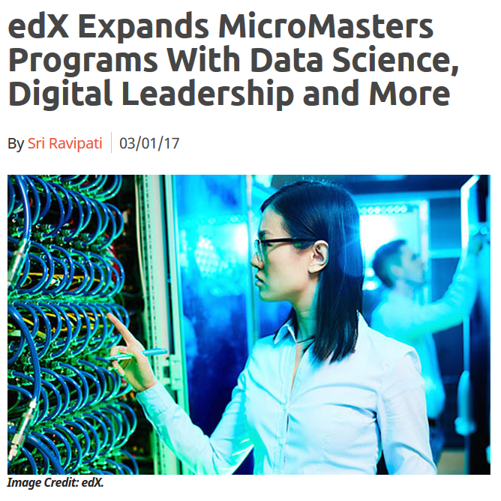
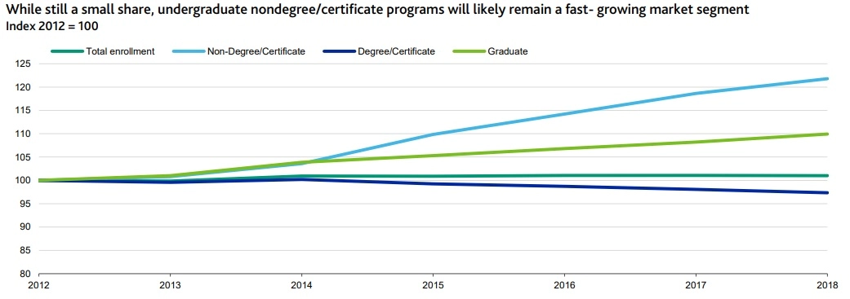
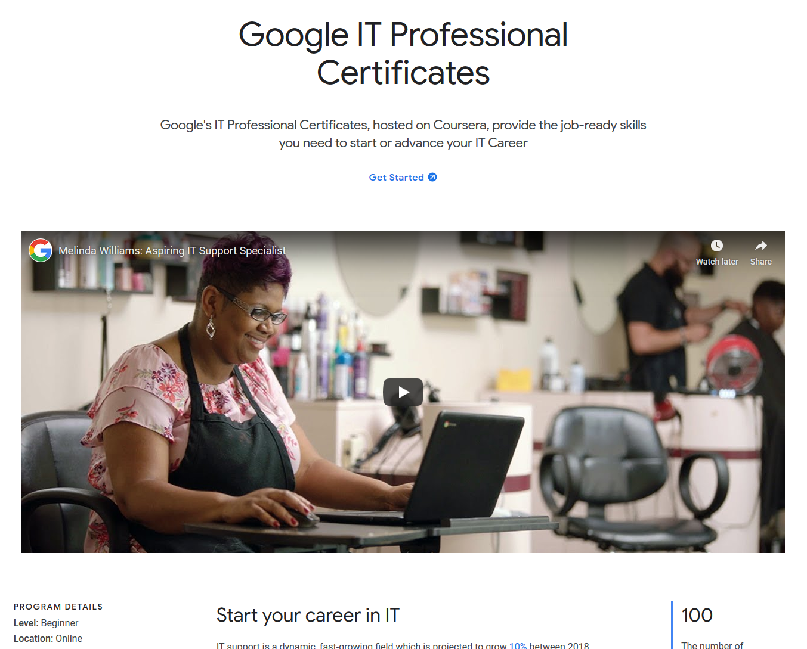
August 27, 2020
Alternative Credentials on the Rise
Paul Fain, Inside Higher Ed https://www.insidehighered.com/news/2020/08/27/interest-spikes-short-term-online-credentials-will-it-be-sustained
Sources: Moody's, U.S. Department of Education

Slide 3
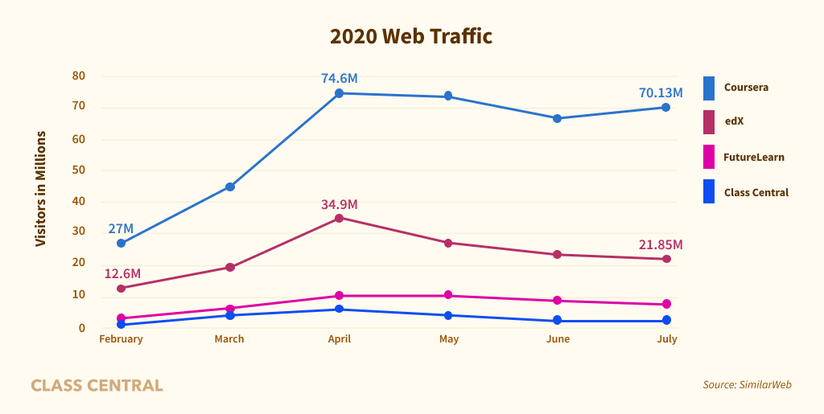
MOOCs Stats
August 16, 2020
By the Numbers: MOOCs During the Pandemic
Dhawal Shah, Class Central
https://www.classcentral.com/report/mooc-stats-pandemic/

Slide 4






MOOC books
(2020) and (2015)
Notes:
Last year, I co-edited a book titled MOOCs and Open Education around the World. MOOCs stands for Massive Open Online Courses. An individual MOOC can enroll tens of thousands of students, and several MOOCs have now surpassed 1 million students in total enrollment. MOOCs are primarily offered by elite universities such as Stanford, MIT, and Harvard through enterprises such as Coursera, edX, and FutureLearn. More people enrolled in MOOCs developed at Harvard in a single year than attended Harvard in its entire 377-year history.

Slide 5


October 22, 2021
Wanted:
Billions of Self-Directed Learners

Slide 6
Study #1
MOOCs Design
Considerations and Challenges
Zhu, M., Bonk, C. J., & Sari, A. (2018). Instructor experiences designing MOOCs in higher education: Pedagogical, resource, and logistical considerations and challenges. Online Learning, 22(4), 203-241.

Slide 7
Research Purpose
  The purpose of this study is to provide suggestions for future MOOC instructors and instructional designers in higher education through exploring MOOC design considerations and challenges from the instructor’s perspective.

Slide 8
Research Questions
  What are the design considerations of instructors when designing MOOCs?
  What challenges do instructors perceive when designing MOOCs?
  How do instructors address the challenges that they perceive related to MOOCs?

Slide 9

Data Collection
  Data Collection:
    Survey, interview, and course review
  Participants:
    143 survey participants (10% response rate)
    12 interviewees

Slide 10
12 Interviewees
No. | Countries | Subject areas | Platforms
1. | The U.S. | Language and Literacy | Coursera
2. | The U.S. | Education | Coursera
3. | The U.S. | Education | Canvas
4. | The U.S. | Chemistry | Coursera
5. | UK | Medicine and Health | FutureLearn
6. | UK | Language and Literacy | FutureLearn
7. | Hong Kong (China) | Math | Coursera
8. | Mainland China | Math | Coursera
9. | Canada | Psychology | Coursera
10. | Australia | Medicine and Health | Open2Study
11. | Sweden | Computer Science | edX
12. | India | Management | edX

Slide 11
RQ1 Survey Results

Slide 12
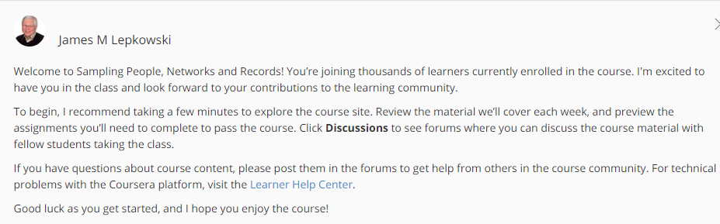
RQ1 Interview Results
  Engage learners
  One instructor from US mentioned:
    “I engaged people in the forum. So each week I would write a message that would be the new welcome page for the week that would say, ‘hey come to the forum and ask questions about this or come to the forum introduce yourself’... Of course, I tried to get students to feel like I was engaged with them during the videos by asking them questions and telling them to do things during the video.”

Slide 13
RQ2 Survey Results

Slide 14

RQ2 Interview Results
  Time limitation
  One instructor from education subject mentioned:
    “I think one of the challenges is time. It does take a lot of time to get the videos done. I did not get a course release when I was doing, and it was a side project at the same time as my regular load.”

Slide 15
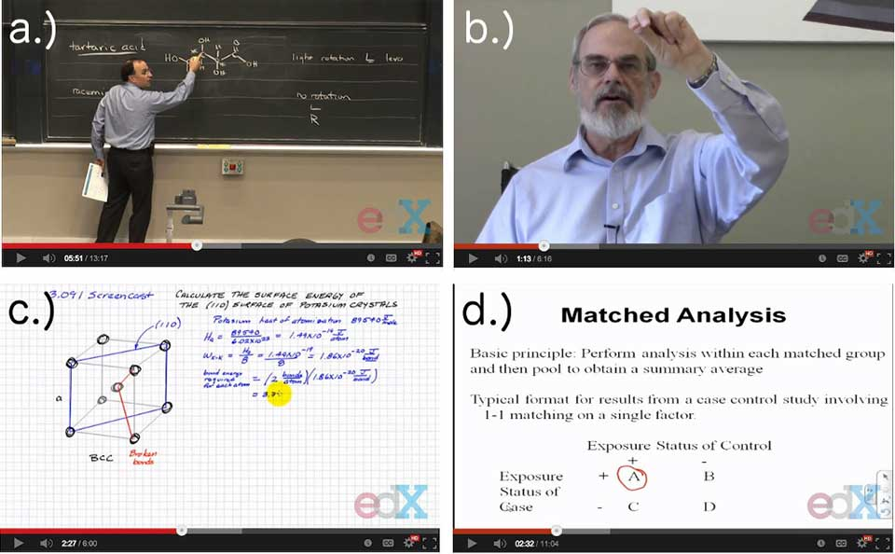
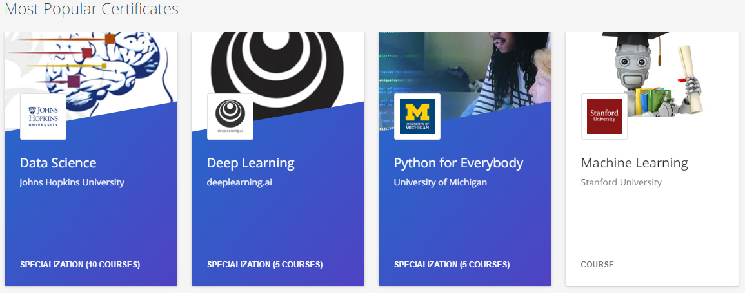
RQ3 Survey Results

Slide 16
Study #2
MOOCs Instructional Design to Facilitate Participants’ Self-directed Learning

Slide 17
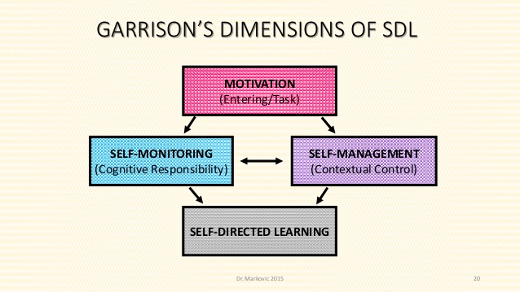
Key Terms
  Self-directed learning (SDL) (Garrison, 1997)
  (1) self-management
  (2) self-monitoring
  (3) motivation
Notes:
Garrison’s model: 3 inter-related part.

Slide 18

Research Purpose
  The purpose is to inform instructors or instructional designers and MOOC providers of the current practices of designing MOOCs to facilitate learners’ SDL.

Slide 19
Research Questions
  How do MOOC instructors perceive participant SDL skills?
  How do MOOC instructors perceive their facilitation of participant SDL skills?
  How do instructors design and deliver MOOCs to facilitate participant SDL skills?
    a. How is technology being used by MOOC instructors to support the development of participant SDL skills?
    b. What technology features or functions do MOOC instructors want to have to improve their facilitation of MOOC participant SDL skills?

Slide 20

Data Collections
  Survey:
  Volunteer sampling (Creswell & Clark, 2017)
  198 instructors responded to the survey (10% response rate)
  Interview:
  Homogeneous purposeful sampling (Creswell & Clark, 2017; Patton, 2002)
  Maximal variation sampling (Creswell & Clark, 2017)
  22 interviewees
  MOOC review:
  Reviewed 22 interviewees’ MOOCs

Slide 21
Pseudonym | Country | Subject area | Platform | Gender | No. of O/B | No. of M | Mode of the M
Lucas | US | Social science | edX | M | 0 | 1 | I without T
Branden | US | Education | Udacity | M | 0 | 5 or more | Self-paced
Logan | US | Literacy and Language | Coursera | M | 5 or more | 5 or more | I with T
Emma | US | Literacy and Language | Coursera | F | 2 | 1 | Self-paced
Jason | US | Science | edX | M | 1 | 1 | I with T
Jackson | US | Medicine and health | Coursera | M | 5 or more | 1 | Self-paced
Samuel | US | Education | FutureLearn | M | 4 | 3 | Self-paced
Hannah | US | Education | Blackboard | F | 5 or more | 1 | I with T
Ashley | US | Education | EdX | F | 0 | 5 or more | I with T
Andrew | UK | Art | FutureLearn | M | 0 | 3 | I with T
Emily | UK | Medicine and health | FutureLearn | F | 2 | 2 | I with T
Aiden | UK | Social science | FutureLearn | M | 0 | 1 | Self-paced
Henry | UK | Social science | FutureLearn | M | 0 | 1 | Self-paced
Joseph | UK | Medicine and health | FutureLearn | M | 1 | 1 | Self-paced
Joshua | UK | Literacy and language | FutureLearn | M | 2 | 2 | I with T
Mason | Australia | Education | Coursera | M | 5 or more | 1 | I with T
Ethan | Australia | Business | Coursera | M | 3 | 1 | I without T
Ben | Australia | Social science | edX | M | 1 | 1 | I with T
Paul | France | Computer Science | Coursera | M | 1 | 1 | I with T
Fernando | Belgium | Research methods | Blackboard | M | 5 or more | 3 | I with T
Jacob | Netherland | Science | Coursera | M | 0 | 1 | I with T
Dylan | Israel | Science | Coursera | M | 5 or more | 3 | I without T
Data Collections
  Interview:

Slide 22
RQ1 Perceptions of SDL
  A majority of the MOOC instructors thought that these skills or attributes are not static, and that SDL as a set of skills can be educated or students’ personal attributes that can be changed.

Slide 23

RQ1 Interview Results
  Emma’s understanding of SDL is more related to self-management and motivation. She said:
    “When I think about self-directed learning, I think about students managing their time and managing the coursework on their own, and how it fits into their schedules and their lives, how they interact with materials, what's going to keep them engaged.”

Slide 24
RQ2 Perceptions of Facilitation of SDL
  Most of MOOC instructors thought that they can intentionally or unintentionally facilitate students’ SDL.

Slide 25

RQ2 Interview Results
  Ashely emphasized the importance of both instructors’ facilitation and students’ SDL skills. She said:
    “The participant has a lot of flexibility on how they approach the content. I mean, obviously, we have things like assignments. We have things like online forums. And there're ways that we scaffold the learning experience. But there still is a lot of choice for the learner.”

Slide 26
RQ3 Strategies to Facilitate SDL
  Students’ intrinsic motivation plays an important role. However, extrinsic motivation provided by the MOOCs might help transfer extrinsic motivation to intrinsic motivation.
Motivations | Strategies
Entering motivation | MOOC instructors helped students identify the needs and goals of learning and sense of achievement.
Task motivation | MOOC instructors motivated students through instruction, learning materials, feedback, and learning community.

Slide 27
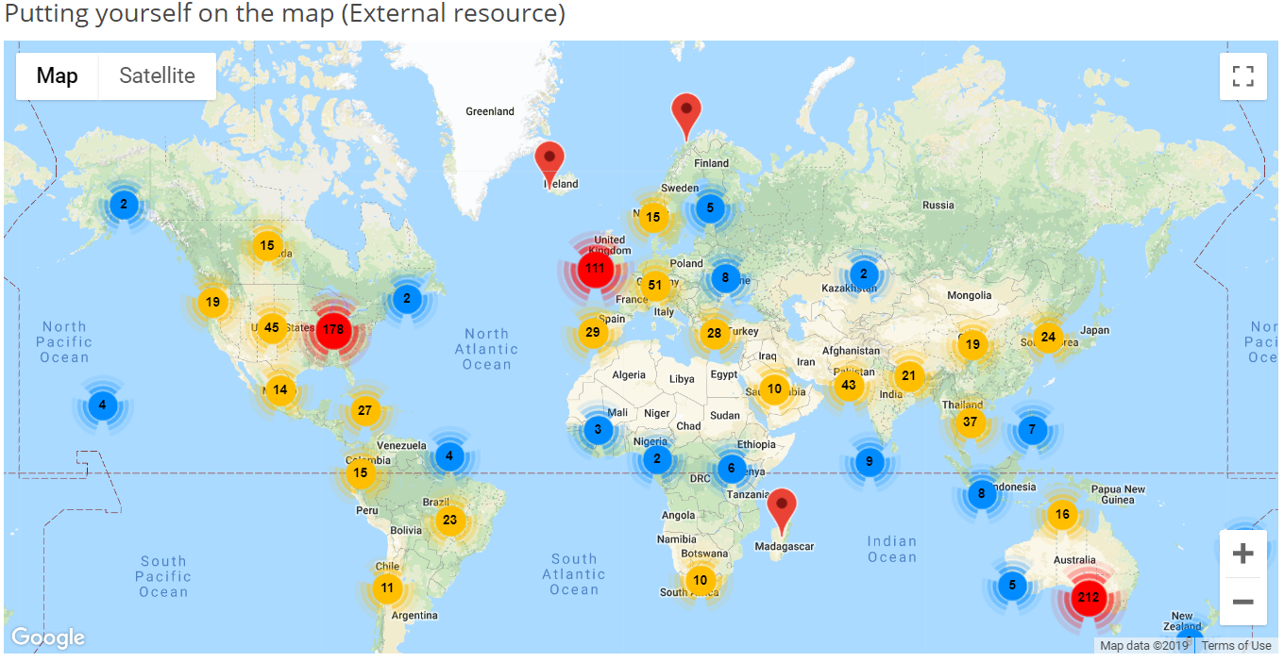
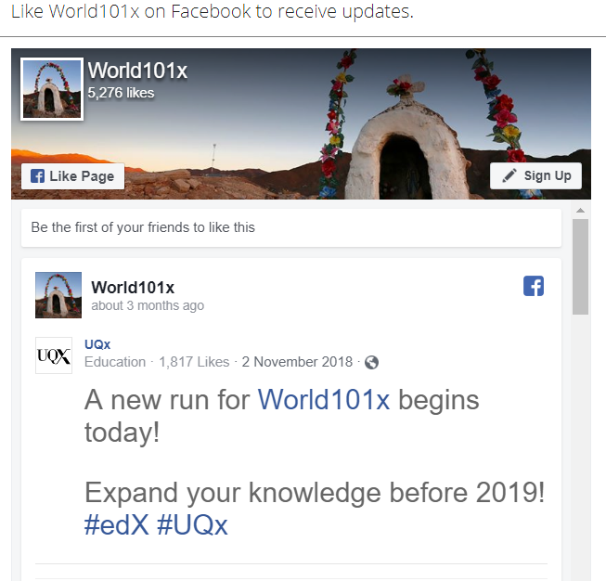
RQ3 Learning Community

Slide 28
RQ3 Strategies to Facilitate SDL
  Both internal feedback and external feedback were provided to help students’ self-monitoring.
Self-monitor |  | Strategies
Internal feedback | Cognition | MOOC instructors provided quizzes for self-assessment, tutorial on technology use, learning advice, navigation of the course, progress indicators, resources, and instructional modeling, etc.
 | Meta-cog | MOOC instructors encouraged students to reflect and think critically by providing reflection questions and building learning community.
External feedback |  | MOOC instructors, teaching assistants, and peers were involved in providing external feedback.

Slide 29
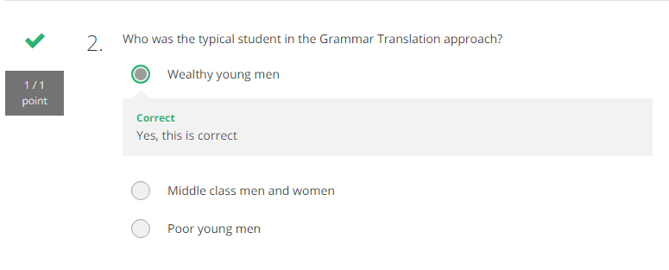
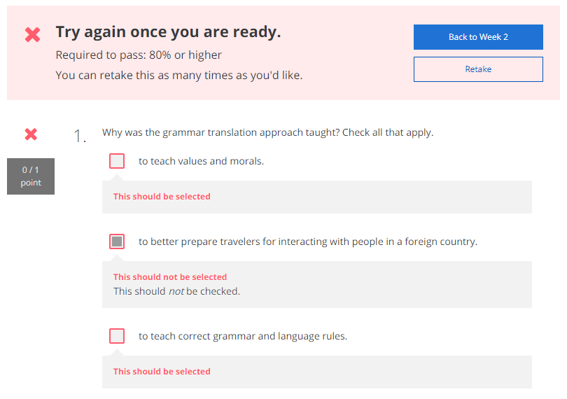
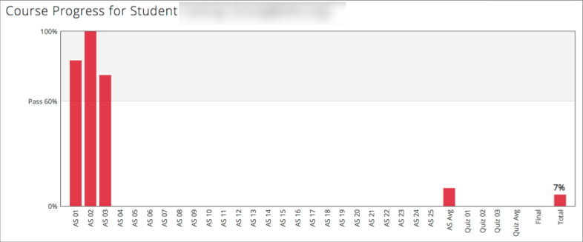
RQ3 Self-assessment (i.e., embedded quizzes) and Progress Indicators

Slide 30
RQ3 Strategies to Facilitate SDL
  They helped students’ self-management concerning setting learning goals, time management, resources and support management although among the three elements of SDL, MOOC instructors had less control over students’ management.
Self-management | Strategies
Enactment of learning goals | Providing discussion questions, reflections, survey, and appreciation students’ learning goals.
Time management | Providing time frame, progress indicator, short learning units, and flexible timeline.
Management of resources and support | Providing flexible learning resources, peer-assessment, accessibilities, clear expectations, and short learning units.

Slide 31
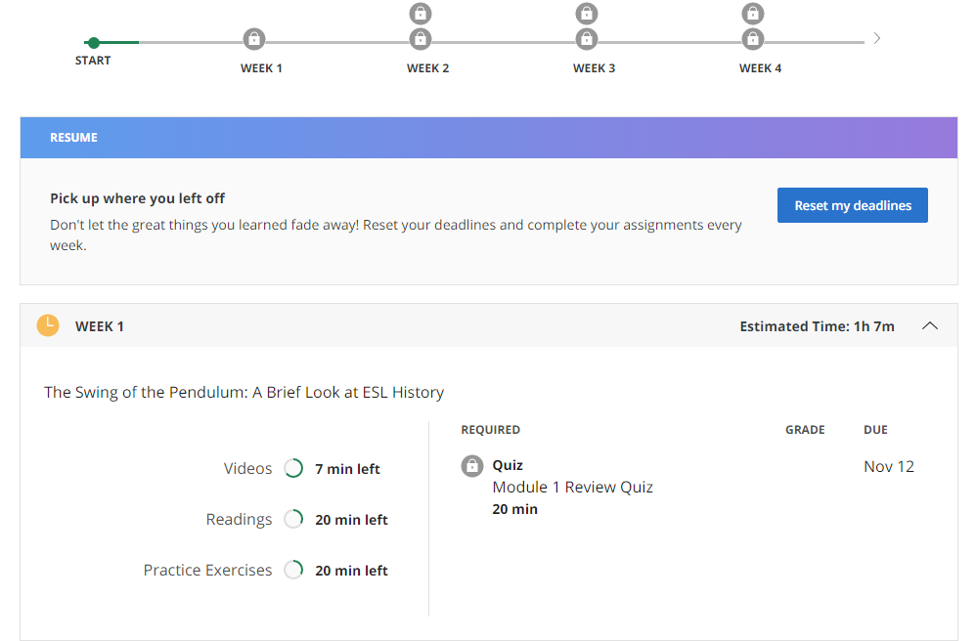
RQ3 Time Management
(e.g., time advisories and estimates)

Slide 32



Top 10 Strategies to Facilitate SDL in MOOCs
  Helping students set their own learning goals.
  Building learning community.
  Offering immediate feedback.
  Embedding quizzes for self-assessment.
  Providing progress indicators.
  Providing reflection questions.
  Designing short learning units.
  Providing flexible timelines.
  Highlighting estimated time frames.
  Making available optional learning materials.

Slide 33
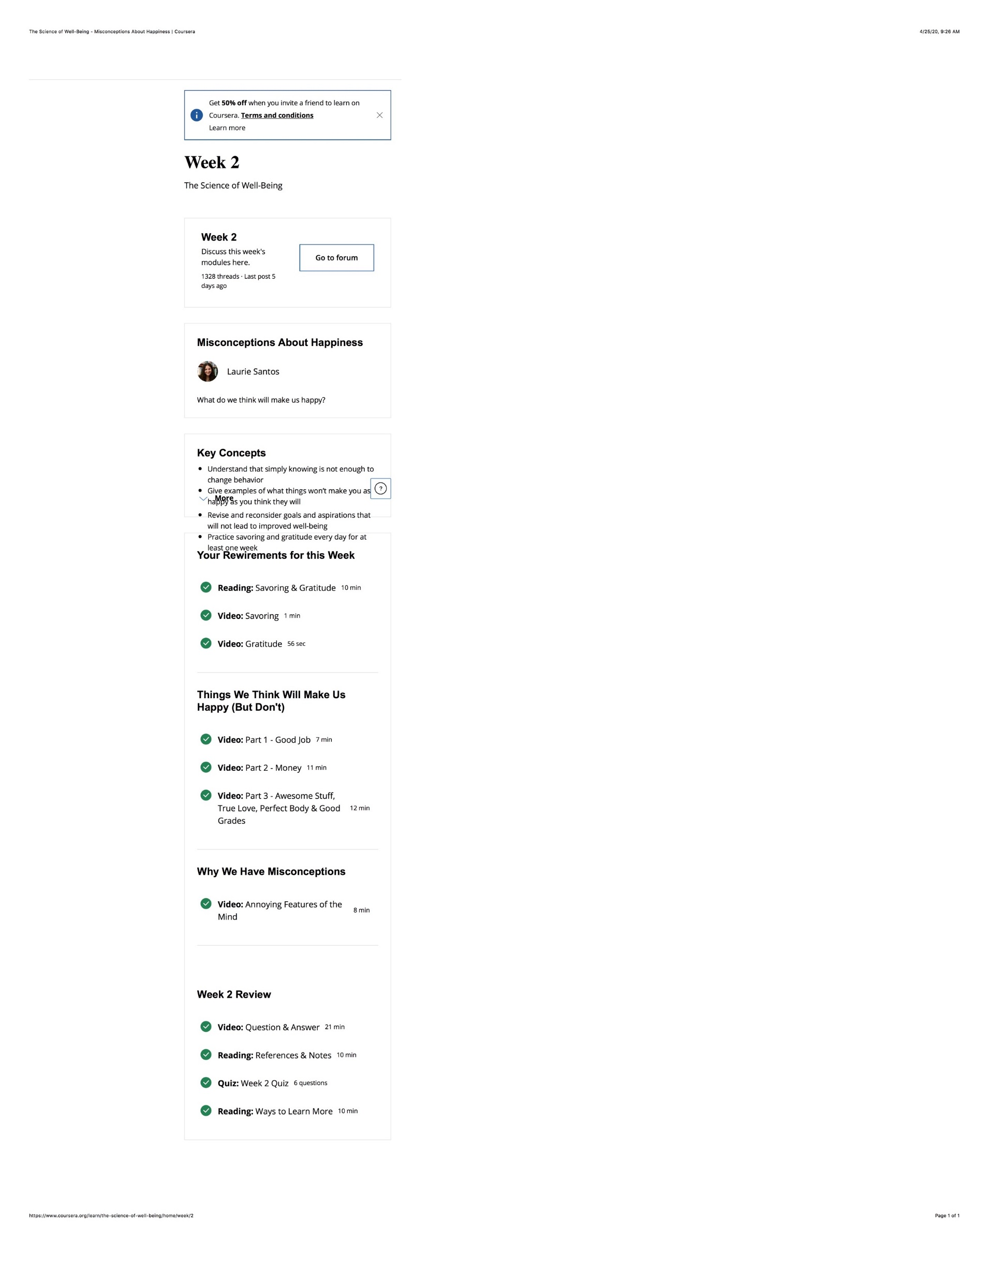
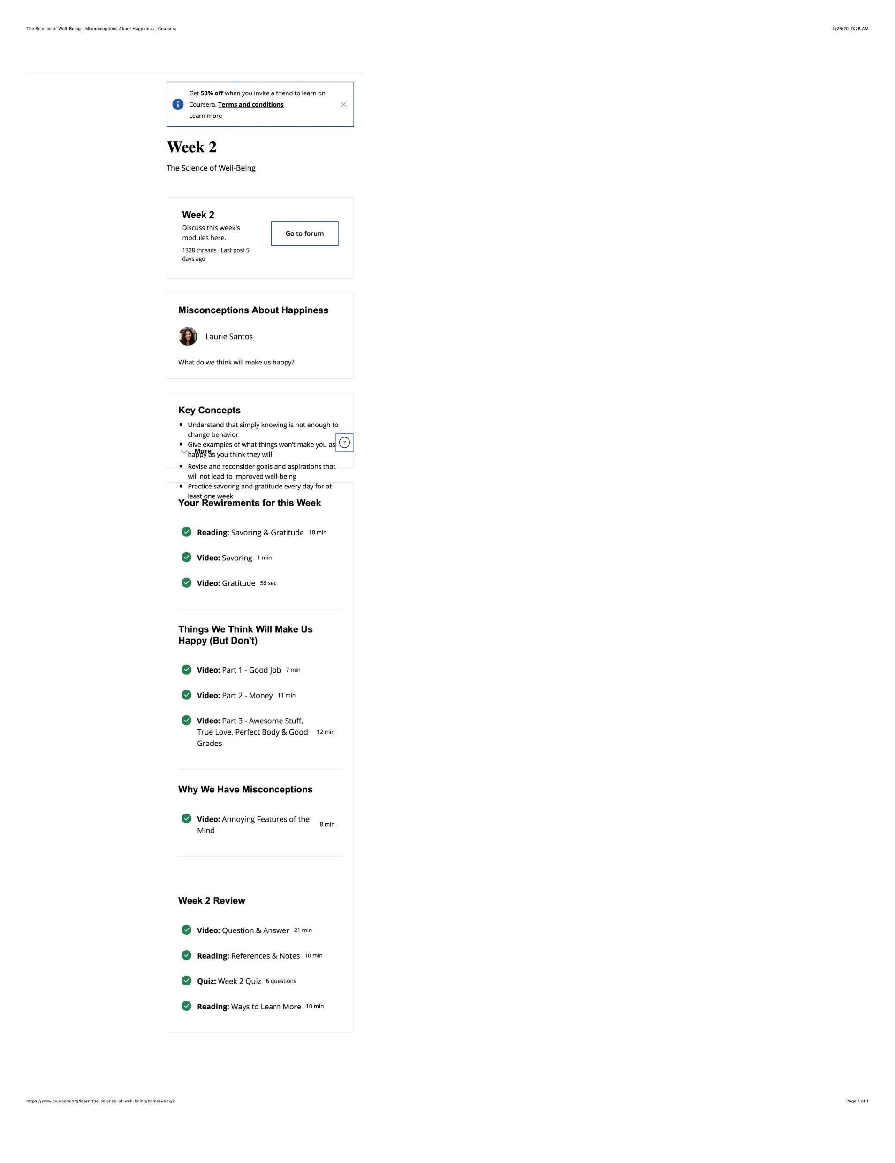
More Strategies to Facilitate SDL in MOOCs
  11. Week overview. The course is divided into week-long segments, and each week is chunked into manageable parts. Very importantly for the participant to be able to anticipate what can get done in one sitting, the length of each video is included.

Slide 34
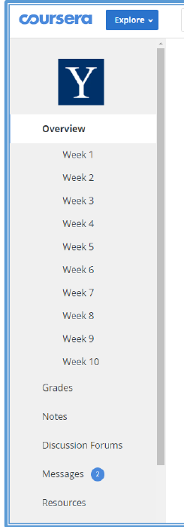
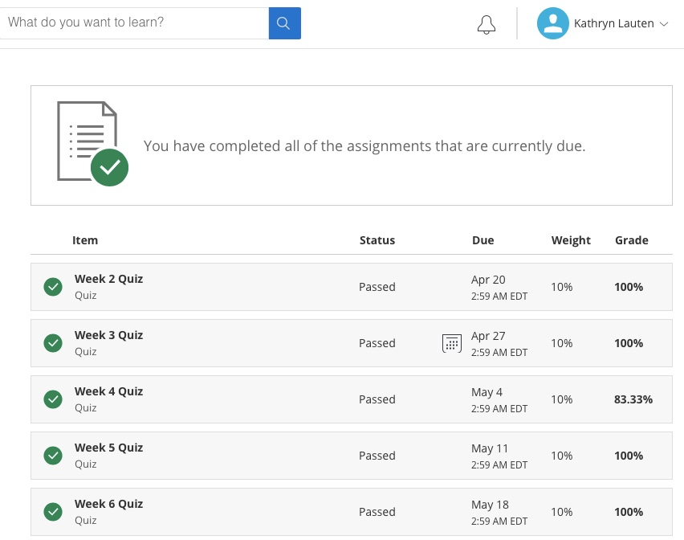
More Strategies to Facilitate SDL in MOOCs
  12. Visuals showing tasks completed or work progress.

Slide 35
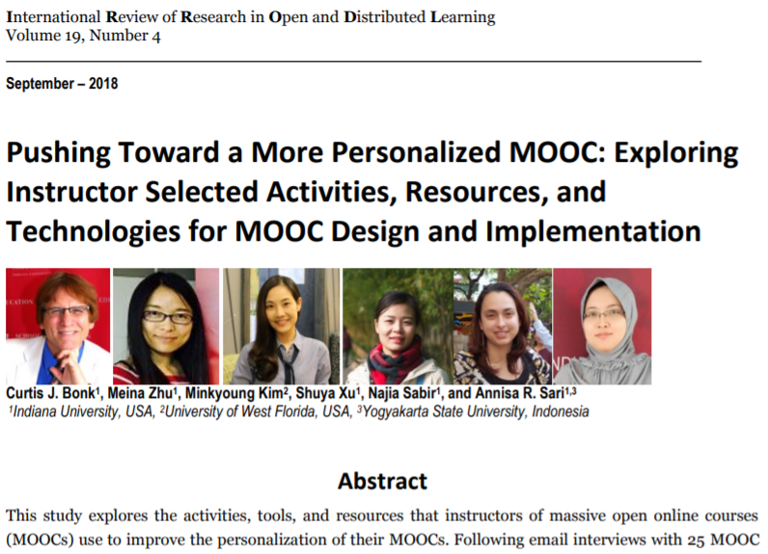
MOOC Study #3

Slide 36
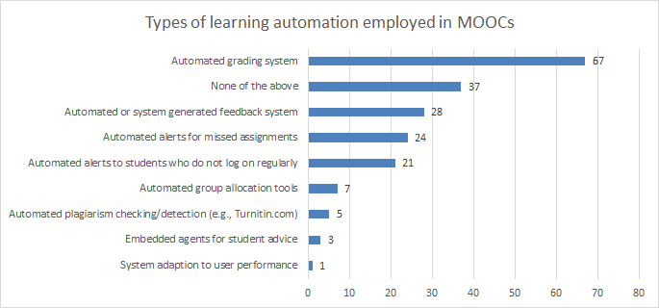
Figure 1. Number of MOOCs that offer different types of learning system automation and adaptation (n=127)

Slide 37
Figure 2: MOOC instructors (n=133) instructional practices to address cultural diversity

Slide 38
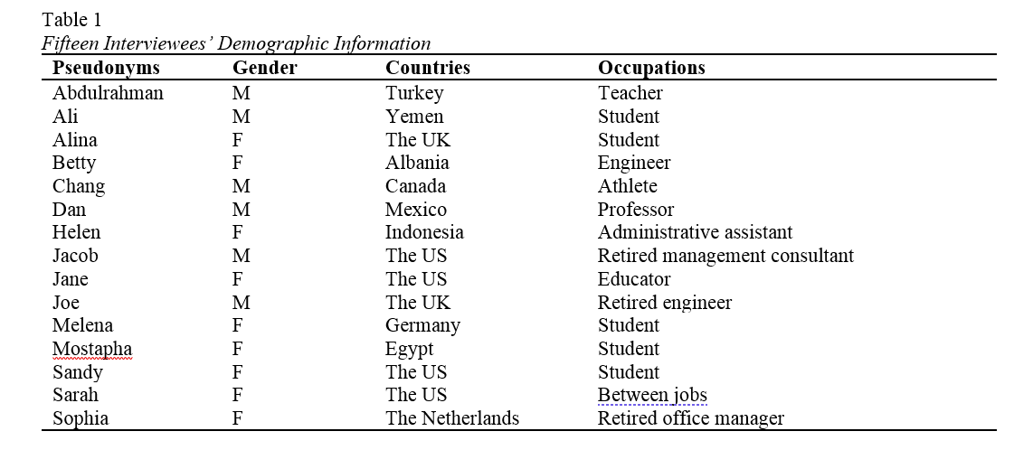
MOOC Study #4
MOOC Learners and SDL
Zhu, M., Bonk, C. J., & Berri, S. (in press). Fostering self-directed learning in MOOCs: Motivation, learning strategies, and instruction. Online Learning

Slide 39
RQ2
RQ2: What were the Learning Strategies that Helped Learners’ SDL in MOOCs?
Dan considered the progress bar to be a good indication of his progress, and it also created a healthy competition among the learners. Seeing where he was at in the course compared to the other learners gave him a push. He stated,
“All the progress bar with milestones, with a small quiz that doesn't count for the evaluation, but they're good for you to check if I'm really learning. And, for example, I like when you have these kinds of nice competition[s], right. Everyone starts a MOOC at the same time, but you see that these weeks you progress faster than other members in the MOOC.”

Slide 40
RQ3
RQ3: What Design and Instructional Elements of MOOCs Facilitate Learners’ SDL from the Student’s Perspective?
Alina believed that having worksheets or a set of questions after each module was the most helpful strategy to evaluate her learning step by step. Being able to answer the questions after each module gave her a sense of how much knowledge she retained before starting the next module. Similarly, Sandy elaborated upon how quizzes and tests were helpful, but she wished they were more advanced and included questions and answers rather than only multiple-choice questions.

Slide 41
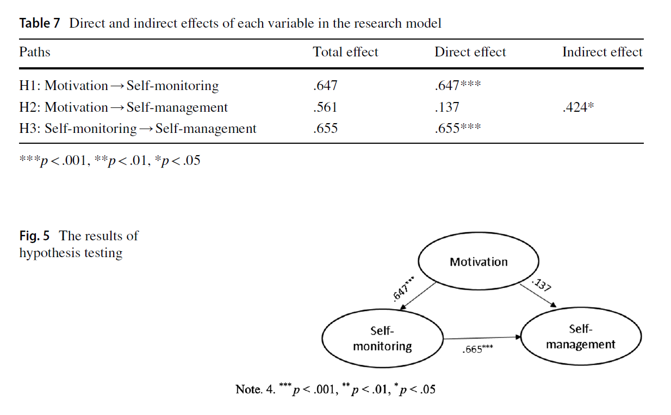
Study #5: Self-Directed learning in MOOCs:
Exploring the Relationships among motivation, self-monitoring, and self-management, Zhu, Bonk, & Doo, 2020, ETR&D
(SEM: Survey of 322 MOOC Learners)

Slide 42

Study #6: Self-directed language learning in Duolingo

Slide 43

Study #6: Overview
This study investigated how the design and delivery of Duolingo support and facilitate student self-directed learning (SDL).
This study used a mixed-method.
84 survey respondents, and 10 semi-structured interviews.

Slide 44
Research Questions
How do Duolingo learners self-manage their learning goals, time, resources, and support?
What strategies are employed by Duolingo learners to overcome challenges and frustrations related to learning foreign languages with Duolingo?
What motivating factors underpin the decisions of learners to learn a foreign language with Duolingo?
How does the design and delivery of Duolingo foster learners to be self-directed learners?

Slide 45
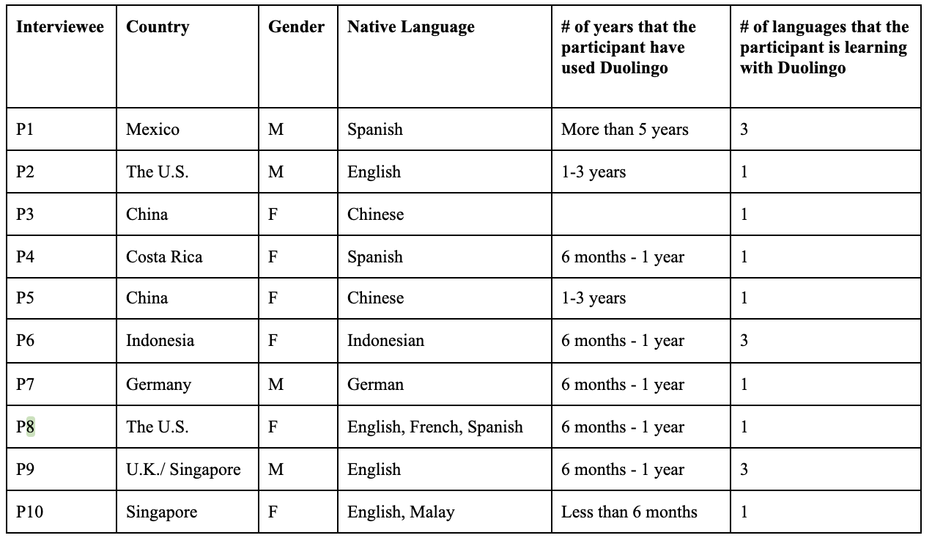
Interview Participants

Slide 46
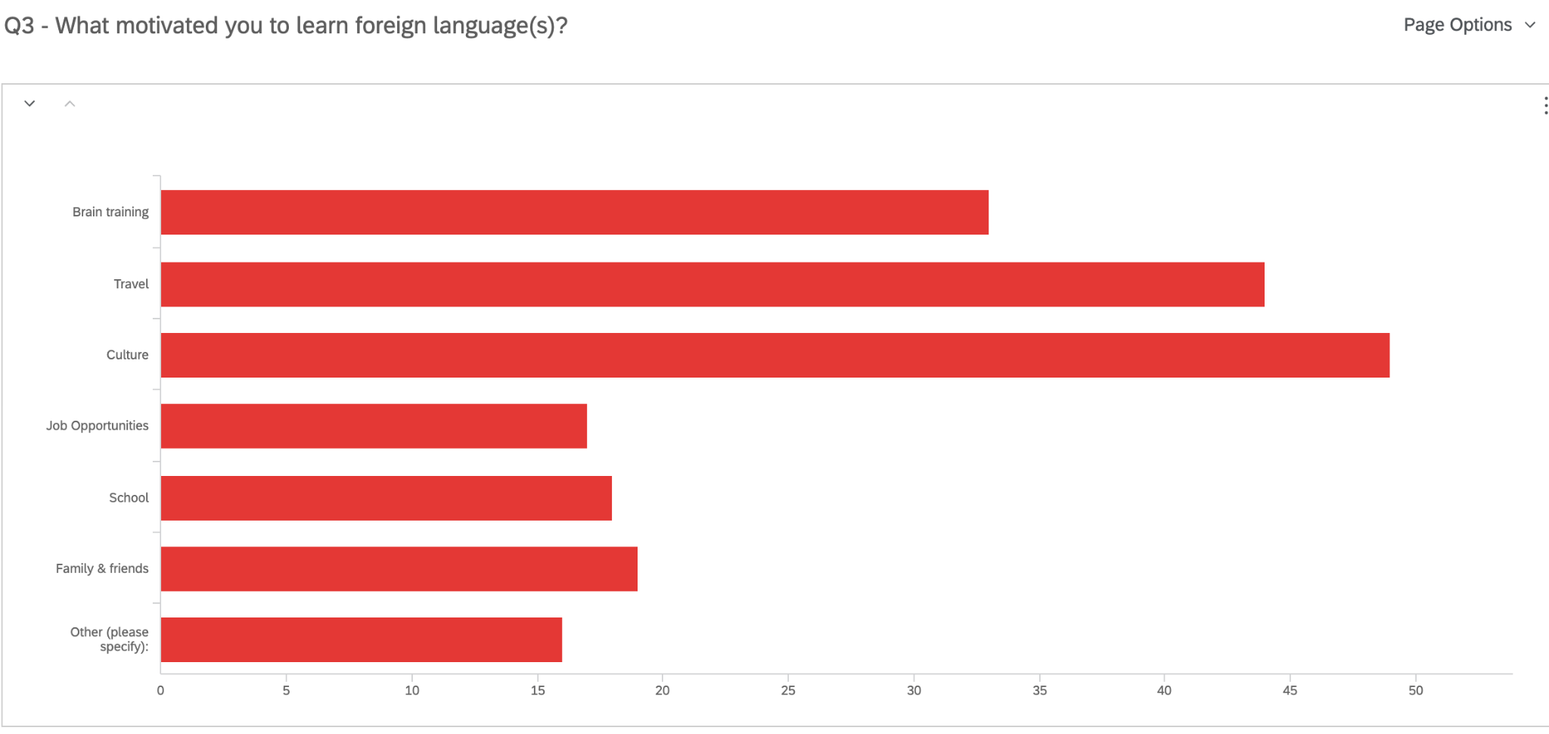
Finding 1: Motivation
Language learners are mostly driven by intrinsic motivators that relates to culture, travel, and brain training.
Q3. What motivated you to learn a foreign language?
Brain Training
Travel
Culture
Job Opportunities
School
Family and Friends
Other

Slide 47


Finding 1: Motivation
The idea is that I would really like to go to Europe someday. (P5)
So in the last month, the idea came up of going from Hamburg with the train to Moscow and then transit to the trains. And then make some stops in Siberia and then end at Beijing and enjoy the visit in China. (P7)
But for people, who are more like my mother, when she talks about it, she is just like, “oh, well, I'm learning it. I don't expect to be conversational and I'm just learning it to keep my mind sharp”. (P8)

Slide 48

Finding 1: Motivation
3. Language learners are particularly motivated for their personal relevant needs, such as practical communications.
I just want to learn to speak and just be confident in this language, and be fluent in the language at some point, and just be able to converse with people who maybe don't speak English or something. (P7)
My goal is to learn Arabic relatively well because of my fiance. That's one of his native languages. And we would love to raise our kids bilingual. (P8)
I'm not an academic. I just enjoy communicating. (P9)
Basically I have a Japanese neighbor who I was trying to communicate with. (P10)
I think ultimately languages are about communication. (P10)

Slide 49

Finding 1: Motivation
4. Peer groups and social events are positive motivators.
I used to post my achievements with my friends on Facebook. And I have motivated people to keep the streaks. We congratulate each other. (P1)
I do interact a lot on the Duolingo Japanese forum. I like to help, help out other Learners. (P2)
I'm looking for Duolingo events as well because we can be more active, like talking with other people, learning with other people as well. (P6)
I think Duolingo, it's kind of good at capitalizing on personal and social motivation, and everybody's mentioned that. (P7)

Slide 50

Finding 2: Self-management
Purely relying on Duolingo to study a foreign language is not effective, a variety of electronic and non-electronic resources are needed to supplement Duolingo learning.
One of the reasons that I do recommend that people have a bunch and you use a bunch of stuff. (P2)
I think my biggest suggestion, as I mentioned a little earlier, is just don't use
Duolingo as your only resources. (P3)
Possibly not to just use Duolingo alone, use it as a starter base
to just get sufficient vocabularies to take you to the next level
of crafting sentences. (P10)

Slide 51

Finding 3: Self-monitoring
Most of the learners highly relies on the technology to support monitoring, such as reinforcing micro learning habits without extra effort and maintaining learning process by receiving frequent practice reminders and notifications.
And after you have chosen the wrong one and at the end of this lesson, the system will provide you with a repeated choice to make you make a choice again. (P3)
And I don't actually see much about self-monitoring in the process. Because they have a clear structure, clear modules. Basically, you just tap in and go with it. (P5)
I think when they come to self-monitoring, it is really lacking, because there's no little test that I can take, and “okay, I have progressed to this level.” (P10)

Slide 52

Do we have time for another study?

Slide 53

Study #7. Present Study…Nepali Youth Learn from MOOCs

Slide 54
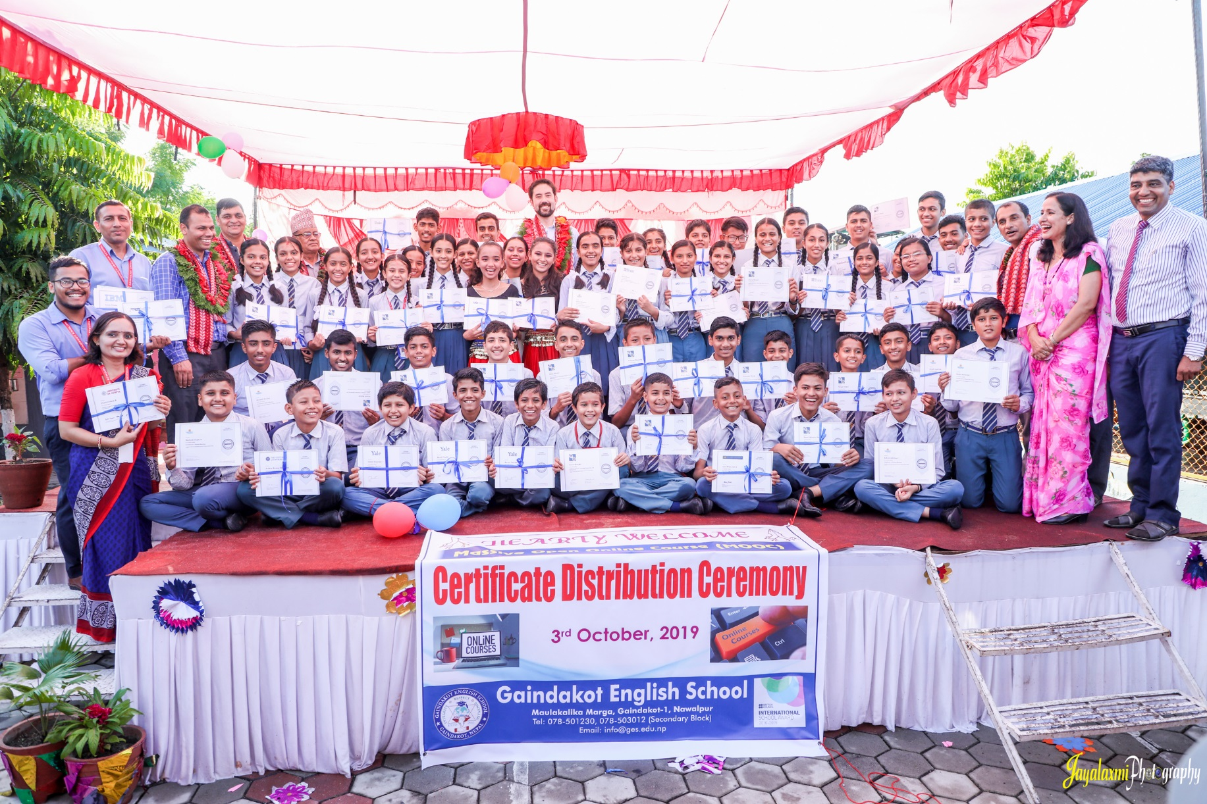
November 9, 2019
Greetings from Nepal,
Baman Kumar Ghimire
Teacher, Motherland Secondary School, Pokhara

Slide 55
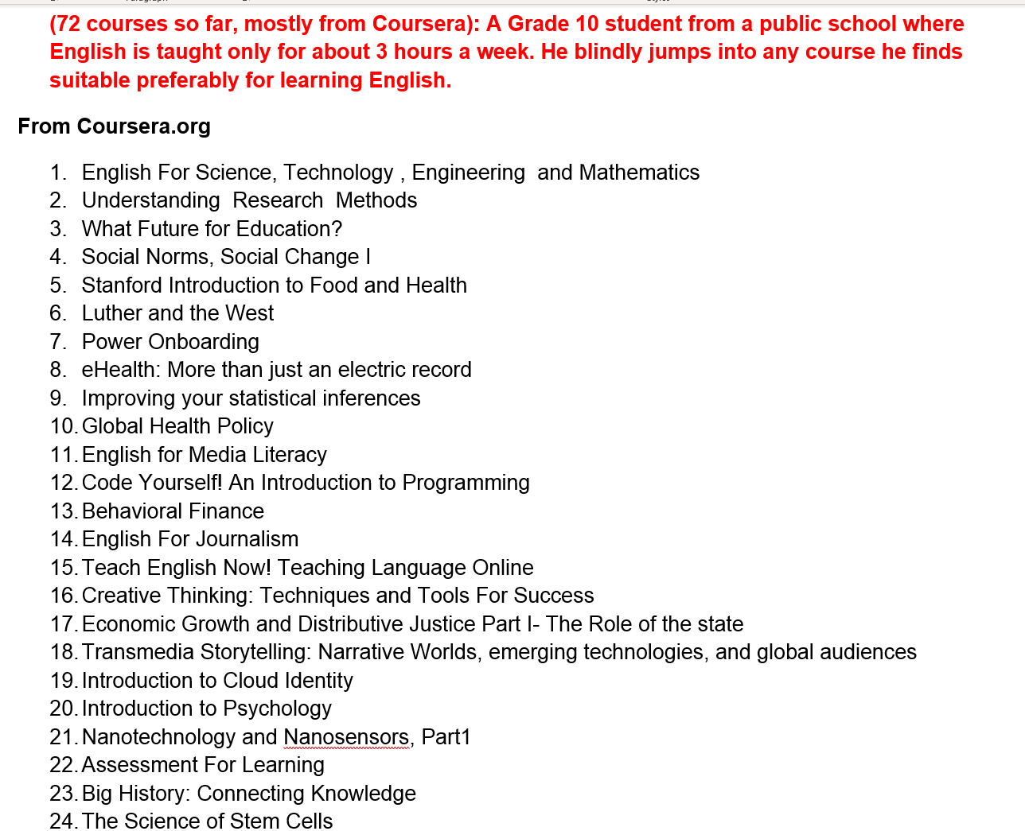

Participant #1
(boy, grade 10)

Slide 56
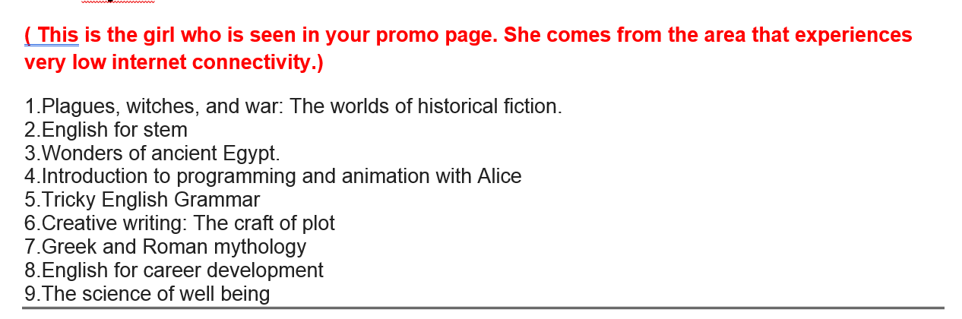

Participant #3
(teenage girl)

Slide 57
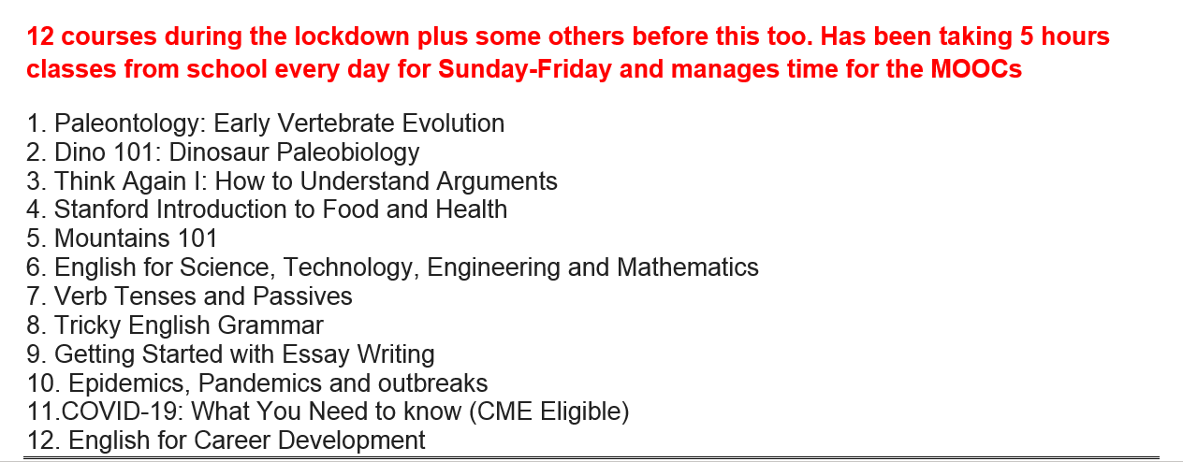

Participant #5
(teenage girl)

Slide 58
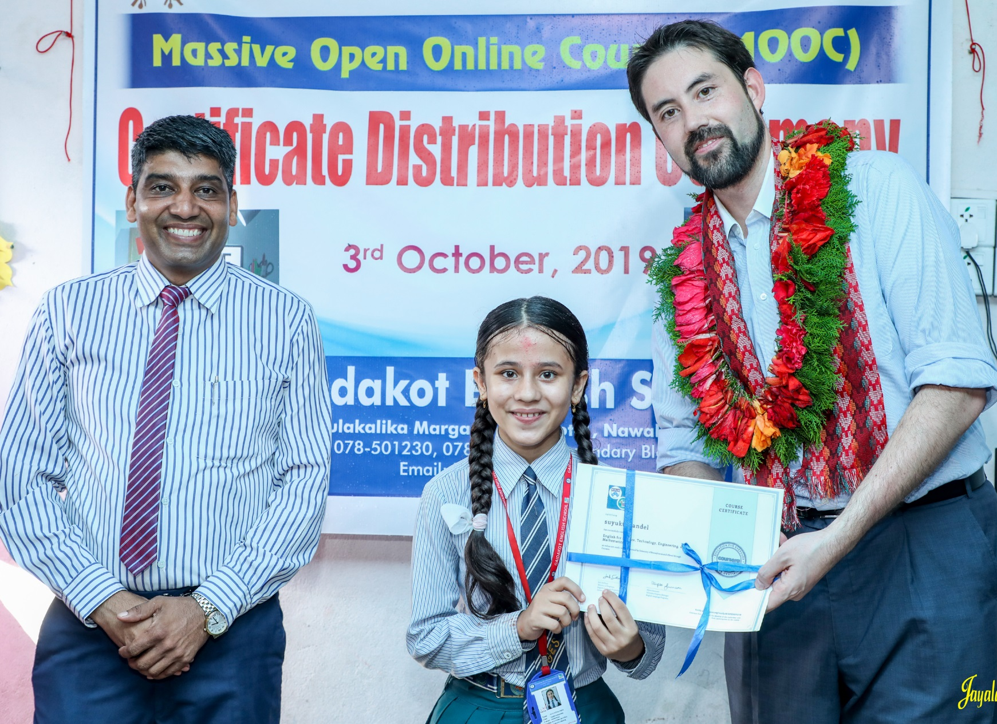

November 9, 2019
Chapter 9. Nepali High School Students in Massive Open Online Courses (MOOCs): Impressive Results and a Promising Future
Baman Kumar Ghimire and Bishwa Raj Gautam
Greetings from Nepal
Baman Kumar Ghimire
Teacher, Motherland Secondary School, Pokhara

Slide 59
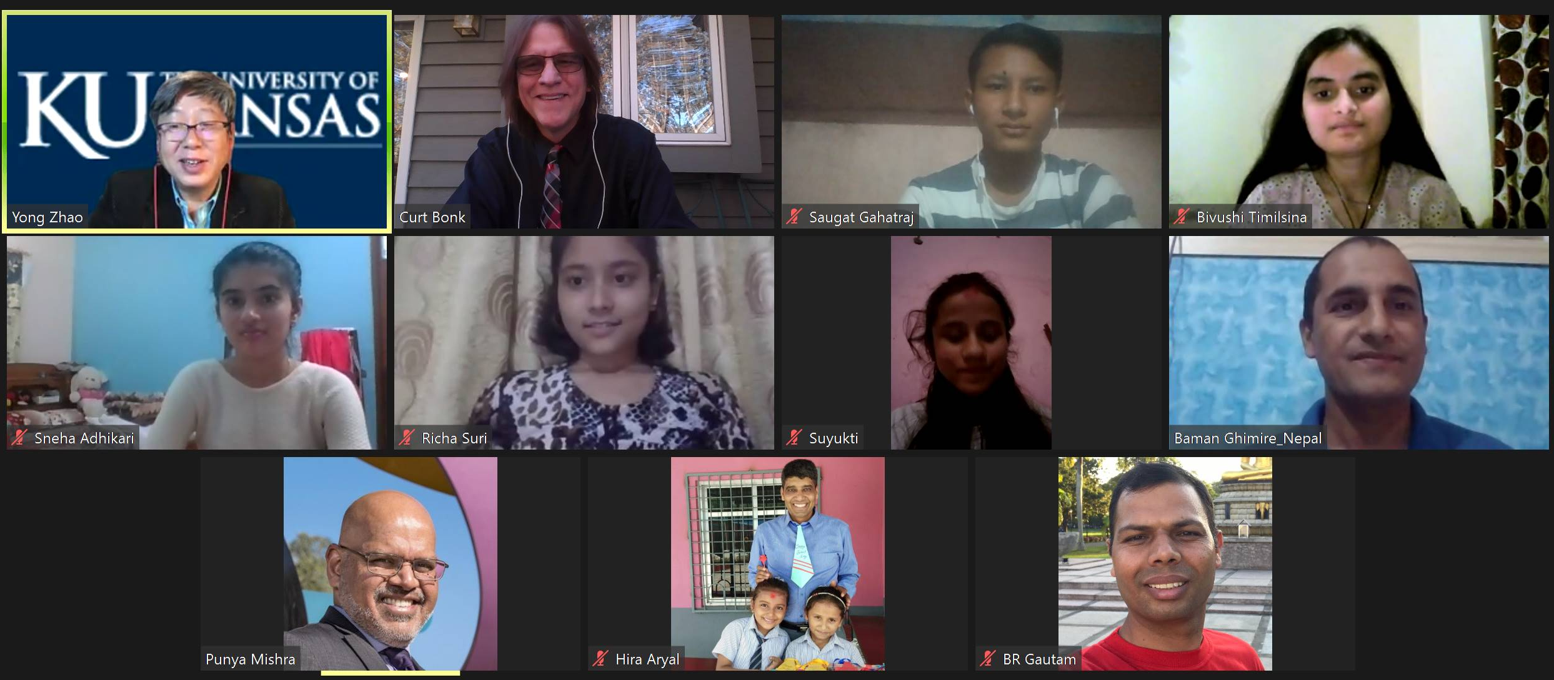
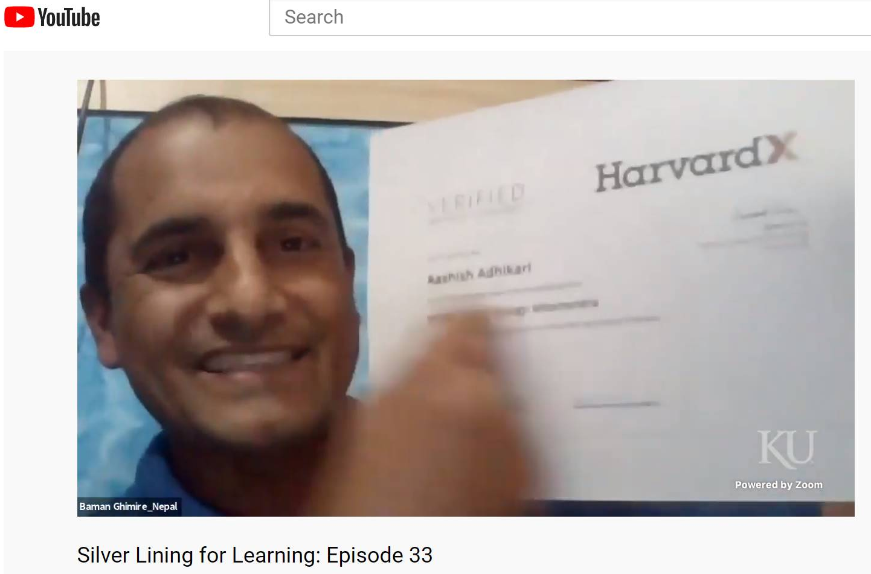
October 31, 2020
Silver Lining for Learning Episode #33: Nepal

Slide 60



Thank you!
Any Questions?
Curtis Bonk: cjbonk@Indiana.edu
Slides and Proceedings Paper at TrainingShare.com: http://www.trainingshare.com (go to “Archived Talks”)

