Slide 1

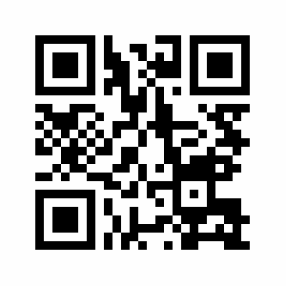
"I Am Pleased To Inform You That...“
Insights and Advice on Getting Published in Educational and Instructional Technology
PART 2
Ana-Paula Correia, Ph.D.
The Ohio State University, USA
Curtis J. Bonk, Ph.D.
Indiana University, USA
Notes:
Ana and Curt
1

Slide 2
Purposes of this Session
(PART 2)
Review Bonk’s writing tips sheet
Define writing and publishing goals
Address questions & comments
Share resources on Google Doc
https://tinyurl.com/ycnazffm
Notes:
Ana

Slide 3

Activity #1
Review Bonk’s writing tips sheet and circle 1 or 2 ideas that were NOT mentioned in Top 20 Writing Tips
and Insights.
Share them with your next chair neighbor.
Notes:
Ana
3

Slide 4

Activity #2
Please stand up and find someone on the other side of the room.
Discuss best 3 writing tips learned.
Jot on post-it note.
Notes:
Curt
4

Slide 5

Activity #3
Write down 3 writing goals, plans and actionable items.
Share them with your next chair neighbor and the large group.
Notes:
Curt
5

Slide 6
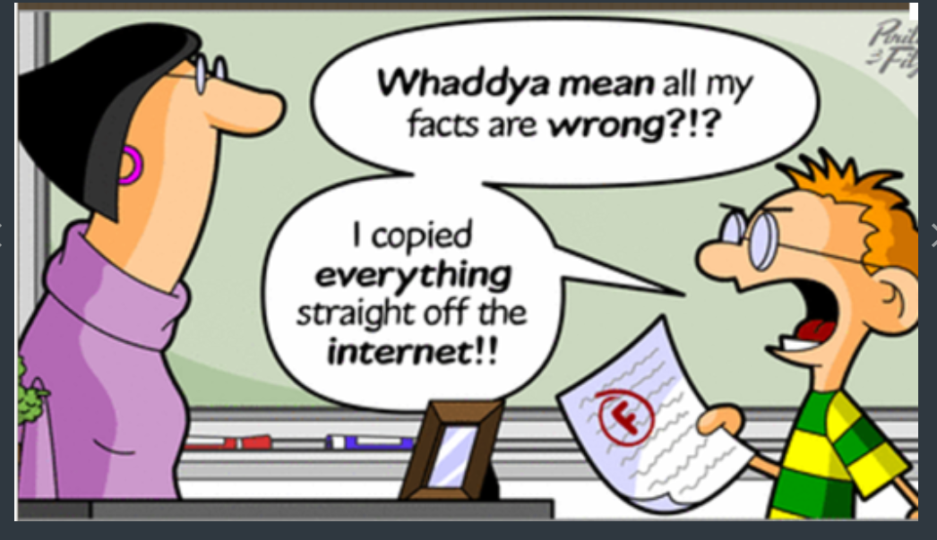
Activity #4
Go to https://tinyurl.com/ycnazffm and share your own resources with this community.
Notes:
Ana
6

Slide 7

Notes:
Curt and Ana
7

Slide 8



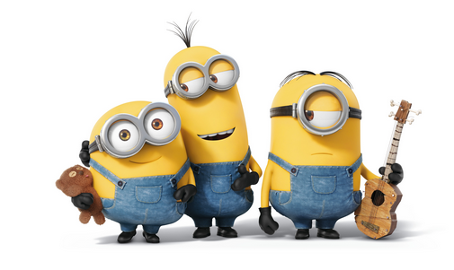
Thank You!
Ana-Paula Correia, OSU | Curt Bonk, IU
correia.12@osu.edu | cjbonk@Indiana.edu
Follow me on Twitter: https://twitter.com/correia65 | TravelinEdMan in Twitter: https://twitter.com/travelinedman
http://anapaulacorreia.com/ | http://curtbonk.com/
Slides: http://www.trainingshare.com/workshop.php
Resources: https://tinyurl.com/ycnazffm
Notes:
Curt and Ana
8

