Slide 1


"I Am Pleased To Inform You That...“
Insights and Advice on Getting Published in Educational and Instructional Technology
Ana-Paula Correia, Ph.D.
The Ohio State University, USA
Curtis J. Bonk, Ph.D.
Indiana University, USA
Notes:
Ana and Curt
1

Slide 2
Purposes of this Session
Discuss the many faces of scholarly publication
Explore the process for getting published
Examine writing tips and insights
Share resources
https://tinyurl.com/ycnazffm
Notes:
Ana

Slide 3

The Many Faces of Scholarly Publication
Diversification of places of publication
Dissemination of open access resources
Increasing influence thru social networking
Notes:
Ana and Curt
3

Slide 4

The Many Faces of Scholarly Publication
The academic persona
Peer recognition
The exploitative nature of open access publishing
Notes:
Ana and Curt
4

Slide 5
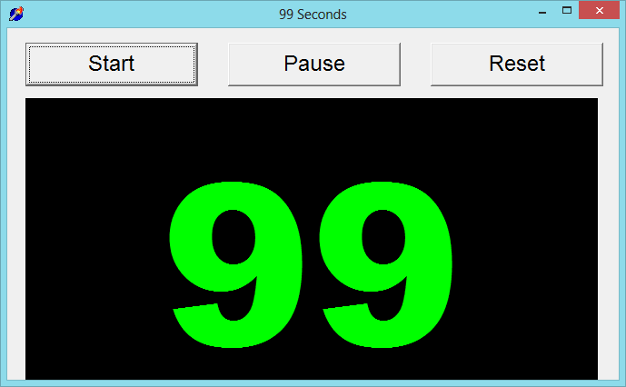
99 Seconds Activity #1
With your next chair neighbor discuss 1 to 2 writing dilemmas currently facing.
Notes:
Ana
5

Slide 6
The Process
Insights and Advice on Getting Published in Educational and Instructional Technology
Notes:
Ana

Slide 7
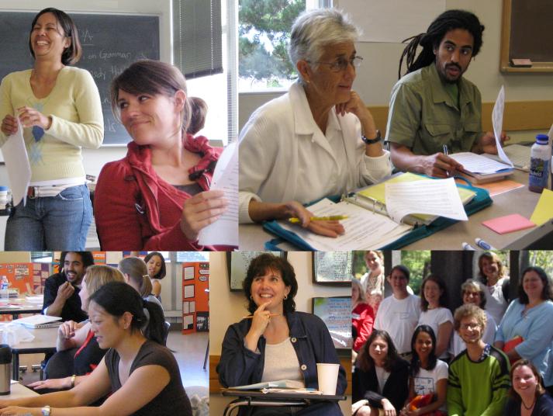
Put Forward your Best Work
Collaborative research projects
Literature reviews
Reflections/
conceptual pieces
Grant projects
Class projects
Notes:
Ana
7

Slide 8

Finding a Journal that Fits
What to look for?
Who will be your target readers?
Who are the authors and journals you cite the most related with your research program?
Is there a match between your work and the journal aims and scope?
What is the journal turnaround time?
What is the journal acceptance rate?
Notes:
Ana
8

Slide 9

Finding a Journal that Fits
Where to look for?
Social Sciences Citation Index (SSCI) is a commercial citation index product of Clarivate Analytics. It was originally developed by the Institute for Scientific Information from the Science Citation Index.
European Reference Index for the Humanities and the Social Sciences (ERIH PLUS) was created and developed by European researchers under the coordination of the Standing Committee for the Humanities of the European Science Foundation.
Notes:
Ana
9

Slide 10
Selecting a Journal
Practitioner Journals
Target practitioners
Deal with problems and issues tied directly to practice
Receive wider circulations and visibility
Refereed or nonrefereed articles
Notes:
Ana

Slide 11

Selecting a Journal
Peer-Reviewed Journals
Top-tier journals: are SSCI-indexed
Second-tier journals: have an established history in the field
Third-tier journals: are newer in the field
Notes:
Ana

Slide 12
TOP-TIER JOURNALS
British Journal of Educational Technology
Educational Technology Research and Development
Computers & Education
Instructional Science
Notes:
Ana
Mention:
http://www.trainingshare.com/resources/distance_ed_journals_and_online_learning_books.php
12

Slide 13



SECOND-TIER JOURNALS
Journal of Educational Computing Research
TechTrends
The American Journal of Distance Education
Notes:
Ana
13

Slide 14
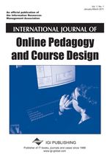


THIRD-TIER JOURNALS
International Journal of Online Pedagogy and Course Design
Contemporary Issues in Technology and Teacher Education
Digital Experiences in Mathematics Education
Notes:
Ana

Slide 15

Get Involved…
Review articles and conference proposals (learn about peer-review criteria and guidelines)
Review book proposals
Do a conference workshop
Organize a symposium
Notes:
Ana

Slide 16
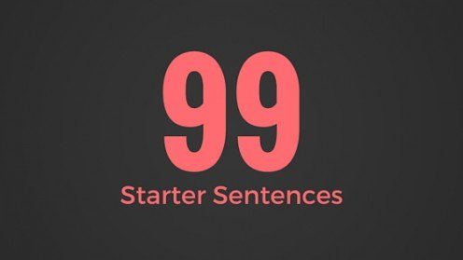

Generate Starter Text…
Author a blog
Use social media
Submit a conference proposal
Write editorials
Write book and software reviews
101
Notes:
Curt

Slide 17
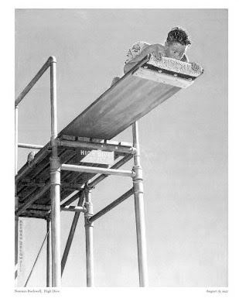
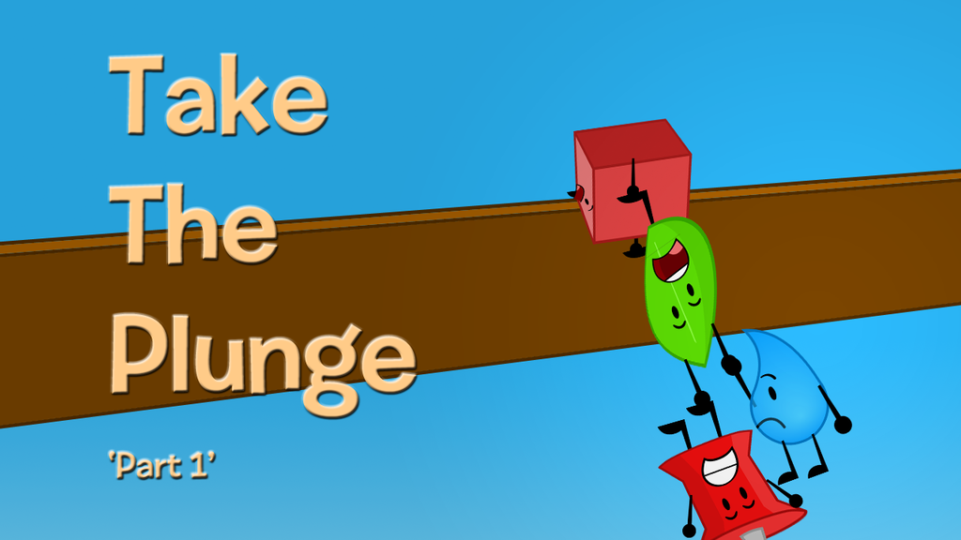
Take the Plunge…Part 1
Look for opportunities to create publishable manuscripts from your dissertation
Contribute with a chapter
Conduct an interview
Write a practical article, newsletter, or book review
Notes:
Ana
17

Slide 18


Take the Plunge…Part 2
Write a major grant proposal
Lead a special journal issue
Edit a book
Sole author a book
Get your name out there!
Notes:
Curt
18

Slide 19
99 Seconds Activity #2
Commit to 1 to 2 ways to take the plunge and share them with your next chair neighbor.
Notes:
Ana
19

Slide 20
Writing Tips and Insights
Insights and Advice on Getting Published in Educational and Instructional Technology
Notes:
Curt
20

Slide 21
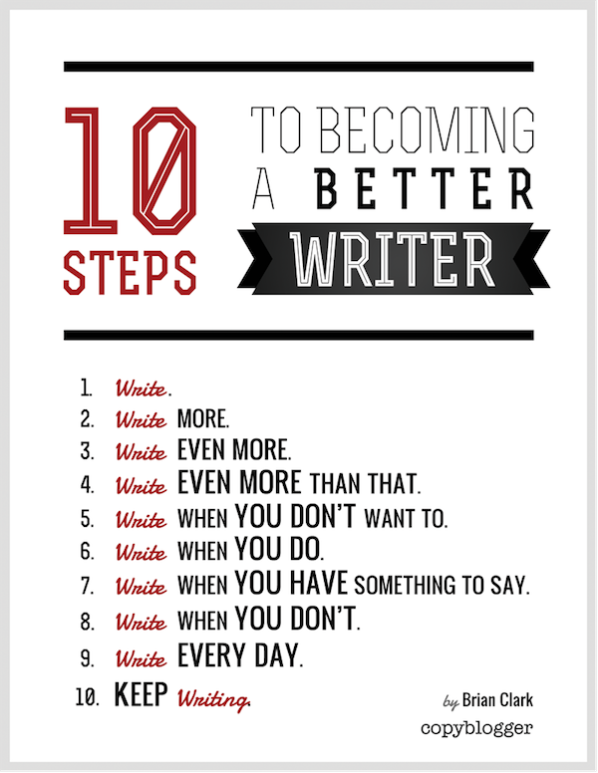
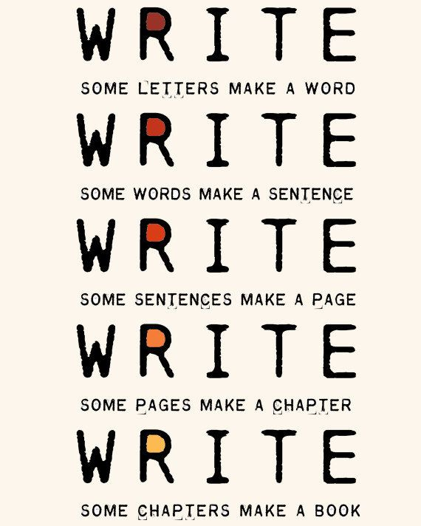
The Top 20 Writing Tips
Notes:
Curt
21

Slide 22


1. Mark Writing Days in Planner
Notes:
Curt
22

Slide 23

2. Maintain a List and Network of Potential Research and Writing Collaborators
Notes:
Curt
23

Slide 24


Sidenote: Find Good People to Work With…Life is Short—Avoid Egomaniacs and People Who Lie
Notes:
Curt
24

Slide 25
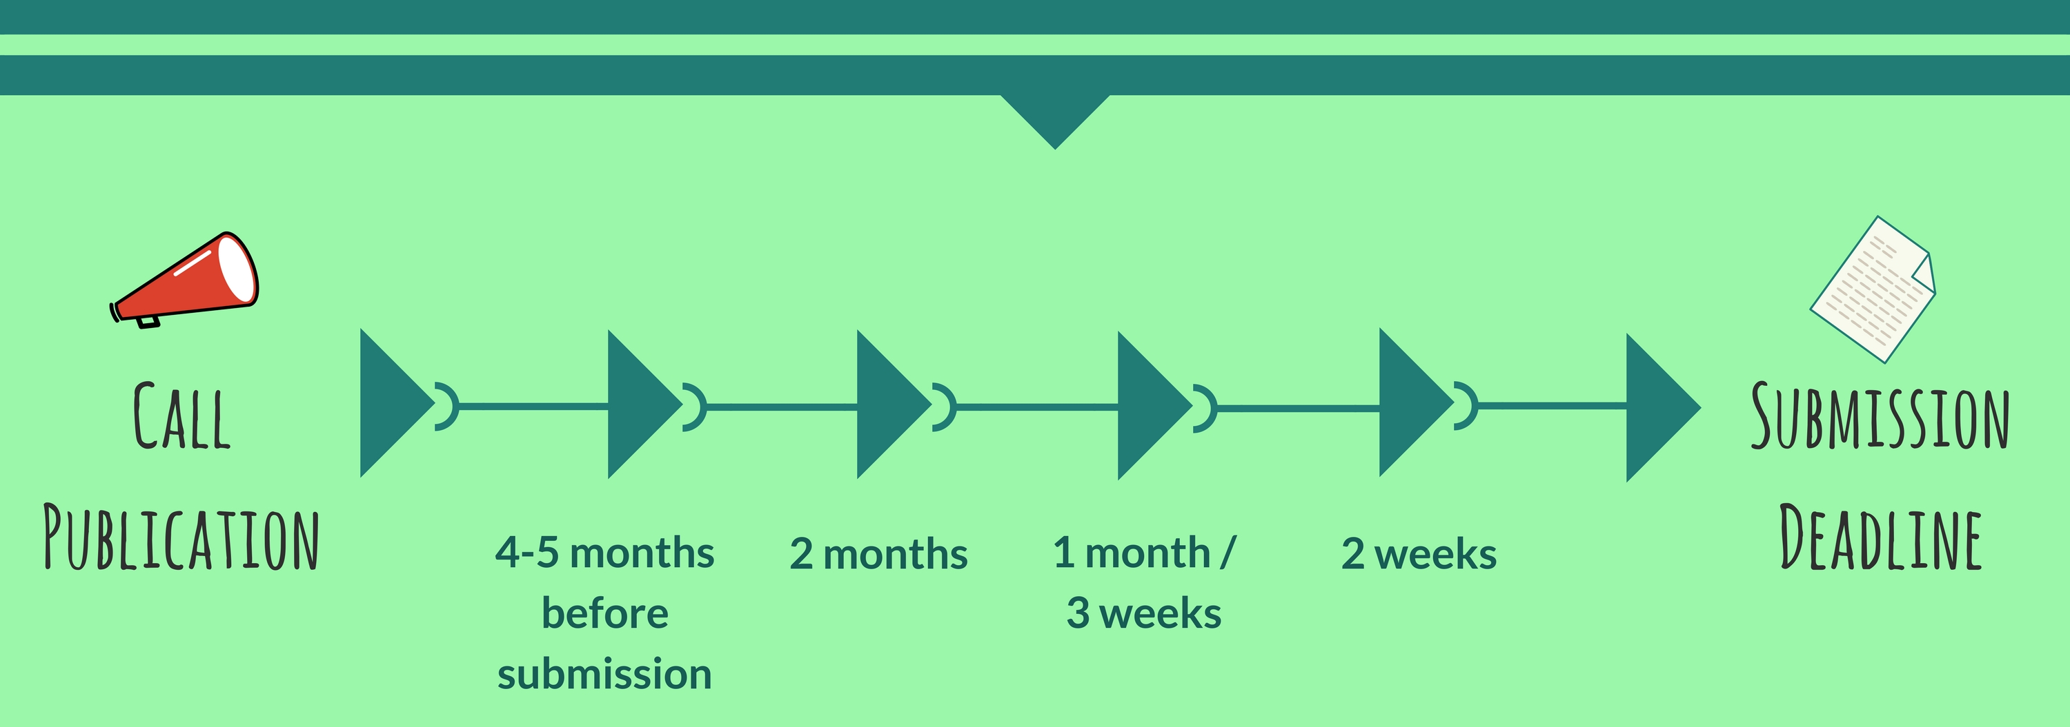
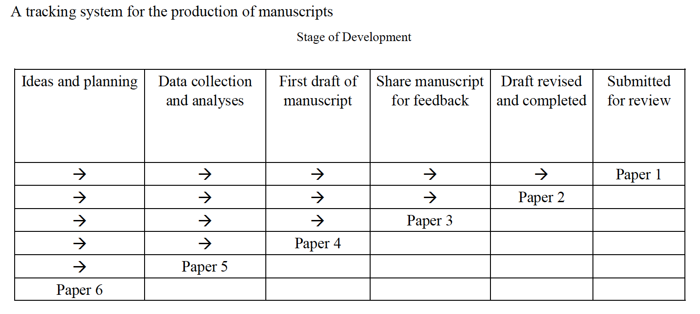
3. Draft a Timeline or Multiple Timelines with Flexible Goals
Notes:
Curt
Screenshot from Cecil’s article
25

Slide 26

4. Think Ahead About the Publishing Potential of Each Project
Notes:
Curt
26

Slide 27
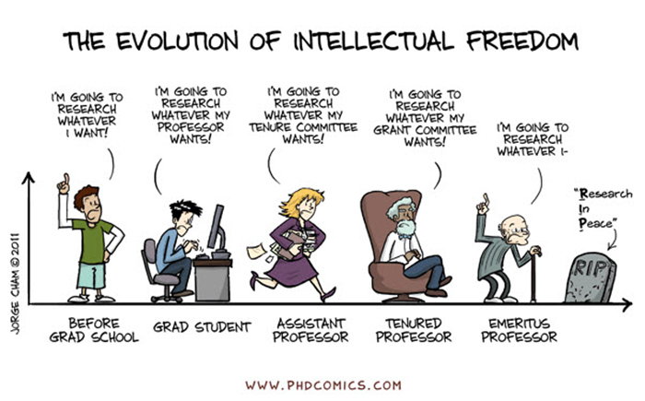
Sidenote: Don’t Just Publish for the Sake of Publishing…
Notes:
Curt
27

Slide 28
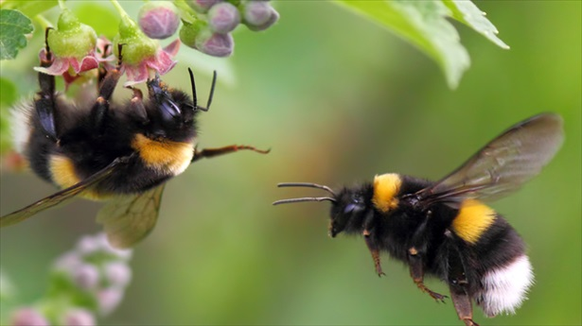

5. Be a Bumblebee and Butterfly
Notes:
Curt
28

Slide 29


6. Find, Save, and Use Starter Text (overcomes writer’s block)
Notes:
Curt
29

Slide 30

7. Always Scan the Reference Sections of Other Articles to See What Journals are Popular
Notes:
Curt
30

Slide 31

8. Avoid High Quality (i.e., SSCI) Journal Fixations
Notes:
Curt
31

Slide 32


9. Be Second or Third Author Sometimes to Spread Limited Resources
Notes:
Curt
32

Slide 33

10. If Need Summer Money, Teach Short Term or Intensive Courses
Notes:
Curt
33

Slide 34
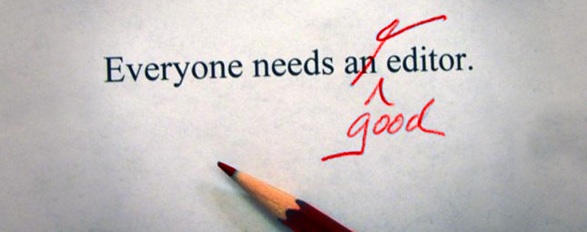

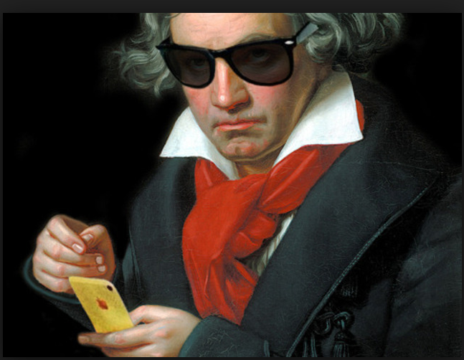
11. Edit Your Papers a Lot! (Mozartian vs. Beethovenian)
Notes:
Curt
34

Slide 35
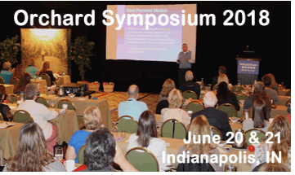
12. Organize Conference Symposia Which Can Lead to Special Journal Issues and Books
Notes:
Curt
35

Slide 36
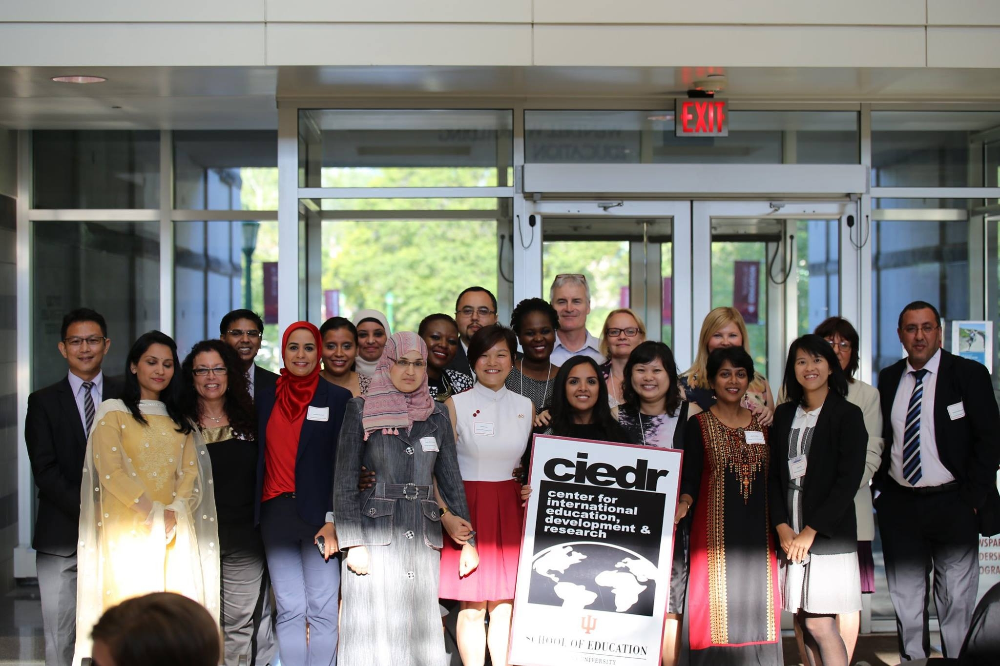
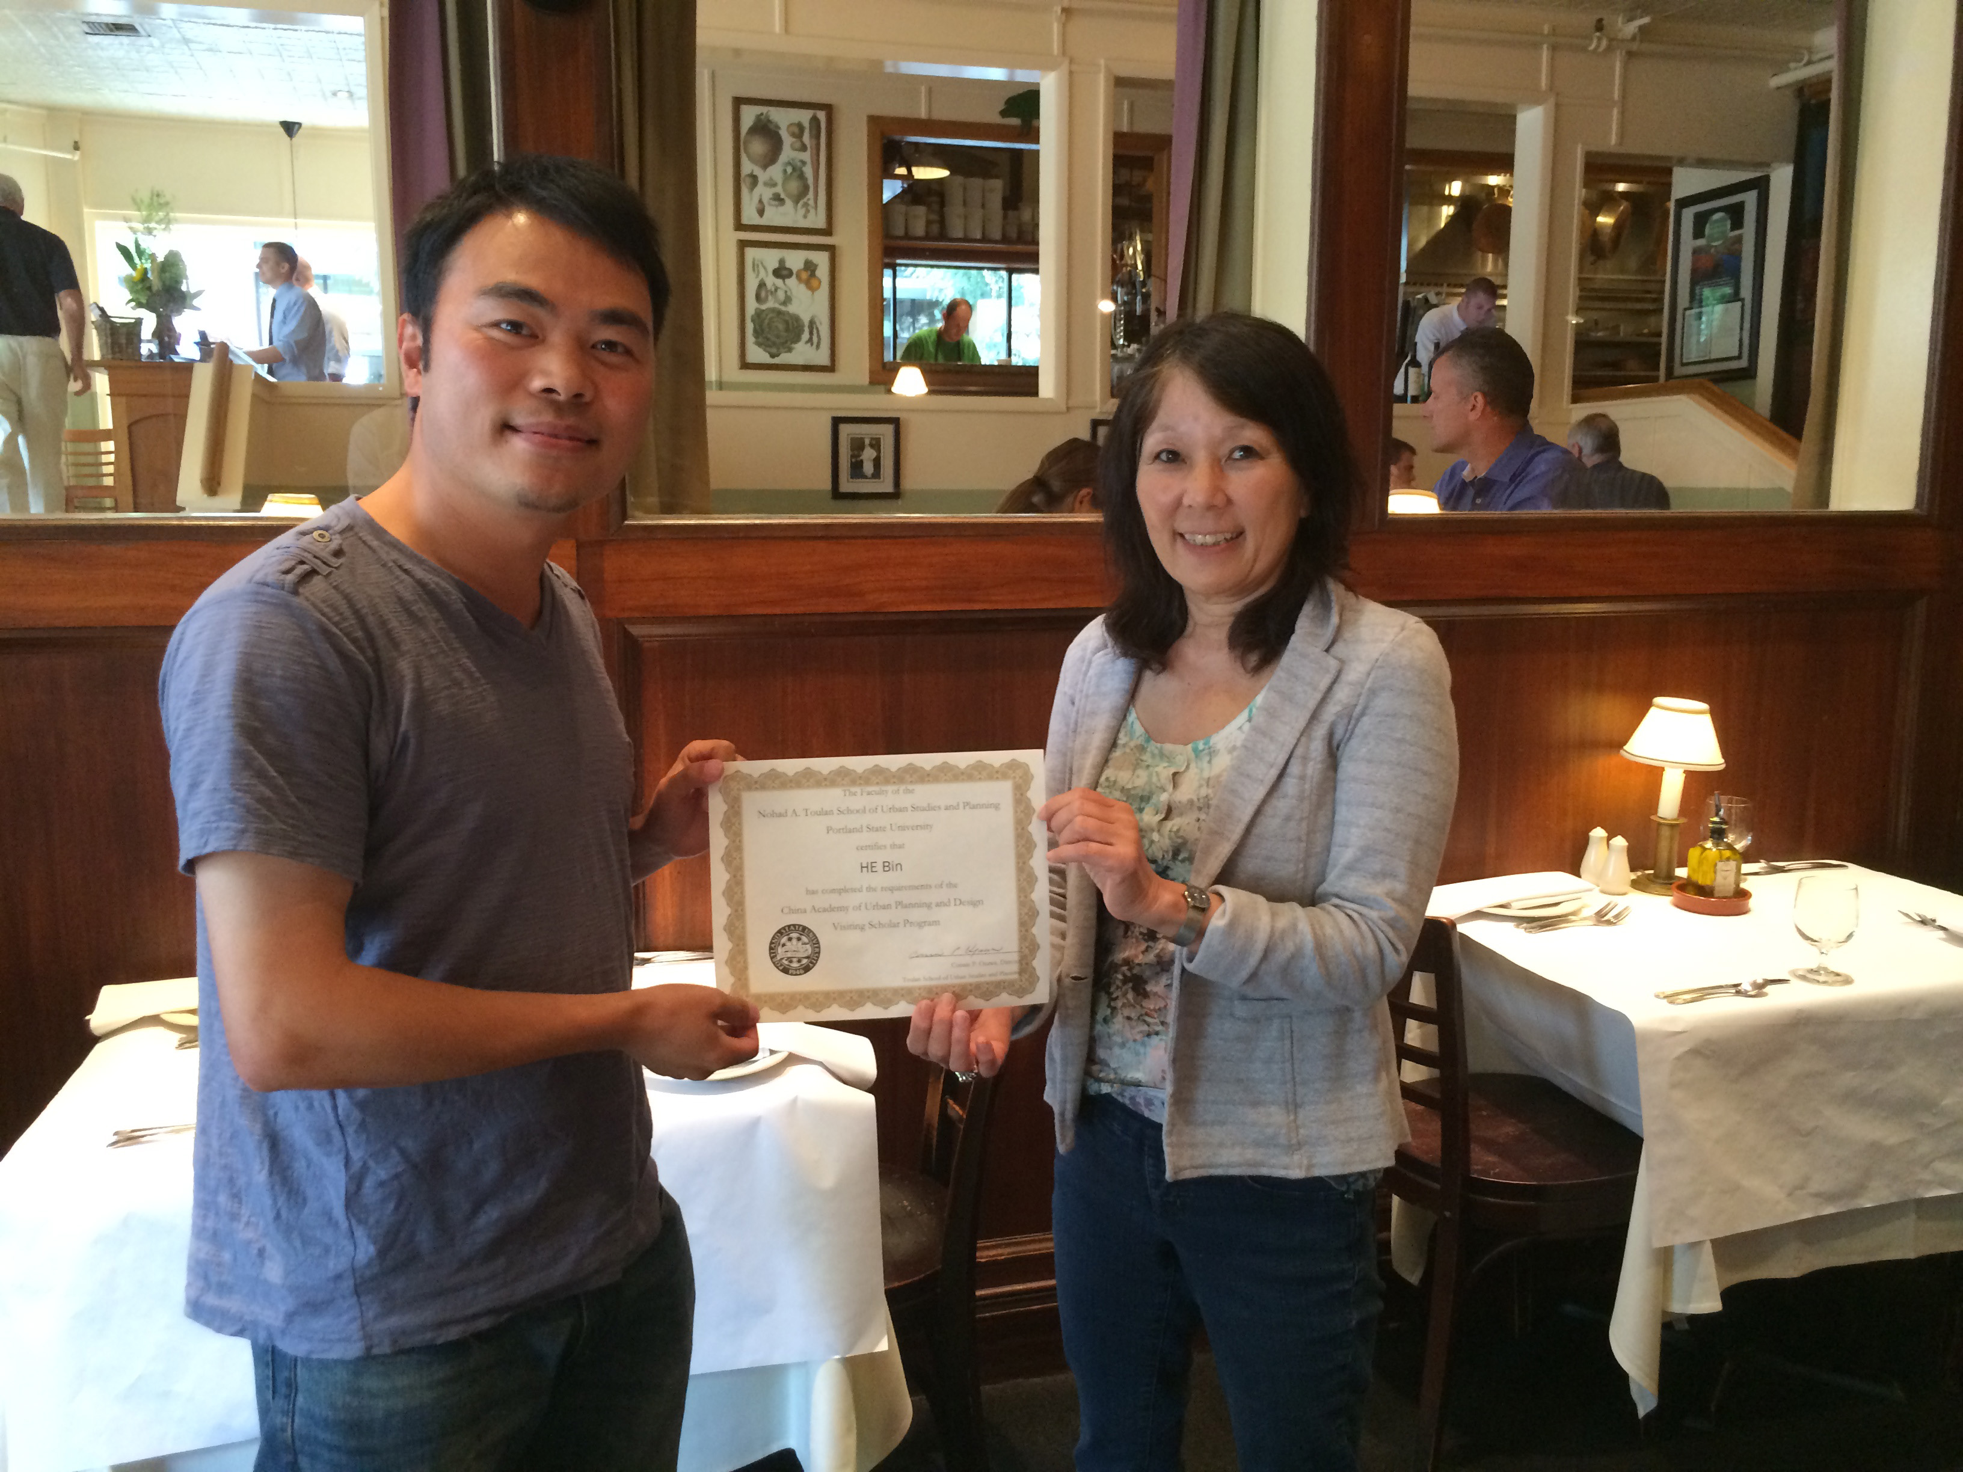

13. Sponsor Visiting Scholars to Work with You; They Often Have Writing Plans
Notes:
Curt
36

Slide 37
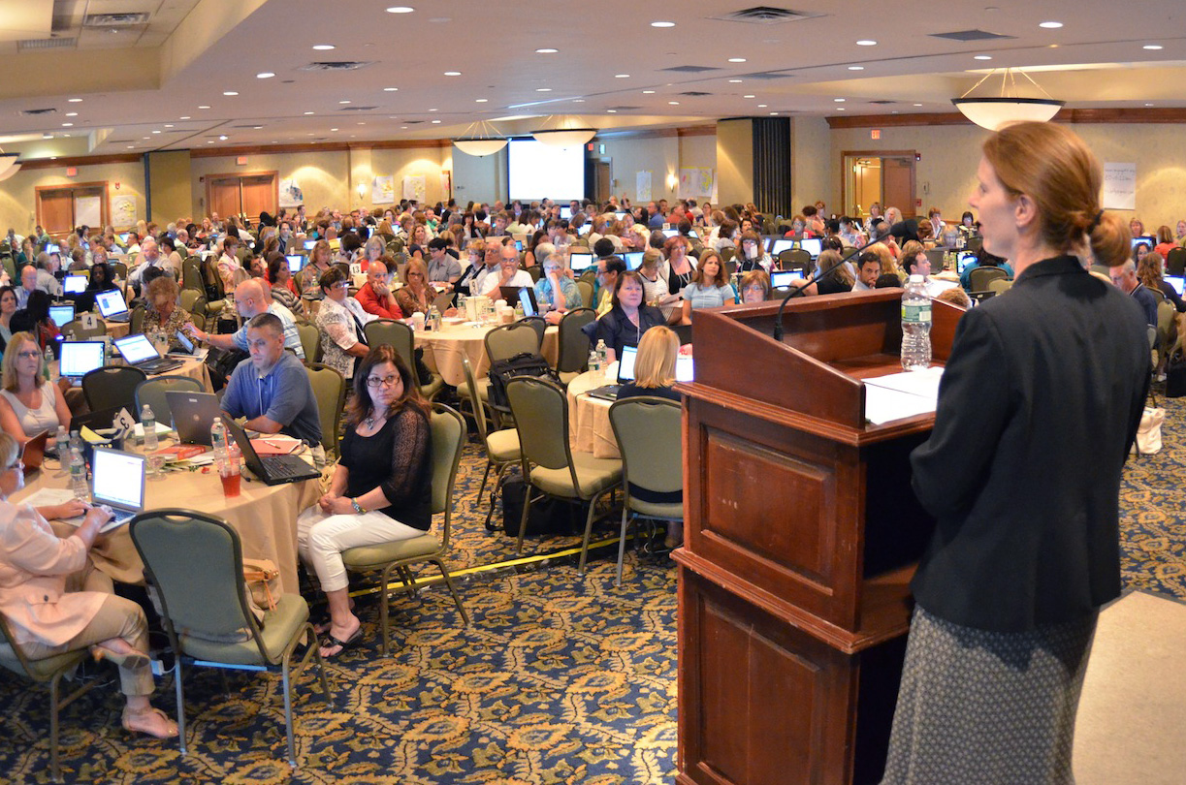

14. Try to Submit or Publish Your Paper Before the Conference
Notes:
Curt
37

Slide 38

15. Be Creative Somewhere
(e.g., unique model, figure, chart, etc.)
Notes:
Curt
38

Slide 39
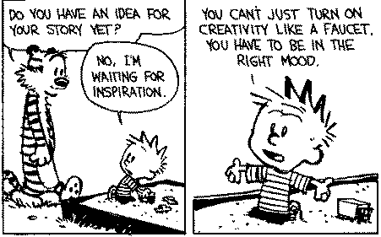

Sidenote: Modify Your Environment (Find or Create Your Personal Sandbox)
Notes:
Curt
39

Slide 40

16. Try Not to Give Up: Persistence and Grit Wins the Day
Notes:
Curt
40

Slide 41

17. Be Polite and Thankful to the Journal or Book Chapter Editors
Notes:
Curt
41

Slide 42

18. Recap Reviewer Points and How You Attempted to Address Them
Notes:
Curt
42

Slide 43
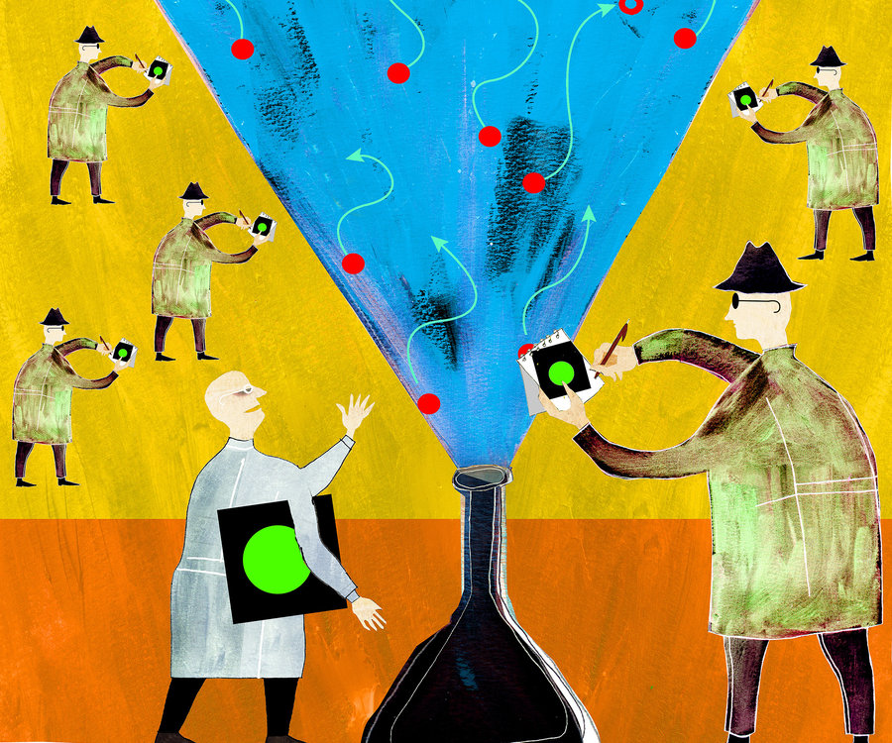


19. Share Your Publication Efforts (e.g., Twitter, Facebook, LinkedIn, email, ResearchGate, Academia.edu, etc.)
Notes:
Curt
43

Slide 44

20. Celebrate Your Writing Accomplishments with Friends
Notes:
Curt
44

Slide 45

Audience Poll:
How many ideas did you get from this session?
0 if I am lucky.
Just 1.
2, yes, 2…just 2!
Do I hear 3? 3!!!!
4-5.
5-10.
More than 10.
Notes:
Curt

Slide 46
Recap of this Session
The many faces of scholarly publication
The process for getting published
Writing tips and insights
Resources
https://tinyurl.com/ycnazffm
Notes:
Ana
Stress to contribute to the resources GoogleDoc.
46

Slide 47



Final Poll: Share Three Words from this Session…? e.g., “I am happy!” and our
“Minions are happy!”
Notes:
Curt

Slide 48

Notes:
Curt

Slide 49



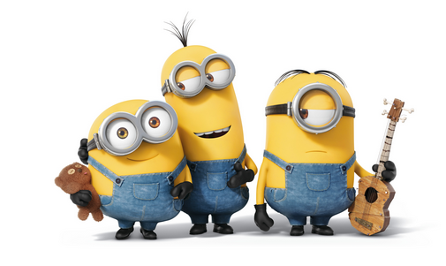
Thank You!
Ana-Paula Correia, OSU | Curt Bonk, IU
correia.12@osu.edu | cjbonk@Indiana.edu
Follow me on Twitter: https://twitter.com/correia65 | TravelinEdMan in Twitter: https://twitter.com/travelinedman
http://anapaulacorreia.com/ | http://curtbonk.com/
Slides: http://www.trainingshare.com/workshop.php
Resources: https://tinyurl.com/ycnazffm
Notes:
Curt and Ana
49

