Slide 1

Discussion: The Clustered Patterns of Learning Engagement in MOOCs and Their Effects on Teaching Presence and Persistence
Paper by: Jeonji Jung & Jeongmin Lee
Curt Bonk, Indiana University, cjbonk@indiana.edu
November 10, 2017

Slide 2

Audience Poll:
Have you ever dropped a MOOC?
Have you ever completed a MOOC? http://elearnhero.com/moocs-completion-rates/

Slide 3

October 11, 2017
MOOCs Are "Dead." What's Next? Uh-oh. One overhyped technology fades as another surges.
John Warner, Inside Higher Ed https://www.insidehighered.com/blogs/just-visiting/moocs-are-dead-whats-next-uh-oh

Slide 4
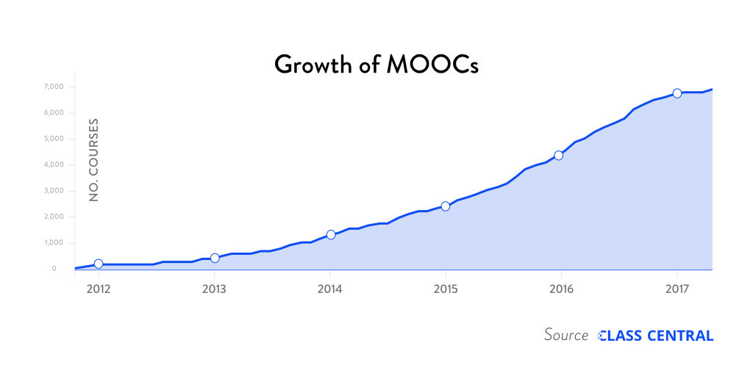

Research Background
The Numbers: MOOCS in 2016 (Dec 25th, Class Central)
Notes:
Dhawa Shah, Class Central
https://www.class-central.com/report/mooc-stats-2016/

Slide 5

June 15, 2017
Massive List of MOOC Providers Around The World
ThaiMOOC / Thailand
Class Central, Dhawal Shah https://www.class-central.com/report/mooc-providers-list/

Slide 6

June 15, 2017
Massive List of MOOC Providers Around The World, K-MOOC (Korea)
(Where to Find MOOCs: The Definitive Guide to MOOC Providers ) https://www.class-central.com/report/mooc-providers-list/

Slide 7

January 5, 2016
Use Of MOOCs And Online Education Is Exploding: Here's Why
Josh Bersin, Forbes http://www.forbes.com/sites/joshbersin/2016/01/05/use-of-moocs-and-online-education-is-exploding-heres-why/#290acdda7f09
Most of the MOOC providers now offer such credentials (there are over 100) and they include tools like Nanodegrees (Udacity), Credentials of Readiness (Harvard), XSeries (EdX), and many more. It’s not yet clear how well these credentials will be recognized by employers, but that’s where this market is going.
Most of these companies focus on technical education – software skills, IT systems, and other technical topics.

Slide 8
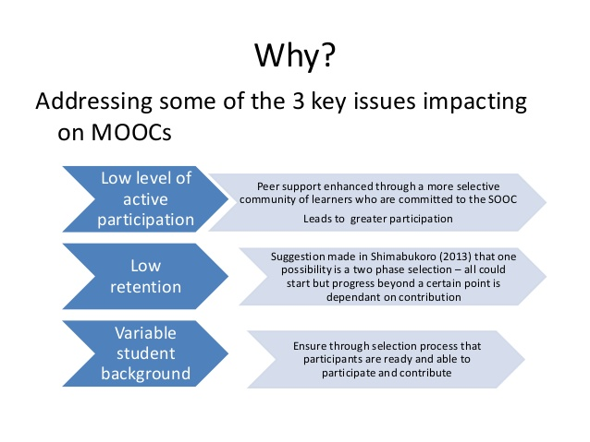
Issues: 1. Participation, 2. Retention, and 3. Variable Learner Background
Nicola Morris
https://www.slideshare.net/nicolajmorris/spocs
https://www.linkedin.com/in/nicolamorris/

Slide 9
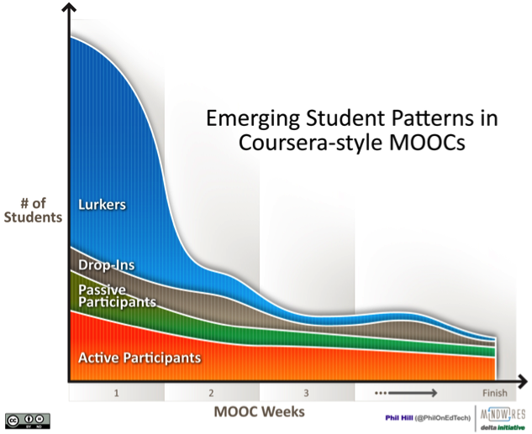
Issue #1: Low Participation
From Phil Hill: Emerging Student Patterns in MOOCs (March 10, 2013)
Emerging Student Patterns in MOOCs: A (Revised) Graphical View
http://mfeldstein.com/emerging-student-patterns-in-moocs-a-revised-graphical-view/

Slide 10
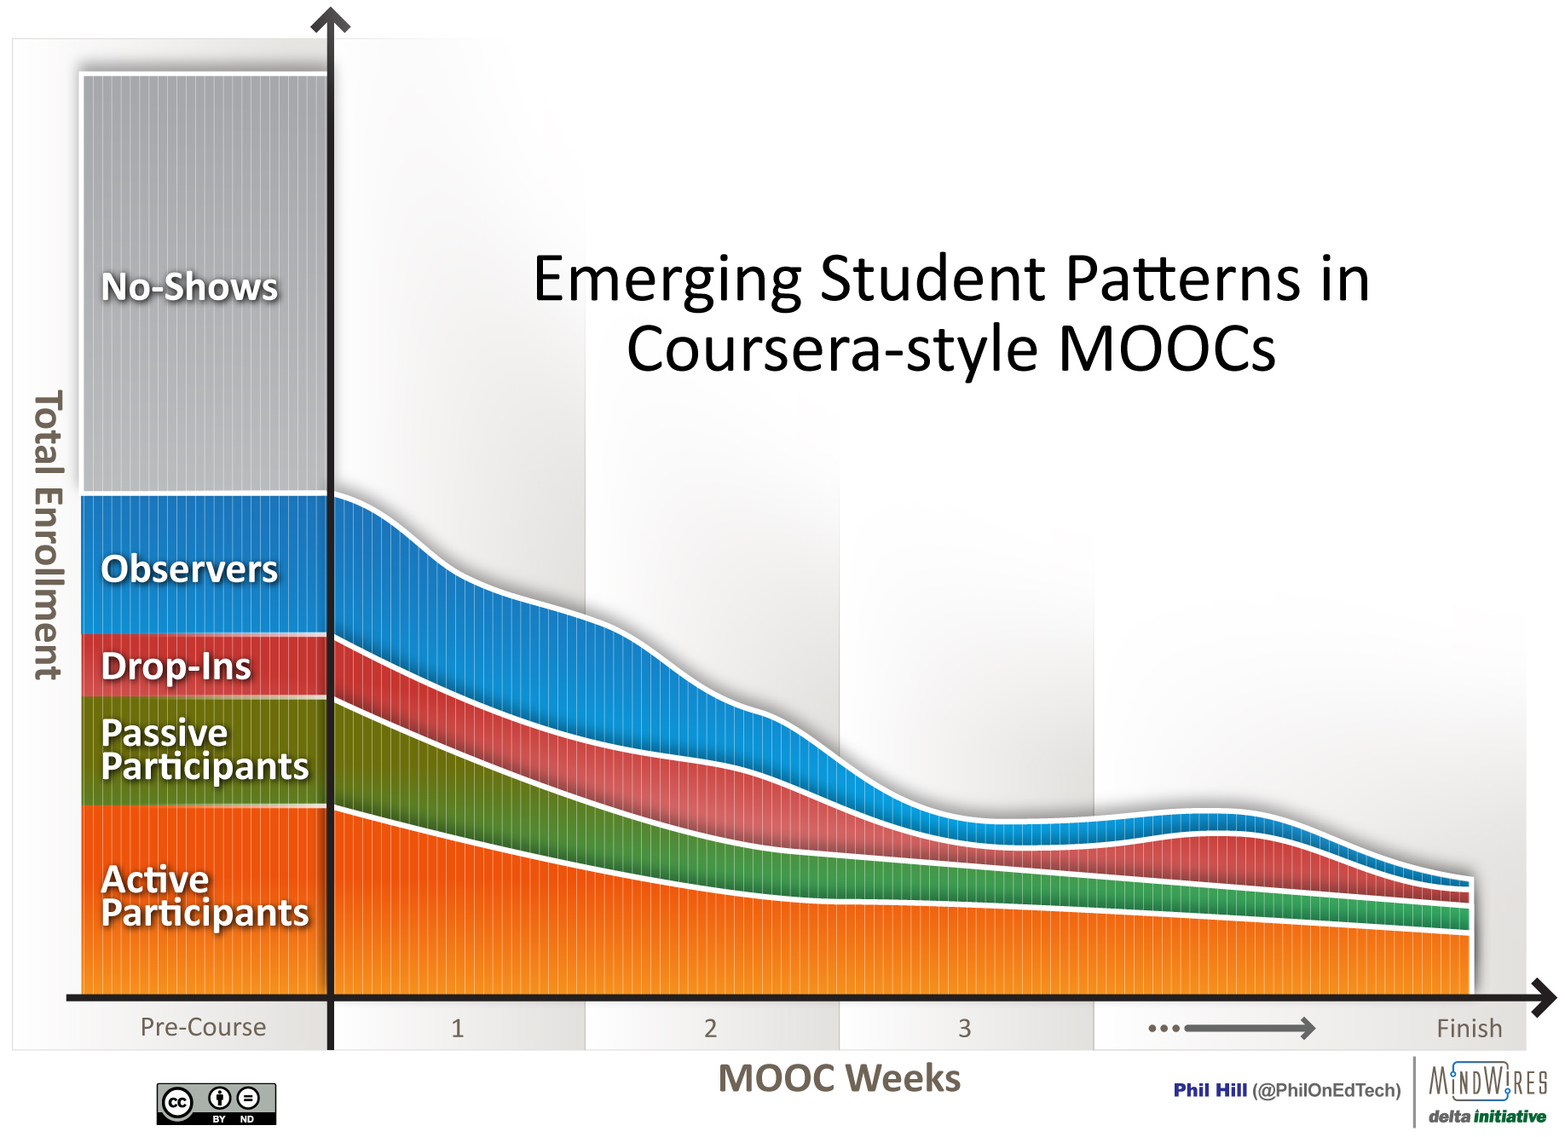
Issue #1: Low Participation
Figure 1. Student activity patterns in xMOOC (Hill, 2013)
(Cited in Terry Anderson (2014, June 24, MOOCs and Distance Education Institutions.
http://terrya.edublogs.org/2013/06/24/moocs-and-distance-education-institutions/

Slide 11
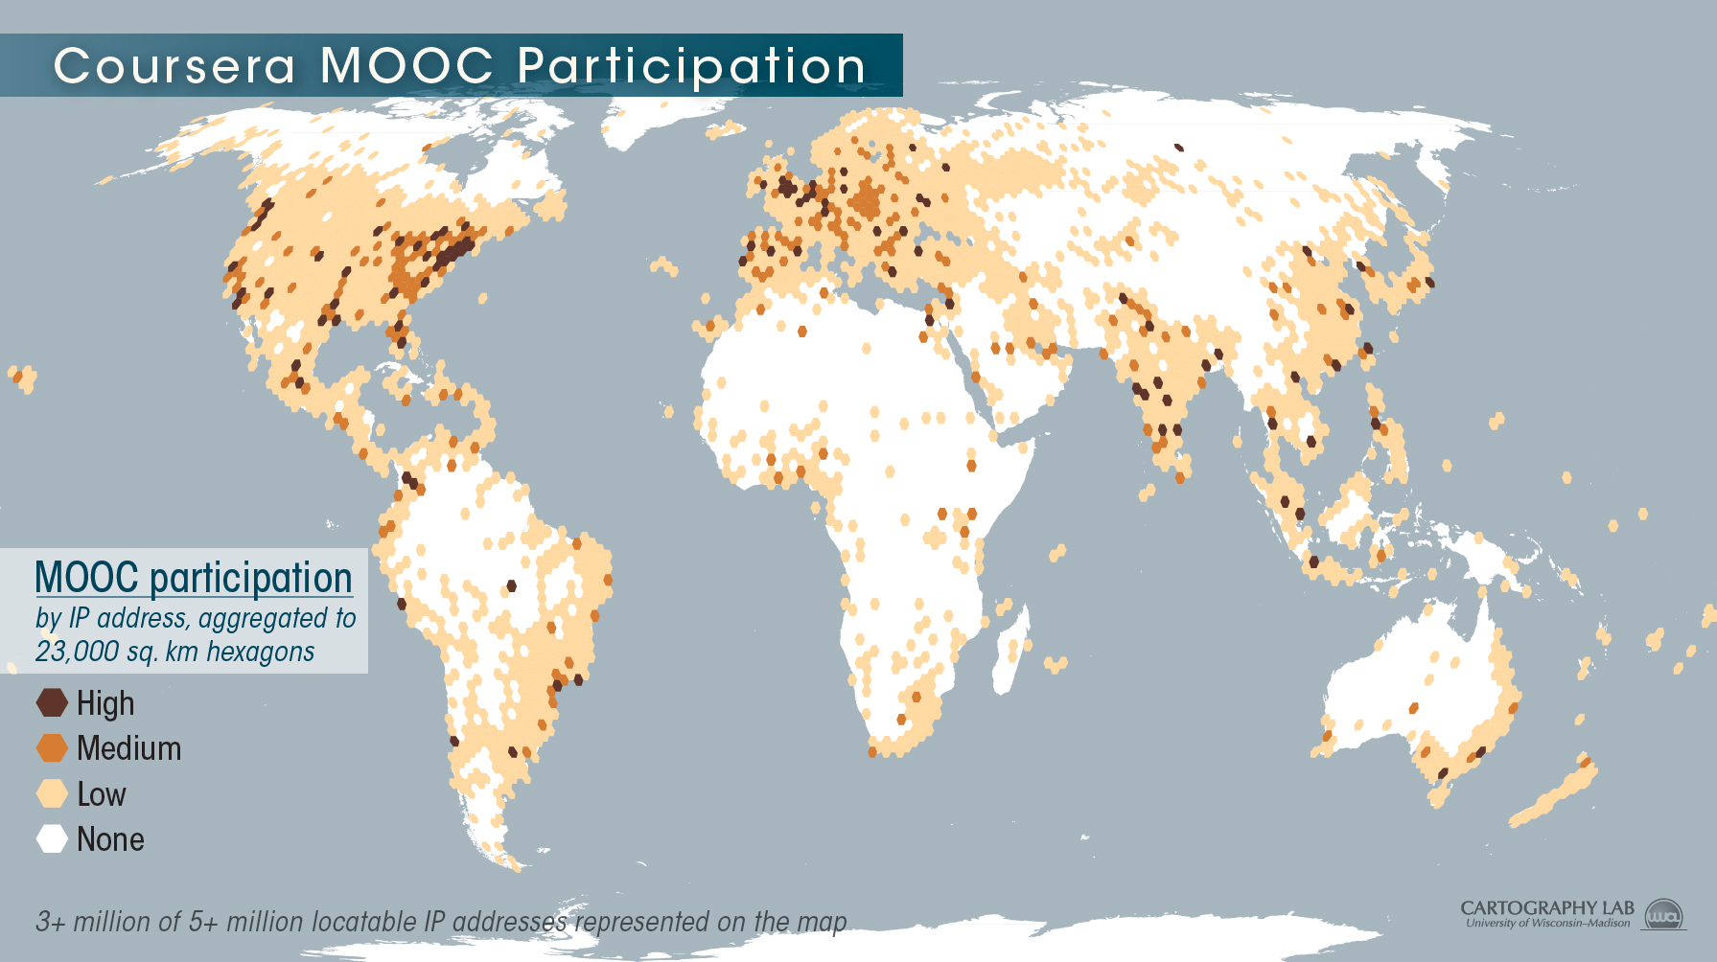
Issue #1: Participation
Mapping Coursera's Global Footprint
Kris Olds, November 19,. 2013, Inside Higher Ed
https://www.insidehighered.com/blogs/globalhighered/mapping-courseras-global-footprint

Slide 12
Findings (Zhu, Bonk, & Sari, 2017)

Slide 13
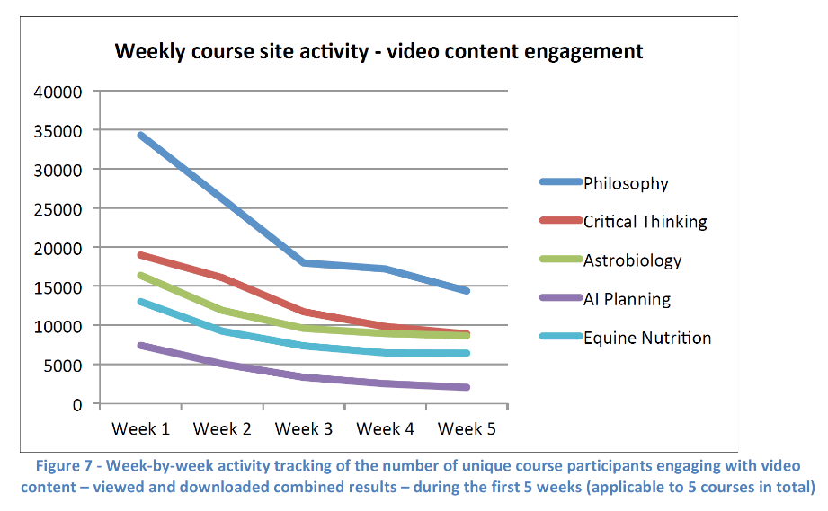
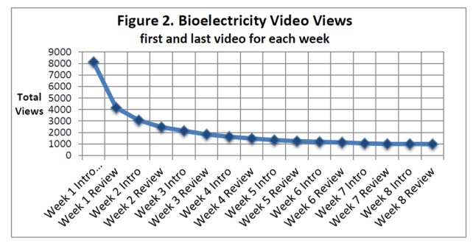
Issue #2. Dropout (i.e., retention) Concerns
MOOCs @ Edinburgh 2013– Report #1

Slide 14
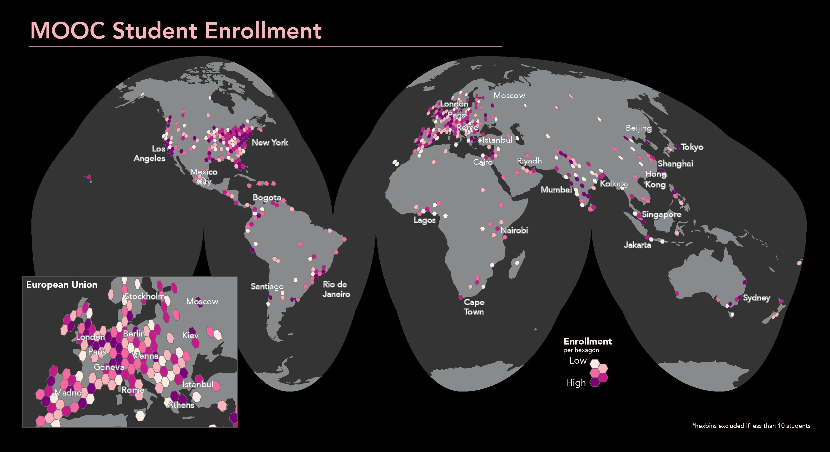
Issue #3: Cultural Diversity
Mapping a MOOC Reveals Global Patterns in Student Engagement (CHE),
Anthony C. Robinson, January 11, 2016
https://wp.chs.harvard.edu/sunoikisis/2016/01/13/mapping-a-mooc-reveals-global-patterns-in-student-engagement-che/
http://www.chronicle.com/img/photos/biz/TotalEnrollment_hex-01.png

Slide 15
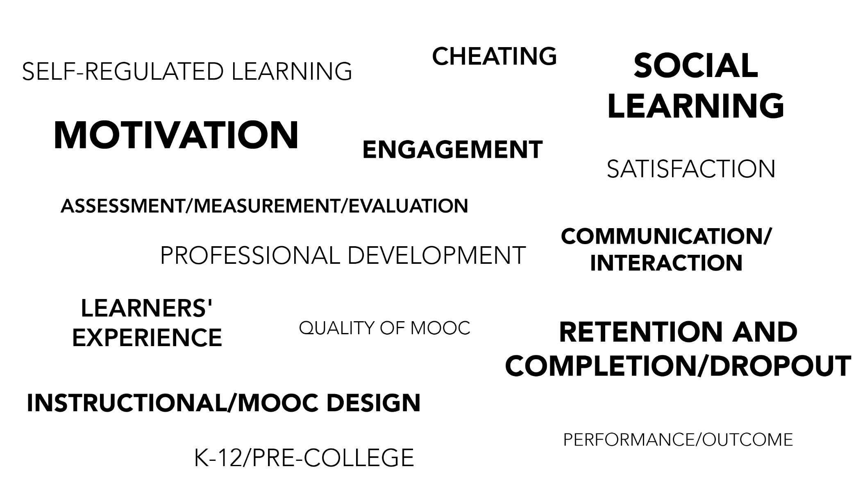
Specific Focus of MOOC Research
(2014-2017) (Zhu, Sari, & Lee, 2017)

Slide 16
November 10, 2017
The Clustered Patterns of Learning Engagement in MOOCs and Their Effects on Teaching Presence and Persistence
By: Jeonji Jung & Jeongmin Lee
“…as the learners in MOOCs are usually allowed a lot of autonomy, there has been raised the necessity to examine the different patterns of participants in engaging in MOOCs and construct the personalized instructional strategies based on the patterns”

Slide 17
November 10, 2017
Concerns and Comments #1
Who determines the level of learner autonomy?
How is autonomy determined here?
Or is it just assumed?

Slide 18
November 10, 2017
The Clustered Patterns of Learning Engagement in MOOCs and Their Effects on Teaching Presence and Persistence
By: Jeonji Jung & Jeongmin Lee
“…the purpose of this study is to cluster the learners’ multidimensional engagement in MOOCs to provide customized treatment for each cluster..”

Slide 19
November 10, 2017
The Clustered Patterns of Learning Engagement in MOOCs and Their Effects on Teaching Presence and Persistence
By: Jeonji Jung & Jeongmin Lee
“…this study was to investigate the differences of each cluster on learning persistence..”

Slide 20
November 10, 2017
The Clustered Patterns of Learning Engagement in MOOCs and Their Effects on Teaching Presence and Persistence
By: Jeonji Jung & Jeongmin Lee
“…the participants in this study were 179 learners who took the course called Digital Storytelling on K-MOOC (Korean-Massive Open Online Courses) in Fall 2016..”

Slide 21
November 10, 2017
Concerns and Comments #2
Is 170 learners enough for generalizations?
What if they had taken an cMOOC? Might the personal interest and internal motivation change?
Self-report data.
Convenience sampling.
76.5% were female.
Most were university students age 20-29.
41% had prior experience with MOOCs.

Slide 22
Context (Zhu, Bonk, & Sari, 2017)

Slide 23
November 10, 2017
The Clustered Patterns of Learning Engagement in MOOCs and Their Effects on Teaching Presence and Persistence
By: Jeonji Jung & Jeongmin Lee
Face validity from 4 educational technology experts.
Cronbach’s alpha (internal consistency of the items is strong)

Slide 24
November 10, 2017
Concerns and Comments #3
Where is the instrument used?
What were some of the items?

Slide 25
November 10, 2017
The Clustered Patterns of Learning Engagement in MOOCs and Their Effects on Teaching Presence and Persistence
By: Jeonji Jung & Jeongmin Lee
“…this study aims to provide specific implications for instructional and learning strategies that can be utilized to facilitate learning engagement and persistence in MOOCs...”

Slide 26
November 10, 2017
The Clustered Patterns of Learning Engagement in MOOCs and Their Effects on Teaching Presence and Persistence
By: Jeonji Jung & Jeongmin Lee
Cluster 1: LEADers
Cluster 2: DOers
Cluster 3: THINKers

Slide 27
November 10, 2017
Concerns and Comments #4
Is LEADers the right word? How about “committed achievers”?
Are these the only 3 clusters? What about learning repeaters, learning socializers, learning experimenters?

Slide 28
November 10, 2017
The Clustered Patterns of Learning Engagement in MOOCs and Their Effects on Teaching Presence and Persistence
By: Jeonji Jung & Jeongmin Lee
Cluster 1: LEADers pursue personal interest and internal motivation.
Cluster 2: Doers want to earn academic credit.
Cluster 3: THINKers want to supplement and further their study; they also want to prepare for exams or job interviews.

Slide 29
November 10, 2017
The Clustered Patterns of Learning Engagement in MOOCs and Their Effects on Teaching Presence and Persistence
By: Jeonji Jung & Jeongmin Lee
Cluster 1: LEADers high on all areas of learning engagement.
Cluster 2: Doers watched more videos and updated their opinions; i.e., they “did” stuff.
Cluster 3: THINKers high in cognitive engagement.

Slide 30
November 10, 2017
The Clustered Patterns of Learning Engagement in MOOCs and Their Effects on Teaching Presence and Persistence
By: Jeonji Jung & Jeongmin Lee
“This study conducted one-way ANOVA twice to examine the differences of each cluster on teaching presence and learning persistence...”

Slide 31
November 10, 2017
Concerns and Comments #5
How was teaching presence measured?
How was learning persistence measured?

Slide 32
November 10, 2017
The Clustered Patterns of Learning Engagement in MOOCs and Their Effects on Teaching Presence and Persistence
By: Jeonji Jung & Jeongmin Lee
“…for more effective customized feedback, there is a need to develop a prediction model for each cluster and suggest individual feedback in detail...”

Slide 33


What’s Next?

Slide 34



Any Questions or Comments?
MOOCsBook: http://moocsbook.com/
Slides at: TrainingShare.com
Papers: PublicationShare.com
Free book: http://tec-variety.com/
Email: curt@worldisopen.com

