Slide 1


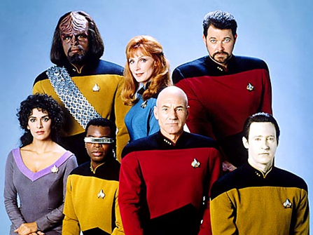
Masterclass #1
Engage Number One:
This is the Next Generation
Curtis J. Bonk, Professor, Indiana University
cjbonk@indiana.edu
http://mypage.iu.edu/~cjbonk/

Slide 2

This Generation of Students

Slide 3
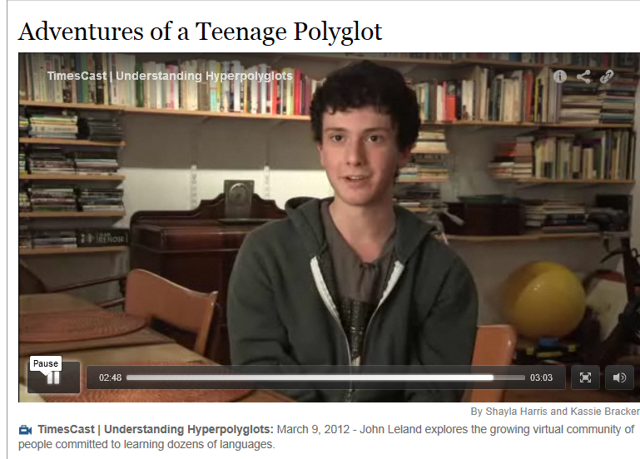
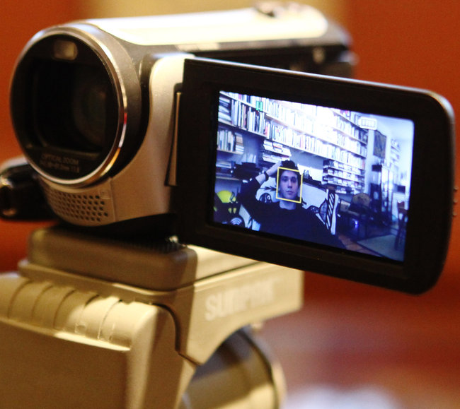
Learning is More Video-Based
Online Learning Polyglots http://www.nytimes.com/2012/03/11/nyregion/a-teenage-master-of-languages-finds-online-fellowship.html?_r=1&pagewanted=all
Timothy posts videos of himself speaking several languages on YouTube.

Slide 4

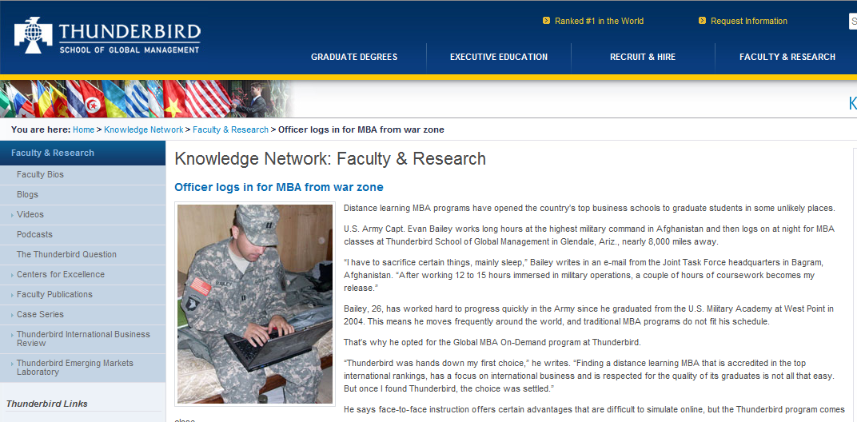
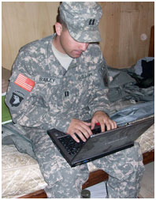

Learning is More Mobile, On Demand, and Online
MBAs from War Zones…!

Slide 5

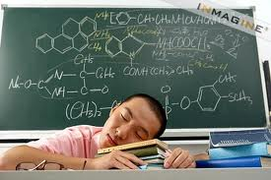

Motivation and Engagement

Slide 6
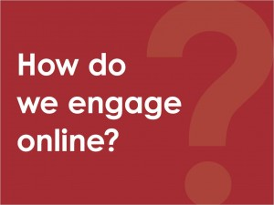
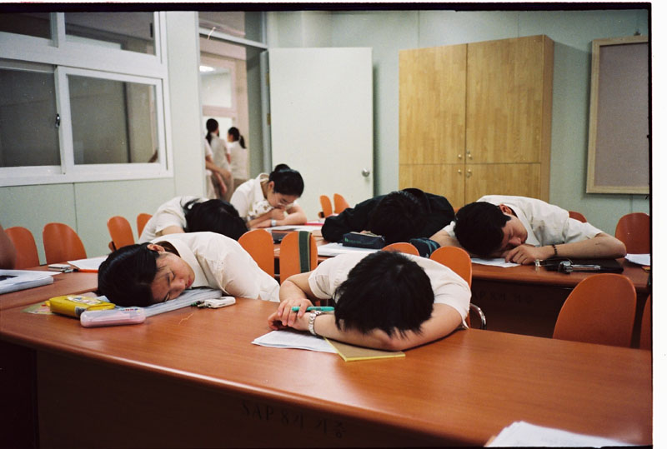

Slide 7

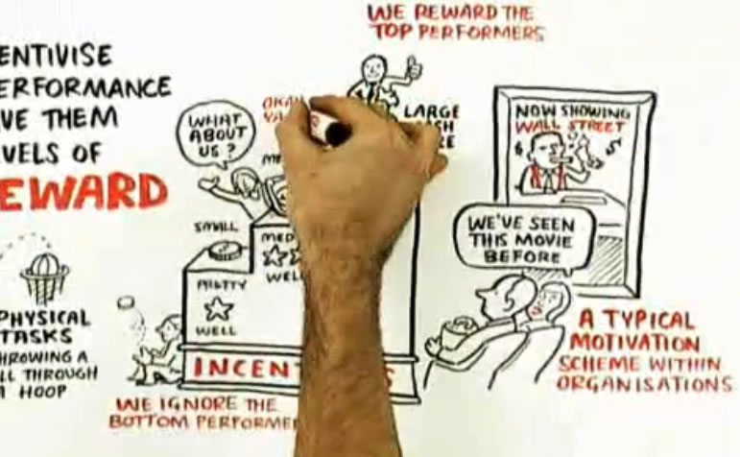
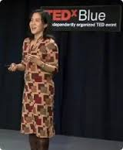
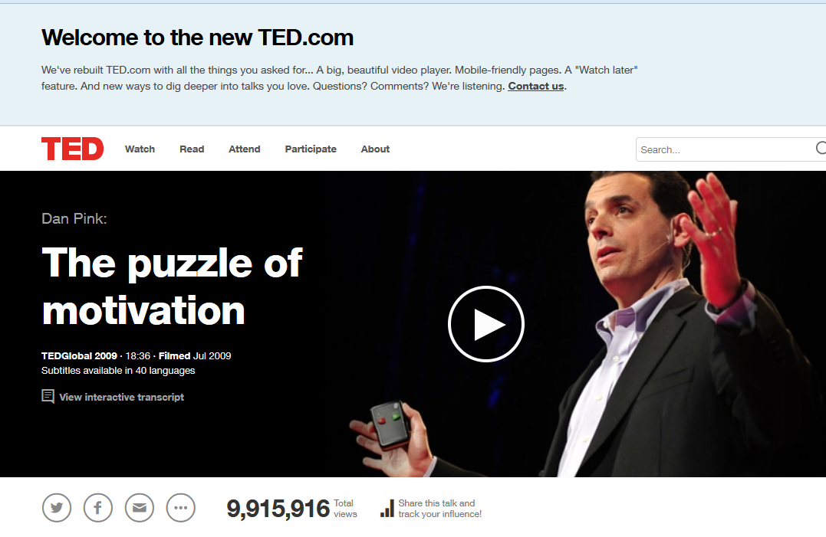
Drive: The Surprising Truth About What Motivates Us
Daniel Pink (2009)
Motivation 3.0
Freedom, challenge, purpose
Creative, interesting, etc.
self-directed work
Intrinsic motivation
Life as play and possibility
Engagement and mastery
Autonomy

Slide 8
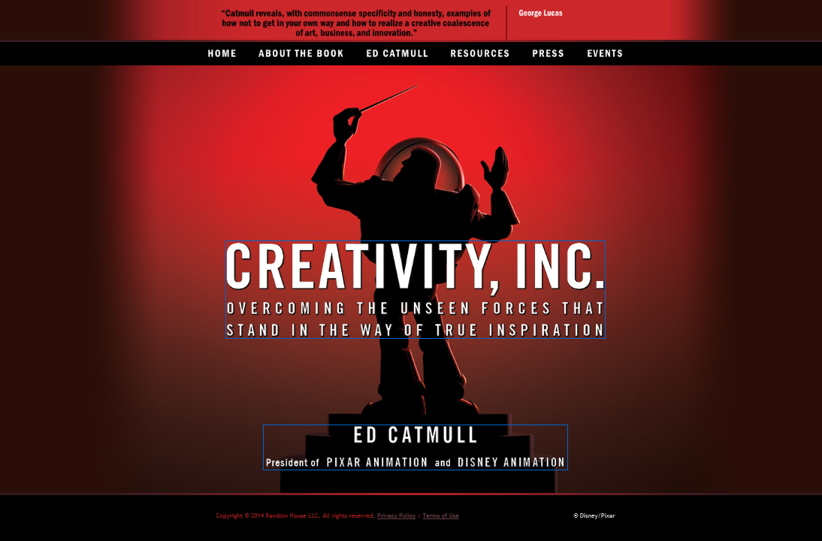
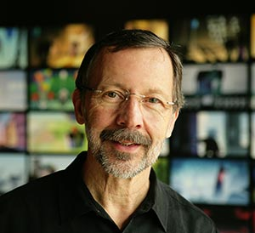
Creativity, Inc.
Ed Catmull, President of Pixar Animation and Disney Animation http://www.creativityincbook.com/

Slide 9
What did Jean-Luc Picard say?

Slide 10

That’s right, Engage!

Slide 11
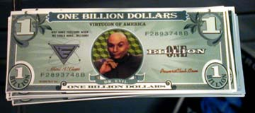
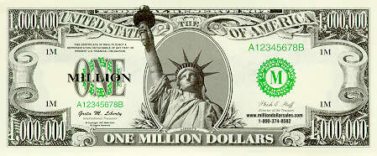
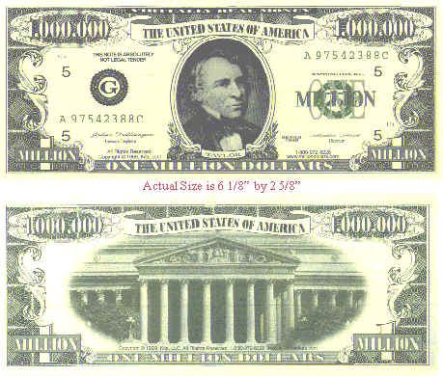
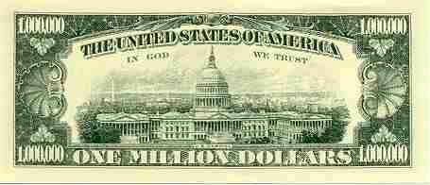


Poll #1: Million Dollar Question: What words come to mind when I say that I want to motivate learners?

Slide 12
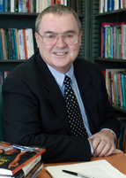
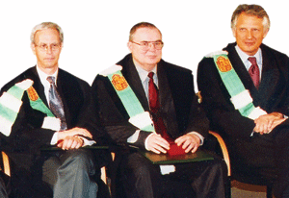
Motivation Research Highlights (Jere Brophy, Michigan State University)
1. Supportive, appropriate challenge, meaningful, moderation/optimal.
2. Teach goal setting and self-reinforcement.
3. Offer rewards for good/improved performance.
4. Novelty, variety, choice, adaptable to interests.
5. Game-like, fun, fantasy, curiosity, suspense, active.
6. Higher levels, divergence, dissonance, peer interaction.
7. Allow to create finished products.
8. Provide immediate feedback, advance organizers.
9. Show intensity, enthusiasm, interest, minimize anxiety.
10. Make content personal, concrete, familiar.

Slide 13
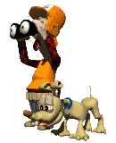
Intrinsic Motivation
“…innate propensity to engage one’s interests and exercise one’s capabilities, and, in doing so, to seek out and master optimal challenges
(i.e., it emerges from needs, inner strivings, and personal curiosity for growth)
See: Deci, E. L., & Ryan, R. M. (1985). Intrinsic motivation and self-determination in human behavior. NY: Plenum Press.

Slide 14
Framework: TEC-VARIETY for
Online Motivation and Retention
Tone/Climate: Psych Safety, Comfort, Belonging
Encouragement, Feedback: Responsive, Supports
Curiosity: Fun, Fantasy, Control
…
Variety: Novelty, Intrigue, Unknowns
Autonomy: Choice: Flexibility, Opportunities
Relevance: Meaningful, Authentic, Interesting
Interactive: Collaborative, Team-Based, Community
Engagement: Effort, Involvement, Excitement
Tension: Challenge, Dissonance, Controversy
Yields Products: Goal Driven, Products, Success, Ownership

Slide 15
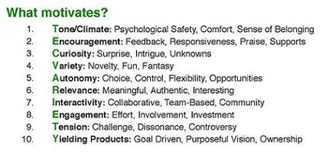

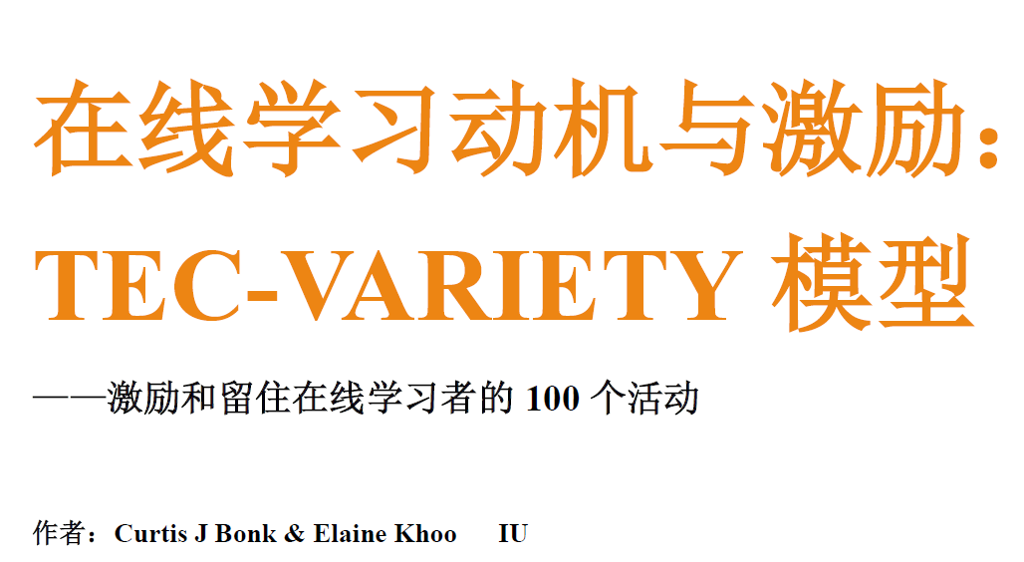
Education 3.0?
Introducing the free “TEC-VARIETY” Framework… http://tec-variety.com/ http://tec-variety.com/TEC-VARIETY-Chinese.pdf

Slide 16




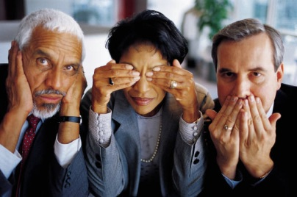
Low Risk
High Risk
1. Risk
Easy to Embed
Extensive Planning
2. Time
Free or Inexpensive
Enterprise Licenses
3. Cost
Instructor-Focus
Student-Focus
4. Student-Centered
Low
High

Slide 17
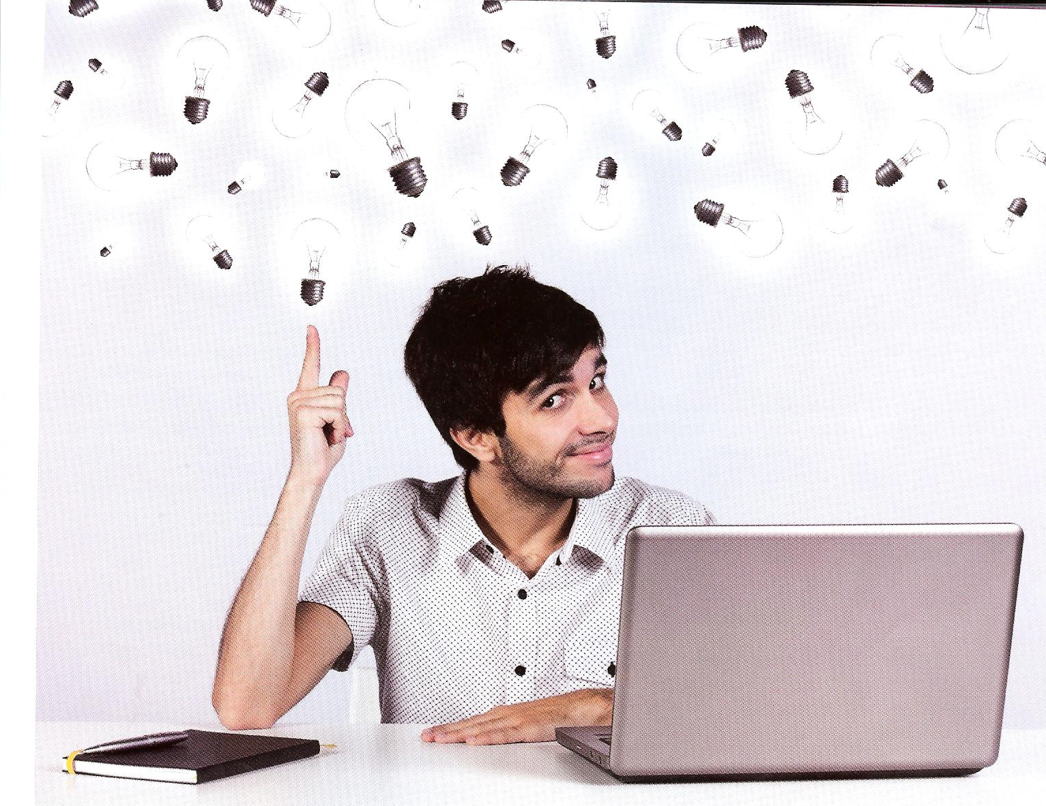
Examples of TEC-VARIETY

Slide 18
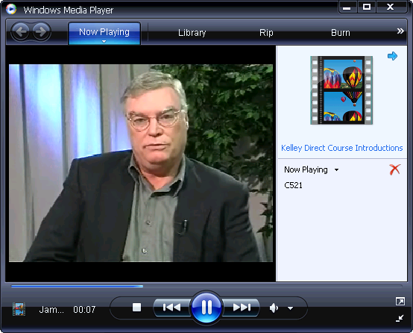
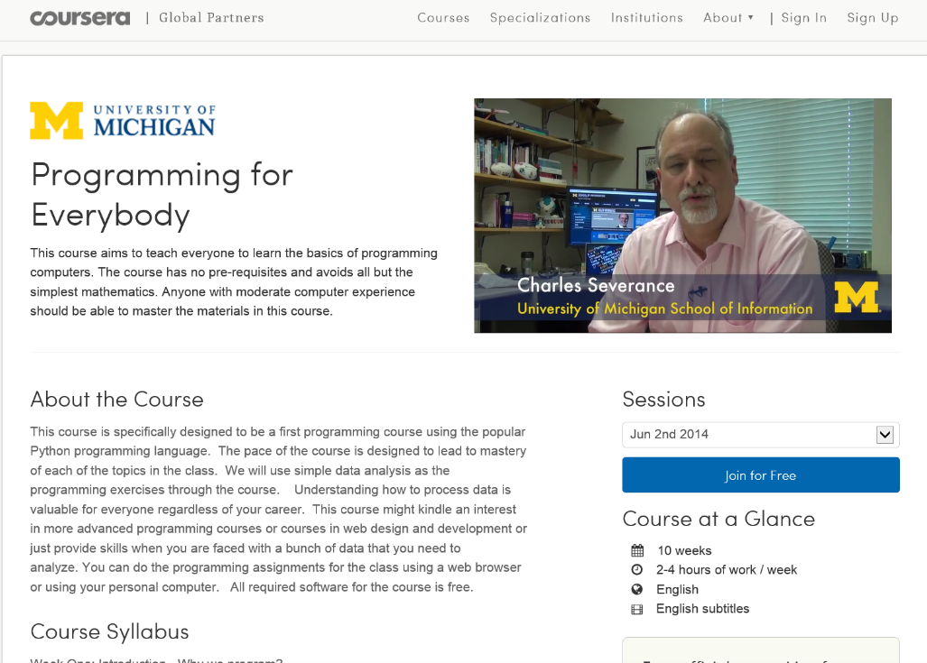
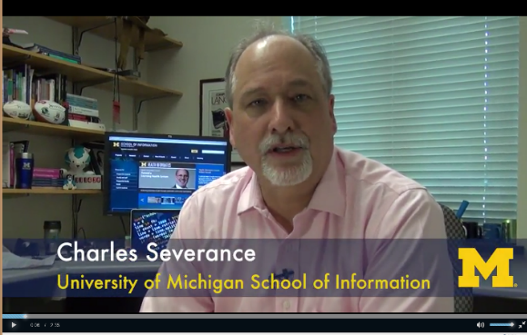
1. Tone/Climate:
A. Instructor Course Introductions
(Theatre 10 Intro Video, October 7, 2014, Elizabeth Dale, West Valley College) https://www.youtube.com/watch?v=_Wzbzc3QiiA
Chuck Severance, U Michigan/Coursera) in Barcelona http://www.youtube.com/watch?v=JzNHvmSv8TI
Chuck Severance, University of Michigan https://www.coursera.org/course/pythonlearn

Slide 19
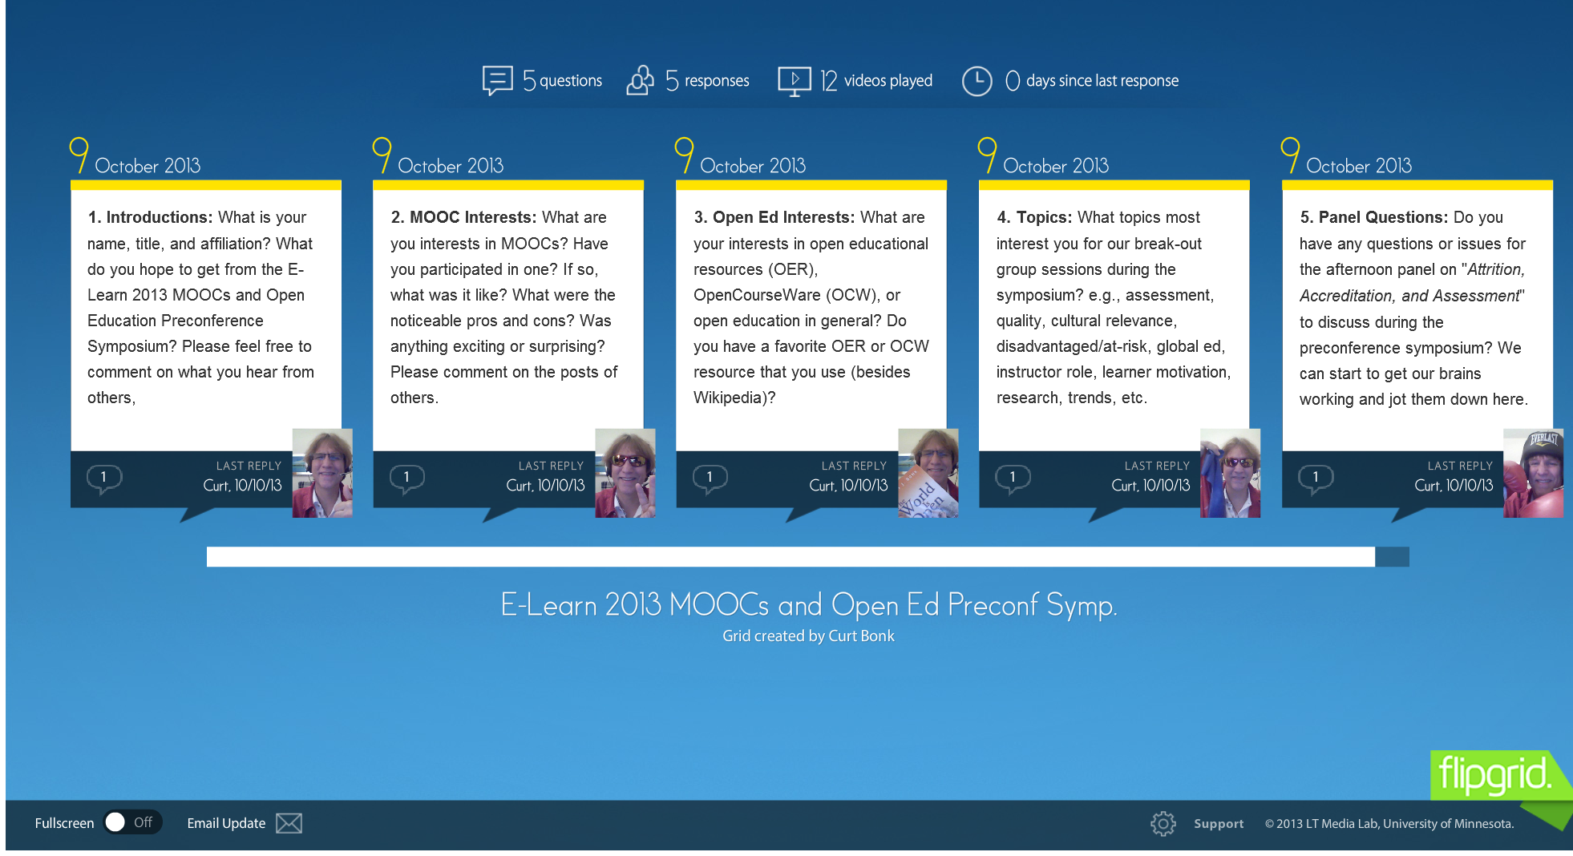
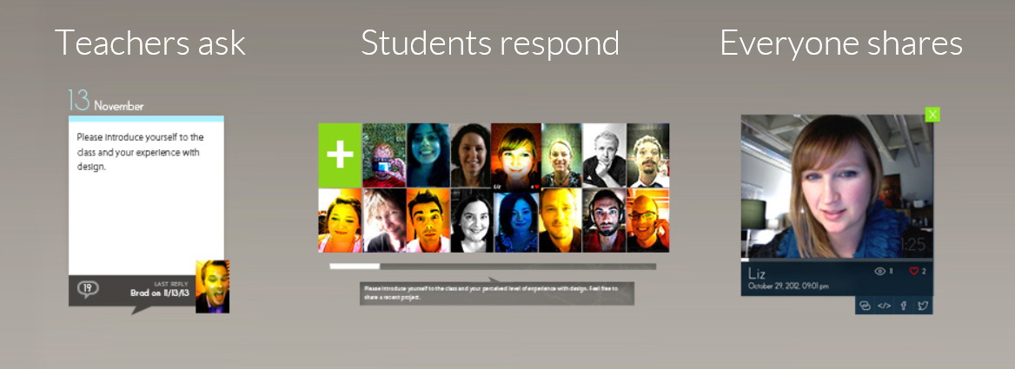
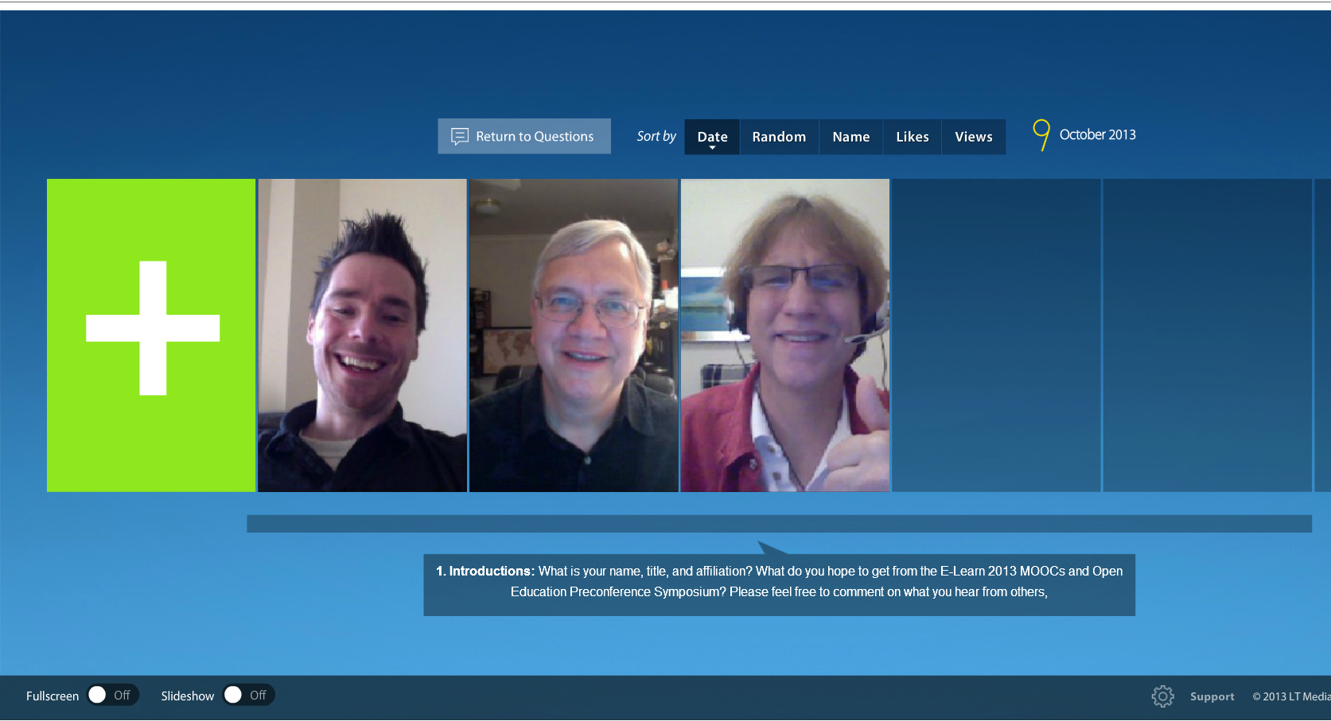
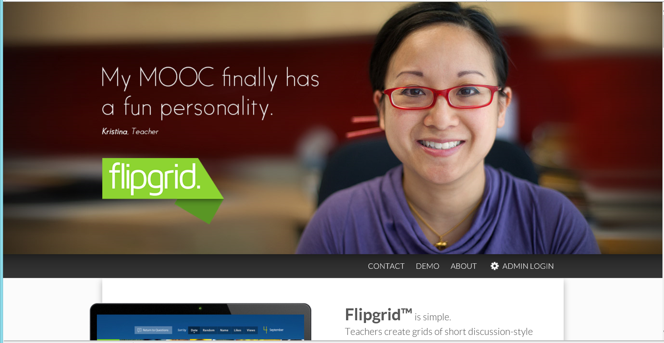
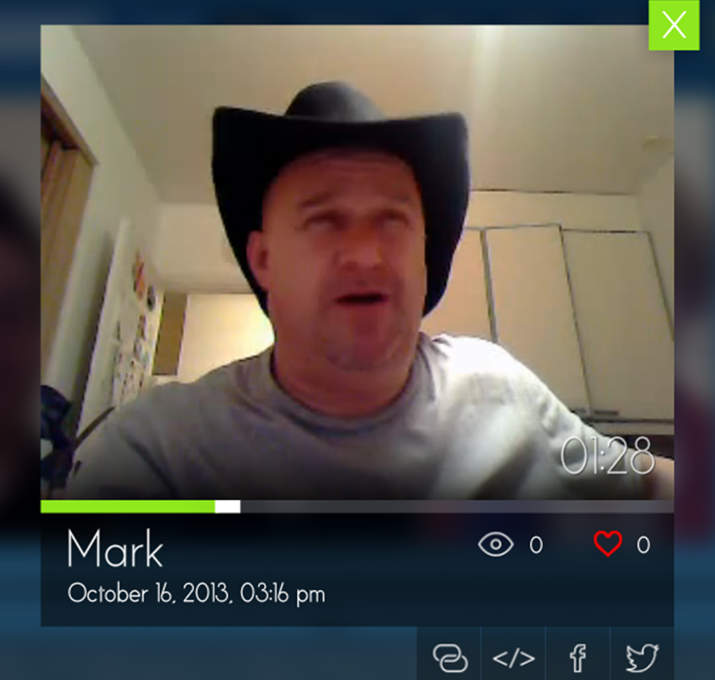
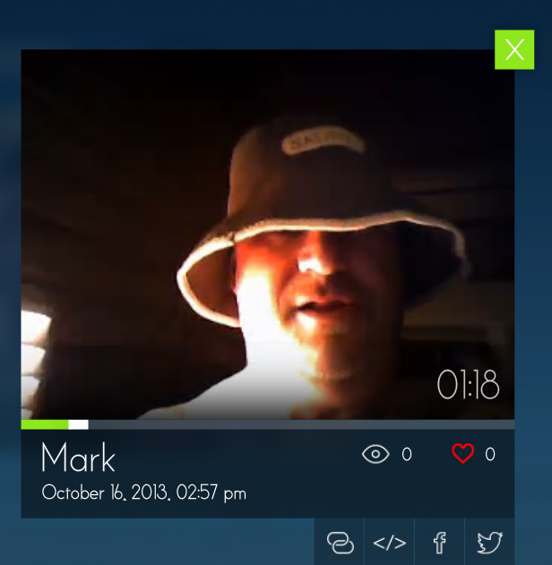
1. Tone/Climate: B. Threaded Video Discussions, e.g., Flipgrid http://flipgrid.com/#429f88c5)

Slide 20
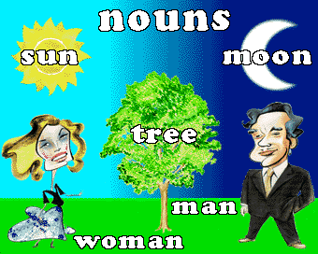
1. Tone/Climate: Social Ice Breakers
C. 8 nouns (adjectives, verbs)
List of nouns: (e.g., pirate, computer, traveler, roadrunner, wind, bookworm, musician, mentor, etc.)
  http://www.momswhothink.com/reading/list-of-nouns.html
List of adjectives: (e.g., lazy, powerful, shy, bored, exotic, cooperative, sloppy, rebel, etc.)
  http://www.momswhothink.com/reading/list-of-adjectives.html
List of verbs: (e.g., coordinate, entertain, amuse, push, unite, beg, dream, publicize, etc.)
  http://www.momswhothink.com/reading/list-of-verbs.html

Slide 21
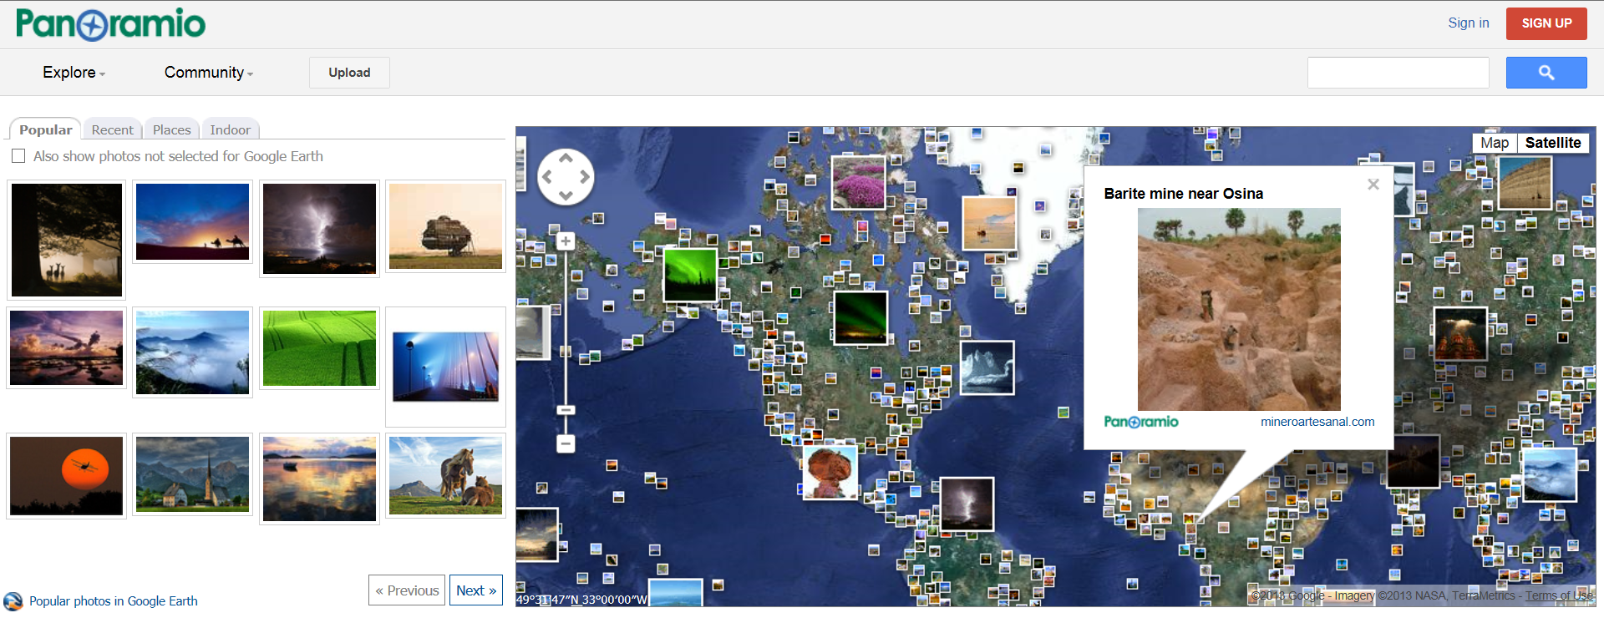
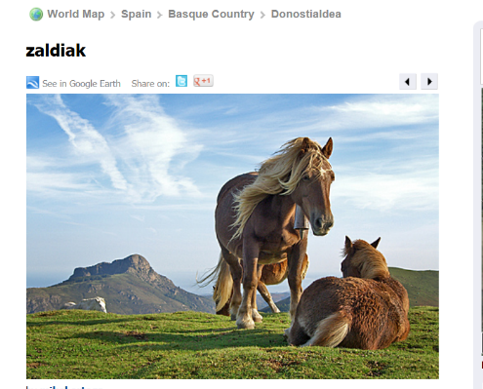
1. Tone/Climate:
D. Share Visuals of Favorite Places
(e.g., Panoramio, http://www.panoramio.com/)

Slide 22
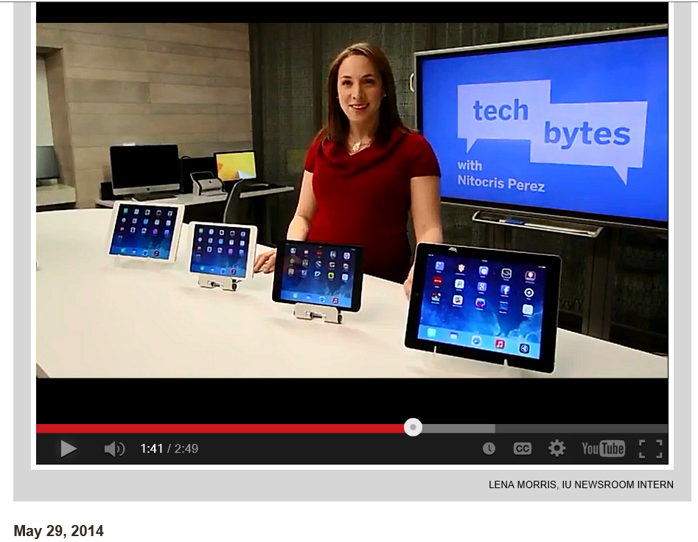
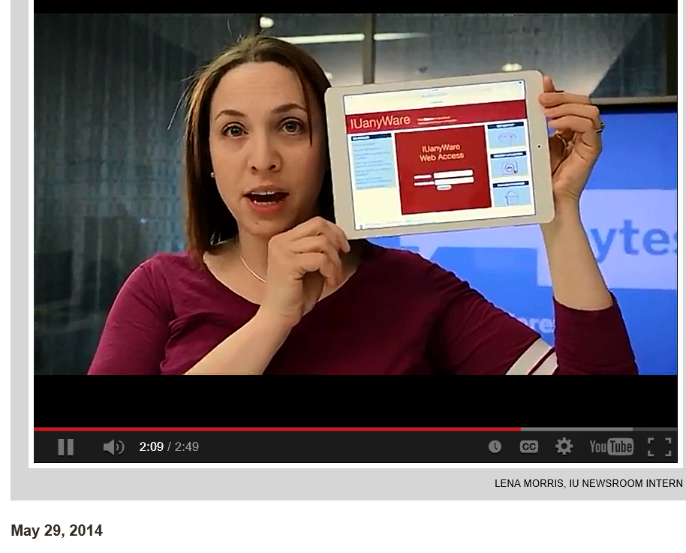
2. Encouragement, Feedback, etc.: A. Demonstrations and Tutorials
B. Tutorials with Screen Capture
(e.g., Jing, Screenr, GoView, etc.) http://inside.iub.edu/features/videos/2014-05-29-inub-vid-cib.shtml

Slide 23
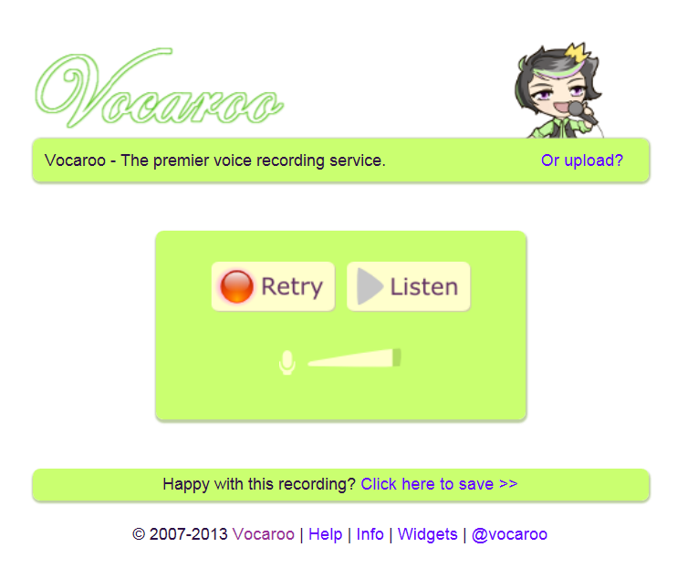
2. Encouragement, Feedback, etc.: B. Voice/Audio Feedback
Vocaroo: http://vocaroo.com/ http://vocaroo.com/delete/s0x8moQAYAiu/a37bbc9408bb8c95
(Recorded by Curt Bonk for the Open University of China)

Slide 24
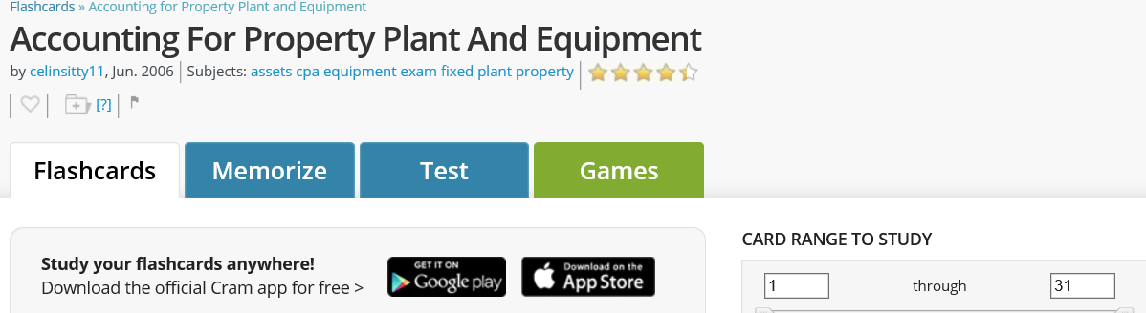
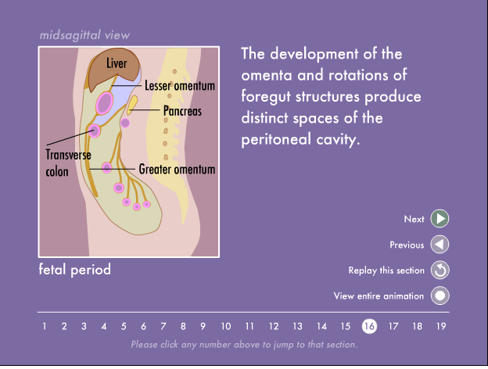
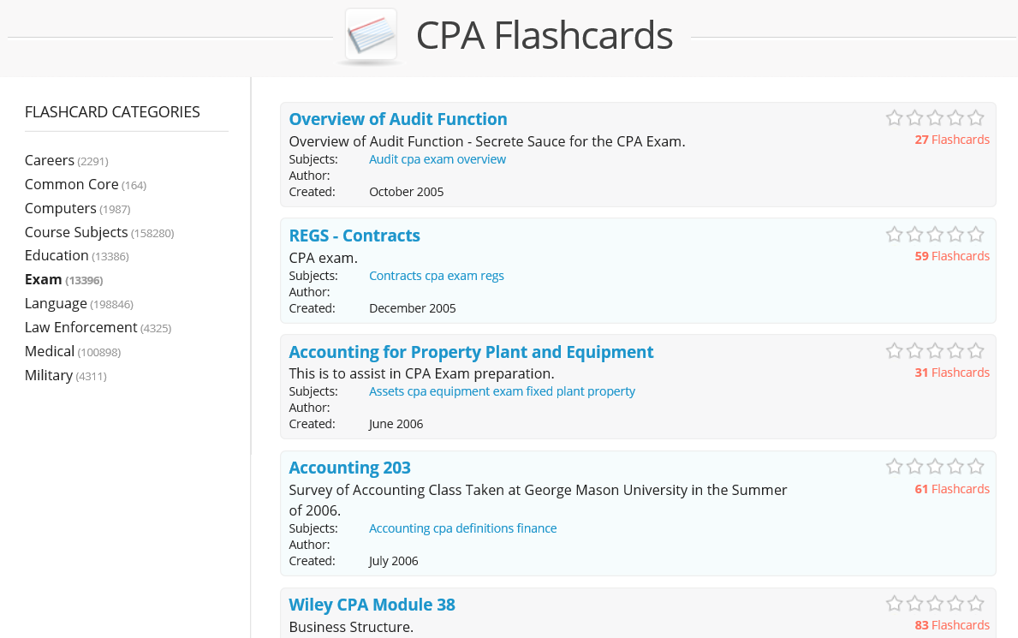
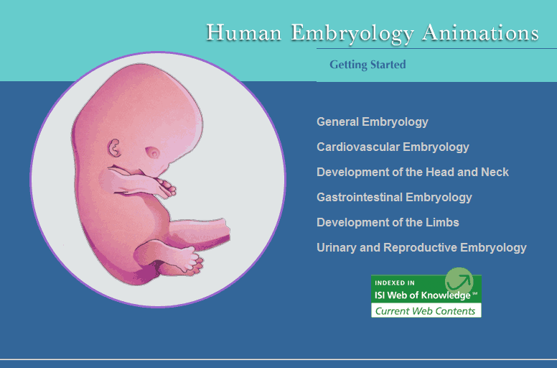
2. Encouragement, Feedback, etc.: C. Online Practice Tests and Quizzes (e.g., CPA Flashcards and Human Embryology Animations)
Notes:
Suggested Course Examples:
KK Light quick check
The call to adventure illustrating culture
Sales Planning as an expanded application activity

Slide 25
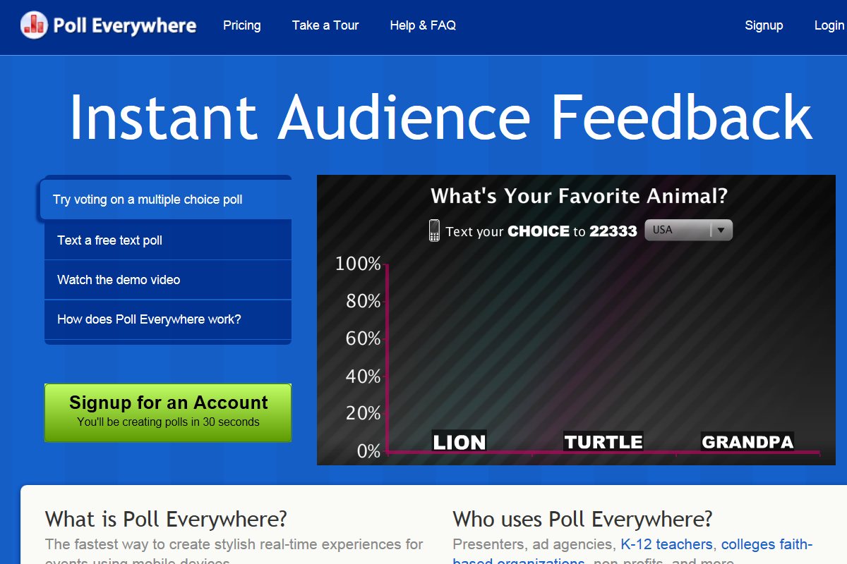
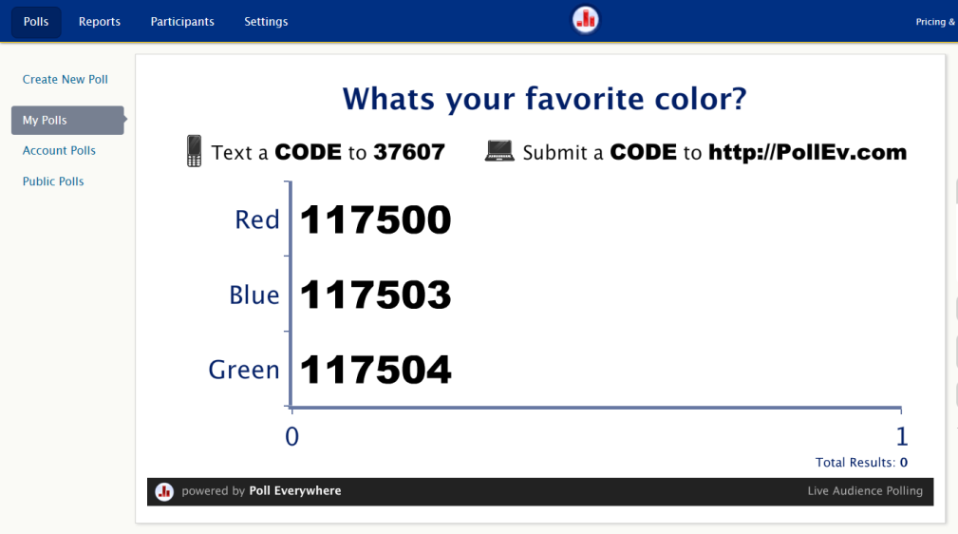
2. Encouragement, Feedback, etc.: D. Blog and Website Polling
(e.g., Poll Everywhere, BlogPolls, BlogPoll, MicroPoll) http://www.polleverywhere.com/

Slide 26
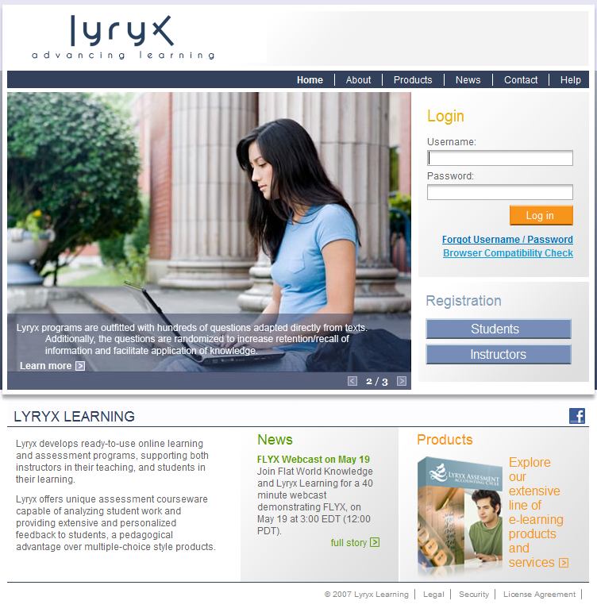
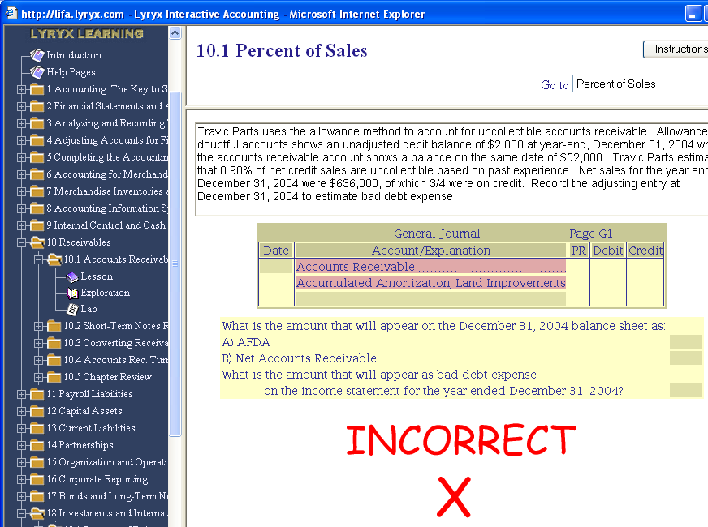
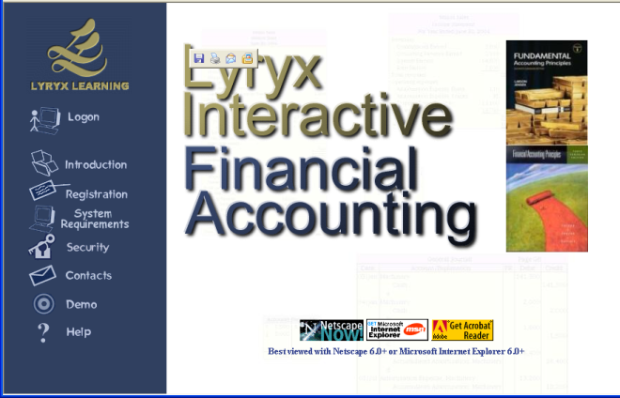
2. Encouragement, Feedback, etc.:
E. Online Accounting Lessons
(e.g., Lyryx; https://lifa.lyryx.co)

Slide 27
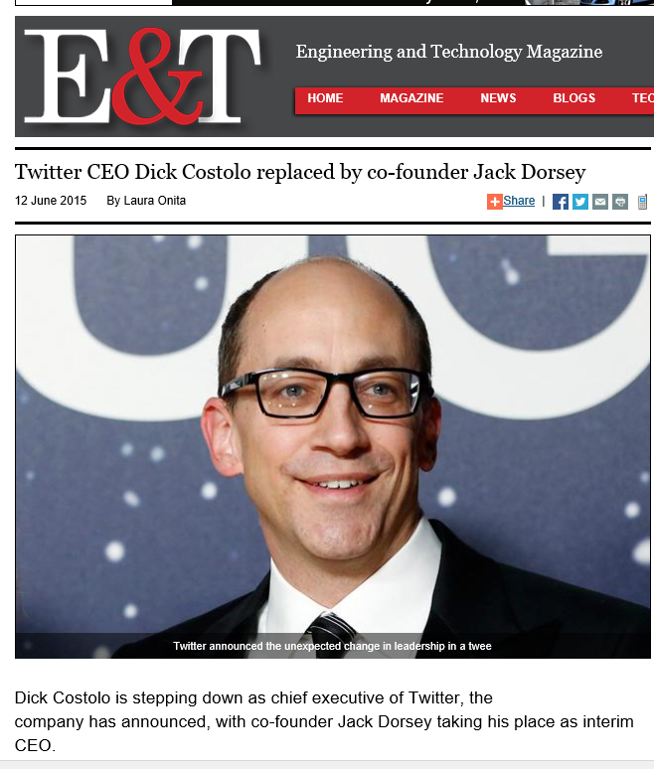
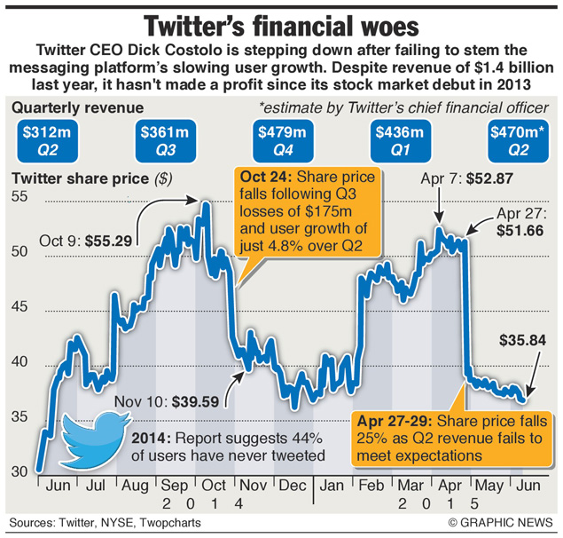
June 12, 2015
3. Curiosity, Fun: A. Something in the News and Infographic
Twitter CEO Dick Costolo replaced by co-founder Jack Dorsey, Laura Onita http://eandt.theiet.org/news/2015/jun/twitter-costolo-dorsey.cfm

Slide 28



3. Curiosity, Fun:
B. Something in the News
(e.g., This may be the oldest surviving Photo of a human, November 7, 2014, CNN, Brandon Griggs; But this image, taken in Paris, France, in 1838) http://www.cnn.com/2014/11/06/living/oldest-photograph-human-daguerre/index.html?hpt=hp_t4 kong

Slide 29




May 25, 2015
3. Curiosity, Fun:
C. Database Searching
(e.g., WolframAlpha) http://www.wolframalpha.com

Slide 30


3. Curiosity, Fun:
D. Tracking the Life of a Computer Scientist (bio.com) http://www.biography.com/people/steve-jobs-9354805 http://www.biography.com/people/ada-lovelace-20825323

Slide 31




4. Variety, Novelty, Fun, Fantasy:
A. Random Lists (Random.org—clocks, coins, playing cards, dice, integers, passwords, jazz scales, lists, sequences, etc.)

Slide 32



5. Autonomy, Choice:
A. Attend Webinar (pick weeks and reflecti)
Cathy Davidson, The End of Higher Education http://connectedcourses.net/thecourse/why-we-need-a-why/
Accounting Today Webinars http://www.accountingtoday.com/web-seminars/

Slide 33


5. Autonomy, Choice:
B. Explore OpenCourseWare and Open Educational Resources
(e.g., MIT OCW, http://ocw.mit.edu/courses/sloan-school-of-management/15-963-management-accounting-and-control-spring-2007/)

Slide 34



5. Autonomy, Choice:
C. Video Repositories and Portals
(e.g., Khan Academy, Computer Programming) https://www.khanacademy.org/computing/computer-programming

Slide 35



Poll #2:
Any light bulbs going off in your head so far…?
Yes definitely***
Yes maybe!
Not yet (but hopefully soon…)

Slide 36







6. Relevance, Meaningfulness:
A. Guest Chats (e.g., Emily Hixon, January 20, 2015) https://connect.iu.edu/p259wpiabg9/

Slide 37


6. Relevance, Meaningfulness:
B. Video Scenario Learning Accounting Interviews and Preparatory Course Review Modules (Franklin University, cost and forensic accounting course) http://video.franklin.edu/Franklin/acct/managerialAccounting/cost-behavior-player.html http://video.franklin.edu/Franklin/acct/342/common/fraudScenario02.html

Slide 38




7. Interactive, Collaborative:
A. Negotiate Meanings Online
(e.g., PiratePad: http://meetingwords.com/) http://blogs.elon.edu/technology/6-collaborative-writing-applications-for-group-projects-or-papers/
MeetingWords, Google Docs, NowComment, MixedInk

Slide 39

7. Interactive, Collaborative:
B. Virtual Sharing Walls, April 6, 2015 e.g., Padlet http://padlet.com/charu/pocketfullofdesign1

Slide 40

January 27, 2015
7. Interactive, Collaborative:
C. Backchannel Chat (TodaysMeet) https://todaysmeet.com/
R678_Emerging_Learning_Technologies https://todaysmeet.com/R678_Emerging_Learning_Technologies

Slide 41


7. Interactive, Collaborative:
D. Collaboration and Discussion in Google Hangouts, Jabber, Skype, etc
(January 29 and February 25, 2013)

Slide 42




July 27, 2015
8. Engagement, Effort:
A. iPhone Virtual Tour and Games
Amazing 360-degree panoramic images show new sides of North Korea, DMZ, CNN, Aram Pan http://www.cnn.com/2015/07/22/travel/gallery/dprk-360-north-korea-photos/?iid=ob_homepage_deskrecommended_pool&iref=obnetwork http://www.dprk360.com/360/air_koryo_Il-18/ http://www.cnn.com/2015/07/22/travel/gallery/dprk-360-north-korea-photos/?iid=ob_homepage_deskrecommended_pool&iref=obnetwork http://www.dprk360.com/360/pyongyang_aerial_view/

Slide 43


8. Engagement, Effort:
B. Simulations

Slide 44








8. Engagement, Effort:
C. Interactive Timeline Maps,
October 22, 2014, Second immigration wave lifts diversity to record high, Edward Greg Toppo and Paul Overberg, USA Today http://www.usatoday.com/longform/news/nation/2014/10/21/diversity-race-ethnicity-change-100-years/16211133/

Slide 45


8. Engagement, Effort:
D. Interactive Map Timelines
(adults with college degrees by county, May 7, 2012) http://todayscampus.com/article/Keith_Hampson_Interviews_Josh_Keller_on__Interactive_Graphics_for_Higher_Education

Slide 46


8. Engagement, Effort:
E. Google Map Gallery
September 16, 2014 http://maps.google.com/gallery/

Slide 47


March 15, 2015
9. Tension, Challenge, etc.:
A. Controversial Issue Debates
SXSW: Tackling the growing gender gap in technology Mike Snider, USA Today http://www.usatoday.com/story/tech/2015/03/15/sxsw-geek-girls-chic-technology-gender-gap/24808699/

Slide 48


August 20, 2015
9. Tension, Challenge, etc.:
B. Controversial Issue Debates
U.S. sees big spike in black and Hispanic women entrepreneurs, Tanzina Vega, CNN Money http://money.cnn.com/2015/08/19/smallbusiness/minority-women-entrepreneur/index.html?iid=SF_LN

Slide 49


10. Yields Products, Goals:
A. Goal Setting Tools
(e.g., I Done This, Milestone Planner, and 43 Things)

Slide 50


10. Yields Products, Goals:
B. Mobile Books and Wikibooks
(e.g., BookRix, http://www.bookrix.com/)

Slide 51




10. Yields Products, Goals:
C. Student Created Mobile Apps
The App Builder: http://www.theappbuilder.com/
Mintian Guo: http://myapp.is/r685final
Videos: Watch selected videos from scholars and educators.
Benefits:
Can easily watch YouTube videos without having to open a separate application
Limitations:
Only accepts YouTube urls

Slide 52






10. Yields Products, Goals:
D. Student Created Videos
Piercarlo Abate: http://www.youtube.com/watch?v=_-TURzHO0aU
Qi Li, Gangnam: http://www.youtube.com/watch?v=7Q429lqxZaU&feature=youtu.be
Miguel Lara (Web 2.0 FREEDOM): http://www.youtube.com/watch?v=8cmCFWi9lW8
Kendal Rasnake (Is IT Right For You?): https://www.youtube.com/watch?v=MJ3GUDICIGw

Slide 53

Commitments:
Stop and Share:
Which principle(s) of TEC-VARIETY will you use?
Tone/Climate
Encouragement, Feedback
Curiosity
Variety
Autonomy
Relevance
Interactive
Engagement
Tension
Yields Products

Slide 54

Recap and Reflect with Neighbor:
Explore Websites from this Session!

Slide 55

Masterclass Part II
Where Are You R2D2?:
Addressing Diverse Learner Needs with the Read, Reflect, Display, and Do Model
Curtis J. Bonk, Professor, Indiana University
cjbonk@indiana.edu
http://mypage.iu.edu/~cjbonk/

Slide 56


Ok, how do you now view the instructor in the Open World of Education?

Slide 57

From Instructor as Credit Manager…

Slide 58


Instructor as Curator

Slide 59


Instructor as Concierge

Slide 60

Addressing Learning Styles

Slide 61


Question: How can technology address diverse learner needs?

Slide 62


Framework #2: The R2D2 Model

Slide 63

August 12, 2015
Create Engaging Learning Experiences
Image adapted from Bonk, C.J. & Zhang, K. (2008). Empowering online learning: 100+ activities for reading, reflecting, displaying, & doing. San Francisco, CA: Jossey-Bass.
Southern Illinois University, Carbondale, Illinois
Heidi Jung and Cheryl L Bosarge
Instructional Designer
Center for Teaching Excellence
Heidi Lynn Jung hjung@siu.edu
Cheryl L Bosarge cbosarge@siu.edu

Slide 64


Slide 65


Slide 66



The R2D2 Method
Read (Auditory and Verbal Learners)
Reflect (Reflective Learners)
Display (Visual Learners)
Do (Tactile, Kinesthetic, Exploratory Learners)

Slide 67



1. Auditory or Verbal Learners
Auditory and verbal learners prefer words, spoken or written explanations.

Slide 68



Read 1a. Collect and Listen to Interactive Stories
(e.g., Meograph: http://www.meograph.com/)

Slide 69


January 28, 2015
Read 1b. Twitter Fed Class Discussions
Live-Tweeting Assignments: To Use or Not to Use? he Chronicle of Higher Education, Adeline Koh http://chronicle.com/blogs/profhacker/live-tweeting-assignments-to-use-or-not-to-use/58949

Slide 70



Read 1c. Grammer Checkers
(e.g., Grammarly, Ginger, GrammarCheck, PaperRater, and SpellCheckPlus) http://www.grammarly.com/

Slide 71


January 28, 2015
Read 1d. Wikipedia Activities (searches, reviews, critiques, edits, reflections, etc.) https://en.wikipedia.org/wiki/Deferred_income

Slide 72

Read 1e.
Video Tutorials, Demonstrations, and How-To’s
Investopedia (videos, tutorials, etc.) http://www.investopedia.com/university/accounting/accounting1.asp

Slide 73


August 31, 2015
Read 1f. Review Blog Resources
(e.g., Martin’s Accounting Blog) http://martinjquinn.com/

Slide 74


2. Reflective and Observational Learners
Reflective and observational learners prefer to reflect, observe, view, and watch learning; they make careful judgments and view things from different perspectives

Slide 75


Reflect 2a. Big Issue Reflections
(Big Questions Online (BQO)), Feb 3, 3015
(e.g., Is curiosity essential for human flourishing?) https://www.bigquestionsonline.com/content/do-we-have-souls

Slide 76




Reflect 2b. Case and Online Discussion (Kelley Direct, IU)
Notes:
Web page hyperlink features create flexibility for case presentation. For example, a long case can be presented in a series and represent the developmental trajectories of a learner’s thinking. A web-based case can developed externally and upload into ANGEL through “Lesson” tab add a “page” feature.

Slide 77


Reflect 2d.
Interpreting Infographics
June 12, 2015
Google vs. Apple https://visual.ly/google-vs-apple-%E2%80%93-facts-figures-app-stores-race

Slide 78



Reflect 2e.
Podcast Show Reflections

Slide 79




Reflect 2f. Workplace Internship, Practicum, and Field Experiences

Slide 80
Poll #3:
Any light bulbs going off in your head so far…?
Yes definitely
Maybe
No

Slide 81



3. Visual Learners
Visual learners prefer diagrams, flowcharts, timelines, pictures, films, and demonstrations.

Slide 82



Display 3a. Virtualize Words Used
(e.g., Wordle, Tagzedo, Tagul, WordSift, Word It Out)

Slide 83


Display 3b.
More Interpreting Infographics
August 5, 2015
How much rainforest in that chocolate bar?
Global Forest Watch, Nancy Harris, Octavia Payne and Sarah Mann http://blog.globalforestwatch.org/2015/08/how-much-rainforest-is-in-that-chocolate-bar/

Slide 84

Display 3c. Map Animations
Yes, Mr. President, We Remade Our Atlas to Reflect Shrinking Ice
Christine Dell'Amore, National Geographic, August 3, 3015 http://news.nationalgeographic.com/2015/08/150803-arctic-ice-obama-climate-nation-science/?utm_content=buffer8a394&utm_medium=social&utm_source=twitter.com&utm_campaign=buffer

Slide 85



Display 3d. (April 28, 2015)
Concept Mapping and Flowcharting
(Bubbl.us, Cmap, Gliffy, Spicynodes, or Mindomo) http://www.spicynodes.org/index.html

Slide 86

Display 3e. Videos for professional development

Slide 87


Display 3f. Video Scenario Learning

Slide 88

Display 3g.
Short Educational Videos:
CNN, BBC, TED, TED-Ed, ForaTV
BBC One-Minute World News (August 31, 2015) http://www.bbc.com/news/business-34105708

Slide 89


Display 3h.
Video Tutorials, Demonstrations, and How-To’s
WonderHowTo, Howcast, MoneySee http://www.howcast.com/ http://www.wonderhowto.com/ http://www.monkeysee.com/play/24452-top-accounting-jobs

Slide 90



4. Tactile/Kinesthetic Learners
Tactile/kinesthetic senses can be engaged in the learning process are role play, dramatization, cooperative games, simulations, creative movement and dance, multi-sensory activities, manipulatives and hands-on projects.

Slide 91


Do 4a. Business Plans and Virtual Mentoring toward Goals,
September 22, 2014, Chronicle of HE http://chronicle.com/article/Start-Up-Slow-Down/148923/?cid=at

Slide 92


Do 4b. Design Article Database in Facebook, Jenny Webeck https://www.facebook.com/JennyBELTT/timeline
Dr. Bonk's creative fun time group (R546) https://www.facebook.com/groups/830496290323899/

Slide 93


Do 4c. Design Article Database in Pinterest, Jenny Webeck https://www.pinterest.com/jennifertwebeck/emerging-learning-technologies/

Slide 94

Poll #4: Which do you prefer…
(A) TEC-VARIETY or (B) R2D2?

Slide 95

Poll #5: How many ideas did you get from this talk?
0 if I am lucky.
Just 1.
2, yes, 2…just 2!
Do I hear 3? 3!!!!
4-5.
5-10.
More than 10.

Slide 96



Any Questions?
Try TEC-VARIETY…Try R2D2
Slides at: TrainingShare.com
Papers: PublicationShare.com
Free Book: http://tec-variety.com/ http://tec-variety.com/TEC-VARIETY-Chinese.pdf
Dr. Curt Bonk – CJBonk@Indiana.edu

