Slide 1

ARTIFICIAL INTELLIGENCE
Versus or plus
Online Collaborativist
Learning
by Linda Harasim, Ph.D
October, 2017

Slide 2
Building the Field of Online
Collaborative Learning
BOOKS
PROJECTS
PRACTICE
1986: Computer Networks for Teachers
1990: Online Education
1993: Global Networks
1995: Learning
Networks
2012: Learning Theory & Online Technologies
2017: Learning Theory & Online Technologies (2nd edition)
1983-> Study Online Education
1985→ Teach Online
1994-2014: Virtual-U collaborative learning platform
1995-2002: Leader of the TeleLearning Network of Centers of Excellence $50 million for R&D
1995-2002: Largest field trials of online education & OCL
1986: 1st online university course in the world
+100 publications
+60 keynotes
OCL Theory Building
OCL Research Methods
OCL Pedagogy
OCL Assessment

Slide 3
My Purpose Today
Celebrate and review Human Civilization
Celebrate the Role of Teaching and Learning
Identify Challenges Ahead
Focus on the Role of Pedagogy & Technology
Consider Artificial Intelligence v Augmented Human Intelligence
Next Steps?

Slide 4
4 Major Paradigms in Human Civilization
3.8 million BCE: Rise of homonids
200,000 BCE: Rise of Homo Sapiens (defined as Intentional Collaborators)
Paradigmatic Shifts in Human Development & Technology
  Speech: 60,000 years BCE
  Writing: 10,000 years BCE
  Printing Press: 1493 AD
  Computer/Internet: 1950s/1969

Slide 5
Human Civilization
Speech: <------→ Collaborative Intelligence Revolution
Writing: <------→ Agrarian Revolution
Printing: → Scientific Revolution -->Enlightenment -->Industrial Revolution
          - -→
AI/Internet:→Knowledge Revolution? or →Automation Revolution?

Slide 6
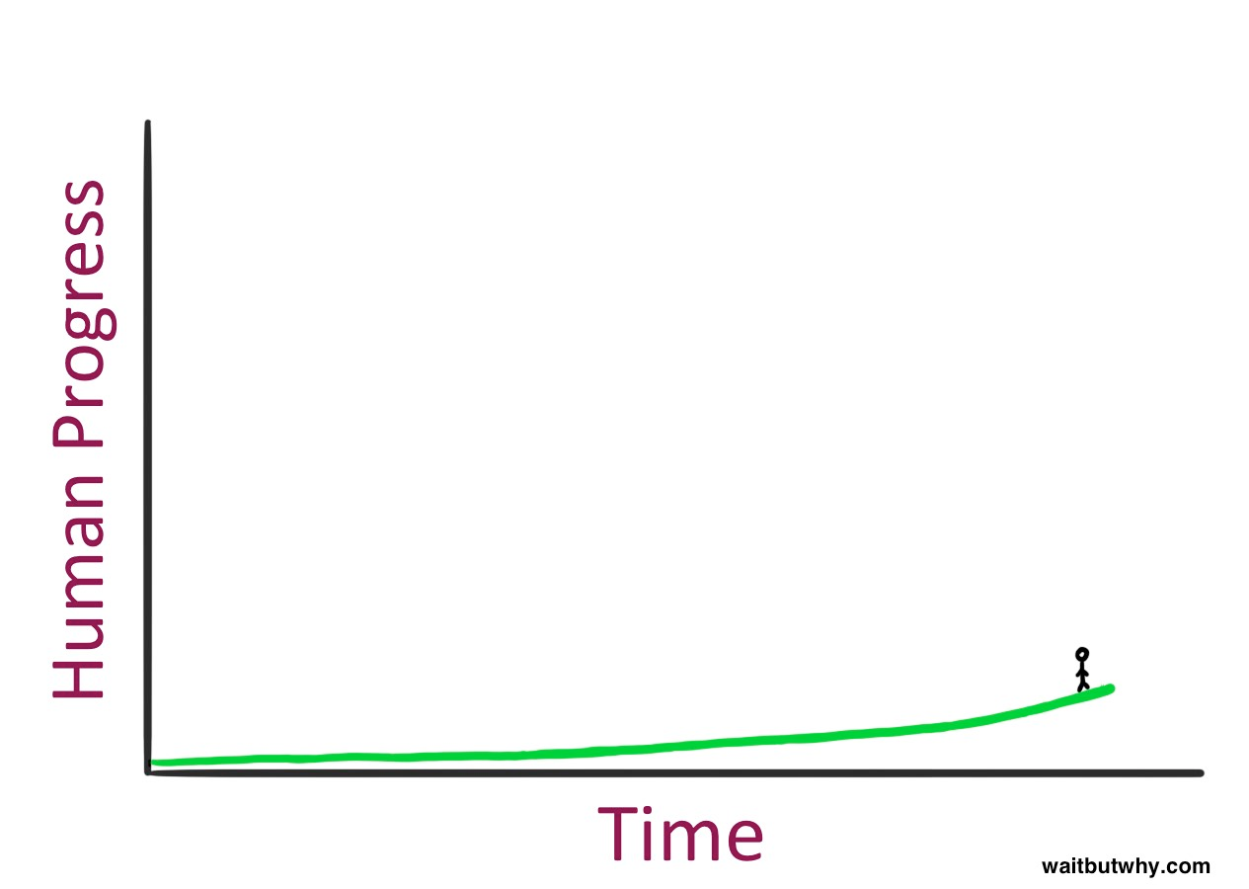

Slide 7
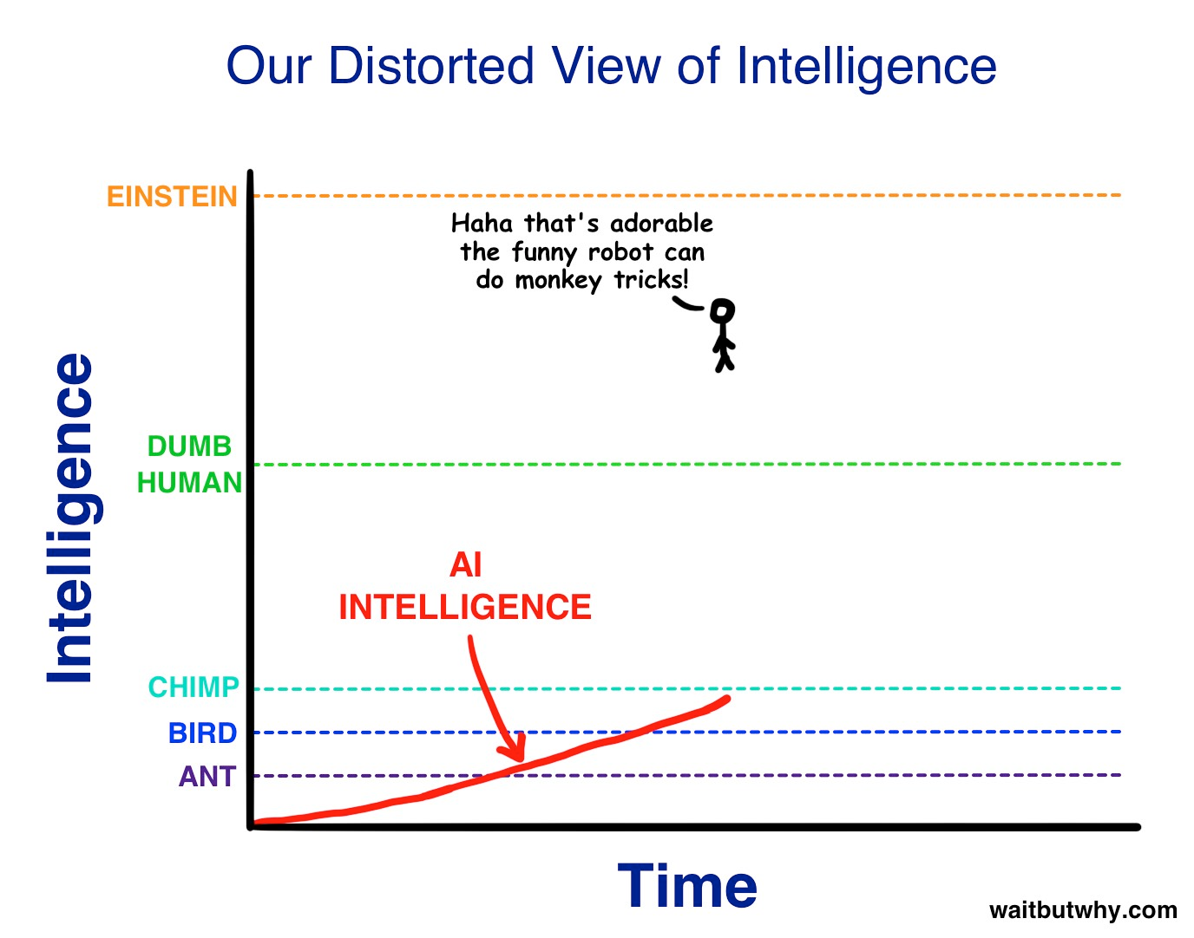

Slide 8
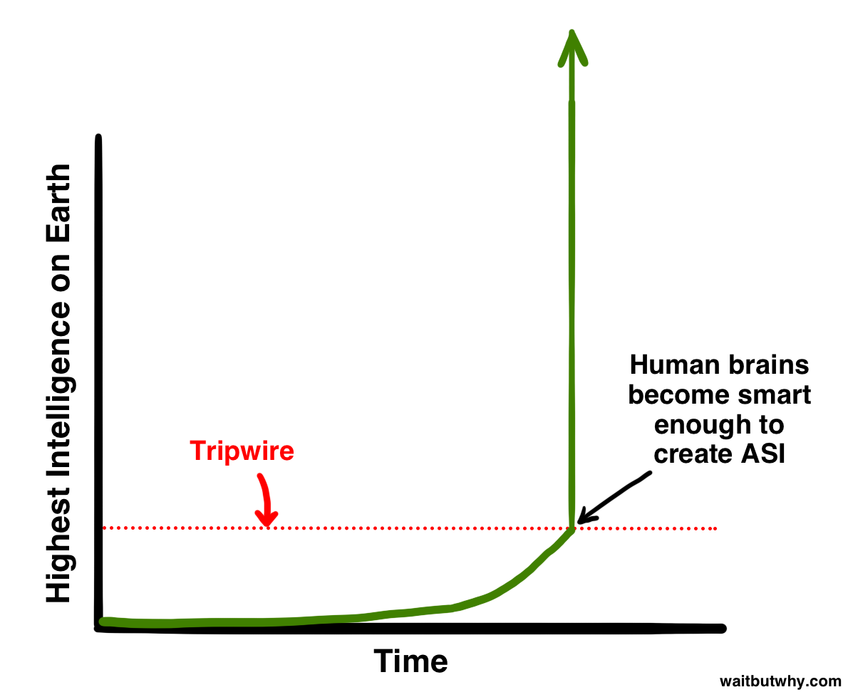

Slide 9
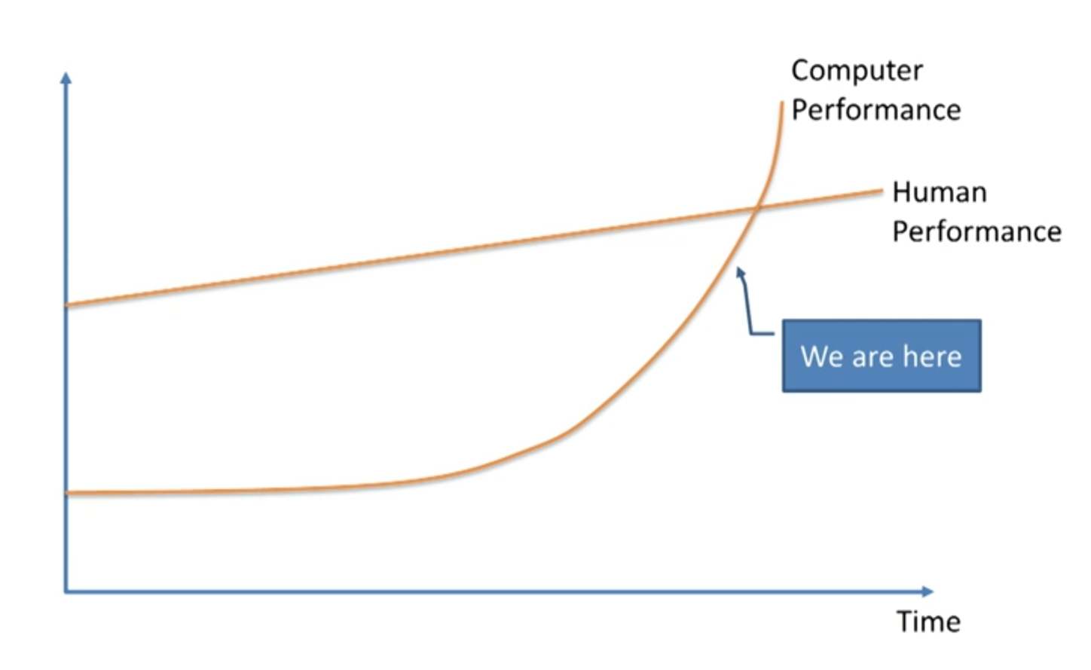

Slide 10
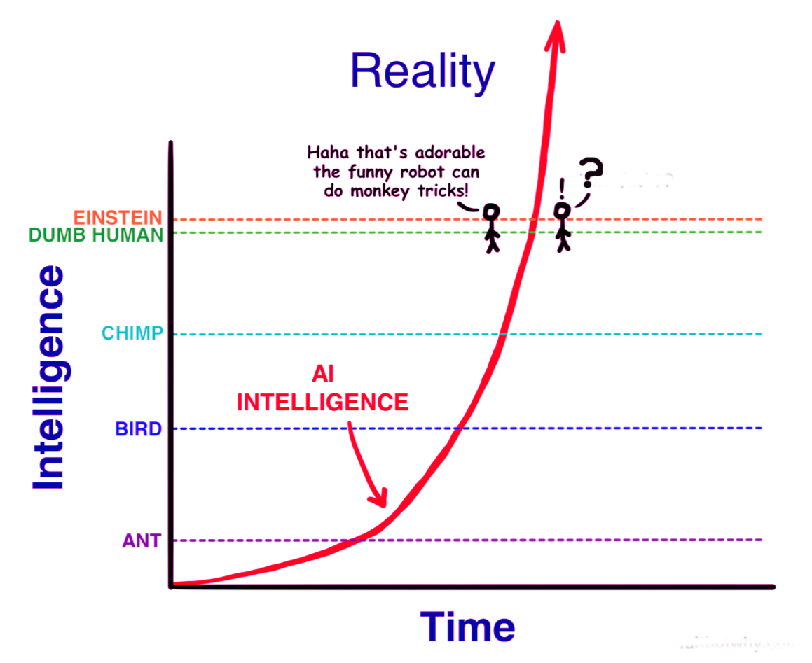

Slide 11
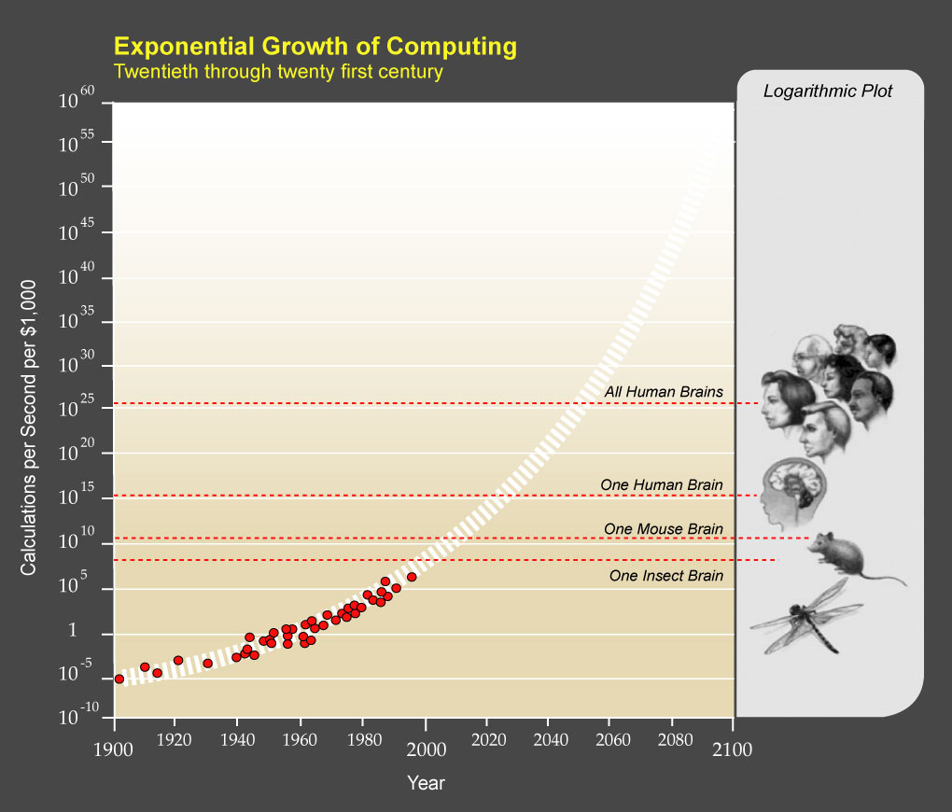

Slide 12
Humans Face an Unprecedented
Future
either…
AI – Artificial Intelligence
Computer Acts Alone
or…
AHI – Augmented Human
Intelligence
Computer Acts thru Human Intentions

Slide 13
CrossRoad
AHI
Knowledge
Humans Decide How Computers Act
AI
Automation
Computers Decide
Where are we at as Humans?

Slide 14
eLearning CrossRoad
AHI
Humans Decide Collaboration Thinking
AI
Computers Decide Individualization Memorization
Where are we at as Teachers?

Slide 15
TEACHERS Face an
Unprecedented Challenge
either….Be replaced by
AI – Artificial Intelligence
or… Change Our Pedagogy to Augment Human THINKING
AHI – Augmented Human
Intelligence

Slide 16

Teachers are key!

Slide 17
eLEARNING’S PEDAGOGICAL
CrossRoad
Artificial Intelligence
Augmented Human Intelligence
NO TEACHERS
INDIVIDUALIZED LEARNING
Memorization + repetition of “correct answer”
EDUCATION IS AUTOMATED
  Packaged Courseware
  AI Delivers Content 24/7
  Autograded Quizzes
  AI assigns future path
COMPUTER ACTS ALONE
AUTOMATION REVOLUTION
HUMAN TEACHER IS KEY
COLLABORATIVE LEARNING
  Seminars, Debates, Projects, Simulations
  Teamwork, Innovation
PROBLEM-CENTERED wrt
  Emphasis on Thinking Skills, Analysis, Creativity
  Real-World Problem Solving with AI tools
TEACHER & LEARNERS develop AHI to create a
KNOWLEDGE REVOLUTION

Slide 18
eLEARNING’S PEDAGOGICAL
OPPORTUNITY
Artificial Intelligence
Augmented Human Intelligence
TEACHER & LEARNERS COLLABORATE, use AI to develop AHI and create a
KNOWLEDGE REVOLUTION
COMPUTER ACTS ALONE
AUTOMATION REVOLUTION

Slide 19
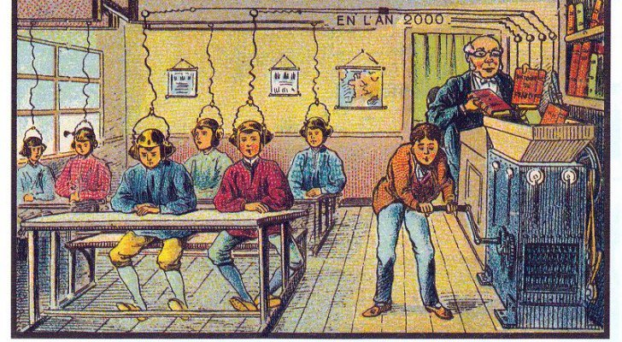
AUTOMATED EDUCATION

Slide 20
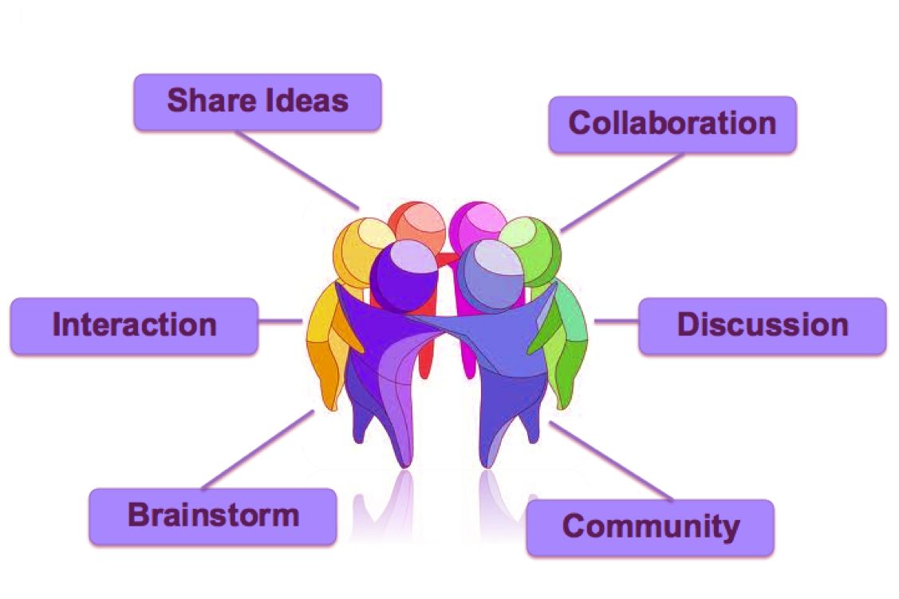

Slide 21
Collaborativist Learning (OCL)
Collaborativism is a THEORY and a PEDAGOGY for
Elearning to develop Augmented Human Intelligence (AHI)
OCL employs AI tools with teamwork to develop AHI
  To use AI tools in Problem Solving in real world scenarios
  Facilitate learner expertise for 21st century knowledge industries
  Knowledge building in scientific and professional communities
OCL is based on DISCOURSE (group discussion)
The TEACHER facilitates learning by engaging LEARNERS in group discussion to understand the discipline and to apply the key analytical terms and AI tools to
  construct knowledge,
  innovate solutions, and
  solve problems.

Slide 22
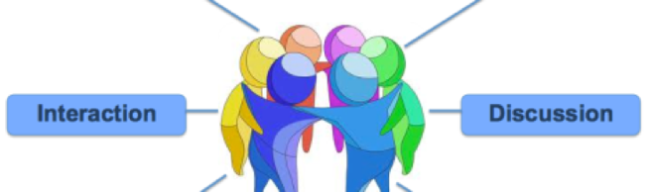


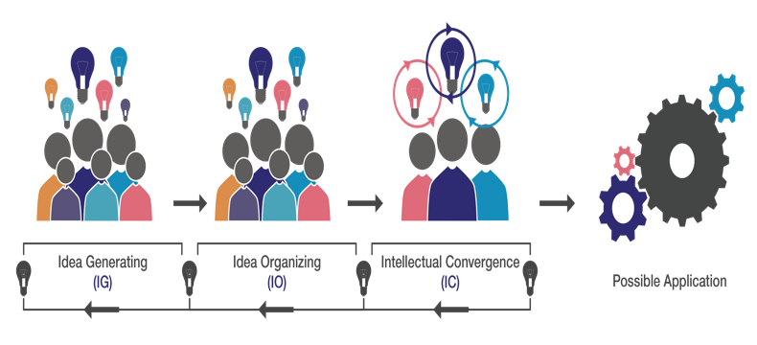
Collaborativism is more than a HUDDLE:
COLLABORATIVISM IS A PEDAGOGY

Slide 23
Collaborativist Learning:
Role of the Teacher
Collaborativist pedagogy is more than huddling:
ROLE OF THE TEACHER:
  To induct the learners into the field
  To provide Content Expertise
    introduce learners to the discipline
      What is the field of knowledge?
      What is the analytical language of the field?
      How to engage and problem solve?
  To provide Process Expertise
    enable learners to apply analytical frameworks and terms
      To engage learners in collaborative problem solving
      3 processes of OCL: IG→IO→IC

Slide 24
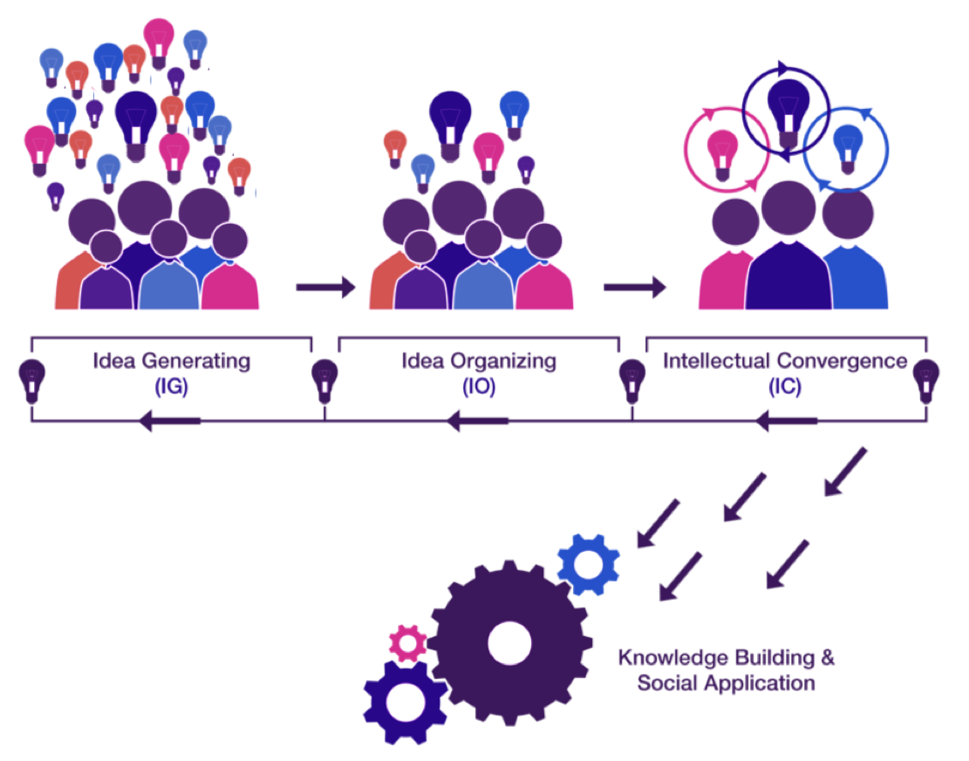
COLLABORATIVIST LEARNING
Theory: 3 Processes
Notes:
Insert OCL Theory/Pedagogy --- insert images from book pg. 94/95.

Slide 25
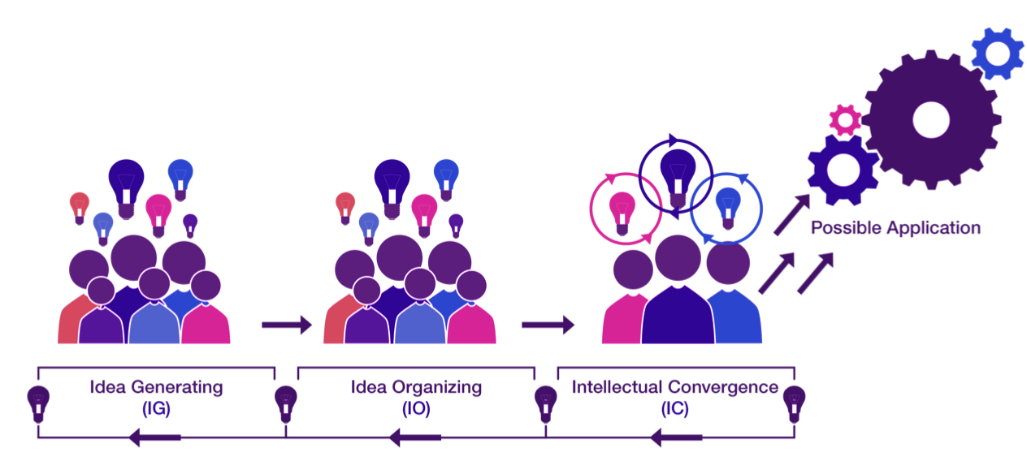
Collaborativist Learning
Theory & Pedagogy
Knowledge Community
Experience
Role of Teacher/Moderator
Inputs

Slide 26
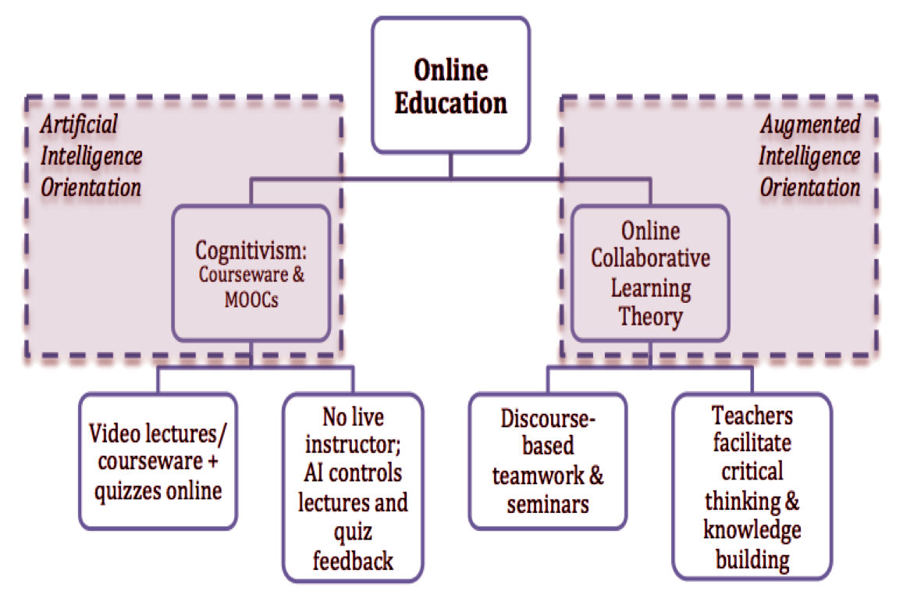

Slide 27
Teachers can chose from or design
many Collaborativist Pedagogies:
Plenary group discussions
Small group discussion
Team projects
Dyads
Debates
Role Plays, Simulations
Student-led Online Seminars (SOS)
+ Employ
AI tools such as AR, Mobile, VR, Gamification

Slide 28
SOS Student Roles:
1. Team Moderate an Online Seminar:
1 week
2. Discussant in an Online Seminar
3 weeks

Slide 29
SOS: Student Moderator Team:
1 week Seminar
Present Seminar Topic that week
Introduce Seminar Design & Schedule
3 Discussion Questions
Readings
Presentation 10%
Facilitation
10%
Facilitate the Quality of Discussion
Facilitate Progress from IG-→IO-→IC
Lessons Learned: In Retrospect
Assess Quality of User Participation
Analyze CHANGE Over TIME in type and level of participation
Reflect on Design and Role as moderator
Discourse
Analysis 20%

Slide 30
Student Role: Discussant in
Seminar: 3 weeks
Log in daily
Do readings
Post minimum 8 messages to reply to 3 DQs
Reply to others
Collaborate
Contribute new ideas, resources
Provide reasons/evidence to agree/disagree
Advance from IG-→IO-→IC
Build
Knowledge

Slide 31
MAKING LEARNING VISIBLE
(Discourse Analysis):
Study the Transcripts of the Online DISCUSSIONS to Identify Learning PROGRESS and activities. Analyze the TRANSCRIPTS according to::
SEMINAR 1:
  Total # of Messages
By date:
  # of message per day
  Size of Messages per day
By Gender
By Role
  Message numbers or size by Moderators, Discussants, Instructor
By Process (IG, IO, IC)
  Messages numbers or size by Process type
    Per day
    Per Participant
CHANGE OVER TIME

Slide 33
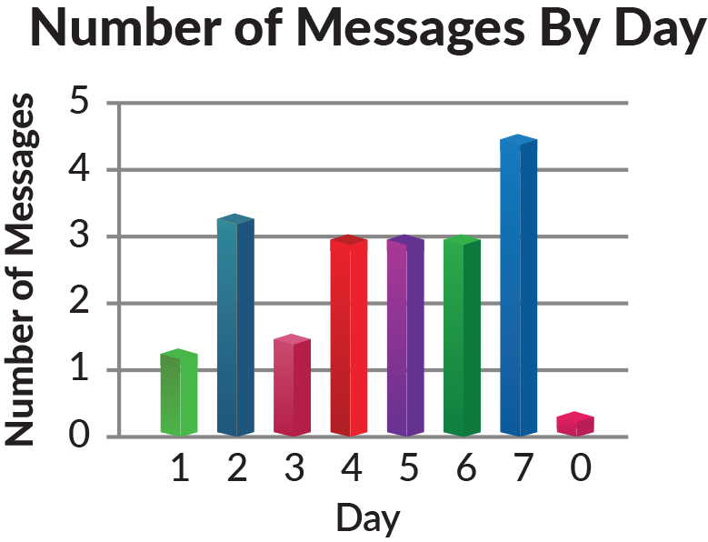
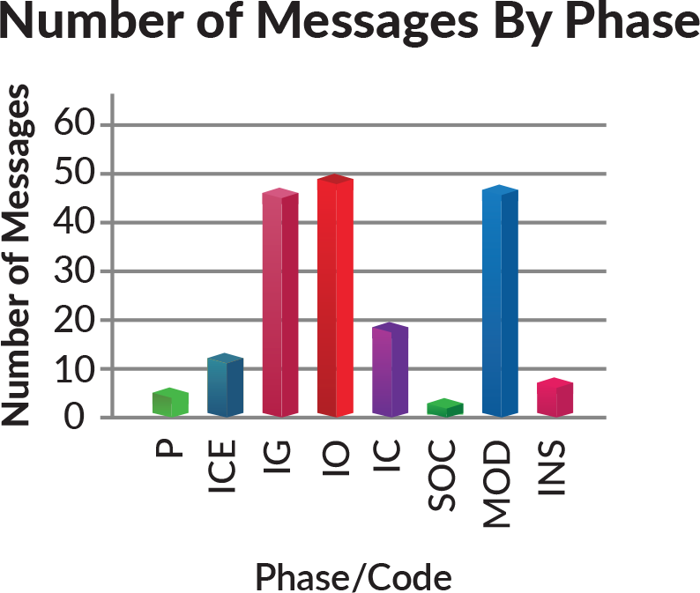

Slide 34
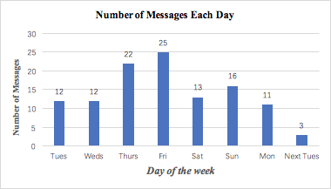
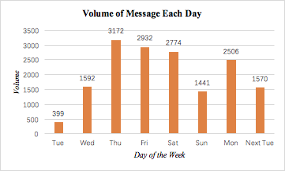
Figure 1: Total Number of Messages by Day
Figure 2: Total Number of Words of Messages by Day

Slide 35
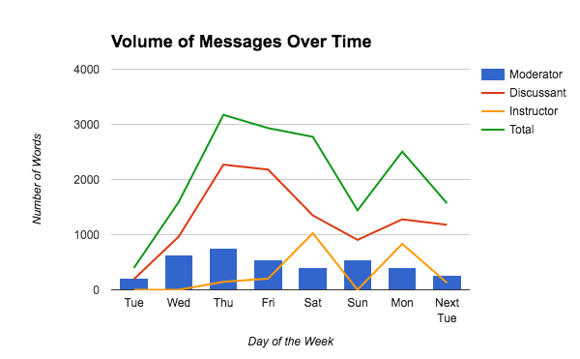

Slide 39
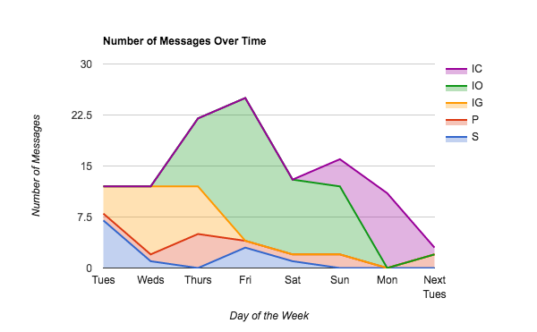

Slide 41
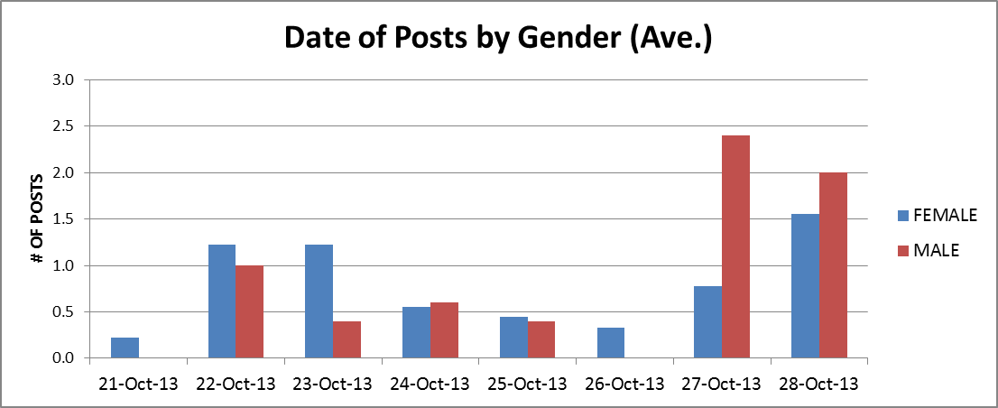
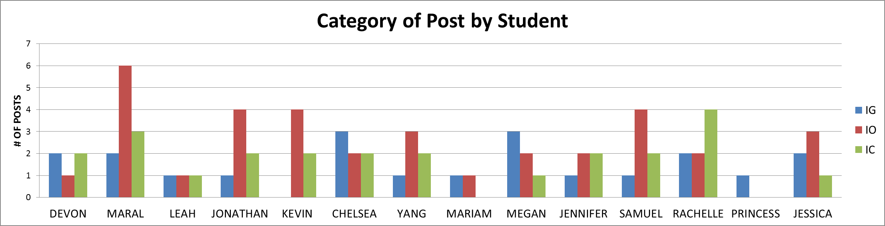
Methodology
# of posts was calculated by total posts separated male/female and dividing it by the total males/females. I did this because there are twice as many females than males in our class - dividing by the entire class would have skewed posts in favour of females.
Methodology
Again, total posts by males/females were divided by the total number of male/female students in the class to avoid skewed gender results.
What is online collaborative learning | November 2014
Notes:
DATE OF POSTS BY GENDER:
Comments
Women tend to post throughout the week. Males favored the final two days - This might have had something to do with Kevin only joining the forum on Sunday.
POSTS BY GENDER AND TOD:
Comments
Not really much to say. Other than males post more in the late evening and females more in the earling morning and early evening.

Slide 42
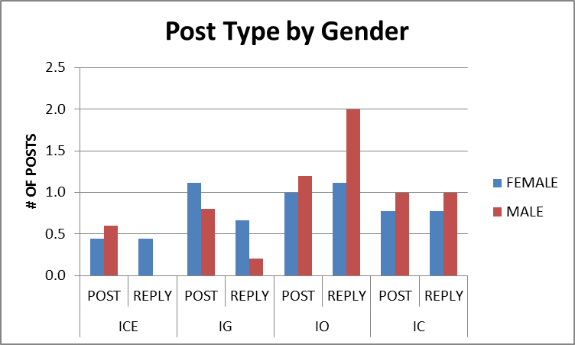
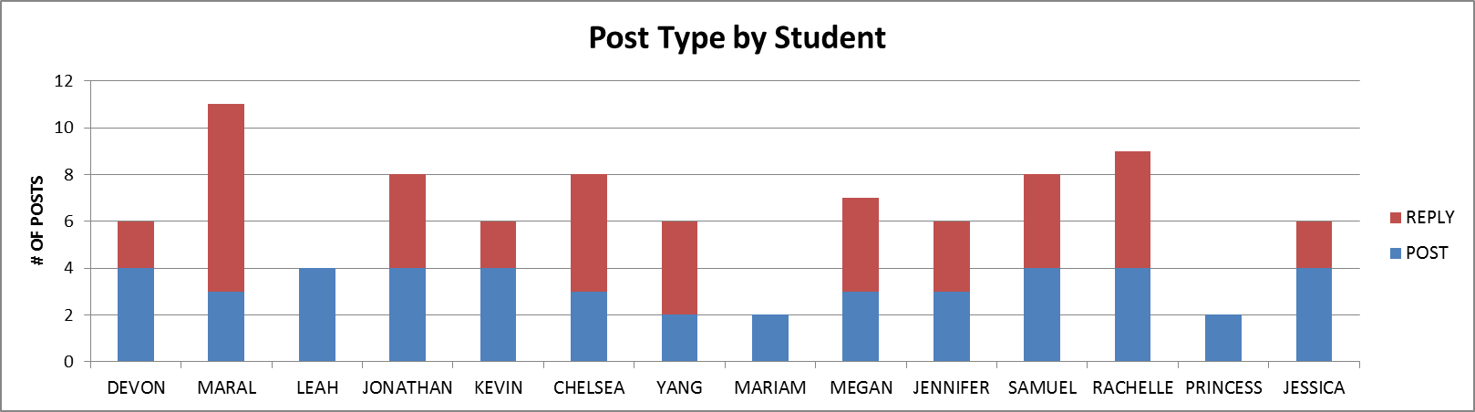
.
What is online collaborative learning | November 2014
Notes:
POST TYPE BY GENDER
Comments
I thought this would be an interesting way to look at the data. I originally thought women would have replied more to others, engaging in a sort of IC throughout the process (because women are supposedly more social). I was WRONG.
Females replied to others in the early stages of the process (ICE and IG). Males engaged in IO much more than females, suggesting they worked harder to organize information in order to lead the way for IC.
POST TYPE BY STUDENT:
Comments
Okay, I think this says alot about who was engaging with others and who was just making their posts to get the job done.
Like I had mentioned before Mariam, and Princess did not fully engage with the process and this shows here. Leah also did not engage with others, suggesting she was posting to meet a quota. The majority of Maral (surprise surprise) and Rachelle and Chelsea's posts were in reply to others, suggesting they were actively engaging in the IC process.

Slide 43
Collaborativist Learning
Theory & Pedagogy
Knowledge Community
Experience
Role of Teacher/Moderator
Inputs

Slide 44
So What…?
If AI Wins?
If AHI Wins?
Automation Model Dominates
Teachers replaced by AI software delivering personalized commercial content
Education is one-way information transfer
Efficiency rules over quality
Unprecedented costs in terms of human values, work, creativity which are replaced by AI
Humanity replaced by AI
AUTOMATION REVOLUTION
Knowledge Model Grows
Educators retain key role and adopt Collaborativist pedagogies to facilitate discourse and critical thinking
Educators encourage human understanding, creativity & ethics
AI to enhance Human Thinking,
Quality rules over Efficiency
Humans Smarten Up
KNOWLEDGE REVOLUTION:
Next Steps…?

Slide 45


Slide 46
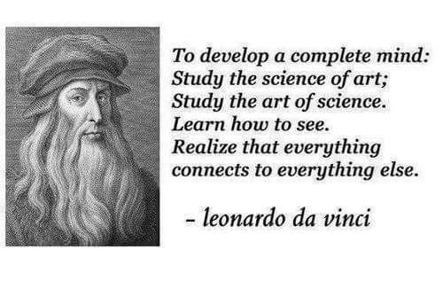

Slide 47

THANK YOU! harasim@sfu.ca
Dr. Linda Harasim is a founder of online education and the creator of Online Collaborative Learning (OCL).
She is a professor in the Communications Department at Simon Fraser University, Vancouver CANADA.
Learning Theory and Online Technology: How New Technologies are Transforming Learning Opportunities.
New York: Routledge Press. (2017, 2nd Edition)

Slide 48
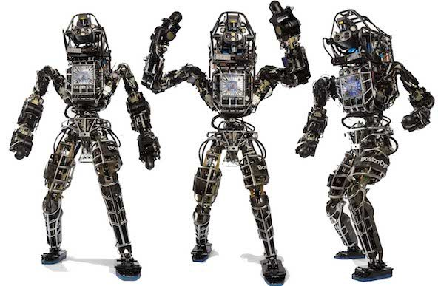
TEACHERS:
Do what Robots Can't! Teach THINKing!!

Slide 49


Slide 50
Reference List
Harasim, Linda. (November 2015). Discussion #1. Communications 453. Retrieved from http://www.fightforeducationsfuture.com/discussion-topic-1/.
Harasim, Linda. (November 2015). Discussion #2. Communications 453. Retrieved from http://www.fightforeducationsfuture.com/discussion-topic-2/.
Urban, Tim. (Jan. 22, 2015). The AI Revolution: The Road to Superintelligence. Retrieved from http://waitbutwhy.com/2015/01/artificial-intelligence-revolution-1.html.
Walia, Arjun. (September 30, 2015). How French Artists In 1899 Envisioned Life In The Year 2000.
Retrieved from http://www.collective-evolution.com/2015/09/30/how-french-artists-in-1899-envisioned-life-in-the-year-2000/.

