Slide 1


Globally Inspired Writing
Insights from Planning to Publishing International Edited Books
Gronseth • Dalton • Schwartz • Bonk • Lee • Reeves • Zhang • Reynolds

Slide 2
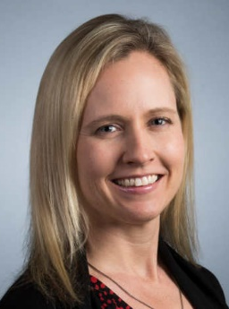
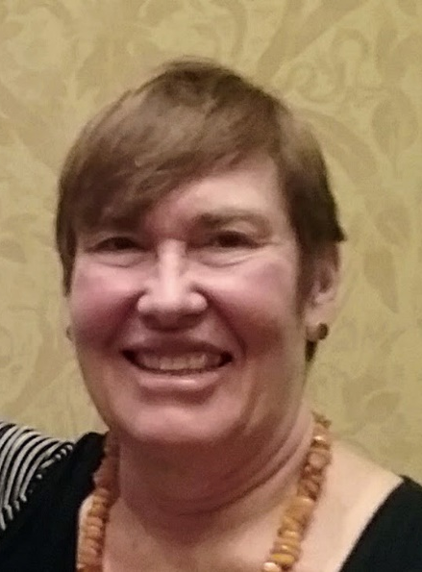

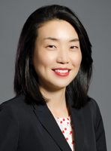


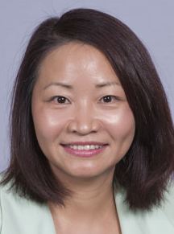
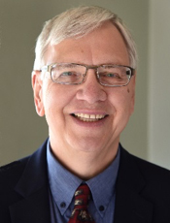
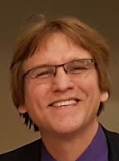
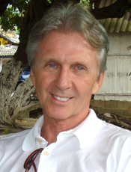

Susie L. Gronseth
Elizabeth M. Dalton
Daniel Schwartz
Mimi Lee
Ke Zhang
Thomas C. Reeves
Curtis J. Bonk
Thomas H. Reynolds

Slide 3
Asking Why
Asking Who
Asking How
Testing the
Water
Making
Promises
Network with Your Network
Which Way the Wind Blows
Draft and Redraft…and Redraft…and Redraft…
The 3 C’s: Communication and Collaboration with Contributors
Mental Exhaustion and Hitting the Wall (i.e., Bonking)
Reflecting Back and
Lightbulbs On
Marketing and Money Matters
Ask Your Own Question
Ask Your Own Question

Slide 4
One more thing…

Slide 5
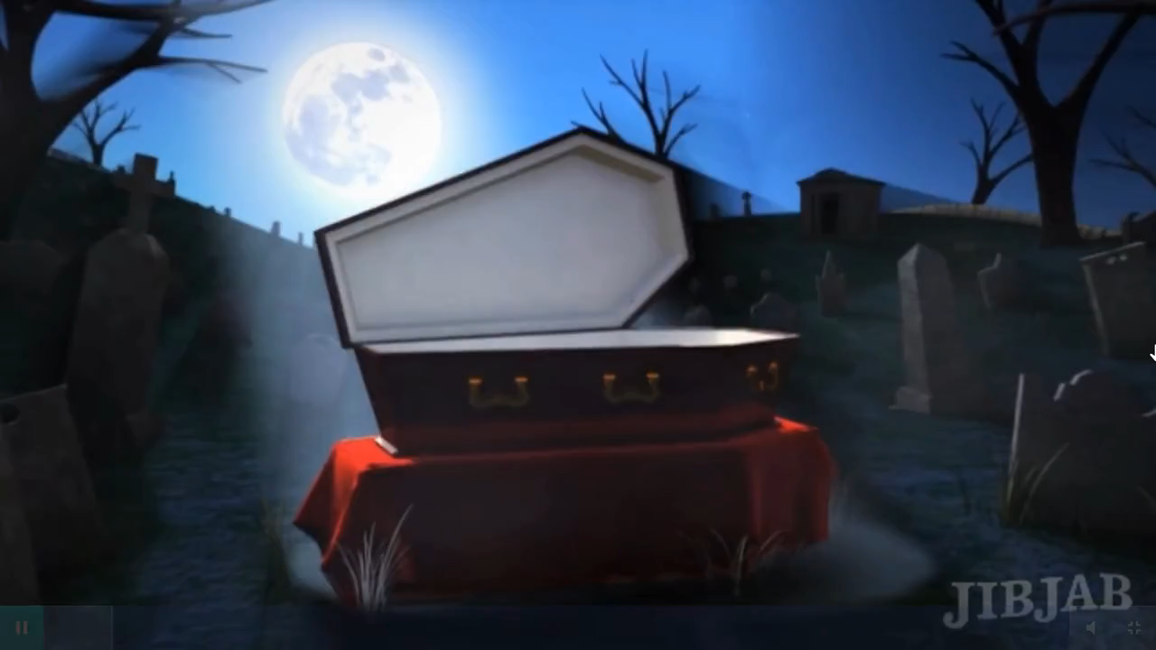

Slide 6
Globally Inspired Writing
Insights from Planning to Publishing International Edited Books
Gronseth • Dalton • Schwartz • Bonk • Lee • Reeves • Zhang • Reynolds

Slide 7
Asking Why/Asking Who/Asking How
Why did you decide to do an edited book?
Who benefits?
How is an edited book viewed at your university for promotion and tenure?

Slide 8
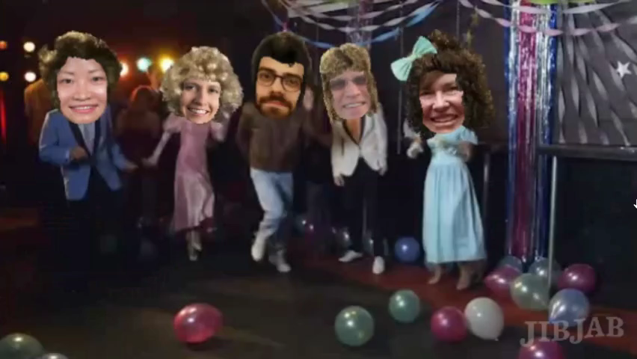
YOU WIN A BOOK!!!

Slide 9
Testing the Water
How do you make the case to start a book project with the publisher?
How do you test the waters? e.g., conference symposia, articles, blog posts, etc.

Slide 10
Making Promises
How do you recruit book participants?
What do you promise them?

Slide 11
Network with Your Network
How important is your network?
How do you maintain that network?
What happens as that network expands and contracts?

Slide 12

YOU WIN A BOOK!!!

Slide 13
Which Way the Wind Blows
How do you organize topics into sections and decide on the format for the book structure?
How is the book title decided?
Is it just random nonsense and seeing which way the wind blows….or…?

Slide 14
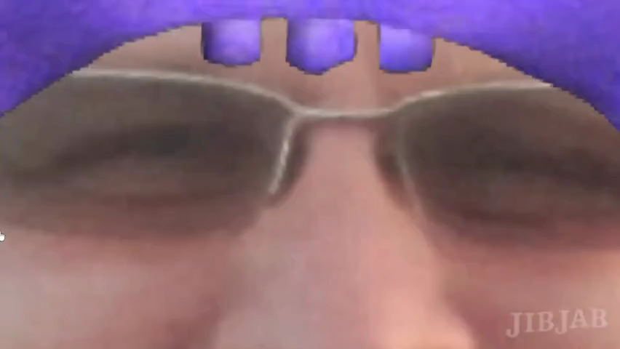
YOU WIN A BOOK!!!

Slide 15
Draft and Redraft…and Redraft…and Redraft…
How do you collaborate as co-editors?
How many drafts of chapters?
How do you manage draft development?
How do you organize the chapters drafts and finalize chapters?
What technology tools do you use?

Slide 16
The 3 C’s: Communication and
Collaboration with Contributors
How do you collaborate with the contributing authors? With the endorsers? With the foreword/epilogue writers?
How do you deal with the loss of a contribution, someone wanting to contribute late in the process, or with unexpected delays?

Slide 17
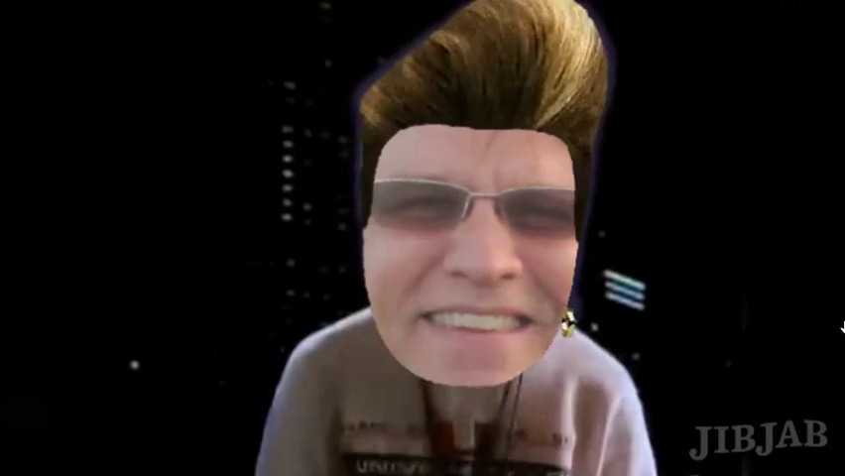
YOU WIN A BOOK!!!

Slide 18
Mental Exhaustion and Hitting the Wall
(i.e., Bonking)
What kinds of challenges do edited books pose? For example,
(1) politics - contributors from countries that don’t agree;
(2) author mandated open access requirements,
(3) negotiating deadlines,
(4) stamina and unforeseen illnesses and job duties,
(5) book length, time, contract, format, book cover, endorsers, credits, photo permissions, or
(6) other…?

Slide 19
Reflecting Back and Lightbulbs On
Reflect back…
What do you now view as the importance and impact of the book project?
Any awakenings?
Any unexpected successes and results?
What would you do differently?

Slide 20
Marketing and Money Matters
How did you market the book and personally benefit from it?
How do you negotiate your book contracts?
What unexpected items cost money?
What resources are needed to successfully roll out a book?

Slide 21
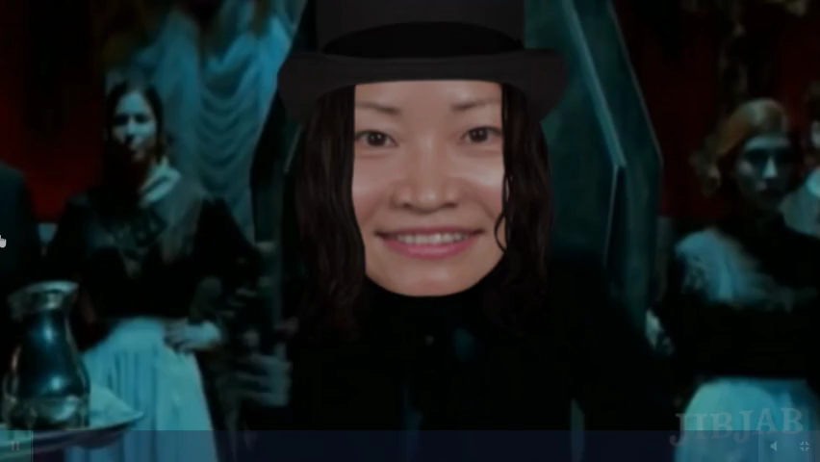
YOU WIN A BOOK!!!

Slide 22
Ask Your Own Question
?

Slide 23
Ask Your Own Question
?

