Slide 1

On-demand Disposable Learning and the 4th Industrial Revolution
Paul Kim, PhD.
Chief Technology Officer & Assistant Dean
Stanford University Graduate School of Education
phkim@stanford.edu

Slide 2
What does OER mean when learning activities go way beyond printable materials?
How do you incorporate ed tech innovations in future OERs?
How do you increase digital footprints in OER learning environments?

Slide 3
Today’s Exercise
_________ is the New________
Emerging Paradigm, Renewed Perspective, Practice
Traditional, Outdated Concept, Behavior

Slide 4

Sitting is the New Smoking

Slide 5
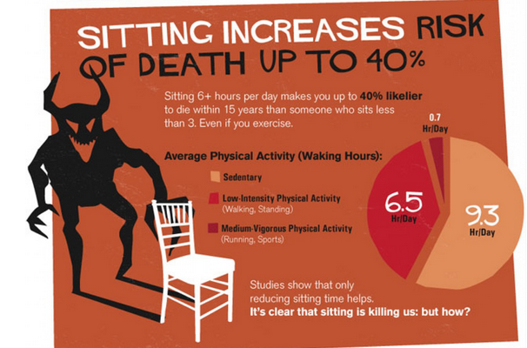

Slide 6
“The illiterate of the 21st Century are not those who cannot read and write but those who cannot learn, unlearn and relearn.”
― Alvin Toffler, Powershift: Knowledge, Wealth, and Power at the Edge of the 21st Century

Slide 7
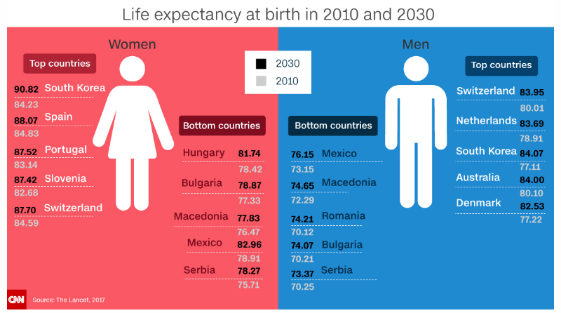
http://www.cnn.com/2017/02/21/health/life-expectancy-increase-globally-by-2030/
Must Re-learn and Re-learn and Re-learn……for very long…

Slide 8

http://ftw.usatoday.com/2017/04/101-year-old-man-kaur-gold-100-m-world-india-masters-games-keep-rocking-awesome-video
100 is the New 20

Slide 9
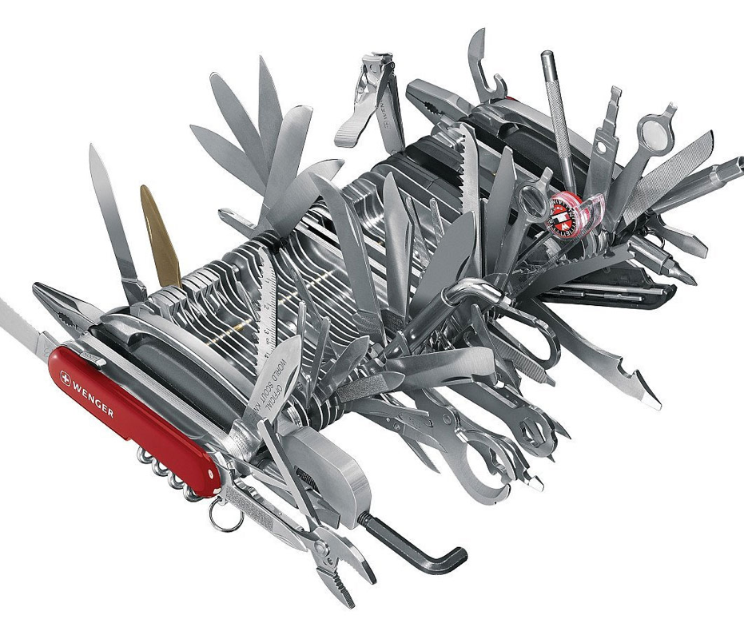

The world of work is changing rapidly
Gmail, Word, Excel, Photoshop, Blog, Podcast, Youtube, What’sApp, Kakaotalk,etc.
McKinsey analysts estimated a
5X
Skillsets needed in the workforce from 2009 to 2012.
Notes:
Transition: And building off these forces, we see tremendous opportunity.

Slide 10
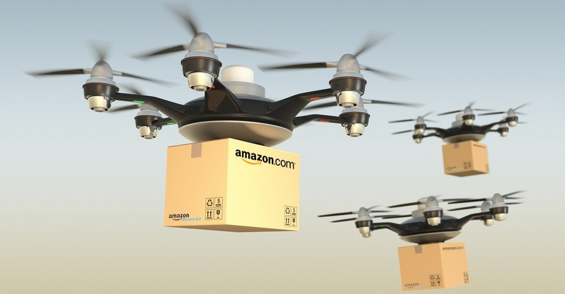
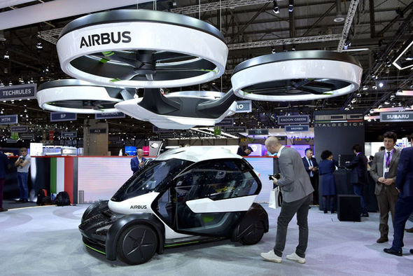
Technological advancement rate
always exceeds
human perception
and behavior change rate…

Slide 11
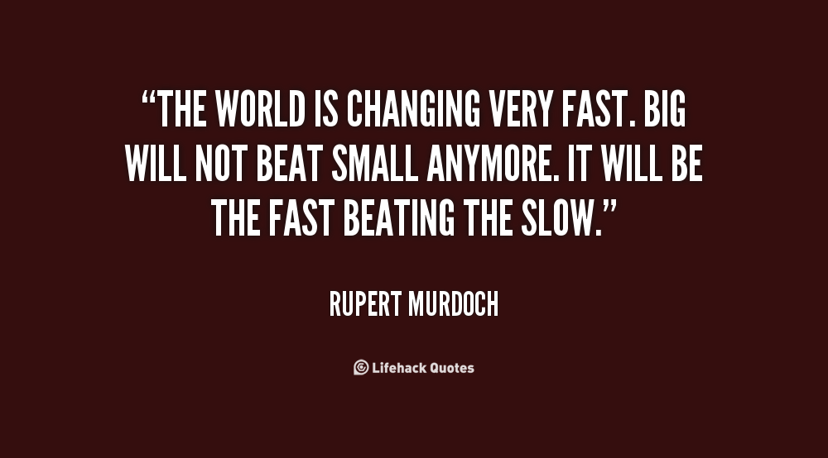
The Fast is the New Big

Slide 12
Who are “the fast movers” in the private sector?

Slide 13








































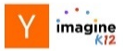



Investment in New Educational Models Continues to Accelerate
Select VC Education Portfolios
 | Key Themes | Select Investments
 | Online Education Language Learning
 | Education Software MOOCs
 | Education Software/Marketplaces Adaptive Learning
 | Education Software Adaptive Learning
 | Supplemental Online Education MOOCs
 | Educational Software Supplemental Online Education
 | Education Software Smart Games Online Higher Education
 | Online Education Language Learning
 | Education Software Online Higher Education
 | Digital Books Smart Games Education Services
 | Education Software Supplemental Online Education
 | Select EdTech Accelerators
VC/Growth Investment in EdTech
$3,028mm invested in 2016
$3B
Online Education,
Adaptive Learning,
MOOCs,
Smart Games
Source: Bloomberg, Capital IQ, VentureSource and GS extrapolations
Perspectives on the Education Landscape

Slide 14


Slide 15
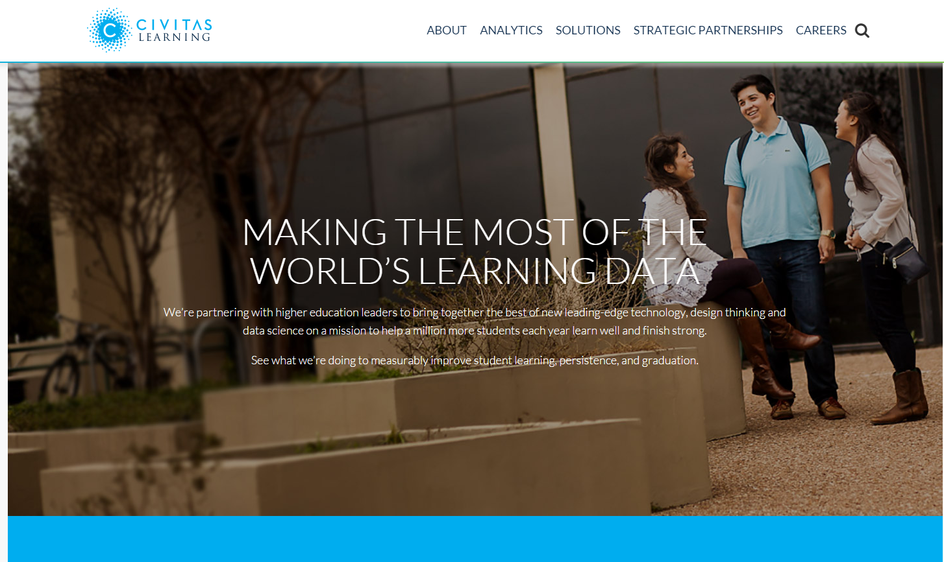
Predictive Analytics

Slide 16

Education Industry is the New Wild Wild West

Slide 17
The Increasing Shortage of Tech workers.
http://www.talentwave.com/the-shortage-of-stem-workers-in-the-us/

Slide 18
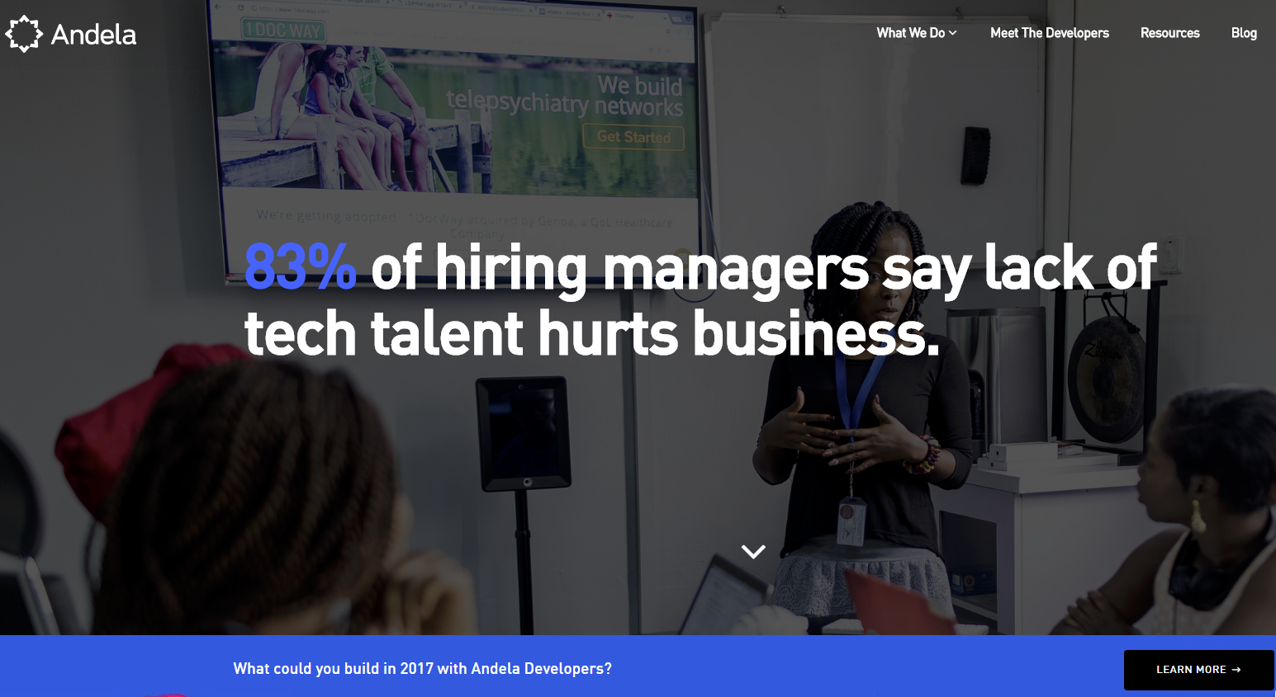
Lagos, Nigeria, Nairobi, Kenya

Slide 19
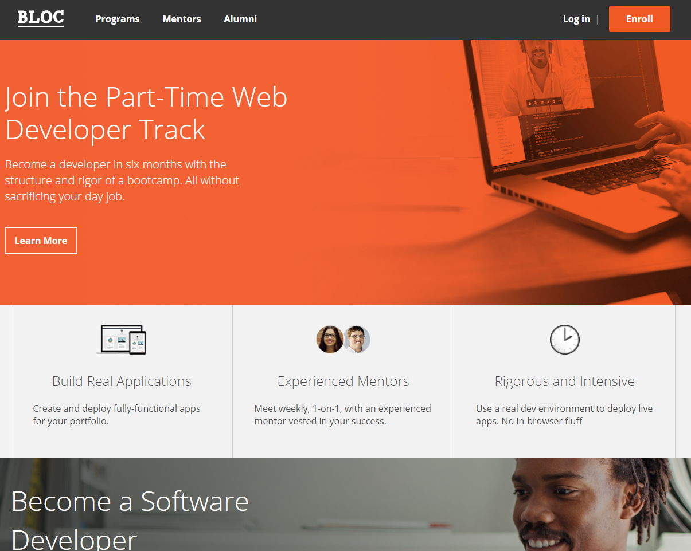
100% Online Boot Camp

Slide 20

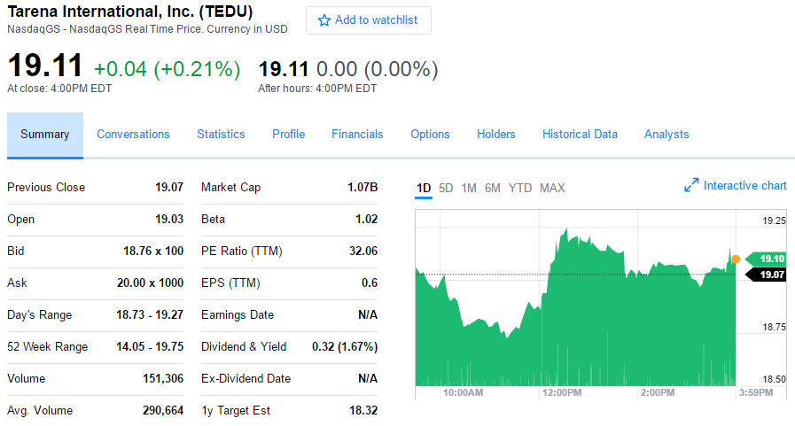
The Rise of Boot Camps
Accelerated Tech Skill Training
Listed on NASDAQ
380K graduates. 90% job placement rate.

Slide 21
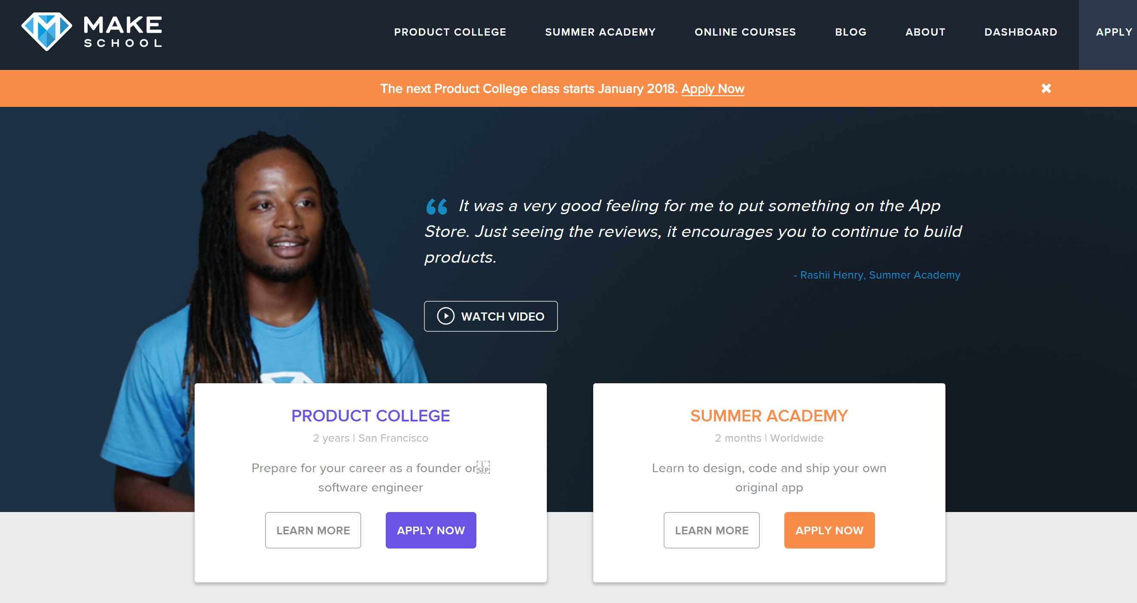

Slide 22
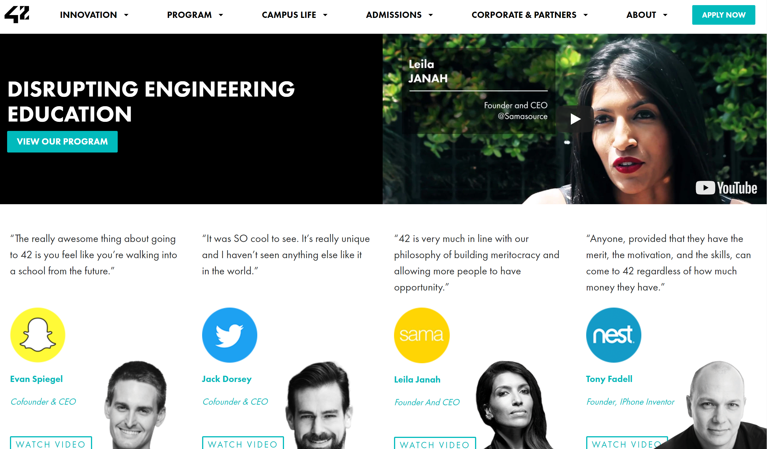

Slide 23
What used to be a privilege for a small group of elite learners has become a disposable learning resource for all.

Slide 24
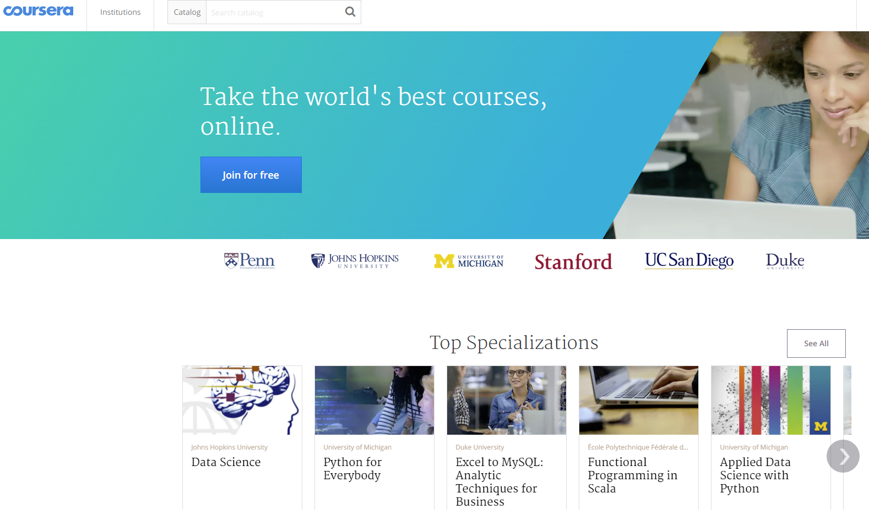

Slide 25
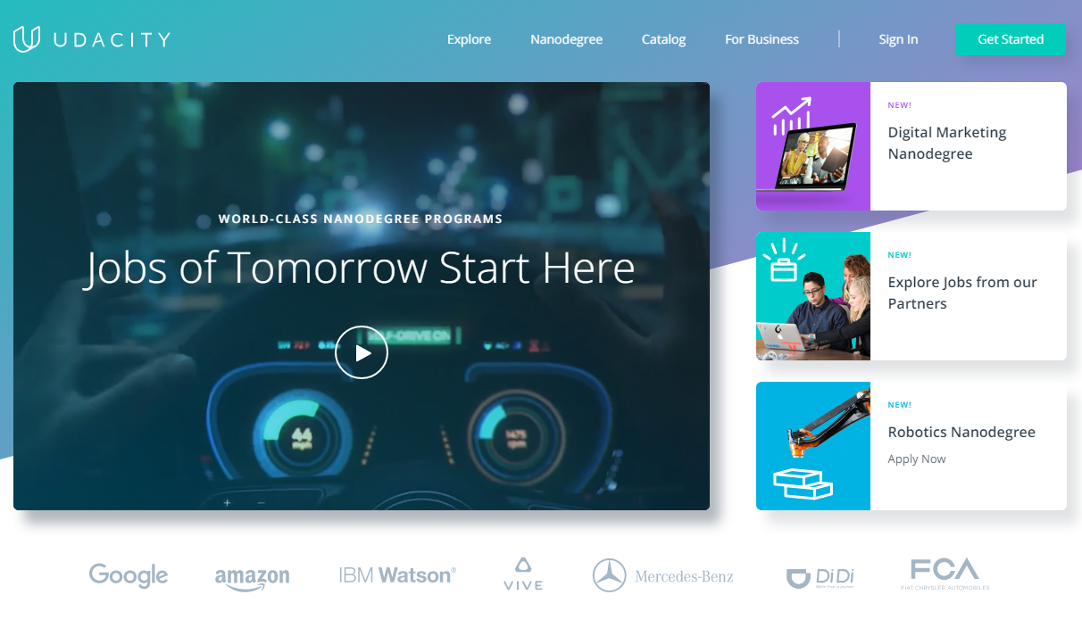

Slide 26


Slide 27
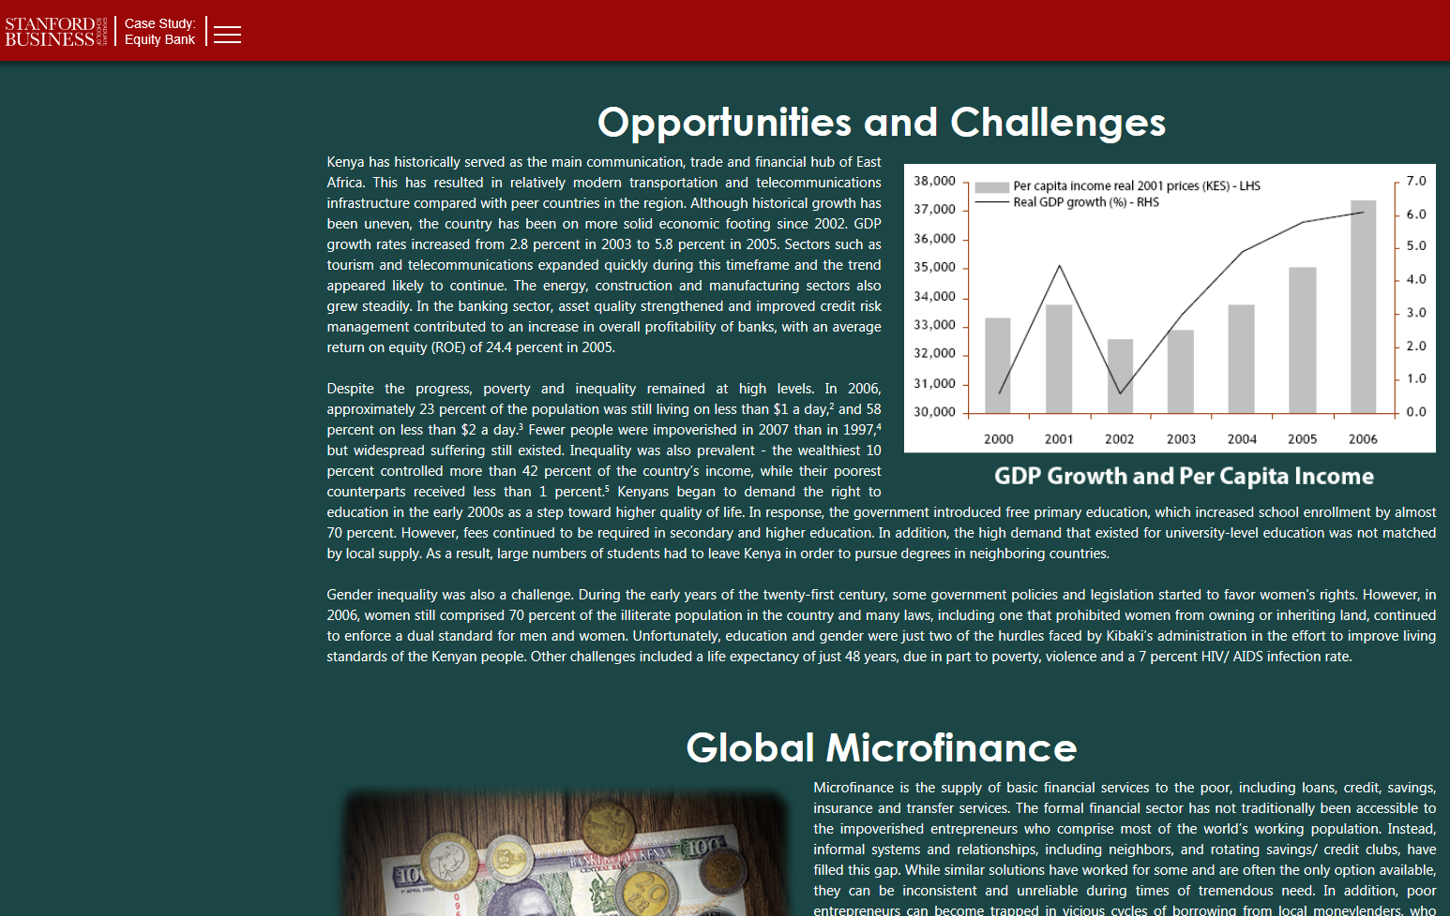

Slide 28

Lifelong Learning is the New Privilege for All

Slide 29
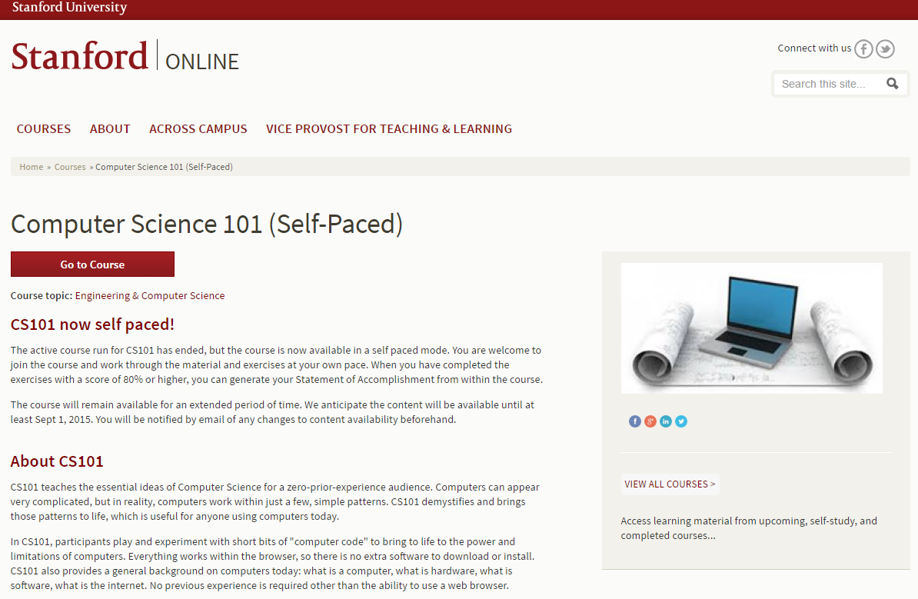

Slide 30
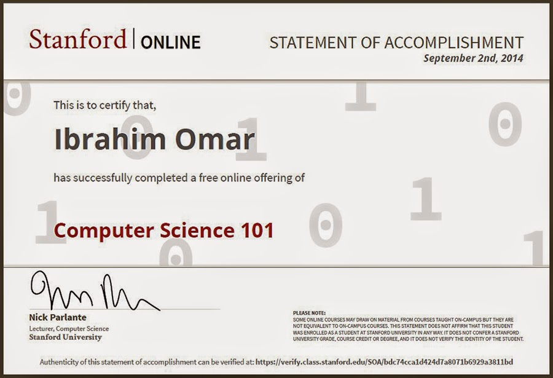

Slide 31

Coding
Big Data Analytics
Remote Work Control
Network Security
SNS Optimization
A.I. Analysis
NLP Development
Authentication
Drone Printing
IOT Integration
Gamification
Design Thinking
VR Development
Data Visualization
Cluster Robots Management
Digital Assistance Optimization

Slide 32
How new collar jobs will be formed?

Slide 33


Slide 34
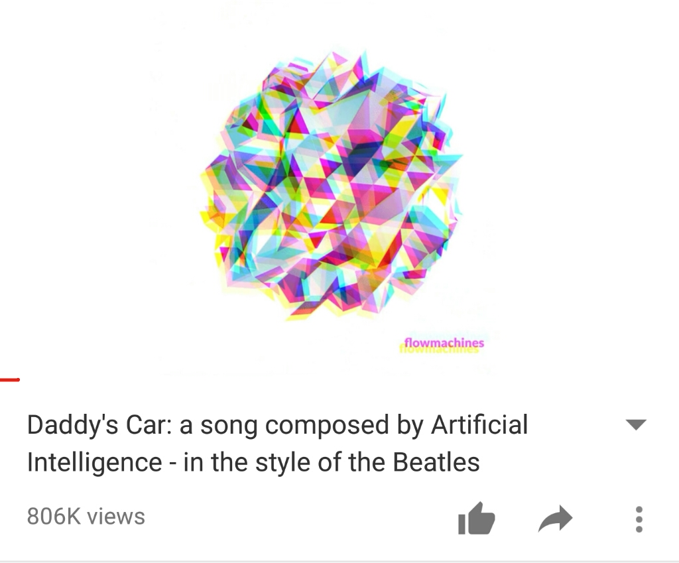

Slide 35



Slide 36


Slide 37


Slide 38
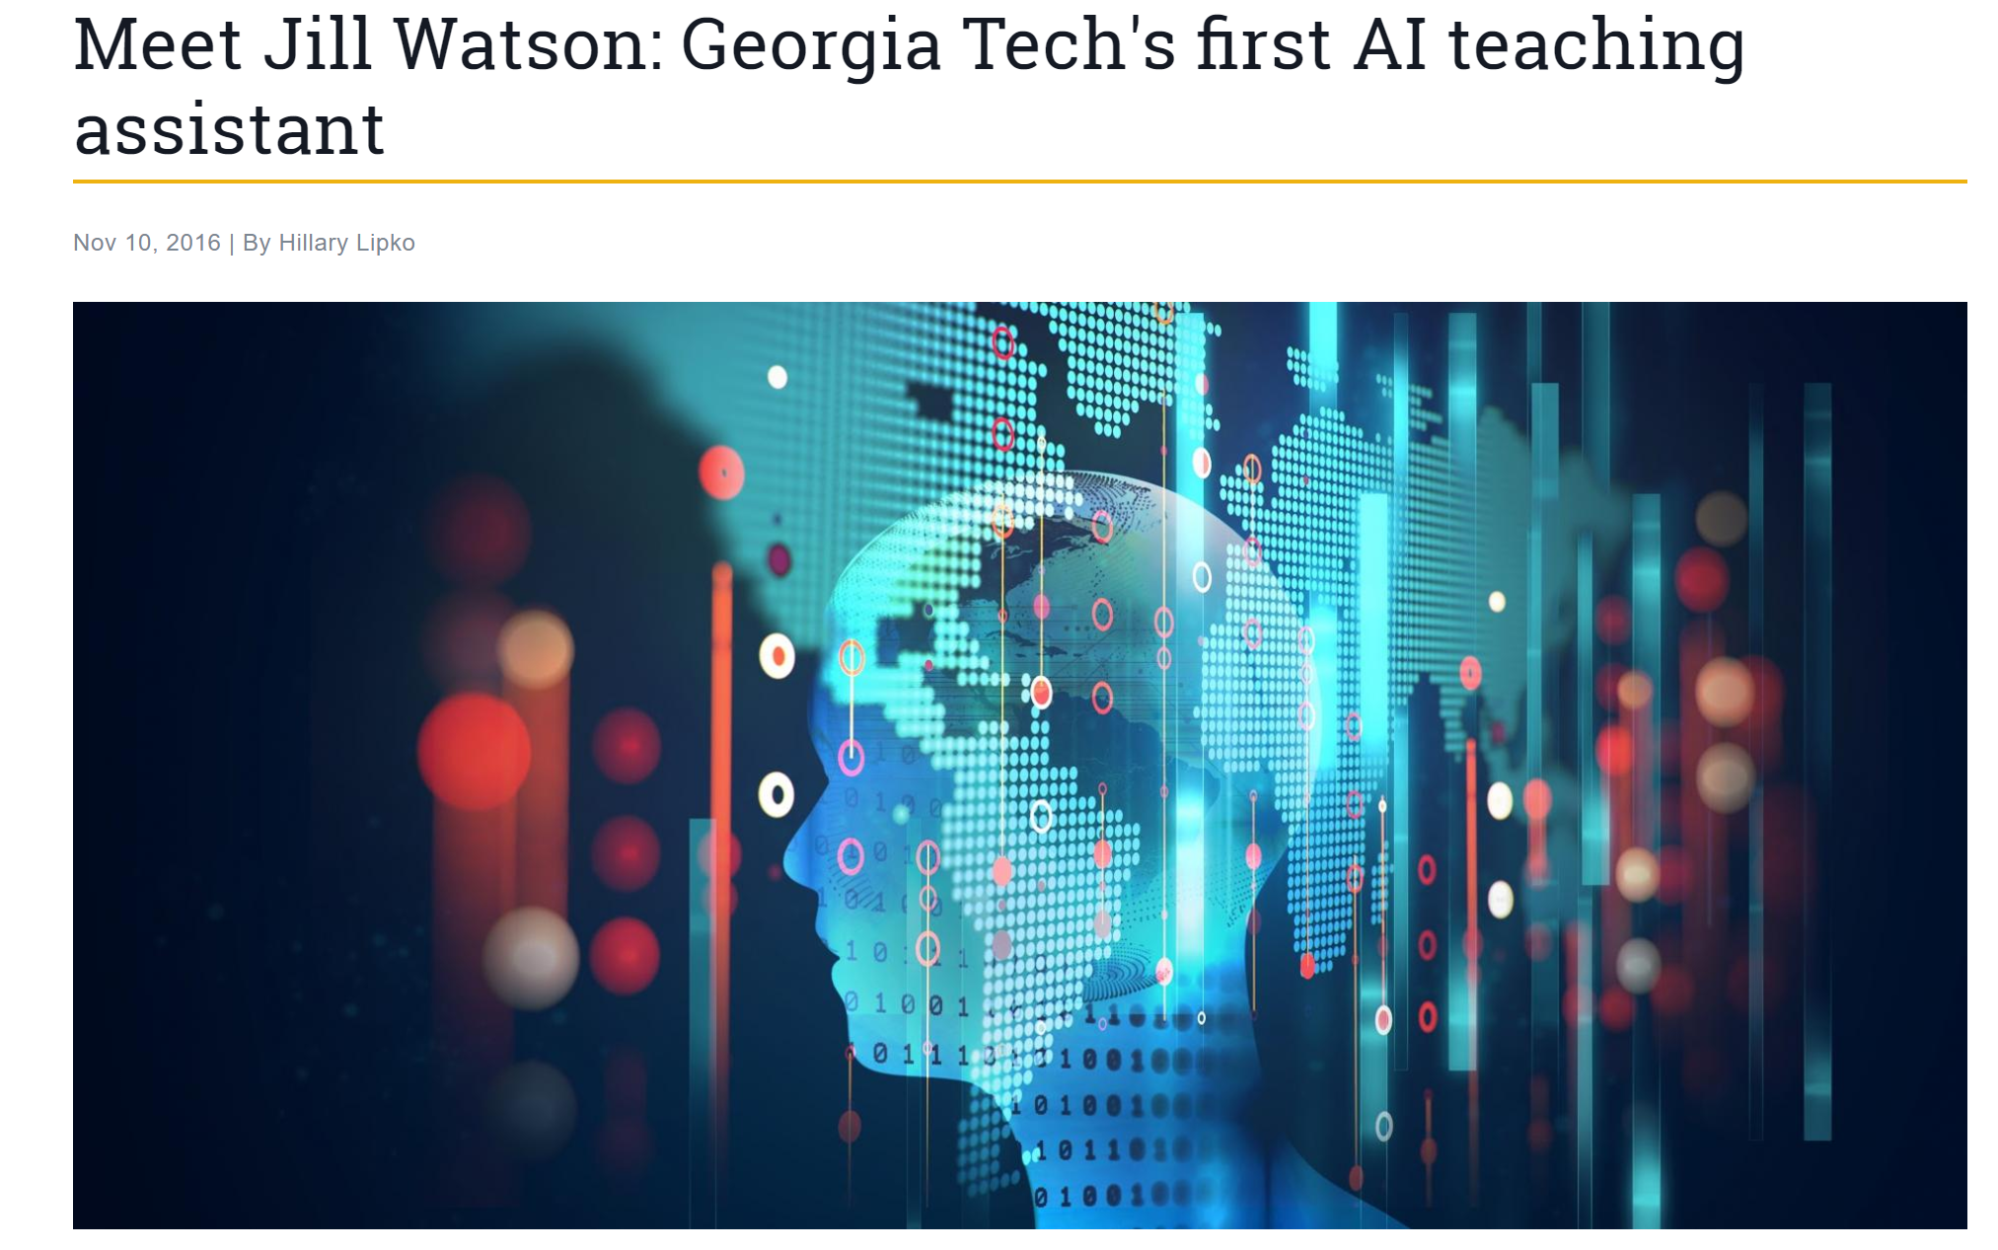

Slide 39
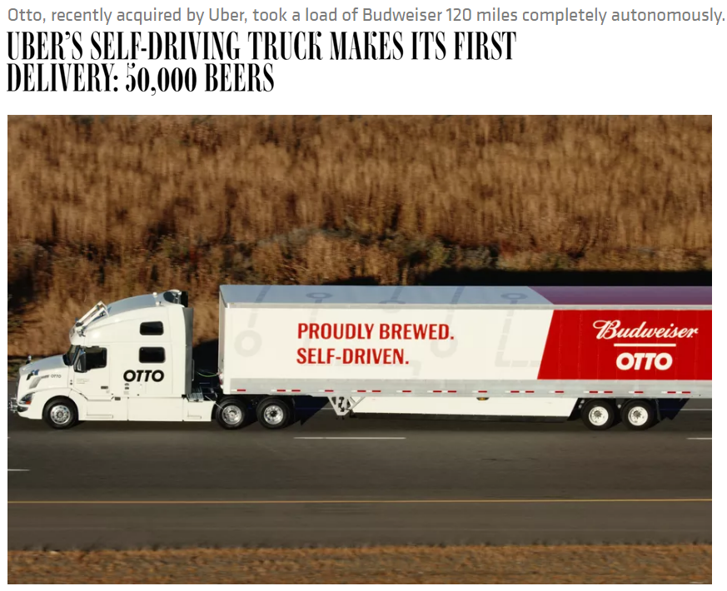

Slide 40
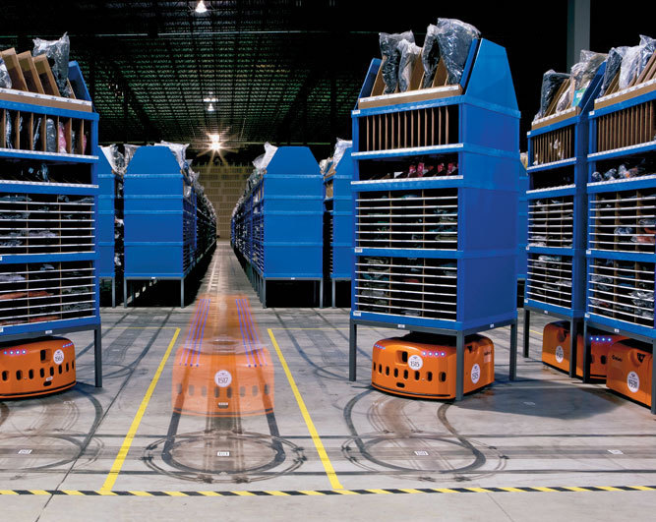

Slide 41
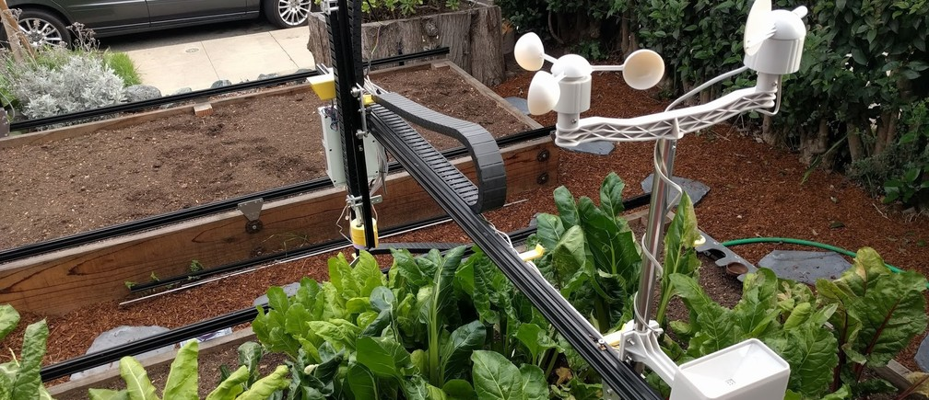
A new farmer who can do farming much better

Slide 42
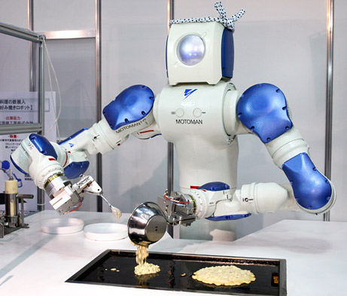

Slide 43


Slide 44
Who are the new lifelong learners in 10 years?

Slide 45
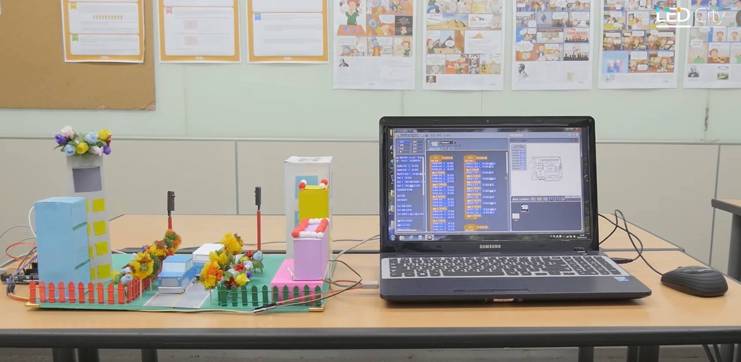
3rd grade @CMS EDU

Slide 46
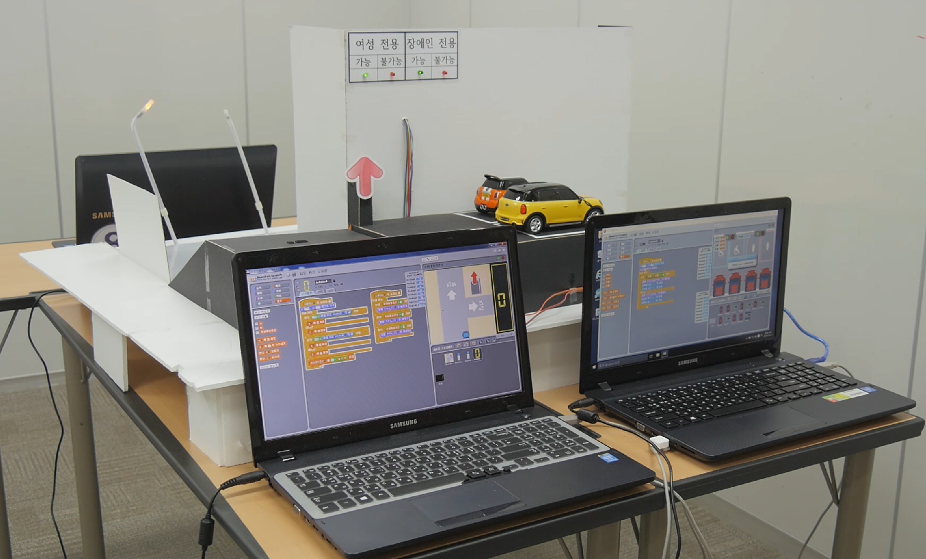
3rd grade @CMS EDU

Slide 47
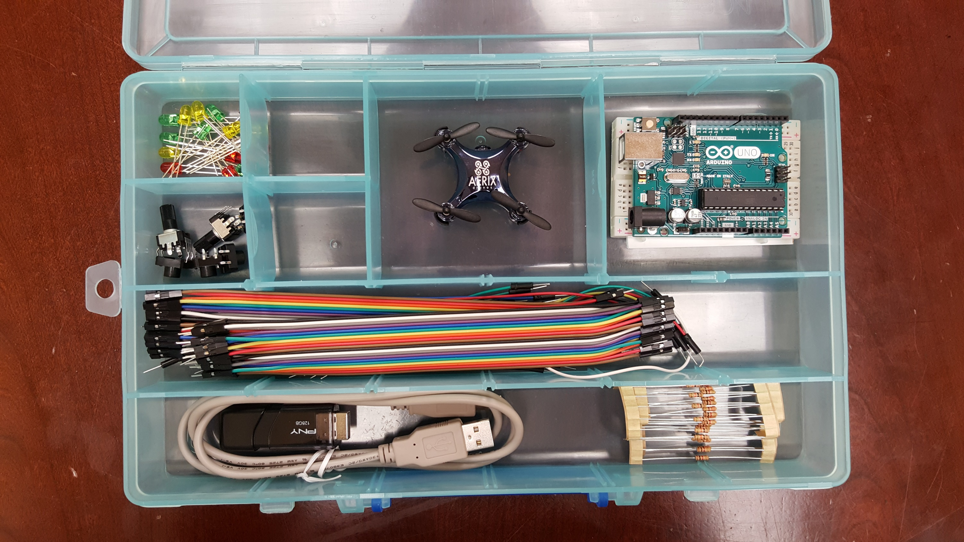

Slide 48
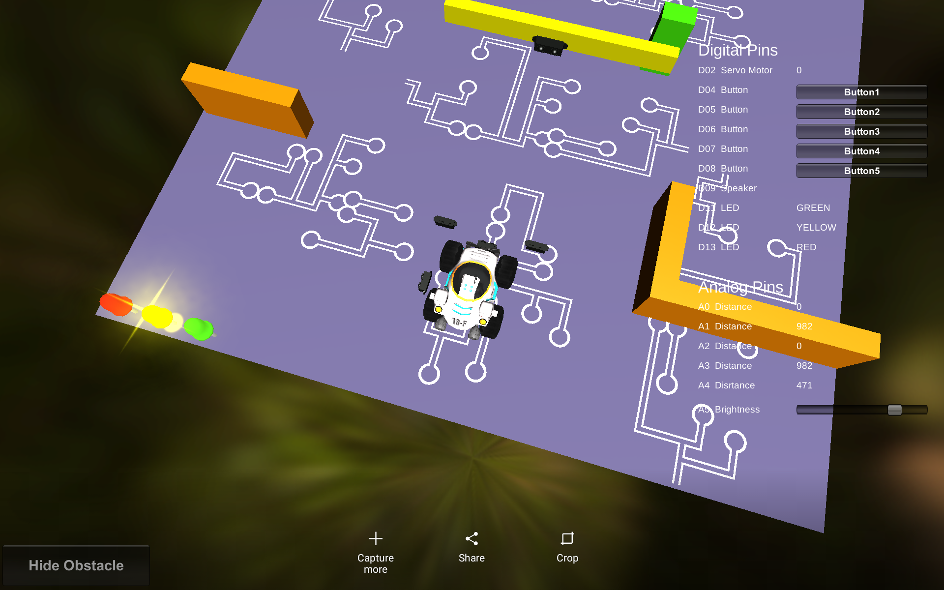


Slide 49
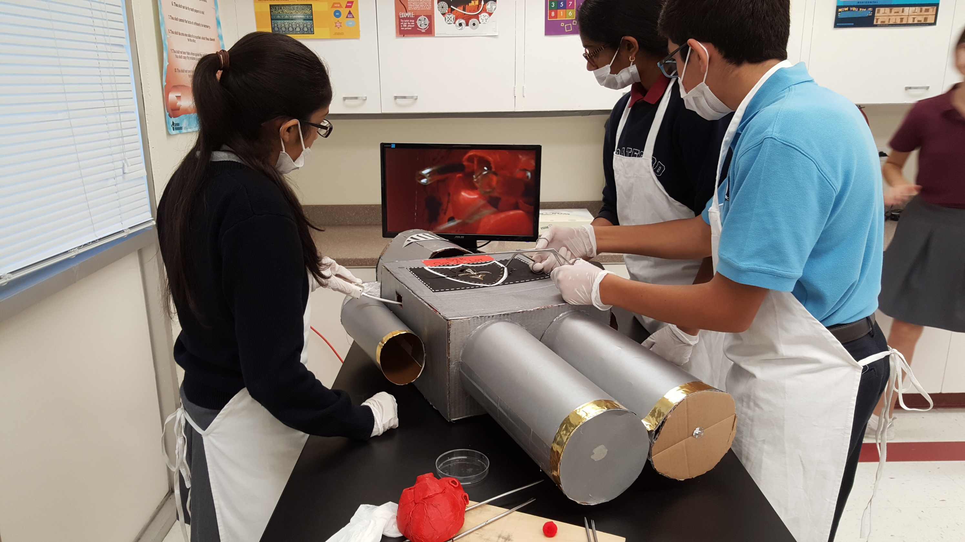
5th Grade
@Stratford School

Slide 50
Maker’s Space is the New School of the Future

Slide 51
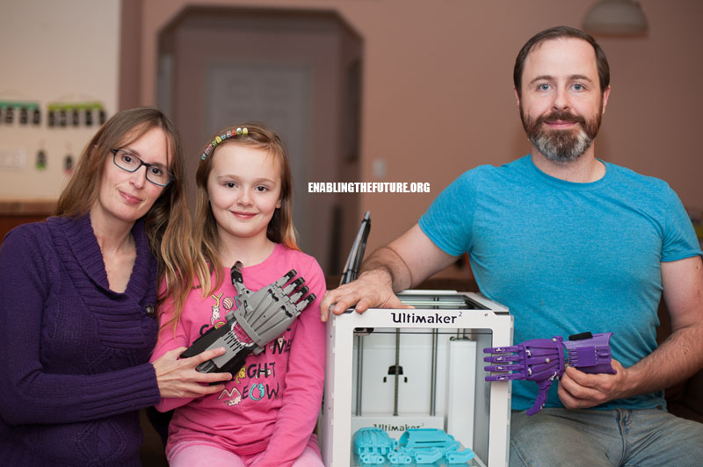

Slide 52

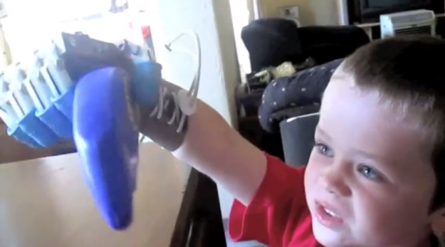
Torrae & Ivan Owen building a hand for Liam

Slide 53
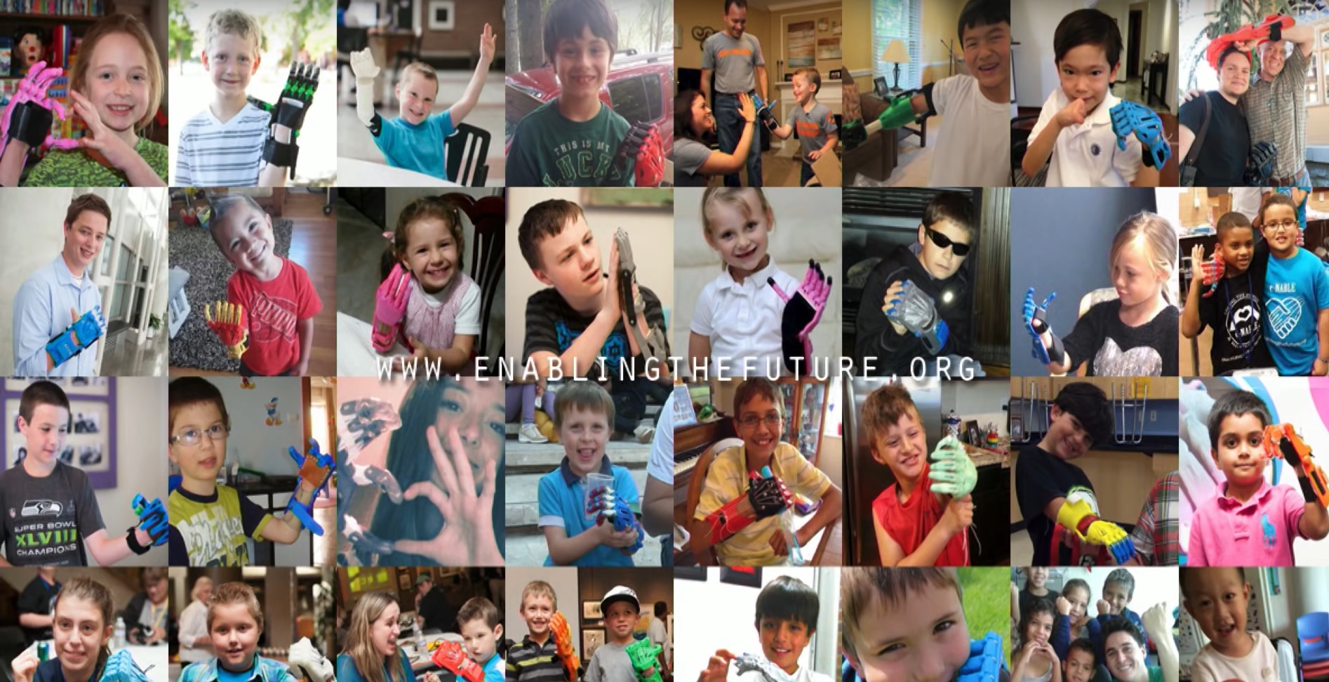

Slide 54
Designer is the New Student of the Future

Slide 55

Creation to Production

Slide 56
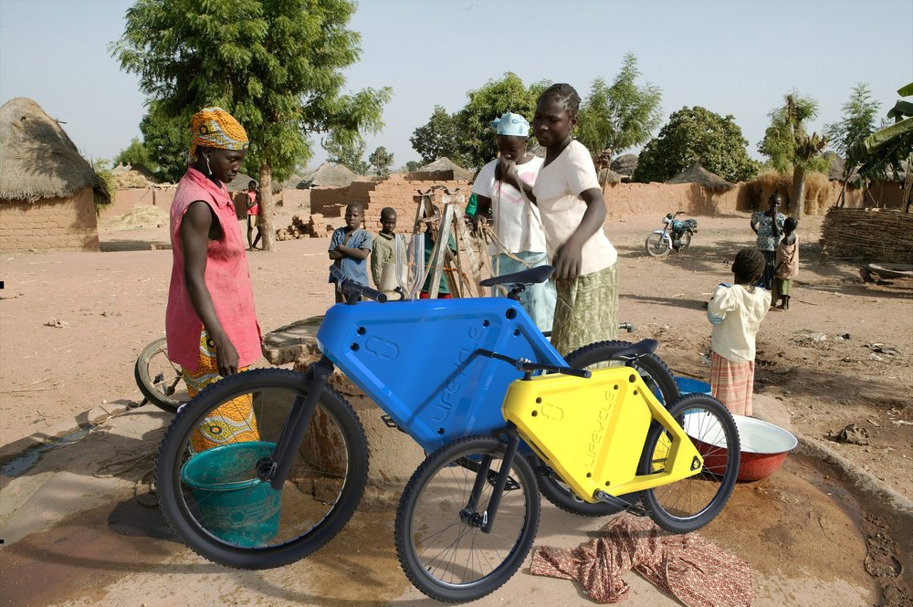
Multidisciplinary Real-world Problem Solving
Multidisciplinary Problem Solving

Slide 57

Digital Footprints – Evidence of learning activities
IoT– Devices and embedded sensors generating data in learning environments
Real-time Assessment

Slide 58
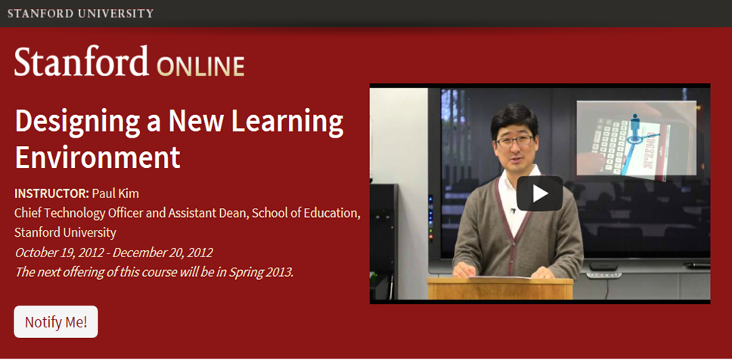
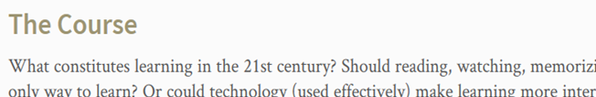
20000 student class!

Slide 59
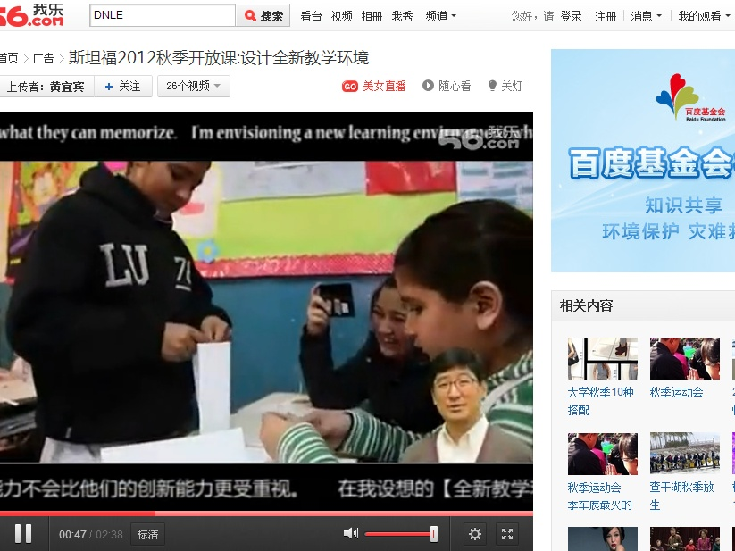
What’s not typical in MOOCs
  Challenges – China, Mideast, social network sites banned, no YouTube access. (Use Youku, 56.com, etc.)

Slide 60
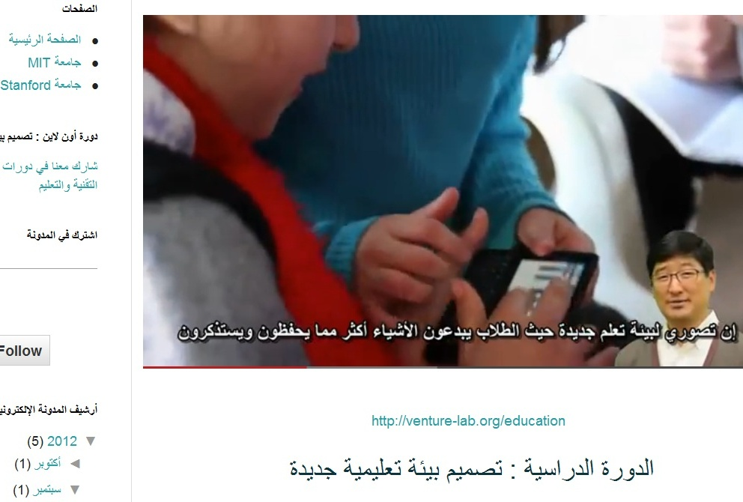
What’s not typical in MOOCs

Slide 61
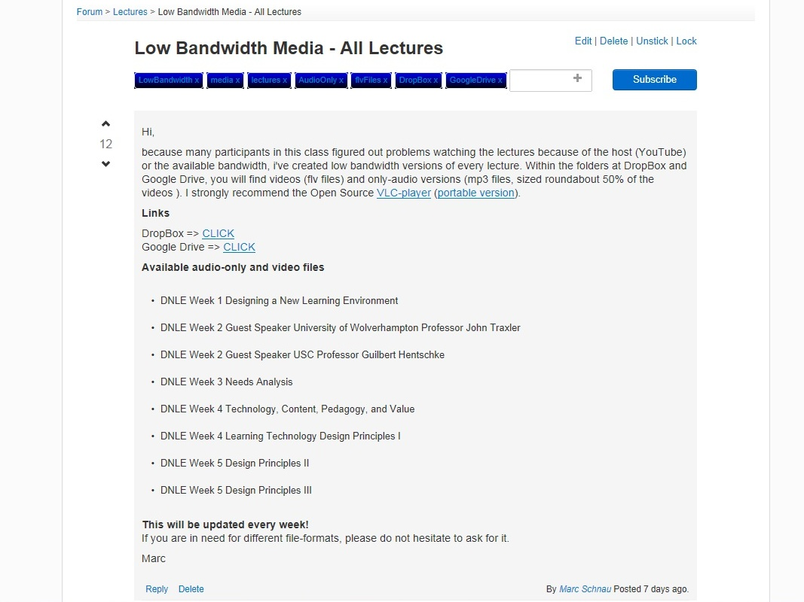
What’s not typical in MOOCs

Slide 62

New Media Consortium
Goldman Sachs
NovoEd
Udemy
and several education leaders

Slide 63

Sharing is the New Learning

Slide 64



Why Share Knowledge on ?
Reach
Share your knowledge with millions of people around the world.
Revenue
Earn money teaching what you know and love.
Passion
Join everyday experts excited about teaching online.

Slide 65

Knowledge Sharing on Udemy
26,000
Experts teaching on Udemy
$45M
Course Sales for top 10 Udemy instructors
$7,000
Average instructor earnings
300+
Instructors have earned $100,000+
6 to 8 weeks
Average time to publish a course
Notes:
Here are a two examples of our instructors

Slide 66
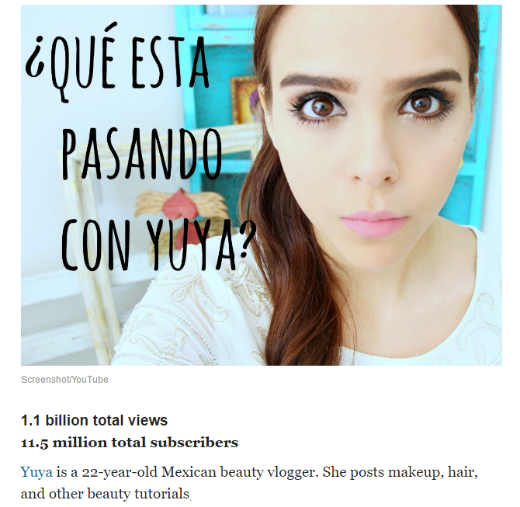


Give for Free,
Earn Respect,
Engage Passionately,
Grow by Supporters,
Earn Handsomely
Some Youtubers earned income as high as 15M

Slide 67

You are the New Edupreneur

Slide 68




Digital Assistant Engine
Asking critical questions is more important than searching for information

Slide 69
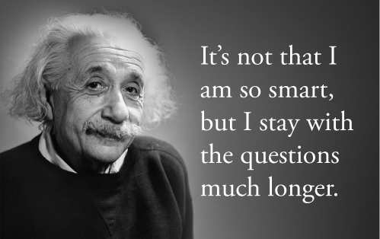

Slide 70
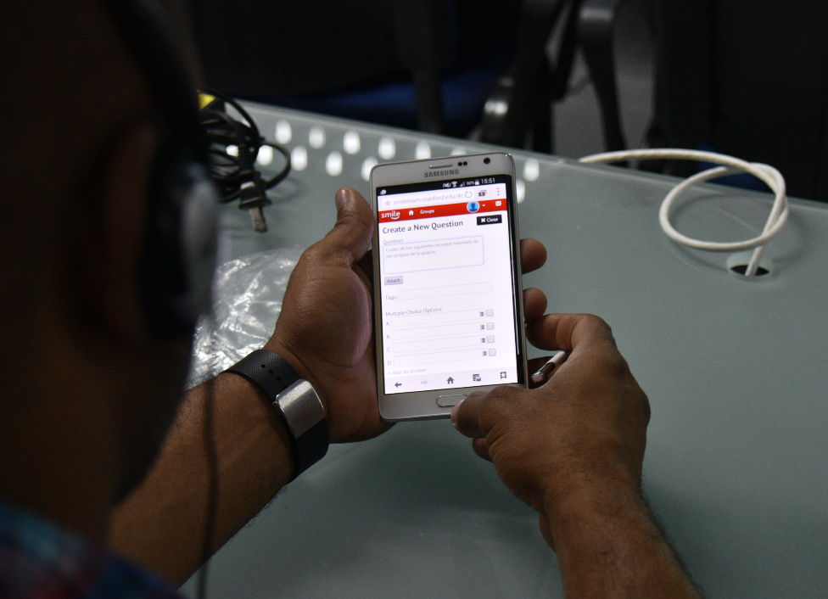
SMILE (Stanford Mobile Inquiry-based Learning Environment)

Slide 71
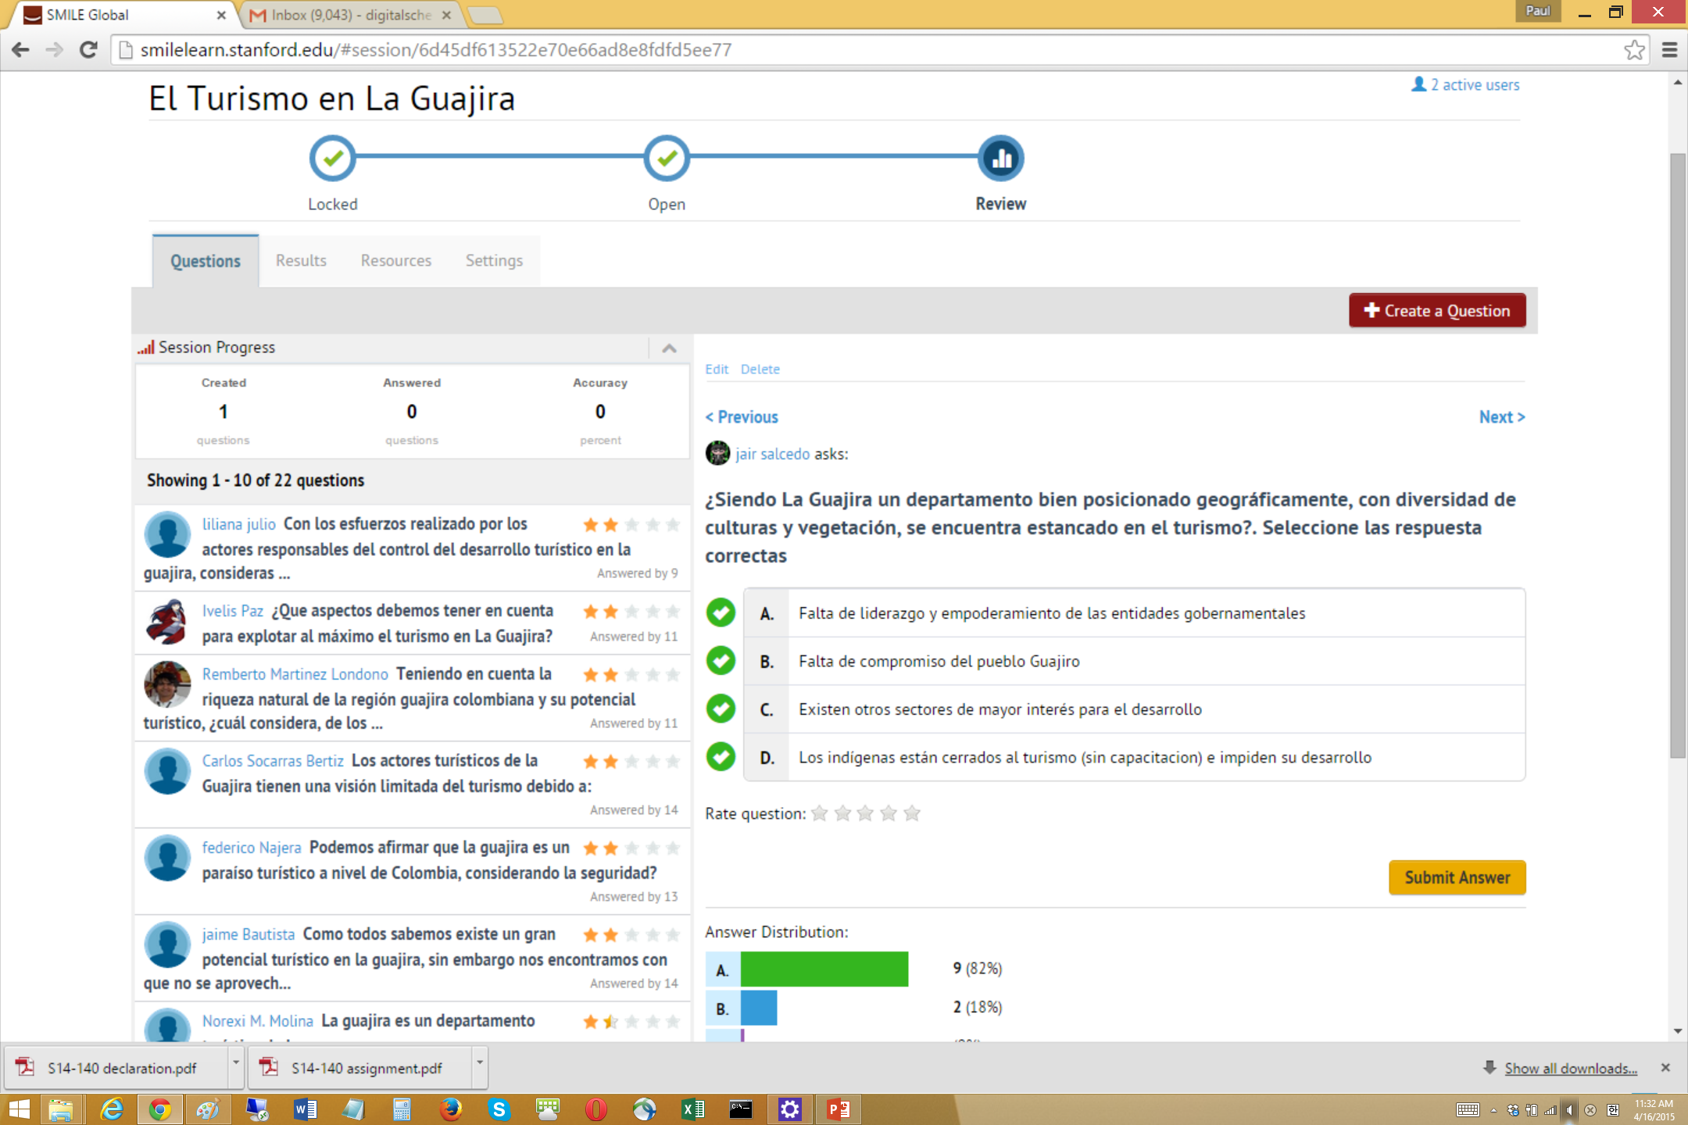

Slide 72

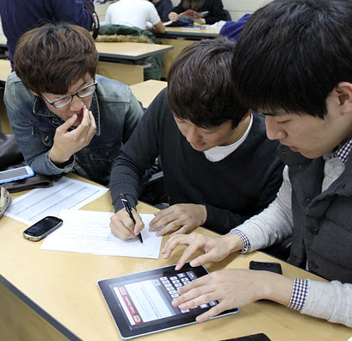
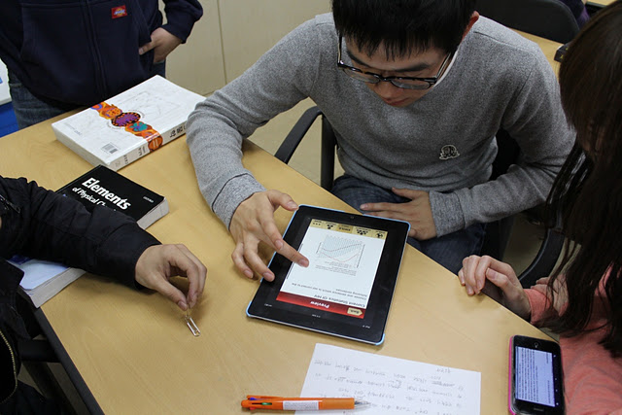
Every student is engaged
  S. Korea. Medical University - BYOD
  Moving from lecture-centered to
  student interaction-centered model.
  Developed local evaluation rubrics.

Slide 73




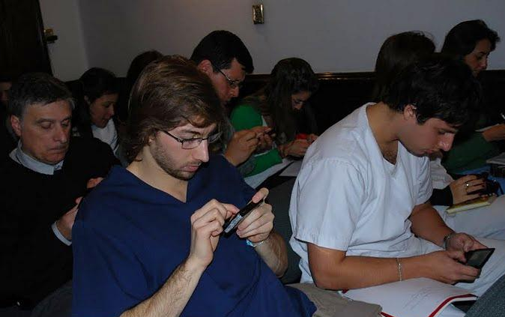
No question? Have you really learned anything?

Slide 74
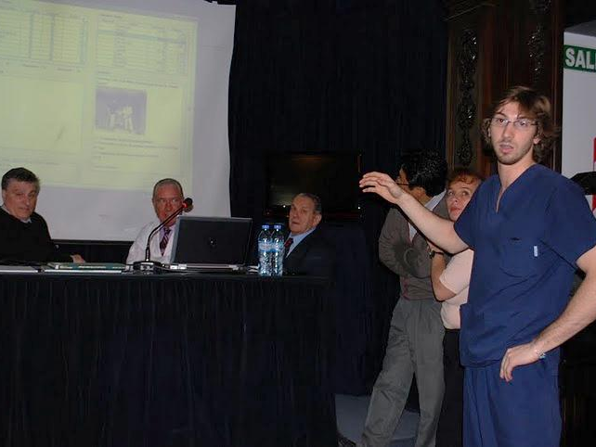

Slide 75


Slide 76


Slide 77
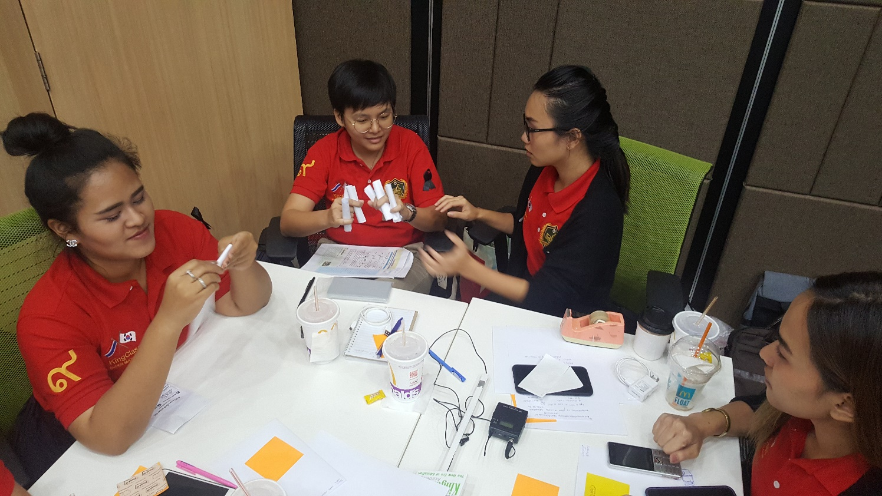

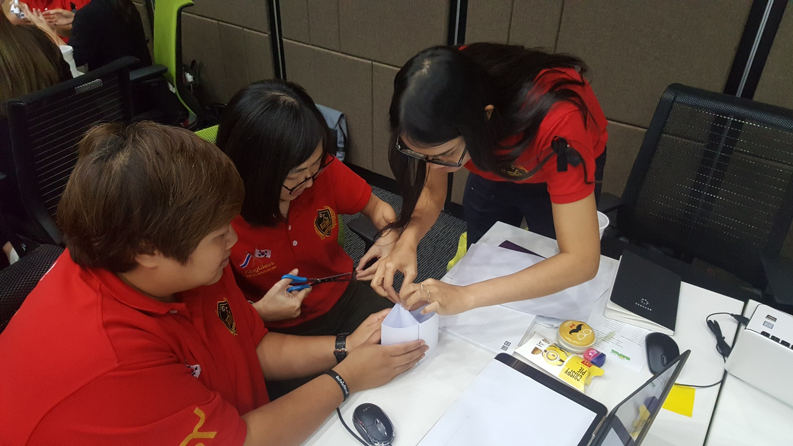

Slide 78


Slide 79
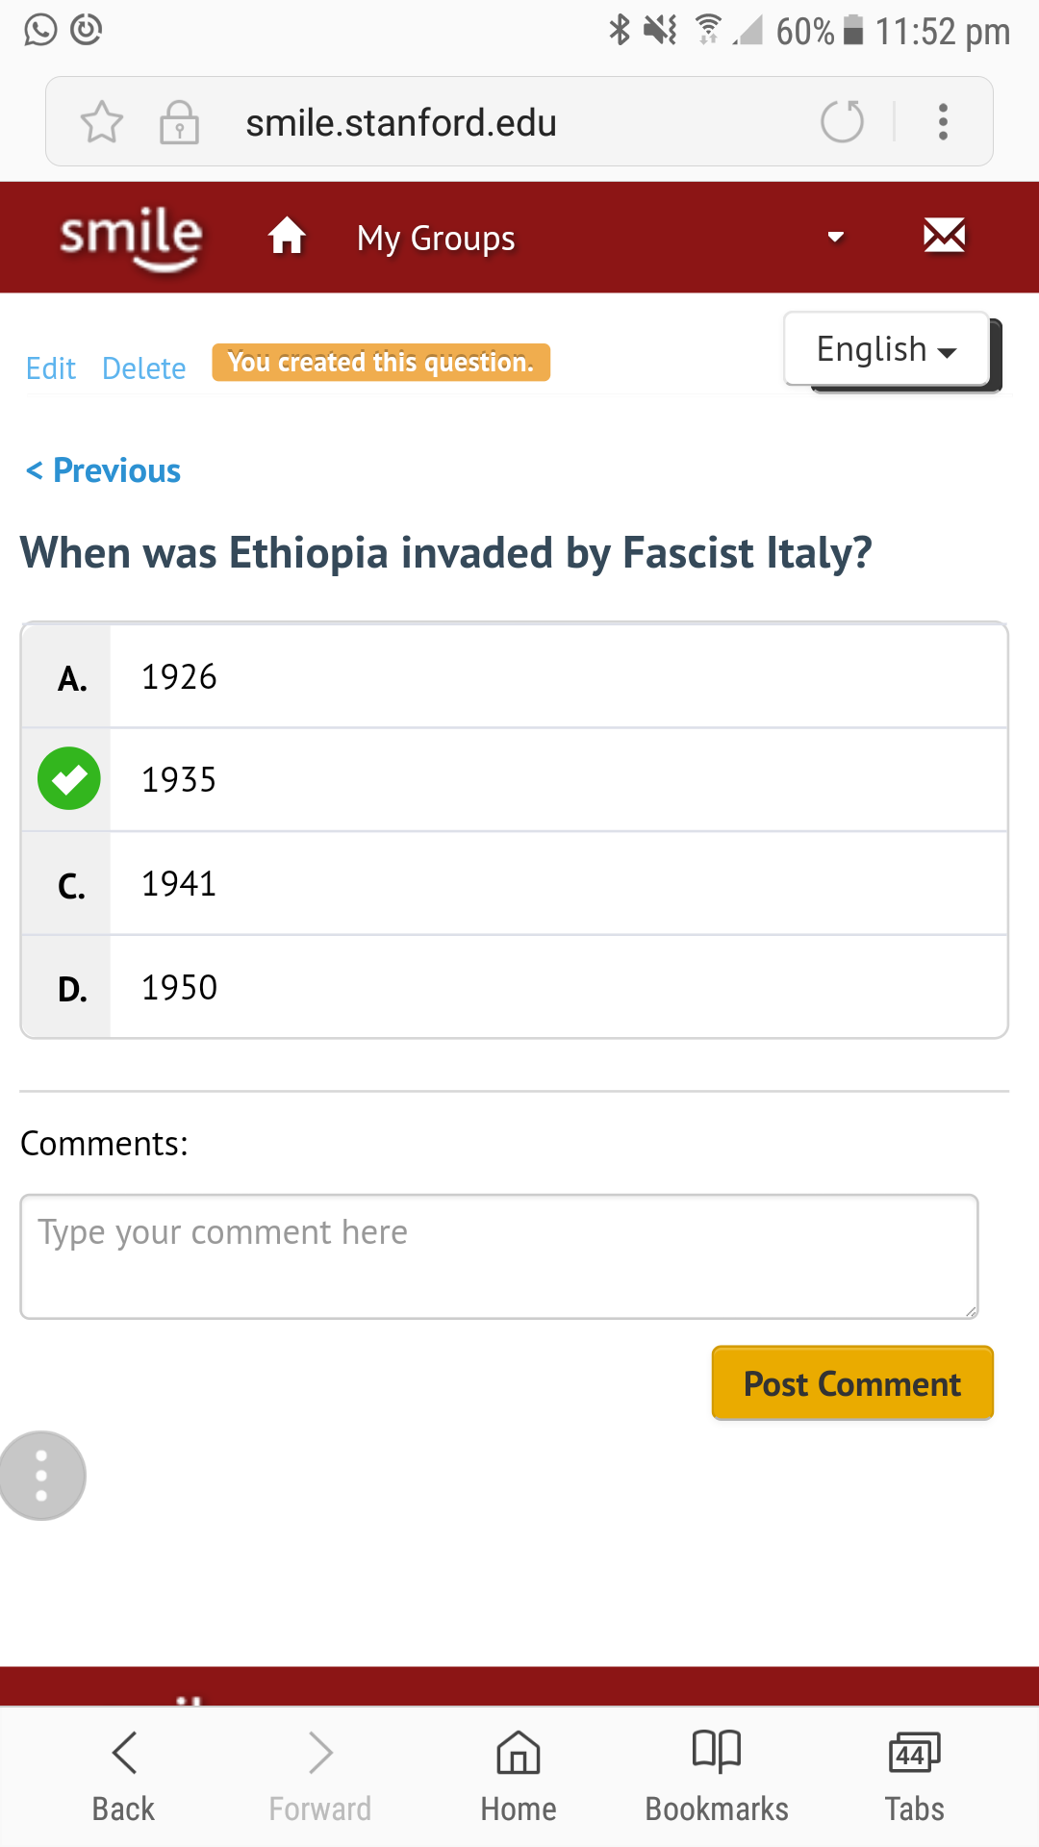


Slide 80
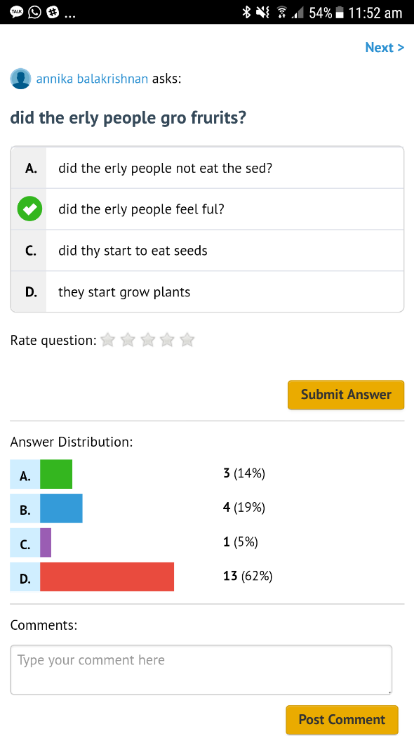


Slide 81




Bridge between MOOCs and Learners in the under-developed regions.
Adhoc local area mobile learning network – content & application server + router + wifi + storage
One button and runs on a battery

Slide 82





Slide 83




Slide 84


$200
$35
4 times faster
4 times more storage
Quad-core CPU

Slide 85


Our system gives statistical analysis on how close each question is to a different type and quality of questions.
Using existing question sets as training data. A few ways to improve the performance of our system:
Use better and more training data (SMILE accumulating questions everyday. You can help!)
Enhance our algorithm layers to make our analysis much deeper learning
AlphaGo training itself with 30,000 games a day.

Slide 86




Innovation Question Fisher: DORY

Slide 87
A Great Question is the New Innovation

Slide 88


Our brain finds ways to “reduce our mental workload,” and one way is to accept without question...
John Kounios, Drexel University

Slide 89
Habit Loop

Slide 90


Do you want to just go with the flow?

Slide 91


Slide 92



Dick Fosbury

Slide 93

Gabi Shull

Slide 94


Slide 95
Email your homework to
phkim@Stanford.edu
_________ is the New________
Emerging Paradigm, Renewed Perspective, Practice
Traditional, Outdated Concept, Behavior

