Slide 1



MOOCs Workshop:
Design-Based Research (DBR) on MOOCs and Open Education
Part 1: MOOC News and Research Topics
Curt Bonk, Indiana University, cjbonk@indiana.edu
Tom Reeves, The University of Georgia, treeves@uga.edu

Slide 2

Audience Poll #1:
Who in here has taken a MOOC?

Slide 3

Fall 2014, On Wisconsin
MOOC, Meet MORC (Massive Open Radio Course)
WHA, UW Madison, College of the Air,1933,
Vocational Training dedicated to Agriculture, and later Home Economics and Typing

Slide 4


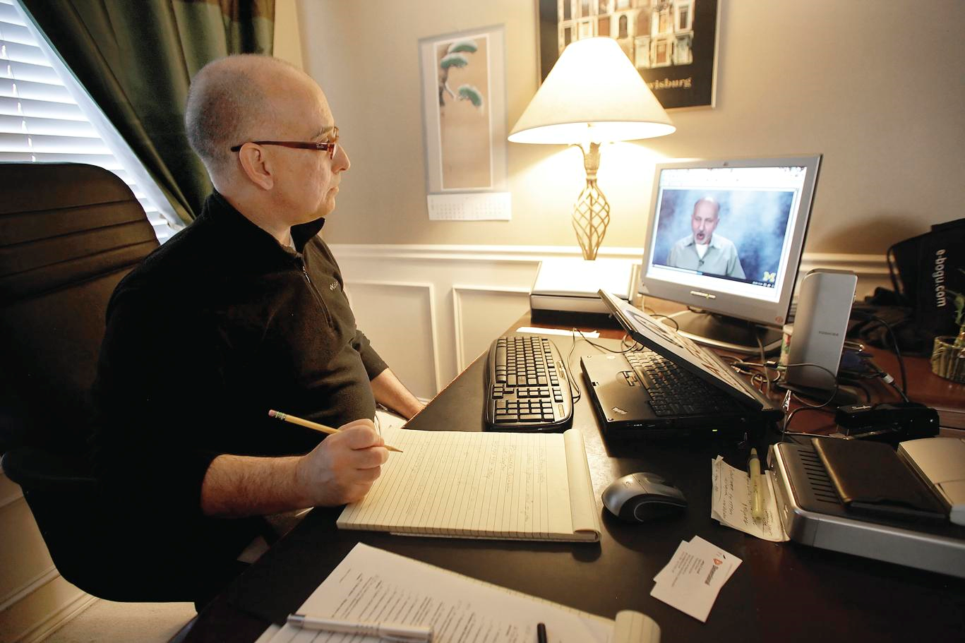
Enter the age of the MOOC…
Frank Basile, an aircraft technician, took an MITx course on circuits and electronics to increase his knowledge.
Joe Alfonso, a financial adviser from Oregon, is taking the online finance course as a "refresher."

Slide 5
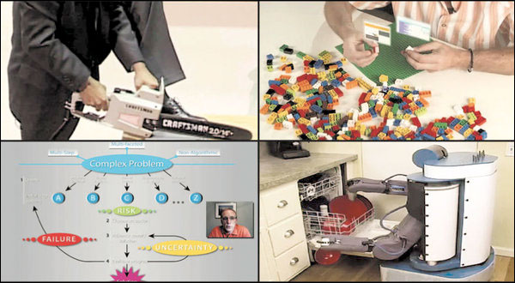

November 2, 2012
The Year of the MOOC,
New York Times, Laura Pappano, http://www.nytimes.com/2012/11/04/education/edlife/massive-open-online-courses-are-multiplying-at-a-rapid-pace.html?pagewanted=all
Clockwise, from top left: an online course in circuits and electronics with an M.I.T. professor (edX); statistics, Stanford (Udacity); machine learning, Stanford (Coursera); organic chemistry, University of Illinois, Urbana (Coursera).

Slide 6


June 19, 2013
2013 is “The Year of the Anti-MOOC”
George Siemens, UW-Madison Summit http://globalhighered.wordpress.com/european-moocs-in-global-context/

Slide 7
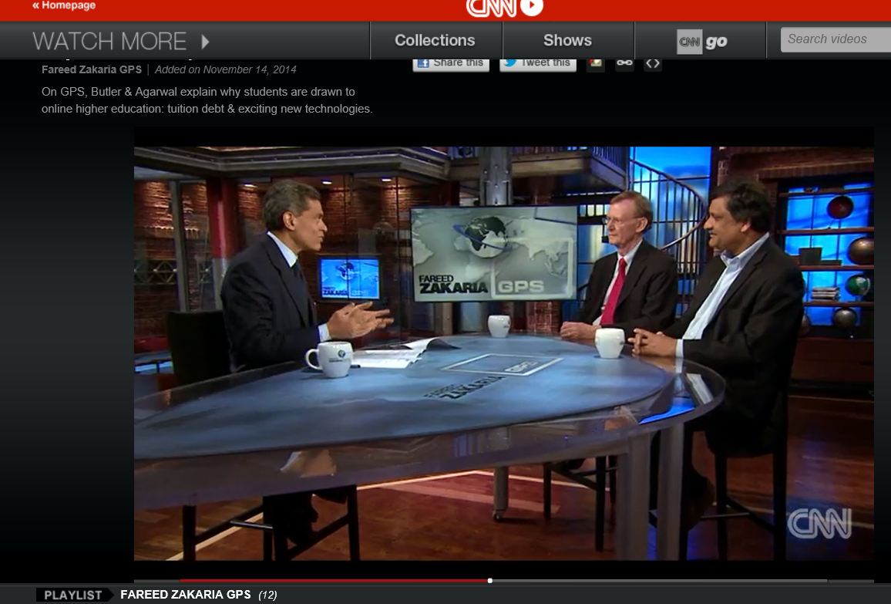
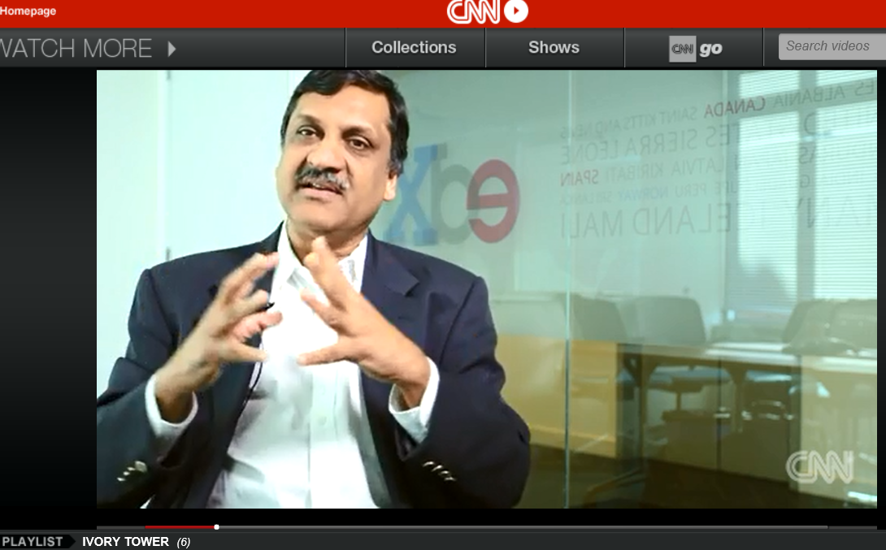
MOOCs Disruptive?
November 14, 2014 (2:25)
Why online ed disrupts the traditional model,
Fareed Zakaria GPS, CNN, On GPS, Stuart Butler & Anant Agarwal explain why students are drawn to online higher education: tuition debt & exciting new technologies http://www.cnn.com/video/data/2.0/video/bestoftv/2014/11/15/exp-gps-moocs-sot.cnn.html

Slide 8
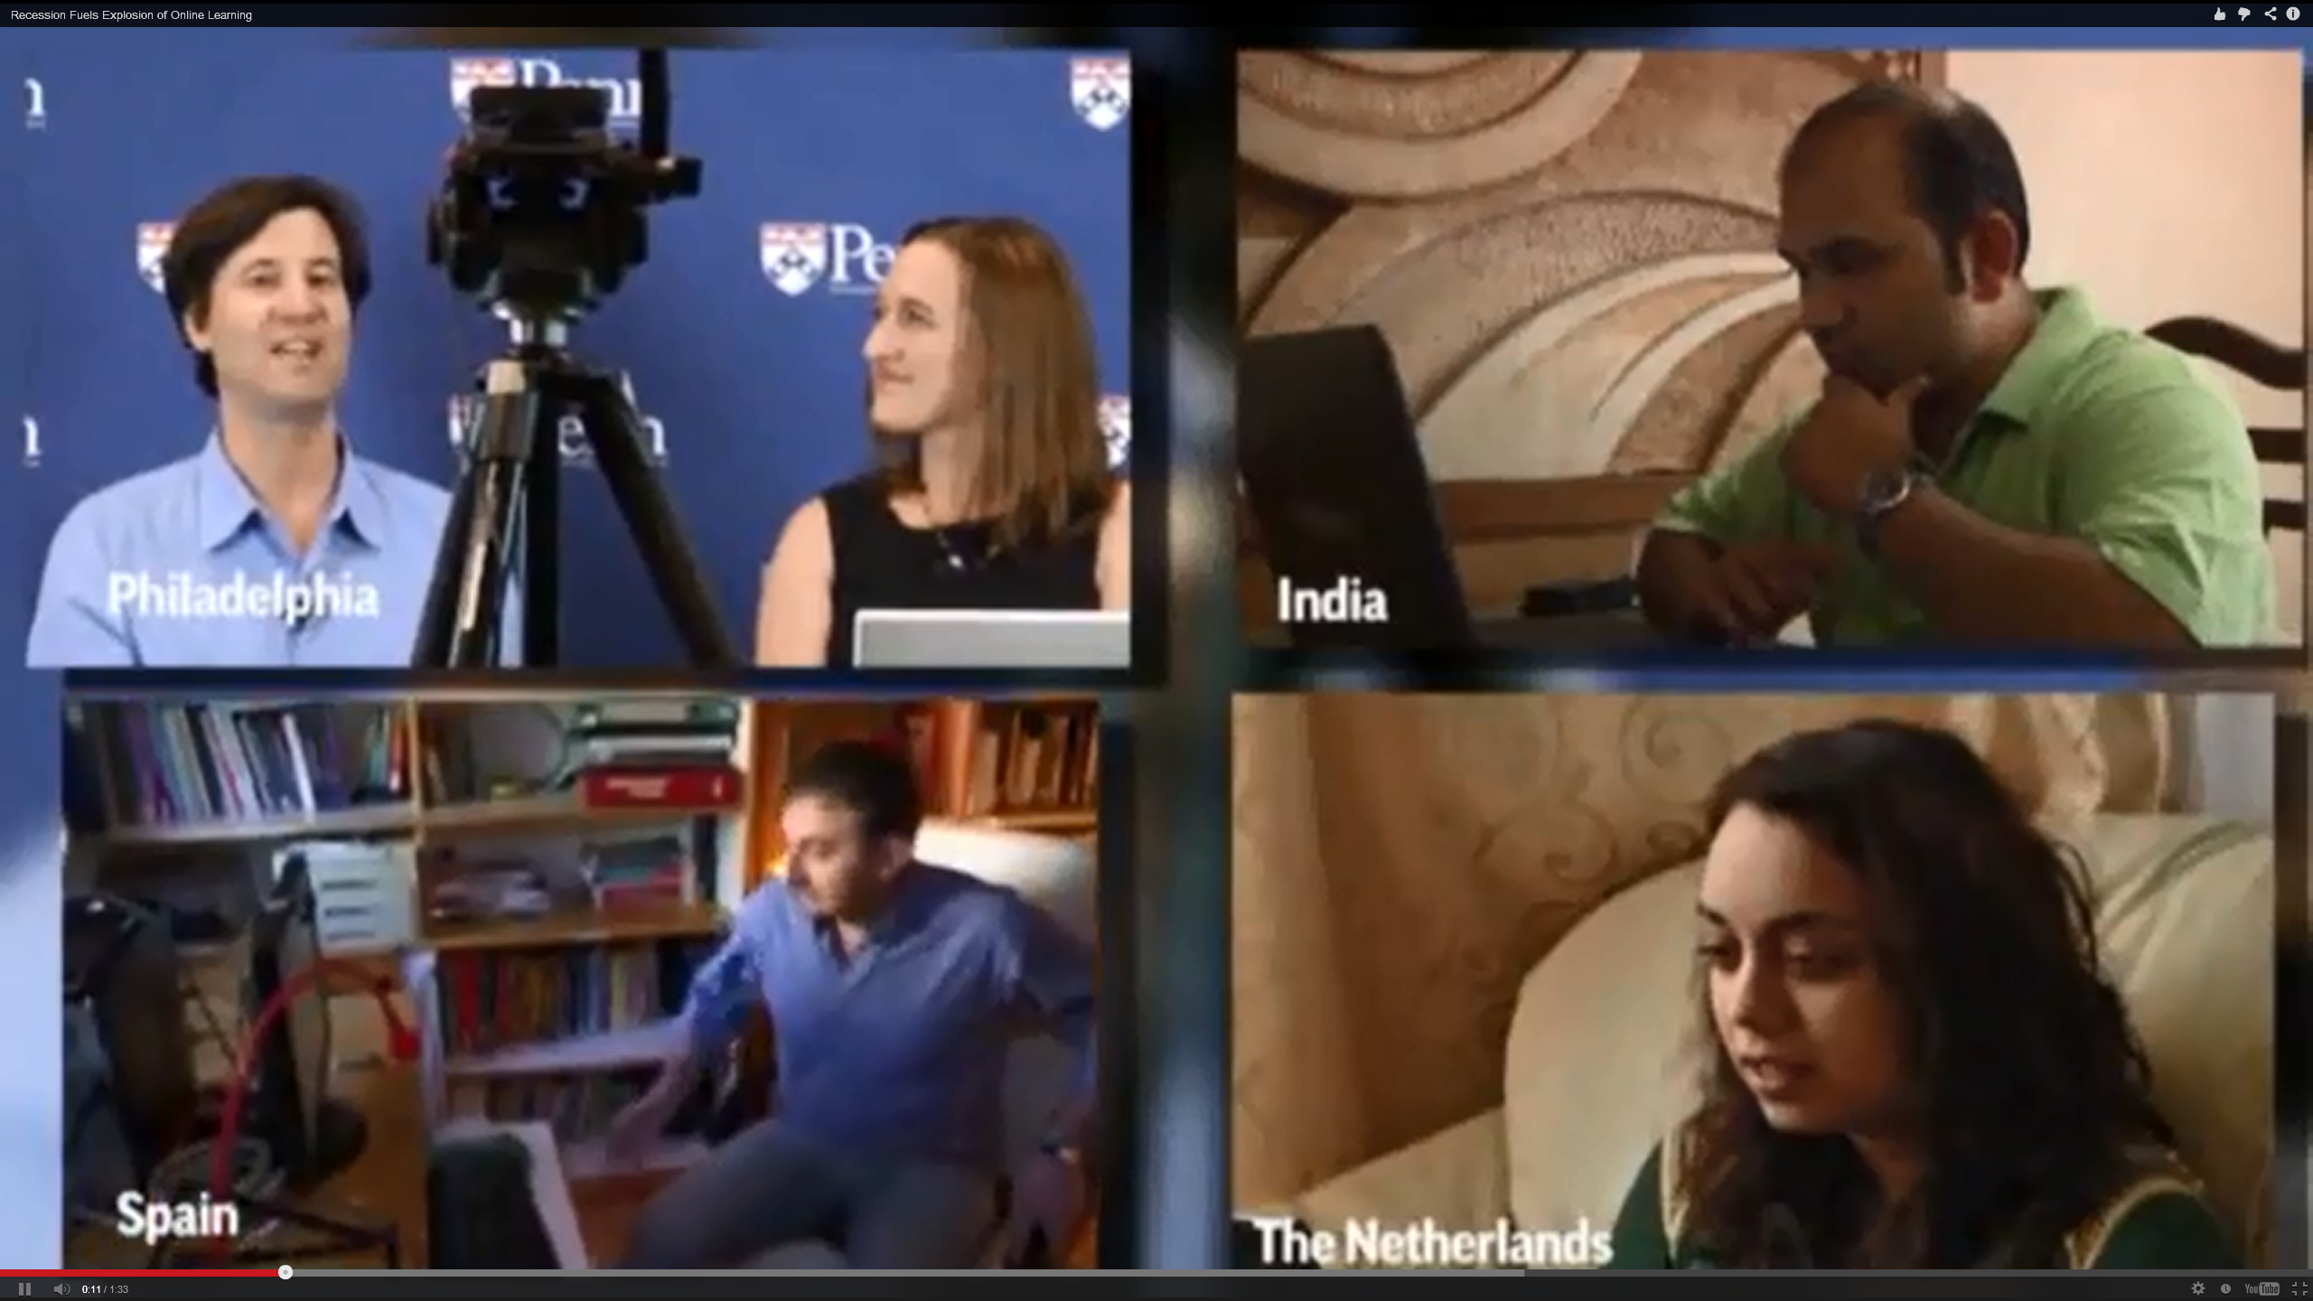

Learning is More Massive
Sample Course: Open Knowledge:
Changing the Global Course of Learning
September 2, 2014 to December 12, 2014, Stanford https://class.stanford.edu/courses/Education/OpenKnowledge/Fall2014/about#
Softcover ($30): http://www.parlorpress.com/invasion_of_the_moocs
Free (PDF): http://www.parlorpress.com/pdf/invasion_of_the_moocs.pdf

Slide 9
August 30, 2015
Massive online courses grow; what's in it for the universities?, Kirk Pinho, Crain’s Detroit Business http://www.crainsdetroit.com/article/20150830/NEWS/308309998/massive-online-courses-grow-whats-in-it-for-the-universities
More than 3.25 million people took massive open online courses through the University of Michigan during the last three years — a figure equivalent to 76 percent of the metro Detroit population of 4.29 million.

Slide 10
August 30, 2015
Massive online courses grow; what's in it for the universities?, Kirk Pinho, Crain’s Detroit Business http://www.crainsdetroit.com/article/20150830/NEWS/308309998/massive-online-courses-grow-whats-in-it-for-the-universities
And all told, there have been between 16 million and 18 million people enrolled in MOOCs, about 2,500 of which had started or were scheduled to start as of July 2015, according to EdSurge Inc., an independent Burlingame, Calif.-based education technology information provider.
A typical MOOC enrollment level is around 25,000 students, according to research by Katy Jordan, a Ph.D. candidate focusing on technology-enhanced learning at The Open University in the United Kingdom.

Slide 11

Discussion Issue
Are we starting our research from the point of view of “here are some serious problems (students are unengaged, disenfranchised people lack access to educational opportunities)”
Or:
Are we simply going to focus on making MOOCs more effective, efficient, etc., without sufficient attention to the needs that they should be fulfilling?

Slide 12
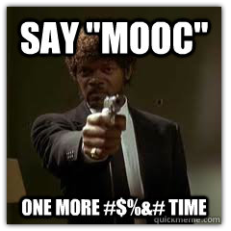
Activity #1: Question
"What are the problems that MOOCs and OER are supposed to address?" or "Are MOOCs and OER "solutions" in search of problems?"
(Note: Best Answers get a MOOCs book.)

Slide 13

30+ Sample MOOC Research Topics

Slide 14
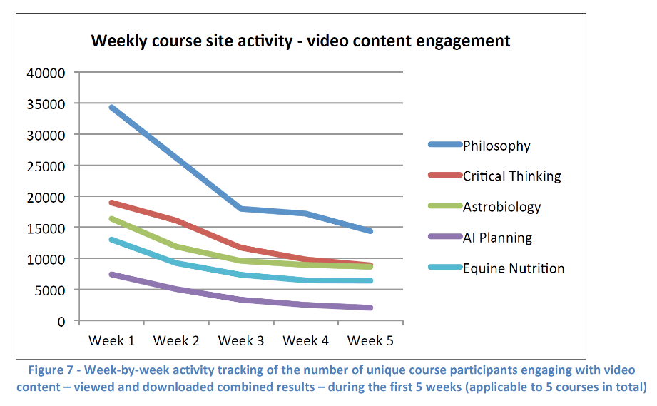
May 2013
Research Topic #1.
Dropout (i.e., retention) Concerns
MOOCs @ Edinburgh 2013– Report #1

Slide 15
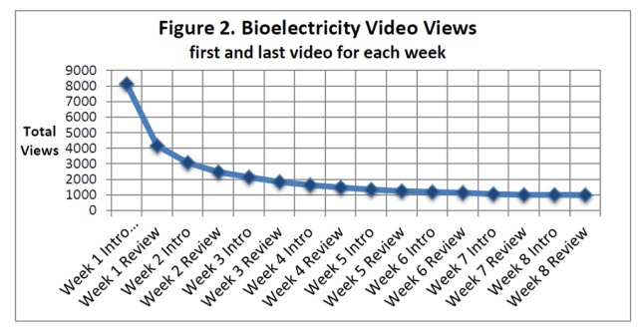
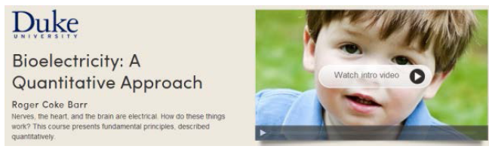
February 5, 2013
Bioelectricity: A Quantitative Approach,
Duke University’s First MOOC http://dukespace.lib.duke.edu/dspace/bitstream/handle/10161/6216/Duke_Bioelectricity_MOOC_Fall2012.pdf

Slide 16
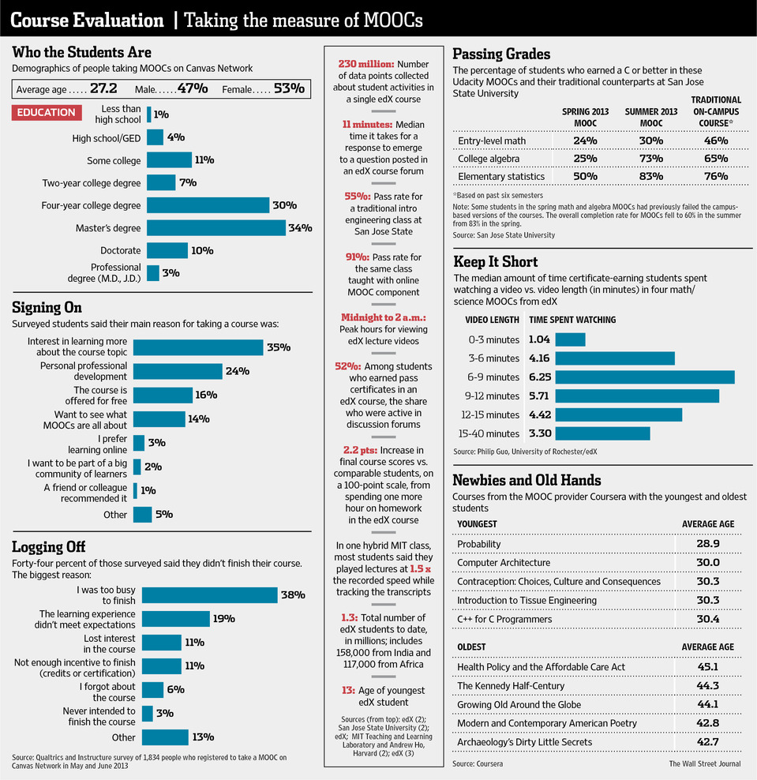

October 8, 2013
An Early Report Card on Massive Open Online Courses, Recap of Canvas courses
Geoffrey A. Fowler, WSJ Online http://online.wsj.com/article/SB10001424052702303759604579093400834738972.html#project%3DMOOCchrtPRINT%26articleTabs%3Dinteractive
Video: http://online.wsj.com/article/SB10001424052702303759604579093400834738972.html#project%3DMOOCchrtPRINT%26articleTabs%3Dvideo

Slide 17
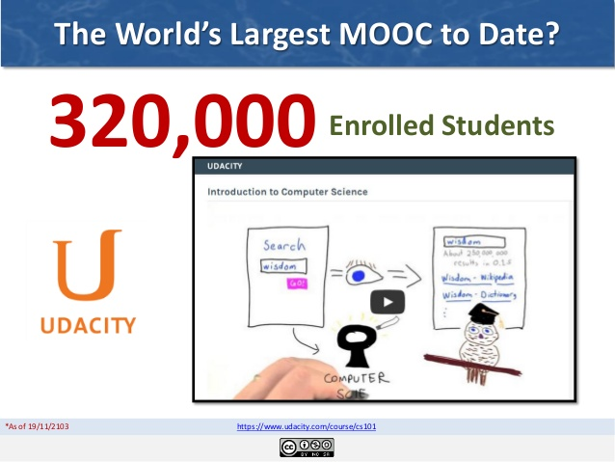
Audience Poll #2:
Have you ever dropped a MOOC?
Have you ever completed a MOOC?

Slide 18
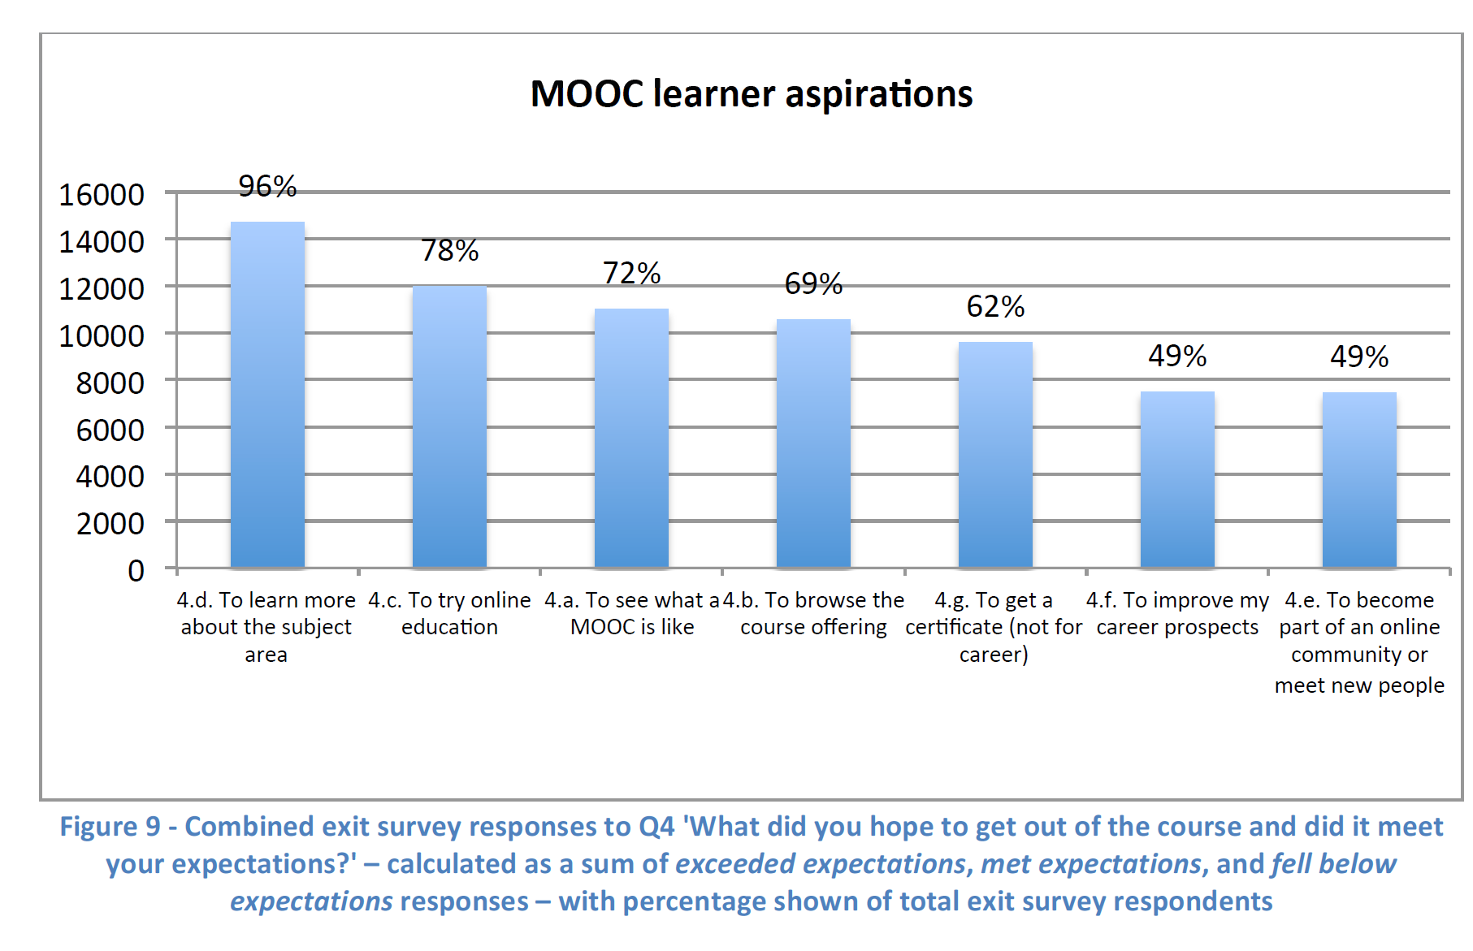
May 2013
Research Topic #2.
MOOC Motivators
MOOCs @ Edinburgh 2013– Report #1

Slide 19
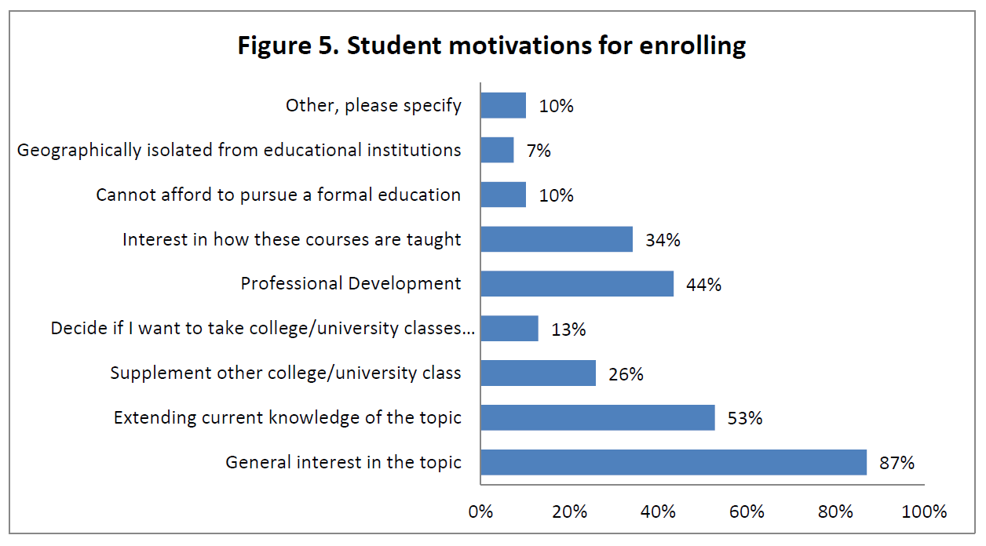
February 5, 2013
Bioelectricity: A Quantitative Approach,
Duke University’s First MOOC http://dukespace.lib.duke.edu/dspace/bitstream/handle/10161/6216/Duke_Bioelectricity_MOOC_Fall2012.pdf

Slide 20
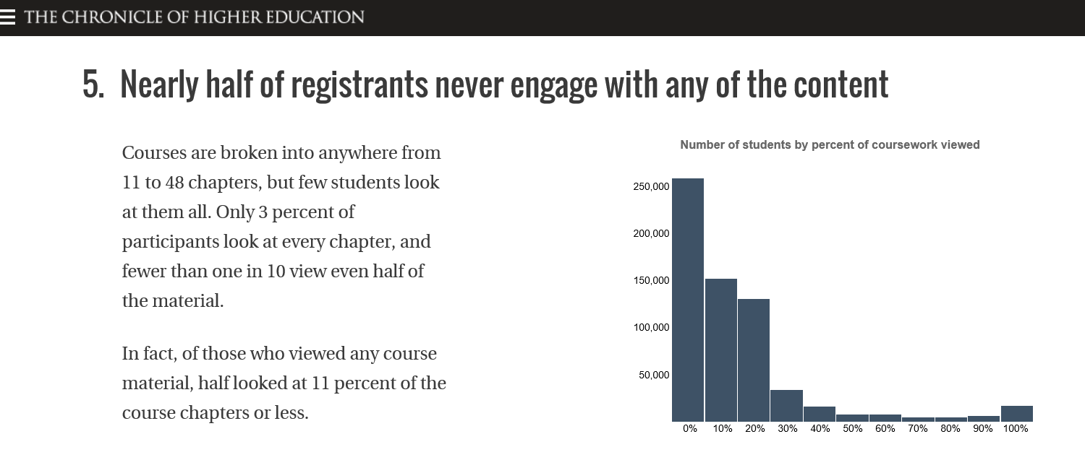
June 13, 2014
Research Topic #3.
Learner Engagement with Content
8 Things You Should Know About MOOCs
Chronicle of Higher Education, Jonah Newman and Soo Oh http://chronicle.com/article/MOOCs-EdX/146901/

Slide 21
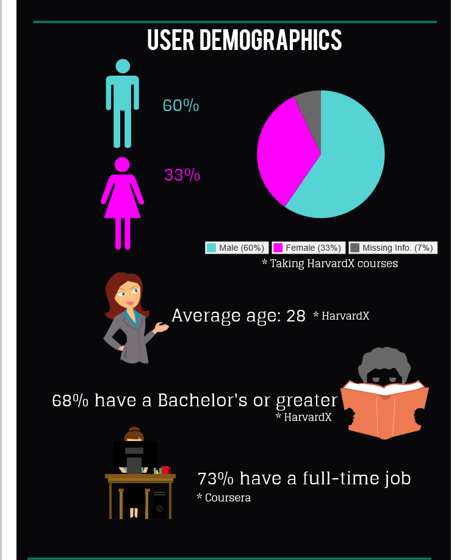
April 17, 2014
Research Topic #4.
Impact of MOOCs Across Age, Gender, and Course Type
Infographic: Global MOOC statistics eCampus News, Meris Stansbury http://www.ecampusnews.com/research/infographic-moocs-global-436/
Inforgraphic: https://magic.piktochart.com/output/1747660-moocs

Slide 22
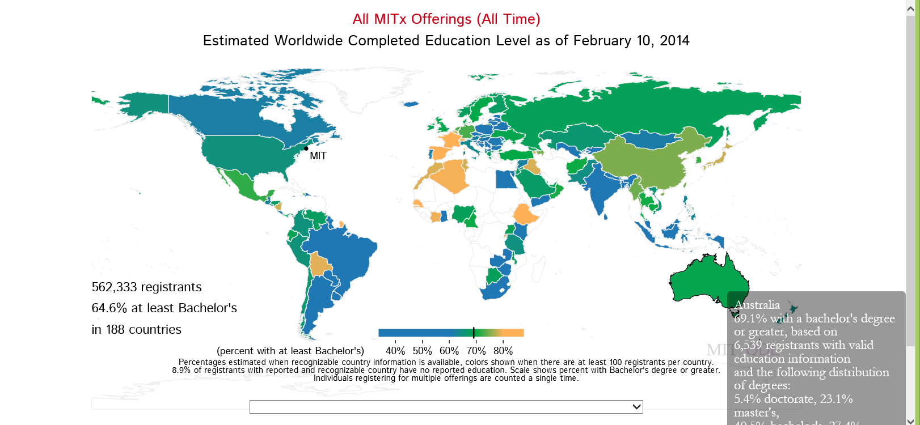
February 20, 2014
What about Education Level?
Harvard and MIT Release Visualization Tools for Trove of MOOC Data
Lawrence Biemiller, Chronicle of Higher Education http://chronicle.com/blogs/wiredcampus/harvard-and-mit-release-visualization-tools-for-trove-of-mooc-data/50631?cid=pm&utm_source=pm&utm_medium=en

Slide 23
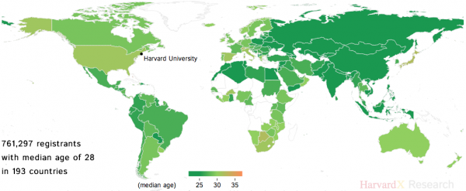
What About Age?
Data Visualization Tools
(Harvard and MIT MOOCs)
Lawrence Biemiller, February 20, 2014, Chronicle of HE http://chronicle.com/blogs/wiredcampus/harvard-and-mit-release-visualization-tools-for-trove-of-mooc-data/50631?cid=pm&utm_source=pm&utm_medium=en

Slide 24
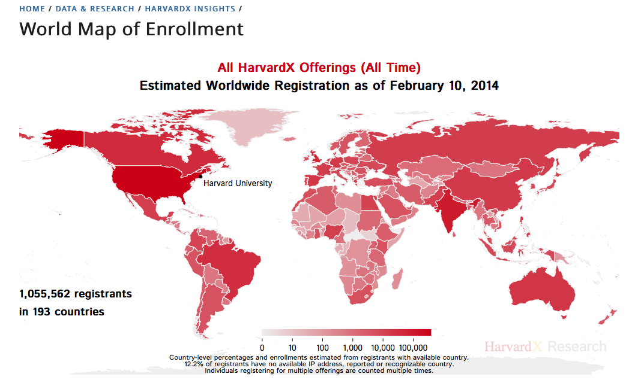
February 20, 2014
Research Topic #5.
Utility of Data Visualization Tools
Harvard and MIT Release Visualization Tools for Trove of MOOC Data
Lawrence Biemiller, Chronicle of Higher Education http://chronicle.com/blogs/wiredcampus/harvard-and-mit-release-visualization-tools-for-trove-of-mooc-data/50631?cid=pm&utm_source=pm&utm_medium=en

Slide 25
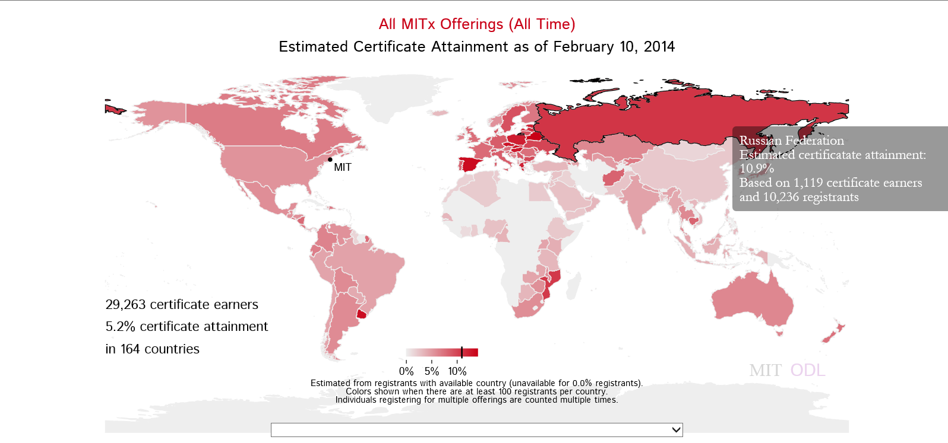
Certificate Earners
Data Visualization Tools
(Harvard and MIT MOOCs)
Lawrence Biemiller, February 20, 2014, Chronicle of HE http://chronicle.com/blogs/wiredcampus/harvard-and-mit-release-visualization-tools-for-trove-of-mooc-data/50631?cid=pm&utm_source=pm&utm_medium=en

Slide 26

April 21, 2014
Research Topic #6. Benefits of MOOCs for Disadvantaged and Underprivileged
The Revolution Is Not Being MOOC-ized, Students are educated, employed, and male.
Gayle Christensen and Brandon Alcorn, UPenn, New Scientist http://www.slate.com/articles/health_and_science/new_scientist/2014/03/mooc_survey_students_of_free_online_courses_are_educated_employed_and_male.html
Filipino youths go online at an Internet café in Manila on Feb. 18, 2014. Two-thirds of Coursera participants come from the developed world, according to a new report.

Slide 27
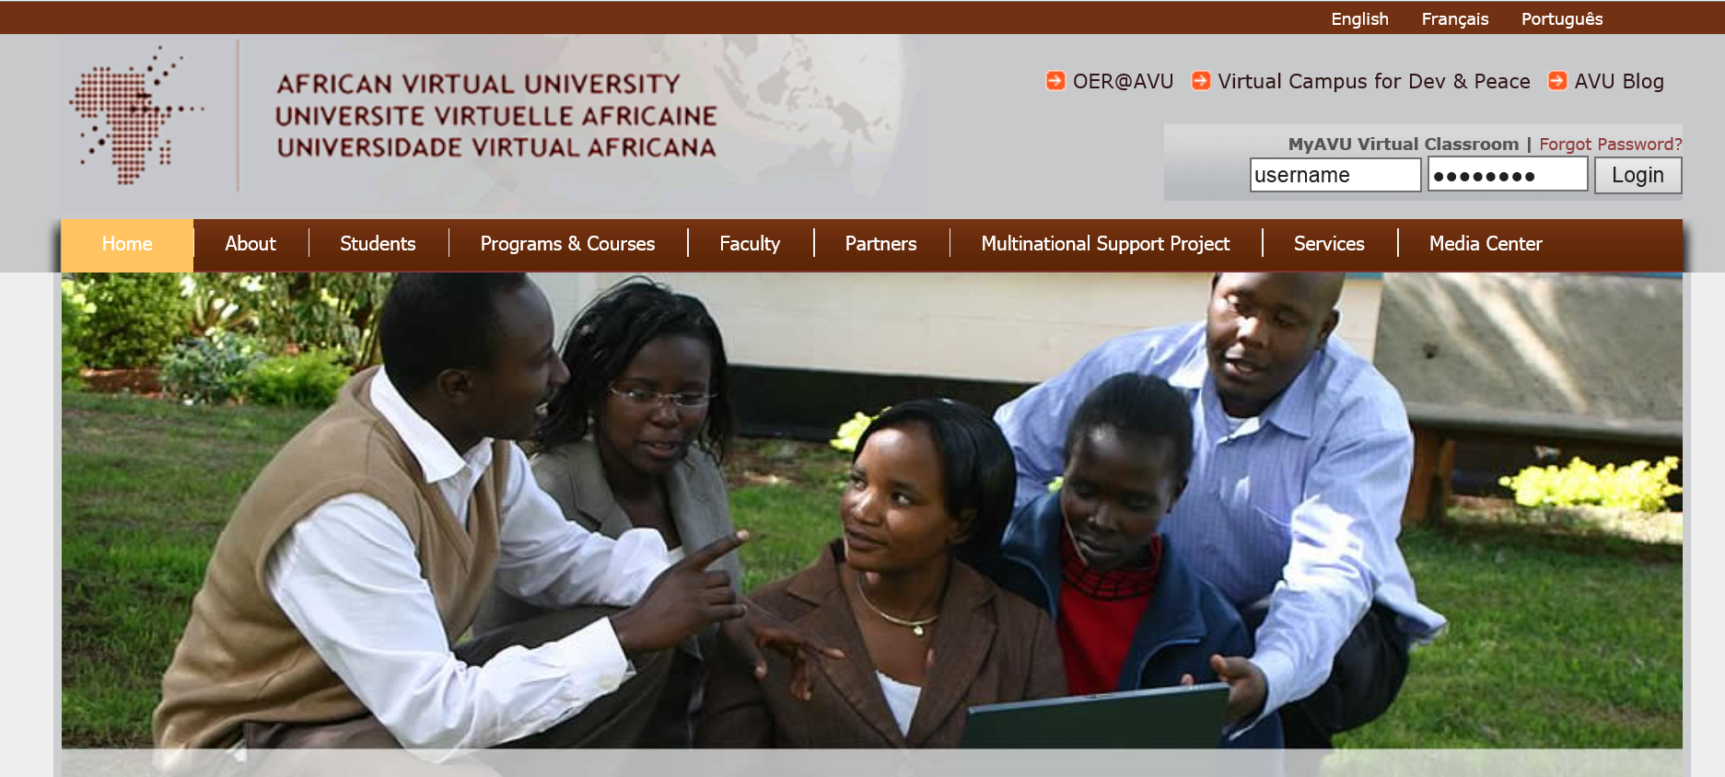
OER and MOOCs in Africa:
The AVU Experience
Griff Richards and Bakary Diallo, African Virtual University
Nairobi, Kenya
It is estimated that only 6% of Africans can access post-secondary education. The development goal is set at 12% even though North America and Europe are somewhere around 45%. The gap is huge. This is not to say that African nations are not investing in post-secondary education. For example, Nigeria has been steadily building universities during the past couple of decades.

Slide 28

June 12, 2014
Research Topic #7. Assessment and Credentialing Issues
Will a degree made up of Moocs ever be worth the paper it's written on?
The University of the People can now hand out degrees to its online students – but will employers take them seriously?, Louise Tickle The Guardian http://www.theguardian.com/higher-education-network/blog/2014/jun/12/moocs-viable-alternative-traditional-degree
Moocs can offer a lot, but they don't offer the feedback of a traditional degree.

Slide 29

May 31, 2014
Research Topic #8.
Localization of Content ocMOOCs and hMOOCs
Revolutionizing online education
Professor creates courses tailored to cultural differences,
Korea JoongAng Daily, KIM BONG-MOON [bongmoon@joongang.co.kr] http://koreajoongangdaily.joins.com/news/article/article.aspx?aid=2989930&cloc=joongangdaily%7Chome%7Cnewslist1
Professor Auh Yoon-il of Kyung Hee Cyber University explains the upcoming Kyung Hee MOOC 2.0 in an interview with the Korea JoongAng Daily at Kyung Hee University on Wednesday. (“one culture” or ocMOOCs and hMOOCs)

Slide 30
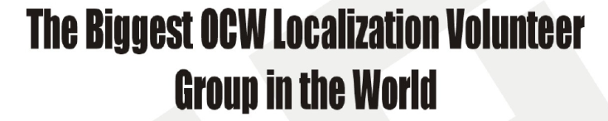

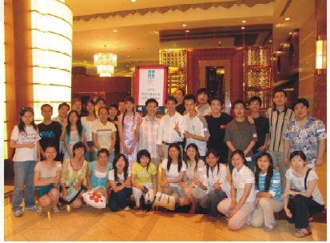

Research Topic #9.
Functioning of Translation Teams
Learning from Localized OER and OCW
(e.g., Opensource Opencourseware Prototype System (OOPS), Lucifer Chu, Janitor of OOPS)

Slide 31
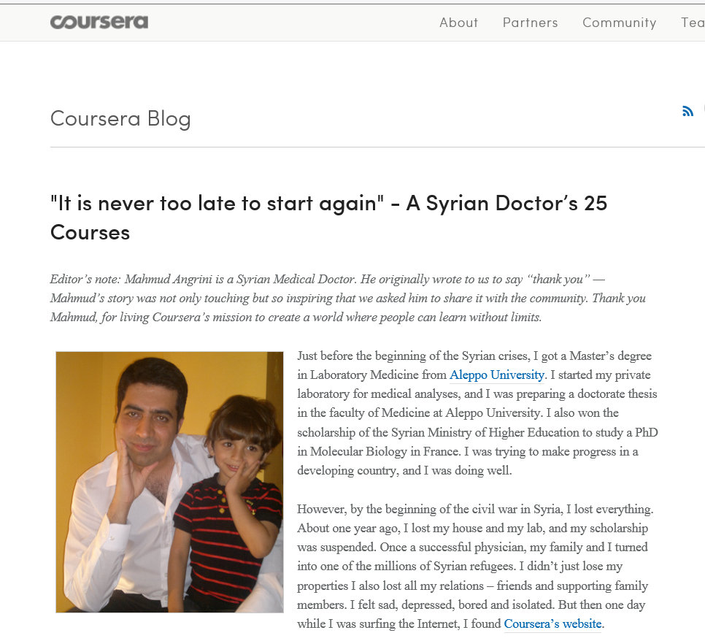
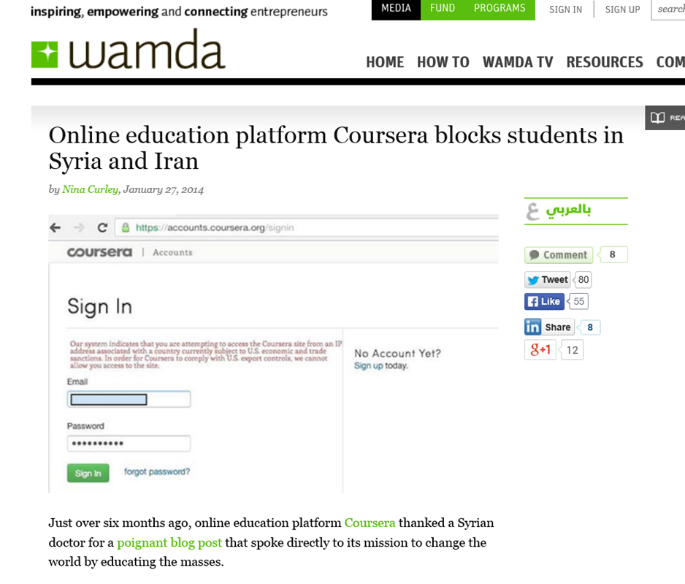
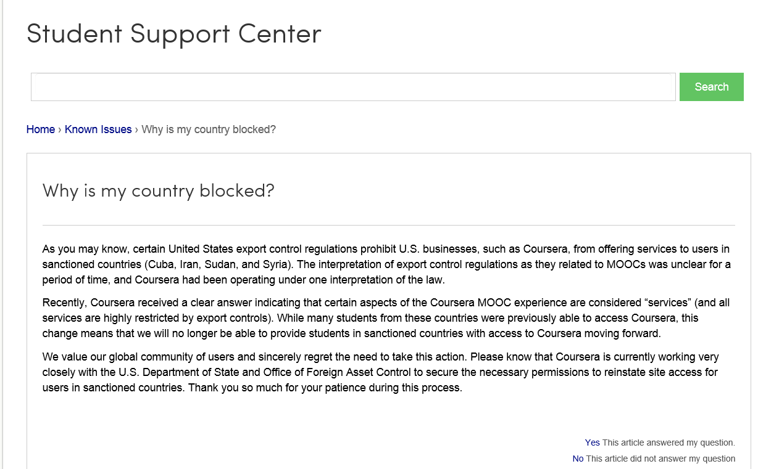


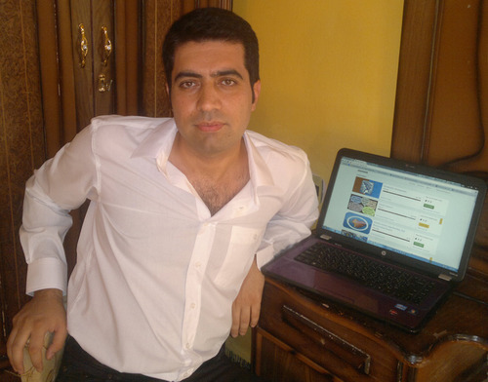
January 27, 2014
Research Topic #10.
Various Geo-Political Issues
Coursera Support Center, Why is my country blocked? http://help.coursera.org/customer/portal/articles/1425714-why-is-my-country-blocked-
Online education platform Coursera blocks students in Syria and Iran, Wamba, Nina Curley http://www.wamda.com/2014/01/coursera-blocks-syria-and-iran-moocs-online-courses

Slide 32
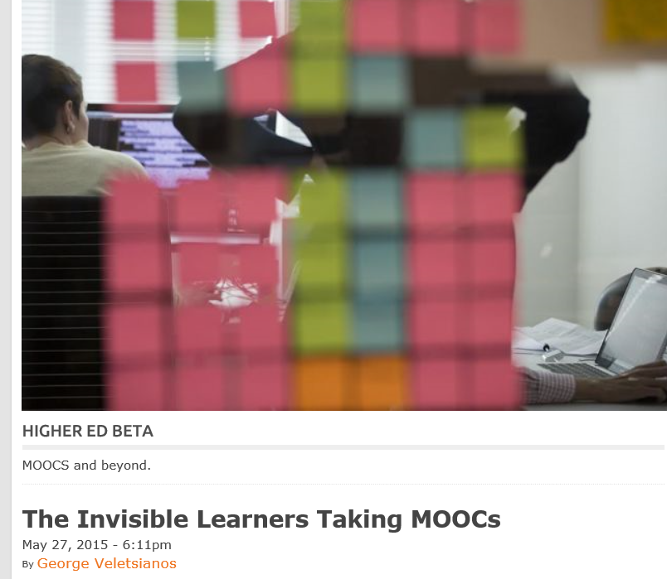
May 27, 2015
Research Topic #11.
MOOC Participant Study Strategies
The Invisible Learners Taking MOOCs,
George Veletsianos, Inside Higher Ed https://www.insidehighered.com/blogs/higher-ed-beta/invisible-learners-taking-moocs

Slide 33


October 1, 2012: MOOC Students
MOOC Learner Study Strategies
4 Massive Open Online Courses and How They Work, Ben Gose, Chronicle of HE http://chronicle.com/blogs/techtherapy/2012/10/03/episode-99-what-wearable-computers-could-mean-for-campuses/
Krissa Swain, of Knoxville, Tenn., is taking "Operations Management" online to help develop her management skills.
Rajeev Bajpai, an airline pilot based in Mumbai, took an online computer-science course to gain programming skills.

Slide 34
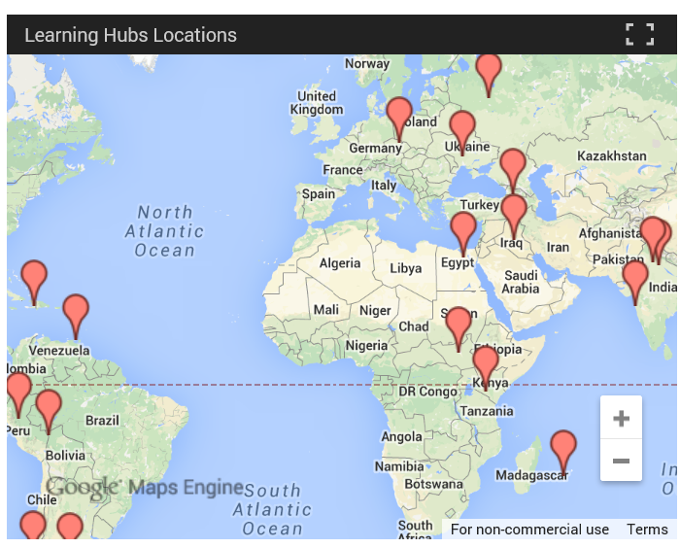
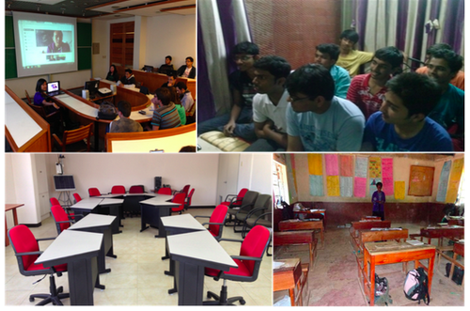
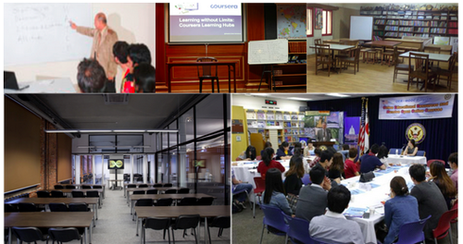
April 30, 2014
Research Topic #12. Impact of Blending FTF Sessions with Online MOOCs
New Learning Hubs Locations Hosted by The New York Public Library and Seven Other Int’l Partners, Coursera Learning Hubs https://www.coursera.org/about/programs/learningHubs http://blog.coursera.org/post/84322385012/new-learning-hubs-locations-hosted-by-the-new-york

Slide 35
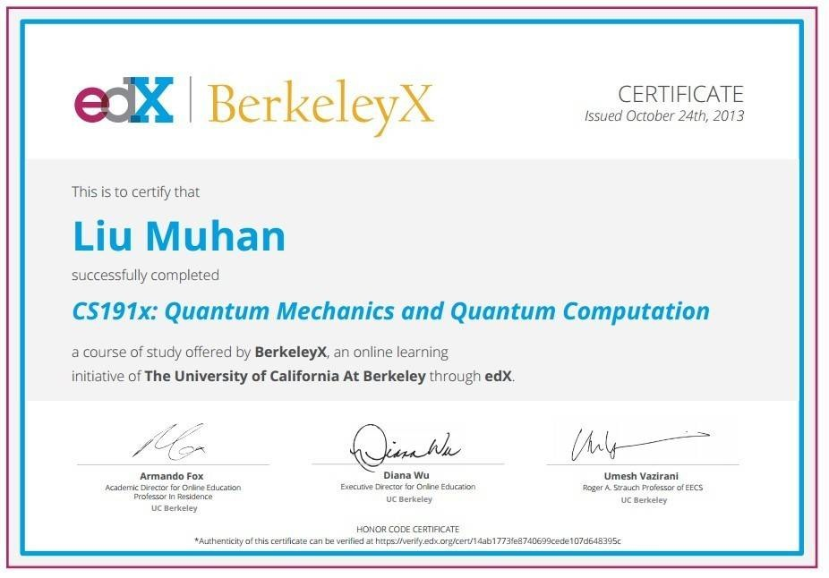
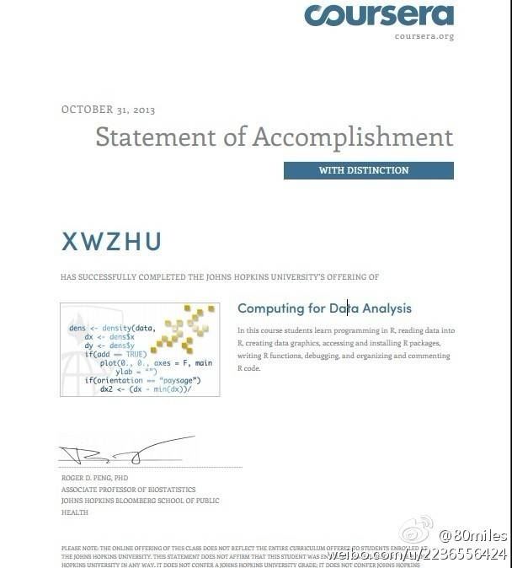
Research Topic #13.
Learning for Enjoyment vs. Credentials and Badges

Slide 36
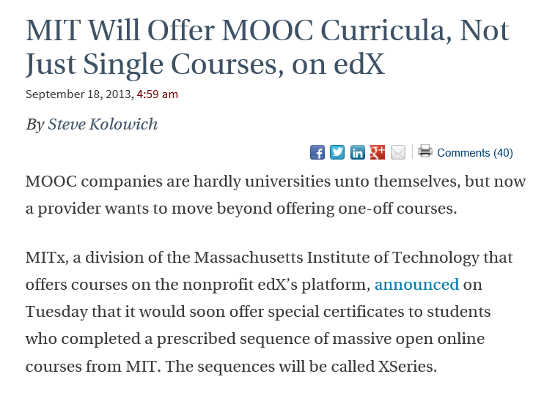
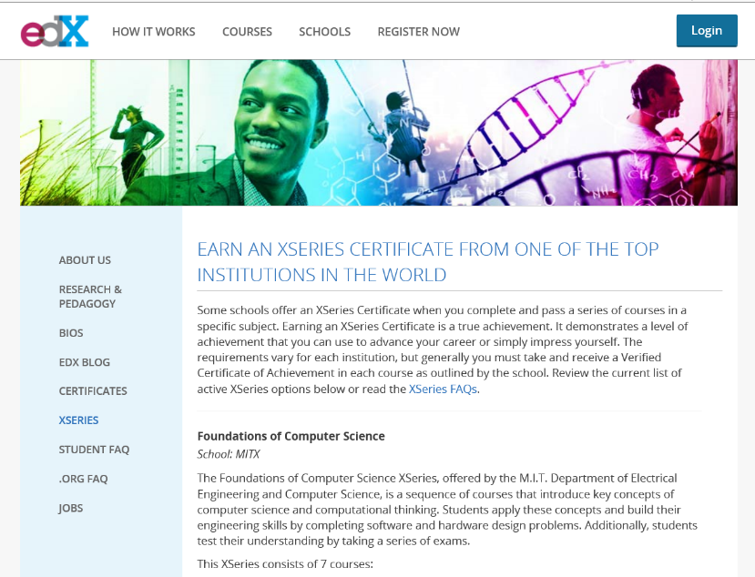
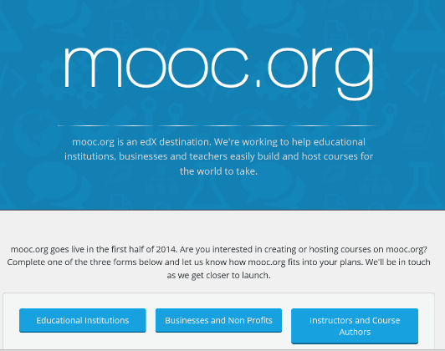
September 18, 2013
MIT Will Offer MOOC Curricula, Not Just Single Courses, on edX, Steve Kolowich, Chronicle of HE http://chronicle.com/blogs/wiredcampus/mit-will-offer-mooc-curricula-not-just-single-courses-on-edx/46715

Slide 37

Learning for Enjoyment Versus Credentials and Badges
“Just play around with ideas for alternatives to printed texts and don't be afraid to create your own, even if they're amateurish…I think we need to de-emphasise formal assessment and accreditation and encourage our playful side to see what is possible. Too much informal learning wants to get itself 'badged' or validated too quickly and this means its losing its genuine amateur status.”

Slide 38
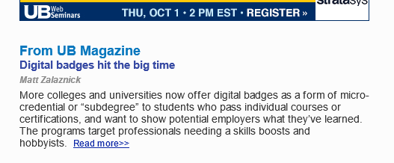
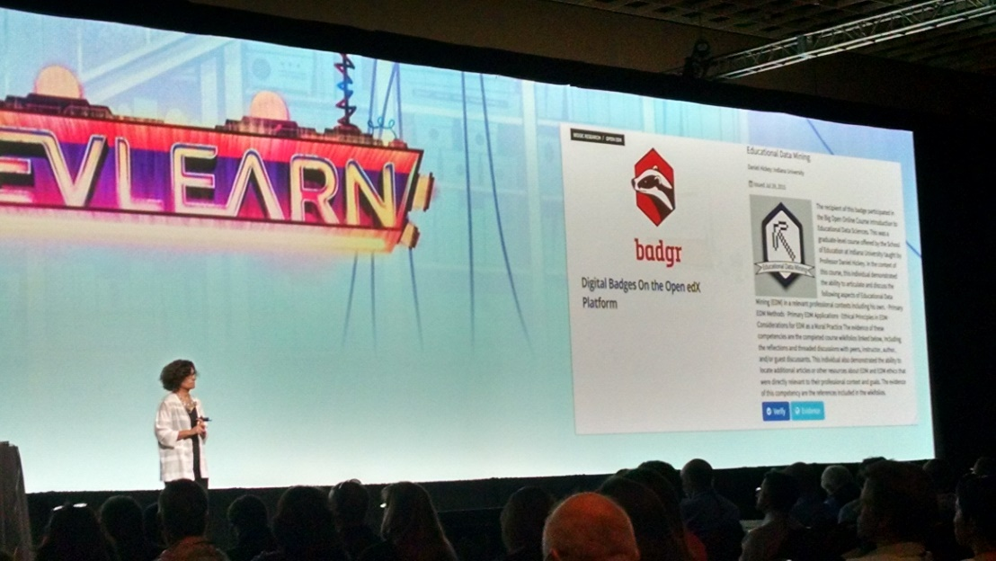
October 1, 2015
Digital badges hit the big time in higher ed: Micro-credential programs target professionals needing a skills boost, Matt Zalaznick, University Business, October 2015 http://www.universitybusiness.com/article/digital-badges-hit-big-time-higher-ed

Slide 39
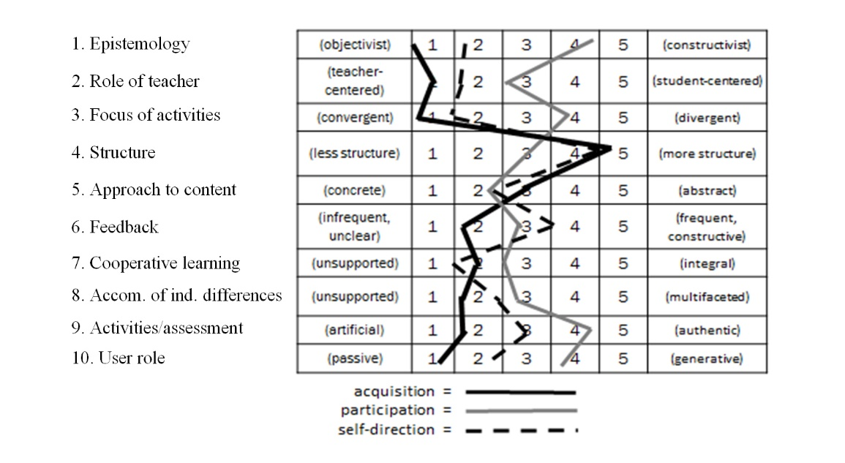
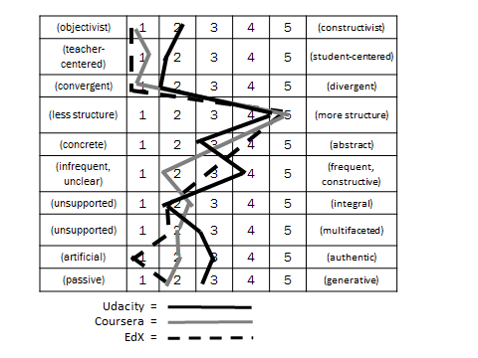
July 2015
Research Topic #14. MOOC Pedagogy
AMP: A Tool for Characterizing the Pedagogical Approaches of MOOCs
Karen Swan, Scott Day, Leonard Bogle, and Traci van Prooyen
University of Illinois Springfield
Figure 3. Ratings Metaphors

Slide 40

September 16, 2013
Research Topic #15. Issues of Quality
Rwandan Degree Program Aims for a 'University in a Box', Chronicle of Higher Education, Megan O’Neil http://chronicle.com/article/Rwandan-Degree-Program-Aims/141631/
Students attend an orientation session at Kepler, a new hybrid program in Kigali, Rwanda, which will use MOOCs and classroom time to help students earn competency-based associate degrees.

Slide 41

Challenges and Issues
Discern the quality of information
Evaluate the quality
Informal learning not taken seriously by their superiors
Certificates and badges may reduce sense of fun and learning enjoyment

Slide 42

Activity #2: Half-Way Pt.
Which of the research ideas mentioned so far match what you have written down?

Slide 43
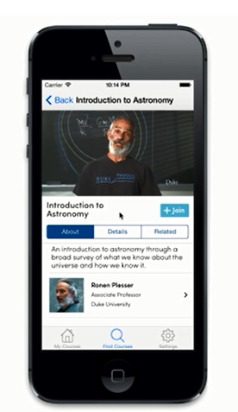
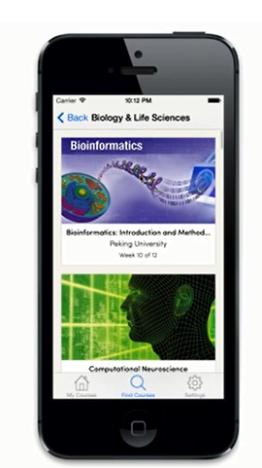
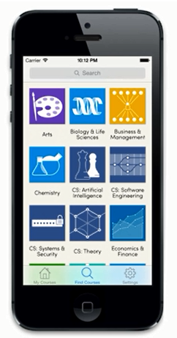
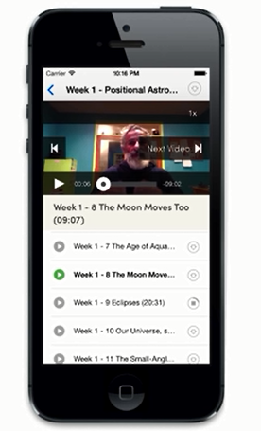
Research Topic #16.
Impact of Mobile MOOCs
(e.g., mobile courses on smartphone)

Slide 44
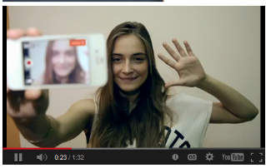
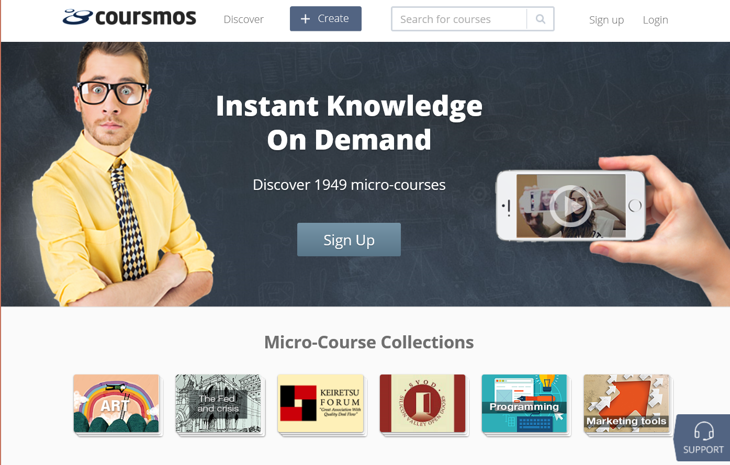
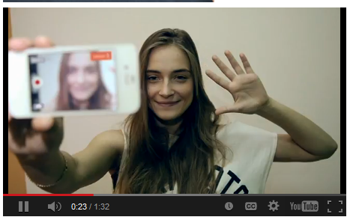
May 5, 2014
Mobile MOOCs: New platform challenges conventional MOOCs eCampus News (https://coursmos.com/) http://www.ecampusnews.com/top-news/new-platform-challenges-conventional-moocs/print/

Slide 45
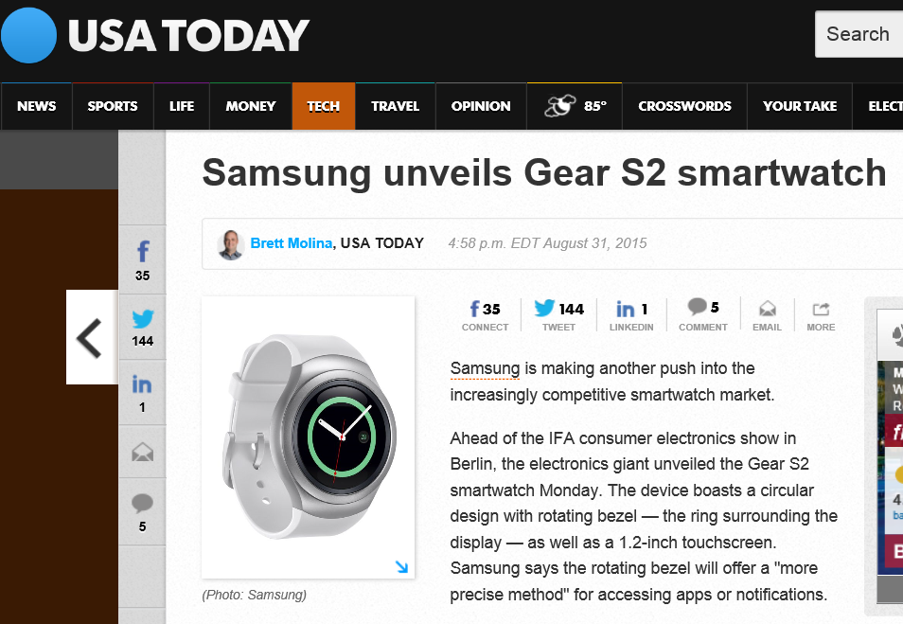
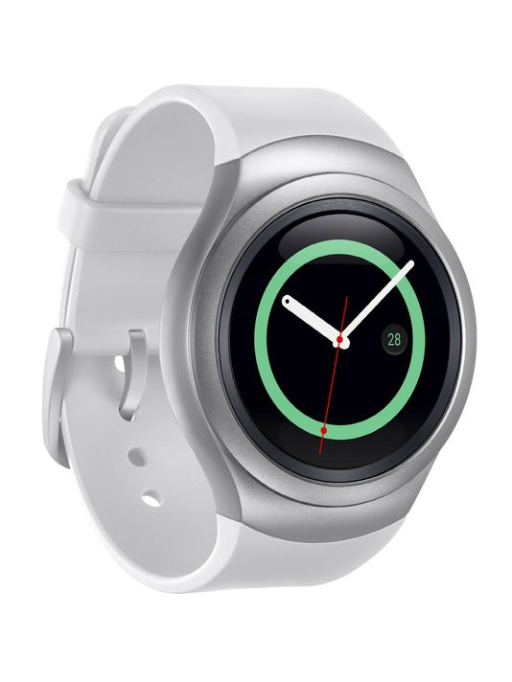
August 31, 2015
MOOC Watch? samsung unveils Gear S2 smartwatch,
USA Today, Brett Molina http://www.usatoday.com/tech/

Slide 46
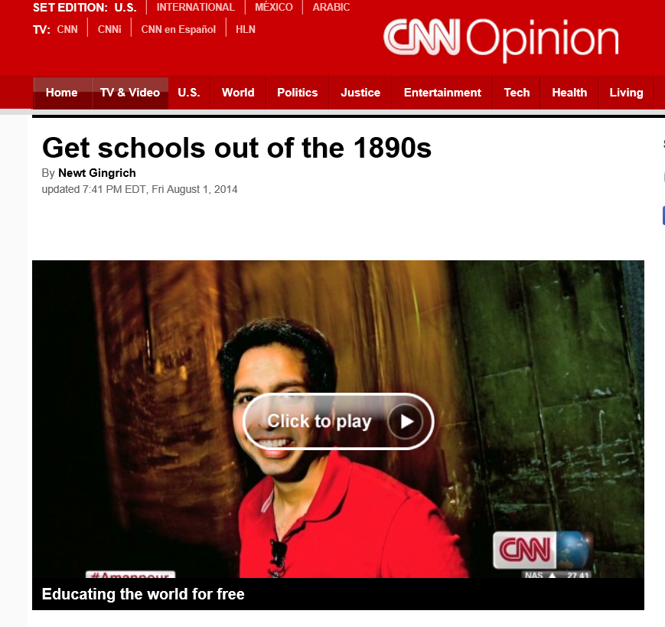

January 7, 2015
Research Topic #17.
Flipped the Classroom with MOOCs
When a Flipped-Classroom Pioneer Hands Off His Video Lectures, This Is What Happens, Jeffrey R. Young, The Chronicle of Higher Education http://chronicle.com/article/When-a-Flipped-Classroom/151031/
A student watches a video of Norman Nemrow's accounting class. Mr. Nemrow started the video lectures nearly 15 years ago at Brigham Young U. He is now retired, but students still watch him on the screen.

Slide 47
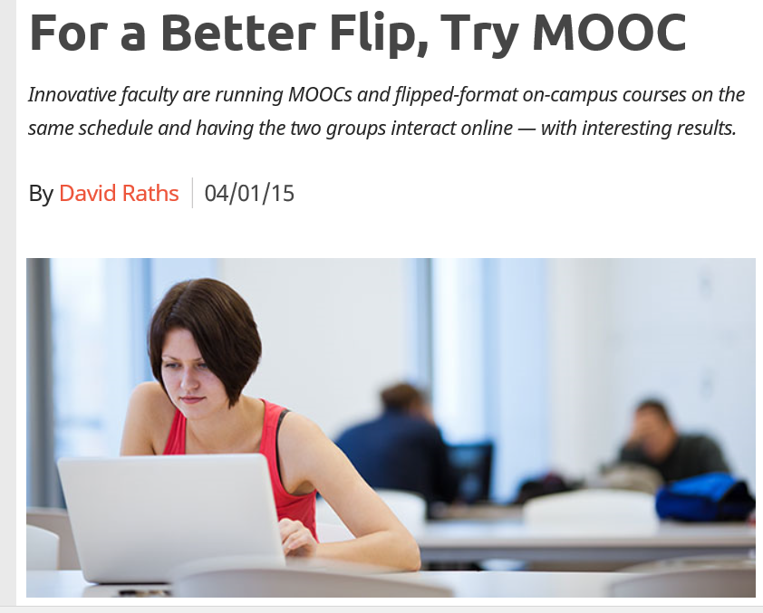

April 1, 2015
For a Better Flip, Try MOOCs
David Raths, Campus Technology http://campustechnology.com/articles/2015/04/01/for-a-better-flip-try-moocs.aspx

Slide 48





June 16, 2015
Learning is More Video-Based
Lynda.com Excel Training, IU
Acquired for $1.5 Billion, April 23, 2015 http://www.lynda.com/Excel-tutorials/Excel-2010-Essential-Training/61219-2.html

Slide 49


April 23, 2015
Research Topic #18.
Cost-Benefit Analysis
Offloading Semesters or Years to MOOCs
The Catch in Arizona State’s Low-Cost Freshman Year Online: No Aid, Chronicle of Higher Education, Thomas Fisher http://chronicle.com/article/The-Catch-in-Arizona-State-s/229617/
Anant Agarwal, the head of edX, which teamed up with Arizona State U. in the new project: “Our mission is to provide education to people who need it the most.”

Slide 50


June 15, 2014
Starbucks offers workers 2 years of free college, CNN Money, Gregory Wallace
(from Arizona State online programs) http://money.cnn.com/2014/06/15/news/economy/starbucks-schultz-education/index.html?hpt=hp_t2 http://www.nytimes.com/2014/06/16/us/starbucks-to-provide-free-college-education-to-thousands-of-workers.html

Slide 51

January 8, 2015
Obama Plan Would Help Many Go to Community College Free
JULIE HIRSCHFELD DAVIS and TAMAR LEWIN, The New York Times http://www.nytimes.com/2015/01/09/us/politics/obama-proposes-free-community-college-education-for-some-students.html?_r=0
President Obama running onto the stage before delivering remarks at Central High School in Phoenix on Thursday. Credit Doug Mills/The New York Times

Slide 52



Building Talent Pipeline
Master’s Degree Is New Frontier of Study Online, August 17, 2013, The New York Times
By Tamar Lewin http://chronicle.com/article/MOOCs-May-Not-Be-So-Disruptive/140965/ http://extensionengine.com/putting-moocs-to-work-recap-infographic/#.VExR4o3wtjs

Slide 53



August 5, 2015
Research Topic #19.
Nanodegrees and Microcredentials
How Nanodegrees Are Disrupting Higher Education
John Waters, Campus Technology http://campustechnology.com/articles/2015/08/05/how-nanodegrees-are-disrupting-higher-education.aspx

Slide 54

September 14, 2015
Philanthropy University https://novoed.com/philanthropy-initiative?referral_token=NOVOED-CC

Slide 55

October 7, 2015
MIT Unveils ‘MicroMaster’s,’ Allowing Students to Get Half Their Degree From MOOCs, Andy Thomason, Chronicle of Higher Education http://chronicle.com/blogs/ticker/mit-unveils-micromasters-allowing-students-to-get-half-their-degree-from-moocs/105615?cid=pm&utm_source=pm&utm_medium=en&elq=5df23adc260141d79bb6b8d5f282aa4a&elqCampaignId=1549&elqaid=6450&elqat=1&elqTrackId=5dc2477c7c354ee48373a9522da104c5

Slide 56

October 7, 2015
MIT Master’s Program to Use MOOCs as ‘Admissions Test’, Jeffrey R. Young, Chronicle of Higher Education http://chronicle.com/article/MIT-Master-s-Program-to-Use/233685

Slide 57

February 2, 2015
Research Topic #20. Accessing Experts Via MOOCs for Informal Learning
Here Comes Professor Everybody: The ‘sharing economy’ meets higher education,
Chronicle of Higher Education, Jeffrey R. Young http://chronicle.com/article/Here-Comes-Professor-Everybody/151445/?cid=at
Kevin deLaplante, an associate professor at Iowa State U., makes an average of $2,500 per month teaching from his home studio (above) on sites like Udemy.

Slide 58


Employee to Employee Training
G2g (Googler to Googler) Training
Seven Ways to Corporate MOOC, Udemy blog, December 23, 2013, Shannon Hughes https://www.udemy.com/organizations/blog/2013/12/23/seven-ways-to-corporate-mooc/
Classes range from management and public speaking, to parenting and mountain climbing.

Slide 59





February 2, 2015
The Expert Cafe
Here Comes Professor Everybody: The ‘sharing economy’ meets higher education,
Chronicle of Higher Education, Jeffrey R. Young http://chronicle.com/article/Here-Comes-Professor-Everybody/151445/?cid=at

Slide 60


August 5, 2015
Shubham Jaglan Overwhelmed by "Dream" Return Home After Double World Championship
Disha Chopra, NDTV Sports http://sports.ndtv.com/golf/news/246551-shubham-jaglan-overwhelmed-by-dream-return-home-after-double-world-championship http://www.ndtv.com/video/player/news/india-s-golf-prodigy-shubham-jaglan-returns-home-to-hero-s-welcome/377614

Slide 61


January 15, 2015
Email from Udemy

Slide 62

September 15, 2015
Research Topic #21.
MOOCs for Social Impact
Social Learning for Social Impact, edX
Join the world’s first GROOC – a MOOC for groups – to collaborate with others globally and create social change. https://www.edx.org/course/social-learning-social-impact-mcgillx-groocx https://www.youtube.com/watch?t=36&v=WNg-5LFAMdI

Slide 63

September 15, 2015
Social Learning for Social Impact, edX
Join the world’s first GROOC – a MOOC for groups – to collaborate with others globally and create social change. https://www.edx.org/course/social-learning-social-impact-mcgillx-groocx https://www.youtube.com/watch?t=36&v=WNg-5LFAMdI

Slide 64

September 15, 2015
Social Learning for Social Impact, edX
Join the world’s first GROOC – a MOOC for groups – to collaborate with others globally and create social change. https://www.edx.org/course/social-learning-social-impact-mcgillx-groocx https://www.youtube.com/watch?t=36&v=WNg-5LFAMdI

Slide 65

September 15, 2015
Social Learning for Social Impact, edX
Join the world’s first GROOC – a MOOC for groups – to collaborate with others globally and create social change. https://www.edx.org/course/social-learning-social-impact-mcgillx-groocx https://www.youtube.com/watch?t=36&v=WNg-5LFAMdI

Slide 66


October 7, 2014
ALISON: Global Health Initiatives
Online Mooc courses deliver Ebola health advice, BBC News, Sean Coughlan http://www.bbc.com/news/education-29521360 http://www.advancelearning.com/why-wait-for-others-to-fight-ebola
Disinfecting a room in Monrovia, Liberia: Online courses are providing health advice to fight Ebola.

Slide 67

ALISON: A New World of Free Certified Learning
Mike Feerick, CEO & Founder, ALISON

Slide 68

September 22, 2015
Research Topic #22.
MOOC Benefits and Impact
Who’s Benefiting from MOOCs, and Why
Chen Zhenghao, Brandon Alcorn, Gayle Christensen, Nicholas Eriksson, Daphne Koller, Ezekiel J. Emanuel, Harvard Business Review https://hbr.org/2015/09/whos-benefiting-from-moocs-and-why

Slide 69

September 22, 2015
Who’s Benefiting from MOOCs, and Why
Chen Zhenghao, Brandon Alcorn, Gayle Christensen, Nicholas Eriksson, Daphne Koller, Ezekiel J. Emanuel, Harvard Business Review https://hbr.org/2015/09/whos-benefiting-from-moocs-and-why

Slide 70

September 22, 2015
Who’s Benefiting from MOOCs, and Why
Chen Zhenghao, Brandon Alcorn, Gayle Christensen, Nicholas Eriksson, Daphne Koller, Ezekiel J. Emanuel, Harvard Business Review https://hbr.org/2015/09/whos-benefiting-from-moocs-and-why

Slide 71

September 4, 2015
Far From Bust: Five Ways MOOCs Are Helping People Get on in Life, The Conversation, Allison Littlejohn, Director of the Caledonian Academy, Glasgow Caledonian University https://www.higheredjobs.com/Articles/articleDisplay.cfm?ID=722&utm_source=10_07_2015&utm_medium=email&utm_campaign=InsiderUpdate
(Open access, adding value to campus courses, engagement measures, enhance careers, online teaching labs)

Slide 72


October 25, 2014
Research Topic #23.
Survey Research on OER Awareness and Use
Opening the Curriculum: Open Educational Resources in U.S. Higher Education, 2014
I. Elaine Allen and Jeff Seaman http://www.onlinelearningsurvey.com/reports/openingthecurriculum2014.pdf

Slide 73


Research Topic #24. Actual Use of Open Access Resources and Materials
Nature, Openwords, etc. http://www.openwords.com/ https://www.facebook.com/Openwords

Slide 74


October 6, 2015
Research Topic #25.
MOOCs as a Learning Supplement
Using MOOCs to Fill In Your Weak Spots, Hanna Peacock, Inside Higher Ed https://www.insidehighered.com/blogs/gradhacker/using-moocs-fill-your-weak-spots?utm_source=Inside+Higher+Ed&utm_campaign=bf05053fb7-DNU20151007&utm_medium=email&utm_term=0_1fcbc04421-bf05053fb7-197362401

Slide 75

April 20, 2015
Research Topic #26. Case Studies
250 MOOCs and Counting: One Man’s Educational Journey, Chronicle of Higher Education http://chronicle.com/article/250-MOOCsCounting-One/229397/?cid=at
If the MOOC movement has faded, nobody told Jima Ngei. Mr. Ngei, who lives in Port Harcourt, Nigeria, has completed and passed 250.
Jima Ngei: “I had this unrelenting fear that this miracle of free access might evaporate soon.”

Slide 76


Various Case Studies:
Life Impact from OER and MOOCs

Slide 77

MIT Data:
Prepares to Reenter University
(41-50 year old male, Middle East)
Most interesting experience of my own was my use of MIT OCW to refresh on Calculus. I purchased the textbook and followed one of several calculus options on the site. This was quite successful in re-introducing Calculus, as a prep to re-entering college 28 years after graduation - this time to study for a Master's.

Slide 78

MIT Data:
Retiree Develops New Hobby
(70+ year old female, North America)
I'm am avid photographer and have developed skills for developing my own website for display of my photography and books I have written that include my photographs…I've had multiple careers, from science, to public administration, and information technology. The development of my art is a new and exciting experience.

Slide 79

Life Changing Example
My life has changed in a big way. I used these new skills to create a small business that supplements my income. I couldn't use this income soley to support myself, but it does pay some bills.

Slide 80

Joining a Learning Community
“My key moment came when I discovered a community of like-minded scholars from around the world. I no longer felt isolated or disconnected. This has become my most valuable support network and I am grateful.”

Slide 81


October 6, 2014
Research Topic #27.
High School Student College Prep and Advanced Placement Courses edX turns attention to high school MOOCs, eSchool News http://www.eschoolnews.com/2014/10/06/high-school-moocs-839/print/

Slide 82


October 6, 2014
High School Initiative https://www.edx.org/high-school-initiative http://www.eschoolnews.com/2014/10/06/high-school-moocs-839/print/

Slide 83











Research Topic #28. MOOC List Access and Use (and ratings)
Enroll in a MOOC and Reflect
(e.g., see Class Central)

Slide 84



August 20, 2015
Research Topic #29. Unique Pedagogy
Syracuse professor offers free ‘Star Trek’ class to the public, USA Today, Amari D. Pollard, LeMayne College http://college.usatoday.com/2015/08/20/syracuse-professor-offers-free-star-trek-class-to-the-public/ r

Slide 85



May 26, 2015
Research Topic #30. Cultural Differences
MOOC Madness in China!
Edtech and MOOC Times in China
Michael Trucano On Tue, 05/12/2015, EduTech https://blogs.worldbank.org/edutech/edtech-and-mooc-times-china

Slide 86



June 26, 2015
In China, Where Everything is a MOOC, Education Week, Justin Reich, HarvardX Research Fellow http://blogs.edweek.org/edweek/edtechresearcher/2015/05/in_china_where_everything_is_a_mooc.html?r=284759497
The most memorable line from my recent visit to China was this: "We have 12 million K-12 teachers in China who need to receive this particular in-service training, so we started with a group of about 200,000."

Slide 87

Activity #3:
What was new or surprising to you from the 30 topics?

Slide 88

Audience Poll #3:
Would you like to research MOOCs now?
A. Yes…
B. No…

Slide 89

Activity #4:
Jot down research idea on a card. Introduce yourself with card to one other person and find way to combine ideas.
(Note: Winner gets a MOOCs special issue.)

Slide 90


We are entering a jumping off point…
(South University of Science and Technology of China, Wednesday June 10, 2015)

Slide 91

The World is very open!
(South University of Science and Technology of China, Wednesday June 10, 2015)

Slide 92

Things are heating up! http://routledge-ny.com/books/details/9781138807419/

Slide 93






MOOCs and Open Education Around the World http://routledge-ny.com/books/details/9781138807419/

Slide 94


Slide 95



Want something FREE?
Introducing the “TEC-VARIETY” book…(Framework #1) http://tec-variety.com/

Slide 96



Any Comments or Questions?
Slides at: TrainingShare.com
Papers: PublicationShare.com
Free Book: http://tec-variety.com/
MOOCsBook: http://moocsbook.com/

