Slide 1
Instructor Experiences in Designing and Delivering Interactive MOOCs in Higher Education
Meina Zhu, Curtis J. Bonk, and Annisa Sari
IST Department, Indiana University
E-Learn, Vancouver, Oct 19th, 2017

Slide 2
2015
Instructional quality of Massive Open Online Courses (MOOCs).
Margaryan, Bianco, & Littlejohn, Computers & Education, 80, 77-83. http://www.sciencedirect.com/science/article/pii/S036013151400178X
“As MOOCs proliferate, drawing in increasing numbers of faculty and learners worldwide, the issue of their instructional quality becomes increasingly pressing.” (p. 82)

Slide 3
October 2015
Predictors of Retention and Achievement in a Massive Open Online Course
Greene, Oswald, & Pomerantz, American Educational Research Journal, 52(5), 925-955. http://aer.sagepub.com/content/early/2015/05/08/0002831215584621
“If MOOCs are to fulfill their promise as a way of providing all learners with opportunities to obtain education at a low cost, much more research is needed regarding how to engage these students and help them to be successful in these environments.” (p. 952)

Slide 4
September 2016
MOOCs, Graduate Skills Gaps, and Employability: A Qualitative Systematic Review of the Literature
David Santandreu Calonge and Mariam Aman Shah, IRRODL, 17(5), 67-90. http://www.irrodl.org/index.php/irrodl/article/view/2675/3881
“In 2013, research had already indicated that MOOCs offered unprecedented choice, customization and gave thousands of participants the possibility to have greater ownership and control over their learning experiences “rather than being constrained by centralized, instructor-controlled learning based on delivery of pre-fabricated curriculum (McLoughlin, 2013).” (p. 78.)

Slide 5
2015
Digging deeper into learners’ experiences in MOOCs: Participation in social networks outside of MOOCs, notetaking and contexts surrounding content consumption
Veletsianos, Collier, & Schneider, BJET, 46(3), 570-587. http://onlinelibrary.wiley.com/doi/10.1111/bjet.12297/abstract
“To gain a deeper and more diverse understanding of the MOOC phenomenon, researchers need to use multiple research approaches (e.g., ethnography, phenomenology, discourse analysis) add content to them.” (p. 583.)

Slide 6
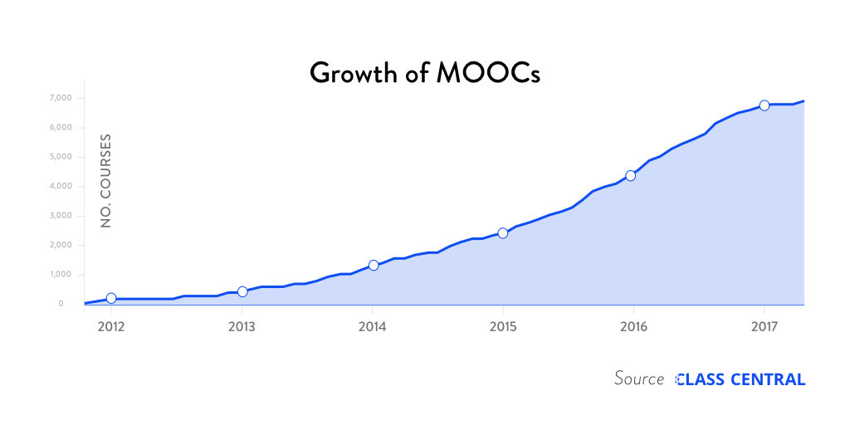
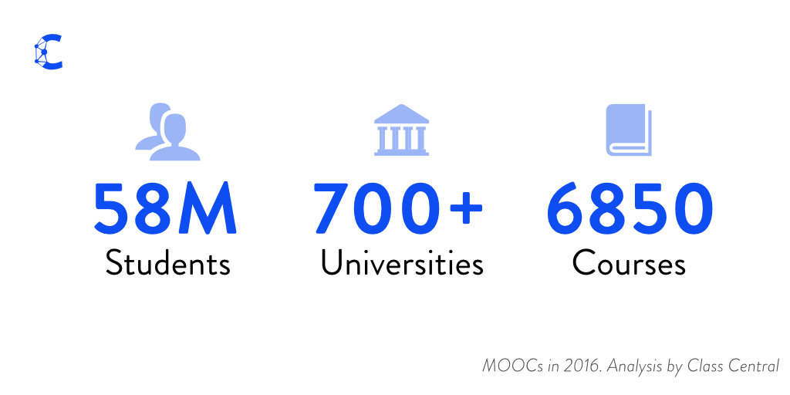
Research Background
The Numbers: MOOCS in 2016 (Dec 25th, Class Central)
Notes:
Dhawa Shah, Class Central
https://www.class-central.com/report/mooc-stats-2016/

Slide 7
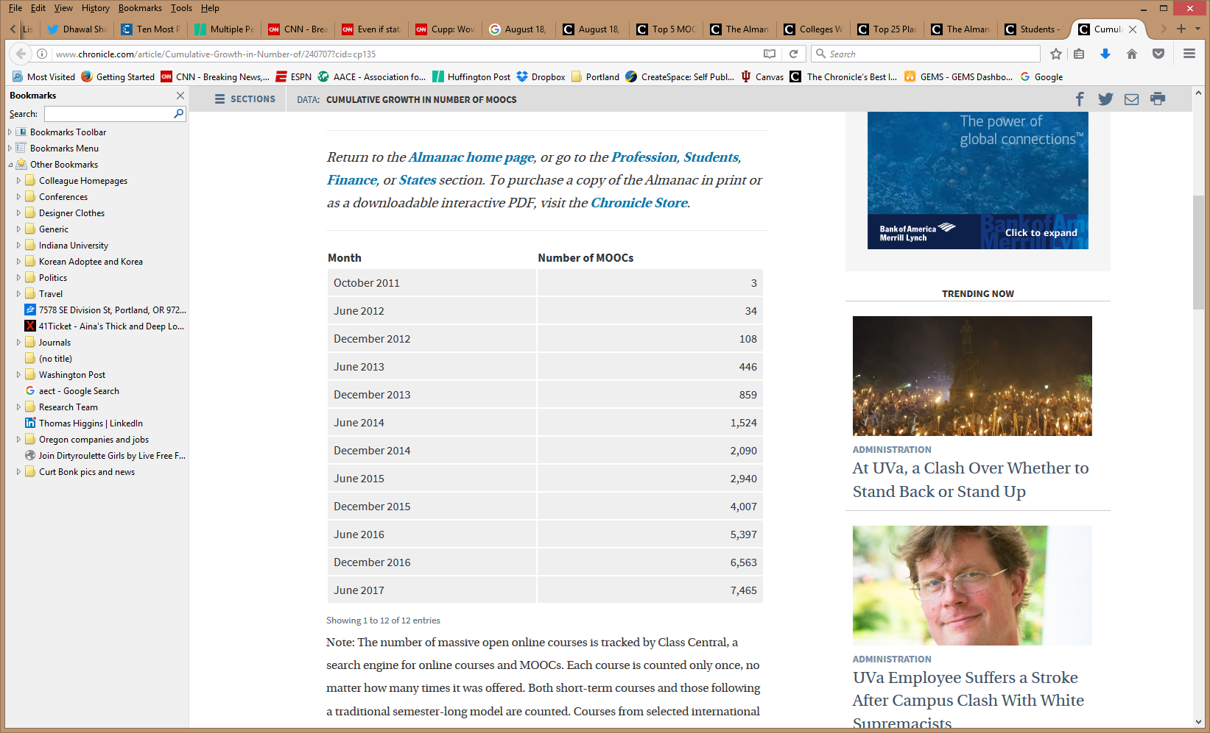
Research Background
Cumulative Growth in Number of MOOCs (2011-2017)
Notes:
Chronicle of Higher Education annual Almanac of data from August.

Slide 8
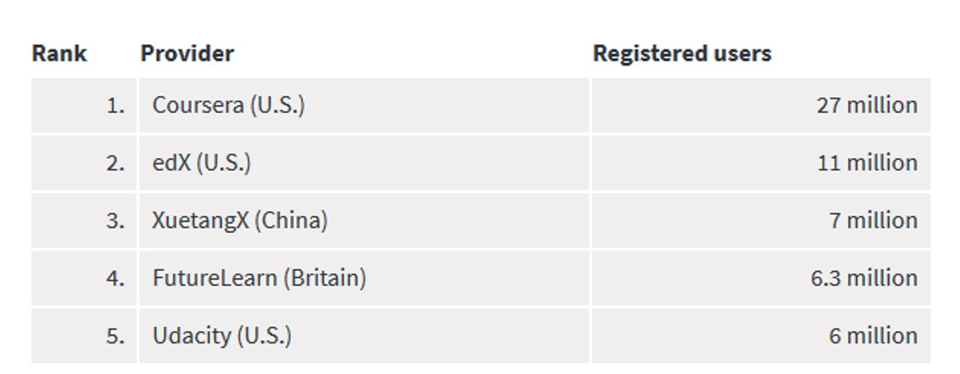
Research Background
Top 5 MOOC providers by number of registered users (2017)
Notes:
Chronicle of Higher Education annual Almanac of data from August.

Slide 9
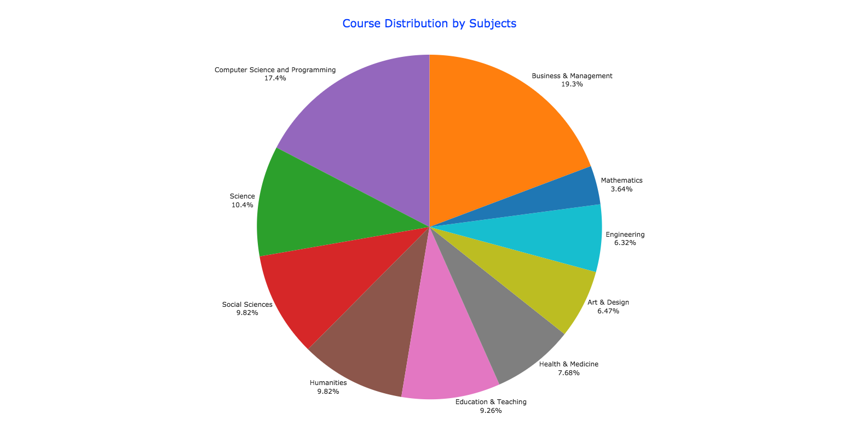
August 17, 2017
By the Numbers: MOOCs in 2016
Class Central, Dhawal Shah https://www.class-central.com/report/mooc-stats-2016/

Slide 10
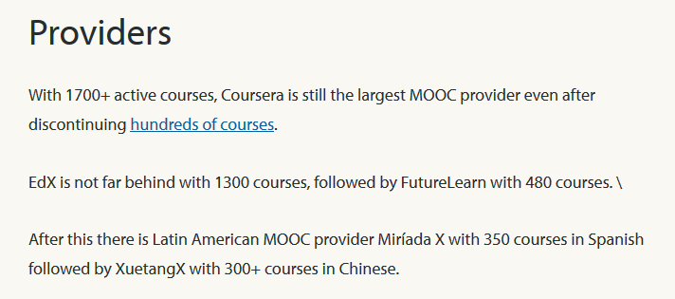
August 17, 2017
By the Numbers: MOOCs in 2016
Class Central, Dhawal Shah https://www.class-central.com/report/mooc-stats-2016/

Slide 11
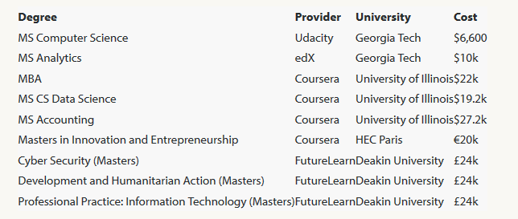
August 7, 2017
FutureLearn and Coventry University to Roll Out 50 Online Degrees (Last year Deakin University announced a similar partnership with FutureLearn)
Class Central, Dhawal Shah https://www.class-central.com/report/futurelearn-coventry-university-roll-50-online-degrees/

Slide 12


June 15, 2017
Massive List of MOOC Providers Around The World, China and Korea
(Where to Find MOOCs: The Definitive Guide to MOOC Providers )
University of China MOOC — icourse163.org / China
Class Central, Dhawal Shah https://www.class-central.com/report/mooc-providers-list/

Slide 13
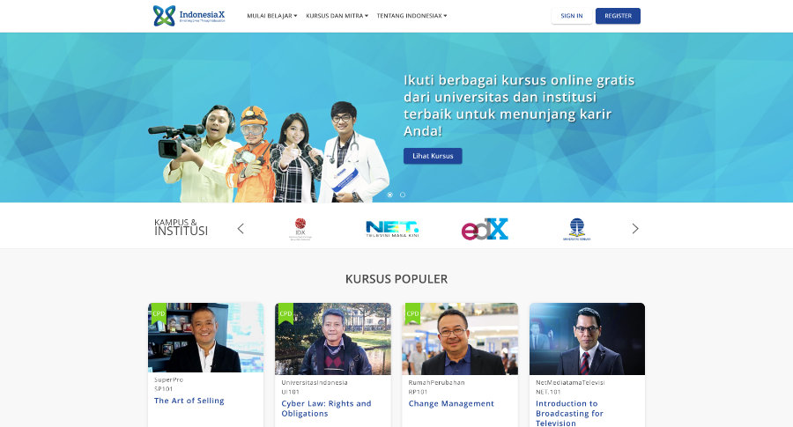
June 15, 2017
Massive List of MOOC Providers Around The World
IndonesiaX
(Where to Find MOOCs: The Definitive Guide to MOOC Providers )
Class Central, Dhawal Shah https://www.class-central.com/report/mooc-providers-list/

Slide 14
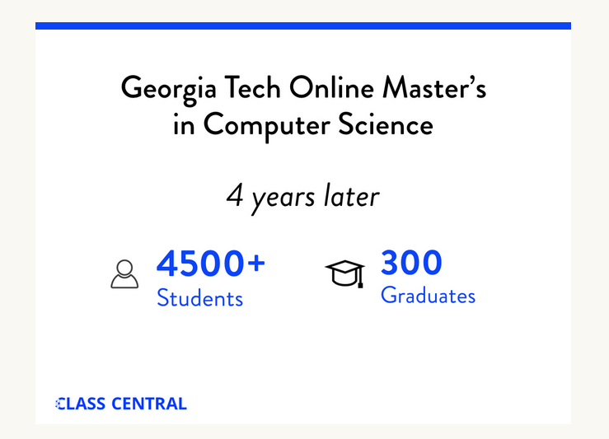
August 7, 2017
FutureLearn and Coventry University to Roll Out 50 Online Degrees (Last year Deakin University announced a similar partnership with FutureLearn)
Class Central, Dhawal Shah https://www.class-central.com/report/futurelearn-coventry-university-roll-50-online-degrees/

Slide 15
Research Background
  MOOCs have grown during the past few years to over 7,000 courses (Shah, 2016, 2017)
  MOOCs can be beneficial to both learners and instructors (Hew & Cheung, 2014)
  Design and final delivery greatly influence students’ interaction and engagement in online learning (Garrison & Cleveland-Innes, 2005).

Slide 16
Research Background
  MOOCs have faced criticisms, including insufficient and low quality instructional design (Ferreira, 2014; Margaryan, Bianco, & Littlejohn, 2015) and low online interaction.
  Instructional design is critical for online learning (MOOC) (Johnson & Aragon, 2003; Phipps & Merisotis, 1999)

Slide 17
Research Background
  Most research on MOOCs has mainly focused on enrollment, perspectives, behaviors, completion rates, and participation patterns in MOOC environments from a learner perspective (Breslow et al., 2013; Liyanagunawardena, Adams, & Williams, 2013)
  A scarcity of studies that focus specifically on MOOC design and delivery (Margaryan, Bianco, & Littlejohn, 2015); especially online interaction and engagement (Wang, Anderson, Chen, & Barbera, 2017)

Slide 18
Research Background
A Systematic Review of Research Methods and Topics of the Empirical MOOC Literature (2014-2016)
Zhu, M., Sari, A., & Lee, M.
1. What are the research methods researchers employed in empirical MOOC studies?
2. What are the research topics or focuses in MOOC studies?
3. How are researchers of empirical MOOC studies geographically distributed?

Slide 19
Research Background (Zhu, M., Sari, A., & Lee, M. study)
Primary Journals of MOOC Publications (2014-2017)
No. | Journal | Total
1 | International Review of Research in Open and Distance Learning (IRRODL) | 31
2 | Computers & Education | 12
3 | British Journal of Educational Technology | 9
4 | Online Learning | 7
5 | Distance Education | 5
6 | Educational Media International | 5
7 | Internet and Higher Education | 5
8 | Journal of Computer Assisted Learning | 5
9 | Computers in Human Behavior | 4
10 | Open Learning | 4
11 | Journal of Online Learning and Teaching | 3
12 | Journal of Asynchronous Learning Network | 3

Slide 20
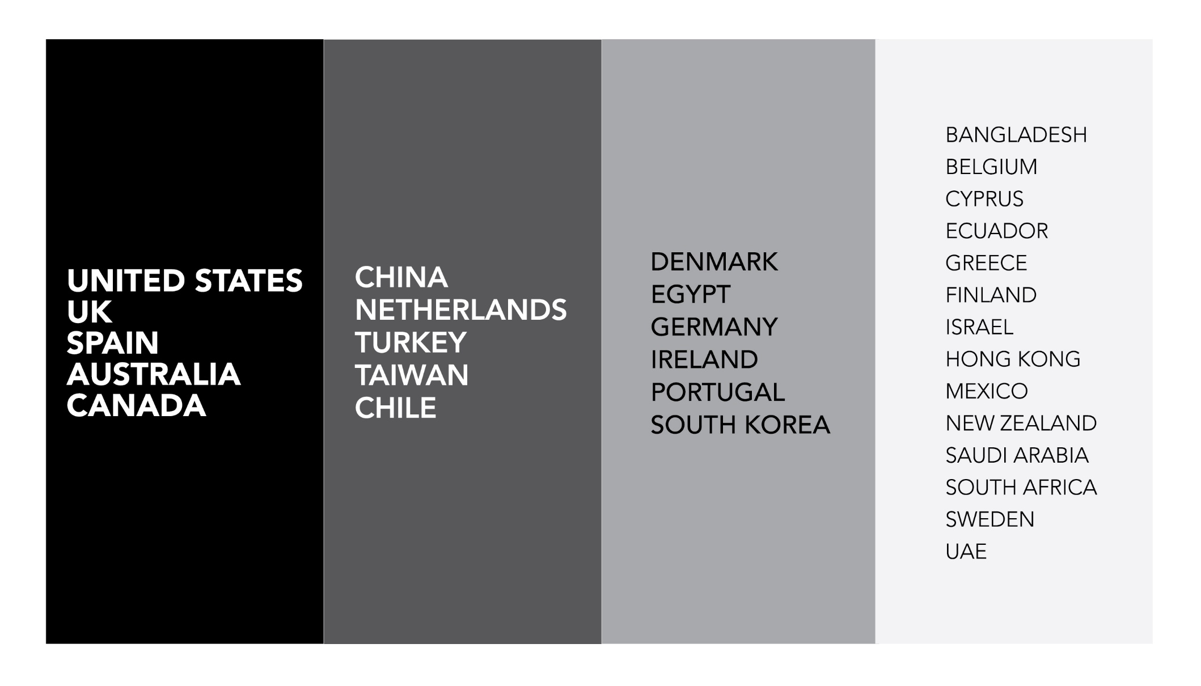
Research Background (Zhu, M., Sari, A., & Lee, M. study)
Location of MOOC Research Team Members (2014-2017)

Slide 21
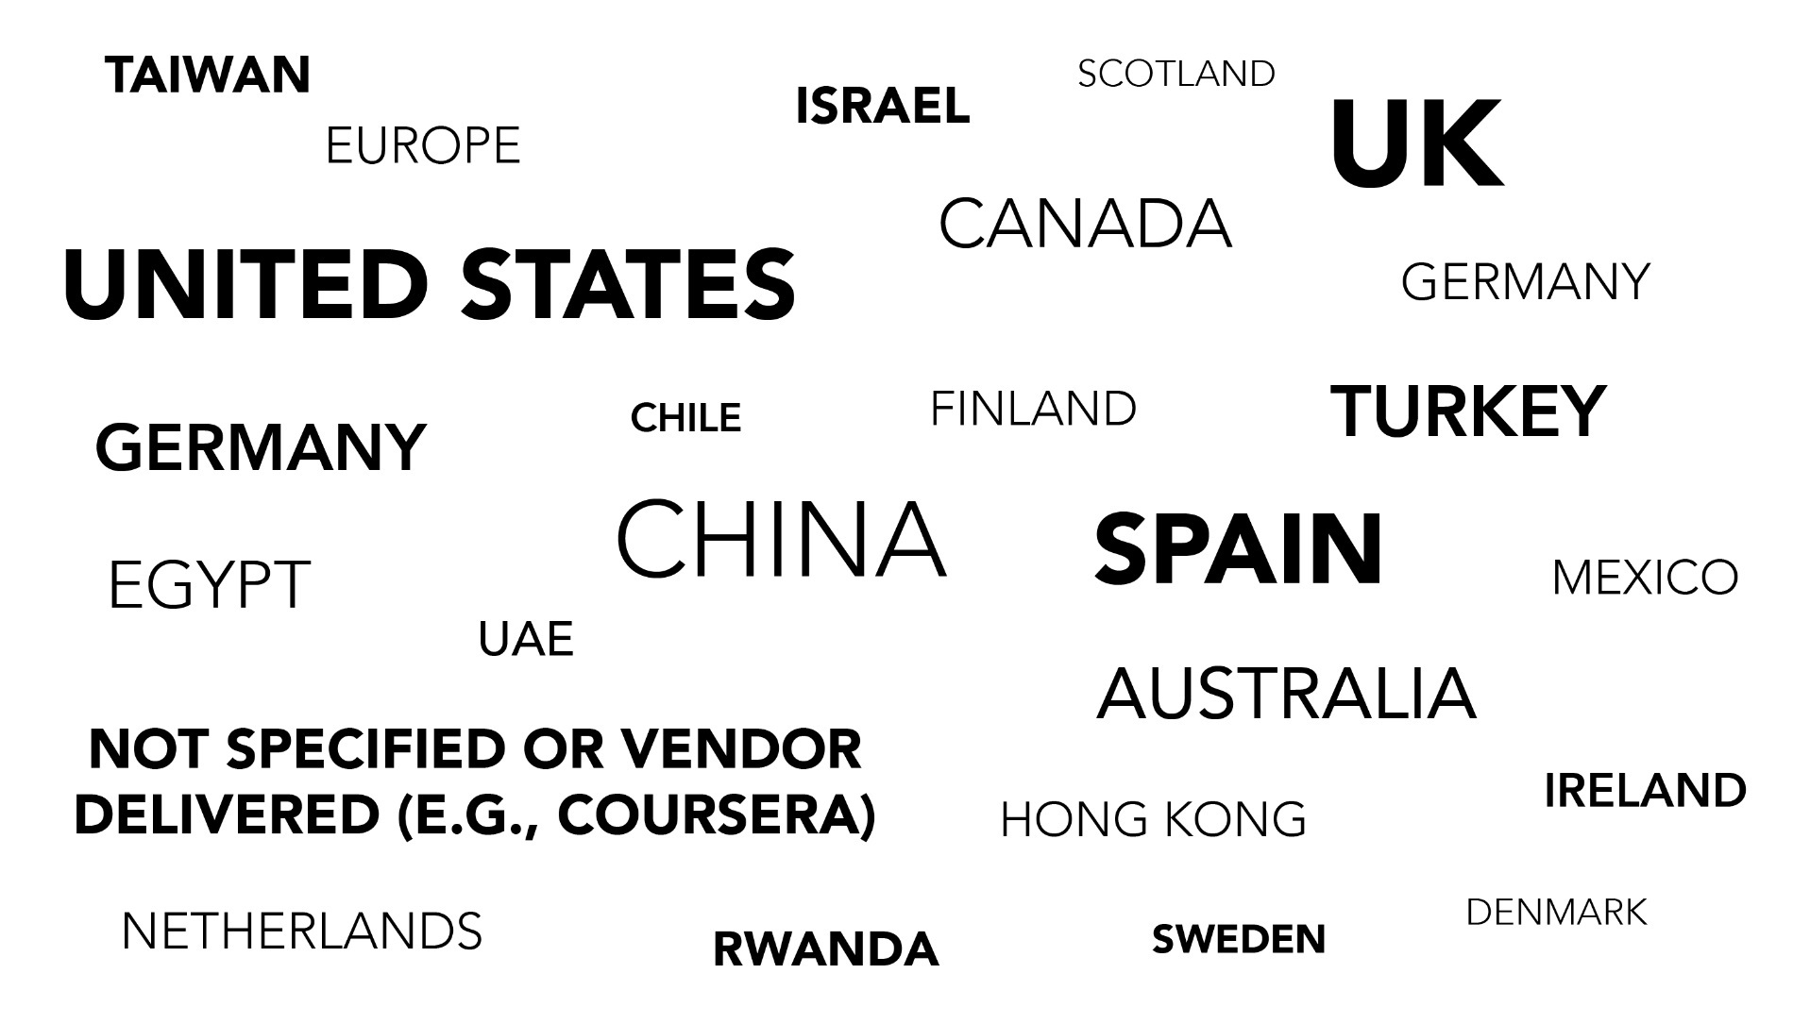
Country of Origin of MOOC Delivery
(2014-2017)

Slide 22
Research Background (Zhu, M., Sari, A., & Lee, M. study)

Slide 23
Results-RQ1-Data Collection Methods
RQ1: What are the research methods researchers employed in empirical MOOC studies?

Slide 24
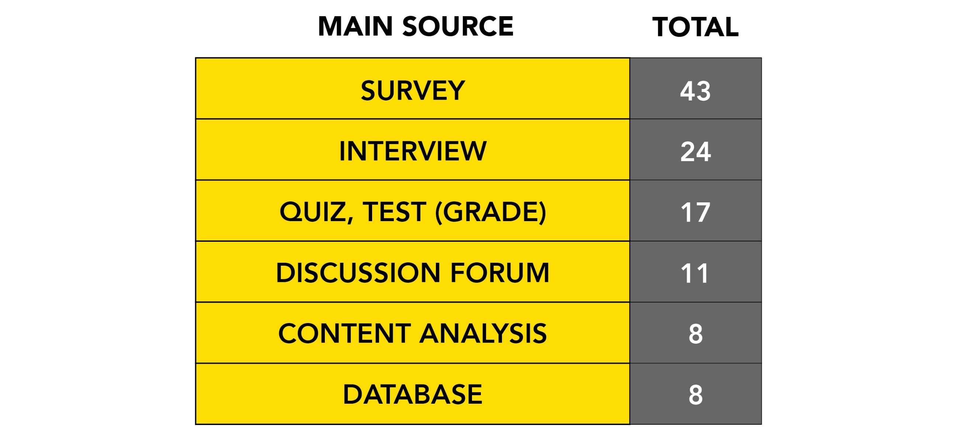
Primary Data Sources for MOOC Research
(2014-2017)

Slide 25
Research Background (Zhu, M., Sari, A., & Lee, M. study)
Primary/general focus of MOOC delivery (out of 146 studies)
(note: some studies have more than one area of focus)

Slide 26
Research Background (Zhu, M., Sari, A., & Lee, M. study)
Research methods used in each research topic (out of 146 studies)
 | Quantitative | Qualitative | Mixed methods
Student-focused | 39 | 9 | 26
Design-focused | 19 | 12 | 17
Context and impact | 9 | 6 | 5
Instructor-focused | 0 | 3 | 2
Notes:
What’s more, most of them use quantitative methods focusing on students. Seldom use mixed methods in instructor-focused research. So more research is needed from instructors perspective using mixed-method study

Slide 27
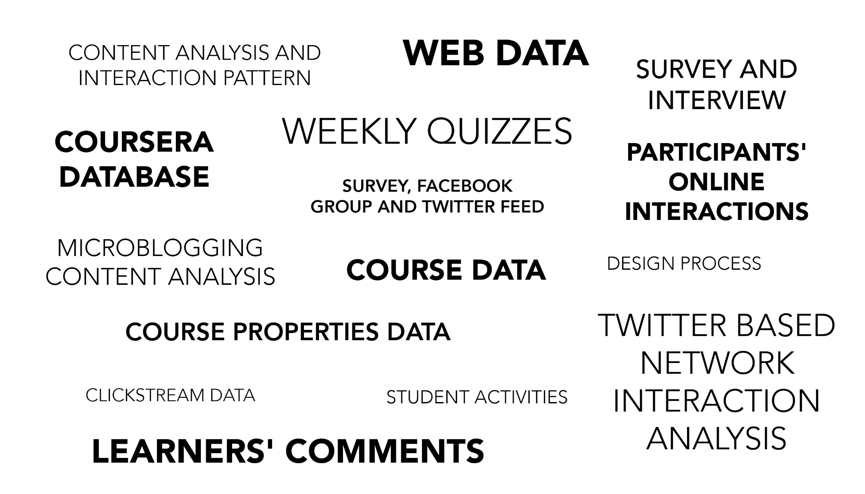
Specific Data Sources for MOOC Research
(2014-2017)

Slide 28
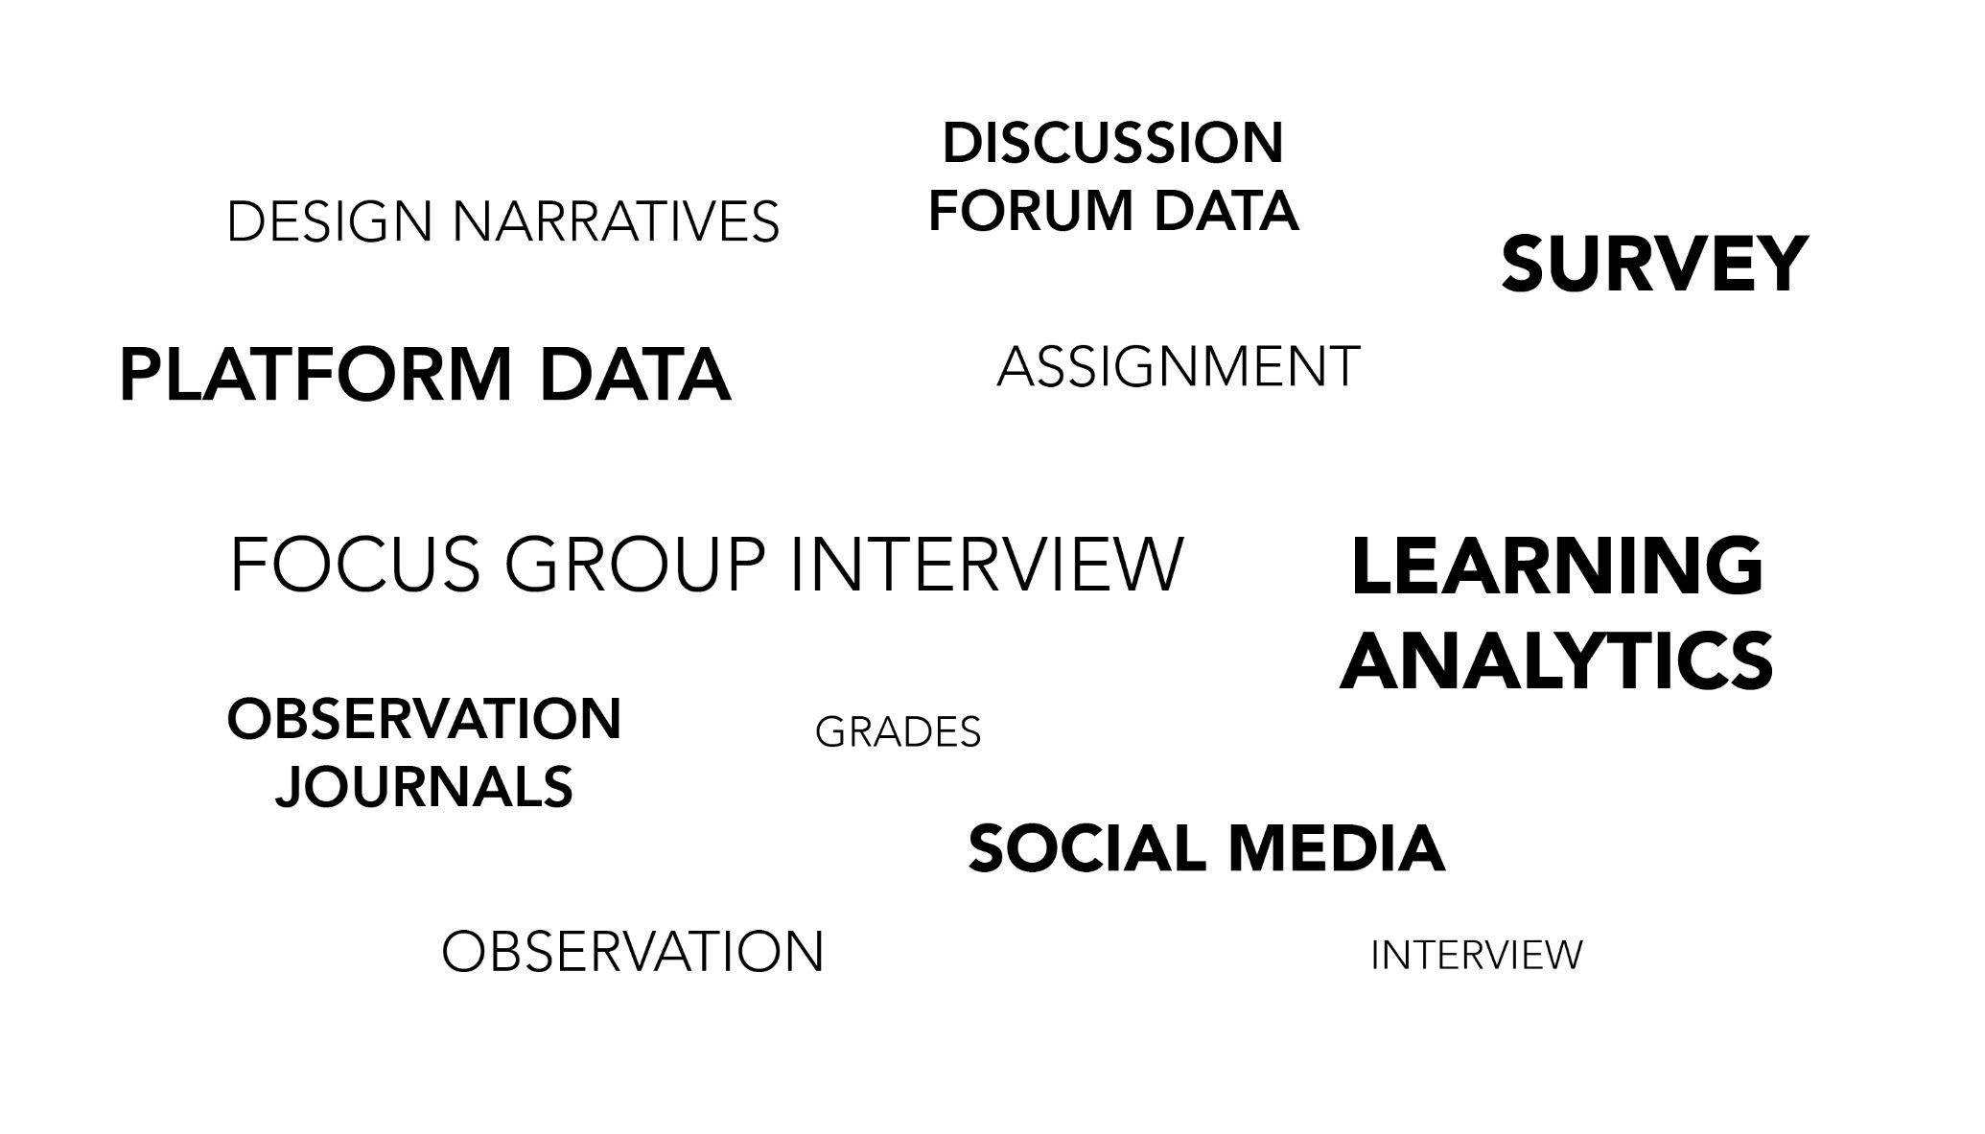
Data Sources of MOOC Research
(Note: when part of 2 or more data sources)
(2014-2017)

Slide 29
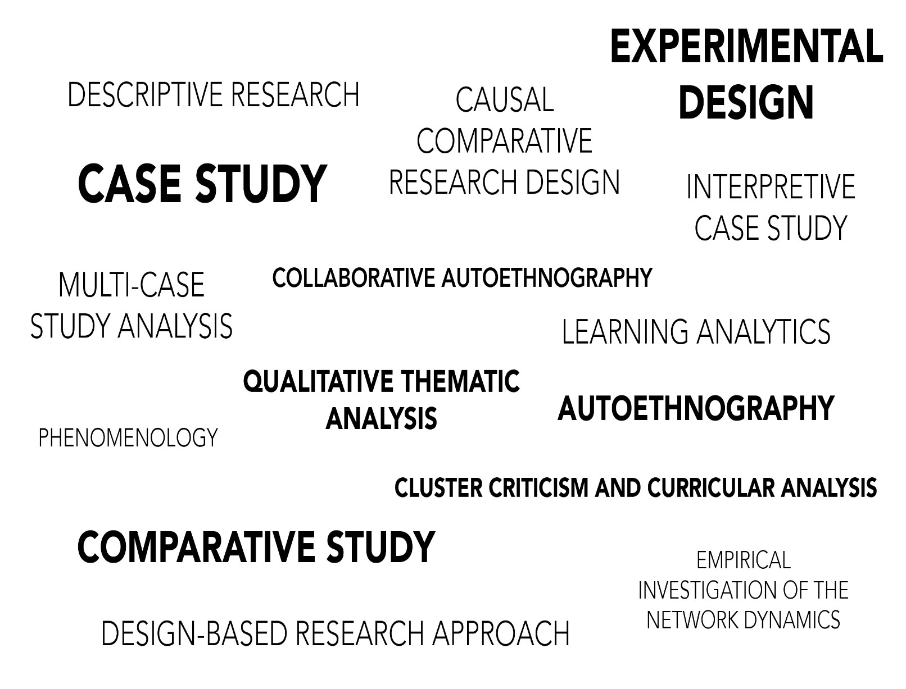
Specific Analytic Method for MOOC Research (2014–2017)

Slide 30
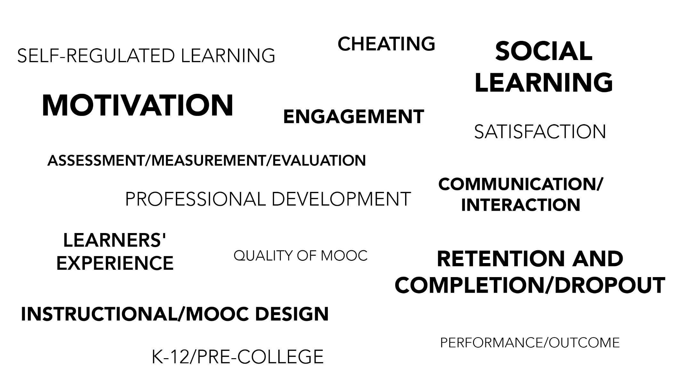
Specific Focus of MOOC Research
(2014-2017)

Slide 31
Research Purpose & Questions
  Help reveal common and successful instructional design and delivery practices in terms of online interaction within MOOCs.
  Research Questions:
  How do MOOC instructors design their courses to encourage interaction among learners?
  How do MOOC instructors design their courses to encourage interaction between instructor and learners?
  How do MOOC instructors design their courses to encourage learner-content interaction?

Slide 32
Research Methods
Research Design: sequential mixed methods design (Creswell & Clark, 2007)
Data Collection: survey, interview, and course review
Participants: 143 survey participants (10% response rate) and 12 interviewees
Notes:
My study used sequential mixed methods design (Creswell & Clark, 2007). We collected data through three data sources. I collected instructors’ email from MOOC providers such as MOOClist, Coursera, FutureLearn. Then I first sent survey to 1400 participants and get 143 valid response. Now I got 2000.
After that we revised our interview questions based on our survey results and selected 12 interviewees from 62 volunteers for interviews with the goal to include instructors from different countries and subject matter areas. These interviewees were with MOOC instructors from the United States (n=4), UK (n=2), China (Mainland and Hong Kong) (n=2), Canada (n=1), Australia (n=1), Sweden (n=1), and India (n=1)
Interviews were conducted via ZOOM. Each interview lasted around 30-60 minutes. The interviews were video-recorded and transcribed verbatim by the first author using tools within Kaltura. To ensure validity, interviewees conducted member-checks to confirm the accuracy of the transcripts. Nine of them provided detailed revision (e.g., misspellings), while three replied without revision but claimed that the transcript was accurate.
I also conducted MOOC review both before and after the interview. Before the interviews, the researchers reviewed the design, course materials, assessments methods, learning activities, and discussion forums of the interviewees’ MOOC to gain an initial understanding of the course, show respect to the interviewees, and enhance the efficiency of the interviews. After the interview, the researcher reviewed the MOOCs in detail to triangulate what the instructors described in the interview in terms of the course design.
Questions: Response rate? 12 interviewee?

Slide 33
Qualitative Research Methods
MOOC instructors interviewed
No. | Countries | Subject areas | Platforms
1. | The U.S. | Language and Literacy | Coursera
2. | The U.S. | Education | Coursera
3. | The U.S. | Education | Canvas
4. | The U.S. | Chemistry | Coursera
5. | UK | Public health | FutureLearn
6. | UK | Language and Literacy | FutureLearn
7. | Hong Kong | Math | Coursera
8. | Mainland China | Math | Coursera
9. | Canada | Psychology | Coursera
10. | Australia | Public Health | Open2Study
11. | Sweden | Computer Science | edX
12. | India | Management | edX
Notes:
My study used sequential mixed methods design (Creswell & Clark, 2007). We collected data through three data sources. I collected instructors’ email from MOOC providers such as MOOClist, Coursera, FutureLearn. Then I first sent survey to 1400 participants and get 143 valid response. Now I got 2000.
After that we revised our interview questions based on our survey results and selected 12 interviewees from 62 volunteers for interviews with the goal to include instructors from different countries and subject matter areas. These interviewees were with MOOC instructors from the United States (n=4), UK (n=2), China (Mainland and Hong Kong) (n=2), Canada (n=1), Australia (n=1), Sweden (n=1), and India (n=1)
Interviews were conducted via ZOOM. Each interview lasted around 30-60 minutes. The interviews were video-recorded and transcribed verbatim by the first author using tools within Kaltura. To ensure validity, interviewees conducted member-checks to confirm the accuracy of the transcripts. Nine of them provided detailed revision (e.g., misspellings), while three replied without revision but claimed that the transcript was accurate.
I also conducted MOOC review both before and after the interview. Before the interviews, the researchers reviewed the design, course materials, assessments methods, learning activities, and discussion forums of the interviewees’ MOOC to gain an initial understanding of the course, show respect to the interviewees, and enhance the efficiency of the interviews. After the interview, the researcher reviewed the MOOCs in detail to triangulate what the instructors described in the interview in terms of the course design.
Questions: Response rate? 12 interviewee?

Slide 34
Data Analysis
RQs | Data Sources | Data analysis
RQs | Survey-multiple-choice questions | Descriptive statistics
 | Interview | Content analysis (Elo & Kyngäs, 2008)
 | MOOC review | Content Analysis

Slide 35
Analytical Framework
Moore’s (1989) Three types of interactions
Interactions | Examples
Learner-learner | Peer-feedback
Learner-instructor | Instructors’ facilitation
Learner-content | Learn from online resources

Slide 36
Context

Slide 37
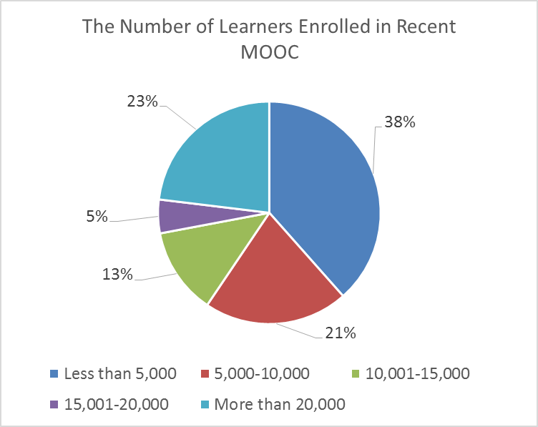
Context

Slide 38
Context

Slide 39
Context

Slide 40
Context

Slide 41
Context

Slide 42
Findings
RQ #1. How do MOOC instructors design the course to encourage interaction among learners?
Asynchronous discussion forums
Pair-based types of tasks
Social media

Slide 43
Findings

Slide 44
Findings
Asynchronous discussion forums
  One instructor mentioned:
  “And then there's also an asynchronous discussion board within each module. So there will be prompt…And then there were a lot of discussions back and forth with students about suggestions on things they could consider, or maybe there were stuck on something and so they would like help…Within discussion forum, there's a showcase and that is the opportunity to get feedback from peers.”

Slide 45
Findings
RQ #2. How do MOOC instructors design the course to encourage interaction between instructor and learners?
Online discussion forums
Platform messages
Social media connections

Slide 46
Findings

Slide 47
Findings
Online discussion forum
  One instructor mentioned:
  “We monitor discussion boards as well. That would not necessarily be like formal assessment. We're just wondering how students are engaging with material. So it's an indicator for us but not a measurable one”

Slide 48
Findings
Not much instructor-learner interaction
  One instructor mentioned:
  “Because there's not much interaction, even between me and students. When I first launched this MOOC, I paid closer attention. Maybe I replied to some students. Now I think Coursera somehow grabs some students to be mentors or something. There are other people commenting. It seems like I do not have to do anything. Every week, perhaps three hundred more students register. Nobody bothers me.”

Slide 49
Findings
Not much instructor-learner interaction
  One instructor from the U.S. mentioned:
  “In the classroom there's more of an interaction at least a reaction between like the instructor and the students, students and student, and you can't really simulate that in this kind of MOOC format.”

Slide 50
Findings

Slide 51
Findings

Slide 52
Findings
An instructor from the US mentioned
  “Within discussion form, there's a showcase and that is the opportunity to get feedback from peers. And also we have facilitators, who are volunteers, who go in and offer feedback.”

Slide 53
Findings
RQ #3. How do MOOC instructors design the course to encourage learner-content interaction?
Discussion forum
Embedded video lectures and tutorials
Article or book readings

Slide 54
Findings

Slide 55
Findings
  One professor from the U.S. stated that:
  “Besides videos, there was a suggested book.”
  Another instructor noted that she used visuals in her MOOC “I had a whole lot of graphical material that I used in class. And I had got them from one of the texts that were published in the area and had been allowed to use them, because I was recommended the textbook.”

Slide 56
Discussion
Most MOOC instructors emphasized a variety of strategies to encourage learner-learner interaction by using asynchronous discussion forums, pair-based assignments or peer reviews, and social media to encourage peer interaction.
Learner-instructor interaction were encouraged through online discussion forum, platform messages, and social media connections.
Learner-content interaction: discussion forums or threads, video lectures and tutorials in the MOOC, readings, practice quizzes and exams were primarily used in MOOCs.

Slide 57
Conclusions
This study indicated that MOOC instructors are trying to encourage online interaction in MOOC; however, there is no universal understanding of strategies of encouraging online interaction and instructor-learner interaction is still not optimal.

Slide 58
Future Directions
Further observations and analyses are needed to better understand how MOOC instructor design and deliver their MOOCs to encourage online interaction and learner success.

Slide 59
Limitations
Limited to MOOCs which are mainly delivered in English
Volunteer bias
Only review 12 MOOC Courses
Notes:
This study has several limitations. First, the MOOC instructors were the ones how course was delivered in English. Other course delivered in Chinese, Spanish were not included. In addition, the participants who volunteered for this study may be more favorable toward MOOC instructional design than those who did not respond.
Finally, we only reviewed the MOOC courses of the 12 interviewees, not all the study participants.
the instructor names, institutions, contact information, and courses were gathered from vendors such as Coursera, FutureLearn, and edX; the MOOC instructor lists from many other MOOC vendors were either not available or were not in English. In effect, for the most part, this study did not include thousands of MOOC instructors whose MOOCs were not presented in English. For instance, MOOCs delivered in other languages such as Chinese, Arabic, Italian, and Spanish were not included in this data.
In addition, the participants who volunteered for this study may be more favorable toward MOOC instructional design than those who did not respond.
Finally, we only reviewed the MOOC courses of the 12 interviewees, not all the study participants.

Slide 60
Thank you!
Questions and Comments…
E-Learn, Vancouver, October 19th, 2017
Meina Zhu, meinzhu@umail.iu.edu
Curtis J. Bonk, cjbonk@Indiana.edu
Annisa Sari, annsari@umail.iu.edu
Indiana University

