Slide 1
Duolingo: Application of AI-Driven Technology to Teach English
Hi!
Aluu!
Salut!
Jambo!
Oi!
Presented by Zixi Li & Curtis J Bonk

Slide 2
Background
Globalization & ELL
Many people whose native language is not English are becoming English language learners (ELL).
Learning with Technology
The newest approach to overcoming the difficulties of learning English involves integrating technology (Ajisoko, 2020).
AI in Language Learning
The use of artificial intelligence (AI) in language learning, such as chatbots, has been extensively investigated in recent studies (Kim et al., 2019)
Notes:
Under the context of globalization and transnational migrants here in the states,
English was the most spoken languages

Slide 3
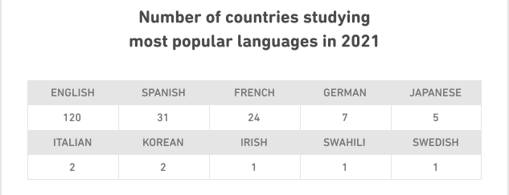
Duolingo
Duolingo is a free language-learning platform, which has become one of the most popular tools for language learning (Jašková, 2014).
It includes a language-learning website and a mobile application, offering free lessons among 40 languages for more than 500 million learners (Blanco, 2021)

Slide 4

(Blanco, 2021)

Slide 5
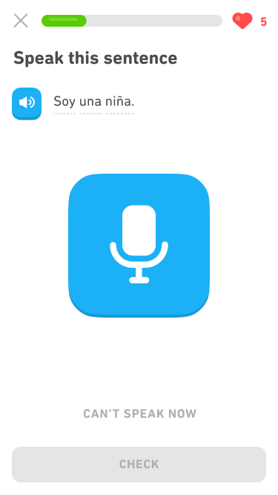
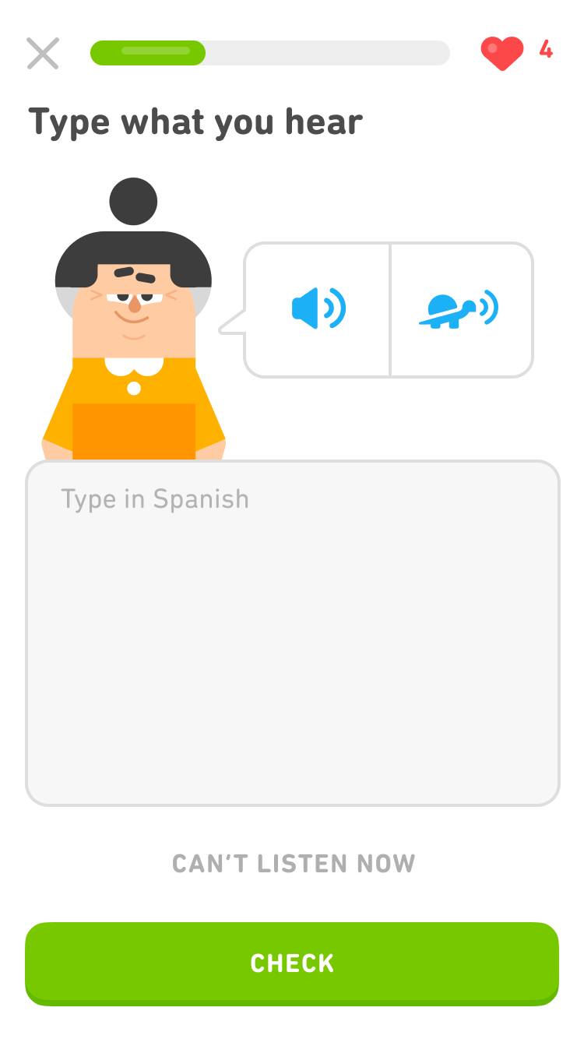
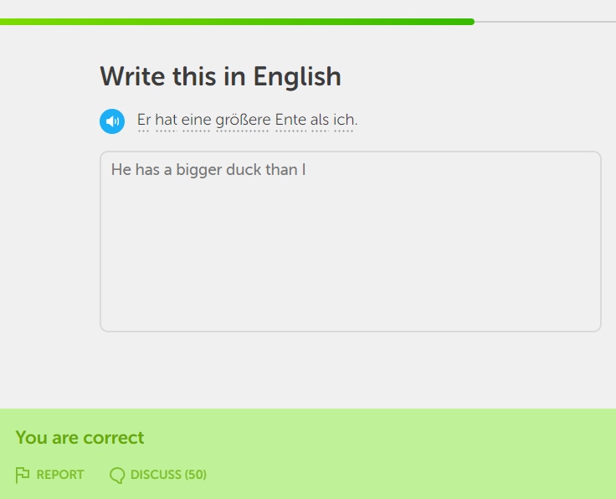
Platform Overview

Slide 6
History
The design intention is based on the experience of expensive English education within the founder’s community in Guatemala.
Rooted in his belief that “free education will really change the world,” Duolingo’s platform launched publicly, free of charge.
Duolingo was originally designed to be used in the context of the non-classroom learning environment with the scope of “beyond the walls of the classroom” (Brebera, 2017).
In 2016, as Duolingo was identified as an effective tool in a classroom setting, Duolingo started a new feature called “Duolingo for Schools” to match the user’s needs. It allows teachers to create assignments and track students activity.
Notes:
The intention to create Duolingo is based on the founder, Luis Von Ahn’s, experience of expensive English education within his own community in Guatemala. Rooted in Von Ahn’s belief that “free education will really change the world,” Duolingo’s platform launched publicly in 2012, free of charge. By the end of the year, Duolingo launched its free mobile application for iOS system. In 2013, Duolingo became available on Android devices.
Duolingo was originally designed to teach users foreign language through phrase translation, which was recognized as an effective learning tool for beginner-level language learners to use in a classroom setting. In 2016, as Duolingo was identified as an effective tool in a classroom setting, Duolingo started a new feature called “Duolingo for Schools” to match the user’s needs. The original phrase translation feature no longer exists. Duolingo’s current mission is to personalize education through game playing.

Slide 7
01
Key Features
¡Hola!

Slide 8
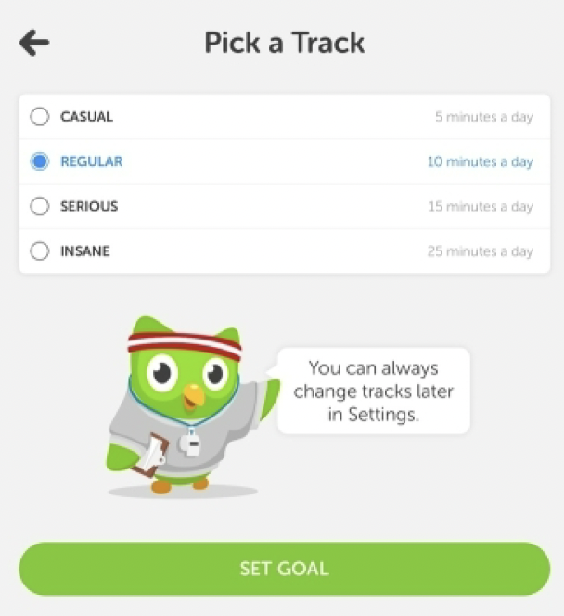
Goal Setting
Based on microlearning.
Is goal-oriented.
Range from 5 min/day to 20 min/day.
Flexibility to personalized.
Teachers may track students’ performance if use “Schools”
Notes:
Duolingo is based on the concept of microlearning, constructed with small learning units and short-term-focused learning activities that reach users through the day (Brebera, 2017). The daily study goal ranges from 5 min/day to 20 min/day, which can be easily completed on the mobile app whether when the learner is waiting in the checkout line at a grocery store or sitting on a bus to school. It provides the learner great flexibility to personalize their learning process that matches their learning goal, learning capability, time limitations, etc. More recently, the context for Duolingo use has extended to a formal classroom setting. Teachers can incorporate Duolingo into their individual lesson plan and track students’ performance through Duolingo (Gigaom: Language-learning app, 2015).

Slide 9
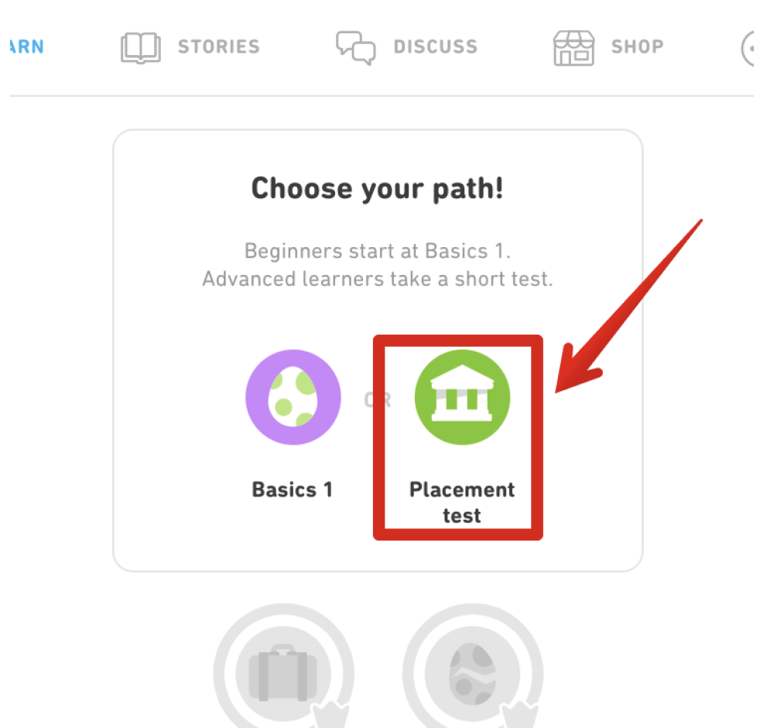
Placement test
Offered at the beginning that enables users to assess their level of proficiency in the target language.
The test only takes few minutes to complete and will provide an approximate estimation of a user's skills.

Slide 10
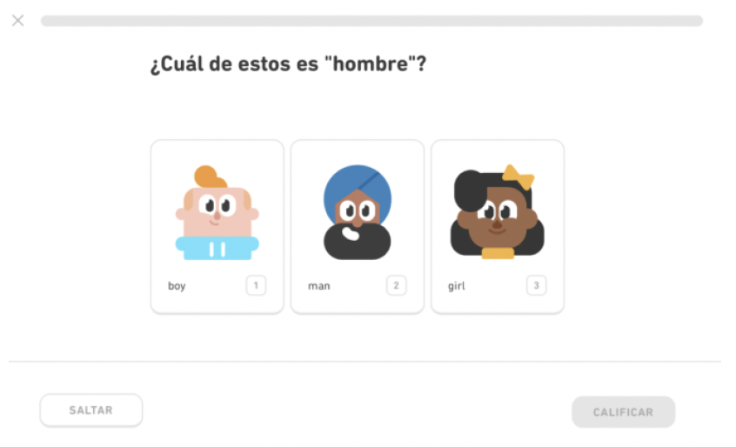
Example Items: Vocabulary
Your learner may get vocabulary questions asking them to identify a picture in response to the question. They can hover over each picture to hear an English speaker pronouncing the word.

Slide 11
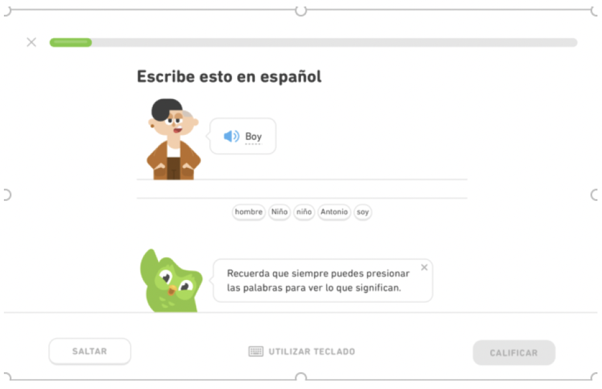
Example Items: Translation
The test includes translation items. Learners are asked to translate an English word or sentence into their native language.

Slide 12
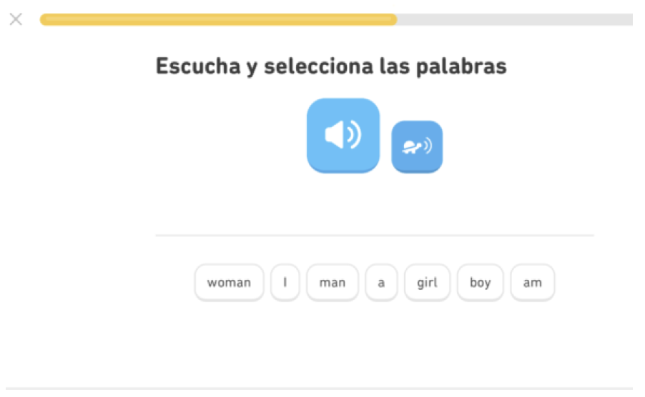
Example Items: Listening
Learners will hear a sentence in English. They can choose to hear it again by clicking on the speaker button or hear it in slow-motion by clicking on the turtle.
Notes:
Learners will hear a sentence in English. They can
choose to hear it again by clicking on the speaker
button or hear it in slow-motion by clicking on the
turtle.
• Then, learners will construct the sentence they
hear by selecting the words and arranging them in
the appropriate sequence.

Slide 13
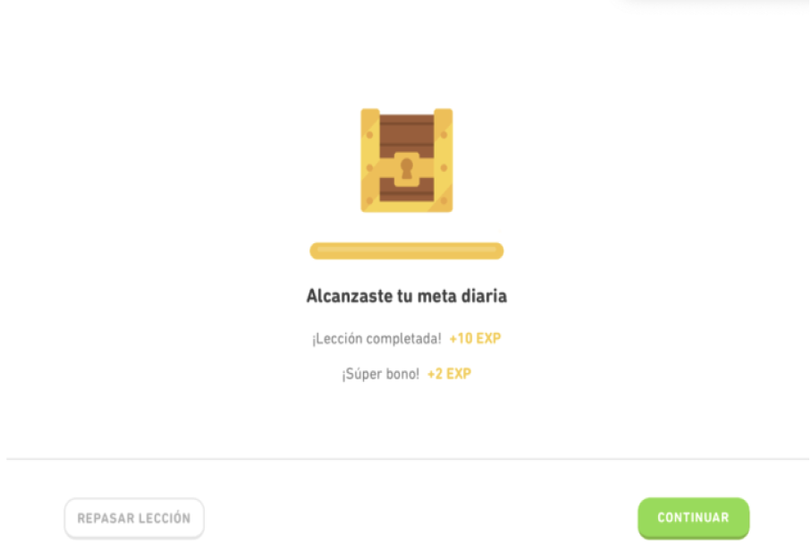
Example Items: After the Test
After completing the test, the learner should see a
treasure chest. Beneath the treasure chest there is
information about the number of experience
points they have been awarded for taking the
test.
Notes:
After completing the test, the learner should see a
treasure chest. Beneath the treasure chest there is
information about the number of experience
points they have been awarded for taking the
test.
• There might also be information about the
amount of lingots—Duolingo currency—that they
have earned.
(We'll learn more about lingots later.)

Slide 14
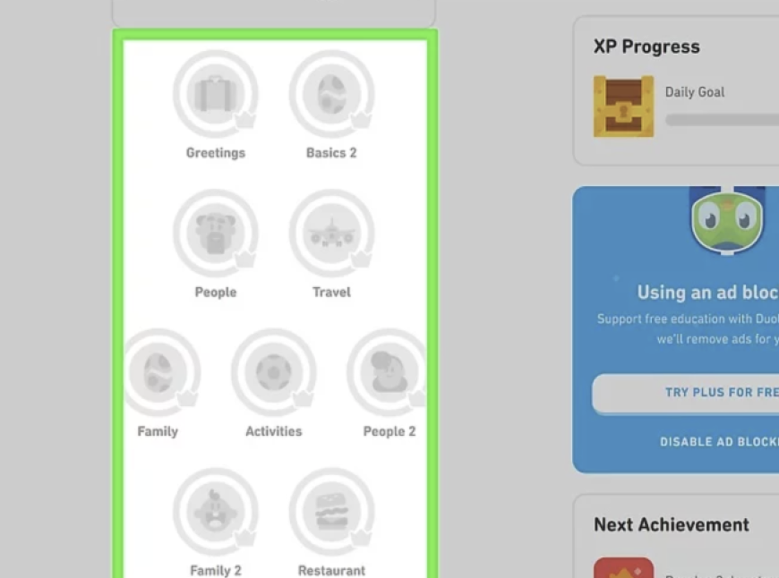
Access the Skill Tree
The skill tree is where you'll do most of your learning.
It's split into different units, and each unit contains multiple lessons.
As you progress through the language, more units will be available to you .
Notes:
The skill tree is where you'll do most of your learning.
It's split into different units, and each unit contains
multiple lessons. As you progress through the language,
more units will be available to you (you'll be able to
unlock them).
There are five levels per unit. Once you click on each
lesson, you'll see what percentage of the way you are
to the next level. You can level up either by finishing
all required lessons in your level or taking the test.

Slide 15
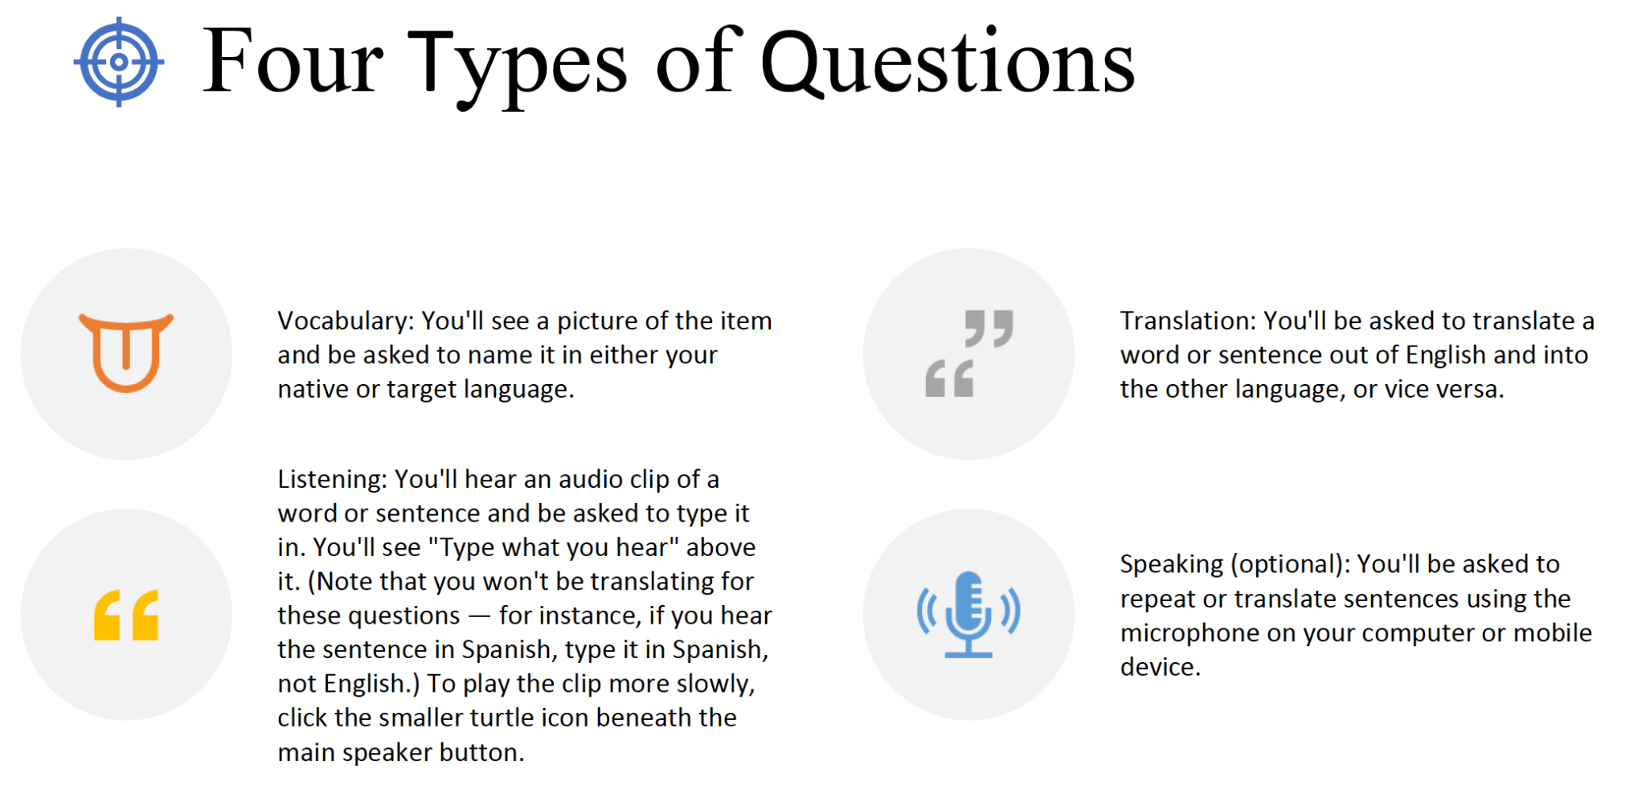
Access the Skill Tree
Notes:
The skill tree is where you'll do most of your learning.
It's split into different units, and each unit contains
multiple lessons. As you progress through the language,
more units will be available to you (you'll be able to
unlock them).
There are five levels per unit. Once you click on each
lesson, you'll see what percentage of the way you are
to the next level. You can level up either by finishing
all required lessons in your level or taking the test.

Slide 16
Access the Skill Tree
The skill tree is where you'll do most of your learning.
It's split into different units, and each unit contains multiple lessons.
As you progress through the language, more units will be available to you .
Notes:
The skill tree is where you'll do most of your learning.
It's split into different units, and each unit contains
multiple lessons. As you progress through the language,
more units will be available to you (you'll be able to
unlock them).
There are five levels per unit. Once you click on each
lesson, you'll see what percentage of the way you are
to the next level. You can level up either by finishing
all required lessons in your level or taking the test.

Slide 17
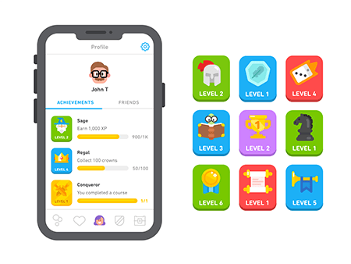
Gamification
Duolingo applies gameful learning to keep the learner motivated and consistently engaged in a positive and casual learning environment.
Its learning process is structured as a learning game that has game features, such as reward, badges, and leader-board, to allow users to learn as playing.
Notes:
Duolingo applies gameful learning to keep the learner motivated and consistently engaged in a positive and casual learning environment. Its learning process is structured as a learning game that has game features, such as reward, badges, and leader-board, to allow users to learn as playing.
. Gems and lingots are used as rewards, functioning as virtual currency that learners gain by completing lessons or skills. Leaderboards provide opportunities for learners to compete with other learners, forming social connections and interactions between online users. The level-system provides a way to track a learner’s learning process. When users learn on Duolingo, they earn experience points (XP), which determine a user’s language level. Badges are important components of Duolingo design, which display user’s achievements in the learning process (Huynh, Zuo, & Ilda, 2016).

Slide 18
02
The AI Behind Duolingo
Jambo!

Slide 19
Why incorporate AI?
The value of Duolingo is to make education universally accessible.
One-on-one tutor is a not available to everyone.
AI can reach to everyone:
  Has sufficient knowledge about the learning materials.
  Keeps learners engaged.
  Gets inside of your head.
(Duolingo, 2021)
Notes:
Dr. Burr Settles is a Research Director at Duoling
a private one-on-one tutor or a really great teacher.
And while that may be true in many cases,
unfortunately not everybody in the world has access to a one-on-one private tutor

Slide 20
How does Duolingo incorporate AI?
Using machine learning and natural language processing to guide lesson design.
  Analyze the vocabulary, grammar content, audio and podcast scripts for Duolingo Stories or Duolingo Podcast or audio lessons.
  Align them with a target level of proficiency
Making materials engaging.
  Create custom voices for audio characters.
  Personalized push notifications.
(Duolingo, 2021)
Notes:
Dr. Burr Settles is a Research Director at Duoling
a private one-on-one tutor or a really great teacher.
And while that may be true in many cases,
unfortunately not everybody in the world has access to a one-on-one private tutor
to remind you to do your daily Duolingo lesson,
it turns out there's an A.I. algorithm
that chose which, out of hundreds of possible messages
we could send you at this precise moment,
to maximize the chances that you want to go and do a lesson on Duolingo.

Slide 21
How does Duolingo incorporate AI?
Innovate Birdbrain system to get inside of learner’s head and personalize learning.
  Base on the zone of proximal development
  Make accurate predictions on the percentage to get right
  Select the personalized exercise so that it’s neither too hard or too easy
  To keep learners challenged but still motivated
(Duolingo, 2021)
Notes:
Dr. Burr Settles is a Research Director at Duoling
a private one-on-one tutor or a really great teacher.
And while that may be true in many cases,
unfortunately not everybody in the world has access to a one-on-one private tutor
to remind you to do your daily Duolingo lesson,
it turns out there's an A.I. algorithm
that chose which, out of hundreds of possible messages
we could send you at this precise moment,
to maximize the chances that you want to go and do a lesson on Duolingo.
have their own unique profile of the sorts of things
they tend to get right and tend to get wrong.
but you're teaching BirdBrain a bit about your personal abilities,
as well as the difficulties of all of the exercises we give you.

Slide 22
03
Duolingo
in Classroom
Ni hao!

Slide 23
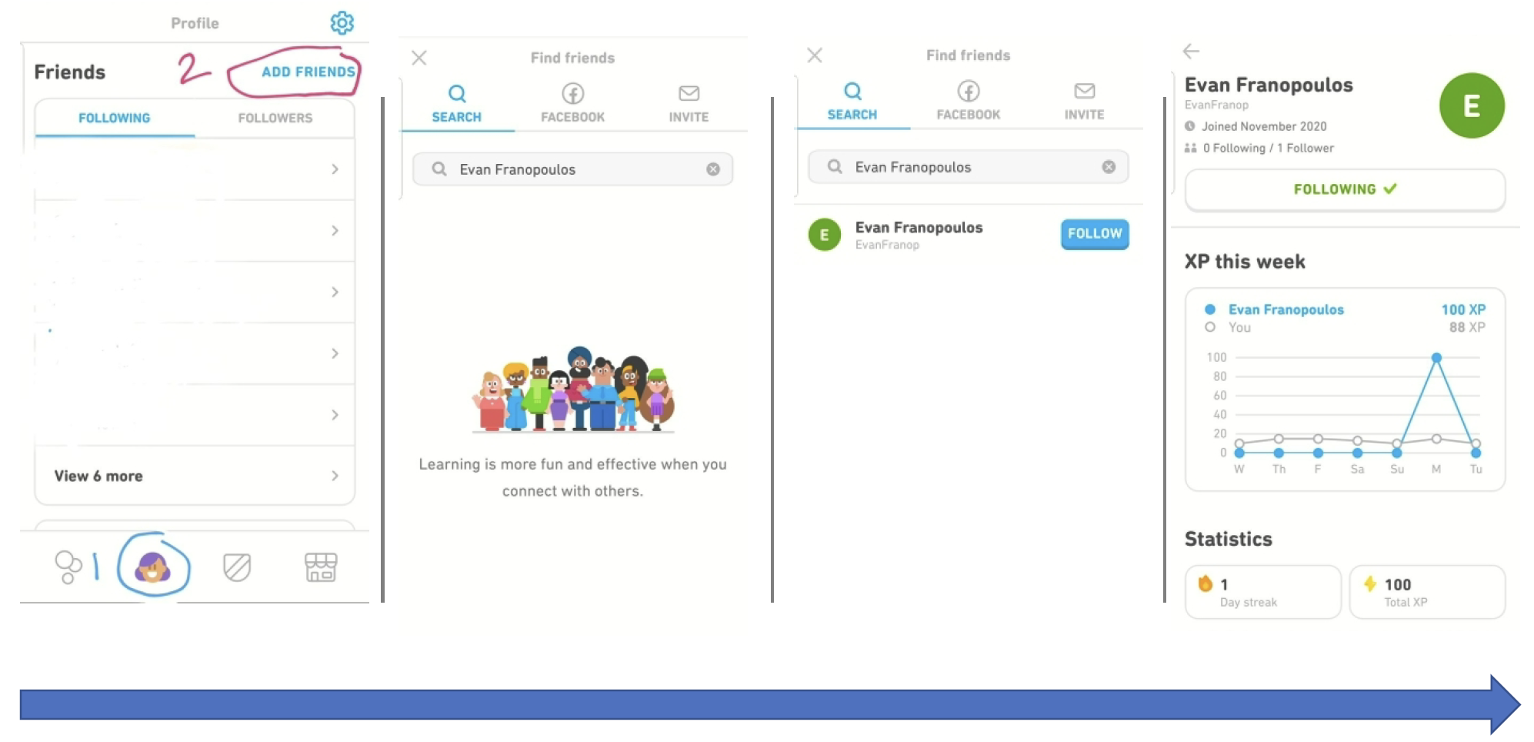
The Friends Feature
Notes:
Dr. Burr Settles is a Research Director at Duoling
a private one-on-one tutor or a really great teacher.
And while that may be true in many cases,
unfortunately not everybody in the world has access to a one-on-one private tutor

Slide 24
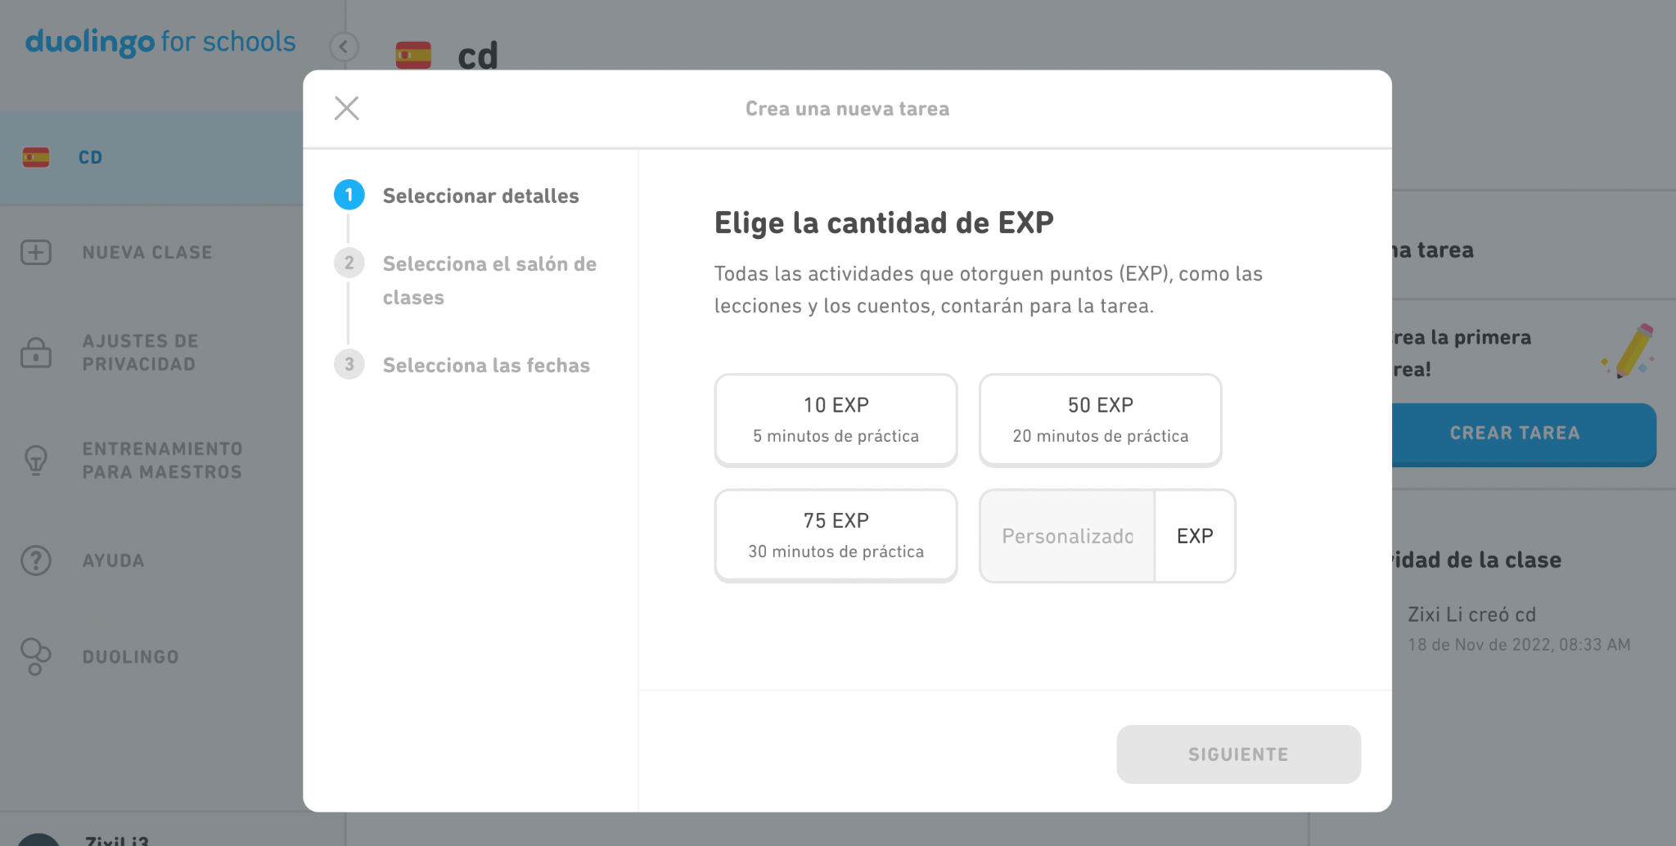
Duolingo for Schools
Notes:
on the right you'll click create XP
assignment once you click that button a
pop-up will appear allowing you to set
the amount of XP you'd like your
students to earn to select whether or
not you'd like multiple classes to
participate in the assignment and add
the beginning and end dates of the
assignment
once you're complete you'll see this
notification letting you know that
you've assigned 10xp 20 XP
once you've done that you'll see this
notification letting you know that your
assignment is created and will be sent
to students with email
um and so on the student end they'll see
an email like this it'll say your
teacher just created a new assignment
you have this long this is when your
assignment is due
and then on their end they'll continue
through their path to earn their XP for
their assignment and their assignments
will show up here in this my assignments
tab
once their assignment is complete and is
complete then they will also get an
email letting them know that their
assignment is finished
a quick note on late assignments
um you see you have this my assignment
box over here

Slide 25
Duolingo for Schools
Teacher dashboards enable easy monitoring
  Visualize student’s learning time, XP earned, and assignments
  Adjust content to the right level
  Manage the cultural inappropriate content (e.g. wine)
Student dashboards are ad-free.
Personalized learning
  AI will adapt student learning
  Students can make mistakes without penalty

Slide 26
04
Our Research
Hi!

Slide 27
Overview of the Study
This study investigated the types of self-directed learning (SDL) skills that learners apply when learning a language out of the classroom with systems like Duolingo. It also explored how the design and delivery of Duolingo can support and facilitate student SDL.

Slide 28
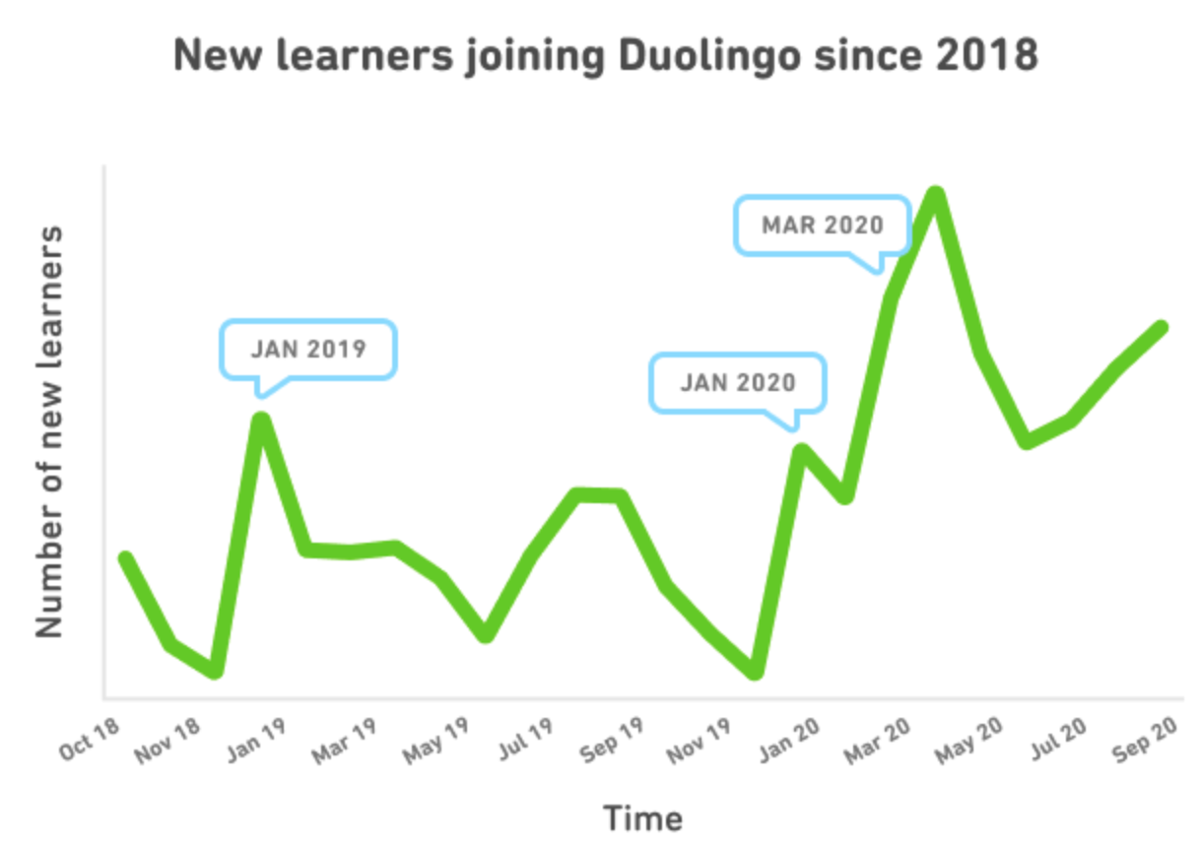
Background
Duolingo (2020)
Notes:
Staying at home leads to a quick expansion of Duolingo.

Slide 29
Context of the Study
Learning with technology (e.g. Duolingo) in an out-of-classroom context is often challenged by the absence of instructors and lack of guidance.
Therefore, it demands a much higher level of self-directed learning (SDL) ability for the learners to be successful.
White (1995) suggests that learners need to have strong independence, autonomy, and control to self-manage learning and make their own decisions in distance language learning.

Slide 30
Research Question
How do Duolingo learners self-manage their learning?
What self-monitoring strategies are employed by Duolingo learners to overcome challenges and frustrations related to learning foreign languages with Duolingo?
What motivating factors underpin the decisions of learners to learn a foreign language with Duolingo?

Slide 31
Garrison’s (1997) Framework of SDL
Self-management is the task control ability that is associated with external activities, such as time, resources, and goal management.
Self-monitoring is the cognitive and metacognitive process of establishing learning strategies and learning paces.
Motivation can initiate and sustain learning efforts towards cognitive goals (Garrison, 1997).

Slide 32
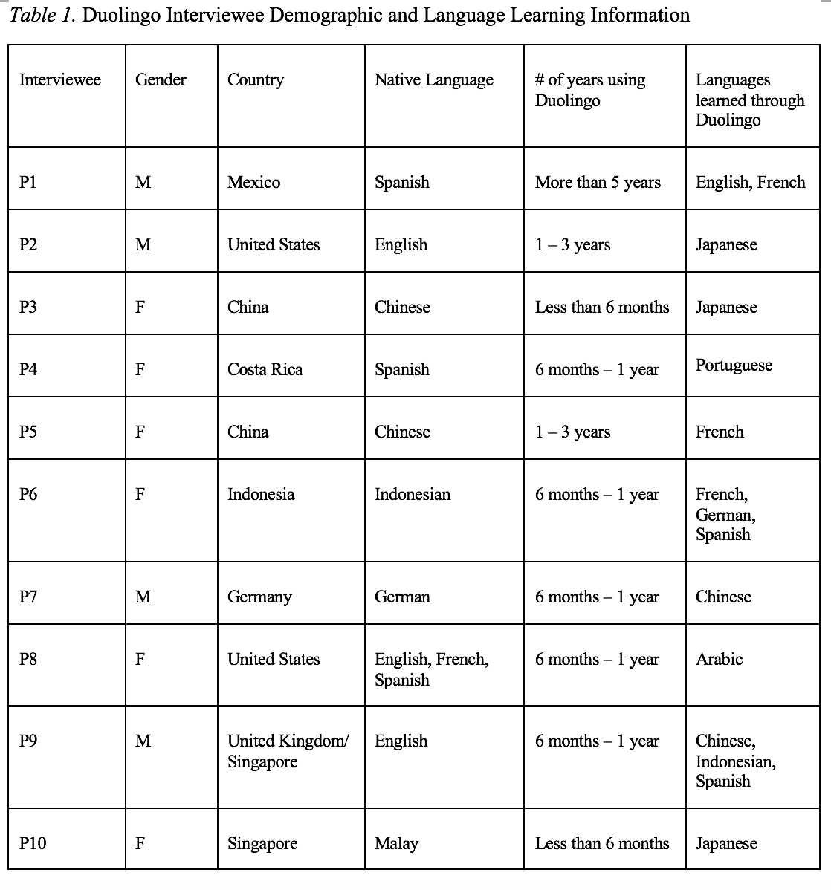
Study Design
The 10 research participants represented a wide range of age and ethnic groups.
Participants of this study were screened and identified through the previous survey that was distributed through the Duolingo forum, an online language community using Discord, as well as through postings on Facebook pages, emails, and WeChat groups. The interviewees’ demographics are listed in Table 1.

Slide 33
Self-management
Specific goals can lead to improved performance, and learners' learning goals can be self-initiated or technology-defined.
Distractions from daily living may make time management difficult, both physically and psychologically.
A single MALL tool like Duolingo is not enough to master a language in all dimensions; as a result, they seek and manage other resources to complement their learning.
Both human and material resources can be used to complement Duolingo learning.

Slide 34
Self-management
“I think my biggest suggestion, as I mentioned a little earlier, is just don't use Duolingo as your only resource. Because particularly nowadays or for any language, there are so many other resources out there and there are certain things that each of them does better or worse than the others.”
Interviewee #2
“My opinion on that is since Duolingo is a non-human system, I think to have a human tutor at the end of a section would actually be a nice relief, a nice change of pace. ”
Interviewee #9

Slide 35
Self-monitoring
Learners self-monitor their learning process through feelings of knowing, content evaluation, and the judgment of the adequacy of information available. Learners can spontaneously recognize the content they learned in Duolingo when they unconsciously encounter the language in daily life. However, they fail to recall the entire knowledge base that they learned with accuracy or completion.
Learners highly rely on technology to monitor their learning through habit reinforcement and tracking.
“Well, what I can do now is when somebody is talking in French, I know that is French. I can identify some really simple French dialogue when somebody says it.”
Interviewee #5
Notes:
Based on the quotes above, it is apparent that learners can spontaneously recognize the content they learned in Duolingo when they unconsciously encounter the language in daily life. However, they fail to recall the entire knowledge base that they learned with accuracy or completion. Therefore, learners can retrieve memory spontaneously at certain situated learning environments instead of recall on demand. As P10 explained:

Slide 36
Motivation
Learners are mostly driven by intrinsic needs and interests, such as culture, travel, and brain training.
Learners use tools like Duolingo to gain a sense of achievement and fulfillment through maintaining streaks, progressing learning, organizing events, and socializations.
“Because sometimes you just lay on your bed, watch some operas or reality shows
and do nothing, but then your Duolingo pops and you'll learn French for five
minutes, and you feel really good about yourself. I don't think people will interpret
this way, but it helped me to build up this positive energy for life.”
Interviewee #5

Slide 37
Discussion
Böhne et al. (2002) indicated that students struggled in a web-based learning environment due to a lack of ways to obtain help when needed.
Tutor support is crucial in SDL because a tutor can facilitate planning the learning process, clarify content, and even provide technical support (Böhne et al., 2002).
The lack of research on resource management strategies might be due to the fact that most prior research either took place in formal learning settings where teachers are present and can provide both human and material resources or investigated what resources learners use towards a target language (e.g. English).

Slide 38
Discussion
Findings indicate that learners seek an integration of internal and external evaluations to self-monitor and make judgments of the effectiveness of their learning process.
Finding suggests that language learning tools might be designed to align with language standards to improve the accuracy of learners' self-evaluations of their learning processes and accomplishments.
Notes:
The interview data illustrate that learners self-monitor their learning process based on a combination of their feelings of knowing, content evaluation, judgment of the adequacy of information available, and the embedded technology features and tools. Nevertheless, half of the interviewees (n=5) expressed a need to assess their learning through other means, such as an international language standardized test which can often be quite decontextualized or more authentic means such as situated real-life conversations. These suggestions indicate that learners seek an integration of internal and external evaluations to self-monitor and make judgments of the effectiveness of their learning process. This finding suggests that language learning tools might be designed to align with language standards to improve the accuracy of learners' self-evaluations of their learning processes and accomplishments.

Slide 39
Discussion
This study found that nine of the ten interviewees were strongly driven by intrinsic motivators, such as social engagement and personal interests, though extrinsic motivation such as for school or obtaining a VISA may also exist.
It suggests that curriculum developers and instructional designers may seek a way to bridge students’ language learning requirements with the students' innate interests and needs, such as socialization.
By doing so, it might close the gap between students’ highly desired learning of languages often pursued informally with their academic needs in formal classroom settings.
Notes:
The present study found that nine of the ten interviewees were strongly driven by intrinsic motivators, such as social engagement and personal interests, though extrinsic motivation such as for school or obtaining a VISA may also exist. Such a finding suggests that curriculum developers and instructional designers may seek a way to bridge students’ language learning requirements with the students' innate interests and needs, such as socialization. If this would occur, it might close the gap between students’ highly desired learning of languages often pursued informally with their academic needs in formal classroom settings.

Slide 40
THANKS
Aluu!
¡Hola!
Do you have any questions?
Zixi Li lizixi@iu.edu
Dr. Curtis J Bonk cjbonk@indiana.edu
Jambo!
Please keep this slide for attribution

Slide 41
References
Ajisoko, P. (2020). The use of Duolingo apps to improve English vocabulary learning. International Journal of Emerging Technologies in Learning (iJET), 15(7), 149-155.
Blanco, C. (2021, December 6). The 2021 Duolingo Language Report. Duolingo Blog. Retrieved from https://blog.duolingo.com/2021-duolingo-language-report/.
Böhne, A., Faltin, N. and Wagner, B. (2002). Self-directed learning and tutorial assistance in a remote laboratory. Proceedings of Interactive Computer Aided Learning Conference, September 25-27, Villach, Austria.
Brebera, P. (2017). Microlearning in Foreign Language Courses: A Threat or a Promise? European Conference on E-Learning, 85-93.
Duolingo. (2021, August 20). The AI Behind Duolingo • Dr. Burr Settles • Duocon 2021 [Video]. YouTube. https://www.youtube.com/watch?v=fnTZdZENRIk
Garrison, D. R. (1997). Self-directed learning: Toward a comprehensive model. Adult Education Quarterly, 48(1), 18-33.
Jašková, V. (2014). Duolingo as a new language-learning website and its contribution to e-learning education, Master’s thesis, Masaryk University, Czech Republic. Retrieved from https://is.muni.cz/th/342420/pedf_m/?lang=en#panelwiki
Kim, N. Y., Cha, Y., & Kim, H. S. (2019). Future English learning: Chatbots and artificial intelligence. Multimedia-Assisted Language Learning, 22(3), 32-53.
White, C. (1995). Autonomy and strategy use in distance foreign language learning: Research findings. System, 23(2), 207-221.

