Slide 1
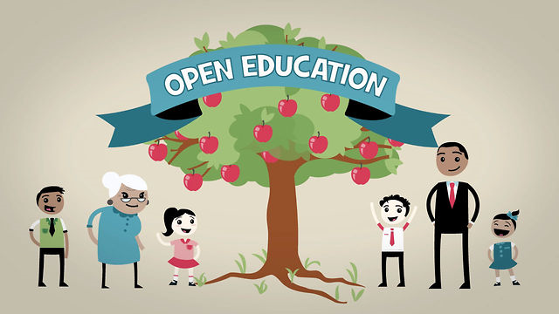
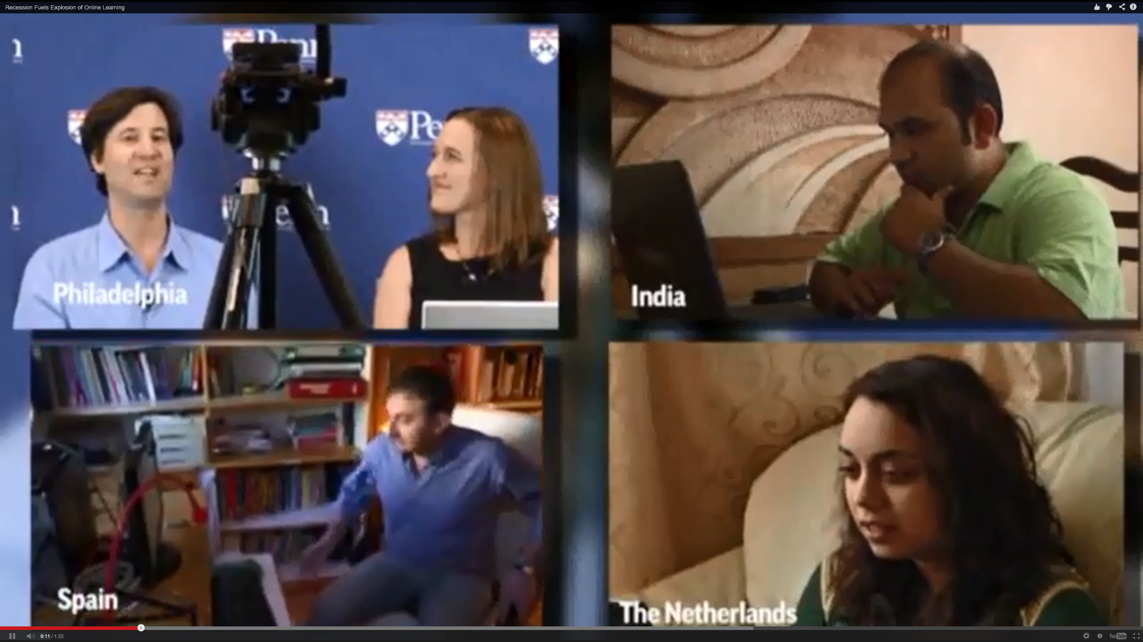
Personalizing the MOOC:
Insights from Experts Around Planet Earth
Curtis J. Bonk, Indiana University
cjbonk@Indiana.edu
KAEIM Conference, Seoul, Korea
May 28, 2016

Slide 2

Part I.
Current Trends and Recent Cycles

Slide 3
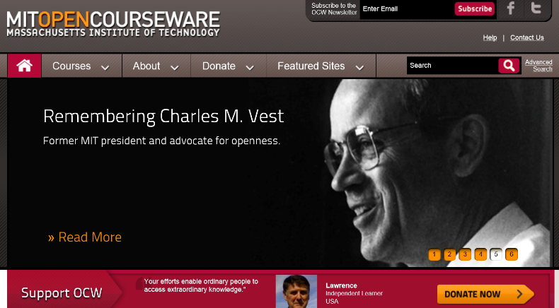
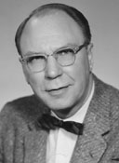
Audience Poll #1:
Do you know what this year is?

Slide 4
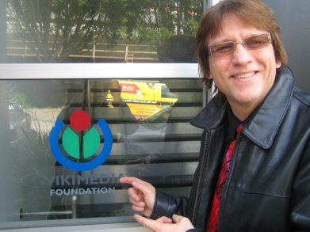


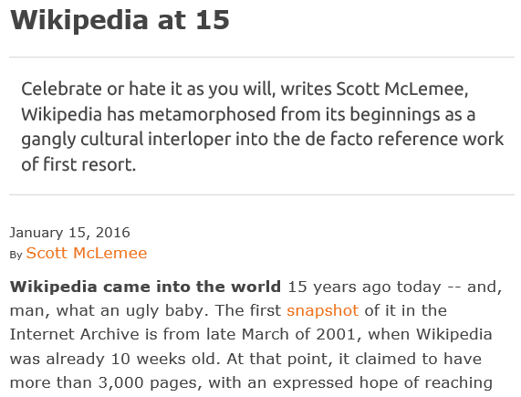
January 15, 2016
Wikipedia is 15!
Scott McLemee, Inside Higher Ed https://www.insidehighered.com/views/2016/01/15/essay-wikipedias-fifteenth-anniversary?utm_source=Inside+Higher+Ed&utm_campaign=4a9a248980-DNU20160115&utm_medium=email&utm_term=0_1fcbc04421-4a9a248980-197362401

Slide 5
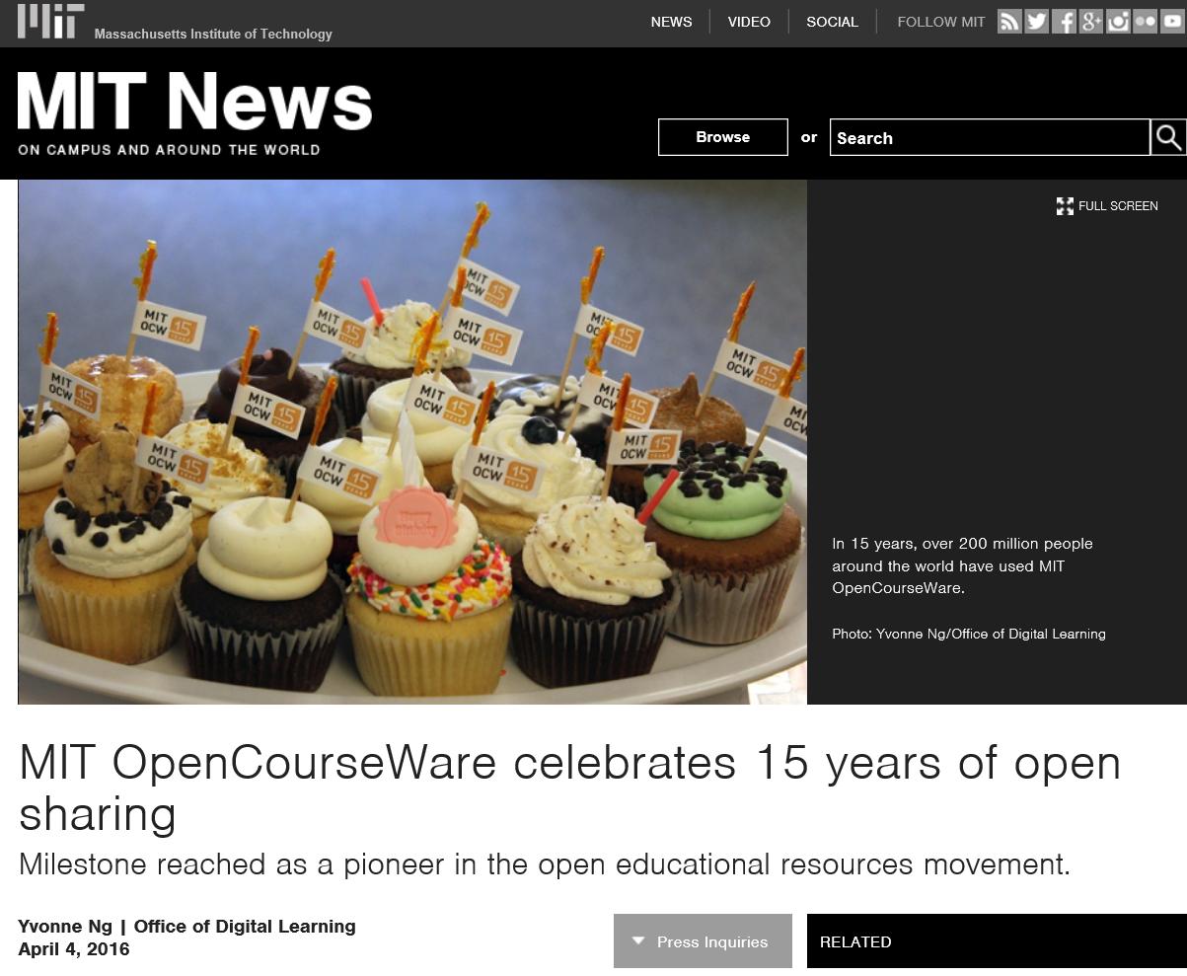
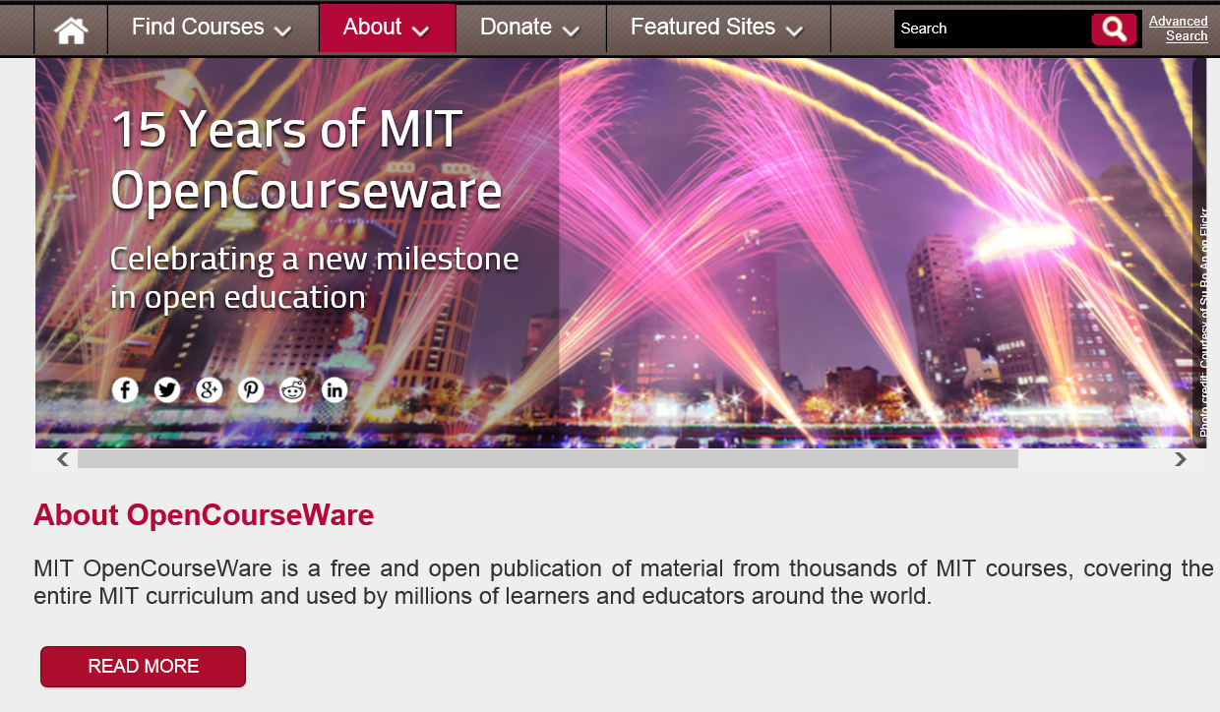
April 4, 2016
MIT OpenCourseWare is 15! http://ocw.mit.edu/about/15-years/

Slide 6
Milestones in Educational Technology
(All 7 year cycles)
1987: Hypercard first shipped.
1994: Netscape goes public.
2001: MIT OCW & Wikipedia Launched.
2008: First MOOC Offered.
2015: The Age of Personalization.

Slide 7

Time to Scratch the 7 Year Itch?

Slide 8
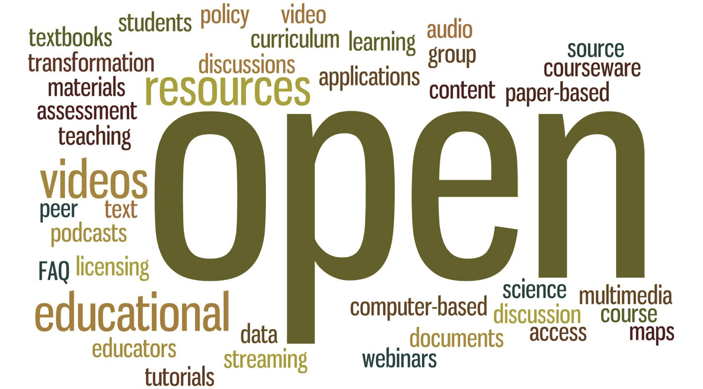
Audience Poll #1:
Who in here has used Opencourseware?

Slide 9
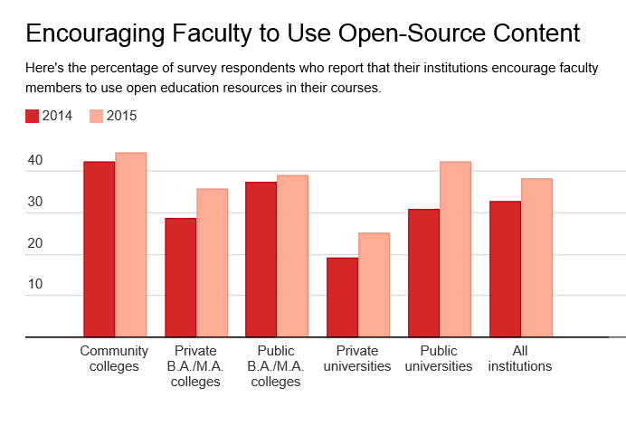
October 29, 2015
Campus Tech Leaders Report More Support for Free Educational Materials, Ellen Wexler, Chronicle of Higher Education http://chronicle.com/blogs/wiredcampus/campus-tech-leaders-report-more-support-for-free-educational-materials/57551?cid=at&utm_source=at&utm_medium=en&elq=e4e3f59aa76642fe887fb1ea8a5a4cee&elqCampaignId=1713&elqaid=6714&elqat=1&elqTrackId=e0e831d54b44442d93aff83de20111dd

Slide 10

Audience Poll #2:
Who in here has taken a MOOC?

Slide 11
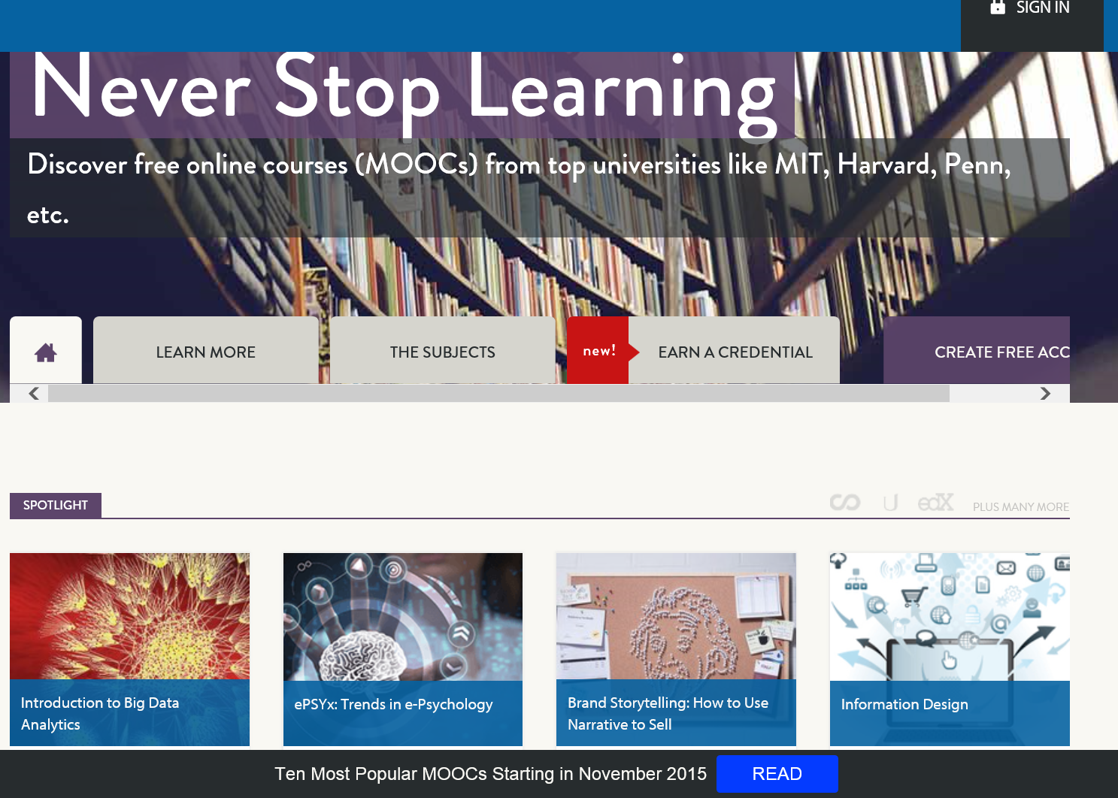
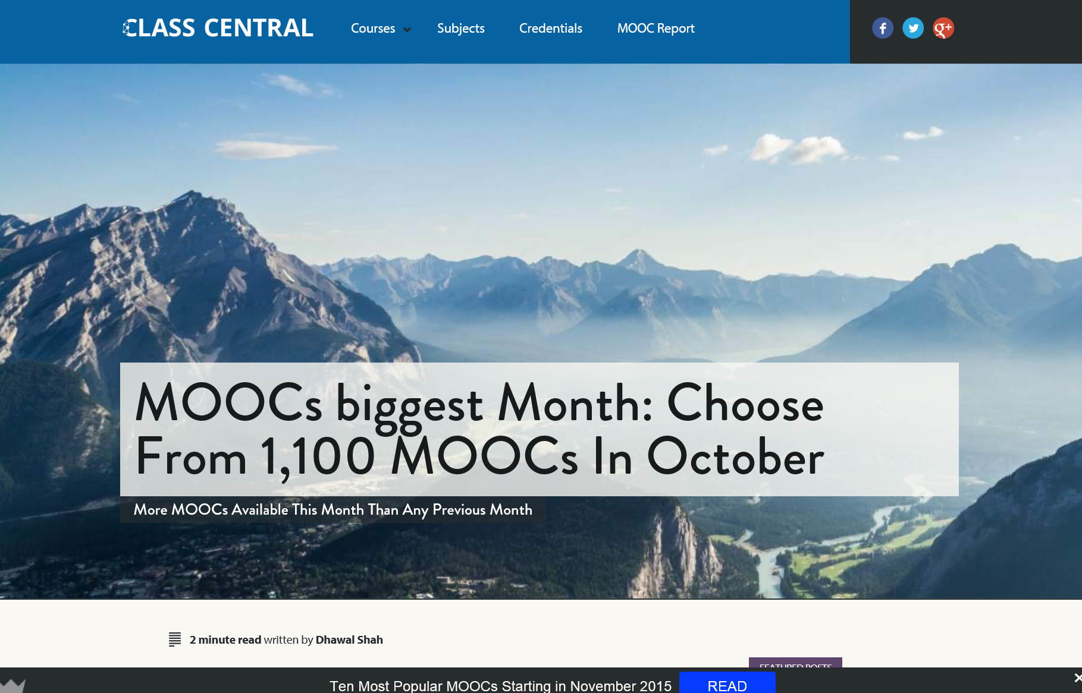
Audience Poll #3:
Who in here has taught a MOOC?

Slide 12
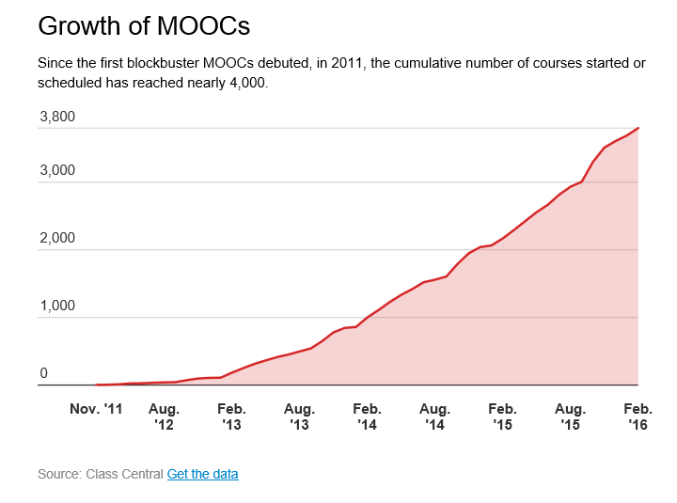
October 19, 2015
MOOCs Are Still Rising, at Least in Numbers,
Ellen Wexler, Chronicle of Higher Education http://chronicle.com/blogs/wiredcampus/moocs-are-still-rising-at-least-in-numbers/57527

Slide 13
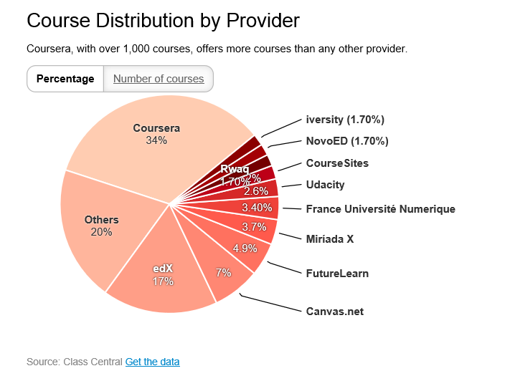
October 19, 2015
MOOCs Are Still Rising, at Least in Numbers,
Ellen Wexler, Chronicle of Higher Education http://chronicle.com/blogs/wiredcampus/moocs-are-still-rising-at-least-in-numbers/57527

Slide 14
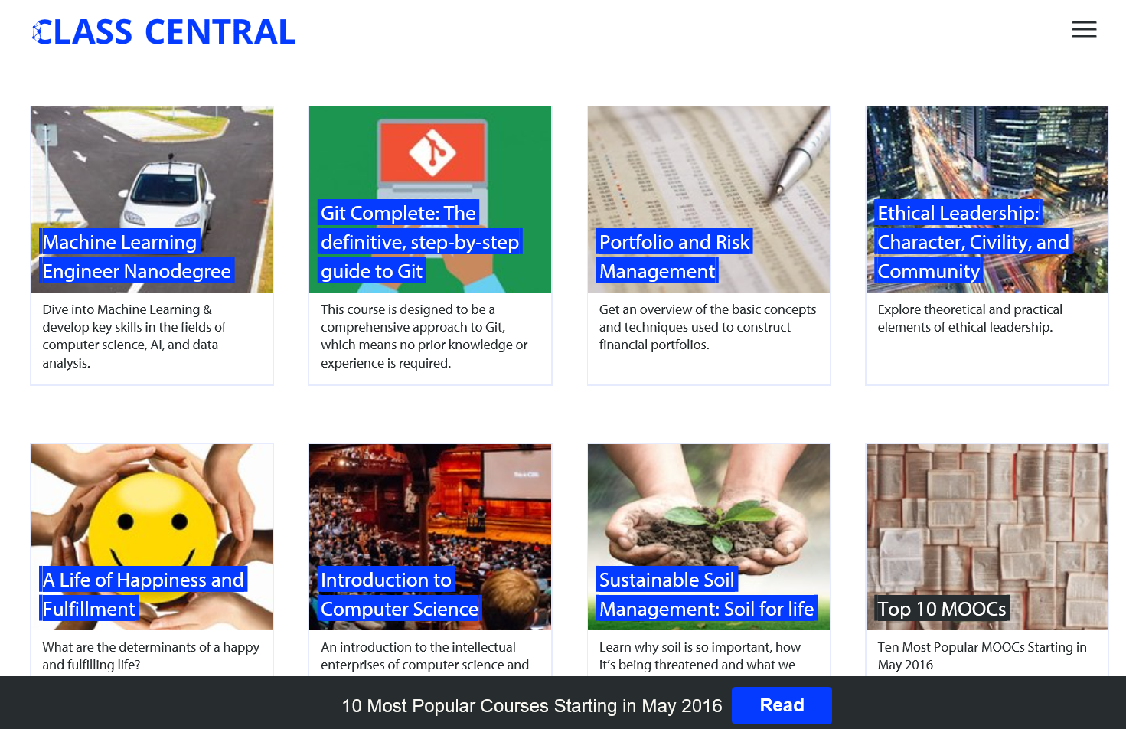
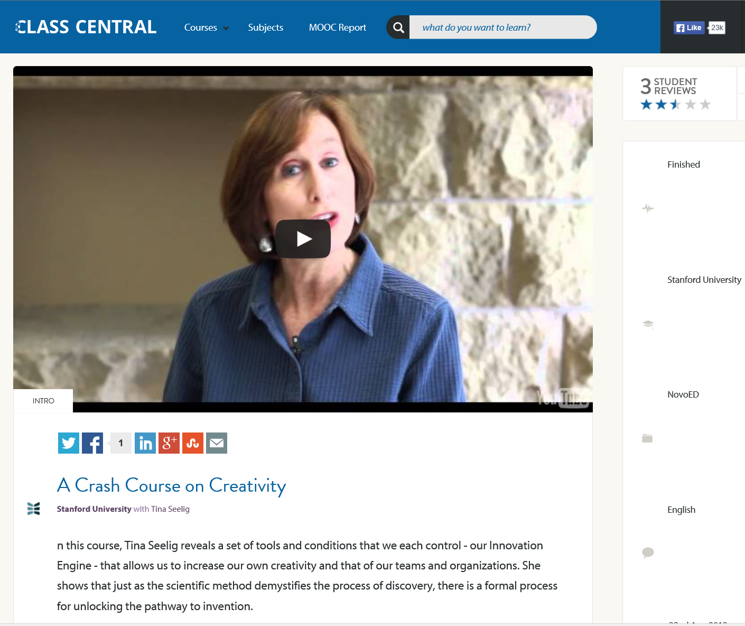
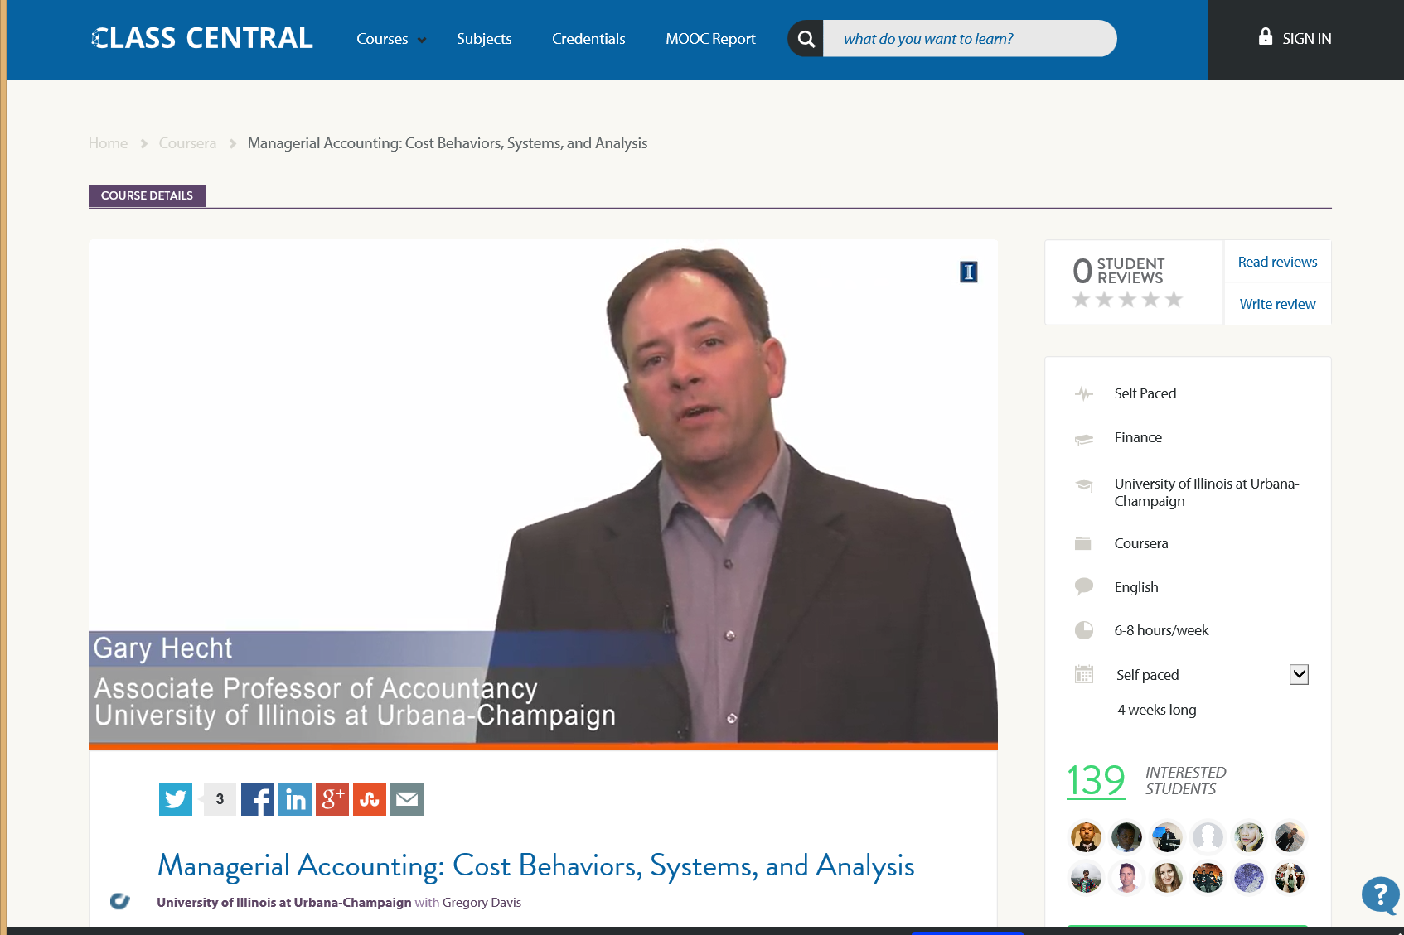
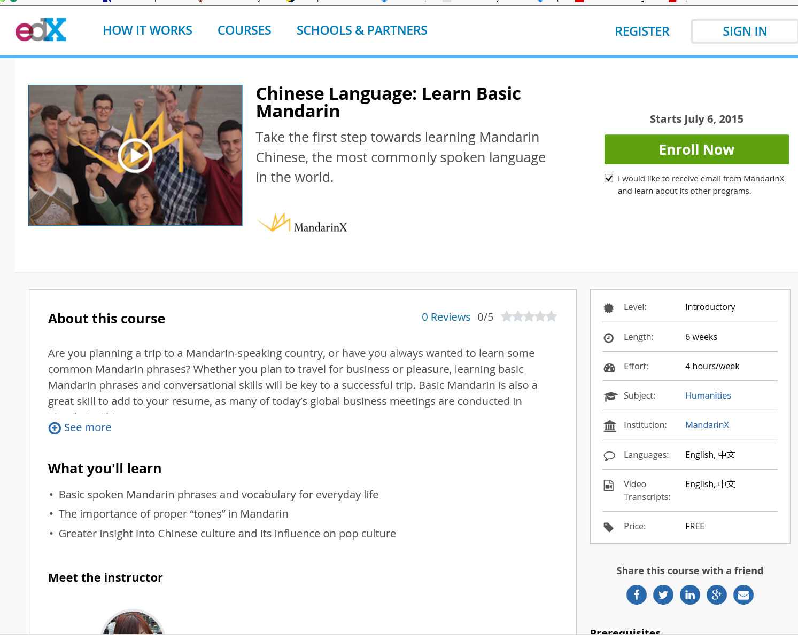
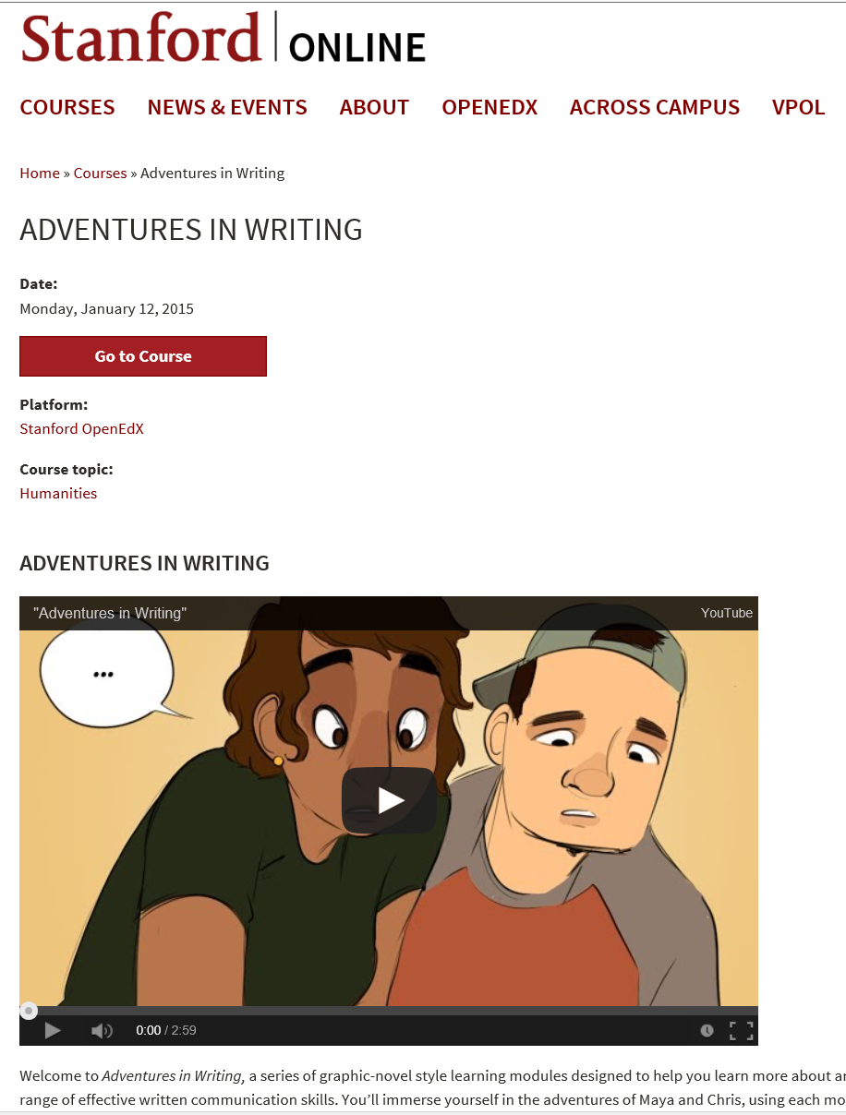
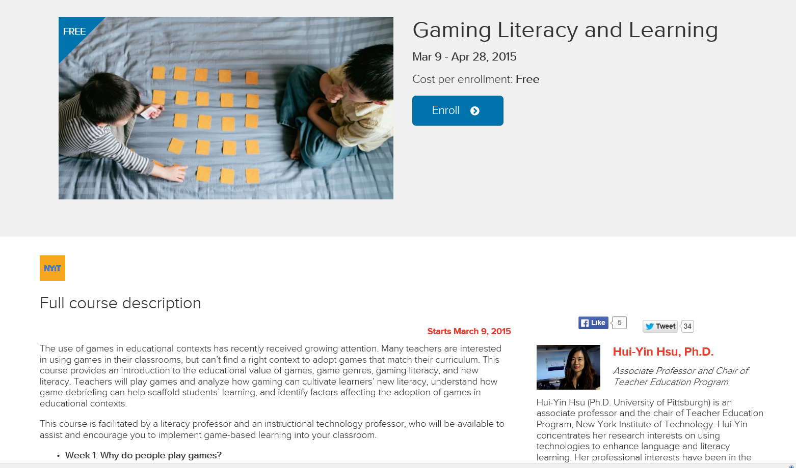
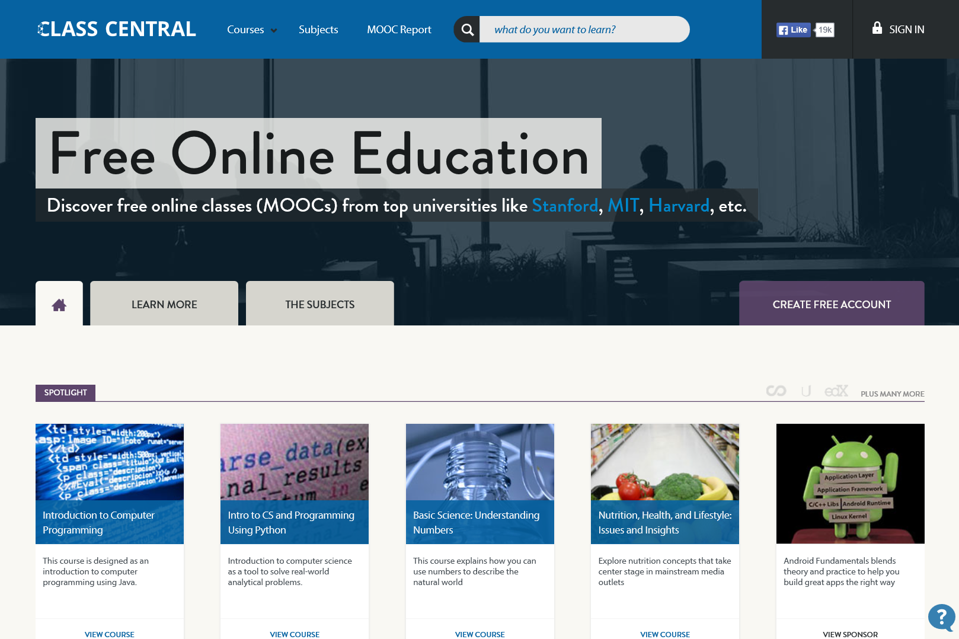
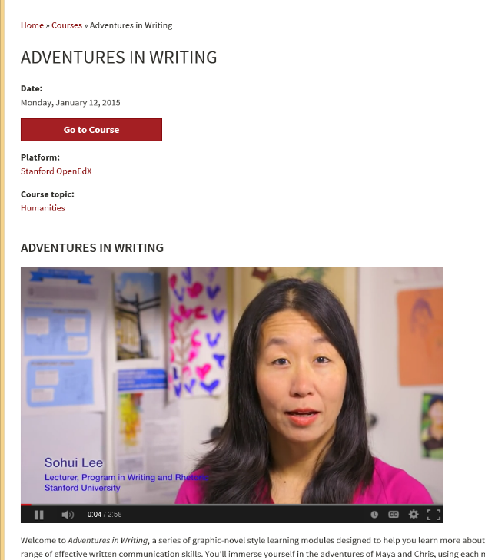
May 19, 2016
MOOC lists:
Class Central, the MOOC list https://www.mooc-list.com/ https://www.class-central.com/

Slide 15
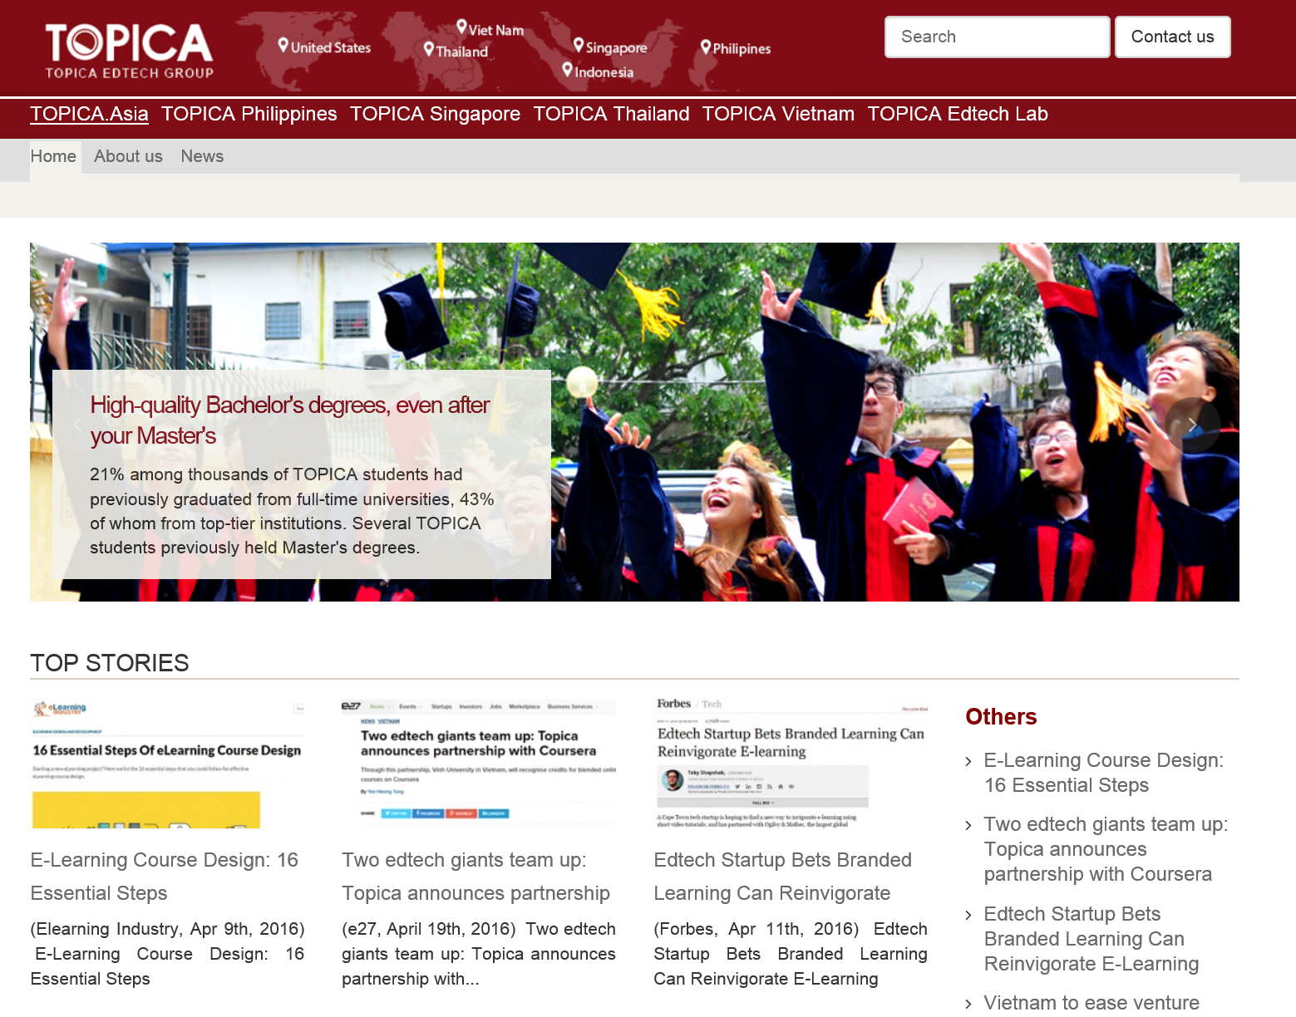


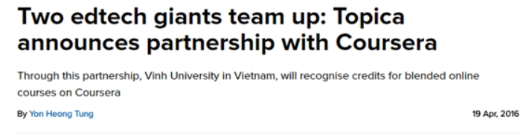
May 19, 2016
Topica Recognizes MOOCs
(Topica EdTech Group…in Southeast Asia) https://topica.asia/

Slide 16

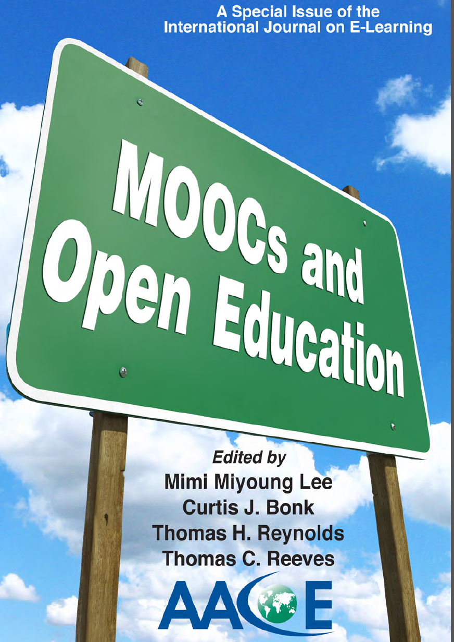

Things are heating up! http://routledge-ny.com/books/details/9781138807419/

Slide 17
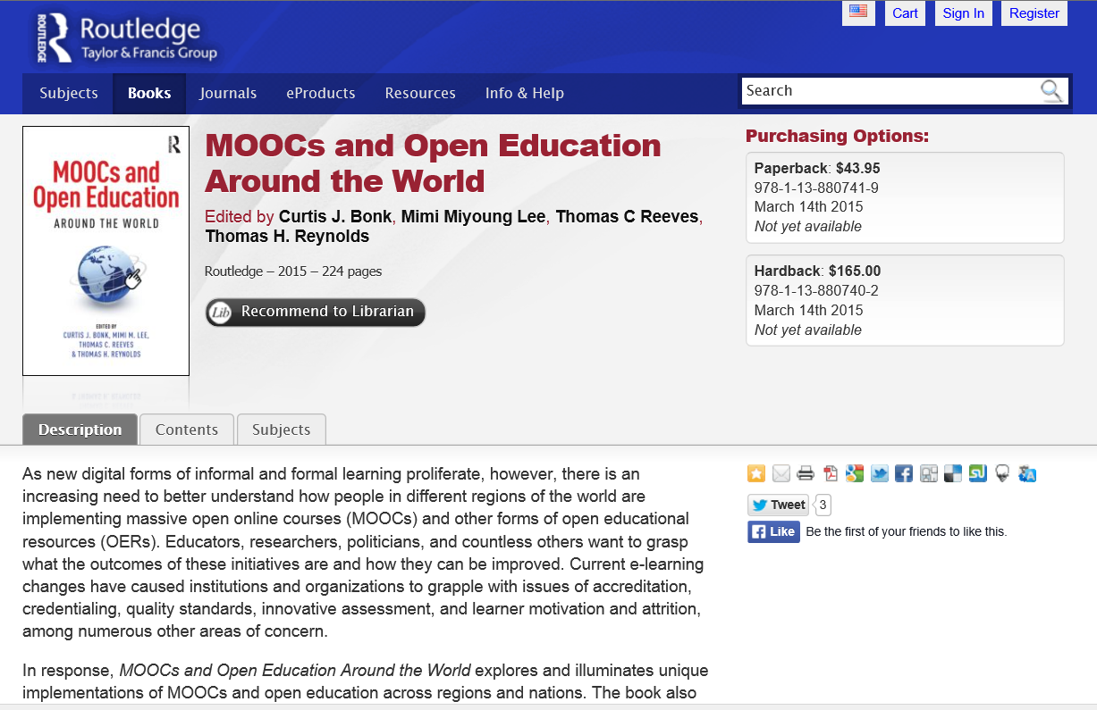



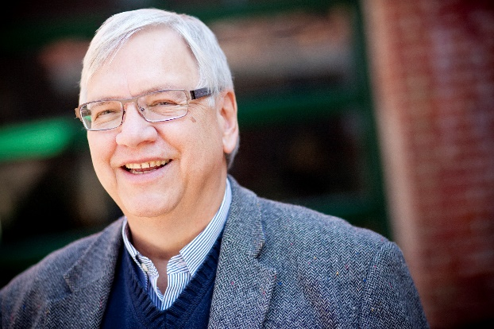
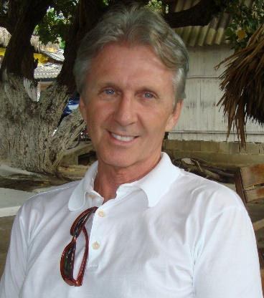
Part II.
MOOCs and Open Education Around the World http://routledge-ny.com/books/details/9781138807419/

Slide 18
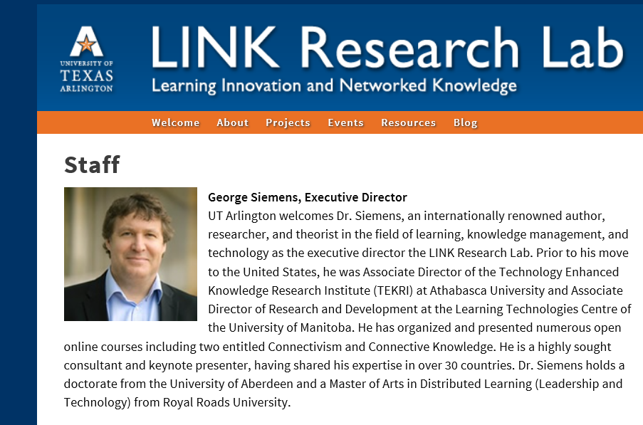
Foreword #1: The Role of MOOCs in the Future of Education?
George Siemens, Executive Director of the Learning Innovation and Networked Knowledge Research Lab, University of Texas Arlington

Slide 19
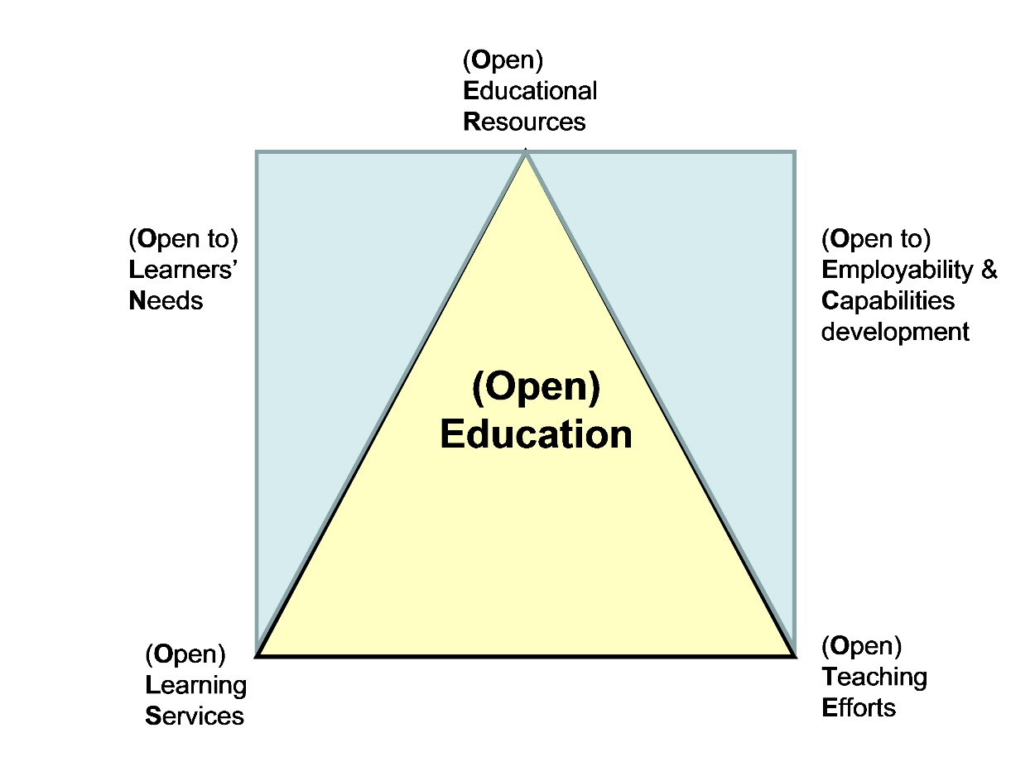
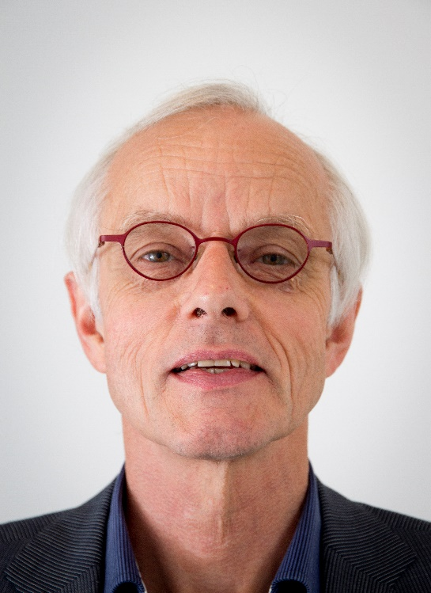
Foreword #2: Open(ing up) Education for All, Boosted by Moocs?
Fred Mulder, UNESCO Chair in Open Educational Resources at the Open University of the Netherlands

Slide 20
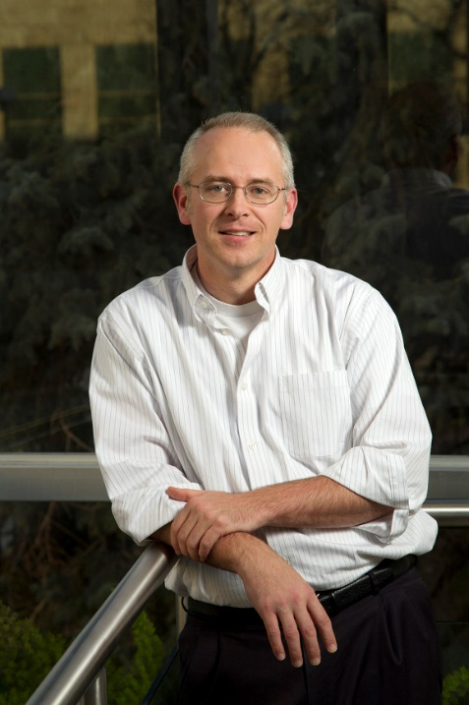
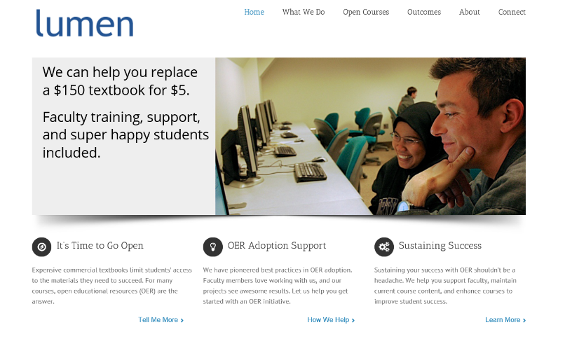
Chapter 1: The MOOC Misstep and the Open Education Infrastructure
David Wiley, Co-founder and Chief Academic Officer, Lumen Learning
The Open Education Infrastructure
Open Credentials
Open Assessments
Open Educational Resources
Open Competencies

Slide 21

Chapter 2: The Single Canon:
MOOCs and Academic Colonization
Karen Head, PhD
The Georgia Institute of Technology
“If MOOC proponents truly seek to offer the best educational opportunities to the world, they will have to open these platforms to a wide variety of institutions and instructors.”

Slide 22

Chapter 3: MOOCs and Open Education in Japan:
A Case of the Open University of Japan
Kumiko Aoki, Ph.D., The Open University of Japan
“It is hoped that MOOCs will play a significant role for stakeholders in Japanese higher education in the near future.”

Slide 23

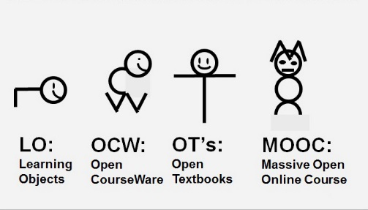
Chapter 4: MOOCs, MERLOT, and Open Educational Services
Gerard L. Hanley, Ph.D.
MERLOT Executive Director
Assistant Vice Chancellor, Academic Technology Services
California State University, Office of the Chancellor
Figure 1. MOOCs as a Recent Evolution of OER

Slide 24
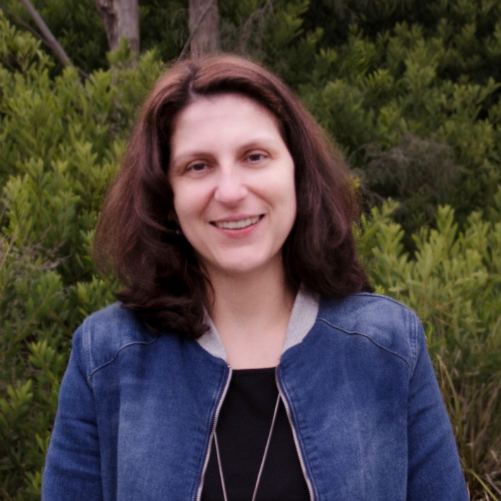
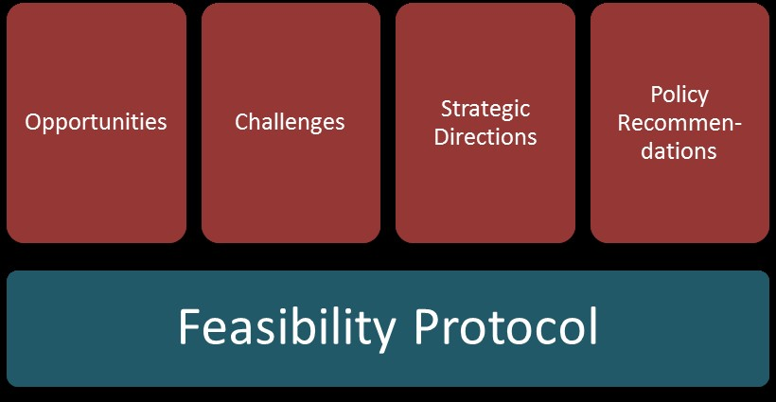
Chapter 5: Enabling Open Education: A Feasibility Protocol for Australian Higher Education
Dr Carina Bossu, University of Tasmania, Australia
Mr David Bull, University of Southern Queensland, Australia
Professor Mark Brown, Dublin City University, Ireland
Figure 5.1. Feasibility Protocol

Slide 25
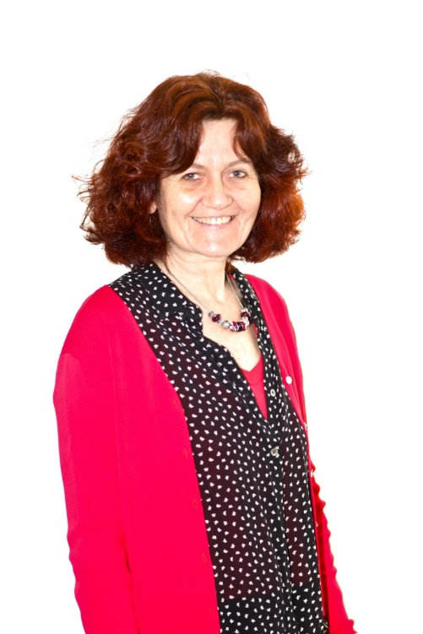
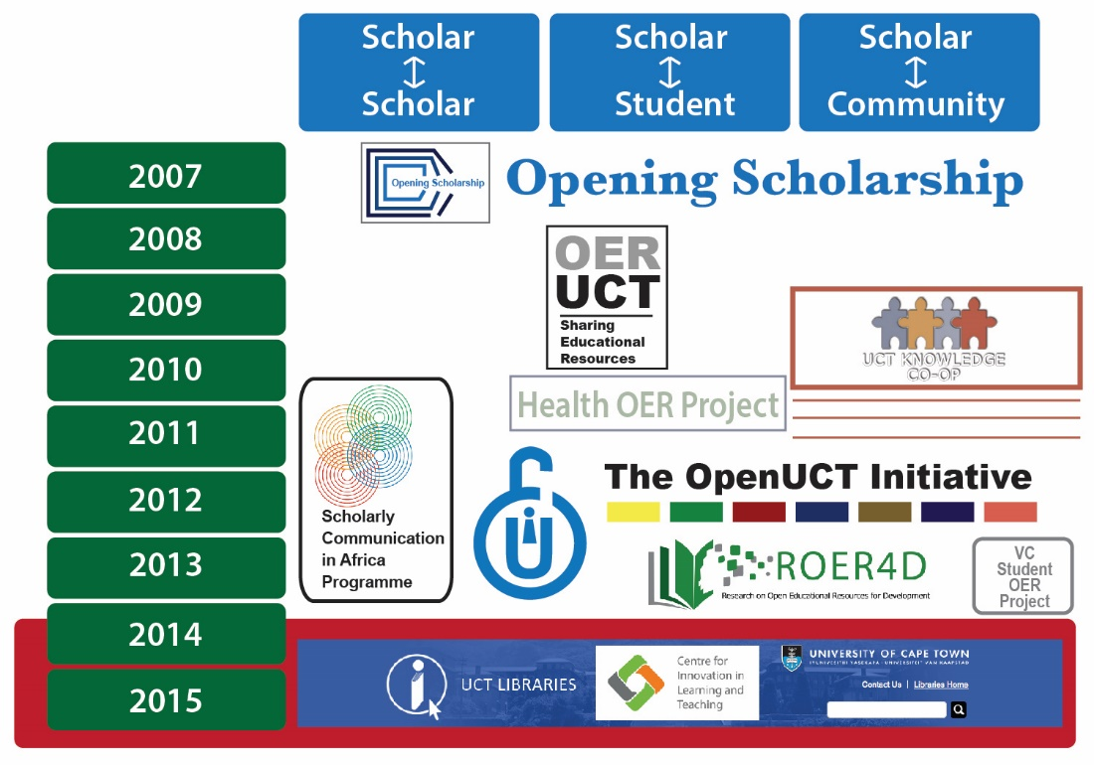
Chapter 6: Open Education at the University of Cape Town
Laura Czerniewicz, Glenda Cox, Cheryl Hodgkinson-Williams, and Michelle Willmers
Figure 3: The openness journey at the University of Cape Town (UCT)

Slide 26
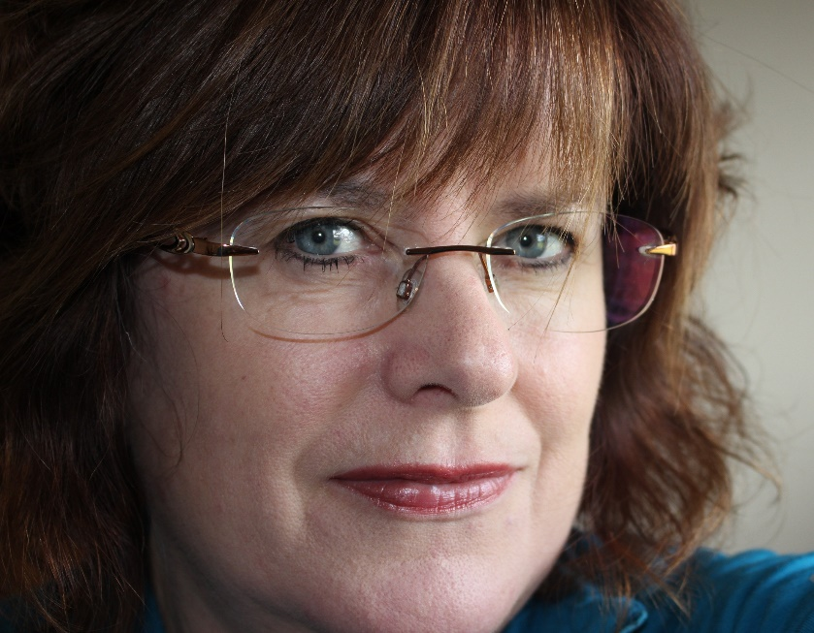
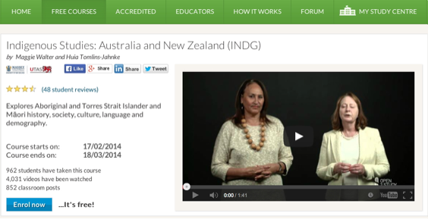
Chapter 8: MOOCs Downunder:
Insights from the Open2Study Experience
Maggie Hartnett, Mark Brown, and Amy Wilson
Massey University, Dublin City University, and Massey University
Figure 3: Example of the Indigenous Studies subject

Slide 27
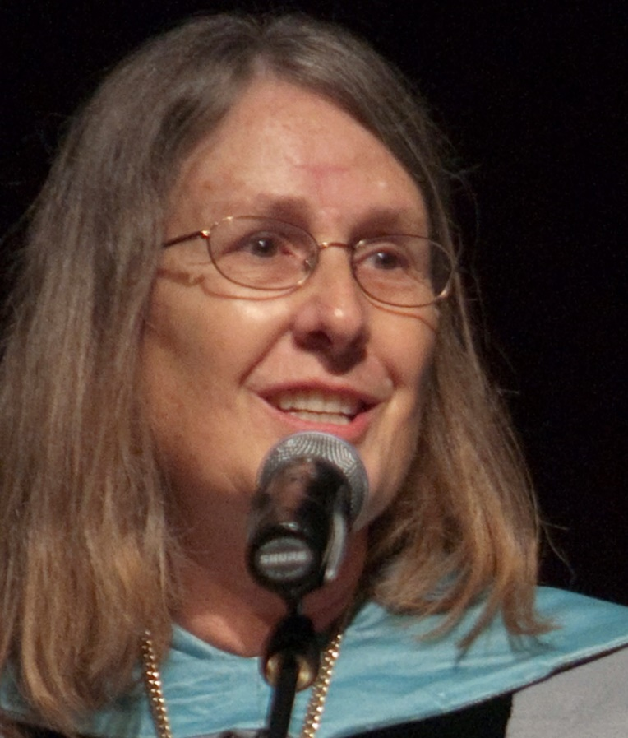
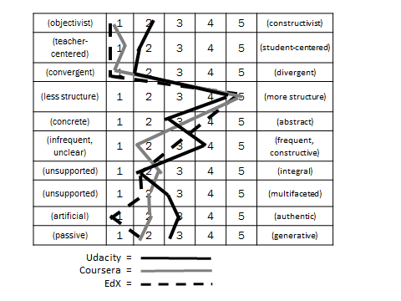
Chapter 10: MOOC Pedagogy
AMP: A Tool for Characterizing the Pedagogical Approaches of MOOCs
Karen Swan, Scott Day, Leonard Bogle, and Traci van Prooyen
University of Illinois Springfield
Figure 3. Ratings Metaphors

Slide 28
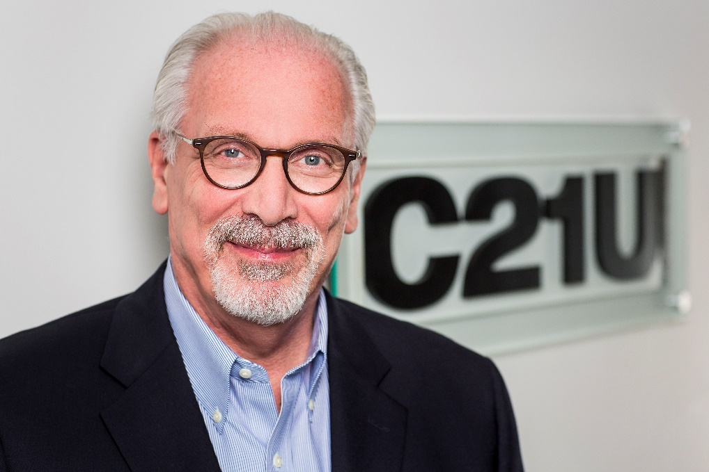
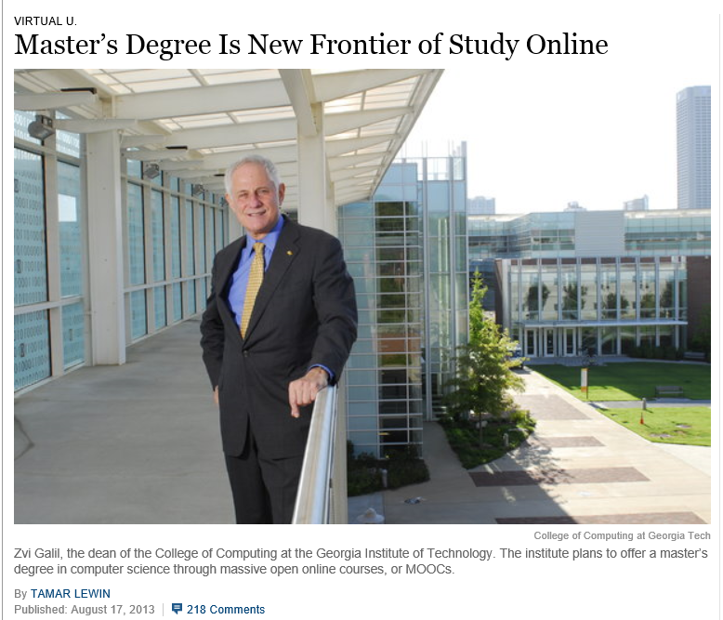
Chapter 13: Unbundling Higher Education and the Georgia Tech Online MS in Computer Science: A Chronicle
Richard DeMillo

Slide 29

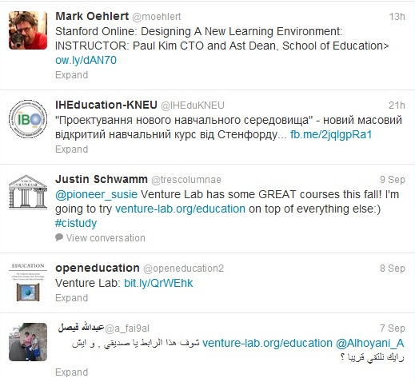
Chapter 14: Creating a Temporary Spontaneous Mini-Ecosystem through a MOOC
Paul Kim and Charlie Chung, Stanford University
Figure 2. Twitter thread announcing the MOOC

Slide 30
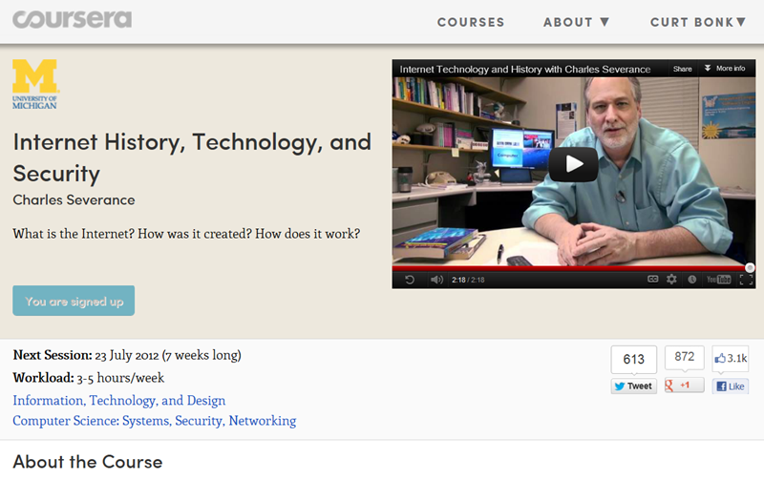
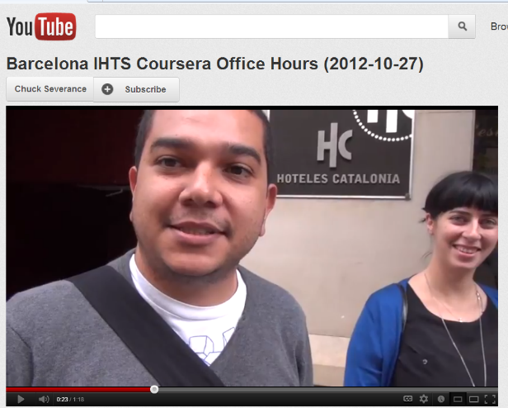
Chapter 15: Learning about MOOCs by Talking to Students
Charles Severance, University of Michigan
Chuck Severance, U Michigan/Coursera) in Barcelona http://www.youtube.com/watch?v=JzNHvmSv8TI
Chuck Severance, University of Michigan https://www.coursera.org/course/pythonlearn

Slide 31
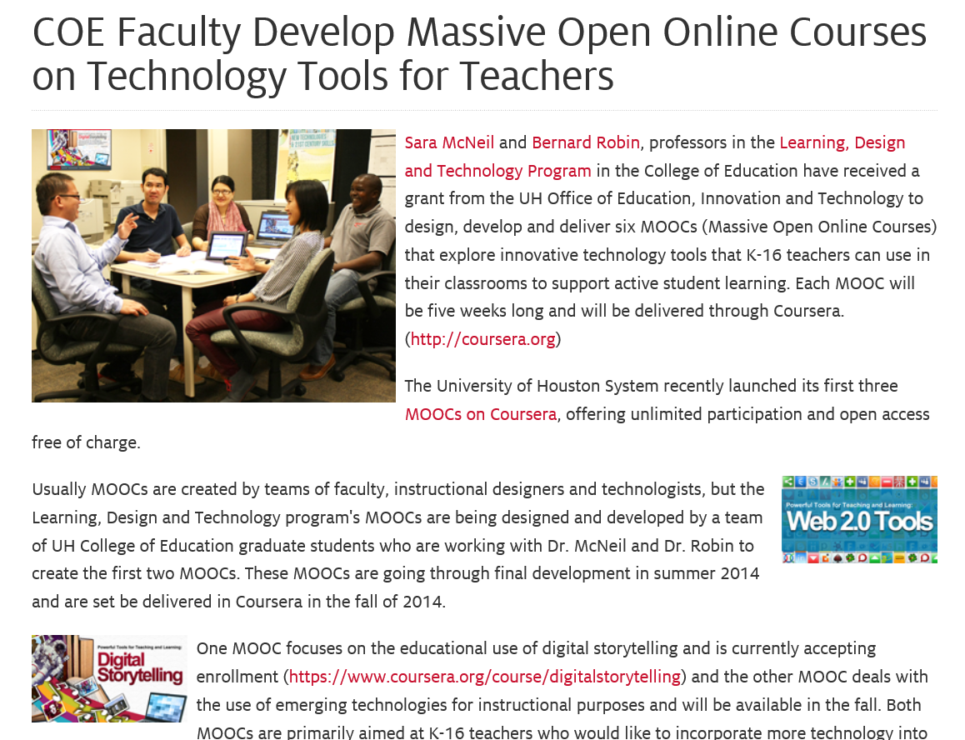
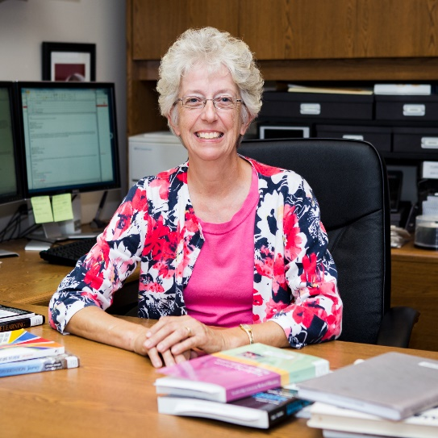
Chapter 16: Collaborative Design and Development of MOOCs for Teacher PD
Bernard Robin and Sara McNeil, Univ. of Houston

Slide 32
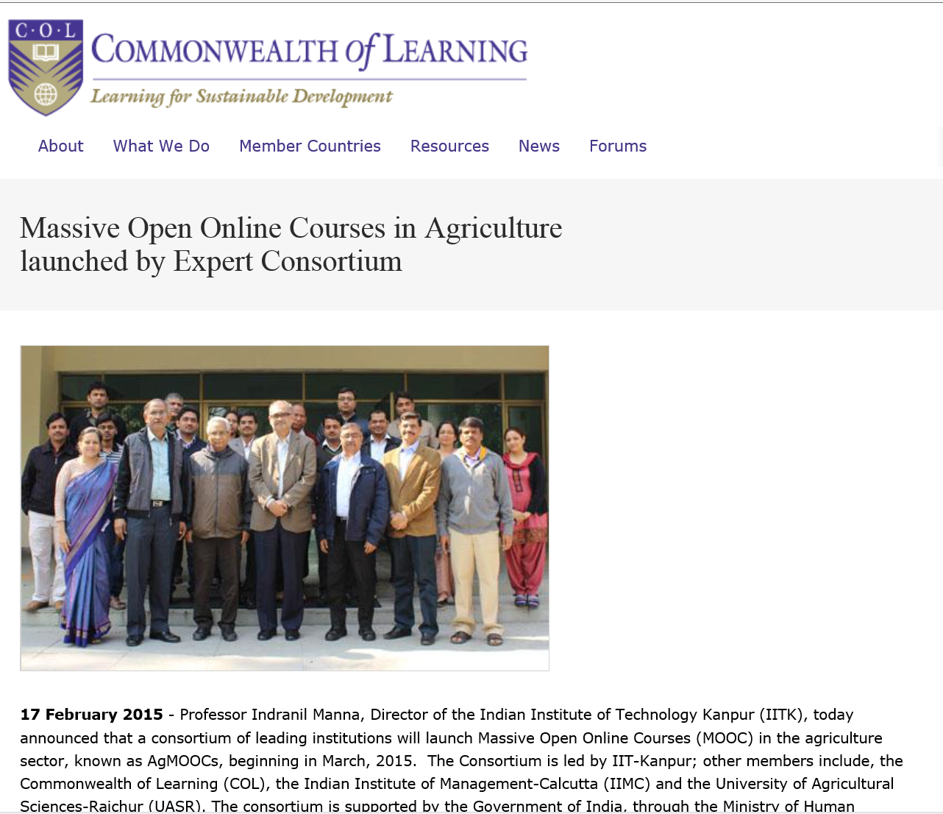




Chapter 18: Changing the Tune: MOOCs for Human Development? A Case Study
Balaji Venkatataraman and Asha Kanwar, COL

Slide 33


Chapter 19: Harnessing the Power of Open Learning to Share Global Prosperity and Eradicate Poverty
Sheila Jagannathan, World Bank, Washington DC
Figure 1: World Bank Group Twin Goals

Slide 34


Chapter 19: Harnessing the Power of Open Learning to Share Global Prosperity and Eradicate Poverty
Sheila Jagannathan, World Bank, Washington DC
MOOCs on Climate Change (e.g., impacts of climate change on farmland) and Risk and Opportunity (reducing the risk of childhood mortality)

Slide 35


Chapter 20: The Glocalization of MOOCs in Southeast Asia
Zoraini Wati Abas, Ed.D.
Figure 2. Eight of thirteen MOOCs offered by Taylor’s University

Slide 36



Chapter 22: OER and MOOCs in Africa: The AVU Experience
Griff Richards and Bakary Diallo,
African Virtual University, Nairobi, Kenya
It is estimated that only 6% of Africans can access post-secondary education. The development goal is set at 12% even though North America and Europe are somewhere around 45%.

Slide 37

Chapter 23: Open Learning in the Corporate Setting
Elliot Masie, The Learning CONSORTIUM @ The MASIE Center
“Open” is an interesting and disruptive word to use about a corporate setting. Yet, Open Learning is one of the most provocative and rapidly changing elements of how corporate learning is being harvested, delivered, and packaged.

Slide 38



Chapter 24: ALISON: A New World of Free Certified Learning
Mike Feerick, CEO & Founder, ALISON

Slide 39




Chapter 28: MOOCs 2030:
A Future for Massive Online Learning
Rebecca Ferguson, Mike Sharples (The Open University, UK), Russell Beale (University of Birmingham)
Figure 1. The Beyond Prototypes Models of the TEL Complex

Slide 40


Part III.
Ideas for Cultural Sensitivity

Slide 41

Chapter 2: USA/Georgia Tech: Karen Head
Be careful with: hand gestures (e.g., finger pointing—use at least two fingers), body movements, English dominance, political issues.
Jokes and humor can easily be misinterpreted.
Be aware of shifting political climates impacting resource access such as YouTube in China.
Many cultures do not have a linear approach (e.g., from A to B) to communication.
Using visual rhetoric (e.g., visual images) to communicate can be a minefield of problems.

Slide 42






January 27, 2014
Various Geo-Political Issues
Coursera Support Center, Why is my country blocked? http://help.coursera.org/customer/portal/articles/1425714-why-is-my-country-blocked-
Online education platform Coursera blocks students in Syria and Iran, Wamba, Nina Curley http://www.wamda.com/2014/01/coursera-blocks-syria-and-iran-moocs-online-courses

Slide 43

Chapter 3: Japan/The Open U Kumiko Aiko
  Make subtitles available in multiple languages based on intended audiences.
  Avoid references to current events that may only be shared by a small subgroup.

Slide 44

Chapter 5: Australia
Carina Bossu
To ensure inclusiveness (including cultural, ethical, and religious), one should openly license all educational materials developed for MOOCs, so as to guarantee the permissions and freedoms required for translation, adaptation, re-use, redistribution, and repackaging.

Slide 45

September 16, 2013
Courses from Open Content
Rwandan Degree Program Aims for a 'University in a Box', Chronicle of Higher Education, Megan O’Neil http://chronicle.com/article/Rwandan-Degree-Program-Aims/141631/
Students attend an orientation session at Kepler, a new hybrid program in Kigali, Rwanda, which will use MOOCs and classroom time to help students earn competency-based associate degrees.

Slide 46

Chap. 6: South Africa
Laura Czerniewicz
The single most important requirement is that MOOCs and MOOC resources be made available under Creative Commons licenses or other open licenses which allow for re-use and adaptation. it is essential a broadcast model be employed.
The agency for and ownership of local resources need to be in the hands of those who best understand local conditions, and therefore they need to be able to create and adapt as they see fit.

Slide 47


Slide 48


Chapter 8:
New Zealand and Ireland
Mark Brown
  Create MOOCs on indigenous cultures and unique languages other than English (e.g., Irish).

Slide 49

May 31, 2014
Localization of Content ocMOOCs and hMOOCs
Revolutionizing online education
Professor creates courses tailored to cultural differences,
Korea JoongAng Daily, KIM BONG-MOON [bongmoon@joongang.co.kr] http://koreajoongangdaily.joins.com/news/article/article.aspx?aid=2989930&cloc=joongangdaily%7Chome%7Cnewslist1
Professor Auh Yoon-il of Kyung Hee Cyber University explains the upcoming Kyung Hee MOOC 2.0 in an interview with the Korea JoongAng Daily at Kyung Hee University on Wednesday. (“one culture” or ocMOOCs and hMOOCs)

Slide 50


Chapter 9: Scotland
U of Edinburgh
Amy Woodgate
  Intermittent Internet access on one’s mobile phone will not help to stream HD videos.
  Simple course designs (e.g., talking heads with minimal hand gestures) helps to make content more available for international audiences. More engaging content is more difficult to convert.

Slide 51





Mobile MOOCs
(e.g., mobile courses on smartphone)

Slide 52

Chapter 11:
India and Canada/COL
Sanjaya Mishra
  Be culturally sensitive to music and pictures while designing content for global audience.
  Consider technology used to develop the content (does it assist reuse and remixing?).
  Instead of focusing too much on the cultural sensitivity of MOOCs and raising costs, try to allow for reuse and remixing of content. Use open source technologies and content.

Slide 53


Chapter 12:
Netherlands/Open U
Fred Mulder and Darco Jansen
To be mindful of:
Different levels of digital literacy skills
Local resources by locals
Legal differences and barriers
Gender, age, and disability issues
Device-specific pedagogy and interface

Slide 54


May 27, 2015
MOOC Participant Study Strategies
The Invisible Learners Taking MOOCs,
George Veletsianos, Inside Higher Ed https://www.insidehighered.com/blogs/higher-ed-beta/invisible-learners-taking-moocs
Rajeev Bajpai, an airline pilot based in Mumbai, took an online computer-science course to gain programming skills.

Slide 55


Chapter 14:
USA/Stanford
Paul Kim and Charlie Chung
  Encourage students to download lecture videos and translate them to other languages and perhaps add captions and make available in their local cloud services.
  Encourage students to create low bandwidth versions of videos for those in low bandwidth areas.
  Encourage students to translate videos and add nuances and words understandable in local languages.
  Encourage students to meet locally in teams to share materials and take care of “sensitive matters.”

Slide 56

August 1, 2014
Can You Really Teach a MOOC in a Refugee Camp?
Steve Kolowich, Chronicle of Higher Education http://chronicle.com/blogs/wiredcampus/can-you-really-teach-a-mooc-in-a-refugee-camp/54191 /
Two men living in Dadaab, a refugee camp in Kenya, would watch lecture videos and take online quizzes at a nearby United Nations compound. (InZone)

Slide 57

April 20, 2015
Case Studies
250 MOOCs and Counting: One Man’s Educational Journey, Chronicle of Higher Education http://chronicle.com/article/250-MOOCsCounting-One/229397/?cid=at
If the MOOC movement has faded, nobody told Jima Ngei. Mr. Ngei, who lives in Port Harcourt, Nigeria, has completed and passed 250.
Jima Ngei: “I had this unrelenting fear that this miracle of free access might evaporate soon.”

Slide 58

Chapter 15:
USA/U Michigan
Chuck Severance
  Avoid troublesome metaphors and examples (e.g., the baseball World Series in the USA).
  Never show lecturer’s face (use audio only)—allows for complete overdubbing in the native language and avoid hand gesture problems.
  Make slides as word free as possible—where possible use symbols
  “Limit” to audio and “No” video OR keep the video “simple”

Slide 59

Chapter 19:
DC/World Bank Institute
Sheila Jagannathan
“Widen” and “increase” representations from more diverse groups and stakeholders (gender, non western, public and private, grass roots, etc.).
Make the contents more culturally sensitive/relevant.

Slide 60

Chapter 20
Indonesia and Malaysia
Zoraini Wati Abas
  Do not expect Asian audience to quickly voice their opinions
  Treat Asian audience as an equal
  Avoid issues related to religion and politics.
  Minimize distractions and negative feelings (e.g., do not show visuals or give examples of prohibited types of foods or animals)

Slide 61



March 4, 2016
MOOCs: vital tools in education of the future – or over-hyped online fad? (embedded video: 8:01)
Euro News, Sarah Chappell
MOOCs: vital tools in education of the future – or over-hyped online fad? http://www.euronews.com/2016/03/04/moocs-vital-tools-that-are-shaping-the-future-of-education-or-over-hyped-online/

Slide 62

Chapter 21:
U of Philippines Open U
Melinda Bandalaria
  Strictly avoid references to religion.
  Use acceptable dress code.
  Even when English is the primary or secondary language of the country, consider making MOOC content available in the major dialects of the country.

Slide 63

April 21, 2014
Internet Café in Manila
The Revolution Is Not Being MOOC-ized, Students are educated, employed, and male.
Gayle Christensen and Brandon Alcorn, UPenn, New Scientist http://www.slate.com/articles/health_and_science/new_scientist/2014/03/mooc_survey_students_of_free_online_courses_are_educated_employed_and_male.html
Filipino youths go online at an Internet café in Manila on Feb. 18, 2014. Two-thirds of Coursera participants come from the developed world, according to a new report.

Slide 64


Chapter 27:
Canada
Helene Fournier and Rita Hop
“Personalize” the learning experience to offset the massiveness.
Need to think hard about how cultural differences might be expressed and accepted in the MOOC platform.
  The road ahead hinges on personalizing learning experiences; the connectivist approach (i.e., cMOOCs) is which participants are in the driver’s seat.

Slide 65

April 28, 2016
Communities
Shindig, Video Chat Tool
Future Trends Forum (with Bryan Alexander) https://bryanalexander.org/

Slide 66


March 1, 2016
Zoom
Tarleton State University, Texas
Dr. Credence Baker

Slide 67


Chapter 28:
UK/FutureLearn
Rebecca Ferguson and Mike Sharples
  Access. In many countries (e.g., in Africa, but also areas of Asia) mobile is the main means of access, so the courses need to be developed for a mobile-first experience, including pedagogy as well as interface.
  Provide transcripts of videos, preferably in multiple languages and multi-language subtitles.
  There are deep-seated cultural differences related to: the value of expert vs learner-originated knowledge; deference to experts; willingness to engage in discussion and critique.

Slide 68

January 20, 2016
Why the Future Is Bright for the World’s Poorest Farmers, Gates Notes, the blog of Bill Gates https://www.gatesnotes.com/Development/The-Future-of-Farming?WT.mc_id=01_20_2016_20_FutureofFarming_BG-LI_&WT.tsrc=BGLI

Slide 69

Part IV.
Personalization of MOOCs

Slide 70

Foreword:
Canada/USA
George Siemens
MOOCs are adopting CMUs OLI project (adaptive learning in stats) (e.g., Candace Thille at Stanford).
Smart Sparrow (adaptive learning company connected to ASU) has started running personalization in MOOCs. One personalized/adaptive MOOC with Australian univ.
Carolyn Rose at CMU recently ran a “Super Heroes” MOOC together with Smithsonian that used personalization approaches through "intelligent agents" to foster dialogue and collaboration.

Slide 71


March 9, 2016 iLearn@america MOOC: The Rise of Superheroes and their Impact on Pop Culture http://www.atamerica.or.id/events/2295/iLearnamerica-MOOC-The-Rise-of-Superheros-and-their-Impact-on-Pop-Culture

Slide 72



October 1, 2014
Acrobatiq http://acrobatiq.com/

Slide 73



October 1, 2014
Smart Sparrow, Heat Maps on Misconceptions http https://www.smartsparrow.com/

Slide 74

Chapter 18:
Canada/COL
Balaji Venkataraman
In the Mooc on mobiles for development the course team received requests from two groups of learners in Sierra Leone and Zambia for the course materials on DVD.
AgMoocs initiative (http://www.agmoocs.in/) uses MooKIT platform designed for access in low bandwidth conditions. It includes a functionality for a learner to hear the voice track on a basic mobile phone.

Slide 75


May 20, 2016 agMOOCs (India) http://www.agmoocs.in/

Slide 76





May 20, 2016 agMOOCs (India) http://www.agmoocs.in/ https://www.facebook.com/ccapatanzania/posts/1540201329627397

Slide 77




September 15, 2015
GROOCs are MOOCs for Social Impact
Social Learning for Social Impact, edX
Join the world’s first GROOC – a MOOC for groups – to collaborate with others globally and create social change. https://www.edx.org/course/social-learning-social-impact-mcgillx-groocx https://www.youtube.com/watch?t=36&v=WNg-5LFAMdI

Slide 78

Chapter 18:
Canada/COL
Balaji Venkataraman
In the Pacific COL supported the U of South Pacific with a specially constructed MOOKIT platform. Social media was integrated with it. Any interested learner can add his or her SM profile to the profile in the course. This will enable a learner to follow the discussions on the course forum on real time using just the smart phone. This bandwidth is cheaper in most Pacific island countries than bandwidth availed for laptops. This facility greatly contributed to increased course participation often overwhelming the team of instructors.

Slide 79

May 19, 2016
Facebook Schools MOOCs on Engagement
Jason Schmitt, EdSurge https://www.edsurge.com/news/2016-05-19-facebook-schools-moocs-on-engagement

Slide 80

Chapter 18:
DOCC/USA
Radhika Gajjala
Doing a "Collaborative" course requires that we engage the context - not just talk to it.... We start by dialogue and engagement with the students - the sensitivity would emerge through interaction and skype conversations and discussion and debate.

Slide 81

Chapter 18:
DOCC/USA
Liz Losh
The Selfie Course…
MOOCs often tend to misestimate the importance of situated experience in approaching learning as a meaning-making process.
Snapchat pedagogy, the ways that MOOCs overlook the importance of the mobile phone as a vehicle for connecting students -- who are individually situated in time, space, status, etc. -- in distributed learning networks.

Slide 82



September 2014
The Selfie Course http://www.selfieresearchers.com/the-selfie-course/

Slide 83

Chapter 19:
DC/World Bank Institute
Sheila Jagannathan
We try to do badging etc. to give motivation and personal incentives such as champion or expert.
We try to customize the discussion forums with regional and very level forums, topics and moderators.
Google hangouts are also used to customize and personalize at country or institutional levels.

Slide 84


Research Topic #23.
Learning for Enjoyment vs. Credentials

Slide 85


March 3, 2016
‘Trump U.’ Draws Unflattering Spotlight to the Candidate as Fraud Cases Move Forward
Chronicle of Higher Education, Corrine Ruff http://chronicle.com/article/Trump-U-Draws/235573?cid=trend_right_a

Slide 86



August 5, 2015
Acceptability of
Nanodegrees and Microcredentials
How Nanodegrees Are Disrupting Higher Education
John Waters, Campus Technology http://campustechnology.com/articles/2015/08/05/how-nanodegrees-are-disrupting-higher-education.aspx

Slide 87





January 13, 2016
Degree gets you a tech job — or your money back, Marco della Cava, USA Today http://www.usatoday.com/story/tech/news/2016/01/13/degree-gets-you-tech-job-your-money-back/78703230/

Slide 88




January 20, 2016
Coursera Specializations https://www.coursera.org/browse?utm_medium=email&utm_source=marketing&utm_campaign=aUAR4L-fEeW6i-NodUB9Qw&languages=en

Slide 89

Chapter 21:
Philippines Open U
Melinda Bandalaria
…one feature that we have integrated into our MOOCs which I think is one effort to personalize learning is the "Multiple Paths to Learning" or the "Learning on the Go". Through this feature, the learner can choose whether to learn through the video lessons, text lessons or podcast.
In terms of gadgets to use, of course, we made sure that the courses are accessible whatever device especially mobile devices, the learner has access to.

Slide 90

May 19, 2016
From MOOC to bootcamp to MIT
MIT News http://news.mit.edu/2016/mooc-bootcamp-mit-0519

Slide 91

Chapter 22:
Canada/Africa
Griff Richards
“I think a concept like personalization is laudable, but I'd like to see where it sits in the list of things to do to improve MOOCs. For example if we look down Hattie's list of useful interventions, would personalization give us the biggest learning bang for the buck of development? Or would we get there through some simpler intervention like simply making the courses more self-paced.”

Slide 92


May 4, 2016
This Mongolian Teenager Aced a MOOC.
Now He Wants to Widen Their Impact
The Chronicle of Higher Education, Jeffrey R. Young http://chronicle.com/article/This-Mongolian-Teenager-Aced-a/236362

Slide 93

Chapter 25:
USA/Illinois
Vickie Cook
Personal notes within the MOOC from either other students or the instructor that the MOOC takes on a personalized emphasis…communications that do not use my name, or are generic to be reused– feel quite cold and impersonal.
Theory of “heutagogy” – basically learning that is self-determined and available in a mobile interface, I think it is important that personalization also create the desire to return to the MOOC for more.

Slide 94

Chapter 25:
USA/Illinois
Ray Schroeder
Most obvious way to personalize is to include group projects, allowing students to self-select into interest areas to conduct collaborative projects that are relevant to the MOOC topic
One of the easiest and most effective ways is to build self-reflection into each module of a MOOC.
Motivated self-determined learners (such as many MOOCers are) do naturally adapt, build upon and scaffold MOOCs to meet their personal learning needs and desires.

Slide 95

Bonk, C. J., Lee. M. M., Reeves, T. C., & Reynolds, T. H. (in press). The emergence and design of massive open online courses (MOOCs). In R. A. Reiser, & J. V. Demsey (Eds.), Trends and issues in instructional design and technology (4th Ed.), (pp.?). Boston, MA: Pearson Education. Available: http://www.publicationshare.com/3

Slide 96

Part V. Ten “10”
MOOC Instructor Guidelines

Slide 97

MOOC Instructor Guide #1.
Plan and Prepare for the Experience

Slide 98

MOOC Guide #2.
Build in Feedback for Each Experience (etc., Peer, Machine, Volunteer, and Self-Assessment)

Slide 99





MOOC Guide #3.
Create Interactivities
(e.g., use Polling Questions)

Slide 100

MOOC Guide #4.
Provide Variation and Choice

Slide 101


MOOC Guide #5.
Combine Sync and Async Instruction
(e.g., David Merrill and Charlie Reigeluth)

Slide 102


MOOC Guide #6.
Design Responsive and Interactive Learning Communities

Slide 103

MOOC Guide #7.
Offer Weekly Recaps and Updates

Slide 104



MOOC Guide #8.
Personalize the Activity or Experience Where Possible!

Slide 105

MOOC Guide #9.
Engage in Resource Sharing

Slide 106

MOOC Guide #10.
Be Willing to Change Midstream.

Slide 107




Any Comments or Questions?
Slides at: TrainingShare.com
Papers: PublicationShare.com
Free Book: http://tec-variety.com/
MOOCsBook: http://moocsbook.com/

