Slide 1

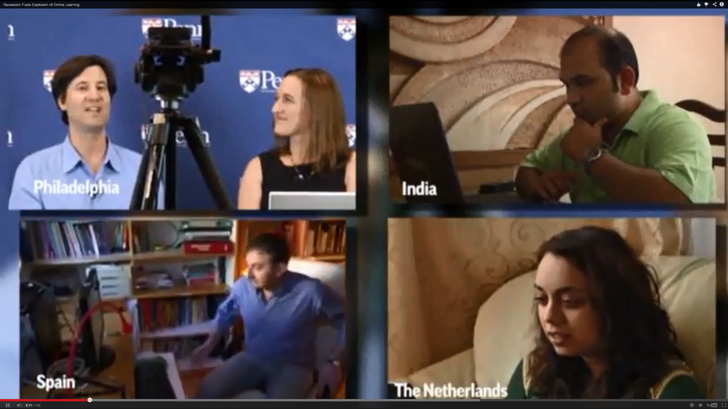
Multimedia in MOOCs:
Best Practices for Cultural Inclusion
AECT Conference, November 6, 2015
Thomas C. Reeves, The University of Georgia
Mimi Miyoung Lee, University of Houston
Curtis J. Bonk, Indiana University
Yadi Ziaee, Athens State University

Slide 2
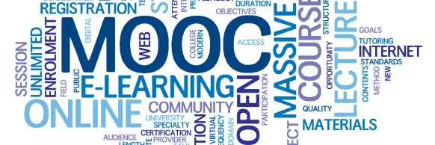
Audience Poll #1:
Who in here has taken a MOOC?

Slide 3
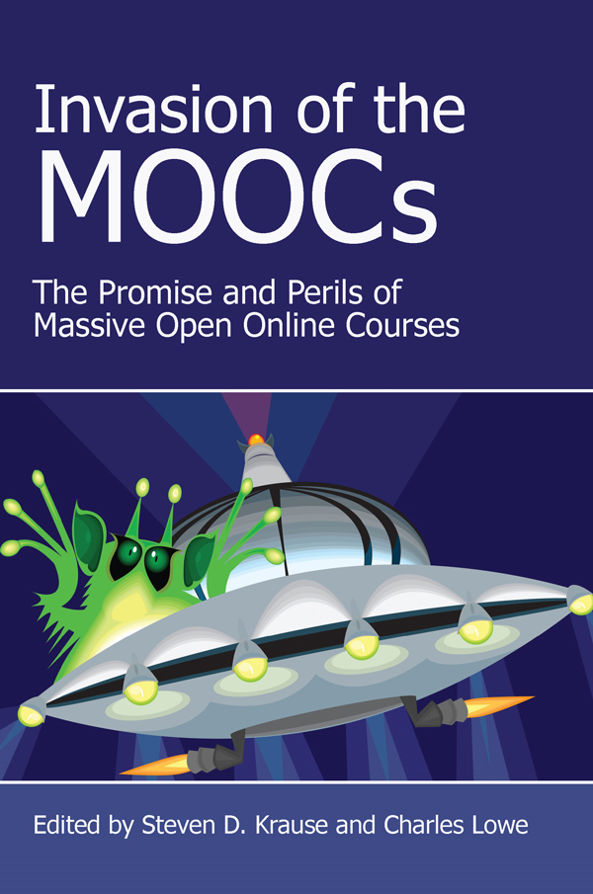
Poll #2: Who would like a free MOOCs book?

Slide 4
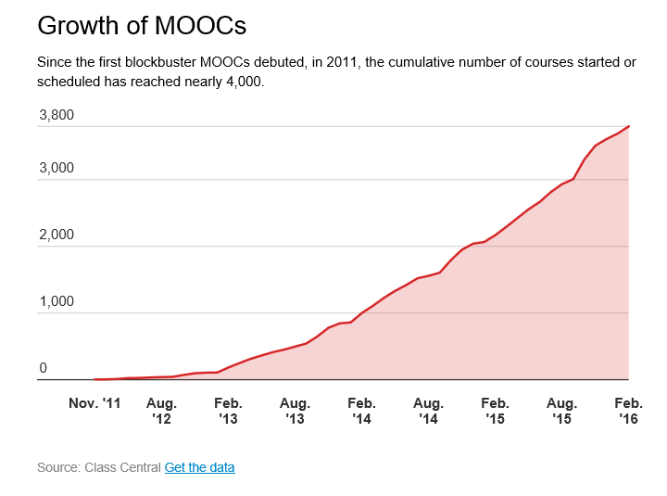
October 19, 2015
MOOCs Are Still Rising, at Least in Numbers,
Ellen Wexler, Chronicle of Higher Education http://chronicle.com/blogs/wiredcampus/moocs-are-still-rising-at-least-in-numbers/57527

Slide 5
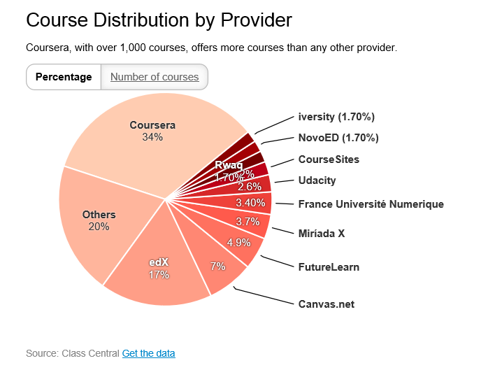
October 19, 2015
MOOCs Are Still Rising, at Least in Numbers,
Ellen Wexler, Chronicle of Higher Education http://chronicle.com/blogs/wiredcampus/moocs-are-still-rising-at-least-in-numbers/57527

Slide 6
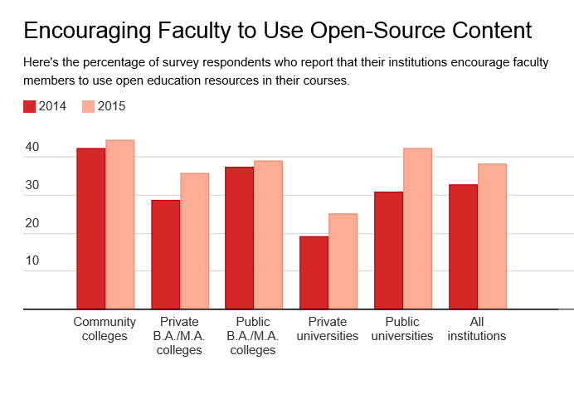
October 29, 2015
Campus Tech Leaders Report More Support for Free Educational Materials, Ellen Wexler, Chronicle of Higher Education http://chronicle.com/blogs/wiredcampus/campus-tech-leaders-report-more-support-for-free-educational-materials/57551?cid=at&utm_source=at&utm_medium=en&elq=e4e3f59aa76642fe887fb1ea8a5a4cee&elqCampaignId=1713&elqaid=6714&elqat=1&elqTrackId=e0e831d54b44442d93aff83de20111dd

Slide 7
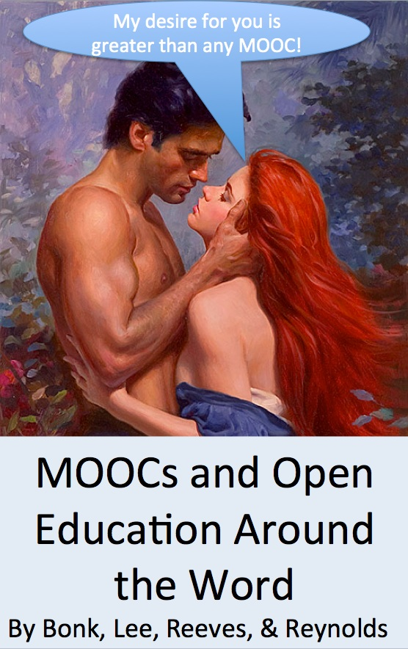
Things are heating up! http://routledge-ny.com/books/details/9781138807419/

Slide 8
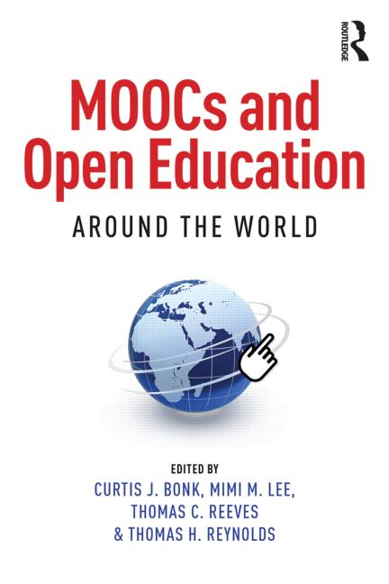
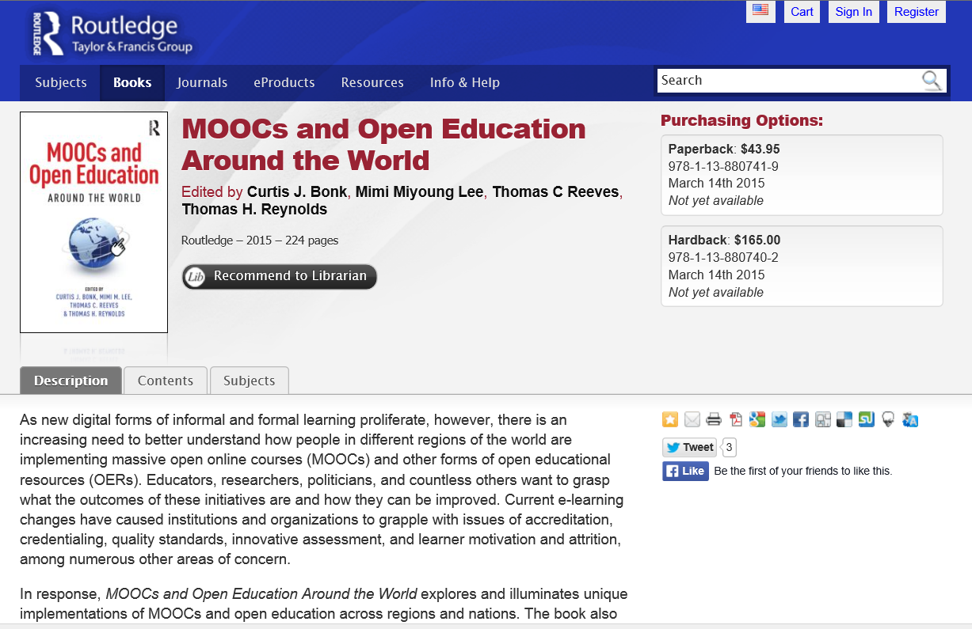

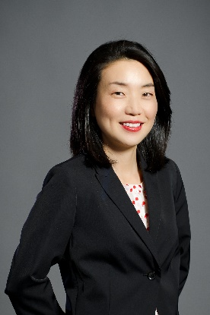
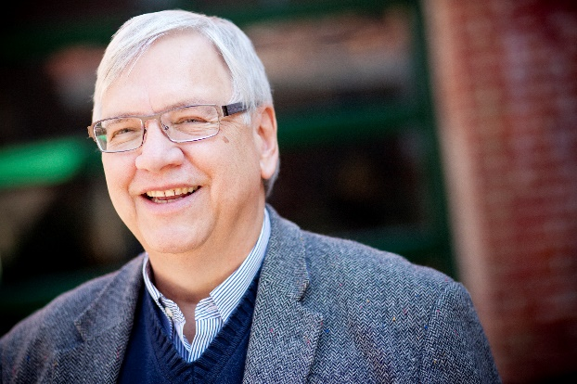
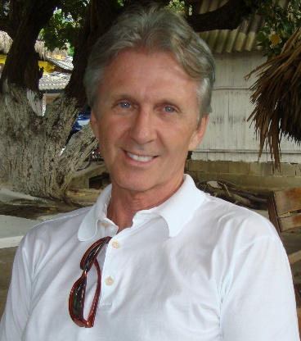
MOOCs and Open Education Around the World http://routledge-ny.com/books/details/9781138807419/

Slide 9
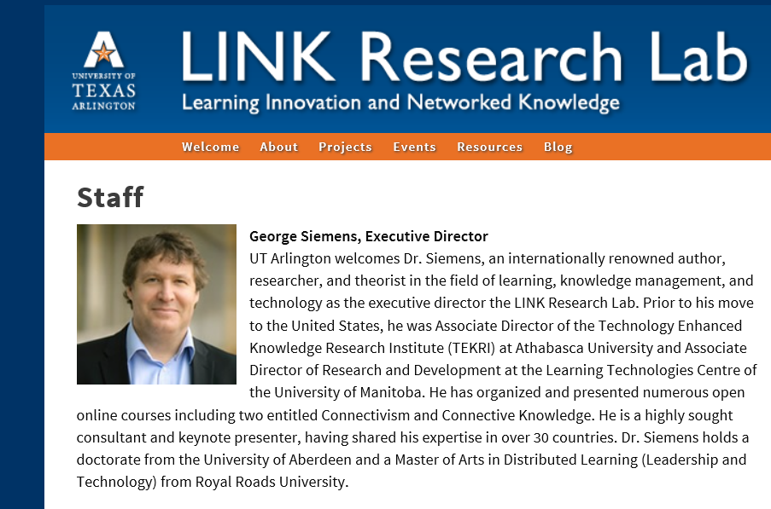
Foreword #1: The Role of MOOCs in the Future of Education?
George Siemens, Executive Director of the Learning Innovation and Networked Knowledge Research Lab, University of Texas Arlington

Slide 10
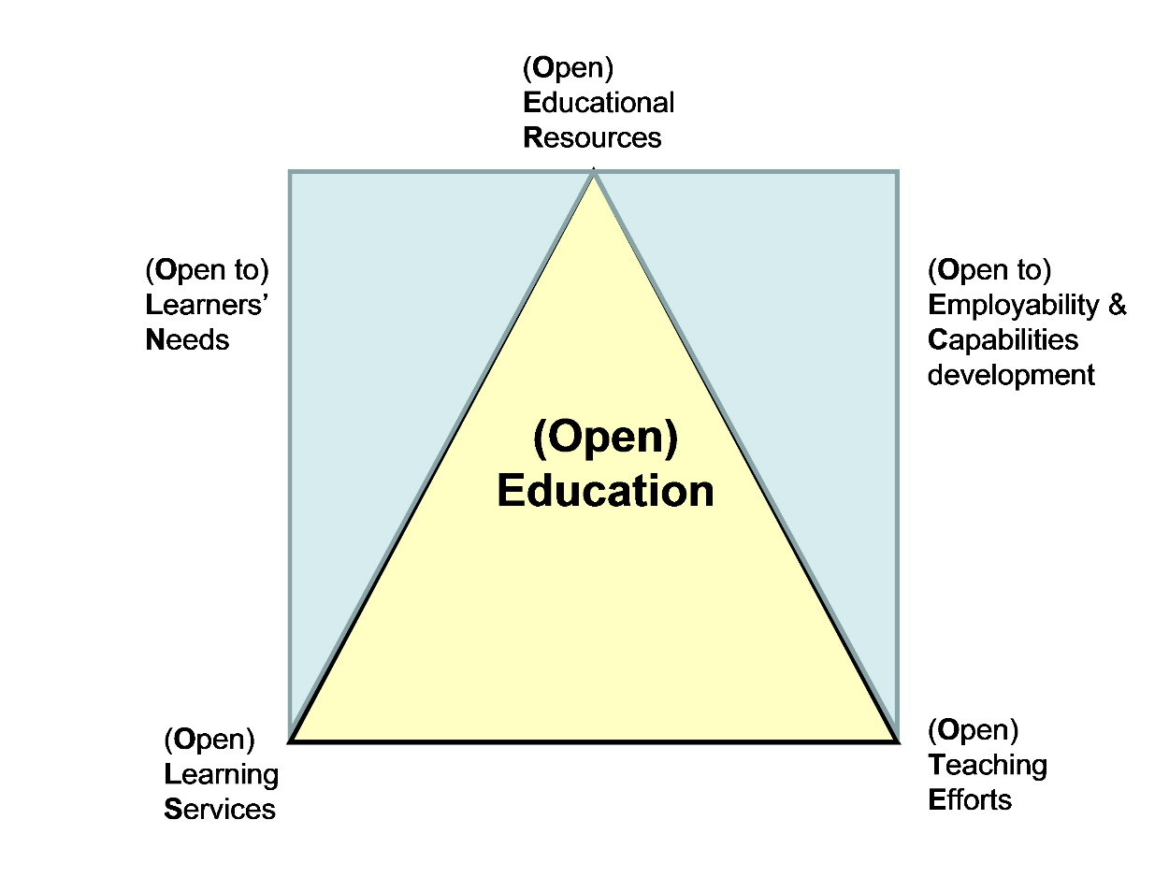
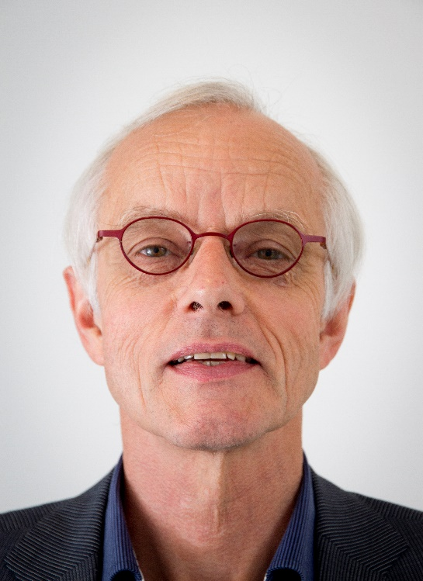
Foreword #2: Open(ing up) Education for All, Boosted by Moocs?
Fred Mulder, UNESCO Chair in Open Educational Resources at the Open University of the Netherlands

Slide 11
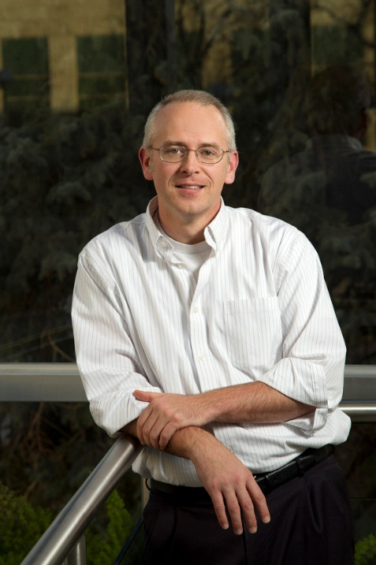
Chapter 1: The MOOC Misstep and the Open Education Infrastructure
David Wiley, Co-founder and Chief Academic Officer, Lumen Learning
The Open Education Infrastructure
Open Credentials
Open Assessments
Open Educational Resources
Open Competencies

Slide 12

Chapter 2: The Single Canon:
MOOCs and Academic Colonization
Karen Head, PhD
The Georgia Institute of Technology
“If MOOC proponents truly seek to offer the best educational opportunities to the world, they will have to open these platforms to a wide variety of institutions and instructors.”

Slide 13

Chapter 3: MOOCs and Open Education in Japan:
A Case of the Open University of Japan
Kumiko Aoki, Ph.D., The Open University of Japan
“It is hoped that MOOCs will play a significant role for stakeholders in Japanese higher education in the near future.”

Slide 14
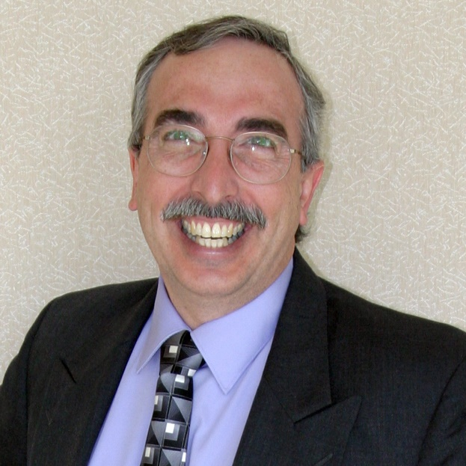
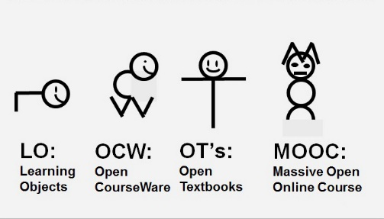
Chapter 4: MOOCs, MERLOT, and Open Educational Services
Gerard L. Hanley, Ph.D.
MERLOT Executive Director
Assistant Vice Chancellor, Academic Technology Services
California State University, Office of the Chancellor
Figure 1. MOOCs as a Recent Evolution of OER

Slide 15
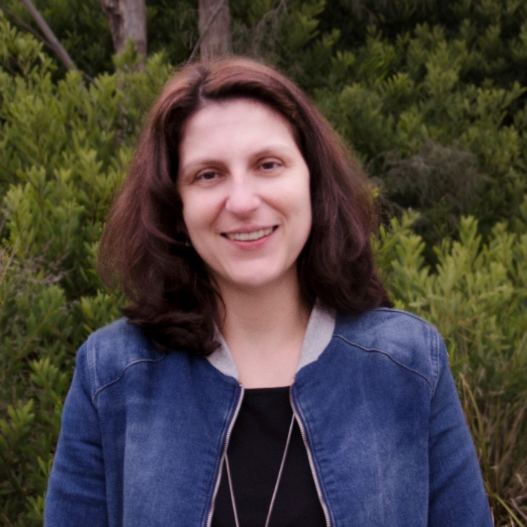
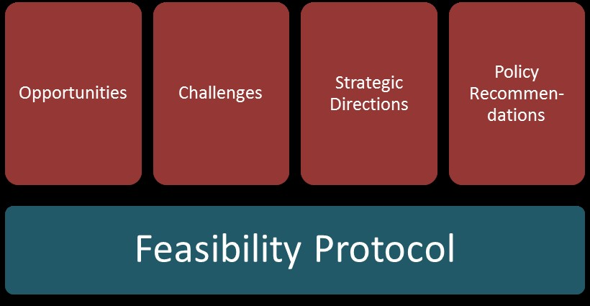
Chapter 5: Enabling Open Education: A Feasibility Protocol for Australian Higher Education
Dr Carina Bossu, University of Tasmania, Australia
Mr David Bull, University of Southern Queensland, Australia
Professor Mark Brown, Dublin City University, Ireland
Figure 5.1. Feasibility Protocol

Slide 16
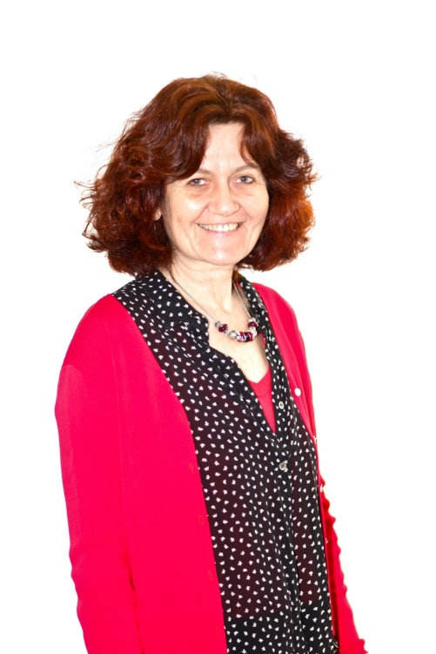
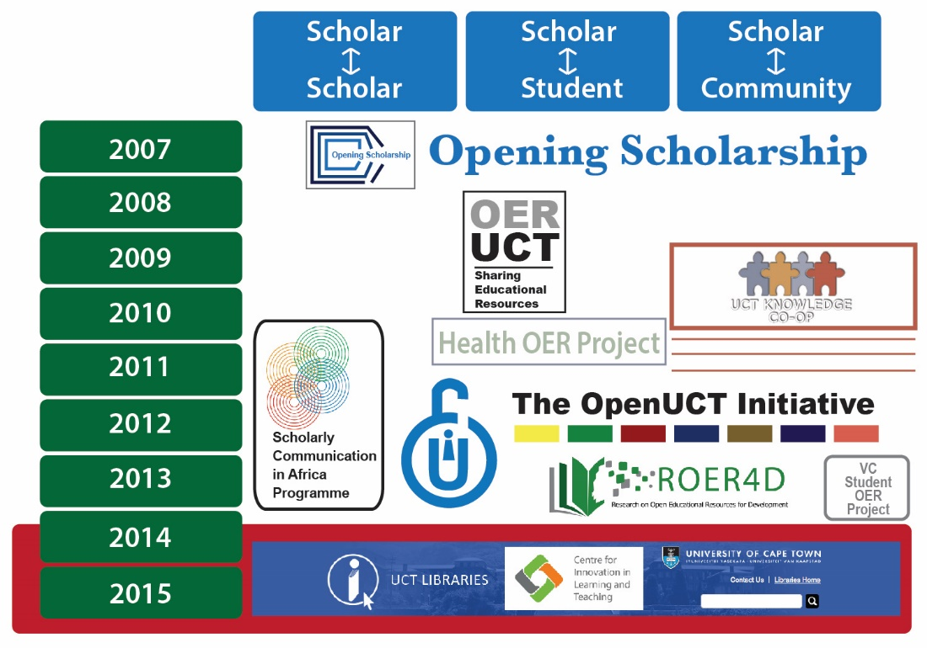
Chapter 6: Open Education at the University of Cape Town
Laura Czerniewicz, Glenda Cox, Cheryl Hodgkinson-Williams, and Michelle Willmers
Figure 3: The openness journey at the University of Cape Town (UCT)

Slide 17
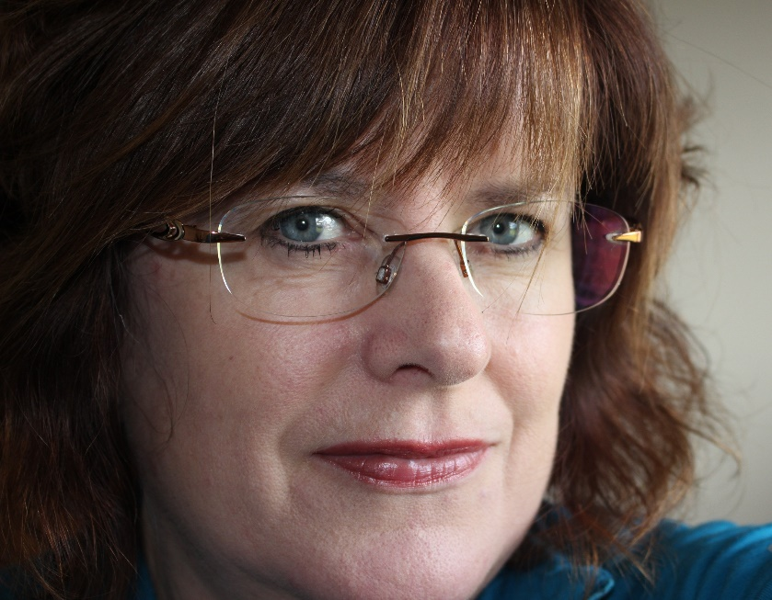
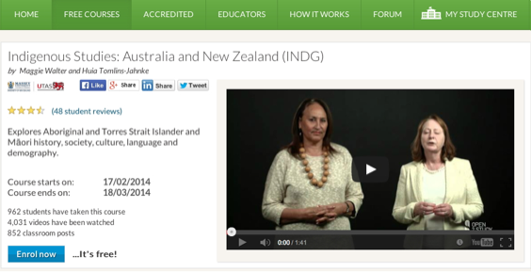
Chapter 8: MOOCs Downunder:
Insights from the Open2Study Experience
Maggie Hartnett, Mark Brown, and Amy Wilson
Massey University, Dublin City University, and Massey University
Figure 3: Example of the Indigenous Studies subject

Slide 18
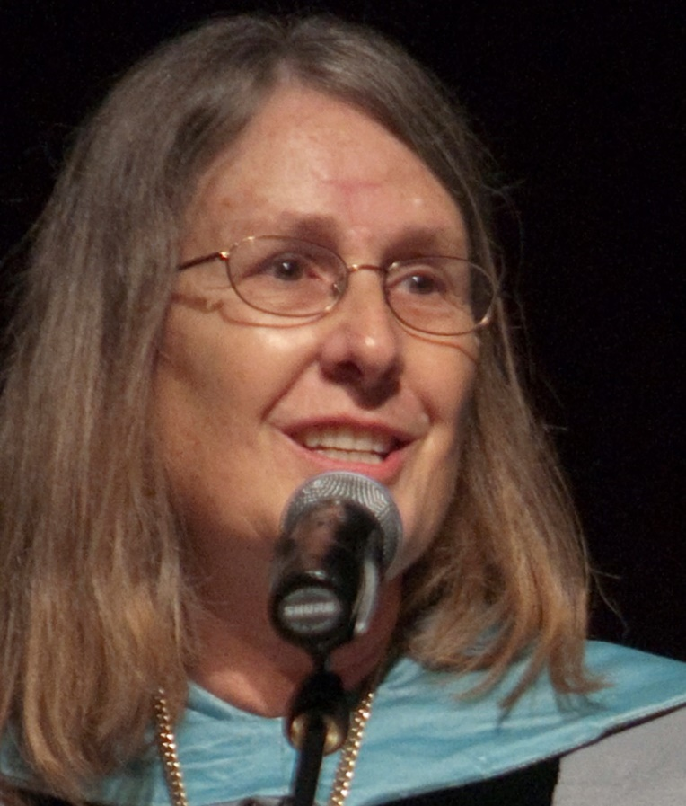
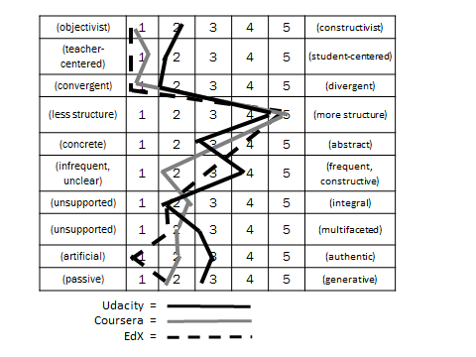
Chapter 10: MOOC Pedagogy
AMP: A Tool for Characterizing the Pedagogical Approaches of MOOCs
Karen Swan, Scott Day, Leonard Bogle, and Traci van Prooyen
University of Illinois Springfield
Figure 3. Ratings Metaphors

Slide 19
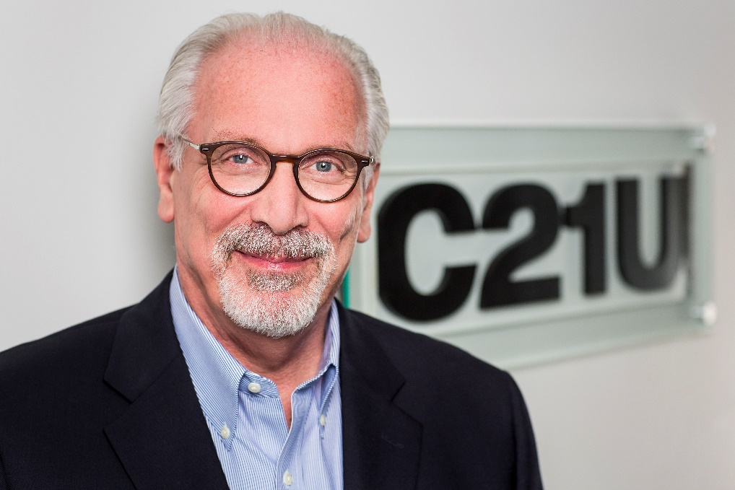
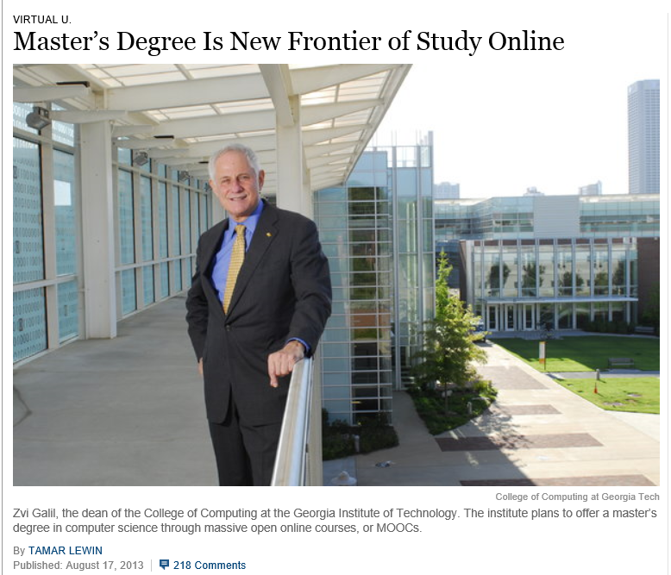
Chapter 13: Unbundling Higher Education and the Georgia Tech Online MS in Computer Science: A Chronicle
Richard DeMillo

Slide 20

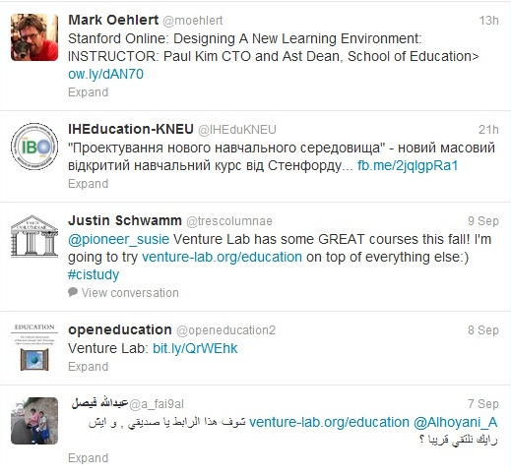
Chapter 14: Creating a Temporary Spontaneous Mini-Ecosystem through a MOOC
Paul Kim and Charlie Chung, Stanford University
Figure 2. Twitter thread announcing the MOOC

Slide 21
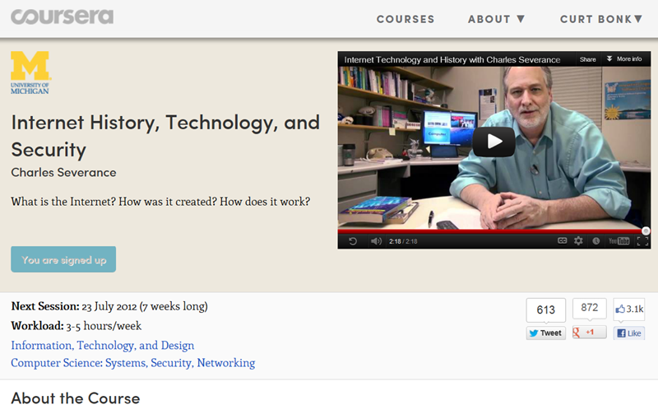
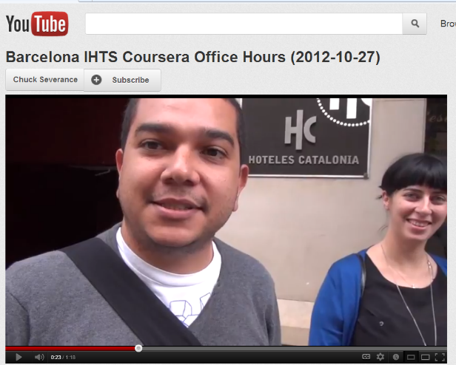
Chapter 15: Learning about MOOCs by Talking to Students
Charles Severance, University of Michigan
Figure 3. Internet History, Technology, and Security on the Coursera Platform.

Slide 22
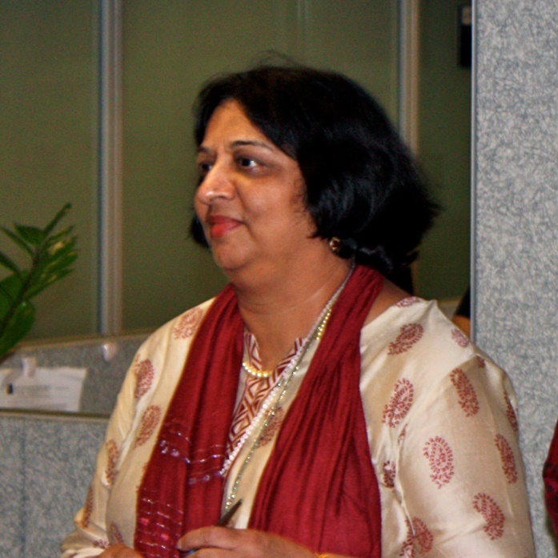

Chapter 19: Harnessing the Power of Open Learning to Share Global Prosperity and Eradicate Poverty
Sheila Jagannathan, World Bank, Washington DC
Figure 1: World Bank Group Twin Goals

Slide 23
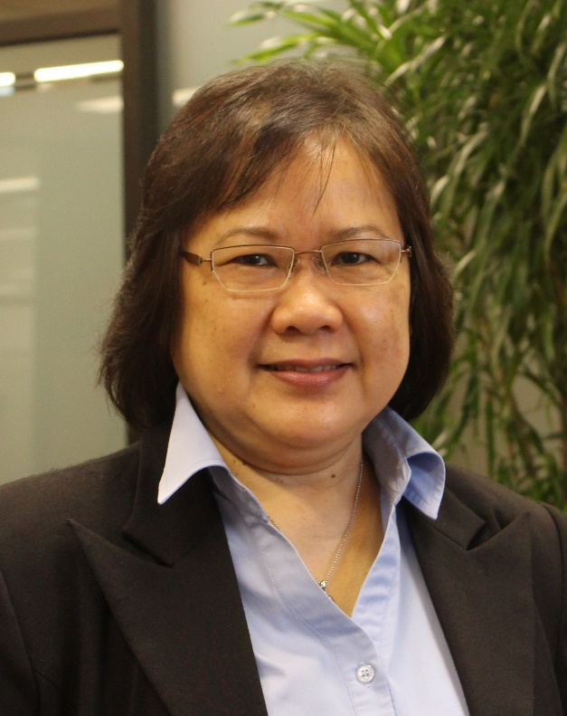
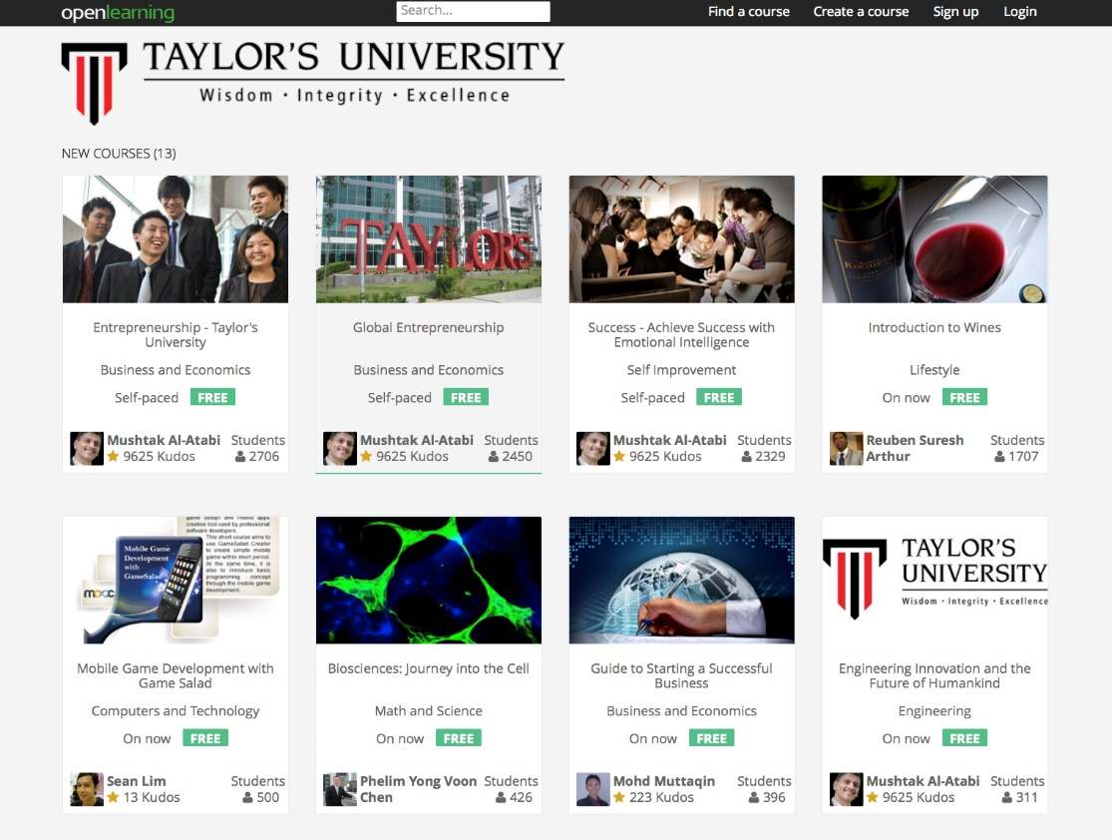
Chapter 20: The Glocalization of MOOCs in Southeast Asia
Zoraini Wati Abas, Ed.D.
Figure 2. Eight of thirteen MOOCs offered by Taylor’s University

Slide 24
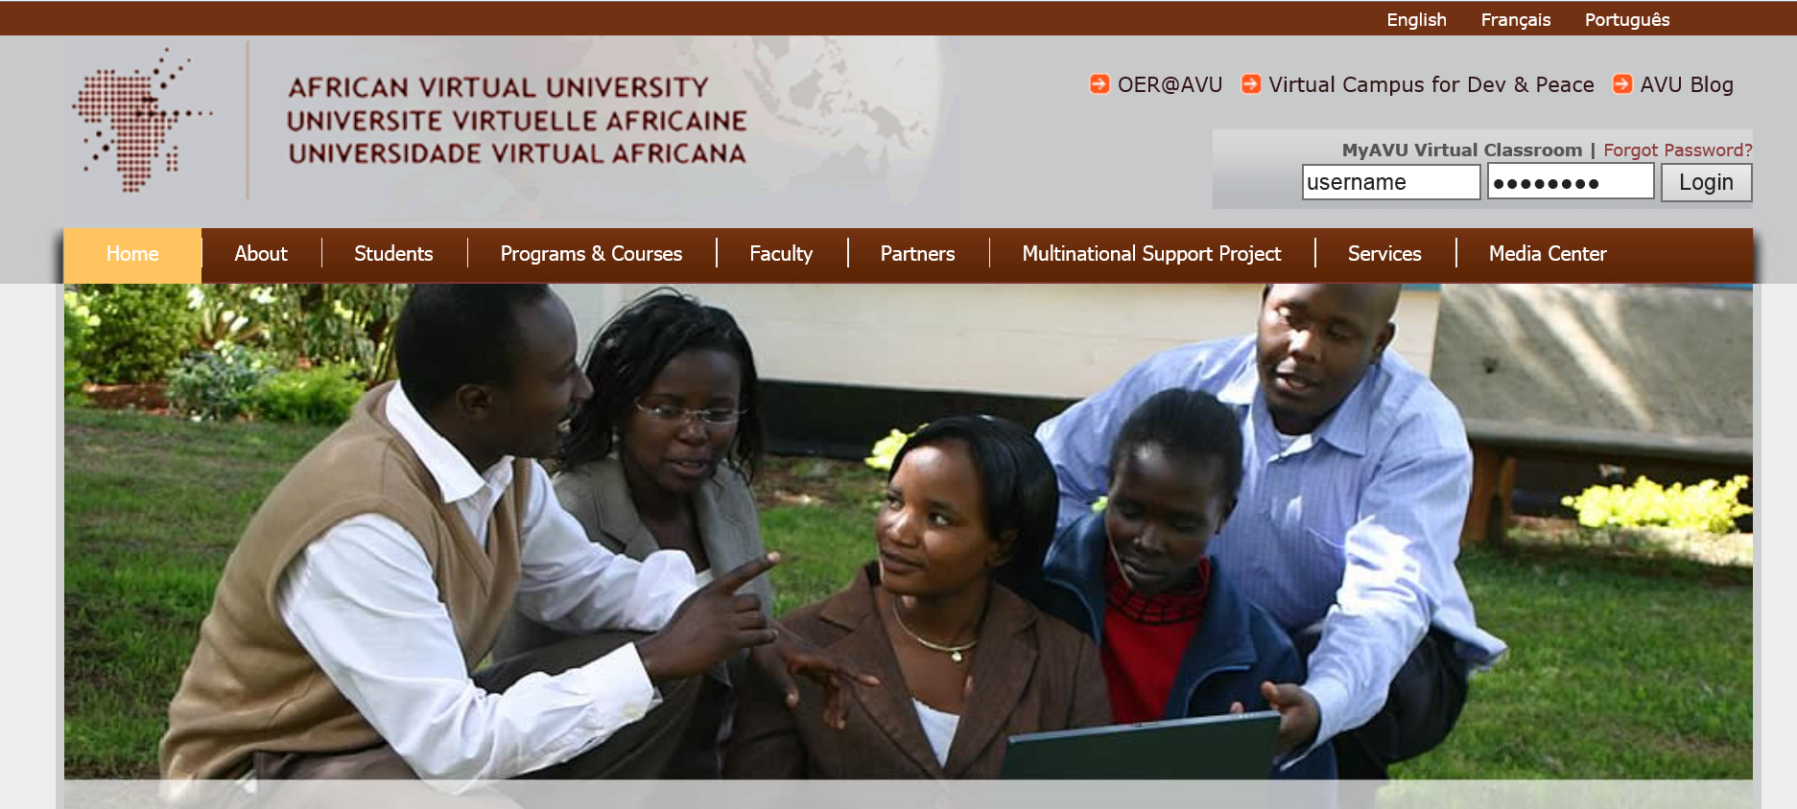
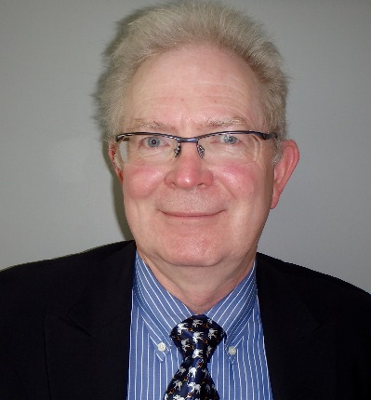
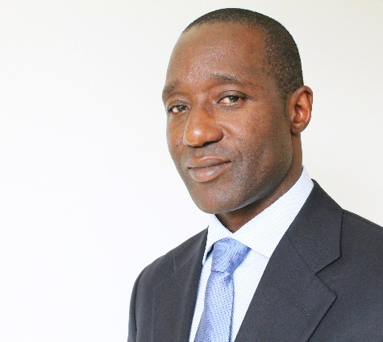
Chapter 22: OER and MOOCs in Africa: The AVU Experience
Griff Richards and Bakary Diallo,
African Virtual University, Nairobi, Kenya
It is estimated that only 6% of Africans can access post-secondary education. The development goal is set at 12% even though North America and Europe are somewhere around 45%.

Slide 25

Chapter 23: Open Learning in the Corporate Setting
Elliot Masie, The Learning CONSORTIUM @ The MASIE Center
“Open” is an interesting and disruptive word to use about a corporate setting. Yet, Open Learning is one of the most provocative and rapidly changing elements of how corporate learning is being harvested, delivered, and packaged.

Slide 26
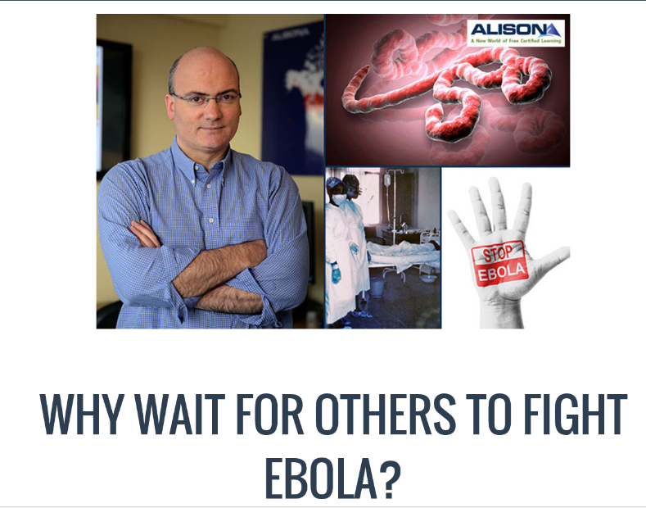

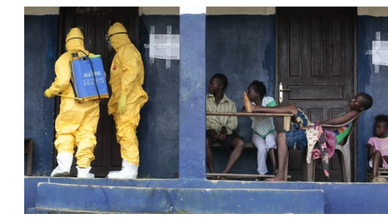
Chapter 24: ALISON: A New World of Free Certified Learning
Mike Feerick, CEO & Founder, ALISON

Slide 27
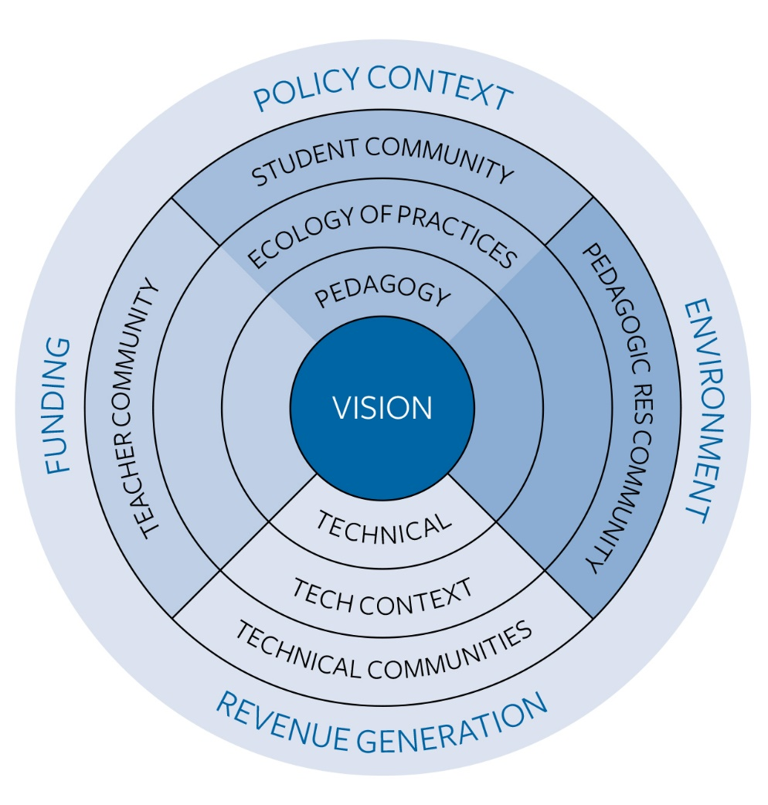
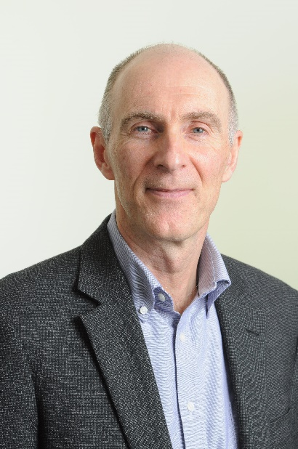
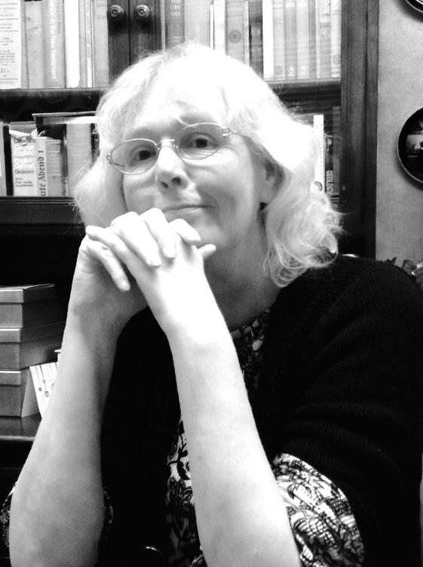
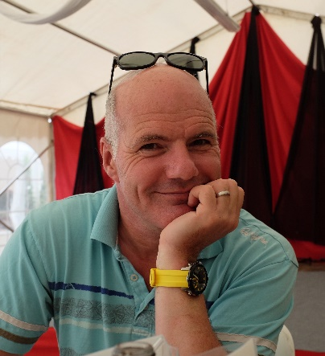
Chapter 28: MOOCs 2030:
A Future for Massive Online Learning
Rebecca Ferguson, Mike Sharples (The Open University, UK), Russell Beale (University of Birmingham)
Figure 1. The Beyond Prototypes Models of the TEL Complex

Slide 28
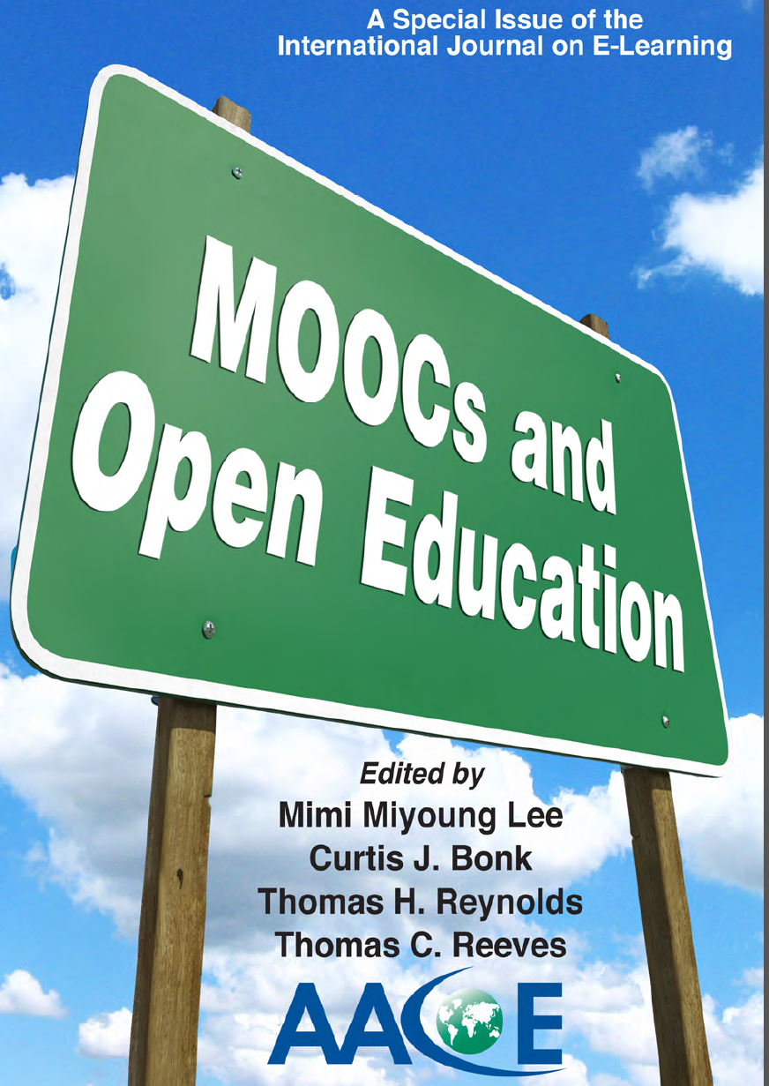

Slide 29
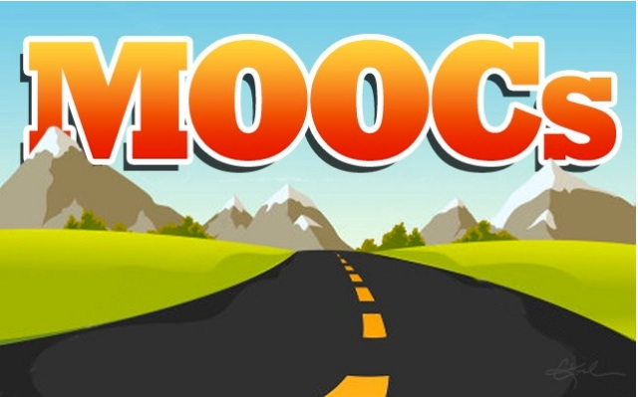
Driving down the road to cultural sensitivity in MOOCs?

Slide 30
Chapter 14 (USA/Stanford): Paul Kim and Charlie Chung
  Encourage students to download lecture videos and translate them to other languages and perhaps add captions and make available in their local cloud services.
  Encourage students to create low bandwidth versions of videos for those in low bandwidth areas.
  Encourage students to translate videos and add nuances and words understandable in local languages.
  Encourage students to meet locally in teams to share materials and take care of “sensitive matters.”

Slide 31
Chapter 15 (USA/U of Michigan): Chuck Severance
  Avoid troublesome metaphors and examples (e.g., the baseball World Series in the USA).
  Never show lecturer’s face (use audio only)—allows for complete overdubbing in the native language and avoid hand gesture problems.
  Make slides as word free as possible—where possible use symbols

Slide 32
Chapter 21 (the Philippines/The Open U): Melinda Bandalaria
  Strictly avoid references to religion.
  Use acceptable dress code.
  Even when English is the primary or secondary language of the country, consider making MOOC content available in the major dialects of the country.

Slide 33
To be mindful of:
Jokes and Humor
Hand gestures or body movements
Mode of communication
Dominance of English
Political issues and current events

Slide 34
To be mindful of:
Different levels of digital literacy skills
Local resources by locals
Legal differences and barriers
Gender, age and disability issues
Device-specific pedagogy and interface

Slide 35
To address the concerns:
“Avoid” troublesome metaphors and images
“Limit” to audio and “No” video OR keep the video “simple”
“Neutralize” cultural issues in the contents
“Personalize” the learning experience to offset the massiveness

Slide 36
To address the concerns:
“Widen” and “increase” representations from more diverse groups and stakeholders
“Engage students” to make the contents more culturally sensitive/relevant

Slide 37
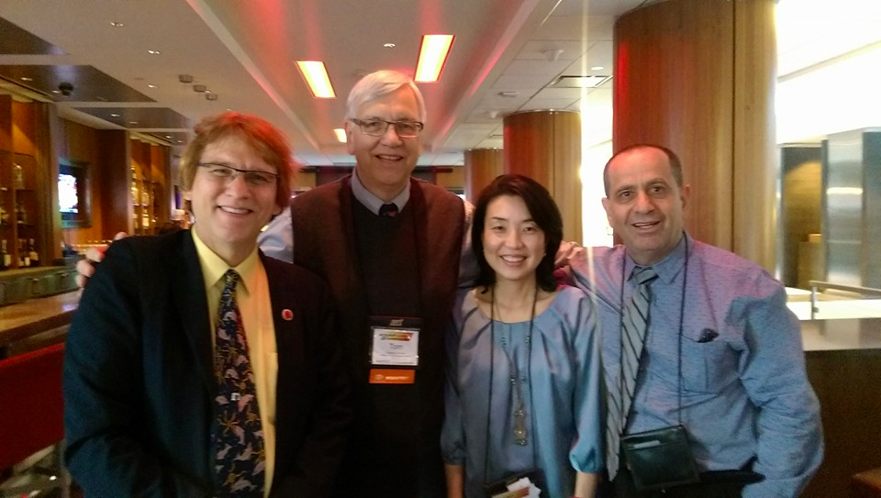
Curt, Tom, Mimi, and Yadi

Slide 38
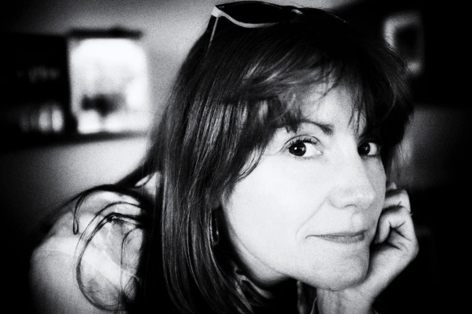
Chapter 2: Karen Head
Be careful with small things like finger pointing—use at least two fingers.
Jokes and humor can easily be misinterpreted.
Be aware of shifting political climates impacting resource access such as YouTube in China.
Many cultures do not have a linear approach (e.g., from A to B) to communication.
Using visual rhetoric (e.g., visual images) to communicate can be a minefield of problems.

Slide 39

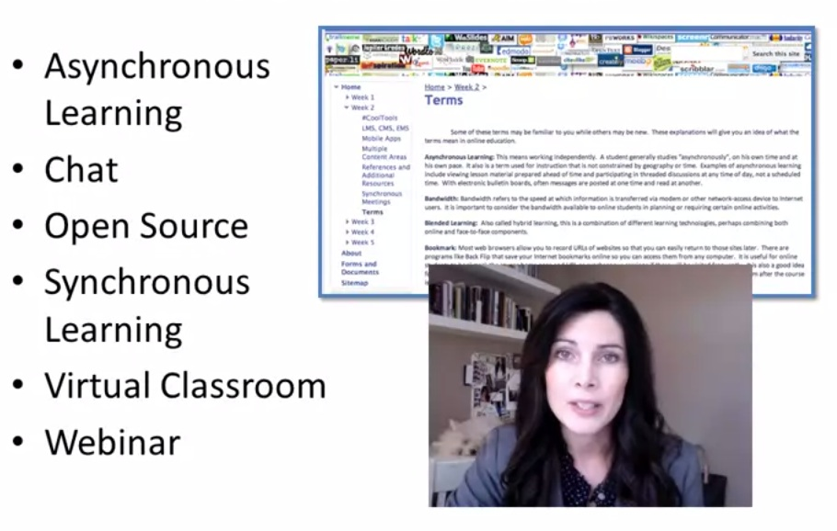
Foundations of Virtual Instruction
dog

Slide 40
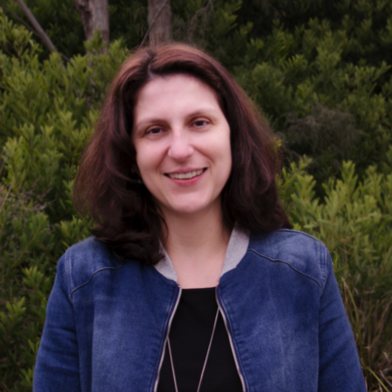
Chapter 5: Carina Bossu
To ensure inclusiveness (including cultural, ethical, and religious), one should openly license all educational materials developed for MOOCs, so as to guarantee the permissions and freedoms required for translation, adaptation, re-use, redistribution, and repackaging.

Slide 41
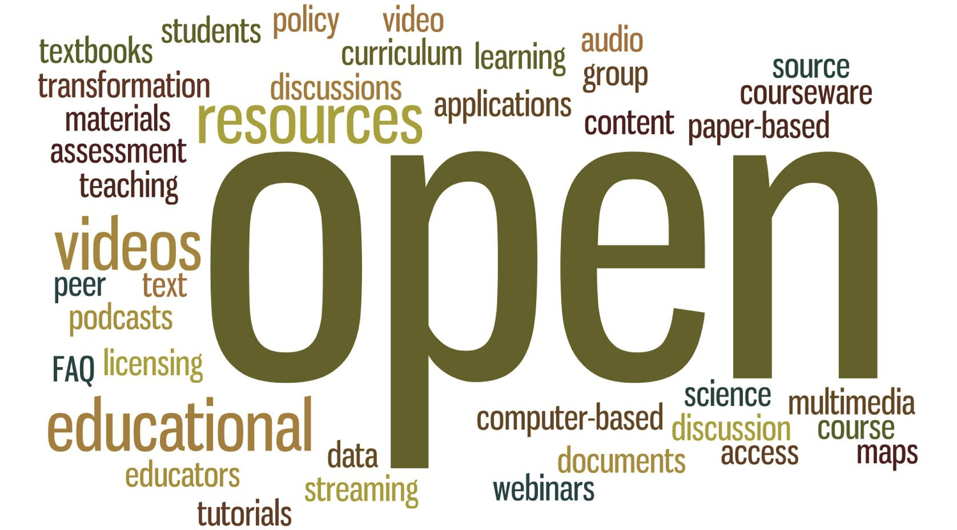

Slide 42


Slide 43

Chap. 6: Laura Czerniewicz
The single most important requirement is that MOOCs and MOOC resources be made available under Creative Commons licenses or other open licenses which allow for re-use and adaptation. No matter how culturally sensitive the materials, it is essential that a broadcast model be employed.
The agency for and ownership of local resources need to be in the hands of those who best understand local conditions, and therefore they need to be able to create and adapt as they see fit.

Slide 44


Slide 45
Additional Slides (not used)

Slide 46

Our research should be driven by a desire for
IMPACT

Slide 47

Too Much Research on Things
MOOCs
iPads and other tablets
Smart phones
3-D printers
Games
Wearable Technology
Virtual Assistants
LMS
Smart boards
Social Media

Slide 48

Too Little Research on Problems
Ineffective primary, secondary, higher education
Increasing gaps between haves and have-nots
Long-term unemployment
Poor public health
Lack of literacy
Hopelessness
Lack of
engagement
Racism
Sexism

Slide 49




Slide 50

(McKenney & Reeves, 2012)
Notes:
This is the research model we present in the book.

