Slide 1

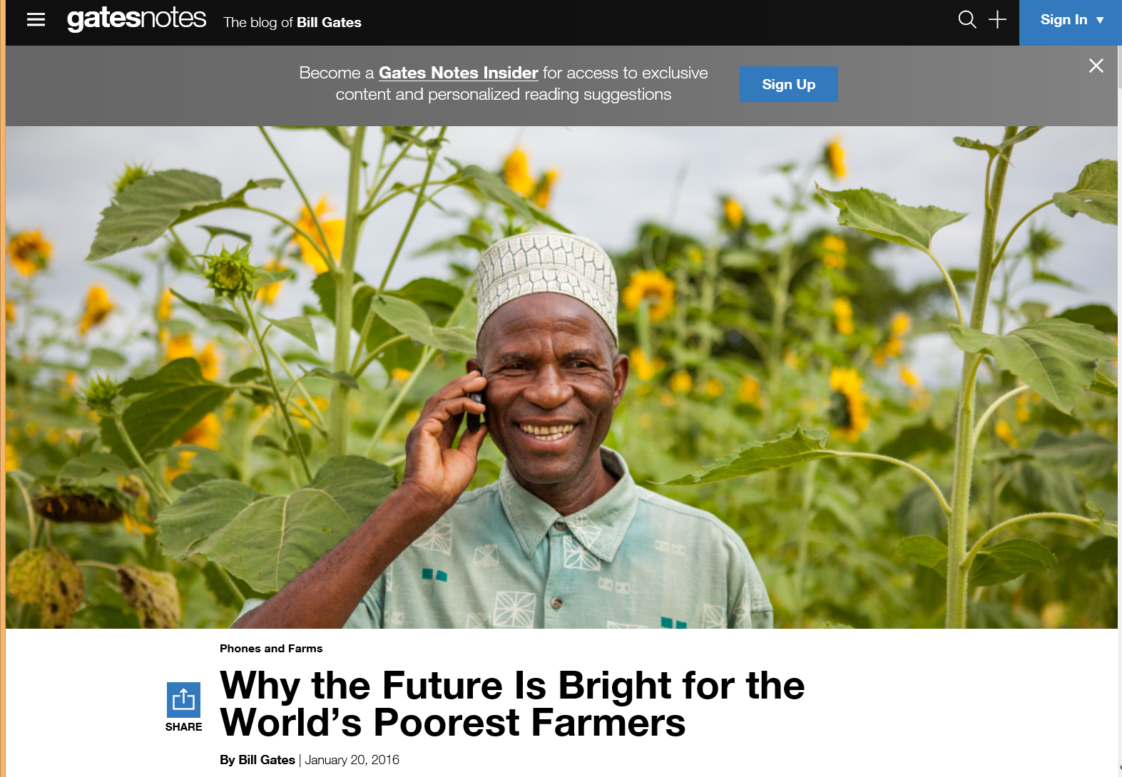
Instructor Efforts to Address Cultural Diversity in MOOC Design and Application
Curtis J. Bonk, Indiana University
Meina Zhu, Indiana University
Annisa Sari, Indiana University
Minkyoung Kim, Texas Tech University
Najia Sabir, Indiana University
Shuya Xu, Indiana University

Slide 2
Concerns Regarding the Emergence of MOOC
Learners are heterogenous (Watson, Ho, & Raman, 1994)
Misunderstanding might occur due to language barrier & communication style (Callaway, Matthew, & Felvegi, 2014)
Different cultures have different communication pattern (Hofstede, 1986; McLouglin, 2006)

Slide 3
Concerns Regarding the Emergence of MOOC
Different learning preferences & styles may vary in different cultures (Fail, 2011; Hofstede, 1983, 1986; Kim & Bonk, 2002)
Thus, it is important to consider cultural diversity in designing MOOC (Ahn, Yoon, & Cha, 2015; Speece, 2012)

Slide 4
The definition of Culture
Beliefs, value, norms, mores, myths, and structural elements that represent on how a group interprets/reacts to its surrounding (Watson, Ho, & Raman, 1994)
Collective programming of the mind that explain the complexities of culture that include attitude, goals, symbols, practices, & values (Hofstede & Hofstede, 2005)

Slide 5
The Need to Understand Culture
Culture affect people’s communication (Ford & Kotze, 2005; Hall, 1976)
Technologies are not culturally neutral (Qayyum, 2016)
There are various ways to address cultural issues, e.g., use a common language like English but encourage subtitling and transcripts, be considerate when using symbols, provide use easy-to-digest examples, understand time differences among participants, engage in role modeling, and build cultural awareness and sensitivity among the learners of the course (Wendler et al, 2002; Yousef et al, 2014)

Slide 6
Why Instructors?
Instructors are one of the five primary elements (instructors, learners, topic, materials, and context) in MOOCs (Kop, 2011)
Few studies leverage instructor perspectives to better understand such personalization and cultural sensitivity (Veletsianos & Shepherson, 2016)

Slide 7


Ideas for Cultural Sensitivity

Slide 8

Chapter 2: USA/Georgia Tech: Karen Head
Be careful with: hand gestures (e.g., finger pointing—use at least two fingers), body movements, English dominance, political issues.
Jokes and humor can easily be misinterpreted.
Be aware of shifting political climates impacting resource access such as YouTube in China.
Many cultures do not have a linear approach (e.g., from A to B) to communication.
Using visual rhetoric (e.g., visual images) to communicate can be a minefield of problems.

Slide 9

Chapter 3: Japan/The Open U Kumiko Aiko
  Make subtitles available in multiple languages based on intended audiences.
  Avoid references to current events that may only be shared by a small subgroup.

Slide 10


Chapter 5: Australia
Carina Bossu
To ensure inclusiveness (including cultural, ethical, and religious), one should openly license all educational materials developed for MOOCs, so as to guarantee the permissions and freedoms required for translation, adaptation, re-use, redistribution, and repackaging.

Slide 11

Chap. 6: South Africa
Laura Czerniewicz
The single most important requirement is that MOOCs and MOOC resources be made available under Creative Commons licenses or other open licenses which allow for re-use and adaptation. it is essential a broadcast model be employed.
The agency for and ownership of local resources needs to be in the hands of those who best understand local conditions, and therefore they need to be able to create and adapt as they see fit.

Slide 12
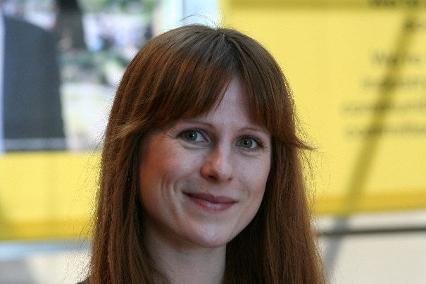
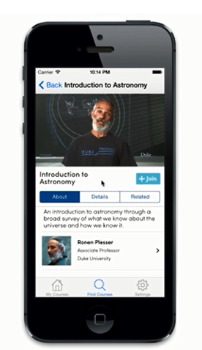
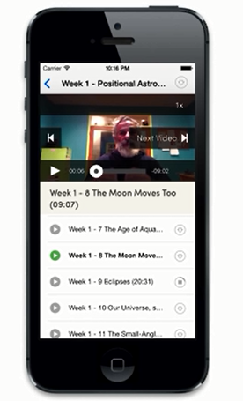
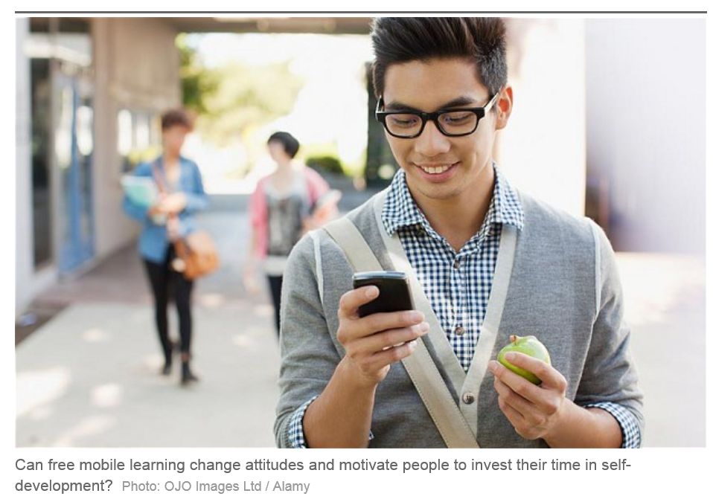

Chapter 9: Scotland
U of Edinburgh
Amy Woodgate
  Intermittent Internet access on one’s mobile phone will not help to stream HD videos.
  Simple course designs (e.g., talking heads with minimal hand gestures) helps to make content more available for international audiences. More engaging content is more difficult to convert.

Slide 13
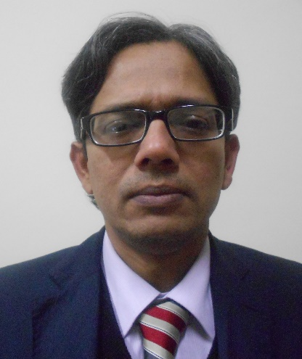
Chapter 11:
India and Canada/COL
Sanjaya Mishra
  Be culturally sensitive to music and pictures while designing content for global audience.
  Consider technology used to develop the content (does it assist reuse and remixing?).
  Instead of focusing too much on the cultural sensitivity of MOOCs and raising costs, try to allow for reuse and remixing of content. Use open source technologies and content.

Slide 14

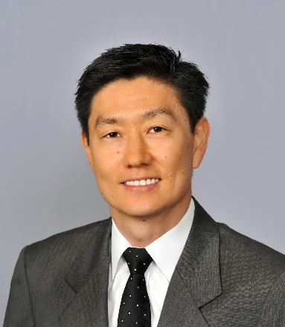
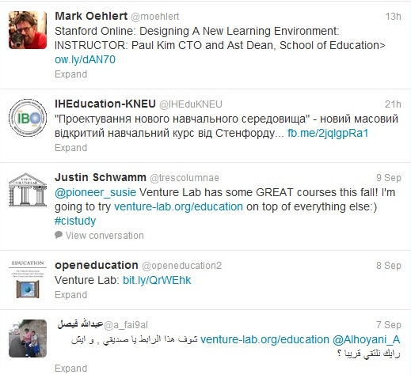
Chapter 14:
USA/Stanford
Paul Kim and Charlie Chung
  Encourage students to download lecture videos and translate them to other languages and perhaps add captions and make available in their local cloud services.
  Encourage students to create low bandwidth versions of videos for those in low bandwidth areas.
  Encourage students to translate videos and add nuances and words understandable in local languages.
  Encourage students to meet locally in teams to share materials and take care of “sensitive matters.”

Slide 15

Chapter 15:
USA/U Michigan
Chuck Severance
  Avoid troublesome metaphors and examples (e.g., the baseball World Series in the USA).
  Never show lecturer’s face (use audio only)—allows for complete overdubbing in the native language and avoid hand gesture problems.
  Make slides as word free as possible—where possible use symbols
  “Limit” to audio and “No” video OR keep the video “simple”

Slide 16
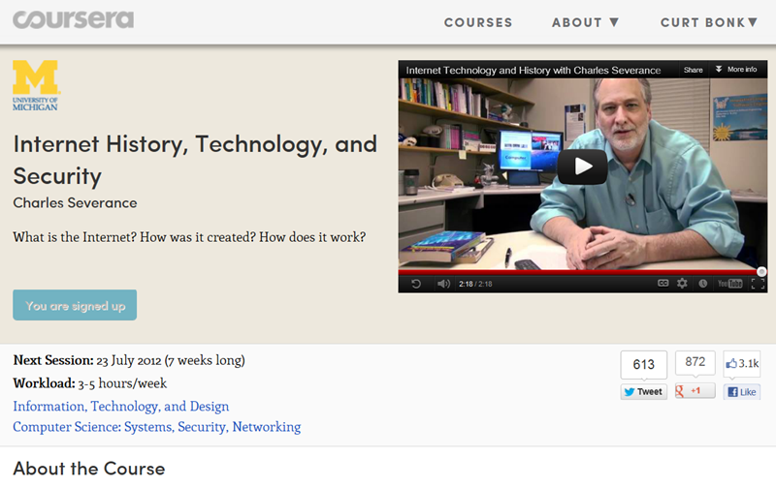
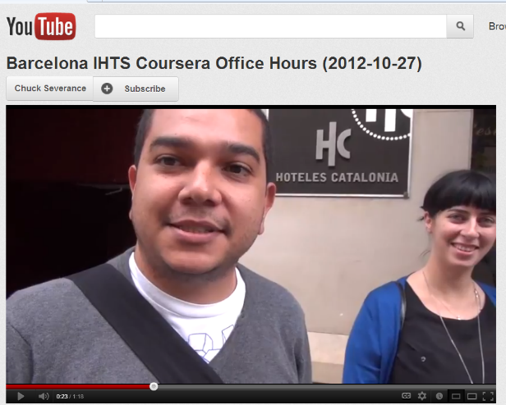
Chapter 15: Learning about MOOCs by Talking to Students
Charles Severance, University of Michigan
Chuck Severance, U Michigan/Coursera) in Barcelona http://www.youtube.com/watch?v=JzNHvmSv8TI
Chuck Severance, University of Michigan https://www.coursera.org/course/pythonlearn

Slide 17
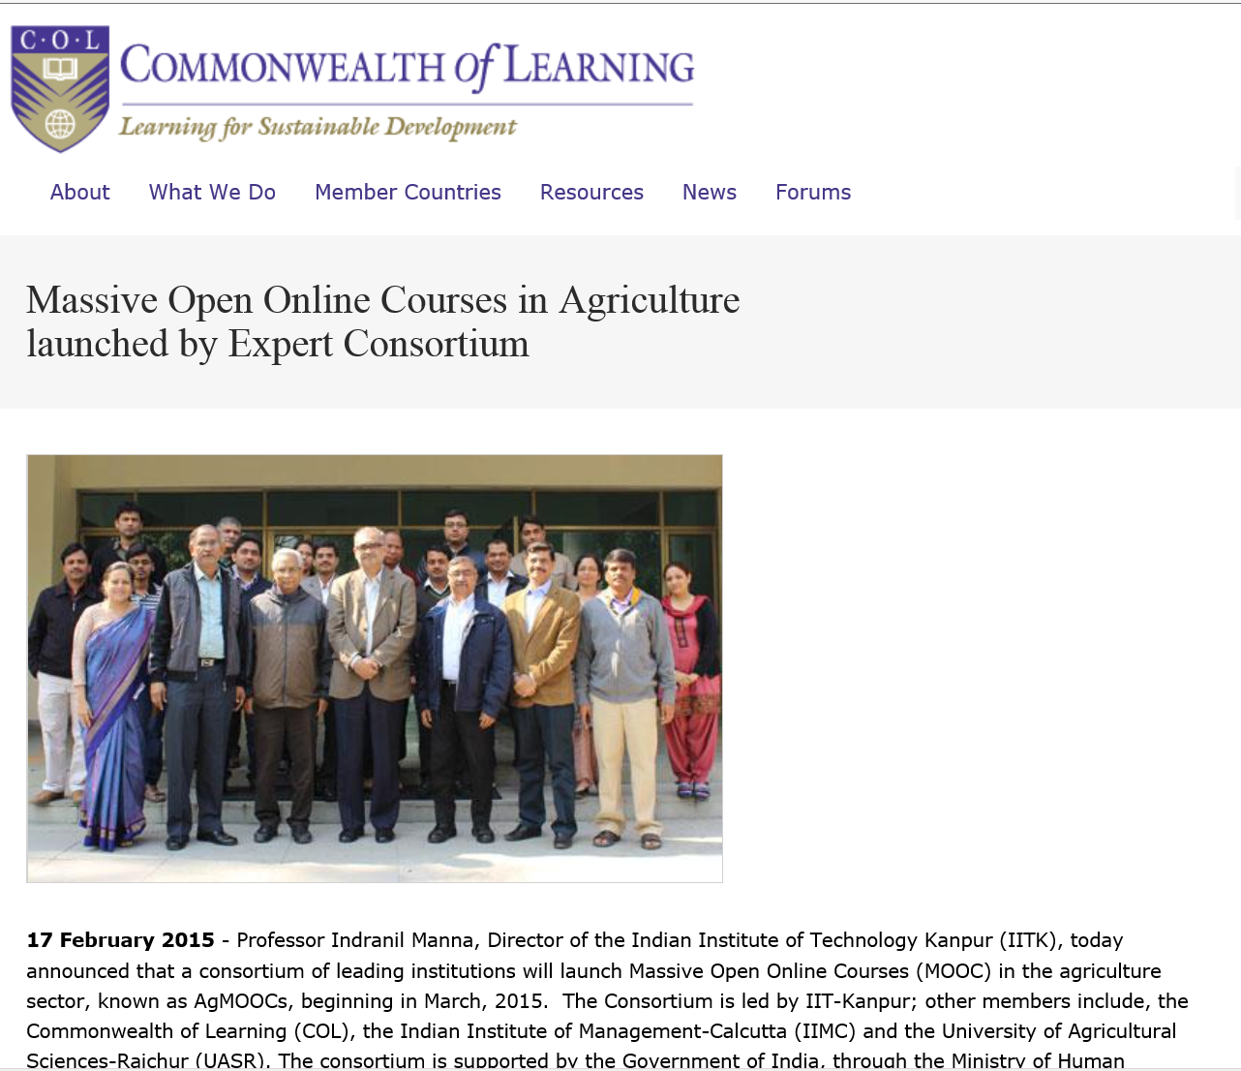
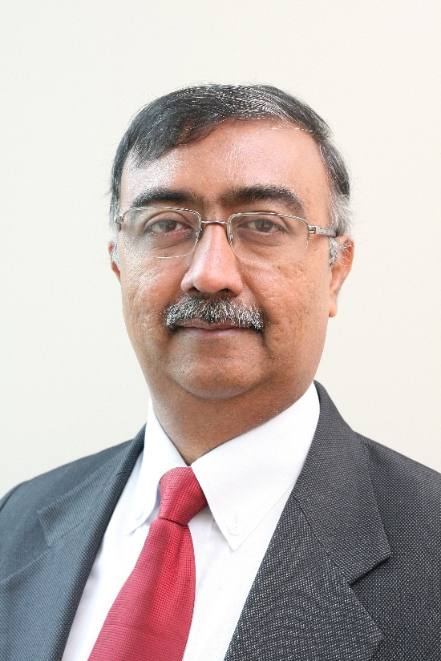
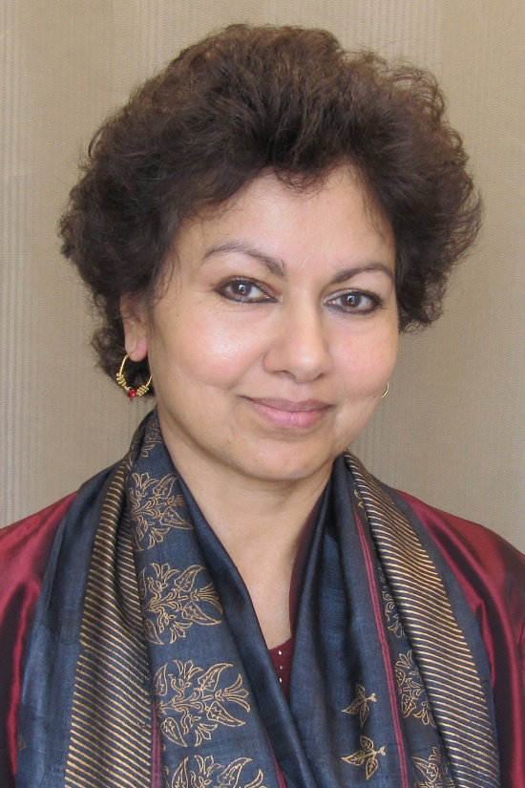
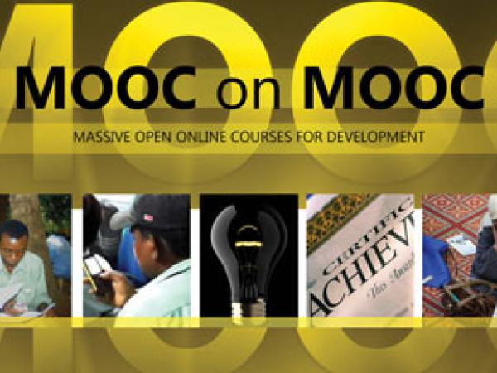
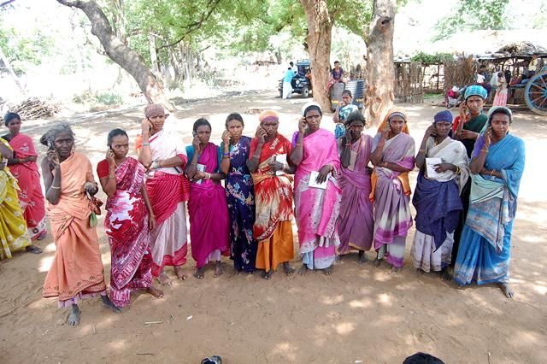
Chapter 18: Changing the Tune: MOOCs for Human Development? A Case Study
Balaji Venkatataraman and Asha Kanwar, COL

Slide 18
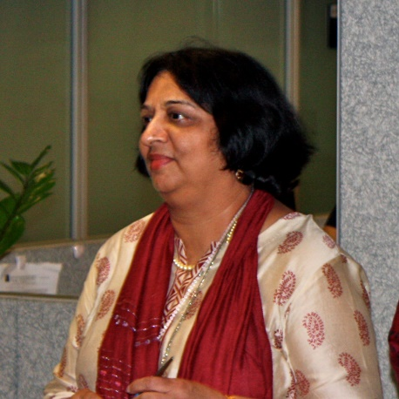

Chapter 19:
DC/World Bank Institute
Sheila Jagannathan
“Widen” and “increase” representations from more diverse groups and stakeholders (gender, non western, public and private, grass roots, etc.).
Make the contents more culturally sensitive/relevant.

Slide 19
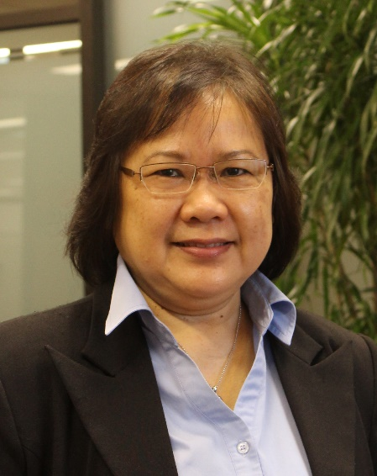
Chapter 20
Indonesia and Malaysia
Zoraini Wati Abas
  Do not expect Asian audience to quickly voice their opinions
  Treat Asian audience as an equal
  Avoid issues related to religion and politics.
  Minimize distractions and negative feelings (e.g., do not show visuals or give examples of prohibited types of foods or animals)

Slide 20
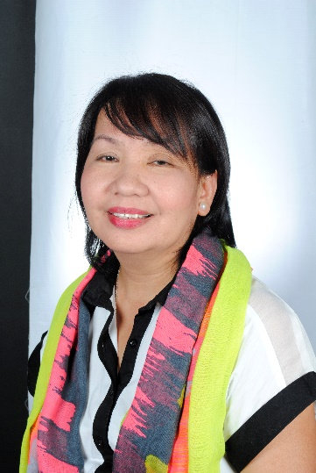
Chapter 21:
U of Philippines Open U
Melinda Bandalaria
  Strictly avoid references to religion.
  Use acceptable dress code.
  Even when English is the primary or secondary language of the country, consider making MOOC content available in the major dialects of the country.

Slide 21
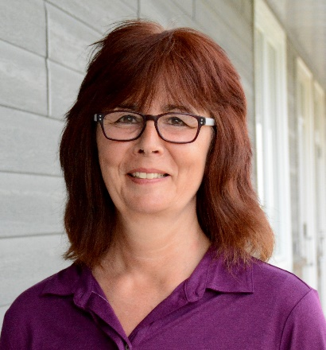
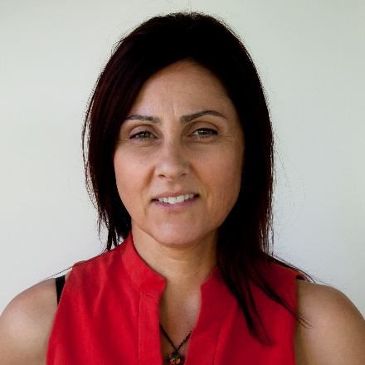
Chapter 27:
Canada
Helene Fournier and Rita Hop
“Personalize” the learning experience to offset the massiveness.
Need to think hard about how cultural differences might be expressed and accepted in the MOOC platform.
  The road ahead hinges on personalizing learning experiences; the connectivist approach (i.e., cMOOCs) is which participants are in the driver’s seat.

Slide 22
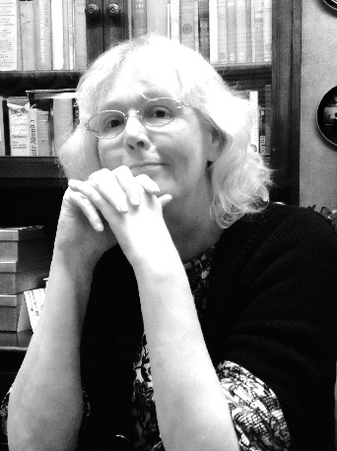
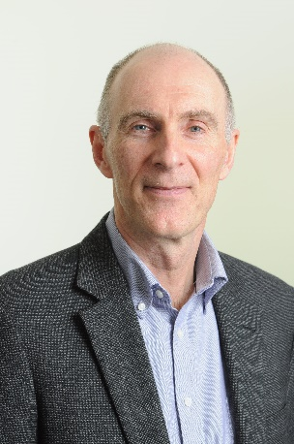
Chapter 28:
UK/FutureLearn
Rebecca Ferguson and Mike Sharples
  Access. In many countries (e.g., in Africa, but also areas of Asia) mobile is the main means of access, so the courses need to be developed for a mobile-first experience, including pedagogy as well as interface.
  Provide transcripts of videos, preferably in multiple languages and multi-language subtitles.
  There are deep-seated cultural differences related to: the value of expert vs learner-originated knowledge; deference to experts; willingness to engage in discussion and critique.

Slide 23
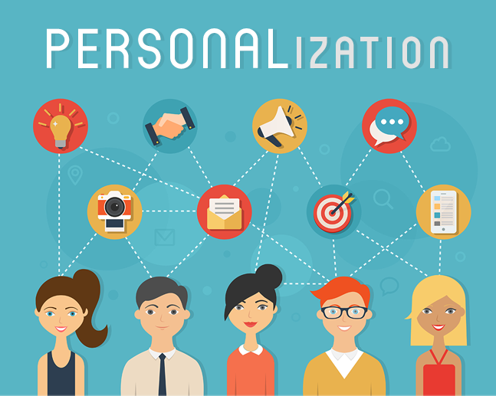
Personalization of MOOCs

Slide 24
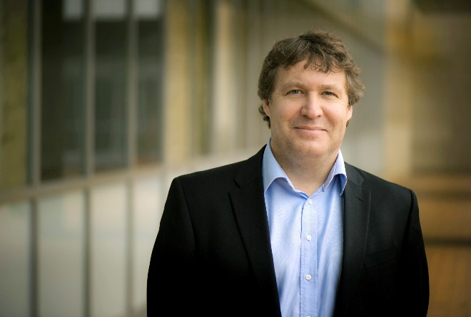
Foreword:
Canada/USA
George Siemens
MOOCs are adopting CMUs OLI project (adaptive learning in stats) (e.g., Candace Thille at Stanford).
Smart Sparrow (adaptive learning company connected to ASU) has started running personalization in MOOCs. One personalized/adaptive MOOC with Australian univ.
Carolyn Rose at CMU recently ran a “Super Heroes” MOOC together with Smithsonian that used personalization approaches through "intelligent agents" to foster dialogue and collaboration.

Slide 25

Chapter 18:
Canada/COL
Balaji Venkataraman
In the Mooc on mobiles for development the course team received requests from two groups of learners in Sierra Leone and Zambia for the course materials on DVD.
AgMoocs initiative (http://www.agmoocs.in/) uses MooKIT platform designed for access in low bandwidth conditions. It includes a functionality for a learner to hear the voice track on a basic mobile phone.

Slide 26
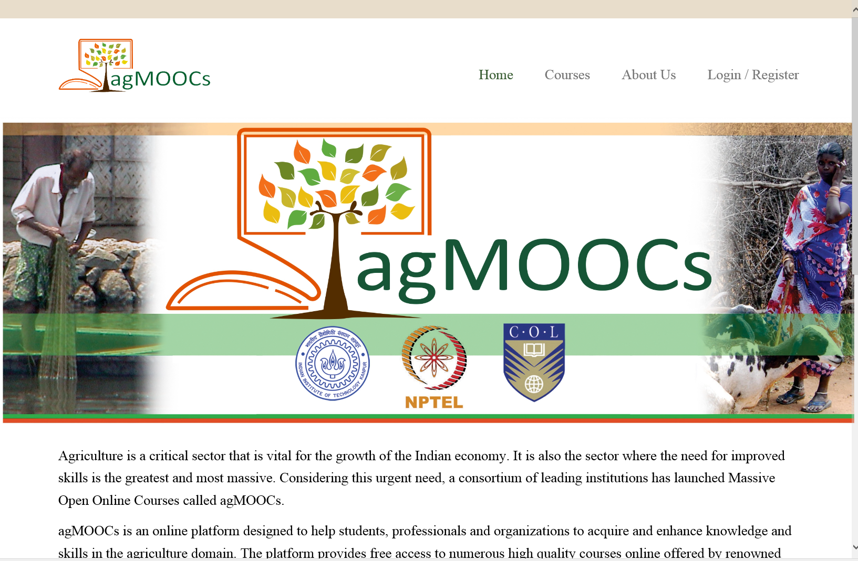
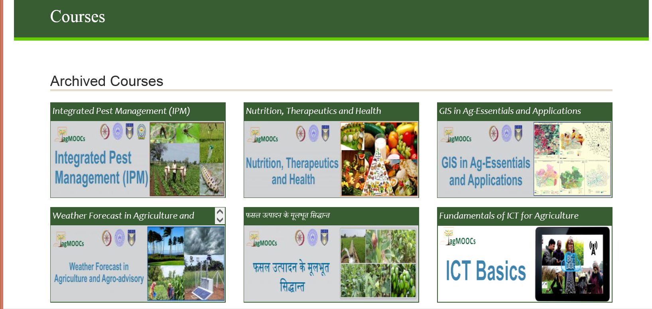
May 20, 2016 agMOOCs (India) http://www.agmoocs.in/

Slide 27

Chapter 18:
Canada/COL
Balaji Venkataraman
In the Pacific COL supported the U of South Pacific with a specially constructed MOOKIT platform. Social media was integrated with it. Any interested learner can add his or her SM profile to the profile in the course. This will enable a learner to follow the discussions on the course forum in real time using just the smart phone. This bandwidth is cheaper in most Pacific island countries than bandwidth availed for laptops. This facility greatly contributed to increased course participation often overwhelming the team of instructors.

Slide 28

Chapter 19:
DC/World Bank Institute
Sheila Jagannathan
We try to do badging etc. to give motivation and personal incentives such as champion or expert.
We try to customize the discussion forums with regional and very level forums, topics and moderators.
Google hangouts are also used to customize and personalize at country or institutional levels.

Slide 29

Chapter 21:
Philippines Open U
Melinda Bandalaria
…one feature that we have integrated into our MOOCs which I think is one effort to personalize learning is the "Multiple Paths to Learning" or the "Learning on the Go." Through this feature, the learner can choose whether to learn through the video lessons, text lessons or podcast.
In terms of gadgets to use, of course, we made sure that the courses are accessible whatever device especially mobile devices, the learner has access to.

Slide 30
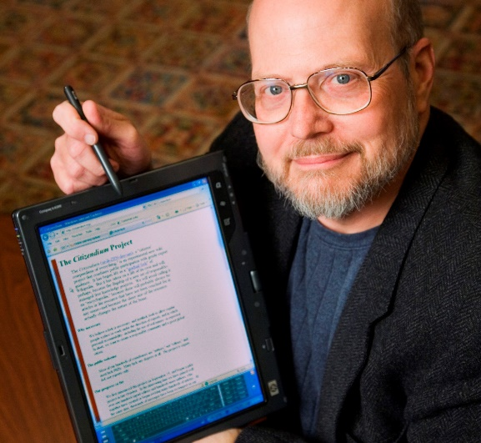
Chapter 25:
USA/Illinois
Ray Schroeder
Most obvious way to personalize is to include group projects, allowing students to self-select into interest areas to conduct collaborative projects that are relevant to the MOOC topic
One of the easiest and most effective ways is to build self-reflection into each module of a MOOC.
Motivated self-determined learners (such as many MOOCers are) do naturally adapt, build upon and scaffold MOOCs to meet their personal learning needs and desires.

Slide 31
MOOC Personalization Survey Results

Slide 32
What is the MOOC you are offering?

Slide 33
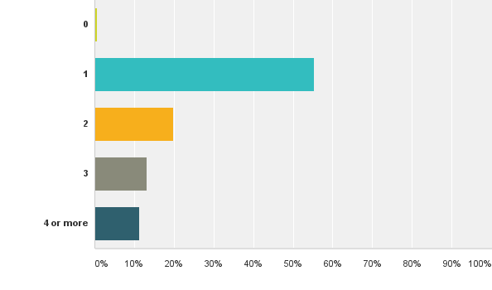
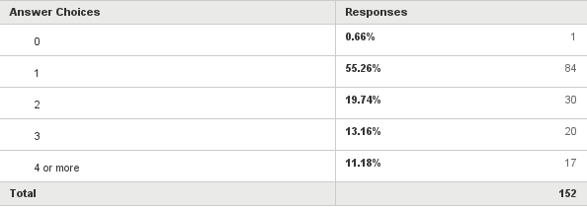
1. How many MOOCs have you taught? (N = 152)

Slide 34
How many MOOCs have you taught (including any that you are currently teaching)?

Slide 35
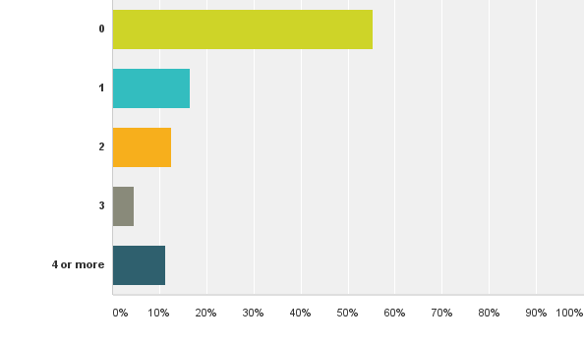
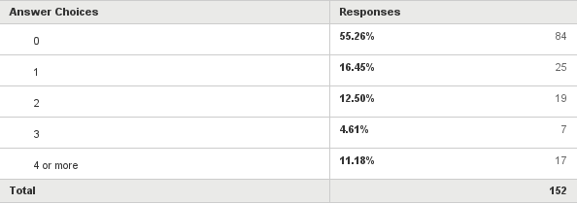
3. How many MOOCs have you completed as a learner (N = 152)

Slide 38
13. How do you address students’ varying competencies and needs?[Check all that apply]

Slide 39
14. What types of learning resources can participants select from in your most recent MOOC?[Check all that apply]

Slide 41
17. How did you design your course to be suitable for students from different cultures and/or linguistic backgrounds?[Check all that apply]

Slide 42
18. Does the structure of your most recent or current MOOC provide any of the following?
[Check all that apply; N = 126]

Slide 43
Does the structure of your most recent or current MOOC provide any of the following?

Slide 44
19. How is student progress/participation monitored or tracked? [Check all that apply; N = 137]

Slide 47
How did you design your course to be suitable for students from different cultures and/or linguistic backgrounds?

Slide 49
On a scale of 1 (low) to 10 (high), how much effort was placed on addressing the needs of individuals from different cultural backgrounds and languages in your most recent MOOC?

Slide 50
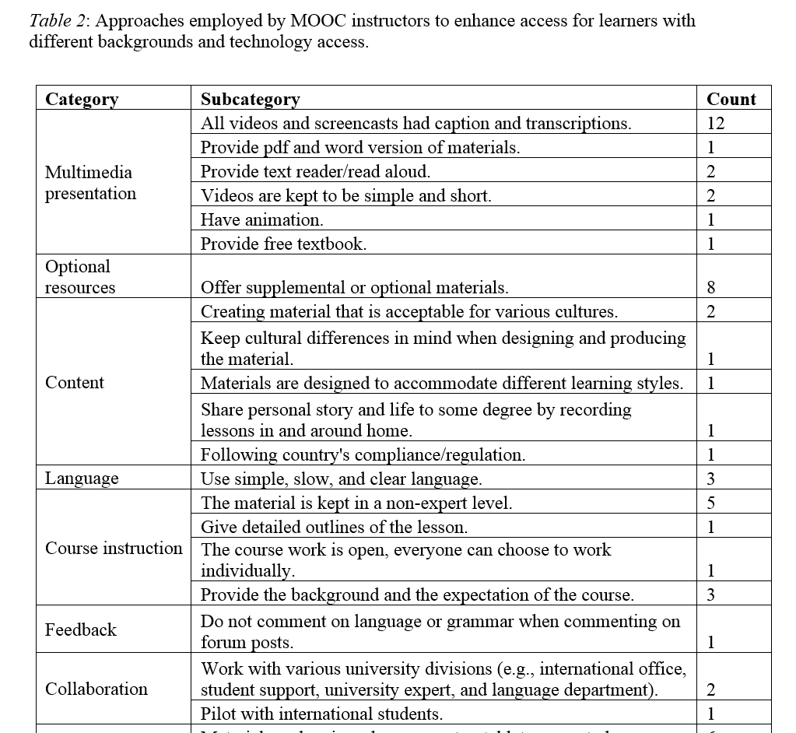
Table 2: Approaches employed by MOOC instructors to enhance access for learners with different backgrounds and technology access.

Slide 51
How MOOC instructors design their courses with the consideration of students’ background and technology access （Top 4 ways):
Providing captions and transcriptions to all videos and screencasted materials
Offering supplemental or optional materials
Making sure that all materials can be viewed on various devices, including computer, tablet, or smartphone
Keeping the materials at the level of a non-expert

Slide 52

Open-ended question 1: Can you provide one or more ways that you attempt to personalize the MOOC experience for those enrolled in the course?
Answered: 36 Skipped: 119
Replying personally to asynchronous discussion messages to explain or reference materials to students as well as to refer to peers. Retweeting and commenting on learners social media posts.
Mainly, we ran moderated peer discussion through Piazza. Students, teachers, and the moderator commented on student contributions.
To give more different case studies and examples, considering different backgrounds and interests. To have high order and low order assessments, considering the personal interest for deepening into content.
Its all about expectations and communication. From the first day of 'launching' we have moderators & academics assigned to welcome and encourage learners to ask questions and post comments for peer-to-peer feedback, etc. We also list specific times when different academics and experts will be online (various times/dates due to international reach) to have 1-2-1 and group discussions where applicable.
I adjust some of the content based on early discussion in the course to better meet the needs of the recruited cohort. Some of the material was co-created and labelled geographically.

Slide 53

Open-ended question 3: How did you design your MOOC to make it easier to access for students with different backgrounds and technology access?
Answered: 34 Skipped: 121
Worked closely with university expert. Consulted with language dept. Talked with and piloted with our international students and friends from Jordan, China, Greece and Turkey.
Follow UK accessibility compliance guidelines. Main course material pitched at entry level but more complex further reading provided to allow students to 'go deeper' as well as range of case study content to facilitate more in-depth analysis.
There was scripts for everything ... videos mainly. There was also downloadable documents produced in different formats to make it easier depending on the technology they had available. The content was 'beginner' level so I think we naturally slowed down and covered the basics in a lot of detail - as well as providing links and documents with more information as different points.
Our content covered examples from different political and religious contexts, across Europe, the Americas, the Middle East and Asia, designed in turn to encourage students from diverse backgrounds to share their own political experience.

Slide 54

Open-ended question 5: If you were to redesign the course for enhanced personalization within your most recent MOOC offering, what would you do?
Answered: 37 Skipped: 118
I would encourage study groups with 'pupil teacher' techniques... champions in the 'crowd' leading smaller groups who are struggling or who would like more social and tutor presence.
Introduce Google Hangouts. Develop alternative pathways for content. Allow students more space to share own competencies and knowledge levels (perhaps wikis etc. ).
I would probably include one or two more items from non-western cultures and find an opportunity for students to share work in a different way.
I would review the latest cognitive science evidence on how best to achieve this important goal and redesign the course and its production accordingly.
I would hire some of our students and alumni to get involved - the students really loved the additional points-of-view and the interaction.
Change the videos - make them shorter and less formal. Give better instructions on use of discussion boards.

Slide 55


Slide 56
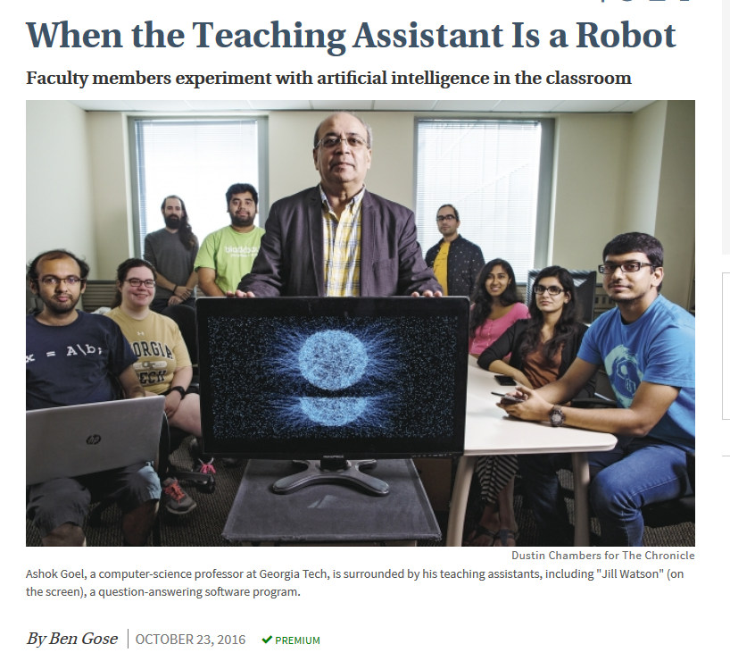
October 23, 2016
Ben Gose, The Chronicle of Higher Education http://www.chronicle.com/article/When-the-Teaching-Assistant-Is/238114

Slide 57
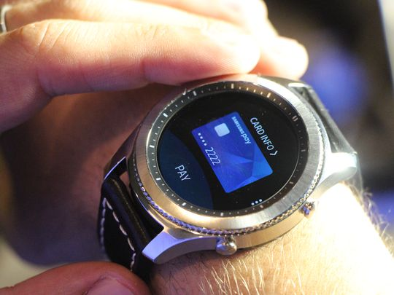
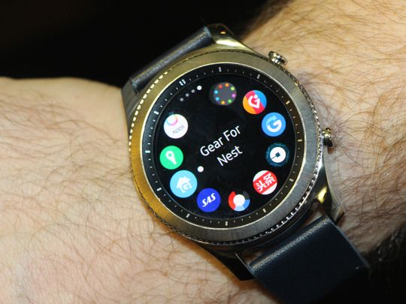
August 31, 2016
Samsung ticks forward with new Gear S3 smartwatch
Edward C. Baig and Eli Blumenthal, USA TODAY http://www.usatoday.com/story/tech/2016/08/31/samsung-ticks-forward-new-gear-s3-smartwatches/89644266/
Samsung Pay on the Gear S3. (Photo: Eli Blumenthal, USA TODAY)
.
Samsung is hoping to have 10,000 apps by the time the Gear S3 launches this fall.

Slide 58
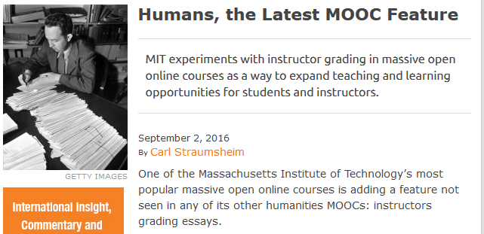
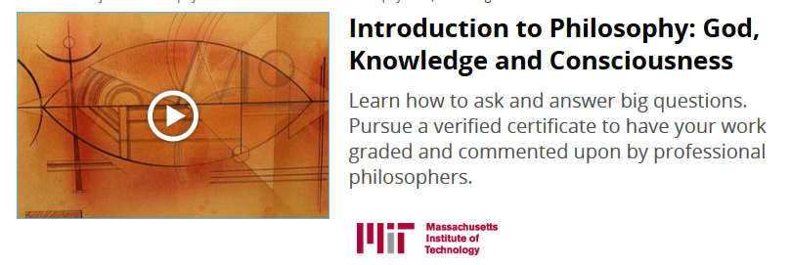
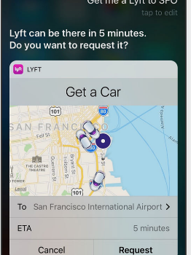
September 2, 2016
Humans, the Latest MOOC Feature
Introduction to Philosophy: God, Knowledge and Consciousness ($300 USD for an identity-verified certificate)
Carl Straumsheim, Inside Higher Ed https://www.insidehighered.com/news/2016/09/02/massachusetts-institute-technology-experiments-instructor-grading-massive-open

Slide 59
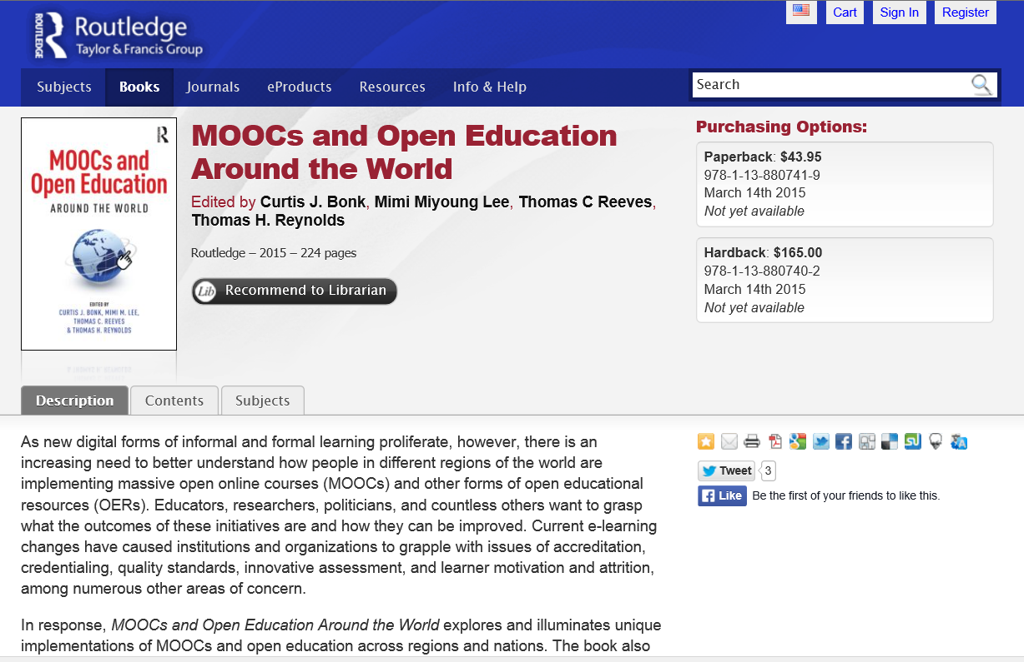
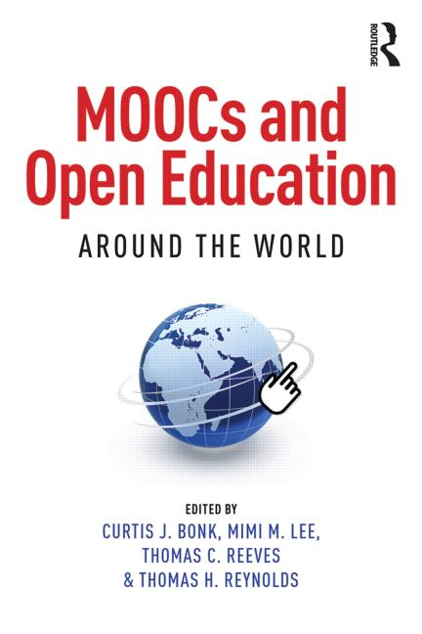
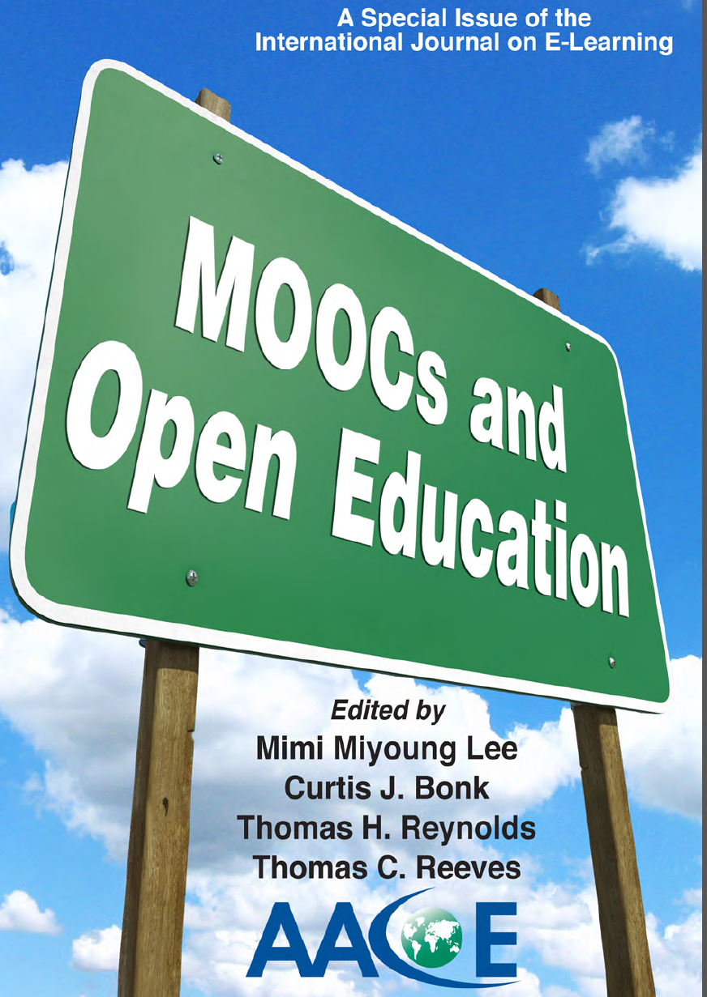

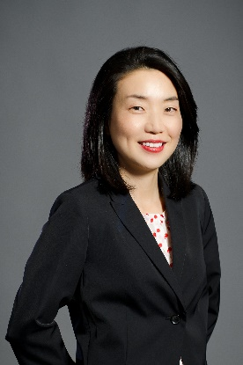


MOOCs and Open Education Around the World http://routledge-ny.com/books/details/9781138807419/

Slide 60
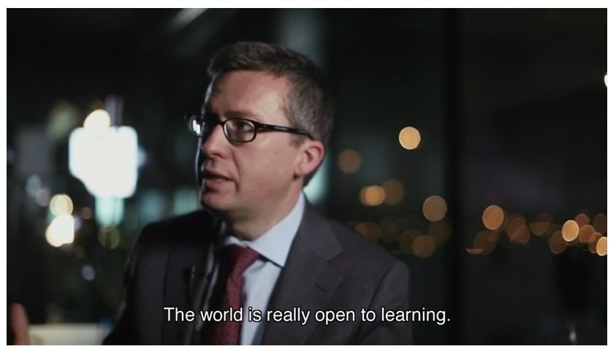
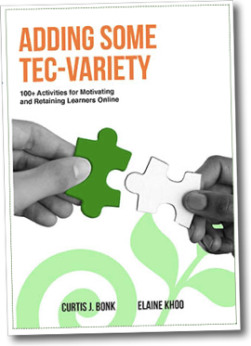


Any Questions or Comments?
Slides at: TrainingShare.com
Papers: PublicationShare.com
Free book: http://tec-variety.com/
Email: cjbonk@Indiana.edu

