Slide 1

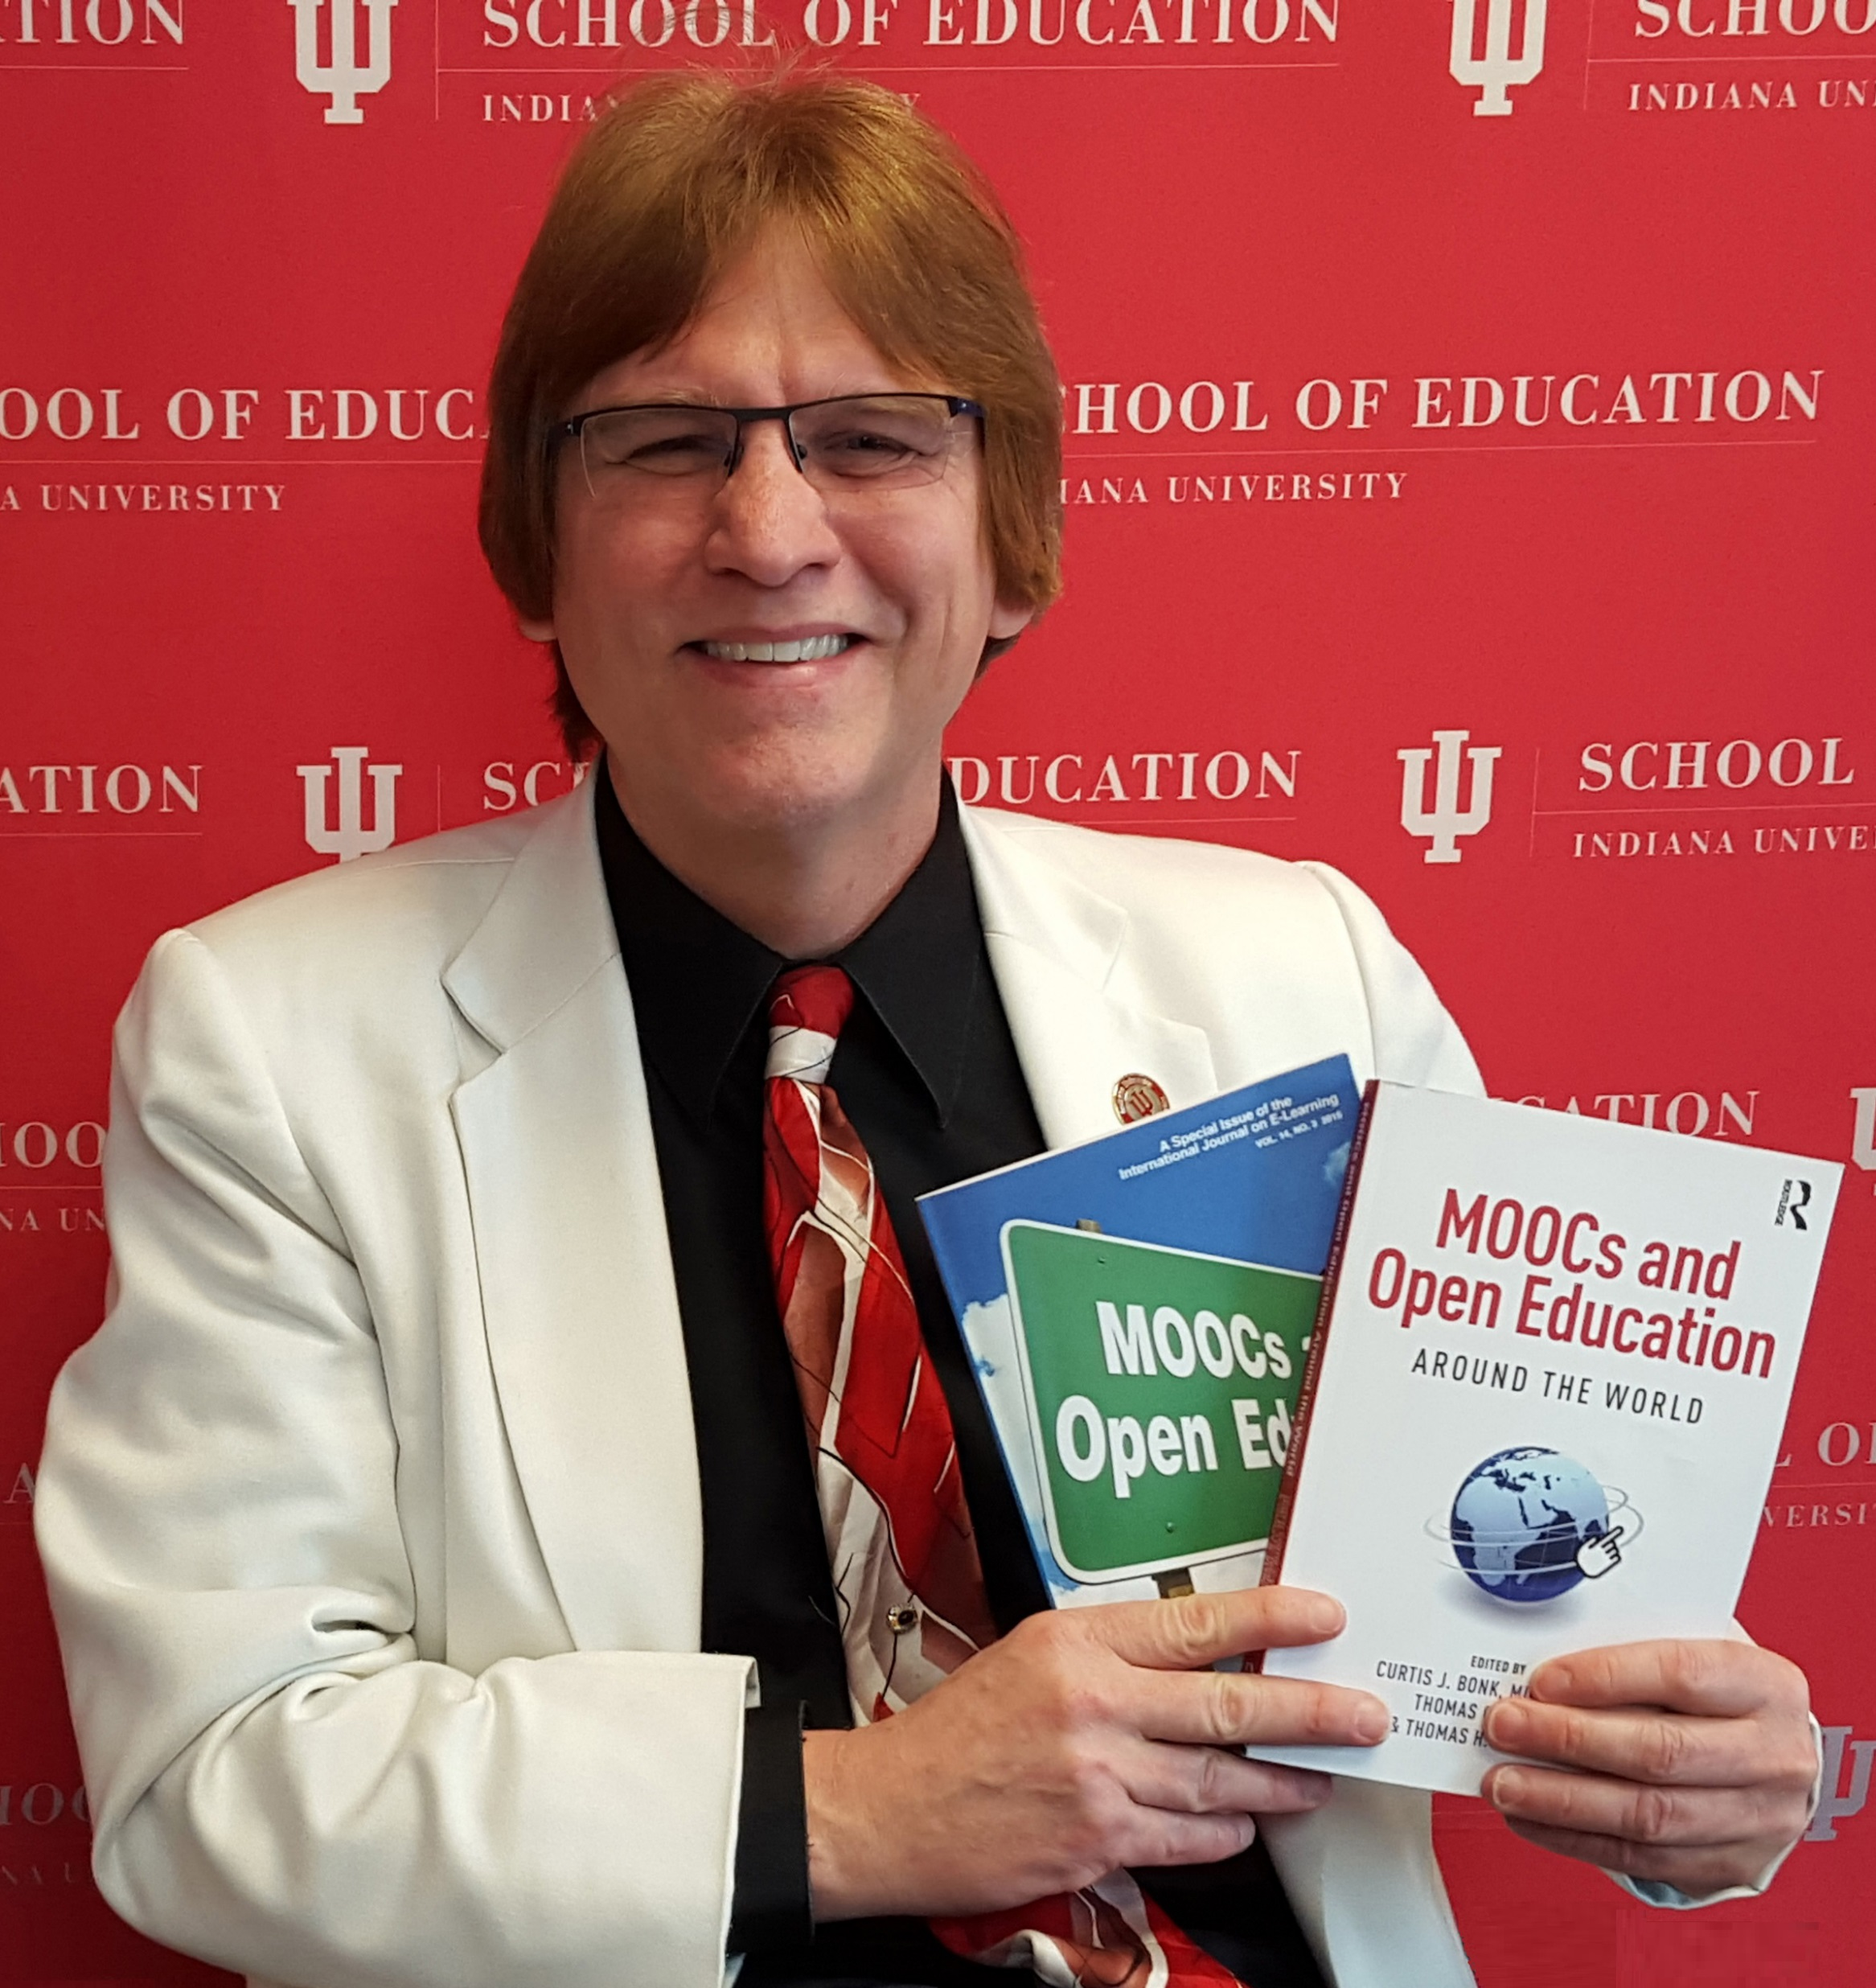

The G³ of Writing and Publishing Tips:
Gentle Guidelines, Great Stories, and Gigantic Scholarly Gains
Curtis J. Bonk, Ph.D., Indiana University
cjbonk@indiana.edu
Notes:
All
1

Slide 2
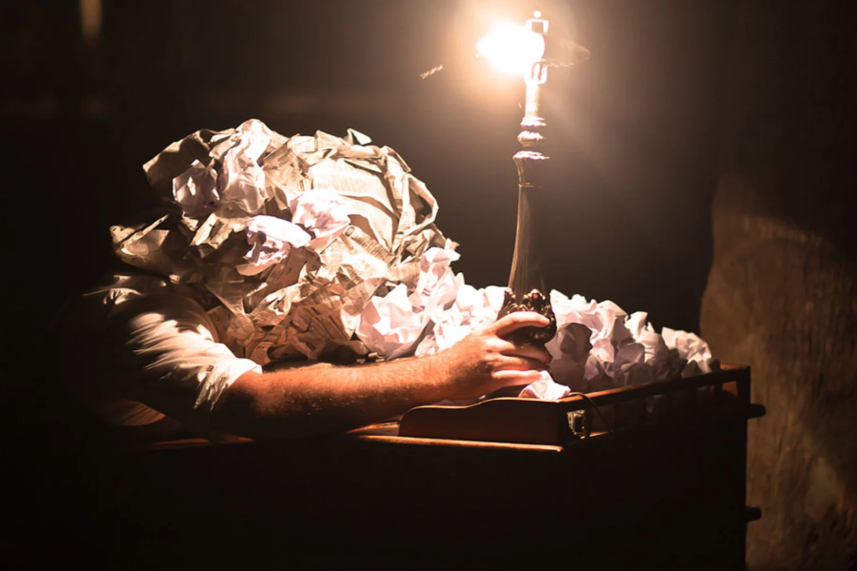
November 17, 2014
The Habits of Highly Productive Writers
Rachel Tour, The Chronicle of Higher Education https://www.chronicle.com/article/the-habits-of-highly-productive-writers/?cid2=gen_login_refresh&cid=gen_sign_in
You have time only if you make it a priority. Productive writers don’t allow themselves the indulgence of easy excuses. When they start to have feelings of self-doubt—I can’t do this, it’s too hard, I’ll never write another good sentence—they tell themselves to stop feeling sorry for themselves and just do the work.
They know there are no shortcuts, magic bullets, special exercises, or incantations.

Slide 3
November 17, 2014
The Habits of Highly Productive Writers
Rachel Tour, The Chronicle of Higher Education https://www.chronicle.com/article/the-habits-of-highly-productive-writers/?cid2=gen_login_refresh&cid=gen_sign_in
They believe in themselves and their work. Perhaps it’s confidence, perhaps it’s Quixote-like delusion, but to be a prolific writer you have to believe that what you’re doing matters. If you second-guess at every step, you’ll soon be going backward. A writer I know likes to say that over the years he has “trained” his family not to expect him to show up for certain things, because they know his work comes first. You have to be willing to risk seeming narcissistic and arrogant, even if you don’t like to think of yourself that way. The work takes priority.

Slide 4

June 7, 2018
6 Ways to Beat Writer’s Block
Rachel Tour, The Chronicle of Higher Education https://www.chronicle.com/article/6-ways-to-beat-writers-block/
Work up a sweat. ...
Take a quick trip. ...
Just keep at it. ...
Heed Anne Lamott's clarion call…”write a shitty draft first.”
Try the “compost” method…a pile of crap can lead to something worth cultivating
Remind yourself that even the best writers get stuck.

Slide 5
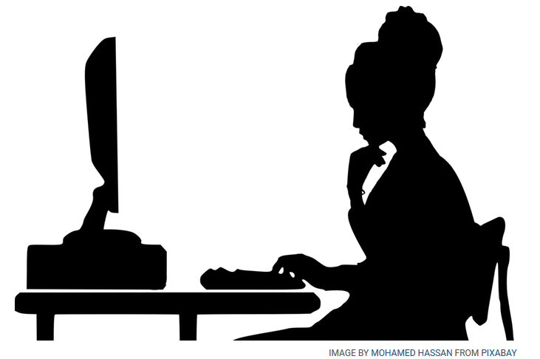
December 11, 2020
How to Find a Writing Routine that Works
Manya Whitaker, The Chronicle of Higher Education https://www.chronicle.com/article/how-to-find-a-writing-routine-that-works
Always work on at least 2 projects.
Review potential publishers and options.
Set a reasonable writing timeline.
Make a writing schedule and plan.
Have a project-based writing schedule.
Expand notion of when “writing.”
Set time writing goals, not word goals.
Write what motivates you that day.
Establish flexible schedules.
Read more and edit as you go.

Slide 6
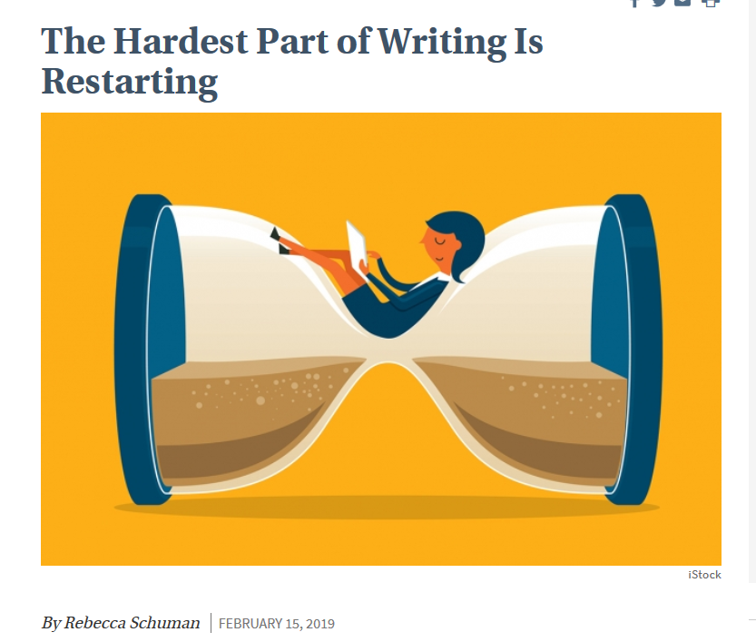
February 15, 2019
The Hardest Part of Writing Is Restarting
Rebecca Schuman, The Chronicle of Higher Education https://www.chronicle.com/article/The-Hardest-Part-of-Writing-Is/245720?cid=cp242

Slide 7

March 31, 2019
Step Away From the Delete Button
Rebecca Schuman, The Chronicle of Higher Education https://www.chronicle.com/article/Step-Away-From-the-Delete/246013?cid=cp242

Slide 8
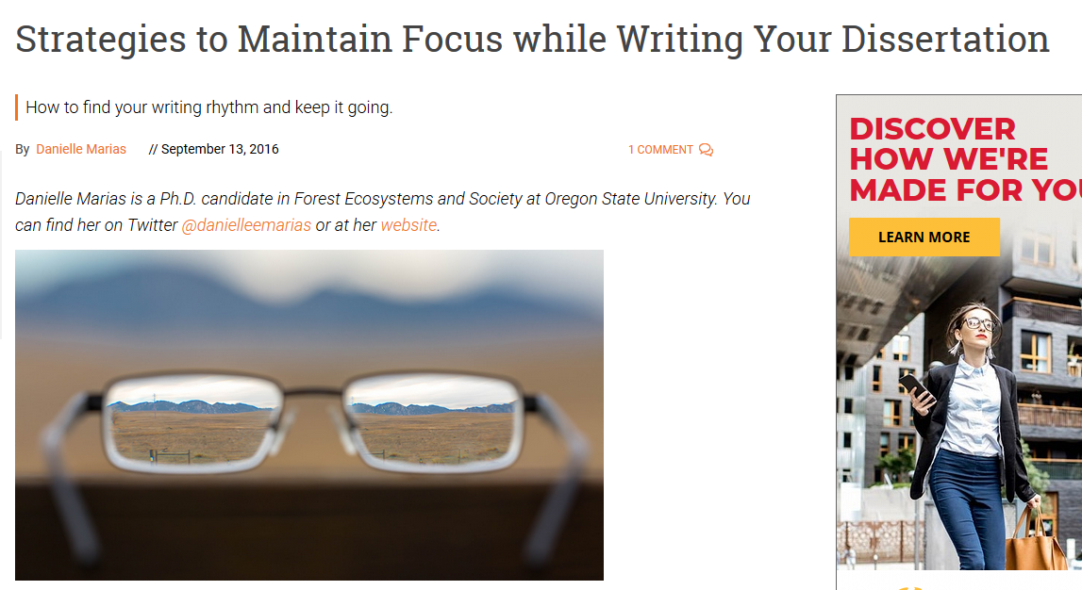
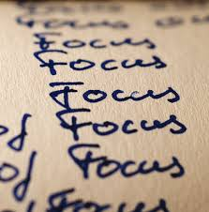
September 13, 2016
Strategies to Maintain Focus while Writing Your Dissertation
GradHacker, Inside Higher Ed https://www.insidehighered.com/blogs/gradhacker/strategies-maintain-focus-while-writing-your-dissertation

Slide 9
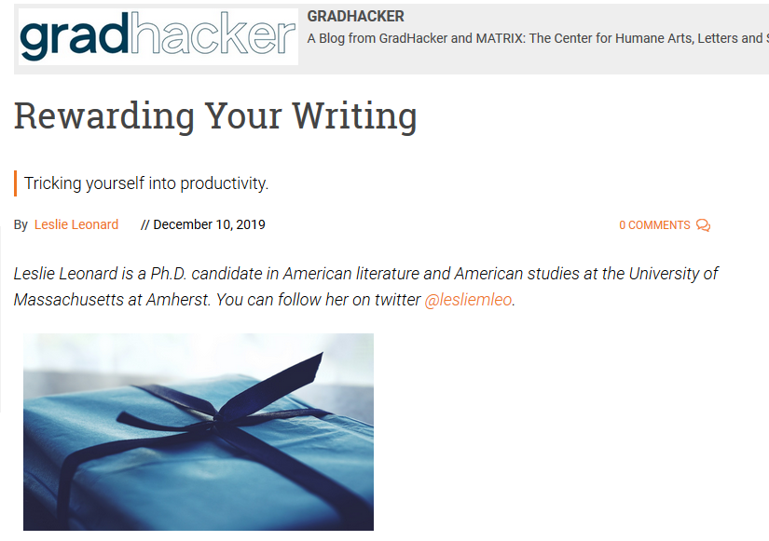
December 10, 2019
Rewarding Your Writing
Leslie Leonard, Inside Higher Ed https://www.insidehighered.com/blogs/gradhacker/rewarding-your-writing

Slide 10
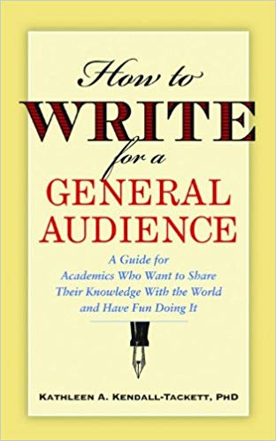
January 19, 2021
Writing for Diverse Audience: Prewriting https://www.insidehighered.com/blogs/gradhacker/crucial-co-writing-considerations
Ask questions about audience
Ask more questions about audience
Restate what you interpreted as the audience
Read, read, and read some more
Scan sample publications
Look to the popular press and news

Slide 11

January 19, 2021
Writing for Diverse Audience: Writing Drafts https://www.insidehighered.com/blogs/gradhacker/crucial-co-writing-considerations
Ask at least two others to read and comment.
Read what you wrote out loud.
Print it and look at it (digital versions can be misleading).
Simplify wording.
Revise and revise and revise some more.
Use a thesaurus.

Slide 12

January 19, 2021
Writing for Diverse Audience https://www.insidehighered.com/blogs/gradhacker/crucial-co-writing-considerations
Be careful on forms of humor and types of jokes.
Avoid political, religious, economic, etc. commentary.
Be careful with metaphors, idioms, and proverbs (e.g., make hay when the sunshines) and domain specific lingo (e.g., “he has a sweet stroke” in baseball).

Slide 13

Curt Bonk:
Reflections on a Hot Streak
1. Persistence and grit.
2. Sense of now.
3. One at a time.
4. Assemble best team for you. Find comfort.
5. Intense and Relaxed Planning.
6. Explore potential publishers and Commit.
7. Everyone has clear role.
8. Set bold and audacious goals.
9. Recheck list. Recheck goals.
10. Revel in good luck. Do not sulk if bad luck.
Notes:
13

Slide 14
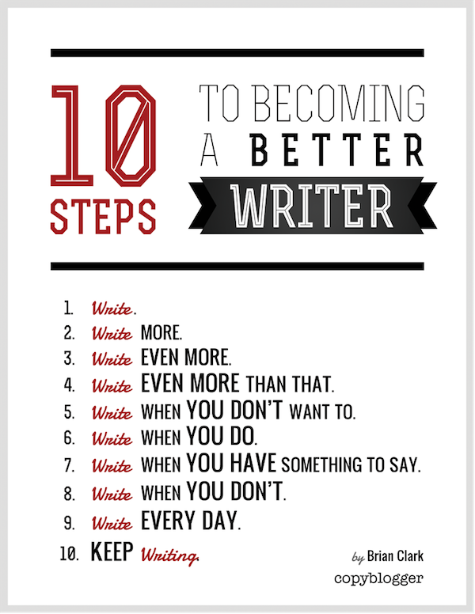
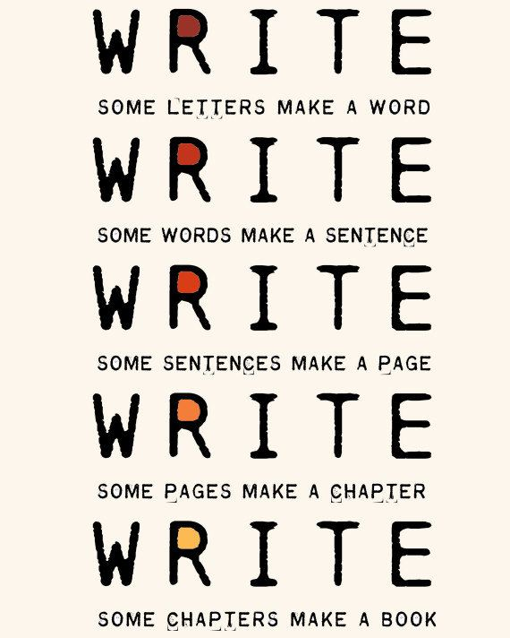
The Top 20 Writing Tips
Notes:
Curt
14

Slide 15


1. Mark Writing Days in Planner
Notes:
Curt
15

Slide 16

2. Maintain a List and Network of Potential Research and Writing Collaborators
Notes:
Curt
16

Slide 17
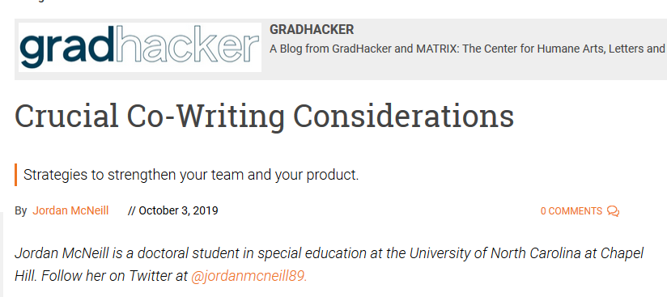

October 3, 2019
Crucial Co-Writing Considerations
Jordan McNeill, Inside Higher Ed https://www.insidehighered.com/blogs/gradhacker/crucial-co-writing-considerations

Slide 18


Sidenote: Find Good People to Work With…Life is Short—Avoid Egomaniacs and People Who Lie
Notes:
Curt
18

Slide 19
October 3, 2019
Crucial Co-Writing Considerations
Jordan McNeill, Inside Higher Ed https://www.insidehighered.com/blogs/gradhacker/crucial-co-writing-considerations
Clarify authorship order ahead of time.
Have an honest conversation about the strengths of each team member--draft, revise, proofread, and format your manuscript.
Be clear on division of labor.
Nonwriting tasks are important too—taking notes, submission guidelines, and keep track of deadlines.
Set up digital collaboration norms and platforms—archiving, tracking, commenting, etc.
Respond to feedback professionally.
Build in time for feedback and revision.
Singular voice throughout paper—assign one member of team to read for writing style and flow.

Slide 20
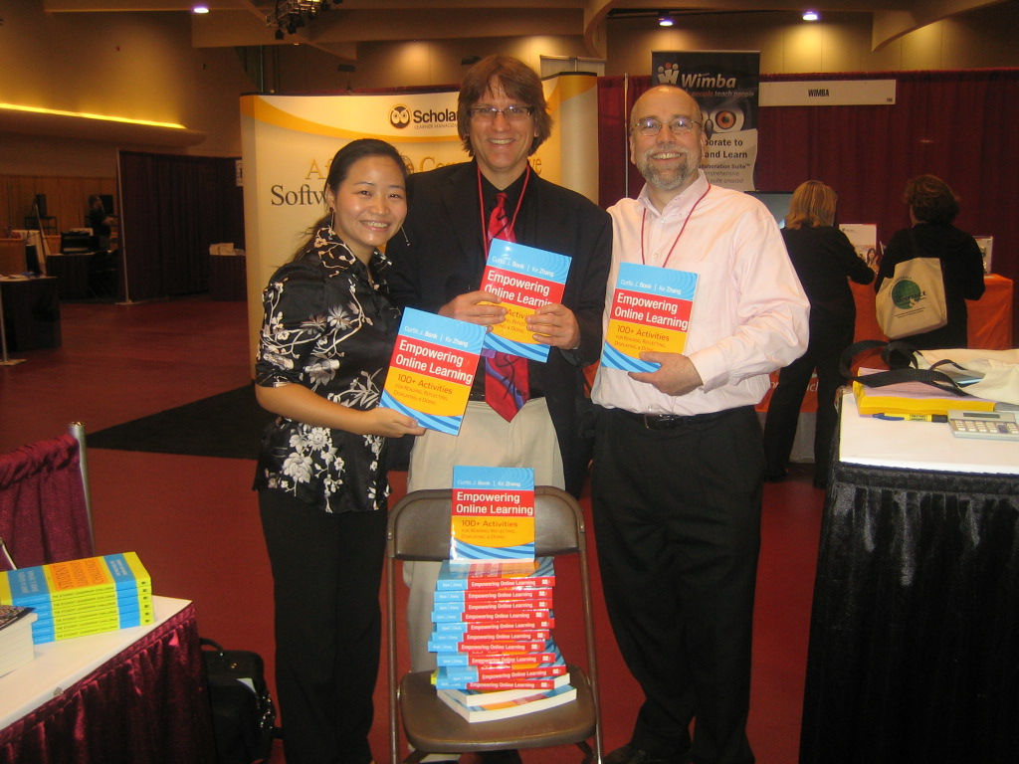
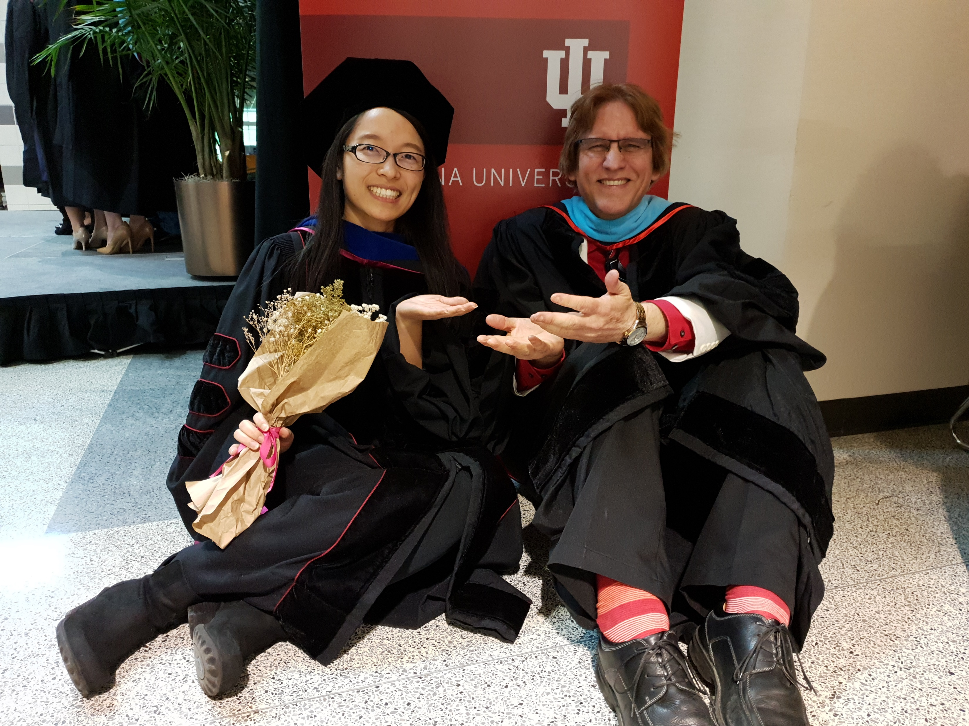
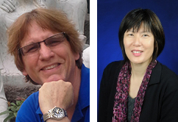
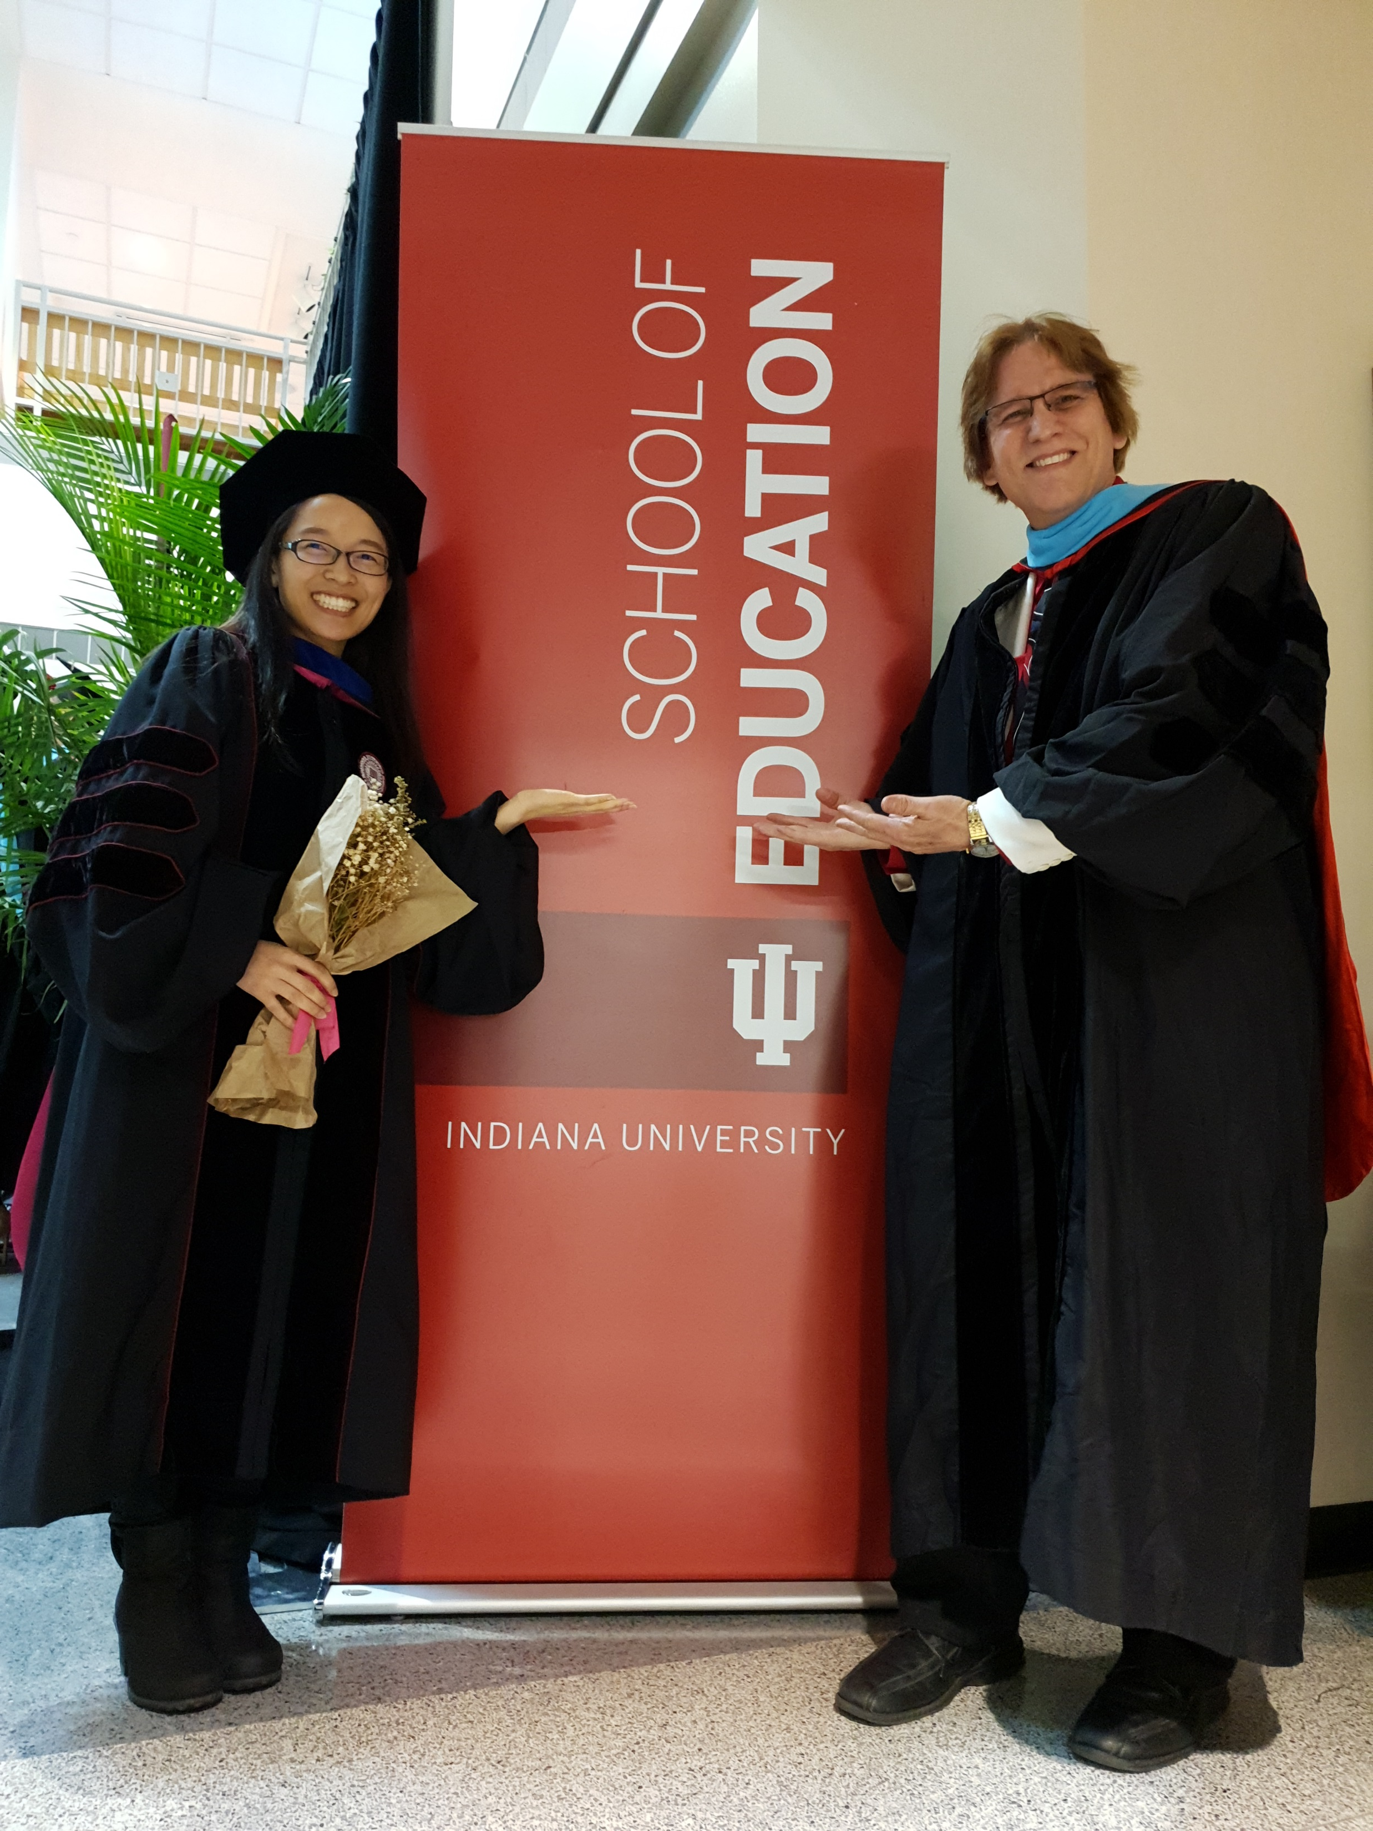
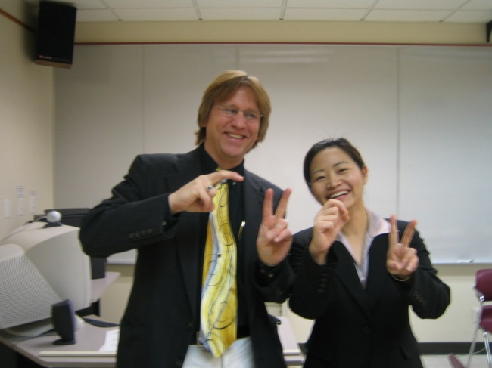
Writing Partners: Curt Bonk
How do you determine your collaborative writing partners? And negotiate tasks?
Life is short: Find kind people who are prompt, positive, and productive and you can trust.

Slide 21

MOOCs book #1
(2015)
Notes:
Last year, I co-edited a book titled MOOCs and Open Education around the World. MOOCs stands for Massive Open Online Courses. An individual MOOC can enroll tens of thousands of students, and several MOOCs have now surpassed 1 million students in total enrollment. MOOCs are primarily offered by elite universities such as Stanford, MIT, and Harvard through enterprises such as Coursera, edX, and FutureLearn. More people enrolled in MOOCs developed at Harvard in a single year than attended Harvard in its entire 377-year history.

Slide 22

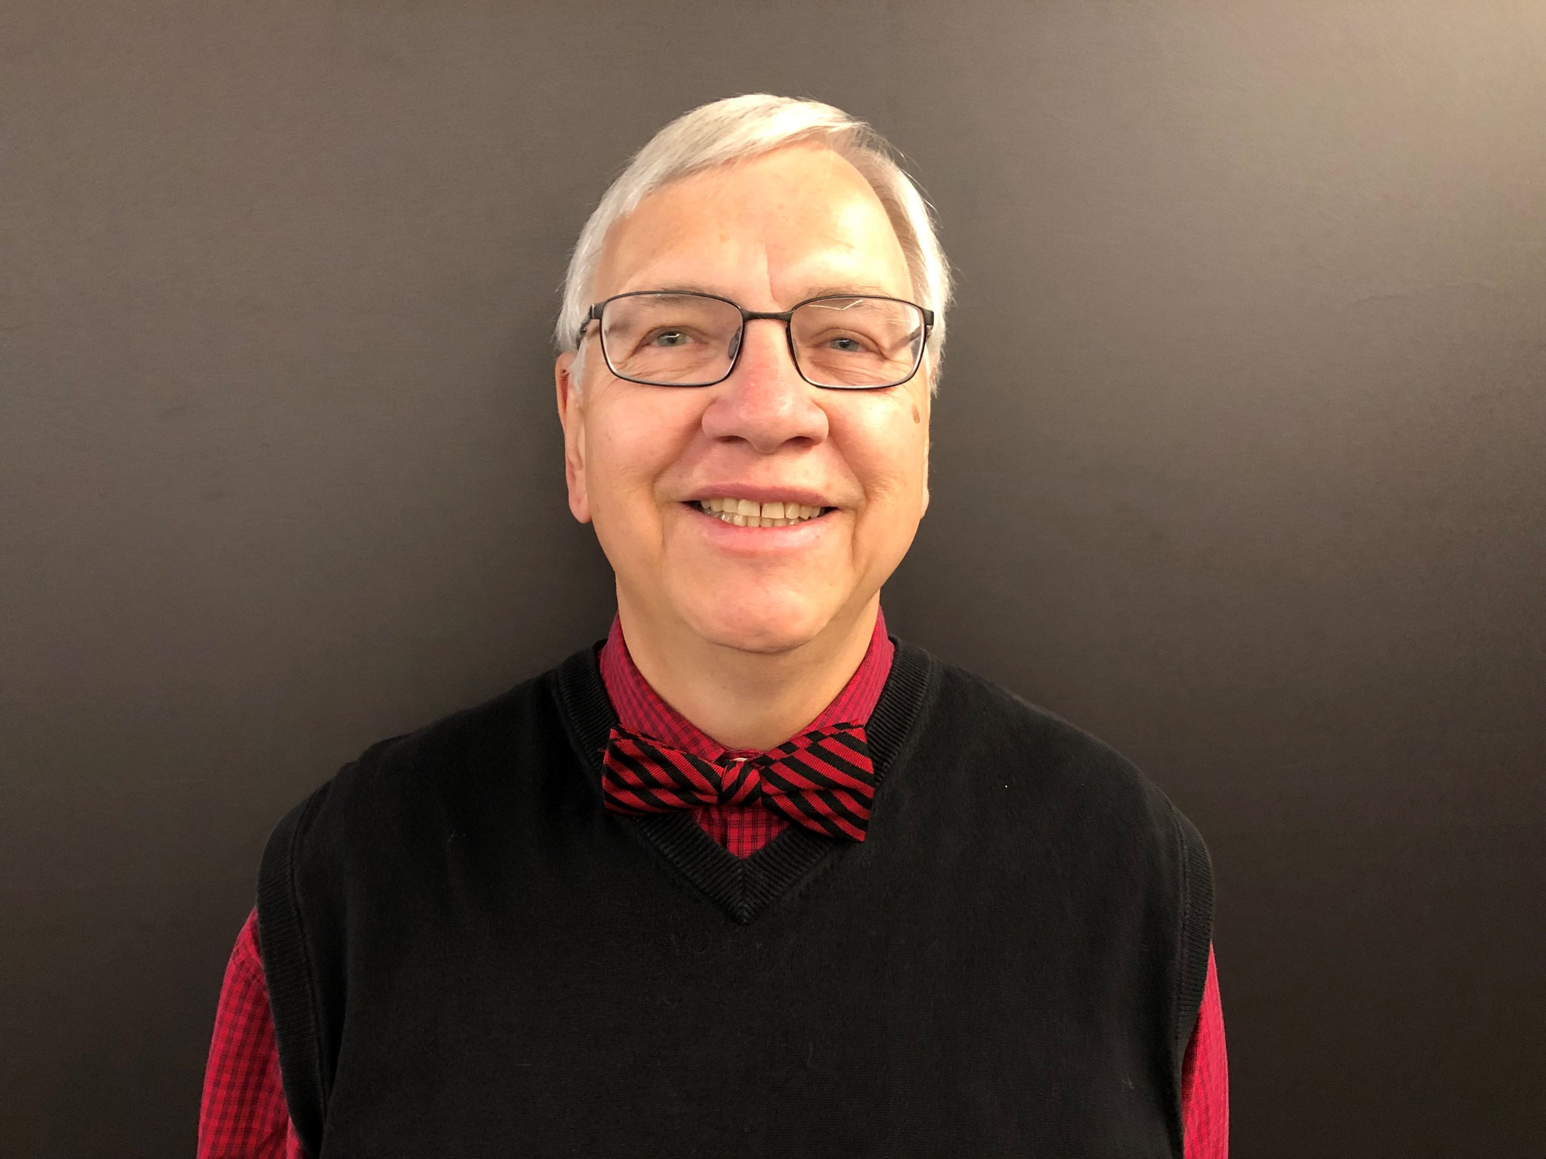

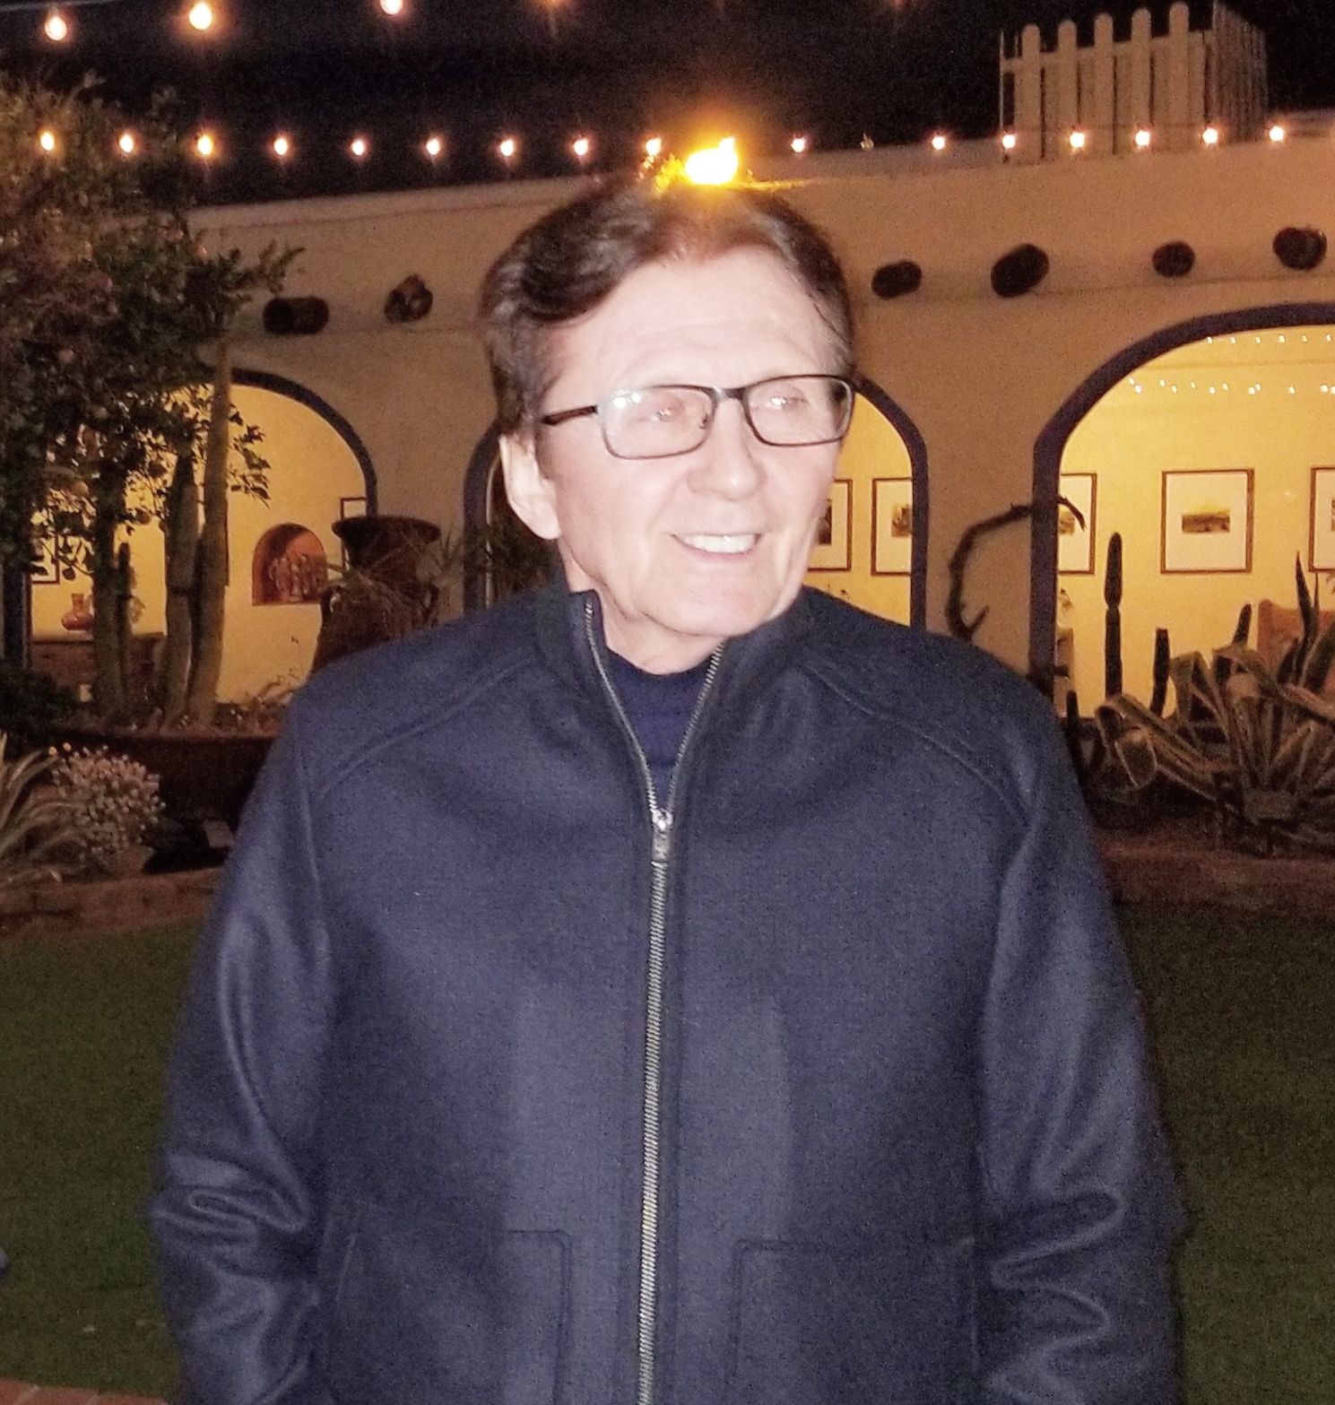
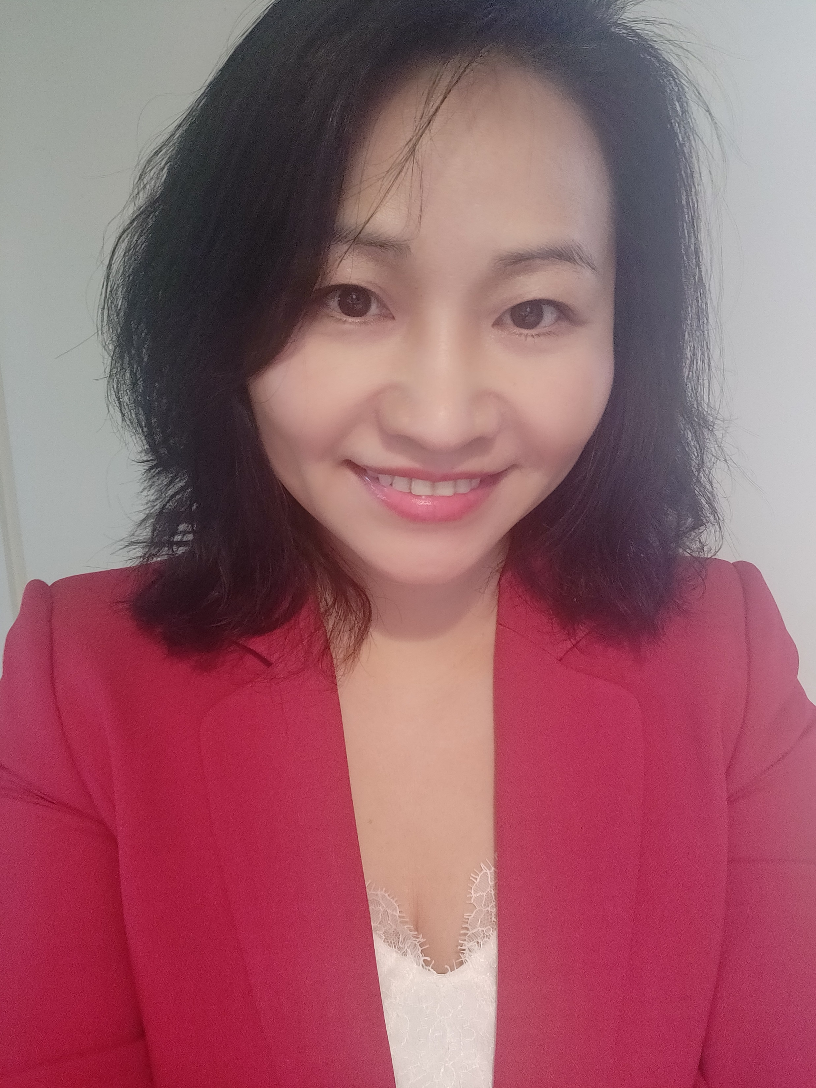
MOOCs book #3
(2020)
Notes:
Last year, I co-edited a book titled MOOCs and Open Education around the World. MOOCs stands for Massive Open Online Courses. An individual MOOC can enroll tens of thousands of students, and several MOOCs have now surpassed 1 million students in total enrollment. MOOCs are primarily offered by elite universities such as Stanford, MIT, and Harvard through enterprises such as Coursera, edX, and FutureLearn. More people enrolled in MOOCs developed at Harvard in a single year than attended Harvard in its entire 377-year history.

Slide 23
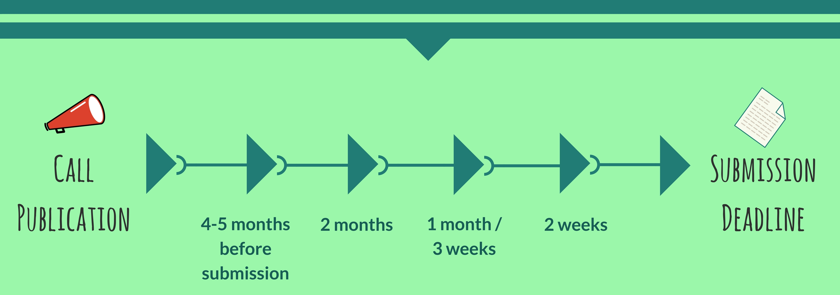
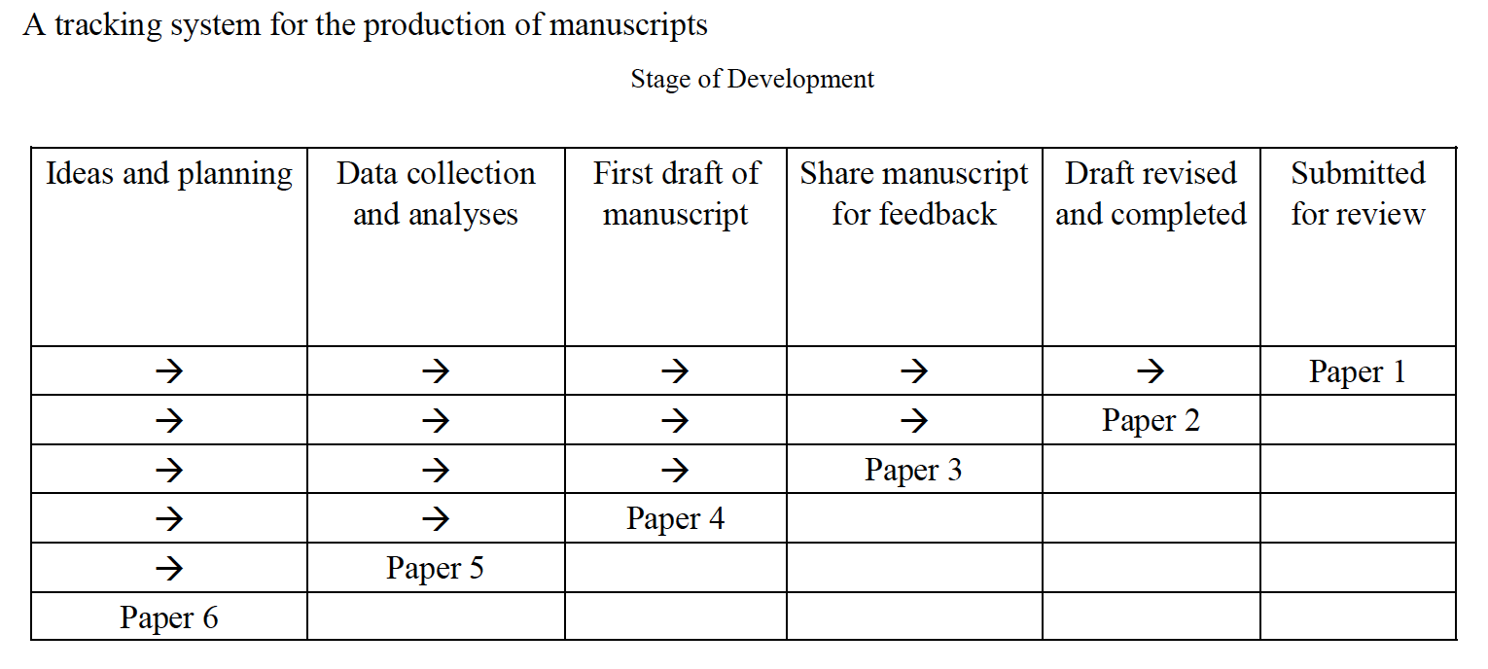
3. Draft a Timeline or Multiple Timelines with Flexible Goals
Notes:
Curt
Screenshot from Cecil’s article
23

Slide 24
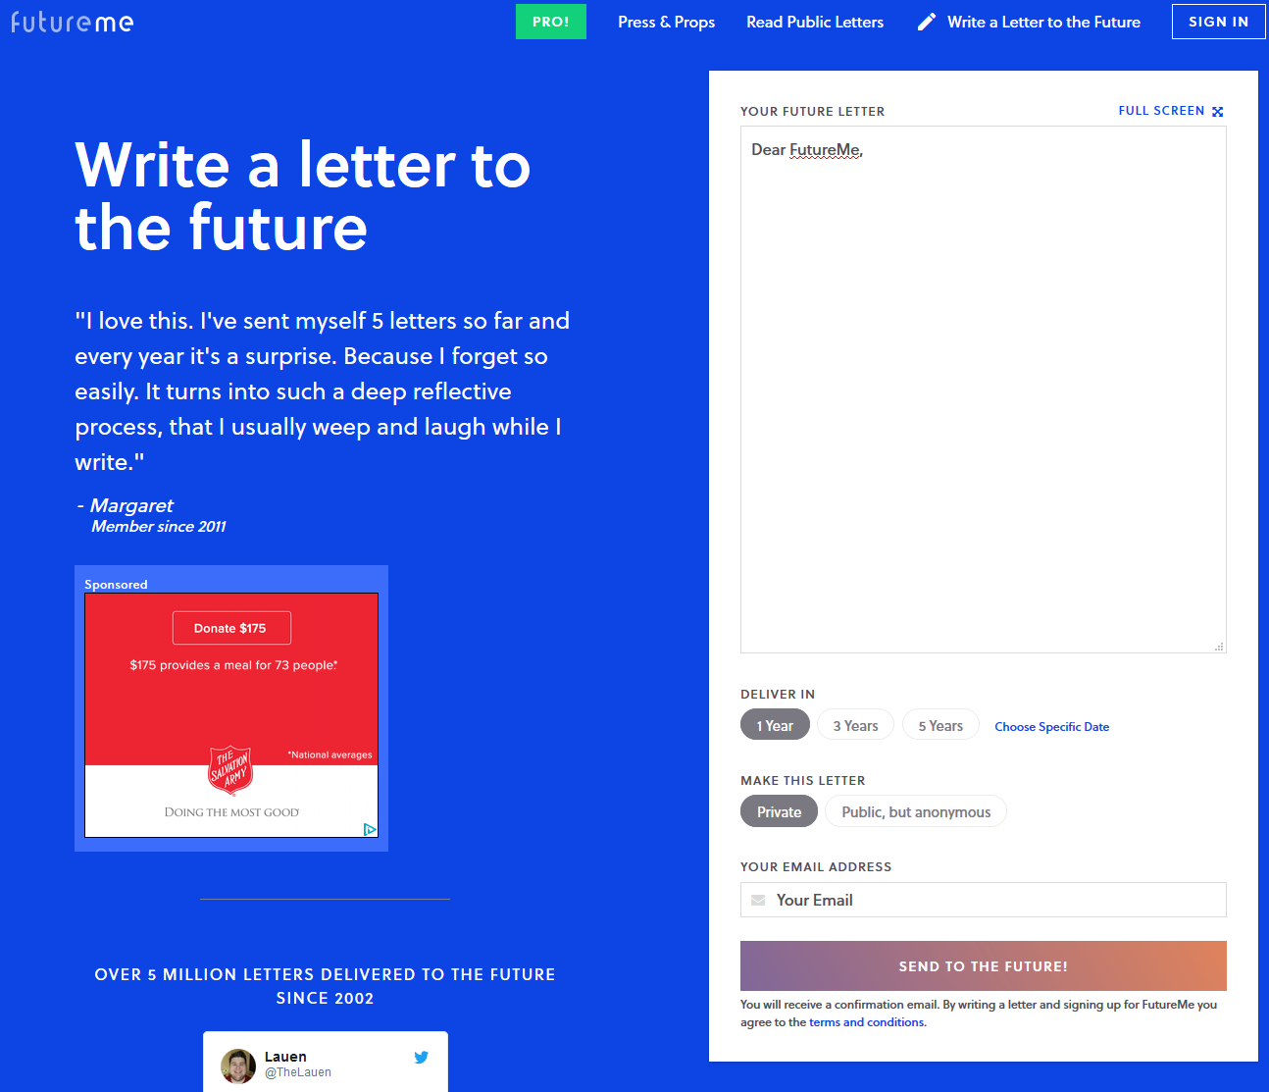
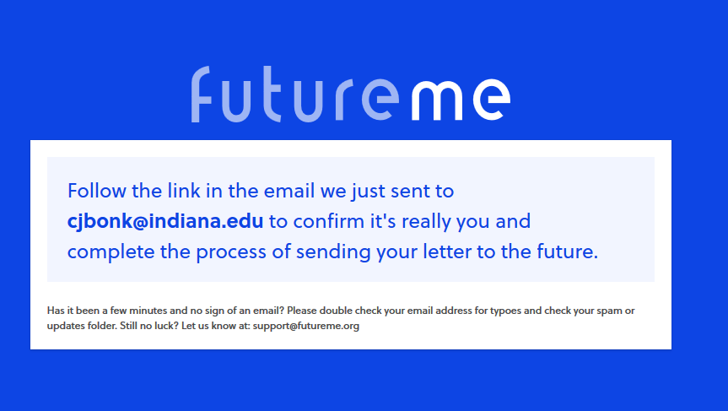
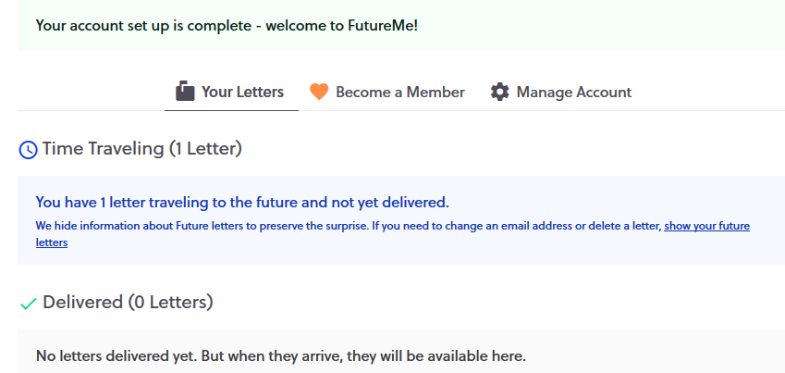
October 10, 2018
Perhaps write to your future self about your goals…
FutureMe.org
Write a letter to the future https://www.futureme.org/
Notes:
Curt
Screenshot from Cecil’s article
24

Slide 25
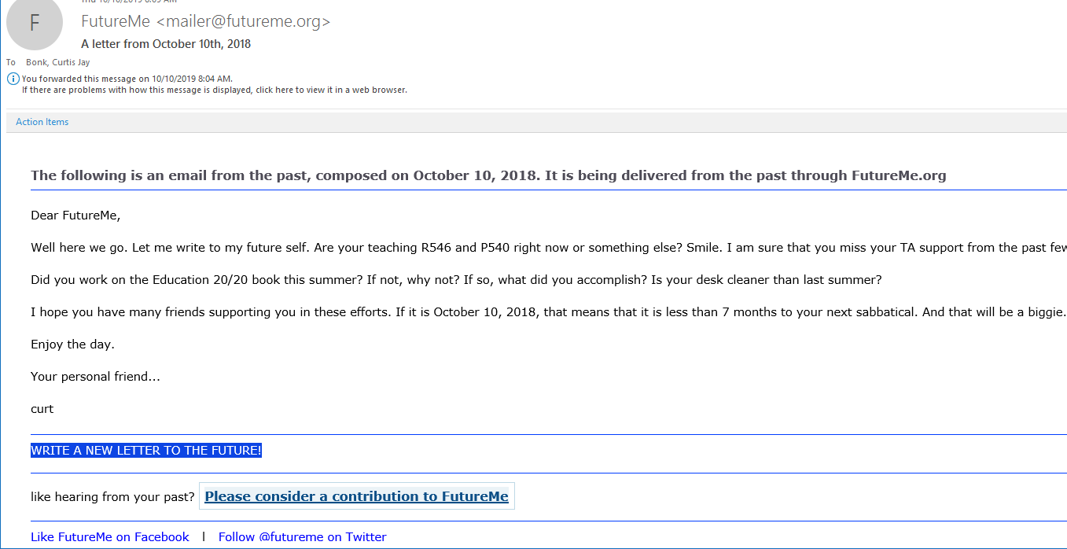
October 10, 2019
The following is an email from the past, composed on October 10, 2018. It is being delivered from the past through FutureMe.org
FutureMe mailer@futureme.org

Slide 26

4. Think Ahead About the Publishing Potential of Each Project or Idea
Notes:
Curt
26

Slide 27
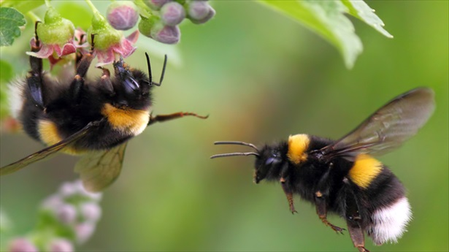

5. Be a Bumblebee and Butterfly
Notes:
Curt
27

Slide 28
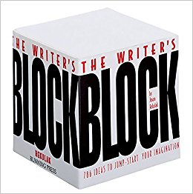

6. Find, Save, and Use Starter Text (overcomes writer’s block)
Notes:
Curt
28

Slide 29

7. Always Scan the Reference Sections of Other Articles to Articles You Like to See What Journals are Popular
Notes:
Curt
29

Slide 30
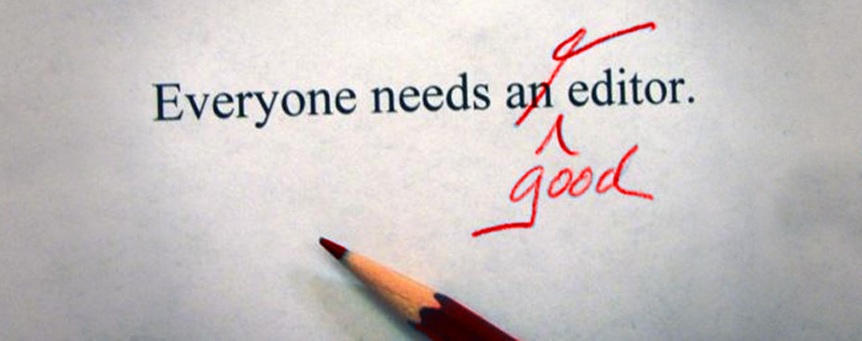
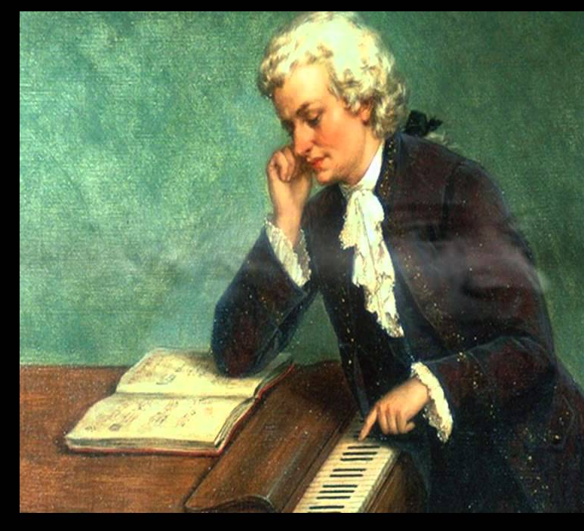
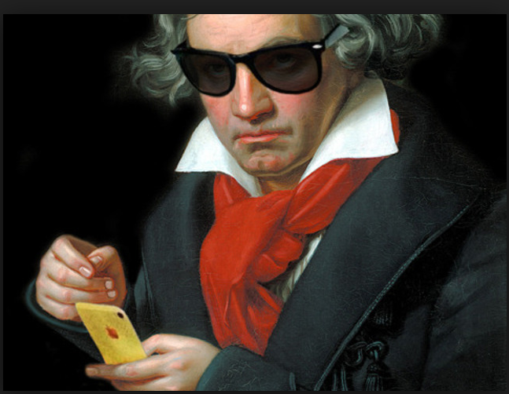
8. Edit Your Papers a Lot! (Mozartian vs. Beethovenian)
Notes:
Curt
30

Slide 31


October 1, 2018
6 Tips to Shape Up Your Writing
Two-Minute Tips: Short videos to help you excel in the academic workplace
Fernanda Zamudio-Suaréz, The Chronicle of Higher Education https://www.chronicle.com/article/6-Tips-to-Shape-Up-Your/244281?cid=cp221 https://www.chronicle.com/specialreport/Two-Minute-Tips/221
Writing is an exercise (write!).
Set goals based on output not input (e.g., 3 pages double-spaced).
Find a voice (don’t just focus on getting published).
Give yourself time (not deadlines).
Pick a puzzle (your writing is an answer to that puzzle).
Edit your work (over and over and over again…just like Beethoven).
Notes:
Curt

Slide 32

9. Be Creative Somewhere
(e.g., unique model, figure, chart, etc.)
Notes:
Curt
32

Slide 33
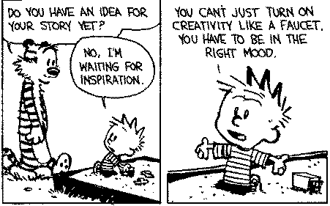

10. Modify Your Environment (Find or Create Your Personal Sandbox)
Notes:
Curt
33

Slide 34

But not too much!
Notes:
Curt
34

Slide 35

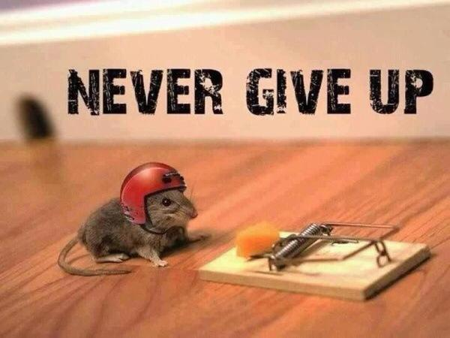
11. Try Not to Give Up: Persistence and Grit Wins the Day
Notes:
Curt
35

Slide 36

12. Be Polite and Thankful to the Editors
Notes:
Curt
36

Slide 37

13. Tackle the Easy Things First
Notes:
Curt
37

Slide 38
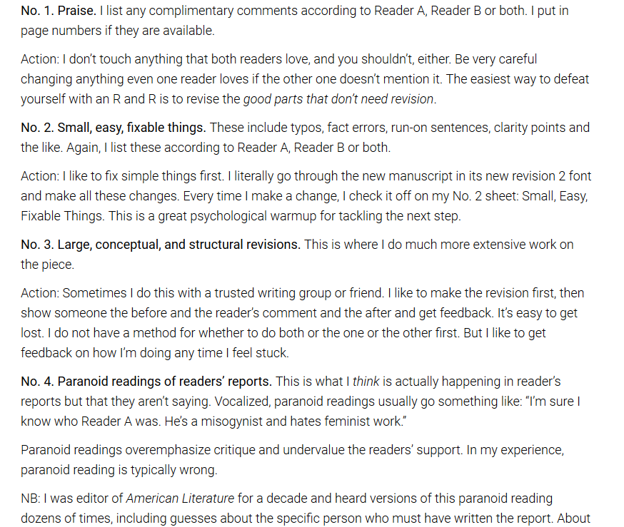
February 12, 2019
From Dreaded to Amazing
Cathy N. Davidson, Inside Higher Ed https://www.insidehighered.com/advice/2019/02/12/how-use-reviewers-revise-and-resubmit-comments-most-effectively-opinion

Slide 39
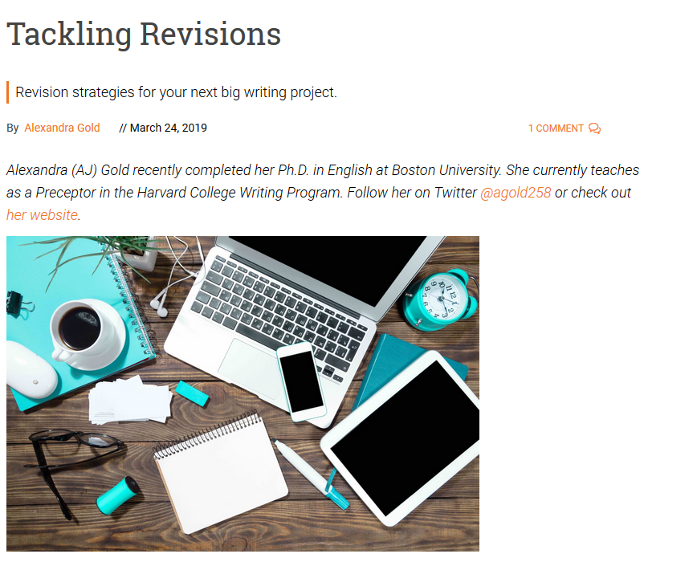
March 24, 2019
Tackling Revisions
Alexandra Gold, Inside Higher Ed https://www.insidehighered.com/blogs/gradhacker/tackling-revisions

Slide 40
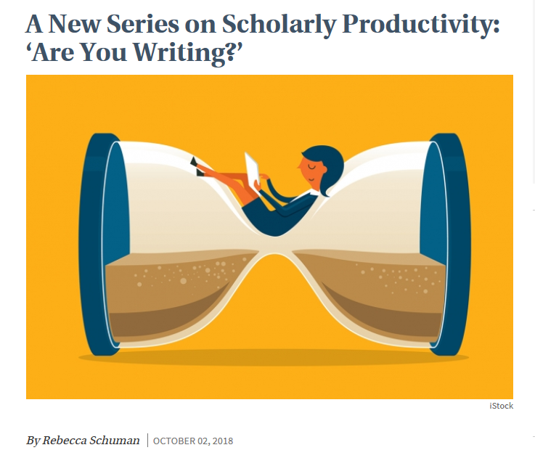
October 4, 2018
A New Series on Scholarly Productivity:
‘Are You Writing?’
Rebecca Shuman, The Chronicle of Higher Education https://www.chronicle.com/article/A-New-Series-on-Scholarly/244689
Read as peer reviewer; mark up everything.
Catalog problems on a 1 to 3 difficulty scale (Level 1 takes less than 30 minutes, Level 2 takes 2 hours or less; Level 3 takes more time).
Fix the easy ones and gain momentum for the harder ones!
Take breaks as needed.
Notes:
Curt

Slide 41


14. Find a Mentor and Ask Senior People for Advice
Notes:
Curt
41

Slide 42
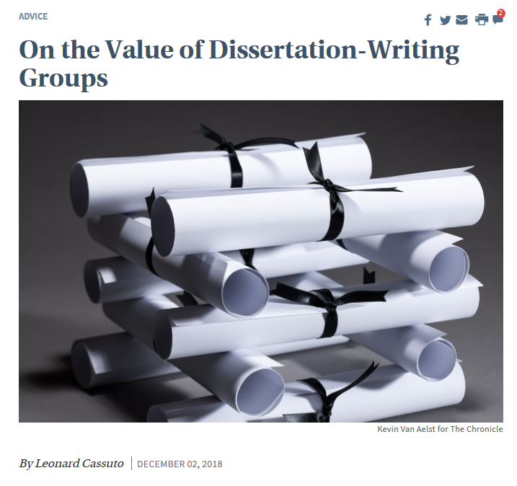

15. Form a Writing Group
Notes:
Curt
42

Slide 43
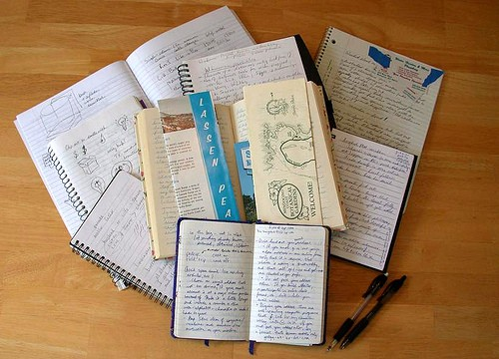
16. Keep a Notebook of What Thinking
Notes:
Curt
43

Slide 44
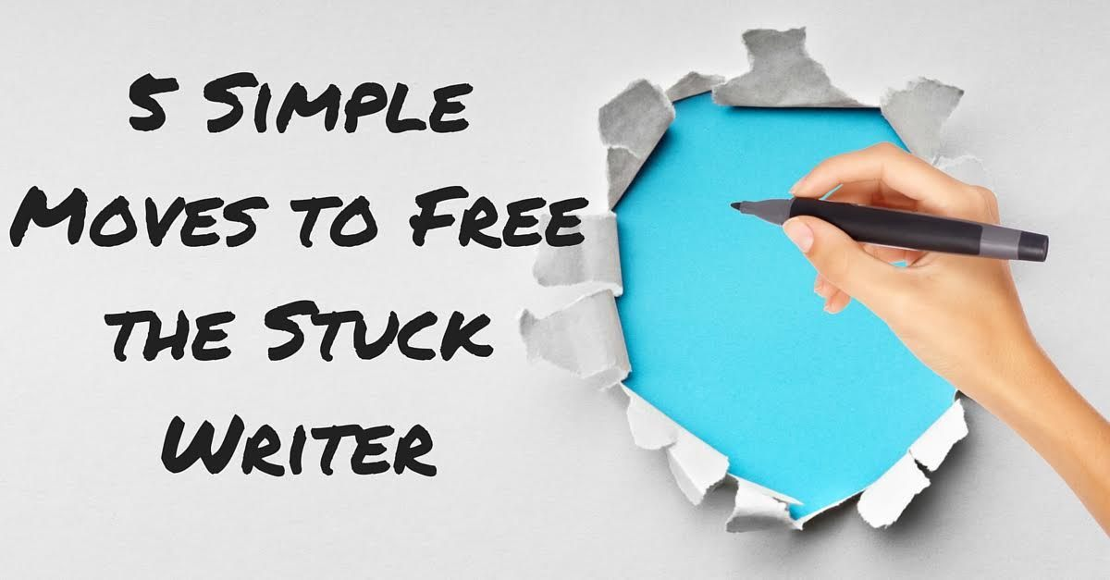
17. Engage in Free Writing
Notes:
Curt
44

Slide 45

18. Read Everyday!

Slide 46
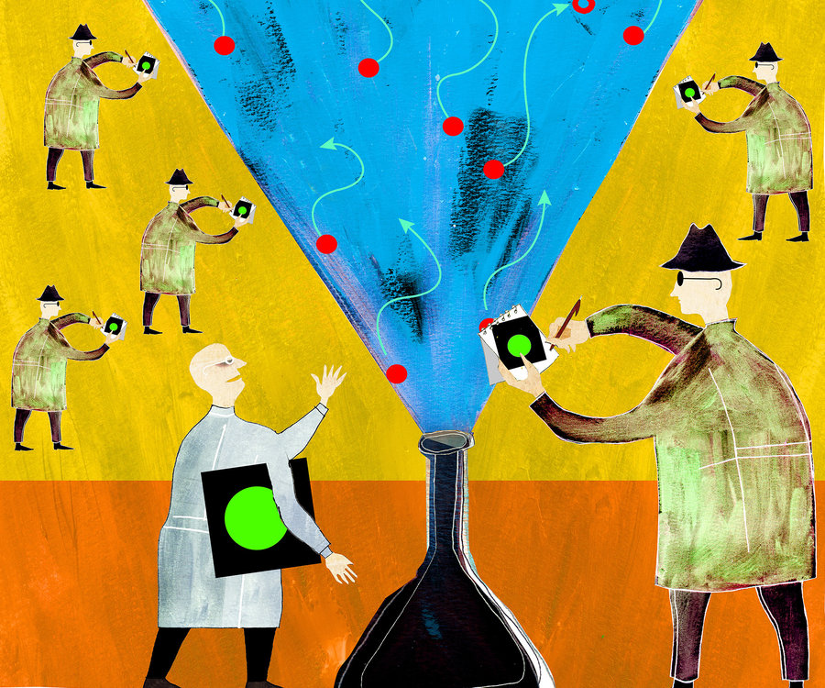


19. Share Your Publication Efforts (e.g., Twitter, Facebook, LinkedIn, email, ResearchGate, Academia.edu, etc.)
Notes:
Curt
46

Slide 47

20. Celebrate Your Writing Accomplishments with Friends
Notes:
Curt
47

Slide 48
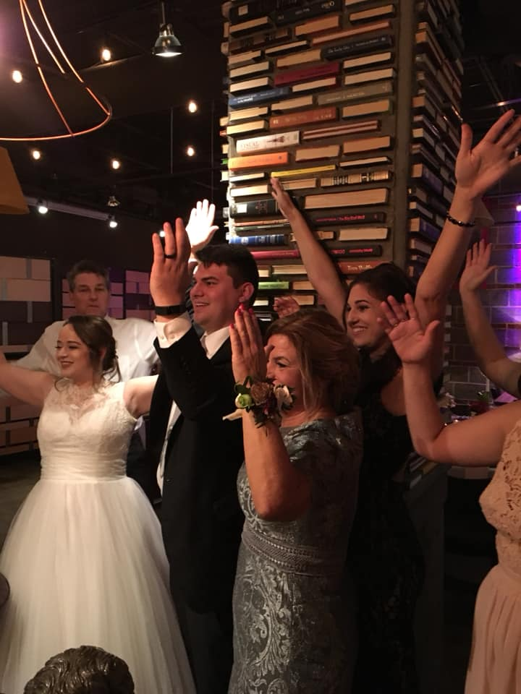
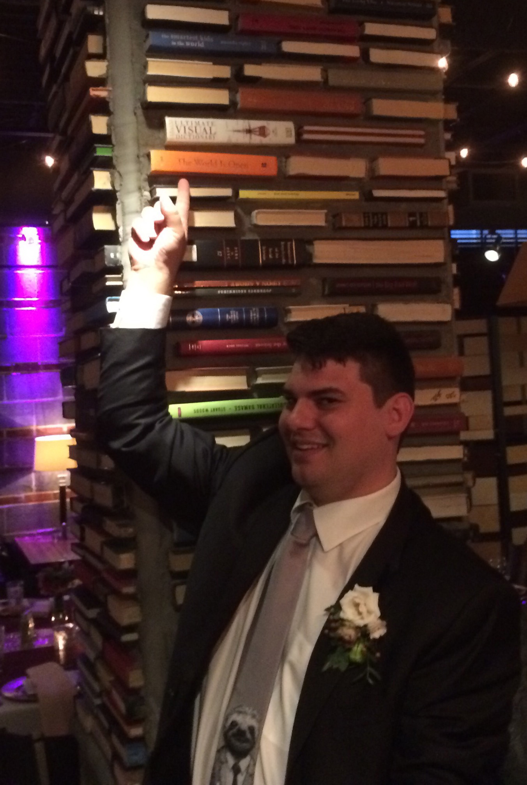
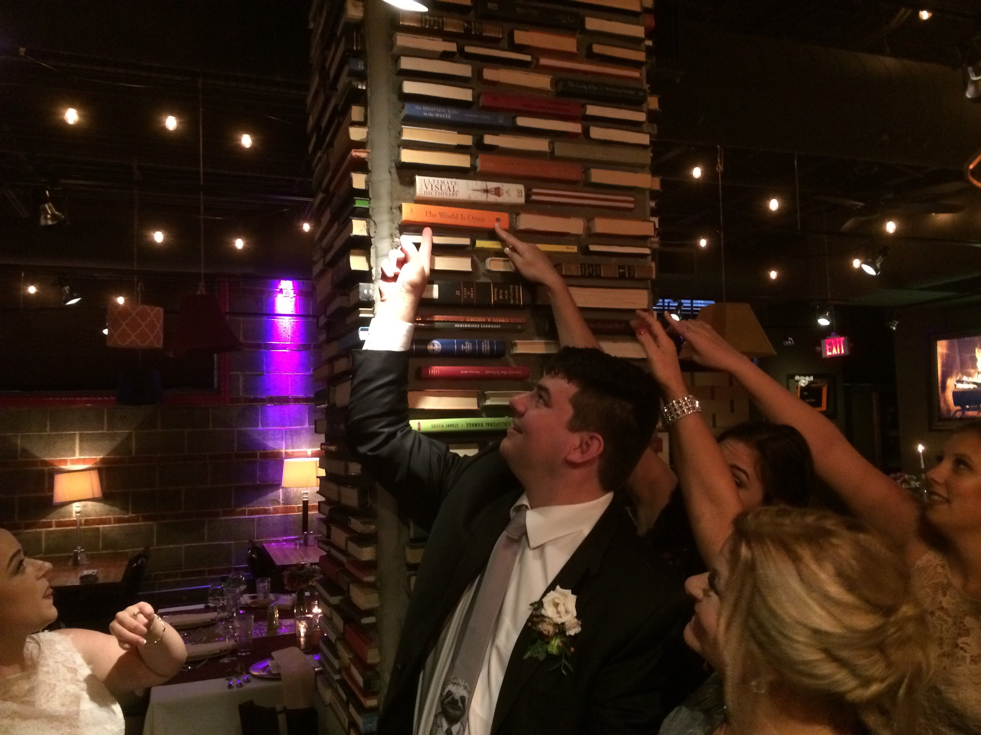
You never know where you’ll be celebrating your writing accomplishments…
Even at a wedding of your nephew!
Notes:
Curt
48

Slide 49
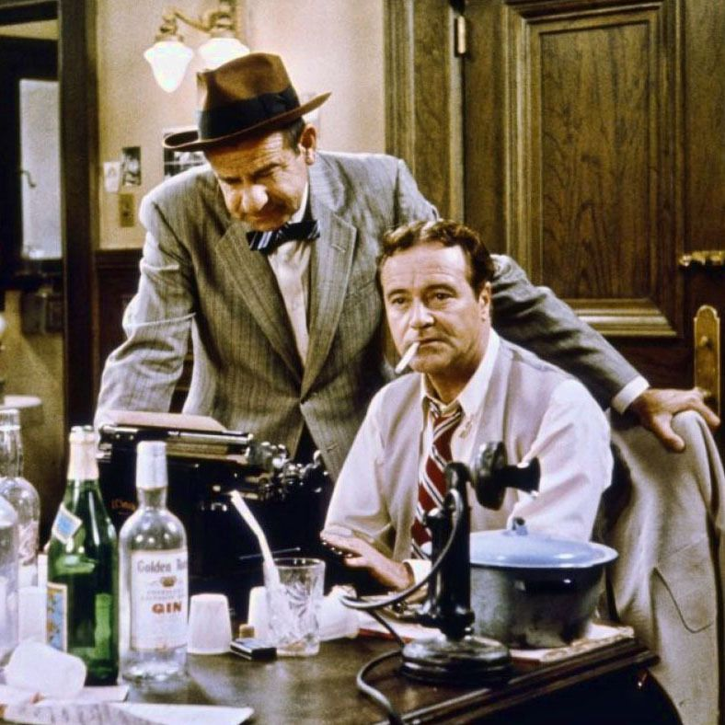
Just don’t celebrate too much!
Notes:
Curt
49

Slide 50
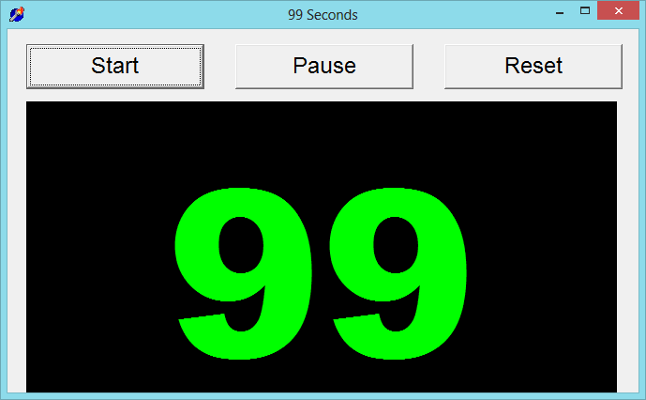

99 Seconds Activity #1
With your next chair neighbor discuss what you plan to write about.
Notes:
Ana
Not sure if we want to keep all these activities as we only have 1 hour and 5 minutes and need to leave time for questions. It’s up to you….
50

Slide 51

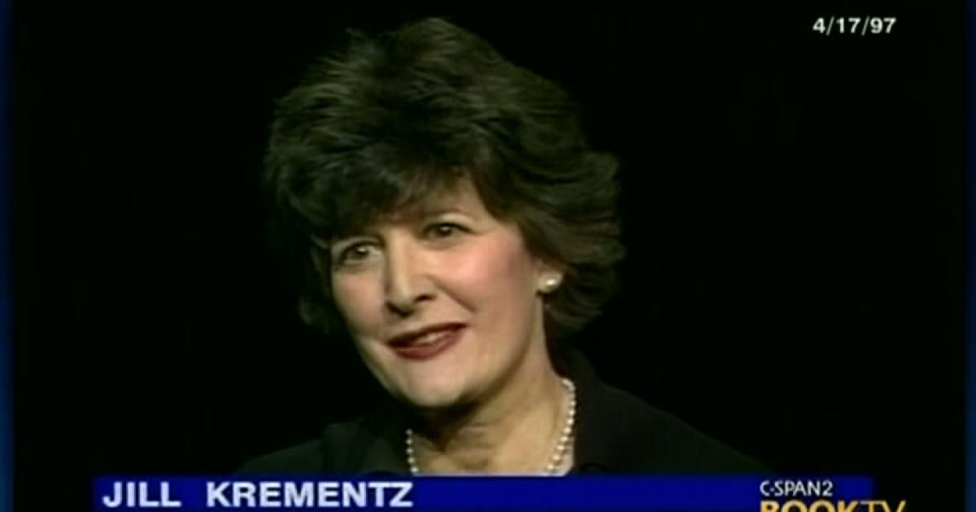
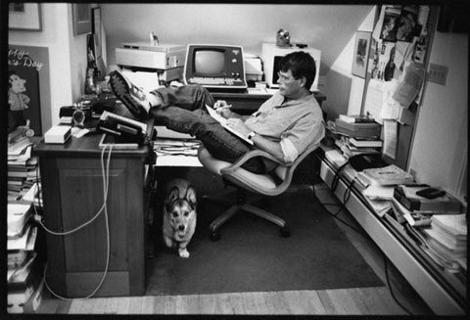

Slide 52
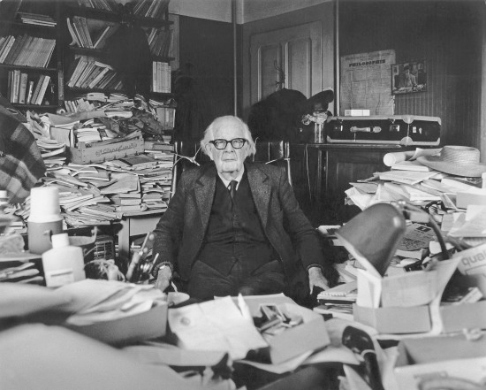
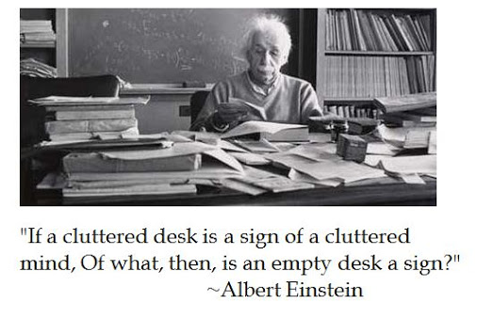
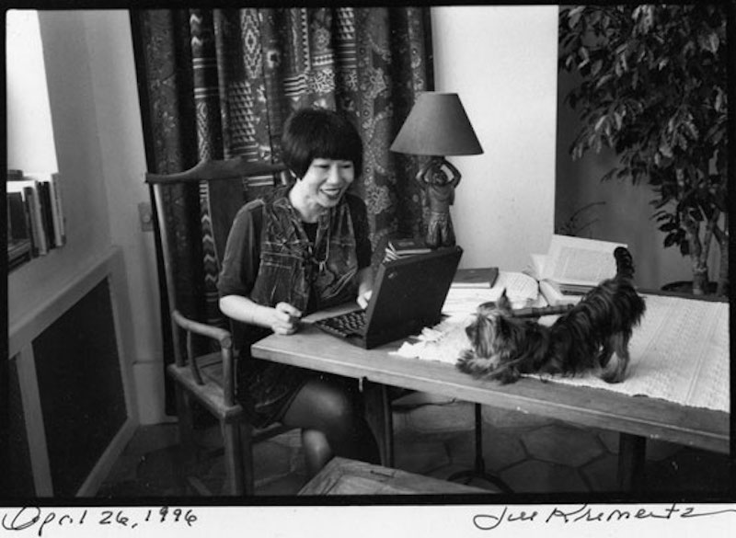
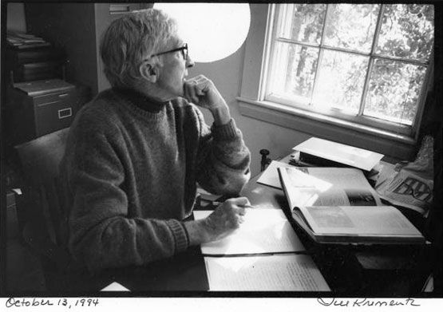

Slide 53

Writing Space: Curt Bonk
I having standing desk…power it up and down via hydraulics. And my office looks out into a forest.

Slide 54

Writing Space: Curt Bonk
Desk #2 is available if needed…and a beer.

Slide 55

Writing Space: Curt Bonk
Paper…I love paper….and my daughter Nicki.

Slide 56
Writing Space Themes of Successful Writers
Openness
Flexibility
Mixed…social spaces as well as private
Modifiability
Multiple screens
Multiple sites
Mobile…on the go
Ubiquitous…we are surrounded by writing spaces

Slide 57

Writing Space: Curt Bonk
My office. I save interesting articles to later reference in papers and books.

Slide 58


Writing Space: Curt Bonk

Slide 59


Basement books: Curt Bonk

Slide 60

Writing Space: Curt Bonk

Slide 61

Plans and Goals: Curt Bonk
How do you schedule your writing? How far in advance do you plan your writing? How do you prioritize your writing? How do you visualize your writing? Do you use a timeline or a planner? Do you have advice for developing a writing plan?
Plan: I save days for writing in my paper planner.
Focus: I say no to things that don’t fit my writing plans.
Track: I note projects in process and completed in my daily Dalia Lama quote of the day.
Monitor: I look at articles I have in review, in revision, and in press in my CV all the time.
Be Responsive: I respond to co-writer requests.
Goals: Put writing plans in annual report.

Slide 62


Writing Tools: Curt Bonk
What particular writing tools do you use? How have they changed over time? What about tools for collaboration?
My top 10 key writing tools:
Keyboard—buy special letter keys
Microsoft Word
Google Search (I hate Bing)
Email. And forward email to self.
TravelinEdMan blog
Dropbox
Zoom (or Skype for team meetings)
Blue pens and lots of paper
My monster syllabus (R678)
FutureMe: Write a letter to yourself in the future: https://www.futureme.org/

Slide 63

Writing Space: Curt Bonk
One of my biggest challenges is my tendency to burn through keyboards!

Slide 64

Behind my house: Curt Bonk

Slide 65

Writing Space: Curt Bonk

Slide 66

Writing Tips: Curt Bonk
Anything special that you do?
My top 10 key writing tips:
Create a “Work” file on your desktop.
Save screen shots, dates, and URLs of articles.
Create “Articles to read” folder on your desktop.
Listen to audiobooks for writing ideas.
Watch movies & look for educational issues and ideas.
Always save documents at least twice.
Send draft of document to yourself on email…restart anywhere.
Ask friends to read second or third draft.
Save articles published by year.
Keep drafts of articles in special files.

Slide 67


10 More Writing Tips: Curt Bonk
Anything special that you do?
My top 20 key writing tips:
11. The Collins thesaurus.
12. Look for historical info online (e.g., Wikipedia and other).
13. Relocate to another room to edit document (i.e., kitchen table).
14. Sometimes sit. Sometimes stand.
15. Print out articles that you read parts of online.
16. Review paper piles on my pool table before you write.
17. Find info and URLs in previous talk slides.
18. Almost be more optimistic than pessimistic.
19. Work when your friends and family are sleeping.
20. Wherever you are is your writing space.

Slide 68

Habits/Rituals/Inspiration: Writing
How do approach your writing tasks? Any rituals that you use and recommend for inspiration? Anything that really works for you?
Save writing ideas on slips of paper and look back at them.
Talk about your ideas.
Save starter text.
Clear email and to-do list.
Create checklist of plans.

Slide 69


Habits/Rituals/Inspiration: Food
How do approach your writing tasks? Any rituals that you use and recommend for inspiration? Anything that really works for you?
Start with a vitamin or health drink.
Grab plate of berries and celery.
Then perhaps tea or coffee.
End with a health drink.
Dilly bars are good after dinner.

Slide 70




Concerns?
Comments?
Commitments?
Curt Bonk, IU, Email: cjbonk@Indiana.edu
Slides: http://www.trainingshare.com/workshop.php
Notes:
All
70

