Slide 1


Embracing the Disrupted Language Teaching and Learning Field:
Analyzing YouTube Content Creation Related to ChatGPT
Curtis J. Bonk and Xiaojing Kou, Indiana University
SCHOOL OF EDUC., INSTRUCTIONAL SYSTEMS TECHNOLOGY Dept.
Belle Li, Purdue University (formerly of IU)
SCHOOL OF EDUC., Dept, of LEARNING DESIGN & TECHNOLOGY
Charon Wang, Colby College (formerly of IU)
& P U R D U E U N I V E R S I T Y

Slide 2

Research Team
Curtis J. Bonk is a professor in the School of Education at Indiana University teaching psychology and technology courses and adjunct in the School of Informatics.
Belle Li is a Dean's full scholarship doctoral student studying Learning Design & Technology at Purdue University.
Xiaojing Kou has served as Director for Center for Language Technology at Indiana University since 2012.
Chaoran Wang a Multilingual Writing Specialist and an Assistant Professor of Writing at Colby College.

Slide 3
Recent Publications
1. Li, B., Kou, X., & Bonk, C. J. (2023). Embracing the disrupted language teaching and learning field: Analyzing YouTube content creation related to ChatGPT. Languages, 8, 197. https://doi.org/10.3390/languages8030197
2. Li, B., Bonk, C. J., & Kou, X. (2023). Exploring the multilingual applications of ChatGPT: Uncovering language learning affordances in YouTuber videos. International Journal of Computer-Assisted Language Learning and Teaching (IJCALLT), 13(1), 1-22. http://doi.org/10.4018/IJCALLT.326135

Slide 4
Manuscripts Currently in Review
3. Li, B., Wang, C., Bonk, C. J., & Kou, X. (Proposal accepted). Exploring inventions in self-directed language learning with generative AI: implementations and perspectives of YouTube content creators. TechTrends.
4. Li, B., Bonk, C. J., Wang, C., & Kou, X. (Under review). Reconceptualizing the self-directed language learning in the era of generative AI: an exploratory analysis. IEEE.

Slide 5
Research Focus
benefits,
drawbacks,
and concerns
Embracing the disrupted language teaching and learning field: Analyzing YouTube content creation related to ChatGPT.
Exploring the multilingual applications of ChatGPT: Uncovering language learning affordances in YouTuber videos.
Exploring inventions in self-directed language learning with generative AI: Implementations and perspectives of YouTube content creators.
Reconceptualizing the self-directed language learning in the era of generative AI: An exploratory analysis.
educational
affordance
best practice
SDL
learning &
instruction
SDL
design & model

Slide 6
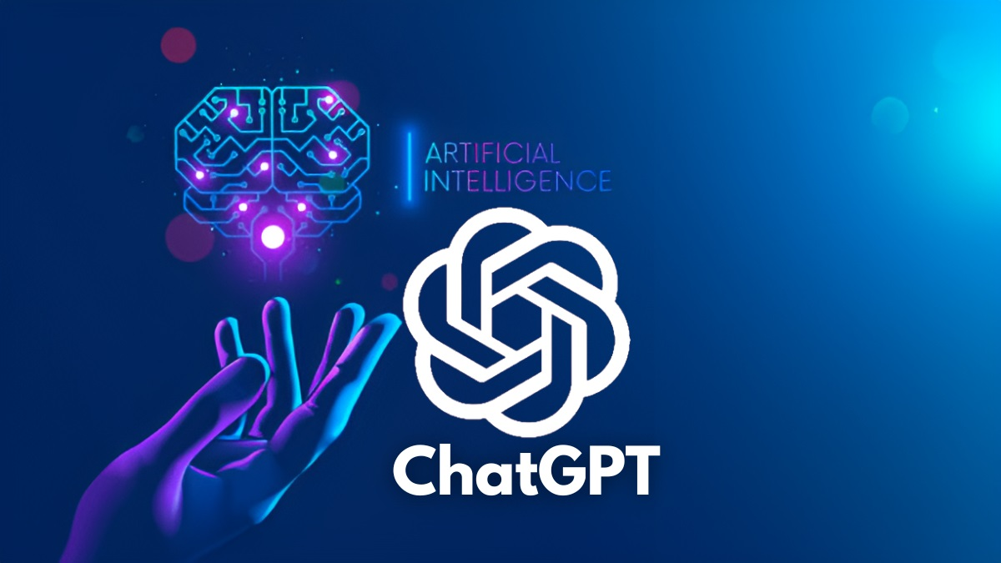
ChatGPT
SECTION 1

Slide 7
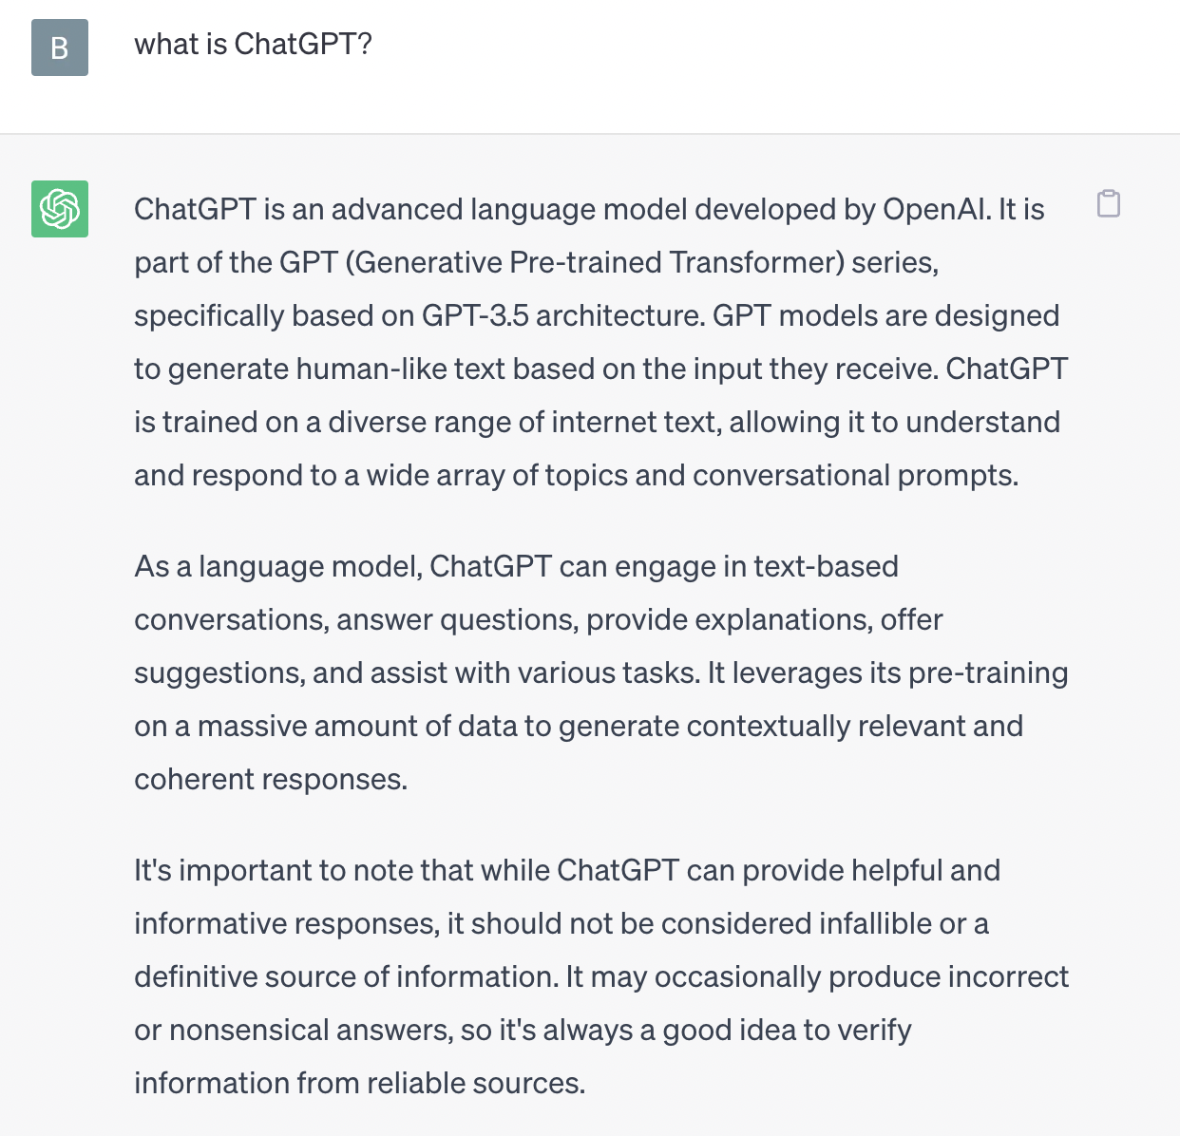
Notes:
stochastic parrot 随机鹦鹉

Slide 8
AI in Language Education
Huang, W., Hew, K. F., & Fryer, L. K. (2022). Chatbots for language learning—Are they really useful? A systematic review of chatbot-supported language learning. Journal of Computer Assisted Learning, 38(1), 237– 257. https://doi.org/10.1111/jcal.12610
Huang, Hew, and Fryer (2022)
  A review of 25 articles on the topic of chatbot-supported language learning.
  Three technical affordances of chatbots: timeliness, ease of use, and personalization.
  Five pedagogical uses: interlocutors, simulations, transmission devices, helplines, and recommendation systems.
  Chatbot challenges: technological limitations, novelty effects, and dealing with cognitive load.

Slide 9
ChatGPT in Education
SECTION TITLE GOES HERE IF NECESSARY
Most of the current discussions about ChatGPT’s implications for education focus on the accuracy and the quality of the content it provides (Rudolph, et al., 2023).
Policies and frequently raise cautionary flags about the potential for misuse (e.g., Yurkevich, 2023)
Provide guidance (e.g., Cox Communications, 2023; McAfee, 2023) and education on ethical use (e.g., Baidoo-Anu & Owusu Ansah, 2023; Mhlanga, 2023)

Slide 10
ChatGPT in Language Education
SECTION TITLE GOES HERE IF NECESSARY
Baskara and Mukarto (2023) explored the integration of ChatGPT into language courses, considering the associated benefits and challenges in higher education.
Kohnke et al. (2023) examined the affordances of the ChatGPT for language teaching and learning.
Koraishi (2023) examined material development and assessment in teaching English as a foreign language (EFL), highlighting ChatGPT as a valuable tool for EFL teachers.

Slide 11
ChatGPT in Language Education
SECTION TITLE GOES HERE IF NECESSARY
4. Hong (2023) investigated the implications of ChatGPT for foreign language teachers, shedding light on its mechanisms and misconceptions.
5. Ali et al. (2023) revealed the positive impact of ChatGPT on reading and writing skills, while, at the same time, attitudes toward listening and speaking skills were neutral

Slide 12

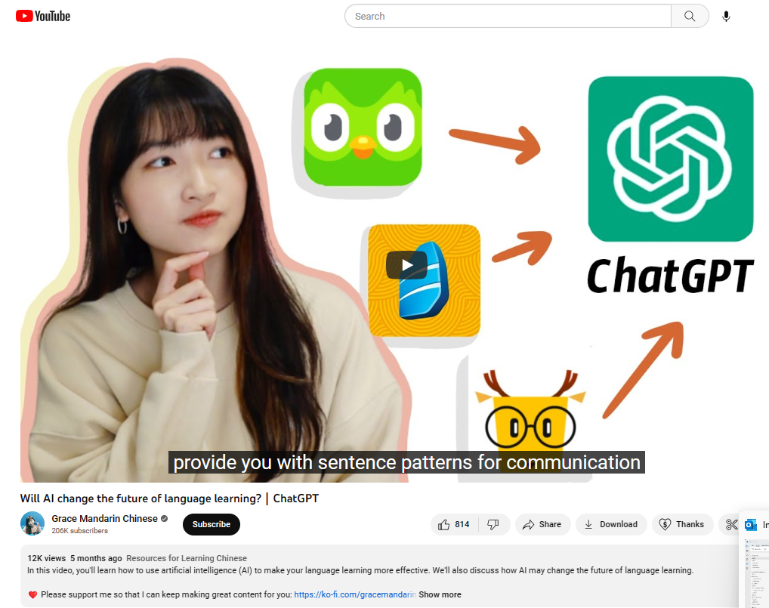
YouTube + YouTuber
SECTION 2

Slide 13
Why YouTuber?
Content creators who facilitate learning on YouTube are often deemed digital pioneers (Chao, 2022; Zavyalova & Galvin, 2022).
YouTubers are:
  1. Early adopters.
  2. Digital pioneers.
YouTube videos:
  3. Play a key role in shaping the ways in which the newly emerging learning tools are perceived and used.

Slide 14
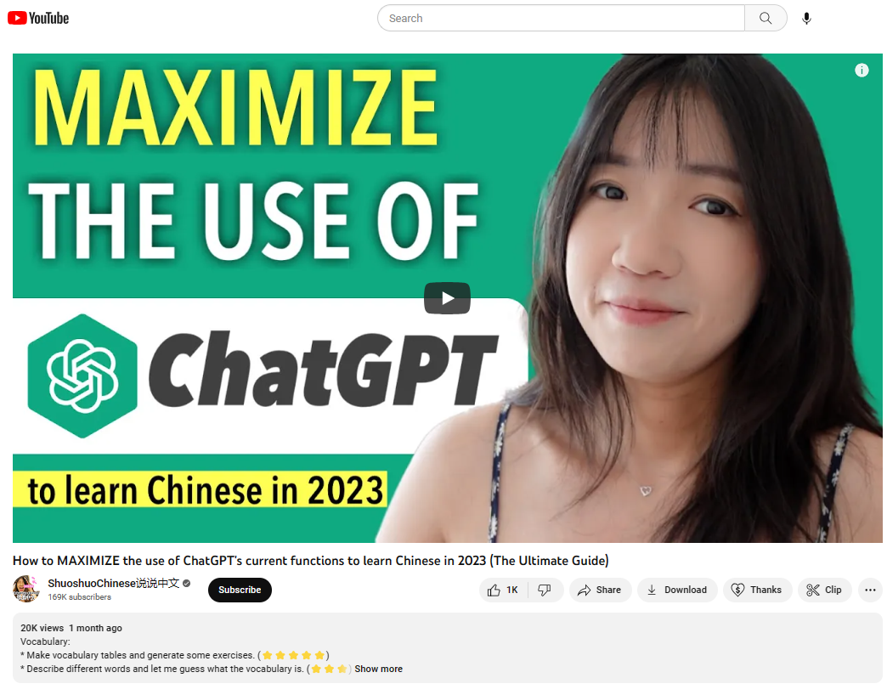
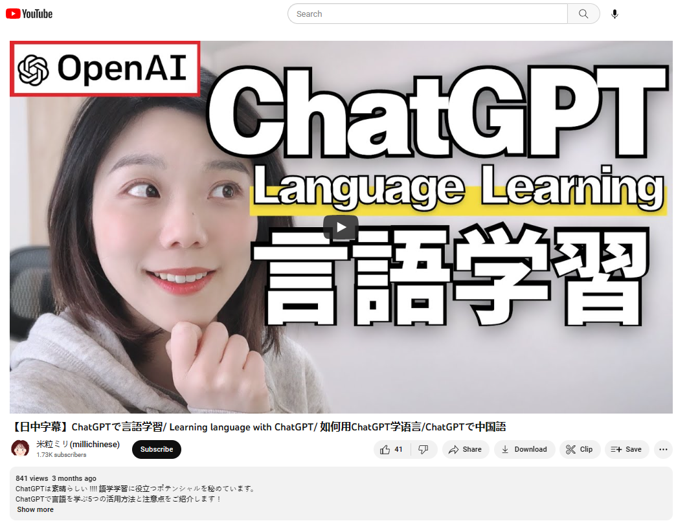
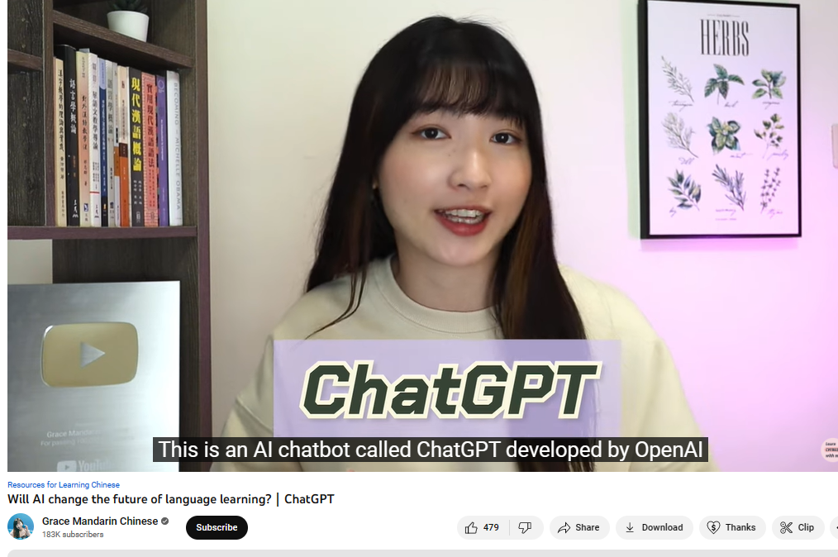
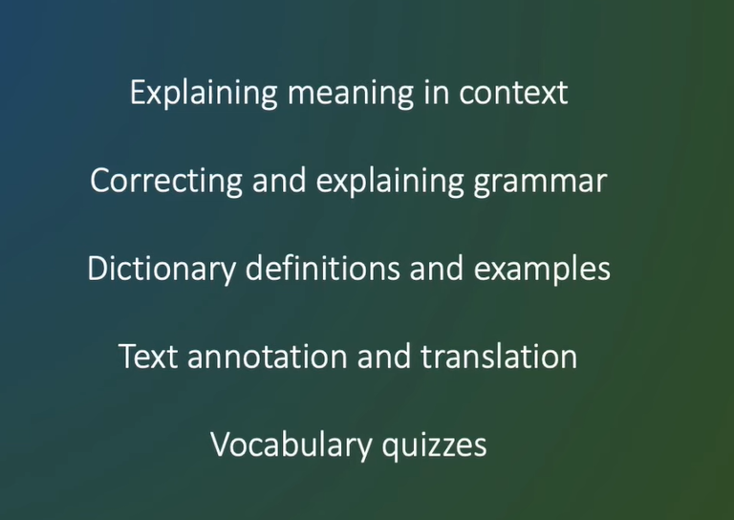
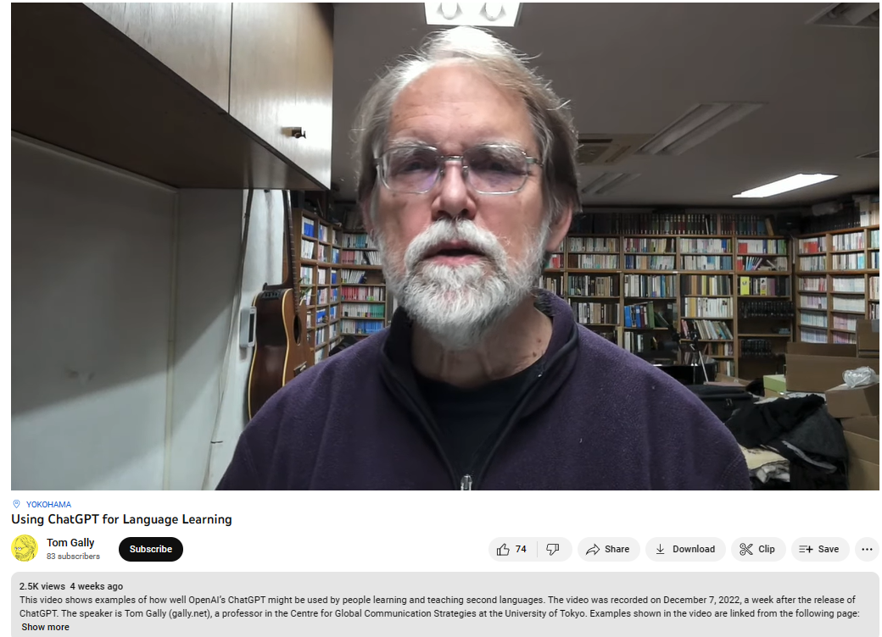
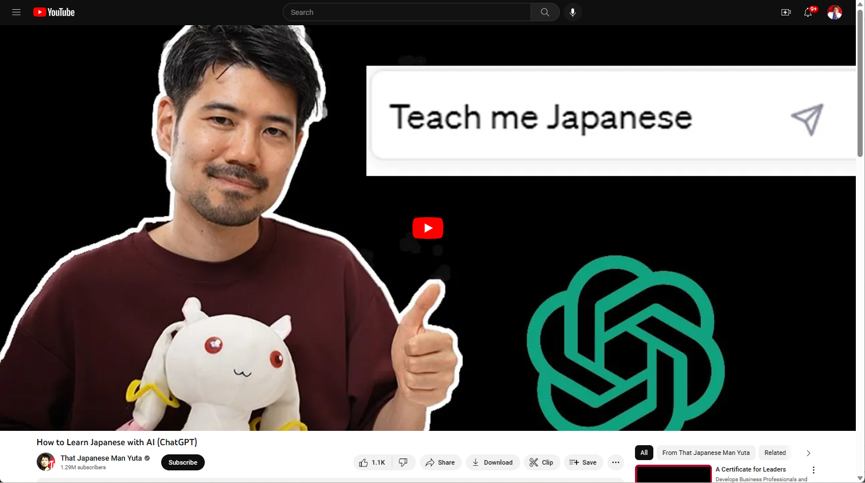
June 17, 2023, YouTubers using ChatGPT
Learning is Increasingly Informal
Will AI change the future of language learning?
ShuoshuoChinese说说中文 https://www.youtube.com/watch?v=TzFepHKifGo

Slide 15


Slide 16
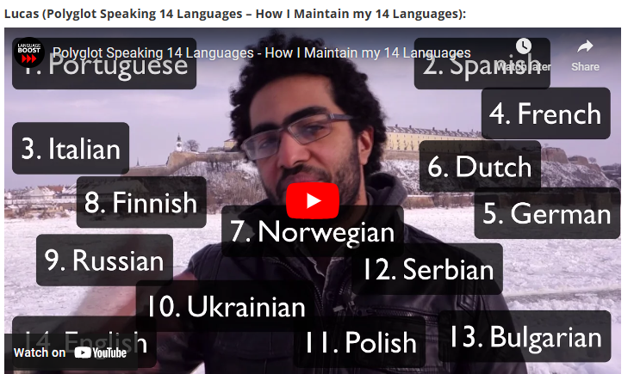

Slide 17
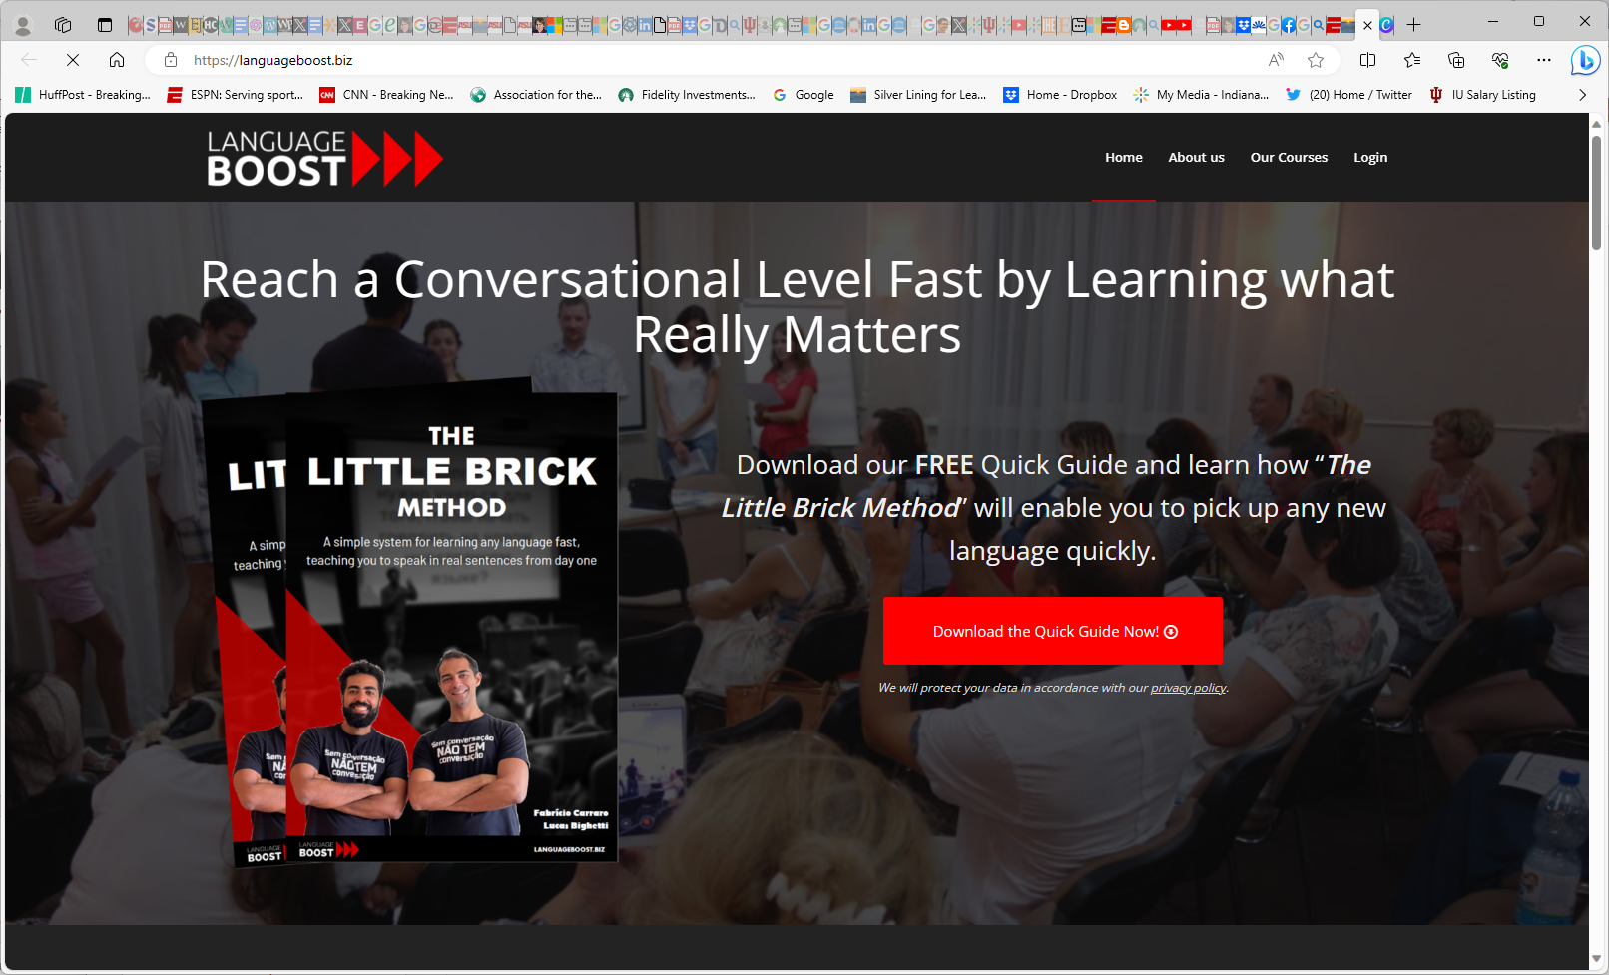

Slide 18
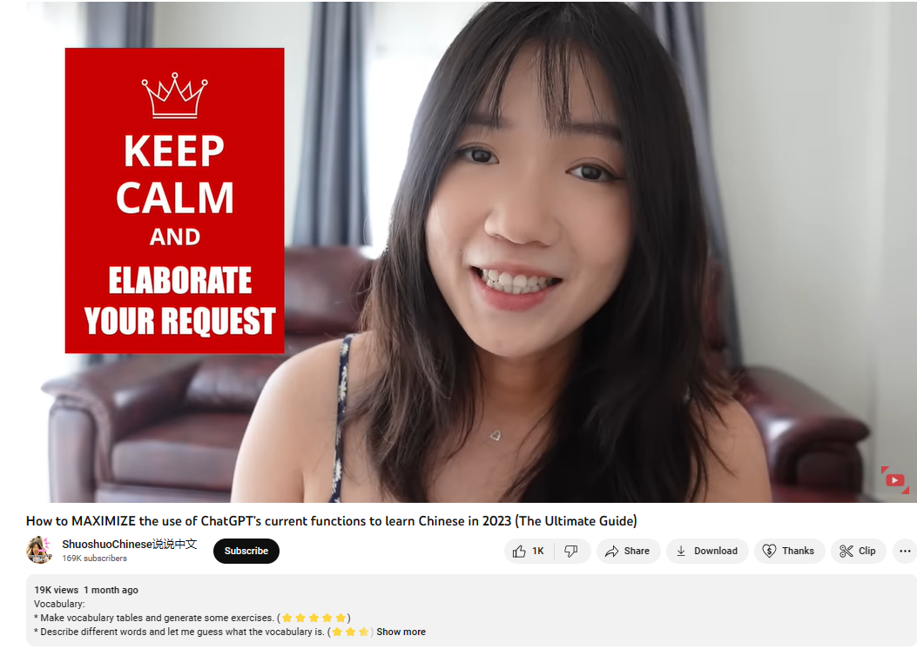
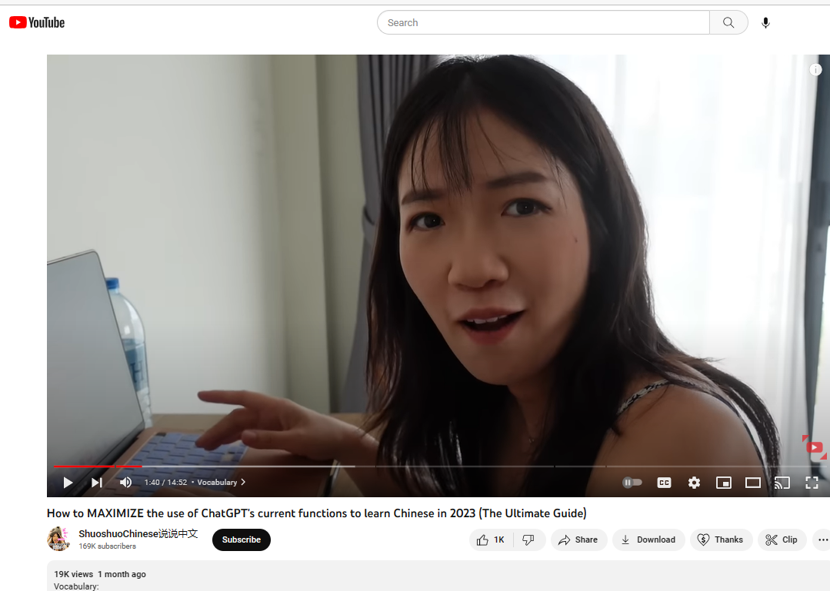
June 12, 2023
ShuoshuoChinese https://www.youtube.com/watch?v=-JgGtrjhFis&t=727s

Slide 19
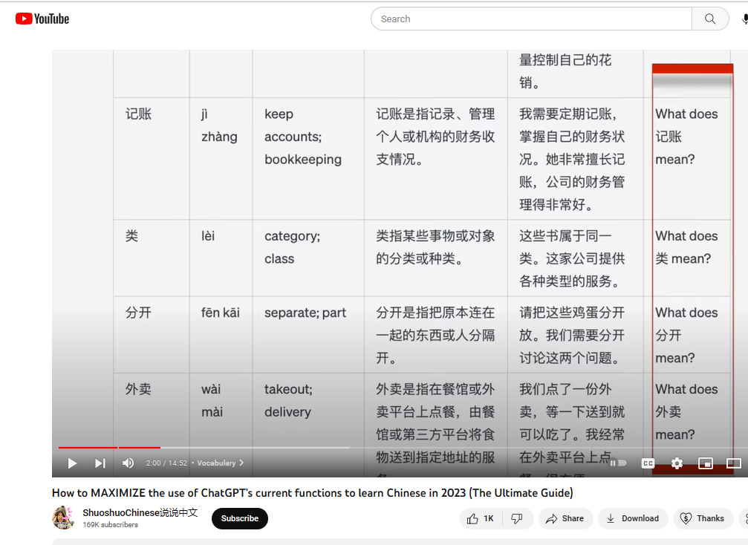
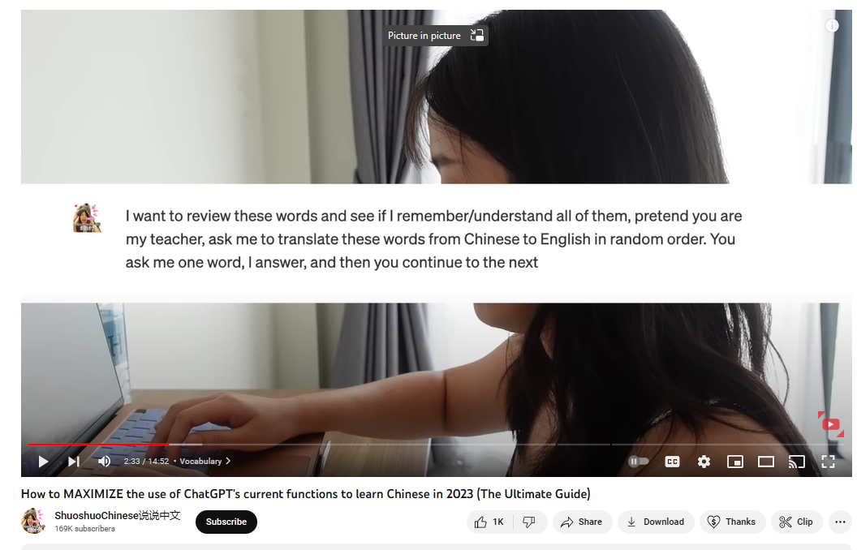
June 12, 2023
ShuoshuoChinese https://www.youtube.com/watch?v=-JgGtrjhFis&t=727s

Slide 20
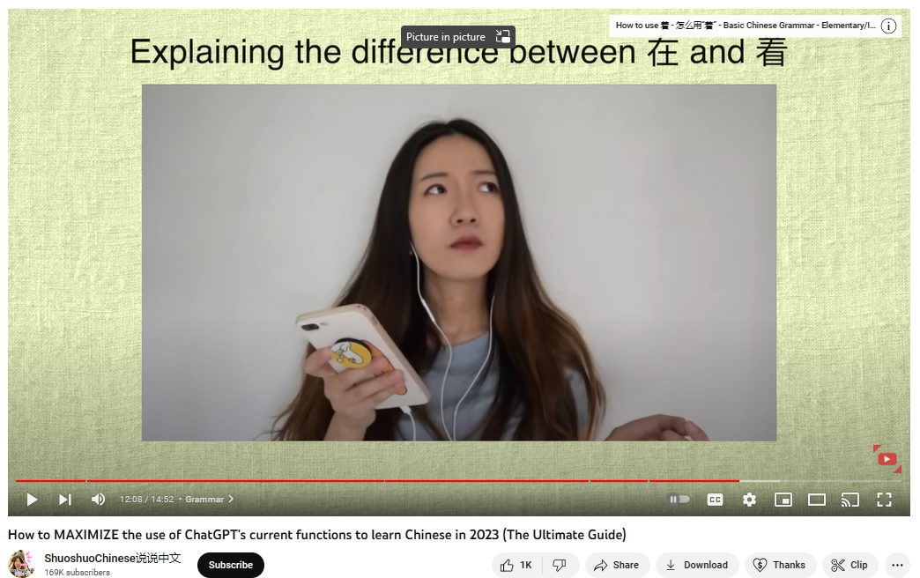
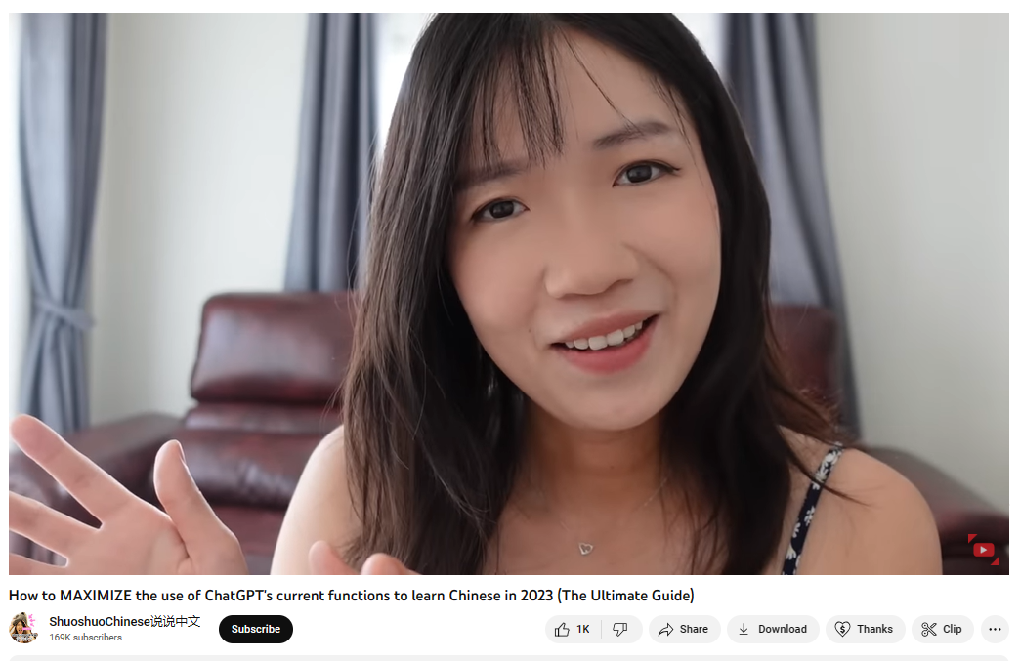
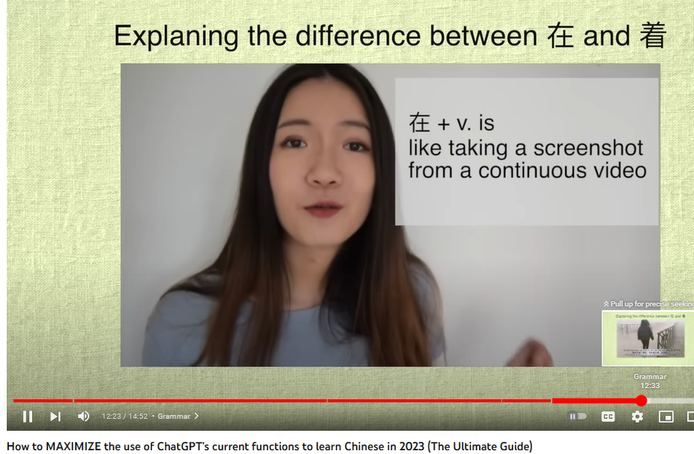
June 12, 2023
ShuoshuoChinese https://www.youtube.com/watch?v=-JgGtrjhFis&t=727s

Slide 21
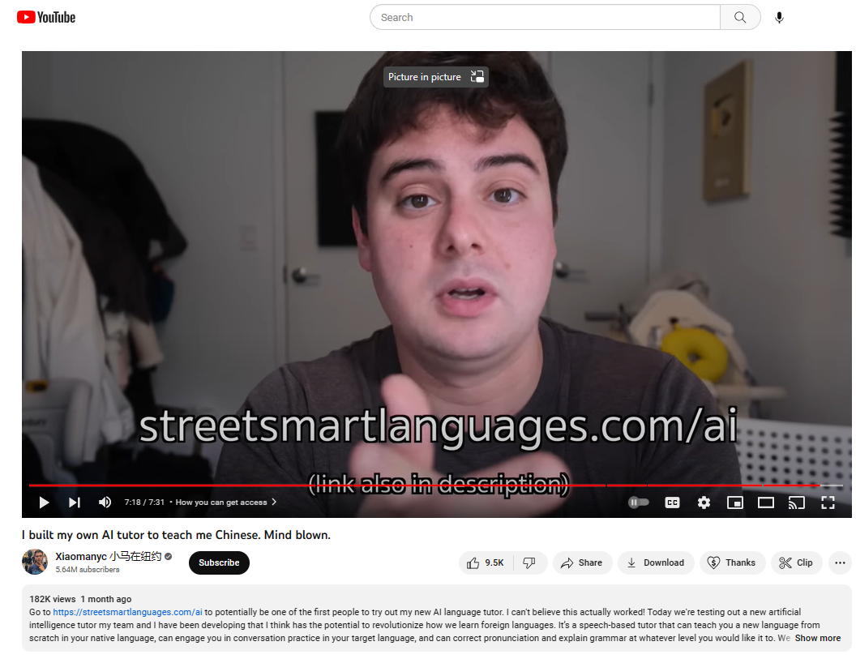
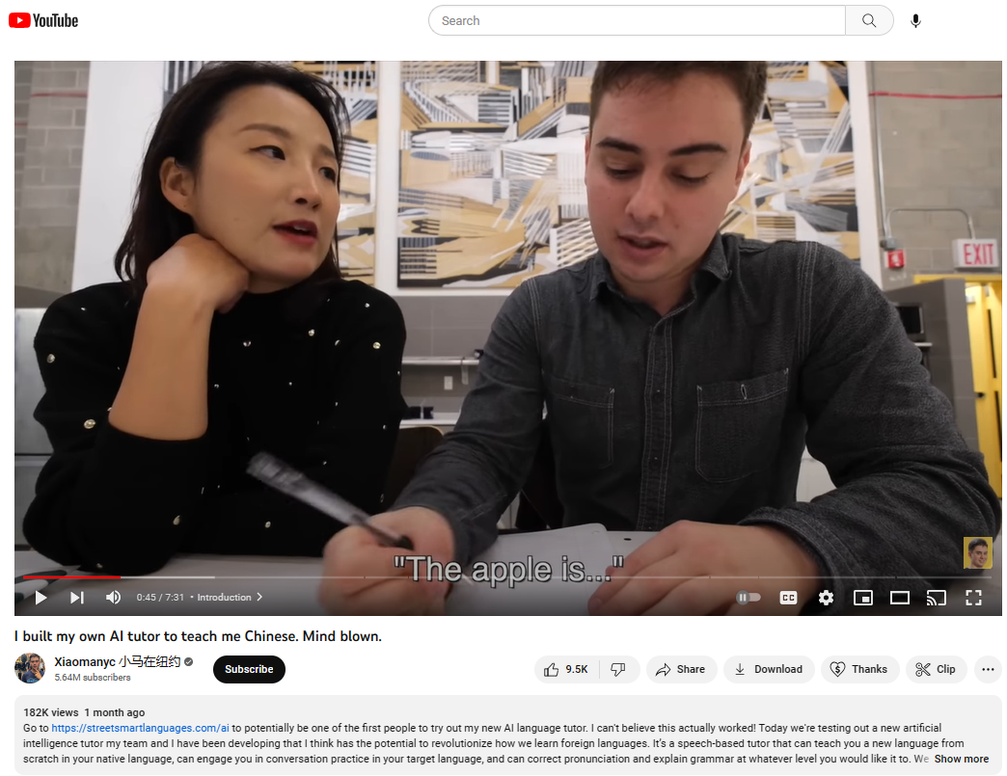
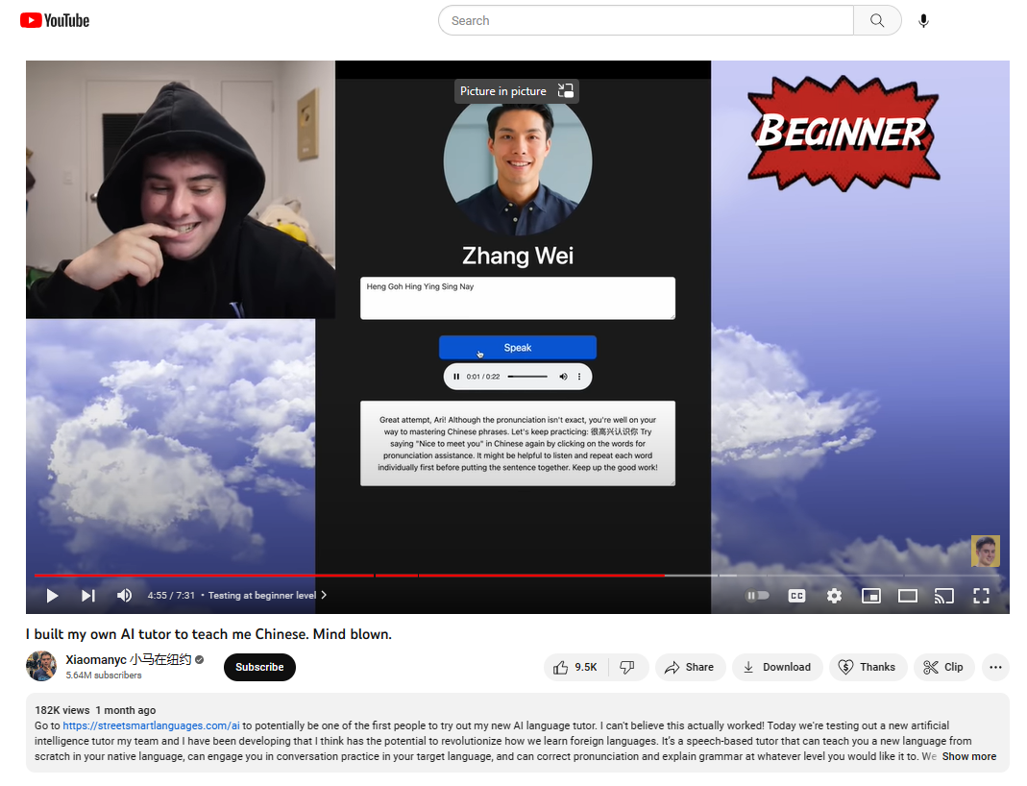
June 17, 2023, YouTubers using ChatGPT
I built my own AI tutor to teach me Chinese. Mind blown.
Xiaomanyc 小马在纽约, Streetsmart Languages https://www.youtube.com/watch?v=YjGk7EmYuxY https://join.streetsmartlanguages.com/ai

Slide 22
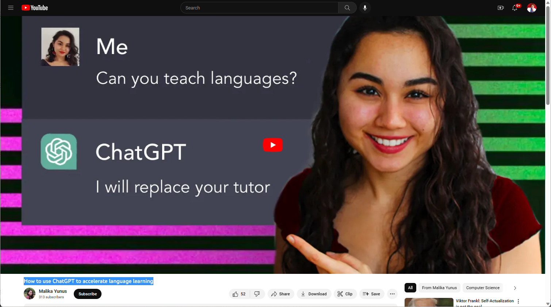
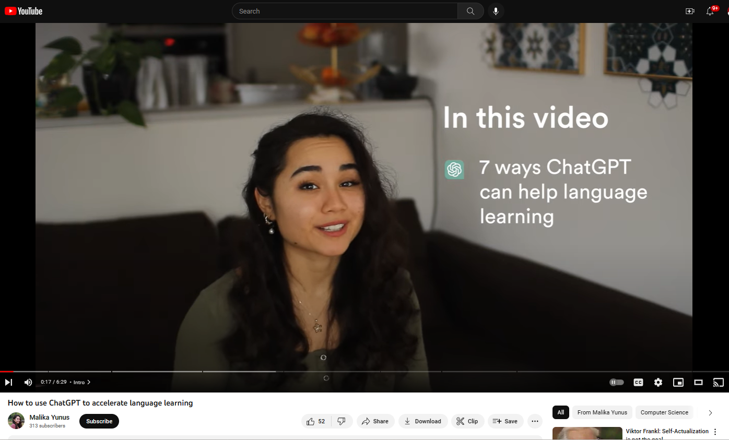
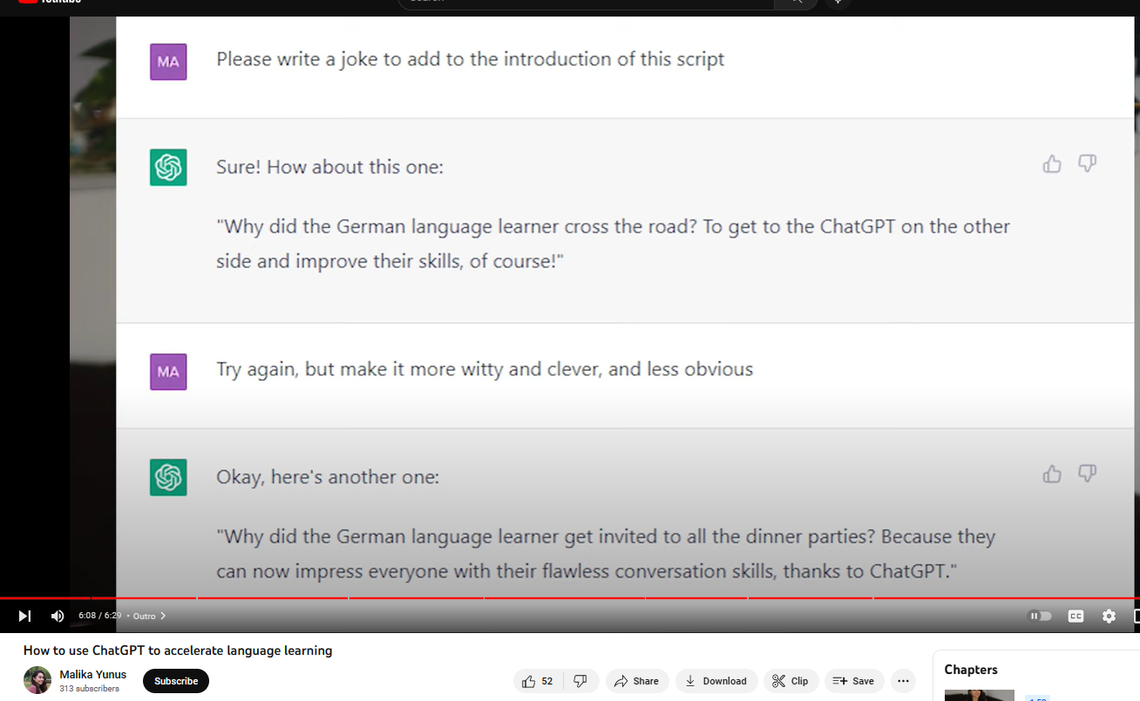
June 17, 2023, YouTubers using ChatGPT
How to use ChatGPT to accelerate language learning, Malika Yunus https://www.youtube.com/watch?v=H5qmmUOod7s

Slide 23
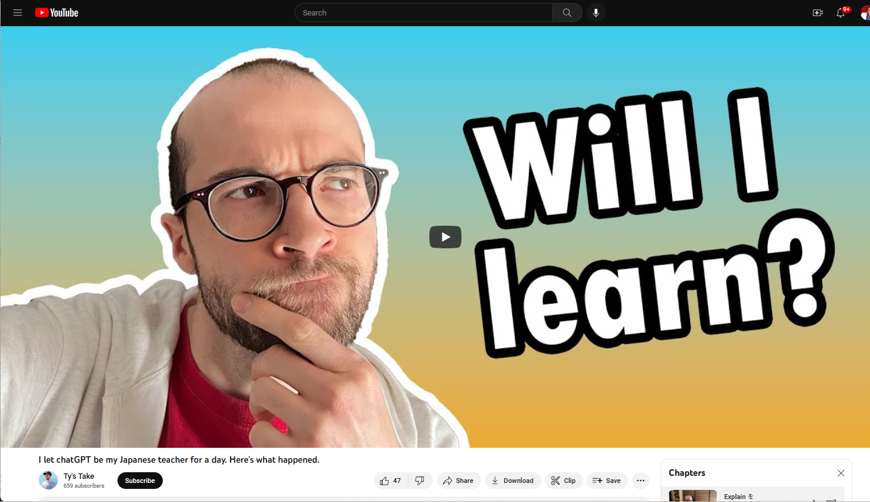
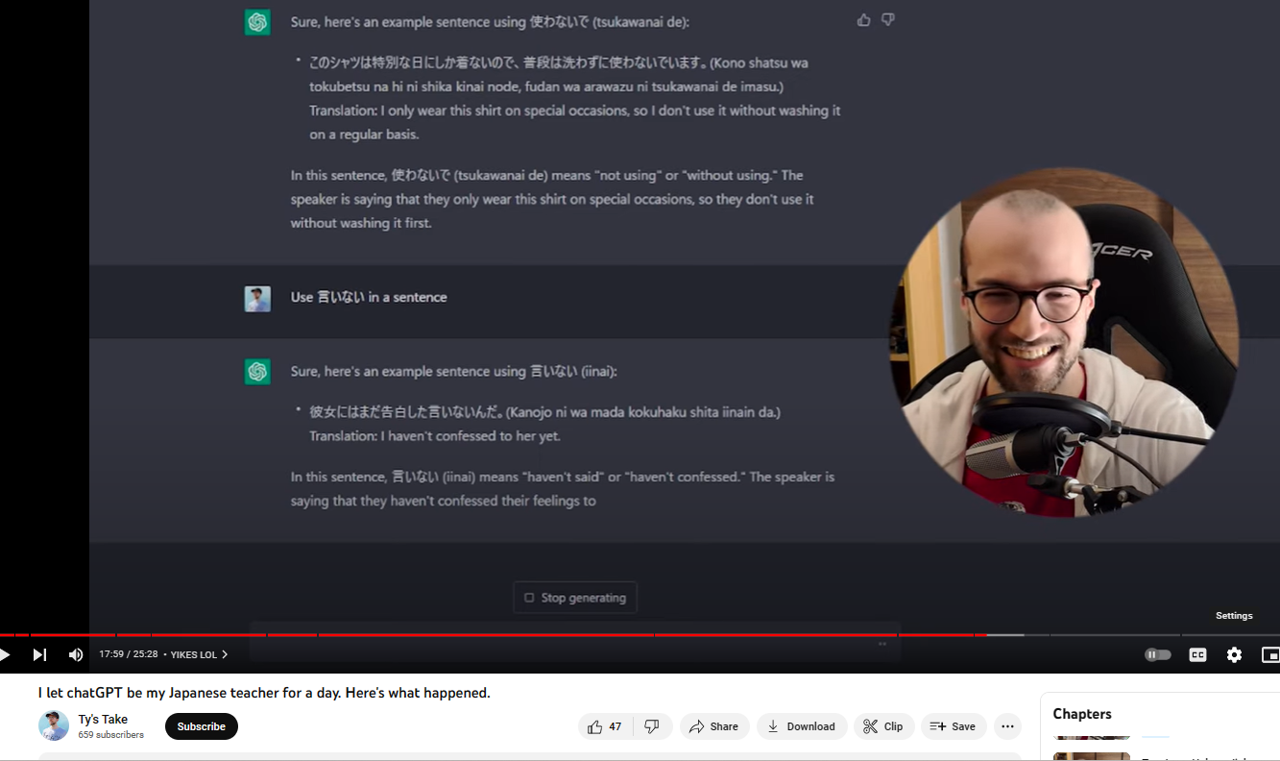
June 17, 2023, YouTubers using ChatGPT
I let chatGPT be my Japanese teacher for a day. Here's what happened, Ty’s Take https://www.youtube.com/watch?v=Xgj7JJfz0Yw

Slide 24
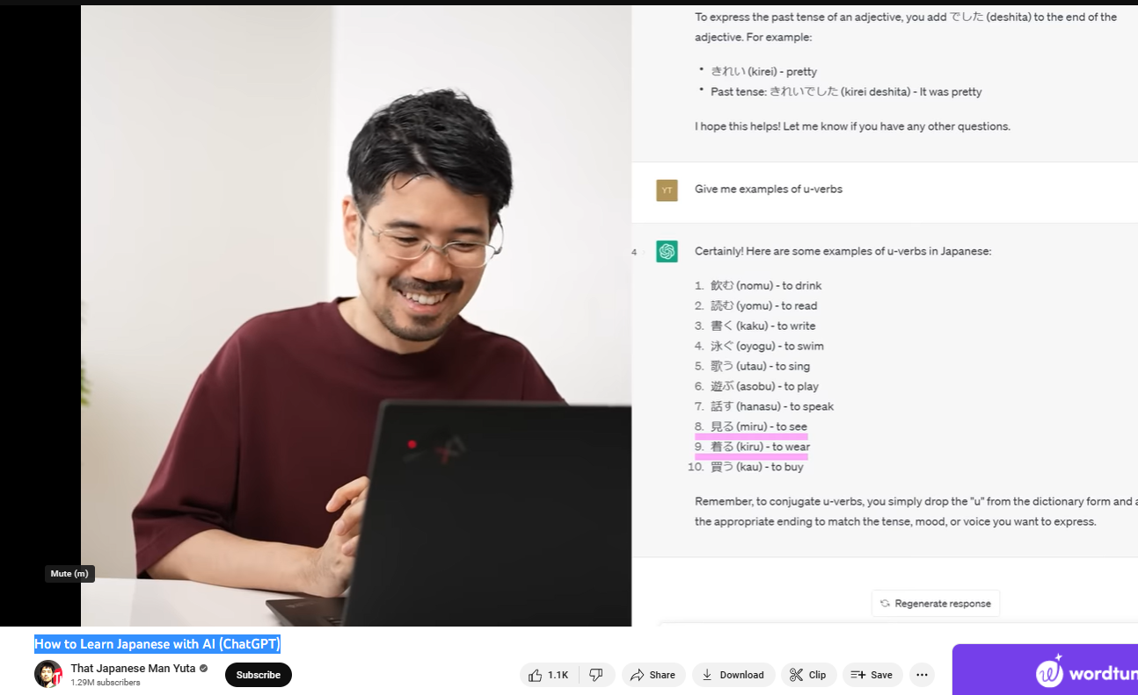
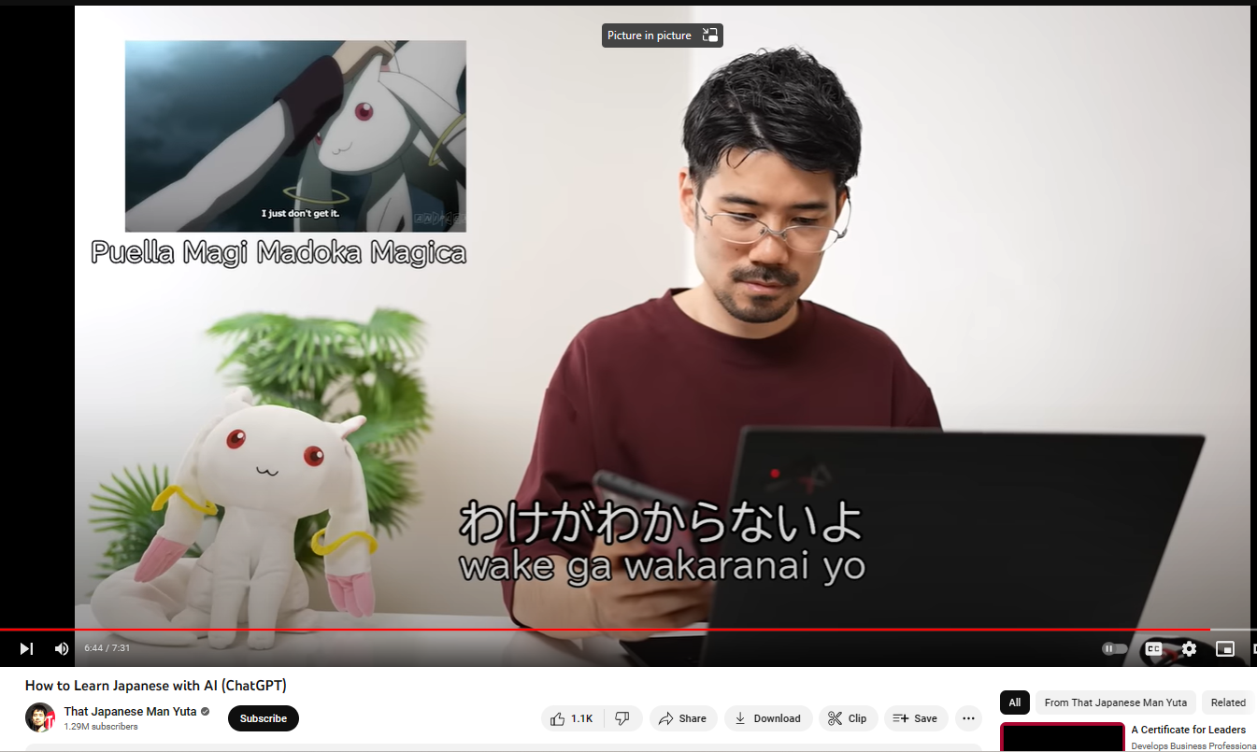
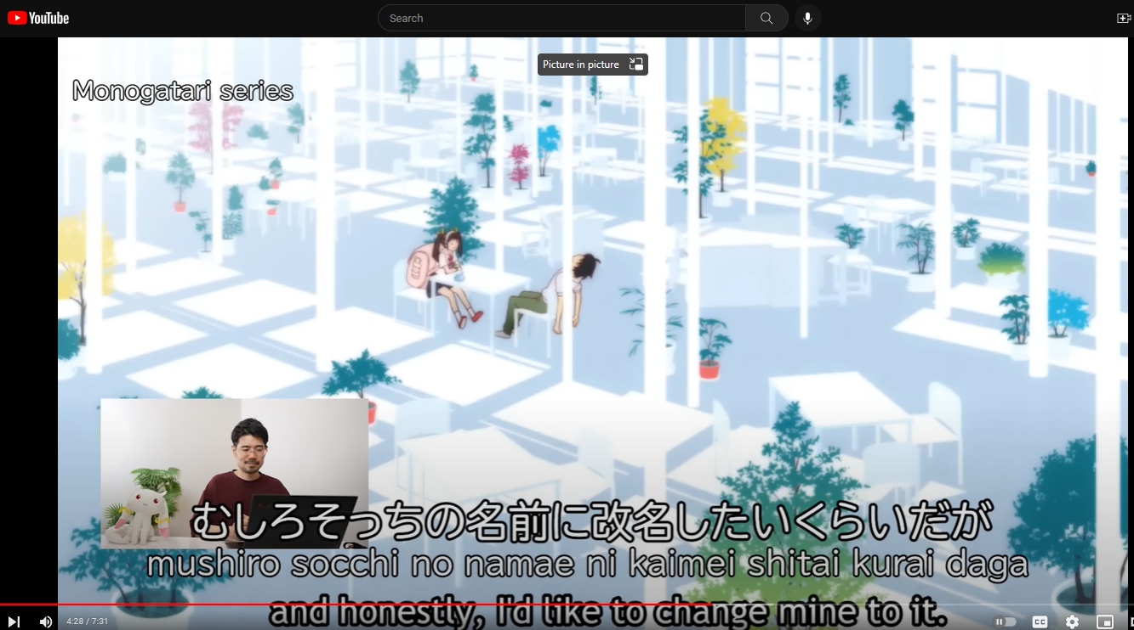
June 17, 2023, YouTubers using ChatGPT
How to Learn Japanese with AI (ChatGPT)
That Japanese Man Yuta https://www.youtube.com/watch?v=HDEvnsvXBww

Slide 25
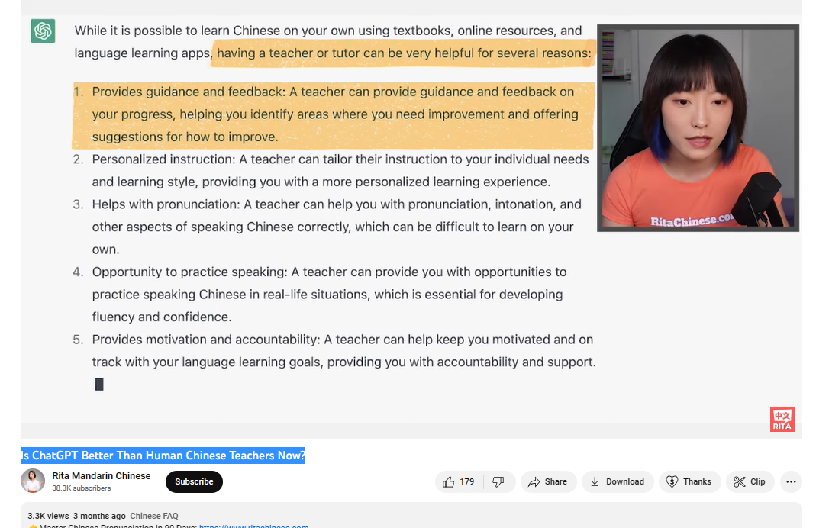
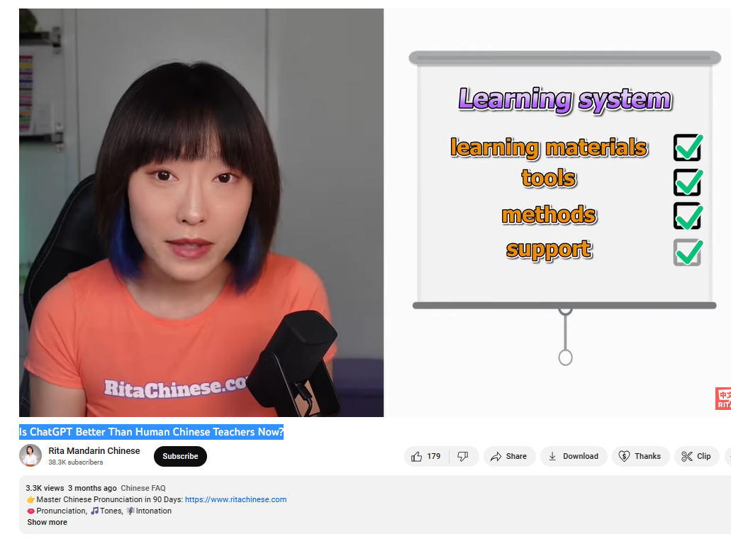
June 17, 2023, YouTubers using ChatGPT
Is ChatGPT Better Than Human Chinese Teachers Now? Rita Mandarin Chinese https://www.youtube.com/watch?v=TzFepHKifGo

Slide 26
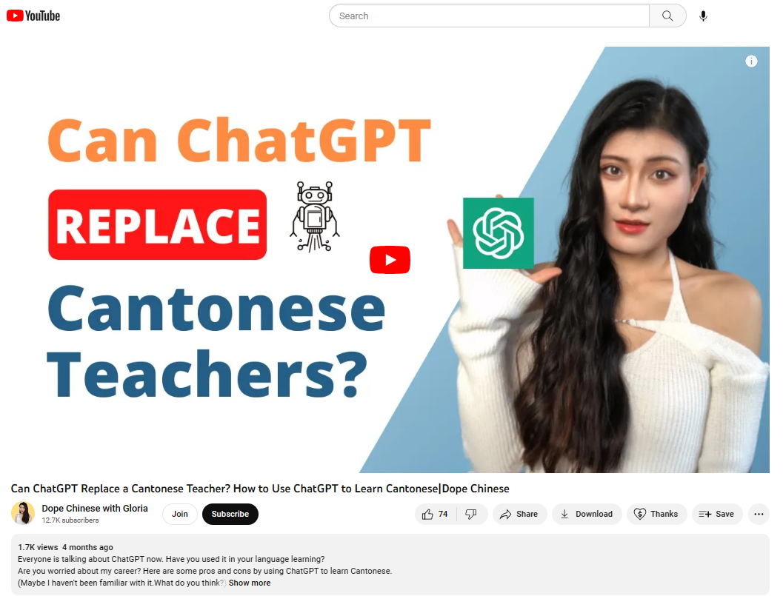
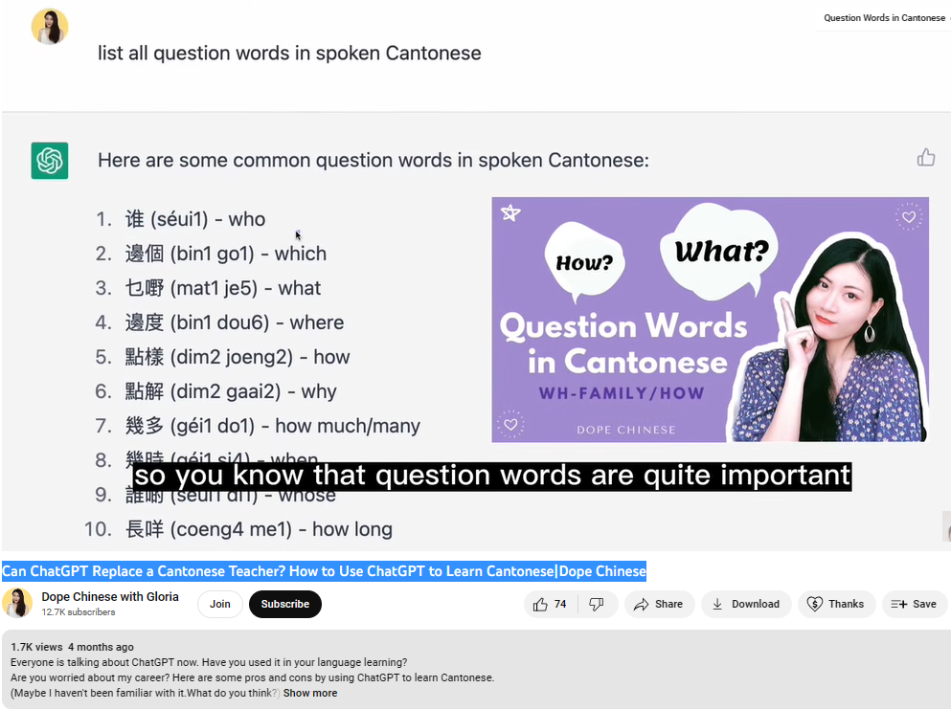
June 17, 2023, YouTubers using ChatGPT
Can ChatGPT Replace a Cantonese Teacher? How to Use ChatGPT to Learn Cantonese|Dope Chinese
Dope Chinese with Gloria https://www.youtube.com/watch?v=x5yAG3qksI4

Slide 27
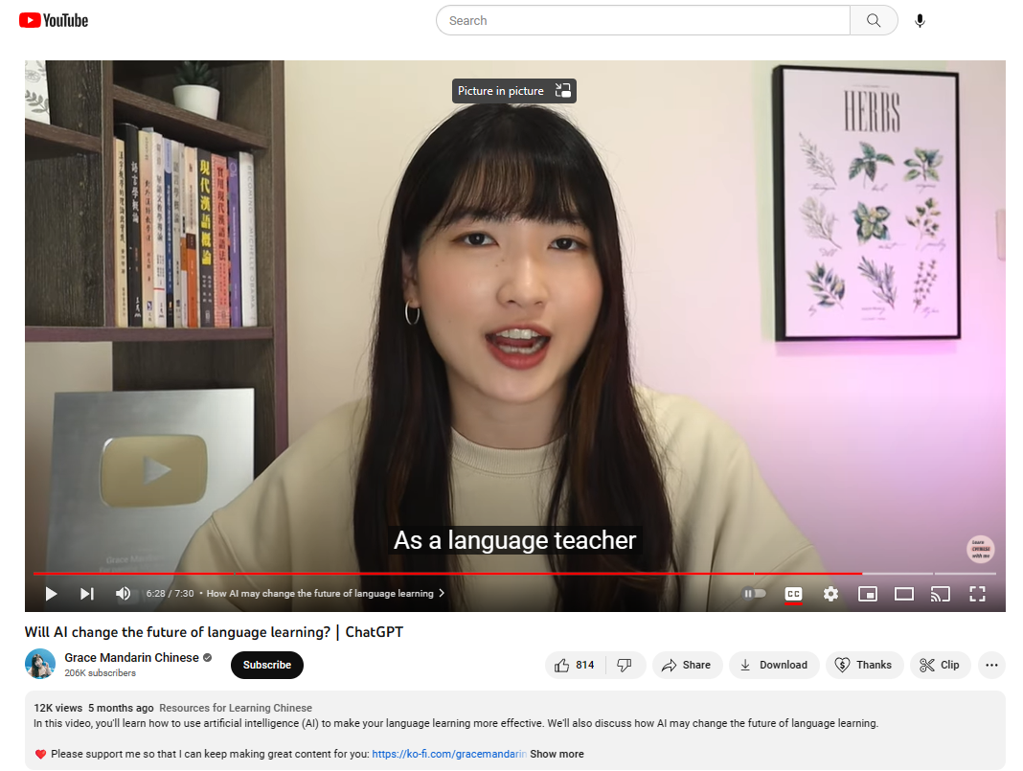
June 17, 2023, YouTubers using ChatGPT
Will AI change the future of language learning?｜ChatGPT
Grace Mandarin Chinese https://www.youtube.com/watch?v=WNfmU6lbVbE

Slide 28
Data Sources for Studies (#1-#4)
Embracing the disrupted language teaching and learning field: Analyzing YouTube content creation related to ChatGPT.
Exploring the multilingual applications of ChatGPT: Uncovering language learning affordances in YouTuber videos.
Exploring inventions in self-directed language learning with generative AI: Implementations and perspectives of YouTube content creators.
Reconceptualizing the self-directed language learning in the era of generative AI: An exploratory analysis.
140 YouTube Videos
YouTube videos & comments
across 18 languages
14 YouTubers
(teacher/professor)
19 YouTubers &
30 Videos

Slide 29

Methods
SECTION 3

Slide 30
Research Methods for Studies (#1-#4)
Mixed-methods: netnographic approach (Hine, 1994; Kozinets; 2002) #1-140 YouTube Videos
  online observations
  content publishing tracking
  systematic content analysis of online videos.
Qualitative: Inductive content analysis (Elo & Kyngäs, 2008; Stemler, 2000) #2-YouTube videos & comments
Qualitative: Iterative thematic analysis (Braun & Clarke, 2006; Braun et al.,2014) #3-14 YouTubers (teacher/professor)
Qualitative: Iterative thematic analysis (Braun & Clarke, 2006) #4-19 YouTubers

Slide 31
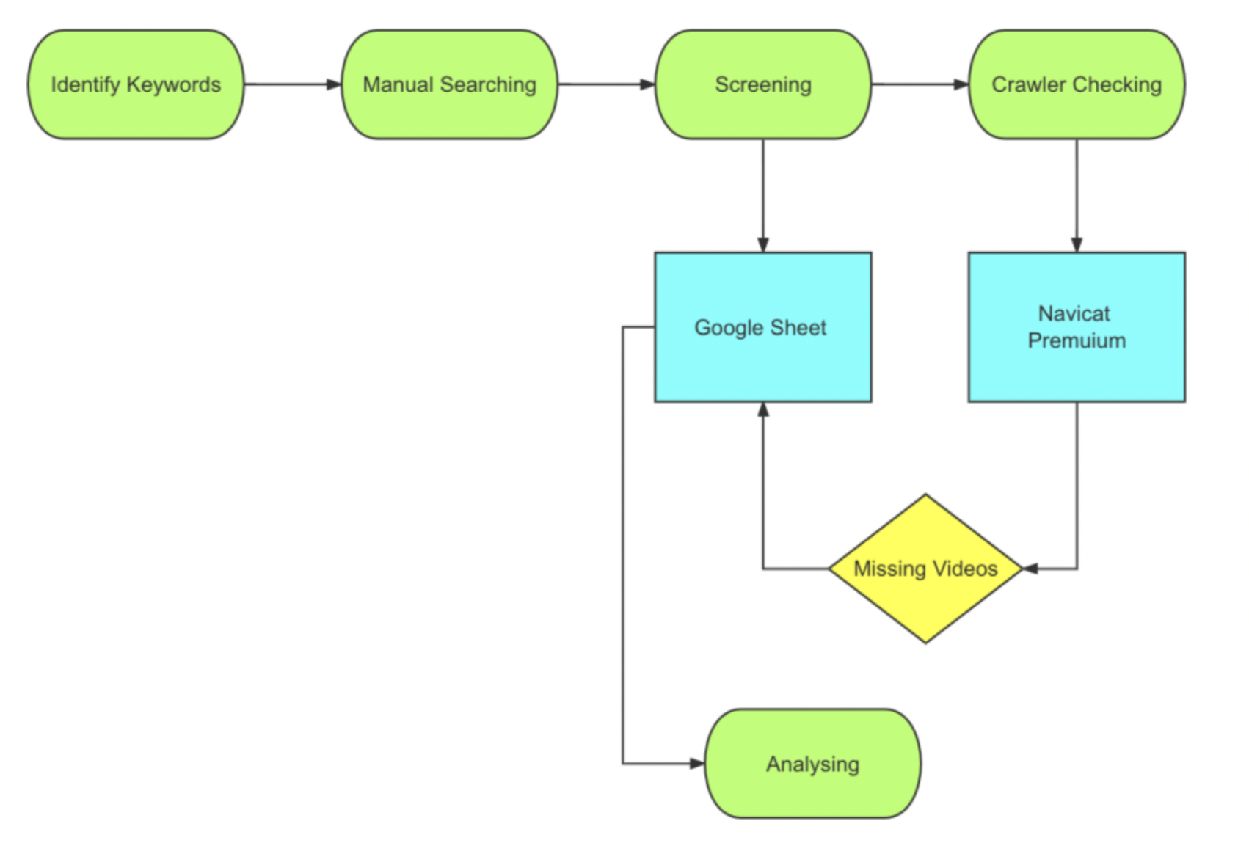
Data Collection Procedures (#1 & #2 )

Slide 32
Video Sampling (#1 & #2)
"ChatGPT AND language learning," "ChatGPT AND language education," and "ChatGPT AND (Chinese OR Japanese OR Spanish OR French OR English OR German OR additional languages here)."
Include videos directly discussing or representing ChatGPT in language education.
Exclude videos not primarily focused on language education (e.g., academic writing).
Exclude videos shorter than a certain duration (e.g., less than 2 minutes).
Notes:
Only those videos that directly discussed or represented ChatGPT in the context of language education were included in the sample. Additionally, to ensure that the research focus remained specific to the representation and discussion of ChatGPT in language education, videos that did not have a primary focus on language education, but rather covered topics such as academic writing, were excluded from the sample. To ensure the quality and relevance of the sample, we excluded videos that were shorter than a certain duration (e.g., less than 2 min) from the analysis.
The selected videos were organized in a Google spreadsheet by their publication date, video title, description, channel name, and “About” page.

Slide 33
Video Sampling (#1 & #2)
Utilize video crawler to collect YouTube videos tagged with ChatGPT and relevant keywords.
Cross-check with existing Google spreadsheet to ensure no eligible videos are missed.
Total of 140 videos were identified by April 10, 2023
Notes:
To maintain a current and comprehensive sample, we also utilized a video crawler to collect all YouTube videos that were tagged with ChatGPT and relevant search keywords in the title, description, and tags. And then we cross-checked these results with their existing Google spreadsheet of identified videos searched by hand to ensure that no eligible videos were missed.

Slide 34
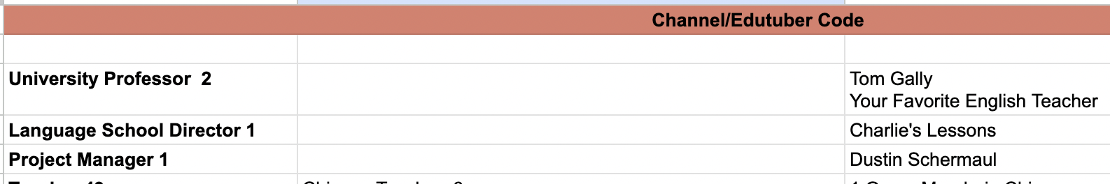
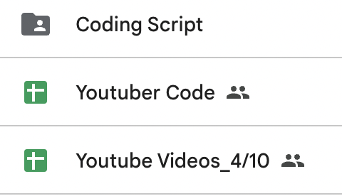

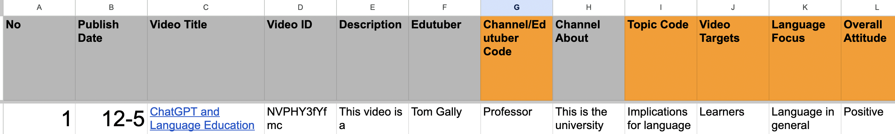
Video Sampling (#1 & #2)
Notes:
This is how we document and organize the included videos
Coding script – systemic content analysis
Youtuber Code – categorize YouTubers in groups – who are posting ChatGPT & language education videos.
Organize them by different languages

Slide 35
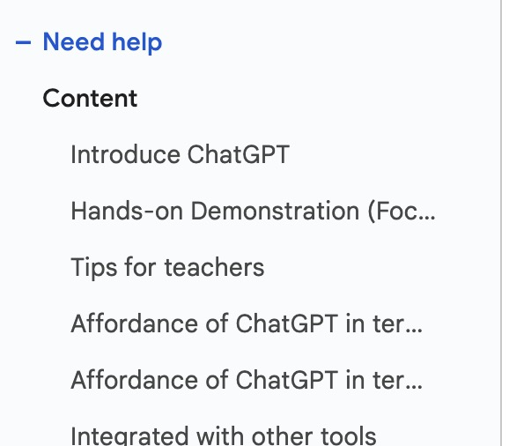
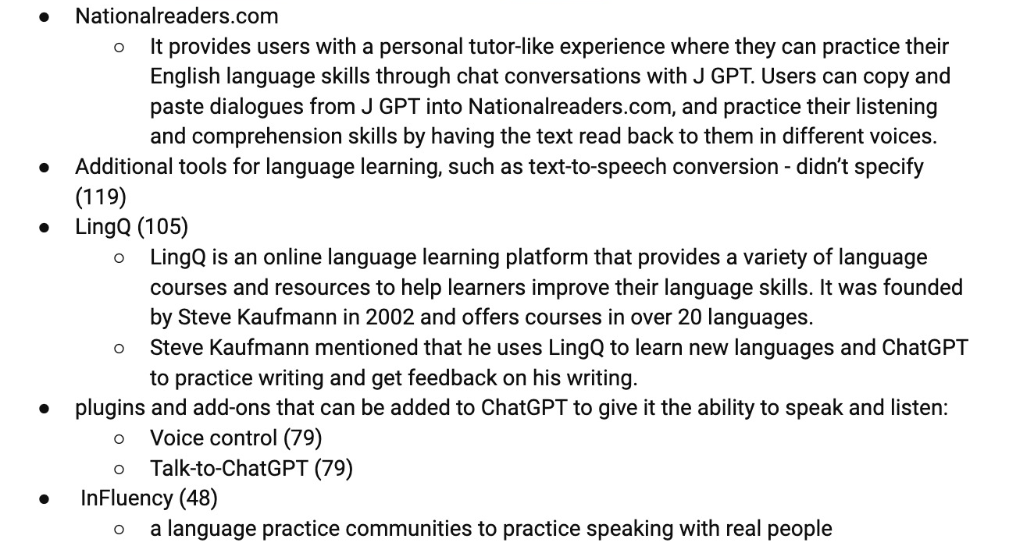
Data Analysis (#1- systematic content analysis of online videos)
Notes:
This is a sample of how we conducted systematic content analysis of online videos

Slide 36
Video Selection Criteria (#2)
Quality and Engagement
Uniqueness and Relevance
Diversification
Validity and Credibility
Notes:
Two rounds of research were conducted, with the first round from 12/15/2022 to 4/10/2023; and the second round from 4/11/2023 to 5/30/2023. The second round aimed to verify the results yield from the first round, remove deleted videos, and add new releases.
We adopted a more rigorous selection criteria

Slide 37
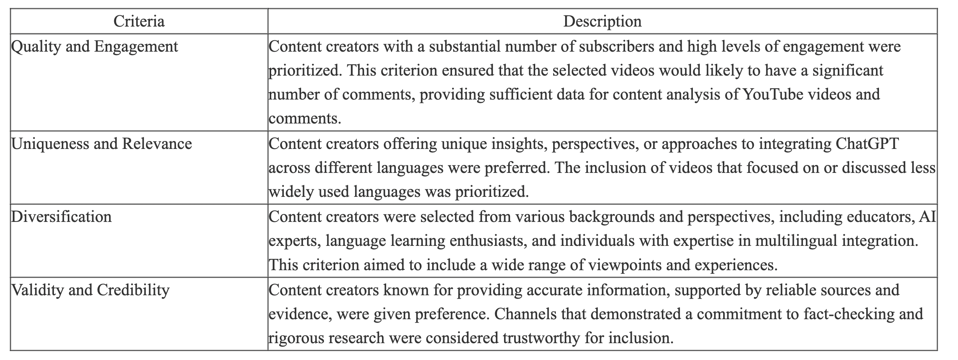
Criteria for Video Selection
Notes:
The refined criteria aimed to encompass a diverse range of content creators, languages, and perspectives.

Slide 38
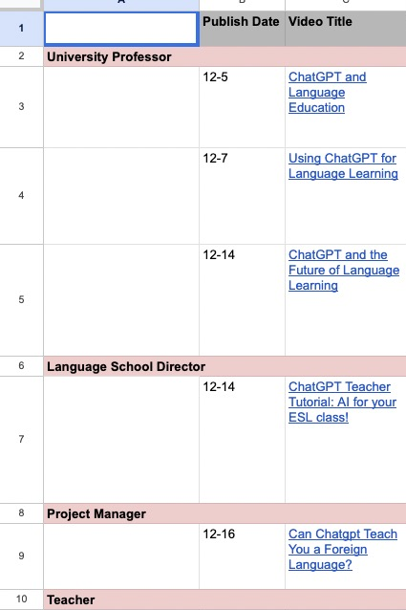
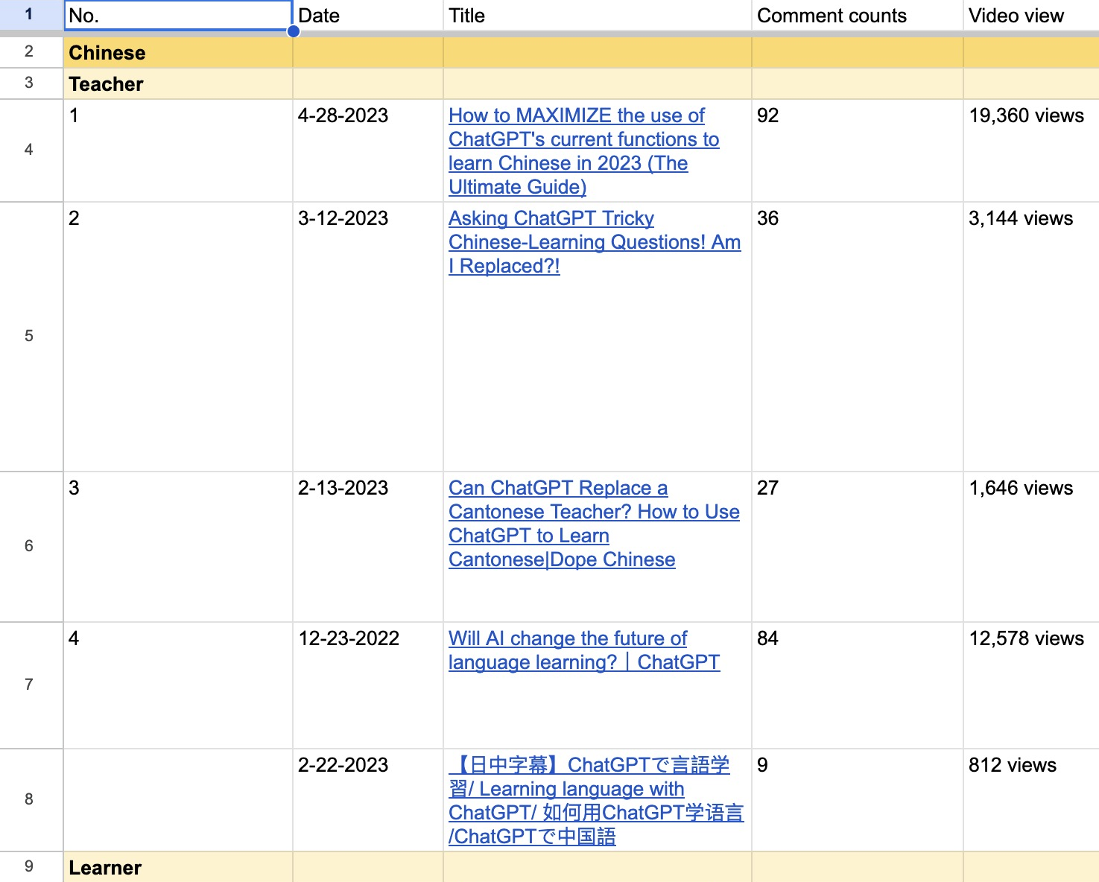
Video Selection Criteria (#2)
Notes:
These images demonstrated our method of organizing videos within our pool to more effectively identify those that best align with the selection criteria.

Slide 39
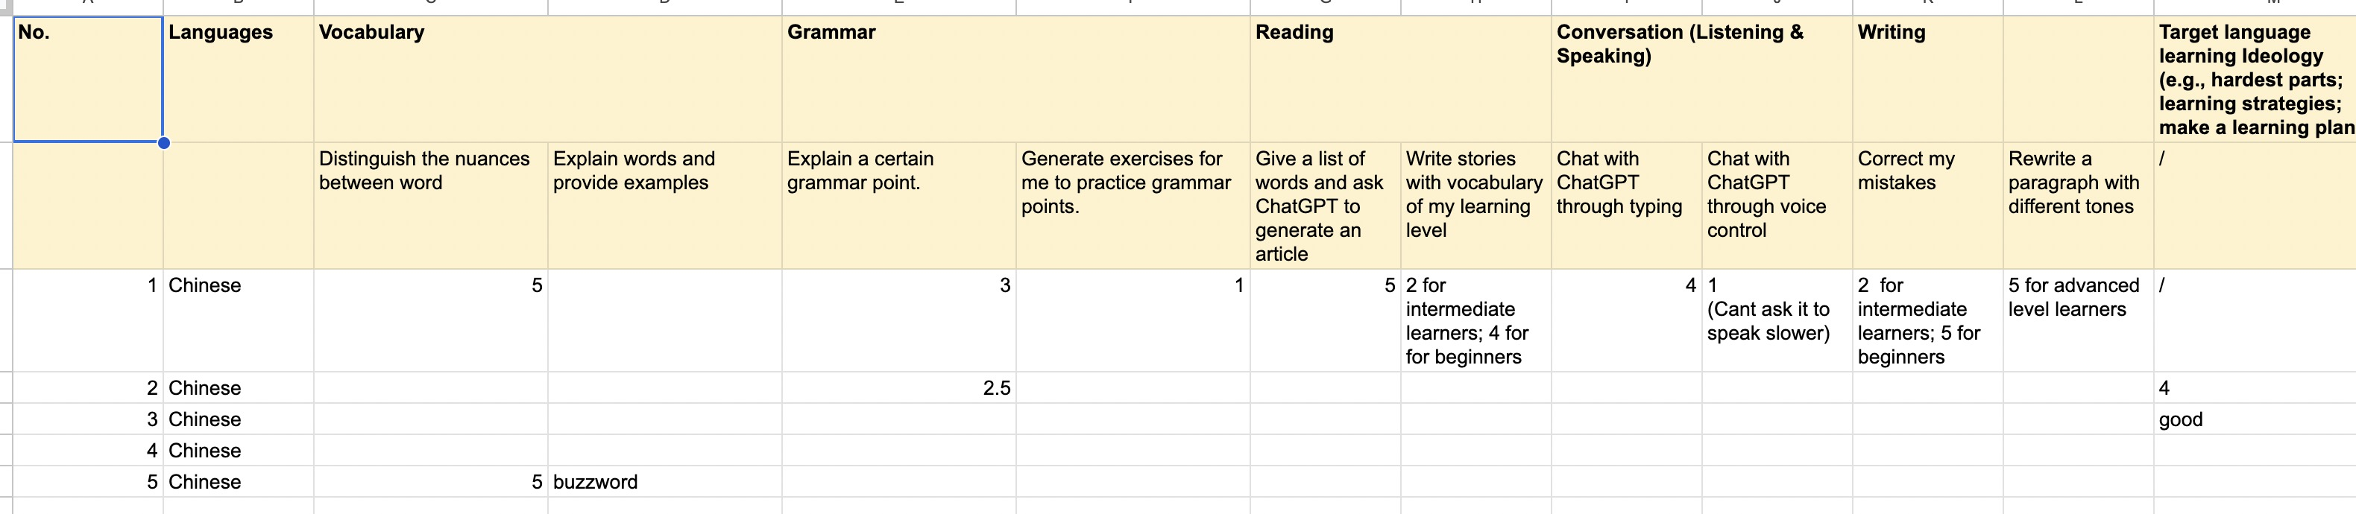
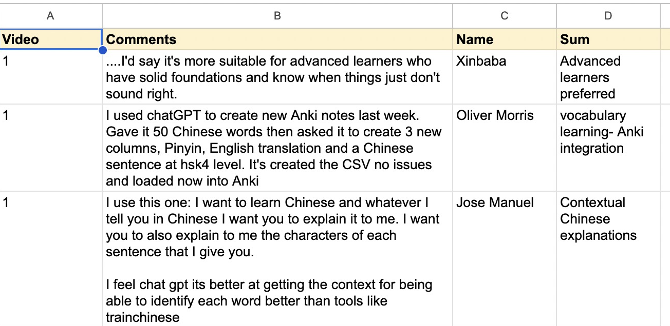
Data Analysis (#2- Inductive content analysis)
Notes:
This is a sample of how we conducted Inductive content analysis

Slide 40

Research Questions
SECTION 4

Slide 41
Study #1
SUBTITLE GOES HERE IF NECESSARY
What is the focus of the discussion and demonstrations by the YouTube content creators of ChatGPT in language education?
How do content creators describe their current practices of using ChatGPT in language education?

Slide 42
RQ1: What is the focus of the discussion and demonstrations by the YouTube content creators of ChatGPT in language education?
a. How has the discussion around ChatGPT and related AI technologies evolved during its’ brief history as a tool for language education on YouTube?
b. Who is producing videos about ChatGPT in language education on YouTube?
c. What are the common topics and themes present in these discussions and demonstrations?

Slide 43
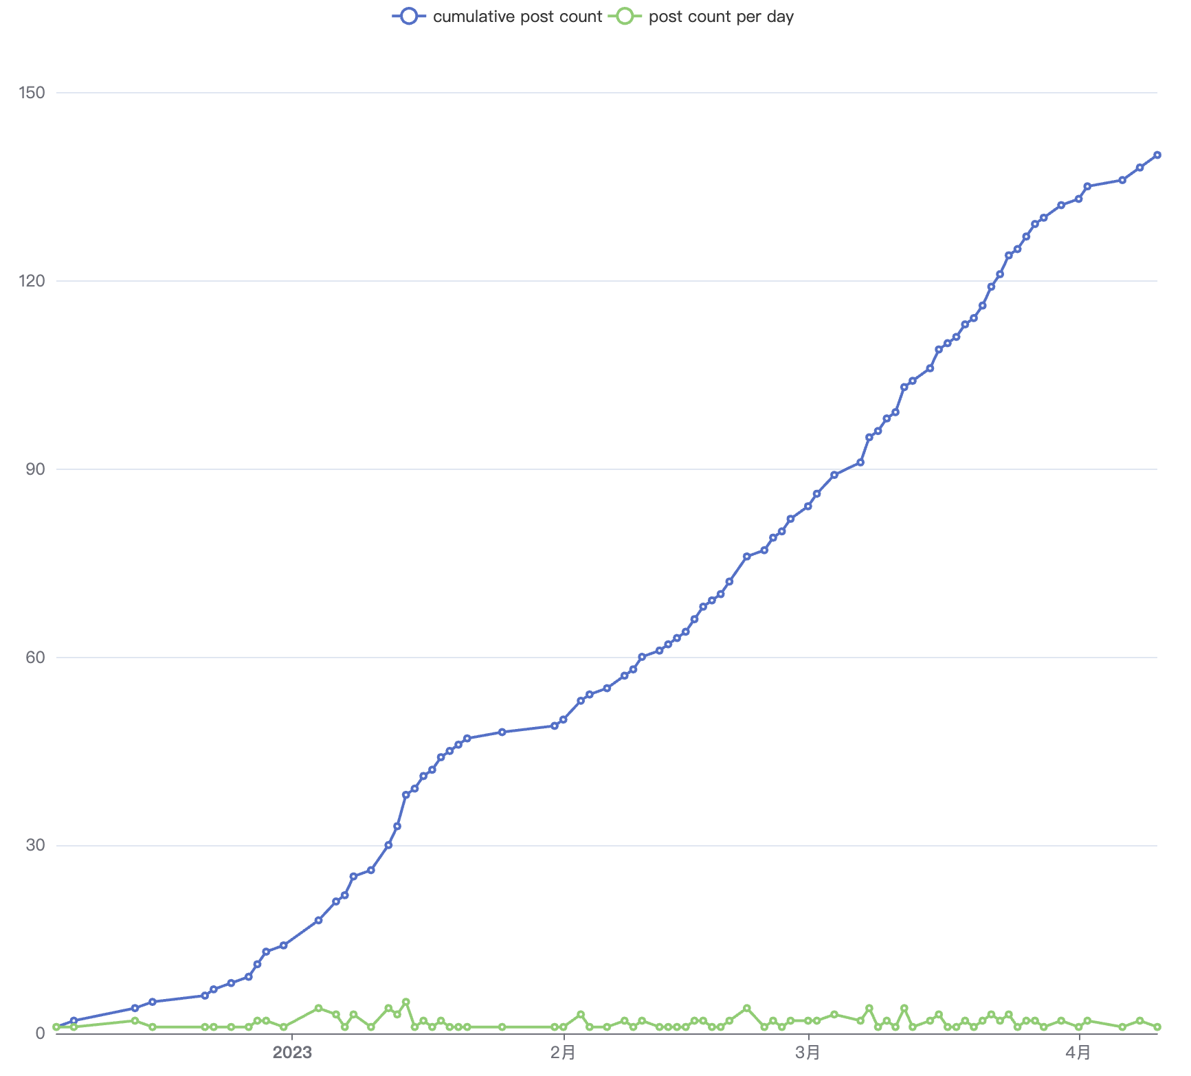
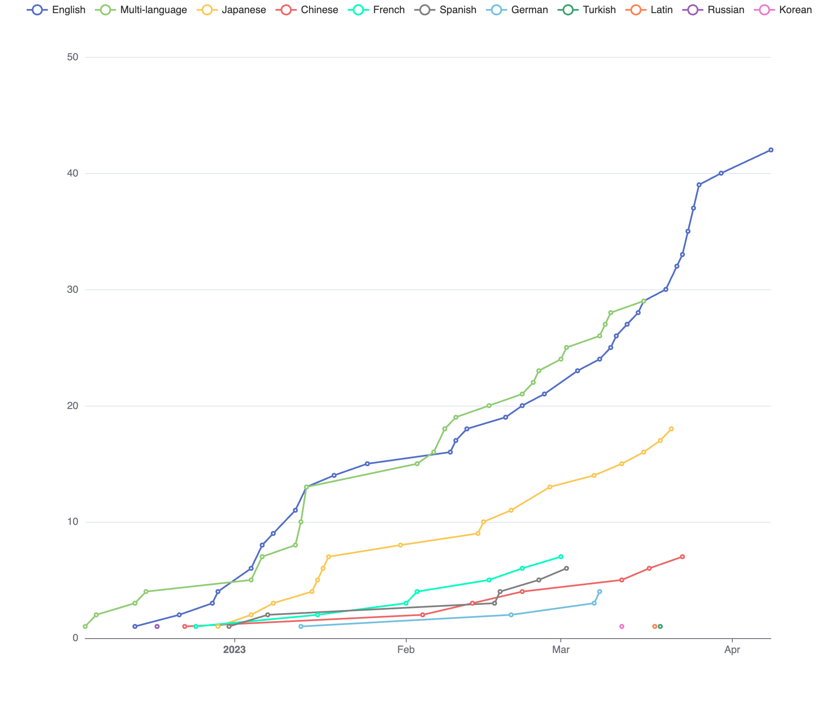
RQ1: What is the focus of the discussion and demonstrations by the YouTube content creators of ChatGPT in language education?
1a. How has the discussion around ChatGPT and related AI technologies evolved during its’ brief history as a tool for language education on YouTube?
Figure 1. Trends in Video Releases from November 30, 2022 to April 10, 2023
Figure 2. Trend of videos posted in different languages
Notes:
The rapid adoption and integration of ChatGPT as a tool for language education on YouTube is evident in the trends that can be observed in Figure 1. The video published by Tom Gally on 5 December 2023 served as the earliest example of the growing interest and recognition of ChatGPT’s potential in language education among educators and researchers.
Figure 1 displays the trends in video releases related to ChatGPT in language education during the period from 30 November 2022 to 10 April 2023. The upward trends revealed in Figure 1 indicate a rising level of interest and engagement among relevant individuals and communities regarding the uses of ChatGPT for language learning.

Slide 44
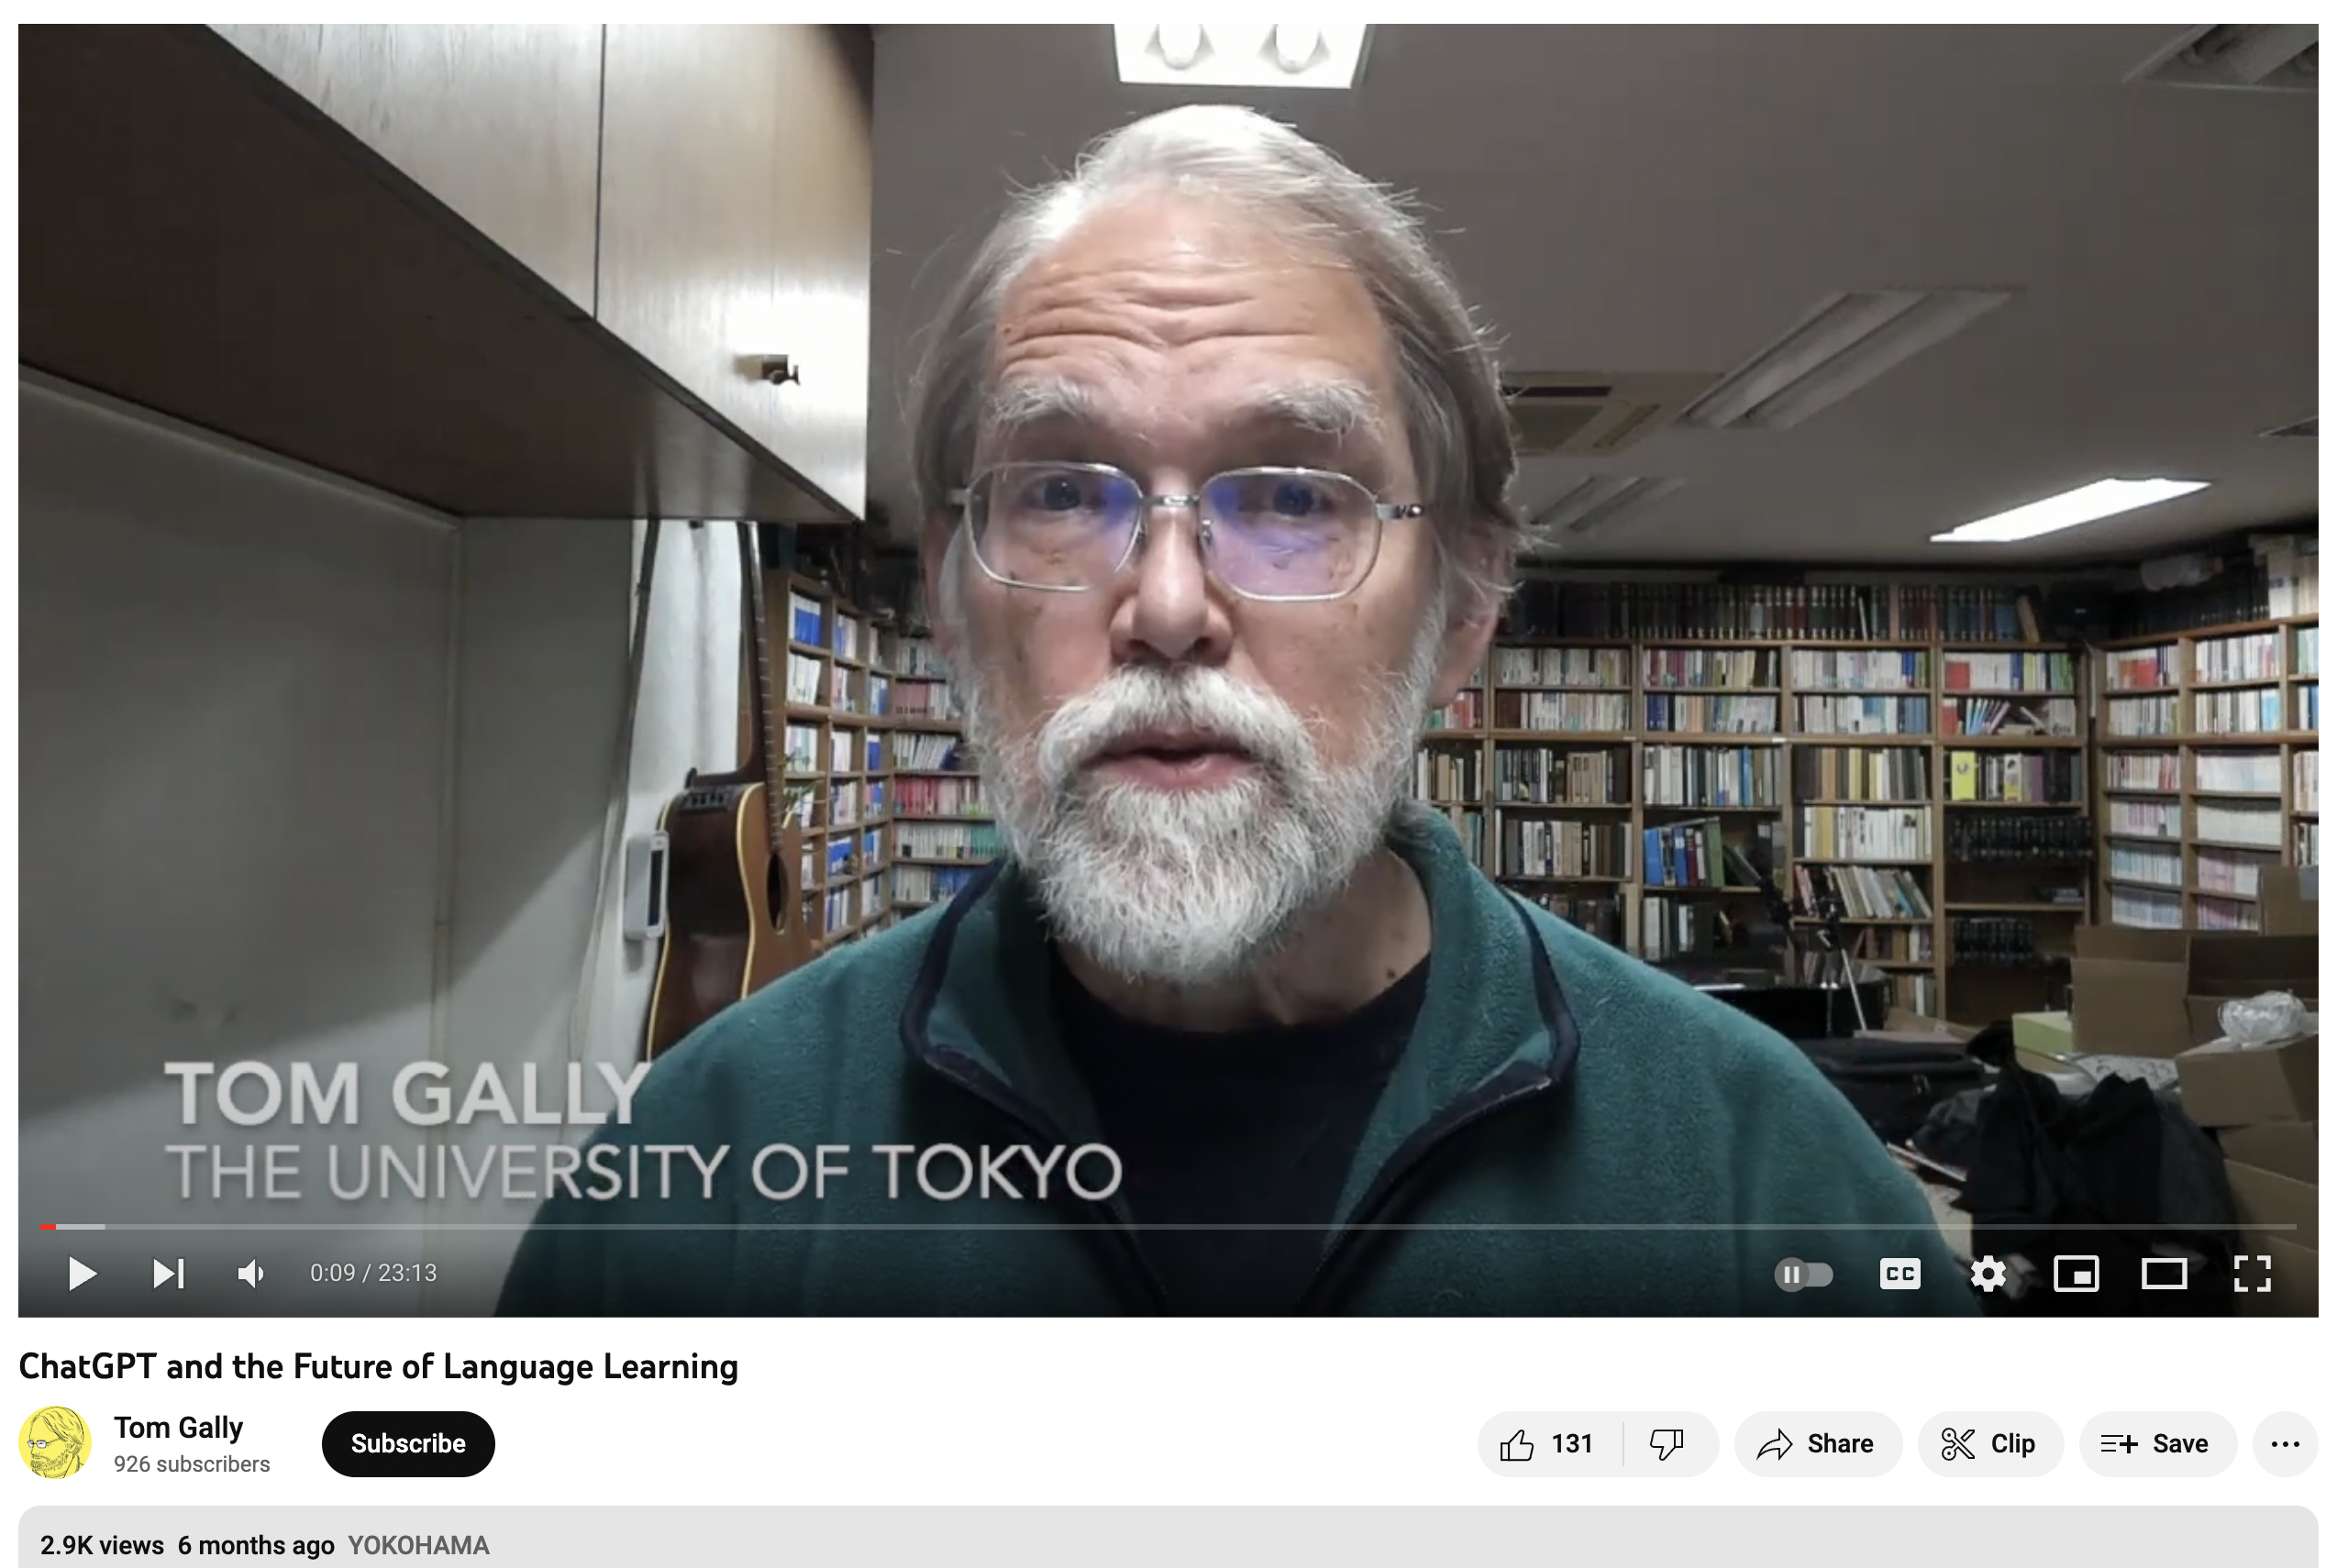
RQ1: What is the focus of the discussion and demonstrations by the YouTube content creators of ChatGPT in language education?
1a. How has the discussion around ChatGPT and related AI technologies evolved during its’ brief history as a tool for language education on YouTube?
Notes:
The video published by Tom Gally on 5 December 2023 served as the earliest example of the growing interest and recognition of ChatGPT’s potential in language education among educators and researchers.

Slide 45
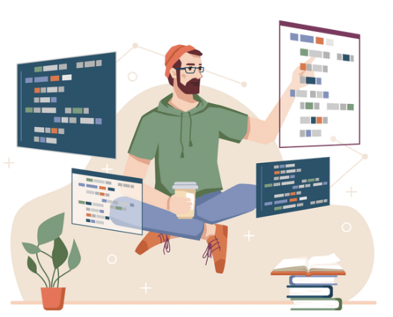



RQ1: What is the focus of the discussion and demonstrations by the YouTube content creators of ChatGPT in language education?
1b. Who is producing videos about ChatGPT in language education on YouTube?
Educators
Learners
Technology
Professionals
e-Learning Providers
Notes:
Educators (n = 58): This category included language teachers (n = 53), teacher trainers (n = 2), educational program directors (n = 1), and professors (n = 2);
Learners (n = 14): This category was mainly language learners, including polyglot language learners (n = 10), Japanese learners (n = 3), and a Spanish learner (n = 1);
Technology Professionals (n = 22): This category included individuals who were employed in technology-related fields. Some worked as project managers (n = 1), data engineers (n = 1), software developers (n = 5), and game developers (n = 1). Others may not have explicitly stated their profession but, nonetheless, created videos based on their specialized skills and knowledge in areas such as coding tutorials (n = 3), emerging technologies (n = 6), and artificial intelligence (n = 4);
e-Learning Providers (n = 8): This category included organizations, institutions, or companies that developed, designed, or provided e-learning solutions and services. These were publishing houses for language teaching materials (n = 1), language learning podcasts or talk shows (n = 2), or any other type of organization that provided e-learning solutions (n = 4).

Slide 46
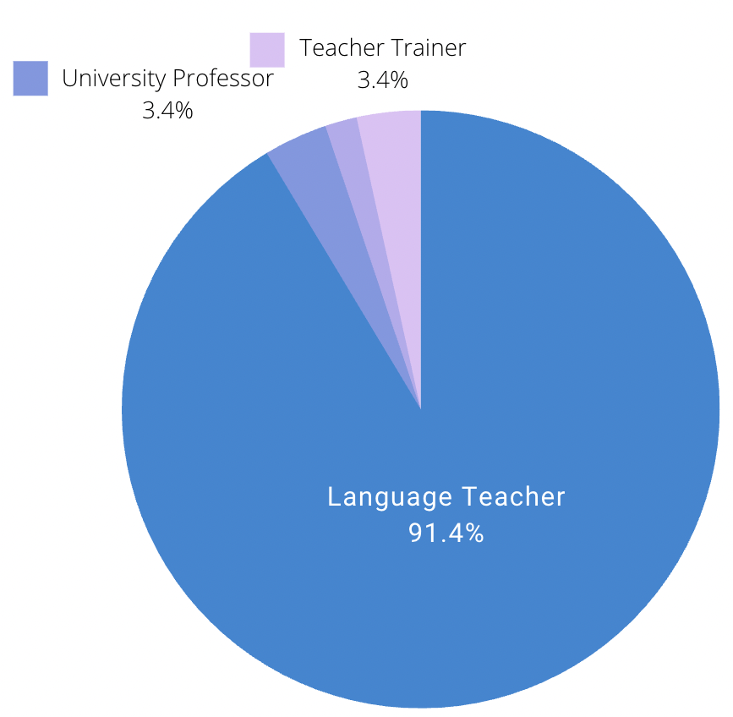

RQ1: What is the focus of the discussion and demonstrations by the YouTube content creators of ChatGPT in language education?
1b. Who is producing videos about ChatGPT in language education on YouTube?
Figure 3. Distribution of Content Creators Producing Videos about ChatGPT in Language Education on YouTube
Figure 4. Distribution of Educators Producing Videos about ChatGPT in Language Education on YouTube
Notes:
Figure 3 and Figure 4 show that the majority of content creators were identified as Educators, primarily language teachers (91.4%). This highlights their interest in using ChatGPT in language education and their active search for innovative tools. Some YouTubers did not directly teach students but provided e-learning content on various languages (7.1%). In effect, they introduced ChatGPT with either language instructors or learners in mind. Learners (12.5%) also played a significant role in creating content on this topic, suggesting that learners also find value in this AI-based tool for language learning.

Slide 47


RQ1: What is the focus of the discussion and demonstrations by the YouTube content creators of ChatGPT in language education?
1b. Who is producing videos about ChatGPT in language education on YouTube?
Figure 5. Distribution of Language Teachers and Learners by Language
Notes:
Figure 5 illustrates the distribution of language teachers and learners by language. The majority of content creators who produced videos about ChatGPT in language education on YouTube were language educators (51.8%), with English teachers being the predominant subgroup (n = 26). Japanese language teachers also demonstrated considerable engagement with ChatGPT, with nine individuals actively creating content related to its application in language instruction. This analysis highlights the diverse linguistic backgrounds and interests of educators who were exploring the potential of ChatGPT in language education. Their sharing has revealed several language-specific factors when utilizing ChatGPT as a tool for language learning and teaching.

Slide 48
RQ1: What is the focus of the discussion and demonstrations by the YouTube content creators of ChatGPT in language education?
1c. What are common topics & themes present in these discussions and demos?
Theme | Codes
Introduce ChatGPT | Natural / human-like conversation Ask it questions and it gives you answers Possessing extensive knowledge
Roles of ChatGPT | Virtual Assistant Tutor [122] [26] On-demand English teacher (19] Personal writing assistant Research Assistance [46] Virtual friend Multi-language support [107] Language genius [89] Language coach [89] Teacher's toolkit [85]
Hands-on Demonstration | Techniques & Tips & Strategies for learners Technique & Tips & Strategies for teachers Common mistakes to avoid when using ChatGPT for language learning The innovative way of using ChatGPT Testing ChatGPT‘s ideology on language learning
Attitudes toward ChatGPT | A game changer for language learning [91] High-Tech Plagiarism [47] Cannot replace language teachers [65] [102]
Solutions | Integrated with other tools (e.g., DeepL, Youglish, and Duolingo) Need for empathy and assistance Pedagogy considerations
Notes:
The 140 videos in our sample covered a wide range of topics, including hands-on demonstrations; innovative ways of using ChatGPT for language learning; implications for language education, learning, and teaching tips and techniques; examples of using GPT-Chat for different languages; pros and cons; tryouts of the affordance of learning languages; comparisons with other language learning/translation tools; and integration into classroom teaching or with other language learning tools and resources (e.g., DeepL, Youglish, and Duolingo). Table 1 provides additional details. The number in the square brackets indicates the unique reference number for each video.

Slide 49

RQ1: What is the focus of the discussion and demonstrations by the YouTube content creators of ChatGPT in language education?
1c. What are the common topics and themes present in these discussions and demonstrations?
Figure 6. The structure pattern of videos about ChatGPT in language education on YouTube
Notes:
Figure 6 provides a typical structure of a YouTube video that discusses the use of ChatGPT in language education.

Slide 50
RQ2: How do content creators describe their current practices of using ChatGPT in language education?
How do they perceive the potential benefits and drawbacks of incorporating ChatGPT in language learning?
What strategies do they use to mitigate any drawbacks and ensure that ChatGPT is effectively used in language education?

Slide 51
RQ2: How do content creators describe current practices of using ChatGPT in language ed?
Q2a. How do they perceive the potential benefits and drawbacks of incorporating ChatGPT in language learning?
Benefits of ChatGPT
1. Providing optimization and enhancement of language learning platforms as an augmentative learning device.
2. Assistance with general questions, vocabulary building, writing tasks, language practice, test preparation, annotating texts, translations, and personalized learning.
3. Acting as an accessible and affordable 24/7 tutor providing relevant information to users as it learns from their interactions.
4. Engaging in conversations and practicing the language in a safe and comfortable environment without fear of judgment or mistakes.
5. Being especially beneficial for students who struggle with traditional teaching methods or have special learning needs.

Slide 52


Slide 53
RQ2: How do content creators describe their current practices of using ChatGPT in language ed?
Q2a. How do they perceive the potential benefits and drawbacks of incorporating ChatGPT in language learning?
Benefits of ChatGPT
6. Creating bespoke content such as learning texts, worksheets, and lesson plans.
7. Helping with job interviews in a foreign language and practicing conversation by generating responses to questions.
8. Providing highly tailored content and transforming how individuals learn languages.
9. Enhancing the language learning experience by fostering learner motivation, improving efficiency, and promoting attentiveness and observation skills
10. Creating an engaging and accessible learning environment that makes language education more enjoyable and readily accessible for learners.
11. Reducing the workload of language teachers.

Slide 54




Notes:
AI-powered language APP

Slide 55




RQ2: How do content creators describe their current practices of using ChatGPT in language ed?
Interview Data

Slide 56


Interview Data (from Study #3)
"I think that's our future. Like it's, it's inevitable right now."
Lucas & Fabricio)
"...it can generate flawless English... if language can produce in that way that isn't taken from chunks out[,] that's machine-produced language, it's not machine-translated language... that really does change things, so the machines can produce language that's accessible in an easy way." (Jo Gakonga)

Slide 57
Interview Data (from Study #3)
“I can talk about anything, and the answers are both positive in terms of the optimism displayed by the bots, and informative. It is very rare to find that combination in a human interlocutor, especially when you want to interact for extended periods, which is what sets it apart...” (Carlos, Interview, May 17, 2023)

Slide 58
RQ2: How do content creators describe their current practices of using ChatGPT in language ed?
Q2a. How do they perceive the potential benefits and drawbacks of incorporating ChatGPT in language learning?
Drawbacks of ChatGPT
1. Lack of emotional or empathetic responses.
2. Limited creativity.
3. Lack of context awareness. 4. Potential of generating inaccurate or inappropriate responses. 5. Incomplete information. 6. Repetition of information.
7. Potential for bias.
8. Inability to learn beyond its training data which goes up until 2021.
9. Potential misuse for malicious purposes.
10. Syntax and grammatical errors.
11. Does not provide much opportunity for speaking practice.

Slide 59
RQ2: How do content creators describe their current practices of using ChatGPT in language education?
Q2a. How do they perceive the potential benefits and drawbacks of incorporating ChatGPT in language learning?
Concerns of ChatGPT
1. The danger of being too dependent on ChatGPT for writing essays and creative writing.
2. Potentially replacing human workers.
3. Creating competition, insecurity, and fear.
4. Data privacy.
5. No connection between the rapid development of AI and the growth of human language faculty.
6. Challenge for teachers as well as organizations and institutions to detect plagiarism.
7. Many replicates countless previous failed attempts to introduce new technology to language education, such as printed books and LP records.

Slide 60


Interview Data (from Study #3)
“..can you use those words and write an article about love, for example, and 10 out of 10 times it gives me a really boring article which I don't think is quite catchy or engaging.” (Shuo Xiong, Interview, June 12, 2023)
“Sometimes it begins to hallucinate or feed you with incorrect information because what it is doing is creating text and it's not always correct.” (Craig Wheland, Interview, May 17, 2023)

Slide 61


Interview Data (from Study #3)
“We have a lot of different versions of English, but it produces this kind of very white bread textbook style, not too old fashioned, not too slang.” (Tom Gally, Interview, May 2, 2023)
“There are concerns when we've got to think about how we are going to make sure that chatGPT is a tool that helps students and doesn't basically undermine some of the skills that really we do believe are fundamental for them.”(Russell, Interview, May 7, 2023)

Slide 62
RQ2: How do content creators describe their current practices of using ChatGPT in language education?
Q2b: What strategies do they use to mitigate any drawbacks and ensure that ChatGPT is effectively used in language teaching and learning?
The need for empathy and assistance for those who cannot use ChatGPT.
Overcoming Limitations of ChatGPT through Using it together with other language learning tools and resources.
Double-checking the answer received from ChatGPT and using other resources such as native speakers or online checking tools.
Integrating effective methods of learning and pedagogy before using ChatGPT in language learning and teaching.

Slide 63
RQ2: How do content creators describe their current practices of using ChatGPT in language education?
Q2b: What strategies do they use to mitigate any drawbacks and ensure that ChatGPT is effectively used in language teaching and learning?
5. Emphasizing the importance of a learner's motivation and efforts.
6. What you get depends on what you ask—users need to learn how to write effective prompts.

Slide 64
Study #2
SUBTITLE GOES HERE IF NECESSARY
How do these communities perceive the educational affordance of incorporating ChatGPT across different languages?
What are the best practices for utilizing ChatGPT in language education, as observed within these communities on YouTube?

Slide 65
RQ1. How do these communities perceive the educational affordance of incorporating ChatGPT across different languages?
Based on Lai et al. (2023)
“High resource” languages, including English, Japanese, Chinese, French, Spanish, German, Portuguese, and Russian.
Korean, Bulgarian and Turkish were categorized as “medium resource” languages.
Lai et al.'s research didn’t include the remaining six languages, Latin, Sorbian, Tajik, Irish, Kashubian, and Latgalian.

Slide 66
ChatGPT is its resemblance to a knowledgeable native speaker rather than a professional language teacher.
ChatGPT‘s behavior can be both positive and informative for users: In situations where finding a human interlocutor who possesses these qualities can be challenging, ChatGPT serves as a valuable tool in avoiding language fatigue during extended conversations.

Slide 67
Two Gaps
Learning Optimization Gap: The first gap arises from learners' inability to fully leverage ChatGPT's technical affordances, leading to reduced educational affordability.
Knowledge Comprehension Gap/ Cognitive Alignment Gap: The second gap emerges between the materials presented by ChatGPT and the learners' capacity to comprehend and absorb the knowledge being conveyed.

Slide 68

Best Practice Cases #1 - Intensive Reading With ChatGPT
Language Learning With Chat GPT: Intensive Reading in Japanese, Spanish, Chinese & French (NiJohnGo) https://www.youtube.com/watch?v=vBbGGn0yxbo

Slide 69


Best Practice Cases #2 - Interactive Text Adventure Game
Language Learning With Chat GPT: Intensive Reading in Japanese, Spanish, Chinese & French (Dustin) https://www.youtube.com/watch?v=vBbGGn0yxbo

Slide 70

Best Practice Cases #3 - PPP Approach With ChatGPT
ChatGTP for language learning https://www.youtube.com/watch?v=vBbGGn0yxbo

Slide 71

Best Practice Cases #4 –
Personalized Vocabulary Table and Reading Materials
How to MAXIMIZE the use of ChatGPT's current functions to learn Chinese in 2023 (The Ultimate Guide) https://www.youtube.com/watch?v=-JgGtrjhFis

Slide 72

Study #3

Slide 73
Study #3
Harnessing ChatGPT As A Loyal Conversational Partner For Language Practice.
Embrace ChatGPT's Imperfections, Don't Dismiss Its Potential.
Use It as A Tool, Not A Crutch.
Fostering a Learner-Centric Approach to GenAI Instruction.
Cultivating Responsible AI Utilization in Language Education.

Slide 74

Study #4

Slide 75


Slide 76

Study #4
Notes:
The study's findings highlight distinct constructs that are both aligned with and extend beyond the scope of Song and Hill's [1] model of SDL when integrating ChatGPT into the language learning process. The researchers identified and added indicators (i.e., technology readiness, content area knowledge, and prior learning experience) in the input category. In addition, they added a new sub-category (i.e., social elements) in the learning context category as well as new indicators and considerations within the personal attribute sub-category; namely, self-efficacy beliefs and attitude - dispositions, emotions, and perspectives). Final modifications to the Song and Hill [1] SDl model included adding “adapting” as an indicator within the autonomous-adaptive process sub-category for SDL category, and “computational agency” as an indicator in the design element sub-category within the learning context category.

Slide 77
Limitations and Implications
Relying solely on YouTube as a source of information for language education
The availability of language learning resources in YouTube may not be equal across different languages.
YouTube videos are created by individuals or organizations with varying levels of expertise and qualifications

Slide 78
USE BLANK SPREADS FOR GRAPHICS OR PHOTOS
Ali, J., Shamsan, M., A., A., Hezam, T. & Mohammed A. A. Q. (2023). Impact of ChatGPT on learning motivation: Teachers and students' voices. Journal of English Studies in Arabia Felix, 2(1), 41-49. 10.56540/jesaf.v2i1.51
Baidoo-Anu, D., & Owusu Ansah, L. (2023). Education in the era of generative artificial intelligence (AI): Understanding the potential benefits of ChatGPT in promoting teaching and learning. Available at SSRN 4337484.
Baskara, R., & Mukarto, M. (2023). Exploring the implications of ChatGPT for language learning in higher education. Indonesian Journal of English Language Teaching and Applied Linguistics, 7(2), 343- 358
Chao, C. (2022). Being a YouTuber that language learners recognize: A study on constructing language teacher identities in social media community of practice. System, 109, 102860. https://doi.org/10.1016/j.system.2022.102860
Cox Communications. (2023). Guide to ChatGPT for Parents and Caregivers. Cox Communications - Residential Articles. Retrieved from https://www.cox.com/residential/articles/guide-to-chatgpt-for-parents-and caregivers.html
Hong, W. C. H. (2023). The impact of ChatGPT on foreign language teaching and learning: opportunities in education and research. Journal of Educational Technology and Innovation, 5(1).

Slide 79
USE BLANK SPREADS FOR GRAPHICS OR PHOTOS
Huang, W., Hew, K. F., & Fryer, L. K. (2022). Chatbots for language learning—Are they really useful? A systematic review of chatbot-supported language learning. Journal of Computer Assisted Learning, 38(1), 237– 257. https://doi.org/10.1111/jcal.12610
Kohnke, L., Moorhouse, B. L., & Zou, D. (2023). ChatGPT for language teaching and learning. RELC Journal, 00336882231162868.
Koraishi, O. (2023). Teaching English in the age of AI: Embracing ChatGPT to optimize EFL materials and assessment. Language Education and Technology, 3(1).
Lai, V. D., Ngo, N. T., Veyseh, A. P. B., Man, H., Dernoncourt, F., Bui, T., & Nguyen, T. H. (2023). ChatGPT beyond English: Towards a comprehensive evaluation of large language models in multilingual learning. arXiv preprint arXiv:2304.05613.
McAfee. (2023). A parent's guide to ChatGPT. McAfee Blogs - Family Safety. https://www.mcafee.com/blogs/family-safety/a-parents-guide-to-chatgpt/
Mhlanga, D. (2023). Open AI in education, the responsible and ethical use of ChatGPT towards lifelong learning. SSTN Electronic Journal. 10.2139/ssrn.4354422

Slide 80
USE BLANK SPREADS FOR GRAPHICS OR PHOTOS
Rudolph, J., Tan, S., & Tan, S. (2023). ChatGPT: Bullshit spewer or the end of traditional assessments in higher education?. Journal of Applied Learning and Teaching, 6(1).
Yurkevich, V. (2023, January 24). Experts warn about possible misuse of new AI tool ChatGPT. WSAZ. https://www.wsaz.com/2023/01/24/experts-warn-about-possible-misuse-new-ai tool-chatgpt/
Zavyalova, K., & Galvin, C. (2022). Teachers as media creators and prosumers: Exploring the reasons & values behind their YouTube pedagogical activity. Irish Educational Studies, 41(1), 187–200. https://doi.org/10.1080/03323315.2021.2022523

