Slide 1

Professor Asha Kanwar, President & CEO
Dr. Venkataraman Balaji, Director, Technology and Knowledge Management
17 October 2017
Notes:
What is MOOC for Development?
The core statement here is that MOOC4DEV is designed for access by learners facing limitations in available connectivity infrastructure and are less-familiar with online learning.
It thus includes arrangements to overcome limitations in available bandwidth
--deliver only audio track and text/script available as PDF; slides used also available as PDF
--can also call learner’s cell phone to deliver the audio track
Rather than use only MOOC space for interactions, enables social media to be integrated with course space;
--learners are far more familiar with online social interactions than with online classroom interactions
--enables access to discussions directly from mobile devices

Slide 2
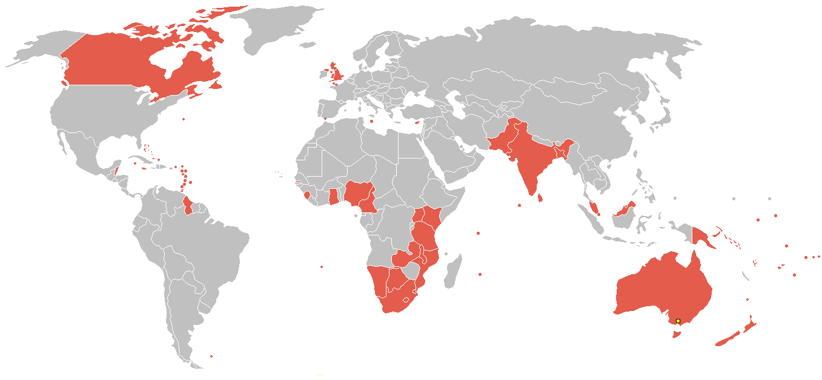
The Commonwealth
Comprises 52 nations around the world
Notes:
Maldives dropped out late 2016.

Slide 3
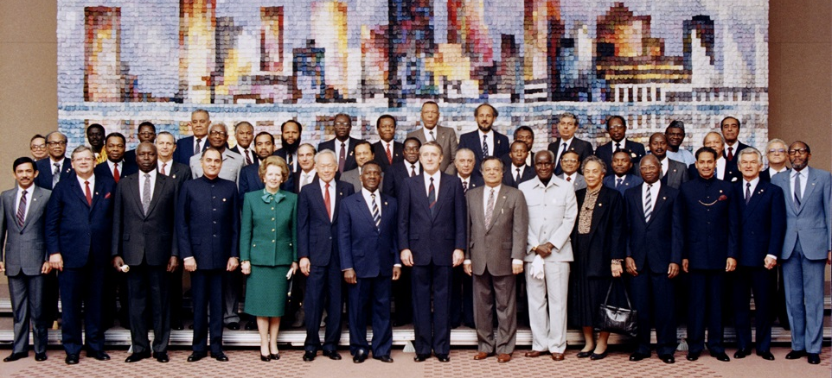
Commonwealth Heads of Government Meeting
Vancouver, 1987
Notes:
We invite you to engage us; tap into our thought leadership, expertise, networks and resources

Slide 4

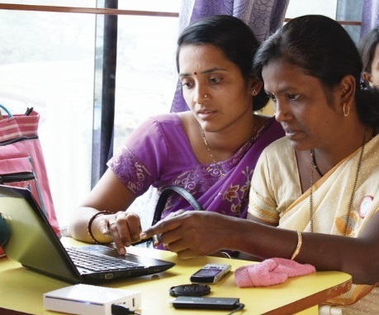
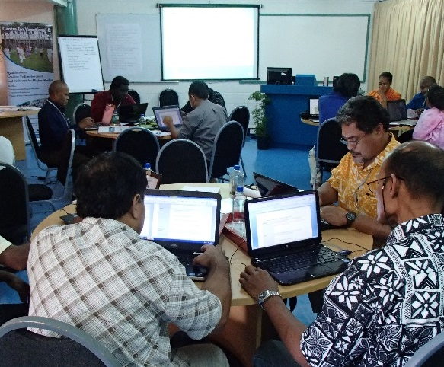
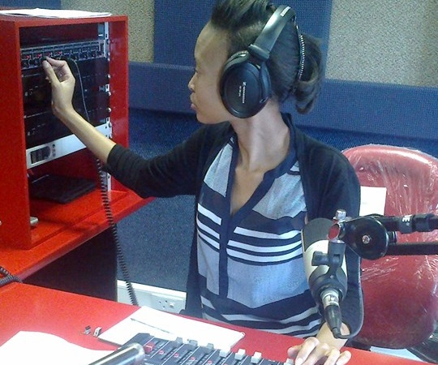
To help Commonwealth governments and institutions
use various technologies to improve access
to learning in support of development

Slide 5
Context

Slide 6



Slide 7

The Youth ‘Bulge’: 1.2 billion 15-29
Of the 2.2 billion population of the Commonwealth,
60% under the age of 30
Source: The Commonwealth Youth Programme, last accessed on October 12, 2017

Slide 8
Gross Enrolment Ratio 2015 by Region and Level of Education
Source: UNESCO Institute for Statistics, Last accessed on October 12, 2017
Notes:
Source: http://unstats.un.org/unsd/methods/m49/m49regin.htm#developed
Developing regions
Africa
Americas excluding Northern America
Caribbean
Central America
South America
Asia excluding Japan
Oceania excluding Australia and New Zealand
Developed regions
Northern America
Europe
Japan
Australia and New Zealand

Slide 9
MOOCs can be an ally in Open Learning
Provide access to quality learning at low costs.
Build capacity at scale.
Improve learning outcomes, through the use of alternative pedagogical approaches.
Be integrated within national quality assurance frameworks.

Slide 10
MOOC as a Tech Suite….
scalability
media technology
assessment techniques online
online event/ conferencing management

Slide 11

Diversification in MOOCs
No longer limited to credit orientation
Not limited to Higher Education sector
Notes:
No longer limited to Higher Education
Not confined to credit oriented courses

Slide 12


Direct Use of a MOOC Service

Slide 13


Adaptation of Tech
XuetangX has Eight Million learners (Sep 2017)

Slide 14
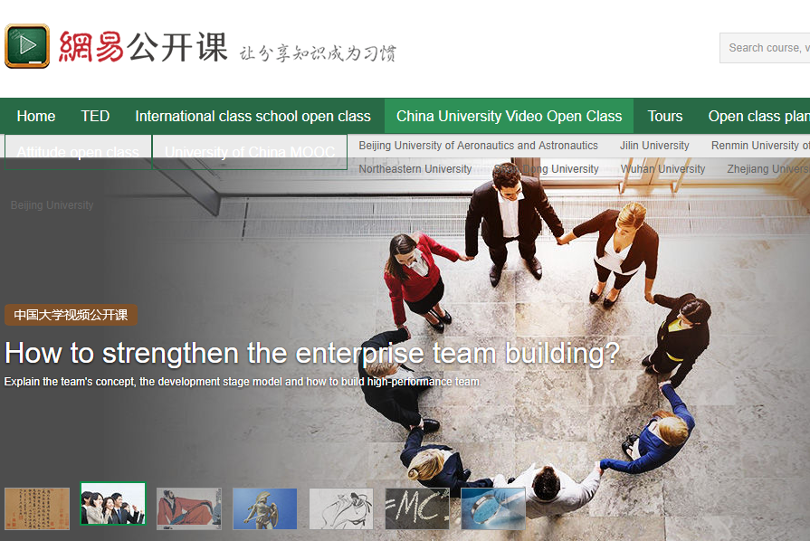

Re-engineering the Tech Suite in MOOC
MOOC portal of Ministry of HRD, India (built by Microsoft)
For-profits in China, such as 163.com

Slide 15
Why is re-engineering necessary for MOOC4D in Open Education
Reaching out to Faculty with no exposure to TEL
Learners not comfortable with peer-grading and online socialising paradigms in industry-grade MOOCs
Strongly felt need for mentoring in the course space
Video streaming demands bandwidth
  implies reasonable or high costs to learners

Slide 16
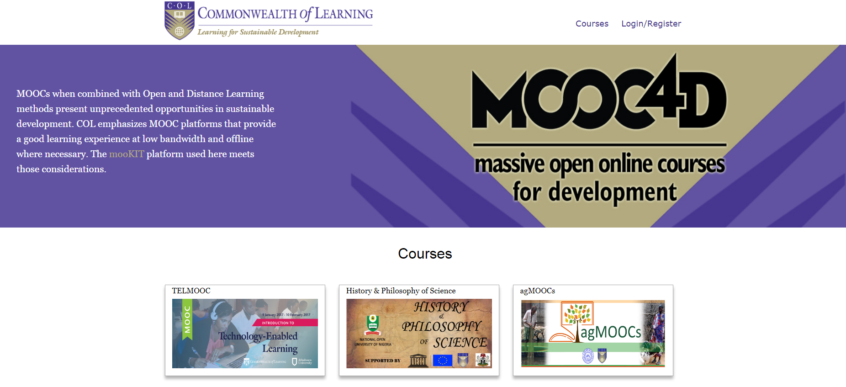
COL’s MOOC4Dev
Adaptation
Re-engineering
and innovation

Slide 17


COL and Indian Institute of Technology Kanpur partnership
MooKIT platform
  Scalable to tens of thousands at low cost
  Uses publicly accessible video streaming services (such as YouTube)
    Content is open (OER)
Audio track of video accessible on a phone
Scripts of talks and slides available (as PDF)
Integrates Social Media into the course discussion space

Slide 18

COL’s MOOC4D:
3
MOOCs using just basic cell phones as access devices
Overview
18
112 countries
MOOCs on topics related to Human and Sustainable Development
20,000 learners
Notes:
18 MOOCs on topics related to Human and Sustainable Development
3 MOOCs using just basic cell phones as access devices
Total of 20 000 learners from
112 countries

Slide 19


Platform used for capture of analytic data covers more offerings by partners
mooKIT Platform Deployment
~112,000
learners in past 30 months
Notes:
Platform used for capture of analytic data covers more offerings by partners
About 112,000 learners in all in 30 months

Slide 20


Videos and text used
Material in video format was couriered on DVDs and memory cards to Sierra Leone and Zambia
The groups completed online assignments and examination; some eligible for certification

Slide 21

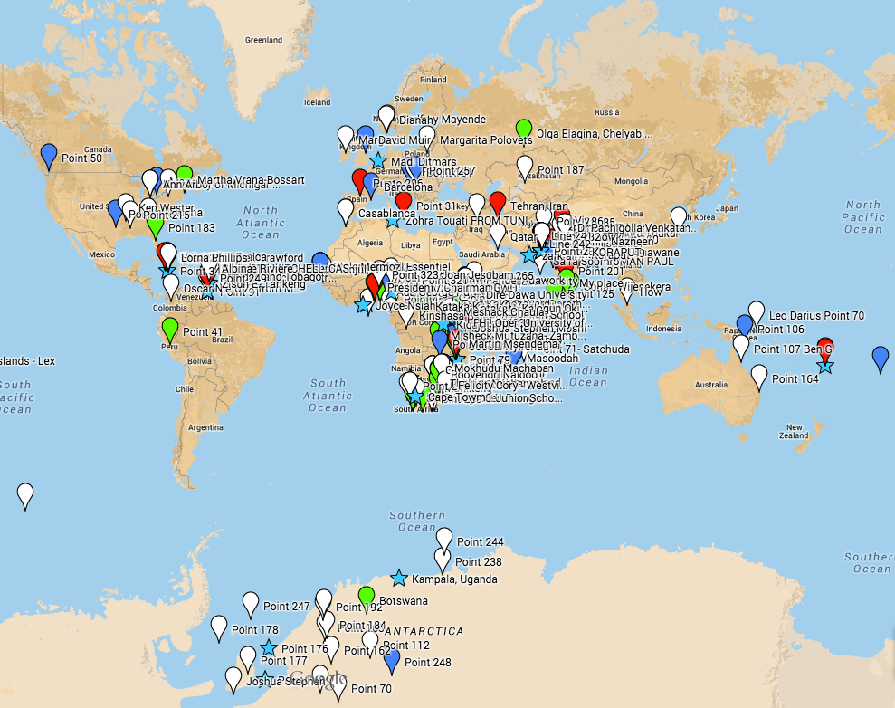
Using ICTs to Enrich Teaching and Learning
Collaboration with African Virtual University (AVU) – 2015
1,692 registered
Use of video clips, graphics and games
Kenya, South Africa, India, United States, Nigeria, Uganda, Trinidad & Tobago, Jamaica, Pakistan, Tanzania

Slide 22

“…..presenters were amazed at the contributions and cross cultural exchanges that happened on Social Media”.
Ian Thomson, Course Manager
Notes:
We are beginning to appreciate a huge potential for MOOCs as a capacity building tool in the Pacific.
The Climate Change MOOC showed that Pacific Islanders are ready for this.
Many of our presenters were amazed at the contributions and cross cultural exchanges that happened on Social media. Much better than F2F classes and on Moodle

Slide 23



Platform support
Notes:
National Open University of Nigeria (NOUN)
MOOC on Tech-Enabled Learning (TELMOOC), COL and Athabasca University
Institute of Tourism Studies, Malta

Slide 24

MOOCs for Agriculture
Online learning
  Food and Ag sector underserved
A consortium conceptualised by COL, anchored at IIT-Kanpur

Slide 25
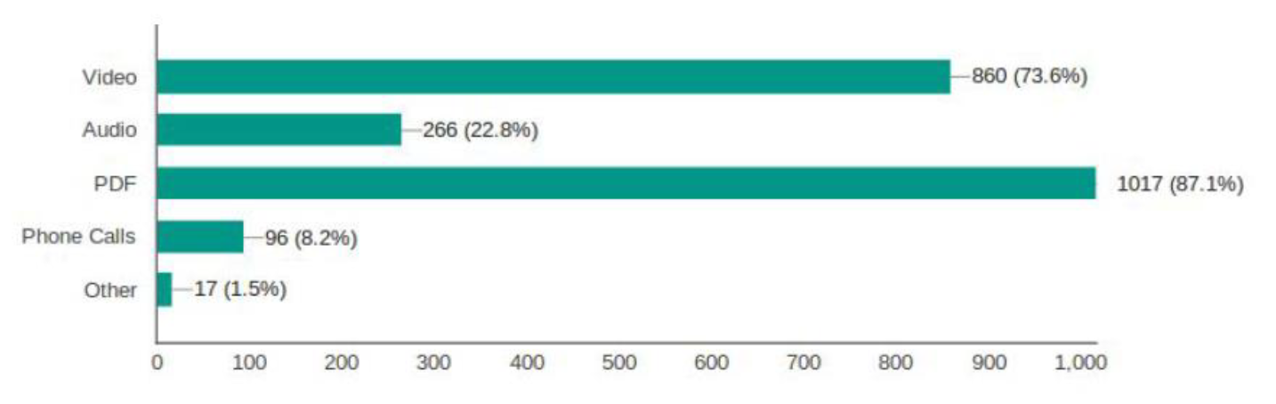
Important to allow content access in multiple formats

Slide 26
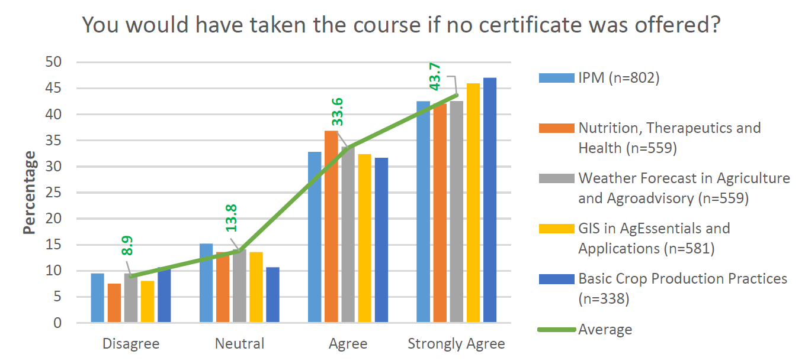
Certificate is not the main source of motivation
Notes:
Responses gathered from several hundred participants in each MOOC

Slide 27
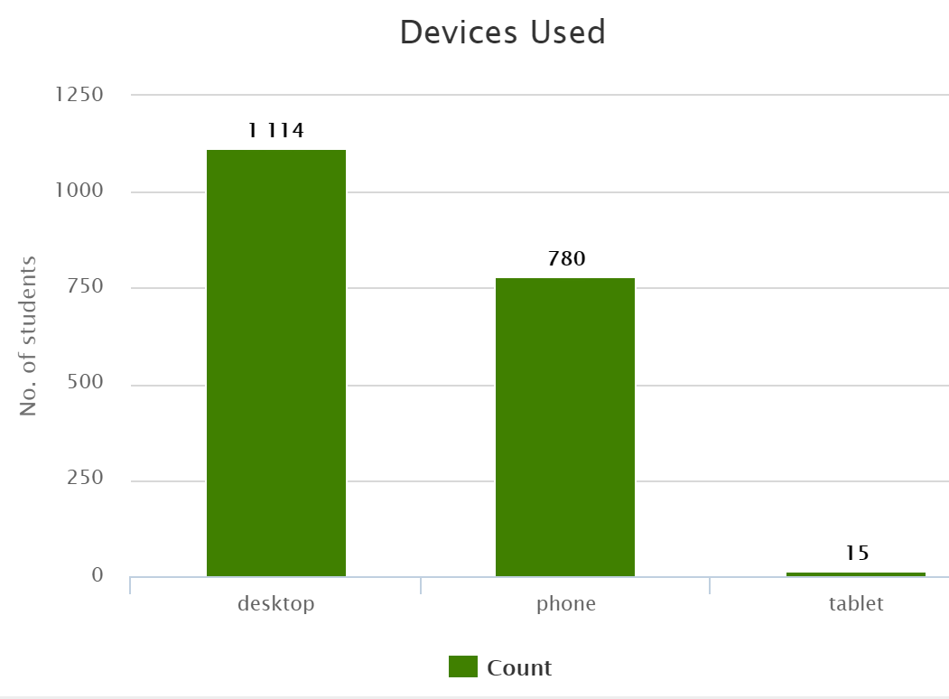
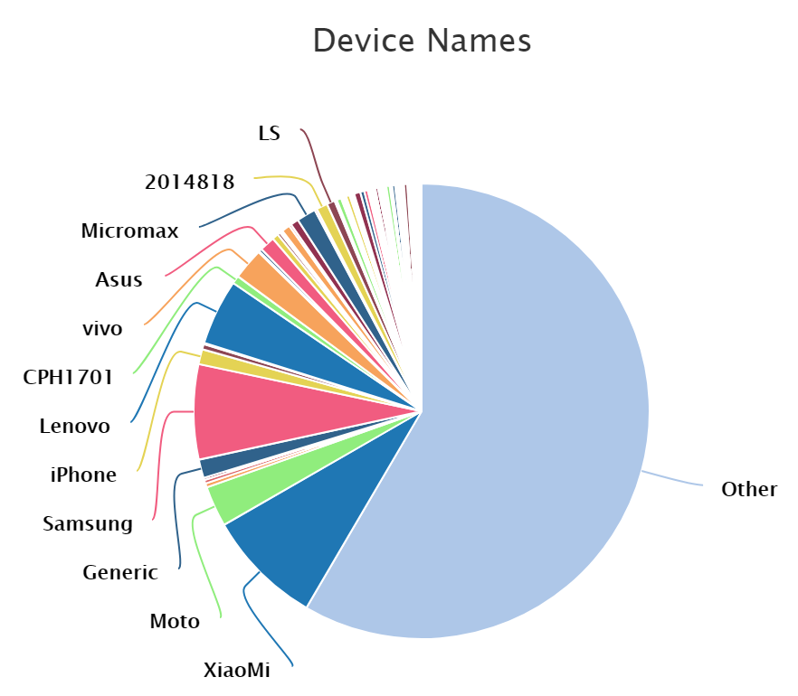
Methods of Access
(Data from a MOOC, 10 October 2017)

Slide 28
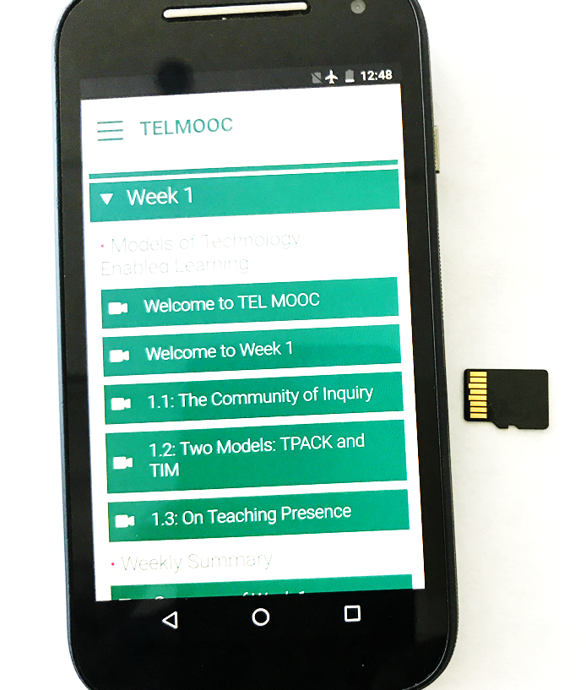

An “Off-lined” MOOC?

Slide 29
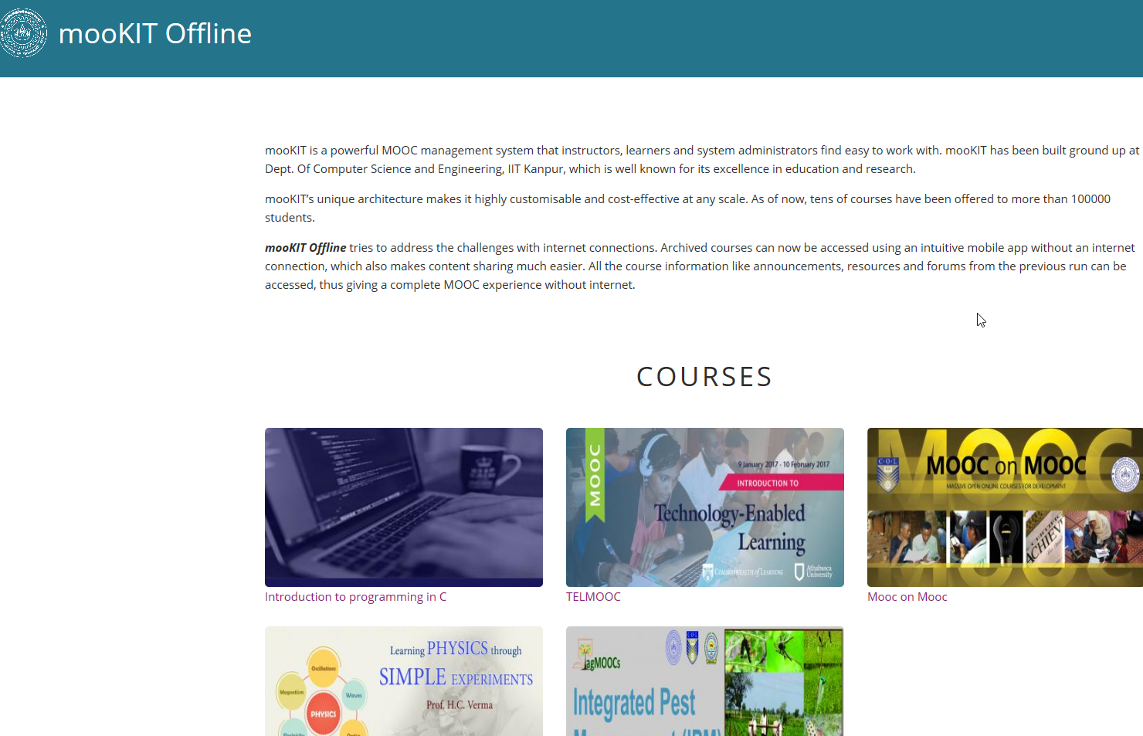

Slide 30
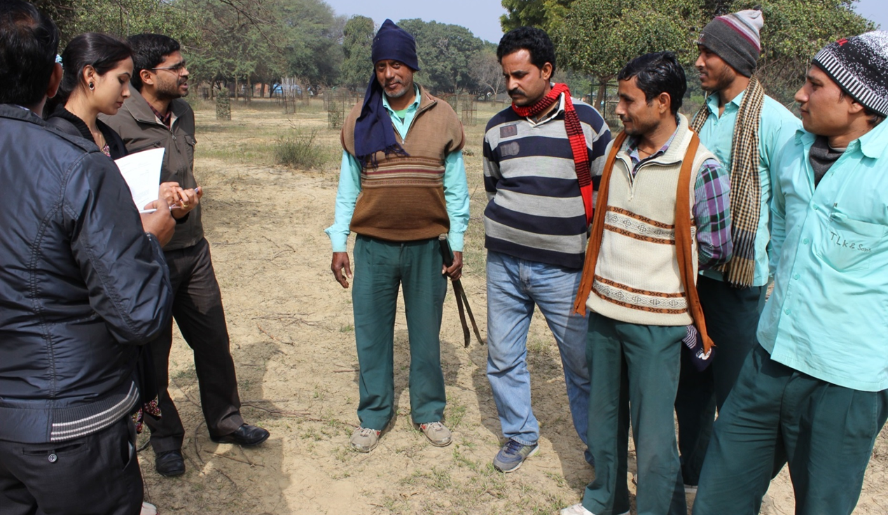
Audio-only MOOC for Semi-skilled Gardeners

Slide 31
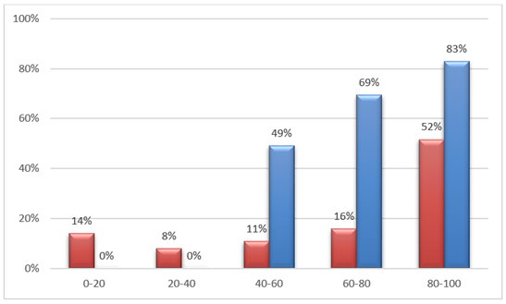
Audio-only MOOC
Correlation between clips listened to and completion rates

Slide 32
Reaching the Bottom Billion
Content should be designed for delivery in low bandwidth
Be able to deliver on a basic phone
Social media integration is a must
Online peer-to-peer interactions must be supplemented with blended approaches
Content should be open (i.e. OER)

Slide 33
Quality

Slide 34
Guidelines for Quality
COL Guidelines for MOOCs
Purpose decides quality indicators
Context critical
Accreditation agencies looking for credit equivalence

Slide 35
Guidelines for QAA of MOOCs
Presage
Process
Product
Platform and Provider
Credits and Credentials
Institutions, Instructors
Learners
Instructional Design
Resources
Learning Process
Engagement and Participation
Satisfaction
Completion

Slide 36
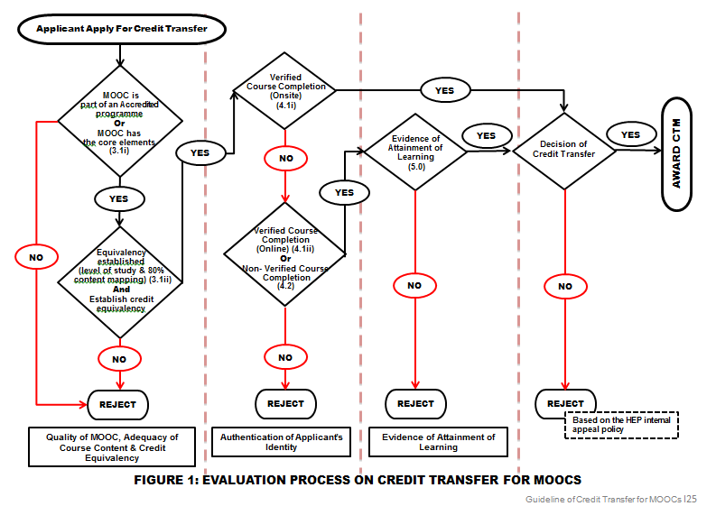
Malaysian MOOC Credit Transfer

Slide 37

Issues for Quality
One size does not fit all
Student verification and academic integrity
Peer assessment needs to be accepted
Delinking of the institutions which teach and the institutions which offer credential

Slide 38
Implications for Policy

Slide 39

National Policy
View MOOC as a new, interactive broadcast medium
Develop credible QA and Credentialing framework
Focus on Higher Education as well as advanced skills development/in-service training
Develop and nurture a capable and robust infrastructure
Manage costs: adopt OER policies

Slide 40
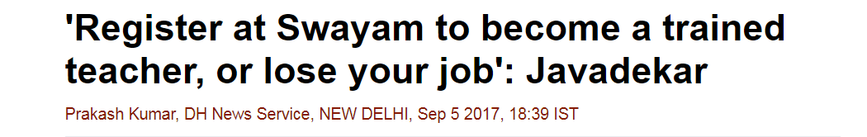
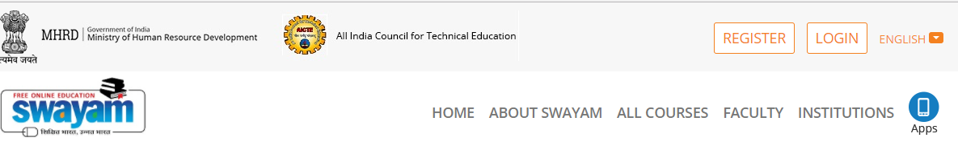

Slide 41
Rise of the Messaging Paradigm
Notes:
A very important trend in Communication Tech that has strong implications for learning is the sudden and rapid rise of Messaging as a paradigm. WhatsApp and Messenger have billions of users and they are messaging systems. Global Traffic due to messaging is larger today than traffic in social media networks. This is to do with the rapid increase in the number of users of smartphones everywhere including developing countries. The graph here shows that by the middle of last year, Apps that work only with Messaging platforms had more users than Apps that work with social media. The implication for the emerging flexible, online learning is enormous.

Slide 42


Mainstreaming of MOOCs in developing countries national systems
Integration of two technologies:
Messaging space for interactions
Use of Blockchains for preserving integrity of learner records
Notes:
May need integration of two technologies:
Messaging space for interactions (as contrasted to the Web)
Messaging systems like WhatsApp are widely used
Use of Blockchains for preserving the integrity of learner records
Rapidly emerging tech, already in use in Financial Tech

Slide 43
Finally, for developing countries
New model of MOOCs required, one that reaches the unreached
MOOCs will supplement rather than replace traditional institutions
Excellent platform for skilling at scale and speed

Slide 44
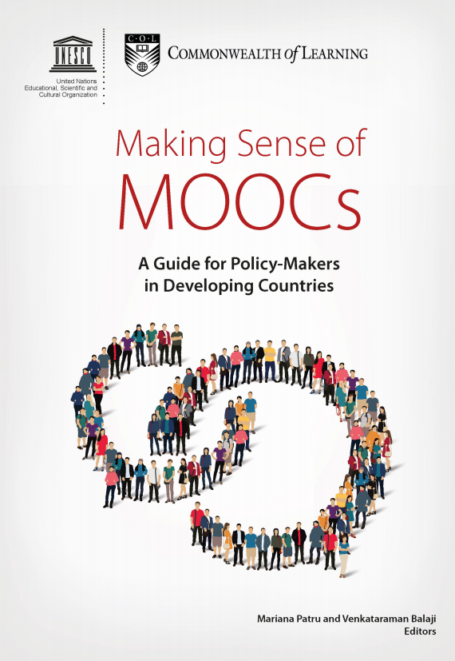
MOOCs
A tool for achieving SDG 4

Slide 45

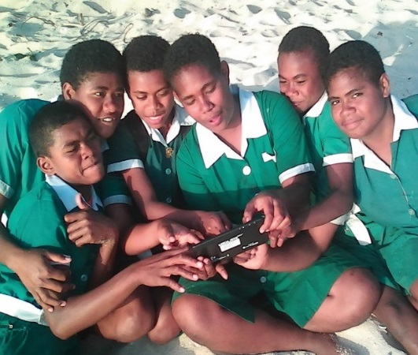
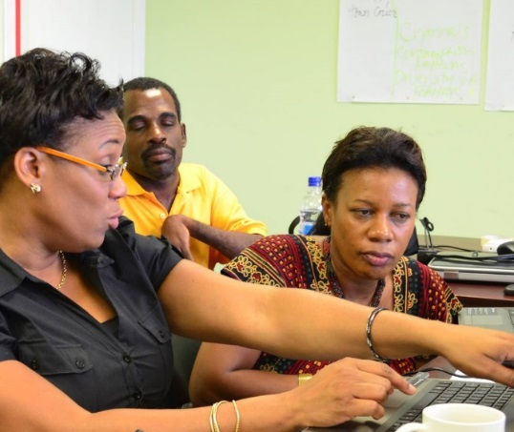
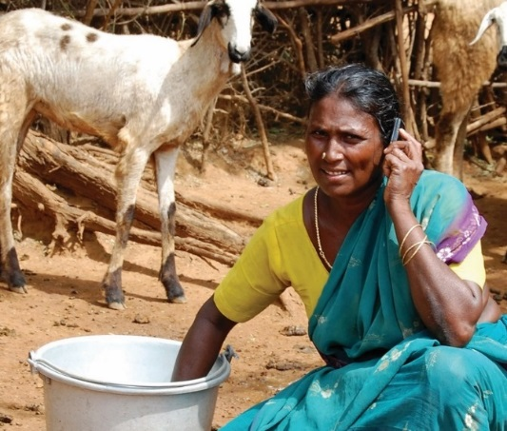
Thank You
col.org

