Slide 1
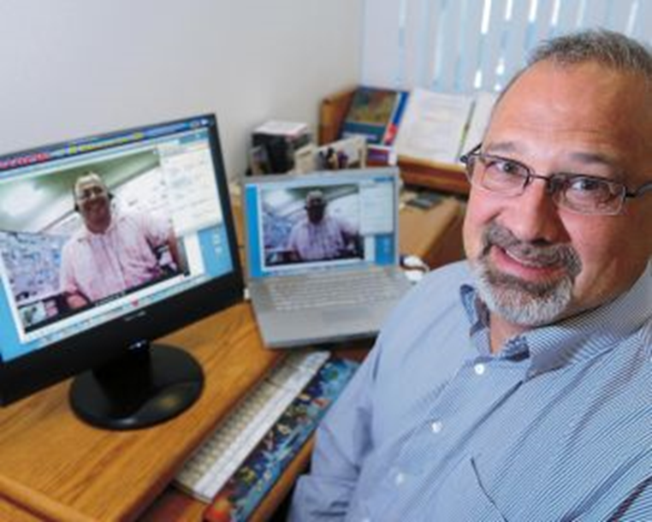
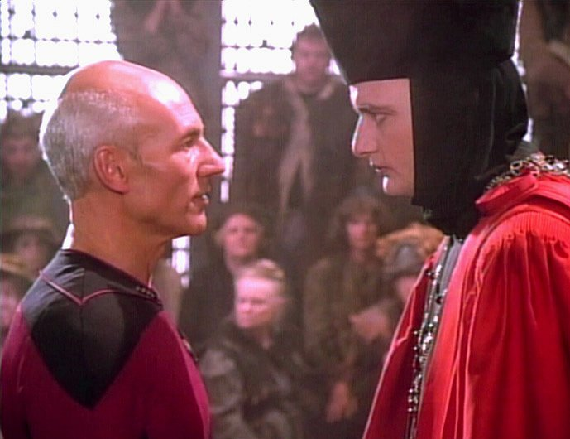
Through the Words of Experts:
Cases of Expanded Classrooms Using Conferencing Technology
Dr. Curtis J. Bonk, cjbonk@indiana.edu
Professor, Indiana University

Slide 2


The Age of Videopedia…
Source: http://reviews-bonuses.net/videopedia-pro-1-0-reviews-bonuses/

Slide 3
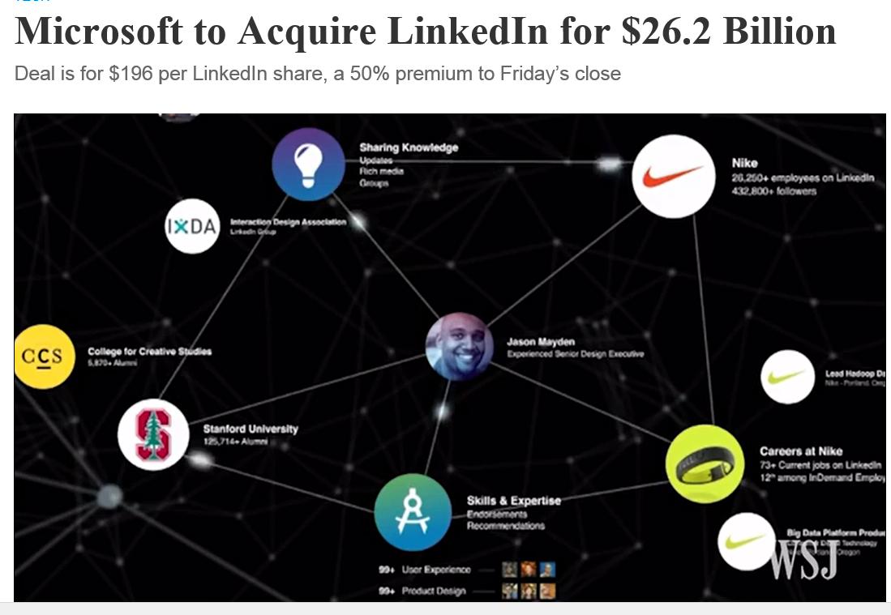
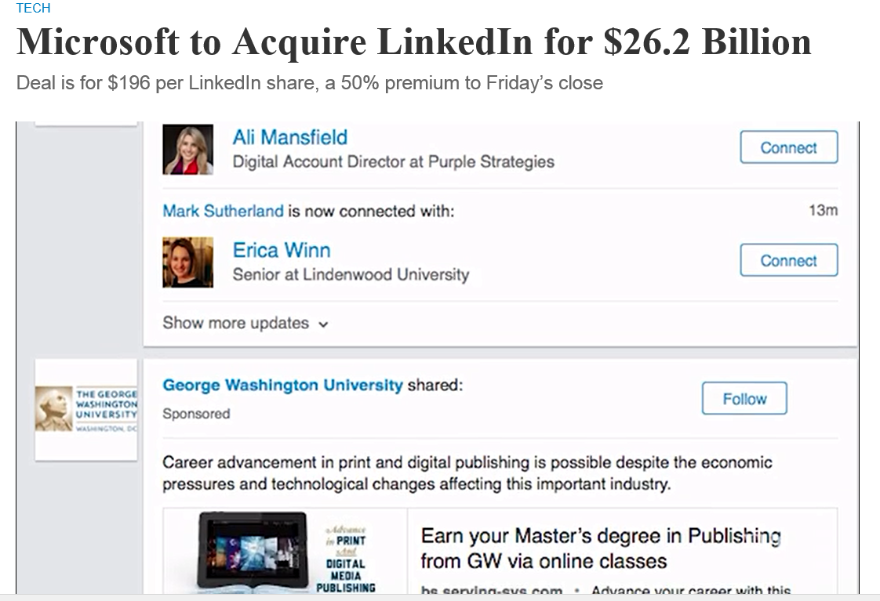
June 14, 2016
Microsoft to Acquire LinkedIn for $26.2 Billion, Jay Greene, CNN Money http://www.wsj.com/articles/microsoft-to-acquire-linkedin-in-deal-valued-at-26-2-billion-1465821523

Slide 4
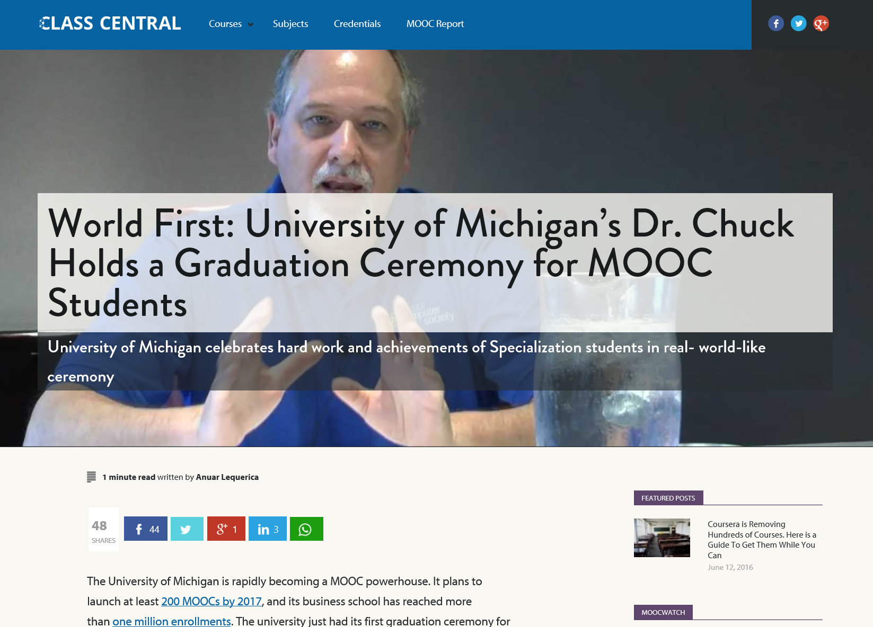
June 14, 2016
World First: University of Michigan’s Dr. Chuck Holds a Graduation Ceremony for MOOC Students
Anuar Lequerica, Class Central https://www.class-central.com/report/dr-chuck-graduate-ceremony-python-specialization/

Slide 5
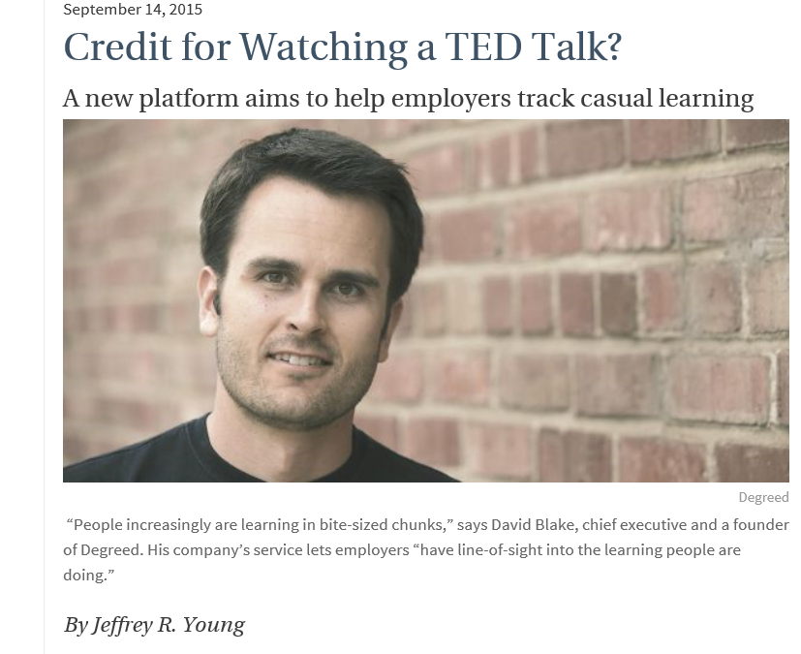
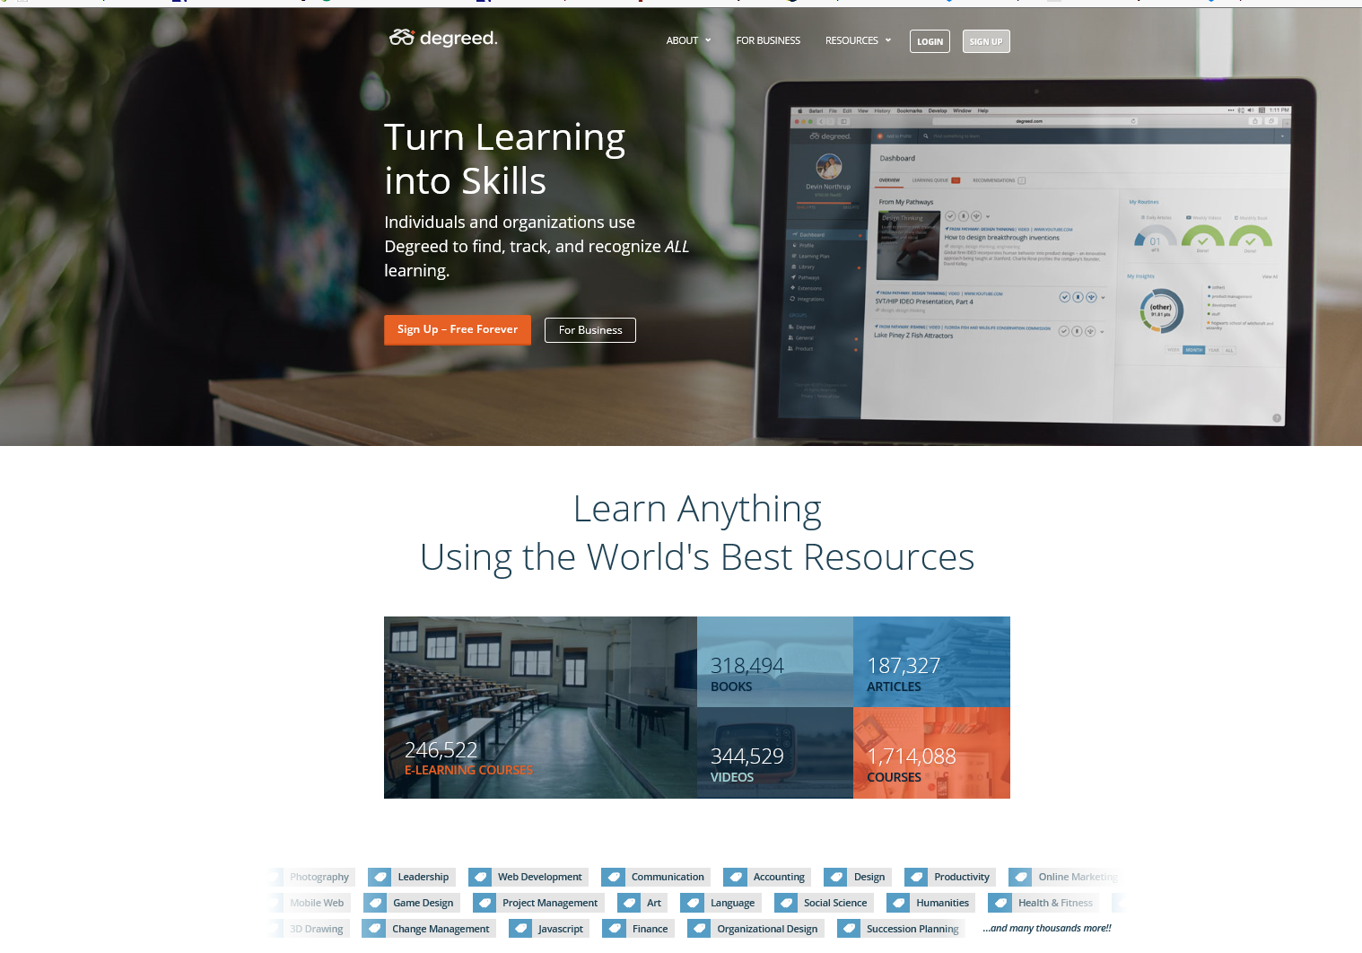
September 14, 2015
Credit for Watching a TED Talk? A new platform aims to help employers track casual learning
Chronicle of Higher Education, Jeffrey R. Young http://chronicle.com/article/Credit-for-Watching-a-TED/232973/?cid=at&utm_source=at&utm_medium=en
Degreed: https://degreed.com/

Slide 6
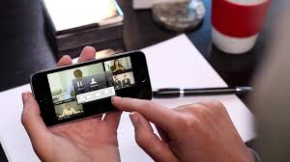
February 2016
Will Video Kill the LMS?
Josh Bersin, CLO http://www.clomedia.com/articles/6720-will-video-based-learning-kill-the-lms
YouTube statistics show more than a billion people regularly watch video, and the number of hours spent watching video rose 60 percent in the last year alone. More than 2 billion people have video-enabled smartphones, and video now makes up 64 percent of Internet traffic on mobile phones.

Slide 7

February 2016
Will Video Kill the LMS?
Josh Bersin, CLO http://www.clomedia.com/articles/6720-will-video-based-learning-kill-the-lms
In the learning industry, companies like BigThink, General Academy, Khan Academy, Pluralsight, Skillsoft, Udacity and Udemy produce thousands of hours of high-quality instructional video—much of it authored by experts, not instructors—which is easy to find, use and absorb on the Internet.

Slide 8
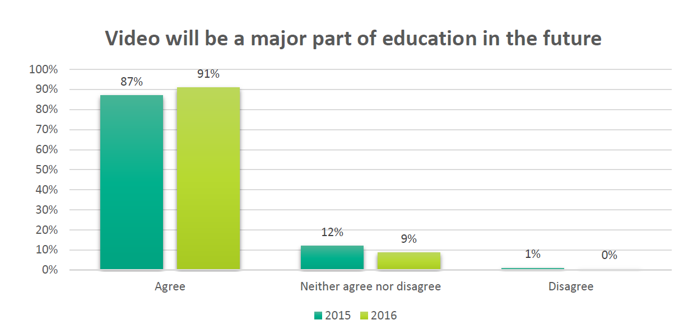
July 18, 2016
Survey: Video Usage in Ed Continues Ramp-up, Dian Schaffhauser, THE Journal https://thejournal.com/articles/2016/07/18/research-video-usage-in-ed-continues-ramp-up.aspx

Slide 9
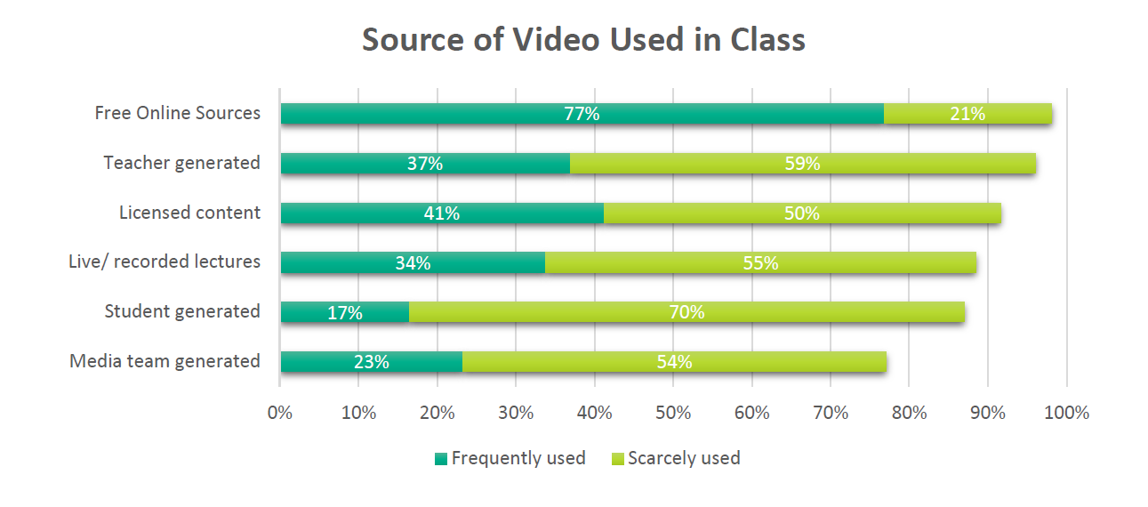
July 18, 2016
Survey: Video Usage in Ed Continues Ramp-up, Dian Schaffhauser, THE Journal https://thejournal.com/articles/2016/07/18/research-video-usage-in-ed-continues-ramp-up.aspx

Slide 10
Part I: Expert Apprenticeship from Video

Slide 11
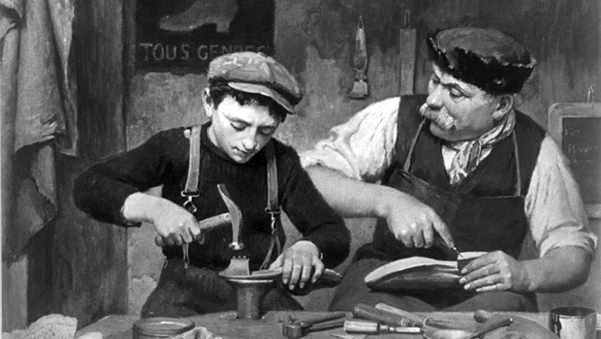
Apprenticeship in the Past…

Slide 12

1. Instructor as Concierge

Slide 13

2. Instructor as Consultant

Slide 14
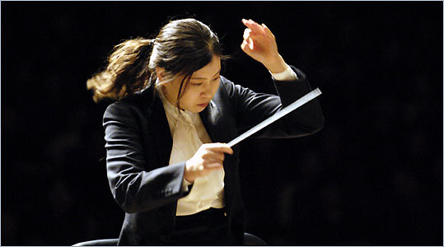
3. Instructor as Conductor

Slide 15

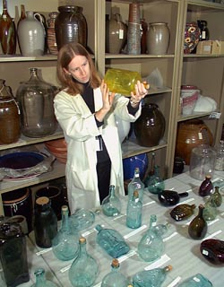
4. Instructor as Curator

Slide 16

5. Instructor as Camping Trip Guide

Slide 17
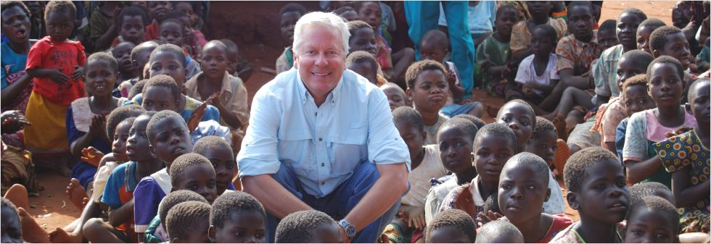
6. Instructor as Course Ambassador

Slide 18
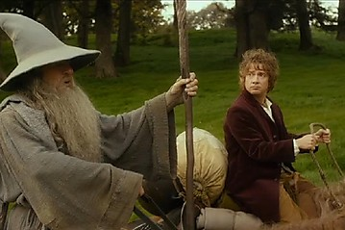
Age of Instructor as Curator, Concierge, Counselor, etc.

Slide 19

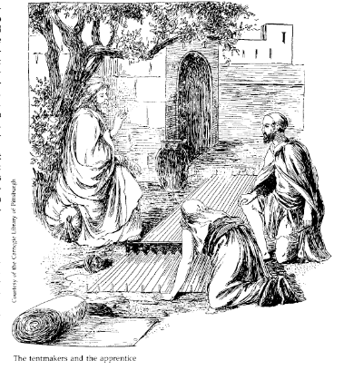
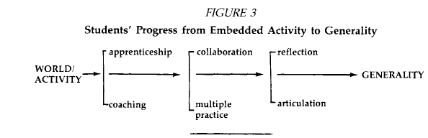
Instruction as a Cognitive Apprenticeship

Slide 20
Rationale Behind Web Conferencing
Reflect on real world
Receive mentoring and advice
Articulate ideas and questions for the expert
Try out initial kernels of ideas
Novice on the boundary peers into discipline
Form new social connections
See new perspectives
Get excited about a discovery, issue, idea, finding, etc.

Slide 21
Principles of Connectivism
Learning and knowledge rests in diversity of opinions.
Learning is a process of connecting specialized nodes or information sources.
Learning is a process of connecting entities
Nurturing and maintaining connections is needed to facilitate continual learning.
Ability to see connections between fields, ideas, and concepts is a core skill.
Capacity to know more is more critical than what is currently known.
Currency (accurate, up-to-date knowledge) is the intent of all connectivist learning activities.

Slide 22
Quote from George Siemens
“The pipe is more important than the content within the pipe. Our ability to learn what we need for tomorrow is more important than what we know today.”
Siemens, 2004

Slide 23

Social Networks
Image: http://www.pcworld.com/article/244021/22_million_workers_used_social_networks_to_land_their_current_job.html

Slide 24
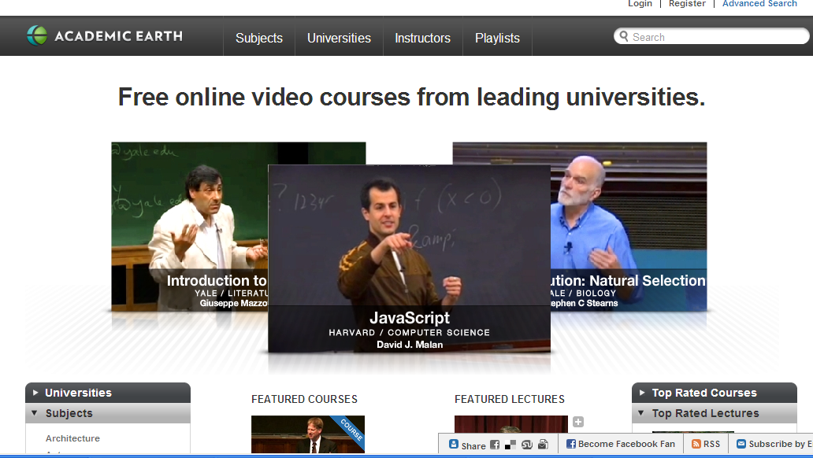
Academic Earth

Slide 25
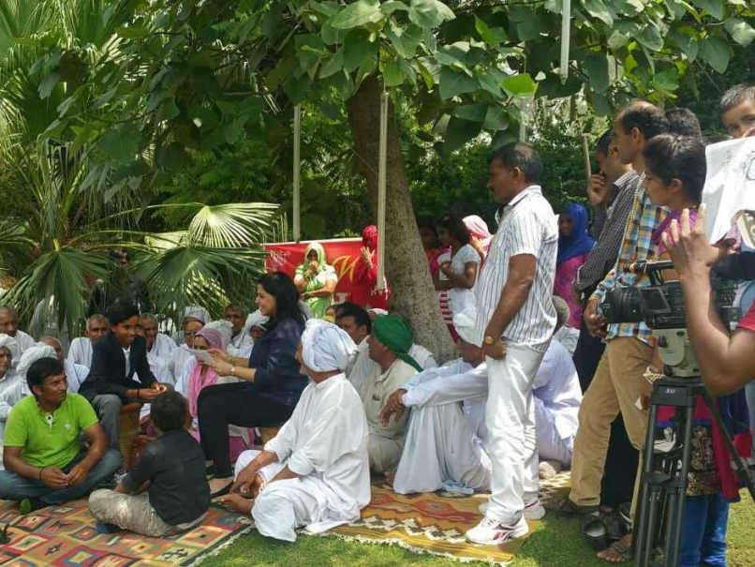
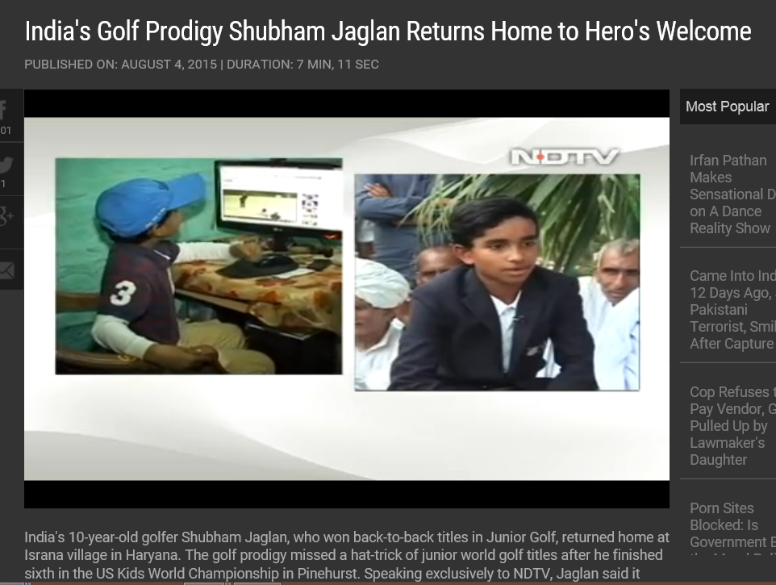
August 5, 2015
Shubham Jaglan Overwhelmed by "Dream" Return Home After Double World Championship
Disha Chopra, NDTV Sports http://sports.ndtv.com/golf/news/246551-shubham-jaglan-overwhelmed-by-dream-return-home-after-double-world-championship http://www.ndtv.com/video/player/news/india-s-golf-prodigy-shubham-jaglan-returns-home-to-hero-s-welcome/377614

Slide 26
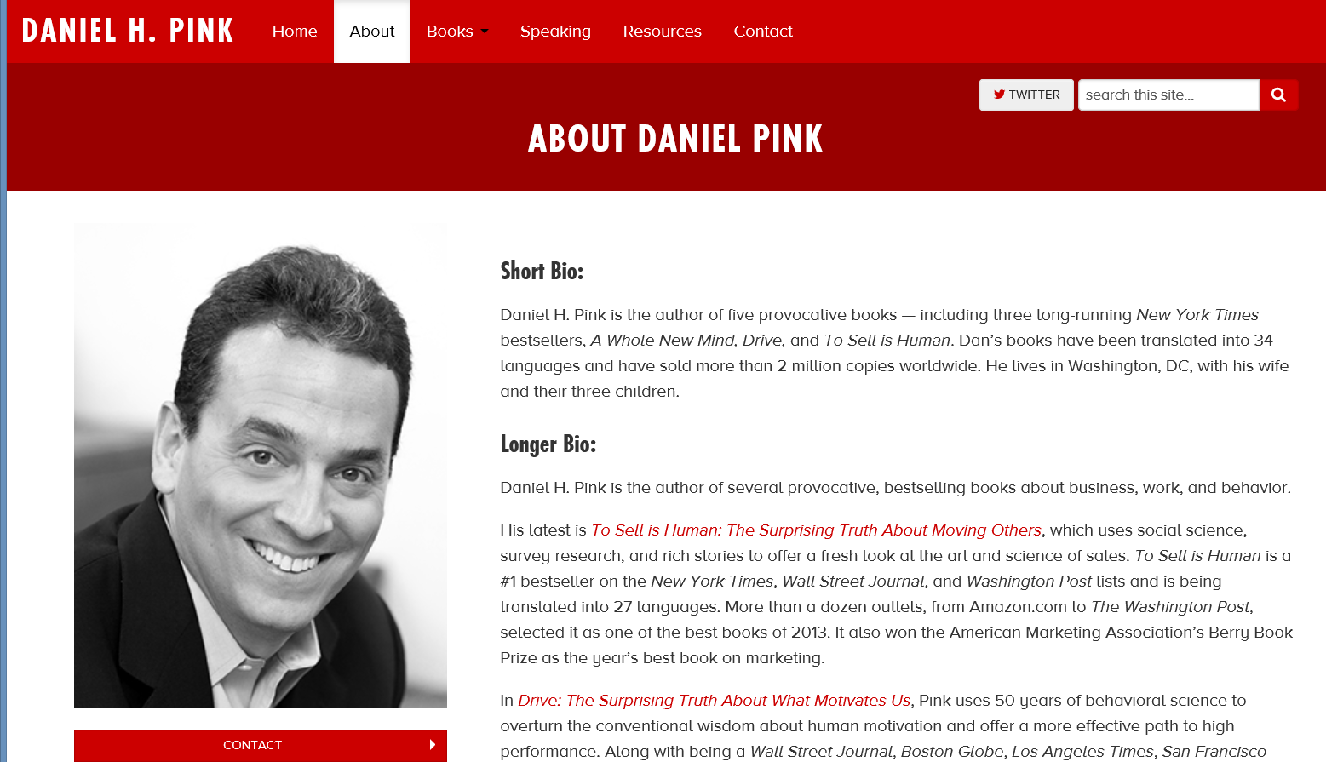
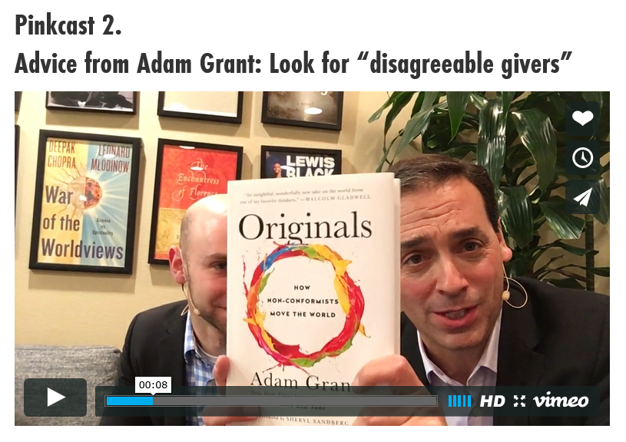
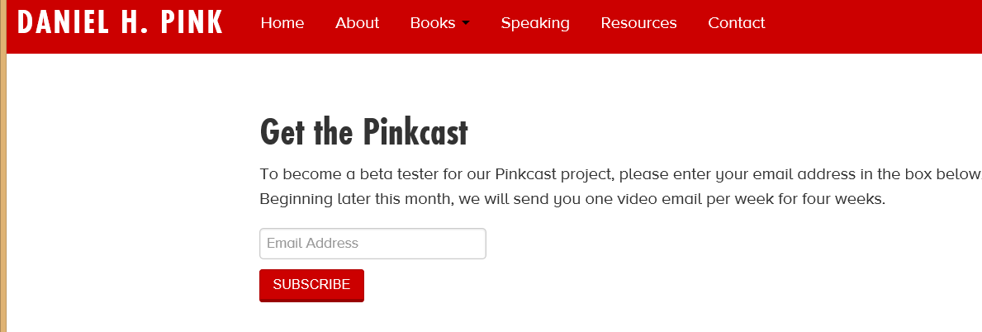
February 17, 2016
Daniel H. Pink, Pinkcast http://www.danpink.com/

Slide 27
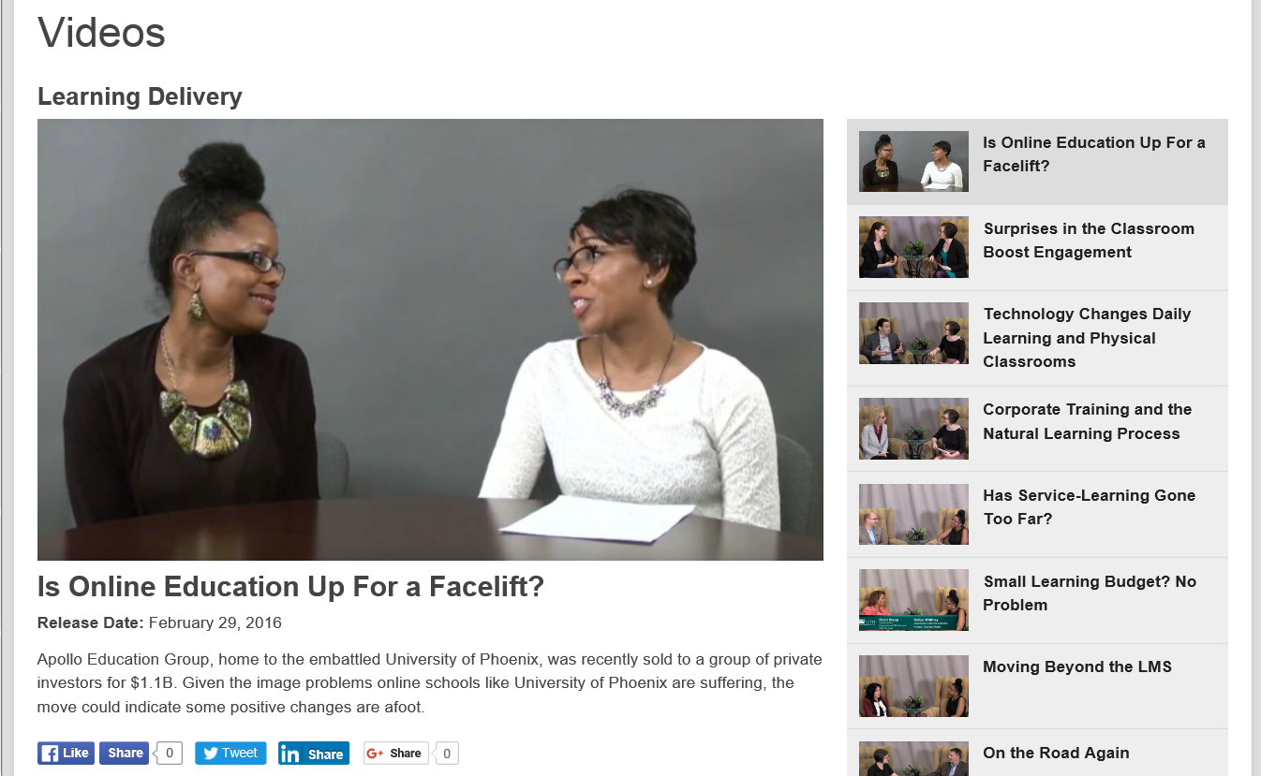
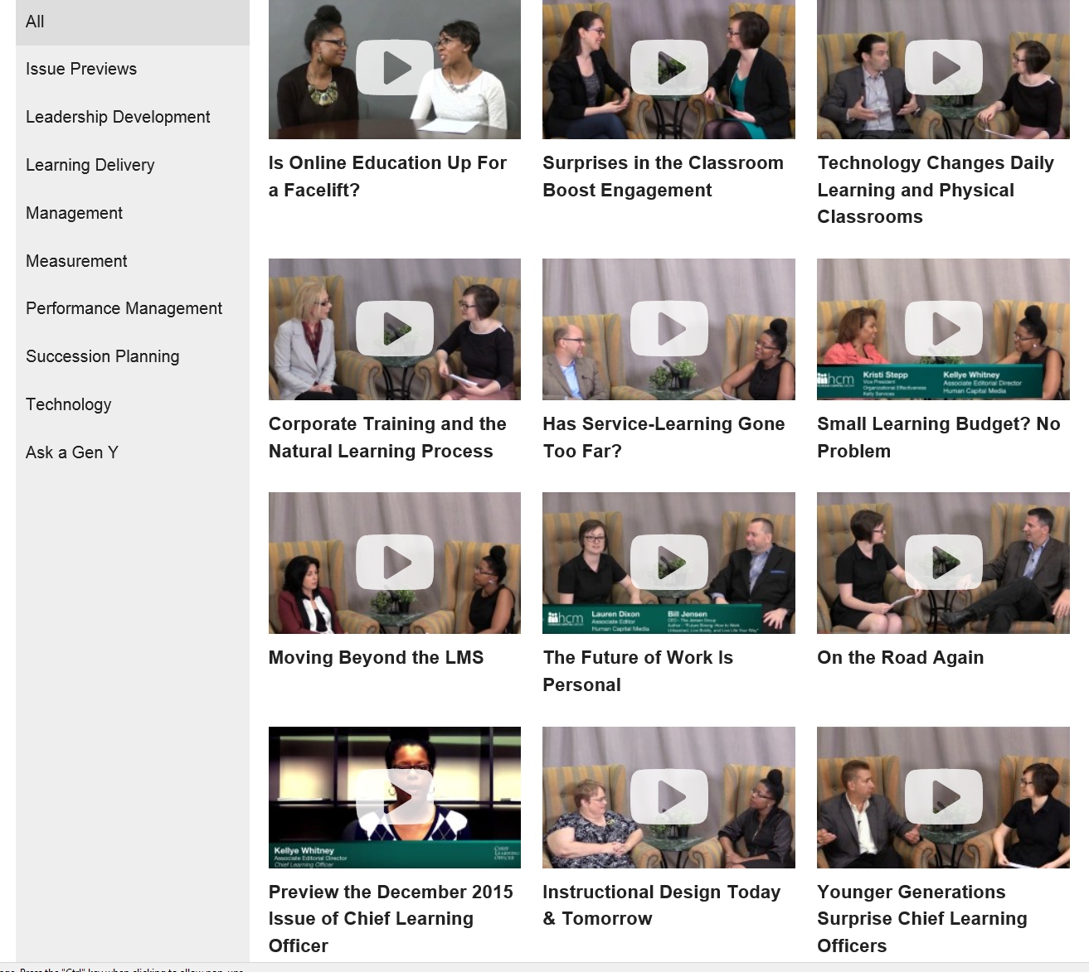
February 29, 2016
Chief Learning Officer Videos https://www.youtube.com/watch?v=6VhR85IOztc https://www.youtube.com/channel/UCIraI8XuWm5aHMPghT94PZA/videos

Slide 28
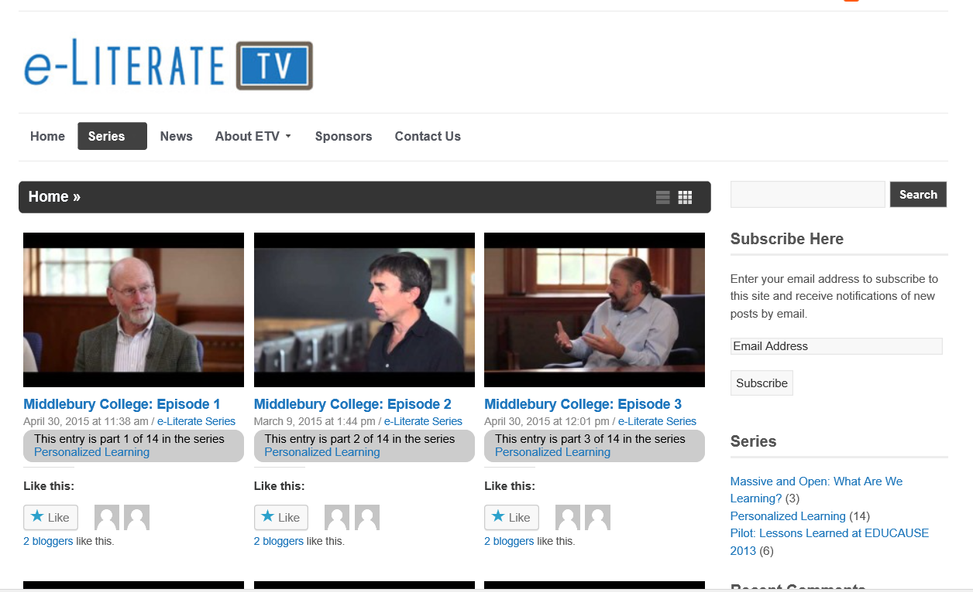
April 4, 2016 e-Literate TV (starting conversations about technology in education) http://e-literate.tv/series/personalized-learning/

Slide 29
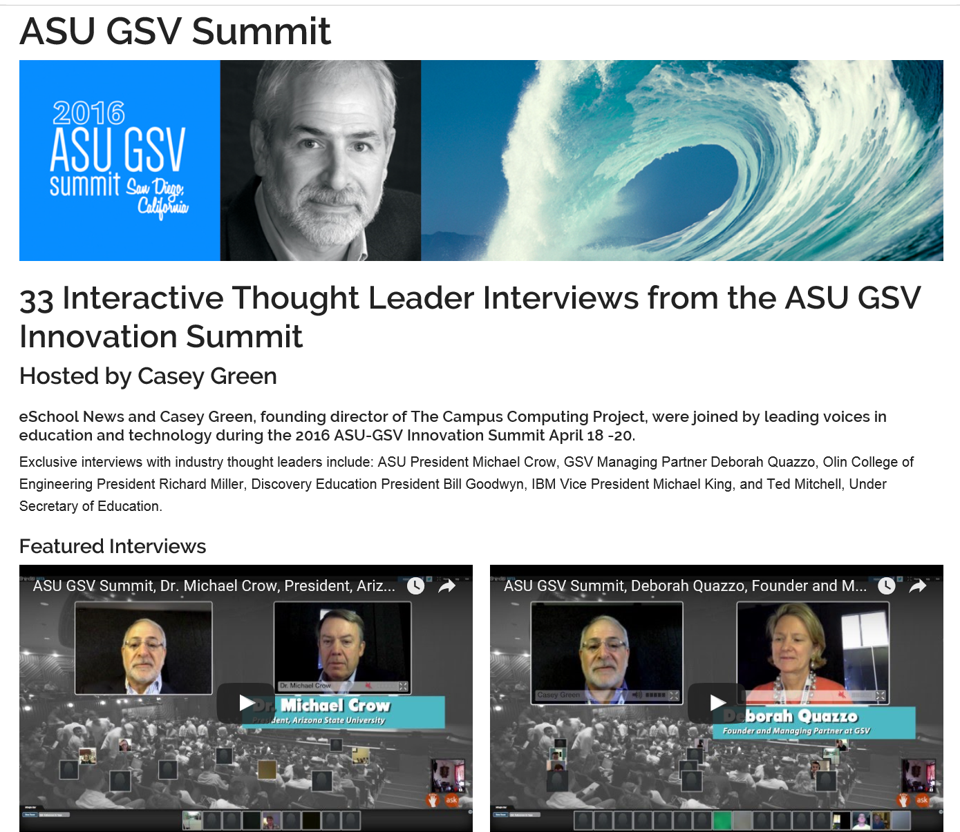
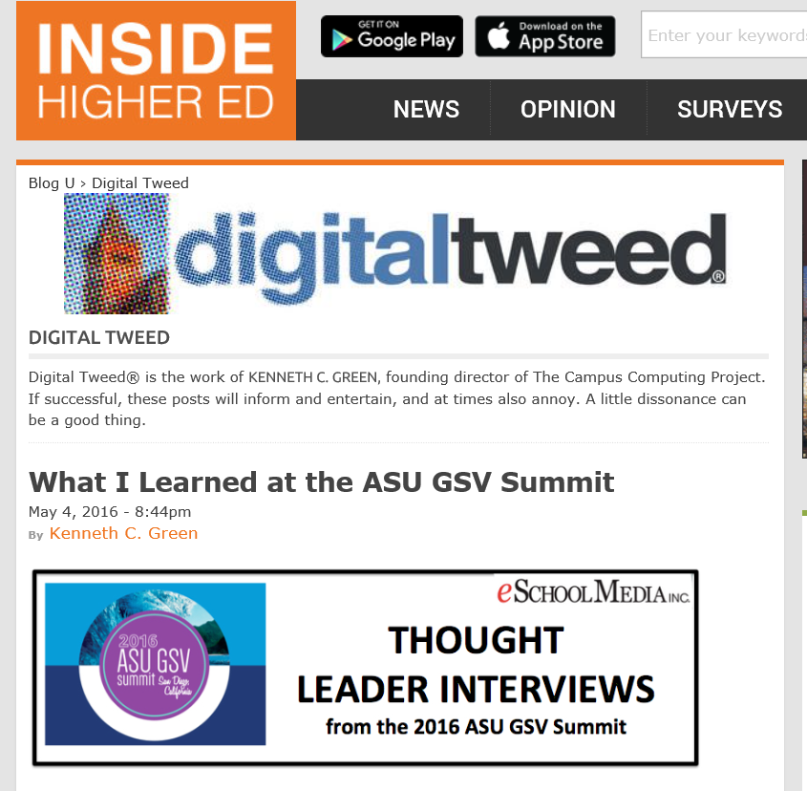
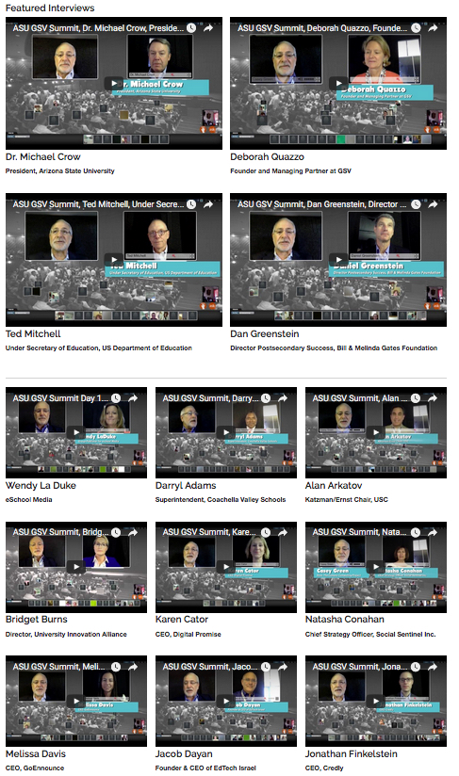
May 4, 2016
What I Learned at the ASU GSV Summit
Kenneth Green, Inside Higher Ed https://www.insidehighered.com/blogs/digital-tweed/what-i-learned-asu-gsv-summit http://www.eschoolnews.com/asugsvsummit/

Slide 30
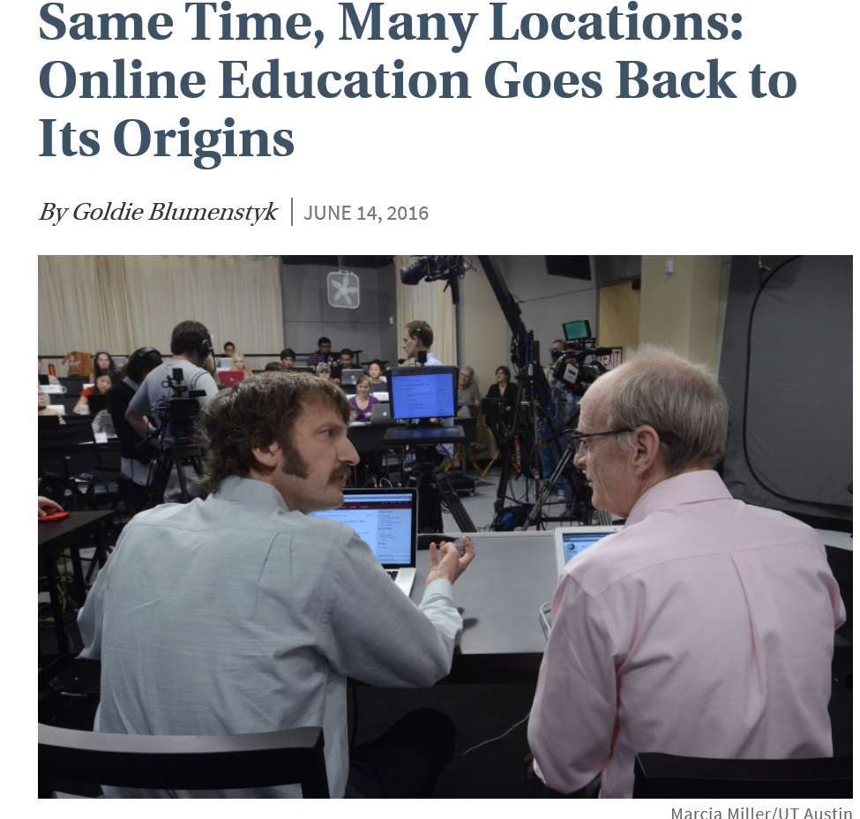
June 13, 2016
Same Time, Many Locations:
Online Education Goes Back to Its Origins
Goldie Blumenstyk, The Chronicle of Higher Education http://chronicle.com/article/Same-Time-Many-Locations-/236788

Slide 31
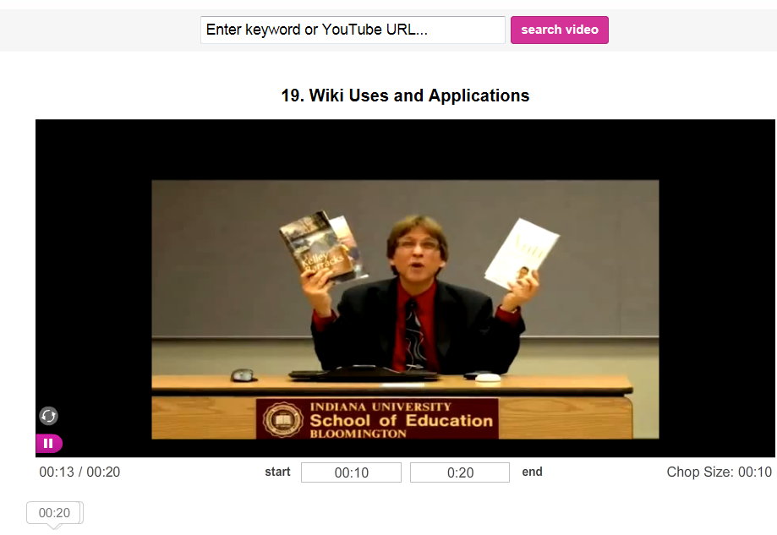
Short Video Anchors
(e.g., TubeChop of V-PORTAL: Video Primers in an Online Repository of e-Teaching and Learning) http://www.tubechop.com/watch/378752

Slide 32

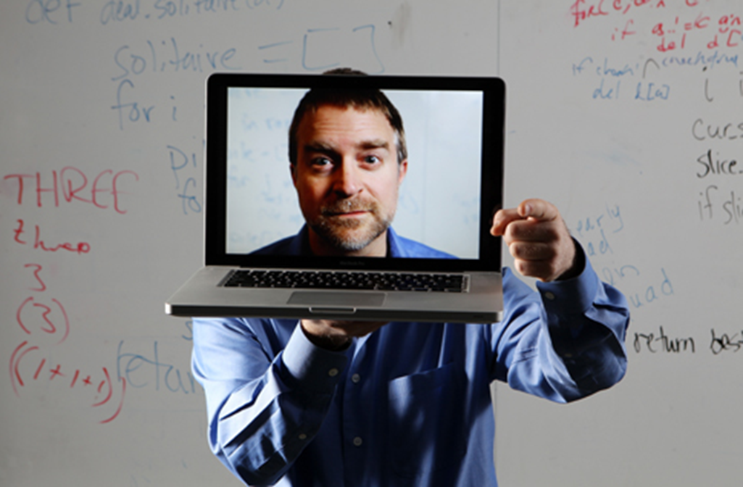
Part II: Lessons Learned…

Slide 33
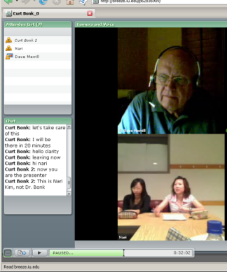
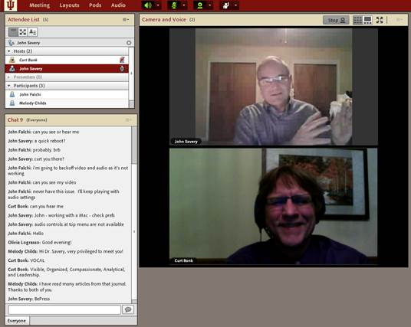
Lesson #1. Combining Asynchronous and Synchronous Events
(e.g., guest was David Merrill, 2007)

Slide 34
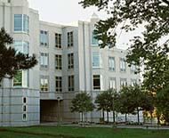
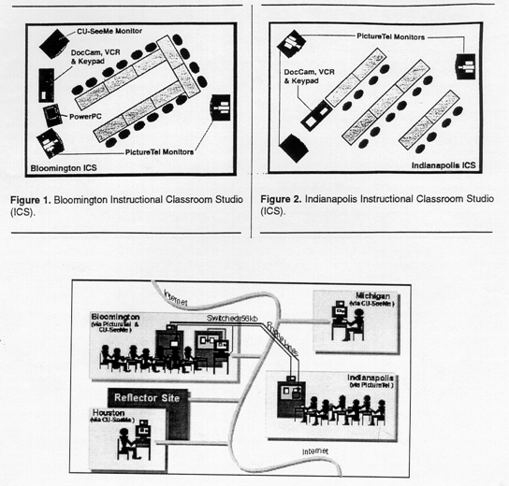
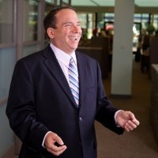
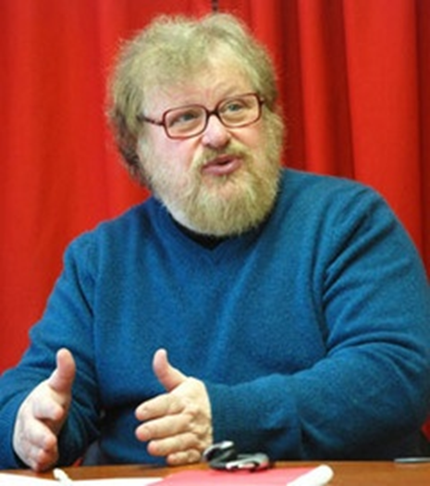
Synchronous + Asynchronous
(e.g., Elliot Soloway and David Palumbo, 1995)
Notes:
94
4

Slide 35
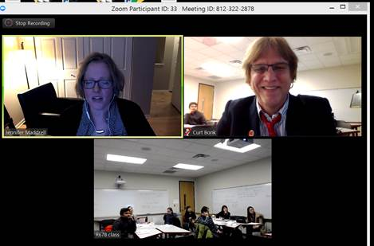
February 15, 2016
Synchronous + Asynchronous
Jennifer Maddrell, R678 (Zoom)

Slide 36
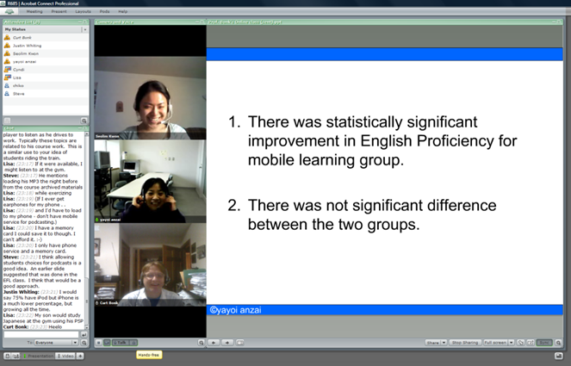
Lesson #2. If Plan, No Instructor Required
(Guest Session Run by Assistant)

Slide 37
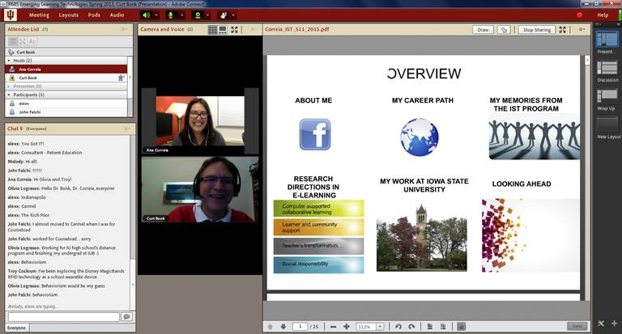
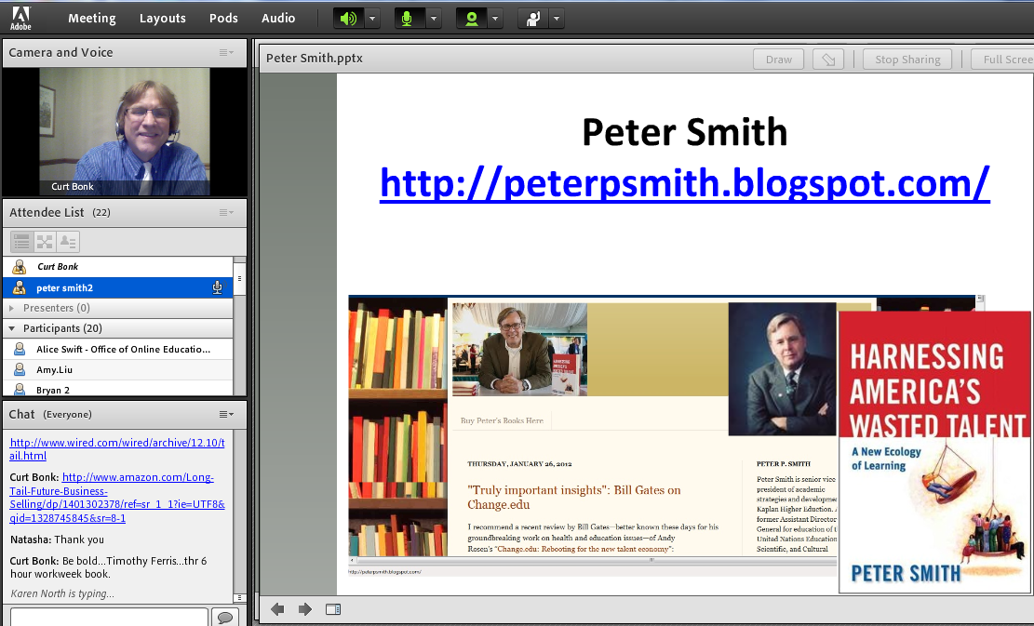
Lesson #3. Test the System
(e.g., Guest No Video)

Slide 38
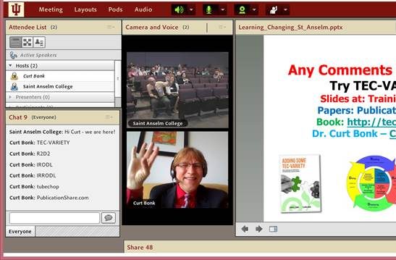
May 2015
Sync Presentation and Chat in Adobe Connect (from hotel room) https://connect.iu.edu/p259wpiabg9/

Slide 39
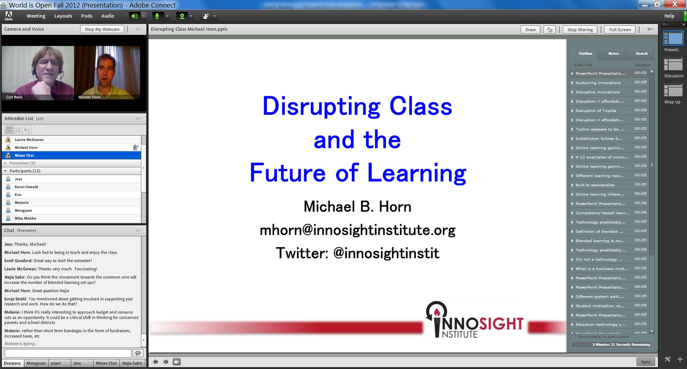
Lesson #4. Guest Starts Semester
Michael Horn and Curt Bonk, R685, August 20, 2012

Slide 40
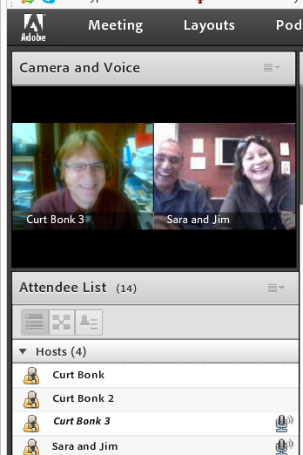
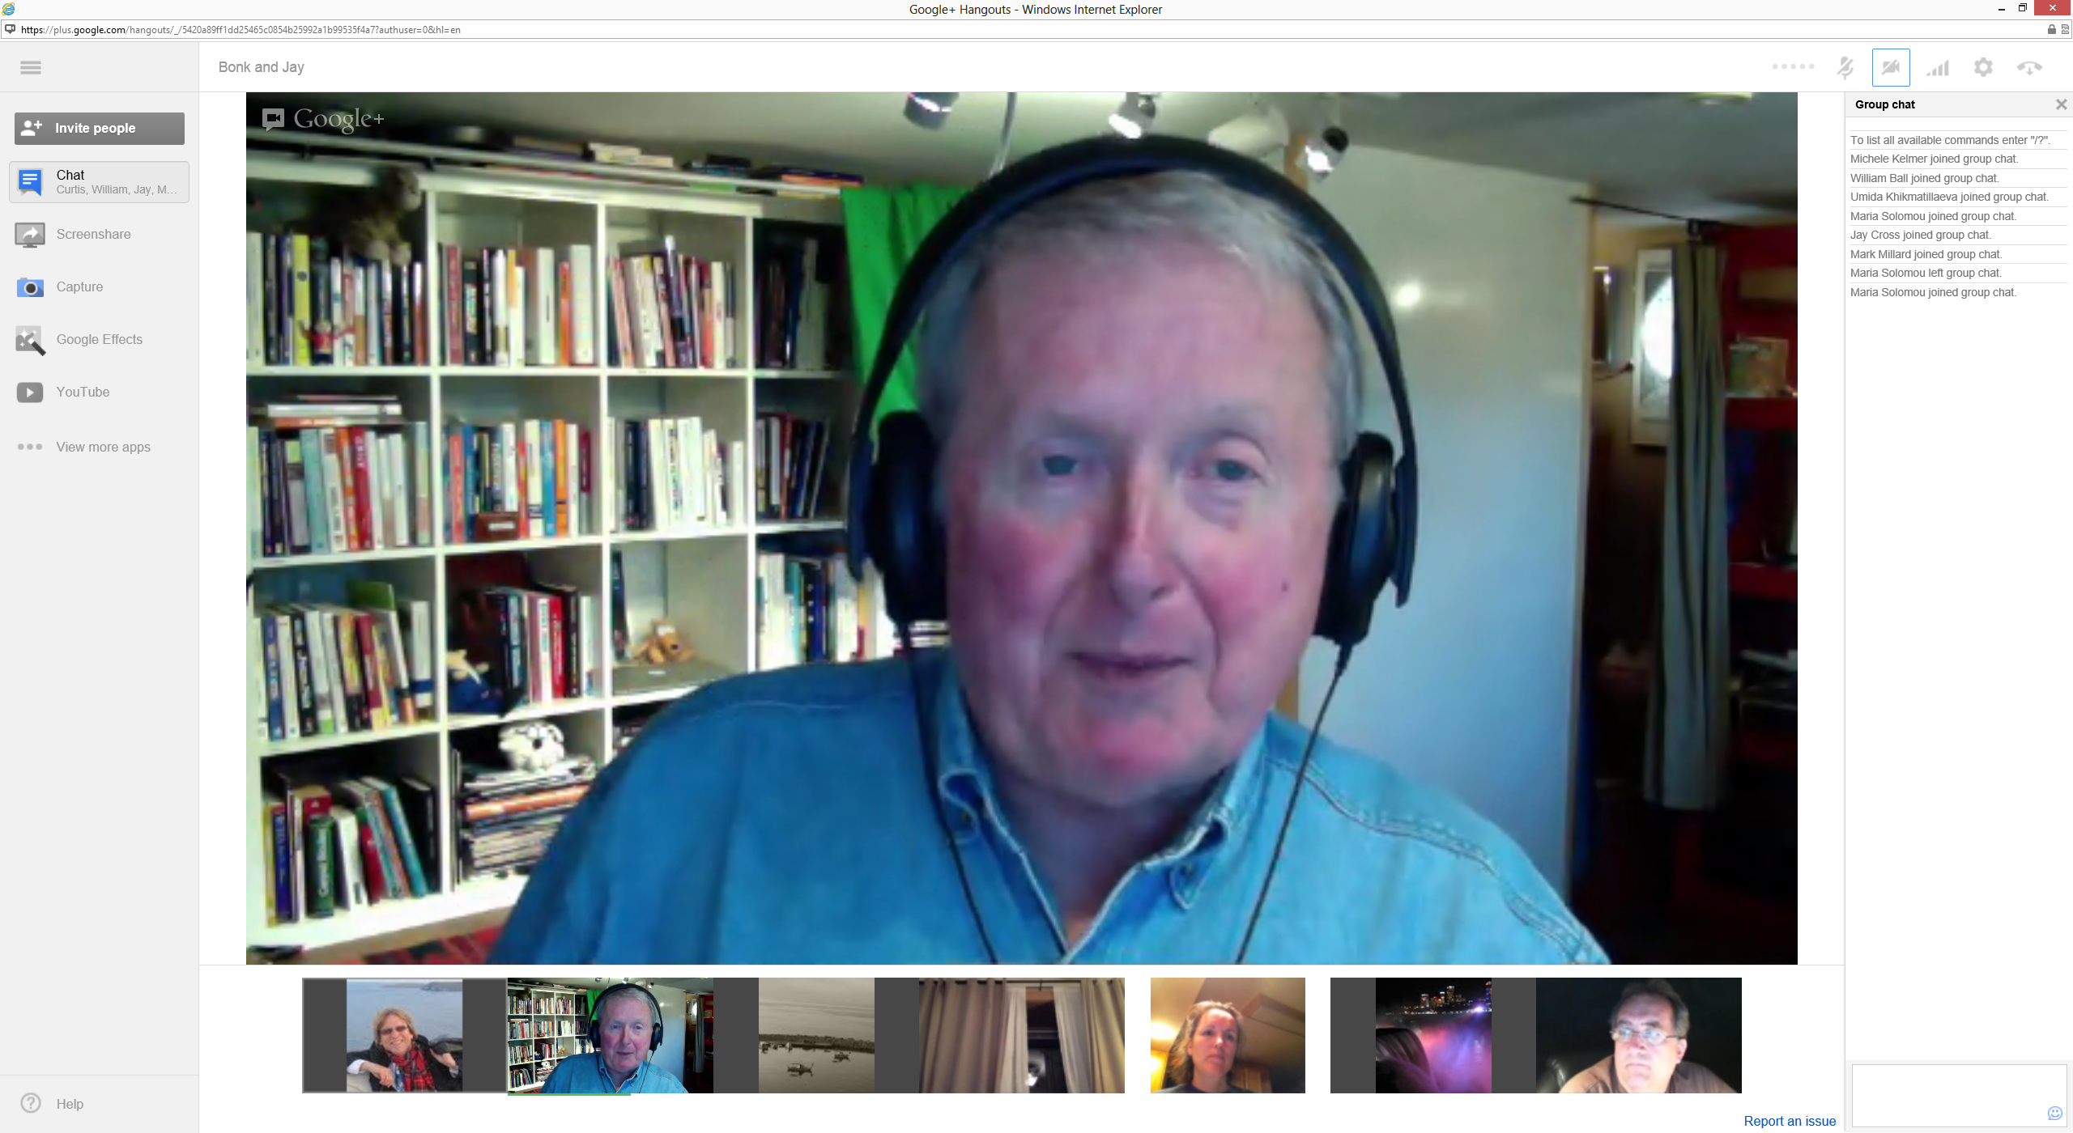
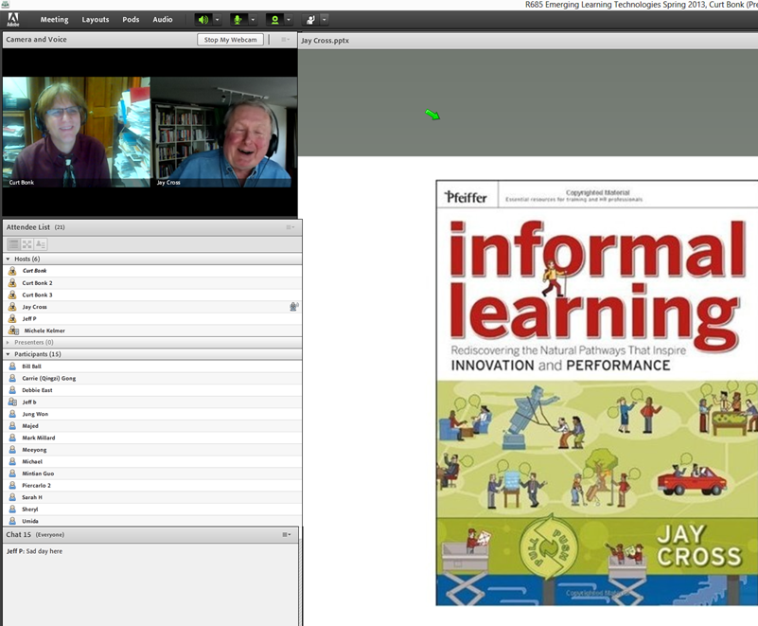
Lesson #5. Multiple Guest Experts
Sara de Freitas and Jim Hensman, U of Coventry, UK
(https://connect.iu.edu/p2ie1yx6z6x/)
Jay Cross, Berkeley (https://connect.iu.edu/p4bytsoronh/)

Slide 41
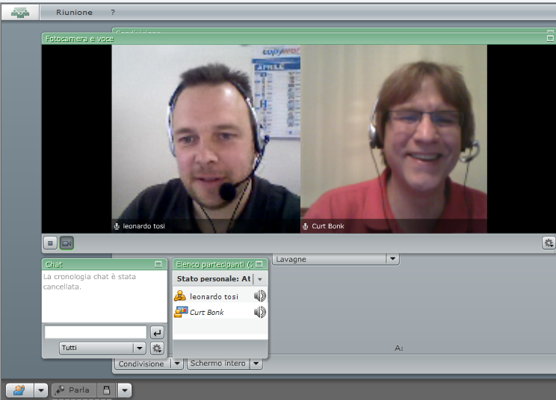
Lesson #6. Be Willing to Reciprocate

Slide 42
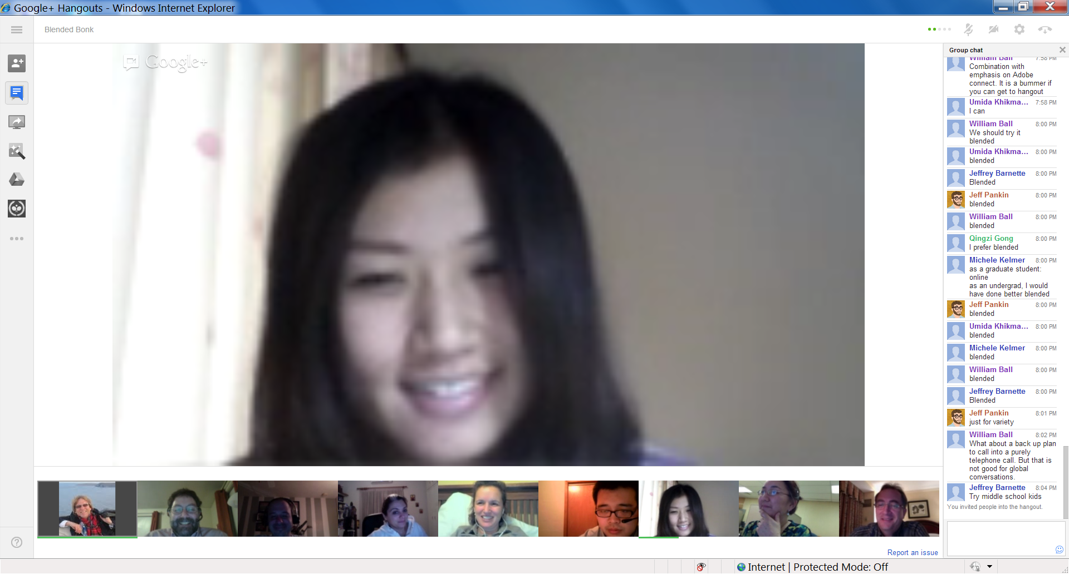
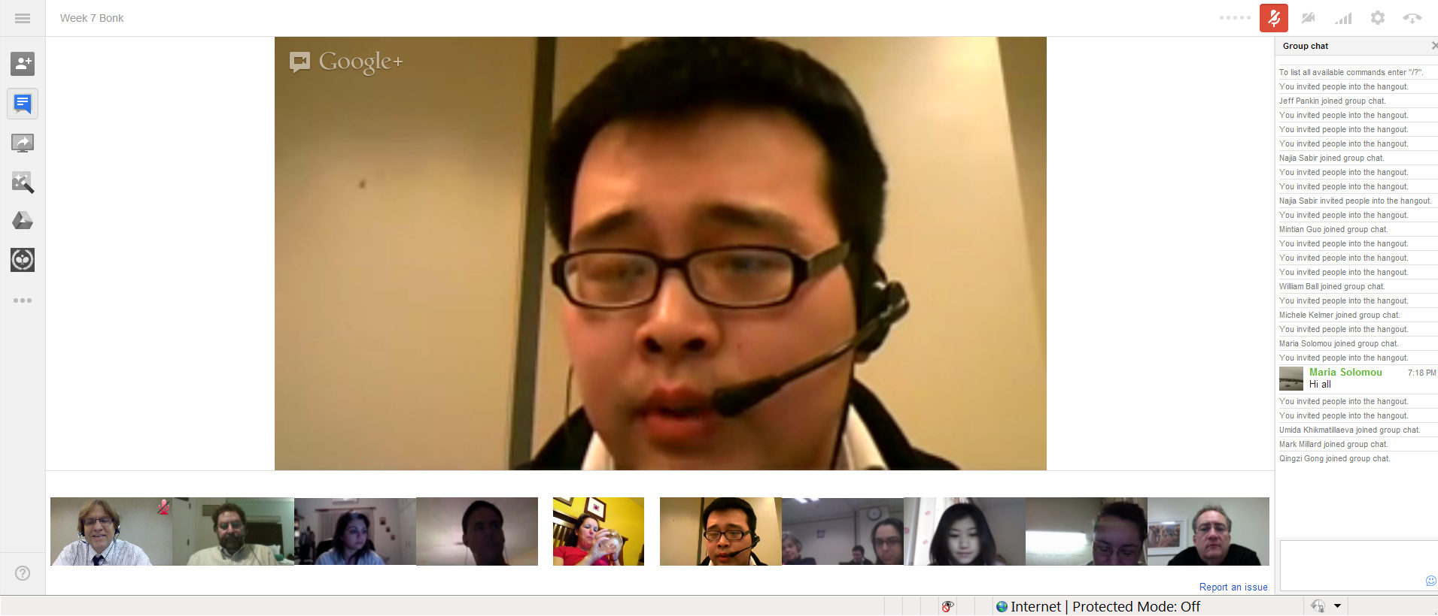
Lesson #7: Experiment with Technology
Collaboration and Discussion in Google Hangouts (1/29/2013)

Slide 43


Lesson #8: Solicit Student Recommendations
Expert Interviews (Rich Culatta, Acting Director, Office of Educational Technology)

Slide 44


Lesson #9: Don’t Give Up!
Serious Gaming Institute, Coventry, UK

Slide 45


Lesson #10: Make a List of Those You Know
Intellagirl Sarah Smith-Robbins and Mark Bell
(Second Life for Dummies)

Slide 46

Part III: Twenty Pedagogical Activities for Class-Related Videoconferencing or Web Conferencing with Experts

Slide 47



1. Expert Presentations with Audience Questioning and Commenting
The guest expert makes a formal or semi-formal presentation of ideas, activities, cultural norms and practices, or research to the class.

Slide 48


2. Expert Demonstrations and Audience Questioning
The guest expert demonstrates a certain technique, idea, principle, etc., while the learners observe and ask follow-up questions.

Slide 49

January 26, 2016
Demo Web Conferencing
Tom Reeves, Guest Appearance Zoom

Slide 50



3. Question and Answer Sessions
The guest expert responds to questions posed by the audience based on a particular topic (the audience might read or watch ahead of time).

Slide 51


4. Responding to Book or Article Quotes
The learners come to the synchronous session with quotes from those articles or resources for the guest expert to respond to.

Slide 52

5. Responding to Publication Visuals
Students find visuals from the culture or country of the guest to respond to; alternatively, they might find charts, tables, figures, and graphs from articles, books, or presentations of the guest expert.

Slide 53

6. Expert Panel
A panel might set up to discuss a particular issue, trend, controversial topic, cultural practice, research finding, announcement, etc.

Slide 54



7. Expert Cultural Sessions
The guest might conduct a short presentation of some aspect of their culture followed by questions from the class.

Slide 55

Q&A Web Conferencing (Feb/May 2015)
Sync Chat in Adobe Connect with students in Kazakhstan about language learning
(Adobe Connect, Jabber, iMeet, GoToMeeting, etc.) https://connect.iu.edu/p259wpiabg9/

Slide 56


8. Expert Interviews and Discussions
Students might read the biography or resume of the guest as well as available articles, books, and other resources about this person. Next, the guest might respond to questions from the class based on these resources.

Slide 57


April 28, 2016
Communities
Shindig, Video Chat Tool
Future Trends Forum (with Bryan Alexander) https://bryanalexander.org/

Slide 58

July 14, 2016
Shindig http://events.shindig.com/event/ftf-wheeler

Slide 59



March 1, 2016
Tarleton State University, Dr. Credence Baker, Zoom

Slide 60






Guest Chats (in Adobe Connect)
(e.g., Emily Hixon, January 20, 2015) https://connect.iu.edu/p259wpiabg9/

Slide 61


February 2016
Discuss Course Requirements
R511 Chat with Charlie Reigeluth

Slide 62









Spring, 2016
Guest Expert Chat (R511) in Zoom
Weekly R511 Chat (e.g., Mike Molenda, Insung Jung, etc.)

Slide 63


March 8, 2016
Book Author Chats (R511)
Robert (Bob) Reiser, Florida State, Zoom

Slide 64


9. Expert Life Stories
The guest expert might detail different stories or situations that he or she has encountered related to a certain topic of the class. Students in the class can comment on them and ask questions as needed.

Slide 65

10. Expert Session Archive Reviews and Discussions
A class might watch one or more guest expert sessions from a previous semester and form discussion groups based on controversial, confusing, or complex aspects of such sessions.

Slide 66


GETideas Channel, Cisco
(Thought Leader Series uploaded to YouTubEdu)
July 22, 2011

Slide 67


November 11, 2015
Learning Talks
Elliott Masie’s Learning 2015 https://emasie.smugmug.com/Learning-2015/Graphic-Illustrations/i-bRhXVKB/A

Slide 68

July 14, 2016
2015 AECT/China Research Symposium - Speakers http://www.aect.org/movies/2015ChinaSymposiumtest.asp

Slide 69


11. Expert Presentations and Webinars
The guest expert presentation followed by questions and answer session.
e.g., Cathy Davidson or Michael Wesch, The End of Higher Education, http://connectedcourses.net/thecourse/why-we-need-a-why/

Slide 70

Web Conferencing
Dubai to Puerto Rico (Edgar Leon) https://www.youtube.com/watch?v=Imxw0YwTh2Y&list=UUClhO-jnvl1pEXd9Skv-_Iw

Slide 71



February 15, 2016
Chris Pedrick and Brad White (Skype, Zoom, and WebEx)
Canadian Forces Training Development Centre/ CFB Borden, Canadian Armed Forces

Slide 72


Videoconference
Shanghai, China, April 28, 2013

Slide 73

May 28, 2015
World Bank Institute workshop to Zhengzhou city, China
Here is his webpage: http://michaeltrucano.com/index.html
Email: mtrucano@worldbank.org https://blogs.worldbank.org/edutech/edtech-and-mooc-times-china

Slide 74



July 31, 2014
12. Celebration Events
Book Launching via Skype
University of Waikato, New Zealand

Slide 75



Cross-Institutional Wikibook Project
(e.g., IU and the University of Houston)

Slide 76

December 16, 2015
Remembering Jay Cross from eLearning Guild in Blab https://blab.im/elearning-guild-remembering-jay-cross

Slide 77


Zoom, Fall 2015
13. Team Meetings and Collaboration
Research Team Meeting

Slide 78


Zoom, June 22, 2016
13. Team Document Review
Research Team Meeting

Slide 79

Zoom, July 23, 2016
13. Team Meetings and Collaboration
Research Team Meeting (from a car)

Slide 80

November 17, 2015
14. Organizational Meetings
Zoom (International Open Badges Extravaganza)
European Meeting (with Dr. Dan Hickey, IU)

Slide 81

September 7, 2015
15. Informal Meetings
Blab https://blab.im/ https://blab.im/jaycross-learning-for-yourself

Slide 82

July 23, 2015
Informal Meeting
(Jay Cross in Skype)

Slide 83

January 19, 2015
16. Planning Meetings
Sonja Stahl and Diane Salmon, National Louis University, Chicago

Slide 84

August 5, 2015
17. Training Sessions
Zoom Collaboration Overview https://www.youtube.com/watch?v=JPsnxom1y9M https://www.youtube.com/watch?v=fGbpwZNW3oI (join a meeting)

Slide 85

January 21, 2016
18. Dissertation Defenses
Dissertation proposal meeting with Susan Herring at UCSC

Slide 86






19. Threaded Video Discussions e.g., Flipgrid http://flipgrid.com/#429f88c5)

Slide 87

March 10, 2016
20. Streaming Conferences
Watch SXSWedu Live, Connie Yowell http://sxswedu.com/live?utm_campaign=Edu+2016&utm_source=hs_email&utm_medium=email&utm_content=27144469&_hsenc=p2ANqtz--ag6U7VJGlpYaciareNq6mryKvA63kCR5O3U8JVQkfAYp7yiTnncHnxw7_PmMpcjioI9V7z1-01hvyCrDPVEAR-x6HwQ&_hsmi=27144469

Slide 88




November 2014
Bonus. Short Cameo Appearances Can Work
Shenzhen, China
Guest Speaker (cameo appearance via Skype from Madrid hotel room)

Slide 89





Final Poll: How many new ideas did you get?
0 if I am lucky.
Just 1.
2, yes, 2…just 2!
Do I hear 3? 3!!!!
4-5.
5-10.
More than 10.

Slide 90


Questions?
Slides at: TrainingShare.com
Papers: PublicationShare.com
Book: http://worldisopen.com/
Email: curt@worldisopen.com

