Slide 1

Accessing Open Access Educational Resources:
Augmenting and Accelerating the Apprenticeship Process
Dr. Curtis J. Bonk, cjbonk@indiana.edu
Professor, Indiana University
Blink Tower: http://vimeo.com/43401199

Slide 2

Read Any OER Research Lately?
October 25, 2014
Opening the Curriculum: Open Educational Resources in U.S. Higher Education, 2014
I. Elaine Allen and Jeff Seaman http://www.onlinelearningsurvey.com/reports/openingthecurriculum2014.pdf

Slide 3

November 25, 2014
OER Research Hub, OER Evidence Report:
Building Understanding of Open Education
2013-2014 http://oerresearchhub.files.wordpress.com/2014/11/oerrh-evidence-report-2014.pdf

Slide 4
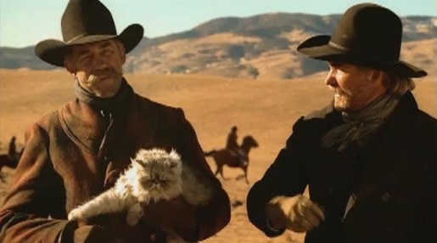
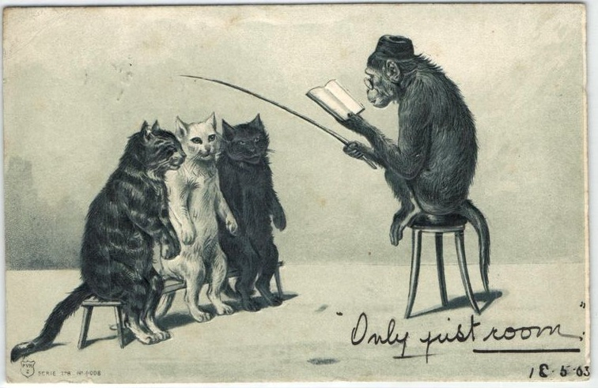
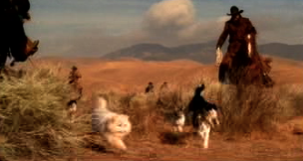
Part I: What is the role of the Instructor in the Open World?
(Instructor as Cat Herder?)

Slide 5
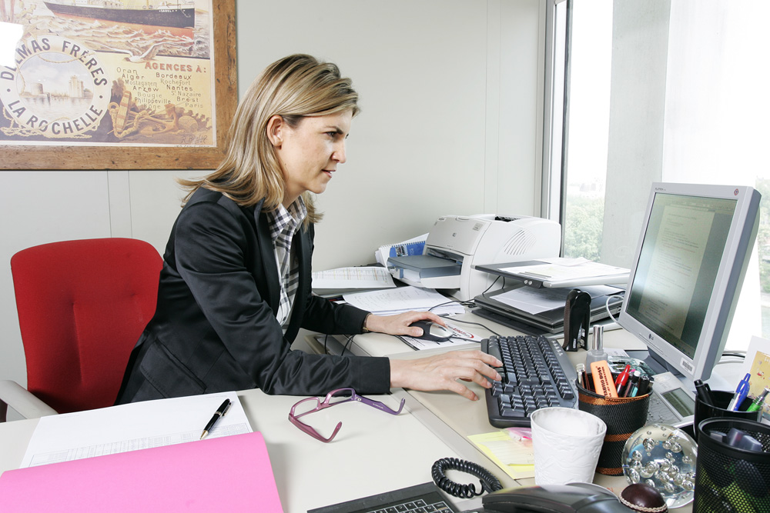
1. Instructor as Credit Manager

Slide 6
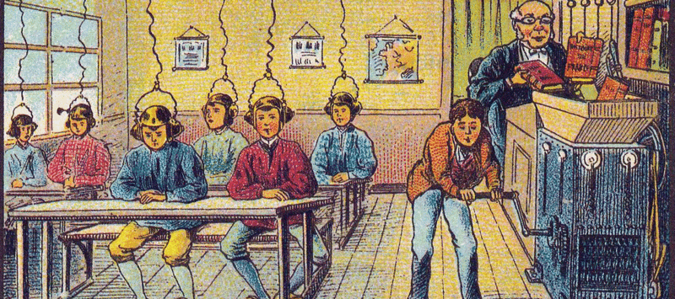
October 21, 2014
Teaching and the University of Tomorrow.
Chronicle of Higher Education, Kelly J. Baker https://chroniclevitae.com/news/768-teaching-and-the-university-of-tomorrow?cid=at&utm_source=at&utm_medium=en
Image: France in 2000 year (XXI century). Future school. From a postcard by Villemard, 1910.

Slide 7
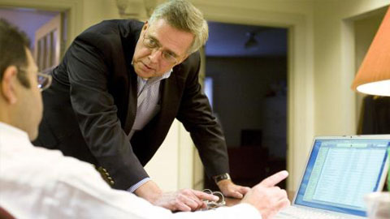
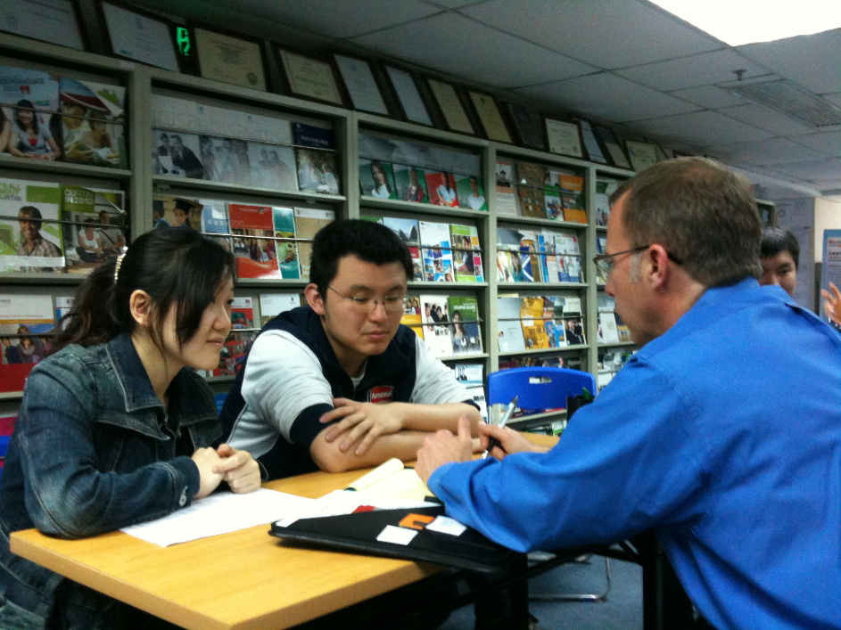
2. Instructor as Counselor

Slide 8

3. Instructor as Consultant

Slide 9
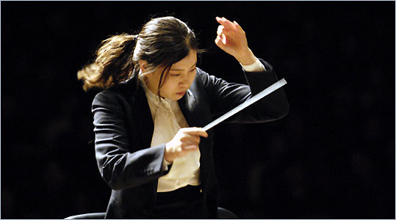
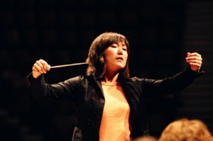
4. Instructor as Conductor

Slide 10
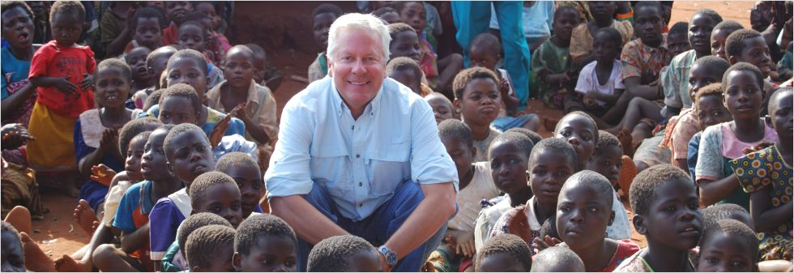
5. Instructor as Course Ambassador

Slide 11
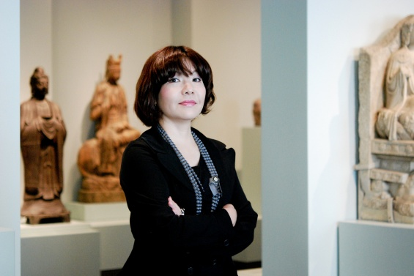
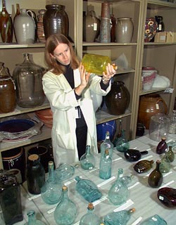
6. Instructor as Curator

Slide 12


7. Instructor as Concierge

Slide 13

8. Instructor as Camping Trip Guide

Slide 14

9. Instructor as Cultivator

Slide 15

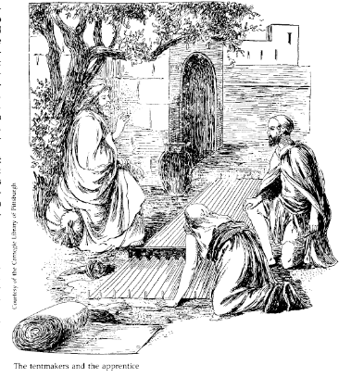
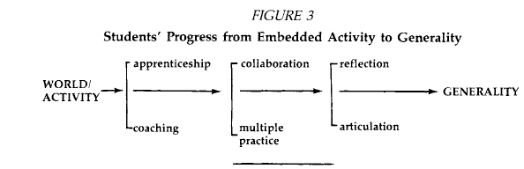
10. Instruction as a Cognitive Apprenticeship

Slide 16
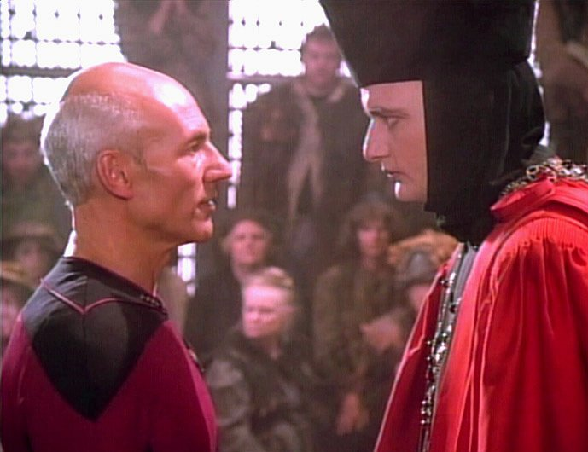
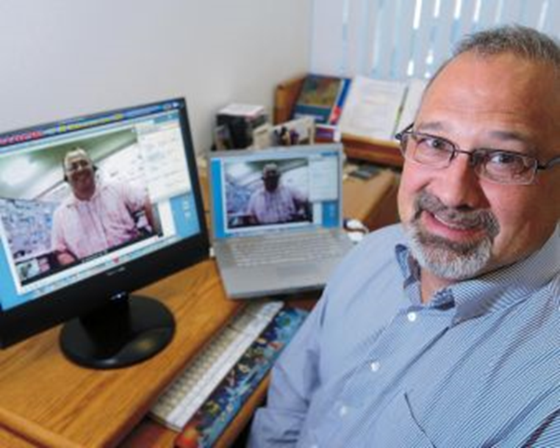
Part II: Expert Apprenticeship from Video

Slide 17


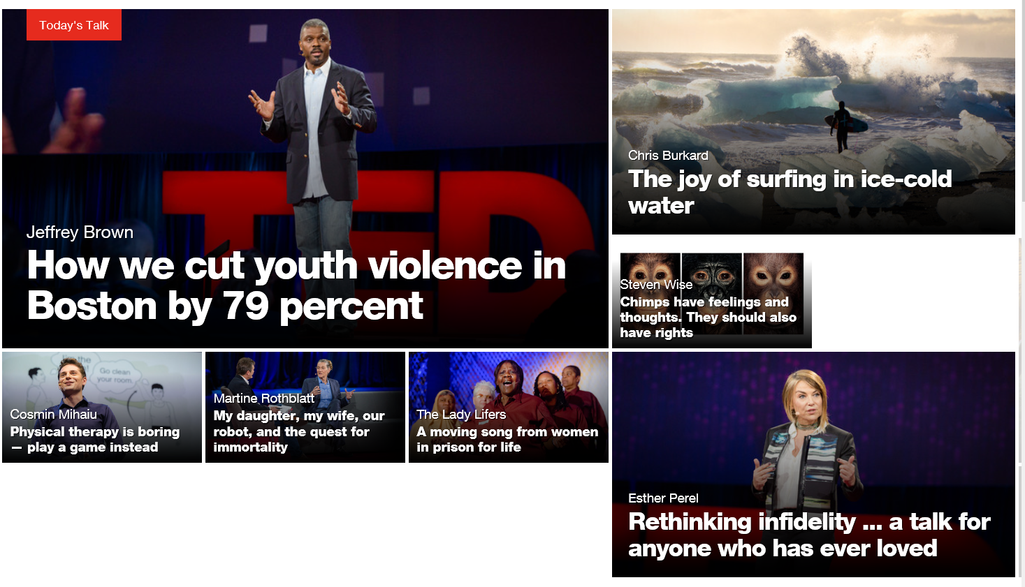

TED Talks https://www.ted.com/

Slide 18
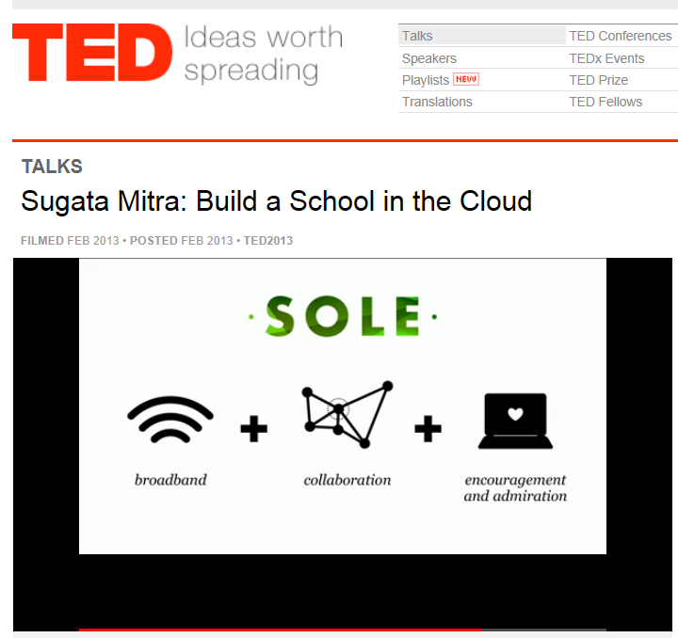
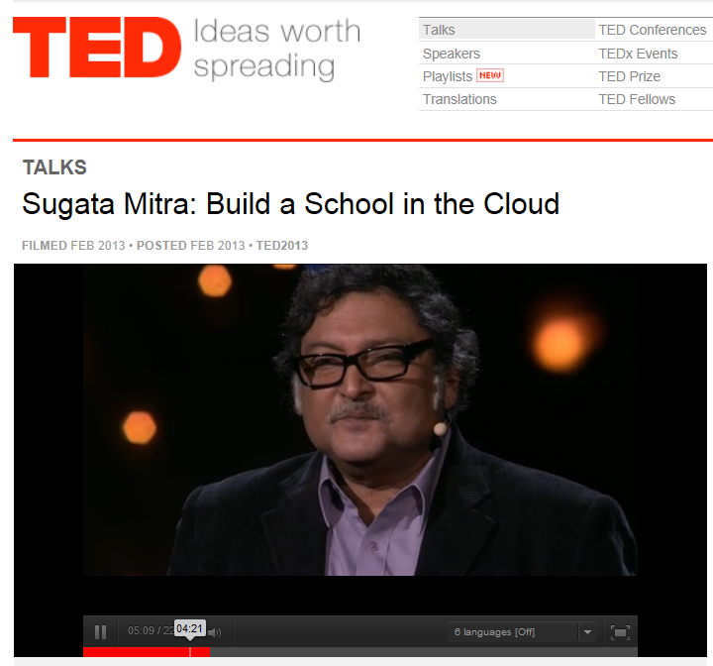
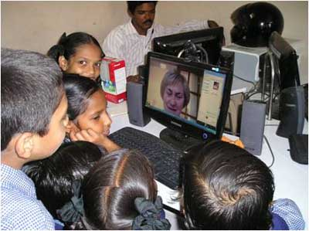
TED Talks
(Build a School in the Cloud; Self-Organized Learning Environments (SOLEs), February 2013, TED Talk from Sugata Mitra http://www.ted.com/talks/sugata_mitra_build_a_school_in_the_cloud.html

Slide 19
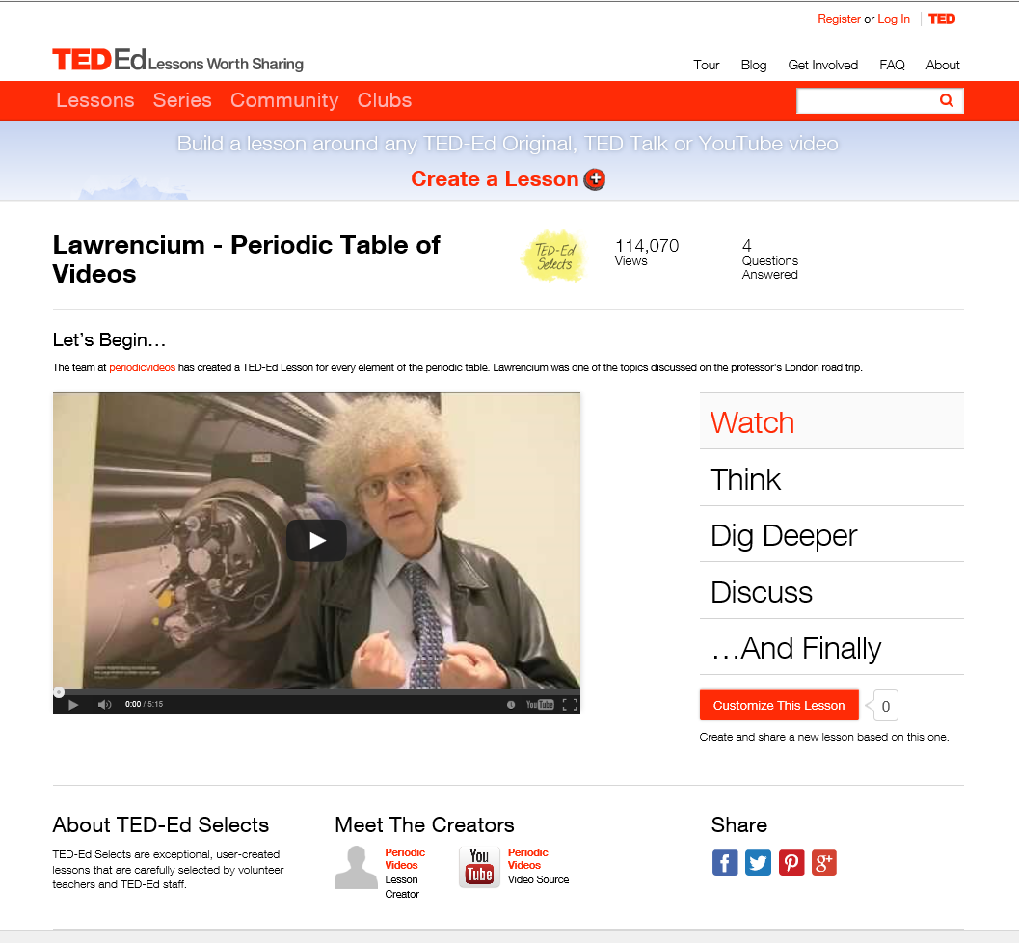
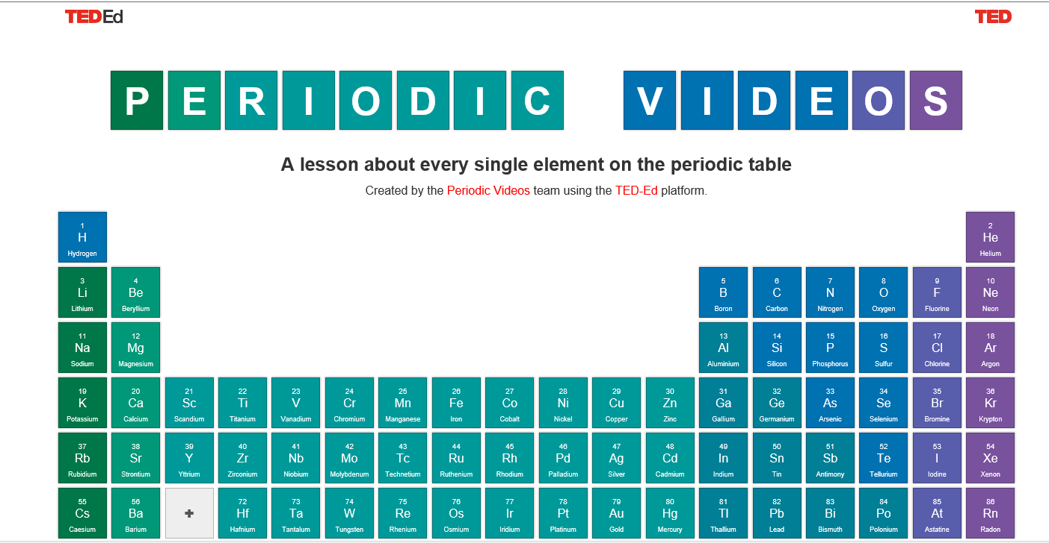
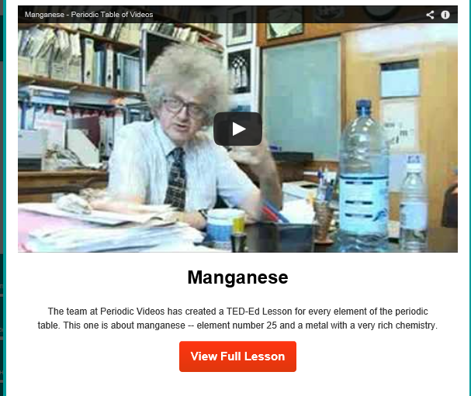
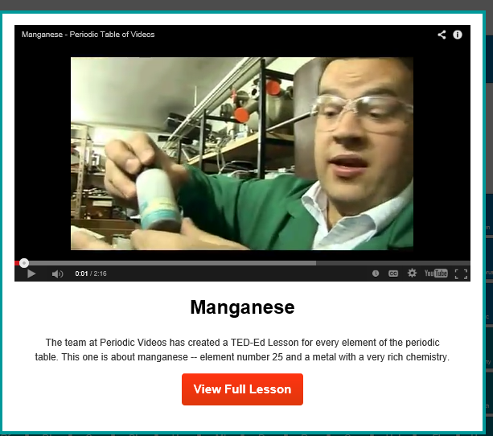
November 1, 2014
TEDEd lesson about every single element on the periodic table http://ed.ted.com/periodic-videos?utm_source=TED-Ed+Subscribers&utm_campaign=92b1054add-2013_09_219_19_2013&utm_medium=email&utm_term=0_1aaccced48-92b1054add-46761201

Slide 20
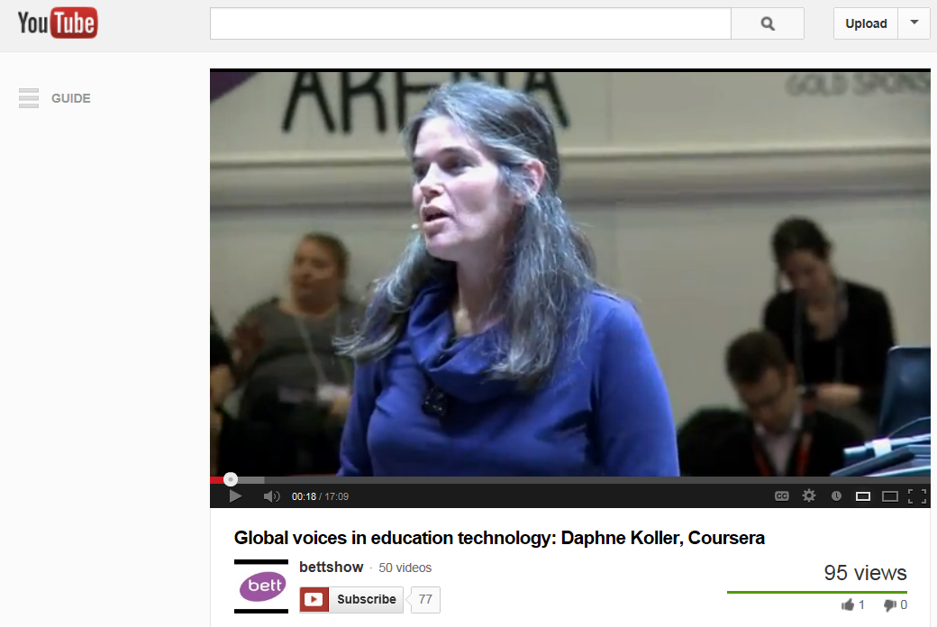
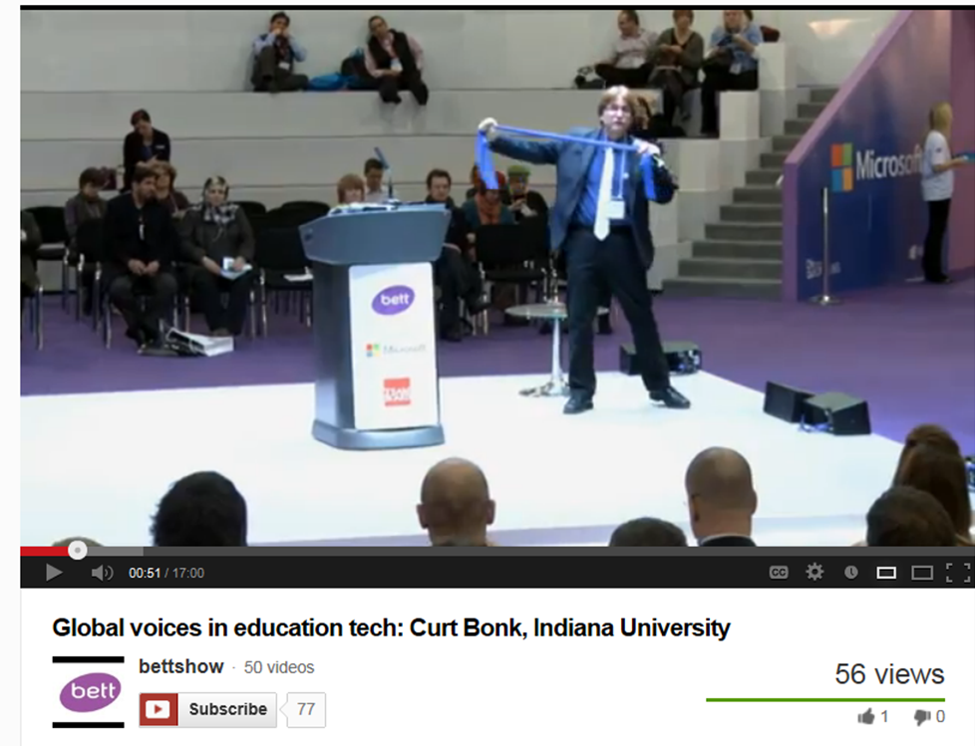
BETT Talks
Global voices in education technology:
Daphne Koller, Coursera BETT 2013 Keynote Talk
(posted March 14, 2013) http://www.youtube.com/watch?v=BMiI6RdlNQs&WT.tsrc=Email&WT.mc_id=NWS14

Slide 21
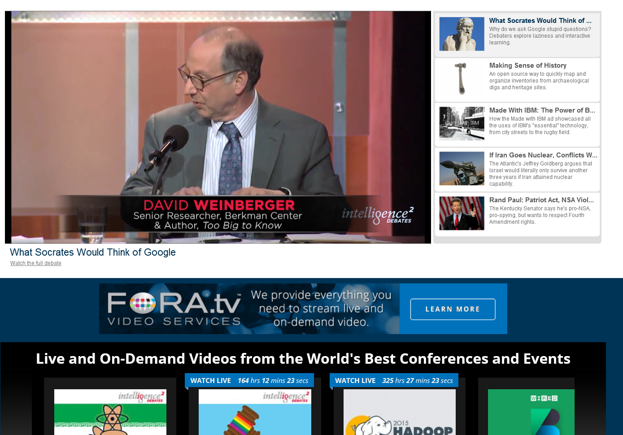
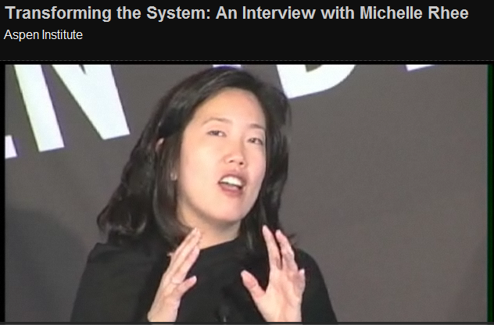
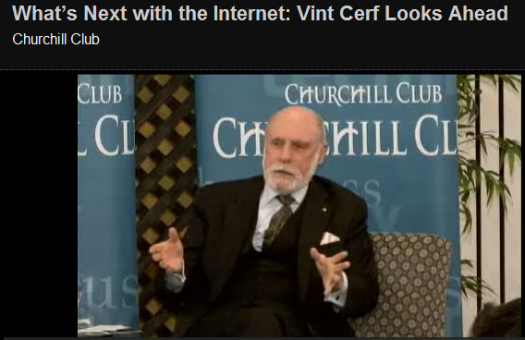
Fora TV (i.e., “the Conference Channel” or “YouTube for Thinkers;” (Live and On-Demand Videos from the World’s Best Conferences and Events) http://library.fora.tv/

Slide 22
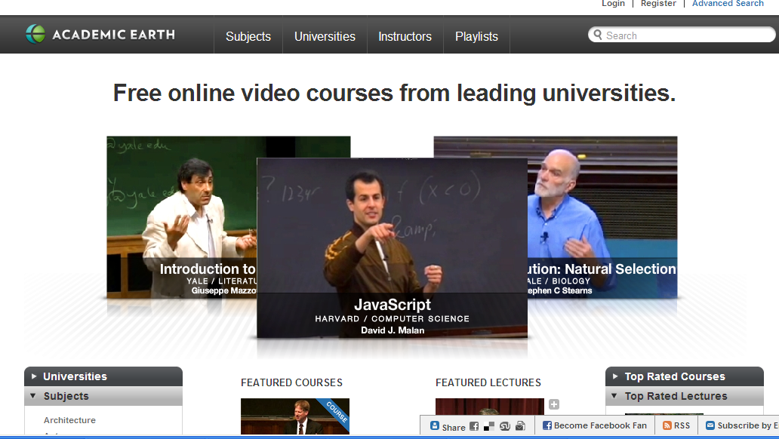
Academic Earth

Slide 23
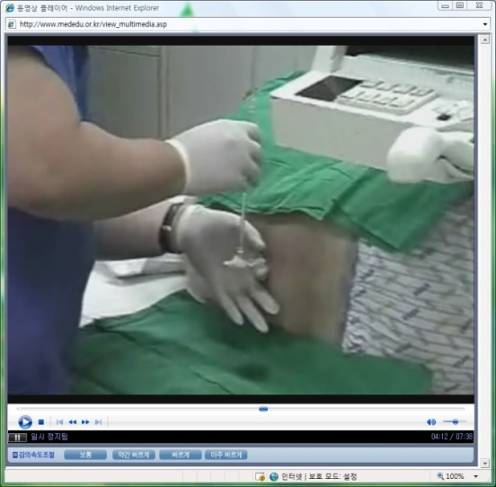
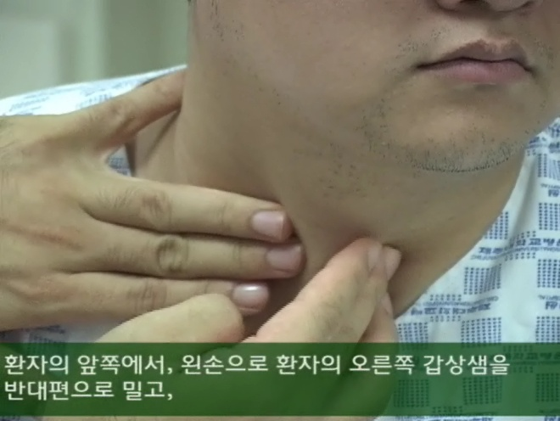
Videos for clinical education (Sungkyunkwan University School of Medicine, www.mededu.or.kr)

Slide 24
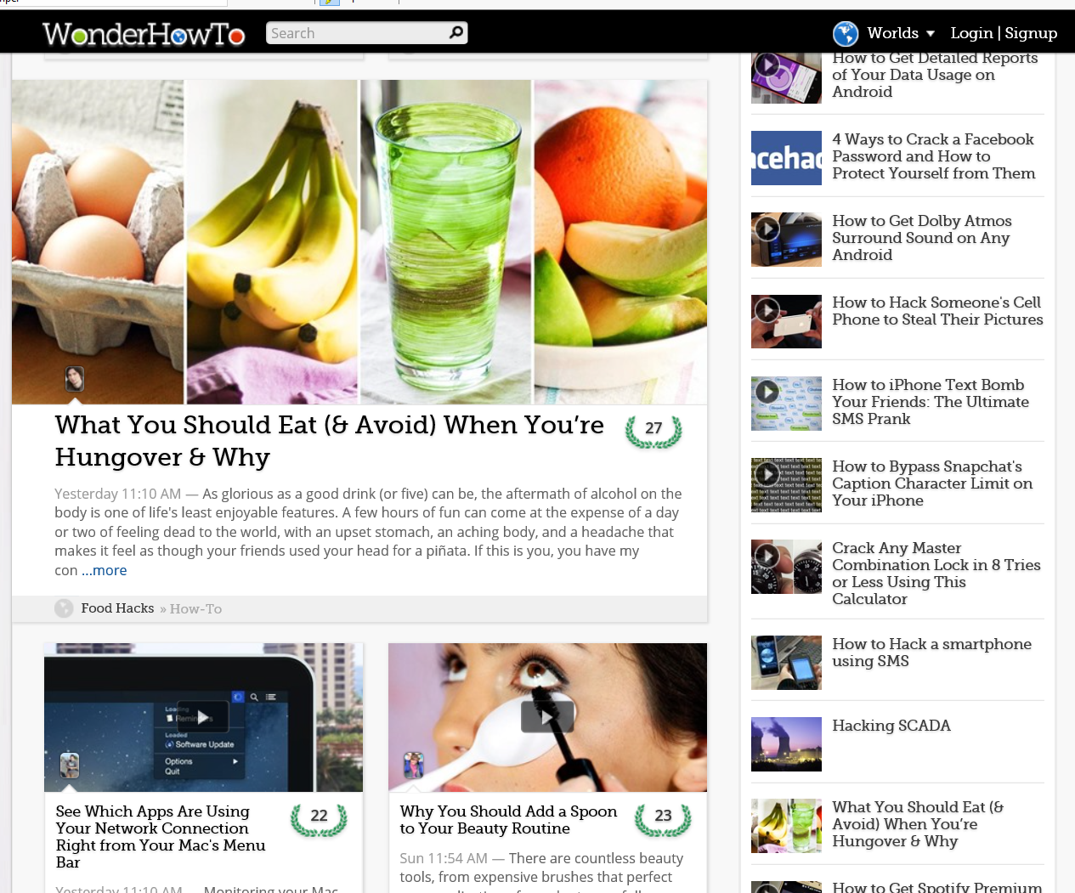
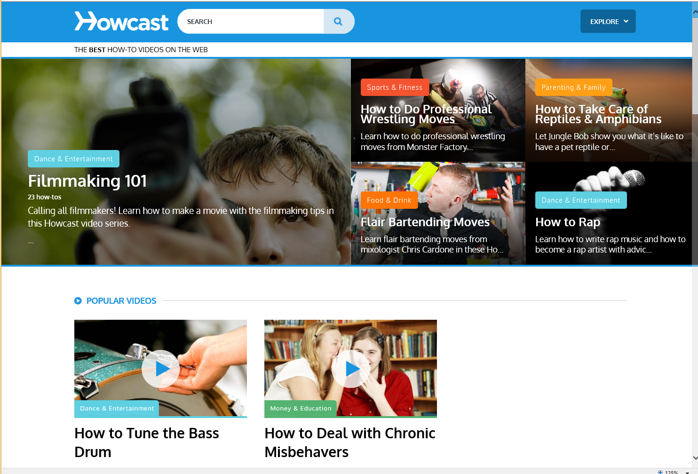
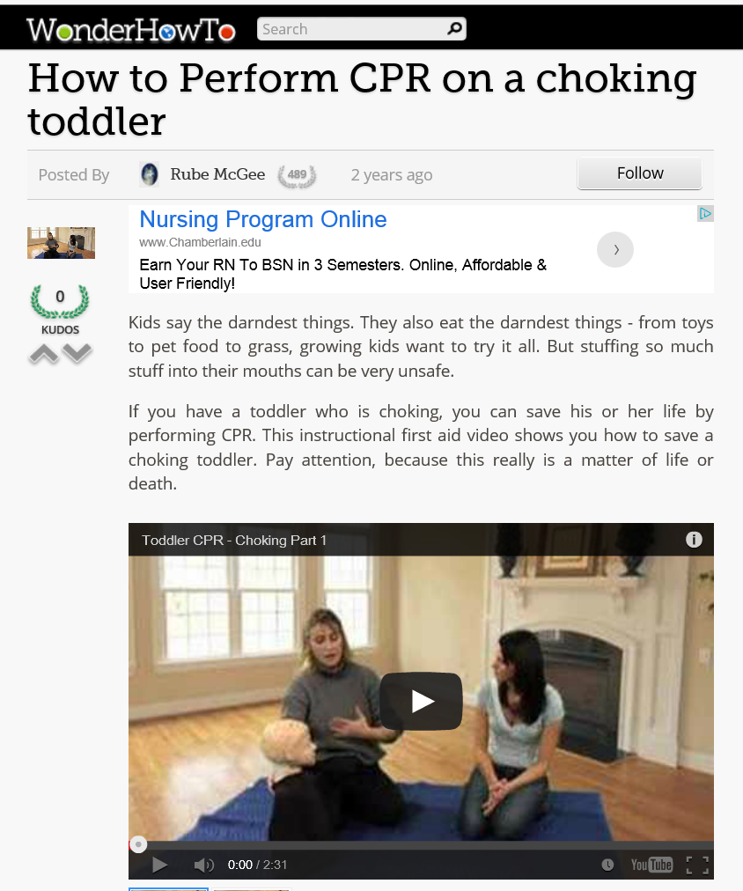
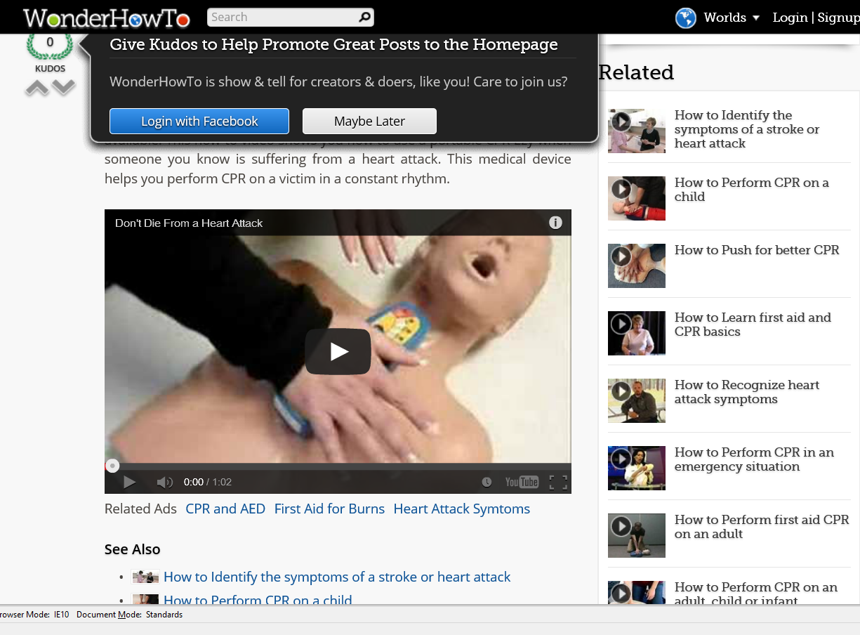
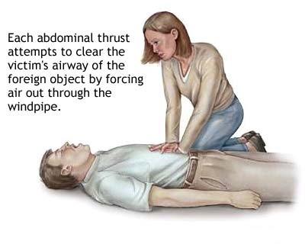
WonderHowTo and Howcast
Anchored Instruction in Shared Online Videos http://www.howcast.com/ http://www.wonderhowto.com/

Slide 25
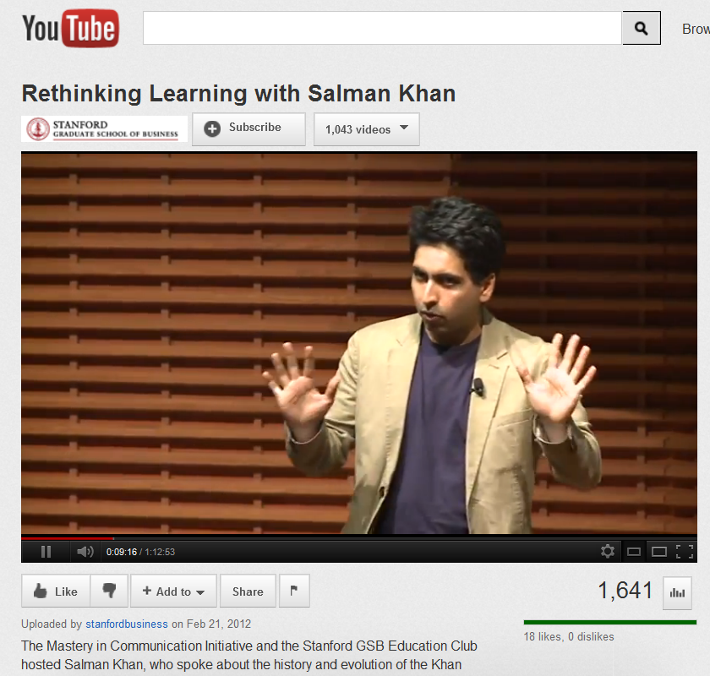

October 15, 2012
Reusable Khan
Lacking Teachers and Textbooks, India’s Schools Turn to Khan Academy to Survive, NY Times, Anupama Chandrasekaran http://india.blogs.nytimes.com/2012/10/15/lacking-teachers-and-textbooks-indias-schools-turn-to-khan-academy-to-survive/
Students at Sree Karpagavalli Vidhyalaya school in Chennai, Tamil Nadu, watching Khan Academy math videos.

Slide 26
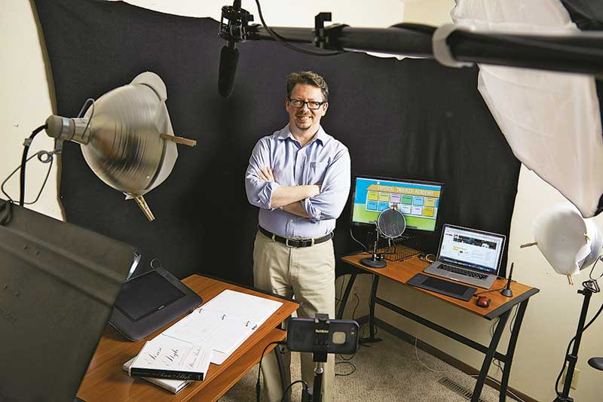
February 2, 2015
Here Comes Professor Everybody: The ‘sharing economy’ meets higher education,
Chronicle of Higher Education, Jeffrey R. Young http://chronicle.com/article/Here-Comes-Professor-Everybody/151445/?cid=at
Kevin deLaplante, an associate professor at Iowa State U., makes an average of $2,500 per month teaching from his home studio (above) on sites like Udemy.

Slide 27
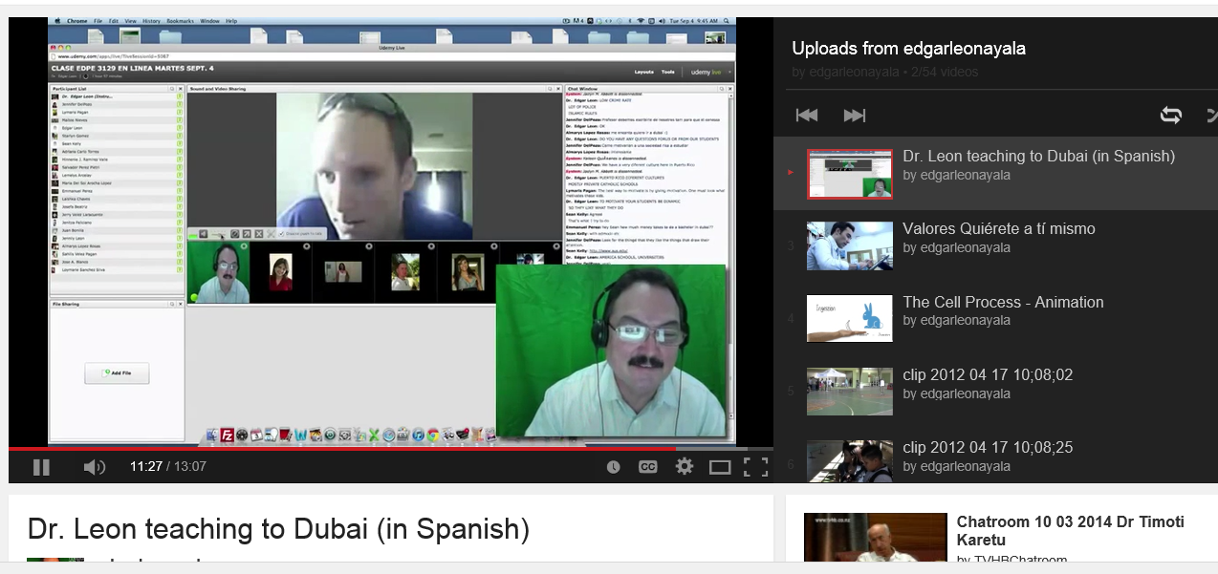
Web Conferencing
Dubai to Puerto Rico (Edgar Leon) https://www.youtube.com/watch?v=Imxw0YwTh2Y&list=UUClhO-jnvl1pEXd9Skv-_Iw

Slide 28
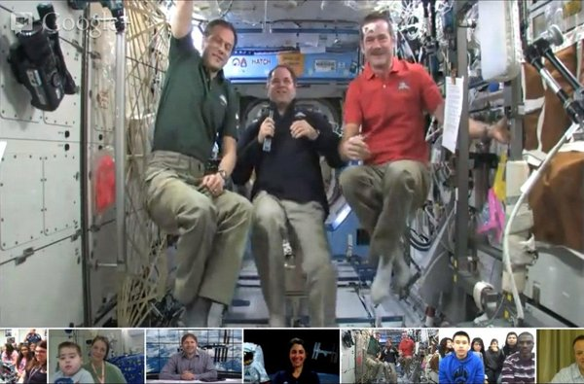
February 22, 2013
NASA's spacey Google+ Hangout shows off zero-G antics – and cats! http://cosmiclog.nbcnews.com/_news/2013/02/22/17057588-nasas-spacey-google-hangout-shows-off-zero-g-antics-and-cats?lite

Slide 29
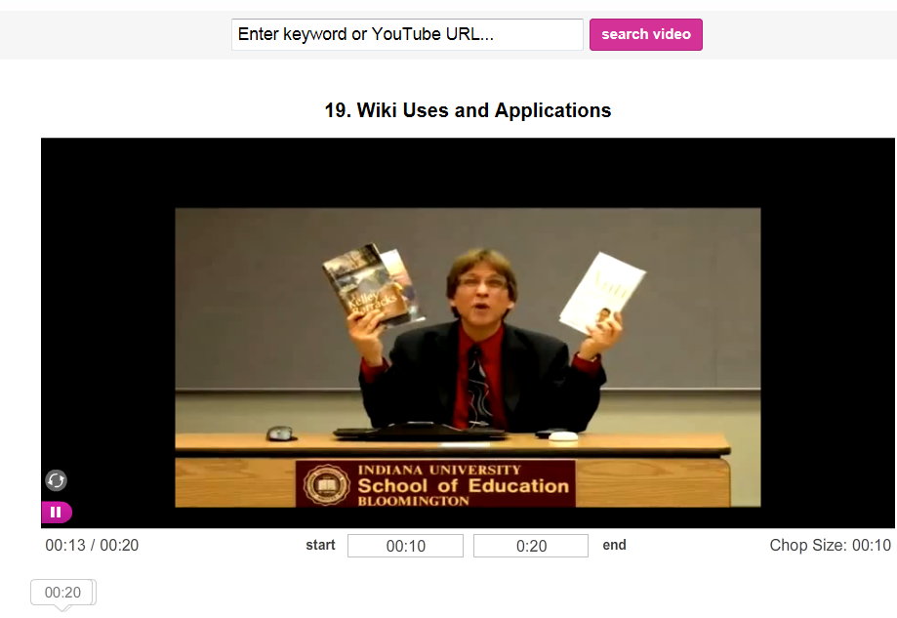
Short Video Anchors
(e.g., TubeChop of V-PORTAL: Video Primers in an Online Repository of e-Teaching and Learning) http://www.tubechop.com/watch/378752

Slide 30

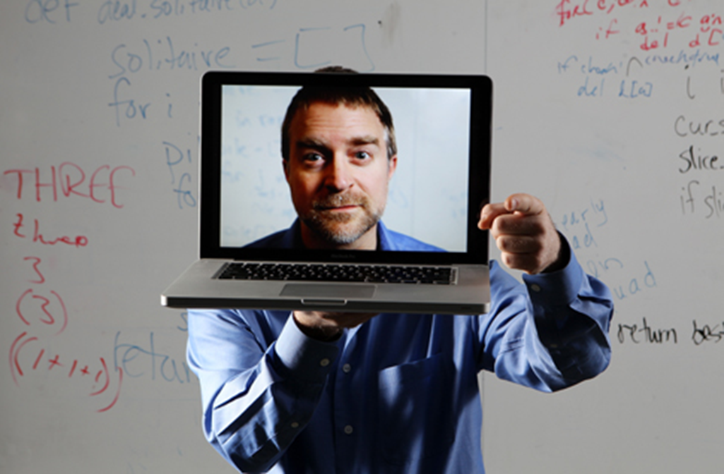
Part III: Lessons Learned…

Slide 31
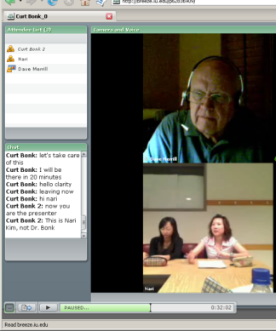
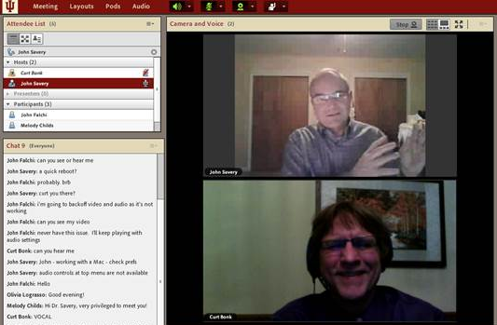
Lesson #1. Combining Asynchronous and Synchronous Events
(e.g., guest was David Merrill, 2007)

Slide 32
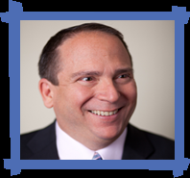
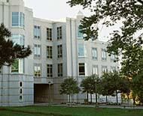
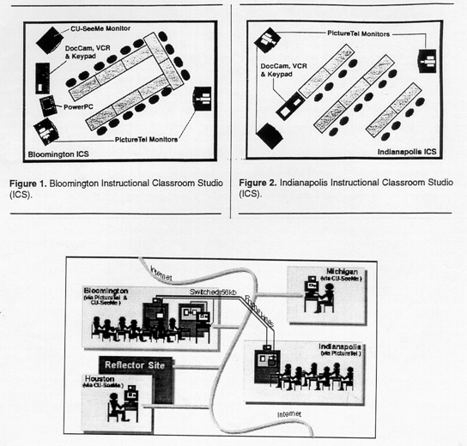
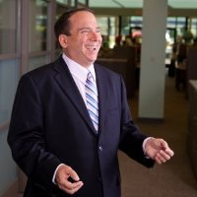
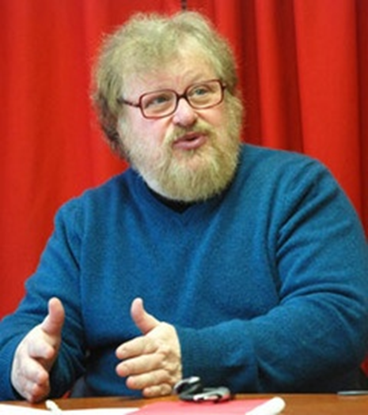
Synchronous + Asynchronous
(e.g., Elliot Soloway and David Palumbo, 1995)
Notes:
94
4

Slide 33

Lesson #2. If Plan, No Instructor Required
(Guest Session Run by Assistant)

Slide 34


Lesson #3. Test the System
(e.g., Guest No Video)

Slide 35

Lesson #4. Guest Starts Semester
Michael Horn and Curt Bonk, R685, August 20, 2012

Slide 36



Lesson #5. Multiple Guest Experts
Sara de Freitas and Jim Hensman, U of Coventry, UK
(https://connect.iu.edu/p2ie1yx6z6x/)
Jay Cross, Berkeley (https://connect.iu.edu/p4bytsoronh/)

Slide 37

Lesson #6. Be Willing to Reciprocate

Slide 38


Lesson #7: Experiment with Technology
Collaboration and Discussion in Google Hangouts (1/29/2013)

Slide 39



Cross-Institutional Wikibook Project
(e.g., IU and the University of Houston)

Slide 40


Lesson #8: Solicit Student Recommendations
Expert Interviews (Rich Culatta, Acting Director, Office of Educational Technology)

Slide 41


Lesson #9: Don’t Give Up!
Serious Gaming Institute, Coventry, UK

Slide 42


Lesson #10: Make a List of Those You Know
Intellagirl Sarah Smith-Robbins and Mark Bell
(Second Life for Dummies)

Slide 43

Part IV: Ten Pedagogical Activities for Class-Related Videoconferencing or Web Conferencing with Experts

Slide 44



1. Expert Presentations with Audience Questioning and Commenting
The guest expert makes a formal or semi-formal presentation of ideas, activities, cultural norms and practices, or research to the class.

Slide 45


2. Expert Demonstrations and Audience Questioning
The guest expert demonstrates a certain technique, idea, principle, etc., while the learners observe and ask follow-up questions.

Slide 46

University of Wisconsin and students in Mexico (agriculture classes)

Slide 47



3. Question and Answer Sessions
The guest expert responds to questions posed by the audience based on a particular topic (the audience might read or watch ahead of time).

Slide 48


4. Responding to Book or Article Quotes
The learners come to the synchronous session with quotes from those articles or resources for the guest expert to respond to.

Slide 49

5. Responding to Publication Visuals
Students find visuals from the culture or country of the guest to respond to; alternatively, they might find charts, tables, figures, and graphs from articles, books, or presentations of the guest expert.

Slide 50

6. Expert Panel
A panel might set up to discuss a particular issue, trend, controversial topic, cultural practice, research finding, announcement, etc.

Slide 51



7. Expert Cultural Sessions
The guest might conduct a short presentation of some aspect of their culture followed by questions from the class.

Slide 52


8. Expert Interviews and Discussions
Students might read the biography or resume of the guest as well as available articles, books, and other resources about this person. Next, the guest might respond to questions from the class based on these resources.

Slide 53




Videoconference
Shanghai, China, April 28, 2013

Slide 54


Videoconferencing (first demo in 1964 at the World’s Fair; use increased in 2003)
Tablets Rock On: Education Tech Through The Ages, Information Week, February 26, 2013 http://www.informationweek.com/education/instructional-it/blended-learning-improves-test-scores-st/240159840

Slide 55


9. Expert Life Stories
The guest expert might detail different stories or situations that he or she has encountered related to a certain topic of the class. Students in the class can comment on them and ask questions as needed.

Slide 56

10. Expert Session Archive Reviews and Discussions
A class might watch one or more guest expert sessions from a previous semester and form discussion groups based on controversial, confusing, or complex aspects of such sessions.

Slide 57


GETideas Channel, Cisco
(Thought Leader Series uploaded to YouTubEdu)
July 22, 2011

Slide 58



Part V. Introducing the free “TEC-VARIETY” Framework… http://tec-variety.com/ http://tec-variety.com/TEC-VARIETY-Chinese.pdf

Slide 59






1. Tone/Climate: A. Threaded Video Discussions, e.g., Flipgrid http://flipgrid.com/#429f88c5)

Slide 60





1. Tone/Climate: B. Video Introductions (Office Hours in Other Countries)
Chuck Severance, U Michigan/Coursera) in Barcelona http://www.youtube.com/watch?v=JzNHvmSv8TI
Chuck Severance, University of Michigan https://www.coursera.org/course/pythonlearn

Slide 61


2. Encouragement, Feedback, etc.: A. Demonstrations and Tutorials
Emerging technology specialist, IU UITS, Nitocris Perez, May 29, 2014 http://inside.iub.edu/features/videos/2014-05-29-inub-vid-cib.shtml

Slide 62



3. Curiosity, Fun:
A. Tracking the Life of a Scientist (bio.com) http://www.biography.com/people/steve-jobs-9354805 http://www.biography.com/people/ada-lovelace-20825323
Dinosaurs (Laboratory News, April 1, 2012): http://www.labnews.co.uk/news/prehistoric-revolution/

Slide 63




May 25, 2015
3. Curiosity, Fun:
B. Something in the News
(e.g., Chinese universities move up in world rankings, China Daily) http://www.cnn.com/2014/12/17/health/healthy-aging/index.html?hpt=hp_t2 http://espn.go.com/sports/endurance/story/_/id/8979487/fauja-singh-101-caps-career-10k-hong-kong http://www.chinadaily.com.cn/china/2015-05/25/content_20805854.htm

Slide 64





3. Curiosity, Fun:
C. Something in the News
New 'massive' dinosaur skeleton discovered, USA Today, September 5, 2014 (Dreadnoughtus) http://www.usatoday.com/story/tech/2014/09/04/dinosaur-skeleton-discovered/15031803/
October 23, 2014: Goofy dinosaur blends Barney and Jar Jar Binks, SF Gate http://www.sfgate.com/news/science/article/Goofy-dinosaur-blends-Barney-and-Jar-Jar-Binks-5840093.php
Incredible 50-foot 'dragon' dinosaur unearthed by Chinese farmers
January 20, 2015: Naomi Ng, for CNN http://www.cnn.com/2015/01/30/asia/china-dragon-dinosaur/index.html

Slide 65




4. Variety, Novelty, Fun:
A. Teach from Vietnam to the World
BBC News Asia, August 14, 2013
Even though he is now very elderly Vinh Bao (age 96) still teaches music, using his computer to coach pupils across the globe. http://www.bbc.com/news/world-asia-23497559

Slide 66


5. Autonomy, Choice:
A. Attend Webinar (pick weeks and reflecti)
Cathy Davidson, The End of Higher Education http://connectedcourses.net/thecourse/why-we-need-a-why/

Slide 67




6. Relevance, Meaningfulness:
A. Case-Based Learning: Instructor Cases
(e.g., Mark Braun, IU)

Slide 68





6. Relevance, Meaningfulness:
B. Video Anchors
(e.g., Learning and Memory Videos)

Slide 69


7. Interactive, Collaborative:
A. Q&A Web Conferencing (Feb/May 2015)
(Adobe Connect, Jabber, iMeet, GoToMeeting, etc.) https://connect.iu.edu/p259wpiabg9/

Slide 70



8. Engagement, Effort:
A. Collaborative Video Annotations and Discussions (Craig Howard, IU) http://scholarworks.iu.edu/journals/index.php/ijdl/article/view/853/912

Slide 71

9. Tension, Challenge, etc.:
A. Cage Matches or Debates
(with online audience topical suggestions)
Cage Match on MOOCs at SXSWedu 2013
(Curt Bonk & Chuck Severance) http://chronicle.com/blogs/wiredcampus/at-south-by-southwest-education-event-tensions-divide-entrepreneurs-and-educators/42777 https://soundcloud.com/sxswedu/cage-match-the-massive-open

Slide 72


10. Yields Products, Goals:
A. Student Created Mobile Apps
The App Builder: http://www.theappbuilder.com/
April 29, 2015
Roosevelt Faulkner, IST, R678
Videos: Watch selected videos from scholars and educators.
Benefits:
Can easily watch YouTube videos without having to open a separate application
Limitations:
Only accepts YouTube urls

Slide 73



March 13, 2015
10. Yields Products, Goals:
B. 20% Time in Education
Kendal Rasnake & Troy Cockrum, IU https://www.dropbox.com/s/tcsr5oae2lcgwuk/20_Time_in_Education-Cockrum_and_Rasnake.mov?n=57312573

Slide 74





Final Poll: How many new ideas did you get?
0 if I am lucky.
Just 1.
2, yes, 2…just 2!
Do I hear 3? 3!!!!
4-5.
5-10.
More than 10.

Slide 75


How do you now view the instructor in the Open World of Education 3.0?

Slide 76






MOOCs and Open Education Around the World http://routledge-ny.com/books/details/9781138807419/

Slide 77



--
The World is Open for Learning!
Dr. Jiao Jianli, Professor of Educational Technology,
Director of Future Education Research Centre
Deputy Dean of School of Information Technology in Education, South China Normal University http://jiao.blogbus.com/

Slide 78



Questions?
Slides at: TrainingShare.com
Papers: PublicationShare.com
Book: http://worldisopen.com/
Email: curt@worldisopen.com

