Slide 1
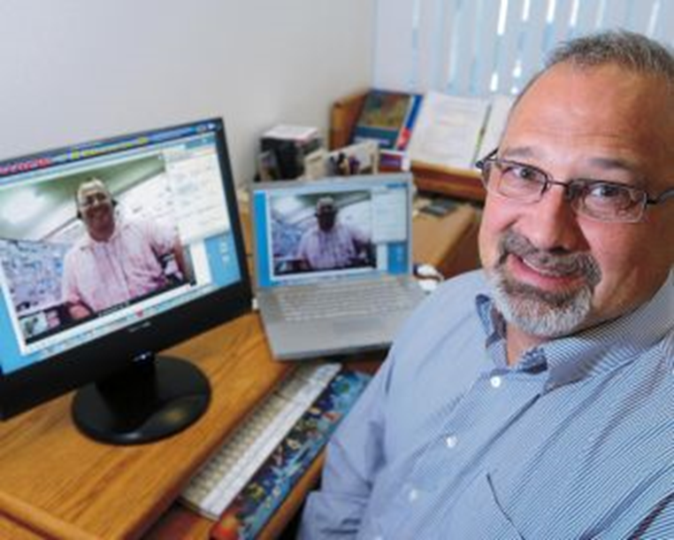
Masterclass #1:
Expanding Learning Possibilities using Conferencing Technology
Dr. Curtis J. Bonk, cjbonk@indiana.edu
Professor, Indiana University

Slide 2
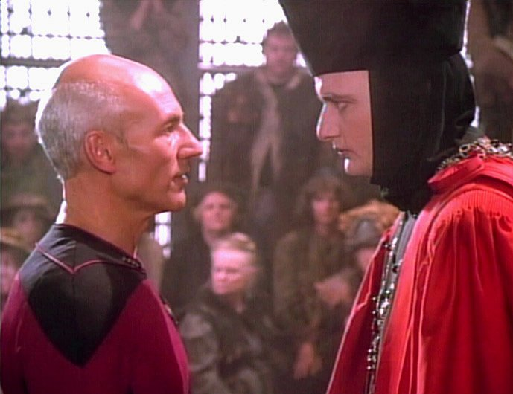
Part I: Expert Apprenticeship from Video

Slide 3
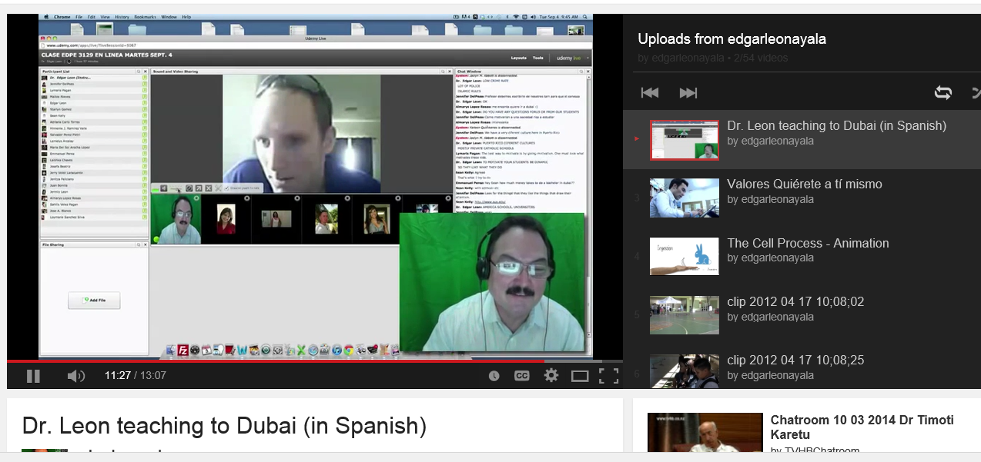
Web Conferencing
Dubai to Puerto Rico (Edgar Leon) https://www.youtube.com/watch?v=Imxw0YwTh2Y&list=UUClhO-jnvl1pEXd9Skv-_Iw

Slide 4
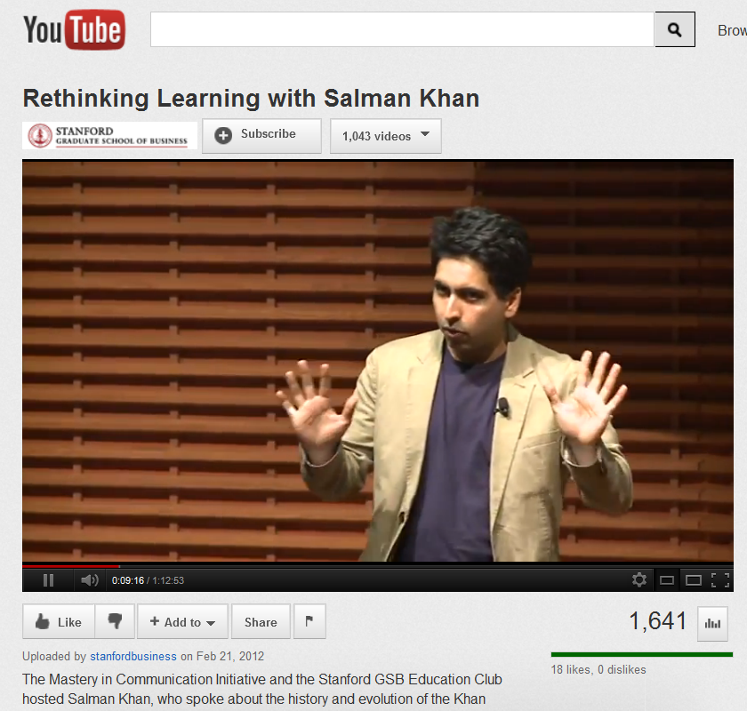
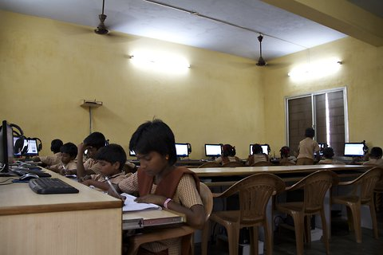
October 15, 2012
Reusable Khan
Lacking Teachers and Textbooks, India’s Schools Turn to Khan Academy to Survive, NY Times, Anupama Chandrasekaran http://india.blogs.nytimes.com/2012/10/15/lacking-teachers-and-textbooks-indias-schools-turn-to-khan-academy-to-survive/
Students at Sree Karpagavalli Vidhyalaya school in Chennai, Tamil Nadu, watching Khan Academy math videos.

Slide 5
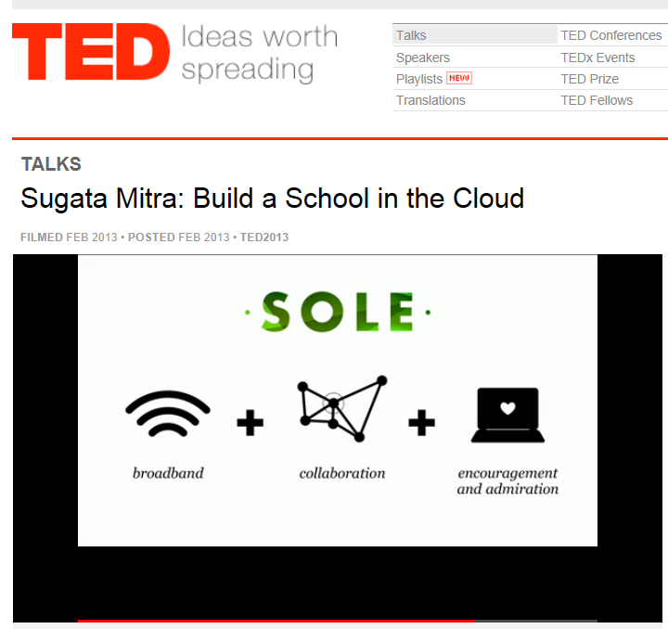
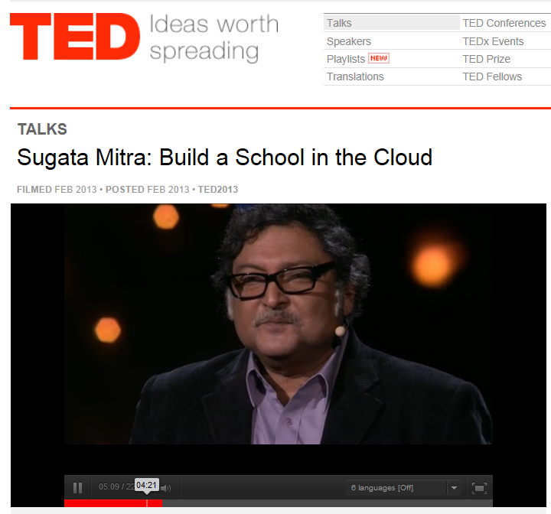
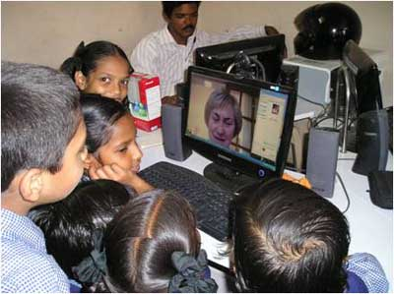
TED Talks
(Build a School in the Cloud; Self-Organized Learning Environments (SOLEs), February 2013, TED Talk from Sugata Mitra http://www.ted.com/talks/sugata_mitra_build_a_school_in_the_cloud.html

Slide 6
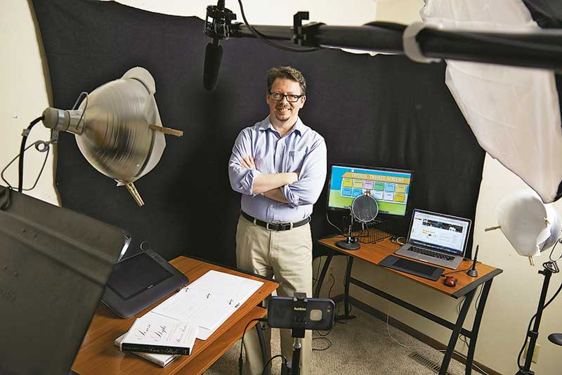
February 2, 2015
Here Comes Professor Everybody: The ‘sharing economy’ meets higher education,
Chronicle of Higher Education, Jeffrey R. Young http://chronicle.com/article/Here-Comes-Professor-Everybody/151445/?cid=at
Kevin deLaplante, an associate professor at Iowa State U., makes an average of $2,500 per month teaching from his home studio (above) on sites like Udemy.

Slide 7
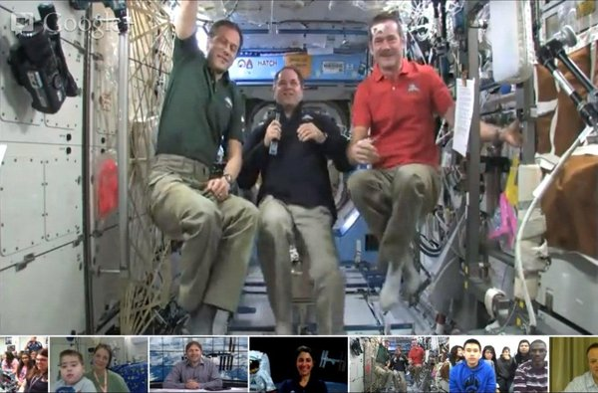
February 22, 2013
NASA's spacey Google+ Hangout shows off zero-G antics – and cats! http://cosmiclog.nbcnews.com/_news/2013/02/22/17057588-nasas-spacey-google-hangout-shows-off-zero-g-antics-and-cats?lite

Slide 8

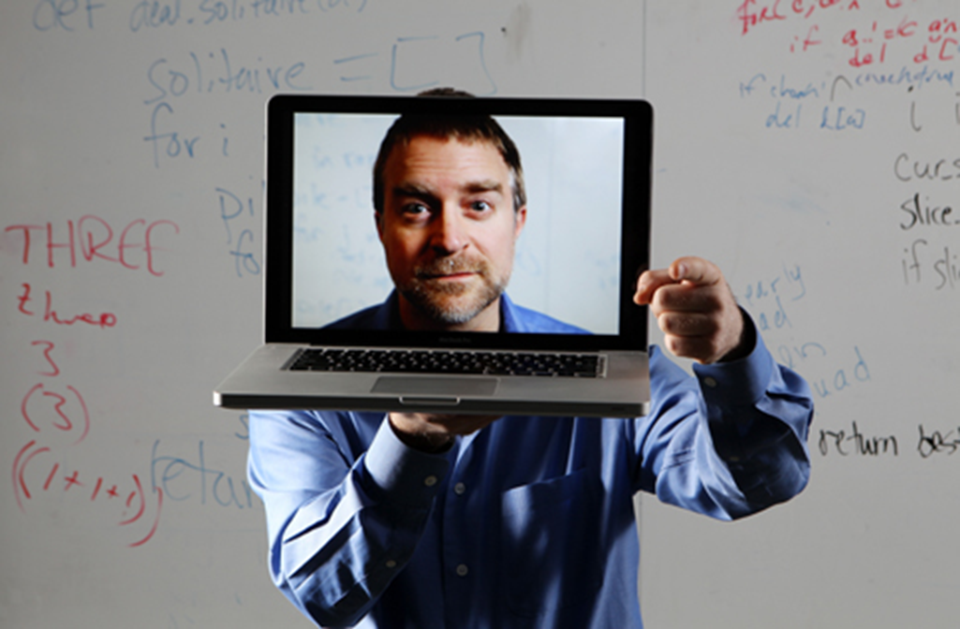
Part II: Lessons Learned…

Slide 9
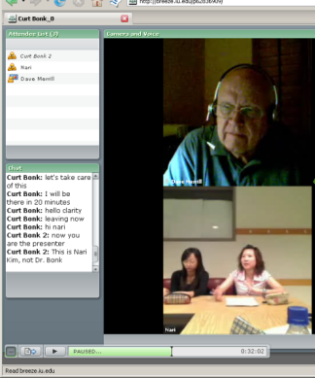
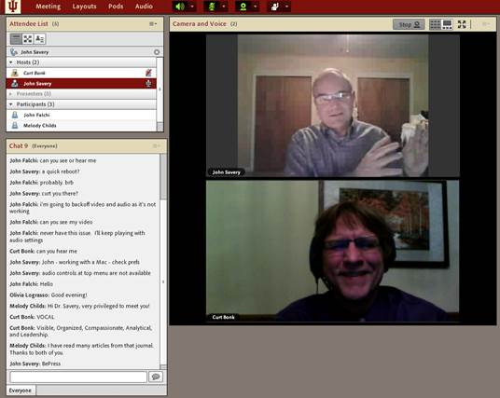
Lesson #1. Combining Asynchronous and Synchronous Events
(e.g., guest was David Merrill, 2007)

Slide 10
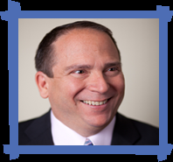
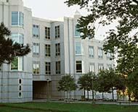
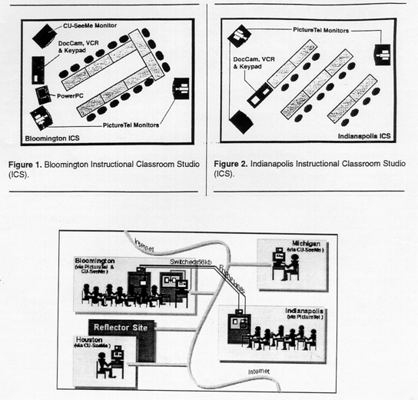
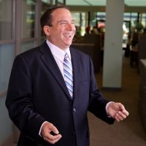
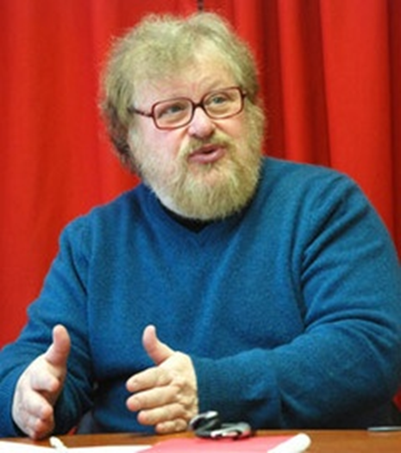
Synchronous + Asynchronous
(e.g., Elliot Soloway and David Palumbo, 1995)
Notes:
94
4

Slide 11
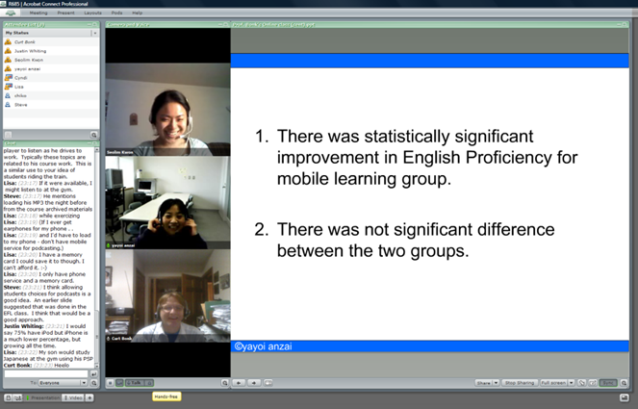
Lesson #2. If Plan, No Instructor Required
(Guest Session Run by Assistant)

Slide 12
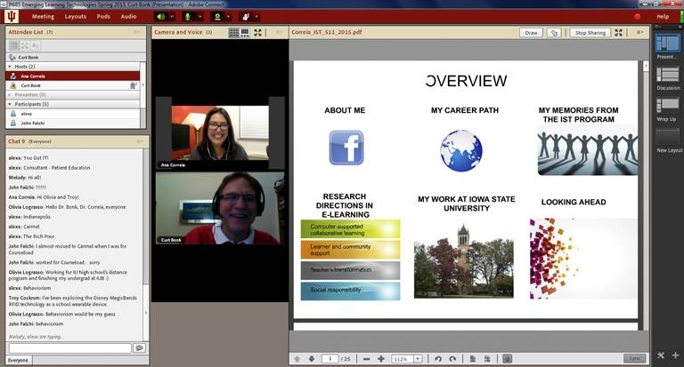
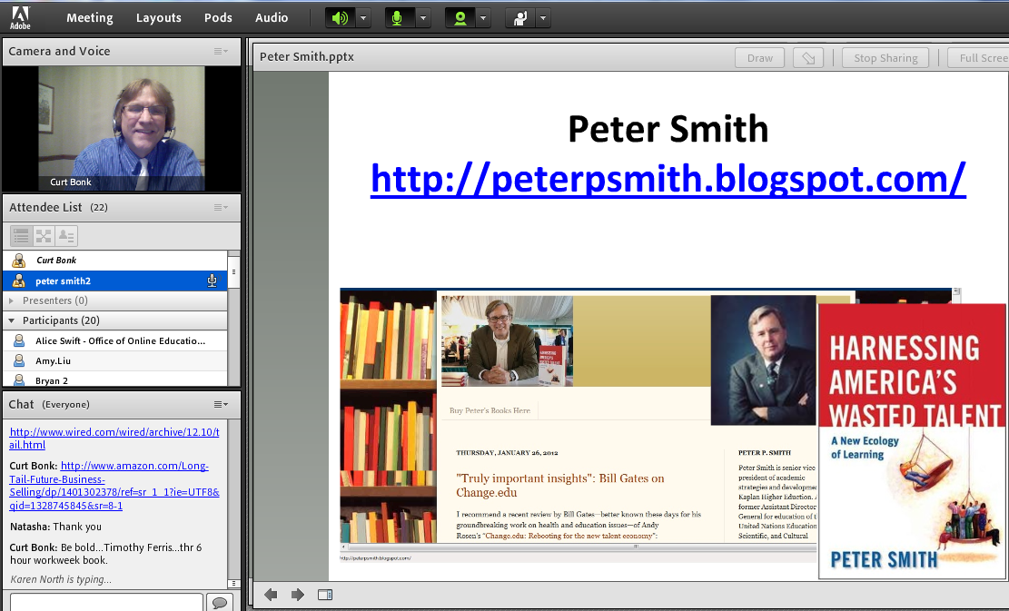
Lesson #3. Test the System
(e.g., Guest No Video)

Slide 13
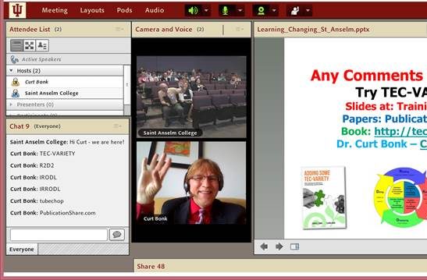
May 2015
Sync Presentation and Chat in Adobe Connect https://connect.iu.edu/p259wpiabg9/

Slide 14
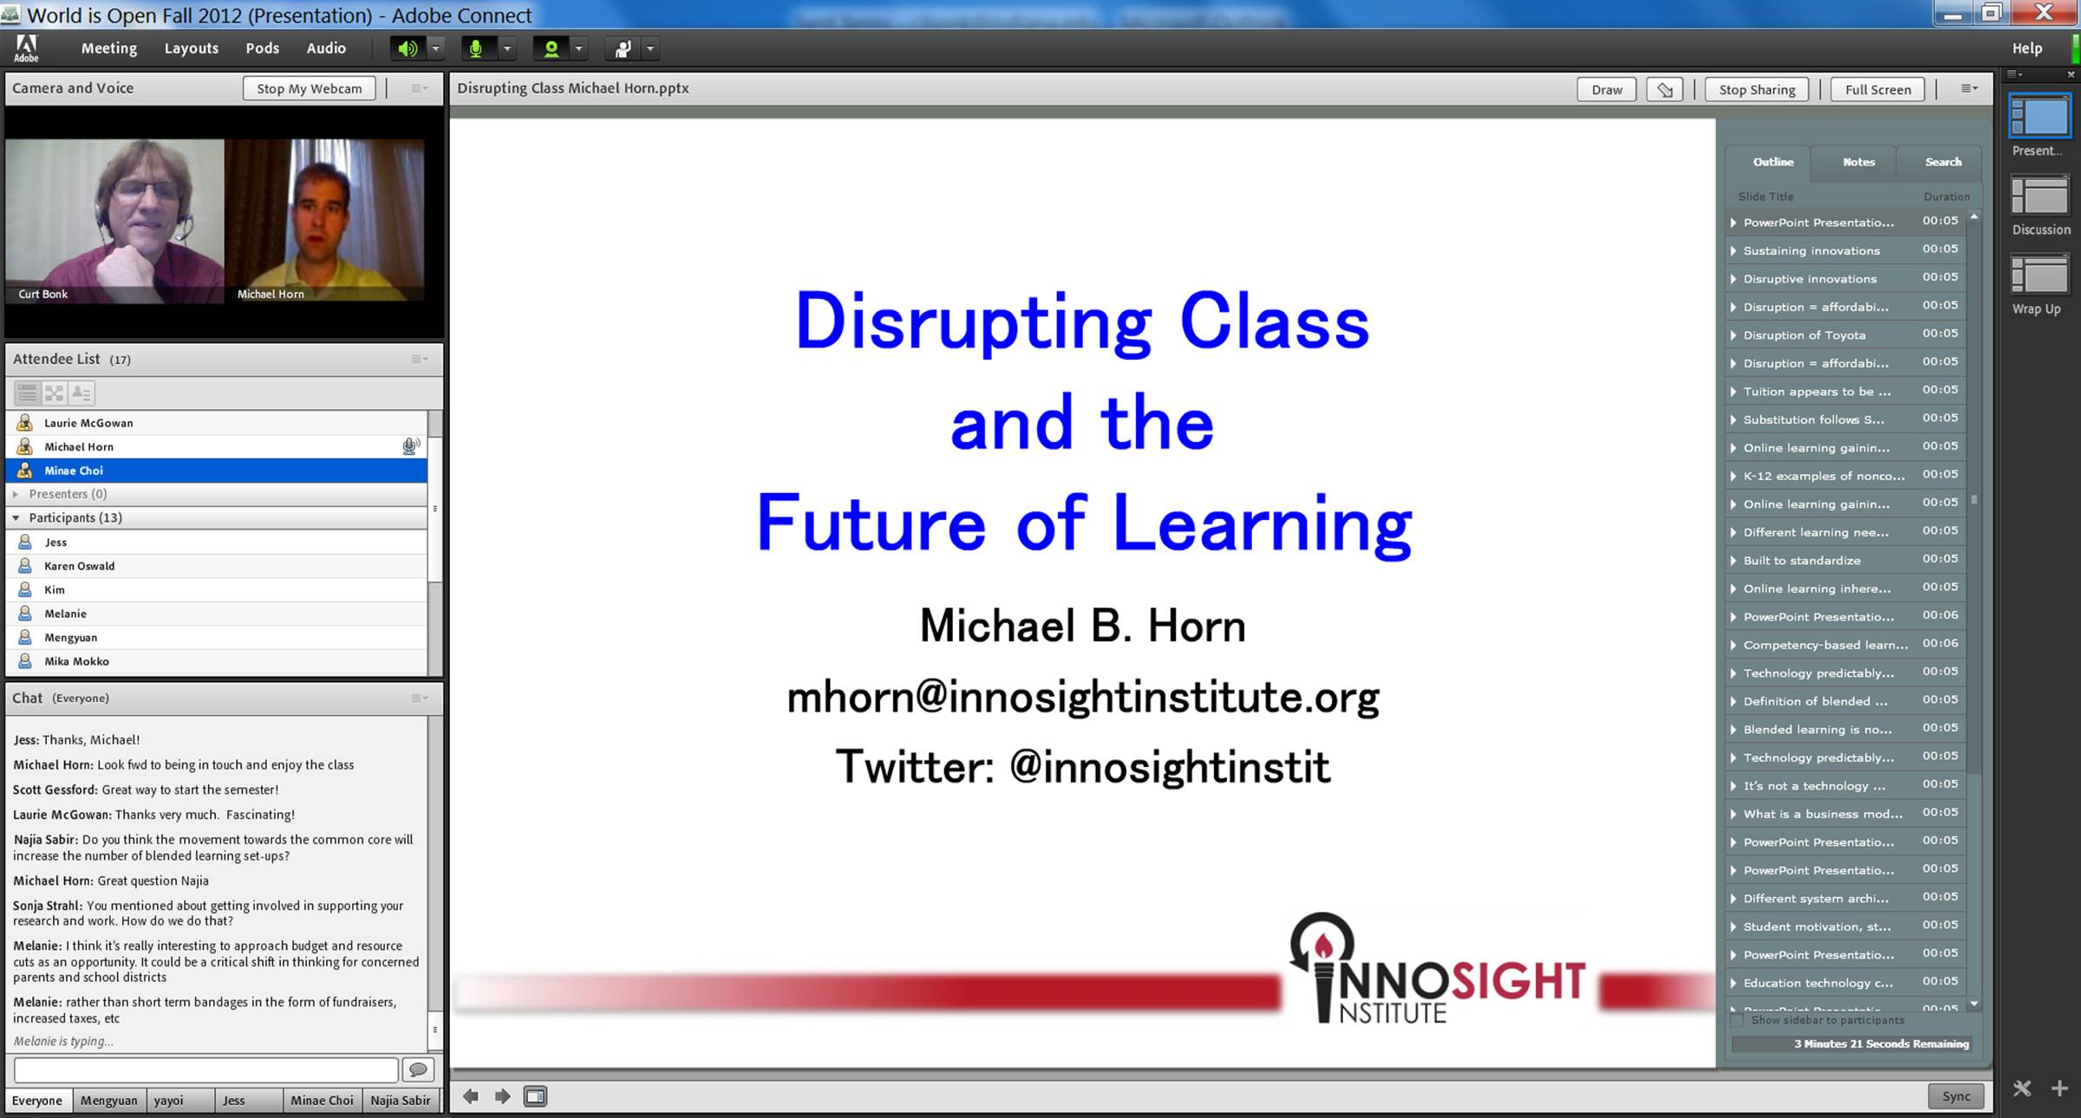
Lesson #4. Guest Starts Semester
Michael Horn and Curt Bonk, R685, August 20, 2012

Slide 15
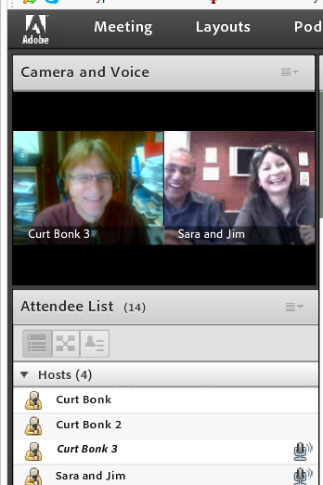
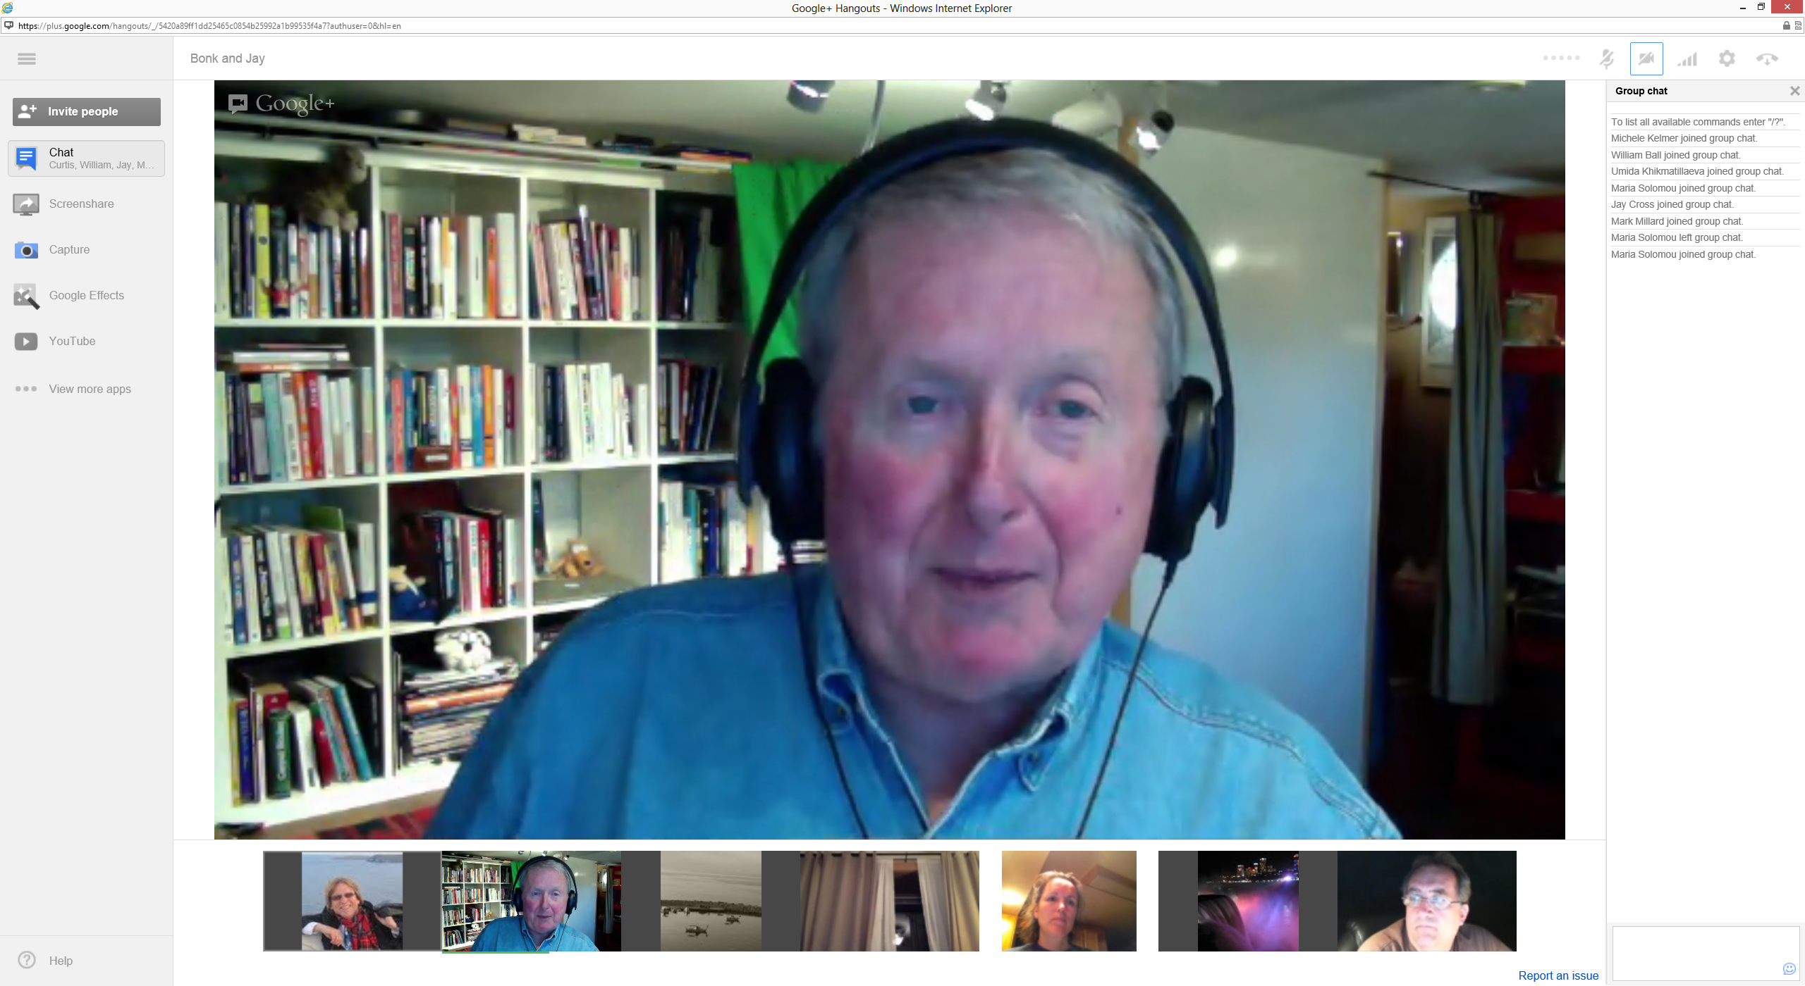
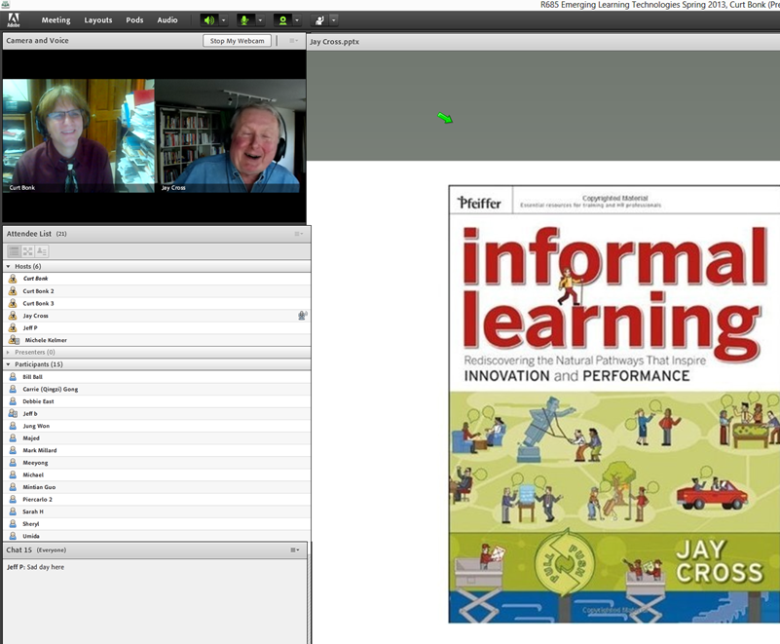
Lesson #5. Multiple Guest Experts
Sara de Freitas and Jim Hensman, U of Coventry, UK
(https://connect.iu.edu/p2ie1yx6z6x/)
Jay Cross, Berkeley (https://connect.iu.edu/p4bytsoronh/)

Slide 16
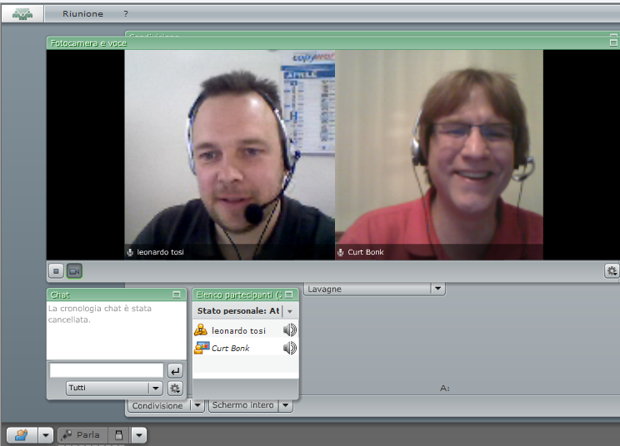
Lesson #6. Be Willing to Reciprocate

Slide 17
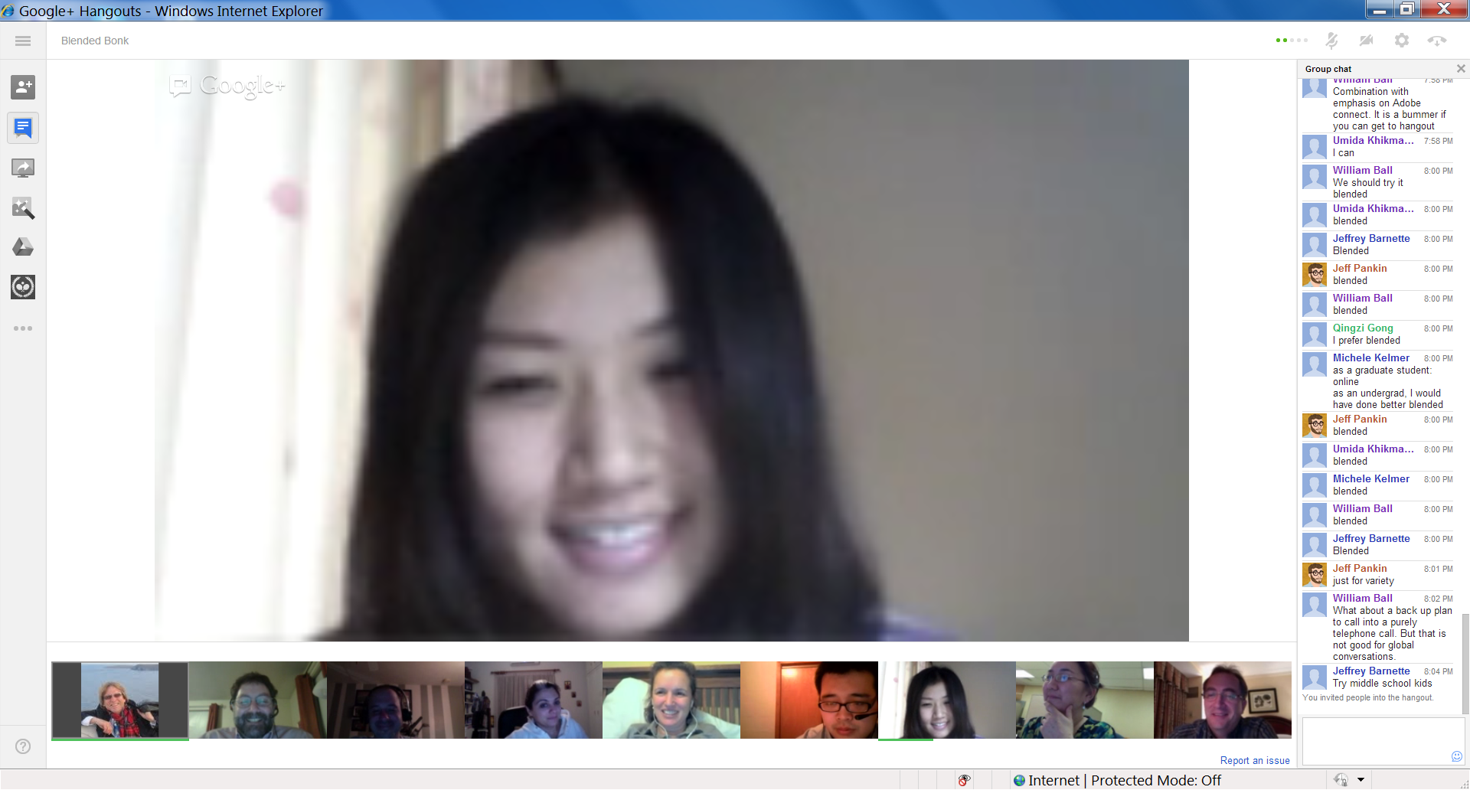
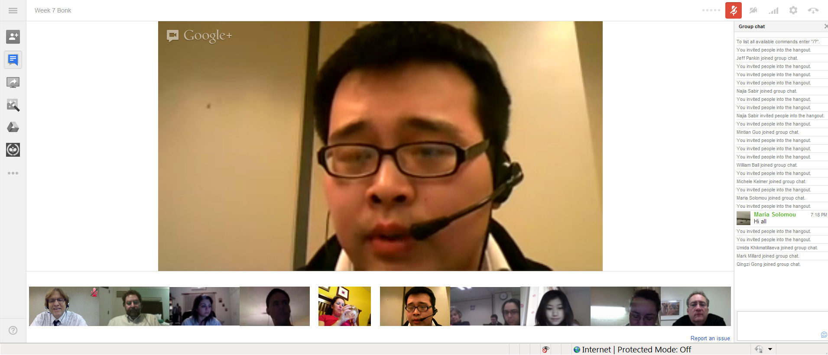
Lesson #7: Experiment with Technology
Collaboration and Discussion in Google Hangouts (1/29/2013)

Slide 18
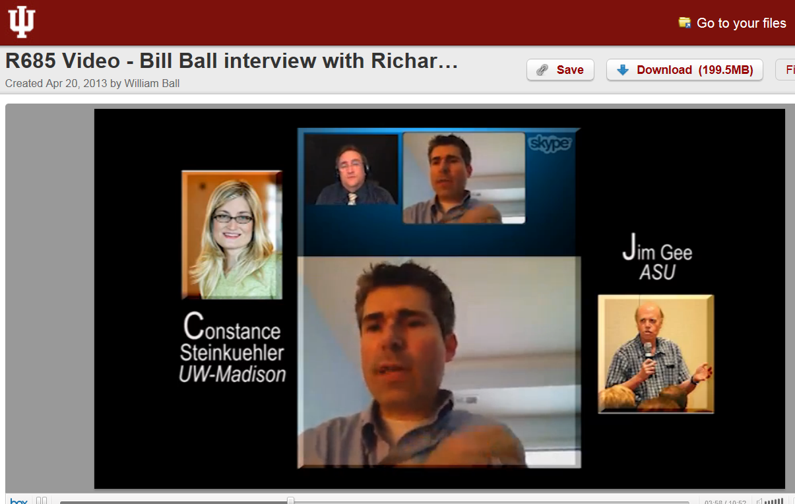
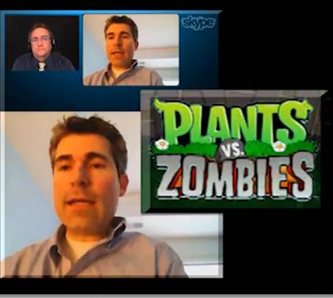
Lesson #8: Solicit Student Recommendations
Expert Interviews (Rich Culatta, Acting Director, Office of Educational Technology)

Slide 19
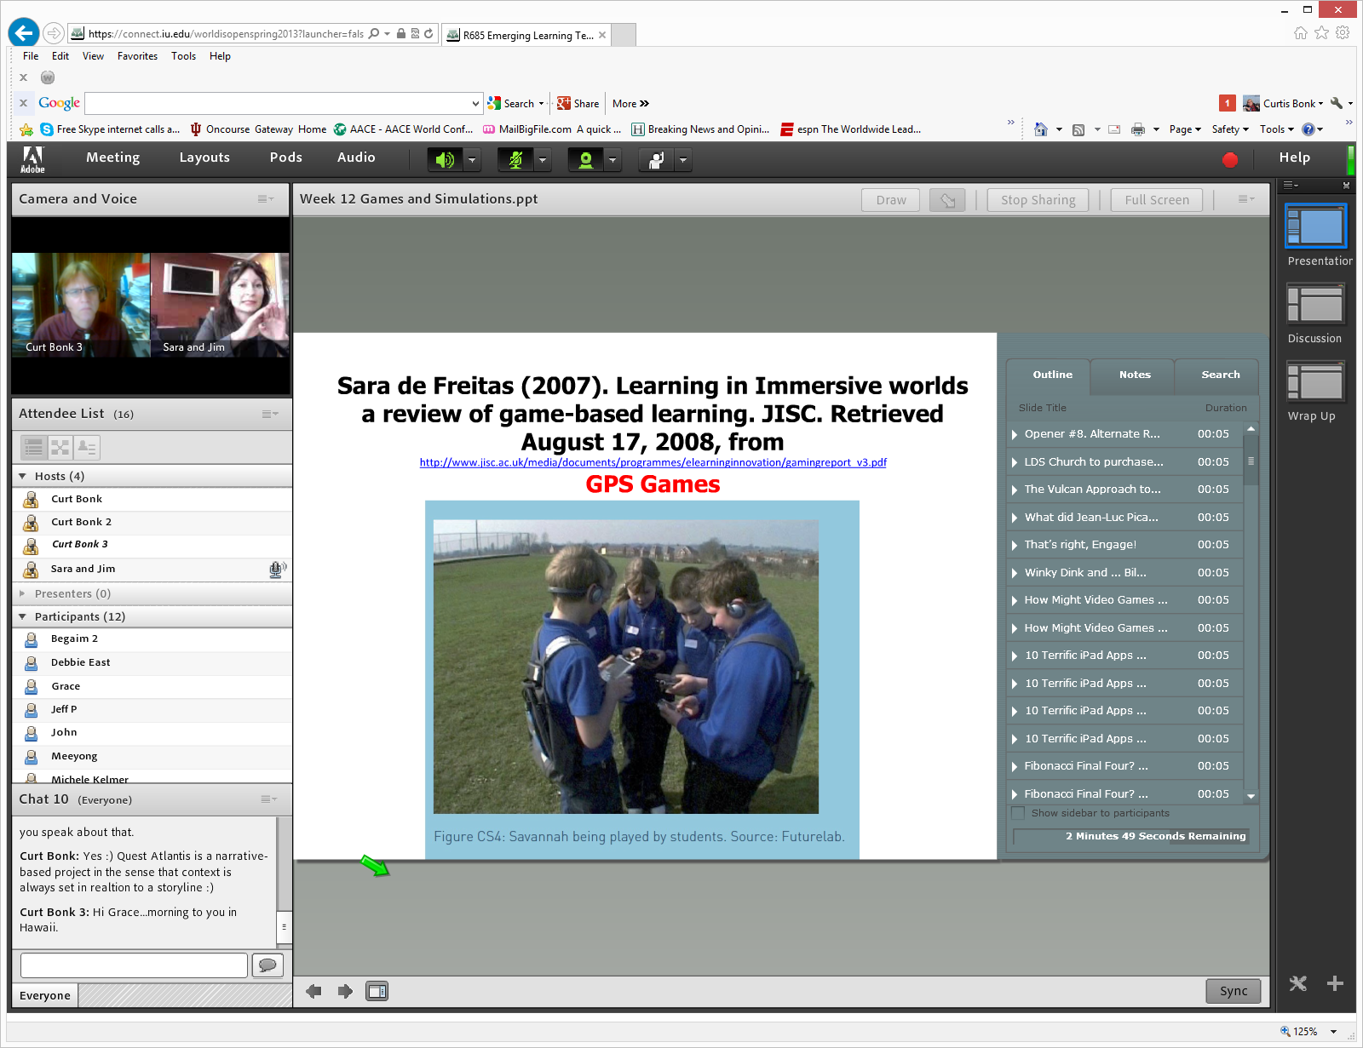

Lesson #9: Don’t Give Up!
Serious Gaming Institute, Coventry, UK

Slide 20
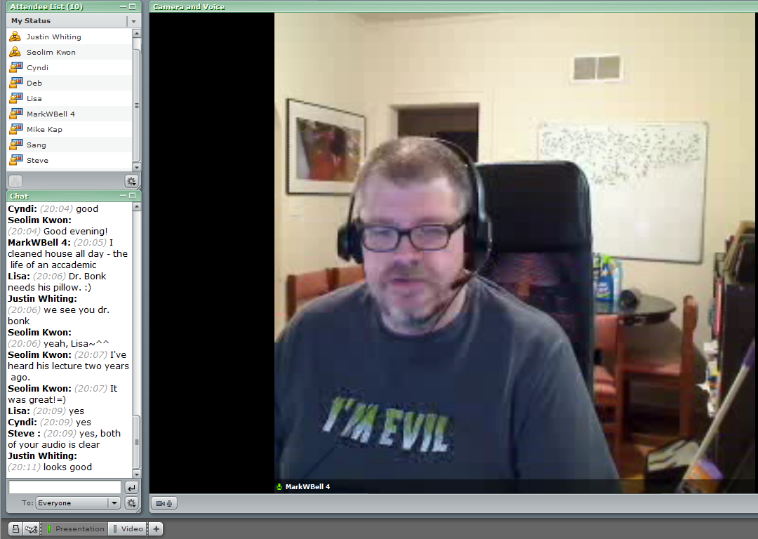
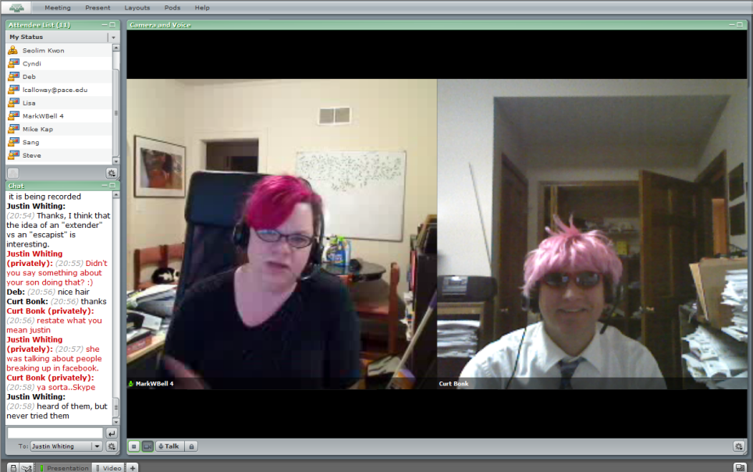
Lesson #10: Make a List of Those You Know
Intellagirl Sarah Smith-Robbins and Mark Bell
(Second Life for Dummies)

Slide 21
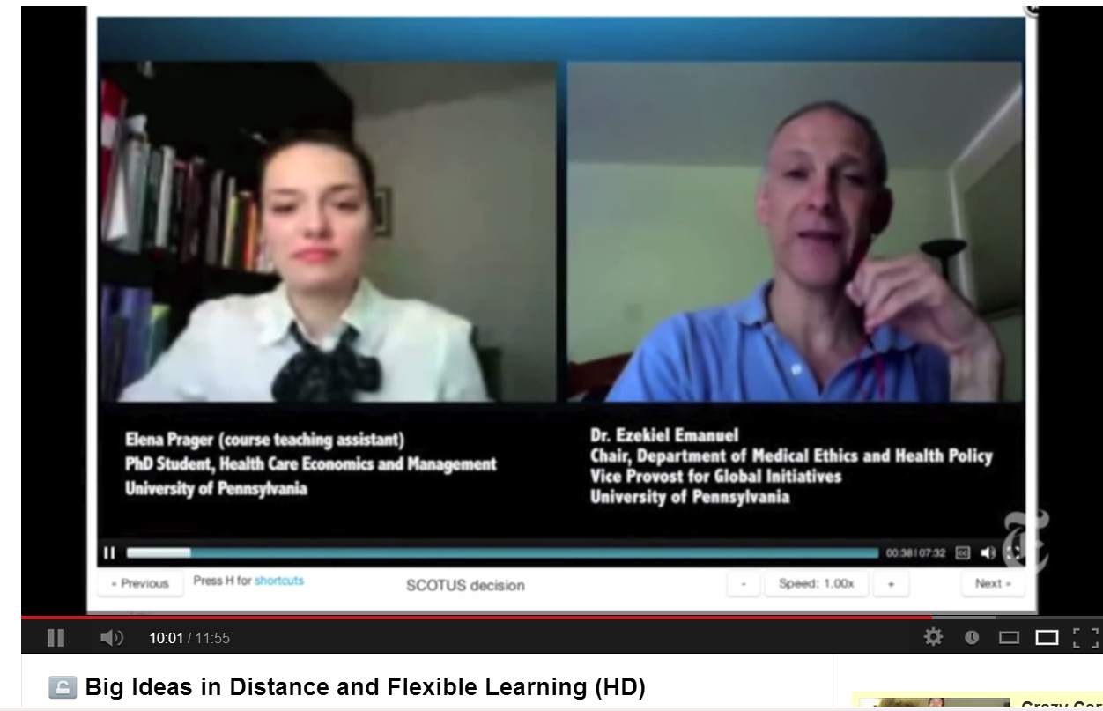
Part III: Twenty Pedagogical Activities for Class-Related Videoconferencing or Web Conferencing with Experts

Slide 22
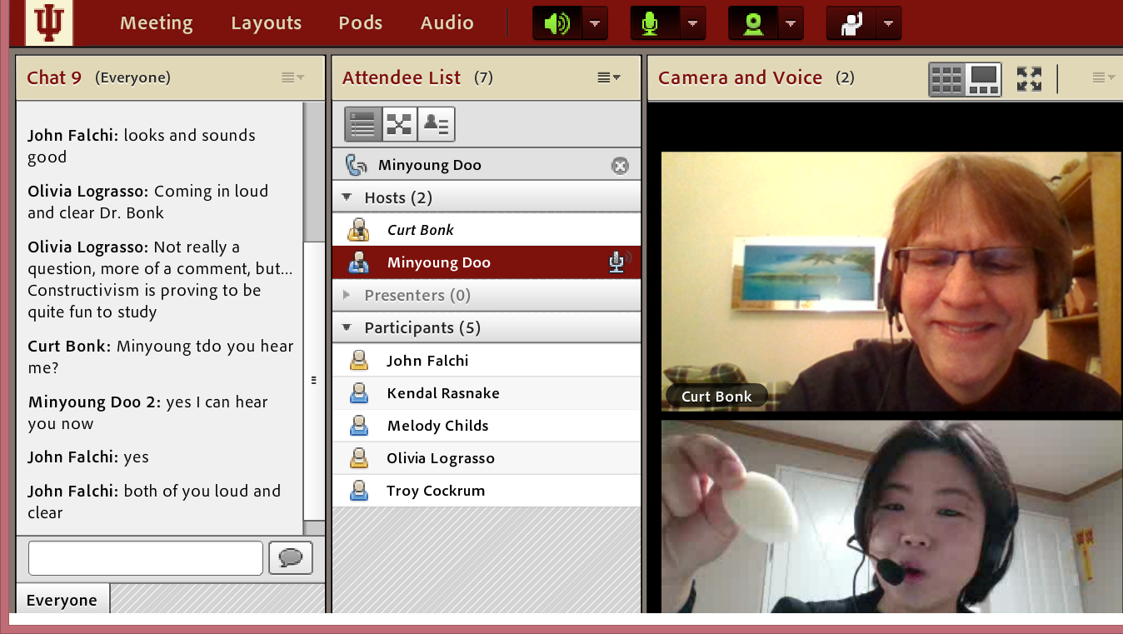
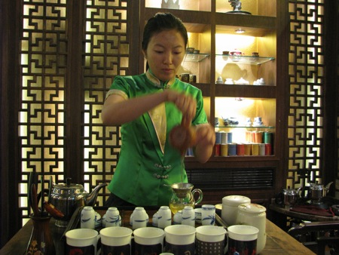
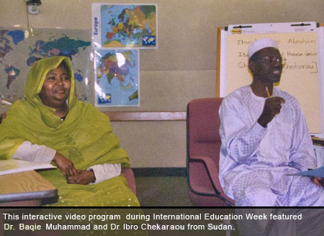
1. Expert Presentations with Audience Questioning and Commenting
The guest expert makes a formal or semi-formal presentation of ideas, activities, cultural norms and practices, or research to the class.

Slide 23
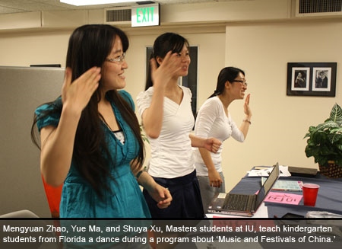
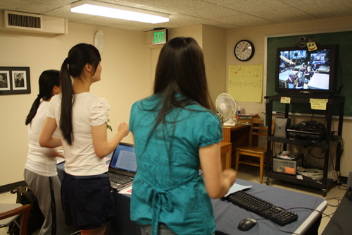
2. Expert Demonstrations and Audience Questioning
The guest expert demonstrates a certain technique, idea, principle, etc., while the learners observe and ask follow-up questions.

Slide 24
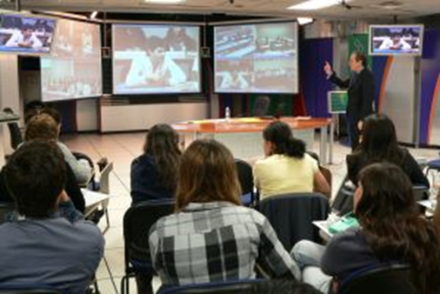
University of Wisconsin and students in Mexico (agriculture classes)

Slide 25
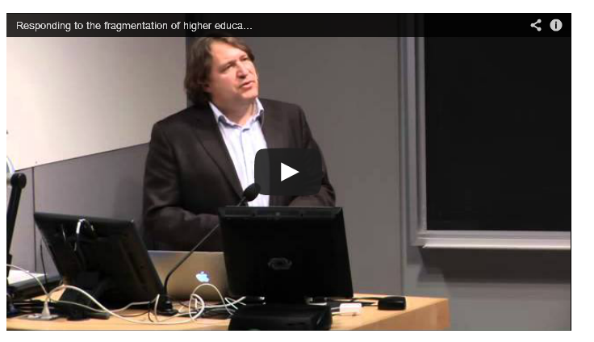
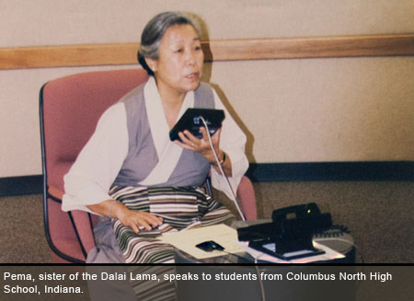
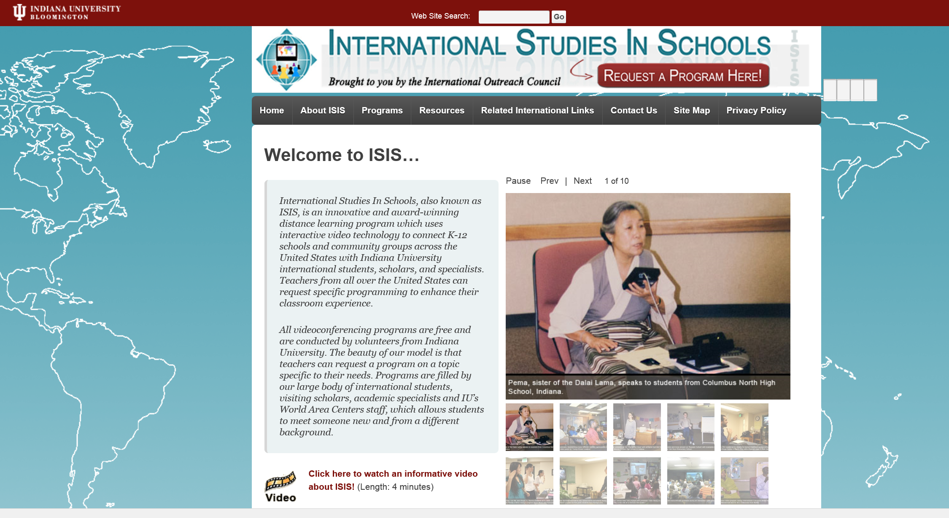
3. Question and Answer Sessions
The guest expert responds to questions posed by the audience based on a particular topic (the audience might read or watch ahead of time).

Slide 26
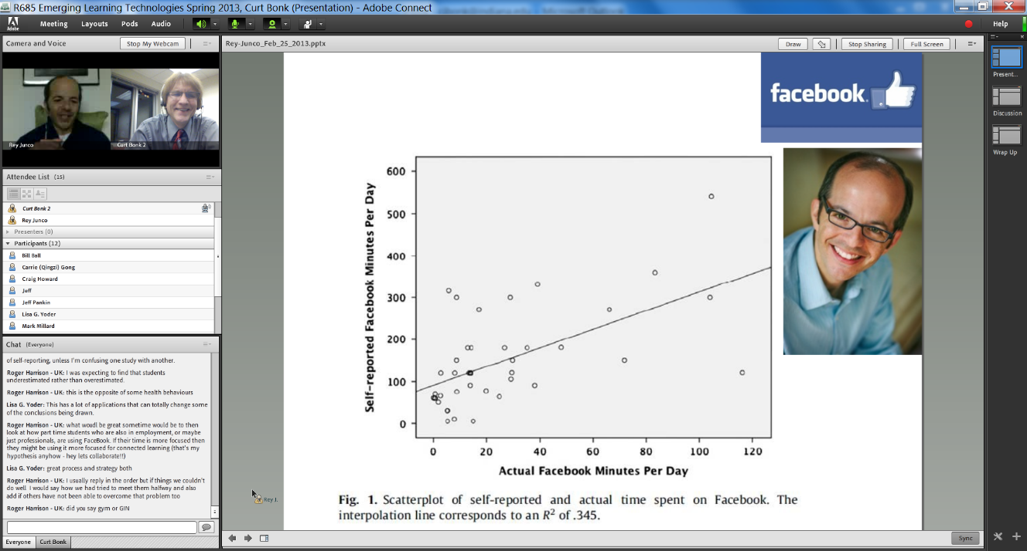
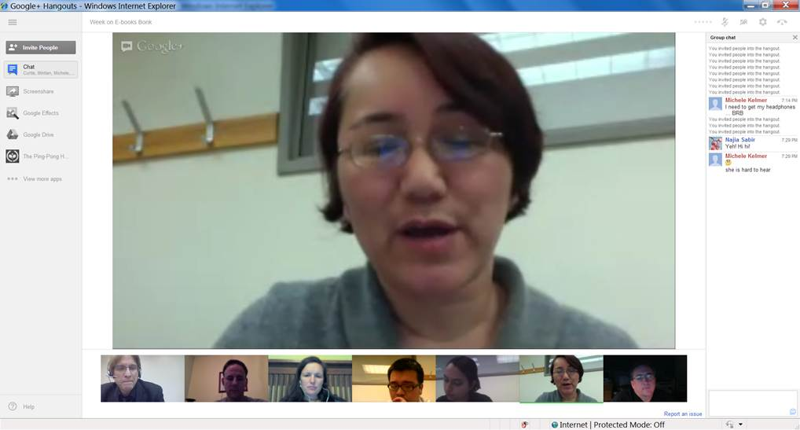
4. Responding to Book or Article Quotes
The learners come to the synchronous session with quotes from those articles or resources for the guest expert to respond to.

Slide 27
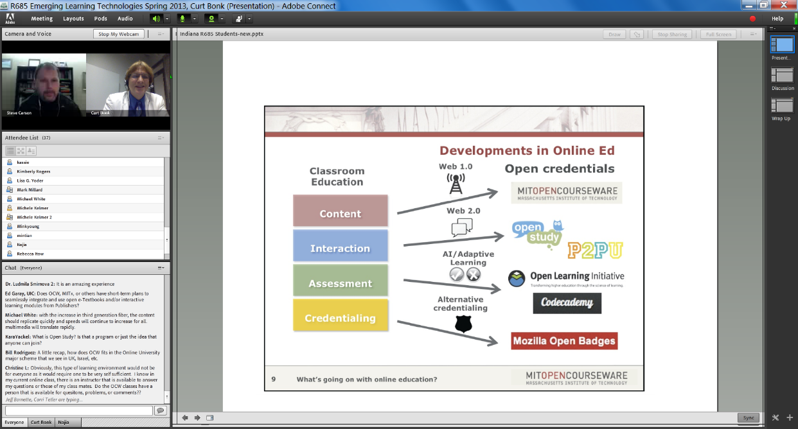
5. Responding to Publication Visuals
Students find visuals from the culture or country of the guest to respond to; alternatively, they might find charts, tables, figures, and graphs from articles, books, or presentations of the guest expert.

Slide 28
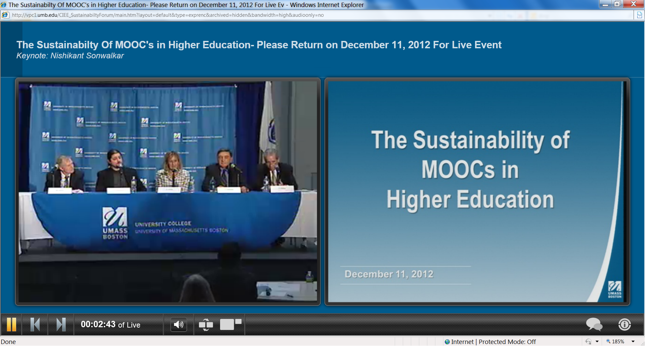
6. Expert Panel
A panel might set up to discuss a particular issue, trend, controversial topic, cultural practice, research finding, announcement, etc.

Slide 29
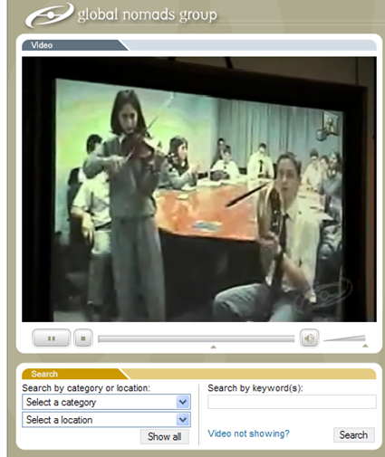
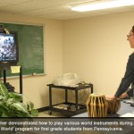

7. Expert Cultural Sessions
The guest might conduct a short presentation of some aspect of their culture followed by questions from the class.

Slide 30

Q&A Web Conferencing (Feb/May 2015)
Sync Chat in Adobe Connect with students in Kazakhstan about language learning
(Adobe Connect, Jabber, iMeet, GoToMeeting, etc.) https://connect.iu.edu/p259wpiabg9/

Slide 31


8. Expert Interviews and Discussions
Students might read the biography or resume of the guest as well as available articles, books, and other resources about this person. Next, the guest might respond to questions from the class based on these resources.

Slide 32

Videoconferencing (first demo in 1964 at the World’s Fair; use increased in 2003)
Tablets Rock On: Education Tech Through The Ages, Information Week, February 26, 2013 http://www.informationweek.com/education/instructional-it/blended-learning-improves-test-scores-st/240159840

Slide 33






Guest Chats (in Adobe Connect)
(e.g., Emily Hixon, January 20, 2015) https://connect.iu.edu/p259wpiabg9/

Slide 34

January 12, 2016
Discuss Course Requirements
R511 Chat with Minkyoung Kim

Slide 35

January 20, 2016
Guest Expert Chat
R511 Chat with Mike Molenda

Slide 36


9. Expert Life Stories
The guest expert might detail different stories or situations that he or she has encountered related to a certain topic of the class. Students in the class can comment on them and ask questions as needed.

Slide 37

10. Expert Session Archive Reviews and Discussions
A class might watch one or more guest expert sessions from a previous semester and form discussion groups based on controversial, confusing, or complex aspects of such sessions.

Slide 38


GETideas Channel, Cisco
(Thought Leader Series uploaded to YouTubEdu)
July 22, 2011

Slide 39


11. Expert Presentations and Webinars
The guest expert presentation followed by questions and answer session.
e.g., Cathy Davidson or Michael Wesch, The End of Higher Education, http://connectedcourses.net/thecourse/why-we-need-a-why/

Slide 40




Videoconference
Shanghai, China, April 28, 2013

Slide 41

May 28, 2015
World Bank Institute workshop to Zhengzhou city, China
Here is his webpage: http://michaeltrucano.com/index.html
Email: mtrucano@worldbank.org https://blogs.worldbank.org/edutech/edtech-and-mooc-times-china

Slide 42

July 31, 2014
12. Celebration Events
Book Launching via Skype
University of Waikato, New Zealand

Slide 43

July 31, 2014
Book Launching via Skype
University of Waikato, New Zealand

Slide 44

July 31, 2014
Book Launching via Skype
University of Waikato, New Zealand

Slide 45



Cross-Institutional Wikibook Project
(e.g., IU and the University of Houston)

Slide 46

December 16, 2015
Remembering Jay Cross from eLearning Guild in Blab https://blab.im/elearning-guild-remembering-jay-cross

Slide 47


Zoom, Fall 2015
13. Team Meetings
Research Team Meeting

Slide 48

November 17, 2015
14. Organizational Meetings
Zoom (International Open Badges Extravaganza)
European Meeting (with Dr. Dan Hickey, IU)

Slide 49

September 7, 2015
15. Informal Meetings
Blab https://blab.im/ https://blab.im/jaycross-learning-for-yourself

Slide 50

July 23, 2015
Informal Meeting
(Jay Cross in Skype)

Slide 51

January 19, 2015
16. Planning Meetings
Sonja Stahl and Diane Salmon, National Louis University, Chicago

Slide 52

August 5, 2015
17. Training Sessions
Zoom Collaboration Overview https://www.youtube.com/watch?v=JPsnxom1y9M https://www.youtube.com/watch?v=fGbpwZNW3oI (join a meeting)

Slide 53

January 21, 2016
18. Dissertation defenses
Dissertation proposal meeting with Susan Herring at UCSC

Slide 54






19. Threaded Video Discussions e.g., Flipgrid http://flipgrid.com/#429f88c5)

Slide 55


November 2014
20. Short Appearances
Shenzhen, China

Slide 56

November 2014
Shenzhen, China

Slide 57

November 2014
Shenzhen, China
Guest Speaker (cameo appearance via Skype from Madrid hotel room)

Slide 58





Final Poll: How many new ideas did you get?
0 if I am lucky.
Just 1.
2, yes, 2…just 2!
Do I hear 3? 3!!!!
4-5.
5-10.
More than 10.

Slide 59


Questions?
Slides at: TrainingShare.com
Papers: PublicationShare.com
Book: http://worldisopen.com/
Email: curt@worldisopen.com

Slide 60


Masterclass #2:
Best Practices for Cultural Inclusion and Sensitivity in MOOCs and E-Learning
Curtis J. Bonk, Indiana University
With help from
Mimi Miyoung Lee, University of Houston
Thomas C. Reeves, The University of Georgia

Slide 61

Audience Poll #1:
Who in here has taken a MOOC?

Slide 62

Poll #2: Who would like a free MOOCs book?

Slide 63

October 19, 2015
MOOCs Are Still Rising, at Least in Numbers,
Ellen Wexler, Chronicle of Higher Education http://chronicle.com/blogs/wiredcampus/moocs-are-still-rising-at-least-in-numbers/57527

Slide 64

October 19, 2015
MOOCs Are Still Rising, at Least in Numbers,
Ellen Wexler, Chronicle of Higher Education http://chronicle.com/blogs/wiredcampus/moocs-are-still-rising-at-least-in-numbers/57527

Slide 65

October 29, 2015
Campus Tech Leaders Report More Support for Free Educational Materials, Ellen Wexler, Chronicle of Higher Education http://chronicle.com/blogs/wiredcampus/campus-tech-leaders-report-more-support-for-free-educational-materials/57551?cid=at&utm_source=at&utm_medium=en&elq=e4e3f59aa76642fe887fb1ea8a5a4cee&elqCampaignId=1713&elqaid=6714&elqat=1&elqTrackId=e0e831d54b44442d93aff83de20111dd

Slide 66


Chapter 4: MOOCs, MERLOT, and Open Educational Services
Gerard L. Hanley, Ph.D.
MERLOT Executive Director
Assistant Vice Chancellor, Academic Technology Services
California State University, Office of the Chancellor
Figure 1. MOOCs as a Recent Evolution of OER

Slide 67


Chapter 6: Open Education at the University of Cape Town
Laura Czerniewicz, Glenda Cox, Cheryl Hodgkinson-Williams, and Michelle Willmers
Figure 3: The openness journey at the University of Cape Town (UCT)

Slide 68


Chapter 8: MOOCs Downunder:
Insights from the Open2Study Experience
Maggie Hartnett, Mark Brown, and Amy Wilson
Massey University, Dublin City University, and Massey University
Figure 3: Example of the Indigenous Studies subject

Slide 69


Chapter 14: Creating a Temporary Spontaneous Mini-Ecosystem through a MOOC
Paul Kim and Charlie Chung, Stanford University
Figure 2. Twitter thread announcing the MOOC

Slide 70


Chapter 15: Learning about MOOCs by Talking to Students
Charles Severance, University of Michigan
Figure 3. Internet History, Technology, and Security on the Coursera Platform.

Slide 71


Chapter 19: Harnessing the Power of Open Learning to Share Global Prosperity and Eradicate Poverty
Sheila Jagannathan, World Bank, Washington DC
Figure 1: World Bank Group Twin Goals

Slide 72


Chapter 20: The Glocalization of MOOCs in Southeast Asia
Zoraini Wati Abas, Ed.D.
Figure 2. Eight of thirteen MOOCs offered by Taylor’s University

Slide 73



Chapter 22: OER and MOOCs in Africa: The AVU Experience
Griff Richards and Bakary Diallo,
African Virtual University, Nairobi, Kenya
It is estimated that only 6% of Africans can access post-secondary education. The development goal is set at 12% even though North America and Europe are somewhere around 45%.

Slide 74



Chapter 24: ALISON: A New World of Free Certified Learning
Mike Feerick, CEO & Founder, ALISON

Slide 75


Slide 76


Driving down the road to cultural sensitivity in MOOCs?

Slide 77
Chapter 14 (USA/Stanford): Paul Kim and Charlie Chung
  Encourage students to download lecture videos and translate them to other languages and perhaps add captions and make available in their local cloud services.
  Encourage students to create low bandwidth versions of videos for those in low bandwidth areas.
  Encourage students to translate videos and add nuances and words understandable in local languages.
  Encourage students to meet locally in teams to share materials and take care of “sensitive matters.”

Slide 78
Chapter 15 (USA/U of Michigan): Chuck Severance
  Avoid troublesome metaphors and examples (e.g., the baseball World Series in the USA).
  Never show lecturer’s face (use audio only)—allows for complete overdubbing in the native language and avoid hand gesture problems.
  Make slides as word free as possible—where possible use symbols

Slide 79
Chapter 21 (the Philippines/The Open U): Melinda Bandalaria
  Strictly avoid references to religion.
  Use acceptable dress code.
  Even when English is the primary or secondary language of the country, consider making MOOC content available in the major dialects of the country.

Slide 80
To be mindful of:
(Mimi Lee, November 2015)
Jokes and Humor
Hand gestures or body movements
Mode of communication
Dominance of English
Political issues and current events

Slide 81
To be mindful of:
(Mimi Lee, November 2015)
Different levels of digital literacy skills
Local resources by locals
Legal differences and barriers
Gender, age and disability issues
Device-specific pedagogy and interface

Slide 82
To address the concerns:
(Mimi Lee, November 2015)
“Avoid” troublesome metaphors and images
“Limit” to audio and “No” video OR keep the video “simple”
“Neutralize” cultural issues in the contents
“Personalize” the learning experience to offset the massiveness

Slide 83
To address the concerns:
(Mimi Lee, November 2015)
“Widen” and “increase” representations from more diverse groups and stakeholders
“Engage students” to make the contents more culturally sensitive/relevant

Slide 84

Chapter 2: Karen Head
(Tom Reeves, November 2016)
Be careful with small things like finger pointing—use at least two fingers.
Jokes and humor can easily be misinterpreted.
Be aware of shifting political climates impacting resource access such as YouTube in China.
Many cultures do not have a linear approach (e.g., from A to B) to communication.
Using visual rhetoric (e.g., visual images) to communicate can be a minefield of problems.

Slide 85


Foundations of Virtual Instruction
dog

Slide 86

Chapter 5: Carina Bossu
(Tom Reeves, November 2016)
To ensure inclusiveness (including cultural, ethical, and religious), one should openly license all educational materials developed for MOOCs, so as to guarantee the permissions and freedoms required for translation, adaptation, re-use, redistribution, and repackaging.

Slide 87


Slide 88

Chap. 6: Laura Czerniewicz
(Tom Reeves, November 2016)
The single most important requirement is that MOOCs and MOOC resources be made available under Creative Commons licenses or other open licenses which allow for re-use and adaptation. No matter how culturally sensitive the materials, it is essential that a broadcast model be employed.
The agency for and ownership of local resources need to be in the hands of those who best understand local conditions, and therefore they need to be able to create and adapt as they see fit.

Slide 89


Slide 90






MOOCs and Open Education Around the World http://routledge-ny.com/books/details/9781138807419/

