Slide 1
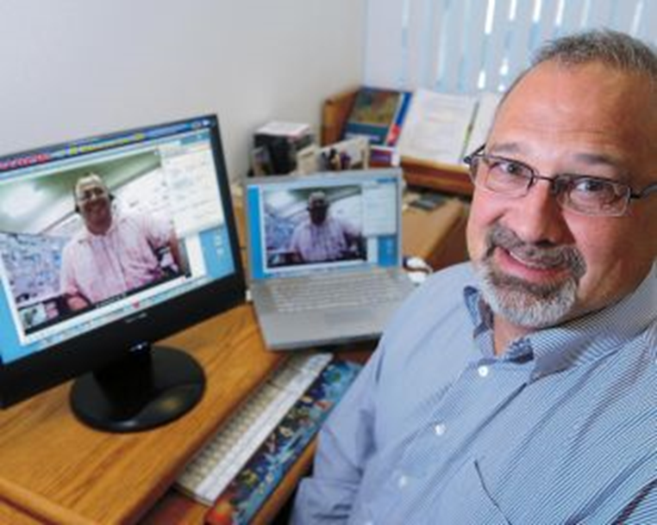
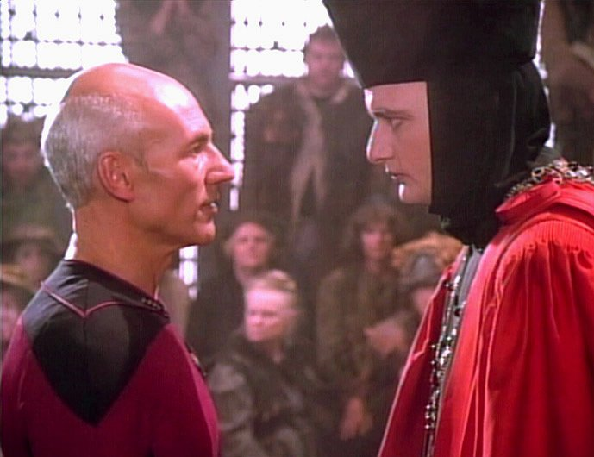
Through the Words of Experts:
Cases of Expanded Classrooms Using Conferencing Technology
Dr. Curtis J. Bonk, cjbonk@indiana.edu
Professor, Indiana University

Slide 2

October 7, 2015
Video killed the radio star. Will it do the same to learning management systems?
Diginomica, Janine Milne http://diginomica.com/2015/10/07/video-killed-the-radio-star-will-it-do-the-same-to-learning-management-systems/#.VrbO2v0UVjs
Only a third to 45% of learning is happening in the classroom now, notes Bersin. L&D is no longer about arranging or giving classroom courses.

Slide 3

October 7, 2015
Video killed the radio star. Will it do the same to learning management systems?
Diginomica, Janine Milne http://diginomica.com/2015/10/07/video-killed-the-radio-star-will-it-do-the-same-to-learning-management-systems/#.VrbO2v0UVjs
Technology is changing so fast, as soon as someone learns something, it’s obsolete in 12 months, so content has got to keep up.

Slide 4
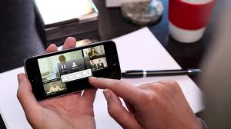
February 2016
Will Video Kill the LMS?
Josh Bersin, CLO http://www.clomedia.com/articles/6720-will-video-based-learning-kill-the-lms
YouTube statistics show more than a billion people regularly watch video, and the number of hours spent watching video rose 60 percent in the last year alone. More than 2 billion people have video-enabled smartphones, and video now makes up 64 percent of Internet traffic on mobile phones.

Slide 5

February 2016
Will Video Kill the LMS?
Josh Bersin, CLO http://www.clomedia.com/articles/6720-will-video-based-learning-kill-the-lms
In the learning industry, companies like BigThink, General Academy, Khan Academy, Pluralsight, Skillsoft, Udacity and Udemy produce thousands of hours of high-quality instructional video—much of it authored by experts, not instructors—which is easy to find, use and absorb on the Internet.

Slide 6
Part I: Expert Apprenticeship from Video

Slide 7

The Problem with Learning Technology
Karen Wilcox, November 7, 2014, Chronicle of Higher Education https://chroniclevitae.com/news/792-the-problem-with-learning-technology?cid=at&utm_source=at&utm_medium=en

Slide 8
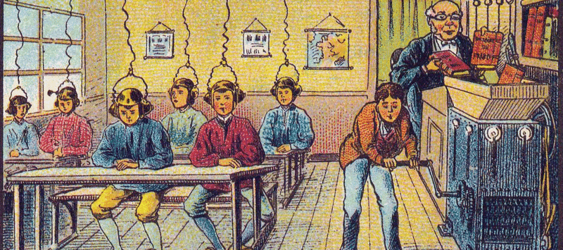
October 21, 2014
Teaching and the University of Tomorrow.
Chronicle of Higher Education, Kelly J. Baker https://chroniclevitae.com/news/768-teaching-and-the-university-of-tomorrow?cid=at&utm_source=at&utm_medium=en
Image: France in 2000 year (XXI century). Future school. From a postcard by Villemard, 1910.

Slide 9
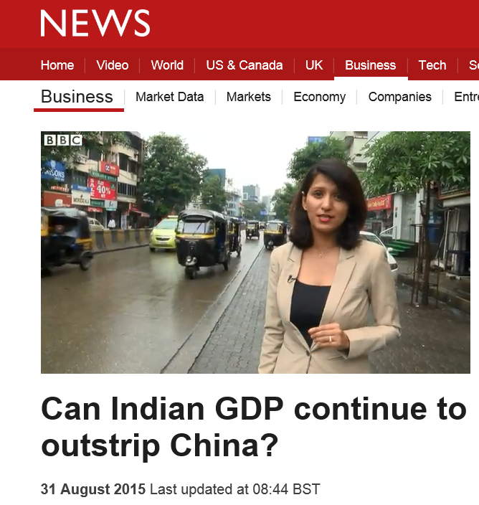
August 31, 2015
Short Educational Video Anchors:
CNN, BBC, TED, TED-Ed, ForaTV
BBC One-Minute World News http://www.bbc.com/news/business-34105708

Slide 10
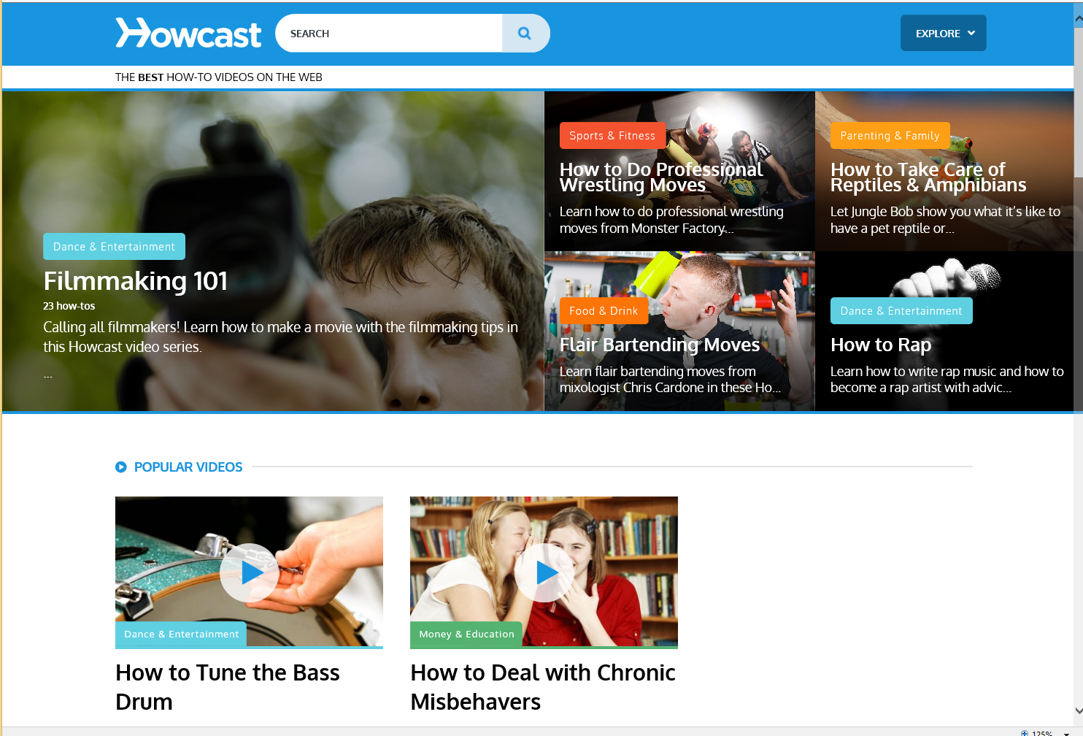
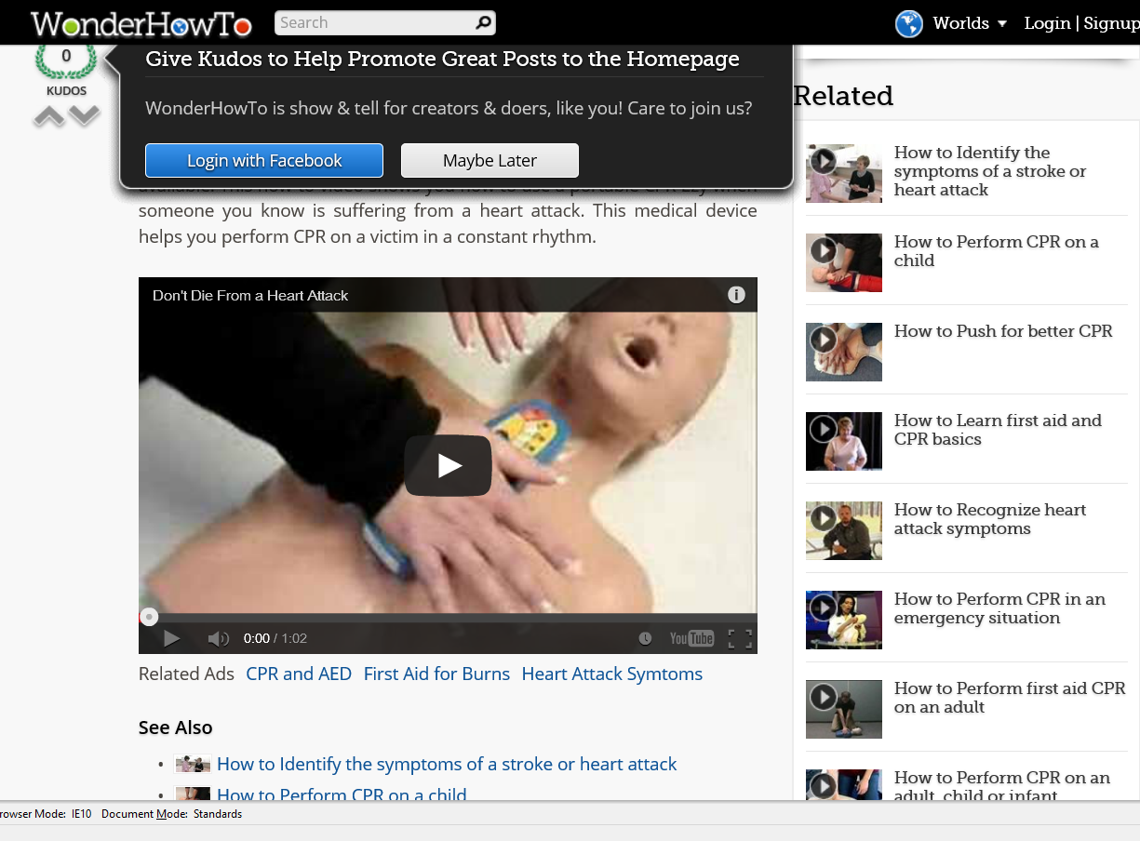
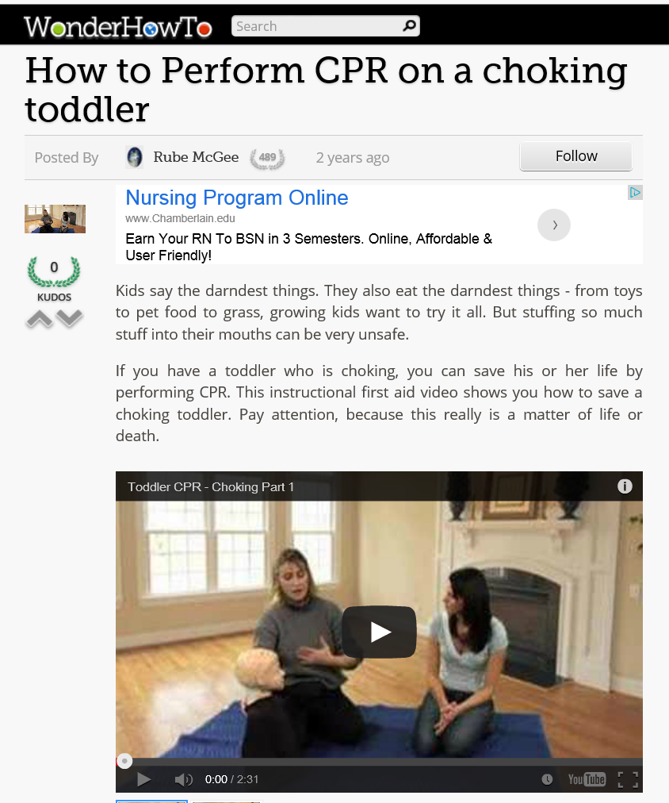
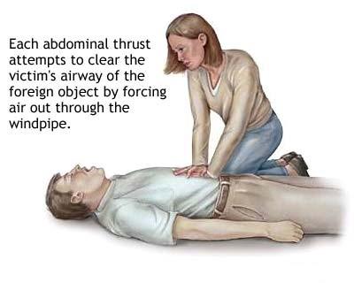
WonderHowTo and Howcast
Anchored Instruction in Shared Online Videos http://www.howcast.com/ http://www.wonderhowto.com/

Slide 11
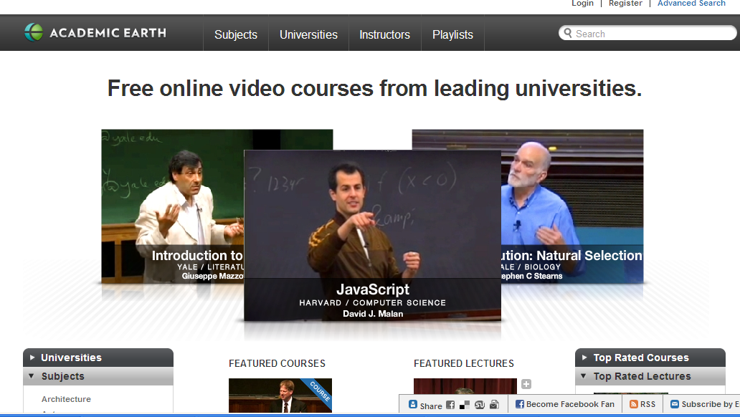
Academic Earth

Slide 12
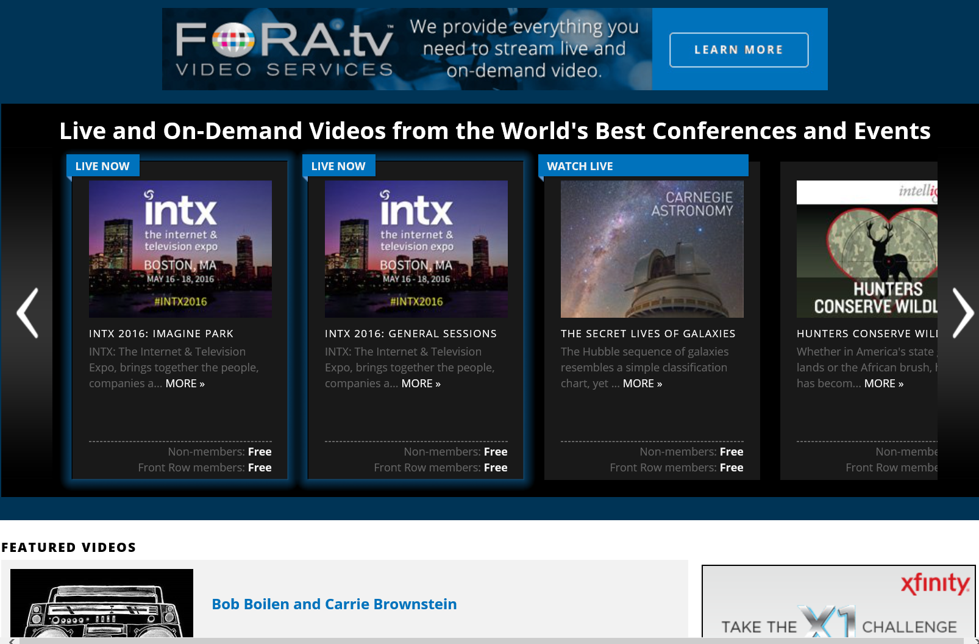
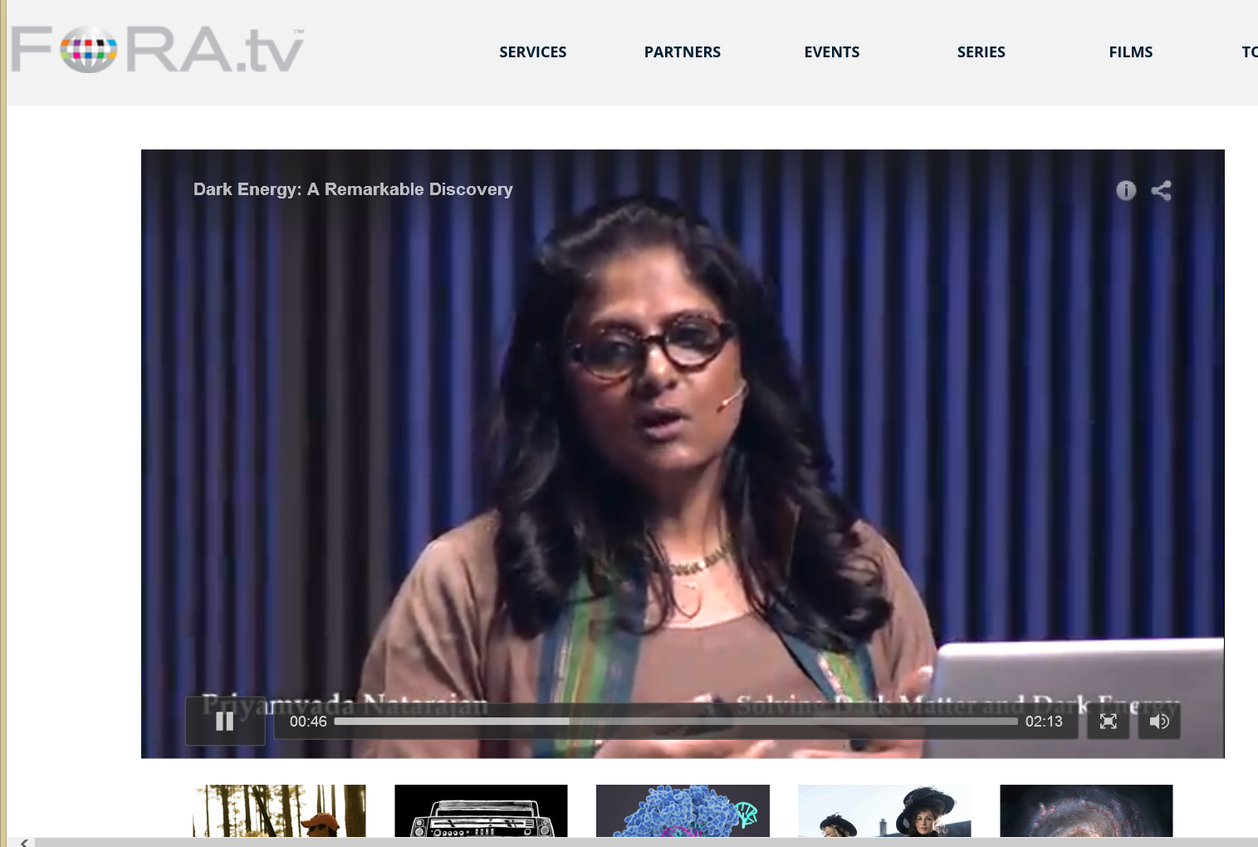
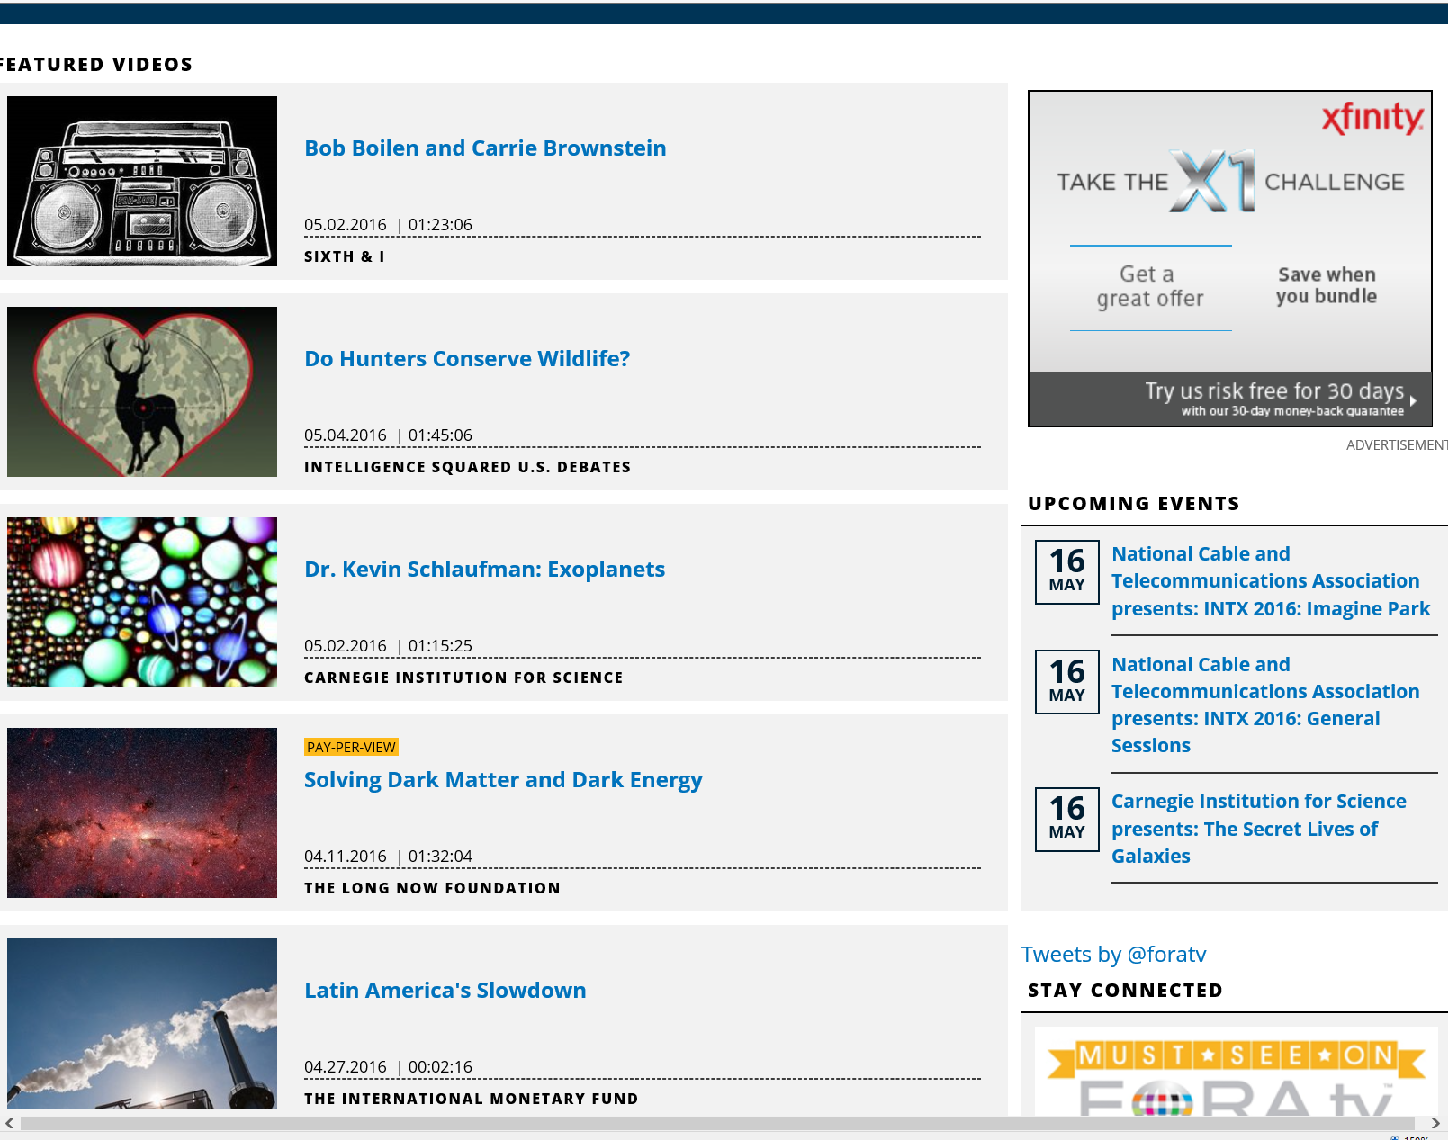
Fora TV (i.e., “the Conference Channel” or “YouTube for Thinkers;” (Live and On-Demand Videos from the World’s Best Conferences and Events) http://library.fora.tv/

Slide 13
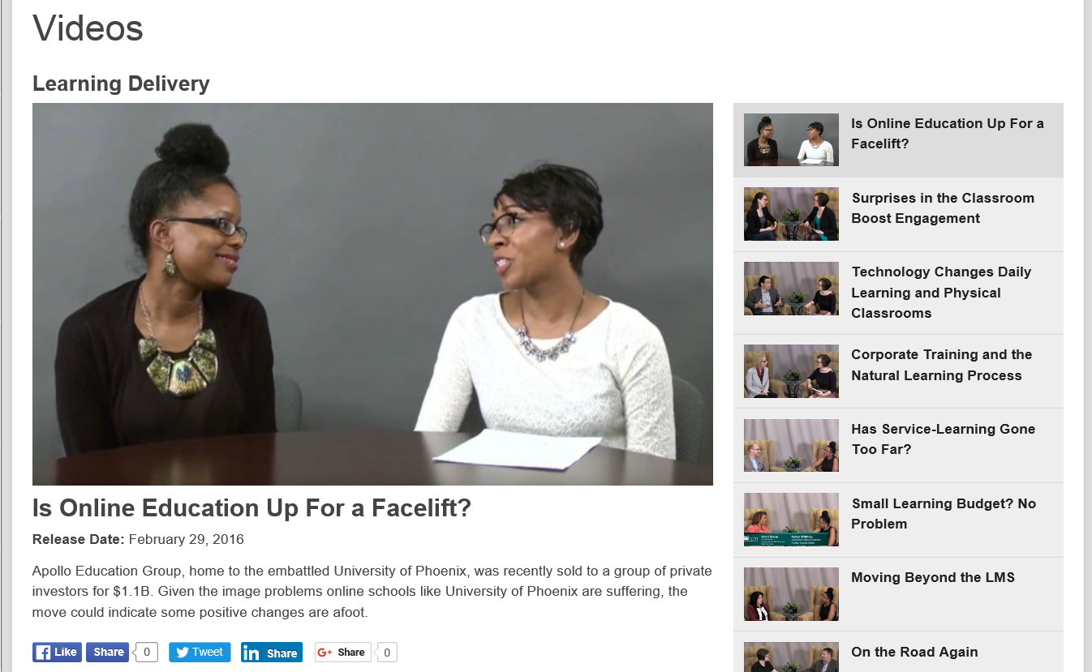
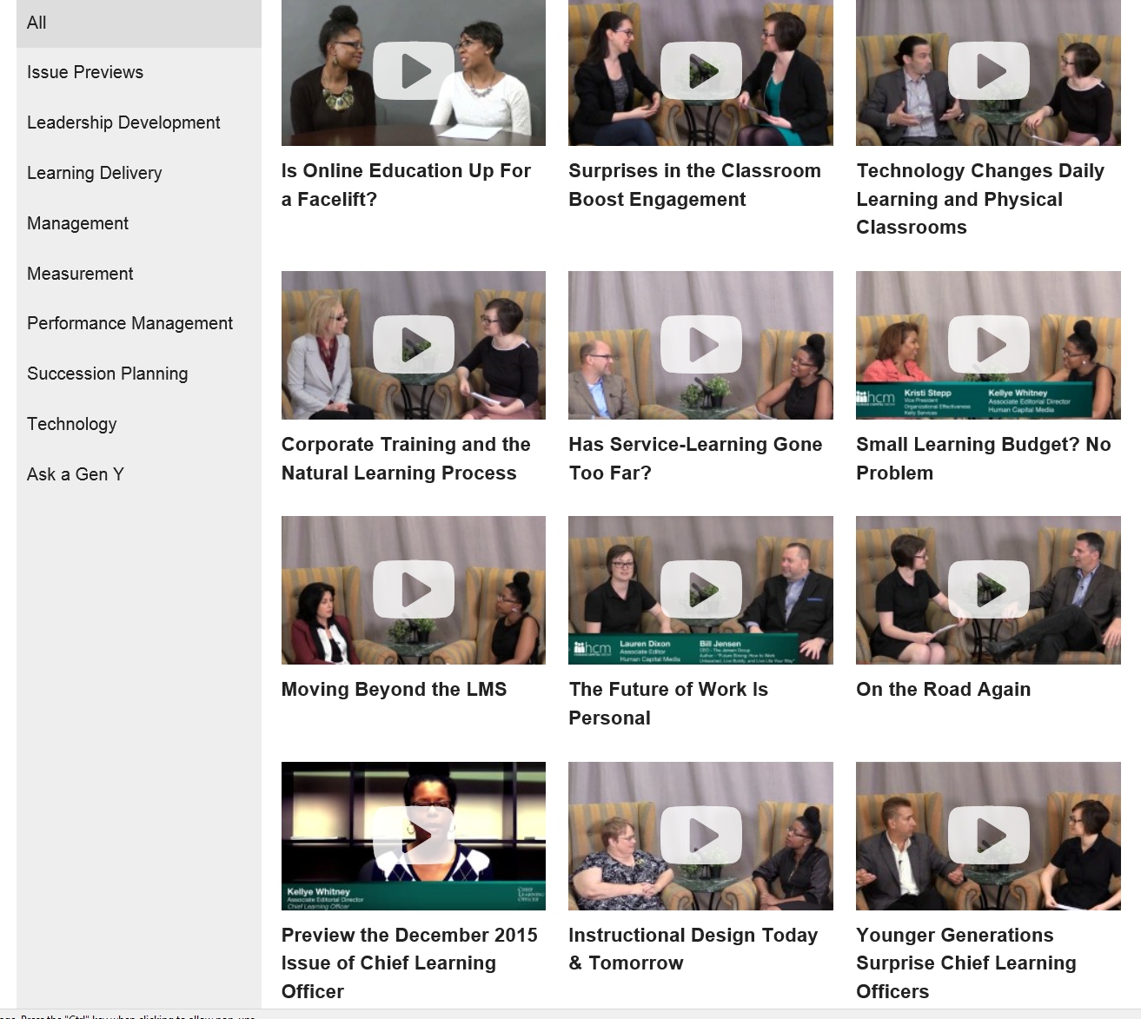
February 29, 2016
Chief Learning Officer Videos https://www.youtube.com/watch?v=6VhR85IOztc https://www.youtube.com/channel/UCIraI8XuWm5aHMPghT94PZA/videos

Slide 14
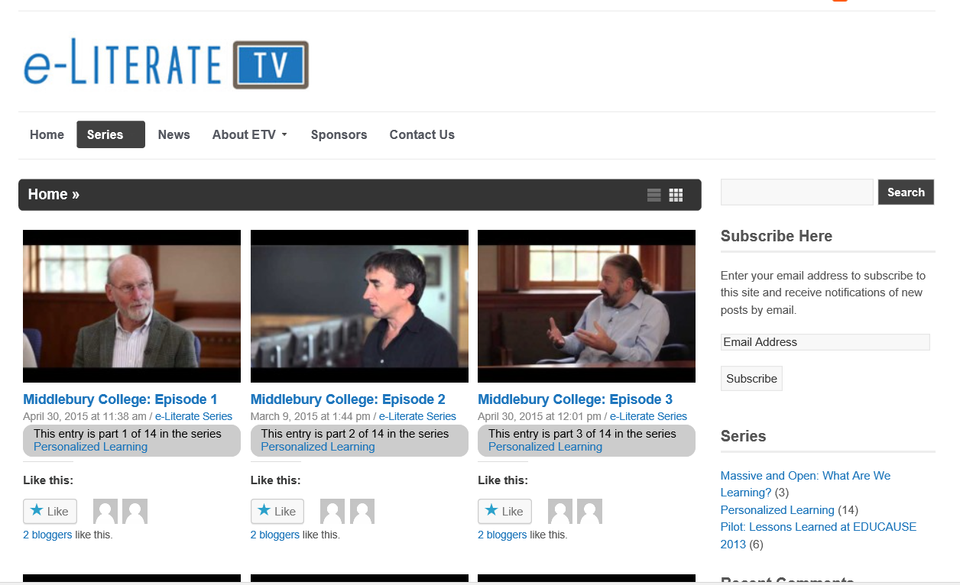
April 4, 2016 e-Literate TV (starting conversations about technology in education) http://e-literate.tv/series/personalized-learning/

Slide 15
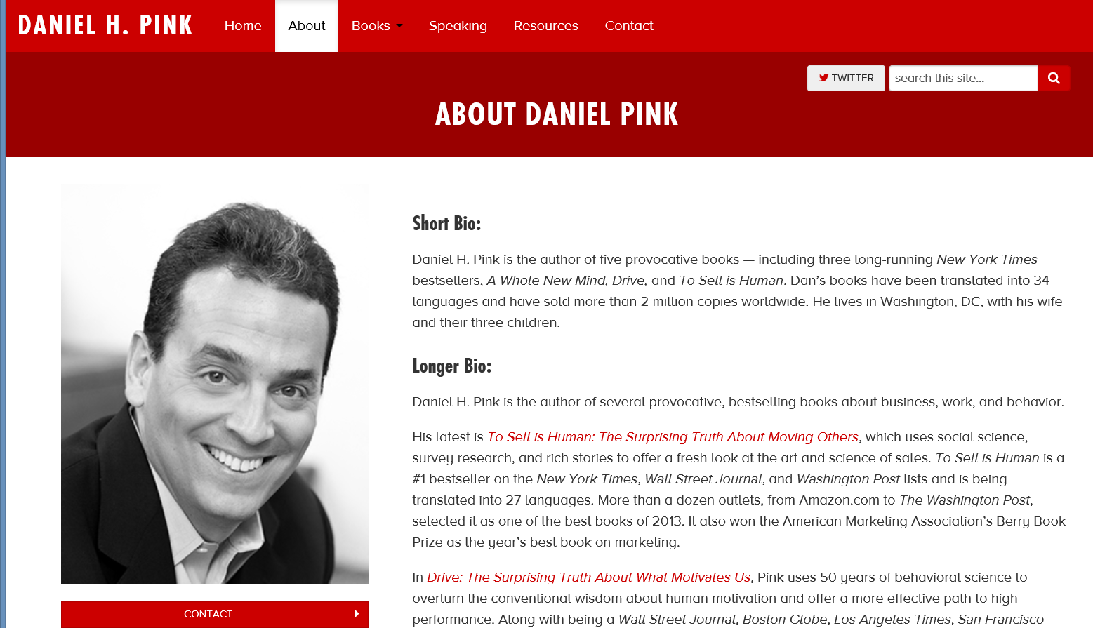
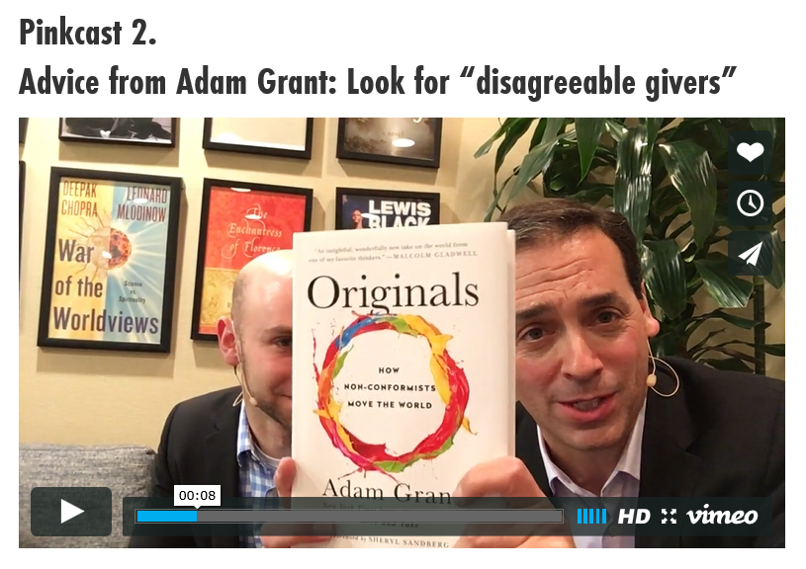
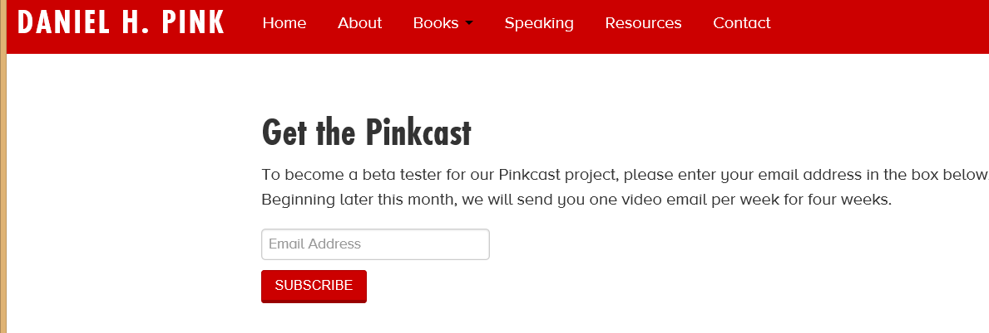
February 17, 2016
Daniel H. Pink, Pinkcast http://www.danpink.com/

Slide 16
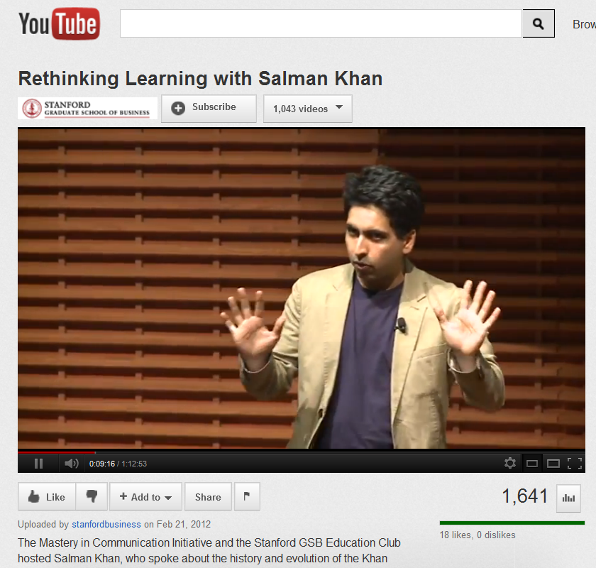

October 15, 2012
Reusable Khan
Lacking Teachers and Textbooks, India’s Schools Turn to Khan Academy to Survive, NY Times, Anupama Chandrasekaran http://india.blogs.nytimes.com/2012/10/15/lacking-teachers-and-textbooks-indias-schools-turn-to-khan-academy-to-survive/
Students at Sree Karpagavalli Vidhyalaya school in Chennai, Tamil Nadu, watching Khan Academy math videos.

Slide 17
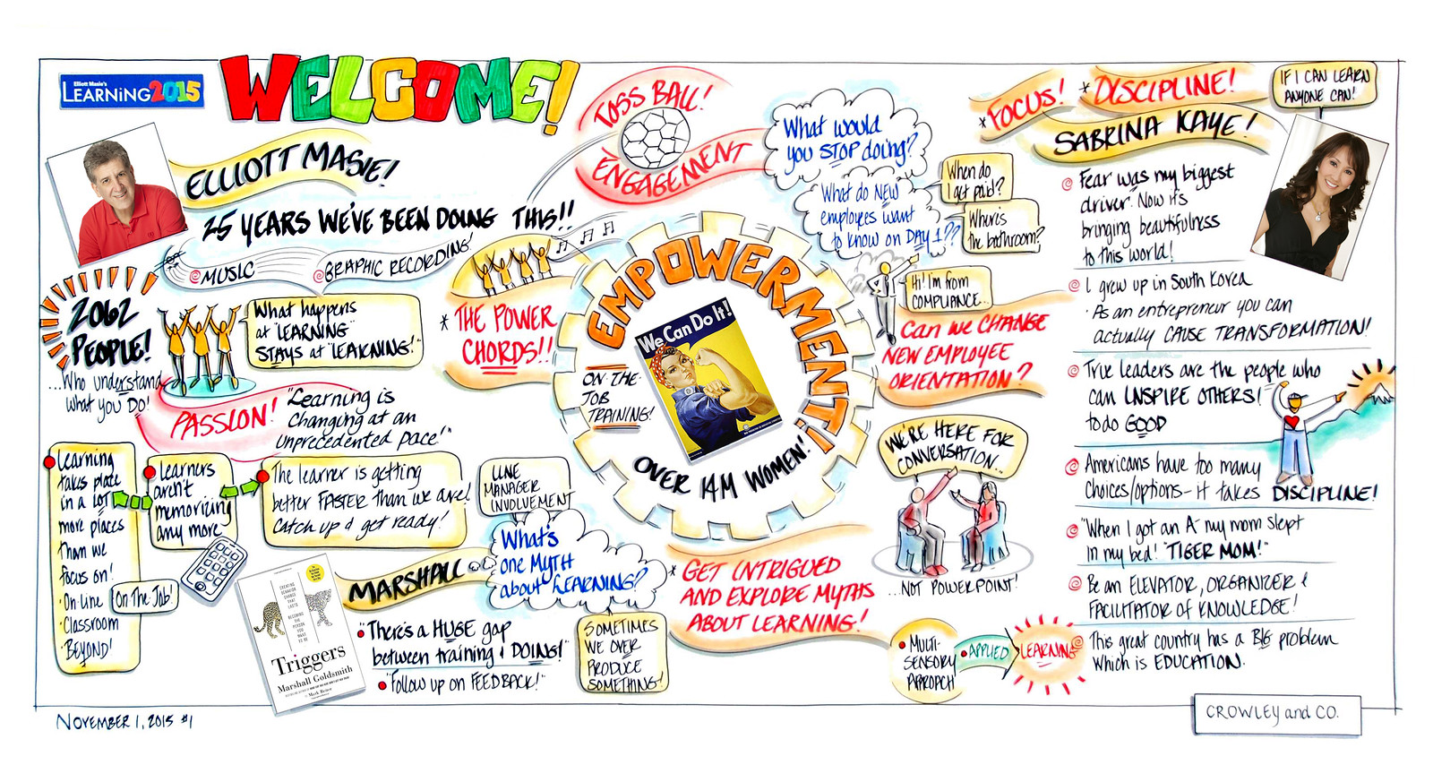
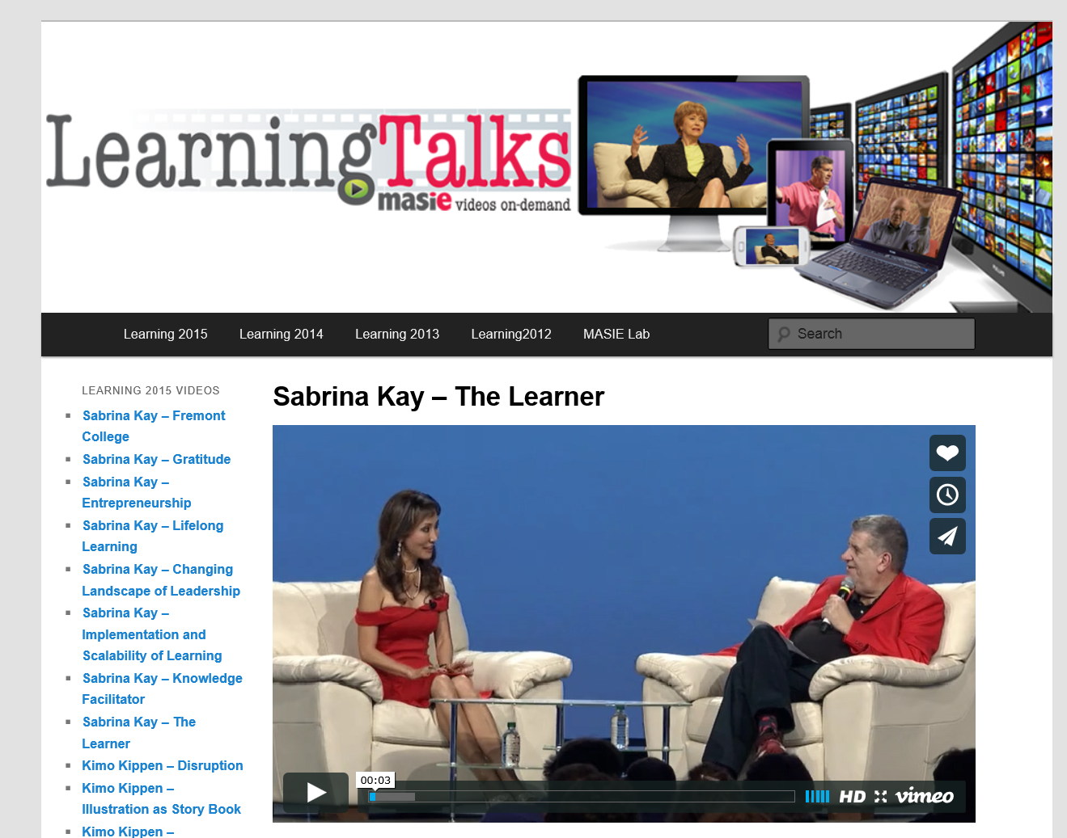
November 11, 2015
Learning Talks
Elliott Masie’s Learning 2015 https://emasie.smugmug.com/Learning-2015/Graphic-Illustrations/i-bRhXVKB/A

Slide 18
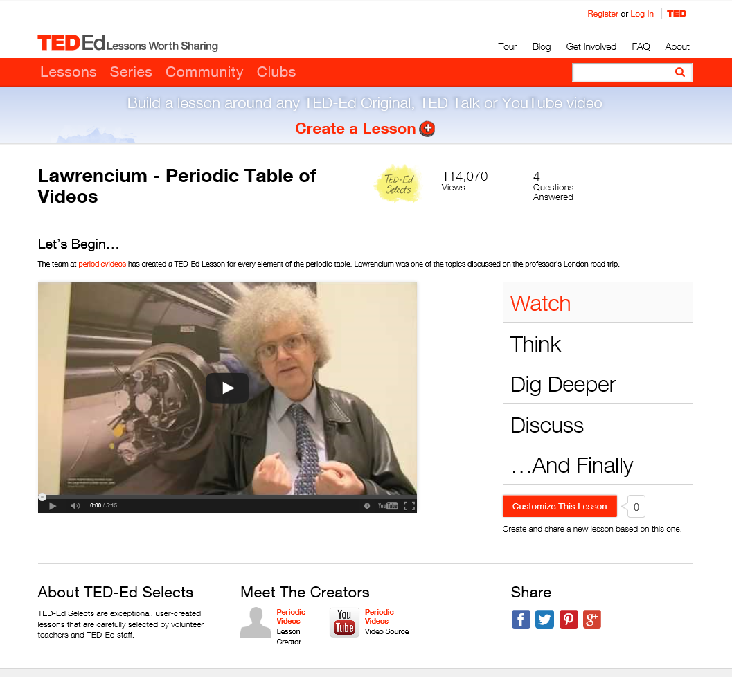
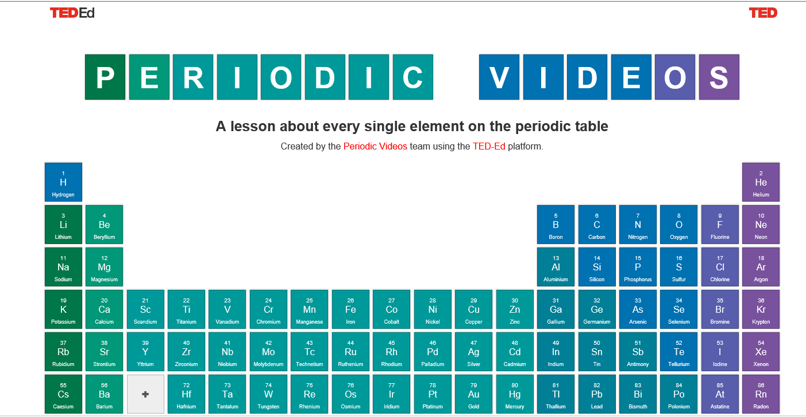
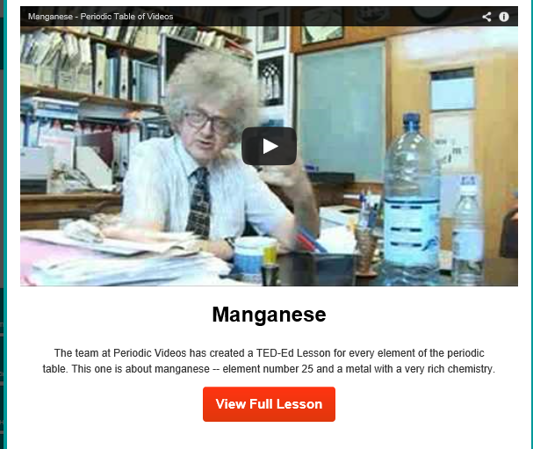
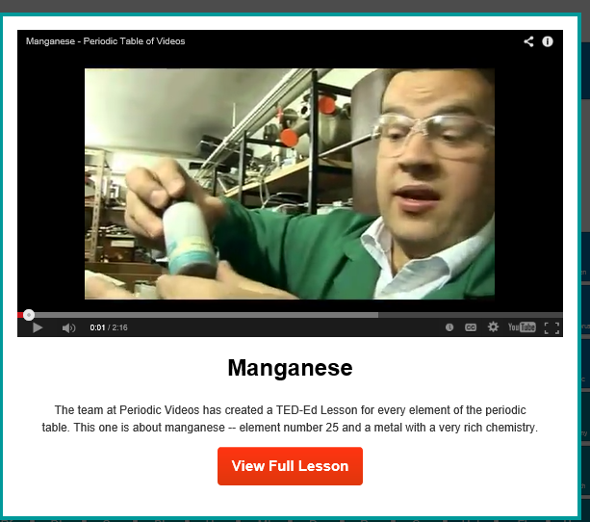
November 1, 2014
TEDEd lesson about every single element on the periodic table http://ed.ted.com/periodic-videos?utm_source=TED-Ed+Subscribers&utm_campaign=92b1054add-2013_09_219_19_2013&utm_medium=email&utm_term=0_1aaccced48-92b1054add-46761201

Slide 19


March 22, 2016
TED-ED clubs give students a platform for sharing ideas, Stephen Noonoo, eSchool News http://www.eschoolnews.com/2016/03/22/ted-ed-clubs-give-students-a-platform-for-sharing-ideas/

Slide 20
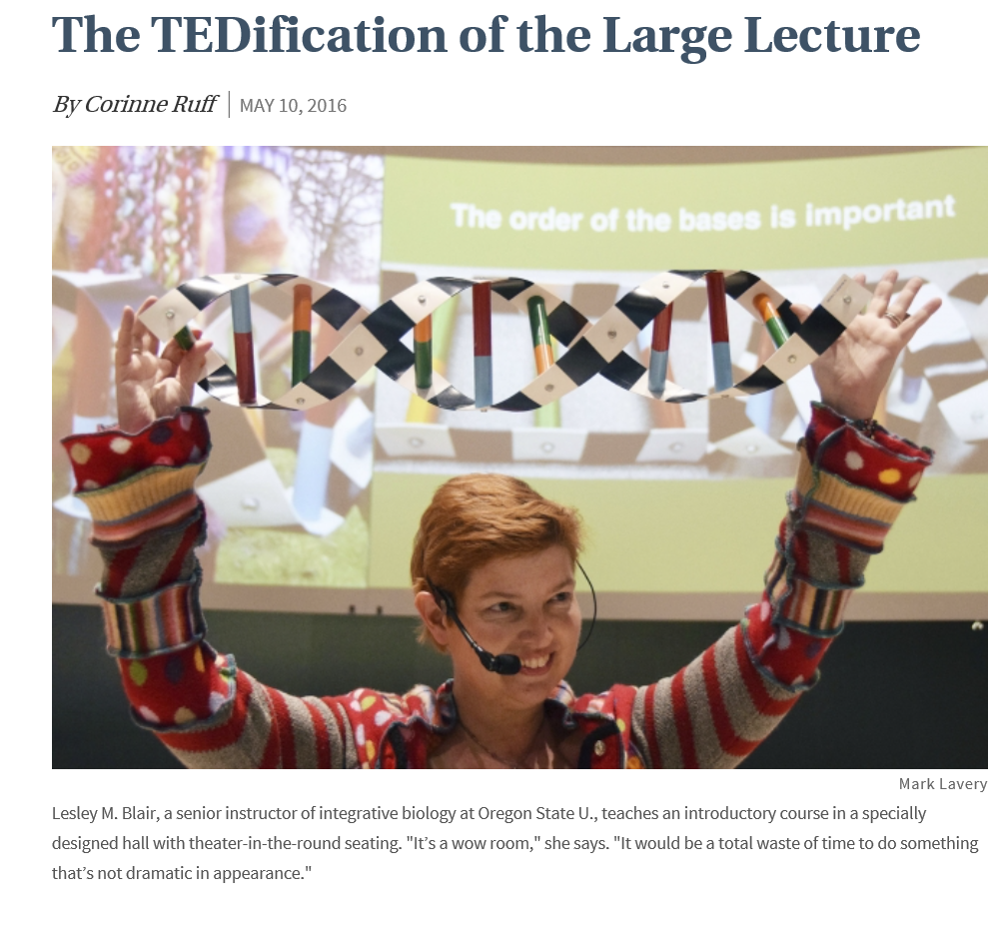
May 10, 2016
The TEDification of the Large Lecture
Corrine Ruff, Chronicle of Higher Education http://chronicle.com/article/The-TEDification-of-the-Large/236418?cid=trend_au&elqTrackId=a24ac995b63549f4ac66471950dcef18&elq=9e456151e0ec4373861fb2b809f3534c&elqaid=9016&elqat=1&elqCampaignId=3095

Slide 21
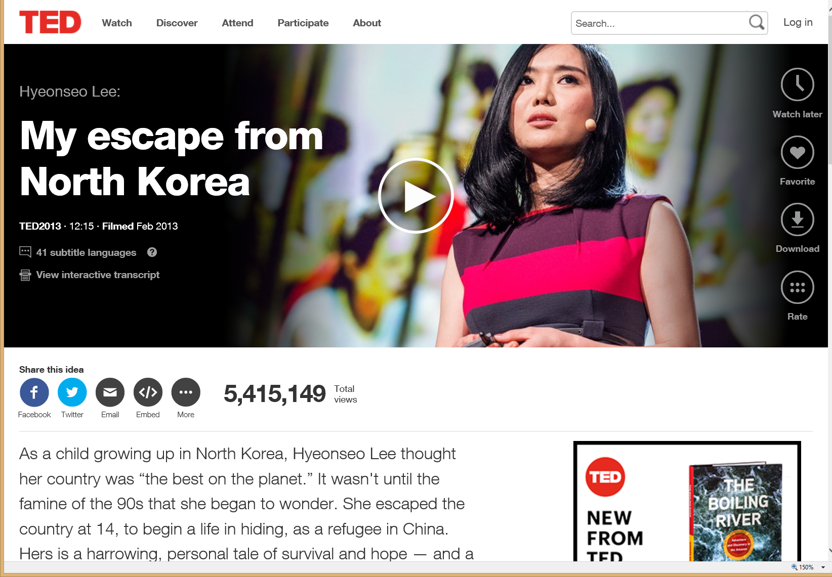
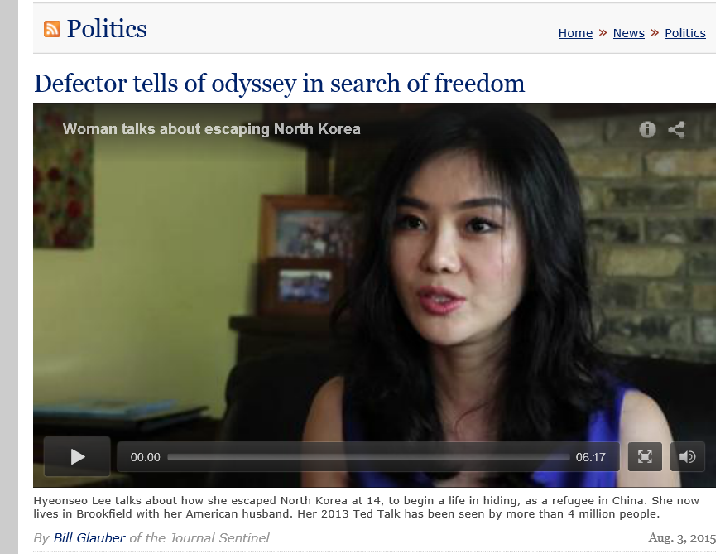
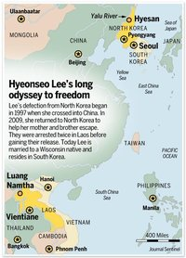

June 20, 2015
Defector tells of odyssey in search of freedom, Milwaukee Journal Sentinel, Bill Glauber of the Journal Sentinel http://www.jsonline.com/news/statepolitics/defector-tells-of-odyssey-in-search-of-freedom-b99546143z1-320523552.html

Slide 22
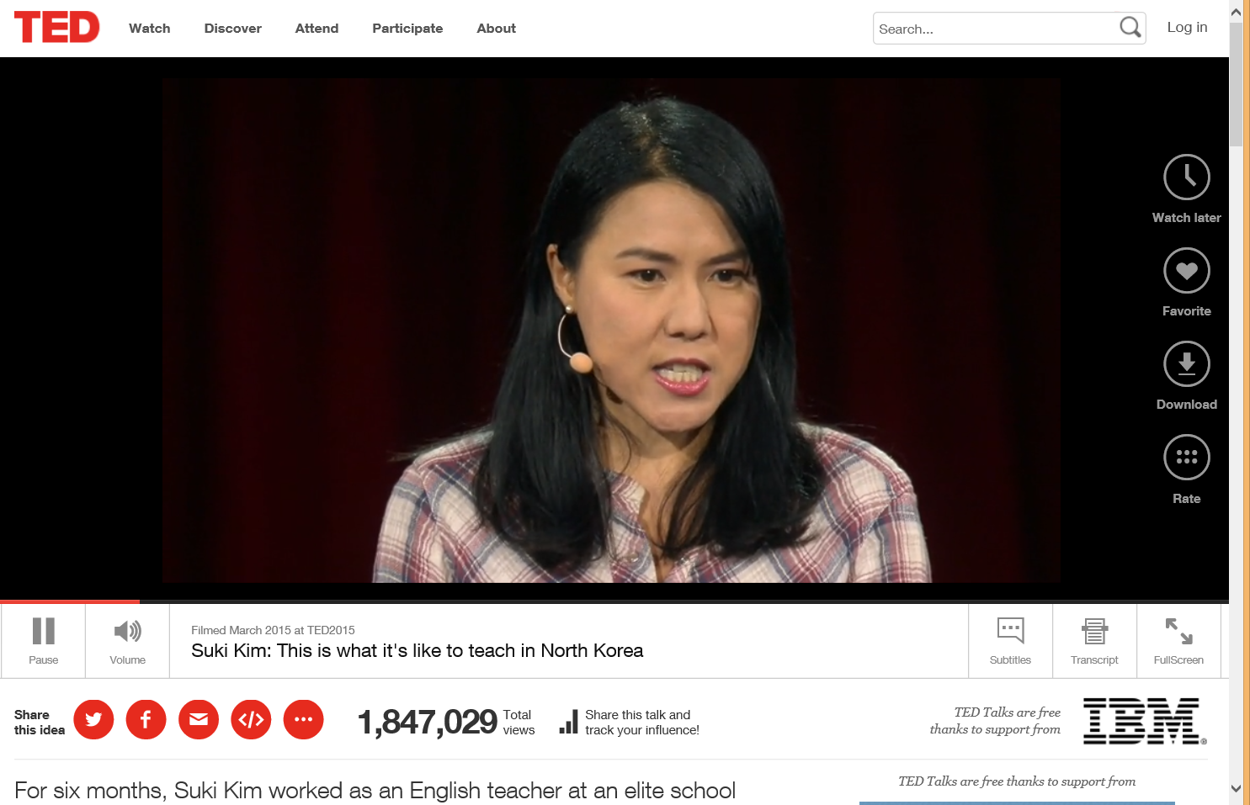
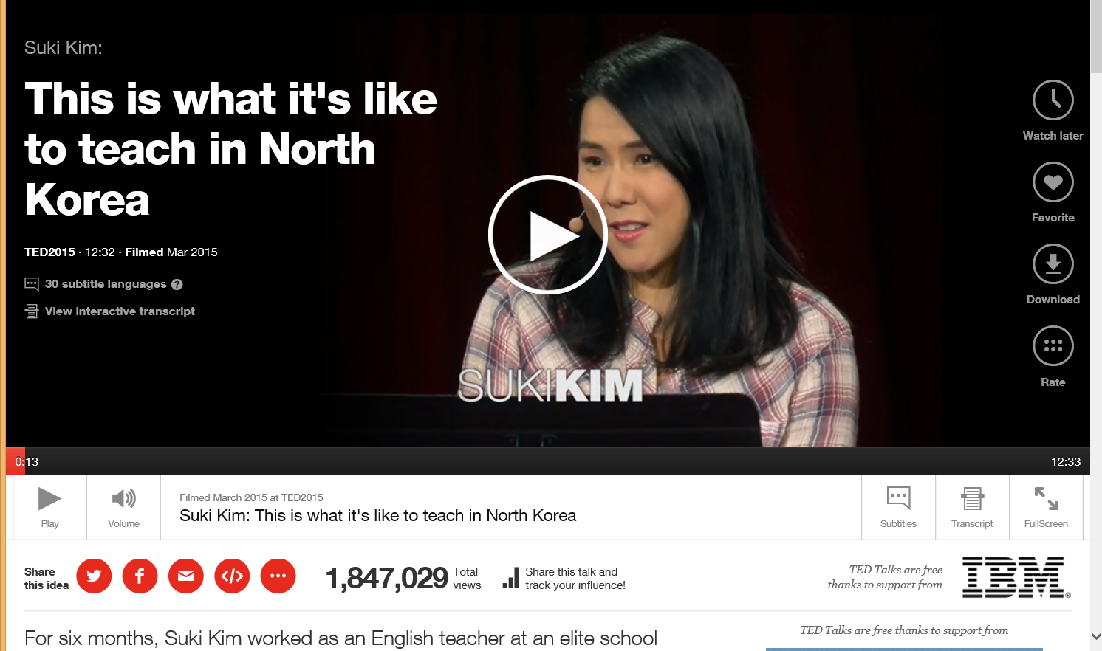
March 2015
Suki Kim: This is what it's like to teach in North Korea, TED http://www.ted.com/talks/suki_kim_this_is_what_it_s_like_to_teach_in_north_korea#t-1777

Slide 23
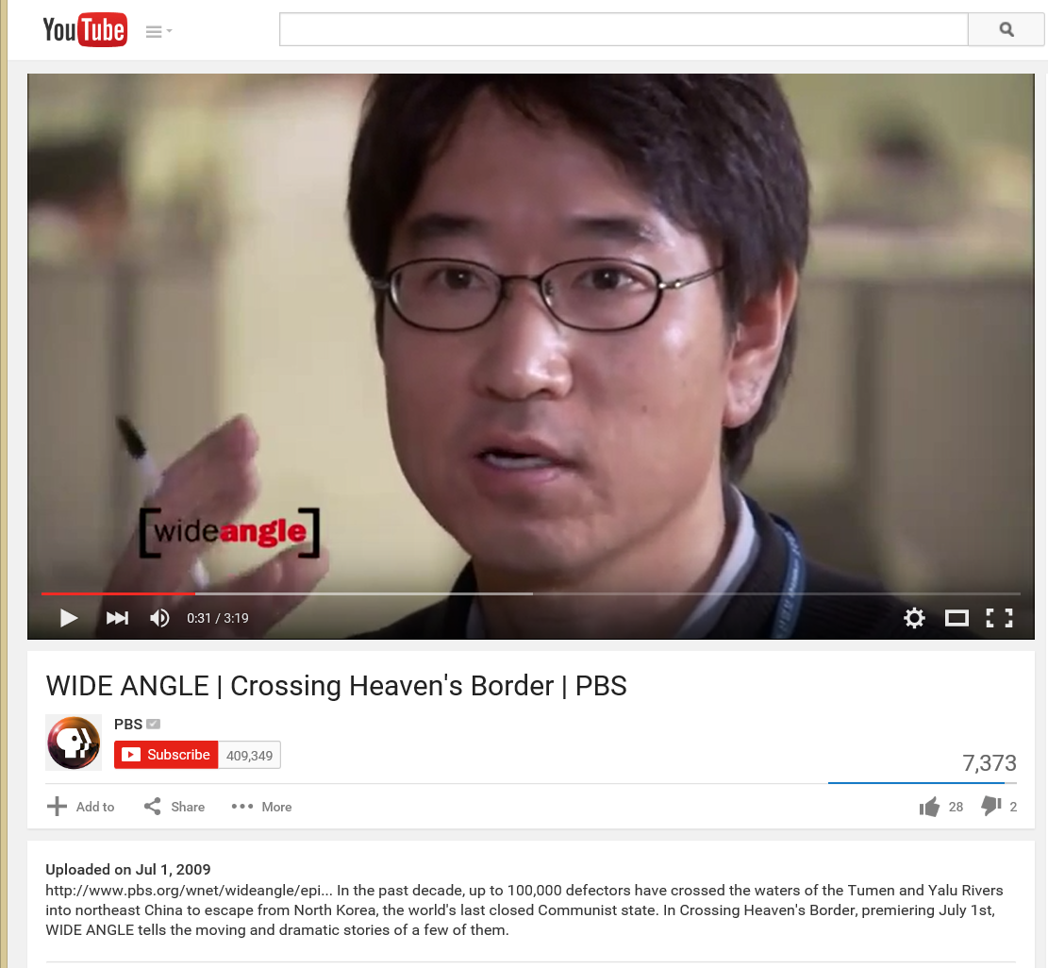
July 1, 2009
Crossing Heaven's Border, PBS
(Intrepid South Korean journalists risk their lives filming undercover for ten months to capture the haunting stories first-hand.) https://www.youtube.com/watch?v=ZmF7HIXr8_E

Slide 24
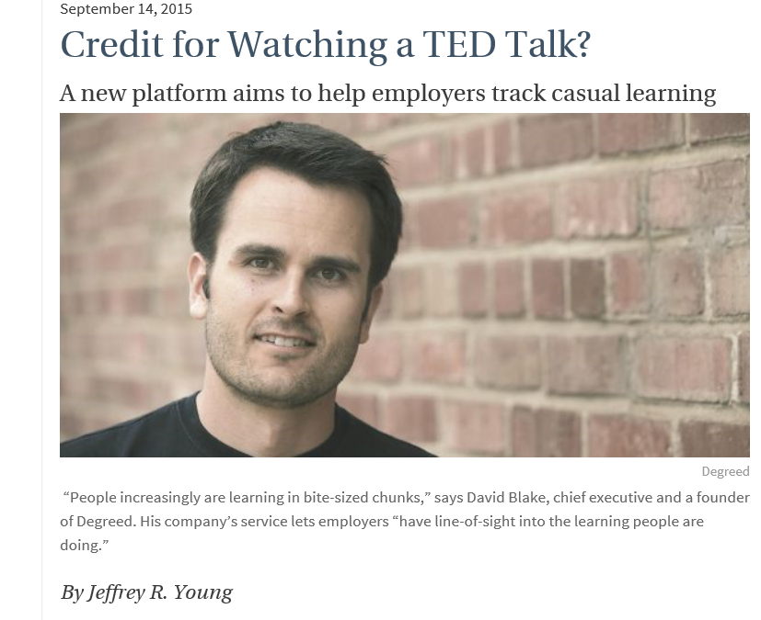
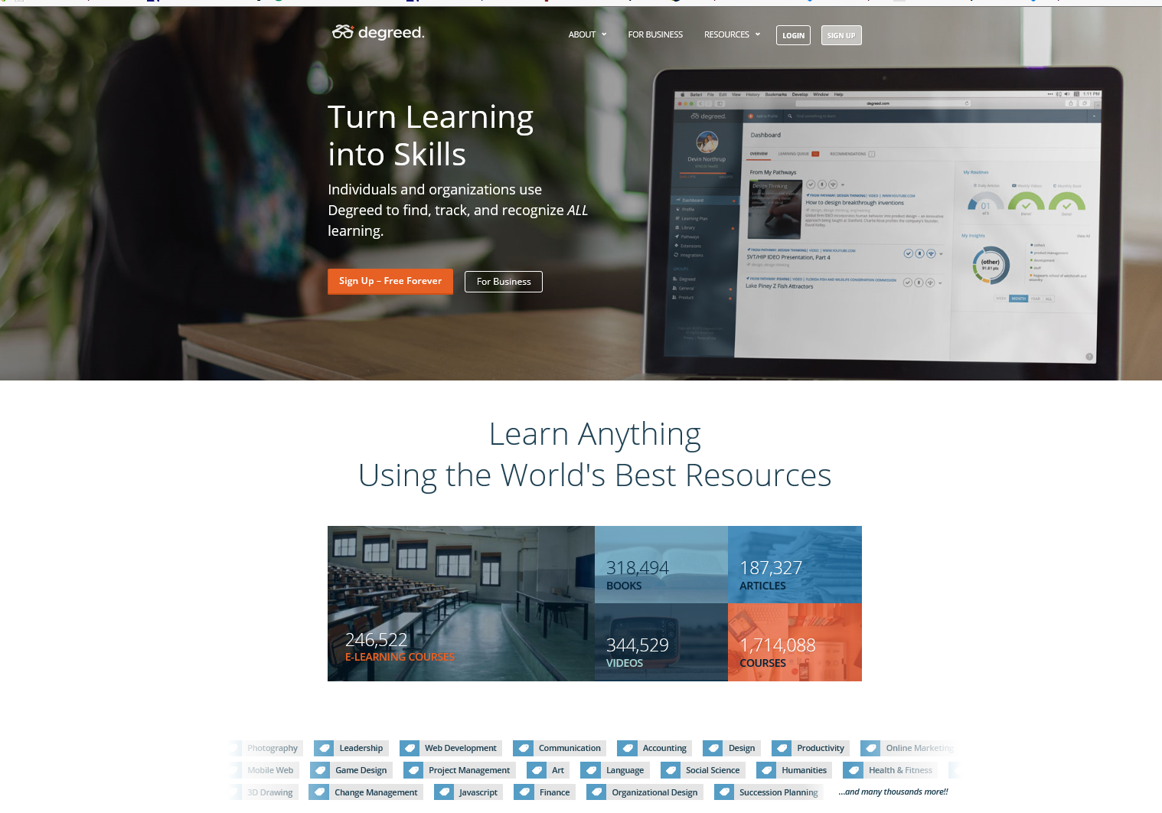
September 14, 2015
Credit for Watching a TED Talk? A new platform aims to help employers track casual learning
Chronicle of Higher Education, Jeffrey R. Young http://chronicle.com/article/Credit-for-Watching-a-TED/232973/?cid=at&utm_source=at&utm_medium=en
Degreed: https://degreed.com/

Slide 25
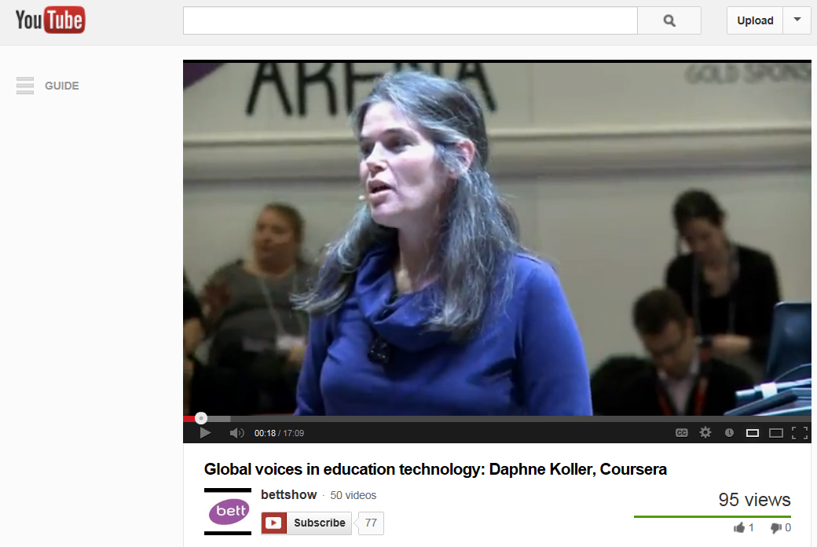
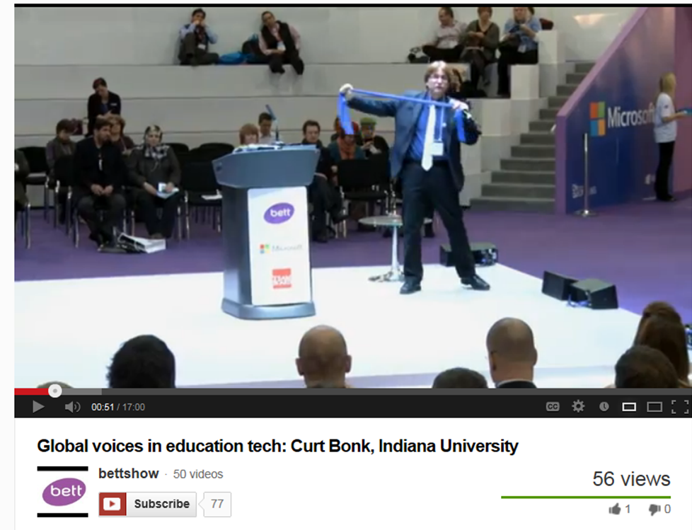
BETT Talks
Global voices in education technology:
Daphne Koller, Coursera BETT 2013 Keynote Talk
(posted March 14, 2013) http://www.youtube.com/watch?v=BMiI6RdlNQs&WT.tsrc=Email&WT.mc_id=NWS14

Slide 26
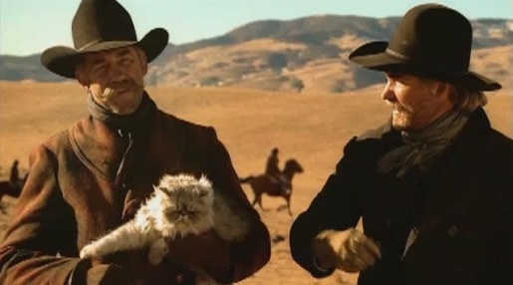
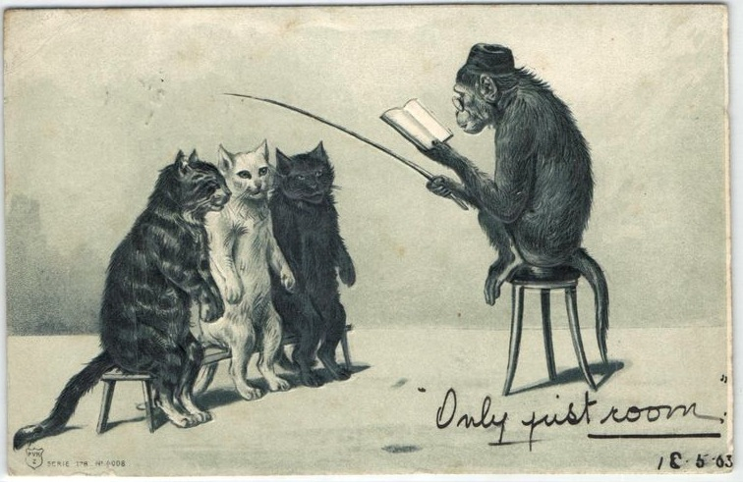
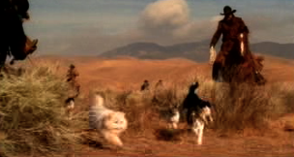
What is the role of the Instructor in the Open World?
(Instructor as Cat Herder?)

Slide 27
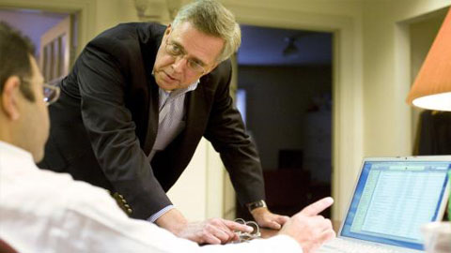
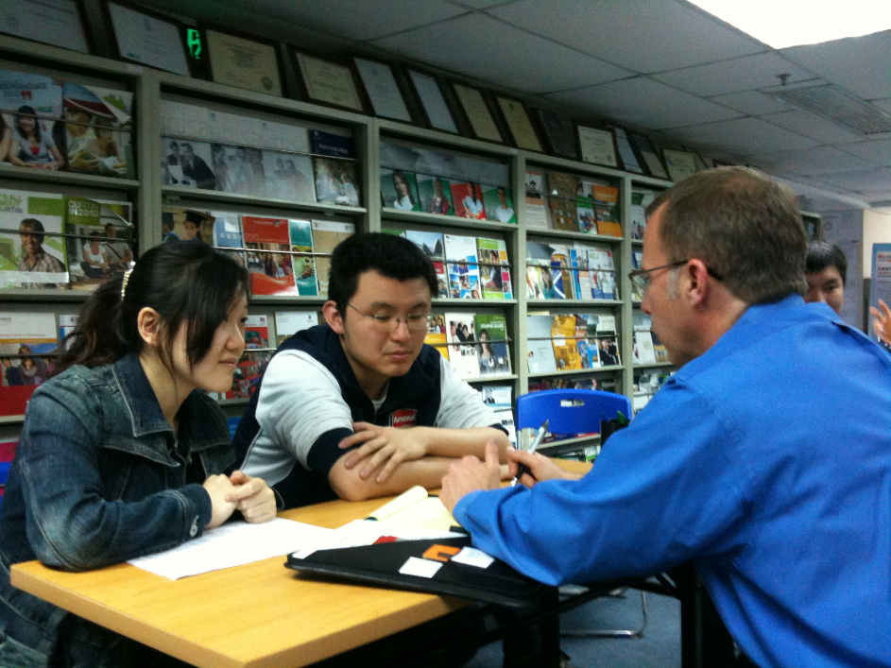
1. Instructor as Counselor

Slide 28
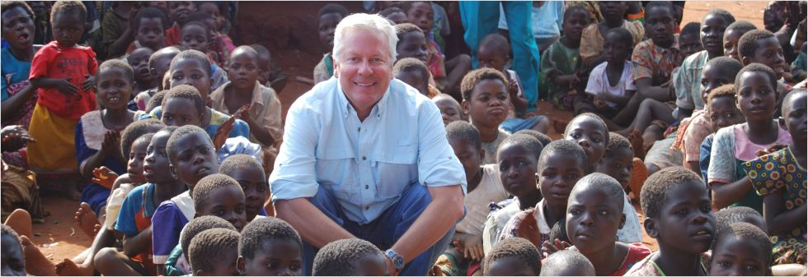
2. Instructor as Course Ambassador

Slide 29

3. Instructor as Camping Trip Guide

Slide 30

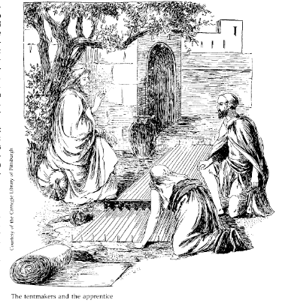
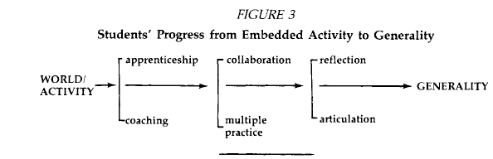
Instruction as a Cognitive Apprenticeship

Slide 31
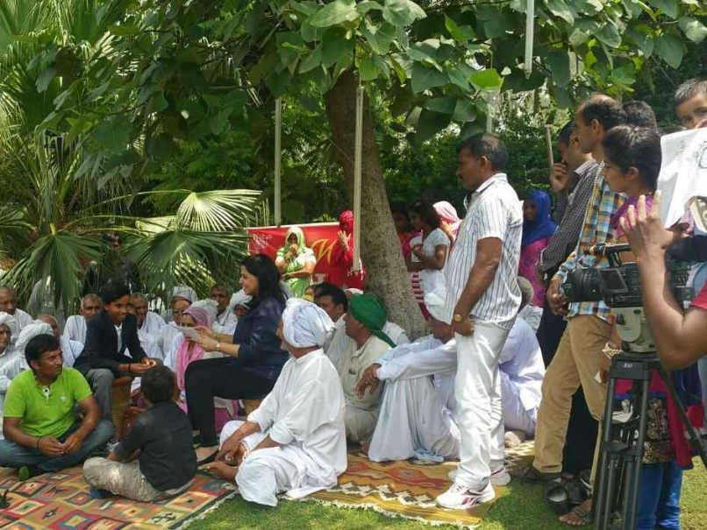
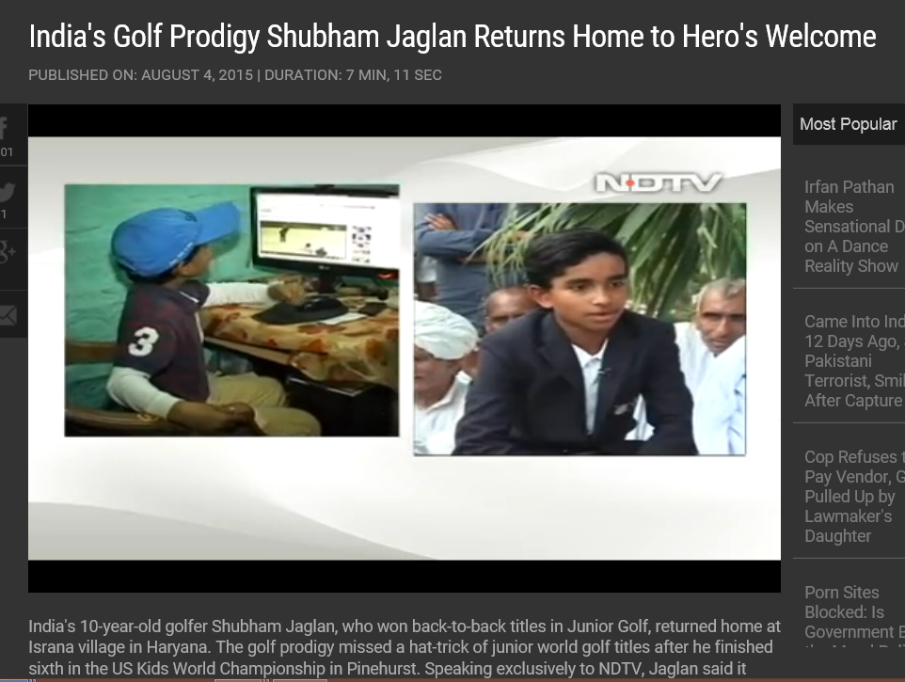
August 5, 2015
Shubham Jaglan Overwhelmed by "Dream" Return Home After Double World Championship
Disha Chopra, NDTV Sports http://sports.ndtv.com/golf/news/246551-shubham-jaglan-overwhelmed-by-dream-return-home-after-double-world-championship http://www.ndtv.com/video/player/news/india-s-golf-prodigy-shubham-jaglan-returns-home-to-hero-s-welcome/377614

Slide 32
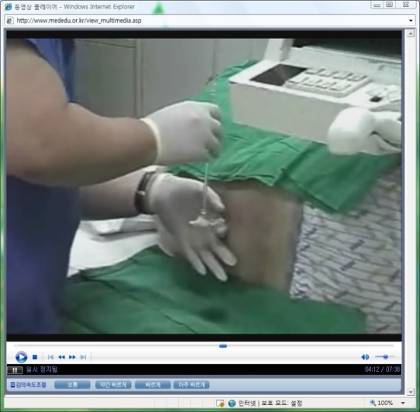
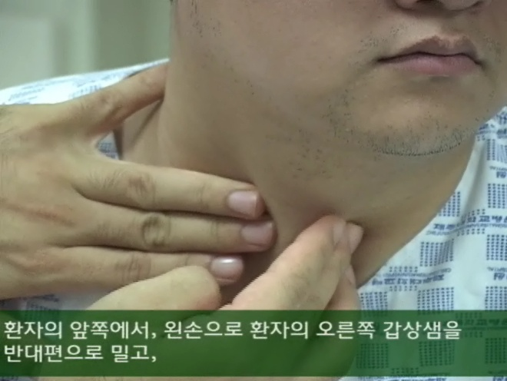
Videos for clinical education (Sungkyunkwan University School of Medicine, www.mededu.or.kr)

Slide 33
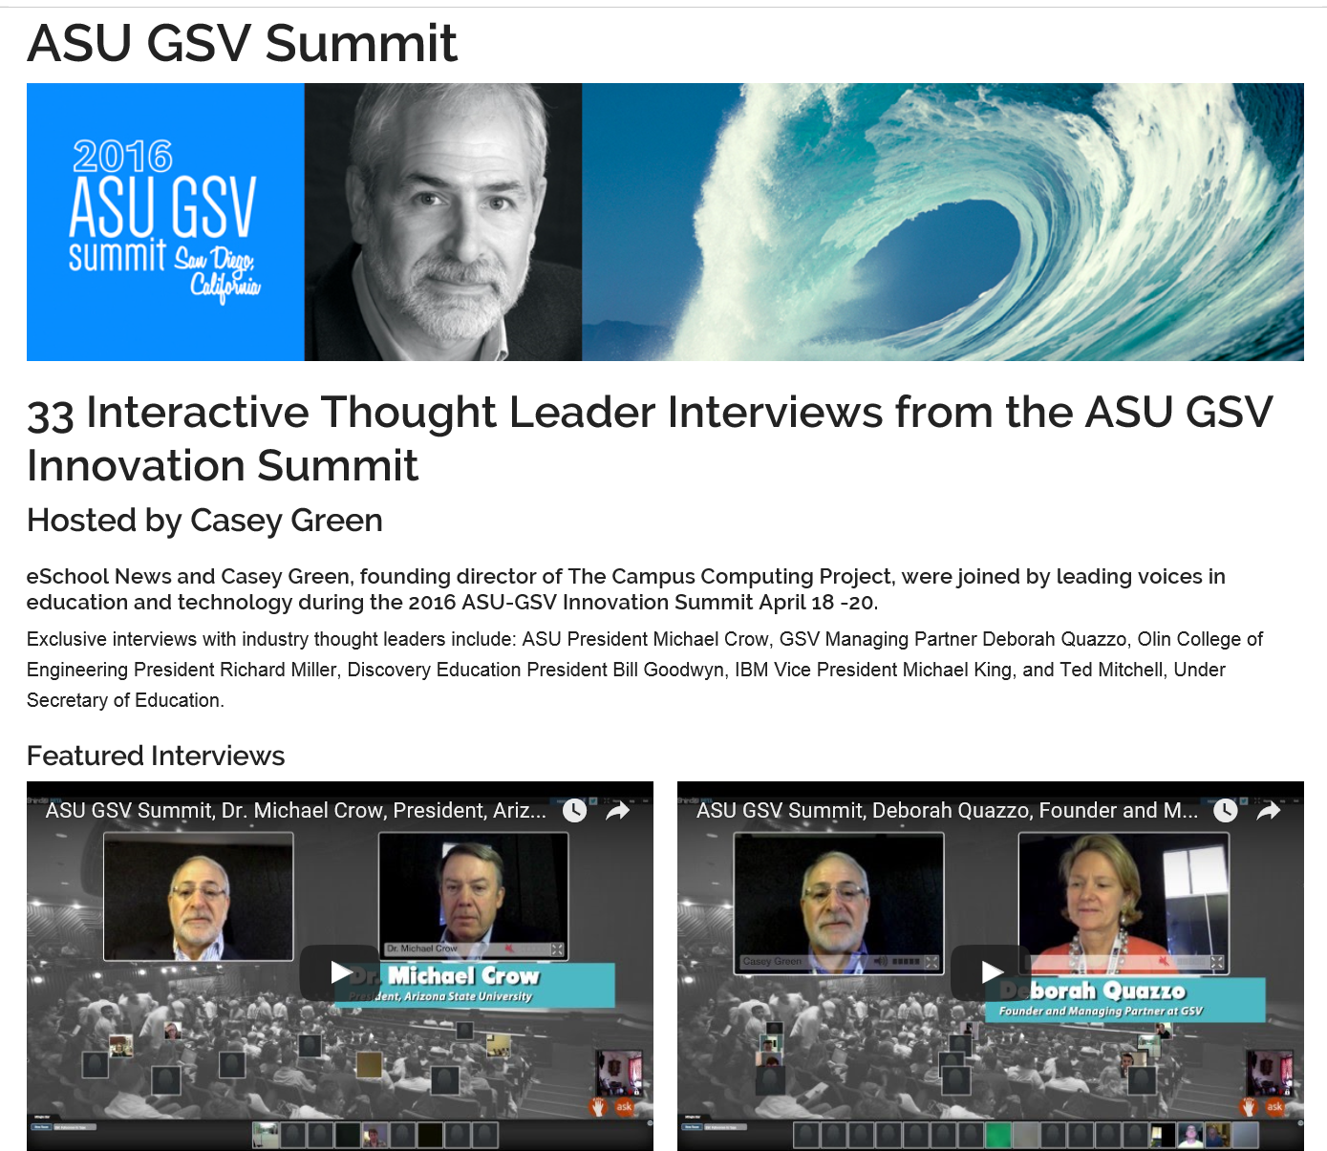


May 4, 2016
What I Learned at the ASU GSV Summit
Kenneth Green, Inside Higher Ed https://www.insidehighered.com/blogs/digital-tweed/what-i-learned-asu-gsv-summit http://www.eschoolnews.com/asugsvsummit/

Slide 34

March 11, 2016
Meerkat tale a sobering reminder for SXSW startups, Edward C. Baig, USA today http://www.usatoday.com/story/tech/columnist/baig/2016/03/11/meerkat-tale-sobering-reminder-forsxsw-startups/81596582/

Slide 35


March 10, 2016
Watch SXSWedu Live, Connie Yowell http://sxswedu.com/live?utm_campaign=Edu+2016&utm_source=hs_email&utm_medium=email&utm_content=27144469&_hsenc=p2ANqtz--ag6U7VJGlpYaciareNq6mryKvA63kCR5O3U8JVQkfAYp7yiTnncHnxw7_PmMpcjioI9V7z1-01hvyCrDPVEAR-x6HwQ&_hsmi=27144469

Slide 36



April 13, 2016
Facebook's Mark Zuckerberg steps into political fray
Jon Swartz and Jessica Guynn, USA Today http://www.usatoday.com/story/tech/2016/04/12/zuckerbergs-10-year-plan-expand-facebook-empire/82936814/
Zuckerberg outlining Facebook's 10-year plan. (Photo: Jon Swartz, USA TODAY)

Slide 37


January 17, 2016
104 year old Fauja Singh runs the Mumbai Marathon
Mosiqi Acharya, SBS http://www.sbs.com.au/yourlanguage/hindi/en/article/2016/01/17/104-year-old-fauja-singh-runs-mumbai-marathon

Slide 38

November 14, 2015
OpenCon 2015 Brussels http://www.opencon2015.org http://www.opencon2015.org/live?splash=1 http://www.opencon2015.org/

Slide 39

Short Video Anchors
(e.g., TubeChop of V-PORTAL: Video Primers in an Online Repository of e-Teaching and Learning) http://www.tubechop.com/watch/378752

Slide 40

February 22, 2013
NASA's spacey Google+ Hangout shows off zero-G antics – and cats! http://cosmiclog.nbcnews.com/_news/2013/02/22/17057588-nasas-spacey-google-hangout-shows-off-zero-g-antics-and-cats?lite

Slide 41


Part II: Lessons Learned…

Slide 42


Lesson #1. Combining Asynchronous and Synchronous Events
(e.g., guest was David Merrill, 2007)

Slide 43





Synchronous + Asynchronous
(e.g., Elliot Soloway and David Palumbo, 1995)
Notes:
94
4

Slide 44


February 15, 2016
Synchronous + Asynchronous
Jennifer Maddrell, R678 (Zoom)

Slide 45

Lesson #2. If Plan, No Instructor Required
(Guest Session Run by Assistant)

Slide 46


Lesson #3. Test the System
(e.g., Guest No Video)

Slide 47

May 2015
Sync Presentation and Chat in Adobe Connect (from hotel room) https://connect.iu.edu/p259wpiabg9/

Slide 48

Lesson #4. Guest Starts Semester
Michael Horn and Curt Bonk, R685, August 20, 2012

Slide 49



Lesson #5. Multiple Guest Experts
Sara de Freitas and Jim Hensman, U of Coventry, UK
(https://connect.iu.edu/p2ie1yx6z6x/)
Jay Cross, Berkeley (https://connect.iu.edu/p4bytsoronh/)

Slide 50

Lesson #6. Be Willing to Reciprocate

Slide 51


Lesson #7: Experiment with Technology
Collaboration and Discussion in Google Hangouts (1/29/2013)

Slide 52


Lesson #8: Solicit Student Recommendations
Expert Interviews (Rich Culatta, Acting Director, Office of Educational Technology)

Slide 53


Lesson #9: Don’t Give Up!
Serious Gaming Institute, Coventry, UK

Slide 54


Lesson #10: Make a List of Those You Know
Intellagirl Sarah Smith-Robbins and Mark Bell
(Second Life for Dummies)

Slide 55

Part III: Twenty Pedagogical Activities for Class-Related Videoconferencing or Web Conferencing with Experts

Slide 56



1. Expert Presentations with Audience Questioning and Commenting
The guest expert makes a formal or semi-formal presentation of ideas, activities, cultural norms and practices, or research to the class.

Slide 57


2. Expert Demonstrations and Audience Questioning
The guest expert demonstrates a certain technique, idea, principle, etc., while the learners observe and ask follow-up questions.

Slide 58

University of Wisconsin and students in Mexico (agriculture classes)

Slide 59

January 26, 2016
Demo Web Conferencing
Tom Reeves, Guest Appearance Zoom

Slide 60



3. Question and Answer Sessions
The guest expert responds to questions posed by the audience based on a particular topic (the audience might read or watch ahead of time).

Slide 61


4. Responding to Book or Article Quotes
The learners come to the synchronous session with quotes from those articles or resources for the guest expert to respond to.

Slide 62

5. Responding to Publication Visuals
Students find visuals from the culture or country of the guest to respond to; alternatively, they might find charts, tables, figures, and graphs from articles, books, or presentations of the guest expert.

Slide 63

6. Expert Panel
A panel might set up to discuss a particular issue, trend, controversial topic, cultural practice, research finding, announcement, etc.

Slide 64



7. Expert Cultural Sessions
The guest might conduct a short presentation of some aspect of their culture followed by questions from the class.

Slide 65

Q&A Web Conferencing (Feb/May 2015)
Sync Chat in Adobe Connect with students in Kazakhstan about language learning
(Adobe Connect, Jabber, iMeet, GoToMeeting, etc.) https://connect.iu.edu/p259wpiabg9/

Slide 66


8. Expert Interviews and Discussions
Students might read the biography or resume of the guest as well as available articles, books, and other resources about this person. Next, the guest might respond to questions from the class based on these resources.

Slide 67


February 11 to June 9, 2016
Future Trends Forum with Bryan Alexander http://www.shindig.com/event/FTF http://events.shindig.com/event/series/splash/64

Slide 68






April 28, 2016
Communities
Shindig, Video Chat Tool
Future Trends Forum (with Bryan Alexander) https://bryanalexander.org/

Slide 69



March 1, 2016
Tarleton State University, Dr. Credence Baker, Zoom

Slide 70

Videoconferencing (first demo in 1964 at the World’s Fair; use increased in 2003)
Tablets Rock On: Education Tech Through The Ages, Information Week, February 26, 2013 http://www.informationweek.com/education/instructional-it/blended-learning-improves-test-scores-st/240159840

Slide 71






Guest Chats (in Adobe Connect)
(e.g., Emily Hixon, January 20, 2015) https://connect.iu.edu/p259wpiabg9/

Slide 72


February 2016
Discuss Course Requirements
R511 Chat with Charlie Reigeluth

Slide 73









Spring, 2016
Guest Expert Chat (R511) in Zoom
Weekly R511 Chat (e.g., Mike Molenda, Insung Jung, etc.)

Slide 74


March 8, 2016
Book Author Chats (R511)
Robert (Bob) Reiser, Florida State, Zoom

Slide 75


9. Expert Life Stories
The guest expert might detail different stories or situations that he or she has encountered related to a certain topic of the class. Students in the class can comment on them and ask questions as needed.

Slide 76

10. Expert Session Archive Reviews and Discussions
A class might watch one or more guest expert sessions from a previous semester and form discussion groups based on controversial, confusing, or complex aspects of such sessions.

Slide 77


GETideas Channel, Cisco
(Thought Leader Series uploaded to YouTubEdu)
July 22, 2011

Slide 78


11. Expert Presentations and Webinars
The guest expert presentation followed by questions and answer session.
e.g., Cathy Davidson or Michael Wesch, The End of Higher Education, http://connectedcourses.net/thecourse/why-we-need-a-why/

Slide 79

Web Conferencing
Dubai to Puerto Rico (Edgar Leon) https://www.youtube.com/watch?v=Imxw0YwTh2Y&list=UUClhO-jnvl1pEXd9Skv-_Iw

Slide 80




Videoconference
Shanghai, China, April 28, 2013

Slide 81

May 28, 2015
World Bank Institute workshop to Zhengzhou city, China
Here is his webpage: http://michaeltrucano.com/index.html
Email: mtrucano@worldbank.org https://blogs.worldbank.org/edutech/edtech-and-mooc-times-china

Slide 82



July 31, 2014
12. Celebration Events
Book Launching via Skype
University of Waikato, New Zealand

Slide 83



Cross-Institutional Wikibook Project
(e.g., IU and the University of Houston)

Slide 84

December 16, 2015
Remembering Jay Cross from eLearning Guild in Blab https://blab.im/elearning-guild-remembering-jay-cross

Slide 85


Zoom, Fall 2015
13. Team Meetings
Research Team Meeting

Slide 86

November 17, 2015
14. Organizational Meetings
Zoom (International Open Badges Extravaganza)
European Meeting (with Dr. Dan Hickey, IU)

Slide 87

September 7, 2015
15. Informal Meetings
Blab https://blab.im/ https://blab.im/jaycross-learning-for-yourself

Slide 88

July 23, 2015
Informal Meeting
(Jay Cross in Skype)

Slide 89

January 19, 2015
16. Planning Meetings
Sonja Stahl and Diane Salmon, National Louis University, Chicago

Slide 90



February 15, 2016
Chris Pedrick and Brad White (Skype, Zoom, and WebEx)
Canadian Forces Training Development Centre/ CFB Borden, Canadian Armed Forces

Slide 91

August 5, 2015
17. Training Sessions
Zoom Collaboration Overview https://www.youtube.com/watch?v=JPsnxom1y9M https://www.youtube.com/watch?v=fGbpwZNW3oI (join a meeting)

Slide 92

January 21, 2016
18. Dissertation Defenses
Dissertation proposal meeting with Susan Herring at UCSC

Slide 93






19. Threaded Video Discussions e.g., Flipgrid http://flipgrid.com/#429f88c5)

Slide 94




November 2014
20. Short Cameo Appearances Can Work
Shenzhen, China
Guest Speaker (cameo appearance via Skype from Madrid hotel room)

Slide 95





Final Poll: How many new ideas did you get?
0 if I am lucky.
Just 1.
2, yes, 2…just 2!
Do I hear 3? 3!!!!
4-5.
5-10.
More than 10.

Slide 96


Questions?
Slides at: TrainingShare.com
Papers: PublicationShare.com
Book: http://worldisopen.com/
Email: curt@worldisopen.com

