Slide 1

AECT Panel:
The Rise of Entrepreneurship in Educational Technology
Curtis J. Bonk, Professor, Indiana University
cjbonk@indiana.edu
http://mypage.iu.edu/~cjbonk/

Slide 2


Question #1. Why have you become interested in exploring Ed Tech as a field from an entrepreneurial perspective? What was the motivation behind it?

Slide 3


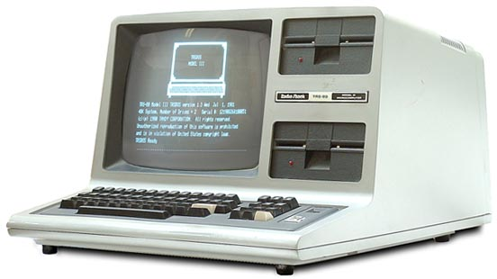
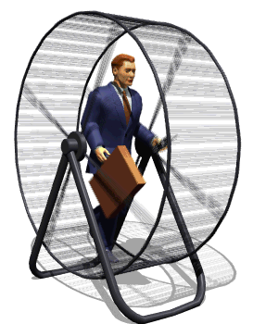
Answer: Imagine my life as an accountant/CPA in a high tech company in the 1980s…

Slide 4

Question #2. How are your views of entrepreneurship brought to life in your work as Educational Technologist? (e.g., entrepreneurial nature through digital scholarship and open educational resources)

Slide 5
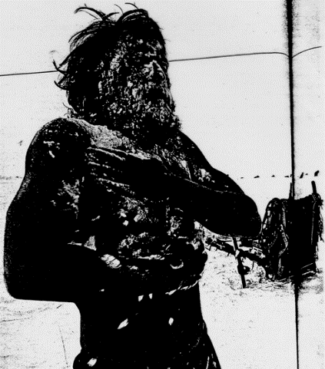
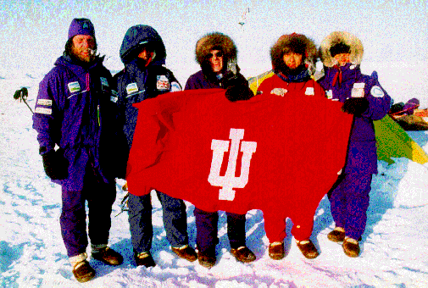
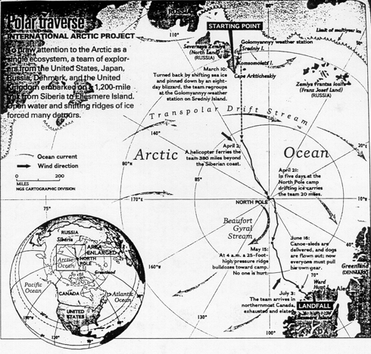
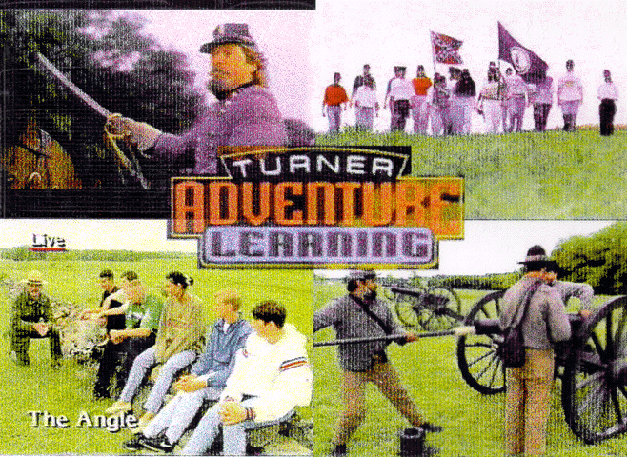
Advice #1: Analyze Existing Data…

Slide 6
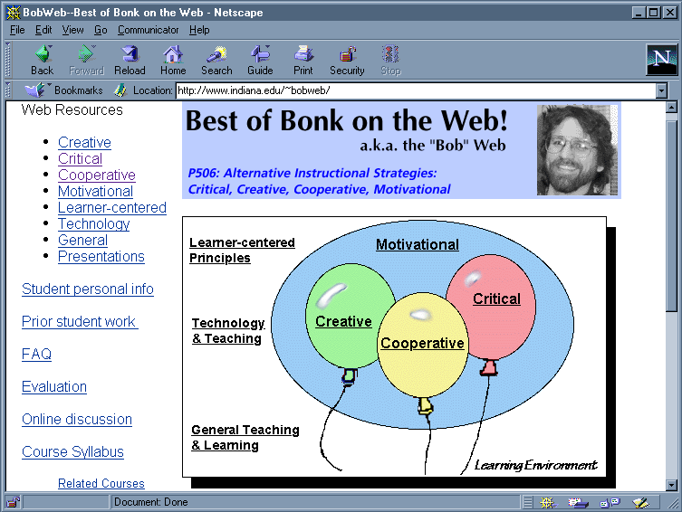
Advice #2: Empower Your Students

Slide 7
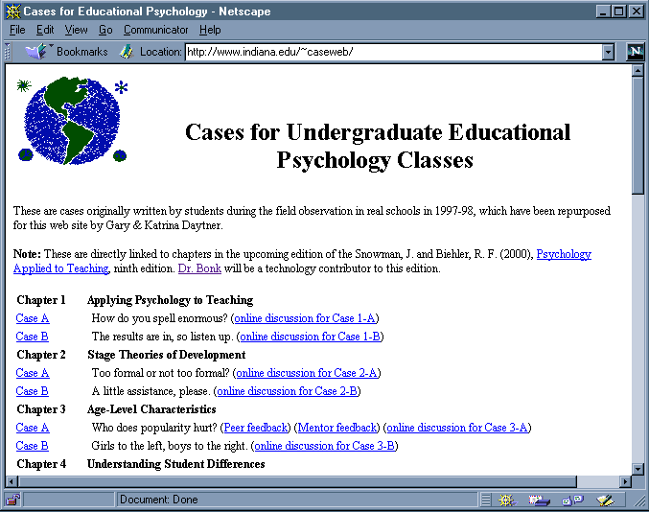
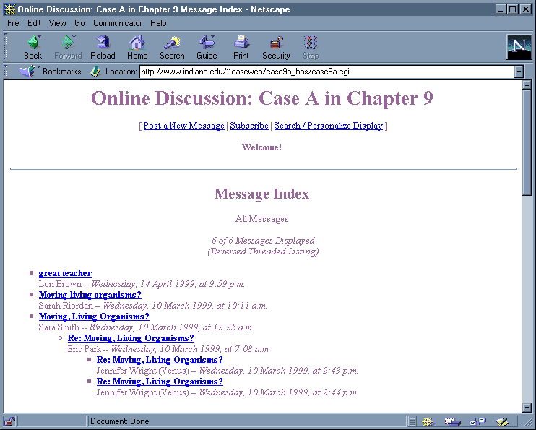
Advice #3: Build on Projects

Slide 8
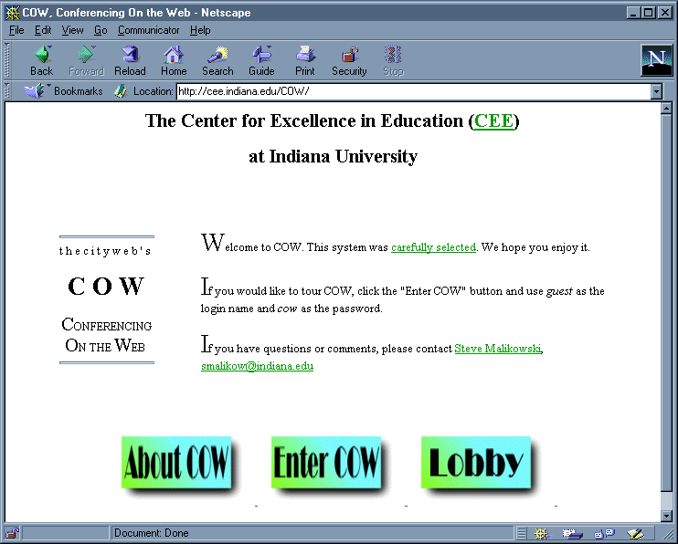
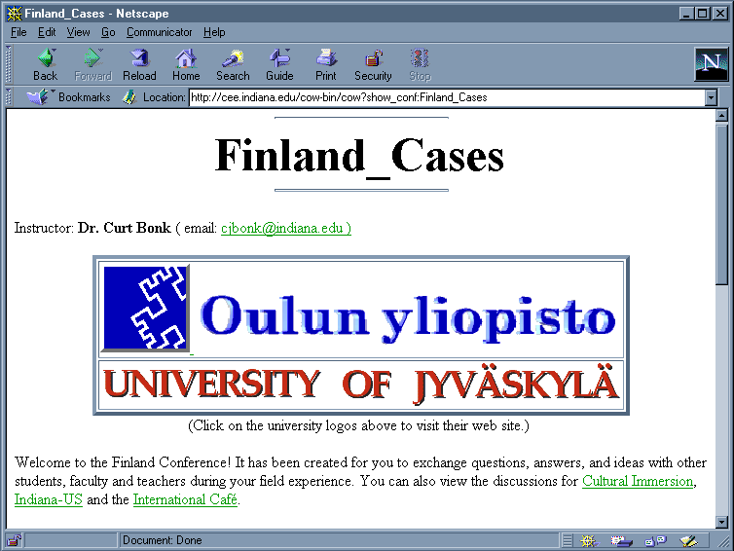
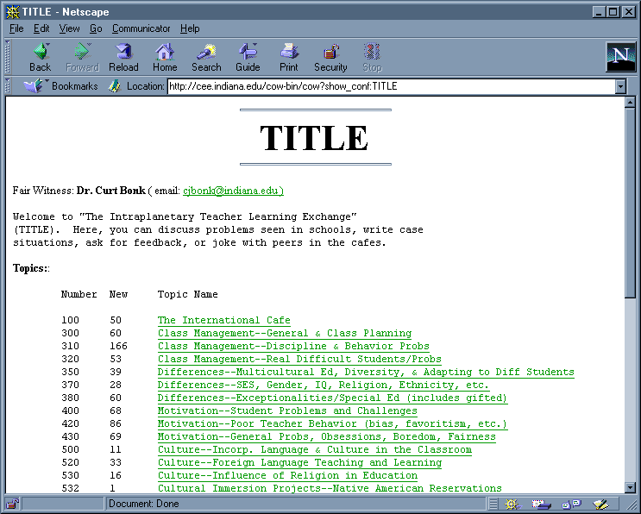
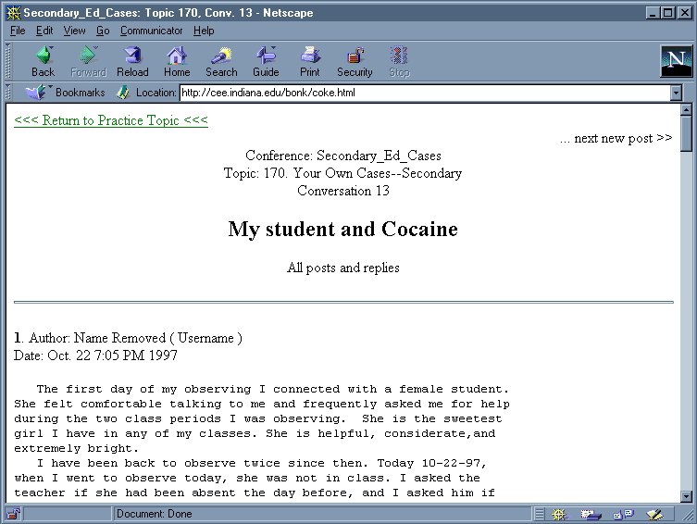
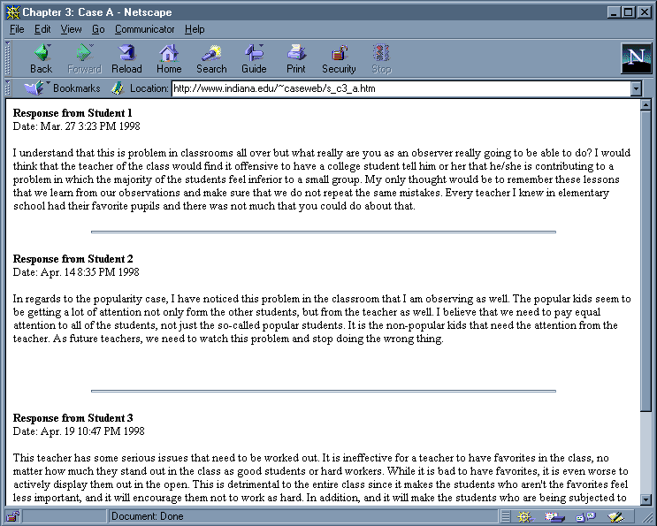
Advice #4: Holy COW: Don’t Ever Ride Your Bike to Work…

Slide 9
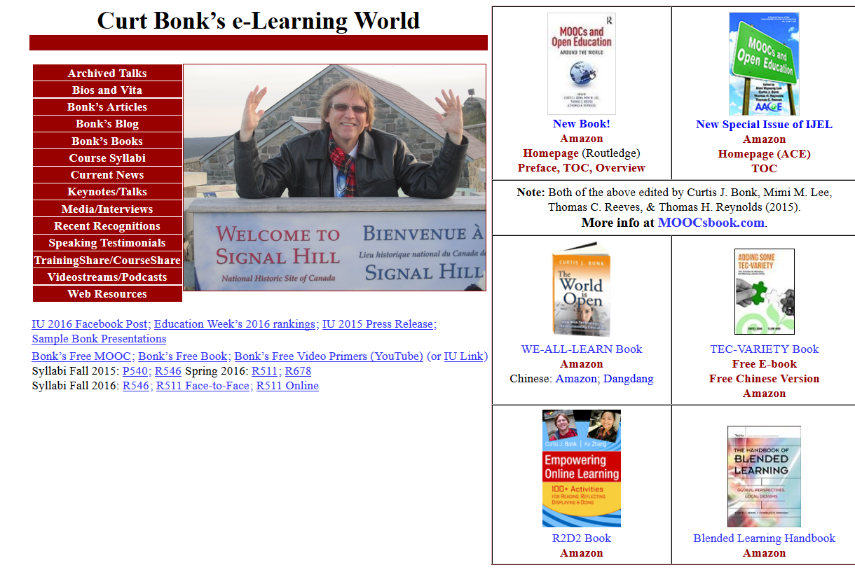
Advice #5: Constantly Update Your Homepage

Slide 10
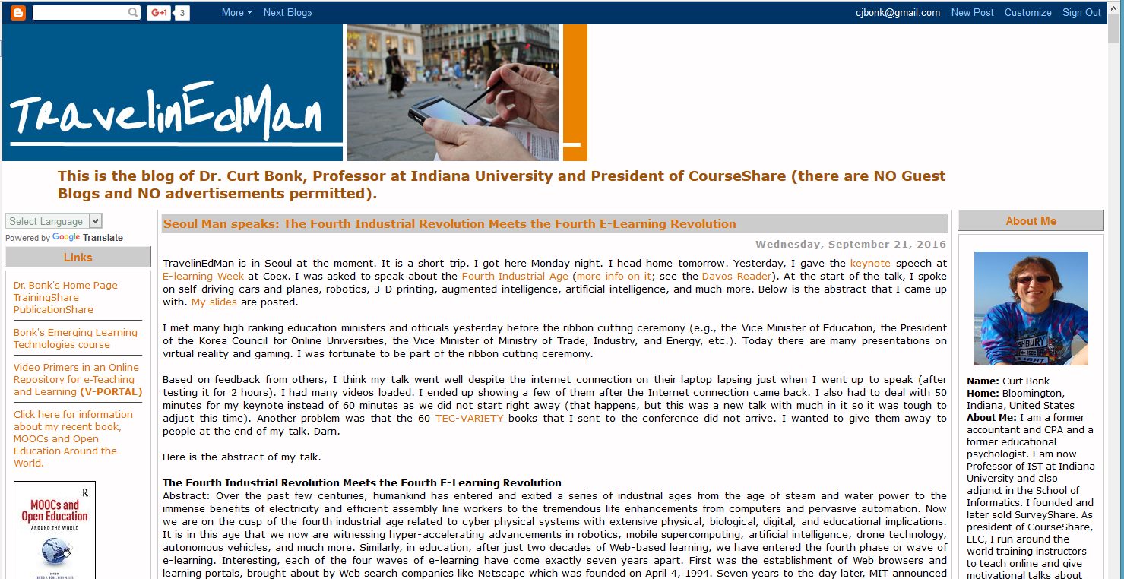
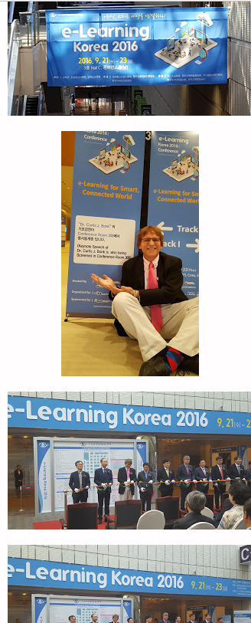
Advice #6: Blog Your Views
(e.g., TravelinEdMan)

Slide 11


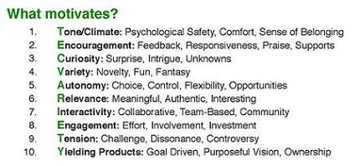
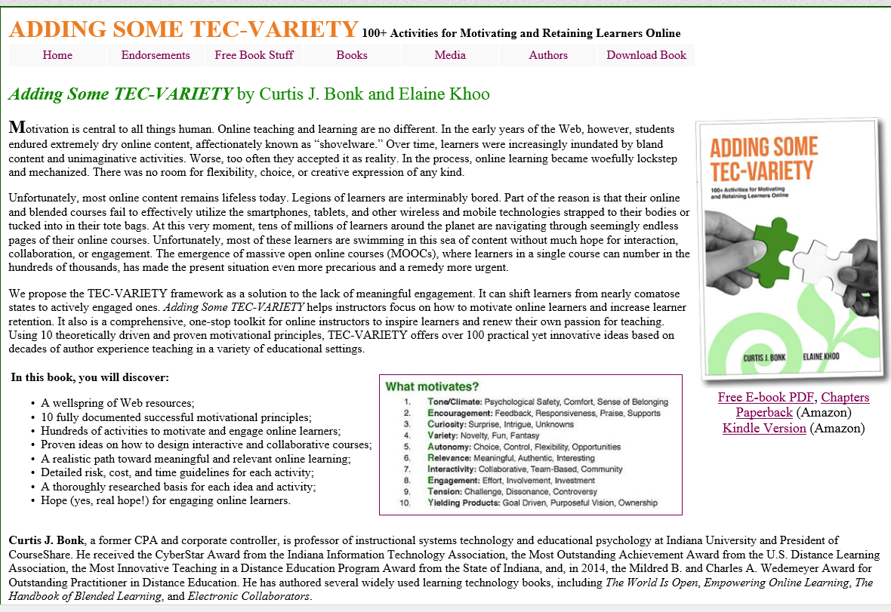
Advice #7: Consider Self-Publishing

Slide 12
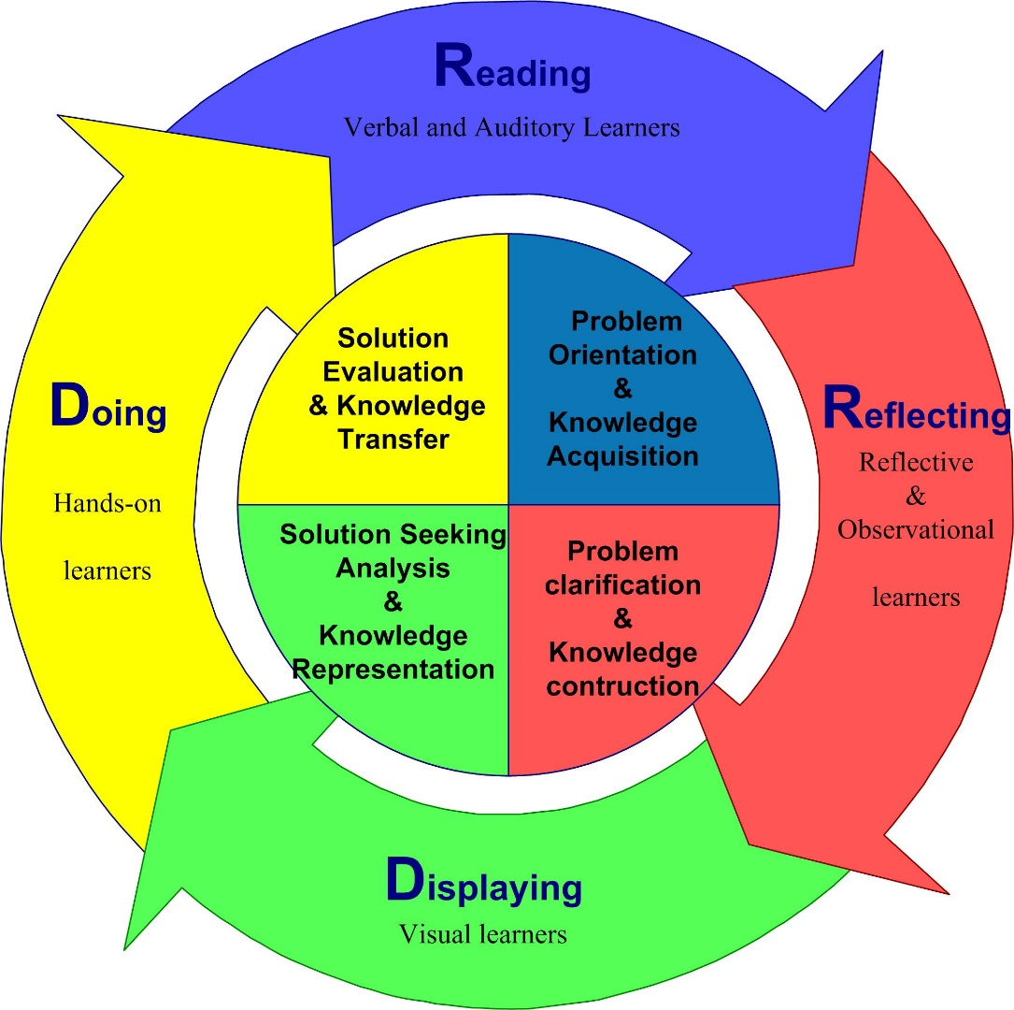
Advice #7a: Create Models and Frameworks

Slide 13
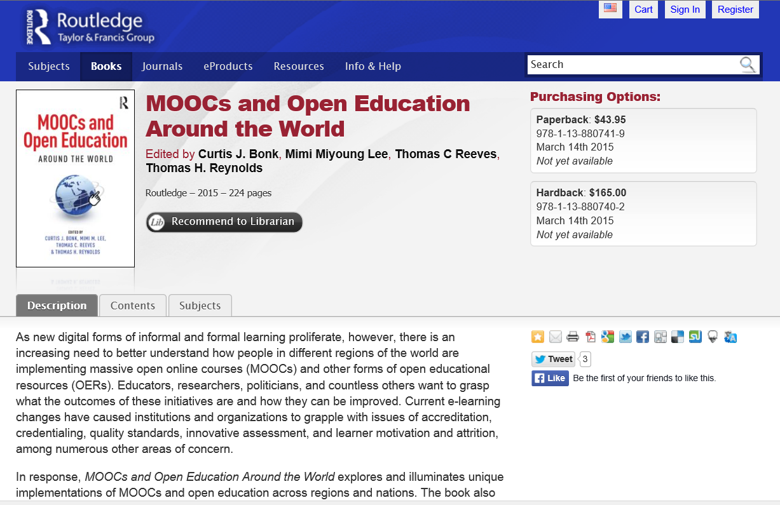



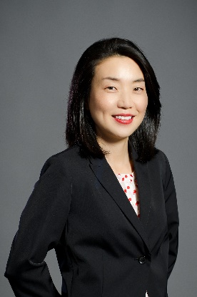
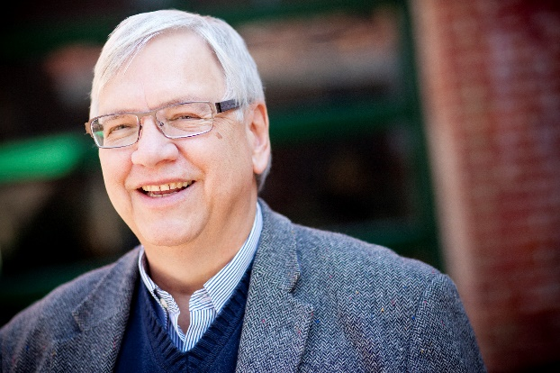

Advice #8: Get a Memorable Homepage URL for your Books
MOOCs and Open Education Around the World http://routledge-ny.com/books/details/9781138807419/

Slide 14
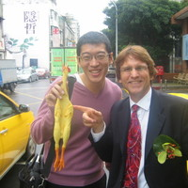
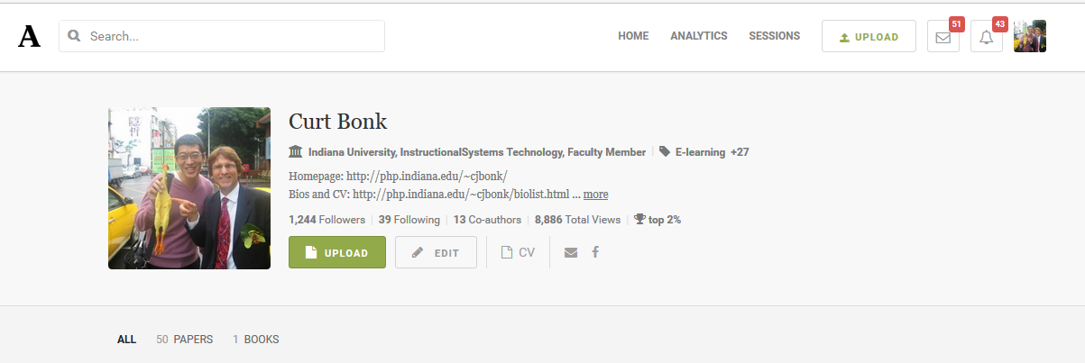
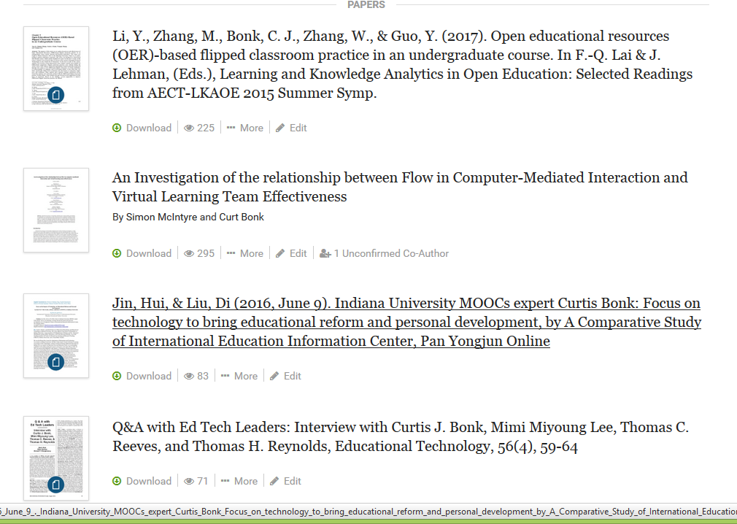
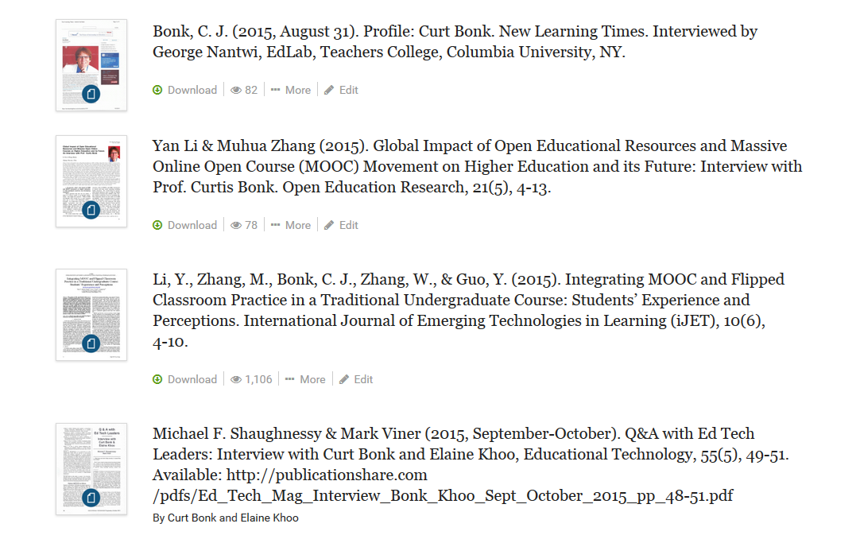
Advice #9: Use Social Media to Share Your Research
(p.s. And try to publish in open access journals) https://indiana.academia.edu/CurtBonk

Slide 15
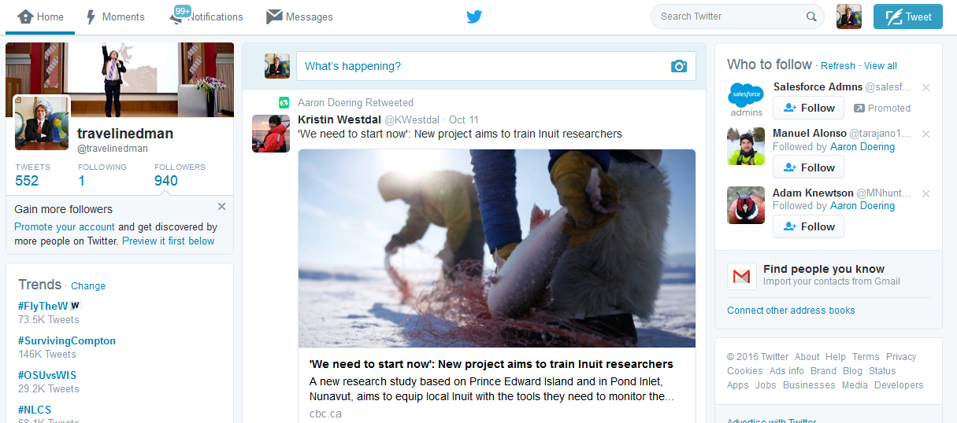
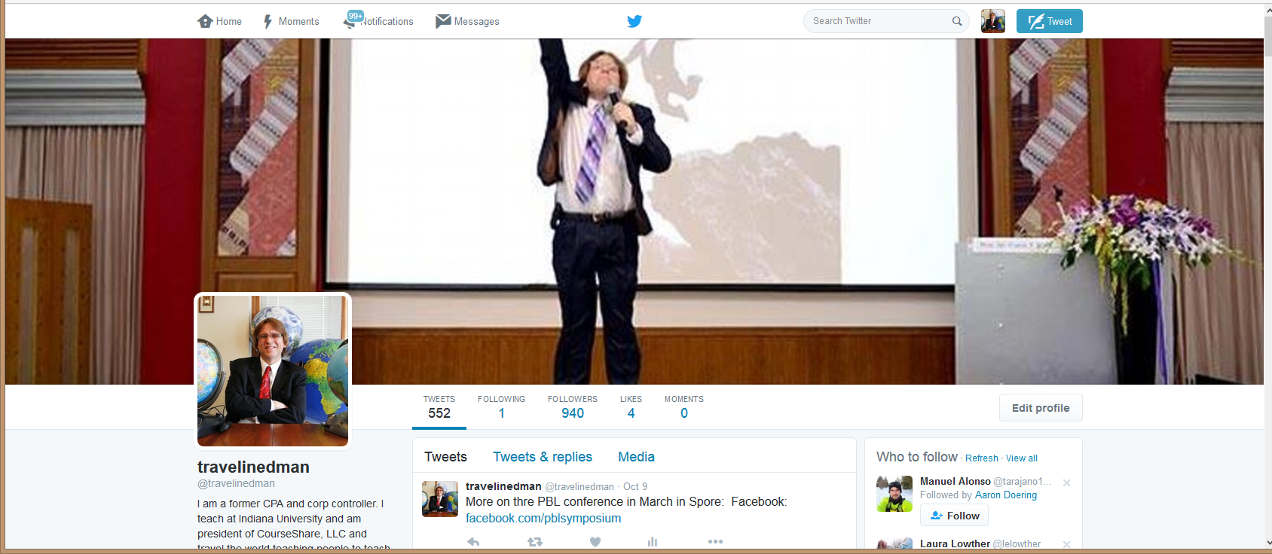
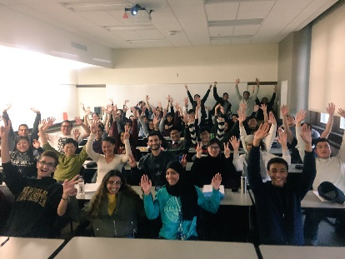

Advice #10: Tweet on Your Travels and Research https://twitter.com/travelinedman

Slide 16
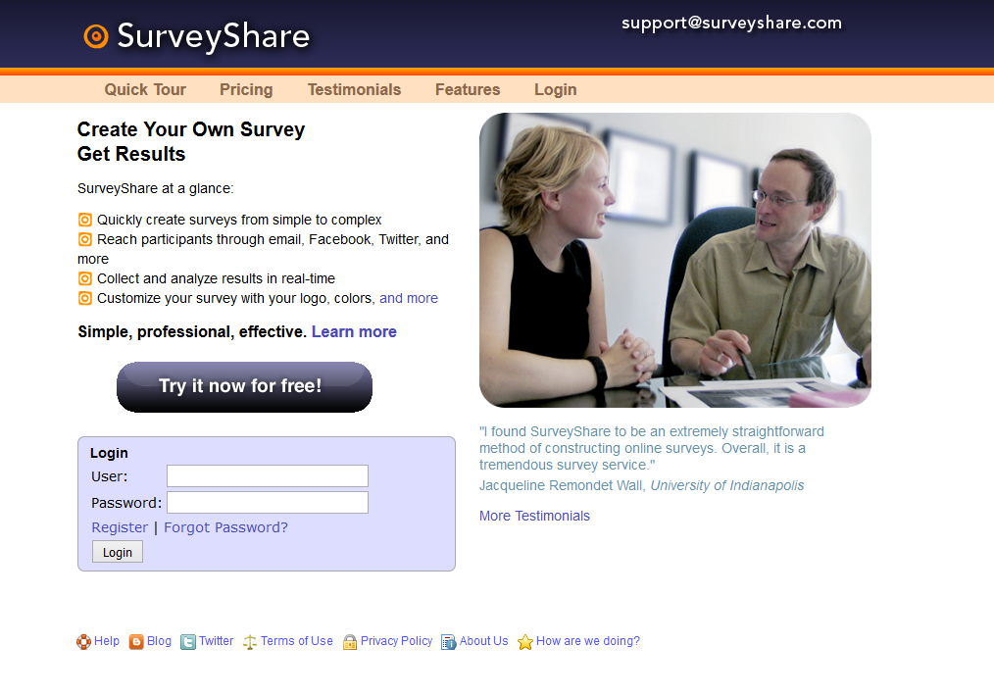
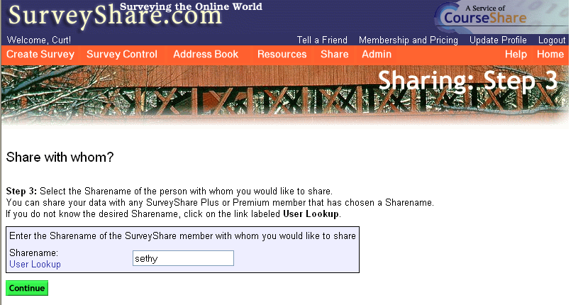
Question #3. What are some of the lessons learned as an Ed Tech entrepreneur?

Slide 17
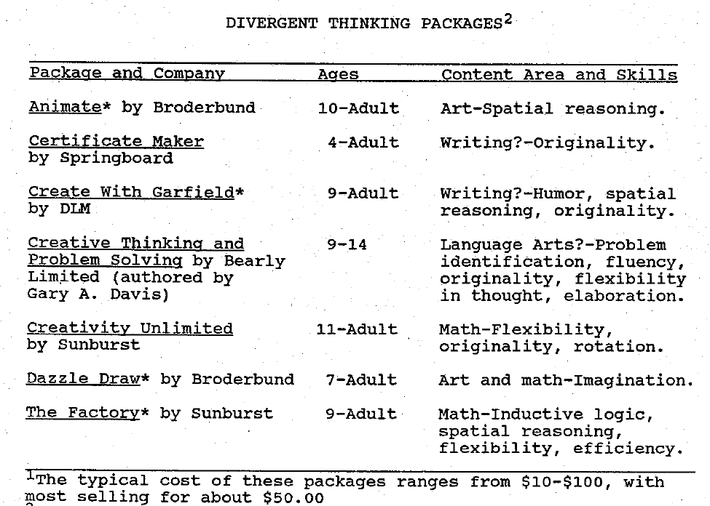
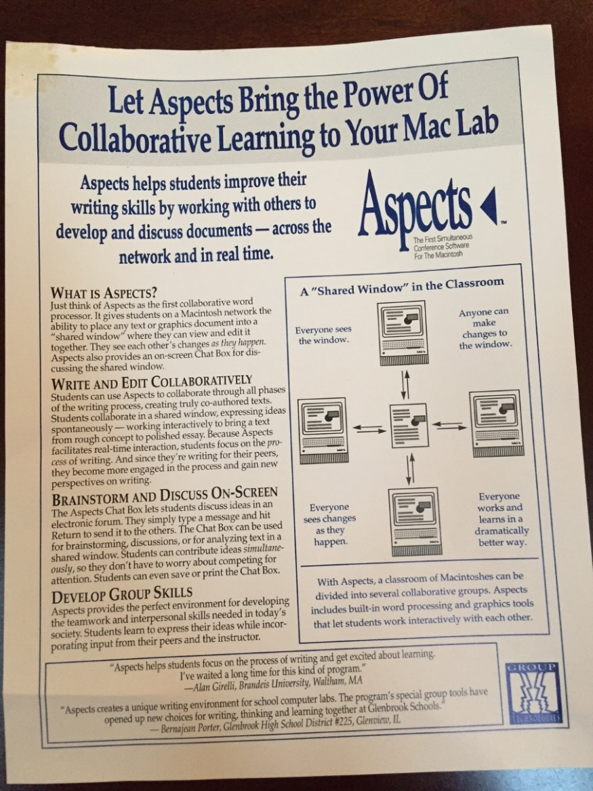
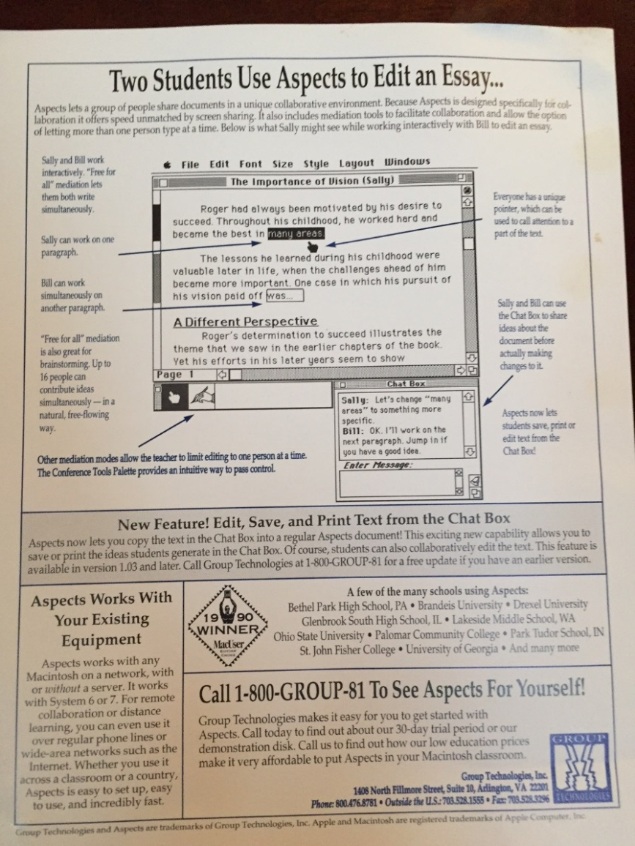
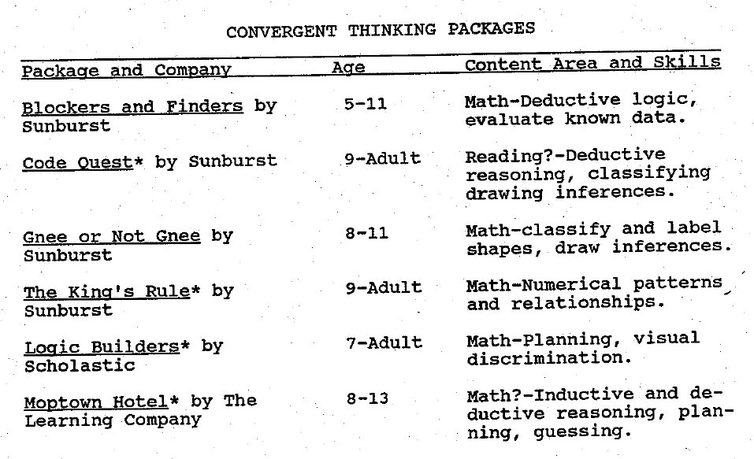
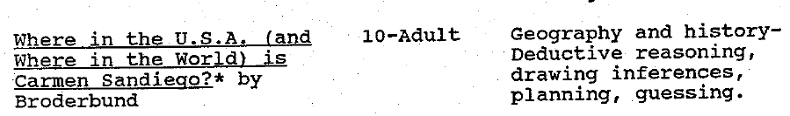
Lesson #1: Write to Vendors…
(e.g., Divergent and Convergent software tools 1987; Aspects and other collab. tools…circa 1991—25 years ago)

Slide 18
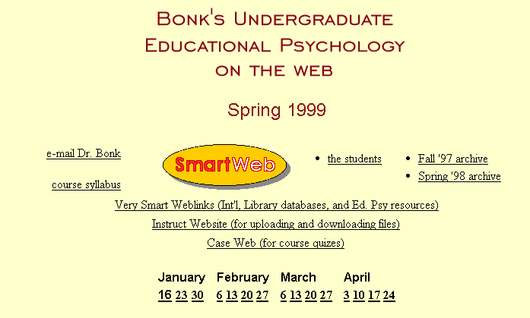
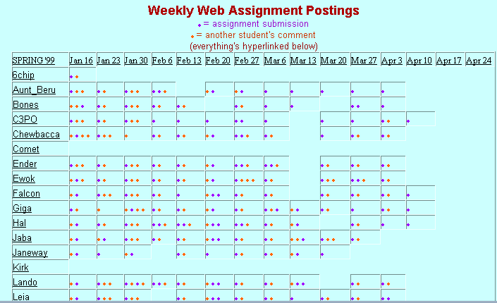
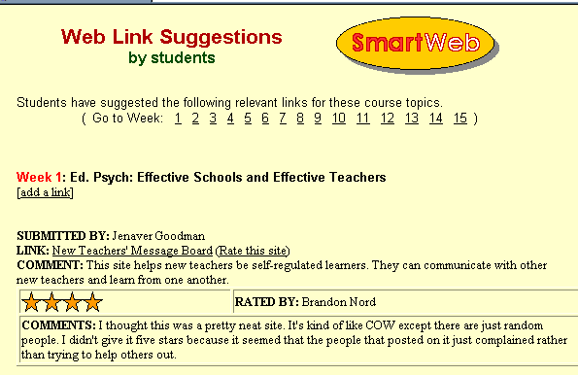
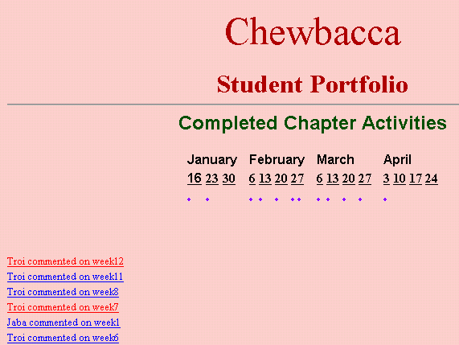
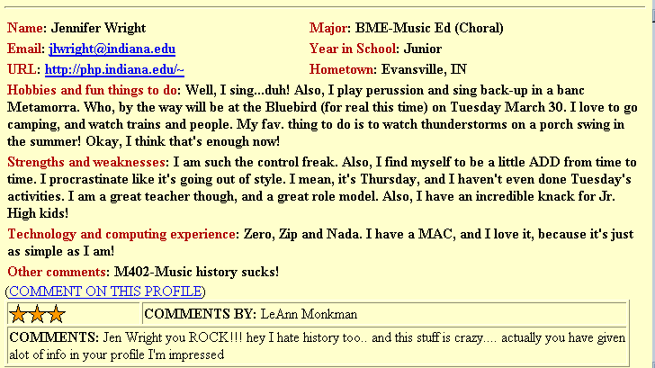
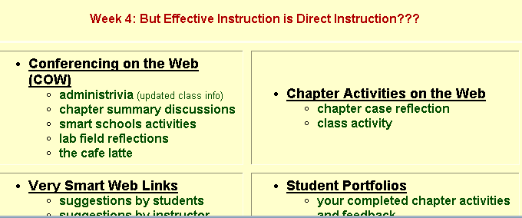
Lesson #2:
Nothing Wrong with Beta Testing

Slide 19
Lesson #3:
Don’t Expect Blackboard to Do It!

Slide 20
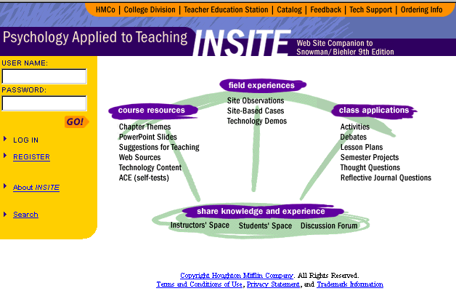
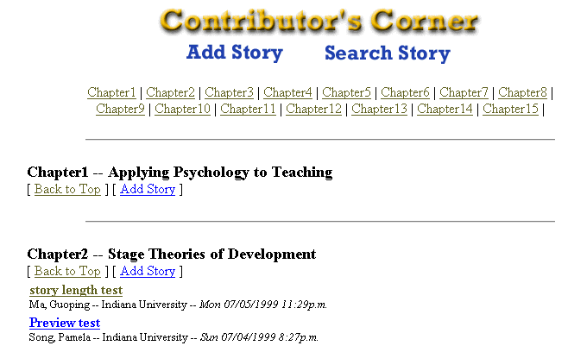
Lesson #4:
Get Reimbursed for Your Innovations

Slide 21
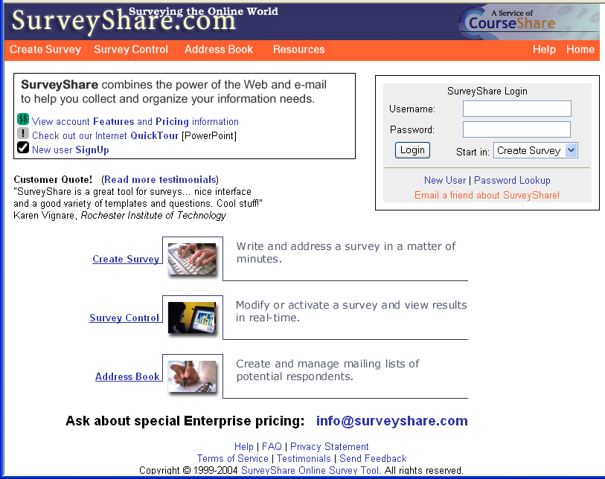
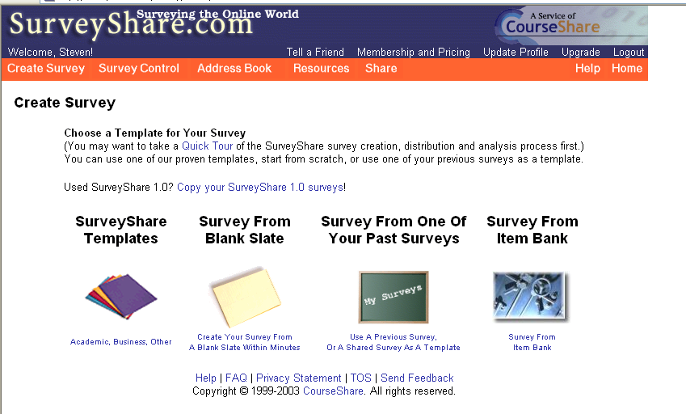
Lesson #5: Don’t Build Software

Slide 22
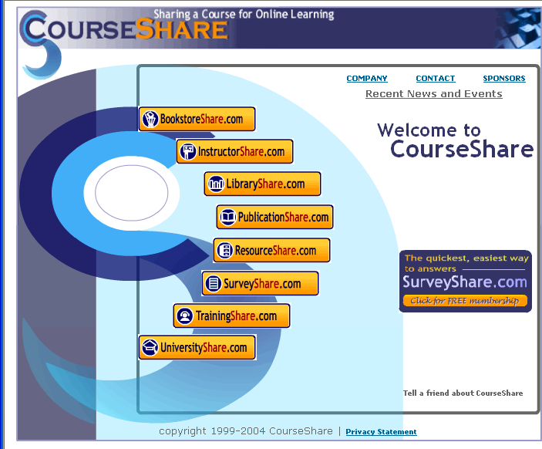
8 “Share” sites (plus FreelanceShare)
Lesson #6: Be Committed
BookstoreShare
InstructorShare
LibraryShare
PublicationShare
ResourceShare
TrainingShare
UniversityShare
SurveyShare

Slide 23
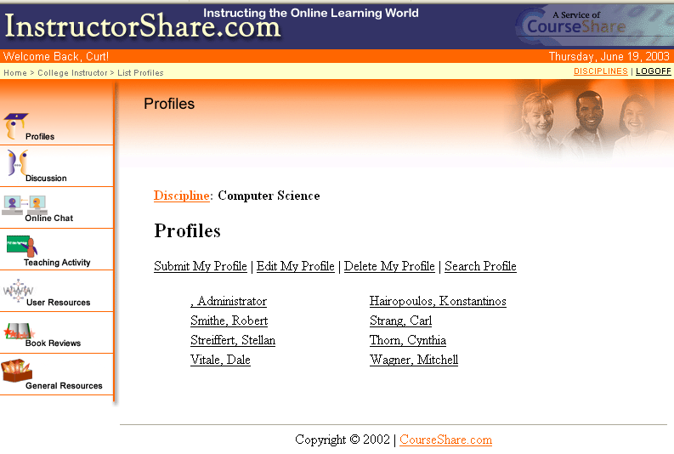
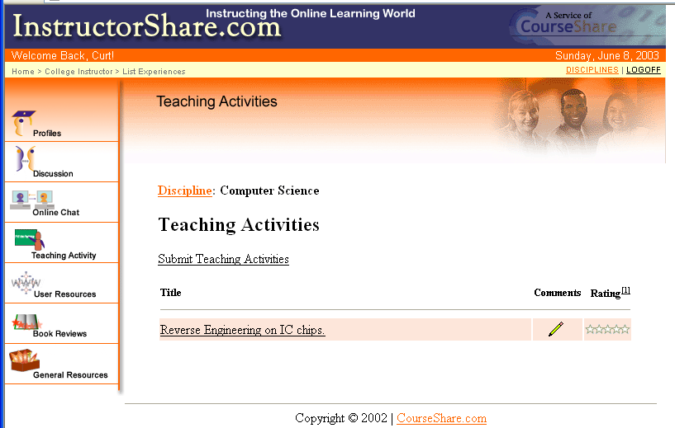
InstructorShare: List of User Profiles for Computer Science Discipline

Slide 24



LibraryShare:
Digital, Public, and University Libraries

Slide 25

ResourceShare:
College Instructor Resource Portal

Slide 26



Lesson #7: Find Likeminded Colleagues

Slide 27



Lesson #8: Some Creative Sparks Need Time to Evolve
Notes:
Curt, this is the end of your introduction.

Slide 28




Lesson #9: Be Open to Novel Partnerships…

Slide 29




Lesson #10: Be bold…and connect to people…(e.g., edited books)

Slide 30





Lesson #10b: Be bold…and facilitate book translation

Slide 31

Question #4. How do you envision the future of Educational Technology?

Slide 32

Any Questions or Comments?
Slides at: TrainingShare.com
Papers: PublicationShare.com
Free book: http://tec-variety.com/
Email: curt@worldisopen.com

