Slide 1
A Systematic Review of Research Methods and Topics of the Empirical MOOC Literature (2014-2016)
Annisa Sari and Meina Zhu
Indiana University
Mimi Miyoung Lee, Ph.D.
University of Houston

Slide 2
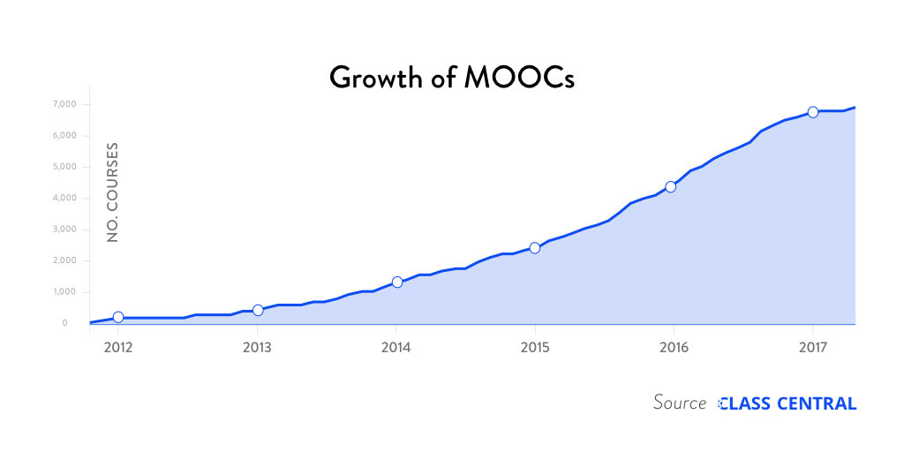
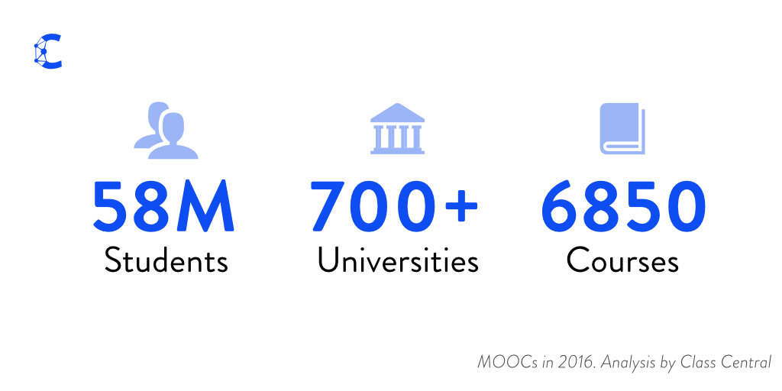
Growth of MOOCs
The Numbers: MOOCS in 2016 (Dec 25th, Class Central)
Notes:
Dhawa Shah, Class Central
https://www.class-central.com/report/mooc-stats-2016/

Slide 3
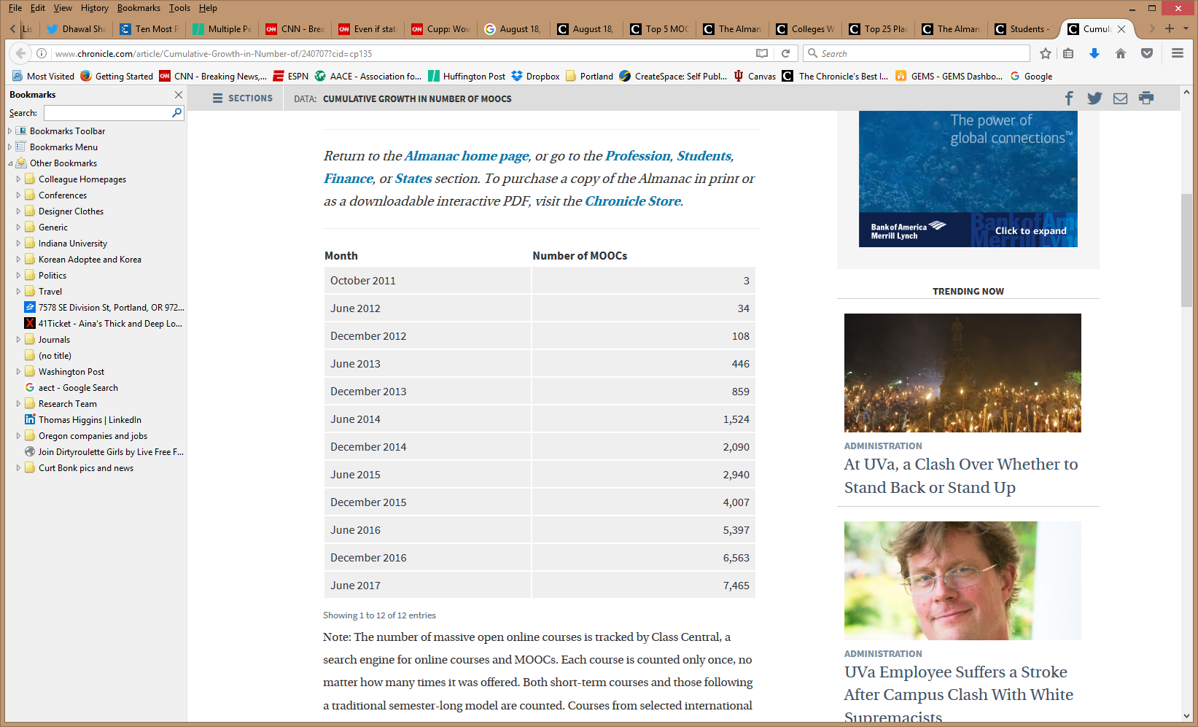
Growth of MOOCs
Cumulative Growth in Number of MOOCs (2011-2017)
Notes:
Chronicle of Higher Education annual Almanac of data from August.

Slide 4
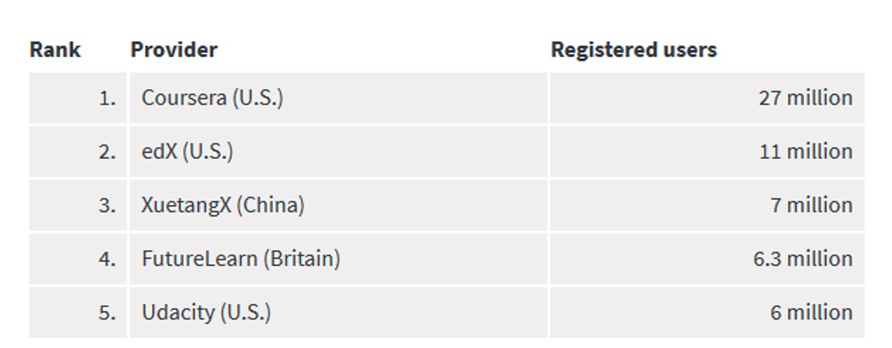
Registrations by MOOC Provider
Top 5 MOOC providers by number of registered users (2017)
Notes:
Chronicle of Higher Education annual Almanac of data from August.

Slide 5

June 15, 2017
Massive List of MOOC Providers Around The World, China
(Where to Find MOOCs: The Definitive Guide to MOOC Providers )
University of China MOOC — icourse163.org / China
Class Central, Dhawal Shah https://www.class-central.com/report/mooc-providers-list/

Slide 6

June 15, 2017
Massive List of MOOC Providers Around The World, K-MOOC (Korea)
(Where to Find MOOCs: The Definitive Guide to MOOC Providers ) https://www.class-central.com/report/mooc-providers-list/

Slide 7
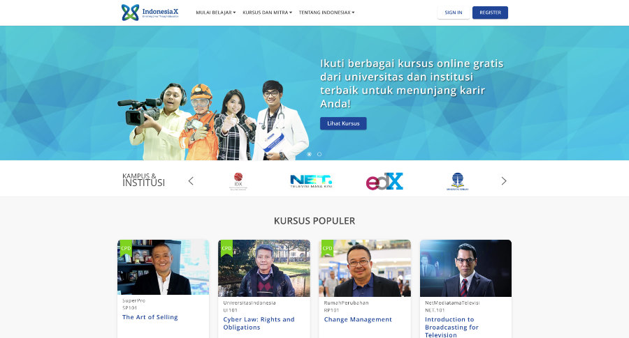
June 15, 2017
Massive List of MOOC Providers Around
The World, IndonesiaX
(Where to Find MOOCs: The Definitive Guide to MOOC Providers ) https://www.class-central.com/report/mooc-providers-list/

Slide 8
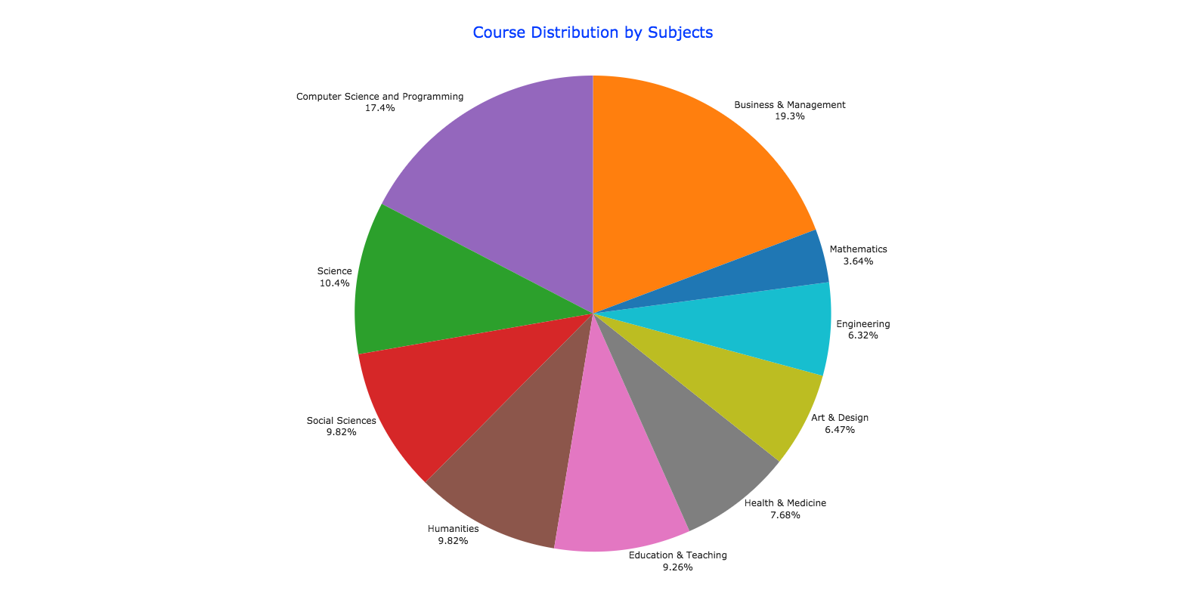
By the Numbers: MOOCs in 2016
Class Central, Dhawal Shah https://www.class-central.com/report/mooc-stats-2016/

Slide 9
November 2014
Where is Research on Massive Open Online Courses Headed? A Data Analysis of the MOOC Research Initiative
Gašević, Kovanović, Joksimović, and Siemens, IRRODL, 15(5), 143-176 http://www.irrodl.org/index.php/irrodl/article/view/1954
“Research needs to come up with theoretical underpinnings that will explain factors related to social aspects in MOOCs that have a completely new context and offer practical guidance of course design and instruction.” (p. 167)

Slide 10
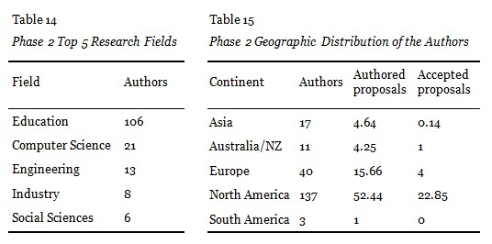
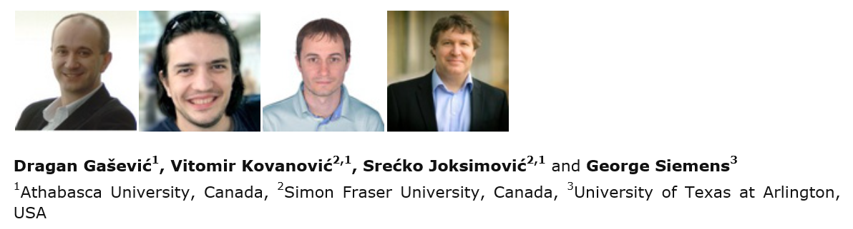
Dragan Gasevic and colleagues
(including George Siemens), 2014, IRRODL, 15(5)
http://www.irrodl.org/index.php/irrodl/article/view/1954

Slide 11
May 25, 2015
Digging deeper into learners’ experiences in MOOCs: Participation in social networks outside of MOOCs, notetaking and contexts surrounding content consumption
Veletsianos, Collier, & Schneider, BJET, 46(3), 570-587. http://onlinelibrary.wiley.com/doi/10.1111/bjet.12297/abstract
“To gain a deeper and more diverse understanding of the MOOC phenomenon, researchers need to use multiple research approaches (e.g., ethnography, phenomenology, discourse analysis) add content to them.” (p. 583.)

Slide 12
May 25, 2015
Digging deeper into learners’ experiences in MOOCs: Participation in social networks outside of MOOCs, notetaking and contexts surrounding content consumption
Veletsianos, Collier, & Schneider, BJET, 46(3), 570-587. http://onlinelibrary.wiley.com/doi/10.1111/bjet.12297/abstract
“Qualitative data and approaches can equip researchers to investigate the reasons why learners engage in video-watching behaviors in the ways that they do.” (p. 583.)

Slide 13

George Veletsianos & Peter Shepherdson’s Study (2016)
A Systematic Analysis And Synthesis of the Empirical MOOC Literature Published in 2013-2015
“Dependence on Particular Research Methods May Restrict our Understanding of MOOCs”

Slide 14
February 2016
A Systematic Analysis and Synthesis of the Empirical MOOC Literature Published in 2013-2015
George Veletsianos and Peter Sheperdson, IRRODL, 17(2), 198-221 http://www.irrodl.org/index.php/irrodl/article/view/2448/3655
“Analysis suggests that researchers have favored a quantitative, if not positivist approach to the conduct of MOOC research. Survey data and secondary data collected via automated methods dominated the analyses. While some interpretive research was conducted in MOOCs in this time period, it was often basic. Very few studies were informed by methods traditionally associated with qualitative research approaches (e.g., interviews, observations, and focus groups).” (p. 214)

Slide 15
August 2017
A Contemporary Review of Research Methods Adopted to Understand Students’ and Instructors’ Use of Massive Open Online Courses (MOOCs)
Ruiqi Deng and Pierre Benckendorff, International Journal of Information and Education Technology, 7(8), 601-607.
“There are a number of research avenues which could be explored based upon the findings of this study. First, additional research strategies should be considered to understand students’ and instructors’ experience in using MOOCs.” (p. 605)

Slide 16
August 2017
A Contemporary Review of Research Methods Adopted to Understand Students’ and Instructors’ Use of Massive Open Online Courses (MOOCs)
Ruiqi Deng and Pierre Benckendorff, International Journal of Information and Education Technology, 7(8), 601-607.
“Second, triangulation of a wider range of research methods and data source should be undertaken. Beyond triangulation of surveys and interviews or log files, MOOC scholars are encouraged to combine other research methods to triangulate findings, such as diary studies and focus groups.” (p. 605)

Slide 17
Research Background
MOOC offerings continue to surge (Almanac, 2017-2018; Shah, 2016),
A scarcity of systematic analysis of empirical studies of recent MOOC research that targets all of the following aspects: research methods adopted by MOOC researchers, the research topics, the geographic locations of MOOC researchers, and the regions of the MOOC delivery.

Slide 18
Research Purpose & Questions
Explores the research paradigms and topics of MOOCs to gain a deeper understanding of the MOOC phenomenon
    1. What are the research methods researchers employed in empirical MOOC studies?
    2. What are the research topics or focuses in MOOC studies?
    3. How are researchers of empirical MOOC studies geographically distributed?
    4. In terms of the delivery of the MOOC, what are the countries which are attracting the most research?

Slide 19
Research Method-Data Collection
Data selection criteria
Empirical study
From education perspective
Published between October 2014 - November 2016
Mainly from Scopus
Keywords “MOOC” and “Massive Online Open Course(s)”
Journal articles
Written in English

Slide 20
Research Method-Data Collection
Journals listed in Scopus
Journals not included in Scopus:
EDUCAUSE Review & Quarterly
Online Learning
the International Journal on E-Learning
Journal of Interactive Media in Education
Journal of Online Learning Research
the Journal of Open Flexible and Distance Learning

Slide 21
Research Method-Data Collection
Exchanged the data collected and cross-checked the re-coded information (inter-rater agreement across all items was 91.1%)
146 papers were included

Slide 22
Research Method-Data Collection
Authors and their affiliations
Location of the authors
Location of the MOOC delivery
Year of publication
Title
Journal name
General analytic method (e.g., qualitative, quantitative, or mixed methods)
Data collection methods
Data analysis methods
General study focus
Special study focus
Article URL address

Slide 23
Context

Slide 24
Context
No | Journal | Total
1 | International Review of Research in Open and Distance Learning (IRRODL) | 31
2 | Computers & Education | 12
3 | British Journal of Educational Technology | 9
4 | Online Learning | 7
5 | Distance Education | 5
6 | Educational Media International | 5
7 | Internet and Higher Education | 5
8 | Journal of Computer Assisted Learning | 5
9 | Computers in Human Behavior | 4
10 | Open Learning | 4
11 | Journal of Online Learning and Teaching | 3
12 | Journal of Asynchronous Learning Network | 3

Slide 25
Research Method-Data Analysis
RQ 1 | Analytical Frameworks
Research Methods | Quantitative research, qualitative research, and mixed-methods (Creswell, 2003)
Data Collection Methods | Interviews, surveys, focus groups, tests, and observations, and discussion forum, platform database, and learning analytics Tashakkori and Teddlie (2003)

Slide 26
Research Method-Data Analysis
RQ 2 | Analytical Frameworks
Research Topics | The five categories were: student-focused, (2) teacher-focused, (3) design-focused, (4) context and impact, and (5) other Veletsianos and Shepherdson (2015)

Slide 27
Research Method-Data Analysis
RQ 3 | Analysis method
Geographical Distribution | Examined the affiliations of all the authors of these 146 studies. When completed, we calculated the country location for all the MOOC authors in this study as well as the locations for just the first author of the 146 MOOC studies.

Slide 28
Research Method-Data Analysis
RQ 4 | Analysis method
Countries of MOOC origin or delivery | The researchers calculated the countries of the MOOC being studied. For the published studies which did not specify the name/location of MOOC delivery or used the general MOOCs for the research, the researchers coded them as “Global.”

Slide 29
Results-RQ1-Data Collection Methods
RQ1: What are the research methods researchers employed in empirical MOOC studies?

Slide 30
Results-RQ1-Data Collection Methods
RQ1: What are the research methods researchers employed in empirical MOOC studies?

Slide 31
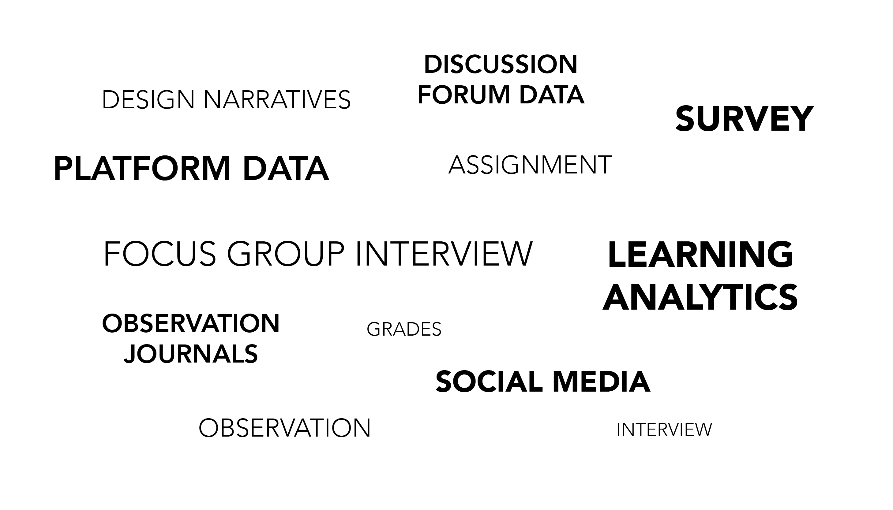
Data Sources of MOOC Research
(2014–2016)

Slide 32
Results-RQ1-Data Collection Methods
RQ1: What are the research methods researchers employed in empirical MOOC studies?

Slide 33
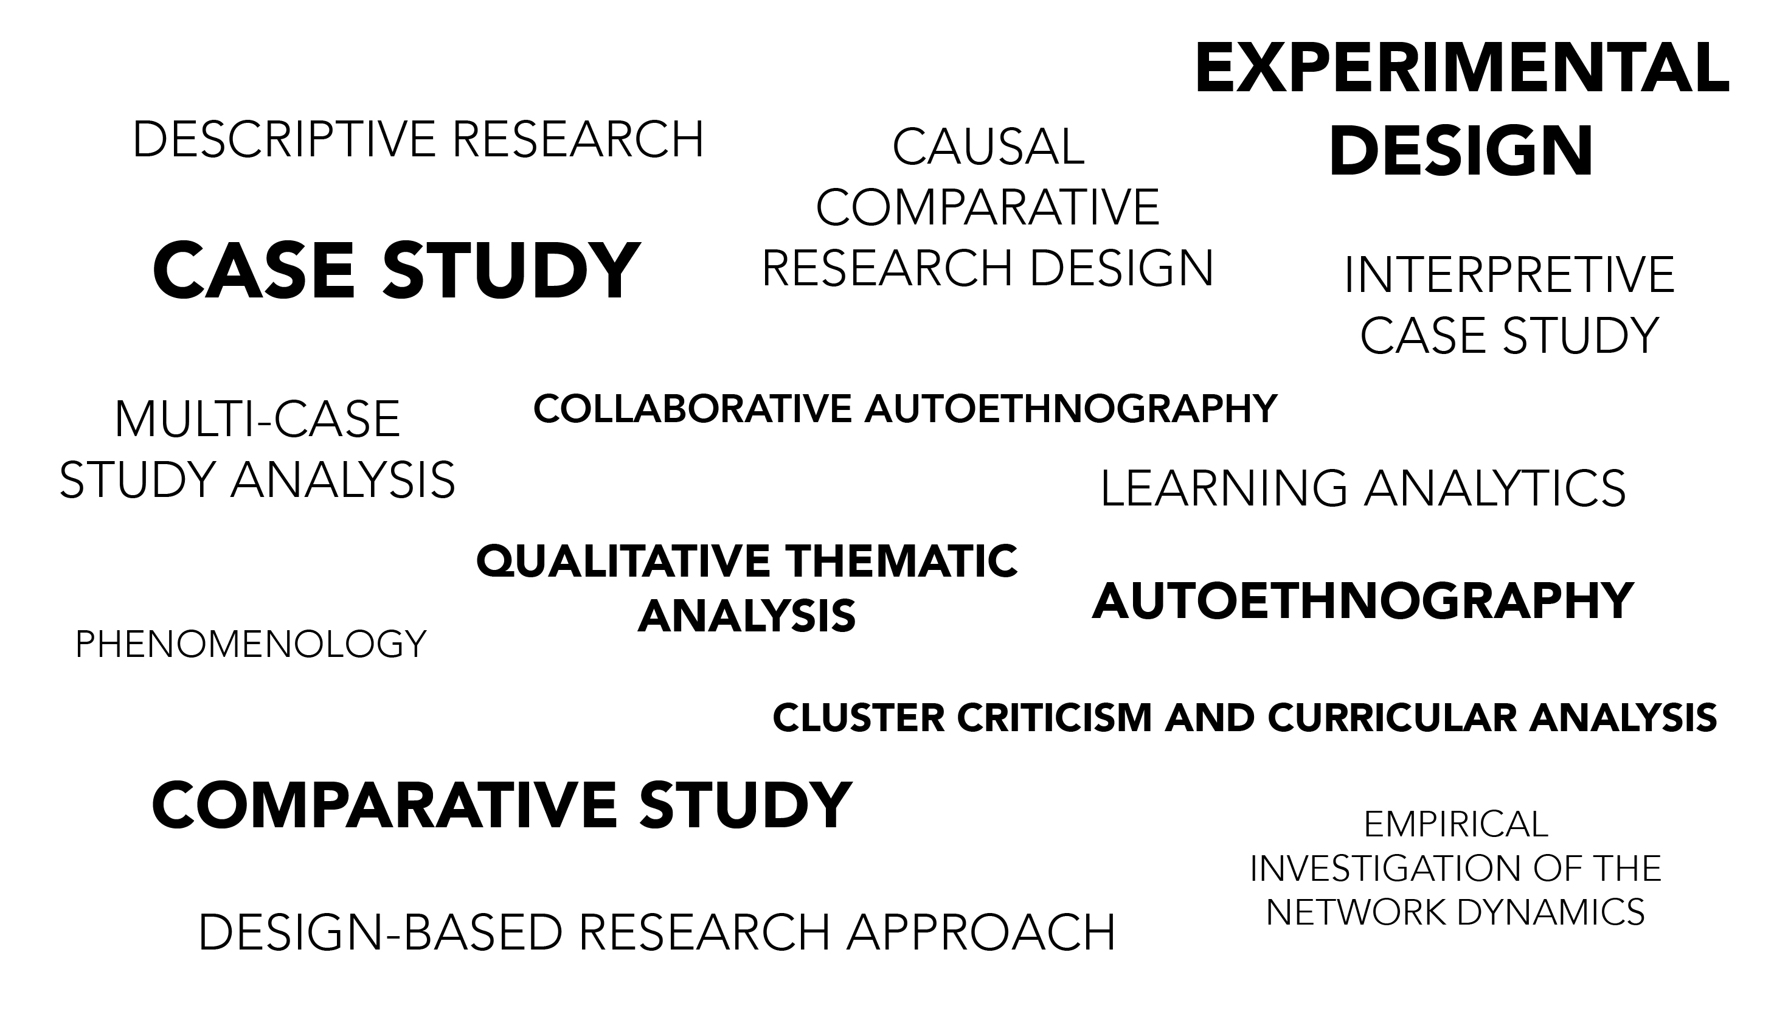
Specific Analytic Method for MOOC Research (2014–2016)

Slide 34
Results-RQ1-Data Analysis Methods
RQ1: What are the research methods researchers employed in empirical MOOC studies?

Slide 35
Results-RQ2-Research Focus
RQ2: What are the research focuses in MOOC studies?

Slide 36
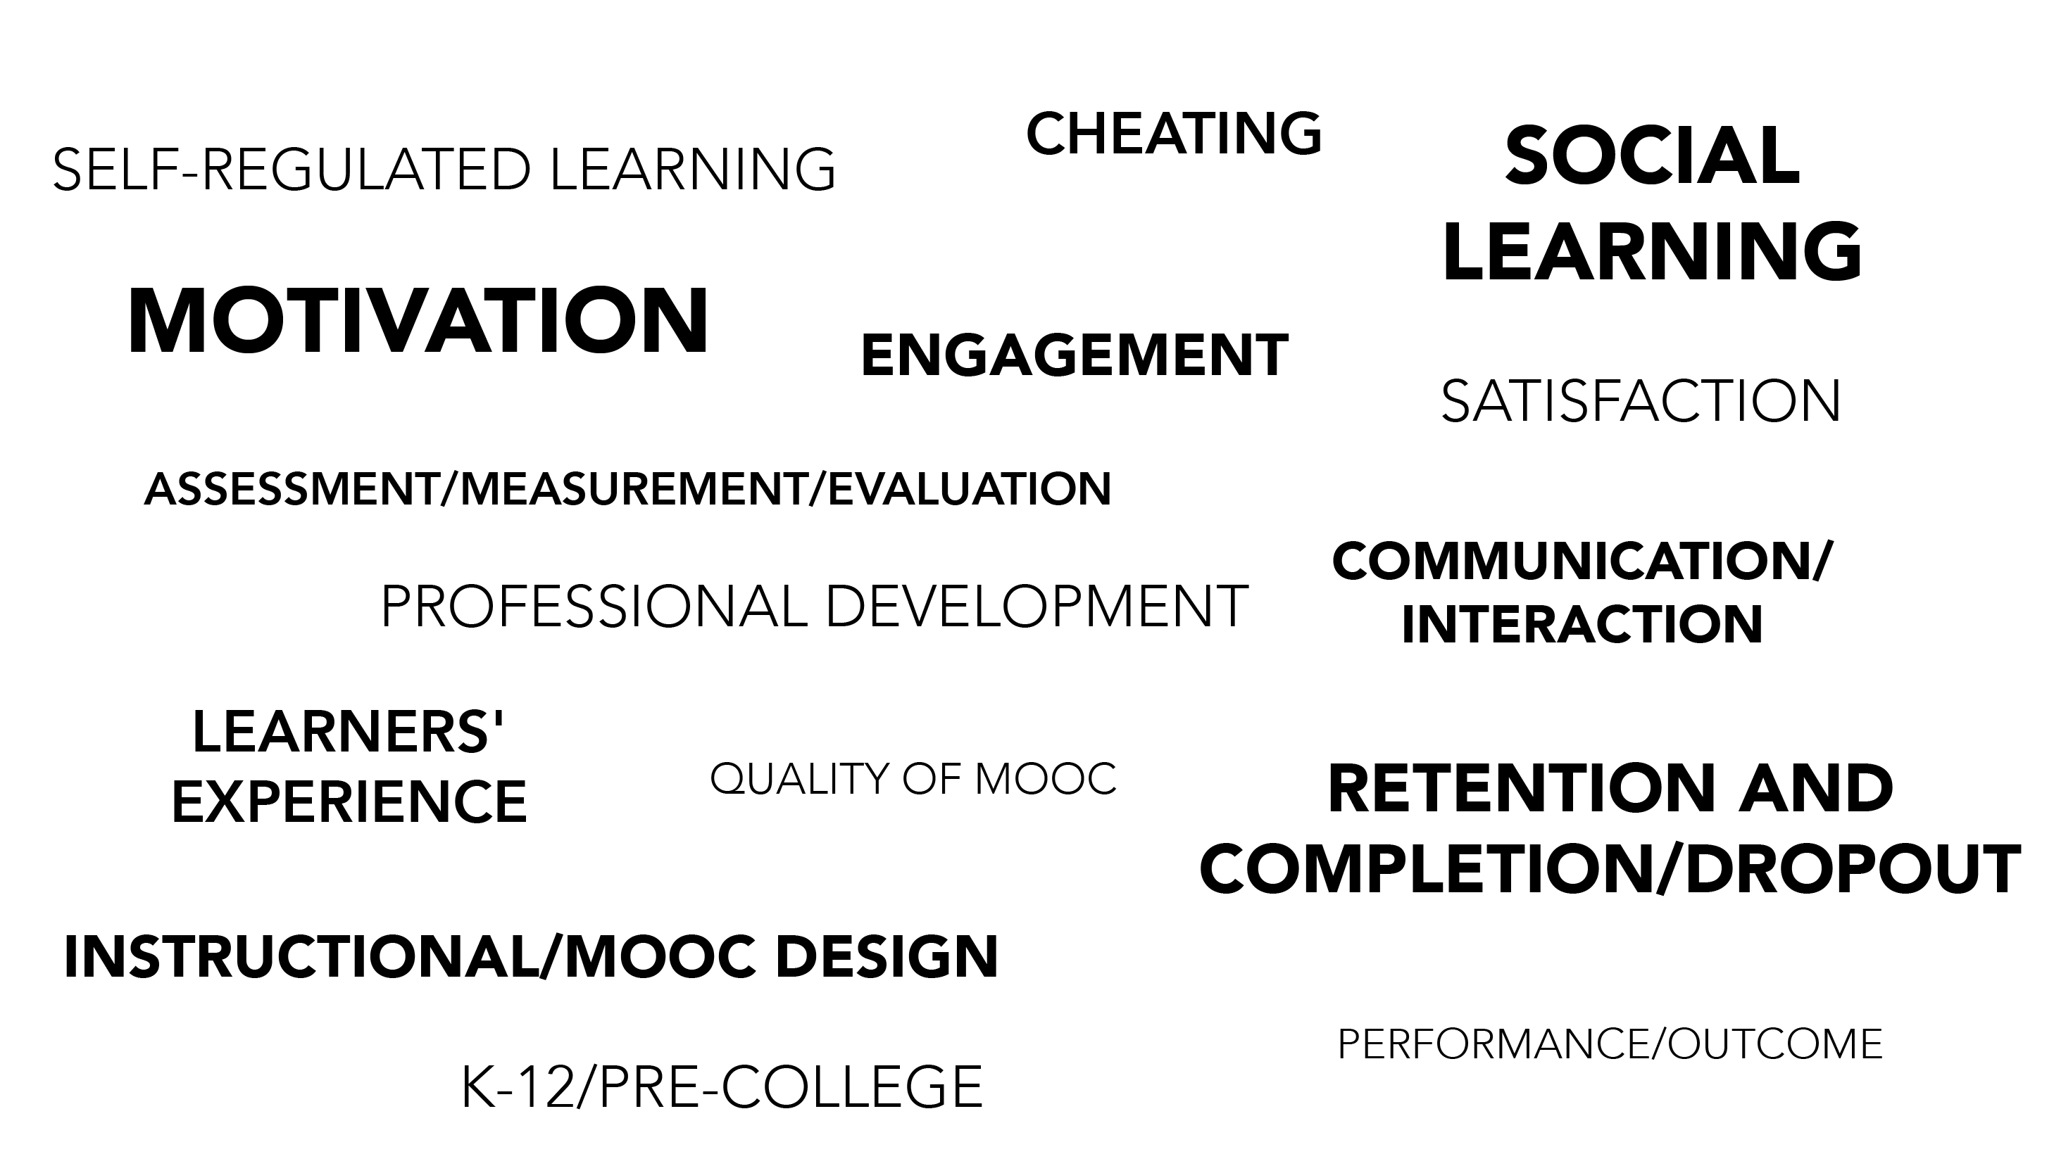
Specific Topics of MOOC
Research (2014–2016)

Slide 37
Results-RQ2-Research Focus
Detailed Focus | Total
Motivation | 11
Retention and completion/dropout | 11
Assessment/measurement/evaluation | 10
Instructional/MOOC design | 10
Learners' experience | 10
Satisfaction | 10
Engagement | 8
Attitude | 7
Performance/outcome | 7
Collaborative learning and peer support | 6
Communication/interaction | 6
Higher education | 5
Professional development | 5
Effectiveness | 4
Self-regulated learning | 4
Specific Topical Focus of MOOC Studies
RQ2: What are the research focuses in MOOC studies?

Slide 38
Results-RQ2-Research Focus
RQ2: What are the research focuses in MOOC studies?
Research Methods Used in Each Research Topic
 | Quantitative | Qualitative | Mixed methods
Student-focused | 39 | 9 | 26
Design-focused | 19 | 12 | 17
Context and impact | 9 | 6 | 5
Instructor-focused | 0 | 3 | 2

Slide 39
Results-RQ3-Geographical Distribution
RQ3: How are researchers of empirical MOOC studies geographically distributed?

Slide 40
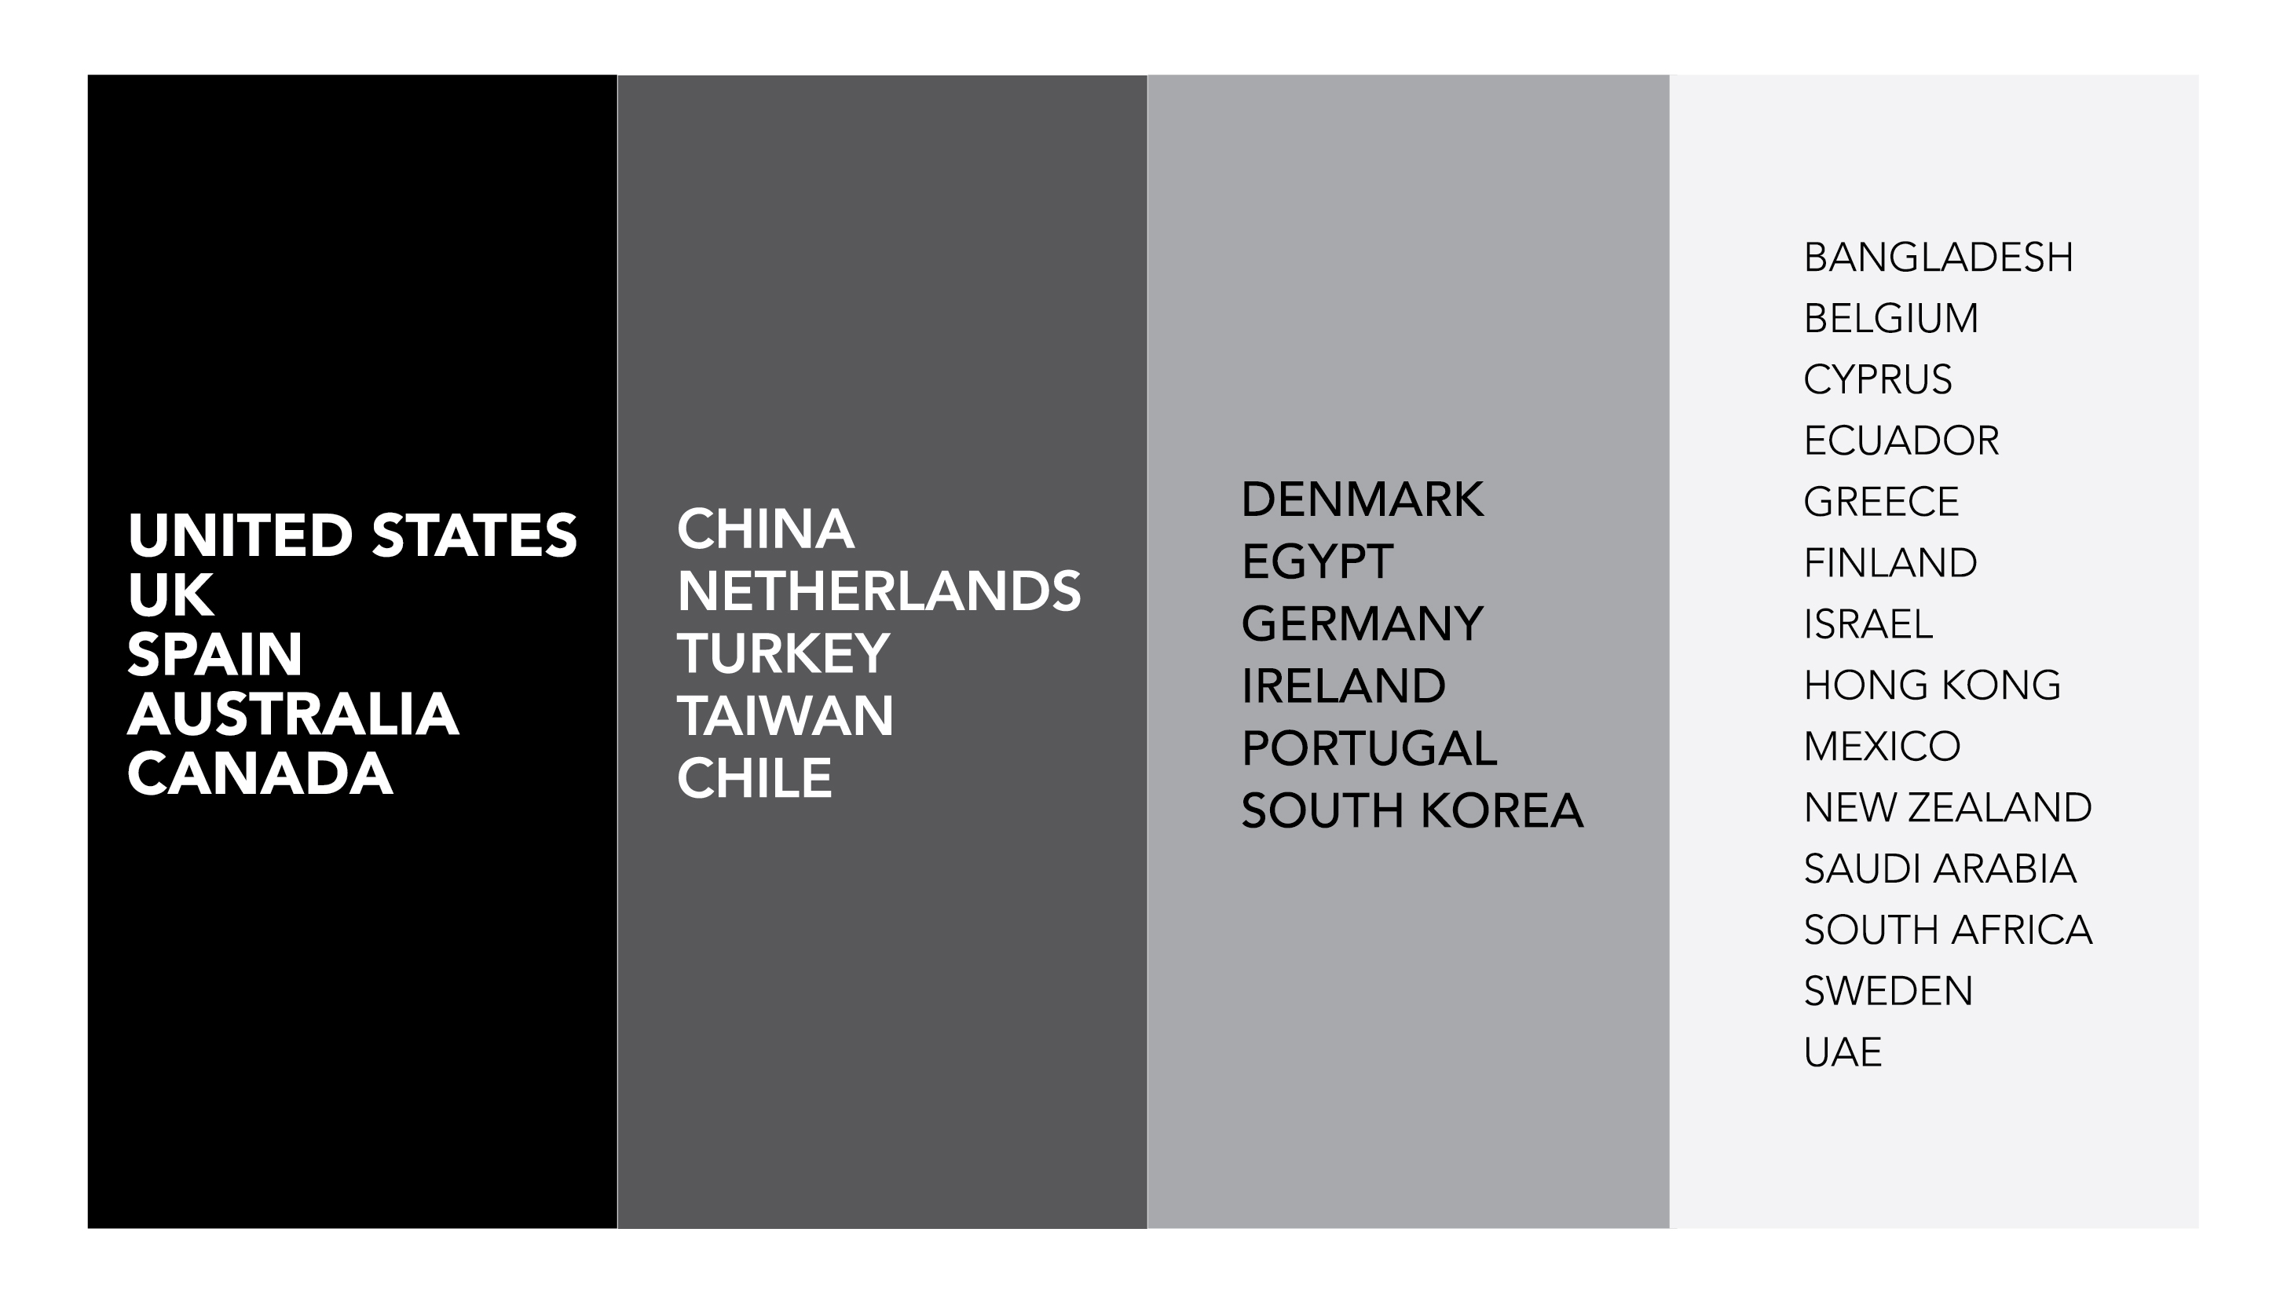
Location of MOOC Research Team Members (2014–2016)

Slide 41
Results-RQ4-Countries of the deliveries
RQ4: In terms of the delivery of the MOOC, what are the countries which are attracting the most research?

Slide 42
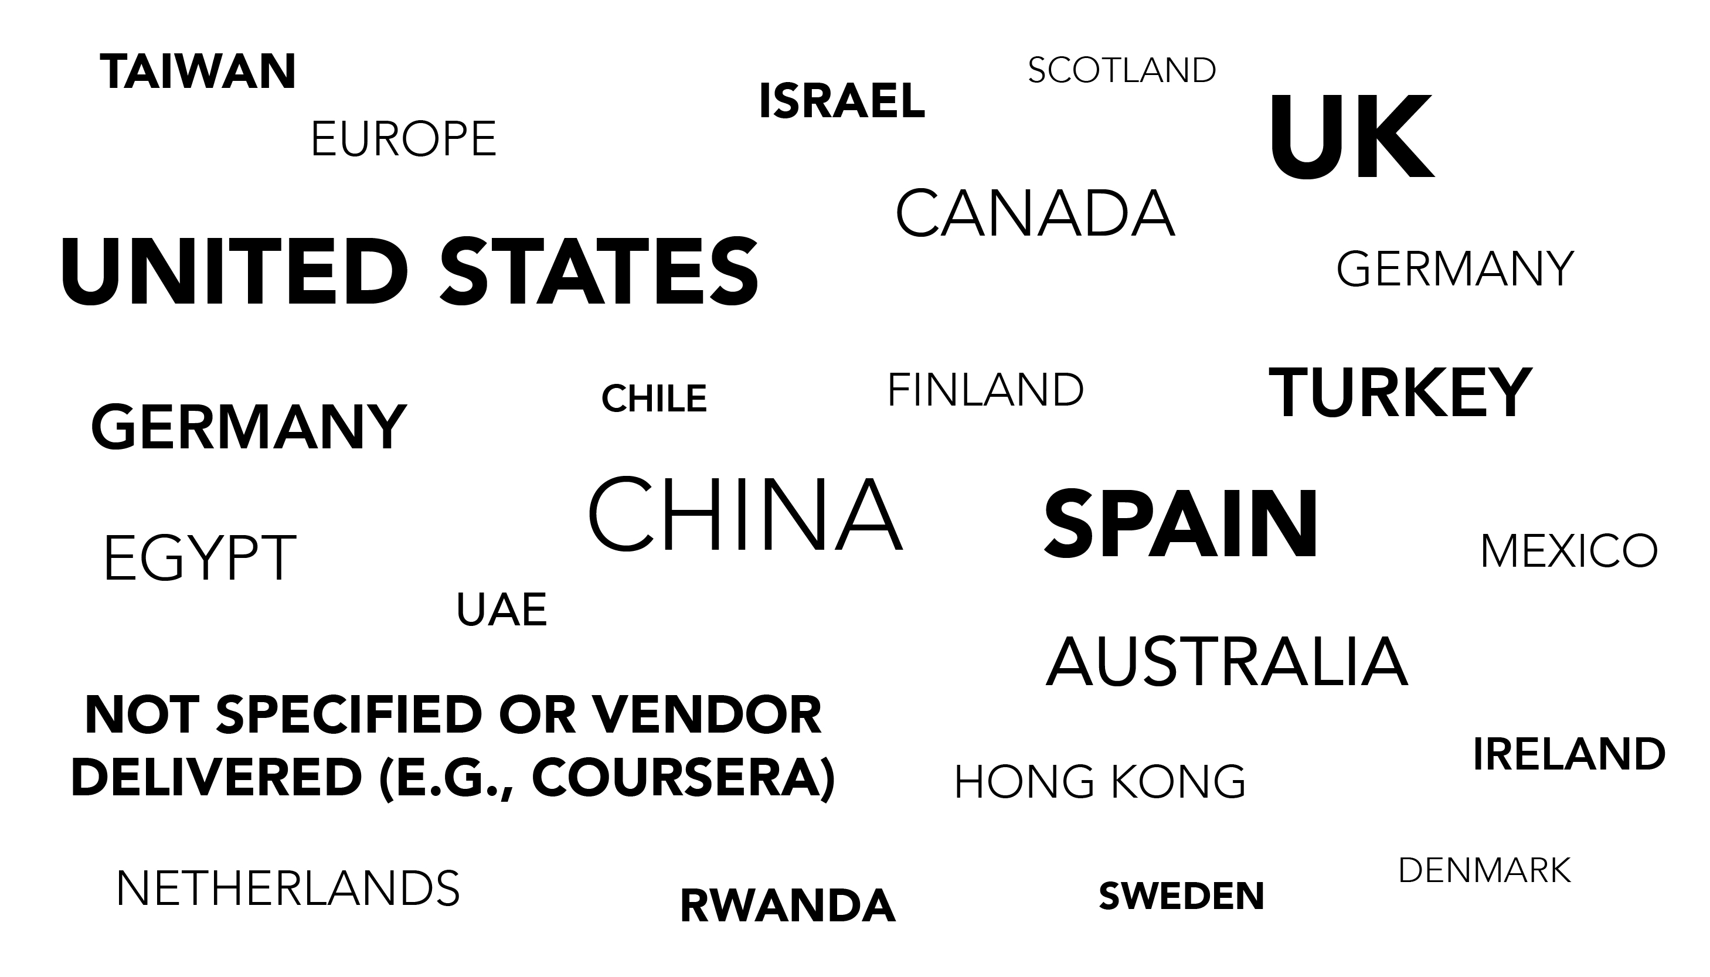
Country of Origin of MOOC Delivery
(2014–2016)

Slide 43
Implications
It may be advantageous for MOOC researchers to target MOOC instructors as well as instructional designers and the entire course development, production, and evaluation team.
The research on MOOCs remains a vital and growing area of interest for educational researchers across disciplines and regions of the world.

Slide 44
Implications
Researchers will be better equipped to build upon and extend the MOOC studies to date by addressing novel topic areas and learner populations while experimenting with research methods yet to be attempted.
Potential funding agencies and institutes will have a better grasp of research areas and topics related to MOOC that might be highly beneficial.

Slide 45
Future directions
A continuous expansion of methodological approaches in MOOCs research is needed.
Cross-cultural comparison research might indicate how MOOC research paradigms differ in various regions of the world.
More localized understanding of educational philosophies and values are needed.

Slide 46
Questions and Comments
Annisa Sari, annsari@umail.iu.edu
Meina Zhu, meinzhu@umail.iu.edu
Indiana University
Mimi Miyoung Lee, Ph.D., mlee7@uh.edu
University of Houston

Slide 47
References
Almanac 2017-2018 (2017, August 13). Cumulative growth in number of MOOCs 2011-2017. The Chronicle of Higher Education. Retrieved from http://www.chronicle.com/article/Cumulative-Growth-in-Number-of/240707?cid=cp135
Bali, M. (2014). MOOC pedagogy: Gleaning good practice from existing MOOCs. MERLOT Journal of Online Learning and Teaching, 10(1), 44-56. Retrieved from https://oerknowledgecloud.org/sites/oerknowledgecloud.org/files/bali_0314.pdf
Bieke, S., De Laat, M., Teplovs, C., & Voogd, S. (2014). Social learning analytics applied in a MOOC environment open education Europa. eLearning Papers, 36, 45–48.
Breslow, L., Pritchard, D. E., DeBoer, J., Stump, G. S., Ho, A. D., & Seaton, D. T. (2013). Studying learning in the worldwide classroom: Research into edX's first MOOC. Research & Practice in Assessment, 8, 13–25. Retrieved from http://files.eric.ed.gov/fulltext/EJ1062850.pdf
Bulfin, S., Pangrazio, L., & Selwyn, N. (2014). Making ‘MOOCs’: The construction of a new digital higher education within news media discourse. The International Review of Research in Open and Distributed Learning, 15(5). Retrieved from http://www.irrodl.org/index.php/irrodl/article/view/1856/3072
Carver, L., & Harrison, L. M. (2013). MOOCs and democratic education. Liberal Education, 99(4), 20. Retrieved from https://aacu.org/liberaleducation/2013/fall/carver-harrison.
Coffrin, C., Corrin, L., de Barba, P. & Kennedy, G. (2014). Visualizing patterns of student engagement and performance in MOOCs. In M. Pistilli, J.Willis, D. Koch, K. Arnold, S. Teasley, A. Pardo (Eds), Proceedings of the fourth international conference on learning analytics and knowledge—LAK ’14 (pp. 83–92). New York: ACM Press. doi: 10.1145/2567574.2567586
Creswell, J. W., Plano Clark, V. L., Gutmann, M. L., & Hanson, W. E. (2003). Advanced mixed methods research designs. Handbook of mixed methods in social and behavioral research, 209, 240. Retrieved from http://www.corwin.com/sites/default/files/upm-binaries/19291_Chapter_7.pdf
De Freitas, S. I., Morgan, J., & Gibson, D. (2015). Will MOOCs transform learning and teaching in higher education? Engagement and course retention in online learning provision. British Journal of Educational Technology, 46(3), 455-471. doi:10.1111/bjet.12268.
Deng, R., & Benckendorff, P. (2017). A contemporary review of research methods adopted to understand students’ and instructors’ use of massive open online courses (MOOCs). International Journal of Information and Education Technology, 7(8). doi: 10.18178/ijiet.2017.7.8.939
Downes, S. (2008). Places to go: Connectivism and connective knowledge. Innovate. Journal of Online Education, 5(1), 1–6. Retrieved from http://nsuworks.nova.edu/cgi/viewcontent.cgi?article=1037&context=innovate
Ebben, M., & Murphy, J. S. (2014). Unpacking MOOC scholarly discourse: A review of nascent MOOC scholarship. Learning, Media and Technology, 39(3), 328-345. http://dx.doi.org/10.1080/17439884.2013.878352
Fournier, H., & Kop, R. (2015). MOOC learning experience design: Issues and challenges. International Journal on E-Learning, 14(3), 289-304. Retrieved from https://scholar.google.com/scholar?hl=en&q=MOOC+learning+experience+design%3A+Issues+and+challenges&btnG=&as_sdt=1%2C15&as_sdtp=

Slide 48
References
Shah, D. (2015). By the numbers: MOOCs in 2015. Class Central. Retrieved from https://www.class-central.com/report/moocs-2015-stats/
Shah, D. (2016). By the numbers: MOOCs in 2016. Class Central. Retrieved from https://www.class-central.com/report/mooc-stats-2016/
Shah, D. (2017a, August 7). FutureLearn and Coventry University to roll out 50 online degrees. Class Central. Retrieved from
https://www.class-central.com/report/futurelearn-coventry-university-roll-50-online-degrees
Shah, D. (2017b, June 22). MOOCWatch #15: MOOCs find their audience. Class Central. Retrieved from https://www.class-central.com/report/moocwatch-15-moocs-lifelong-learners/
Skrypnyk, O., Joksimović, S., Kovanović, V., Gašević, D., & Dawson, S. (2015). Roles of course facilitators, learners, and technology in the flow of information of a cMOOC. The International Review of Research in Open and Distributed Learning, 16(3). Retrieved from http://dx.doi.org/10.19173/irrodl.v16i3.2170
Tashakkori, A., & Teddlie, C. (2003). Handbook on mixed methods in the behavioral and social sciences. Thousand Oaks, CA: Sage.
Veletsianos, G., Collier, A., & Schneider, E. (2015). Digging deeper into learners' experiences in MOOCs: Participation in social networks outside of MOOCs, notetaking, and contexts surrounding content consumption. British Journal of Educational Technology, 46(3), 570–587. doi:10.1111/bjet.12297
Veletsianos, G., & Shepherdson, P. (2015). Who studies MOOCs? Interdisciplinarity in MOOC research and its changes over time. The International Review of Research in Open and Distributed Learning, 16(3). Retrieved from http://dx.doi.org/10.19173/irrodl.v16i3.2202
Veletsianos, G., & Shepherdson, P. (2016). A systematic analysis and synthesis of the empirical MOOC literature published in 2013–2015. The International Review of Research in Open and Distributed Learning, 17(2). Retrieved from http://dx.doi.org/10.19173/irrodl.v17i2.2448
Yuan, L., Powell, S., & Olivier, B. (2014). Beyond MOOCs: Sustainable online learning in institutions – A white paper. Cetis – Centre for Educational Technology, Interoperability and Standards. University of Bolton, UK. Retrieved from http://publications.cetis.org.uk/wp-content/uploads/2014/01/Beyond-MOOCs-Sustainable-Online-Learning-in-Institutions.pdf

